Slide 1

MIT TC Downscaling:
Step 1: Seed each ocean basin with a very large number of weak, randomly located cyclones
Step 2: Cyclones are assumed to move with the large- scale atmospheric flow in which they are embedded, plus a correction for the earth’s rotation and sphericity (beta-drift)
Step 3: Run the detailed hurricane intensity model (CHIPS) for each cyclone, and note how many achieve at least tropical storm strength (Model is phrased in angular momentum coordinates. Flow- dependent resolution)
Step 4: Using the small fraction of surviving events, determine storm statistics. Can easily generate 100,000 events
Details: Emanuel et al., Bull. Amer. Meteor. Soc, 2008
Notes:
1
In this downscaling technique, one starts with large scale airflow and thermodynamic conditions supplied from a climate reanalysis or a climate model. This time-evolving global state is randomly seeded with very weak proto-vortices. They move according to the air currents supplied from the climate analysis or climate model. Their intensity is calculated using a deterministic numerical model that was first developed to forecast real hurricane intensity in real time, and is still being used that way. This intensity model predicts that the vast majority of seeds die; the survivors are considered to represent the true hurricane climatology associated with that climate analysis or climate model.

Slide 2
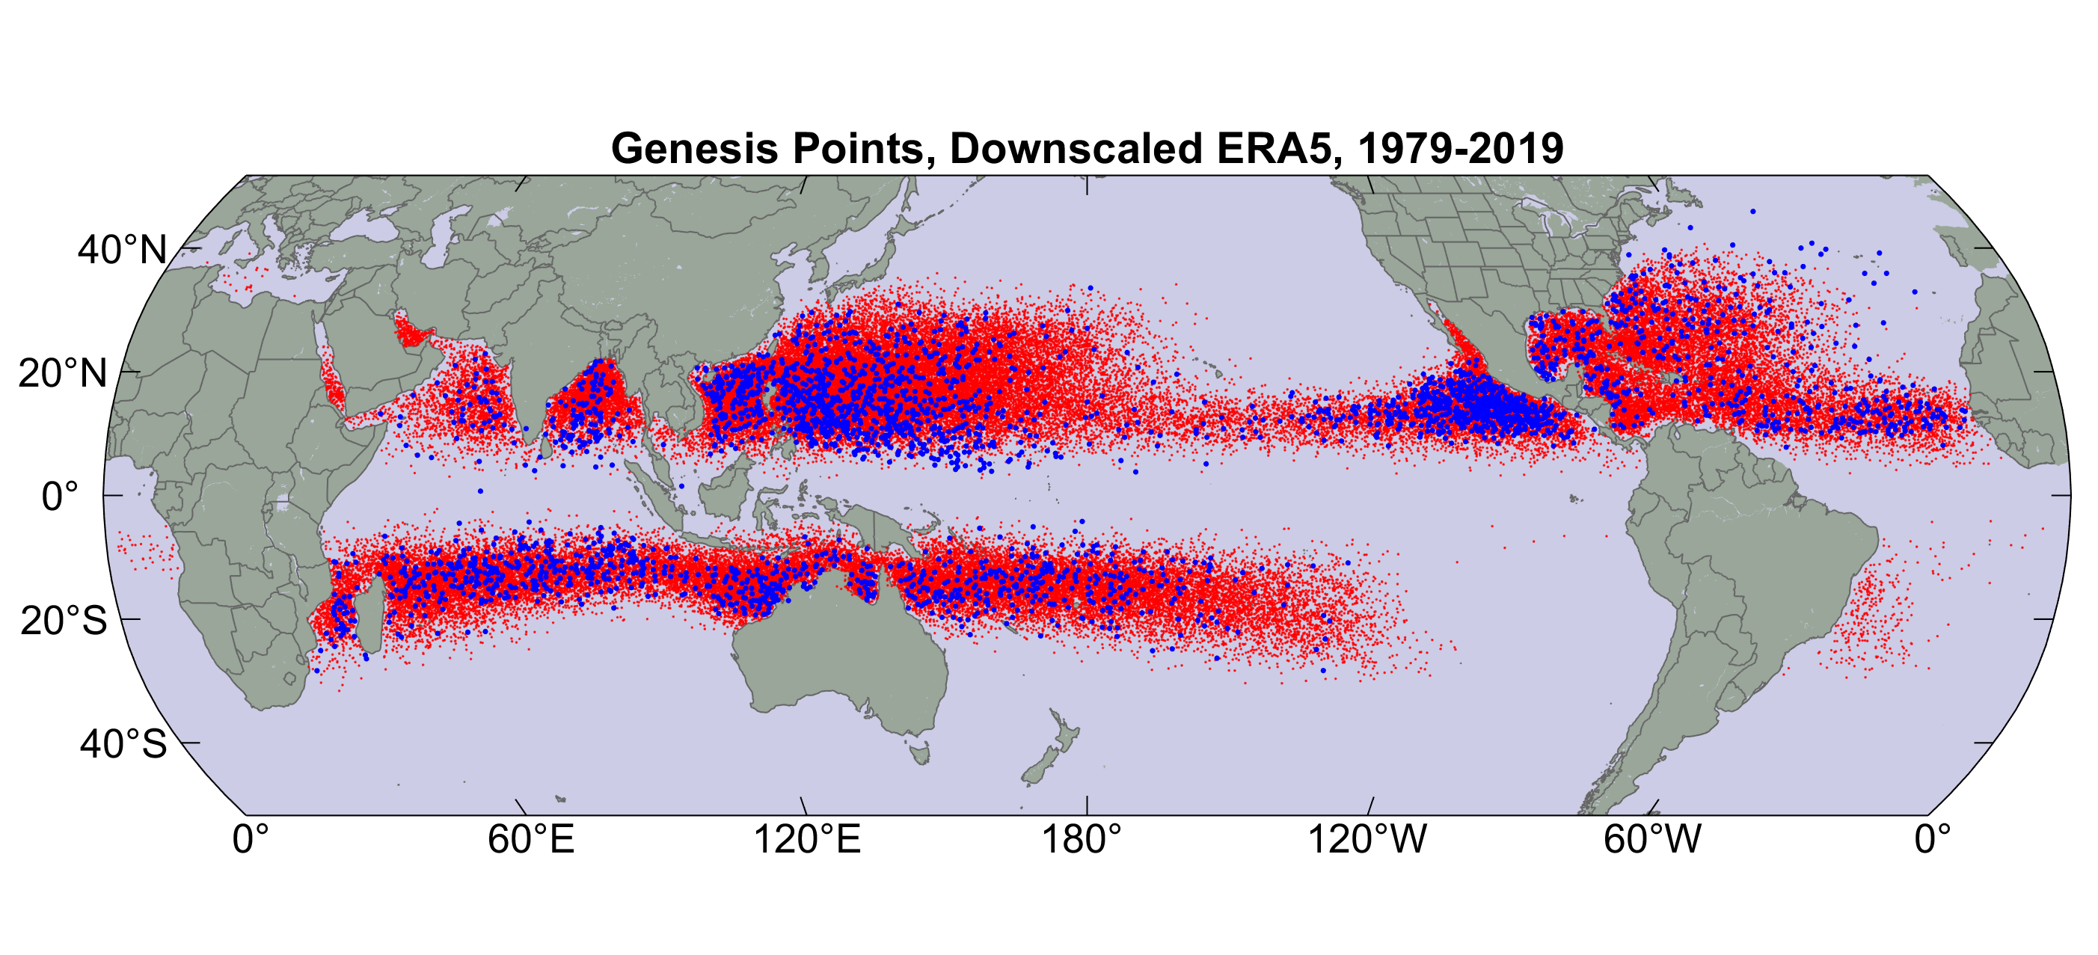
Origin points of successful seeds (red); observed genesis locations (blue)
Notes:
Note that there are many more synthetic genesis points than historical ones in this map. The synthetic storms have been downscaled from the state-of-the-art ERA-5 climate reanalysis that comes from the European Center for Medium Range Weather Forecasts (ECMWF). Both the synthetic and historical points are from the period 1979-2019.

Slide 3
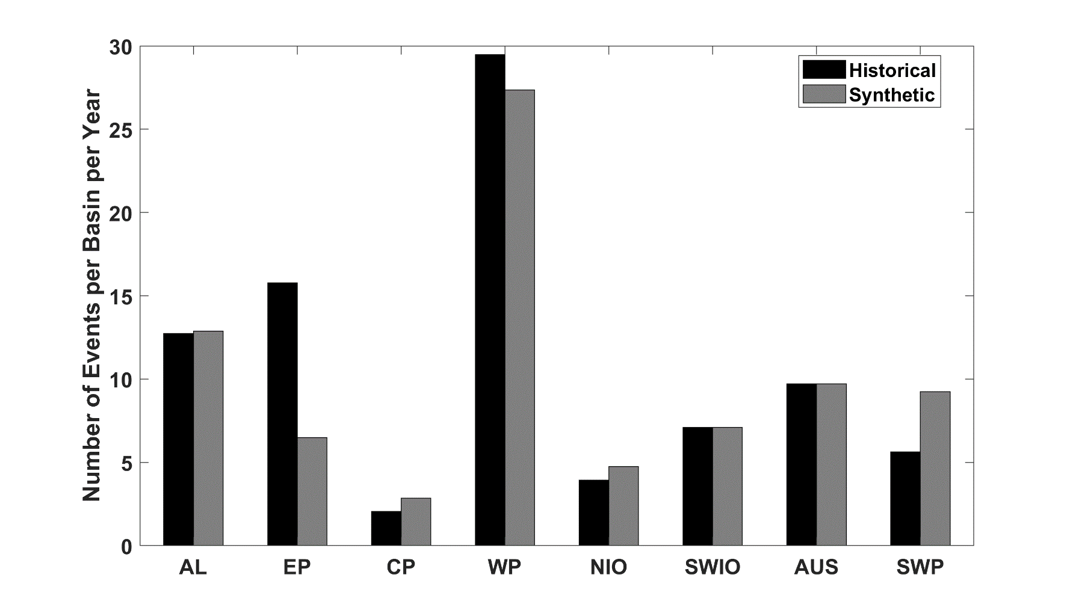
Average annual number of tropical cyclones over the period 1980-2020 in observations (IBTrACS; Knapp et al. 2010; black bars) and from random seeding of ERA-5 (gray bars)
Notes:
These are cyclone counts, synthetic and historical, in ocean basins: AL=North Atlantic; EP=Eastern North Pacific; CP =Central North Pacific; WP=Western North Pacific; NIO=North Indian Ocean; SWIO=Southwest Indian Ocean, AUS=Australian region; SWP= Southwest Pacific Ocean.

Slide 4
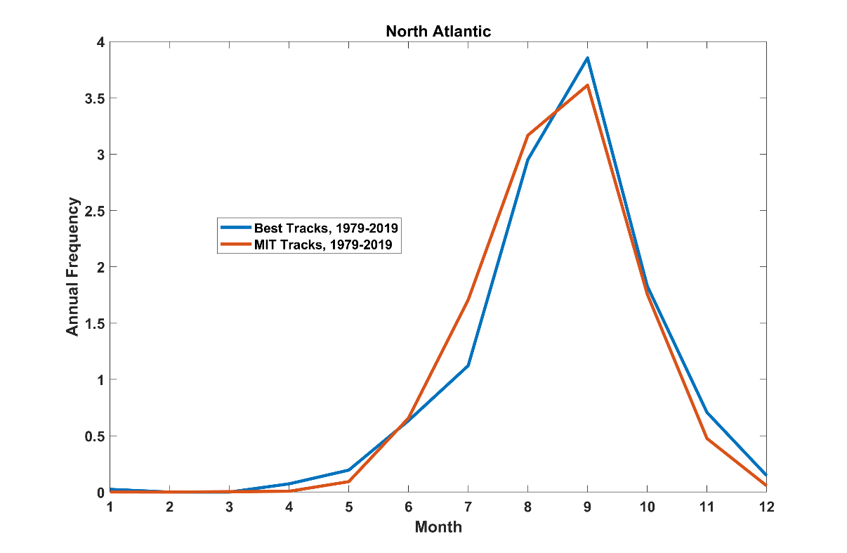
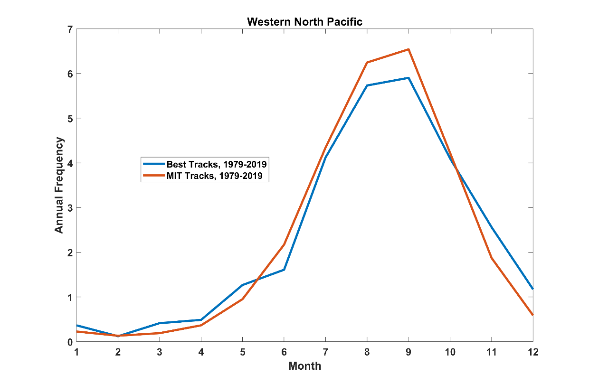
Seasonal Cycle
North Atlantic
Seasonal Cycle
Northwest Pacific
Notes:
The annual average number of tropical cyclones per month from the synthetic cyclones (red) and historical cyclones (blue), for the period 1979-2019. The upper chart is for the North Atlantic and the lower chart is for the western North Pacific.

Slide 5
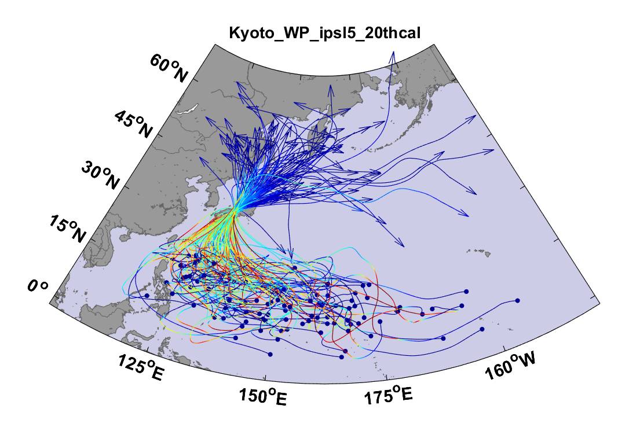
Example:
Top 100 out of 2000 TCs Affecting Kyoto, 1981-2000
Notes:
Typhoon tracks downscaled from a climate model simulation of the period 1981-2000, filtered to all be passing within 150 km of the city of Kyoto, Japan. The dots are the origin points and the colors denote the intensity of the storm at various points along its track. The are the 100 most intense typhoons, as measure by maximum winds speeds within 150 km of Kyoto, out of a set of 2,000.

Slide 6
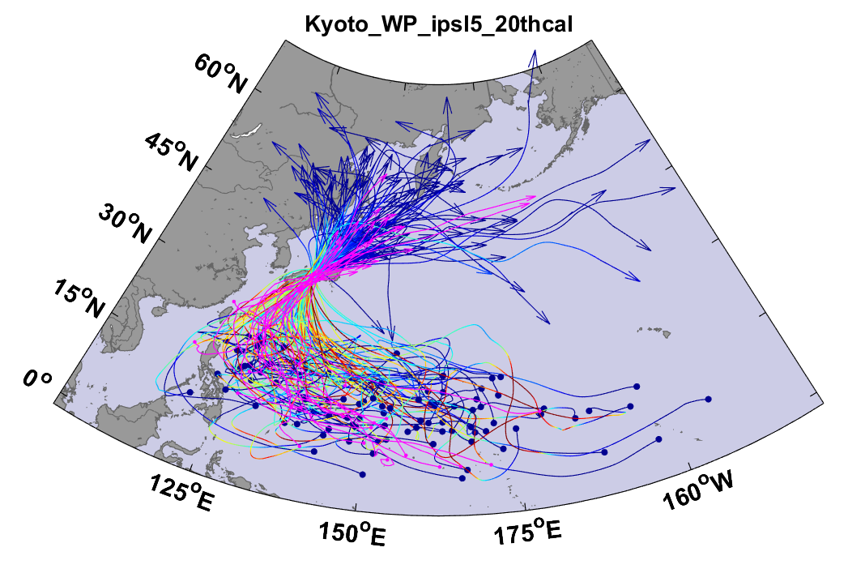
Same, but with top 20 historical tracks
Notes:
Same as previous chart but with historical storms, 1981-2000, overlaid in magenta.

Slide 7
Cumulative Distribution of Storm Lifetime Peak Wind Speed, with Sample of 3993 Synthetic Tracks
90% confidence bounds
Notes:
For a set of almost 4,000 synthetic tropical cyclone downscaled from ERA-5 reanalyses over the period 1980-2020, the red curve on this chart shows that annual number of storms whose lifetime maximum wind speed exceeds the value on the bottom axis. The blue dots are the same from historical observations. The blue shading represents the span from the 5th to the 95th percentile of estimated sampling error of the historical tracks.

Slide 8

Return Periods
Notes:
The blue dots represent the wind speed associated with synthetic tropical cyclones whose return period is shown on the bottom axis. The green dots are the same but from historical storms. All these storms cross the New England coastline, and the wind speeds represent the maximum surface winds in the storms as they cross the coastline. The plus signs are estimates of the sampling error of the historical events. The red line is a theoretical curve fit to the blue dots.

Slide 9
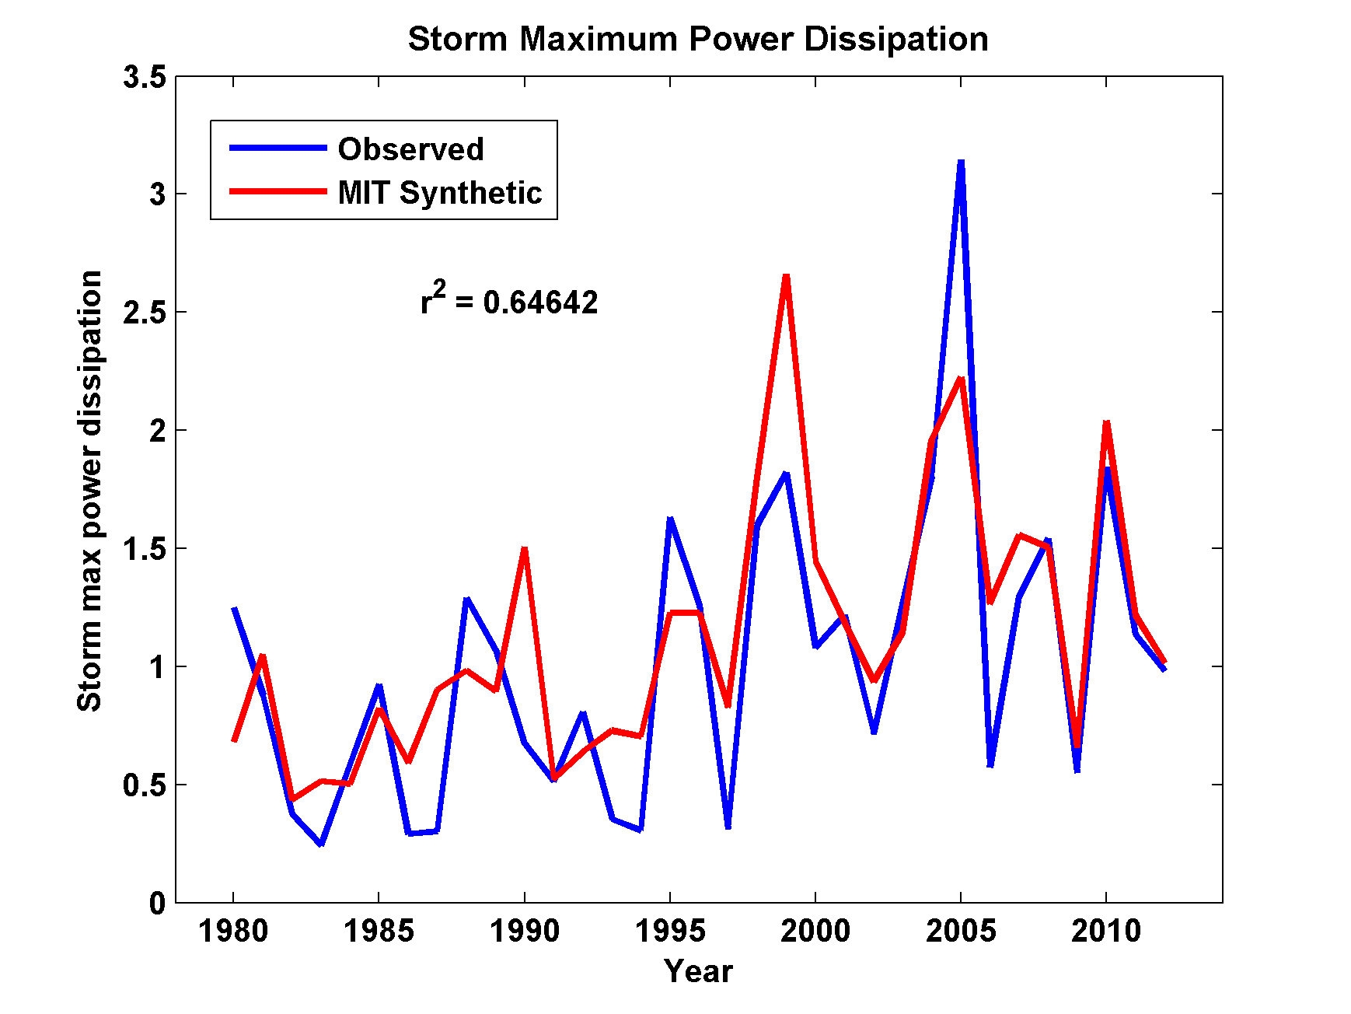
Captures Much of the Observed North Atlantic Interannual Variability
r²=0.65
Notes:
This chart shows the number of historical (blue) and synthetic( (red) storms in the North Atlantic each year. This shows that our technique is pretty good at simulating natural interannual variability.

Slide 10
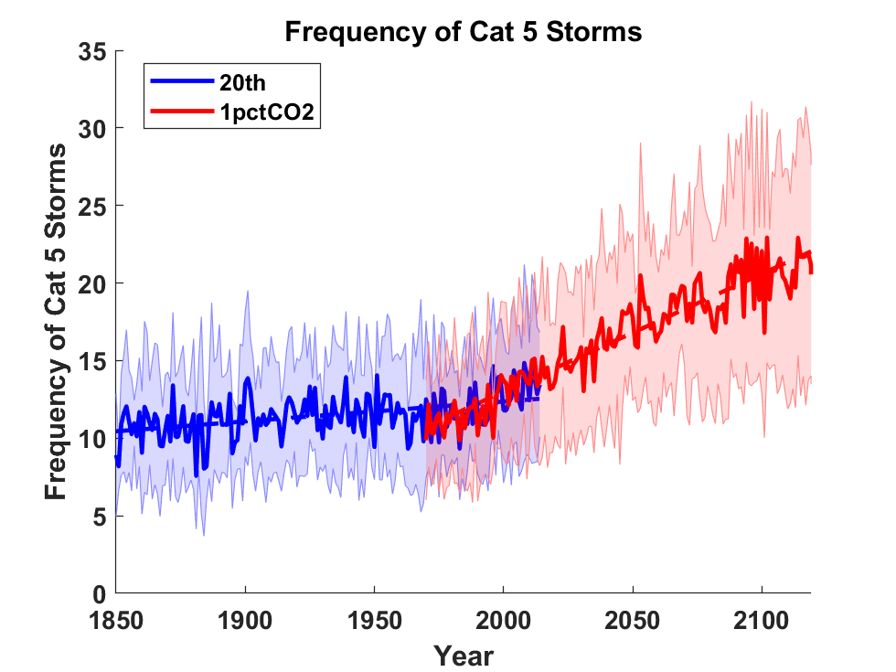
Application to Global Climate Change Simulations:
Global CAT 5 Tropical Cyclone Frequency from 9 Current Generation (CMIP6) Climate Models
Notes:
The global frequency of CAT 5 hurricanes simulated by 9 climate models for an historical period (blue) and a simulation in which CO2 increases at a rate of 1% per year (red). The thick blue and red curves show the multi-model means and the sading indicates the scatter among the 9 climate models downscaled.

Slide 11
Satellite-derived proportion of major hurricane fixes
Time series of fractional proportion of global major hurricane estimates to all hurricane estimates for the period 1979–2017. Each point, except the earliest, represents the data in a sequence of 3-y periods. The first data point is based on only 2 y (1979 and 1981) to avoid the years with no eastern hemisphere coverage. The linear Theil−Sen trend (black line) is significant at the 98% confidence level (Mann−Kendall P value = 0.02). The proportion increases by 25% in the 39-y period (about 6% per decade).
Kossin et al., PNAS, 2020

Slide 12
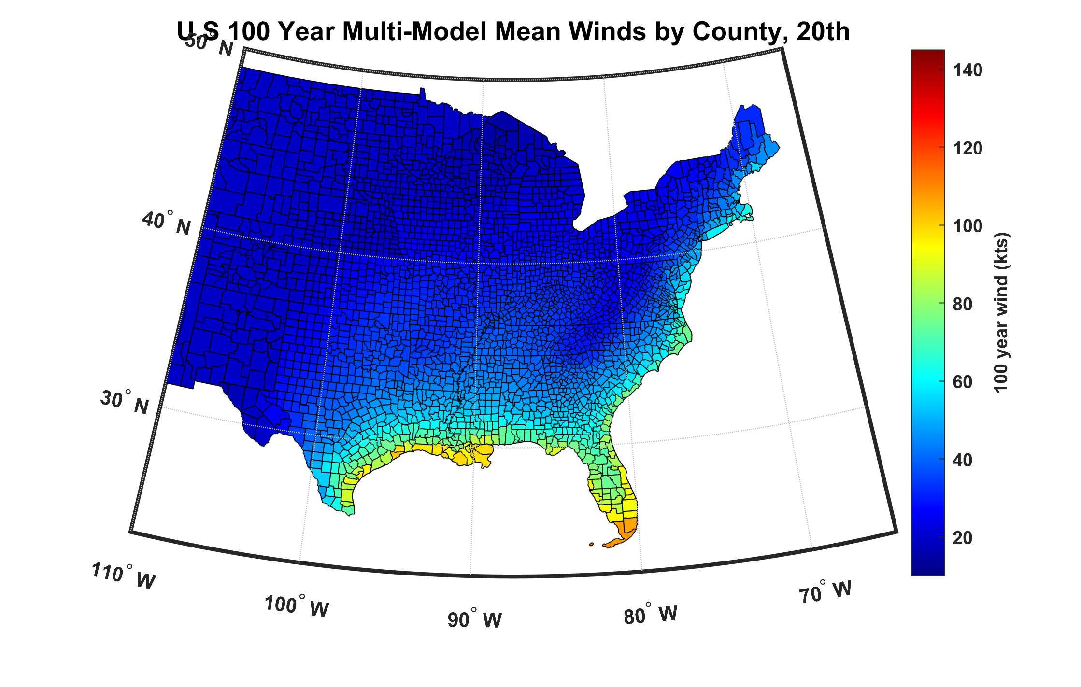
100-year hurricane peak wind based on downscaling 8 CMIP6 climate models, 1984-2014
Notes:
The multi-model mean wind speed associated with the 100-year event in each U.S. county, as downscaled from 8 global climate models for the period 1984-2014. This is the wind speed in each county whose annual probability is 1%.

Slide 13
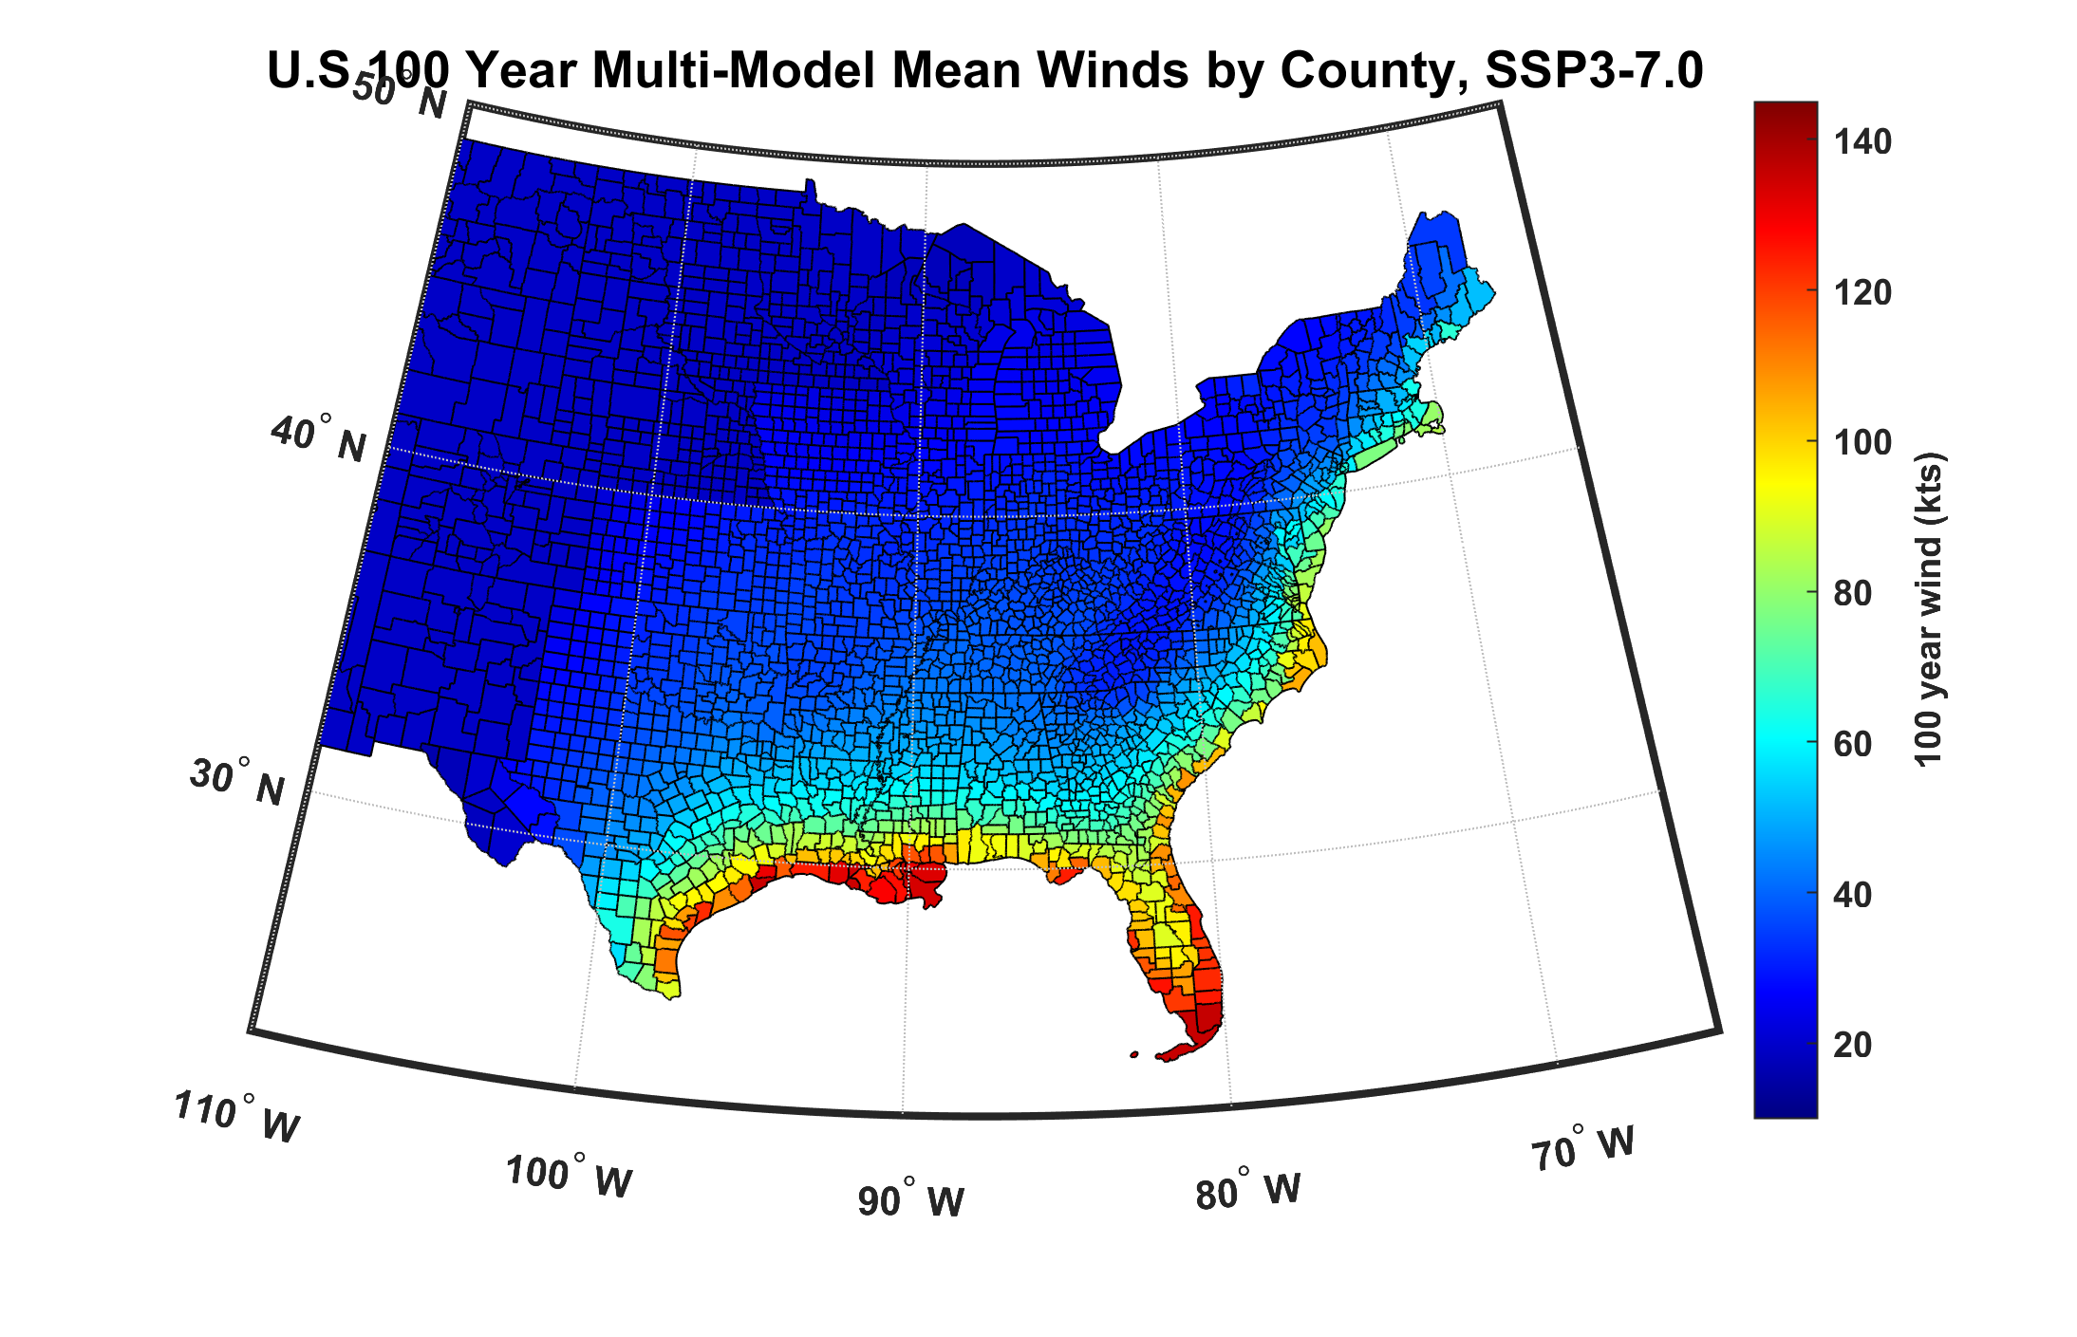
100-year hurricane peak wind based on downscaling 8 CMIP6 climate models, 2070-2100
Notes:
Same as the previous figure except for the period 2070-2100 under a modest global warming scenario. The color scale is the same in both charts.

Slide 14
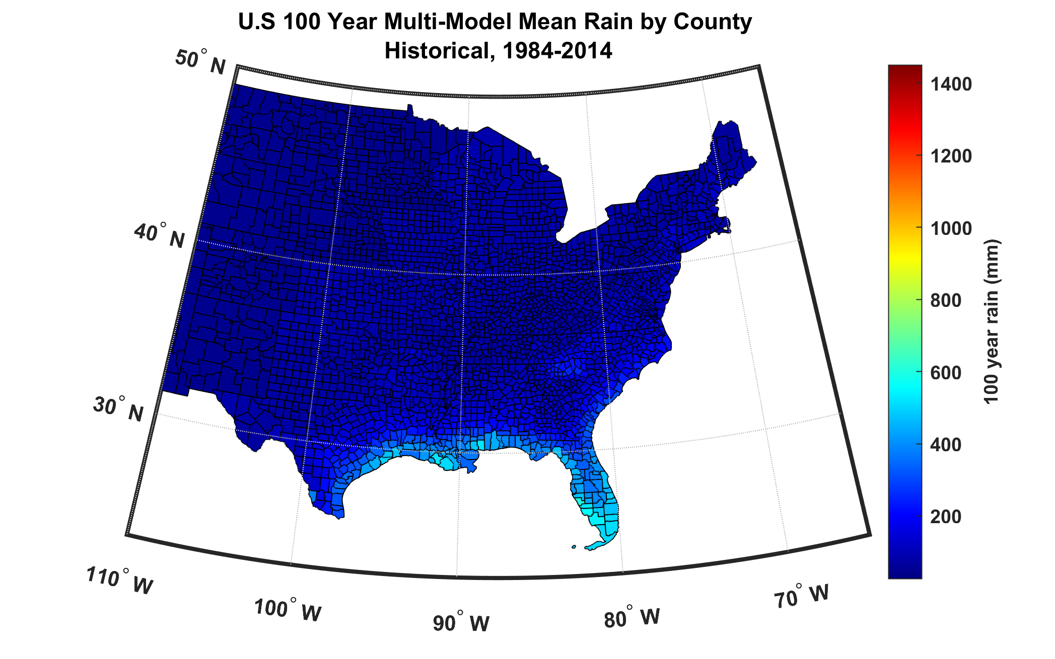
100-year hurricane storm total rain based on downscaling 8 climate models, 1984-2014
Notes:
This and the next chart are identical to the two previous charts but show the 100-year storm total rainfall from hurricanes, rather than wind.

Slide 15
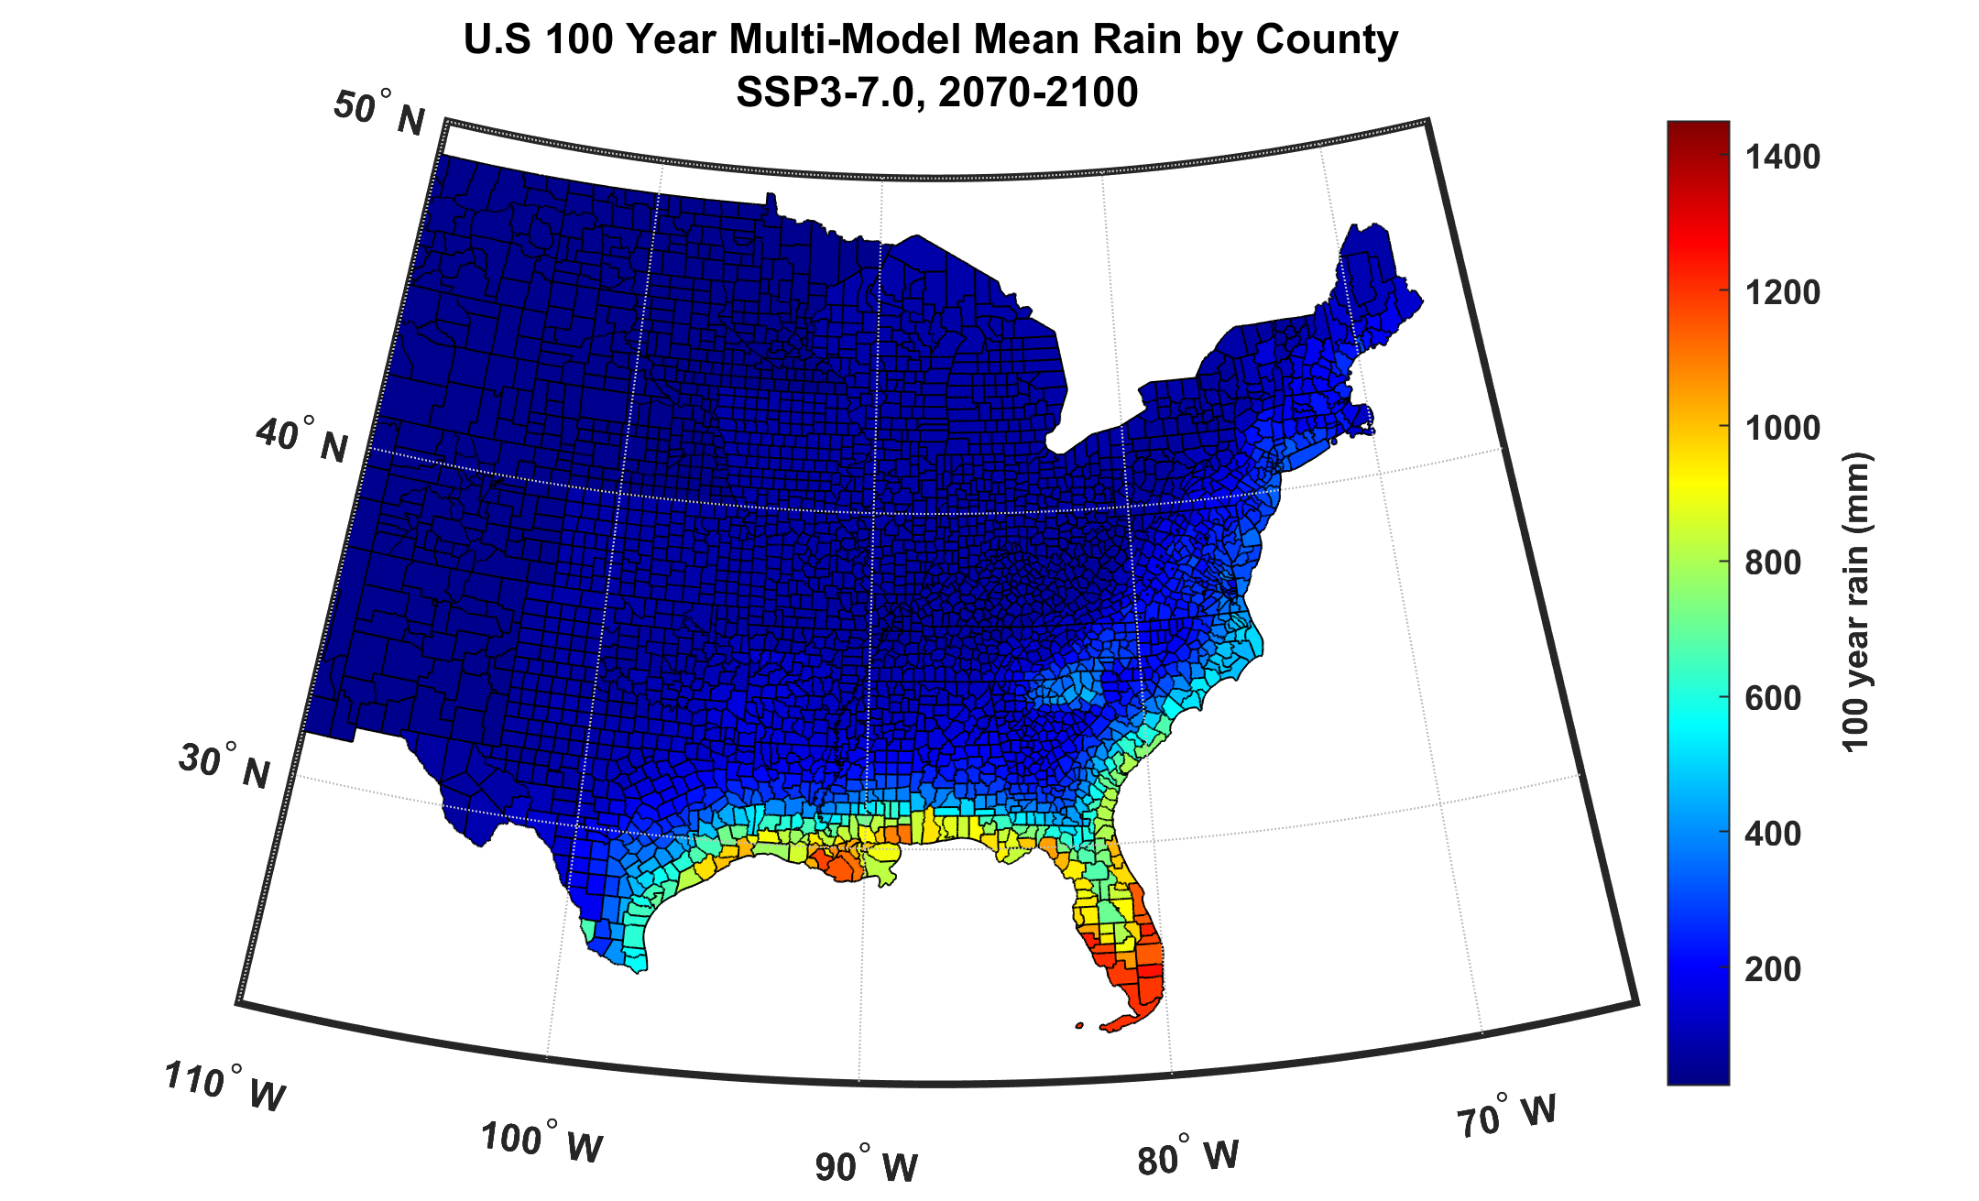
100-year hurricane storm total rain based on downscaling 8 climate models, 2070-2100
Notes:
Same color scale as previous chart.

Slide 16
Miami
Downscale 4500 events from ERA-5 reanalyses, 1985-2014, passing within 150 km of Miami
Downscale 4500 events from historical simulations of 9 CMIP6-generation climate models, 1985-2014
Downscale 4500 events from SSP3-7.0 simulations of 9 CMIP6-generation climate models, 2071-2100
If you would like to use these tropical cyclone sets for research purposes, please write me (emanuel@mit.edu)

Slide 17
Notes:
Annual exceedance frequency of peak wind within 150 km of Miami based on downscaled ERA-5 reanalysis over the period 1970 to 2022 (red curve) and based on historical storms (blue dots). As before, the shading represents an estimate of the historical sampling error. Since there are so few storms that meet this criterion, there is much sampling uncertainty.

Slide 18
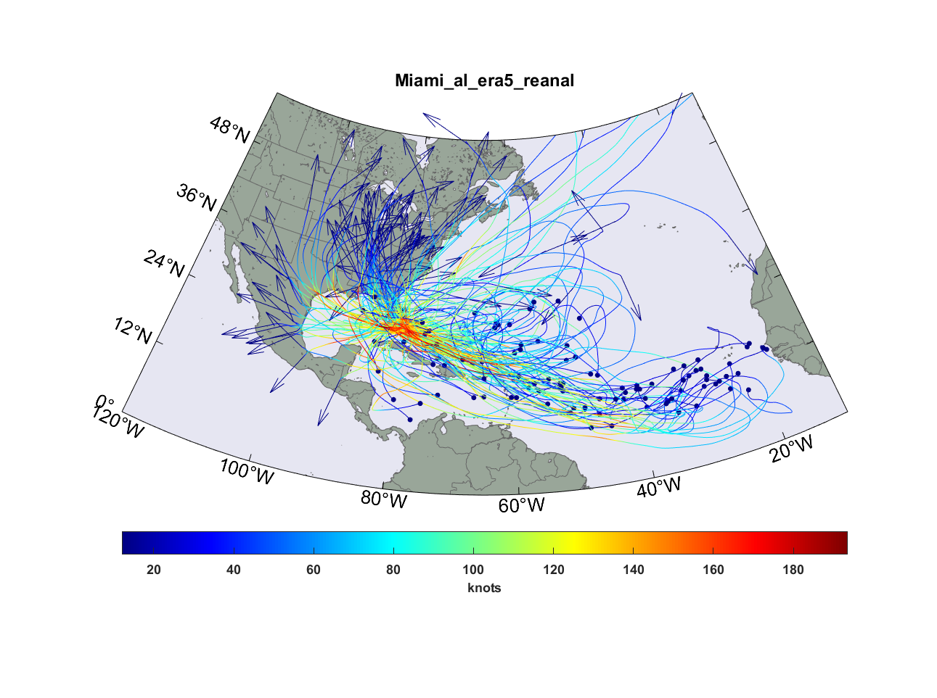
Top 100 out of 4,500 TCs passing within 150 km of Miami, downscaled from ERA-5 reanalyses
Notes:
Similar to Slide 5 but for Miami

Slide 19
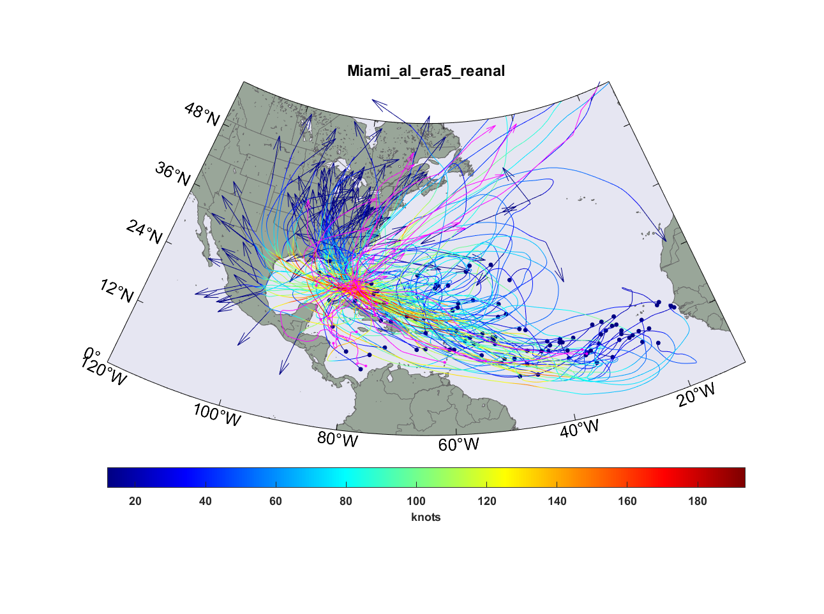
Same but with top 15 hurricanes passing within 150 km of Miami, 1970-2022 superimposed (magenta curves)
Notes:
Similar to Slide 6 but for Miami

Slide 20
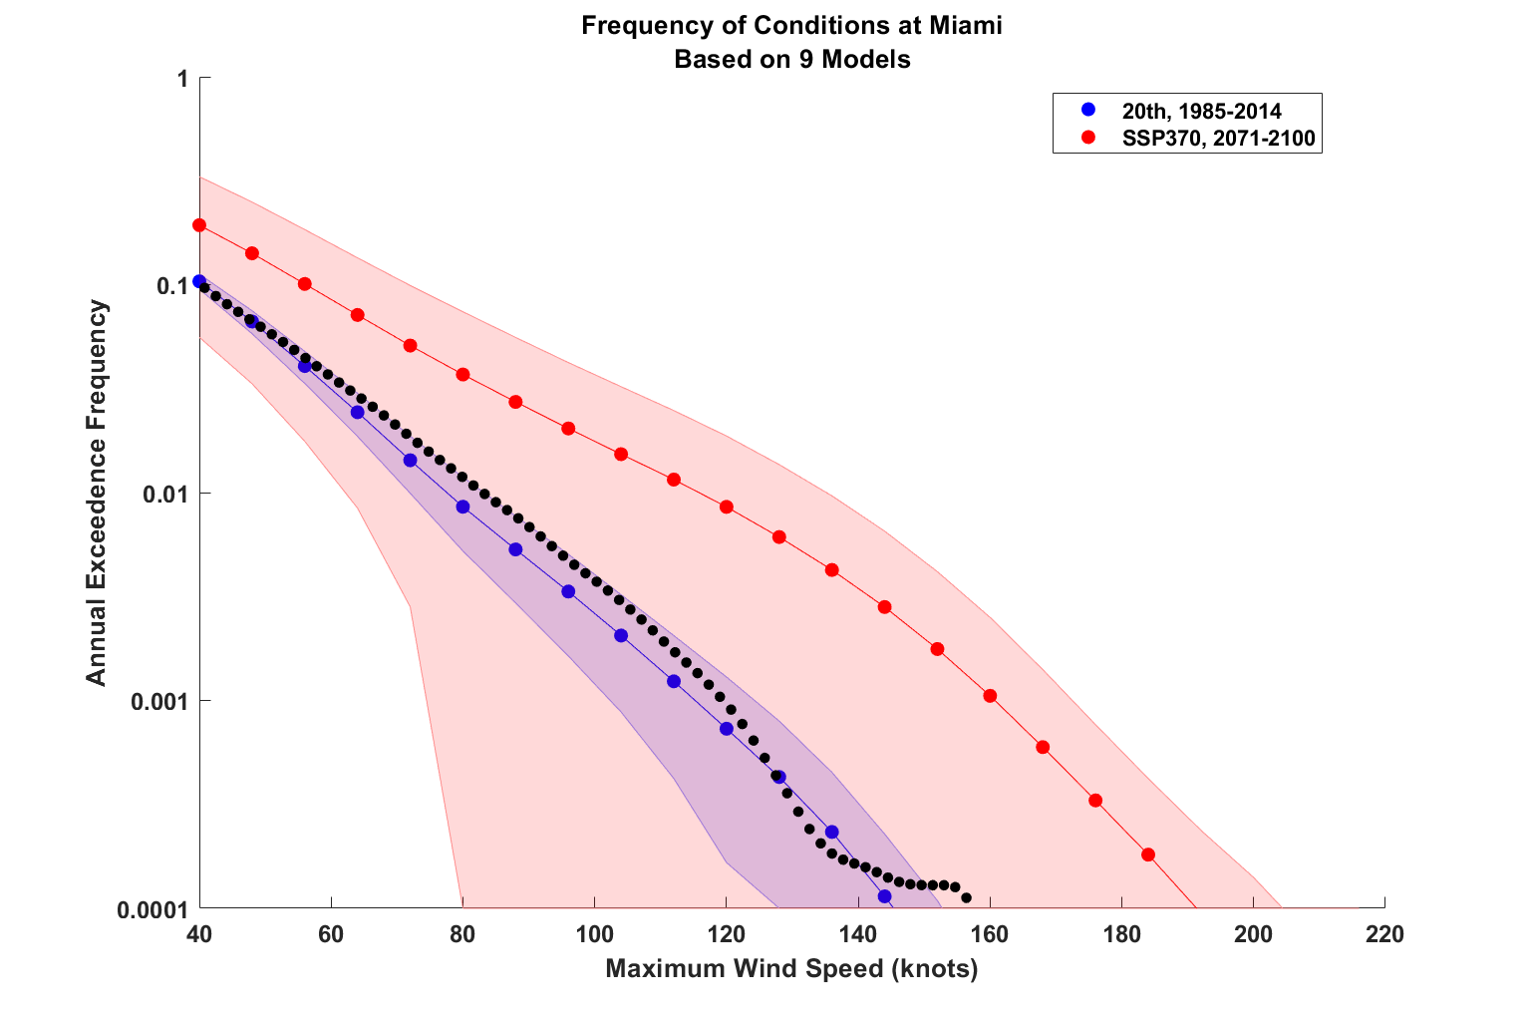
Notes:
Similar to slide 7 but for winds at downtown Miami using synthetic storms downscaled from 9 climate models. (Note that the y-axis is logarithmic in this case.) Solid blue and red curves with dots are the multi-model means, and the shading represents the scatter among the climate models. Blue is for the historical period 1985-2014 while red is for a future warmer climate during 2071-2100. Note the very large scatter for the simulations of the future climate. The black curve with dots comes from downscaling the ERA-5 climate reanalysis (as opposed to climate models) for the period 1985-2014.

Slide 21
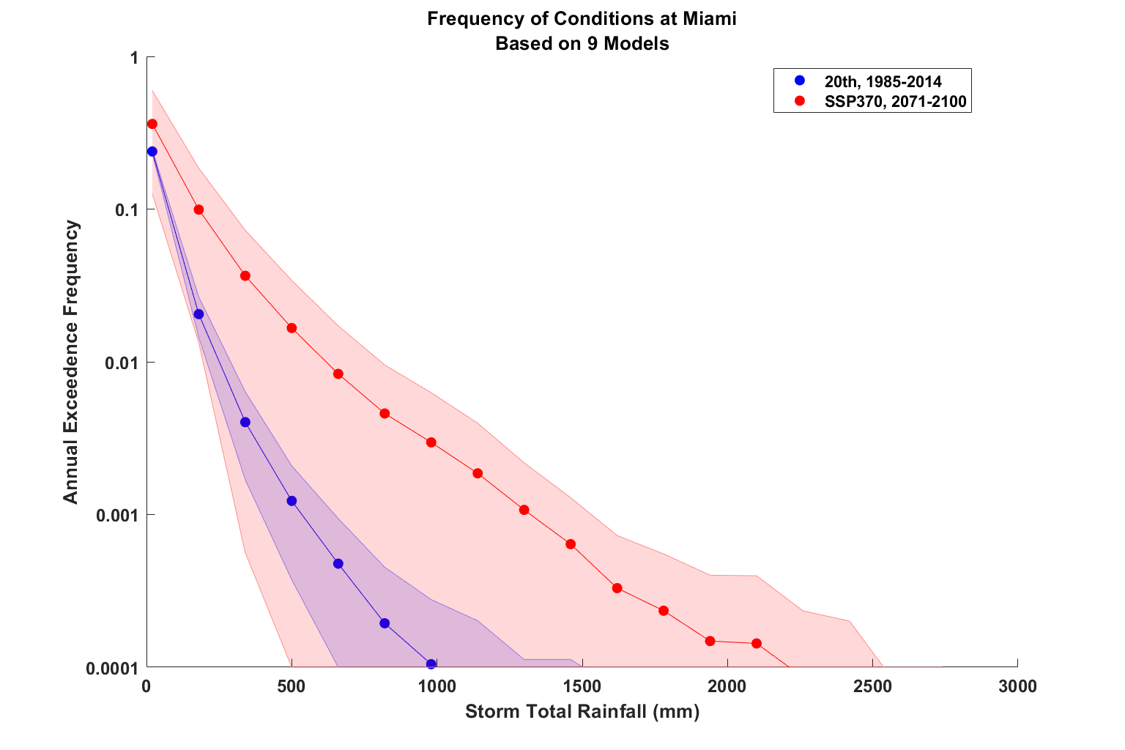
Notes:
Same as previous slide but for storm total rainfall in downtown Miami.

