Slide 1
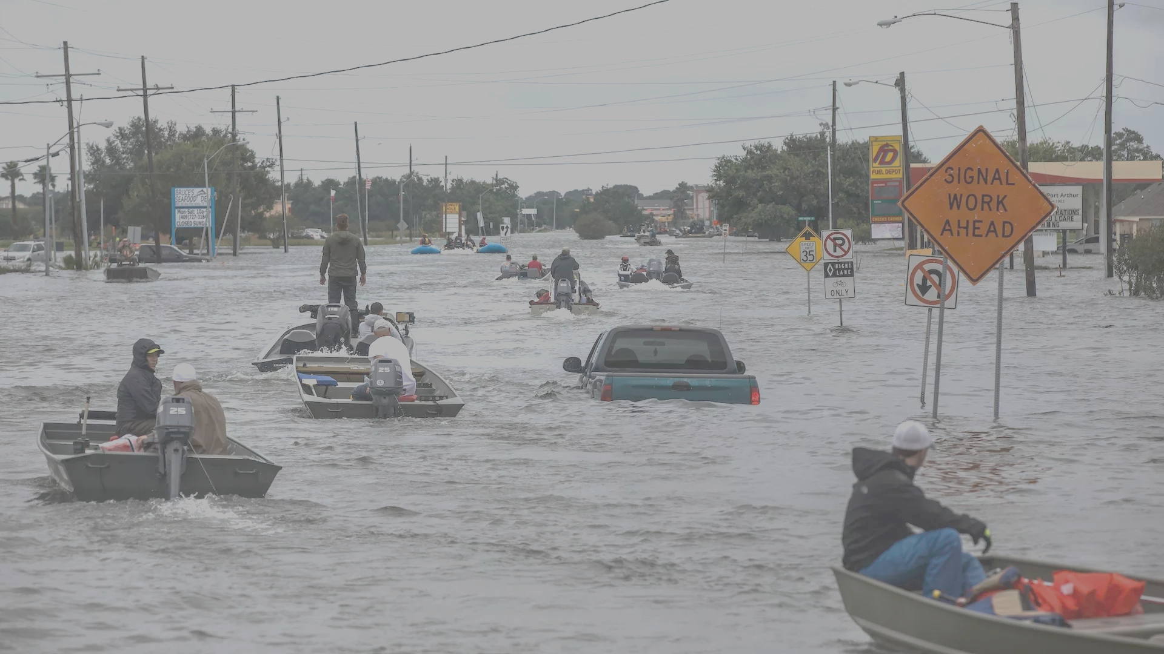
Using Physics to Help Assess Long-Term Tropical Cyclone Flood Risks
Kerry Emanuel
Notes:
1

Slide 2


Risk Assessment: The Problem
Event Probability
Damage Probability
Current and Future Probability Density of U.S. TC Wind Damages
Current and Future Damage Probability

Slide 3

The Heart of the Problem:
Societies are usually well adapted to frequent events (> 1/100 yr)
Societies are often poorly adapted to rare events (< 1/100 yr)
Robust direct estimates of the character of ~100 yr events require ~1,000 years of data
We do not have ~1,000 years of meteorological observations

Slide 4
How We Deal with This:
For local events, accumulate statistics over locations far enough apart to sample different individual events, but close enough to sample the same overall climatology.
  Example: 500 mm of hurricane rain in metro Houston may be a 100-year event, but a 20-year event over coastal Texas
Extrapolate well-sampled events to rare events using extreme value theory. Dicey!

Slide 5
How We COULD Deal with This:
Bring physics to bear on natural hazard risk assessment… problem too important to leave to statisticians
But several impediments:
  Academic stove-piping: Too applied for scientists; too complicated for risk professionals
  Near monopoly in commercial risk modeling
  Brute force modeling probably too expensive to be practical for many applications
  May now be impractical to run regional models for ~1,000 years, driven by climate models, but that day is coming

Slide 6

Limitations of a strictly statistical approach to hurricane risk assessment
>50% of all normalized U.S. hurricane damage, 1900-2017, caused by top 10 events, all but one (Sandy) were category 3, 4 and 5
>75% of all damage caused by top 30 events
>78% of all damage caused by storms of category 3 and greater
Landfalling storm statistics are inadequate for assessing hurricane risk

Slide 7
Bringing Physics to Bear: Risk Assessment by Direct Numerical Simulation of Hurricanes
The Problem
The hurricane eyewall is an intense, circular front, attaining scales of ~ 1 km or less
At the same time, the storm’s circulation extends to ~1000 km and is embedded in much larger scale flows

Slide 8

Modeling challenge: Today’s global models are too coarse to simulate destructive hurricanes over ~1,000 years
Histograms of Tropical Cyclone Intensity as Simulated by a Global Model with 50 km grid point spacing. (Courtesy Isaac Held, GFDL)
Category 3
Modeled
Observed
Global models do not simulate the storms that cause destruction
Wind Speed (meters per second)

Slide 9
How to deal with this?
Embed a high-resolution, fast coupled ocean-atmosphere hurricane model in global climate model or climate reanalysis data
Coupled Hurricane Intensity Prediction Model (CHIPS) has been used for 16 years to forecast real hurricanes in near-real time

Slide 10
Time-dependent, axisymmetric model phrased in R space (CHIPS)
Hydrostatic and gradient balance above PBL
Moist adiabatic lapse rates on M surfaces above PBL
Boundary layer quasi-equilibrium convection
Deformation-based radial diffusion
Coupled to simple 1-D ocean model
Environmental wind shear effects parameterized

Slide 11
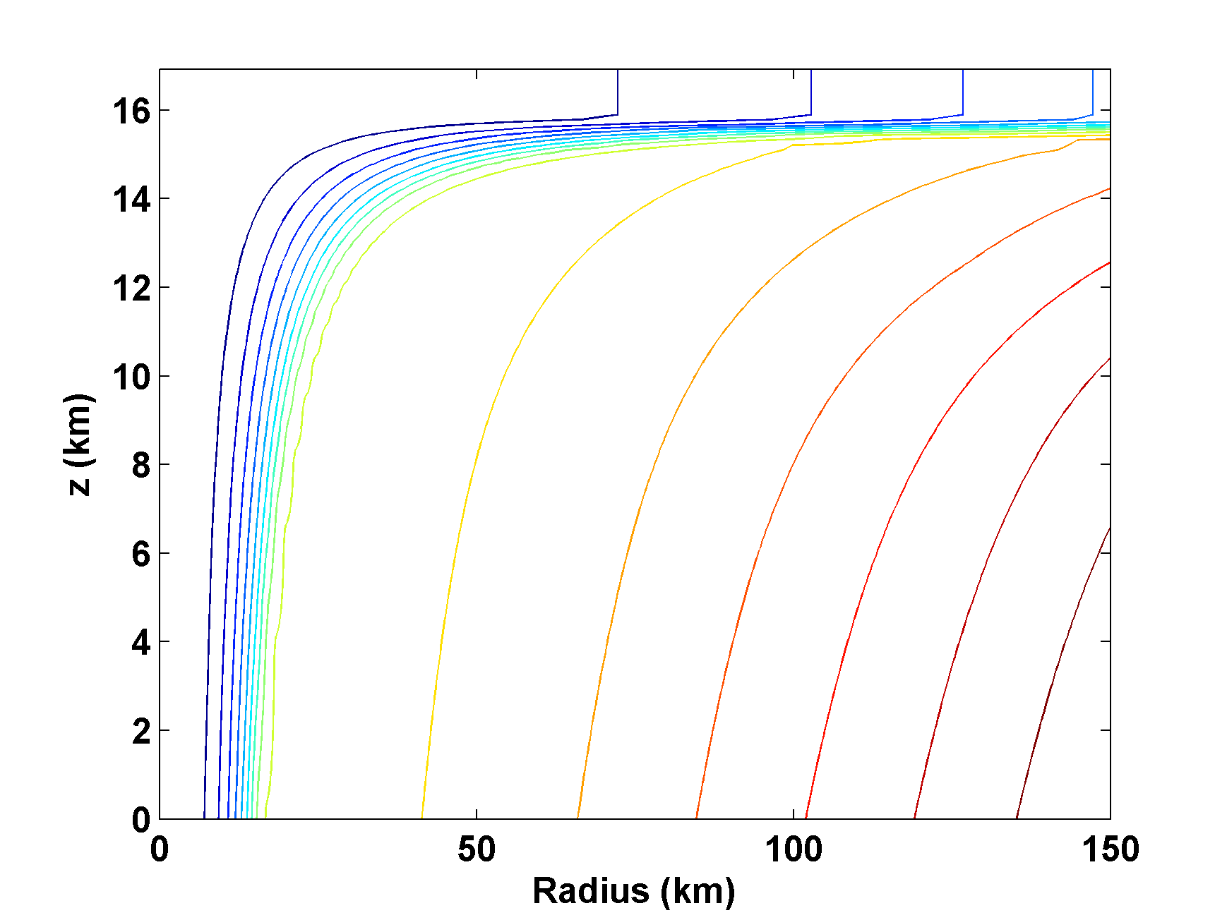
Angular Momentum Distribution
Altitude (km)
Storm Center

Slide 12
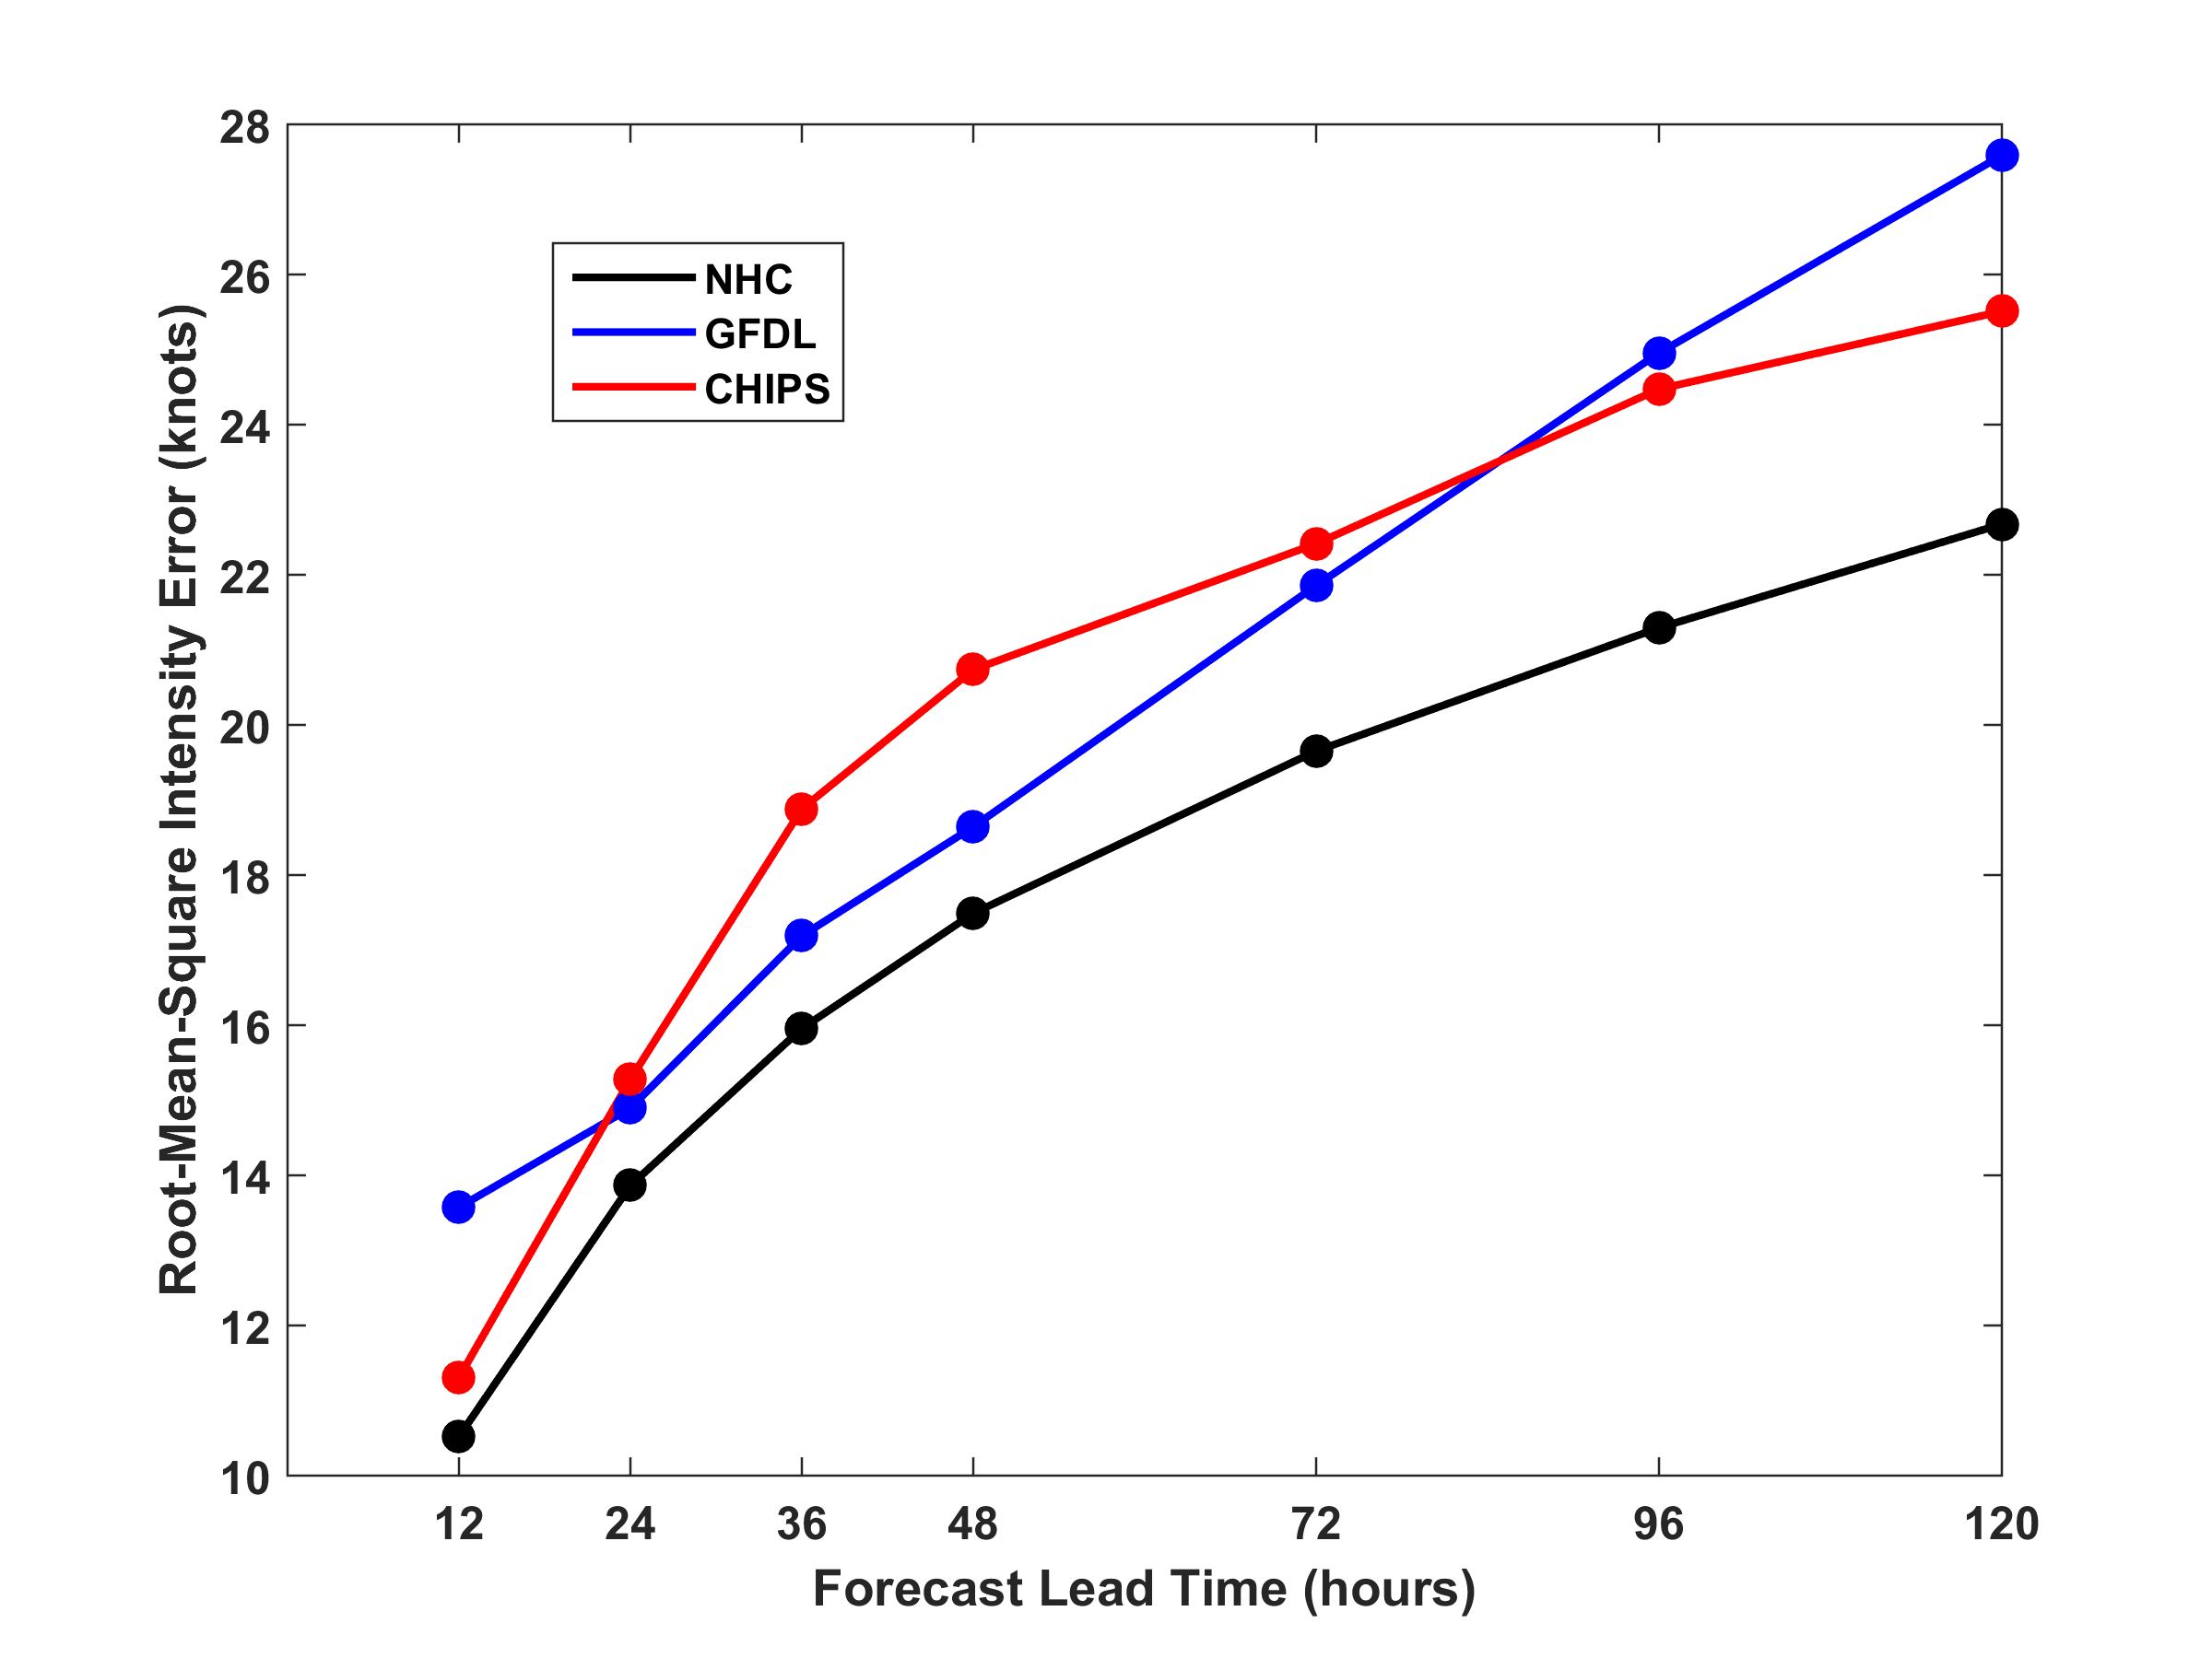
RMS Intensity Error, 2009-2015
North Atlantic

Slide 13
How Can We Use This Model to Help Assess Hurricane Wind, Surge, and Rain Risk in Current and Future Climates?

Slide 14
Risk Assessment Approach:
Step 1: Seed each ocean basin with a very large number of weak, randomly located cyclones
Step 2: Cyclones are assumed to move with the large scale atmospheric flow in which they are embedded, plus a correction for beta drift
Step 3: Run the CHIPS model for each cyclone, and note how many achieve at least tropical storm strength
Step 4: Using the small fraction of surviving events, determine storm statistics
Details: Emanuel et al., Bull. Amer. Meteor. Soc, 2008
Notes:
14

Slide 15
Synthetic Track Generation:
Generation of Synthetic Wind Time Series
Postulate that TCs move with vertically averaged environmental flow plus a “beta drift” correction
Approximate “vertically averaged” by weighted mean of 850 and 250 hPa flow

Slide 16
Synthetic wind time series
Monthly mean, variances and co-variances from re-analysis or global climate model data
Synthetic time series constrained to have the correct monthly mean, variance, co-variances and an ω⁻³ power series

Slide 17
Calibration
Absolute genesis frequency calibrated to globe during the period 1980-2005
Notes:
17

Slide 18
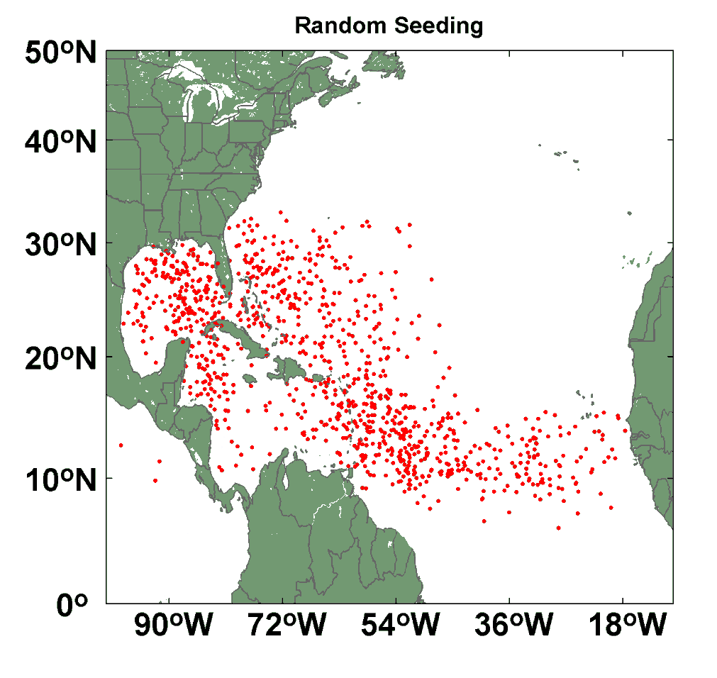
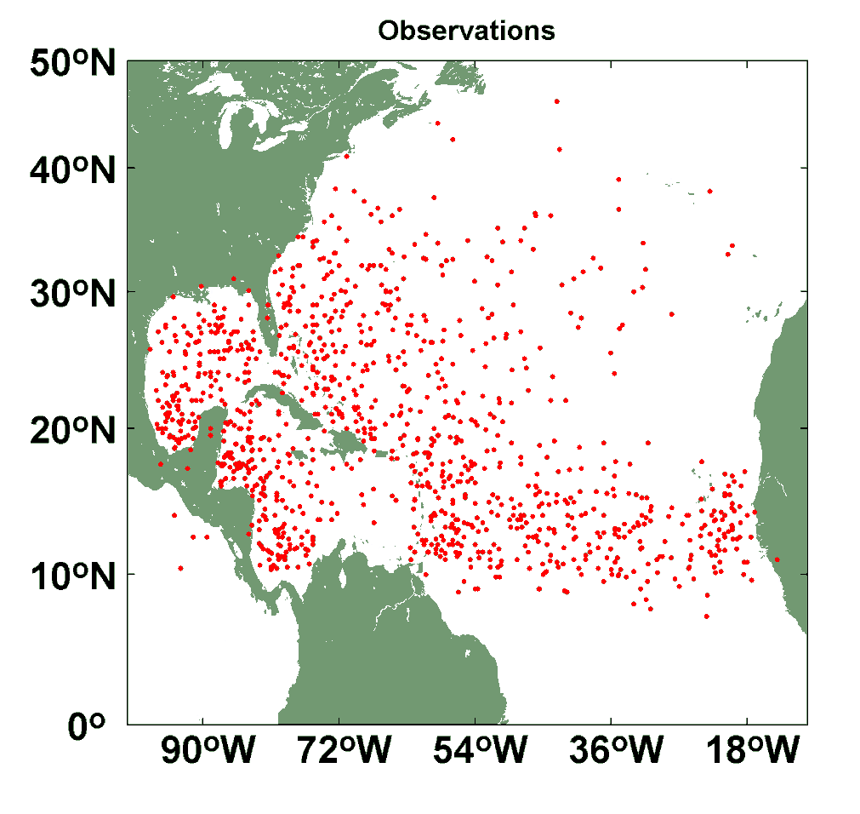
Comparison of Random Seeding Genesis Locations with Observations

Slide 19
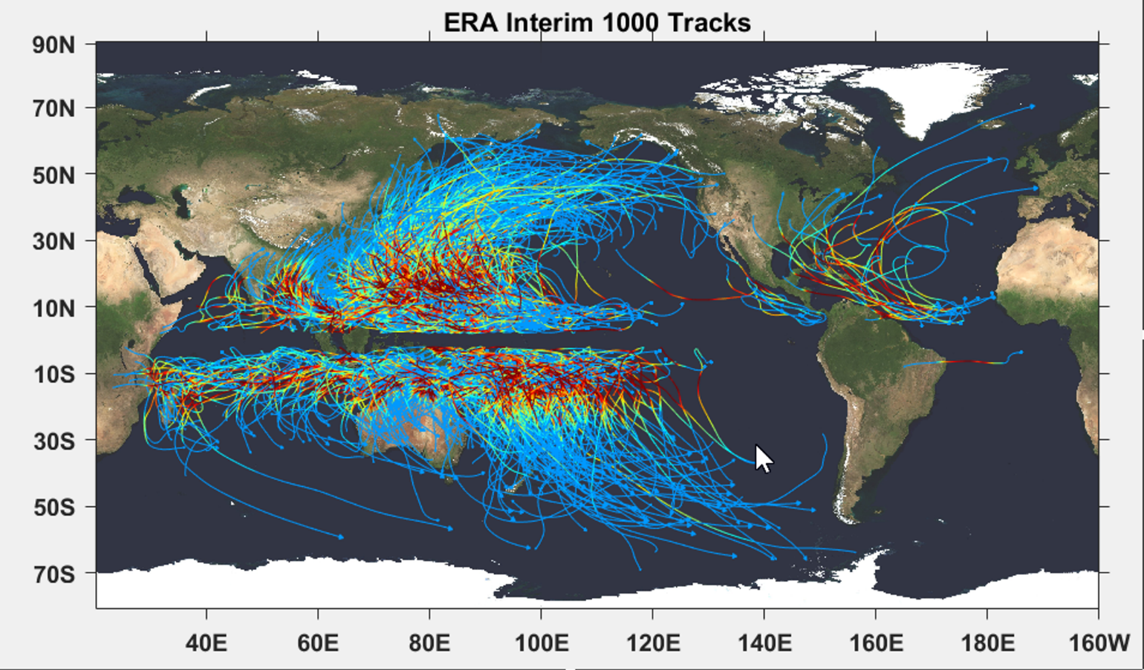

Slide 20
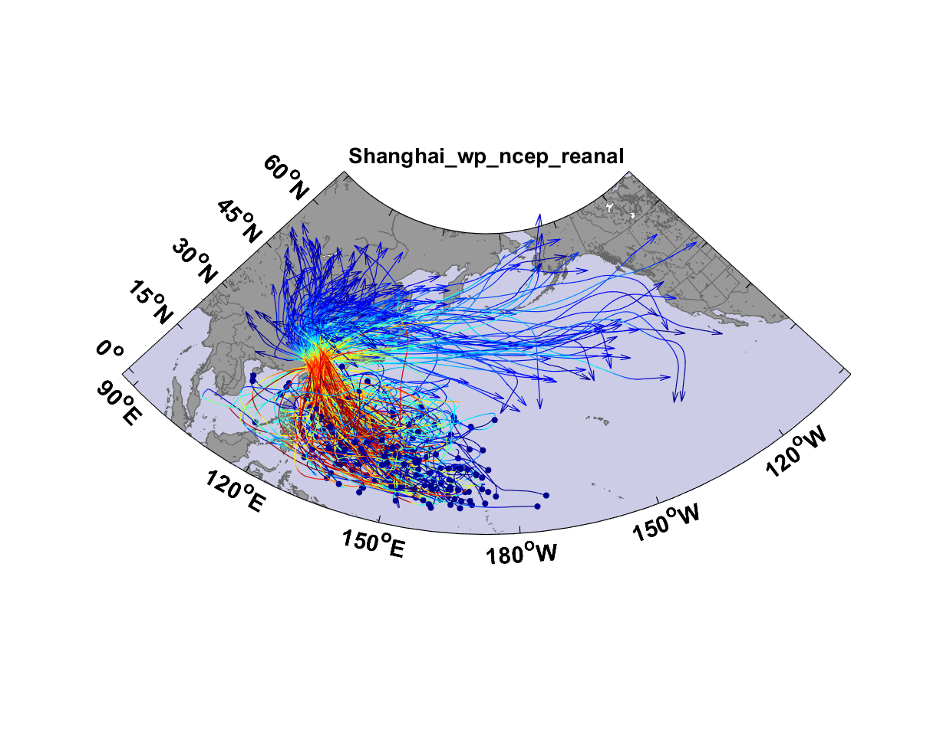
Top 200 out of 5180 TCs Affecting Shanghai

Slide 21
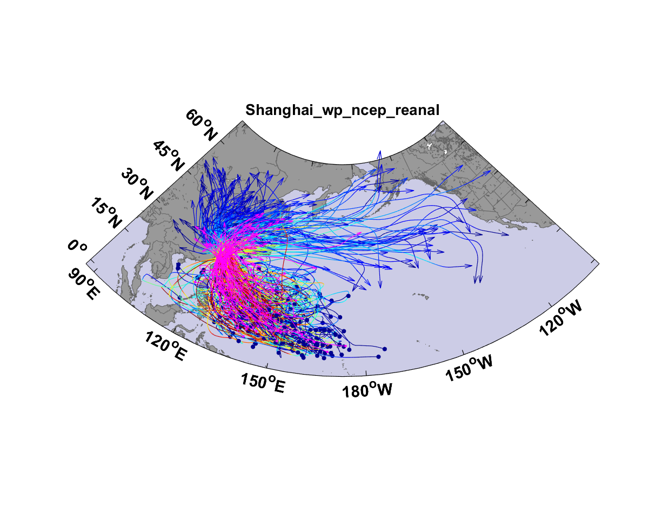
Top 200 out of 5180 TCs Affecting Shanghai

Slide 22

Cumulative Distribution of Storm Lifetime Peak Wind Speed, with Sample of 1755 Synthetic Tracks
90% confidence bounds

Slide 23
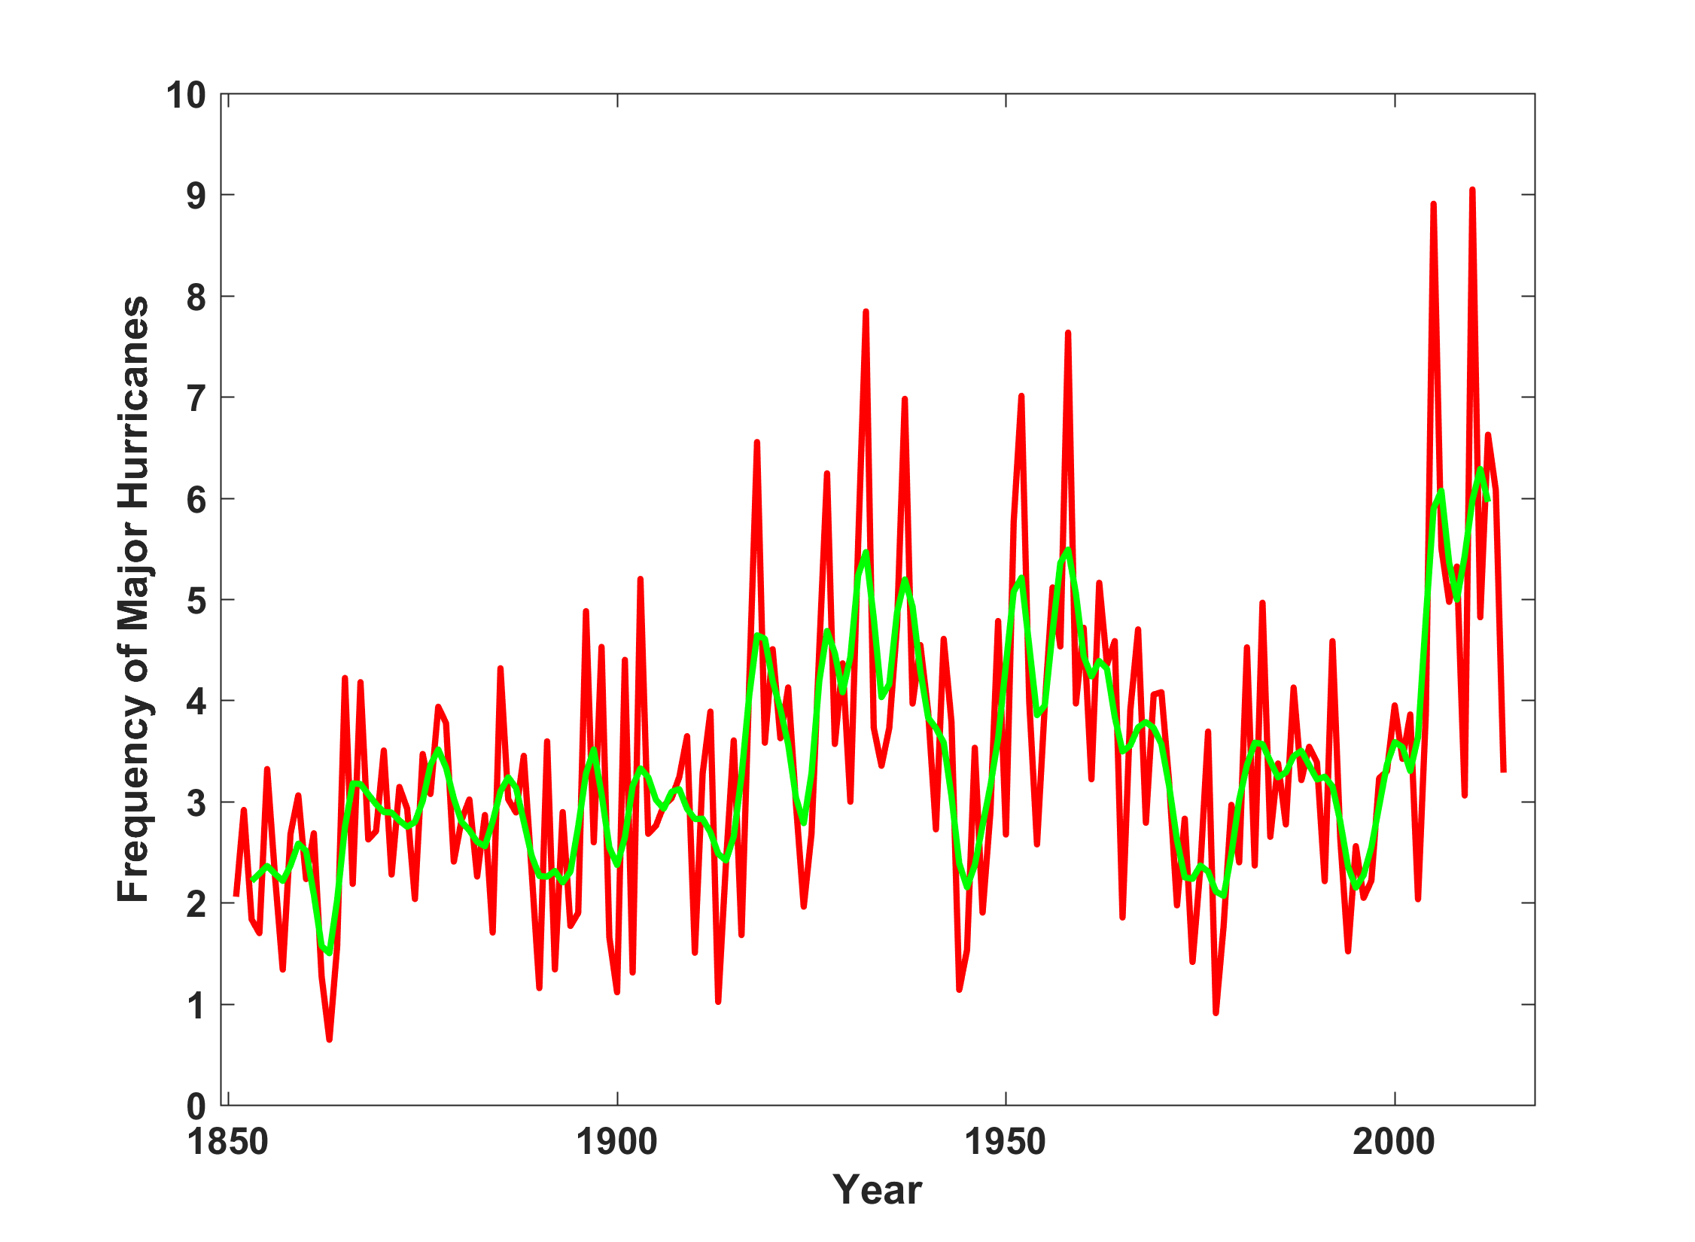
North Atlantic Major Hurricanes Downscaled from NOAA 20th Century Reanalysis
(Forced by sea surface temperature, surface pressure, and sea ice only)

Slide 24
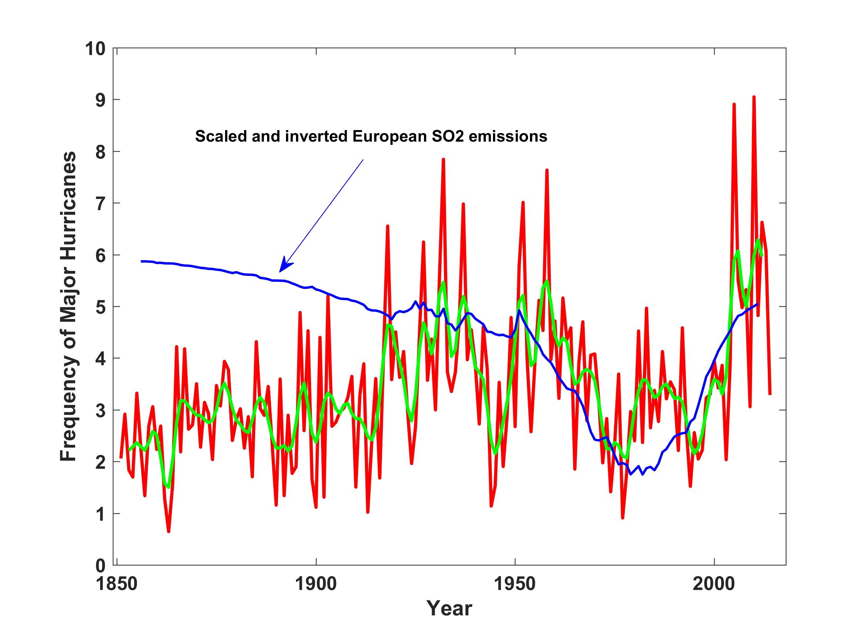
North Atlantic Major Hurricanes Downscaled from NOAA 20th Century Reanalysis
(Forced by sea surface temperature, surface pressure, and sea ice only)

Slide 25
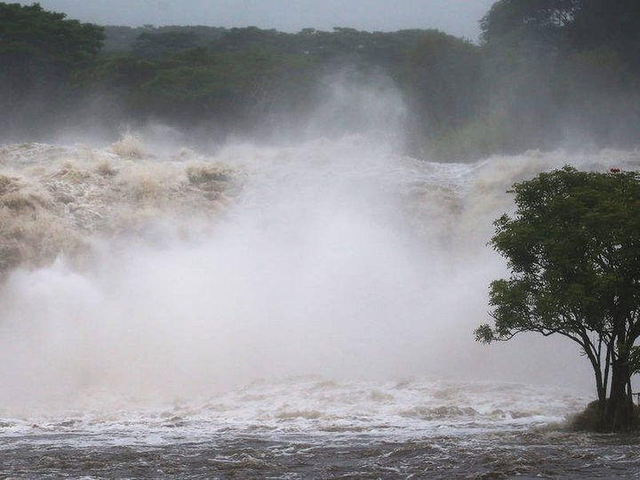
Commercial risk modeling has been focused on wind, but most damage and mortality is caused by water!
Hurricane Lane, big island of Hawaii

Slide 26

Publicly
insured…
No $$$
Privately insured… $$$

Slide 27


Storm Surge Simulation (Ning Lin)
SLOSH model
(Jelesnianski et al. 1992)
SLOSH mesh
~ 10³ m
ADCIRC mesh
~ 10² m
Battery
ADCIRC model
(Luettich et al. 1992)
ADCIRC mesh
~ 10 m
(Colle et al. 2008)
Notes:
Given the storm wind and pressure fields (which is estimated from the Holland parametric pressure model) we can simulate the surge. Surge simulations with high resolution are computationally intensive, so to make it possible to simulate accurate surges for our large synthetic storm sets, we apply the two hydrodynamic models with girds of various resolutions in such a way that the main computational effort is concentrated on the storms that determine the risk. First, we apply the SLOSH model, using a mesh with resolution of about 1 km around NYC to simulate the surges for all storms and select the storms that have return periods, in terms of the surge height at the Battery, greater than 10 years. Second, we apply the ADCIRC simulation, using a grid mesh with resolution of ~100 m around NYC, to each of the selected storms. Then, we apply another ADCIRC mesh with resolution as high as ~10 m around NYC, for a set of the most extreme events, to check if the resolution of our ADCIRC grid is sufficient and if needed to make statistical correction to the results.

Slide 28
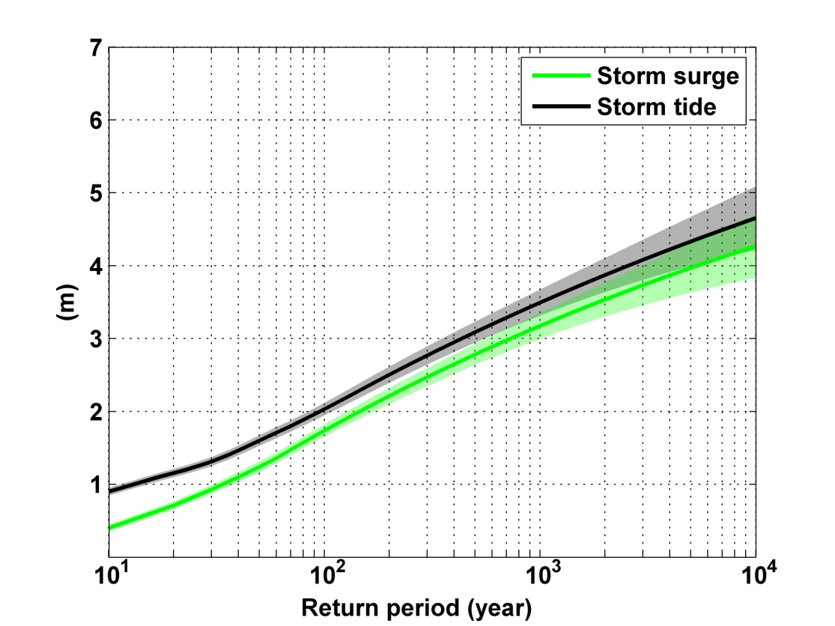
Sandy, 2012
Sandy: ~ 400 years
Notes:
Storm surge and storm tide (surge and tide) return level curves for the Battery, NYC, for the 1981-2000 NCAR/NCEP climate conditions (5000 synthetic storms). Astronomical tide and nonlinear interaction between surge and tide are accounted for statistically.

Slide 29
Predicting Rainfall
The CHIPS models predicts updraft and downdraft convective mass flux as a function of time and potential radius, BUT:
Storing these variables at all radii would increase overall storage requirements by a factor of ~50
(We are dealing with 10,000-100,000 individual events)

Slide 30
Basic strategy: Reconstruct time-evolving
2-D wind field by fitting a canonical radial wind profile to predicted values of V_{max} and r_{max} and adding a constant background wind. Allow resulting vortex to interact with background wind and thermodynamic fields.
Use Quasi-Balanced Physics

Slide 31
Calculating vertical motion in middle troposphere from time-dependent azimuthal gradient wind. Four components:
Vertical motion at the top of the boundary layer owing to frictional effects within the boundary layer. This is estimated using a slab boundary layer model forced by the model gradient wind as well as the low-level environmental wind used as an input to the storm synthesizer. Use spatially varying drag coefficient.
Vertical motion at the top of the boundary layer forced by topography interacting with the combination of storm and environmental flow.

Slide 32
Vertical stretching between the top of the boundary layer and the middle troposphere associated with changes in the vorticity of the (axisymmetric) gradient wind.
Add mid-tropospheric vertical motion caused by the dynamical interaction of the axisymmetric vortical flow and the background shear/horizontal temperature gradient.

Slide 33
Given mid-tropospheric vertical motion, rainfall is calculated by assuming ascent along a moist adiabat, calculated using the environmental 600 hPa temperature plus a correction for the storm’s warm core

Slide 34
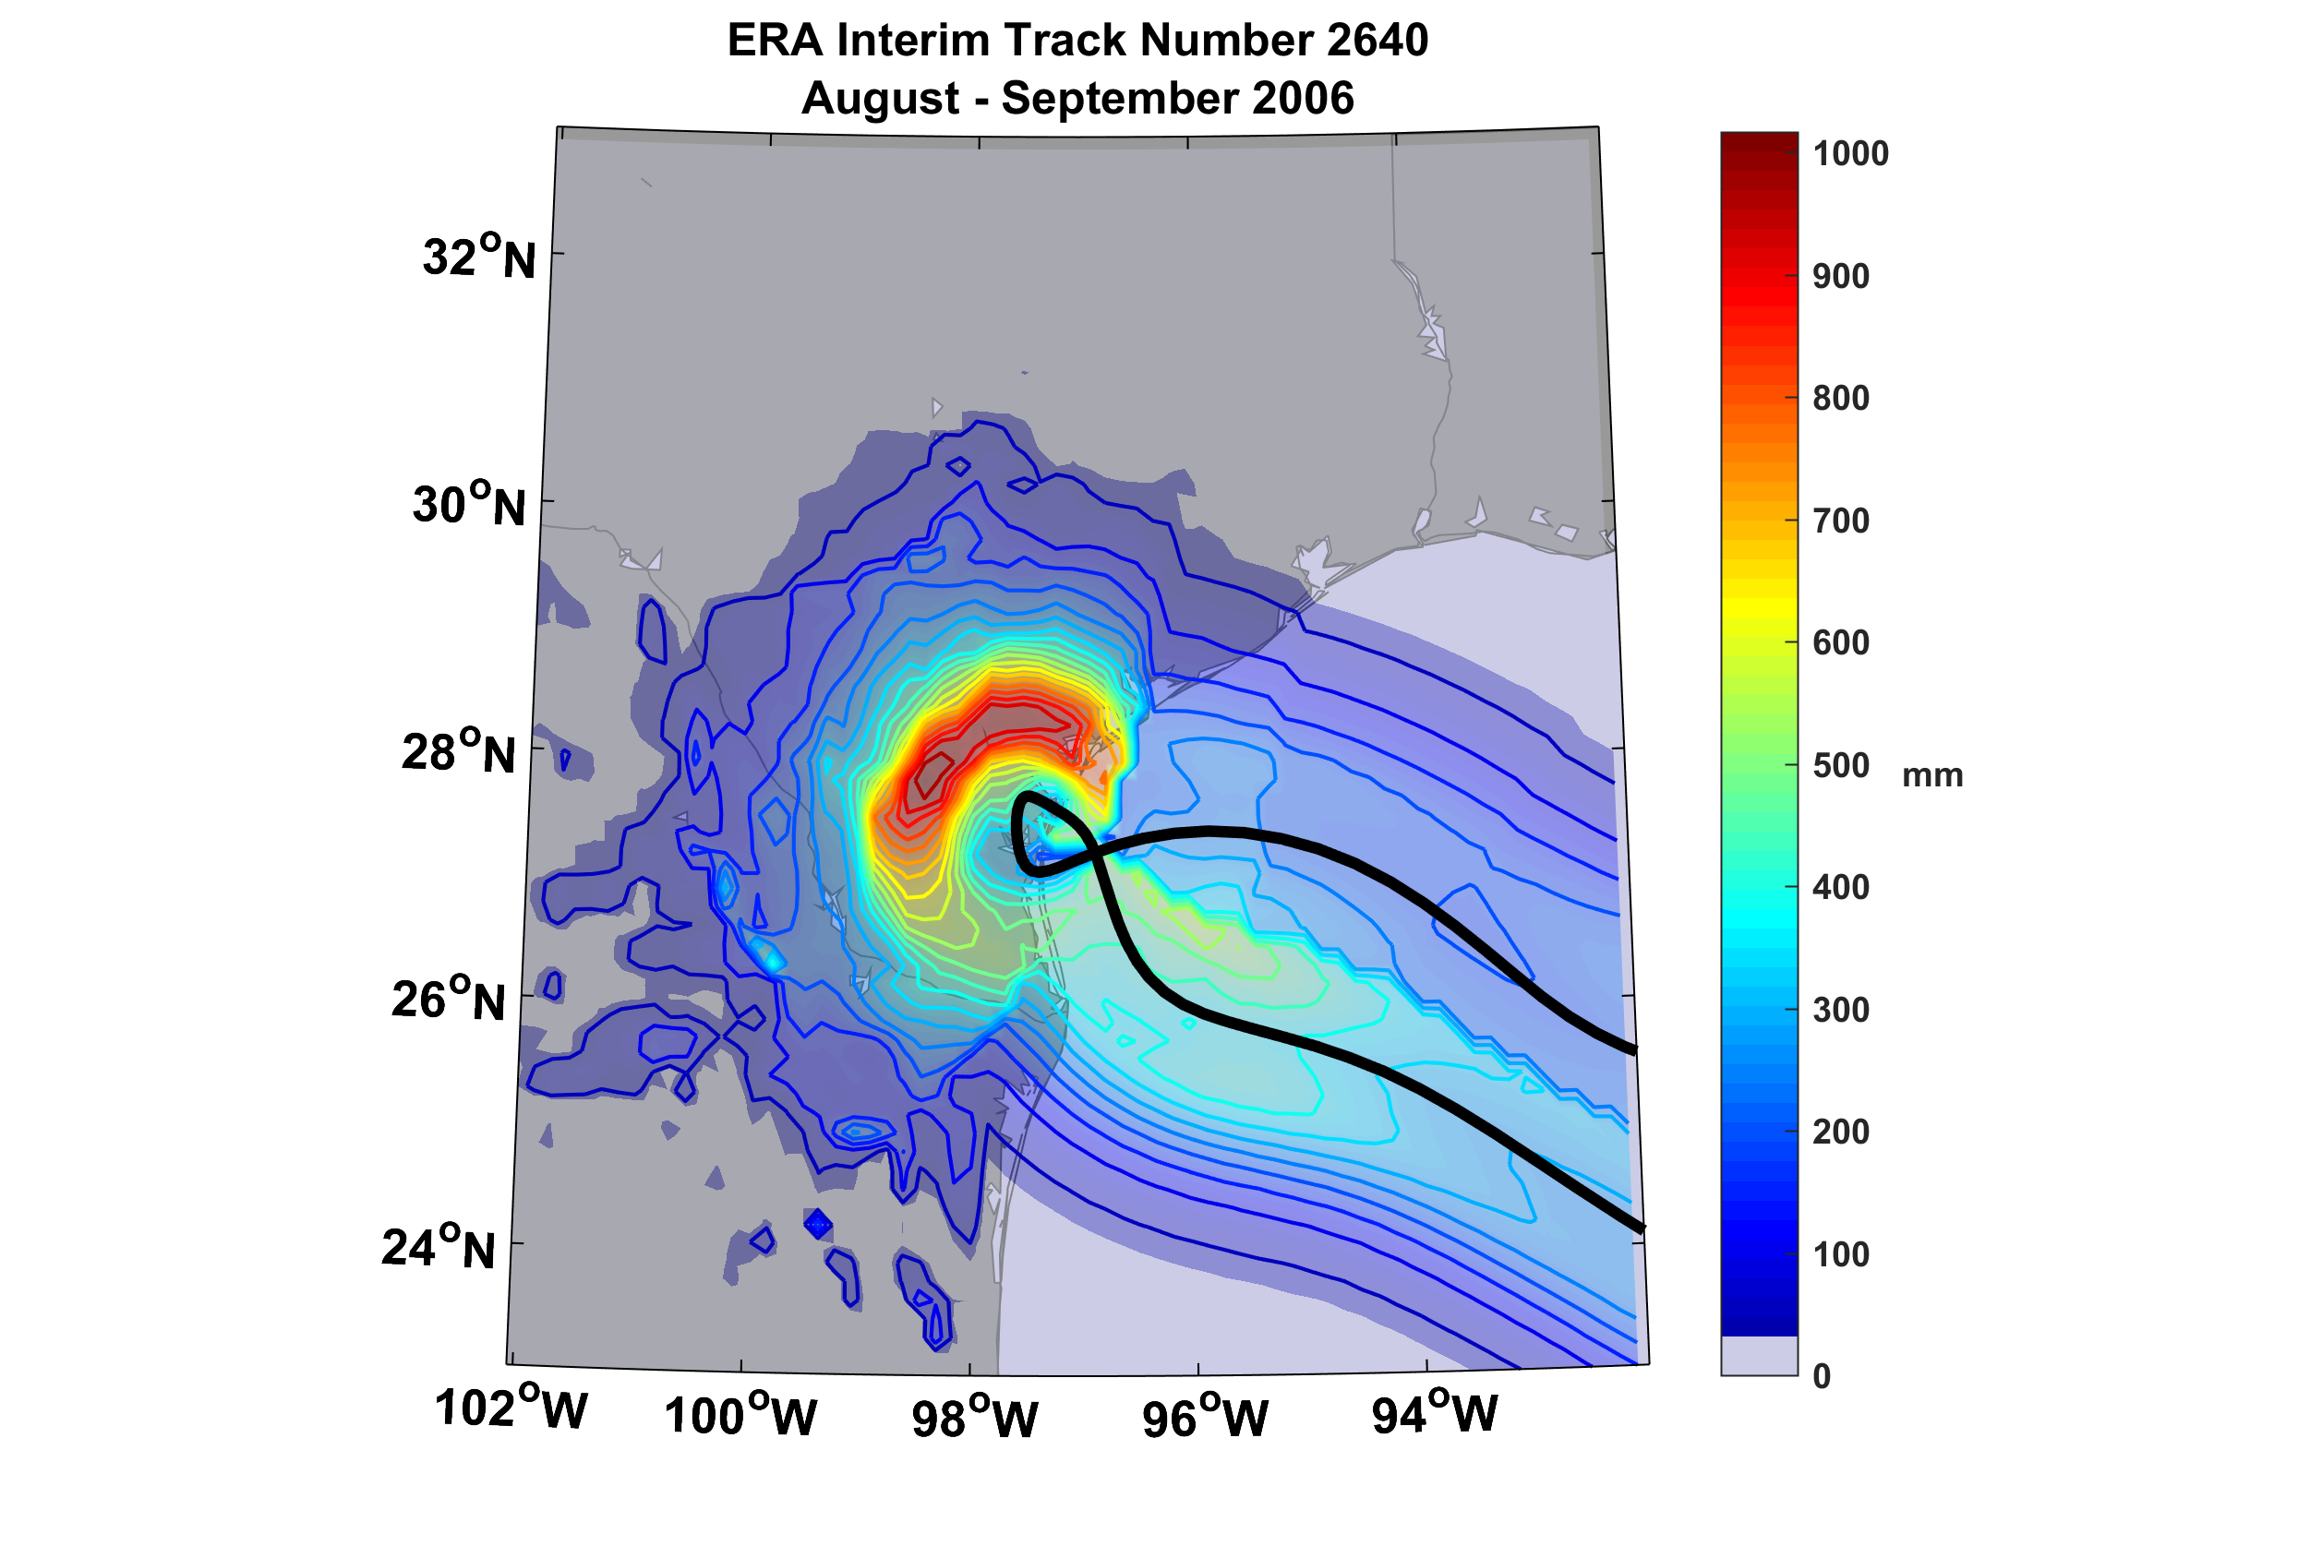
Example of Accumulated Rainfall from a Harvey-like Event Downscaled from ERA Interim Reanalysis

Slide 35
A hurricane affecting Boston
7” of rain in downtown Boston

Slide 36
Physics is fine, but how do we evaluate how well it works?
Evaluation of rainfall predictions against observations is tough!
  Only 32 years of NEXRAD radar data
  Rain gauges go back much further in time but can be unreliable in strong winds and are subject to large sampling error
We used both radar and gauge data and averaged both over circles of 100 km radius of 35 radar sites. (Feldmann and Emanuel, 2019, in review)
Many thanks to Monika Feldmann

Slide 37
NEXRAD Sites

Slide 38
Some Examples
Estimated gauge sampling error
Estimated radar sampling error

Slide 41
Effects of Climate Change
More moisture in boundary layer
Stronger storms but more compact inner regions
Possibly larger storm diameters
Storms may be moving faster or slower

Slide 42
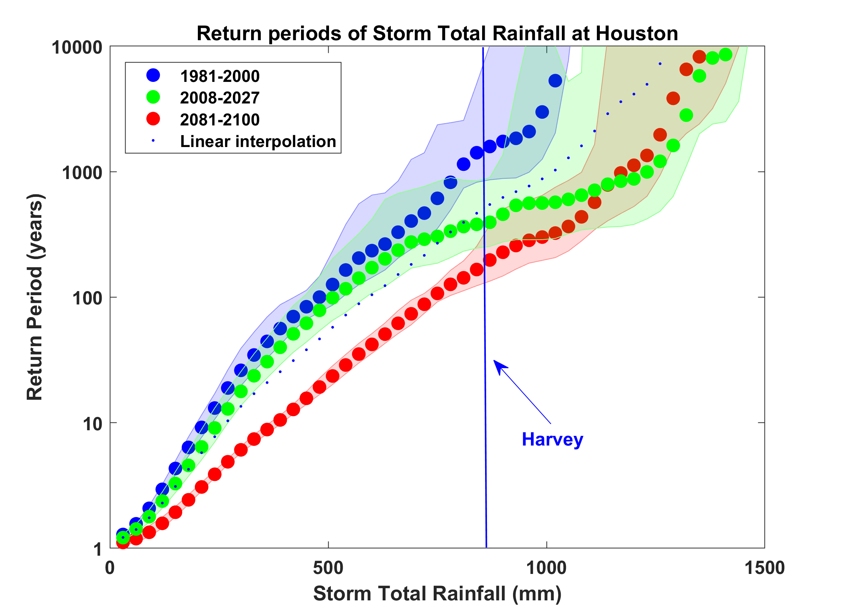
Probability of Storm Accumulated Rainfall in Harris County, from 6 Climate models, 1981-2000, 2008-2027, and 2081-2100, Based on 2000 Events Each, and Using RCP 8.5. Shading Shows Spread Among the Models.

Slide 43
A Black Swan Event

Slide 44

MIT’s Hurricane Flood Risk
(with Sai Ravela, Ken Strzepek, and the MIT Resilience Committee)

Slide 45
Sea Level Rise / Storm Surge Propagation (2070)
Courtesy Ken Strzepek
1-3 feet peak
<1 foot peak
1% or 100 year SLR/SS event under climate change conditions (2070) (precipitation not yet included)
Note: not for distribution – in-progress MIT Flood Vulnerability Study (Jun 2017); based on MassDOT/Central Artery Flood Modelling assumptions for river levels
Notes:
Scenario shows 1% probability storm surge event in 2070 (with sea level rise and climate changes)
Surge would flank the Charles River dam and flood areas of the campus with 1-3 feet of peak flood water.
Rather than overtop the seawall along Memorial Drive, surge water would propagate stormwater drainage pipes and flood lowest campus elevation areas along Vassar and Albany and Main St.
Areas that would likely be flooded include many of the same lower elevation areas that are of risk and noted below under probable precipitation-flooding areas.
Scenario only accounts for a surge of seawater, not precipitation run-off from Cambridge land.
Surge would likely bring salty water into campus utility and building systems.
KEY ASSUMPTIONS FOR MODELLING: MassDOT/Central Artery Tunnel Flood Study - https://www.massdot.state.ma.us/Portals/8/docs/environmental/SustainabilityEMS/Pilot_Project_Report_MassDOT_FHWA.pdf

Slide 46
Summary
History is too short and imperfect to estimate many natural hazard risks
We should bring physics to bear on estimating weather risks
Physical modeling permits us to estimate how weather risks will evolve in a changing climate

Slide 47
Spares

Slide 48
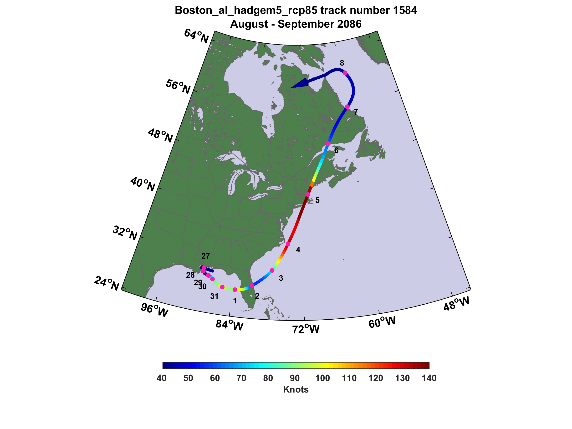

Slide 49
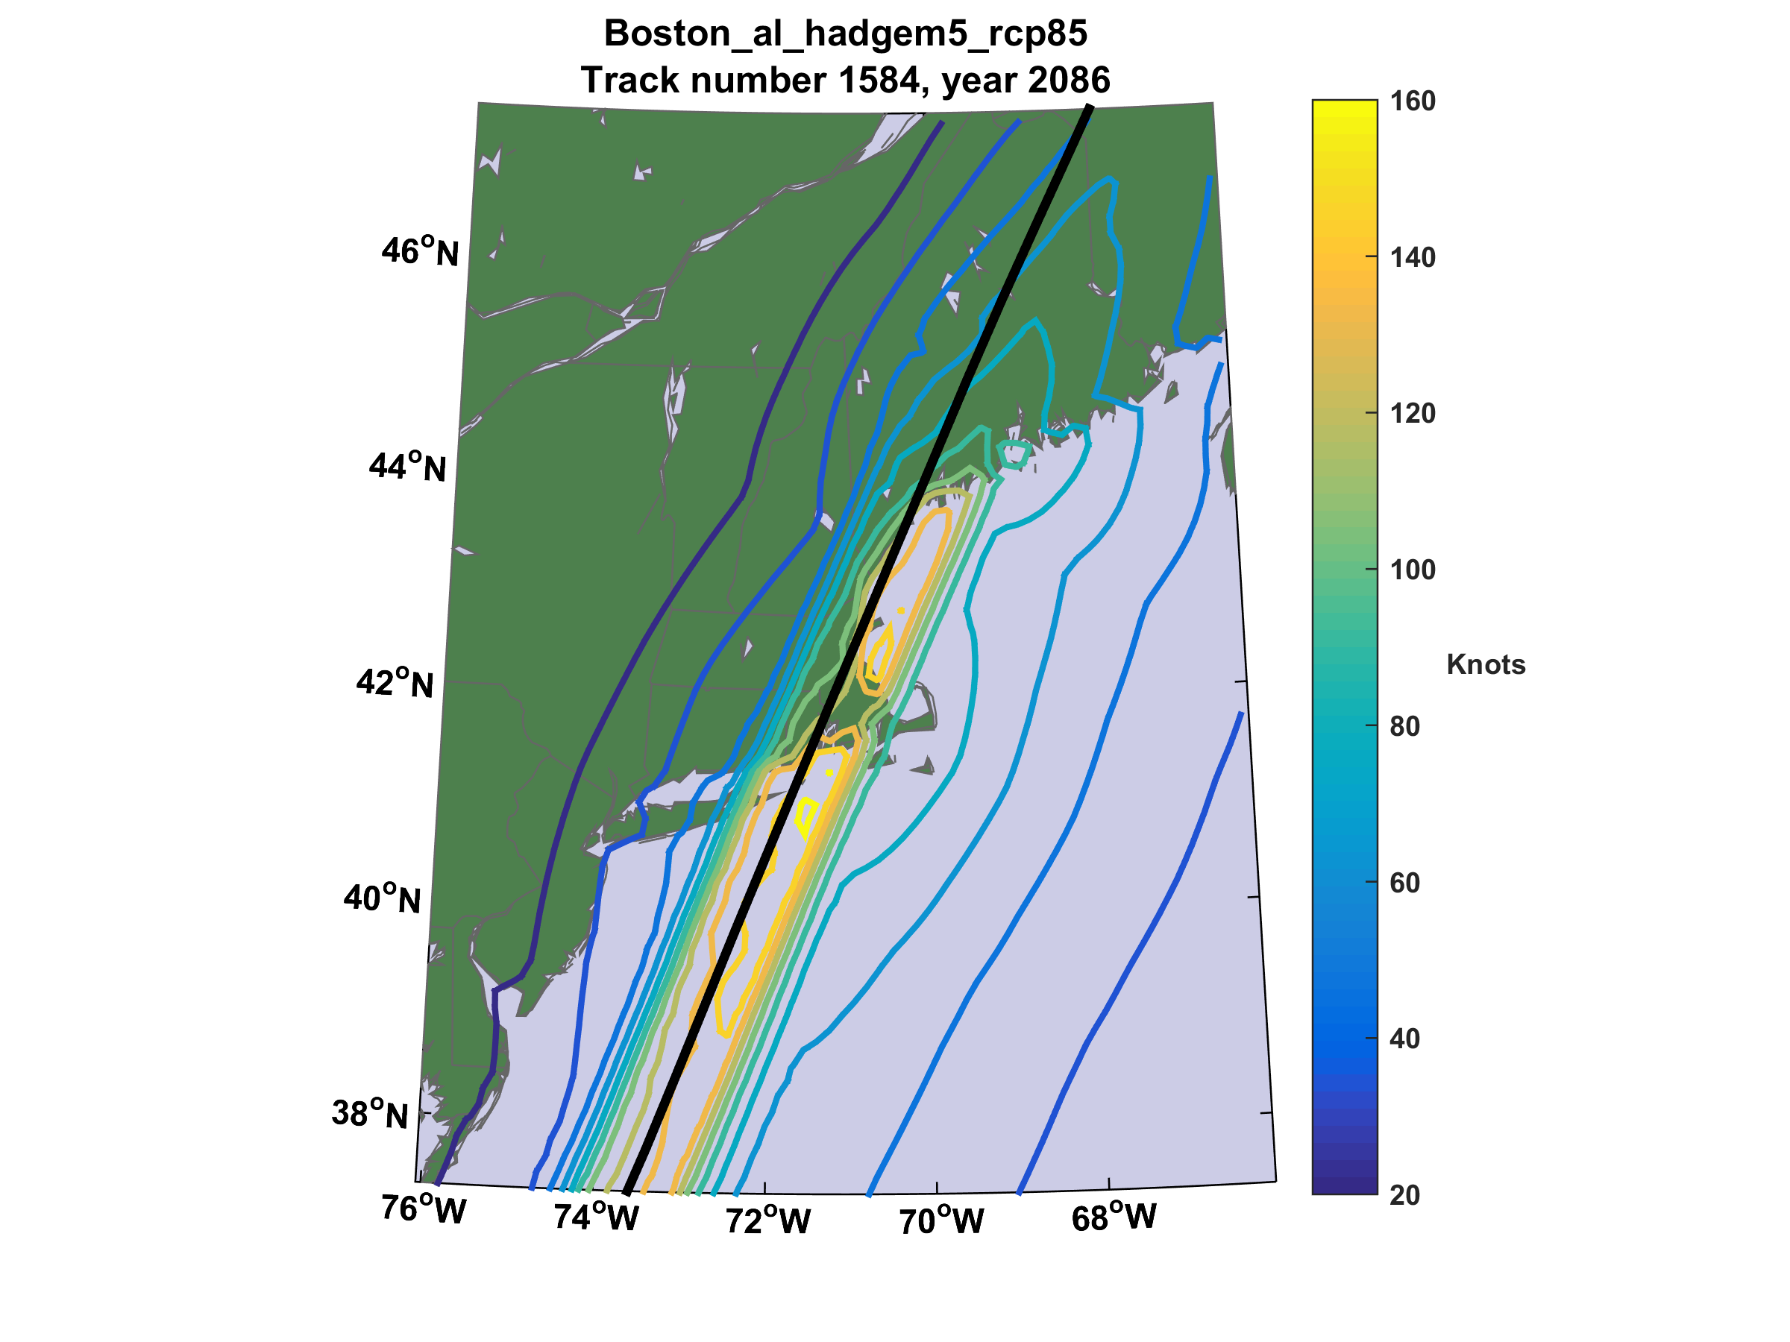

Slide 50
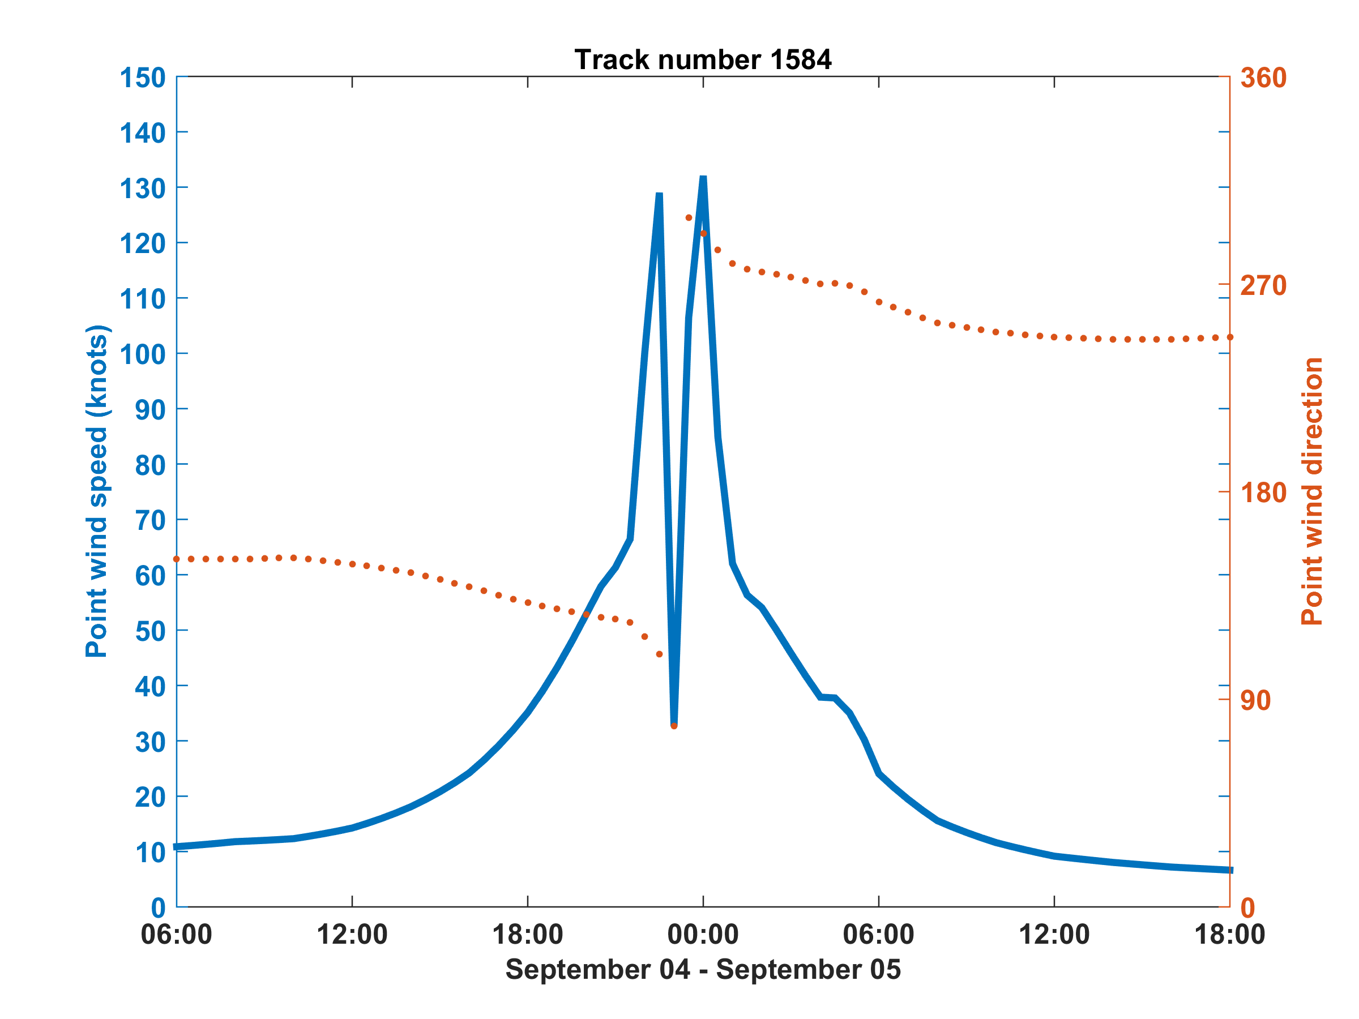
Wind speed and direction at Logan Airport

Slide 51
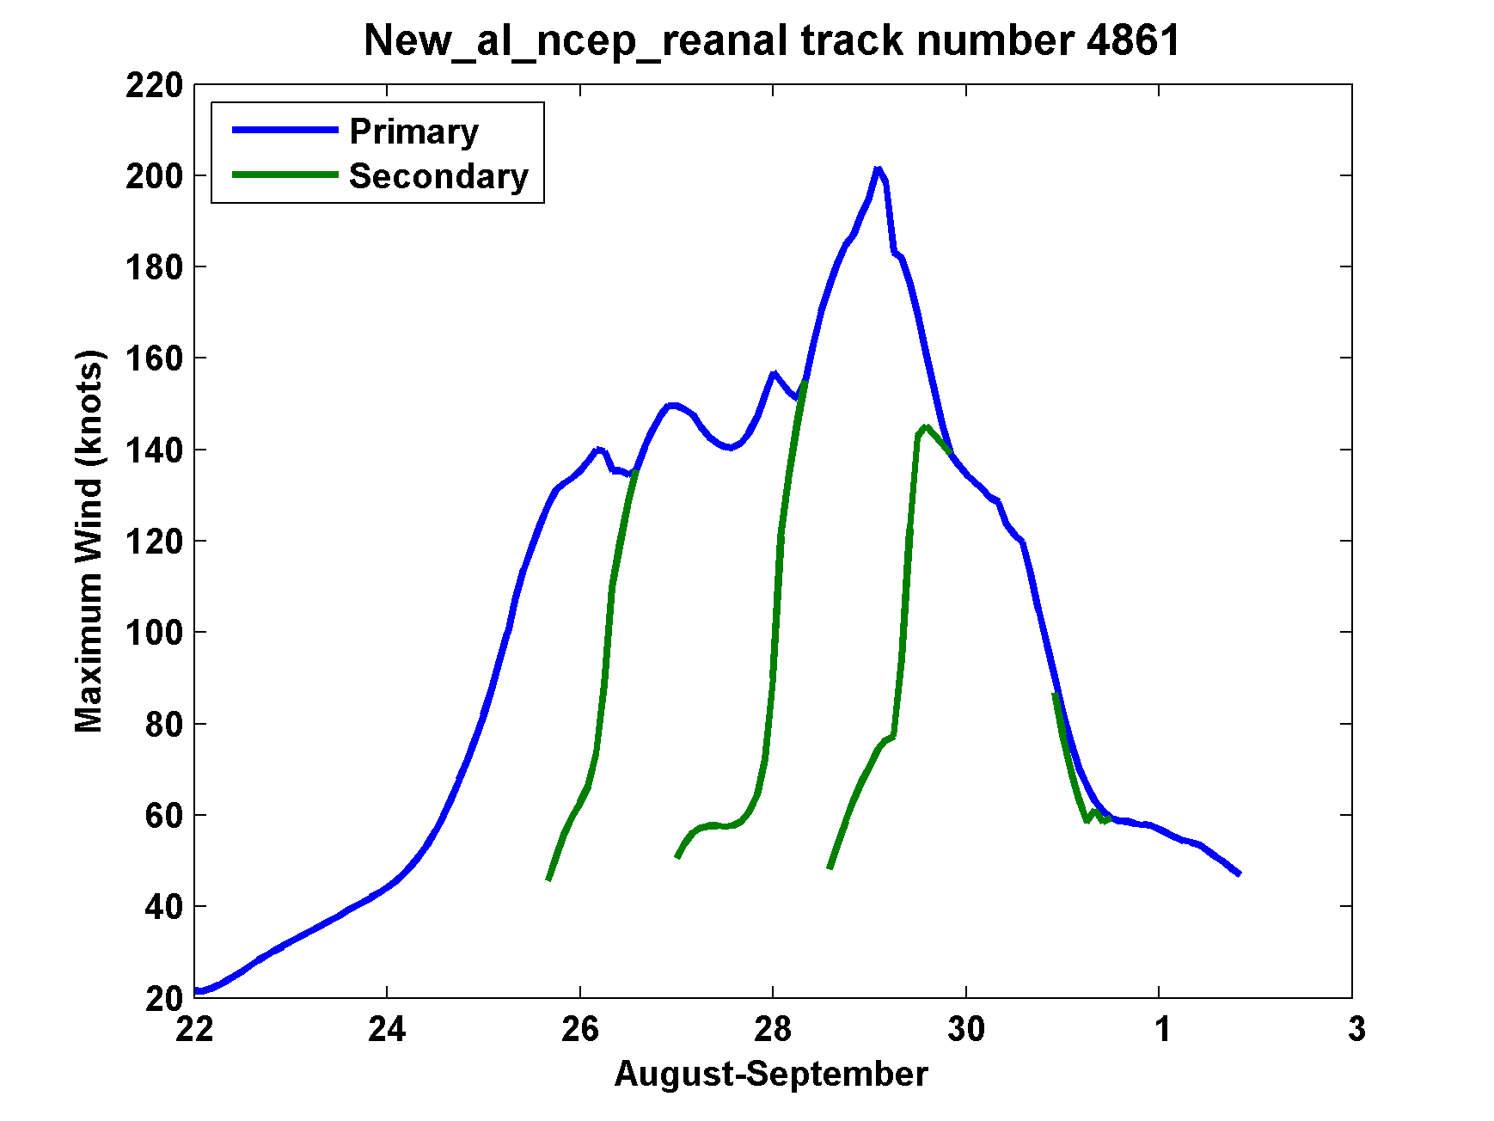
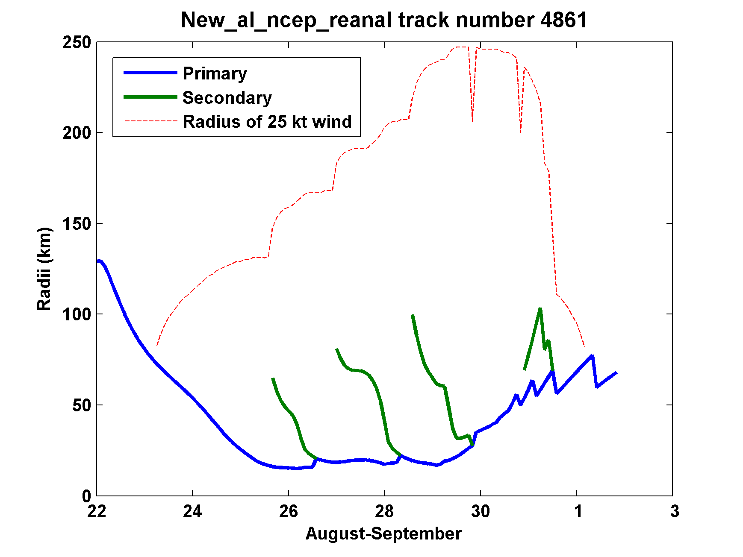
Secondary
eyewalls

Slide 52

Return Periods

Slide 53
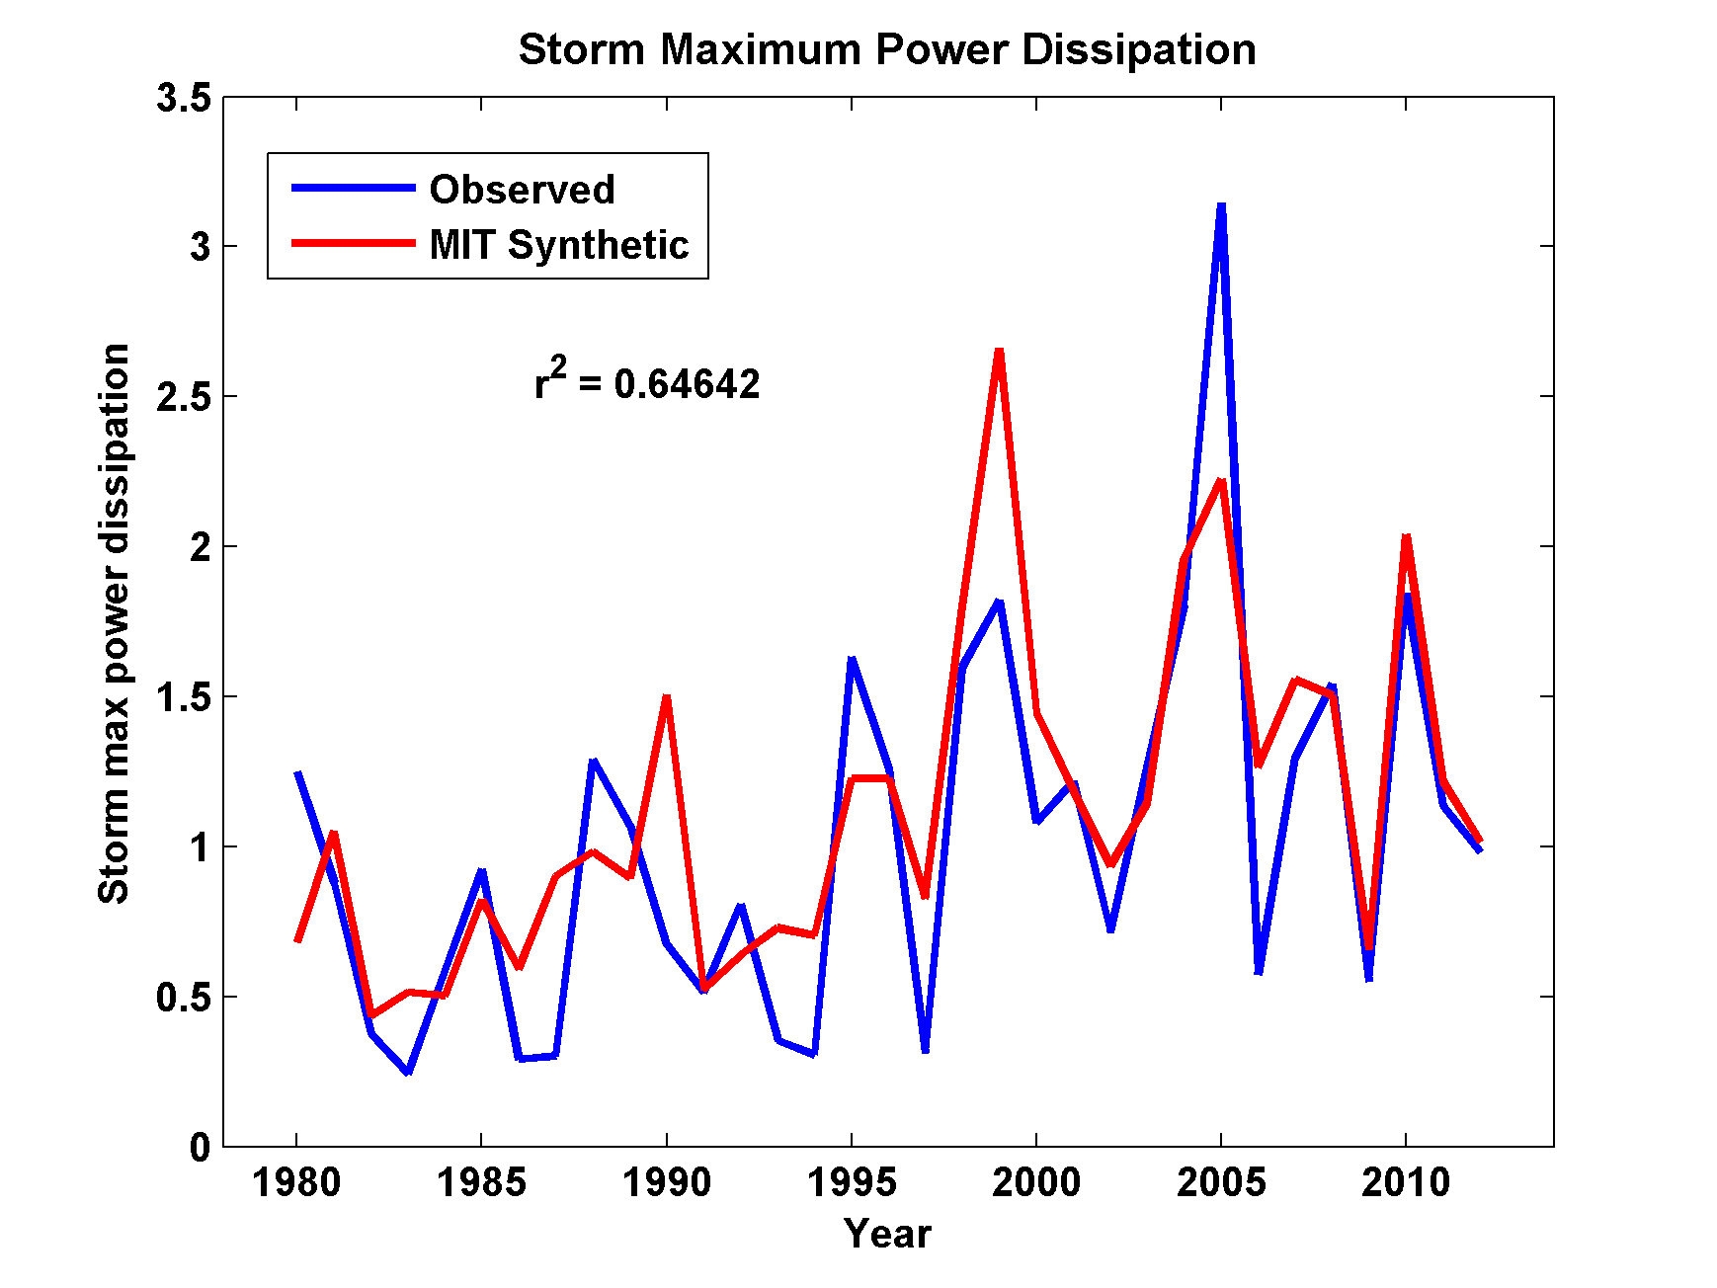
Captures Much of the Observed North Atlantic Interannual Variability
r²=0.65

Slide 54
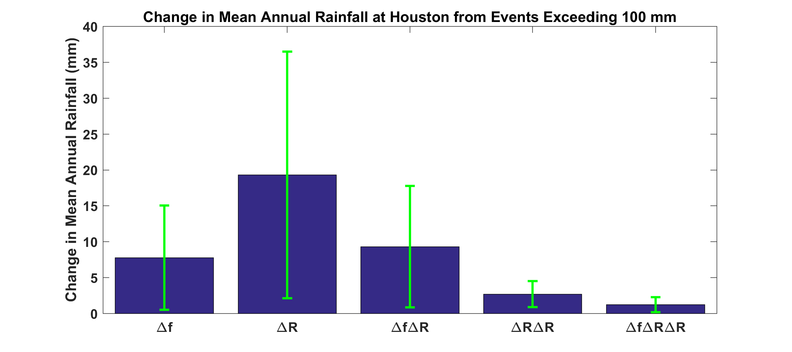
Contributions to Changes in Annual Mean Hurricane Rainfall at Houston from Changes in Overall Event Frequency and in Average Storm Rainfall
Δf = Change in overall hurricane frequency
ΔR= Change in Rainfall amounts in excess of 100 mm

Slide 55
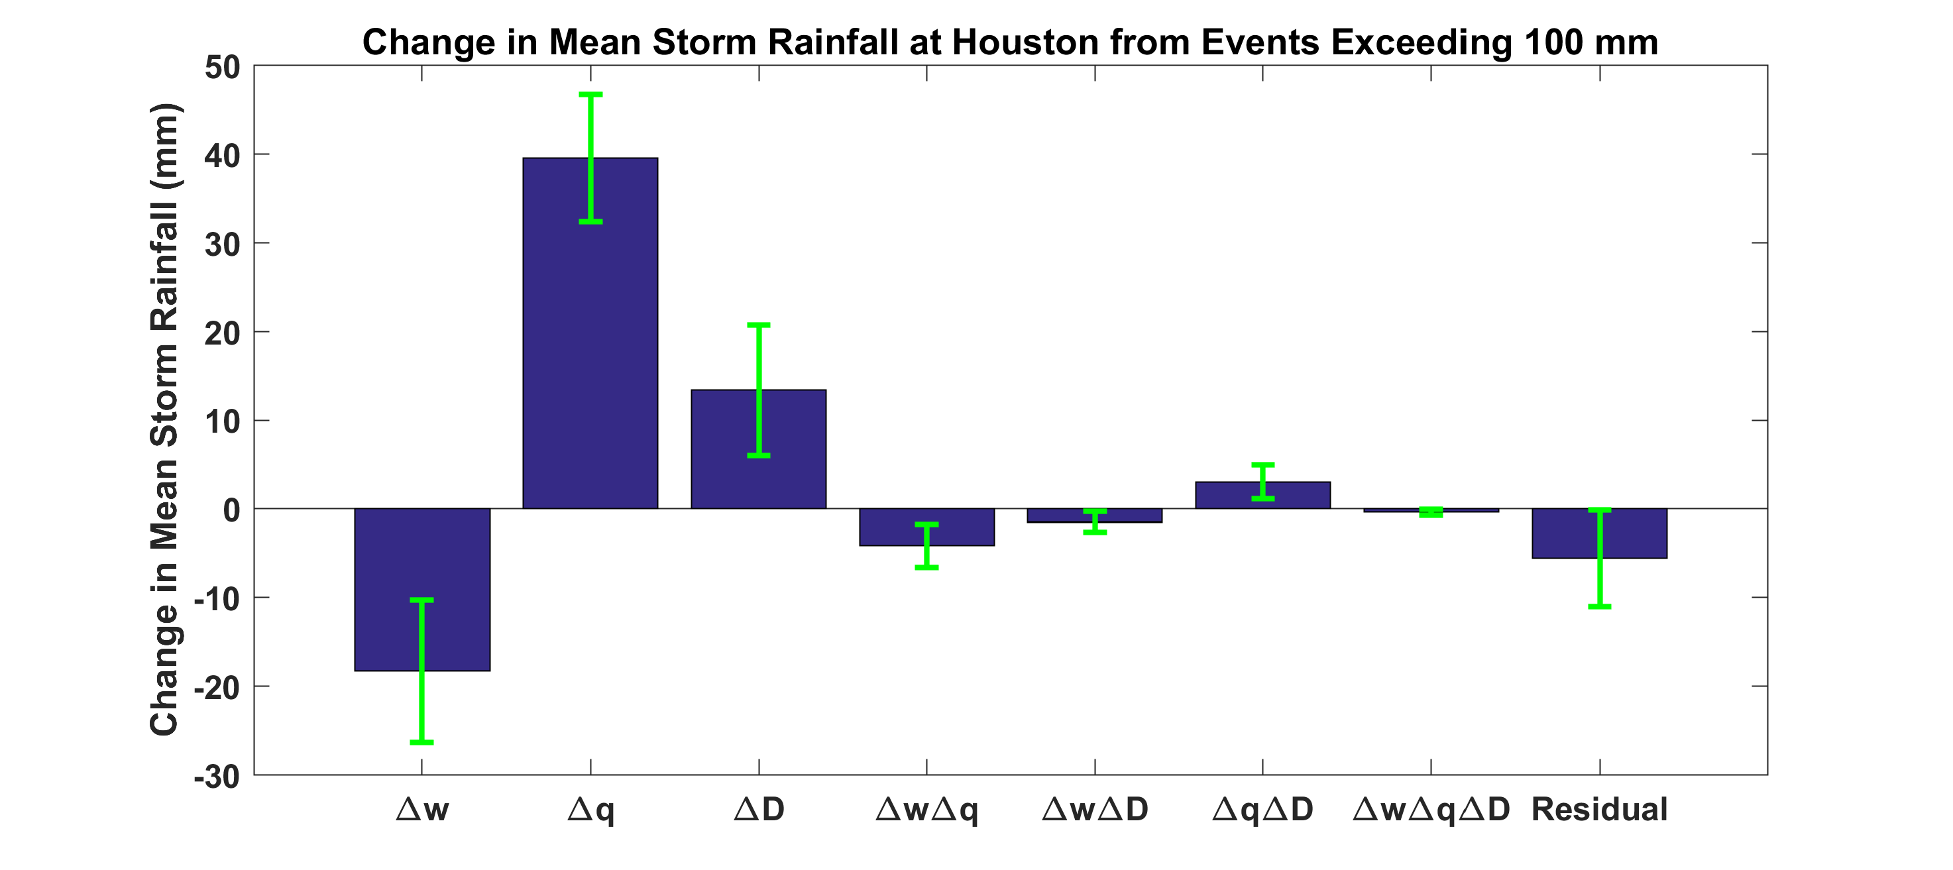
Contributions to Changes in Hurricane Rainfall at Houston from Changes in Updraft Speed, Water Vapor Content, and Storm Duration
Δw = Change in updraft speed
Δq = Change in water vapor concentration
ΔD = Change in storm duration

