Slide 1
Explicit RCE Simulations and Self-Aggregation of Convection

Slide 2
Explicit Simulation of Radiative-Convective Equilibrium
(Work of EAPS PhD students Allison Wing and Martin Singh)

Slide 3
Approach: Idealized modeling of convective organization in radiative-convective equilibrium using a cloud resolving model
System for Atmospheric Modeling (SAM) of Khairoutdinov and Randall (2003)
Constant solar insolation: 413.98 W/m²
Horizontal Resolution: 3km
Vertical Resolution: 64 levels
Periodic lateral boundaries
Initial sounding from domain average of smaller domain run in RCE
Fully interactive RRTM radiation and surface fluxes.
Rigid Lid
28 km
Fixed SST
297-312 K
768 km
768 km
Notes:
Three-dimensional cloud resolving model Anelastic equations of motion RRTM radiation scheme SAM 1-moment microphysics scheme
Prognostic thermodynamic variables:
Liquid water/ice moist static energy: h_{L} = c_{p}T + gz – L_{c}(q_{c}+q_{r})-L_{s}(q_{i}+q_{s}+q_{g})
Total nonprecipitating water
Total precipitating water

Slide 5
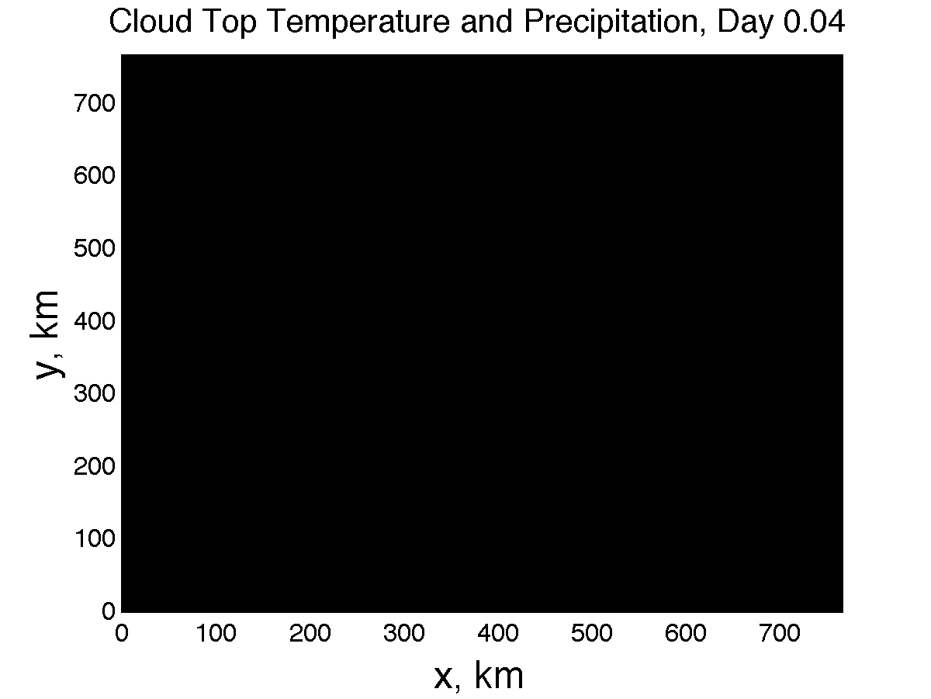

Slide 6

Characteristics, including some surprises:
As predicted by Bjerknes (1938), fractional area is small
Net upward convective mass flux, M, constrained by
But M ~ σw... what determines w?
fractional area

Slide 7
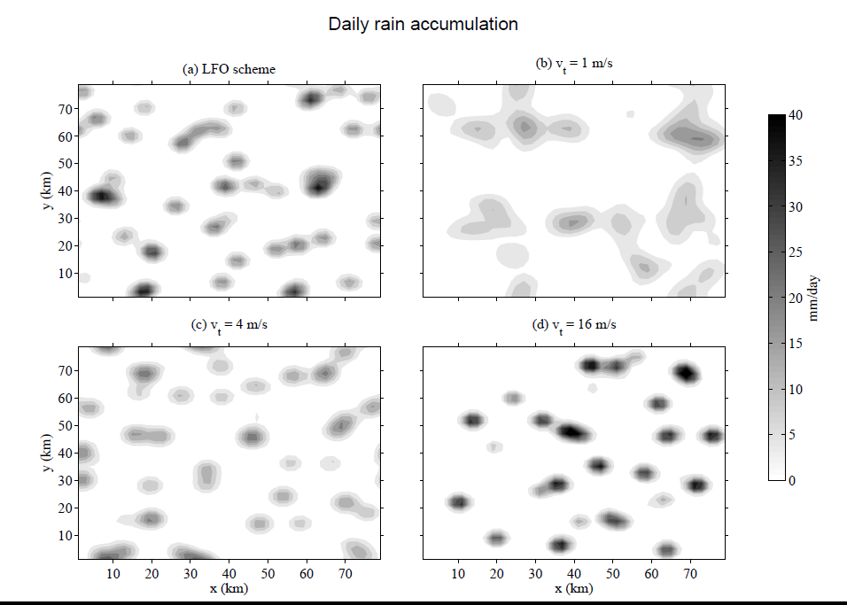
Courtesy Martin Singh
Standard Scheme
V_{t}=1 m/s
V_{t}=4 m/s
V_{t}=16 m/s

Slide 8
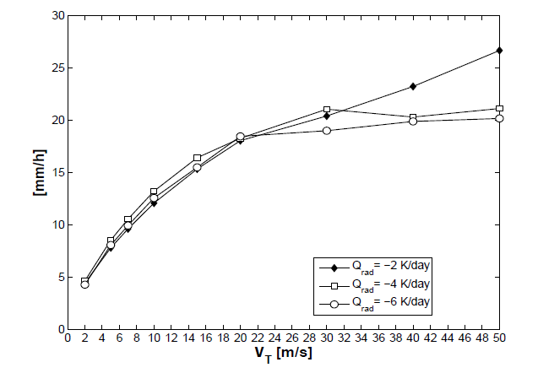
Rainfall Intensity vs. Terminal Fall Speed
(Note: MEAN rainfall invariant, as radiative cooling is specified)
Parodi and Emanuel, 2009

Slide 9
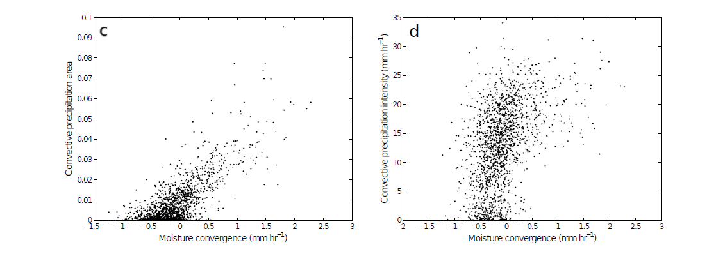
Comparison of Large-scale Moisture Convergence to Radar-Derived Convective Quantities
(Davies et al., submitted)
Convective precipitation
Convective precipitation intensity
Courtesy Christian Jakob

Slide 10
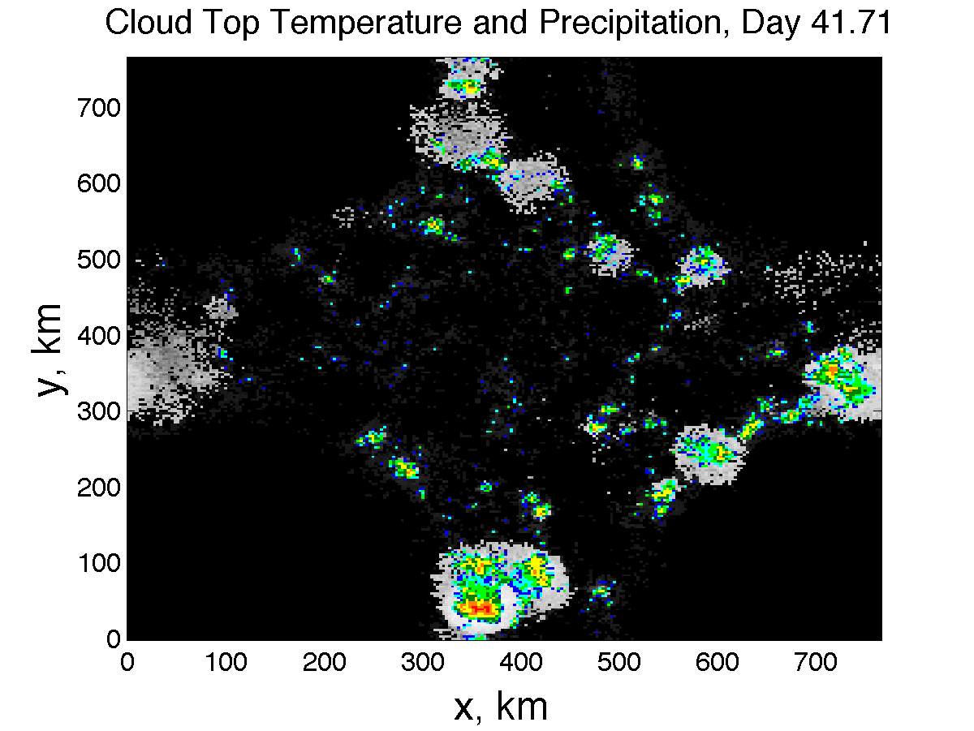

Slide 11
Evolution of Vertically Integrated Water Vapor
Notes:
Day 1 is pretty homogeneous. By day 10 small area has become drier.

Slide 12
Evolution of Vertically Integrated Water Vapor
Notes:
Over next 20 days, small dry patch amplfies and expands. By day 30 covers nearly a quarter of the domain.

Slide 13
Evolution of Vertically Integrated Water Vapor
Notes:
Process continues and by day 50 areas of the domain not in dry patch have become moister than they were initially.

Slide 14
Evolution of Vertically Integrated Water Vapor
Notes:
Now the expanding dry region has confined all the moist area (which is now moister than anywhere earlier in the simulation) to one band. This band evolves

Slide 15
Evolution of Vertically Integrated Water Vapor
Notes:
Evolves into a single circular cluster in which high tpw values are concentrated. Outside the moist cluster, the rest of the domain has very low values of tpw.

Slide 16
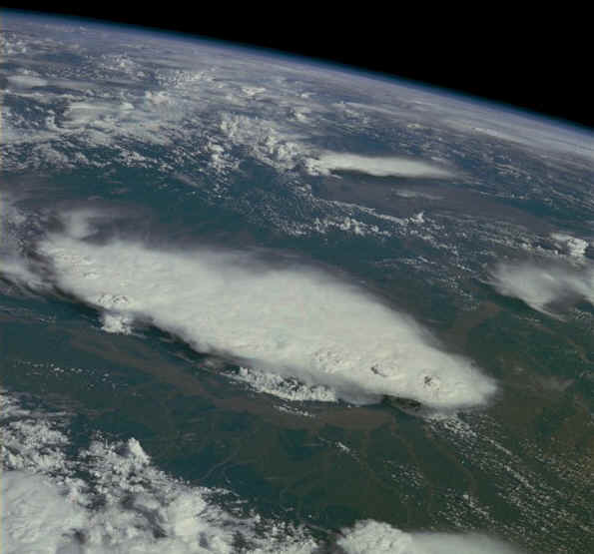
Monsoonal Thunderstorms, Bangladesh and India, July 1985

Slide 17
Surface Temperature Dependence
Larger domain needed for high SSTs to aggregate
Notes:
Speculated that high SST simulations required a larger domain size, perhaps because of the large values of dry static stability that occur at high temperature.

Slide 18

Analysis of Feedback Terms
Framework: Budget for spatial variance of column integrated frozen moist static energy
Consider anomalies from the horizontal mean (primes)
Feedback term: FMSE anom * Diabatic term anom
Positive Feedback: Process increases FMSE of already moist region
Negative Feedback: Process decreases FMSE of moist region
Notes:
Surface fluxes. Column shortwave heating, column longwave cooling. FMSE conserved, convection can’t change column integral.
Advantages: not just det by removing processes, actually can compare magnitudes within given simulation, calc a number that is relevant.

Slide 19
Total Diabatic Feedback Term
All terms normalized by
Black line:
DRY
MOIST
DRY
MOIST
Notes:
Explain axes, black line. When does cluster form? Point out pos fb (red) in dry region, beginning, shifting to moister regions as progresses. Strong pos fv developing in moist regions ~day 60. Point out blue (neg fb) in dry days 30-60, but h’ still increasing in magnitude there. Colors -> magnitude UNITS J/m^2 W/m^2

Slide 20
Column Shortwave Flux Convergence
DRY
MOIST
DRY
MOIST
Notes:
SW: mostly a positive feedback. Magnitude indicates not trivial, important.

Slide 21
Column Longwave Flux Convergence
DRY
MOIST
DRY
MOIST
Notes:
LW is sometimes pos fb, sometimes neg. magnitude comparable to sw. point out super strong in moistest regions – LW cloud fb maintaining cluster.

Slide 22
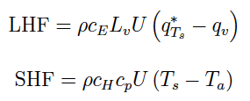
Surface Enthalpy Flux Partitioning
Partition surface enthalpy flux anomalies into
  part due to U’
  part due to Δq’ or ΔT’
  part due to U’Δq’ or U’ΔT’

Slide 23
Total Surface Flux Feedback Term
DRY
MOIST
DRY
MOIST
Notes:
Sfc flux: mostly negative fb.

Slide 24
Surface Flux – Wind Feedback Term
DRY
MOIST
DRY
MOIST
Notes:
This is WISHE term. Conflicting results. Here it is primarly a positive fb--- and a strong wrong. But main role is to counteract….

Slide 25
Surface Flux –Air-Sea Disequilibrium Feedback Term
DRY
MOIST
DRY
MOIST
Notes:
…strong neg disequilibrium fb.

Slide 26
Convergence Term
DRY
MOIST
DRY
MOIST

Slide 27
MIT Single-Column Model
Run into RCE state with fixed SST, then re-initialized in Weak Temperature Gradient mode with T fixed at 850 hPa and above; small perturbations to w in initial condition

Slide 28
Results
No drift from RCE state when SST <~ 32 C
Migration toward states with ascent or descent at higher SSTs
These states correspond to multiple equilibria in two-column models by Raymond and Zeng (2000) and by several others since (e.g. Sobel et al., 2007; Sessions et al. 2010)

Slide 30
Perturbation shortwave (red), longwave (blue), and net (black) radiative heating rates in response to an instantaneous reduction of specific humidity of 20% from the RCE states for (left) SST525C and (right) 40C. Note the different scales on the abscissas.

Slide 31
Perturbation net radiative heating rates in response to an instantaneous reduction of specific humidity of 20% from the RCE states for SSTs ranging from 25 to 45C.

Slide 32
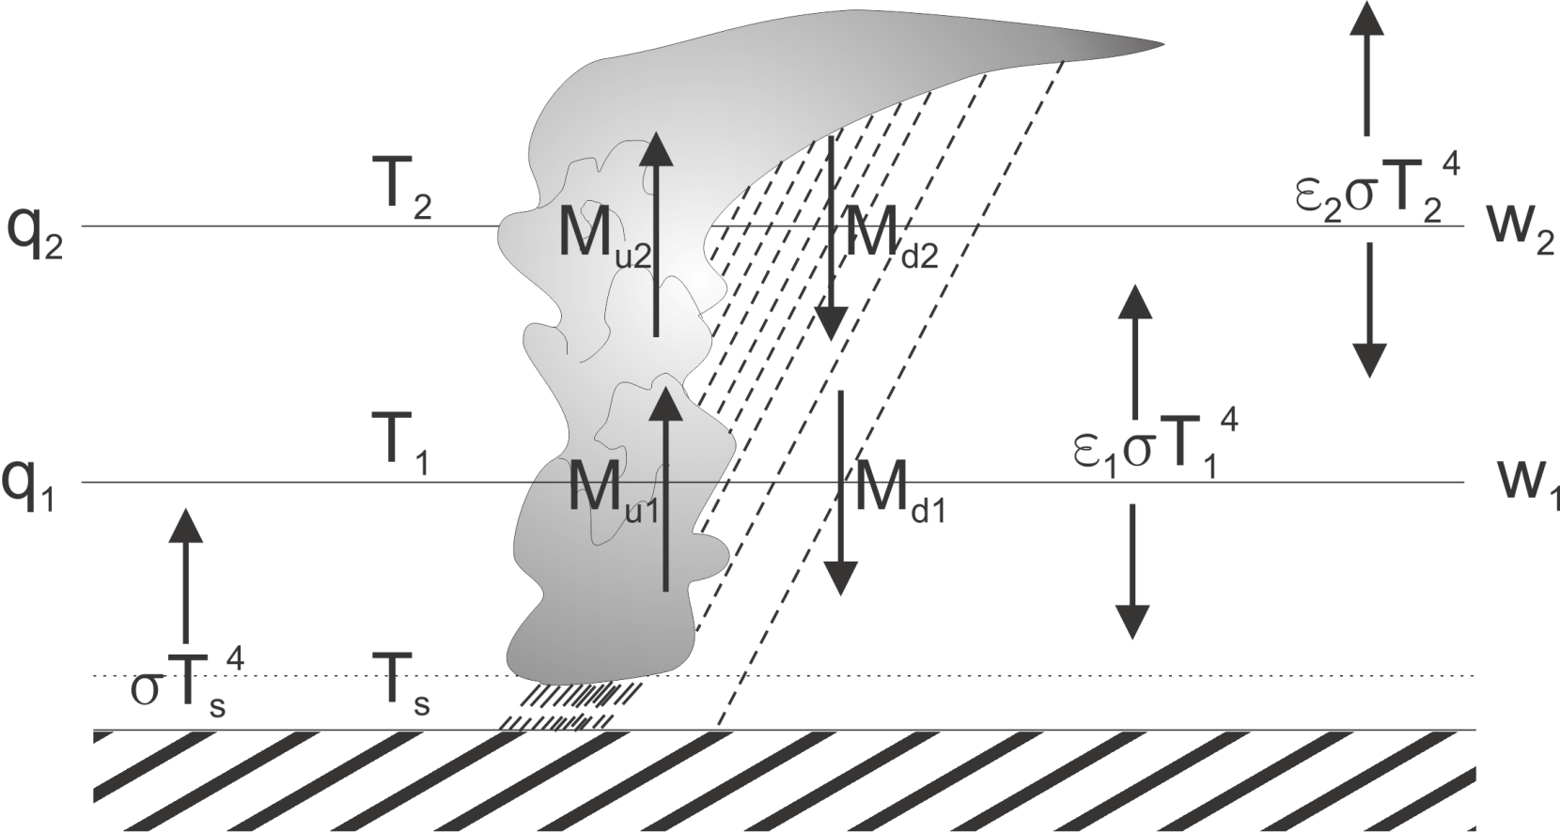
3. Two-Layer Model
Temperatures held constant, IR emissivities depend on q, convective mass fluxes calculated from boundary layer QE, w’s calculated from WTG

Slide 33
Results of Linear Stability Analysis of Two-Layer Model:
Criterion for instability:
Dry static stabilities
emissivities
Precipitation efficiency
< 0
< 0
> 0
Radiative-convective equilibrium becomes linearly unstable when the infrared opacity of the lower troposphere becomes sufficiently large, and when precipitation efficiency is large

Slide 34
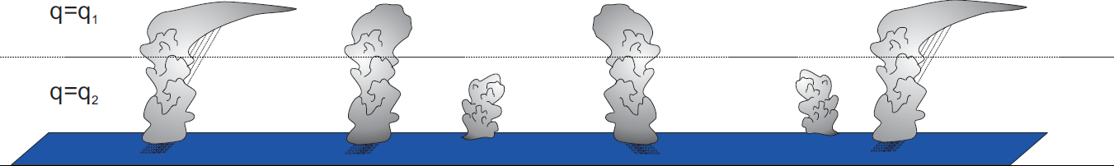
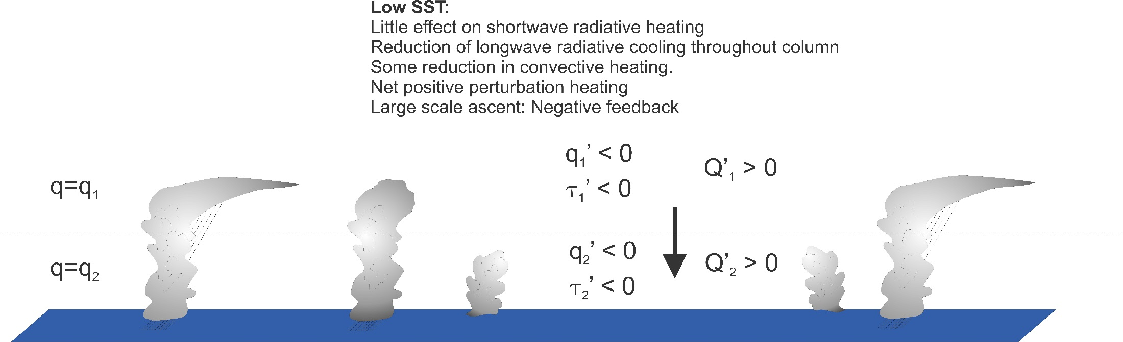
Interpretation
Ordinary Radiative-Convective Equilibrium
Introduce local downward vertical velocity

Slide 35
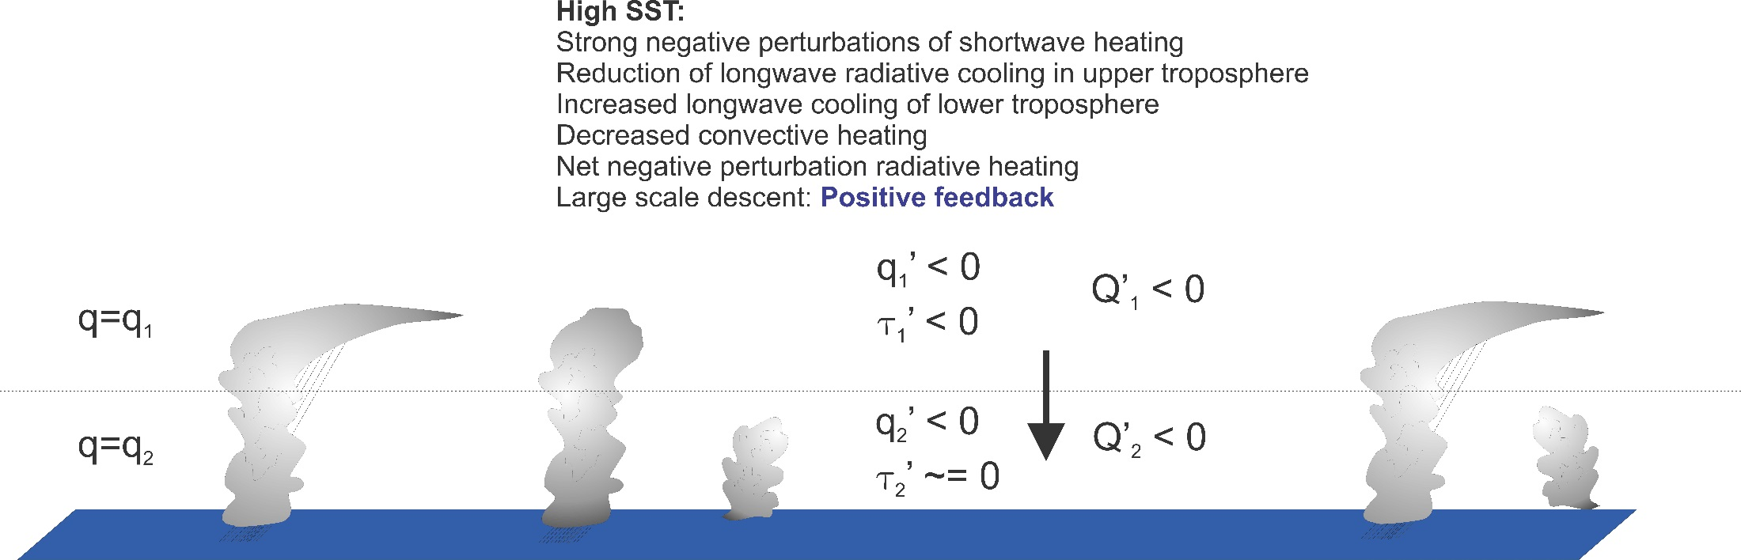

Slide 36
Note:
Once cluster forms, it is strongly maintained by intense negative OLR anomaly associated with central dense overcast. But cloud feedbacks are NOT important in instigating the instability. This leads to strong hysteresis in the radiative-convective system

Slide 37
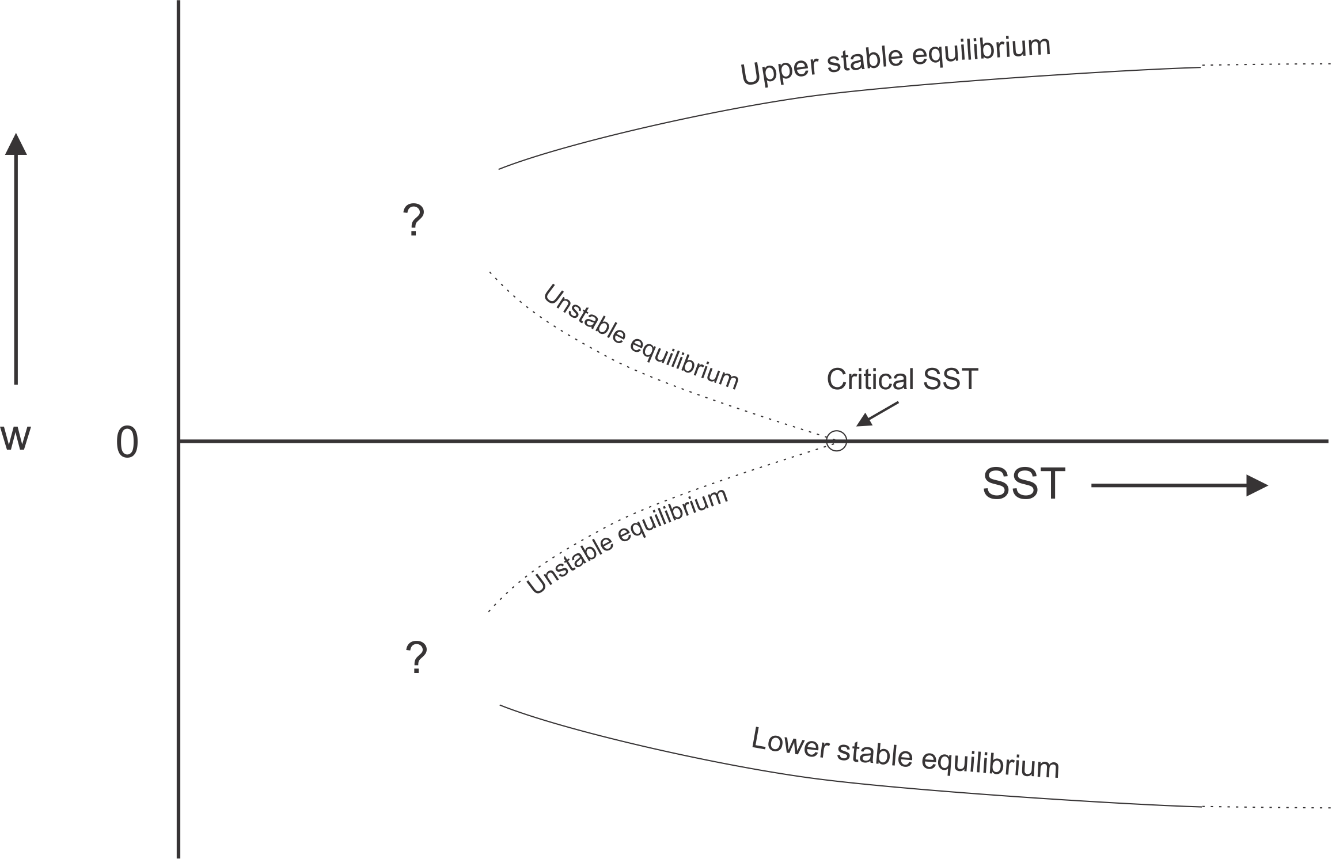
Hypothesized Subcritical Bifurcation
Clustering metric

Slide 38
Consequences

Slide 39
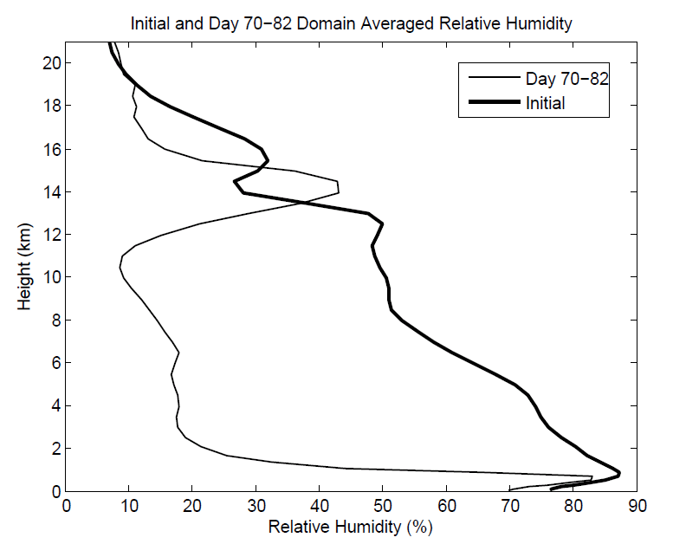
Aggregation Dramatically Dries Atmosphere!

Slide 40
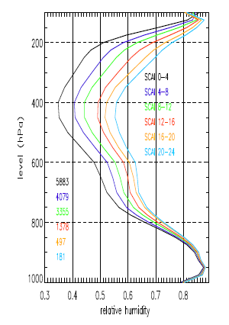
Variation of tropical relative humidity profiles with a Simple Convective Aggregation Index (SCAI).
Courtesy Isabelle Tobin, Sandrine Bony, and Remy Roca
Tobin, Bony, and Roca, J. Climate, 2012

Slide 41
Hypothesis
At high temperature, convection self-aggregates
→Horizontally averaged humidity drops dramatically
→Reduced greenhouse effect cools system
→Convection disaggregates
→Humidity increases, system warms
→System wants to be near phase transition to aggregated state

Slide 42
Recipe for Self-Organized Criticality
(First proposed by David Neelin, but by different mechanism)
System should reside near critical threshold for self-aggregation: Regulation of tropical sea surface temperature
Convective cluster size should follow power law distribution

Slide 43
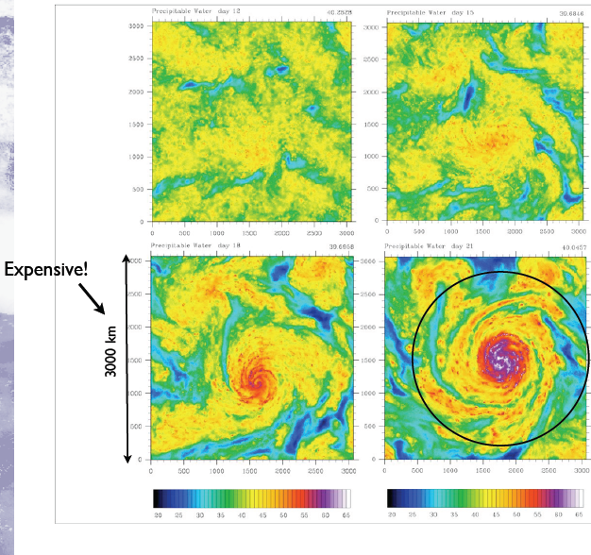
Self-Aggregation on an f-plane
(with Marat Khairoutdinov)

Slide 44
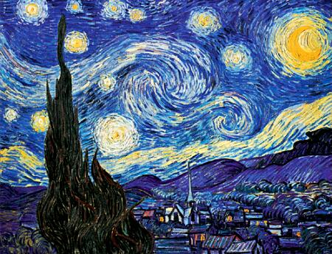
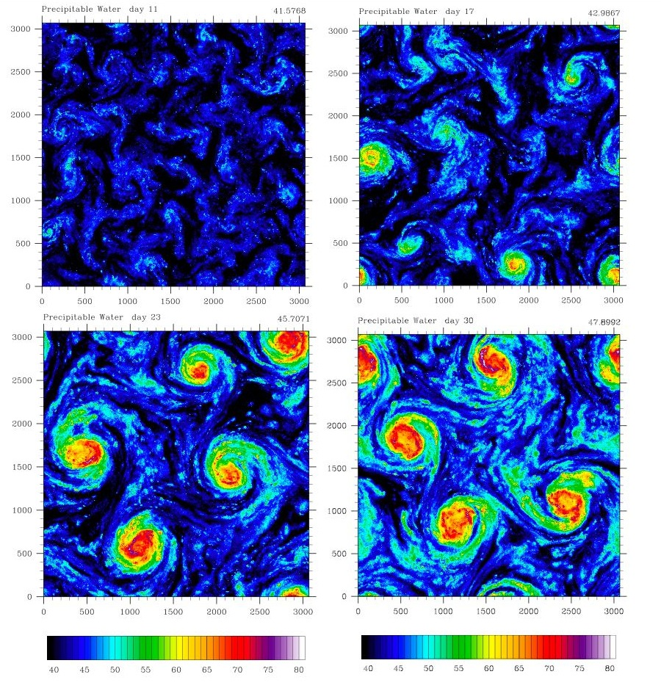
Self-Aggregation on an f-plane
Vincent Van Gogh: Starry Night

Slide 45
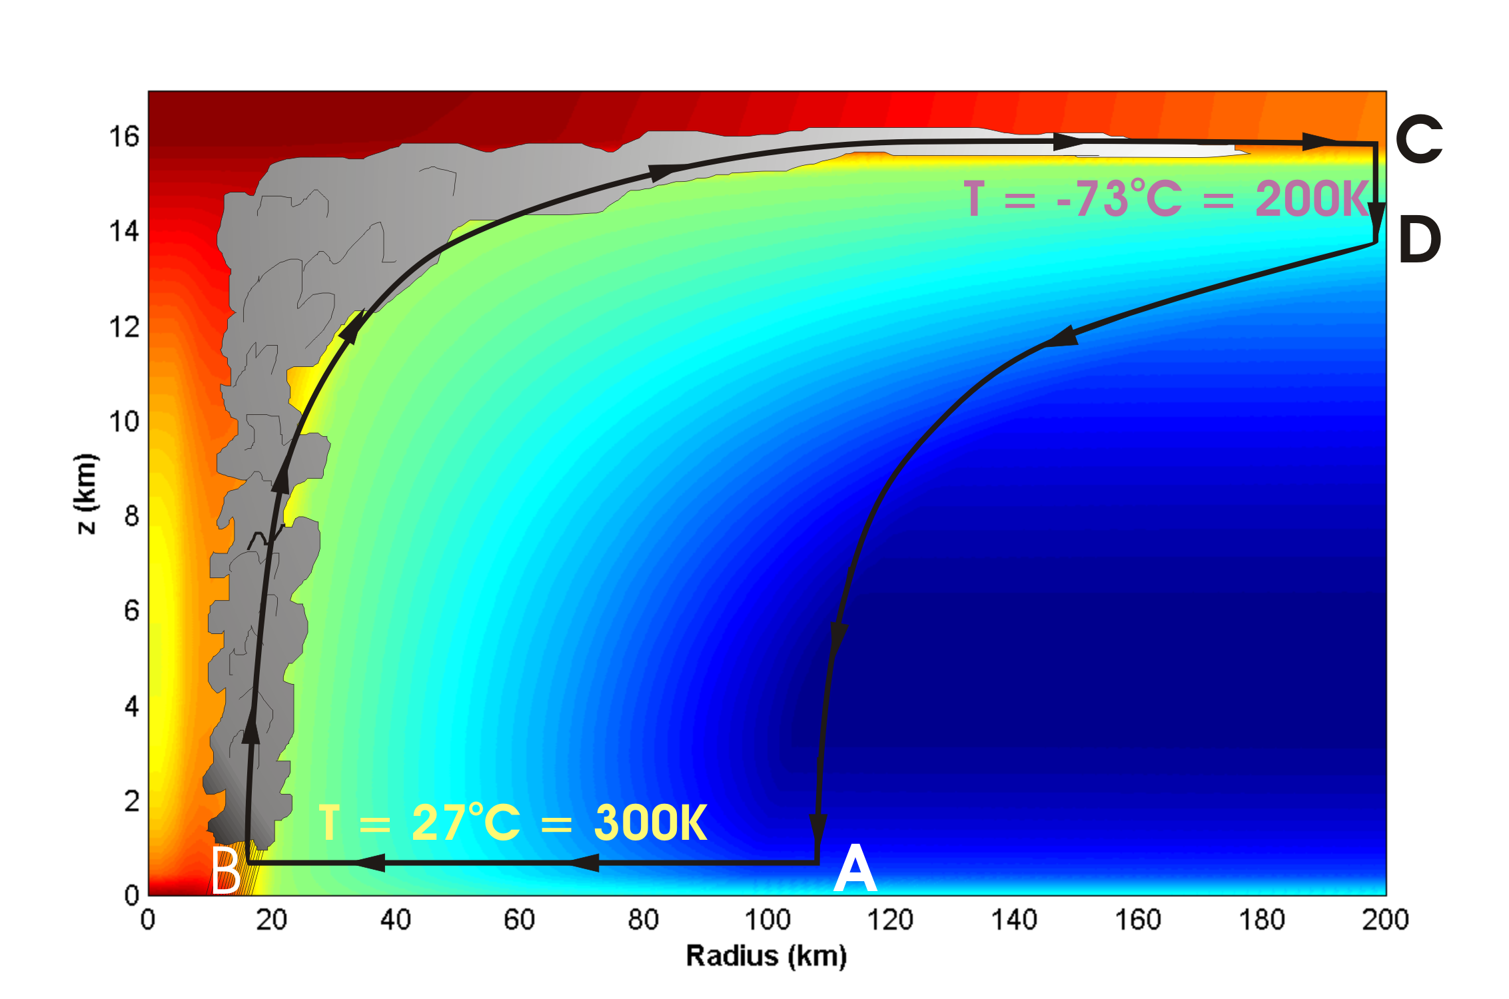
Energy Production

Slide 46
Theoretical Upper Bound on Hurricane Maximum Wind Speed:
Surface temperature
Ratio of exchange coefficients of enthalpy and momentum
Outflow temperature
Air-sea enthalpy disequilibrium

Slide 47
Annual Maximum Potential Intensity (m/s)

Slide 48

Hurricane-World Scaling
Radius of maximum winds:
Distance between storm centers:
Number density:

Slide 49
Hurricane-World Scaling
Modified thermodynamic efficiency:
Angular velocity of earth’s rotation:
Saturation water concentration of sea surface:
Net top-of-atmosphere upward radiative flux:
Net upward surface radiative flux:
Potential intensity:

Slide 50
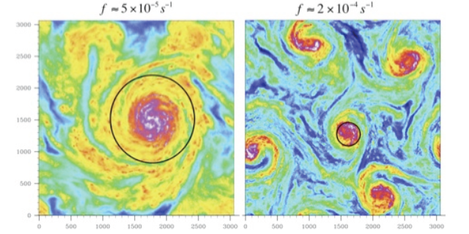

Slide 51
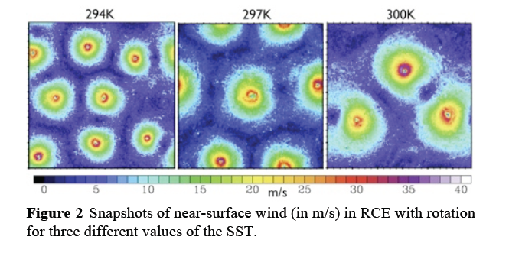

Slide 54
Summary
Radiative-Convective Equilibrium remains an interesting problem in climate science
At high temperature, RCE is unstable, owing to the particular dependencies of convection and radiation on atmospheric water vapor and clouds
Aggregation of convection may have profound effects on climate
Physics of aggregation may not operate well, if at all, in today’s climate models

