Slide 1
Radiative-Convective Model

Slide 2
Overview of Model: Convection
The convection scheme of Emanuel and Živkovic-Rothman (1999) uses a buoyancy sorting algorithm and represents an entire spectrum of convective clouds, from shallow, non-precipitating cumulus to deep precipitating cumulonimbus. Precipitation re-evaporates and drives an unsaturated downdraft that imports enthalpy and moisture into the subcloud layer. Re-evaporation of cloud water, resulting from entrainment of dry air, drives penetrative downdrafts within the clouds. The cloud base mass flux is continuously relaxed so as to produce near neutrality of a parcel lifted dry adiabatically, and then moist adiabatically, to the first level above its lifted condensation level. This maintains a form of boundary layer quasi-equilibrium, wherein convection maintains neutral stability of air lifted from the boundary layer to a level just above the top of the boundary layer.

Slide 3
Overview of Model: Radiation
Radiative transfer is computed interactively using the shortwave parameterization of Fouquart and Bonnel (1980) and Morcrette’s (1991) longwave parameterization. Radiative fluxes are computed at each vertical level every 3 hours using instantaneous profiles of temperature, humidity, cloud fraction and cloud water path, and a climatological distribution of ozone. The user can specify concentrations of important greenhouse gases such as carbon dioxide, methane, ozone, and CFCs. The radiation can be fully time dependent, specified at a particular date and latitude, or averaged over a day or a year.

Slide 4
Overview of Model: Cloud-Radiation Interaction
Stratiform clouds are represented using the parameterization of Bony and Emanuel (2001). This scheme is based upon the idea that the convection scheme predicts the local concentration of condensed water (the in-cloud water content) produced at the subgrid scale, and that a statistical cloud scheme predicts how this condensed water is spatially distributed within the domain. The cloud scheme uses a probability distribution function (PDF) of the total water whose variance and skewness coefficient are diagnosed from the amount of condensed water produced at the subgrid scale by cumulus convection and at the large scale by supersaturation, from the degree of saturation of the environment, and from the lower bound of the total water distribution that is taken equal to zero.

Slide 5
Overview of Model: Surface fluxes and surface energy balance
Surface sensible and latent heat fluxes are calculated using conventional aerodynamic flux formulae with a constant exchange coefficient of 1.2 x 10⁻³. A specified background wind is enhanced by a gustiness factor produced by the convection scheme.
Surface temperature can be specified, or calculated assuming that the surface is a slab of water of fixed depth.

Slide 6
Overview of Model: Full Model
The model calculates time tendencies of temperature and specific humidity at each model pressure level, from the calculated vertical fluxes of enthalpy from the radiation, convection, cloud, and surface flux schemes, and of moisture from the convection, cloud, and surface flux schemes.
These tendencies as marched forward in time using a leap-frog scheme with an Asselin filter.

Slide 7
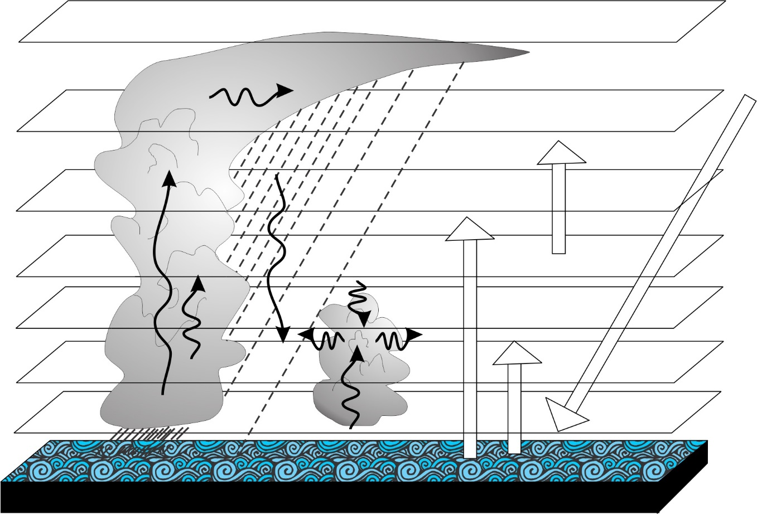
Image credit: K. Emanuel

Slide 8
Main References
Convective Scheme:
Emanuel, K.A., 1991: A scheme for representing cumulus convection in large-scale models. J. Atmos. Sci., 48, 2313-2335.
Emanuel, K. A., and M. Zivkovic-Rothman, 1999: Development and evaluation of a convection scheme for use in climate models. J. Atmos. Sci., 56, 1766-1782.
Radiation Scheme:
Fouquart, Y., and B. Bonnel (1980), Computation of solar heating of the Earth's atmosphere: A new parameterization, Beitr. Phys. Atmos., 53, 35-62.
Morcrette, J.-J. (1991), Radiation and cloud radiative properties in the European Centre for Medium-Range Weather Forecasts forecasting system, J. Geophys. Res., 96, 9121-9132.

Slide 9
Cloud-Radiation Scheme:
Bony, S., and K. A. Emanuel (2001), A parameterization of the cloudiness associated with cumulus convection: evaluation using TOGA COARE data., J. Atmos. Sci., 58, 3158-3183.
Radiative-Convective Model:
Rennó, N. O., K. A. Emanuel, and P. H. Stone (1994), Radiative-convective model with an explicit hydrological cycle, Part I: Formulation and sensitivity to model parameters., J. Geophys. Res., 99, 14429-14441.

