Slide 1
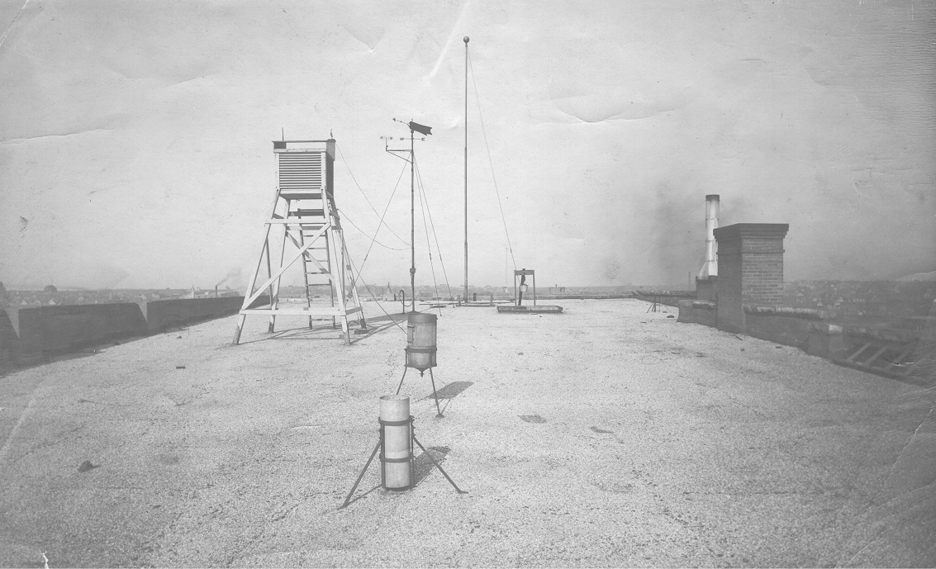
Climate Change During the Instrumental Period
Image Credit: NOAA
Notes:
http://www.srh.noaa.gov/oun/?n=officehistory

Slide 2
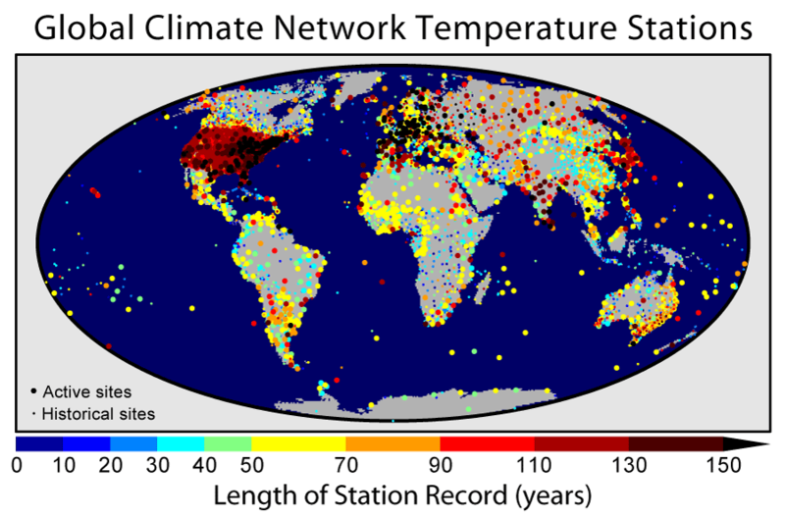
Image credit: Robert A. Rohde/Global Warming Art
Notes:
http://en.wikipedia.org/wiki/File:GHCN_Temperature_Stations.png . Map of the land-based long-term monitoring stations included in the Global Historical Climatology Network. Colors indicate the length of the temperature record available at each site. This figure was created by Robert A. Rohde from published data and is incorporated into the Global Warming Art project. This file is licensed under the Creative Commons Attribution-Share Alike 3.0 Unported license.
You are free: to share – to copy, distribute and transmit the work
to remix – to adapt the work
Under the following conditions: attribution – You must attribute the work in the manner specified by the author or licensor (but not in any way that suggests that they endorse you or your use of the work).
share alike – If you alter, transform, or build upon this work, you may distribute the resulting work only under the same or similar license to this one.

Slide 3
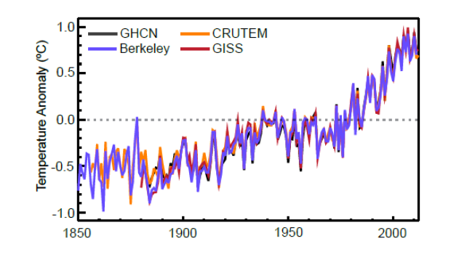
Global annual average Land-Surface Air Temperature (LSAT) anomalies relative to a 1961–1990
Image credit: IPCC AR5
Notes:
Figure 2.14: Global annual average Land-Surface Air Temperature (LSAT) anomalies relative to a 1961–1990
climatology from the latest versions of four different datasets (Berkeley, CRUTEM, GHCN and GISS). IPCC AR5: http://www.ipcc.ch/

Slide 4

Comparison to Paleo reconstructions of temperature change over the last 2000 years
“Hockey Stick”
Instrumental Record
Year
Image credit: Robert A. Rohde/Global Warming Art
Notes:
4
The original version of this figure was prepared by Robert A. Rohde from publicly available data, and is incorporated into the Global Warming Art project. Permission is granted to copy, distribute and/or modify this document under the terms of the GNU Free Documentation License, Version 1.2 or any later version published by the Free Software Foundation; with no Invariant Sections, no Front-Cover Texts, and no Back-Cover Texts. A copy of the license is included in the section entitled GNU Free Documentation License.
This file is licensed under the Creative Commons Attribution-Share Alike 3.0 Unported license.

Slide 5
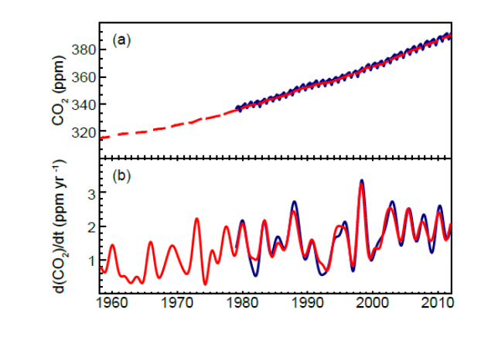
Globally averaged CO2 dry-air mole fractions at monthly time resolution based on measurements from Mauna Loa, Hawaii and South Pole (red) and NOAA/ESRL/GMD at quasi-weekly time resolution (blue). SIO values are deseasonalized. b) Instantaneous growth rates for globally averaged atmospheric CO2 using the same color code as in (a).
Image credit: IPCC AR5
Notes:
Figure 2.1: a) Globally averaged CO2 dry-air mole fractions from Scripps Institution of Oceanography (SIO) at
monthly time resolution based on measurements from Mauna Loa, Hawaii and South Pole (red) and
NOAA/ESRL/GMD at quasi-weekly time resolution (blue). SIO values are deseasonalized. b) Instantaneous growth
rates for globally averaged atmospheric CO2 using the same colour code as in (a). Growth rates are calculated as the
time derivative of the deseasonalized global averages (Dlugokencky et al., 1994).

Slide 6
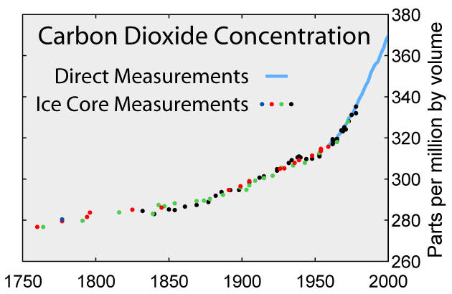
Comparison to Ice Core Measurements
Image credit: Robert A. Rohde/Global Warming Art
Notes:
This image is an original work created for Global Warming Art by Robert A. Rohde.
It is intended to be widely used, but the terms of use vary depending on the application.

Slide 7
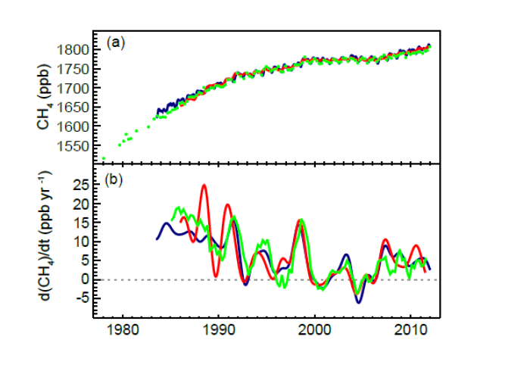
Globally averaged CH4 dry-air mole fractions (green; 4 values per year, except prior to 1984, when they are of lower and varying frequency), AGAGE (red; monthly), and NOAA/ESRL/GMD (blue; quasi-weekly). b) Instantaneous growth rate for globally averaged atmospheric CH4 using the same color code as in (a).
Methane
Image credit: IPCC AR5
Notes:
Figure 2.2: a) Globally averaged CH4 dry-air mole fractions from UCI (green; 4 values per year, except prior to 1984,
when they are of lower and varying frequency), AGAGE (red; monthly), and NOAA/ESRL/GMD (blue; quasi-weekly).
b) Instantaneous growth rate for globally averaged atmospheric CH4 using the same colour code as in (a). Growth rates
were calculated as in Figure 2.1.

Slide 8
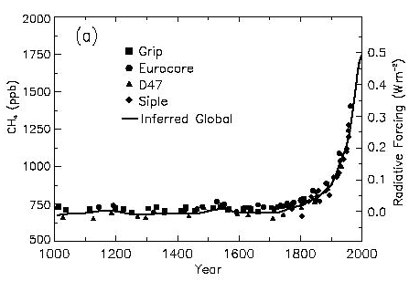
Image credit: IPCC TAR
Notes:
Change in CH₄ abundance (mole fraction, in ppb = 10⁻⁹) determined from ice cores, firn, and whole air samples plotted for the last 1,000 years. Data sets are as follows: Grip, Blunier et al. (1995) and Chappellaz et al. (1997); Eurocore, Blunier et al. (1993); D47, Chappellaz et al. (1997); Siple, Stauffer et al. (1985); Global (inferred from Antarctic and Greenland ice cores, firn air, and modern measurements), Etheridge et al. (1998) and Dlugokencky et al. (1998). Radiative forcing, approximated by a linear scale since the pre-industrial era, is plotted on the right axis.
From IPCC Working Group 1, Third Assessment Report, 2001

Slide 9
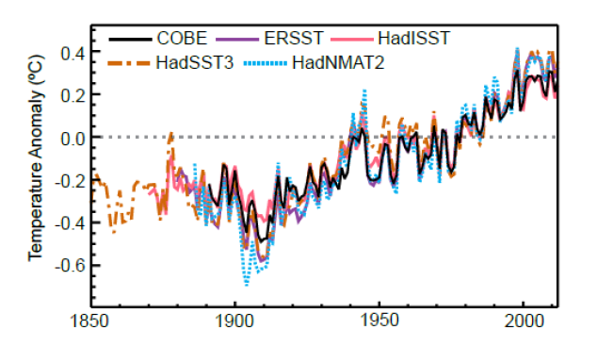
Global annual average Sea Surface Temperature (SST) and Night Marine Air Temperature (NMAT) relative to a 1961–1990 climatology from state of the art datasets. Spatially interpolated products are shown by solid lines; non-interpolated products by dashed lines
Image credit: IPCC AR5
Notes:
Figure 2.18: Global annual average Sea Surface Temperature (SST) and Night Marine Air Temperature (NMAT)
relative to a 1961–1990 climatology from state of the art datasets. Spatially interpolated products are shown by solid
lines; non-interpolated products by dashed lines.

Slide 10
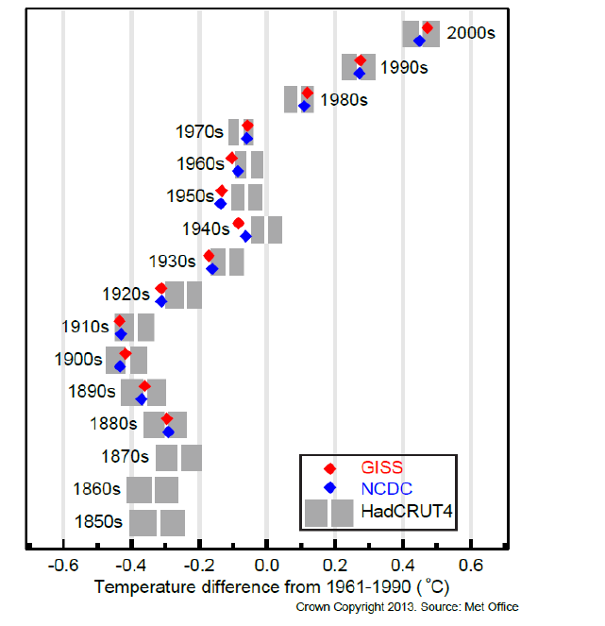
Image credit: IPCC AR5
Notes:
Figure 2.19: Decadal Global Mean Surface Temperature (GMST) anomalies (white vertical lines in grey blocks) and
their uncertainties (90% confidence intervals as grey blocks) based upon the Land-Surface Air Temperature (LSAT)
and Sea Surface Temperature (SST) combined HadCRUT4 (v4.1.1.0) ensemble (Morice et al., 2012). Anomalies are
relative to a 1961–1990 climatology.1850s indicates the period 1850-1859, and so on. NCDC MLOST and GISS
dataset best-estimates are also shown.

Slide 11
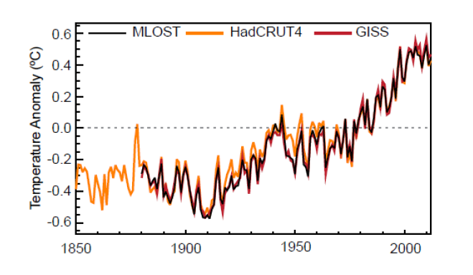
Image credit: IPCC AR5
Notes:
Figure 2.20: Annual Global Mean Surface Temperature (GMST) anomalies relative to a 1961–1990 climatology from
the latest version of the three combined Land-Surface Air Temperature (LSAT) and Sea Surface Temperature (SST)
datasets (HadCRUT4, GISS and NCDC MLOST). Published dataset uncertainties are not included for reasons
discussed in Box 2.1.

Slide 12
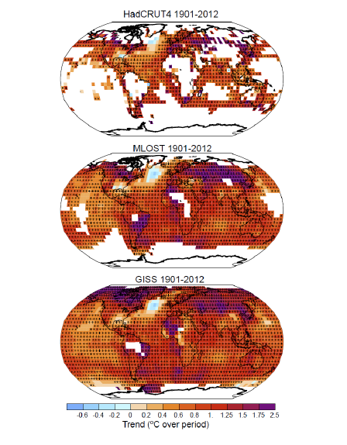
Image credit: IPCC AR5
Notes:
Figure 2.21: Trends in Global Mean Surface Temperature (GMST) from the three datasets of Figure 2.20 for 1901–
2012. White areas indicate incomplete or missing data. Trends have been calculated only for those grid boxes with
greater than 70% complete records and more than 20% data availability in first and last decile of the period. Black plus
signs (+) indicate grid boxes where trends are significant (i.e., a trend of zero lies outside the 90% confidence interval).
Differences in coverage primarily reflect the degree of interpolation to account for data void regions undertaken by the
dataset providers ranging from none beyond grid box averaging (HadCRUT4) to substantial (GISS).

Slide 13
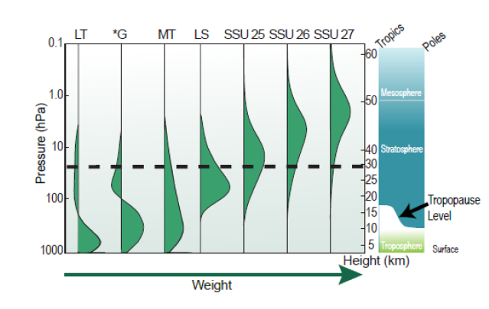
Image credit: IPCC AR5
Notes:
Figure 2.23: Vertical weighting functions for those satellite temperature retrievals discussed in this chapter (modified
from Seidel et al. (2011)). The dashed line indicates the typical maximum altitude achieved in the historical radiosonde
record. The three SSU channels are denoted by the designated names 25, 26 and 27. LS (Lower Stratosphere) and MT
(Mid Troposphere) are two direct MSU measures and LT (Lower Troposphere) and *G (Global Troposphere) are
derived quantities from one or more of these that attempt to remove the stratospheric component from MT.

Slide 14
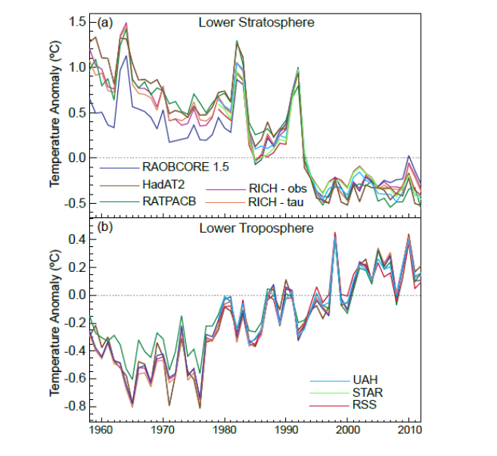
Image credit: IPCC AR5
Notes:
Figure 2.24: Global annual average lower stratospheric (top) and lower tropospheric (bottom) temperature anomalies
relative to a 1981–2010 climatology from different datasets. STAR does not produce a lower tropospheric temperature
product. Note that the y-axis resolution differs between the two panels.

Slide 15
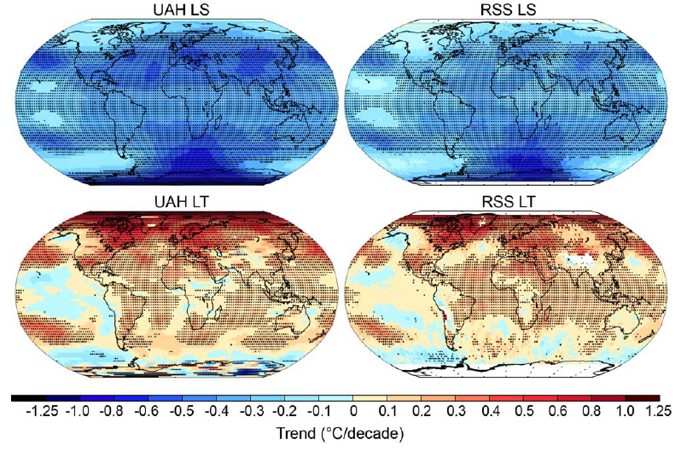
Image credit: IPCC AR5
Notes:
Figure 2.25: Trends in MSU upper air temperature over 1979–2012 from UAH (left hand panels) and RSS (right hand
panels) and for LS (top row) and LT (bottom row). Data are temporally complete within the sampled domains for each
dataset. White areas indicate incomplete or missing data. Black plus signs (+) indicate grid boxes where trends are
significant (i.e., a trend of zero lies outside the 90% confidence interval).

Slide 16
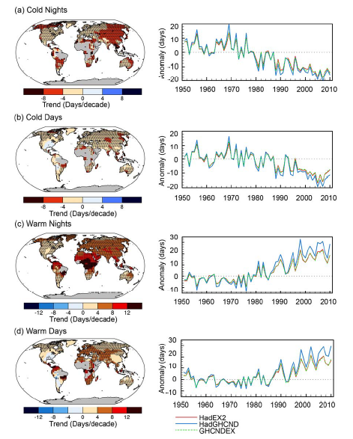
Image credit: IPCC AR5
Notes:
Figure 2.32: Trends in annual frequency of extreme temperatures over the period 1951–2010, for: (a) cold nights
(TN10p), (b) cold days (TX10p), (c) warm nights (TN90p) and (d) warm days (TX90p) (Box 2.4, Table 1). Trends were
calculated only for grid boxes that had at least 40 years of data during this period and where data ended no earlier than
2003. Grey areas indicate incomplete or missing data. Black plus signs (+) indicate grid boxes where trends are
significant (i.e., a trend of zero lies outside the 90% confidence interval). The data source for trend maps is HadEX2
(Donat et al., 2013c) updated to include the latest version of the European Climate Assessment dataset (Klok and Tank,
2009). Beside each map are the near-global time series of annual anomalies of these indices with respect to 1961–1990
for three global indices datasets: HadEX2 (red); HadGHCND (Caesar et al., 2006; blue) and updated to 2010 and
GHCNDEX (Donat et al., 2013a; green). Global averages are only calculated using grid boxes where all three datasets
have at least 90% of data over the time period. Trends are significant (i.e., a trend of zero lies outside the 90%
confidence interval) for all the global indices shown

Slide 17
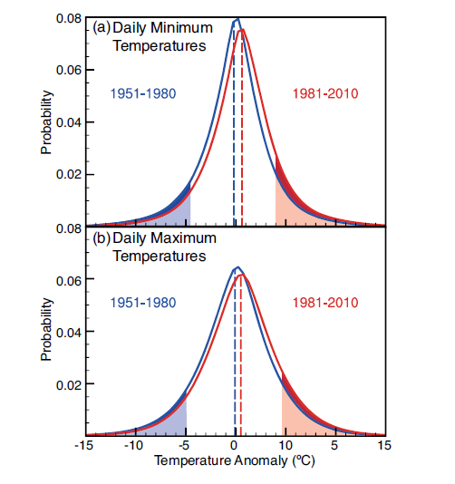
Image credit: IPCC AR5
Notes:
2.2, Figure 1: Distribution of (a) daily minimum and (b) daily maximum temperature anomalies relative to a
1961–1990 climatology for two periods: 1951–1980 (blue) and 1981–2010 (red) using the HadGHCND dataset. The
shaded blue and red areas represent the coldest 10% and warmest 10% respectively of (a) nights and (b) days during the
1951–1980 period. The darker shading indicates by how much the number of the coldest days and nights has reduced
(dark blue) and by how much the number of the warmest days and nights has increased (dark red) during the 1981–2010
period compared to the 1951–1980 period.

Slide 18
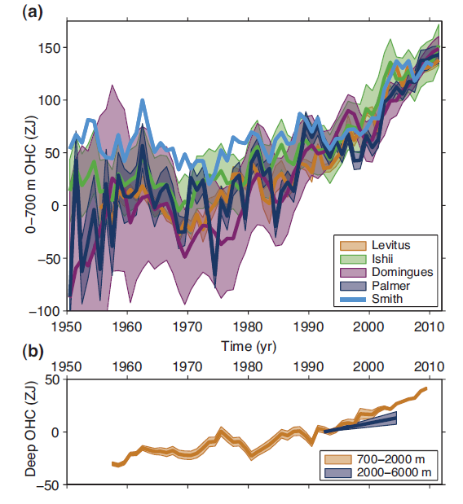
Image credit: IPCC AR5
Notes:
Figure 3.2: a) Observation-based estimates of annual global mean upper (0–700 m) ocean heat content in ZJ (1 ZJ =
1021 Joules) updated from (see legend): (Levitus et al., 2012), (Ishii and Kimoto, 2009), (Domingues et al., 2008),
(Palmer et al., 2007), and (Smith and Murphy, 2007). Uncertainties are shaded, and plotted as published (at the one
standard error level, except one standard deviation for Levitus, with no uncertainties provided for Smith). Estimates are
shifted to align for 2006–2010, five years that are well measured by Argo, and then plotted relative to the resulting
mean of all curves for 1971, the starting year for trend calculations. b) Observation-based estimates of annual five-year
running mean global mean mid-depth (700–2000 m) ocean heat content in ZJ (Levitus et al., 2012) and the deep (2000 -
6000 m) global ocean heat content trend from 1992–2005 (Purkey and Johnson, 2010), both with one standard error
uncertainties shaded (see legend).

Slide 19
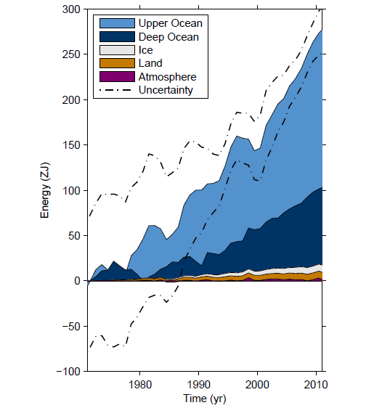
Image credit: IPCC AR5
Notes:
Box 3.1, Figure 1: Plot of energy accumulation in ZJ (1 ZJ = 1021 J) within distinct components of Earth’s climate
system relative to 1971 and from 1971–2010 unless otherwise indicated. See text for data sources. Ocean warming (heat
content change) dominates, with the upper ocean (light blue, above 700 m) contributing more than the deep ocean (dark
blue, below 700 m; including below 2000 m estimates starting from 1992). Ice melt (light grey; for glaciers and ice
caps, Greenland and Antarctic ice sheet estimates starting from 1992, and Arctic sea ice estimate from 1979–2008);
continental (land) warming (orange); and atmospheric warming (purple; estimate starting from 1979) make smaller
contributions. Uncertainty in the ocean estimate also dominates the total uncertainty (dot-dashed lines about the error
from all five components at 90% confidence intervals).

Slide 20
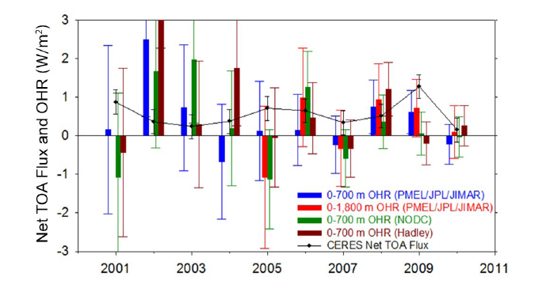
Image credit: IPCC AR5
Notes:
Figure 2.12: Comparison of net Top Of Atmosphere (TOA) flux and upper Ocean Heating Rates (OHR). Global annual
average (July to June) net TOA flux from CERES observations (based upon the EBAF-TOA_Ed2.6r product)(black
line) and 0-700 (blue) and 0-1,800 m (red) OHR from the Pacific Marine Environmental Laboratory/Jet Propulsion
Laboratory/Joint Institute for Marine and Atmospheric Research (PMEL/JPL/JIMAR), 0-700 m OHR from the National
Oceanic Data Center (NODC) (Levitus et al., 2009)(green), and 0-700 m OHR from the Hadley Center (Palmer et al.,
2007)(brown). The length of the coloured bars corresponds to the magnitude of OHR. Thin vertical lines are error bars,
corresponding to the magnitude of uncertainties. Uncertainties for all annual OHR are given at one standard error
derived from ocean heat content anomaly uncertainties (Lyman et al., 2010). CERES net TOA flux uncertainties are
given at the 90% confidence level determined following Loeb et al. (2012). Adapted from Loeb et al.(2012).

Slide 21
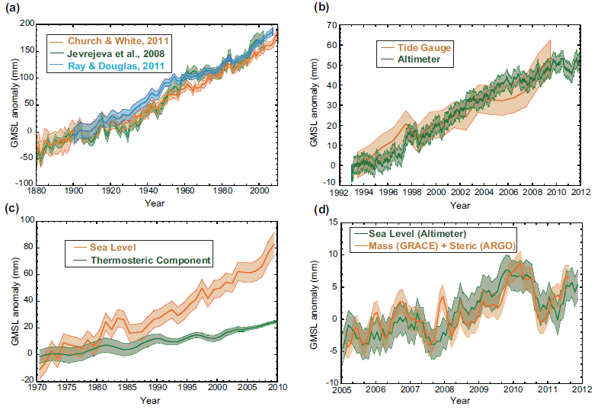
Image credit: IPCC AR5
Notes:
Figure 3.13: Global mean sea level anomalies (in mm) from the different measuring systems as they have evolved in
time, plotted relative to 5-year mean values that start at a) 1900, b) 1993, c) 1970, and d) 2005. a) Yearly average
GMSL reconstructed from tide gauges (1900–2010) by three different approaches (Jevrejeva et al., 2008; Church and
White, 2011; Ray and Douglas, 2011), b) GMSL (1993–2010) from tide gauges and altimetry (Nerem et al., 2010) with
seasonal variations removed and smoothed with a 60-day running mean c) GMSL (1970–2010) from tide gauges along
with the thermosteric component to 700 m, (3-year running mean) estimated from in situ temperature profiles (updated
from Domingues et al., 2008), d) the GMSL (nonseasonal) from altimetry and that computed from the mass component
(GRACE) and steric component (Argo) from 2005–2010 (Leuliette and Willis, 2011), all with a 3-month running mean
filter. All uncertainty bars are one standard error as reported by the authors. The thermosteric component is just a
portion of total sea level, and is not expected to agree with total sea level.

Slide 22
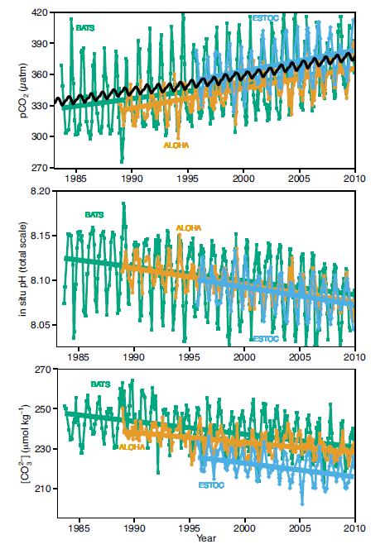
Image credit: IPCC AR5
Notes:
Figure 3.18: Long-term trends of surface seawater pCO2 (top), pH (middle), and carbonate ion (bottom) concentration
at three subtropical ocean time series in the North Atlantic and North Pacific Oceans, including: a) Bermuda Atlantic
Time-series Study (BATS, 31°40′N, 64°10′W; green) and Hydrostation S (32°10′, 64°30′W) from 1983 to present
(updated from Bates, 2007); b) Hawaii Ocean Time-series (HOT) at Station ALOHA (A Long-term Oligotrophic
Habitat Assessment; 22°45′N, 158°00′W; orange) from 1988 to present (updated from Dore et al., 2009), and; c)
European Station for Time series in the Ocean (ESTOC, 29°10′N, 15°30′W; blue) from 1994 to present (updated from
González-Dávila et al., 2010). Atmospheric pCO2 (black) from the Mauna Loa Observatory Hawaii is shown in the top
panel. Lines show linear fits to the data, whereas Table 3.2 give results for harmonic fits to the data (updated from Orr,
2011).

Slide 23
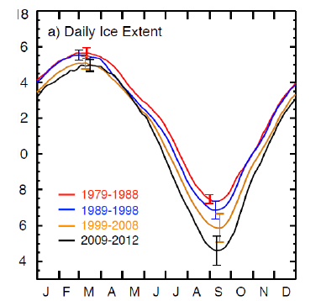
Image credit: IPCC AR5
Notes:
Figure 4.2: (a) Plots of decadal averages of daily sea ice extent in the Arctic (1979 to 1988 in red, 1989 to 1998 in blue,
1999 to 2008 in gold) and a four-year average daily ice extent from 2009 to 2012 in black.

Slide 24
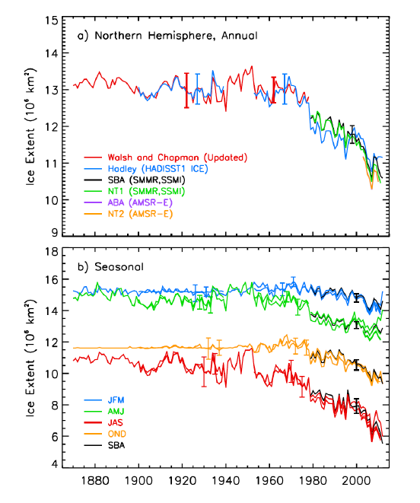
Image credit: IPCC AR5
Notes:
Figure 4.3: Ice extent in the Arctic from 1870 to 2011. (a) Annual ice extent, and (b) seasonal ice extent using averages
of mid-month values derived from in situ and other sources including observations from the Danish meteorological
stations from 1870 to 1978 (updated from, Walsh and Chapman, 2001). Ice extent from a joint Hadley and NOAA
project (called HADISST1_Ice) from 1900 to 2011 is also shown. The yearly and seasonal averages for the period from
1979 to 2011 are shown as derived from SMMR and SSM/I passive microwave data (called SBA and NT1) using
procedures in Comiso and Nishio (2008), and Cavalieri et al. (1984), respectively; and from AMSR2 procedures (called
ABA and NT2) from Comiso and Nishio (2008) and Markus and Cavalieri (2000). In (b), data from the different
seasons are shown in different colours to illustrate variation between seasons, with SBA data from the procedure in
Comiso and Nishio (2008) shown in black.

Slide 25
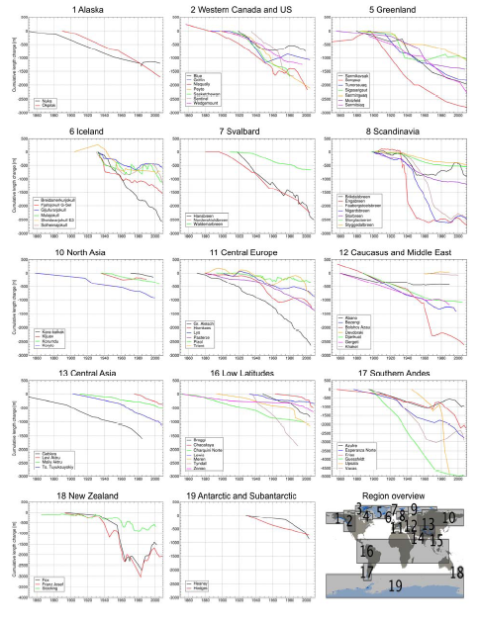
Image credit: IPCC AR5
Notes:
Figure 4.9: Selection of long-term cumulative glacier length changes as compiled from in situ measurements (WGMS,
2008), reconstructed data points added to measured time series (region 5) from Leclercq et al. (2012), and additional
time series from reconstructions (regions 1, 2, 7, 10, 12, 16, 17, and 18) from Leclercq and Oerlemans (2012).
Independent of their (highly variable) temporal density, all measurement points are connected by straight lines. The
glacier Mulajokull (region 6) is of surge type and some of the glaciers showing strong retreat either terminate
(Guessfeldt and Upsala in region 17) or terminated (Engabreen and Nigardsbreen in region 8) in lakes. For region 11,
many more time series are available (see, WGMS, 2008), but are not shown for graphical reasons.

Slide 26
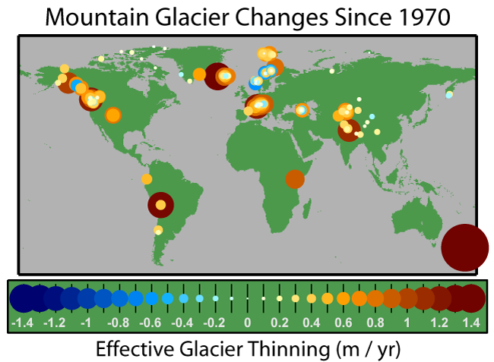
Image credit: Robert A. Rohde/Global Warming Art
Notes:
This figure was originally prepared by Rober A. Rohde from published data and is incorporated into the Global Warming Art project. Permission is granted to copy, distribute and/or modify this document under the terms of the GNU Free Documentation License, Version 1.2 or any later version published by the Free Software Foundation; with no Invariant Sections, no Front-Cover Texts, and no Back-Cover Texts. A copy of the license is included in the section entitled GNU Free Documentation License.

Slide 27
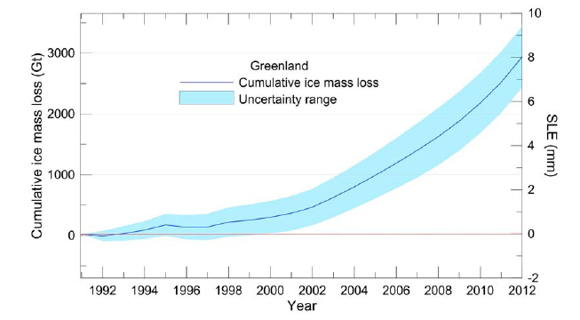
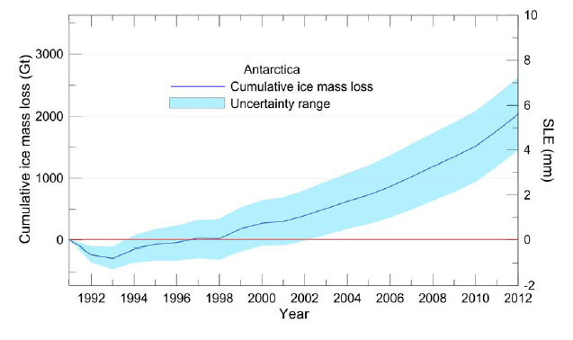
Image credit: IPCC AR5
Notes:
Figure 4.15: Cumulative ice mass loss (and sea level equivalent, SLE) from Greenland derived as annual averages from
18 recent studies (see main text and Appendix 4.A for details).
Figure 4.16: Cumulative ice mass loss (and sea level equivalent, SLE) from Antarctica derived as annual averages from
10 recent studies (see main text and Appendix 4.A for details).

Slide 28
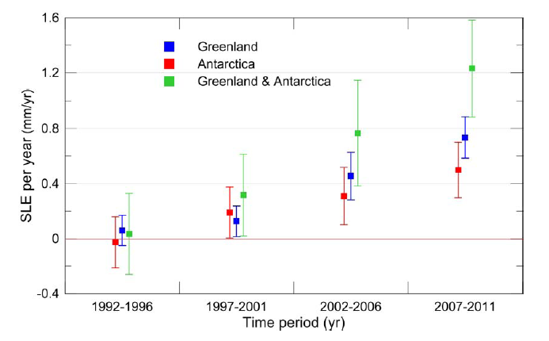
Image credit: IPCC AR5
Notes:
Figure 4.17: Rate of ice sheet loss in sea level equivalent averaged over 5-year periods between 1992 and 2011. These
estimates are derived from the data in Figure 4.15 and Figure 4.16.

Slide 29
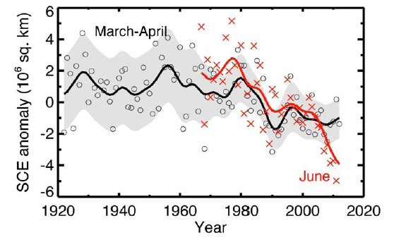
Image credit: IPCC AR5
Notes:
Figure 4.19: March-April NH snow cover extent (SCE, circles) over the period of available data, filtered with a 13-
term smoother and with shading indicating the 95% confidence interval; and June SCE (red crosses, from satellite data
alone), also filtered with a 13-term smoother. The width of the smoothed 95% confidence interval is influenced by the
interannual variability in SCE. Updated, from Brown and Robinson (2011). For both time series the anomalies are
calculated relative to the 1971–2000 mean.

Slide 30
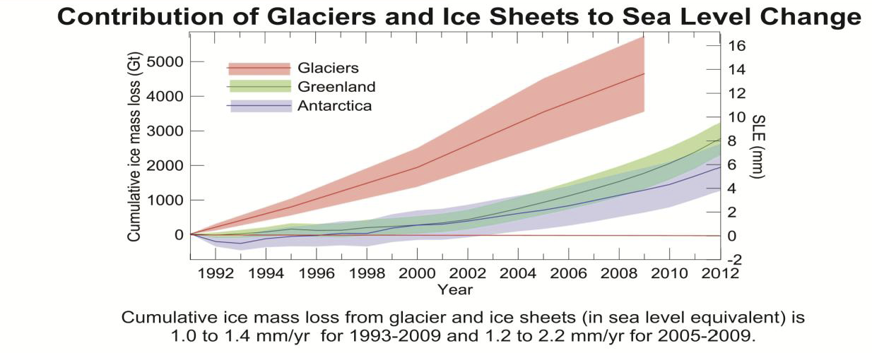
Image credit: IPCC AR5
Notes:
Figure 4.25: Schematic summary of the dominant observed variations in the cryosphere. The inset figure summarises
the assessment of the sea level equivalent of ice loss from the ice sheets of Greenland and Antarctica, together with the
contribution from all glaciers except those in the periphery of the ice sheets (Section 4.3.4).

Slide 31
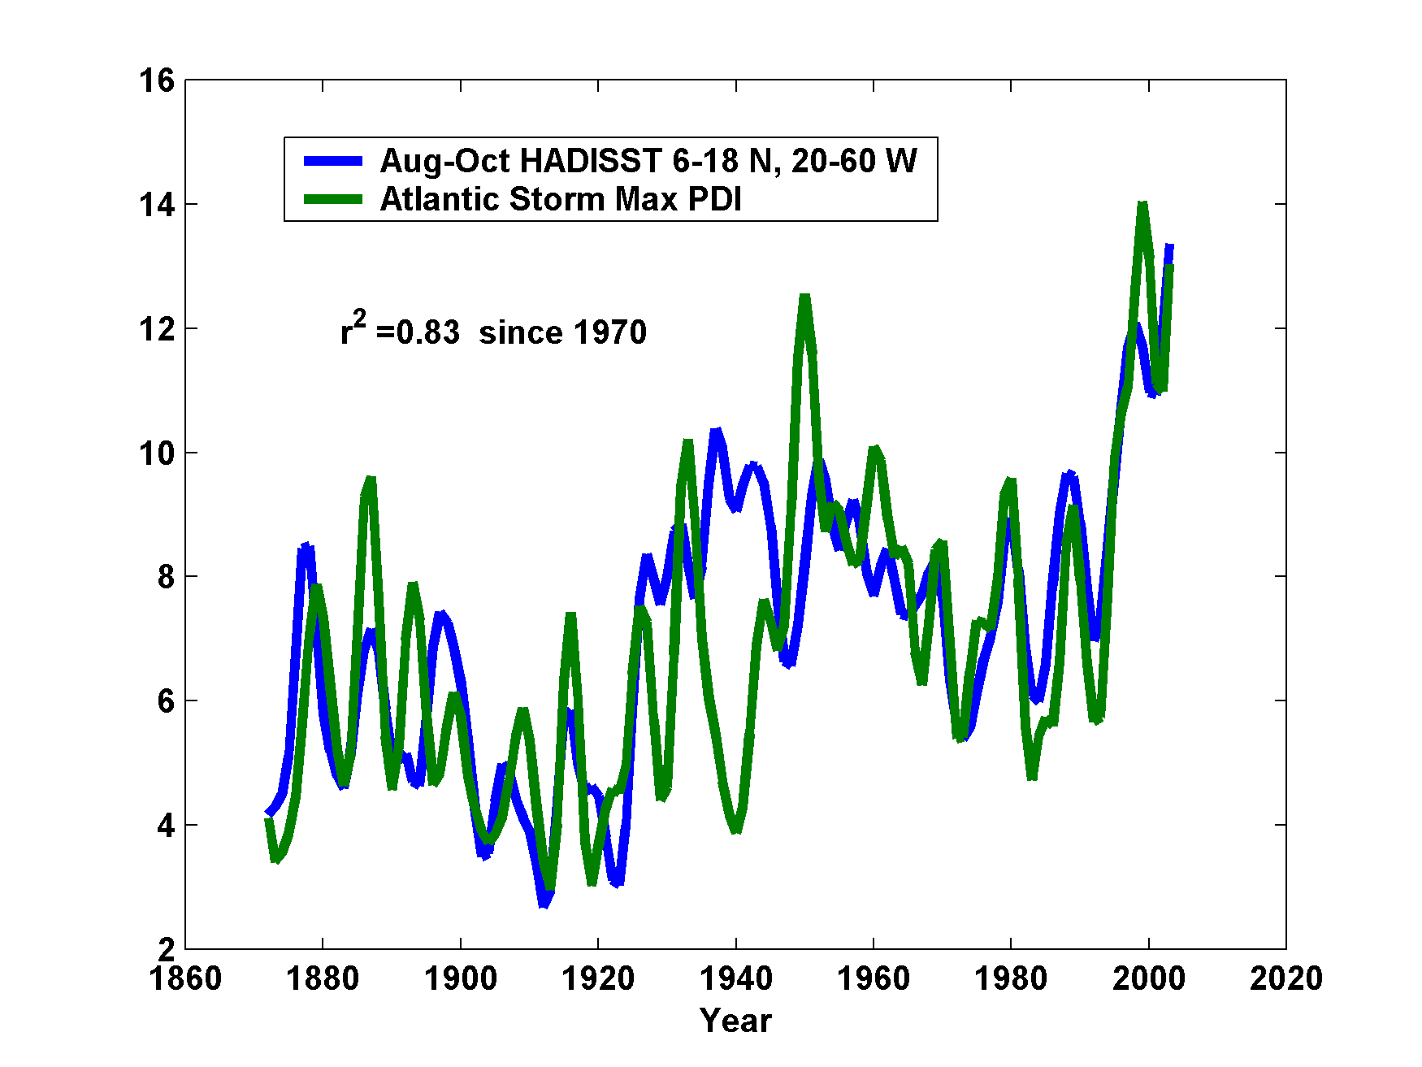
Hurricane Power is Changing in Concert with Tropical Ocean Temperature
Image credit: Kerry Emanuel
Notes:
This is my own figure

Slide 32
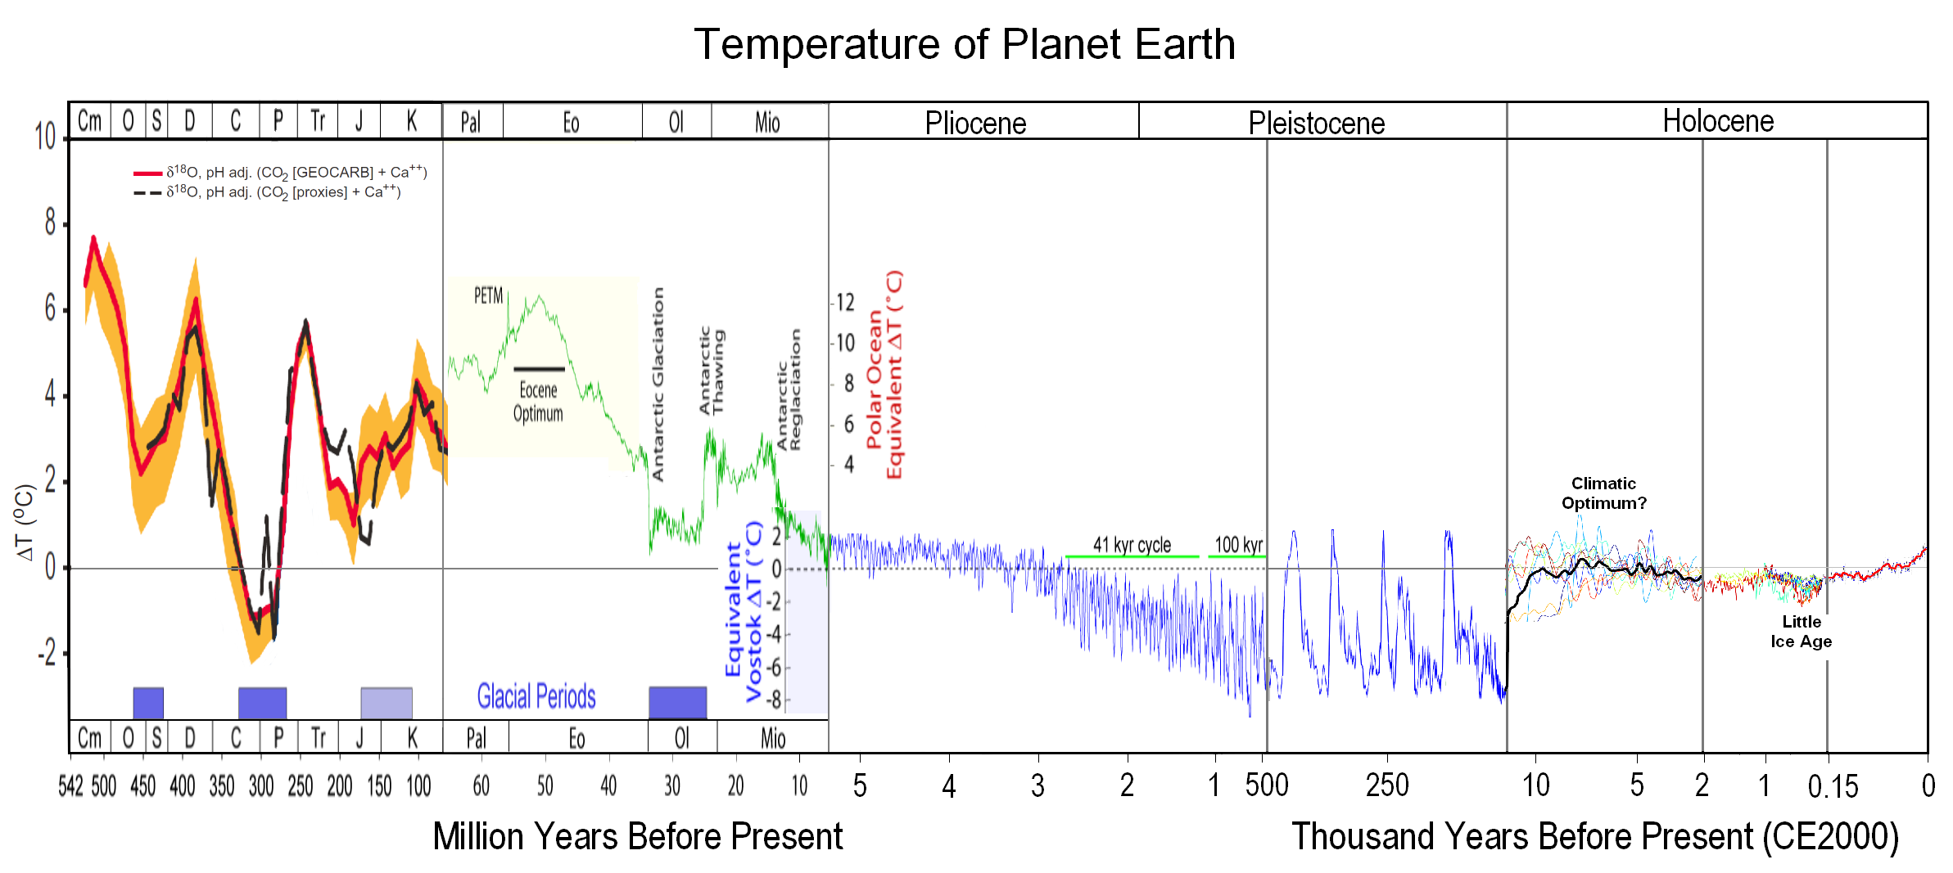
Climate History Summary
Image credit: Global Warming Art
Notes:
Constructed from GFDL/CC 2.5 Attribution-NonCommercial images obtained from Global Warming Art . Permission is granted to copy, distribute and/or modify this document under the terms of the GNU Free Documentation License, Version 1.2 or any later version published by the Free Software Foundation; with no Invariant Sections, no Front-Cover Texts, and no Back-Cover Texts. A copy of the license is included in the section entitled GNU Free Documentation License. See http://en.wikipedia.org/wiki/File:All_palaeotemps.png

