Slide 1
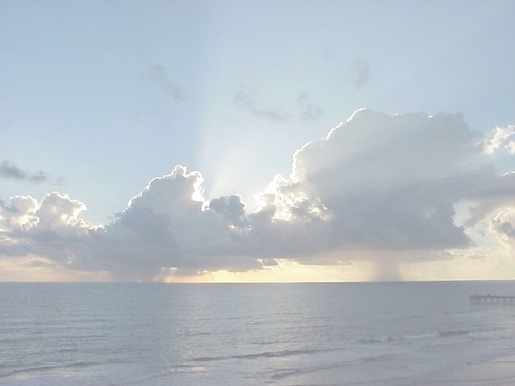
A Little Climate Physics
Kerry is this your original? If not, something selected from http://www.flickr.com/search/?q=sunset+clouds+ocean&l=deriv&ss=0&ct=0&mt=all&w=all&adv=1
(with license CC BY or CC BY-NC-SA) would be a better choice.
Notes:
Source?

Slide 2
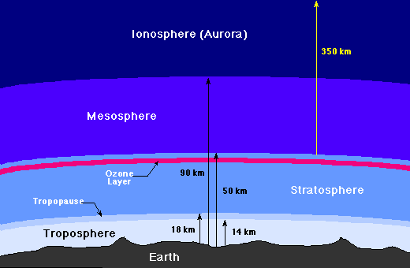
Atmospheric Structure
Image credit: NASA
Notes:
Widely blogged. Let’s call this Source: NASA. Found a cropped version of this used in NASA 2007 outreach, at http://science1.nasa.gov/media/medialibrary/2007/07/18/18jul_tc4_resources/layers_strip.gif

Slide 3
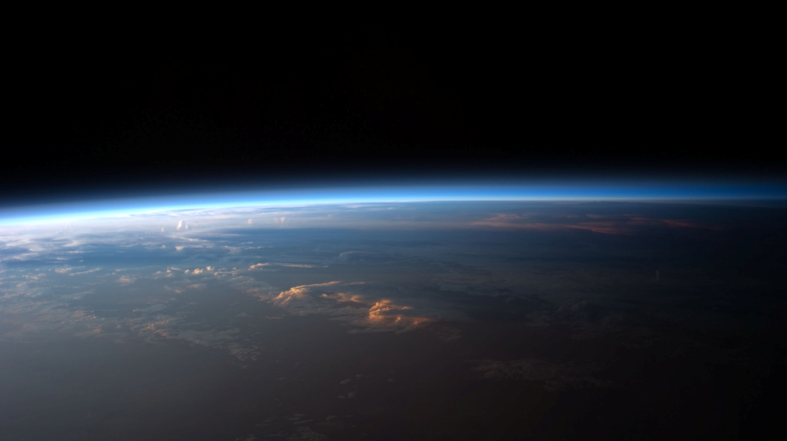
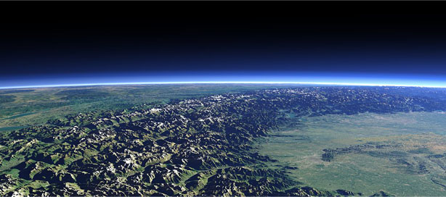
Earth’s Atmosphere is Thin!
Source unknown – relatively weak as fair use claim.
Can this NASA public domain alternative be substituted?
Notes:
Can’t find, searched on “earth limb” as well as stratosphere, etc.
Alternates? – NASA public domain: http://commons.wikimedia.org/wiki/File:Sunset_over_Western_South_America.jpg

Slide 4
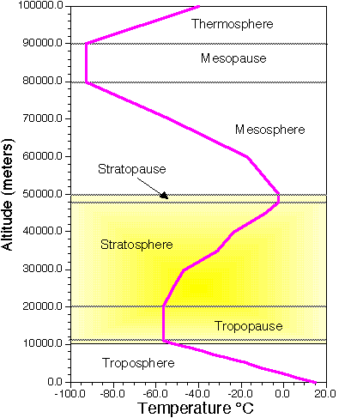
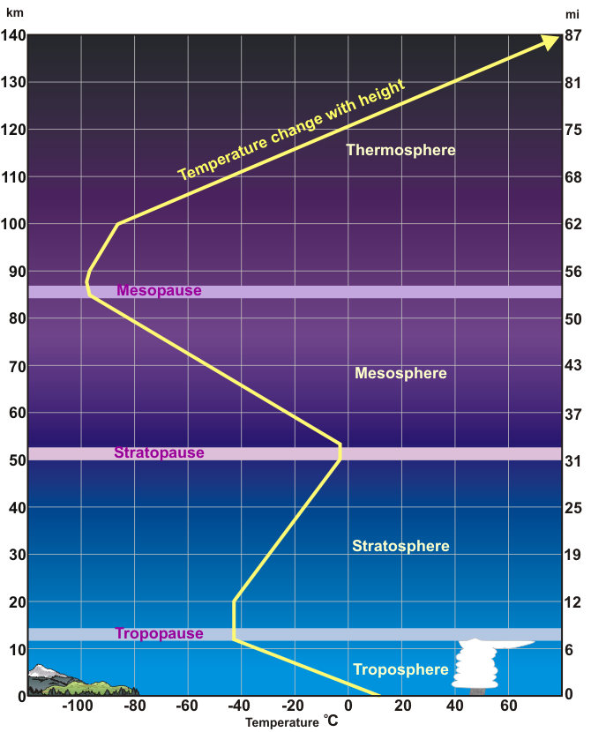
Replace with this PD alternate – US National Weather Service
Notes:
Suggest replace with public domain (US National Weather Service, via )
Slide image, probably from http://www.atmo.arizona.edu/students/courselinks/spring07/atmo336s3/lectures/sec1/atmslayers.gif
Dr. E. Robert (Rob) Kursinski, Associate Professor
Department of Atmospheric Sciences
Office: Physics and Atmospheric Sciences (PAS) Building, Room 580.
Office Hours: TBD
Phone: 621-2139 (voice mail)
Email: kursinski@atmo.arizona.edu

Slide 5
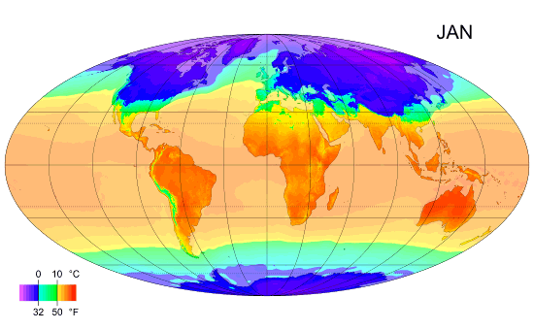
Image credit: © Wikimedia User:PZmaps. License CC BY-SA.
http://commons.wikimedia.org/wiki/File:MonthlyMeanT.gif
Notes:
Source: http://commons.wikimedia.org/wiki/File:MonthlyMeanT.gif (animated GIF)
(c) Wikimedia User:PZmaps
License CC BY-SA
References as its source, http://www.cru.uea.ac.uk/cru/data/hrg.htm

Slide 6
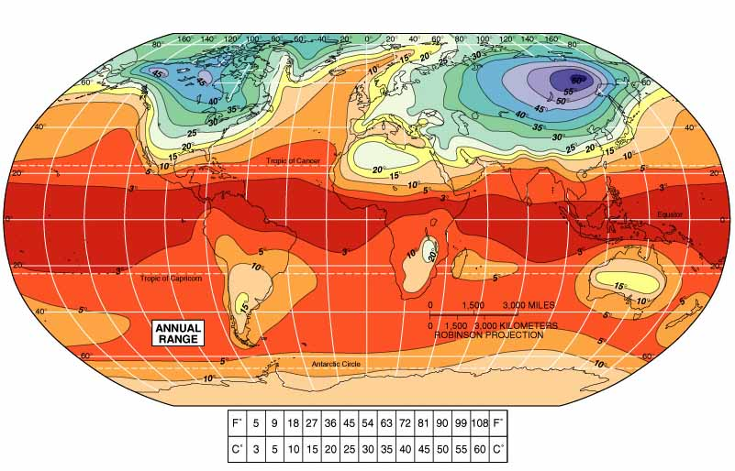
Annual Temperature Range (ºC)
Image © Pearson Education. Source: Christopherson, R. W., and M-L Byrne. Geosystems: An Introduction to Physical Geography.
Notes:
Fair use – image is distributed in freely available PPT for educator use.
http://wps.prenhall.com/ca_ph_christopherson_phygeo_1/42/10952/2803953.cw/-/2803983/index.html
Christopherson, R. W., and M-L Byrne. Geosystems: An Introduction to Physical Geography. Pearson Education.

Slide 7
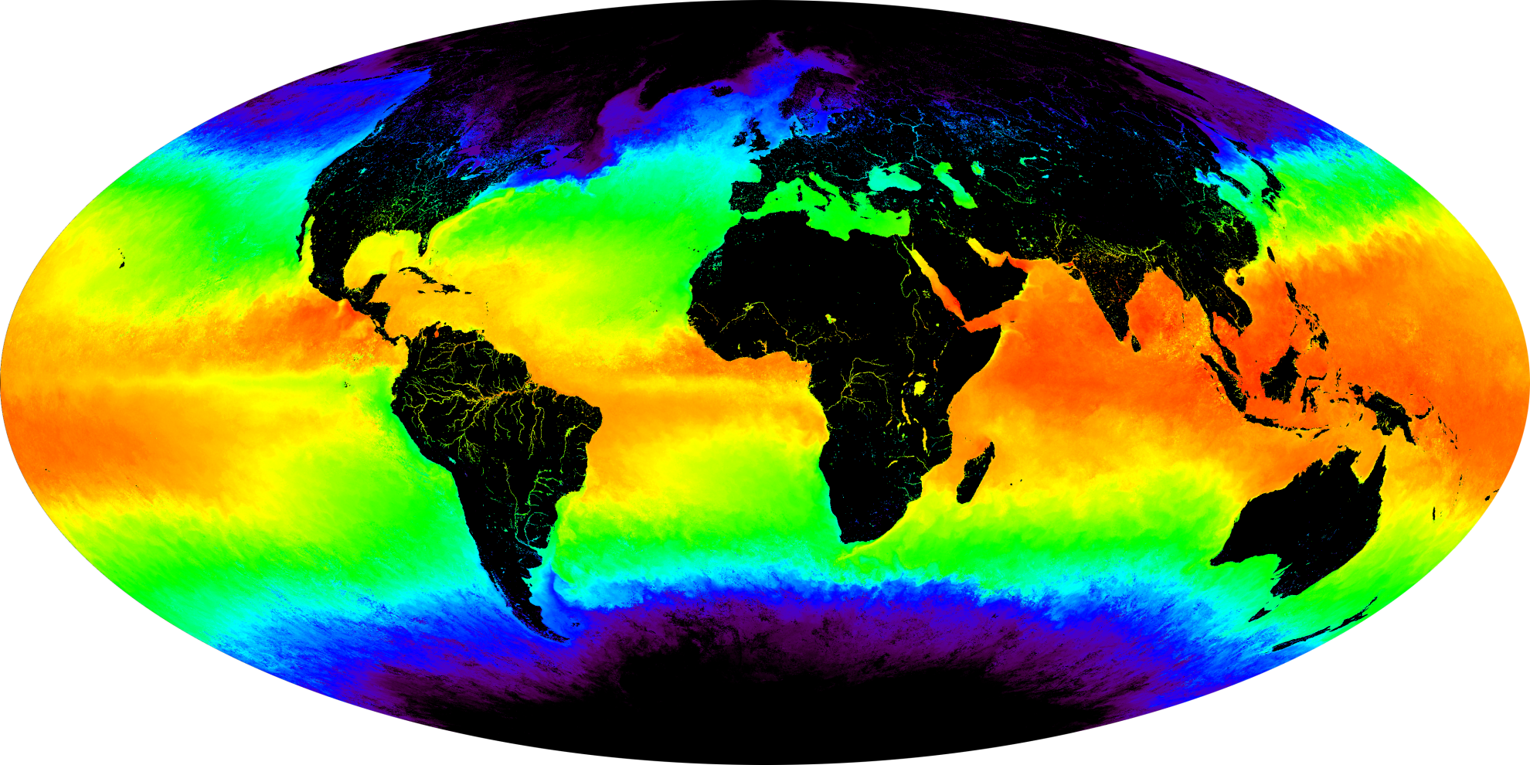
Sea Surface Temperature
Image credit: NASA Visible Earth (MODIS Oceans Group, NASA Goddard Space Flight Center)
Notes:
http://visibleearth.nasa.gov/view.php?id=54229

Slide 8
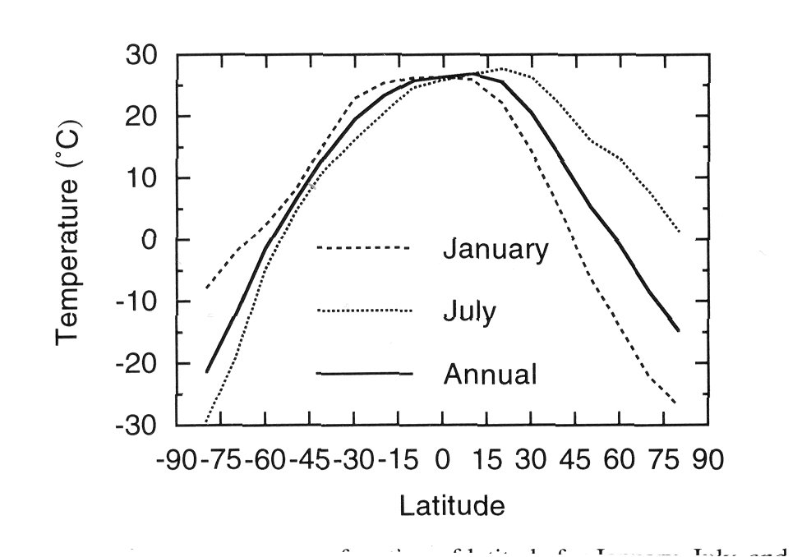
Notes:
Basic graph = “de minimus” fair use (trivial case)
Could be from COMET / UCAR , based on style match.
Courtesy of COMET® and UCAR (University Corporation for Atmospheric Research), sponsored in part through cooperative agreement(s) with the National Oceanic and Atmospheric Administration (NOAA), U.S. Department of Commerce (DOC).
Per https://www.meted.ucar.edu/about_legal.php, Terms of use: “Want to use our stuff? Most of the material made available on MetEd is free for non-commercial, educational use. We encourage you to use our material to enhance your education and training efforts. The legal speak posted on this page gives you the details. But if you have any questions about the reuse of our material, please get in touch.”

Slide 9
Atmospheric Composition

Slide 10
Atmospheric Composition
Gas Name | Chemical Formula | Percent Volume
Nitrogen | N2 | 78.08%
Oxygen | O2 | 20.95%
*Water | H2O | 0 to 4%
Argon | Ar | 0.93%
*Carbon Dioxide | CO2 | 0.0360%
Neon | Ne | 0.0018%
Helium | He | 0.0005%
*Methane | CH4 | 0.00017%
Hydrogen | H2 | 0.00005%
*Nitrous Oxide | N2O | 0.00003%
*Ozone | O3 | 0.000004%
* variable gases

Slide 11
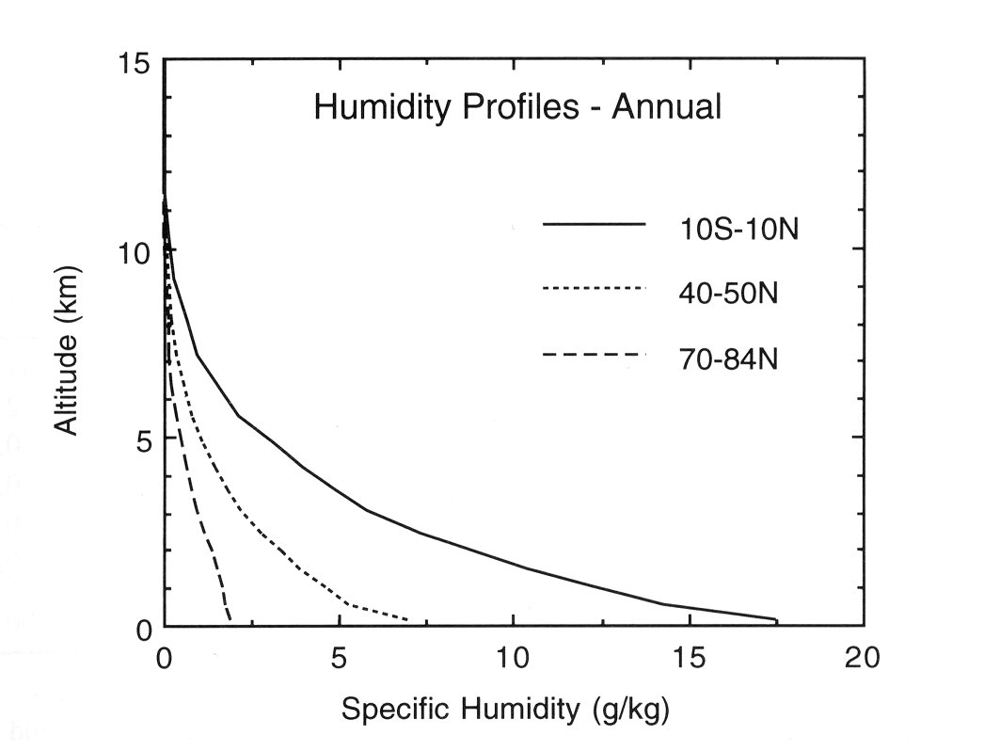
Notes:
Basic graph = “de minimus” fair use (trivial case)
See slide 8 notes.
Color version at http://www.goes-r.gov/users/comet/tropical/textbook_2nd_edition/navmenu.php_tab_2_page_5.3.0.htm
Courtesy of COMET® and UCAR (University Corporation for Atmospheric Research), sponsored in part through cooperative agreement(s) with the National Oceanic and Atmospheric Administration (NOAA), U.S. Department of Commerce (DOC).

Slide 12
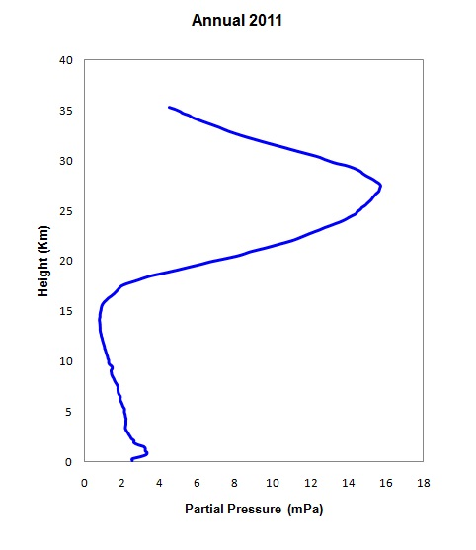
Vertical Profile of Partial Pressure of Ozone
from Malaysian Meteorological Department
Notes:
Basic graph = “de minimus” fair use (trivial case)

Slide 13
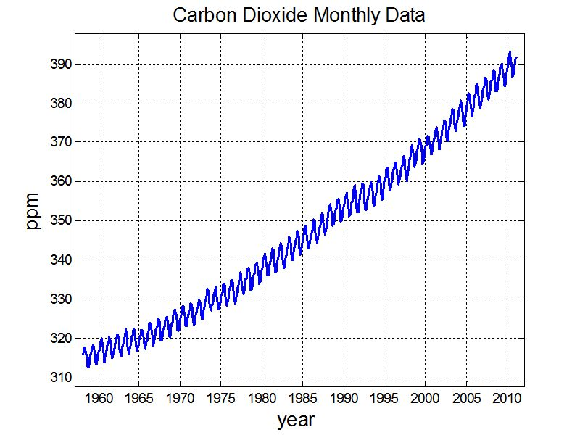
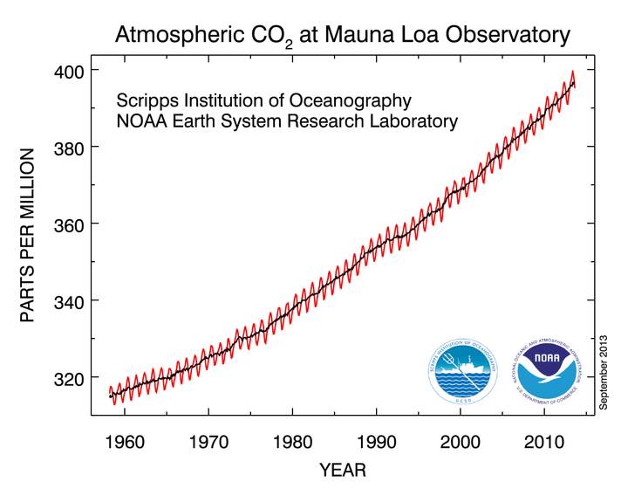
Can’t find this version. Replace with public domain NOAA?
Notes:
Data matches Mauna Loa graph, credit NOAA

Slide 14
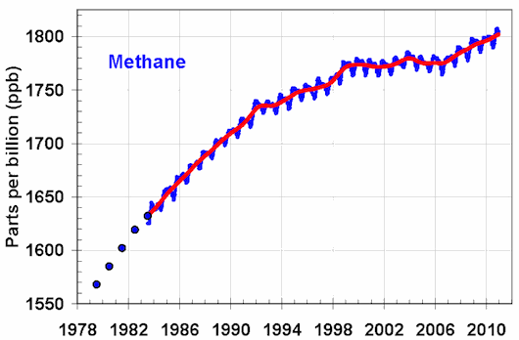
Image credit: NOAA
Notes:
http://www.esrl.noaa.gov/gmd/aggi/

Slide 15
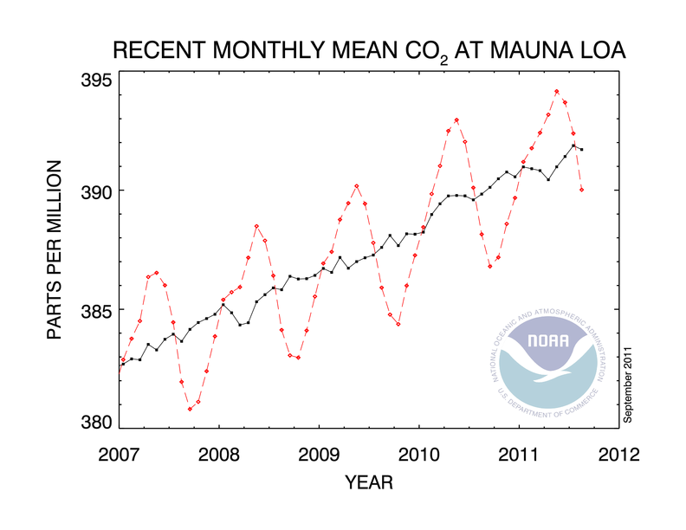
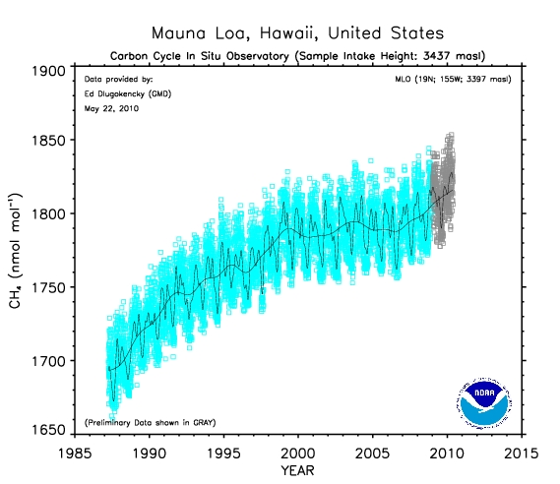
CO₂
CH₄

Slide 16
Elements of Thermal Balance:
Solar Radiation
Luminosity: 3.9 x 10²⁶ J s⁻¹ = 6.4 x 10⁷ Wm⁻²
at top of photosphere
Mean distance from earth: 1.5 x 10¹¹ m
Flux density at mean radius of earth

Slide 18
Disposition of Solar Radiation:
Absorption by clouds, atmosphere, and surface

Slide 19
Terrestrial Radiation:
Effective emission temperature:

Slide 20
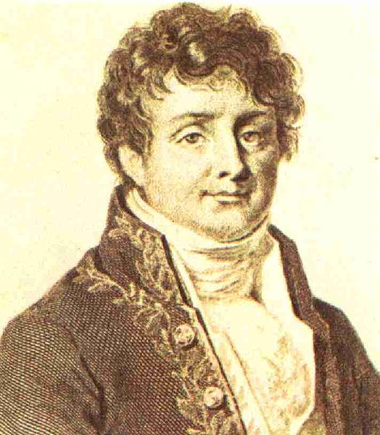


The Greenhouse Effect
Jean Baptiste Joseph Fourier
(1768-1830)
John Tyndall (1820-1893)
Notes:
Public domain images, no problem

Slide 21
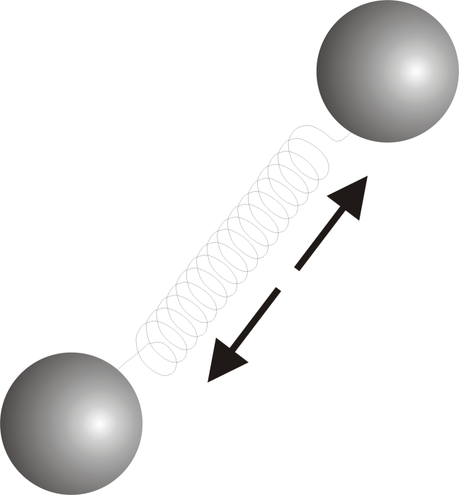
Tyndall’s Discovery:
Oxygen (O₂) and Nitrogen (N₂), which together comprise about 97% of the atmosphere, are transparent to solar and infrared radiation
If that’s all there were:
= Stefan-Boltzmann constant
a = Planetary albedo
= Solar constant

Slide 22
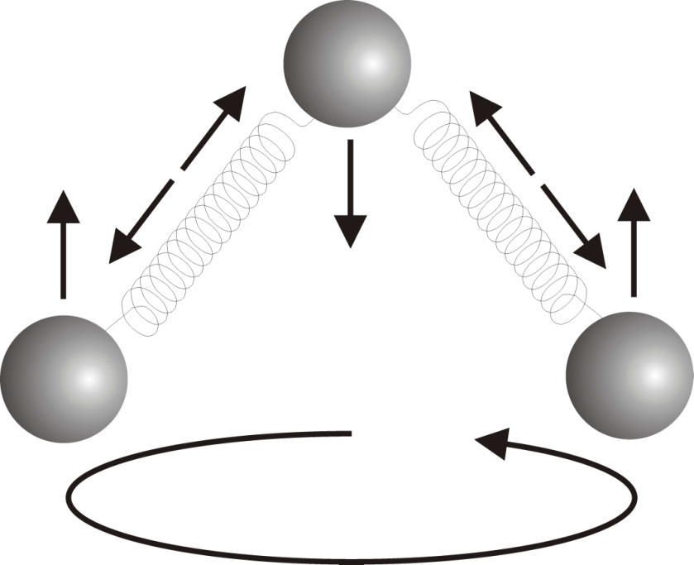
But certain trace gases interact strongly with radiation:
H₂0 (water vapor)
CO₂ (carbon dioxide)
CH₄ (methane)
Clouds also interact strongly with radiation. Together, they yield:

Slide 23

Tyndall’s Essential Results:
Oxygen (O₂ ) and nitrogen (N₂), though they make up ~98% of the atmosphere, are almost entirely transparent to solar and terrestrial radiation
Water vapor (H₂O), carbon dioxide (CO₂), nitrous oxide (N₂O), and a handful of other trace gases make the lower atmosphere nearly opaque to infrared radiation, though still largely transparent to solar radiation (but clouds have strong effects on radiation at all wavelengths)

Slide 24
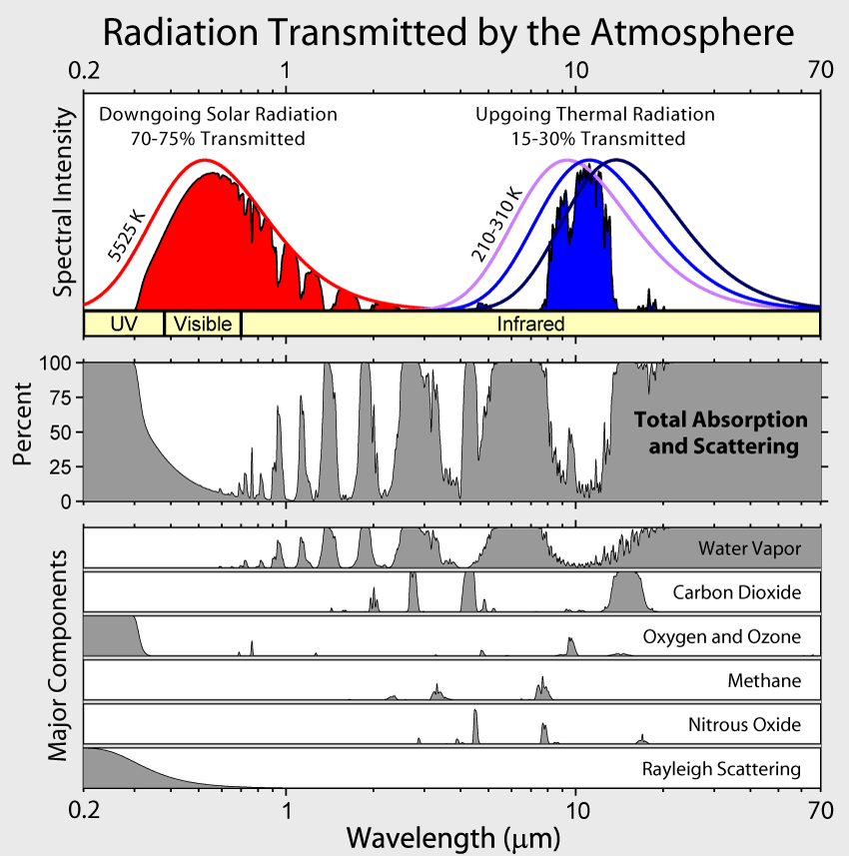
Image created by Robert A. Rohde / Global Warming Art
Notes:
http://commons.wikimedia.org/wiki/File:Atmospheric_Transmission.png which shows CC BY-SA, along with link for more detailed terms to
http://www.globalwarmingart.com/wiki/File:Atmospheric_Transmission_png
Which specifies use is fine, along with credit line now added to slide.

Slide 25
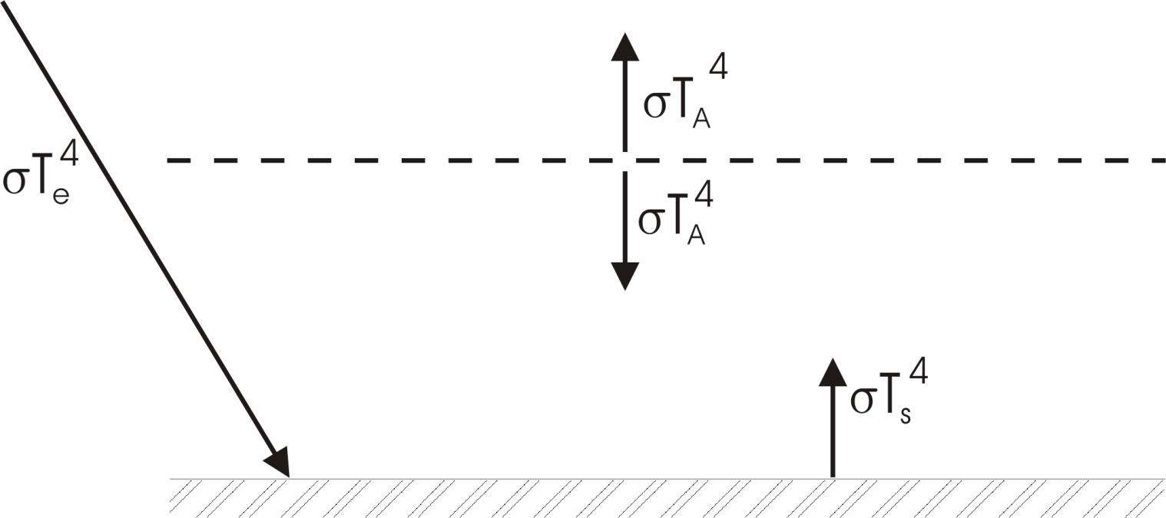
Simple Model
Top-of-atmosphere energy balance:
Surface energy balance:
Infrared radiation emitted by atmosphere
Incoming sunlight
Infrared radiation emitted by surface
Atmosphere transparent to solar radiation
Atmosphere opaque to infrared radiation
Infrared emission from surface and each layer
In this model, the surface receives as much radiation from the atmosphere as it does directly from the sun

Slide 26
Radiative Equilibrium:
Top of Atmosphere:
Surface:

Slide 27
Surface temperature too large because:
Real atmosphere is not opaque
Heat transported by convection as well as by radiation
Will be covered later in course

Slide 28
Annual Average Radiation

Slide 29
Elements of the Greenhouse Effect
from IPCC AR4
Notes:
Full citation follows this format – note Cambridge U Press.
Climate Change 2007: The Physical Science Basis. Working Group I Contribution to the Fourth Assessment Report of the Intergovernmental Panel on Climate Change, Figure X.Y. Cambridge University Press. Used with permission.

Slide 30
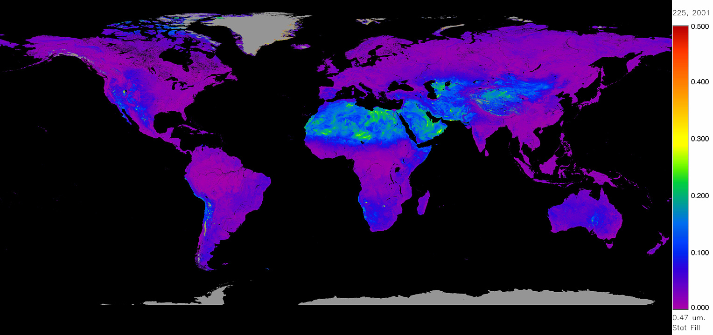
Annual Average Surface Albedo
Image credit: NASA (MODIS Atmosphere)
Notes:
Source: from this NASA collection http://modis-atmos.gsfc.nasa.gov/ALBEDO/browse.html

Slide 31
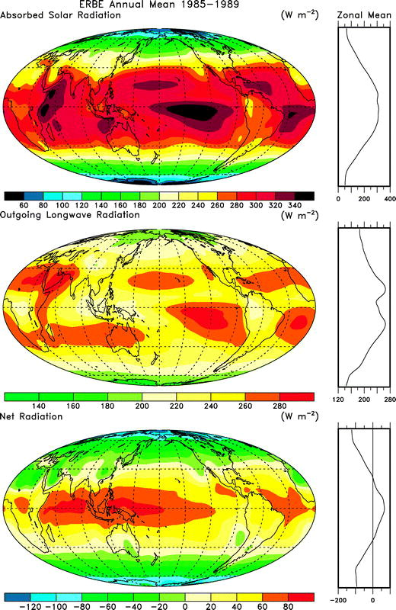
Annual Mean Absorbed Solar Radiation
From Trenbert, K. E., and D. P. Stepaniak. “Seamless Poleward Atmospheric Energy Transports and Implications for the Hadley Circulation.” J. Climate 16 (2003): 3706-3722. © American Meteorological Society.
Notes:
Fair use with credit?
Trenbert, K. E., and D. P. Stepaniak. “Seamless Poleward Atmospheric Energy Transports and Implications for the
Hadley Circulation.” J. Climate 16 (2003): 3706-3722.
(c) American Meteorological Society.

Slide 32
Annual Mean Outgoing Longwave Radiation
From Trenbert, K. E., and D. P. Stepaniak. “Seamless Poleward Atmospheric Energy Transports and Implications for the Hadley Circulation.” J. Climate 16 (2003): 3706-3722. © American Meteorological Society.
Notes:
Fair use with credit?
Trenbert, K. E., and D. P. Stepaniak. “Seamless Poleward Atmospheric Energy Transports and Implications for the
Hadley Circulation.” J. Climate 16 (2003): 3706-3722.
(c) American Meteorological Society.

Slide 33
Annual Mean Net Absorbed Radiation
From Trenbert, K. E., and D. P. Stepaniak. “Seamless Poleward Atmospheric Energy Transports and Implications for the Hadley Circulation.” J. Climate 16 (2003): 3706-3722. © American Meteorological Society.
Notes:
Fair use with credit?
Trenbert, K. E., and D. P. Stepaniak. “Seamless Poleward Atmospheric Energy Transports and Implications for the
Hadley Circulation.” J. Climate 16 (2003): 3706-3722.
(c) American Meteorological Society.

Slide 34
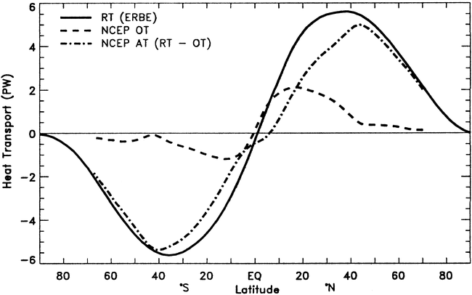
Roles of atmosphere and ocean
net
ocean
atmosphere
From Trenberth, K. E., and J. M. Caron. “Estimates of meridional atmosphere and ocean heat transports.”
J. Climate 14 (2001) 3433-3443. © American Meteorological Society.
Notes:
Fair use (c) AMS?
Fig 7 in Trenberth, K. E., and J. M. Caron. “Estimates of meridional atmosphere and ocean heat transports.” J. Climate 14 (2001) 3433-3443.

Slide 35
Seasonal and other Variability

Slide 36
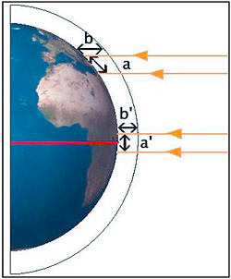
Radiation per unit surface area depends on the cosine of the solar zenith angle
Image credit: Kelt, D. A. “Chapter 3: Climatic determinants of global patterns of biodiversity.” MarineBio Conservation Society. Sept 2004. <http://marinebio.org/oceans/conservation/moyle/ch3.asp>
Notes:
Image credit: (c) Kelt, D. A. “Chapter 3: Climatic determinants of global patterns of biodiversity.” MarineBio Conservation Society. Sept 2004. <http://marinebio.org/oceans/conservation/moyle/ch3.asp>
Grabbed from http://jisibhlphysics.wikispaces.com/8.4.13+Outline+reasons+for+seasonal+and+regional+variations+in+the+solar+power+incident+per+unit+area+of+the+Earth%E2%80%99s+surface.

Slide 37
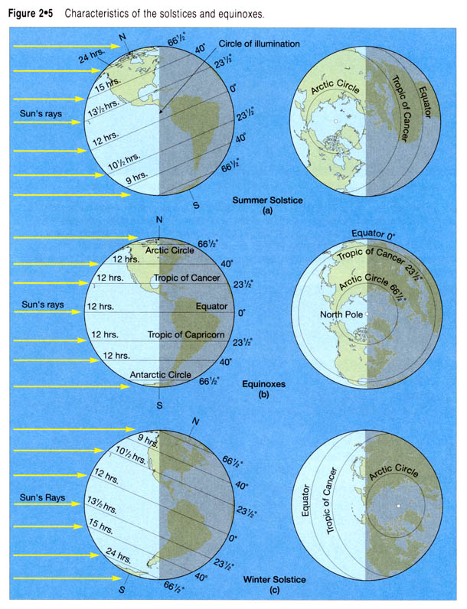
Seasonality
Notes:
Not sourced to original. Wiki credits to www.earth.rochester.edu, but looks very scanned from a book.
Fair use (c) source unknown.
Grabbed from http://jisibhlphysics.wikispaces.com/8.4.13+Outline+reasons+for+seasonal+and+regional+variations+in+the+solar+power+incident+per+unit+area+of+the+Earth%E2%80%99s+surface.

Slide 38
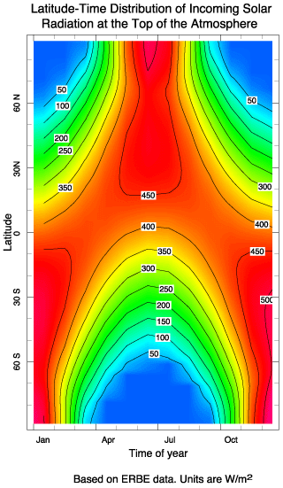
Seasonal variation of solar radiation
Notes:
Fair use.
Not sourced to original. Wiki credits to www.ldeo.columbia.edu
Lamont-Doherty Earth Observatory, Columbia U
Cached: http://www.ldeo.columbia.edu/~kushnir/MPA-ENVP/Climate/lectures/energy/analema.gif but not online any longer
→ Source unknown
Grabbed from http://jisibhlphysics.wikispaces.com/8.4.13+Outline+reasons+for+seasonal+and+regional+variations+in+the+solar+power+incident+per+unit+area+of+the+Earth%E2%80%99s+surface.

Slide 39
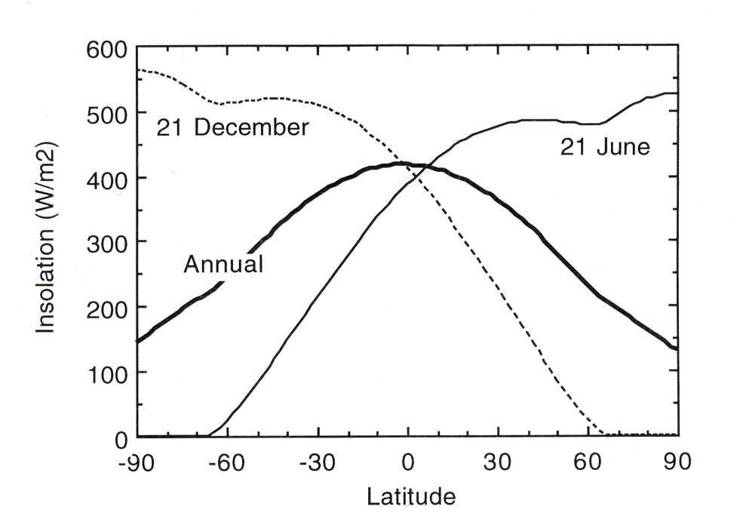
Notes:
Basic graph = “de minimus” fair use (trivial case)
Could be from COMET / UCAR , based on style match.
Courtesy of COMET® and UCAR (University Corporation for Atmospheric Research), sponsored in part through cooperative agreement(s) with the National Oceanic and Atmospheric Administration (NOAA), U.S. Department of Commerce (DOC).
Per https://www.meted.ucar.edu/about_legal.php, Terms of use: “Want to use our stuff? Most of the material made available on MetEd is free for non-commercial, educational use. We encourage you to use our material to enhance your education and training efforts. The legal speak posted on this page gives you the details. But if you have any questions about the reuse of our material, please get in touch.”

Slide 40
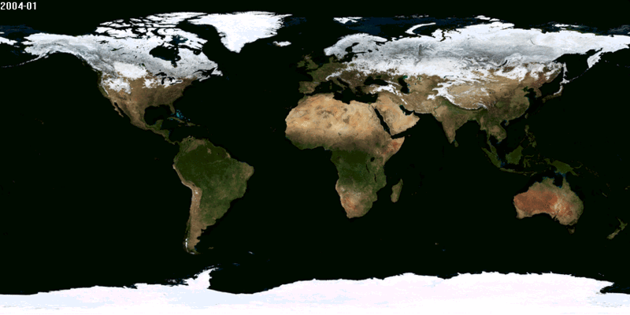
NASA Blue Marble

Slide 41
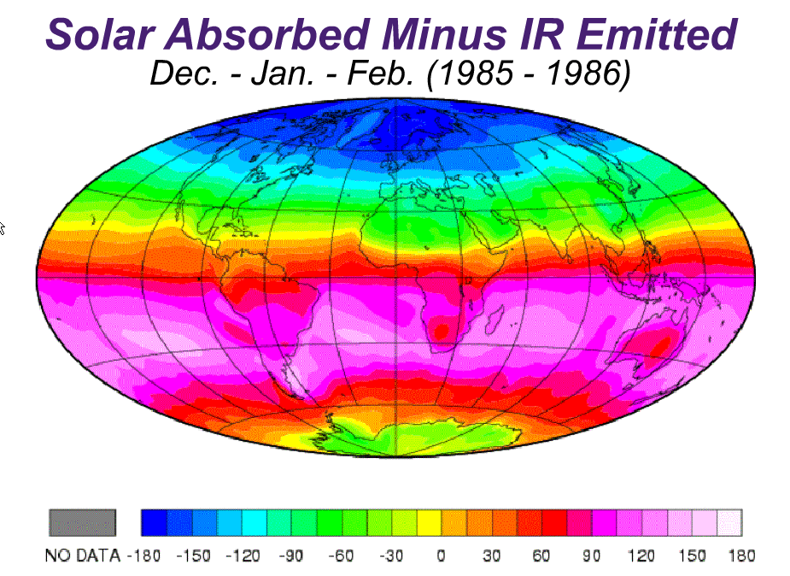
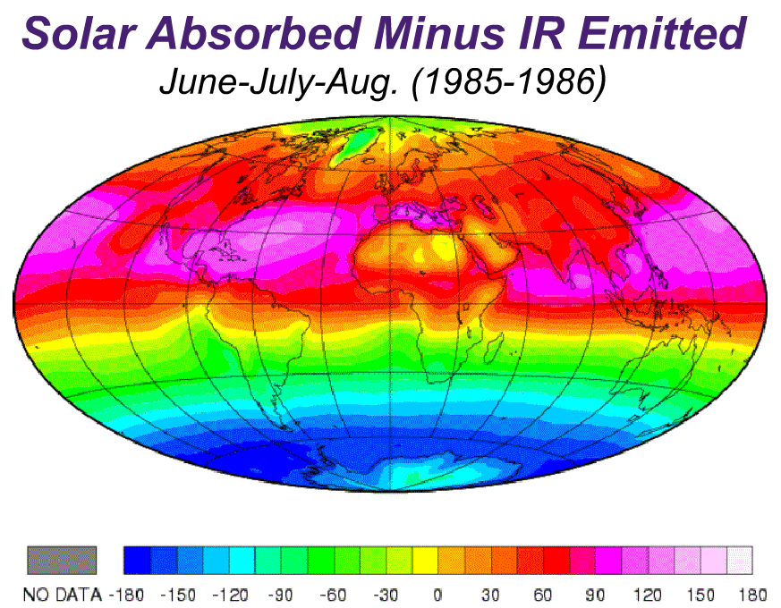
Notes:
Source cannot be verified.
Fair use.
p. 14 of this UN document http://css.escwa.org.lb/sdpd/1338/bd4.pdf has the map w/o headings
Credits “Dr. Ostermeyer” but no further info.
On the original slide: https://www.atmos.washington.edu/2003Q3/101/webnotes.html
Specifically, http://www.atmos.washington.edu/2003Q3/101/notes/EnergyBalanceMapDJF.gif and
http://www.atmos.washington.edu/2003Q3/101/notes/EnergyBalanceMapJJA.gif
However, uncredited and probably not the original.

Slide 42
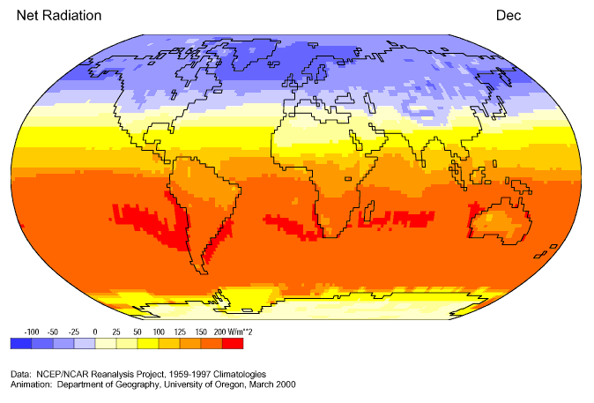
Image credit: Global Climate Animations, http://www.uwyo.edu/jshinker/animations/global/.
Created through cooperative work between the Department of Geography at the University of Oregon and the Department of Geography at University of Wyoming .
Notes:
Fair use. Would probably be friendly to us, but website has no terms of use.
From Global Climate Animations, http://www.uwyo.edu/jshinker/animations/global/
“Created through cooperative work between the
Department of Geography at the University of Oregon and the Department of Geography at University of Wyoming ©
Contact: Jacqueline J. Shinker.”
Fair use, © University of Oregon and University of Wyoming

Slide 43
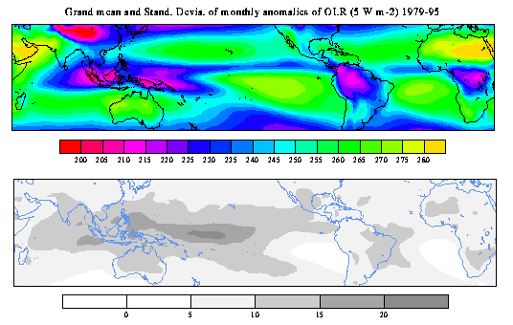
Mean and STD OLR 1979-95
Image credit: NOAA/NCEP
Notes:
Public domain – National Centers for Environmental Predicition (NCEP) @ NOAA

Slide 44
Summary of this Section
Climate variations involve principally the earth’s troposphere and stratosphere
Seasonal temperature variations are most prominent over high northern latitude continents
Over 97% of the mass of the atmosphere is comprised of molecular nitrogen (N₂) and oxygen (O₂)

Slide 45
Trace amounts of water vapor, carbon dioxide, ozone, methane, and a handful of other gases are, together with clouds, responsible for a powerful greenhouse effect
The greenhouse effect occurs because the surface must be hot enough to radiate away not only the sunlight it absorbs but the infrared back-radiation it receives from the atmosphere and clouds within it

Slide 46
Carbon dioxide and methane, both long-live greenhouse gases, have been increasing since the mid 19th Century, and also show a seasonal cycle
Currents in the atmosphere and oceans transport heat away from the tropics and toward the poles, so that on average, the tropics absorb more radiation than they emit to space, while the poles emit more radiation than they absorb

