Slide 1
Hurricanes
I: Observed characteristics

Slide 2

What is a Hurricane?
Formal definition: A tropical cyclone with 1-min average winds at 10 m altitude in excess of 32 m/s (64 knots or 74 MPH) occurring over the North Atlantic or eastern North Pacific

Slide 3

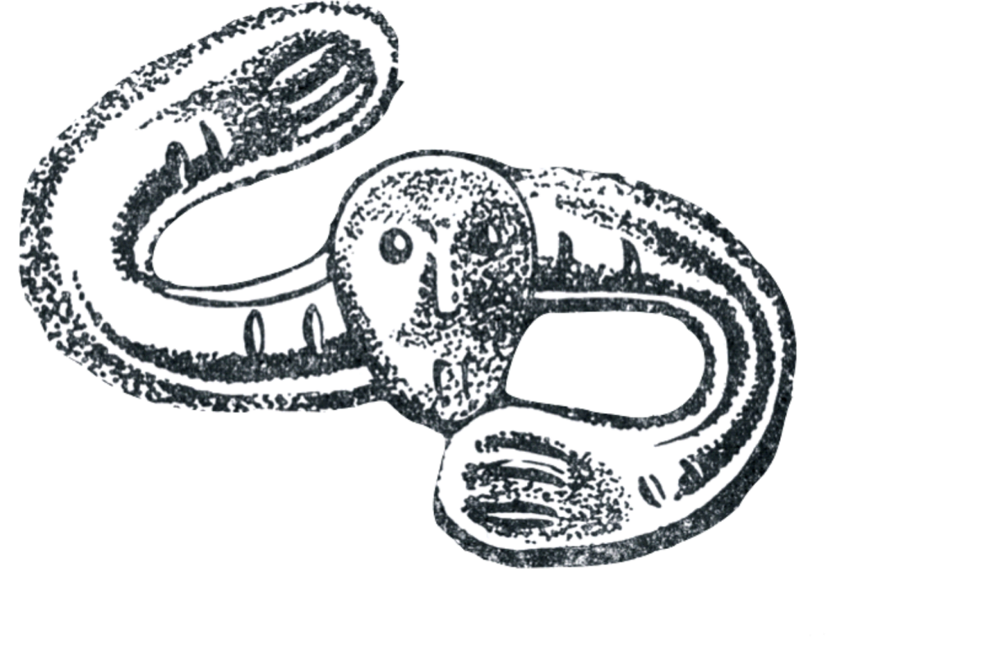
The word Hurricane is derived from the Mayan word Huracan and the Taino and Carib word Hunraken, a terrible God of Evil, and brought to the West by Spanish explorers
Notes:
3

Slide 4
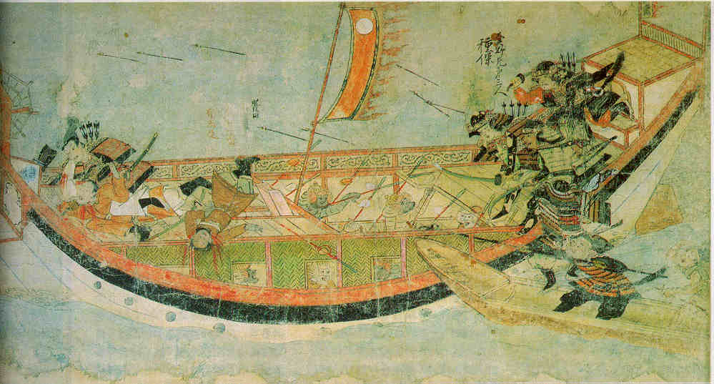
Early historical encounters: The Mongol invasions of Japan in 1274 and 1281
Scene from the 13th century Mongol invasion scrolls, based on a narrative written by the Japanese warrior Takezaki Suenaga.

Slide 5
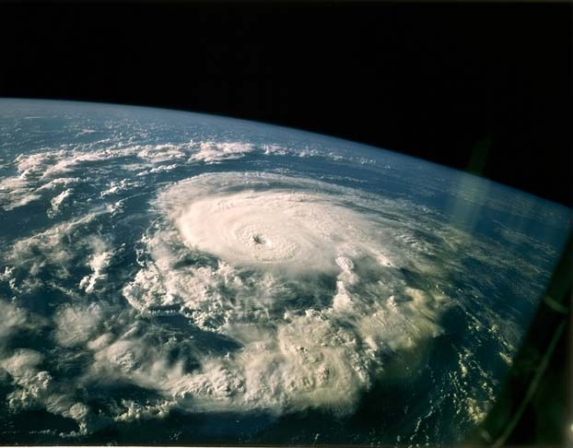

Slide 6


Slide 7
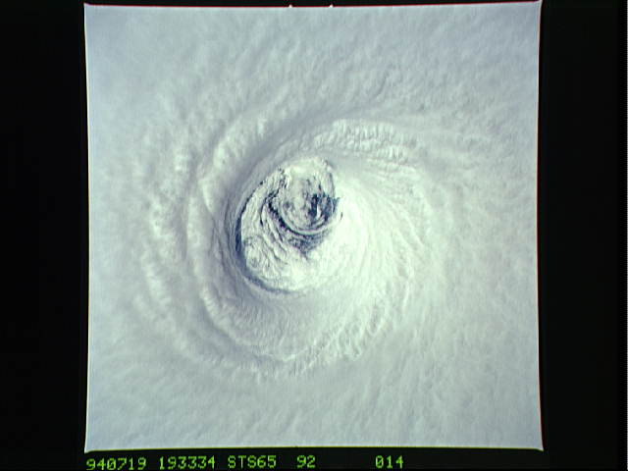

Slide 8
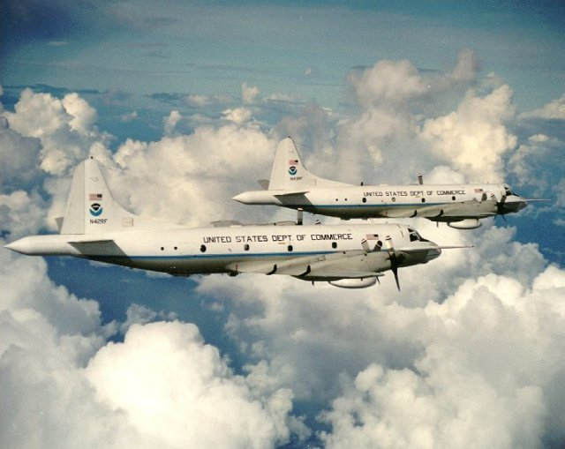

Slide 9


Slide 10


Slide 11
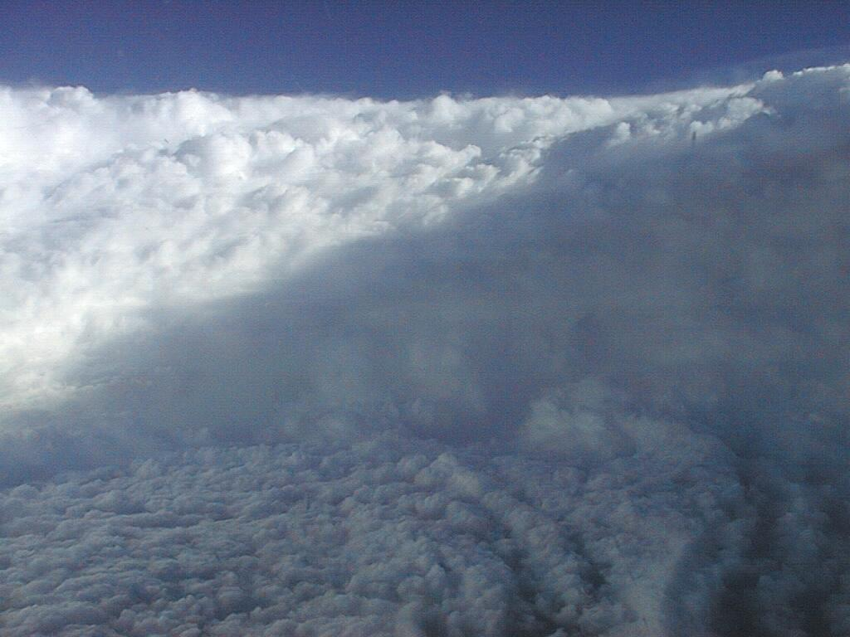

Slide 12


Slide 13
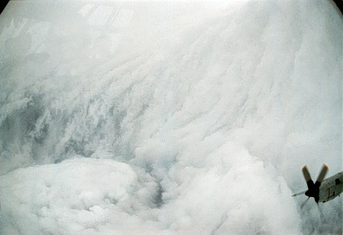

Slide 14
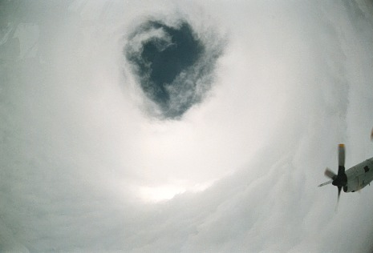

Slide 15
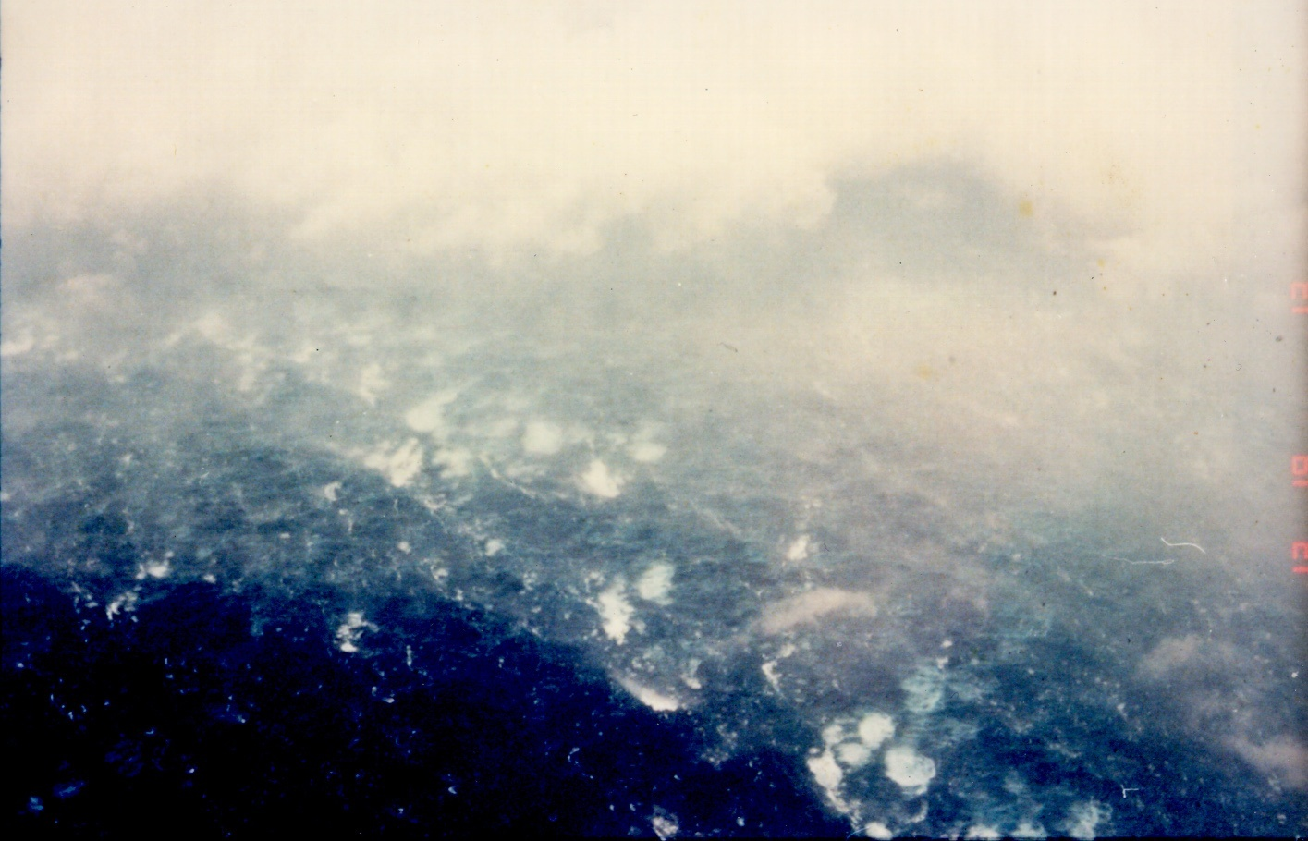

Slide 16
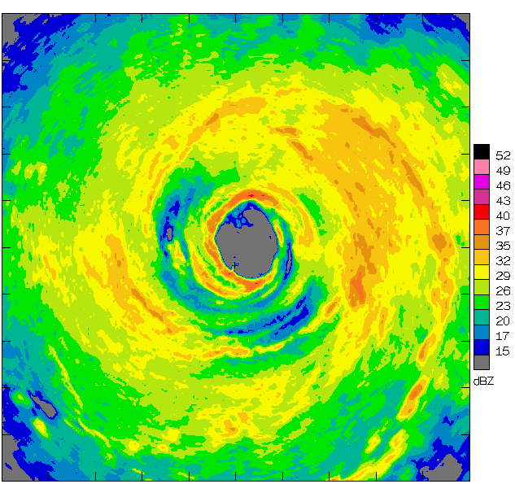
Airborne Radar: Horizontal Map
360 km
(220 mi)

Slide 17
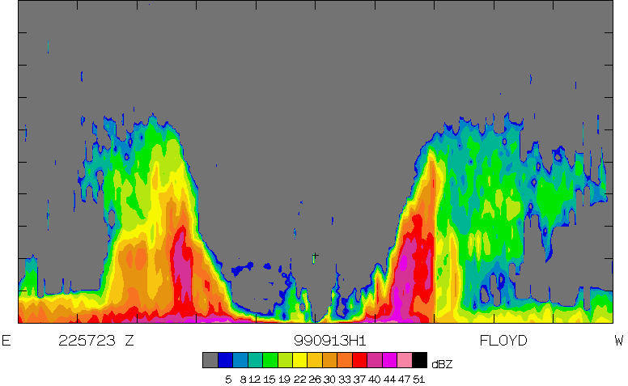
Airborne Radar: Vertical Slice
20 km
(12 mi)
120 km
(75 mi)

Slide 18
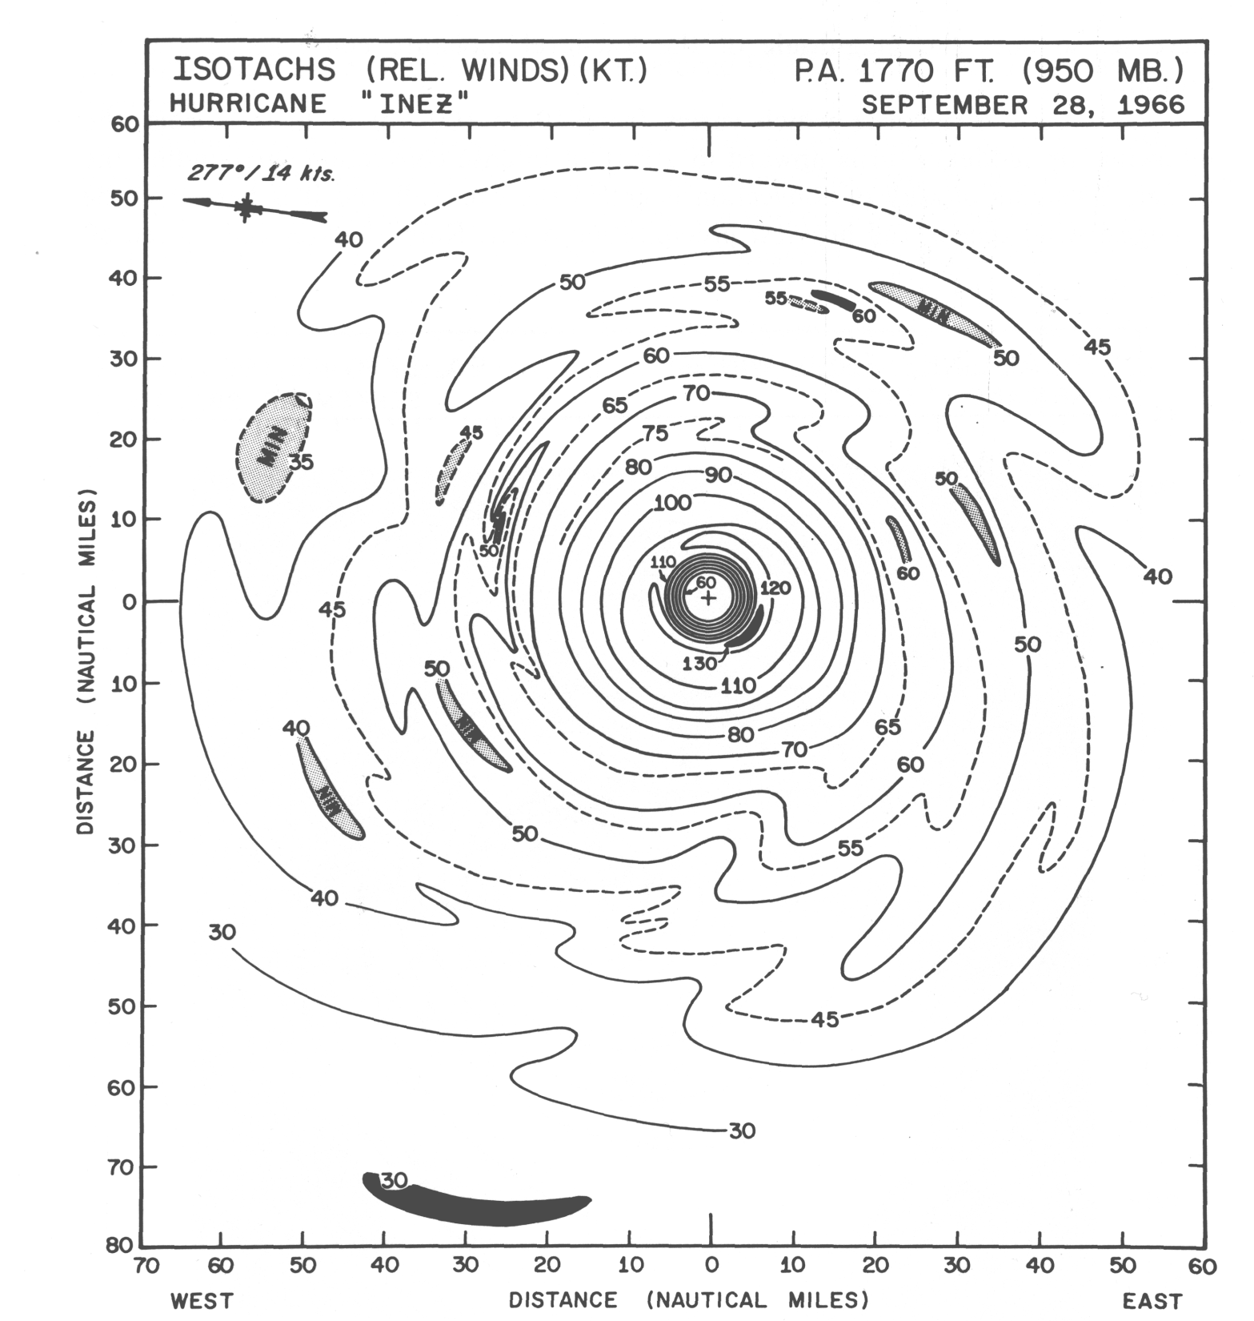

Slide 19
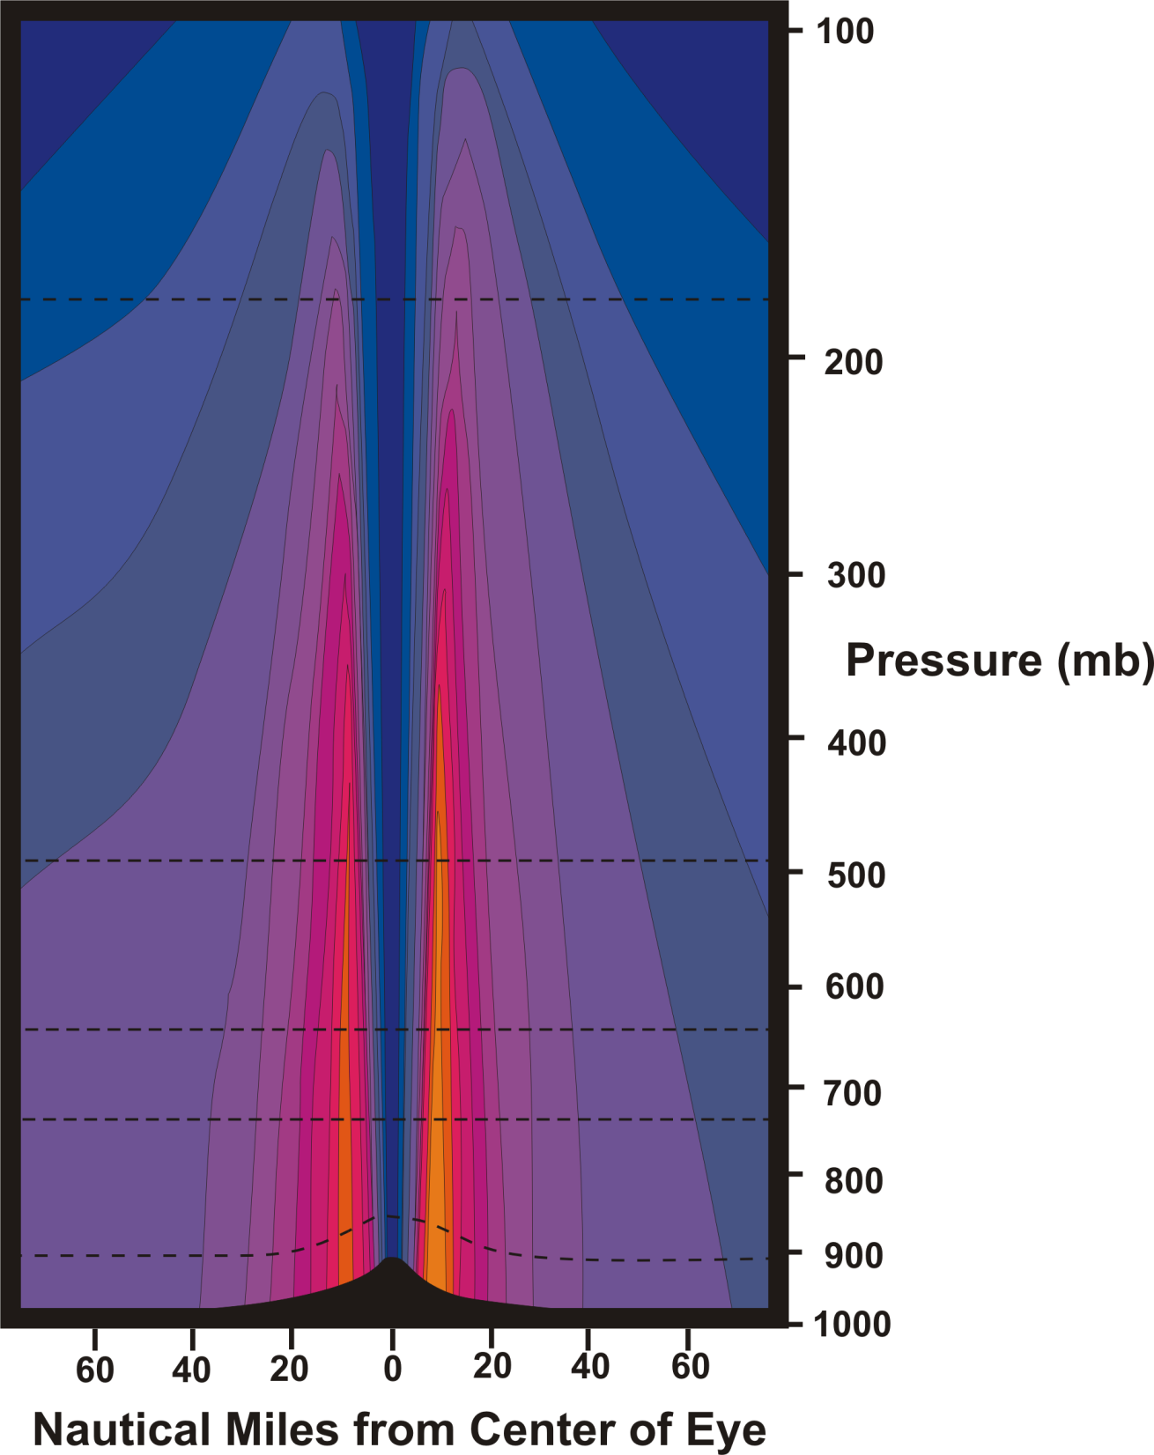
Azimuthal wind

Slide 20

Temperature perturbation at constant altitude

Slide 21
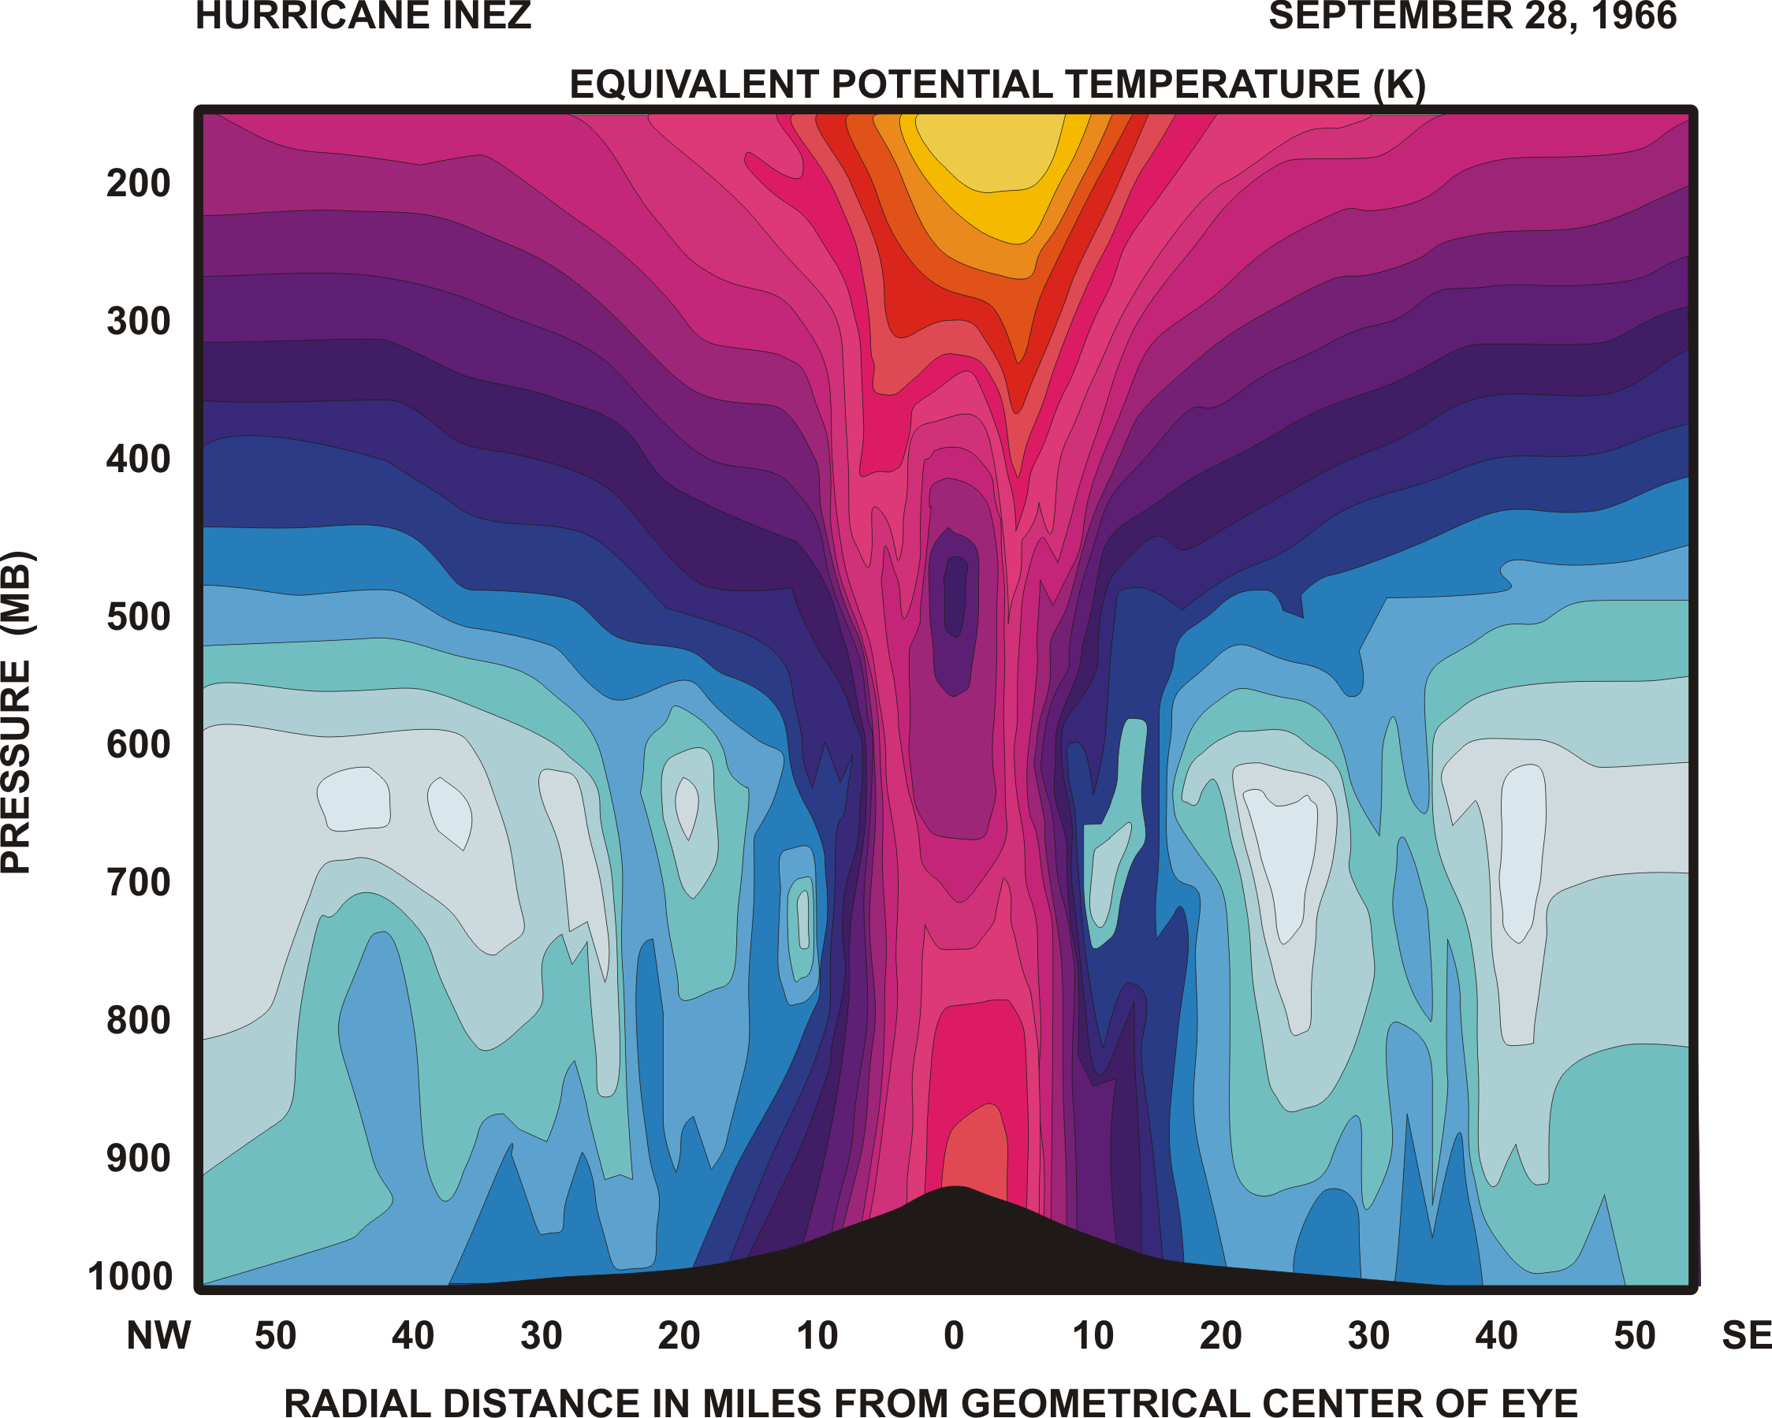

Slide 22
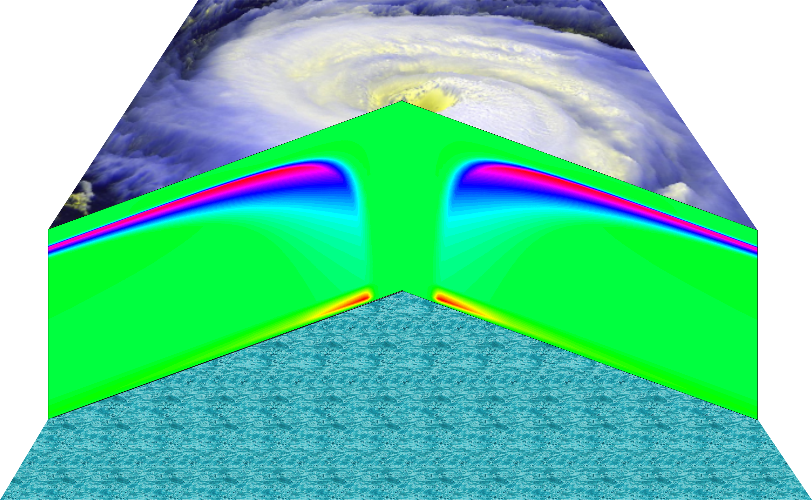
Radial wind

Slide 23
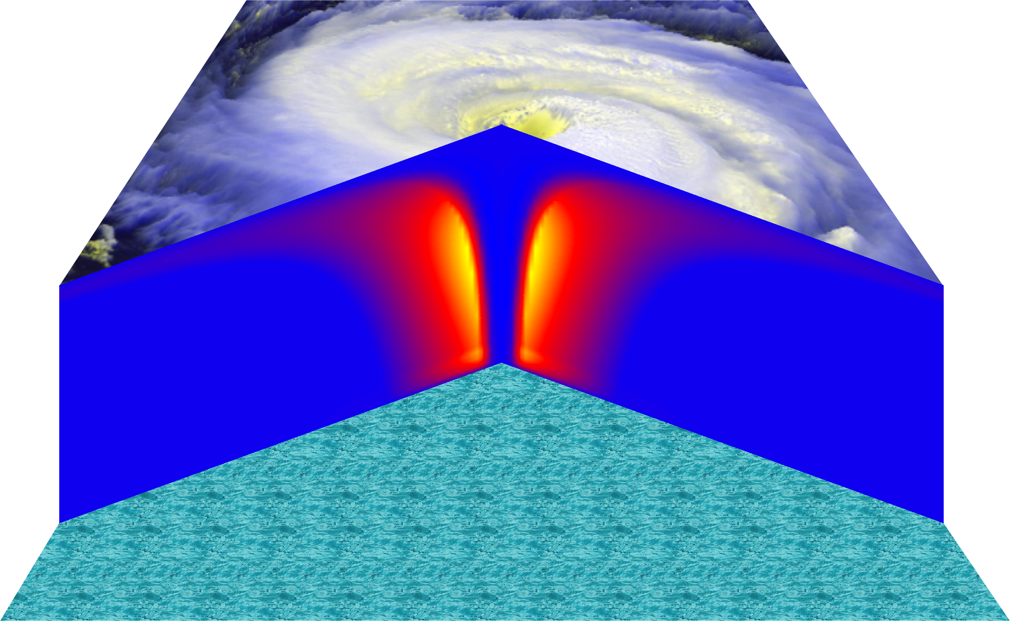
Vertical velocity

Slide 24
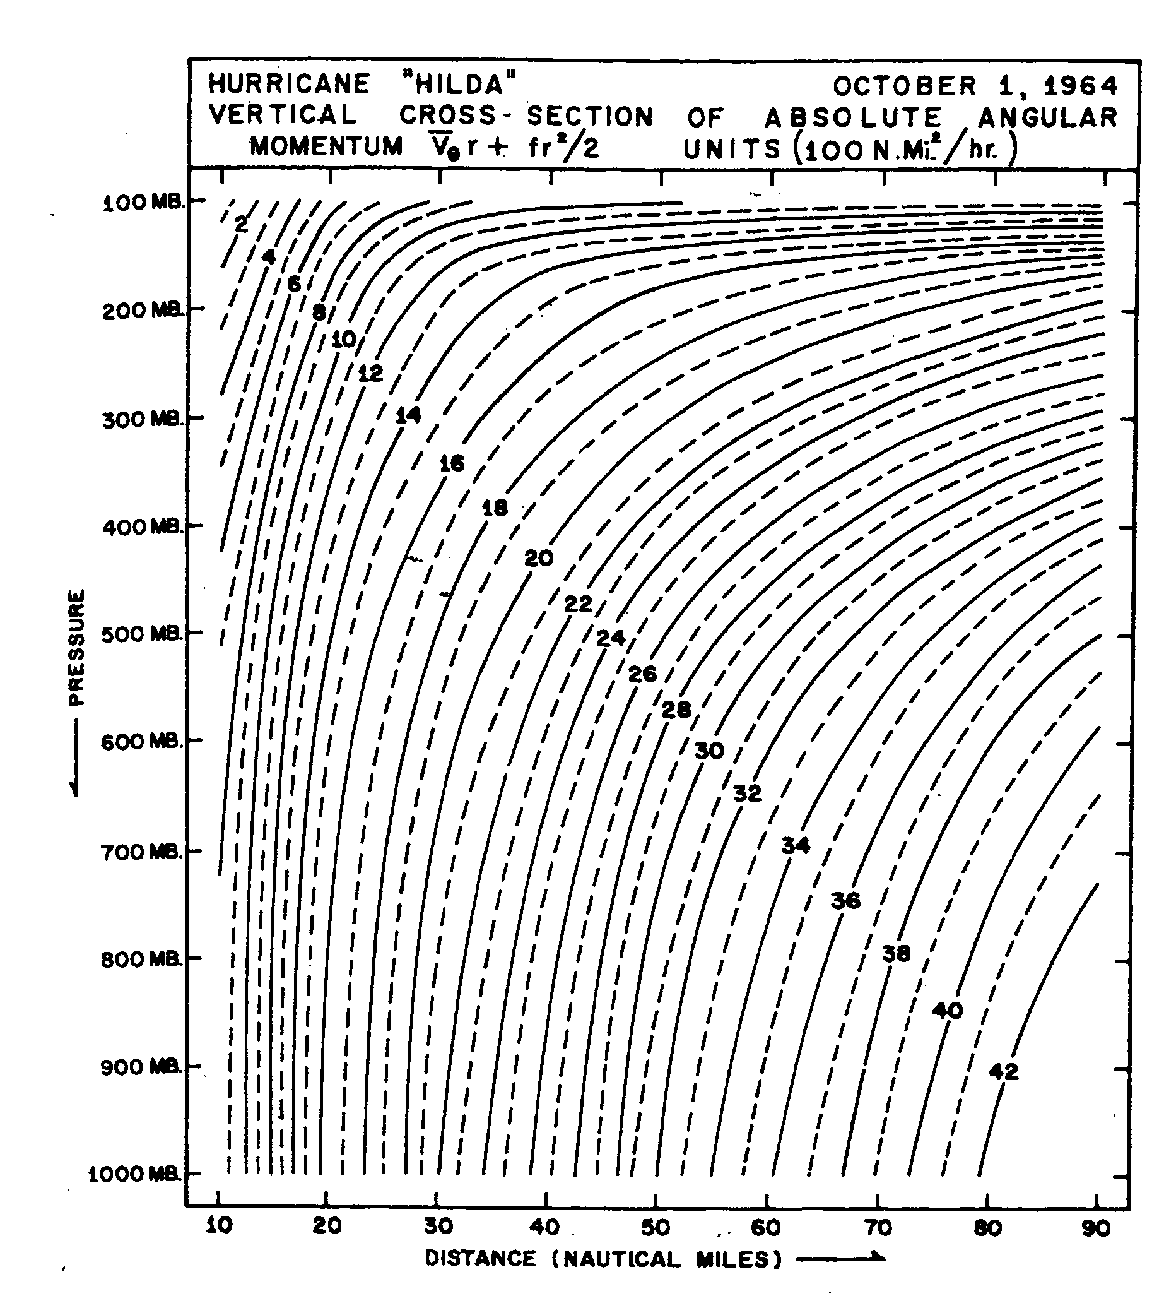
Angular momentum per unit mass

Slide 25
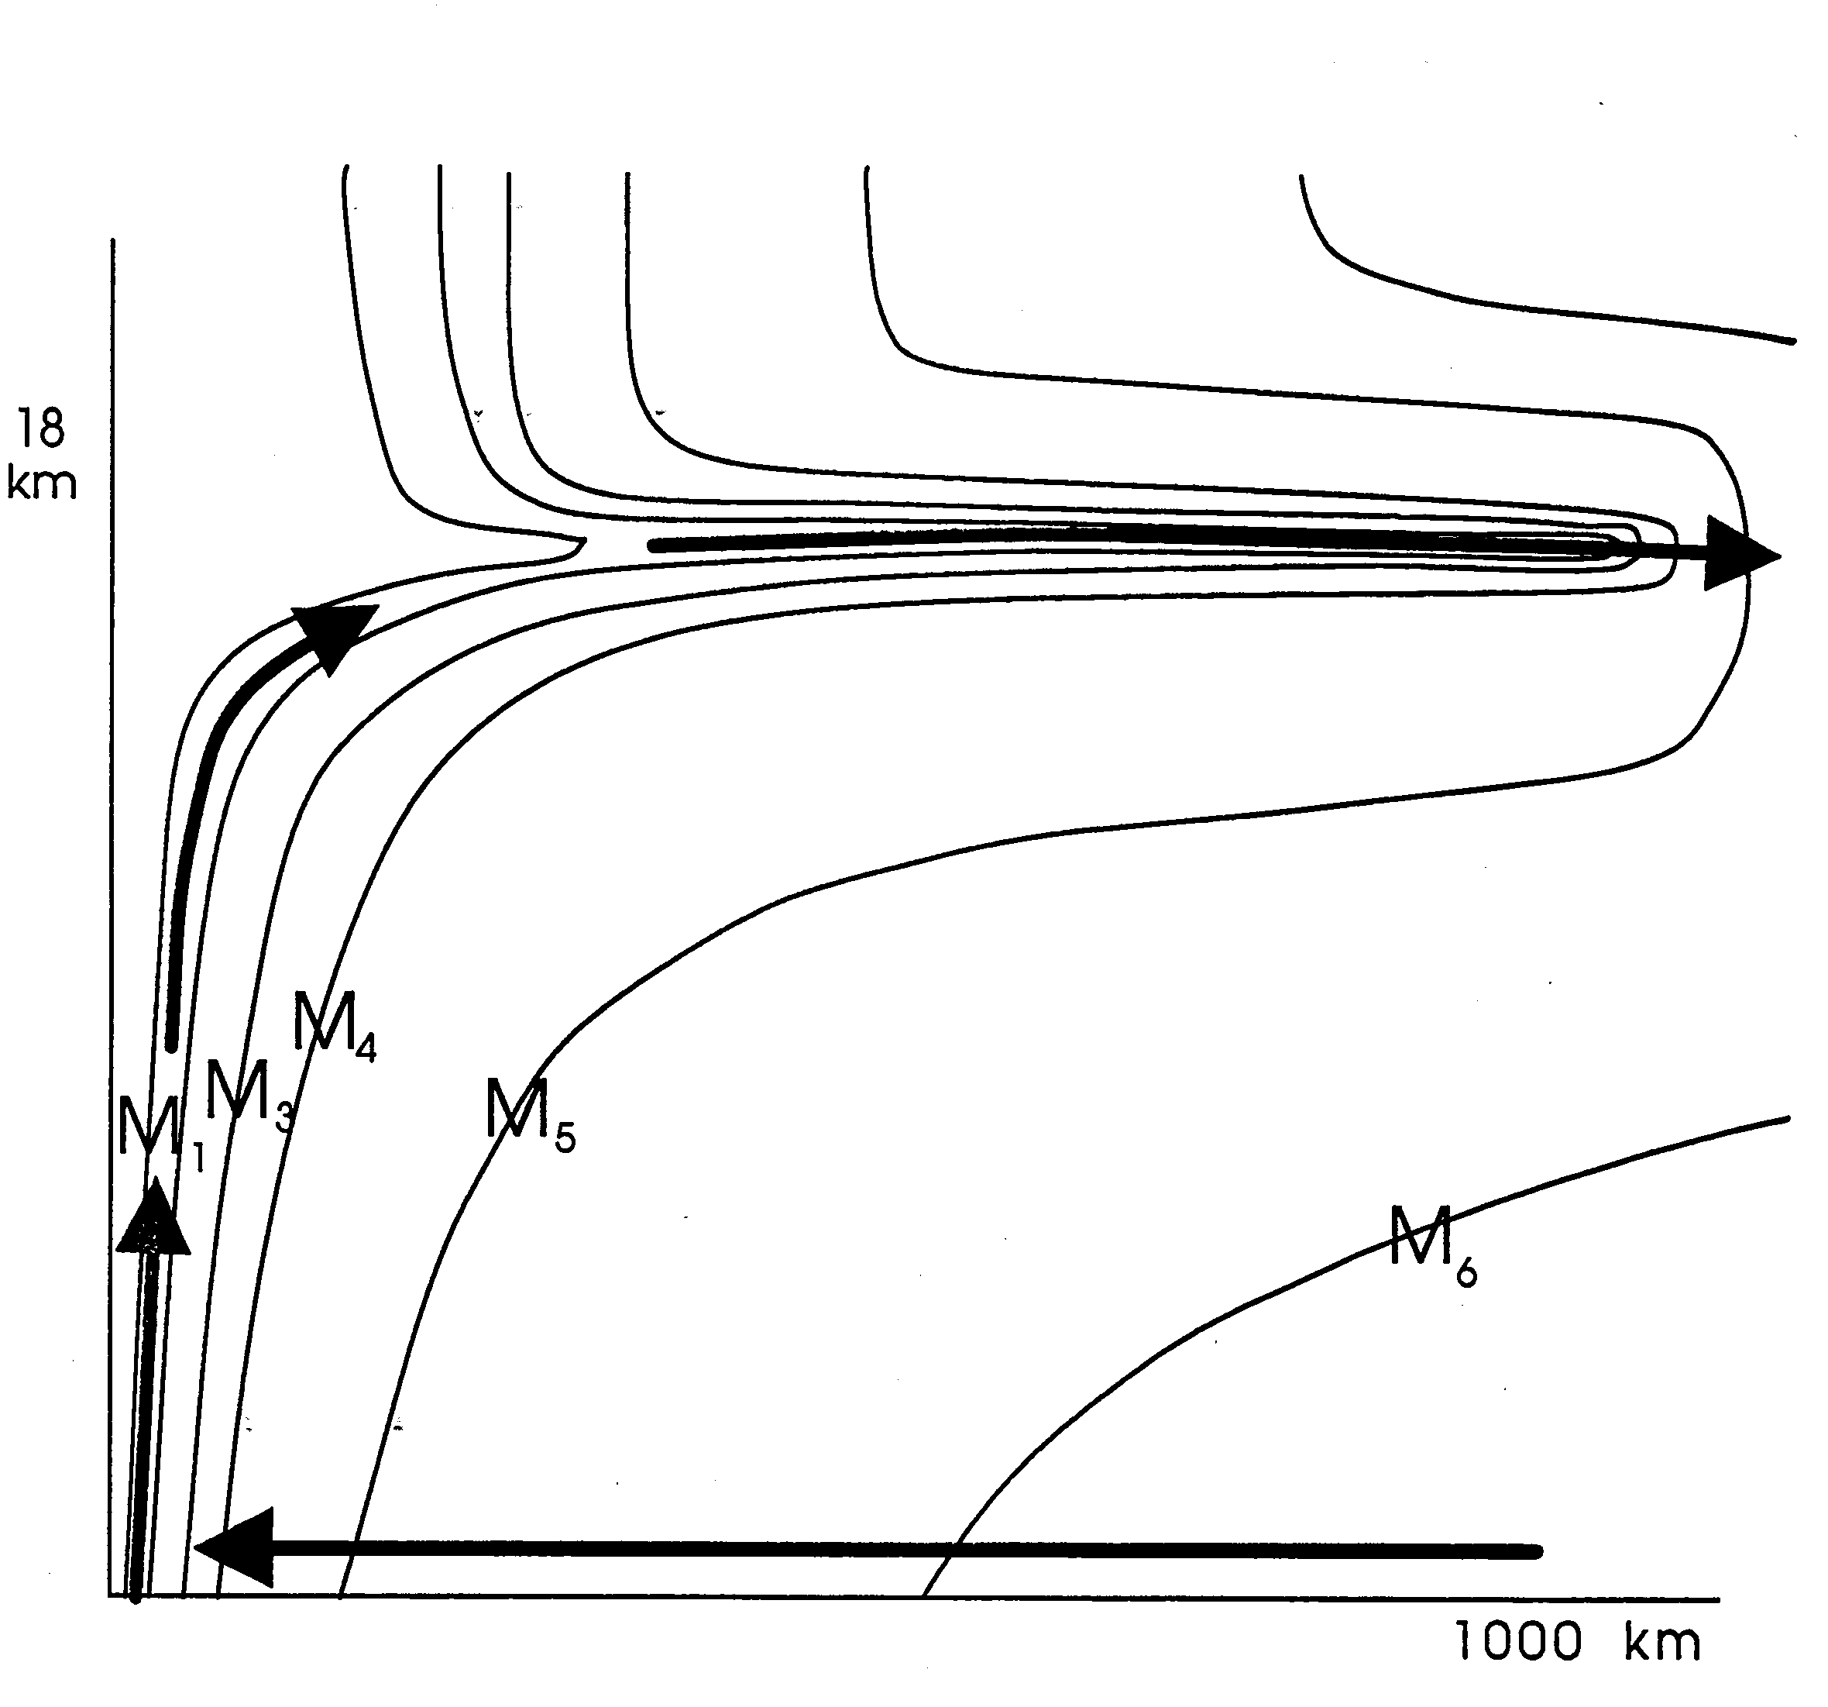

Slide 26
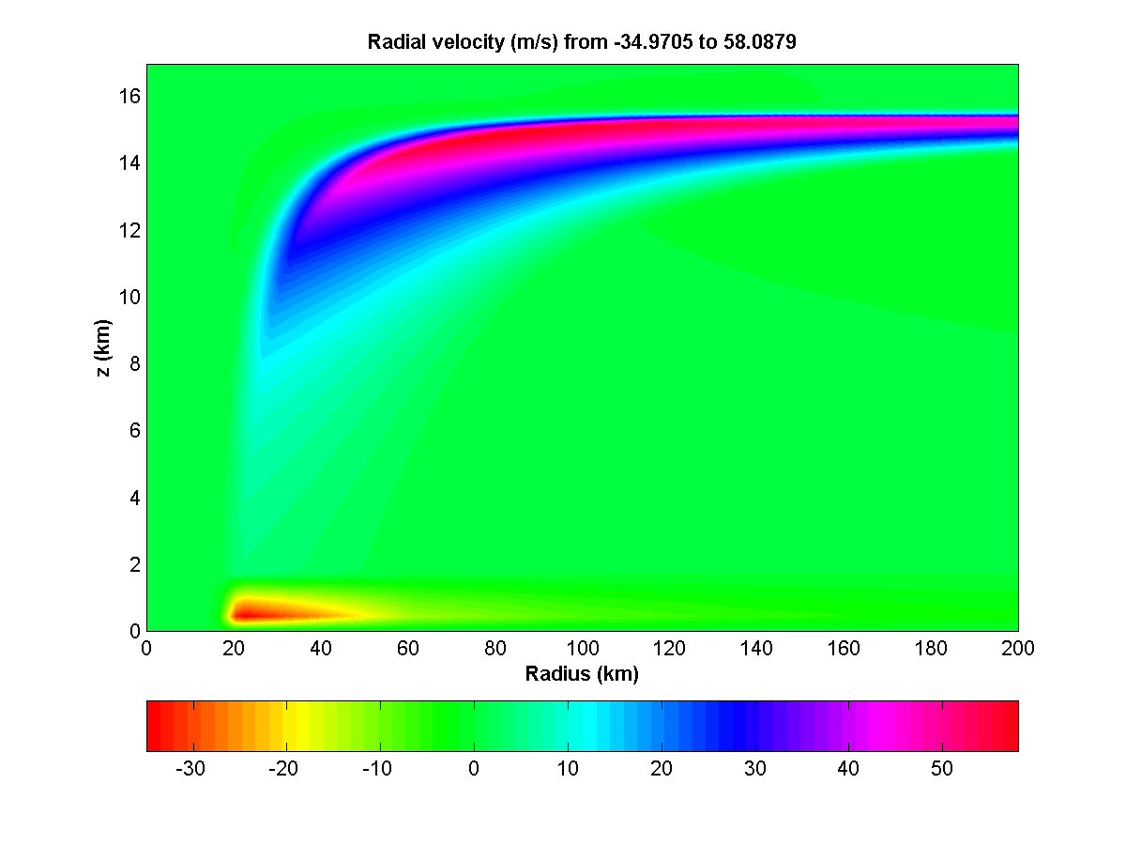

Slide 27
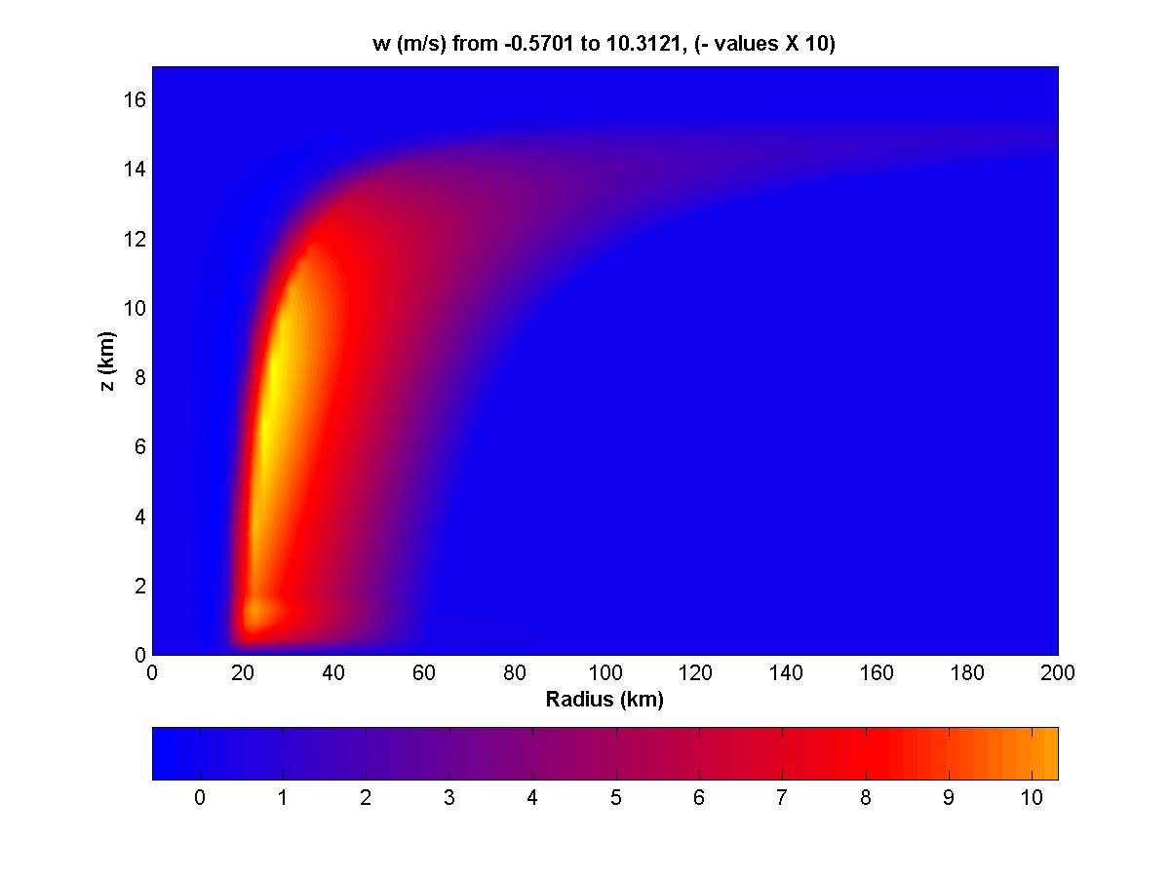

Slide 28
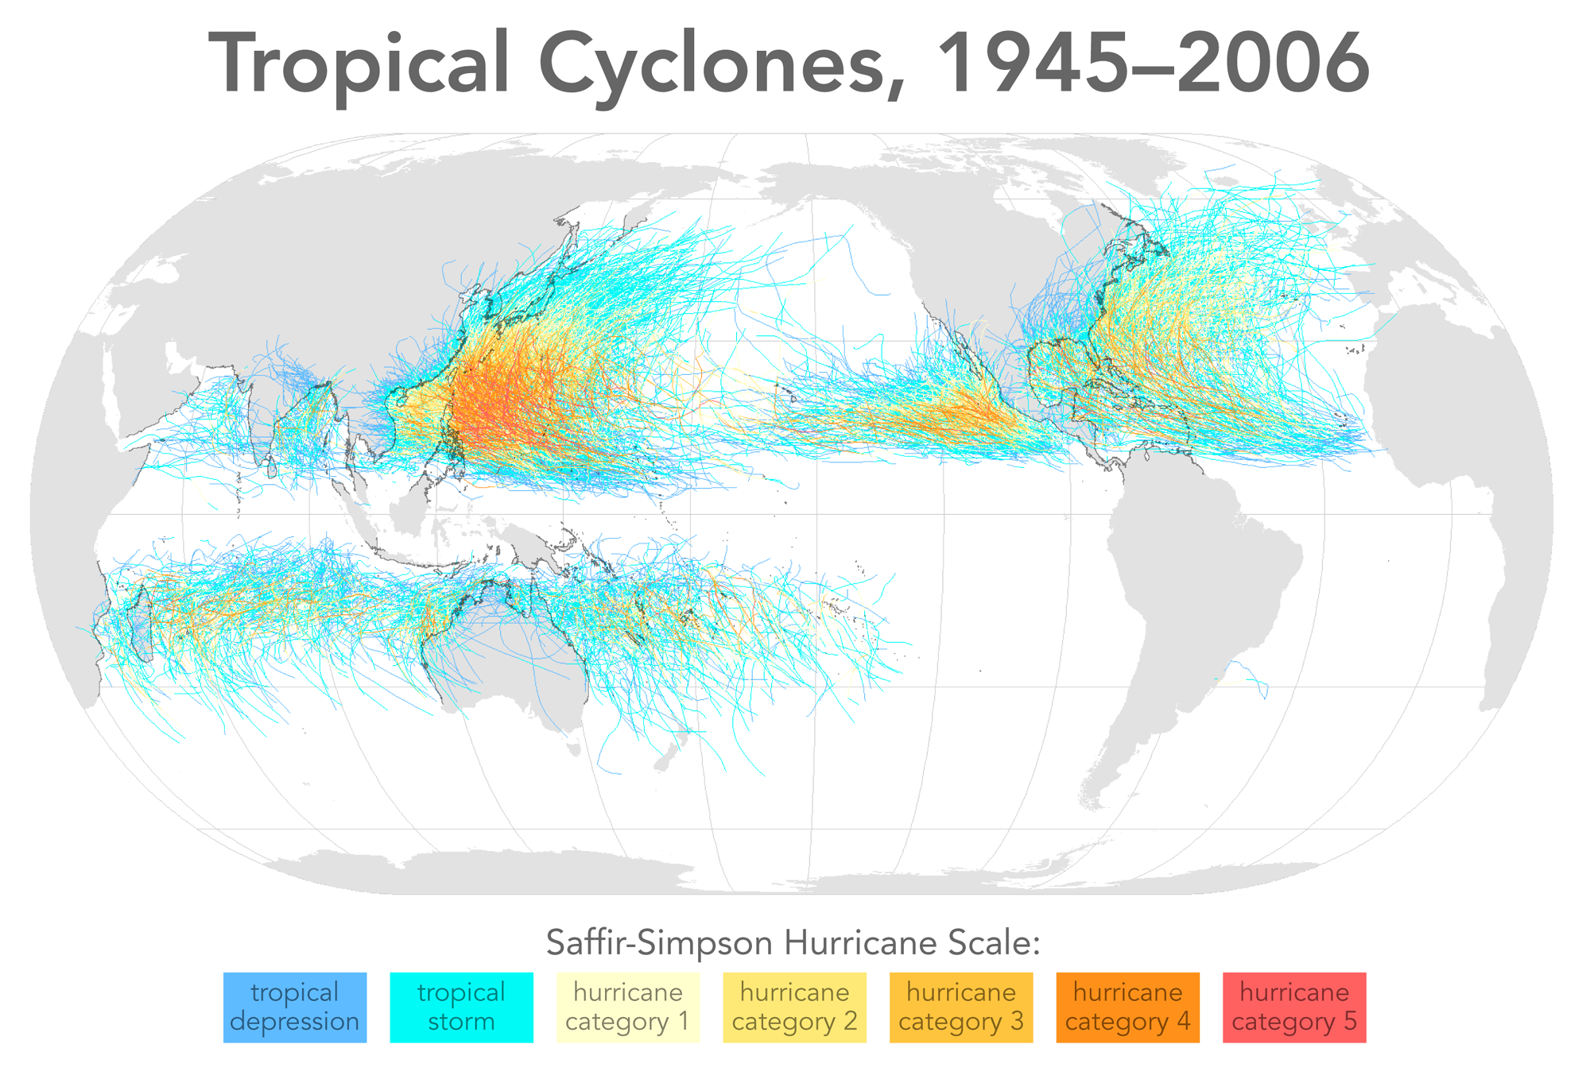

Slide 29
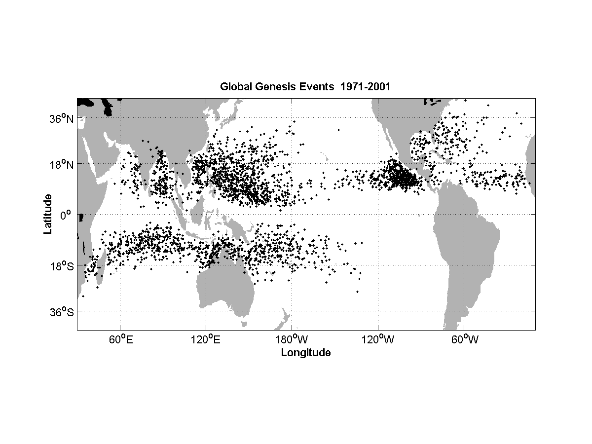

Slide 30
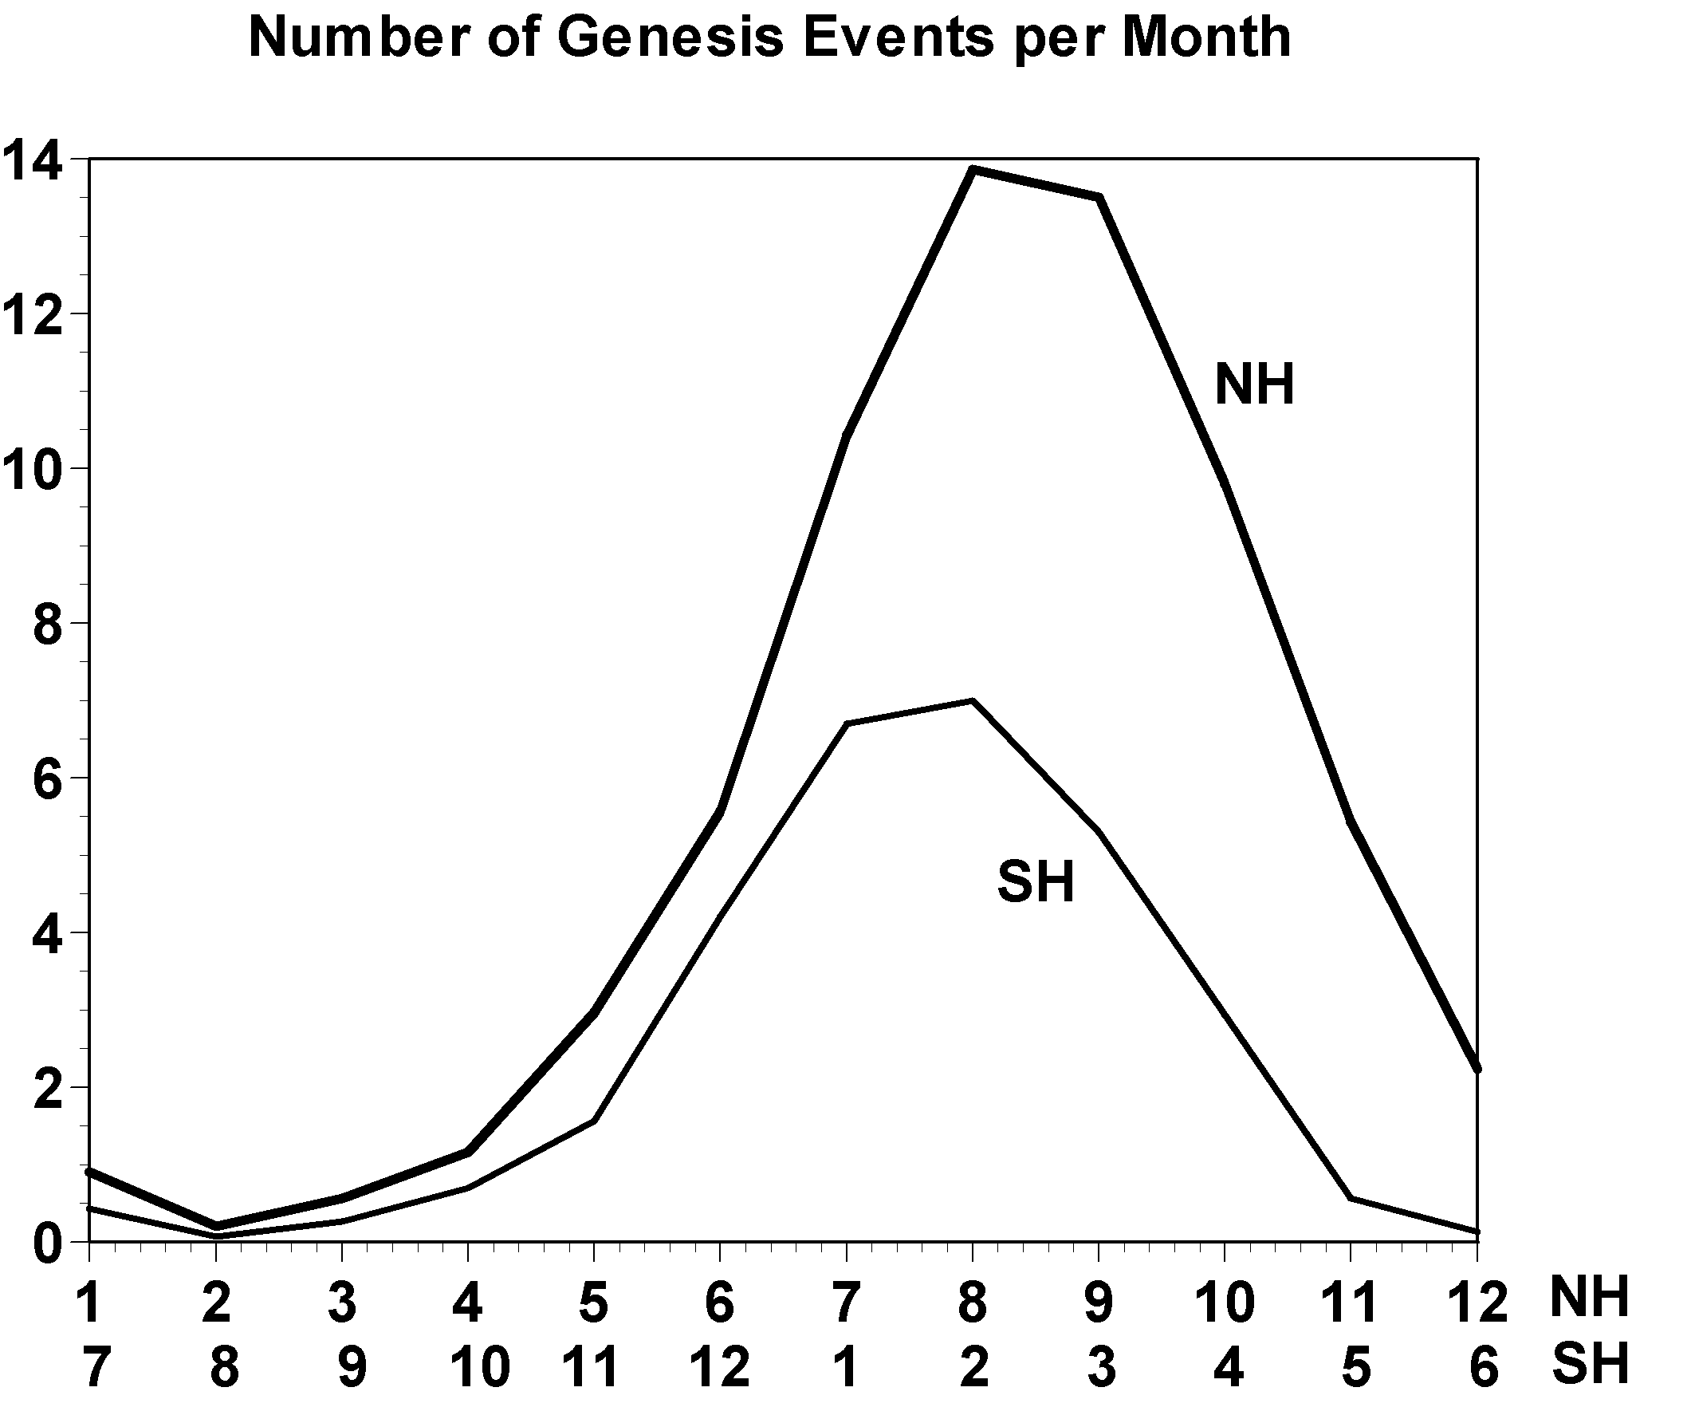

Slide 31
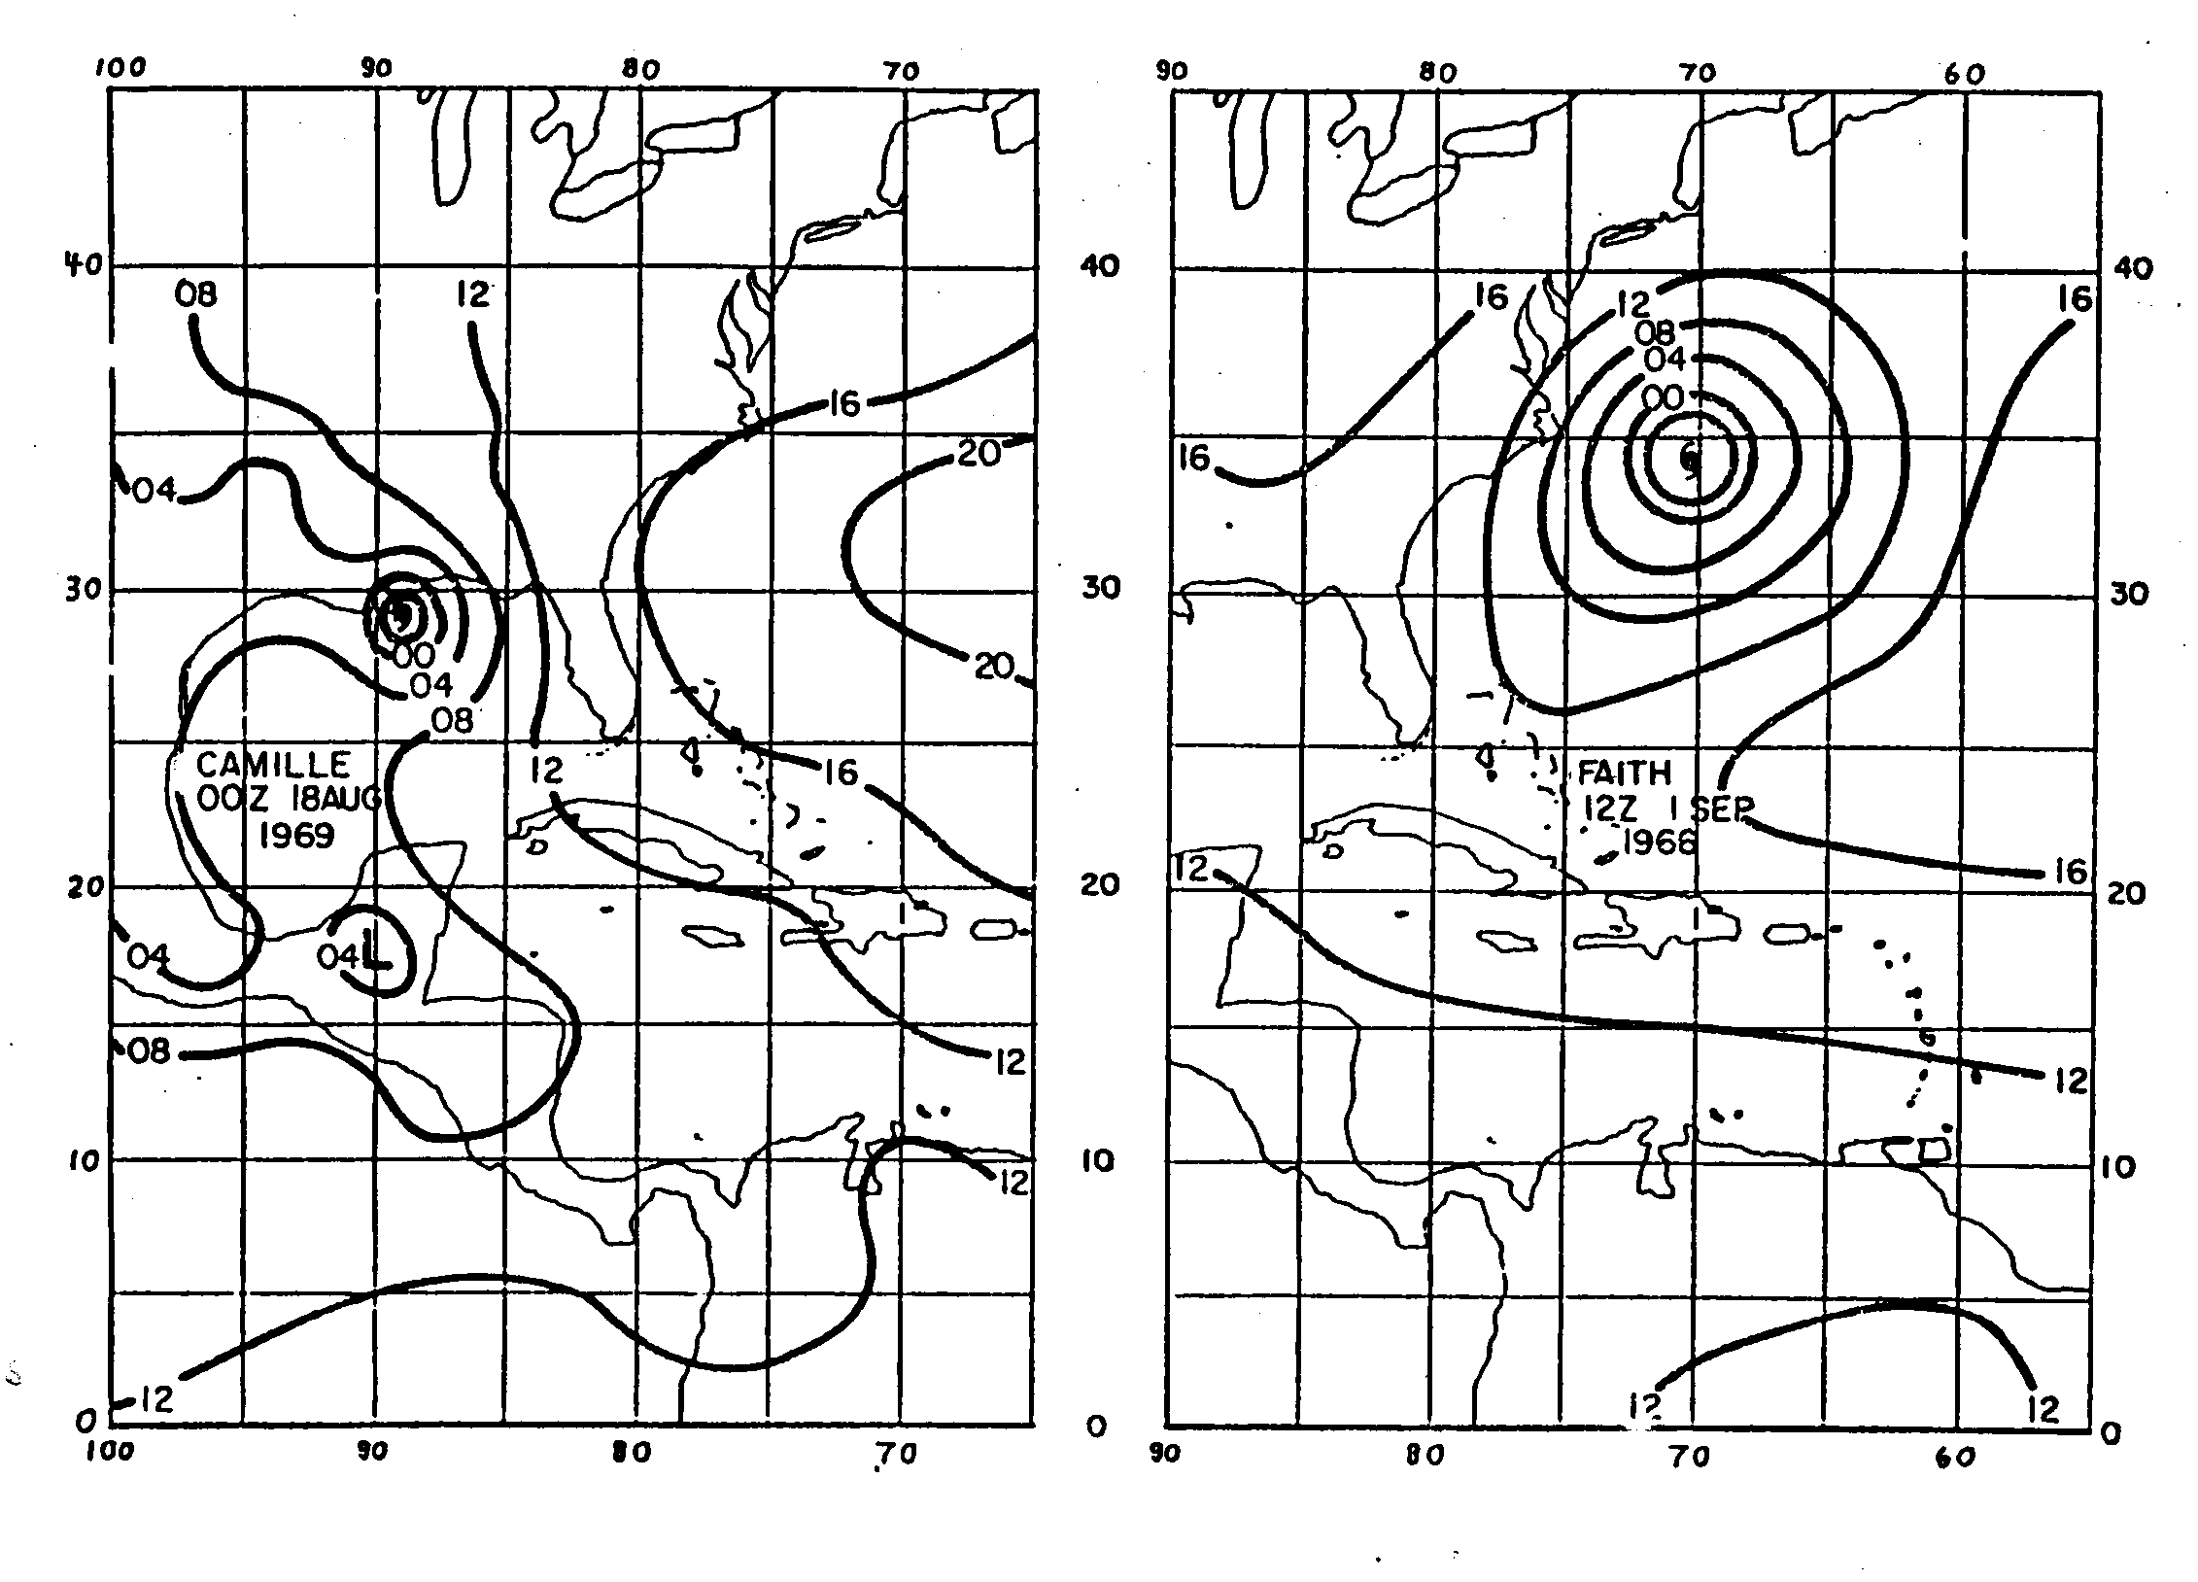

Slide 32
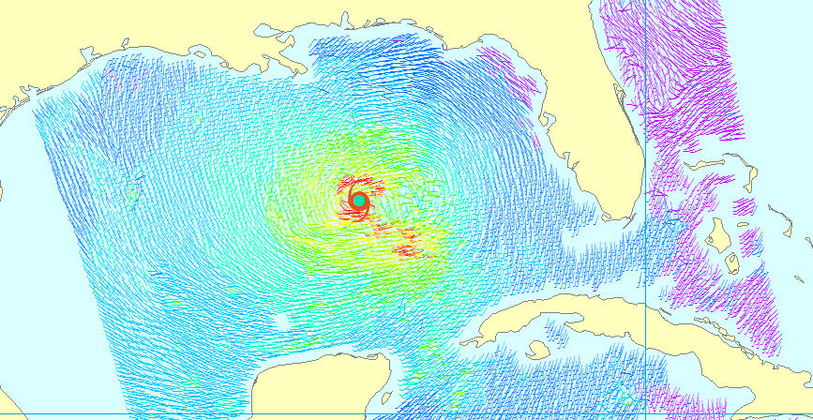
Use QuickScat to develop climatology of outer winds

Slide 33
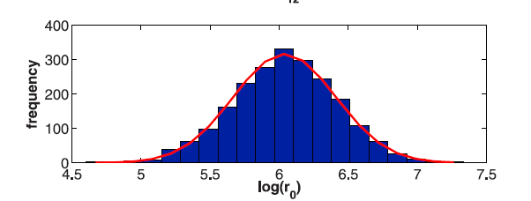
Outer radius very nearly follows a log-normal distribution with a median value of about 420 km

Slide 34
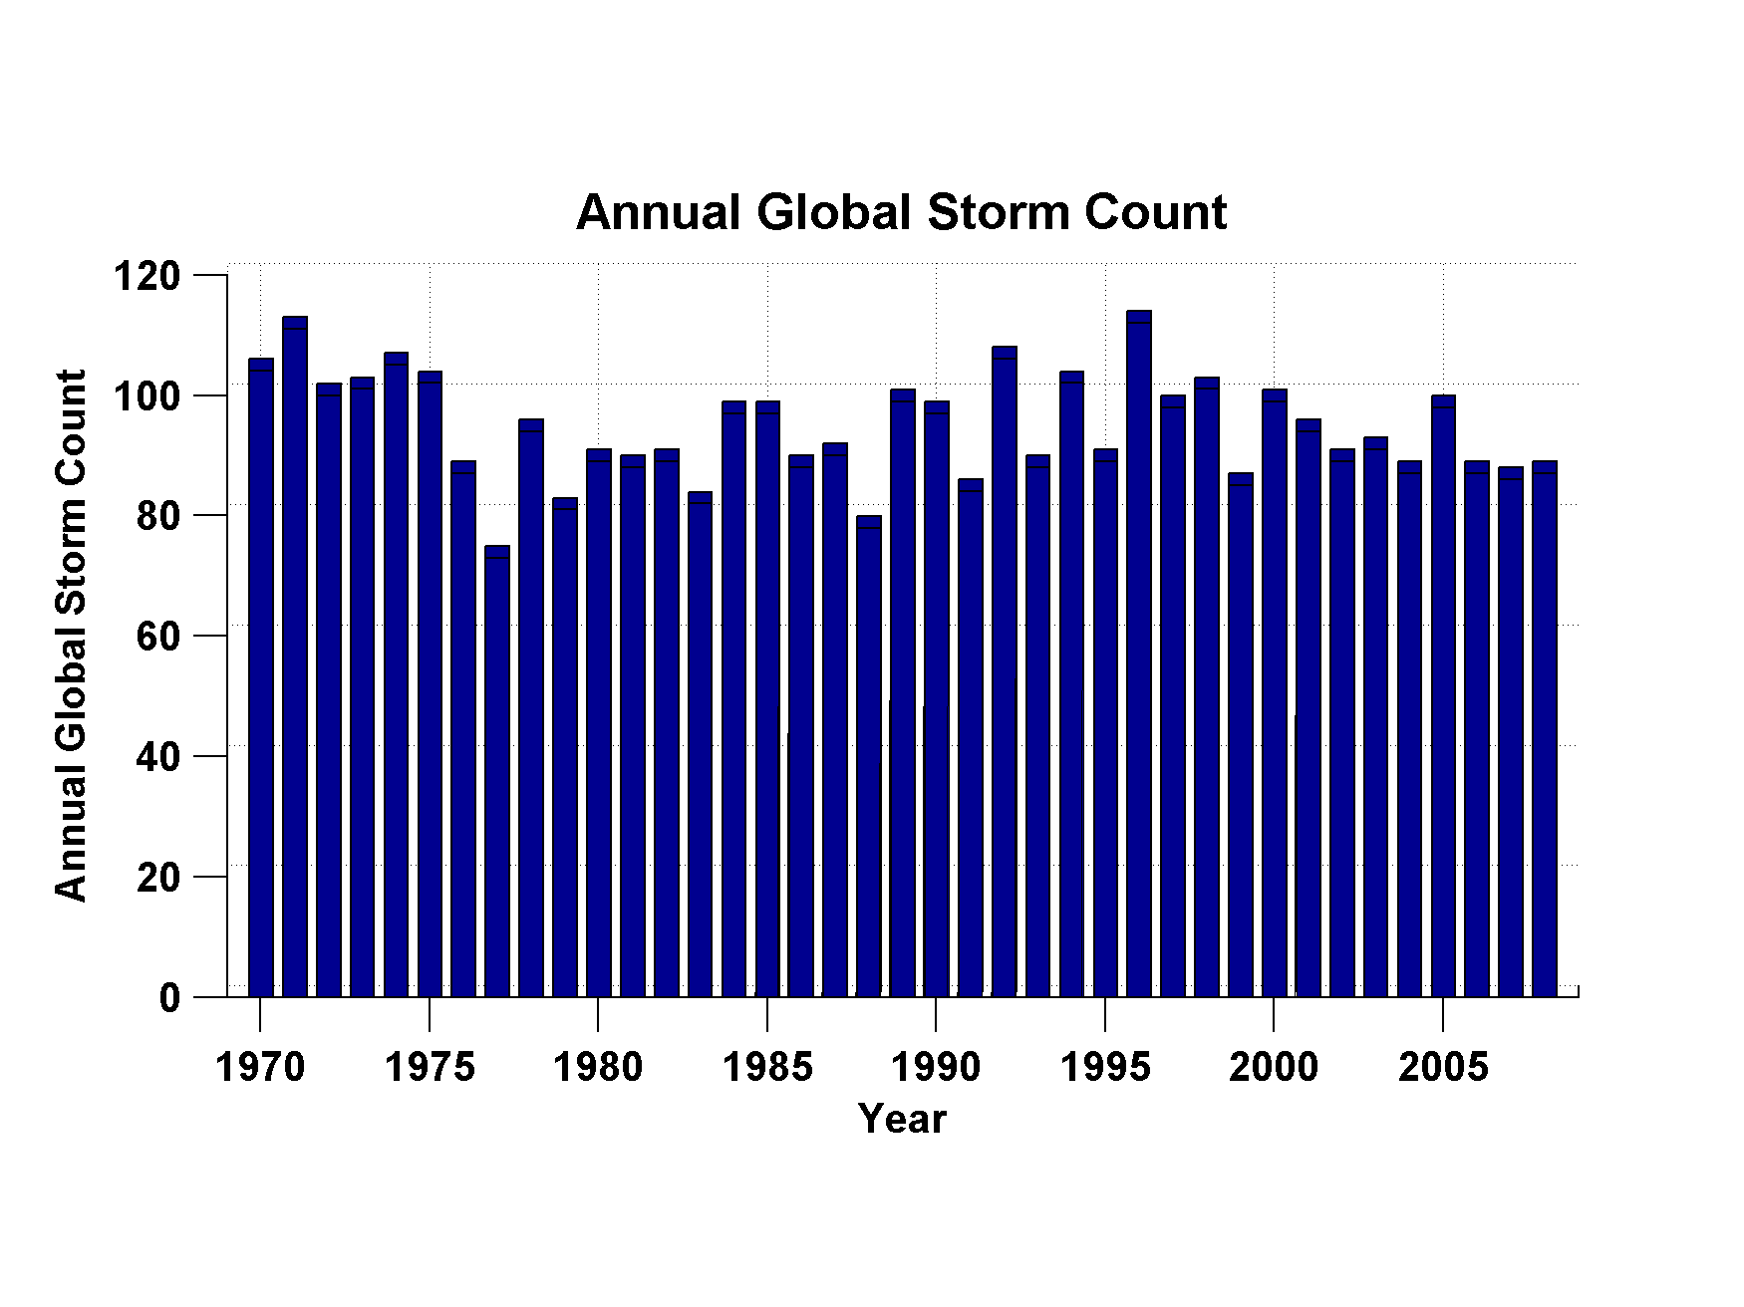
Global Tropical Cyclone Frequency, 1970-2008
Data Sources: NOAA/TPC and NAVY/JTWC
Notes:
34

Slide 36
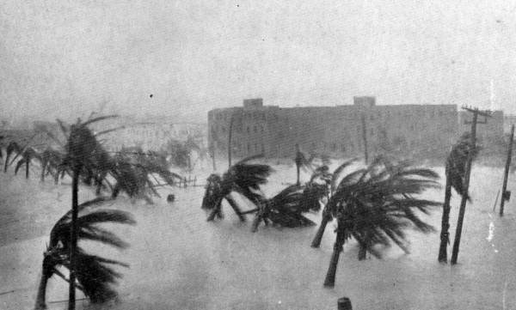
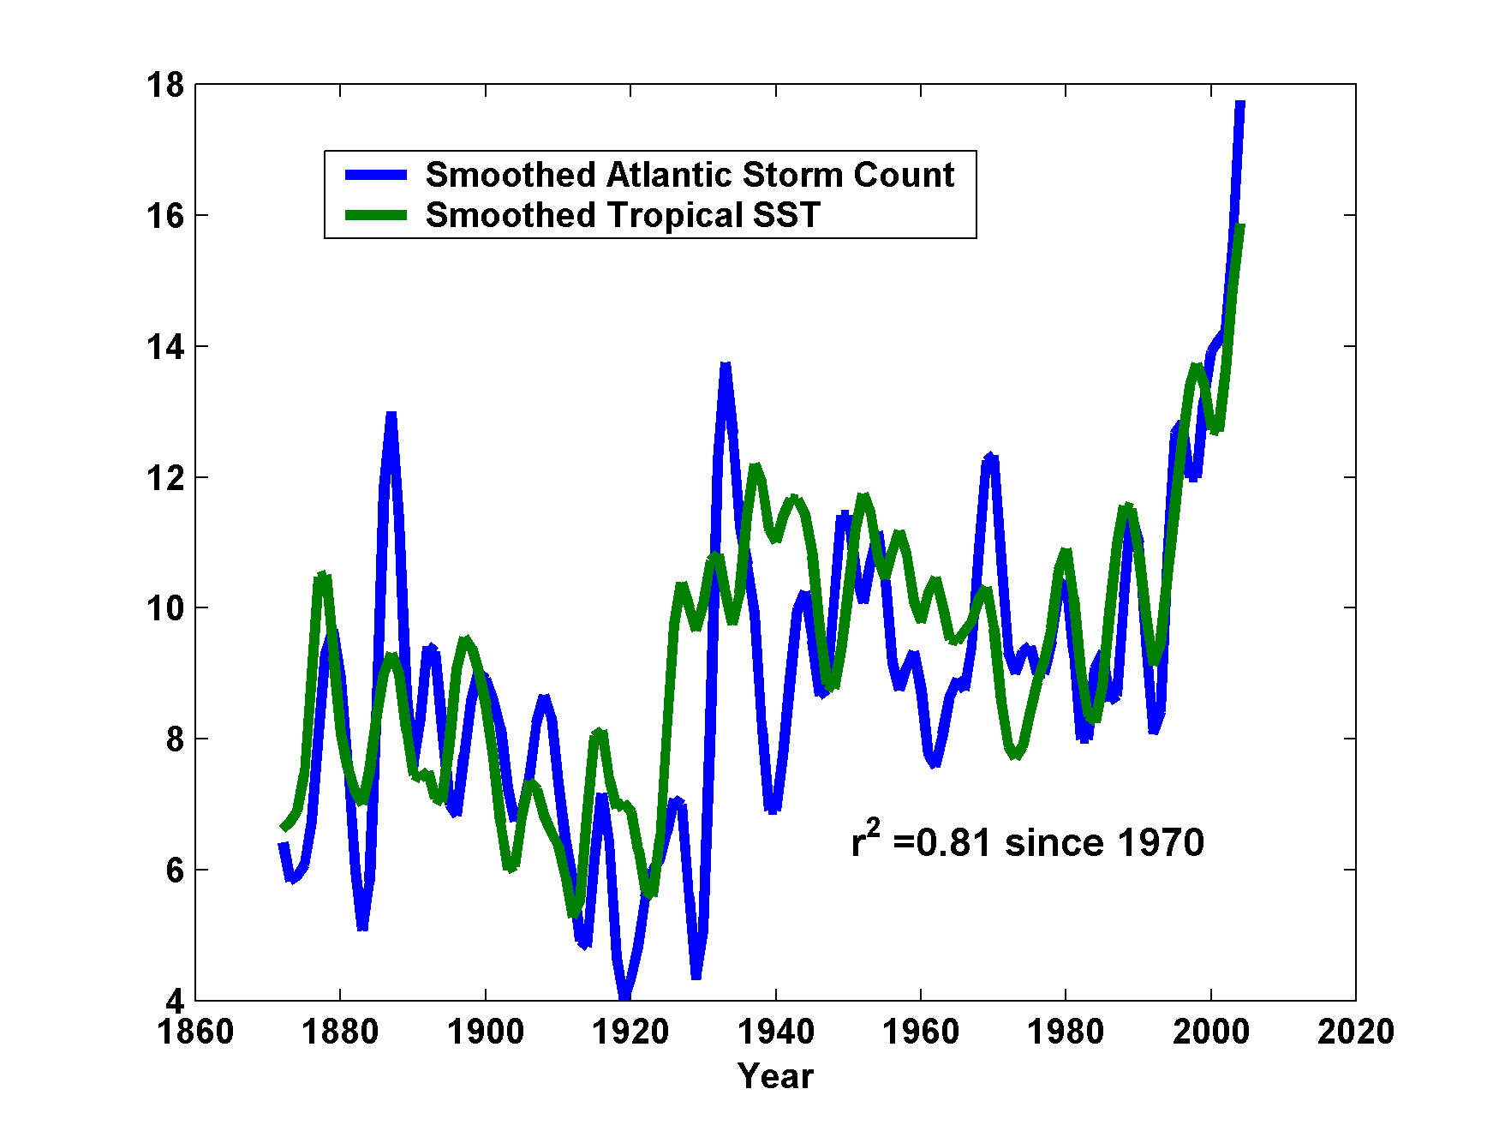
In Atlantic, the Frequency of Storms is Well Correlated with Tropical Atlantic Sea Surface Temperatures
Years covered: 1870-2006
Number of Storms
Scaled Temperature
Notes:
Same as the previous slide, but the ocean surface temperature in a patch of the tropical North Atlantic between Africa and the Caribbean, during August-October, has been added (blue curve). This ocean temperature has been multiplied by a constant to make it easier to compare to the annual storm frequency, and the curve has been smoothed as in the previous slide.

Slide 37
Better Intensity Metric:
The Power Dissipation Index
A measure of the total frictional dissipation of kinetic energy in the hurricane boundary layer over the lifetime of the storm

Slide 38
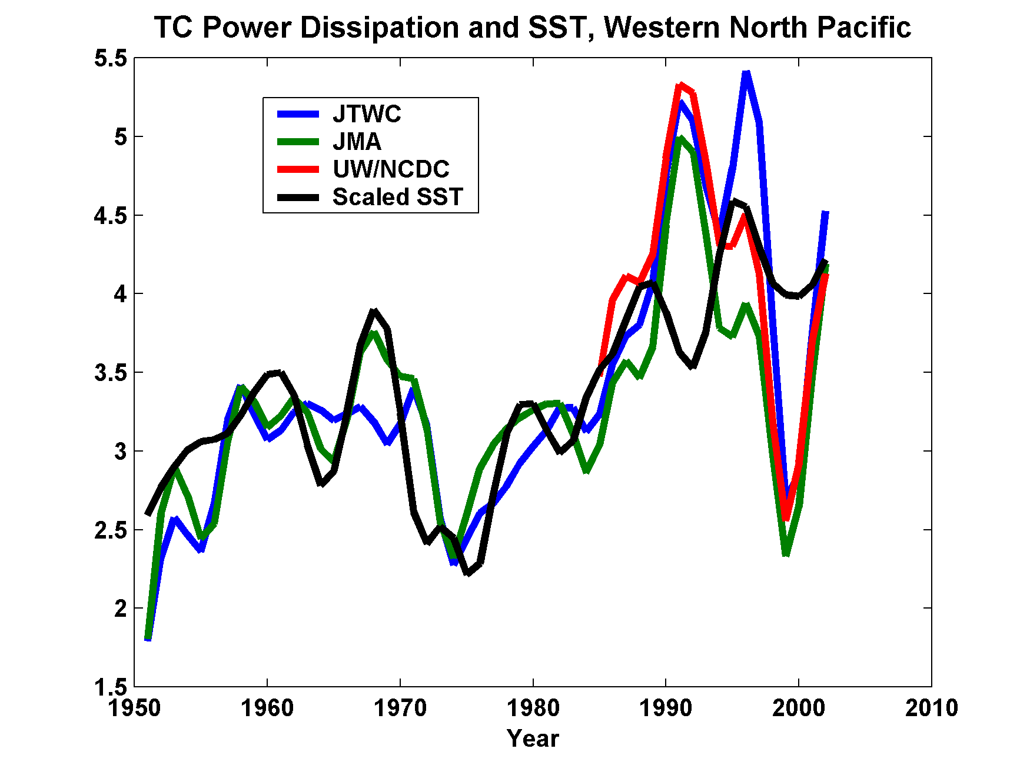
Three Analyses of Tropical Cyclone Power Dissipation in the Western North Pacific, and SST in the Main Development Region
Years covered: 1949-2004

Slide 39
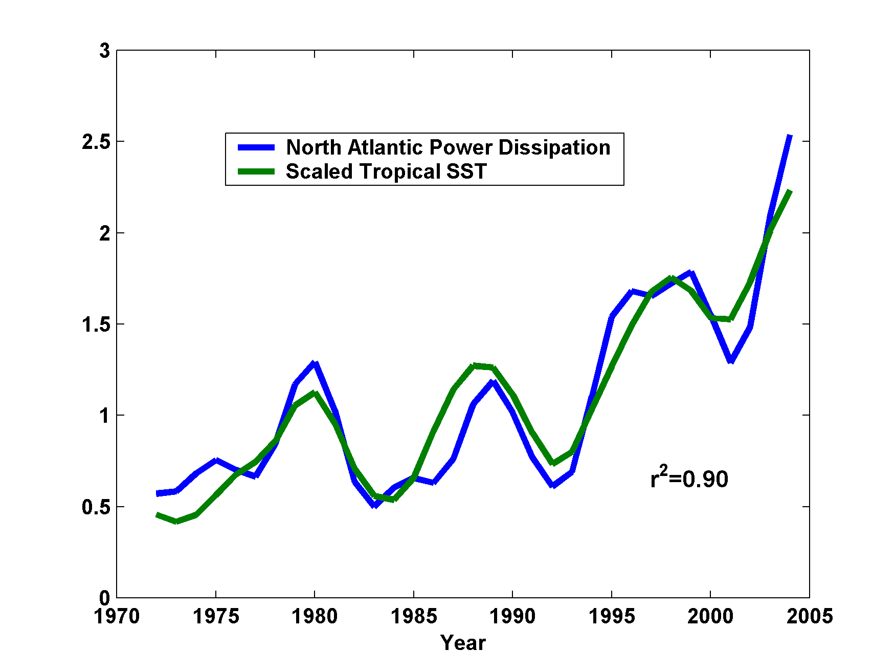
In the Atlantic, Power Dissipation and SST are Exceptionally Well Correlated through the Modern Instrumental Record
Years covered: 1970-2006

Slide 40
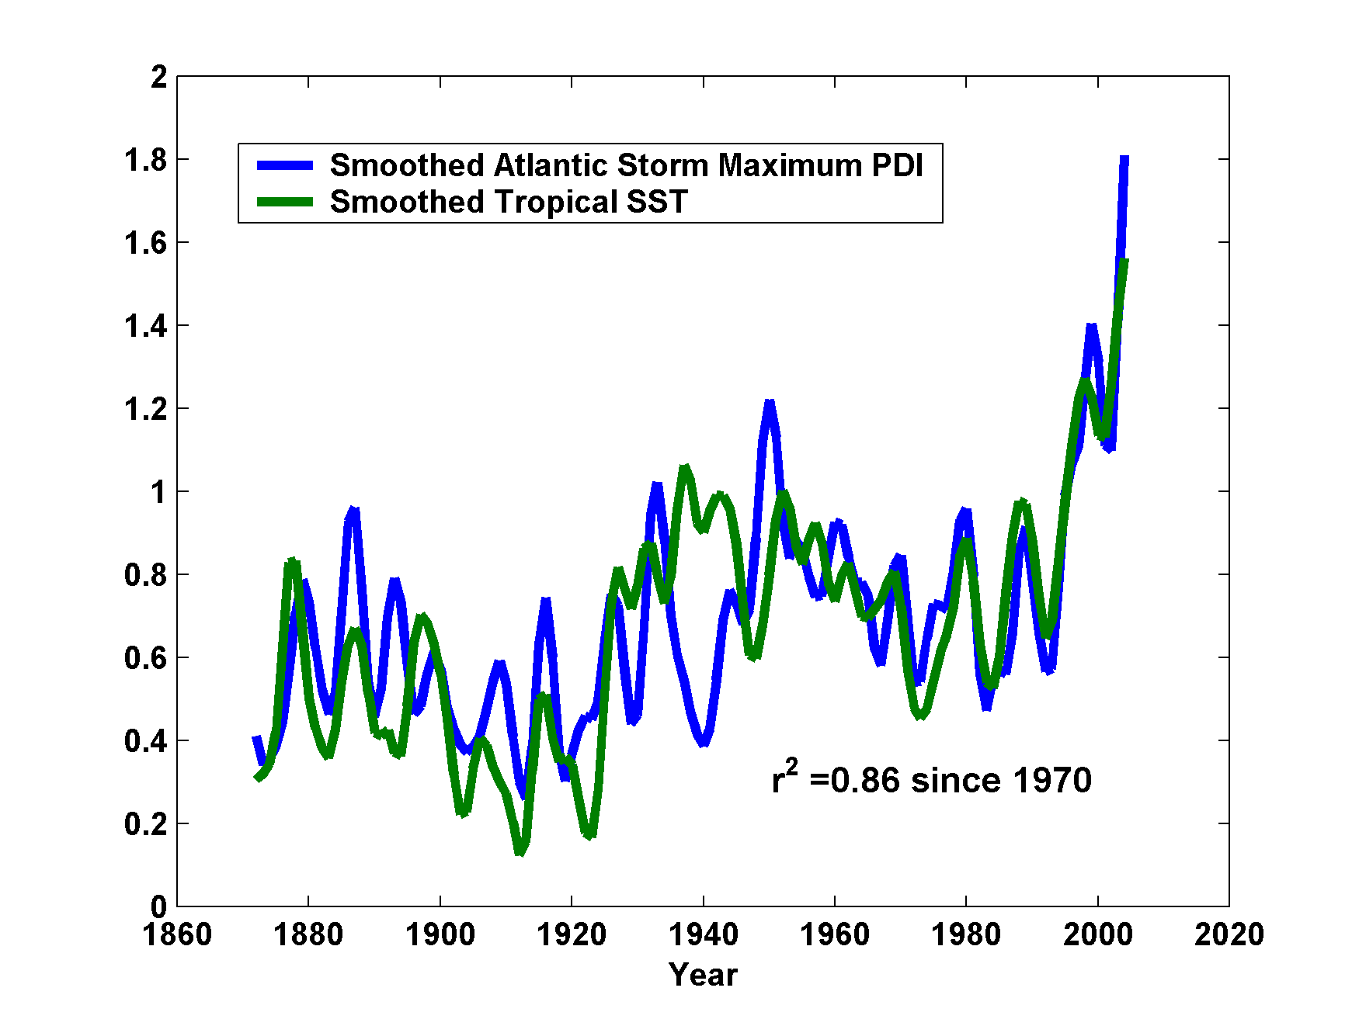
Atlantic Sea Surface Temperatures and Storm Maximum Power Dissipation
(Smoothed with a weighted filter)
Years covered: 1870-2006
Power Dissipation Index (PDI)
Scaled Temperature
Notes:
This graph is similar to the previous graph, but the ocean surface temperature has been added for comparison. The low value of storm power in the early 1940s is thought to be due to the lack of reports from ships at sea because of the radio silence imposed during WWII.

Slide 41
Pushing Back the Record of Tropical Cyclone Activity:
Paleotempestology
Notes:
41

Slide 42
Paleotempestology
barrier beach
upland
overwash fan
backbarrier marsh
a)
lagoon
barrier beach
upland
overwash fan
b)
backbarrier marsh
lagoon
terminal lobes
flood tidal delta
Source: Jeff Donnelly, WHOI
Notes:
42

Slide 43
Source: Jeff Donnelly, Jon Woodruff, Phil Lane; WHOI
Notes:
43

Slide 44
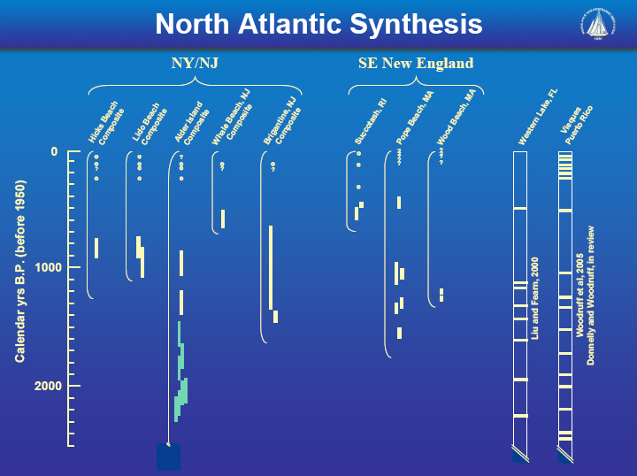
Source: Jeff Donnelly, Jon Woodruff, Phil Lane; WHOI
Notes:
44

Slide 45
Socio-Economic Consequences of Hurricanes

Slide 46
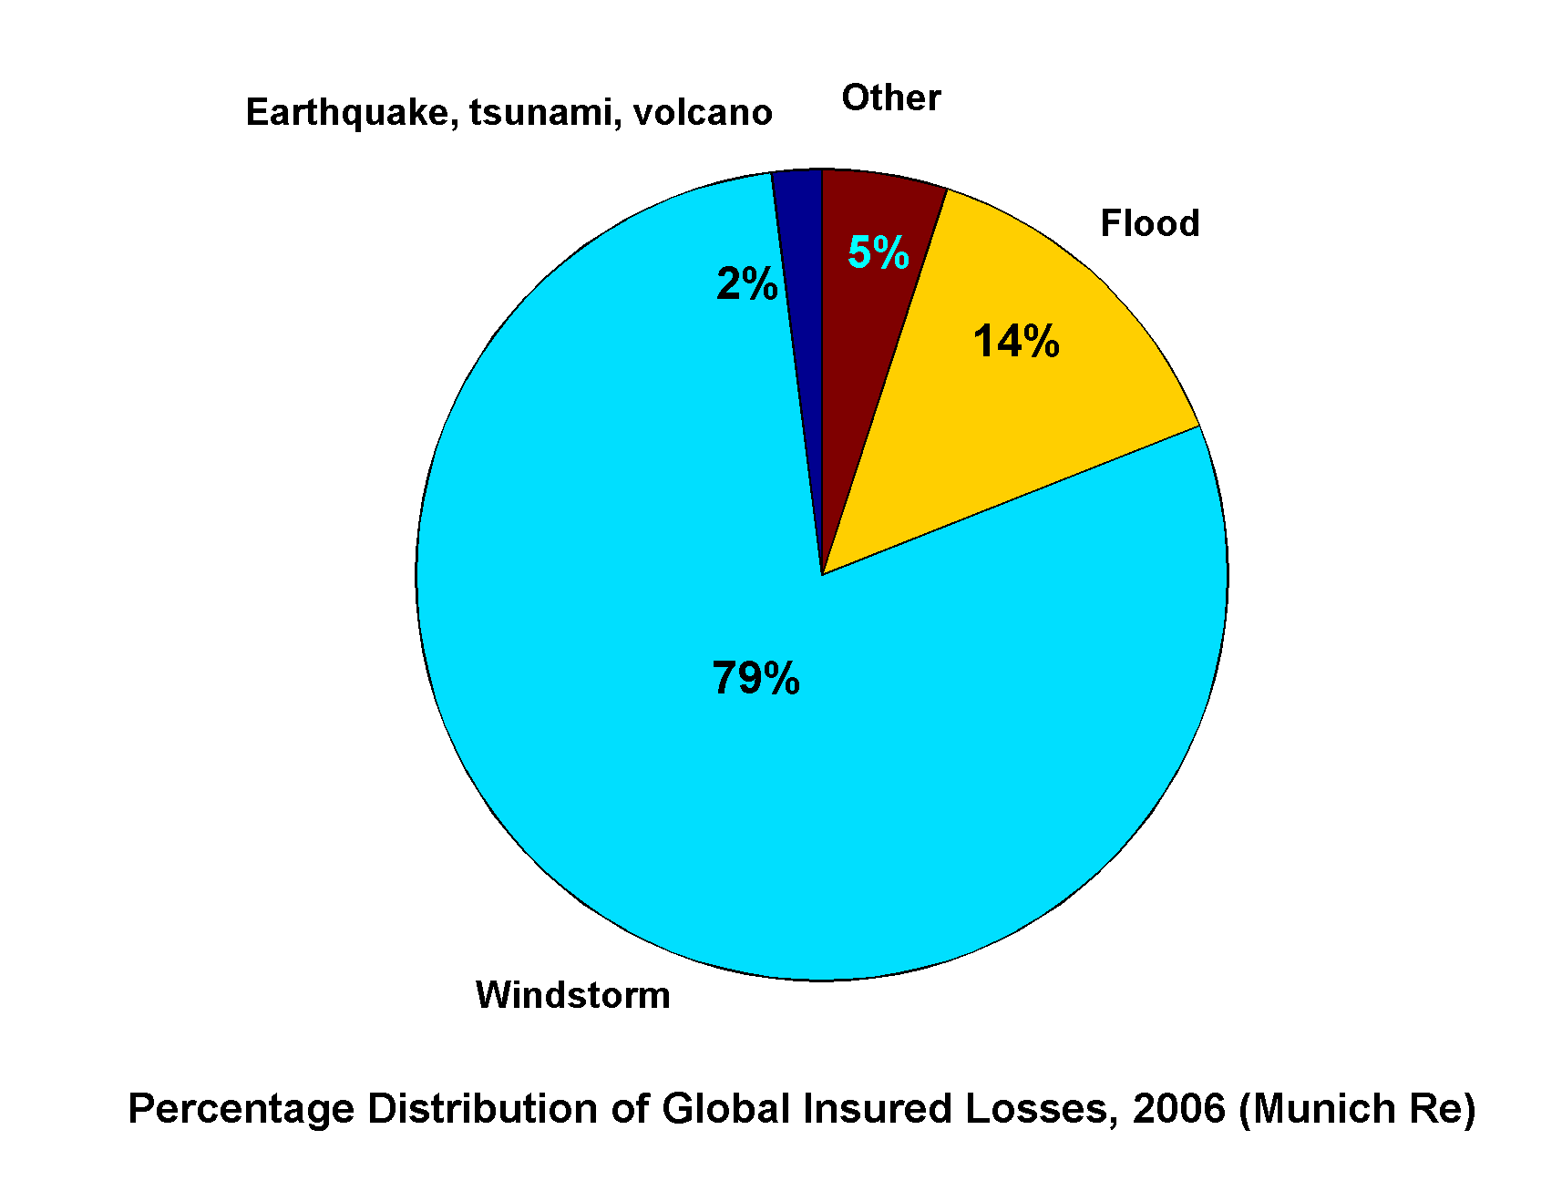
Windstorms Account for Bulk of Insured Losses Worldwide

Slide 47
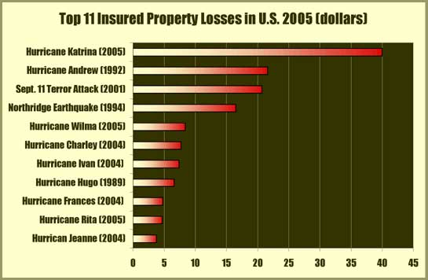

Slide 48
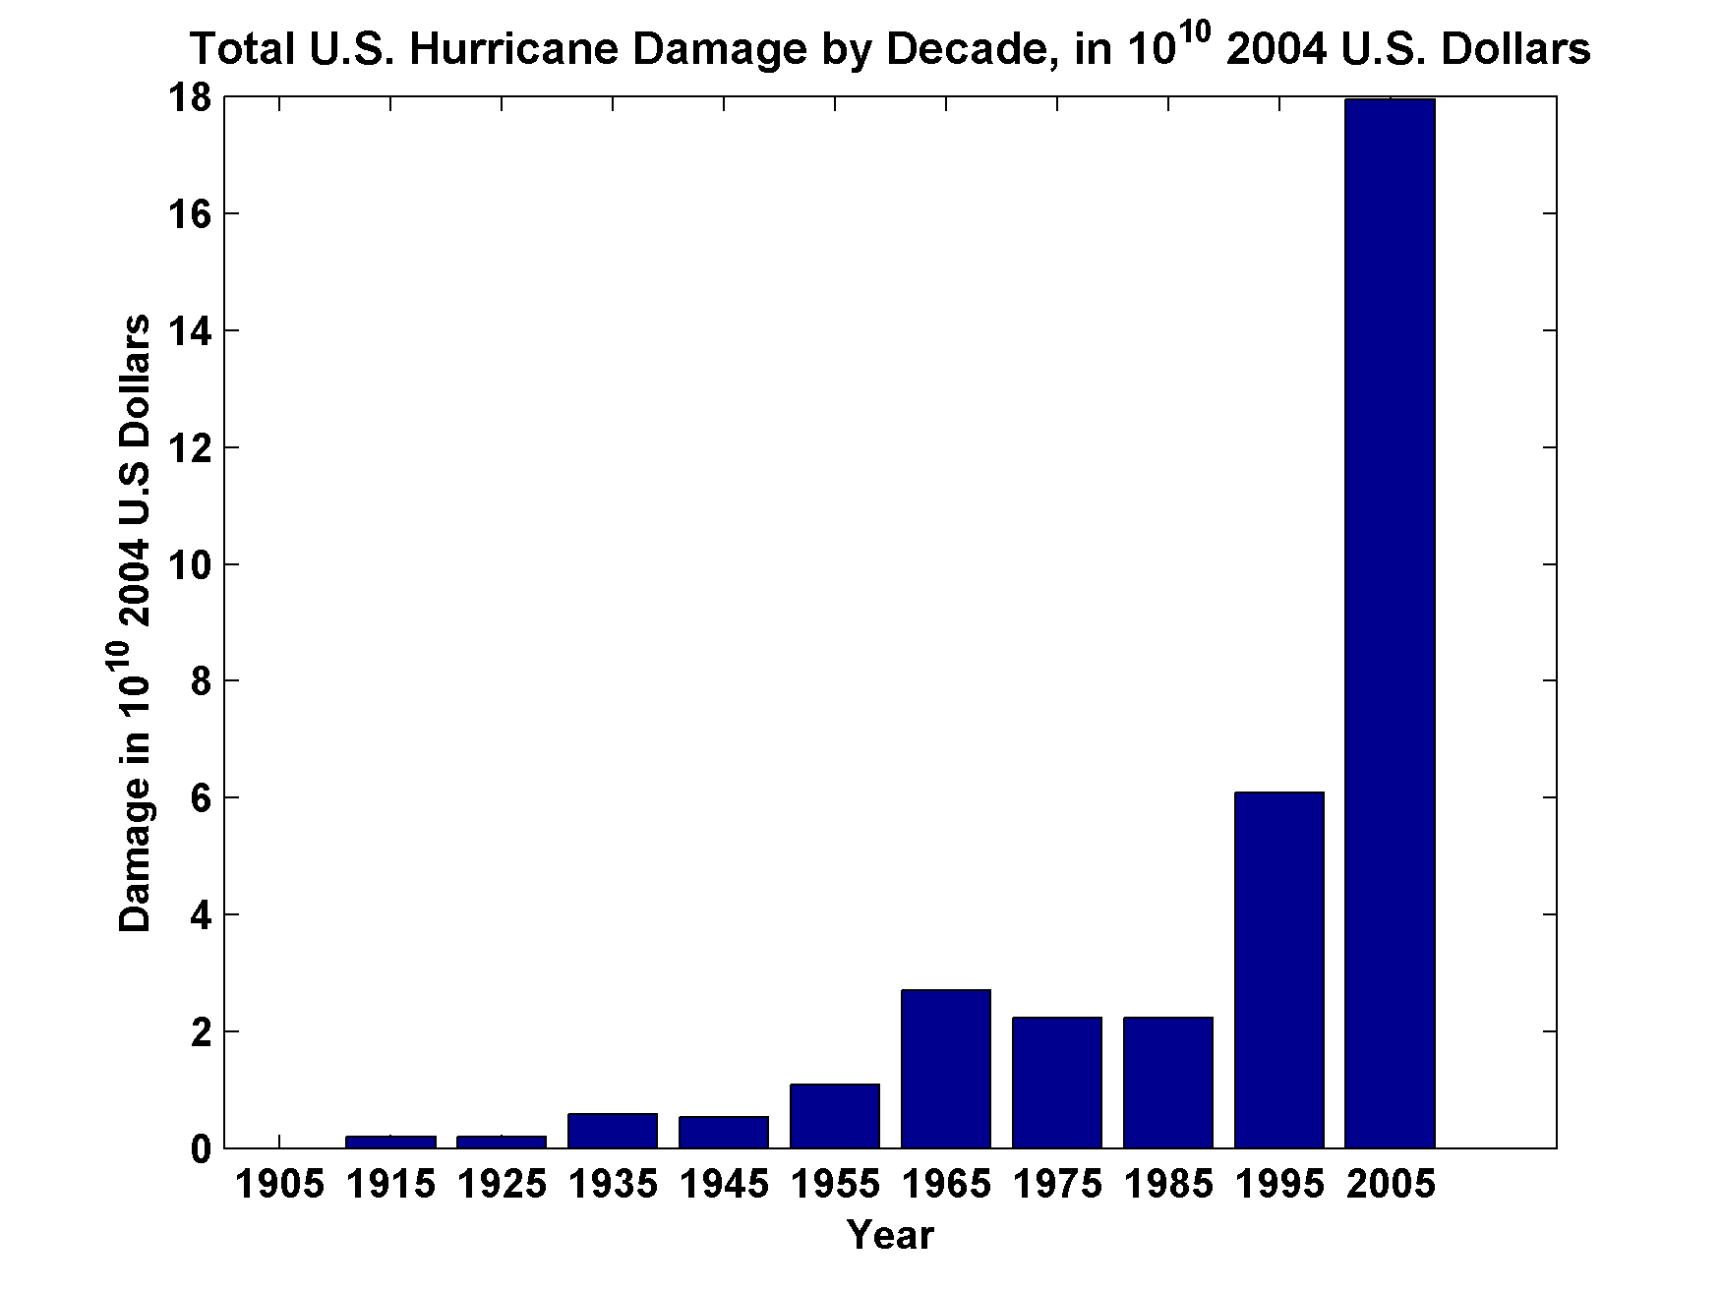
Total U.S. Hurricane Damage by Decade, in 10¹⁰ 2004 U.S. Dollars
Source: Roger Pielke, Jr.

Slide 49
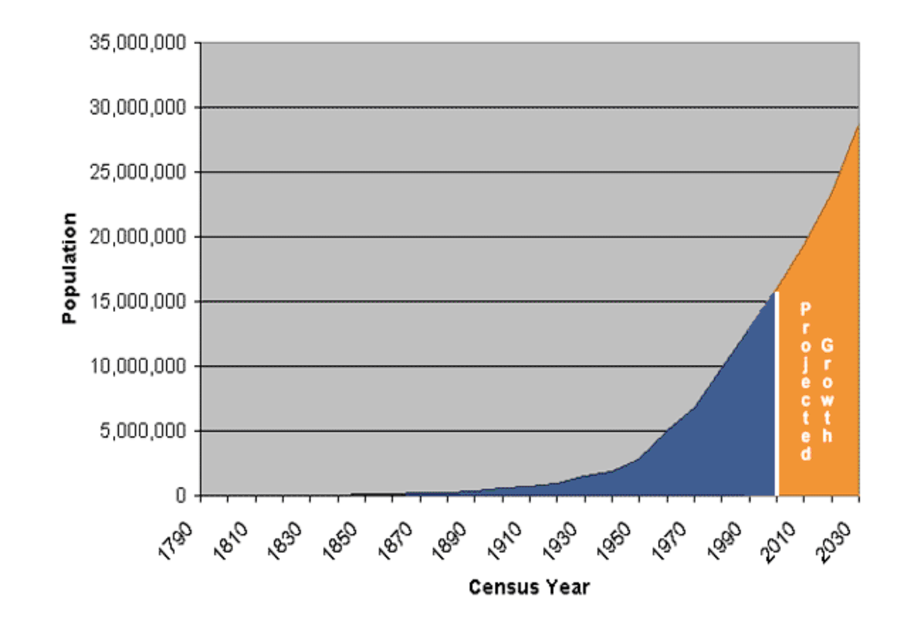
Population of Florida, 1790-2004

Slide 50
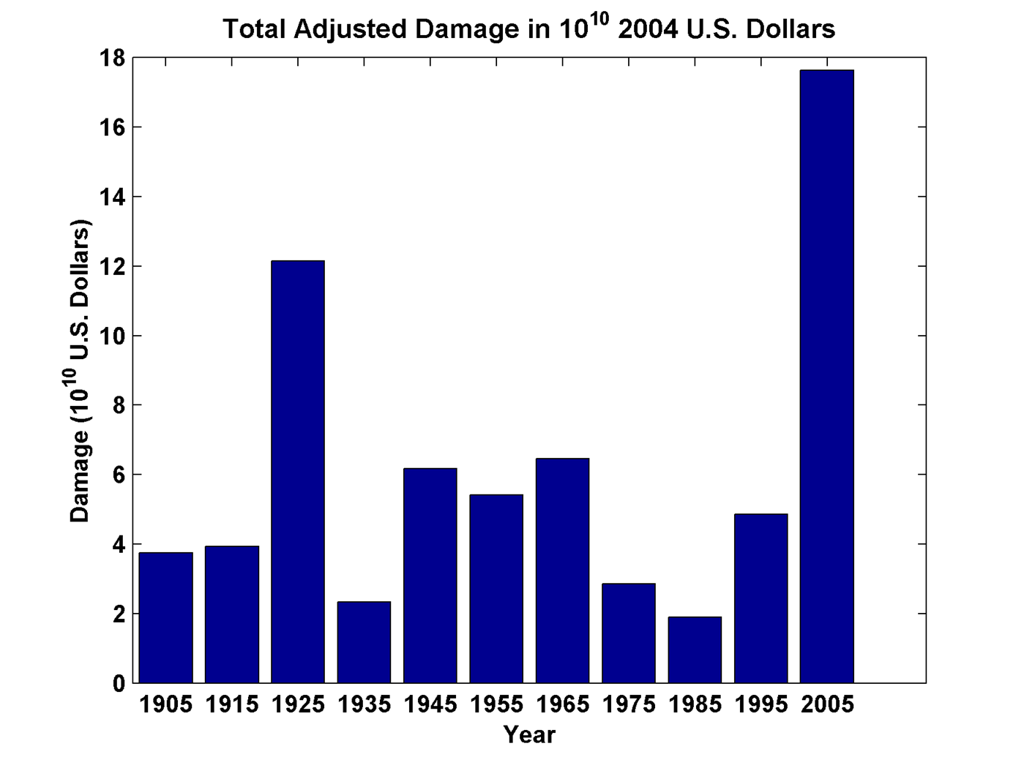
Total Adjusted Damage by Decade, in 10¹⁰ 2004 U.S. Dollars
Source: Roger Pielke, Jr.

Slide 51
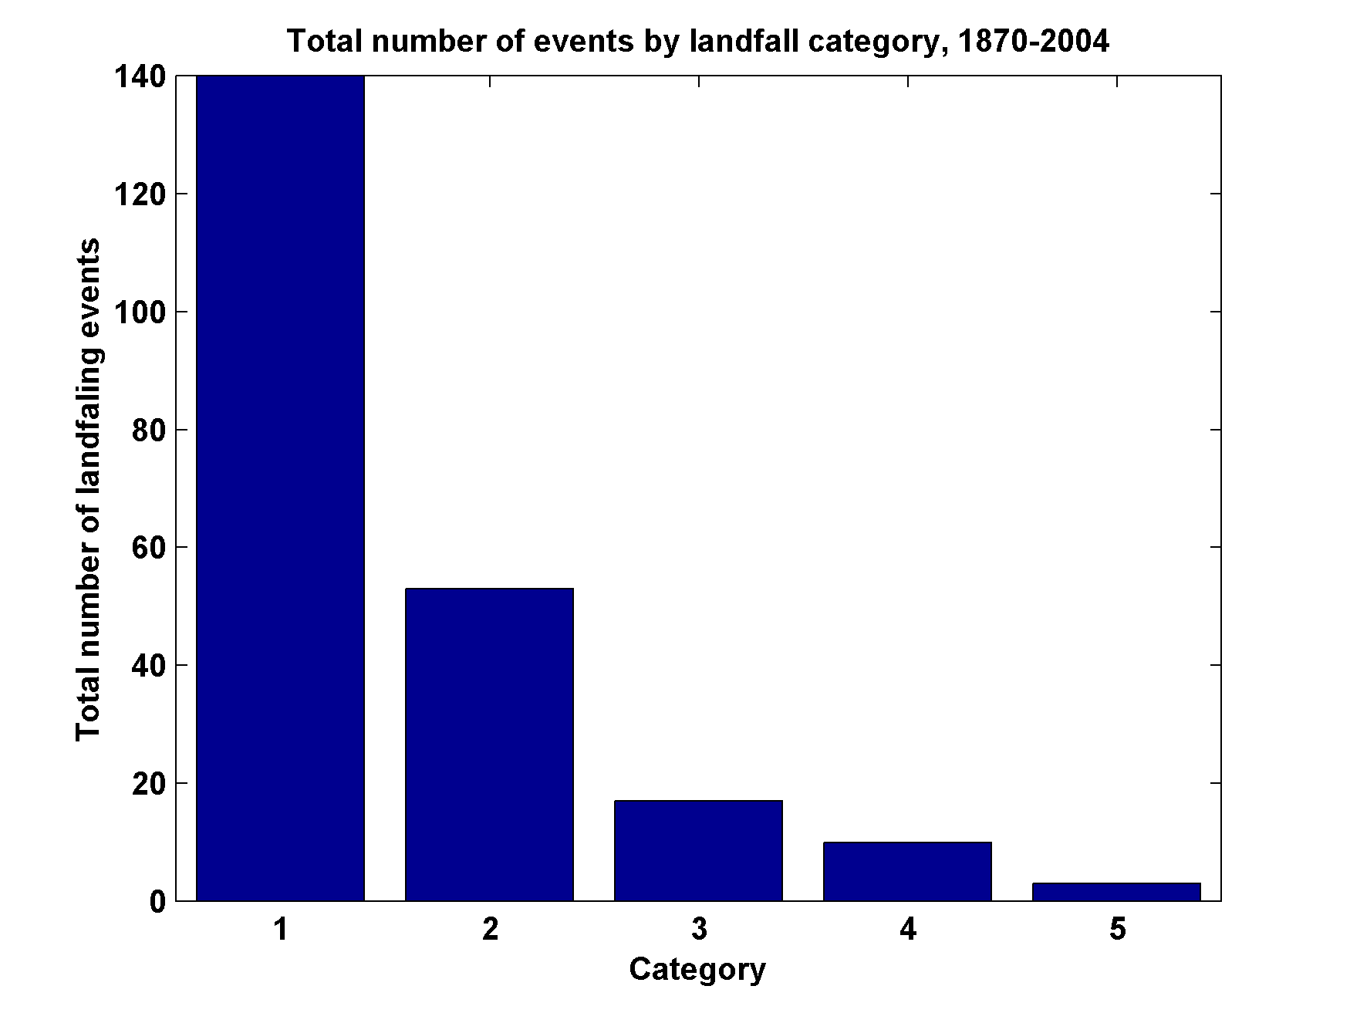
Total Number of Landfall Events, by Category, 1870-2004

Slide 52
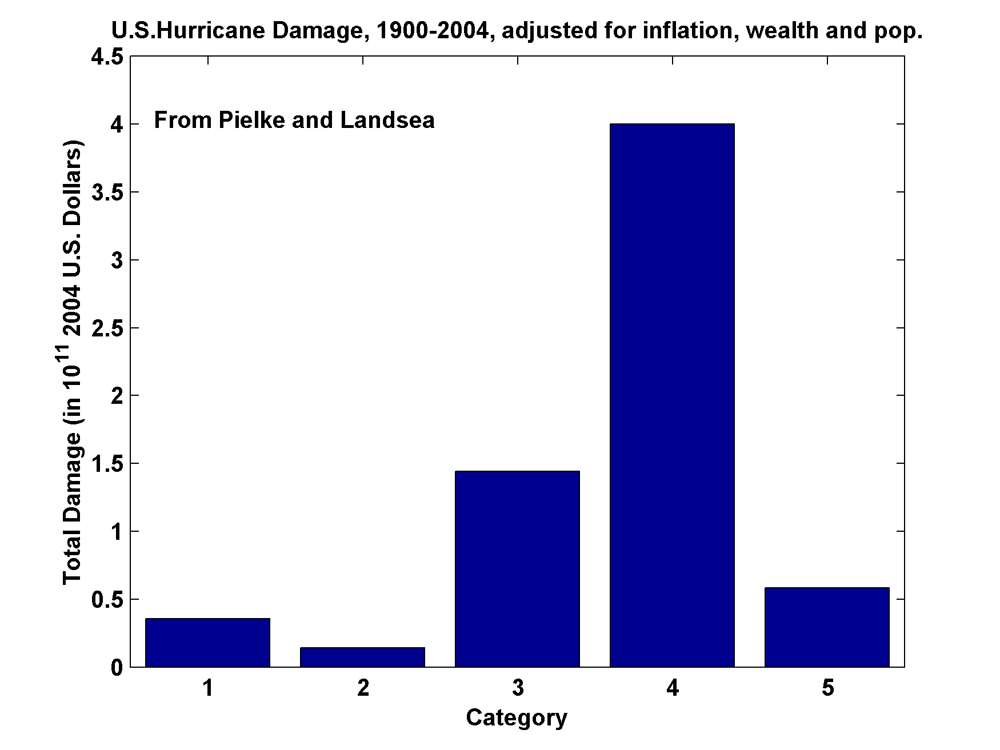
U.S. Hurricane Damage, 1900-2004,Adjusted for Inflation, Wealth, and Population

Slide 53
Infamous U.S. Hurricanes

Slide 54
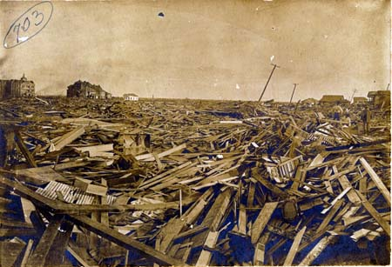
Galveston, 1900

Slide 55
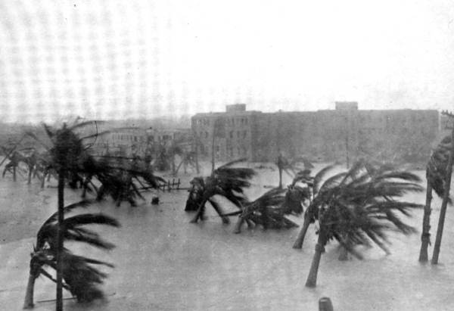
Miami, 1926

Slide 56
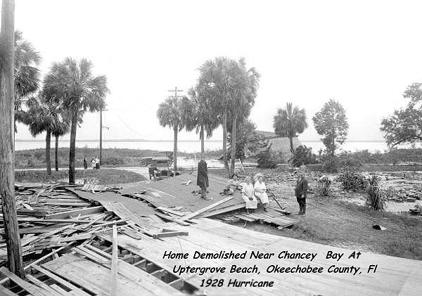
Okeechobee Hurricane of 1928

Slide 57
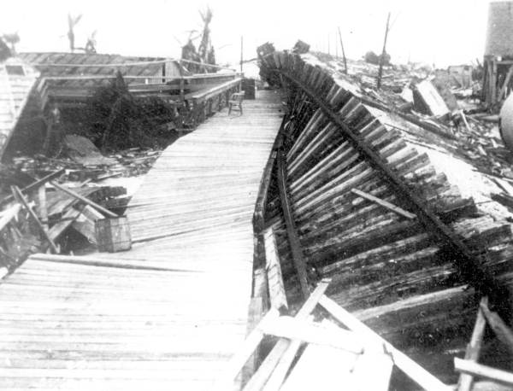
Labor Day Hurricane of 1935, Florida Keys
Indian Key absolutely swept clean, not a blade of grass, and over the high center of it were scattered live conchs that came in with the sea, craw fish, and dead morays. The whole bottom of the sea blew over it.
- Ernest Hemingway

Slide 58
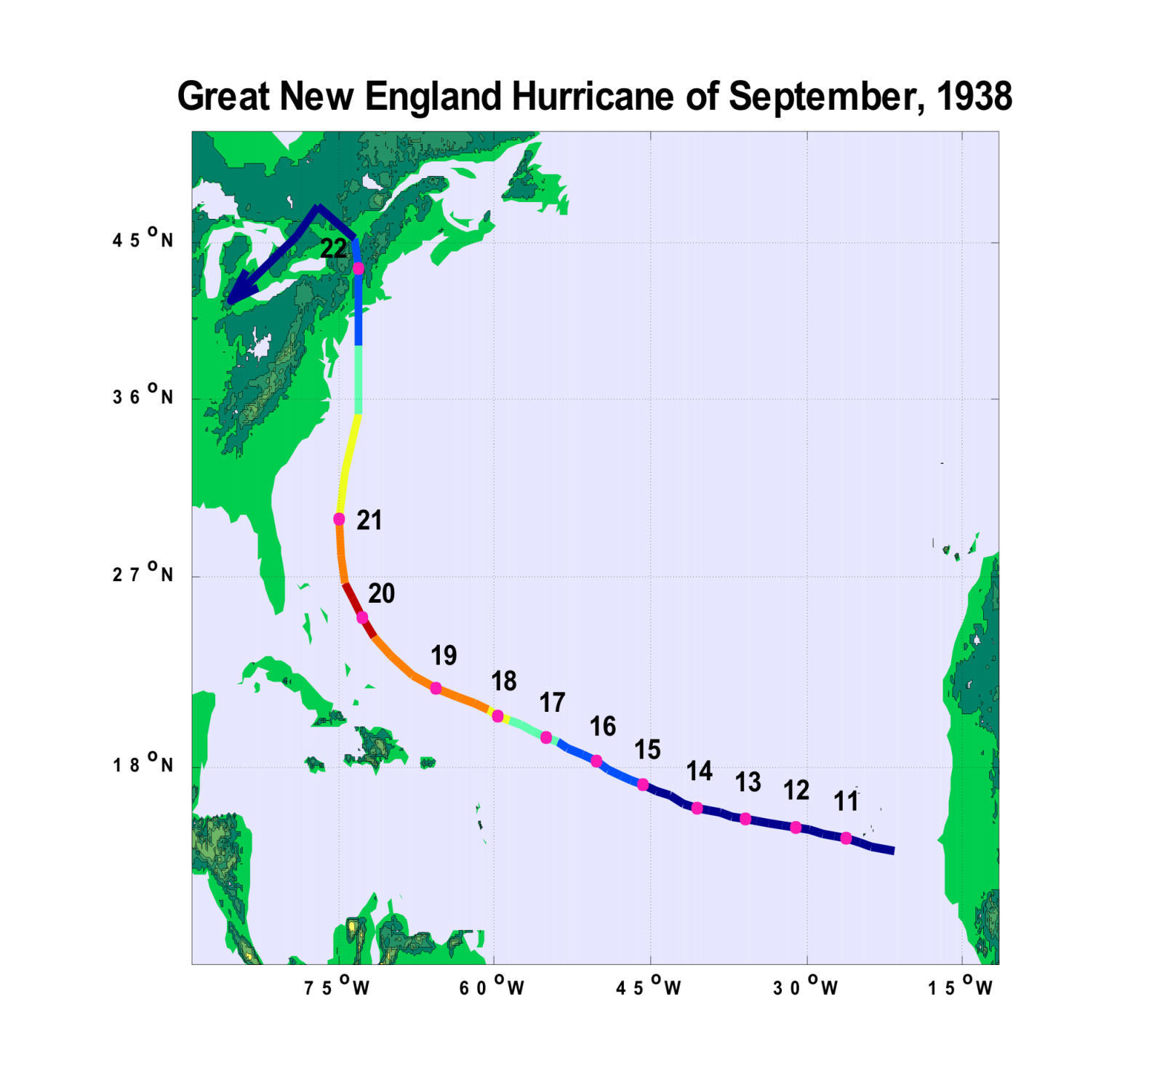

Slide 59
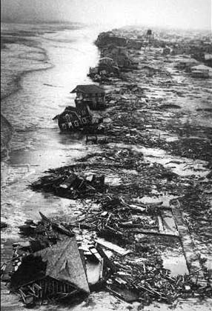
Long Island Shore after the 1938 Hurricane

Slide 60
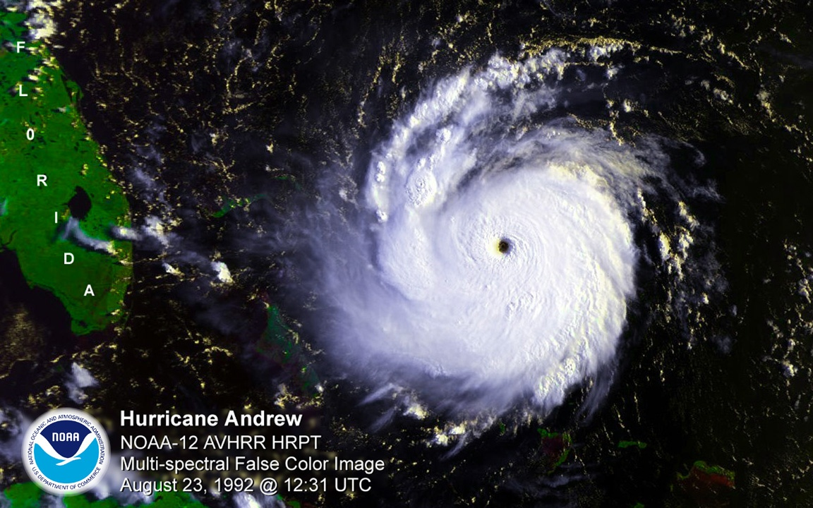
Andrew, 1992

Slide 61
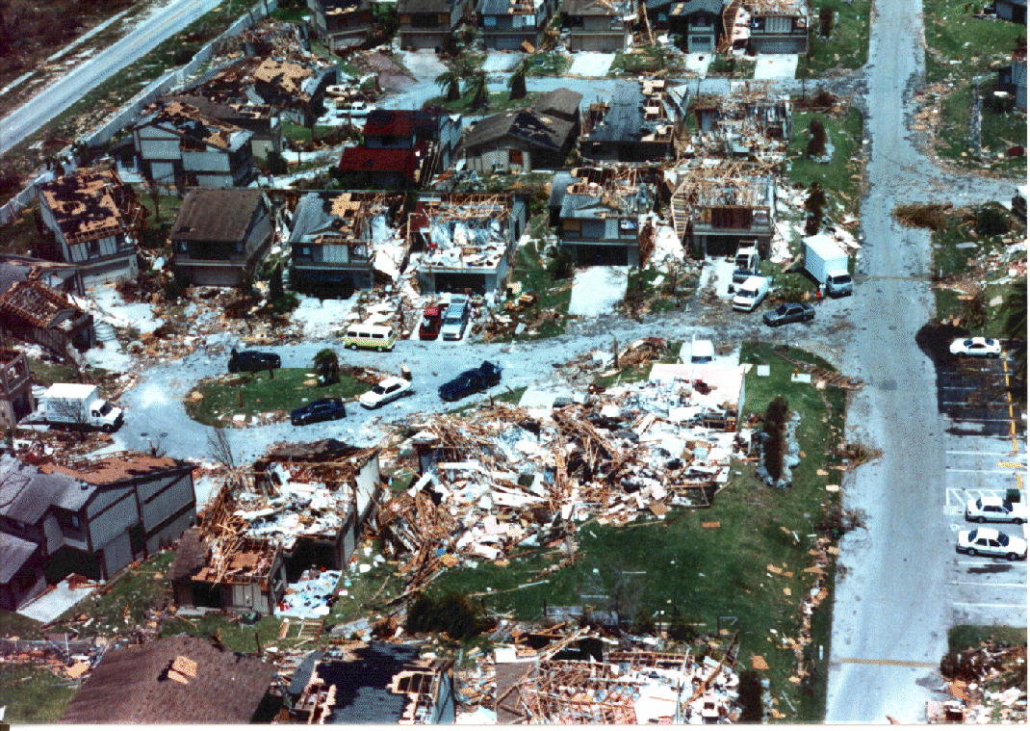

Slide 62
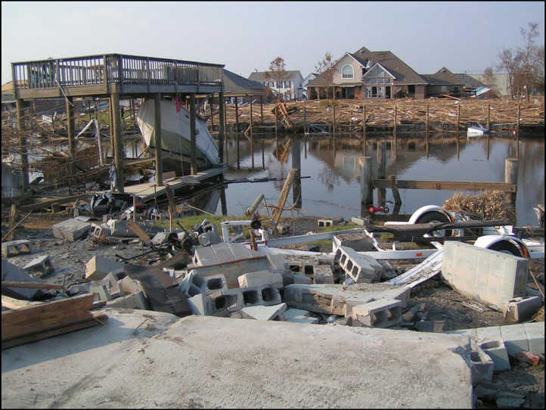
Hurricane Katrina, 2005

Slide 63
