Slide 1

Climate Risks, Hurricanes and Coastal Flooding
Kerry Emanuel
Lorenz Center
Massachusetts Institute of Technology

Slide 2
Program
A brief review of climate and climate science
Climate risks
How hurricanes are responding to climate
Quantifying hurricane risk
Solutions (We can talk about these in the Q&A)

Slide 3
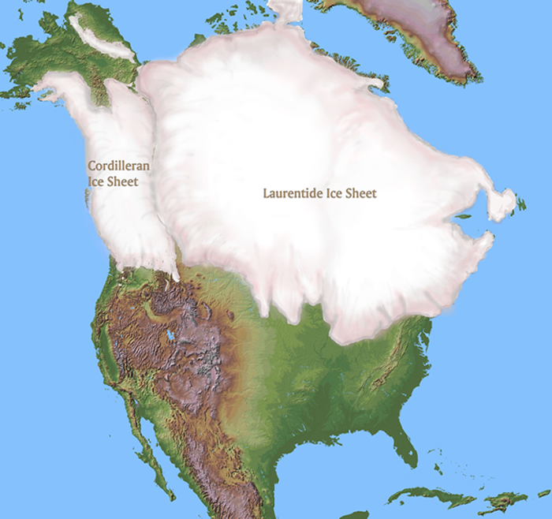
~ 20,000 years before present

Slide 4

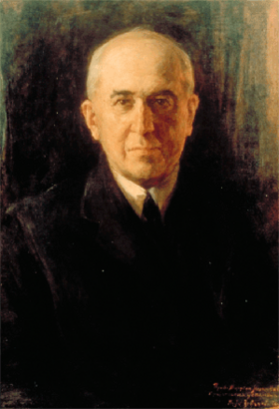
Climate Forcing by Orbital Variations (1912)
Milutin Milanković, 1879-1958

Slide 5


John Tyndall (1820-1893)

Slide 6

Tyndall’s Essential Results:
Oxygen (O₂ ), nitrogen (N₂), and argon (Ar), though they make up ~99% of the atmosphere, are almost entirely transparent to solar and terrestrial radiation
Water vapor (H₂O), carbon dioxide (CO₂), nitrous oxide (N₂O), and a handful of other trace gases make the lower atmosphere nearly opaque to infrared radiation, though still largely transparent to solar radiation (but clouds have strong effects on radiation at all wavelengths). Together they increase the Earth’s surface temperature from about 0ºF to around 60ºF.

Slide 7
Tyndall’s Essential Results:
Water Vapor (H₂O), about 0.25% of the mass of the atmosphere, is the most important greenhouse gas, but responds to atmospheric temperature change on a time scale of about 2 weeks
Climate is therefore strongly influenced by long-lived greenhouse gases (e.g. CO₂, CH₄, N₂O) that together comprise about 0.04% of the mass of the atmosphere. Concentration of CO₂ has increased by 43% since the dawn of the industrial revolution

Slide 8
Our Influence on Greenhouse Gases

Slide 9

Svante Arrhenius, 1859-1927
“Any doubling of the percentage of carbon dioxide in the air would raise the temperature of the earth's surface by 4°; and if the carbon dioxide were increased fourfold, the temperature would rise by 8°.” – Världarnas utveckling (Worlds in the Making), 1906

Slide 10
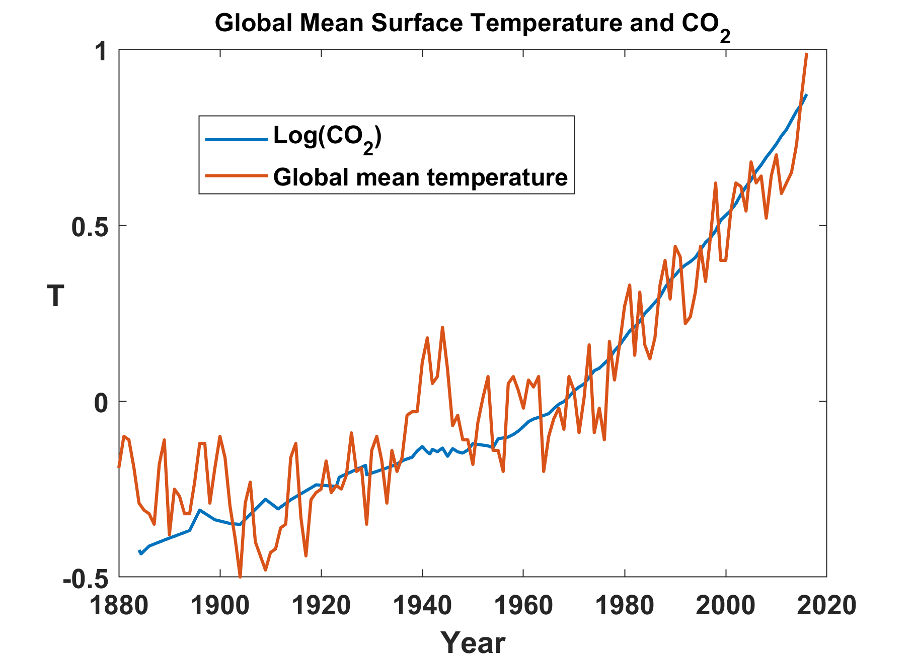

Slide 11
Predicting the Future:
Sources of Uncertainty
Cloud Feedback
Water Vapor Feedback
Ocean Response
Aerosols

Slide 12


Estimate of how much global climate will warm as a result of doubling CO₂: a probability distribution
Source: 100000 PAGE09 runs
Chris Hope, U. Cambridge
courtesy Tim Palmer
Notes:
Describe pdf. Reflects post-IPCC knowledge as well as IPCC AR4.

Slide 13
Known Risks
Increasing sea level
Increasing hydrological events… droughts and floods
Armed conflict
More heat stress and other health risks
Increasing incidence of high category hurricanes and associated storm surges and freshwater flooding
Some increase in plant productivity
Reduction in health problems related to cold weather
Benefits

Slide 14

Hurricanes

Slide 15
The Global Hurricane Hazard
About 10,000 deaths per year since 1971
$700 Billion 2015 U.S. Dollars in Damages Annually since 1971
Global population exposed to hurricane hazards has tripled since 1970
EM-DAT, 2016: The OFDA/CRED International Disaster Database
http://www.emdat.be/.

Slide 16
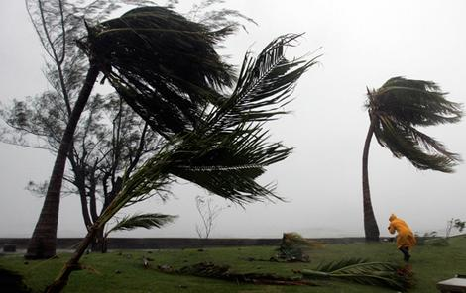
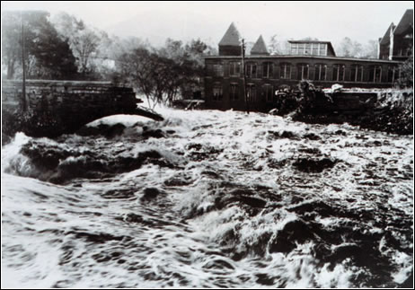
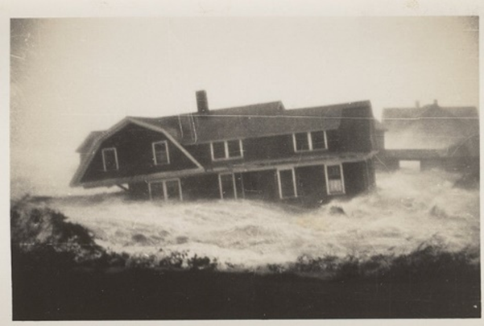
Hurricane Risks:
Wind
Rain
Storm Surge

Slide 17

Publicly
insured…
No $$$
Privately insured… $$$

Slide 18
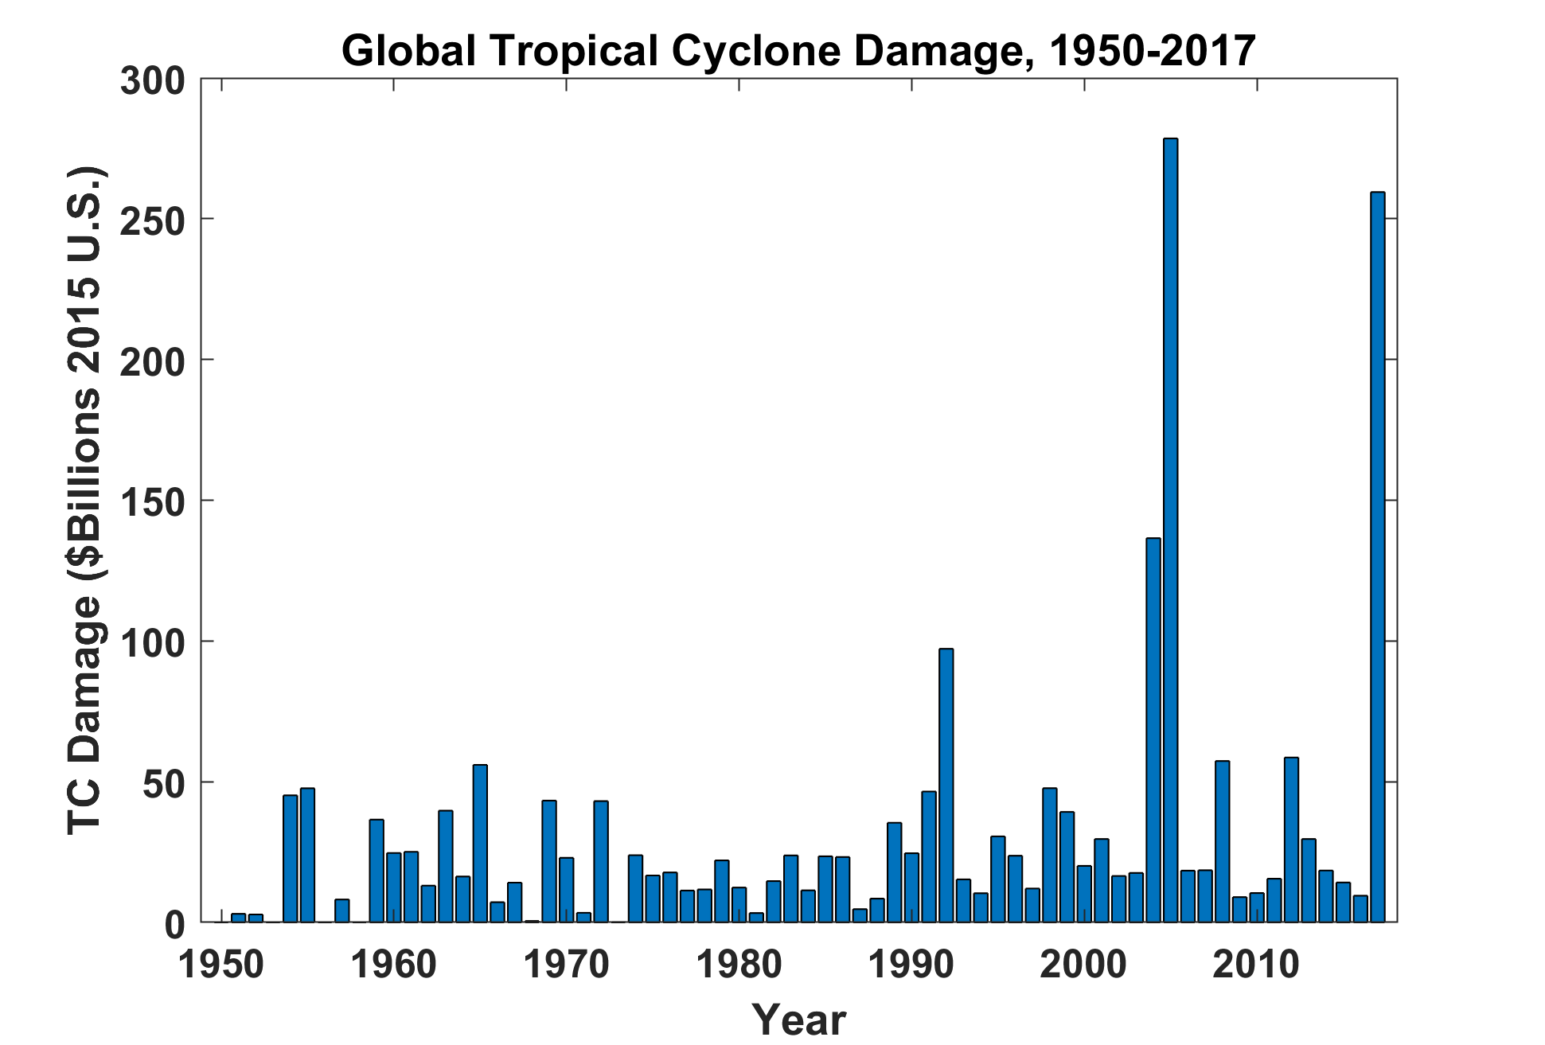
EM-DAT, 2018: The OFDA/CRED International Disaster Database
http://www.emdat.be/. GDP correction from Federal Reserve Bank

Slide 19

Is Hurricane Risk Changing?

Slide 20
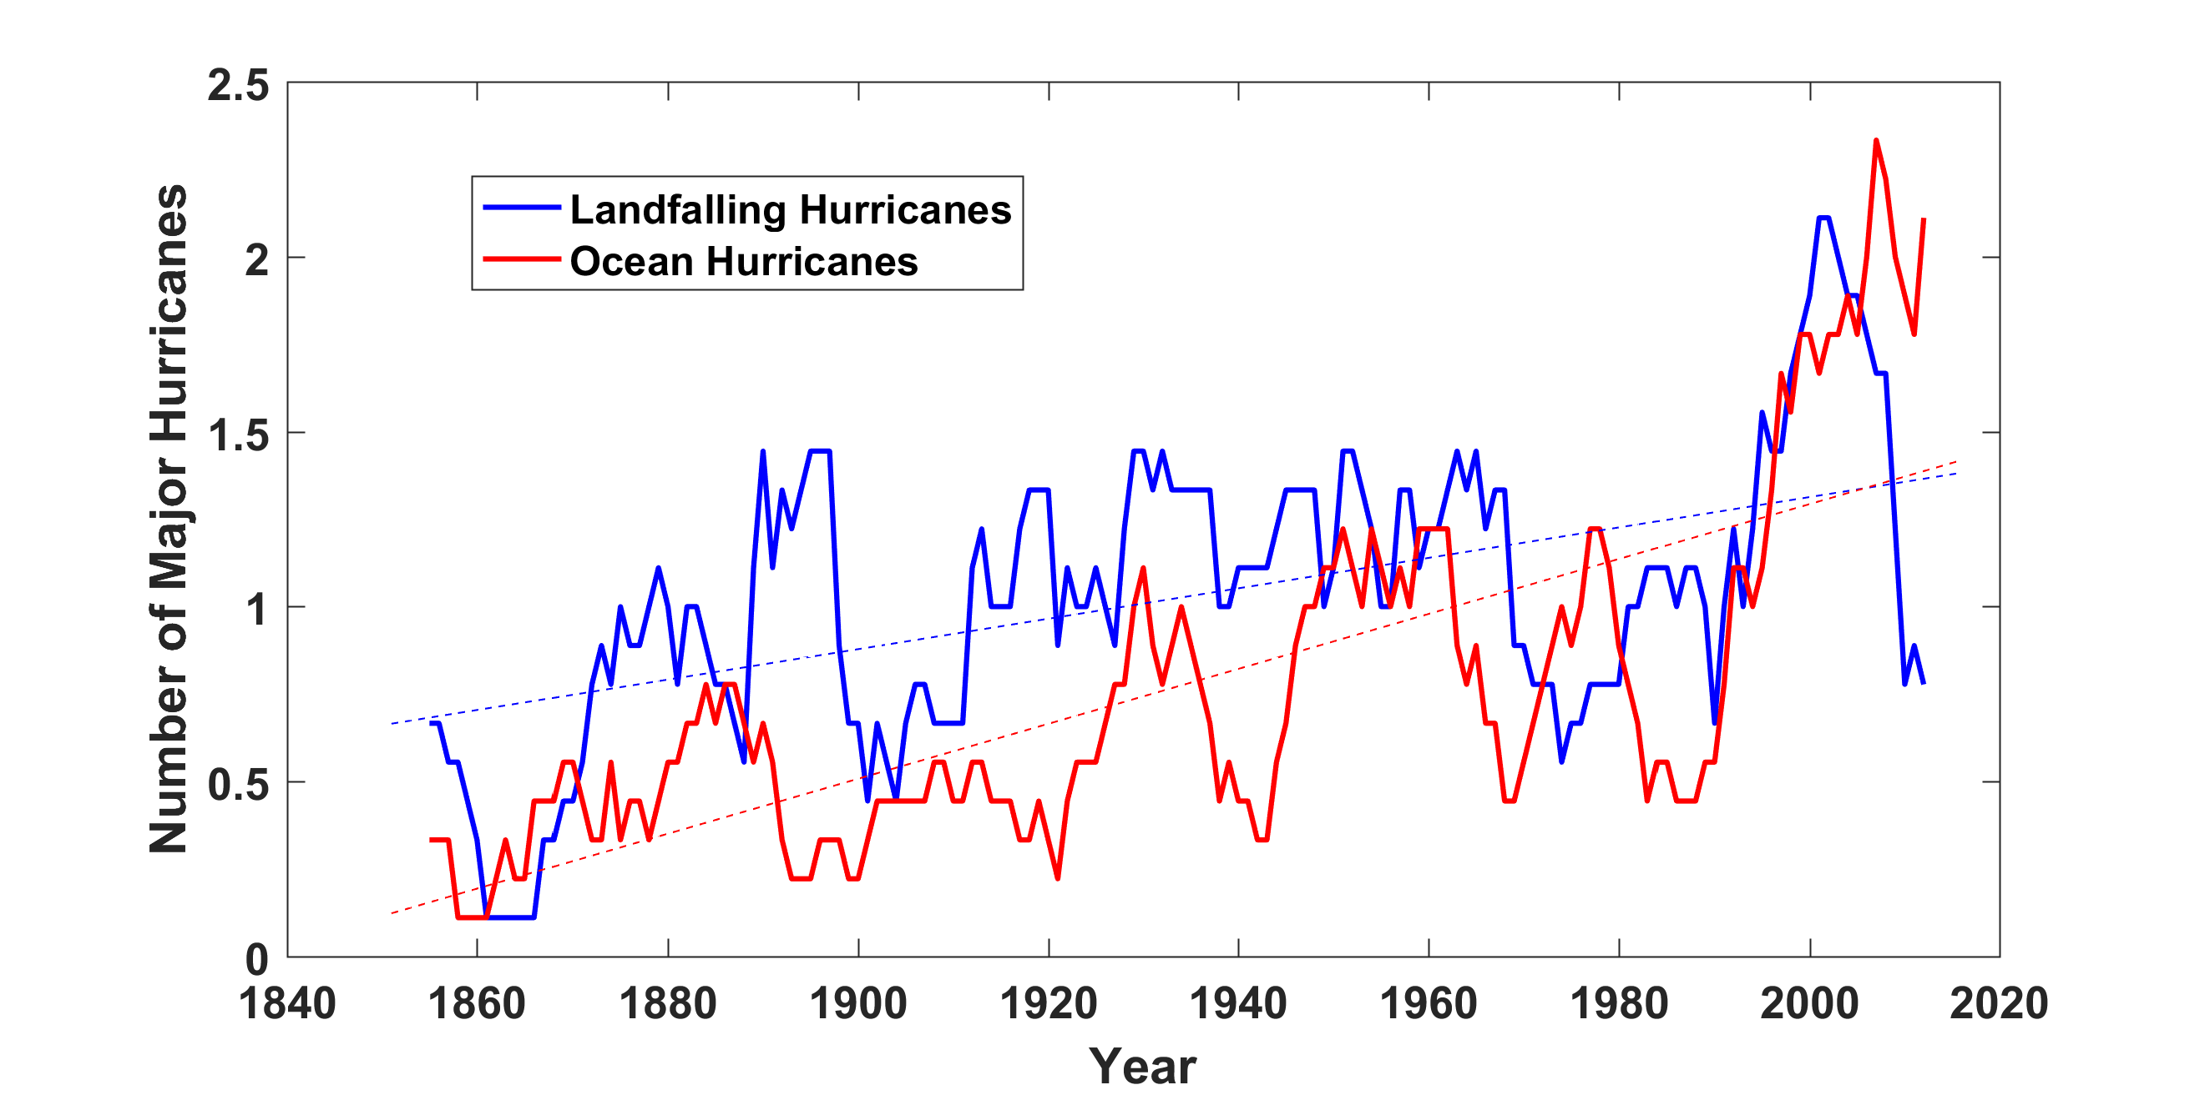
Historical Records:
Prior to 1970, Many Storms Were Missed
Major hurricanes in the North Atlantic, 1851-2016, smoothed using a 10-year running average. Shown in blue are storms that either passed through the chain of Lesser Antilles or made landfall in the continental U.S.; all other major hurricanes are shown in red. The dashed lines show the best fit trend lines for each data set.

Slide 21
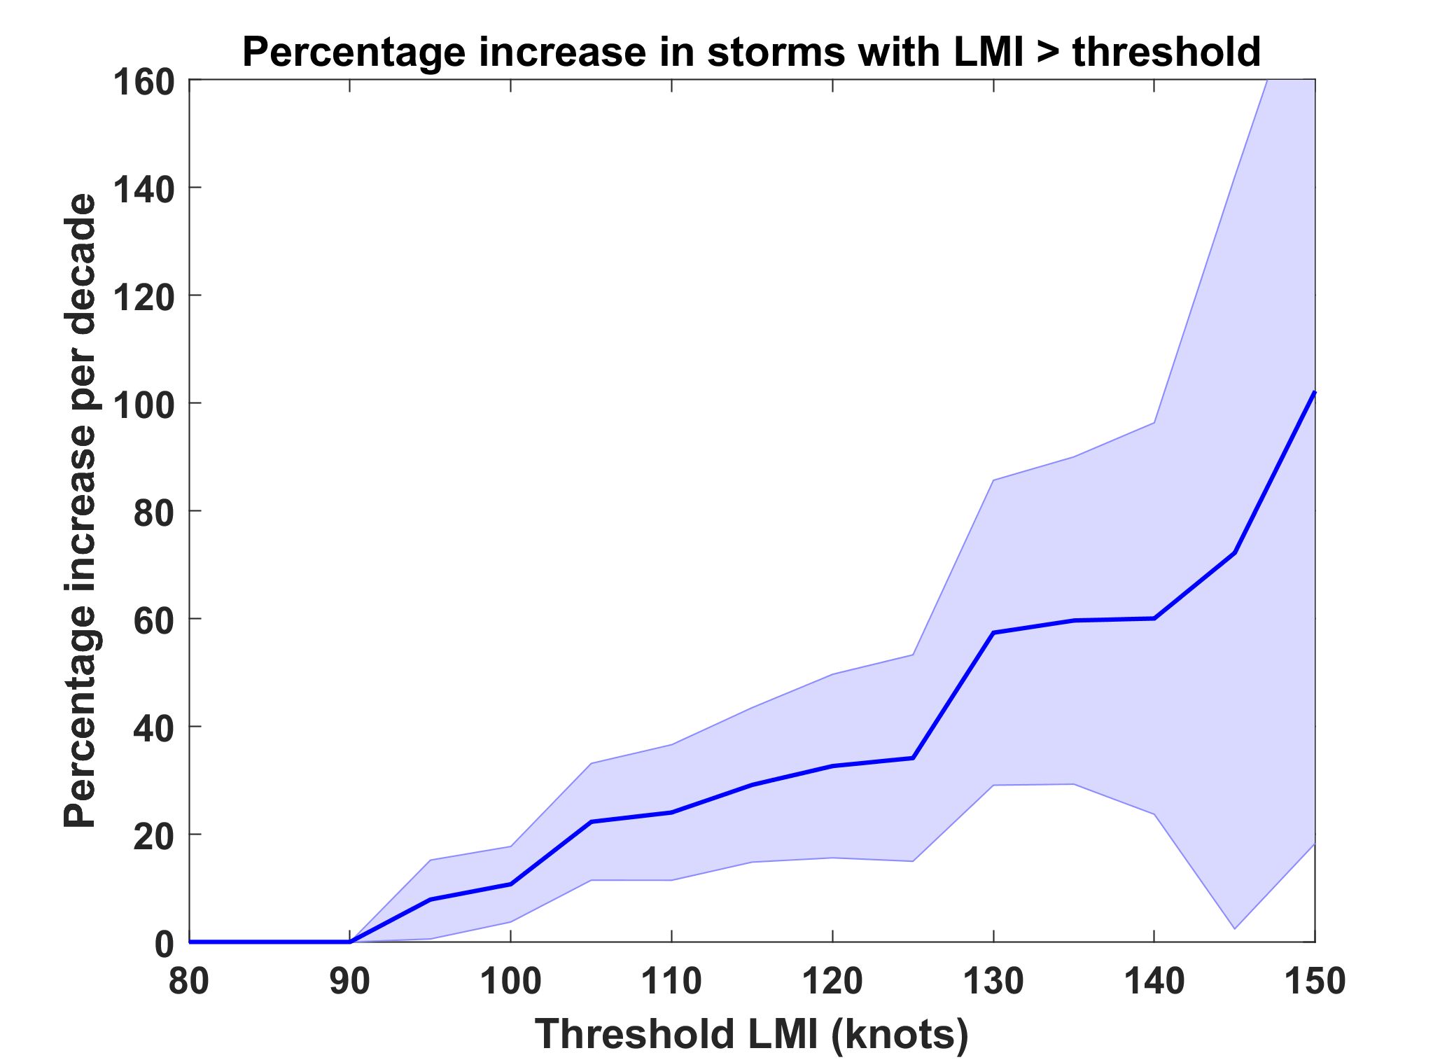
Trends in Global TC Frequency Over Threshold Intensities, from Historical TC Data, 1980-2016. Trends Shown Only When p < 0.05.

Slide 22
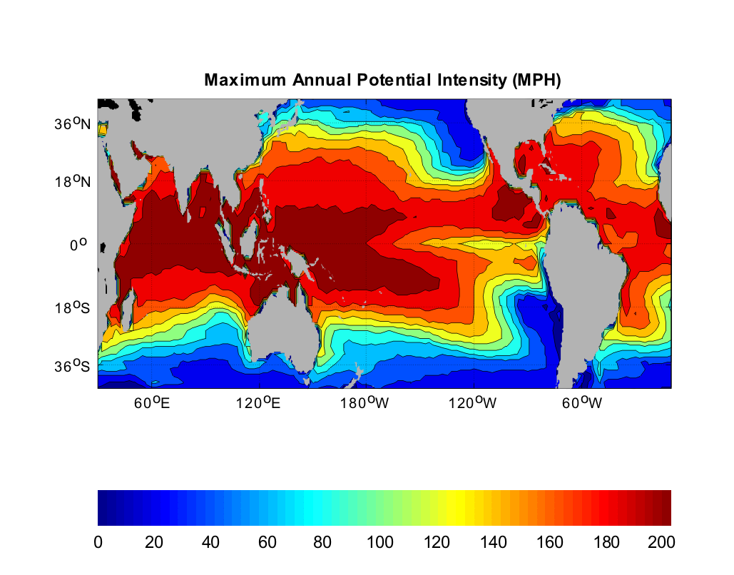
Heat Engine Theory Predicts Maximum Hurricane Winds (“Potential Intensity”)
MPH
Notes:
22

Slide 23
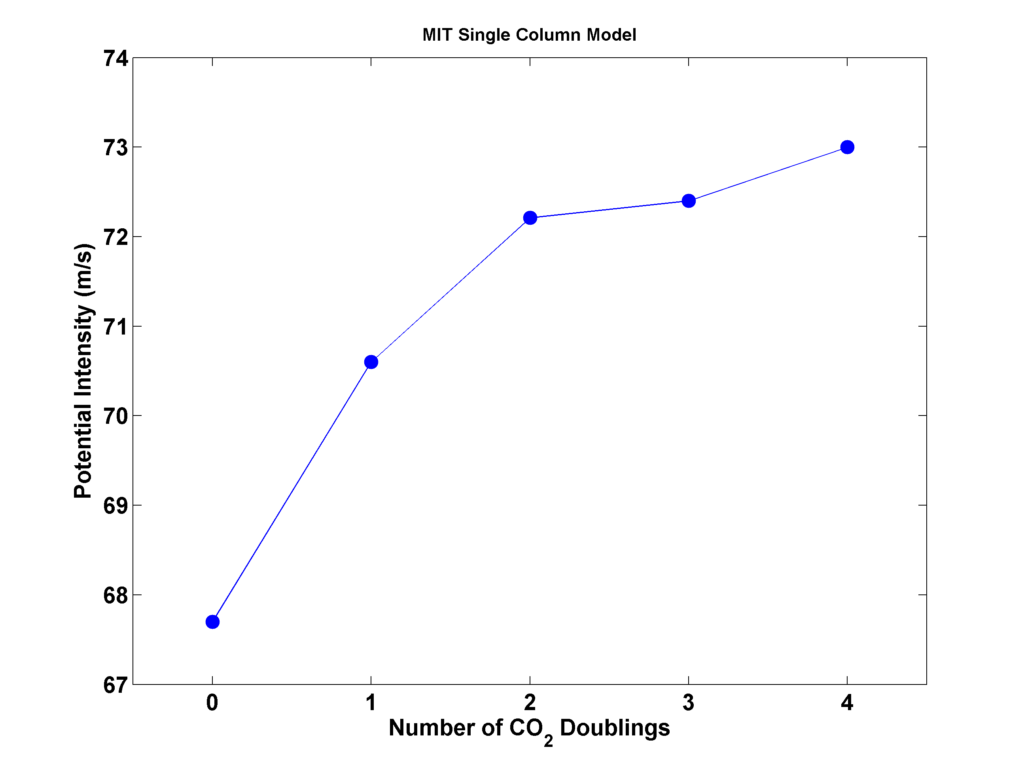
Potential Intensity and CO₂

Slide 24
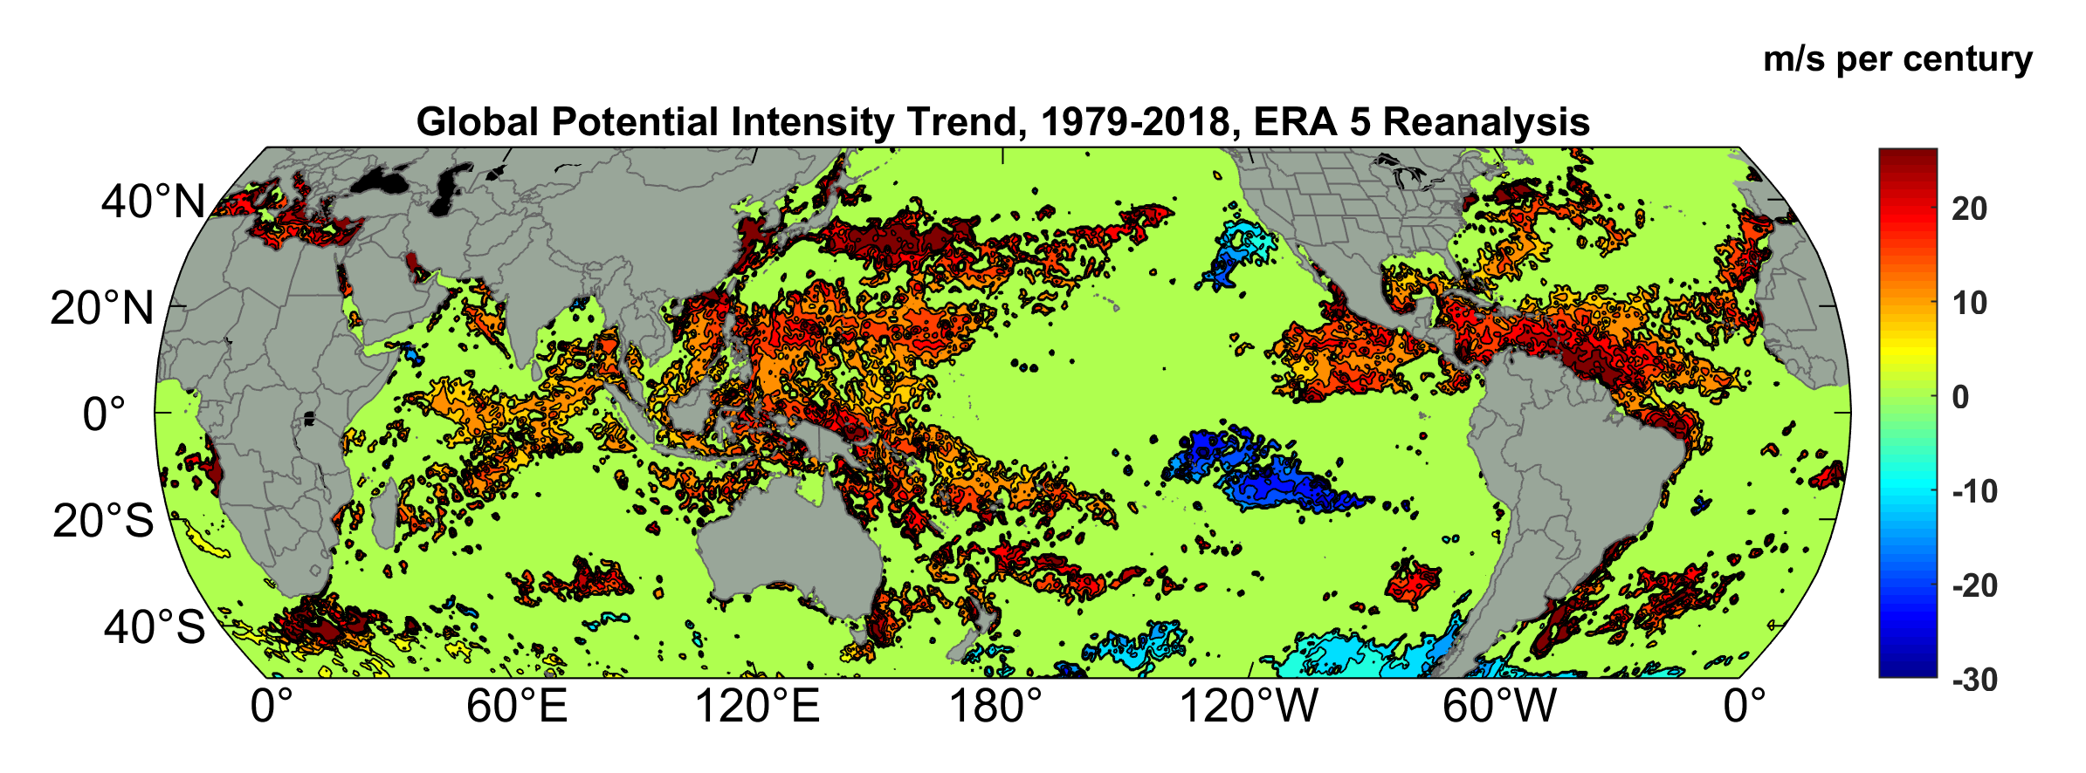
Potential Intensity Trend, 1979-2018, ERA 5 Reanalysis
(Trend shown only where p value < 0.05)

Slide 25
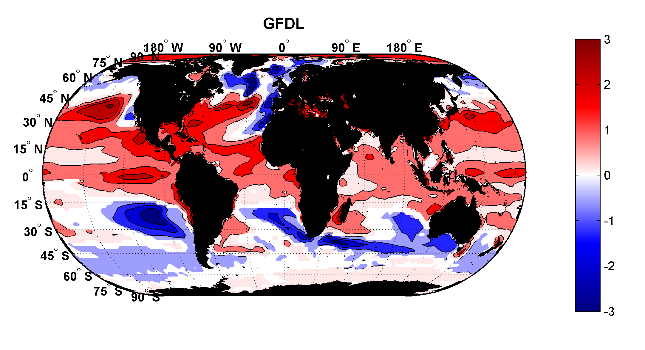
Projected Trend Over 21st Century: GFDL model under RCP 8.5
ms⁻¹decade⁻¹

Slide 26

Inferences from Basic Theory:
Potential intensity increases with global warming
Incidence of high-intensity hurricanes should increase
Increases in potential intensity should be faster in sub-tropics
Hurricanes will produce substantially more rain: Fundamental physics yields a ~7% increase in water vapor per 1ºC warming

Slide 27

Dealing with Evolving Hurricane Risk
Notes:
27

Slide 28


Risk Assessment in a Changing Climate: The Problem
Event Probability
Damage Probability
Current and Future Probability Density of U.S. TC Wind Damages
Current and Future Damage Probability

Slide 29
The Heart of the Problem:
Societies are usually well adapted to frequent events (> 1/100 yr)
Societies are often poorly adapted to rare events (< 1/100 yr)
Robust estimates of the character of ~100 yr events require ~1,000 years of data
We do not have ~1,000 years of meteorological observations

Slide 30
How We Deal with This:
For local events, accumulate statistics over locations far enough apart to sample different individual events, but close enough to sample the same overall climatology.
  Example: 500 mm of TC rain in metro Houston may be a 100-year event, but a 20-year event over coastal Texas
Extrapolate well-sampled events to rare events using extreme value theory. Dicey!

Slide 31
How We COULD Deal with This:
Bring physics to bear on natural hazard risk assessment… problem too important to leave to actuaries.
But several impediments:
  Academic stove-piping: Too applied for scientists; too complicated for risk professionals
  Brute force modeling probably too expensive to be practical for many applications

Slide 32
Using Physics to Estimate Hurricane Risk

Slide 33
Why Not Use Global Climate Models to Simulate Hurricanes?

Slide 34

Problem: Today’s models are far too coarse to simulate destructive hurricanes
Histograms of Tropical Cyclone Intensity as Simulated by a Global Model with 30 mile grid point spacing. (Courtesy Isaac Held, GFDL)
Category 3
Modeled
Observed
Global models do not simulate the storms that cause destruction
Wind Speed (meters per second)

Slide 35
How to deal with this?
Embed high-resolution, fast coupled ocean- atmosphere hurricane model in global climate model or climate reanalysis data
Coupled Hurricane Intensity prediction Model (CHIPS) has been used for 18 years to forecast real hurricanes in near- real time
Can easily generate > 100,000 storms

Slide 36
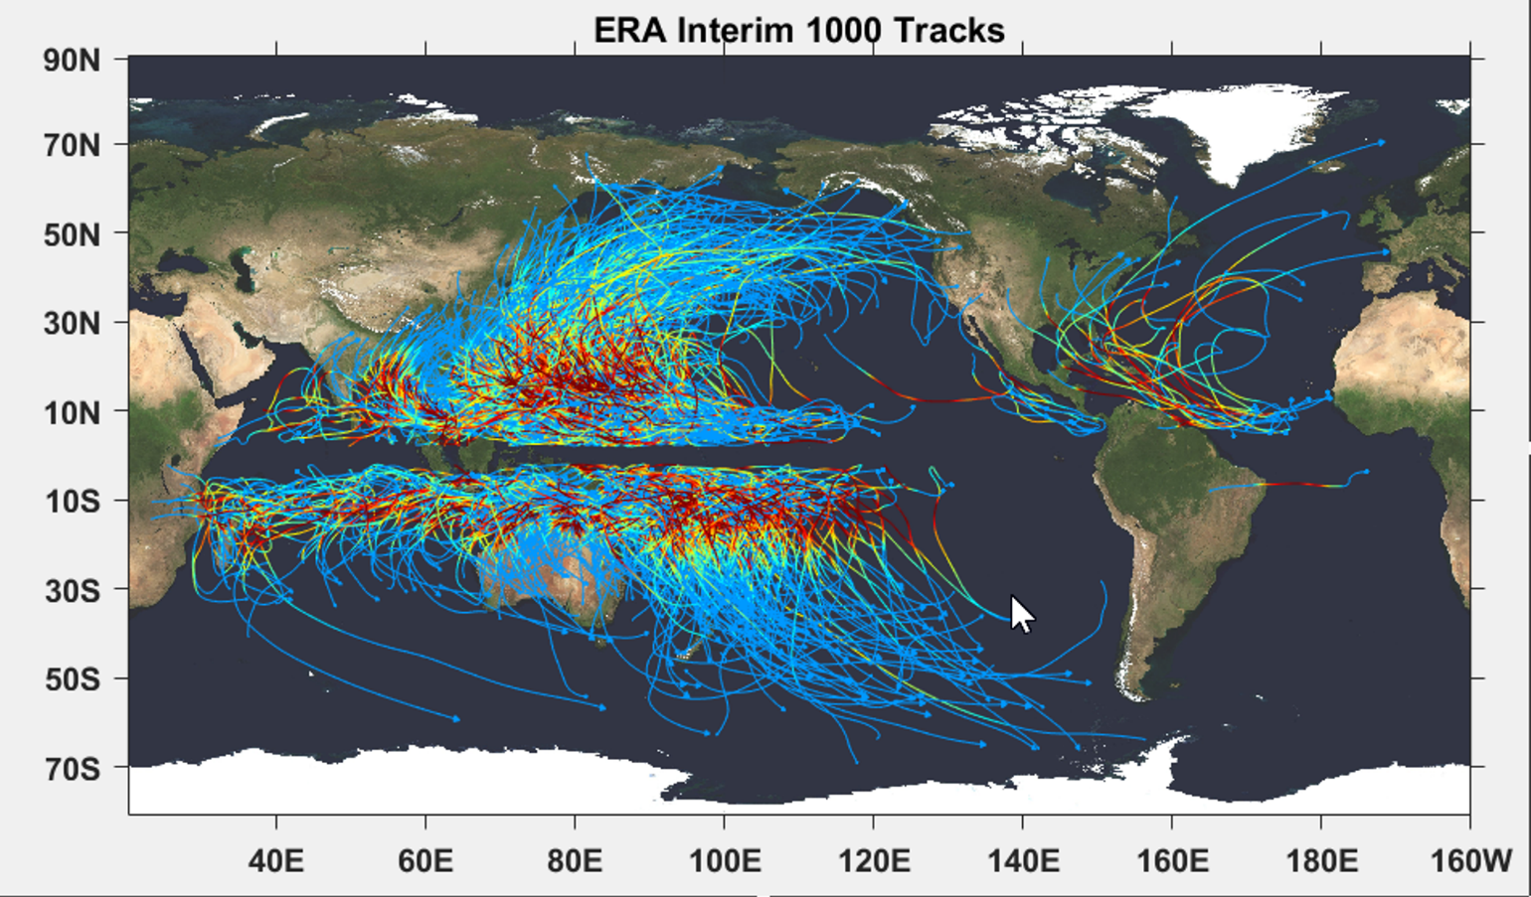

Slide 37
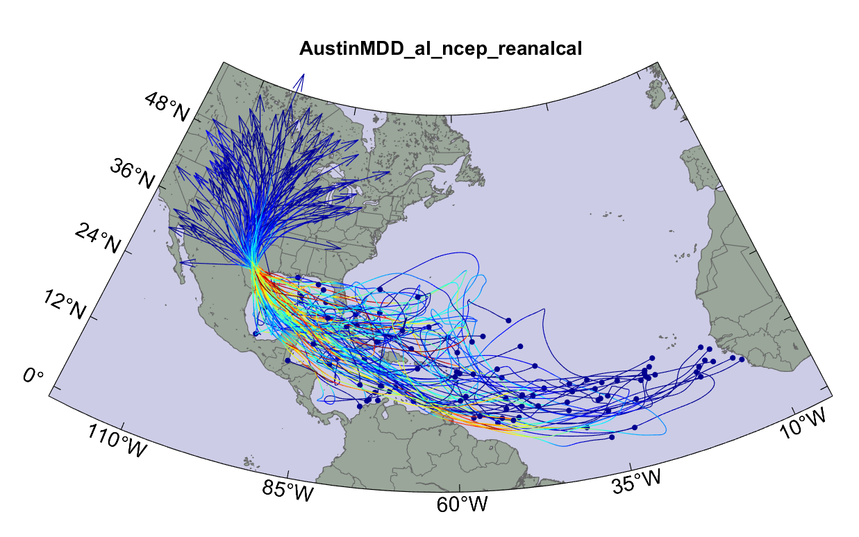
Top 100 of 4,400 hurricanes affecting Austin, TX

Slide 38
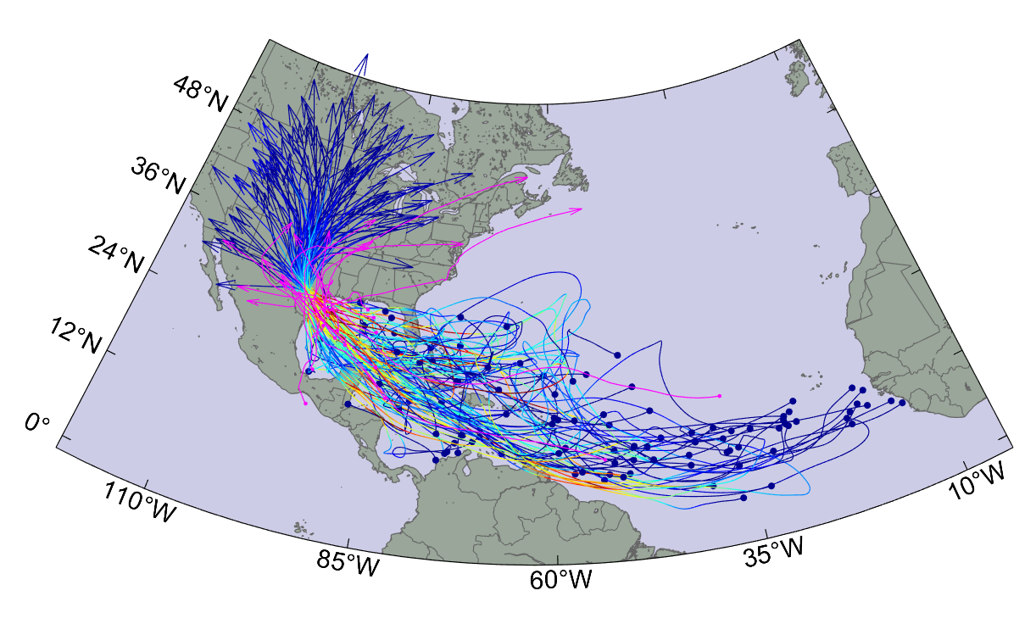
Same, with 20 historical hurricanes added

Slide 39

Cumulative Distribution of Storm Lifetime Peak Wind Speed, with Sample of 1755 Synthetic Tracks
90% confidence bounds

Slide 40
Atlantic Annual Cycle

Slide 41
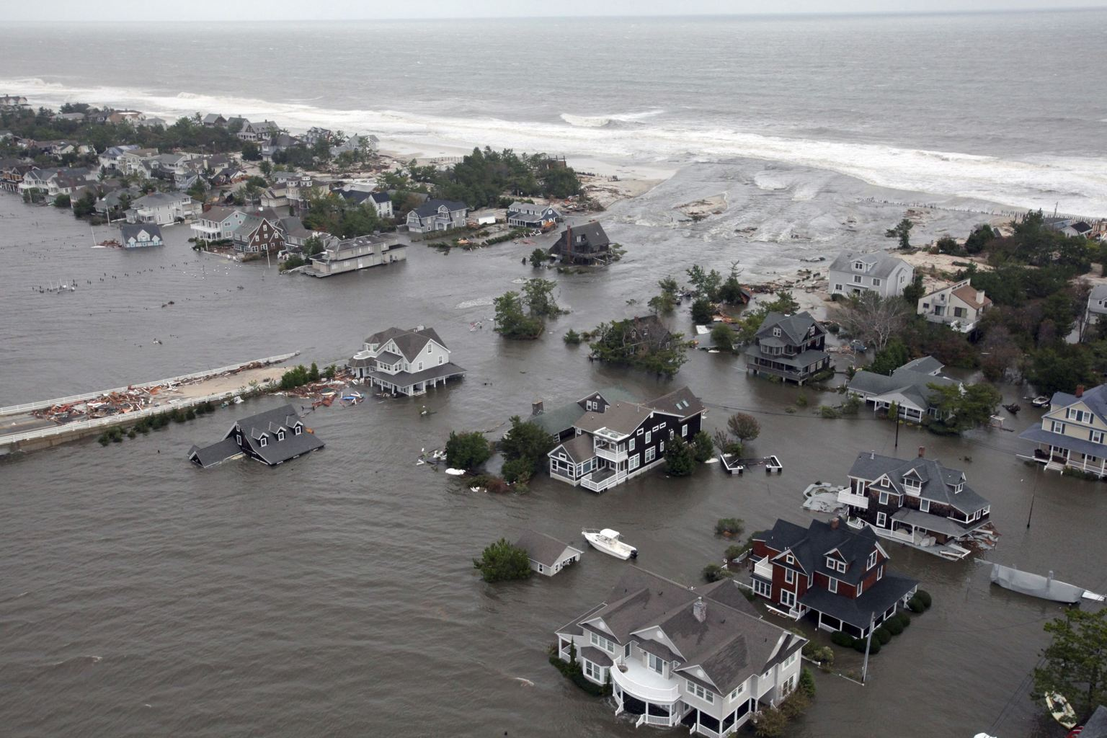
Storm Surges

Slide 42


Storm Surge Simulation (Ning Lin)
SLOSH model
(Jelesnianski et al. 1992)
SLOSH mesh
~ 10³ m
ADCIRC mesh
~ 10² m
Battery
ADCIRC model
(Luettich et al. 1992)
ADCIRC mesh
~ 10 m
(Colle et al. 2008)
Notes:
Given the storm wind and pressure fields (which is estimated from the Holland parametric pressure model) we can simulate the surge. Surge simulations with high resolution are computationally intensive, so to make it possible to simulate accurate surges for our large synthetic storm sets, we apply the two hydrodynamic models with girds of various resolutions in such a way that the main computational effort is concentrated on the storms that determine the risk. First, we apply the SLOSH model, using a mesh with resolution of about 1 km around NYC to simulate the surges for all storms and select the storms that have return periods, in terms of the surge height at the Battery, greater than 10 years. Second, we apply the ADCIRC simulation, using a grid mesh with resolution of ~100 m around NYC, to each of the selected storms. Then, we apply another ADCIRC mesh with resolution as high as ~10 m around NYC, for a set of the most extreme events, to check if the resolution of our ADCIRC grid is sufficient and if needed to make statistical correction to the results.

Slide 43
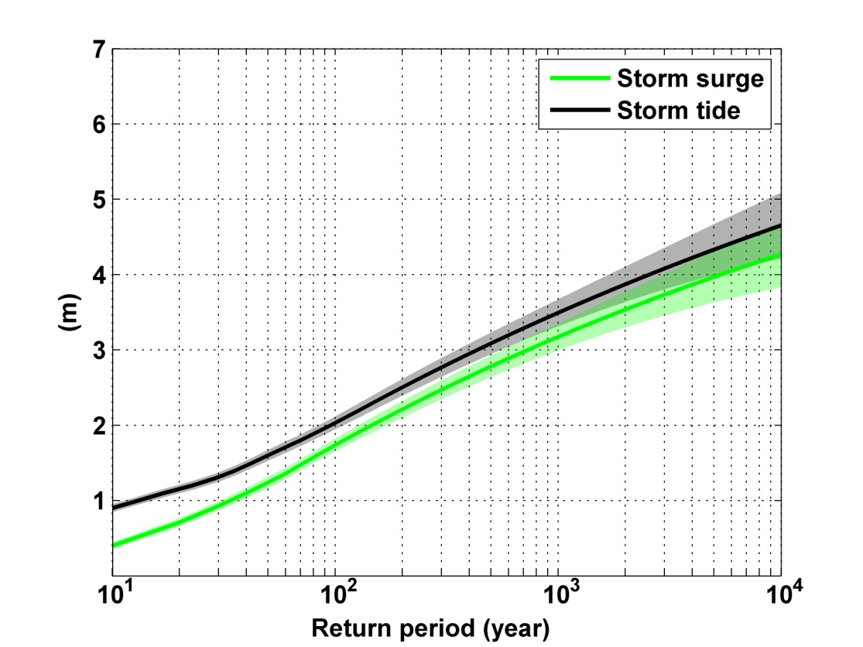
Sandy, 2012
Sandy: ~ 400 years
Notes:
Storm surge and storm tide (surge and tide) return level curves for the Battery, NYC, for the 1981-2000 NCAR/NCEP climate conditions (5000 synthetic storms). Astronomical tide and nonlinear interaction between surge and tide are accounted for statistically.

Slide 44
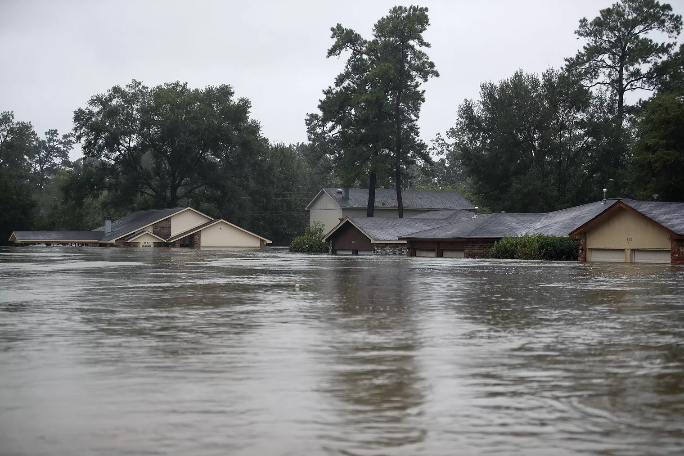
Rain

Slide 45
An Example:
Estimated gauge sampling error
Estimated radar sampling error

Slide 46
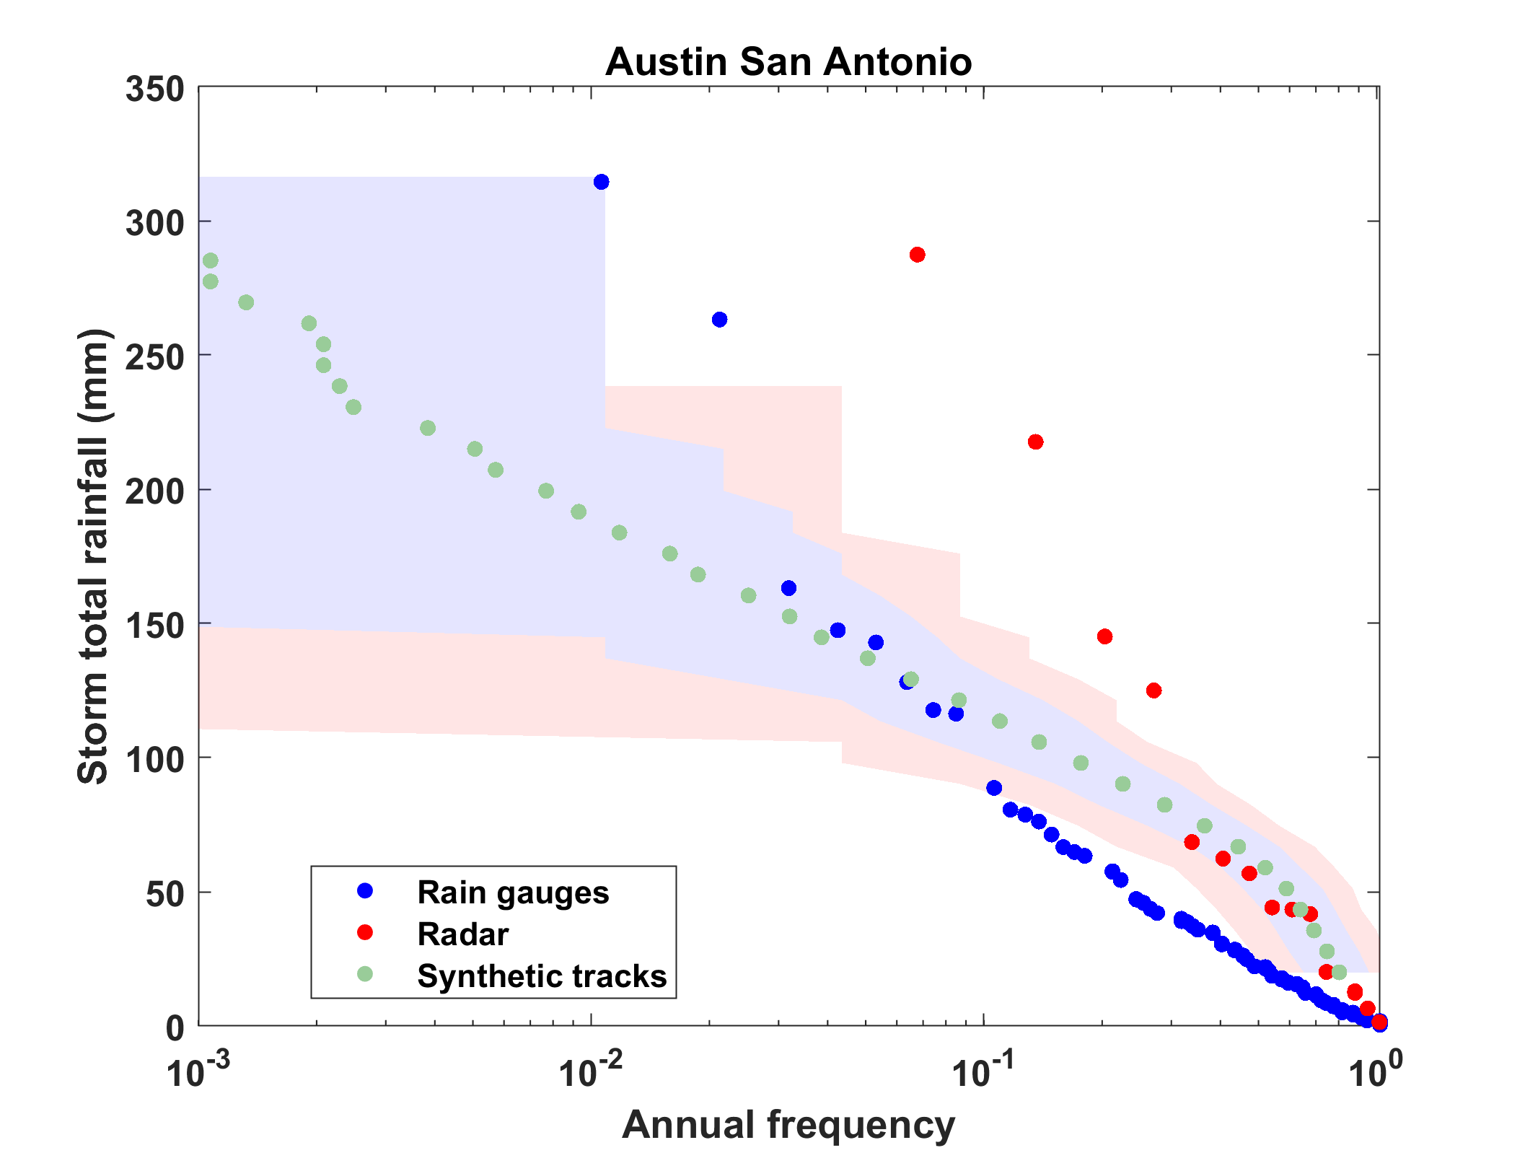

Slide 47
Effects of Climate Change
More moisture in boundary layer
Stronger storms but more compact inner regions
Possibly larger storm diameters
Storms may be moving faster or slower

Slide 48
Taking Climate Change Into Account

Slide 49
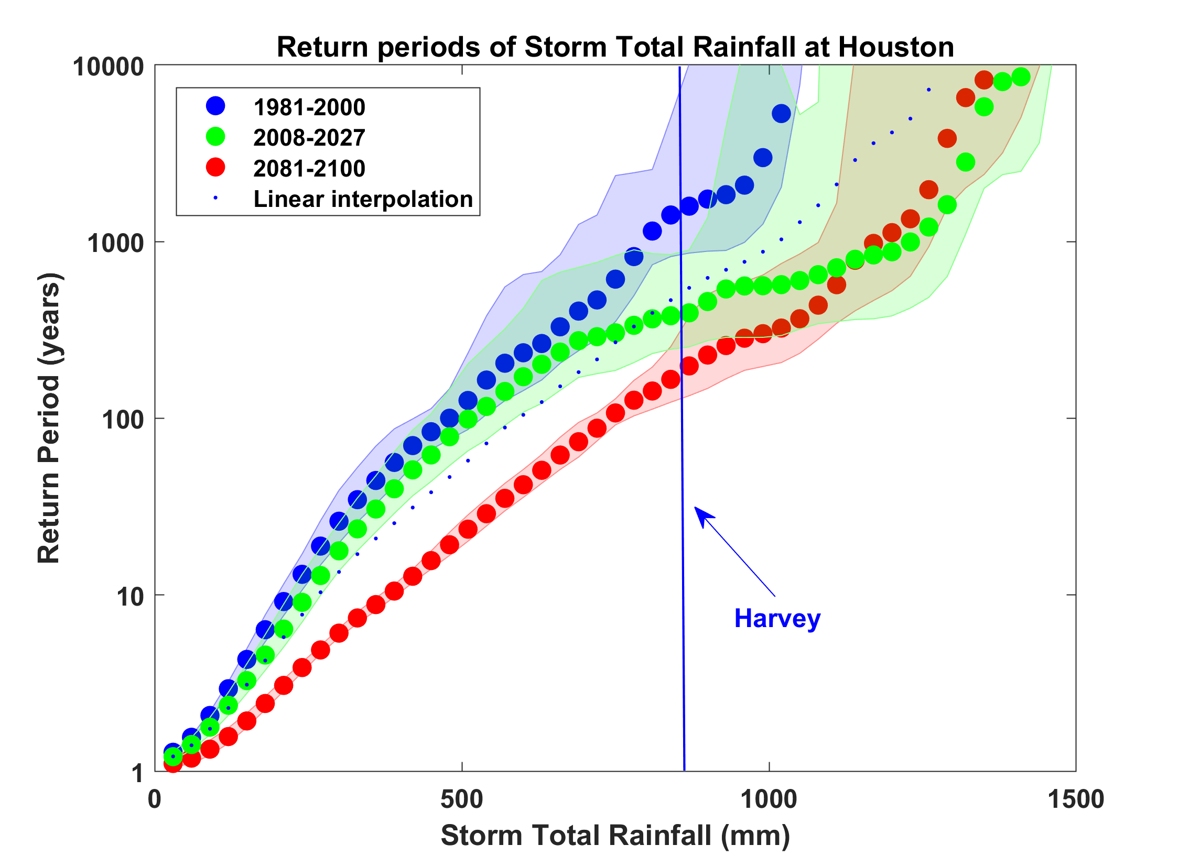
Probability of Storm Accumulated Rainfall in Harris County, from 6 Climate models, 1981-2000, 2008-2027, and 2081-2100, Based on 2000 Events Each, and Using RCP 8.5. Shading Shows Spread Among the Models.

Slide 50
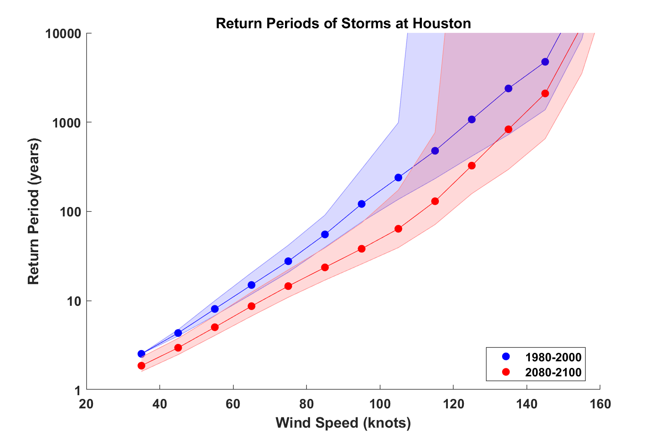

Slide 51

GCM flood height return level, Battery, Manhattan
(assuming SLR of 1 m for the future climate )
Black: Current climate (1981-2000)
Blue: A1B future climate (2081-2100)
Red: A1B future climate (2081-2100) with R₀ increased by 10% and R_{m} increased by 21%
Lin et al. (2012)
Notes:
Then we calculate the flood height (including surge, tide, and sea level rise) return level for the four climate models, assuming a sea level rise of 1 m for the future climate, for the Battery, NYC. These results show that the combined effects of storm climatology change and sea level rise will greatly shorten the flood return periods for NYC and, by the end of the century, the current 100-year surge flooding may happen less than every 30 years, with CNRM and GFDL prediction to be less than 10 years, and the 500-year flooding may happen less than every 200 years, with the CNRM and GFDL prediction to be 20-30 years.

Slide 52
Summary
There is compelling evidence that we are changing the climate in significant and risky ways
Among the many risks of climate change, extreme events are both early harbingers of change and among its worst consequences
Tropical cyclones are among the most damaging and lethal of extreme weather phenomena

Slide 53
Summary (continued)
Potential intensity theory demonstrates that the thermodynamic limit on hurricane intensity rises with temperature
Observations show that this limit is indeed increasing
Physics can be used to model hurricane risk in current and future climates
Global warming is not merely a problem for the future; current risk estimates are already out of date
Students: Please contact me if you would like access to our Austin hurricane events sets

