Slide 1

Tropical Cyclone Risk in a Changing Climate
Kerry Emanuel
Lorenz Center, MIT
Notes:
1

Slide 2
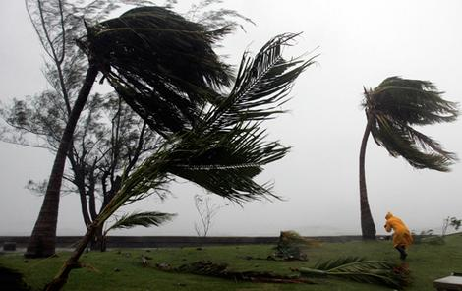
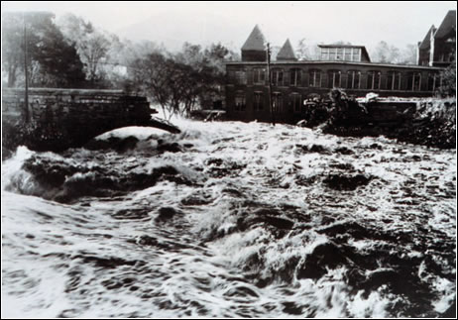
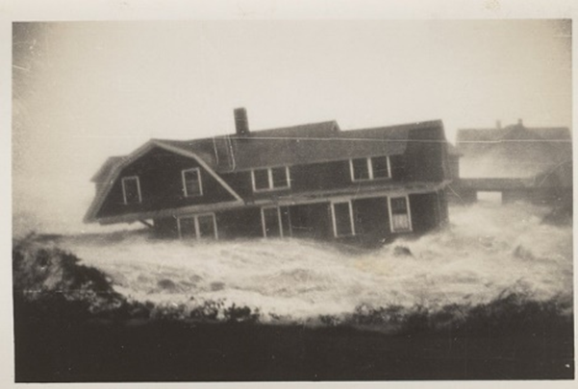

Hurricane Risks:
Wind
Rain
Storm Surge

Slide 3
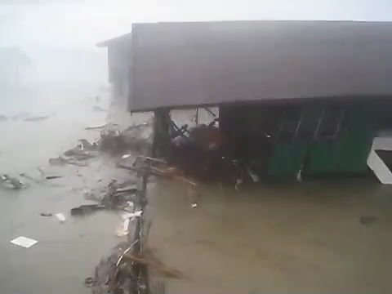

Slide 4
The Global Hurricane Hazard
About 10,000 deaths per year since 1971
$700 Billion 2015 U.S. Dollars in Damages Annually since 1971
Global population exposed to hurricane hazards has tripled since 1970
EM-DAT, 2016: The OFDA/CRED International Disaster Database
http://www.emdat.be/.

Slide 5

Publicly
insured…
No $$$
Privately insured… $$$

Slide 6

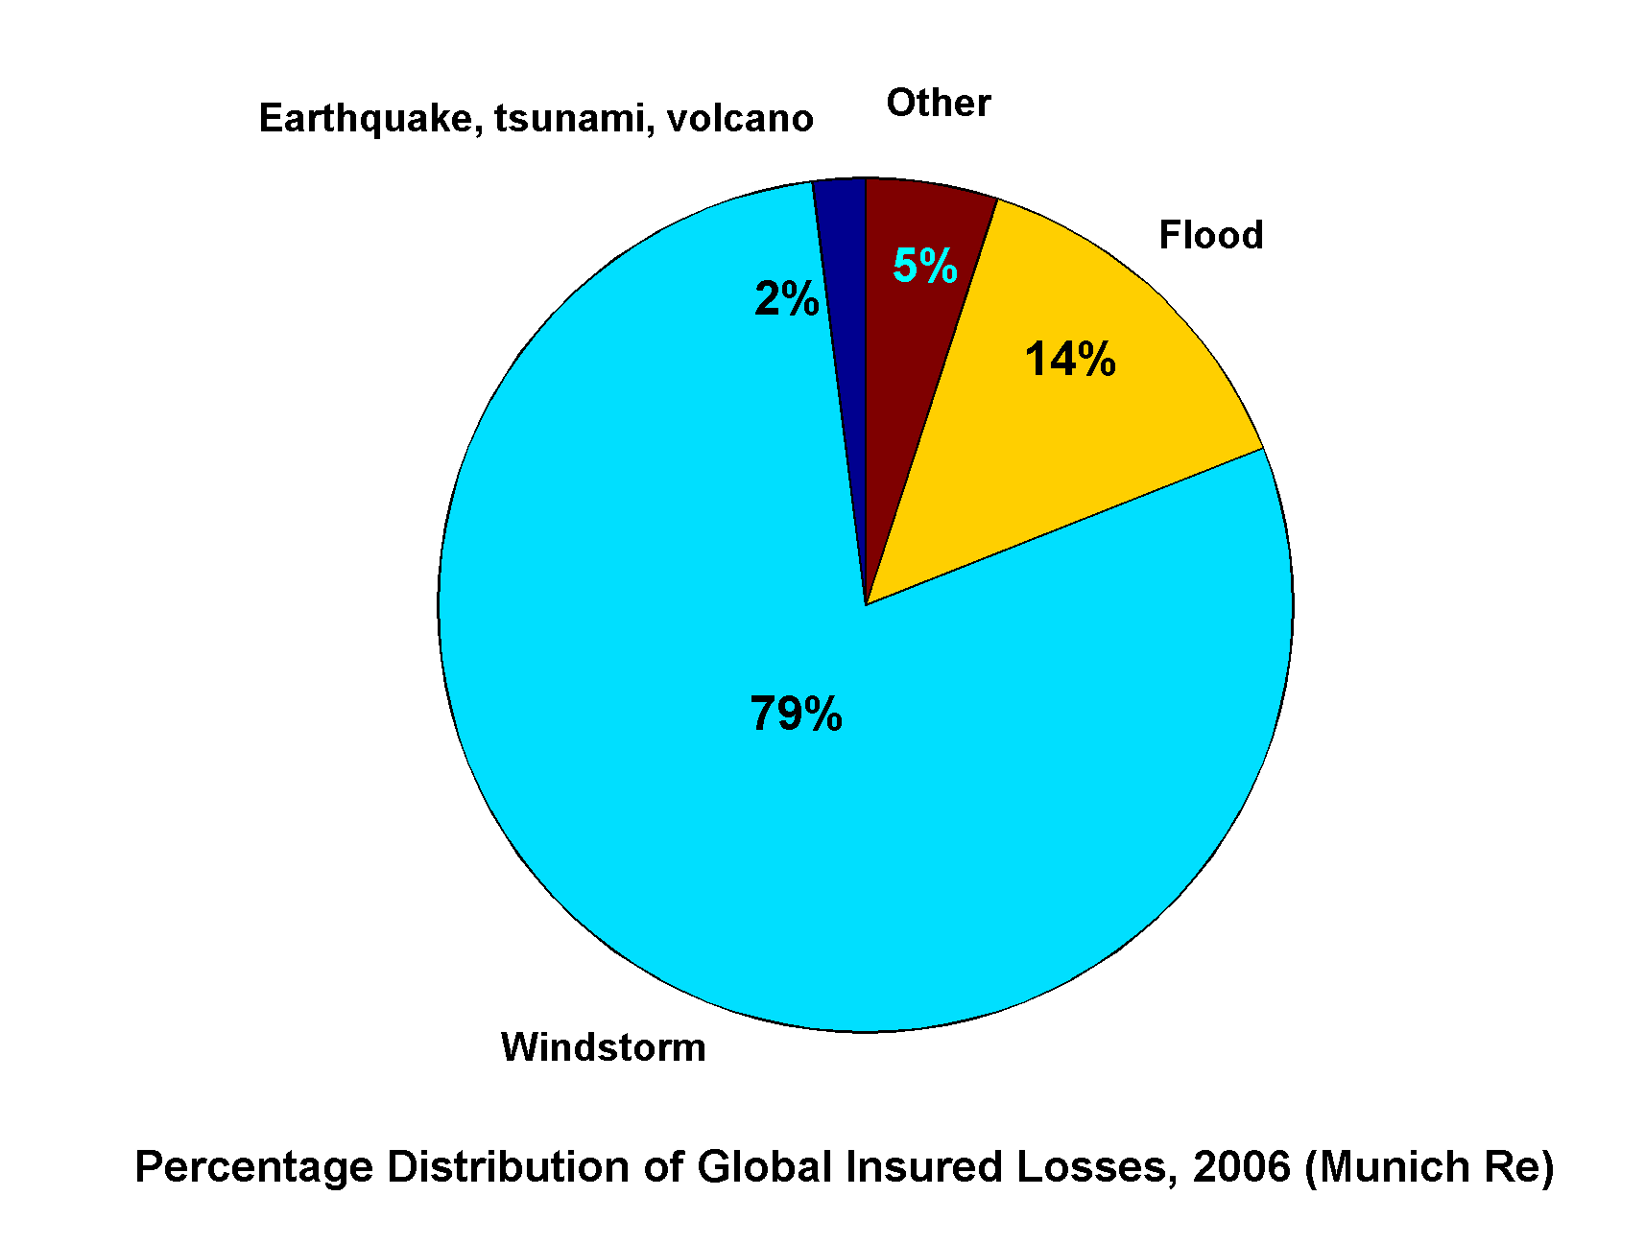
Windstorms Account for Bulk of Insured Losses Worldwide

Slide 7
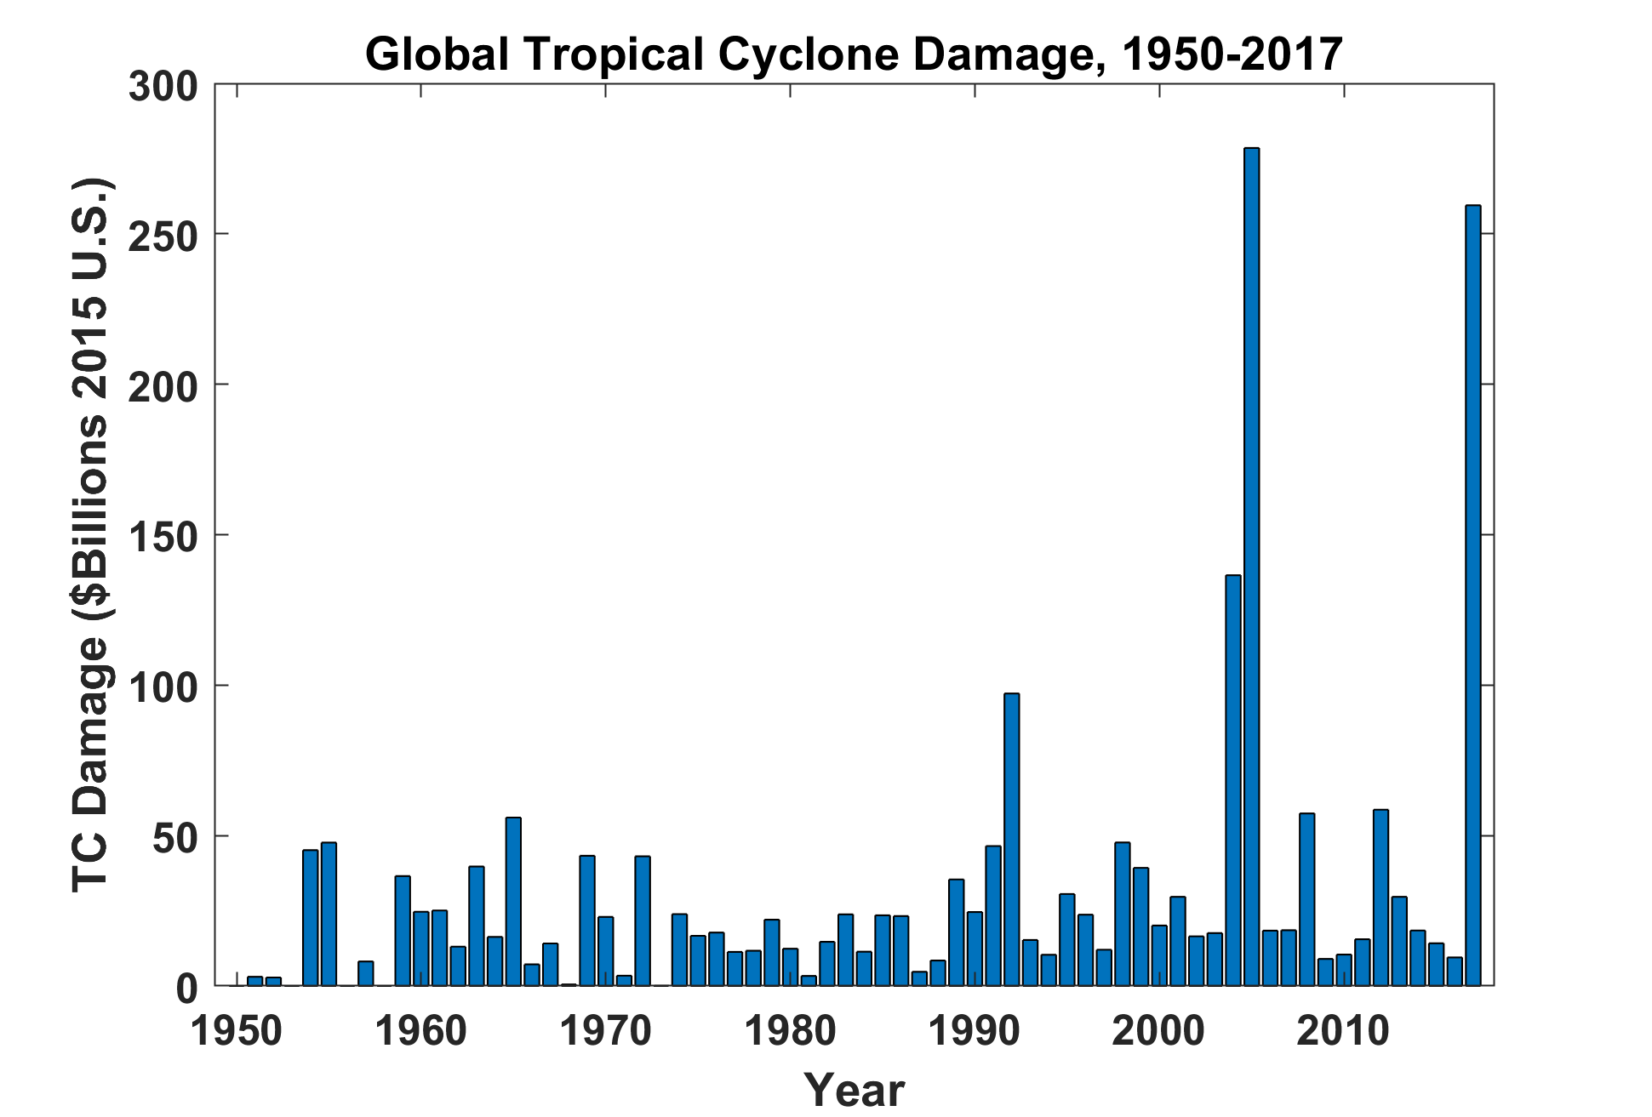
EM-DAT, 2018: The OFDA/CRED International Disaster Database
http://www.emdat.be/. GDP correction from Federal Reserve Bank

Slide 8

Is Hurricane Risk Changing?

Slide 9

Historical Records
Pre-1943: Anecdotal accounts from coastal cities and ships
1943: Introduction of routine aircraft reconnaissance in Atlantic, western North Pacific
1958: Inertial navigation permits direct measurement of wind speed at flight level
1970: Complete global detection by satellites
1978: Introduction of satellite scatterometry
1987: Termination of airborne reconnaissance in western North Pacific
2017: Introduction of CYGNSS scatterometry

Slide 10
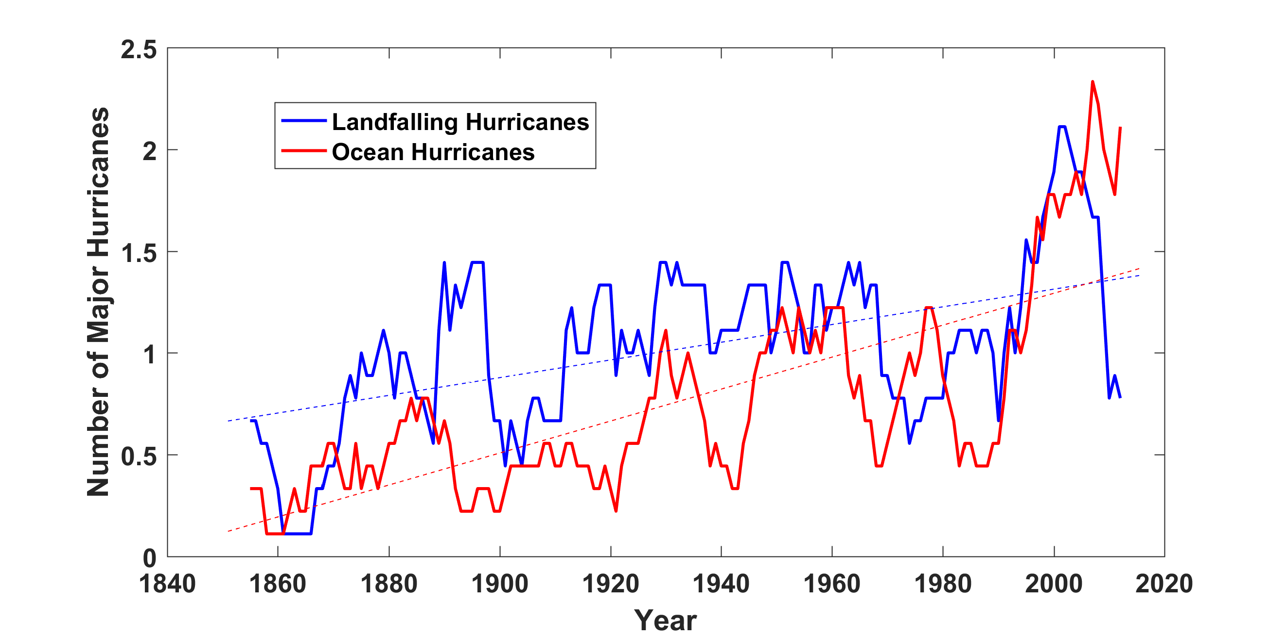
Historical Records:
Prior to 1970, Many Storms Were Missed
Major hurricanes in the North Atlantic, 1851-2016, smoothed using a 10-year running average. Shown in blue are storms that either passed through the chain of Lesser Antilles or made landfall in the continental U.S.; all other major hurricanes are shown in red. The dashed lines show the best fit trend lines for each data set.

Slide 11
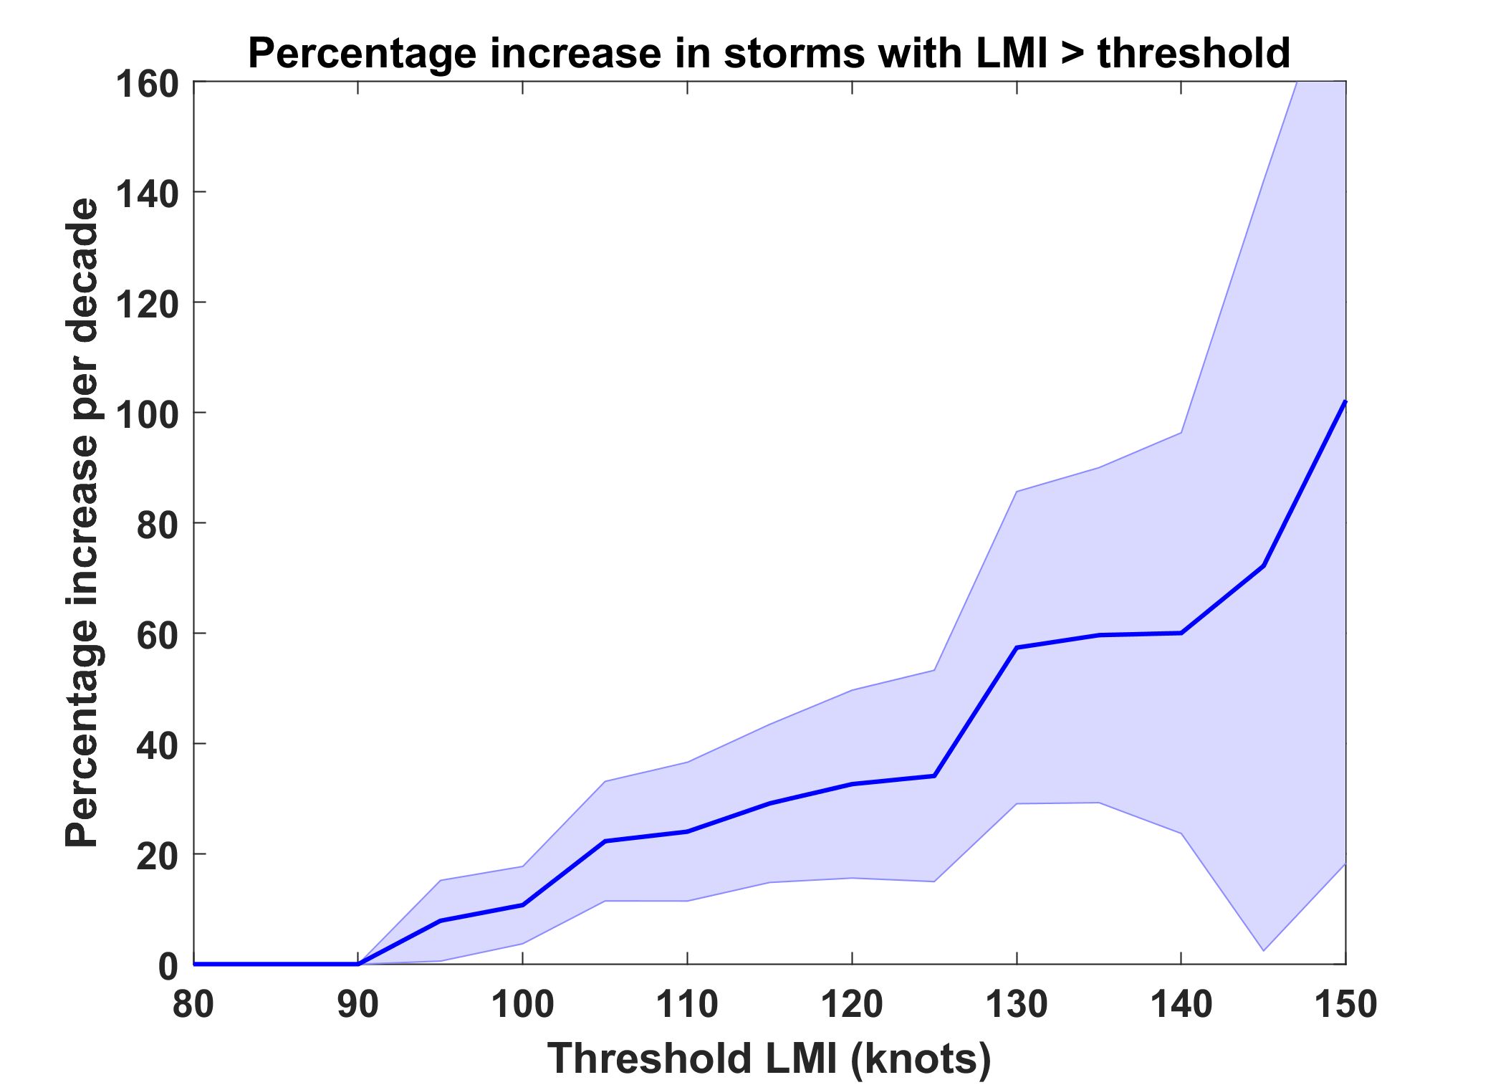
Trends in Global TC Frequency Over Threshold Intensities, from Historical TC Data, 1980-2016. Trends Shown Only When p < 0.05.

Slide 12
Hurricanes are reaching peak intensity at higher latitudes
Time series of the latitudes at which tropical cyclones reach maximum intensity.
From Kossin et al. (2014)

Slide 13
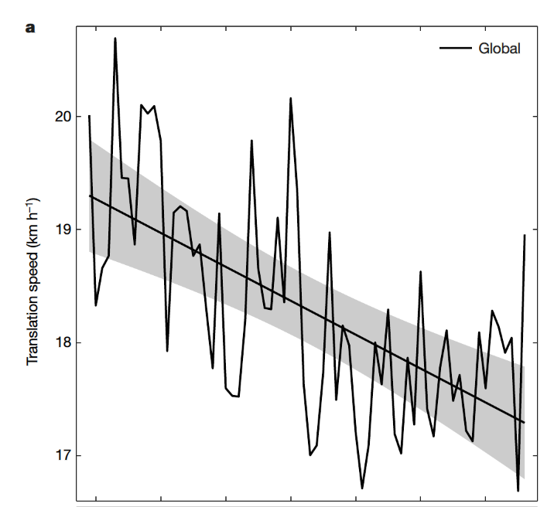
Tropical Cyclones are Slowing Down (Kossin, Nature, 2018)

Slide 14
Paleotempestology
barrier beach
upland
overwash fan
backbarrier marsh
a)
lagoon
barrier beach
upland
overwash fan
b)
backbarrier marsh
lagoon
terminal lobes
flood tidal delta
Source: Jeff Donnelly, WHOI
Notes:
14

Slide 15
Map of the western North Pacific showing study area (open red square). The locations of Nagasaki, Kagoshima Bay, and Tanegashima are identified by a, b, and c, respectively.
Woodruff et al., Quatern. Sci. Rev., 2009

Slide 16
Seismic surveys for Lake Namakoike and Lake Kaiike .
Tracklines are shown in Figure 1. Green shading identifies top sedimentary unit
described in text (Unit 1), and yellow shading identifies lower unit (Unit 2).
Truncated stratigraphy and cut/fill features at the contact between the two units
are suggestive of an erosional incision. Vertical lines indicate locations and
approximate depths for cores NKI5 and KI2.
Woodruff et al., Quatern. Sci. Rev., 2009

Slide 17
Sr time-series for cores NKI5 (black) and KI2 (gray), compared to b) El Niño reconstructions from Laguna Pallcocha, Ecuador (Moy et al., 2002), and c) proxy records of hurricane-induced sedimentation from Laguna Playa Grande, Vieques, Puerto Rico (Donnelly and Woodruff, 2007).
Woodruff et al., Quatern. Sci. Rev., 2009

Slide 18
Possible Mongol invasion typhoon
Woodruff et al., Quatern. Sci. Rev., 2009

Slide 19
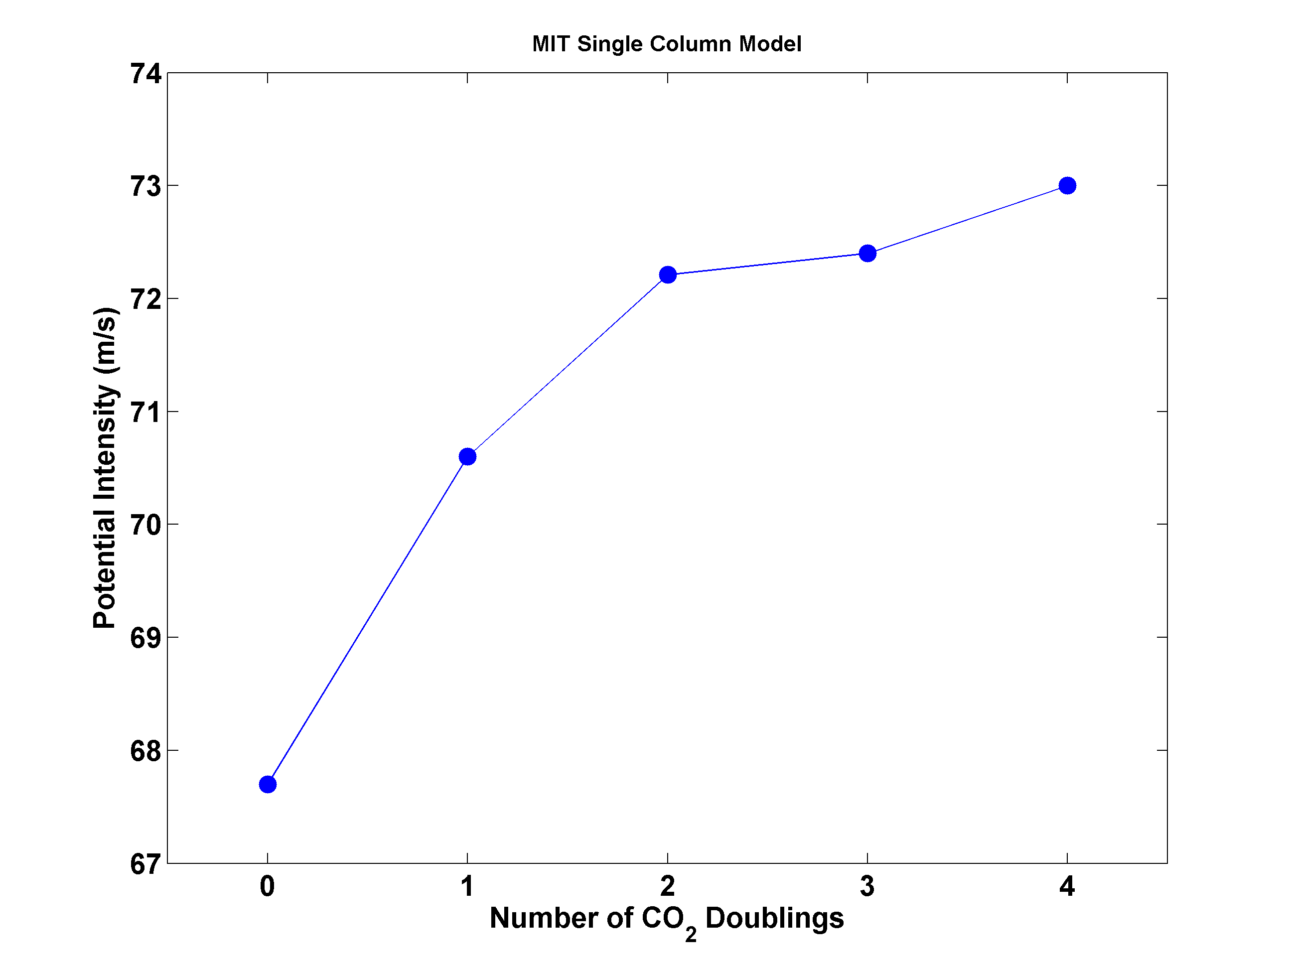
Potential Intensity and CO₂

Slide 20
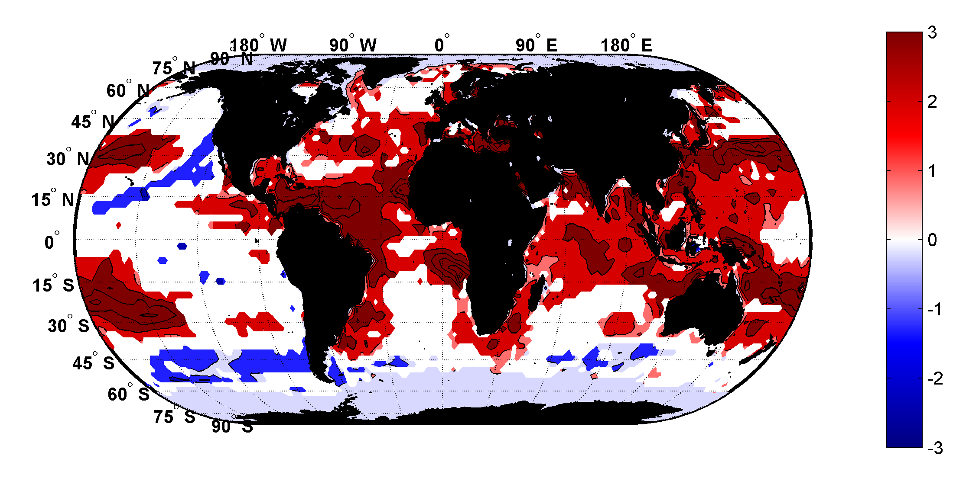
Trends in Thermodynamic Potential for Hurricanes, 1980-2010
(NCAR/NCEP Reanalysis)
ms⁻¹decade⁻¹

Slide 21
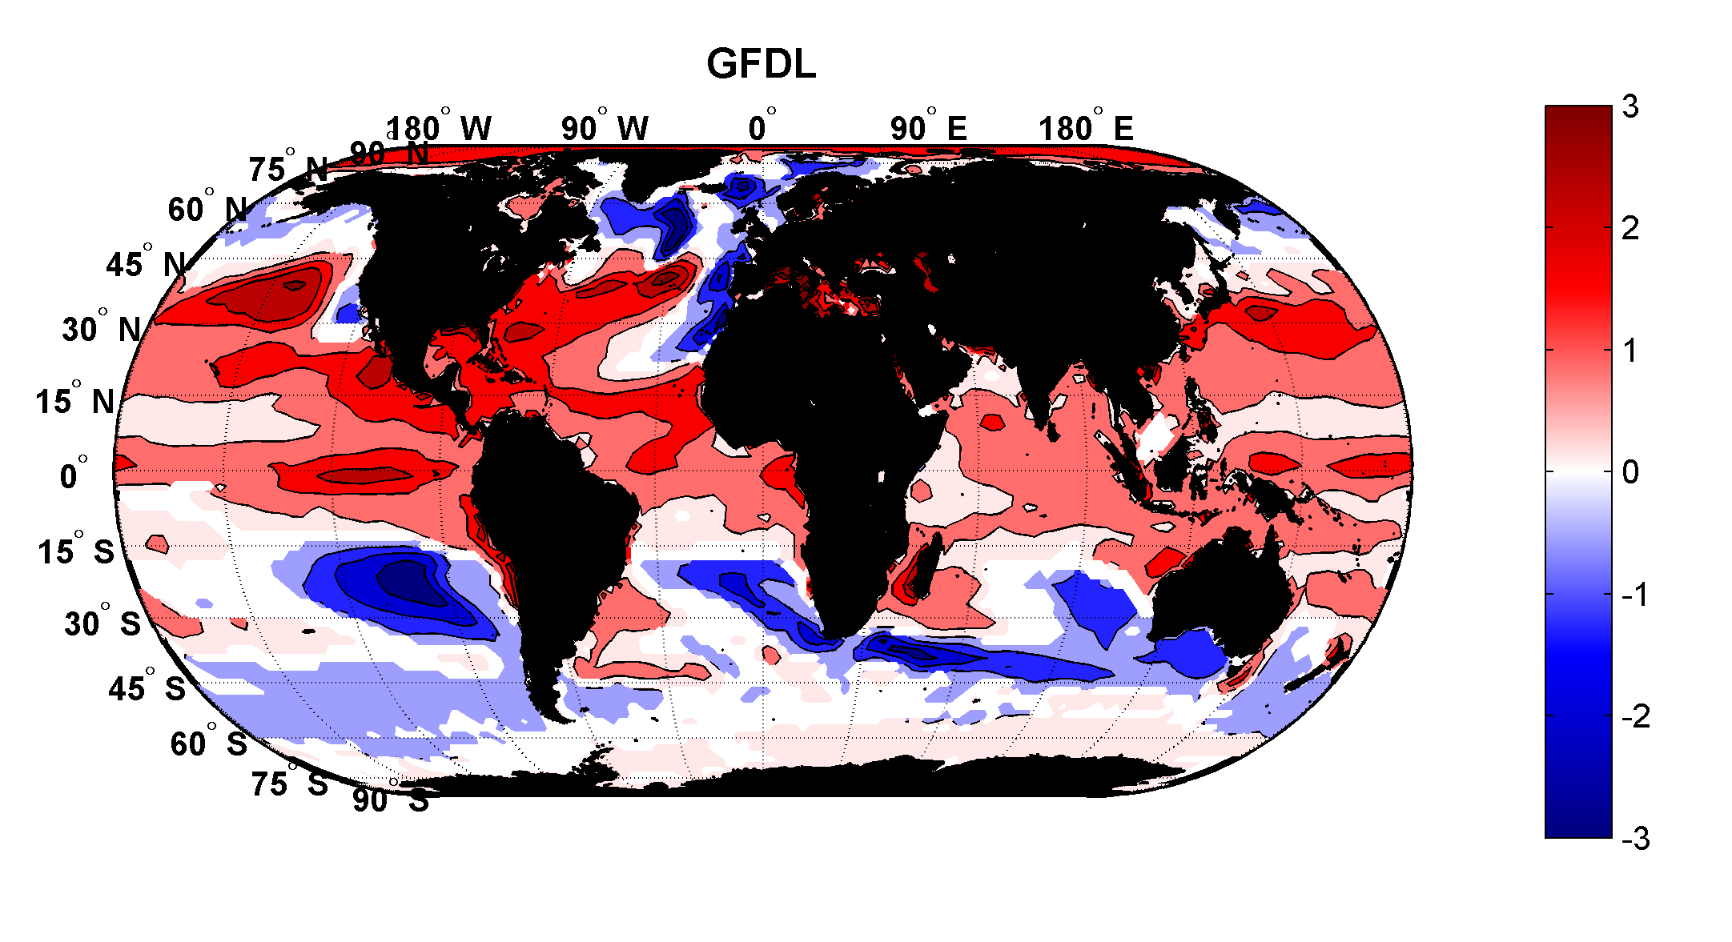
Projected Trend Over 21st Century: GFDL model under RCP 8.5
ms⁻¹decade⁻¹

Slide 22
Inferences from Basic Theory:
Potential intensity increases with global warming
Incidence of high-intensity hurricanes should increase
Increases in potential intensity should be faster in sub-tropics
Hurricanes will produce substantially more rain: Clausius-Clapeyron yields ~7% increase in water vapor per 1ºC warming

Slide 23


Risk Assessment in a Changing Climate: The Problem
Event Probability
Damage Probability
Current and Future Probability Density of U.S. TC Wind Damages
Current and Future Damage Probability

Slide 24
The Heart of the Problem:
Societies are usually well adapted to frequent events (> 1/100 yr)
Societies are often poorly adapted to rare events (< 1/100 yr)
Robust estimates of the character of ~100 yr events require ~1,000 years of data
We do not have ~1,000 years of meteorological observations

Slide 25
How We Deal with This:
For local events, accumulate statistics over locations far enough apart to sample different individual events, but close enough to sample the same overall climatology.
  Example: 500 mm of TC rain in metro Houston may be a 100-year event, but a 20-year event over coastal Texas
Extrapolate well-sampled events to rare events using extreme value theory. Dicey!

Slide 26
How We COULD Deal with This:
Bring physics to bear on natural hazard risk assessment… problem too important to leave to statisticians
But several impediments:
  Academic stove-piping: Too applied for scientists; too complicated for risk professionals
  Brute force modeling probably too expensive to be practical for many applications
  May now be impractical to run WRF for ~1,000 years, driven by GCMs, but that day is coming

Slide 27
Using Physics to Estimate Hurricane Risk

Slide 28
Why Not Use Global Climate Models to Simulate Hurricanes?

Slide 29

Problem: Today’s models are far too coarse to simulate destructive hurricanes
Histograms of Tropical Cyclone Intensity as Simulated by a Global Model with 30 mile grid point spacing. (Courtesy Isaac Held, GFDL)
Category 3
Modeled
Observed
Global models do not simulate the storms that cause destruction
Wind Speed (meters per second)

Slide 30
How to deal with this?
Embed high-resolution, fast coupled ocean-atmosphere hurricane model in global climate model or climate reanalysis data
Coupled Hurricane Intensity prediction Model (CHIPS) has been used for 16 years to forecast real hurricanes in near-real time

Slide 31
Time-dependent, axisymmetric model phrased in R space (CHIPS)
Hydrostatic and gradient balance above PBL
Moist adiabatic lapse rates on M surfaces above PBL
Boundary layer quasi-equilibrium convection
Deformation-based radial diffusion
Coupled to simple 1-D ocean model
Environmental wind shear effects parameterized

Slide 32
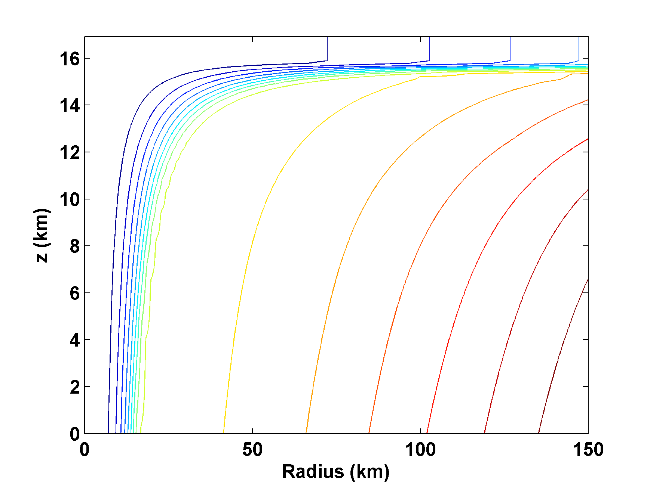
Angular Momentum Distribution
Altitude (km)
Storm Center

Slide 33
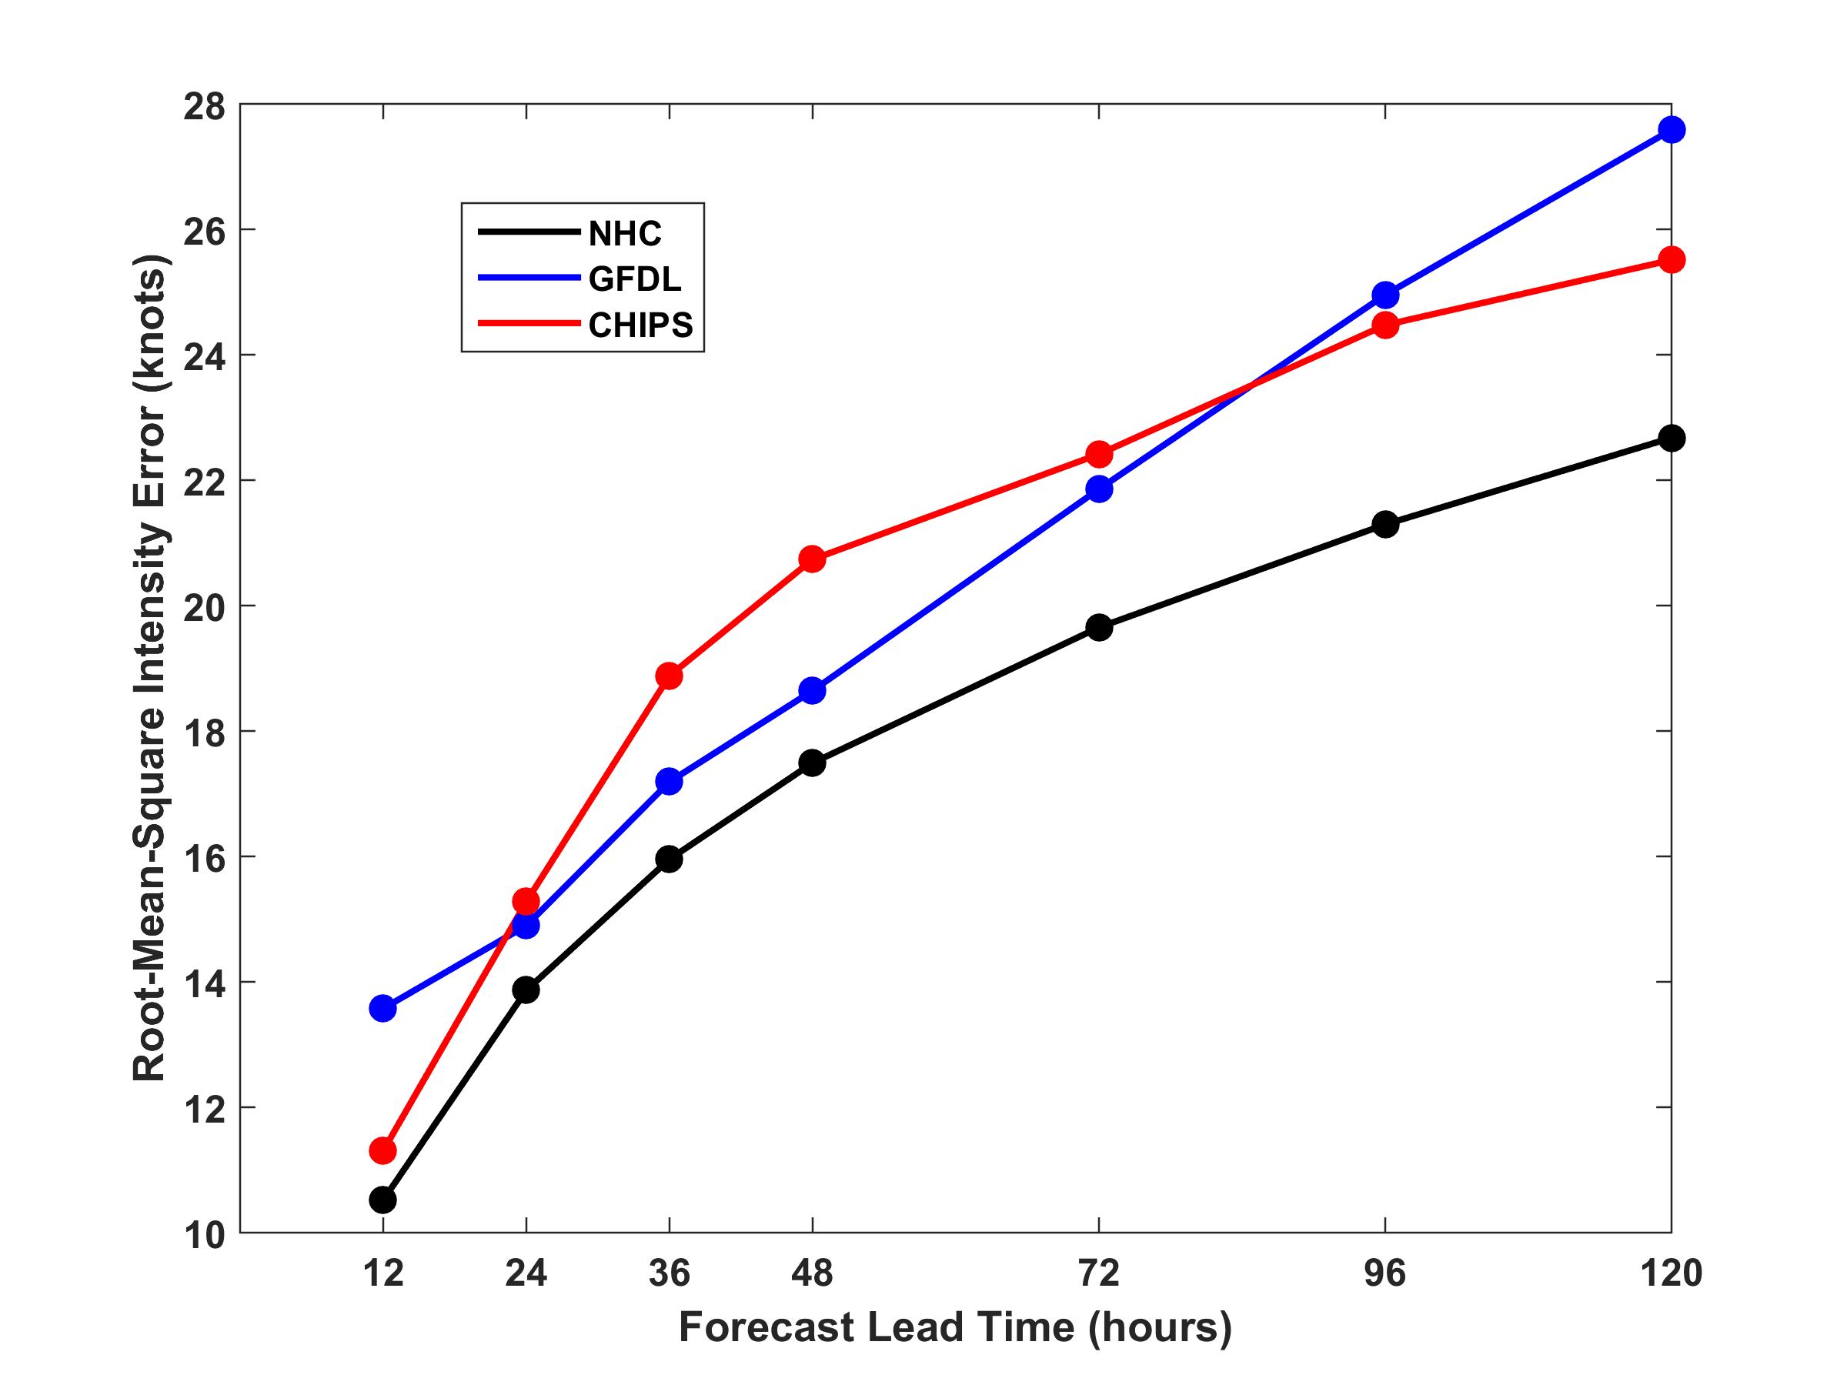
RMS Intensity Error, 2009-2015
North Atlantic

Slide 34
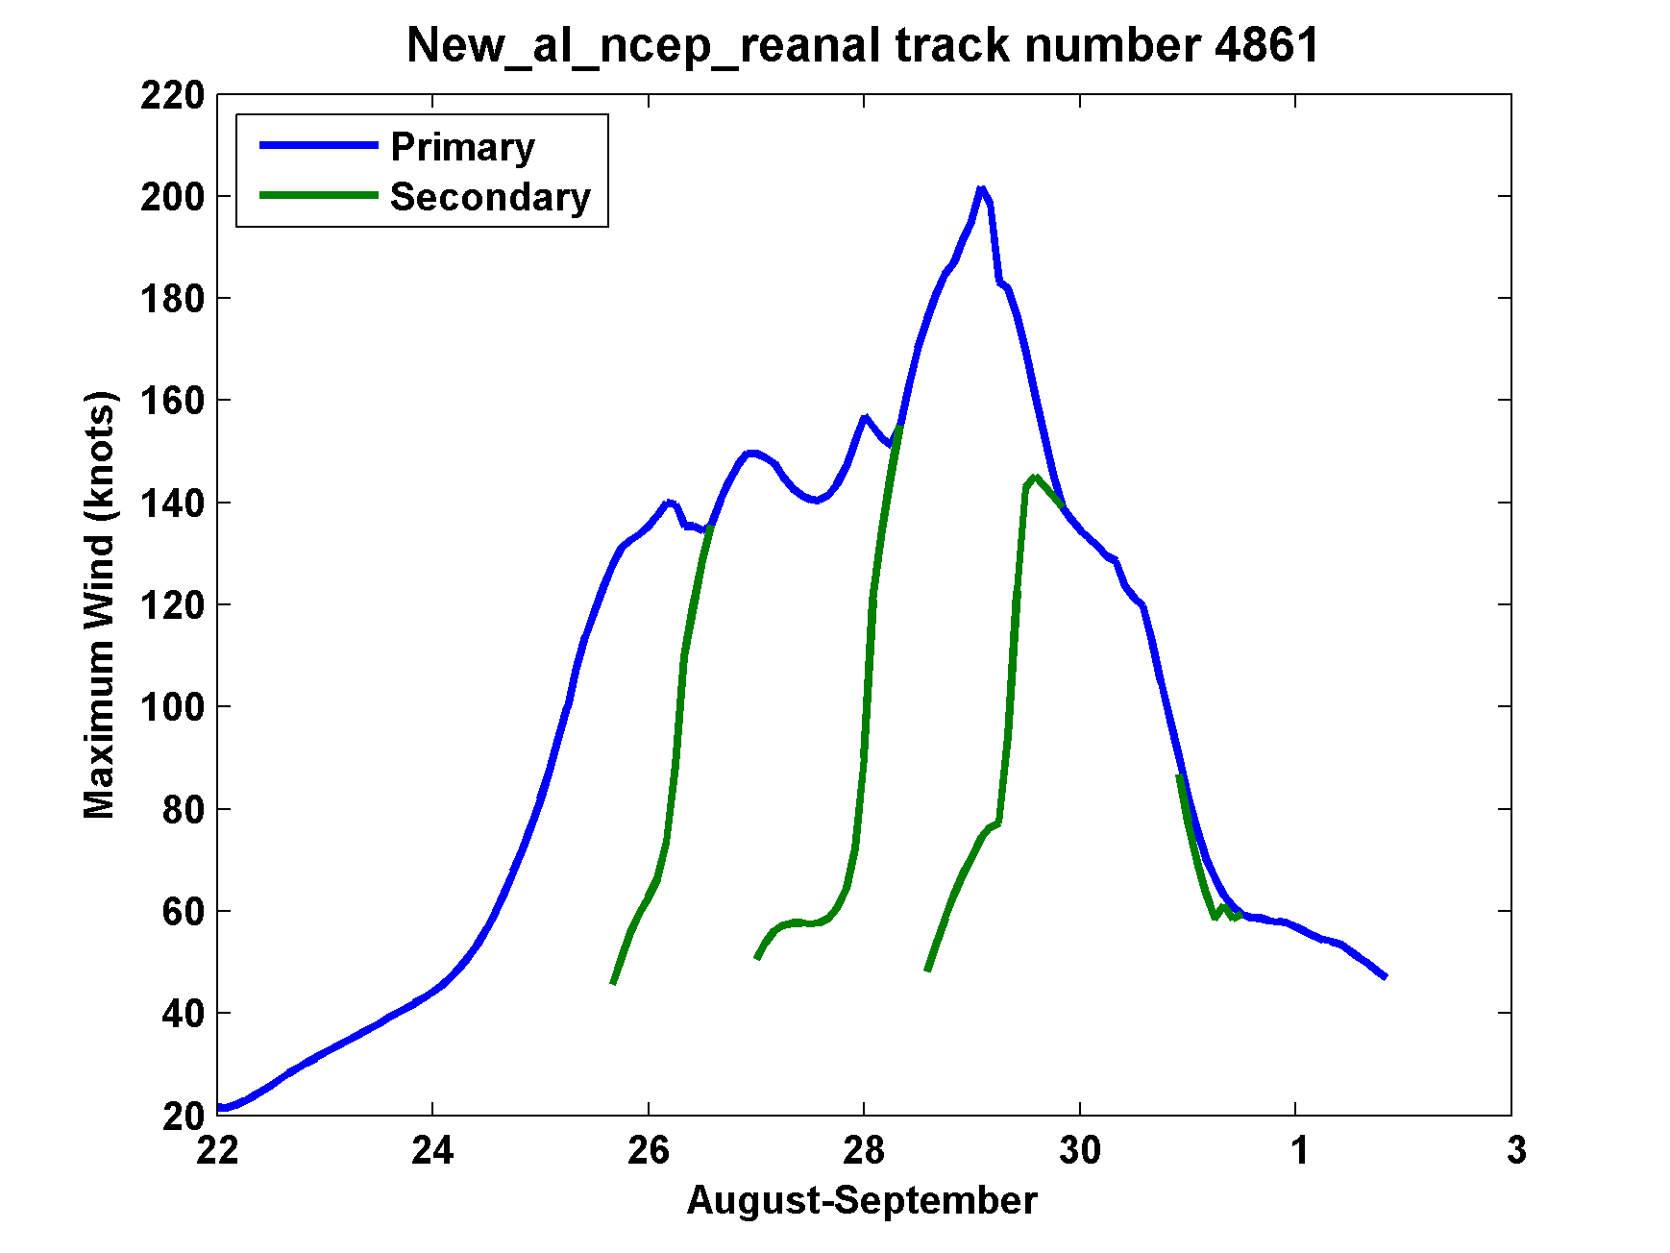
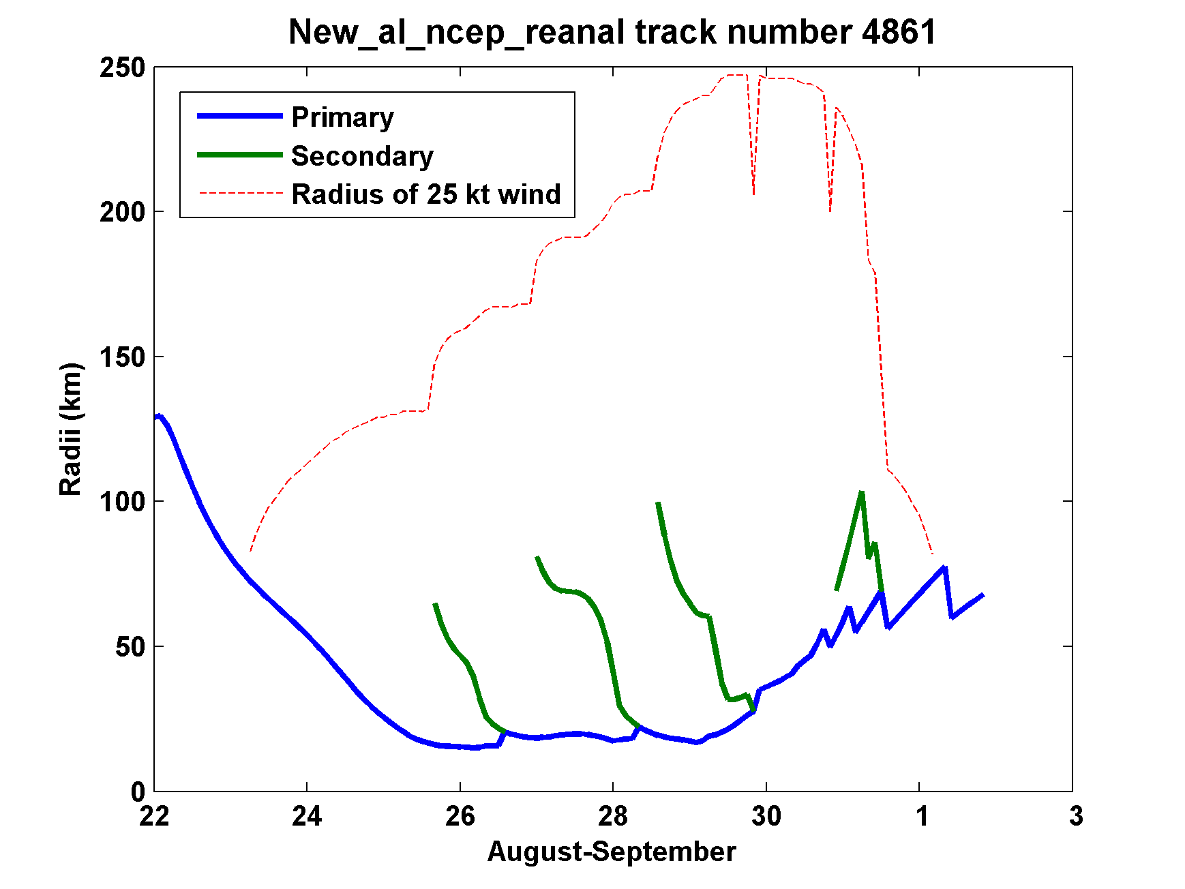
Secondary
eyewalls

Slide 35
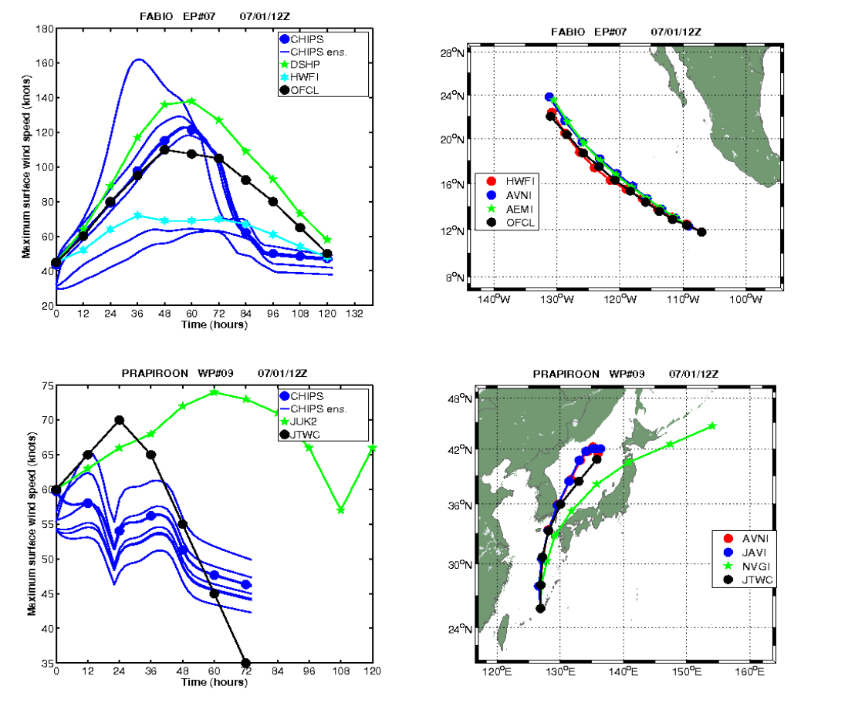
Real-time forecasts at http://wind.mit.edu/~emanuel/storm.html

Slide 36
RMS Intensity Error, 2009-2015
North Atlantic

Slide 37
How Can We Use This Model to Help Assess Hurricane Risk in Current and Future Climates?

Slide 38
Risk Assessment Approach:
Step 1: Seed each ocean basin with a very large number of weak, randomly located cyclones
Step 2: Cyclones are assumed to move with the large scale atmospheric flow in which they are embedded, plus a correction for the earth’s rotation and sphericity
Step 3: Run the CHIPS model for each cyclone, and note how many achieve at least tropical storm strength
Step 4: Using the small fraction of surviving events, determine storm statistics. Can easily generate 100,000 events
Details: Emanuel et al., Bull. Amer. Meteor. Soc, 2008
Notes:
38

Slide 39
Synthetic Track Generation:
Generation of Synthetic Wind Time Series
Postulate that TCs move with vertically averaged environmental flow plus a “beta drift” correction
Approximate “vertically averaged” by weighted mean of 850 and 250 hPa flow

Slide 40
Synthetic wind time series
Monthly mean, variances and co-variances from re-analysis or global climate model data
Synthetic time series constrained to have the correct monthly mean, variance, co-variances and an ω⁻³ power series

Slide 41
Calibration
Absolute genesis frequency calibrated to globe during the period 1980-2005
Notes:
41

Slide 42
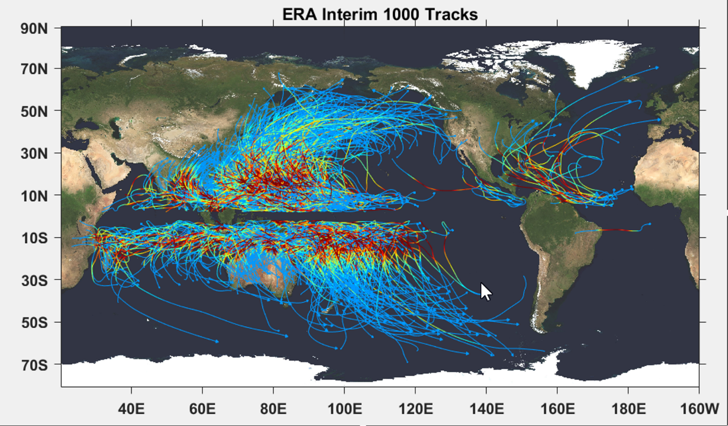

Slide 43
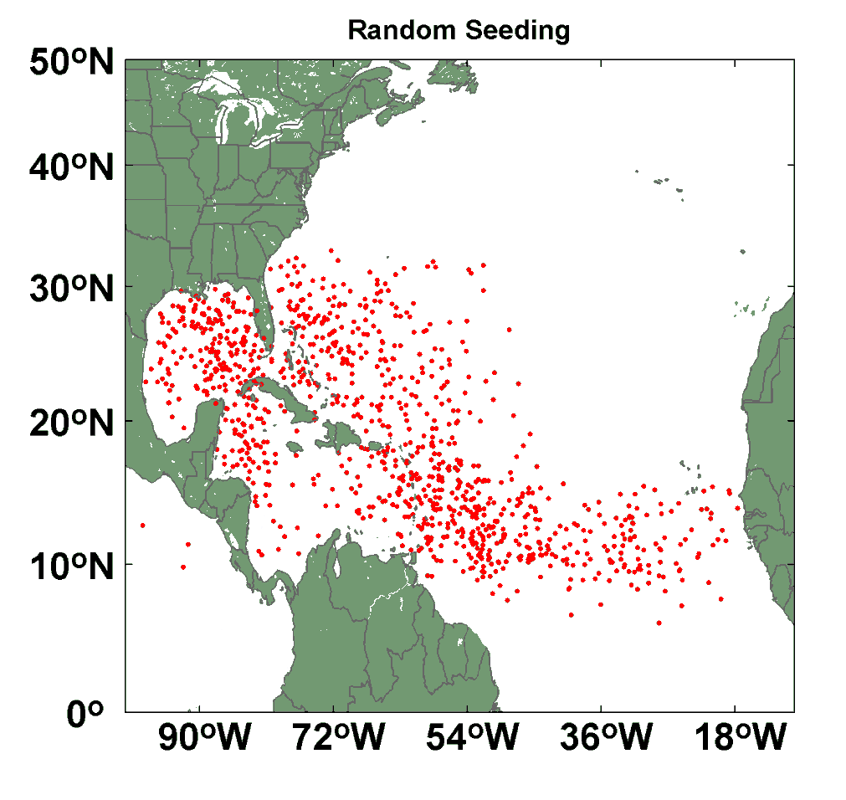
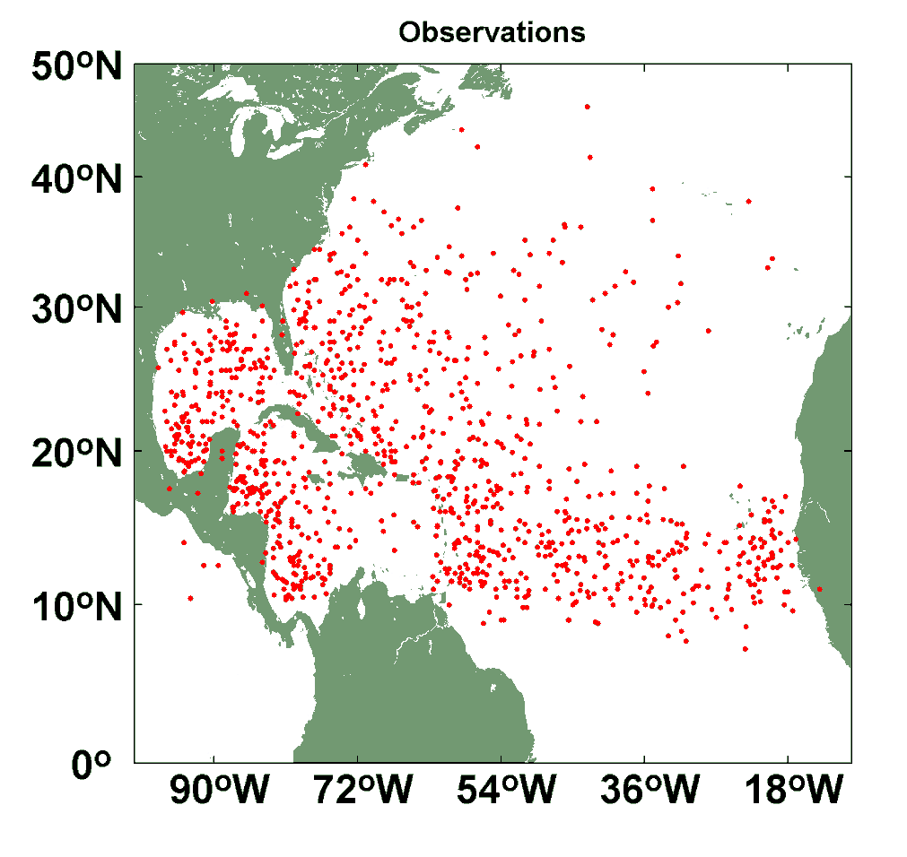
Comparison of Random Seeding Genesis Locations with Observations

Slide 44
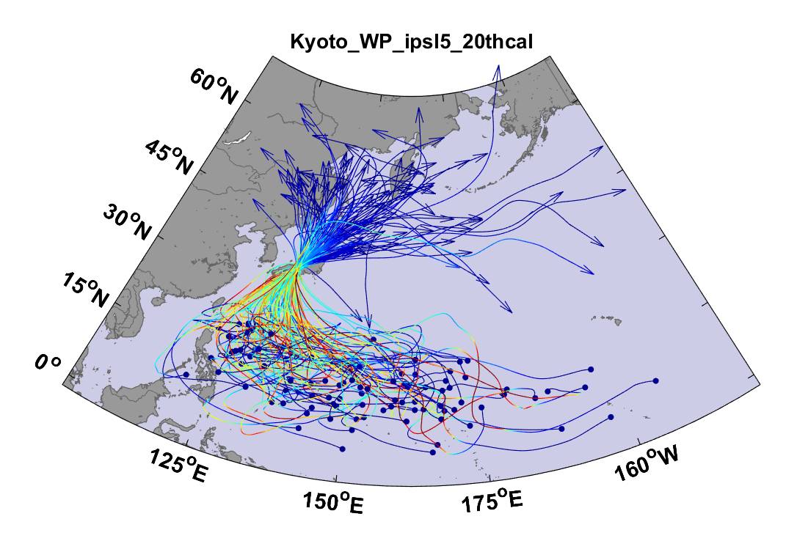
Top 100 out of 2000 TCs Affecting Kyoto, 1981-2000

Slide 45
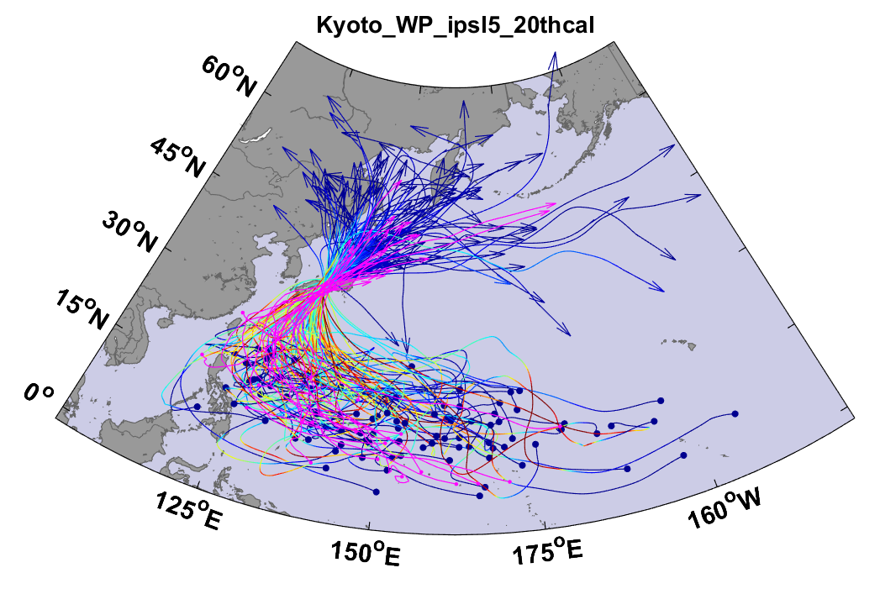
Same, but with top 20 historical tracks

Slide 46
Sample Kyoto track

Slide 49
Storm total rainfall

Slide 50
Rain rate at Kyoto

Slide 51

Cumulative Distribution of Storm Lifetime Peak Wind Speed, with Sample of 1755 Synthetic Tracks
90% confidence bounds

Slide 52

Return Periods

Slide 53
Atlantic Annual Cycle

Slide 54

Captures effects of regional climate phenomena (e.g. ENSO, AMM)

Slide 55
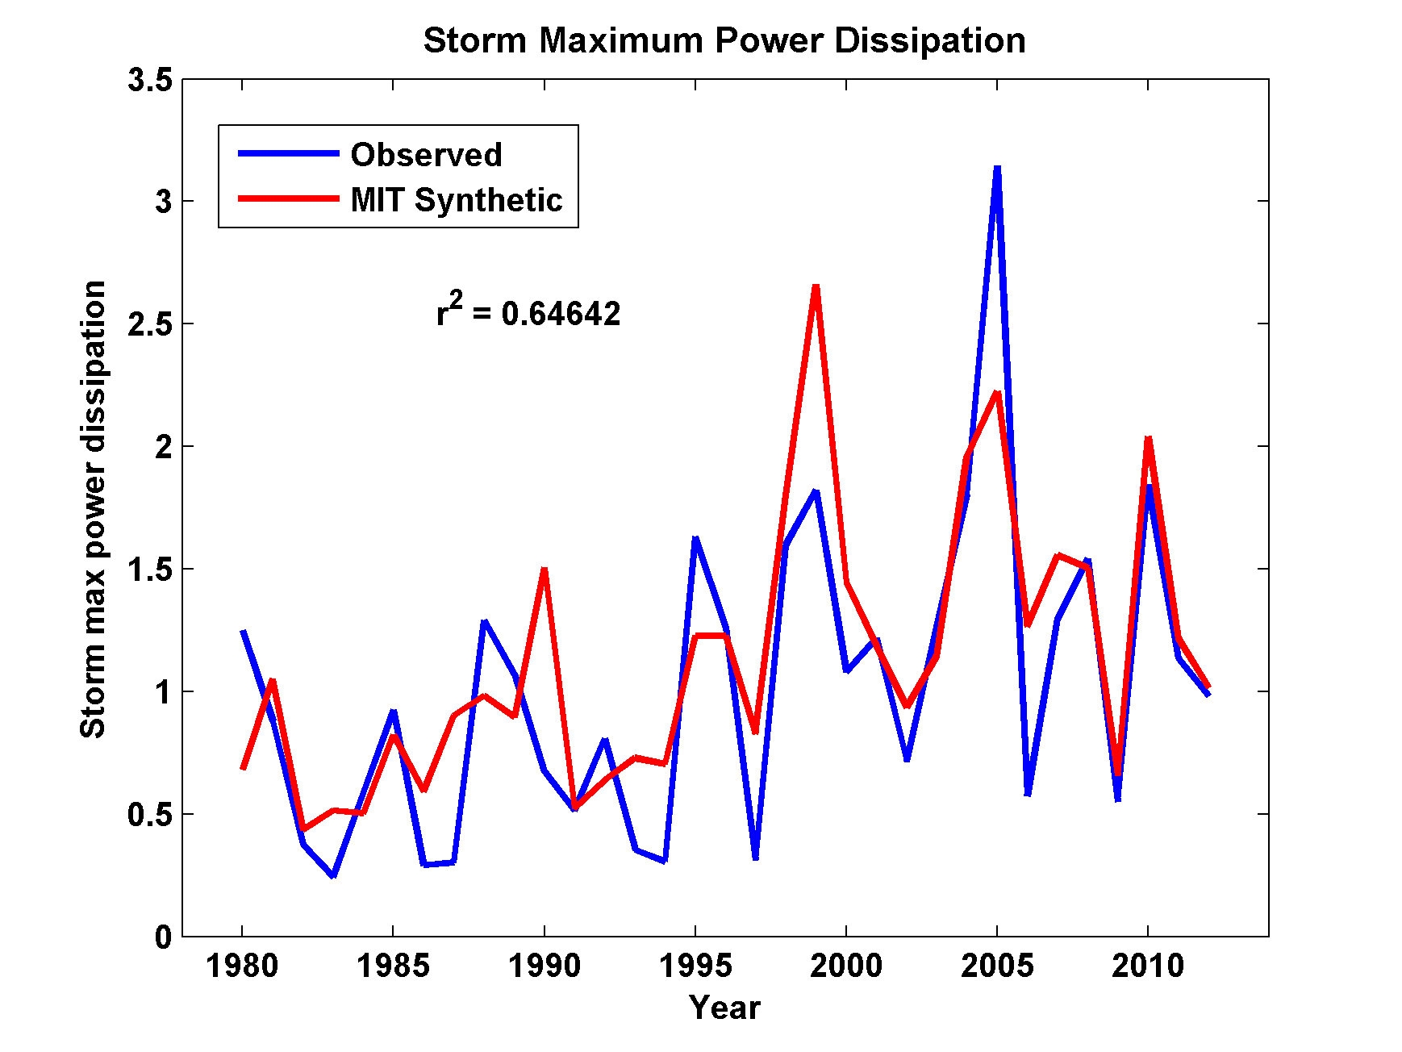
Captures Much of the Observed North Atlantic Interannual Variability
r²=0.65

Slide 56
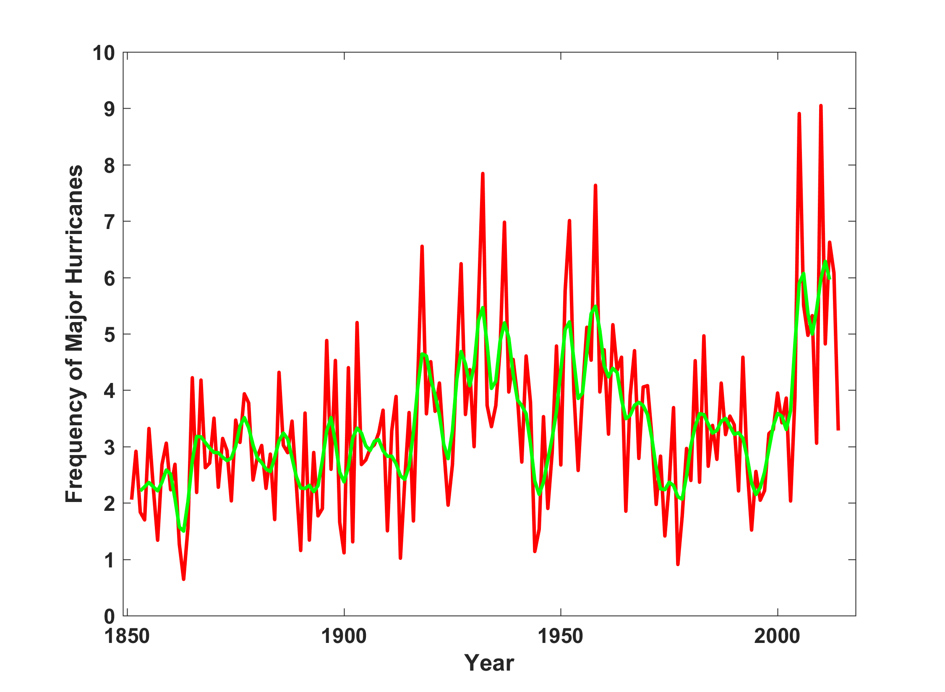
North Atlantic Major Hurricanes Downscaled from NOAA 20th Century Reanalysis
(Forced by sea surface temperature, surface pressure, and sea ice only)

Slide 57
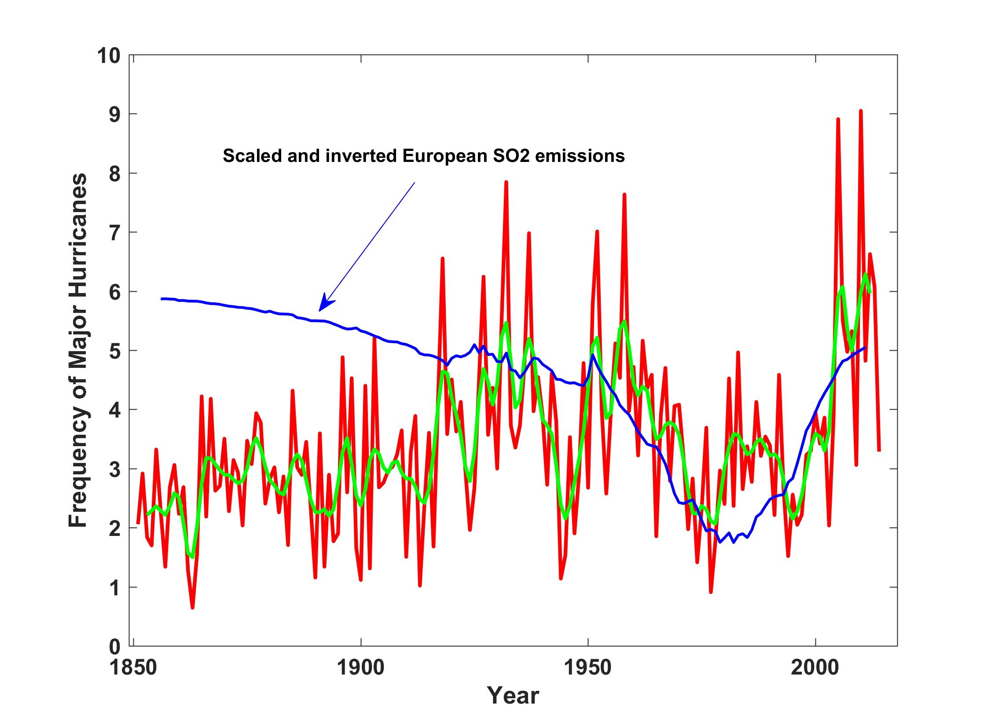
North Atlantic Major Hurricanes Downscaled from NOAA 20th Century Reanalysis
(Forced by sea surface temperature, surface pressure, and sea ice only)

Slide 58


Storm Surge Simulation (Ning Lin)
SLOSH model
(Jelesnianski et al. 1992)
SLOSH mesh
~ 10³ m
ADCIRC mesh
~ 10² m
Battery
ADCIRC model
(Luettich et al. 1992)
ADCIRC mesh
~ 10 m
(Colle et al. 2008)
Notes:
Given the storm wind and pressure fields (which is estimated from the Holland parametric pressure model) we can simulate the surge. Surge simulations with high resolution are computationally intensive, so to make it possible to simulate accurate surges for our large synthetic storm sets, we apply the two hydrodynamic models with girds of various resolutions in such a way that the main computational effort is concentrated on the storms that determine the risk. First, we apply the SLOSH model, using a mesh with resolution of about 1 km around NYC to simulate the surges for all storms and select the storms that have return periods, in terms of the surge height at the Battery, greater than 10 years. Second, we apply the ADCIRC simulation, using a grid mesh with resolution of ~100 m around NYC, to each of the selected storms. Then, we apply another ADCIRC mesh with resolution as high as ~10 m around NYC, for a set of the most extreme events, to check if the resolution of our ADCIRC grid is sufficient and if needed to make statistical correction to the results.

Slide 59
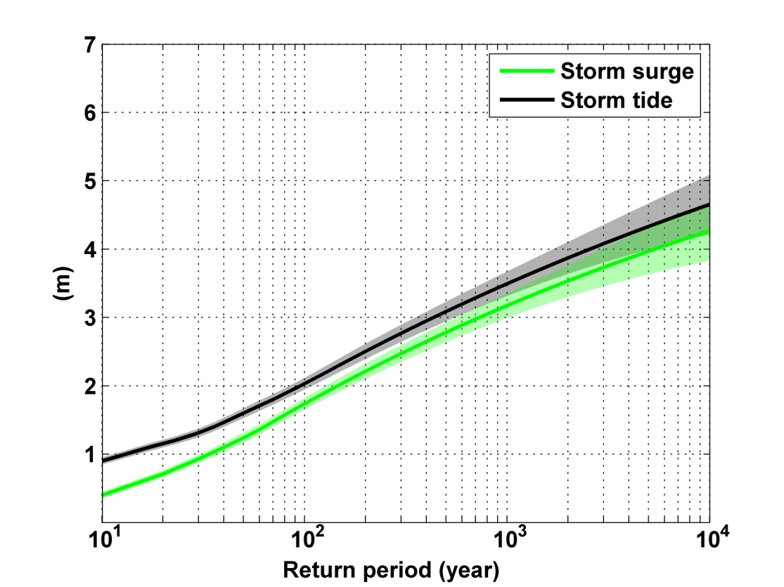
Sandy, 2012
Sandy: ~ 400 years
Notes:
Storm surge and storm tide (surge and tide) return level curves for the Battery, NYC, for the 1981-2000 NCAR/NCEP climate conditions (5000 synthetic storms). Astronomical tide and nonlinear interaction between surge and tide are accounted for statistically.

Slide 60
Predicting Rainfall
The CHIPS models predicts updraft and downdraft convective mass flux as a function of time and potential radius, BUT:
Storing these variables at all radii would increase overall storage requirements by a factor of ~50
(We are dealing with 10,000-100,000 individual events)

Slide 61
Basic strategy: Reconstruct time-evolving
2-D wind field by fitting a canonical radial wind profile to predicted values of V_{max} and r_{max} and adding a constant background wind. Allow resulting vortex to interact with background wind and thermodynamic fields.
Rainfall calculated using quasi-balanced dynamics

Slide 62
QB is fine, but how do we evaluate how well it works?
Evaluation of rainfall predictions against observations is tough!
  Only 32 years of NEXRAD data
  Rain gauges go back much further in time but can be unreliable in strong winds and are subject to large sampling error
We used both radar and gauge data and averaged both over circles of 100 km radius of 35 radar sites. (Feldmann and Emanuel, 2019, in review)
Many thanks to Monika Feldmann

Slide 63
NEXRAD Sites

Slide 64
Some Examples
Estimated gauge sampling error
Estimated radar sampling error

Slide 67
Effects of Climate Change
More moisture in boundary layer
Stronger storms but more compact inner regions
Possibly larger storm diameters
Storms may be moving faster or slower

Slide 68
Taking Climate Change Into Account

Slide 69
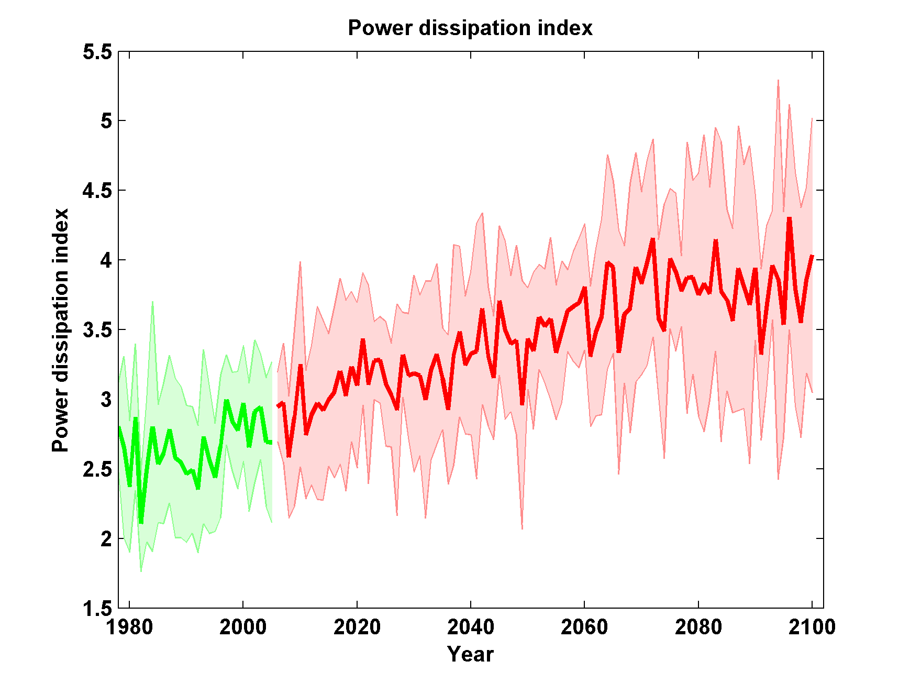
Global Hurricane Power under RCP 8.5
Six CMIP5 Models

Slide 70

GCM flood height return level, Battery, Manhattan
(assuming SLR of 1 m for the future climate )
Black: Current climate (1981-2000)
Blue: A1B future climate (2081-2100)
Red: A1B future climate (2081-2100) with R₀ increased by 10% and R_{m} increased by 21%
Lin et al. (2012)
Notes:
Then we calculate the flood height (including surge, tide, and sea level rise) return level for the four climate models, assuming a sea level rise of 1 m for the future climate, for the Battery, NYC. These results show that the combined effects of storm climatology change and sea level rise will greatly shorten the flood return periods for NYC and, by the end of the century, the current 100-year surge flooding may happen less than every 30 years, with CNRM and GFDL prediction to be less than 10 years, and the 500-year flooding may happen less than every 200 years, with the CNRM and GFDL prediction to be 20-30 years.

Slide 71
Aerts, C. J. H. J., W. J. W. Botzen, K. Emanuel, N. Lin, H. de Moel, and E. O. Michel-Kerjan, 2014: Evaluating flood resilience strategies for coastal megacities. Science, 344, 473-475.

Slide 72
Benefit-Cost Ratios

Slide 73
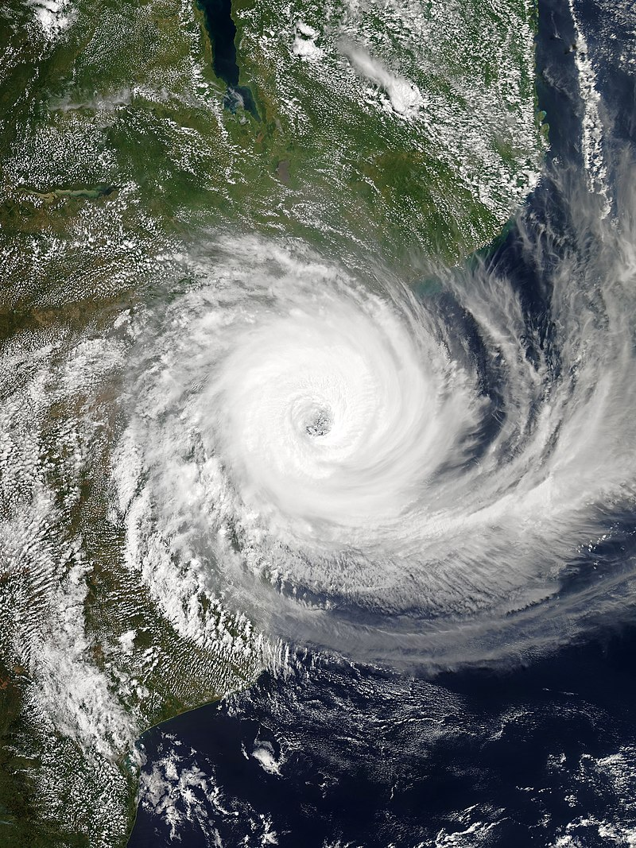
Tropical Cyclone Idai, 2019
Second-deadliest tropical cyclone recorded in the South-West Indian Ocean basin
Third-deadliest tropical cyclone on record in the southern hemisphere
Peak winds of 100 knots
> 500 mm rainfall in some locations
Storm surge of 4.4 m at Beira
~90% of Beira destroyed
> 1,000 lives lost

Slide 74
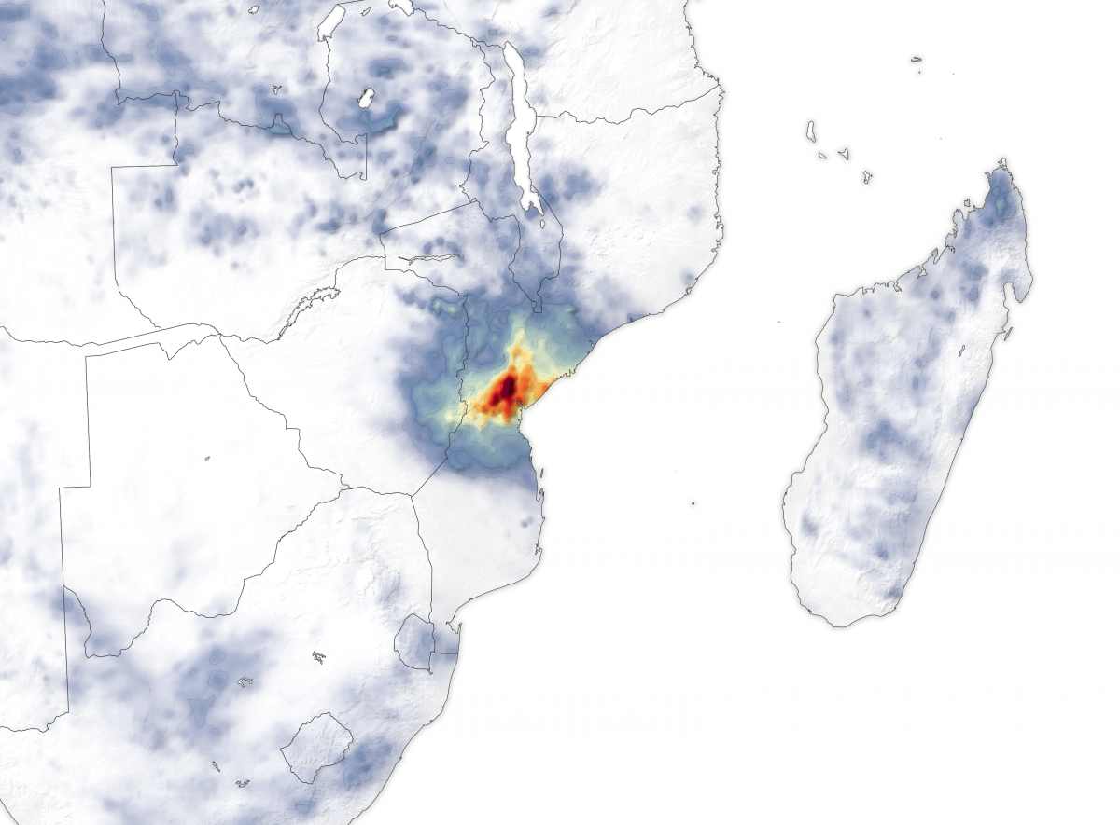
Rainfall accumulation from March 13 to March 20, 2019. Many areas received as much as 50 centimeters (20 inches) of rain. These data are remotely-sensed estimates that come from the Integrated Multi-Satellite Retrievals (IMERG), a product of the Global Precipitation Measurement (GPM) mission. Local rainfall amounts can be significantly higher when measured from the ground. Credit: NASA

Slide 75
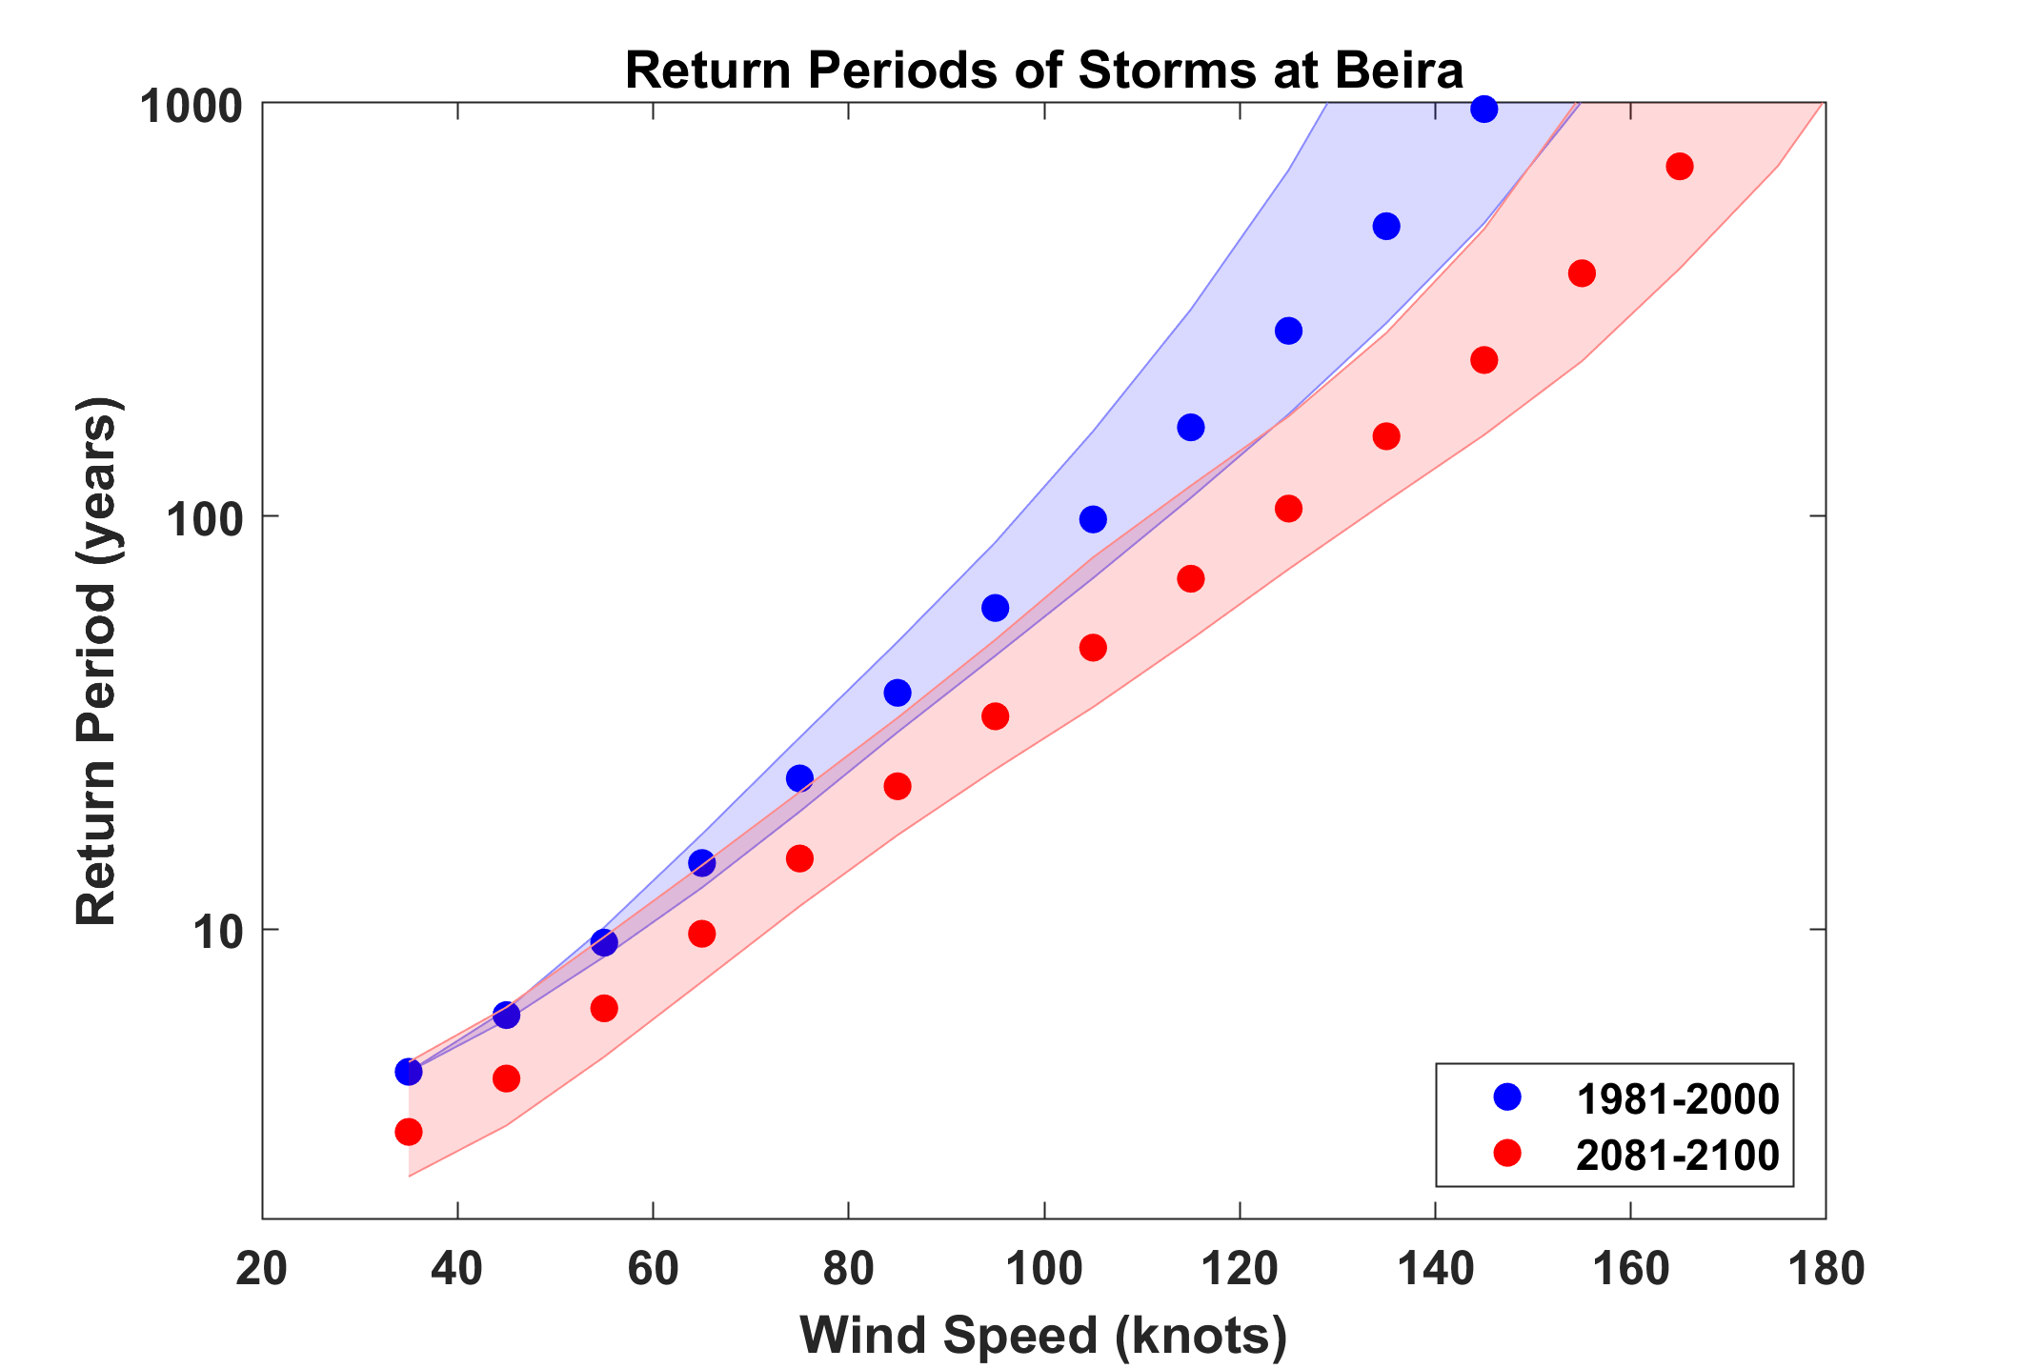
Based on 7 CMIP5 models
Idai

Slide 76
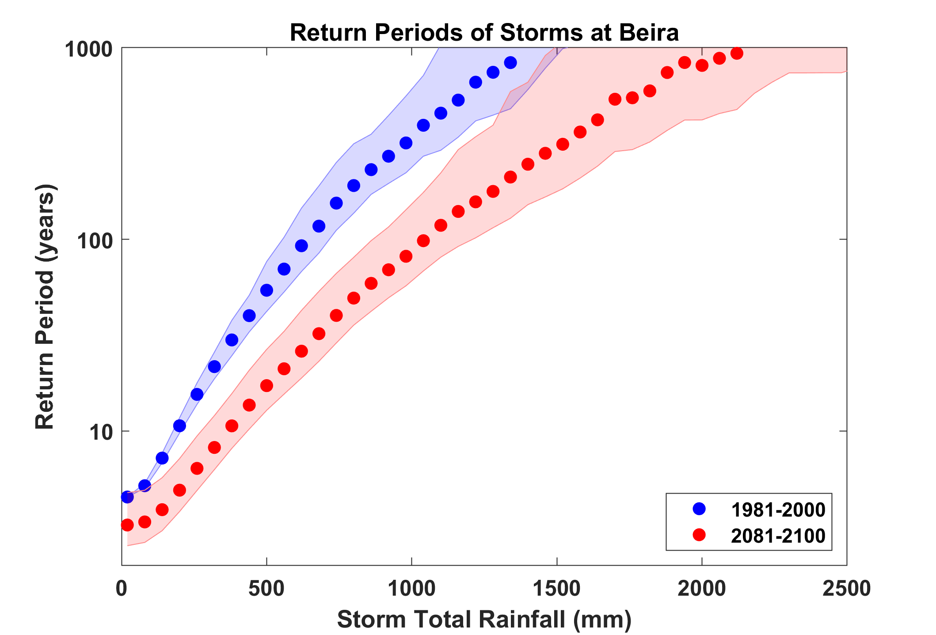
Idai

Slide 77
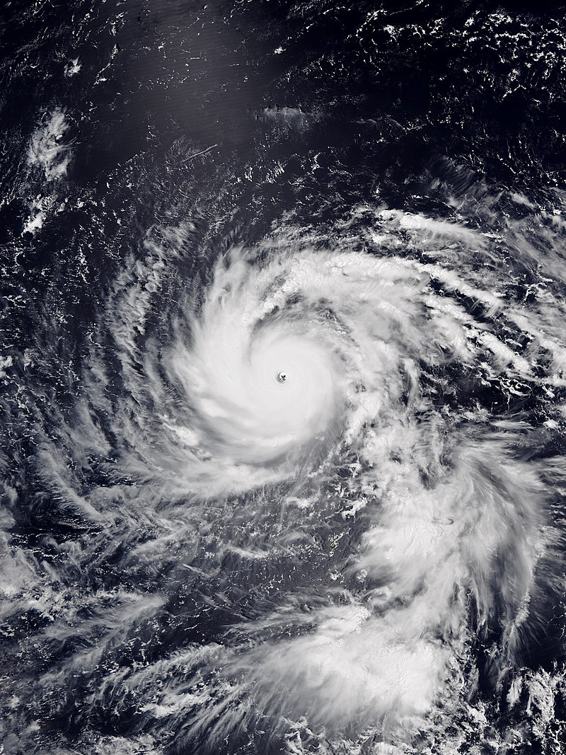
Typhoon Jebi, 2018
Strongest typhoon to strike Japan since Typhoon Yancy in 1993
90 kts sustained wind at landfall
Broke the historical records of sustained winds at 53 weather stations and maximum gust at 100 weather stations in Japan
Storm surge of 3.3 m at Osaka
11 deaths, >600 injured

Slide 78
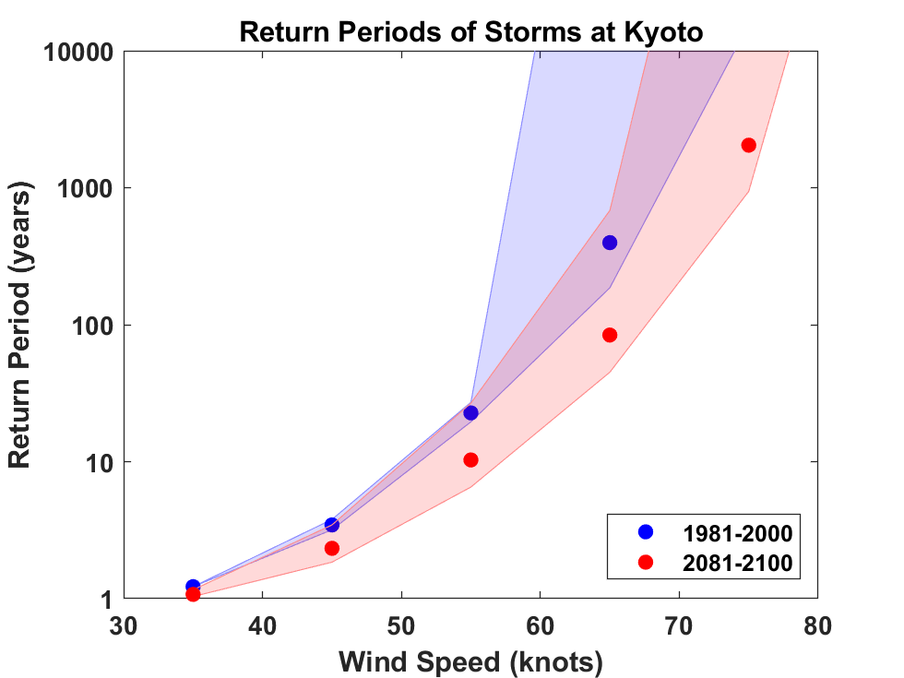
Based on 5 CMIP5 models
Jebi (estimated)

Slide 79
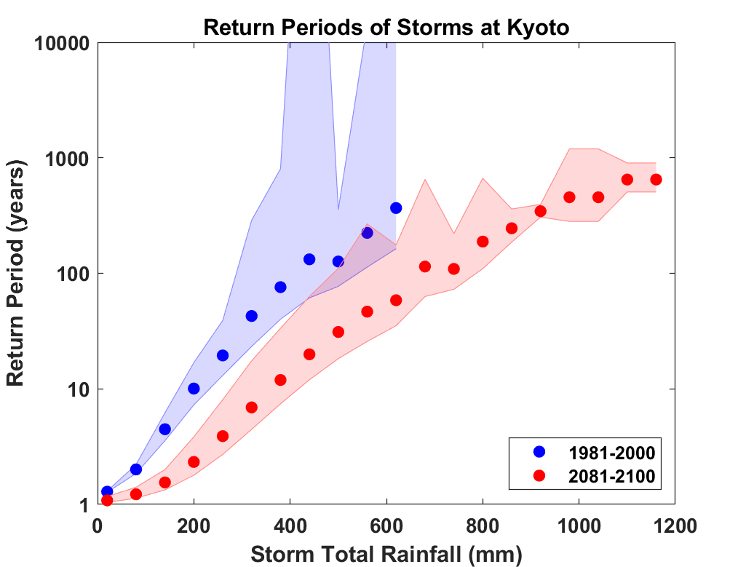


Slide 80
A Black Swan Event

Slide 81
Summary
The observational record of hurricanes is too short and noisy, and of a quality too low to make robust inferences of climate signals
Satellite data do show a migration of peak intensity toward higher latitudes and some indication of a greater fraction of intense storms
Recovery of hurricane proxies from the geological record is beginning to show some climate signals

Slide 82
Summary (continued)
Potential intensity theory demonstrates that the thermodynamic limit on hurricane intensity rises with temperature
Observations show that this limit is indeed increasing
Physics can be used to model hurricane risk in current and future climates

Slide 83
Spare Slides

Slide 84
Calculating vertical motion in middle troposphere from time-dependent azimuthal gradient wind. Four components:
Vertical motion at the top of the boundary layer owing to frictional effects within the boundary layer. This is estimated using a slab boundary layer model forced by the model gradient wind as well as the low-level environmental wind used as an input to the storm synthesizer. Use spatially varying drag coefficient.
Vertical motion at the top of the boundary layer forced by topography interacting with the combination of storm and environmental flow.

Slide 85
Vertical stretching between the top of the boundary layer and the middle troposphere associated with changes in the vorticity of the (axisymmetric) gradient wind.
Add mid-tropospheric vertical motion caused by the dynamical interaction of the axisymmetric vortical flow and the background shear/horizontal temperature gradient. Classical quasi-balance reasoning!

Slide 86
Given mid-tropospheric vertical motion, rainfall is calculated by assuming ascent along a moist adiabat, calculated using the environmental 600 hPa temperature plus a correction for the storm’s warm core

