Slide 1

The Problem of Hurricanes and Climate
Kerry Emanuel
Program in Atmospheres, Oceans and Climate
The Lorenz Center
Massachusetts Institute of Technology
Notes:
1

Slide 2

Program
How should we assess hurricane risk?
What have hurricanes been like in the past, and how will they be affected by global warming?

Slide 3
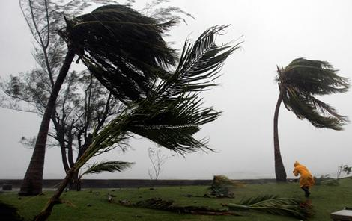
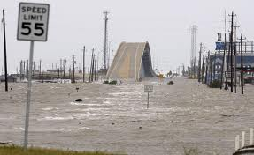
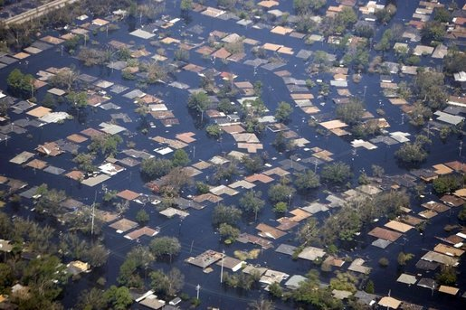
Hurricane Risks:
Wind
Storm Surge
Rain

Slide 4
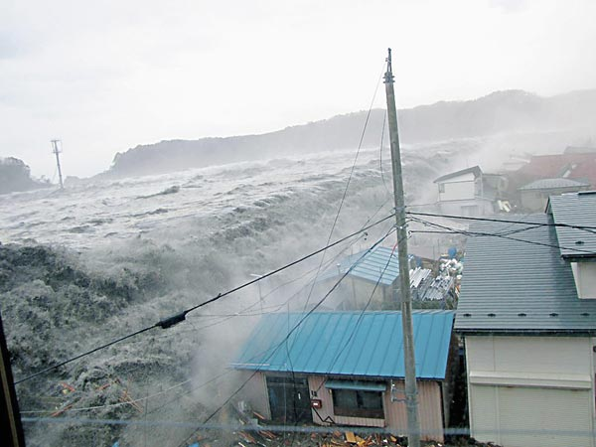

Slide 5

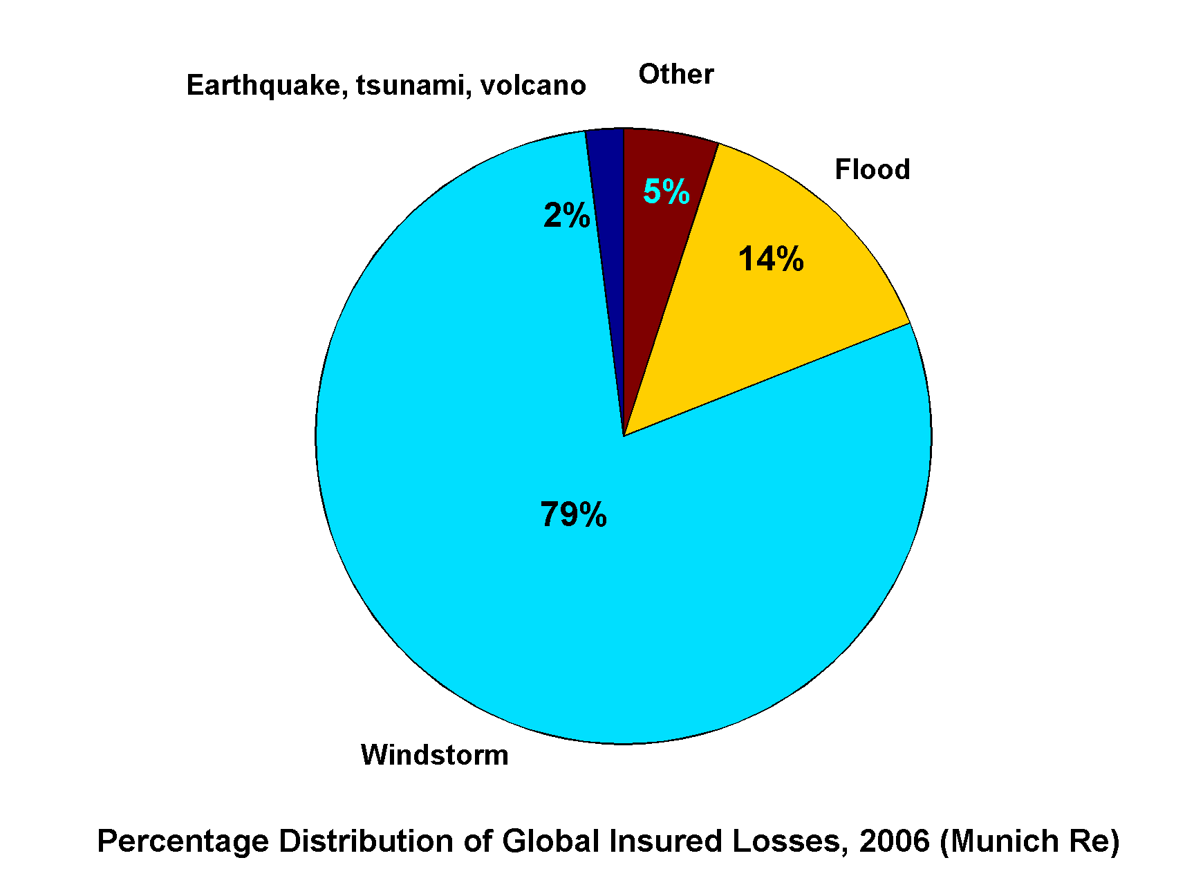
Windstorms Account for Bulk of Insured Losses Worldwide

Slide 6
Limitations of a strictly statistical approach
>50% of all normalized U.S. hurricane damage caused by top 8 events, all category 3, 4 and 5
>90% of all damage caused by storms of category 3 and greater
Category 3,4 and 5 events are only 13% of total landfalling events; only 30 since 1870
Landfalling storm statistics are inadequate for assessing hurricane risk

Slide 7
Additional Problem:
Nonstationarity of climate

Slide 8
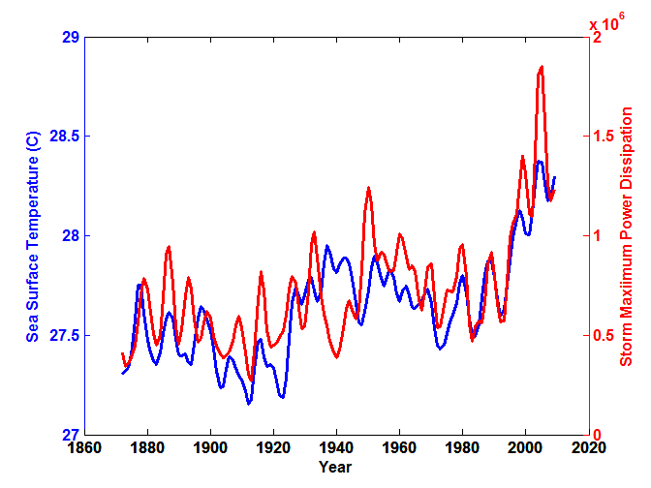
Atlantic Sea Surface Temperatures and Storm Max Power Dissipation
(Smoothed with a 1-3-4-3-1 filter)
Years included: 1870-2011
Data Sources: NOAA/TPC, UKMO/HADSST1
Notes:
8
The low value of storm power in the early 1940s is thought to be due to the lack of reports from ships at sea because of the radio silence imposed during WWII.

Slide 9
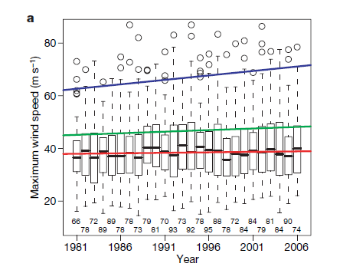
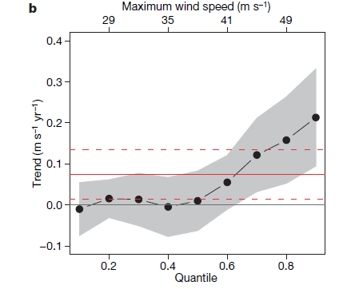
Analysis of satellite-derived tropical cyclone
lifetime-maximum wind speeds
Box plots by year. Trend lines are shown
for the median, 0.75 quantile, and 1.5 times the interquartile range
Trends in global satellite-derived tropical cyclone maximum wind speeds by quantile, from 0.1 to 0.9 in increments of 0.1.
Elsner, Kossin, and Jagger, Nature, 2008

Slide 10
Paleotempestology
barrier beach
upland
overwash fan
backbarrier marsh
a)
lagoon
barrier beach
upland
overwash fan
b)
backbarrier marsh
lagoon
terminal lobes
flood tidal delta
Source: Jeff Donnelly, WHOI
Notes:
10

Slide 11
Jeffrey P. Donnelly and Jonathan D. Woodruff, Nature, 2007

Slide 12
Risk Assessment by Direct Numerical Simulation of Hurricanes:
The Problem
The hurricane eyewall is a front, attaining scales of ~ 1 km or less
At the same time, the storm’s circulation extends to ~1000 km and is embedded in much larger scale flows
The computational nodes of global models are typically spaced 100 km apart

Slide 13

Histograms of Tropical Cyclone Intensity as Simulated by a Global Model with 50 km grid point spacing. (Courtesy Isaac Held, GFDL)
Category 3
Modeled
Observed
Global models do not simulate the storms that cause destruction

Slide 14
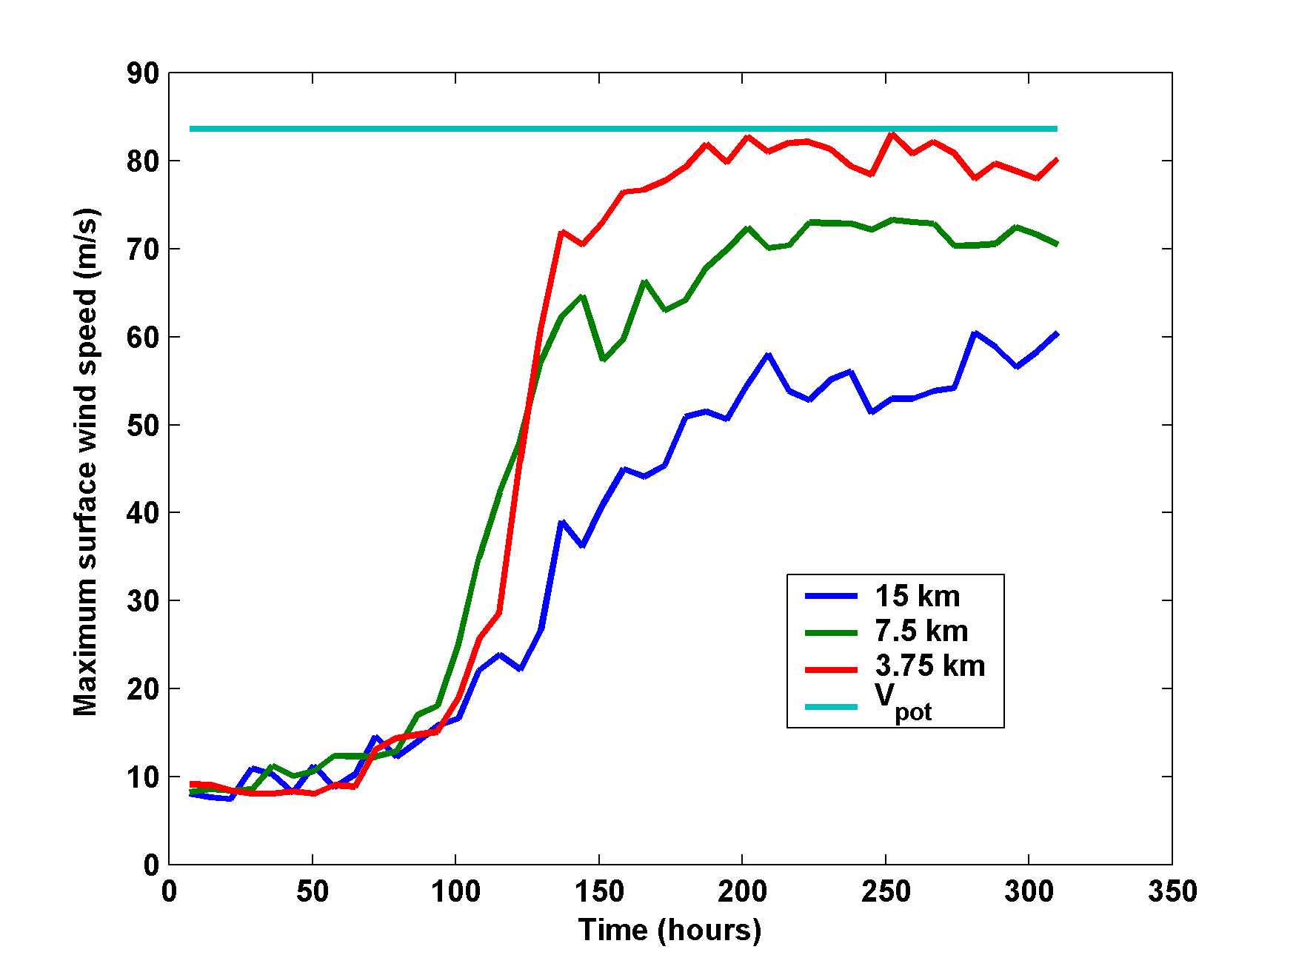
Numerical convergence in an axisymmetric, nonhydrostatic model (Rotunno and Emanuel, 1987)

Slide 15
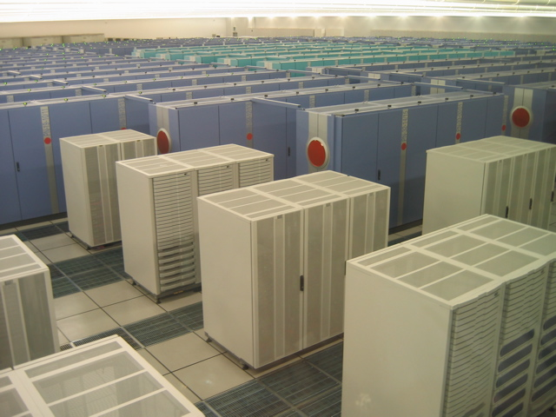
How to deal with this?
Option 1: Brute force and obstinacy

Slide 16


How to deal with this?
Option 1: Brute force and obstinacy
Option 2: Applied math and modest resources

Slide 17
Time-dependent, axisymmetric model phrased in R space
Hydrostatic and gradient balance above PBL
Moist adiabatic lapse rates on M surfaces above PBL
Boundary layer quasi-equilibrium convection
Deformation-based radial diffusion
Coupled to simple 1-D ocean model
Environmental wind shear effects parameterized

Slide 18
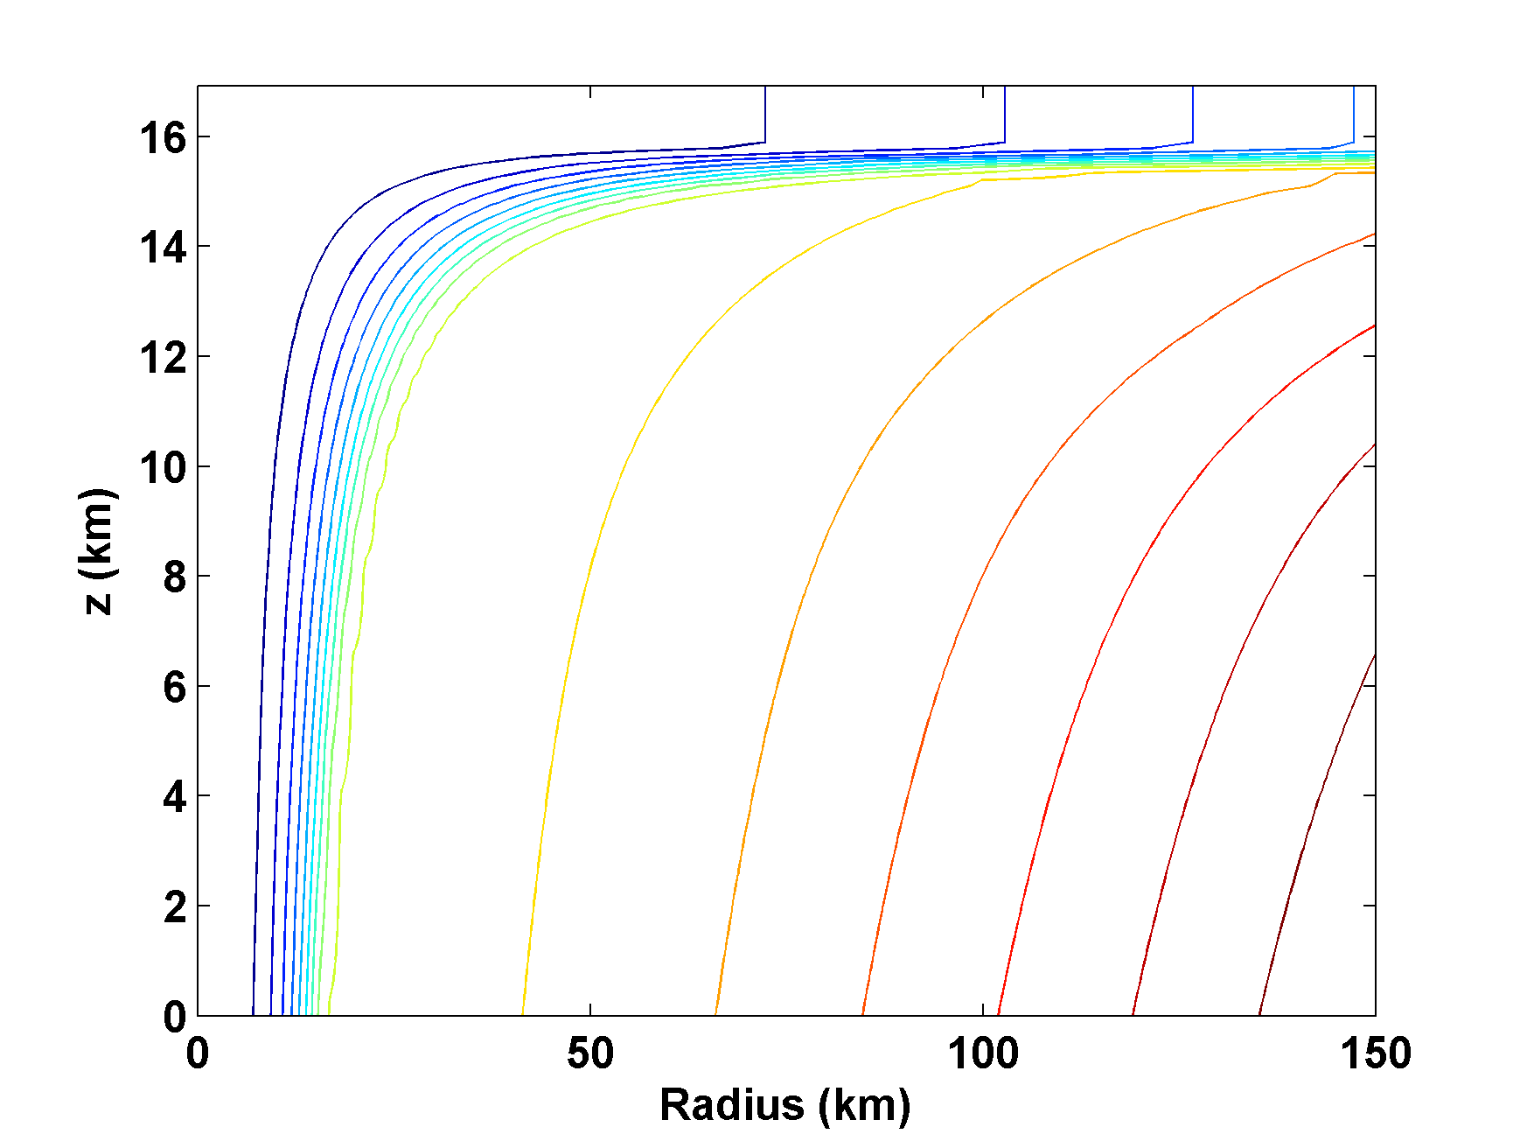
Angular Momentum Distribution

Slide 19

Application to Real-Time Hurricane Intensity Forecasting
Must add ocean model
Must account for atmospheric wind shear

Slide 20
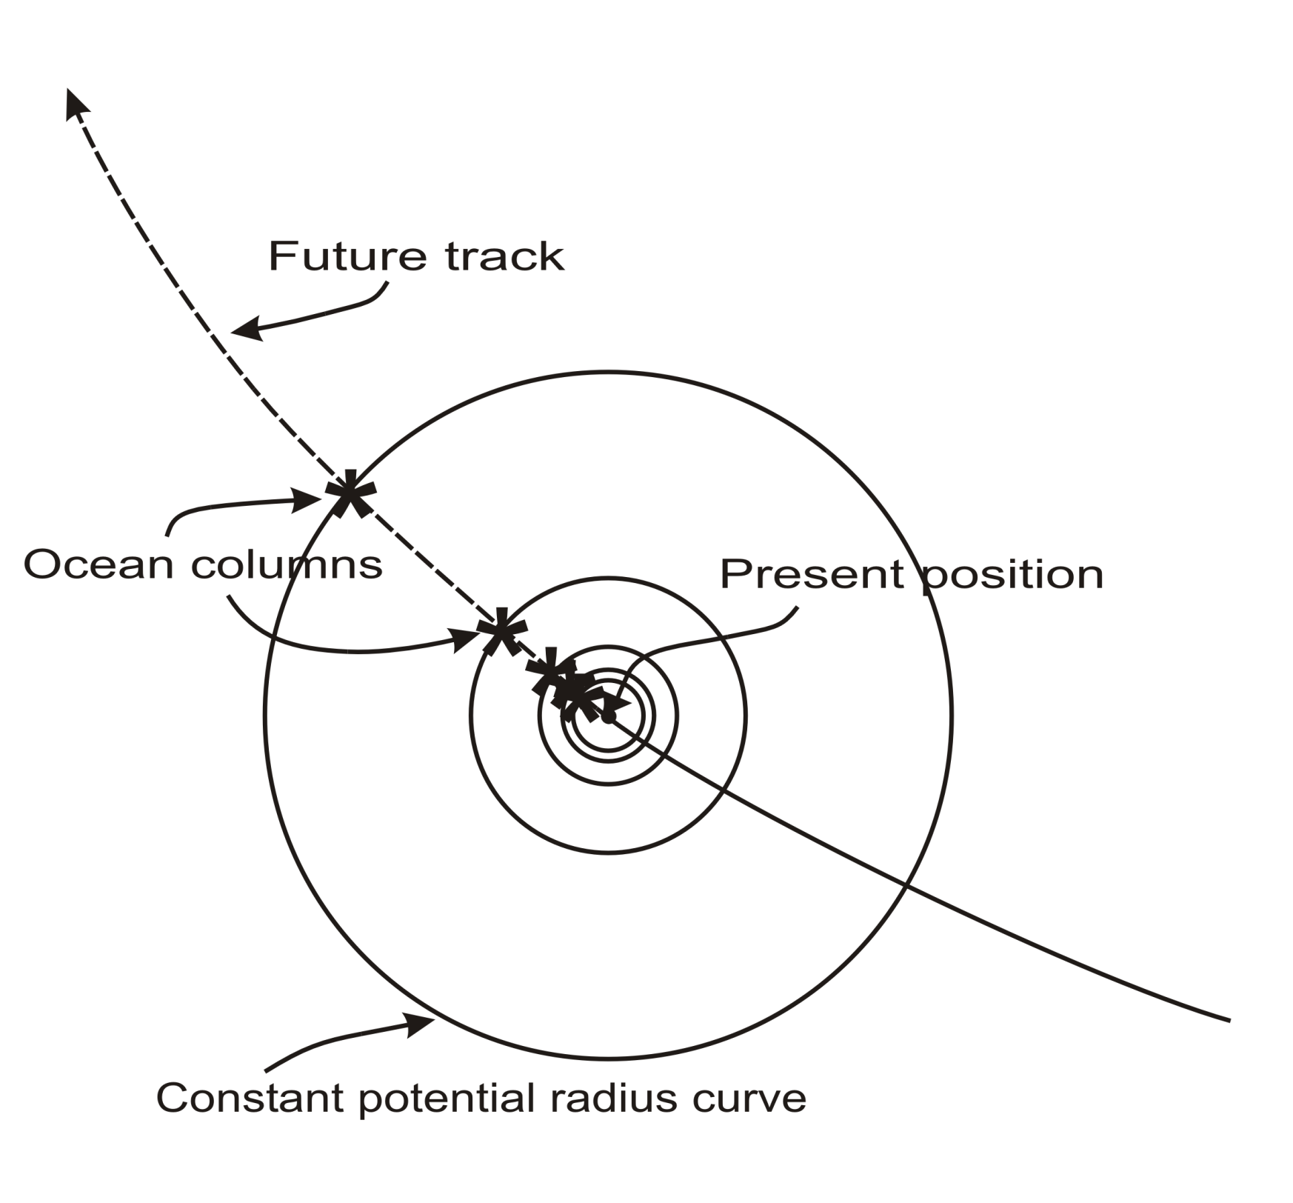
Ocean columns integrated only
along predicted storm track.
Predicted storm center SST
anomaly used for input to ALL
atmospheric points.

Slide 21
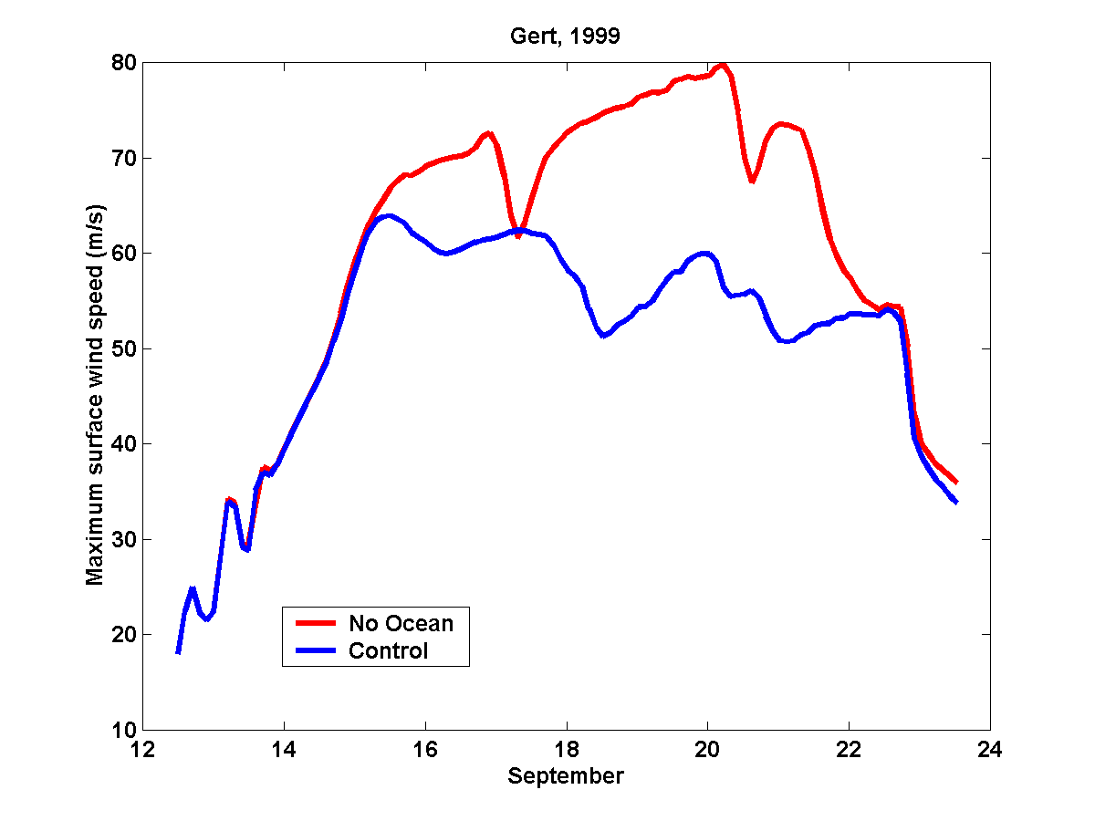
Comparing Fixed to Interactive SST:
Model with Fixed Ocean Temperature
Model including Ocean Interaction

Slide 22
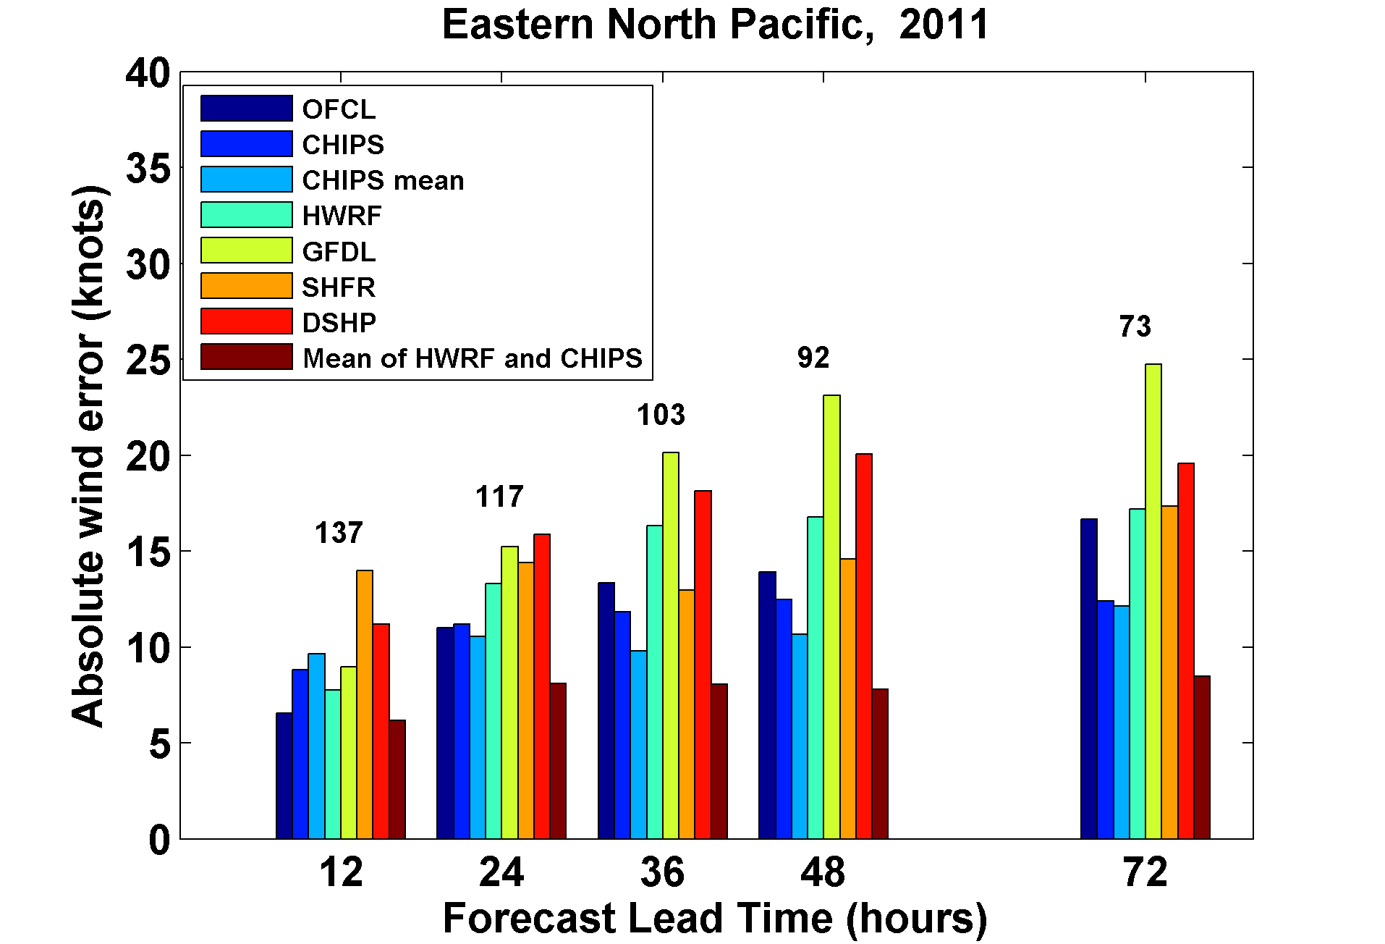

Slide 23
How Can We Use This Model to Help Assess Hurricane Risk in Current and Future Climates?

Slide 24
Risk Assessment Approach:
Step 1: Seed each ocean basin with a very large number of weak, randomly located cyclones
Step 2: Cyclones are assumed to move with the large scale atmospheric flow in which they are embedded, plus a correction for beta drift
Step 3: Run the CHIPS model for each cyclone, and note how many achieve at least tropical storm strength
Step 4: Using the small fraction of surviving events, determine storm statistics
Details: Emanuel et al., Bull. Amer. Meteor. Soc, 2008
Notes:
24

Slide 25
Synthetic Track Generation:
Generation of Synthetic Wind Time Series
Extract winds from climatological or global climate model output
Postulate that TCs move with vertically averaged environmental flow plus a “beta drift” correction
Approximate “vertically averaged” by weighted mean of 850 and 250 hPa flow

Slide 26
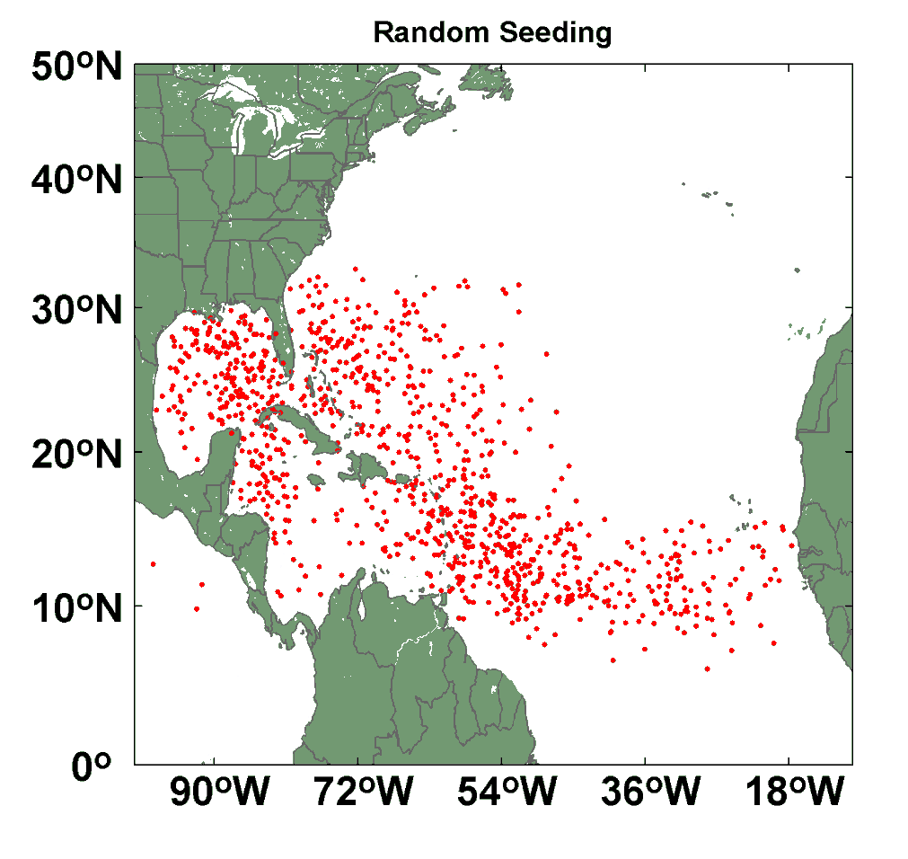
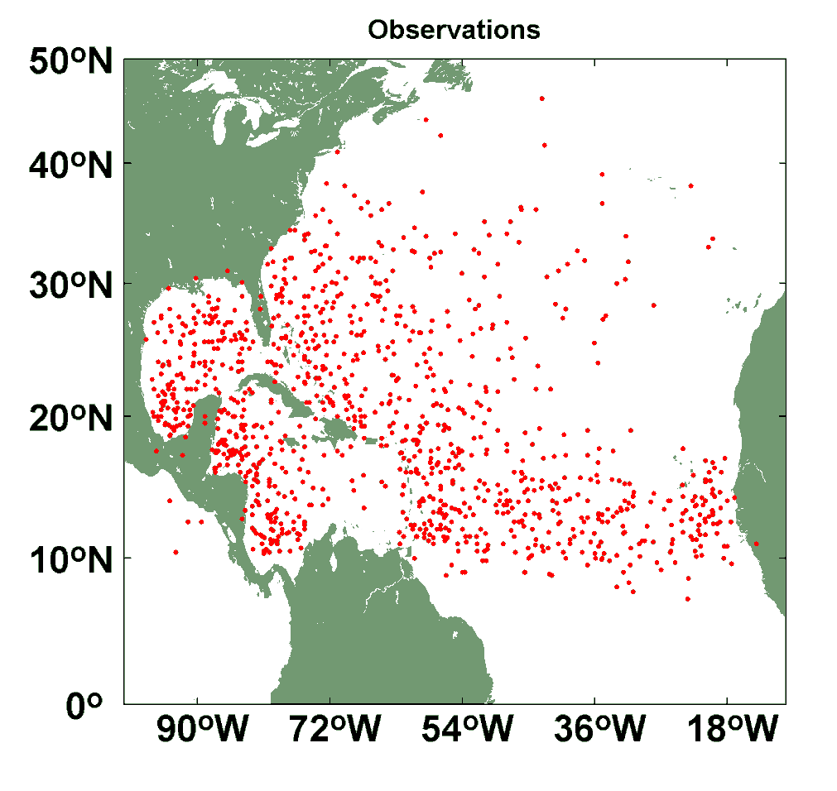
Comparison of Random Seeding Genesis Locations with Observations

Slide 27
Calibration
Absolute genesis frequency calibrated to globe during the period 1980-2005
Notes:
27

Slide 29

Cumulative Distribution of Storm Lifetime Peak Wind Speed, with Sample of 1755 Synthetic Tracks
95% confidence bounds

Slide 30

Captures effects of regional climate phenomena (e.g. ENSO, AMM)

Slide 31
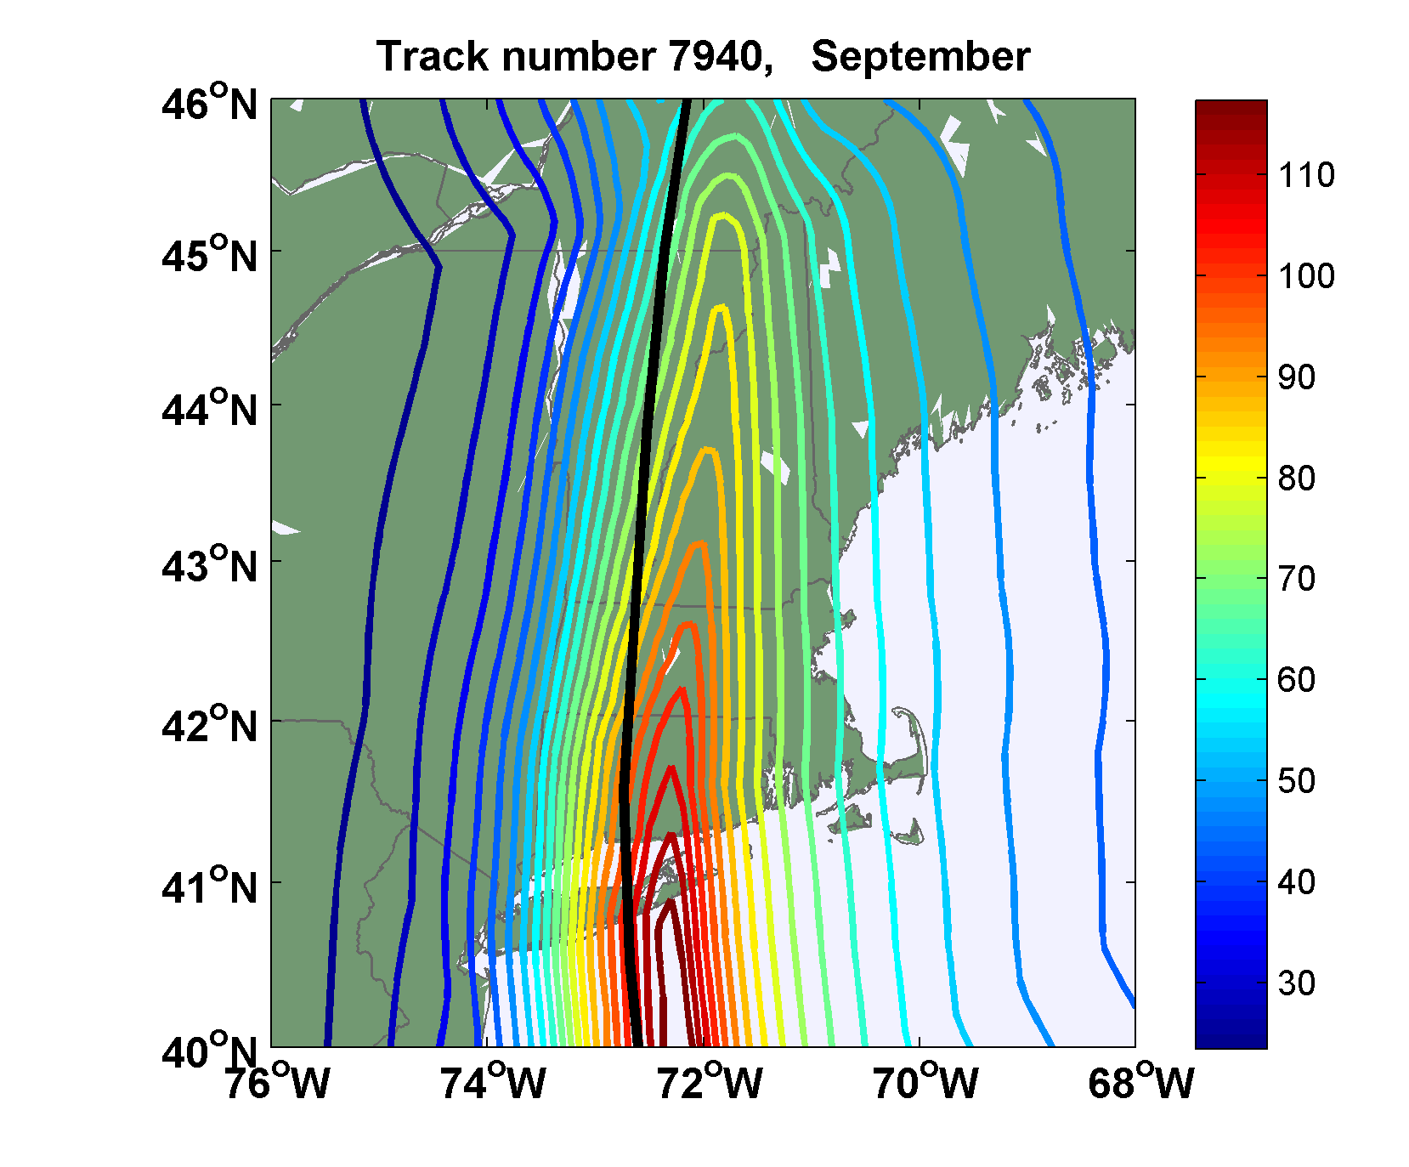
Sample Storm Wind Swath

Slide 32

Return Periods

Slide 33
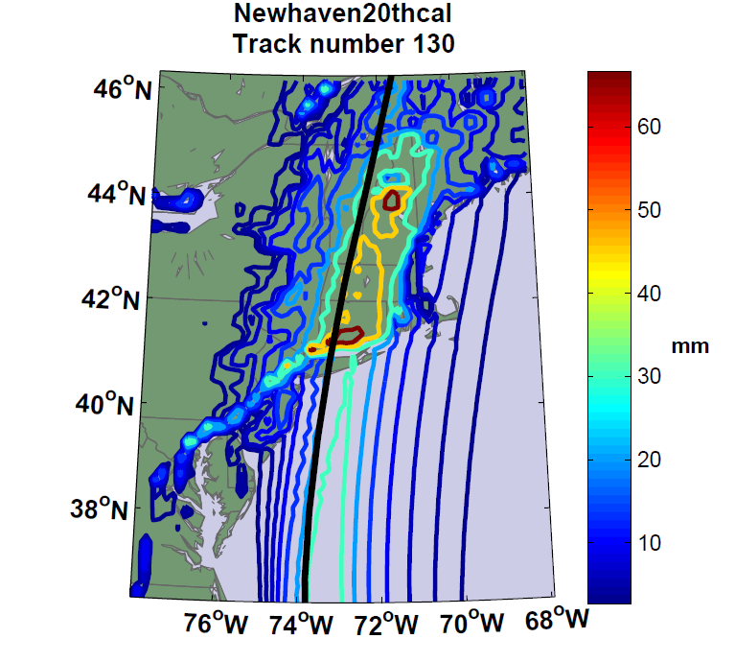
Accumulated Rainfall (mm)

Slide 34


Storm Surge Simulation
SLOSH model
(Jelesnianski et al. 1992)
SLOSH mesh
~ 10³ m
ADCIRC mesh
~ 10² m
Battery
ADCIRC model
(Luettich et al. 1992)
ADCIRC mesh
~ 10 m
(Colle et al. 2008)
Notes:
Given the storm wind and pressure fields (which is estimated from the Holland parametric pressure model) we can simulate the surge. Surge simulations with high resolution are computationally intensive, so to make it possible to simulate accurate surges for our large synthetic storm sets, we apply the two hydrodynamic models with girds of various resolutions in such a way that the main computational effort is concentrated on the storms that determine the risk. First, we apply the SLOSH model, using a mesh with resolution of about 1 km around NYC to simulate the surges for all storms and select the storms that have return periods, in terms of the surge height at the Battery, greater than 10 years. Second, we apply the ADCIRC simulation, using a grid mesh with resolution of ~100 m around NYC, to each of the selected storms. Then, we apply another ADCIRC mesh with resolution as high as ~10 m around NYC, for a set of the most extreme events, to check if the resolution of our ADCIRC grid is sufficient and if needed to make statistical correction to the results.

Slide 35
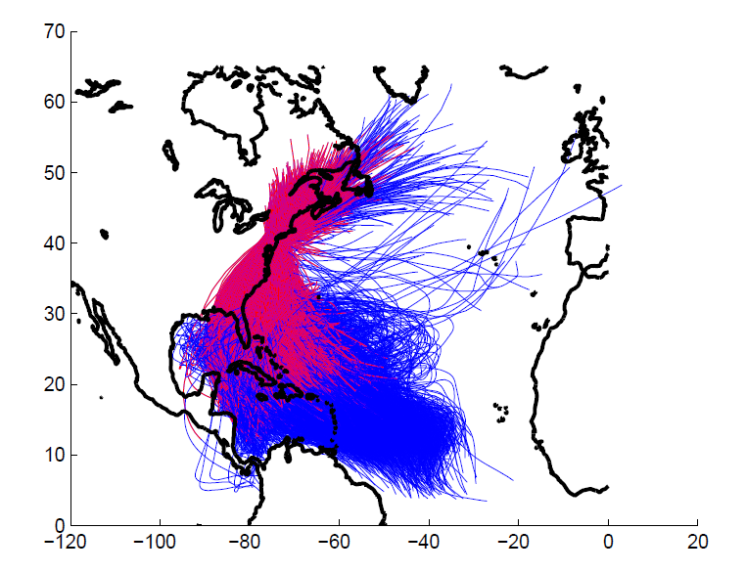
5000 synthetic storm tracks under current climate. (Red portion of each
track is used in surge analysis.)

Slide 36
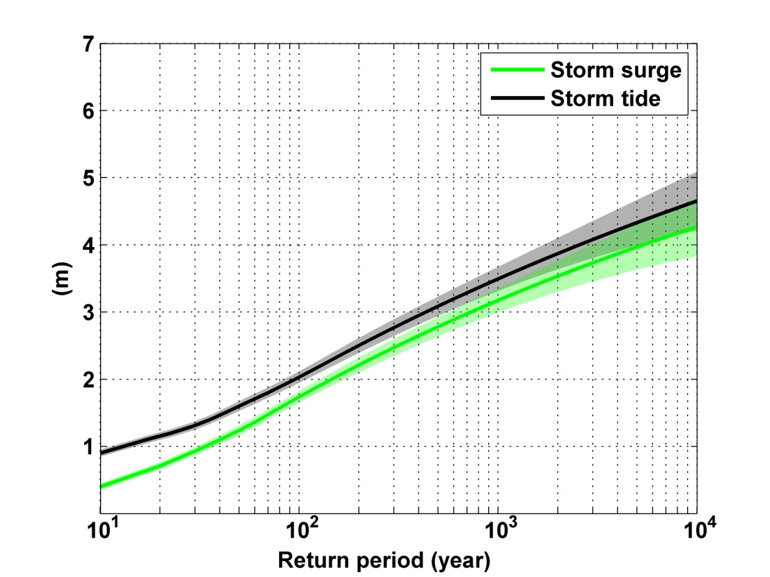
Notes:
Storm surge and storm tide (surge and tide) return level curves for the Battery, NYC, for the 1981-2000 NCAR/NCEP climate conditions (5000 synthetic storms). Astronomical tide and nonlinear interaction between surge and tide are accounted for statistically.

Slide 37
Woodruff et al., Geochemistry, Geophysics, and Geosystems, 2008
Notes:
Top: Modeled hurricane tracks (black) passing within 75 km of Vieques. (b) Cumulative frequency distribution for maximum sustained wind speed for historical (green bars) and synthetic storms (red bars) shown in Figure 2a while passing within 75 km of Vieques. Grey dashed line represents the cumulative frequency distribution obtained using the peaks-over-threshold (POT) statistical model presented by Elsner et al. [2008].
Bottom: Model distributions predicted for events/century (red) and resolvable deposits/century (blue) using modern hurricane climatology and with varying wind speed exceedance thresholds required for overwash. Median (circle), 16th-to-84th percentiles (thick line), and 2.5-to-97.5 percentiles (thin line) are presented. Shading indicates estimated current 90 knot wind speed threshold required for overwash deposition at LPG4. (a) Results for 156 year simulations at a temporal resolution of 5 years. Actual overwash occurrence rate based on historical observation (red arrows) and number of deposits observed within historical sediments at LPG4 (blue arrows) are noted.

Slide 38
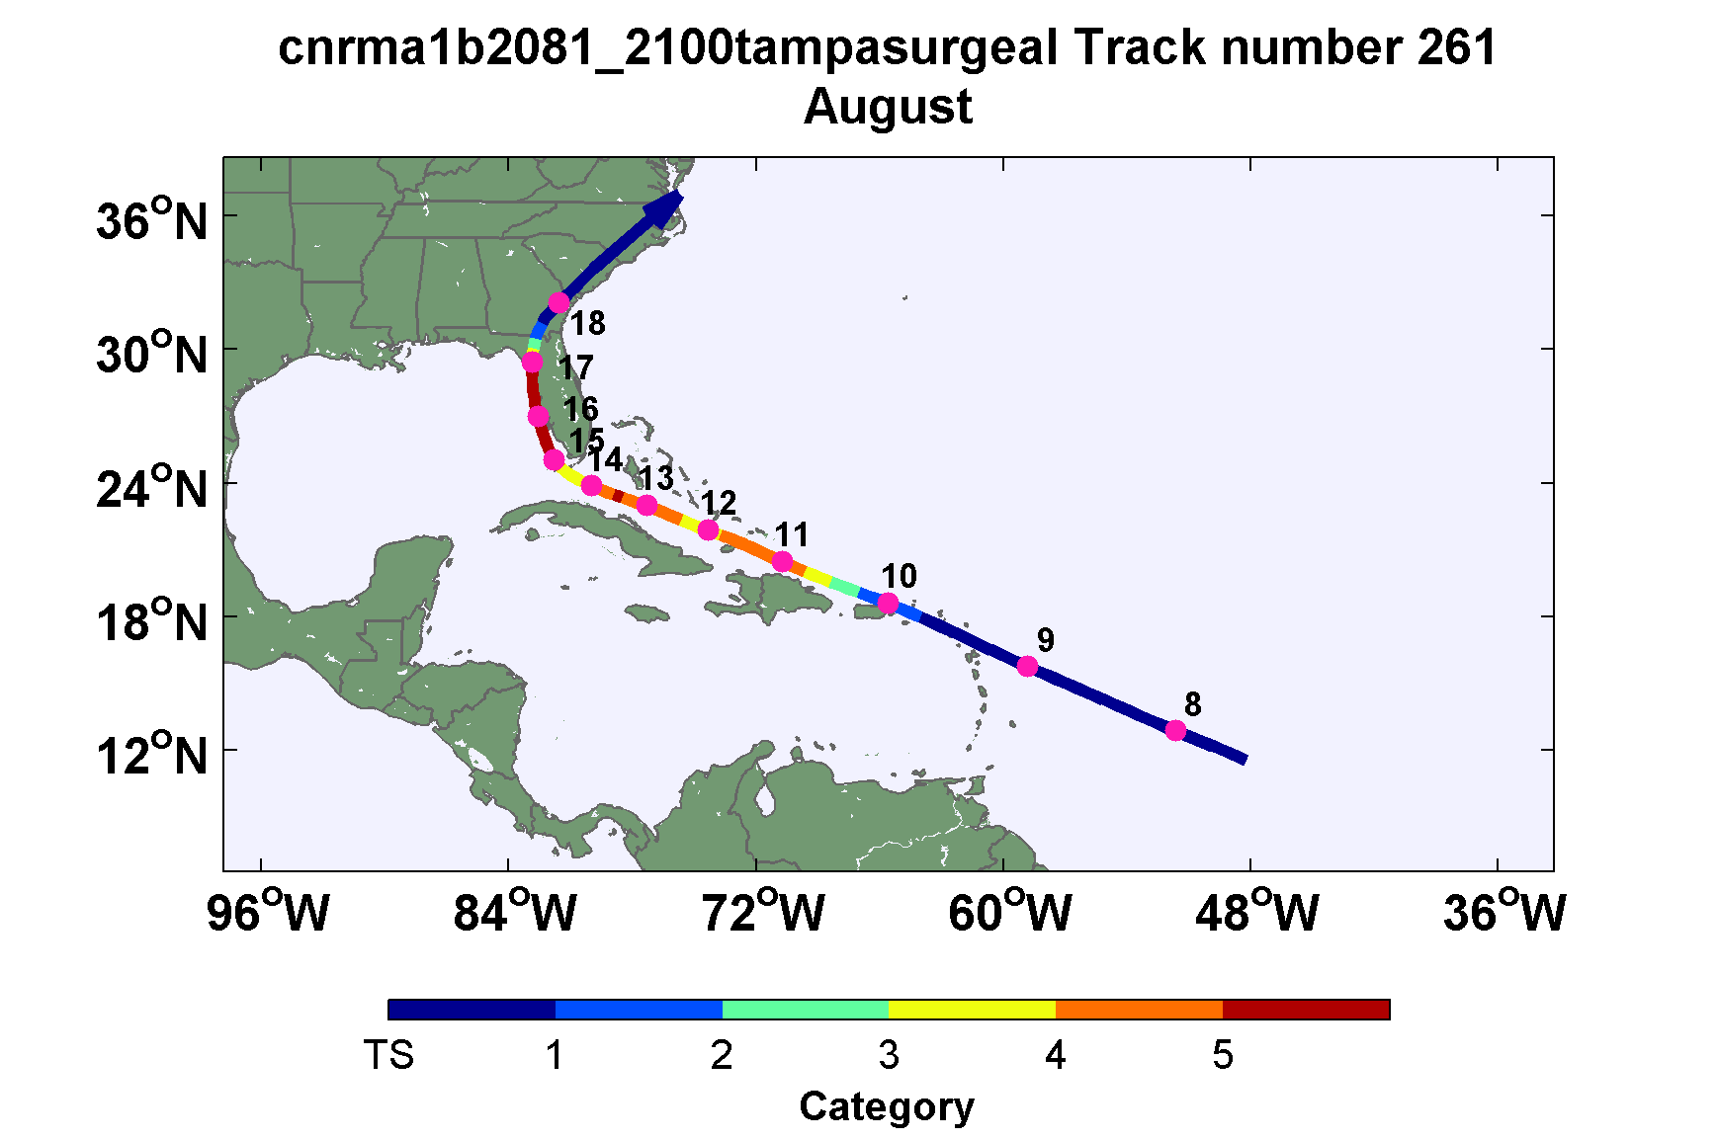
A Black Swan

Slide 39
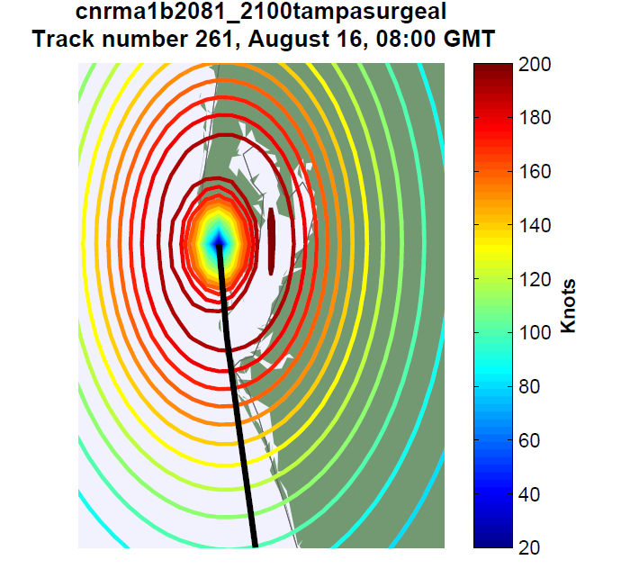

Slide 40
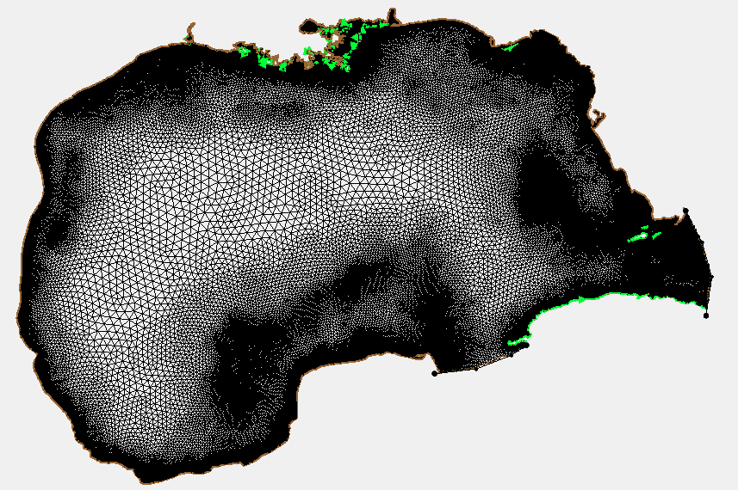
ADCIRC Mesh

Slide 41
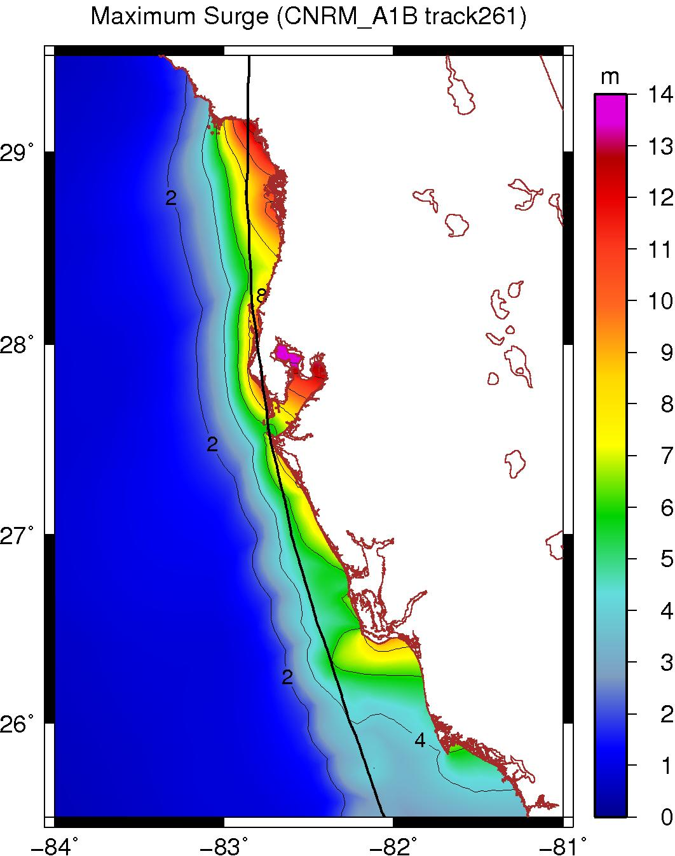
Peak Surge at each point along Florida west coast

Slide 42
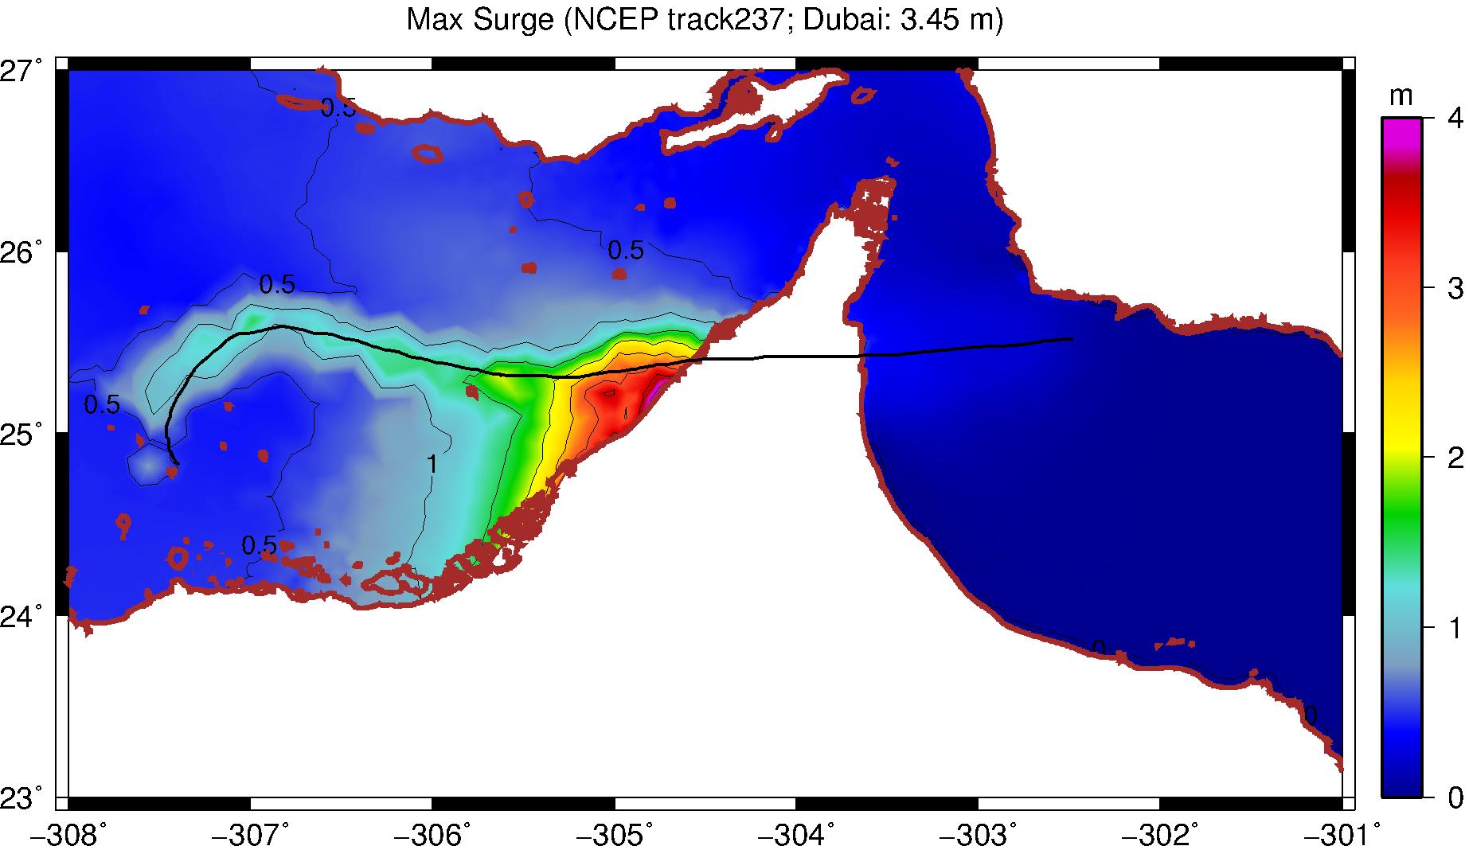
Dubai

Slide 43
Taking Climate Change Into Account

Slide 44
Potential Intensity:
Theoretical Upper Bound on Hurricane Maximum Wind Speed:
Surface temperature
Ratio of exchange coefficients of enthalpy and momentum
Outflow temperature
Air-sea enthalpy disequilibrium

Slide 45
Annual Maximum Potential Intensity (m/s)

Slide 46
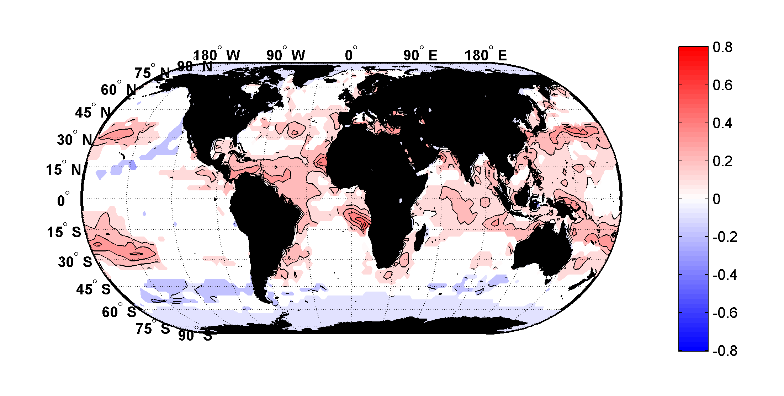
Trends in Thermodynamic Potential for Hurricanes, 1980-2010

Slide 47
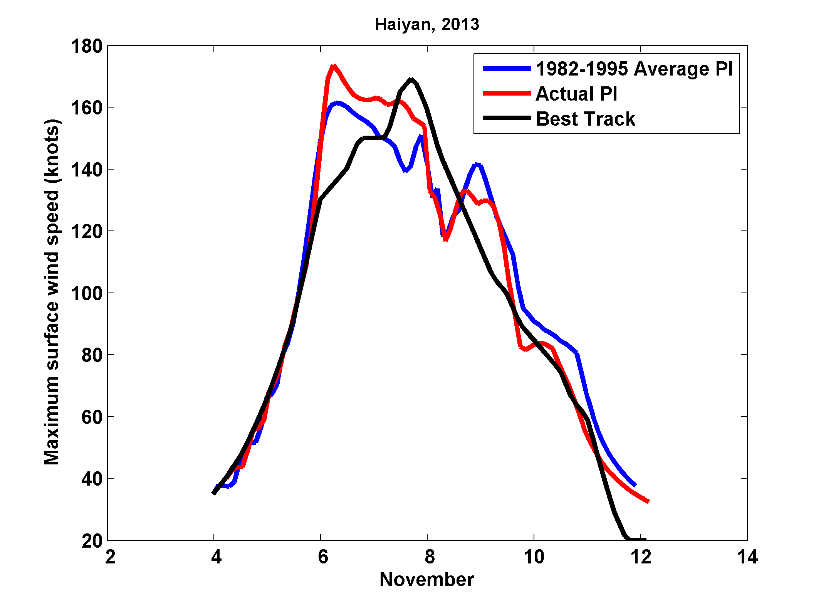
Hindcasts of Haiyan: Actual Thermal Conditions vs. 1982-1995 Average Conditions

Slide 48
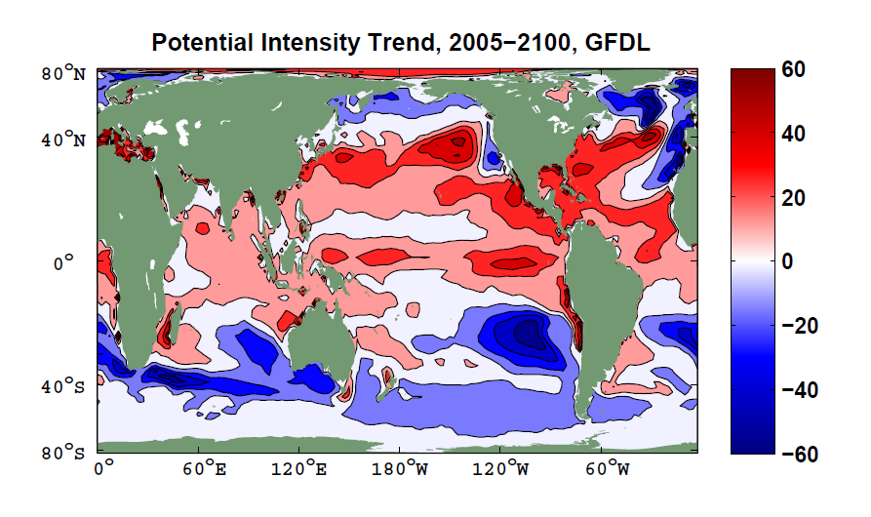
Units: Nautical miles per hour, per century

Slide 49
Downscaling of AR5 GCMs
GFDL-CM3
HadGEM2-ES
MPI-ESM-MR
MIROC-5
MRI-CGCM3
Historical: 1950-2005, RCP8.5 2006-2100

Slide 50
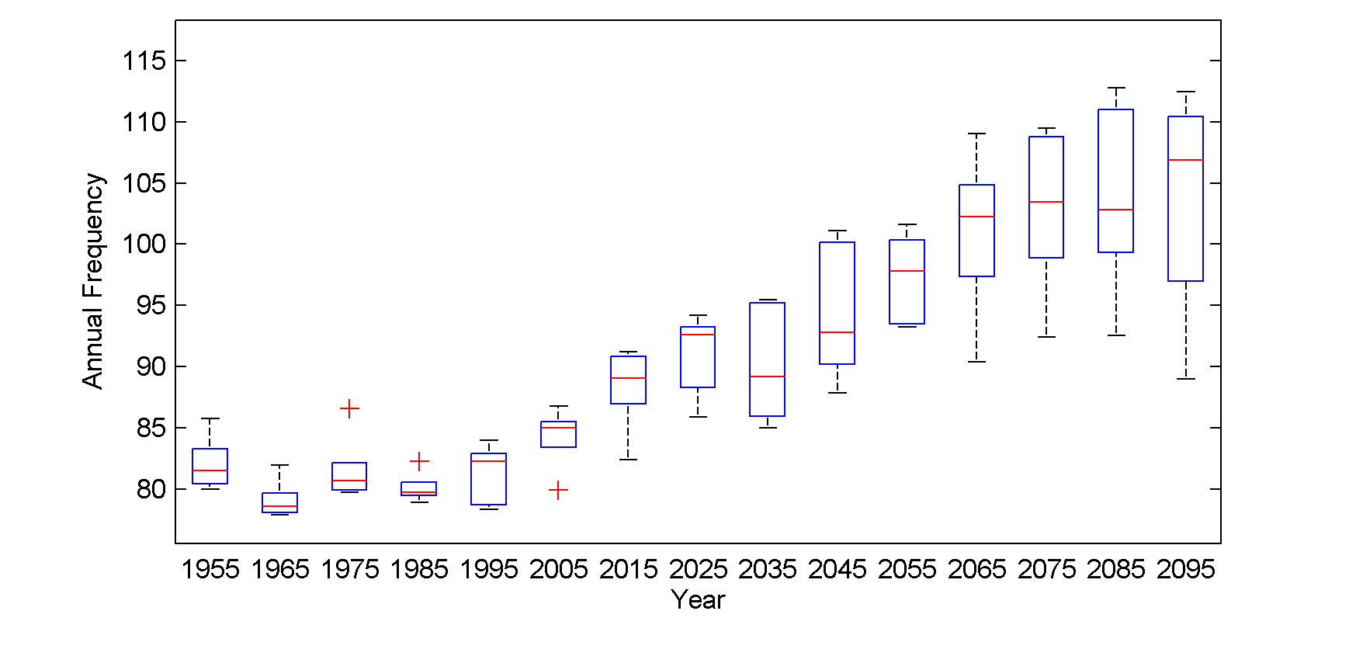
Global annual frequency of tropical cyclones averaged in 10-year blocks for the period 1950-2100, using historical simulations for the period 1950-2005 and the RCP 8.5 scenario for the period 2006-2100. In each box, the red line represents the median among the 5 models, and the bottom and tops of the boxes represent the 25th and 75th percentiles, respectively. The whiskers extent to the most extreme points not considered outliers, which are represented by the red + signs. Points are considered outliers if they lie more than 1.5 times the box height above or below the box.

Slide 51
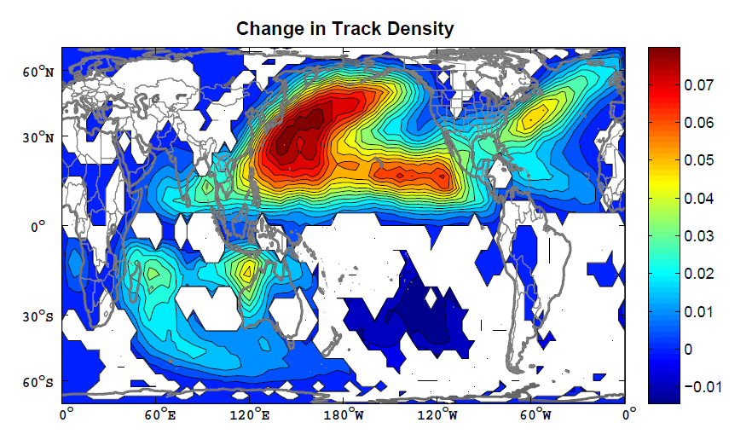
Change in track density, measured in number of events per 4º X 4º square per year, averaged over the five models. The change is simply the average over the period 2006-2100 minus the average over 1950-2005. The white regions are where fewer than 4 of the 5 models agree on the sign of the change.

Slide 52
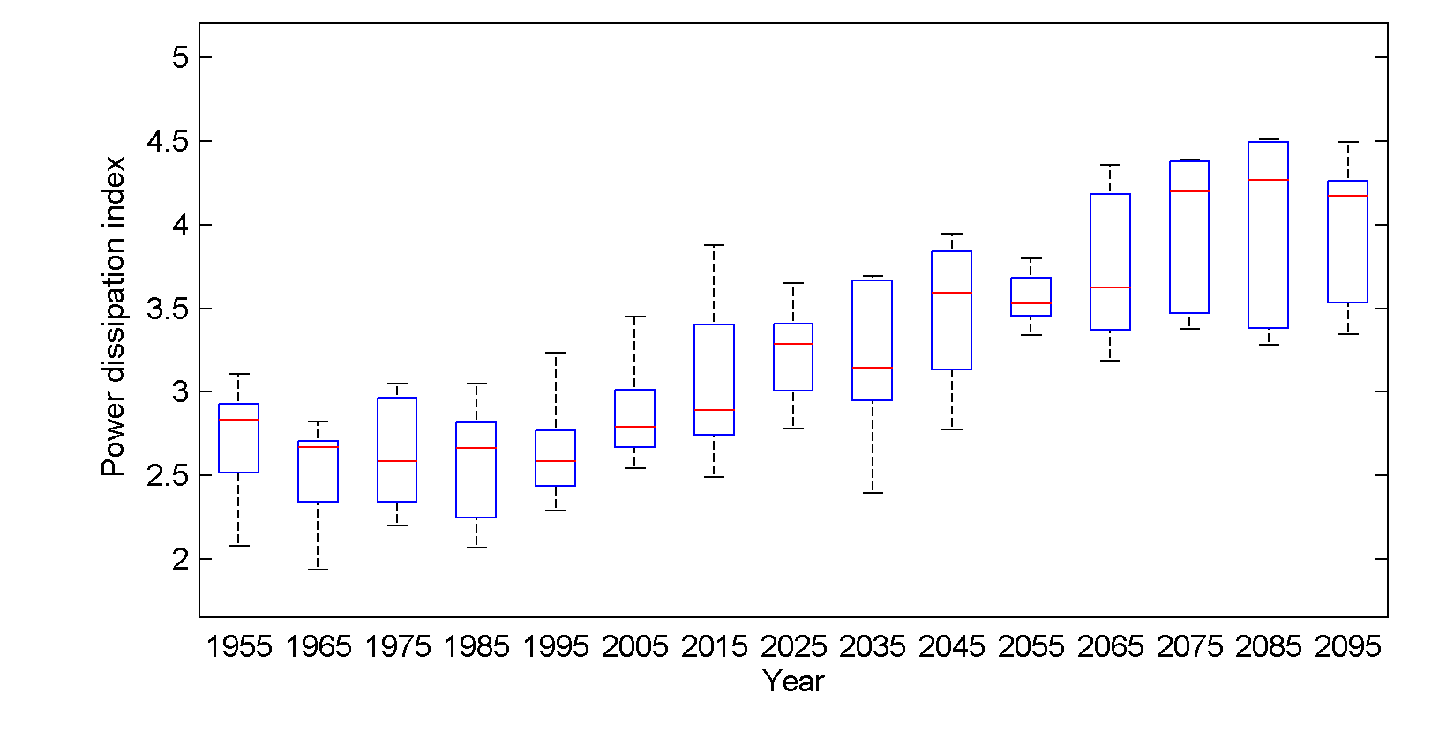
Global Tropical Cyclone Power Dissipation

Slide 53
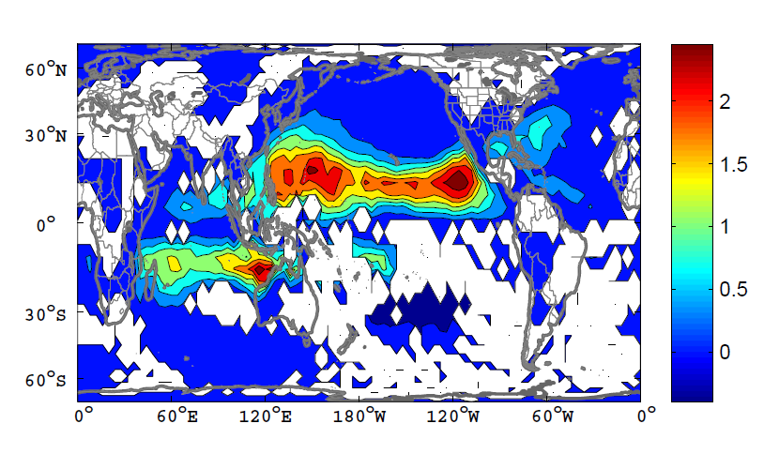
Change in Power Dissipation

Slide 54
Return period (horizontal axis, in years) of medicanes according to the maximum wind induced at the surface (vertical axis, in knots). Continuous lines refer to the current climate and dashed lines to the future climate (SRES A2, 2081-2100), following the color coding indicated in the legend.
Romero, R., and K. Emanuel (2013), Medicane risk in a changing climate, J. Geophys. Res. Atmos., 118, doi:10.1002/jgrd.50475.

Slide 55
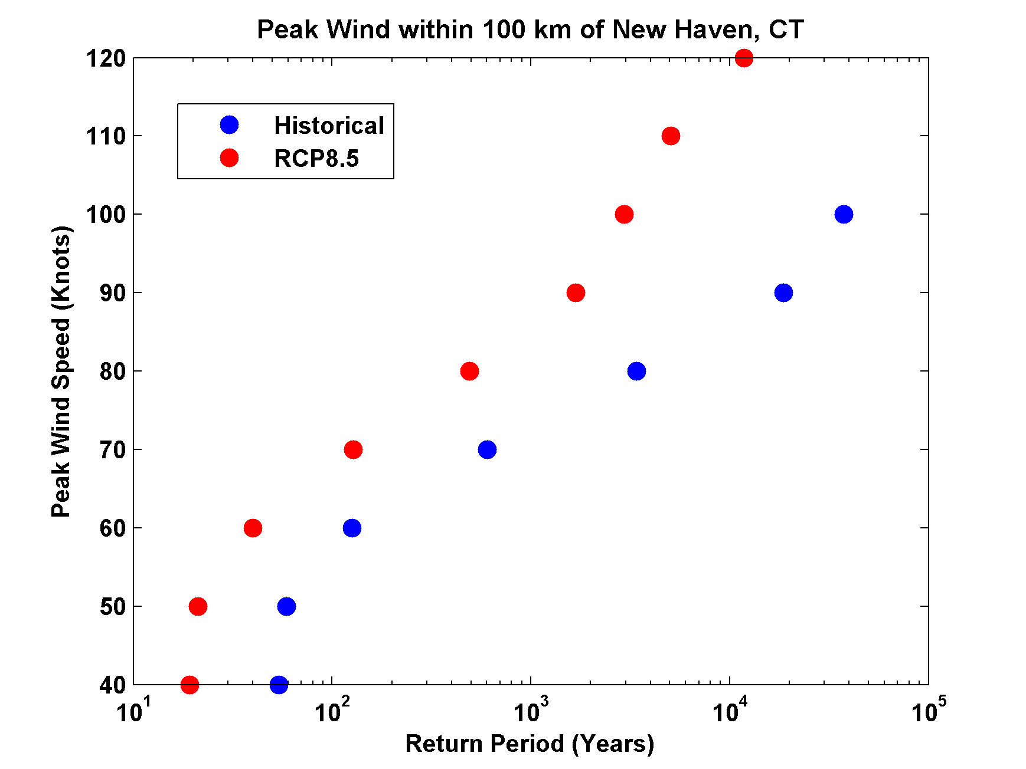
Return Periods based on GFDL Model

Slide 56
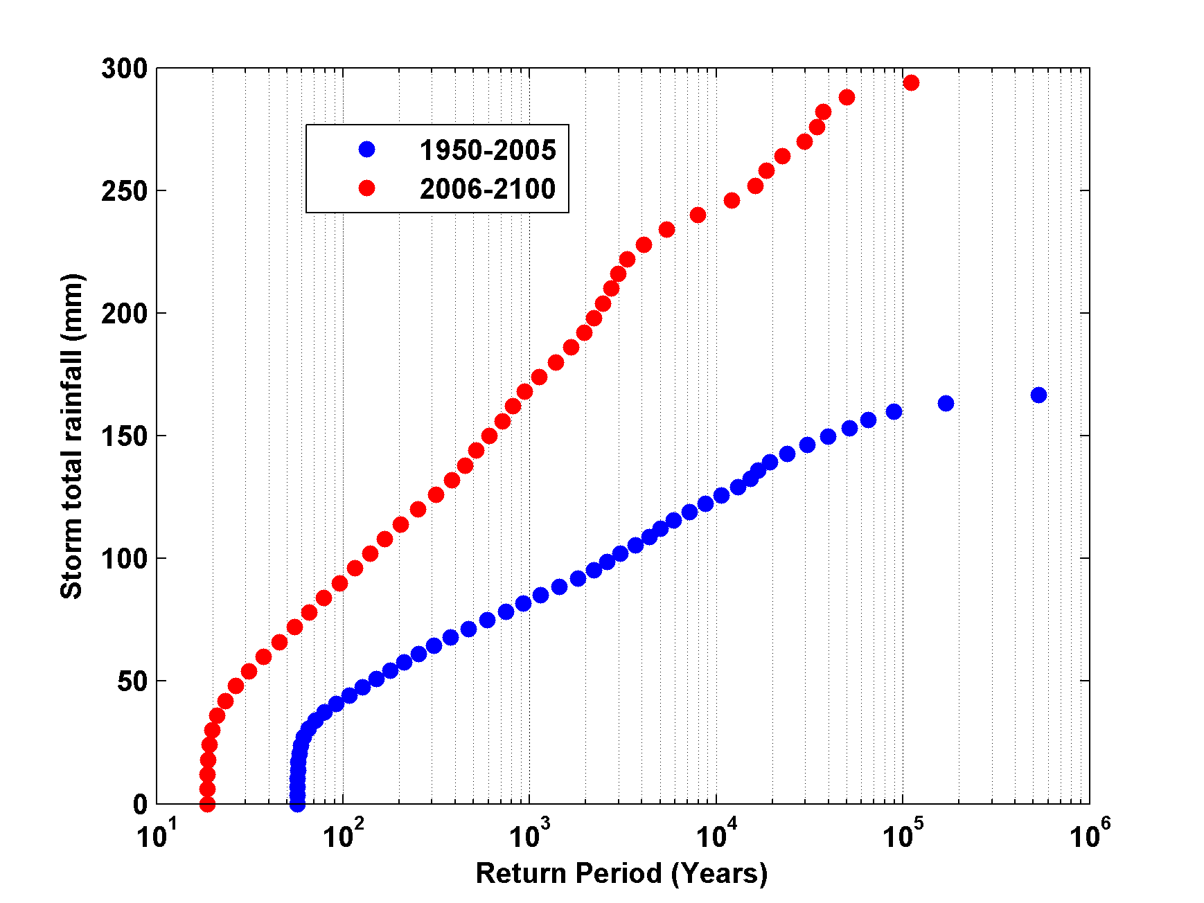
Return Periods of Storm Total Rainfall at New Haven
GFDL Model

Slide 57

GCM flood height return level
(assuming SLR of 1 m for the future climate )
Black: Current climate (1981-2000)
Blue: A1B future climate (2081-2100)
Red: A1B future climate (2081-2100) with R₀ increased by 10% and R_{m} increased by 21%
Lin et al. (2012)
Notes:
Then we calculate the flood height (including surge, tide, and sea level rise) return level for the four climate models, assuming a sea level rise of 1 m for the future climate, for the Battery, NYC. These results show that the combined effects of storm climatology change and sea level rise will greatly shorten the flood return periods for NYC and, by the end of the century, the current 100-year surge flooding may happen less than every 30 years, with CNRM and GFDL prediction to be less than 10 years, and the 500-year flooding may happen less than every 200 years, with the CNRM and GFDL prediction to be 20-30 years.

Slide 58
Integrated Assessments with Robert Mendelsohn, Yale
The impact of climate change on global tropical cyclone damage
Robert Mendelsohn, Kerry Emanuel, Shun Chonabayashi & Laura Bakkensen, 2012
Nature Climate Change, 2, 205-209

Slide 59


Probability Density of TC Damage, U.S. East Coast
Damage Multiplied by Probability Density of TC Damage, U.S. East Coast

Slide 60
Summary
History is too short and imperfect to estimate hurricane risk
Better estimates can be made from paleotempestology and downscaling hurricane activity from climatological or global model output
Hurricanes clearly vary with climate and there is a risk that hurricane threats will increase over this century

Slide 61
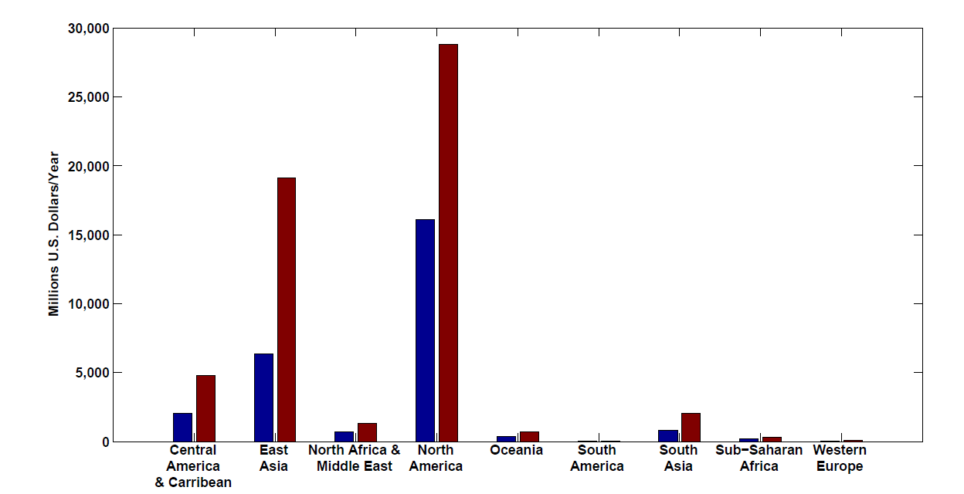
Present and future baseline tropical cyclone damage by region.
Changes in income will increase future tropical cyclone damages in 2100 in every region even if climate does not change. Changes are larger in regions experiencing faster economic growth, such as East Asia and the Central America–Caribbean region.

Slide 62
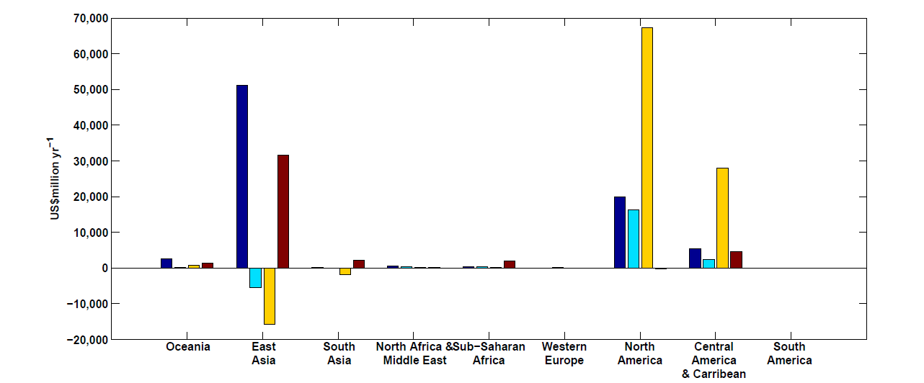
Climate change impacts on tropical cyclone damage by region in 2100. Damage is concentrated in North America, East Asia and Central America–Caribbean. Damage is generally higher in the CNRM and GFDL climate scenarios.

Slide 63
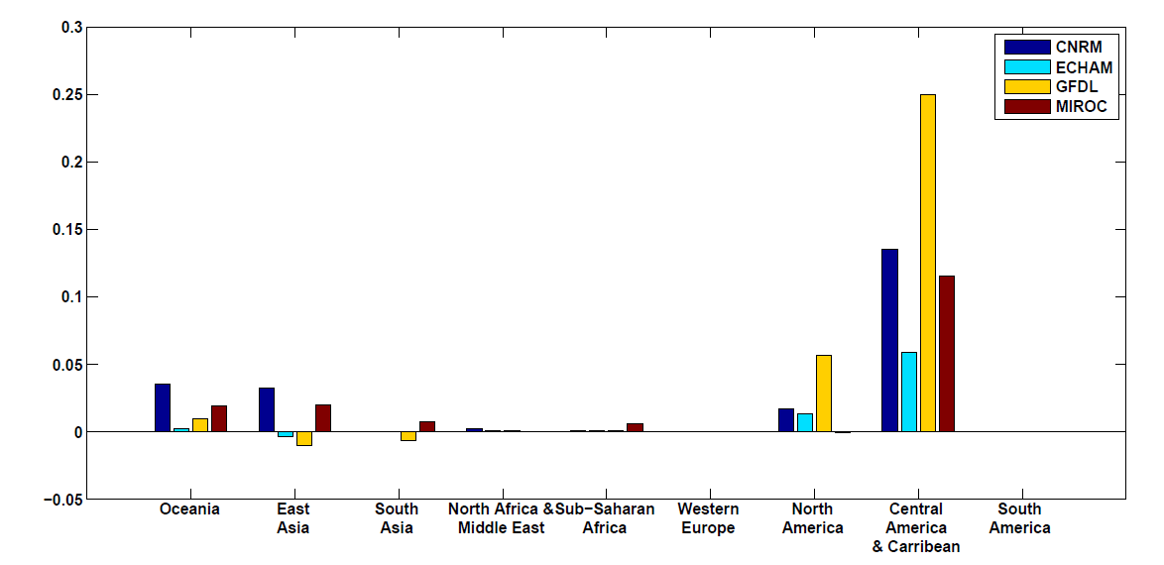
Climate change impacts on tropical cyclone damage divided by GDP by region in 2100. The ratio of damage to GDP is highest in the Caribbean–Central American region but North America, Oceania and East Asia all have above-average ratios.

Slide 64
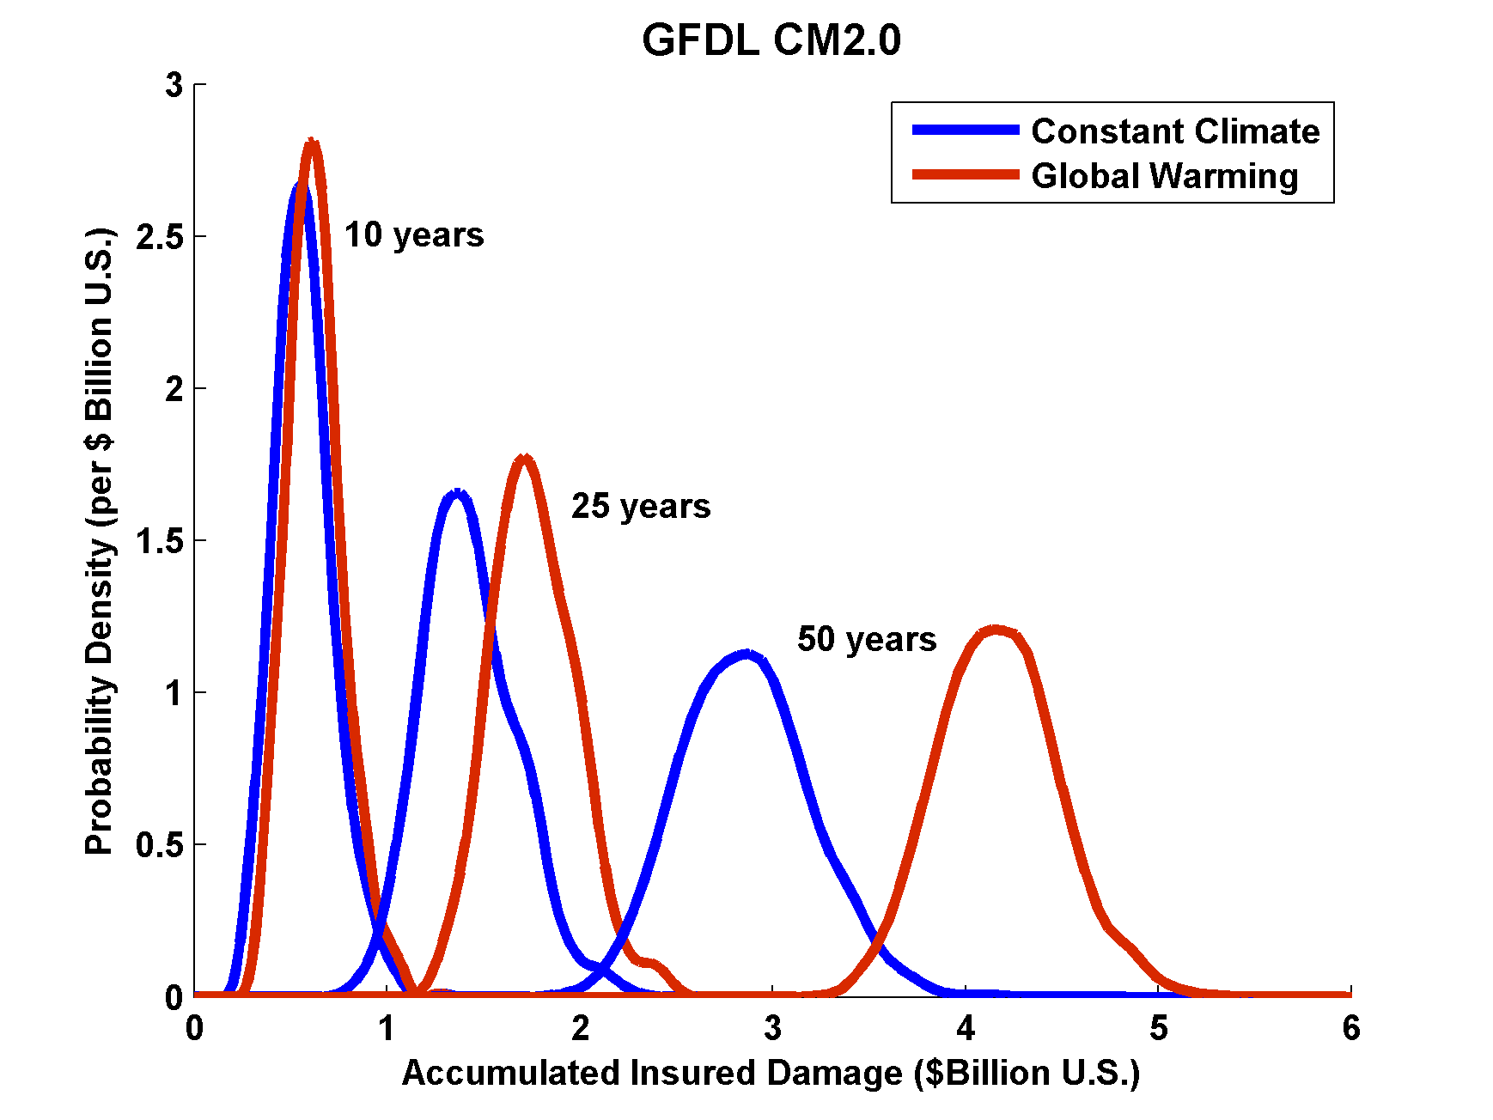
Projections of U.S. Insured Damage
Emanuel, K. A., 2012, Weather, Climate, and Society

