Slide 1
Physics-Based Risk Assessment
Why we need to bring physics to bear on estimating natural hazard risk
Kerry Emanuel
Lorenz Center
Massachusetts Institute of technology

Slide 2
Flawed Basis of Current Risk Modeling
Almost all current risk assessments are based on historical statistics
Historical records are flawed and short, particularly outside North America
Moreover, the past 50-150 years is a poor guide to the present owing to climate change that has already occurred
Risk modelers have been slow to migrate to a physics-based approach

Slide 3
The quiet revolutions in numerical weather prediction and climate simulation
The first computational weather forecasts were made in the mid 1950s
Today, virtually every weather forecast beyond 6 hours is based wholly or heavily on numerical weather prediction models
Three-day forecasts today are as accurate as 1-day forecasts were 40 years ago
Climate models are becoming increasingly reliable in simulating such phenomena as severe winter storms, large-scale floods, droughts, and heatwaves

Slide 4
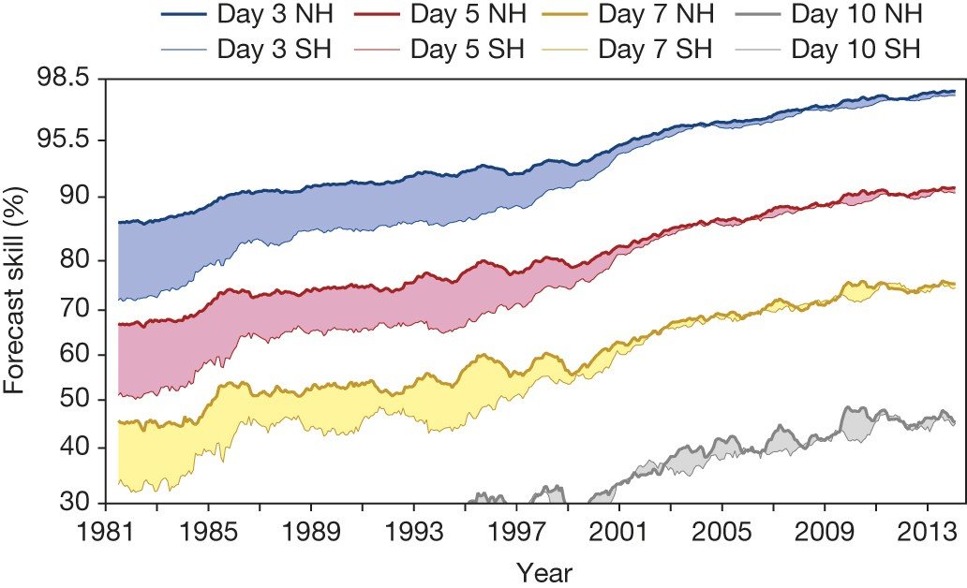
Evolution of forecast skill of a global numerical weather prediction model

Slide 5
Satellite Image
Global Model

Slide 6

Tropical Cyclone Risk

Slide 7

What Are Historical Records Based On?
Pre-1943: Anecdotal accounts from coastal cities and ships
1943: Introduction of routine aircraft reconnaissance in Atlantic, western North Pacific
1958: Inertial navigation permits direct measurement of wind speed at flight level
1970: Complete global detection by satellites
1978: Introduction of satellite scatterometry
1987: Termination of airborne reconnaissance in western North Pacific

Slide 8
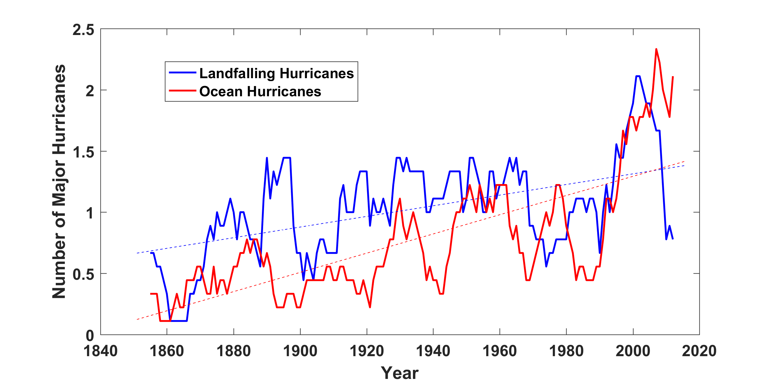
Historical Records:
Prior to 1970, Many Storms Were Missed
Major hurricanes in the North Atlantic, 1851-2016, smoothed using a 10-year running average. Shown in blue are storms that either passed through the chain of Lesser Antilles or made landfall in the continental U.S.; all other major hurricanes are shown in red. The dashed lines show the best fit trend lines for each data set.

Slide 9
The Heart of the Problem:
Societies are usually well adapted to frequent events (> 1/100 yr)
Societies are often poorly adapted to rare events (< 1/100 yr)
Robust estimates of the character of ~100 yr events require ~1,000 years of data
We do not have ~1,000 years of meteorological observations

Slide 10
Is Hurricane Risk Changing?

Slide 11
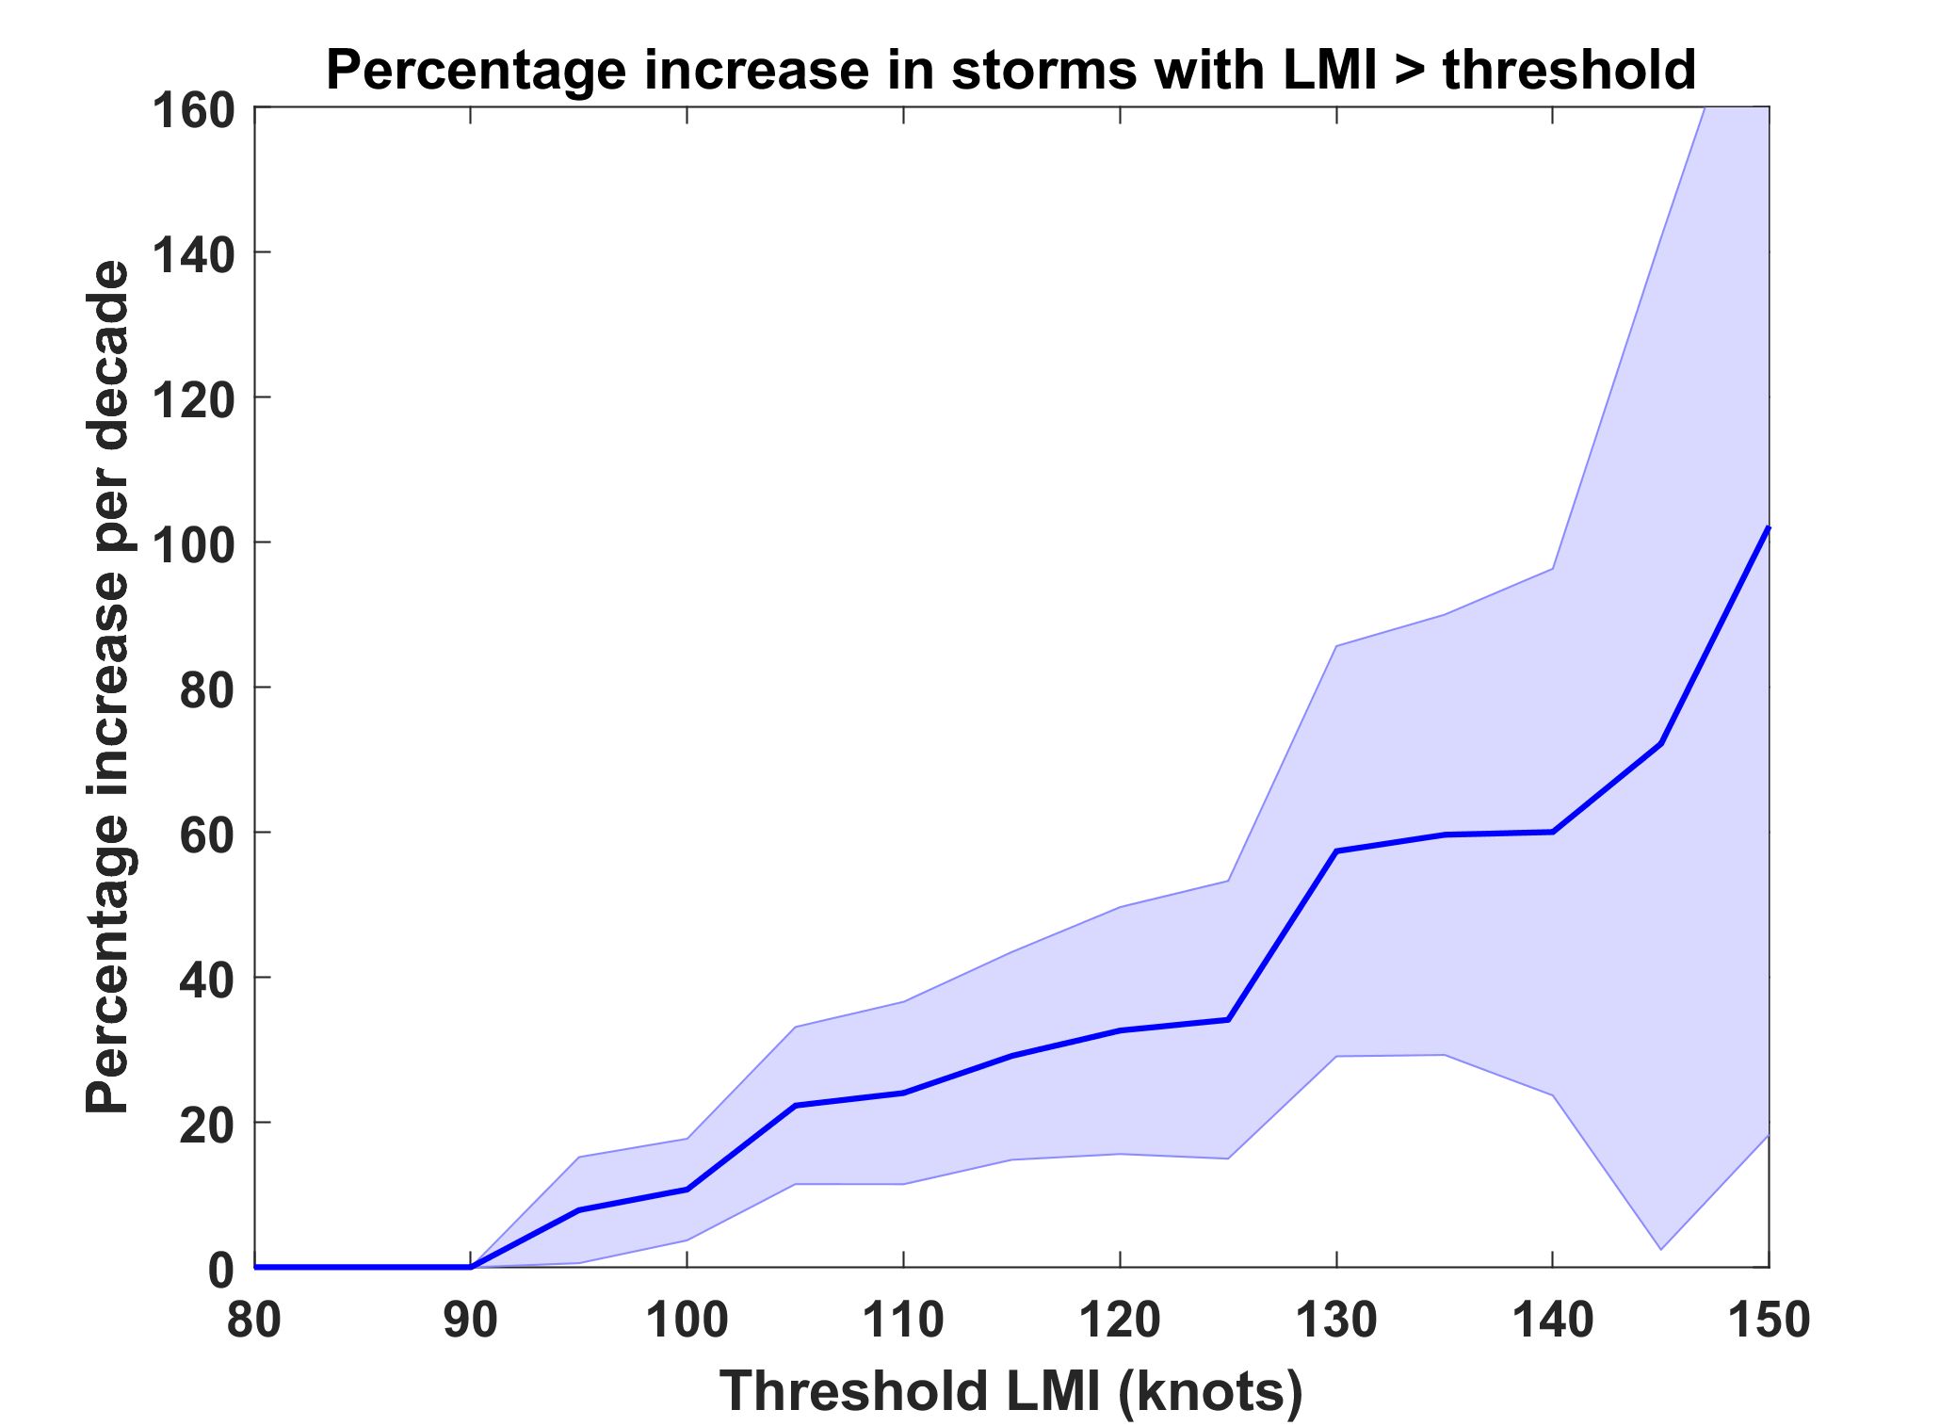
Trends in Global TC Frequency Over Threshold Intensities, from Historical TC Data, 1980-2016. Trends Shown Only When p < 0.05.

Slide 12
Hurricanes are reaching peak intensity at higher latitudes
Time series of the latitudes at which tropical cyclones reach maximum intensity.
From Kossin et al. (2014)

Slide 13
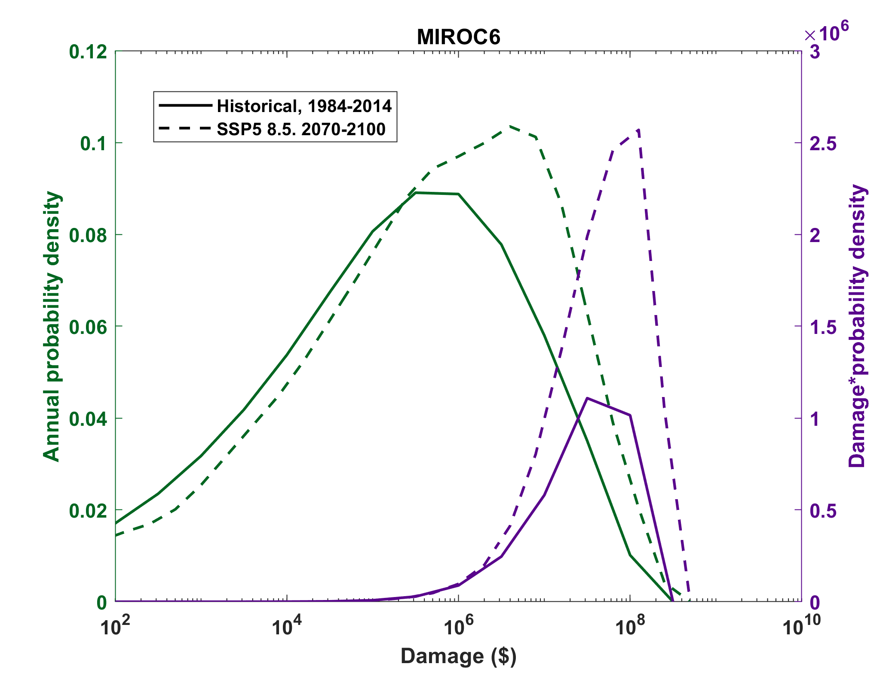

Slide 14

Climate models cannot yet be used to make direct estimates of hurricane risk
Histograms of Tropical Cyclone Intensity as Simulated by a Global Model with 30 mile grid point spacing. (Courtesy Isaac Held, GFDL)
Category 3
Modeled
Observed
Global models do not simulate the storms that cause destruction
Wind Speed (meters per second)

Slide 15
Using Physics to Assess Hurricane Risk
Reliable, global records of coarse-scale climate are robust and widely available
Cull from these datasets the key statistics known to control tropical cyclone generation, movement, and intensity evolution
Bootstrap these key statistic to create unlimited synthetic time series of the hurricane-relevant environmental variables
Use these to drive specialized, very high resolution physical hurricane models
Extensively validate the results against historical hurricane data
Exact same method can be applied to output of climate models

Slide 16
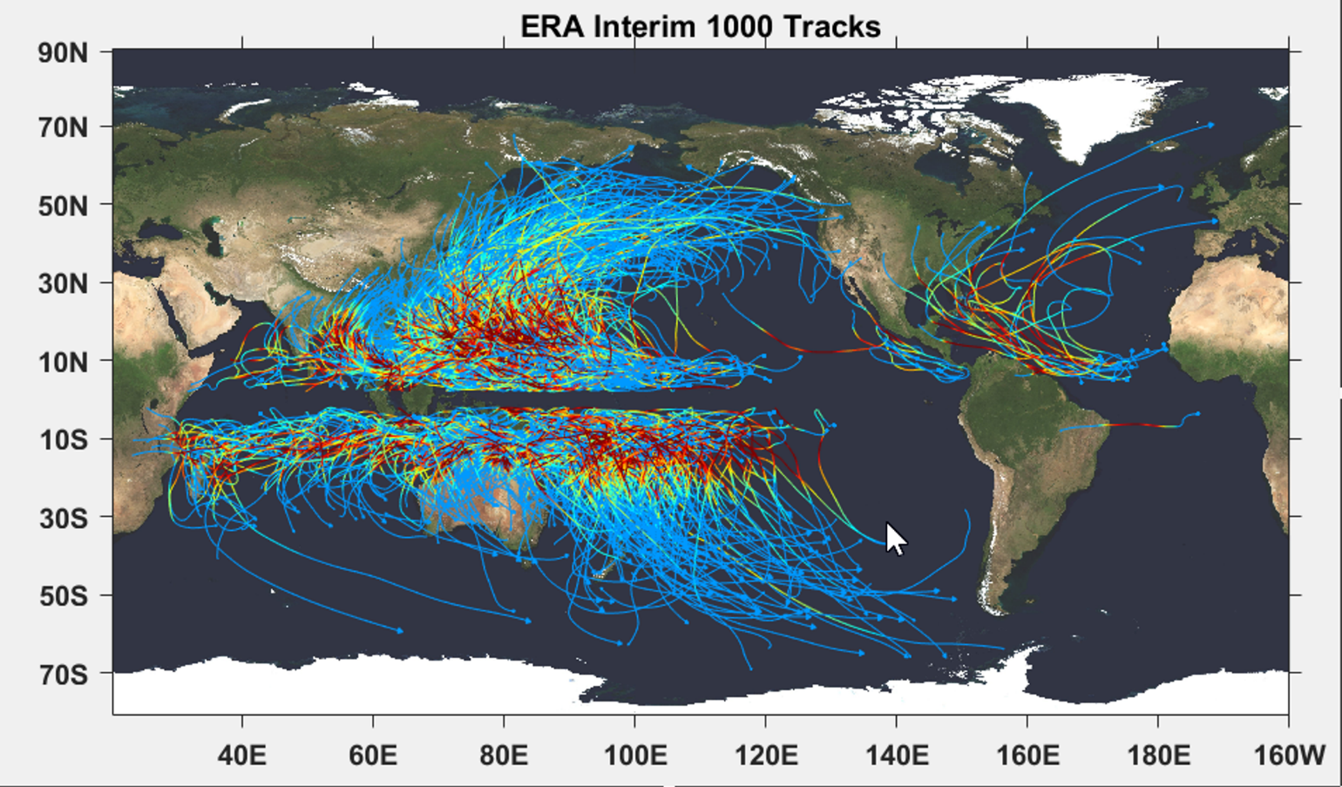

Slide 17

Cumulative Distribution of Storm Lifetime Peak Wind Speed, with Sample of 1755 Synthetic Tracks
90% confidence bounds

Slide 18
Atlantic Annual Cycle

Slide 19
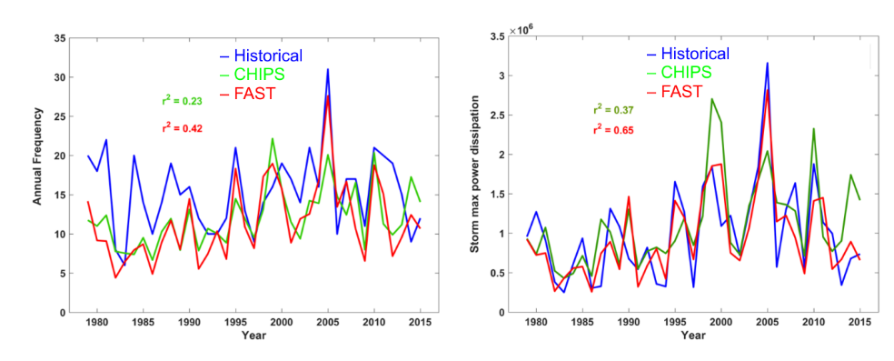
Atlantic Interannual Variability
Frequency
Power Dissipation

Slide 20

Captures effects of regional climate phenomena (e.g. ENSO, AMM)

Slide 21
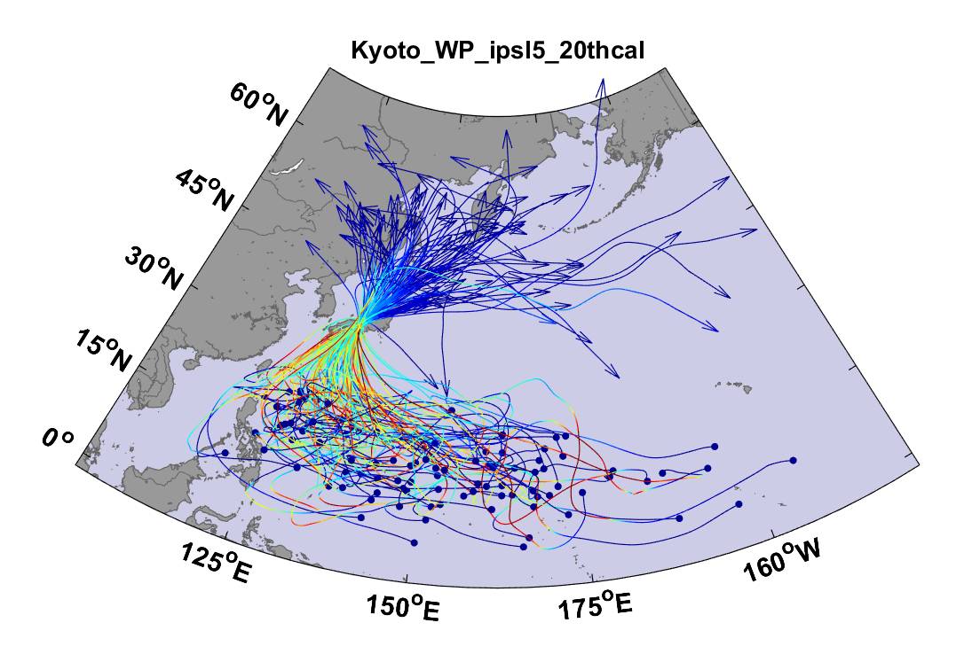
Example:
Top 100 out of 2000 TCs Affecting Kyoto, 1981-2000

Slide 22
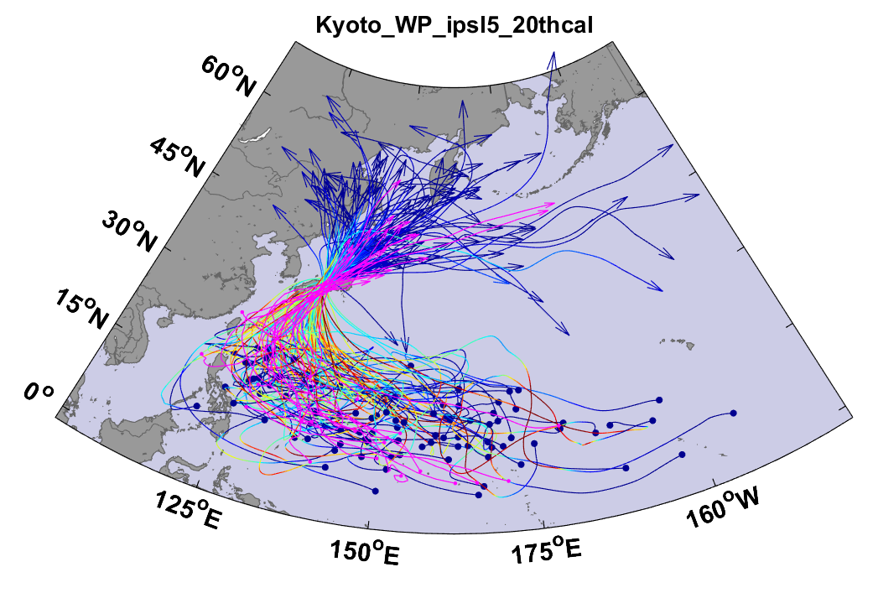
Same, but with top 20 historical tracks

Slide 23
Comparison of Wind Risk Derived from Physically Modeled Events to Historical Data

Slide 24
Sample Kyoto track

Slide 26
Model produced wind fields are used to drive hydrodynamic storm surge models to estimate surge risk
Model produced rain can be used to drive flood models to estimate flood risk

Slide 27
Storm total rainfall

Slide 28
Taking Climate Change Into Account
Downscale 5 CMIP6 models for the historical period, 1984-2014, and for the period 2070-2100 under Shared Socioeconomic Pathway 5 (business as usual, heavy reliance on fossil fuels, no serious attempt at mitigation. The 5 models used were
Canadian Ensemble Climate Model (CAN-ESM 5)
GFDL-ESM4
MIROC-6
MRI-ESM2-0
UKMO UKESM1-0-LL
Two other models that produced excessively large climate responses were downscaled but discarded for the analyses presented here

Slide 29
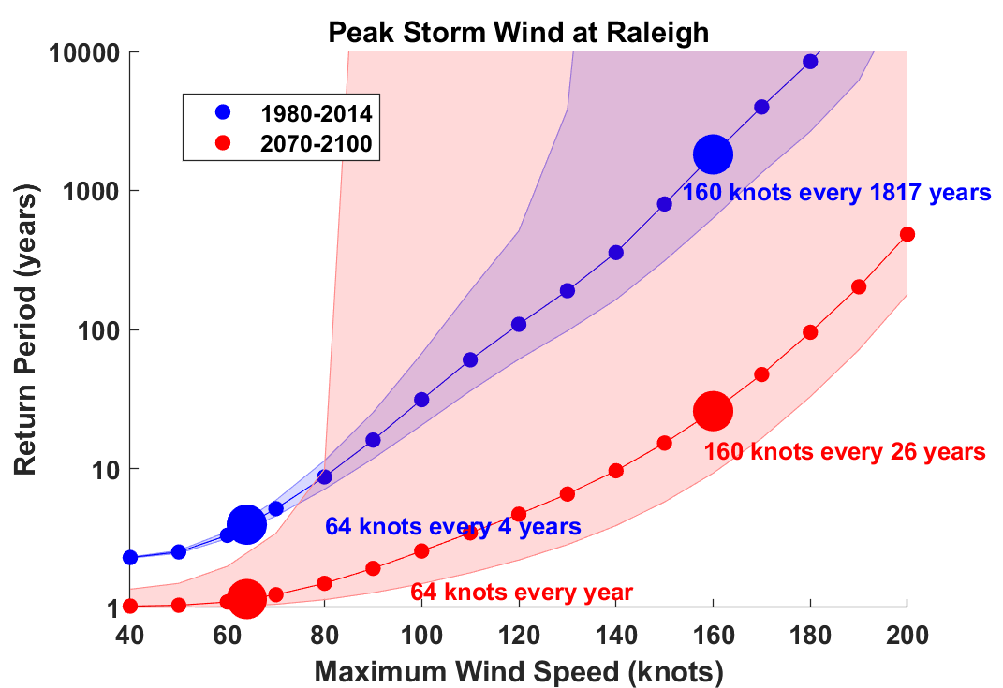

Slide 30
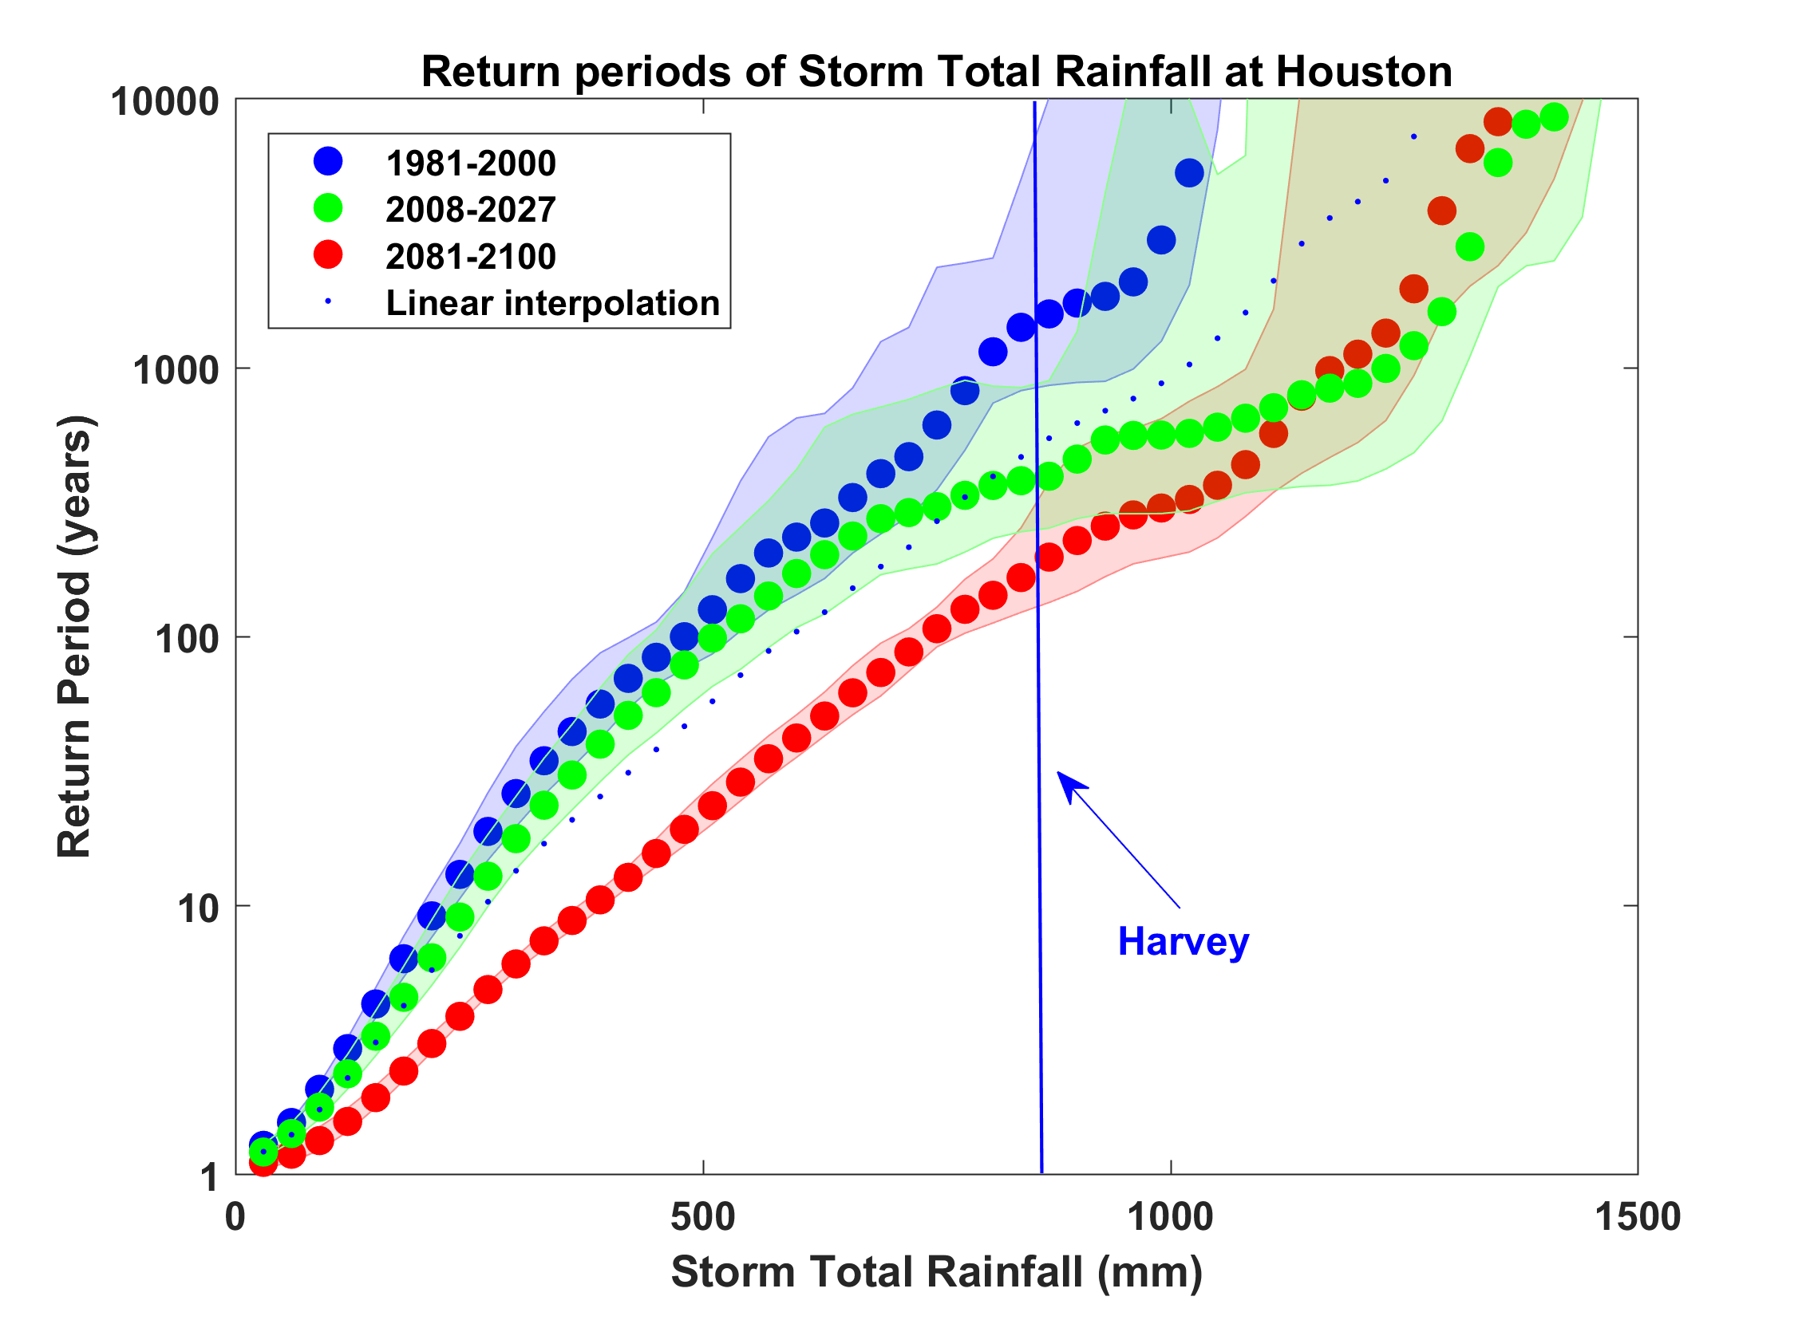
Probability of Storm Accumulated Rainfall in Harris County, from 6 Climate models, 1981-2000, 2008-2027, and 2081-2100, Based on 2000 Events Each, and Using RCP 8.5. Shading Shows Spread Among the Models.

Slide 31
Take-Away Points
We need to move away from sole dependence on flawed historical data in assessing natural hazard risk and embrace advanced modeling techniques
We can no longer regard climate change as a problem for the future; it has already tangibly affected important risks, e.g. Harvey’s rainfall was ~3 times more likely in 2017 than in 1970
Insurance industry could help catalyze insurance-relevant research in universities and government labs by creating a demand for graduates with backgrounds in physics-based risk assessment

Slide 32

Satellite Image
Climate Model

