Slide 1

Hurricanes and Climate Change
Kerry Emanuel
Lorenz Center, MIT
Notes:
1

Slide 2
Program
Overview of hurricanes
Overview of climate change
How climate change might affect hurricanes
Quantifying hurricane risk in a changing climate

Slide 3

The View from Space

Slide 4

View of the eye of Hurricane Katrina on August 28th, 2005, as seen from a NOAA WP-3D hurricane reconnaissance aircraft.

Slide 5

A Little Physics

Slide 6
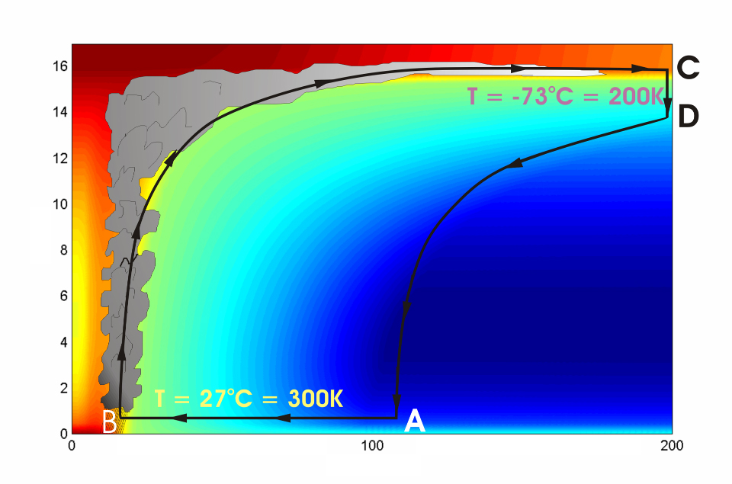




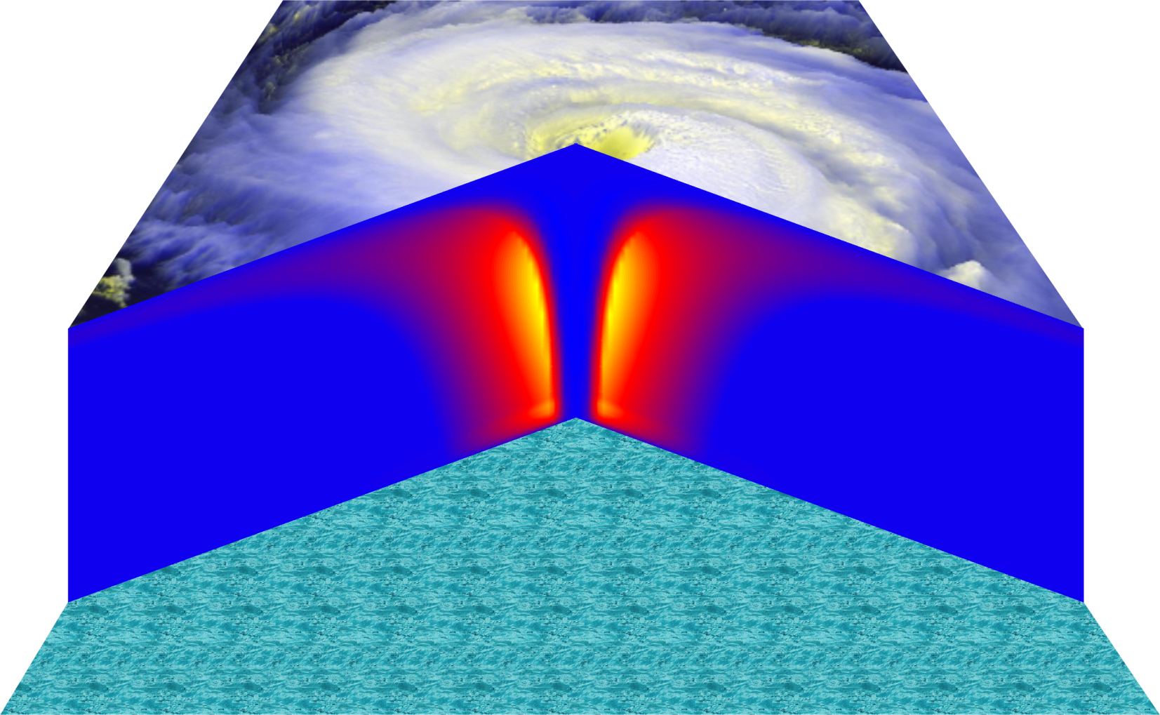
Cross-section through a Hurricane & Energy Production
eye
edge
Isothermal compression
Adiabatic expansion
Adiabatic compression
Height above ocean
Nearly isothermal expansion
Low entropy
Ocean surface
Radius (km)
Notes:
NOTE: We have animated the path of air for this slide and included labels to help our audience understand what you will be describing. Many of them will have never even heard of a Carnot heat engine and do not have a strong understanding of entropy. We would like to do whatever we can in to make this information accessible to our audience. Please let us know if you approve of these changes, and feel free to replace the labels as needed. The simpler you can keep your description of this, the better. You do an excellent job of describing the process in your book.
***
The energy cycle of a mature hurricane - the hurricane as a Carnot heat engine. This two-dimensional plot of the thermodynamic cycle shows a vertical cross section of the hurricane, whose storm center lies along the left edge. The colors depict the entropy distribution; cooler colors indicate lower entropy. Loosely, this means the total heat content of the air. Note that as air approaches the eyewall, its entropy increases rapidly, reflecting the large input of heat from the ocean.
Let’s follow a sample of air that begins at point A near the sea surface, a hundred kilometers or so from the storm center. The process mainly responsible for driving the storm is the evaporation of seawater, which transfers energy from sea to air. As a result of that transfer, air spirals inward close to the sea surface, between Points A and B. The storm center is an area of relatively low pressure, so the pressure on air decreases as it travels from A to B. But it is always in contact with the sea surface, which acts as an almost unlimited heat reservoir, so its temperature is approximately constant (acquiring entropy at a constant temperature). It is during this leg that enormous quantities of heat are added to the air from evaporation of seawater. Evaporation of water is a very efficient way to transfer heat from one body to another. That is why you feel cold when you are wet, especially if it is windy and/or dry: evaporation is taking heat from your body. Thus the addition of heat in leg A-B shows up mostly as an increase in humidity in the air. This form of heat is called latent heat. Evaporation of sea water into the inflowing air is by far the most important source of heat driving the hurricane, which makes leg A-B the firebox of the hurricane. When hurricanes reach land, they quickly die because they are cut off from their oceanic energy source. At point B, the air turns and flows upward through the towering cumulonimbus clouds that make up the hurricane’s eyewall. It is here that the latent heat is converted to sensible heat as water vapor condenses. But it is important to note that although there is enormous conversion between these two forms of heat, the total heat content (entropy, actually) remains approximately constant along this leg (note that the colors do not change along leg B-C). As the air flows upward, the pressure on it decreases very rapidly. What we have here is an example of adiabatic expansion. By the time the air reaches point C in the high troposphere or lower stratosphere, some 12 to 18 kilometers above the sea surface, the adiabatic expansion has lowered its temperature to a value close to that of the undisturbed upper tropical atmosphere, around -70°C or about 200 Kelvin. The air remains at approximately this temperature as it sinks down toward the tropopause (point D). Although the air is undergoing compression, it is losing heat by electromagnetic radiation to space. The depicted compression is very nearly isothermal. Finally, between D and A, the air returns to its starting point while undergoing an adiabatic compression. Voilà, the four legs of a Carnot cycle.
In a real hurricane, the energy cycle is open because hurricanes continuously exchange air with their environment.
Image is copyrighted 2005 by Oxford University Press.
Description from “Divine Wind: The History and Science of Hurricanes”, Kerry Emanuel, 2005, Oxford University Press, 296 p.

Slide 7
Annual Maximum Potential Intensity (m/s)

Slide 8
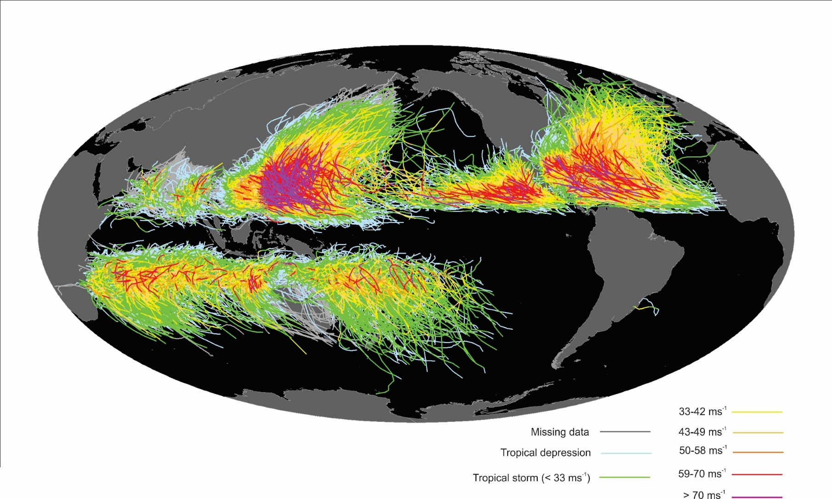
Global Climatology
Tracks of all tropical cyclones in the historical record from 1851 to 2010. The tracks are colored according to the maximum wind at 10 m altitude, on the scale at lower right.

Slide 9
The Global Hurricane Hazard
About 15,000 deaths per year since 1971
$ 1.1 trillion 2015 U.S. dollars in damages ($21 billion/yr) since 1971
Global population exposed to hurricane hazards has tripled since 1970
EM-DAT, 2020: The OFDA/CRED International Disaster Database
http://www.emdat.be/.

Slide 10
Global Tropical Cyclone Damage Normalized by Gross World Product
380% increase since 1970
Population of TC-prone regions increased by ~200%
Suggests that climate change has contributed to increasing damage
EM-DAT, 2020: The OFDA/CRED International Disaster Database
http://www.emdat.be/.

Slide 11


Slide 12
Overview of Greenhouse Gas-Induced Climate Change

Slide 13


John Tyndall (1820-1893)

Slide 14
Atmospheric Composition
The orange sliver makes the difference between a mean surface temperature of 0ºF and of 60ºF.

Slide 15
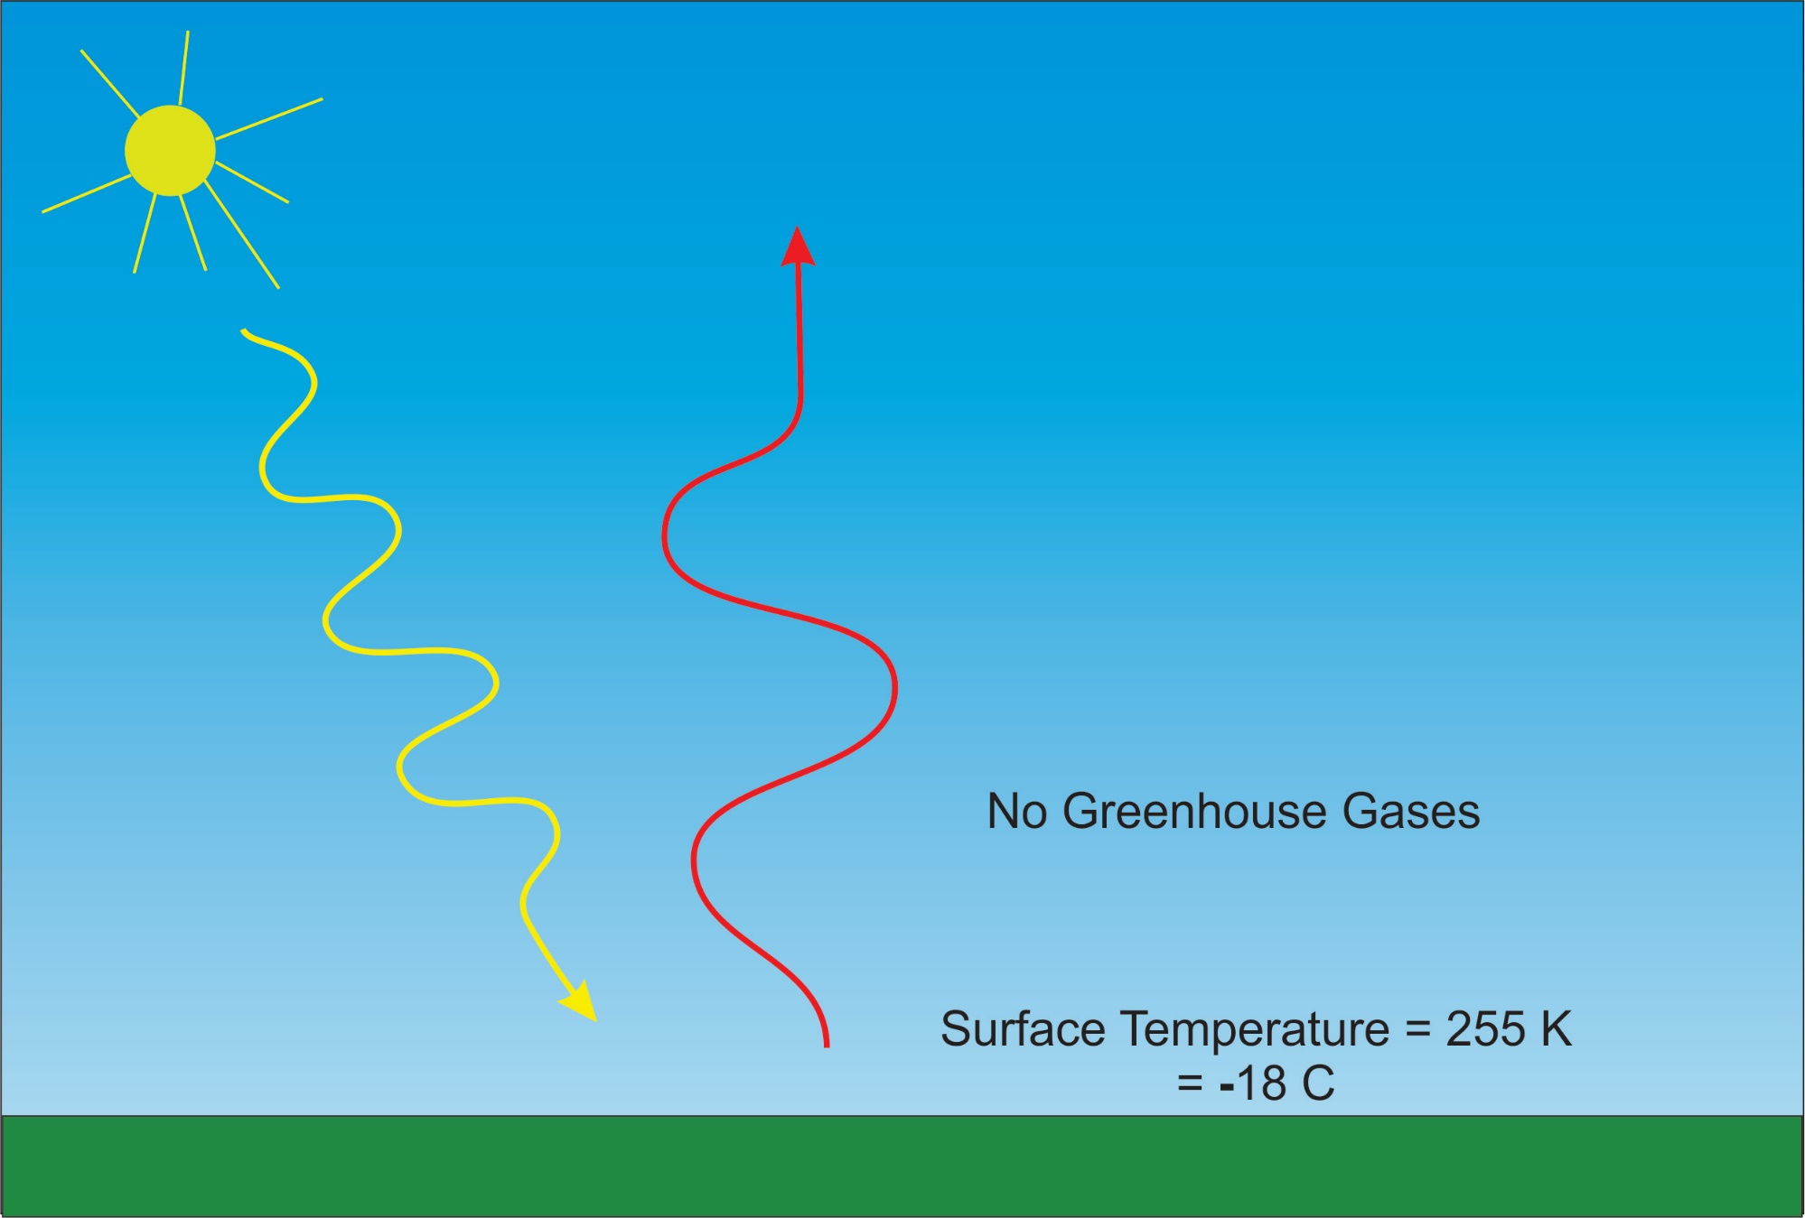

Slide 16
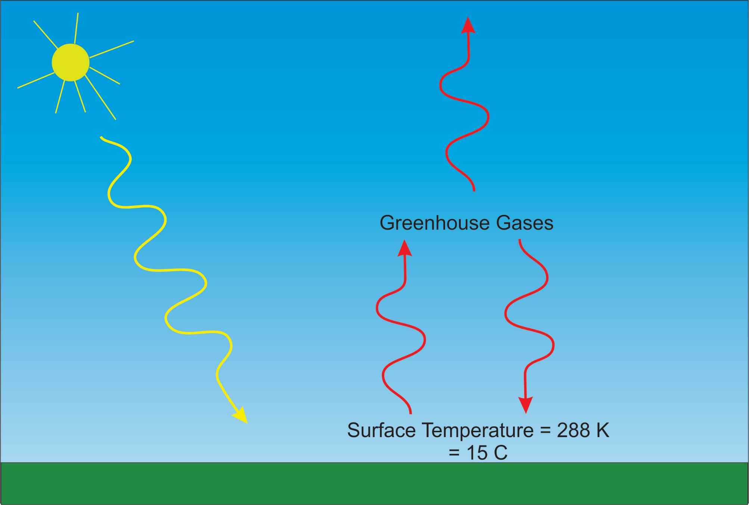

Slide 17
Our Influence on Greenhouse Gases

Slide 18

Svante Arrhenius, 1859-1927
“Any doubling of the percentage of carbon dioxide in the air would raise the temperature of the earth's surface by 4°; and if the carbon dioxide were increased fourfold, the temperature would rise by 8°.” – Världarnas utveckling (Worlds in the Making), 1906

Slide 19
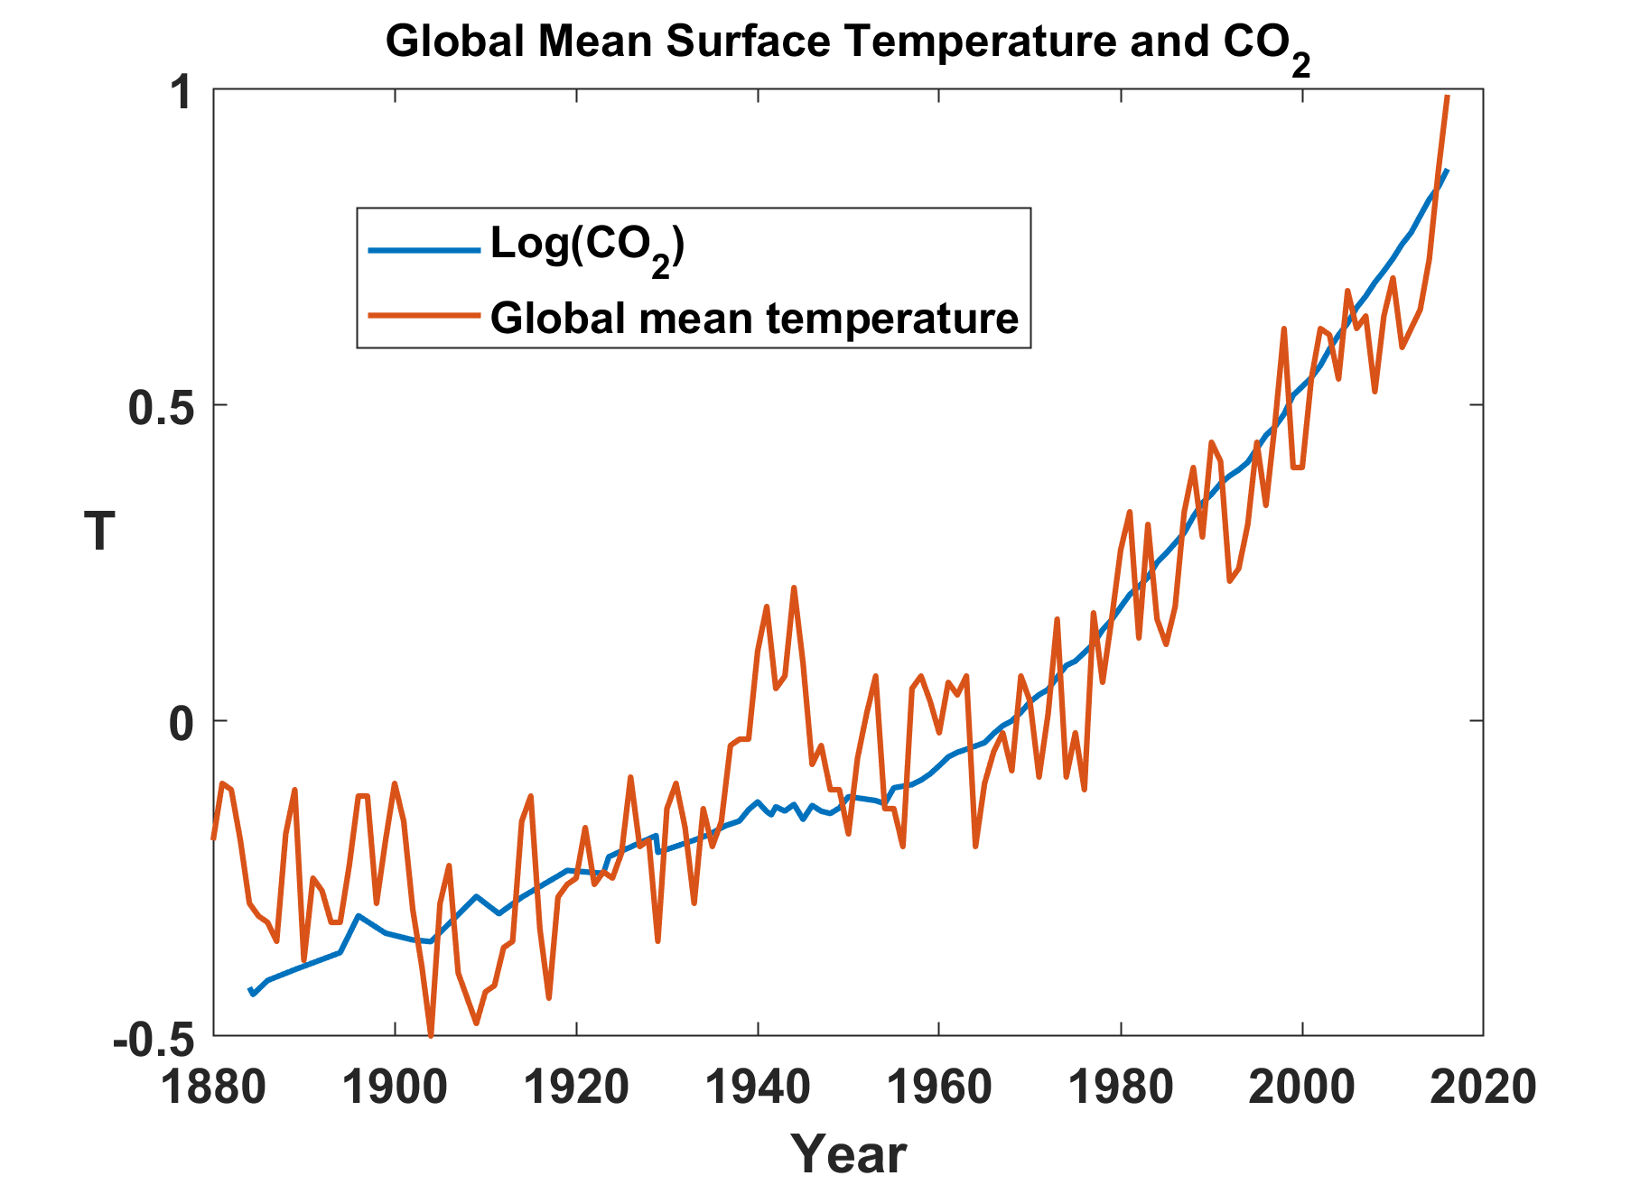

Slide 20
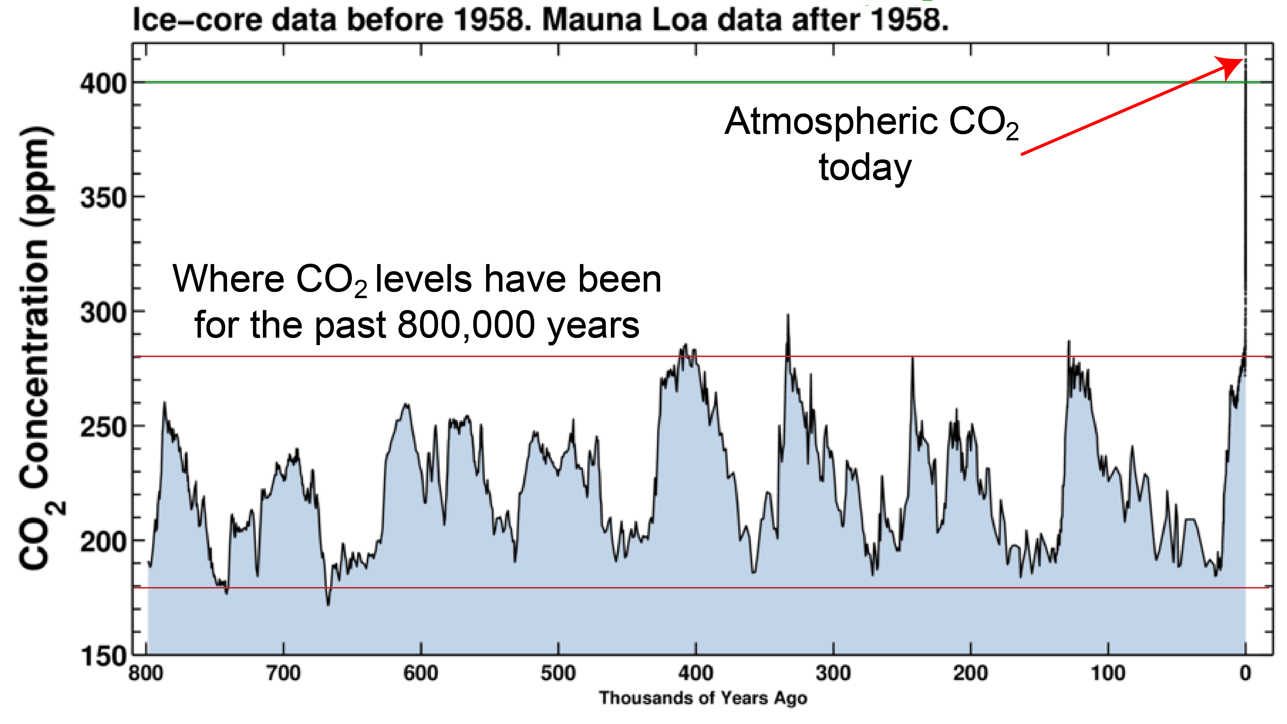

Slide 21
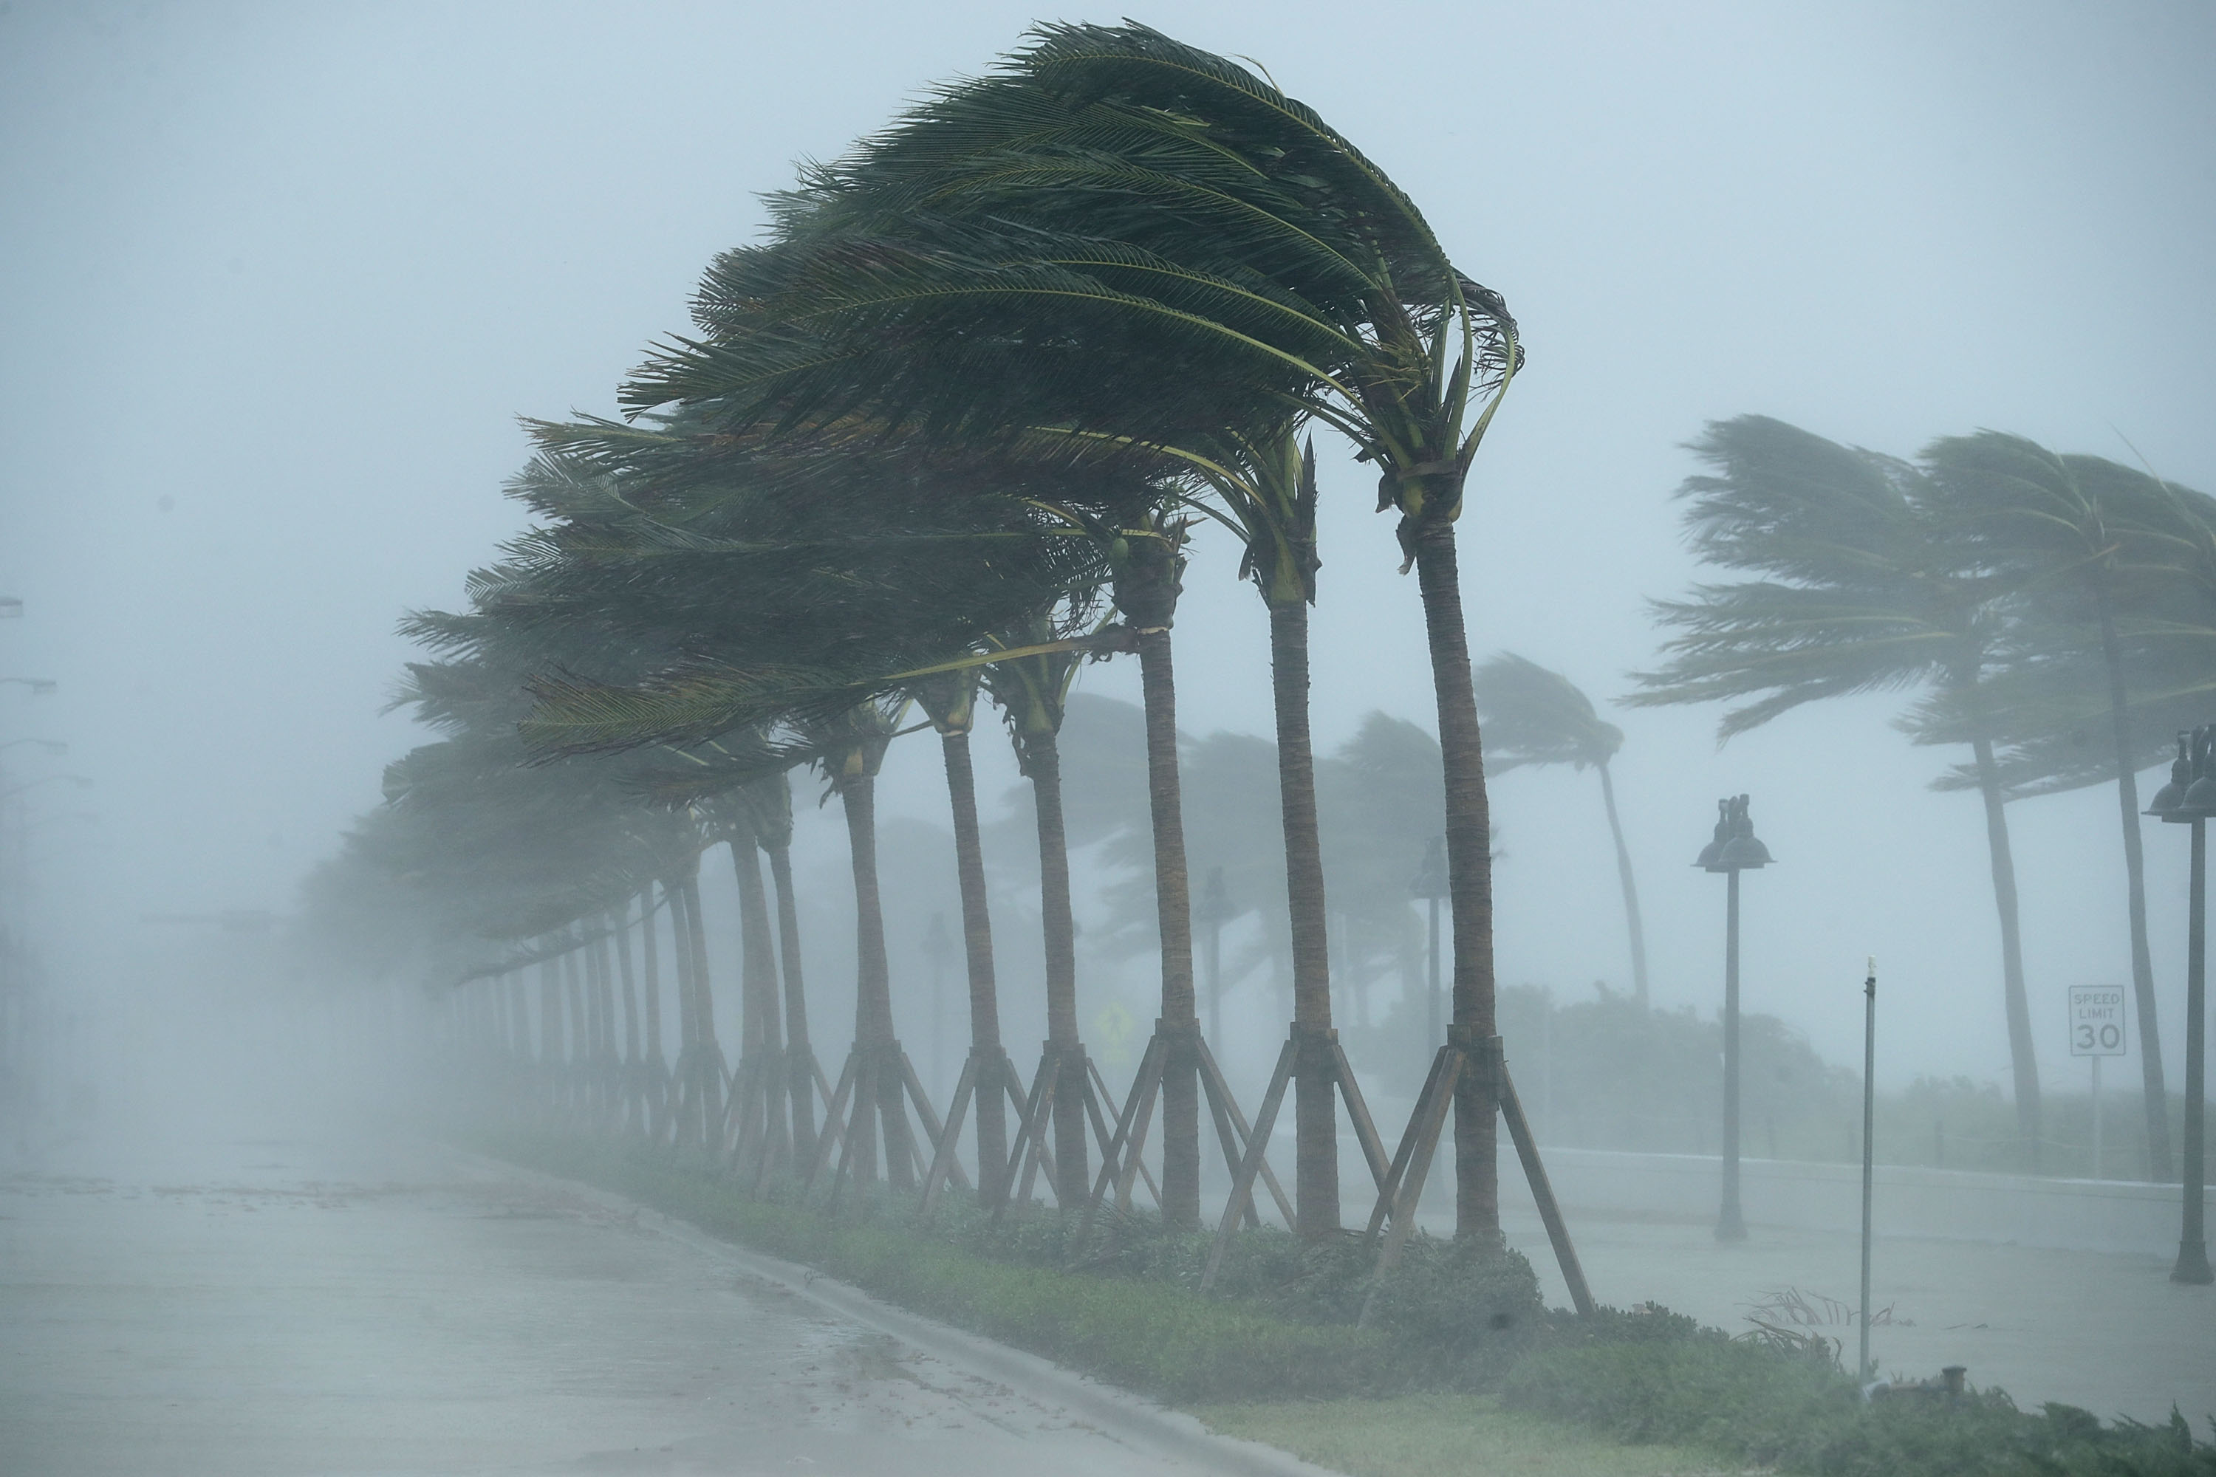
Climate Change Effects on Hurricanes

Slide 22
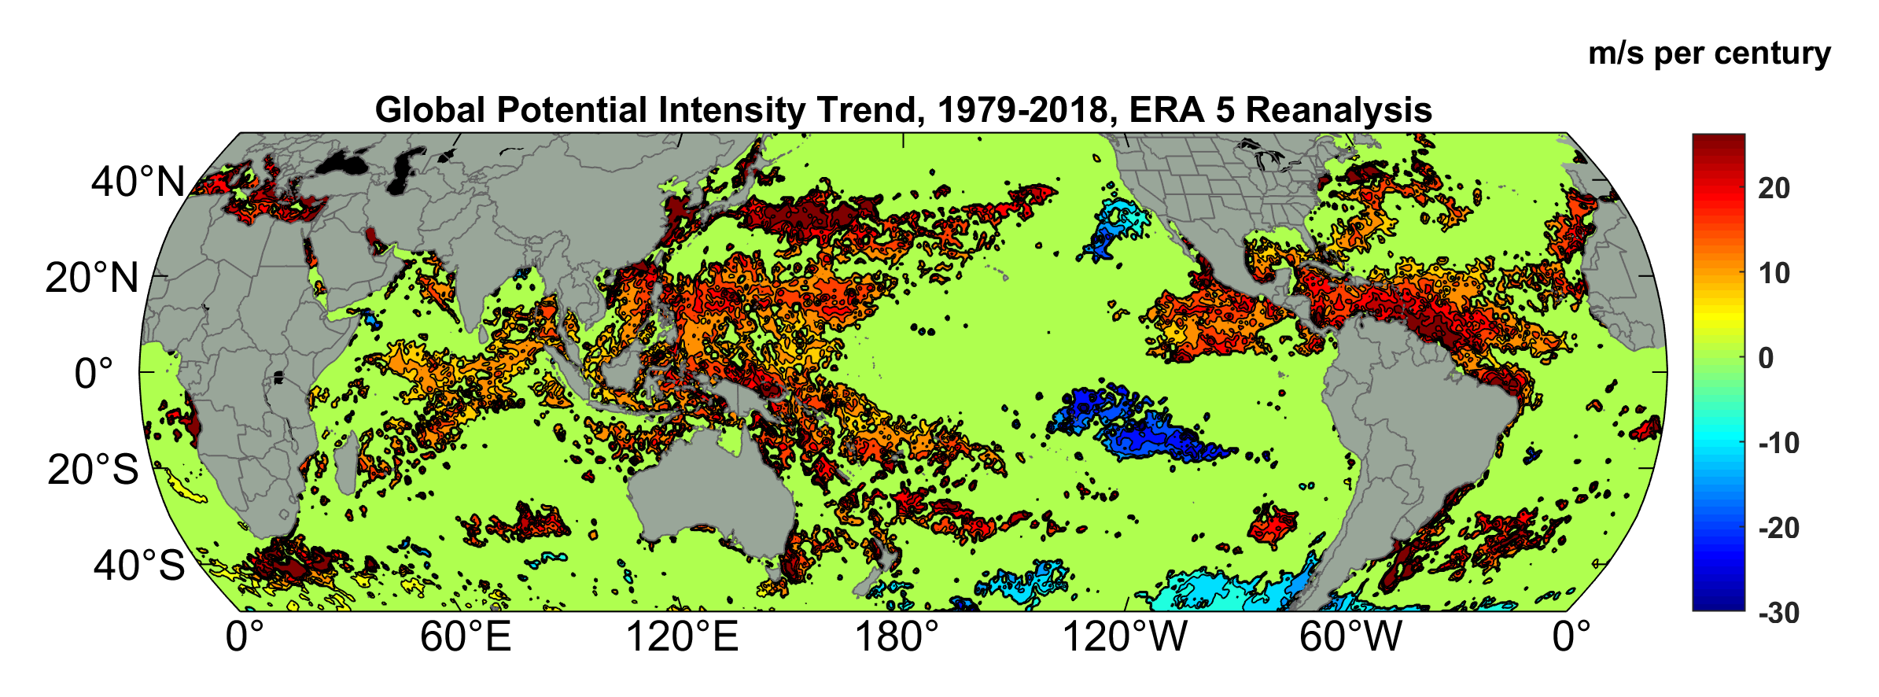
“Potential Intensity” is the theoretical upper bound on maximum surface winds, based on the Carnot-like energy cycle of hurricanes
Potential Intensity Trend, 1979-2018, ERA 5 Reanalysis
(Trend shown only where p value < 0.05)

Slide 23
Satellite-derived proportion of major hurricane fixes
Time series of fractional proportion of global major hurricane estimates to all hurricane estimates for the period 1979–2017. Each point, except the earliest, represents the data in a sequence of 3-y periods. The first data point is based on only 2 y (1979 and 1981) to avoid the years with no eastern hemisphere coverage. The linear Theil−Sen trend (black line) is significant at the 98% confidence level (Mann−Kendall P value = 0.02). The proportion increases by 25% in the 39-y period (about 6% per decade).
Kossin et al., PNAS, 2020

Slide 24
How do we quantify hurricane risks, accounting for climate change?

Slide 25
Flawed Basis of Current Risk Modeling
Almost all current risk assessments are based on historical statistics
Historical records are flawed and short
Moreover, the past 50-150 years is a poor guide to the present owing to climate change that has already occurred
Risk modelers have been slow to migrate to a physics-based approach

Slide 26
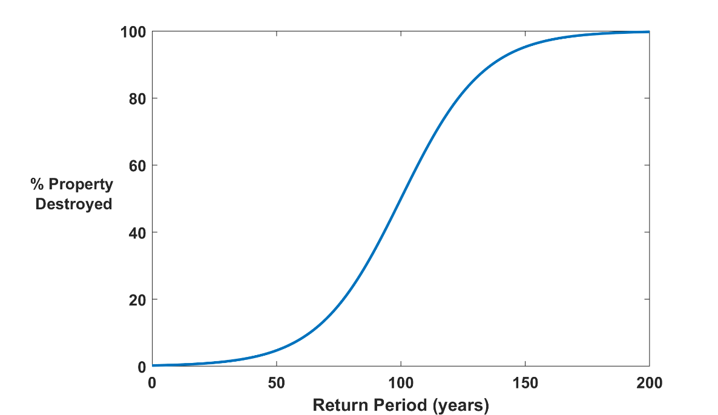

The Heart of the Natural Disaster Problem:
Societies are usually well adapted to frequent events (> 1/100 yr)
Societies are often poorly adapted to rare events
(< 1/100 yr)
Large cost increases result when > 100-yr events become < 100-yr events

Slide 27
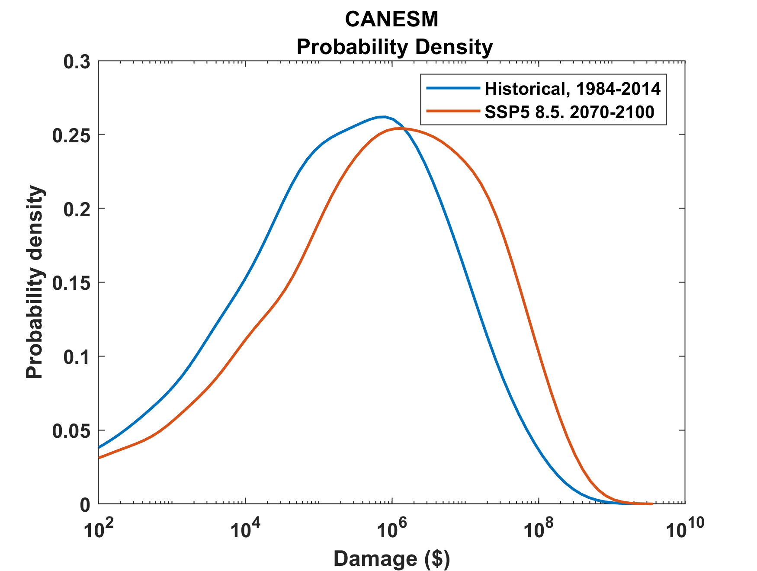
Example:
Tropical Cyclone Risk Arises Largely from High Intensity Events
1984-2014
2070-2100
Probability
Probability density of annual damage to a portfolio of insured property in the U.S.

Slide 28
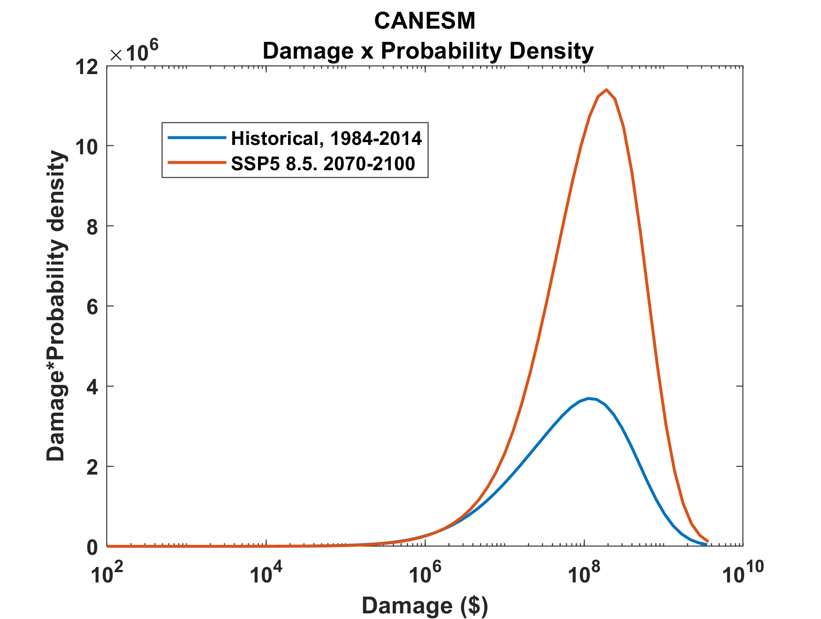
Tropical Cyclone Risk Arises Largely from High Intensity Events
2070-2100
Total expected damage proportional to area under curves
Risk
1984-2014
Damage times probability density of annual damage to a portfolio of insured property in the U.S.

Slide 29
Historical Records
Hurricane records: ~70 years of good records (U.S.)
Even if we had 200 years of great records, the past is no longer a good guide to the present
We need to turn to physical models to get better estimates of current (and future) weather risks

Slide 30
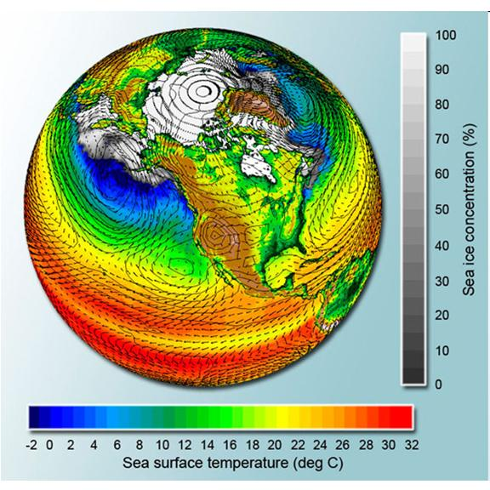
Why Not use Climate Models to Simulate Future Hurricanes?

Slide 31

Problem: Today’s models are far too coarse to simulate destructive hurricanes
Histograms of Tropical Cyclone Intensity as Simulated by a Global Model with 30 mile grid point spacing. (Courtesy Isaac Held, GFDL)
Category 3
Modeled
Observed
Global models do not simulate the storms that cause destruction
Wind Speed (meters per second)

Slide 32
Using Physics to Assess Hurricane Risk
Reliable, global records of coarse-scale climate are robust and widely available
Cull from these datasets the key statistics known to control tropical cyclone generation, movement, and intensity evolution
Bootstrap these key statistic to create unlimited synthetic time series of the hurricane-relevant environmental variables
Use these to drive a specialized, very high resolution physical hurricane model coupled to the ocean
Extensively validate the results against historical hurricane data
Exact same method can be applied to output of climate models

Slide 33
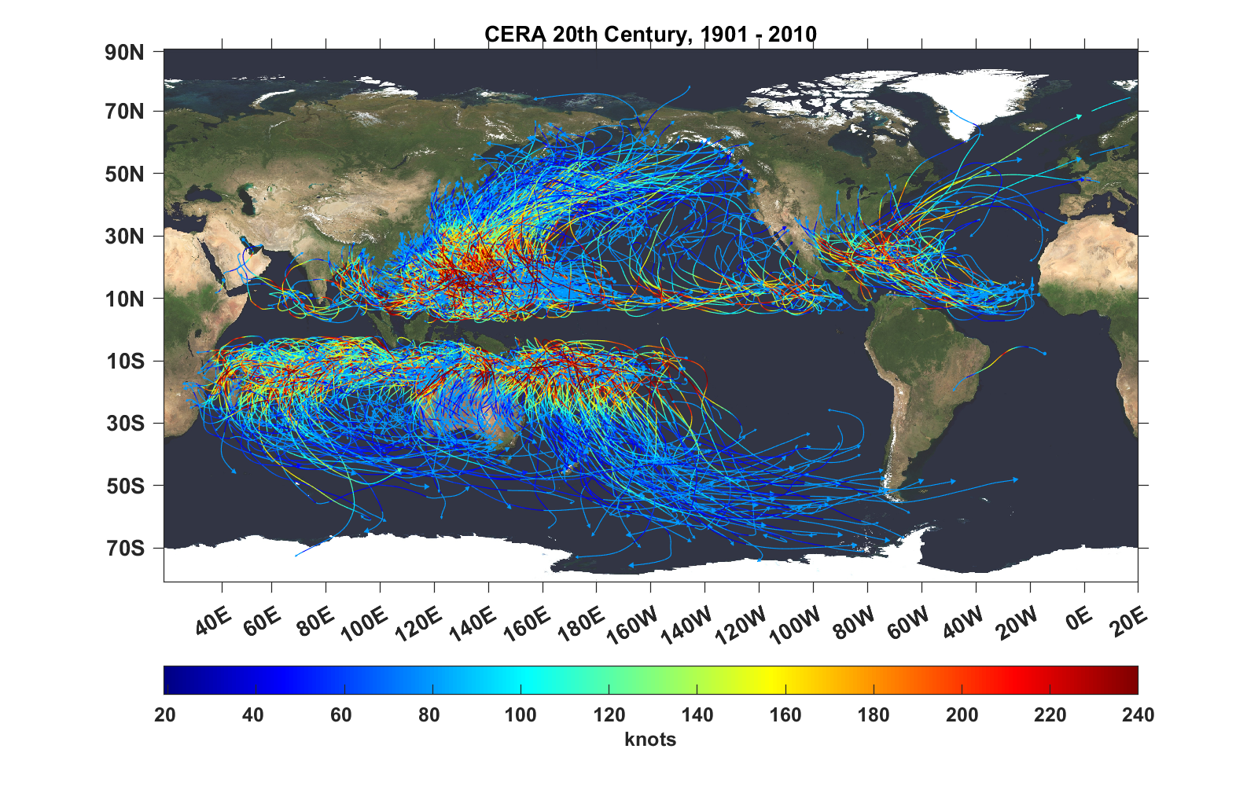
Top 1,000 storms Downscaled from CERA 29th Century Reanalysis

Slide 34
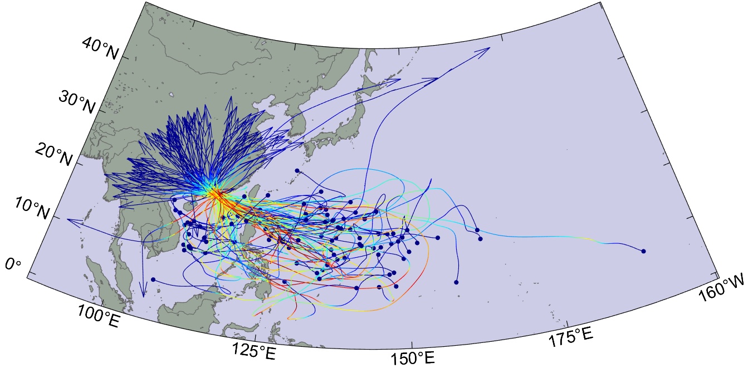
Top 100 of 4,500 tropical cyclones affecting Hong Kong, downscaled from UKMO CMIP6, 20th Century

Slide 35
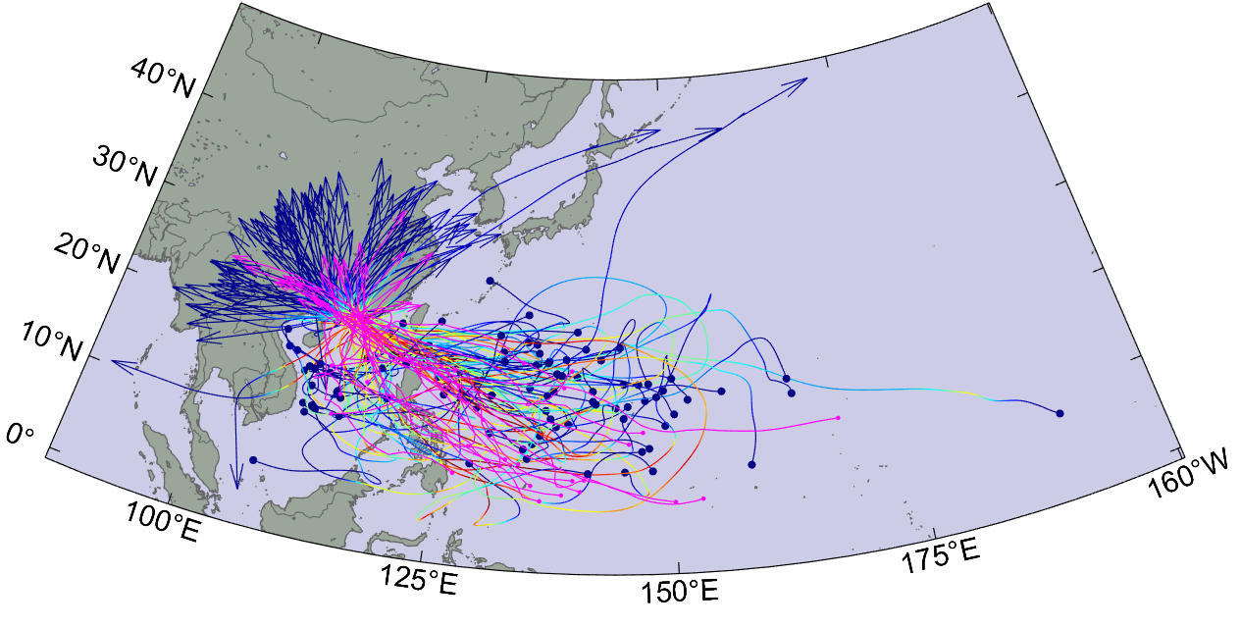
With historical tracks superimposed

Slide 36
Atlantic Annual Cycle

Slide 37
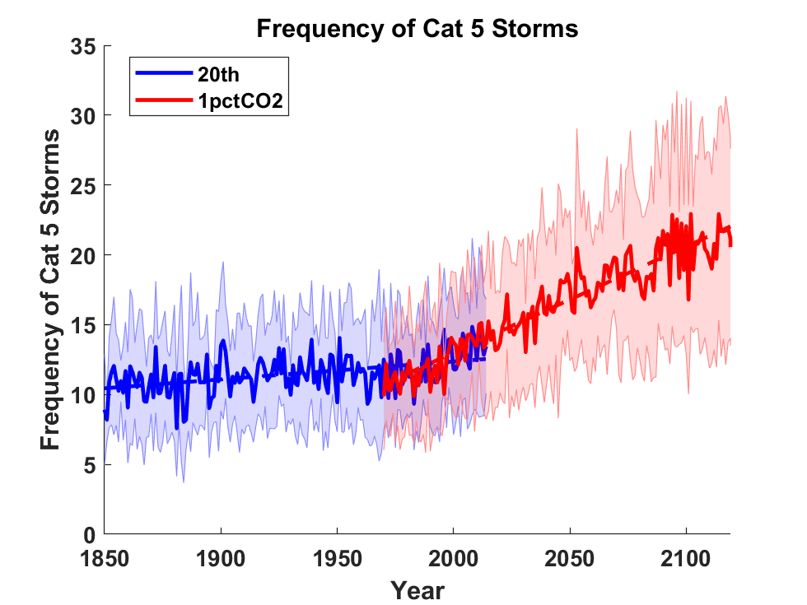
Global Tropical Cyclone Frequency from 9 Current Generation (CMIP6) Climate Models

Slide 38
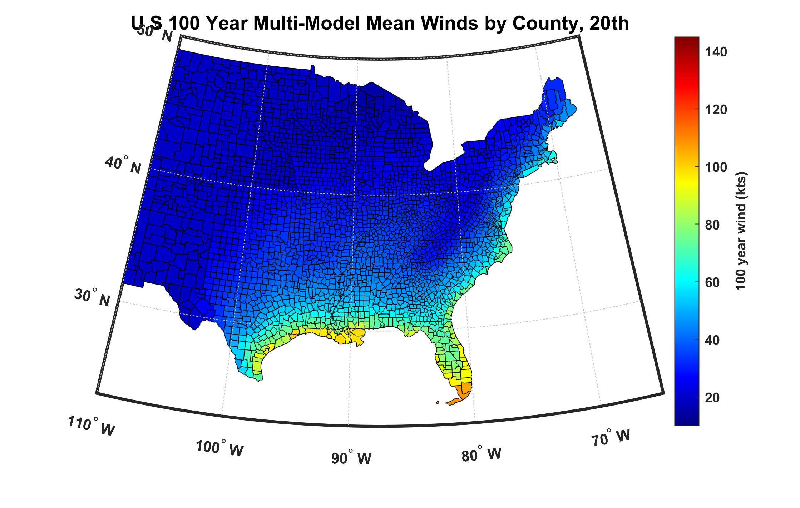
100-year hurricane peak wind based on downscaling 8 climate models, 1984-2014

Slide 39
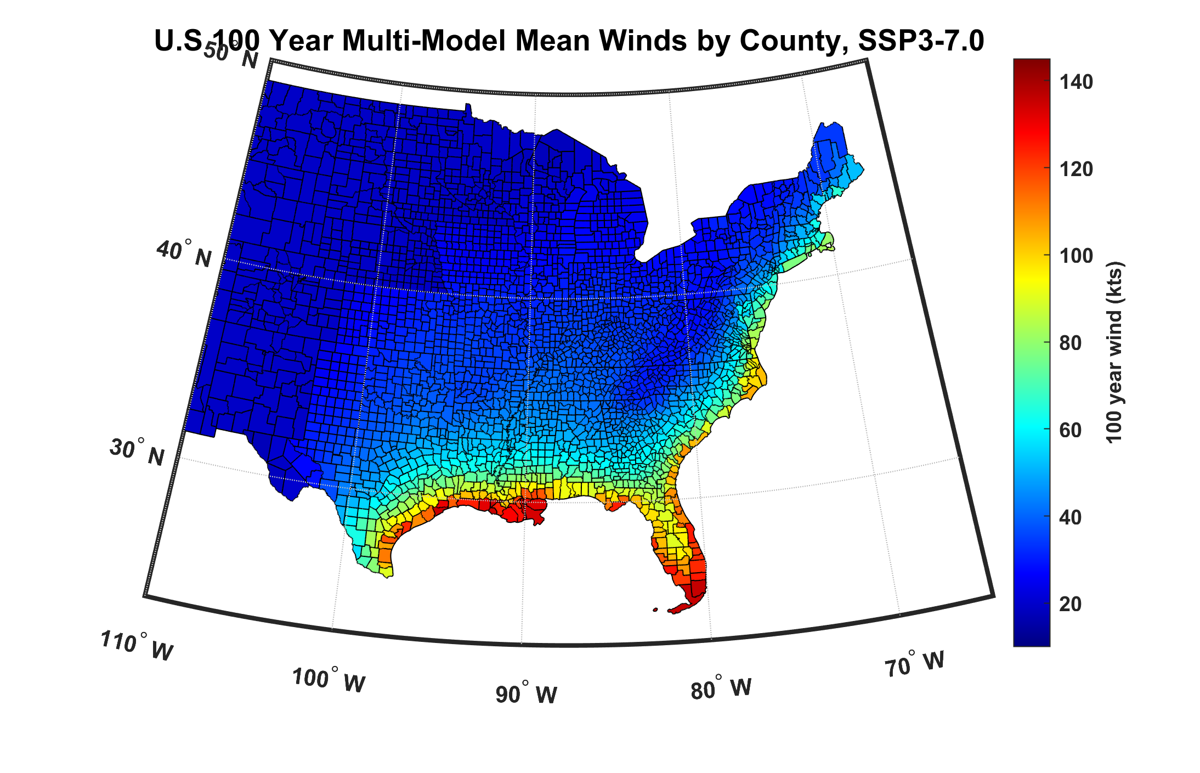
100-year hurricane peak wind based on downscaling 8 climate models, 2070-2100

Slide 40


Storm Surge Simulation (Ning Lin)
SLOSH model
(Jelesnianski et al. 1992)
SLOSH mesh
~ 10³ m
ADCIRC mesh
~ 10² m
Battery
ADCIRC model
(Luettich et al. 1992)
ADCIRC mesh
~ 10 m
(Colle et al. 2008)
Notes:
Given the storm wind and pressure fields (which is estimated from the Holland parametric pressure model) we can simulate the surge. Surge simulations with high resolution are computationally intensive, so to make it possible to simulate accurate surges for our large synthetic storm sets, we apply the two hydrodynamic models with girds of various resolutions in such a way that the main computational effort is concentrated on the storms that determine the risk. First, we apply the SLOSH model, using a mesh with resolution of about 1 km around NYC to simulate the surges for all storms and select the storms that have return periods, in terms of the surge height at the Battery, greater than 10 years. Second, we apply the ADCIRC simulation, using a grid mesh with resolution of ~100 m around NYC, to each of the selected storms. Then, we apply another ADCIRC mesh with resolution as high as ~10 m around NYC, for a set of the most extreme events, to check if the resolution of our ADCIRC grid is sufficient and if needed to make statistical correction to the results.

Slide 41

GCM flood height return level, Battery, Manhattan
(assuming SLR of 1 m for the future climate )
Black: Current climate (1981-2000)
Blue: A1B future climate (2081-2100)
Red: A1B future climate (2081-2100) with R₀ increased by 10% and R_{m} increased by 21%
Lin et al. (2012)
Notes:
Then we calculate the flood height (including surge, tide, and sea level rise) return level for the four climate models, assuming a sea level rise of 1 m for the future climate, for the Battery, NYC. These results show that the combined effects of storm climatology change and sea level rise will greatly shorten the flood return periods for NYC and, by the end of the century, the current 100-year surge flooding may happen less than every 30 years, with CNRM and GFDL prediction to be less than 10 years, and the 500-year flooding may happen less than every 200 years, with the CNRM and GFDL prediction to be 20-30 years.

Slide 42
2,000 year rain event for Houston

Slide 43
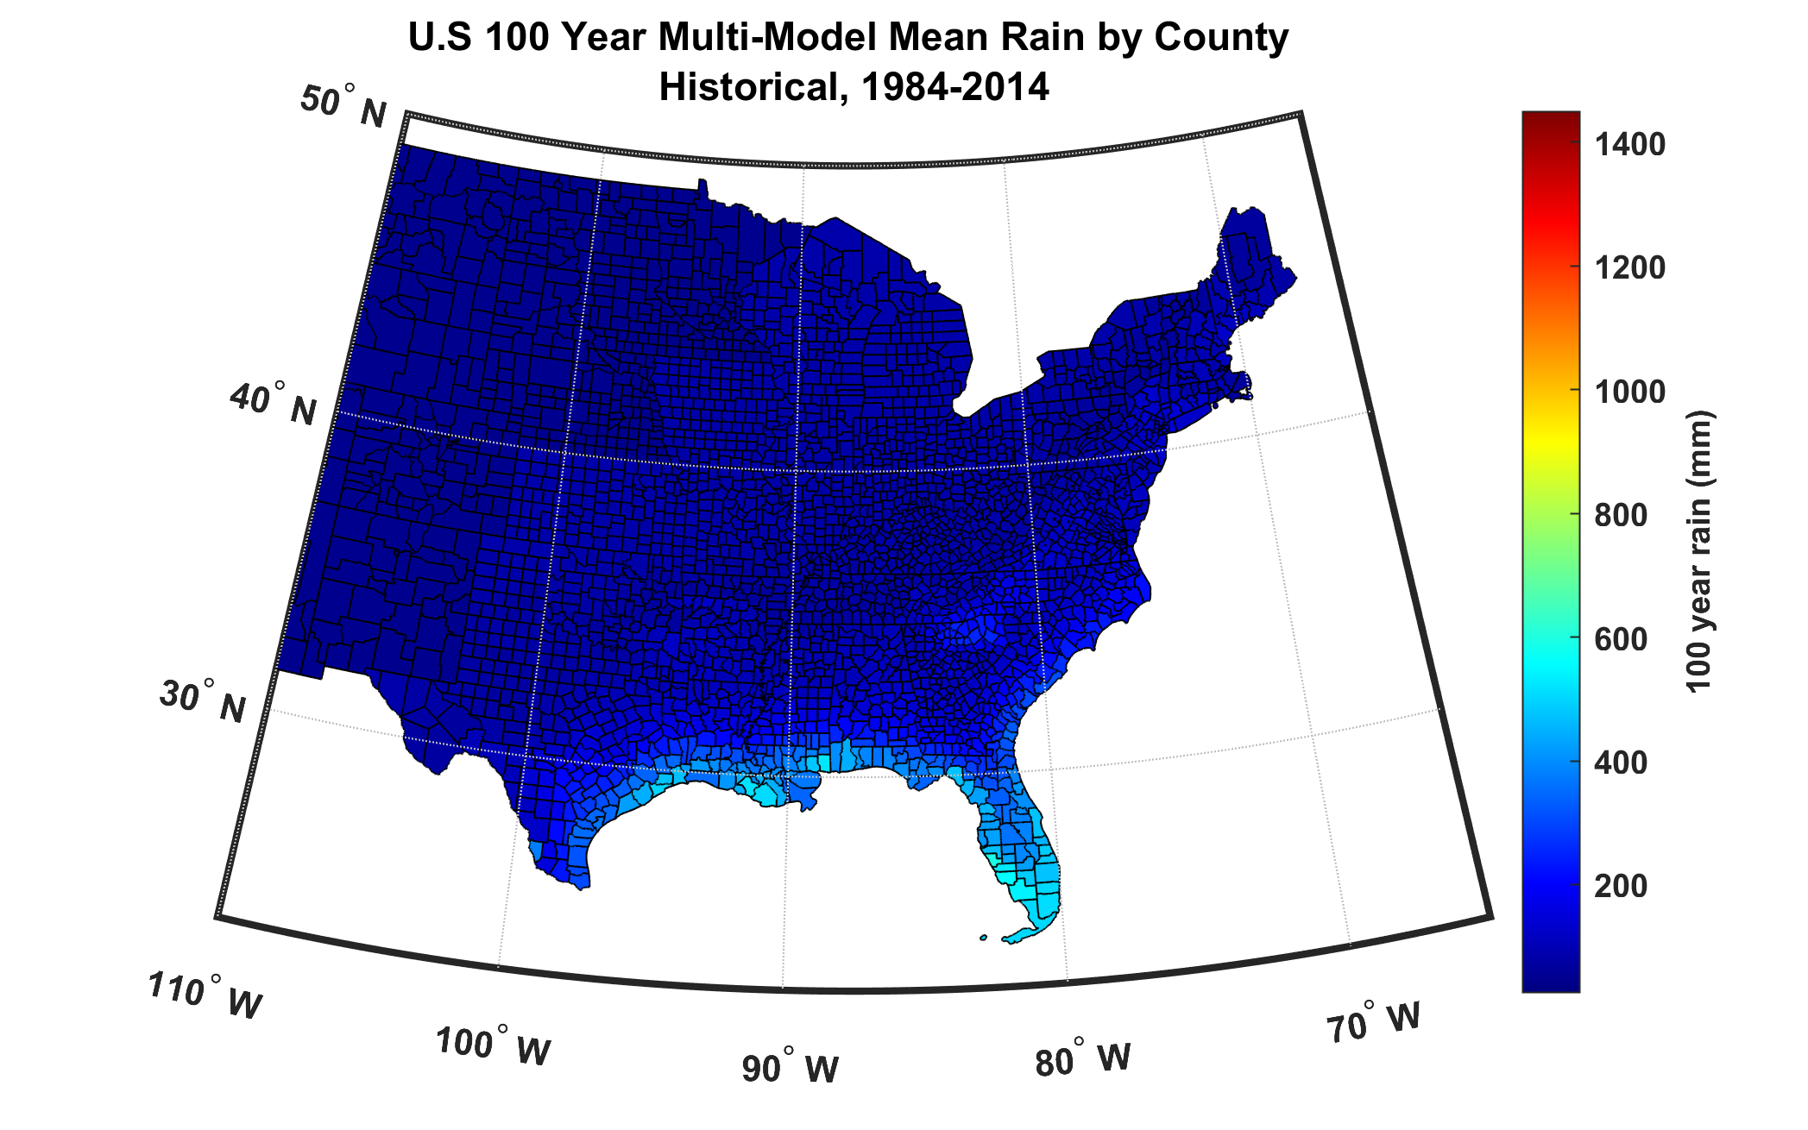
100-year hurricane storm total rain based on downscaling 8 climate models, 1984-2014

Slide 44
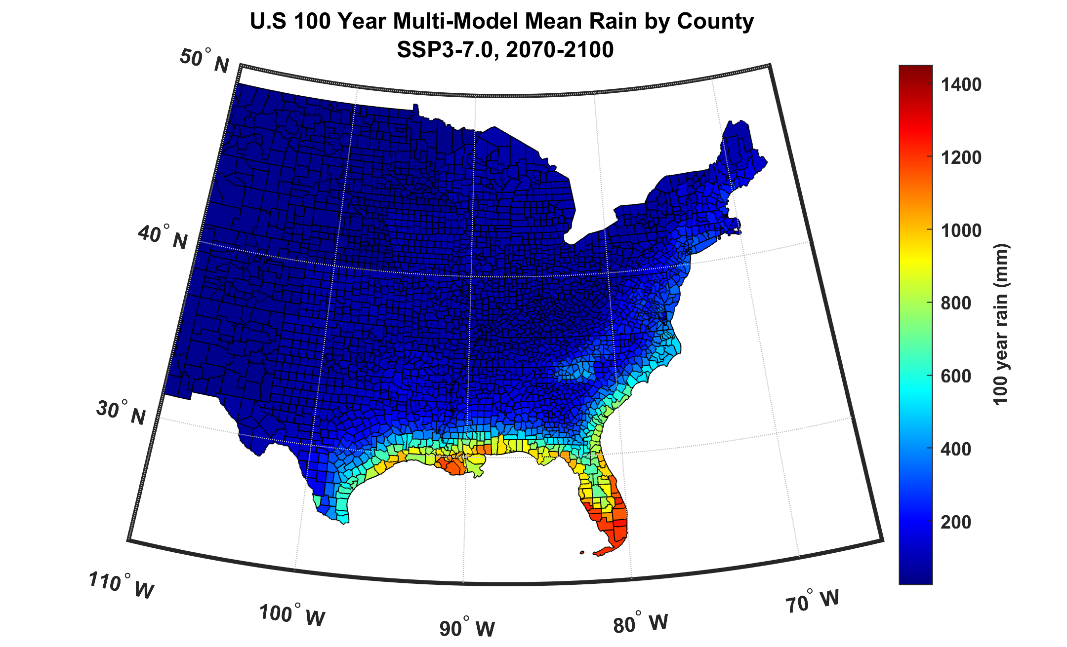
100-year hurricane storm total rain based on downscaling 8 climate models, 2070-2100

Slide 45
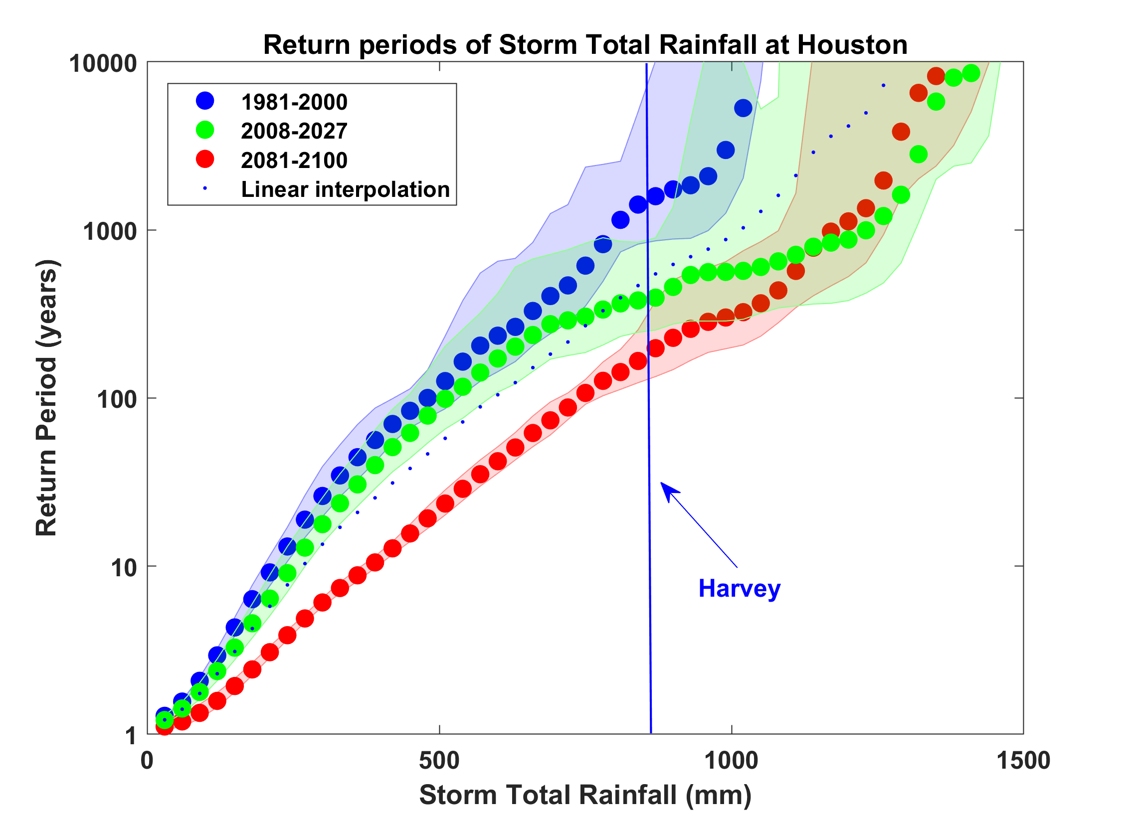
Probability of Storm Accumulated Rainfall in Harris County, from 6 Climate models, 1981-2000, 2008-2027, and 2081-2100, Based on 2000 Events Each, and Using RCP 8.5. Shading Shows Spread Among the Models.

Slide 46
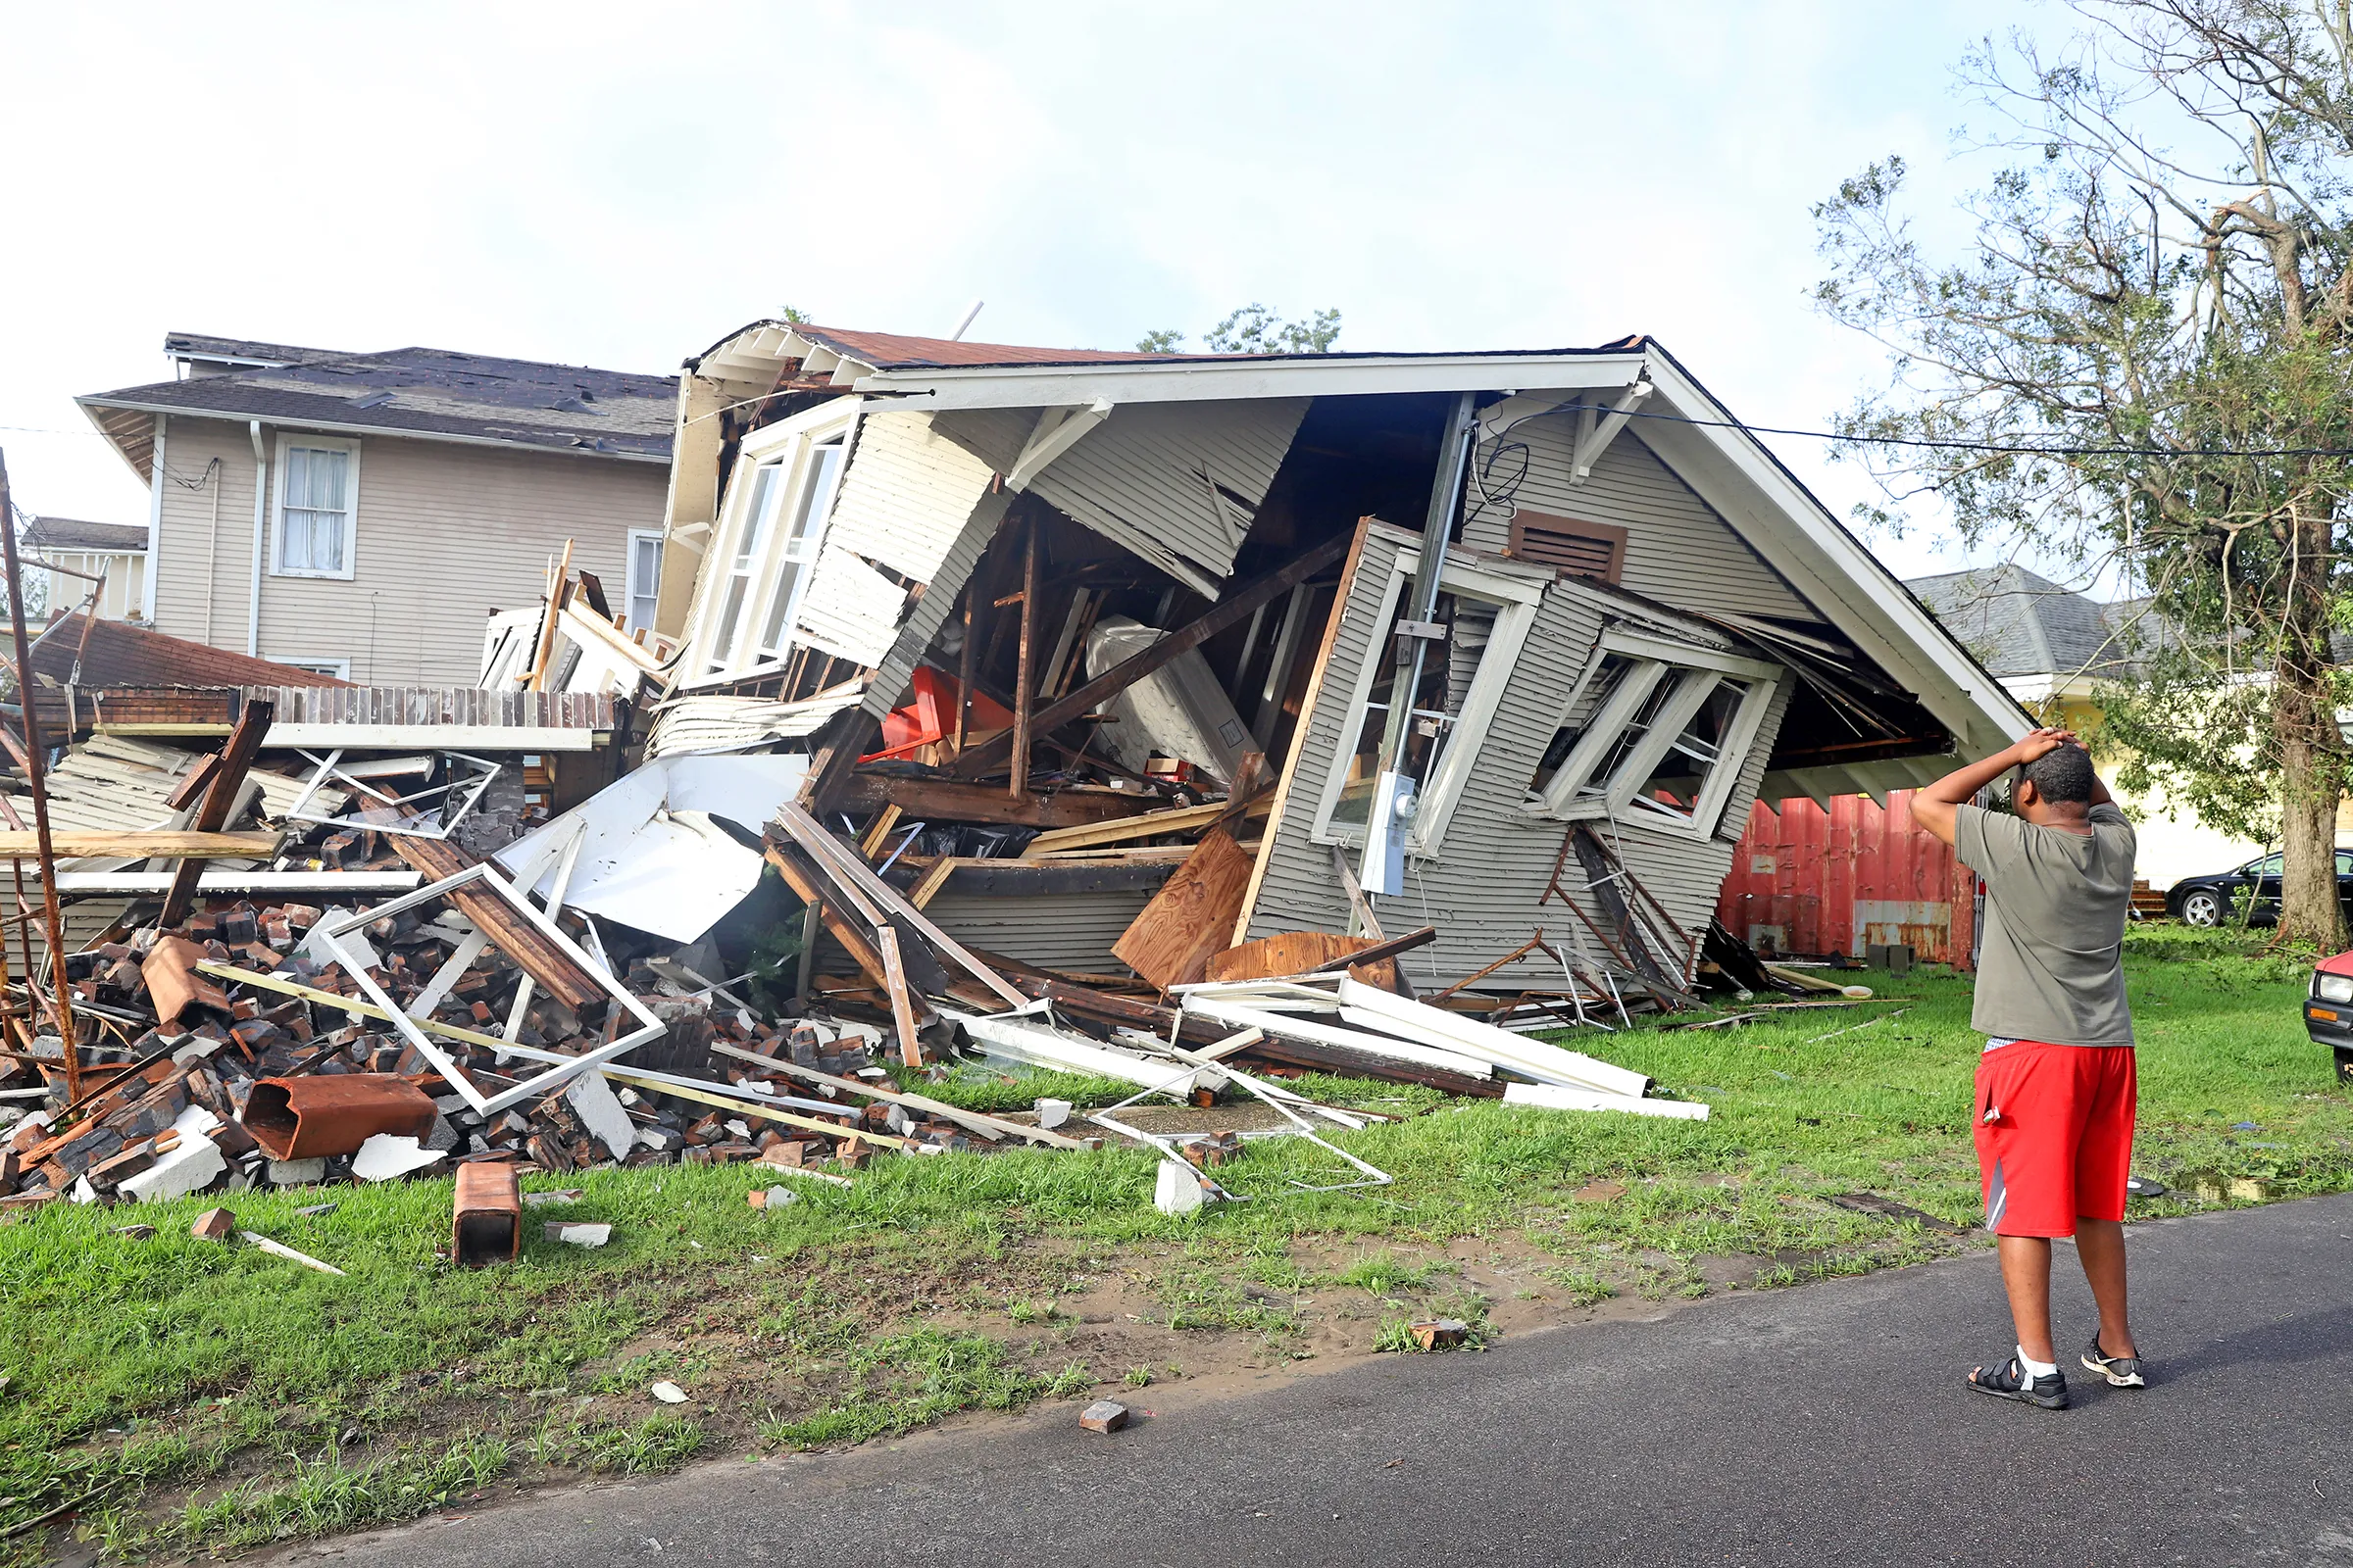
Making it Personal

Slide 47
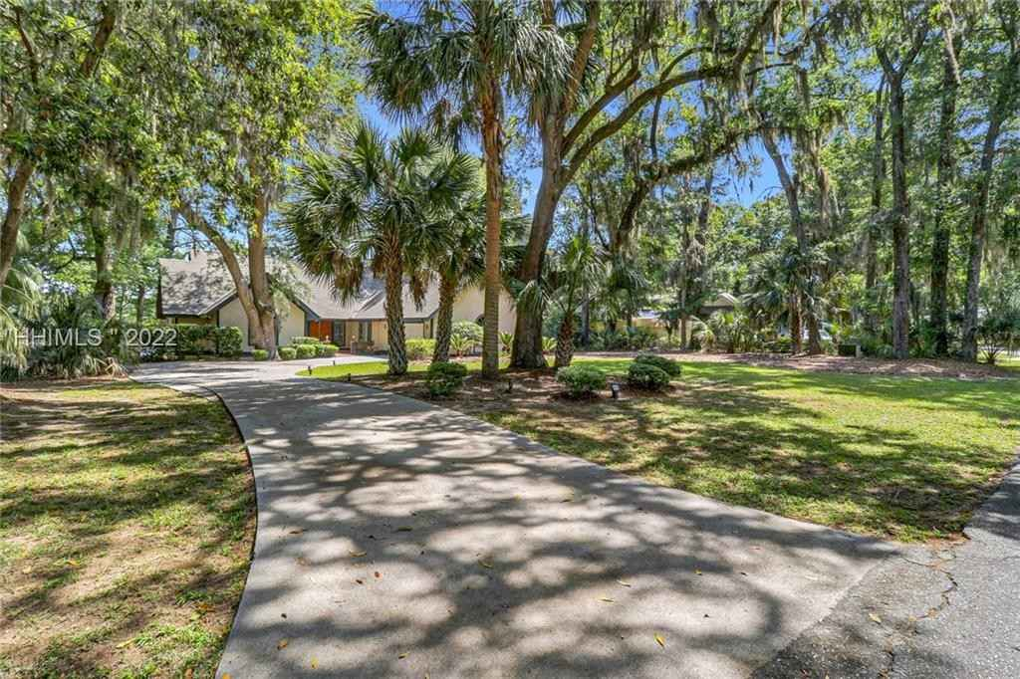
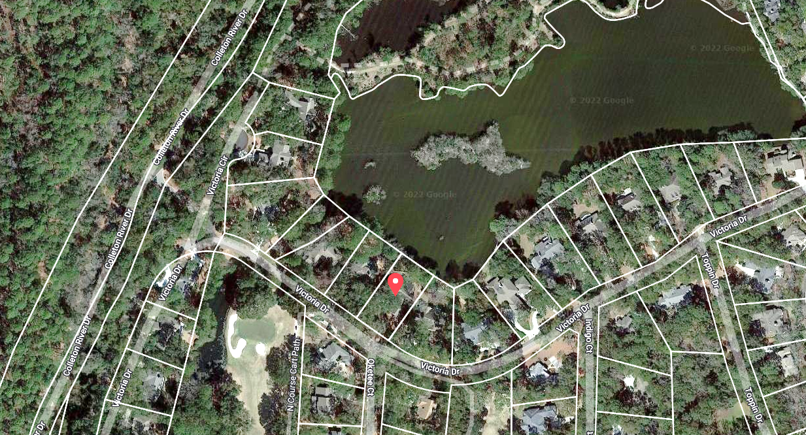



Property currently for sale in Hilton Head, SC
Realtor.com
Work of First Street Foundation

Slide 48
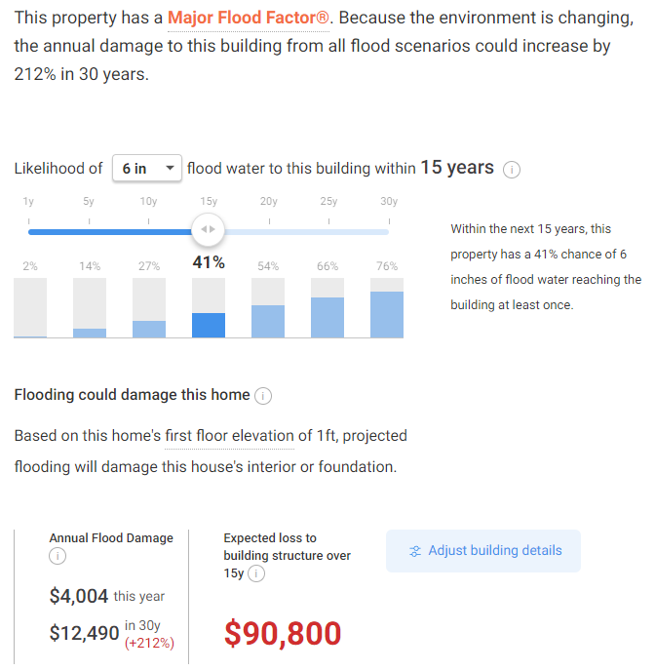

Slide 49
Summary
Hurricanes are examples of organized structures arising from conditions of thermodynamic disequilibrium between tropical oceans and atmosphere.
This disequilibrium is caused and maintained by the greenhouse effect. Adding greenhouse gases to the atmosphere increases the degree of disequilibrium
Hurricanes are significant societal hazards

Slide 50
Other Take-Away Points
We need to move away from sole dependence on flawed historical data in assessing climate- and weather-related natural hazard risk and embrace advanced modeling techniques
We can no longer regard climate change as a problem for the future; it has already tangibly affected important risks, e.g. Hurricane Harvey’s rainfall was ~3 times more likely in 2017 than in 1970
Hurricane-induced flooding is probably the most serious potential effect of climate change on hurricane-related risks

