Slide 1
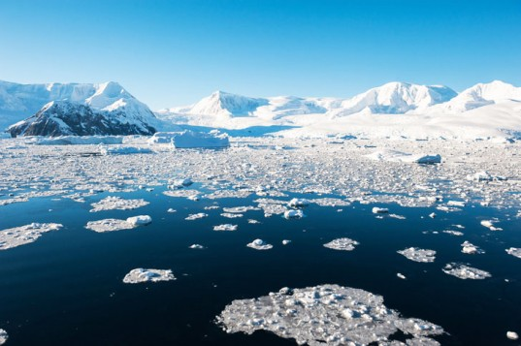
Science of Climate Change
Kerry Emanuel
Department of Earth, Atmospheric, and Planetary Sciences, MIT

Slide 2

Common Misperceptions about Climate and Climate Science
Earth’s climate is inherently stable
Climate science is very young
Human activities can have only a minuscule effect compared to nature
The idea that we are altering climate is based exclusively on complex, unreliable models
Anthropogenic climate change is controversial among climate scientists

Slide 3
Common Misperceptions about Climate and Climate Science
Earth’s climate is inherently stable
Climate science is very young
Human activities can have only a minuscule effect compared to nature
The idea that we are altering climate is based exclusively on complex, unreliable models
Anthropogenic climate change is controversial among climate scientists

Slide 4
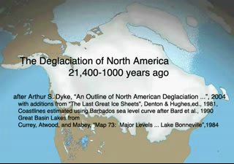

Slide 5


Slide 6
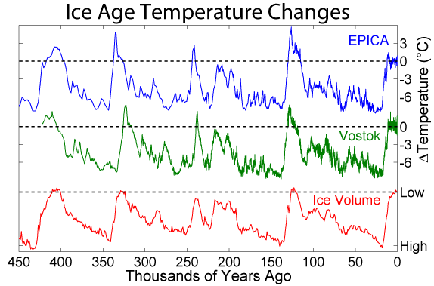
Last 450 Thousand Years

Slide 7

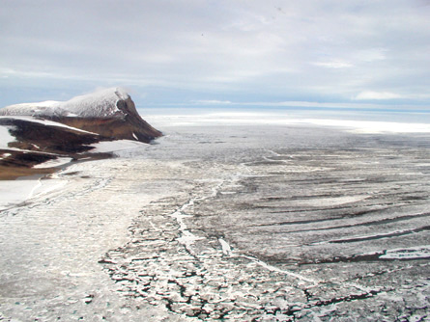

The Snowball Earth, 650-750 mya

Slide 8
Common Misperceptions about Climate and Climate Science
Earth’s climate is inherently stable
Climate science is very young
Human activities can have only a minuscule effect compared to nature
The idea that we are altering climate is based exclusively on complex, unreliable models
Anthropogenic climate change is controversial among climate scientists

Slide 9
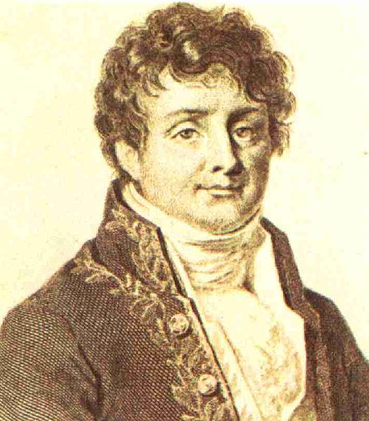


Jean Baptiste Joseph Fourier
(1768-1830)
John Tyndall (1820-1893)

Slide 10

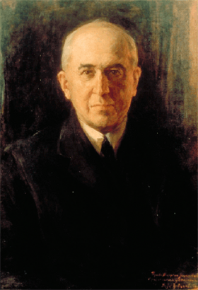
Climate Forcing by Orbital Variations (1912)
Milutin Milanković, 1879-1958

Slide 11
Last 450 Thousand Years

Slide 12
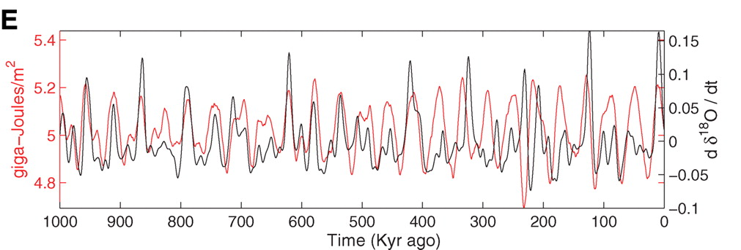
Strong Correlation between High Latitude Summer Insolation and Ice Volume
Black: Time rate of change of ice volume
Red: Summer high latitude sunlight
P. Huybers, Science, 2006

Slide 13

Svante Arrhenius, 1859-1927
“Any doubling of the percentage of carbon dioxide in the air would raise the temperature of the earth's surface by 4°; and if the carbon dioxide were increased fourfold, the temperature would rise by 8°.” – Världarnas utveckling (Worlds in the Making), 1906

Slide 14
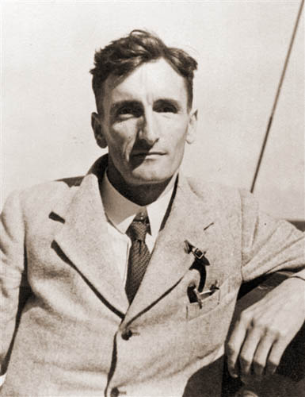
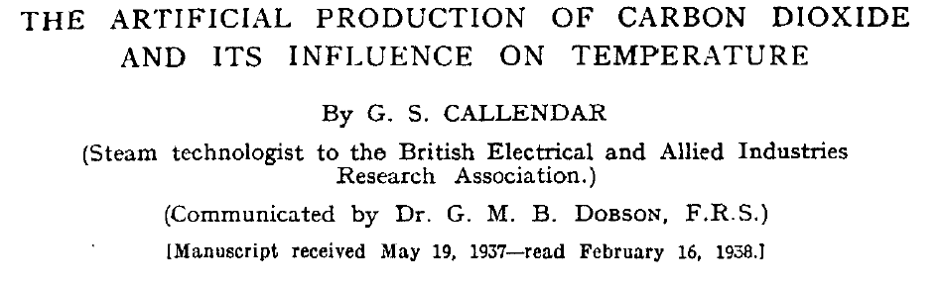
Guy Stewart Callendar (1898 - 1964)

Slide 15
Carbon Dioxide and Climate:
A Scientific Assessment
Report to the National Academy of Sciences
Jule G. Charney and co-authors
1979
When it is assumed that the CO2 content of the atmosphere is doubled and statistical thermal equilibrium is achieved, the more realistic of the modeling efforts predict a global surface warming of between 2°C and 3.5 °C, with greater increases at high latitudes.

Slide 16
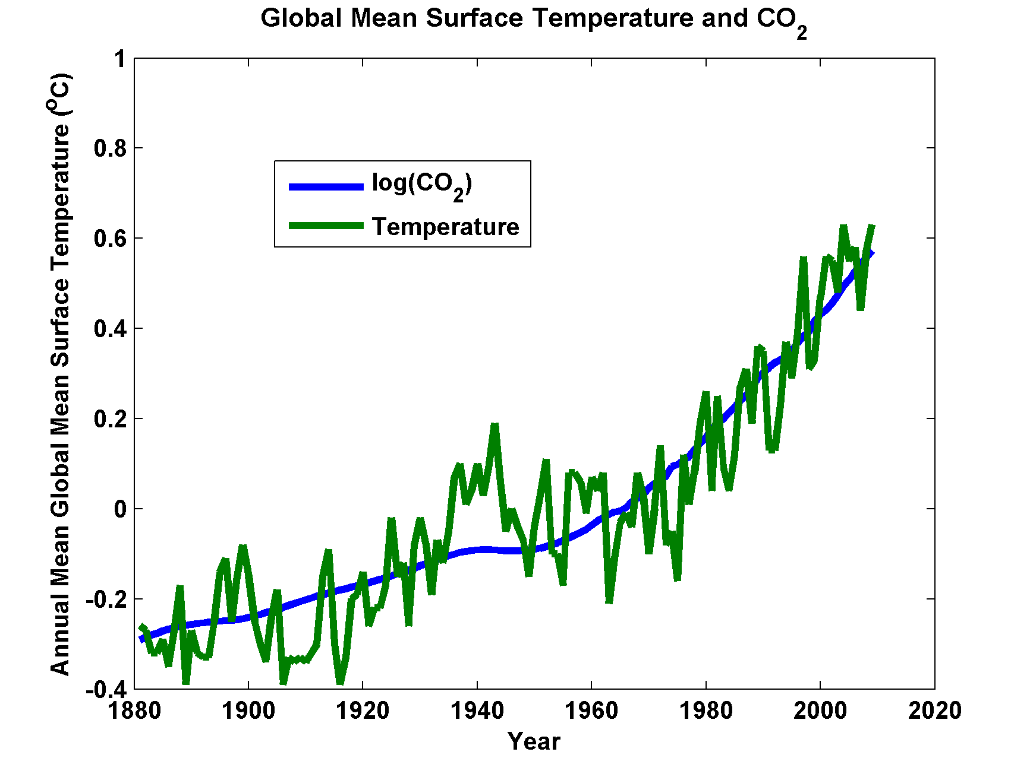

Slide 17
Common Misperceptions about Climate and Climate Science
Earth’s climate is inherently stable
Climate science is very young
Human activities can have only a minuscule effect compared to nature
The idea that we are altering climate is based exclusively on complex, unreliable models
Anthropogenic climate change is controversial among climate scientists

Slide 18
John Tyndall (1820-1893)

Slide 19
Tyndall’s Essential Results:
Oxygen (O₂ ), nitrogen (N₂), and argon (Ar), though they make up ~99% of the atmosphere, are almost entirely transparent to solar and terrestrial radiation
Water vapor (H₂O), carbon dioxide (CO₂), nitrous oxide (N₂O), and a handful of other trace gases make the lower atmosphere nearly opaque to infrared radiation, though still largely transparent to solar radiation (but clouds have strong effects on radiation at all wavelengths). Together they increase the Earth’s surface temperature from about 0ºF to around 60ºF.

Slide 20
Atmospheric Composition

Slide 21
Water Vapor (H₂O), about 0.25% of the mass of the atmosphere, is the most important greenhouse gas, but responds to atmospheric temperature change on a time scale of about 2 weeks
Climate is therefore strongly influenced by long-lived greenhouse gases (e.g. CO₂, CH₄, N₂O) that together comprise about 0.04% of the mass of the atmosphere. Concentration of CO₂ has increased by 43% since the dawn of the industrial revolution

Slide 22
Common Misperceptions about Climate and Climate Science
Earth’s climate is inherently stable
Climate science is very young
Human activities can have only a minuscule effect compared to nature
The idea that we are altering climate is based exclusively on complex, unreliable models
Anthropogenic climate change is controversial among climate scientists

Slide 23
Paleoclimate

Slide 24
Last 450 Thousand Years

Slide 25

Paleo reconstructions of temperature change over the last 2000 years
“Hockey Stick”
Instrumental Record
Year
Notes:
25

Slide 26
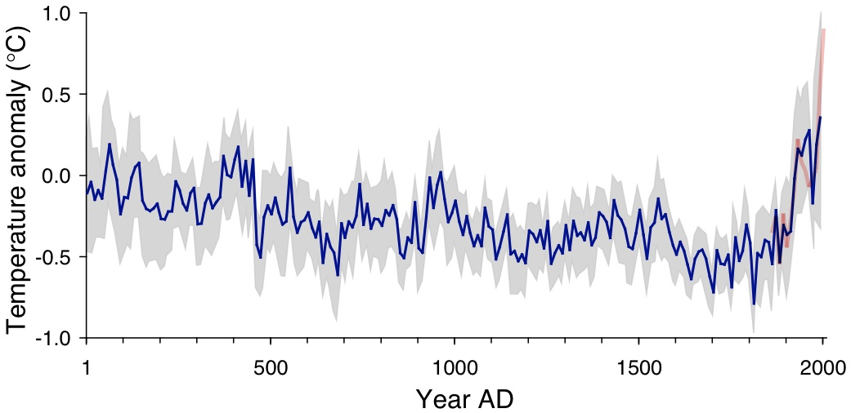
Arctic air temperature change reconstructed (blue), observed (red)
The long-term cooling trend in the Arctic was reversed during recent decades. The blue line shows the estimated Arctic average summer temperature over the last 2000 years, based on proxy records from lake sediments, ice cores, and tree rings. The shaded area represents variability among the 23 sites use for the reconstruction. The red line shows the recent warming based on instrumental temperatures. From Kaufman et al. (2009).

Slide 27
Instrumental Record

Slide 28
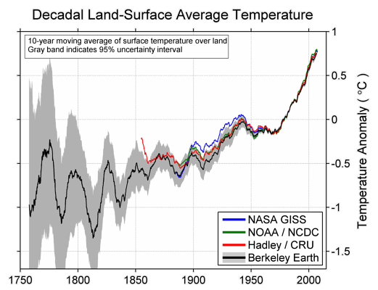

Slide 29
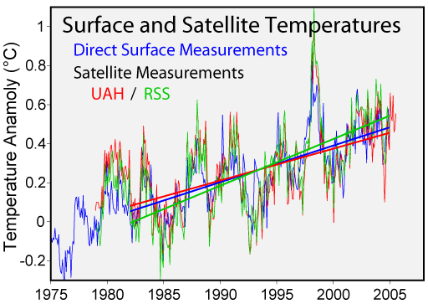

Slide 30
Distribution of temperature change, 1901-2005

Slide 31
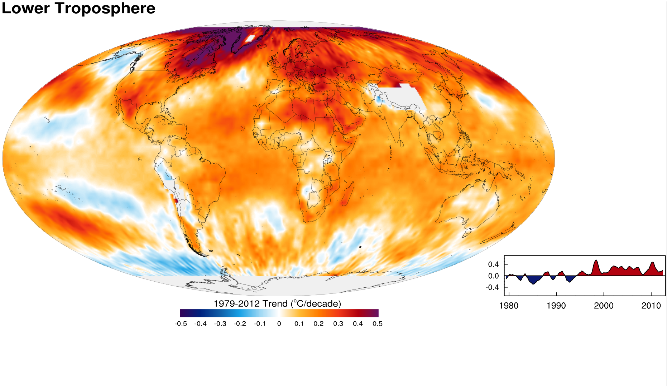
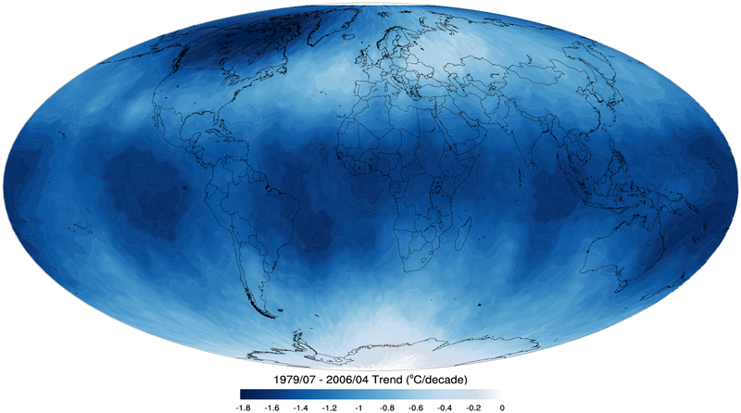
Tropospheric temperature trend from 1979-2012 based on satellite measurements (RSS)
Top of the stratosphere (TTS) 1979-2006 temperature trend.

Slide 32
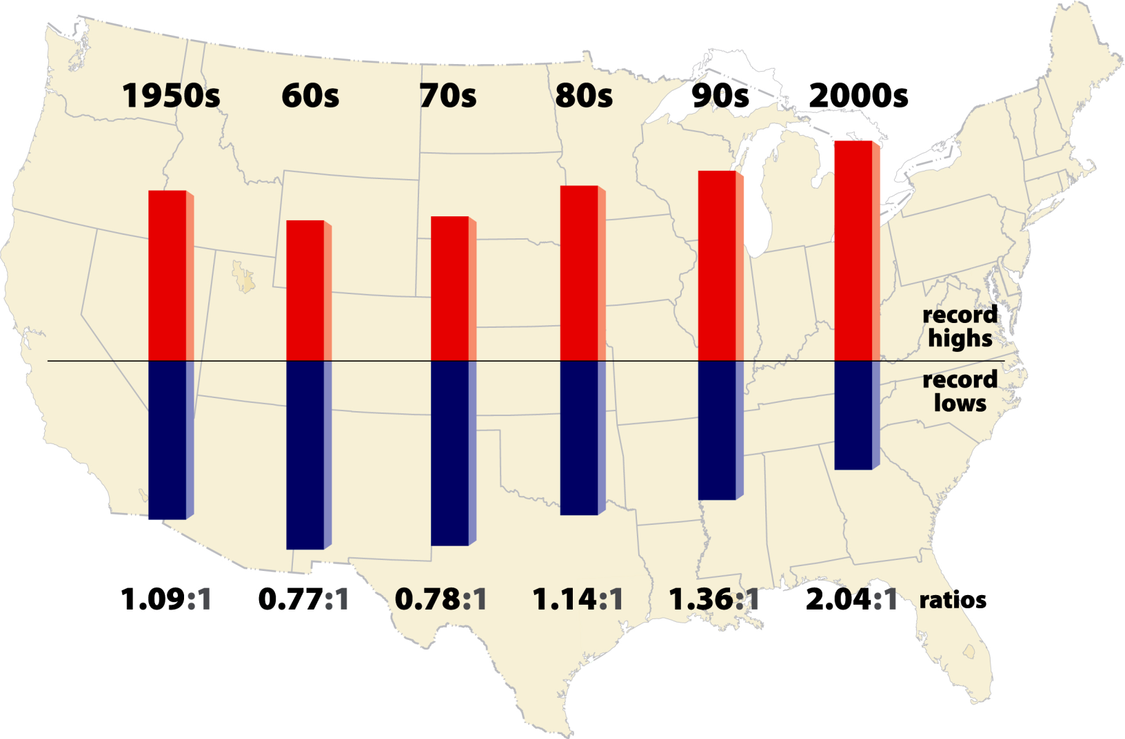
High vs Low Temperature Records
2011- 2.7:1

Slide 33
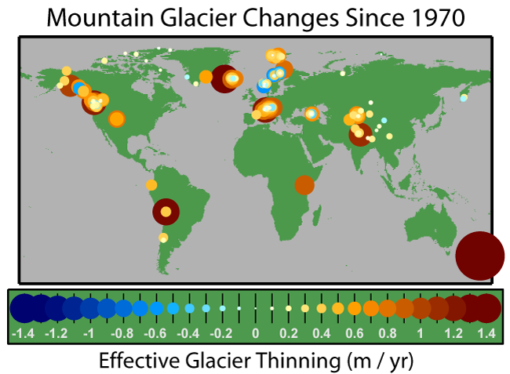

Slide 34
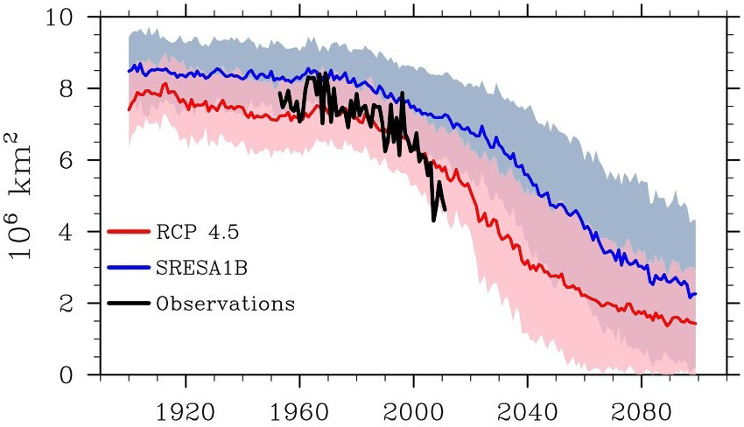
September Arctic Sea Ice Extent
.
2012
Credit: National Snow and Ice Data Center courtesy Stroeve et al. 2012

Slide 35
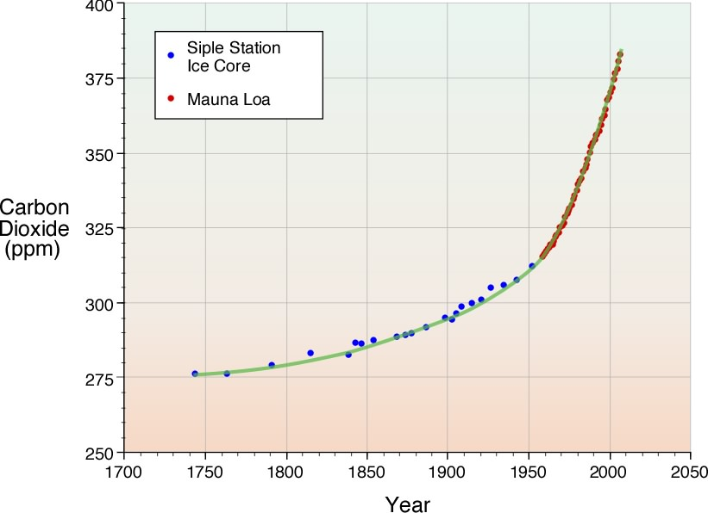
Carbon Dioxide from Ice Cores and Direct Measurements

Slide 36
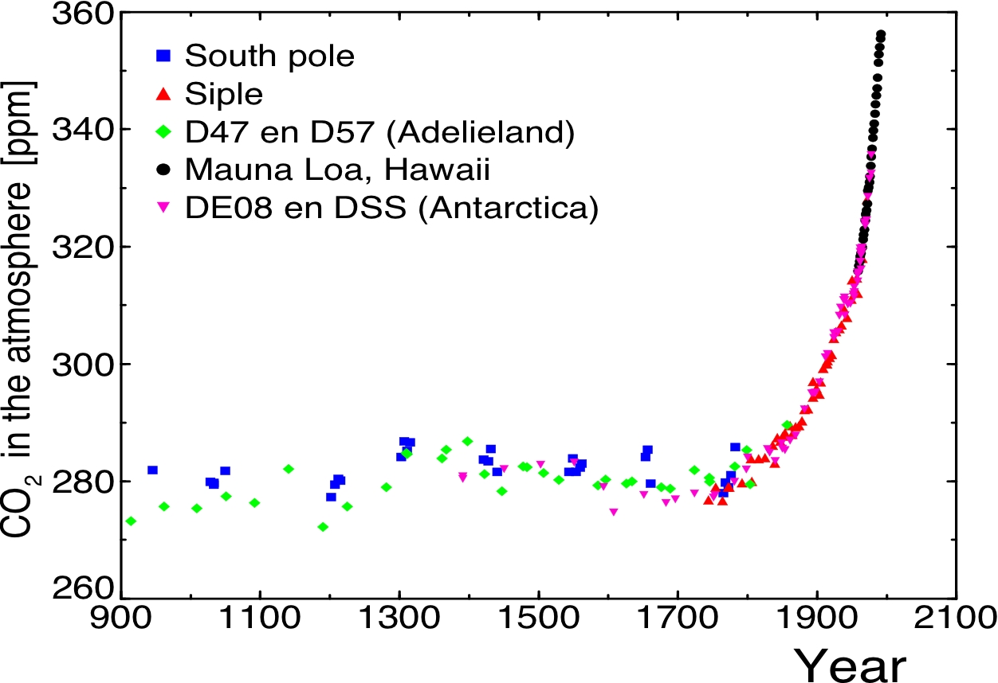

Slide 37
Variation in carbon dioxide and methane over the past 20,000 years, based on ice core and other records

Slide 38

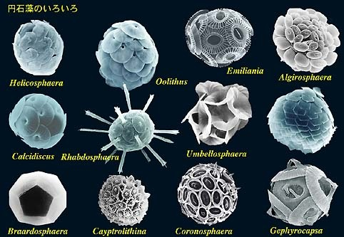

The Oceans Are Becoming More Acidic
Acidification through CO₂ threatens marine life
Plankton
Coral Reefs
Notes:
Abbildung 4.3-1
Aragonitsättigung und
gegenwärtige Riffstandorte
von Warmwasserkorallen
(blaue Punkte). (a)
vorindustrielle Werte
(ca. 1870, atmosphärische
CO2-Konzentration
280 ppm), (b) Gegenwart
(ca. 2005, 375 ppm CO2), (c)
Zukunft (ca. 2065, 517 ppm
CO2). Der Grad der
Aragonitsättigung (Ù)
bezeichnet das relative
Verhältnis zwischen dem
Produkt der Konzentrationen
von Kalzium- und
Karbonationen und dem
Löslichkeitsprodukt für
Aragonit. Standorte mit
einer Aragonitsättigung
unterhalb von 3,5 sind nur
noch bedingt für riffbildende
Warmwasserkorallen
geeignet (marginal),
unterhalb von 3 sind sie
ungeeignet.
Quelle: Steffen et al., 2004

Slide 39
Simple Models

Slide 40
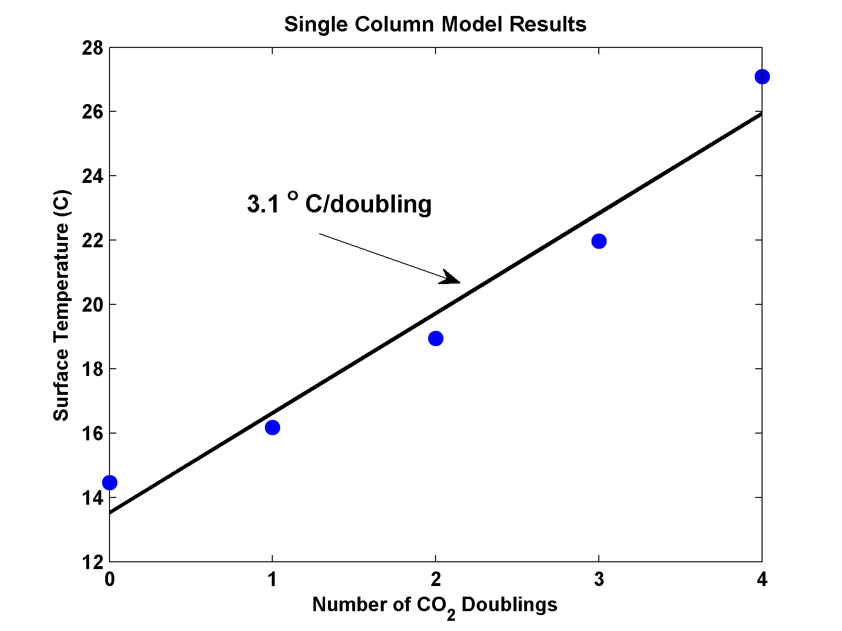
MIT Single Column Model
IPCC Estimate:
2-4.5 ºC

Slide 41
Common Misperceptions about Climate and Climate Science
Earth’s climate is inherently stable
Climate science is very young
Human activities can have only a minuscule effect compared to nature
The idea that we are altering climate is based exclusively on complex, unreliable models
Anthropogenic climate change is controversial among climate scientists

Slide 42
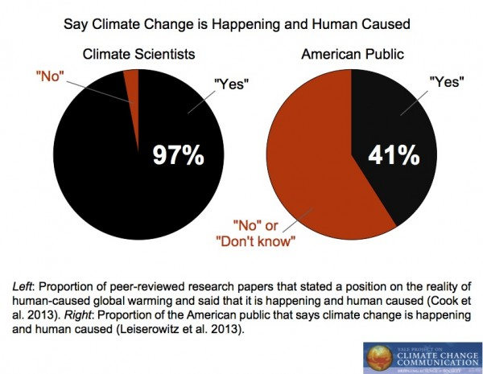

Slide 43
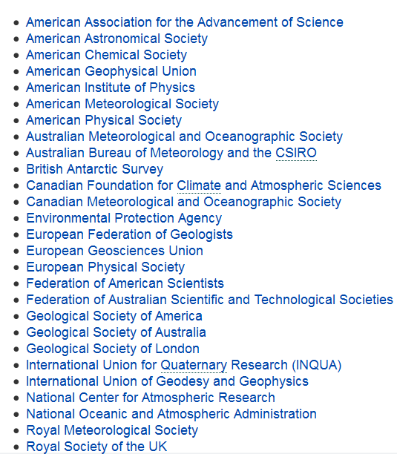
Scientific organizations that endorse the consensus position that "most of the global warming in recent decades can be attributed to human activities":

Slide 44
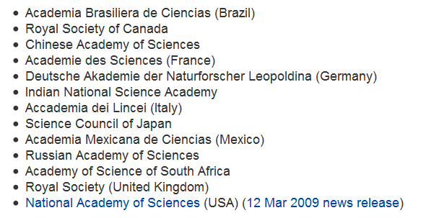
Academies of Science

Slide 45

The Future

Slide 46


Estimate of how much global climate will warm as a result of doubling CO₂: a probability distribution
Source: 100000 PAGE09 runs
Chris Hope, U. Cambridge
courtesy Tim Palmer
Notes:
Describe pdf. Reflects post-IPCC knowledge as well as IPCC AR4.

Slide 47
Sources of Uncertainty
Cloud Feedback
Water Vapor Feedback
Ocean Response
Aerosols

Slide 48
Consequences

Slide 49
Past and Projected Sea Level vs. Temperature
(Source: WBGU after David Archer 2006)
Notes:
This graph shows how temperature and sea level were closely related in Earth’s history. During the last Ice Age, temperatures were about 6 ºC colder than now, while sea level was 120 meters lower. During the Pliocene, when it was last significantly warmer than now (by about 2 ºC), sea level was 20-30 meters higher. During the Eocene there was almost no ice on the planet, and sea level was about 70 meters higher.
The history of climate thus sends a strong warning: past climate changes by just a few degrees in global temperature have come with very large sea level changes, by tens of meters. In the long run, this is likely to happen again. The sea level rise by the year 2100 (likely below one meter) is only the small beginning of a much larger rise that will unfold over coming centuries and perhaps millennia, caused by our carbon emissions in this century.

Slide 50
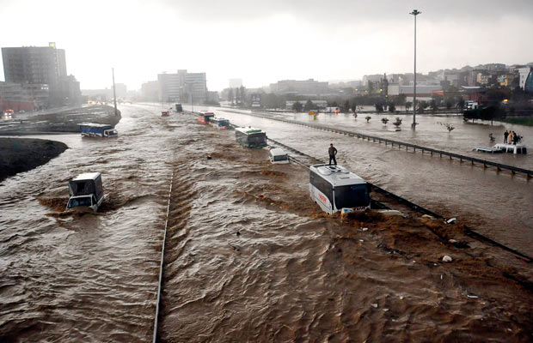
Hydrological Extremes Increase with Temperature
Floods

Slide 51
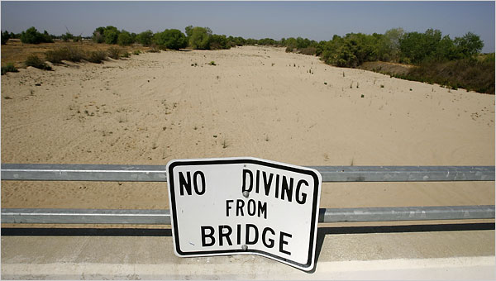
Drought

Slide 52
“Climate change could have significant geopolitical impacts around the world, contributing to poverty, environmental degradation, and the further weakening of fragile governments. Climate change will contribute to food and water scarcity, will increase the spread of disease, and may spur or exacerbate mass migration.”
    -- Quadrennial Defense Review, U.S. Department of Defense, February, 2010

Slide 53

Hurricanes

Slide 54
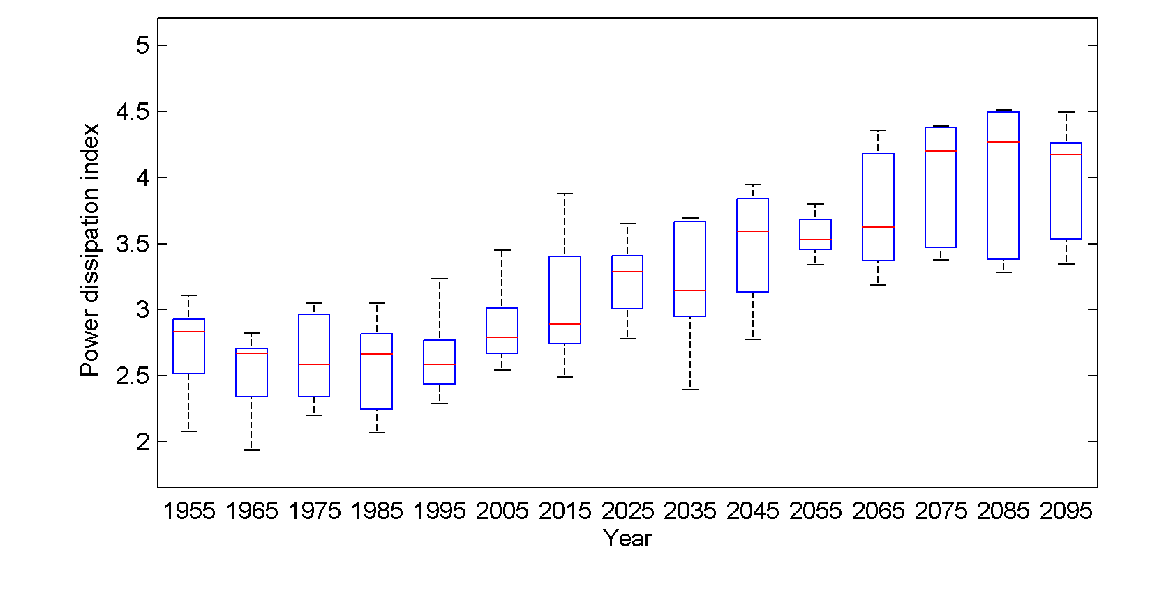
Projected Global Tropical Cyclone Power Dissipation
Global annual tropical cyclone power dissipation averaged in 10-year blocks for the period 1950-2100, using historical simulations for the period 1950-2005 and the RCP 8.5 scenario for the period 2006-2100. In each box, the red line represents the median among the 5 models, and the bottom and tops of the boxes represent the 25th and 75th percentiles, respectively. The whiskers extent to the most extreme points not considered outliers, which are represented by the red + signs. Points are considered outliers if they lie more than 1.5 times the box height above or below the box.

Slide 55
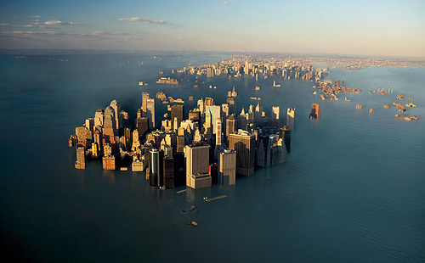
Why We Need to Act Now

Slide 56

IPCC 2007: Doubling CO₂ will lead to an increase in mean global surface temperature of 2 to 4.5 ºC.
Atmospheric CO₂ assuming that emissions stop altogether after peak concentrations
Global mean surface temperature corresponding to atmospheric CO₂ above
Courtesy Susan Solomon

Slide 57
Dealing with Climate Change
Reduce emissions
  gasification of coal—potential CO₂ capture
  alternative sources– nuclear, wind, etc.
  unlikely to effect major reductions
  focus on non-CO₂ greenhouse gases
Carbon capture and sequestration
Other geoengineering
  technically feasible, $20-30 billion/year
  side effects, e.g. reduced precipitation
Adaptation

Slide 58
Summary of Main Points
Several aspects of climate science are well established
Projections remain highly uncertain, particularly at the regional scale
Ill effects felt mostly through sea level rise, weather extremes and through indirect fallout, such as global armed conflict

Slide 59
Summary of Main Points
Highly asymmetric risk function
Rational response to risk impeded by well-funded and highly effective marketing campaign by fossil fuel interests
Rational measures possible when many begin to notice tangible climate change

