Slide 1

Hurricane Risk: Present and Future
Kerry Emanuel
Program in Atmospheres, Oceans, and Climate
Massachusetts Institute of Technology
WindRiskTech, L.L.C.
Notes:
Are hurricanes becoming more powerful and destructive? Are these changes due to a natural cycle of hurricane activity or are they caused by human-induced climate change? Although this is currently a hot debate among scientists, new research suggests that the destructive potential of hurricanes is increasing due to the heating of the oceans.
Image: Satellite image of Hurricane Floyd approaching the east coast of Florida in 1999. The image has been digitally enhanced to lend a three-dimensional perspective. Credit: NASA/Goddard Space Flight Center.

Slide 2

Limitations of a strictly statistical approach
>50% of all normalized damage caused by top 8 events, all category 3, 4 and 5
>90% of all damage caused by storms of category 3 and greater
Category 3,4 and 5 events are only 13% of total landfalling events; only 30 since 1870
Landfalling storm statistics are inadequate for assessing hurricane risk

Slide 3
Additional Problem:
Nonstationarity of climate

Slide 4
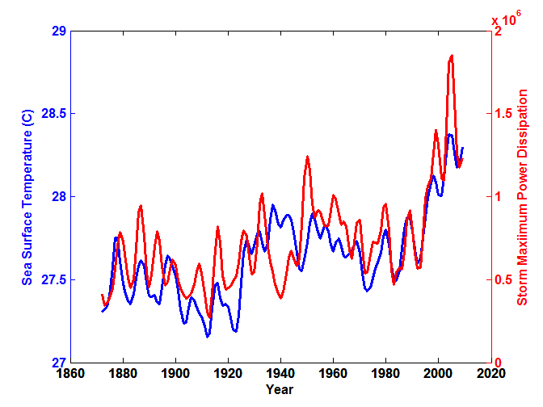
Atlantic Sea Surface Temperatures and Storm Max Power Dissipation
(Smoothed with a 1-3-4-3-1 filter)
Years included: 1870-2011
Data Sources: NOAA/TPC, UKMO/HADSST1
Notes:
4
The low value of storm power in the early 1940s is thought to be due to the lack of reports from ships at sea because of the radio silence imposed during WWII.

Slide 5
Risk Assessment by Direct Numerical Simulation of Hurricanes:
The Problem
The hurricane eyewall is an intense, circular front, attaining scales of ~ 1 km or less
At the same time, the storm’s circulation extends to ~1000 km and is embedded in much larger scale flows

Slide 6

Histograms of Tropical Cyclone Intensity as Simulated by a Global Model with 50 km grid point spacing. (Courtesy Isaac Held, GFDL)
Modeled
Observed
Global models do not simulate the storms that cause destruction
Category 3

Slide 7
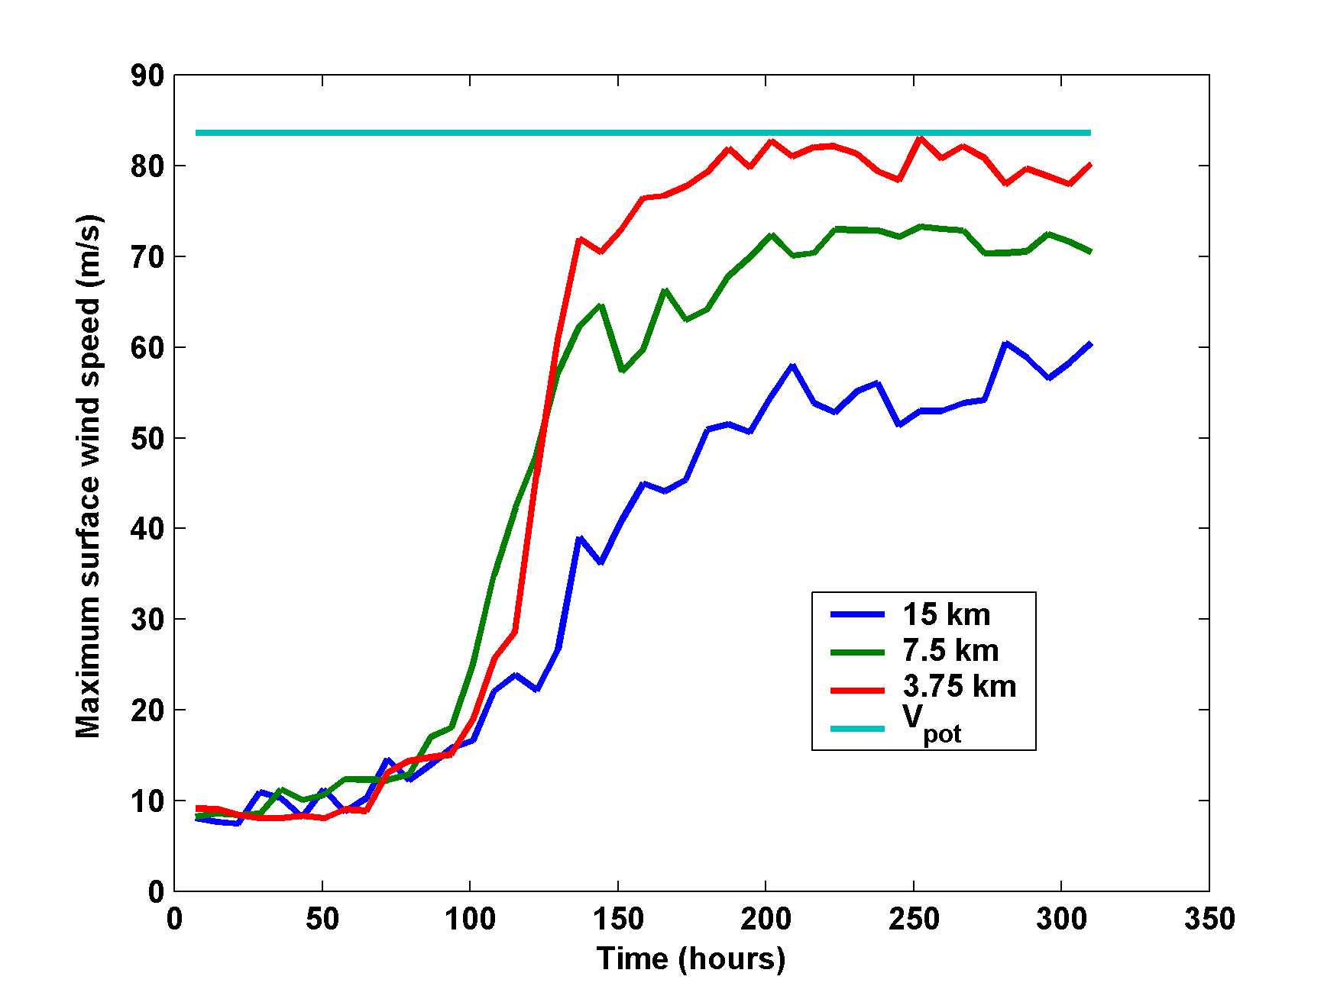
Numerical convergence in an axisymmetric, nonhydrostatic model (Rotunno and Emanuel, 1987)
Theoretical Maximum Intensity
Distance between computational nodes

Slide 8
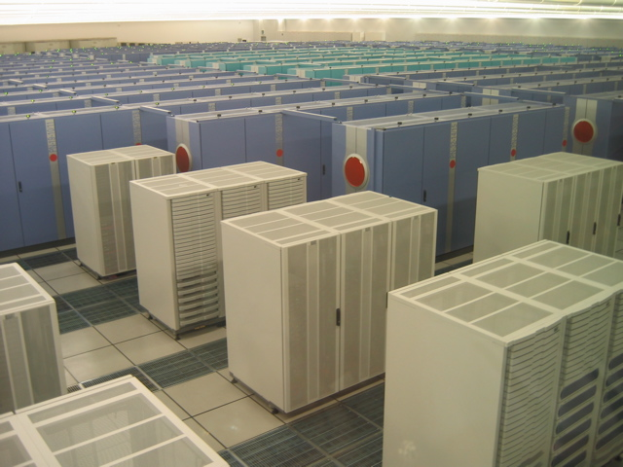
How to deal with this?
Option 1: Brute force and obstinacy

Slide 9
Multiply nested grids

Slide 10


How to deal with this?
Option 1: Brute force and obstinacy
Option 2: Applied math and modest resources

Slide 11
Basic equations written as a function of radius (distance from the storm Center), altitude, and time
Re-Write in terms of angular momentum, altitude, and time

Slide 12
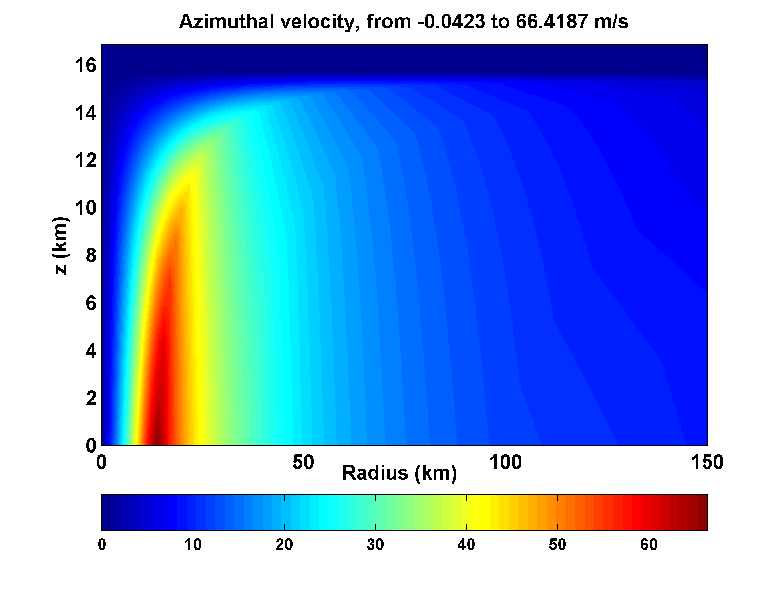

Slide 13
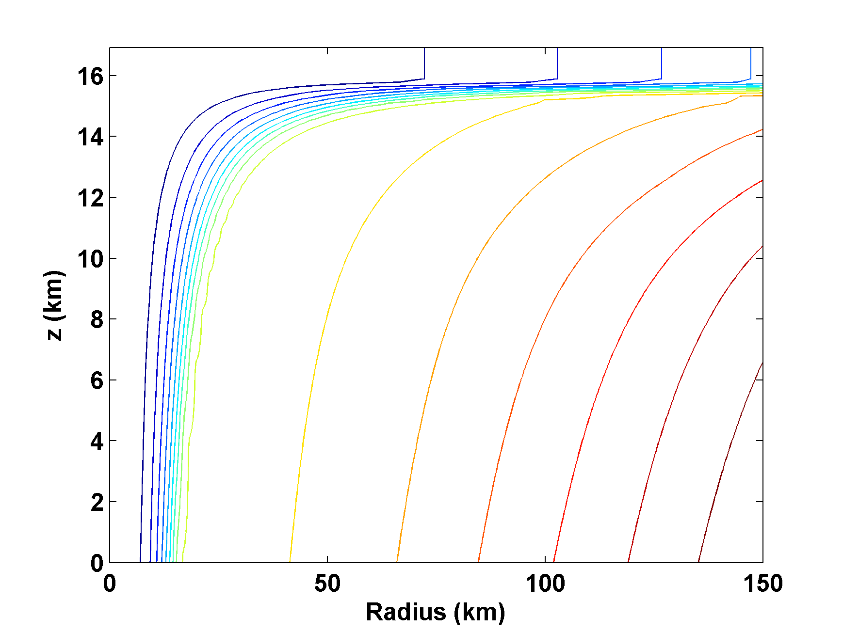
Angular Momentum Distribution
Altitude (km)
Storm Center

Slide 14
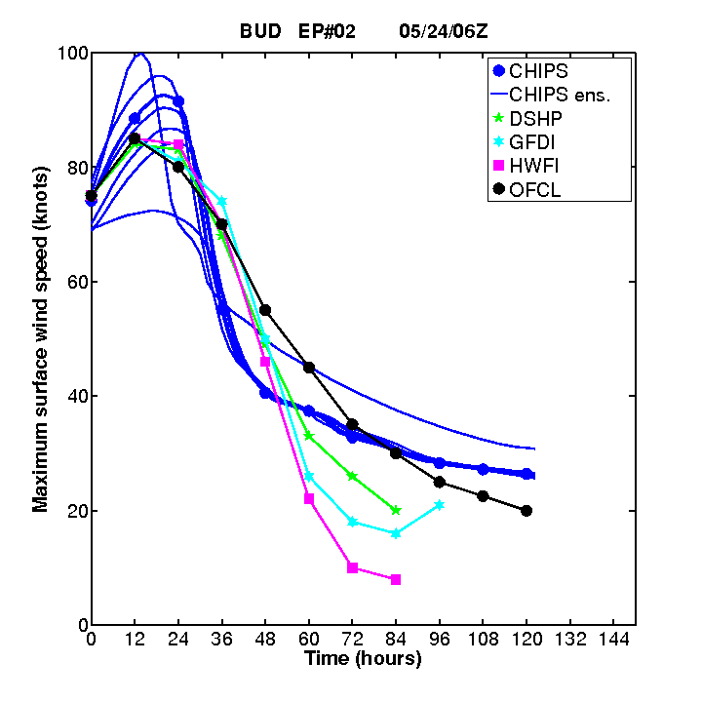
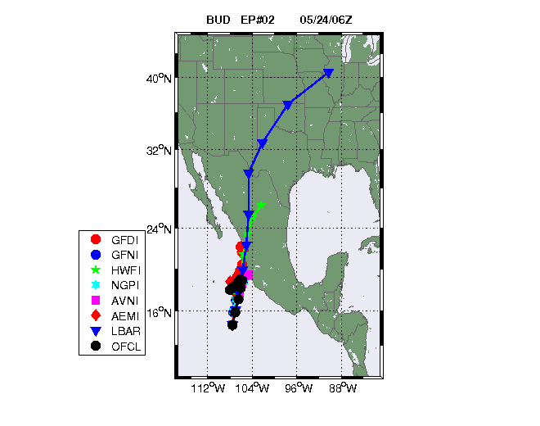
Originally Developed as a Student Laboratory Tool, Later Adapted as a Hurricane Intensity Forecasting Model
(http://wind.mit.edu/~emanuel/storm.html)

Slide 15
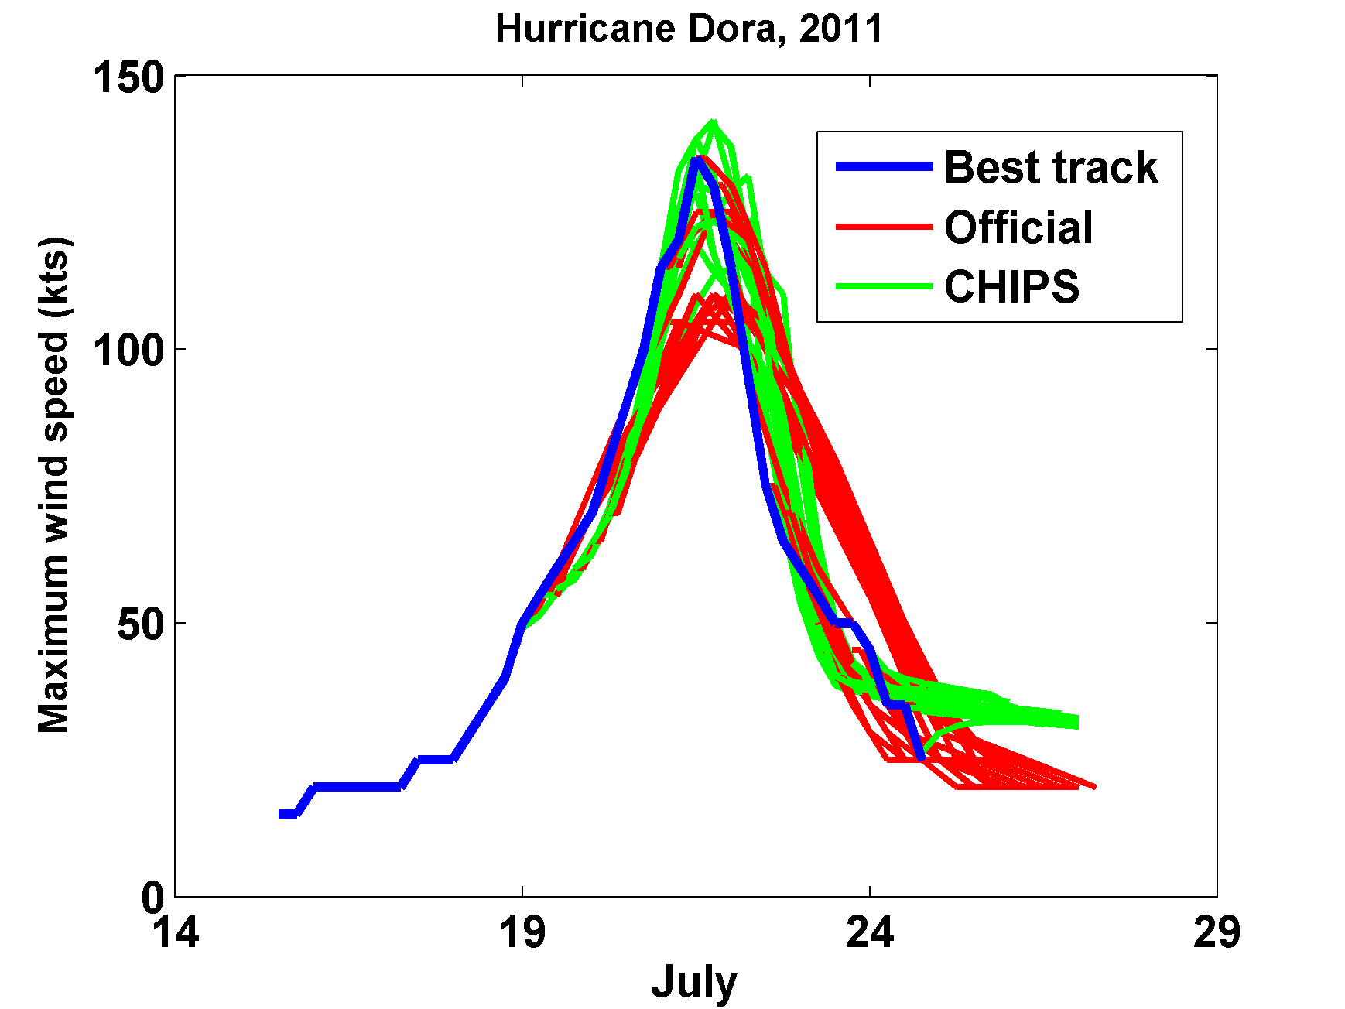

Slide 16
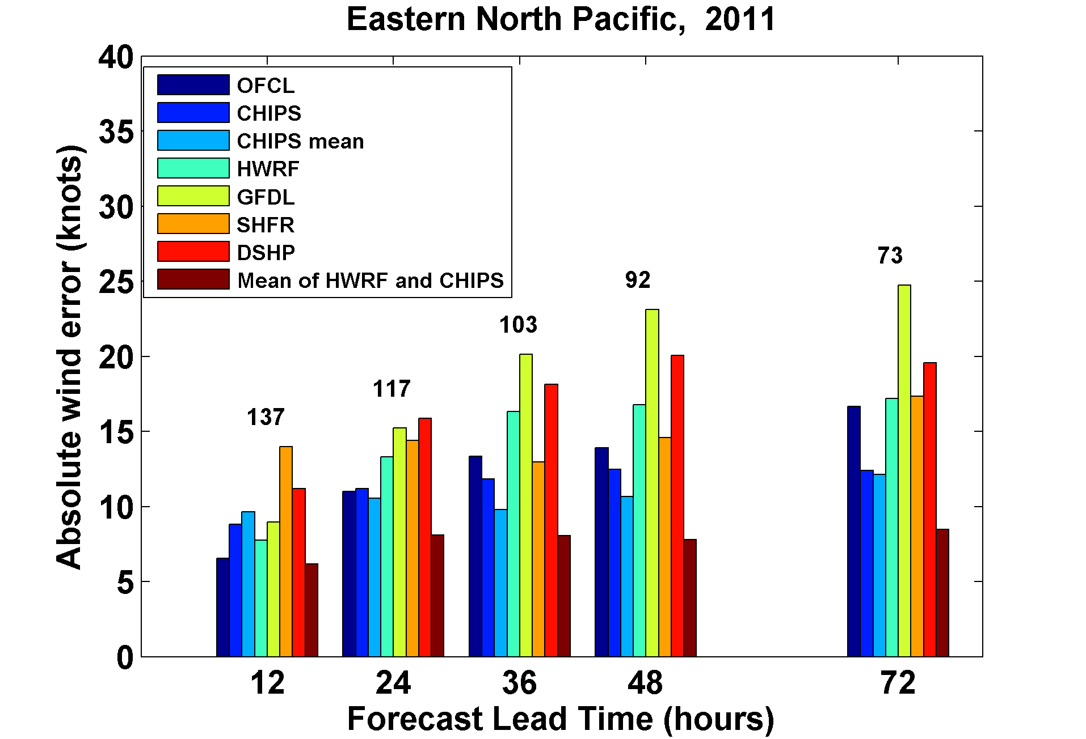

Slide 17
How Can We Use This Model to Help Assess Hurricane Risk in Current and Future Climates?

Slide 18
Risk Assessment Approach:
Step 1: Seed each ocean basin with a very large number of weak, randomly located cyclones
Step 2: Cyclones are assumed to move with the large scale atmospheric flow in which they are embedded, plus a correction for beta drift
Step 3: Run the CHIPS model for each cyclone, and note how many achieve at least tropical storm strength
Step 4: Using the small fraction of surviving events, determine storm statistics
Details: Emanuel et al., Bull. Amer. Meteor. Soc, 2008
Notes:
18

Slide 19
Synthetic Track Generation:
Generation of Synthetic Wind Time Series
Postulate that TCs move with vertically averaged environmental flow plus a “beta drift” correction for effects of the earth’s curvature and rotation
Approximate “vertically averaged” by weighted mean of about 1.5 and 10 km altitude

Slide 20
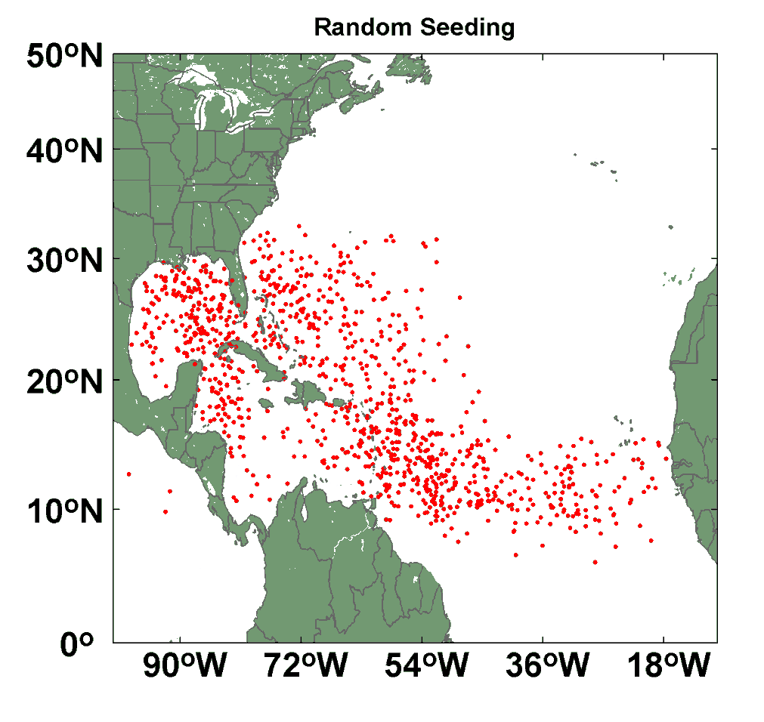
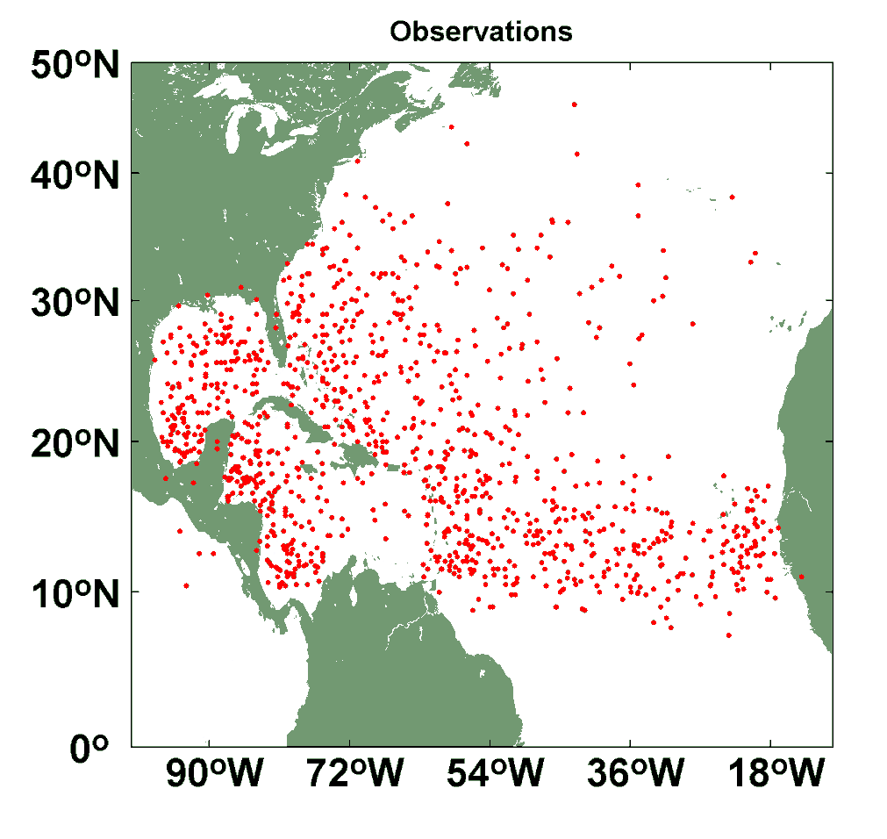
Comparison of Random Seeding Genesis Locations with Observations

Slide 21
Calibration
Absolute genesis frequency calibrated to globe during the period 1980-2005
Notes:
21

Slide 23
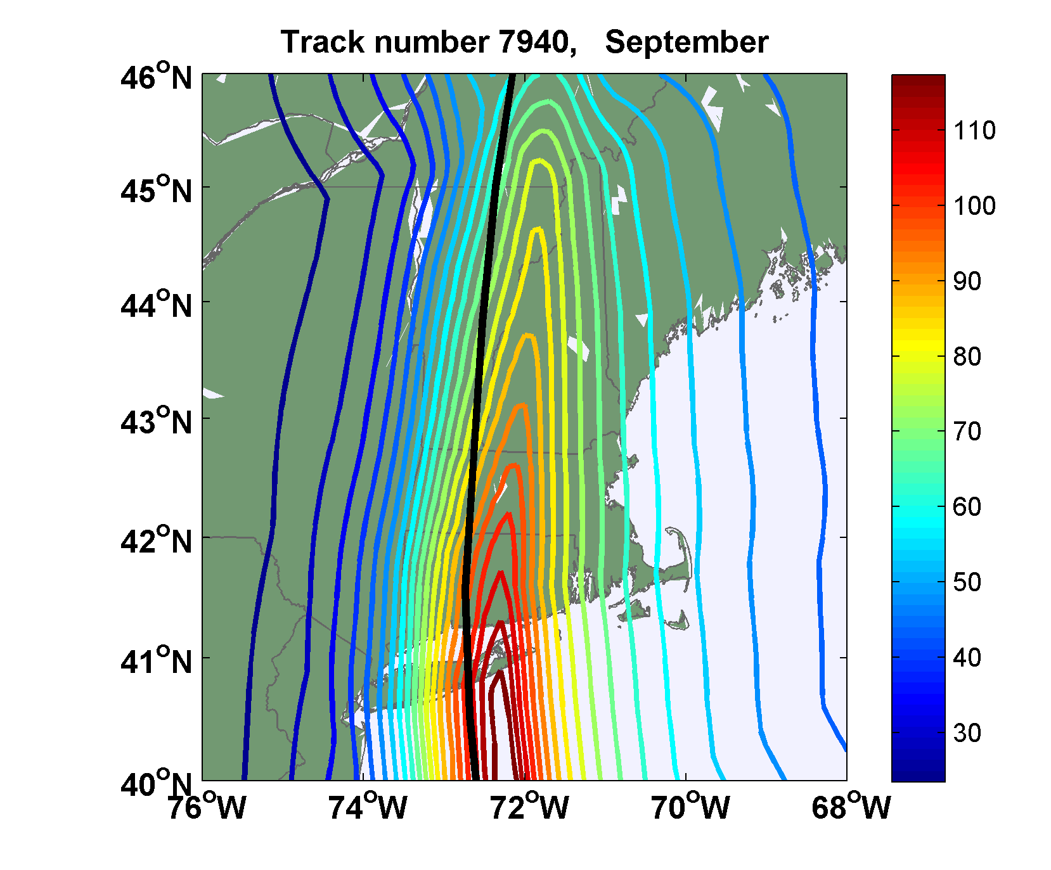
Sample Storm Wind Swath

Slide 24
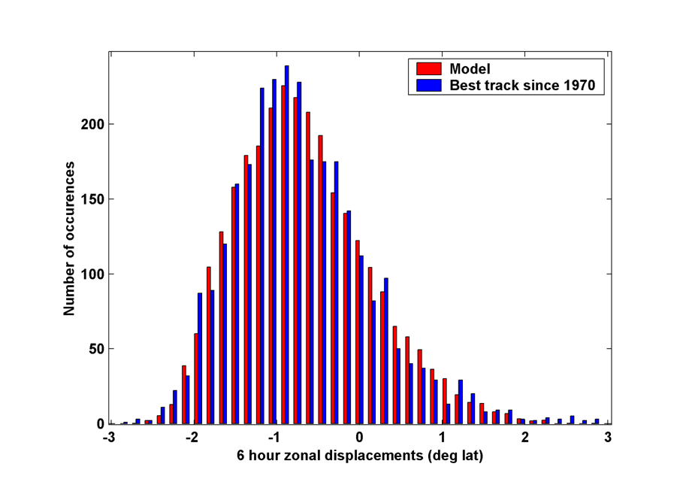
6-hour zonal displacements in region bounded by 10º and 30º N latitude, and 80º and 30º W longitude, using only post-1970 hurricane data
Notes:
24

Slide 25

Cumulative Distribution of Storm Lifetime Peak Wind Speed, with Sample of 1755 Synthetic Tracks
95% confidence bounds

Slide 26

Return Periods

Slide 27
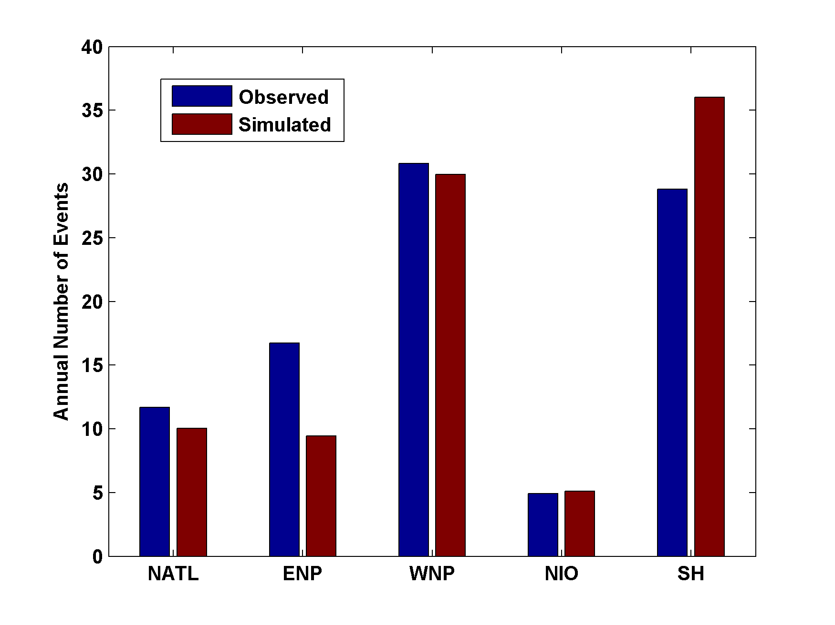
Genesis rates
Western North Pacific
Southern Hemisphere
Eastern North Pacific
Atlantic
North Indian Ocean
Notes:
27

Slide 28

Captures effects of regional climate phenomena (e.g. ENSO, AMM)

Slide 29
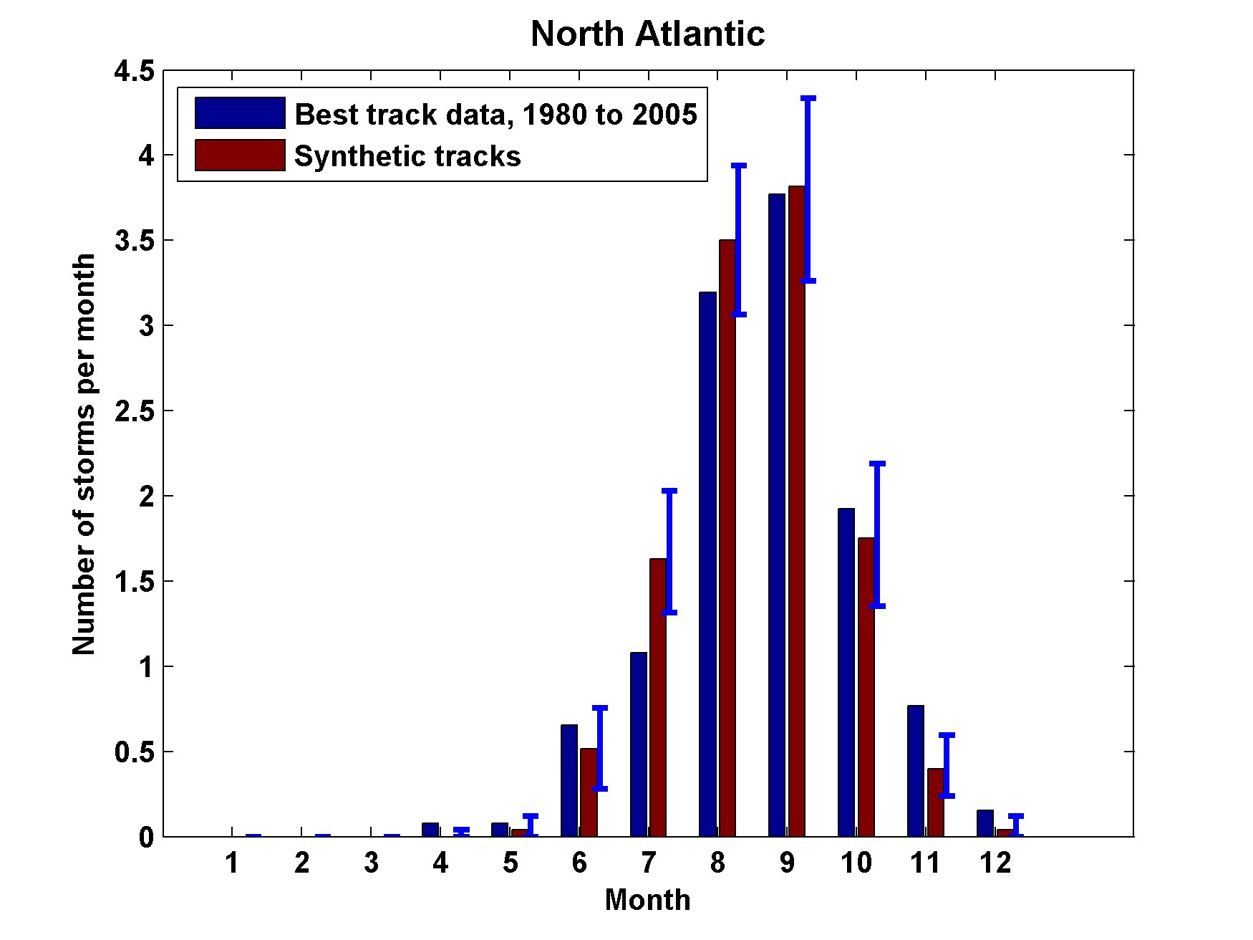
Seasonal Cycles
Atlantic
Notes:
29

Slide 30
Coupling large hurricane event sets to surge models (with Ning Lin)
Couple synthetic tropical cyclone events (Emanuel et al., BAMS, 2008) to surge models
  SLOSH
  ADCIRC (fine mesh)
  ADCIRC (coarse mesh)
Generate probability distributions of surge at desired locations

Slide 31
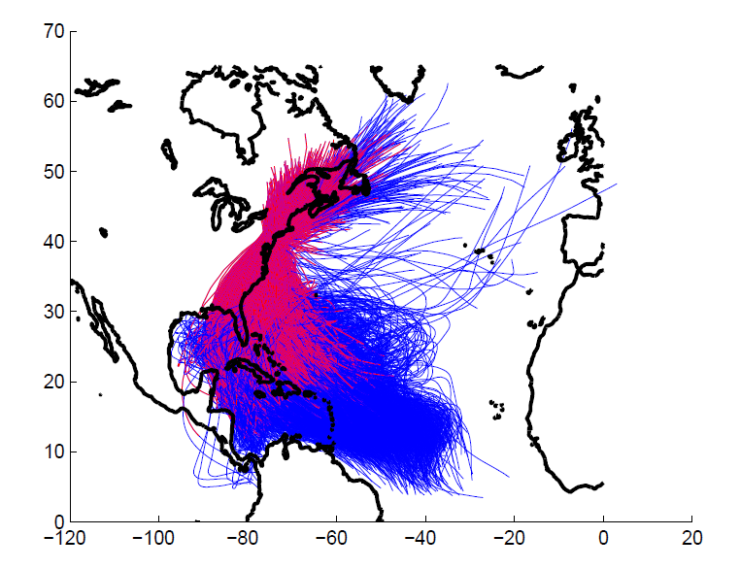
5000 synthetic storm tracks under current climate. (Red portion of each
track is used in surge analysis.)

Slide 32
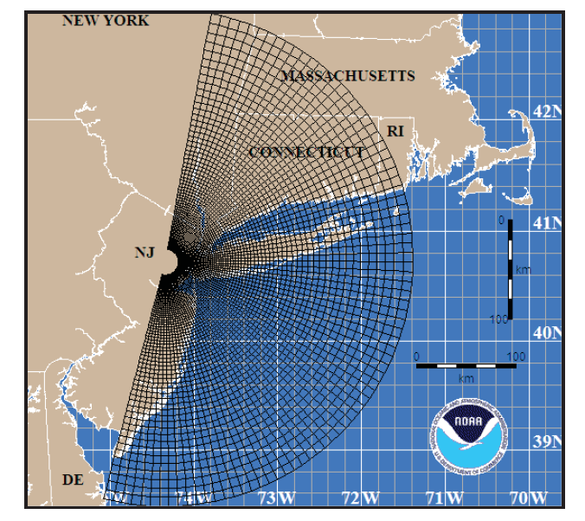
SLOSH mesh for the New York area (Jelesnianski et al., 1992)

Slide 33
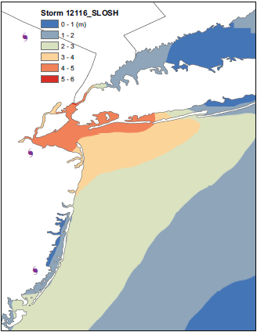
Surge map for single event

Slide 34
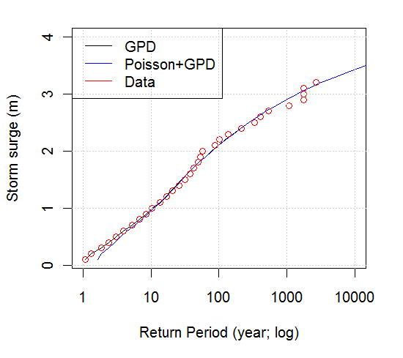
Surge Return Periods for The Battery, New York

Slide 35
Applications to Climate Change

Slide 36
1. Last 20 years of 20th century simulations
2. Years 2180-2200 of IPCC Scenario A1b (CO₂ stabilized at 720 ppm)
Compare two simulations each from 7 IPCC models:

Slide 37
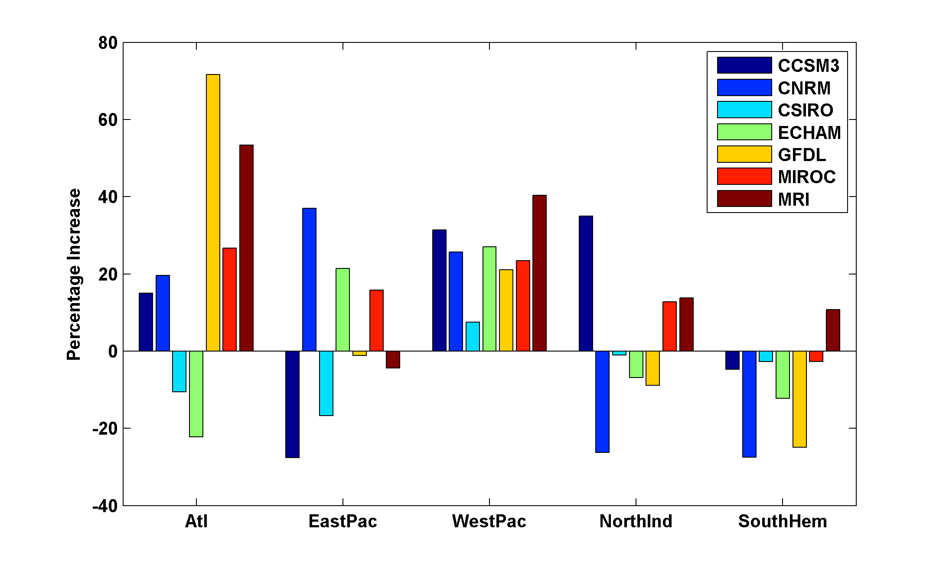
Basin-Wide Percentage Change in Power Dissipation
Notes:
37
37

Slide 38
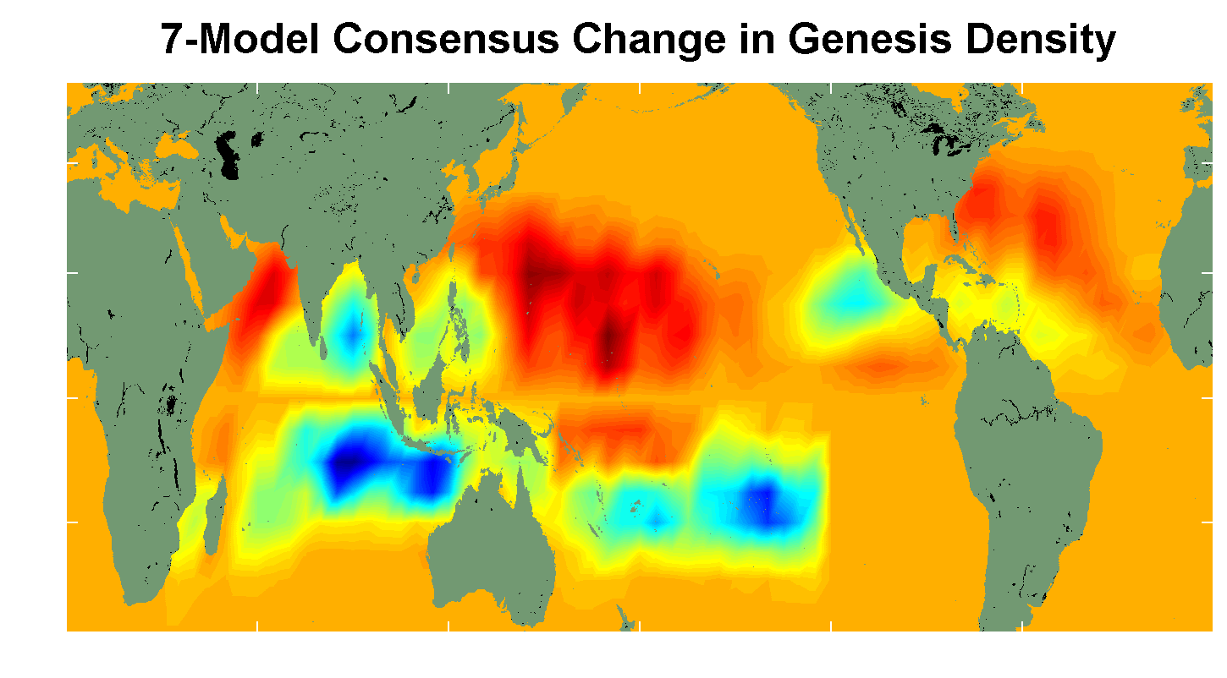
7 Model Consensus Change in Storm Frequency
Notes:
38
38

Slide 39
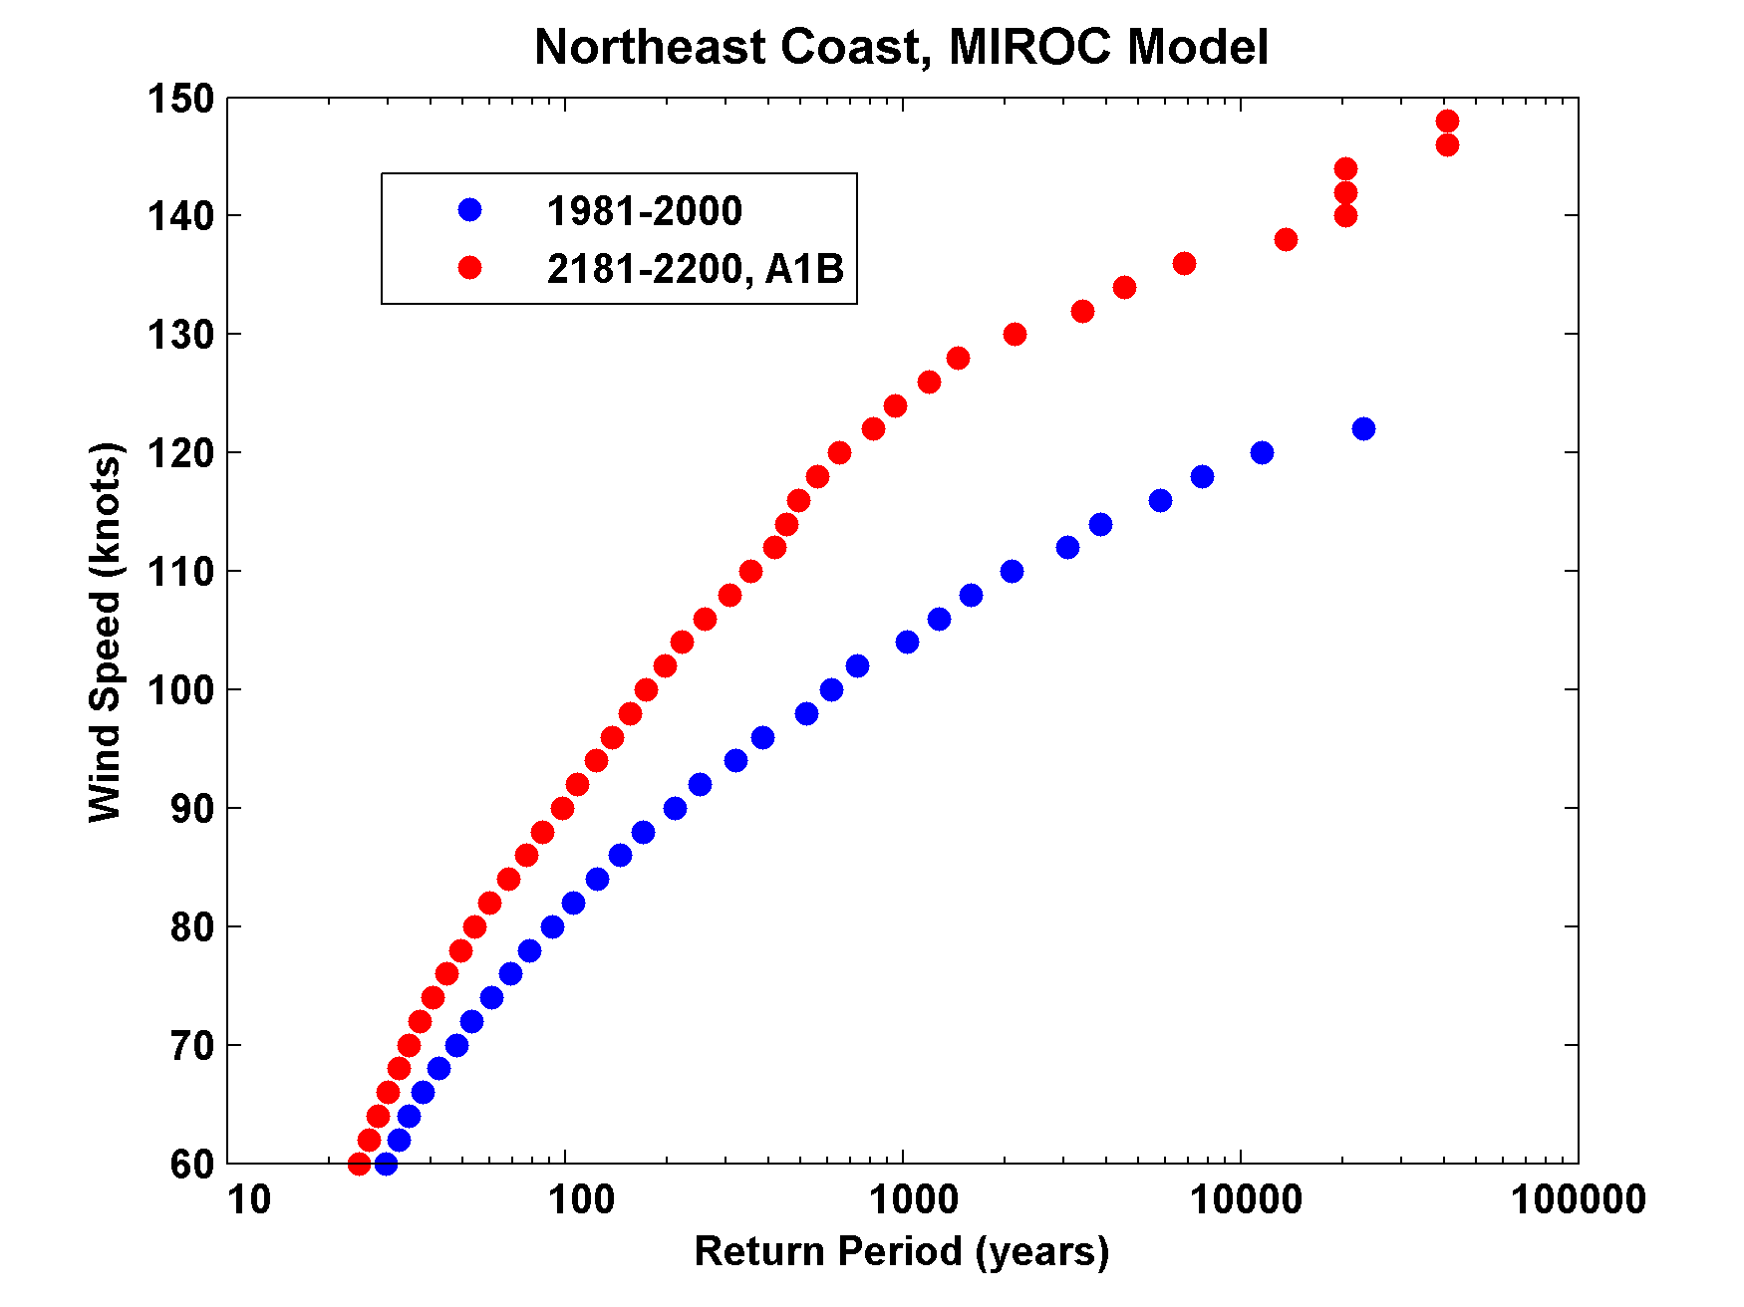

Slide 40
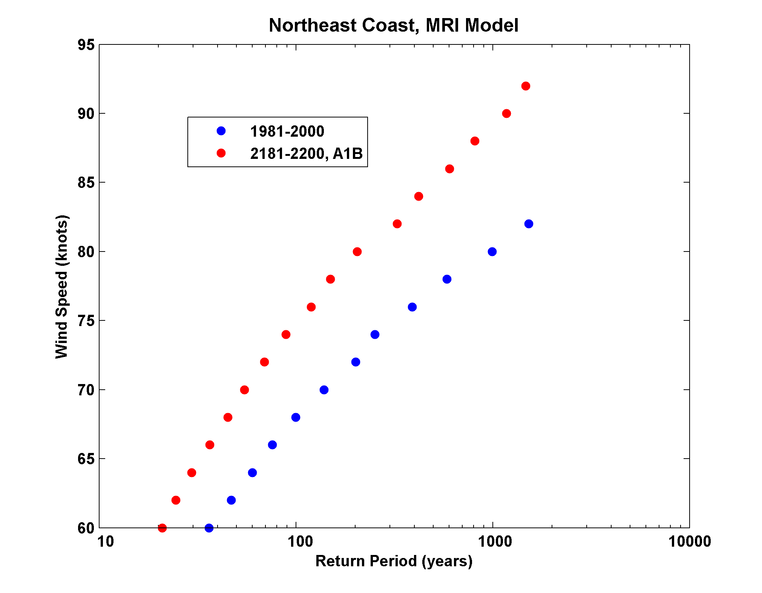

Slide 41
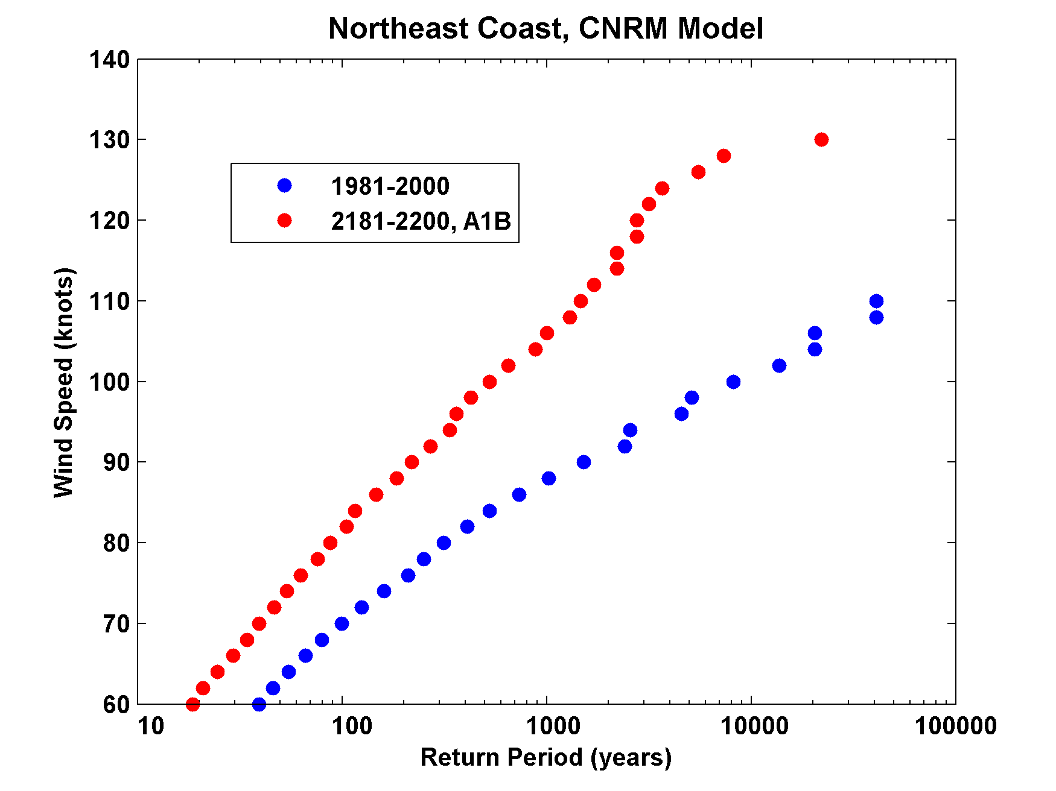

Slide 42
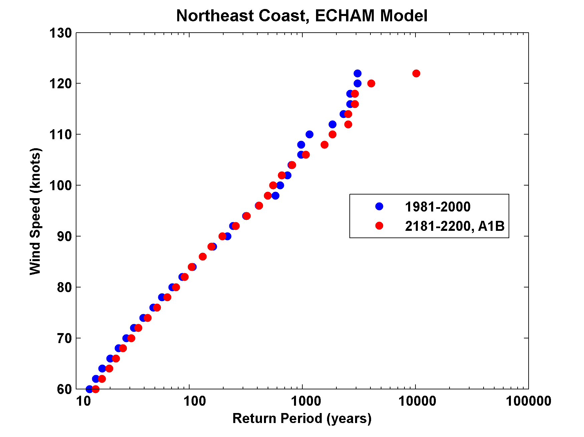

Slide 43
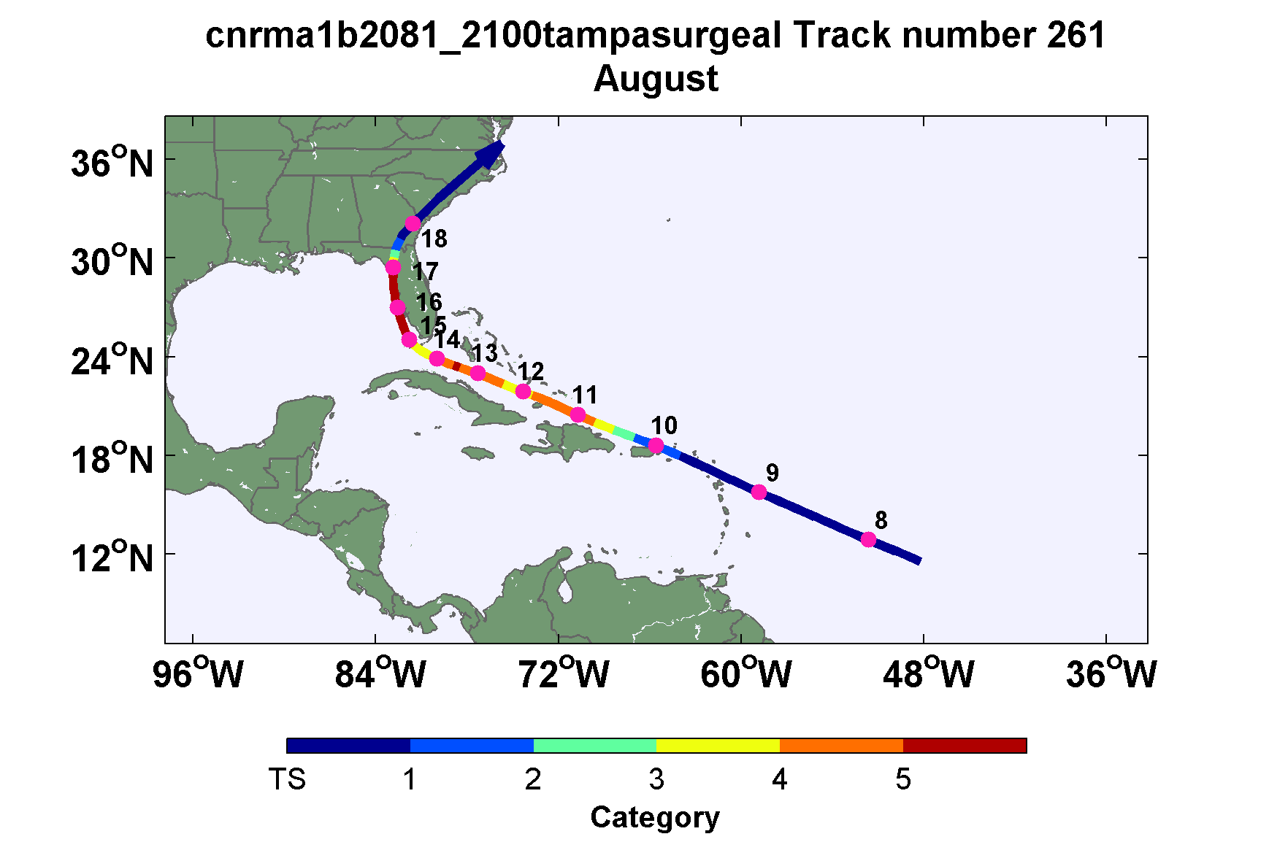
Example: Intense event in future climate downscaled from CNRM model

Slide 44
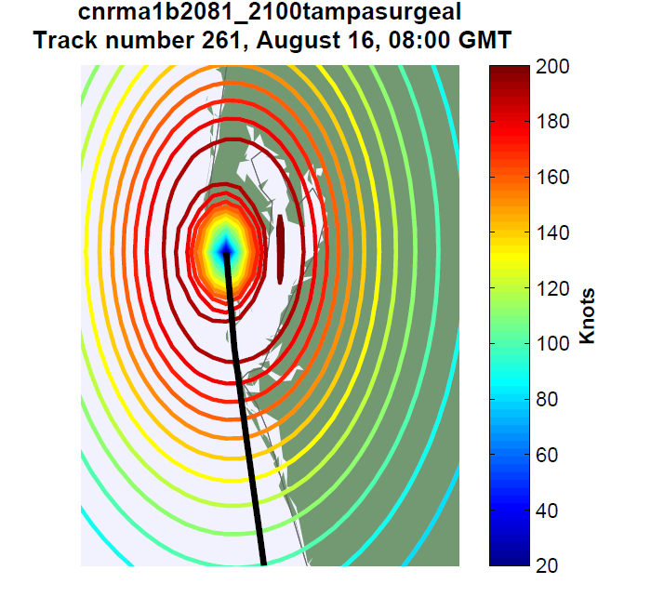

Slide 45
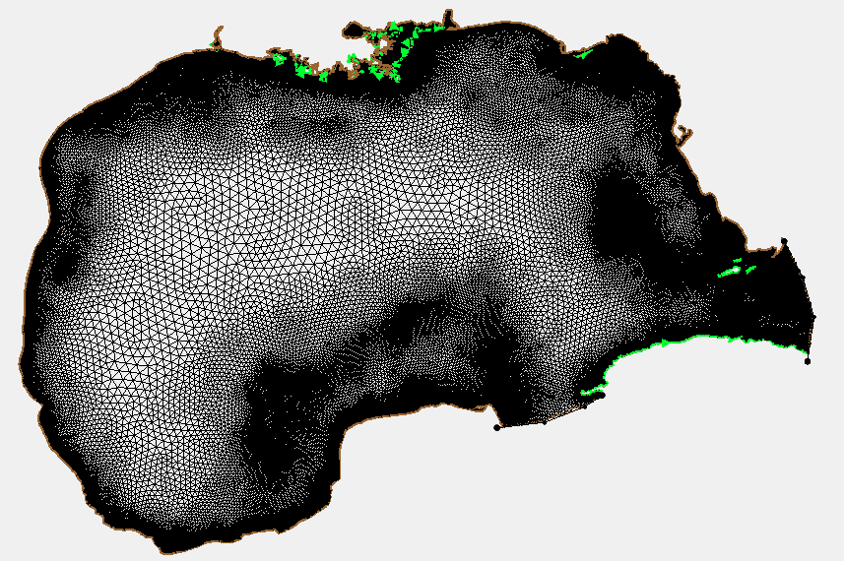
ADCIRC Mesh

Slide 46
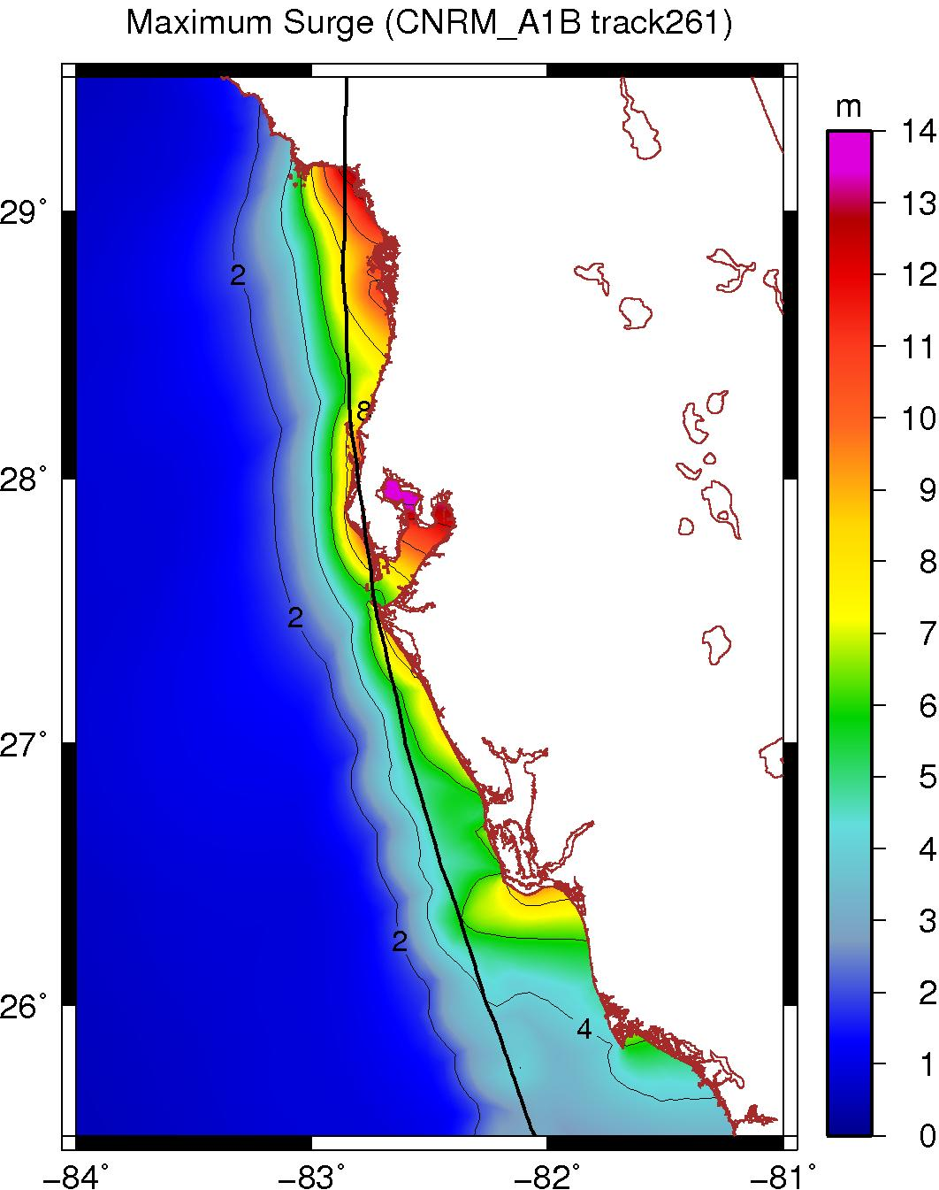
Peak Surge at each point along Florida west coast

Slide 47
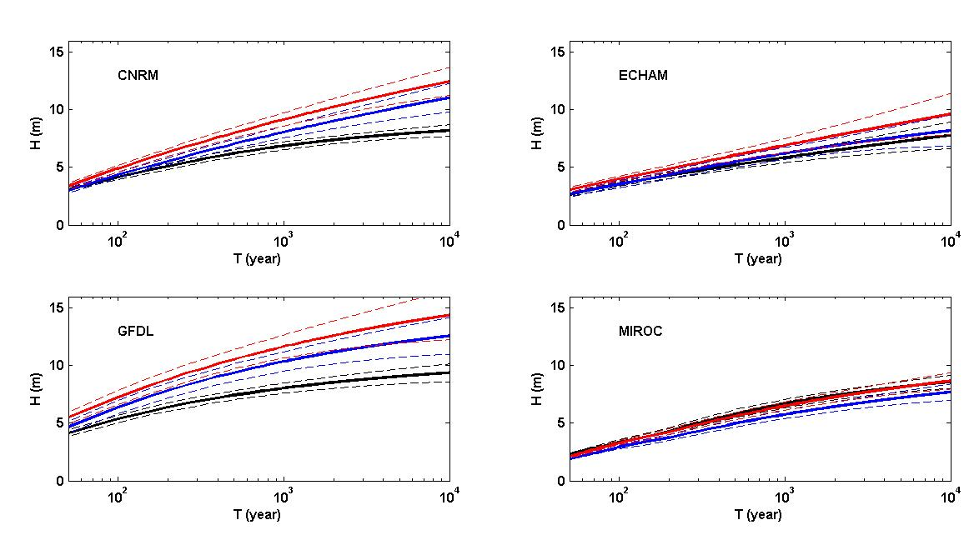
Return levels for Tampa, including three cases : control (black), A1B (blue), A1B with 1.1ro and 1.21 rm (red)

Slide 48
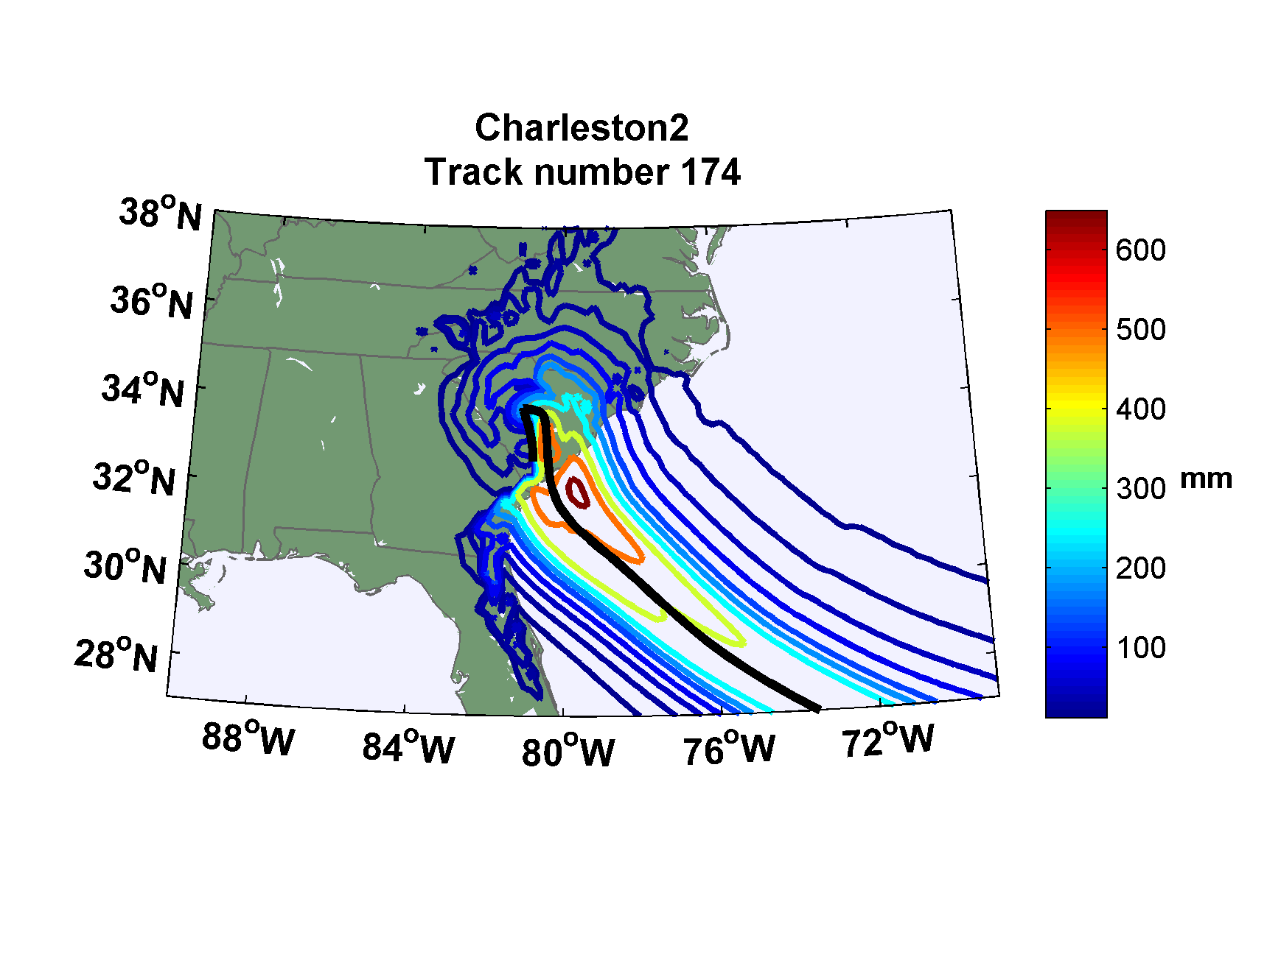
Rainfall

Slide 49
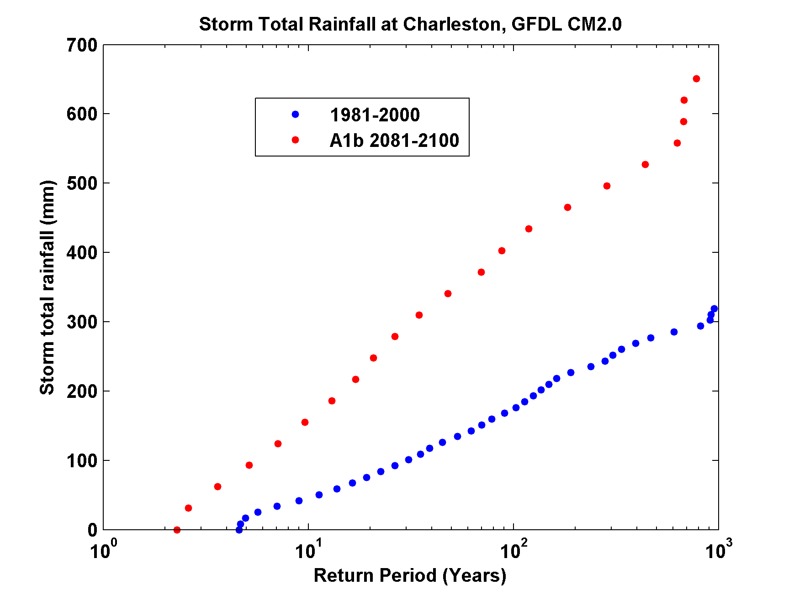
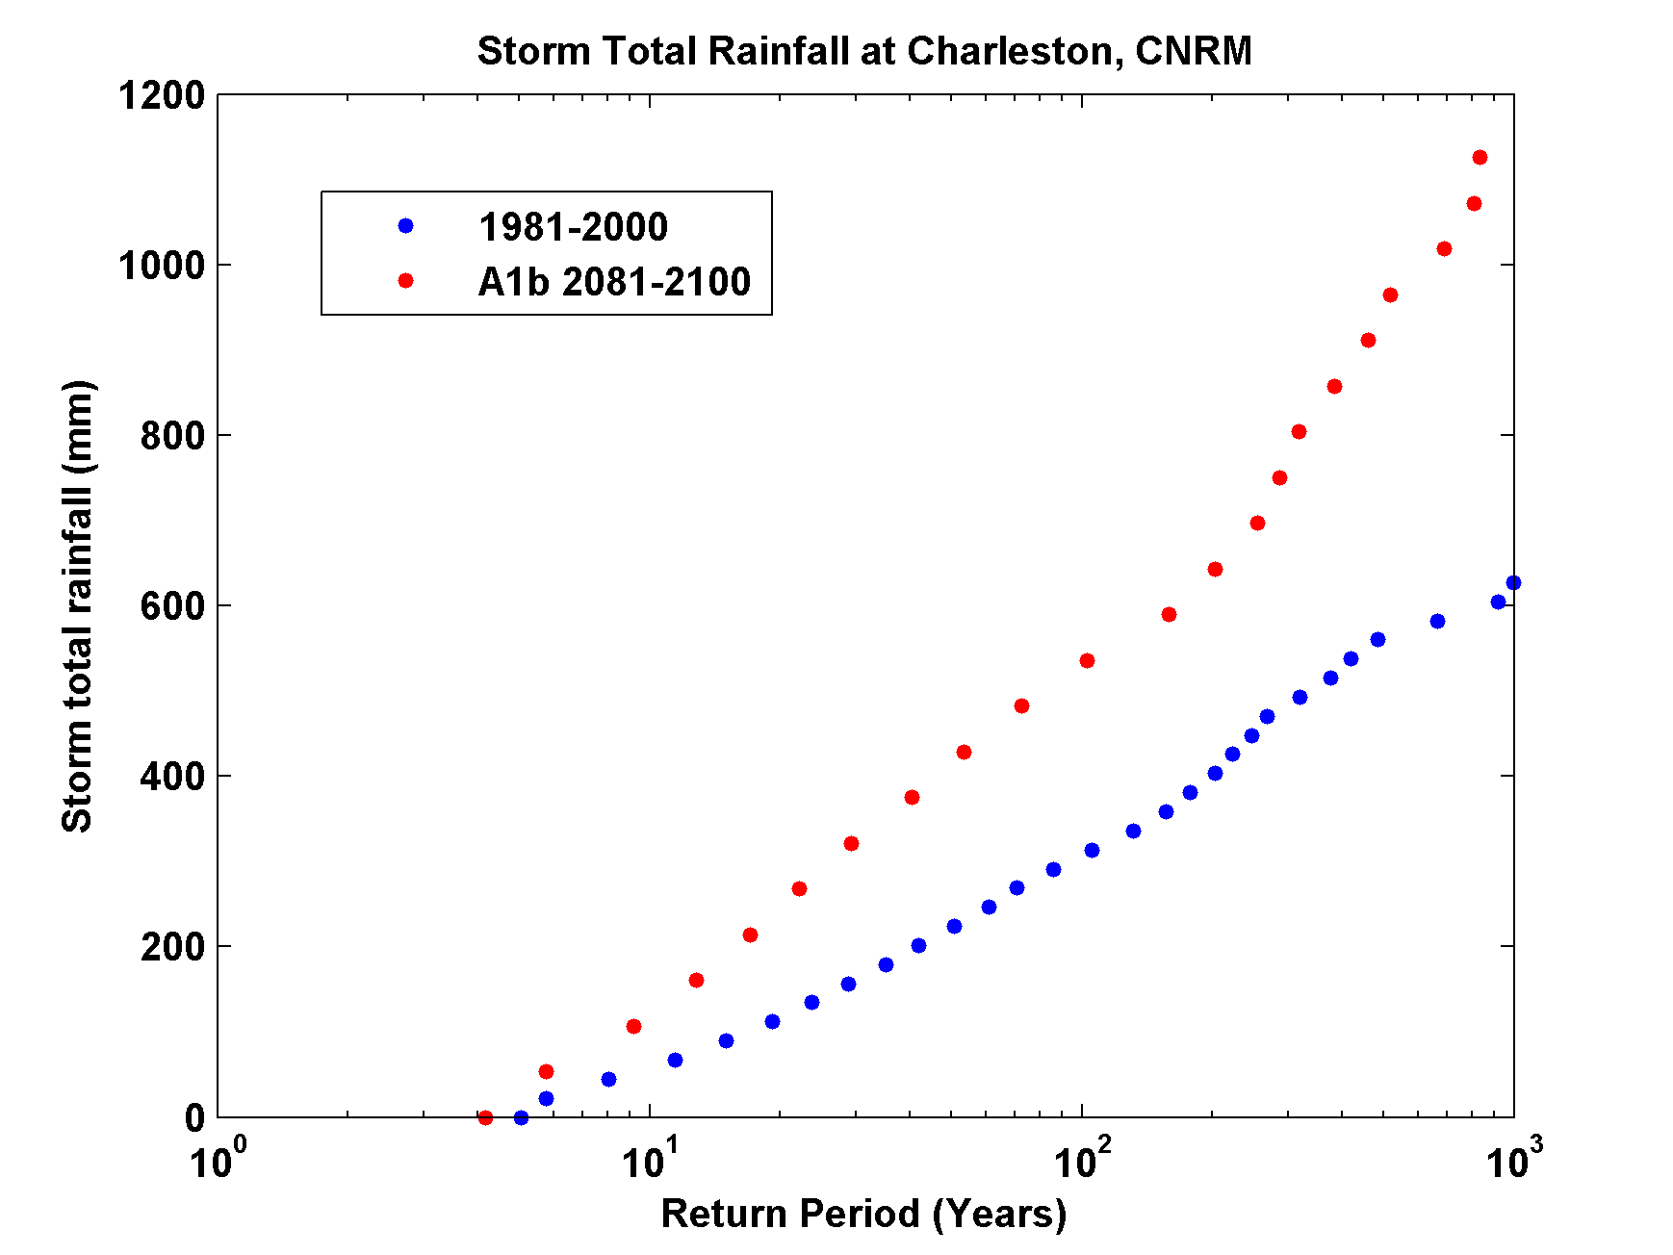
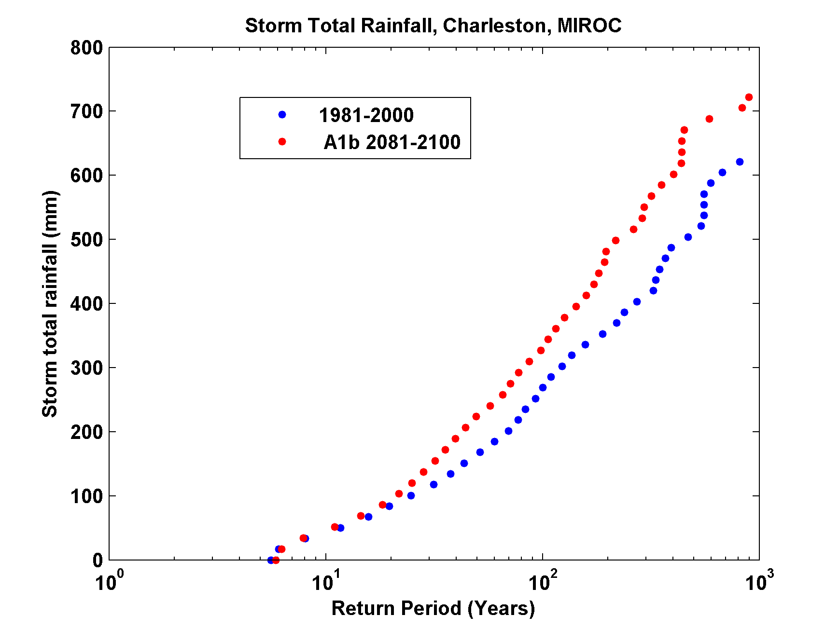
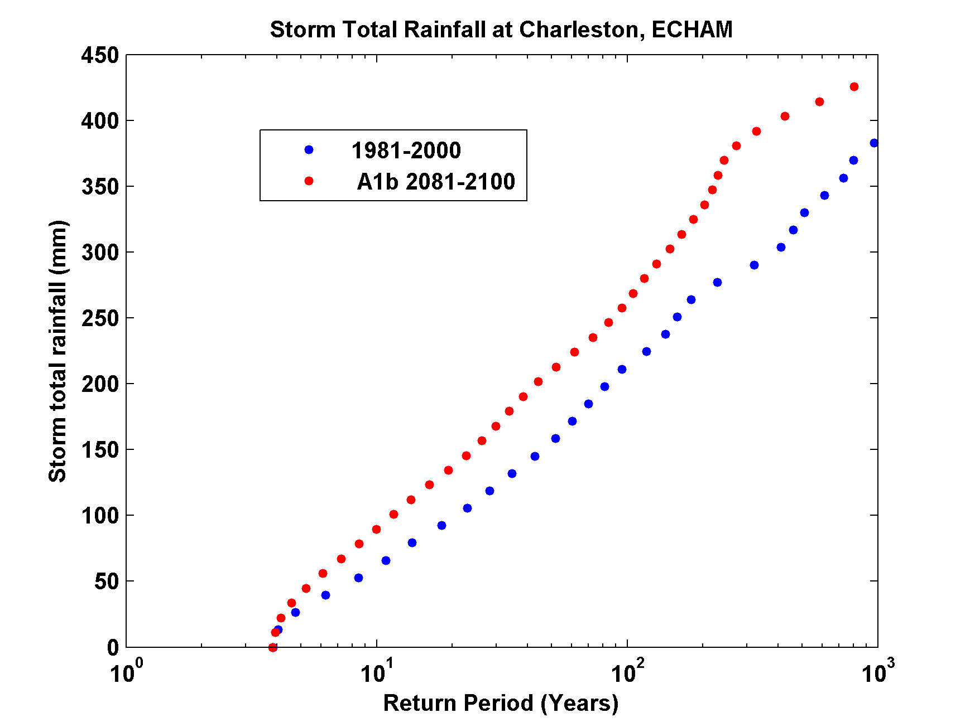

Slide 50
Integrated Assessments with Robert Mendelsohn, Yale

Slide 51


Probability Density of TC Damage, U.S. East Coast
Damage Multiplied by Probability Density of TC Damage, U.S. East Coast

Slide 52
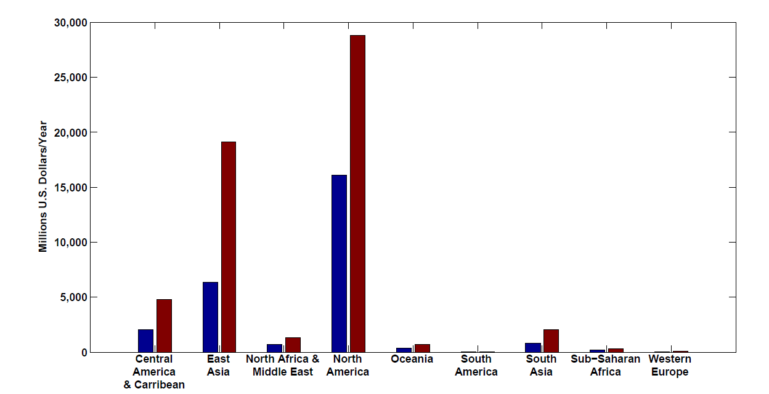
Present and future baseline tropical cyclone damage by region.
Changes in income will increase future tropical cyclone damages in 2100 in every region even if climate does not change. Changes are larger in regions experiencing faster economic growth, such as East Asia and the Central America–Caribbean region.

Slide 53
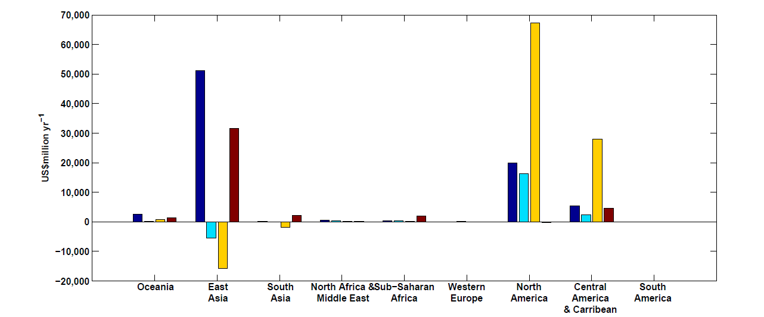
Climate change impacts on tropical cyclone damage by region in 2100. Damage is concentrated in North America, East Asia and Central America–Caribbean. Damage is generally higher in the CNRM and GFDL climate scenarios.

Slide 54
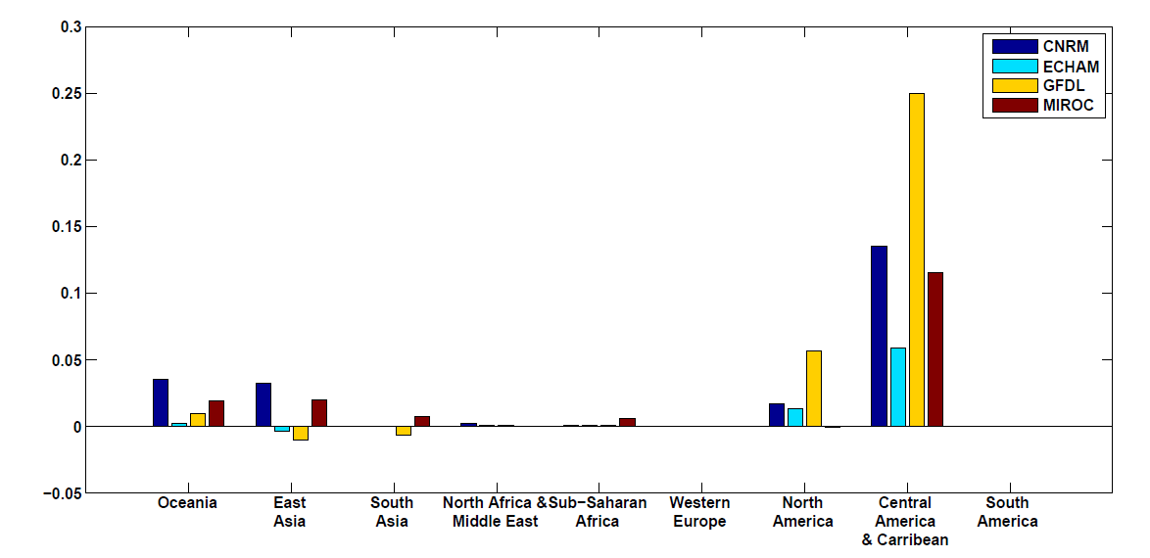
Climate change impacts on tropical cyclone damage divided by GDP by region in 2100. The ratio of damage to GDP is highest in the Caribbean–Central American region but North America, Oceania and East Asia all have above-average ratios.

Slide 55
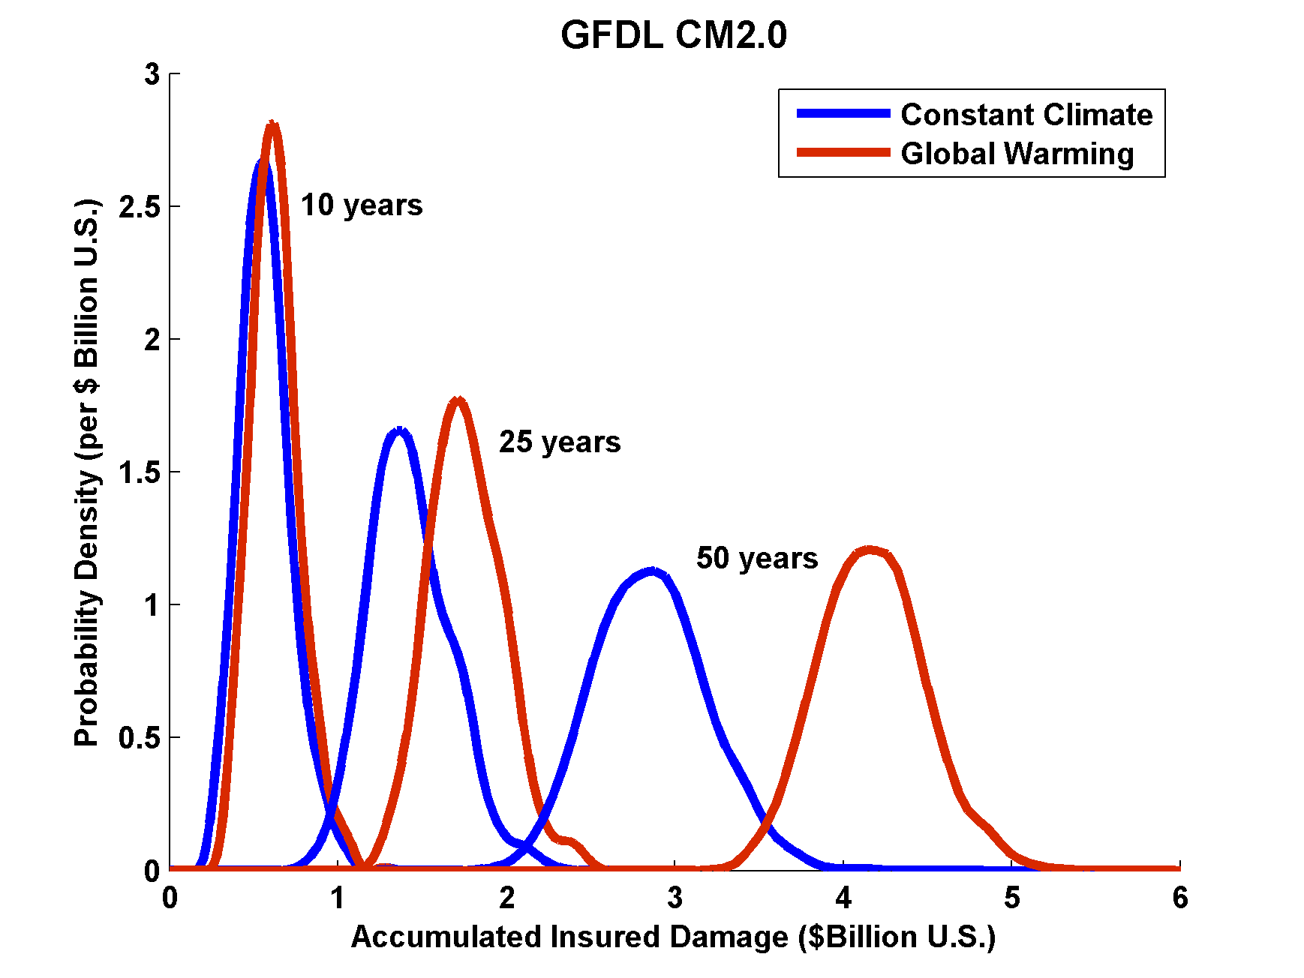
Projections of U.S. Insured Damage
Emanuel, K. A., 2012, Weather, Climate, and Society

Slide 56
Summary:
History too short and inaccurate to deduce real risk from tropical cyclones
Global (and most regional) models are far too coarse to simulate reasonably intense tropical cyclones
Globally and regionally simulated tropical cyclones are not coupled to the ocean

Slide 57
We have developed a technique for downscaling global models or reanalysis data sets, using a very high resolution, coupled TC model phrased in angular momentum coordinates
Model shows skill in capturing spatial and seasonal variability of TCs, has an excellent intensity spectrum, and captures well known climate phenomena such as ENSO and the effects of warming over the past few decades

Slide 58
Spare Slides

Slide 59
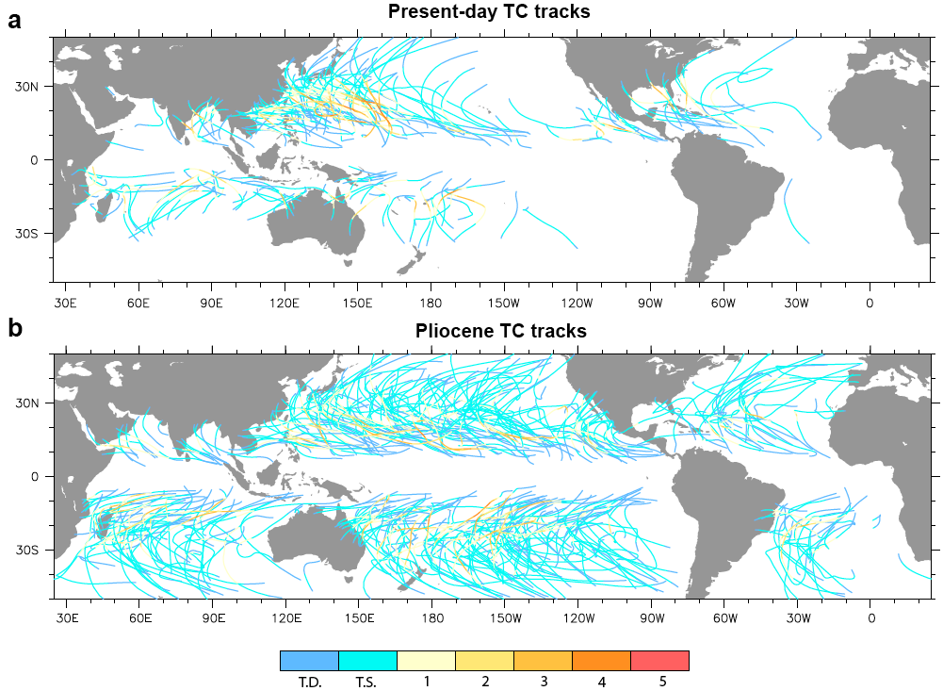
Application to Other Climates

Slide 60
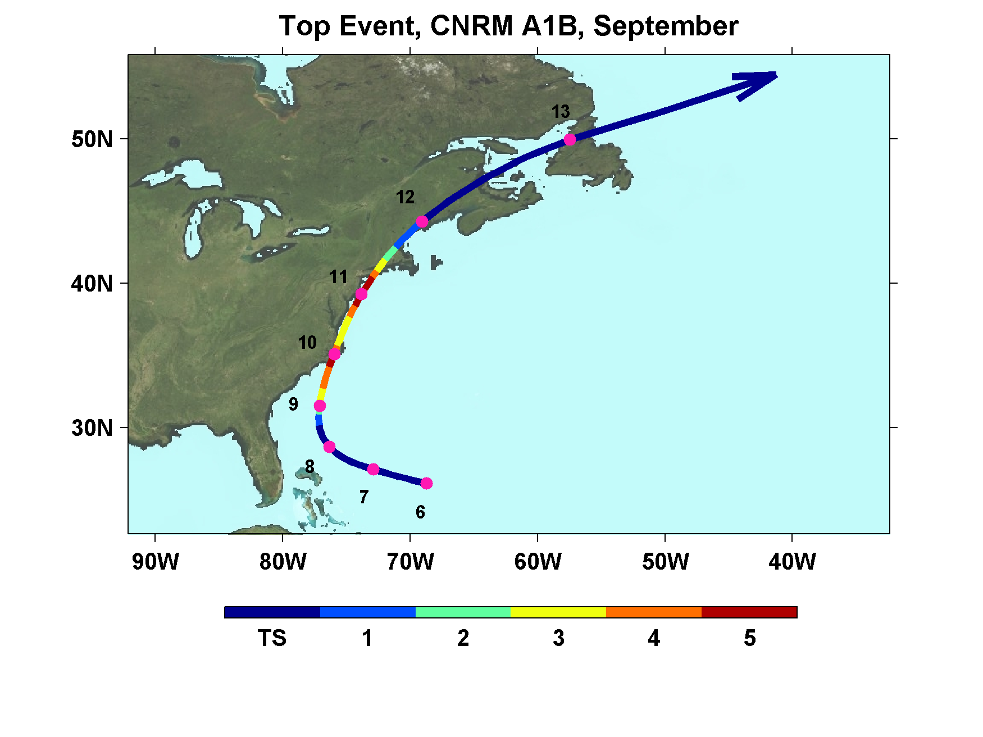

Slide 61
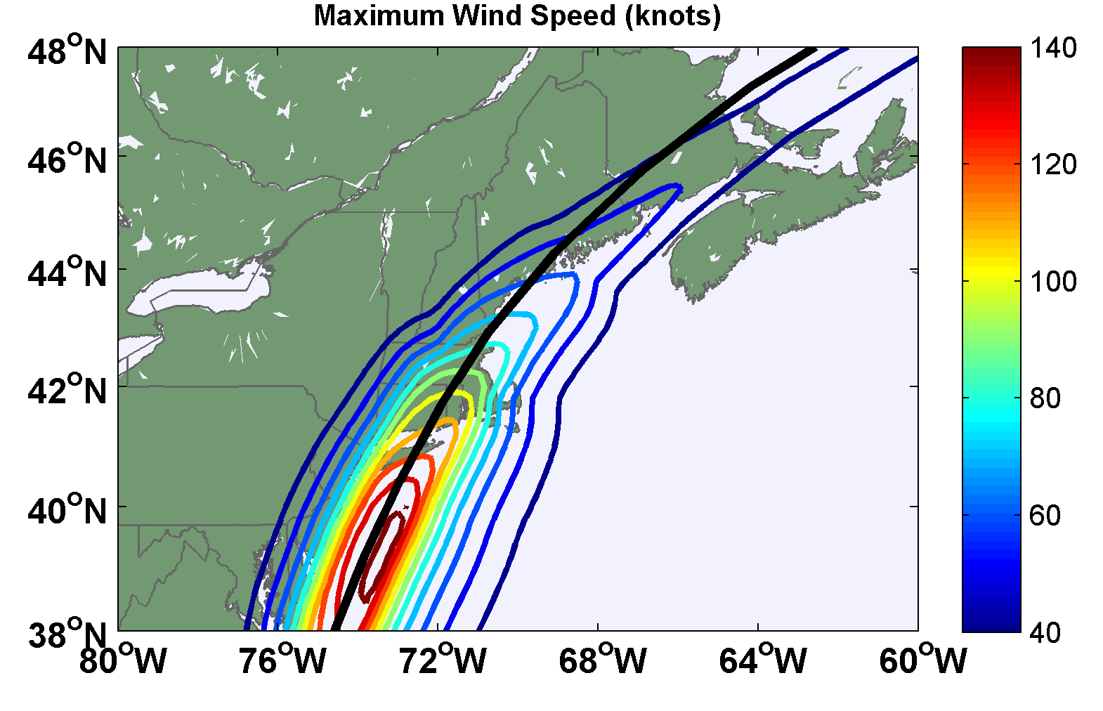

Slide 62

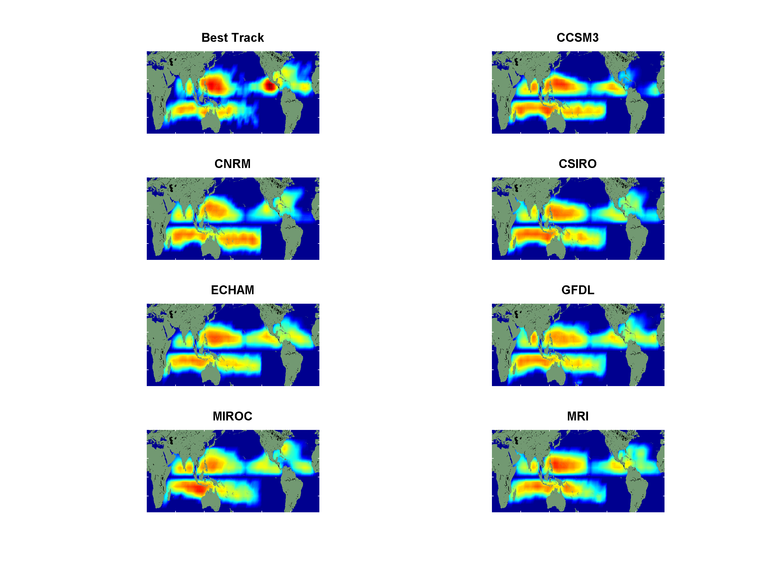
Genesis Distributions
Notes:
62

Slide 63
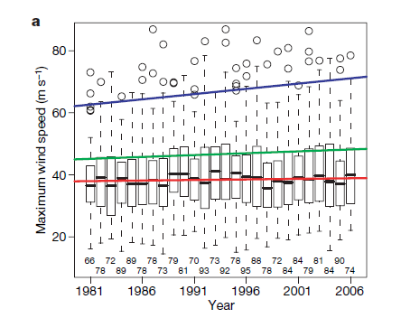
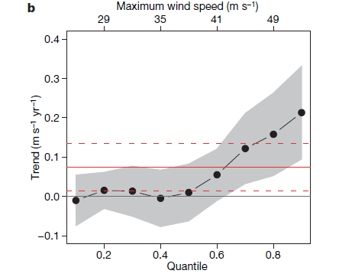
Analysis of satellite-derived tropical cyclone
lifetime-maximum wind speeds
Box plots by year. Trend lines are shown
for the median, 0.75 quantile, and 1.5 times the interquartile range
Trends in global satellite-derived tropical cyclone maximum wind speeds by quantile, from 0.1 to 0.9 in increments of 0.1.
Elsner, Kossin, and Jagger, Nature, 2008

Slide 64
Physics of Mature Hurricanes

Slide 65
Theoretical Upper Bound on Hurricane Maximum Wind Speed:
POTENTIAL INTENSITY
Surface temperature
Ratio of exchange coefficients of enthalpy and momentum
Outflow temperature
Air-sea enthalpy disequilibrium

Slide 66
Annual Maximum Potential Intensity (m/s)

Slide 67
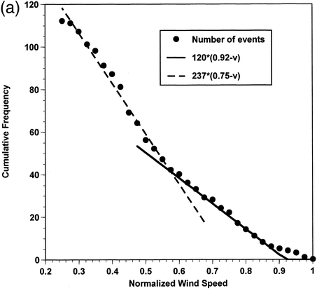

Slide 68
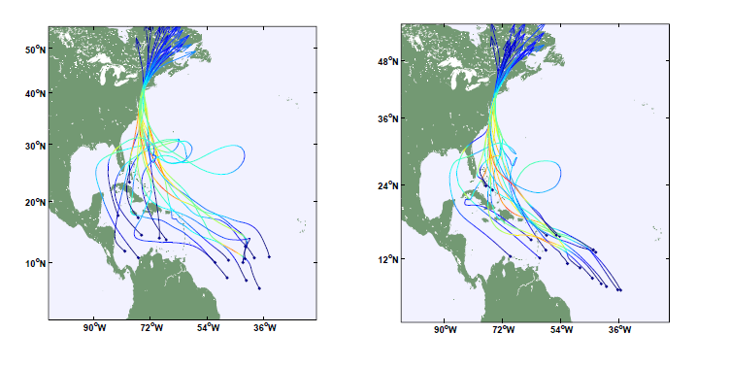
Tracks of 18 “most dangerous” storms for the Battery, under the current (left) and A1B (right) climate, respectively

Slide 69
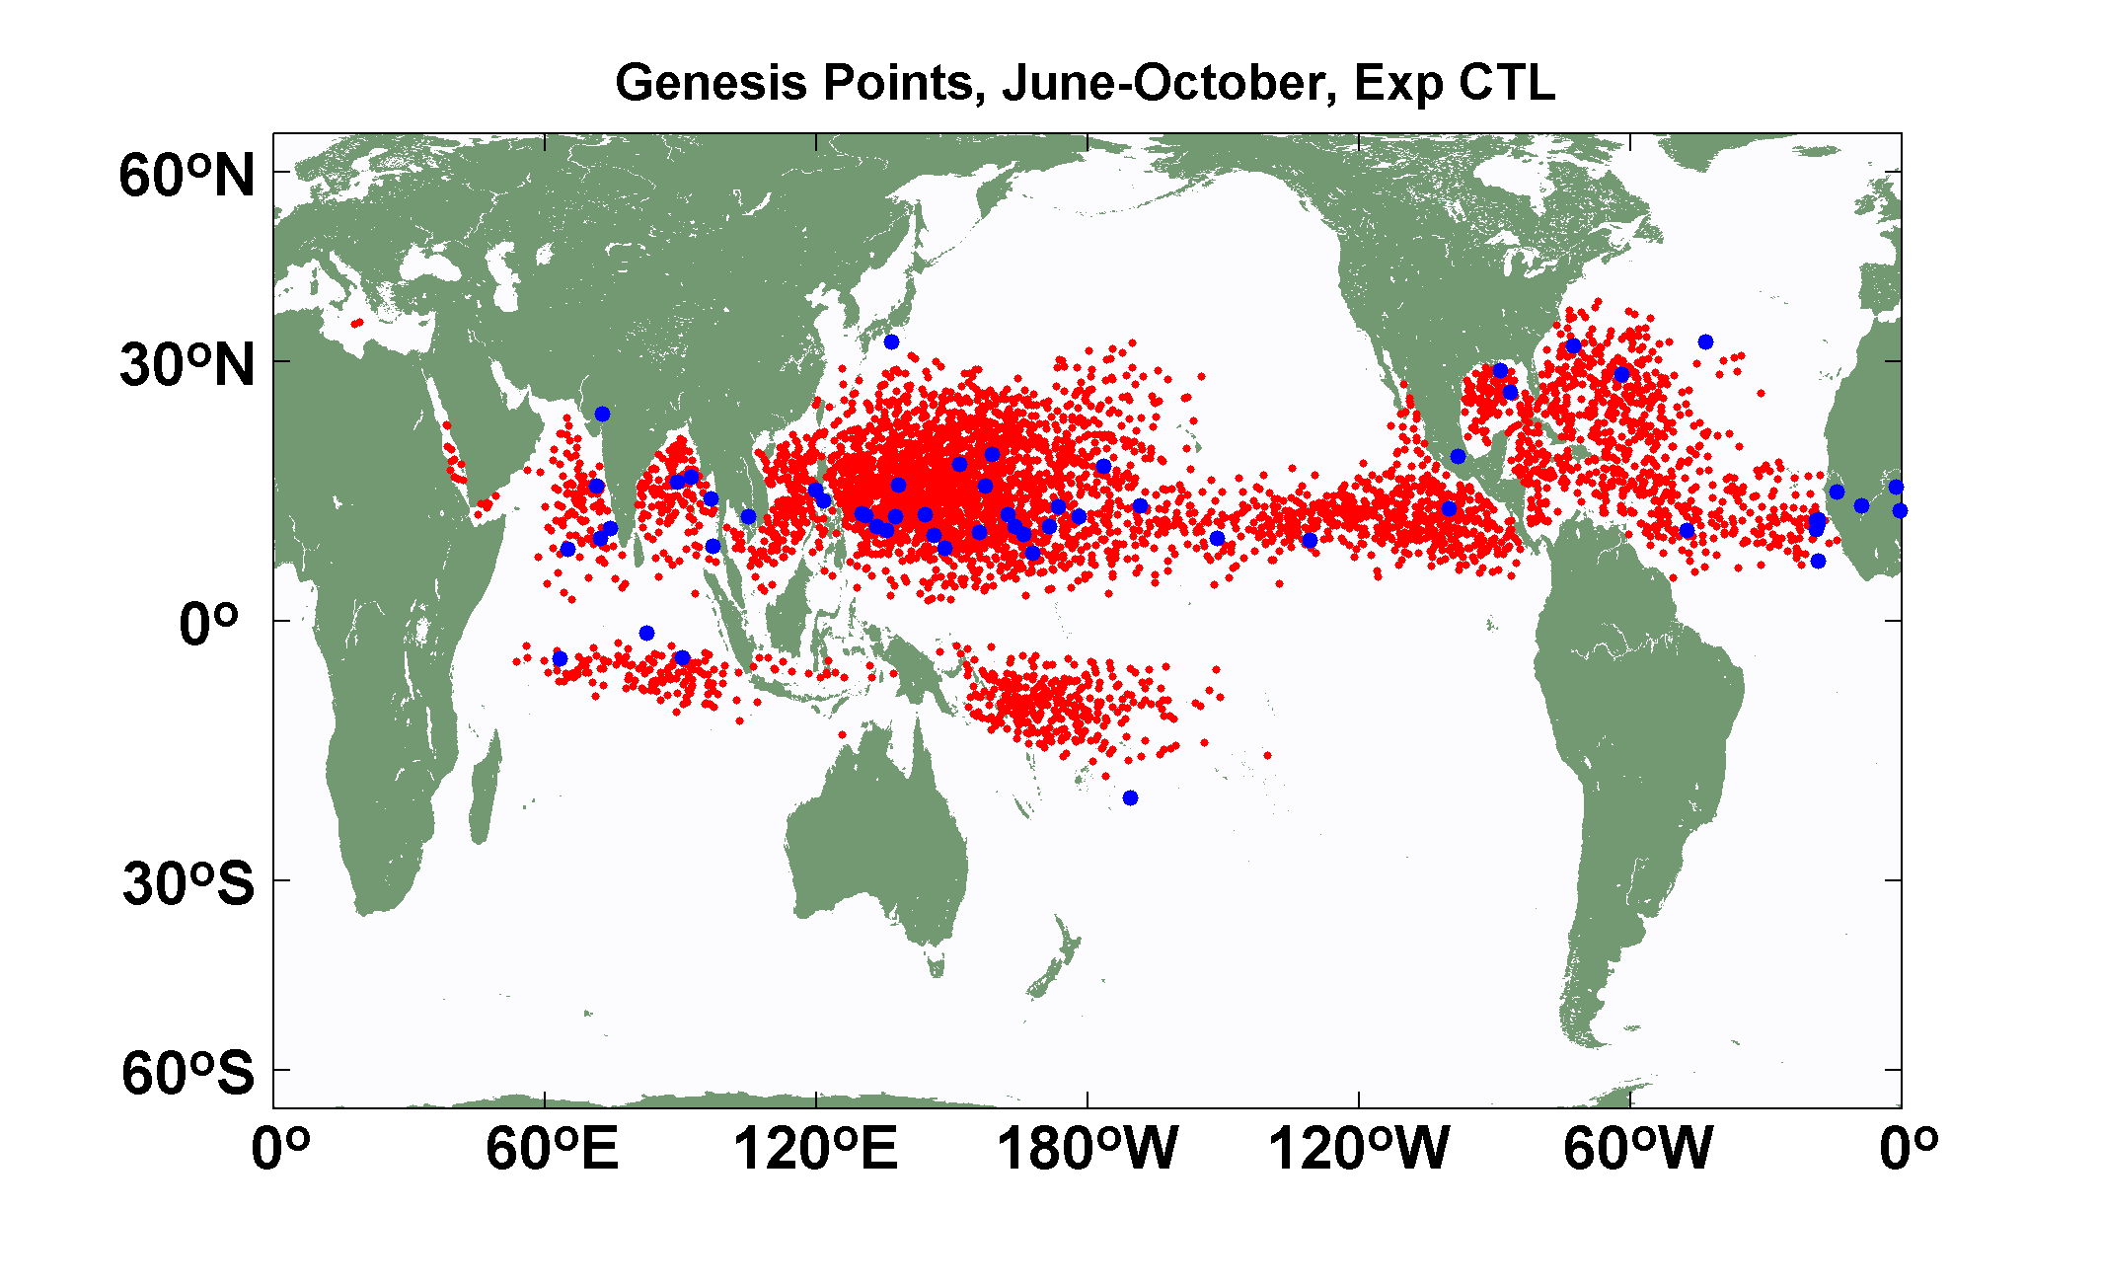
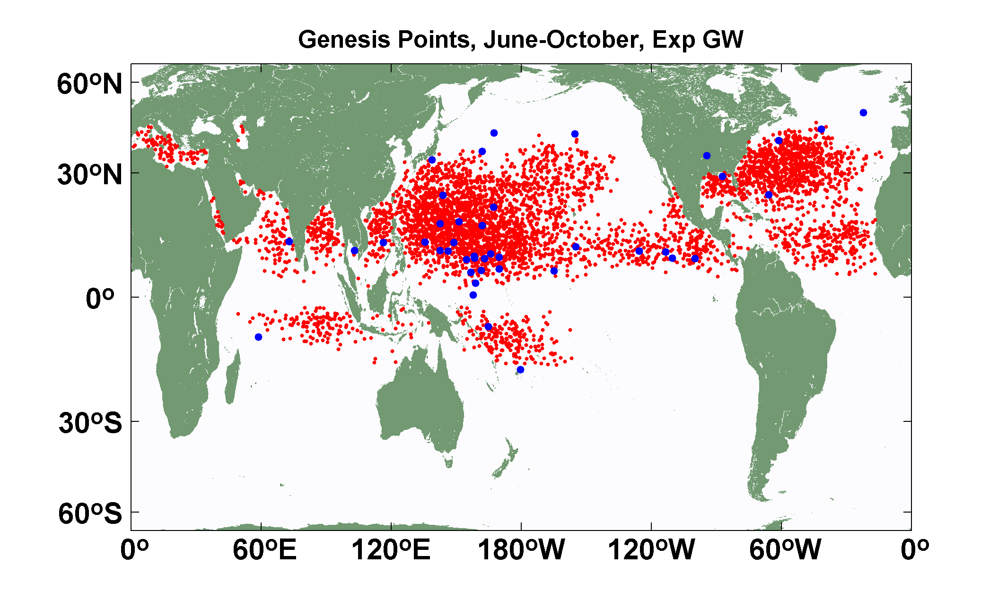
Explicit (blue dots) and downscaled (red dots) genesis points for June-October for Control (top) and Global Warming (bottom) experiments using the 14-km resolution NICAM model. Collaborative work with K. Oouchi.

Slide 70
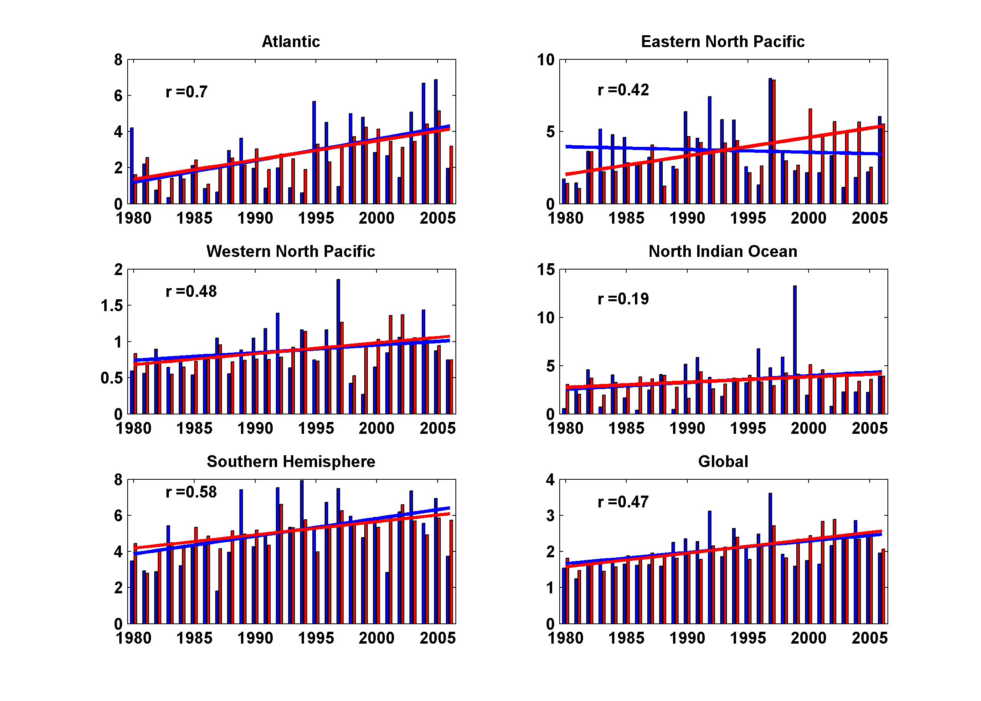
Simulated vs. Observed Power Dissipation Trends, 1980-2006
Notes:
70
70

Slide 71

Total Number of United States Landfall Events, by Category, 1870-2004

Slide 72

U.S. Hurricane Damage, 1900-2004, Adjusted for Inflation, Wealth, and Population

Slide 73

3000 Tracks within 100 km of Miami
95% confidence bounds

Slide 74

Ocean Component:
((Schade, L.R., 1997: A physical interpreatation of SST-feedback.
Preprints of the 22nd Conf. on Hurr. Trop. Meteor., Amer. Meteor. Soc., Boston, pgs. 439-440.)
Mixing by bulk-Richardson number closure
Mixed-layer current driven by hurricane model surface wind

Slide 75

Ocean columns integrated only
Along predicted storm track.
Predicted storm center SST
anomaly used for input to ALL
atmospheric points.

Slide 76

Comparing Fixed to Interactive SST:
Model with Fixed Ocean Temperature
Model including Ocean Interaction

Slide 77

Some early results
Instantaneous rainfall rate (mm/day) associated with Hurricane Katrina at 06 GMT 29 August 2005 predicted by the model driven towards Katrina’s observed wind intensity along its observed track

Slide 78


Observed (left) and simulated storm total rainfall accumulation during Hurricane Katrina of 2005. The plot at left is from NASA’s Multi-Satellite Precipitation Analysis, which is based on the Tropical Rainfall Measurement Mission (TRMM) satellite, among others. Dark red areas exceed 300 mm of rainfall; yellow areas exceed 200 mm, and green areas exceed 125 mm

Slide 79

Example showing baroclinic and topographic effects

