Slide 1
Why We Should Mitigate Climate Change
Kerry Emanuel
Lorenz Center
MIT

Slide 2
First, a Little History of Climate Science…

Slide 3

Beginnings of human civilization
Polar radiative forcing: 10 W/m² (4 W/m² for 2 x CO₂)
Global mean temperature fluctuation: ~5 C

Slide 4

Svante Arrhenius, 1859-1927
“Any doubling of the percentage of carbon dioxide in the air would raise the temperature of the earth's surface by 4°; and if the carbon dioxide were increased fourfold, the temperature would rise by 8°.” – Världarnas utveckling (Worlds in the Making), 1906

Slide 5
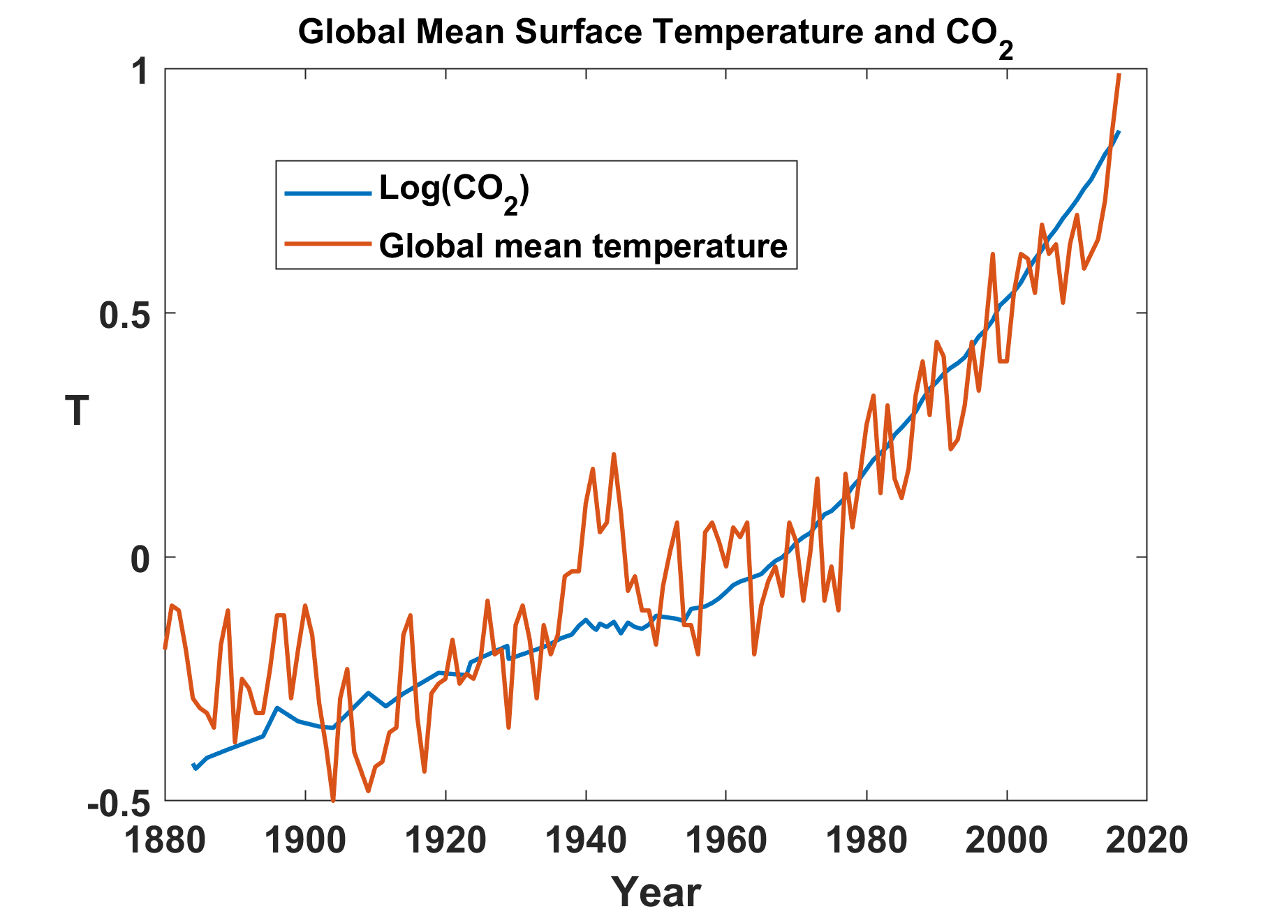
IPCC AR6: Observed increases in well-mixed greenhouse gas (GHG) concentrations since around 1750 are unequivocally caused by human activities. It is very likely that well-mixed GHGs were the main driver of tropospheric warming since 1979.

Slide 6
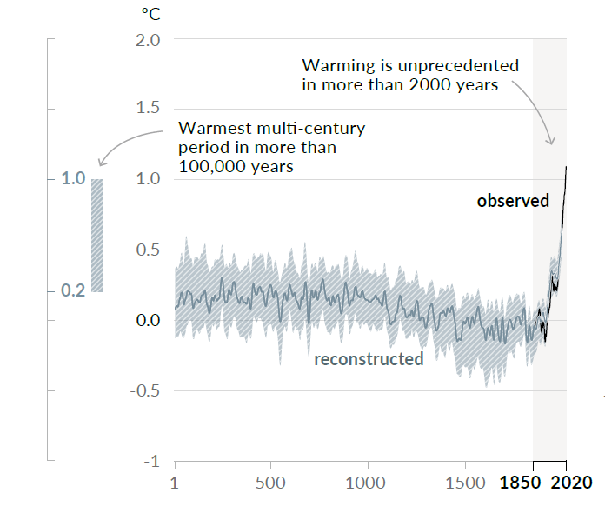
Changes in global surface temperature reconstructed from paleoclimate archives (solid grey line, 1–2000) and from direct observations (solid black line, 1850–2020), both relative to 1850–1900 and decadally averaged. The vertical bar on the left shows the estimated temperature (very likely range) during the warmest multi-century period in at least the last 100,000 years, which occurred around 6500 years ago during the current interglacial period (Holocene). The Last Interglacial, around 125,000 years ago, is the next most recent candidate for a period of higher temperature. These past warm periods were caused by slow (multi-millennial) orbital variations. The grey shading with white diagonal lines shows the very likely ranges for the temperature reconstructions.

Slide 7
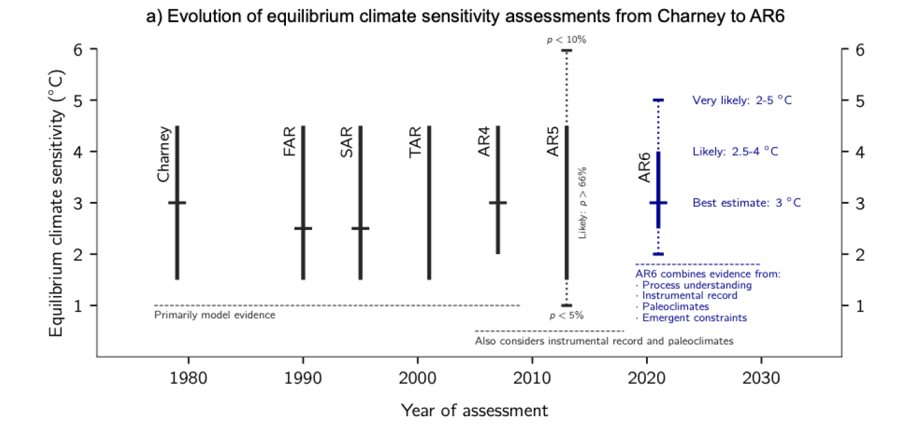
Equilibrium climate sensitivity is the equilibrium response of annual mean global mean surface temperature to doubling CO₂
Arrhenius, 1906
There is not now, nor has there ever been, an attempt by climate scientists to cover up or downplay uncertainty in climate projections

Slide 8
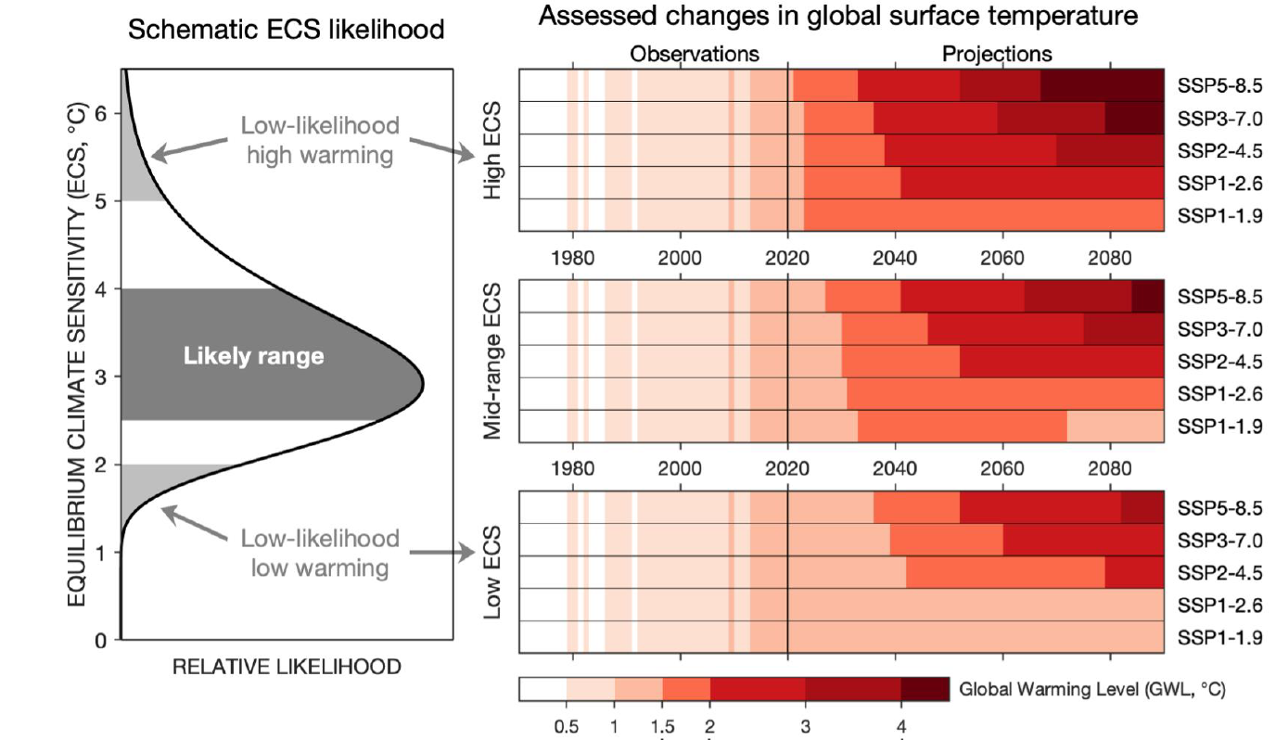
Projection uncertainty arises from uncertainty in future emissions and climate model uncertainty
From IPCC AR6

Slide 9
Hypothesis Testing vs. Risk Assessment
Hypothesis testing
  Applied in purest form when no risks are in play
  Very high bar for detecting signal
  Great recent example: LIGO
Risk assessment
  Appropriate framework for societal risks such as climate change
  May involve signal detection and attribution
  But, in a Bayesian framework, puts weight on priors based on, e.g. physics and models
  Decisions must often be made with incomplete information
  Example: Decisions commanders make on battlefields
The part of climate science devoted to global warming is largely a matter of risk assessment, adaptation, and mitigation

Slide 10
Formal Definition of Risk:

Slide 11
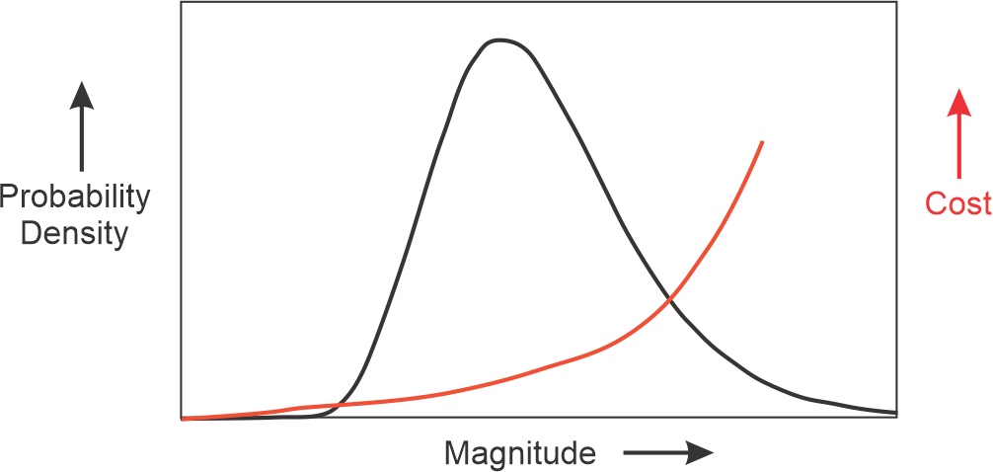
Uncertainty increases risk

Slide 12
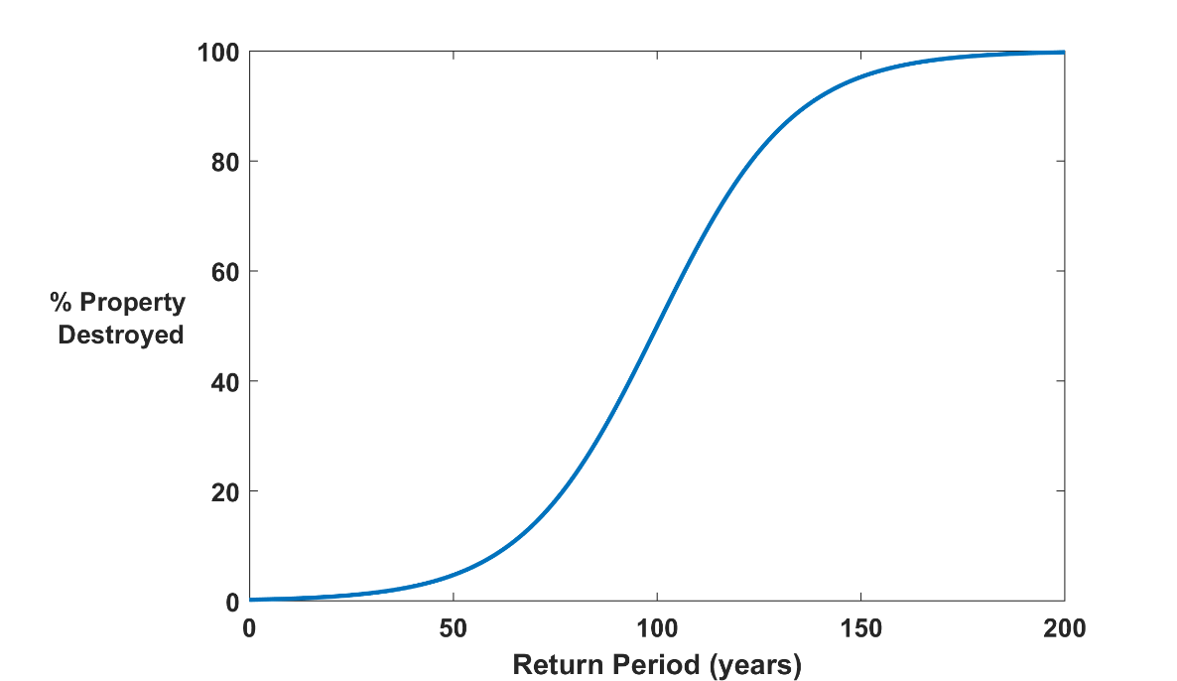

Why Climate Risk is Dominated by Extreme Events:
Societies are usually well adapted to frequent events (> 1/100 yr)
Societies are often poorly adapted to rare events (< 1/100 yr)
Large cost increases result when > 100-yr events become < 100-yr events

Slide 13
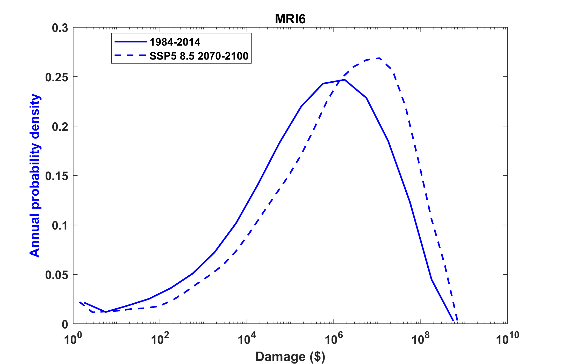
Example:
Tropical Cyclone Risk Arises Largely from High Intensity Events
Probability
Probability density of annual damage to a portfolio of insured property in the U.S.

Slide 14
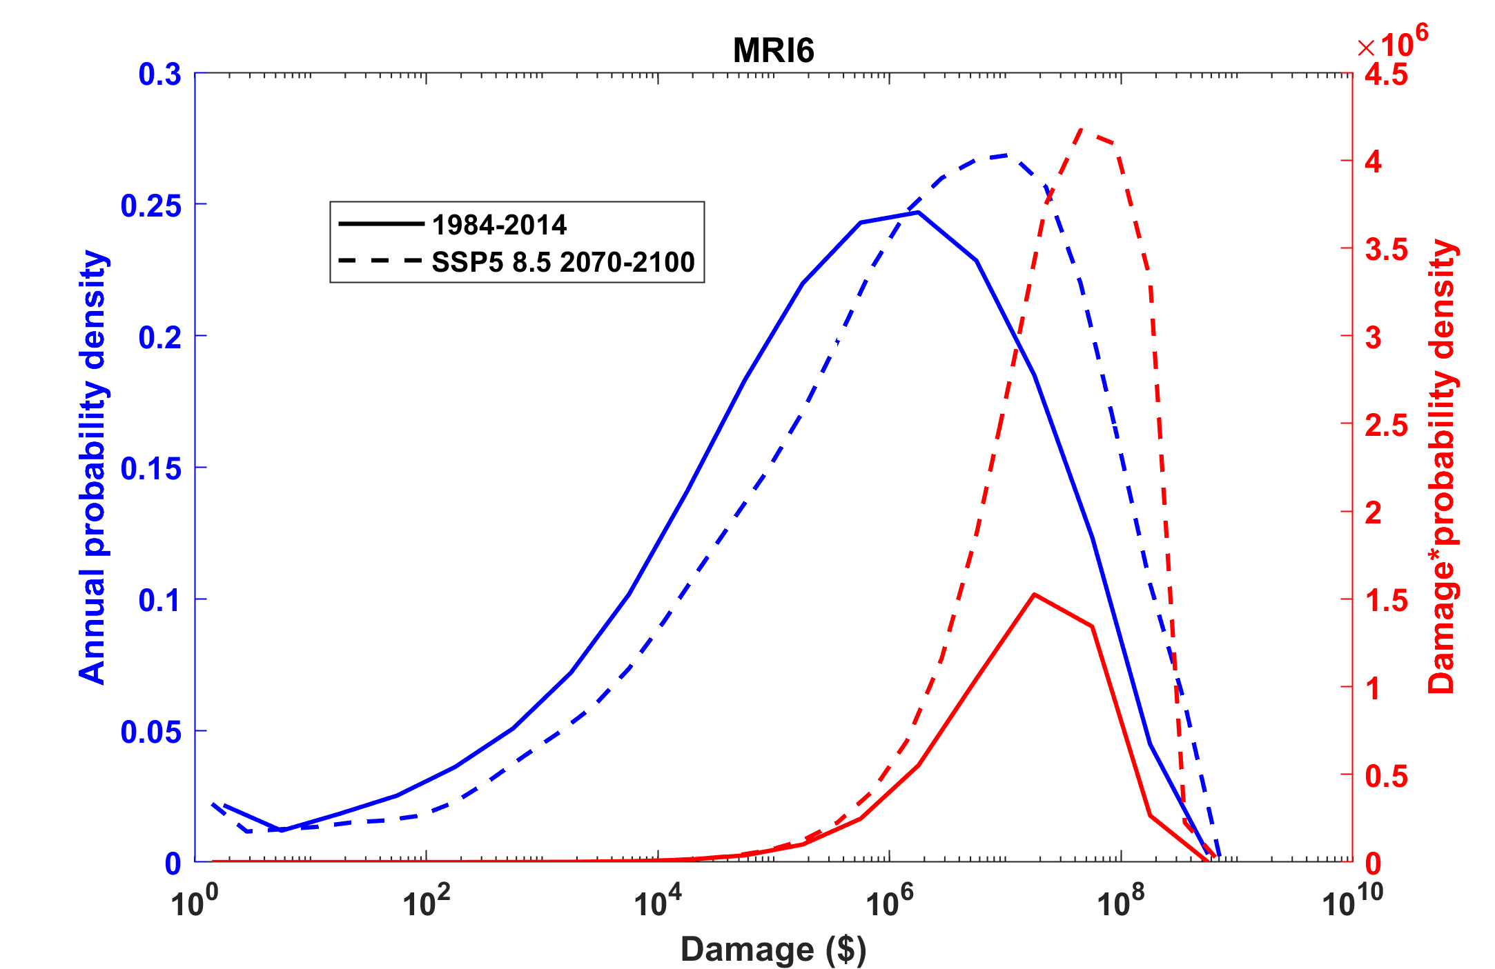
Tropical Cyclone Risk Arises Largely from High Intensity Events
Total expected damage proportional to area under curves.
~3.5-fold increase in damages
Risk
Damage times probability density of annual damage to a portfolio of insured property in the U.S.

Slide 15
Note that the events that dominate long-term risk are rare and may not be formally detectable in observed time series.
Should we therefore neglect them?

Slide 16
Rational Approach to Climate Policy
Assess climate risks
Use these to assess economic risks
Formulate policies to address the risks

Slide 17
Hsiang et al., Science, 2017
Total direct damage to U.S. economy, summed across all assessed sectors, as a function of global mean temperature change. Dot-whiskers indicate the distribution of direct damages in 2080 to 2099 (averaged) for multiple realizations of each combination of climate models and scenario projection (dot, median; dark line, inner 66% credible interval; medium line, inner 90%; light line, inner 95%). Green are from RCP2.6, yellow from RCP4.5, red from RCP8.5

Slide 18
“The net economic impact of human-induced climate change will be minimal through at least the end of the century”
-- Steve Koonin, “Unsettled”

Slide 19
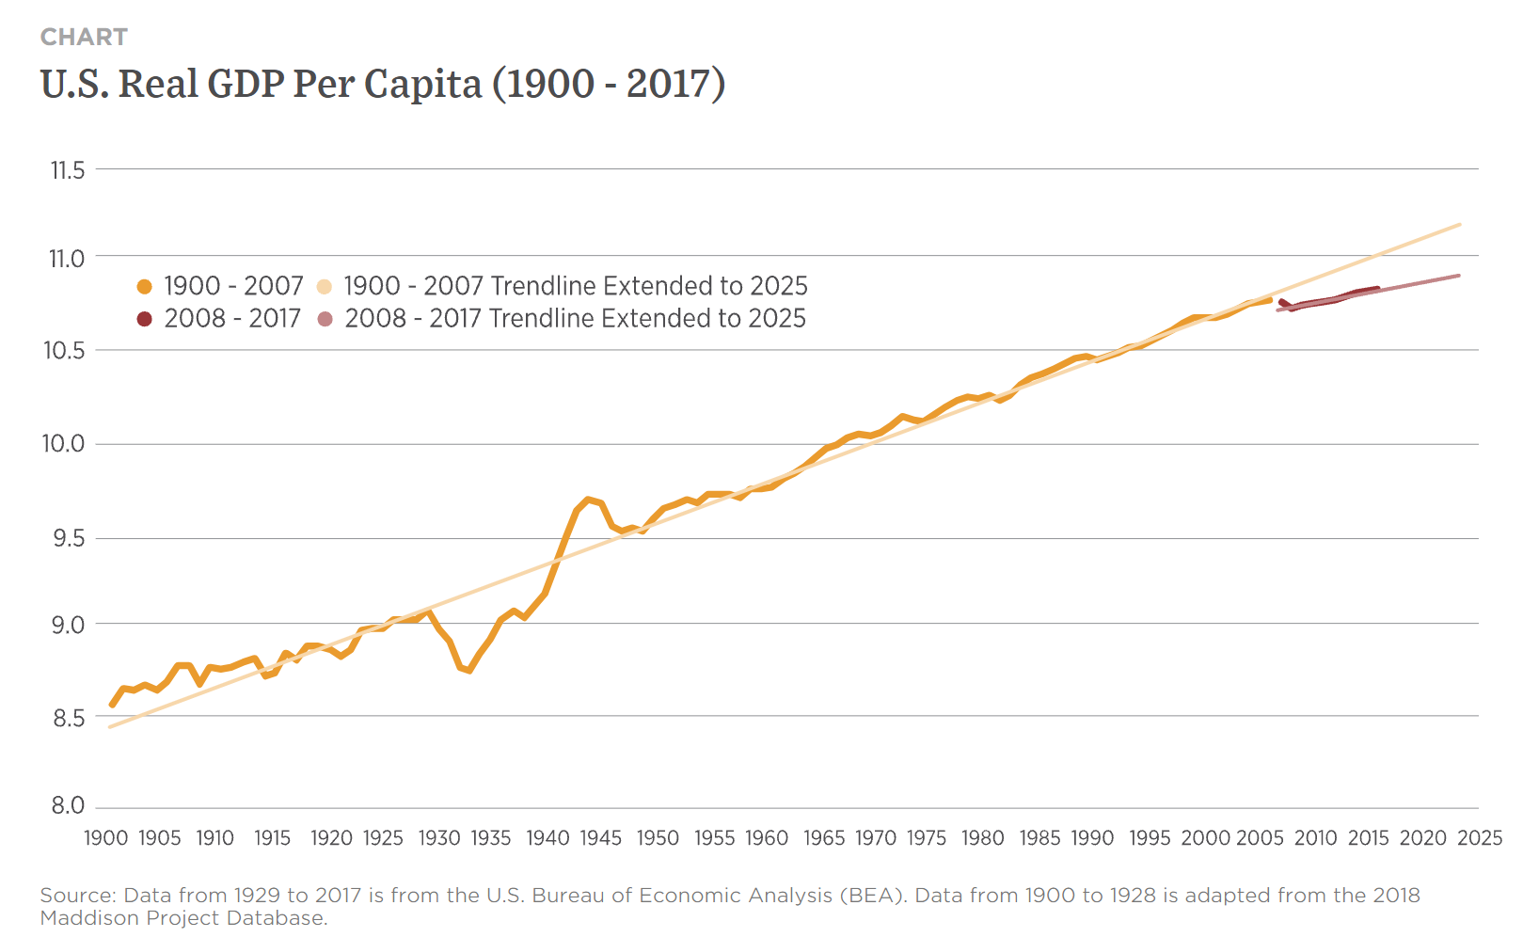
At peak, U.S spent ~40% of its GDP on war effort
But loss of GDP from climate change likely to be sustained over many years.
“Many people do not appreciate that this is actually a few percent per year, every year.” – Amir Jina, co-author
Great Depression
3.3% drop

Slide 20
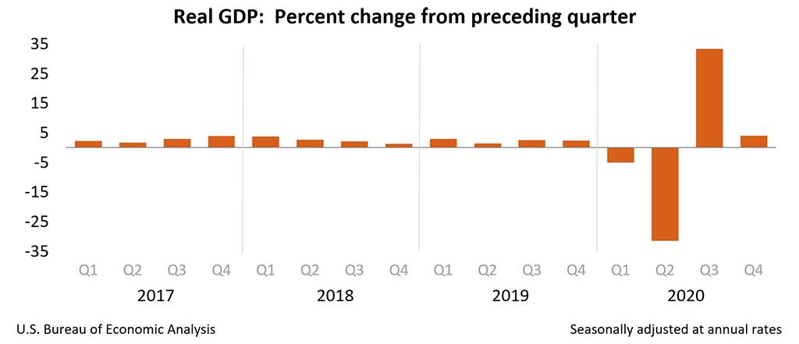
Effect of COVID Pandemic on U.S. GDP
As of October 18th, 4.9 million deaths globally

Slide 21
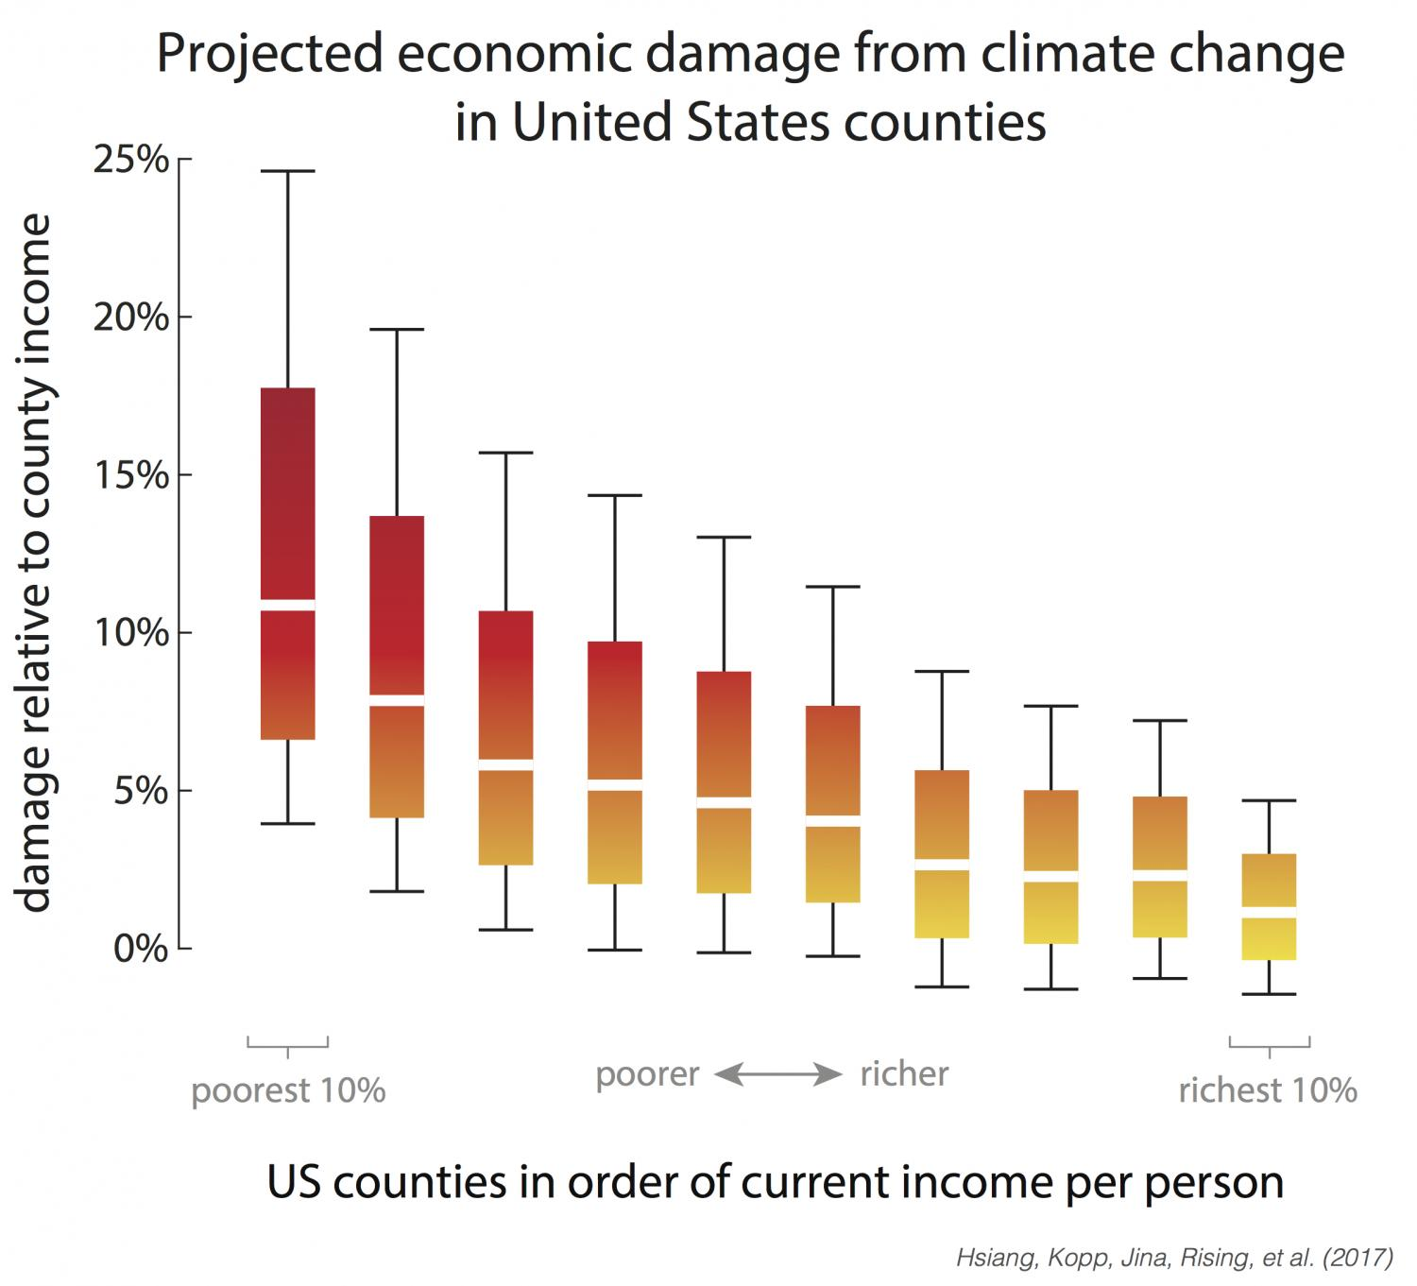
Range of economic damages per year for groupings of US counties, based on their income (29,000 simulations for each of 3,143 counties). The poorest 10% of counties are the leftmost box plot. The richest 10% are the rightmost box plot. Damages are fraction of county income. White lines are median estimates, boxes show the inner 66% of possible outcomes, outer whiskers are inner 90% of possible outcomes.

Slide 22
Summary
There is little question that we are incurring non-trivial societal and economic risks by adding greenhouse gases to the atmosphere
Uncertainty in the quantification of these hazards and their economic consequences increases risk
A rational approach would warrant spending at least as much to mitigate the risk as the hazard is likely to cost
The possibility of catastrophic outcomes, even at very low probability, justifies some degree of risk aversion and thus willingness to pay some risk premium
There is no rational basis for zero mitigation.

Slide 23
Spare Slides

Slide 24
Notes on Page 1 of “Unsettled”
“Heat waves in the U.S. are now no more common than they were in 1900, and the warmest temperatures have not risen in the past 50 years.”
Comment: Cherry-picking…U.S. is 1.5% of global surface area, 5% of global land area.
AR6: It is virtually certain that the [global] frequency and intensity of hot extremes and the intensity and duration of heat waves have increased since 1950 and will further increase in the future even if global warming is stabilized at 1.5°C.
“Humans have had no detectable impact on hurricanes over the past century”
AR6: It is likely that the proportion of major (Category 3–5) tropical cyclones (TCs) and the frequency of rapid TC intensification events have increased over the past four decades. The average location of peak TC wind intensity has very likely migrated poleward in the western North Pacific Ocean since the 1940s, and TC forward translation speed has likely slowed over the contiguous USA since 1900. It is likely that the poleward migration of TCs in the western North Pacific and the global increase in TC intensity rates cannot be explained entirely by natural variability

Slide 25
“Greenland’s ice sheet isn’t shrinking more rapidly than it was eighty years ago”
AR6: The Special Report on the Ocean and Cryosphere also found that summer melting rate had increased since the 1990s to a rate unprecedented over the last 350 years (very high confidence), being two to five times greater than the pre- industrial rates (medium confidence).
It is very likely that human influence has contributed to the observed surface melting of the Greenland Ice Sheet over the past two decades. The rate of recent GMSL rise (3.6±0.5 mm yr-1 for 2006–2015) is about 2.5 times larger than for 1901–1990.

Slide 26
Tilting at Strawmen
“There has been no significant trend in the global number of tropical cyclones nor has any trend been identified in the number of U.S. landfalling hurricanes”.
In fact, there has never been a scientific prediction that the global numbers of tropical cyclones should increase; in fact, the “weak” consensus view is that they may actually drop. The theoretical prediction, dating back to 1987, is that the incidence of very high intensity hurricanes should increase, and there is now some evidence that that is happening. As for U.S. landfalling hurricanes; they constitute about 3% of all hurricanes. If one looks at the trend in ALL (not just U.S.) Atlantic landfalls, there has been a significant increase.
Koonin spends some time showing that there has been no detectable increase in U.S. tornadoes. But no one in the scientific community ever suggested there was, or that the observational data could be used to find trends.

Slide 27
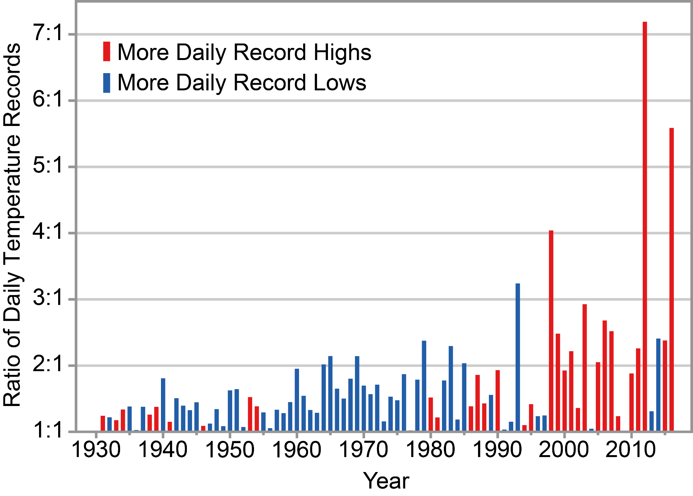
Figure from Fourth National Climate Assessment

Slide 28
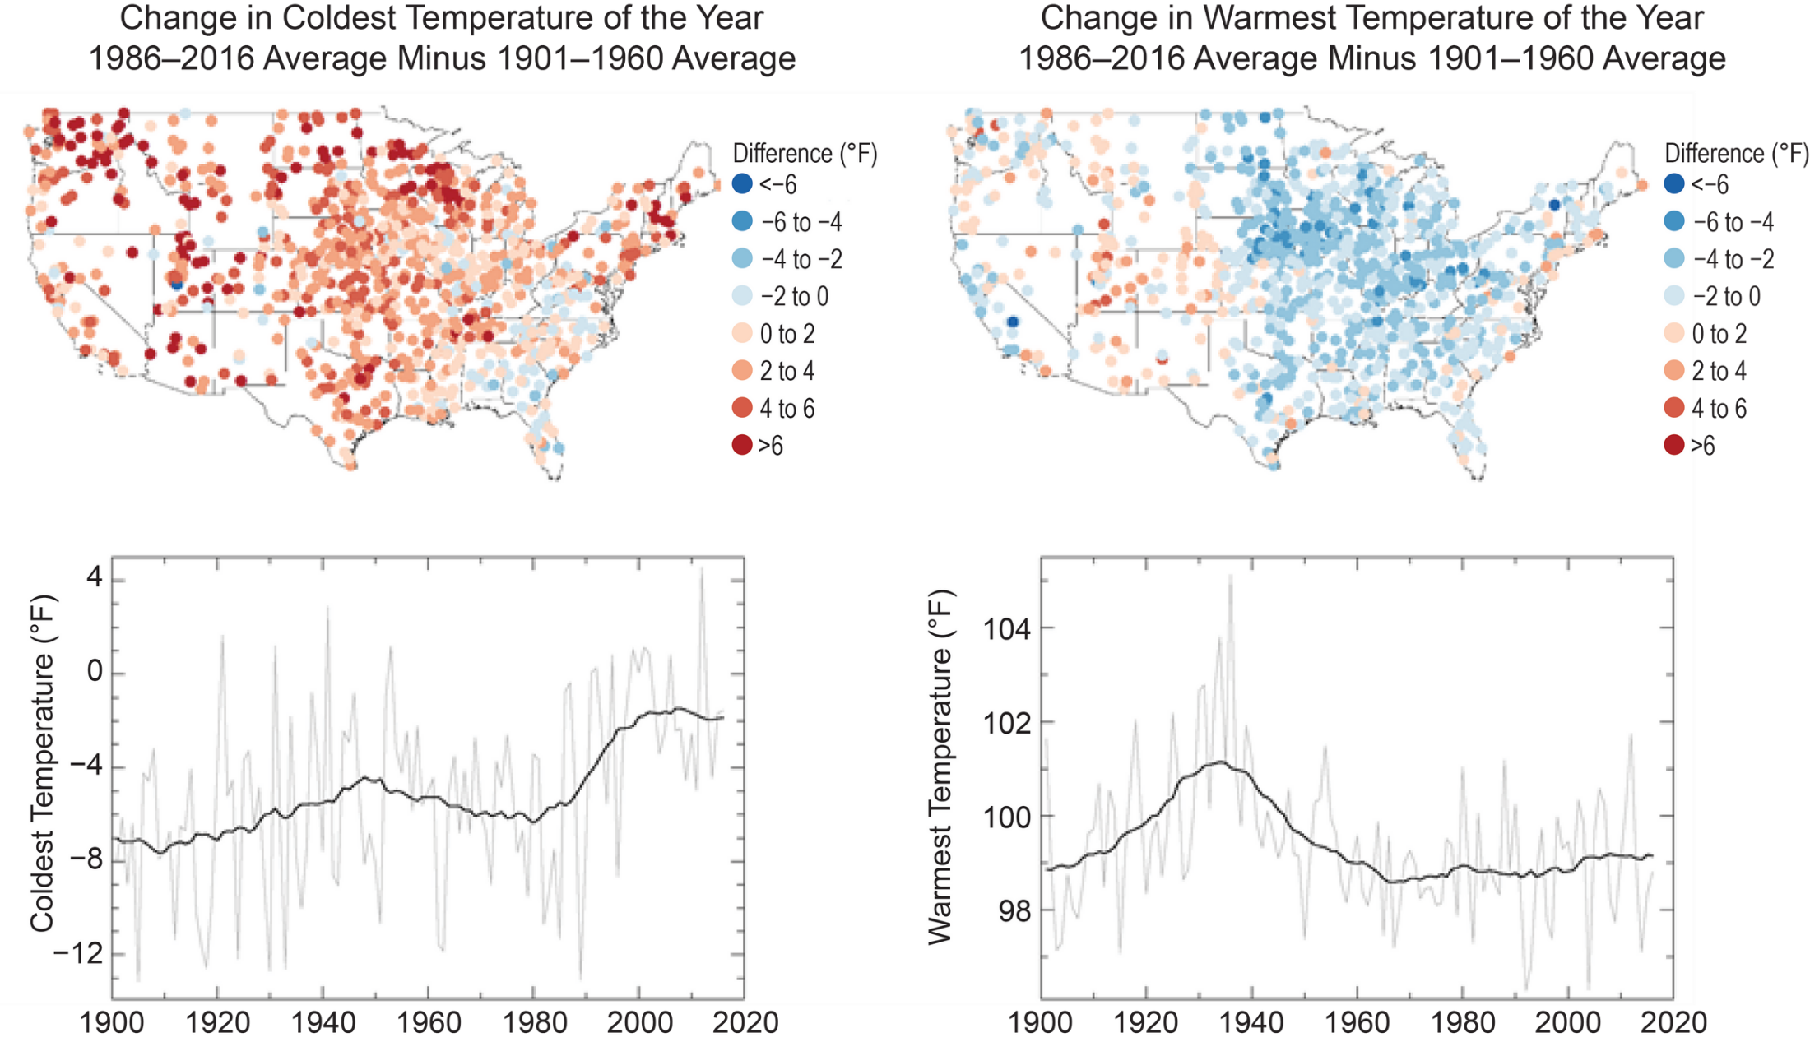

Slide 29
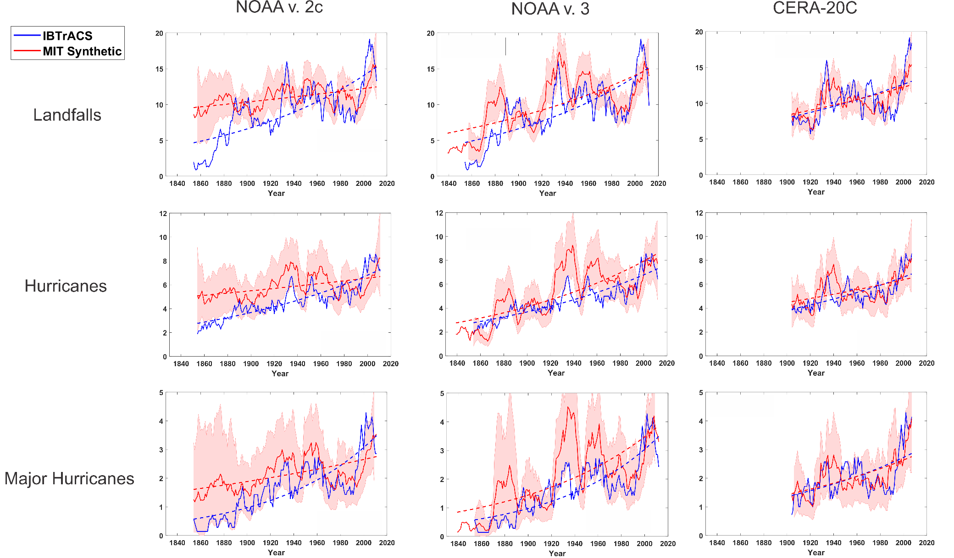
Charts show 7-year running means
(ALL landfalls, not just U.S.)
Shading shows estimate of historical sampling error….90% of subsamples of the synthetic tracks at rate of historical tracks should lie within shading

Slide 30
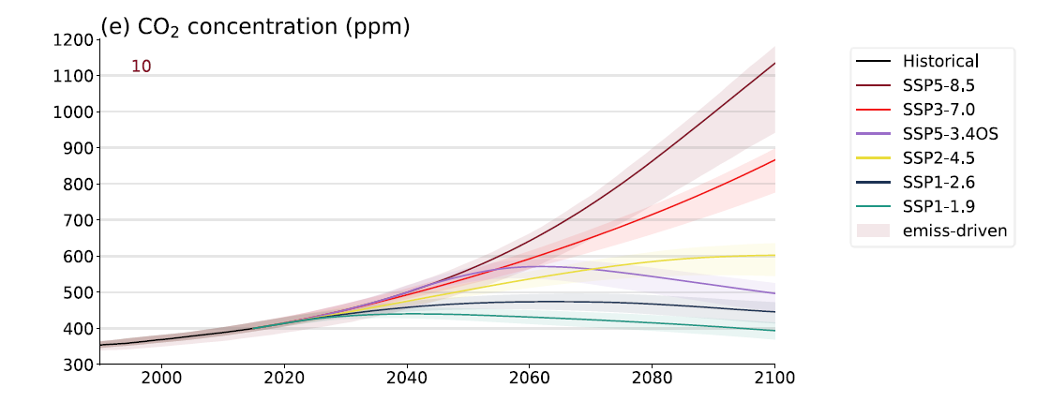

Slide 31
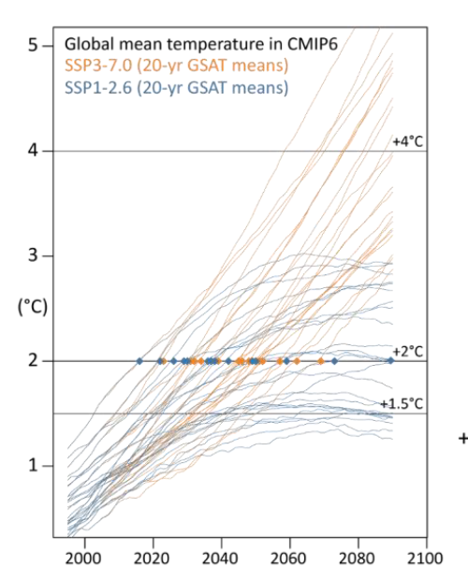

Slide 32
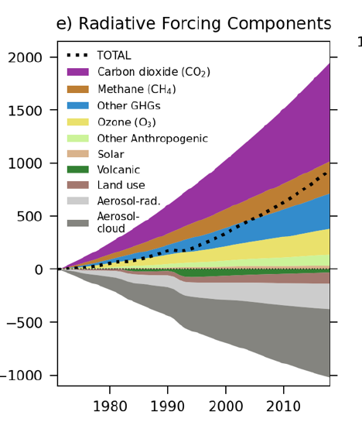

Slide 33
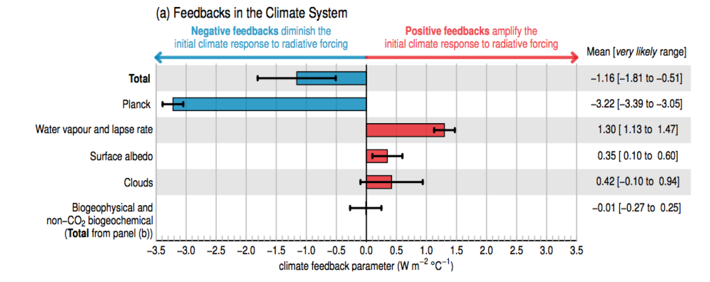

Slide 36
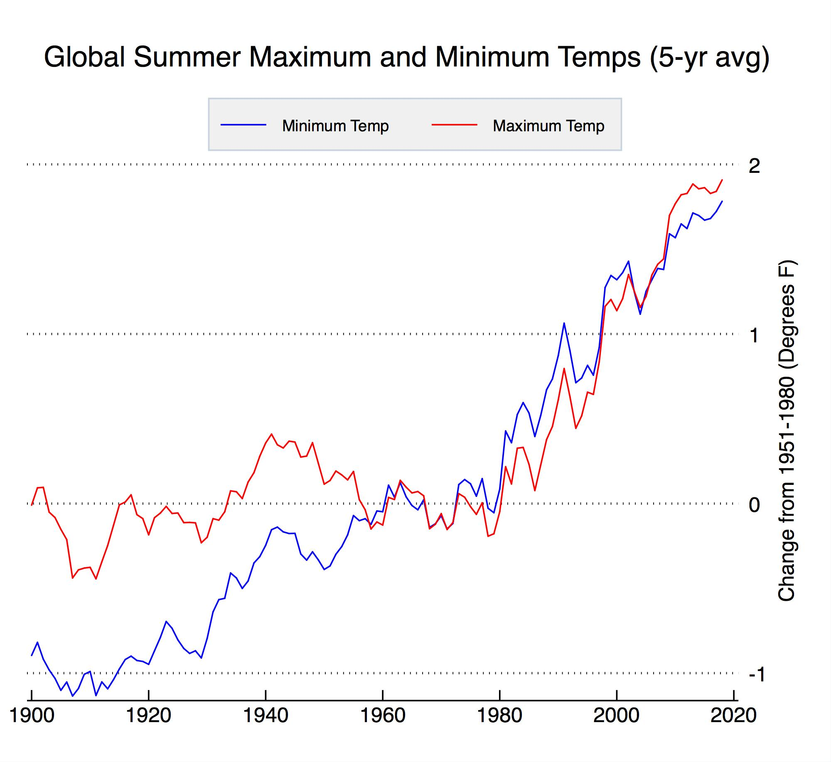

Slide 37
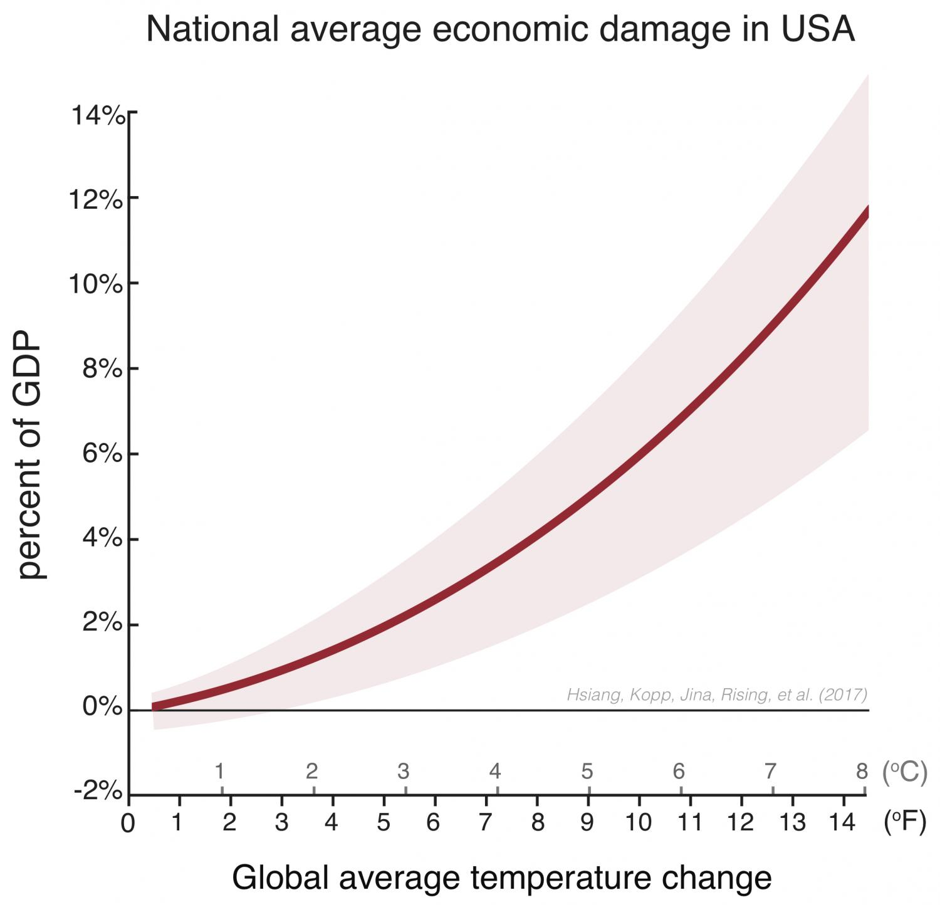

Slide 38
The likely range of total human-caused global surface temperature increase from 1850–1900 to 2010–2019 is 0.8°C to 1.3°C, with a best estimate of 1.07°C. It is likely that well-mixed GHGs contributed a warming of 1.0°C to 2.0°C, other human drivers (principally aerosols) contributed a cooling of 0.0°C to 0.8°C, natural drivers changed global surface temperature by –0.1°C to 0.1°C, and internal variability changed it by –0.2°C to 0.2°C. It is very likely that well-mixed GHGs were the main driver of tropospheric warming since 1979

