Slide 1

What We Know About Climate Change:
Risks and Opportunities
Kerry Emanuel
Lorenz Center
Department of Earth, Atmospheric, and Planetary Sciences, MIT
Web: emanuel.mit.edu

Slide 2

Summary of Main Points:
Earth’s climate is stable within certain limits, but sensitive to change in forcing within those limits.
Climate science has a long and illustrious history
The idea that we are altering climate is based on simple physics, simple models, and complex models
Human activities can and do have a strong effect on climate
We are beginning to quantify some climate-related risks
It is necessary to start to decarbonize now and to move quickly to finish the job
Where there is risk there is also opportunity

Slide 3
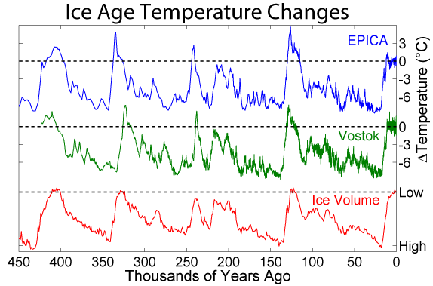
Last 450 Thousand Years

Slide 4
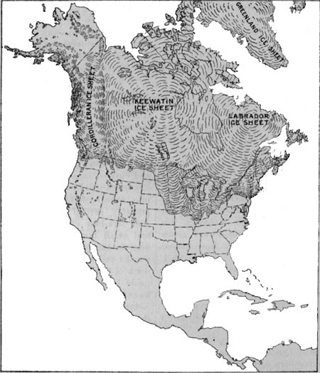
Maximum extent of first major Pleistocene Glaciation: The Pre-Illinoian Stage, formerly known as the Nebraskan Glacial

Slide 5
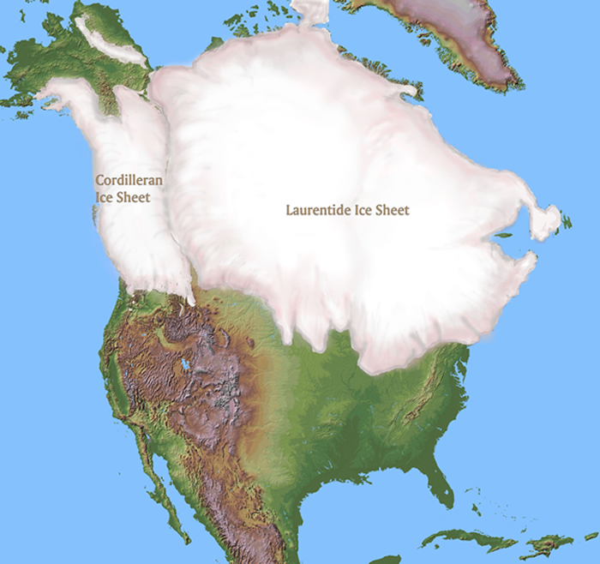
Most recent glacial maximum, ~ 20,000 years before present

Slide 6
Source: Annan and Hargreaves, Clim. Past, 9, 367–376, 2013

Slide 7

Polar radiative forcing: 10 W/m² (4 W/m² for 2 x CO₂)
Global mean temperature fluctuation: ~5 C

Slide 8

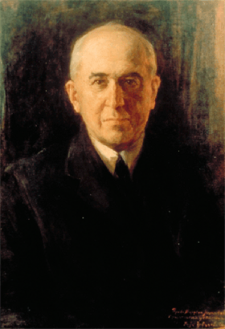
Climate Forcing by Orbital Variations (1912)
Milutin Milanković, 1879-1958

Slide 9
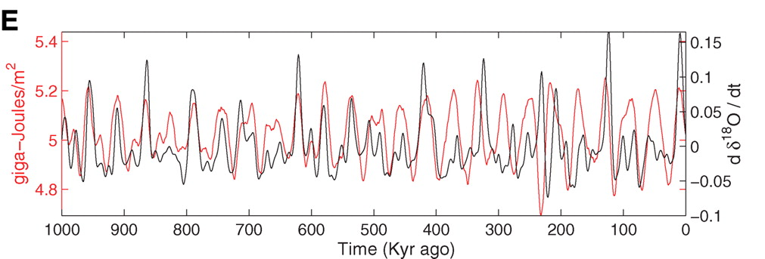
Strong Correlation between High Latitude Summer Insolation and Ice Volume
Black: Time rate of change of ice volume
Red: Summer high latitude sunlight
P. Huybers, Science, 2006

Slide 10


John Tyndall (1820-1893)

Slide 11
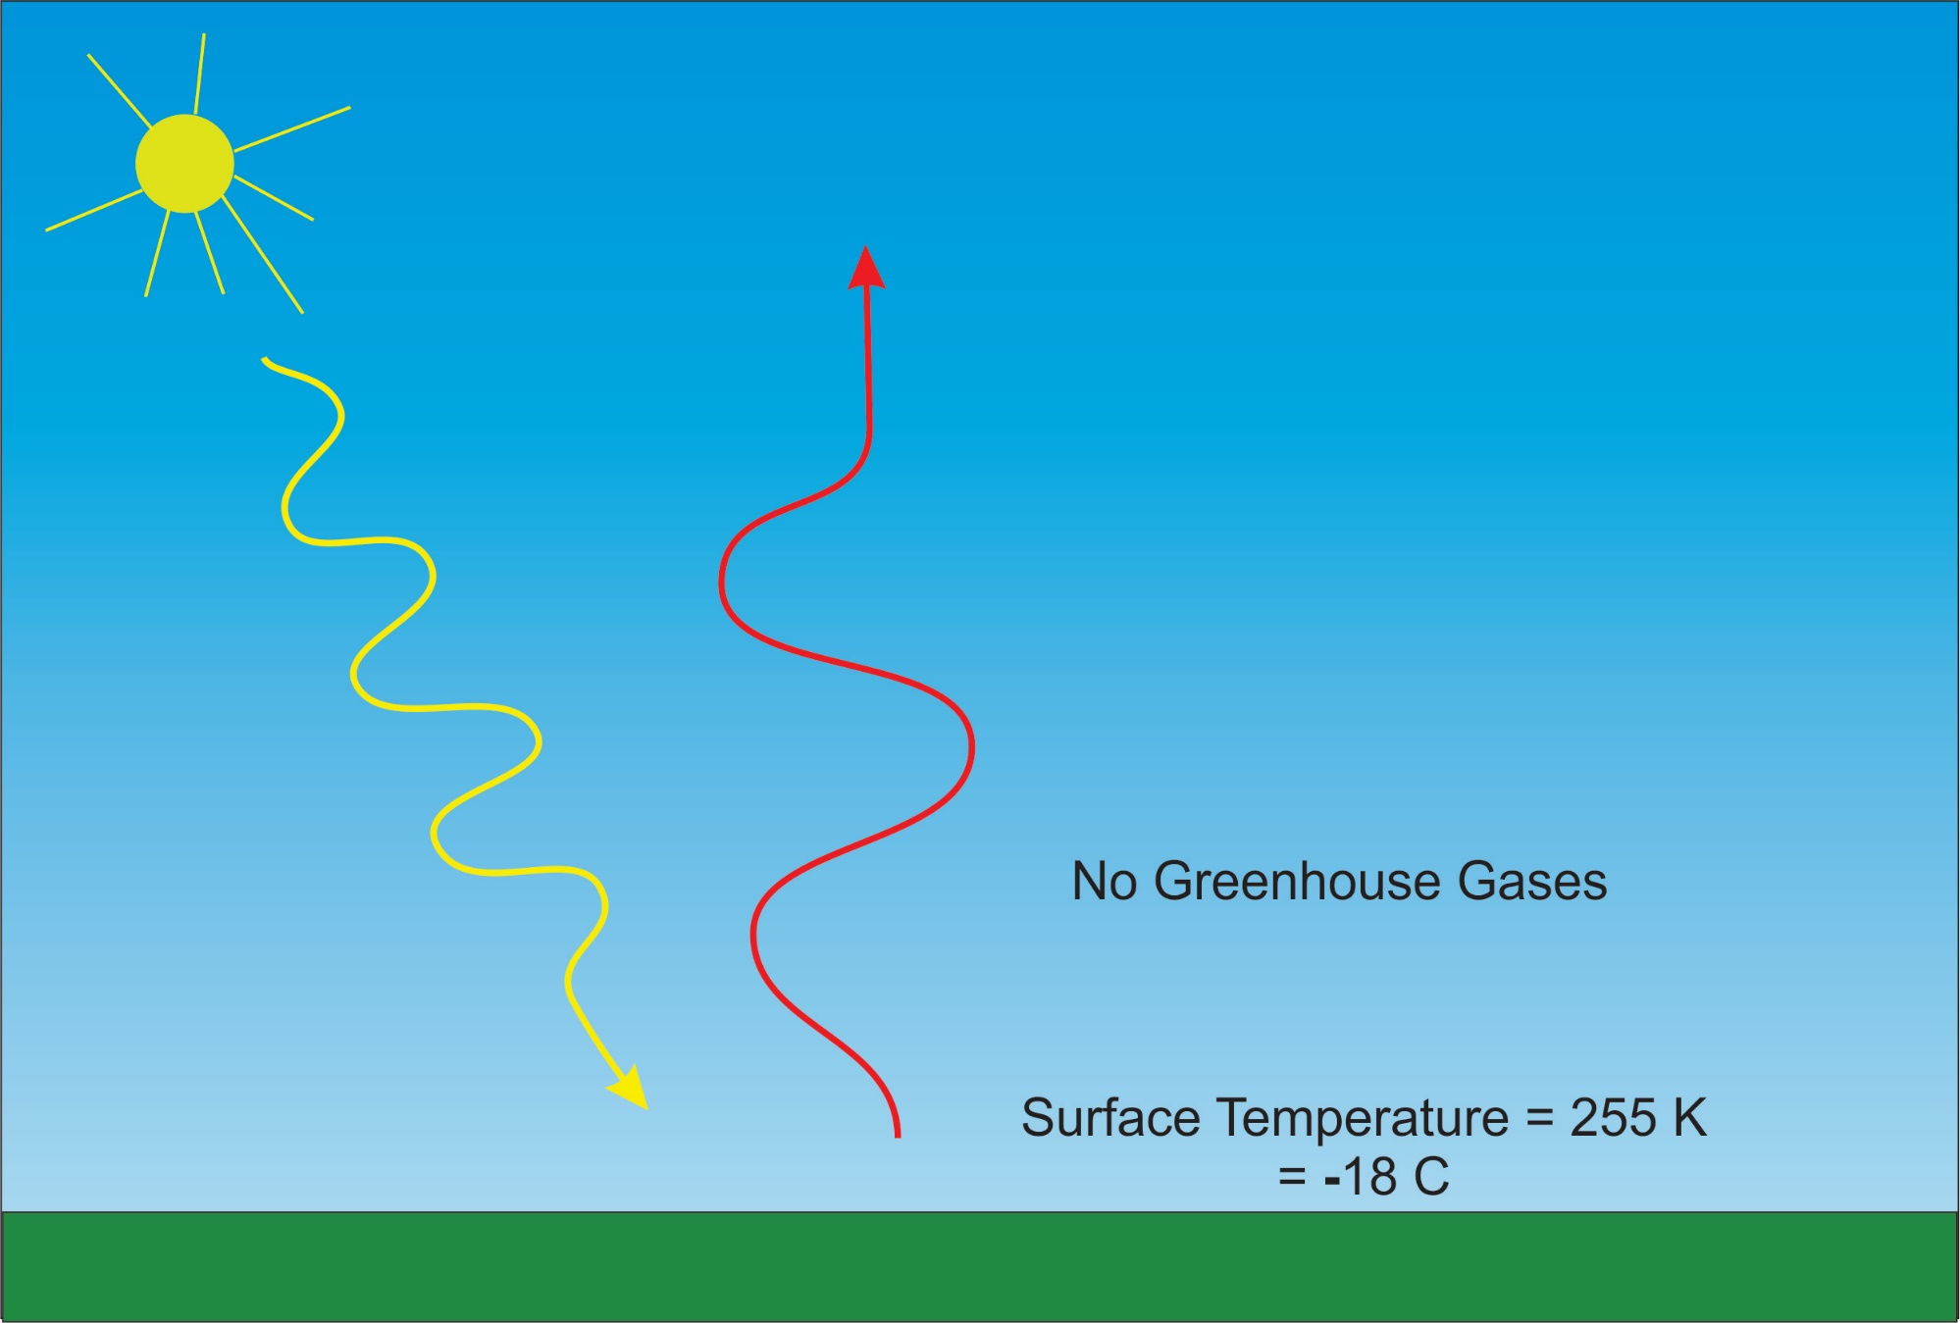

Slide 12
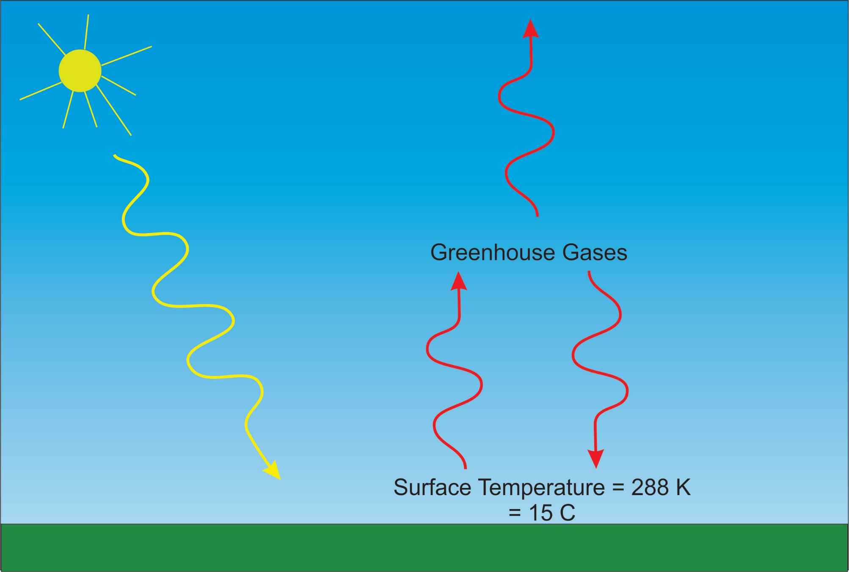

Slide 13
Tyndall’s Essential Results:
Oxygen (O₂ ), nitrogen (N₂), and argon (Ar), though they make up ~99% of the atmosphere, are almost entirely transparent to solar and terrestrial radiation
Water vapor (H₂O), carbon dioxide (CO₂), nitrous oxide (N₂O), and a handful of other trace gases make the lower atmosphere nearly opaque to infrared radiation, though still largely transparent to solar radiation (but clouds have strong effects on radiation at all wavelengths). Together they increase the Earth’s surface temperature from about 0ºF to around 60ºF.

Slide 14
Atmospheric Composition
The orange sliver makes the difference between a mean surface temperature of 0ºF and of 60ºF.

Slide 15
Water Vapor (H₂O), about 0.25% of the mass of the atmosphere, is the most important greenhouse gas, but responds to atmospheric temperature change on a time scale of about 2 weeks
Climate is therefore strongly influenced by long-lived greenhouse gases (e.g. CO₂, CH₄, N₂O) that together comprise about 0.04% of the mass of the atmosphere. Concentration of CO₂ has increased by 43% since the dawn of the industrial revolution

Slide 16

Svante Arrhenius, 1859-1927
“Any doubling of the percentage of carbon dioxide in the air would raise the temperature of the earth's surface by 4°; and if the carbon dioxide were increased fourfold, the temperature would rise by 8°.” – Världarnas utveckling (Worlds in the Making), 1906

Slide 17
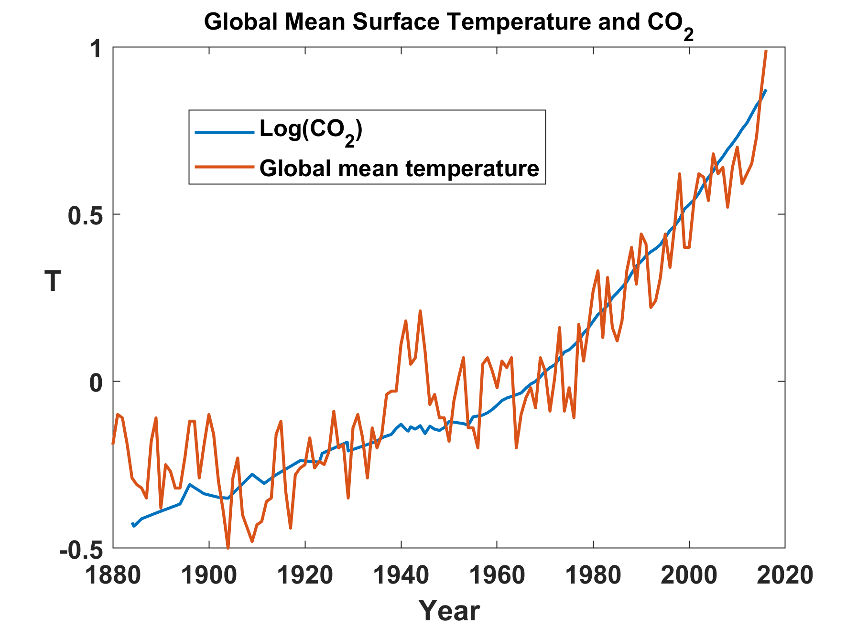

Slide 18
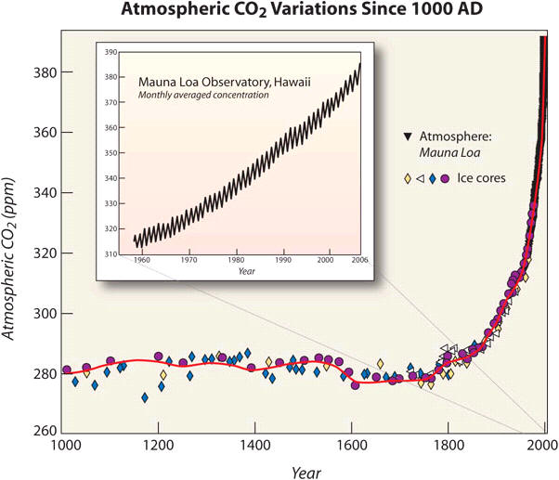

Slide 19
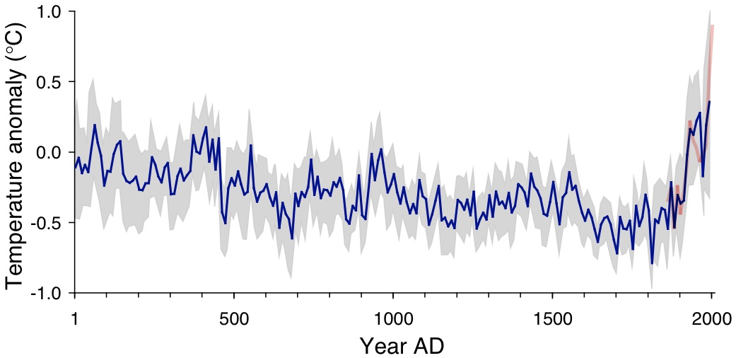
Arctic air temperature change reconstructed (blue), observed (red)
The long-term cooling trend in the Arctic was reversed during recent decades. The blue line shows the estimated Arctic average summer temperature over the last 2000 years, based on proxy records from lake sediments, ice cores, and tree rings. The shaded area represents variability among the 23 sites use for the reconstruction. The red line shows the recent warming based on instrumental temperatures. From Kaufman et al. (2009).

Slide 20
Other Trends

Slide 21
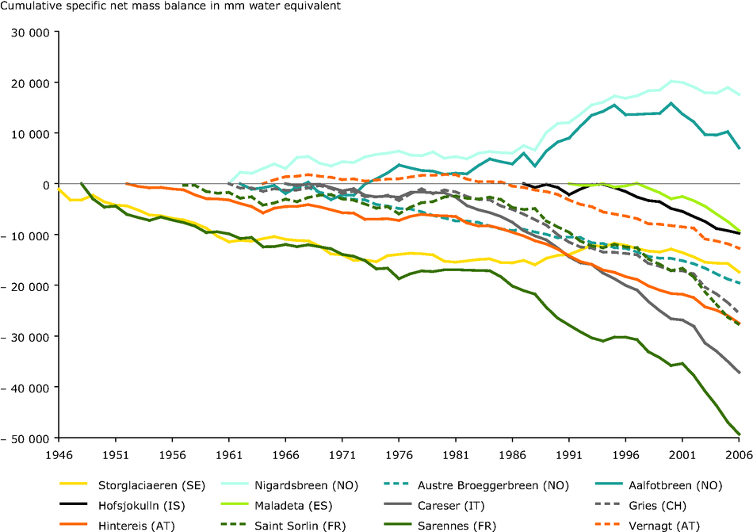
European Alpine Glaciers

Slide 22
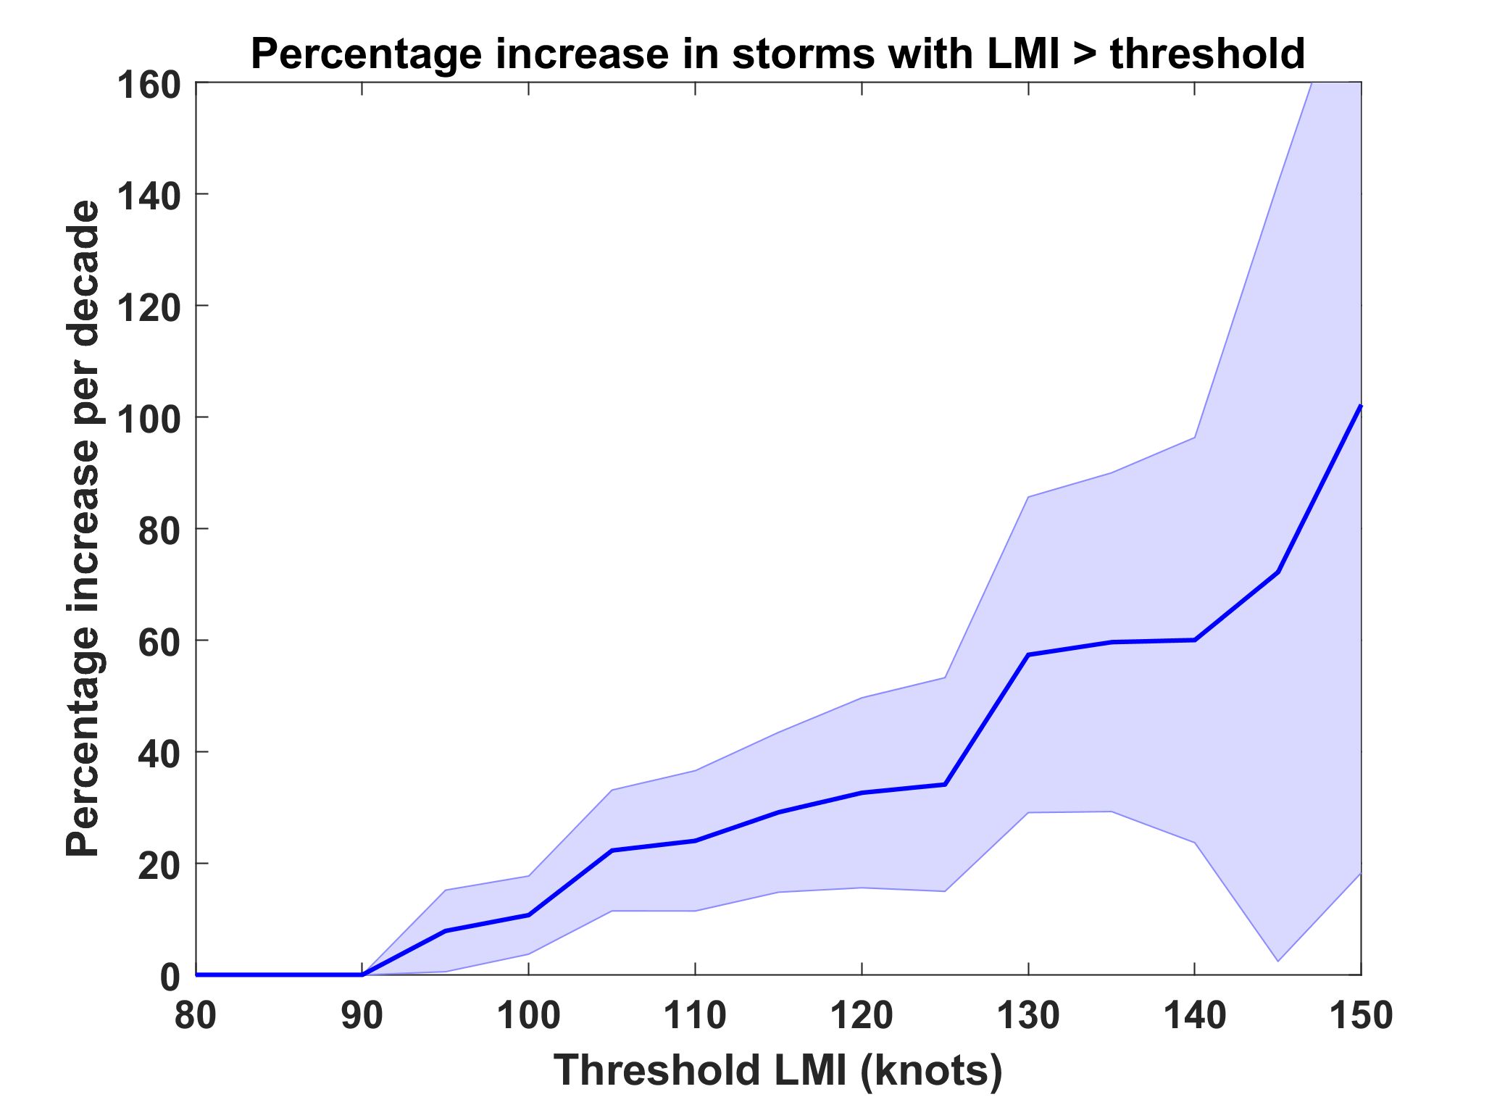
Trends in Global TC Frequency Over Threshold Intensities, from Historical TC Data, 1980-2016. Trends Shown Only When p < 0.05.

Slide 23
Hurricanes are reaching peak intensity at higher latitudes
Time series of the latitudes at which tropical cyclones reach maximum intensity.
From Kossin et al. (2014)

Slide 24

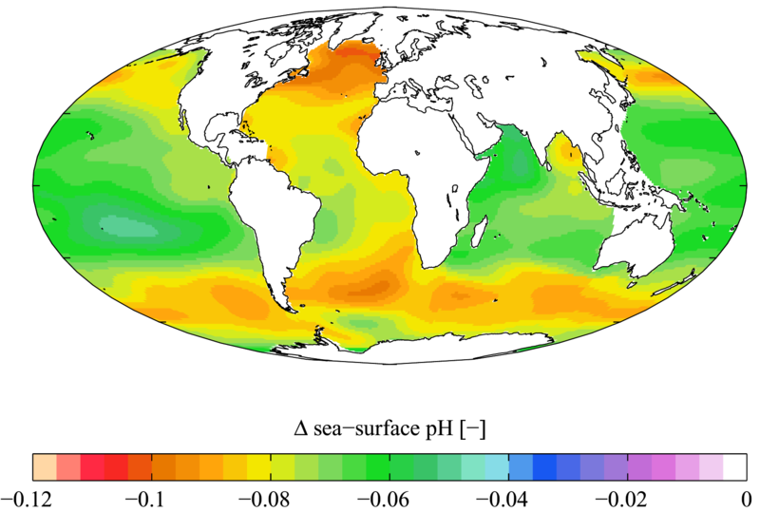

Slide 25

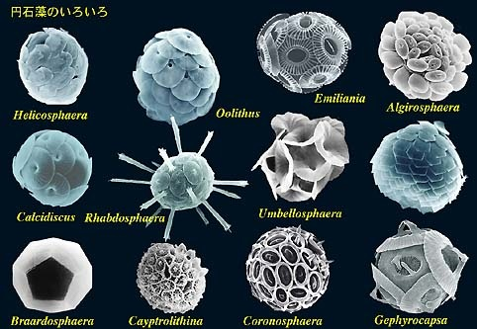

Acidification through CO₂ threatens marine life
Plankton
Coral Reefs
Notes:
Abbildung 4.3-1
Aragonitsättigung und
gegenwärtige Riffstandorte
von Warmwasserkorallen
(blaue Punkte). (a)
vorindustrielle Werte
(ca. 1870, atmosphärische
CO2-Konzentration
280 ppm), (b) Gegenwart
(ca. 2005, 375 ppm CO2), (c)
Zukunft (ca. 2065, 517 ppm
CO2). Der Grad der
Aragonitsättigung (Ù)
bezeichnet das relative
Verhältnis zwischen dem
Produkt der Konzentrationen
von Kalzium- und
Karbonationen und dem
Löslichkeitsprodukt für
Aragonit. Standorte mit
einer Aragonitsättigung
unterhalb von 3,5 sind nur
noch bedingt für riffbildende
Warmwasserkorallen
geeignet (marginal),
unterhalb von 3 sind sie
ungeeignet.
Quelle: Steffen et al., 2004

Slide 26
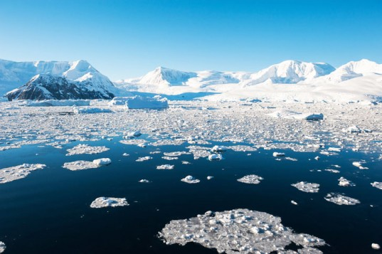
Simple Models of Climate Change

Slide 27
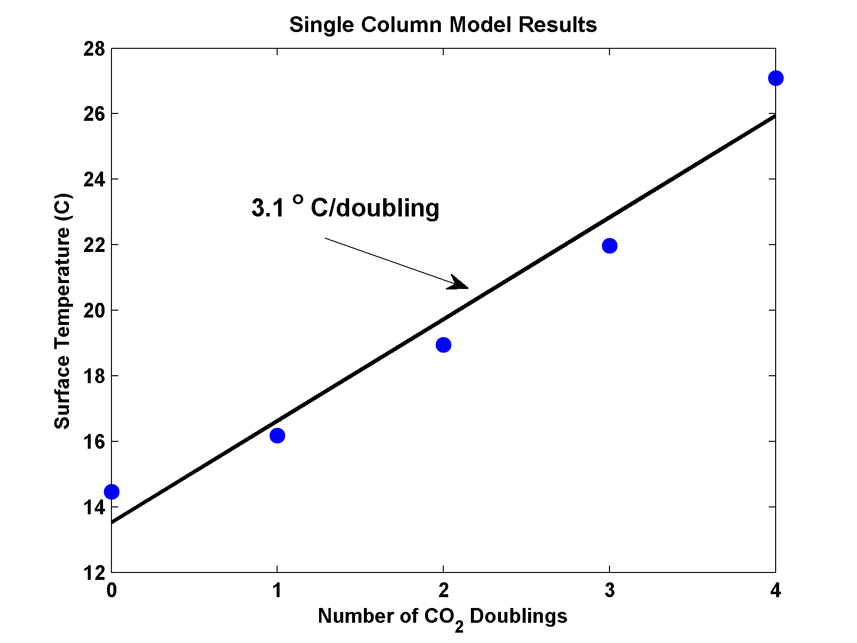
MIT Single Column Model
(Radiation and Convection Only)
IPCC Estimate:
2-4.5 ºC

Slide 28
Global Climate Models

Slide 29
20th Century With and Without Human Influences
Based on 4-member PCM ensembles, Meehl et al., J. Climate, 2004

Slide 30
The Future

Slide 31
Sources of Uncertainty
Cloud Feedback
Water Vapor Feedback
Ocean Response
Aerosols

Slide 32


Estimate of how much global climate will warm as a result of doubling CO₂: a probability distribution
Source: 100000 PAGE09 runs
Chris Hope, U. Cambridge
courtesy Tim Palmer
Notes:
Describe pdf. Reflects post-IPCC knowledge as well as IPCC AR4.

Slide 33

CO₂ Will Go Well Beyond Doubling
Double Pre-Industrial

Slide 34

IPCC 2007: Doubling CO₂ will lead to an increase in mean global surface temperature of 2 to 4.5 ºC.
Atmospheric CO₂ assuming that emissions stop altogether after peak concentrations
Global mean surface temperature corresponding to atmospheric CO₂ above
Courtesy Susan Solomon

Slide 35
Known Risks
Increasing sea level
Increasing hydrological events… droughts and floods
Increasing incidence of high category hurricanes and associated storm surges and freshwater flooding
More heat stress and other health risks
Armed conflict
Some increase in plant productivity
Reduction in health problems related to cold weather
Benefits

Slide 36
“Taken as a whole, the range of published evidence indicates that the net damage costs of climate change are likely to be significant and to increase over time.”
- Intergovernmental Panel on Climate Change

Slide 37
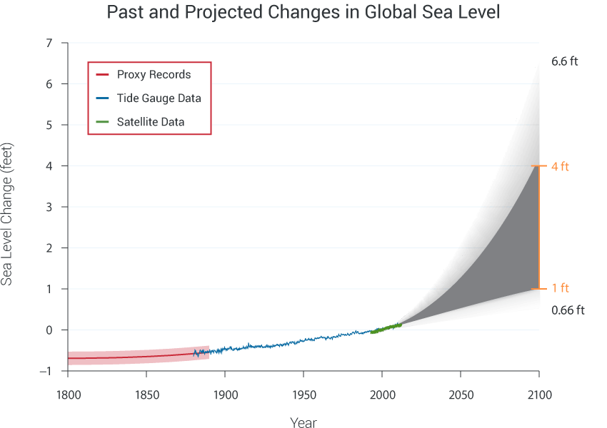

Slide 38
Specific Risks:
Heat
Notes:
Image credit: IPCC (2001)

Slide 39
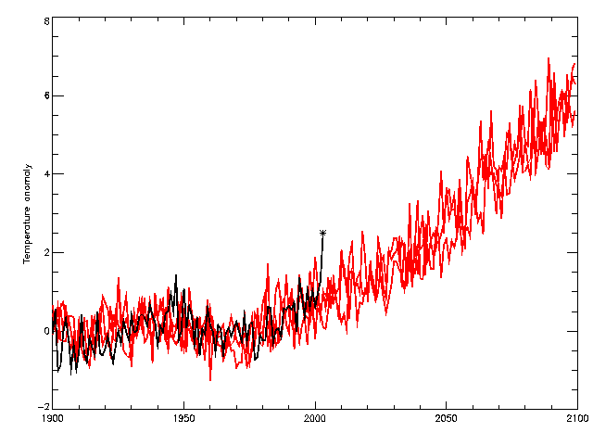
Heat Waves
2060s
observations
HadCM3 Medium-High (SRES A2)
2040s
2003
Temperature anomaly (wrt 1961-90) °C

Slide 40

Hydrological Extremes
Rainfall intensity (how hard it rains when/where it is raining) scales with the Clausius-Clapeyron equation, doubling for every 10º C temperature increase
Wet places get wetter, dry places get drier; incidence of both floods and droughts increases
Large potential effects on food and water supplies; major national security issue

Slide 41
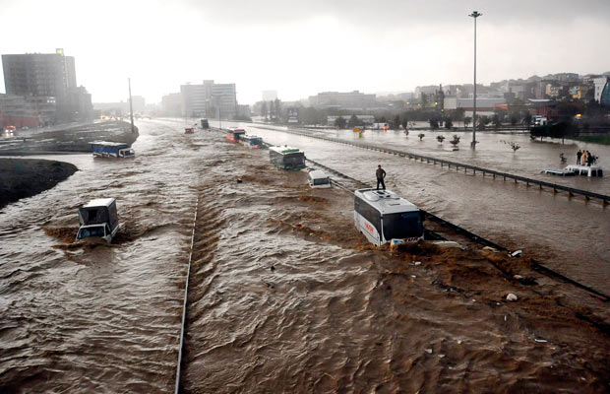
Hydrological Extremes Increase with Temperature
Floods

Slide 42
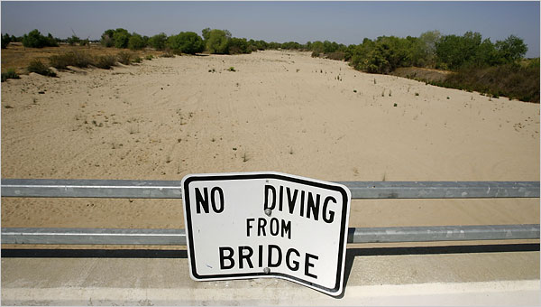
Drought

Slide 43
“Climate change could have significant geopolitical impacts around the world, contributing to poverty, environmental degradation, and the further weakening of fragile governments. Climate change will contribute to food and water scarcity, will increase the spread of disease, and may spur or exacerbate mass migration.”
    -- Quadrennial Defense Review, U.S. Department of Defense, February, 2010

Slide 44
Ocean Acidification

Slide 45

Hurricanes

Slide 46
2017 Hurricane Records
Harvey’s storm total rainfall was largest ever recorded from a hurricane in the U.S.
Hurricane Irma sustained Category 5 winds for longer than ever recorded in any tropical cyclone on the planet
Hurricane Irma was the first recorded Atlantic hurricane to reach Cat 4 status outside the Caribbean and the second strongest hurricane ever recorded in the Atlantic
The 2017 hurricanes caused more than $300 billion in damages, the largest of any hurricane season on record

Slide 47
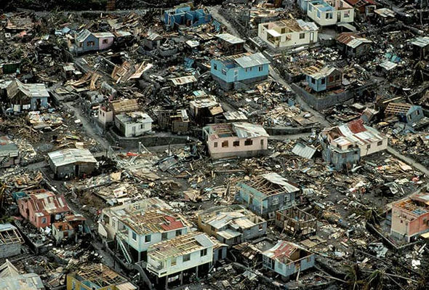
Dominica in the wake of Hurricane Maria

Slide 48
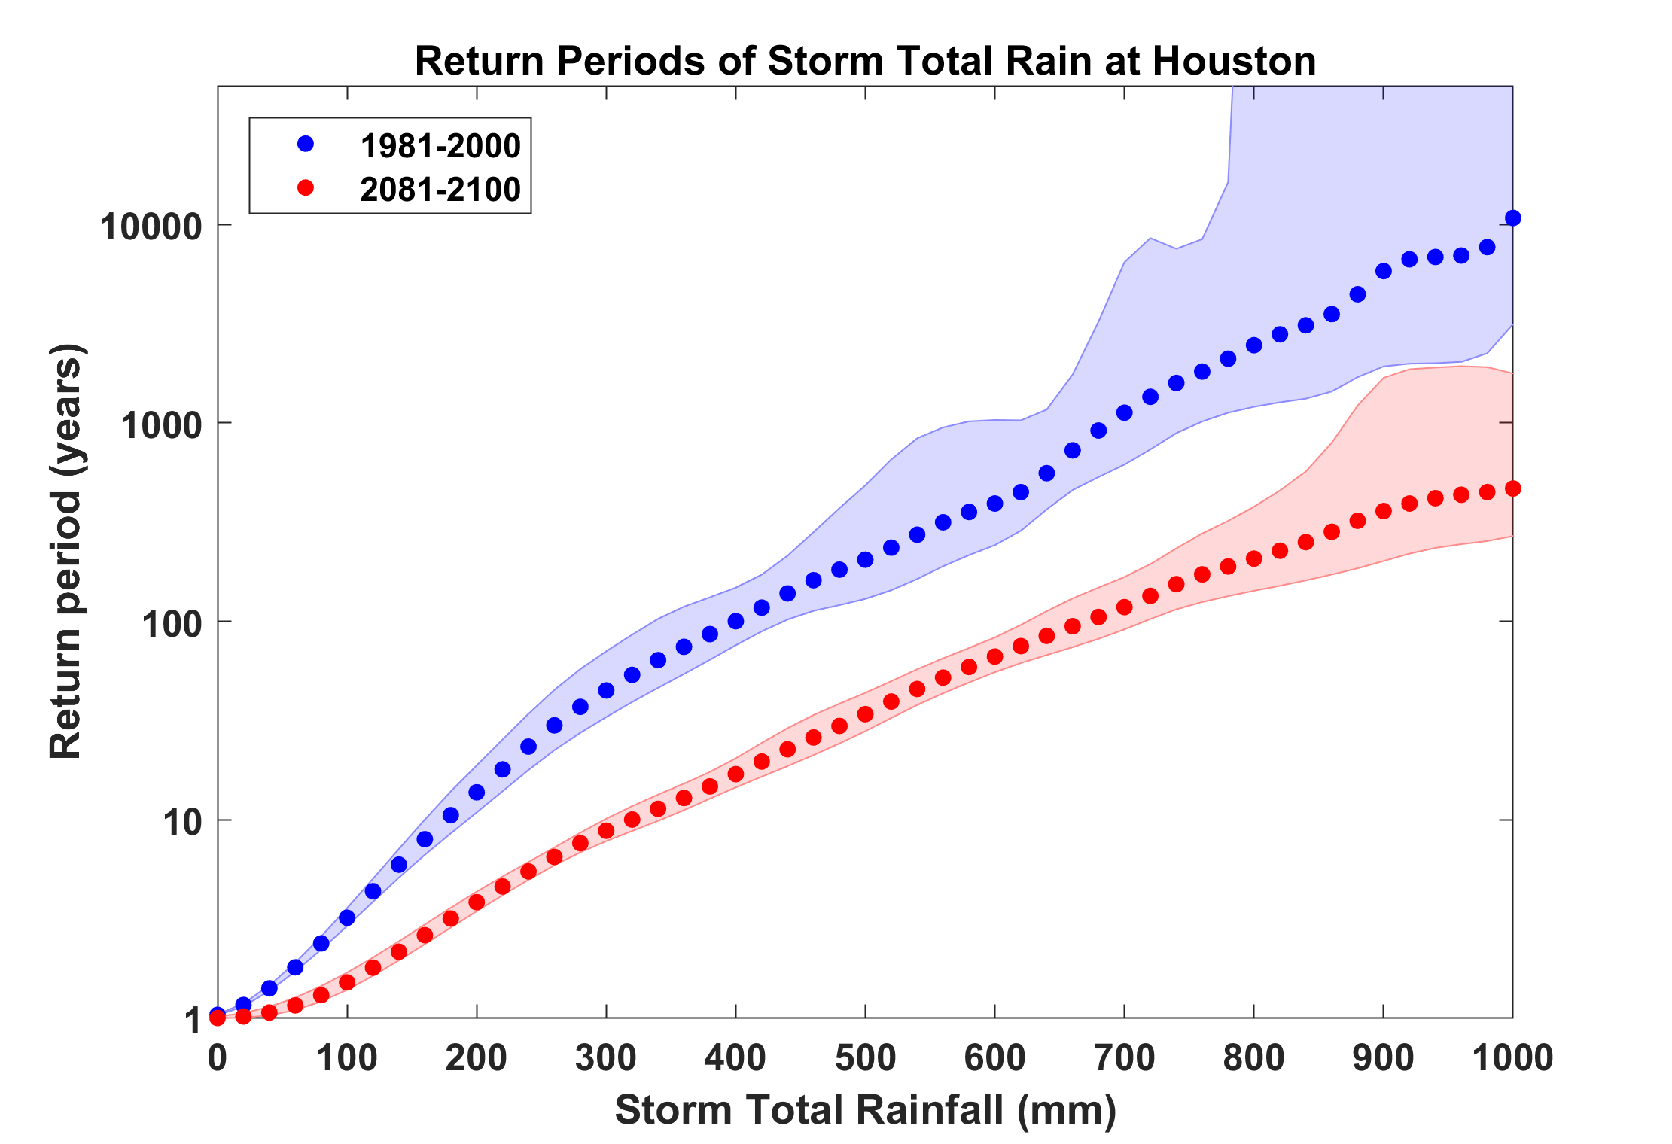
Probability of Storm Accumulated Rainfall at Houston, from 6 Climate models, 1981-2000 and 2081-2100, Based on 2000 Events Each. Shading shows spread among the models.
Harvey

Slide 49
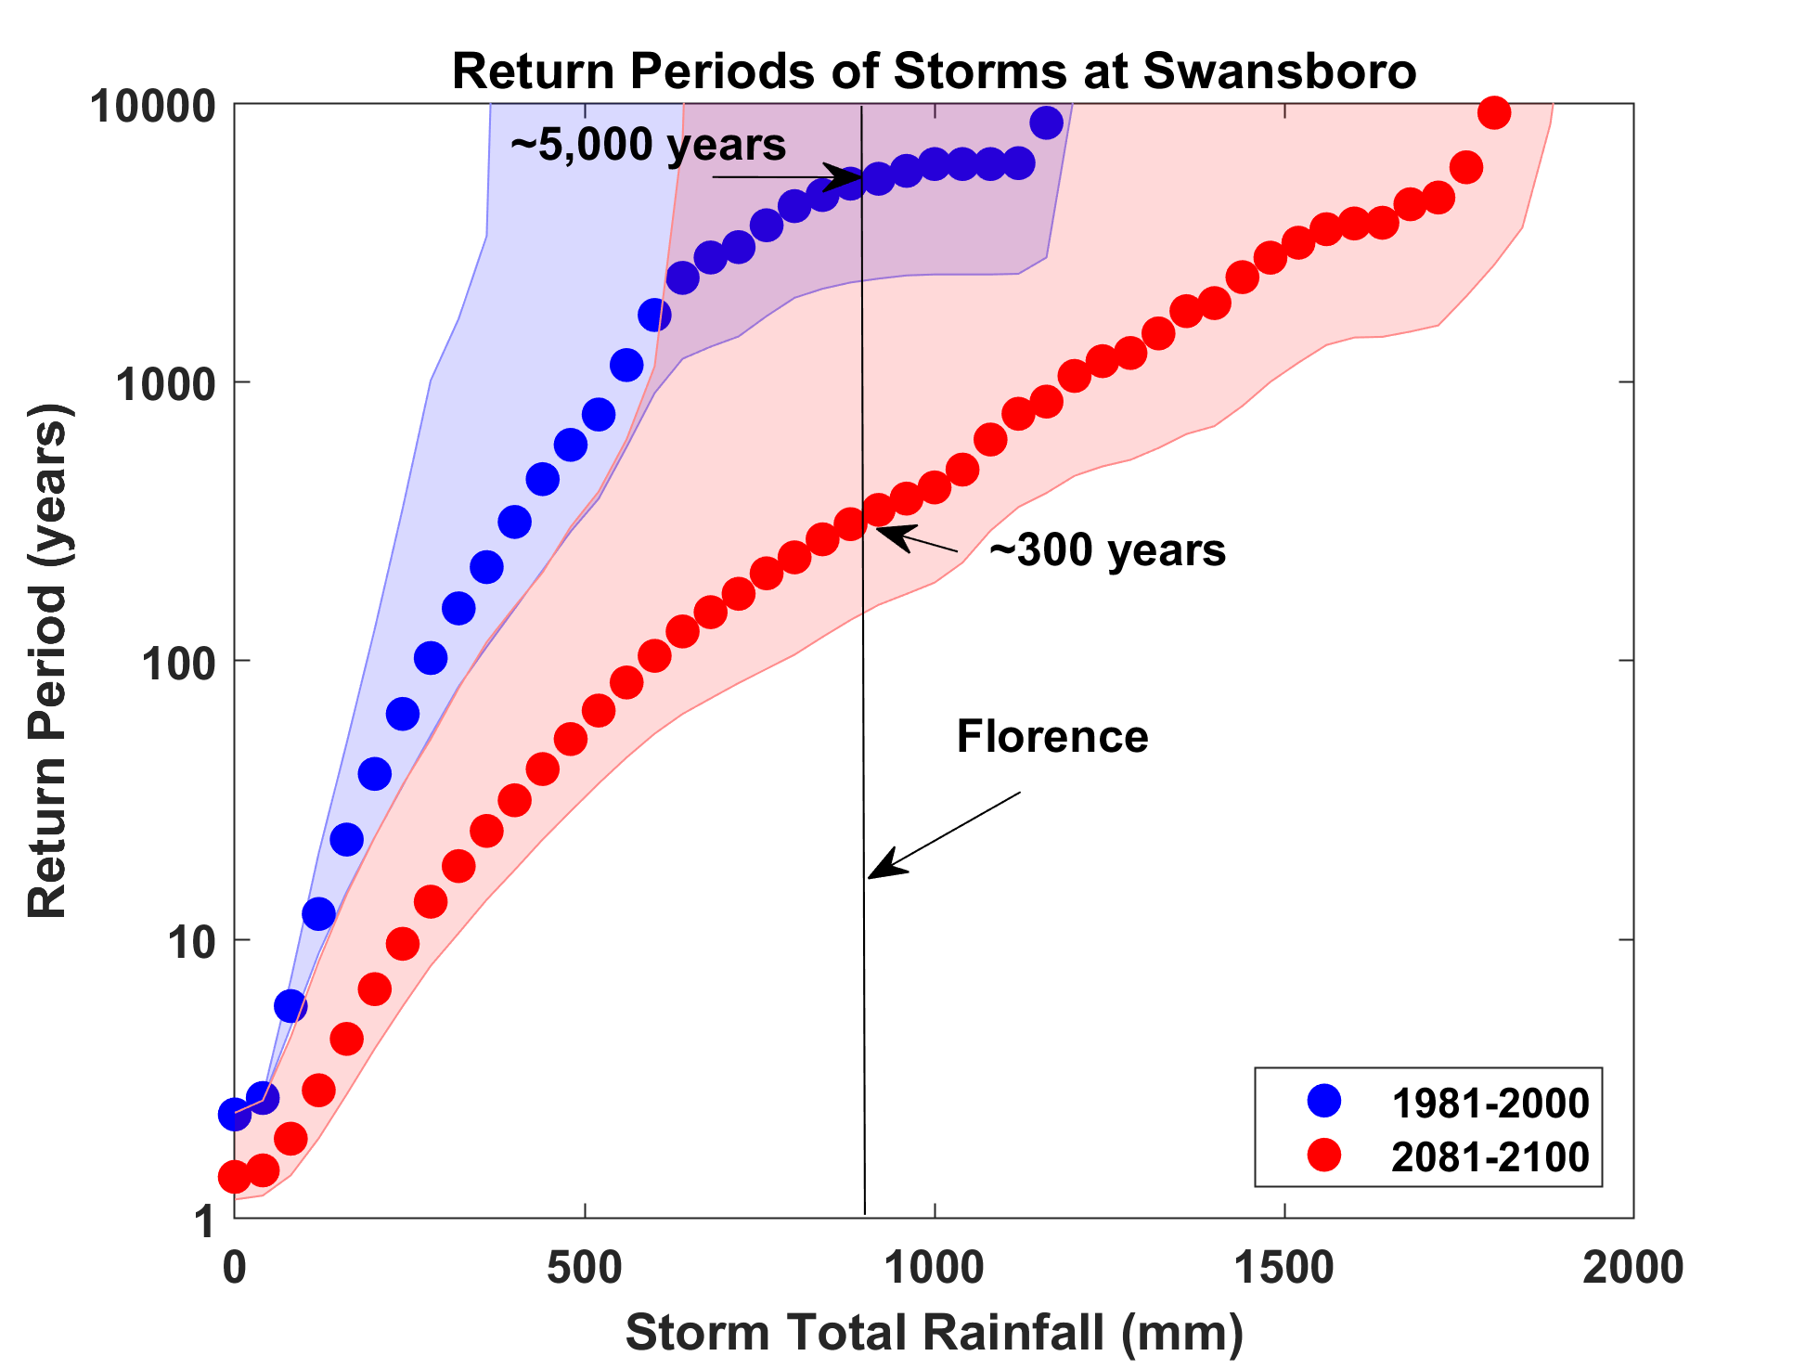

Slide 50
Sea level rise + changing storms
Sea level rise alone
From: American Climate Prospectus Economic Risks in the United States

Slide 51
Solutions and Opportunities
Renewables (solar and wind)
  Might provide up to 30% of current power needs
  Limited by intermittency and lack of storage
Carbon Capture and Sequestration
  Currently would add ~$200/ton to energy costs
  Reasonable prospects for reducing this to ~$100/ton
  Currently little incentive to develop this
Nuclear fission and fusion

Slide 52
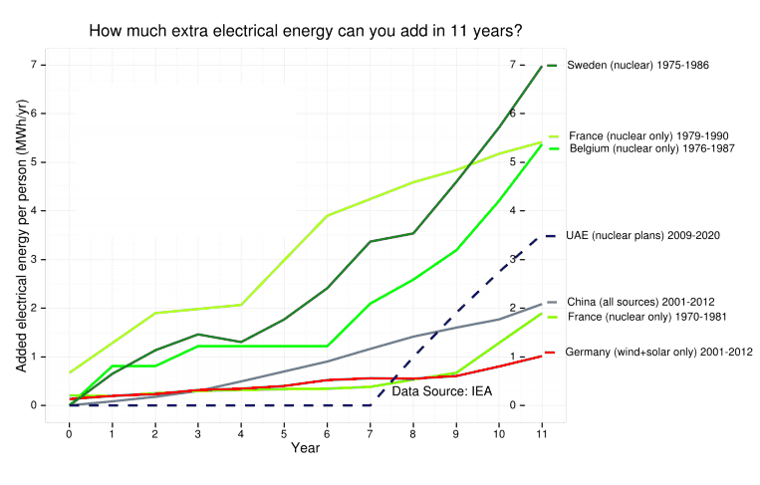
Ramping up Fission Power

Slide 53
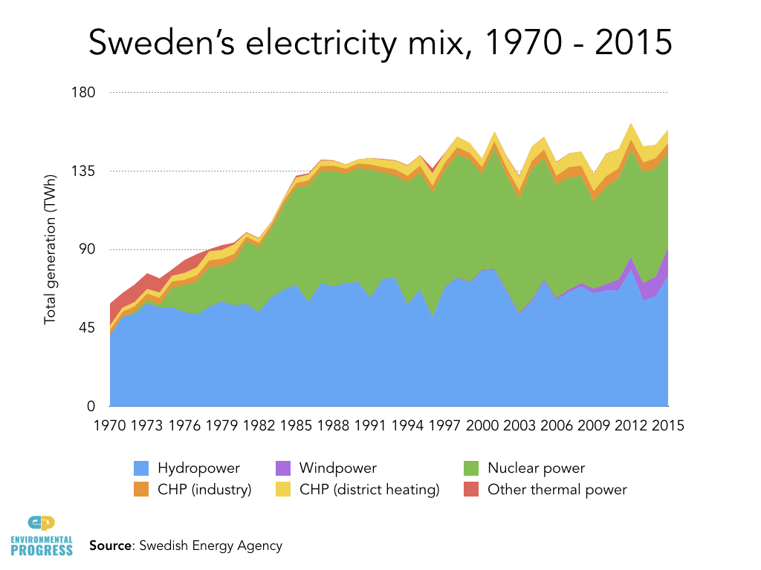
CHP=Combined Heat & Power (co-generation)

Slide 54
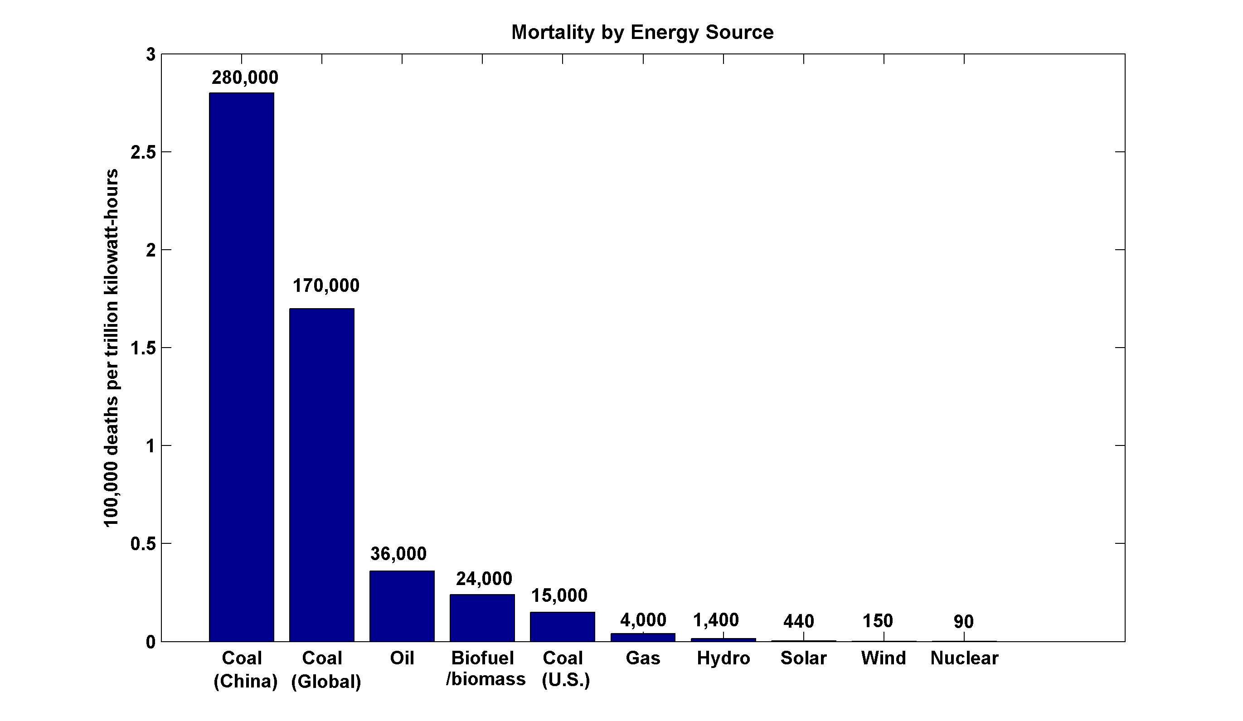
~13,000 premature deaths annually in the U.S. from coal production and combustion
Nuclear power, by replacing fossil fuels, has prevented an estimated 1.84 million air-pollution related deaths worldwide
(includes Chernobyl, Fukushima)

Slide 55
We Can Do Even Better:
Next Generation (Gen IV) Fission Reactors
One Example: Molten Salt Reactors
  Passively safe
  Can help process waste from Light Water Reactors
  Operate at ambient pressure
  Can run on thorium; unsuitable for weapons
  Estimated plant lifetime > 80 years

Slide 56
Summary of Main Points
Several aspects of climate science are well established
Earth’s climate is strongly bounded but shows strong sensitivity within the bounds
Climate science dates back well into the 19th century and is well established

Slide 57
Summary of Main Points
Earth’s greenhouse effect triples the amount of radiation absorbed by the surface though it is regulated by trace gases comprising no more than 0.04% of the mass of the atmosphere. The concentration of CO₂ has increased by ~45% since the dawn of the industrial revolution
Beginning with the calculations of Arrhenius more than 100 years ago, simple models predict an increase in global mean surface temperature of around 3 ºC for each doubling of CO₂. These are consistent with the results of global climate models
Long atmospheric lifetime (~1000 years) of CO₂ limits window of time in which serious risks could be curtailed

Slide 58
Summary of Main Points
Renewables are fine, but if we want to decarbonize fast, nuclear fission is essential. Climate risks are far greater than nuclear risks.
We will eventually need to do this anyway. Why not start now?
Real world economics: 20 years from now, will we be selling clean energy technology to China and India, or buying it from them?

Slide 59
Spare Slides

Slide 60
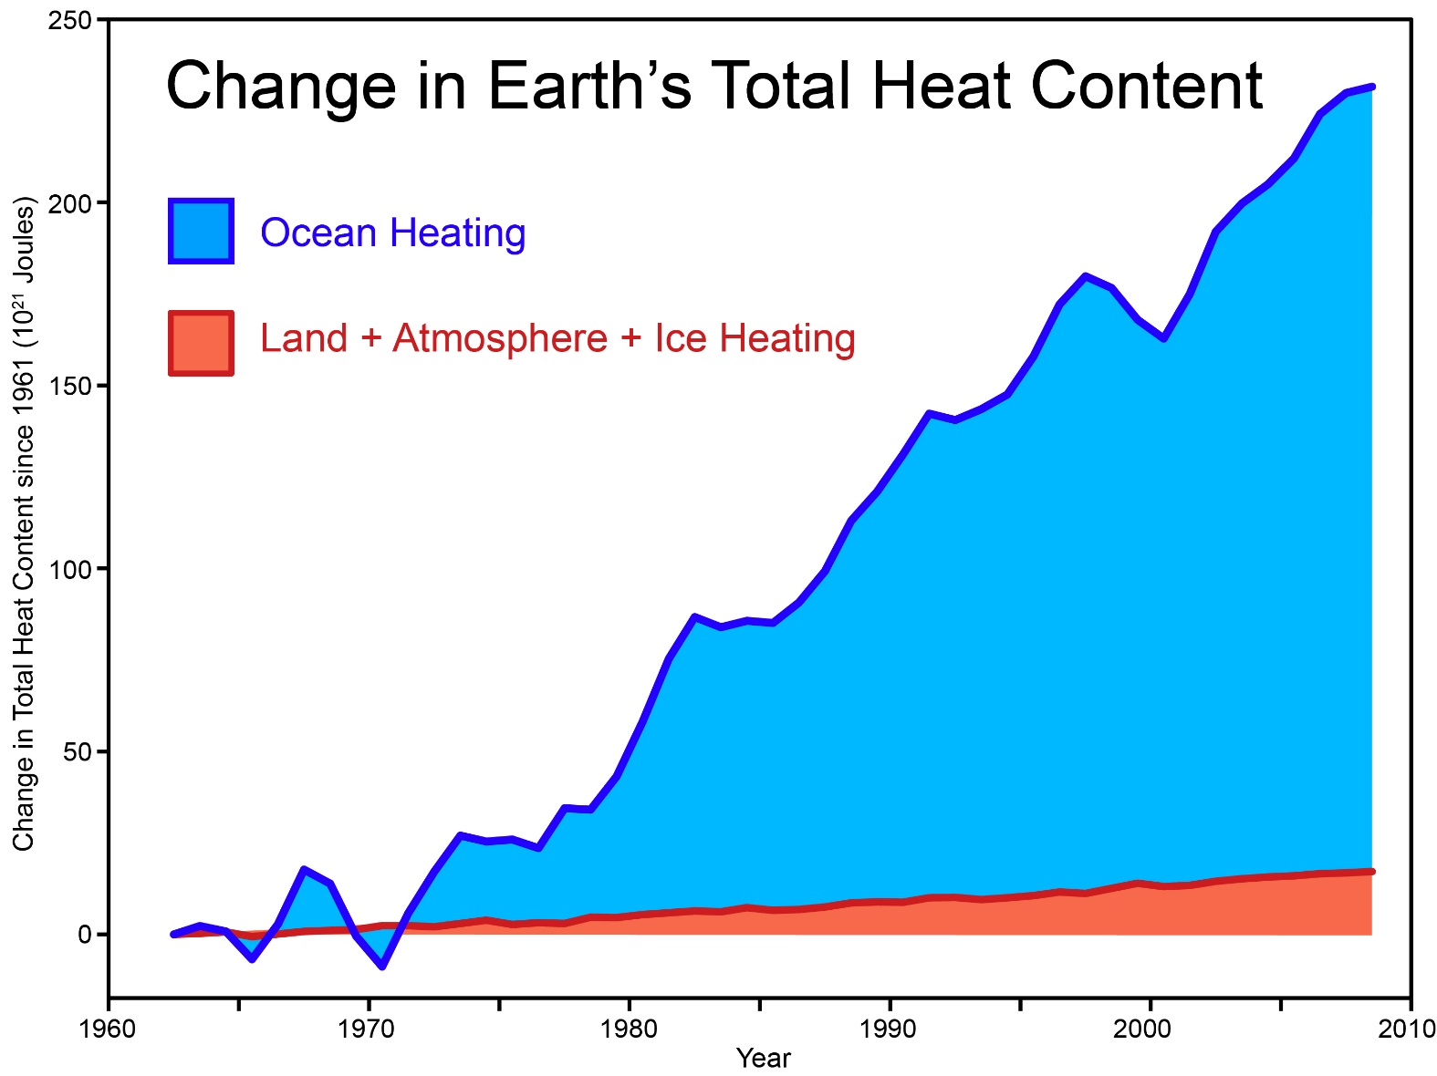
Total amount of heat from global warming that has accumulated in Earth's climate system since 1961, from Church et al. (2011) (many thanks to Neil White from the CSIRO for sharing their data).
Notes:
http://www.skepticalscience.com/graphics.php?g=46

Slide 62
Energy Source Mortality Rate (deaths/trillionkWhr)
Coal – global average 170,000 (50% global electricity)
Coal – China 280,000 (75% China’s electricity)
Coal – U.S. 15,000 (44% U.S. electricity)
Oil (electricity) 36,000 (36% of energy, 8% of Natural Gas 4,000 (20% global electricity)
Biofuel/Biomass 24,000 (21% global energy)
Solar (rooftop) 440 (< 1% global electricity)
Wind 150 (~ 1% global electricity)
Hydro – global average 1,400 (15% global electricity)
Nuclear – global average 90 (17% global electricity w/Chern&Fukush)

Slide 63
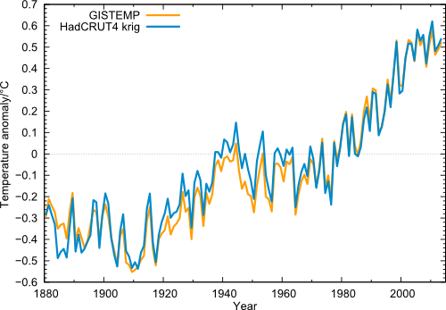
Global temperature (annual values) in the data from NASA GISS (orange) and from Cowtan & Way (blue), i.e. HadCRUT4 with interpolated data gaps.

Slide 64
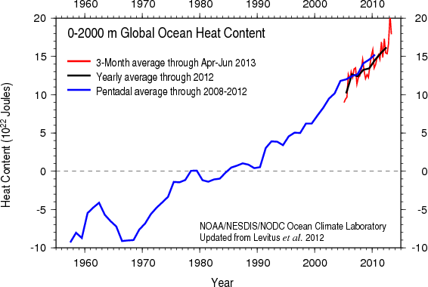
Based on bathythermograph and ARGO (post-2004) data
Image credit: NOAA

Slide 65
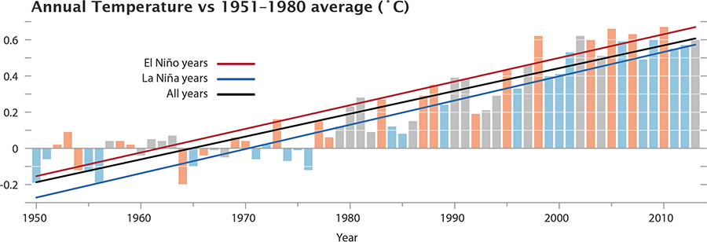
The GISS data, with El Niño and La Niña conditions highlighted. Neutral years like 2013 are gray.

Slide 66
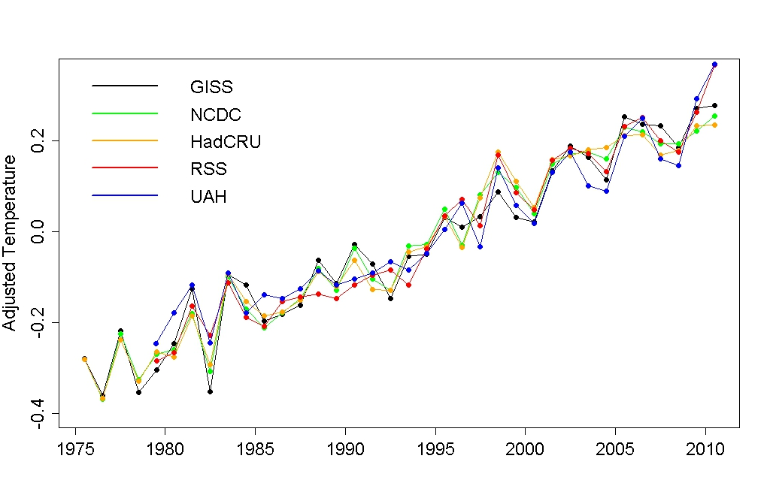
Adjusted annual average temperature data with the estimated impact of El Niño, volcanic eruptions, solar variation, and the residual annual cycle removed.
Notes:
http://tamino.wordpress.com/2011/01/20/how-fast-is-earth-warming/

Slide 67
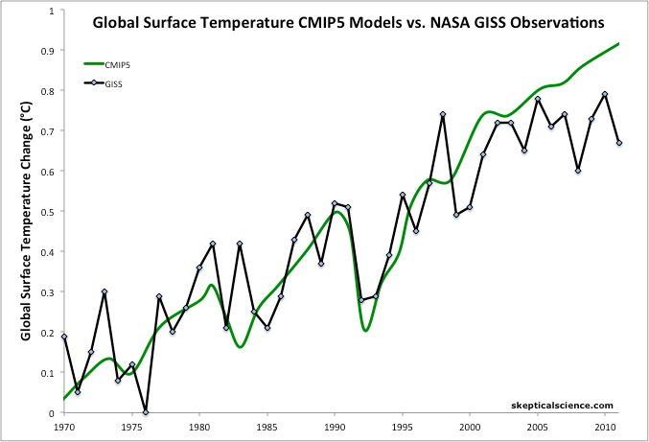
Figure 1: Average global temperature surface anomaly multi-model mean from CMIP5 (green) and as measured by the NASA Goddard Institute for Space Studies (GISS black). Most of this figure is a hindcast of models fitting past temperature data.
Notes:
http://www.skepticalscience.com/christy-exaggerates-model-data-discrepancy.html

Slide 68
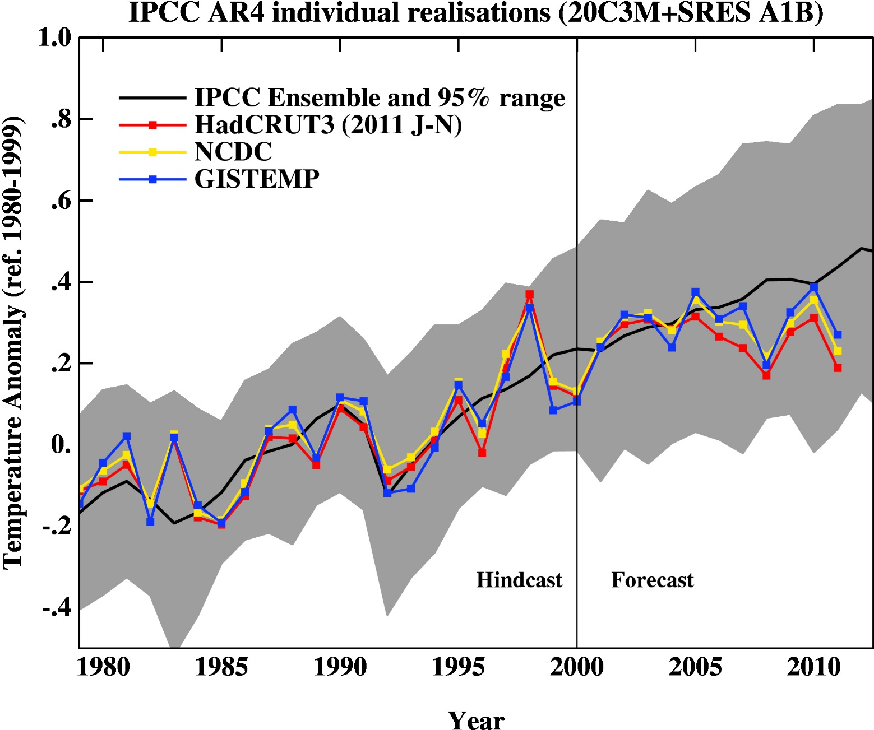
Figure 2: 2007 IPCC report model ensemble mean (black) and 95% individual model run envelope (grey) vs. surface temperature anomaly from GISS (blue), NOAA (yellow), and HadCRUT3 (red).
Notes:
http://www.skepticalscience.com/christy-exaggerates-model-data-discrepancy.html

Slide 69
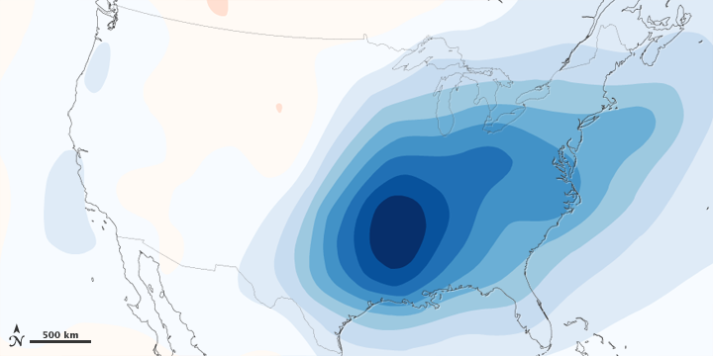
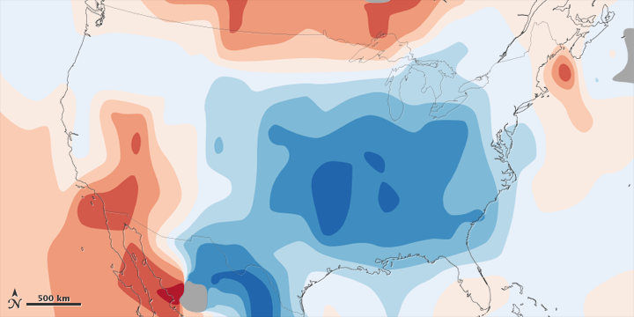
Figure 5: 1970-1990 aerosol loading of the atmosphere over the lower 48 United States and estimated associated surface air temperature change.
Figure 6: Observed total surface temperature change over the lower 48 United States from 1930 to 1990.
Notes:
http://www.skepticalscience.com/christy-exaggerates-model-data-discrepancy.html

Slide 70
Past and Projected Sea Level vs. Temperature
(Source: WBGU after David Archer 2006)
Notes:
This graph shows how temperature and sea level were closely related in Earth’s history. During the last Ice Age, temperatures were about 6 ºC colder than now, while sea level was 120 meters lower. During the Pliocene, when it was last significantly warmer than now (by about 2 ºC), sea level was 20-30 meters higher. During the Eocene there was almost no ice on the planet, and sea level was about 70 meters higher.
The history of climate thus sends a strong warning: past climate changes by just a few degrees in global temperature have come with very large sea level changes, by tens of meters. In the long run, this is likely to happen again. The sea level rise by the year 2100 (likely below one meter) is only the small beginning of a much larger rise that will unfold over coming centuries and perhaps millennia, caused by our carbon emissions in this century.

Slide 71

Paleo reconstructions of temperature change over the last 2000 years
“Hockey Stick”
Instrumental Record
Year
Notes:
71

Slide 72
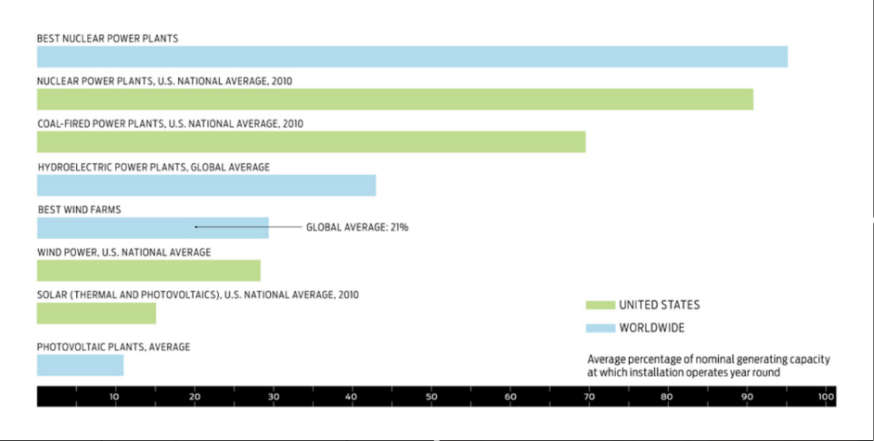
Renewables Require Baseload

Slide 73
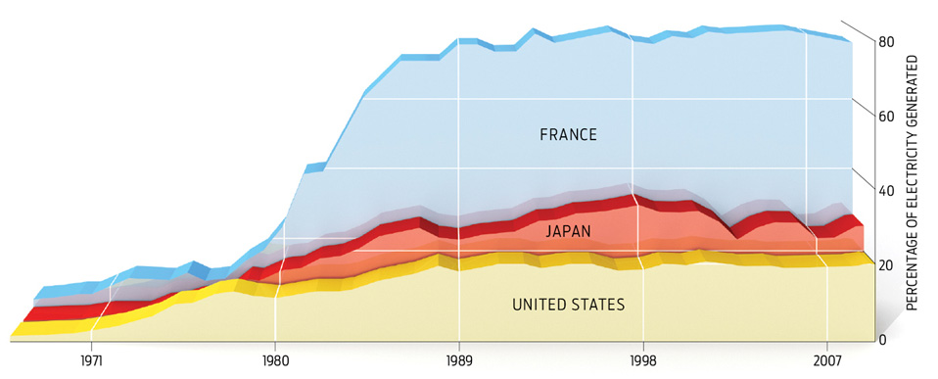
Can be deployed on 15-25 year time scale

Slide 74
Carbon Dioxide and Climate:
A Scientific Assessment
Report to the National Academy of Sciences
Jule G. Charney and co-authors
1979
When it is assumed that the CO2 content of the atmosphere is doubled and statistical thermal equilibrium is achieved, the more realistic of the modeling efforts predict a global surface warming of between 2°C and 3.5 °C, with greater increases at high latitudes.

Slide 75
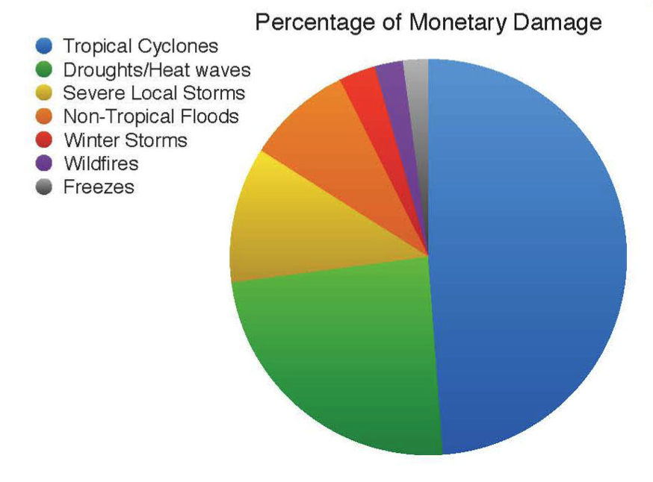
Total US Damages by Natural Hazard, 1980-2012
Source: NOAA

Slide 76
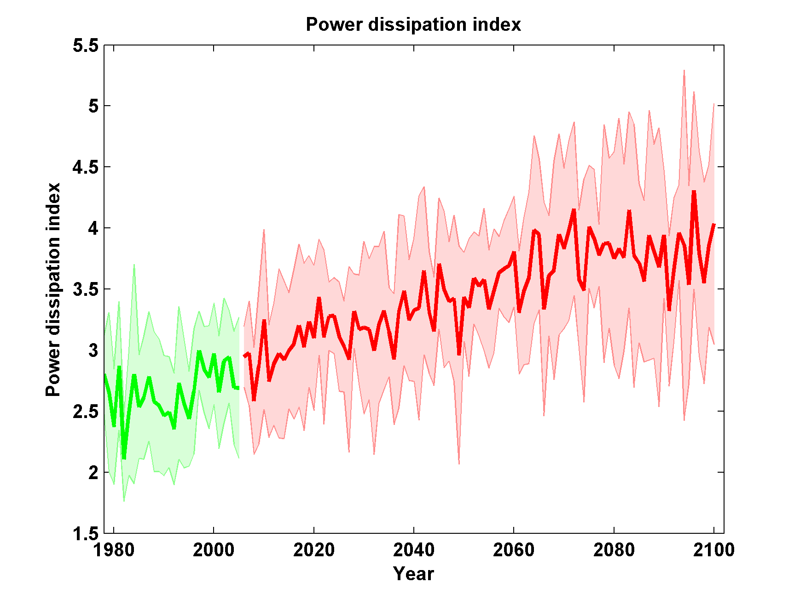
Global Hurricane Power under RCP 8.5

Slide 77
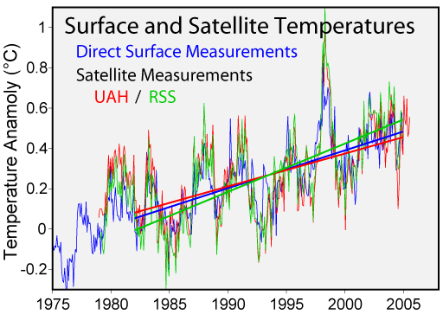

Slide 78
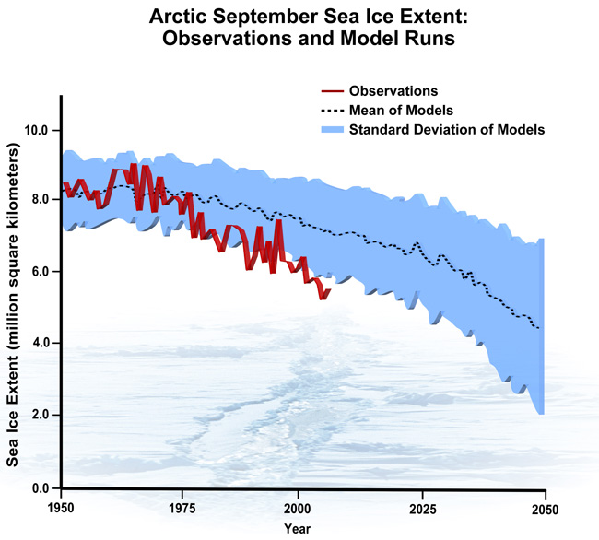
September Arctic Sea Ice Extent

Slide 79
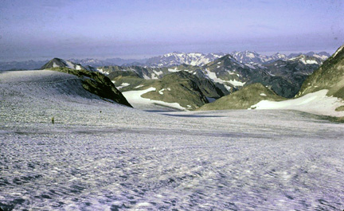
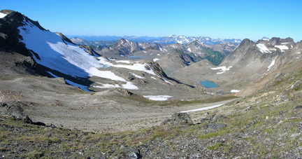
White Chuck Glacier,
Washington state, in 1973
White Chuck Glacier in 2006 from same vantage point. The glacier retreated 1.2 miles in 30 years.

Slide 80
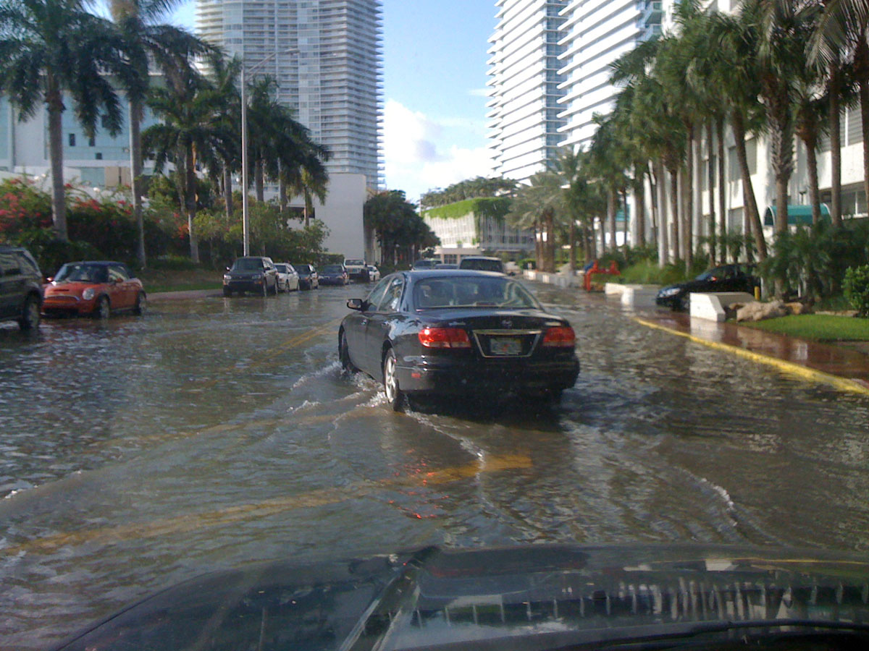
Miami Beach

Slide 81
Ramping up Fission Power

Slide 82
Carbon Emissions and GDP in Sweden

Slide 83
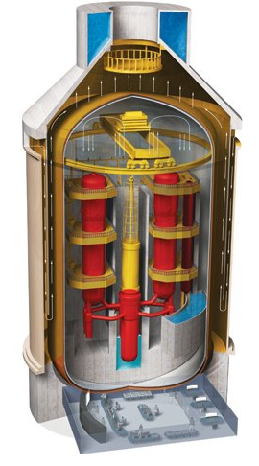
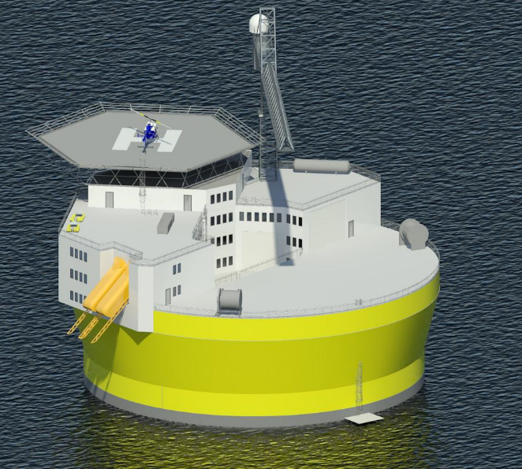
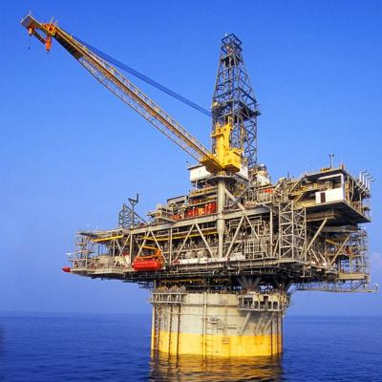
Offshore floating nuclear power plant
+
=
Floating rig
Nuclear reactor
OFNP
Reduced capital cost (>90% cut in reinforced concrete)
Reduced construction/decommissioning schedule
Flexible siting + minimal local infrastructure (‘plug and play’)
Reliable passive cooling; no land/ocean contamination
Profs. J. Buongiorno, M. Golay, N. Todreas

Slide 84
We Can Do Even Better:
Next Generation (Gen IV) Fission Reactors
One Example: Molten Salt Reactors
  Passively safe
  Can help process waste from Light Water Reactors
  Operate at ambient pressure
  Can run on thorium; unsuitable for weapons
  Estimated plant lifetime > 80 years

Slide 85
Turning Electricity into Liquid Fuels
E-CEM (Electrolytic Cation Exchange Module)
  Developed by U.S. Navy
  Uses electricity to synthesize liquid fuel from CO₂ in seawater and electrolysis to get H₂, then combined into hydrocarbons
  Carbon-neutral
  Can be done for $3-6 per gallon.

Slide 86
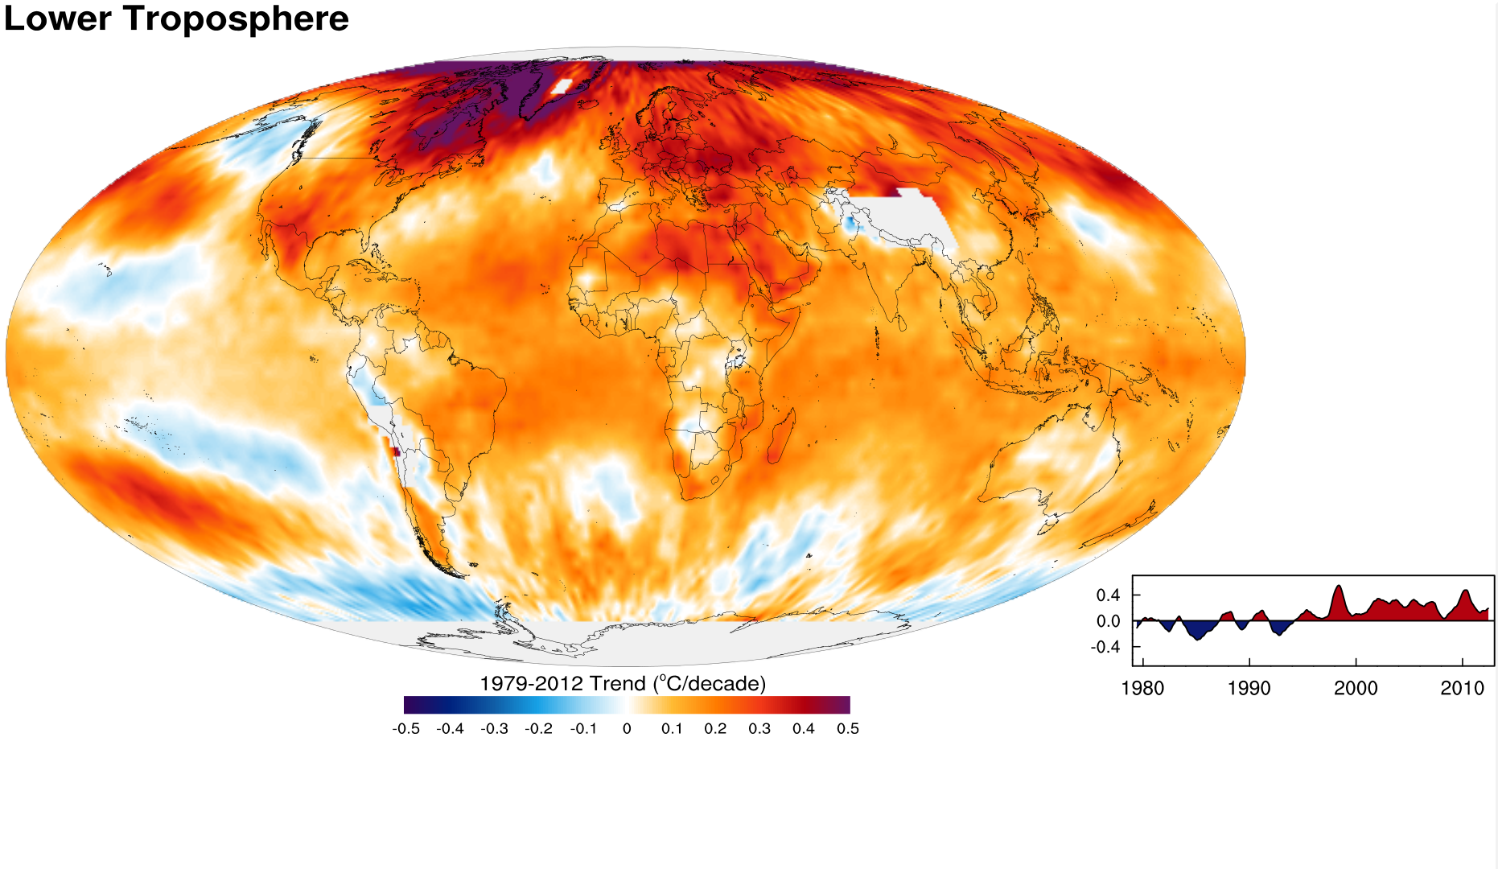
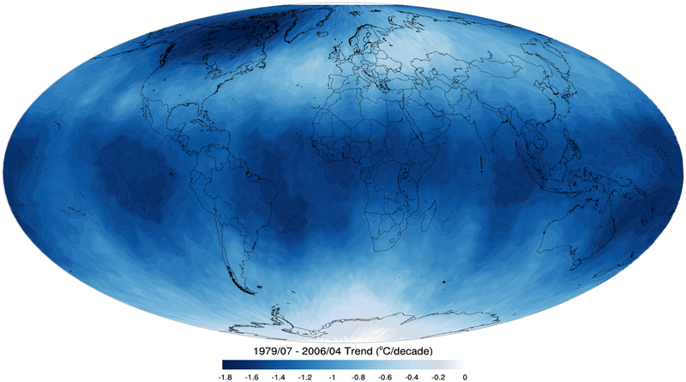
Tropospheric temperature trend from 1979-2012 based on satellite measurements (RSS)
Top of the stratosphere (TTS) 1979-2006 temperature trend.

Slide 87
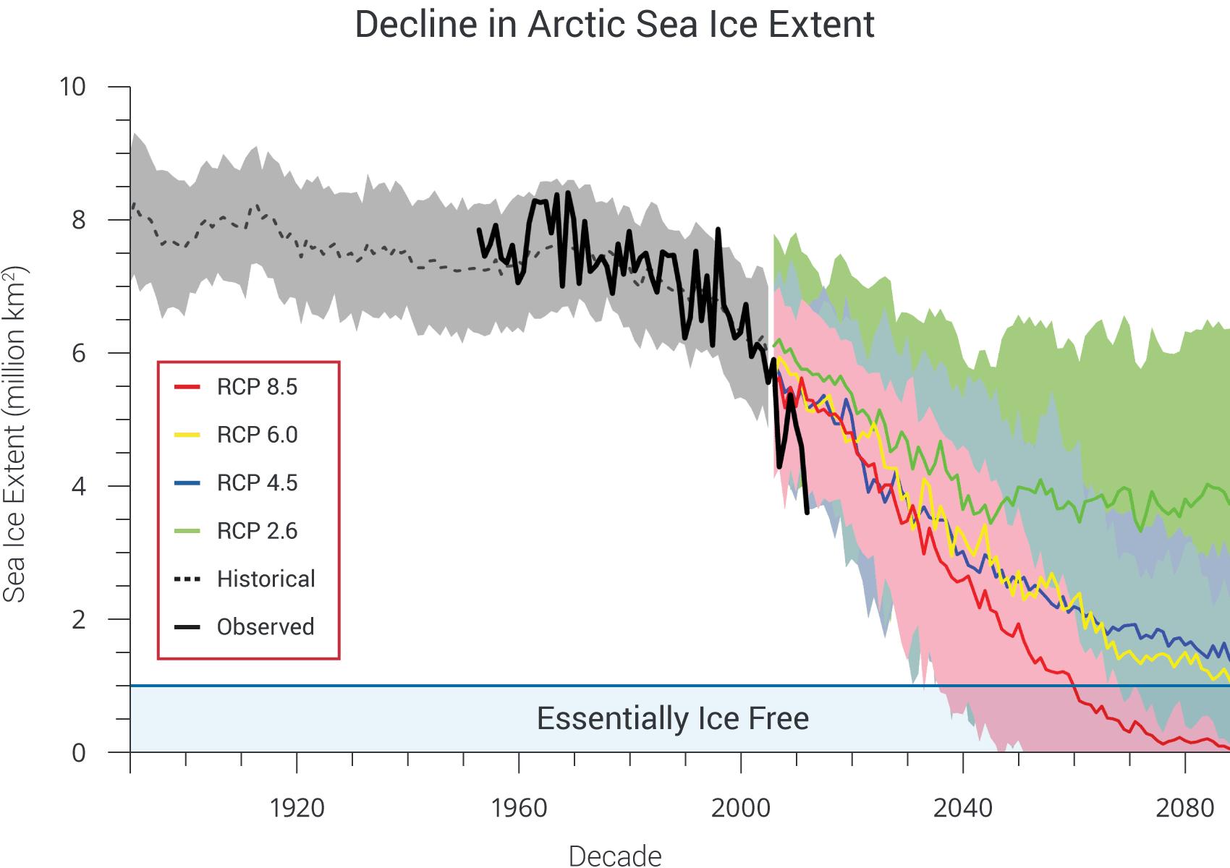
Notes:
Model simulations of Arctic sea ice extent for September (1900-2100) based on observed concentrations of heat-trapping gases and particles (through 2005) and four scenarios. Colored lines for RCP scenarios are model averages (CMIP5) and lighter shades of the line colors denote ranges among models for each scenario. Dotted gray line and gray shading denotes average and range of the historical simulations through 2005. The thick black line shows observed data for 1953-2012. These newer model (CMIP5) simulations project more rapid sea ice loss compared to the previous generation of models (CMIP3) under similar forcing scenarios, although the simulated September ice losses under all scenarios still lag the observed loss of the past decade. Extrapolation of the present observed trend suggests an essentially ice-free Arctic in summer before mid-century. The Arctic is considered essentially ice-free when the areal extent of ice is less than one million square kilometers. (Figure source: adapted from Stroeve et al. 2012).

