Slide 1

Global Warming: The Risk and How to Confront It
Kerry Emanuel
Lorenz Center
Massachusetts Institute of Technology
Notes:
1

Slide 2

Program
Overview of Climate Change
Climate Change Consequences
How to Make Progress

Slide 3
Greenhouse Gases
The orange sliver (can you see it?) makes the difference between a mean surface temperature of -18ºC and of 15ºC.

Slide 4
Carbon Dioxide Content is Increasing
Carbon dioxide concentrations from ice cores (green dots) and direct measurements (blue curve)
Source: IPCC Assessment Report 5 (Chapter 6)

Slide 5
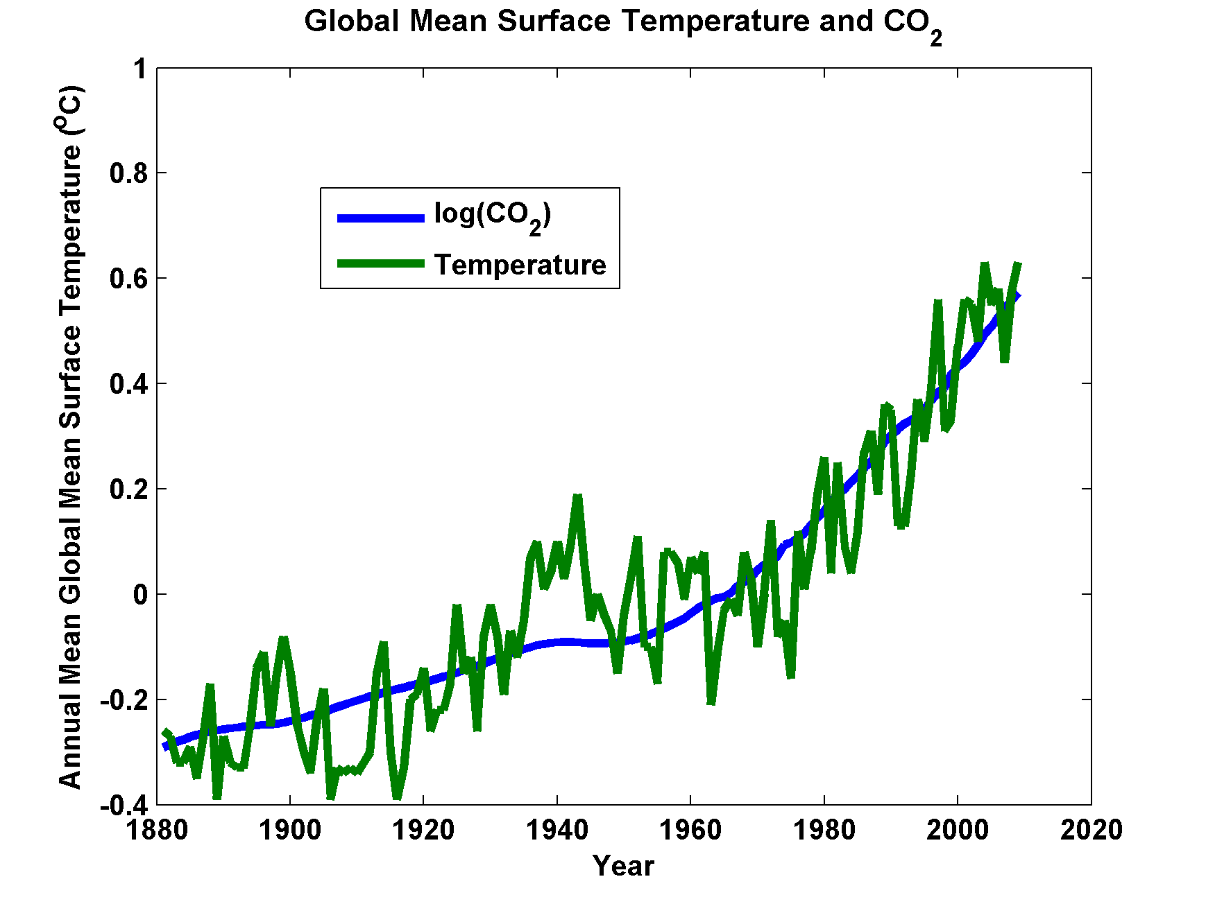

Slide 6
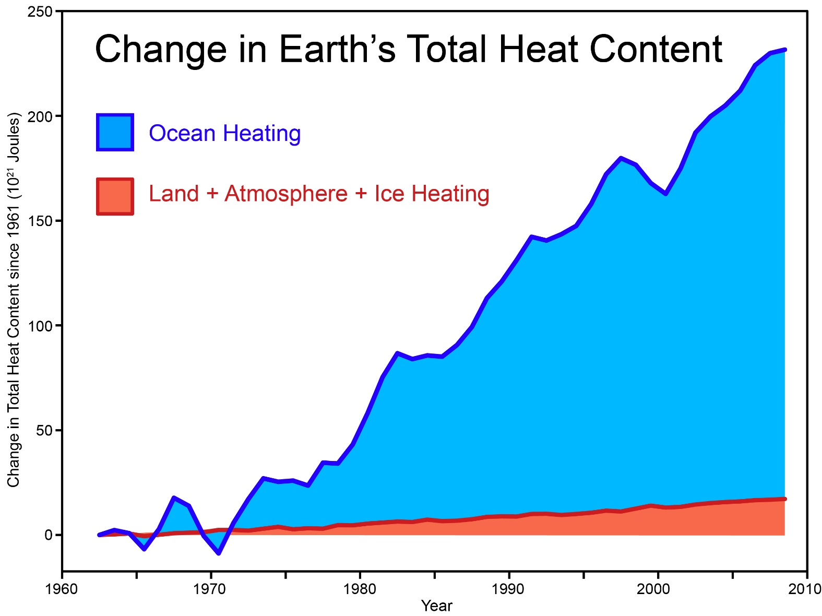
Total amount of heat from global warming that has accumulated in Earth's climate system since 1961, from Church et al. (2011) (many thanks to Neil White from the CSIRO for sharing their data).
Notes:
http://www.skepticalscience.com/graphics.php?g=46

Slide 7
Supercomputers Not Needed to Understand This

Slide 8

Svante Arrhenius, 1859-1927
“Any doubling of the percentage of carbon dioxide in the air would raise the temperature of the earth's surface by 4°C; and if the carbon dioxide were increased fourfold, the temperature would rise by 8°C.” – Världarnas utveckling (Worlds in the Making), 1906
Latest estimate from IPCC (2013): 1.5 – 4.5 ºC

Slide 9
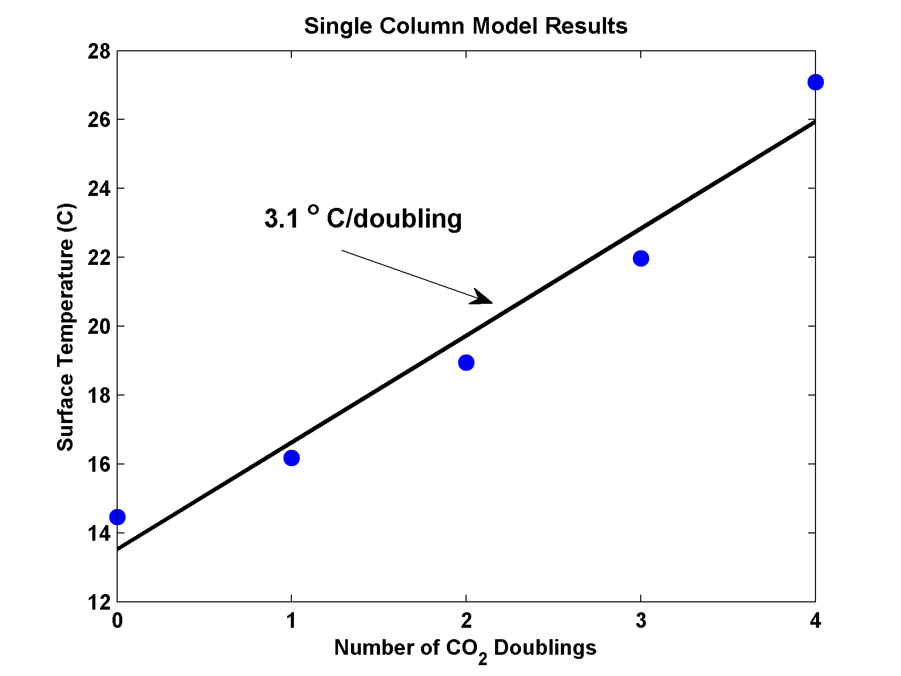
MIT Single Column Model
(Can be run on a laptop)
IPCC Estimate:
1.5-4.5 ºC

Slide 10
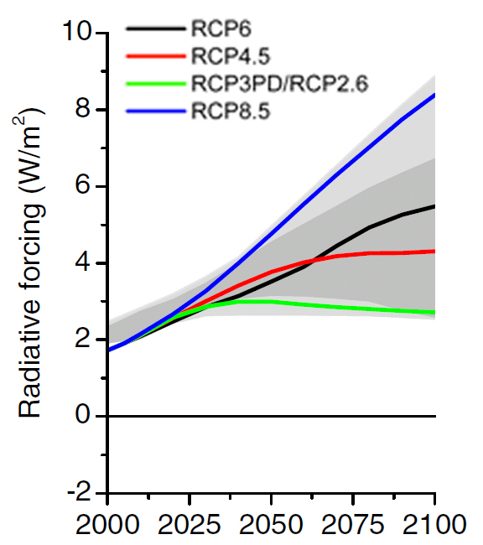
Projections
Radiative Forcing of the Representative Concentration Pathways (RCPs). The light grey area captures 98% of the range in previous IAM scenarios, and dark grey represents 90% of the range.
Image credit: IPCC Fifth Assessment Report

Slide 11
Image credit: IPCC Fifth Assessment Report

Slide 12
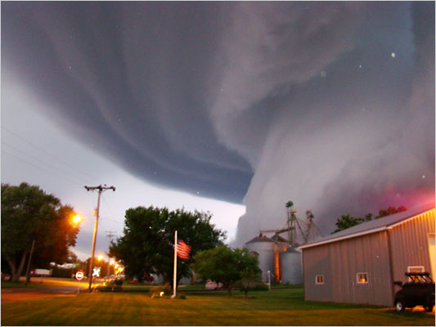
Consequences for Weather Extremes

Slide 13
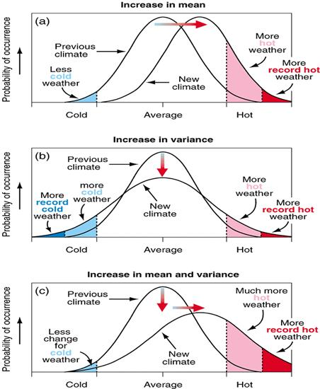
Large Risks in the Tail of the Distribution
Notes:
Image credit: IPCC (2001)

Slide 14
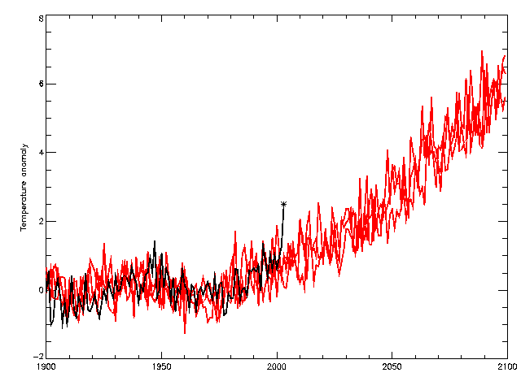
Heat Waves
2060s
observations
HadCM3 Medium-High (SRES A2)
2040s
2003
Temperature anomaly (wrt 1961-90) °C

Slide 15
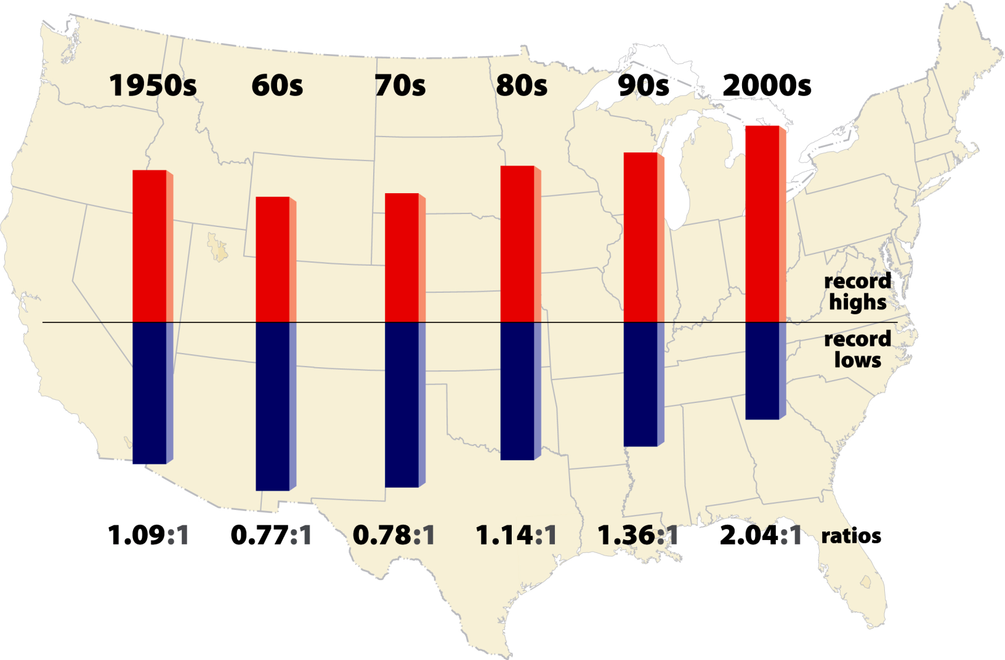
High vs Low Temperature Records
2011- 2.7:1

Slide 16
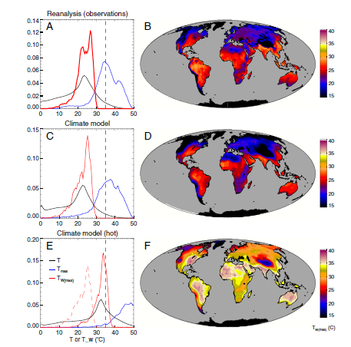
Sherwood and Huber, PNAS, 2010
Adaptation Limit:
Maximum Tolerable Wet Bulb Temperature
12º increase in mean global T

Slide 17
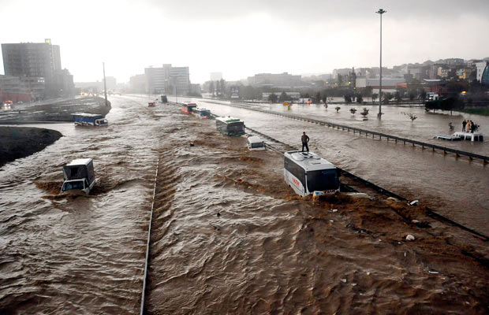
Hydrological Extremes Increase with Temperature
Floods

Slide 18
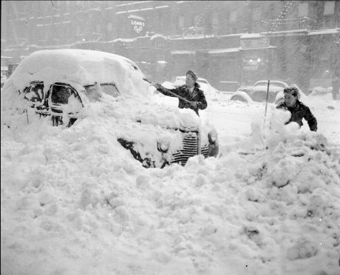
Blizzards

Slide 19
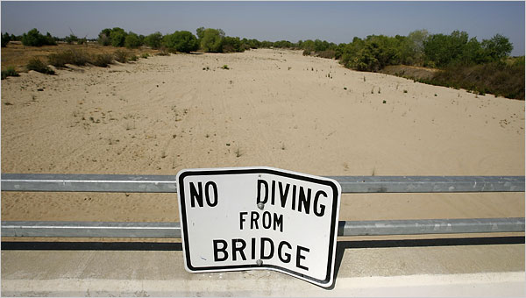
Drought

Slide 20
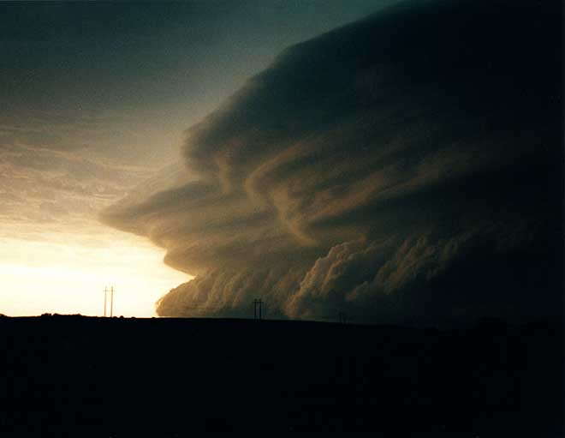
Severe Thunderstorms

Slide 21
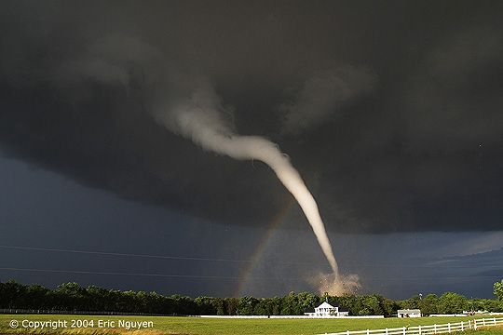
Tornadoes

Slide 22

Hail Storms

Slide 23
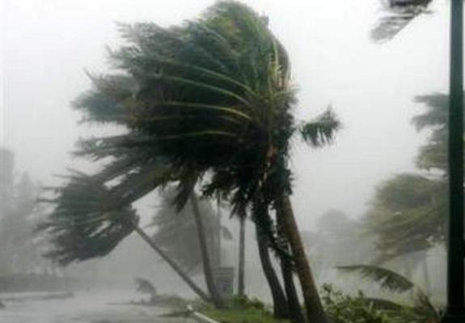
Hurricanes

Slide 24
Intensity Theory
Potential Intensity: Maximum sustainable surface wind speed in a given thermodynamic environment (sea surface temperature and atmospheric temperature profile)

Slide 25
Annual Maximum Potential Intensity (m/s)

Slide 26
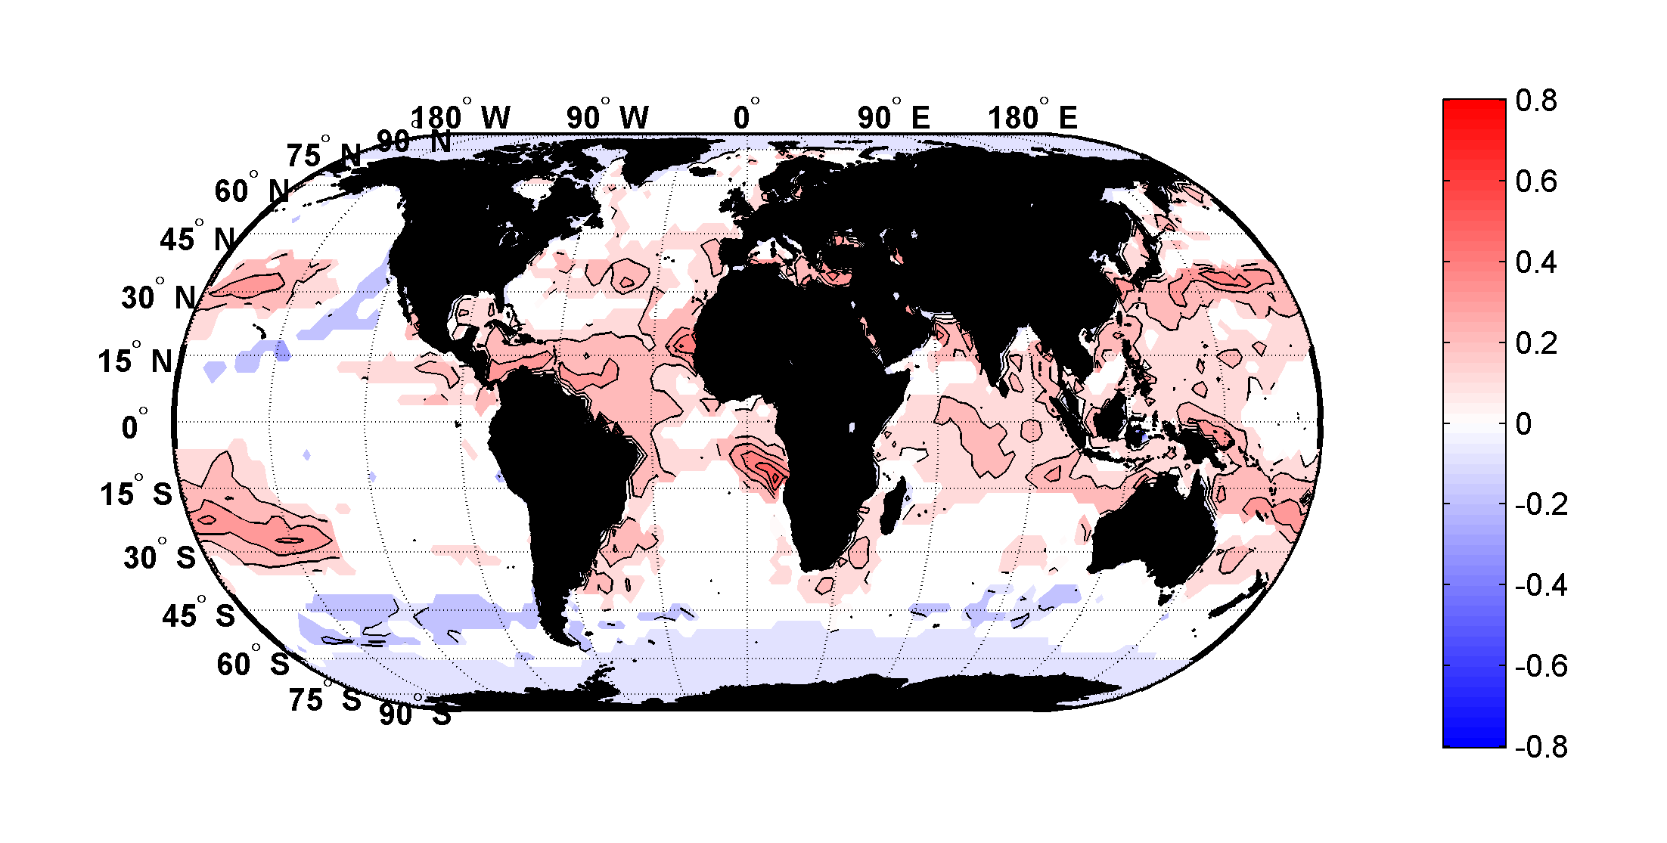
Trends in Thermodynamic Potential for Hurricanes, 1980-2010

Slide 27
Some Empirical Findings

Slide 28
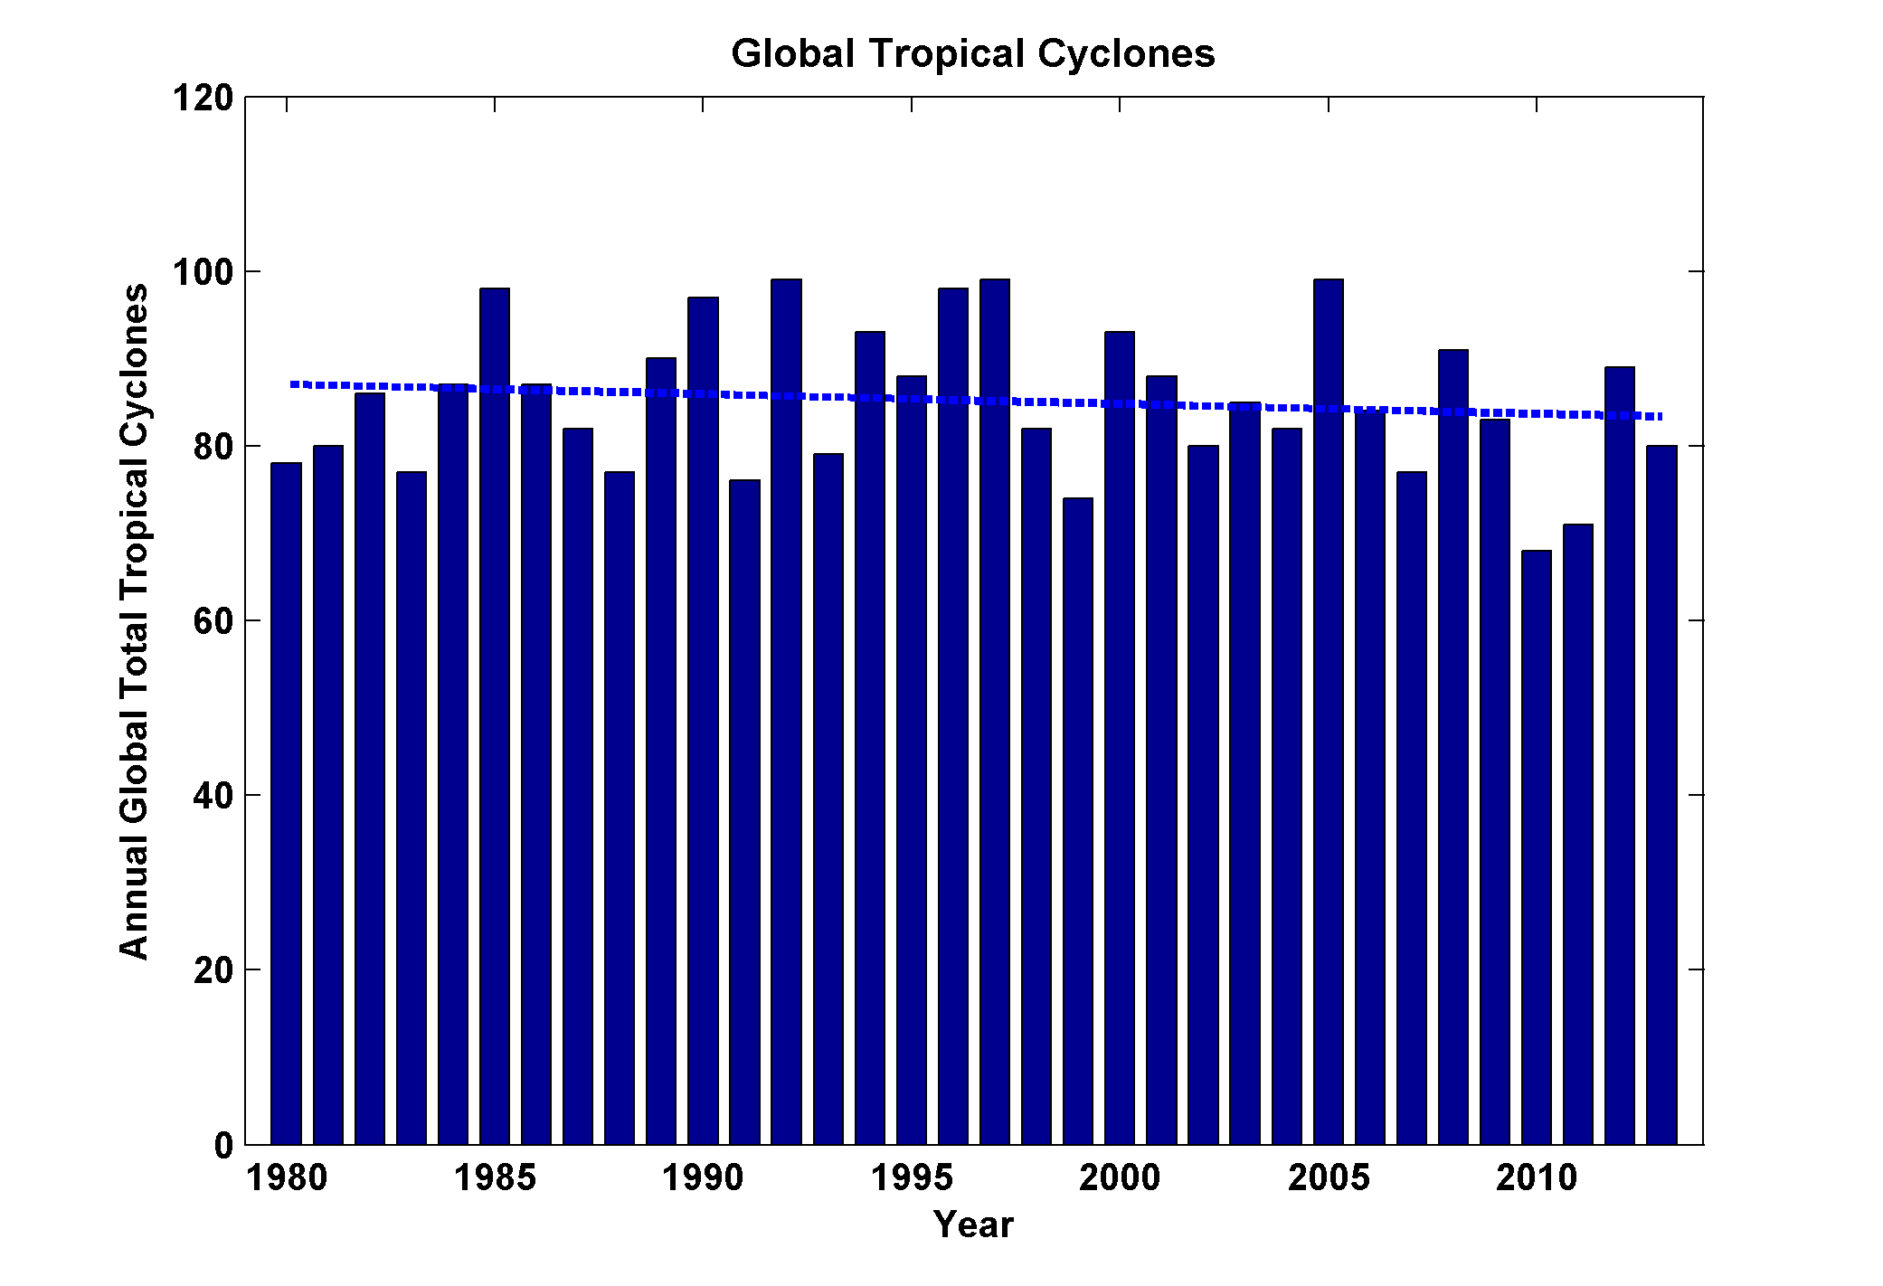
Global Tropical Cyclone Frequency, 1980-2013
Data Sources: NOAA/TPC and NAVY/JTWC
Notes:
28

Slide 29
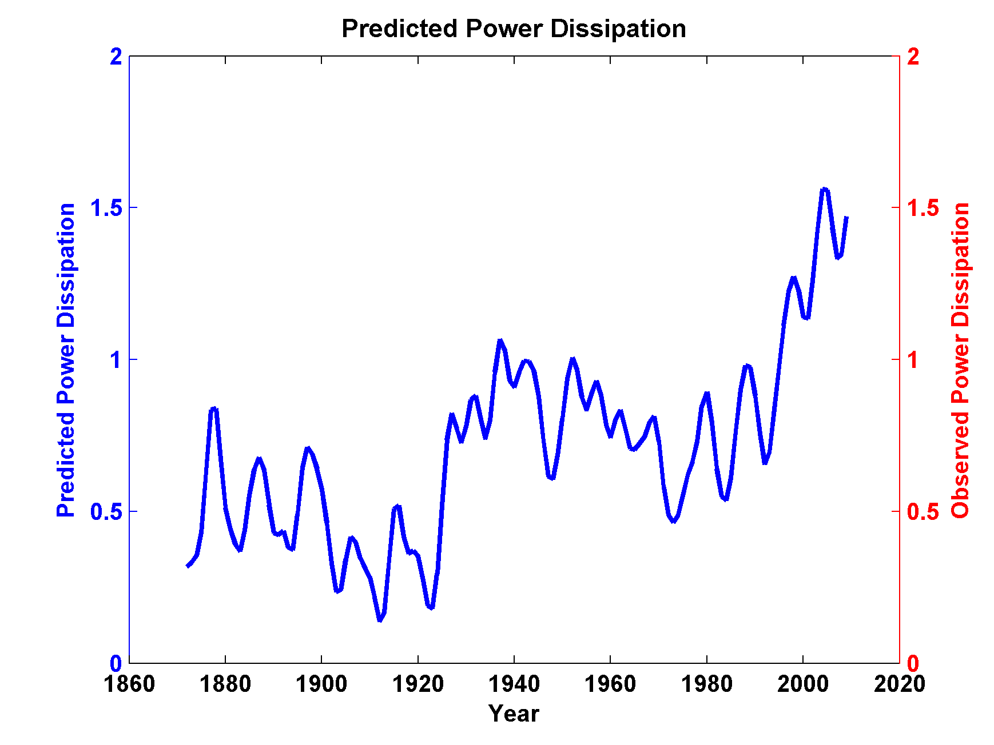
Sea Surface Temperature Scaled to Observed Hurricane Power Dissipation, 1980-2011

Slide 30
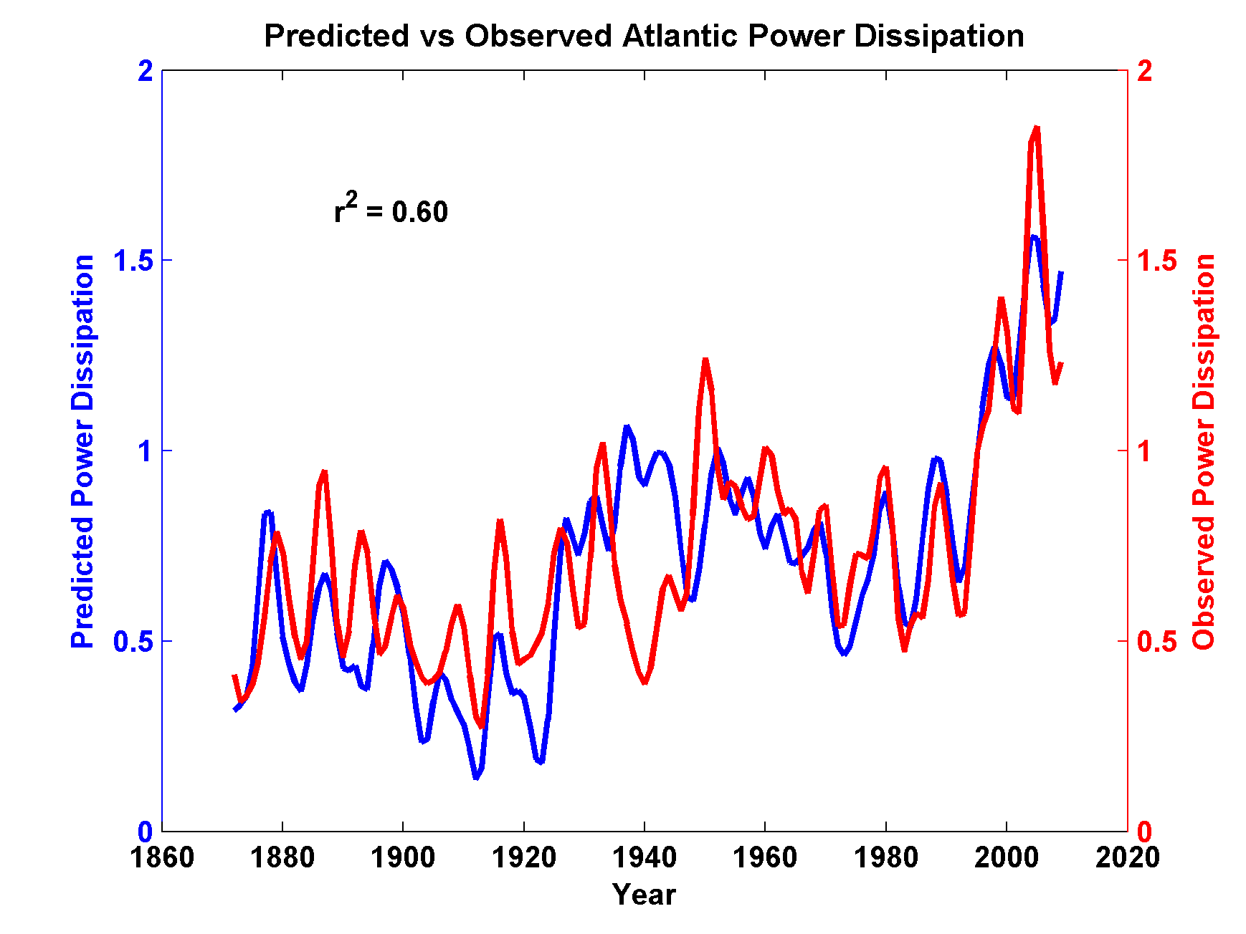
Compare to Observed Storm Maximum Power Dissipation

Slide 31
Looking Ahead:
Using Physics to Assess Hurricane Risk

Slide 33
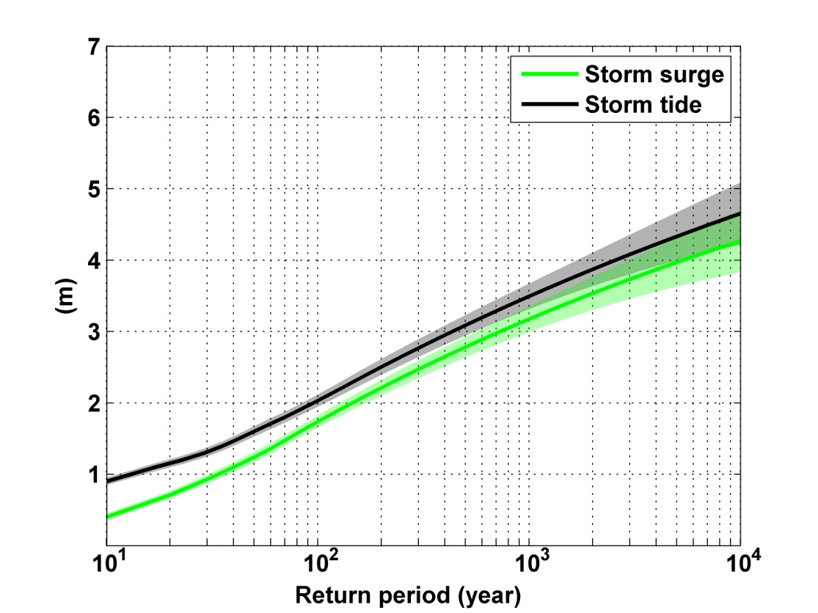
Notes:
Storm surge and storm tide (surge and tide) return level curves for the Battery, NYC, for the 1981-2000 NCAR/NCEP climate conditions (5000 synthetic storms). Astronomical tide and nonlinear interaction between surge and tide are accounted for statistically.

Slide 34
Downscaling of AR5 GCMs
GFDL-CM3
HadGEM2-ES
MPI-ESM-MR
MIROC-5
MRI-CGCM3
Historical: 1950-2005, RCP8.5 2006-2100

Slide 35
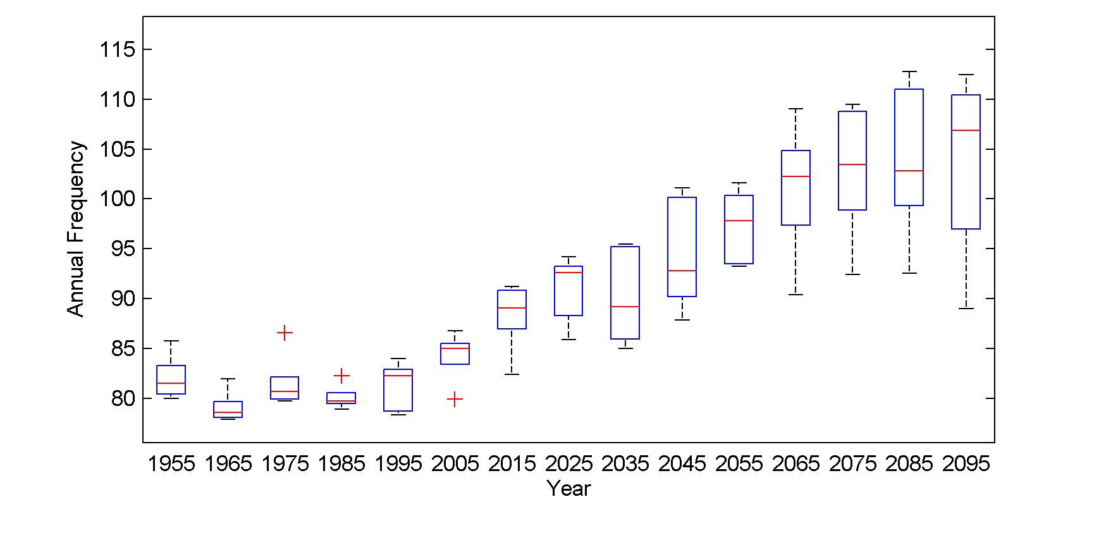
Global annual frequency of tropical cyclones averaged in 10-year blocks for the period 1950-2100, using historical simulations for the period 1950-2005 and the RCP 8.5 scenario for the period 2006-2100. In each box, the red line represents the median among the 5 models, and the bottom and tops of the boxes represent the 25th and 75th percentiles, respectively. The whiskers extent to the most extreme points not considered outliers, which are represented by the red + signs. Points are considered outliers if they lie more than 1.5 times the box height above or below the box.

Slide 36
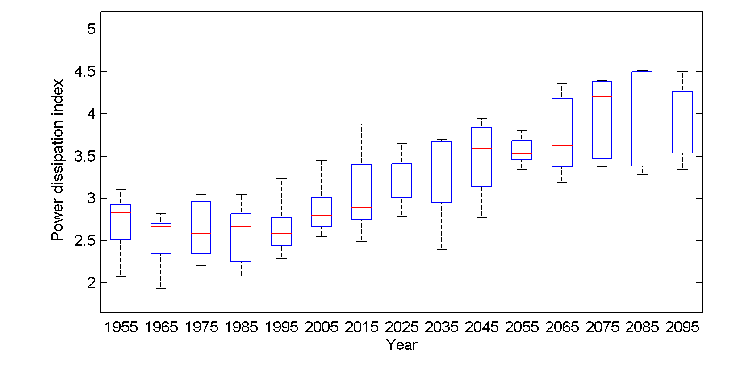
Global Tropical Cyclone Power Dissipation

Slide 37

GCM flood height return level
(assuming SLR of 1 m for the future climate )
Black: Current climate (1981-2000)
Blue: A1B future climate (2081-2100)
Red: A1B future climate (2081-2100) with R₀ increased by 10% and R_{m} increased by 21%
Lin et al. (2012)
Notes:
Then we calculate the flood height (including surge, tide, and sea level rise) return level for the four climate models, assuming a sea level rise of 1 m for the future climate, for the Battery, NYC. These results show that the combined effects of storm climatology change and sea level rise will greatly shorten the flood return periods for NYC and, by the end of the century, the current 100-year surge flooding may happen less than every 30 years, with CNRM and GFDL prediction to be less than 10 years, and the 500-year flooding may happen less than every 200 years, with the CNRM and GFDL prediction to be 20-30 years.

Slide 38
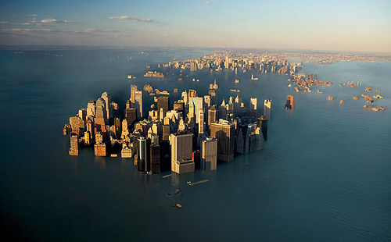
Why We Need to Act Now

Slide 39

IPCC 2007: Doubling CO₂ will lead to an increase in mean global surface temperature of 2 to 4.5 ºC.
Atmospheric CO₂ assuming that emissions stop altogether after peak concentrations
Global mean surface temperature corresponding to atmospheric CO₂ above
Image source: Solomon, S., G.-K. Plattner, R. Knutti, and P. Friedlingstein, 2009, PNAS, 106, 1704-1709

Slide 40
“Climate change could have significant geopolitical impacts around the world, contributing to poverty, environmental degradation, and the further weakening of fragile governments. Climate change will contribute to food and water scarcity, will increase the spread of disease, and may spur or exacerbate mass migration.”
    -- Quadrennial Defense Review, U.S. Department of Defense, February, 2010

Slide 41
Summary of Global Warming Effects on Extreme Weather
Projections of climate change effects on weather extremes vary a great deal depending on type of event and model projections
Incidence of floods increases fairly rapidly
Incidence of drought also increases rapidly

Slide 42
Frequency of intense (destructive) hurricanes projected to increase
Very little currently known about response of severe thunderstorms to climate change

Slide 43
Options for Dealing with Climate Change
Reduce emissions
  gasification of coal
  alternative energy– solar, nuclear, wind, etc.
Carbon capture and sequestration
Other geoengineering
  technically feasible, $20-30 billion/year
  side effects, e.g. reduced precipitation
Adaptation

Slide 44
The Nature of the Beast

Slide 45
Consider the Following Statements:
In all probability, we will successfully adapt to climate change brought about by doubling CO₂.
In all probability, if you allow your 8-year-old to cross a busy street to catch her school bus, she will make it.
There is a 99% chance she will make it.
There is a 1% chance that she will not.

Slide 46


Estimate of how much global climate will warm as a result of doubling CO₂: a probability distribution
Source: 100000 PAGE09 runs
Degrees C
Chris Hope, U. Cambridge
courtesy Tim Palmer
Notes:
Reflects post-IPCC knowledge as well as IPCC AR4.

Slide 47

CO₂ Will Likely Go Well Beyond Doubling
Double Pre-Industrial

Slide 48
Annual global climate change costs (in trillions of dollars) in low emissions (purple) and business as usual (A1B; red) scenarios. The dashed lines represent the 5% and 95% probability range. Annual global climate change costs (in trillions of dollars) in low emissions (purple) and business as usual (A1B; red) scenarios. The dashed lines represent the 5% and 95% probability range.
Notes:
Source: http://www.jbs.cam.ac.uk/fileadmin/user_upload/research/workingpapers/wp1105.pdf

Slide 49
My generation is pushing yours in front of a bus.
A bus we are driving, and which we refuse to slow down.
In all probability you will make it.
Maybe you won’t.

Slide 50
What Can You Do?
Conserve energy and find ways to design buildings/vehicles that use less energy
Get involved in efforts to develop clean energy and/or carbon capture and sequestration
Find ways to make it known to the generation now in power that you care about the future of Earth’s climate!

Slide 51
Global Tropical Cyclone Power Dissipation

Slide 52
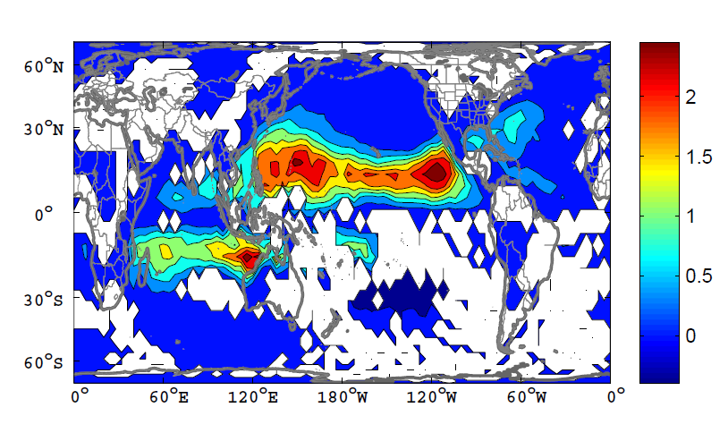
Change in Power Dissipation

Slide 53
Integrated Assessments with Robert Mendelsohn, Yale

Slide 54


Probability Density of TC Damage, U.S. East Coast
Damage Multiplied by Probability Density of TC Damage, U.S. East Coast

Slide 55
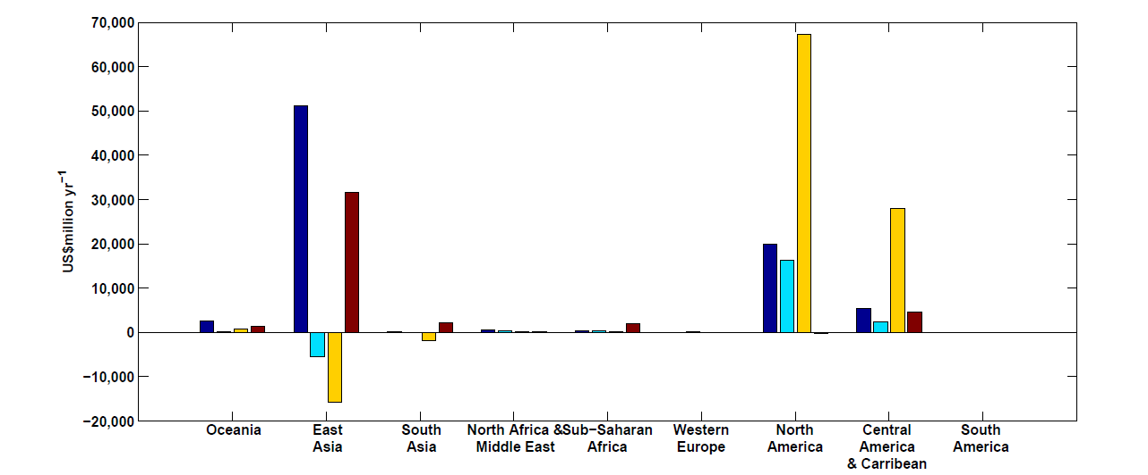
Mendelsohn et al., 2012
Climate change impacts on tropical cyclone damage by region in 2100. Damage is concentrated in North America, East Asia and Central America–Caribbean. Damage is generally higher in the CNRM and GFDL climate scenarios.

Slide 56
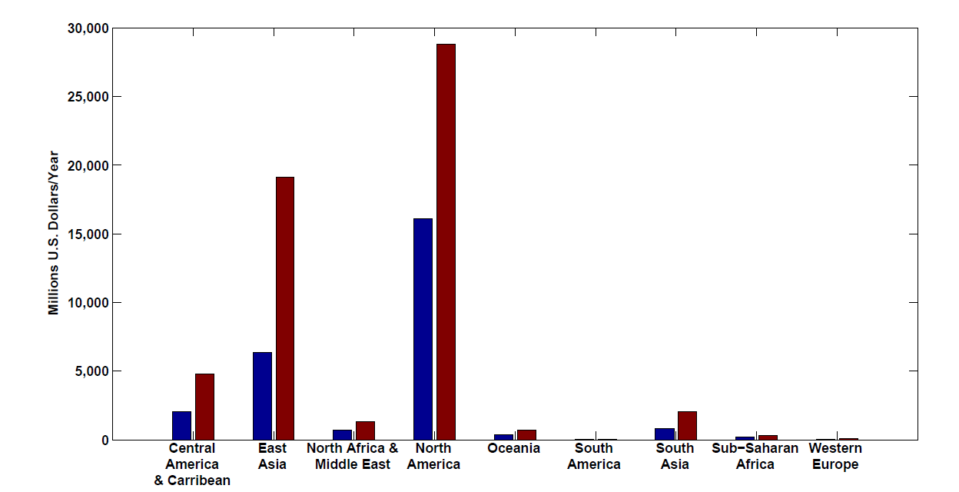
Present and future baseline tropical cyclone damage by region.
Changes in income will increase future tropical cyclone damages in 2100 in every region even if climate does not change. Changes are larger in regions experiencing faster economic growth, such as East Asia and the Central America–Caribbean region.

Slide 57
Climate change impacts on tropical cyclone damage by region in 2100. Damage is concentrated in North America, East Asia and Central America–Caribbean. Damage is generally higher in the CNRM and GFDL climate scenarios.

Slide 58
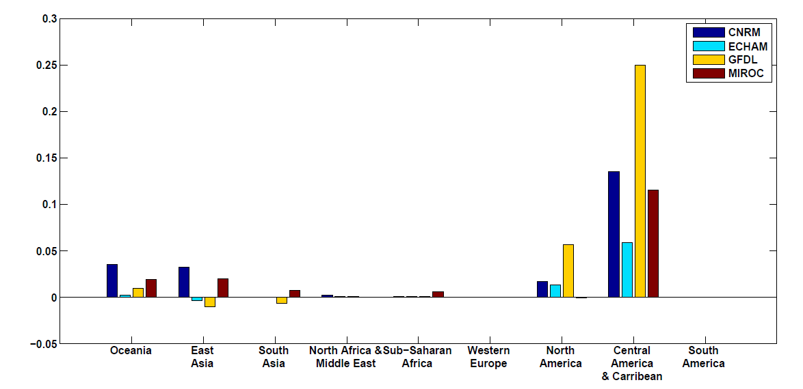
Climate change impacts on tropical cyclone damage divided by GDP by region in 2100. The ratio of damage to GDP is highest in the Caribbean–Central American region but North America, Oceania and East Asia all have above-average ratios.

Slide 59

What is Causing Changes in Tropical Atlantic Sea Surface Temperature?

Slide 60
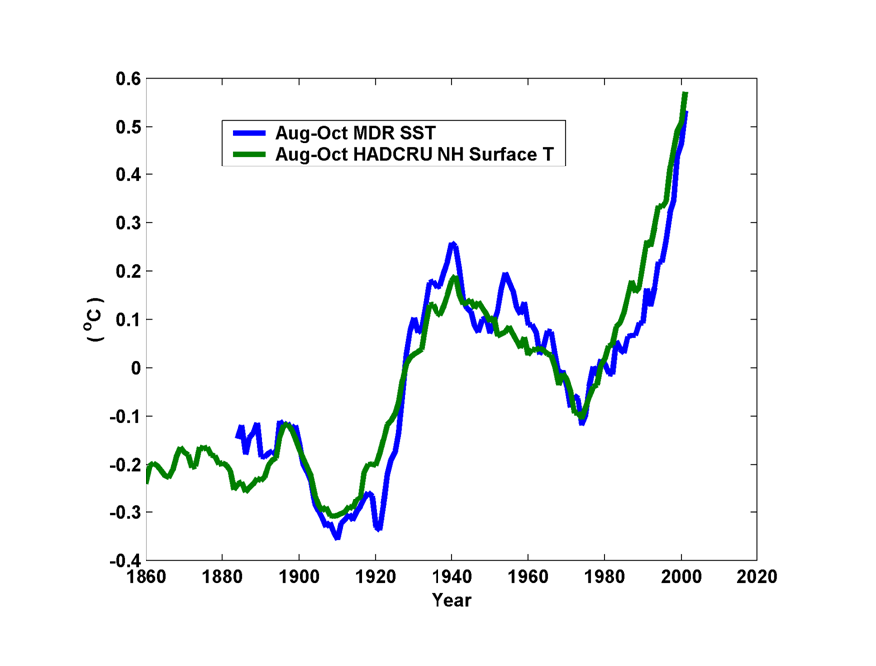
10-year Running Average of Aug-Oct Northern Hemisphere Surface Temp and Hurricane Region Ocean Temp

Slide 61
Estimates of Global Mean Surface Temperature from the Instrumental Record
Notes:
61

Slide 62
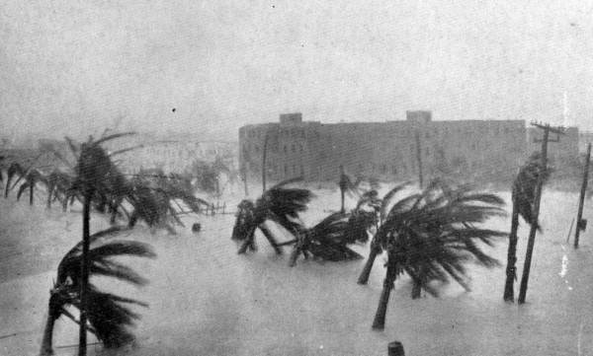
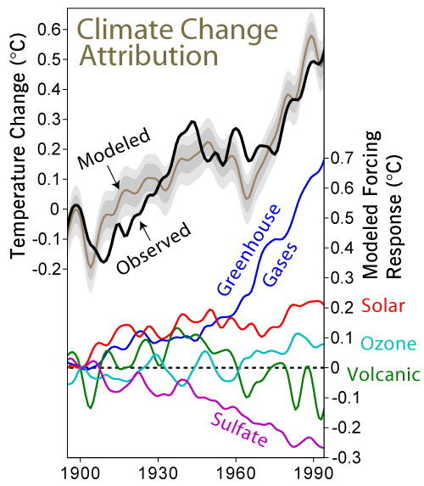

Slide 63
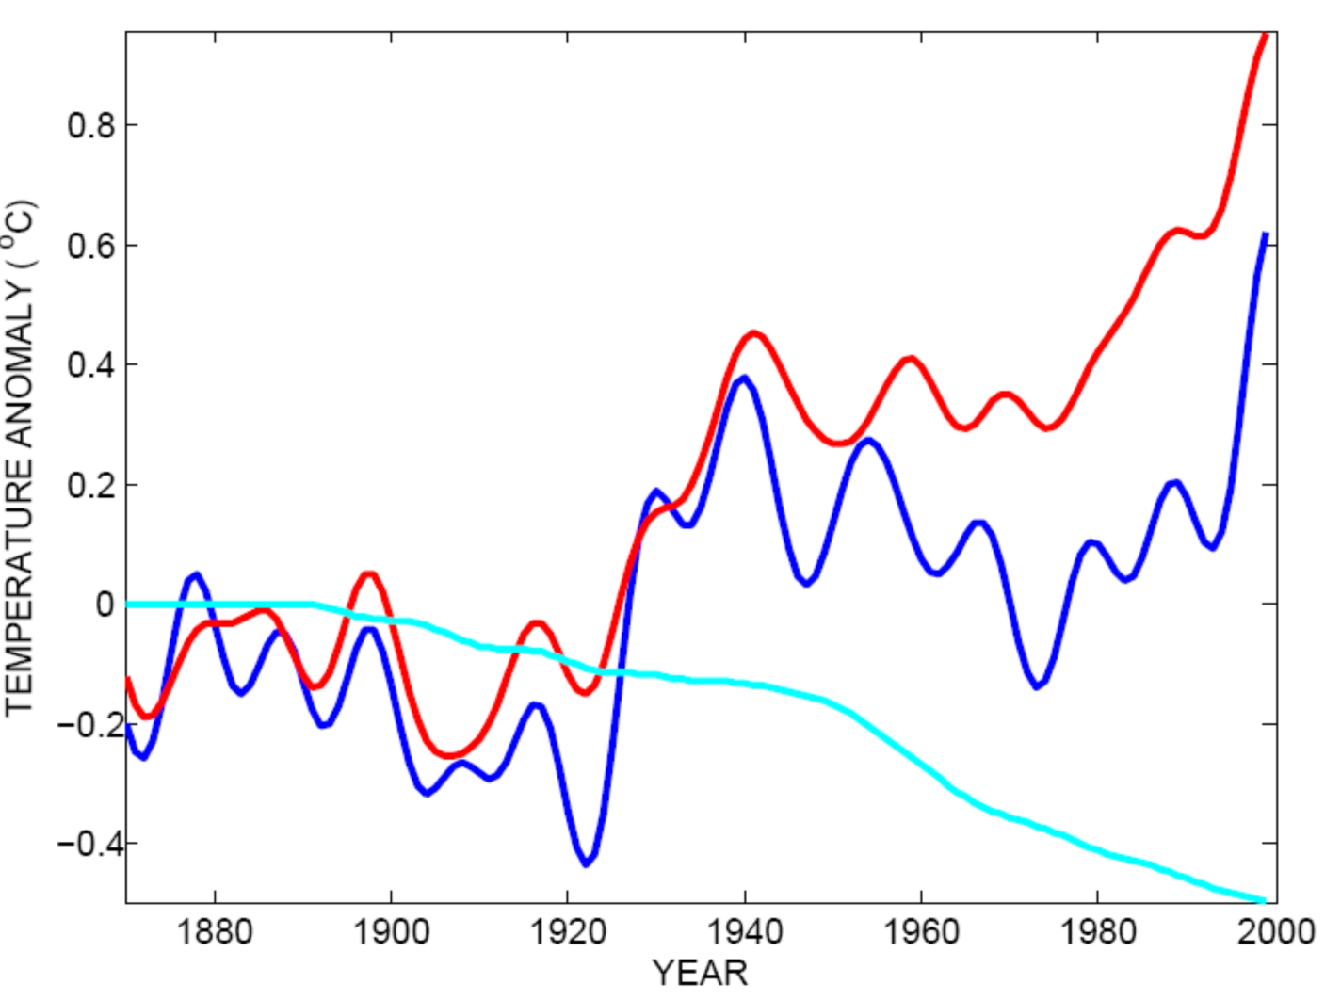
Tropical Atlantic SST(blue), Global Mean Surface Temperature (red),
Aerosol Forcing (aqua)
Global mean surface temperature
Tropical Atlantic sea surface temperature
Sulfate aerosol radiative forcing
Mann, M. E., and K. A. Emanuel, 2006. Atlantic hurricane trends linked to climate change. EOS, 87, 233-244.

Slide 64
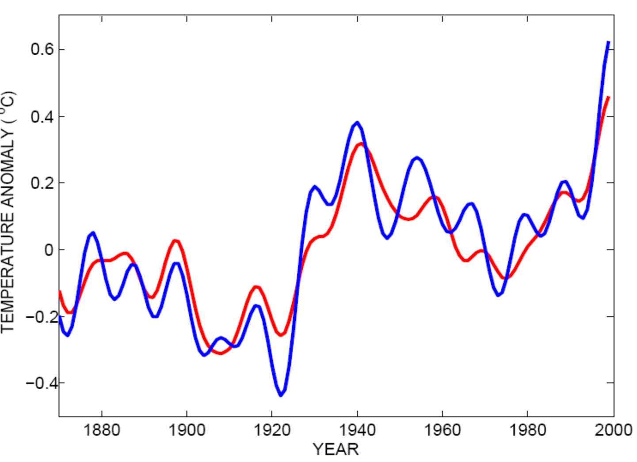
Best Fit Linear Combination of Global Warming and Aerosol Forcing (red) versus Tropical Atlantic SST (blue)
Tropical Atlantic Sea Surface Temperature
Global Surface T + Aerosol Forcing
Mann, M. E., and K. A. Emanuel, 2006. Atlantic hurricane trends linked to climate change. EOS, 87, 233-244.

Slide 65
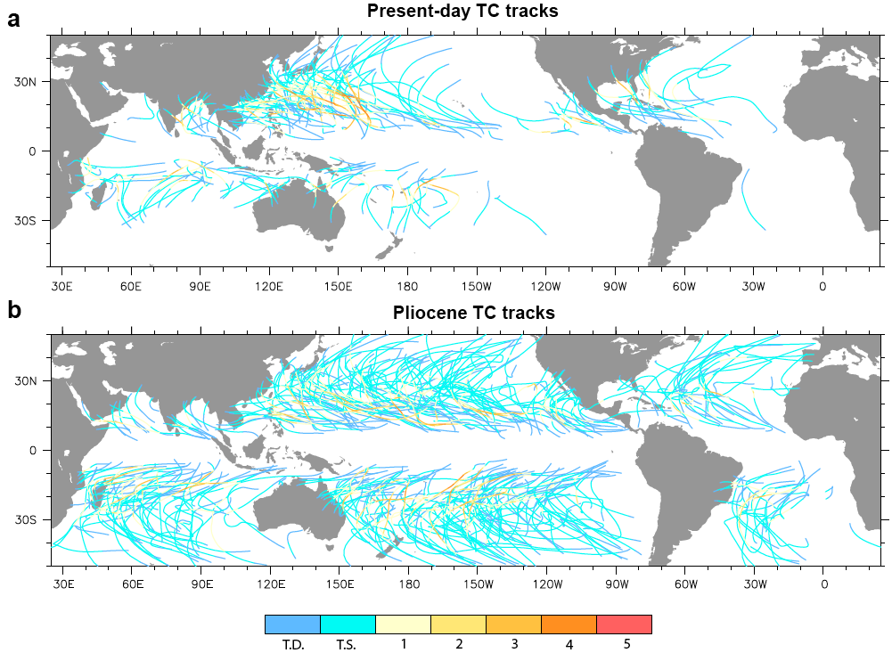
Application to the Climate of the Pliocene

