Slide 1

A Physics-Based Approach to Tropical Cyclone Risk Assessment
Why we need to bring physics to bear on estimating natural hazard risk
Kerry Emanuel
Lorenz Center
Massachusetts Institute of technology

Slide 2
Flawed Basis of Current Risk Modeling
Almost all current risk assessments are based on historical statistics
Historical records are flawed and short
Moreover, the past 50-150 years is a poor guide to the present owing to climate change that has already occurred
Risk modelers have been slow to migrate to a physics-based approach
We need to catalyze a transition to physics-based risk modeling
Institutions of higher education are critical to this transition

Slide 3
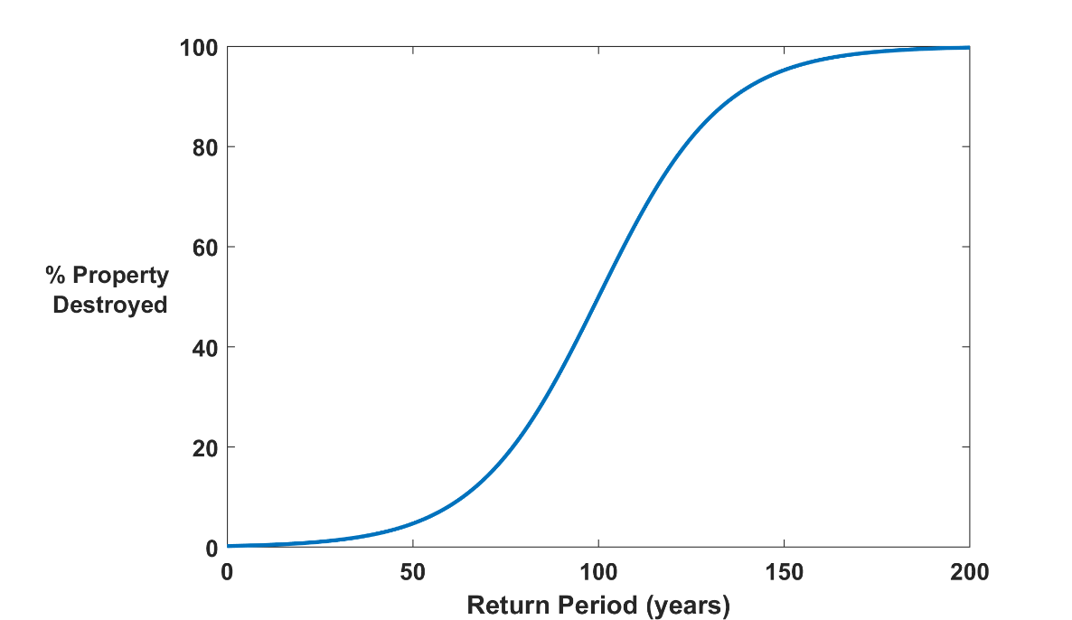

Why Climate Risk is Dominated by Extreme Events:
Societies are usually well adapted to frequent events (> 1/100 yr)
Societies are often poorly adapted to rare events (< 1/100 yr)
Large cost increases result when > 100-yr events become < 100-yr events
Largest slope

Slide 4
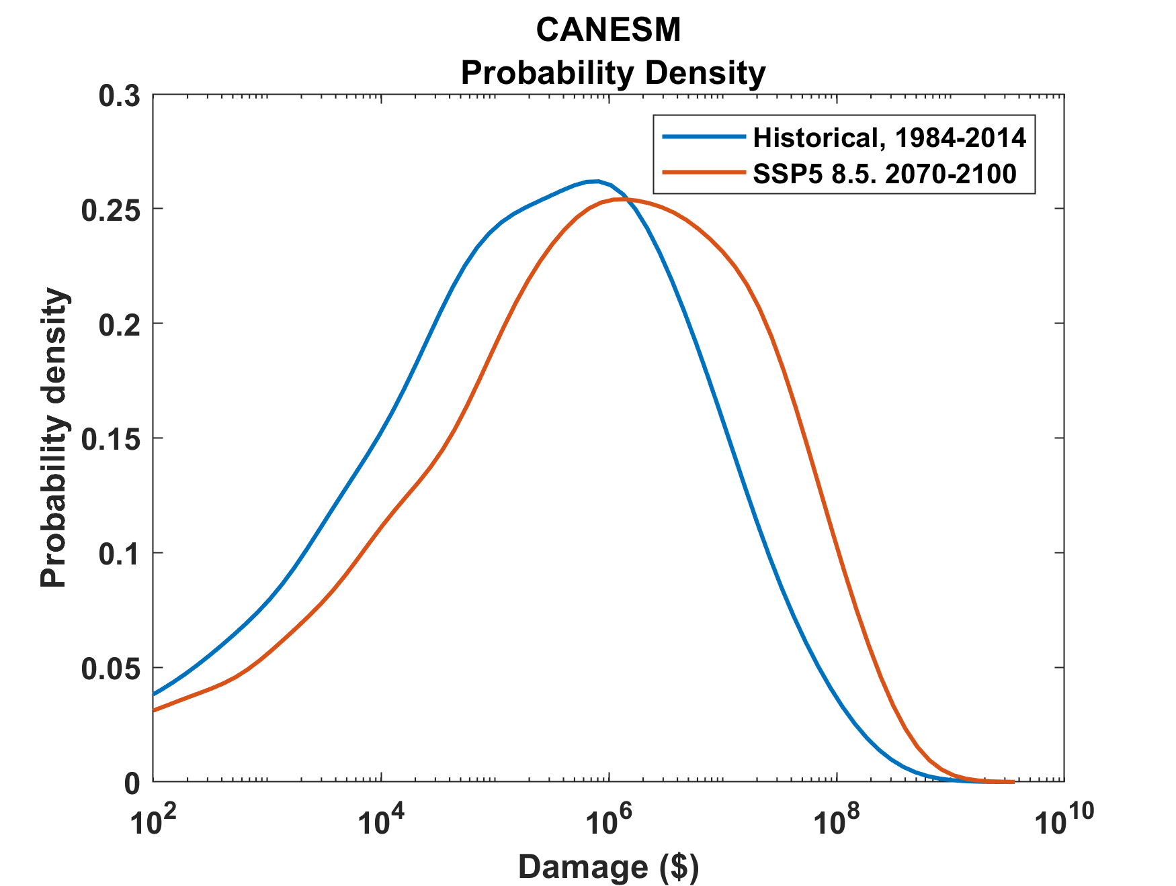
Example:
Tropical Cyclone Risk Arises Largely from High Intensity Events
1984-2014
2070-2100
Probability
Probability density of annual damage to a portfolio of insured property in the U.S.

Slide 5
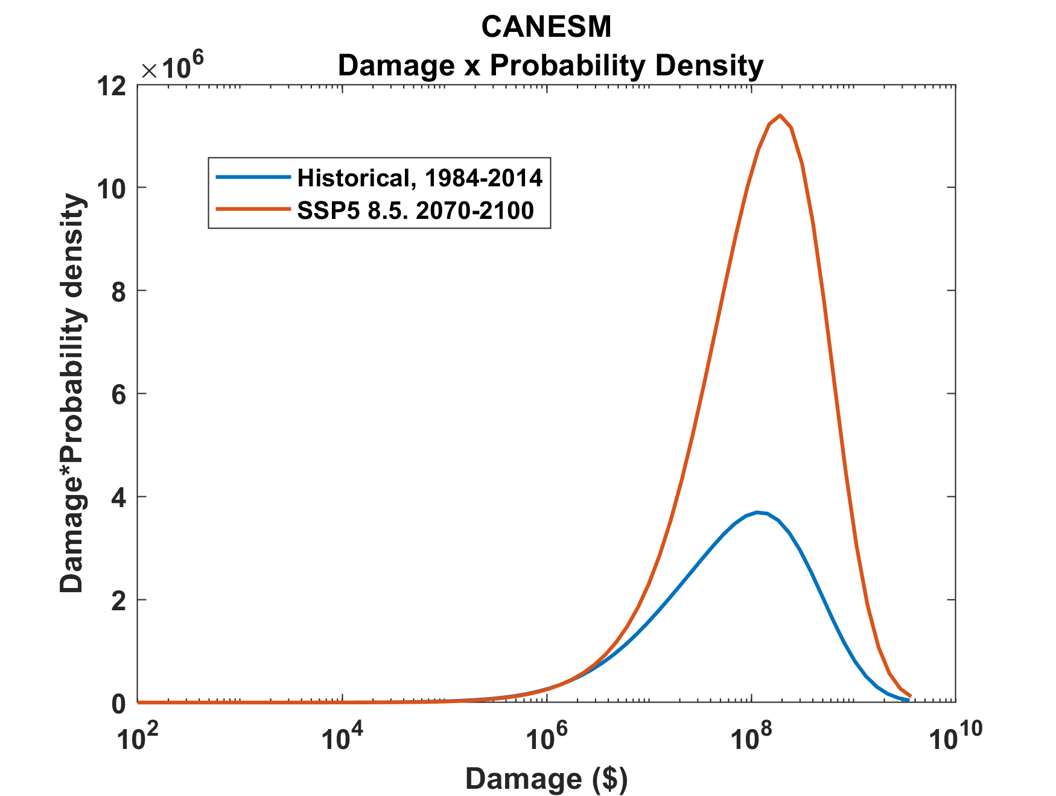
Tropical Cyclone Risk Arises Largely from High Intensity Events
2070-2100
Total expected damage proportional to area under curves
Risk
1984-2014
Damage times probability density of annual damage to a portfolio of insured property in the U.S.

Slide 6
Historical Records
Riverine floods: ~100 years of good records (U.S.)
Flash floods and tropical-cyclone induced floods: Somewhat less than 100 years
Even if we had 100 years of great records, the past is no longer a good guide to the present
We need to turn to physical models to get better estimates of current (and future) weather risks

Slide 7

Case in Point: Hurricane Risk

Slide 8
Example: Flooding from Hurricane Harvey, 2017
Three independent scientific studies appeared in 2017:
van Oldenborgh et al: “We conclude that global warming made the precipitation about 15% (8%–19%) more intense, or equivalently made such an event three (1.5–5) times more likely.”
Risser and Wehner: “We find that human-induced climate change likely increased the chances of the observed precipitation accumulations during Hurricane Harvey in the most affected areas of Houston by a factor of at least 3.5.”
Emanuel: “In 2017 the annual probability [of Hurricane Harvey’s rainfall in Harris County] would be 6%, a sixfold increase since the late 20th century.

Slide 9
What Are Atlantic Historical Records Based On?
Pre-1943: Anecdotal accounts from coastal cities and ships
1943: Introduction of routine aircraft reconnaissance in Atlantic, western North Pacific
1958: Inertial navigation permits direct measurement of wind speed at flight level
1970: Complete global detection by satellites
1978: Introduction of satellite scatterometry
1987: Termination of airborne reconnaissance in western North Pacific

Slide 10
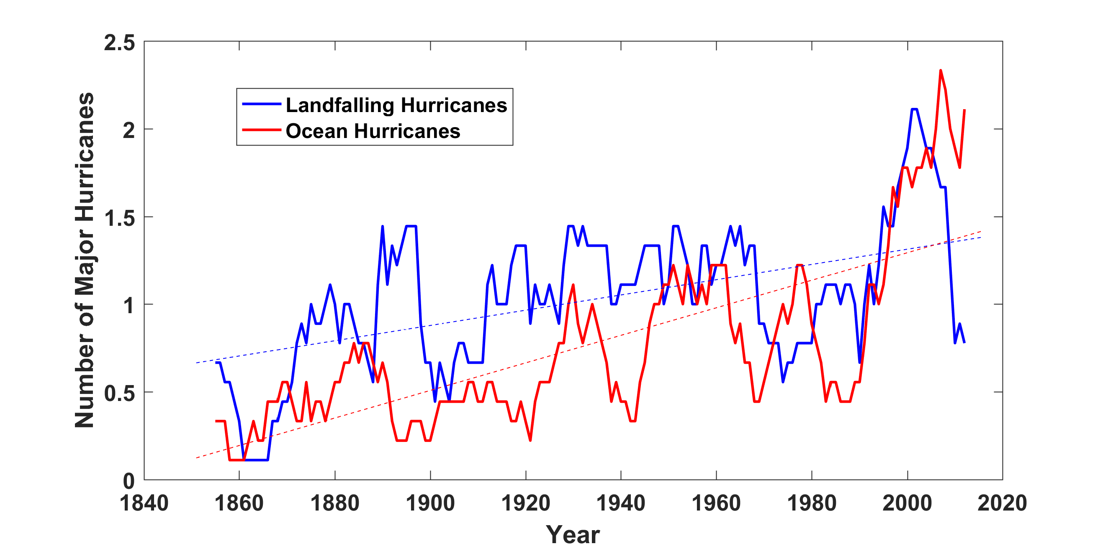
Historical Records:
Prior to 1970, Many Storms Were Missed
Major hurricanes in the North Atlantic, 1851-2016, smoothed using a 10-year running average. Shown in blue are storms that either passed through the chain of Lesser Antilles or made landfall in the continental U.S.; all other major hurricanes are shown in red. The dashed lines show the best fit trend lines for each data set.

Slide 11
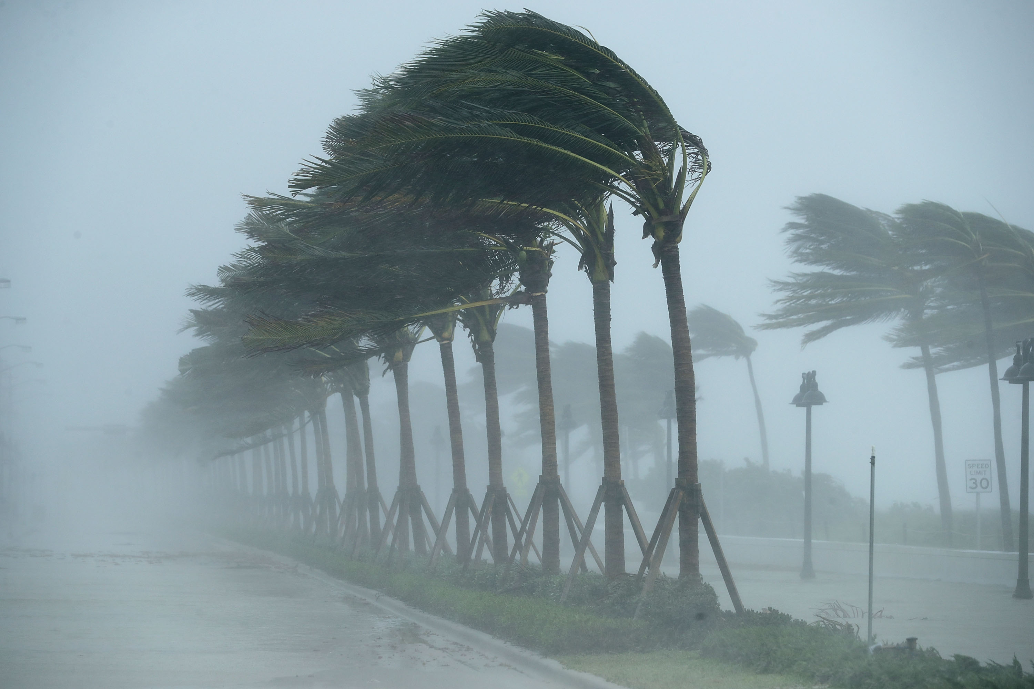
Using Physical Models to Estimate Hurricane Risk

Slide 12
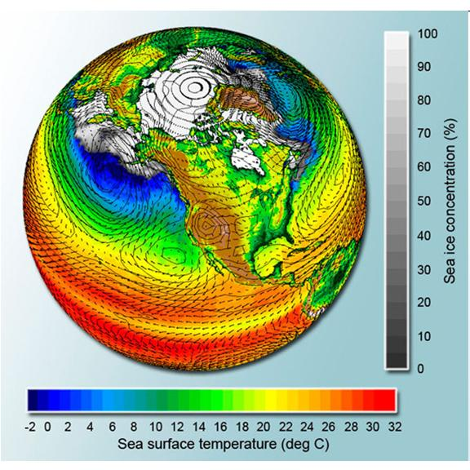
Why Not use Climate Models to Simulate Future Hurricanes?

Slide 13

Problem: Today’s models are far too coarse to simulate destructive hurricanes
Histograms of Tropical Cyclone Intensity as Simulated by a Global Model with 50 km grid point spacing. (Courtesy Isaac Held, GFDL)
Category 3
Modeled
Observed
Global models do not simulate the storms that cause destruction
Wind Speed (meters per second)

Slide 14
Using Physics to Assess Hurricane Risk
Reliable, global records of coarse-scale climate are robust and widely available
Cull from these datasets the key statistics known to control tropical cyclone generation, movement, and intensity evolution
Bootstrap these key statistic to create unlimited synthetic time series of the hurricane-relevant environmental variables
Use these to drive specialized, very high resolution physical hurricane models (CHIPS)
Extensively validate the results against historical hurricane data
Exact same method can be applied to output of climate models

Slide 15

MIT Synthetic Hurricanes
Embed high-resolution, fast coupled ocean-atmosphere hurricane model in global climate model or climate reanalysis data
Coupled Hurricane Intensity prediction Model (CHIPS) has been used for 20 years to forecast real hurricanes in near-real time

Slide 16
Risk Assessment Approach:
Step 1: Seed each ocean basin with a very large number of weak, randomly located cyclones
Step 2: Cyclones are assumed to move with the large scale atmospheric flow in which they are embedded, plus a correction for the earth’s rotation and sphericity (beta-drift)
Step 3: Run the CHIPS coupled intensity model for each cyclone, and note how many achieve at least tropical storm strength
Step 4: Using the small fraction of surviving events, determine storm statistics. Can easily generate 100,000 events
Details: Emanuel et al., Bull. Amer. Meteor. Soc, 2008
Notes:
16

Slide 17
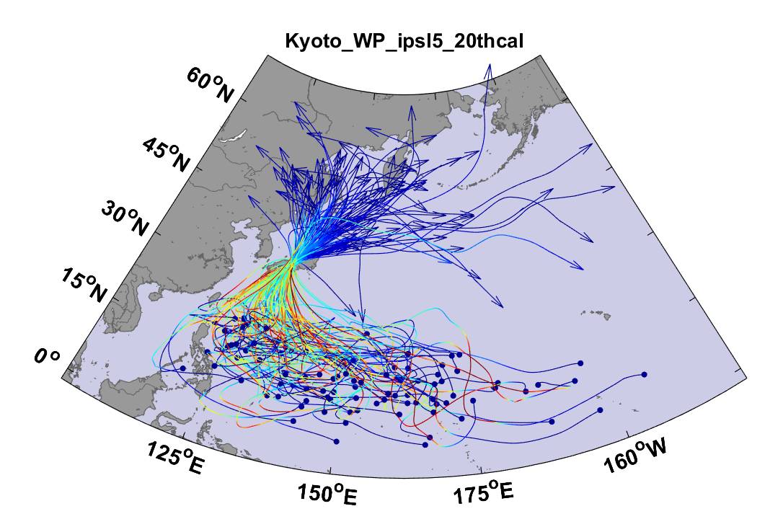
Example:
Top 100 out of 2000 TCs Affecting Kyoto, 1981-2000

Slide 18
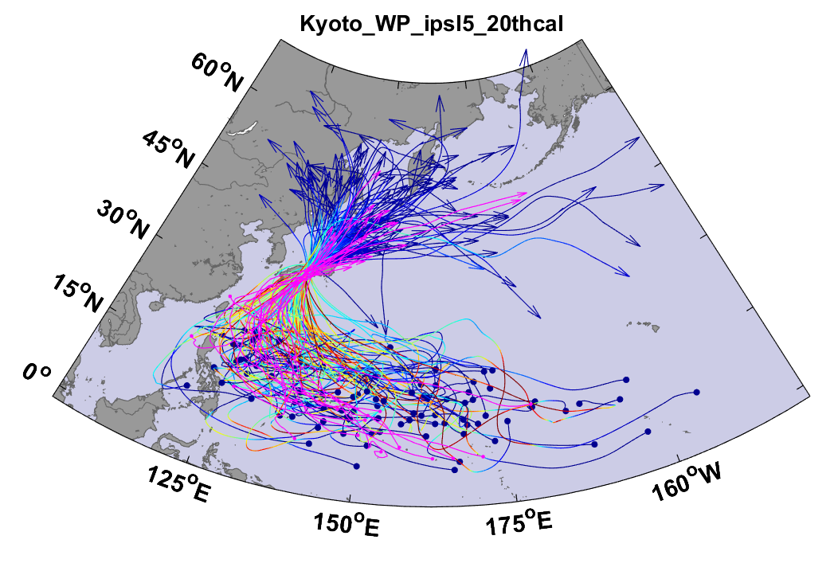
Same, but with top 20 historical tracks

Slide 19
Atlantic Annual Cycle

Slide 20

Cumulative Distribution of Storm Lifetime Peak Wind Speed, with Sample of 1755 Synthetic Tracks
Blue bars: Actual
Red bars: Predicted
90% confidence bounds

Slide 21

Captures effects of regional climate phenomena (e.g. ENSO, AMM)
Blue bars: Actual
Red bars: Predicted

Slide 22
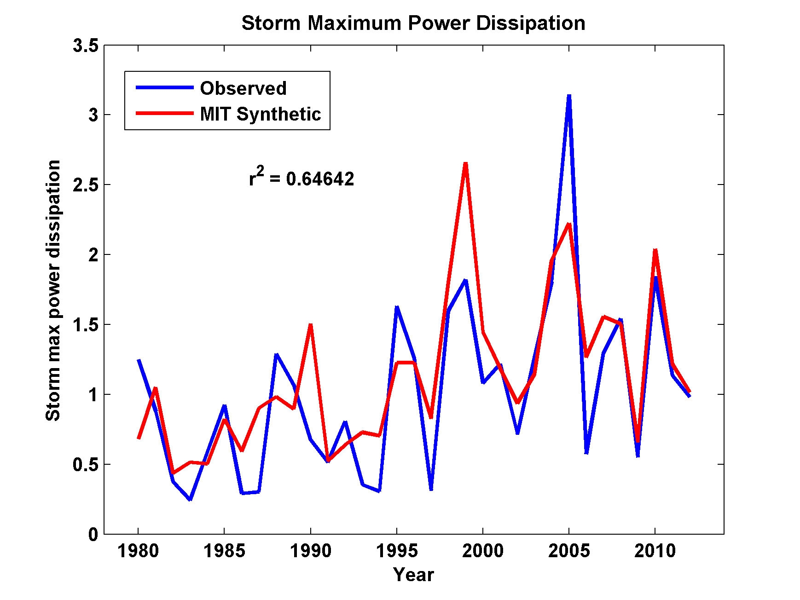
Captures Much of the Observed North Atlantic Interannual Variability
r²=0.65

Slide 23
Major Hurricanes
7-year running averages

Slide 24
All Landfalls, NOAA 20th Century v.3
7-year running averages
Suggests some landfalls missed prior to 1900

Slide 25
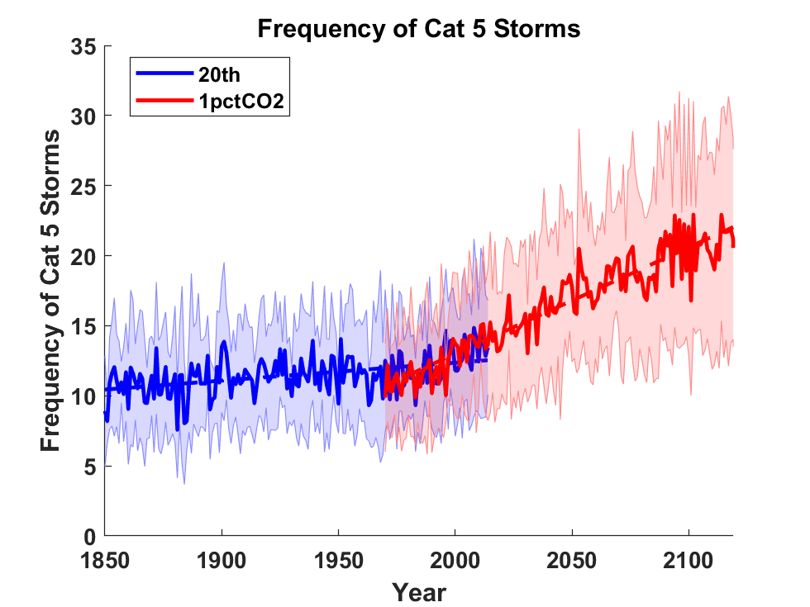
Global Tropical Cyclone Frequency from 9 Current Generation (CMIP6) Climate Models

Slide 26
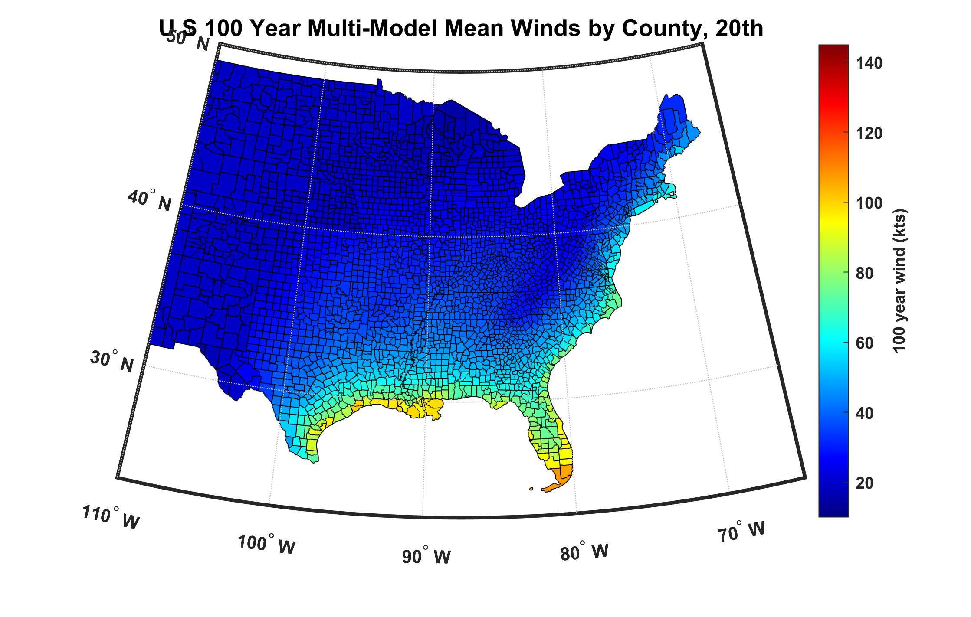
100-year hurricane peak wind based on downscaling 8 CMIP6 climate models, 1984-2014

Slide 27
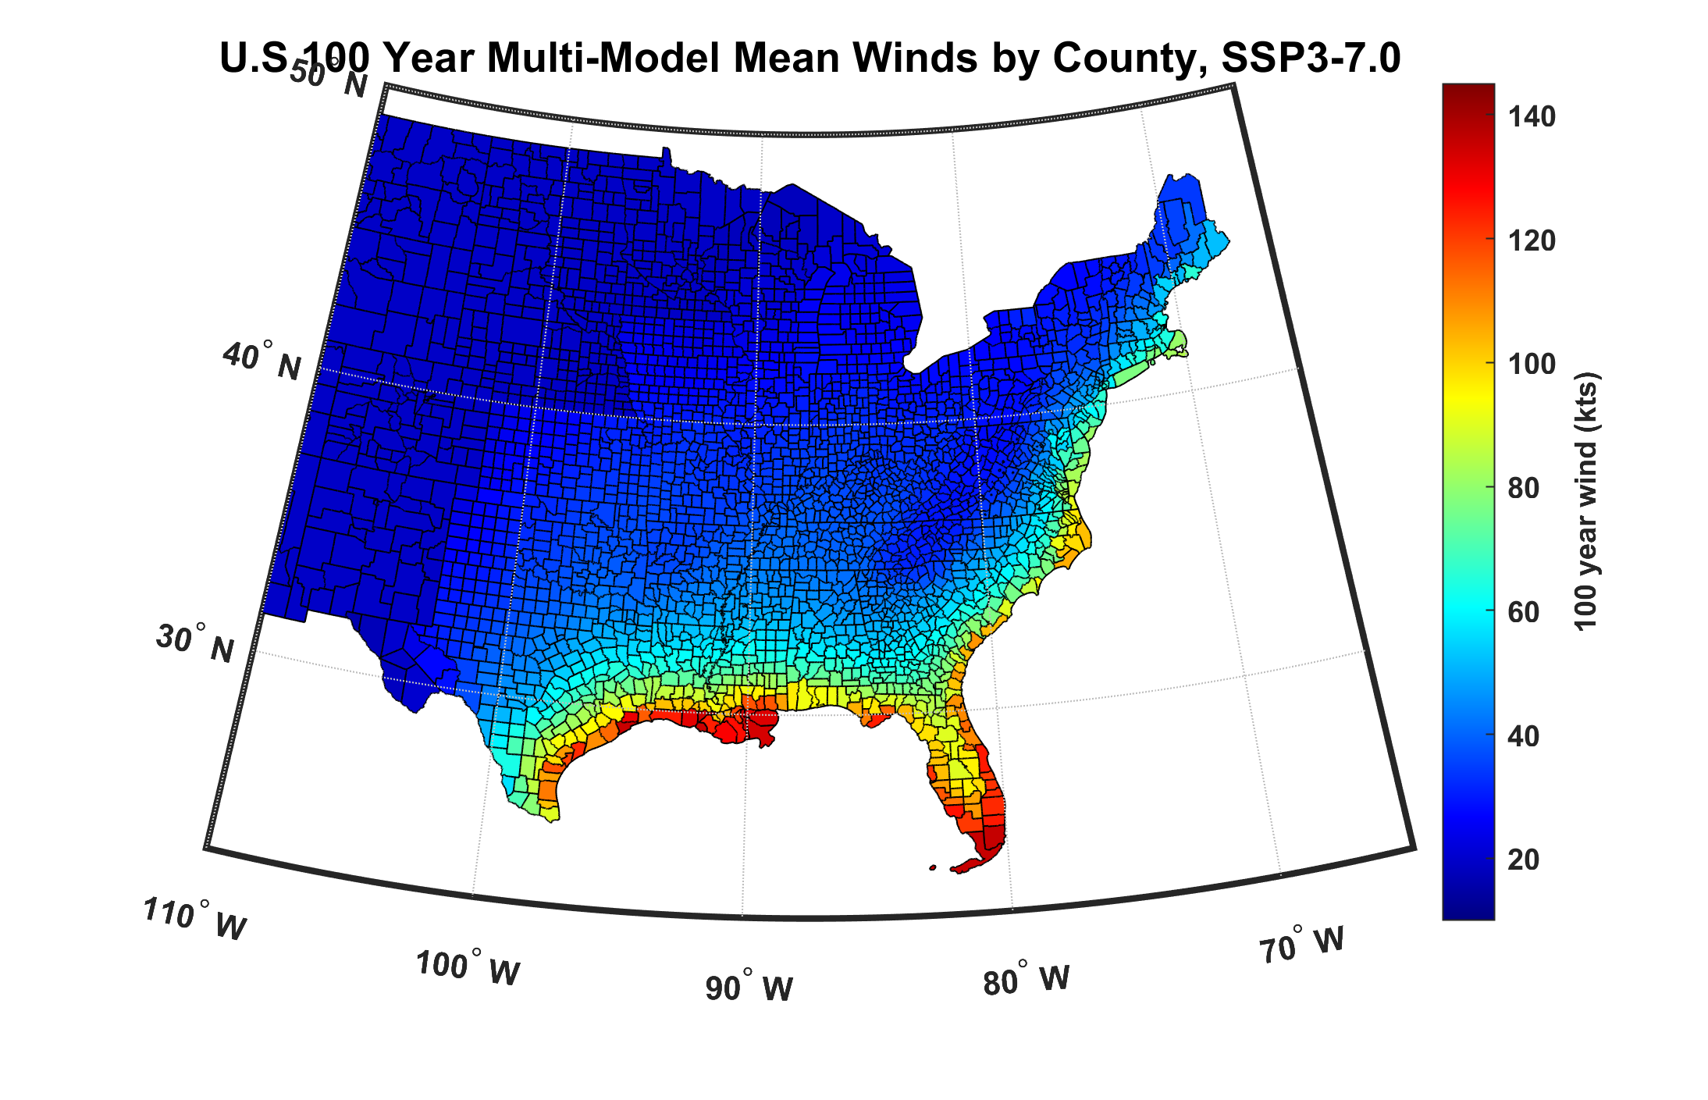
100-year hurricane peak wind based on downscaling 8 CMIP6 climate models, 2070-2100

Slide 28
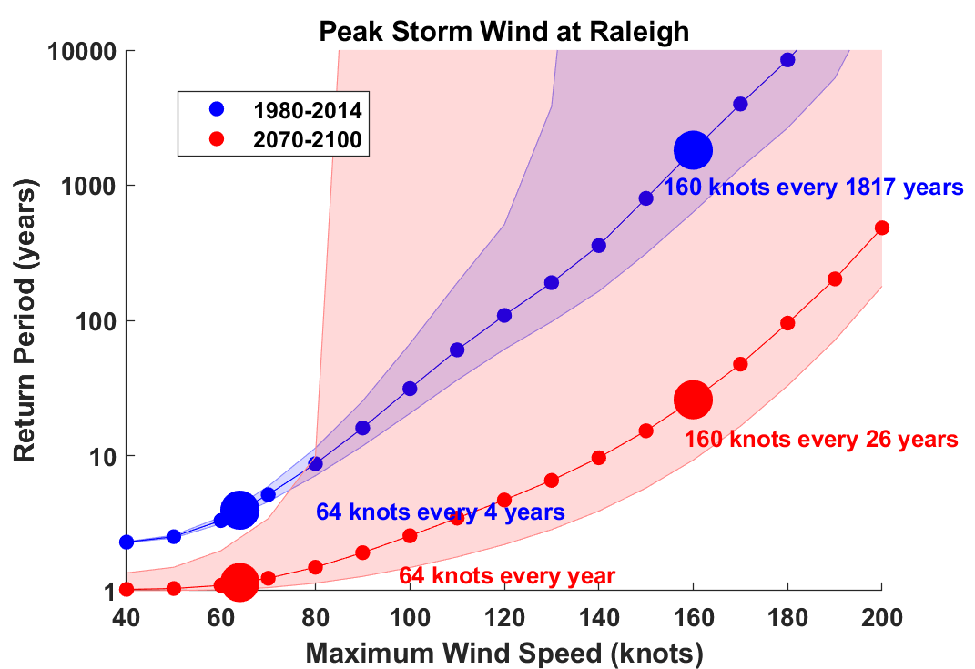

Slide 29
Probability density of impacts exceeding the 100 billion USD impact for the four synthetic datasets (IBTrACS_p, STORM, MIT, CHAZ). Percentages printed above each probability density indicate the fraction of all impacts in the corresponding dataset above the 100 billion USD threshold. Meiler et al. Nat. Comm., 2022

Slide 30
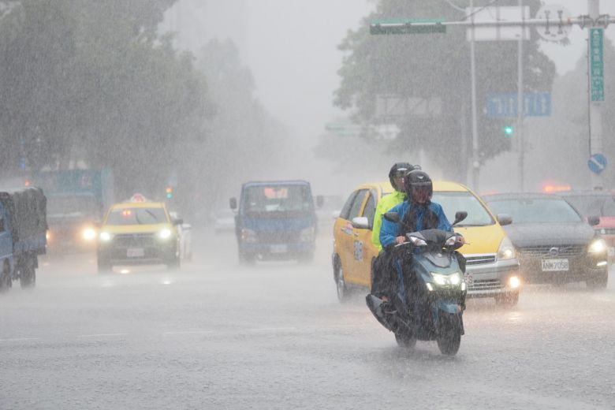
Hurricane Rain

Slide 31

~500 from water, ~80 from wind

Slide 32
Predicting Rainfall
The CHIPS models predicts updraft and downdraft convective mass flux as a function of time and potential radius, BUT:
Storing these variables at all radii would increase overall storage requirements by a factor of ~50
(We are dealing with 10,000-100,000 individual events)

Slide 33
Basic strategy: Reconstruct time-evolving
2-D wind field by fitting a canonical radial wind profile to predicted values of V_{max} and r_{max} and adding a constant background wind. Allow resulting vortex to interact with background wind shear and thermodynamic fields.
Apply Quasi-Balanced Dynamics to Stored TC and Environmental Fields
Details: Feldmann et al, J. App. Meteor. Clim., 2019

Slide 34
Testing the Algorithm
Identify TC rainfall affecting NEXRAD sites
Choose local Daily Global Historical Climatology Network (GHCN-D) rain gauges located near NEXRAD sites
Compare statistical distributions of storm total rainfall from synthetic TCs with NEXRAD-derived rain and rain at nearby gauges
Details: Feldmann et al, J. App. Meteor. Clim., 2019

Slide 35
NEXRAD Sites

Slide 36
An Example:
Estimated gauge sampling error
Estimated radar sampling error
Feldmann et al, J. App. Meteor. Clim., 2019

Slide 37
2,000 year rain event for Houston

Slide 38
Effects of Climate Change
More moisture in boundary layer
Stronger storms but more compact inner regions
Possibly larger storm diameters
Storms may be moving faster or slower

Slide 39
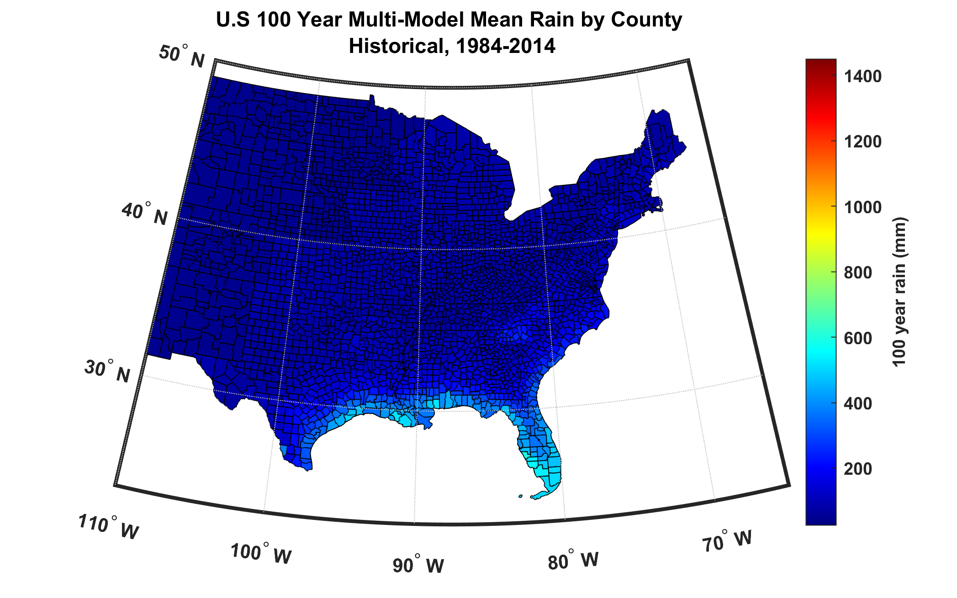
100-year hurricane storm total rain based on downscaling 8 climate models, 1984-2014

Slide 40
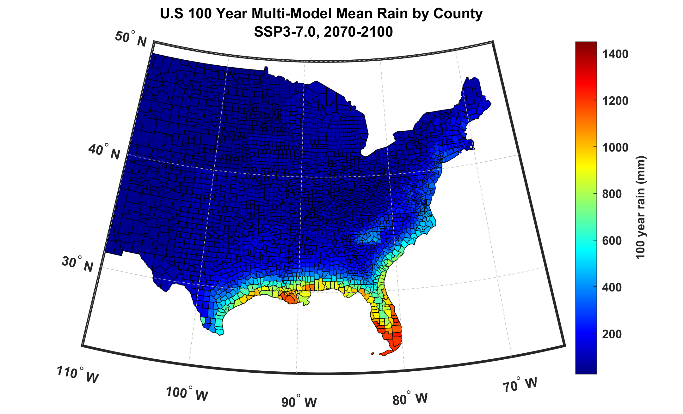
100-year hurricane storm total rain based on downscaling 8 climate models, 2070-2100

Slide 41
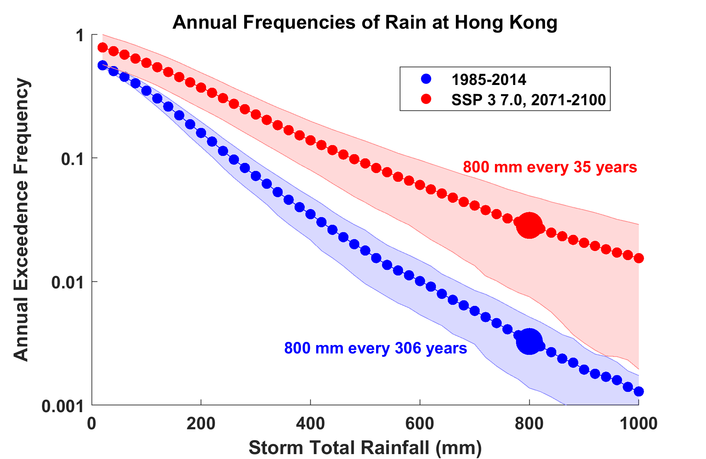
Based on 9 CMIP6 models

Slide 42
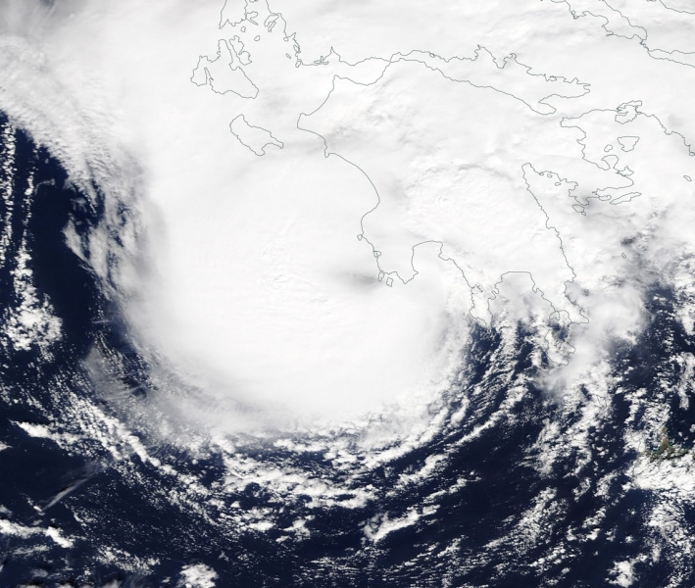
Mediterranean Hurricanes (“Medicanes”)
Medicane “Zorba” making landfall in southwest Peloponnese, September 29th 2018

Slide 43
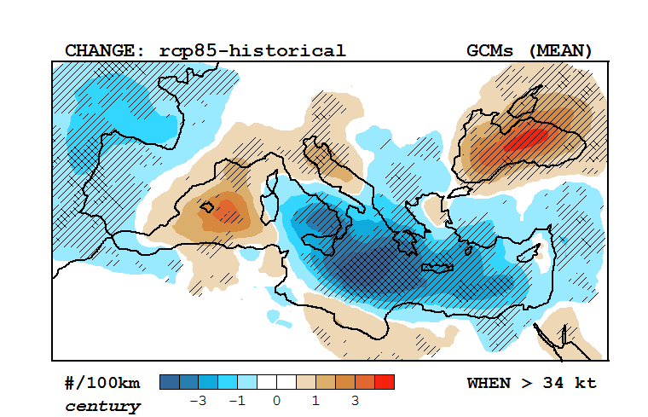
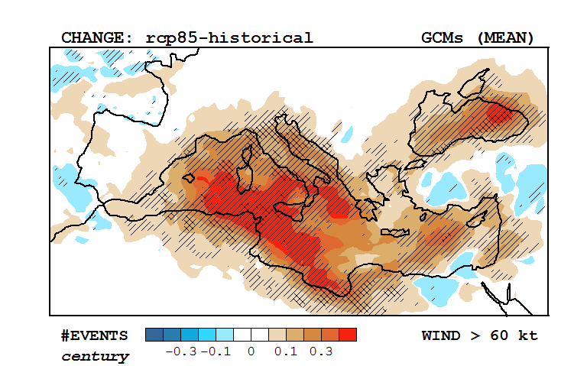
Response of Medicanes to a Changing Climate
Change in multi-model mean track density, RCP 8.5 –historical (2090-1995)
Based on downscaling of 30 CMIP5 models
(light and dark hatching; > 66% and 80% consensus)
Change in multi-model mean frequency of winds > 60 knots, RCP 8.5 –historical (2090-1995)
Romero and Emanuel, J. Clim., 2017

Slide 44
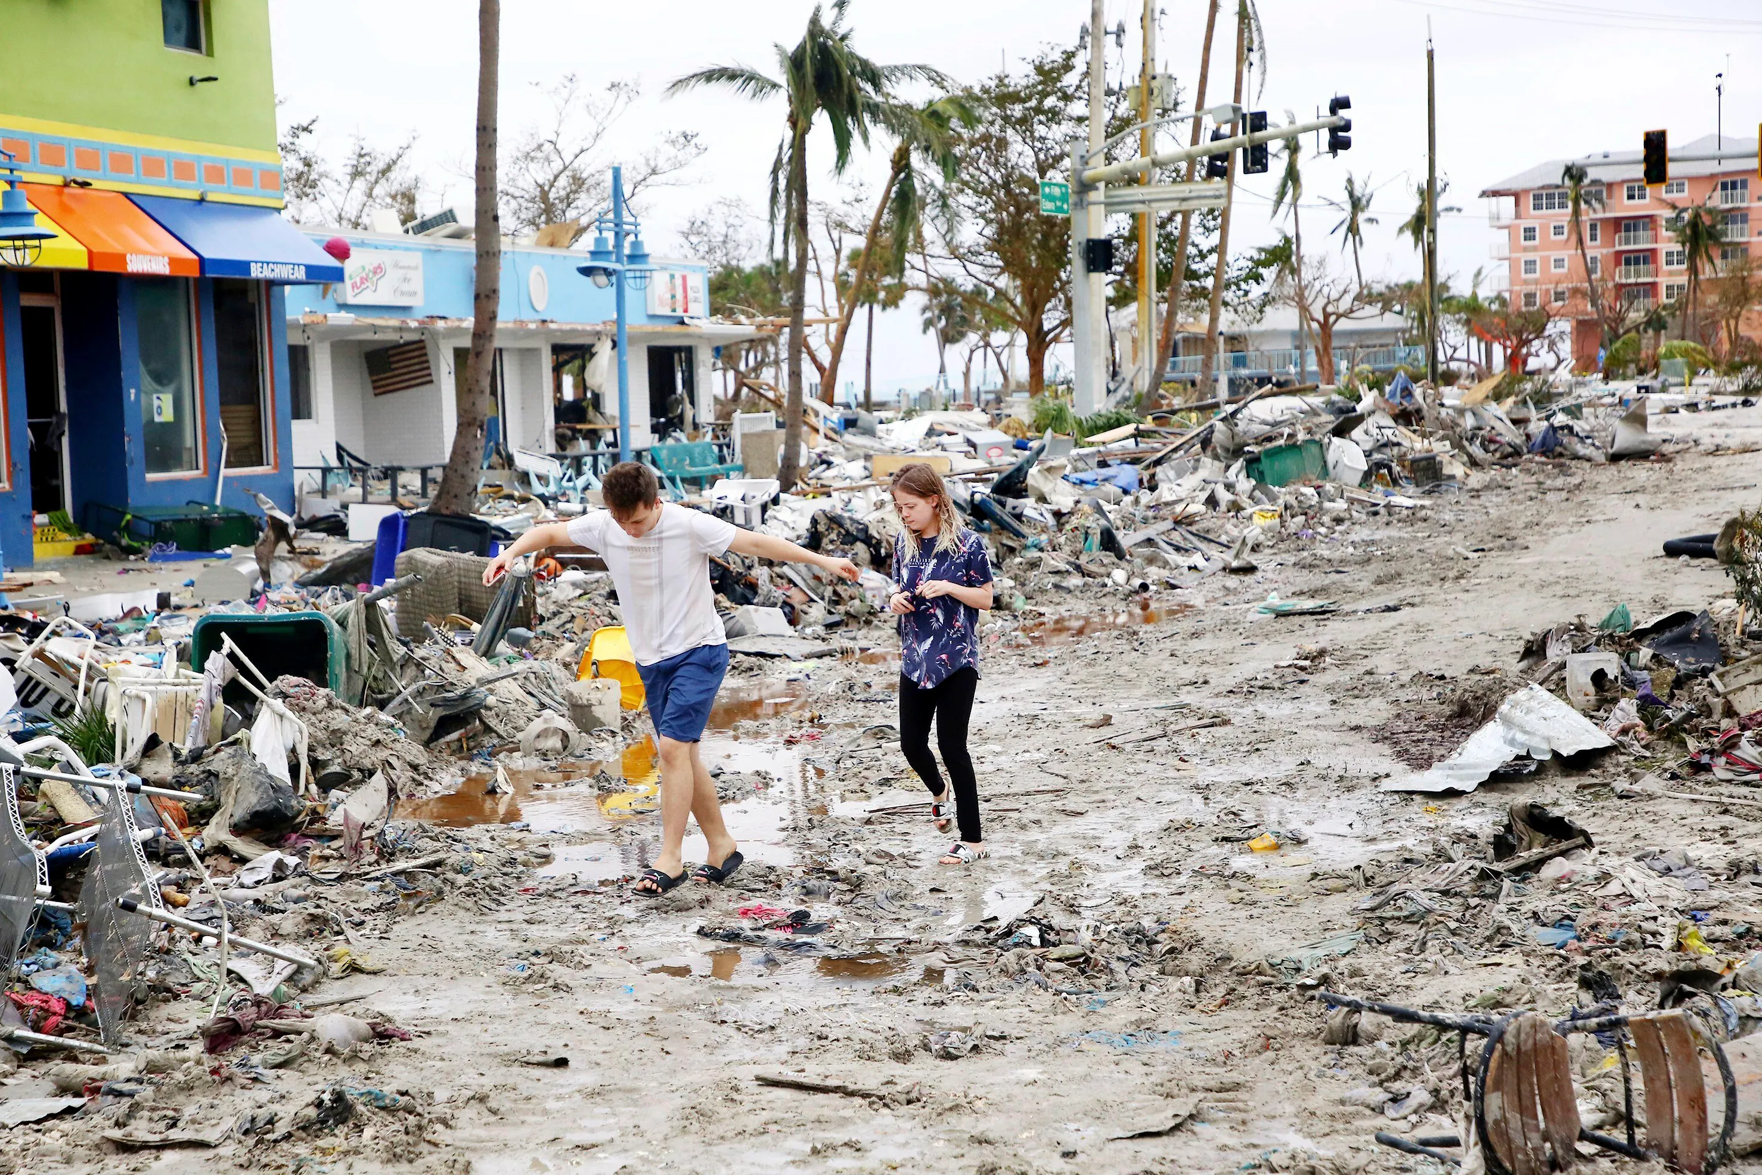
Making Risk Personal:
All Climate Change is Local!

Slide 45
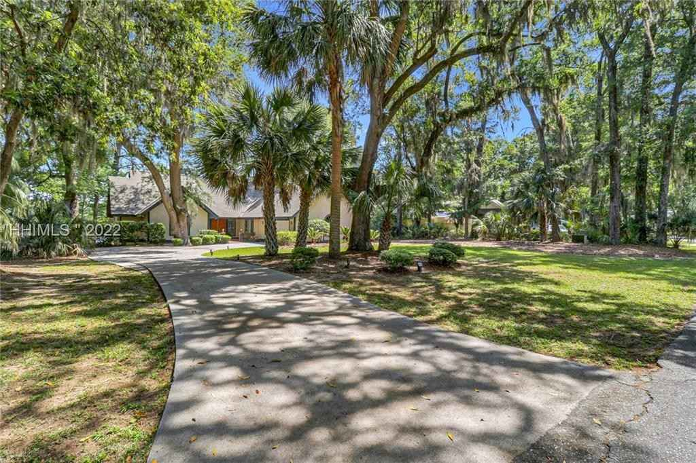
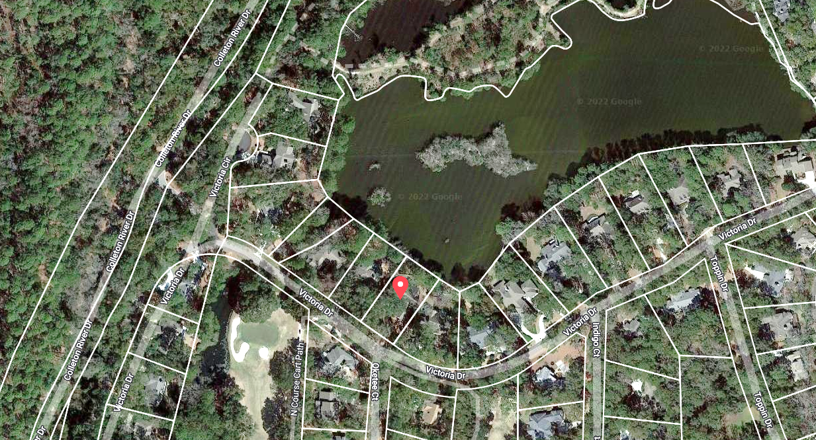



Property currently for sale in Hilton Head, SC
Realtor.com
Work of First Street Foundation

Slide 46
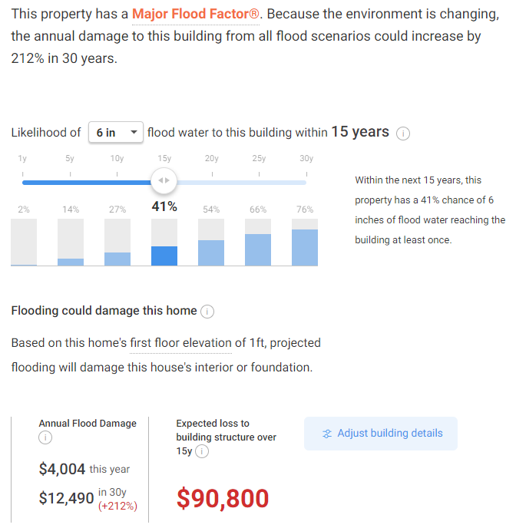

Slide 47
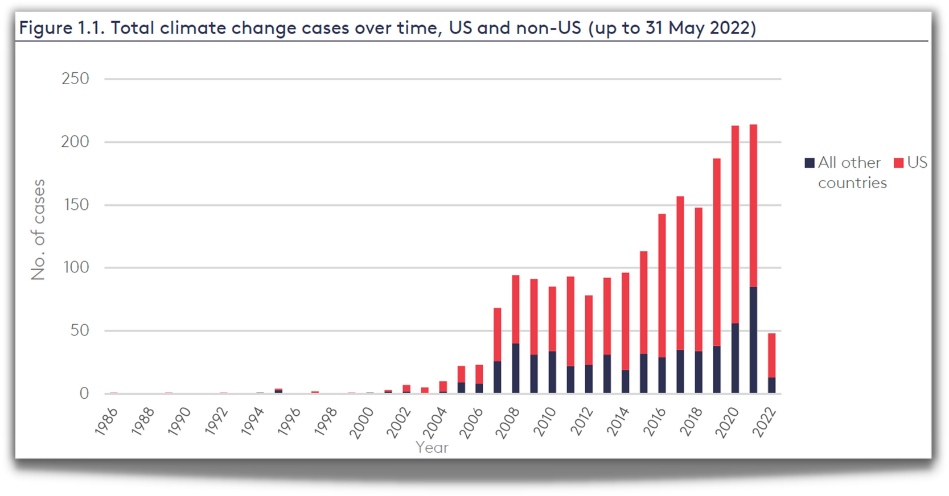

CLIMATE
LITIGATION
TRENDS
Currently 2,000+ U.S. climate cases
Source: Joana Setzer & Catherine Higham, Global Trends in Climate Change Litigation 9 (June 2022) (based on data from the Sabin Center and Climate Change Laws of the World databases)
Courtesy Sandra Thiam and Jarryd Page of the Climate Judiciary Project of the Environmental Law Institute

Slide 48
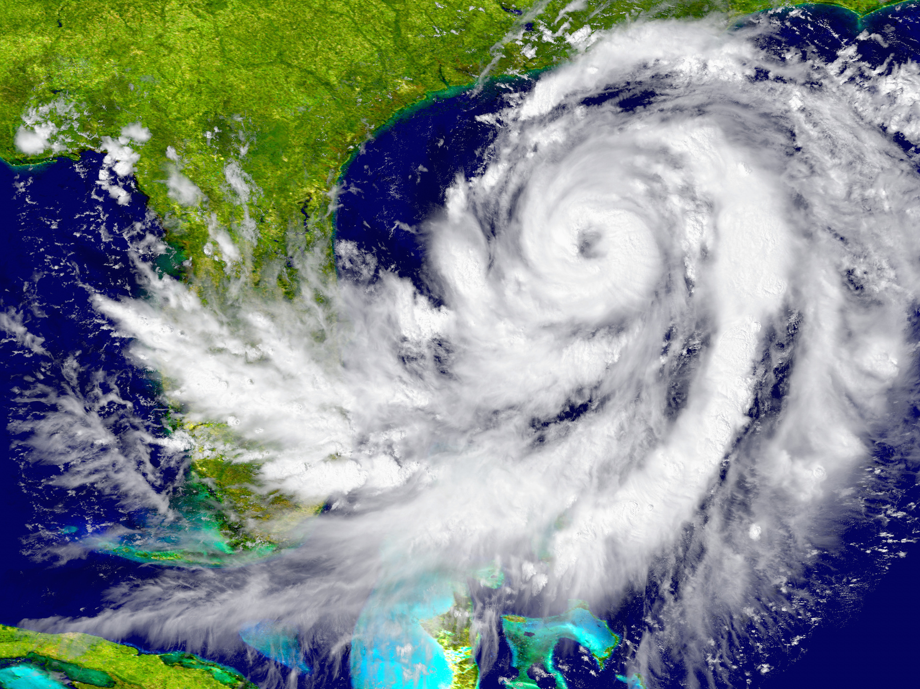
HURRICANE LITIGATION
Litigation happens before (planning and preparation) and after (impacts)
Can include:
  Torts (negligence, nuisance, trespass)
  Zoning and land use
  Impact assessments
  Insurance claims
Courtesy Sandra Thiam and Jarryd Page of the Climate Judiciary Project of the Environmental Law Institute

Slide 49
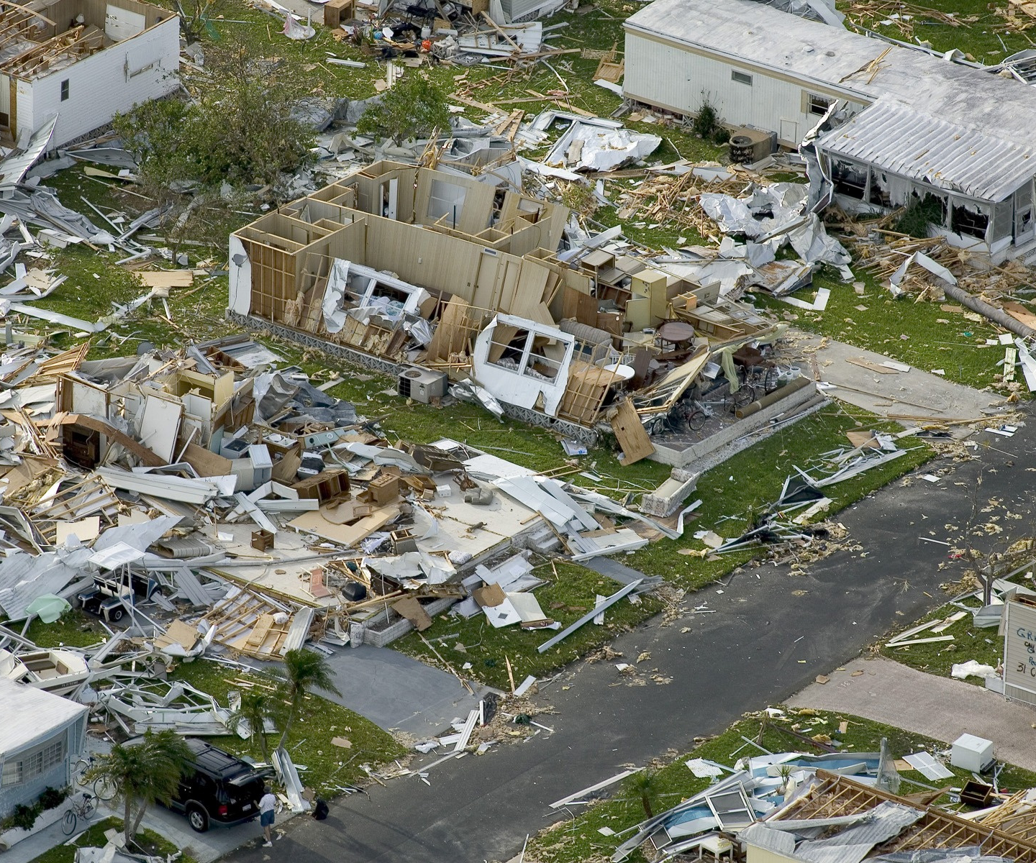
LEGAL ISSUES RELATED
TO HURRICANES:
INSURANCE
  whether homeowners' insurance settlements with insurance companies for damages sustained in a hurricane were appropriate
    (class action following Hurricane Sandy)
Courtesy Sandra Thiam and Jarryd Page of the Climate Judiciary Project of the Environmental Law Institute

Slide 50
Take-Away Points
We need to move away from sole dependence on flawed historical data in assessing climate- and weather-related natural hazard risk and embrace advanced modeling techniques
We need to bring physical modeling to bear on natural hazard risk. Institutions of higher education are crucial to this effort
We can no longer regard climate change as a problem for the future; it has already tangibly affected important risks, e.g. Hurricane Harvey’s rainfall was ~3 times more likely in 2017 than in 1970

Slide 51
Taking Climate Change Into Account

Slide 52

GCM flood height return level, Battery, Manhattan
(assuming SLR of 1 m for the future climate )
Black: Current climate (1981-2000)
Blue: A1B future climate (2081-2100)
Red: A1B future climate (2081-2100) with R₀ increased by 10% and R_{m} increased by 21%
Lin et al. (2012)
Notes:
Then we calculate the flood height (including surge, tide, and sea level rise) return level for the four climate models, assuming a sea level rise of 1 m for the future climate, for the Battery, NYC. These results show that the combined effects of storm climatology change and sea level rise will greatly shorten the flood return periods for NYC and, by the end of the century, the current 100-year surge flooding may happen less than every 30 years, with CNRM and GFDL prediction to be less than 10 years, and the 500-year flooding may happen less than every 200 years, with the CNRM and GFDL prediction to be 20-30 years.

Slide 53
Is Hurricane Risk Changing?

Slide 54
Satellite-derived proportion of major hurricane fixes
Time series of fractional proportion of global major hurricane estimates to all hurricane estimates for the period 1979–2017. Each point, except the earliest, represents the data in a sequence of 3-y periods. The first data point is based on only 2 y (1979 and 1981) to avoid the years with no eastern hemisphere coverage. The linear Theil−Sen trend (black line) is significant at the 98% confidence level (Mann−Kendall P value = 0.02). The proportion increases by 25% in the 39-y period (about 6% per decade).
Kossin et al., PNAS, 2020

Slide 55
Hurricanes are reaching peak intensity at higher latitudes
Time series of the latitudes at which tropical cyclones reach maximum intensity.
From Kossin et al. (2014)

Slide 56
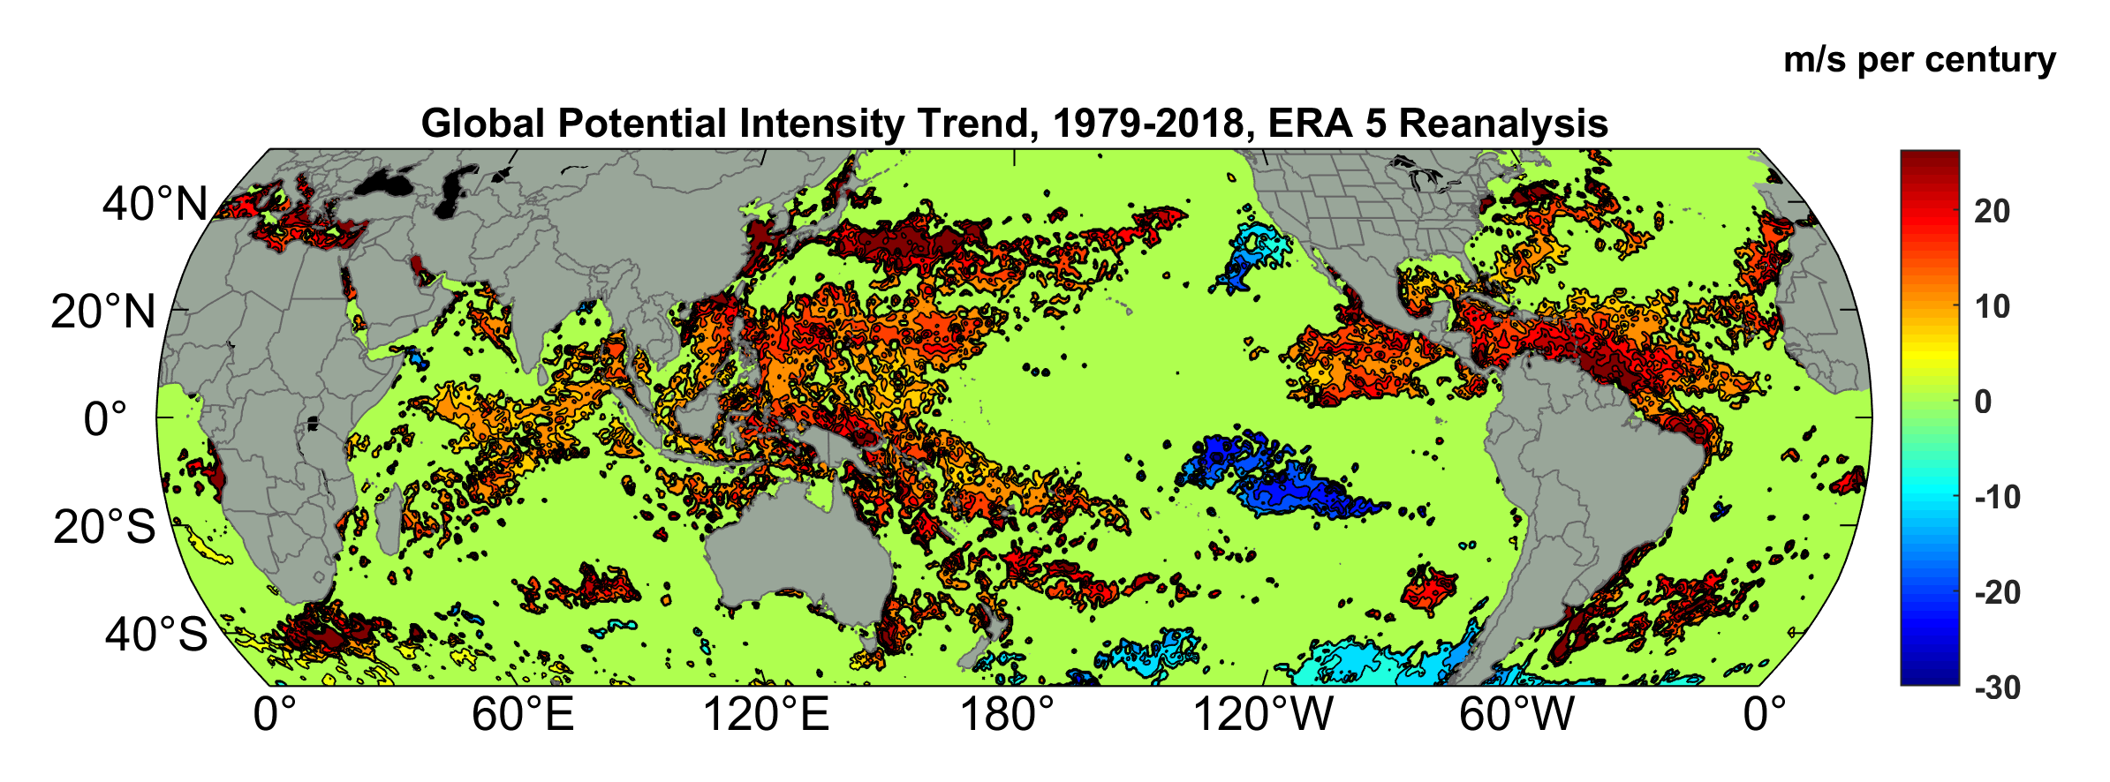
Potential Intensity Trend, 1979-2018, ERA 5 Reanalysis
(Trend shown only where p value < 0.05)

Slide 57
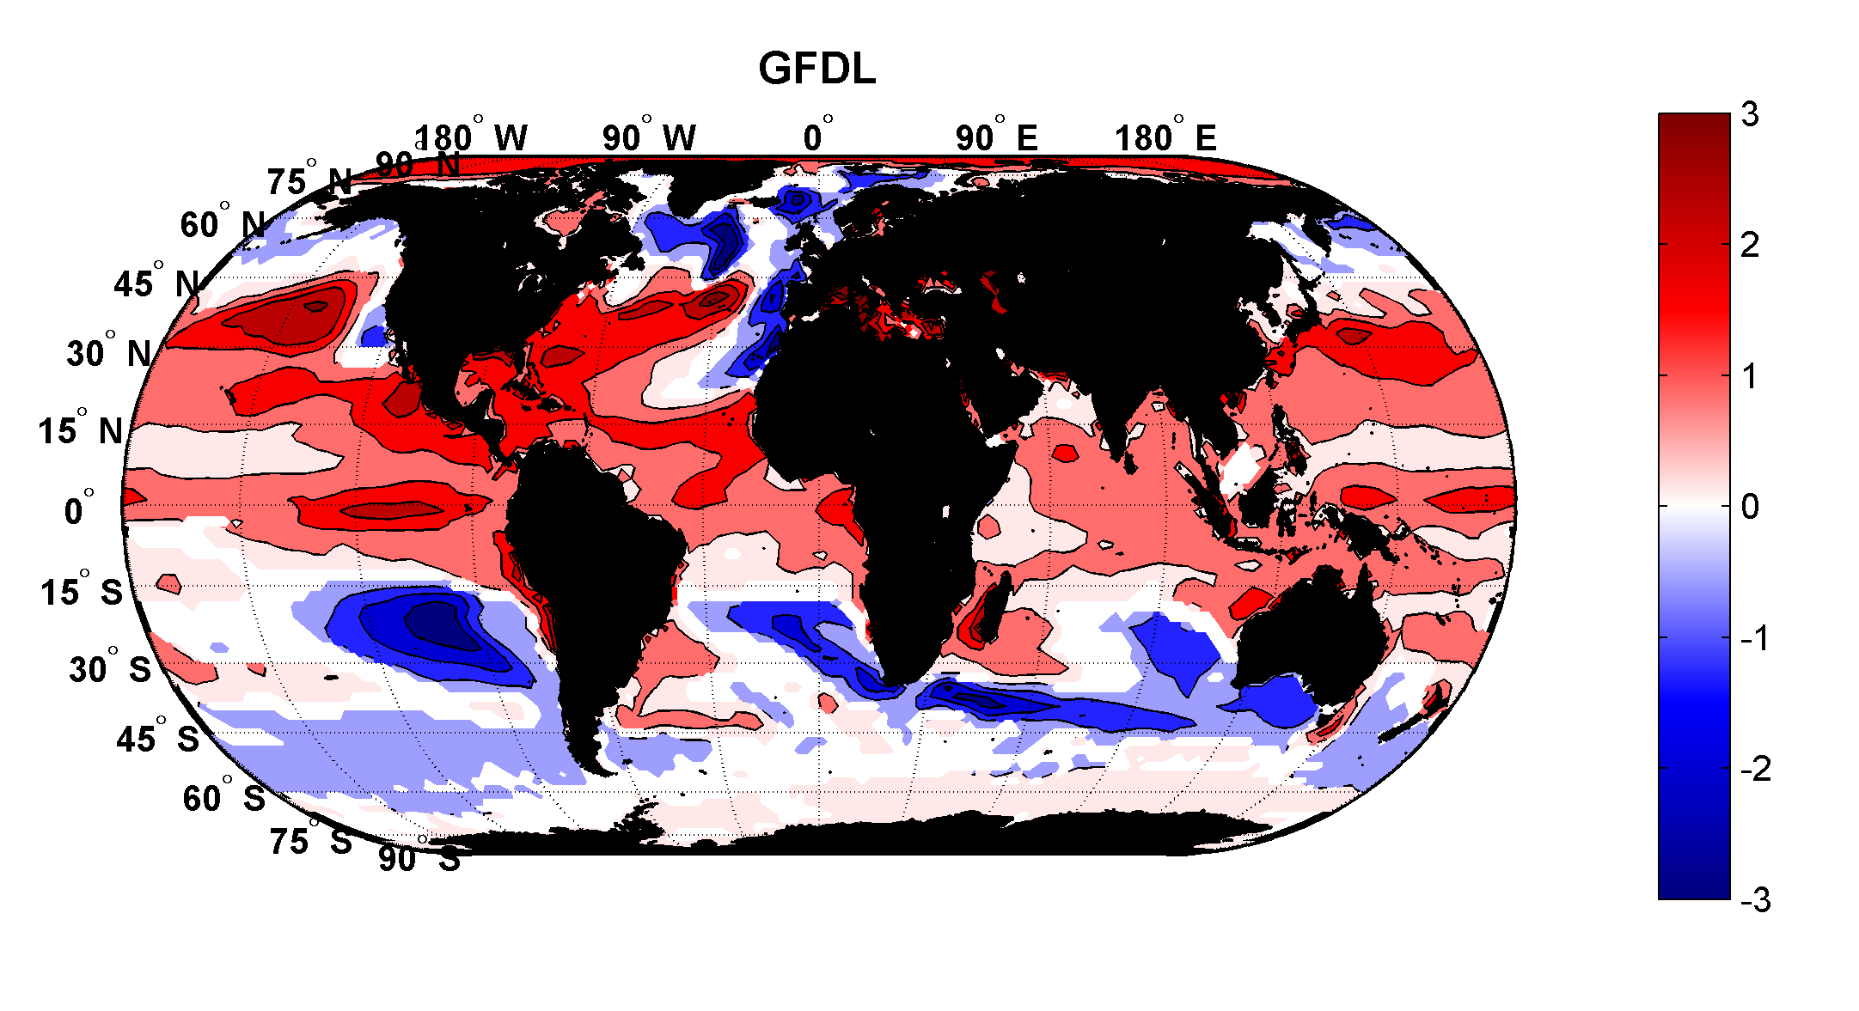
Projected Trend Over 21st Century: GFDL model under RCP 8.5
ms⁻¹decade⁻¹

Slide 58
Inferences from Basic Theory:
Potential intensity increases with global warming
Incidence of high-intensity hurricanes should increase
Increases in potential intensity should be faster in sub-tropics
Hurricanes will produce substantially more rain: Clausius-Clapeyron yields ~7% increase in water vapor per 1ºC warming

Slide 59
Cumulative Distribution of Storm Lifetime Peak Wind Speed, with Sample of 1755 Synthetic Tracks
90% confidence bounds

Slide 60
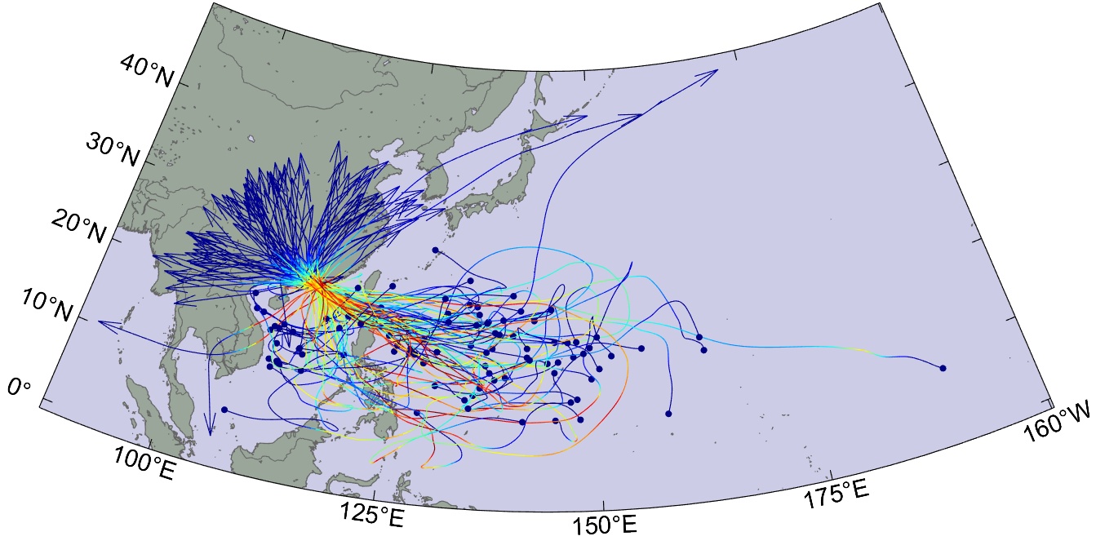
Top 100 of 4,500 tropical cyclones affecting Hong Kong, downscaled from UKMO CMIP6, 20th Century

Slide 61
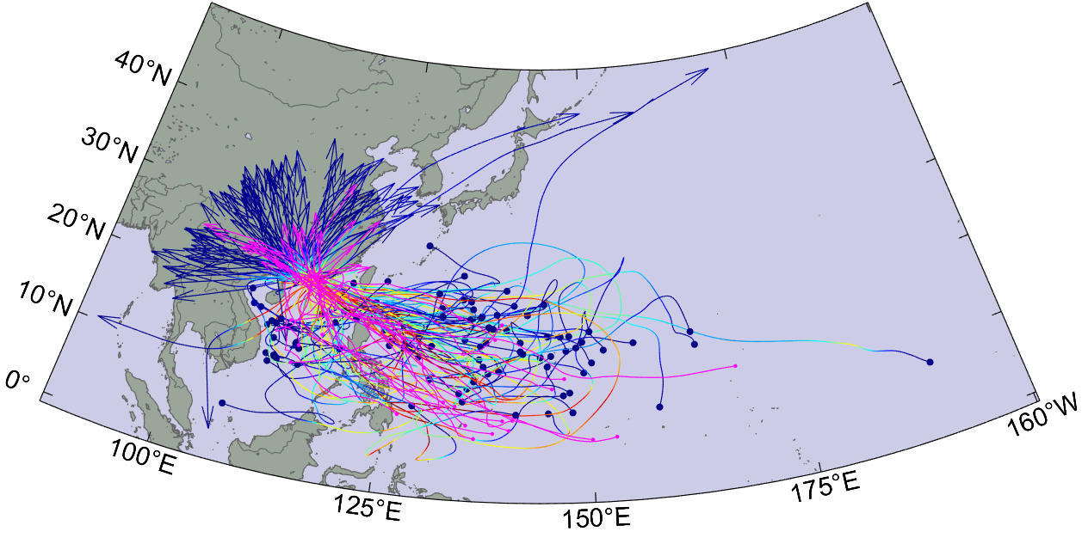
With historical tracks superimposed

Slide 62

Return Periods

Slide 63


Storm Surge Simulation (Ning Lin)
SLOSH model
(Jelesnianski et al. 1992)
SLOSH mesh
~ 10³ m
ADCIRC mesh
~ 10² m
Battery
ADCIRC model
(Luettich et al. 1992)
ADCIRC mesh
~ 10 m
(Colle et al. 2008)
Notes:
Given the storm wind and pressure fields (which is estimated from the Holland parametric pressure model) we can simulate the surge. Surge simulations with high resolution are computationally intensive, so to make it possible to simulate accurate surges for our large synthetic storm sets, we apply the two hydrodynamic models with girds of various resolutions in such a way that the main computational effort is concentrated on the storms that determine the risk. First, we apply the SLOSH model, using a mesh with resolution of about 1 km around NYC to simulate the surges for all storms and select the storms that have return periods, in terms of the surge height at the Battery, greater than 10 years. Second, we apply the ADCIRC simulation, using a grid mesh with resolution of ~100 m around NYC, to each of the selected storms. Then, we apply another ADCIRC mesh with resolution as high as ~10 m around NYC, for a set of the most extreme events, to check if the resolution of our ADCIRC grid is sufficient and if needed to make statistical correction to the results.

Slide 64
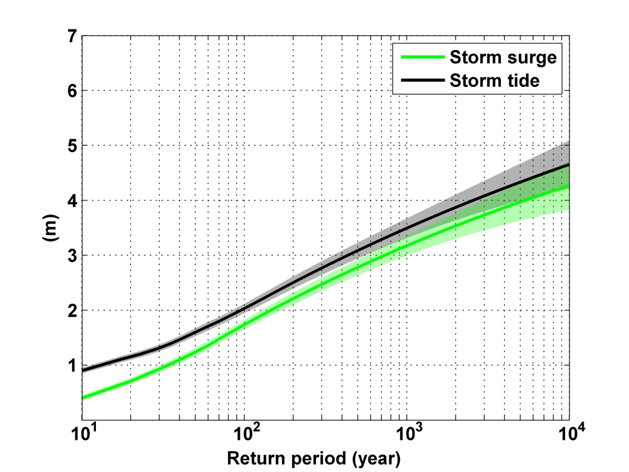
Sandy, 2012
Sandy: ~ 400 years
Notes:
Storm surge and storm tide (surge and tide) return level curves for the Battery, NYC, for the 1981-2000 NCAR/NCEP climate conditions (5000 synthetic storms). Astronomical tide and nonlinear interaction between surge and tide are accounted for statistically.

Slide 65
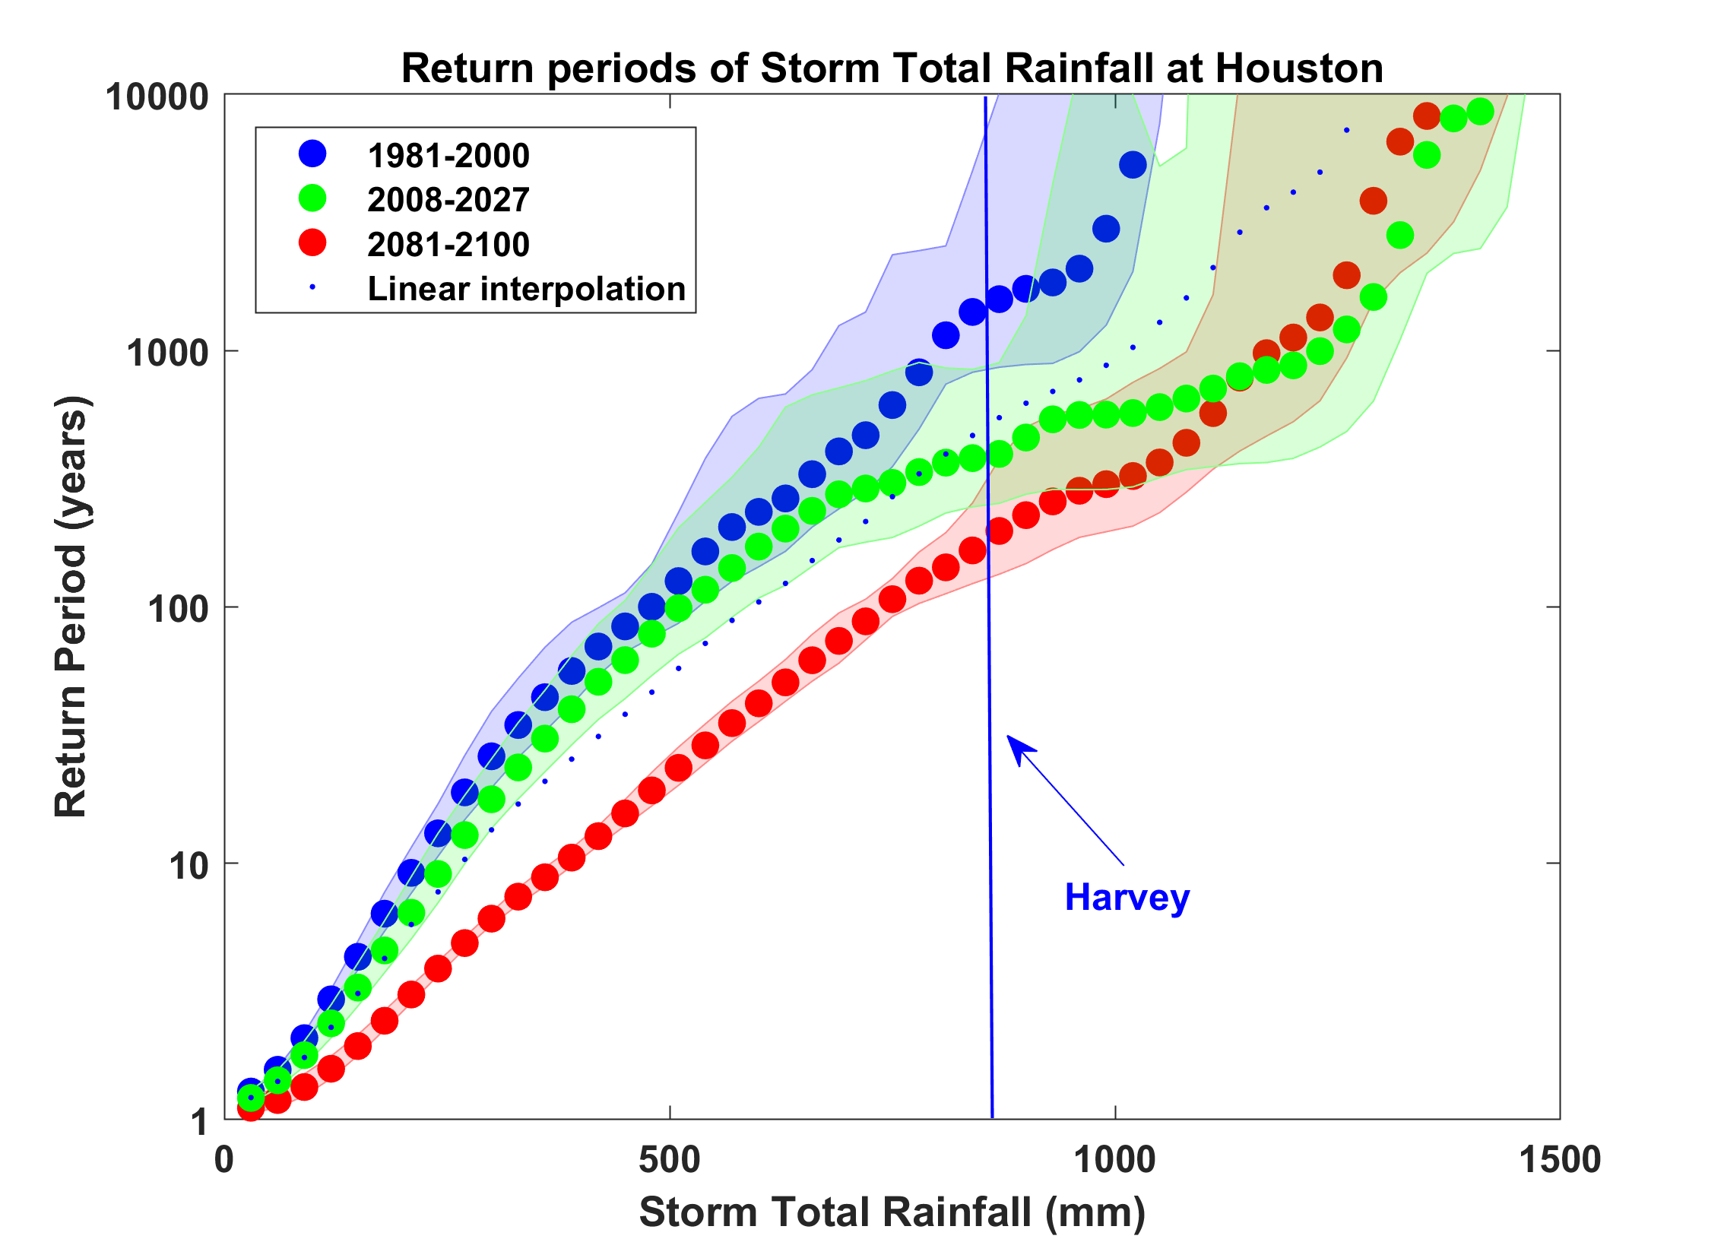
Probability of Storm Accumulated Rainfall in Harris County, from 6 Climate models, 1981-2000, 2008-2027, and 2081-2100, Based on 2000 Events Each, and Using RCP 8.5. Shading Shows Spread Among the Models.

