Slide 1

Using Physics to Assess New England Hurricane Risk
Kerry Emanuel
Program in Atmospheres, Oceans, and Climate
Massachusetts Institute of Technology
Notes:
Are hurricanes becoming more powerful and destructive? Are these changes due to a natural cycle of hurricane activity or are they caused by human-induced climate change? Although this is currently a hot debate among scientists, new research suggests that the destructive potential of hurricanes is increasing due to the heating of the oceans.
Image: Satellite image of Hurricane Floyd approaching the east coast of Florida in 1999. The image has been digitally enhanced to lend a three-dimensional perspective. Credit: NASA/Goddard Space Flight Center.

Slide 2
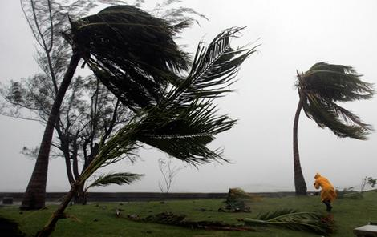
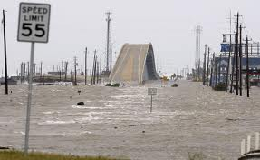
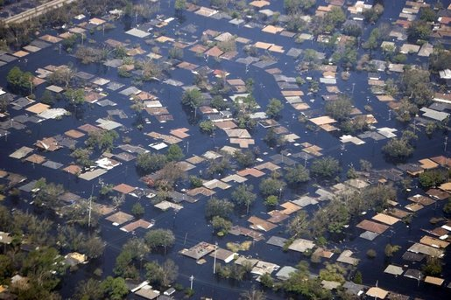

Hurricane Risks:
Wind
Storm Surge
Rain

Slide 3
Limitations of a strictly statistical approach
>50% of all normalized damage caused by top 8 events, all category 3, 4 and 5
>90% of all damage caused by storms of category 3 and greater
Category 3,4 and 5 events are only 13% of total landfalling events; only 30 since 1870
Landfalling storm statistics are inadequate for assessing hurricane risk
This is particularly true in New England

Slide 4
Example:
Historical Surge Events Affecting New York City

Slide 5
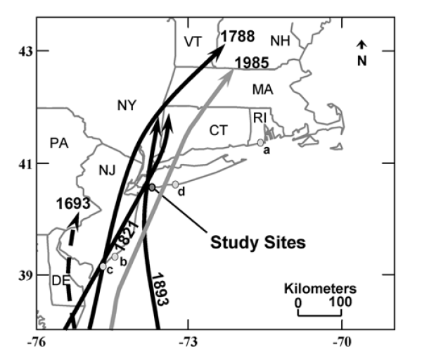
Tracks of historical hurricanes affecting NYC and western Long Island
Source: Scileppi and Donnelly, 2007: Geochem., Geophys., Geosys., 8

Slide 6
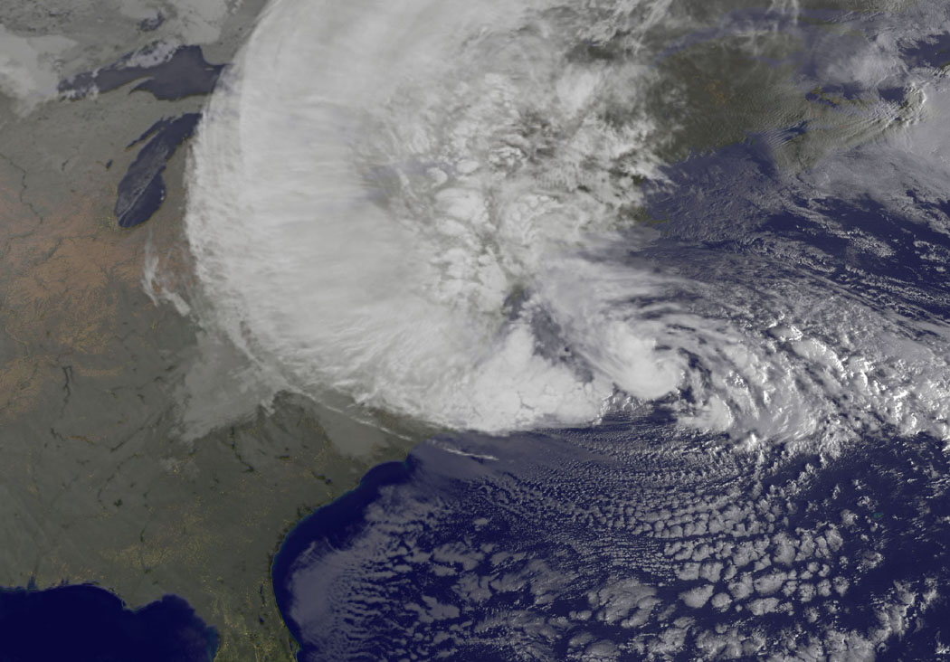
Sandy

Slide 7
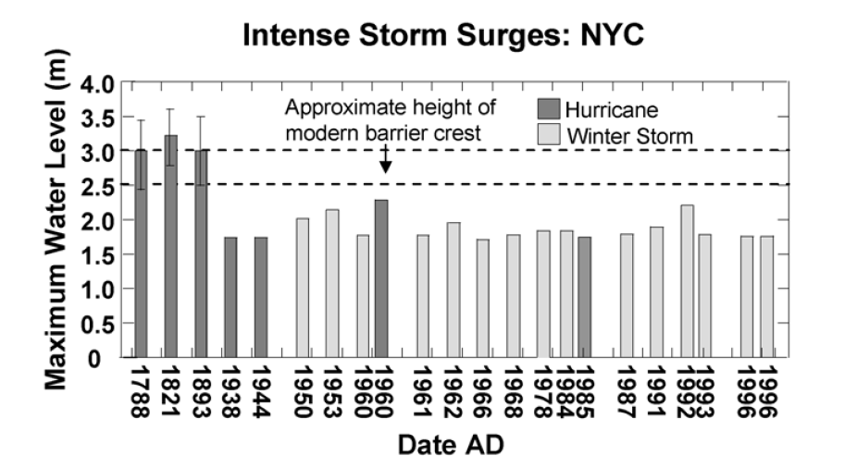
From historical archives
From tide gauge at the Battery
Sandy
Source: Scileppi and Donnelly, 2007: Geochem., Geophys., Geosys., 8

Slide 8
Additional Problem:
Nonstationarity of climate

Slide 9
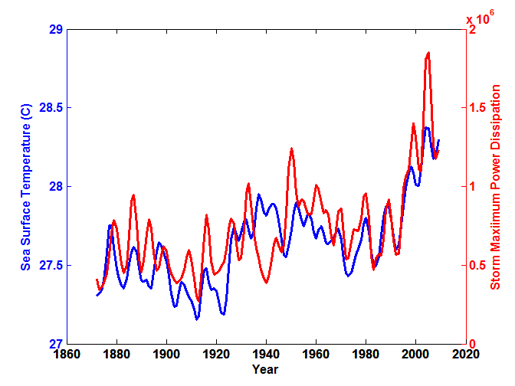
Atlantic Sea Surface Temperatures and Storm Max Power Dissipation
(Smoothed with a 1-3-4-3-1 filter)
Years included: 1870-2011
Data Sources: NOAA/TPC, UKMO/HADSST1
Notes:
9
The low value of storm power in the early 1940s is thought to be due to the lack of reports from ships at sea because of the radio silence imposed during WWII.

Slide 10
Risk Assessment by Direct Numerical Simulation of Hurricanes:
The Problem
The hurricane eyewall is a strong front, attaining scales of ~ 1 km or less
At the same time, the storm’s circulation extends to ~1000 km and is embedded in much larger scale flows

Slide 11

Histograms of Tropical Cyclone Intensity as Simulated by a Global Model with 50 km grid point spacing. (Courtesy Isaac Held, GFDL)
Modeled
Observed
Global models do not simulate the storms that cause destruction
Category 3

Slide 12
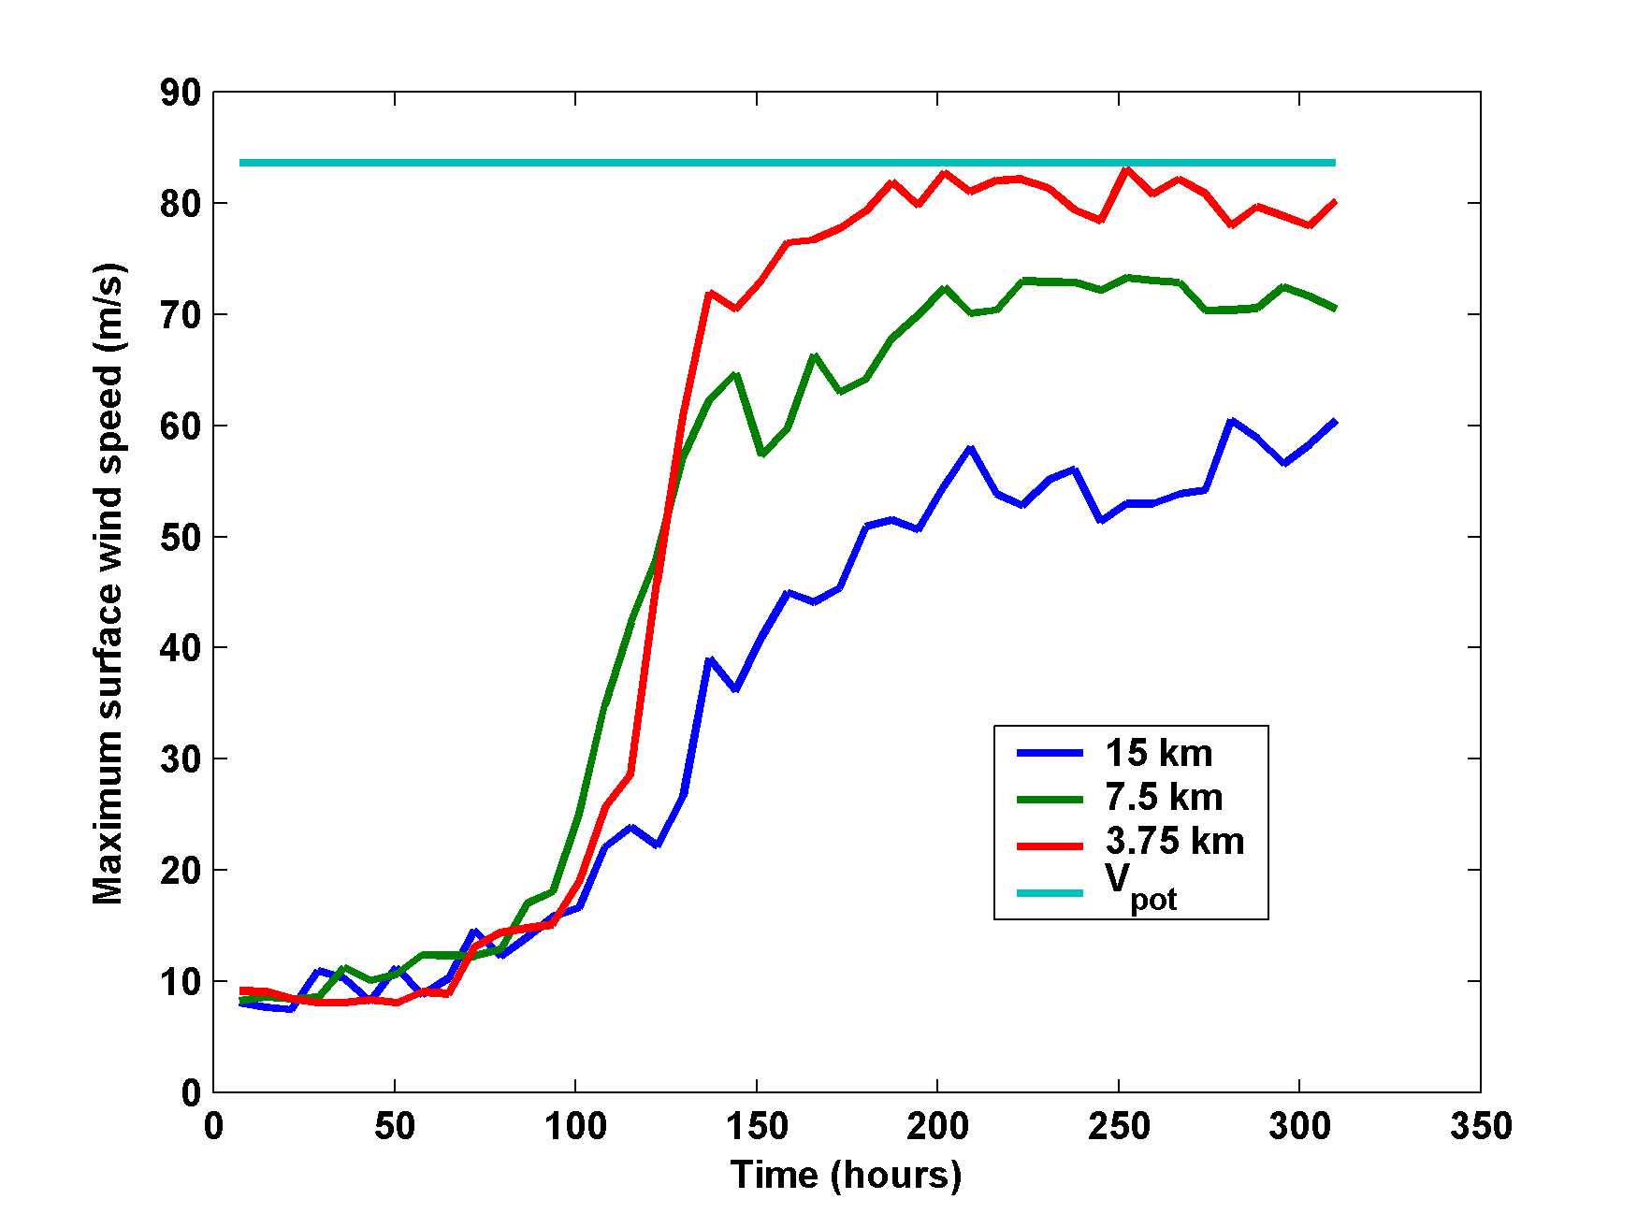
Numerical convergence in an axisymmetric, nonhydrostatic model (Rotunno and Emanuel, 1987)

Slide 13
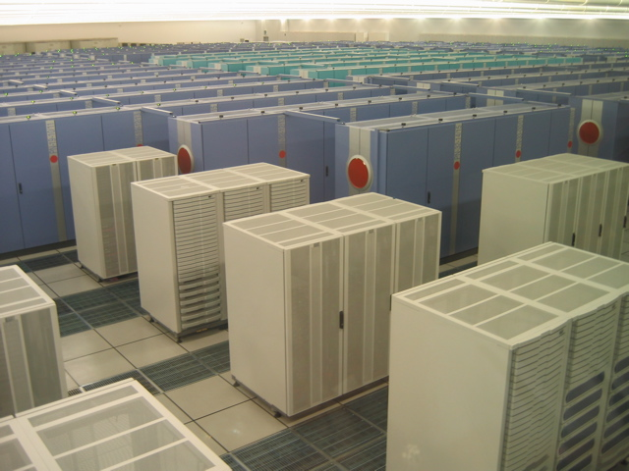
How to deal with this?
Option 1: Brute force and obstinacy

Slide 14
Multiply nested grids

Slide 15


How to deal with this?
Option 1: Brute force and obstinacy
Option 2: Applied math and modest resources

Slide 16
Time-dependent, axisymmetric model
Uses a flow-dependent coordinate system
Simplified Physics
Coupled to simple 1-D ocean model
Environmental wind shear effects parameterized

Slide 17
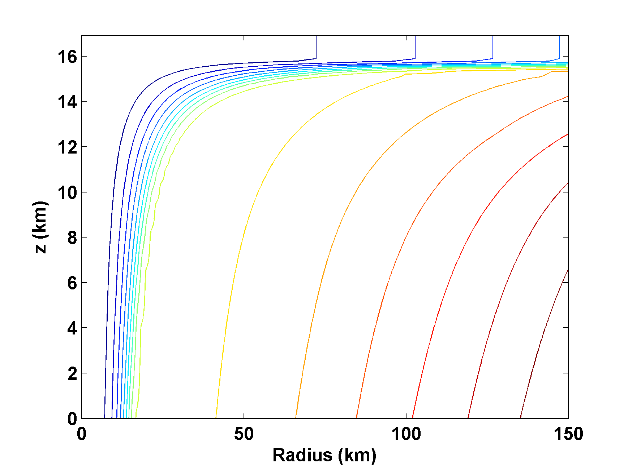
Angular Momentum Distribution
Storm center

Slide 18
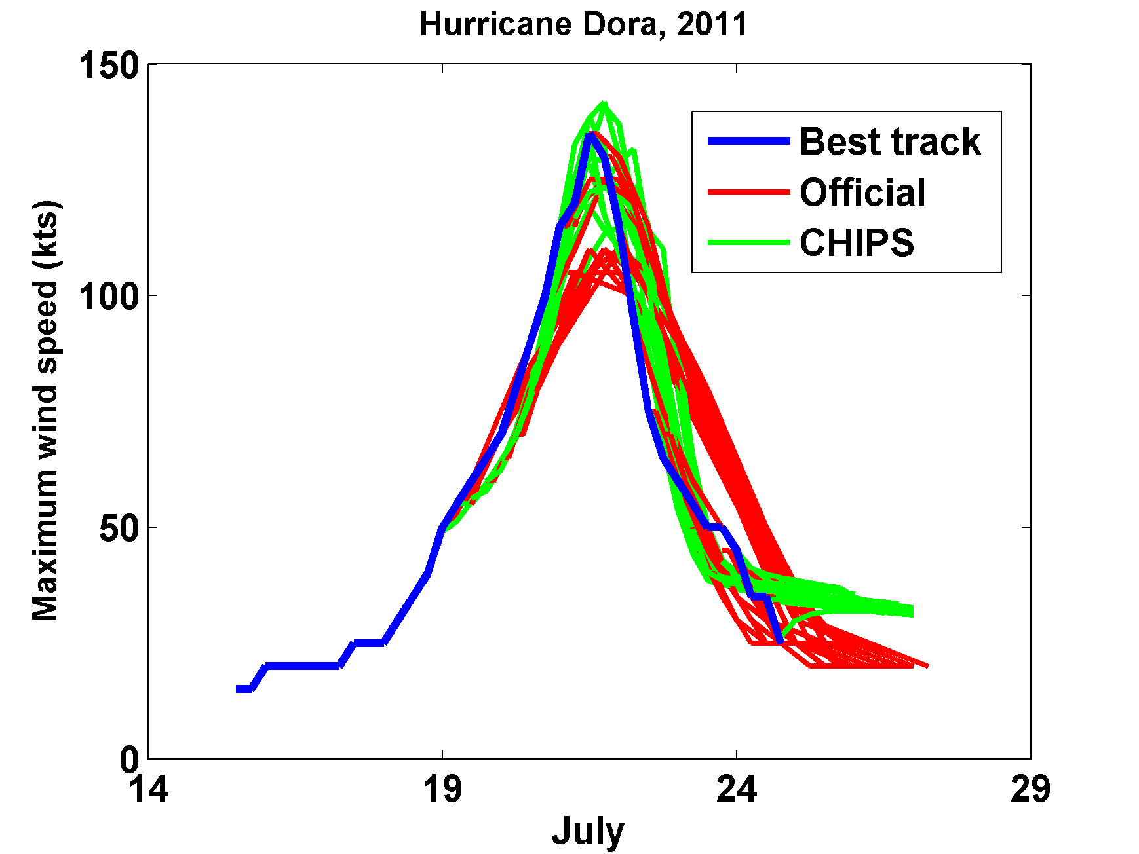

Slide 19
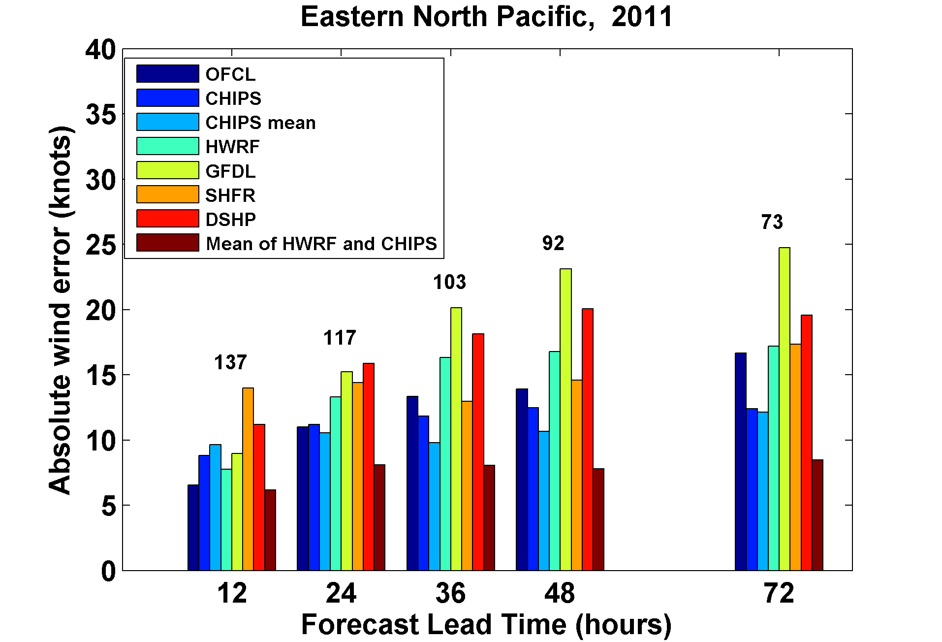

Slide 20
How Can We Use This Model to Help Assess Hurricane Risk in Current and Future Climates?

Slide 21
Risk Assessment Approach:
Step 1: Seed each ocean basin with a very large number of weak, randomly located cyclones
Step 2: Cyclones are assumed to move with the large scale atmospheric flow in which they are embedded, plus a correction for beta drift
Step 3: Run the CHIPS model for each cyclone, and note how many achieve at least tropical storm strength
Step 4: Using the small fraction of surviving events, determine storm statistics
Details: Emanuel et al., Bull. Amer. Meteor. Soc, 2008
Notes:
21

Slide 22
Synthetic Track Generation:
Generation of Synthetic Wind Time Series
Postulate that TCs move with vertically averaged environmental flow plus a “beta drift” correction
Approximate “vertically averaged” by weighted mean of 850 and 250 hPa flow

Slide 23
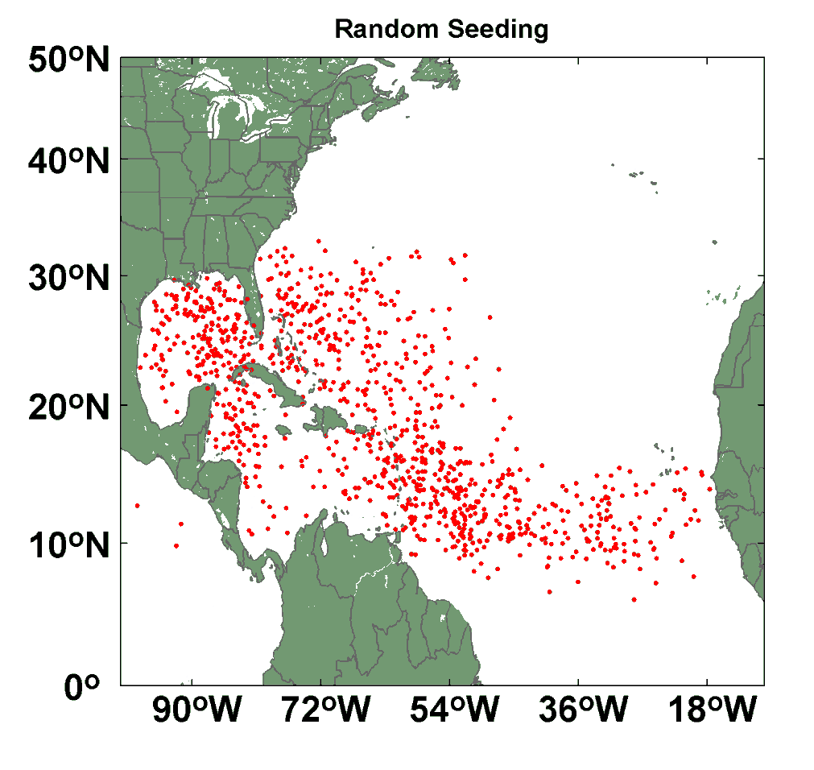
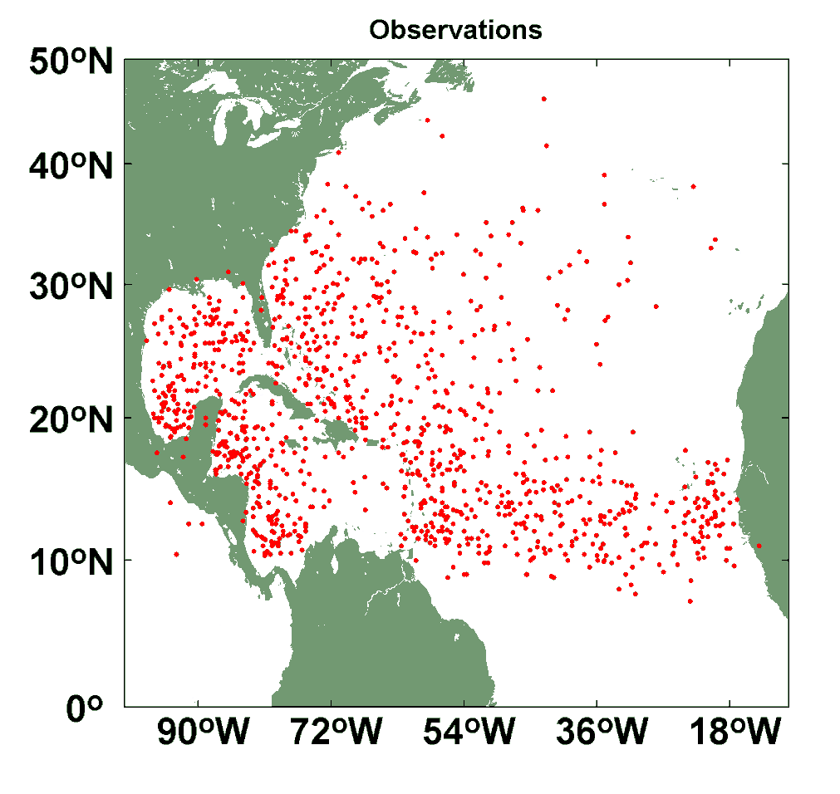
Comparison of Random Seeding Genesis Locations with Observations

Slide 24
Calibration
Absolute genesis frequency calibrated to globe during the period 1980-2005
Notes:
24

Slide 26
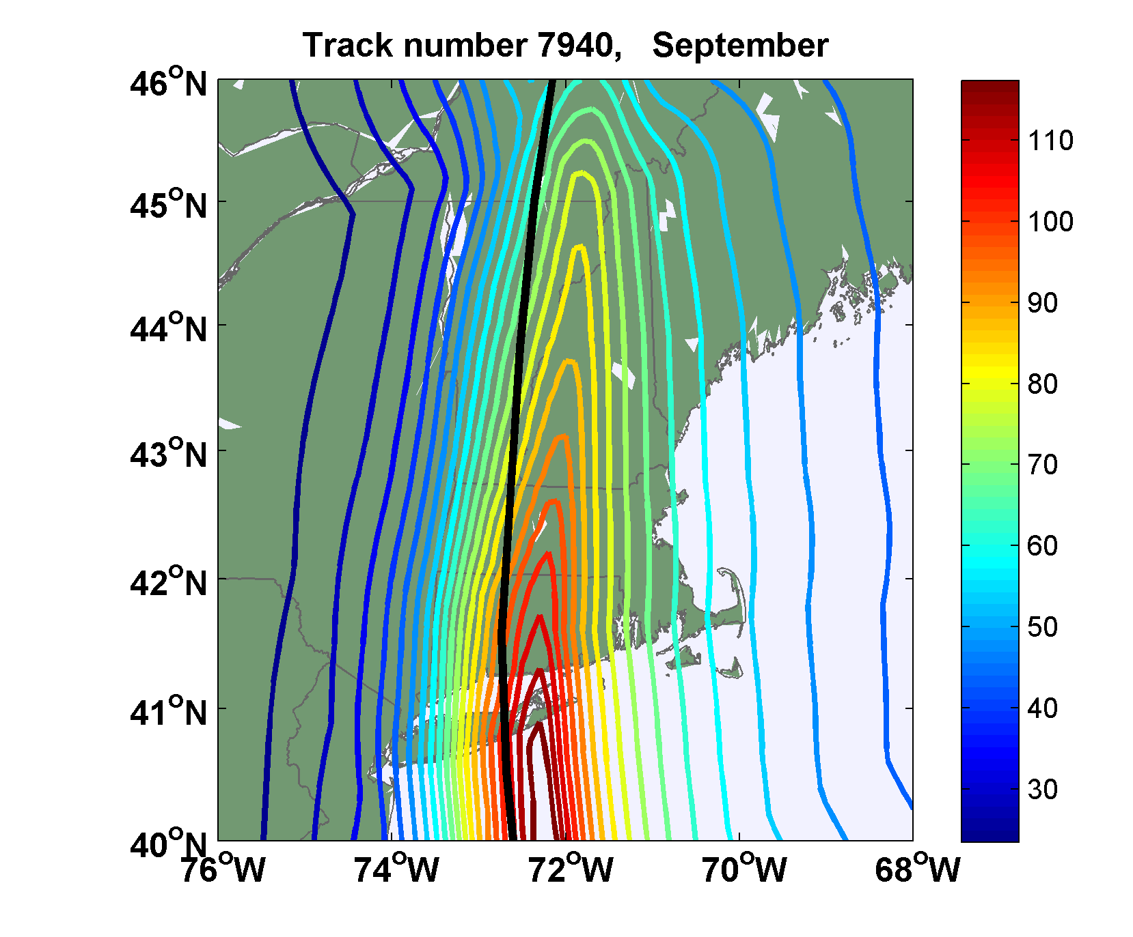
Sample Storm Wind Swath

Slide 27
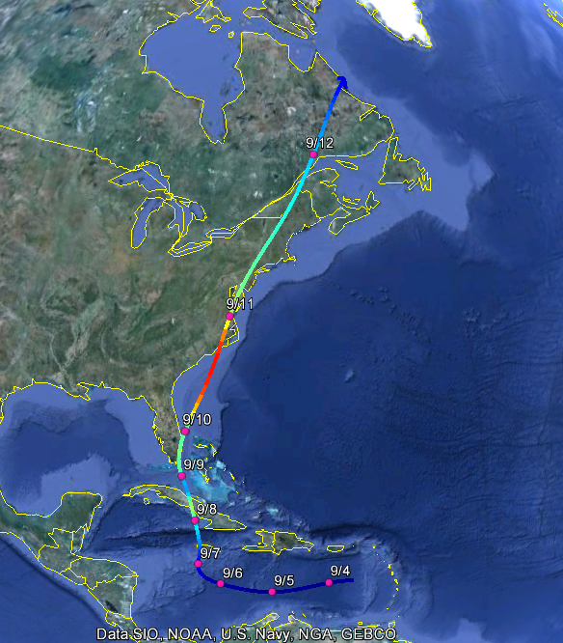
Example: Hurricane affecting New York City

Slide 28
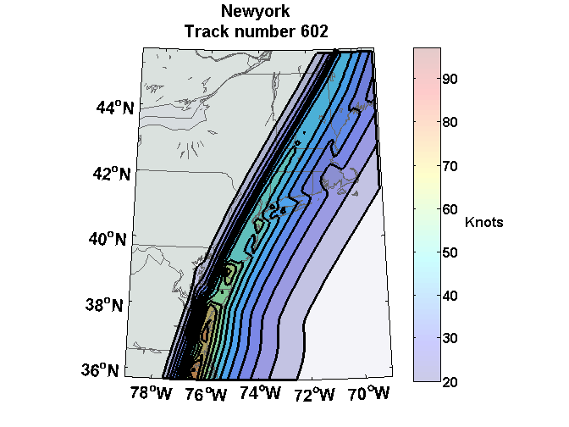
Wind Swath

Slide 29
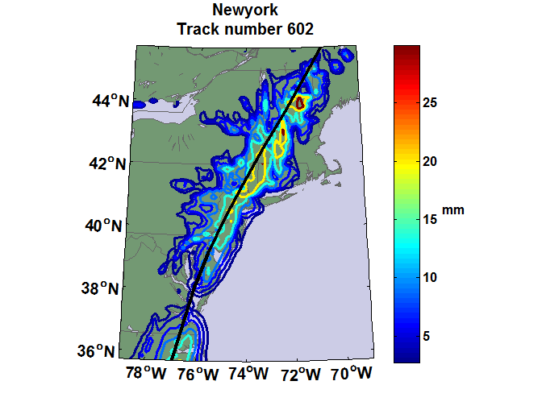
Accumulated Rainfall (mm)

Slide 30
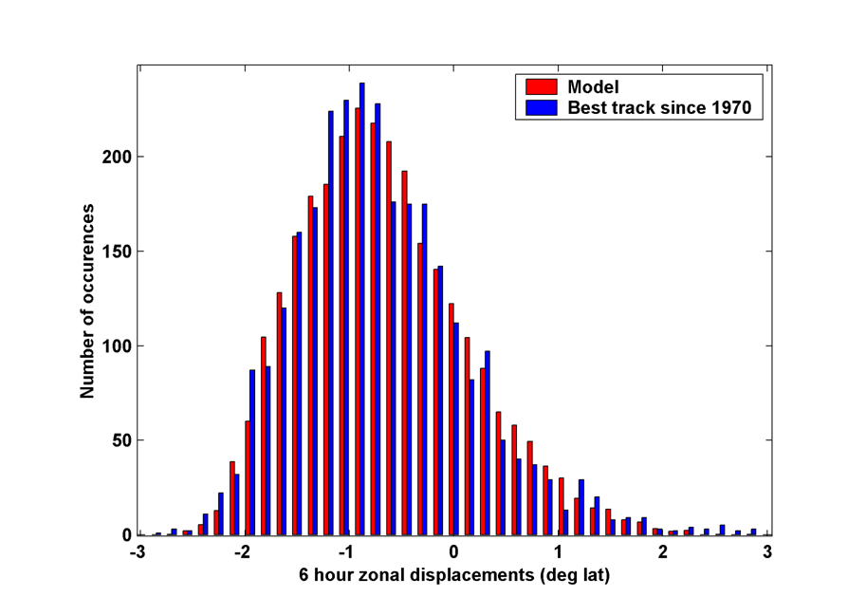
6-hour zonal displacements in region bounded by 10º and 30º N latitude, and 80º and 30º W longitude, using only post-1970 hurricane data
Notes:
30

Slide 31

Cumulative Distribution of Storm Lifetime Peak Wind Speed, with Sample of 1755 Synthetic Tracks
95% confidence bounds

Slide 32

Return Periods

Slide 33
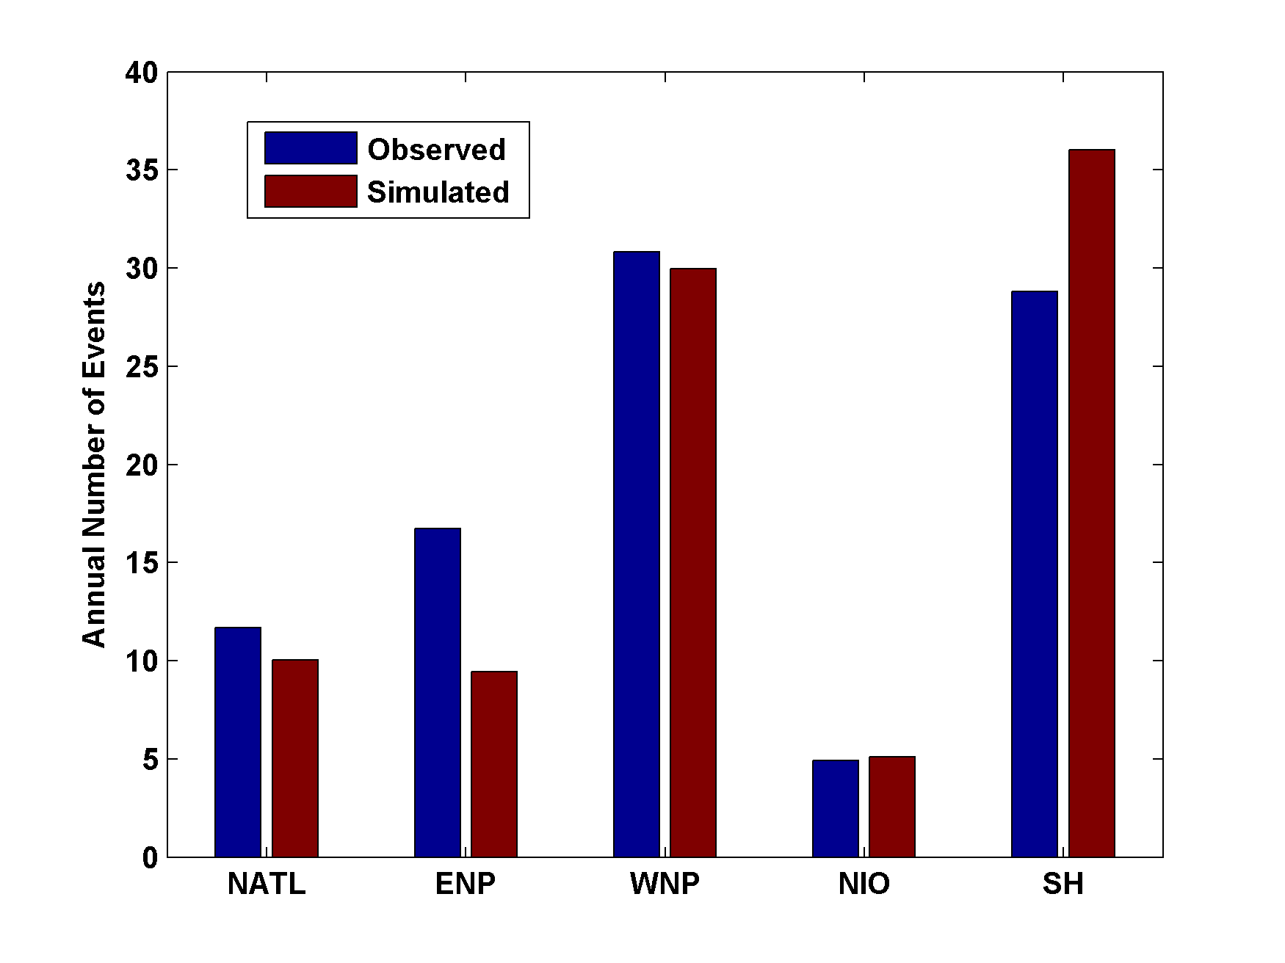
Genesis rates
Western North Pacific
Southern Hemisphere
Eastern North Pacific
Atlantic
North Indian Ocean
Notes:
33

Slide 34

Captures effects of regional climate phenomena (e.g. ENSO, AMM)

Slide 35
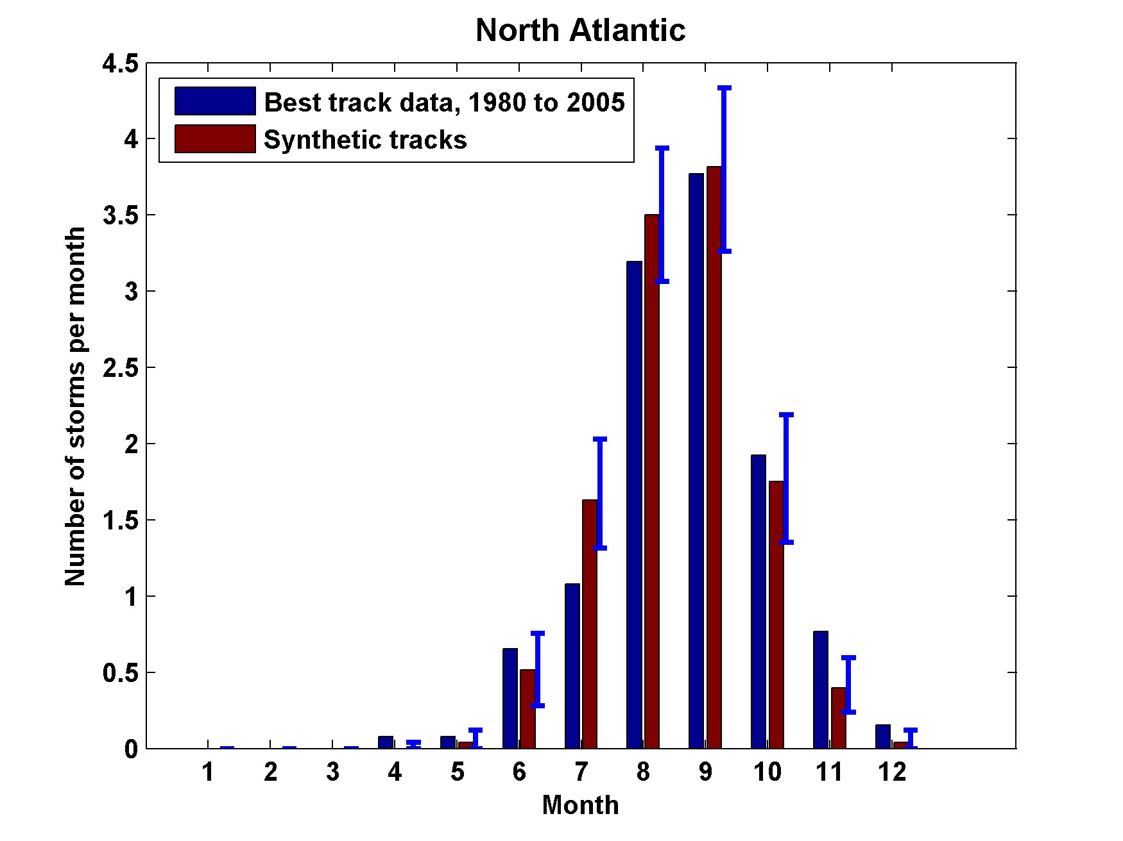
Seasonal Cycles
Atlantic
Notes:
35

Slide 36
Coupling large hurricane event sets to surge models (with Ning Lin)
Couple synthetic tropical cyclone events (Emanuel et al., BAMS, 2008) to surge models
  SLOSH
  ADCIRC (fine mesh)
  ADCIRC (coarse mesh)
Generate probability distributions of surge at desired locations

Slide 37


Storm Surge Simulation
SLOSH model
(Jelesnianski et al. 1992)
SLOSH mesh
~ 10³ m
ADCIRC mesh
~ 10² m
Battery
ADCIRC model
(Luettich et al. 1992)
ADCIRC mesh
~ 10 m
(Colle et al. 2008)
Notes:
Given the storm wind and pressure fields (which is estimated from the Holland parametric pressure model) we can simulate the surge. Surge simulations with high resolution are computationally intensive, so to make it possible to simulate accurate surges for our large synthetic storm sets, we apply the two hydrodynamic models with girds of various resolutions in such a way that the main computational effort is concentrated on the storms that determine the risk. First, we apply the SLOSH model, using a mesh with resolution of about 1 km around NYC to simulate the surges for all storms and select the storms that have return periods, in terms of the surge height at the Battery, greater than 10 years. Second, we apply the ADCIRC simulation, using a grid mesh with resolution of ~100 m around NYC, to each of the selected storms. Then, we apply another ADCIRC mesh with resolution as high as ~10 m around NYC, for a set of the most extreme events, to check if the resolution of our ADCIRC grid is sufficient and if needed to make statistical correction to the results.

Slide 38
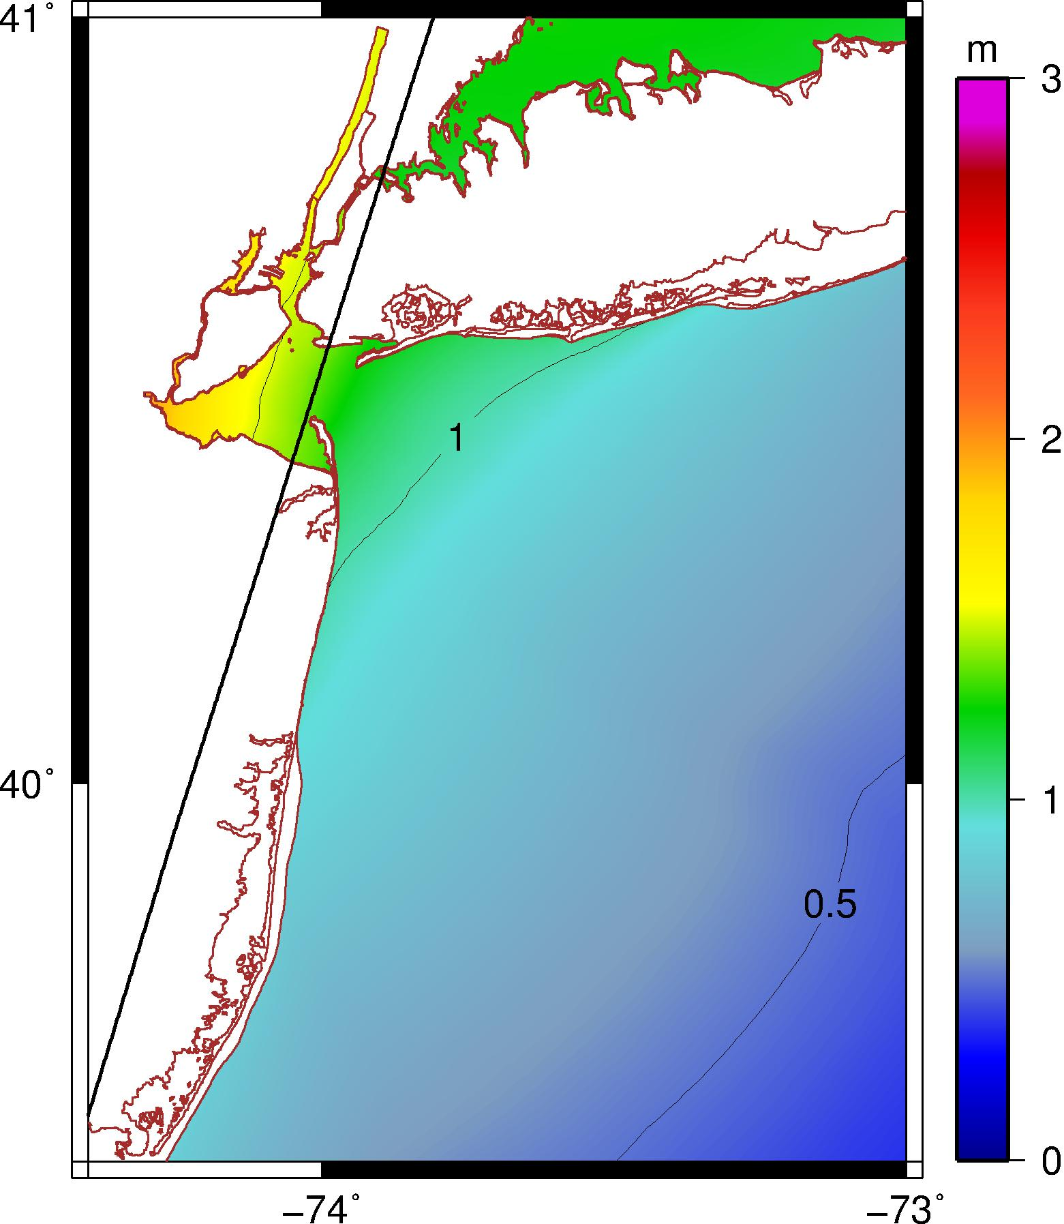
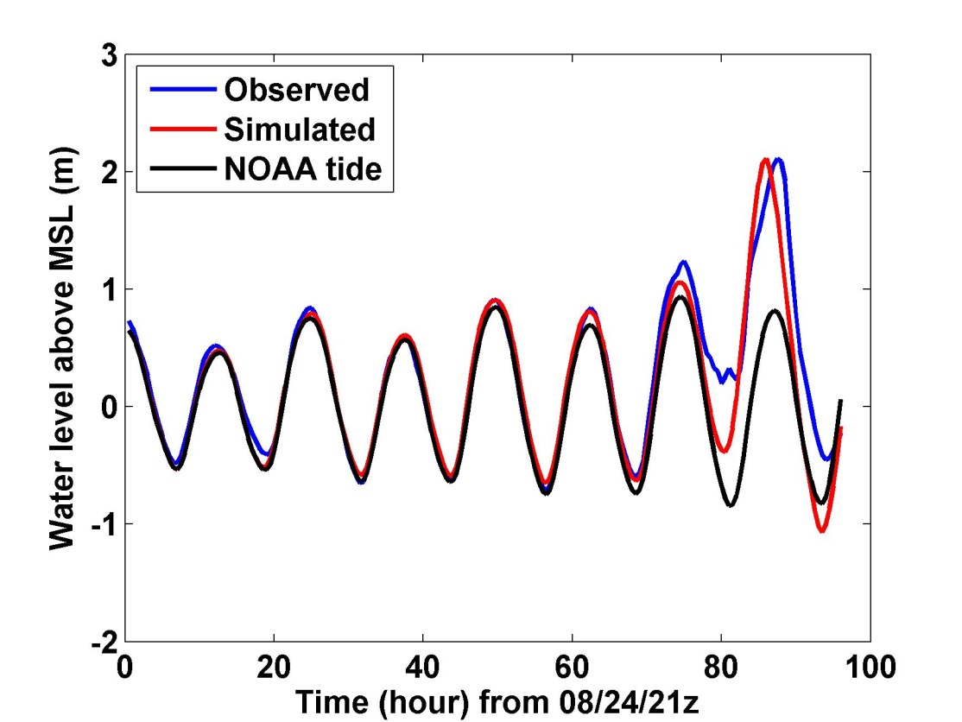
Hurricane Irene (2011) Hindcast
1.3 m
V_{m} = 17 m/s, P_{c} = 977 mb
R_{m}= 83 km, U_{t} = 12 m/s, ds = 9 km
Notes:
Our simulation for Hurricane Irene’s surge using the ADCIRC model. The storm track, intensity, and size are obtained from the observation. This storm passed to the right of the Battery with relatively low intensity and generated a peak surge of about 1.3 m at the Battery. The surge happened right at the high tide and thus the total water level was about 2.1 m above the MSL. The plot to the right shows that the simulated and observed water levels compare very well, thus Irene offered us a good opportunity to validate our wind field and storm surge modeling method.

Slide 39
Hurricane Sandy (2012) Hindcast
HWRF Forecast at 2012102818z
3.25 m
3.34 m
Notes:
ADCIRC simulation of surge (not including tide or wave setup), assuming hurricane parametric wind and pressure profiles, same methods as for Irene and synthetic storms.

Slide 40
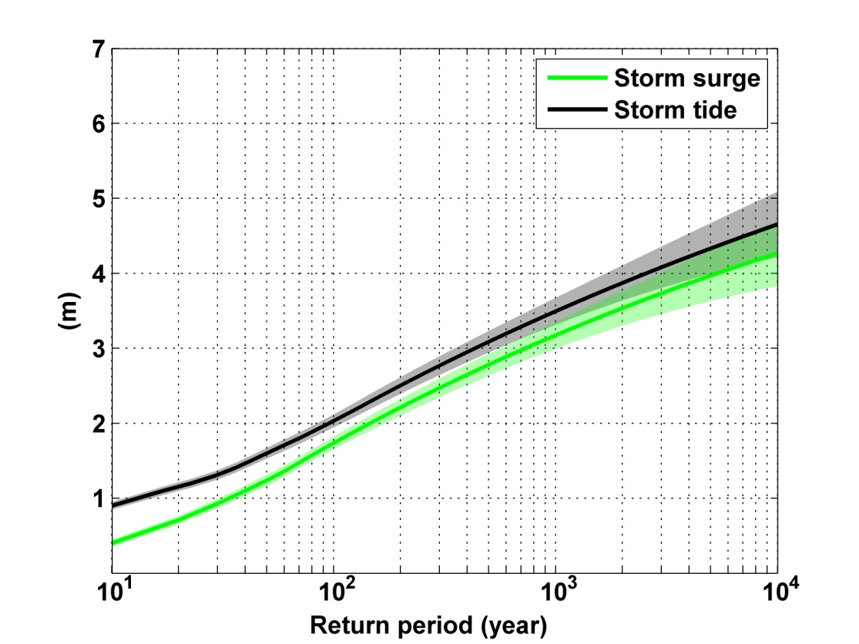
Notes:
Storm surge and storm tide (surge and tide) return level curves for the Battery, NYC, for the 1981-2000 NCAR/NCEP climate conditions (5000 synthetic storms). Astronomical tide and nonlinear interaction between surge and tide are accounted for statistically.

Slide 41
Looking Ahead

Slide 42
1. Last 20 years of 20th century simulations
2. Years 2180-2200 of IPCC Scenario A1b (CO₂ stabilized at 720 ppm)
Compare two simulations each from 7 IPCC models:

Slide 43
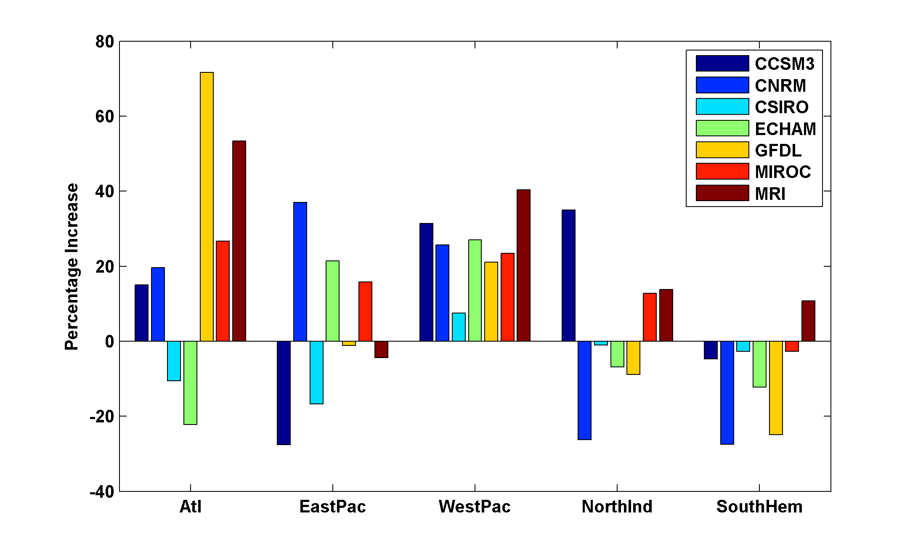
Basin-Wide Percentage Change in Power Dissipation
Notes:
43
43

Slide 44
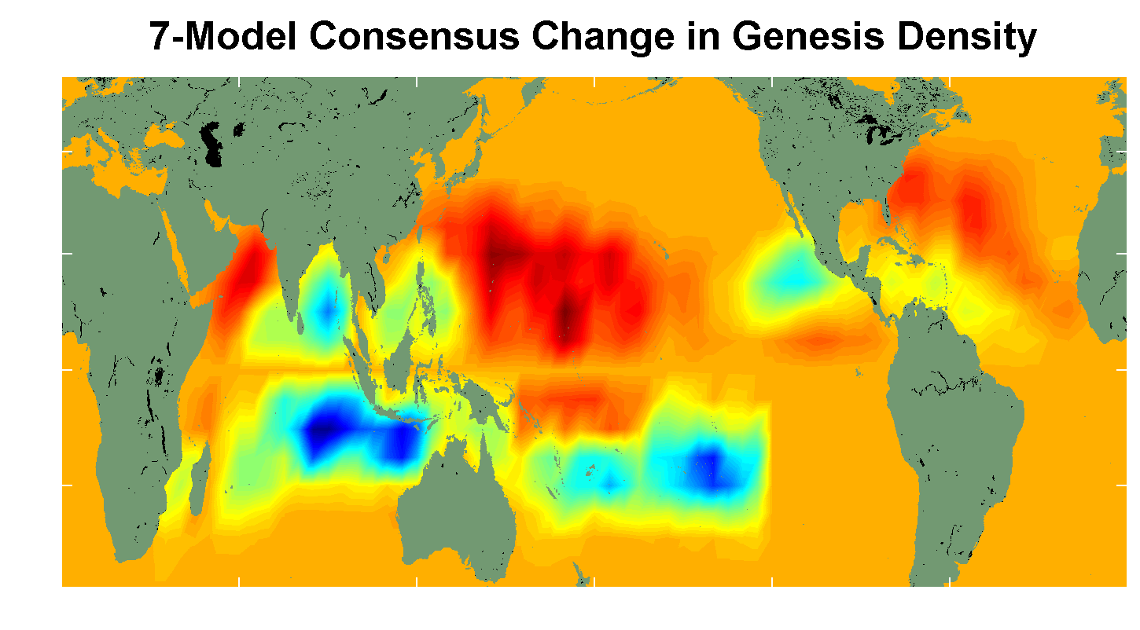
7 Model Consensus Change in Storm Frequency
Notes:
44
44

Slide 45
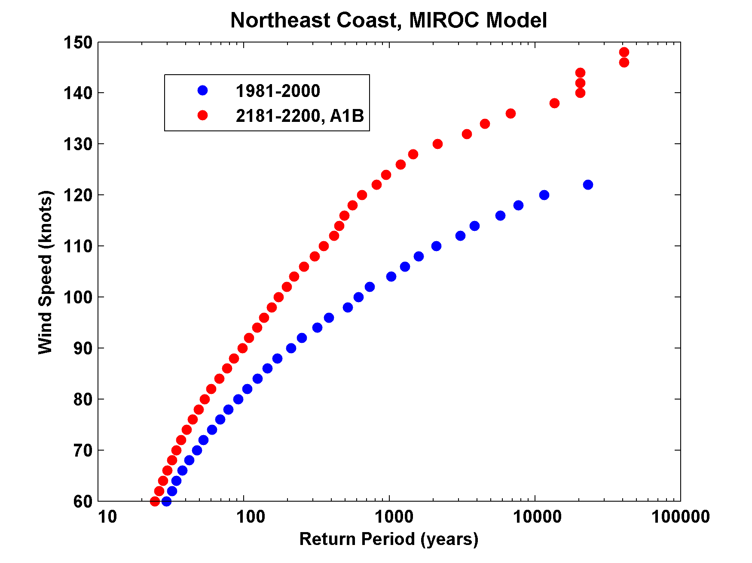

Slide 46
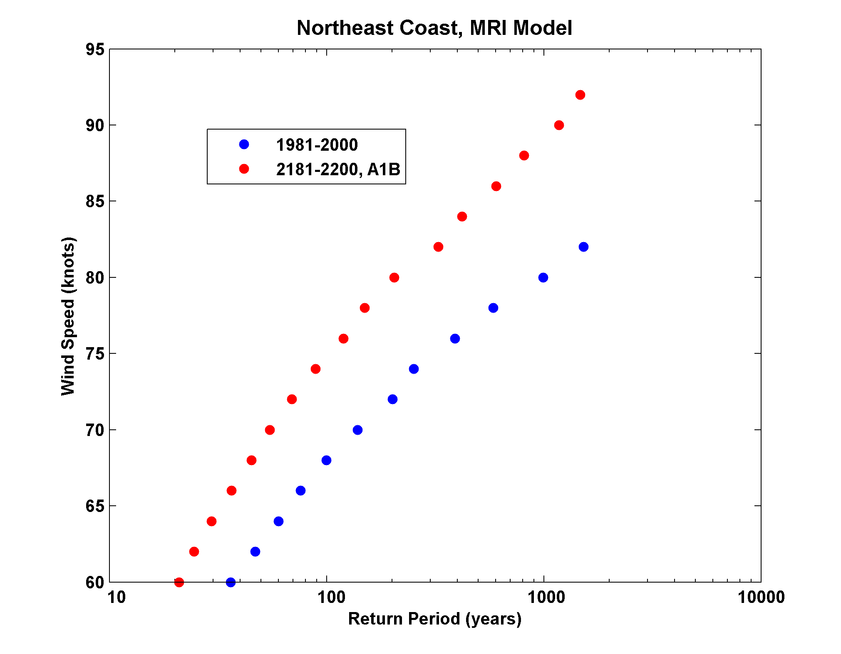

Slide 47
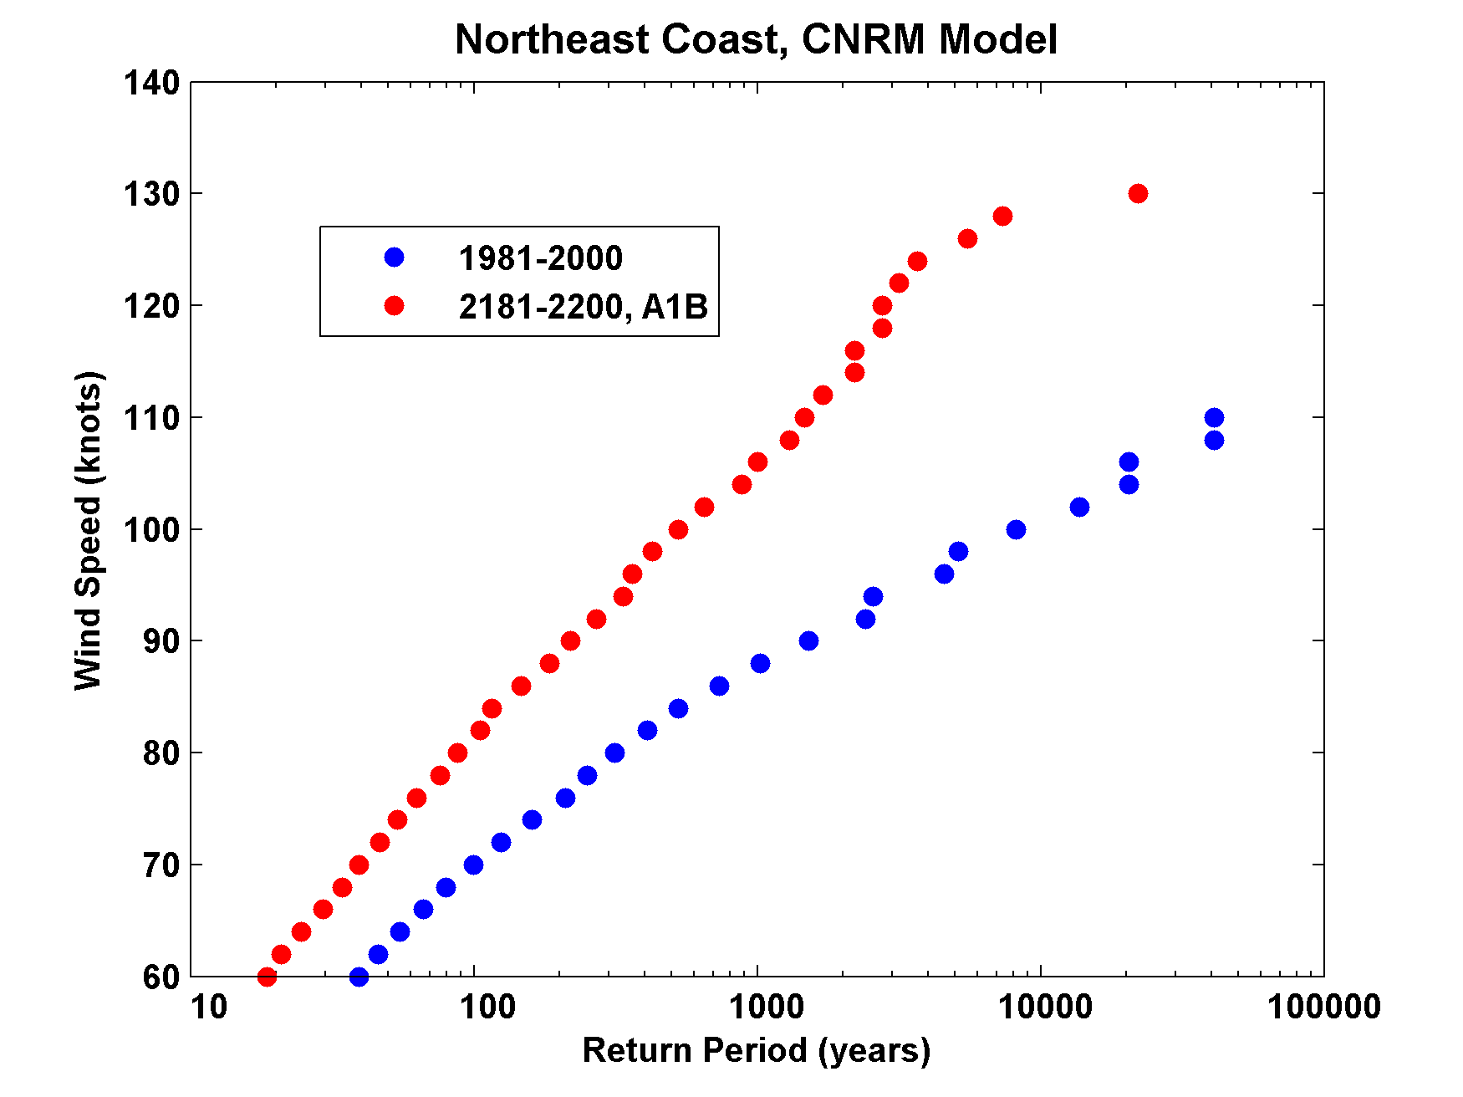

Slide 48
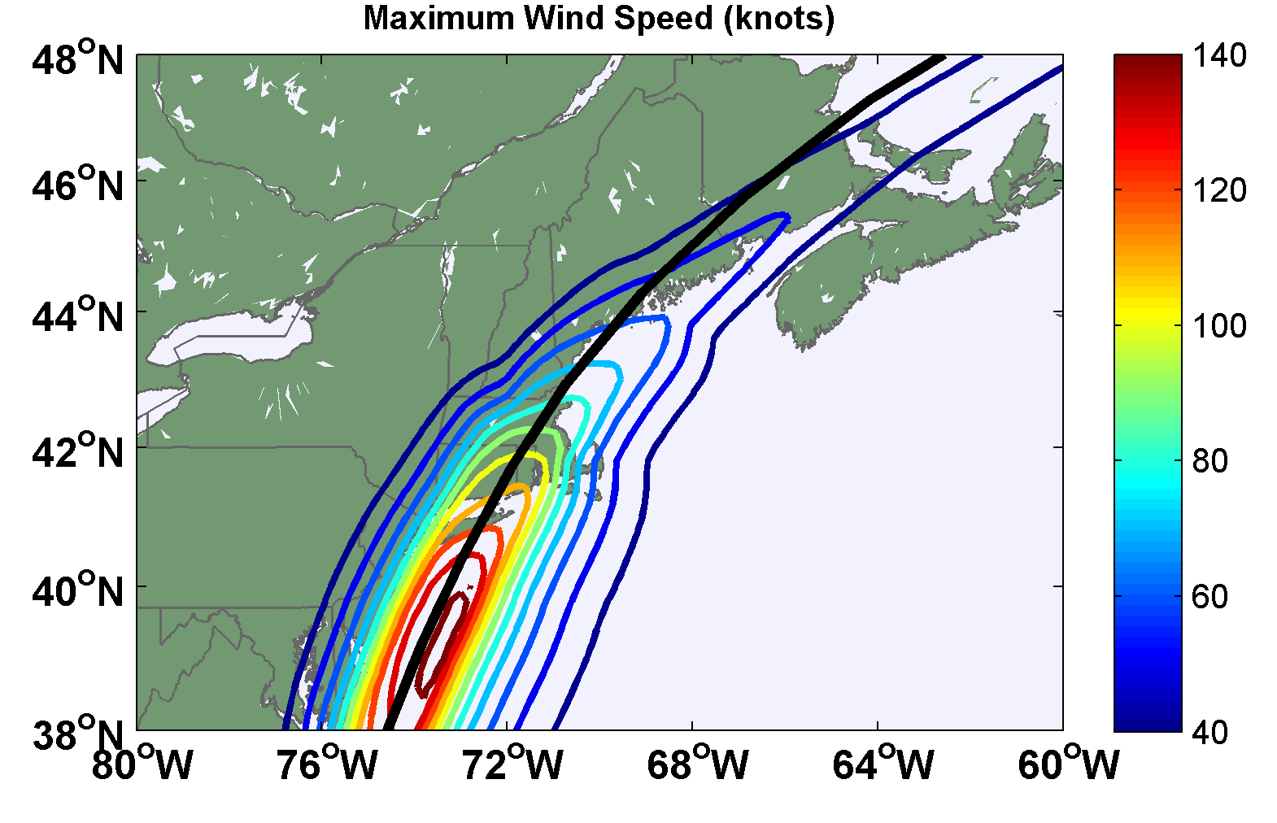

Slide 49
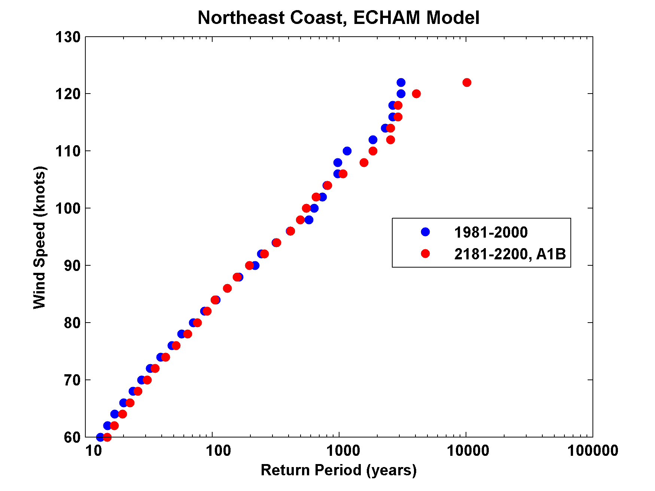

Slide 50

GCM flood height return level
(assuming SLR of 1 m for the future climate )
Black: Current climate (1981-2000)
Blue: A1B future climate (2081-2100)
Red: A1B future climate (2081-2100) with R₀ increased by 10% and R_{m} increased by 21%
Lin et al. (2012)
Notes:
Then we calculate the flood height (including surge, tide, and sea level rise) return level for the four climate models, assuming a sea level rise of 1 m for the future climate, for the Battery, NYC. These results show that the combined effects of storm climatology change and sea level rise will greatly shorten the flood return periods for NYC and, by the end of the century, the current 100-year surge flooding may happen less than every 30 years, with CNRM and GFDL prediction to be less than 10 years, and the 500-year flooding may happen less than every 200 years, with the CNRM and GFDL prediction to be 20-30 years.

Slide 51
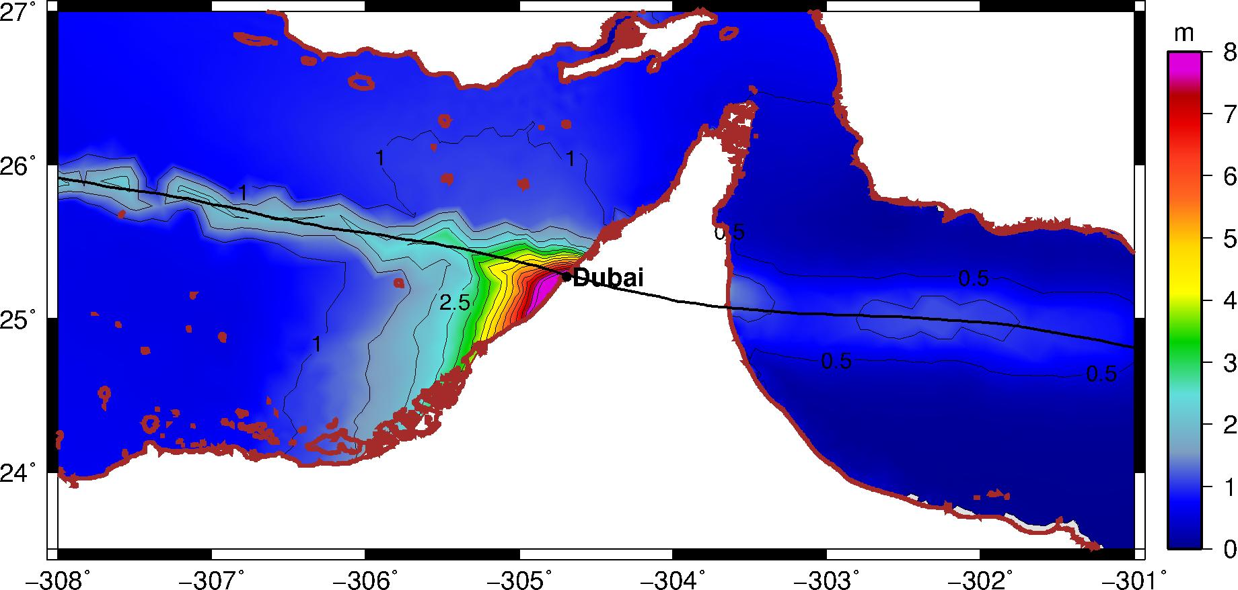
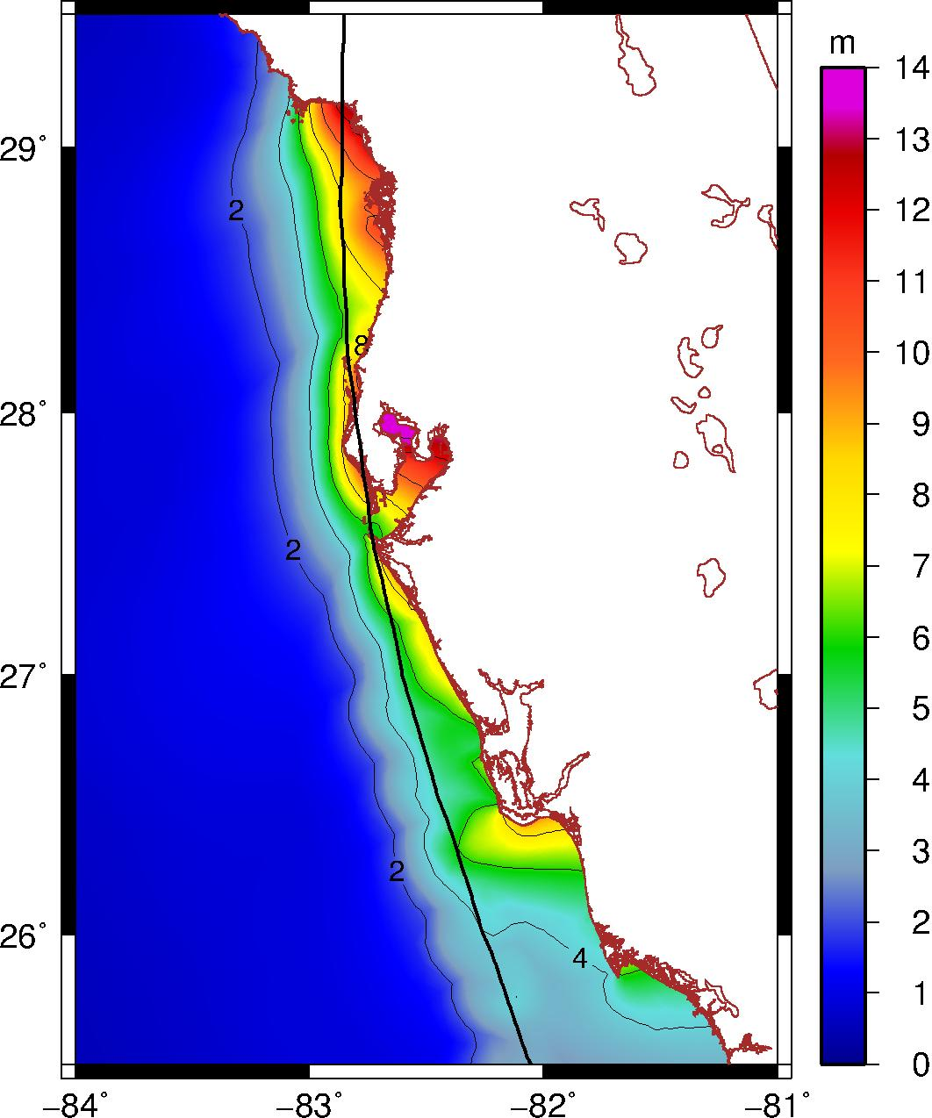
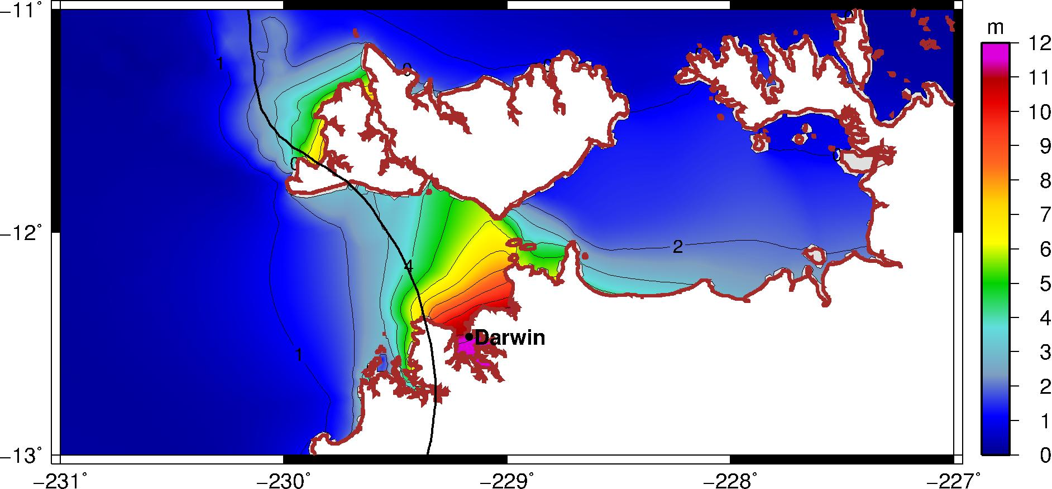
Black Swan Tropical Cyclones
Tampa
Notes:
ADCIRC simulation of surge (not including tide or wave setup), assuming hurricane parametric wind and pressure profiles, same methods as for Irene and synthetic storms.

Slide 52
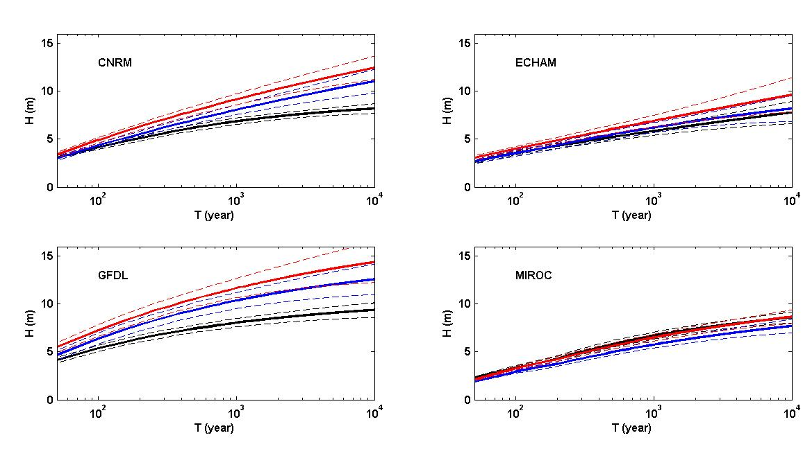
Return levels for Tampa, including three cases : control (black), A1B (blue), A1B with 1.1ro and 1.21 rm (red)

Slide 53
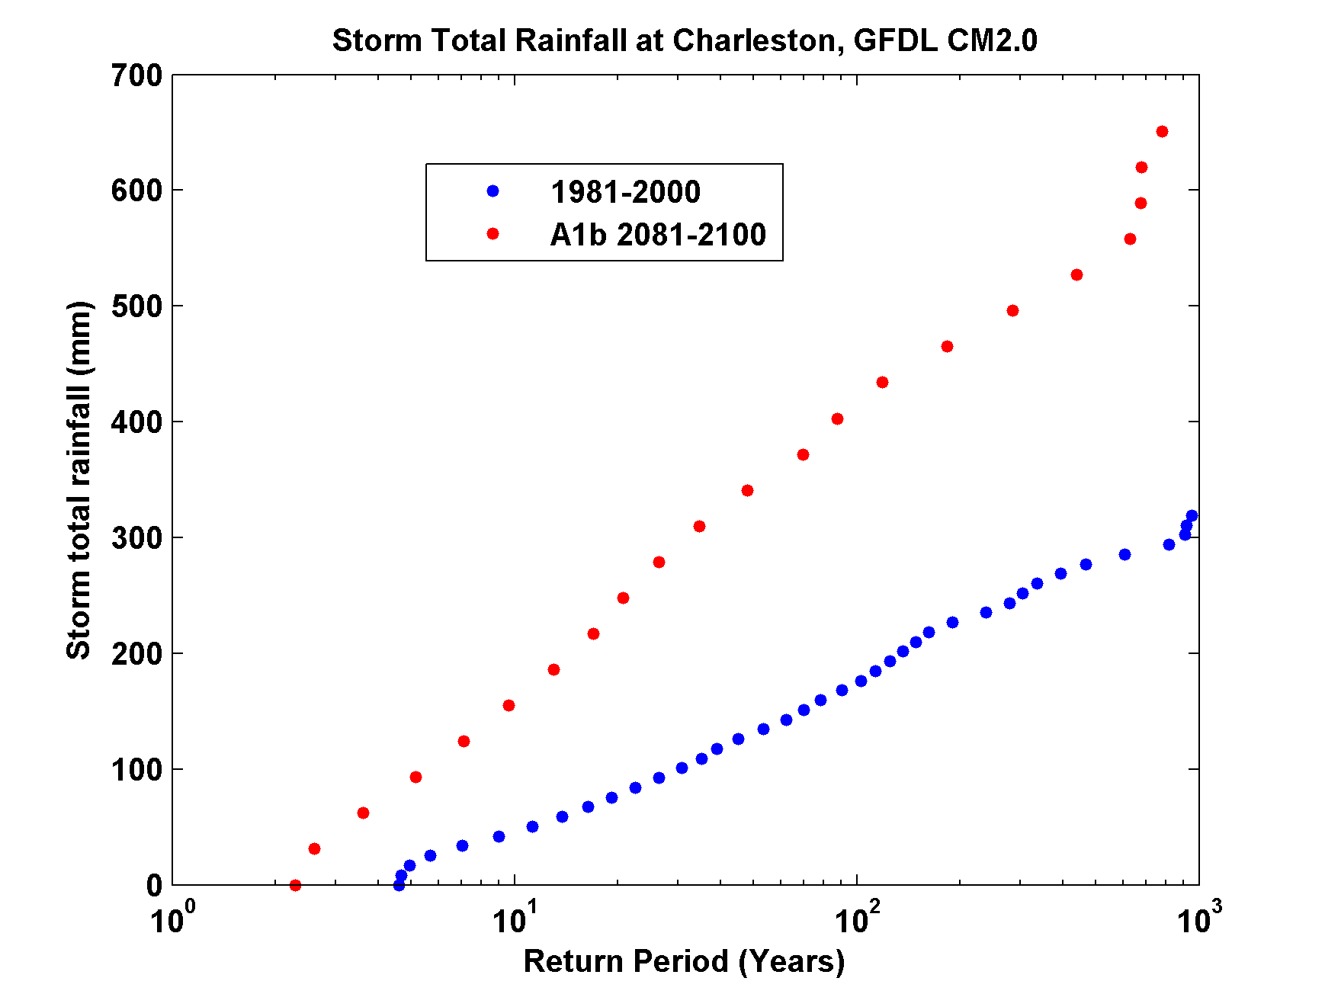
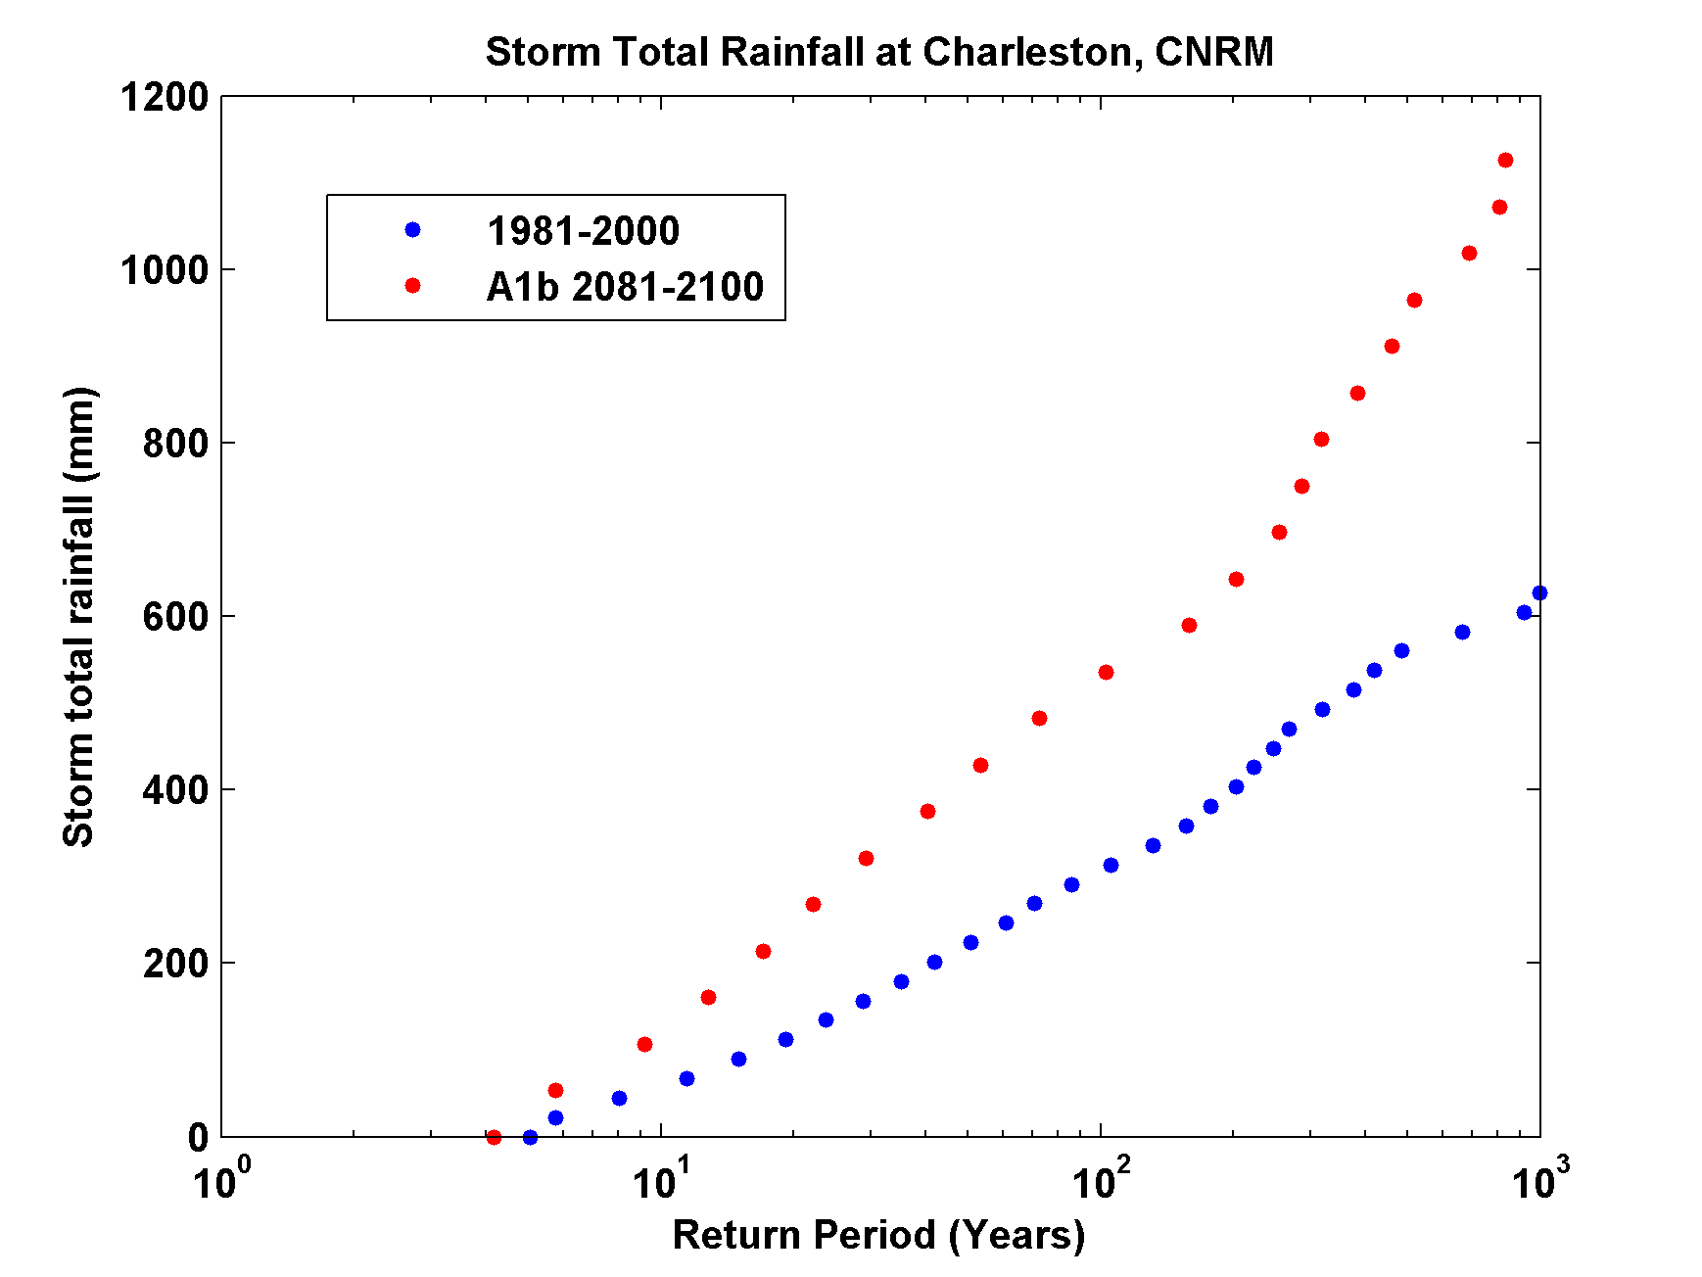
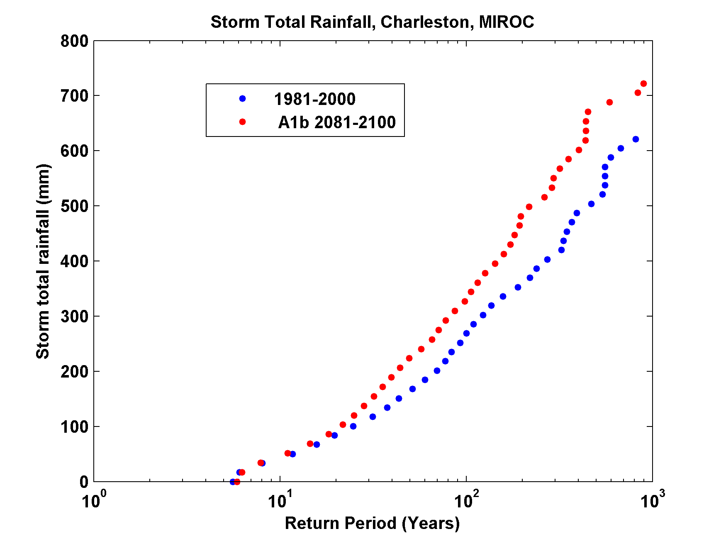
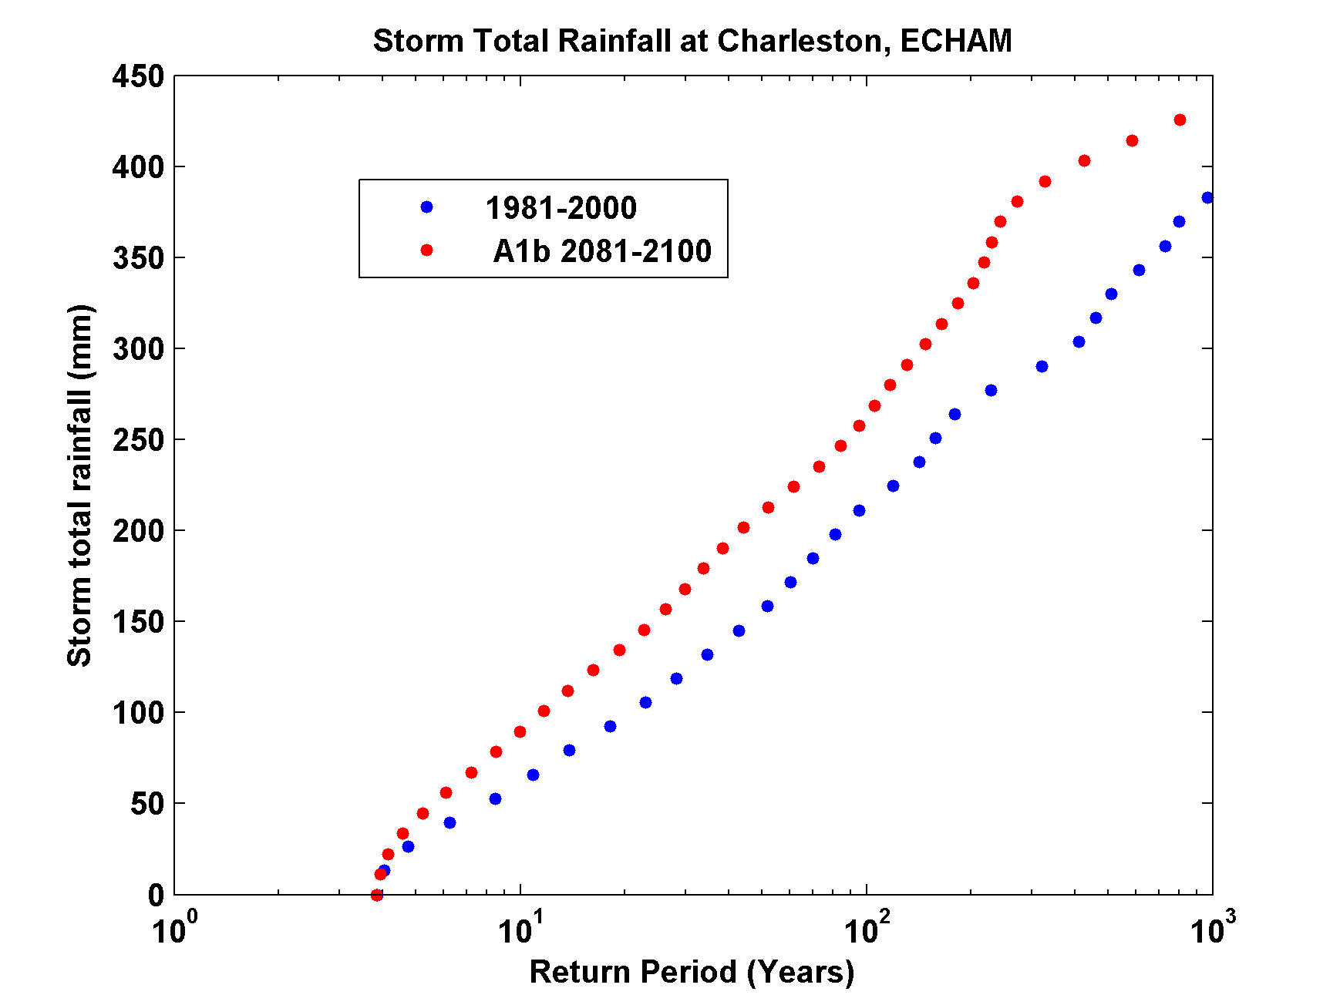

Slide 54
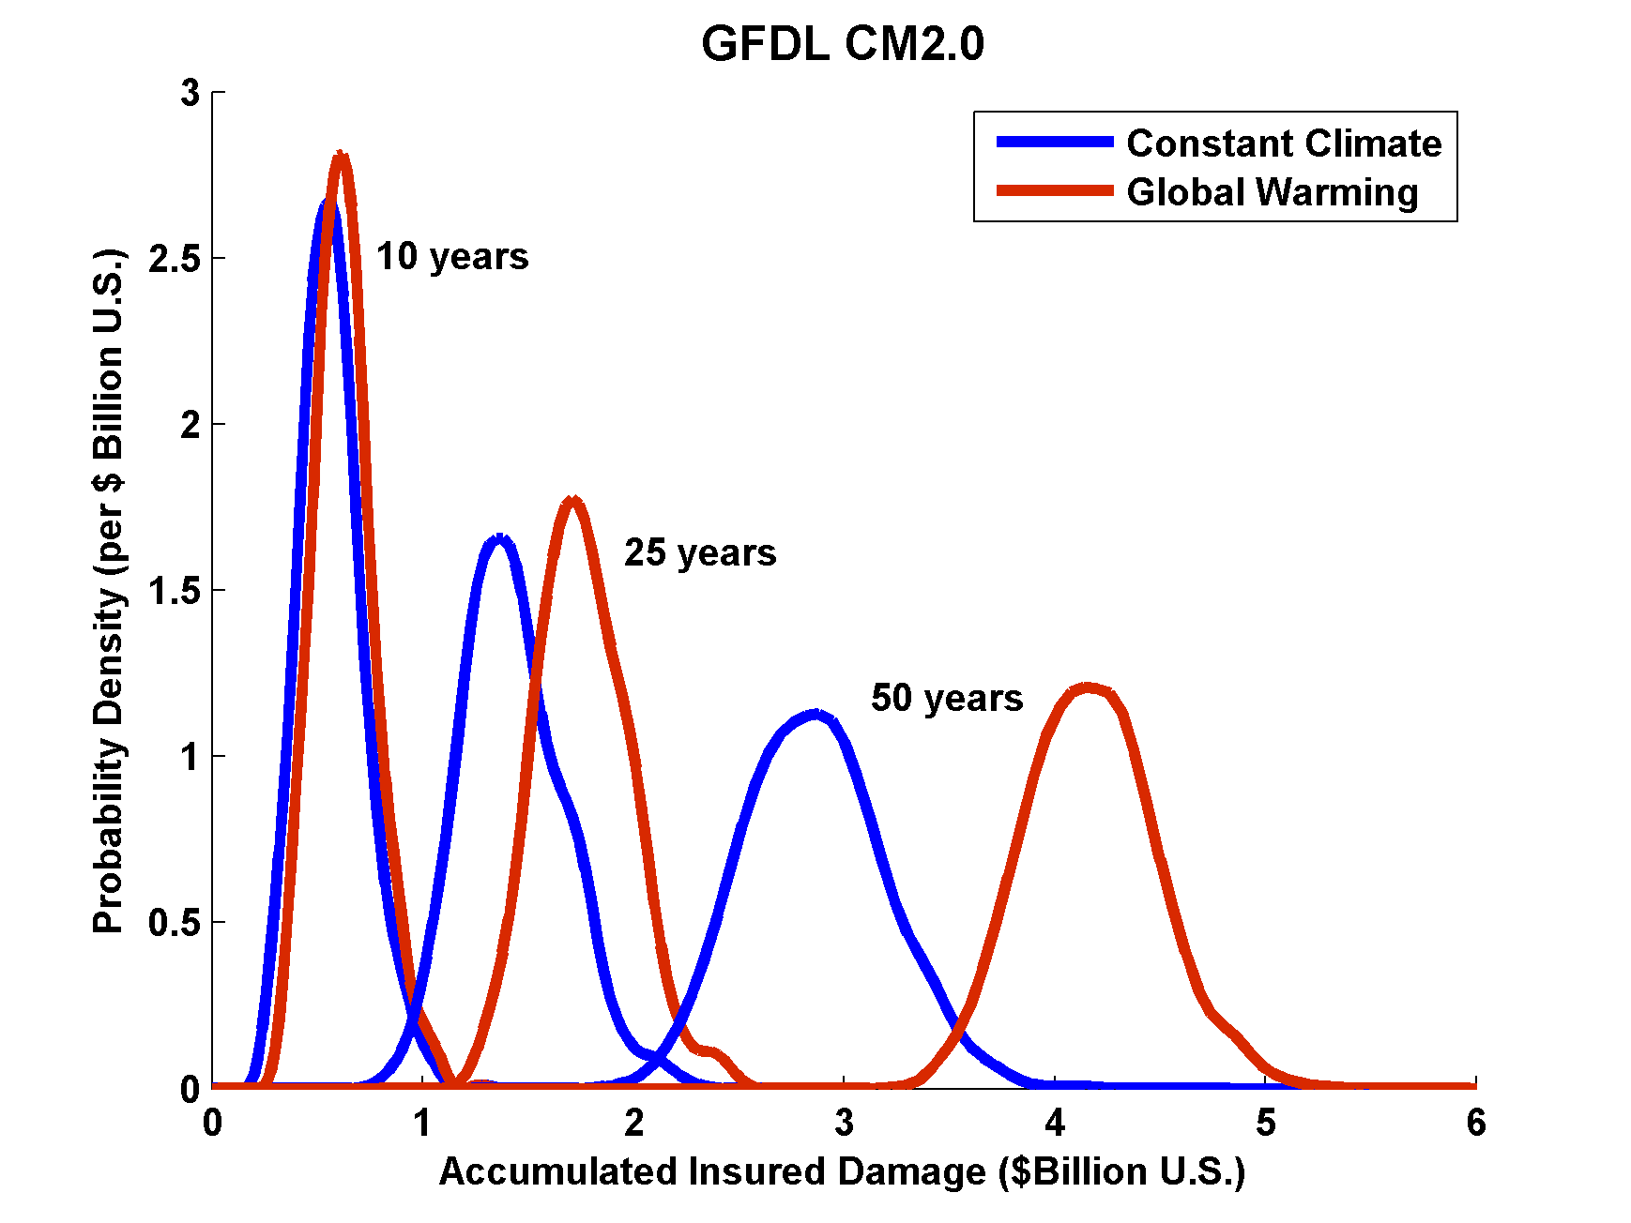
Projections of U.S. Insured Damage
Emanuel, K. A., 2012, Weather, Climate, and Society

Slide 55
Summary:
History too short and inaccurate to deduce real risk from tropical cyclones
Global (and most regional) models are far too coarse to simulate reasonably intense tropical cyclones
Globally and regionally simulated tropical cyclones are not coupled to the ocean

Slide 56
We have developed a technique for downscaling global models or reanalysis data sets, using a very high resolution, coupled TC model phrased in angular momentum coordinates
Model shows skill in capturing spatial and seasonal variability of TCs, has an excellent intensity spectrum, and captures well known climate phenomena such as ENSO and the effects of warming over the past few decades

Slide 57
Technique can also be used to assess tropical cyclone-related flood risks
When coupled to a hydrodynamic surge model, long-term surge risk can be assessed

Slide 58
Spare Slides

Slide 59
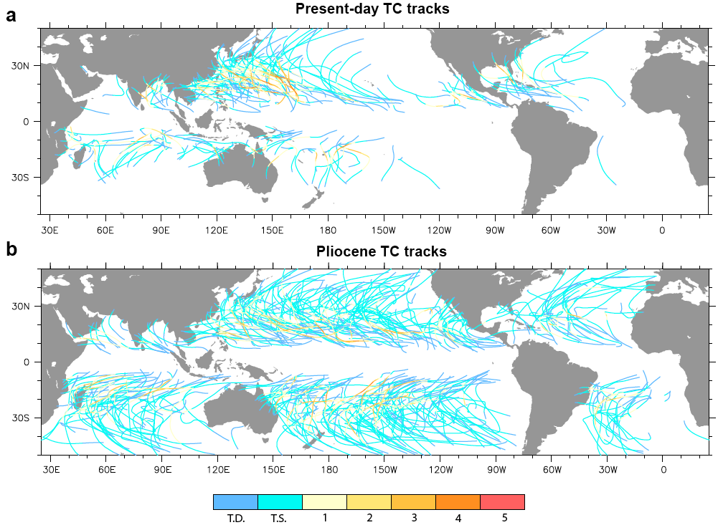
Application to Other Climates

Slide 60

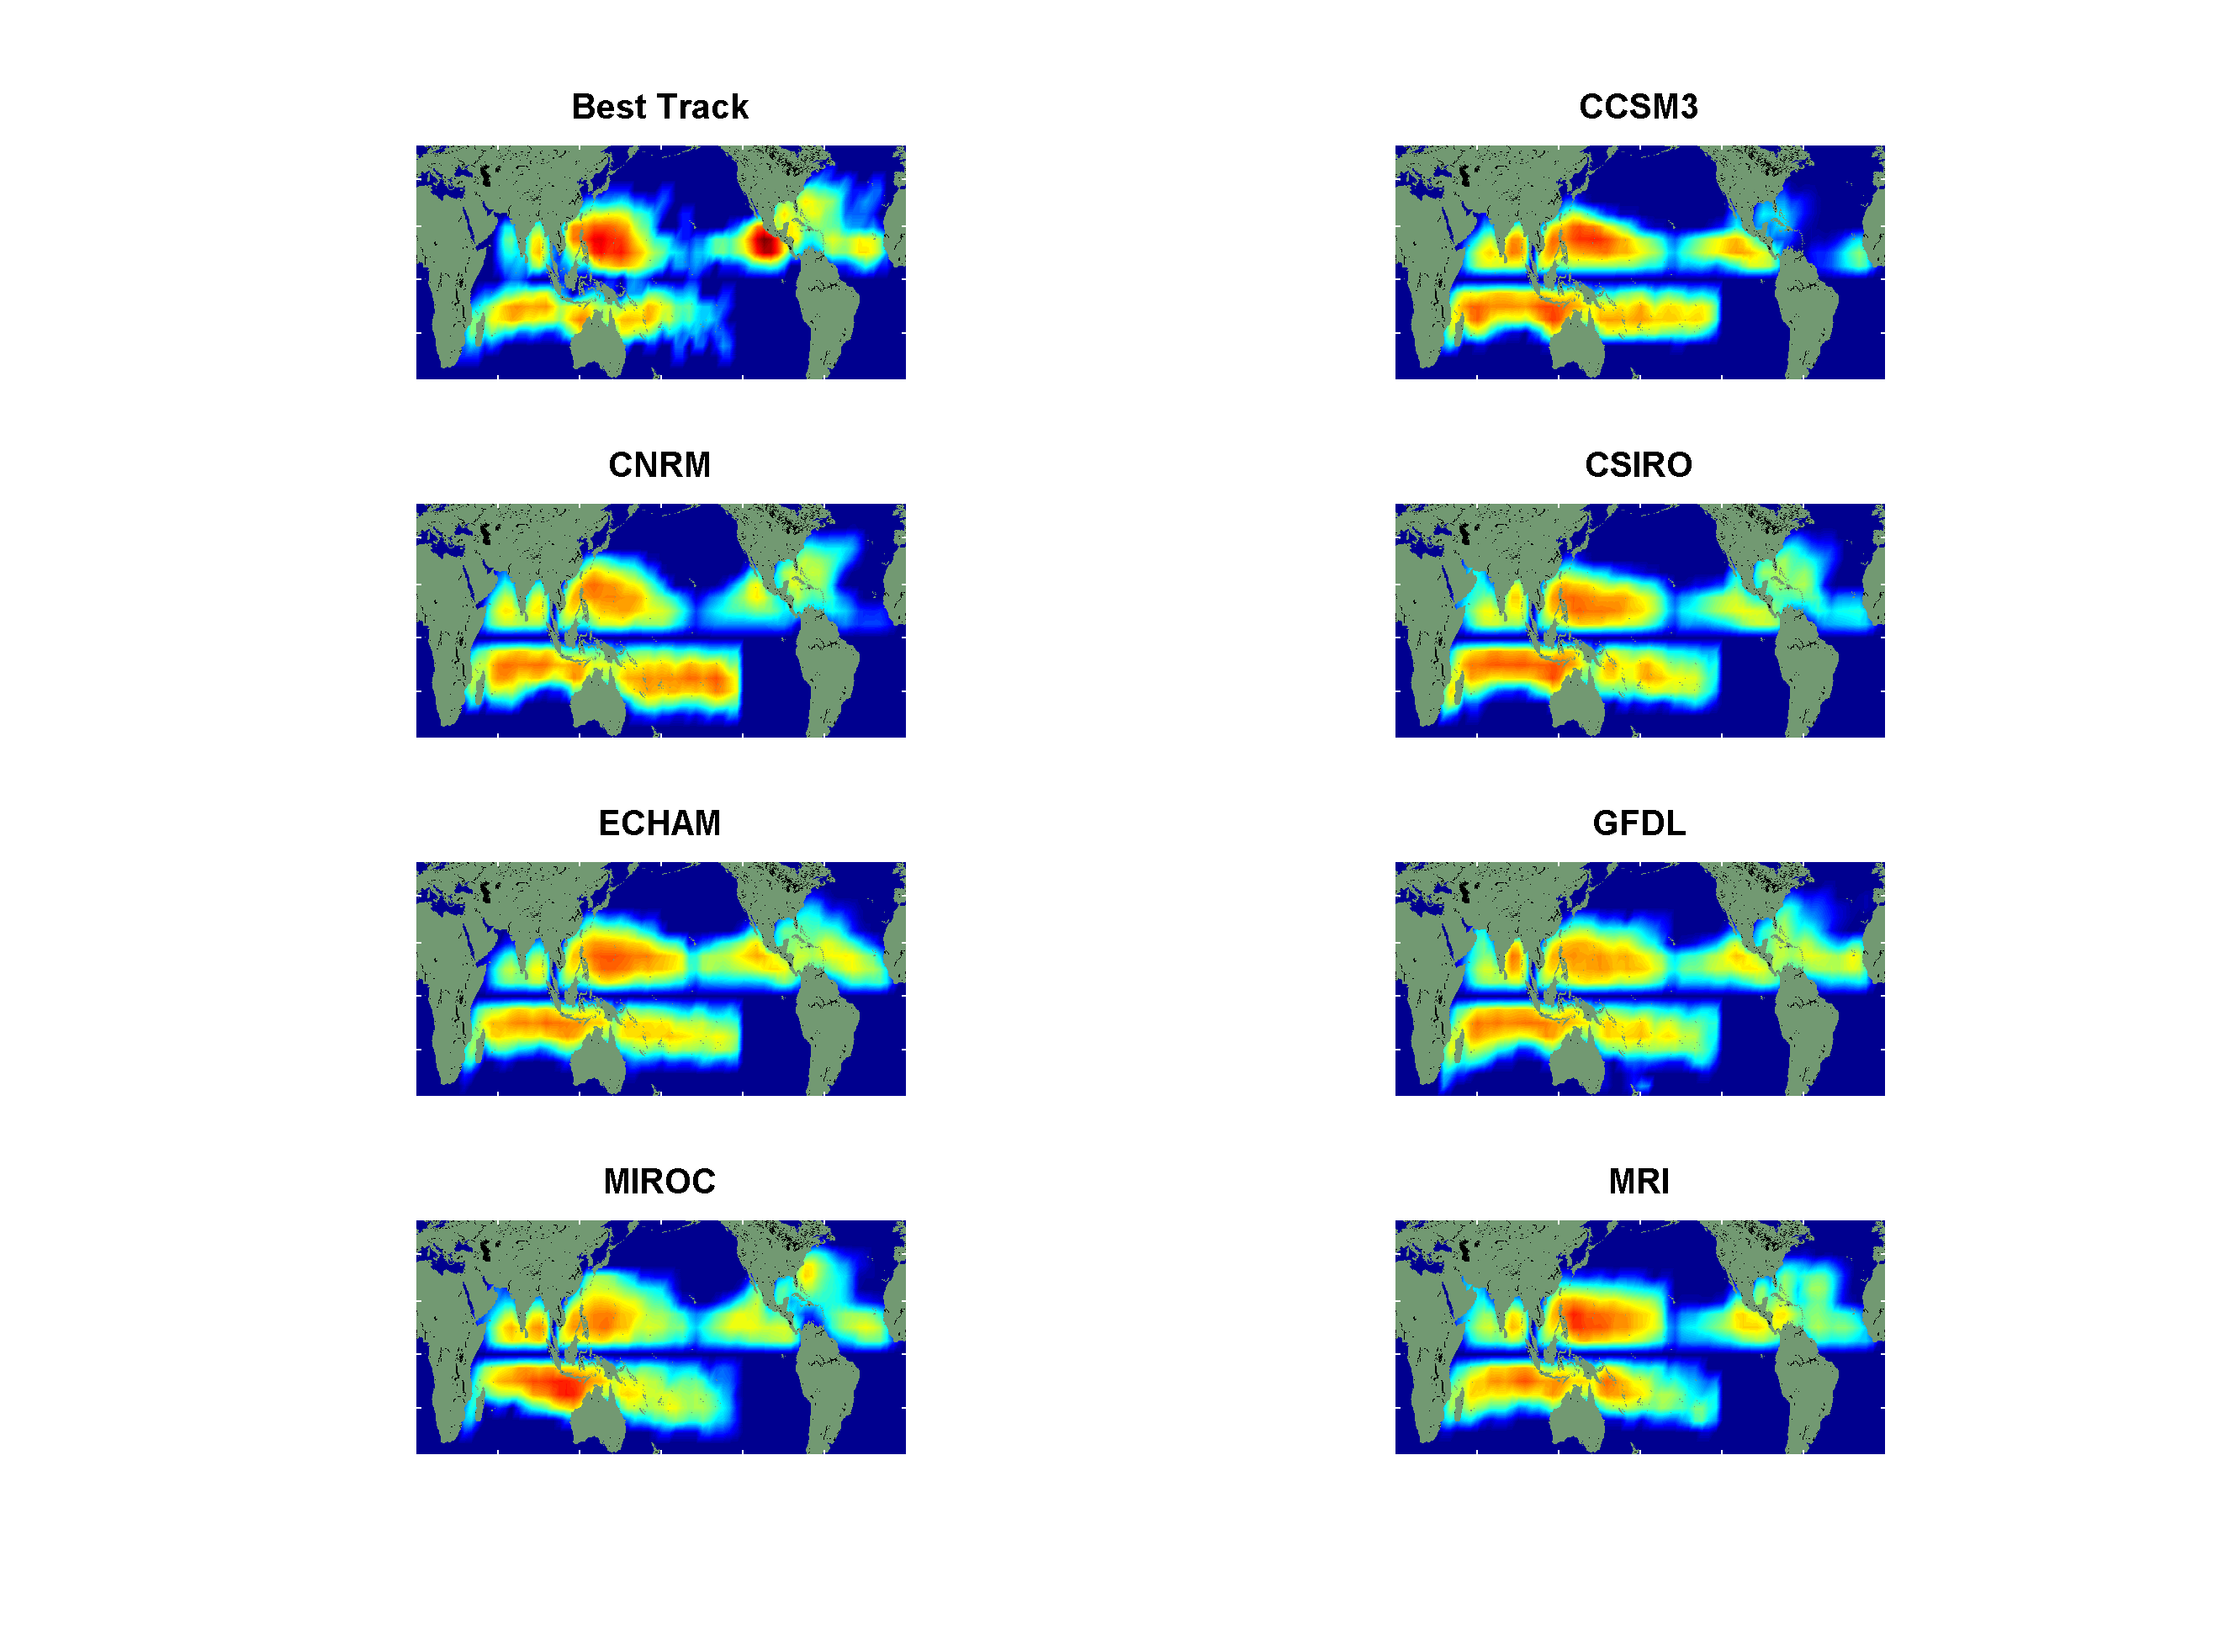
Genesis Distributions
Notes:
60

Slide 61
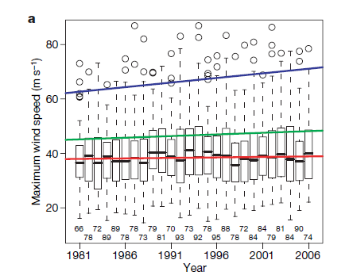
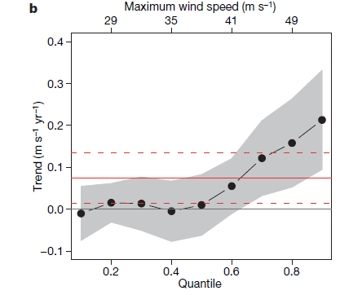
Analysis of satellite-derived tropical cyclone
lifetime-maximum wind speeds
Box plots by year. Trend lines are shown
for the median, 0.75 quantile, and 1.5 times the interquartile range
Trends in global satellite-derived tropical cyclone maximum wind speeds by quantile, from 0.1 to 0.9 in increments of 0.1.
Elsner, Kossin, and Jagger, Nature, 2008

Slide 62
Theoretical Upper Bound on Hurricane Maximum Wind Speed:
POTENTIAL INTENSITY
Surface temperature
Ratio of exchange coefficients of enthalpy and momentum
Outflow temperature
Air-sea enthalpy disequilibrium

Slide 63
Annual Maximum Potential Intensity (m/s)

Slide 64
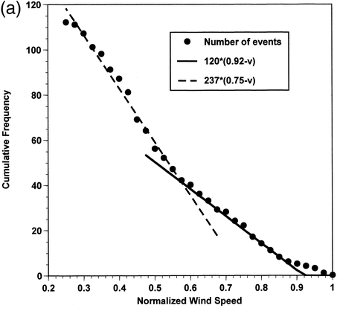

Slide 65
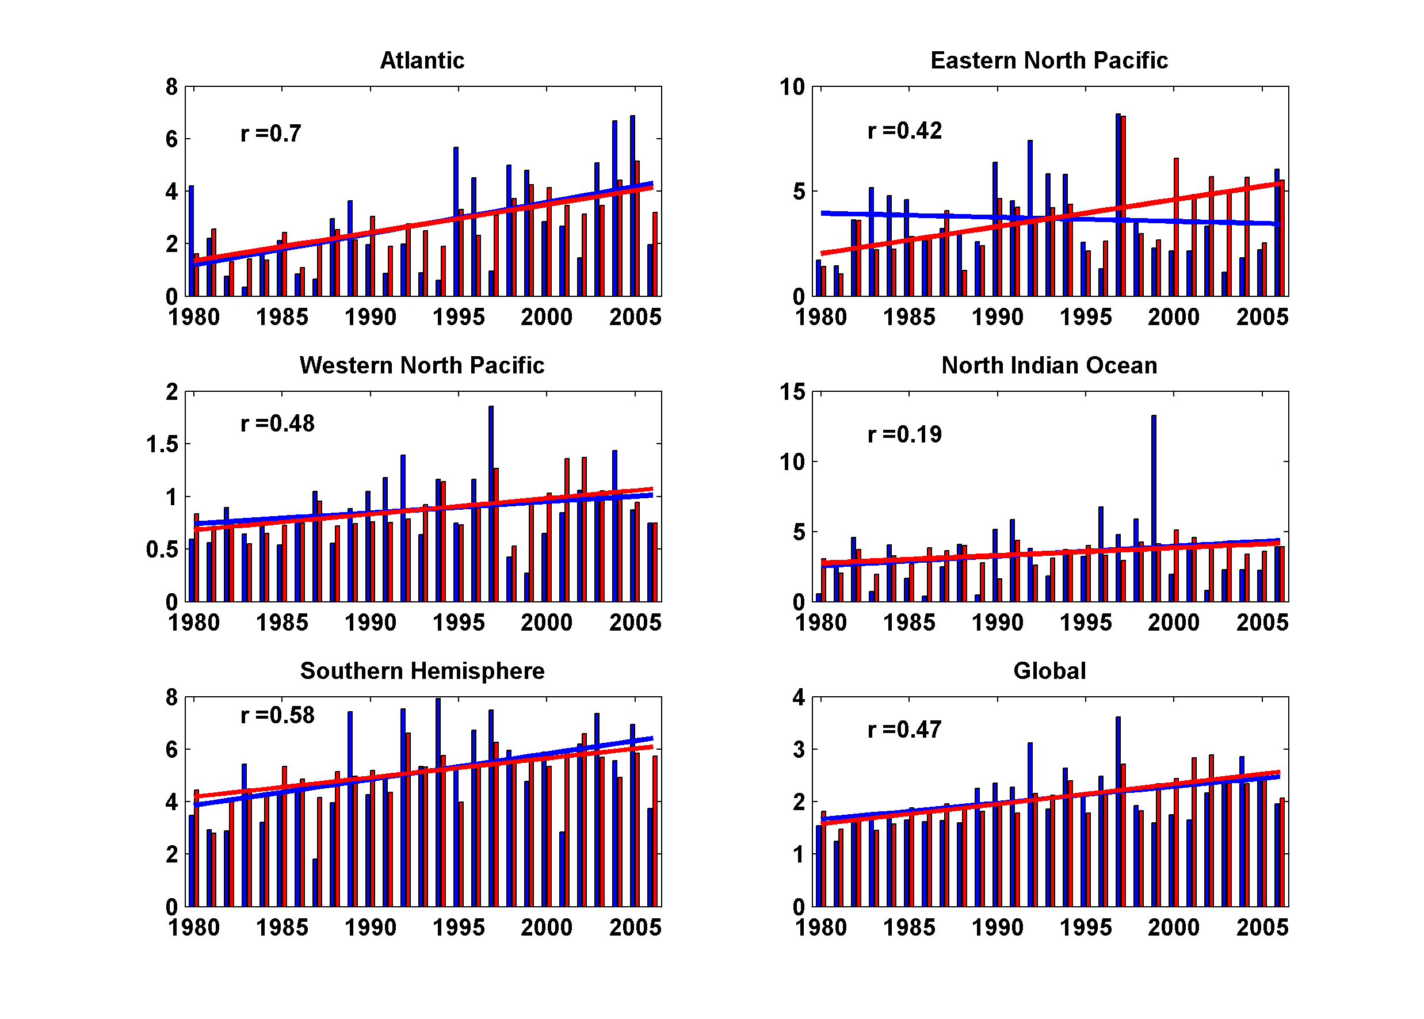
Simulated vs. Observed Power Dissipation Trends, 1980-2006
Notes:
65
65

Slide 66
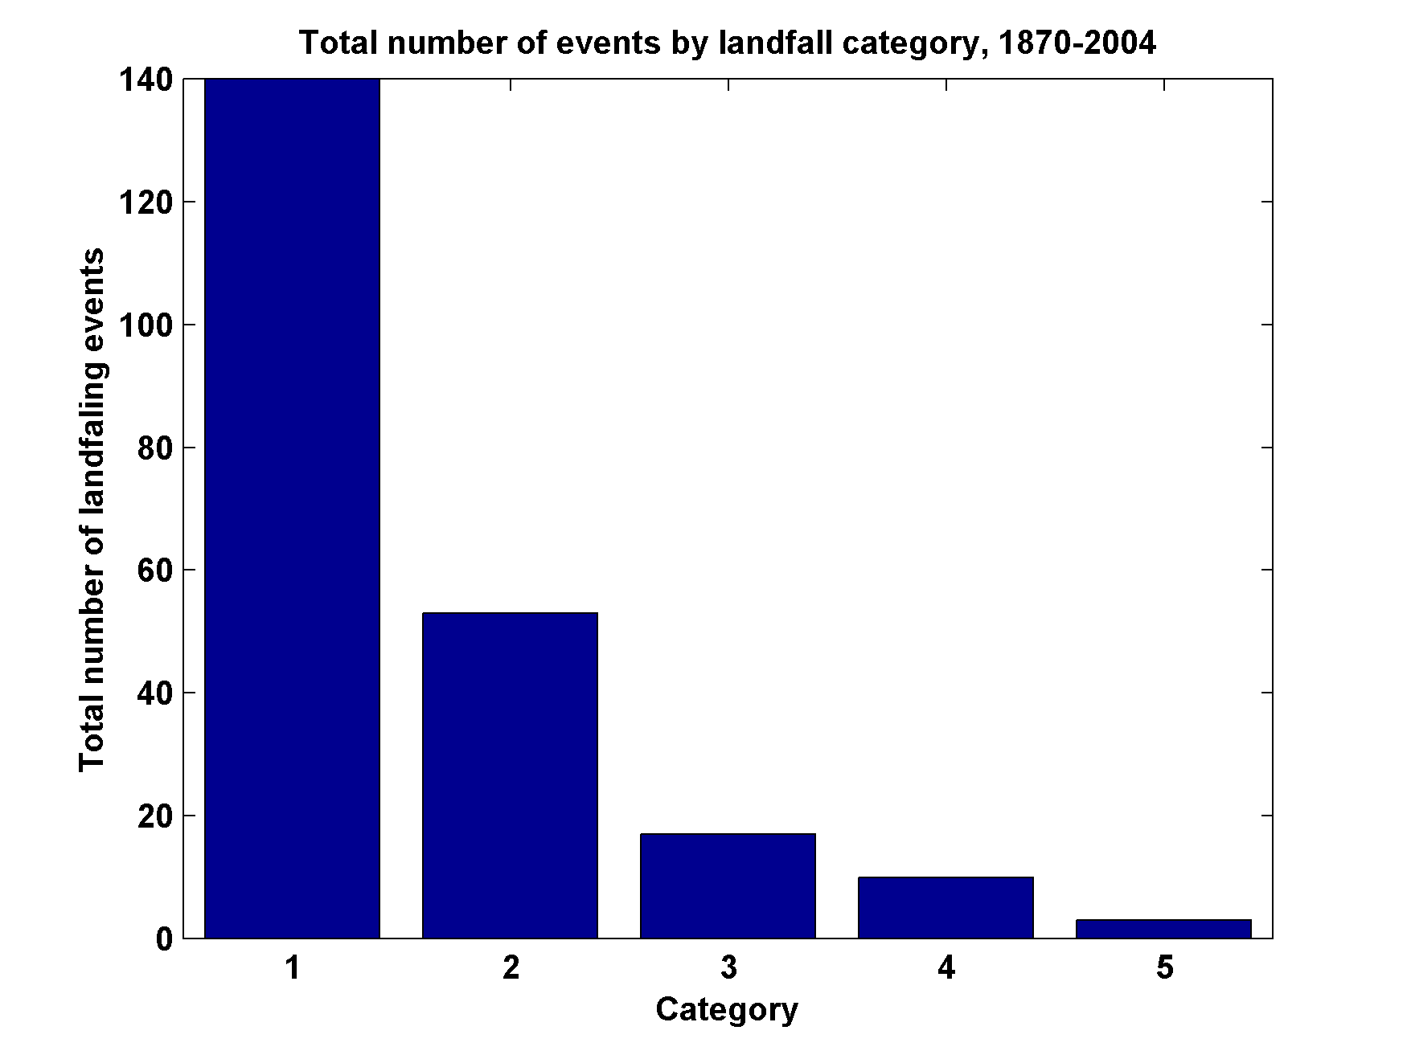
Total Number of United States Landfall Events, by Category, 1870-2004

Slide 67
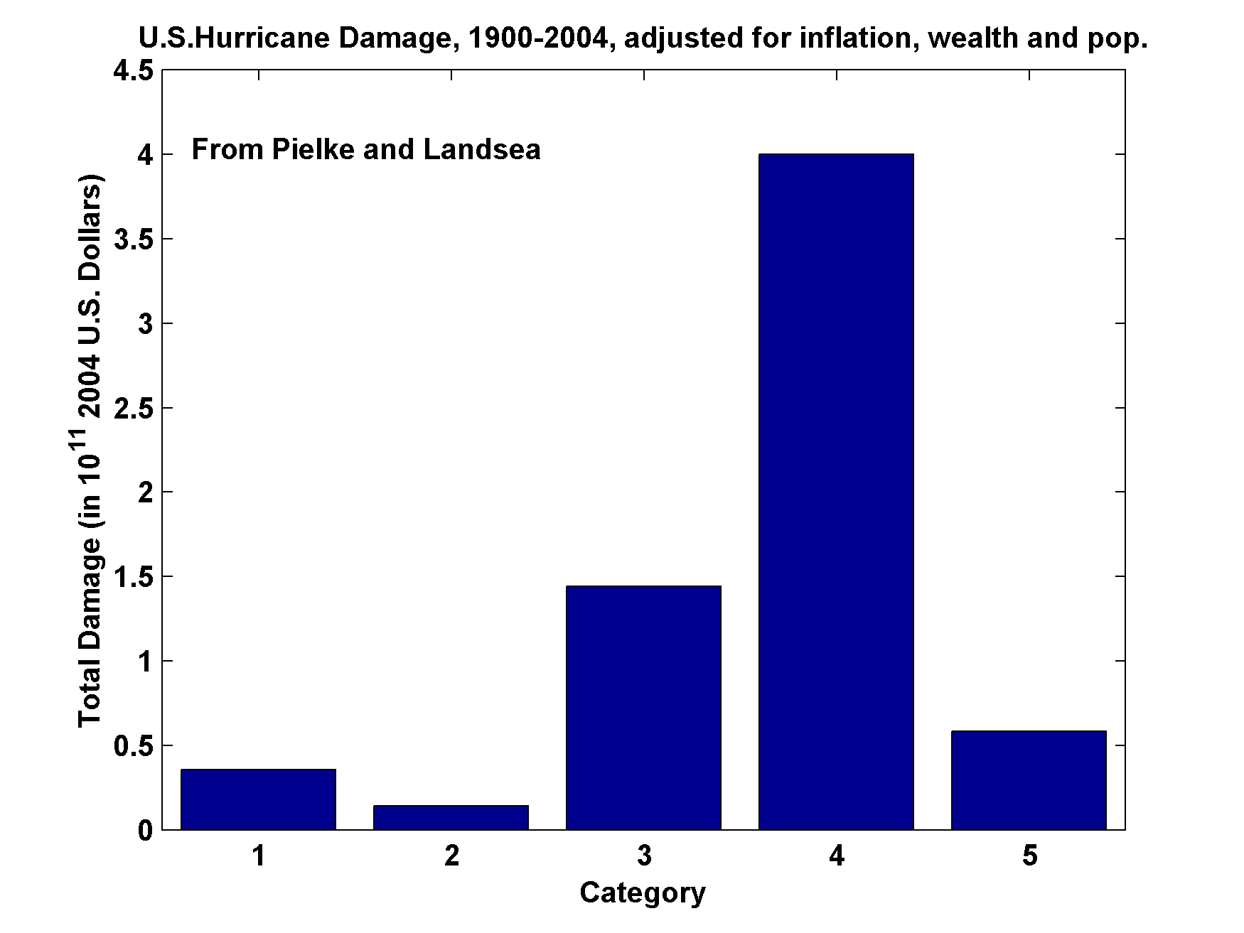
U.S. Hurricane Damage, 1900-2004, Adjusted for Inflation, Wealth, and Population

Slide 68
Seasonal Cycles
Atlantic
Notes:
68

Slide 69
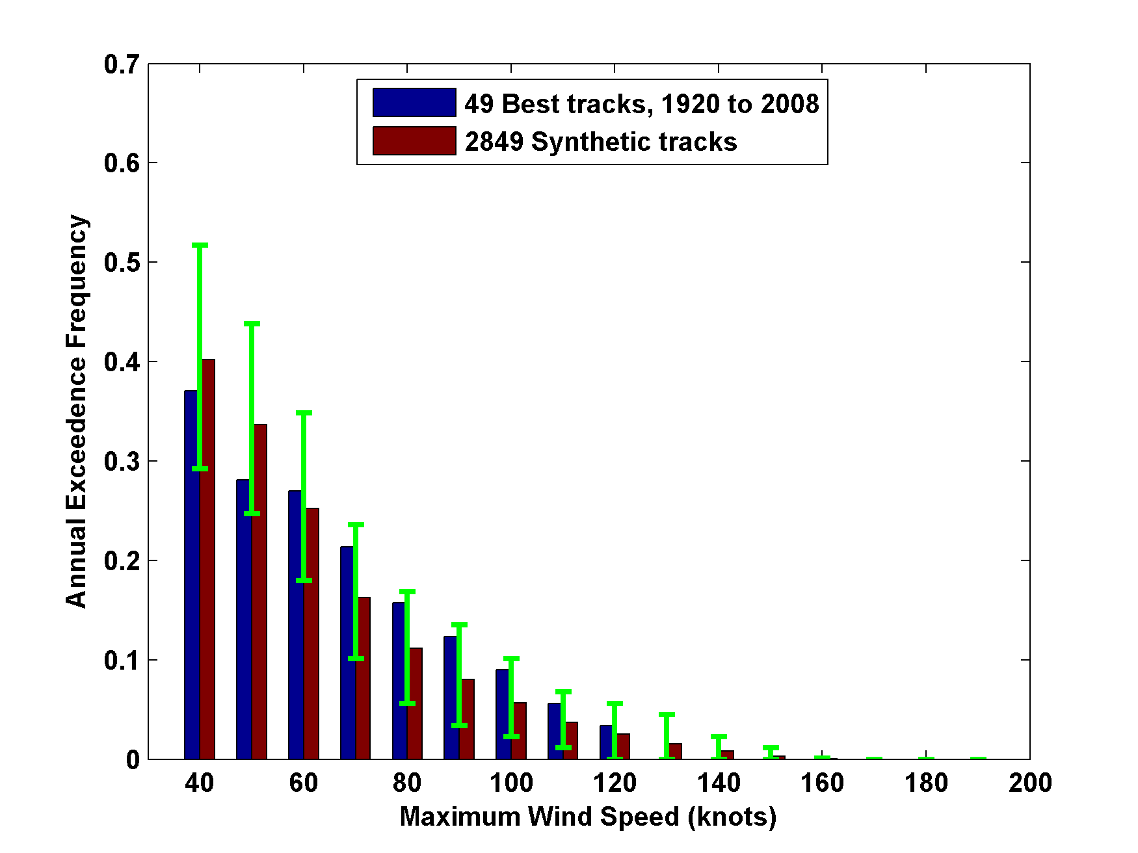
3000 Tracks within 100 km of Miami
95% confidence bounds

Slide 70
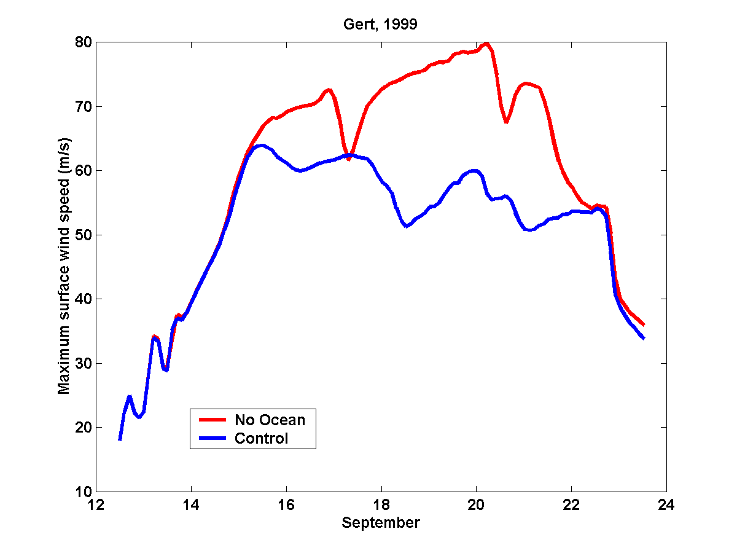
Comparing Fixed to Interactive SST:
Model with Fixed Ocean Temperature
Model including Ocean Interaction

Slide 71

Some early results
Instantaneous rainfall rate (mm/day) associated with Hurricane Katrina at 06 GMT 29 August 2005 predicted by the model driven towards Katrina’s observed wind intensity along its observed track

Slide 72


Observed (left) and simulated storm total rainfall accumulation during Hurricane Katrina of 2005. The plot at left is from NASA’s Multi-Satellite Precipitation Analysis, which is based on the Tropical Rainfall Measurement Mission (TRMM) satellite, among others. Dark red areas exceed 300 mm of rainfall; yellow areas exceed 200 mm, and green areas exceed 125 mm

Slide 73

Example showing baroclinic and topographic effects

Slide 74


Slide 75

Example: Intense event in future climate downscaled from CNRM model

Slide 76


Slide 77

ADCIRC Mesh

Slide 78

Peak Surge at each point along Florida west coast

Slide 79
Integrated Assessments with Robert Mendelsohn, Yale

Slide 80


Probability Density of TC Damage, U.S. East Coast
Damage Multiplied by Probability Density of TC Damage, U.S. East Coast

Slide 81

Present and future baseline tropical cyclone damage by region.
Changes in income will increase future tropical cyclone damages in 2100 in every region even if climate does not change. Changes are larger in regions experiencing faster economic growth, such as East Asia and the Central America–Caribbean region.

Slide 82

Climate change impacts on tropical cyclone damage by region in 2100. Damage is concentrated in North America, East Asia and Central America–Caribbean. Damage is generally higher in the CNRM and GFDL climate scenarios.

Slide 83

Climate change impacts on tropical cyclone damage divided by GDP by region in 2100. The ratio of damage to GDP is highest in the Caribbean–Central American region but North America, Oceania and East Asia all have above-average ratios.

