Slide 1
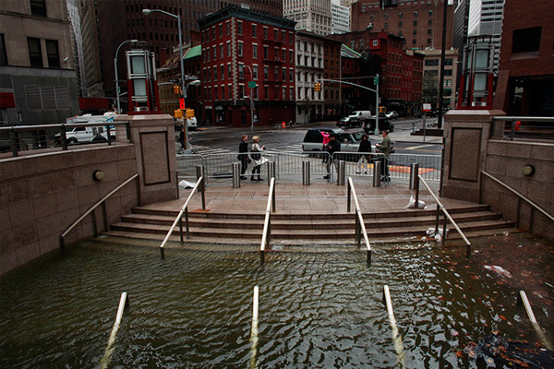
Assessing Storm Surge Risk at New York City
Kerry Emanuel
Massachusetts Institute of Technology
Notes:
1

Slide 2

Program
Brief Review of Tropical Cyclones
Why historical statistics are inadequate for assessing long-term surge risk in NYC
Physically based method for estimating surge risk

Slide 3
More Information about this Talk:
Physically based assessment of hurricane surge threat under climate change
Ning Lin, Kerry Emanuel, Michael Oppenheimer
& Erik Vanmarcke
Nature Climate Change, 2, 462–467 (February, 2012) doi:10.1038/nclimate1389
“The combined effects of storm climatology change and a 1m SLR may cause the present NYC 100-yr surge flooding to occur every 3–20 yr and the present 500-yr flooding to occur every 25–240 yr by the end of the century”

Slide 4

Brief Overview of Tropical Cyclones
Notes:
4

Slide 5

The View from Space

Slide 6
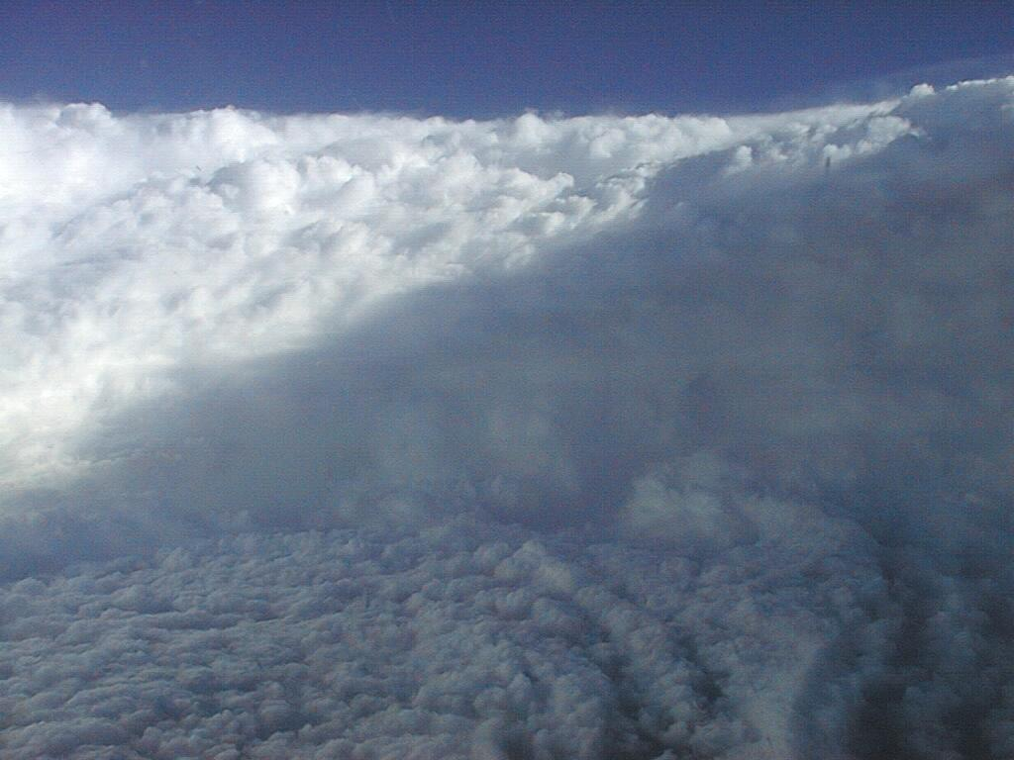

Slide 7
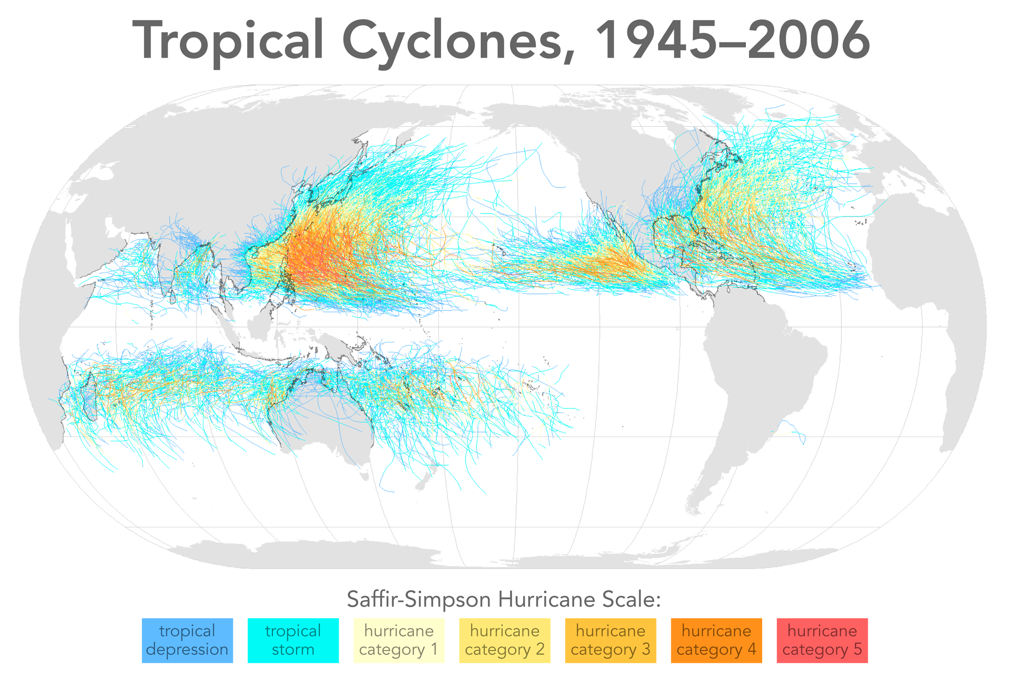

Slide 8
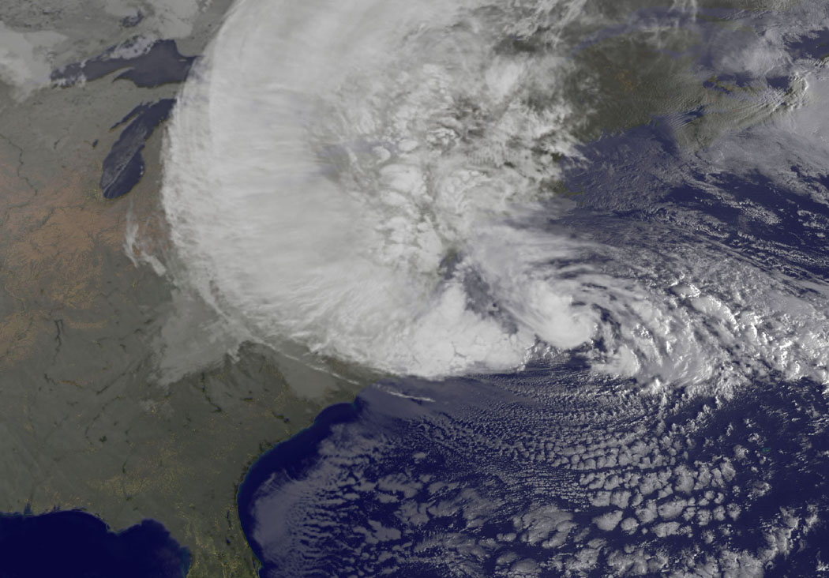
Sandy

Slide 9
Limitations of a strictly statistical approach
U.S. Hurricanes in General
>50% of all normalized damage caused by top 8 events, all category 3, 4 and 5
>90% of all damage caused by storms of category 3 and greater
Category 3,4 and 5 events are only 13% of total landfalling events; only 30 since 1870
Landfalling storm statistics are inadequate for assessing hurricane risk

Slide 10
Historical Surge Events Affecting New York City

Slide 11
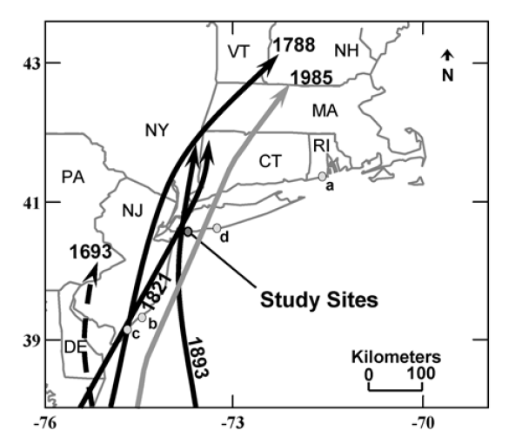
Tracks of historical hurricanes affecting NYC and western Long Island
Source: Scileppi and Donnelly, 2007: Geochem., Geophys., Geosys., 8

Slide 12
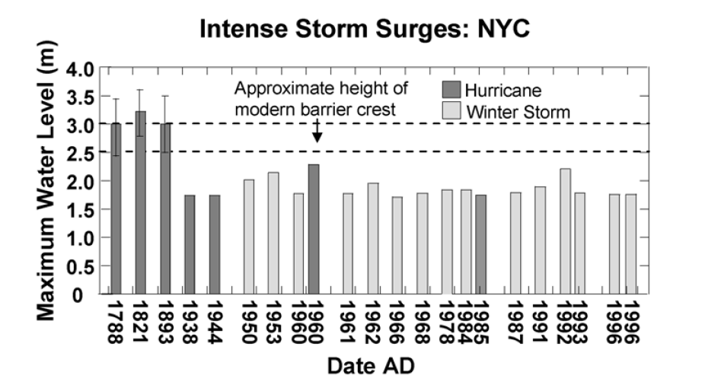
From historical archives
From tide gauge at the Battery
Sandy
Source: Scileppi and Donnelly, 2007: Geochem., Geophys., Geosys., 8

Slide 13
Additional Problem:
Nonstationarity of climate

Slide 14
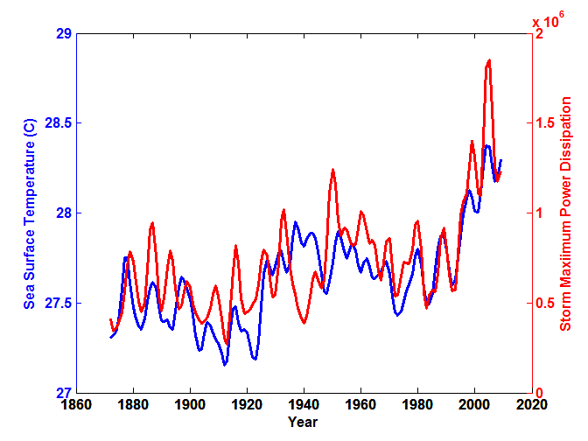
Atlantic Sea Surface Temperatures and Storm Max Power Dissipation
(Smoothed with a 1-3-4-3-1 filter)
Years included: 1870-2011
Data Sources: Hurricanes: NOAA/TPC; Sea Surface Temperatures: UKMO/HADSST1
Notes:
14
The low value of storm power in the early 1940s is thought to be due to the lack of reports from ships at sea because of the radio silence imposed during WWII.

Slide 15
Bringing Physics to Bear: Risk Assessment by Direct Numerical Simulation of Hurricanes
The Problem
The hurricane eyewall is an intense, circular front, attaining scales of ~ 1 km or less
At the same time, the storm’s circulation extends to ~1000 km and is embedded in much larger scale flows

Slide 16

Histograms of Tropical Cyclone Intensity as Simulated by a Global Model with 50 km grid point spacing. (Courtesy Isaac Held, GFDL)
Modeled
Observed
Global models do not simulate the storms that cause destruction
Category 3

Slide 17
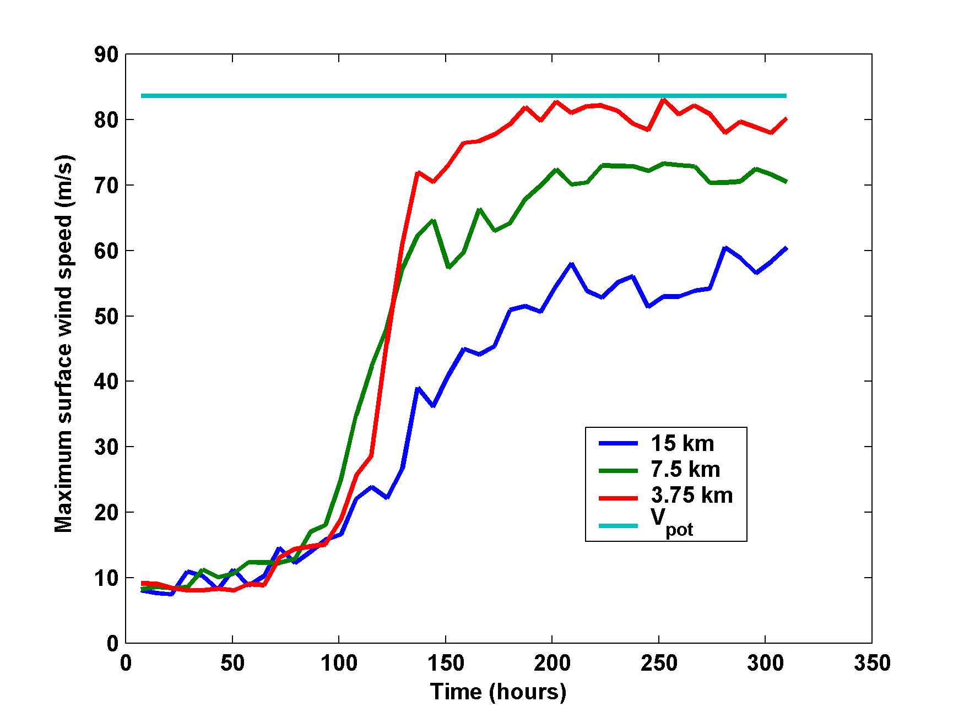
Numerical convergence in an axisymmetric, nonhydrostatic model (Rotunno and Emanuel, 1987)
Theoretical Maximum Intensity
Distance between computational nodes

Slide 18
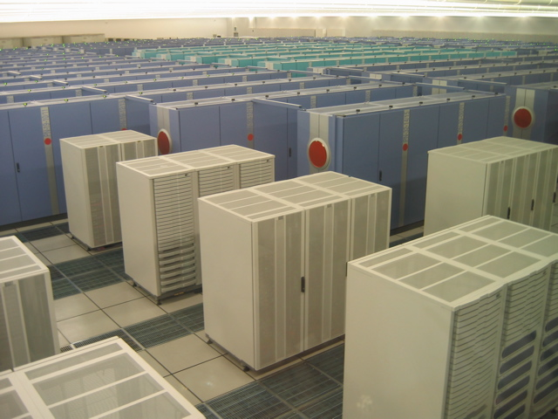
How to deal with this?
Option 1: Brute force and obstinacy

Slide 19


How to deal with this?
Option 1: Brute force and obstinacy
Option 2: Applied math and modest resources

Slide 20
Time-dependent, axisymmetric model phrased in R space
Hydrostatic and gradient balance above PBL
Moist adiabatic lapse rates on M surfaces above PBL
Boundary layer quasi-equilibrium convection
Deformation-based radial diffusion
Coupled to simple 1-D ocean model
Environmental wind shear effects parameterized

Slide 21
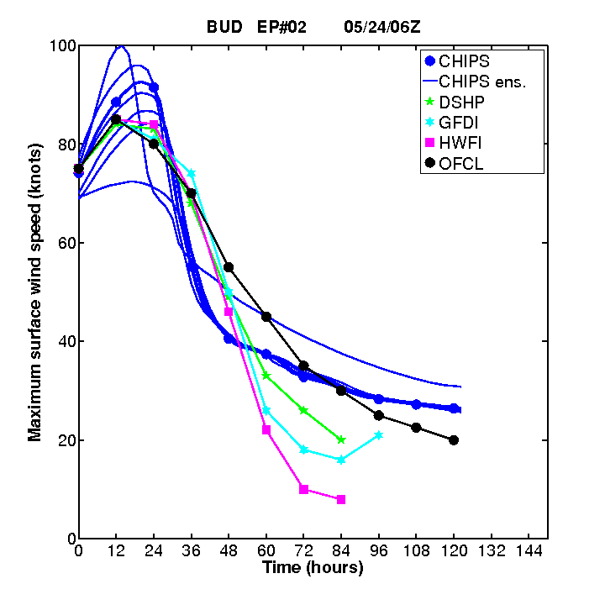
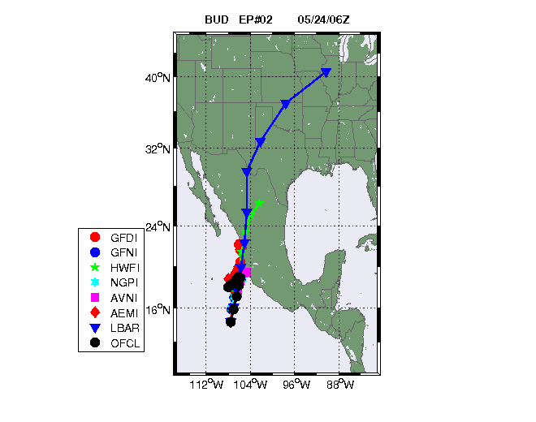
Originally Developed as a Student Laboratory Tool, Later Adapted as a Hurricane Intensity Forecasting Model
(http://wind.mit.edu/~emanuel/storm.html)

Slide 22
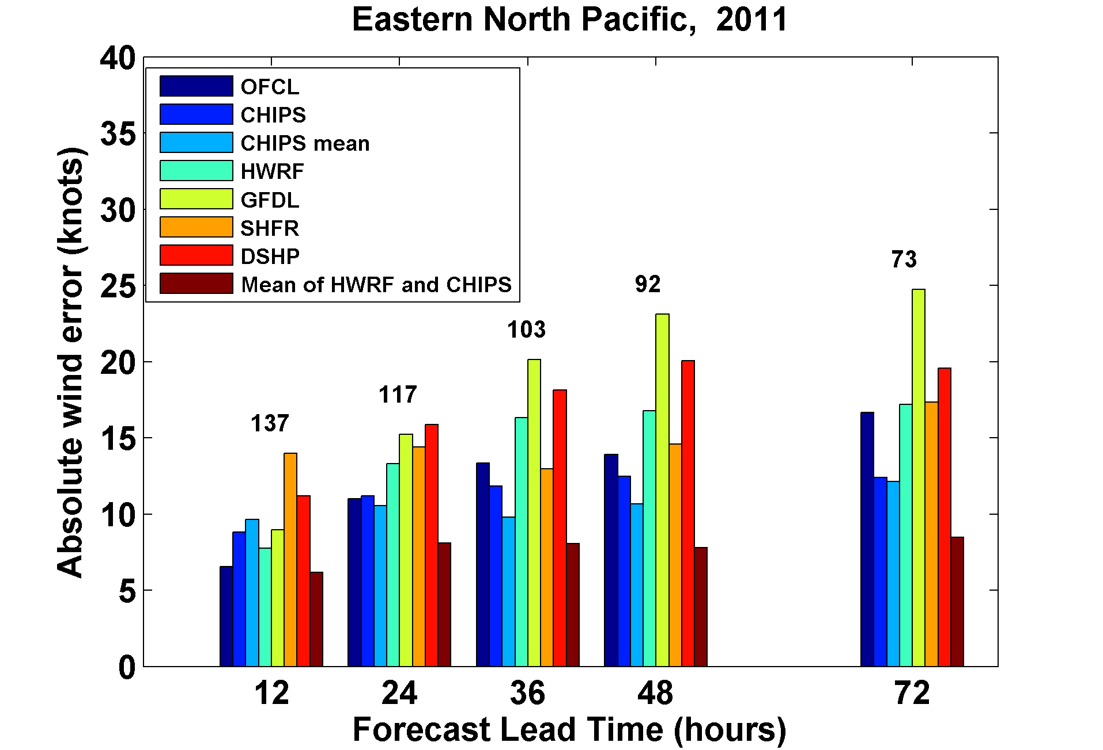

Slide 23
How Can We Use This Model to Help Assess Hurricane Wind and Rain Risk in Current and Future Climates?

Slide 24
Risk Assessment Approach:
Step 1: Seed each ocean basin with a very large number of weak, randomly located cyclones
Step 2: Cyclones are assumed to move with the large scale atmospheric flow in which they are embedded, plus a correction for beta drift
Step 3: Run the CHIPS model for each cyclone, and note how many achieve at least tropical storm strength
Step 4: Using the small fraction of surviving events, determine storm statistics
Details: Emanuel et al., Bull. Amer. Meteor. Soc, 2008
Notes:
24

Slide 25
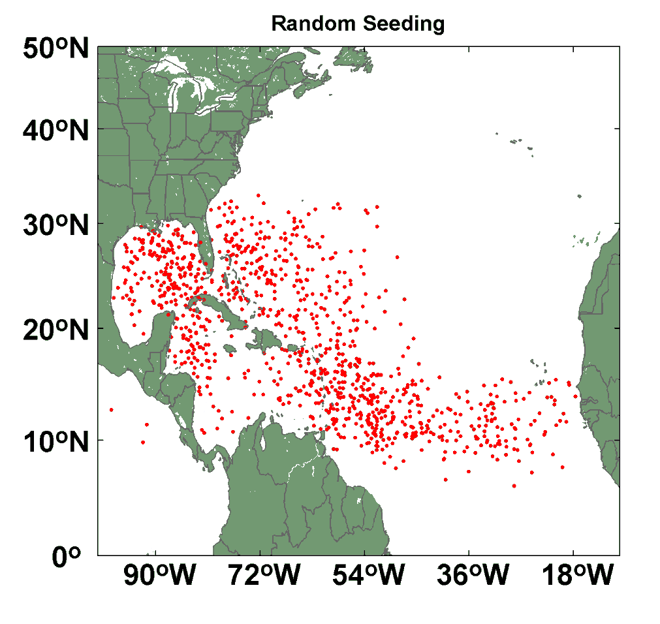
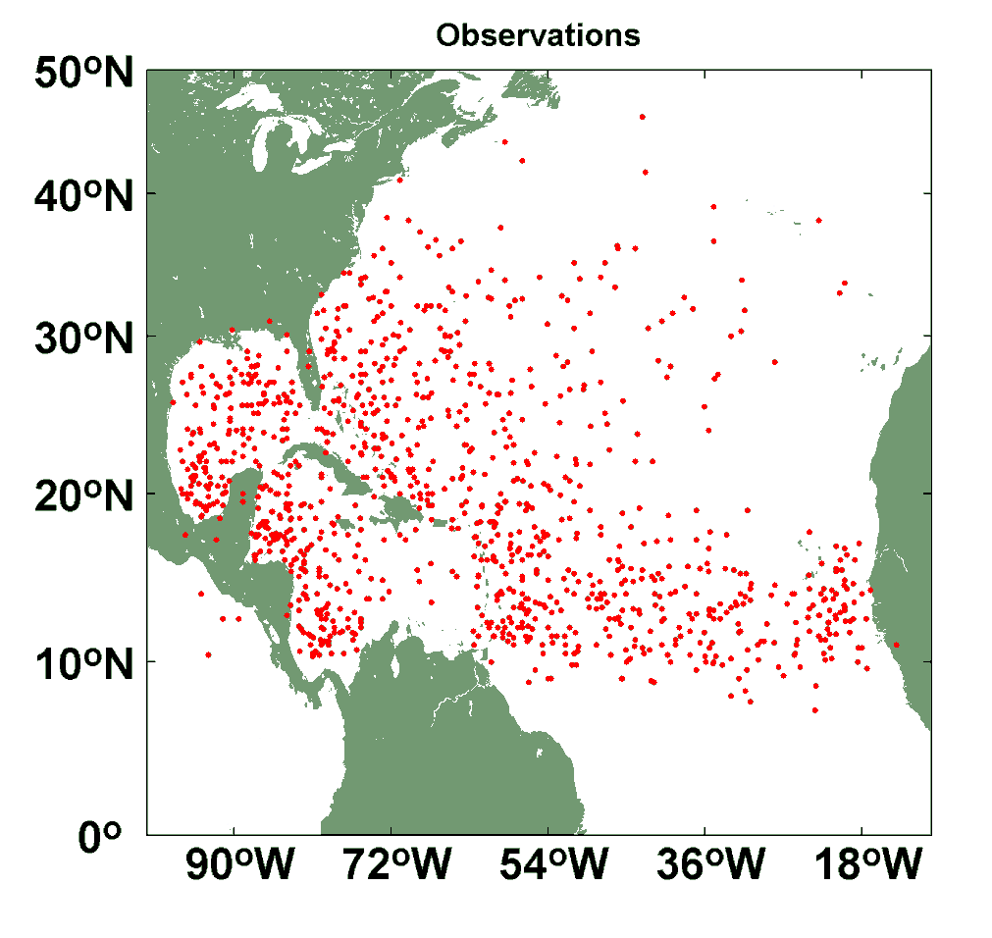
Comparison of Random Seeding Genesis Locations with Observations

Slide 26
Calibration
Absolute genesis frequency calibrated to globe during the period 1980-2005
Notes:
26

Slide 28
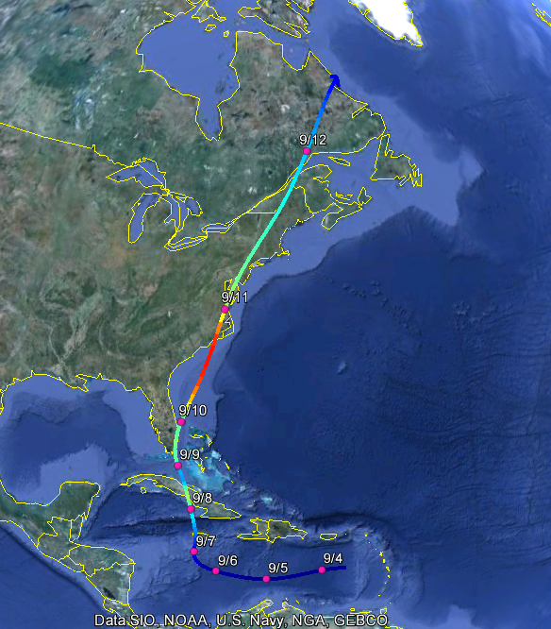
Example: Hurricane affecting New York City

Slide 29
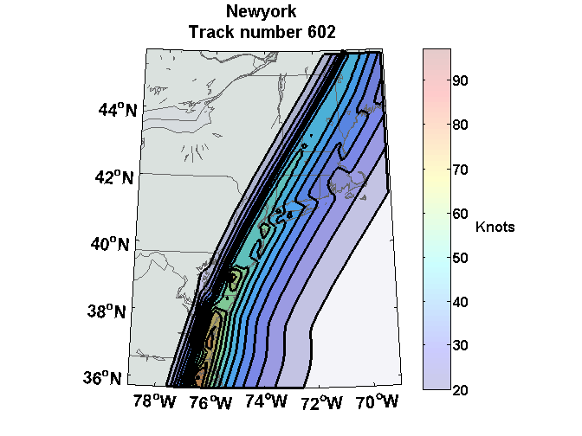
Wind Swath

Slide 30
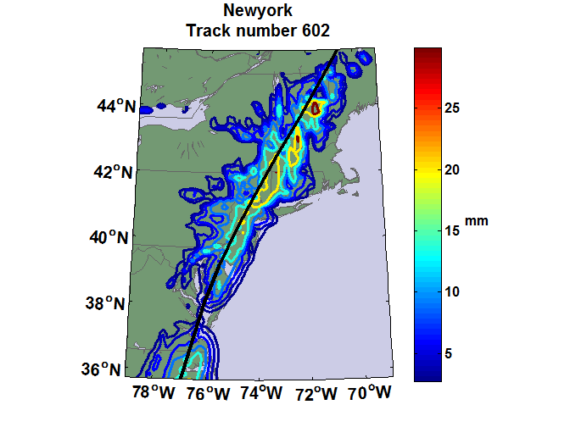
Accumulated Rainfall (mm)

Slide 31

Return Periods

Slide 32
Coupling large hurricane event sets to surge models (with Ning Lin)
Couple synthetic tropical cyclone events (Emanuel et al., BAMS, 2008) to surge models
  SLOSH
  ADCIRC (fine mesh)
  ADCIRC (coarse mesh)
Generate probability distributions of surge at desired locations

Slide 33


Storm Surge Simulation
SLOSH model
(Jelesnianski et al. 1992)
SLOSH mesh
~ 10³ m
ADCIRC mesh
~ 10² m
Battery
ADCIRC model
(Luettich et al. 1992)
ADCIRC mesh
~ 10 m
(Colle et al. 2008)
Notes:
Given the storm wind and pressure fields (which is estimated from the Holland parametric pressure model) we can simulate the surge. Surge simulations with high resolution are computationally intensive, so to make it possible to simulate accurate surges for our large synthetic storm sets, we apply the two hydrodynamic models with girds of various resolutions in such a way that the main computational effort is concentrated on the storms that determine the risk. First, we apply the SLOSH model, using a mesh with resolution of about 1 km around NYC to simulate the surges for all storms and select the storms that have return periods, in terms of the surge height at the Battery, greater than 10 years. Second, we apply the ADCIRC simulation, using a grid mesh with resolution of ~100 m around NYC, to each of the selected storms. Then, we apply another ADCIRC mesh with resolution as high as ~10 m around NYC, for a set of the most extreme events, to check if the resolution of our ADCIRC grid is sufficient and if needed to make statistical correction to the results.

Slide 34
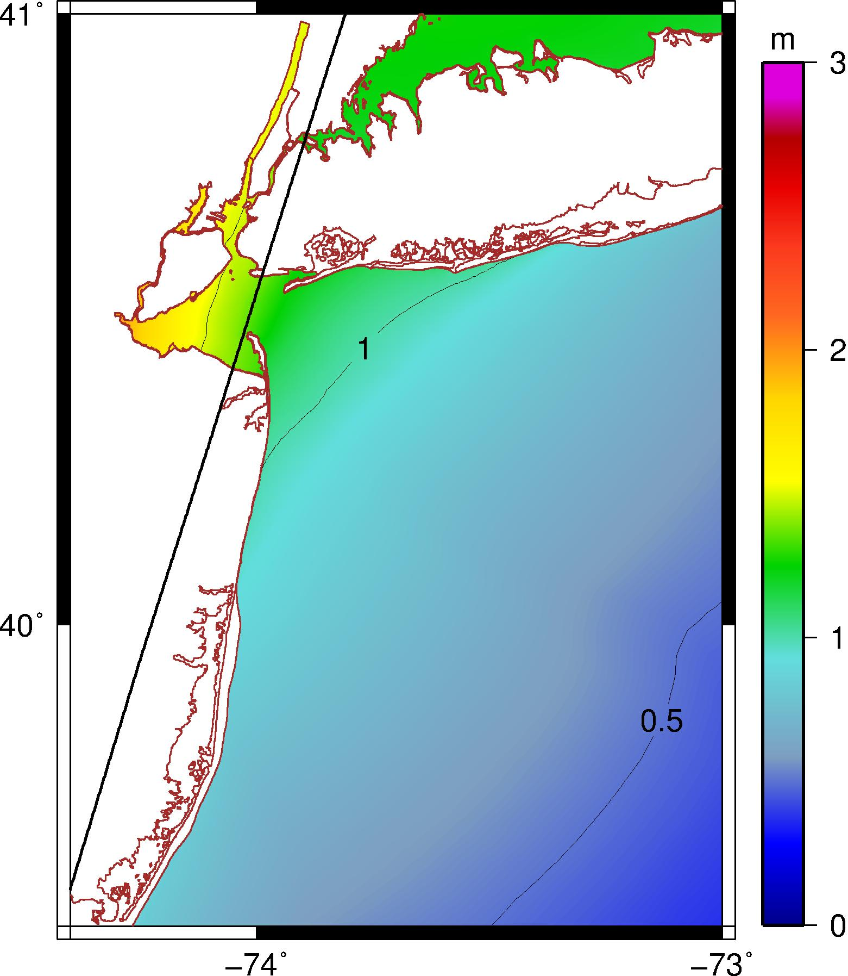
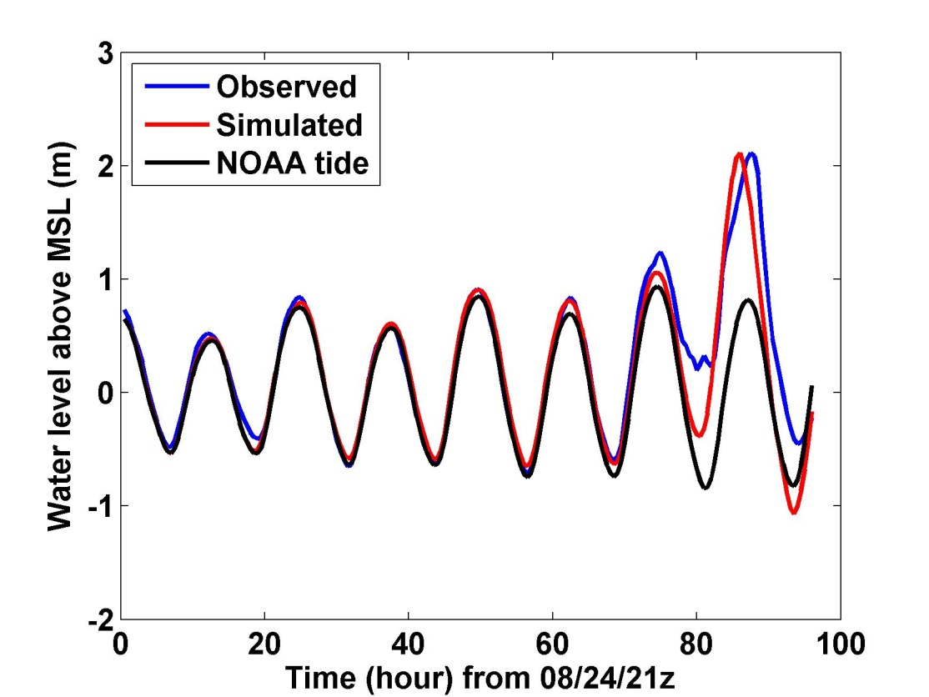
Hurricane Irene (2011) Hindcast
1.3 m
V_{m} = 17 m/s, P_{c} = 977 mb
R_{m}= 83 km, U_{t} = 12 m/s, ds = 9 km
Notes:
Our simulation for Hurricane Irene’s surge using the ADCIRC model. The storm track, intensity, and size are obtained from the observation. This storm passed to the right of the Battery with relatively low intensity and generated a peak surge of about 1.3 m at the Battery. The surge happened right at the high tide and thus the total water level was about 2.1 m above the MSL. The plot to the right shows that the simulated and observed water levels compare very well, thus Irene offered us a good opportunity to validate our wind field and storm surge modeling method.

Slide 35
Hurricane Sandy (2012) Hindcast
HWRF Forecast at 2012102818z
3.25 m
3.34 m
Notes:
ADCIRC simulation of surge (not including tide or wave setup), assuming hurricane parametric wind and pressure profiles, same methods as for Irene and synthetic storms.

Slide 36
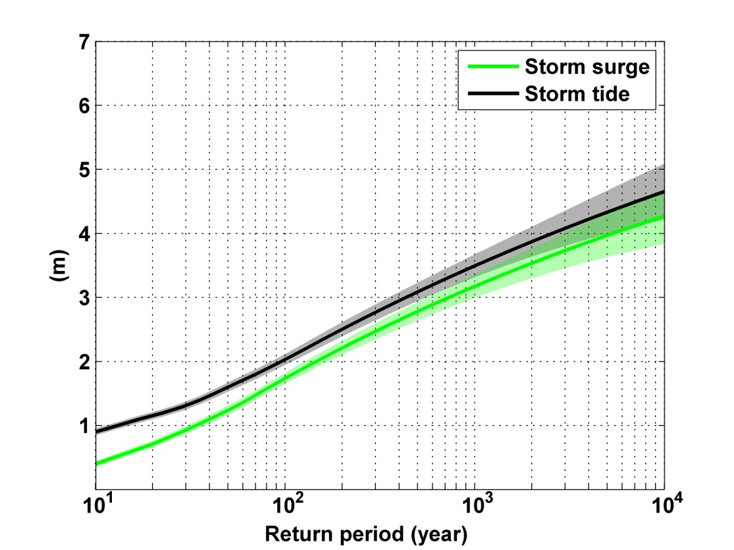
Notes:
Storm surge and storm tide (surge and tide) return level curves for the Battery, NYC, for the 1981-2000 NCAR/NCEP climate conditions (5000 synthetic storms). Astronomical tide and nonlinear interaction between surge and tide are accounted for statistically.

Slide 37
Looking Ahead

Slide 38

GCM flood height return level
(assuming SLR of 1 m for the future climate )
Black: Current climate (1981-2000)
Blue: A1B future climate (2081-2100)
Red: A1B future climate (2081-2100) with R₀ increased by 10% and R_{m} increased by 21%
Lin et al. (2012)
Notes:
Then we calculate the flood height (including surge, tide, and sea level rise) return level for the four climate models, assuming a sea level rise of 1 m for the future climate, for the Battery, NYC. These results show that the combined effects of storm climatology change and sea level rise will greatly shorten the flood return periods for NYC and, by the end of the century, the current 100-year surge flooding may happen less than every 30 years, with CNRM and GFDL prediction to be less than 10 years, and the 500-year flooding may happen less than every 200 years, with the CNRM and GFDL prediction to be 20-30 years.

Slide 39
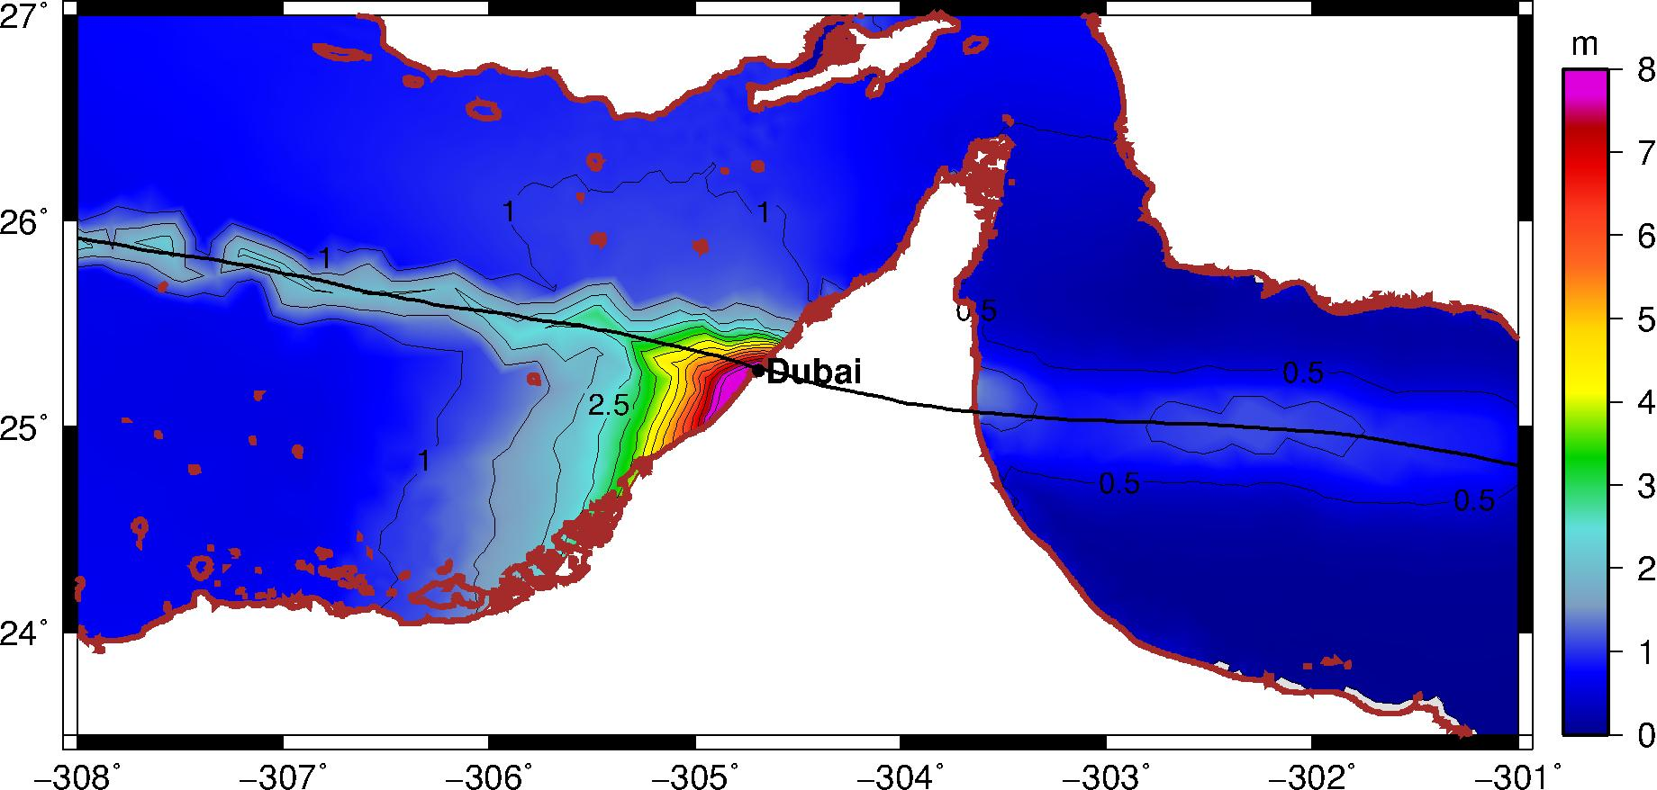
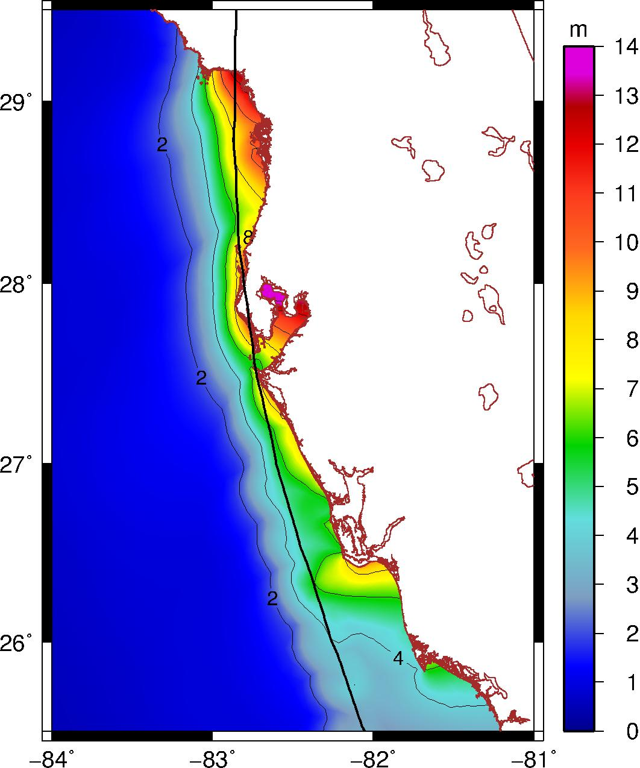
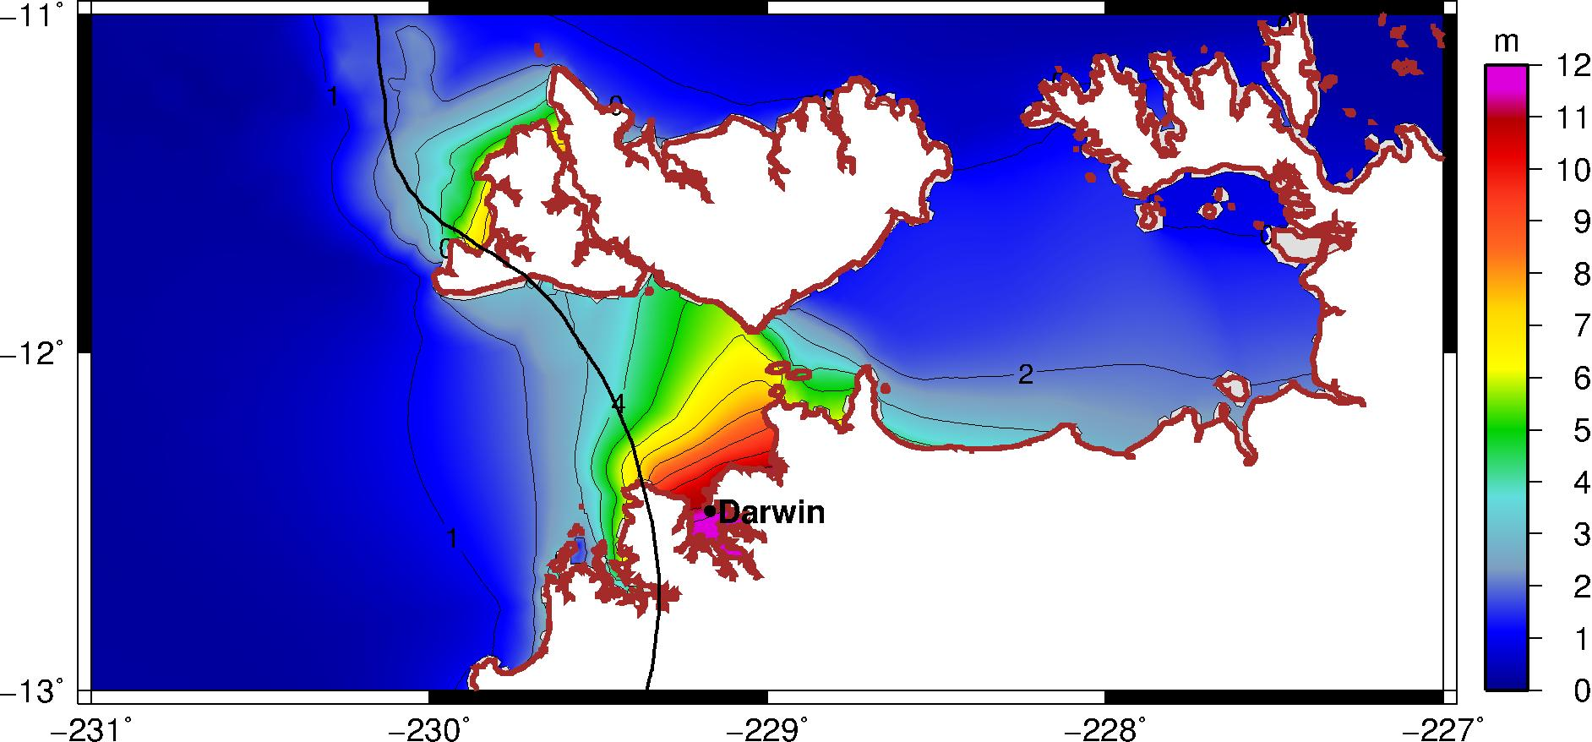
Black Swan Tropical Cyclones
Tampa
Notes:
ADCIRC simulation of surge (not including tide or wave setup), assuming hurricane parametric wind and pressure profiles, same methods as for Irene and synthetic storms.

Slide 40
Summary
Historical records are in general too short to permit accurate estimates of surge risk
Climate change also compromises estimates based strictly on historical records

Slide 41
Simple but high resolution coupled tropical cyclone model can be used to ‘downscale” tropical cyclone activity and associated surges from global climate data sets
Studies based on this downscaling suggest some sensitivity of tropical cyclones to climate state, and possibly important changes in tropical activity over the next century

Slide 42
The 500 year flooding event in New York City is expected to occur every 25-240 years as a result of sea level rise and increased incidence of intense tropical cyclones
New York City is also susceptible to winter storm- and hybrid storm-induced surges. More work needs to be done to estimate risks from such events

Slide 43
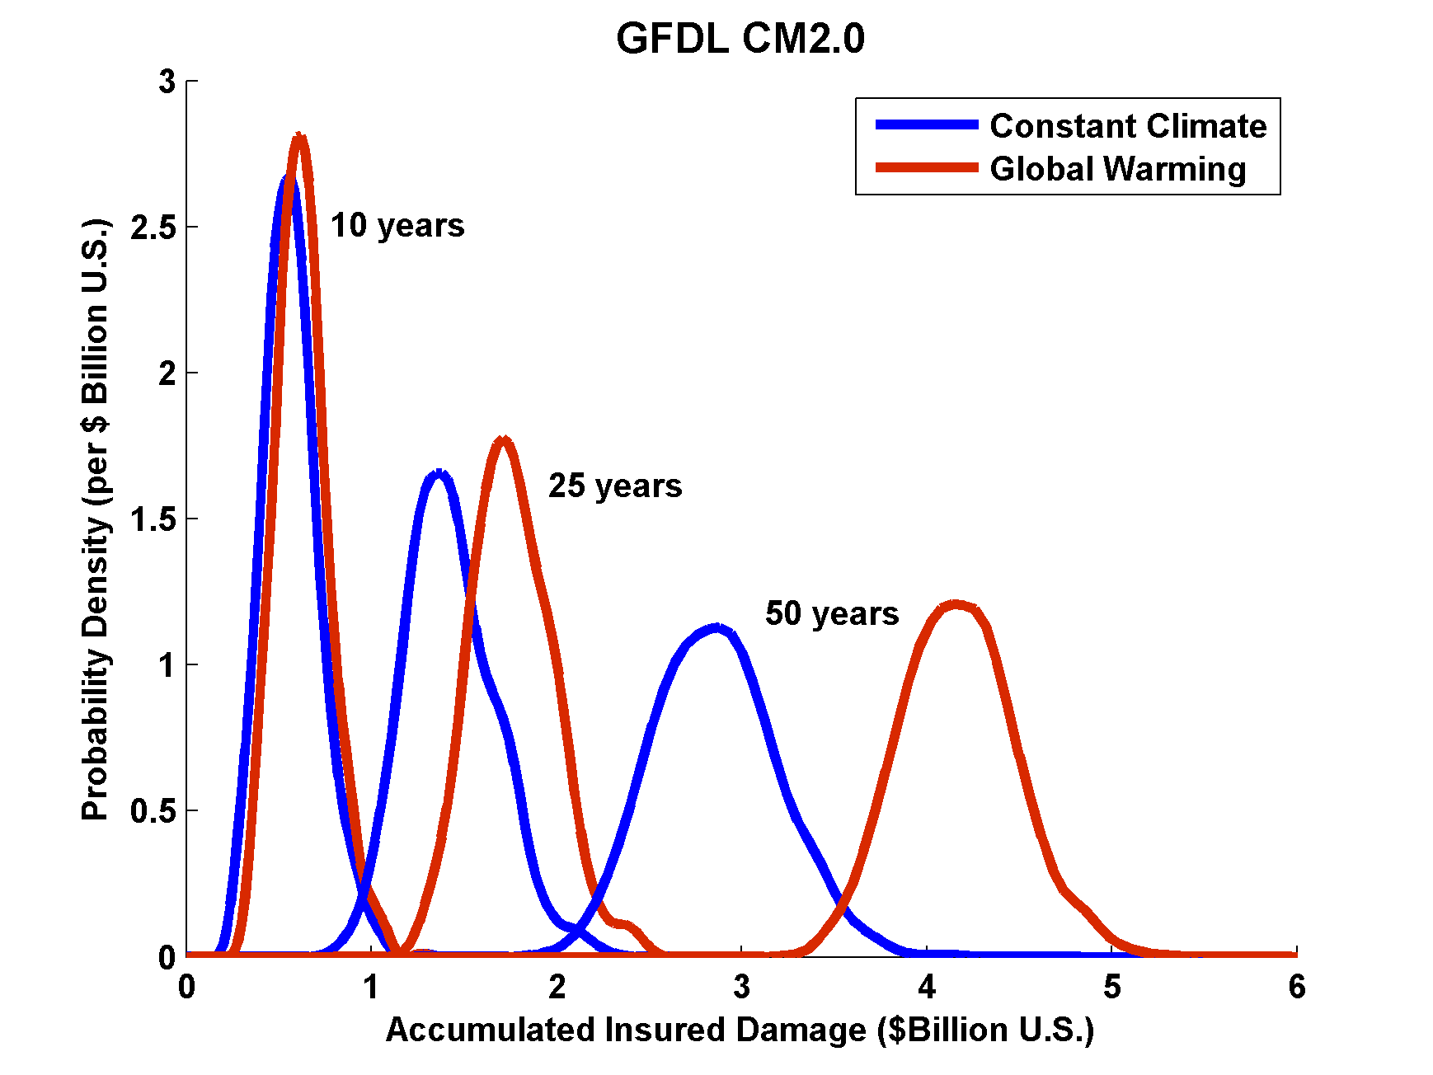
Projections of U.S. Insured Damage
Emanuel, K. A., 2012, Weather, Climate, and Society

Slide 44
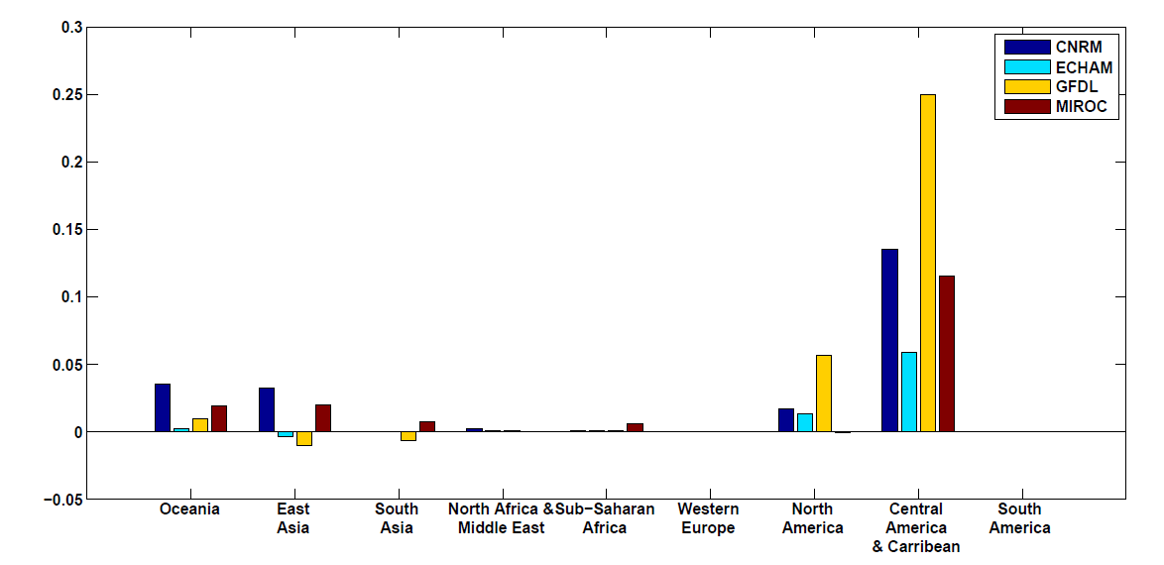
Climate change impacts on tropical cyclone damage divided by GDP by region in 2100. The ratio of damage to GDP is highest in the Caribbean–Central American region but North America, Oceania and East Asia all have above-average ratios.

Slide 45
Feedback of Global Tropical Cyclone Activity on the Climate System
Notes:
45

Slide 46
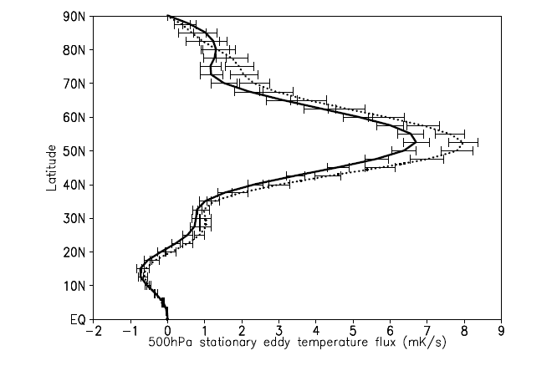
Hart, 2010
500hPa zonal mean meridional temperature flux (mK/s) of the stationary eddies for January through March. The dotted (solid) curve represents the composite mean of the winters following inactive (active) northern hemisphere TC seasons. Error bars represent the standard error of the mean for datasets of size varying from N=9 to 13. Flux calculated using NCAR/NCEP reanalysis for the period 1960‐2008

Slide 47
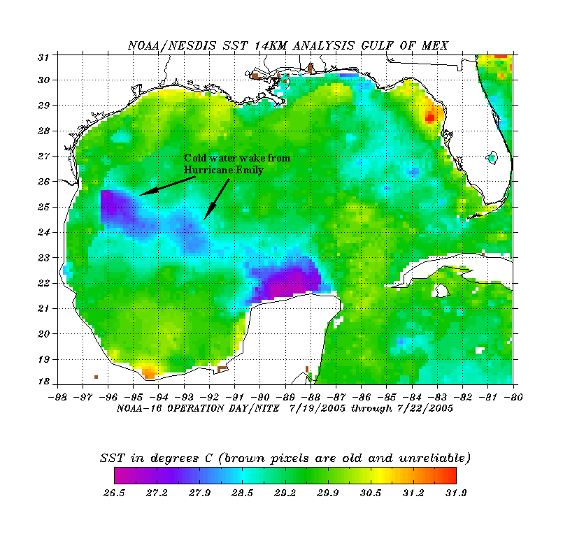
The wake of Hurricane Emily (July 2005)
Sea Surface Temperature in the Wakes of Hurricanes
Hurricane Dennis
(one week earlier)
Source: Rob Korty, CalTech
Notes:
47
We know that tropical cyclones are responsible for strong mixing of the upper oceans and this can be seen in satellite images…

Slide 48
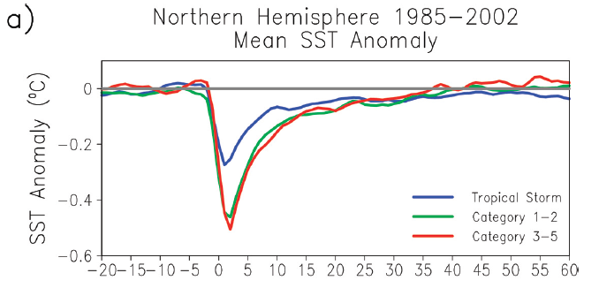
Wake Recovery
Hart, Maue, and Watson, Mon. Wea. Rev., 2007

Slide 49
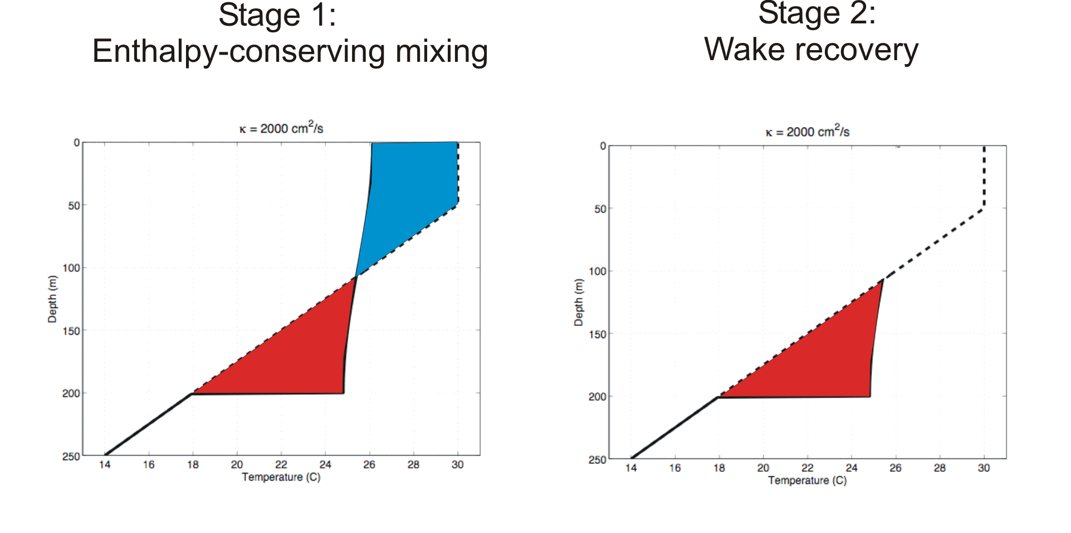
Direct mixing by tropical cyclones
Emanuel (2001) estimated global rate of heat input as 1.4 X 10¹⁵ Watts
Source: Rob Korty, CalTech
Notes:
49

Slide 50
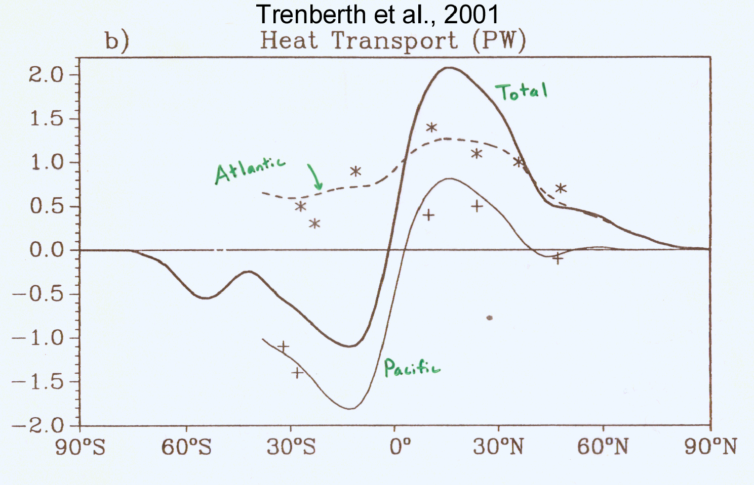
TC Mixing May Induce Much or Most of the Observed Poleward Heat Flux by the Oceans
Notes:
50

Slide 51
Estimate from satellite-derived wake recoveries
Extrapolation from detailed ocean measurements of one storm
Estimate of total heat uptake by tropical oceans

Slide 52
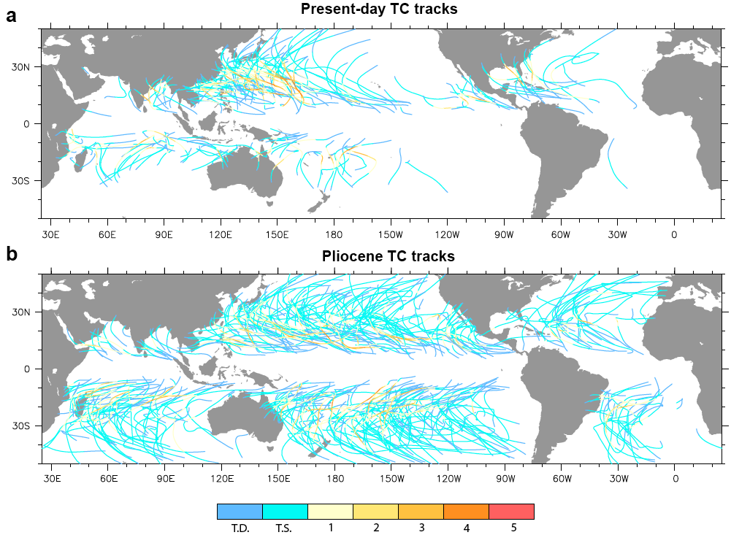

Slide 53
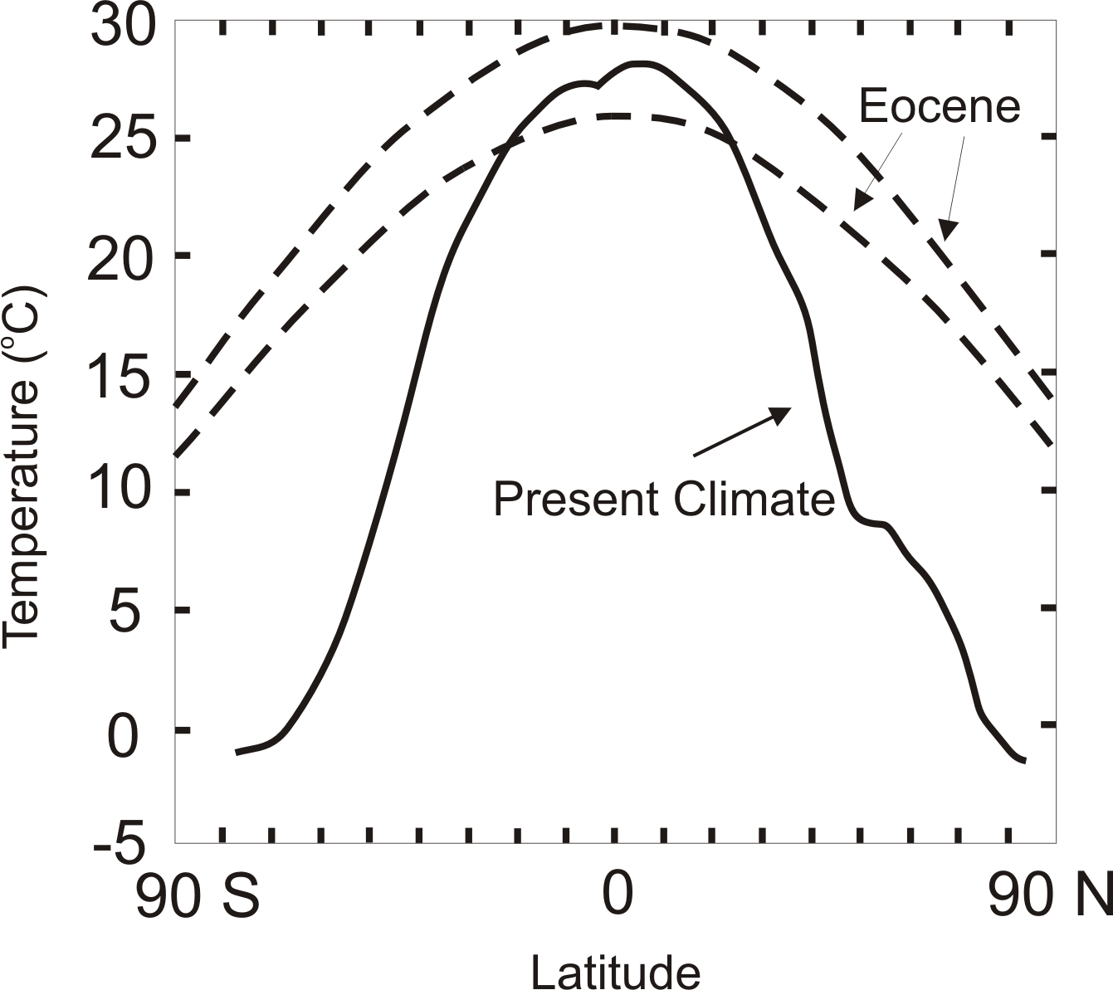
TC-Mixing may be Crucial for High-Latitude Warmth and Low-Latitude Moderation During Warm Climates, such as that of the Eocene
Notes:
53

Slide 54

Depiction of central North America, ~60 million years ago
Our future?
Figure courtesy of Rob Korty, CalTech
Notes:
54

Slide 55
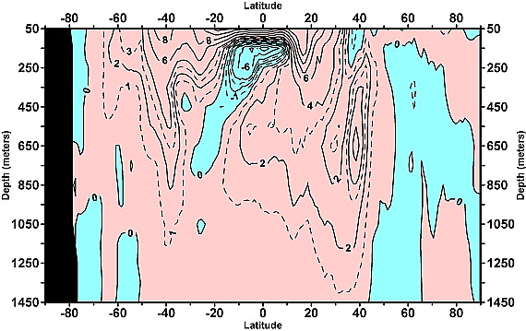
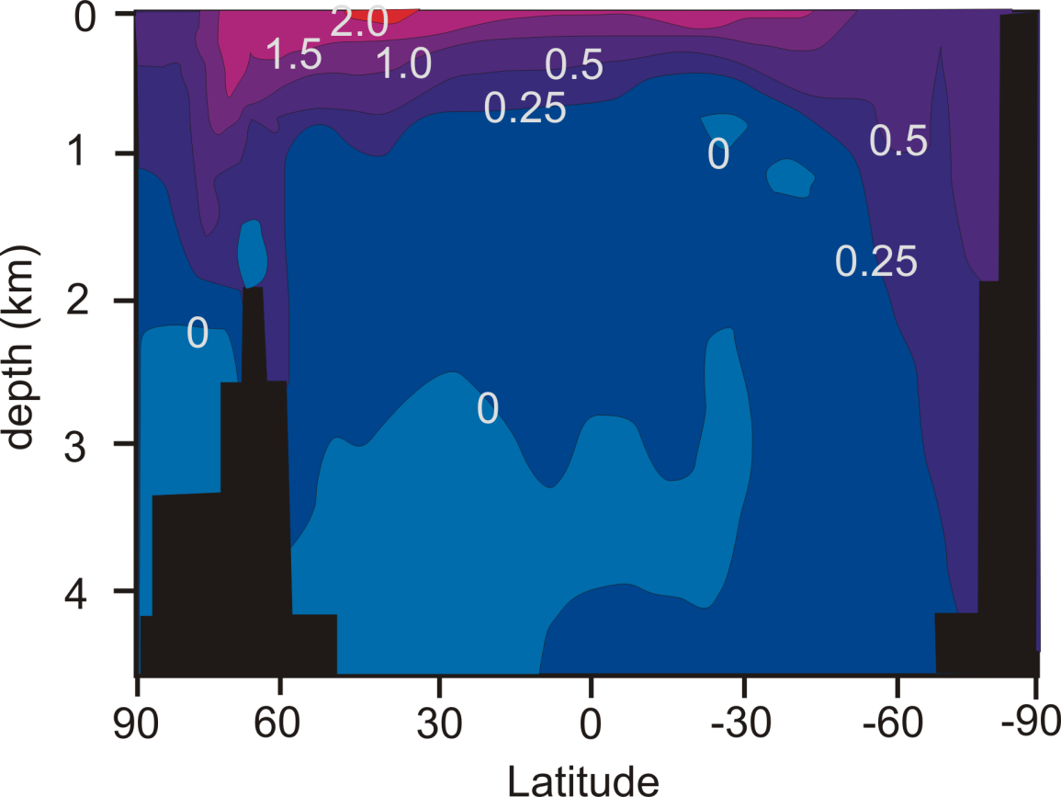
Linear trend (1955–2003) of the zonally integrated heat content of the world ocean by one-degree latitude belts for 100-m thick layers. Source: Levitus et al., 2005
TC-Mixing may explain difference between observed and modeled ocean warming
Zonally averaged temperature trend due to global warming in a coupled climate model. Source: Manabe et al, 1991
Notes:
55

Slide 56
Pushing Back the Record of Tropical Cyclone Activity:
Paleotempestology
Notes:
56

Slide 57
Paleotempestology
barrier beach
upland
overwash fan
backbarrier marsh
a)
lagoon
barrier beach
upland
overwash fan
b)
backbarrier marsh
lagoon
terminal lobes
flood tidal delta
Source: Jeff Donnelly, WHOI
Notes:
57

Slide 58
Source: Jeff Donnelly, Jon Woodruff, Phil Lane; WHOI
Notes:
58

Slide 59
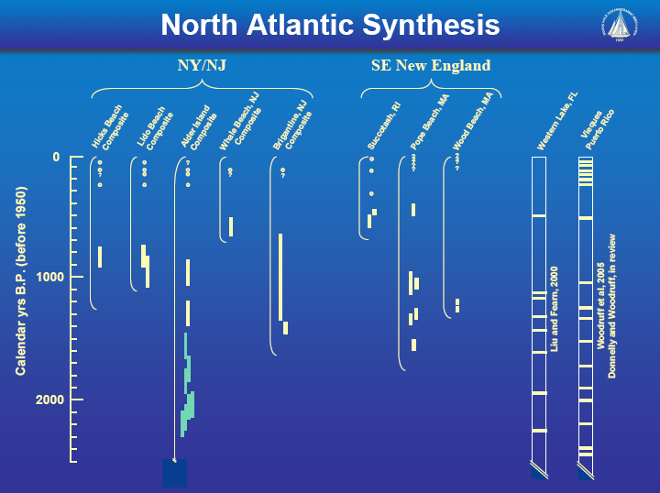
Source: Jeff Donnelly, Jon Woodruff, Phil Lane; WHOI
Notes:
59

Slide 60
Inferences from Modeling

Slide 61
The Problem:
Global models are far too coarse to simulate high intensity tropical cyclones
Embedding regional models within global models introduces problems stemming from incompatibility of models, and even regional models are usually too coarse

Slide 62
Histograms of Tropical Cyclone Intensity as Simulated by a Global Model with 50 km grid point spacing. (Courtesy Isaac Held, GFDL)
Category 3

Slide 63


Probability Density of TC Damage, U.S. East Coast
Damage Multiplied by Probability Density of TC Damage, U.S. East Coast

Slide 64
To the extent that they simulate tropical cyclones at all, global models simulate storms that are largely irrelevant to society and to the climate system itself, given that ocean stirring effects are heavily weighted towards the most intense storms

Slide 65
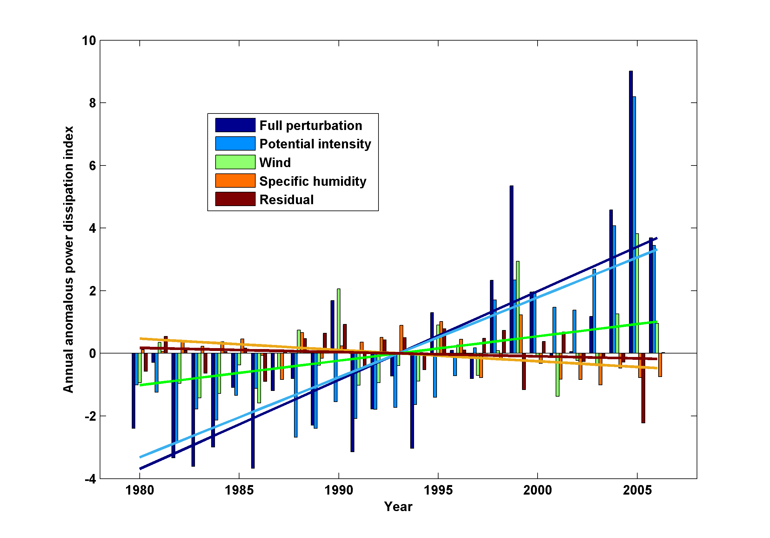
Decomposition of PDI Trends

Slide 66
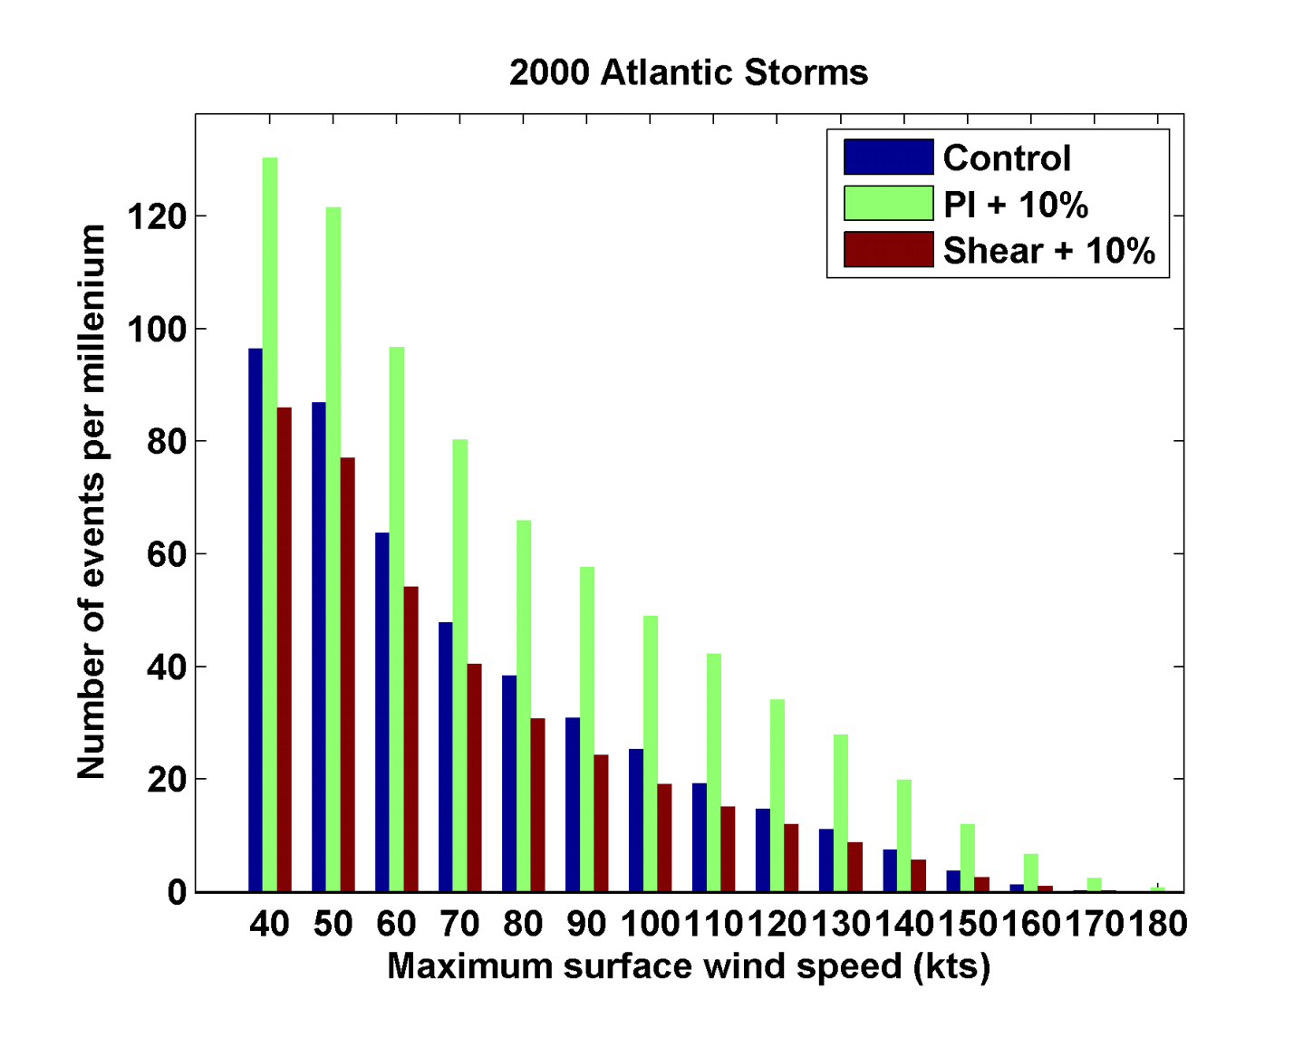
Sensitivity to Shear and Potential Intensity

Slide 67
Hydrostatic Compensation (following Holloway and Neelin)
Perturbations to moist adiabatic troposphere:
Stratospheric compensation:

Slide 68
For typical values of the parameters

Slide 69
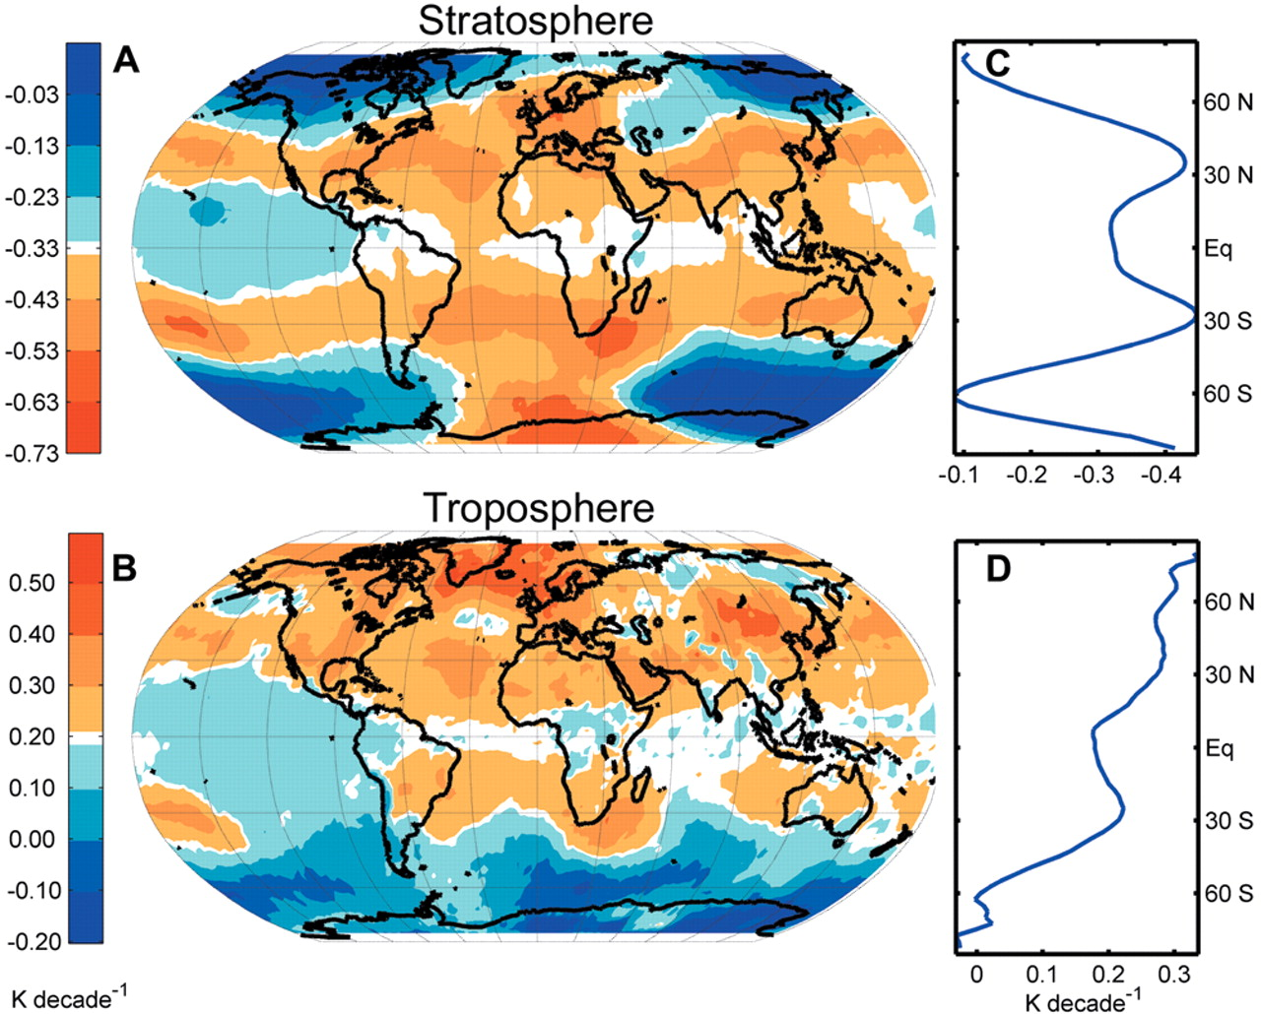
Ozone may not explain spatial pattern of cooling
(Fu and Wallace, Science, 2006)

Slide 70
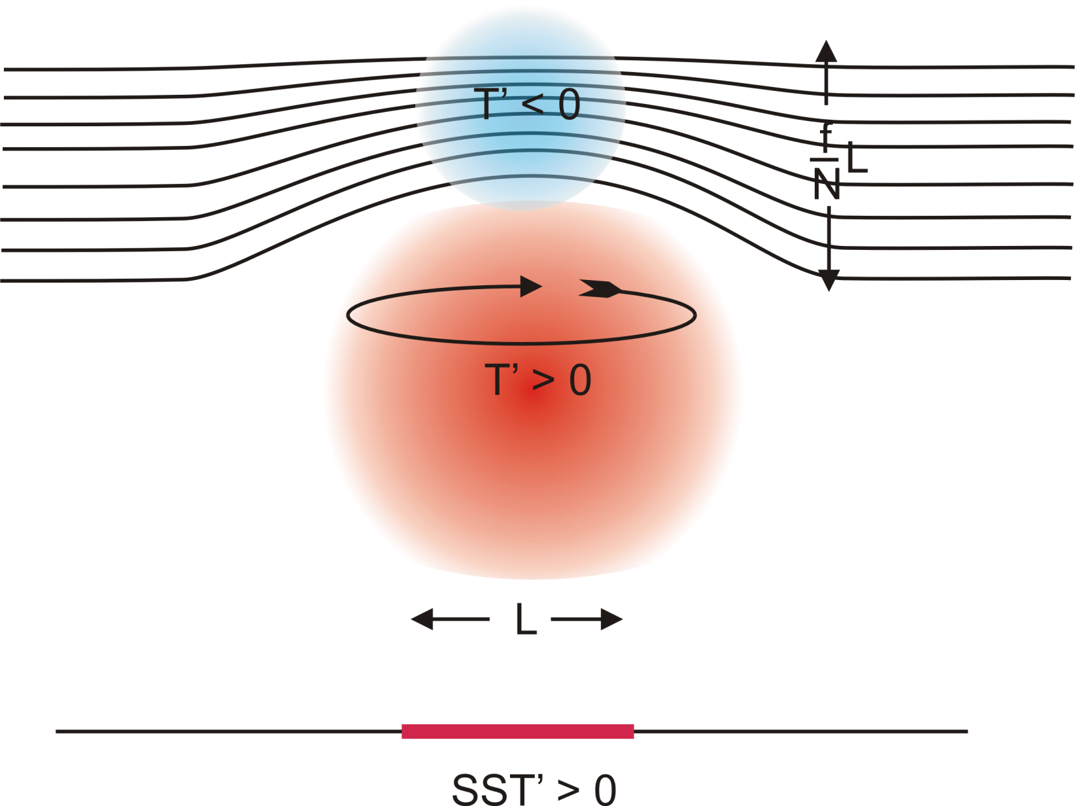
Stratospheric Compensation

Slide 71
Application to the Climate of the Pliocene

Slide 72
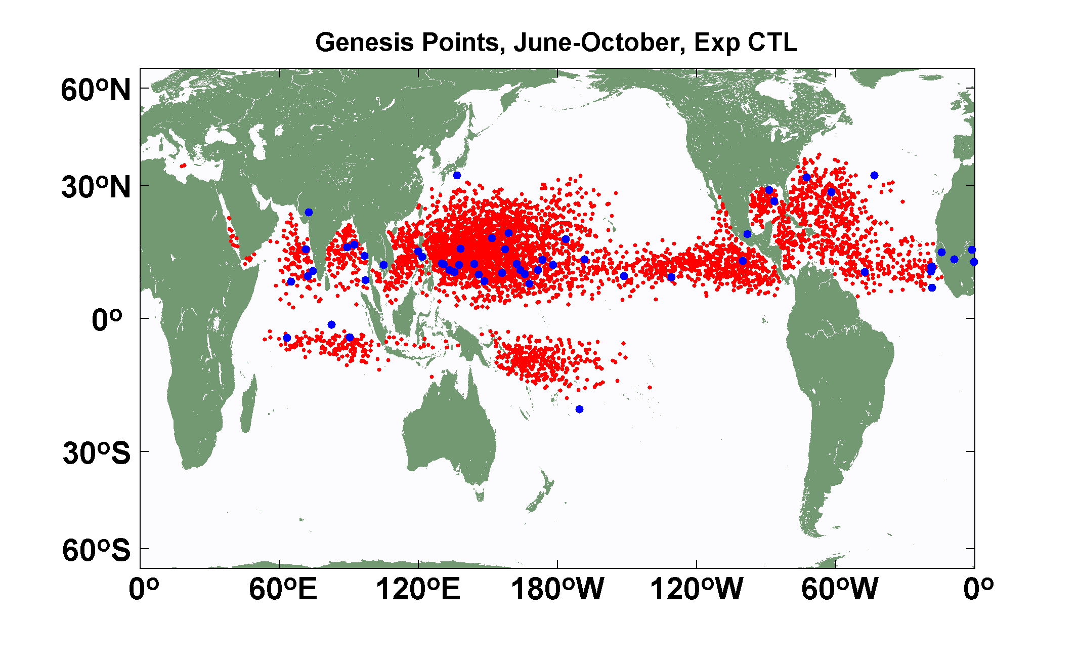
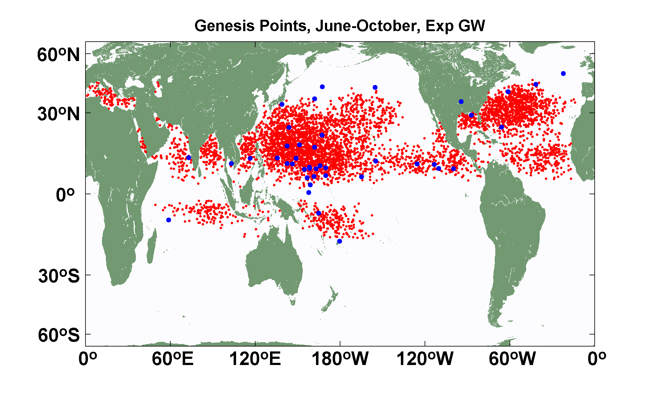
Explicit (blue dots) and downscaled (red dots) genesis points for June-October for Control (top) and Global Warming (bottom) experiments using the 14-km resolution NICAM model. Collaborative work with K. Oouchi.

Slide 73
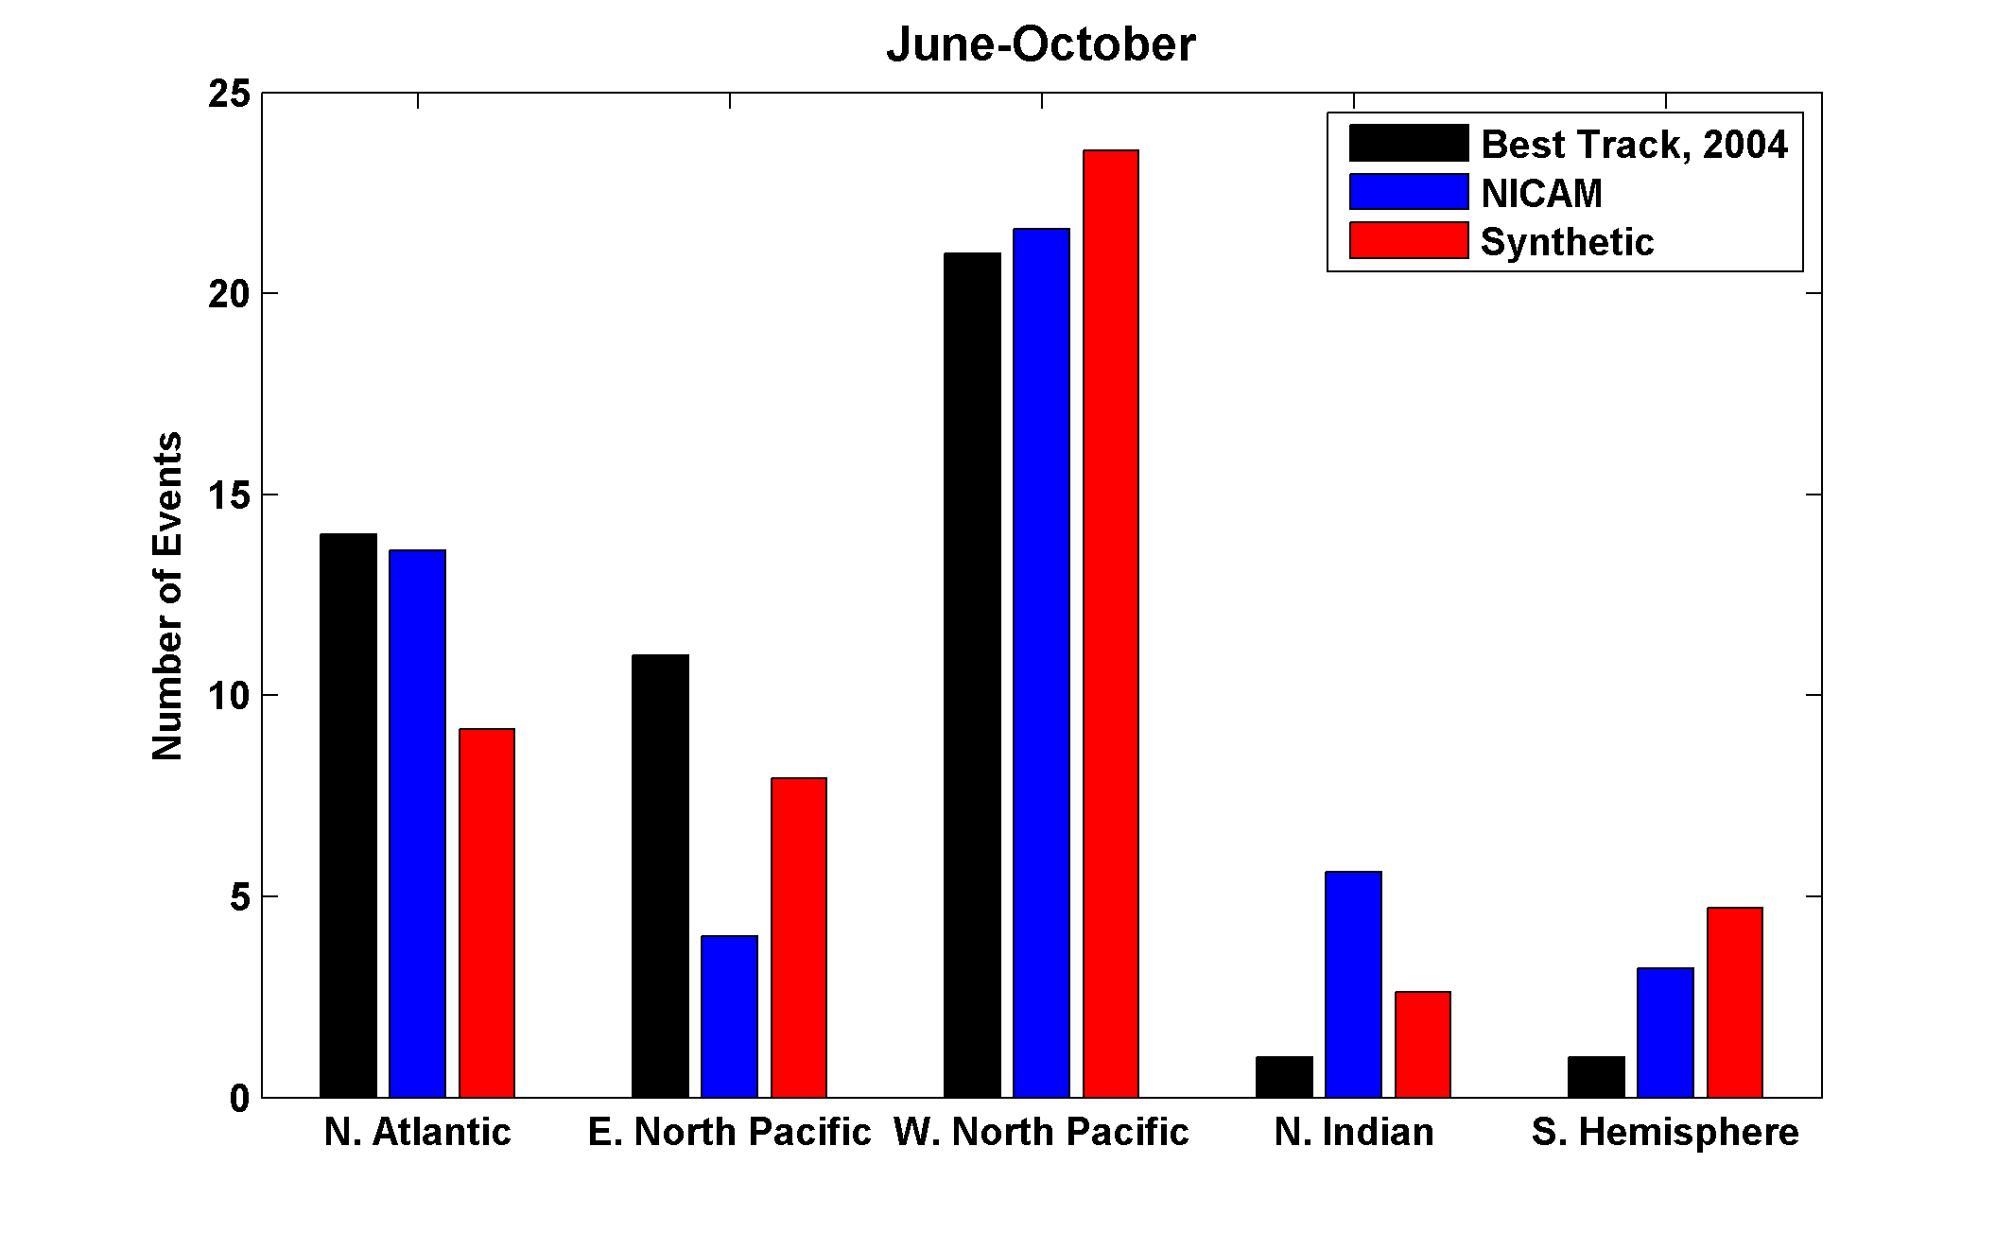

Slide 74
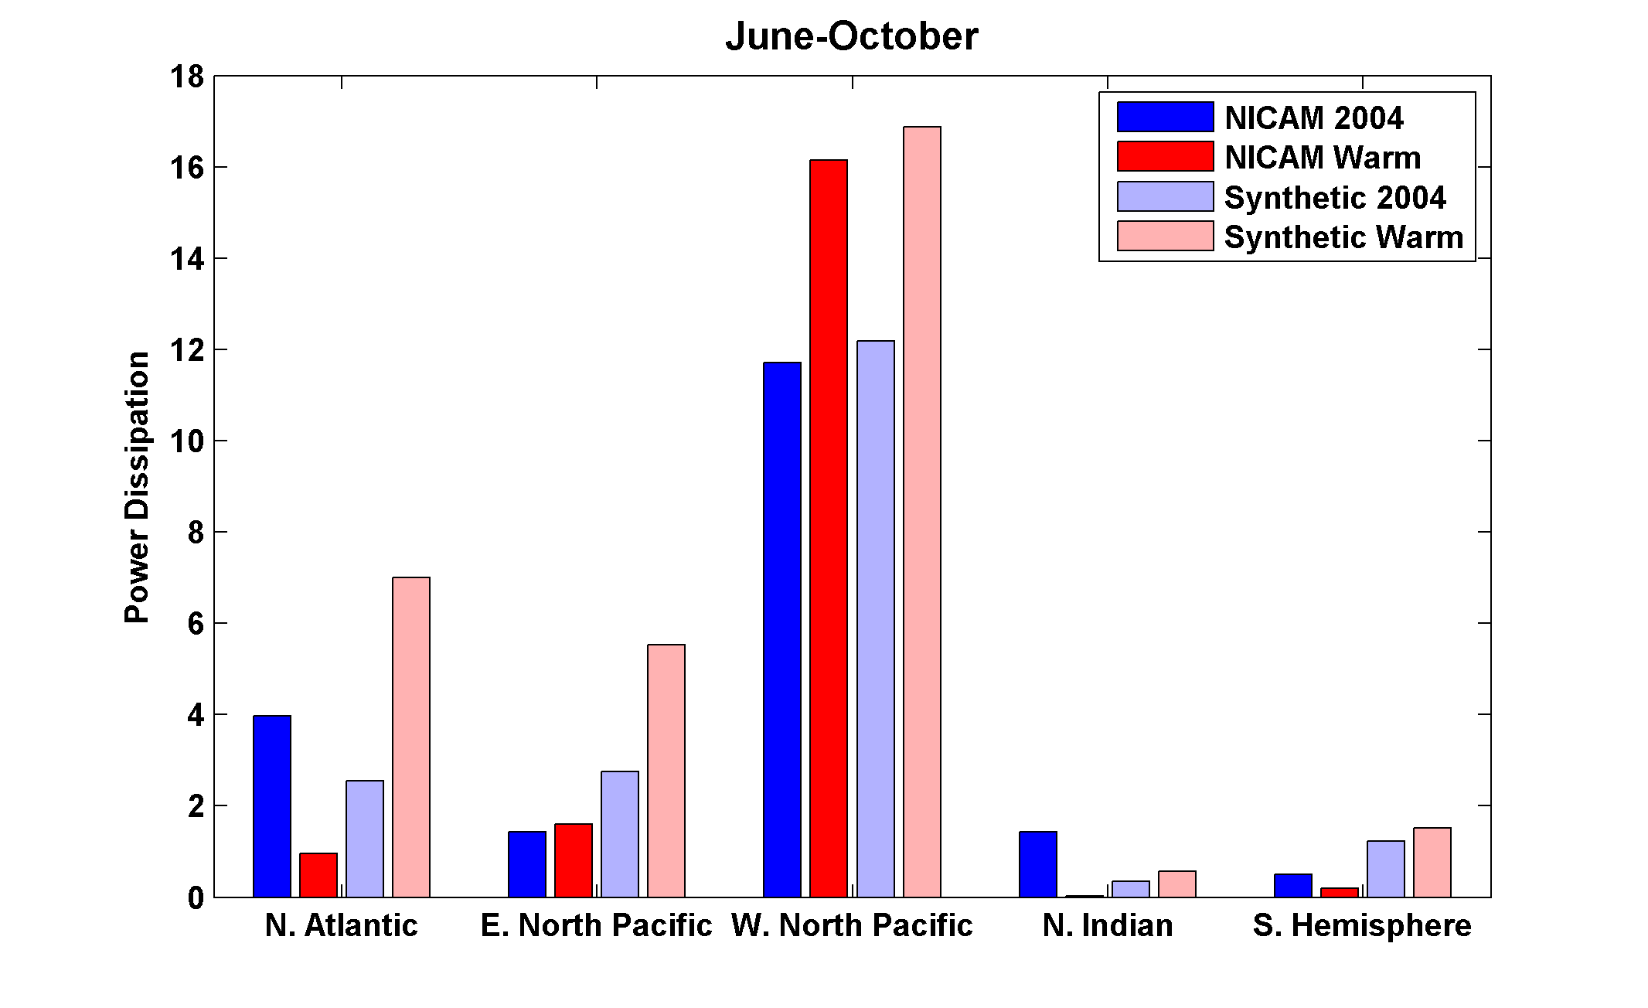
Change in Power Dissipation with Global Warming

Slide 75
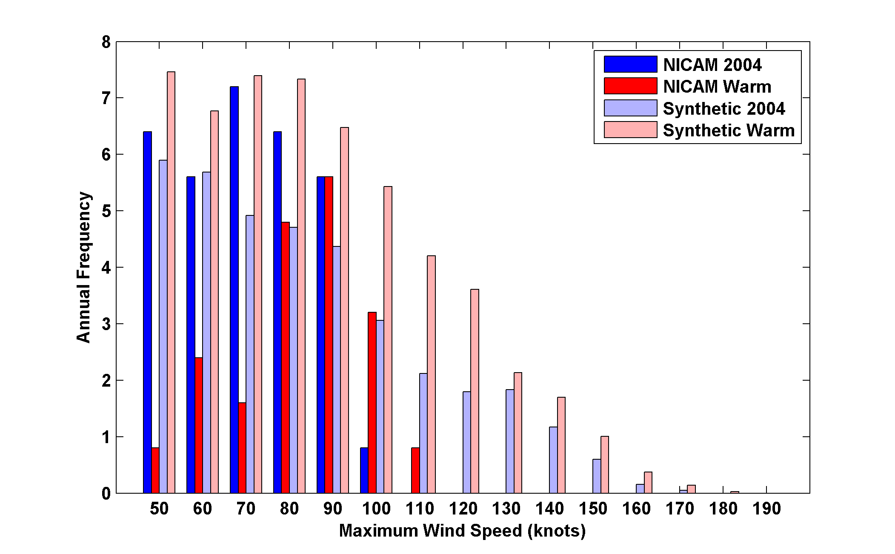
Probability Density by Storm Lifetime Peak Wind Speed, Explicit and Downscaled Events

Slide 76
The Importance of Potential Intensity for Genesis and for Storm Intensity

Slide 77
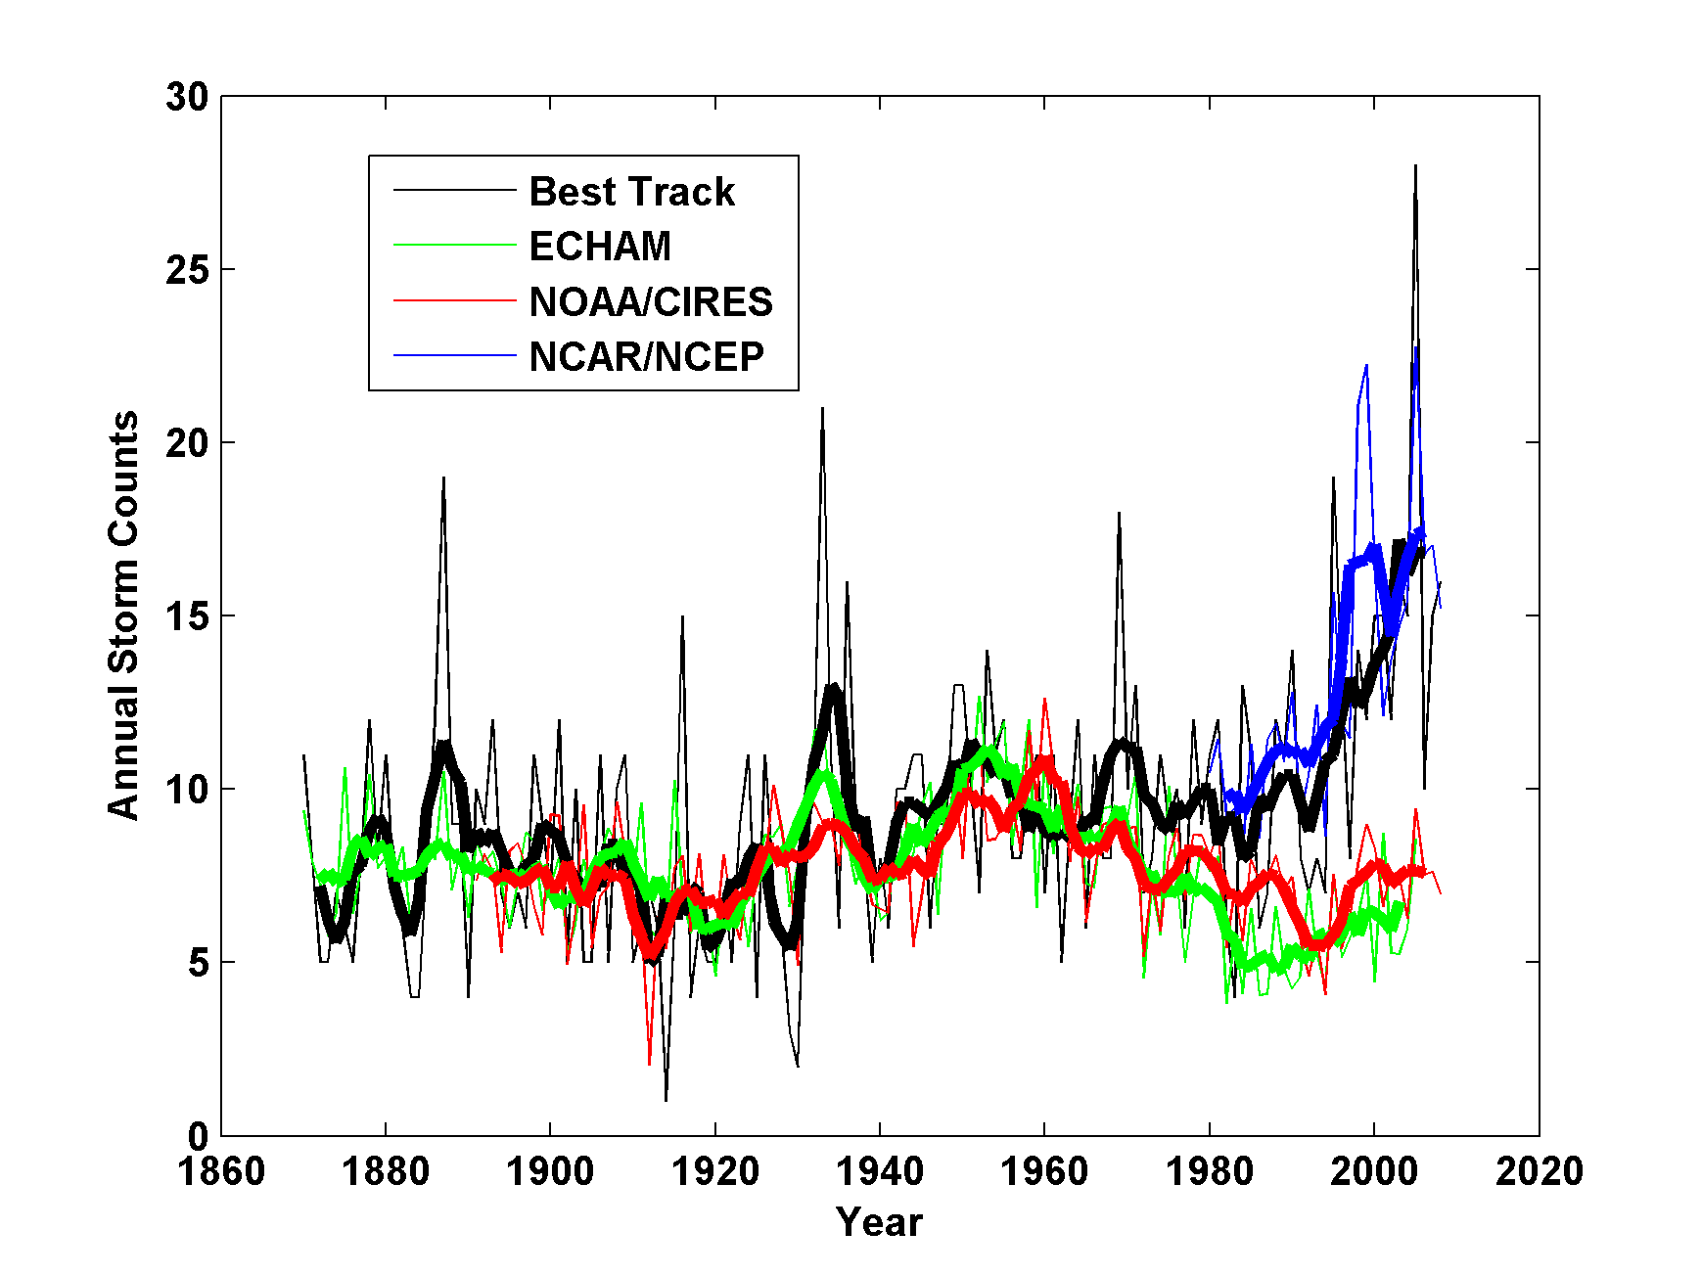
Application to Re-analyses and AGCMs
Annual Atlantic tropical cyclone counts: Unadjusted best-track data (black); and downscaled from the NCAR/NCEP reanalysis, 1980-2008 (blue), the ECHAM 5 simulation, 1870-2005 (green), and the NOAA/CIRES reanalysis, 1891-2008 (red). Thin lines show annual values, thick lines show 5-year running means

Slide 78
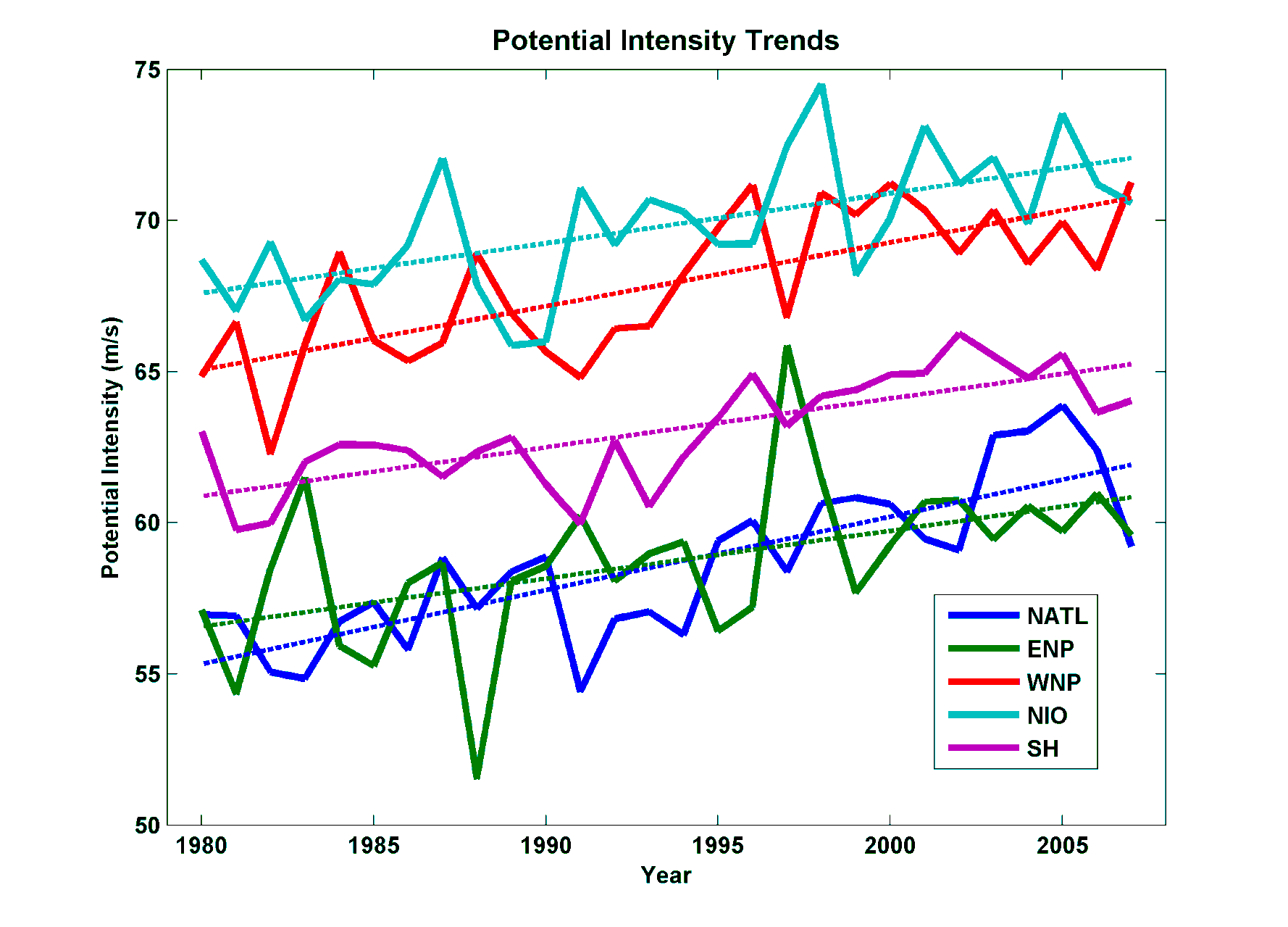
Interpretation of Recent Trends in Potential Intensity
North Indian
Western North Pacific
Southern Hemisphere
North Atlantic
Eastern North Pacific
From NCAR/NCEP reanalysis data, 1980-2008

Slide 79
Potential intensity has been increasing by about 12 ms⁻¹K⁻¹, compared to accepted value of 4 ms⁻¹K⁻¹. What is the source of this discrepancy?

Slide 80
Surface wind speeds have not changed much since 1980. Key variable: Outflow temperature, which in general decreases with:
Increasing SST
Decreasing temperature of lower stratosphere and/or troposphere transition layer

Slide 81
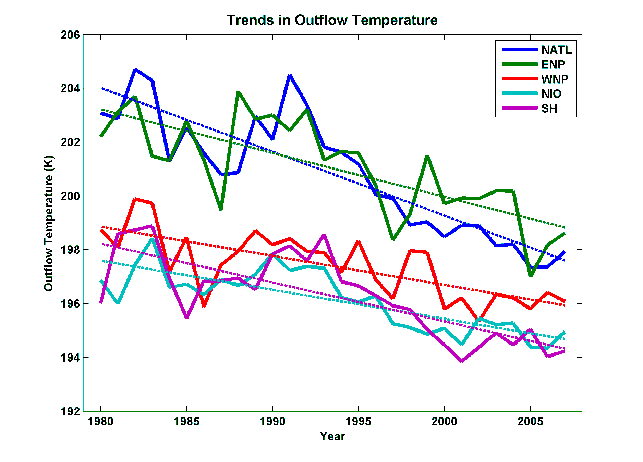
Importance of Trends in Outflow Temperature
From NCEP Reanalysis

Slide 82
Do Climate Models Capture Lower Stratospheric Cooling?

Slide 83
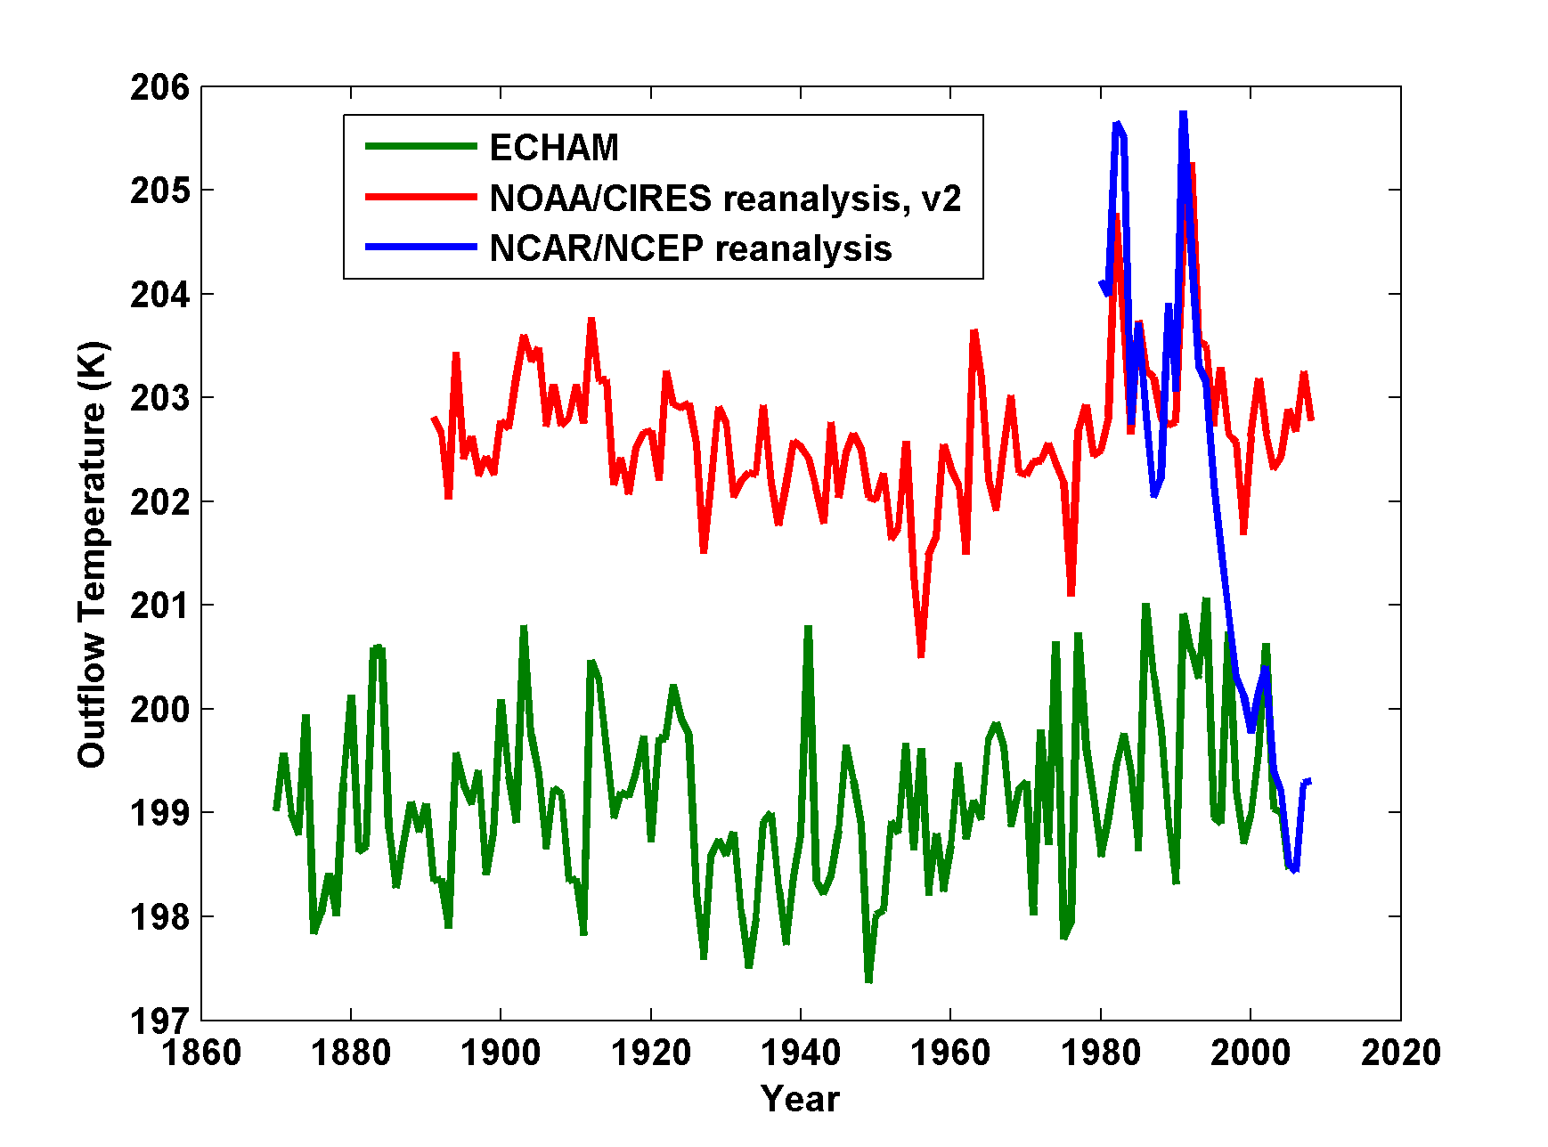
AGCMs, driven by observed SSTs, do not get the cooling!
August-October outflow temperatures averaged over the Atlantic MDR from the ECHAM 5 simulation (green), the NOAA/CIRES 20th Century reanalysis, version 2 (red) and the NCAR/NCEP reanalysis (blue)

Slide 84
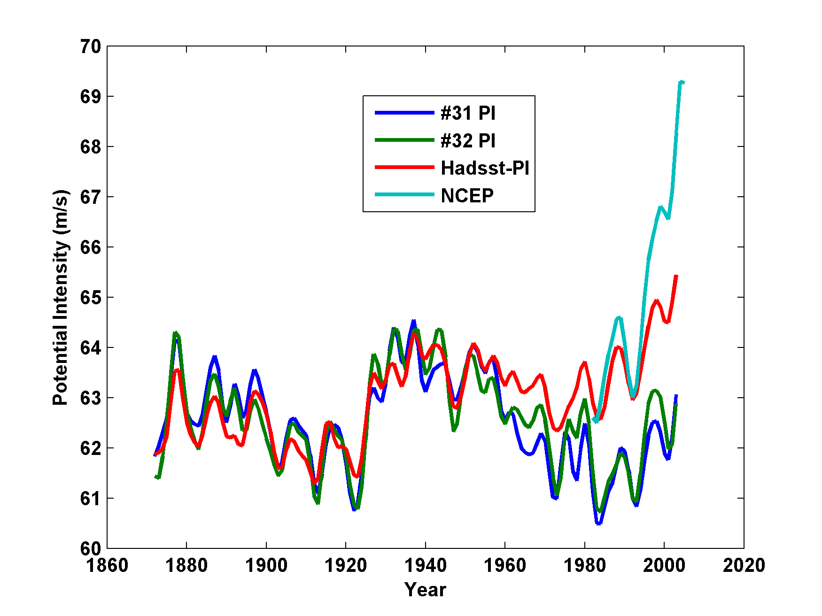
As a result, they miss the recent increase in potential intensity
NCEP
# 31: ECHAM without aerosols
#32: ECHAM with aerosols

Slide 85
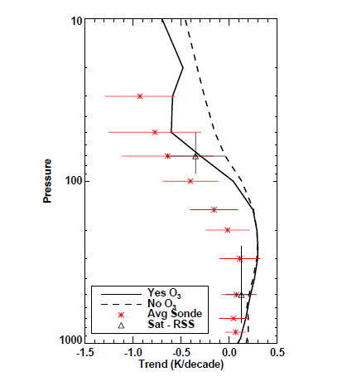
1979-1999 Temperature Trends, 30S-30N. Red: Radiosondes; Solid Black: Mean of Models with Ozone; Dashed Black: Mean of Models without Ozone (Cordero and Forster, 2006)

Slide 86
Combine expression for potential intensity, V_{max}, with energy balance of ocean mixed layer:
Net surface radiative flux
SST
Outflow T
Ocean mixed layer depth
Mixed layer heat flux
Drag coefficient
Mean surface wind speed
Valid on time scales > thermal equilibration time of ocean mixed layer (~ 2 years)

Slide 87

Probability densities of 2-hour intensity change

Slide 88

Log of the probability density of 6-hour intensity change

Slide 89

Cumulative Distribution of Storm Lifetime Peak Wind Speed, with Sample of 1755 Synthetic Tracks
95% confidence bounds

Slide 90

Genesis rates
Western North Pacific
Southern Hemisphere
Eastern North Pacific
Atlantic
North Indian Ocean
Notes:
90

Slide 91

Captures effects of regional climate phenomena (e.g. ENSO, AMM)

Slide 92

Seasonal Cycles
Atlantic
Notes:
92

