Slide 1
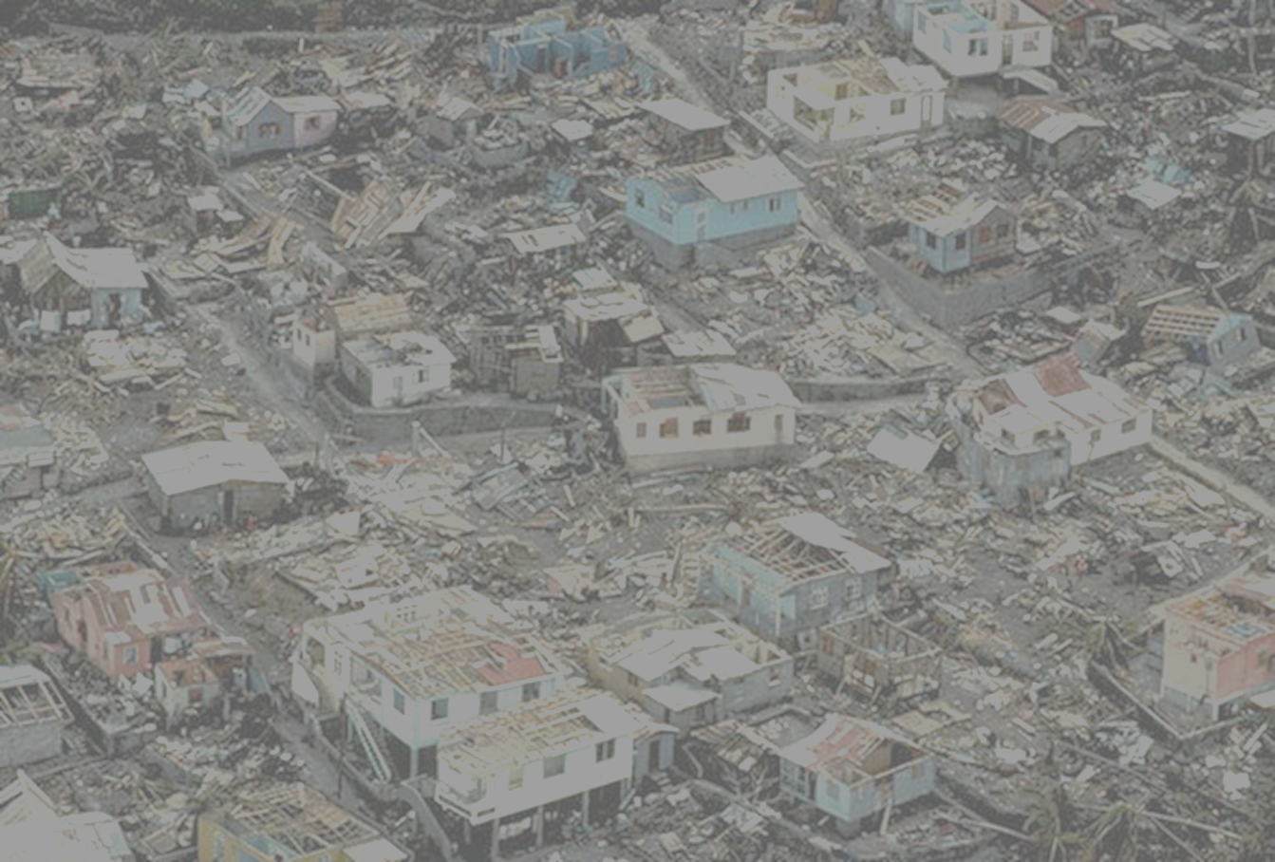
Modeling Hurricane Risk in a Changing Climate
Kerry Emanuel
Lorenz Center
Massachusetts Institute of Technology

Slide 2

A Few Essential Points
Most hurricane losses arise from water, not wind
Sea level is rising and will continue to do so
Coastal storm intensity and freshwater flooding are expected to increase as the climate warms
Climate change has already invalidated statistically based risk assessments
Flood insurance likely to migrate from government to the private sector
Current approach of statistical hazard modeling inadequate to assess present and changing risk

Slide 3
The Global Hurricane Hazard
About 10,000 deaths per year since 1971
$700 Billion 2015 U.S. Dollars in Damages Annually since 1971
Global population exposed to hurricane hazards has tripled since 1970
EM-DAT, 2016: The OFDA/CRED International Disaster Database
http://www.emdat.be/.

Slide 4

Publicly
insured…
No $$$
Privately insured… $$$

Slide 5
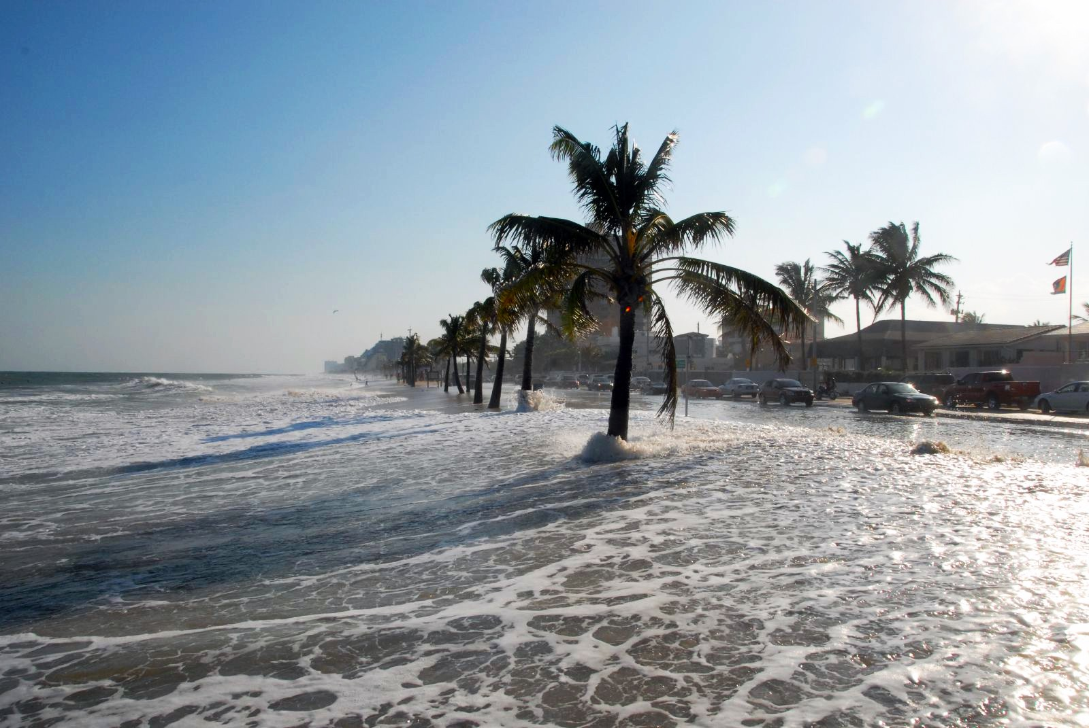
Sea Level Rise

Slide 6
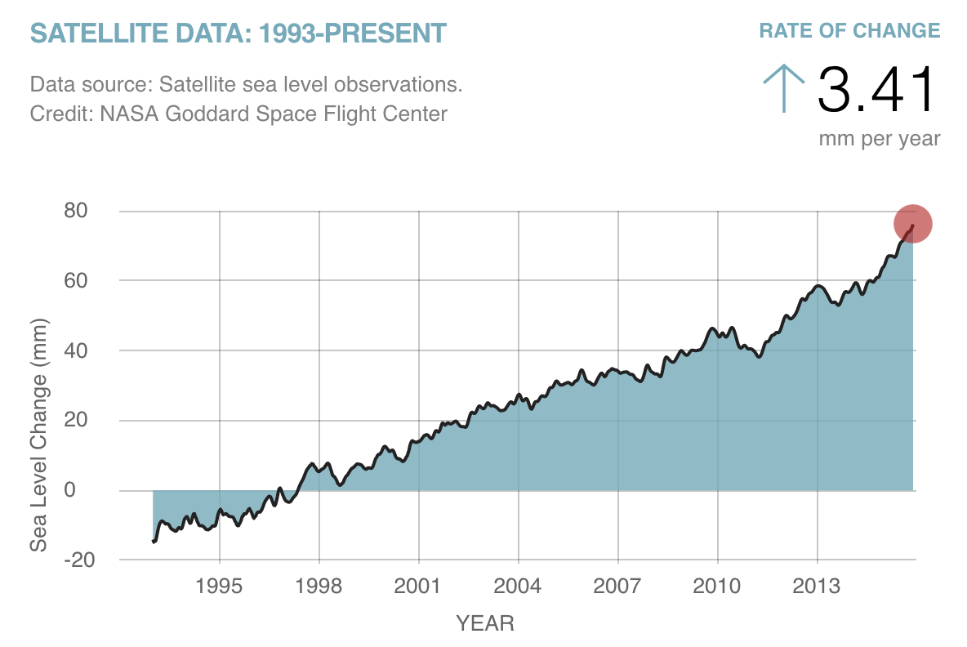

Slide 7
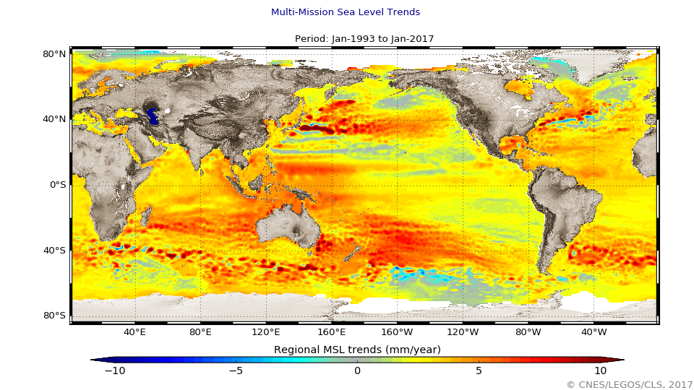
Combined map of regional patterns of observed sea level (in mm/year). This map can be obtained using gridded, multi-mission Ssalto/Duacs data since 1993, which enable the local slopes to be estimated with a very high resolution (1/4 of a degree on a Cartesian projection). Isolated variations in MSL are thus revealed, mainly in the major ocean currents and ENSO events (Credits EU Copernicus Marine Service, CLS, Cnes, Legos). http://www.altimetry.info/thematic-use-cases/ocean-applications/mean-sea-level/

Slide 8
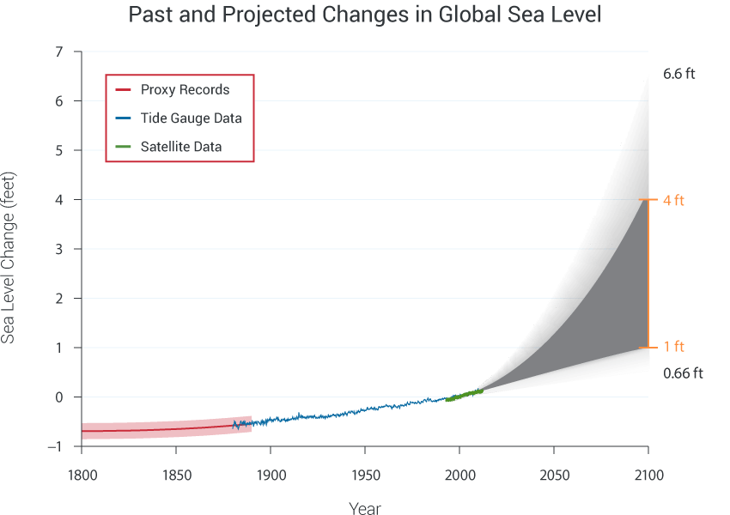
Today

Slide 9
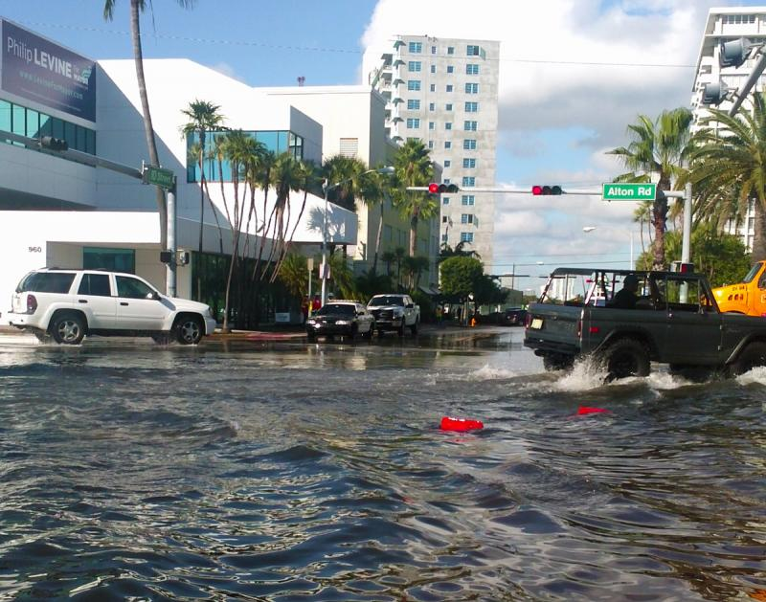
“Nuisance Flooding”, Miami Beach

Slide 10
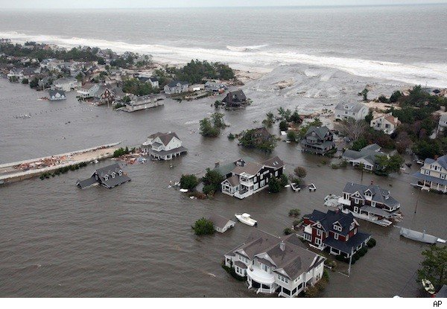
Coastal Storm Surge Flooding
Flooding from Hurricane Sandy
Credit: Associated Press

Slide 11
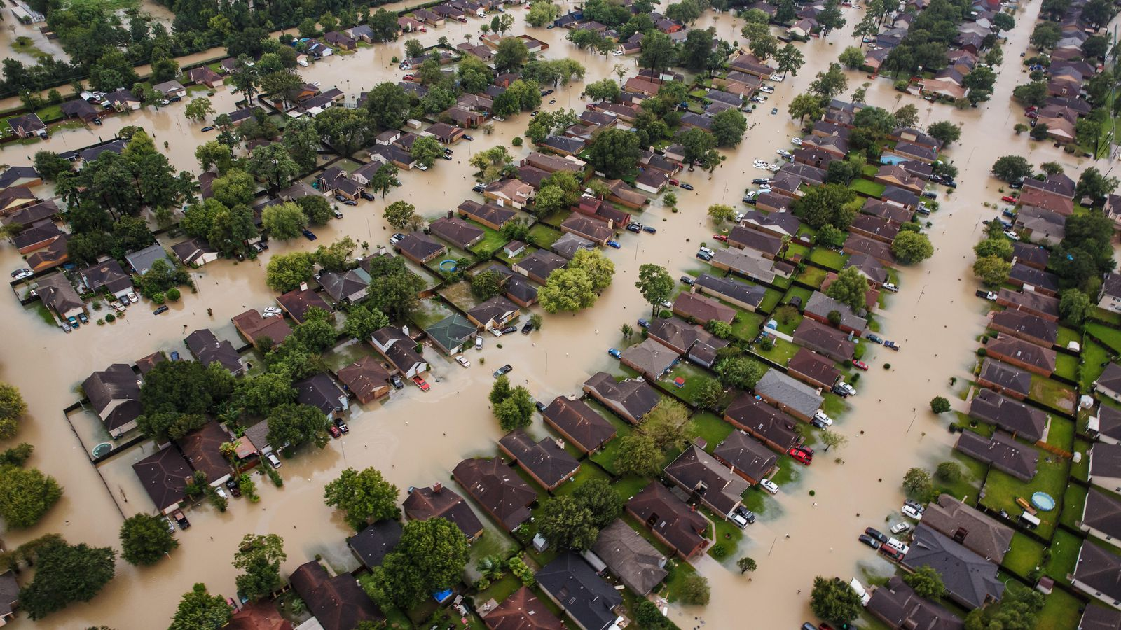
Flooding from Hurricane Harvey

Slide 12


Risk Assessment in a Changing Climate: The Problem
Event Probability
Damage Probability
Current and Future Probability Density of U.S. TC Wind Damages
Current and Future Damage Probability

Slide 13
The Heart of the Problem:
Societies are usually well adapted to frequent events (> 1/100 yr)
Societies are often poorly adapted to rare events (< 1/100 yr)
Robust estimates of the character of ~100 yr events require ~1,000 years of data
We do not have ~1,000 years of meteorological observations

Slide 14
How We COULD Deal with This:
Bring physics to bear on natural hazard risk assessment… problem too important to leave to statisticians
But several impediments:
  Academic stove-piping: Too applied for scientists; too complicated for risk professionals
  Near monopoly in commercial risk modeling
  Brute force modeling probably too expensive to be practical for many applications
  May now be impractical to run regional models for ~1,000 years, driven by climate models, but that day is coming

Slide 15
Why Not Use Global Climate Models to Simulate Hurricanes?

Slide 16

Global models do not simulate the storms that cause most destruction
Category 2-3 boundary
Modeled
Histograms of Tropical Cyclone Intensity as Simulated by a Global Model with 50 km grid point spacing. (Courtesy Isaac Held, GFDL)
Observed

Slide 17

MIT Approach:
Embed Detailed Hurricane Model within Global Climate Models
Notes:
17

Slide 18

Embed high-resolution, fast coupled ocean-atmosphere hurricane model in global climate model or climate reanalysis data
Coupled Hurricane Intensity prediction Model (CHIPS) has been used for 18 years to forecast real hurricanes in near-real time

Slide 19
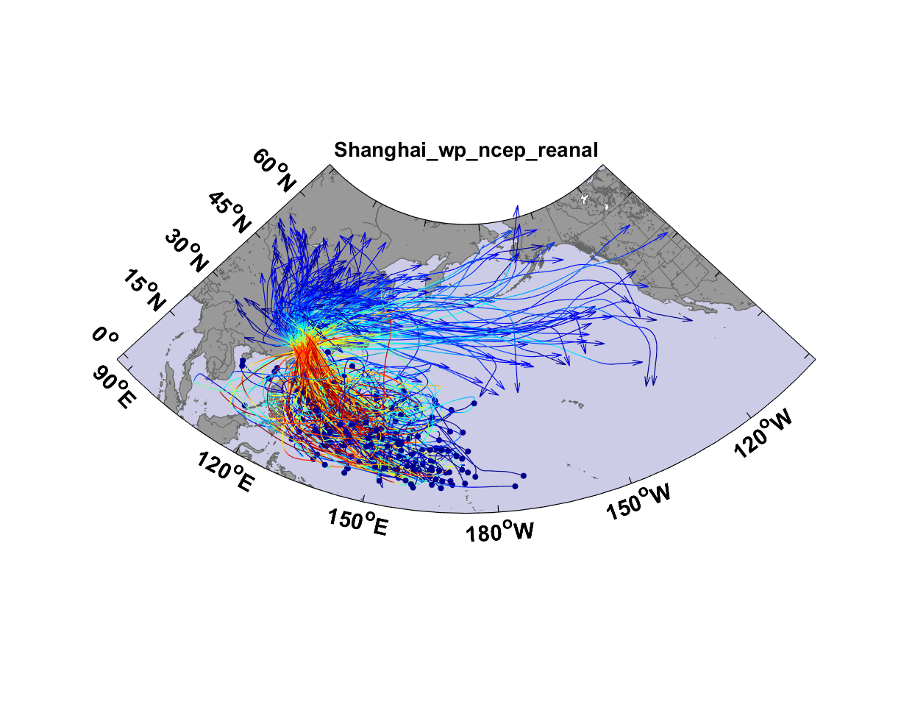
Top 200 out of 5180 TCs Affecting Shanghai

Slide 20
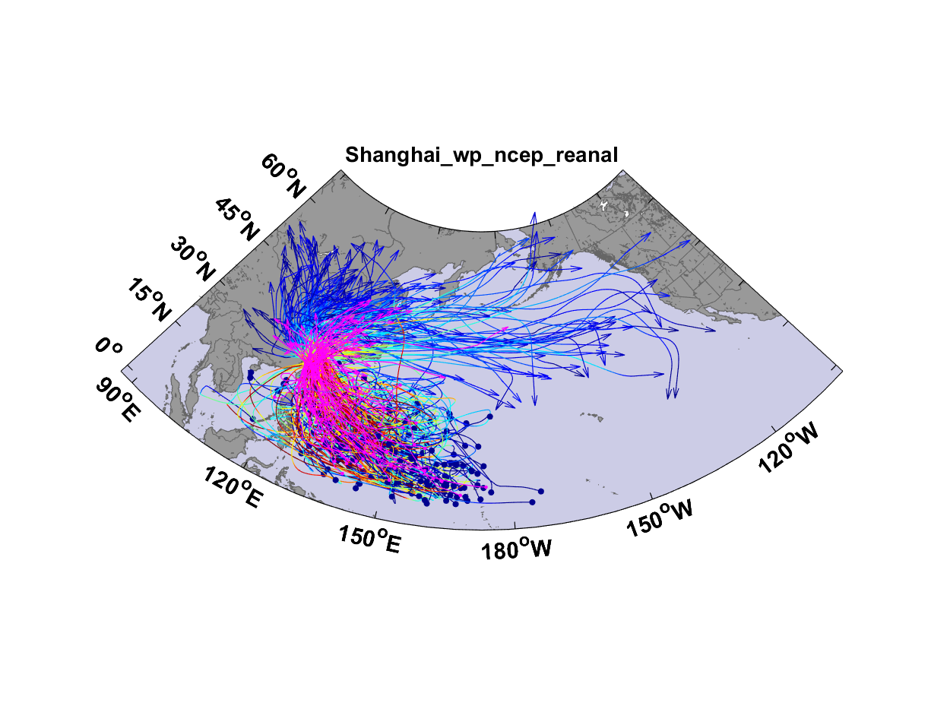
Top 200 out of 5180 TCs Affecting Shanghai

Slide 21
Taking Climate Change Into Account

Slide 22
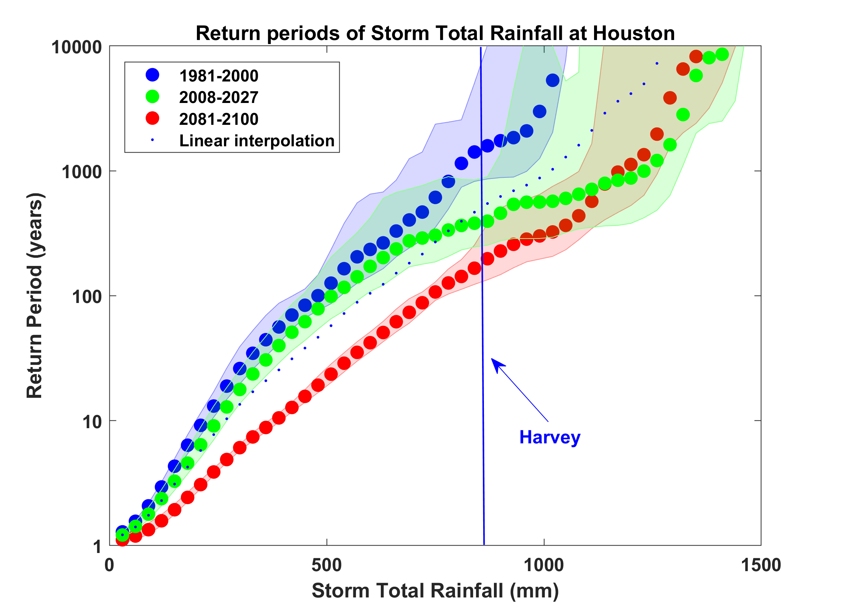
Probability of Storm Accumulated Rainfall in Harris County, from 6 Climate models, 1981-2000, 2008-2027, and 2081-2100, Based on 2000 Events Each, and Using RCP 8.5. Shading Shows Spread Among the Models.

Slide 23
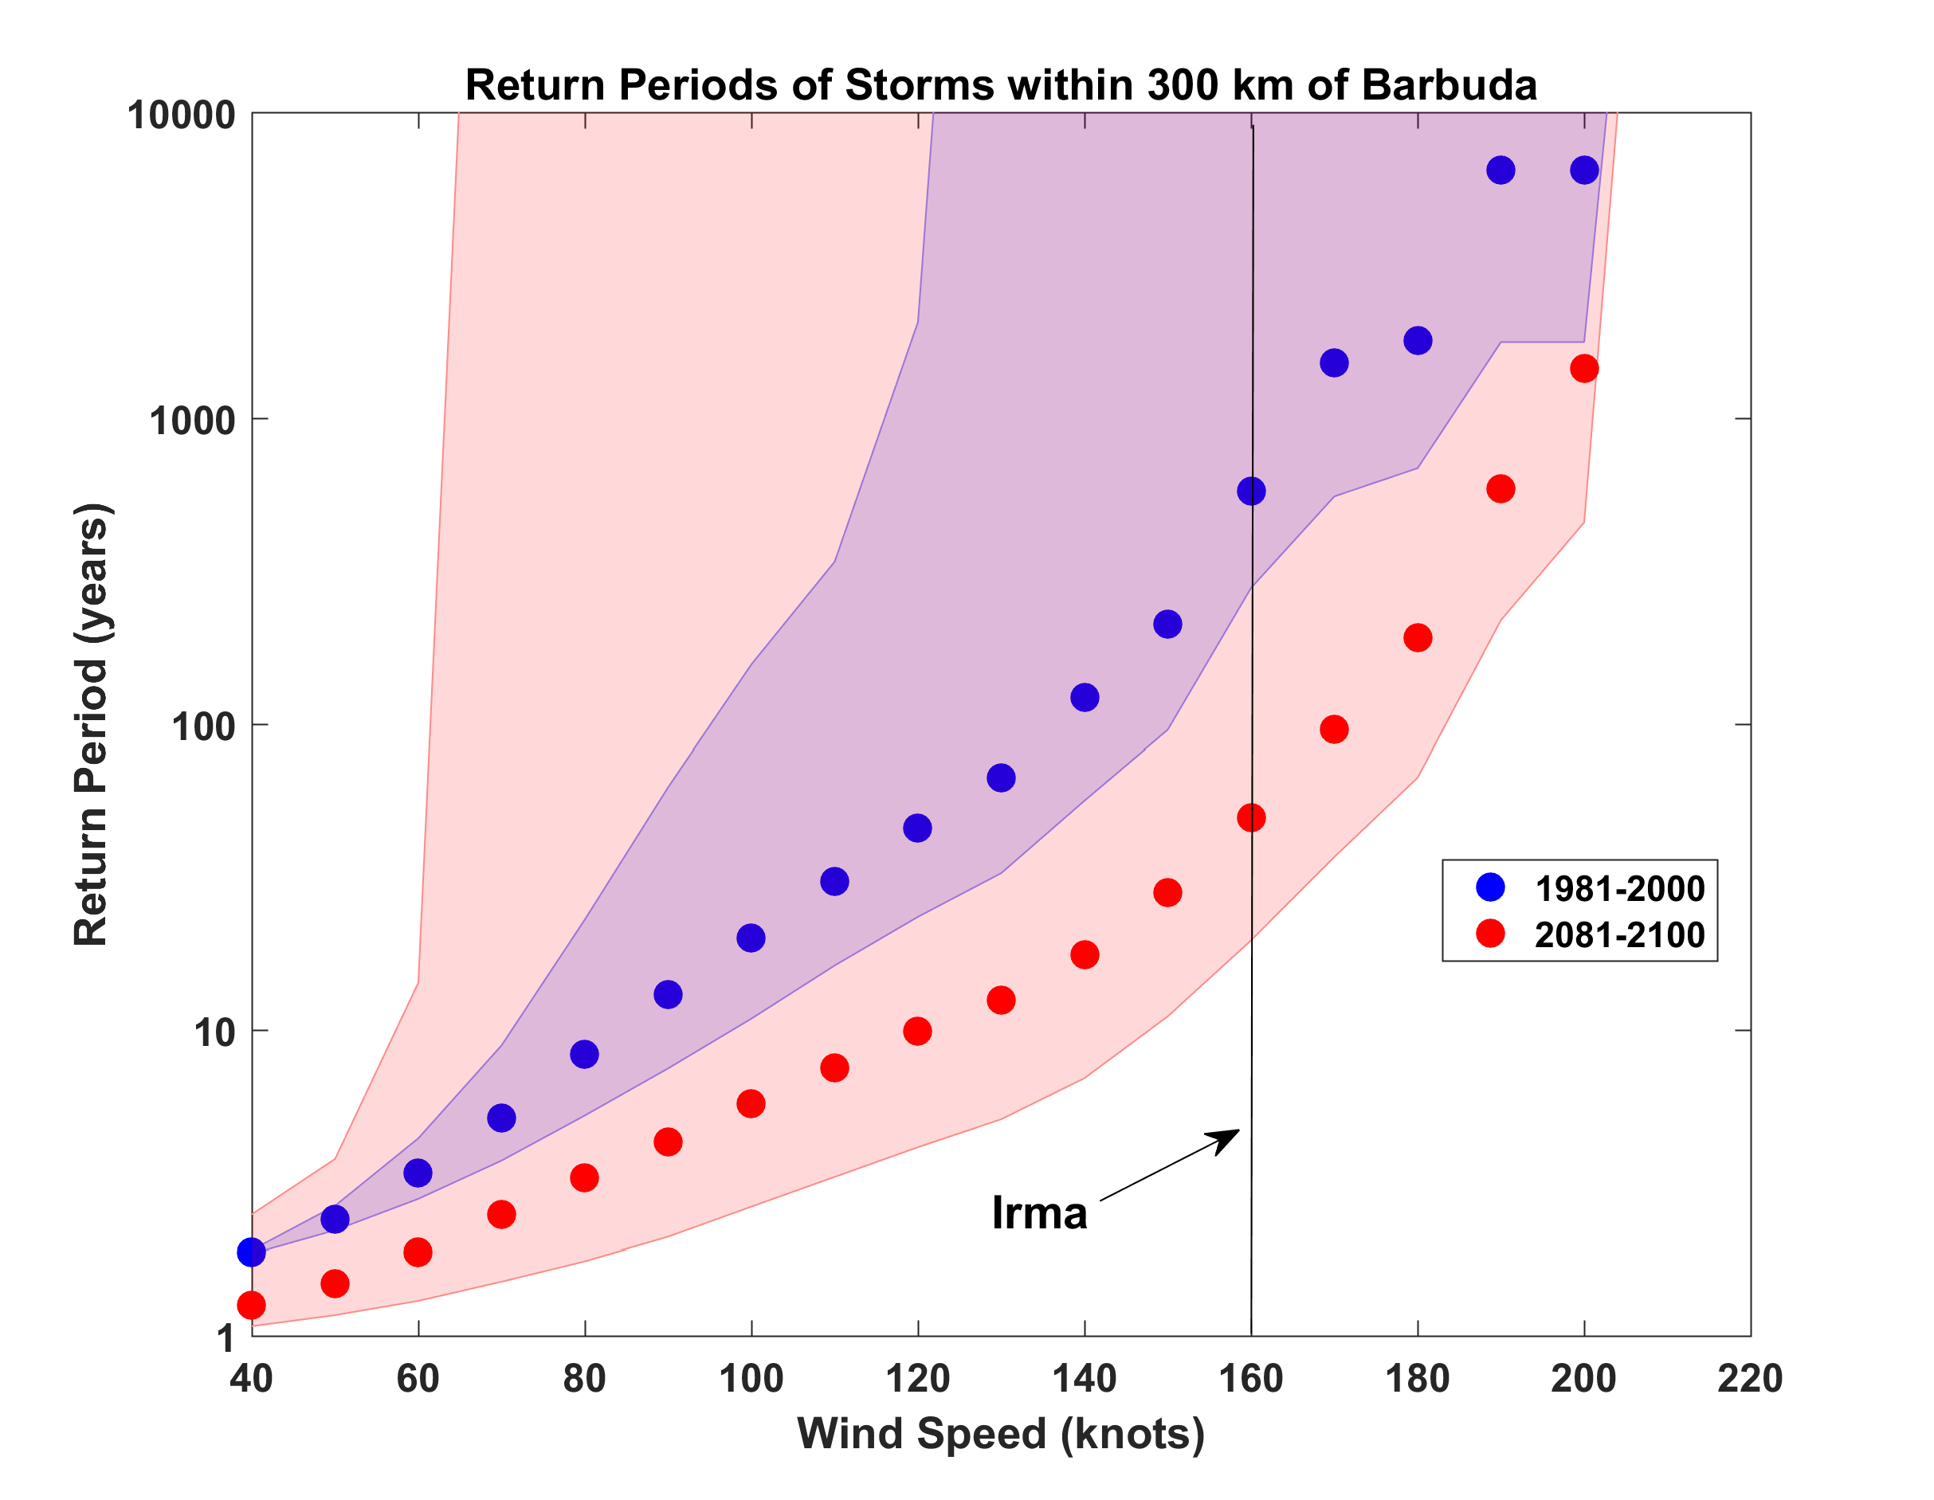
Probabilities of Storms of Irma’s Intensity within 300 km of Barbuda, from 6 Climate models, 1981-2000 and 2081-2100, Based on 2000 Events Each. Shading shows spread among the models.

Slide 24

GCM flood height return level, Battery, Manhattan
(assuming SLR of 1 m for the future climate )
Black: Current climate (1981-2000)
Blue: A1B future climate (2081-2100)
Red: A1B future climate (2081-2100) with R₀ increased by 10% and R_{m} increased by 21%
Lin et al. (2012)
Notes:
Then we calculate the flood height (including surge, tide, and sea level rise) return level for the four climate models, assuming a sea level rise of 1 m for the future climate, for the Battery, NYC. These results show that the combined effects of storm climatology change and sea level rise will greatly shorten the flood return periods for NYC and, by the end of the century, the current 100-year surge flooding may happen less than every 30 years, with CNRM and GFDL prediction to be less than 10 years, and the 500-year flooding may happen less than every 200 years, with the CNRM and GFDL prediction to be 20-30 years.

Slide 25
Aerts, C. J. H. J., W. J. W. Botzen, K. Emanuel, N. Lin, H. de Moel, and E. O. Michel-Kerjan, 2014: Evaluating flood resilience strategies for coastal megacities. Science, 344, 473-475.

Slide 26
Benefit-Cost Ratios

Slide 27
Summary
Demographic trends and rising GDP are exposing more people and built infrastructure to coastal risks
Natural hazard records are inadequate for making robust risk assessments
Changing climate has already made historically based risks assessments obsolete

Slide 28
Summary
We need to bring physics to bear on the assessment of natural hazard risks
Academic stovepiping and complacency in the risk modeling industry are the main obstacles to progress
Firms like Century Equity can help by advocating for better approaches to natural hazard risk assessment

Slide 29
Spare Slides

Slide 30
Sea level rise + changing storms
Sea level rise alone
From: American Climate Prospectus Economic Risks in the United States

Slide 32
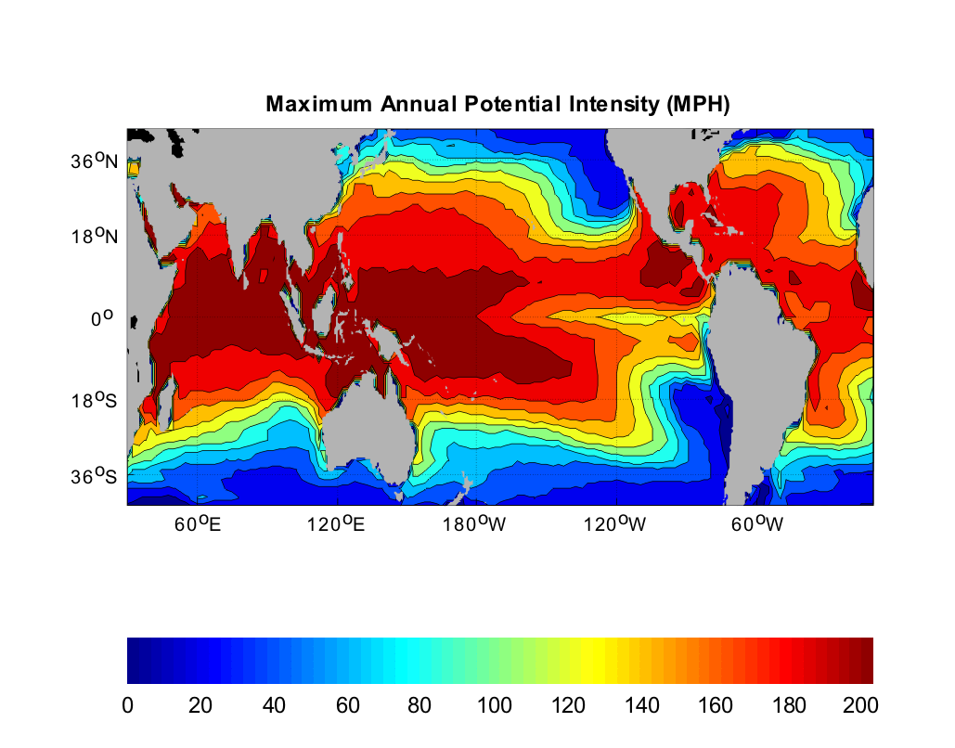
Heat Engine Theory Predicts Maximum Hurricane Winds
MPH
Notes:
32

Slide 33
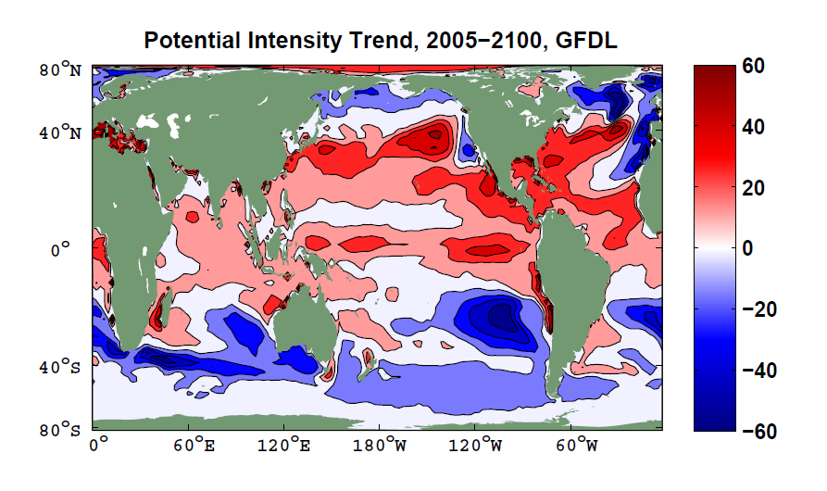

Slide 34
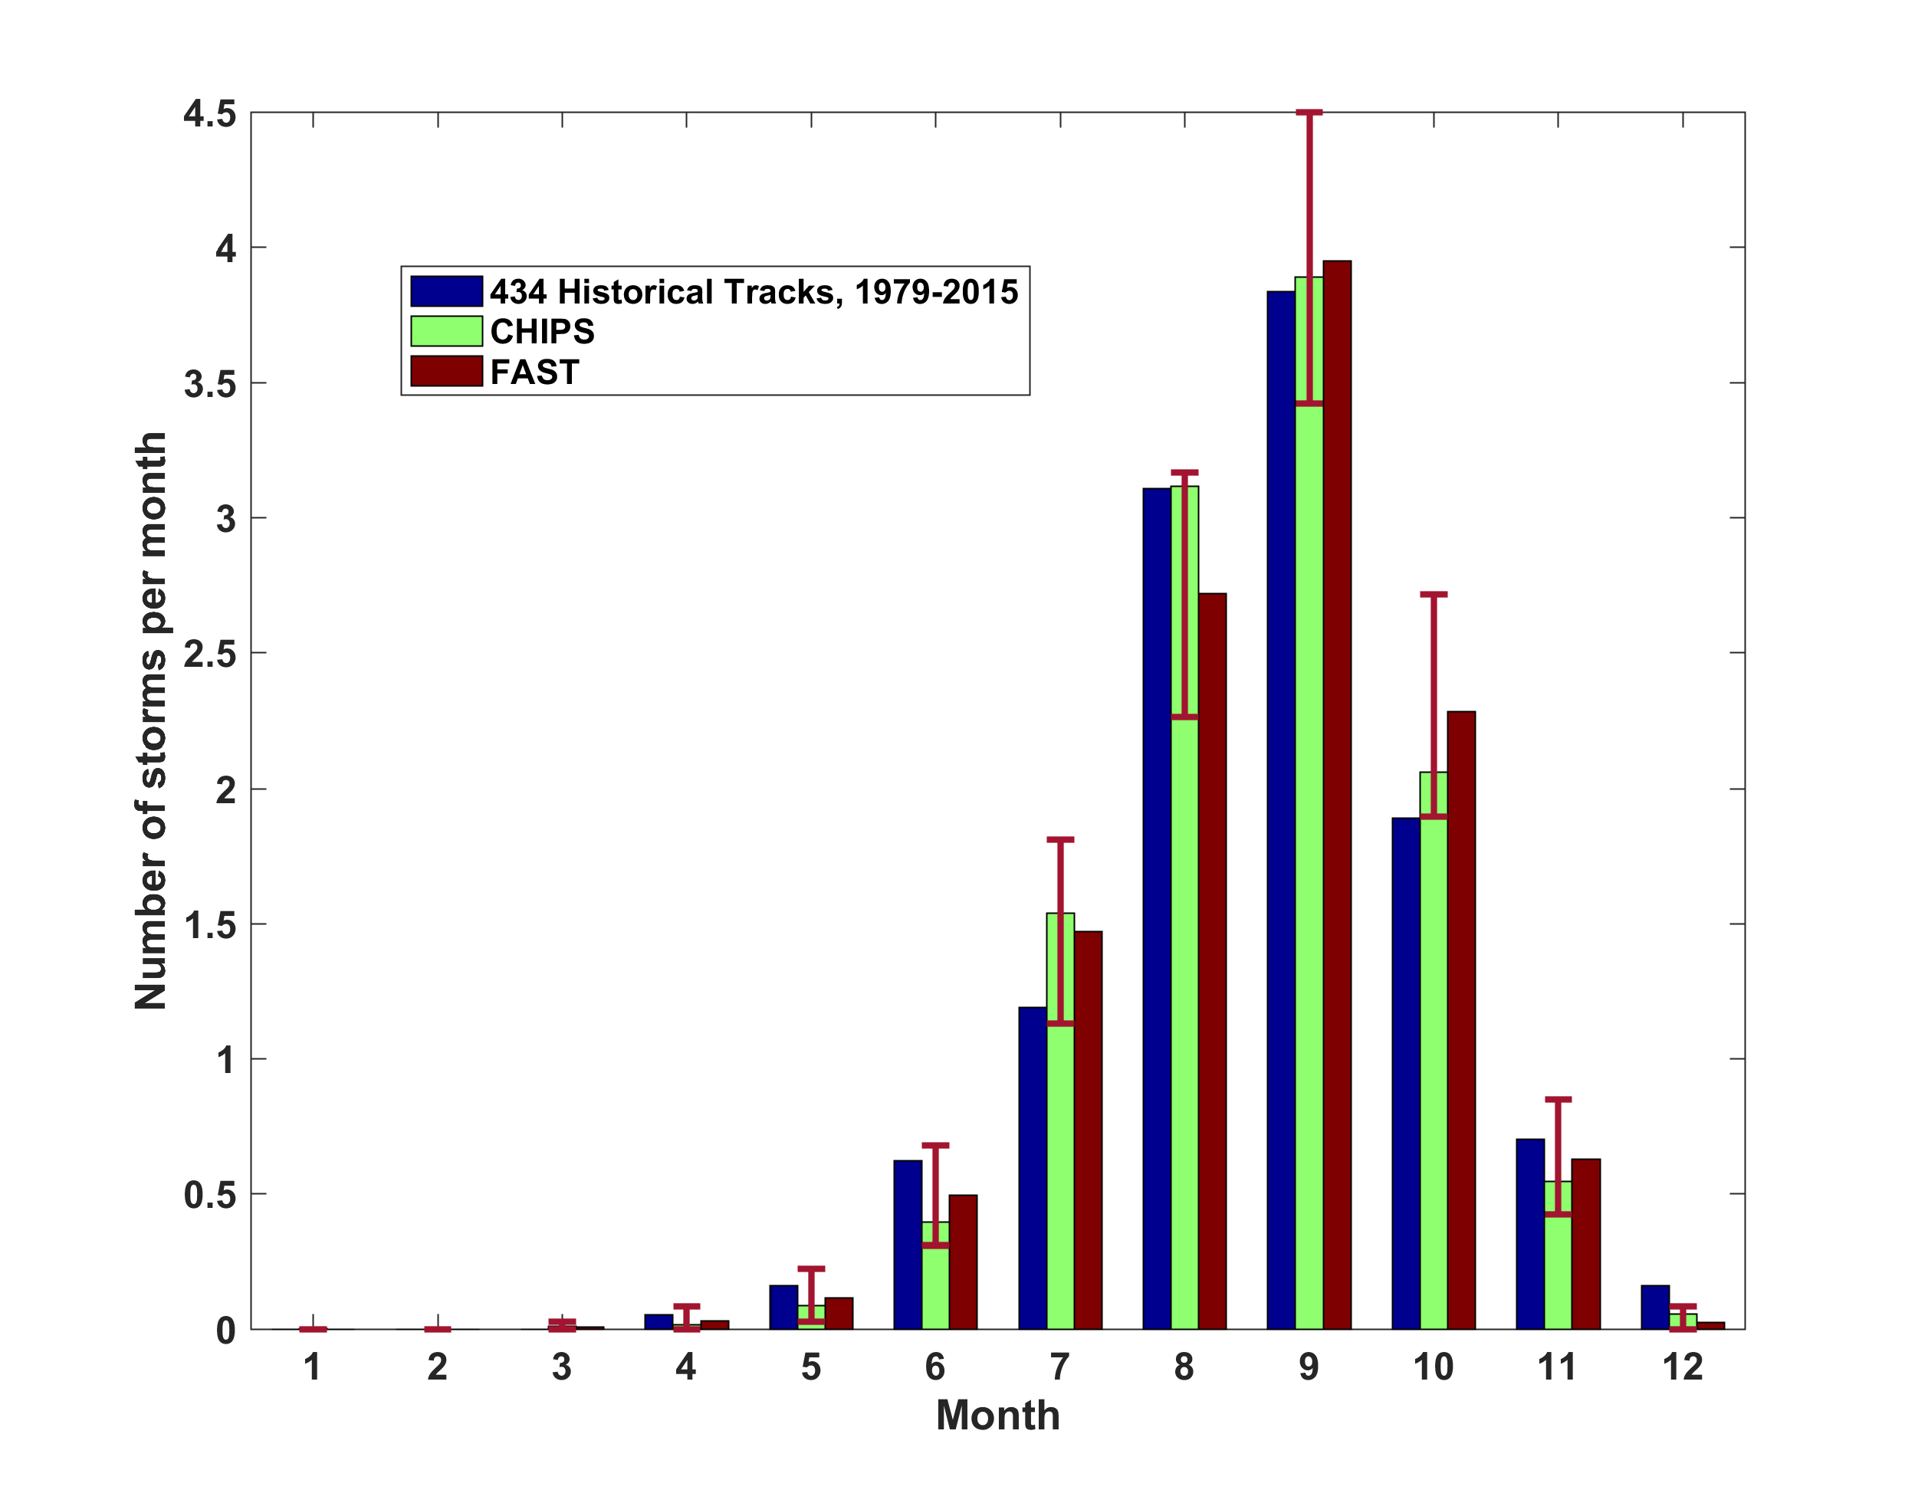
Atlantic Annual Cycle

Slide 35

Captures effects of regional climate phenomena (e.g. ENSO, AMM)

Slide 36
CMIP5 Models

Slide 37
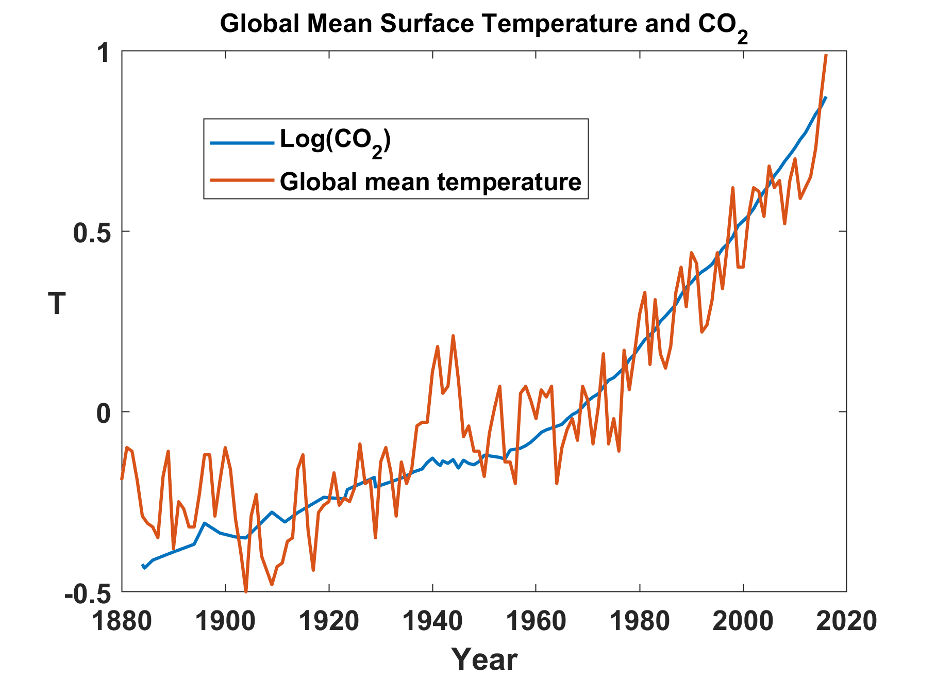

Slide 38
Limitations of a strictly statistical approach to hurricane risk assessment
>50% of all normalized U.S. hurricane damage, 1900-2017, caused by top 10 events, all but one (Sandy) were category 3, 4 and 5
>75% of all damage caused by top 30 events
>78% of all damage caused by storms of category 3 and greater
Landfalling storm statistics are inadequate for assessing hurricane risk

