Slide 1
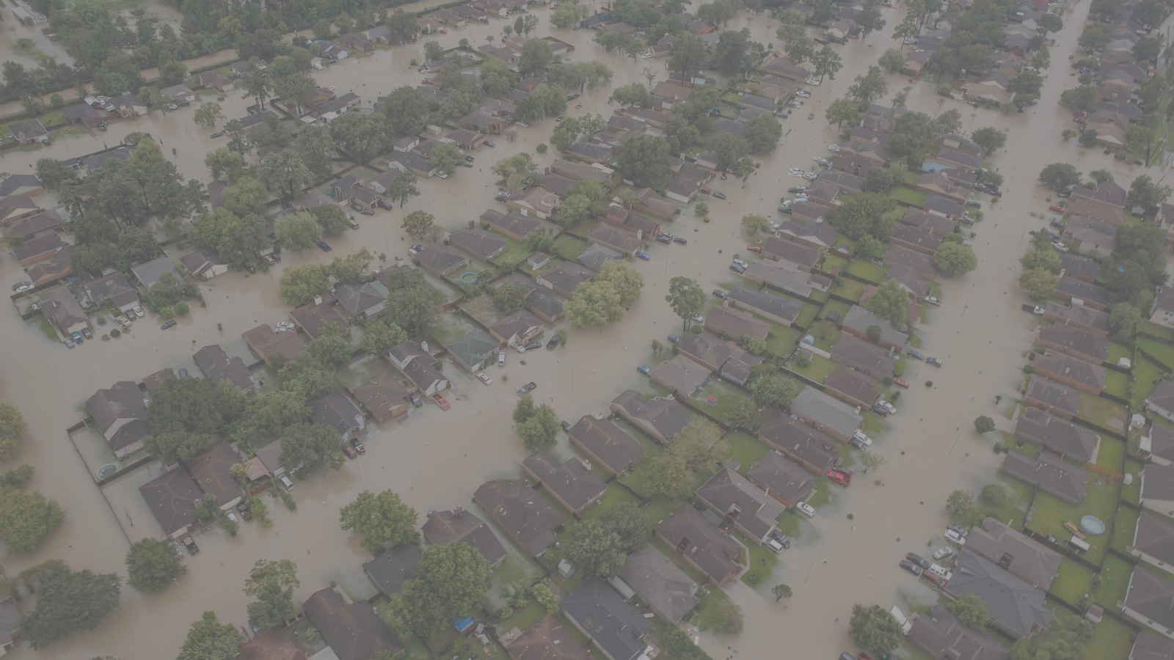
Are Coastal Cities Sustainable?
Kerry Emanuel
EAPS and Lorenz Center, MIT
Notes:
1

Slide 2

A Few Essential Points
Sea level is rising and will continue to do so
In many places, the most serious consequences come from storm surges
Hurricane intensity and freshwater flooding are expected to increase
Resilience and sustainability are local issues
A few case studies

Slide 3

Svante Arrhenius, 1859-1927
“Any doubling of the percentage of carbon dioxide in the air would raise the temperature of the earth's surface by 4°; and if the carbon dioxide were increased fourfold, the temperature would rise by 8°.” – Världarnas utveckling (Worlds in the Making), 1906

Slide 4
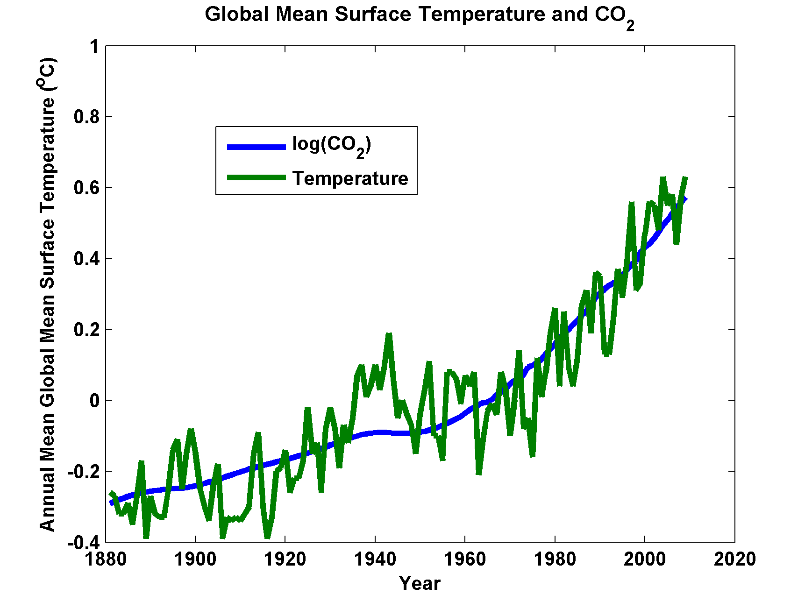

Slide 5
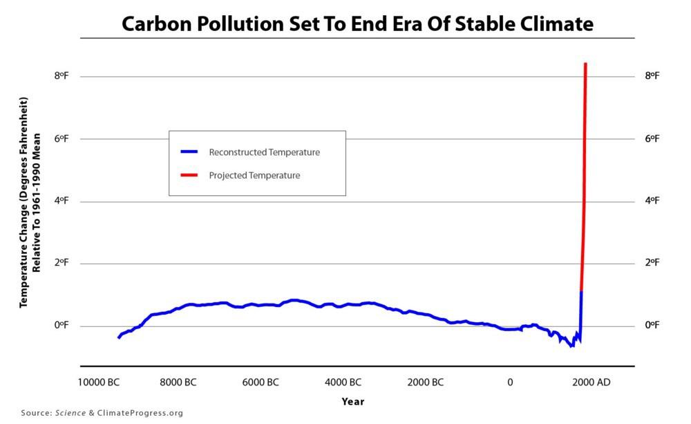

Slide 6
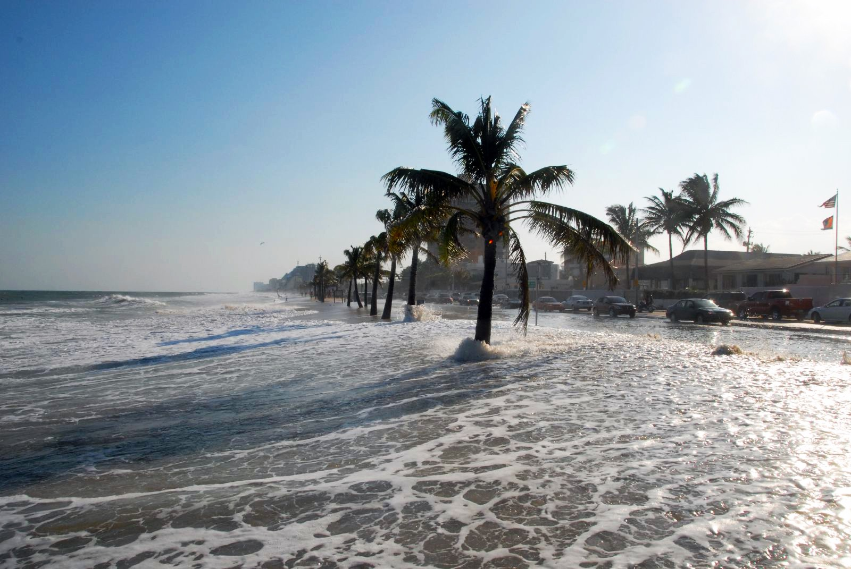
Sea Level Rise

Slide 7
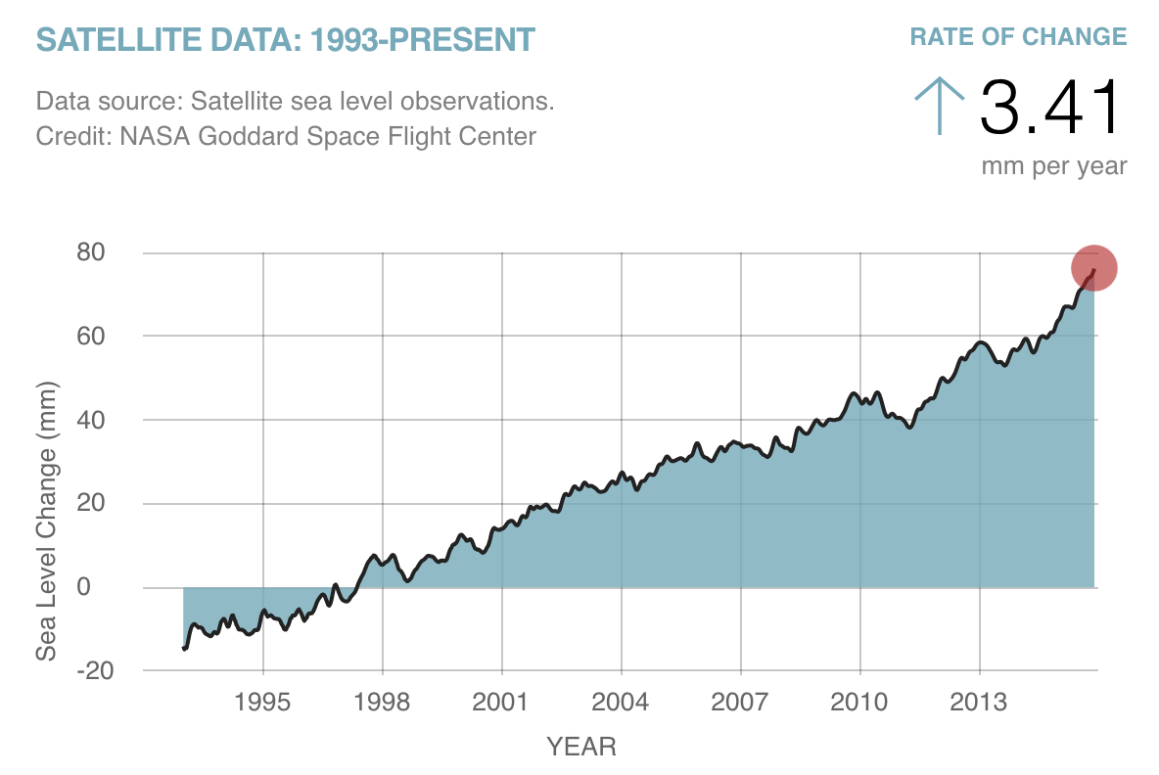

Slide 8
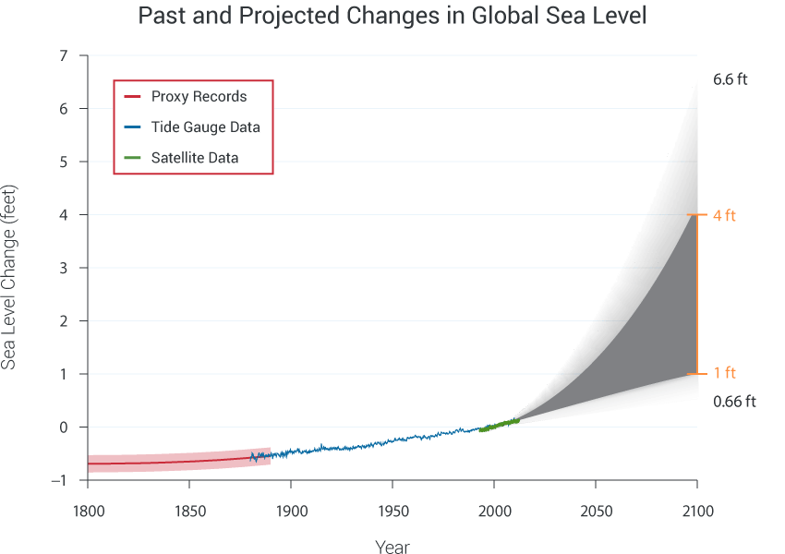
Today

Slide 9
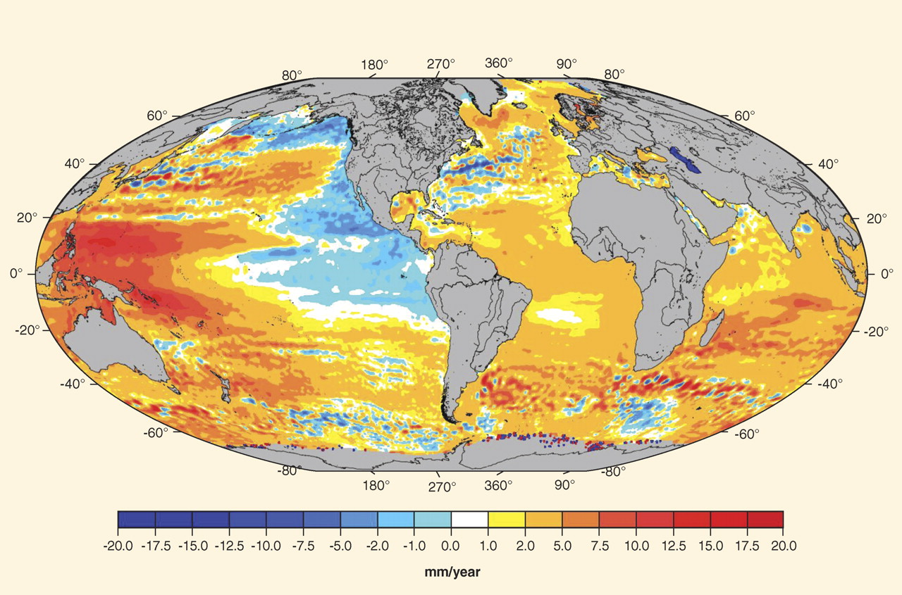
Regional sea-level trends from satellite altimetry (Topex/Poseidon, Jason-1&2, GFO, ERS-1&2, and Envisat missions) for the period October 1992 to July 2009. AVISO (Archiving, Validation and Interpretation of Satellite Oceanographic data), available at www.aviso.oceanobs.com/

Slide 10
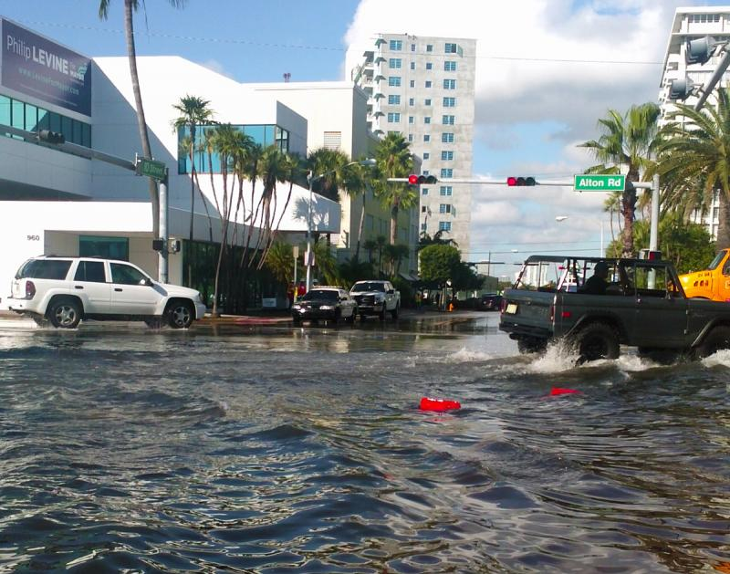
“Nuisance Flooding”, Miami Beach

Slide 11
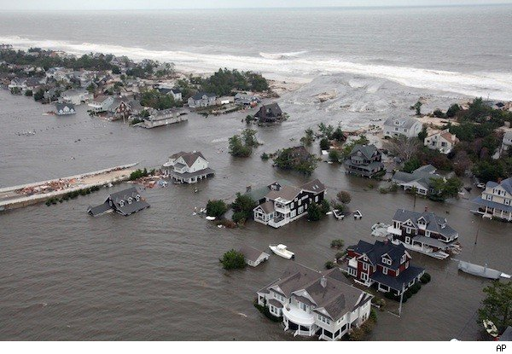
Coastal Storm Surge Flooding
Flooding from Hurricane Sandy
Credit: Associated Press

Slide 12
The Global Hurricane Hazard
About 10,000 deaths per year since 1971
$700 Billion 2015 U.S. Dollars in Damages Annually since 1971
Global population exposed to hurricane hazards has tripled since 1970
EM-DAT, 2016: The OFDA/CRED International Disaster Database
http://www.emdat.be/.

Slide 13
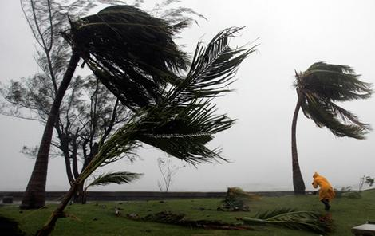
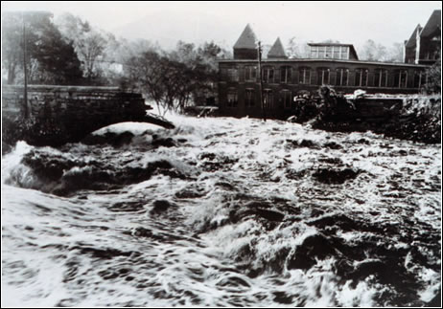
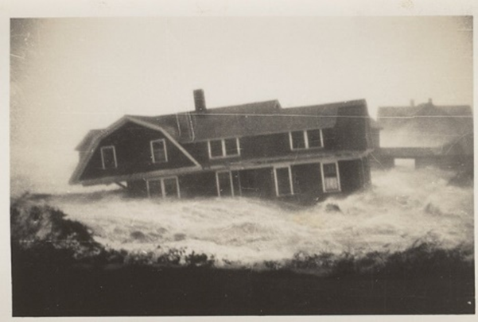

Hurricane Risks:
Wind
Rain
Storm Surge

Slide 14
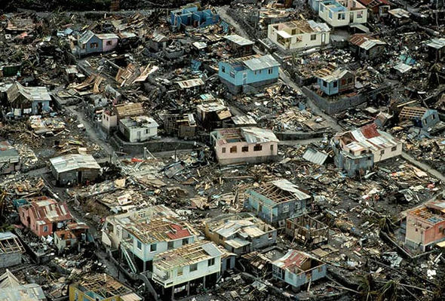
Dominica in the wake of Hurricane Maria

Slide 15

Publicly
insured…
No $$$
Privately insured… $$$
It is likely that water risks will be absorbed by private insurance in the U.S.

Slide 16
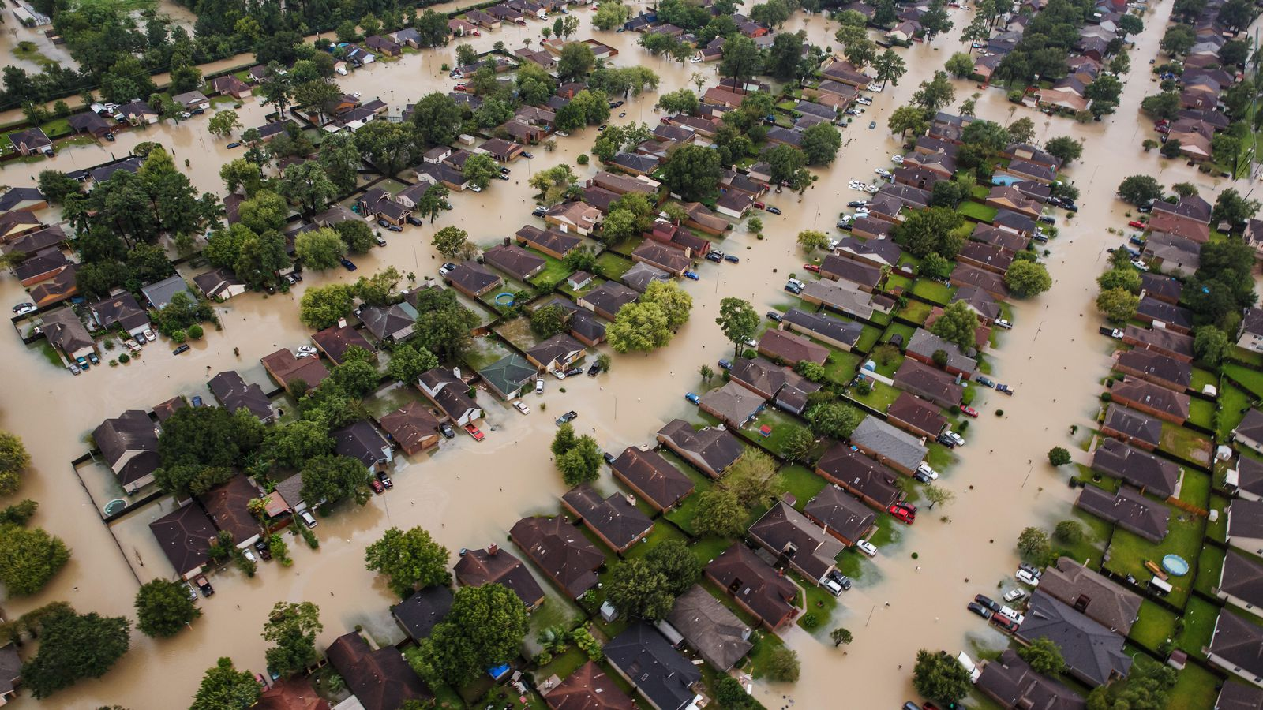
Flooding from Hurricane Harvey

Slide 17

Limitations of the Actuarial Approach
Notes:
17

Slide 18
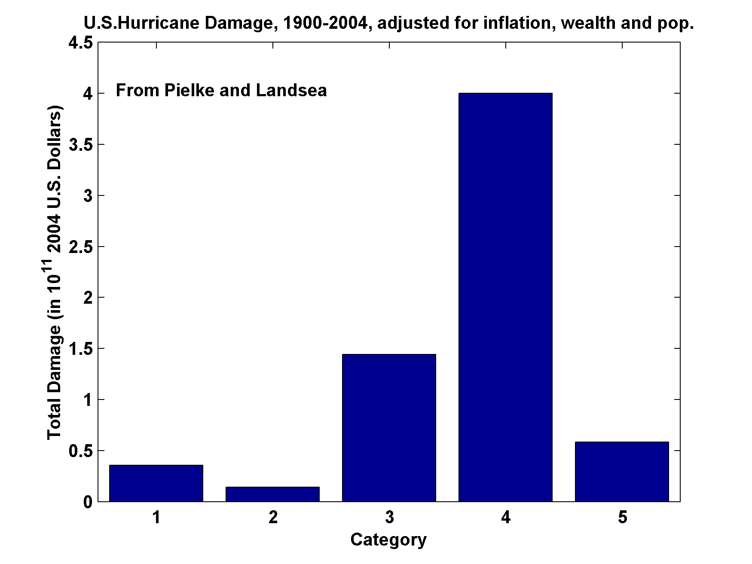
U.S. Hurricane Damage, 1900-2004,Adjusted for Inflation, Wealth, and Population

Slide 19
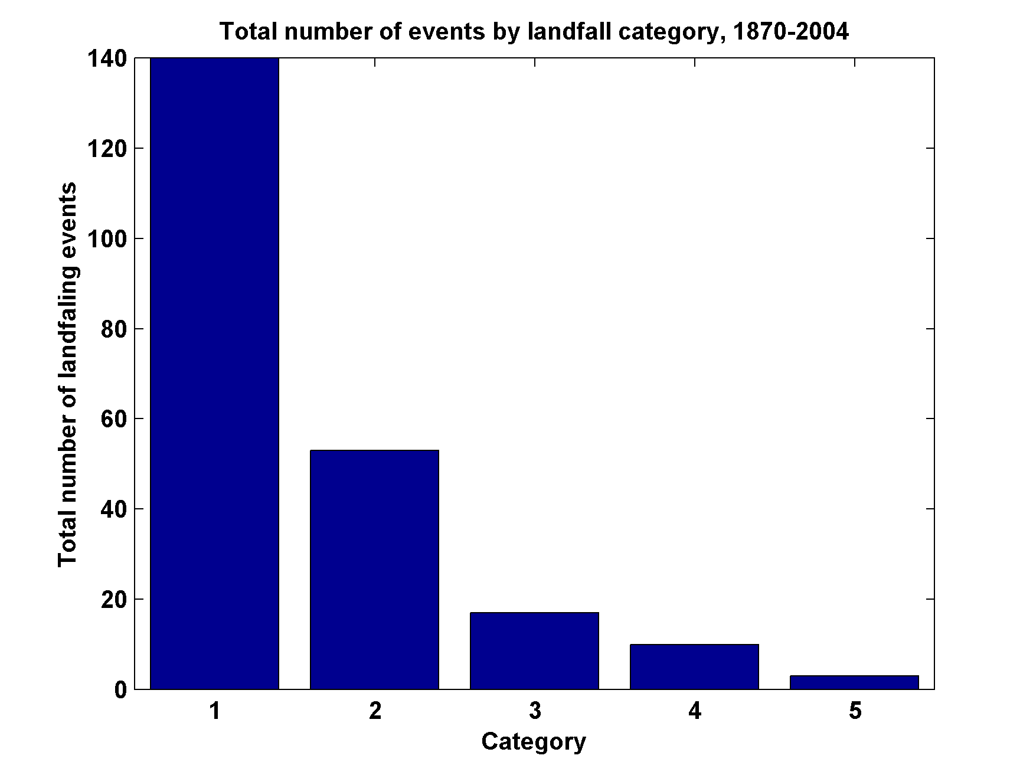
Total Number of Landfall Events, by Category, 1870-2004

Slide 20
Limitations of a strictly statistical approach to hurricane risk assessment
>50% of all normalized U.S. hurricane damage caused by top 8 events, all category 3, 4 and 5
>90% of all damage caused by storms of category 3 and greater
Category 3,4 and 5 events are only 13% of total landfalling events; only 30 since 1870
Landfalling storm statistics are inadequate for assessing hurricane risk

Slide 21
Risk Assessment by Direct Numerical Simulation of Hurricanes:
The Problem
The hurricane eyewall is a front, attaining scales of ~ 1 km or less
At the same time, the storm’s circulation extends to ~1000 km and is embedded in much larger scale flows
The computational nodes of global models are typically spaced 100 km apart

Slide 22

Histograms of Tropical Cyclone Intensity as Simulated by a Global Model with 50 km grid point spacing. (Courtesy Isaac Held, GFDL)
Category 3
Modeled
Observed
Global models do not simulate the storms that cause destruction

Slide 23
How to deal with this?
Embed high-resolution, fast coupled ocean-atmosphere hurricane model in GCM or reanalysis data
Or apply mathematical emulator of a full physics intensity model

Slide 24
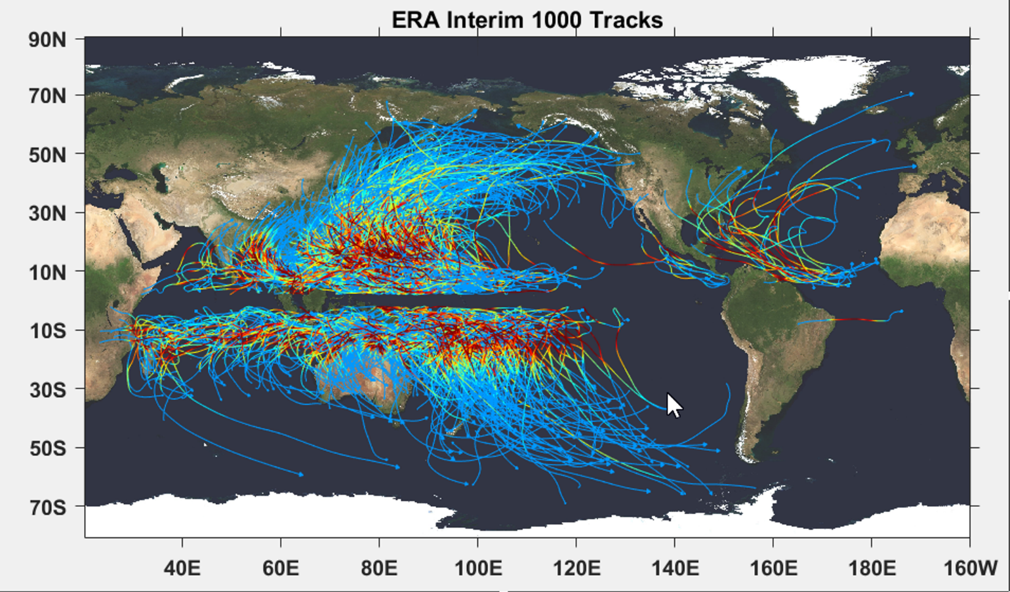

Slide 25
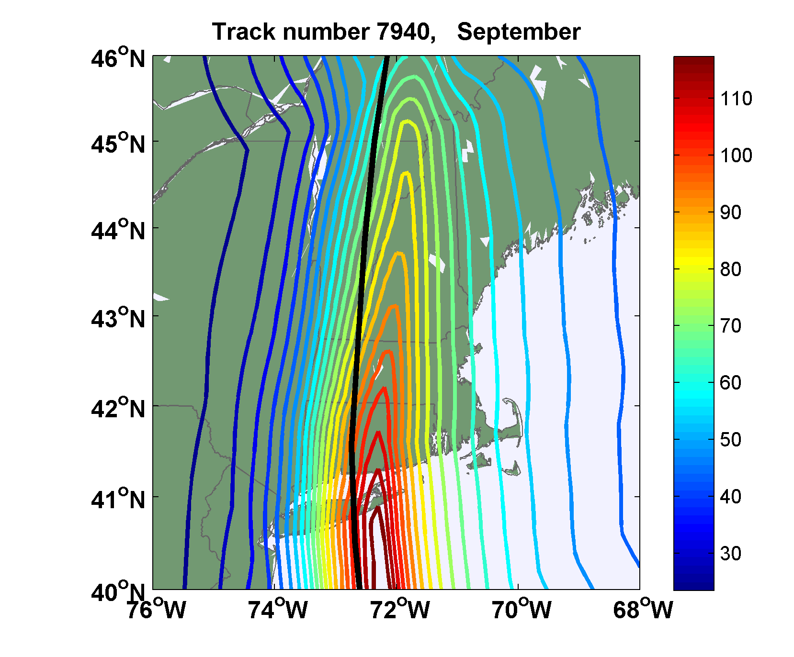
Sample Storm Wind Swath

Slide 26

Return Periods

Slide 27
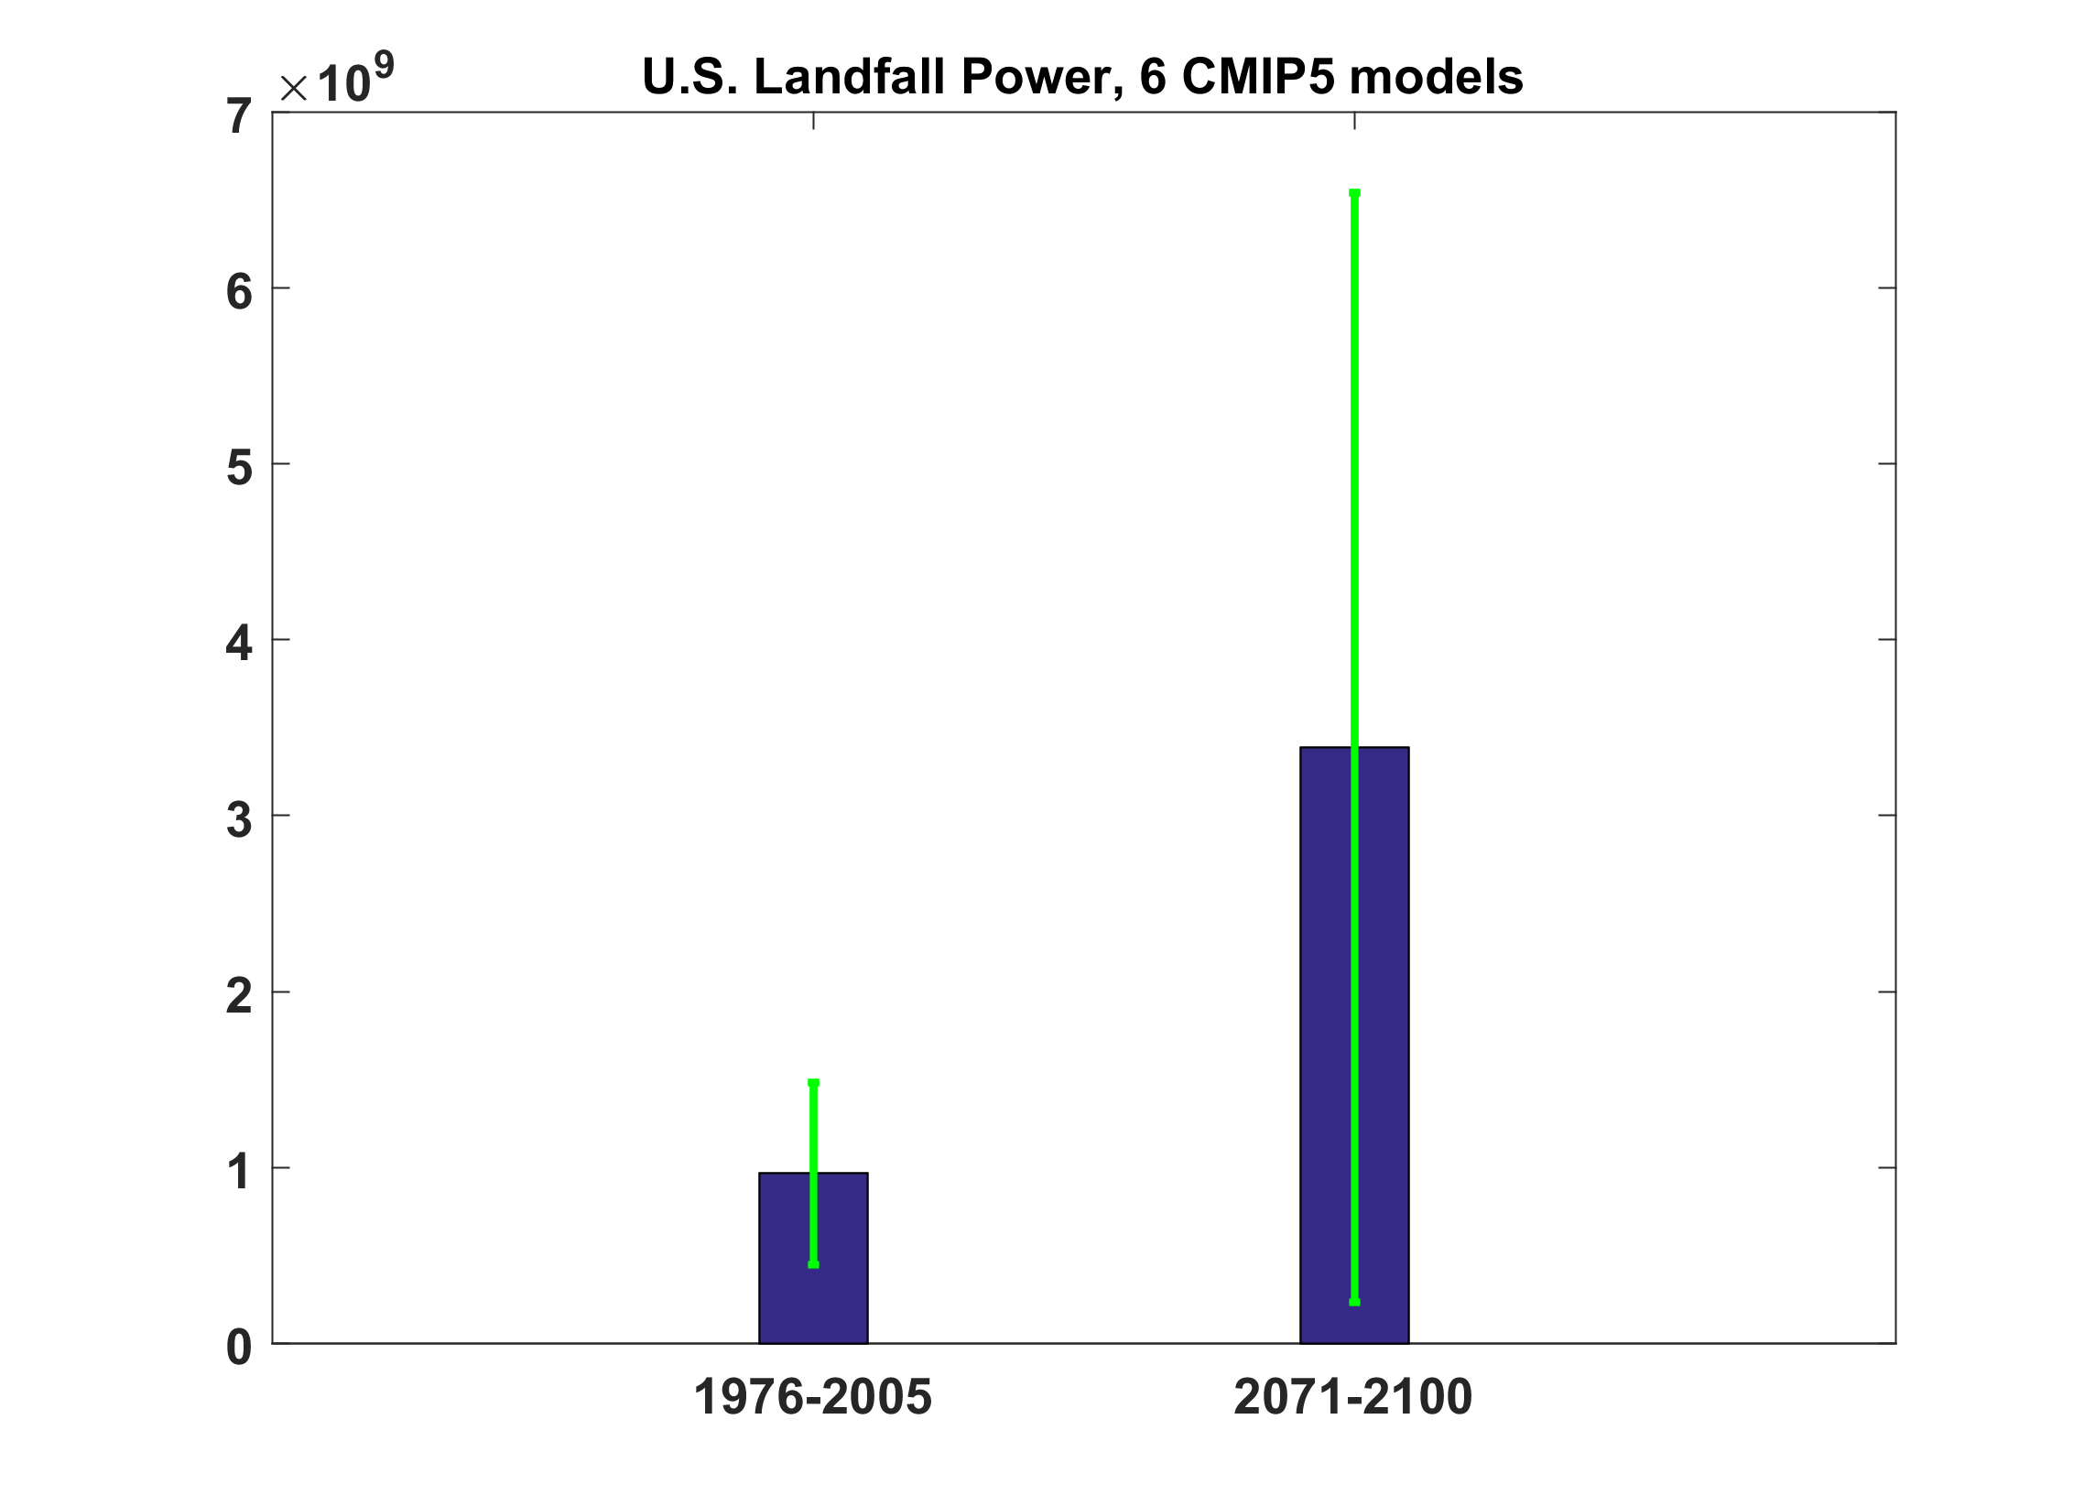
Projections of U.S. Hurricane Landfall Power from 6 CMIP5 models

Slide 28
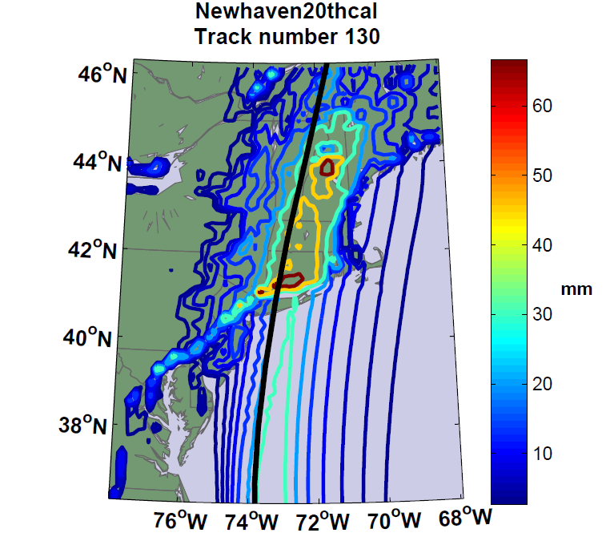
Accumulated Rainfall (mm)

Slide 29
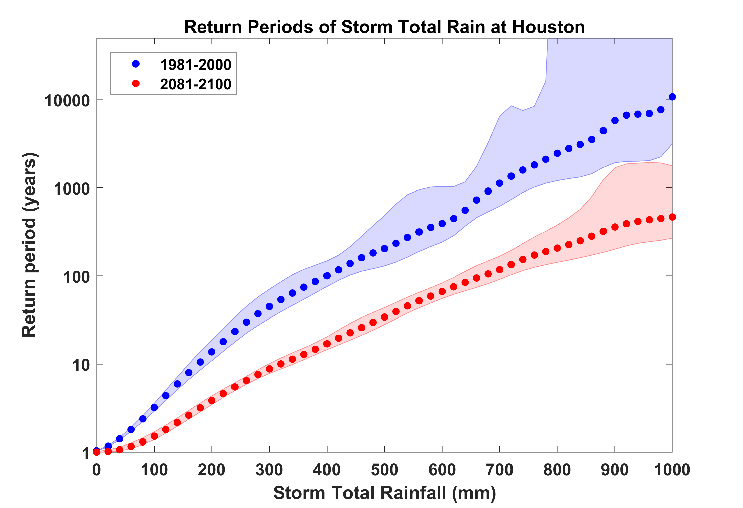
Probability of Storm Accumulated Rainfall at Houston, from 6 Climate models, 1981-2000 and 2081-2100, Based on 2000 Events Each. Shading shows spread among the models.
Harvey

Slide 30


Storm Surge Simulation
SLOSH model
(Jelesnianski et al. 1992)
SLOSH mesh
~ 10³ m
ADCIRC mesh
~ 10² m
Battery
ADCIRC model
(Luettich et al. 1992)
ADCIRC mesh
~ 10 m
(Colle et al. 2008)
Notes:
Given the storm wind and pressure fields (which is estimated from the Holland parametric pressure model) we can simulate the surge. Surge simulations with high resolution are computationally intensive, so to make it possible to simulate accurate surges for our large synthetic storm sets, we apply the two hydrodynamic models with girds of various resolutions in such a way that the main computational effort is concentrated on the storms that determine the risk. First, we apply the SLOSH model, using a mesh with resolution of about 1 km around NYC to simulate the surges for all storms and select the storms that have return periods, in terms of the surge height at the Battery, greater than 10 years. Second, we apply the ADCIRC simulation, using a grid mesh with resolution of ~100 m around NYC, to each of the selected storms. Then, we apply another ADCIRC mesh with resolution as high as ~10 m around NYC, for a set of the most extreme events, to check if the resolution of our ADCIRC grid is sufficient and if needed to make statistical correction to the results.

Slide 31
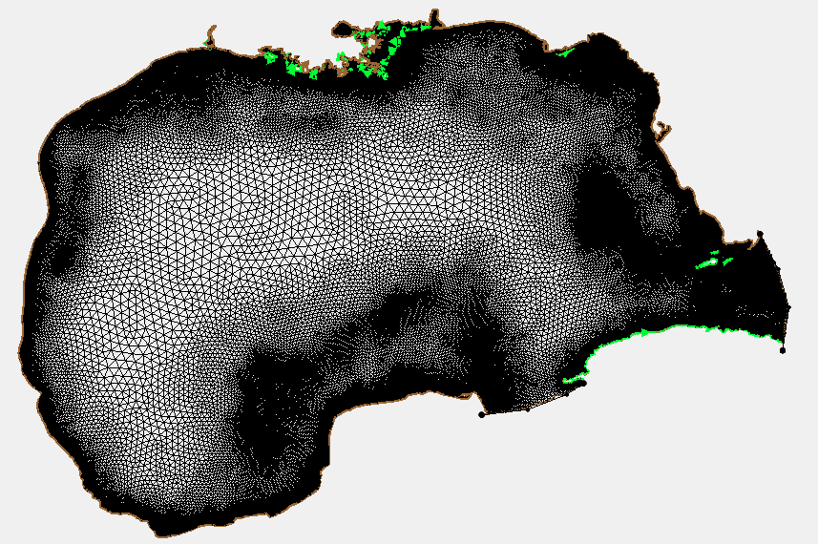
ADCIRC Mesh

Slide 32
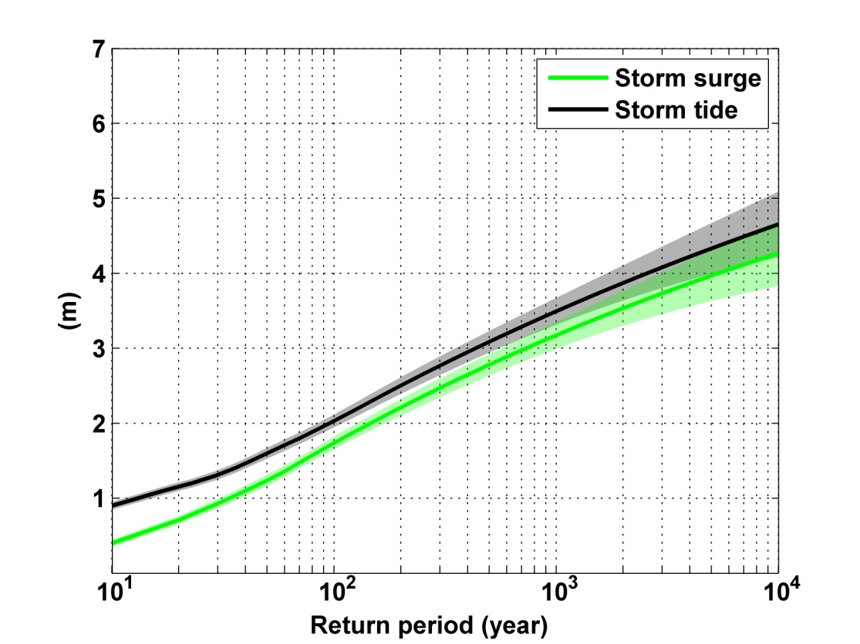
Sandy: ~ 400 years
Notes:
Storm surge and storm tide (surge and tide) return level curves for the Battery, NYC, for the 1981-2000 NCAR/NCEP climate conditions (5000 synthetic storms). Astronomical tide and nonlinear interaction between surge and tide are accounted for statistically.

Slide 33

GCM flood height return level, Battery, Manhattan
(assuming SLR of 1 m for the future climate )
Black: Current climate (1981-2000)
Blue: A1B future climate (2081-2100)
Red: A1B future climate (2081-2100) with R₀ increased by 10% and R_{m} increased by 21%
Lin et al. (2012)
Notes:
Then we calculate the flood height (including surge, tide, and sea level rise) return level for the four climate models, assuming a sea level rise of 1 m for the future climate, for the Battery, NYC. These results show that the combined effects of storm climatology change and sea level rise will greatly shorten the flood return periods for NYC and, by the end of the century, the current 100-year surge flooding may happen less than every 30 years, with CNRM and GFDL prediction to be less than 10 years, and the 500-year flooding may happen less than every 200 years, with the CNRM and GFDL prediction to be 20-30 years.

Slide 34
Aerts, C. J. H. J., W. J. W. Botzen, K. Emanuel, N. Lin, H. de Moel, and E. O. Michel-Kerjan, 2014: Evaluating flood resilience strategies for coastal megacities. Science, 344, 473-475.

Slide 35
Benefit-Cost Ratios

Slide 36
Sea level rise + changing storms
Sea level rise alone
From: American Climate Prospectus Economic Risks in the United States

Slide 37
MIT Tropical Storm Model
Hourly Precipitation
5Km by 5 km Grid

Slide 38
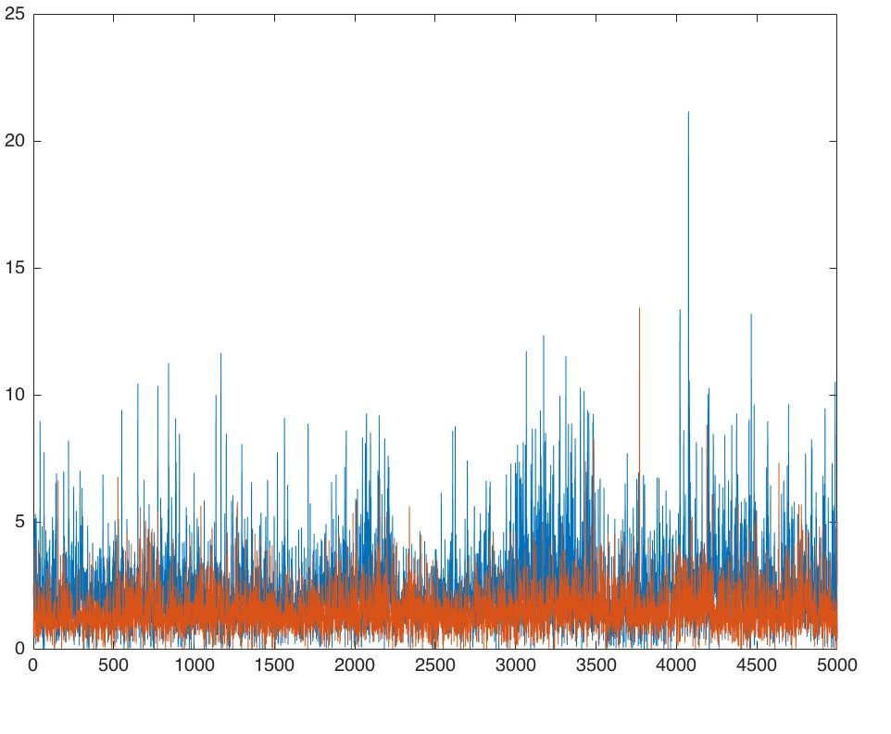
CLIMATE VULNERABILITY: FLOODING
Research Study Goals
Engage faculty expertise in MIT campus-focused study
Determine MIT flood exposure under climate change
Integrate and update MIT campus portion of Cambridge flood map
Communicate findings to City and campus area stakeholders
Preliminary Findings
Cambridge:
  Future storms yield more rain than historic storms
  More frequent probability of intense rain storms
  MIT Campus:
  Most of campus exposed to flooding from 100 year storm, today
  Greater exposure anticipated under future 100 year storm
Modelling of Future Cambridge Precipitation Totals (24 hour storms)
Red: Baseline modelled storms (1981-2000)
Blue: Projected storms climate change (2081-2100)
Total rainfall per storm (inches)
Number of modelled storms
Source: Dr. Kerry Emanuel (Professor of Atmospheric Science); Dr. Ken Strzepek (Research Scientist, MIT Joint Program on Science and Policy of Global Change)
Notes:
Research Study Goals
Engage faculty expertise in MIT campus-focused study
Determine MIT flood exposure under climate change
Integrate and update MIT campus portion of Cambridge flood map
Communicate findings to City and campus area stakeholders
Preliminary Findings
Cambridge:
Future storms yield more rain than historic storms
More frequent probability of intense rain storms
MIT Campus:
Most of campus exposed to flooding from 100 year storm, today
Greater exposure anticipated
BACKGROUND CONTEXT FOR SLIDES
GOAL: MIT seeks to bring its research expertise in global climate change modelling to the Cambridge campus-scale for enhancing the region and campus understanding of anticipated climate change impacts.
The Cambridge Climate Vulnerability Assessment (2015) only modelled publicly-owned stormwater systems, so this study seeks to model the MIT campus and stormwater system and feed this portion back into the City’s comprehensive model.
Background:
(Cambridge Climate Vulnerability Assessment deems “inland flooding” as a primary climate hazard, characterized by intense precipitation that exceeds capacity of stormwater systems causing a back-up and flooding of manholes and streets).
(City modelled and mapped this flooding and revealed significant city-wide flooding of critical infrastructure and assets for 100 year probability storm with 24 hours of rainfall in 2030 and 2070 climate conditions.)
METHOD: To determine MIT’s campus flood exposure to future precipitation events, MIT Office of Sustainability engaged faculty expertise with global modelling methods to:
Downscale MIT Synthetic Tropical Cyclone Generator to Cambridge for evaluating the probability of tropical storms impacting Cambridge
Evaluate probability of rainfall totals from 5,000 storms under future climate conditions, aligning with Cambridge study parameters.
Model the campus stormwater system to determine its capacity to cope with projected rainfall amounts for future 10, 50, 100, 500 year storms
PRELIMINARY FINDINGS:
Cambridge: Future storms under climate change conditions yield considerably more rainfall to Cambridge during 24 hour rainfall events compared to historic 24 hour rainfall totals; with greater probability of return of intense storms
MIT Campus: Much of the campus is likely to be exposed to flooding from a 100 year probability storm today, with even more flooding anticipated from a 100 year storm in the future.
NEXT STEPS:
Finalize study to confirm projected flood exposure and inundation maps from different size storms (early Feb)
Integrate updated flood model into City of Cambridge flood model by filing in the missing MIT portion and identifying potential impacts with City/campus boundary conditions (Feb)
Communicate results to city and campus stakeholders (Feb/March)
GRAPHIC NOTES
RED notes rainfall totals from tropical storm model of 5,000 storms during 20th century climate conditions (1981 – 2000)
BLUE notes rainfall totals from tropical storm model of 5,000 storms during future climate change conditions (2081-2100) under GHG atmospheric level RCP 8.5).
RCP 8.5 - "Representative Concentration Pathway (RCP) refers to aconsistent set of projections for climate modeling, pattern scaling and atmospheric chemistry modeling," (NOAA)
Study is being led by Dr. Kerry Emanuel (Professor of Atmospheric Science) and Dr. Ken Strzepek (Research Scientist, MIT Joint Program on Science and Policy of Global Change)

Slide 39
2070 - 100 Year 24 hour Precipitation for over Cambridge Massachusetts
CCVA-Analog vs. The MIT Synthetic Tropical Cyclone Generator

Slide 40
Sea Level Rise / Storm Surge Propagation (2070)
Courtesy Ken Strzepek
1-3 feet peak
<1 foot peak
1% or 100 year SLR/SS event under climate change conditions (2070) (precipitation not yet included)
Note: not for distribution – in-progress MIT Flood Vulnerability Study (Jun 2017); based on MassDOT/Central Artery Flood Modelling assumptions for river levels
Notes:
Scenario shows 1% probability storm surge event in 2070 (with sea level rise and climate changes)
Surge would flank the Charles River dam and flood areas of the campus with 1-3 feet of peak flood water.
Rather than overtop the seawall along Memorial Drive, surge water would propagate stormwater drainage pipes and flood lowest campus elevation areas along Vassar and Albany and Main St.
Areas that would likely be flooded include many of the same lower elevation areas that are of risk and noted below under probable precipitation-flooding areas.
Scenario only accounts for a surge of seawater, not precipitation run-off from Cambridge land.
Surge would likely bring salty water into campus utility and building systems.
KEY ASSUMPTIONS FOR MODELLING: MassDOT/Central Artery Tunnel Flood Study - https://www.massdot.state.ma.us/Portals/8/docs/environmental/SustainabilityEMS/Pilot_Project_Report_MassDOT_FHWA.pdf

Slide 41
Summary
History is too short and imperfect to estimate hurricane risk
Better estimates can be made from downscaling hurricane activity from climatological or global model output
Hurricanes clearly vary with climate and there is a risk that hurricane threats will increase over this century

