Slide 1

The Coming Revolution in Weather Hazard Modeling
Why we need to bring physics to bear on estimating natural hazard risk
Kerry Emanuel
Lorenz Center
Massachusetts Institute of technology

Slide 2
Flawed Basis of Current Risk Modeling
Almost all current risk assessments are based on historical statistics
Historical records are flawed and short
Moreover, the past 50-150 years is a poor guide to the present owing to climate change that has already occurred
Risk modelers have been slow to migrate to a physics-based approach
Risk modeling industry is being challenged by non-profits and start-ups
Government and the insurance industry should accelerate this transition

Slide 3
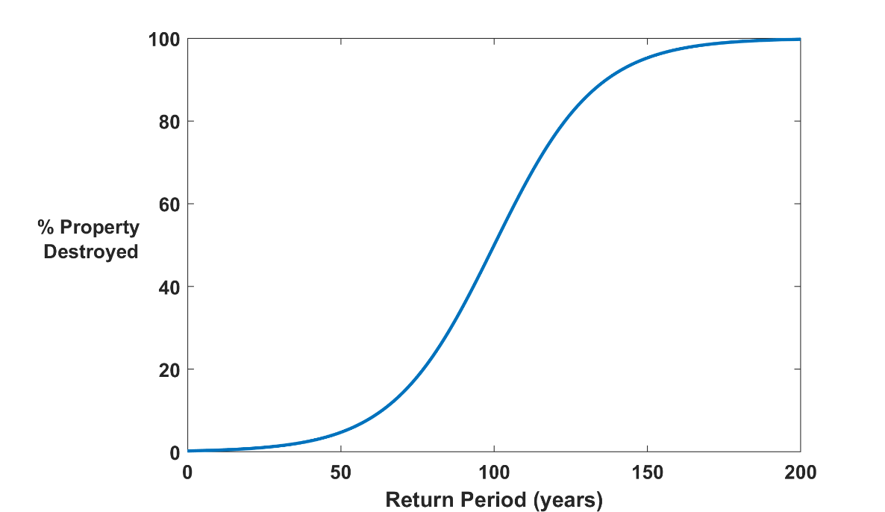

Why Climate Risk is Dominated by Extreme Events:
Societies are usually well adapted to frequent events (> 1/100 yr)
Societies are often poorly adapted to rare events (< 1/100 yr)
Large cost increases result when > 100-yr events become < 100-yr events
Largest slope

Slide 4
Historical Records
Riverine floods: ~100 years of good records (U.S.)
Flash floods and tropical-cyclones: Somewhat less than 100 years
Even if we had 100 years of great records, the past is no longer a good guide to the present
We need to turn to physical models to get better estimates of current (and future) weather risks

Slide 5
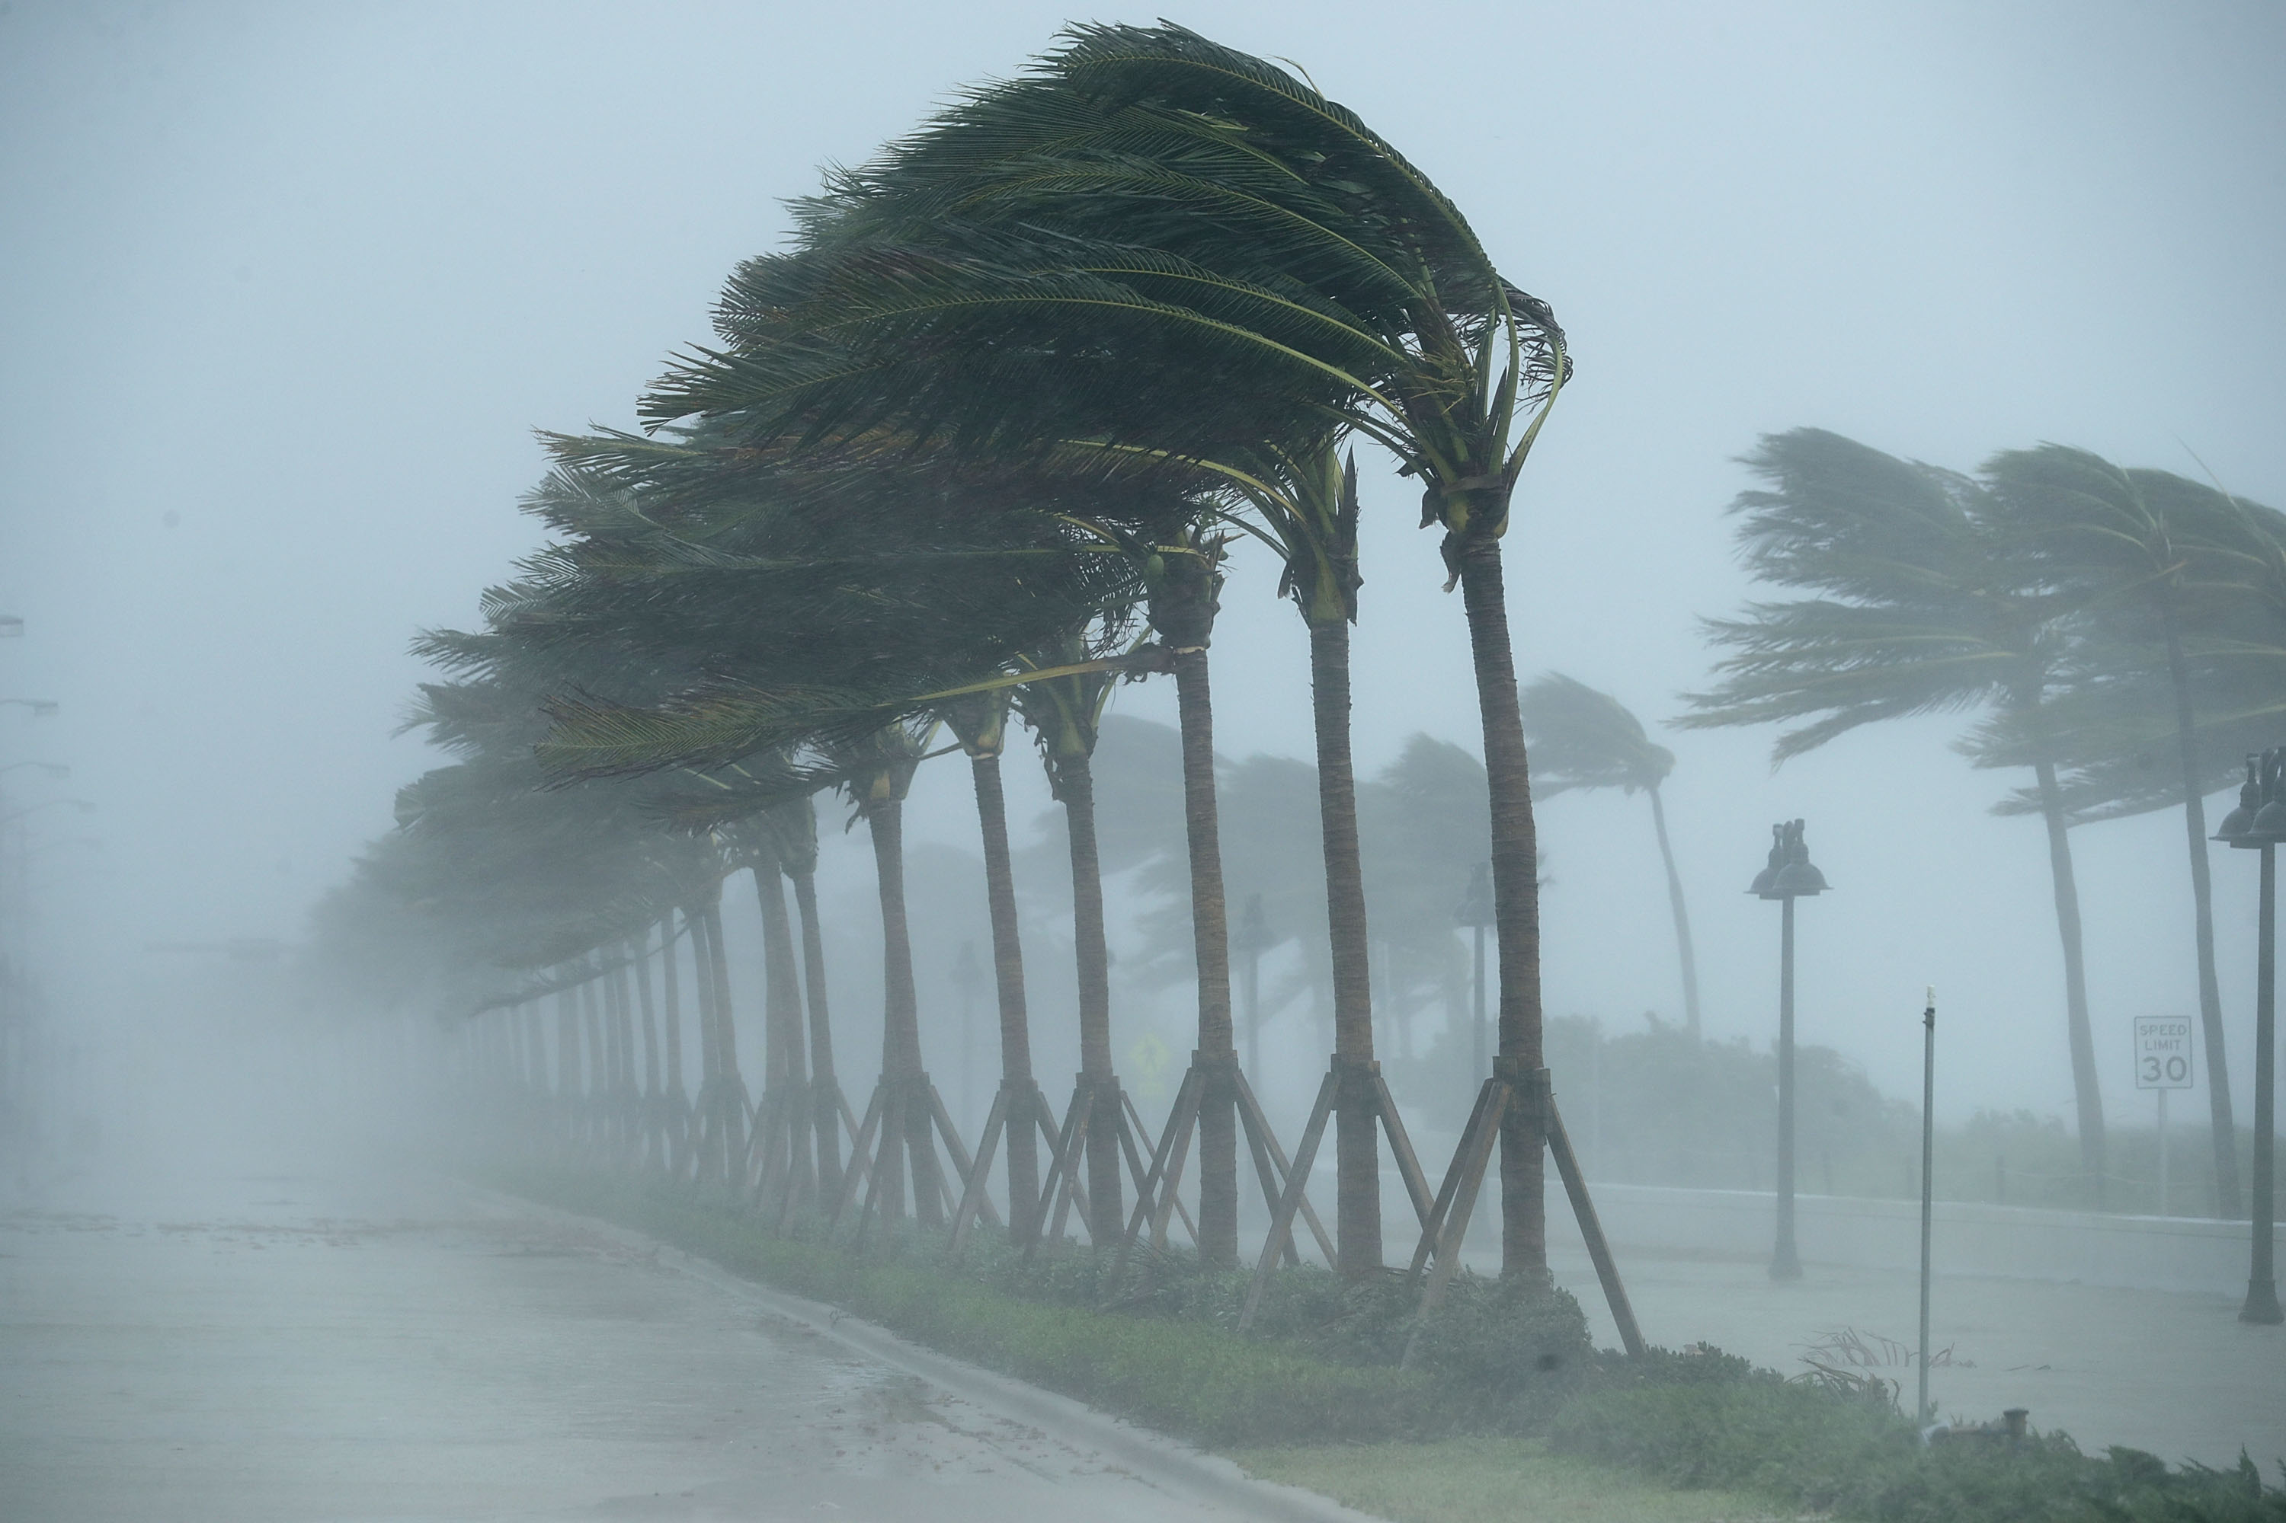
Using Physical Models to Estimate Weather Risk

Slide 6
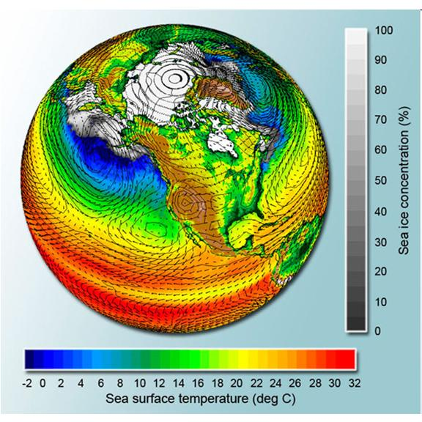
Doing it right:
Bring Physical Models to Bear on Risk Estimation

Slide 7
A physical model is an algorithm for solving the equations governing the system dynamics and physics
Satellite Image
Global Model

Slide 8
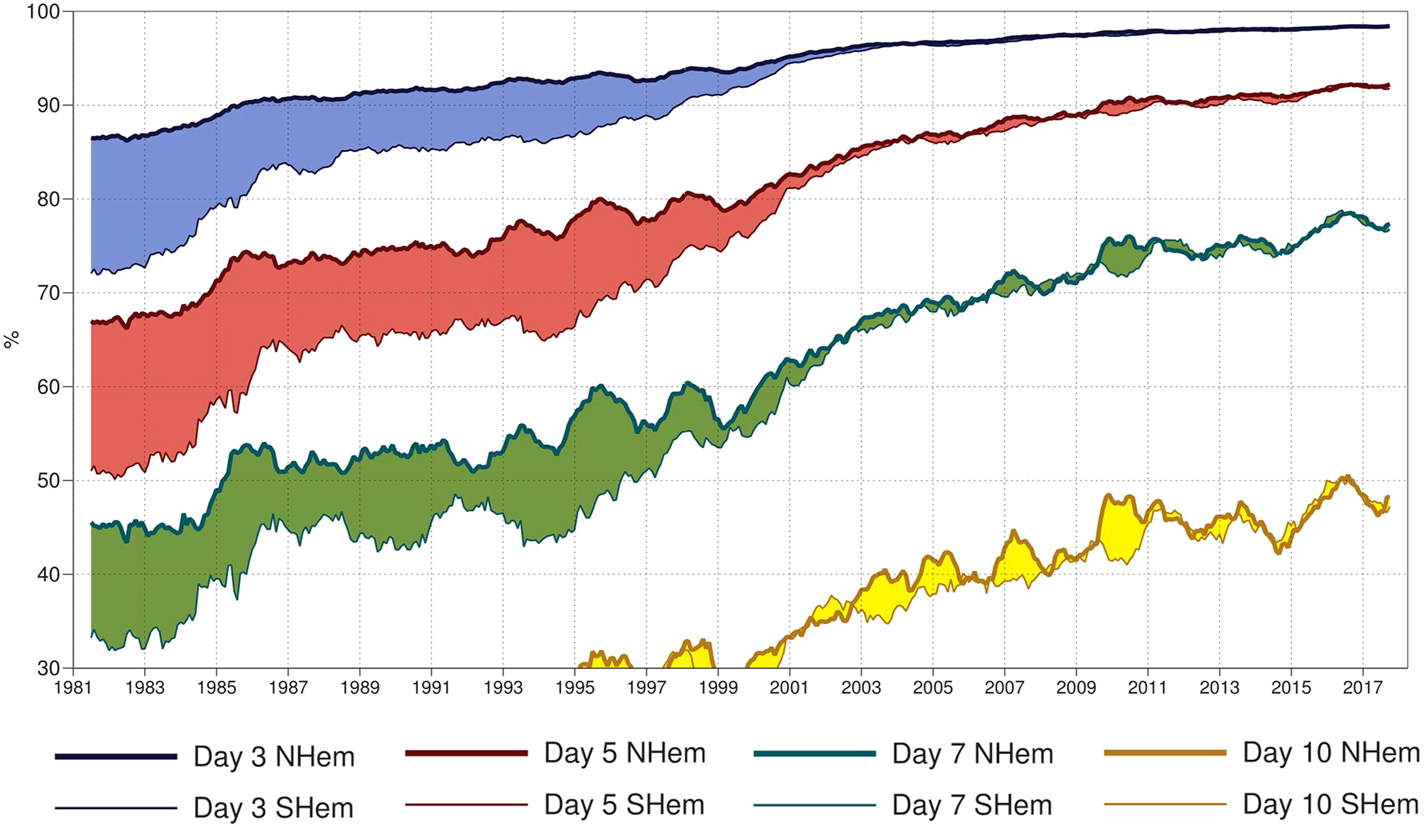
7-day forecast today about as accurate as 3-day forecast in 1980
A measure of the skill of numerical weather prediction models

Slide 9
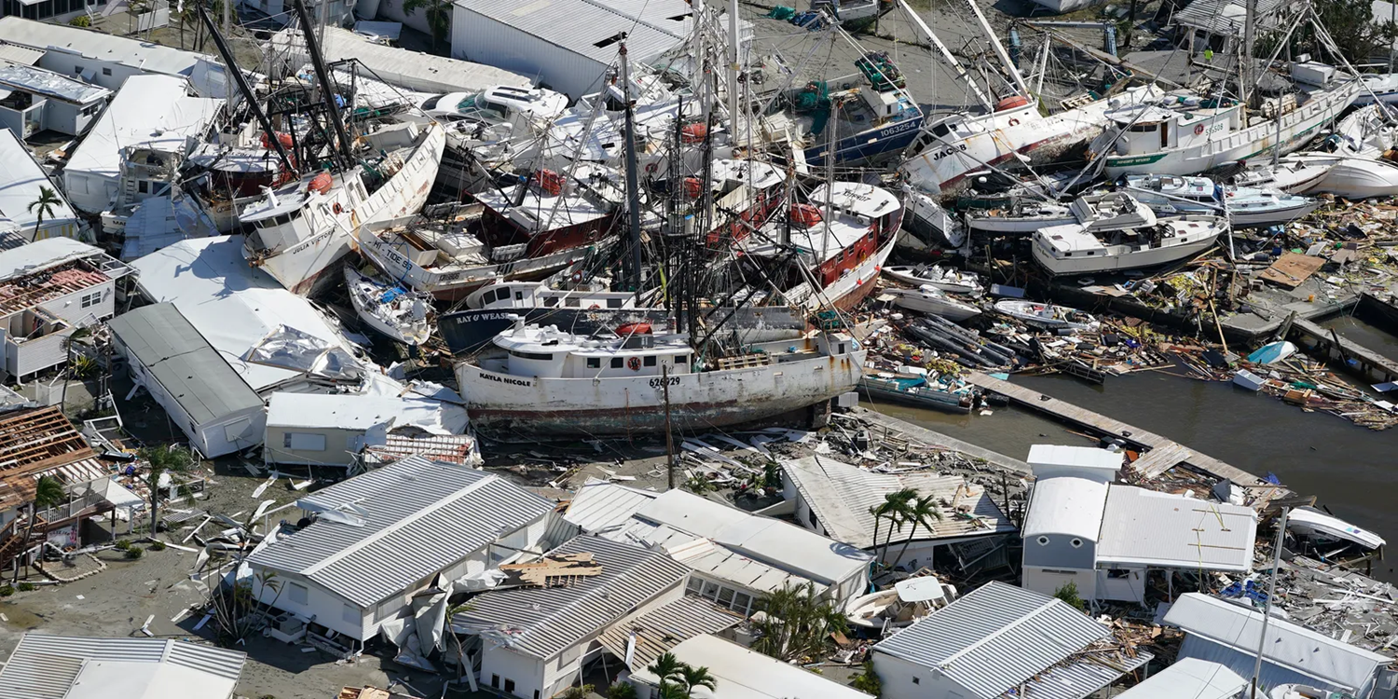
How can we bring physical modeling to bear on weather risk assessment?

Slide 10

Example: Hurricane Risk

Slide 11
Case in Point: Flooding from Hurricane Harvey, 2017
Three independent scientific studies appeared in 2017:
van Oldenborgh et al: “We conclude that global warming made the precipitation about 15% (8%–19%) more intense, or equivalently made such an event three (1.5–5) times more likely.”
Risser and Wehner: “We find that human-induced climate change likely increased the chances of the observed precipitation accumulations during Hurricane Harvey in the most affected areas of Houston by a factor of at least 3.5.”
Emanuel: “In 2017 the annual probability [of Hurricane Harvey’s rainfall in Harris County] would be 6%, a sixfold increase since the late 20th century.

Slide 12
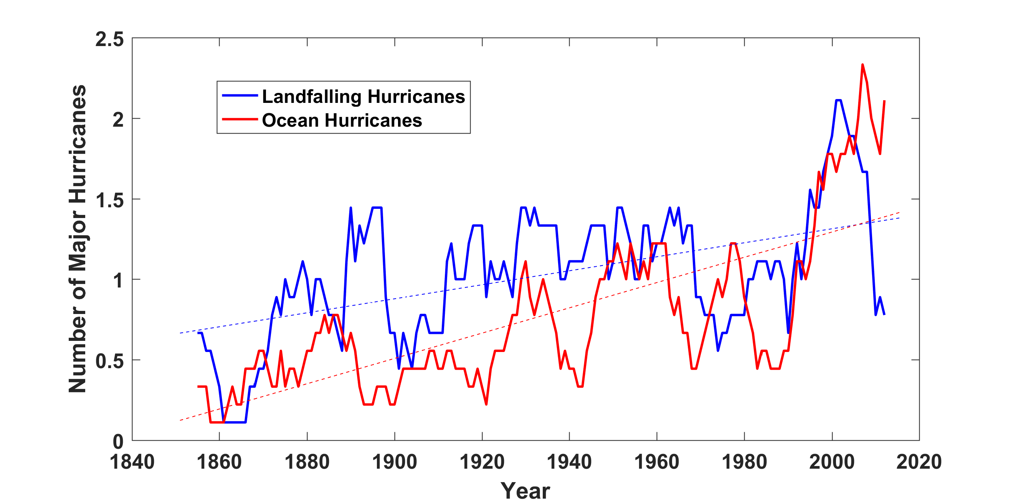
Historical Records:
Prior to 1970, Many Storms Were Missed
Major hurricanes in the North Atlantic, 1851-2016, smoothed using a 10-year running average. Shown in blue are storms that either passed through the chain of Lesser Antilles or made landfall in the continental U.S.; all other major hurricanes are shown in red. The dashed lines show the best fit trend lines for each data set.

Slide 13
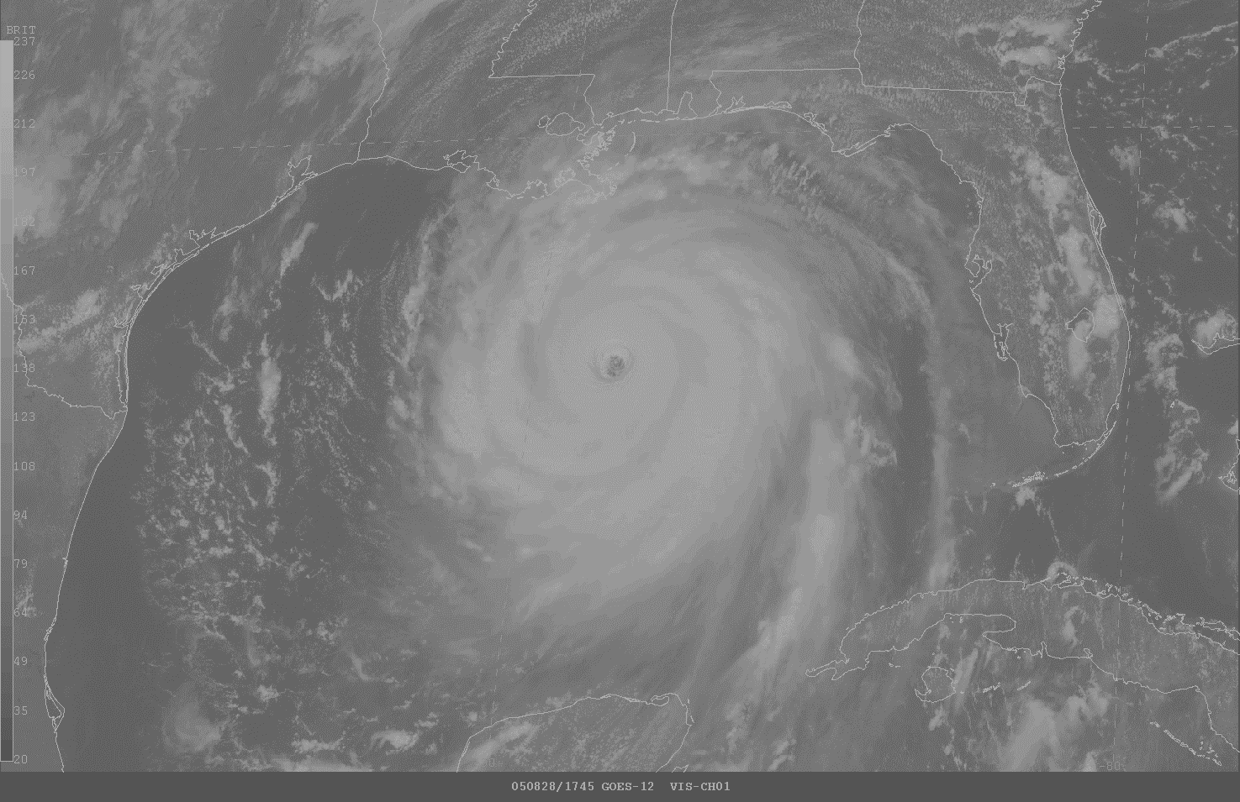
Physical Modeling of Hurricanes

Slide 14

Problem: Today’s models are far too coarse to simulate destructive hurricanes
Histograms of Tropical Cyclone Intensity as Simulated by a Global Model with 50 km grid point spacing. (Courtesy Isaac Held, GFDL)
Category 3
Modeled
Observed
Global models do not simulate the storms that cause destruction
Wind Speed (meters per second)

Slide 15
Using Physics to Assess Hurricane Risk
Reliable, global records of coarse-scale climate are robust and widely available
Cull from these datasets the key statistics known to control tropical cyclone generation, movement, and intensity evolution
Bootstrap these key statistic to create unlimited synthetic time series of the hurricane-relevant environmental variables
Use these to drive specialized, very high resolution physical hurricane models
Extensively validate the results against historical hurricane data
Exact same method can be applied to output of climate models

Slide 16

MIT Synthetic Hurricanes
Embed high-resolution, fast coupled ocean-atmosphere hurricane model in global climate model or climate reanalysis data
Coupled Hurricane Intensity prediction Model (CHIPS) has been used for 20 years to forecast real hurricanes in near-real time

Slide 17
Risk Assessment Approach:
Step 1: Seed each ocean basin with a very large number of weak, randomly located cyclones
Step 2: Cyclones are assumed to move with the large scale atmospheric flow in which they are embedded, plus a correction for the earth’s rotation and sphericity (beta-drift)
Step 3: Run the CHIPS coupled intensity model for each cyclone, and note how many achieve at least tropical storm strength
Step 4: Using the small fraction of surviving events, determine storm statistics. Can easily generate 100,000 events
Details: Emanuel et al., Bull. Amer. Meteor. Soc, 2008
Notes:
17

Slide 18
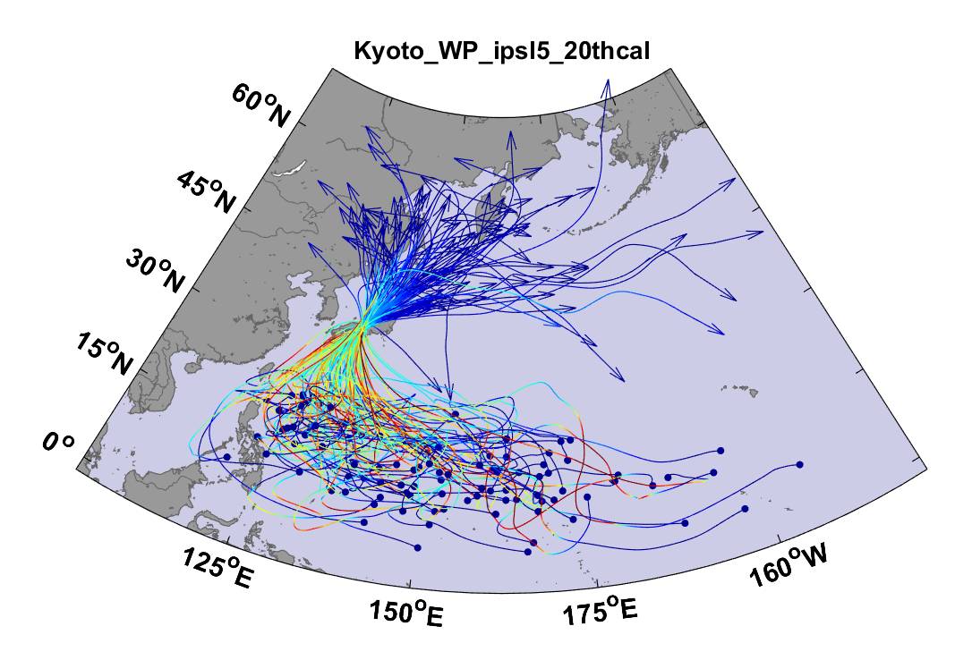
Example:
Top 100 out of 2000 TCs Affecting Kyoto, 1981-2000

Slide 19
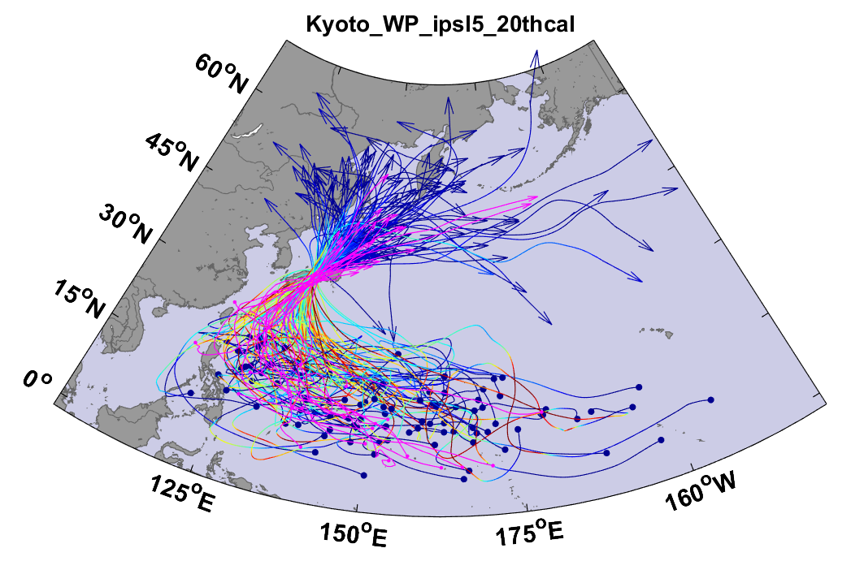
Same, but with top 20 historical tracks

Slide 20
Atlantic Annual Cycle

Slide 21

Cumulative Distribution of Storm Lifetime Peak Wind Speed, with Sample of 1755 Synthetic Tracks
Blue bars: Actual
Red bars: Predicted
90% confidence bounds

Slide 22

Captures effects of regional climate phenomena (e.g. ENSO, AMM)
Blue bars: Actual
Red bars: Predicted

Slide 23
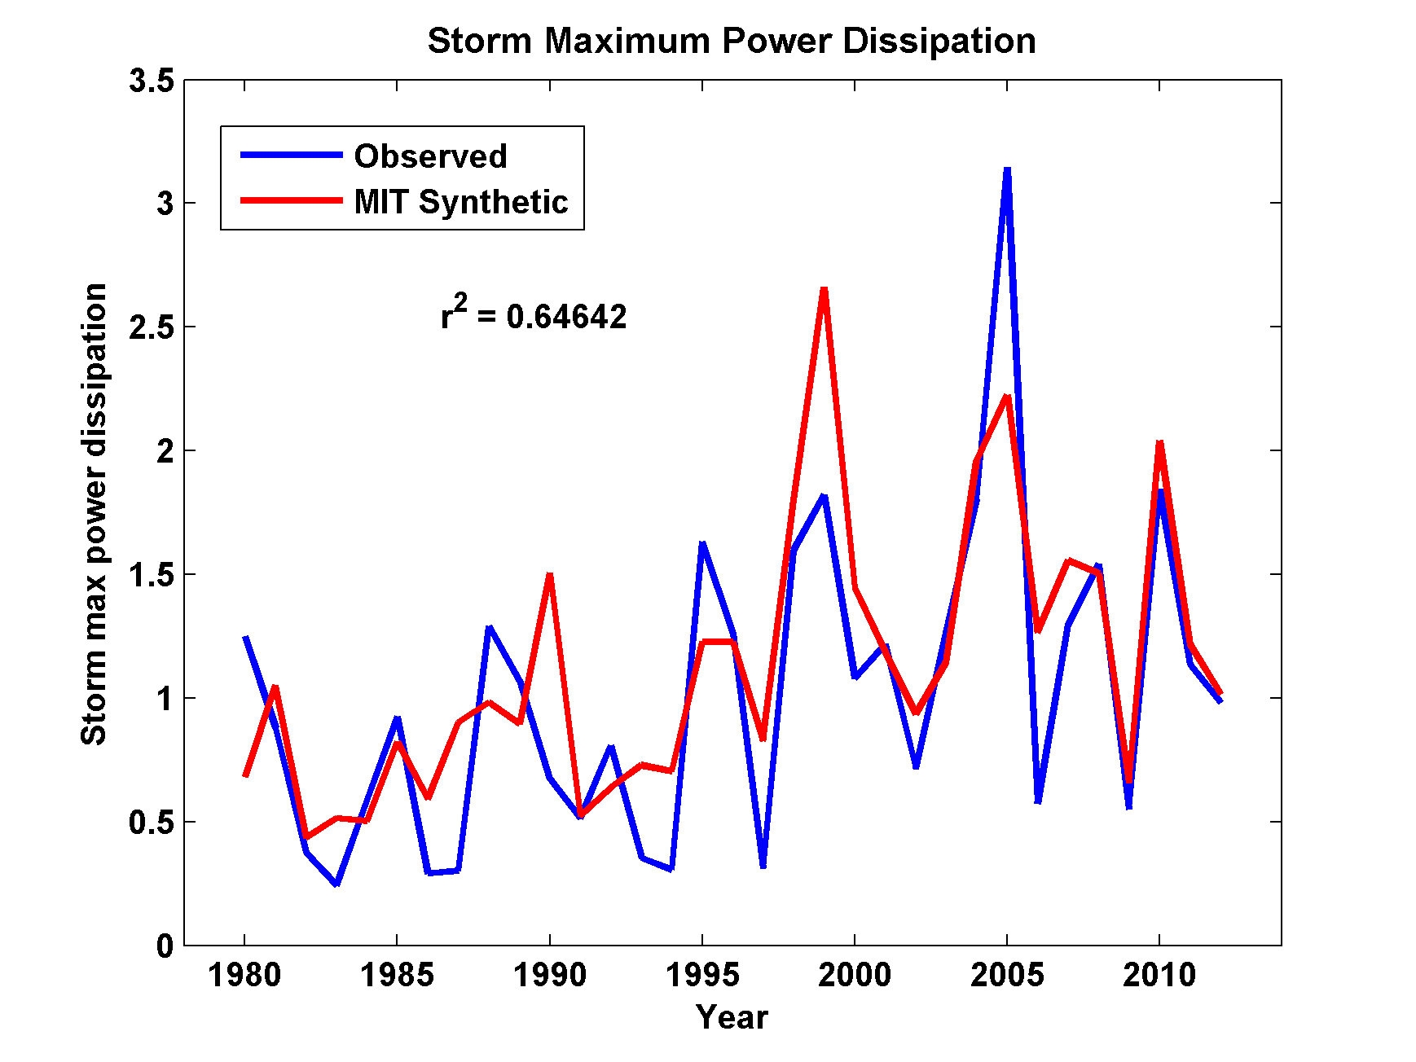
Captures Much of the Observed North Atlantic Interannual Variability
r²=0.65

Slide 24
Application to global gridded climate data:
Major Hurricanes
7-year running averages

Slide 25
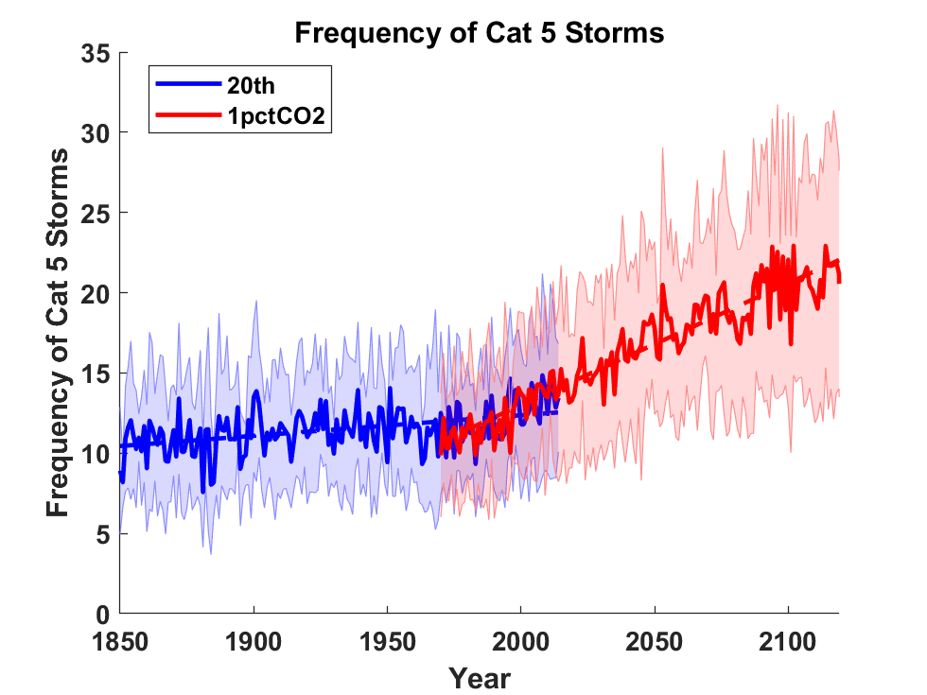
Application to Global Climate Change Simulations:
Global CAT 5 Tropical Cyclone Frequency from 9 Current Generation (CMIP6) Climate Models

Slide 26
Satellite-derived proportion of major hurricane fixes
Time series of fractional proportion of global major hurricane estimates to all hurricane estimates for the period 1979–2017. Each point, except the earliest, represents the data in a sequence of 3-y periods. The first data point is based on only 2 y (1979 and 1981) to avoid the years with no eastern hemisphere coverage. The linear Theil−Sen trend (black line) is significant at the 98% confidence level (Mann−Kendall P value = 0.02). The proportion increases by 25% in the 39-y period (about 6% per decade).
Kossin et al., PNAS, 2020

Slide 27
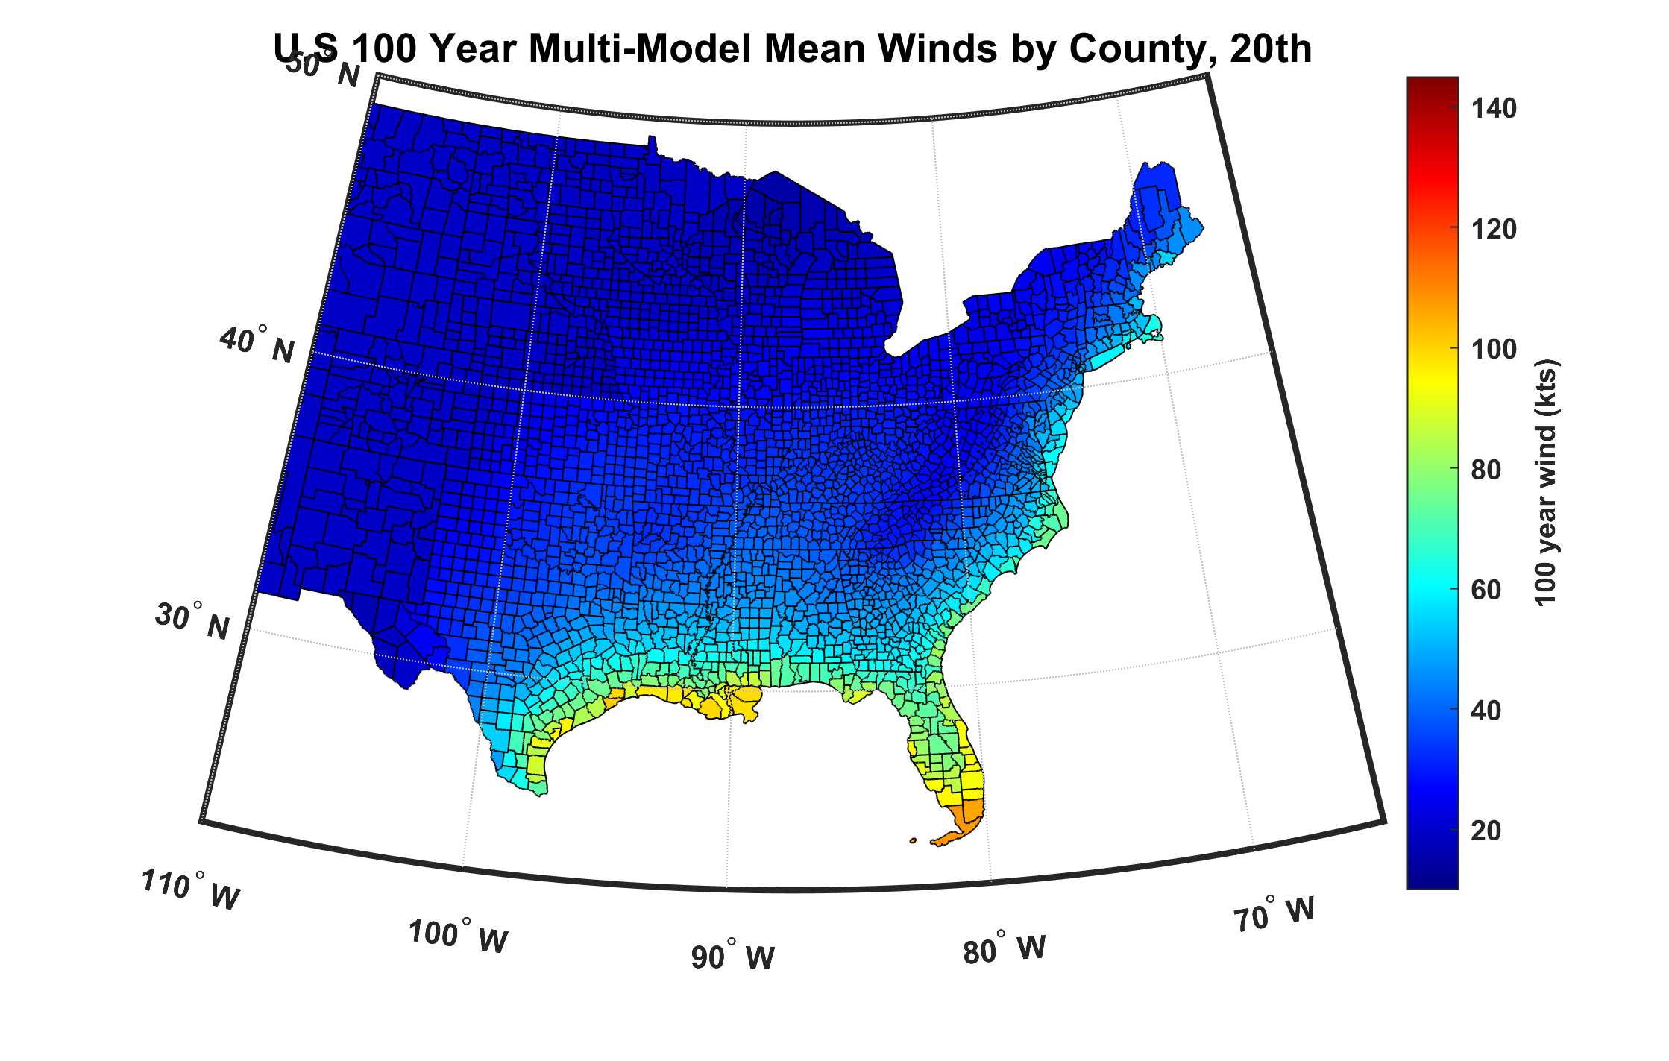
100-year hurricane peak wind based on downscaling 8 CMIP6 climate models, 1984-2014

Slide 28
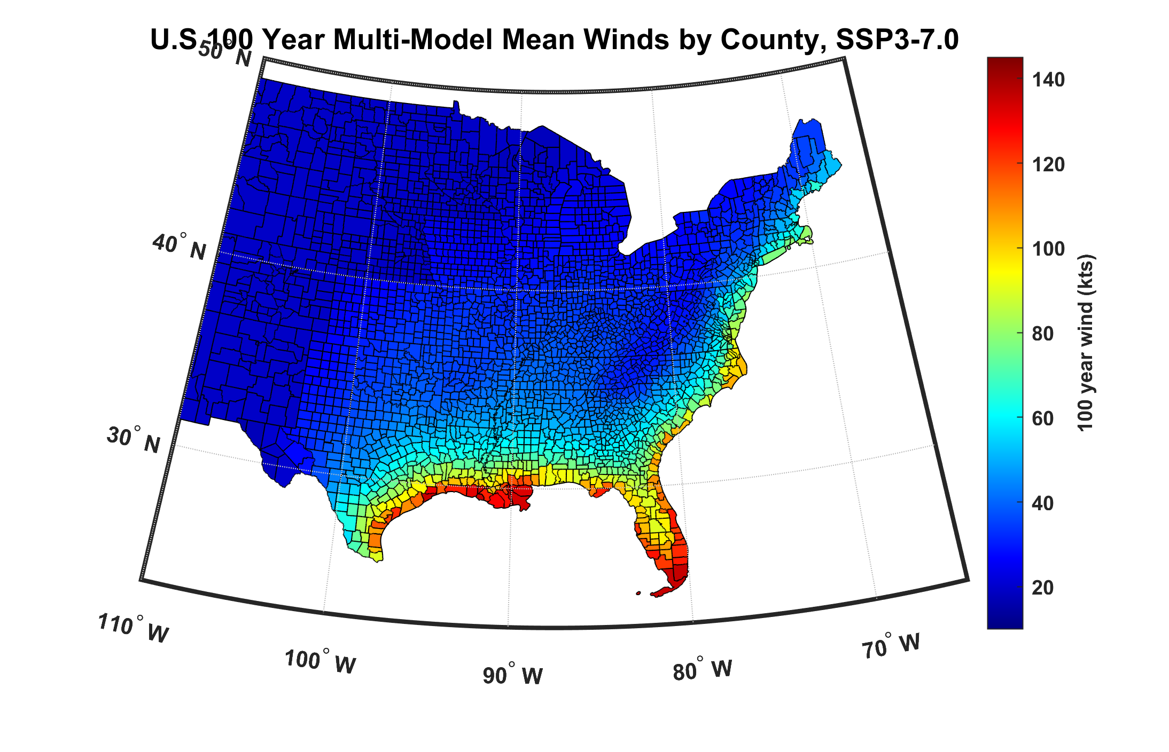
100-year hurricane peak wind based on downscaling 8 CMIP6 climate models, 2070-2100

Slide 29
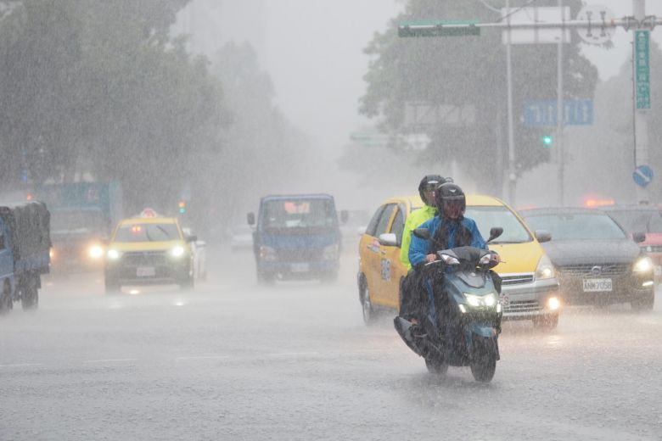
Hurricane Rain

Slide 30

~500 from water, ~80 from wind

Slide 31
2,000 year rain event for Houston

Slide 32
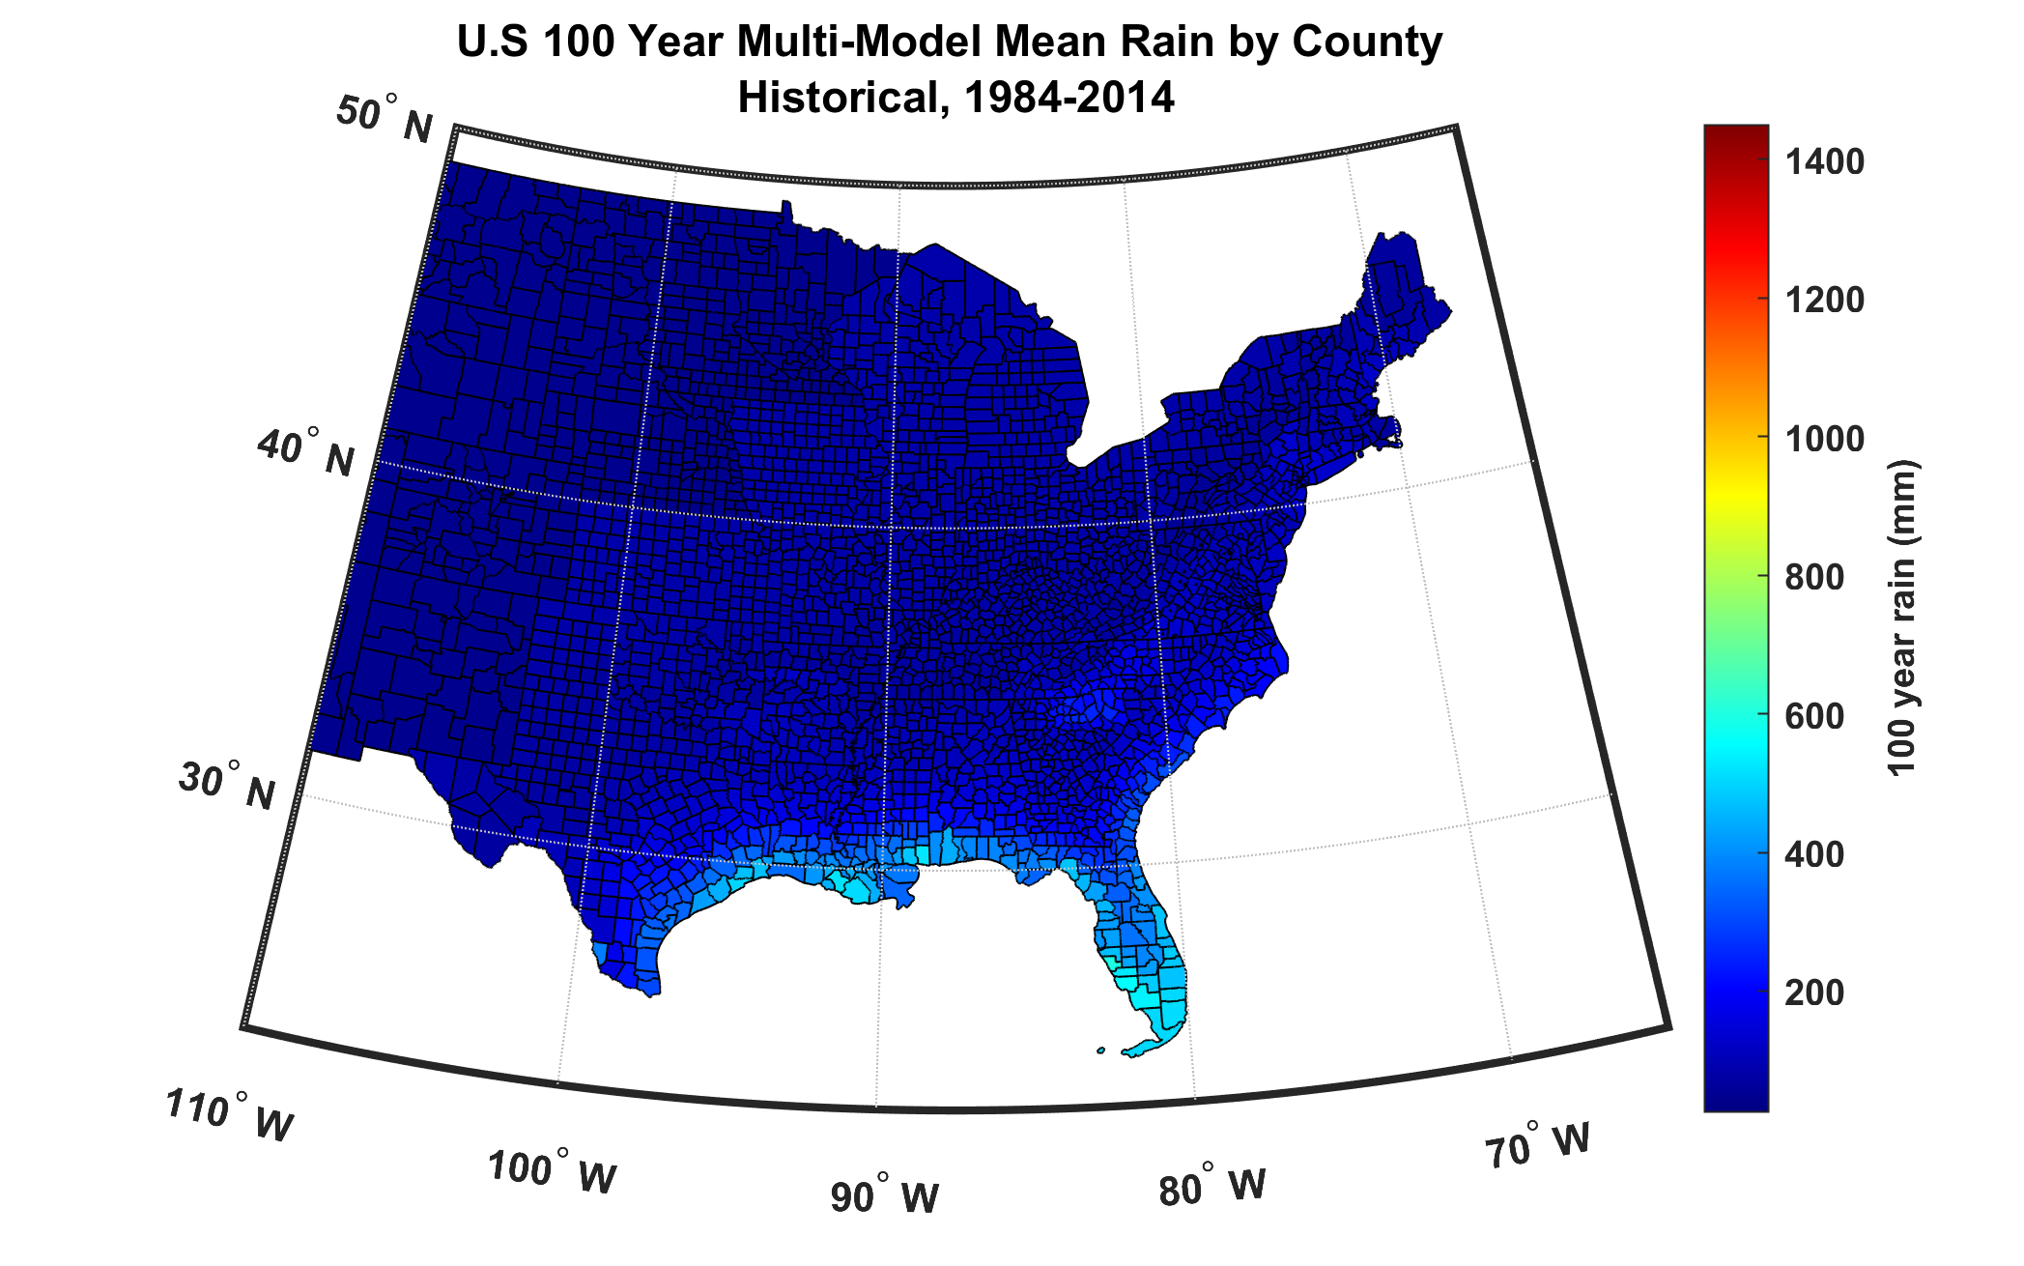
100-year hurricane storm total rain based on downscaling 8 climate models, 1984-2014

Slide 33
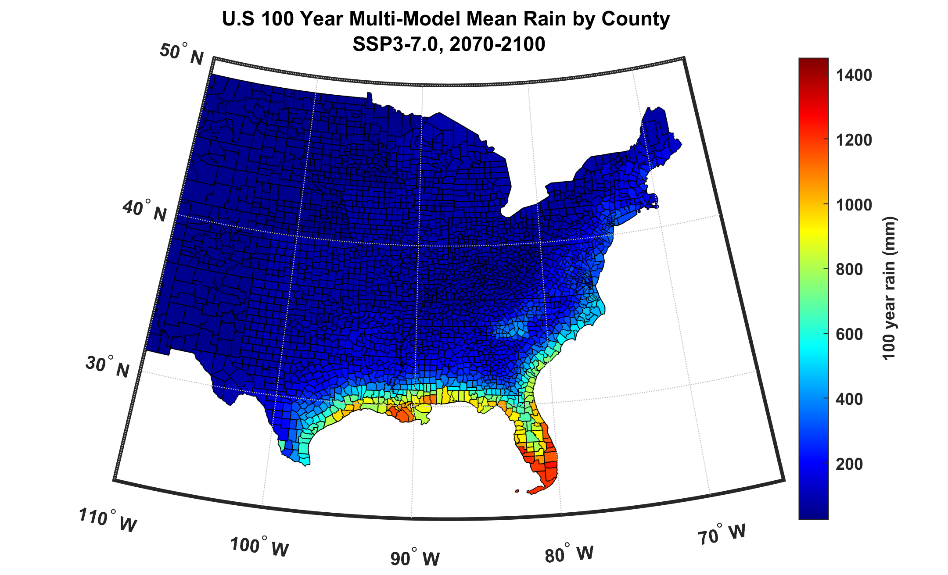
100-year hurricane storm total rain based on downscaling 8 climate models, 2070-2100

Slide 34
The nature of financial risks from weather hazards:
Hurricanes as an example
TIVs of particular insurance firm aggregated over zip codes
Net TIV: $ 2 trillion
12,968 zip codes

Slide 35
Procedure:
Generate 6,200 synthetic hurricane events affecting eastern U.S. from each of 8 global climate models for two period of time: 1985 – 2014 and 2071 – 2100 (SSP3 7.0)
Calculate peak wind speed at each zip code centroid for each hurricane event
Use damage function to convert peak with to percentage of insured value destroyed
Apply to TIV at each of the 12,968 zip codes and sum over them to estimate total loss to insurance form

Slide 36
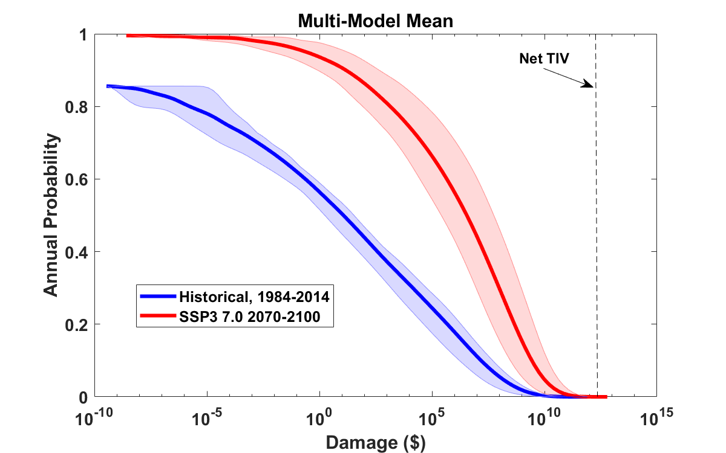
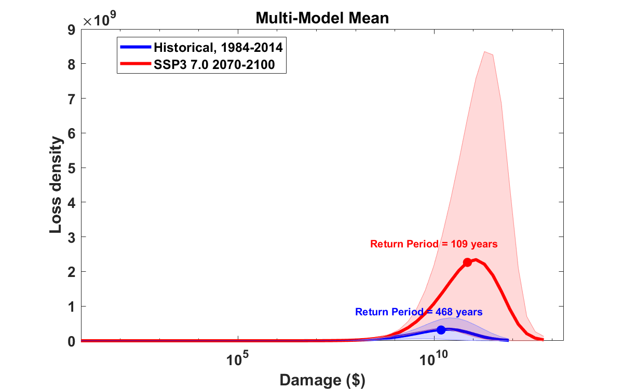
Median annual loss (2-year return period)
1984 – 2014: $ 12
2070 – 2100: $ 3.5 million
Average annual loss:
1984 – 2014: $536 million
2070 – 2100: $ 4.1 billion
Annual average loss strongly dominated by VERY rare events!
These will not be evident in historical records

Slide 37
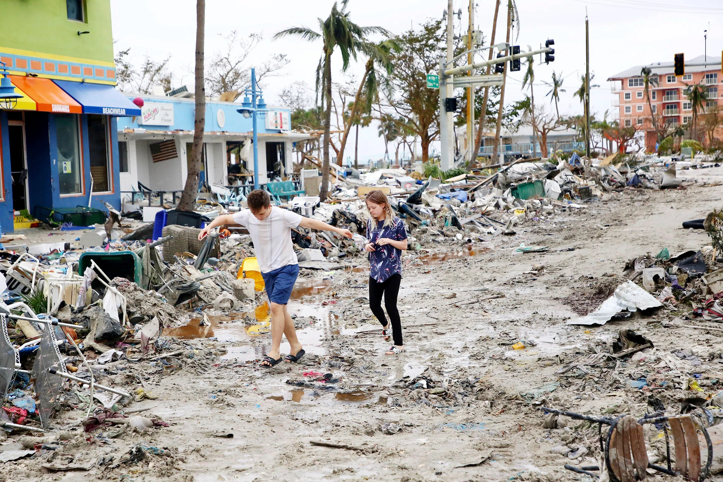
Making Risk Personal:
All Climate Change is Local!

Slide 38
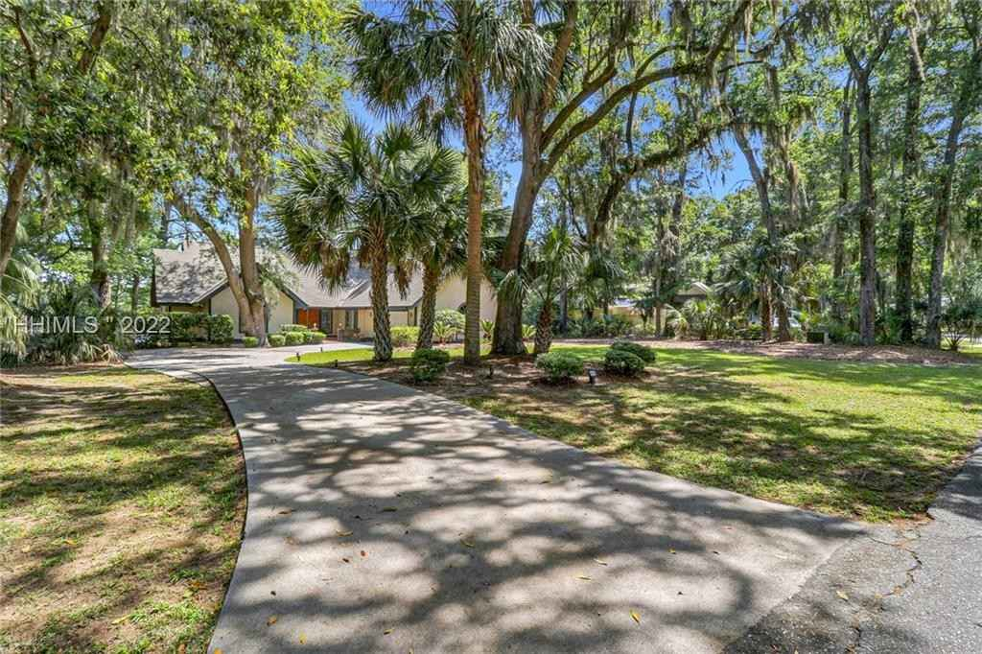
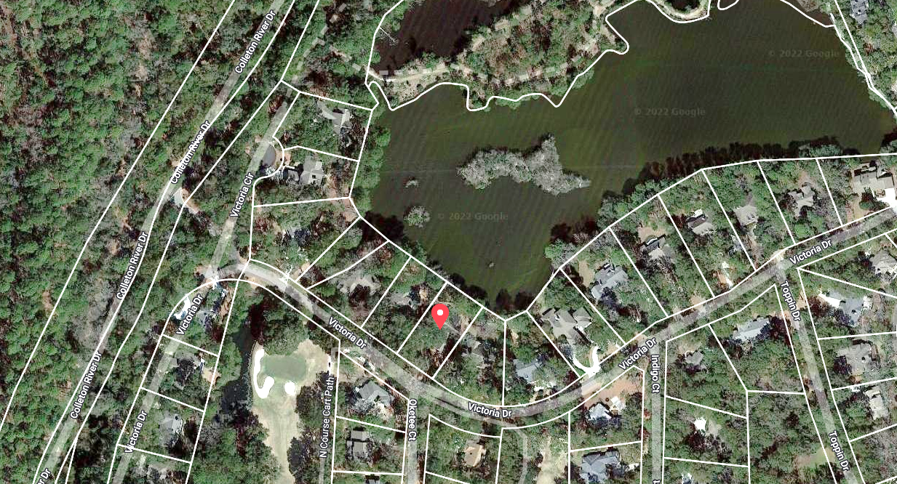
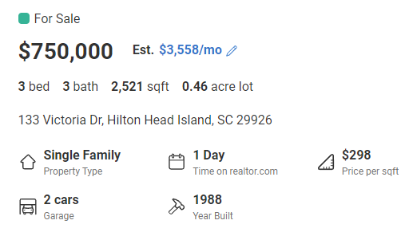


Property currently for sale in Hilton Head, SC
Realtor.com
Work of First Street Foundation

Slide 39
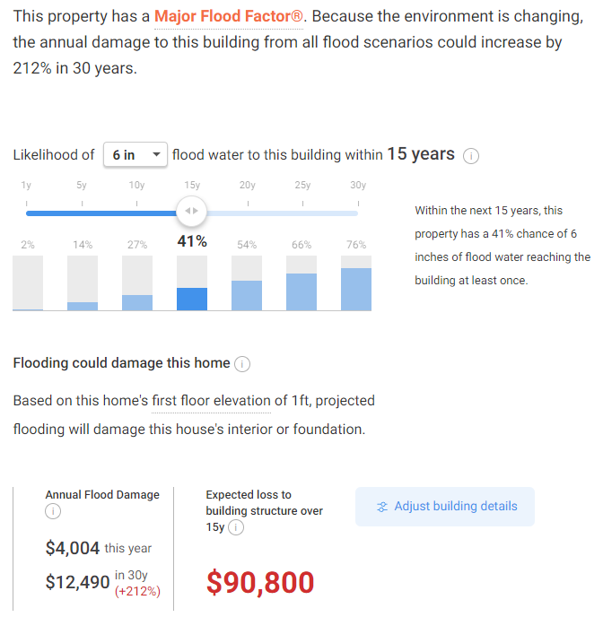

Slide 40
Take-Away Points
We need to move away from sole dependence on flawed historical data in assessing climate- and weather-related natural hazard risks and embrace advanced physical modeling techniques
Government, the insurance industry, and institutions of higher education are crucial to this effort
We can no longer regard climate change as a problem for the future; it has already tangibly affected important risks, e.g. Hurricane Harvey’s rainfall was ~3 times more likely in 2017 than in 1970
There is a large gap between current practice and what is possible and desirable. Let’s fill it.

Slide 41
Spare Slides

Slide 42
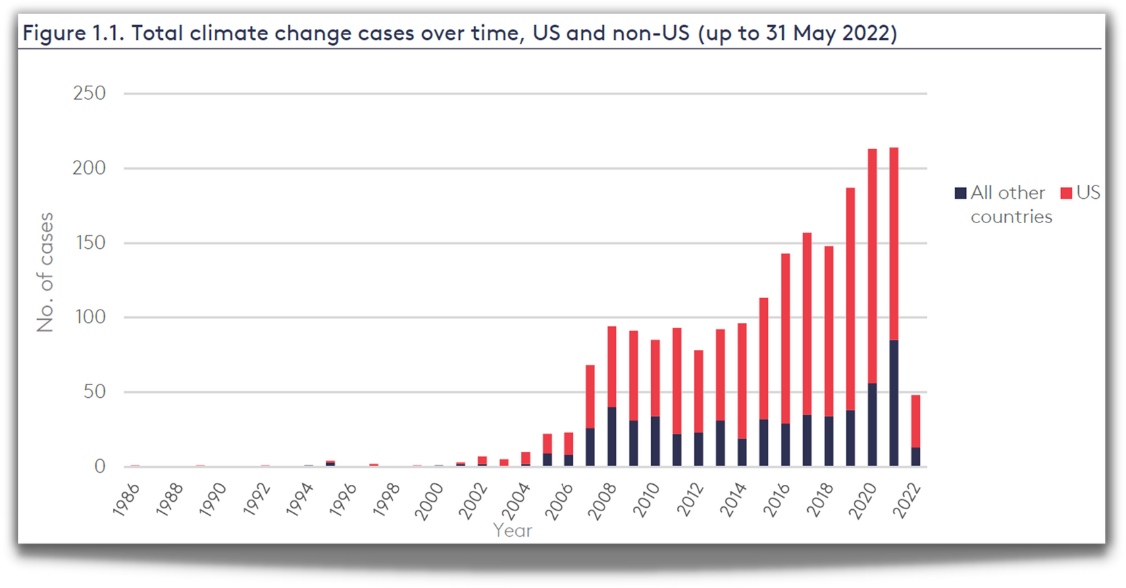

CLIMATE
LITIGATION
TRENDS
Currently 2,000+ U.S. climate cases
Source: Joana Setzer & Catherine Higham, Global Trends in Climate Change Litigation 9 (June 2022) (based on data from the Sabin Center and Climate Change Laws of the World databases)
Courtesy Sandra Thiam and Jarryd Page of the Climate Judiciary Project of the Environmental Law Institute

Slide 43
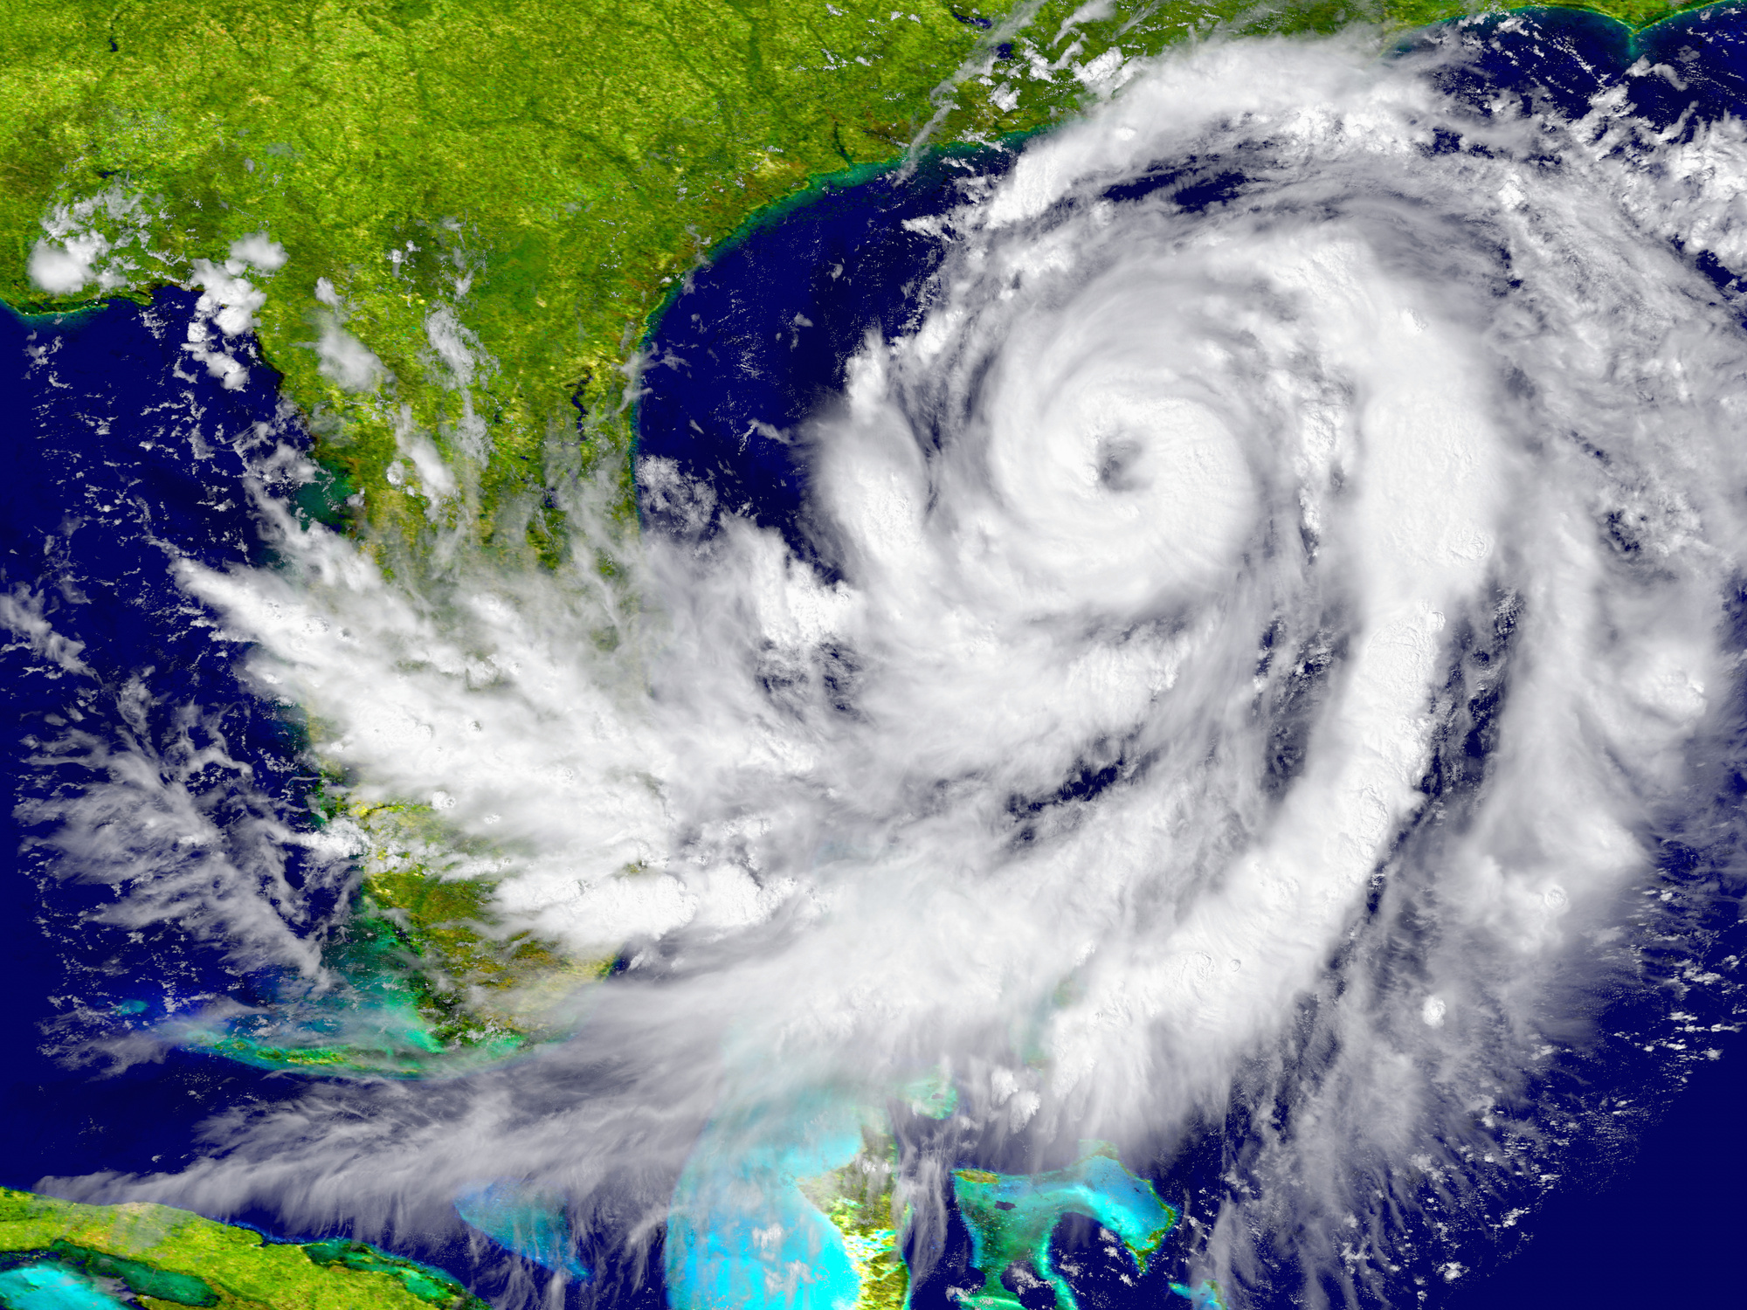
HURRICANE LITIGATION
Litigation happens before (planning and preparation) and after (impacts)
Can include:
  Torts (negligence, nuisance, trespass)
  Zoning and land use
  Impact assessments
  Insurance claims
Courtesy Sandra Thiam and Jarryd Page of the Climate Judiciary Project of the Environmental Law Institute

Slide 44
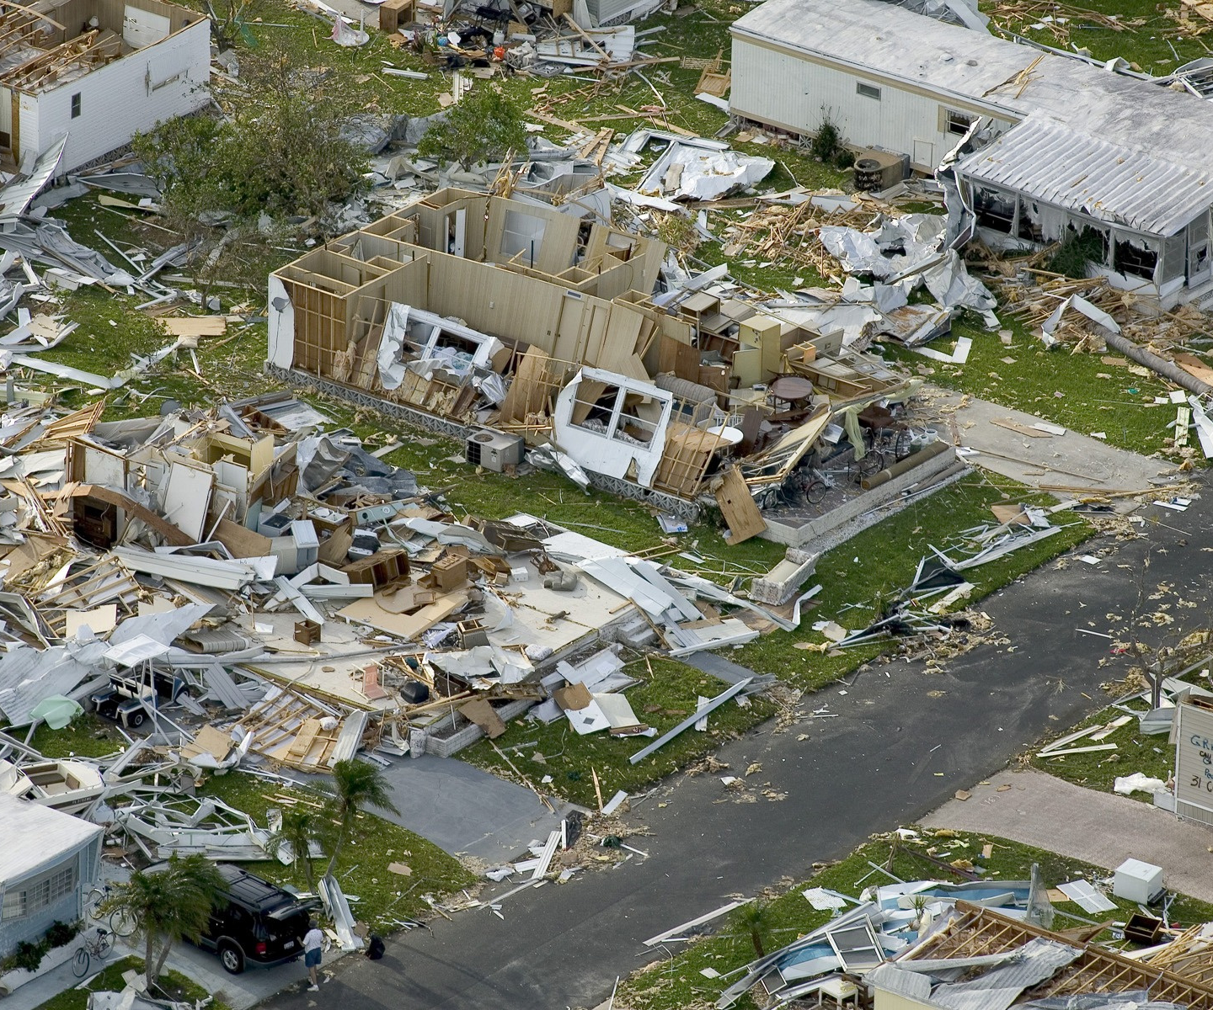
LEGAL ISSUES RELATED
TO HURRICANES:
INSURANCE
  whether homeowners' insurance settlements with insurance companies for damages sustained in a hurricane were appropriate
    (class action following Hurricane Sandy)
Courtesy Sandra Thiam and Jarryd Page of the Climate Judiciary Project of the Environmental Law Institute

