Slide 1
Hurricanes in the Gulf of Mexico: The History and Future of the Texas Coast
Kerry Emanuel
Massachusetts Institute of Technology
Notes:
1
What are hurricanes? How have they affected Texas and the Gulf though history? Are they getting worse and will they continue to get worse as the region warms? In this talk we will tackle these questions and others.
Image: Satellite image of Hurricane Floyd approaching the east coast of Florida in 1999. The image has been digitally enhanced to lend a three-dimensional perspective. Credit: NASA/Goddard Space Flight Center.

Slide 2
Program
Overview of hurricanes
History of Texas hurricanes
Texas hurricane risk, present and future
Notes:
We will begin with a broad-brush over view of hurricanes and continue with a review of Texas hurricane history. We will finish up with a presentation of new findings on the effect of climate change on hurricanes in Texas and round the world.

Slide 3
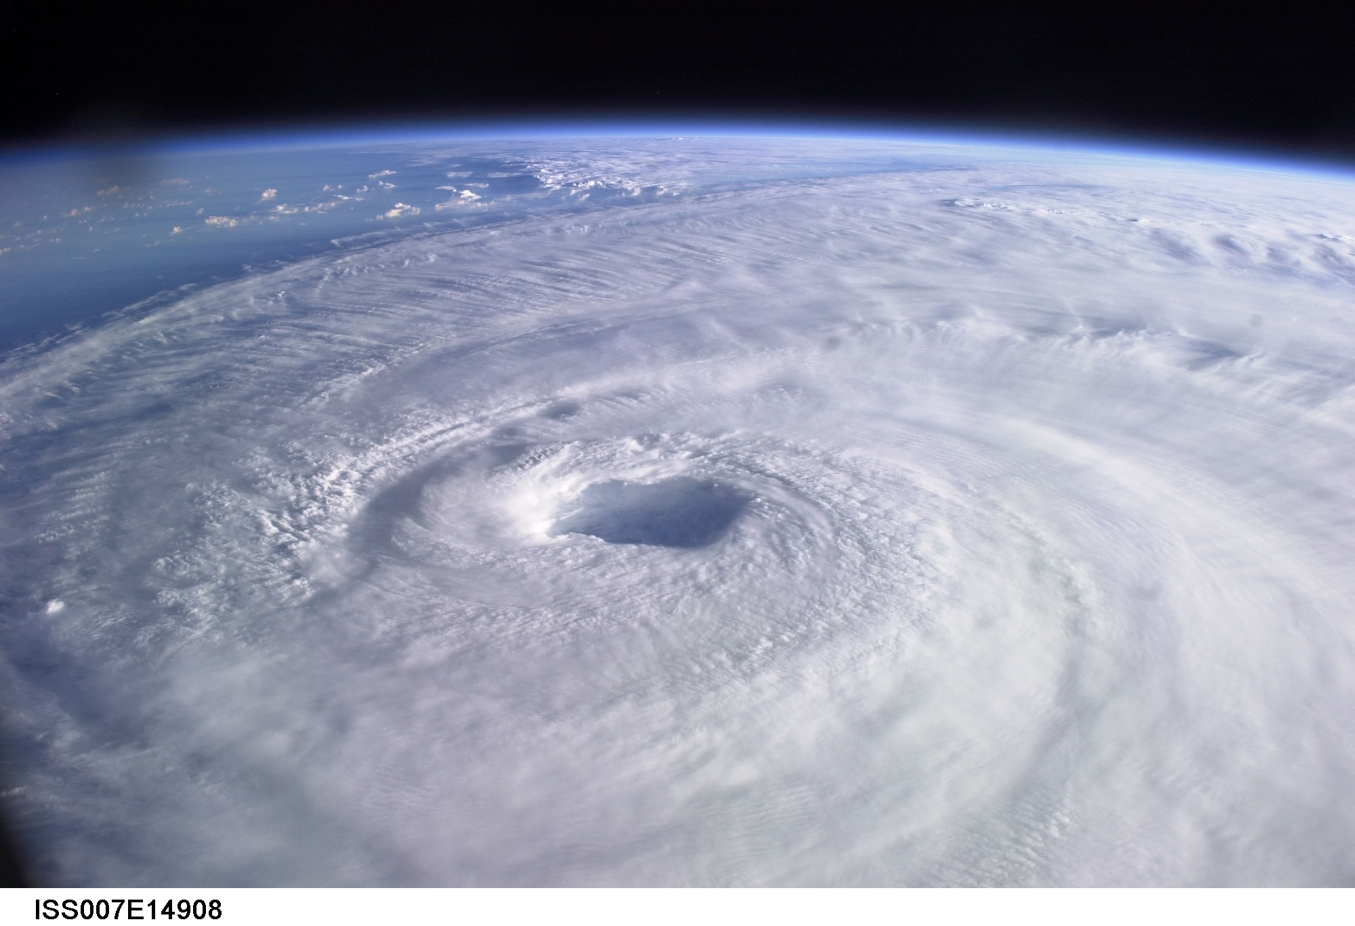
Overview of Hurricanes
Notes:
3

Slide 4
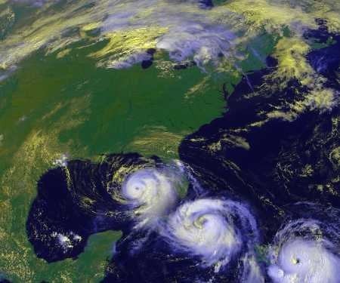
What is a Hurricane?
Formal definition:
A tropical cyclone with 1-minute average winds at 10 meter altitude in excess of 32 meters/second (64 knots or 74 miles per hour) occurring over the North Atlantic or eastern North Pacific
Notes:
A hurricane is a tropical cyclone with a 1-minute average winds at 10 meter altitude in excess of 32 meters/second (64 knots or 74 mph) occurring over the North Atlantic or eastern North Pacific.
Image: Data derived from NOAA GOES satellite. Credit: Dennis Chesters, Marit Jentoft-Nilsen, Craig Mayhew, and Hal Pierce, Laboratory for Atmospheres, NASA Goddard Space Flight Center (http://rsd.gsfc.nasa.gov/rsd/images/Georges.html).
Definitions
A tropical cyclone is a storm system fueled by the heat released when moist air rises and condenses. The name underscores their origin in the tropics and their cyclonic nature, which is that its circulation is counterclockwise in the northern hemisphere and clockwise in the southern hemisphere. Depending on their location and strength, there are various terms by which tropical cyclones are known, such as hurricane, typhoon, tropical storm, and tropical depression (from and for more information see http://en.wikipedia.org/wiki/Hurricane.

Slide 5
The word Hurricane is derived from the Mayan word Huracan and the Taino and Carib word Hunraken, a terrible God of Evil, and brought to the West by Spanish explorers
Notes:
The early inhabitants of Cuba carved images in stone of the god wind and destruction they called Huracán. The various likenesses of Huracán invariably consist of a head with intermediate gender with no torso, and two distinctive arms spiraling out from its sides. Most of these images exhibit cyclonic (counterclockwise) spirals. The Cuban ethnologist Fernando Ortiz believes that they were inspired by the tropical hurricanes that have always plagued the Caribbean. If so, the Tainos (a group of American Indians in northeastern South America) discovered the vortical nature of hurricanes many years before the descendants of European settlers did. How they may have made this deduction remains mysterious. The spiral rain bands so well known to us from satellite pictures were not “discovered” until meteorological radar was developed during World War II, and they are far too big to be discerned by eye from the ground. What ever its source, the image of Huracán remains an enigmatic premonition of what would be seen in radar and satellite imagery many hundreds of years later, and what would form the basis of the internationally recognized symbol of a tropical cyclone.
The image on the left shows the likeness of the god Huracán from a Cuban ceramic vase.
The image on the right is the universal symbol of the tropical cyclone. In the southern hemisphere, the arms are curved in the opposite sense.
The images are copyrighted 2005 by Oxford University Press.
Description from “Divine Wind: The History and Science of Hurricanes”, Kerry Emanuel, 2005, Oxford University Press, 296 p.
Definitions
Vortical means of, relating to, or moving in a vortex; whirling (from http://www.answers.com/topic/vortical).
Vortex is a spiral motion of fluid within a limited area, especially a whirling mass of water or air that sucks everything near it toward its center (from http://www.answers.com/topic/vortex).

Slide 6
The View from Space
Notes:
The advent of reconnaissance aircraft and radar in the 1940s, and of satellites in the 1960s, gave scientists the means to determine the detailed structure and evolution of hurricanes. Today, almost everything we know about hurricanes is based on observations by aircraft, radar, and satellites. This satellite image shows Hurricane Floyd approaching the east coast of Florida in 1999. This image has been digitally enhanced to lend a three-dimensional perspective. The swirling mass of clouds is about 300 kilometers (180 miles) across, and Floyd’s eye is about 50 kilometers (30 miles) in diameter. Surrounding the eye is a deep ring of thick cloud called the eyewall. A thin veil of very high cloud covers most of the swirling mass of thicker clouds; this is the veil of cirrus, made up of tiny ice crystals. Underneath it, and thus invisible from above, are several spiral shaped bands of deep, thick cumulonimbus clouds, interspersed between relatively clear sky. These spiral bands produce heavy rains and gusty winds well outside the eyewall of the hurricane, where the strongest winds are found.
Image: Satellite image of Hurricane Floyd approaching the east coast of Florida in 1999. The image has been digitally enhanced to lend a three-dimensional perspective. Credit: NASA/Goddard Space Flight Center.
Description from “Divine Wind: The History and Science of Hurricanes”, Kerry Emanuel, 2005, Oxford University Press, 296 p.
Definitions
Reconnaissance is the military term for the active gathering of information about an enemy, or other conditions, by physical observation (from and for more information see http://en.wikipedia.org/wiki/Reconnaissance).
The eye is a region of mostly calm weather found at the center of strong tropical cyclones. The eye of a storm is usually circular and typically 25–40–65 kilometers (40 miles) in diameter. It is surrounded by the eyewall, where the most severe weather of a cyclone occurs (from and for more information see http://en.wikipedia.org/wiki/Eyewall).
Cirrus clouds are thin and often wispy clouds that are the most common form of high-level clouds. Typically found at heights greater than 20,000 feet (6,000 meters), cirrus clouds are composed of ice crystals that originate from the freezing of supercooled water droplets (from and for more information see http://weather.about.com/library/glossary/blglossary.htm).
Cumulonimbus clouds are large and vertically developed clouds that are fueled by vigorous convective updrafts (sometimes in excess 50 knots), the tops of cumulonimbus clouds can easily reach 39,000 feet (12,000 meters) or higher (from and for more information see http://weather.about.com/library/glossary/blglossary.htm).

Slide 7
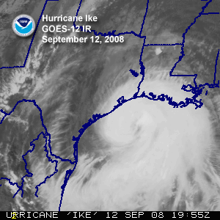

Slide 8
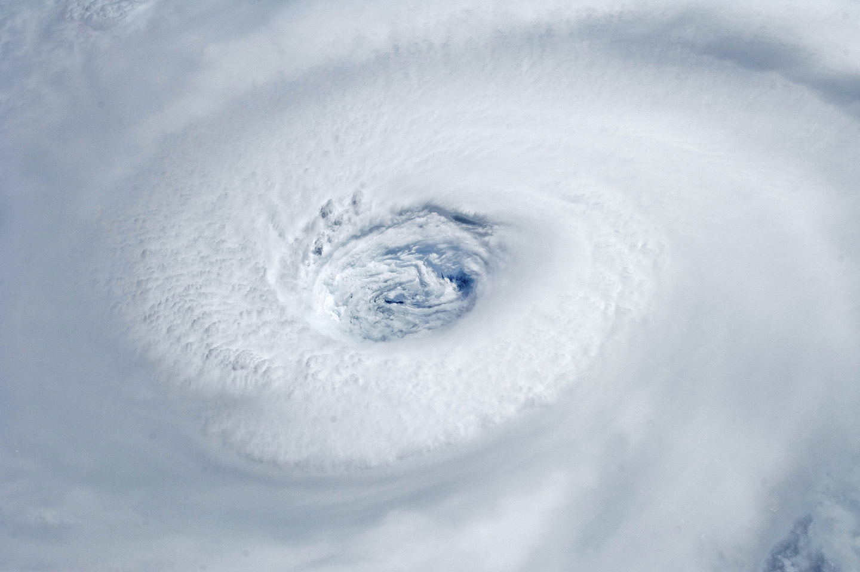
Igor, 2010
Notes:
Astronauts aboard the International Space Station took this digital photograph of the eye of Hurricane Igor at 10:56 Atlantic Daylight Time (13:56 UTC) on September 14, 2010. The storm was a category four hurricane on the Saffir-Simpson scale of intensity. At the time of the image, Igor was centered in the Atlantic Ocean near 18°N 52°W and slowly moving west-northwest at 11 kilometers (7 miles) per hour, according to the U.S. National Hurricane Center. Maximum sustained winds of 213 km (132 mi.) per hour, with gusts to 259 km (161 mi.) per hour. Credit: NASA

Slide 9
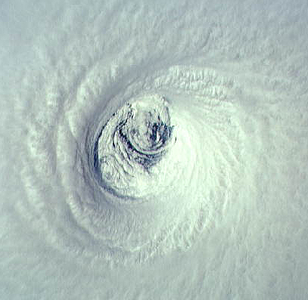
Emelia, 1994
Notes:
The eye of Hurricane Emilia over the eastern North Pacific ocean, as seen from directly above by the crew of the space shuttle Columbia on July 19th, 1994. At this time, Emilia had maximum sustained winds of 155 miles per hour. Looking at the eye from above is like staring down the middle of a bathtub whirlpool, except that the boundaries are made of cloud and the “funnel” comes to an abrupt end at the sea surface. The eyewall is visible as the stadium of thick, white cloud surrounding the eye. This is where the strongest winds and heaviest rains are found. Unlike the bathtub whirlpool, the air inside the eyewall is going up, not down, as it swirls around the eye. There are spiral striations along the inner edge of the eyewall and two big swirling eddies in the low clouds at the base of the eye. No mere photograph can do justice to the sensation of being inside the eye of a hurricane. Imagine a Roman coliseum 20 miles wide and 10 miles high, with a cascade of ice crystals falling along the coliseum’s blinding white walls.
Image: The eye of Hurricane Emilia over the eastern North Pacific on July 19, 1994, at 19:33 GMT. Credit: NASA Johnson Space Center Digital Image Collection.
Description from “Divine Wind: The History and Science of Hurricanes”, Kerry Emanuel, 2005, Oxford University Press, 296 p.
Definitions
Striations are grooves or channels in cloud formations, arranged parallel to the flow of air and therefore depicting the airflow relative to the parent cloud. Striations often reveal the presence of rotation, as in the barber pole or "corkscrew" effect often observed with the rotating updraft of an Low Precipitation (LP) storm (from http://www.srh.weather.gov/srh/jetstream/append/glossary_s.htm).
Eddies are water or air currents flowing in circular patterns (from www.terrax.org/sailing/glossary/ge.aspx).

Slide 10
Notes:
The eye of Hurricane Georges in this photo taken from a reconnaissance aircraft gives some impression of a hurricane’s eye.
However impressive a hurricane’s visual appearance, it is the instruments aboard satellites and aircraft that reveal the essence of a hurricane’s structure and inner workings. In the early days of aircraft reconnaissance, the crew estimated wind speeds by looking down and noting how rough the sea appeared. Today, a sophisticated array of instruments automatically collects large quantities of high-quality data, which are taken back to laboratories and analyzed.
Image: The eye of Hurricane Georges in photo taken from a reconnaissance aircraft. The eyewall at right is casting a shadow across part of the eyewall ahead. Credit: Michael Black, Hurricane Research Division, NOAA-AOML, Miami, Florida.
Description from “Divine Wind: The History and Science of Hurricanes”, Kerry Emanuel, 2005, Oxford University Press, 296 p.

Slide 11
Hurricane Structure: Wind Speed
Azimuthal component of wind
< 11 mph - > 145 mph
Notes:
A composite view of the distribution of wind speed in a typical hurricane based on measurements made from research aircraft. In this image and the two that follow, the center of the hurricane is in the center of the panel and the cutaway extends outward about 200 km (125 miles) and upward to about 18 km (11 miles). A satellite image of the top of a storm has been superimposed.
This image shows the speed of the wind going counterclockwise around the center of the storm; the black dashed lines show the altitudes at which the aircraft were flying. The darkest shade of blue indicates the lightest winds, less than 5 meters/second (11 mph). Each successive color represents an increment of 5 meters/second (11 mph), with bright orange showing winds in excess of 65 meters/second (145 mph). The strongest winds occur just above the ocean in a ring around the center, slightly outside the eyewall of the storm. Winds decrease rapidly inward toward the center, which is practically calm. They also decrease outward from the ring of maximum wind , but much more slowly, so that strong winds can still be found 100 kilometers (60 miles) from the center of the storm. As we go up from the surface, the counterclockwise winds get lighter and lighter. If the highest aircraft had flown even higher, it would have actually encountered “negative” wind speed, which here means winds going the other way (clockwise) around the center.
Image is copyrighted 2005 by Oxford University Press.
Image and description from “Divine Wind: The History and Science of Hurricanes”, Kerry Emanuel, 2005, Oxford University Press, 296 p.

Slide 12
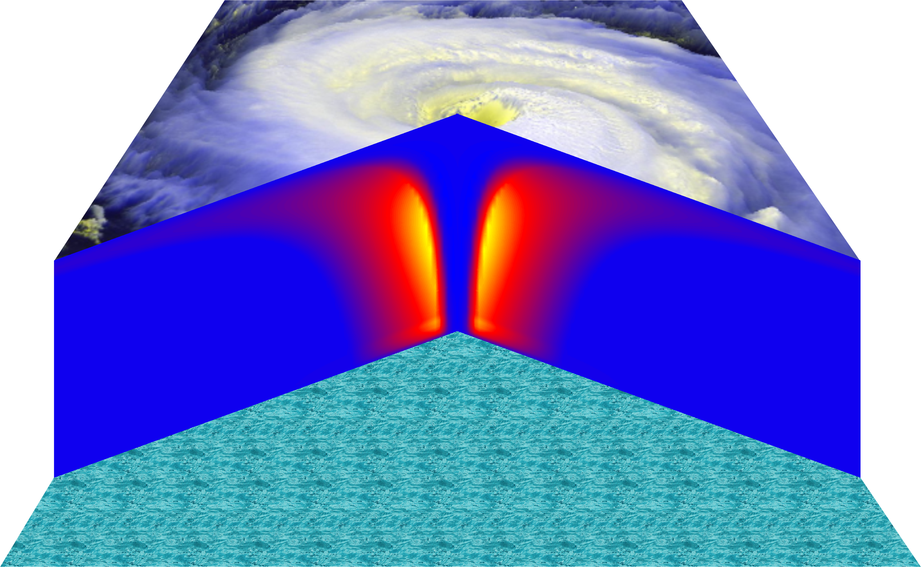
Vertical Air Motion
Updraft Speed
Strong upward motion in the eyewall
Notes:
This image shows a composite view of the distribution of updraft (vertical air motion) in a typical hurricane based on computer model calculations. The yellow and orange represent a strong upward motion in the eyewall. Although it is too weak to be seen in this figure, there is downward motion in the eye itself, strongest right next to the eyewall, and also in a broad region outside the eyewall. But since this figure is made by averaging the air motion along circles centered at the storm center, the strong updrafts associated with the spiral rain bands are missed.
Image is copyrighted 2005 by Oxford University Press.
Description from “Divine Wind: The History and Science of Hurricanes”, Kerry Emanuel, 2005, Oxford University Press, 296 p.

Slide 13
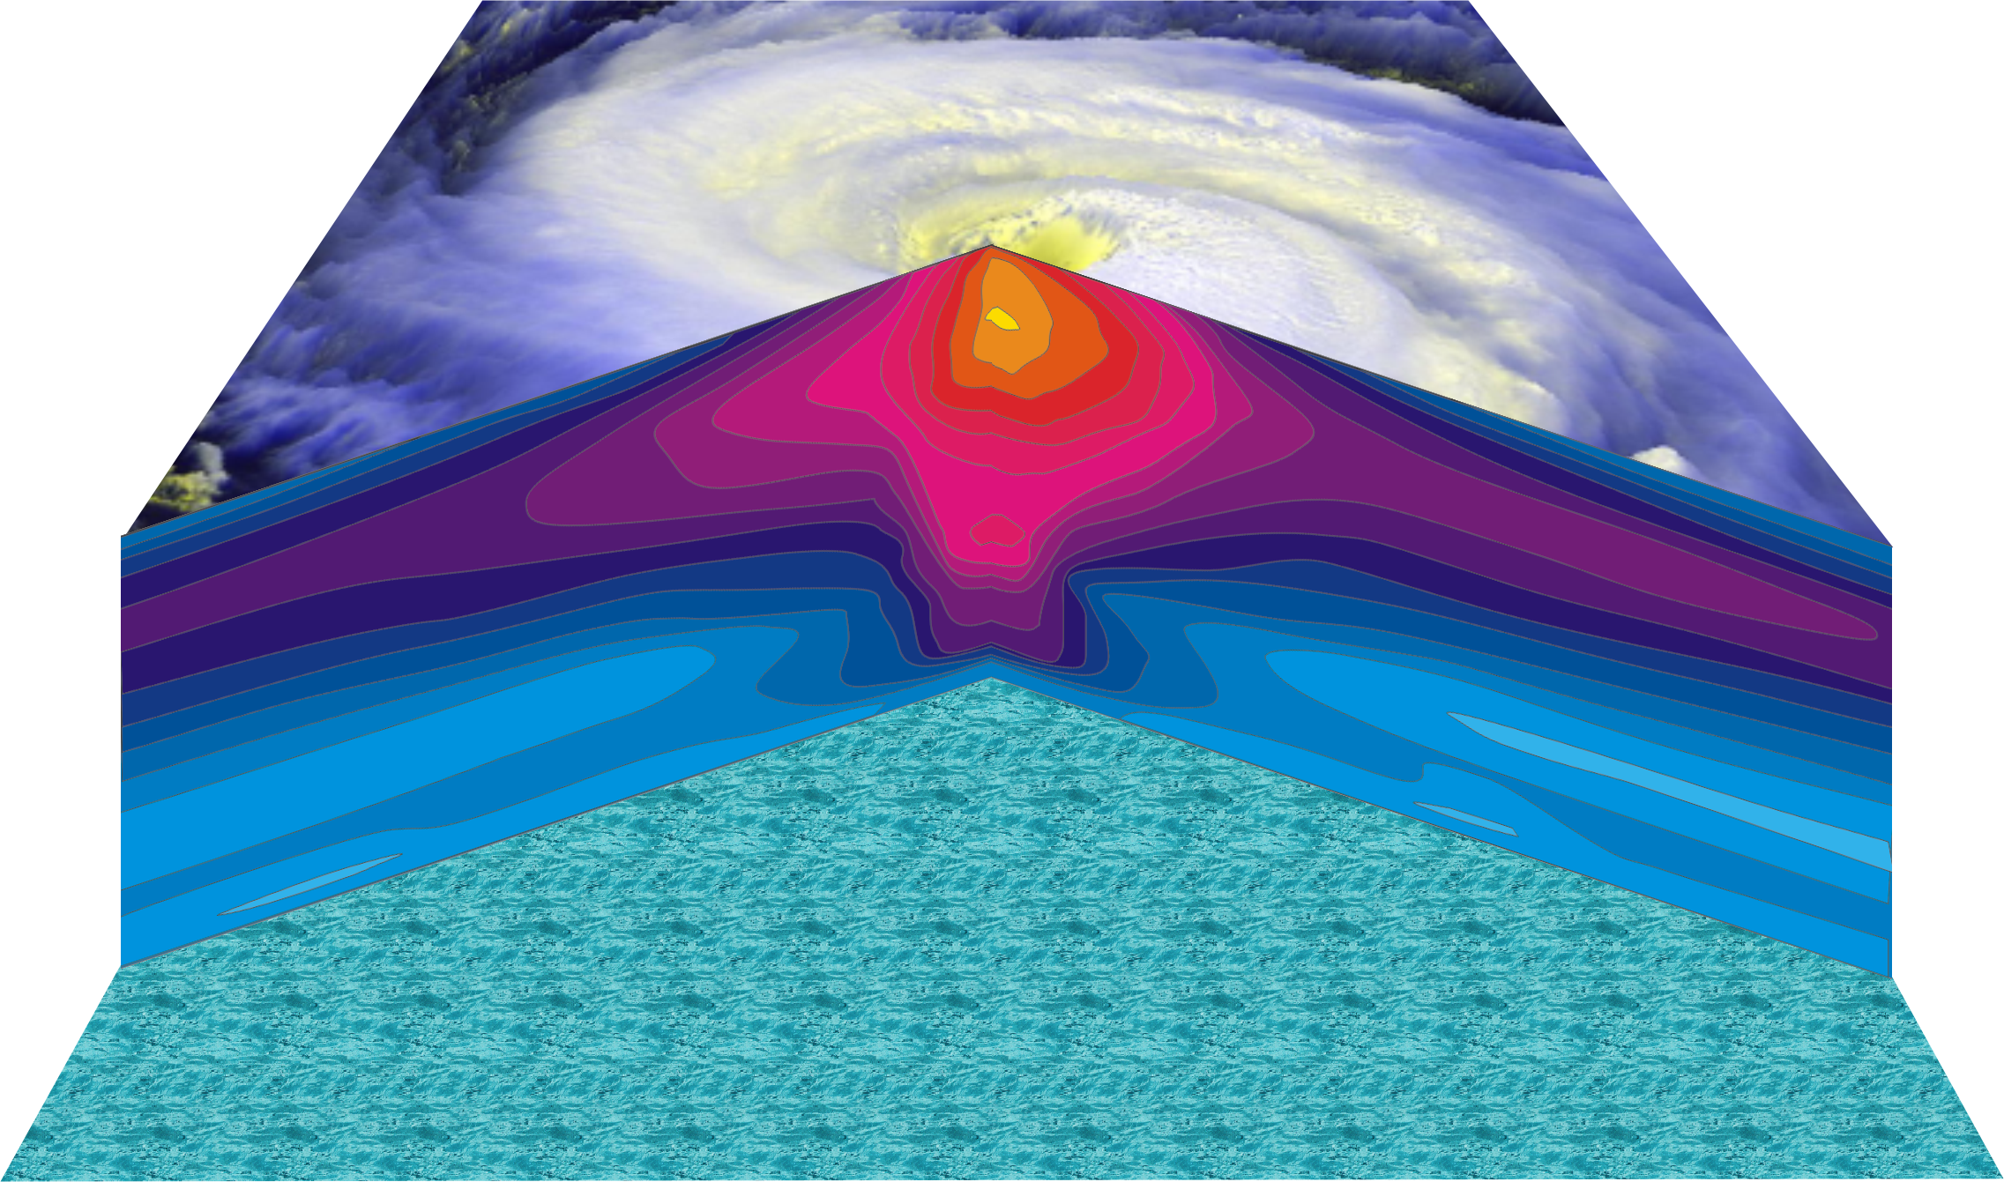
Hurricane Temperature Perturbations
No temperature difference - > 16°C (29°F) warmer
Notes:
This image shows a composite view of the distribution of temperature in a typical hurricane. This actually shows the difference between the temperature at any point and the temperature at the same altitude far away from the storm. The lightest shade of blue shows no temperature difference, while bright yellow shows air that is more than 16°C (29°F) warmer than its distant environment; each shade represents an increment of 1°C (1.8°F). Hurricanes are very hot in their centers, especially near their tops. This great warmth is one consequence of the enormous amount of heat sucked out of the ocean by the storm. On the other hand, there is very little change in temperature as you move in toward the eye along the surface of the ocean.
The distributions of temperature and wind in hurricanes are related to each other. Look carefully at the images in this slide and the slide that shows wind speed. Notice that the rate at which the wind decreases upward is proportional to the rate at which the temperature decreases outward. This relationship is fundamental to rotating fluid flows and is called the thermal wind relation.
Image is copyrighted 2005 by Oxford University Press.
Description from “Divine Wind: The History and Science of Hurricanes”, Kerry Emanuel, 2005, Oxford University Press, 296 p.
Definitions
Thermal wind is a theoretical concept that describes the wind shear between two levels in terms of the geostrophic wind at those two levels (from and for more information see http://wxman256.home.att.net/fcst/wf-pt5e.html). The basic principle of the thermal wind relationship is that in the presence of a horizontal temperature gradient, the wind speed must increase with increasing height (from and for more information see http://opwx.db.erau.edu/~mullerb/Therm_wind.html).
Wind shear is the change of wind speed or direction with distance, usually vertical (from http://ggweather.com/glossary.htm).

Slide 14
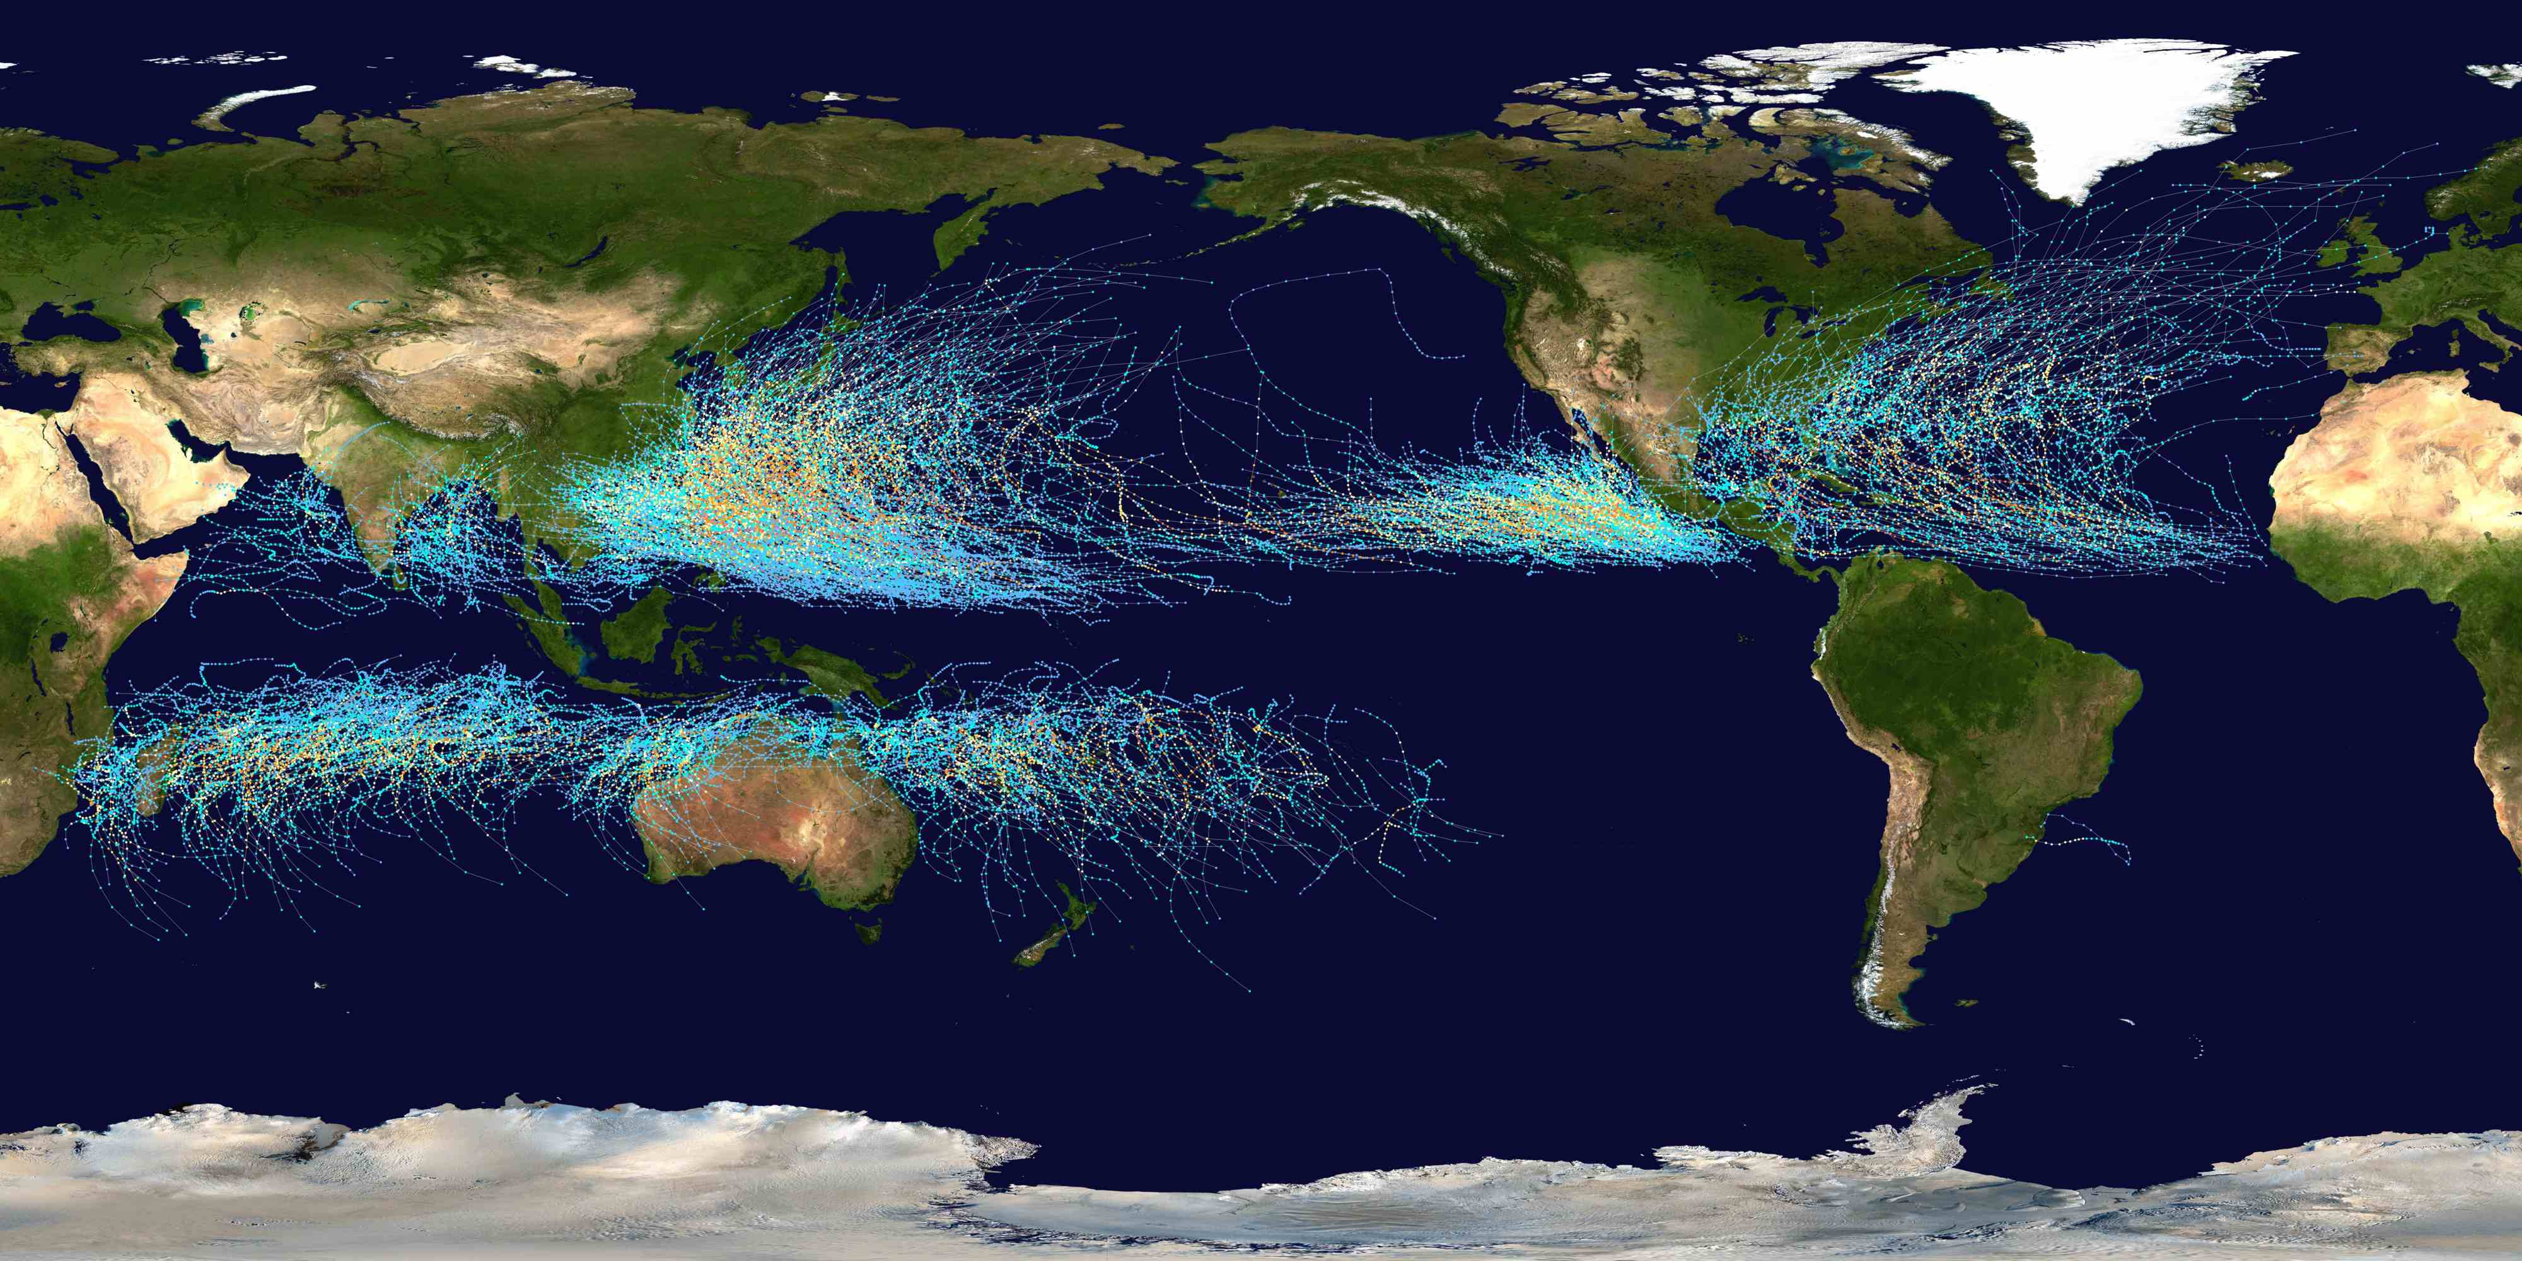
Tracks of all tropical cyclones, 1985-2005
Source: Wikipedia
Notes:
This map shows the tracks of all Tropical cyclones which formed worldwide from 1985 to 2005. The points show the locations of the storms at six-hourly intervals and use the color scheme shown to the right from Saffir-Simposon Hurricane Scale (from and for more information see http://en.wikipedia.org/wiki/Image:Global_tropical_cyclone_tracks-edit2.jpg).
Image: Global Tropical Cyclone Tracks. Created using User:jdorje/Tracks by Nilfanion on 2006-08-05. Background image from Image: Whole_world_-_land_and_oceans.jpg (NASA). Tracking data for storms in the North Atlantic and East Pacific is from the National Hurricane Center. Tracking data for storms in the Indian Ocean, the Northwest Pacific and the South Pacific is from the Joint Typhoon Warning Center. Tracking data for Cyclone Catarina in the South Atlantic was published in Gary Padgett’s April 2004 Monthly Tropical Cyclone Summary and was originally produced by Roger Edson, University of Guam.

Slide 15
Annual Cycle of Tropical Cyclones
Number of Events per Month
a
Northern
Hemisphere
(NH)
a
Southern
Hemisphere
(SH)
Jan Feb Mar Apr May Jun Jul Aug Sep Oct Nov Dec NH
Jul Aug Sep Oct Nov Dec Jan Feb Mar Apr May Jun SH
Notes:
This graph shows the average number of tropical cyclones per month in the northern and southern hemispheres. Hurricanes tend to follow the sun, peaking in the summer and autumn and all but vanishing during the early spring. Typhoons can develop over the western North Pacific during any month of the year, but they are rare in the winter.
Image is copyrighted 2005 by Oxford University Press.
Image and description from “Divine Wind: The History and Science of Hurricanes”, Kerry Emanuel, 2005, Oxford University Press, 296 p.

Slide 16
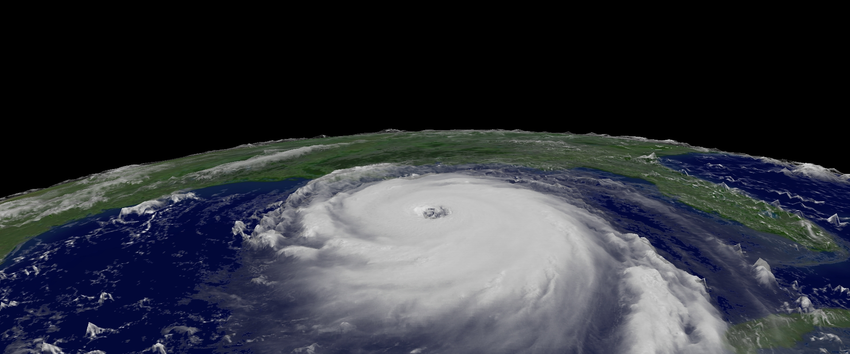
We First Need to Know How Hurricanes Work
Notes:
Image: Hurricane Katrina - Hurricane Katrina regional imagery, 2005.08.28 at 1515Z. Centerpoint Latitude: 26:13:59N Longitude: 88:08:03W. Hurricane Katrina is moving west-northwest near 12 MPH. A turn toward the northwest is expected over the next 24 hours. Credit: US Dept of Commerce, NOAA, NESDIS (http://www.nnvl.noaa.gov/cgi-bin/index.cgi?page=items&ser=109663&large=1).

Slide 17
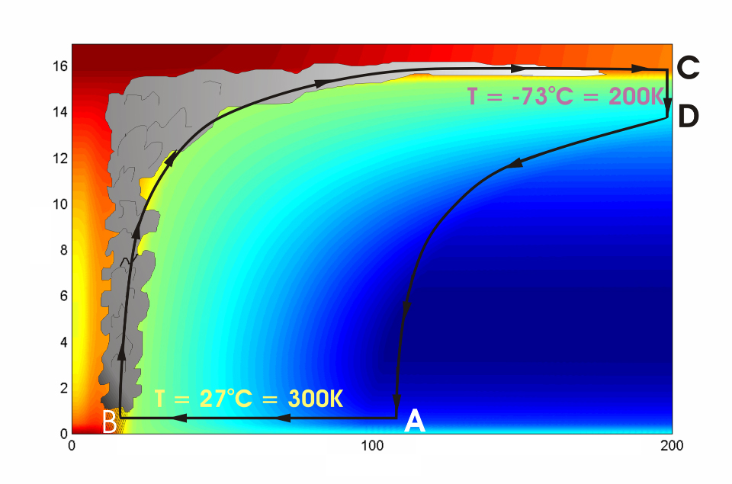
Cross-section through a Hurricane & Energy Production
eye
edge
Air loses energy
Hot air rises
Height above ocean (km)
Cooled air sinks
Low entropy (temperature)
Air spirals inward and gains energy from the ocean
Ocean surface
Radius (km)
Notes:
The energy cycle of a mature hurricane - the hurricane as a Carnot heat engine. This two-dimensional plot of the thermodynamic cycle shows a vertical cross section of the hurricane, whose storm center lies along the left edge. The colors depict the entropy distribution; cooler colors indicate lower entropy. Loosely, this means the total heat content of the air. Note that as air approaches the eyewall, its entropy increases rapidly, reflecting the large input of heat from the ocean.
Let’s follow a sample of air that begins at point A near the sea surface, a hundred kilometers or so from the storm center. The process mainly responsible for driving the storm is the evaporation of seawater, which transfers energy from sea to air. As a result of that transfer, air spirals inward close to the sea surface, between Points A and B. The storm center is an area of relatively low pressure, so the pressure on air decreases as it travels from A to B. But it is always in contact with the sea surface, which acts as an almost unlimited heat reservoir, so its temperature is approximately constant (acquiring entropy at a constant temperature). It is during this leg that enormous quantities of heat are added to the air from evaporation of seawater. Evaporation of water is a very efficient way to transfer heat from one body to another. That is why you feel cold when you are wet, especially if it is windy and/or dry: evaporation is taking heat from your body. Thus the addition of heat in leg A-B shows up mostly as an increase in humidity in the air. This form of heat is called latent heat. Evaporation of sea water into the inflowing air is by far the most important source of heat driving the hurricane, which makes leg A-B the firebox of the hurricane. When hurricanes reach land, they quickly die because they are cut off from their oceanic energy source. At point B, the air turns and flows upward through the towering cumulonimbus clouds that make up the hurricane’s eyewall. It is here that the latent heat is converted to sensible heat as water vapor condenses. But it is important to note that although there is enormous conversion between these two forms of heat, the total heat content (entropy, actually) remains approximately constant along this leg (note that the colors do not change along leg B-C). As the air flows upward, the pressure on it decreases very rapidly. What we have here is an example of adiabatic expansion. By the time the air reaches point C in the high troposphere or lower stratosphere, some 12 to 18 kilometers above the sea surface, the adiabatic expansion has lowered its temperature to a value close to that of the undisturbed upper tropical atmosphere, around -70°C or about 200 Kelvin. The air remains at approximately this temperature as it sinks down toward the tropopause (point D). Although the air is undergoing compression, it is losing heat by electromagnetic radiation to space. The depicted compression is very nearly isothermal. Finally, between D and A, the air returns to its starting point while undergoing an adiabatic compression. Voilà, the four legs of a Carnot cycle.
In a real hurricane, the energy cycle is open because hurricanes continuously exchange air with their environment.
Image is copyrighted 2005 by Oxford University Press.
Description from “Divine Wind: The History and Science of Hurricanes”, Kerry Emanuel, 2005, Oxford University Press, 296 p.
Definitions
The Carnot heat engine uses a particular thermodynamic cycle studied by Nicolas Léonard Sadi Carnot in the 1820s and expanded upon by Thomas Benoit in the 1840s and 50s. A heat engine is an engine that uses heat to produce mechanical work by carrying a working substance through a cyclic process from and for more information see http://en.wikipedia.org/wiki/Carnot_heat_engine).
Entropy is the measure of disorganization or degradation in the universe that reduces available energy, or tendency of available energy to dwindle. Chaos, opposite of order (from www.himalayasaltcrystal.com/glossary.htm).
Latent heat is the energy released or absorbed during a change of state (from www.indiaweather.in/gloss_j.asp).
Sensible heat is the heat that can be felt or sensed. The energy input which causes an increase or decrease in temperature (from www.aaronprocess.com/glossary.asp).
Adiabatic refers to changes in temperature caused by the expansion (cooling) or compression (warming) of a body of air as it rises or descends in the atmosphere, with no exchange of heat with the surrounding air (www.bbc.co.uk/weather/weatherwise/glossary/).
The troposphere is the lowest layer of the atmosphere and contains about 95 percent of the mass of air in the Earth's atmosphere. The troposphere extends from the Earth's surface up to about 10 to 15 kilometers. All weather processes take place in the troposphere. Ozone that is formed in the troposphere plays a significant role in both the greenhouse gas effect and urban smog (from ilrdss.sws.uiuc.edu/glossary/glossary_allresults.asp?glosID=T&page=5).
The Stratosphere is the layer of atmosphere that lies about 15 to 50 kilometres above the Earth's surface. In the stratosphere, the temperature rises with increasing height, which is the opposite of the situation in the lower atmosphere. Ozone occurs in minute quantities throughout the full depth of the atmosphere, but its concentration peaks within the stratosphere at an altitude of about 35 kilometres. This is referred to as the ozone layer. There is little up-and-down air movement in the stratosphere, so the ozone layer stays in position (from www.science.org.au/nova/004/004glo.htm)/
The tropopause is a boundary region in the atmosphere between the troposphere and the stratosphere (from en.wikipedia.org/wiki/Tropopause).
Electromagnetic radiation refers to energy transfer in the form of electric and magnetic waves that travel at the speed of light. Examples: light, radio waves, gamma rays, x-rays (from ie.lbl.gov/education/glossary/Glossary.htm).
Isothermal means to have equal or constant temperature with respect to either space or time (from www.4wx.com/glossary/i.php).

Slide 18
Energy Cycle gives Maximum Hurricane Wind Speed
This depends on:
Magnitude of the greenhouse effect
Sea surface temperature
Temperature high up in the atmosphere
Average speed of the trade winds within which hurricanes form

Slide 19
Heat Engine Theory Predicts Maximum Hurricane Winds
MPH
Notes:
19
Map of annual theoretical peak wind speed that any hurricane can attain, in miles per hour, for the climate for the late 20th century. Calculated by the author by applying heat engine theory to climatological atmospheric and sea surface temperature data.

Slide 20
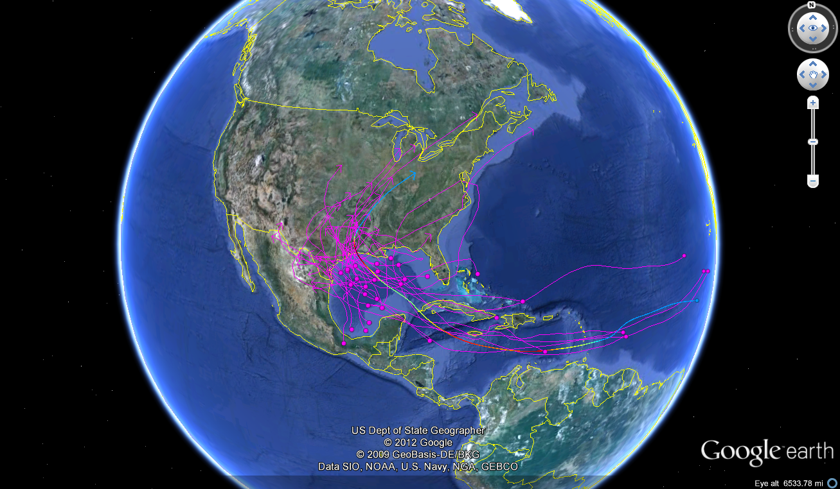
Notes:
Tracks of 33 Atlantic tropical cyclones that affected Texas, 1851-2010. Dots show estimated locations where storms formed. Created by the author using NOAA “HURDAT” data set.

Slide 21
Notable Texas Hurricanes
see: http://www.hpc.ncep.noaa.gov/research/txhur.pdf
Notes:
A fine short narrative of Texas hurricanes by David Roth may be found free online at
http://www.hpc.ncep.noaa.gov/research/txhur.pdf

Slide 22
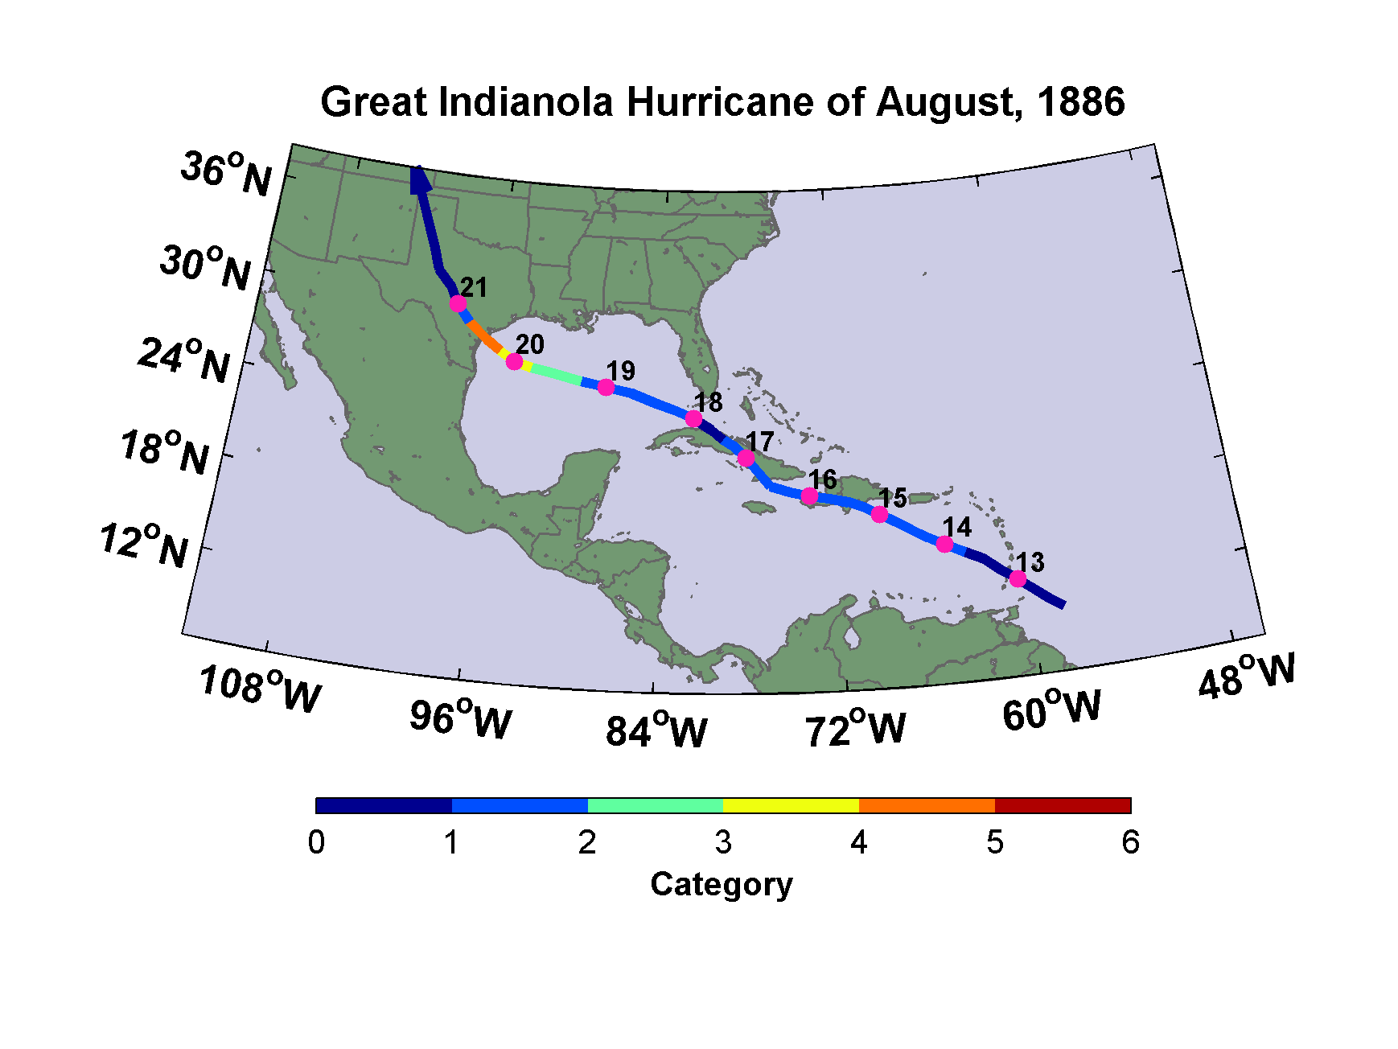
Notes:
Track of the Great Indianola Hurricane of 1886. Dates are days in August, and colors indicate Saffir-Simpson category.
Following description from “Texas Hurricane History”, David Roth, National Weather Service, Camp Springs, MD: http://www.hpc.ncep.noaa.gov/research/txhur.pdf
August 18-20th, 1886: Indianola suffered its fatal calamity from a hurricane, only 11 years after the last major storm swept through the area. Winds increased throughout the night of the 19th. Matagorda Bay began to invade the city by daylight on the 20th. The wind increased to 72 mph before the Signal Office building collapsed; the observer was killed by a falling timber during his attempt at escape. A lamp in the office burned down the building, along with more than a block of neighboring buildings on both sides of the street, despite the heavy rain. Although the storm was of shorter duration than the one in 1875, winds were considered higher. A storm surge of 15 feet inundated the region, covering the base of the Matagorda Island lighthouse with four feet of water. A large schooner was carried five miles inland (Malsch).
The town was a “universal wreck;” not a house that was left standing was safe to dwell in. Buildings that survived the 1875 storm were destroyed. Houses, carriages, personal property, and dead animals were strewn along the coastal plain. About two and a half miles of railroad track was washed away, not to be rebuilt. The village of Quintana, formerly the sister city of Velasco and also located at the mouth of the Brazos River, was almost entirely swept away. Despite Texas legend and according to the Houston Post, Indianola was not totally abandoned after this storm, as the next storm in this history shows. However, most people in town permanently left for the greener pastures of Victoria and San Antonio.
In Galveston, winds were “furiously from the southeast” at 10 AM on the 19th, causing area sand to reduce visibility to near zero (Houston Post). Winds increased until 5 PM, and remained high until noon on the 20th, peaking at 50 mph at 10 AM. Houses careened in the storm surge after midnight. Wires and trees were downed, bridges were submerged, and communication was cut off. In Houston, winds increased to gale force at 9:30 AM on the 19th. The height of the bayou rose 5-6 feet during the storm.
In Victoria, the worst of the storm occurred at 5 AM on the 20th. An eastbound train was blown over. Two churches were damaged beyond repair; six were heavily damaged. Very few buildings escaped the hurricane unharmed. At Rockport, 6 or 7 houses were leveled along with Temperance Hall and Fulton’s cistern factory. Many homes in Beeville were damaged. A couple trying to cross the swollen stream near Floresville were swept downstream, and one of the pair perished. Cuero reported a considerable loss. Several houses were destroyed at Edna. Corpus Christi saw winds of 75 mph out of the northwest, drying up the bay for two hours, leaving boats “high and dry”.
It was considered the worst storm ever in much of interior Southern Texas. Goliad had numerous homes unroofed. La Grange had considerable damage to fruit and cotton. Weimar saw two churches leveled and great destruction to corn and cotton. Throughout Bexar county, cotton was in ruin; its Methodist church was also destroyed. In south-central Texas, damage was considerable. The storm continued northwest and caused a gale to blow at 10 AM on the 20th...with the center of the system over San Antonio at 2:40 PM. Winds increased to near 80 mph and the lowest pressure observed was 29.03." Damage at San Antonio alone totaled $2.5 million. At New Braunfels, the International freight depot was destroyed.
One of the most positive aspects of the tempest was the rain it brought. A serious drought had developed across the region. In Galveston, water was being sold for 10¢ a bucket, twice the going rate for beer. It was so bad at Corpus Christi that residents had to give water to the
poor, lest they die of dehydration. The drought was considered broken at Stephenville. Heavy rains led to flooding of streams in central Texas.
A number of ships met their fate off Galveston. A large schooner went on a rampage and broke through the Santa Fe bridge, pushing the train into the angry seas. The schooner Livonia capsized just off the sand bar in 6 fathoms of water. The J.W. Perry foundered fifteen miles
offshore. Around 30 people died and total damages were estimated near $3 million.
Preceding this disaster, Indianola had been Texas’ leading port of call. Due to the major destruction to the infrastructure, Galveston reaped the benefits, thereby becoming Indianola’s successor. The winds of change would blow again around the turn of the century.

Slide 23
Galveston, 1900
The opinion held by some who are unacquainted with the actual conditions of things, that Galveston will at some time be seriously damaged by some such disturbance, is simply an absurd delusion
Isaac Cline, Local Forecast Official and Section Director, U.S Weather Bureau, Galveston, Texas, in The Galveston News, 1891
Wonderful account of the event in Isaac’s Storm, by Erik Larson
Notes:
Isaac Cline, the highly educated and much respected head of the local US Weather Bureau office in Galveston, had read a scientific paper by a leading oceanographer of the day that argues that large storm surges are not possible when there is much shallow water offshore. We now know that the opposite is the case.

Slide 24
August 28th, 1900: Willis Moore, Head of the United States Weather Bureau, issues an edict banning the transmission of all West Indian storm reports from its own Havana office to its New Orleans office. It also forbade chief forecasters from issuing hurricane warnings without prior approval from Washington. Moore followed up with a message delivered through Western Union:
The United States Weather Bureau in Cuba has been greatly annoyed by independent observatories securing a few scattered reports and then attempting to make weather predictions and issue hurricane warnings to the detriment of commerce and the embarrassment of the Government service. I have reason to believe that they are copying, or contemplate doing so, data from our daily weather maps in New Orleans and cabling the same to Havana.
Notes:
The U.S. Weather Bureau had a reputation for insularity that continued until quite recently. In this case, jealousy of the very successful Cuban forecasters caused the head of the Weather Bureau to make a decision that arguably cost 8,000 lives.

Slide 25
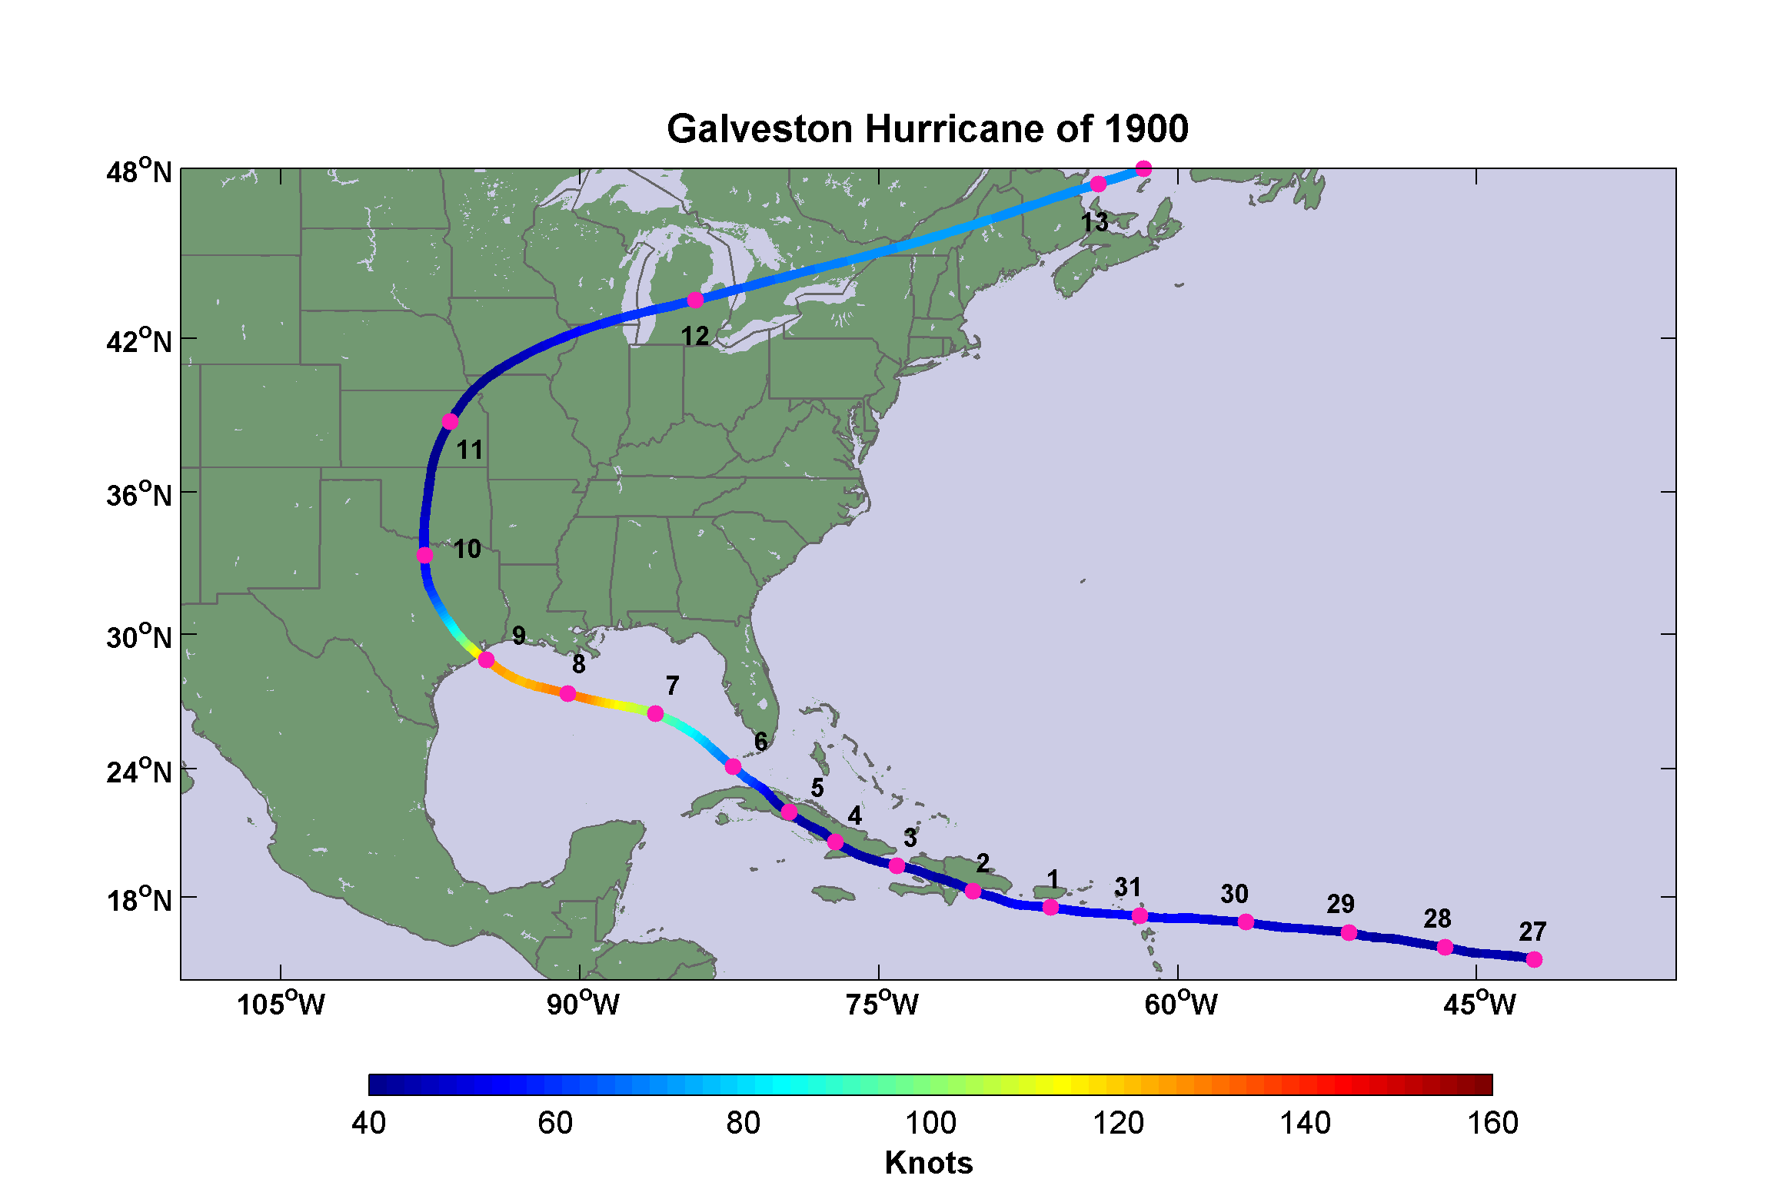
Notes:
Track of the Great Galveston Hurricane of 1900. Dates are days in August and September, and colors indicate wind speed in nautical miles per hour (knots).
Following description from “Texas Hurricane History”, David Roth, National Weather Service, Camp Springs, MD: http://www.hpc.ncep.noaa.gov/research/txhur.pdf
The question from the Racer’s Storm [of 1837] was tragically prophetic as the Great Galveston Hurricane showed on September 7-9th, 1900. It towers alone as the worst natural disaster in the United States in terms of lives lost; the most frequently used estimate of the death toll is 8,000. The potential of this disaster had been shown in the destructions of Santiago in 1844, Clarksville/Baghdad in 1867, and Indianola in 1875 and 1886. At the time, the population of Galveston was near 30,000. Most of its structures were of wood frame, built just above ground
level and supported by pilings.
A new innovation helped relay details about what the storm did in the Caribbean Islands; it was known as the wireless telegraph. Word had been received of a hurricane which had struck Trinidad and destroyed almost all the structures on that island. Word of the storm’s passing over Cuba and moving northwest into the Gulf in the direction of Texas had been relayed to the local weather office in Galveston Island. Sailors began to arrive in the port telling of nasty weather offshore.
On the 6th, a hurricane watch was posted along the Gulf Coast, westward to New Orleans. Winds began to increase as high, fish-scale shaped clouds (altocumulus) began to move inland. By the next day, the hurricane watch was extended west to include Texas. Driving rain began at 4 AM. Large waves began to pound the shores of Galveston Island. The pressure began to fall rapidly at the Weather Bureau station. This caused them to hoist a Hurricane Flag - their version of a hurricane warning. This action caused about 20,000 people to evacuate, a move that saved many lives.
Yet a number of people ignored the warning. Gentry from Houston rode out to the island via train to witness the huge waves first hand. Through the morning of the 8th, greater and greater numbers of people crowded the beaches. Isaac Cline of the Weather Bureau could not believe what was happening. He took matters into his own hands and rode with his brother down the beach in a horse-drawn buggy, warning people to go back to the mainland - in effect, making him a modern day Paul Revere. Unfortunately, few listened. The weather, however, changed their minds as a wooden pagoda along the beach and its associated boardwalk became mere driftwood before the crowd’s eyes. Then they began to disperse. For many, it turned out to be far too late. A steamer broke free of its moorings and went on a rampage, destroying all three bridges to the mainland.
Winds of 100 mph blew away the anemometer at the Weather Bureau. The pressure fell to 28.44". Winds gusting over 125 mph sent raging waters covering Galveston Island by 15 feet just before midnight, with additional waves much higher on top of the storm surge. As flood
waters rose, people fled towards the center of the island, which had slightly higher ground. This turned out to be fruitless, as it merely delayed the inevitable. The force of the wind sent boards, chairs, and tree limbs sailing through the air. Pebbles and shards of glass became deadly
missiles. When the water began rising, Harry Claiborne, keeper of the Bolivar Point Lighthouse, fled to the safety of his workplace. People soon after began pounding on the door, begging entry into the sanctuary of the lighthouse. The tower was soon crammed with 124 people, many of which were from a train stranded in the rising waters. After a while, the big door to the lighthouse was hidden under four feet of water . The lighthouse survived the storm (Roberts).
Wooden buildings floated off their pilings and smashed into one another. As houses disintegrated, unfortunate occupants were thrust into the water to drown. In all, more than 2600 houses were demolished. The picture to the right shows the devastation which occurred to Galveston, provided by the Galveston County Daily News. Twelve square blocks, 3/4 of the city, were completely wiped out. All bridges across the bay were destroyed, along with 15 miles of railroad track. All communications with the mainland were lost. Vast quantities of rain fell, with Galveston (10") and Brazoria (10") setting 24 hour rainfall records for September.
The British Freighter Kendall Castle was moored offshore. Several ships were driven against it. But is was when the Norwegian freighter Guller nudged against the Castle that it was sent on a “wild ride” over the Halfmoon Shoal lighthouse, pounding it into the sand, on its way to
Texas City (Cipra). Very little damage was seen at Sabine Pass, which shows how small the core of this storm was in areal extent.
However, fewer than 2000 of those remaining on the island survived. The weather office chief survived, but his wife drowned. Bolivar Point Lighthouse became the center of relief activities after the storm. The lighthouse over the ensuing days let people in the area know that
at least one thing still worked on the island, as it helped storm-battered ships return to shore. Martial law was declared. Looters were shot on the spot.
The old first capitol building of the Republic of Texas at West Columbia was destroyed. Mustang Island also saw many bodies littering the beach. Alvin saw 8.05" of rain fall on the 9th, setting a 24 hour rainfall record for September. Quintana was partially abandoned, after being seriously harmed by both the 1899 Flood and this hurricane. Corpus Christi had a stiff northeast breeze, but exceptional fishing. In Flour Bluff Harbor, millions of red, trout, and mullet infested the waters, in their avoidance of the hurricane. Local residents feasted on the tarpon and helped out Galveston with over $1000 for food and clothing. The storm accelerated after moving inland, racing north to the Great Lakes while still packing 70 mph winds. The low then moved across Canada, the North Atlantic, and Northern Europe before finally dying in Siberia. Thirty million dollars in damage occurred.
A massive public works project was then undertaken to raise the Galveston’s elevation and build a three mile long, 17 foot high, concrete seawall. This has, to date, prevented a tragedy of such proportions from occurring in Galveston. The city never quite regained its importance as a port, due to the construction of the Houston ship channel, similar to the fate of Indianola fourteen years before. As population swells along the coast, construction expanded into areas not protected by the seawall. Those that have not learned from history are doomed to repeat it.

Slide 26
The storm will probably continue slowly northward and its effects will be felt as far as the lower portion of the middle Atlantic coast by Friday night.
- Forecast issued by U.S. Weather Bureau, 8:00 AM Thursday, September 6, 1900
Notes:
The shear incompetence of the U.S. Weather Bureau in Washington is evident in this astoundingly bad forecast. Even an amateur would have noticed that the hurricane had passed west of Key West, Florida.

Slide 27
Sunday, September 9, 1900, revealed one of the most horrible sights that ever a civilized people looked upon. - Isaac Cline
Notes:
This damage could not have been avoided. But the loss of 8,000 lives can be blamed on incompetence and petty politics in Washington.

Slide 28
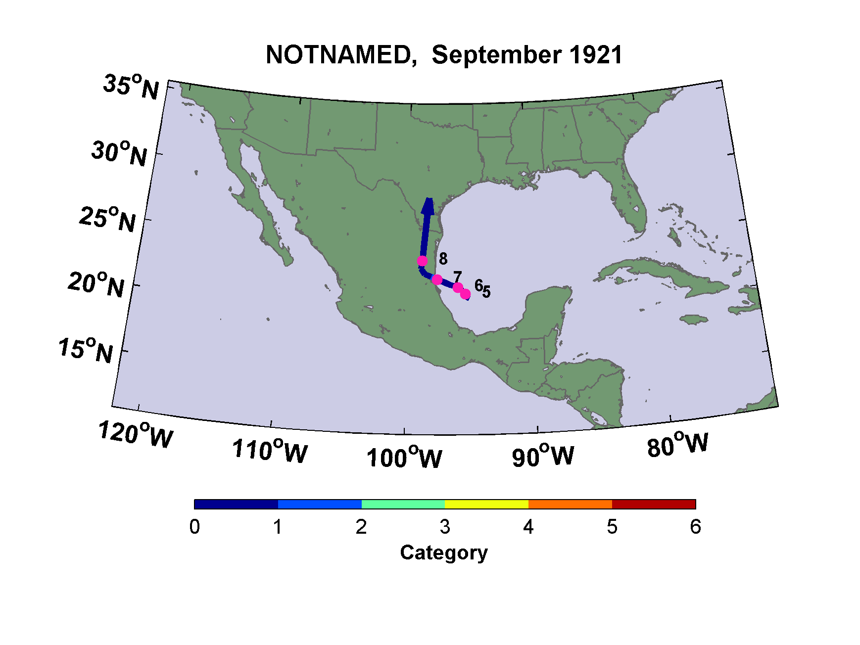
The Great San Antonio Flood of 1921
Notes:
This weak tropical storm was not even categorized as a such by the time it dropped record rainfall on San Antonio

Slide 29
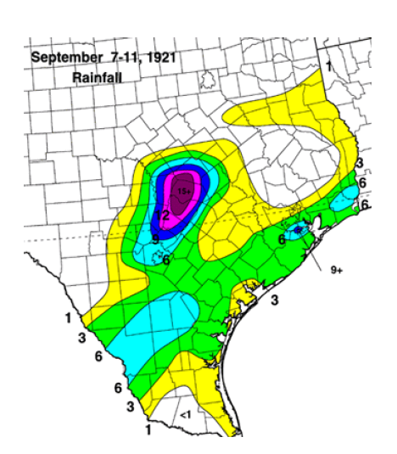
Rainfall in inches
Notes:
Figure and text from “Texas Hurricane History”, David Roth, National Weather Service, Camp Springs, MD: http://www.hpc.ncep.noaa.gov/research/txhur.pdf
September 7-11th, 1921: [In September, 1921], a tropical storm rapidly spun up in the Bay of Campeche. It progressed northwest into Mexico and crossed the Rio Grande. After passing inland into Texas on the 8th, it could barely be identified as a cyclone, except for its associated deluge that drifted northward through Texas. At Taylor, 23.11" of rain fell in 24 hours. A new 18 hour rainfall record for the United States was set in Williamson County when 36.40" fell. Thrall reported nearly 40 inches of rain in total, 38.2" in a 24 hour period. The map shows the rainfall accumulations throughout southern and central Texas related to this cyclone (after Tannehill).
Torrential rains accompanying the decaying system caused one of the most destructive floods in San Antonio’s history. The waters rose so rapidly (a flash flood) that automobiles were deserted and the occupants sought safety in high buildings. Nearly seven feet of water stood in the large hotels, theaters, and stores. In San Antonio alone, 51 lives were lost in the flooding and damage was estimated at $5 million. The largest floods occurred on the Little and San Gabriel Rivers north of Austin and south of Temple. Along the Little River, at least 159 drowned. Total damages were estimated near $19 million. In all, 215 died due to the flood in the five county area around San Antonio.

Slide 30
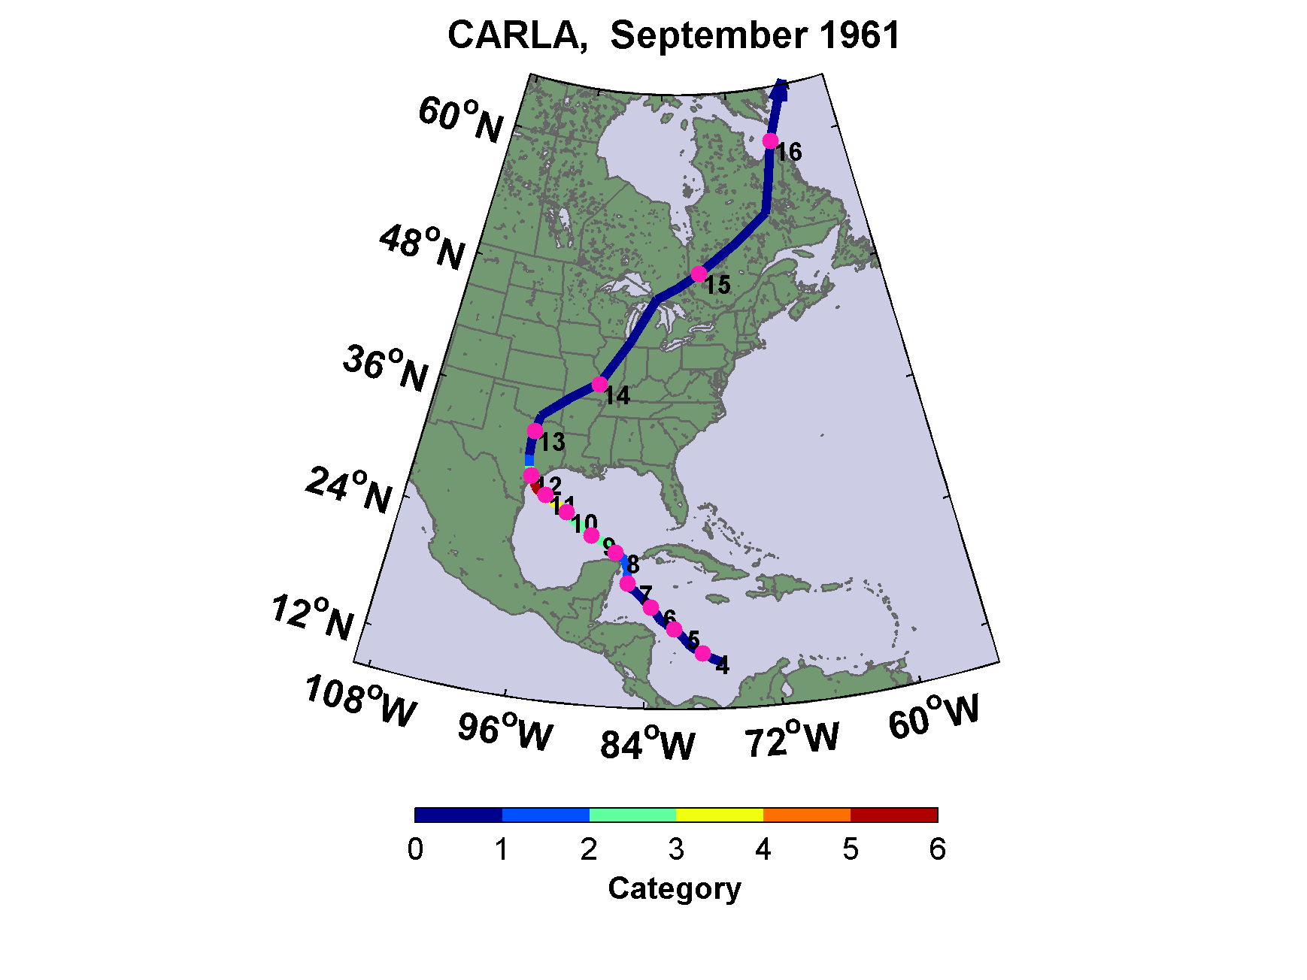
Notes:
Text from “Texas Hurricane History”, David Roth, National Weather Service, Camp Springs, MD: http://www.hpc.ncep.noaa.gov/research/txhur.pdf
September 11-13th, 1961 (Carla): No history of Texas hurricanes would be complete without a thorough mention of Carla, which made landfall near Port Lavaca. Carla was among the largest hurricanes of historical record. It stalled offshore, making a fairly large loop off Pass Cavallo, before finally striking the coast. The storm produced many tornadoes, gusts estimated to 175 mph, torrential rains, and a 22 foot storm surge at Port O’Connor. Hurricane force gusts were seen along nearly the entire coast of Texas. Winds gusted to 86 mph at Corpus Christi.
Her path of devastation inland extended from Victoria to Dallas. The death toll was limited to 34, which was attributed in part to what was the largest peace time evacuation of an area in history, up until that time. A quarter million people fled the Middle and Upper Texas coasts to move inland to safety. Evacuation was slow however; it took four hours to get from Port Arthur to Beaumont on U.S. 69.
Twenty-six tornadoes were spawned, one of which tore apart 120 buildings and killed six in Galveston. Structures outside the seawall were severely damaged by the storm surge. The Ursuline Convent, which was the oldest educational institution in Galveston, was destroyed by Carla (Guthrie). Texas City saw 90% of its homes flooded. Surfside, near Freeport, saw extensive damage. The trail of destruction extended down the coast to Port Isabel, where 4-5 foot storm surges were seen. Port O’Connor was 75% wiped out. The Matagorda Island Air Force Base was almost erased from existence. Damage to the air force base was $18 million.
In Jefferson County, 180 miles from the landfalling storm, $17.5 million in damage occurred, with $14 million of it water damage. Highway 87 was totally destroyed between Sabine Pass and High Island, but later rebuilt. Three to four feet of water flooded Port Arthur. The only injuries reported there were due to snake bites. Rain totaled 19 inches at Votan. The 5.15” of rain that fell in Victoria set a rainfall record for the 11th. A vast amount of coastline was inundated, which totaled 1.7 million acres. Carla’s area of destruction extended well to the east into Louisiana. Total damages were estimated at $408 million for Texas.

Slide 31
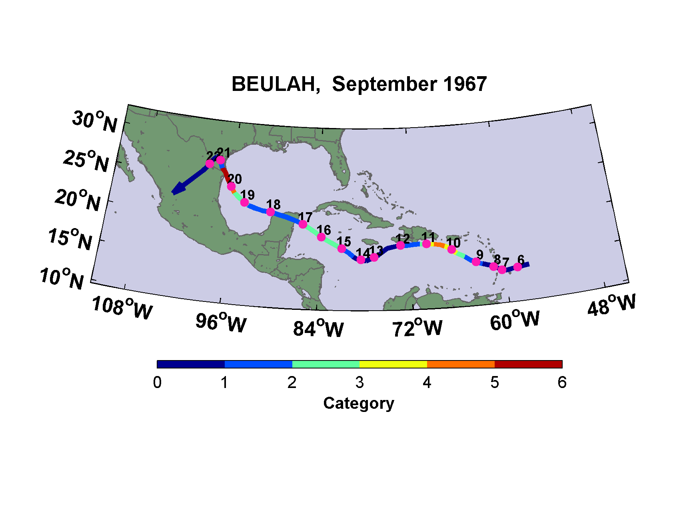
Notes:
Text from “Texas Hurricane History”, David Roth, National Weather Service, Camp Springs, MD: http://www.hpc.ncep.noaa.gov/research/txhur.pdf
September 20-22nd, 1967 (Beulah): Hurricane Beulah was the third largest hurricane on record, after Carla in 1961 (see above for more on Carla) and the Great New England Hurricane of 1938. The storm slowly traversed the Caribbean Sea from the 8th through mid month (track to the right). It struck the coast near Brownsville at 8 AM on the 20th, and then curved left with its track paralleling the coast to the southwest thereafter.
The lowest pressure recorded on land was 28.07". Winds gusted to 136 mph on the S. S. Shirley Lykes, located in the Port of Brownsville. Hurricane-force winds extended up along the coast to Corpus Christi, which received gusts to 86 mph at 8:35 PM on the 20th. Winds gusted to 110 mph at their local U.S. Army Corp of Engineers office. The storm surge reached 20 feet along lower sections of Padre Island. Thirty one cuts were made completely through the Island. At Port Isabel, only the new bank and the lighthouse escaped any damage. Citrus fruit and tree damage totaled $15 million in the Rio Grande Valley due to the winds.
San Antonio saw horrible flooding with Beulah. A few locations saw over 30" of rain with the storm. At Pettus, in Bee County, rainfall reached 27.38". At Falfurrias, in Brooks County, more than 25 inches of rain fell; more than falls during a normal year. The San Antonio River went 18.4 feet above flood stage at Goliad, the Lavaca River near Edna crested 5.2 feet above flood stage. The Navidad River at Ganado crested 10.9 feet above flood stage. The area south and east of a Laredo, San Antonio, Matagorda arc was isolated over a week due to the massive flood; 1.4 million acres were submerged. Daily rainfall records were set at Laredo (3.61" on the 22nd), Victoria (6.63" on the 20th and 5.27" on the 21st), and at Corpus Christi (3.48" on the 20th and 6.38" on the 21st). Only 0.04”of rain fell at Nederland. Record streamflow in Late September flooded the Rio Grande downstream from Falcon Dam near Roma. Most of it was due to the heavy rains which fell in Mexico the week before.
An amazing 115 tornadoes were spawned by the system, the most ever known to be generated by a tropical system (7 times the previous record set by Isbell in 1964). Most of the tornadoes were confined to the entire coast of Texas. One killer tornado touched down in Palacios on the
morning of the 10th, killing 4 people and injuring 6 more. A tornado near Louise in Wharton County caused one death. Twenty nine counties were declared major disaster areas by then President Lyndon Baines Johnson. Forty-four people died in Texas during Beulah; 5 by tornado, 39 by flood. One hundred ten boats were also victim to the storm. Damages were estimated at $160 million.

Slide 32
Hurricane Katrina, 2005
A major hurricane could swamp New Orleans under 20 feet of water, killing thousands. Human activities along the Mississippi River​ have dramatically increased the risk, and now only massive reengineering of southeastern Louisiana can save the city
-- Mark Fischetti, “Drowning New Orleans”, Scientific American, October, 2001
Notes:
Hurricane Katrina had, in essence, been predicted years in advance, and the city government had rehearsed for a Katrina-like event.

Slide 33
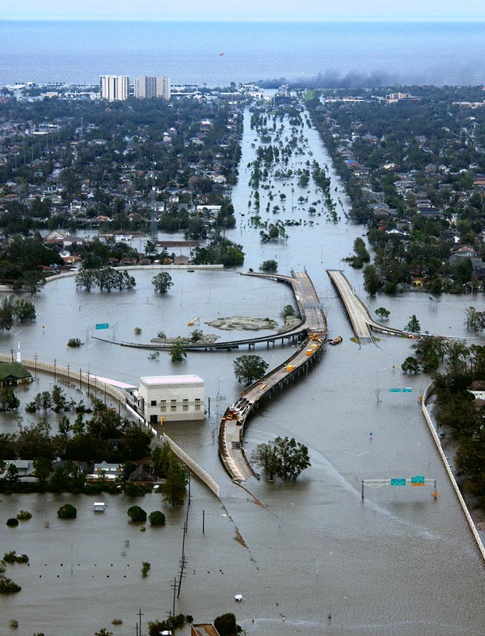

Slide 34
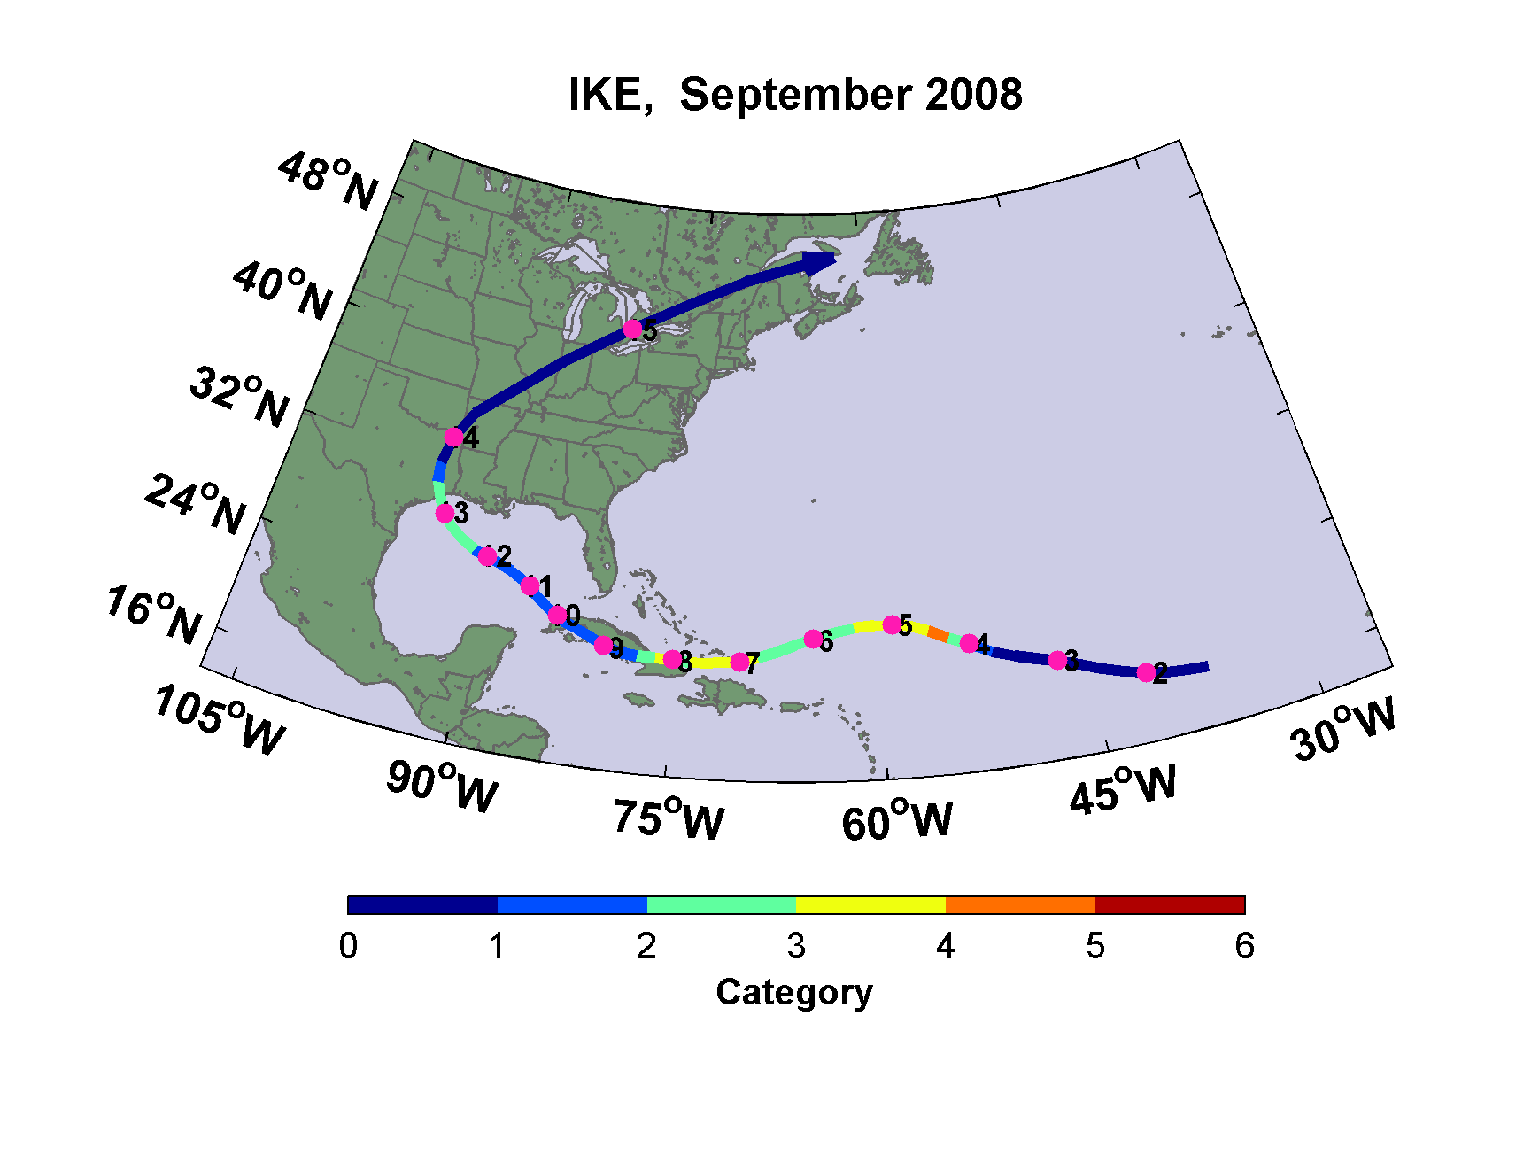
Notes:
Hurricane Ike of 2008 was the costliest hurricane in the history of Texas.

Slide 35
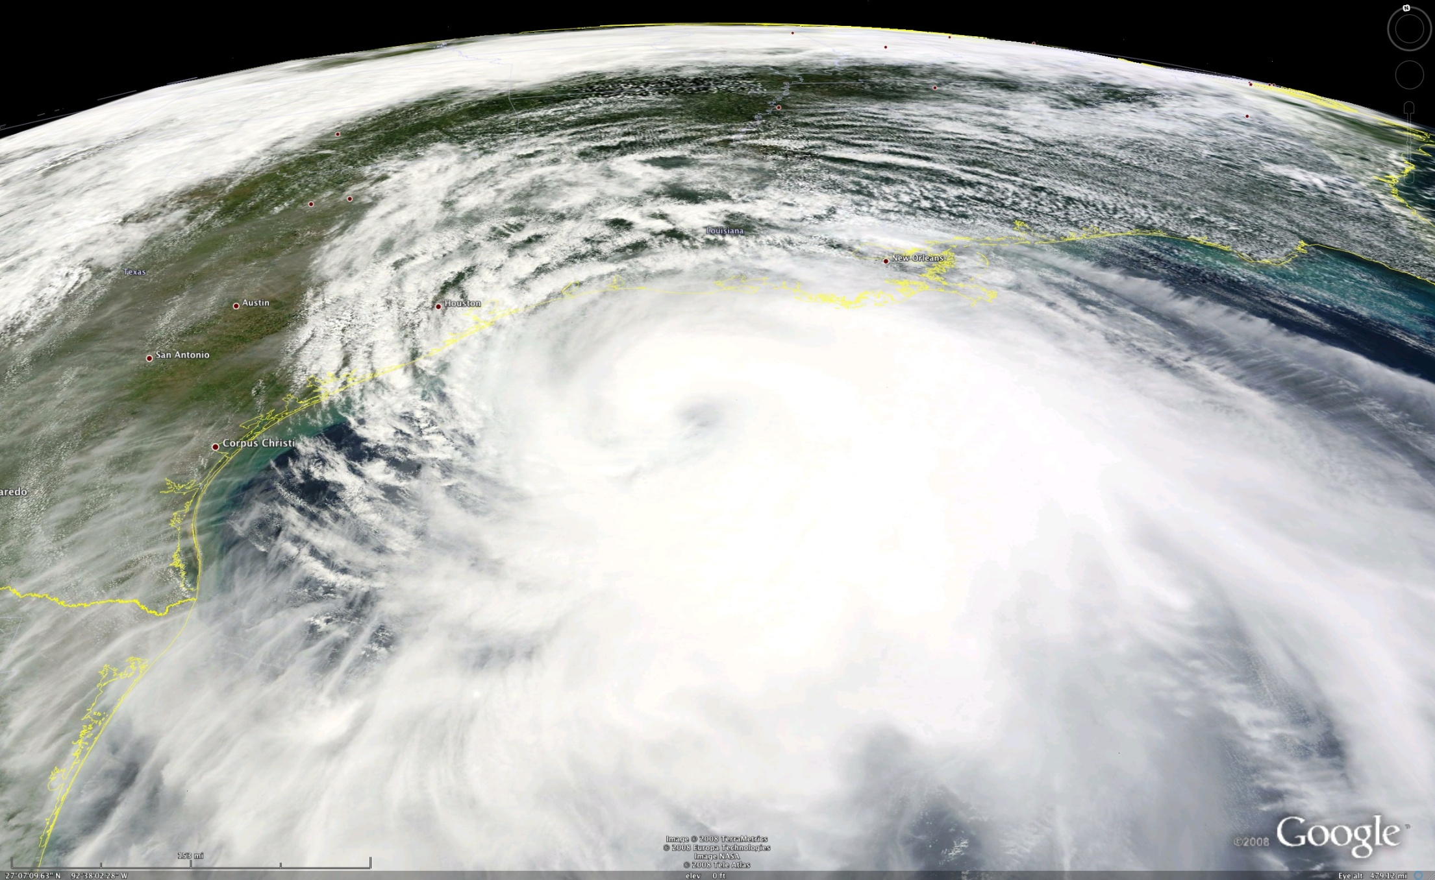
Hurricane Ike, 2008
Notes:
This satellite image shows Ike approaching Texas. Modis true-color image. Credit: NASA.

Slide 36
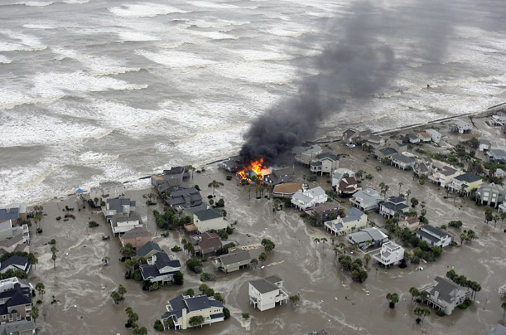
Notes:
Text from “Texas Hurricane History”, David Roth, National Weather Service, Camp Springs, MD: http://www.hpc.ncep.noaa.gov/research/txhur.pdf
September 12-15th, 2008 (Ike): A tropical wave left the coast of Africa on August 28th. The system slowly organized, becoming a tropical depression, then a tropical storm by September 1st. The cyclone moved westward for much of its lifetime as the subtropical ridge extended westward to its north. By the 3rd, Ike had become a major hurricane as it rapidly intensified underneath an upper level high. Ike wavered between category 2 and 4 strength as the effect of northerly vertical wind shear and eyewall replacement cycles caused fluctuations in strength. On the 7th, Ike moved through the southeast Bahamas into eastern Cuba. Briefly emerging into the northwest Caribbean, Ike remained a hurricane through its next landfall across western Cuba on the 9th. Land interaction with western Cuba appears to have made Ike a larger cyclone, and after emerging into the Gulf of Mexico, its central pressure fell significantly on the 10th as it moved over the warm waters of the Loop Current. The large system strengthened back into a category 2 hurricane, which moved west-northwest through the Gulf of Mexico around the periphery of the subtropical ridge. On the 12th, Ike became slightly more compact as it moved into a confluent zone between the subtropical ridge to its east-northeast and upper level troughing across the Plains. This allowed maximum sustained winds to increase despite a relatively constant central pressure. Ike developed a banding-type eye, and moved into Galveston, Texas, and weakened as it moved into through eastern Texas and Arkansas. The system became an extratropical cyclone as it approached the Mid-Mississippi Valley, and rapidly accelerated northeast through southeast Canada on the 14th and 15th.
A large storm surge accompanied Ike, particularly along the western Louisiana and upper Texas coastlines. The worse damage was seen in Galveston and Chambers counties. The communities of Crystal Beach, Gilchrist, and High Island experienced near total destruction of property. The storm knocked out power to 2.6 million people across Texas and Louisiana. There were 20 direct and 64 indirect deaths associated with Ike. Damages totaled $19.3 billion.

Slide 37
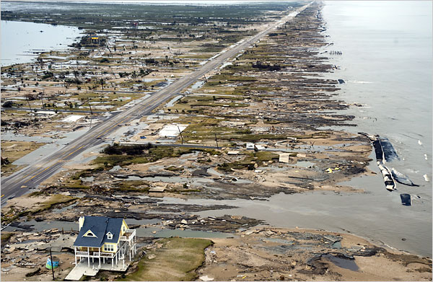
Notes:
The Bolivar Peninsula, after Ike

Slide 38
Assessing Texas Hurricane Risk: Present and Future

Slide 39
Limitations of a strictly statistical approach
>50% of all damage caused by top 8 events, all category 3, 4 and 5
>90% of all damage caused by storms of category 3 and greater
Category 3,4 and 5 events are only 13% of total landfalling events; only 30 since 1870
Thus There are too few hurricanes in history to make really good estimates of hurricane risk
Notes:
There are far too few hurricanes in history to make really good estimates of hurricane risk

Slide 40
Additional Problem: Climate Change
Notes:
And besides, history may not be a good guide to the future of climate change is causing hurricanes to change

Slide 41
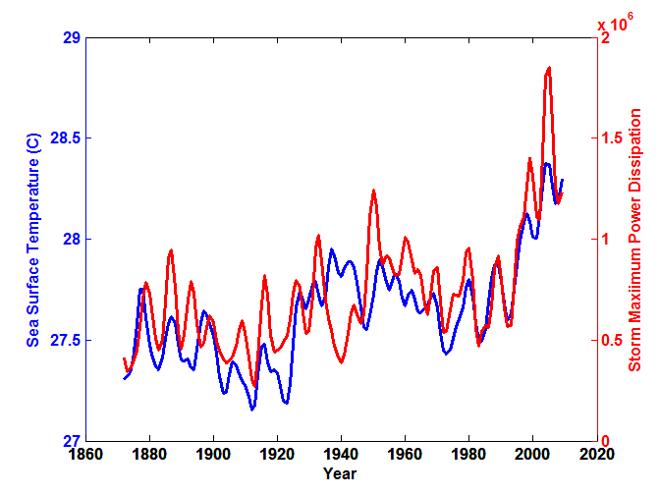
Atlantic Sea Surface Temperatures and Storm Max Power Dissipation
(Smoothed with a 1-3-4-3-1 filter)
Years included: 1870-2011
Data Sources: Hurricanes: NOAA/TPC; Sea Surface Temperatures: UKMO/HADSST1
Notes:
41
The red curve shows a measure of Atlantic hurricane power going back to 1870. The blue curve shows the temperature of the tropical Atlantic during hurricane season.
The low value of storm power in the early 1940s is thought to be due to the lack of reports from ships at sea because of the radio silence imposed during WWII.

Slide 42
Our Approach to Hurricane Risk Assessment:
Step 1: Seed each ocean basin with a very large number of weak, randomly located very weak hurricanes
Step 2: Storms are assumed to move with the large scale atmospheric flow in which they are embedded
Step 3: Run a detailed hurricane simulation model for each storm, and throw away those that fail to achieve at least tropical storm strength
Step 4: Using the small fraction of surviving events, determine storm risk statistics
Details: Emanuel et al., Bull. Amer. Meteor. Soc, 2008
Notes:
42

Slide 43
Notes:
Here is an example of 1,000 synthetic tracks created from a large-scale climate data set. It is easy to create 100,000 such tracks.

Slide 44
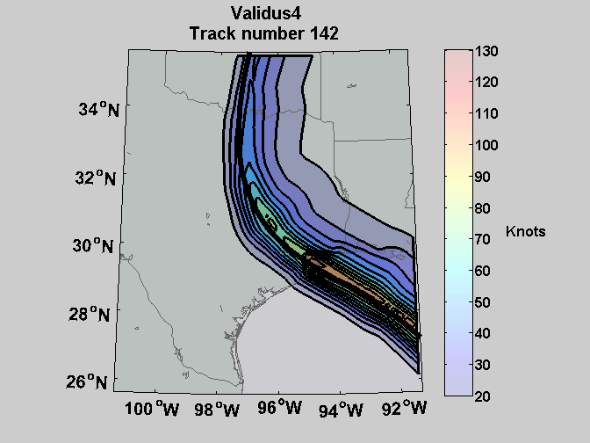
Sample Storm Wind Swath
Notes:
This chart contours the peak wind speed (in nautical miles per hour) experienced at each point during the passage of a particular synthetic storm.

Slide 45
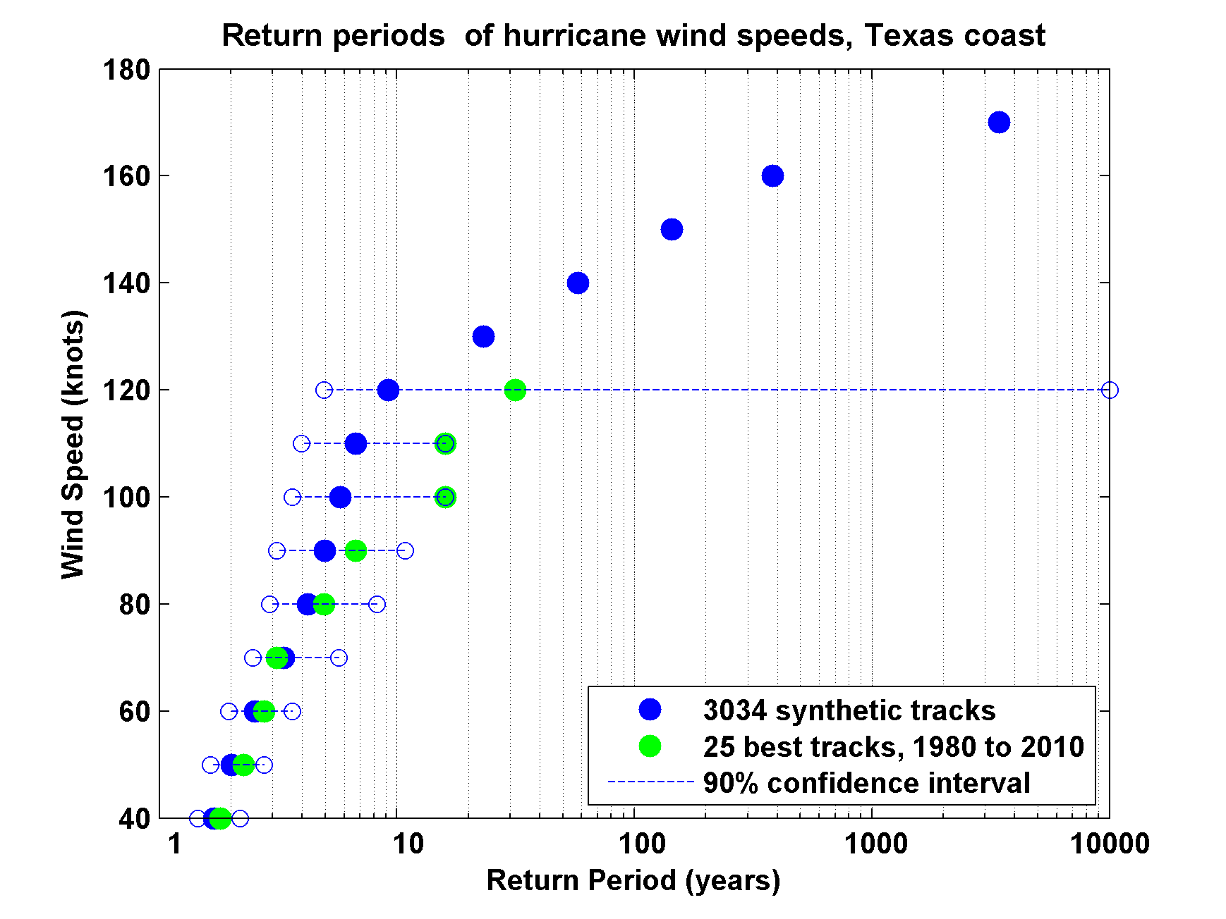
Notes:
Return intervals of hurricanes with maximum sustained winds exceeding the speed at right, based on 3034 synthetic hurricanes that make landfall in Texas (blue dots), and based on 25 historical events (green dots). The horizontal dashed lines show the intervals in which 90% of the historical events are expected to lie, based on the synthetic events.

Slide 46
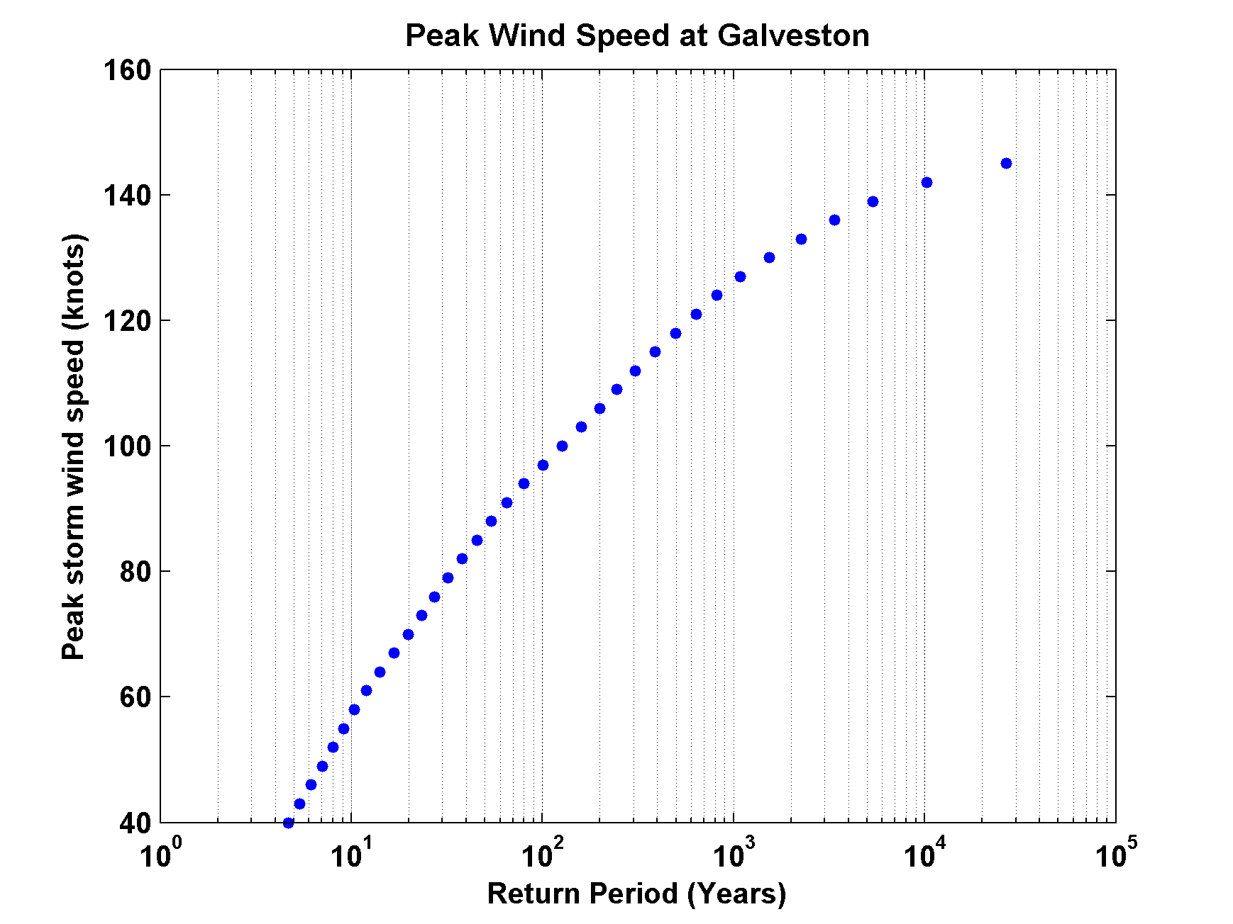
Notes:
Return periods of peak winds at Galveston, based on over 3000 synthetic hurricanes that affect the coast of Texas.

Slide 47
Rainfall
The simulation model also predicts rainfall

Slide 48
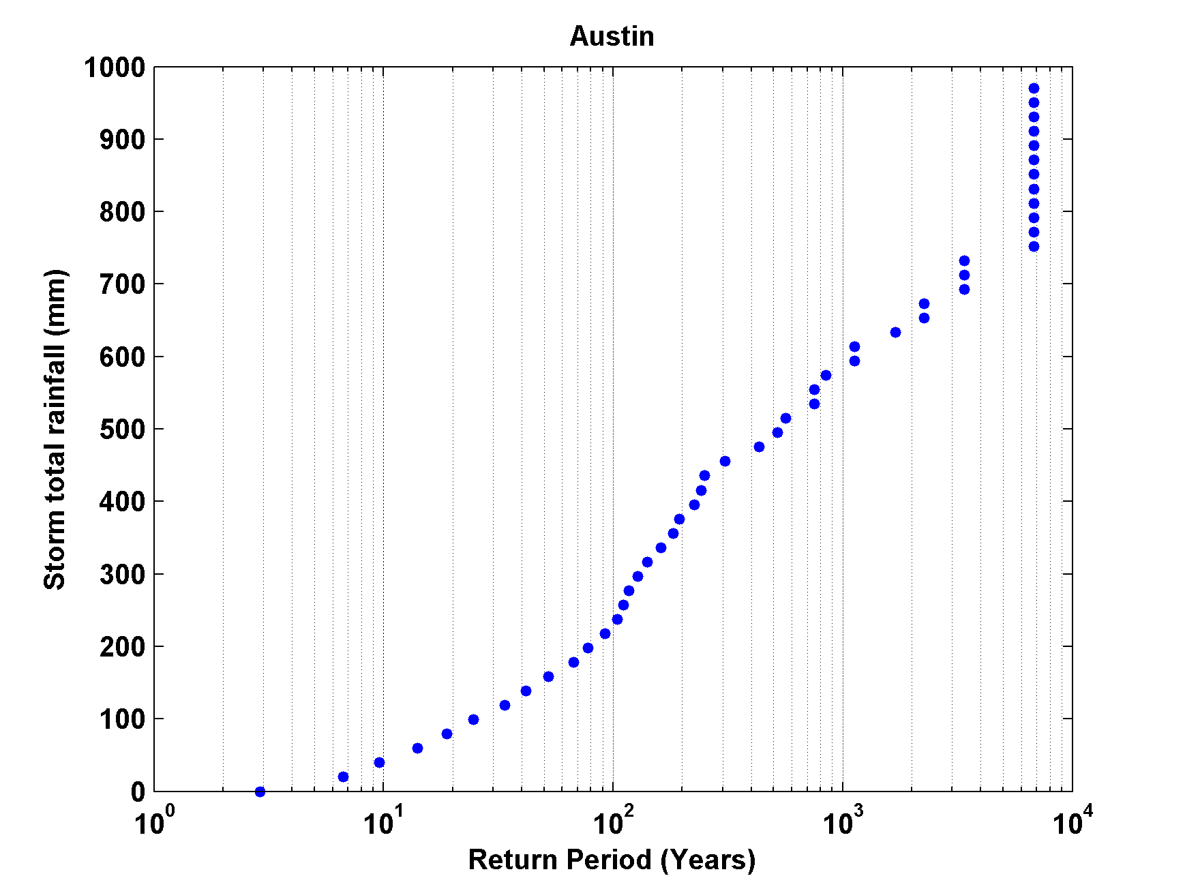
Austin
Notes:
Return periods for rainfall amounts (in mm) given at right, at Austin, Texas, based on more than 3,000 synthetic hurricanes affecting Texas.

Slide 49
Future Texas Hurricane Risk
Notes:
Synthetic hurricanes can be generated from the output of global climate models just as easily as from climate data sets. We apply the technique to 4 different climate models run in support of the upcoming IPCC report: Those of the NOAA/Princeton Geophysical Fluid Dynamics Laboratory (GFDL), the United Kingdom’s Hadley Centre Global Environmental Model (HadGEM), Germany’s Max Planck Institute (MPI) model, and France’s Institut Pierre Simon LaPlace (IPSL) model.

Slide 50
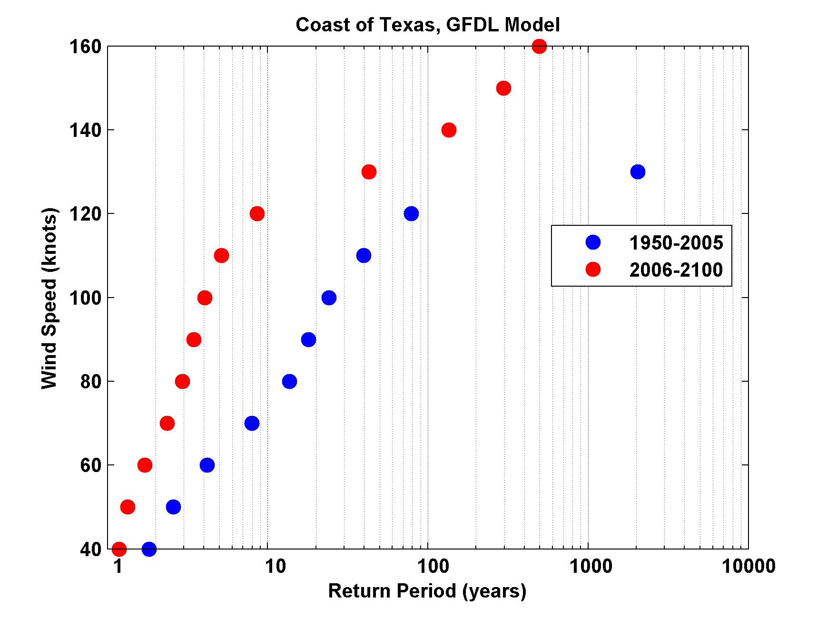
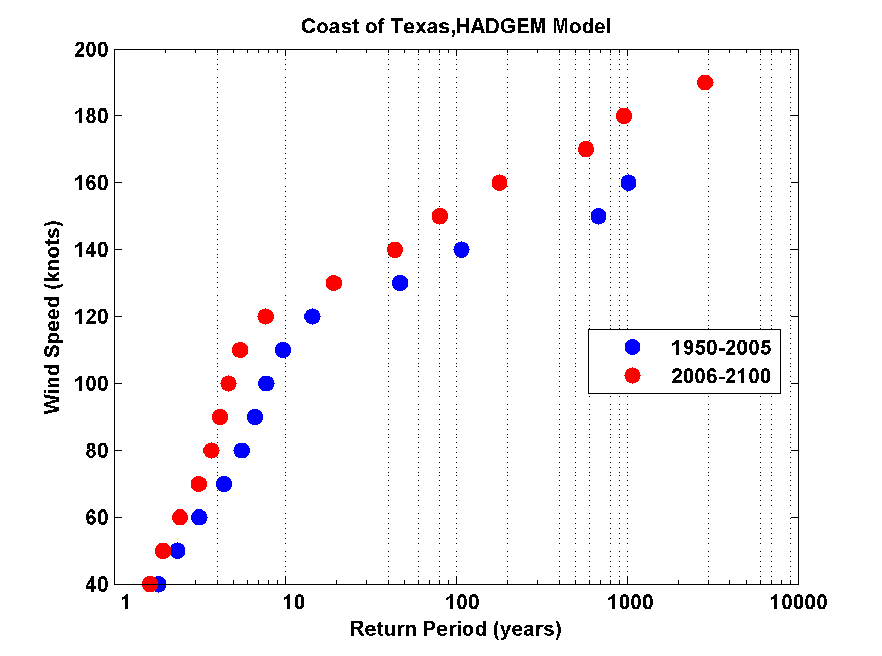
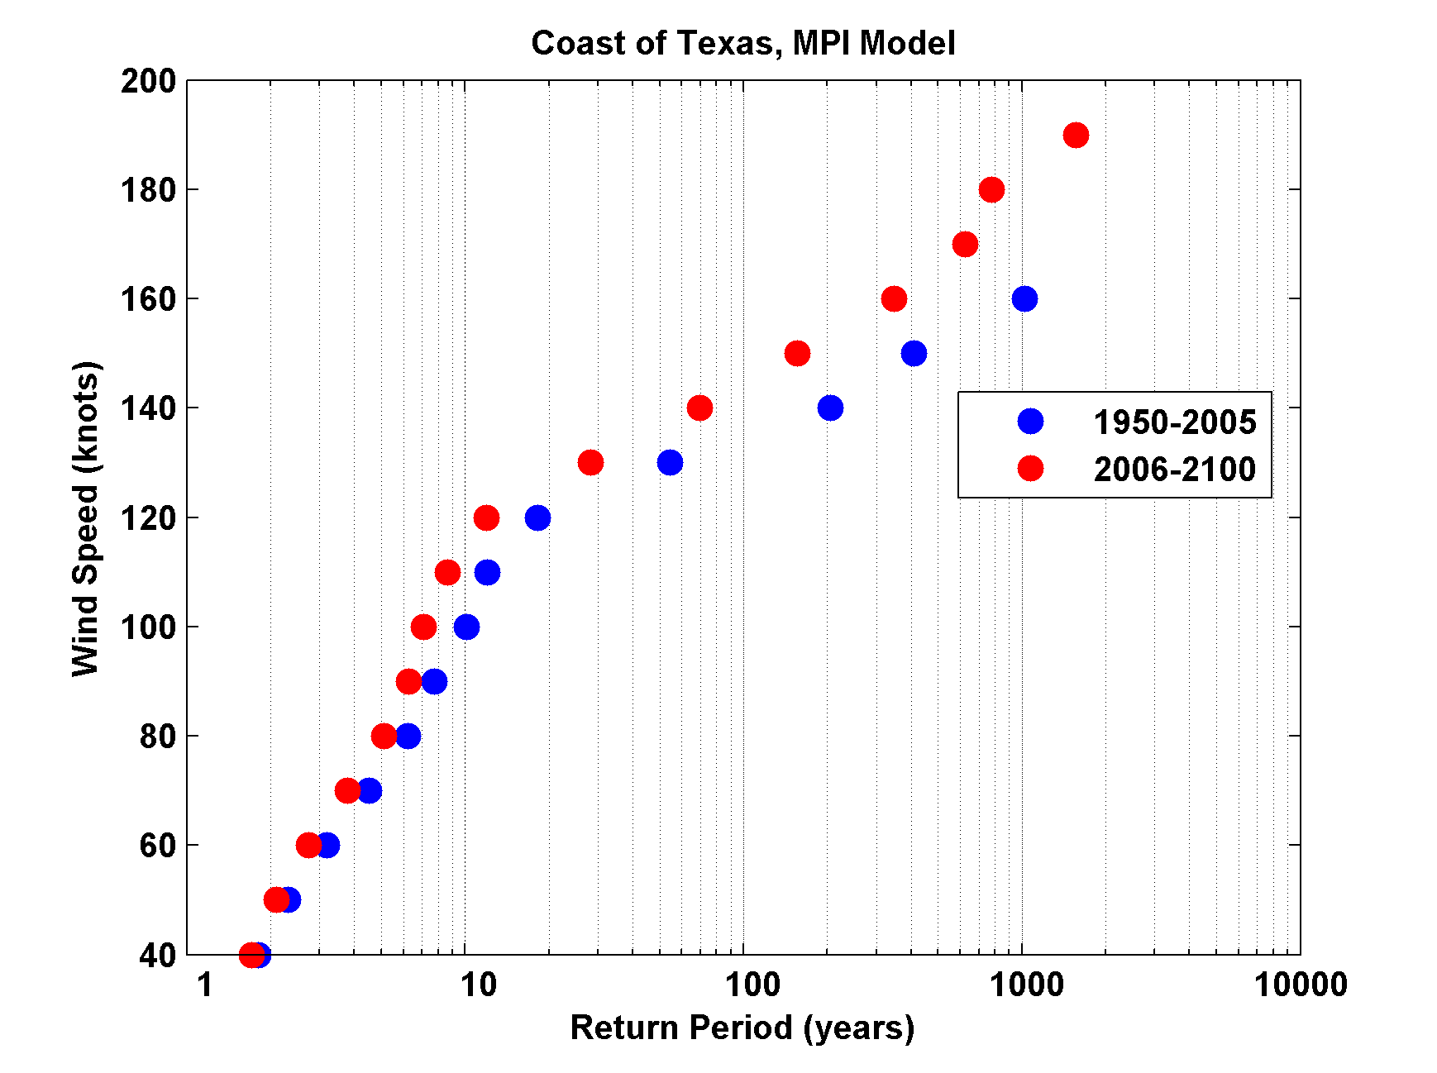
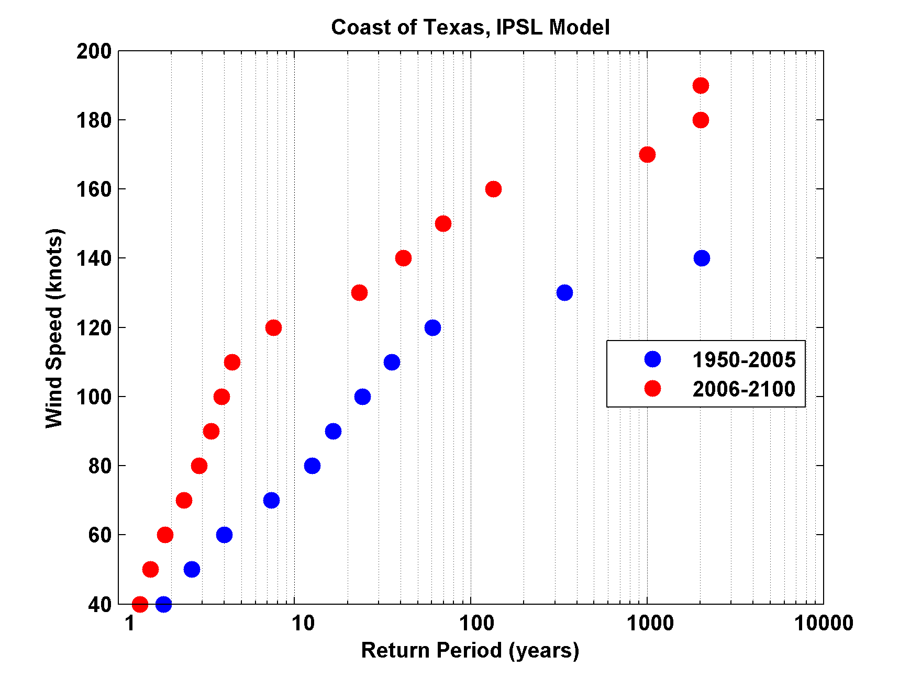
Notes:
These results are based on several thousand synthetic hurricanes crossing the coast of Texas, generated from each of the 4 climate models described in the previous slide. They show the return periods (logarithmic scale at bottom) as a function of wind speed (knots) shown on left-hand axes. The blue dots pertain to the simulated climate of the period 1950-2005, while the red dots are for the period 2006-2100, assuming that global warming continues, with a peak radiative forcing of 8.5 Watts per square meter.
Hurricanes generated from all 4 climate models show increased activity (reduced return periods). For example, the GFDL model (upper left) shows that a hurricane wind speed of 130 knots, now expected on the coast of Texas once in 2,000 years, will occur on average once in 45 years in the future.

Slide 51
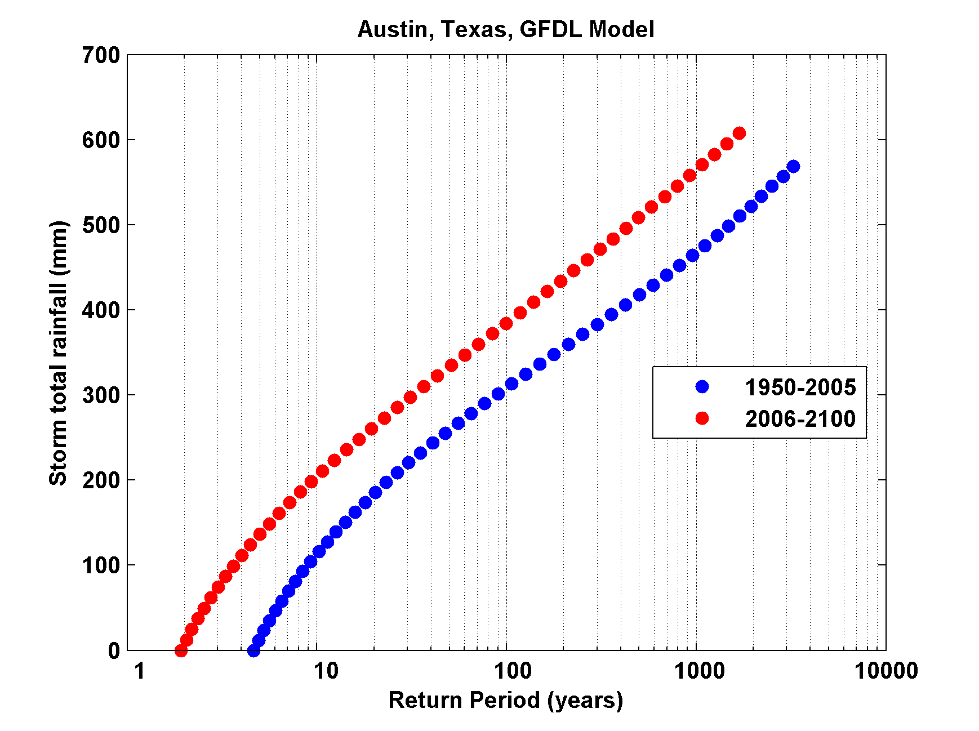
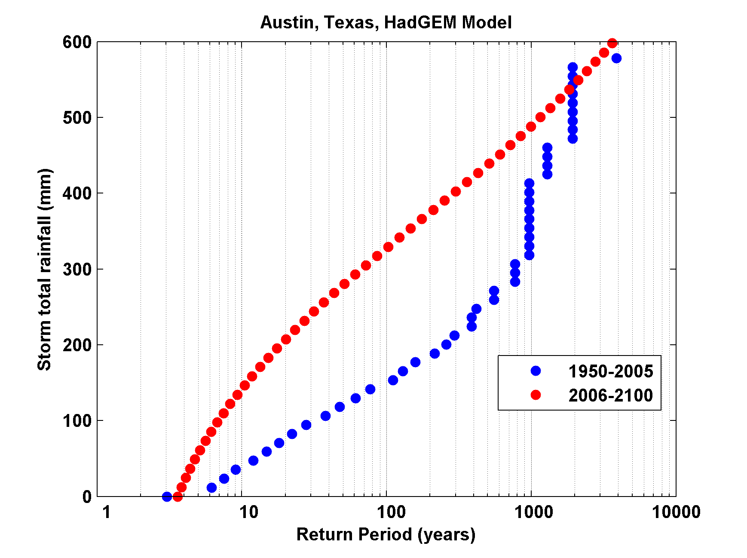
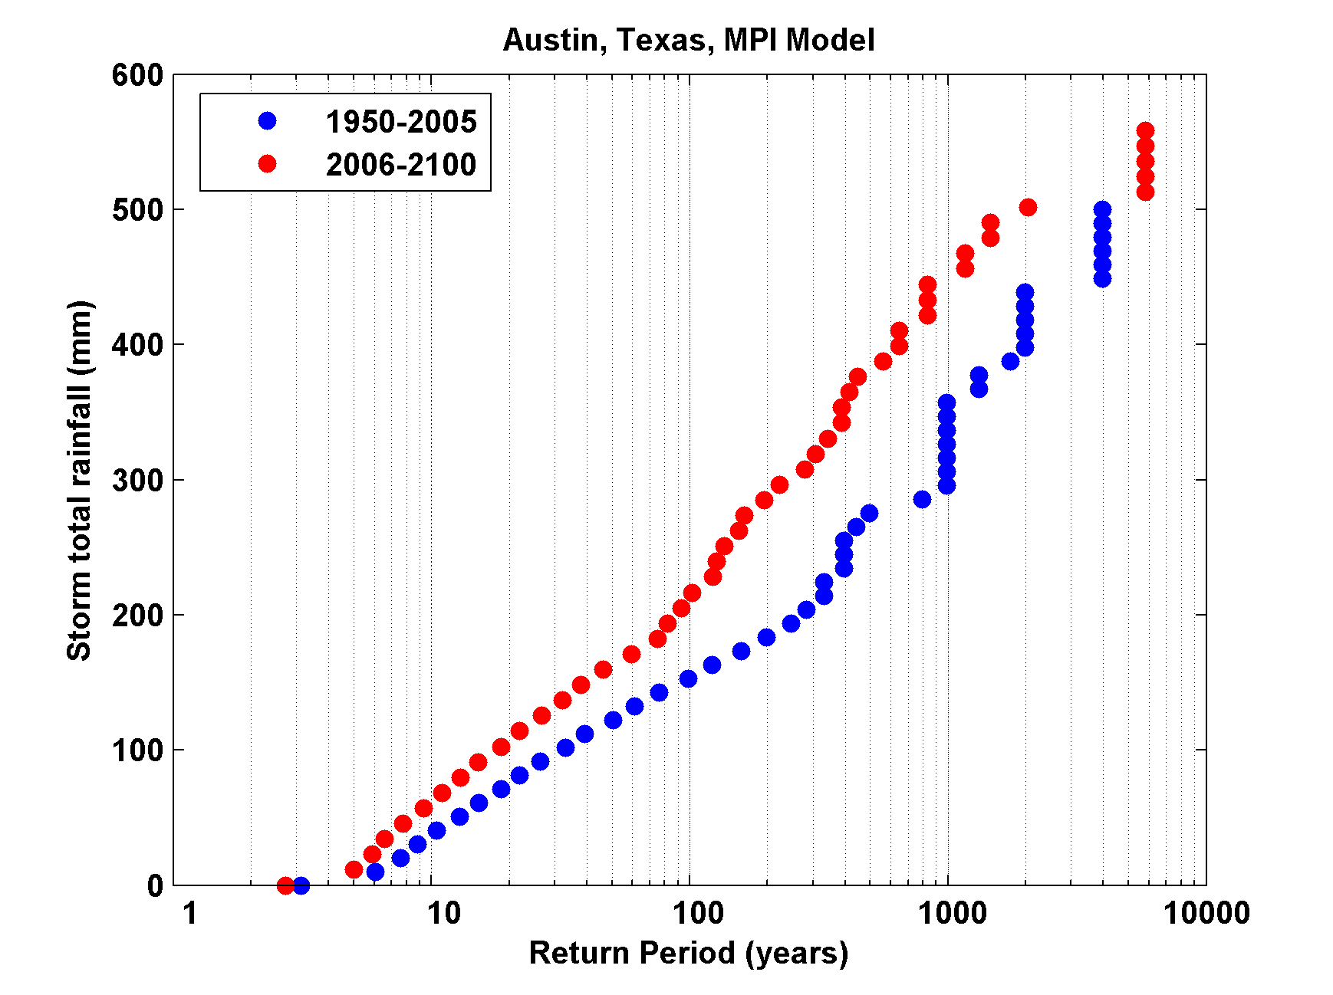
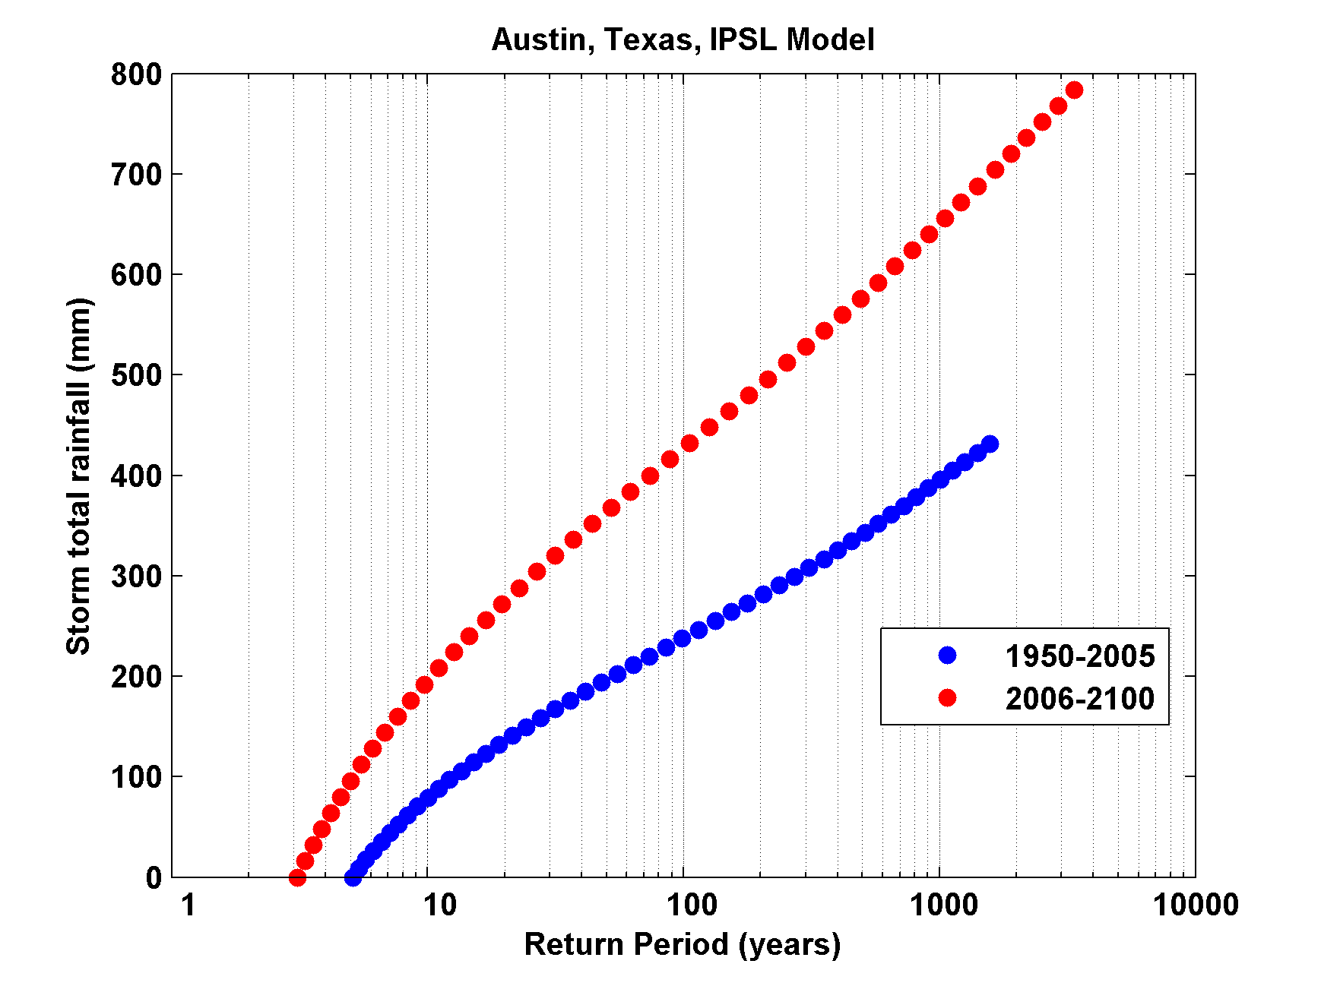
Notes:
This is similar to the previous plot but shows return periods for storm total rainfall (in millimeters) for the city of Austin, Texas. Hurricanes simulated from all 4 climate models show dramatically increased risk of heavy hurricane rains in Austin. This is both because a warmer atmosphere holds more water and because there are more and stronger hurricanes in the warmer climate.

Slide 52
Summary
Texas has long suffered from devastating hurricanes, including the Galveston Hurricane of 1900, the worst natural disaster in U.S. history
Texas is susceptible to all three hurricane hazards: wind, rain, and storm surge

Slide 53
Global warming increases the incidence of intense, destructive hurricanes and this is reflected in model projections of increased risk of high winds, surges, and floods associated with Texas hurricanes.

