Slide 1
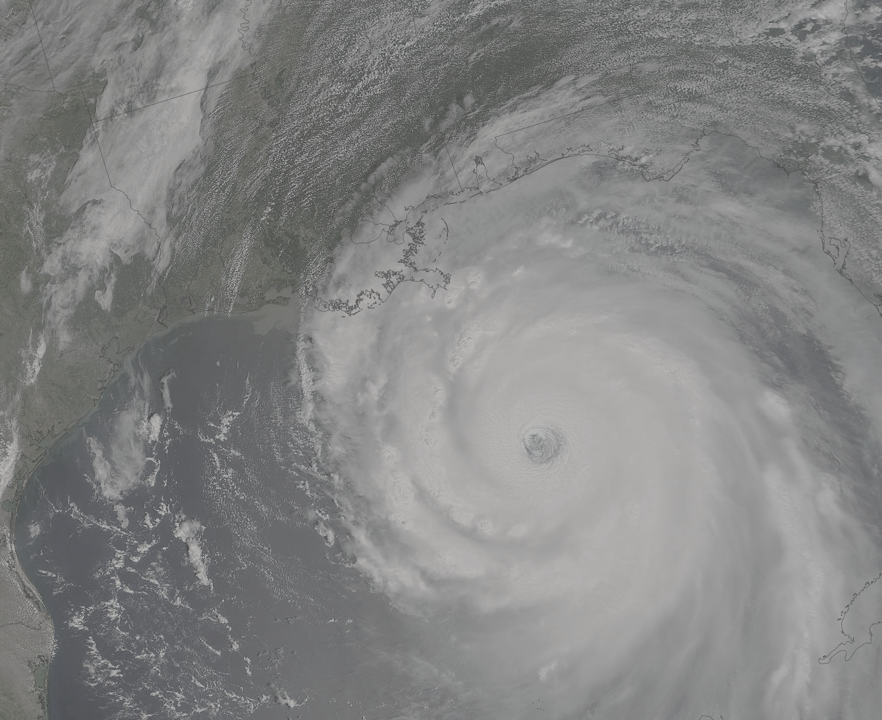
Hurricane Katrina: What Have We Learned and Where are We Going?
Kerry Emanuel
Lorenz Center
Massachusetts Institute of Technology
Notes:
1

Slide 2

Katrina Forecasts
Science of Predictability
Quantifying Forecast Uncertainty
Climate Change
New Directions in Theoretical Research

Slide 3
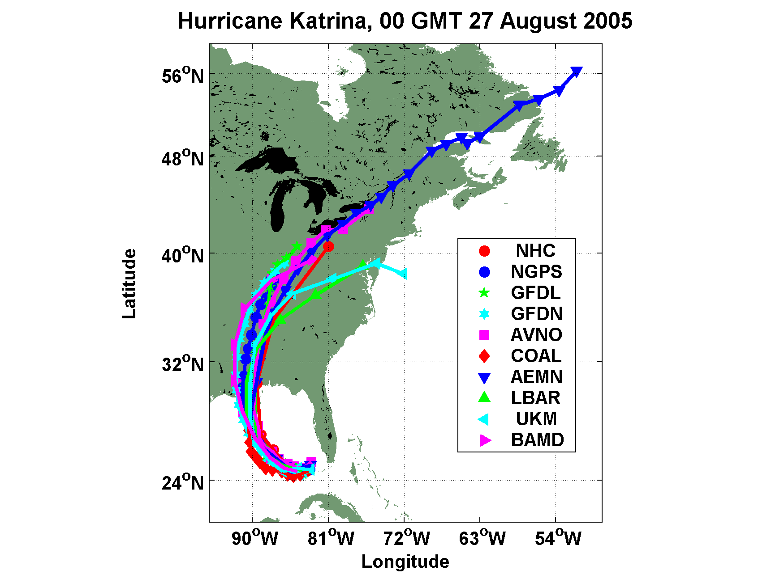
Katrina: Excellent Track Forecasts

Slide 4
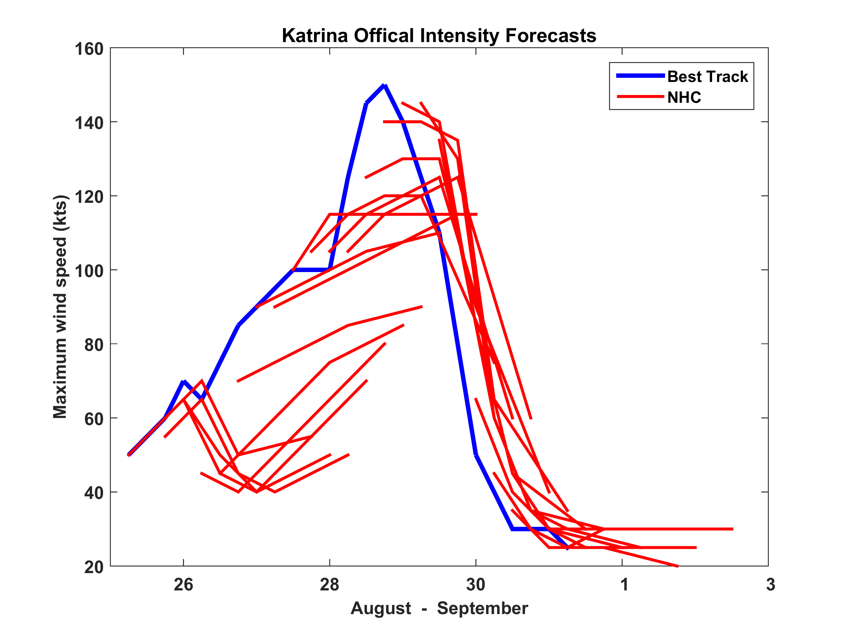
Katrina: Deficient Intensity Forecasts

Slide 5
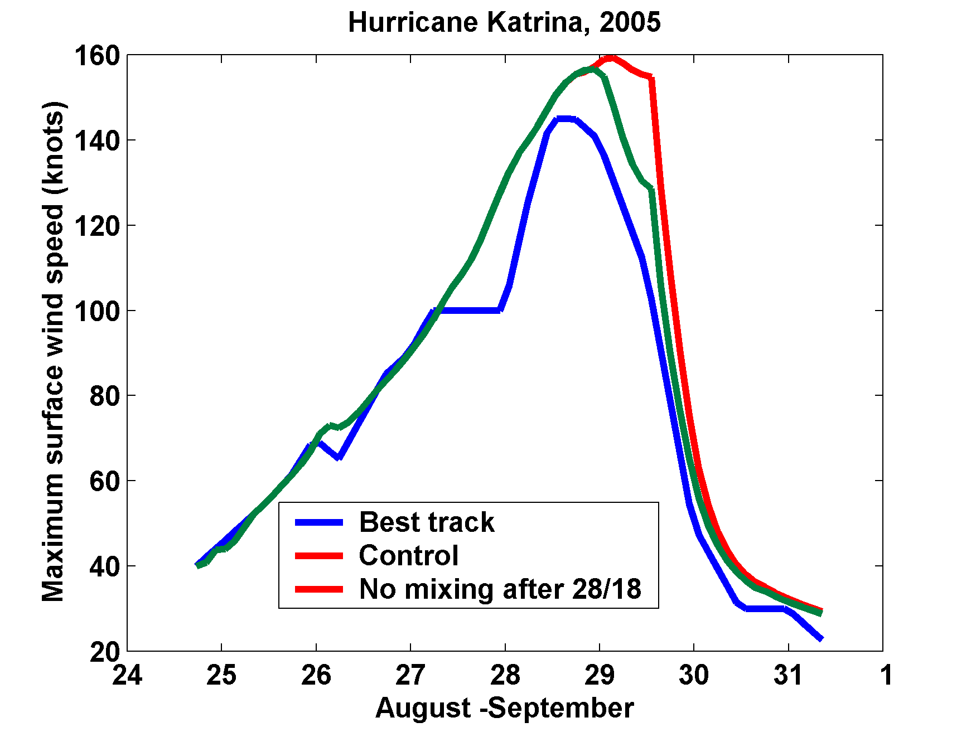
Importance of Ocean Mixing
(hindcasts using CHIPS model)

Slide 6
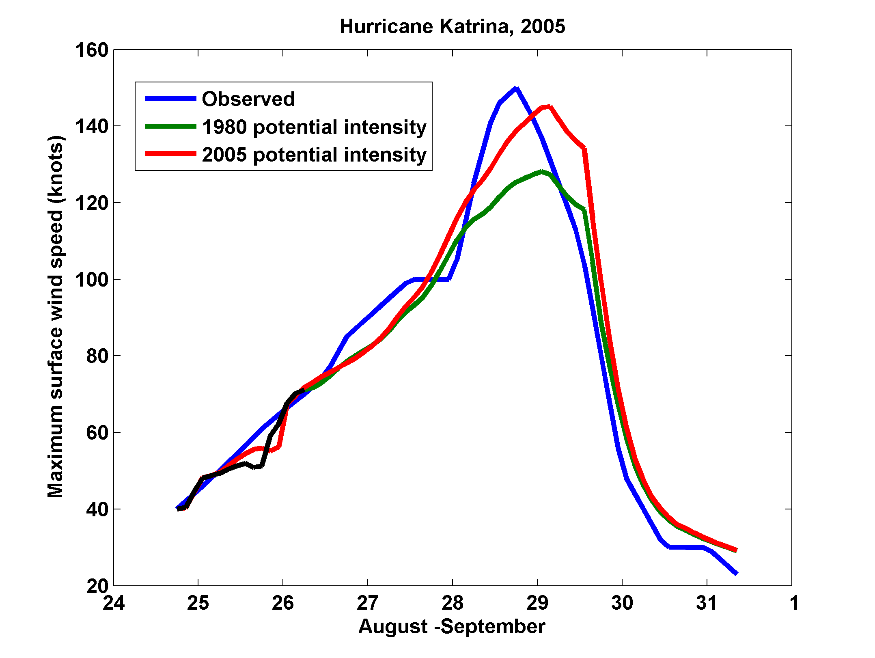
Katrina: Effects of Climate Change
(hindcasts using CHIPS model)

Slide 7
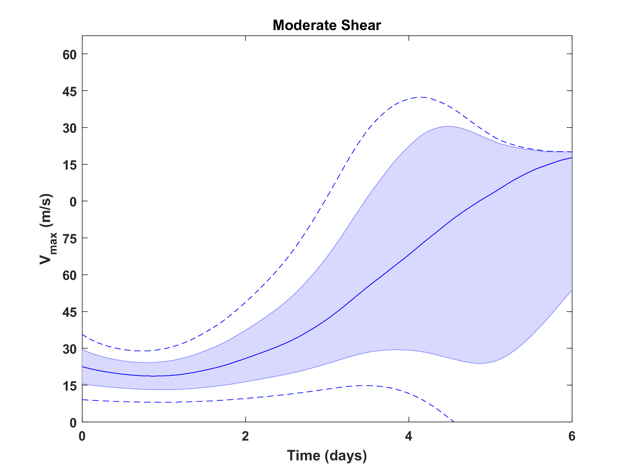
Effect of Environmental Wind Shear on Fundamental Predictability of Intensity: Low Predictability with Moderate Shear
(Jon Moskaitis, Fuqing Zhang)

Slide 8
Quantifying Forecast Uncertainty: Large Ensembles of Embedded TC Models
Best Track
NHC

Slide 9
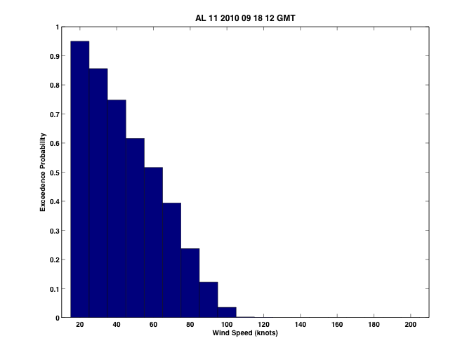
Wind exceedence probabilities for Bermuda (32.4N, 64.7W)
Sample size:
1000 tracks
Observed at airport (TXKF):
59kts
(81kts gusts)
Quantitative probabilistic forecasts should become primary guidance and should serve as the main basis for forecast skill assessments

Slide 10
Some Research Directions
Importance of Hurricane Outflow (ONR Tropical Cyclone Intensity experiment)
Theoretical and Practical Predictability Horizons
Climate Control of Hurricanes and Hurricane Influence on Climate
Genesis
Dry Hurricanes

Slide 11
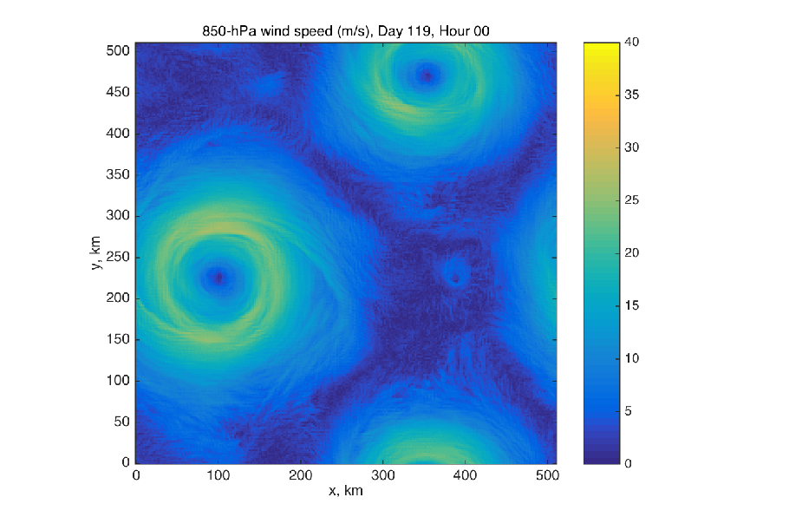
Dry Hurricanes in Dry RCE State
Tim Cronin, Harvard University

Slide 12
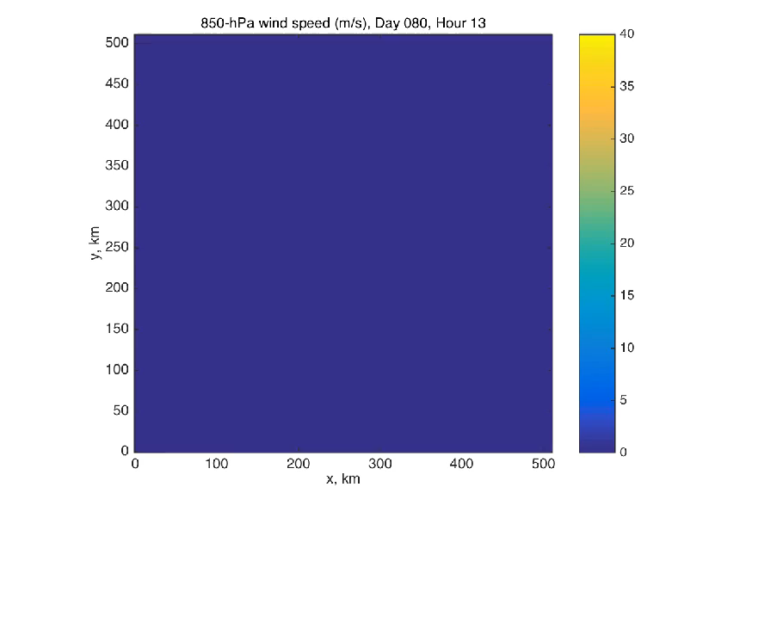
Dry Hurricanes in Dry RCE State
Tim Cronin, Harvard University

Slide 13
Summary
Continued progress in hurricane track predictive skill since Katrina
Slow erosion of TC intensity errors
Better understanding of controls on intensity and fundamental predictability limits
Growing recognition of value of probabilistic TC forecasting
TC Research remains lively and productive

