Slide 1

TROPICAL CYCLONES IN A WARMING WORLD
Kerry Emanuel
Massachusetts Institute of Technology
Notes:
1

Slide 2
Issues
What processes control rates of formation of tropical cyclones?
What processes control the actual and potential intensity of TCs?
What have TCs been like in the past, and how will they be affected by global warming?

Slide 3
The Genesis Puzzle

Slide 4
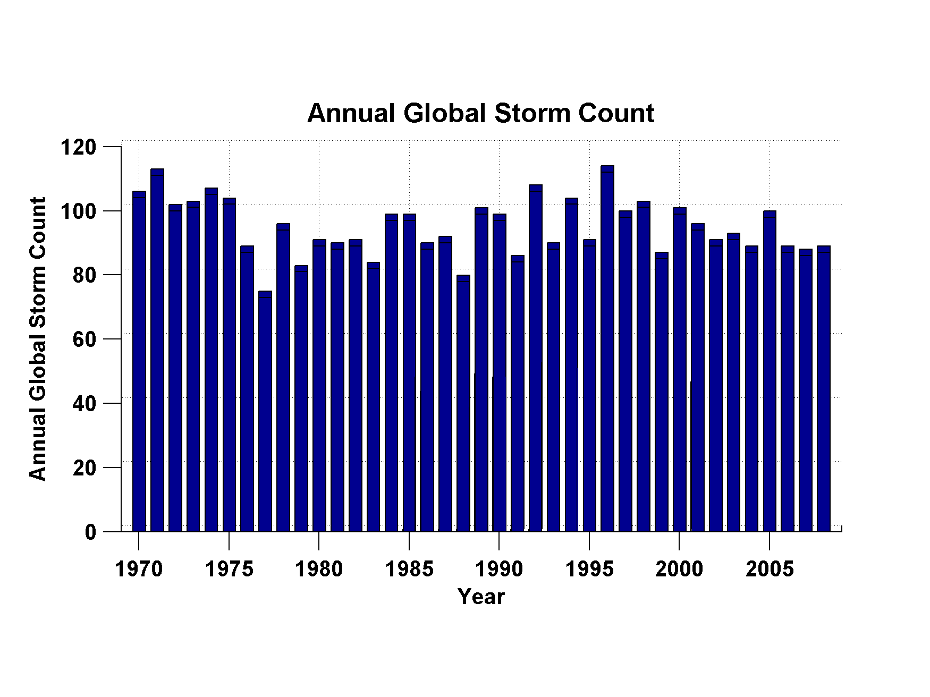
Global Tropical Cyclone Frequency, 1970-2008
Data Sources: NOAA/TPC and NAVY/JTWC
Notes:
4

Slide 5
Tropical Cyclones Often Develop from Cloud Clusters:
When/Why Does Convection Form Clusters?

Slide 6
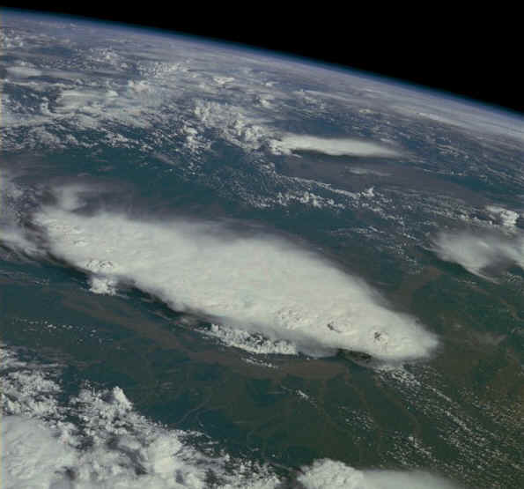
Monsoonal Thunderstorms, Bangladesh and India July 1985

Slide 7
Simplest Statistical Equilibrium State:
Radiative-Convective Equilibrium

Slide 8
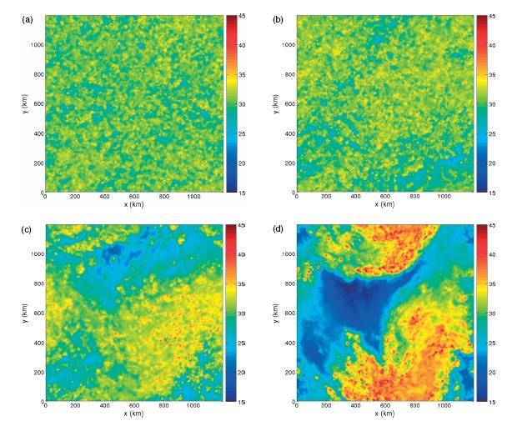
Vertically integrated water vapor at 4 days (Nolan et al., QJRMS, 2007)

Slide 9
Vertically integrated water vapor at 4 (a), 6 (b), 8 (c), and 10 (d) days (Nolan et al., QJRMS, 2007)

Slide 10
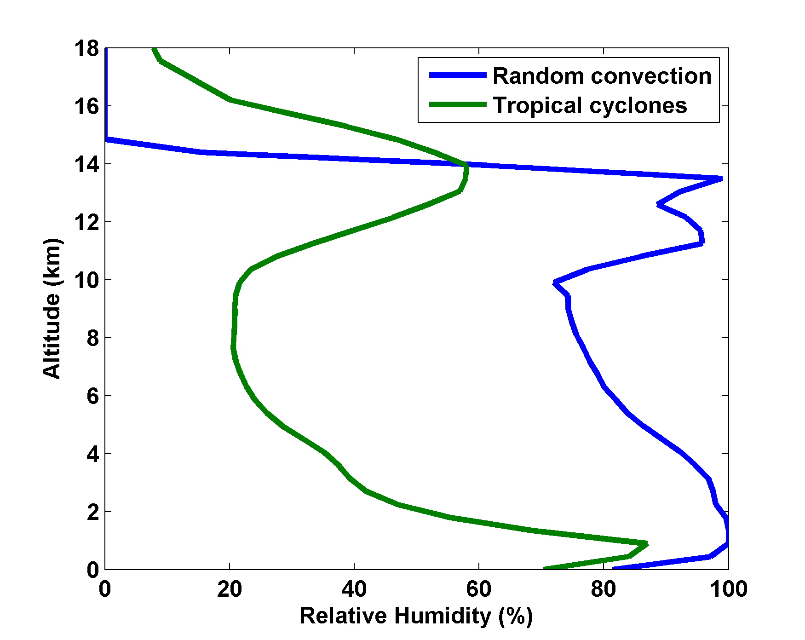
Nolan et al., QJRMS, 2007

Slide 11

Empirical Necessary Conditions for Self-Aggregation (after Held et al., 1993; Bretherton et al., 2005; Nolan et al.; 2007)
Small vertical shear of horizontal wind
Interaction of radiation with clouds and/or water vapor
Feedback of convective downdraft surface winds on surface fluxes
Sufficiently high surface temperature

Slide 12
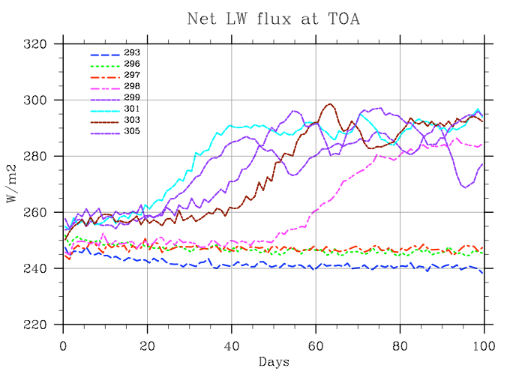
Self-Aggregation is Temperature-Dependent (Nolan et al., 2007; Emanuel and Khairoutdinov, in preparation, 2010)

Slide 13
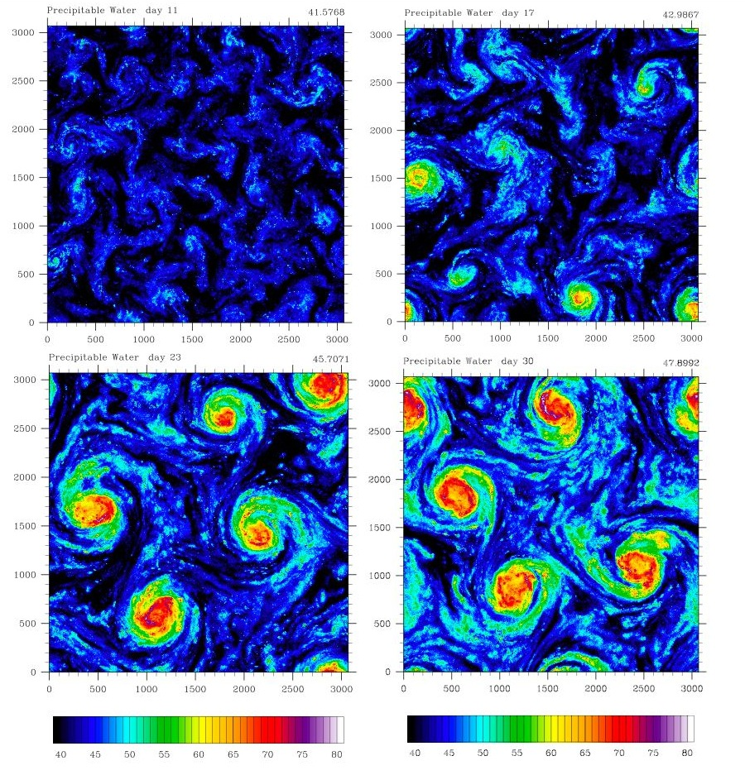

Extension to f-plane
Distance between vortex centers scales as V_{pot}/f

Slide 14
Intensity:
Some Empirical Results

Slide 15

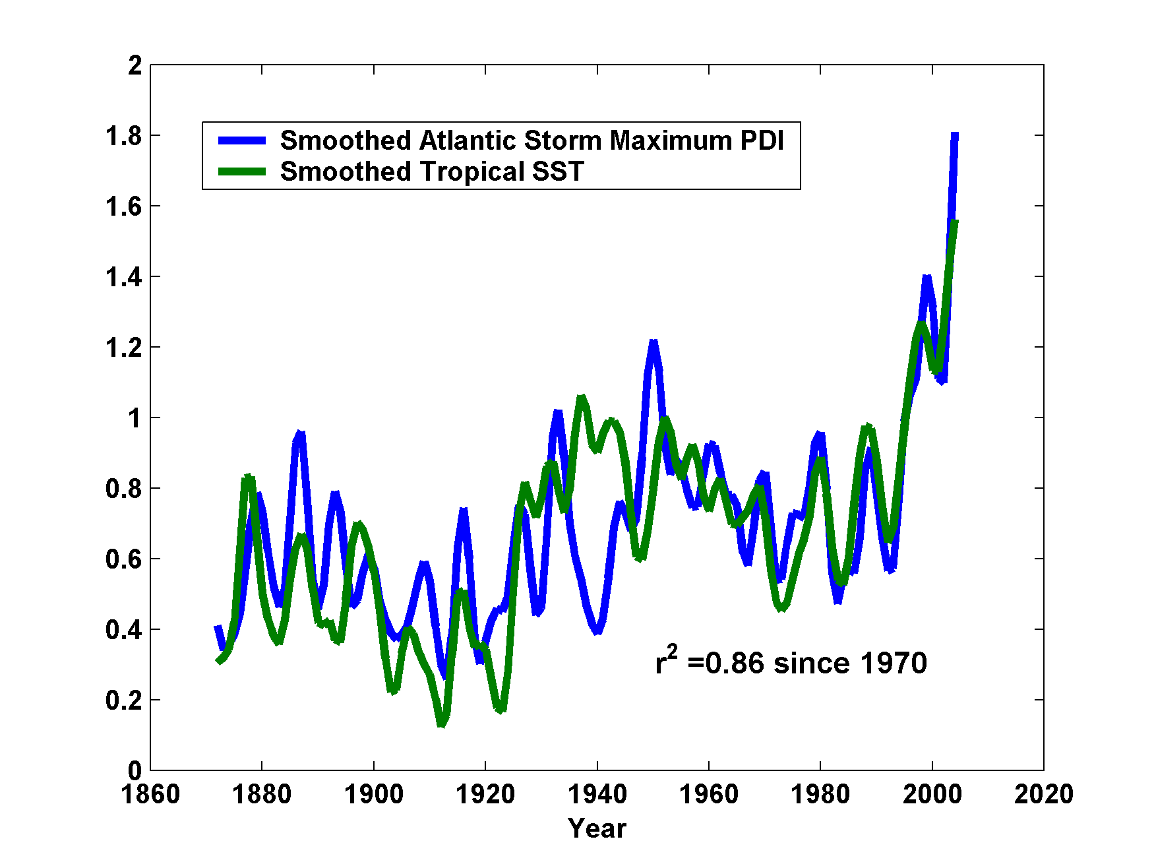
Atlantic Sea Surface Temperatures and Storm Max Power Dissipation
(Smoothed with a 1-3-4-3-1 filter)
Years included: 1870-2006
Power Dissipation Index (PDI)
Scaled Temperature
Data Sources: NOAA/TPC, UKMO/HADSST1
Notes:
15
The low value of storm power in the early 1940s is thought to be due to the lack of reports from ships at sea because of the radio silence imposed during WWII.

Slide 16
Tropical cyclone power dissipation has nearly tripled since the 1980s, though there has been an increase of only 0.5º C in sea surface temperature

Slide 17
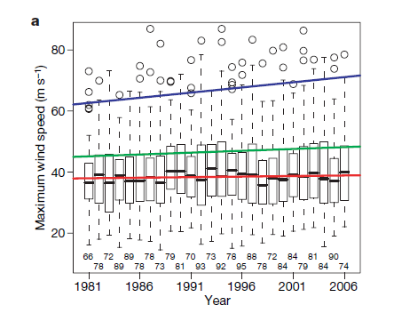
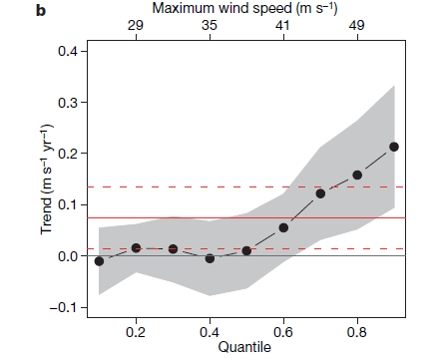
Analysis of satellite-derived tropical cyclone
lifetime-maximum wind speeds
Box plots by year. Trend lines are shown
for the median, 0.75 quantile, and 1.5 times the interquartile range
Trends in global satellite-derived tropical cyclone maximum wind speeds by quantile, from 0.1 to 0.9 in increments of 0.1.
Elsner, Kossin, and Jagger, Nature, 2008

Slide 18
The Importance of Potential Intensity for Genesis and for Storm Intensity

Slide 19
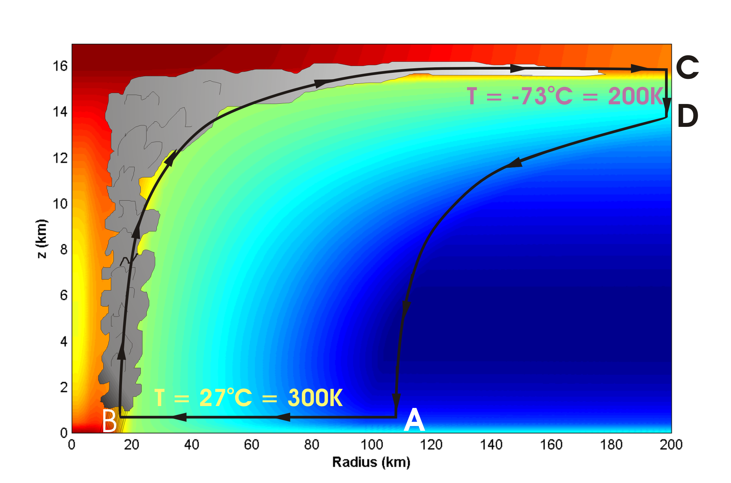
Energy Production Cycle

Slide 20
Theoretical Upper Bound on Hurricane Maximum Wind Speed:
Surface temperature
Air-sea enthalpy disequilibrium
Ratio of exchange coefficients of enthalpy and momentum
Outflow temperature
s₀* = saturation entropy of sea surface
s_{b} = actual entropy of subcloud layer

Slide 21
Condition of convective neutrality:
s_{b} = s* of free troposphere
Also, s* of free troposphere is approximately spatially uniform (WTG approximation)
approximately constant
What matters, apparently, is the SST (s₀*) relative to the tropospheric temperature (s*)

Slide 22
Annual Maximum Potential Intensity (m/s)

Slide 23
Empirical Evidence for the Importance of Potential Intensity to TC Genesis: A Genesis Potential Index (GPI)
Base choice of predictors on physics, intuition, past experience
850 hPa absolute vorticity (h)
850 – 250 hPa shear (S)
Potential intensity (PI)
Non-dimensional subsaturation of the middle troposphere:

Slide 24
New Genesis Potential Index:
850 hPa absolute vorticity (h)
850 – 250 hPa shear (S)
Potential intensity (PI)
Non-dimensional subsaturation of the middle troposphere:

Slide 25
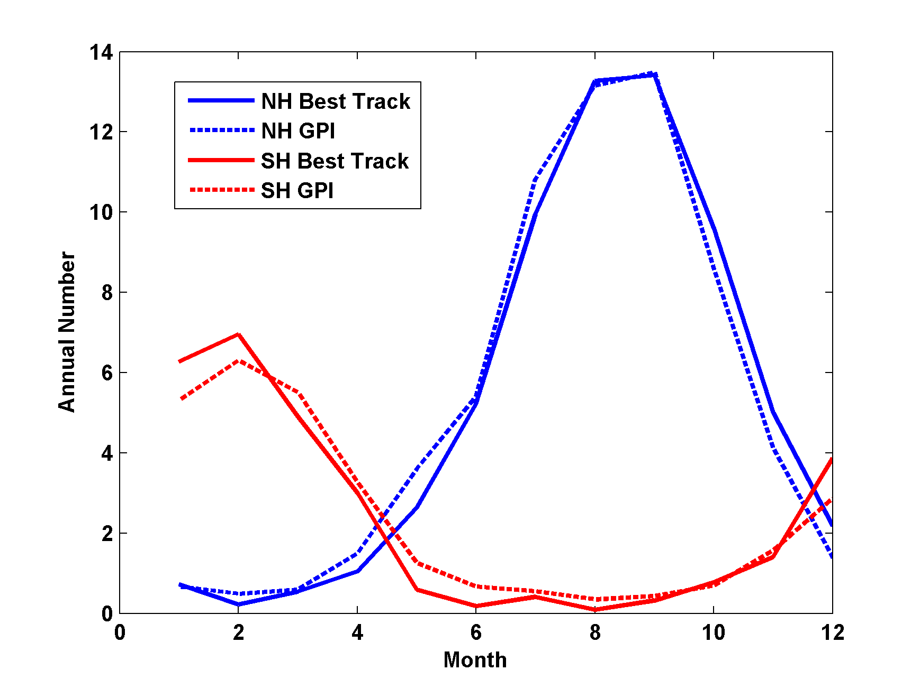
Performance

Slide 26
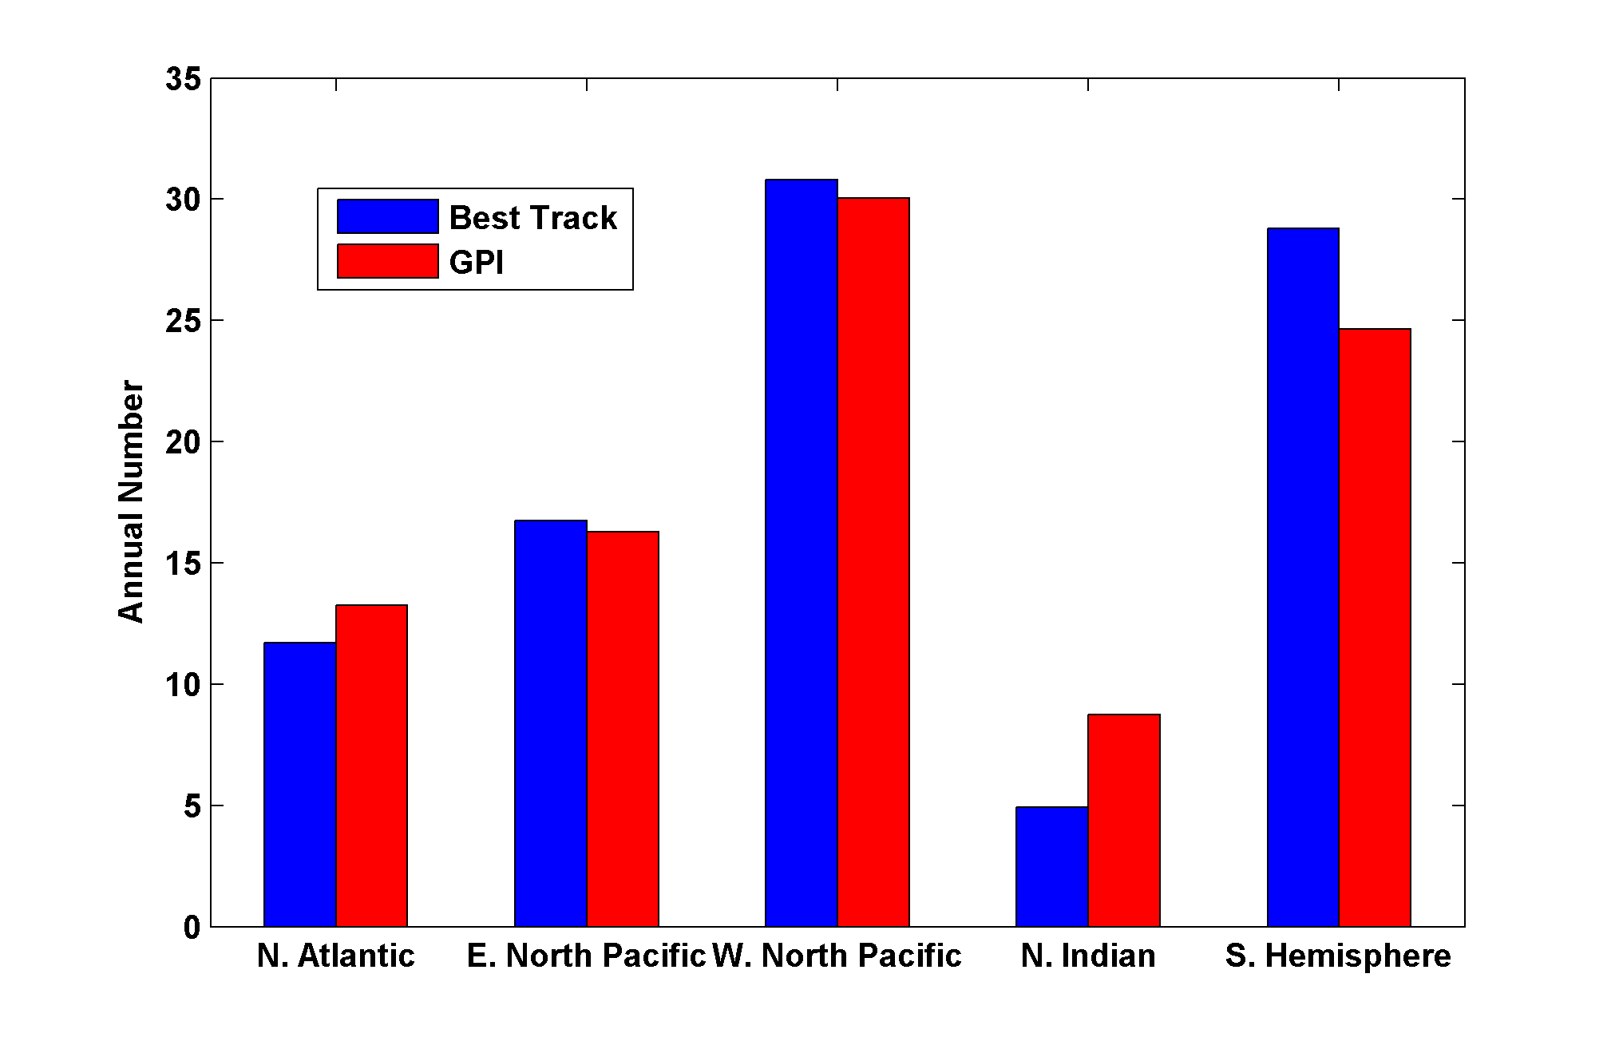
Basin Frequencies

Slide 27
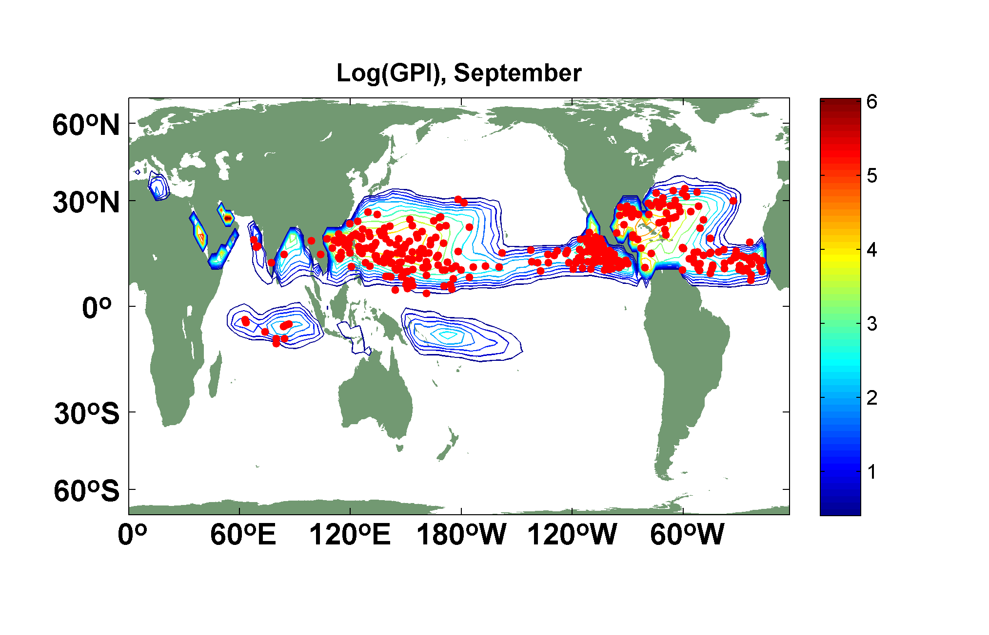
Spatial Distribution

Slide 28
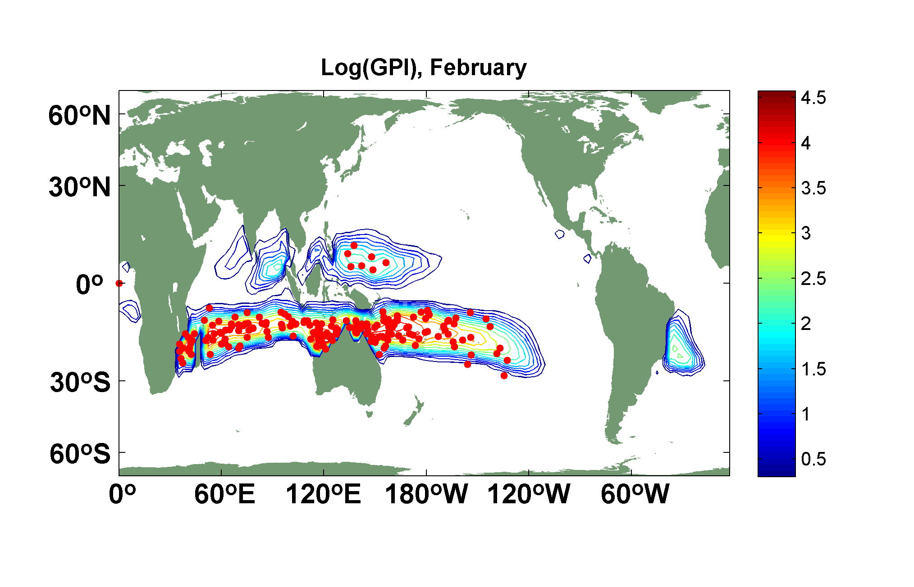

Slide 29
Climate Control of Potential Intensity
Ocean Surface Energy Balance:

Slide 30
Potential intensity is determined by local radiative balance, local convergence of ocean heat flux, local surface wind speed, and local outflow temperature only
Remote influences limited to remote effects on surface wind surface radiation ocean heat flux and, in marginal zones, on outflow temperature
SST cannot vary independently of free atmospheric temperature on long time scales

Slide 31
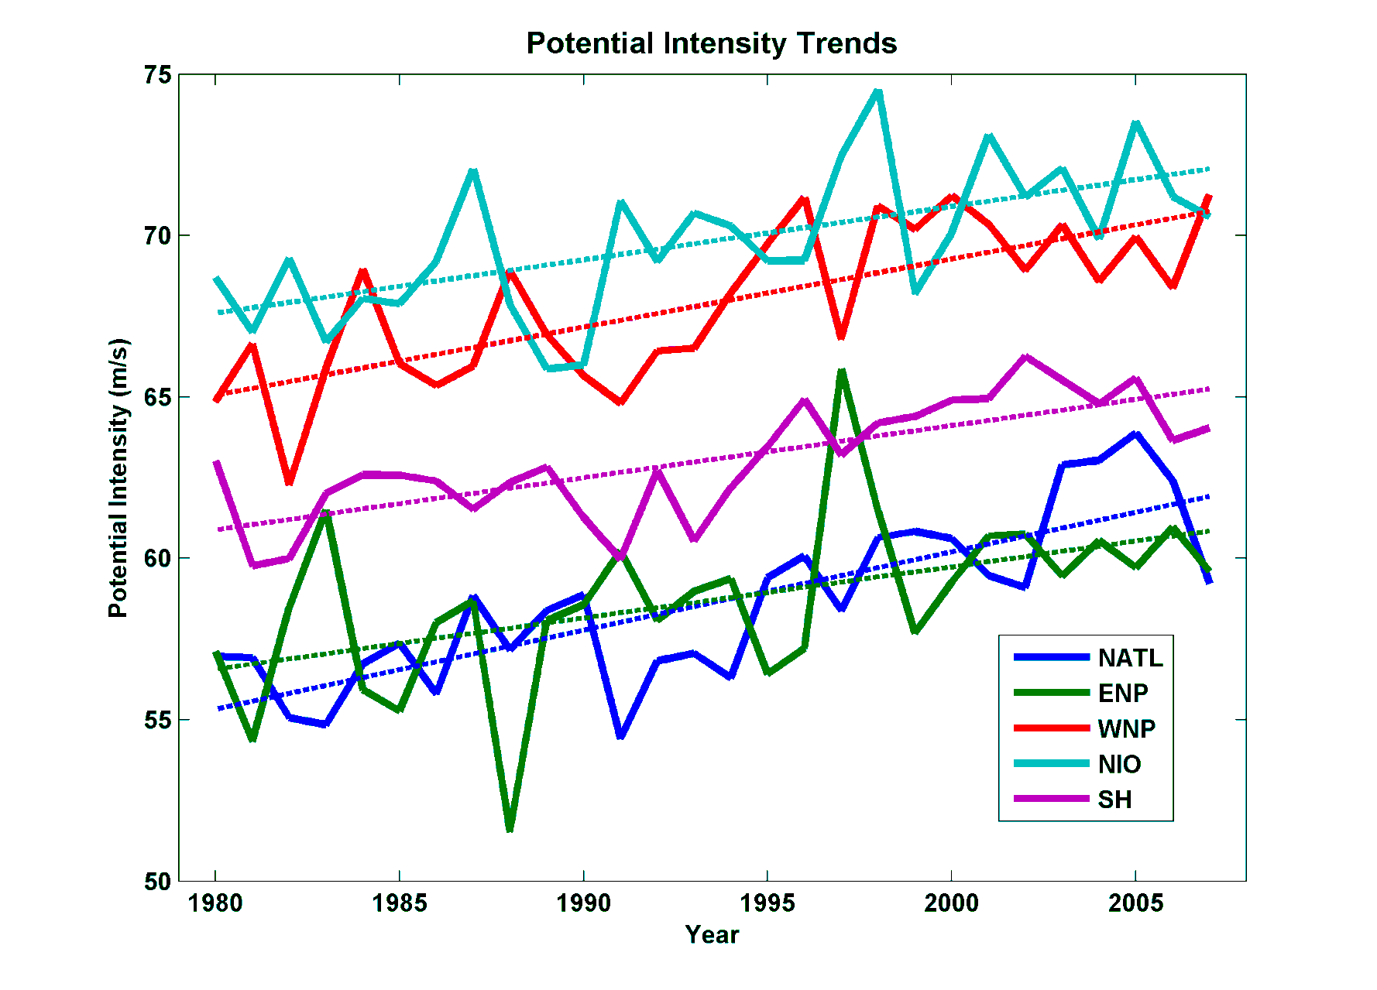
Interpretation of Recent Trends in Potential Intensity
North Indian
Western North Pacific
Southern Hemisphere
North Atlantic
Eastern North Pacific
From NCAR/NCEP reanalysis data, 1980-2008

Slide 32
Potential intensity has been increasing by about 12 ms⁻¹K⁻¹, compared to accepted value of 4 ms⁻¹K⁻¹. What is the source of this discrepancy?

Slide 33
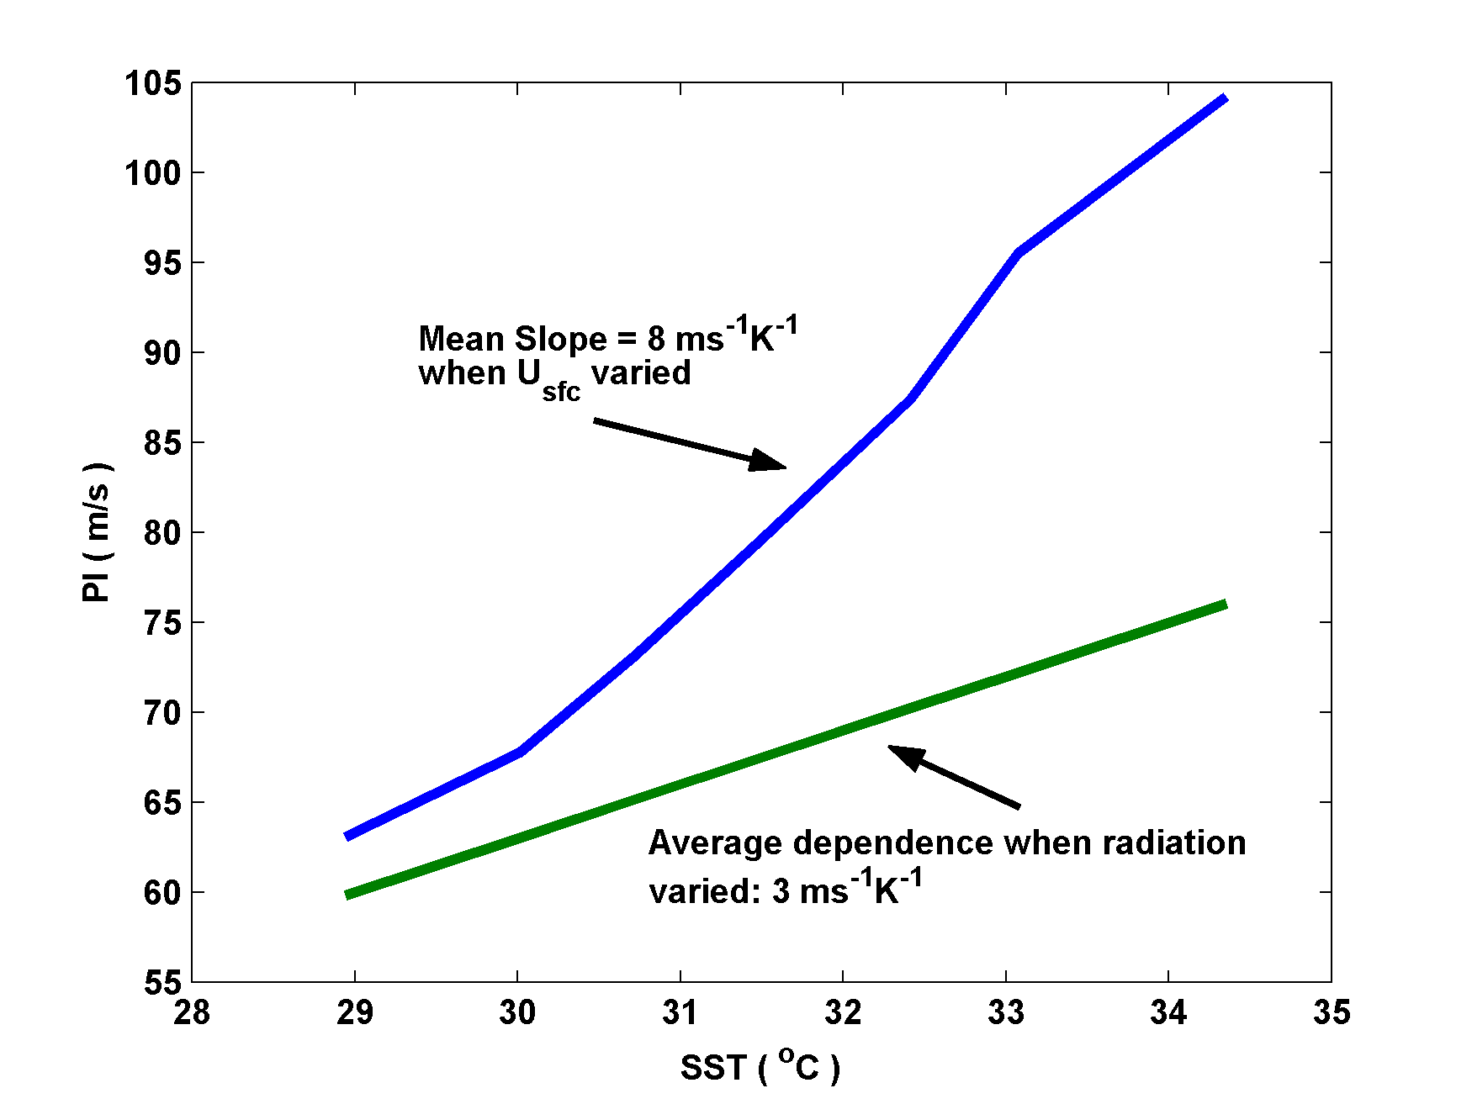
Answer: Potential Intensity is not a function of SST per se
Showing potential intensity vs. SST, varying mean surface wind (blue) and CO₂ content (green)

Slide 34
Combine expression for potential intensity, V_{max}, with energy balance of ocean mixed layer:
Net surface radiative flux
SST
Outflow T
Ocean mixed layer depth
Mixed layer heat flux
Drag coefficient
Mean surface wind speed
Valid on time scales > thermal equilibration time of ocean mixed layer (~ 2 years)

Slide 35
Surface wind speeds have not changed much since 1980. Key variable: Outflow temperature, which in general decreases with:
Increasing SST
Decreasing temperature of lower stratosphere and/or troposphere transition layer

Slide 36
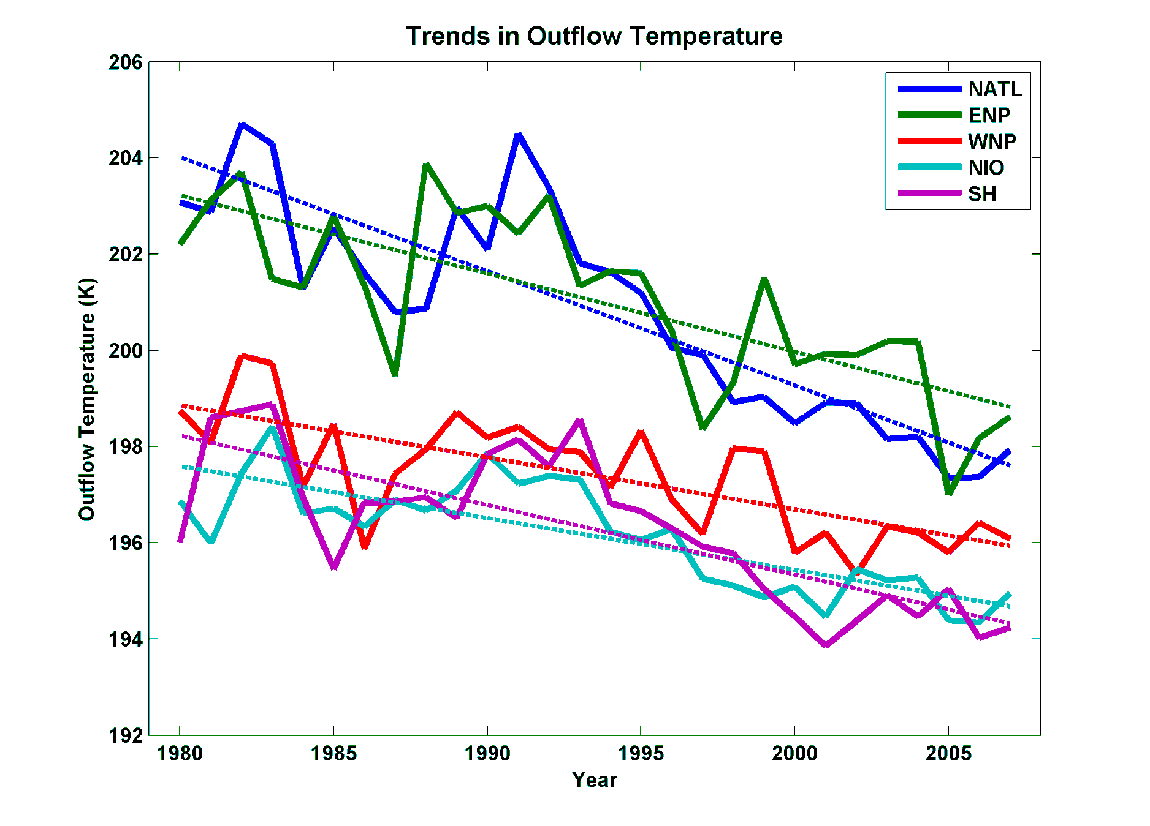
Importance of Trends in Outflow Temperature
From NCEP Reanalysis

Slide 38
Does NCEP Reanalysis Capture Lower Stratospheric Cooling?

Slide 39
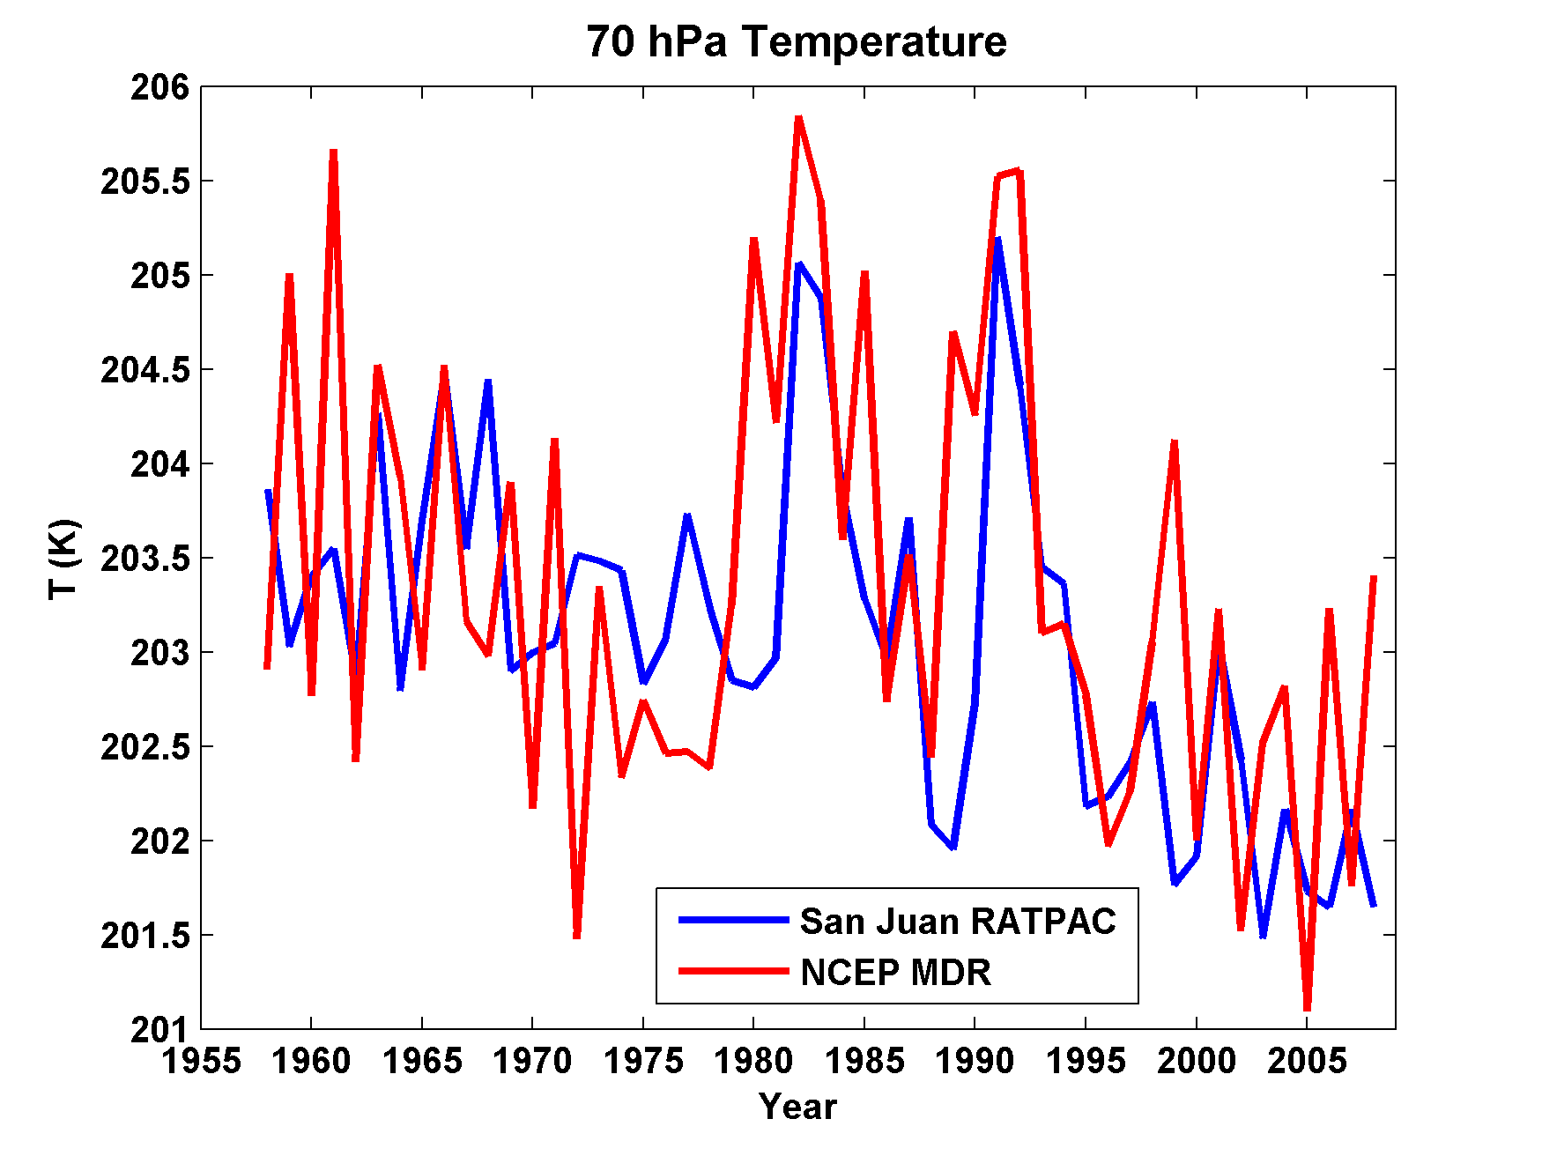
Yes, Pretty Much

Slide 40
Do AGCMs Capture Lower Stratospheric Cooling?

Slide 41
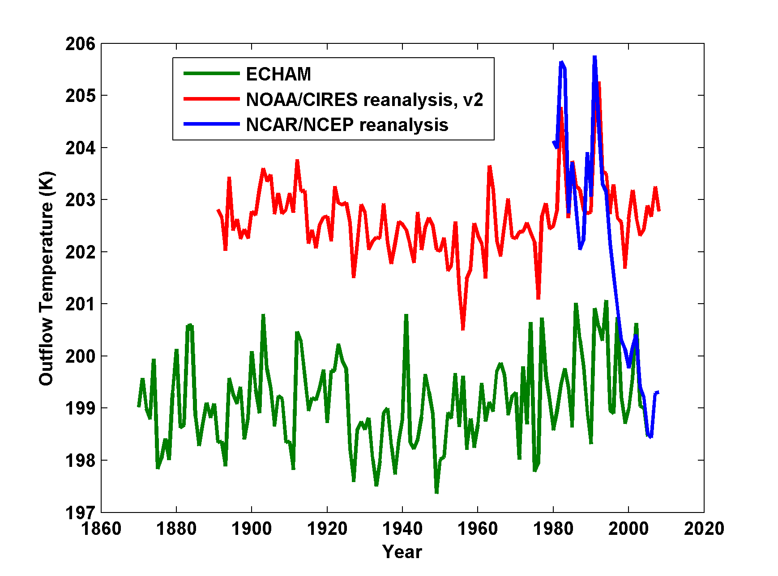
But AGCMs, driven by observed SSTs, do not get the cooling!
August-October outflow temperatures averaged over the Atlantic MDR from the ECHAM 5 simulation (green), the NOAA/CIRES 20th Century reanalysis, version 2 (red) and the NCAR/NCEP reanalysis (blue)

Slide 42
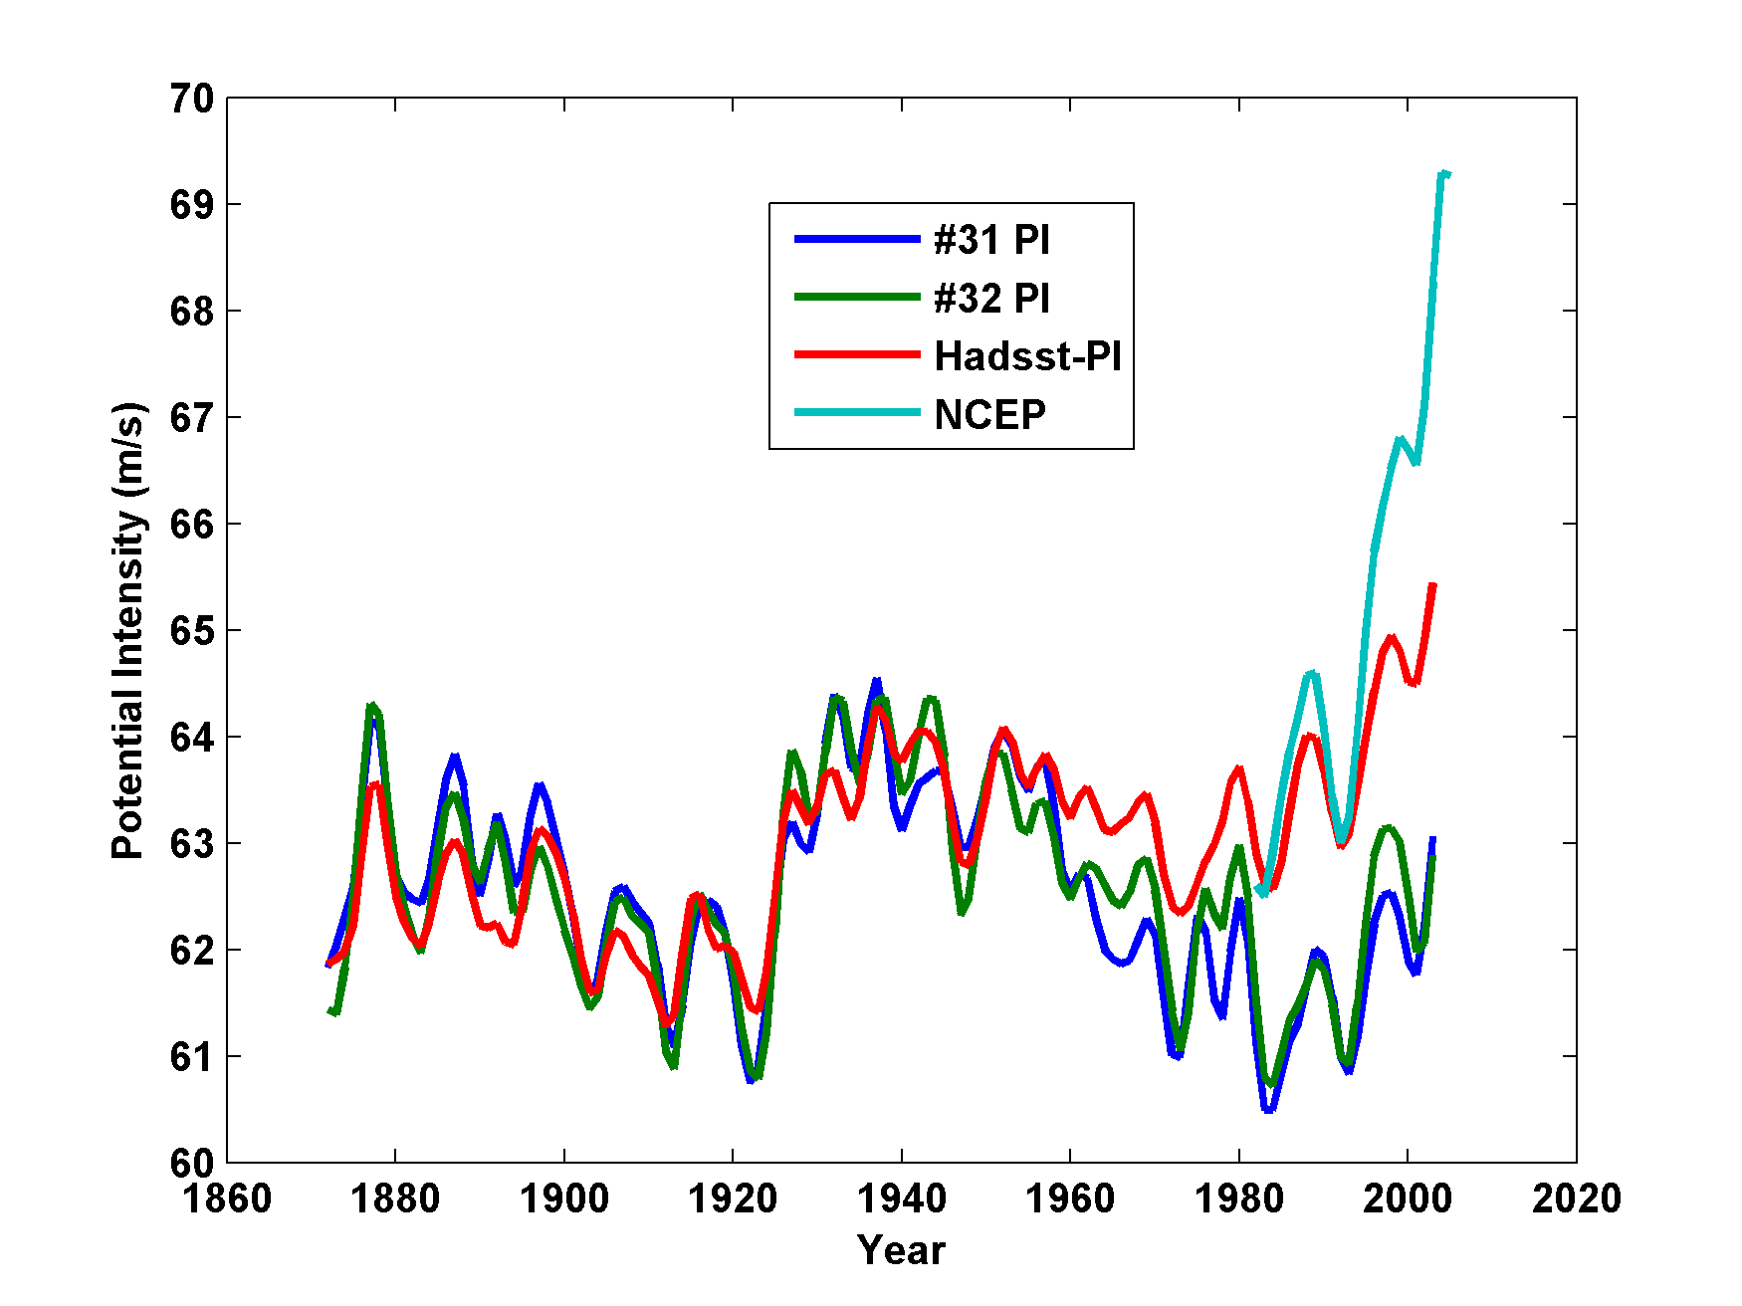
As a result, they miss the recent increase in potential intensity
NCEP
# 31: ECHAM without aerosols
#32: ECHAM with aerosols

Slide 43
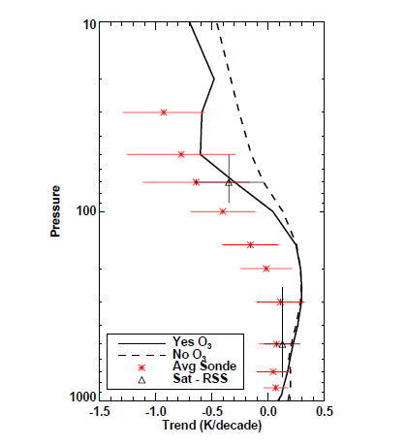
1979-1999 Temperature Trends, 30S-30N. Red: Radiosondes; Solid Black: Mean of Models with Ozone; Dashed Black: Mean of Models without Ozone (Cordero and Forster, 2006)

Slide 44
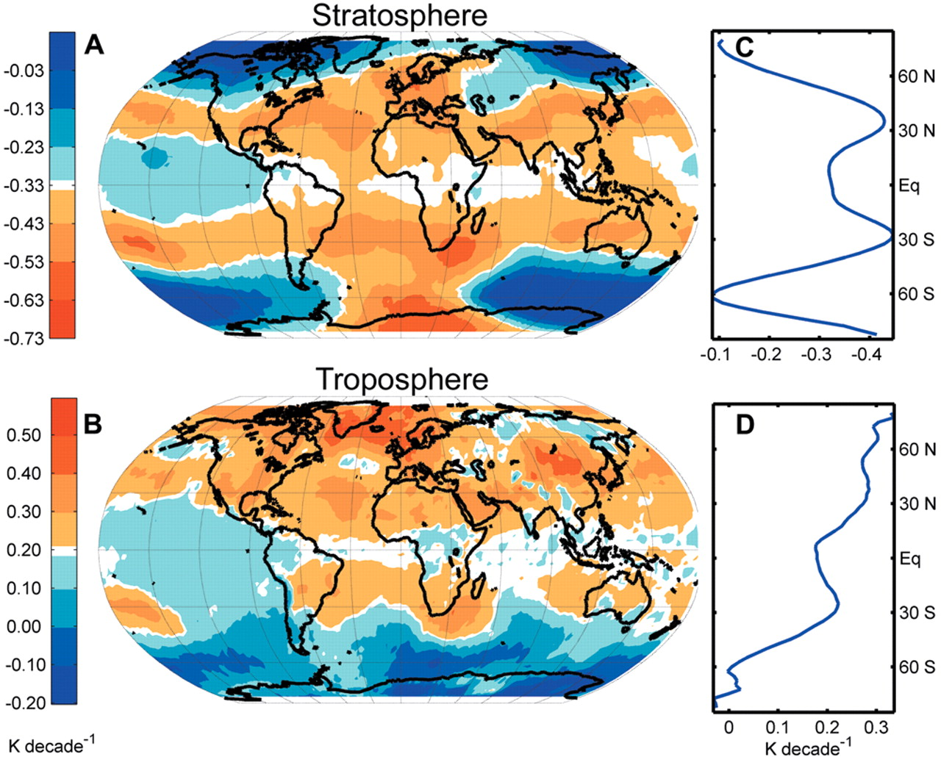
Ozone may not explain spatial pattern of cooling
(Fu and Wallace, Science, 2006)

Slide 45
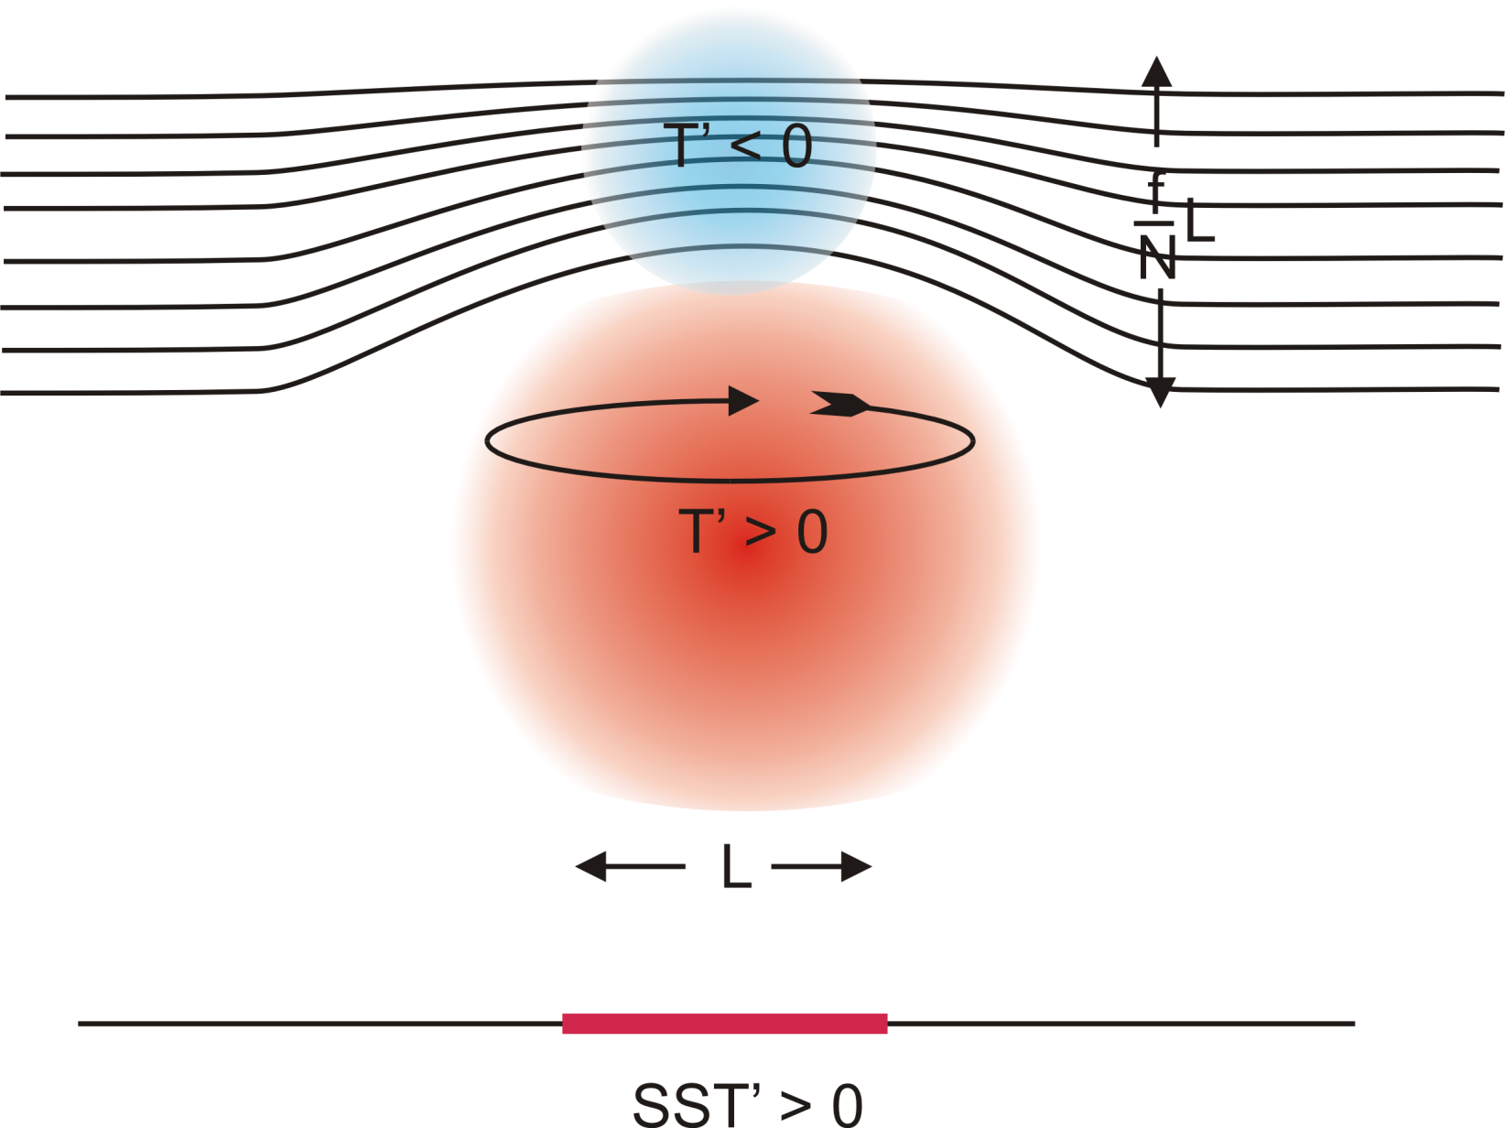
Stratospheric Compensation

Slide 46
Our Approach to TC Downscaling
Step 1: Seed each ocean basin with a very large number of weak, randomly located vortices
Step 2: Vortices are assumed to move with the large scale atmospheric flow in which they are embedded
Step 3: Run a coupled, ocean-atmosphere computer model for each vortex, and note how many achieve at least tropical storm strength; discard others
Step 4: Using the small fraction of surviving events, determine storm statistics.

Slide 47
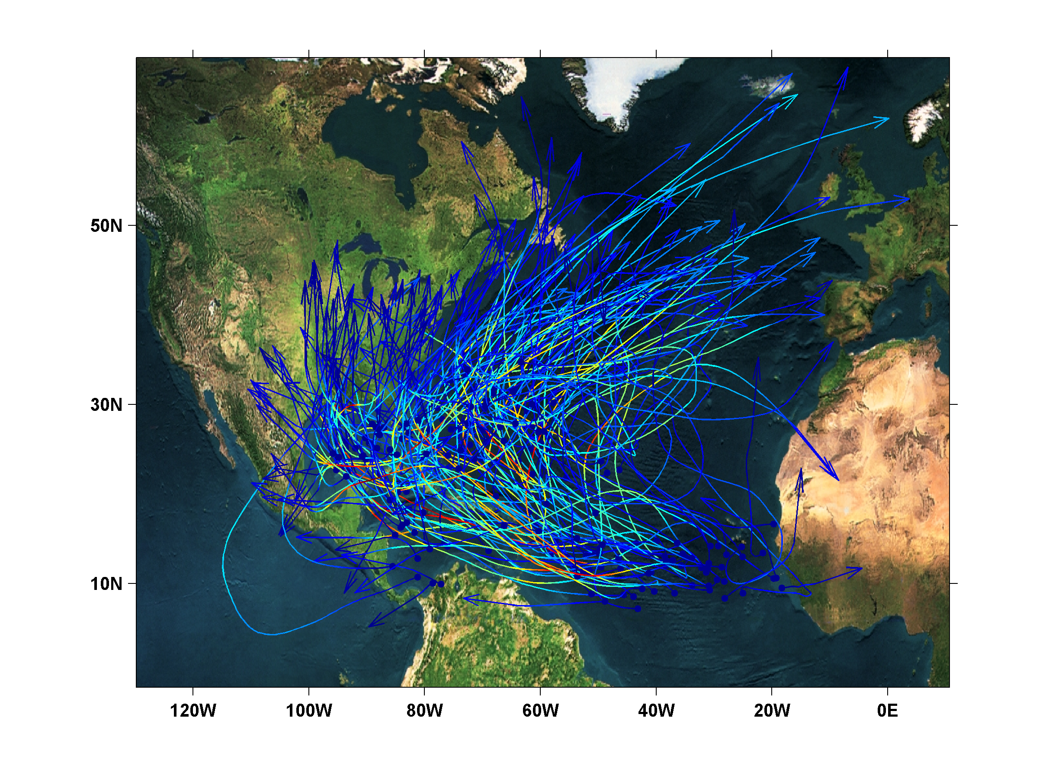
New Downscaling Technique: 200 Synthetic U.S. Landfalling tracks (color coded by S-S Scale)

Slide 48
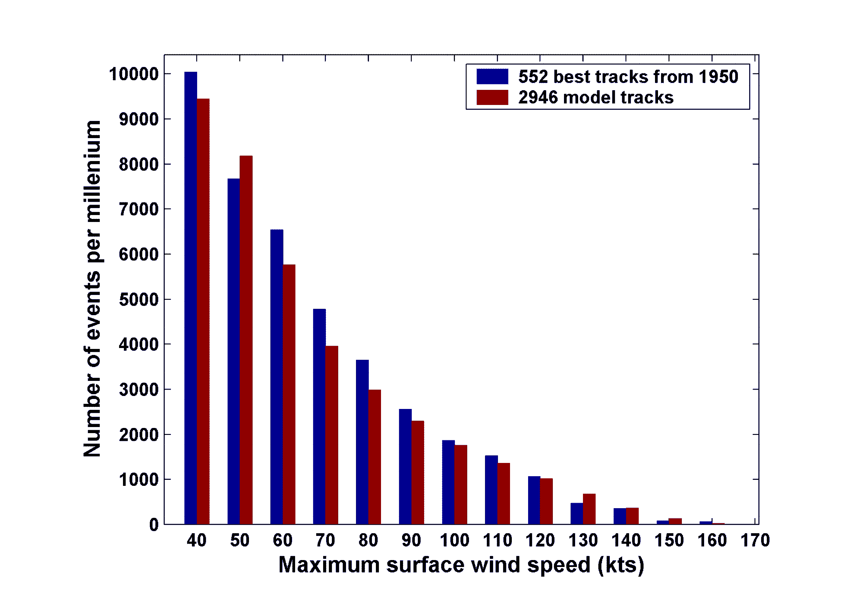
Cumulative Distribution of Storm Lifetime Peak Wind Speed, with Sample of 2946 Synthetic Tracks

Slide 49
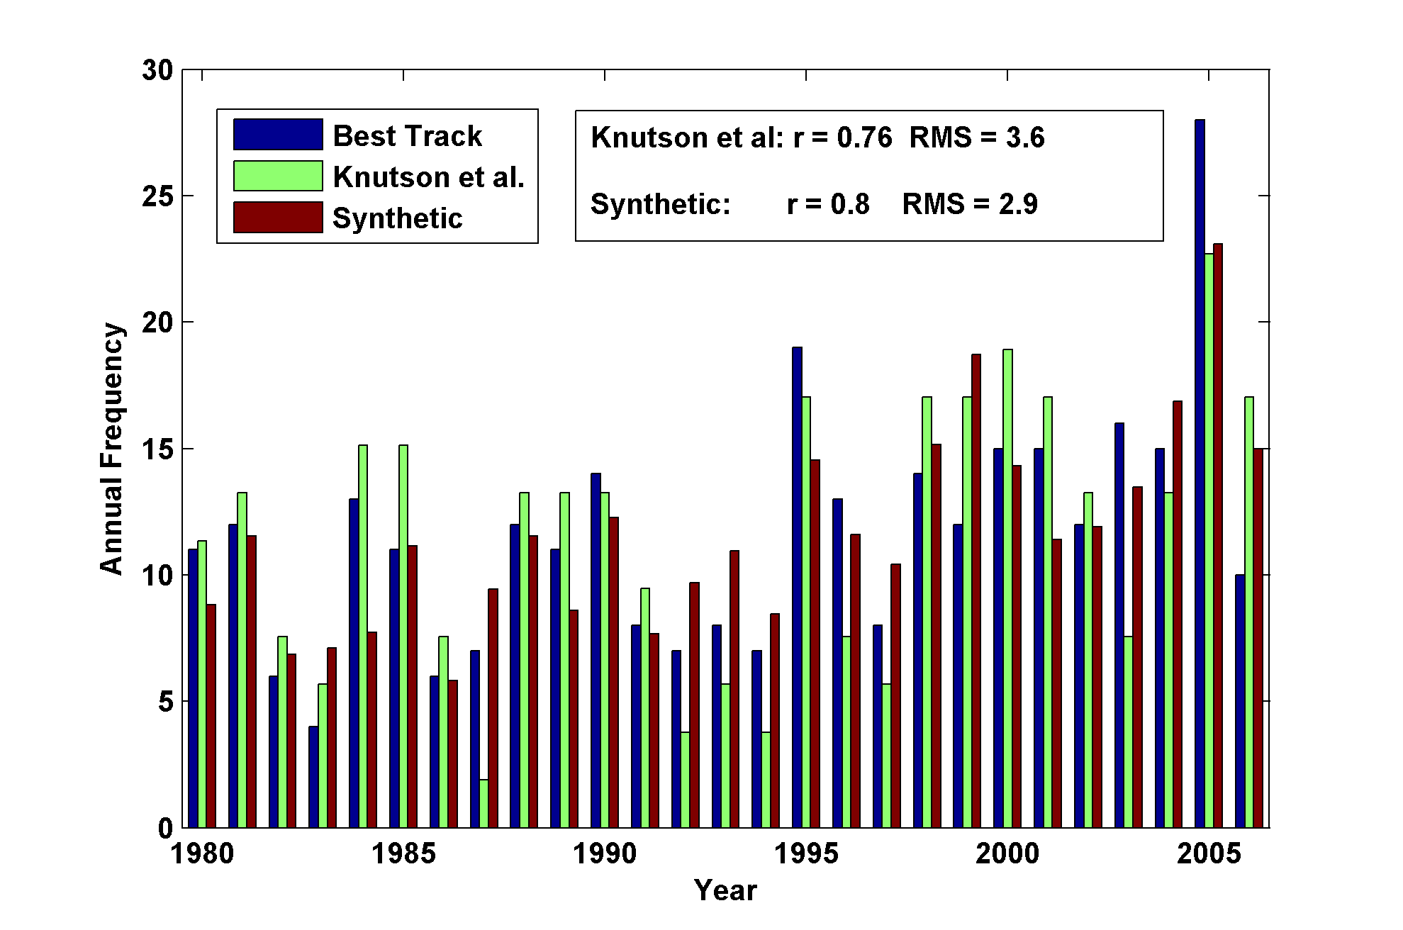
Year by Year Comparison with Best Track and with Knutson et al., 2007

Slide 50
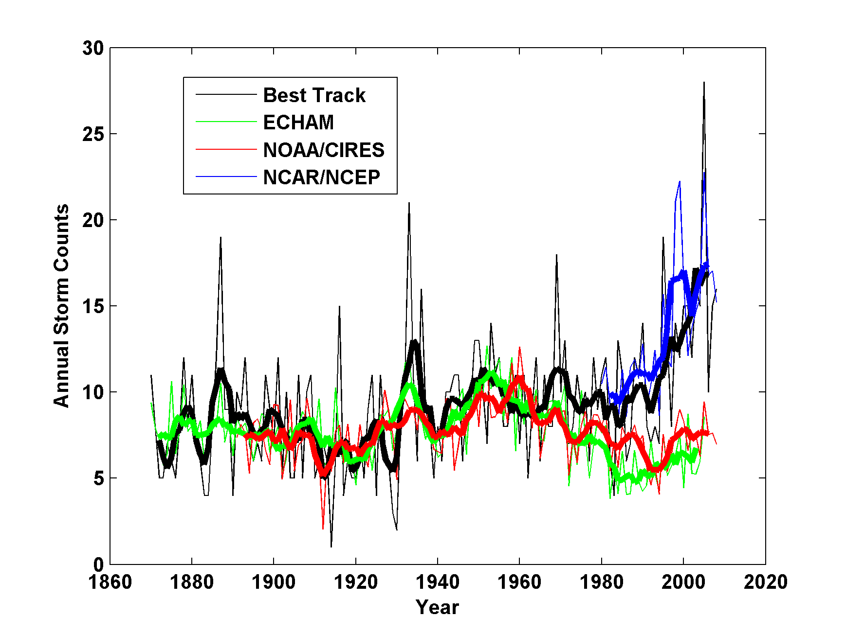
Application to Re-analyses and AGCMs
Annual Atlantic tropical cyclone counts: Unadjusted best-track data (black); and downscaled from the NCAR/NCEP reanalysis, 1980-2008 (blue), the ECHAM 5 simulation, 1870-2005 (green), and the NOAA/CIRES reanalysis, 1891-2008 (red). Thin lines show annual values, thick lines show 5-year running means

Slide 51
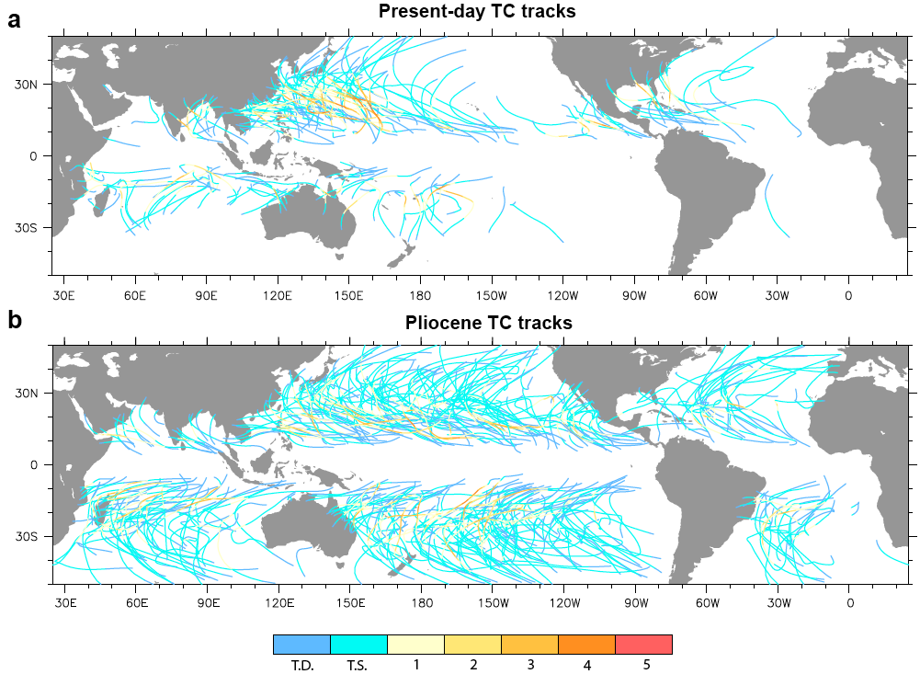
Application to the Climate of the Pliocene

Slide 52
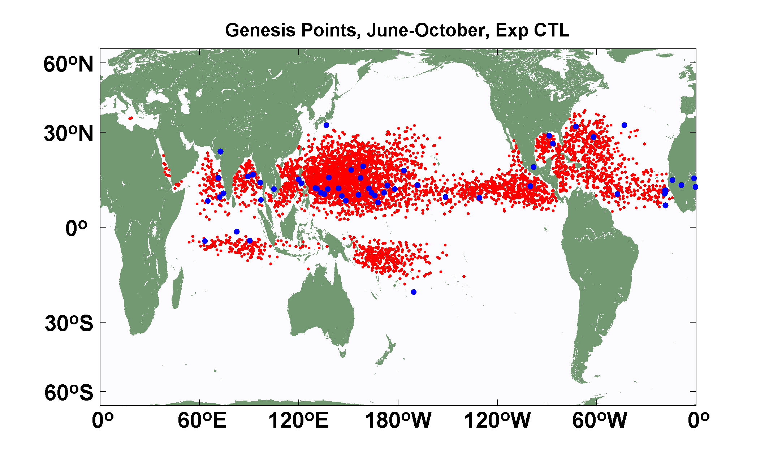
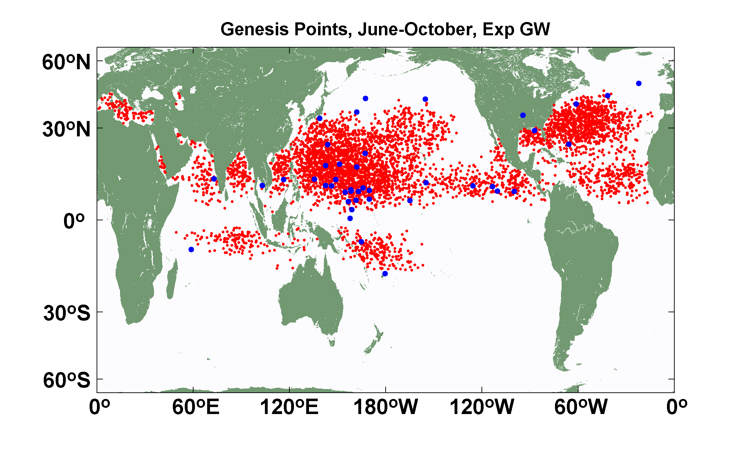
Explicit (blue dots) and downscaled (red dots) genesis points for June-October for Control (top) and Global Warming (bottom) experiments using the 14-km resolution NICAM model. Collaborative work with K. Oouchi.

Slide 53
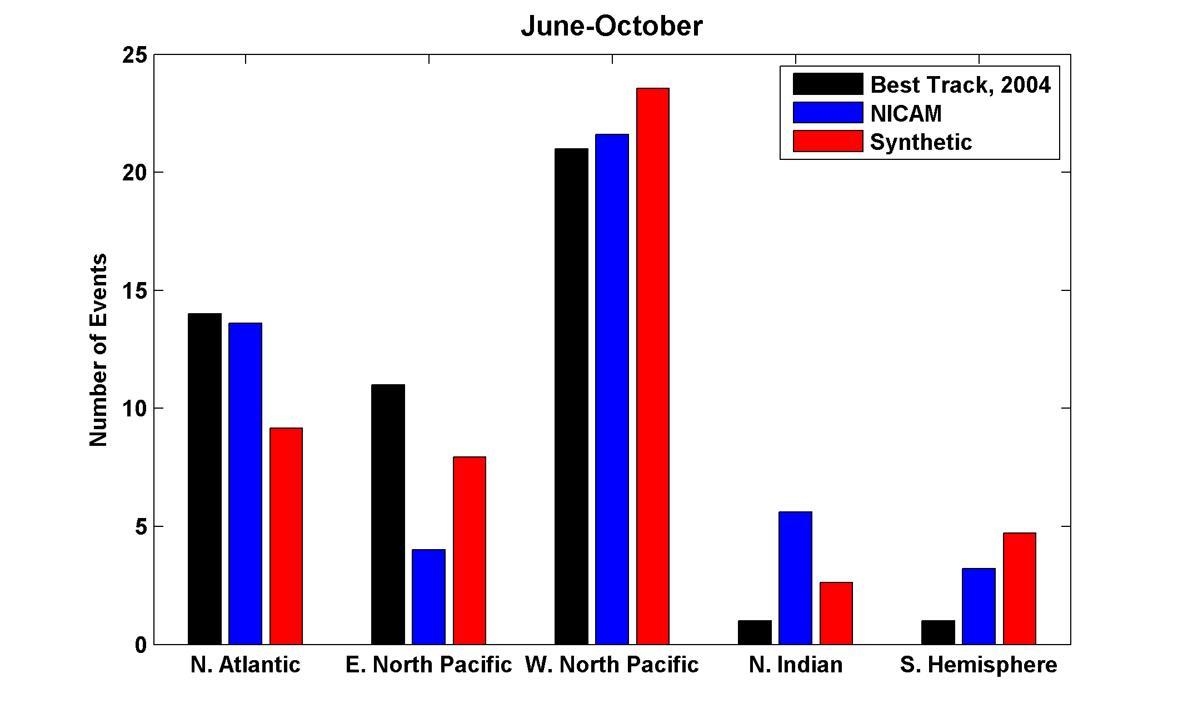

Slide 54
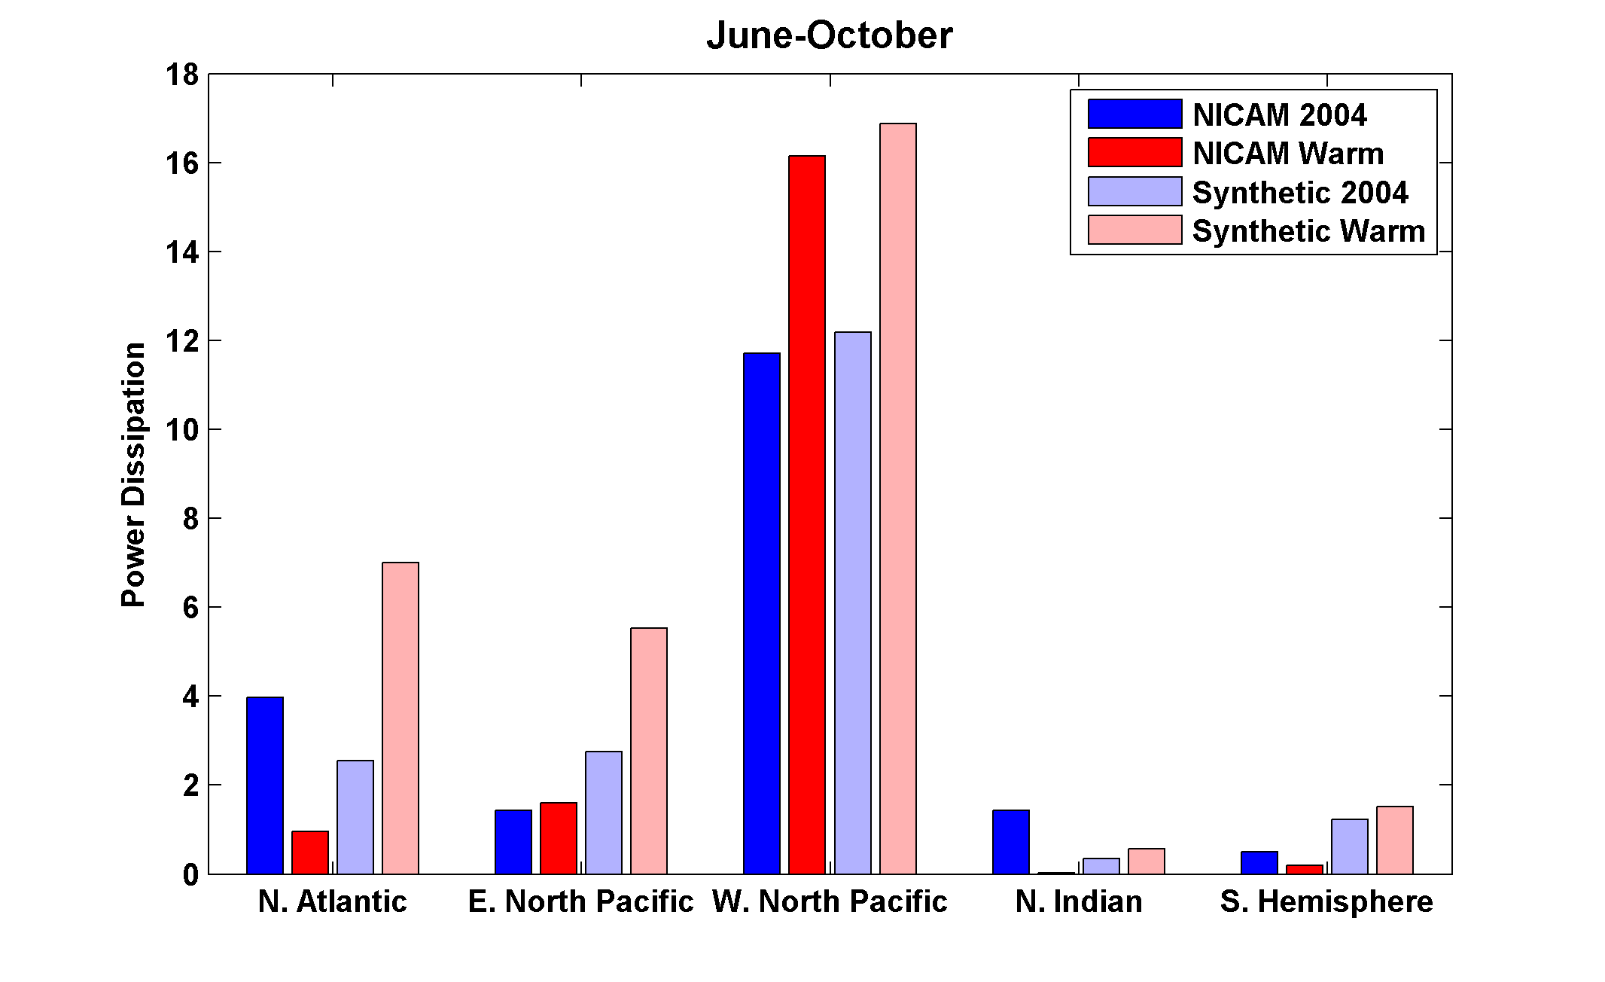
Change in Power Dissipation with Global Warming

Slide 55
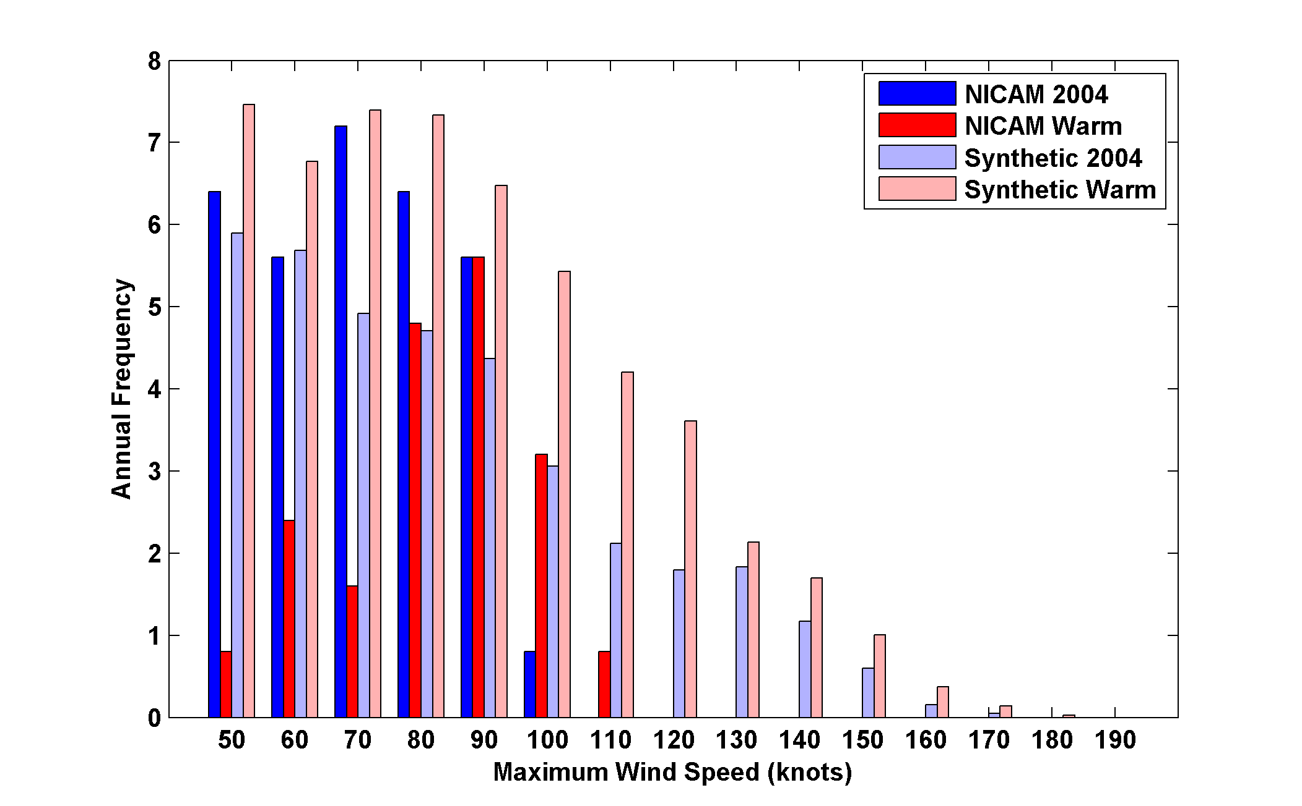
Probability Density by Storm Lifetime Peak Wind Speed, Explicit and Downscaled Events

Slide 56
Summary
Potential intensity is an important (but not the only) control on tropical cyclone activity, including frequency and intensity
On time scales long enough for the ocean mixed layer to be in thermal equilibrium, potential intensity is controlled largely by surface radiation, surface wind speed, ocean heat fluxes, and outflow temperature

Slide 57
Recent large, upward trends in potential intensity are partly and perhaps mostly attributable to cooling of the lower stratosphere
Models forced with observed SSTs not very successful in capturing this cooling

Slide 58
Simple but high resolution coupled TC model can be used to ‘downscale” TC activity from global climate data sets
Studies based on this downscaling suggest large sensitivity of TCs to climate state, and possibly important role for TC-induced ocean mixing and atmospheric drying/heating in regulating climate

Slide 59
Feedback of Global Tropical Cyclone Activity on the Climate System
Notes:
59

Slide 60
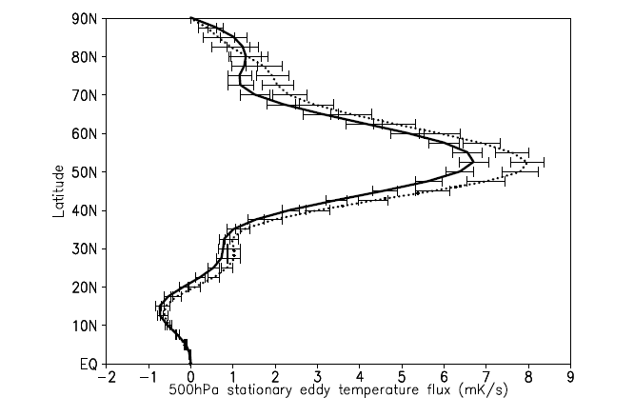
Hart, 2010
500hPa zonal mean meridional temperature flux (mK/s) of the stationary eddies for January through March. The dotted (solid) curve represents the composite mean of the winters following inactive (active) northern hemisphere TC seasons. Error bars represent the standard error of the mean for datasets of size varying from N=9 to 13. Flux calculated using NCAR/NCEP reanalysis for the period 1960‐2008

Slide 61
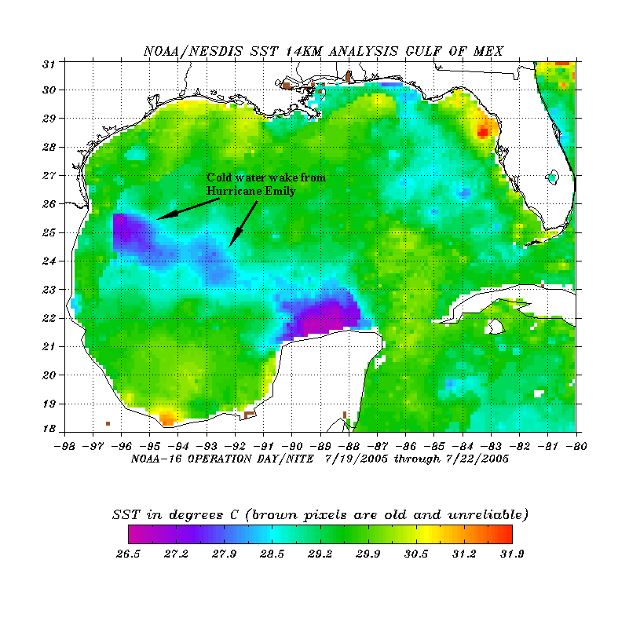
The wake of Hurricane Emily (July 2005)
Sea Surface Temperature in the Wakes of Hurricanes
Hurricane Dennis
(one week earlier)
Source: Rob Korty, CalTech
Notes:
61
We know that tropical cyclones are responsible for strong mixing of the upper oceans and this can be seen in satellite images…

Slide 62
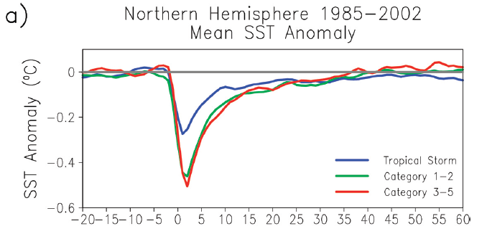
Wake Recovery
Hart, Maue, and Watson, Mon. Wea. Rev., 2007

Slide 63
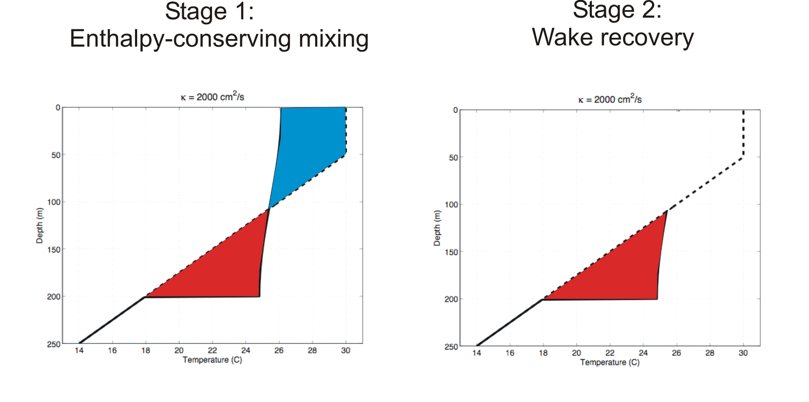
Direct mixing by tropical cyclones
Emanuel (2001) estimated global rate of heat input as 1.4 X 10¹⁵ Watts
Source: Rob Korty, CalTech
Notes:
63

Slide 64
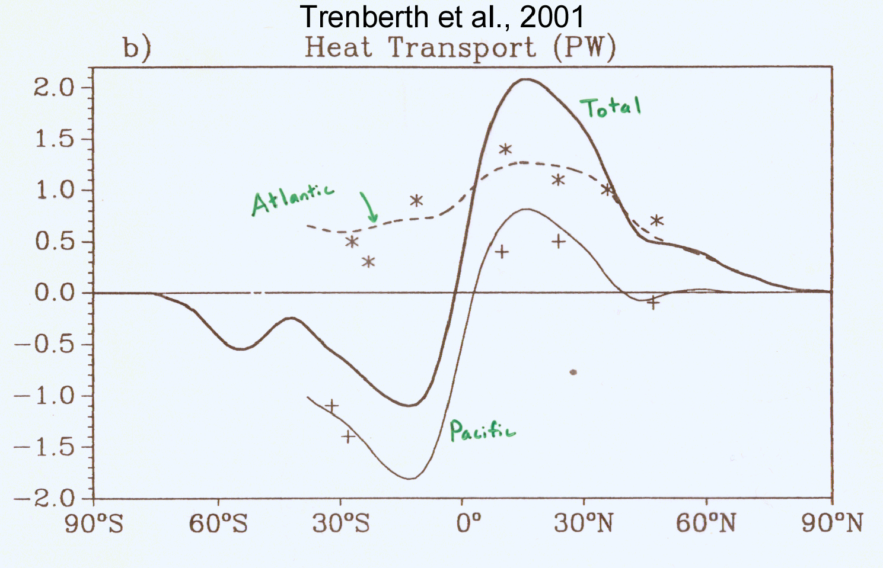
TC Mixing May Induce Much or Most of the Observed Poleward Heat Flux by the Oceans
Notes:
64

Slide 65
Estimate from satellite-derived wake recoveries
Extrapolation from detailed ocean measurements of one storm
Estimate of total heat uptake by tropical oceans

Slide 67
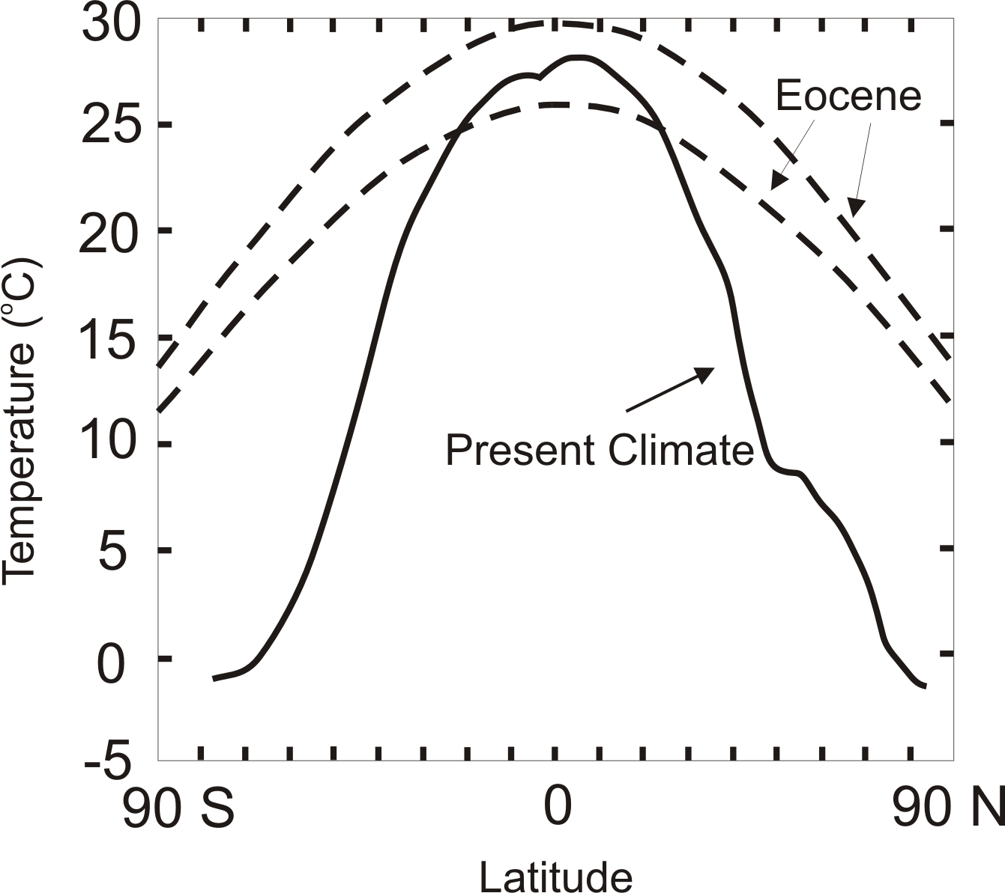
TC-Mixing may be Crucial for High-Latitude Warmth and Low-Latitude Moderation During Warm Climates, such as that of the Eocene
Notes:
67

Slide 68

Depiction of central North America, ~60 million years ago
Our future?
Figure courtesy of Rob Korty, CalTech
Notes:
68

Slide 69
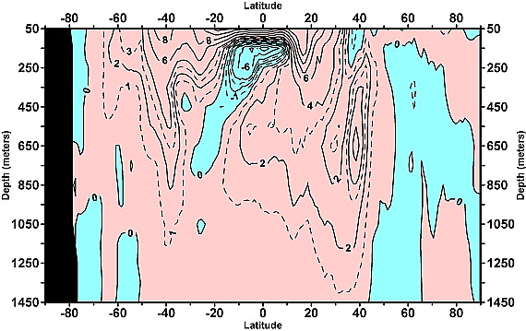
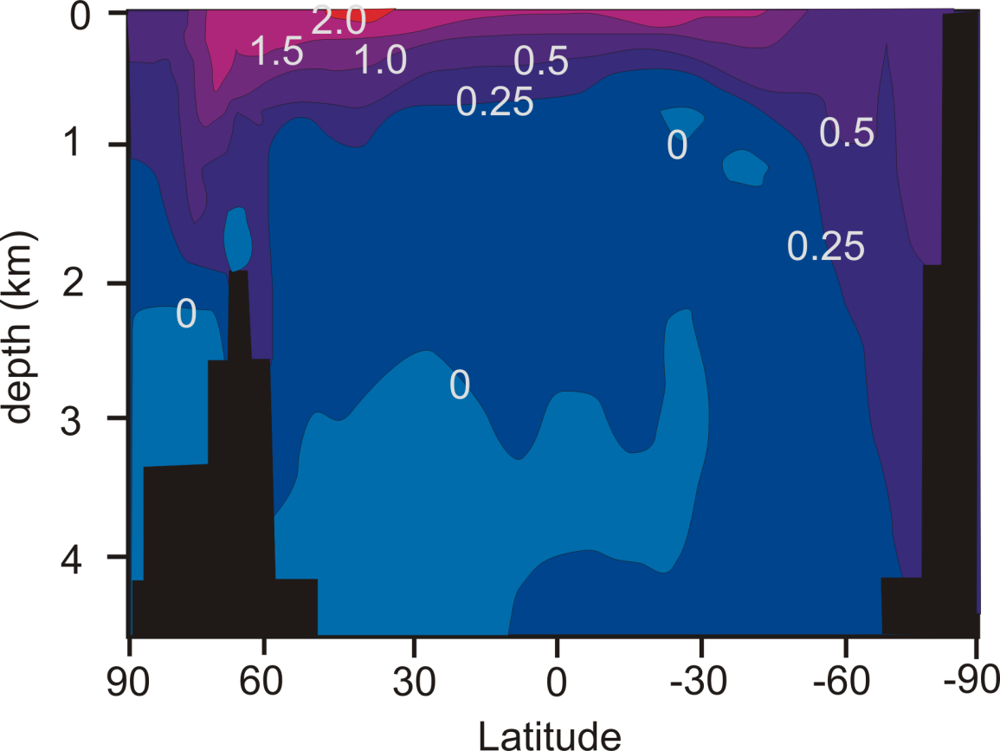
Linear trend (1955–2003) of the zonally integrated heat content of the world ocean by one-degree latitude belts for 100-m thick layers. Source: Levitus et al., 2005
TC-Mixing may explain difference between observed and modeled ocean warming
Zonally averaged temperature trend due to global warming in a coupled climate model. Source: Manabe et al, 1991
Notes:
69

Slide 70
What is Causing Changes in Tropical Atlantic Sea Surface Temperature?

Slide 71
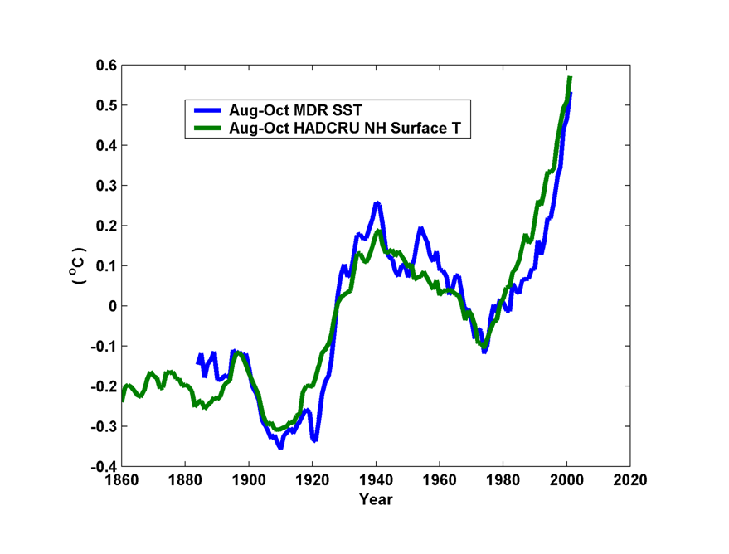
10-year Running Average of Aug-Oct Northern Hemisphere Surface Temp and Hurricane Region Ocean Temp

Slide 72
Estimates of Global Mean Surface Temperature from the Instrumental Record
Notes:
72

Slide 73
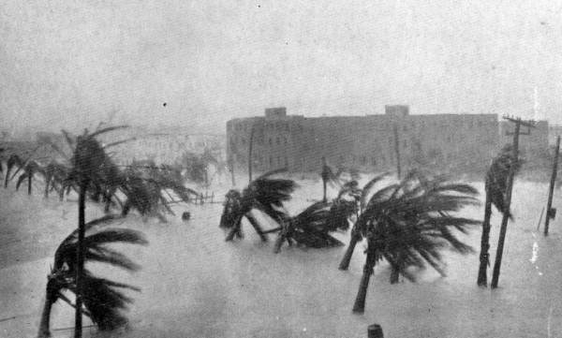
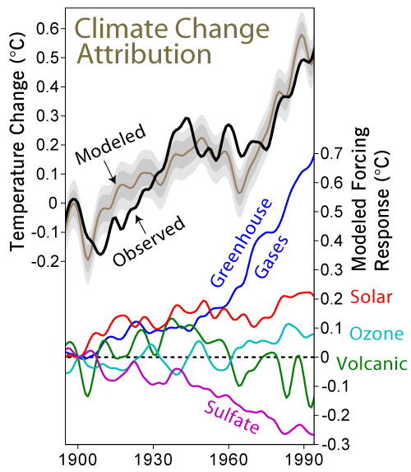

Slide 74
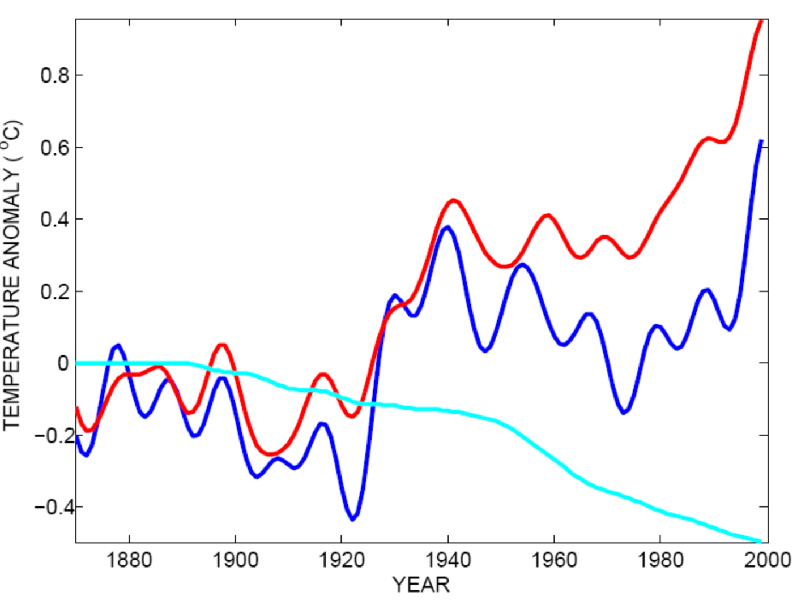
Tropical Atlantic SST(blue), Global Mean Surface Temperature (red),
Aerosol Forcing (aqua)
Global mean surface temperature
Tropical Atlantic sea surface temperature
Sulfate aerosol radiative forcing
Mann, M. E., and K. A. Emanuel, 2006. Atlantic hurricane trends linked to climate change. EOS, 87, 233-244.

Slide 75
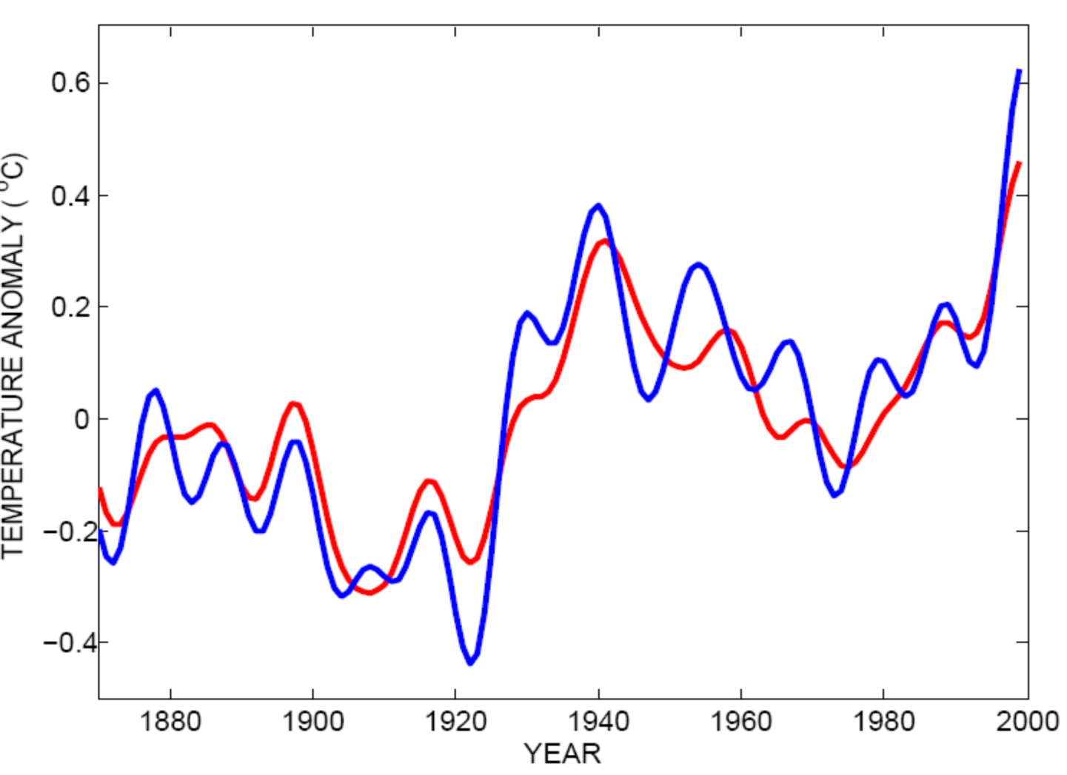
Best Fit Linear Combination of Global Warming and Aerosol Forcing (red) versus Tropical Atlantic SST (blue)
Tropical Atlantic Sea Surface Temperature
Global Surface T + Aerosol Forcing
Mann, M. E., and K. A. Emanuel, 2006. Atlantic hurricane trends linked to climate change. EOS, 87, 233-244.

Slide 76
Pushing Back the Record of Tropical Cyclone Activity:
Paleotempestology
Notes:
76

Slide 77
Paleotempestology
barrier beach
upland
overwash fan
backbarrier marsh
a)
lagoon
barrier beach
upland
overwash fan
b)
backbarrier marsh
lagoon
terminal lobes
flood tidal delta
Source: Jeff Donnelly, WHOI
Notes:
77

Slide 78
Source: Jeff Donnelly, Jon Woodruff, Phil Lane; WHOI
Notes:
78

Slide 79
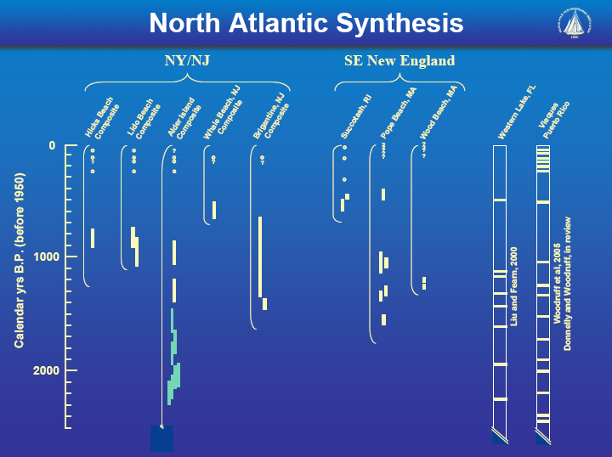
Source: Jeff Donnelly, Jon Woodruff, Phil Lane; WHOI
Notes:
79

Slide 80
Inferences from Modeling

Slide 81
The Problem:
Global models are far too coarse to simulate high intensity tropical cyclones
Embedding regional models within global models introduces problems stemming from incompatibility of models, and even regional models are usually too coarse

Slide 82

Histograms of Tropical Cyclone Intensity as Simulated by a Global Model with 50 km grid point spacing. (Courtesy Isaac Held, GFDL)
Category 3

Slide 83


Probability Density of TC Damage, U.S. East Coast
Damage Multiplied by Probability Density of TC Damage, U.S. East Coast

Slide 84
To the extent that they simulate tropical cyclones at all, global models simulate storms that are largely irrelevant to society and to the climate system itself, given that ocean stirring effects are heavily weighted towards the most intense storms

Slide 85
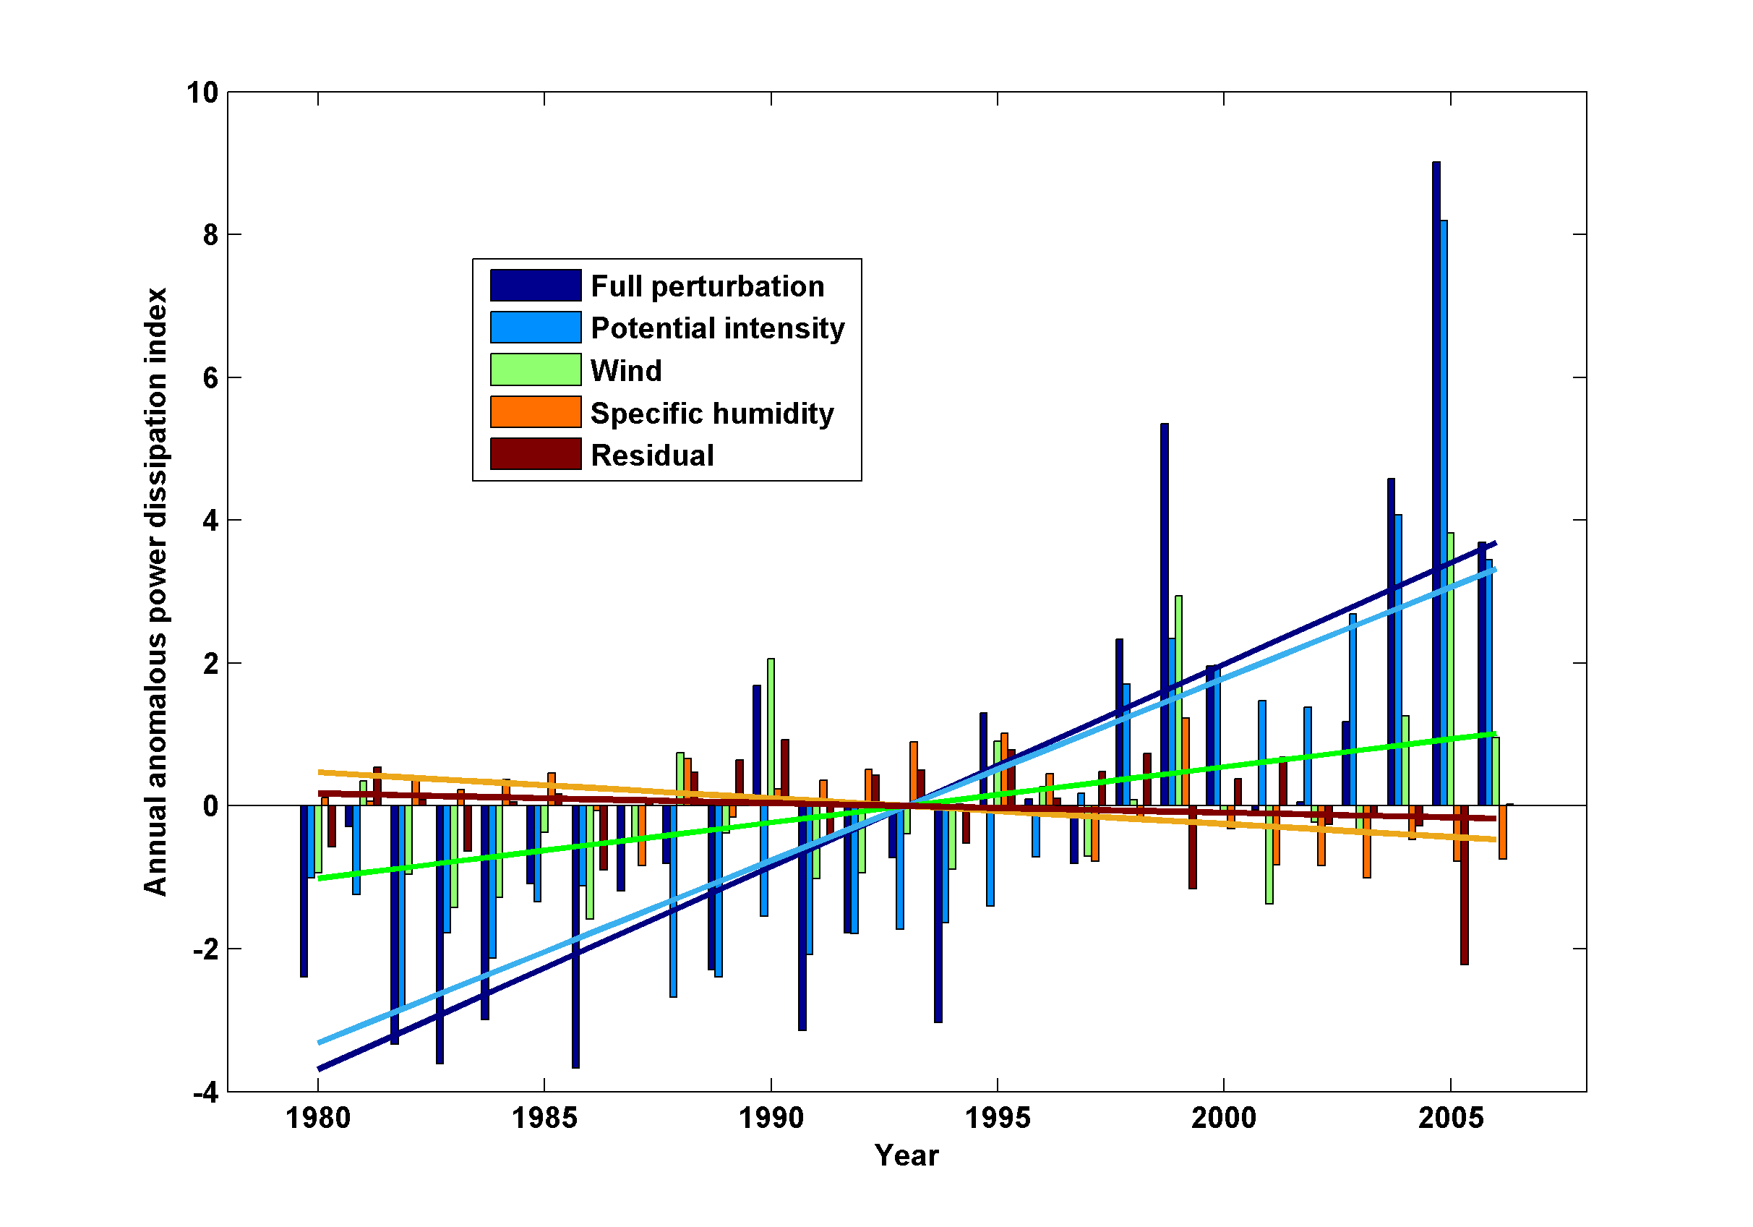
Decomposition of PDI Trends

Slide 86
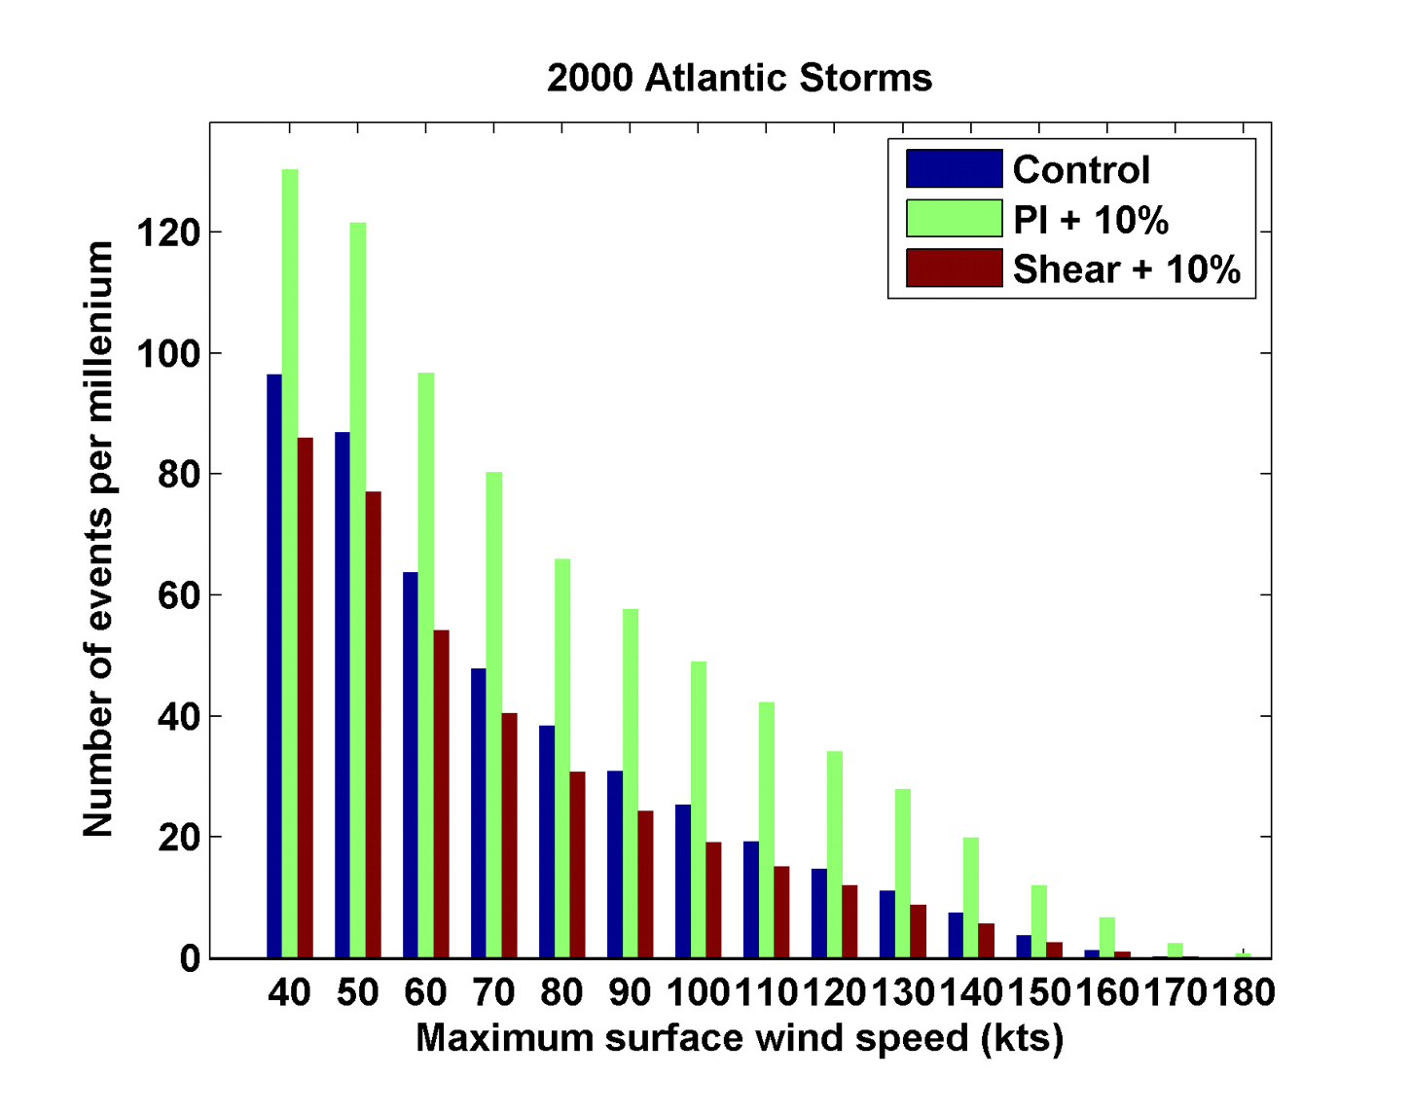
Sensitivity to Shear and Potential Intensity

Slide 87
Reminder: Problems with Potential Intensities
NCEP
# 31: ECHAM without aerosols
#32: ECHAM with aerosols

Slide 88
Hydrostatic Compensation (following Holloway and Neelin)
Perturbations to moist adiabatic troposphere:
Stratospheric compensation:

Slide 89
For typical values of the parameters

