Slide 1

Using Physics to Generate Tropical Cyclone Event Catalogs
Kerry Emanuel and Sai Ravela
Massachusetts Institute of Technology
Notes:
1
Are hurricanes becoming more powerful and destructive? Are these changes due to a natural cycle of hurricane activity or are they caused by human-induced climate change? Although this is currently a hot debate among scientists, new research suggests that the destructive potential of hurricanes is increasing due to the heating of the oceans.
Image: Satellite image of Hurricane Floyd approaching the east coast of Florida in 1999. The image has been digitally enhanced to lend a three-dimensional perspective. Credit: NASA/Goddard Space Flight Center.

Slide 2
Risk Assessment Methods
Methods based on hurricane history
Numerical Simulations
Downscaling Approaches

Slide 3
Issues with Historically Based Risk Assessment
Historical record too short to provide robust assessment of intense (damaging) events
Numerous quality problems with historical records
History may be a poor guide to the future, owing to natural and anthropogenic climate change

Slide 4

Using Global and Regional Models to Simulate Hurricanes
The Problem:
Global models are far too coarse to simulate high intensity tropical cyclones
Embedding regional models within global models introduces problems stemming from incompatibility of models, and even regional models are usually too coarse
Models to expensive to run many times.

Slide 5

Histograms of Tropical Cyclone Intensity as Simulated by a Global Model with 50 km grid point spacing. (Courtesy Isaac Held, GFDL)
Category 3

Slide 6
Our Solution:
Drive a simple but very high resolution, coupled ocean-atmosphere TC model using boundary conditions supplied by a global model or reanalysis data set

Slide 7
CHIPS: A Time-dependent, axisymmetric coupled model phrased in R space
Hydrostatic and gradient balance above PBL
Moist adiabatic lapse rates on M surfaces above PBL
Boundary layer quasi-equilibrium
Deformation-based radial diffusion

Slide 8
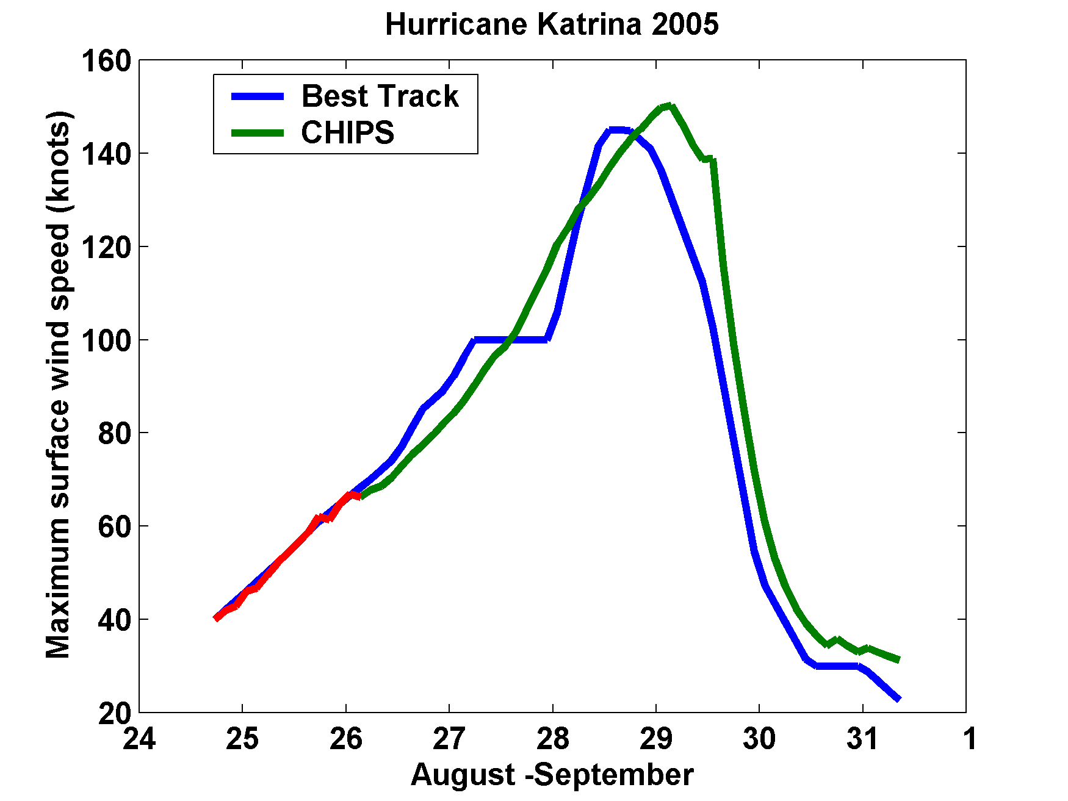
Hindcast of Katrina

Slide 9
Application to Assessing Tropical Cyclone Risk in a Changing Climate

Slide 10
Approach:
Step 1: Seed each ocean basin with a very large number of weak, randomly located cyclones
Step 2: Cyclones are assumed to move with the large scale atmospheric flow in which they are embedded, plus a correction for earth rotation and curvature
Step 3: Run the CHIPS model for each cyclone, and note how many achieve at least tropical storm strength
Step 4: Using the small fraction of surviving events, determine storm statistics.
Details: Emanuel et al., Bull. Amer. Meteor. Soc., 2008
Notes:
10

Slide 11
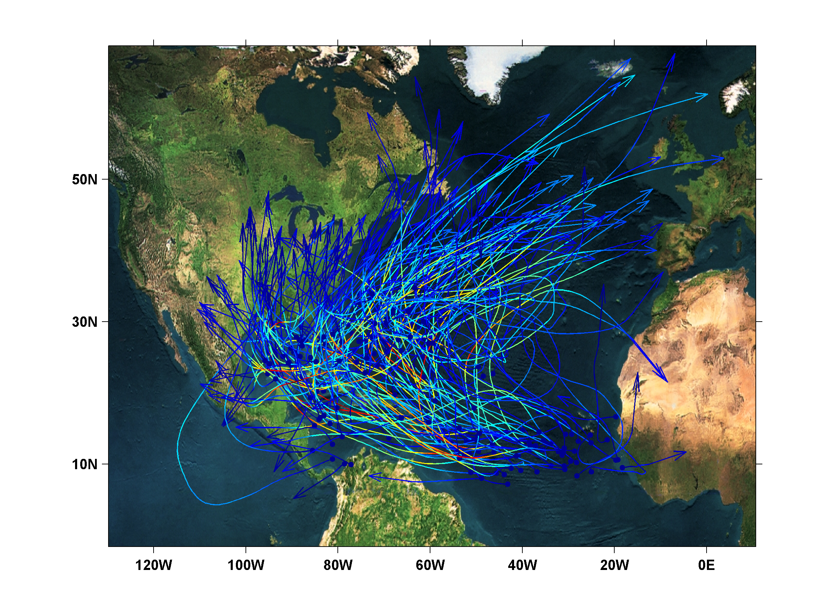
200 Synthetic U.S. Landfalling tracks (color coded by Saffir-Simpson Scale)

Slide 12
Calibration
Absolute genesis frequency calibrated to North Atlantic during the period 1980-2005
Notes:
12

Slide 13
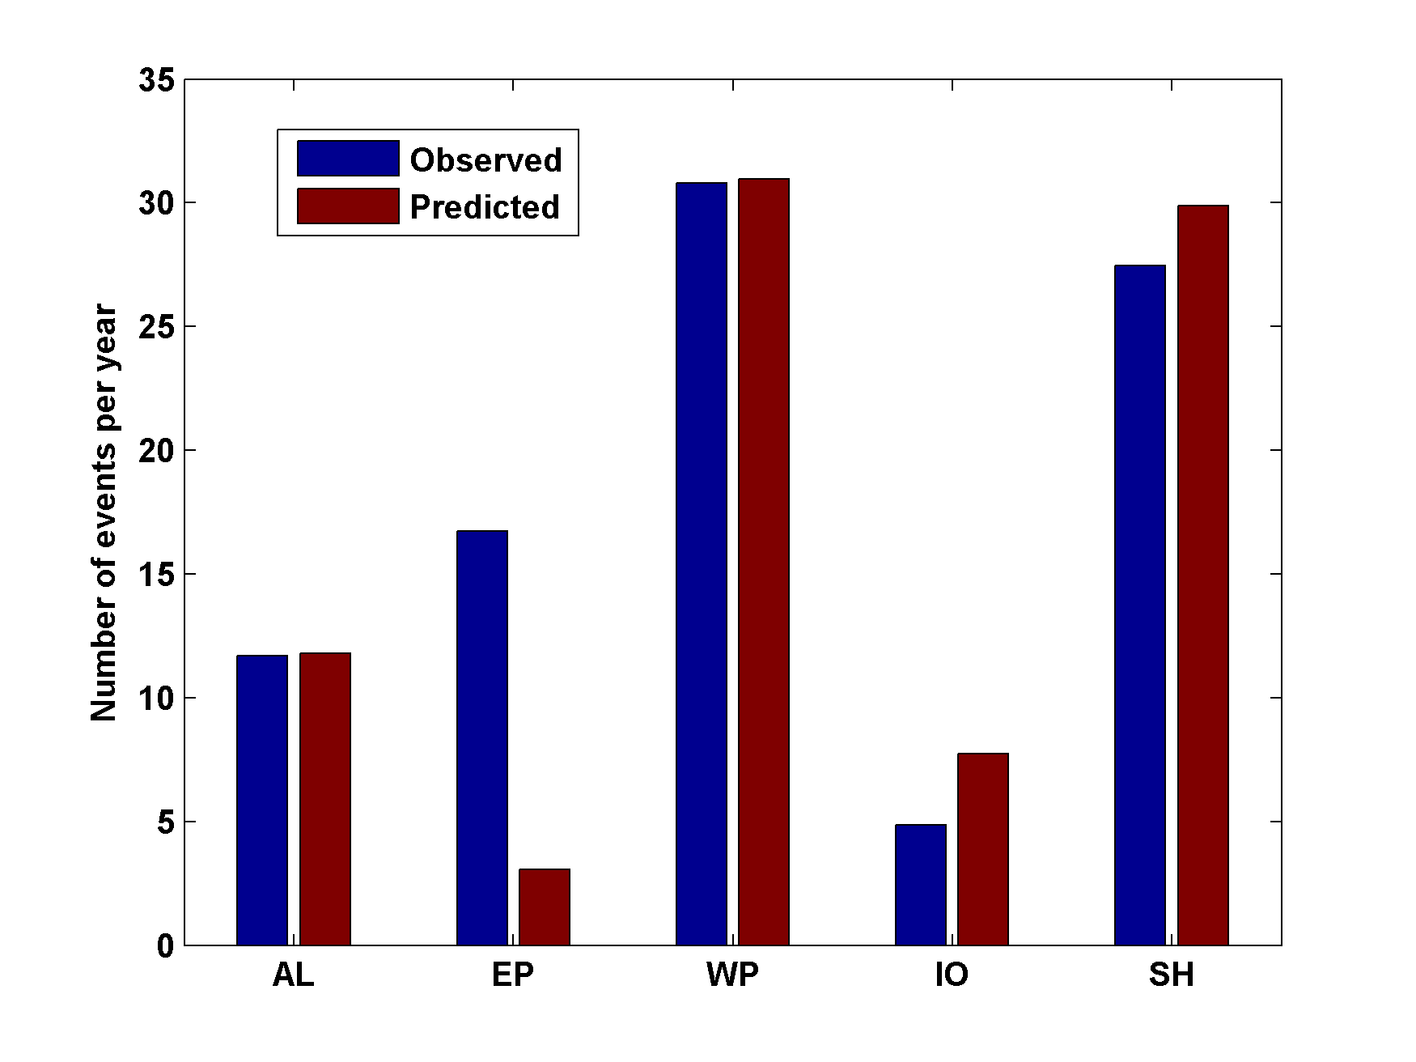
Genesis rates
Western North Pacific
Southern Hemisphere
Eastern North Pacific
Atlantic
North Indian Ocean
Calibrated to Atlantic
Notes:
13

Slide 14

Cumulative Distribution of Storm Lifetime Peak Wind Speed, with Sample of 1755 Synthetic Tracks
95% confidence bounds

Slide 15
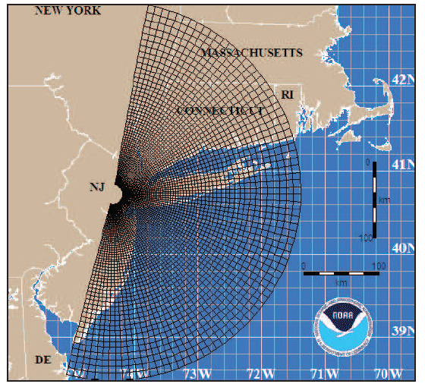
Couple to Storm Surge Model (SLOSH)
Courtesy of Ning Lin, Princeton University

Slide 16
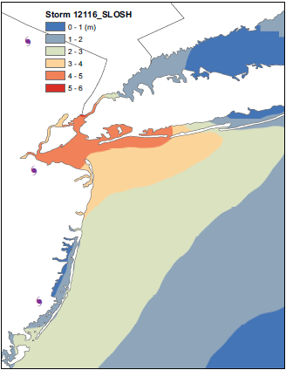
Surge map for single event

Slide 17
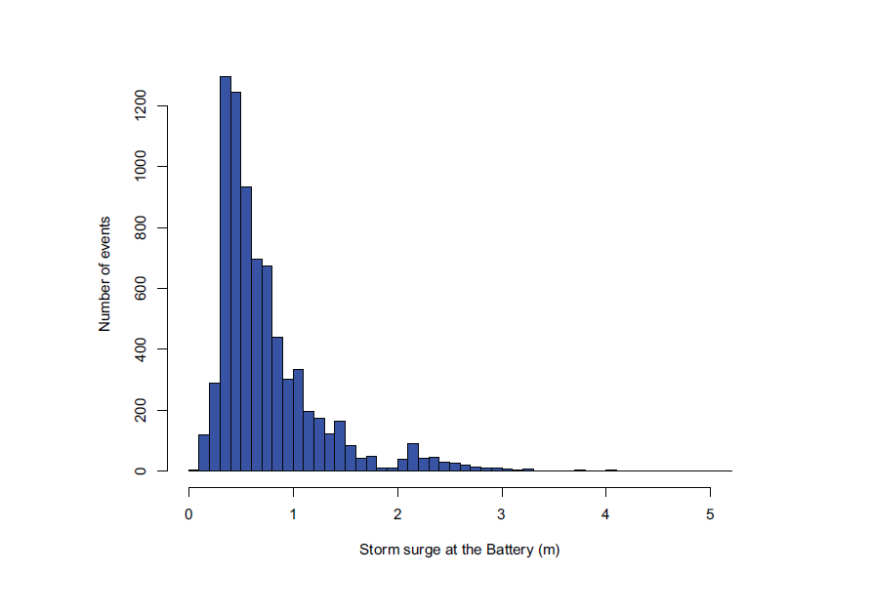
Histogram of the SLOSH-model simulated (primary) storm surge at the Battery for 7555 synthetic tracks that pass within 200 km of the Battery site.

Slide 18
Now Use Daily Output from IPCC Models to Derive Wind Statistics, Thermodynamic State Needed by Synthetic Track Technique

Slide 19
1. Last 20 years of 20th century simulations
2. Years 2180-2200 of IPCC Scenario A1b (CO₂ stabilized at 720 ppm)
Compare two simulations each from 7 IPCC models:

Slide 20
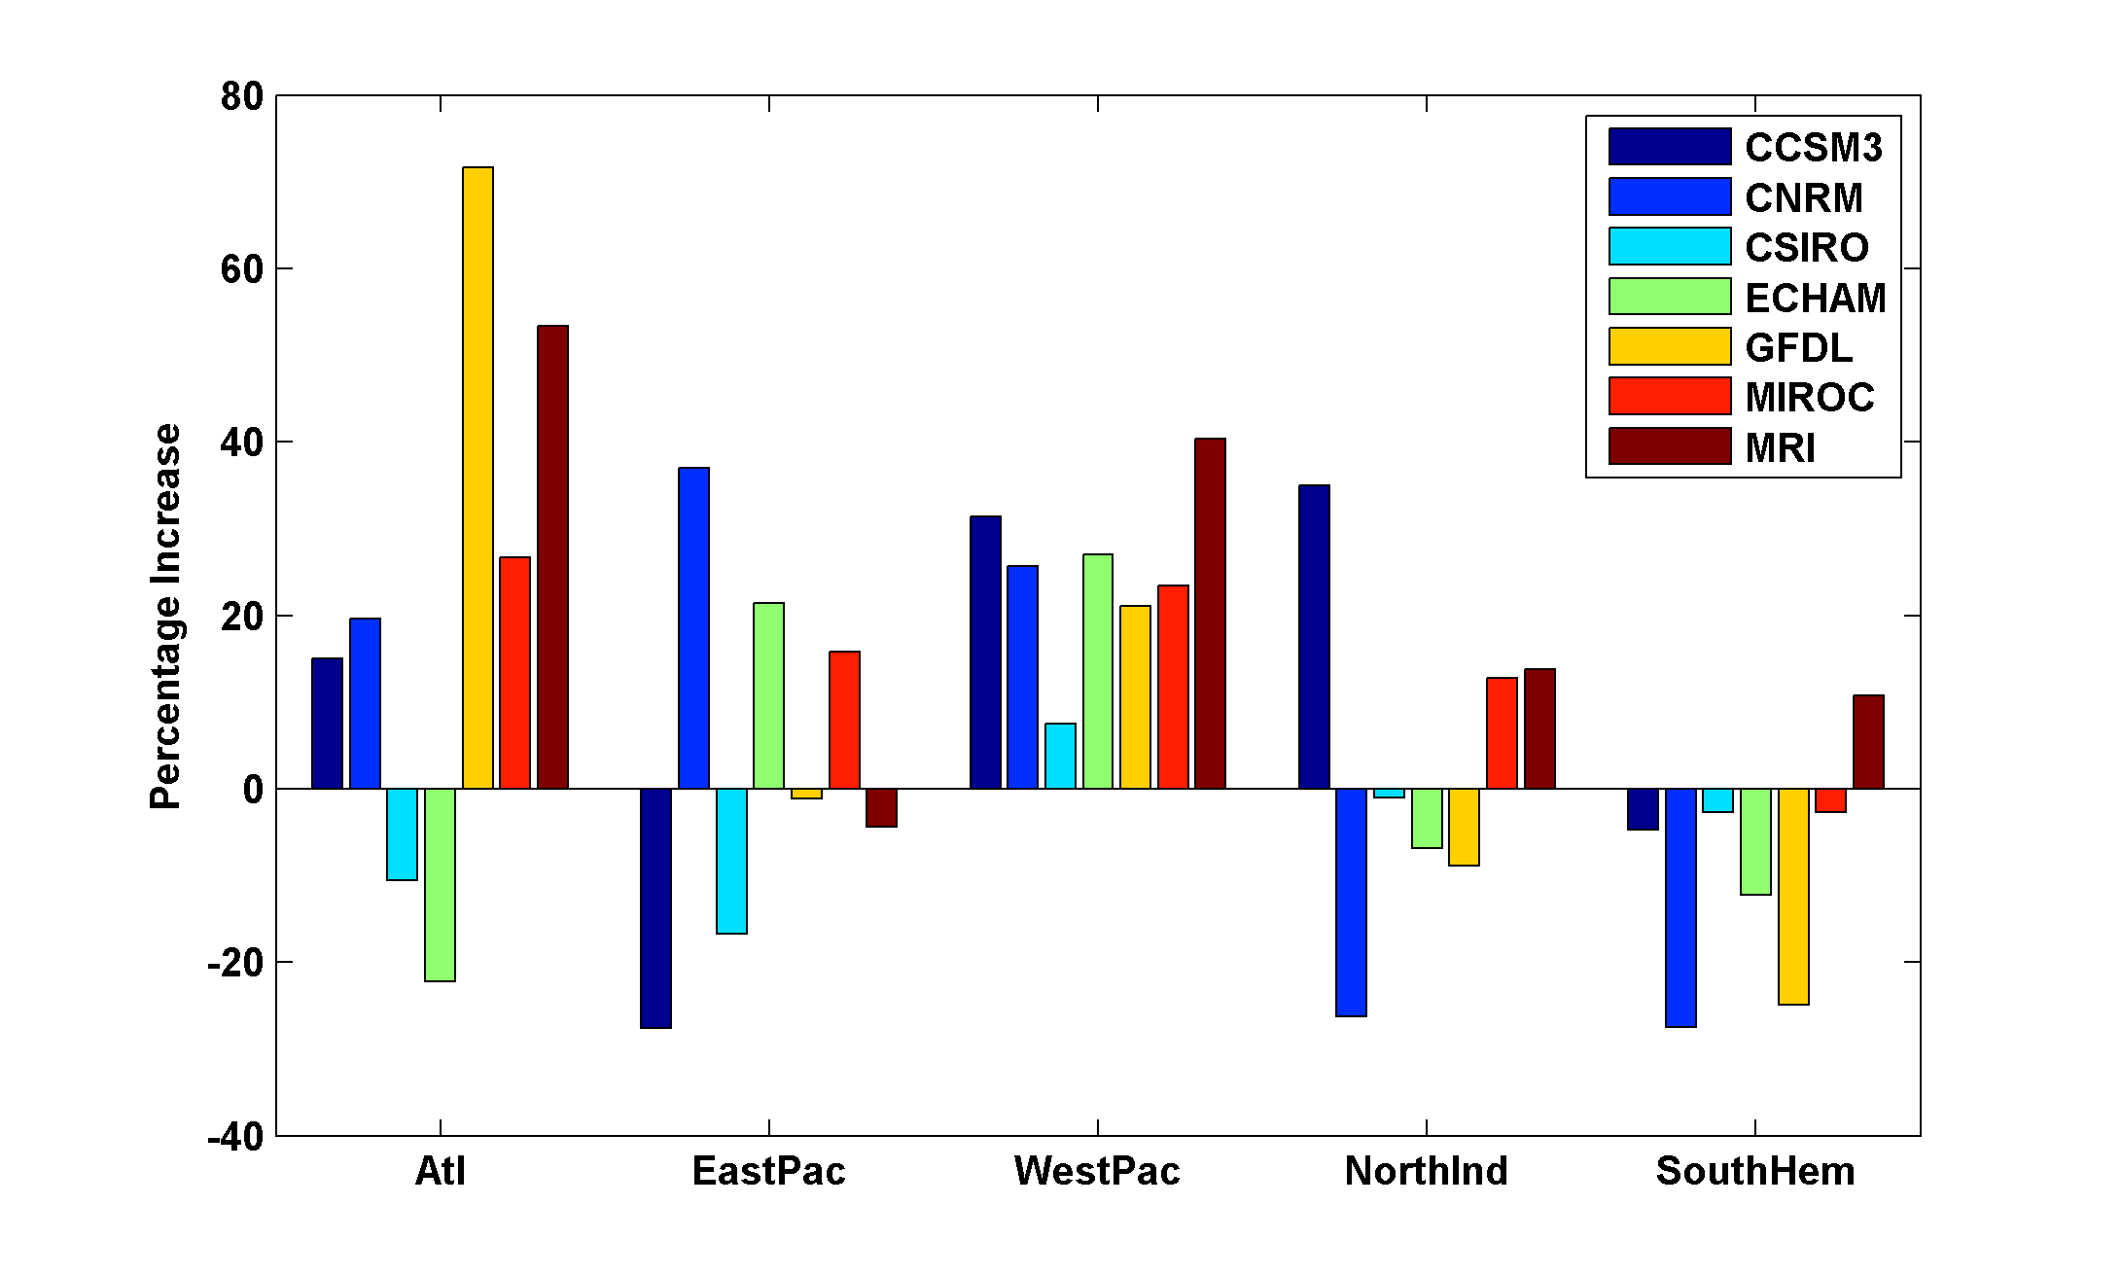
Basin-Wide Percentage Change in Power Dissipation
Different Climate Models
Notes:
20
20

Slide 21
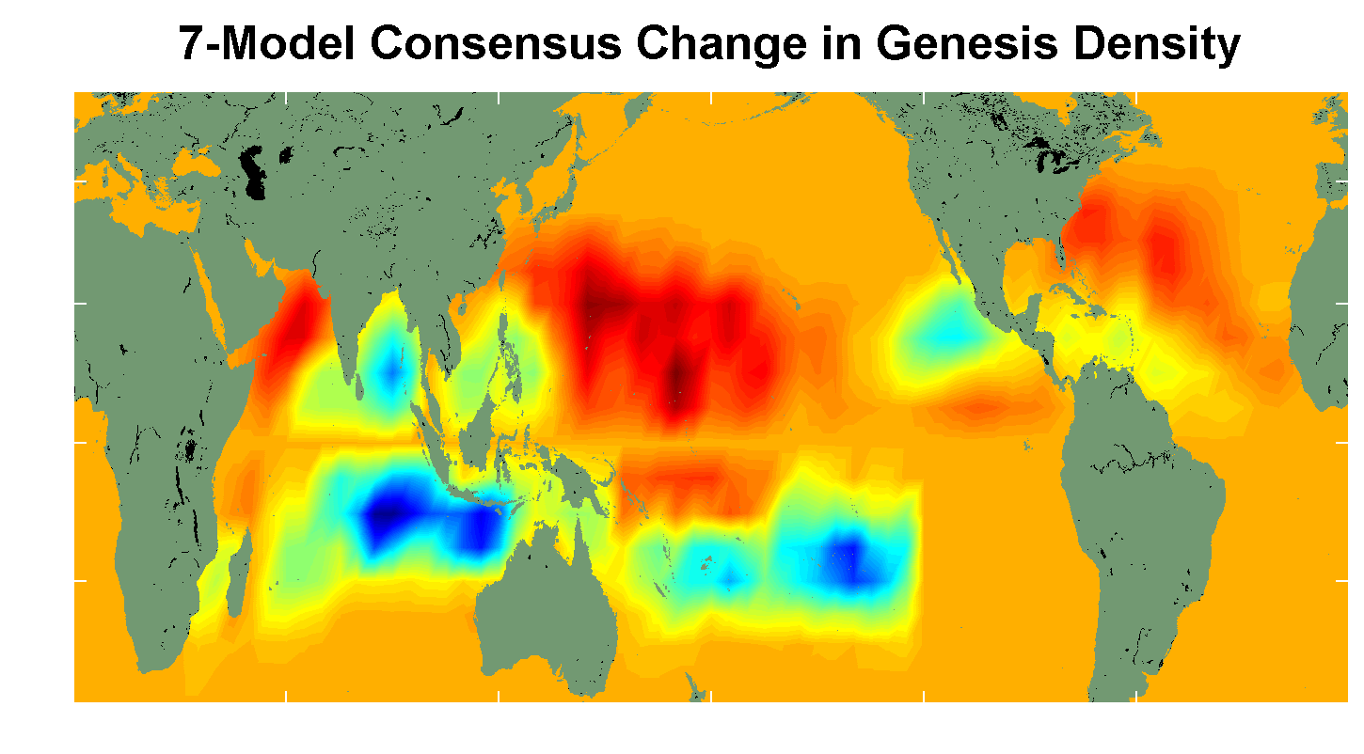
7 Model Consensus Change in Storm Frequency
Notes:
21
21

Slide 22
Economic Analysis of Impact of Climate Change on Tropical Cyclone Damages
With Robert Mendelsohn
Yale

Slide 24
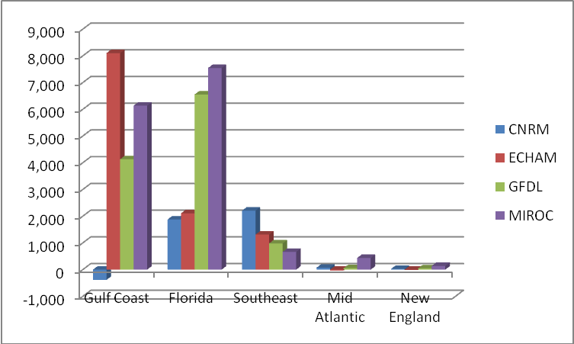
Change in Total Annual Damage in U.S. $millions,
2000-2100, under Scenario A1b

Slide 25
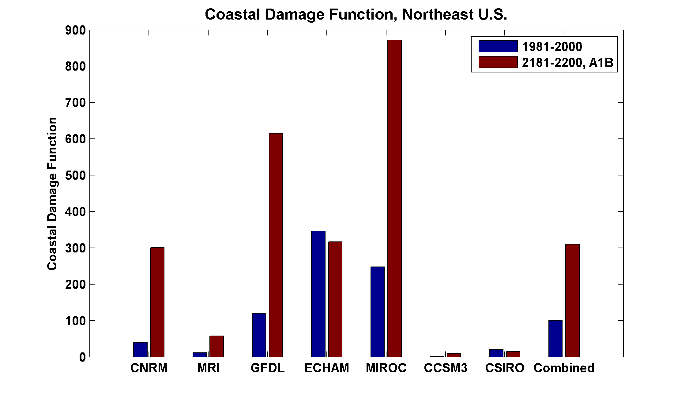

Slide 26
Summary:
History to short and inaccurate to deduce real risk from tropical cyclones
Global (and most regional) models are far too coarse to simulate reasonably intense tropical cyclones
Globally and regionally simulated tropical cyclones are not coupled to the ocean

Slide 27
Summary (2)
We have developed a technique for downscaling global models or reanalysis data sets, using a very high resolution, coupled TC model phrased in angular momentum coordinates
Model shows high skill in capturing spatial and seasonal variability of TCs, has an excellent intensity spectrum, and captures well known climate phenomena such as ENSO and the effects of warming over the past few decades

Slide 28
Summary (3)
Application to global models under warming scenarios shows great regional and model-to-model variability. As with many other climate variables, global models are not yet capable of simulating regional variability of TC metrics
Predicted climate impacts from all extreme events (including tropical storms) range from $17 to $25 billion/yr global damages by 2100

Slide 29
Spare Slides

Slide 30
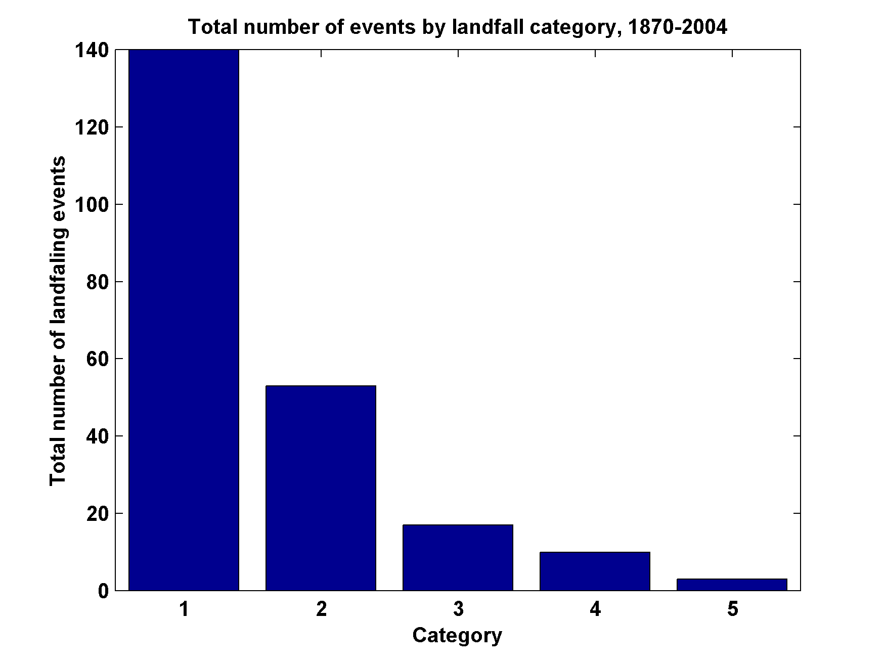
Total Number of Landfall Events, by Category, 1870-2004
Source: Pielke and Landsea

Slide 31
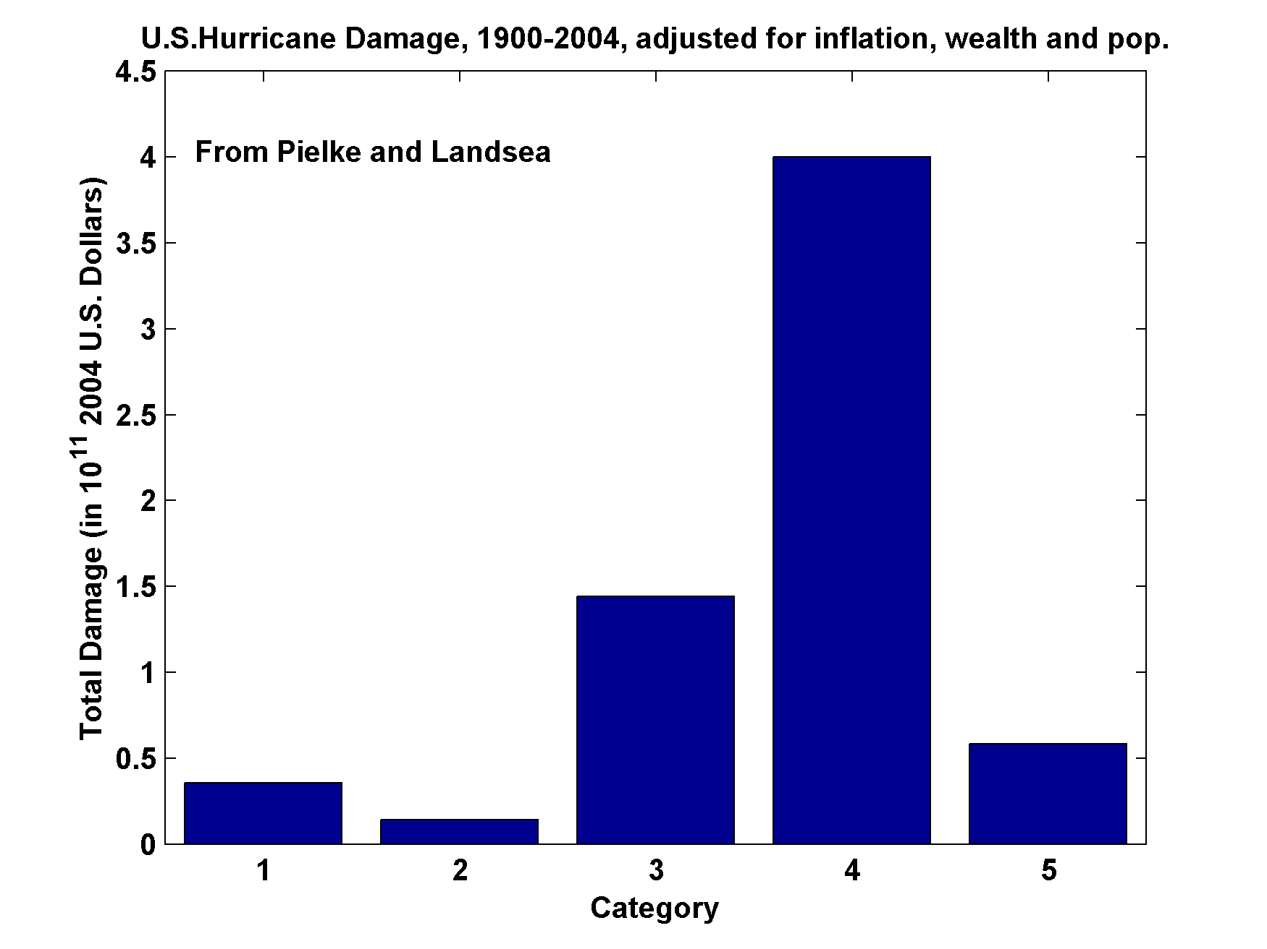
U.S. Hurricane Damage, 1900-2004, Adjusted for Inflation, Wealth, and Population

Slide 32
Some U.S. Hurricane Damage Statistics:
>50% of all normalized damage caused by top 8 events, all category 3, 4 and 5
>90% of all damage caused by storms of category 3 and greater
Category 3,4 and 5 events are only 13% of total landfalling events; only 30 since 1870
Landfalling storm statistics are grossly inadequate for assessing hurricane risk

Slide 33
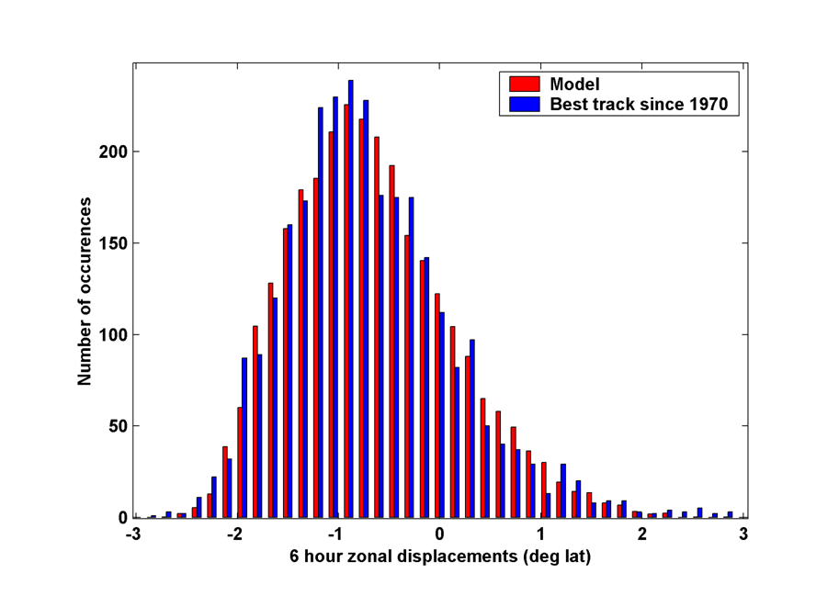
6-hour zonal displacements in region bounded by 10º and 30º N latitude, and 80º and 30º W longitude, using only post-1970 hurricane data
Notes:
33

Slide 34
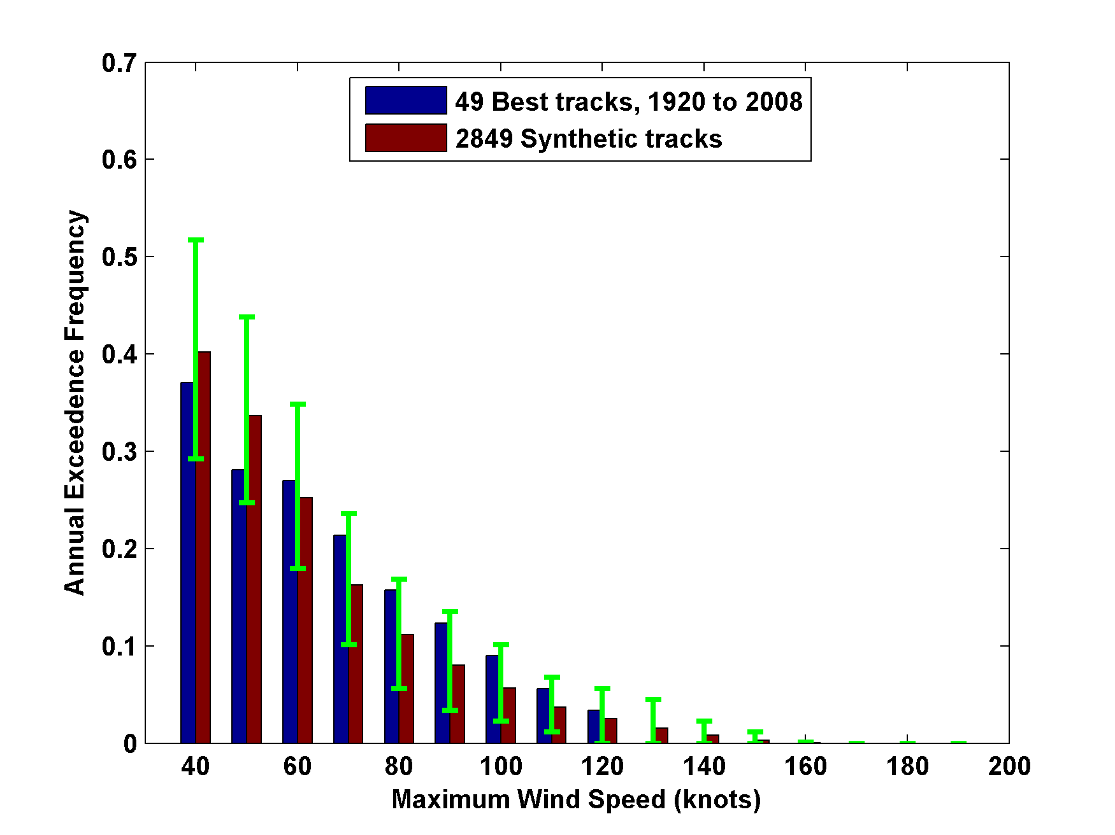
3000 Tracks within 100 km of Miami
95% confidence bounds

Slide 35

Return Periods

Slide 36
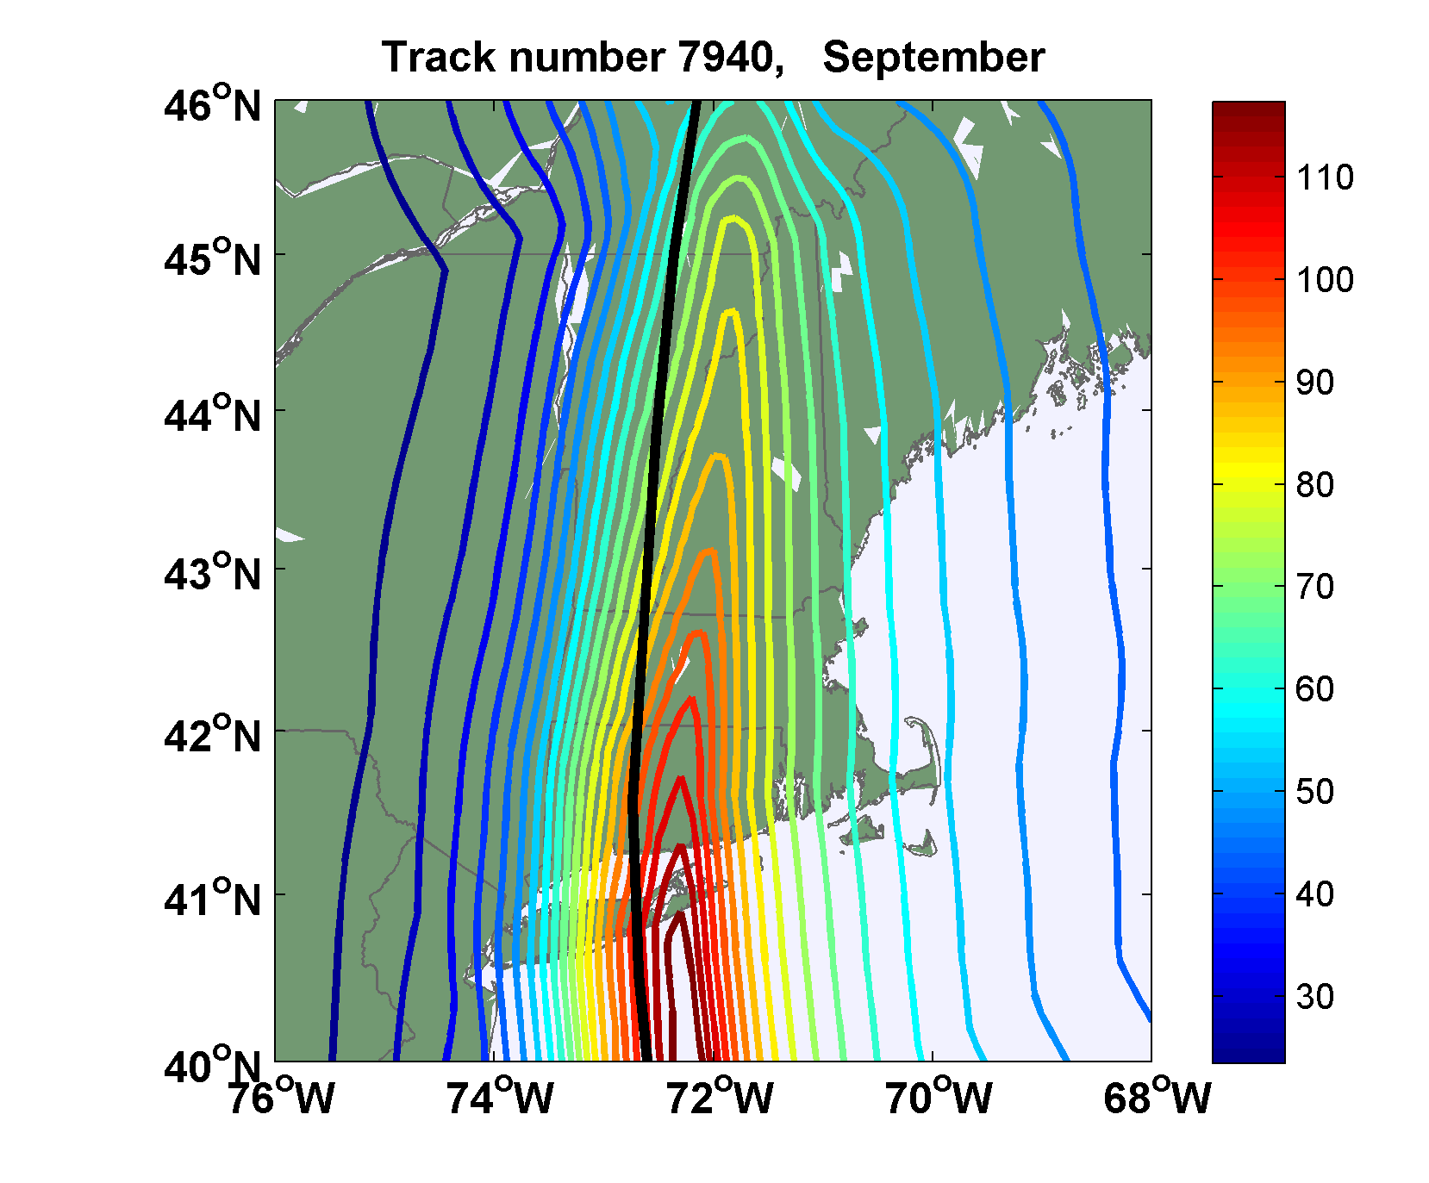
Sample Storm Wind Swath

Slide 37

Captures effects of regional climate phenomena (e.g. ENSO, AMM)

Slide 38
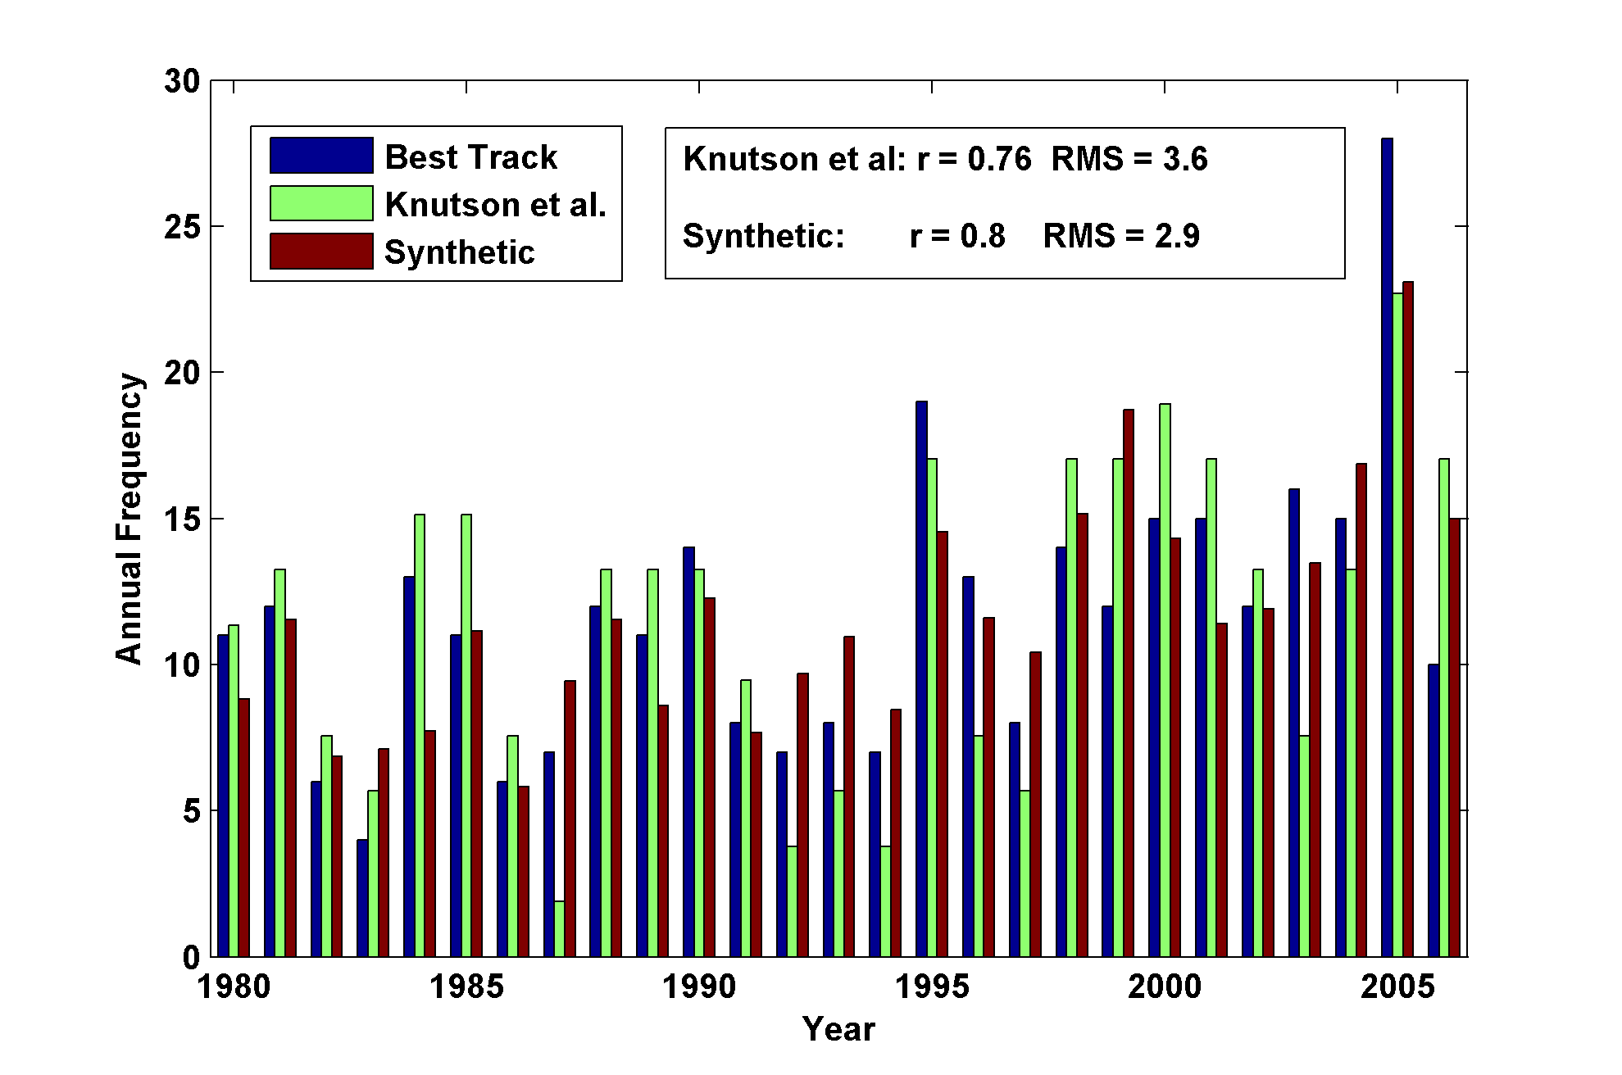
Year by Year Comparison with Best Track and with Knutson et al., 2007

Slide 39
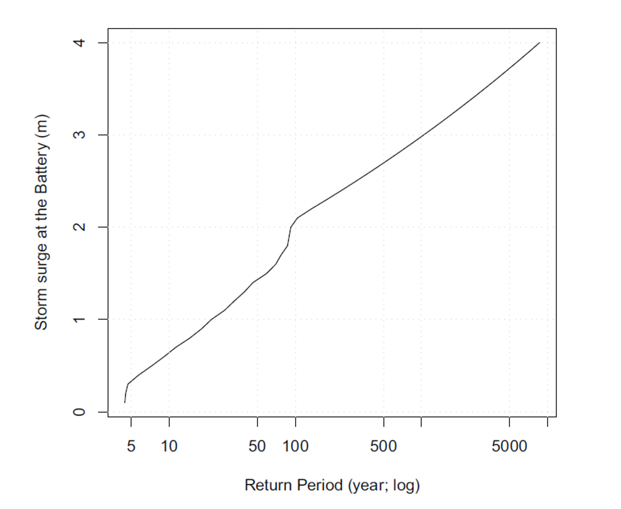
Surge Return Periods, New York City

