Slide 1
A Simple, Fast Tropical Cyclone Intensity Algorithm for Risk Models
Kerry Emanuel
Lorenz Center, MIT

Slide 2
Motivations
Most current TC risk models are based on statistical algorithms for generating synthetic tracks and associated wind fields
Statistical TC intensity algorithms may be inadequate in accounting for such processes as ocean interaction and struggle to account for natural or manmade climate change in a physically consistent way
Deterministic modelling currently too expensive to run very large event sets
We here develop a simple fast, but physically consistent algorithm for estimating TC intensity along given tracks

Slide 3
Intensity Model
Begin with theoretical rate equation for TCs without shear or ocean interaction (Emanuel, J. Atmos. Sci., 2012):
= surface drag coefficient,
= boundary layer depth
= potential intensity (defined w/o dissipative heating or pressure dependence)
= Azimuthal 10 m wind speed
Add in effects of shear according to Tang and Emanuel (J. Atmos. Sci., 2010) and ocean interaction according to Schade and Emanuel (J. Atmos. Sci., 1999)

Slide 4
Complete model consists of a pair of coupled ODE’s:
= inner core moisture variable (0-1),
= full potential intensity,
= magnitude of 850-250 hPa environmental wind shear,

Slide 5
Γ = ocean thermal stratification (K/100 m),
h_{m} = ocean mixed layer depth (m),
u_{T} = translation speed (m/s),
T_{s} = ocean surface temperature,
T_{o} = outflow temperature,
C_{k} = surface enthalpy exchange coefficient,
L_{v}= latent heat of vaporization,
q₀*= saturation specific humidity at T_{s},
R_{d} = gas constant for dry air.

Slide 6
Required Input:
Track, including dates and times.
Potential intensity and outflow temperature along track: Can be calculated using a simple algorithm operating on sea surface temperature and atmospheric temperature and moisture profiles. Monthly means usually suffice.
850-250 hPa environmental shear; daily values.
SST
Upper ocean mixed layer depth and sub-mixed layer thermal stratification.
Initial intensity
Integration time: ~0.002 s per track on conventional laptop

Slide 7
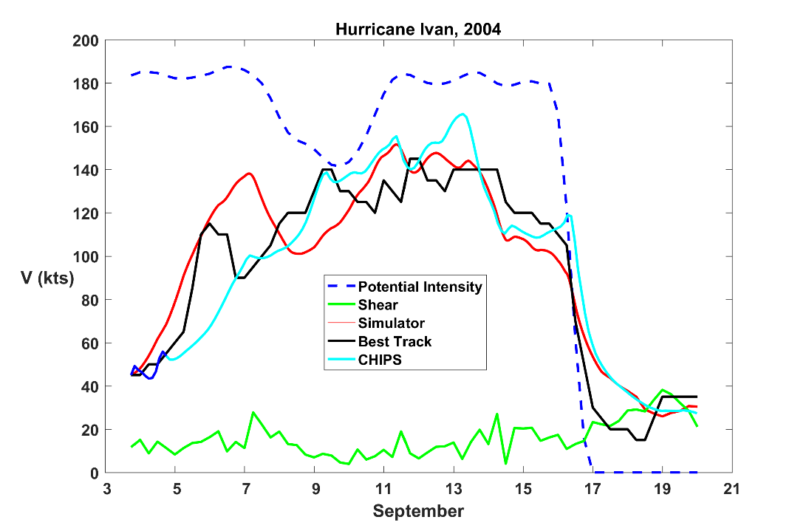
Performance in Hindcasts

Slide 8
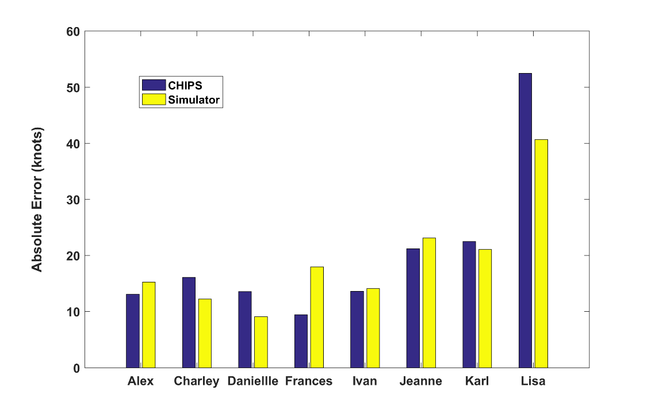
Atlantic 2004 Season

Slide 9
MIT Risk Assessment Approach: (Emanuel et al., 2006, 2008)
Step 1: Seed each ocean basin with a very large number of weak, randomly located cyclones
Step 2: Cyclones are assumed to move with the large scale atmospheric flow in which they are embedded, plus a correction for the earth’s rotation and sphericity
Step 3: Run this intensity model for each cyclone, and note how many achieve at least tropical storm strength
Step 4: Using the small fraction of surviving events, determine storm statistics. Can easily generate 100,000 events
Details: Emanuel et al., Bull. Amer. Meteor. Soc, 2008
Notes:
9

Slide 10
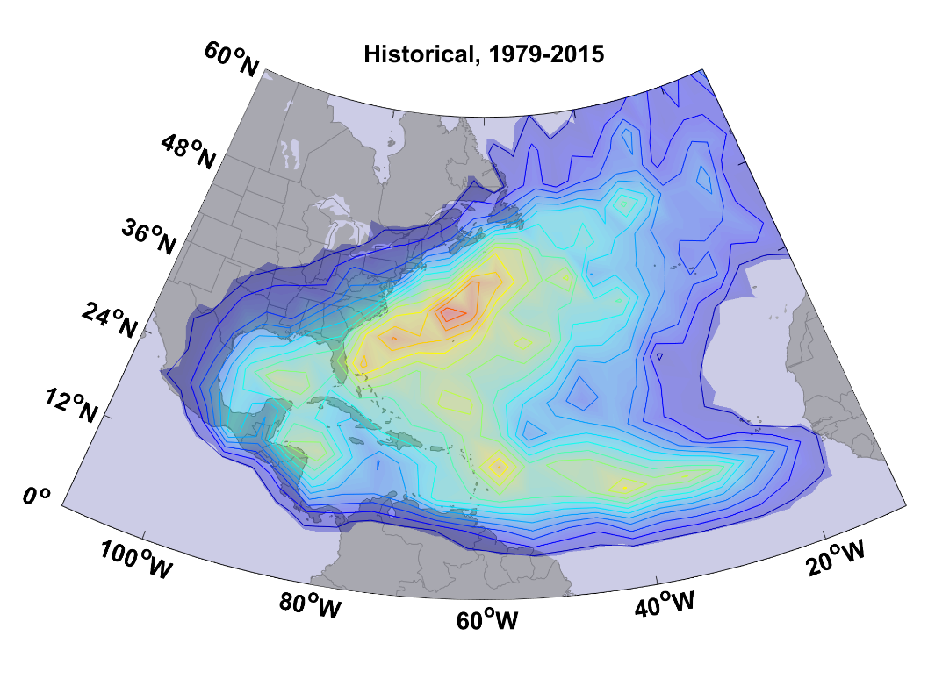
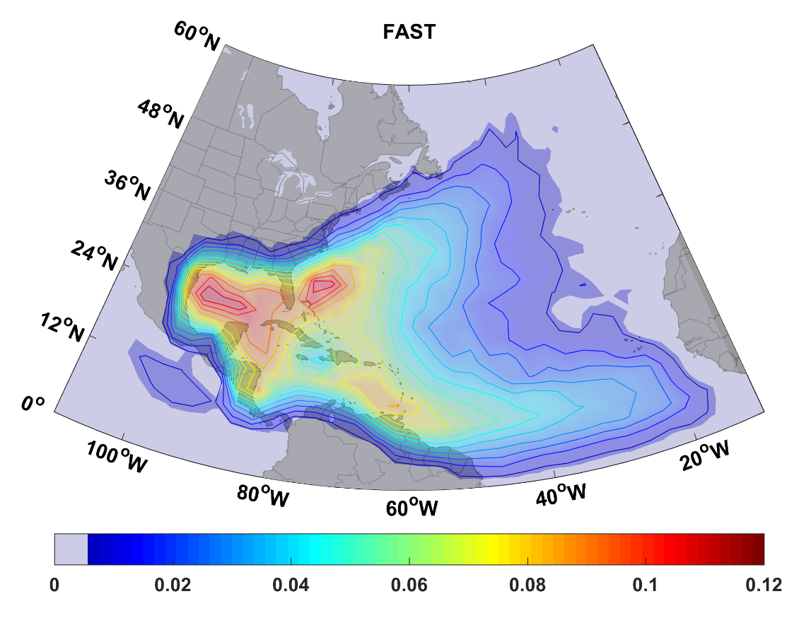
Historical Track Density, 1979-2015
Track Density Based on 3700 Synthetic Events Downscaled from NCAR/NCEP Reanalyses, 1979-2015

Slide 11
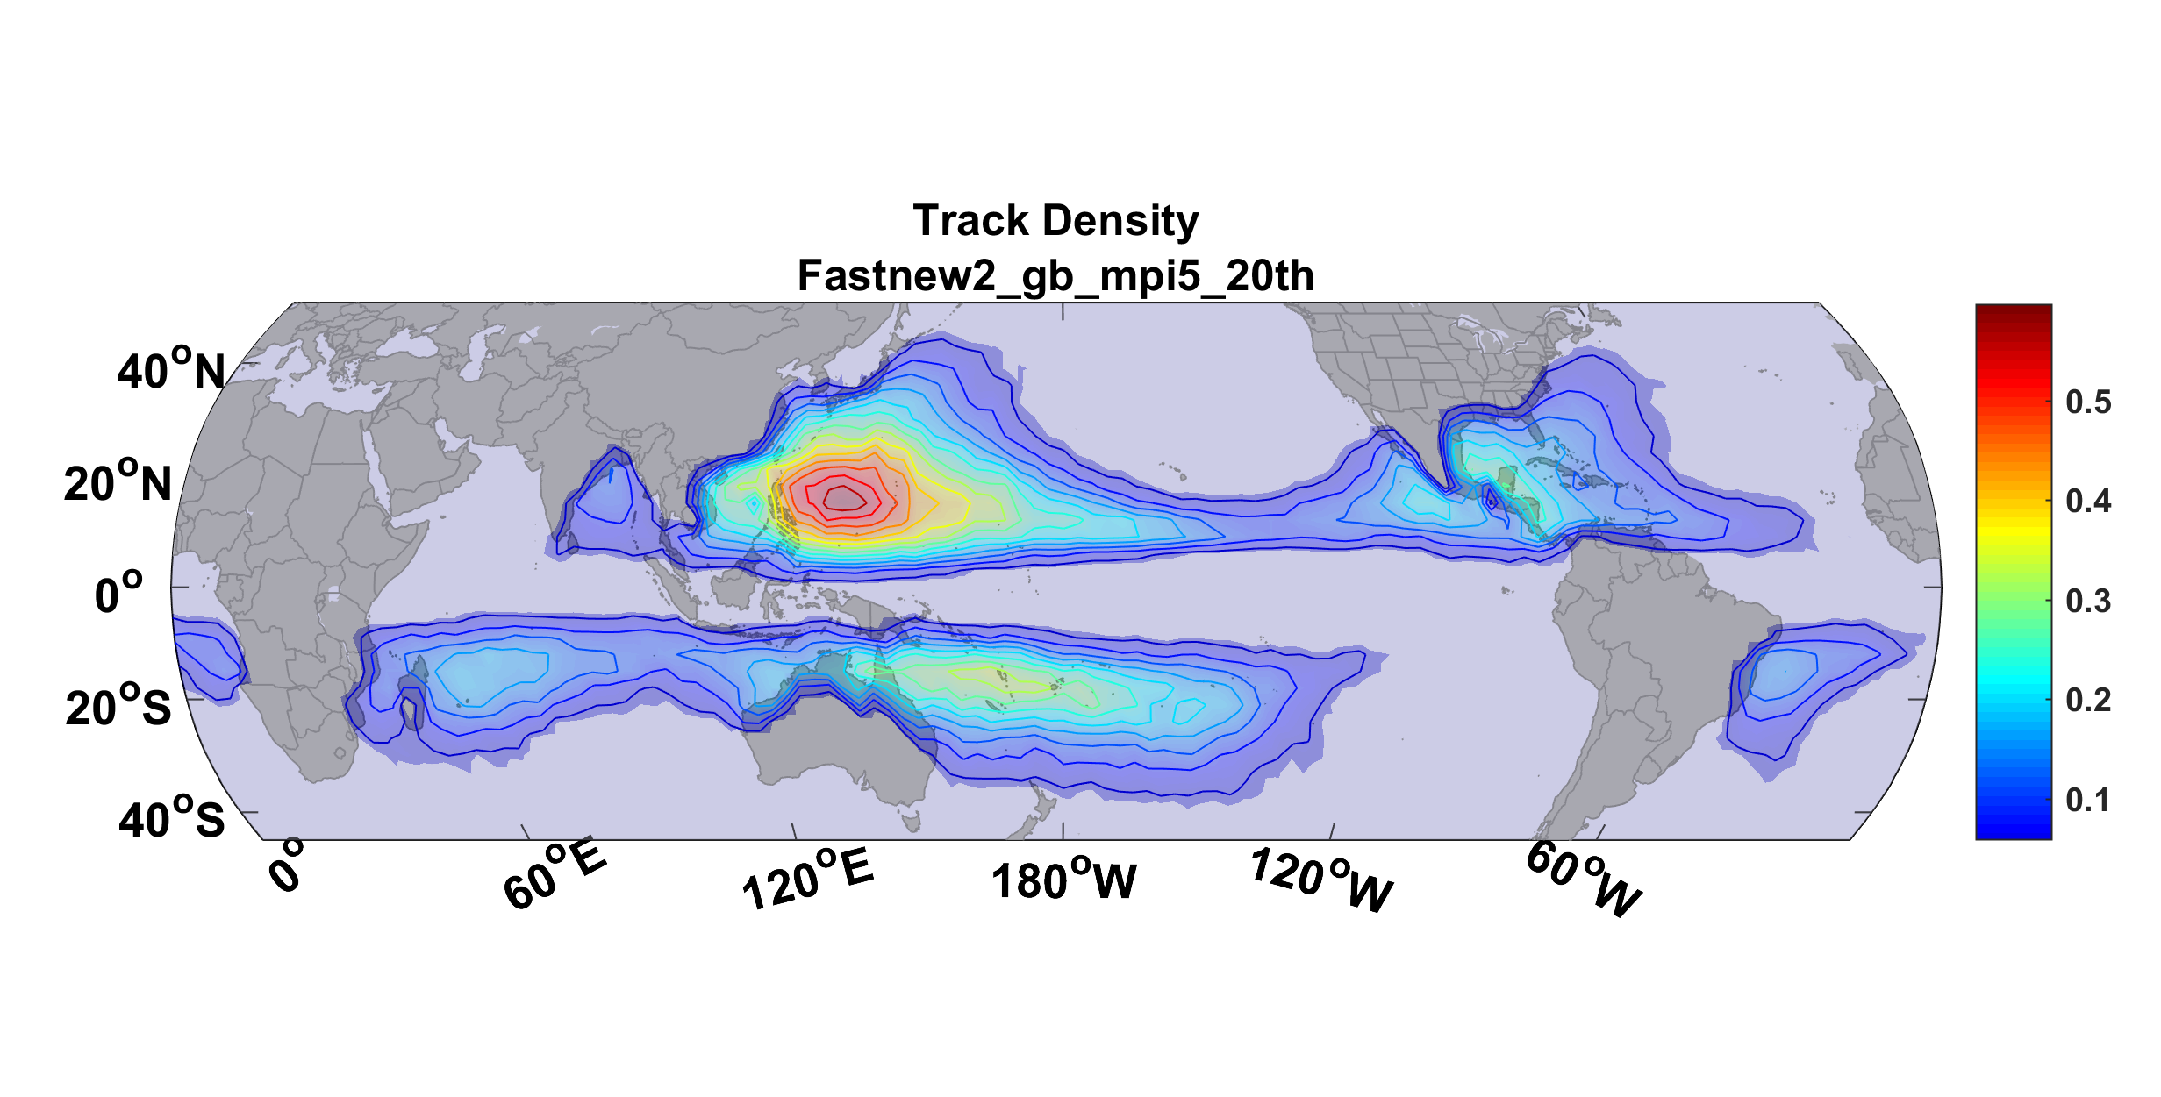
Downscaled from Max Planck Model, 1950-2005

Slide 12
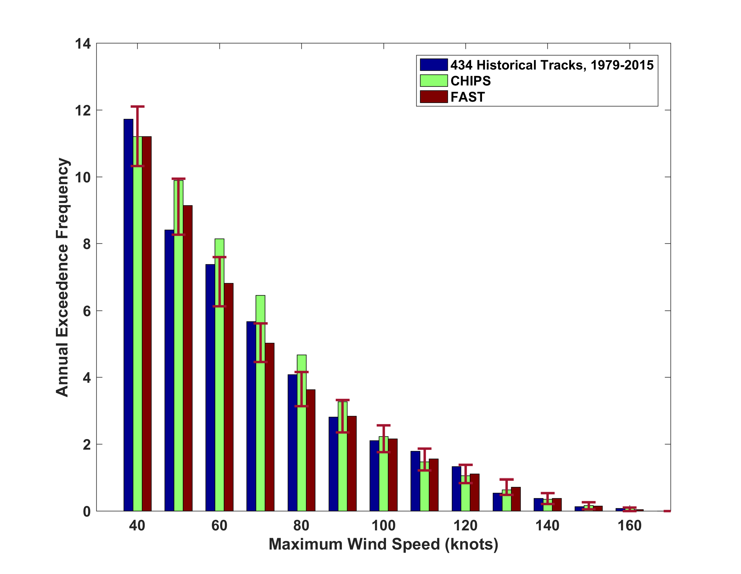
Comparisons of Annual Exceedance Frequencies, Atlantic, 1979-2015

Slide 13
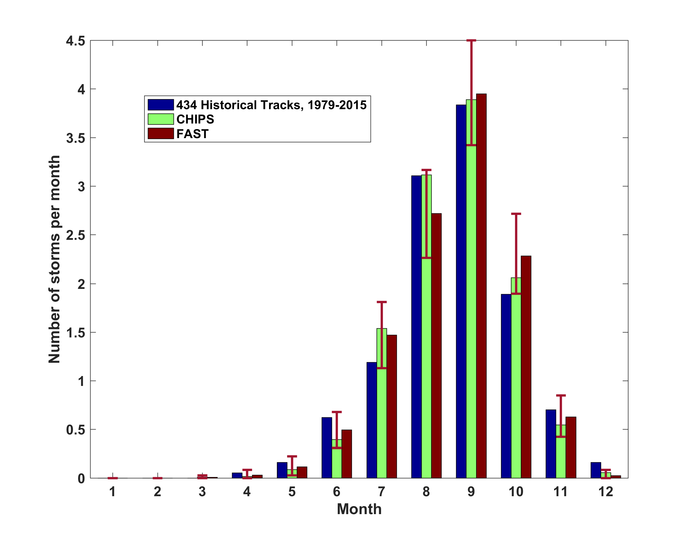
Atlantic Annual Cycle

Slide 14
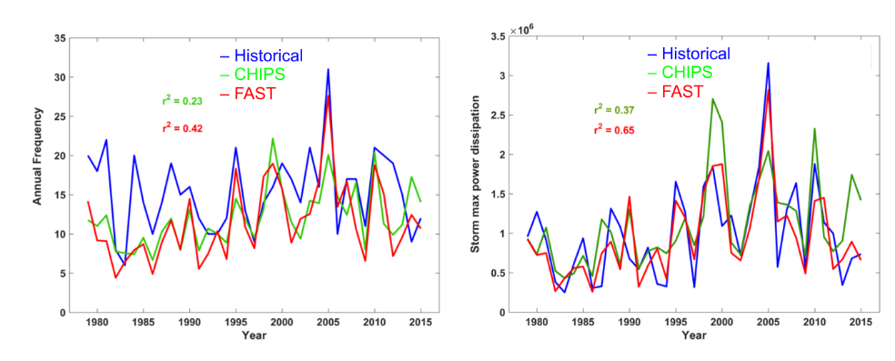
Atlantic Interannual Variability
Frequency
Power Dissipation

Slide 15
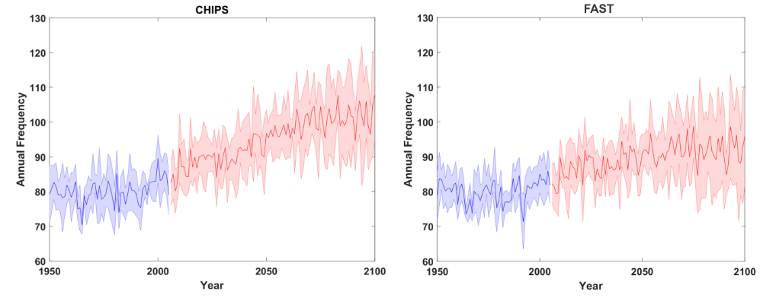
Downscaling 7 CMIP5 Models, RCP 8.5
Annual Frequency

Slide 16
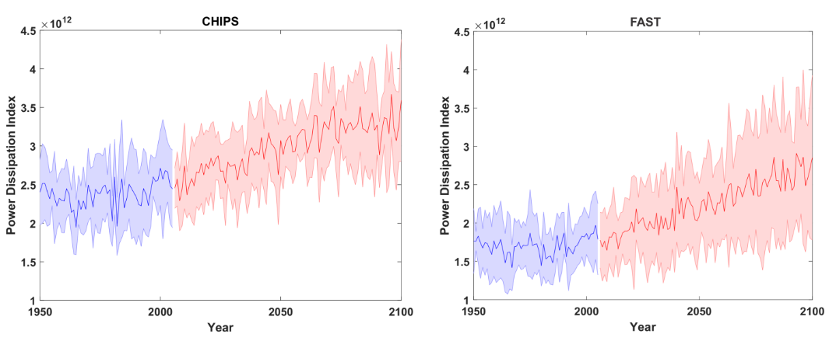
Power Dissipation Index

Slide 17
Summary
New, fast intensity simulator provides intensity along specified tracks, given atmospheric and oceanic environmental conditions along track
Designed for use in risk models
1,000 tracks in 2 seconds using laptop computer. (More processing time in interpolating environmental conditions to tracks
Competitive with CHIPS in quality of intensity probability distributions, spatial distribution, annual cycle, and hindcasts of individual events and Atlantic intraseasonal variability
Easy to code
Emanuel, K., 2007: A fast intensity simulator for tropical cyclone risk analysis. Nat. Hazards, DOI 10.1007/s11069-017-2890-7 (open access)

