Slide 1
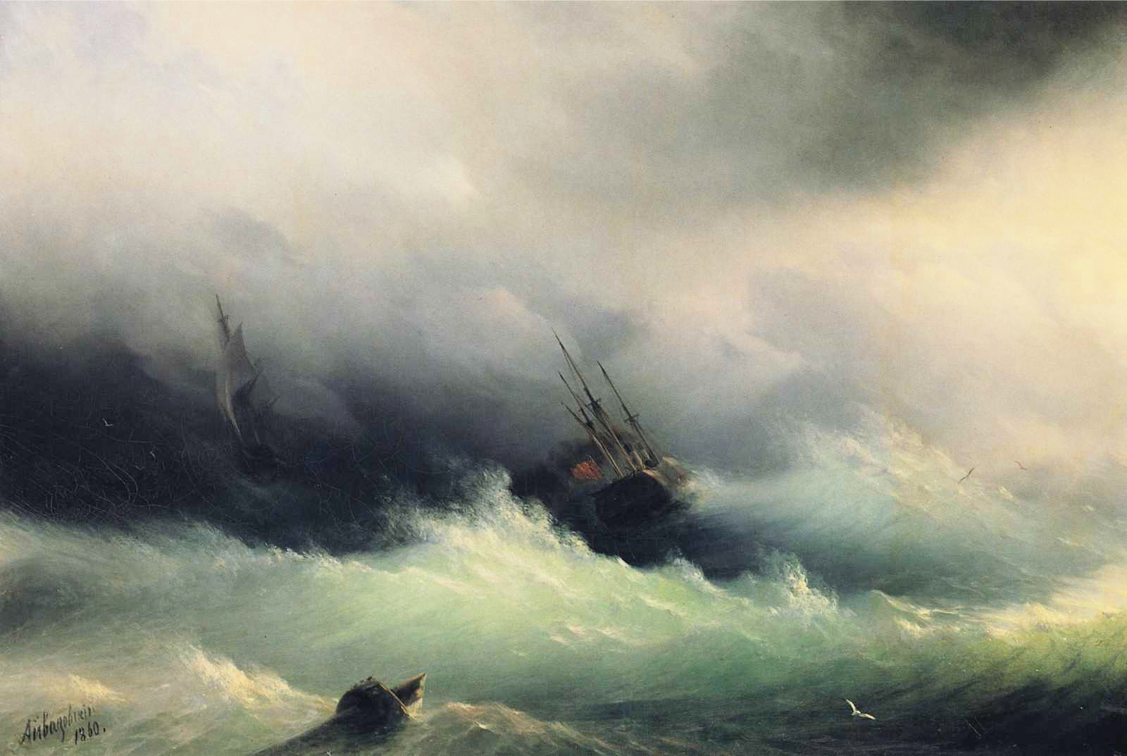
Trends and Volatility in Tropical Cyclone Risk
Kerry Emanuel
Lorenz Center
Massachusetts Institute of Technology

Slide 2
Program
The case for using physics, as encoded in numerical models, to quantify TC risk in the current and future climates
Past and future trends in TC activity
Modeling TC loss: The importance of volatility
Modeling insurance business performance

Slide 3
Flawed Basis of Current Risk Modeling
Most current risk assessments are based on historical statistics
Historical records are flawed and too short (stay tuned)
Moreover, the past 50-150 years is a poor guide to the present owing to climate change that has already occurred
We need to bring physics to bear on weather hazard risk
Risk modelers have been slow to migrate to a physics-based approach
Risk modeling industry is being challenged by non-profits and start-ups
Government and the insurance industry should accelerate this transition
Climate and weather researchers are getting more involved in physical modeling of risk

Slide 4
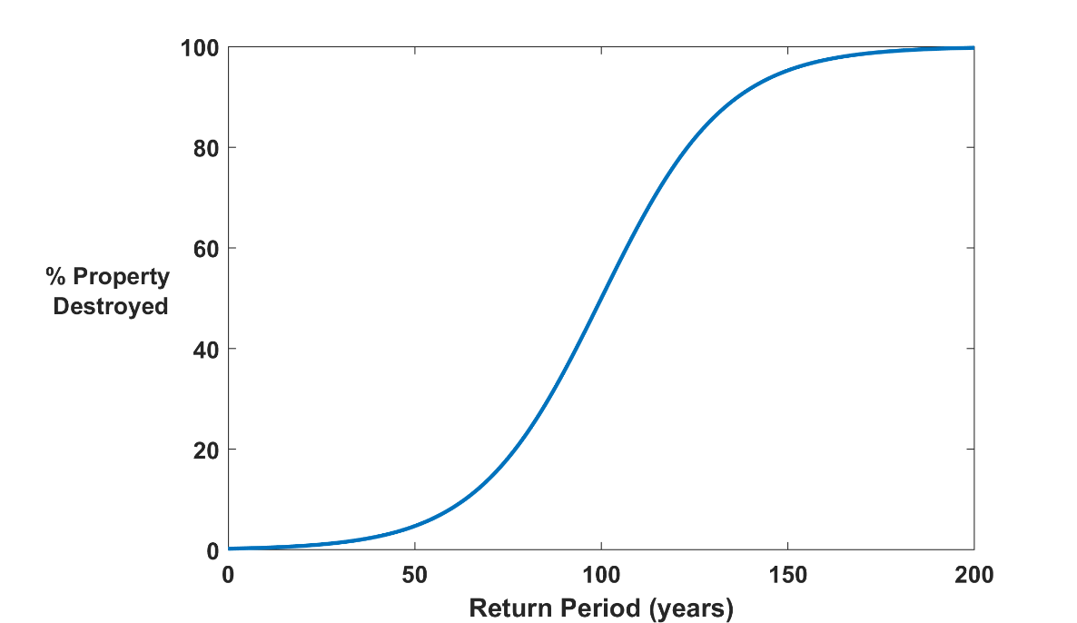

Why Natural Hazard Risks are Dominated by Extreme Events:
Societies are usually well adapted to frequent events (> 1/100 yr)
Societies are often poorly adapted to rare events (< 1/100 yr)
Large cost increases result when > 100-yr events become < 100-yr events
Largest slope

Slide 5
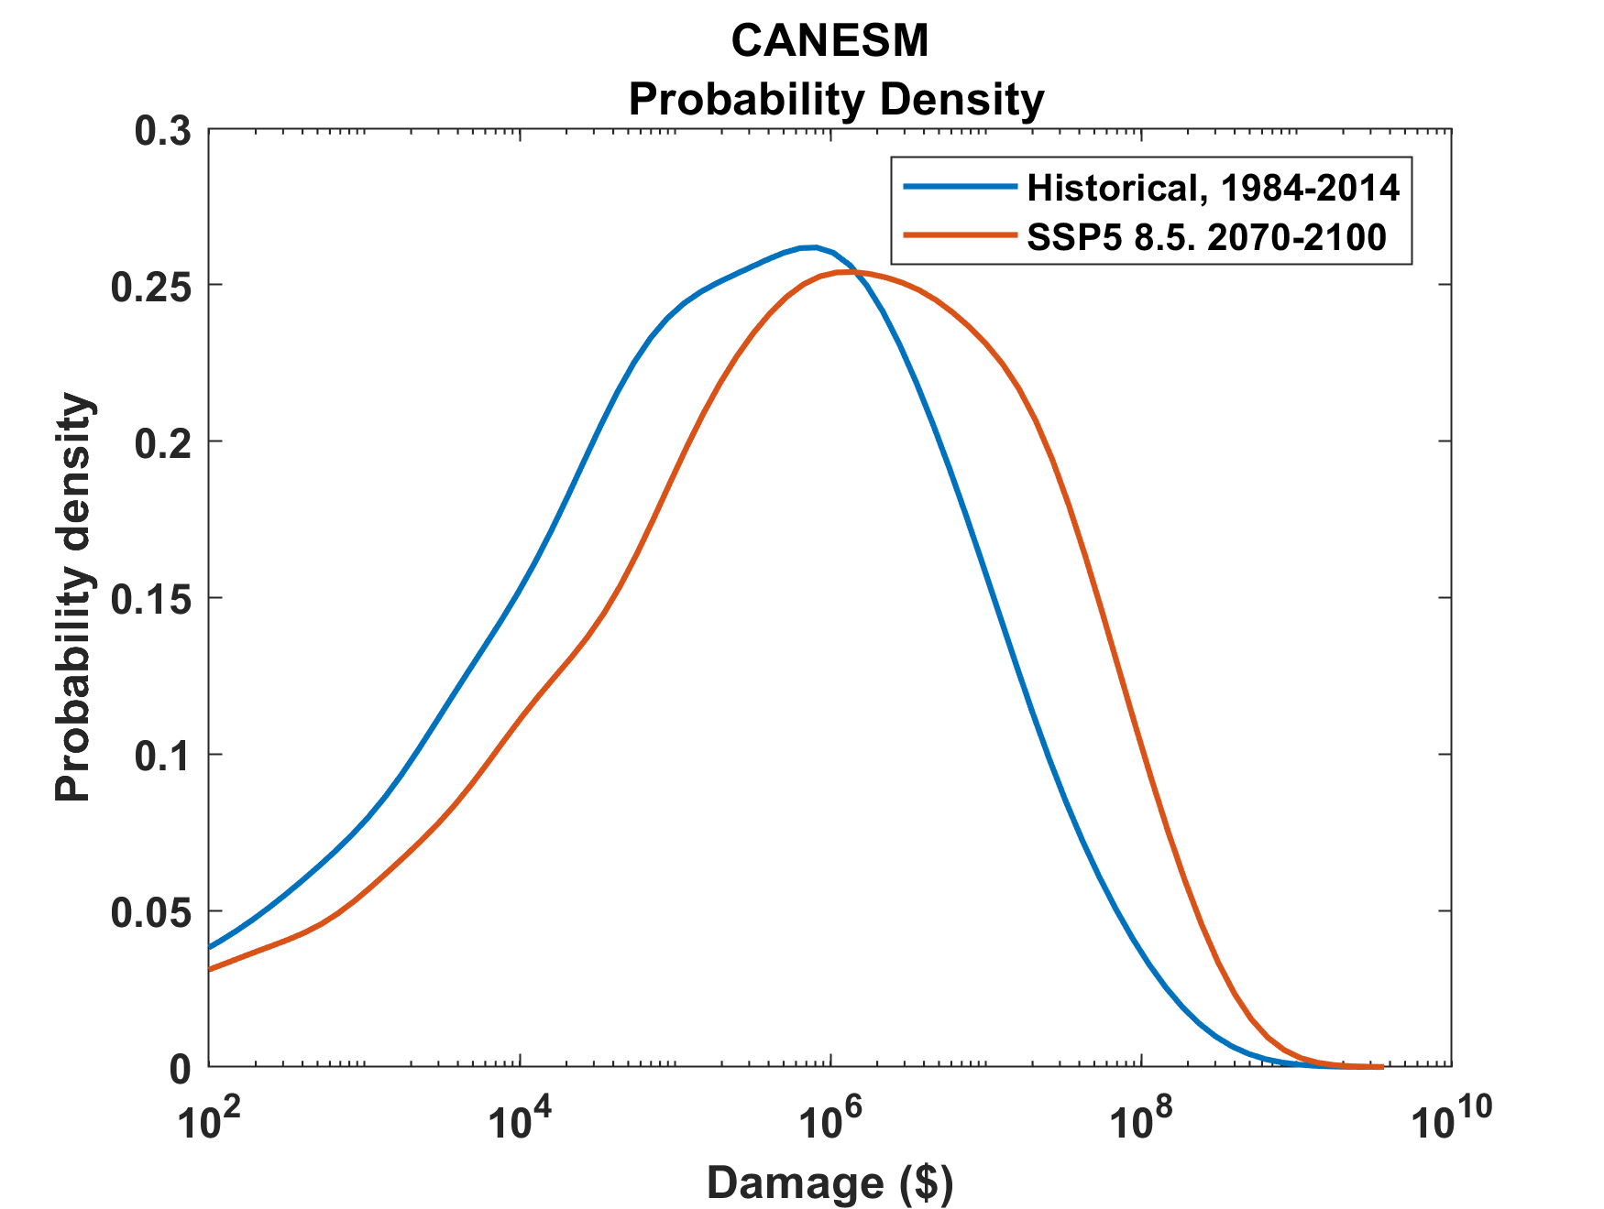
Example:
Tropical Cyclone Risk Arises Largely from High Intensity Events
1984-2014
2070-2100
Probability
Probability density of annual damage to a portfolio of insured property in the U.S.

Slide 6
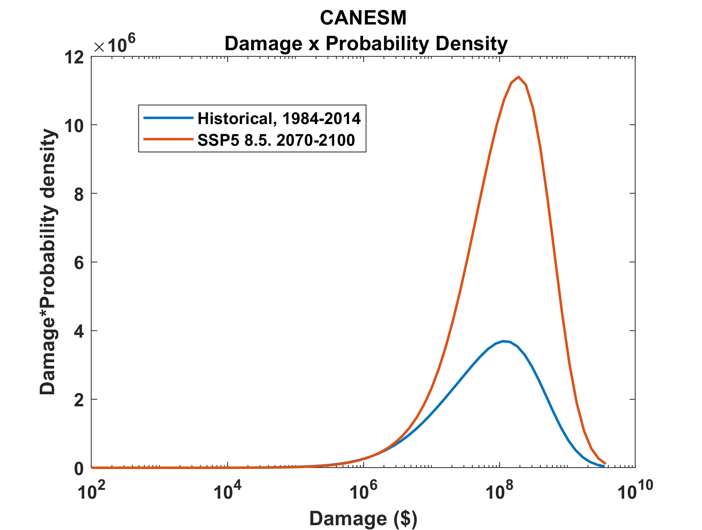
Tropical Cyclone Risk Arises Largely from High Intensity Events
2070-2100
Total expected damage proportional to area under curves
Risk
1984-2014
Damage times probability density of annual damage to a portfolio of insured property in the U.S.

Slide 7
Historical Records
Riverine floods: ~100 years of good records (U.S.)
Flash floods and tropical-cyclone induced floods: Somewhat less than 100 years
Even if we had 100 years of great records, the past is no longer a good guide to the present
We need to turn to physically based models to get better estimates of current (and future) weather risks

Slide 8
What Are Atlantic Historical TC Records Based On?
Pre-1943: Anecdotal accounts from coastal cities and ships
1943: Introduction of routine aircraft reconnaissance in Atlantic, western North Pacific
1958: Inertial navigation permits quantitative measurement of wind speed at flight level
1970: Complete global detection by satellites
1978: Introduction of satellite scatterometry
1987: Termination of airborne reconnaissance in western North Pacific

Slide 9
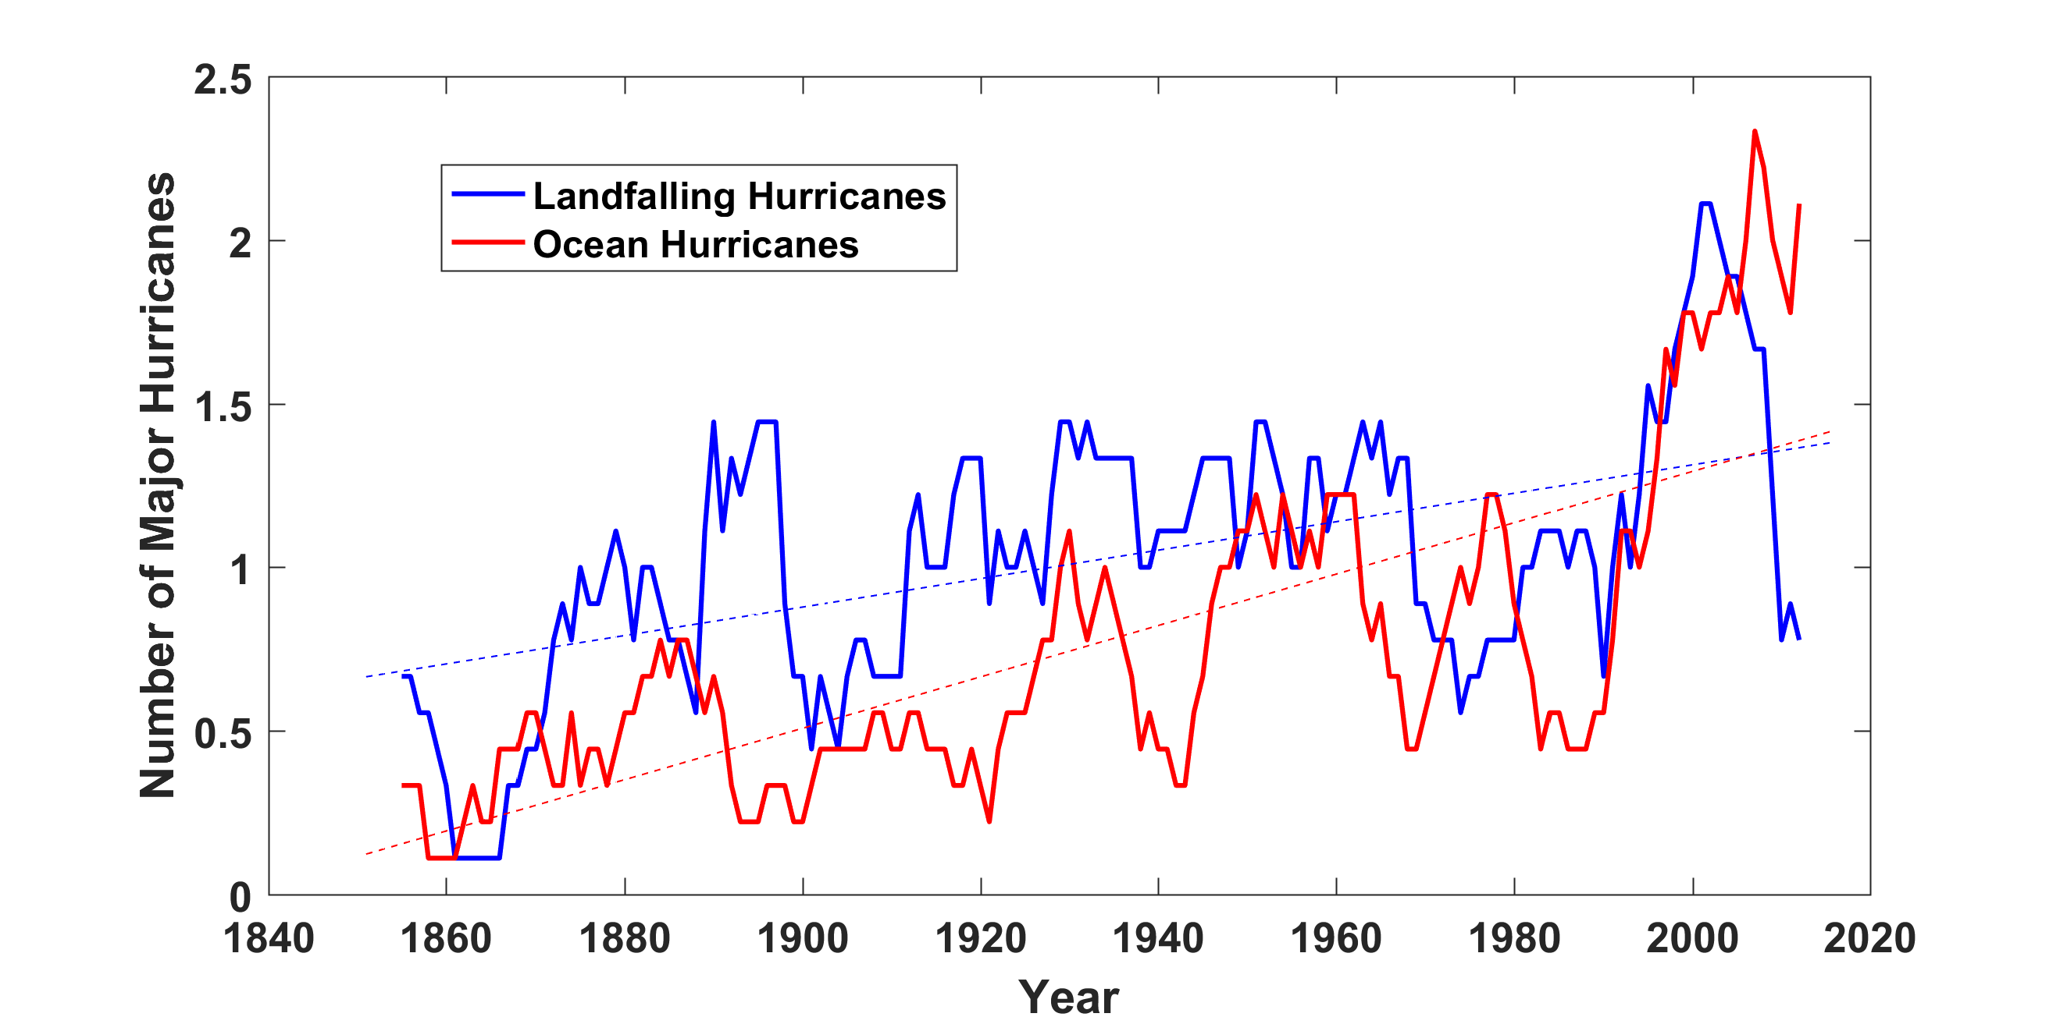
Historical Records: Prior to ~1970, Many Storms Were Missed
Major hurricanes in the North Atlantic, 1851-2016, smoothed using a 10-year running average. Shown in blue are storms that either passed through the chain of Lesser Antilles or made landfall in the continental U.S.; all other major hurricanes are shown in red. The dashed lines show the best fit trend lines for each data set.

Slide 10
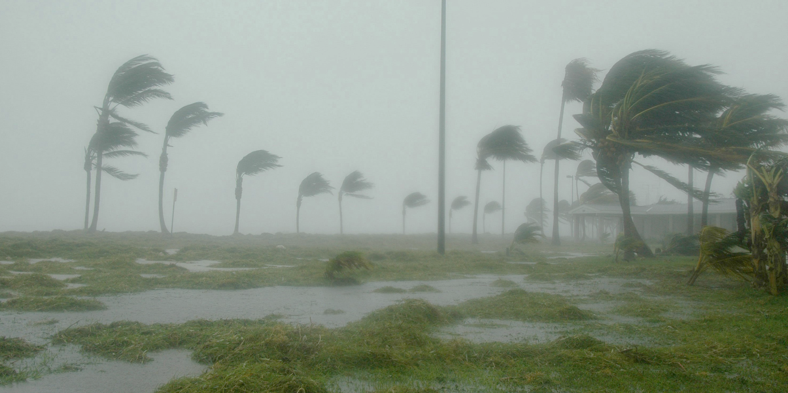
Historically Based Risk Assessments Are Now A Poor Guide to the Present

Slide 11
Example: Flooding from Hurricane Harvey, 2017
Three independent scientific studies appeared in 2017:
van Oldenborgh et al: “We conclude that global warming made the precipitation about 15% (8%–19%) more intense, or equivalently made such an event three (1.5–5) times more likely.”
Risser and Wehner: “We find that human-induced climate change likely increased the chances of the observed precipitation accumulations during Hurricane Harvey in the most affected areas of Houston by a factor of at least 3.5.”
Emanuel: “In 2017 the annual probability [of Hurricane Harvey’s rainfall in Harris County] would be 6%, a sixfold increase since the late 20th century.

Slide 12
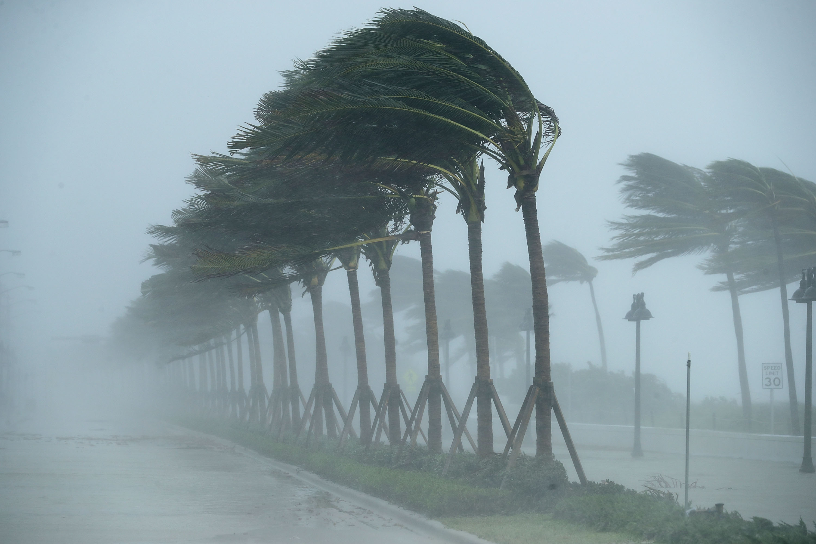
Bringing Physics to Tropical Cyclone Risk Assessment

Slide 13
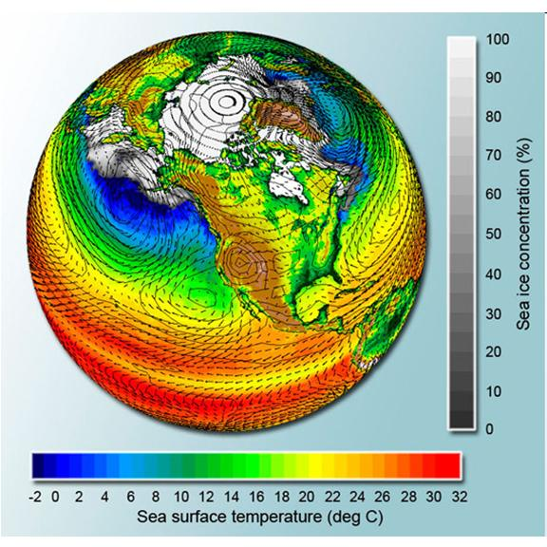
Why Not use Climate Models to Simulate Future Hurricanes?

Slide 14
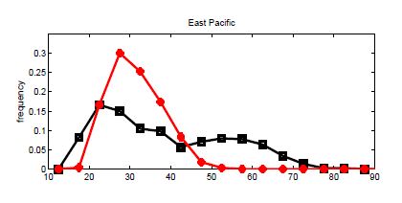
Problem: Today’s models are far too coarse to simulate destructive hurricanes
Histograms of Tropical Cyclone Intensity as Simulated by a Global Model with 50 km grid point spacing. (Courtesy Isaac Held, GFDL)
Category 3
Modeled
Observed
Global models do not simulate the storms that cause destruction
Wind Speed (meters per second)

Slide 15
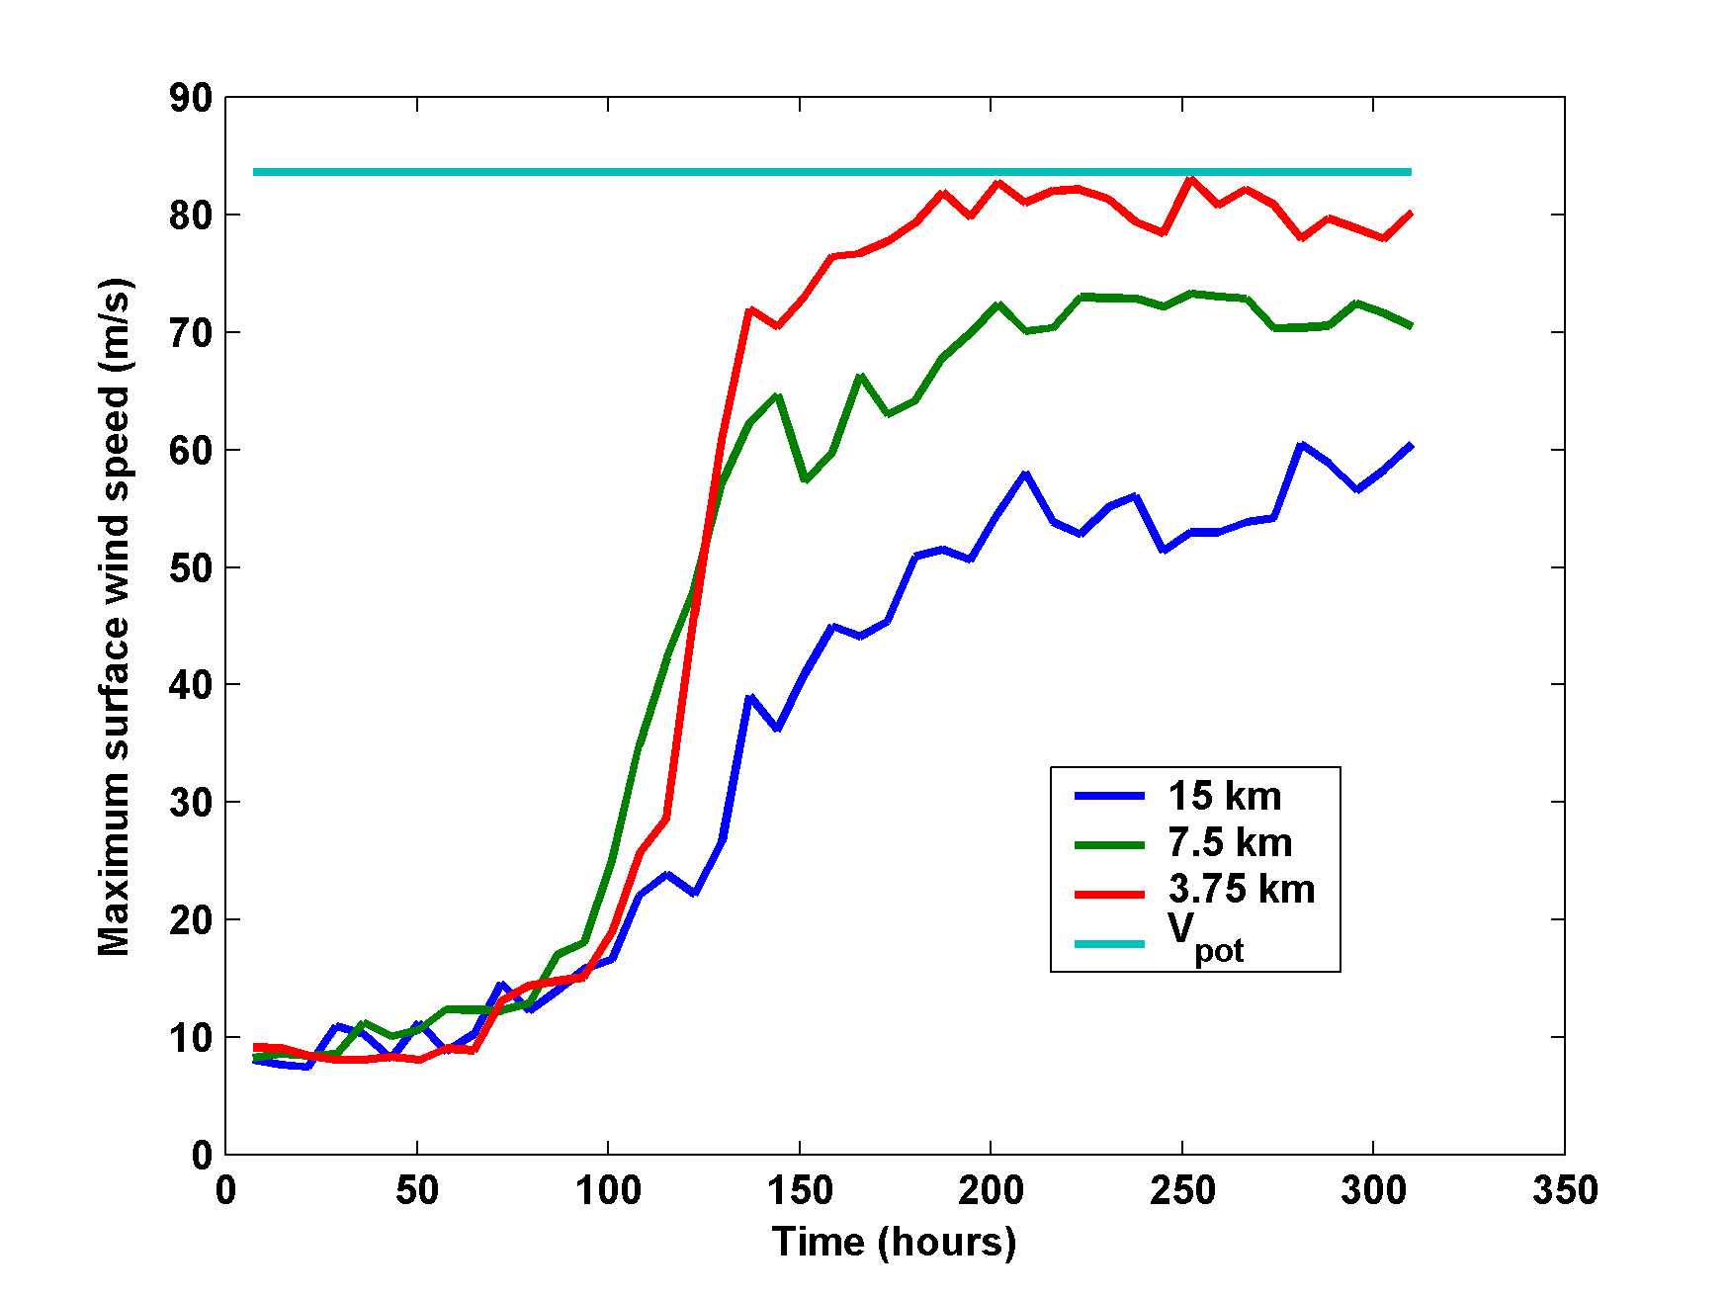
What it Takes to Simulate a Hurricane Accurately
Distance between computational nodes
Typical Climate Model Grid spacings: of 50-200 km
We need high resolution AND Order(1000 yr) simulations

Slide 16
Using Physics to Assess Hurricane Risk
Reliable, global records of coarse-scale climate are robust and widely available
Cull from these datasets the key statistics known to control tropical cyclone generation, movement, and intensity evolution
Bootstrap these key statistics to create unlimited synthetic time series of the hurricane-relevant environmental variables
Use these to drive specialized, very high resolution physical hurricane models (CHIPS)
Extensively validate the results against historical hurricane data
Exact same method can be applied to output of climate models

Slide 17

MIT Synthetic Hurricanes
Embed high-resolution, fast coupled ocean-atmosphere hurricane model in global climate model or climate reanalysis data
Coupled Hurricane Intensity prediction Model (CHIPS) has been used for 20 years to forecast real hurricanes in near-real time

Slide 18
Risk Assessment Approach:
Step 1: Seed each ocean basin with a very large number of weak, randomly located cyclones
Step 2: Cyclones are assumed to move with the large scale atmospheric flow in which they are embedded, plus a correction for the earth’s rotation and sphericity (beta-drift)
Step 3: Run the CHIPS coupled intensity model for each cyclone, and note how many achieve at least tropical storm strength
Step 4: Using the small fraction of surviving events, determine storm statistics. Can easily generate 100,000 events
Details: Emanuel et al., Bull. Amer. Meteor. Soc, 2008
Notes:
18

Slide 19
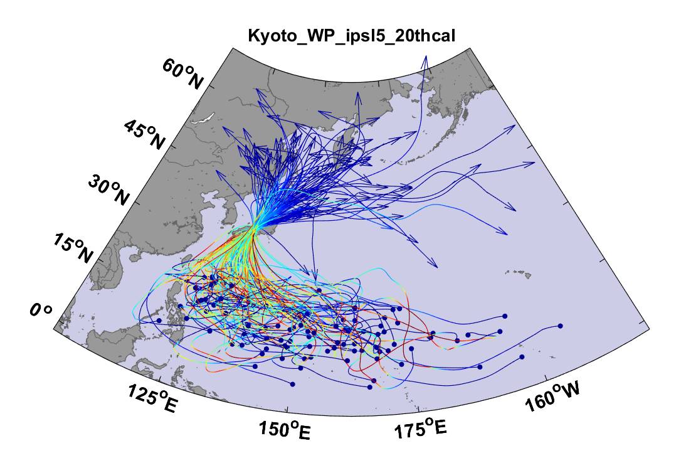
Example:
Top 100 out of 2000 TCs Affecting Kyoto, 1981-2000

Slide 20
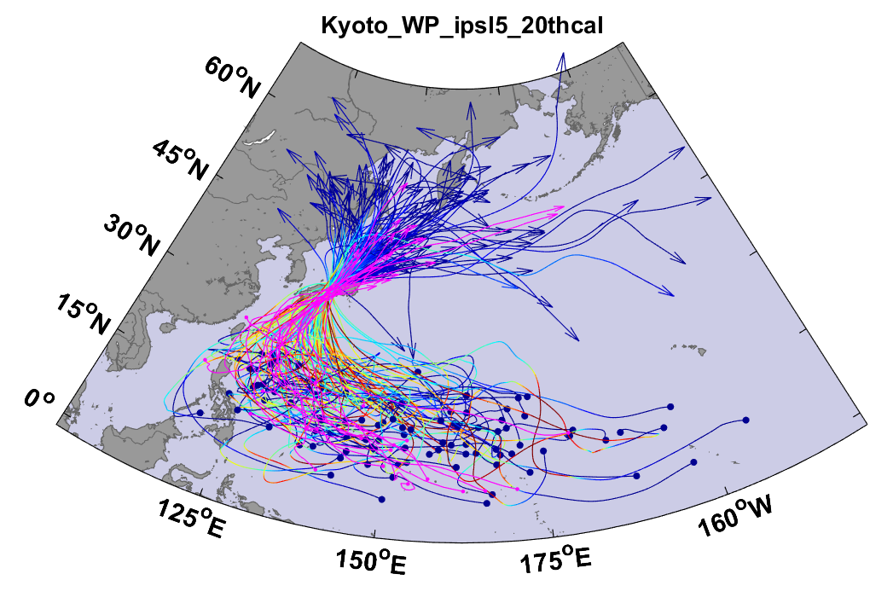
Same, but with top 20 historical tracks

Slide 21
Atlantic Annual Cycle

Slide 22
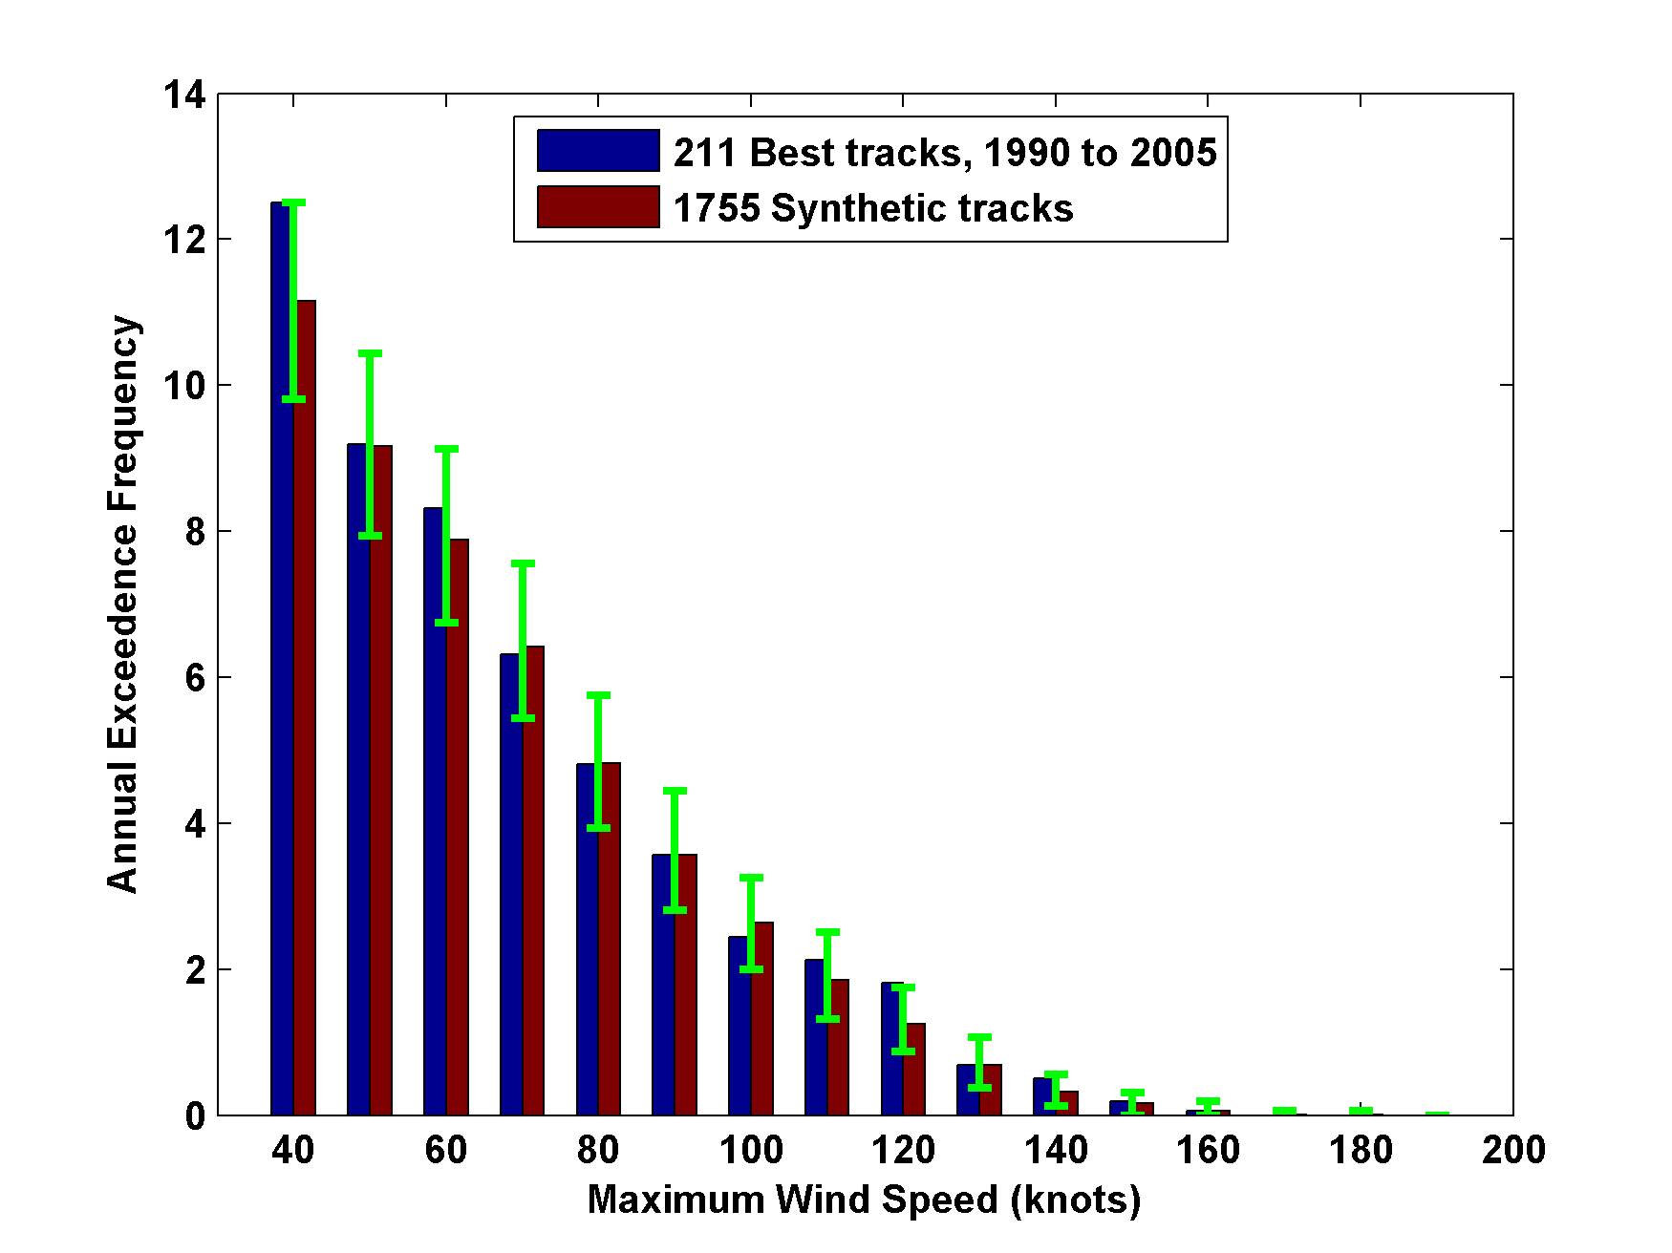
Cumulative Distribution of Storm Lifetime Peak Wind Speed, with Sample of 1755 Synthetic Tracks
Blue bars: Actual
Red bars: Predicted
90% confidence bounds

Slide 23
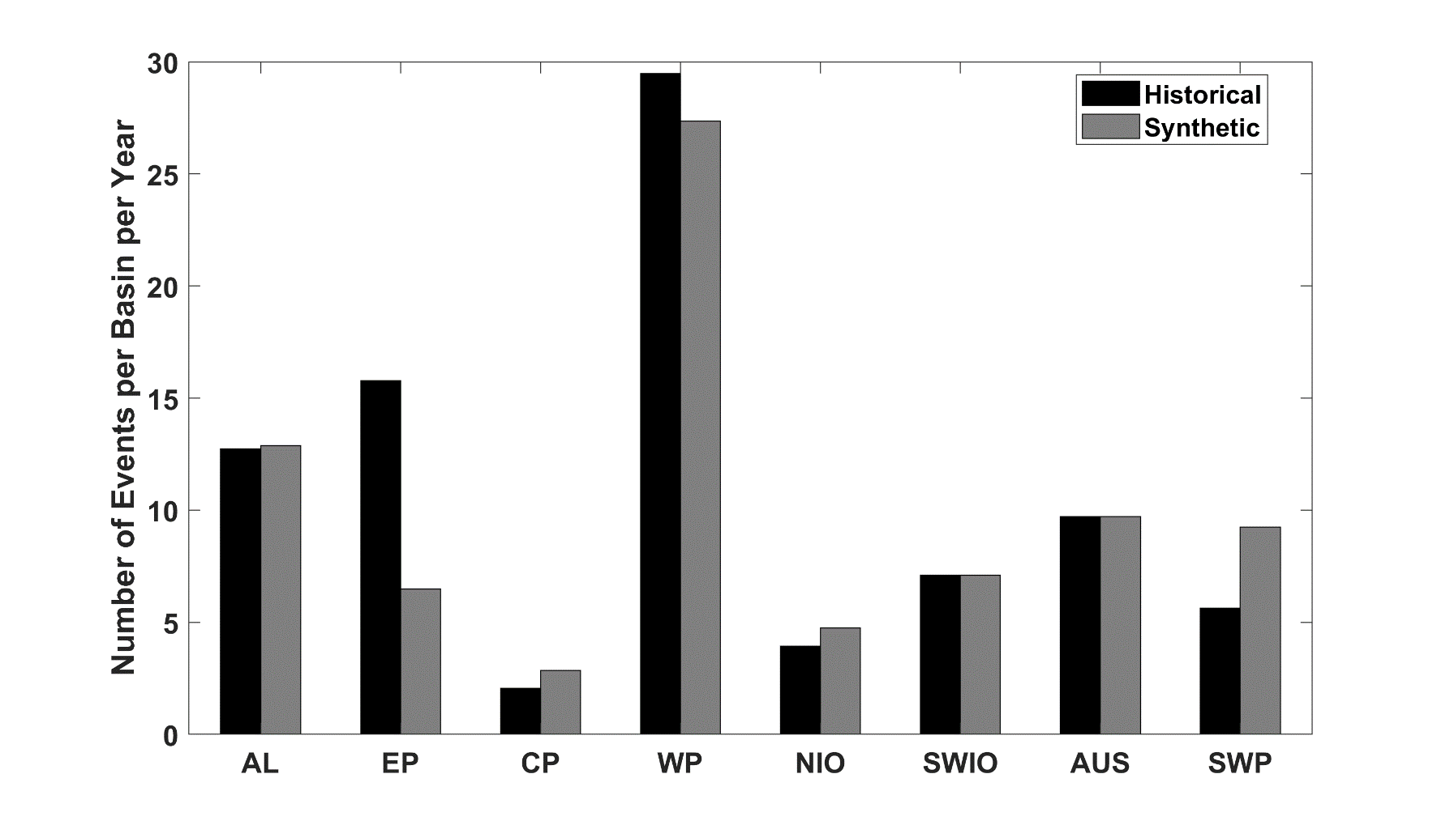
Average annual number of tropical cyclones over the period 1980-2020 in observations (IBTrACS; Knapp et al. 2010; black bars) and from random seeding of ERA-5 (gray bars)

Slide 24
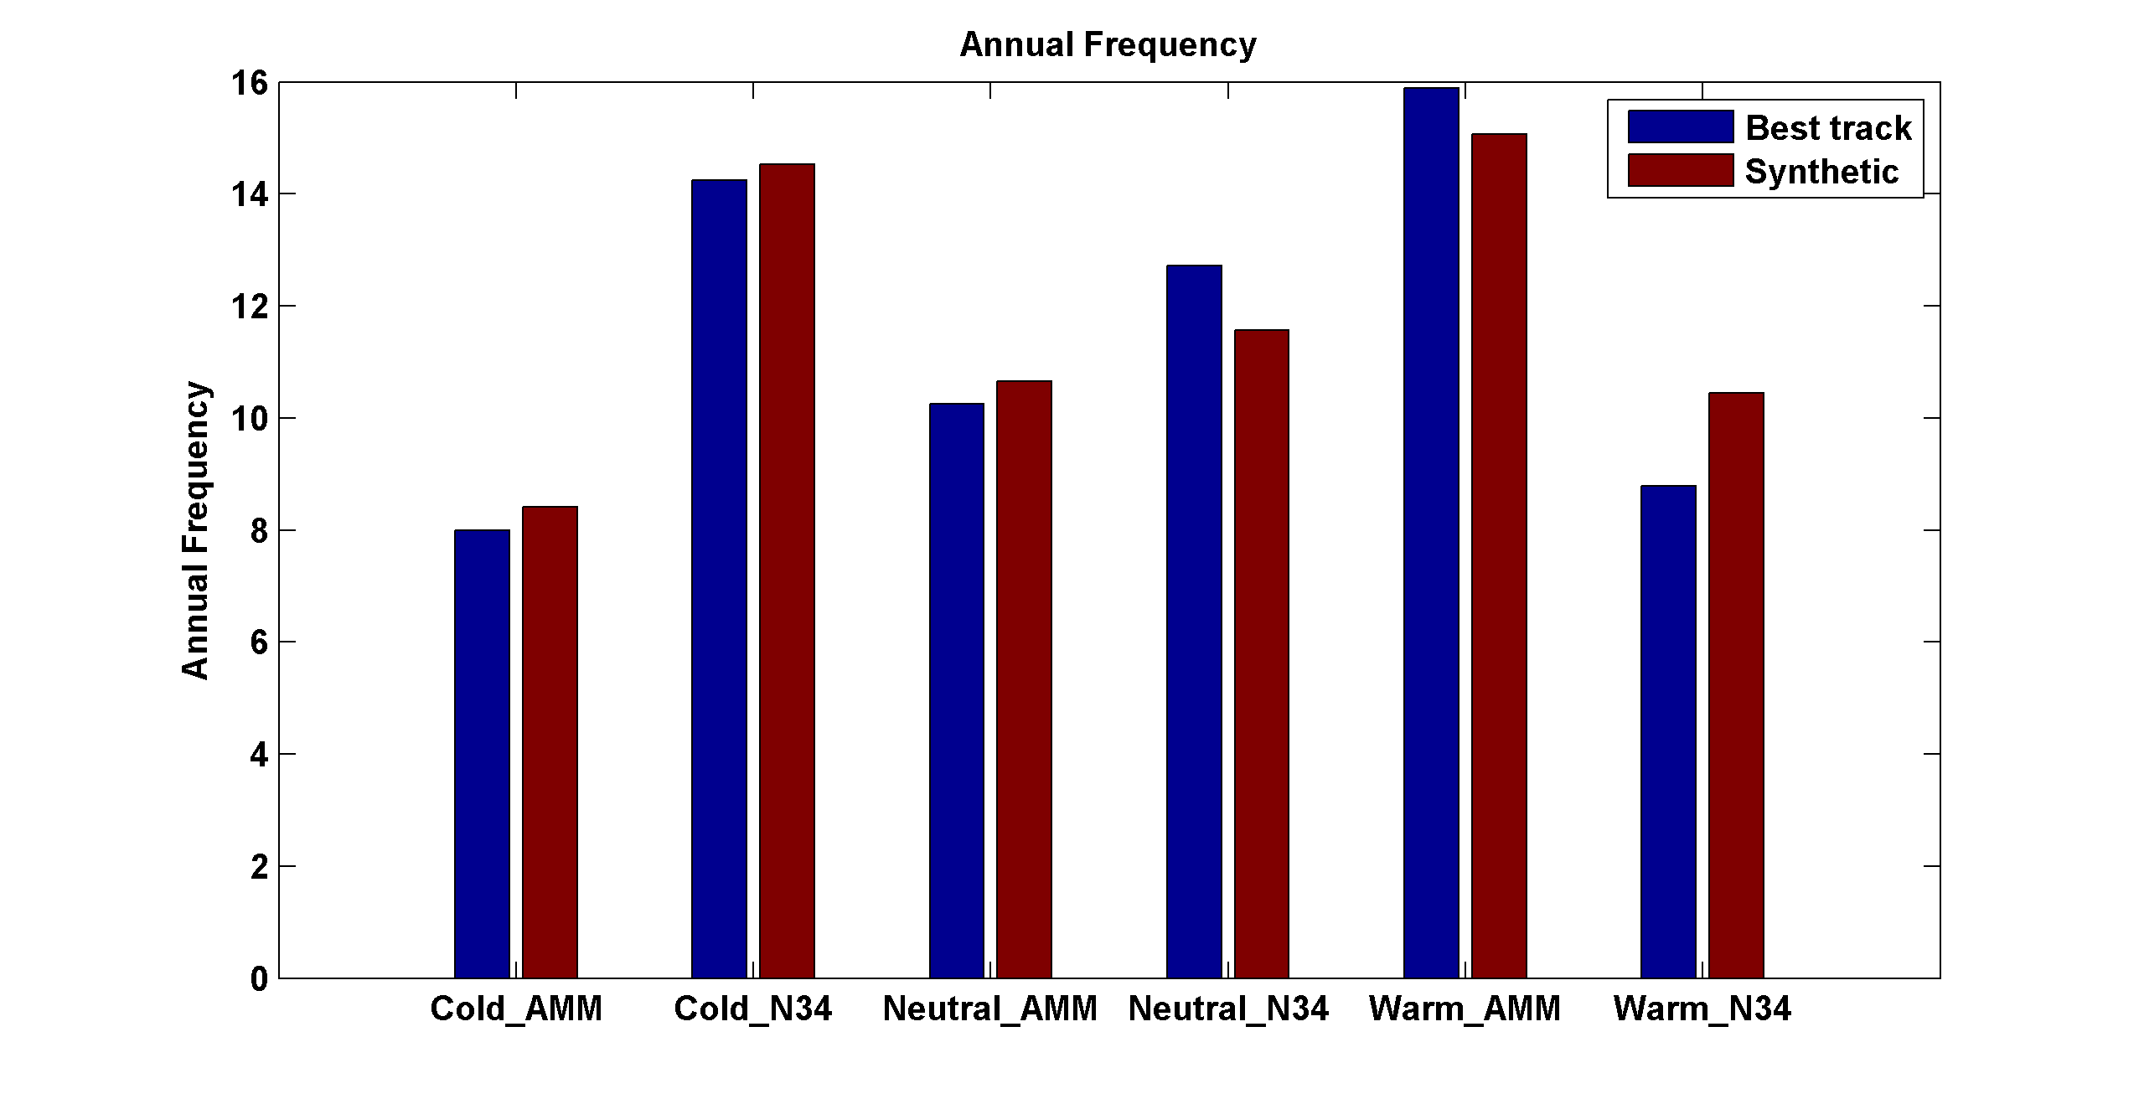
Captures effects of regional climate phenomena (e.g. ENSO, AMM)
Blue bars: Actual
Red bars: Predicted

Slide 25
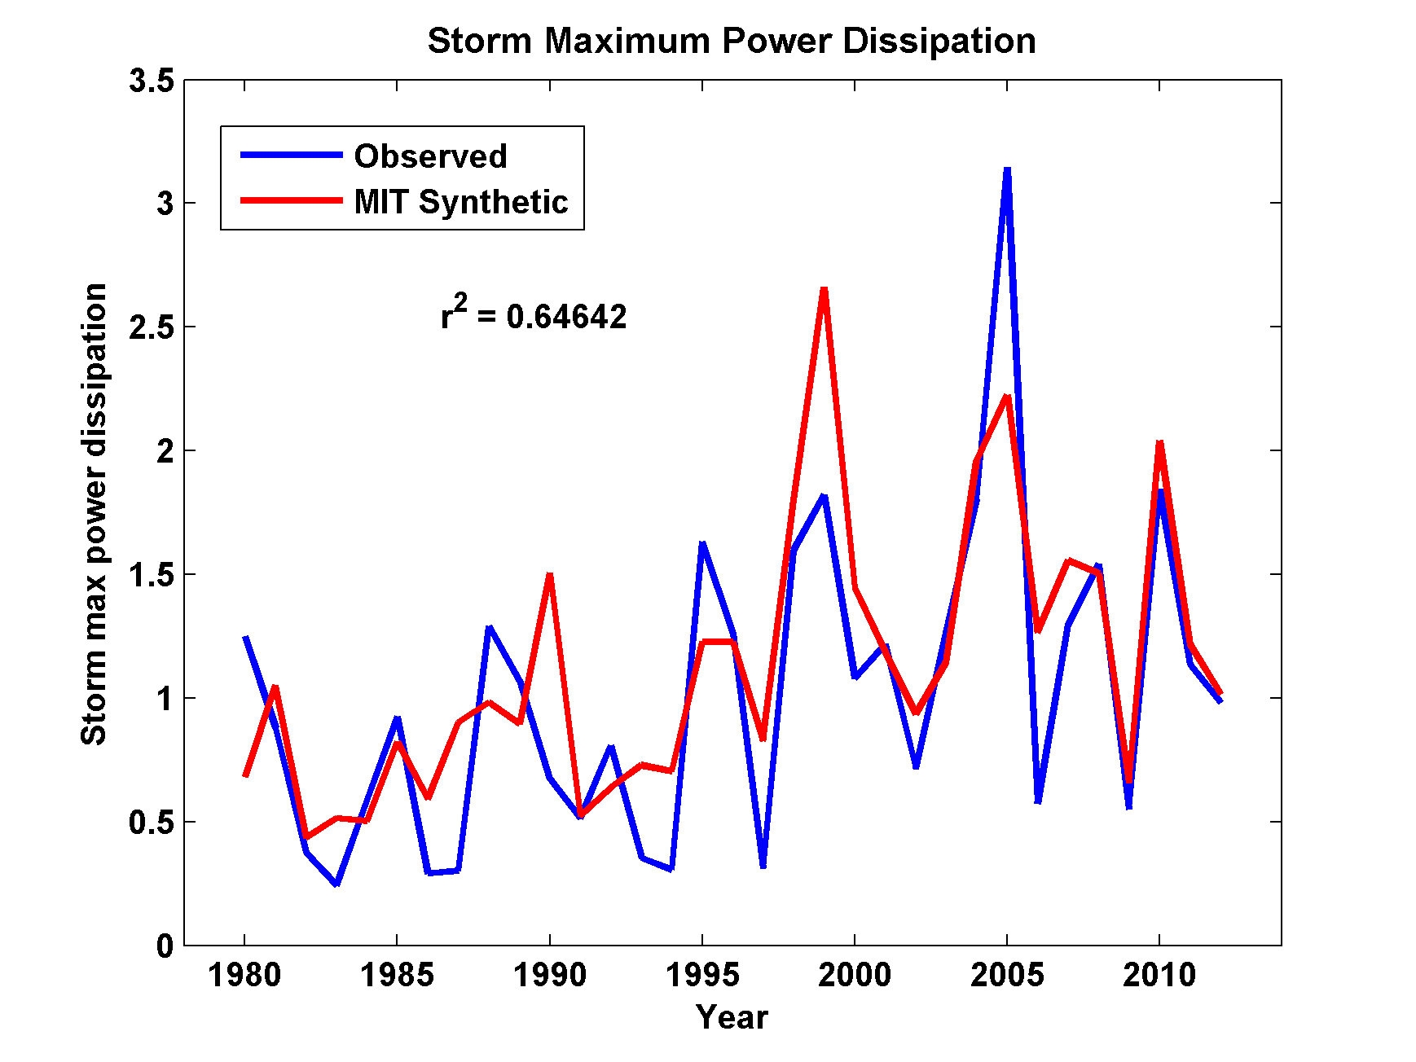
Captures Much of the Observed North Atlantic Interannual Variability
r²=0.65

Slide 26
Major Hurricanes
7-year running averages

Slide 27
All Landfalls, NOAA 20th Century v.3
7-year running averages
Suggests some landfalls missed prior to 1900

Slide 28
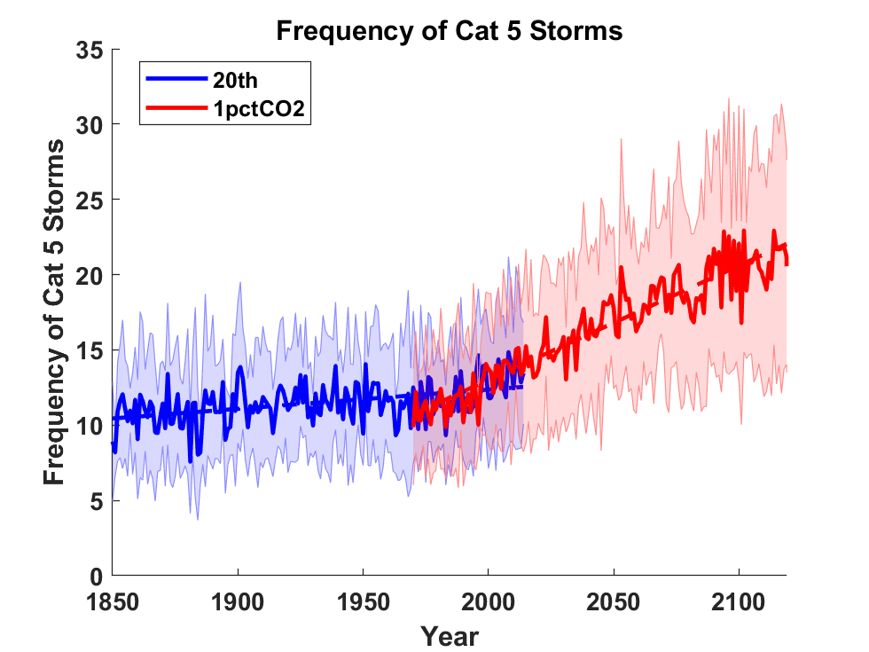
Global Tropical Cyclone Frequency from 9 Current Generation (CMIP6) Climate Models

Slide 29
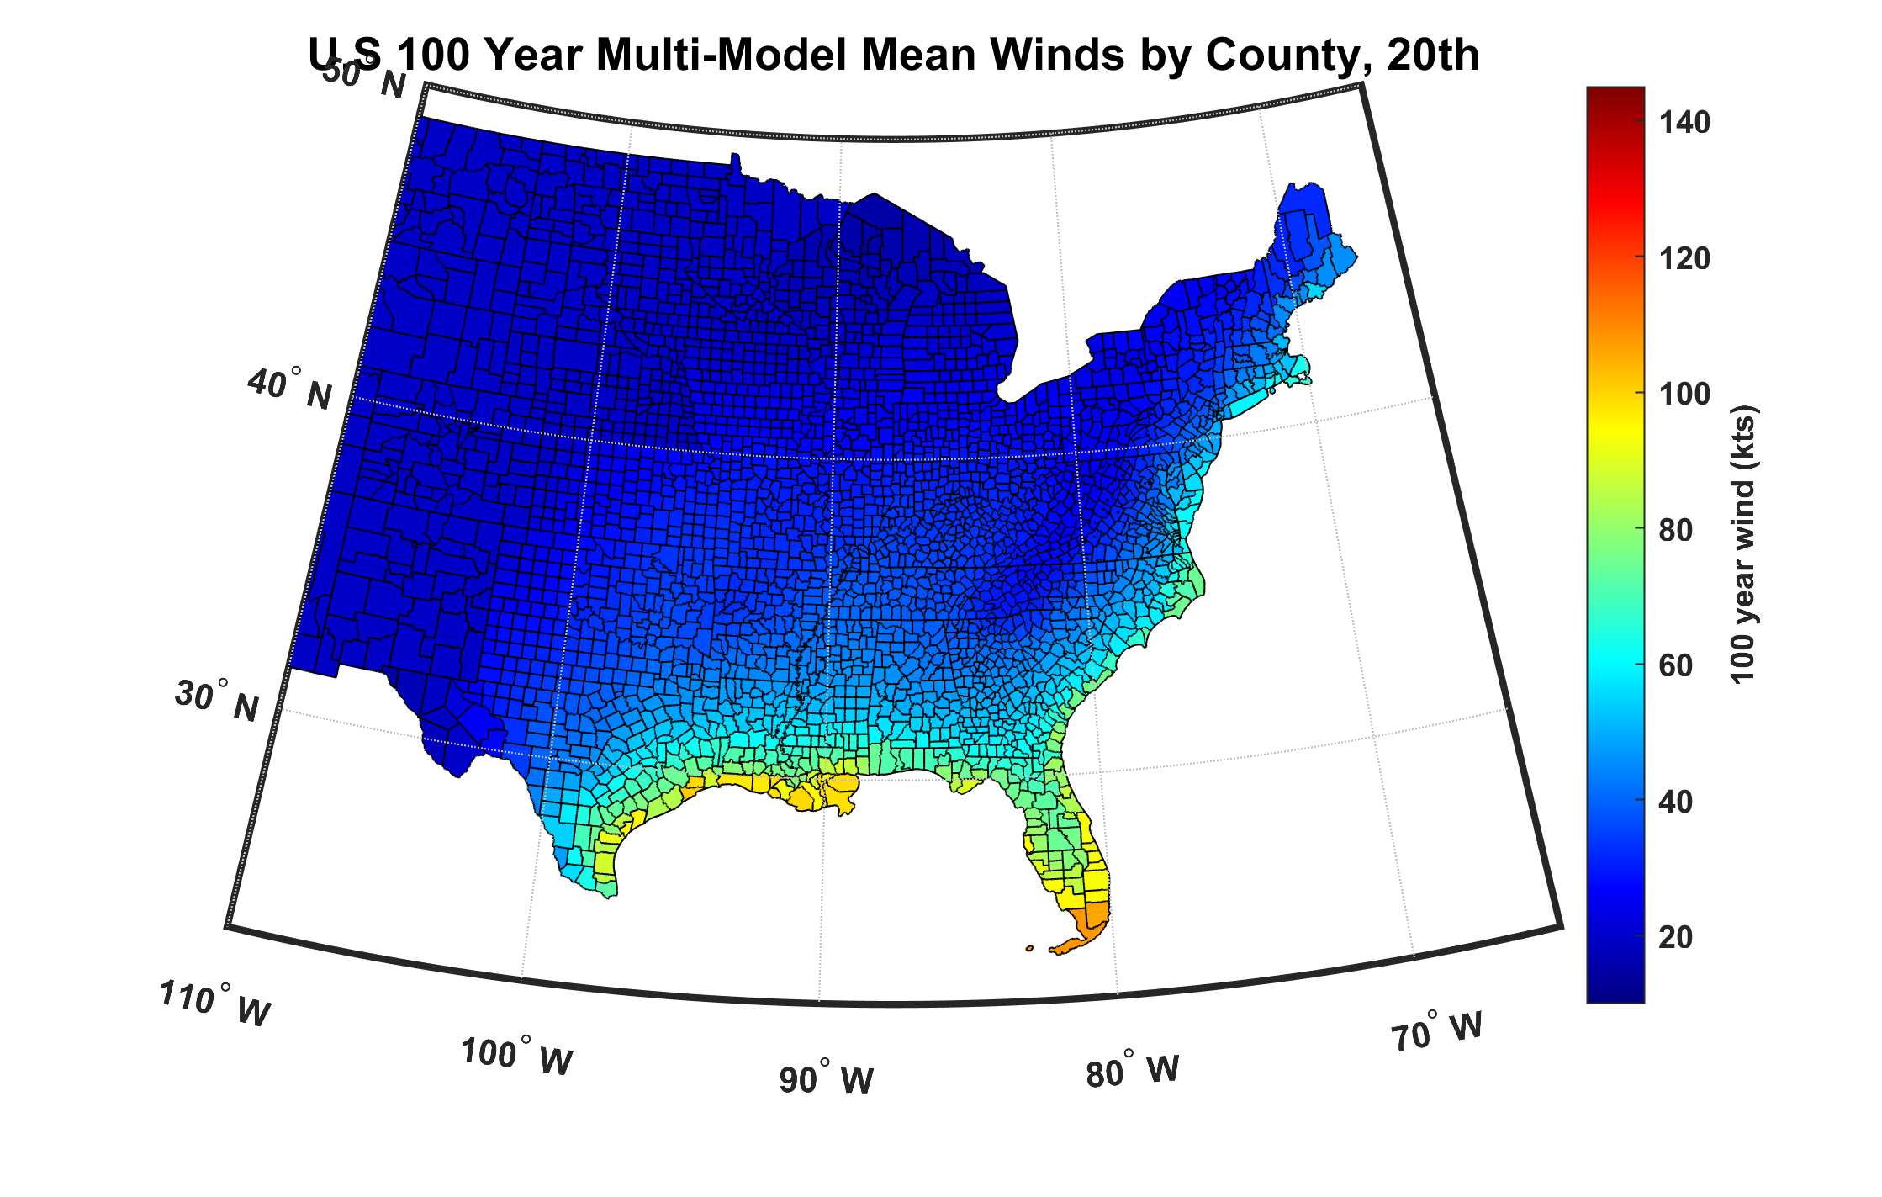
100-year hurricane peak wind based on downscaling 8 CMIP6 climate models, 1984-2014

Slide 30
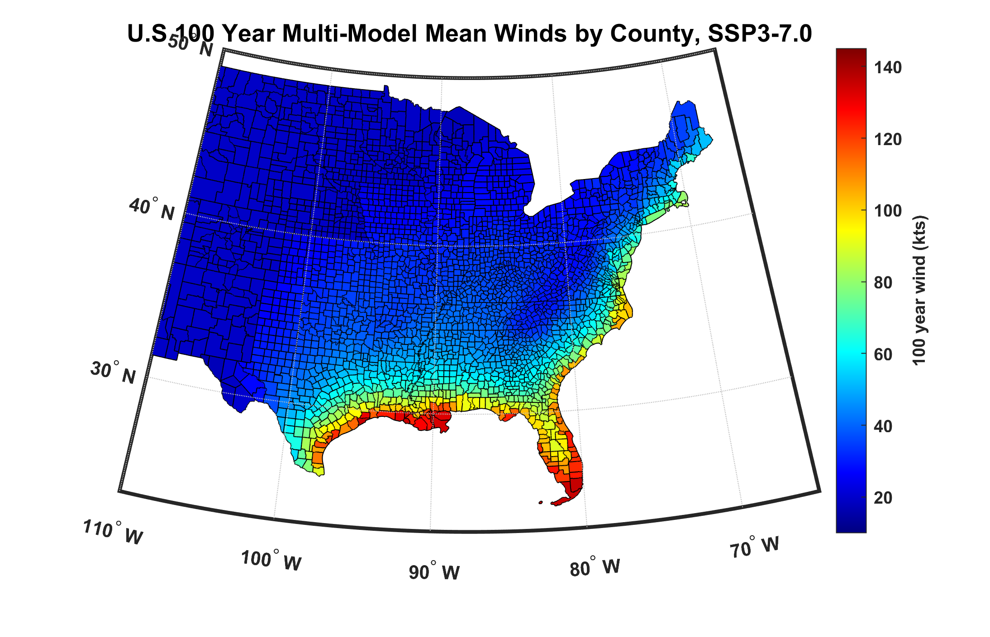
100-year hurricane peak wind based on downscaling 8 CMIP6 climate models, 2070-2100

Slide 31
2,000 year rain event for Houston

Slide 32
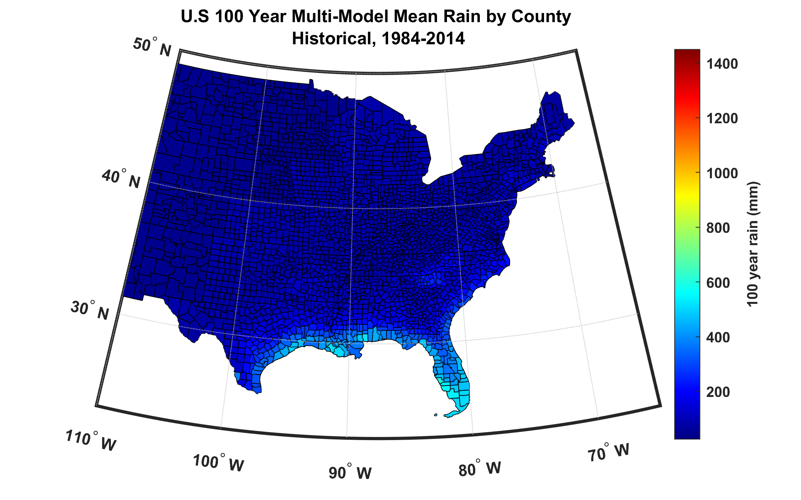
100-year hurricane storm total rain based on downscaling 8 climate models, 1984-2014

Slide 33
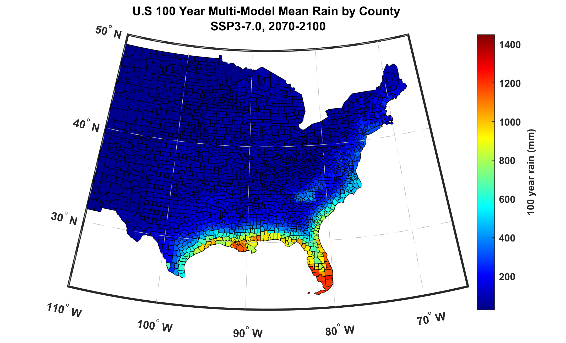
100-year hurricane storm total rain based on downscaling 8 climate models, 2070-2100

Slide 34
Lin, N., and K. Emanuel, 2015: Grey swan tropical cyclones. Nature Climate Change, 6, 106, https://doi.org/10.1038/nclimate2777.

Slide 35
Lin, N., and K. Emanuel, 2015: Grey swan tropical cyclones. Nature Climate Change, 6, 106, https://doi.org/10.1038/nclimate2777.

Slide 36
Modeling TC Loss: The Importance of Volatility

Slide 37
Strategy
Begin with an exposure data set
Use synthetic event set to calculate peak winds from each event at each property
Apply simple wind damage function to total value at each property and sum over properties to get portfolio loss for each event

Slide 38
Synthetic Event Set
20,000 tropical cyclones downscaled from the United Kingdom Meteorological Office UKESM1-0-LL global climate model run for 100 years during the pre-industrial climate. Natural variability, like ENSO, but no long- term trends
Excellent agreement with observed distribution among 64 Gulf and east coast gates

Slide 39
Coastal Gates Locations
Notes:
The 64 coastal “gates” running from Texas to Maine, used to make the next slide.

Slide 40
Coastal Gate Landfall Counts
Notes:
The black dots and line are from the official U.S. hurricane database, IBTrACS, while the red curve and shading pertain to the synthetic tracks. Each series has been smoothed with a 7-point running mean. The shading represents the expected range of sampling error of the observed tracks., spanning from the 5th to the 95th percentile. That is, if th4e historical tracks were drawn from the same distribution as the synthetic tracks, then about 10% of the should lie outside the shading.
Note: This is done as one test of the fidelity of the synthetic data set. I do not use the coastal gates in anything that follows.

Slide 41
Time series of Landfall Power Dissipation Using All 20,000 Synthetic TCs
Notes:
Using a single year’s worth of TCS each year would yield an considerably more erratic time series. So, even without global climate change, there is much natural variability. Given that there are 200 events each year in this time series, very little of the variability is owing to chance in this series and most of it arises from systematic or random year-to-year variability of the climate itself.

Slide 42
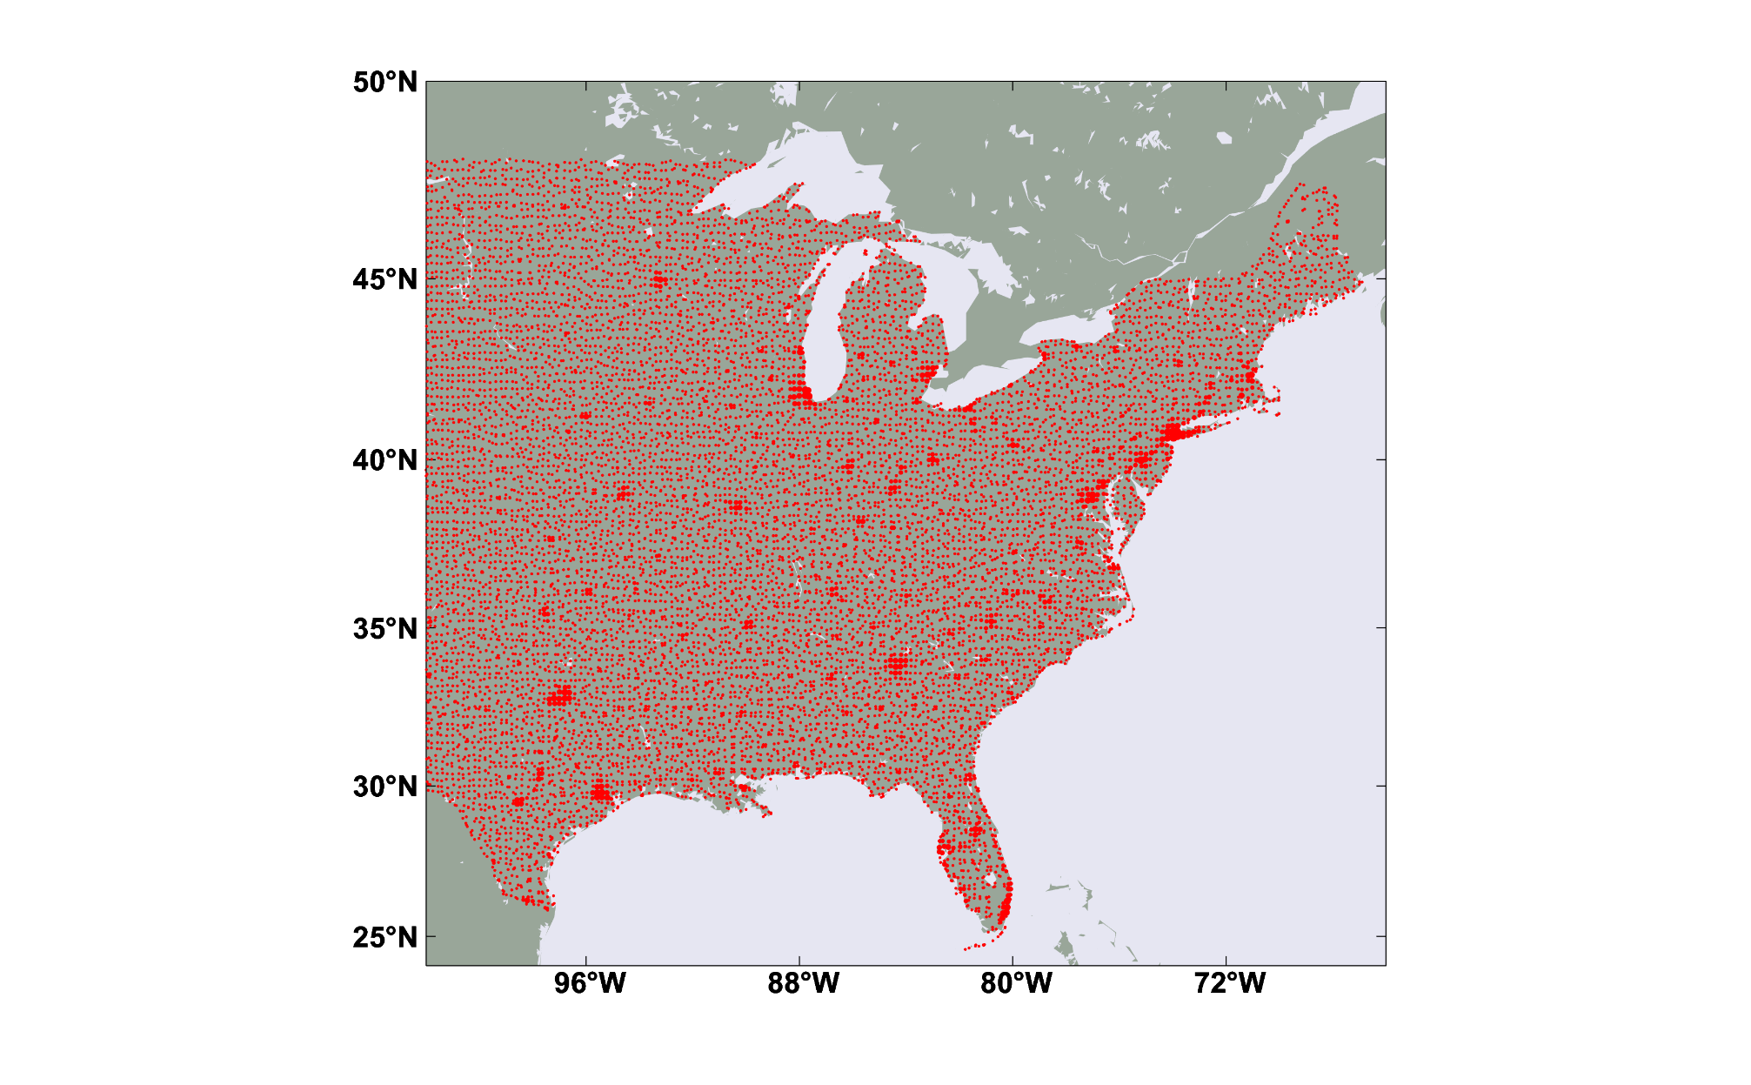
Exposure database
LITPOP exposure database (ETH, Zurich)
Net Value: ~$ 41.1 trillion
11,781 20 x 20 km blocks

Slide 43
Procedure
Apply a set of 20,000 synthetic tropical cyclones making landfall in the continental U.S, downscaled from a stable climate
At each block centroid, calculate the peak wind generated by each event and apply a damage function that estimates the fraction of property value destroyed
Using aggregated exposure, calculate loss at each block and sum over all blocks
From the set of 20,000 storms create many (10,000) 1,000- year time series of loss by randomly drawing from a Poisson distribution based on the annual frequency of landfalling tropical cyclones each year
This illustration is for a stationary climate but we will later apply this to evolving climate states

Slide 44
Simple Damage Function
For each property, calculate the peak wind speed during each event in a time period during which, for example, building codes were developed
From the whole event set, calculate the return periods of wind
From these, calculate the 130-year wind event at each property, but place lower bound of 40 knots
Normalize peak winds of all events by the 130-year wind at each property
Percentage P of value destroyed for winds > 40 knots:

Slide 45
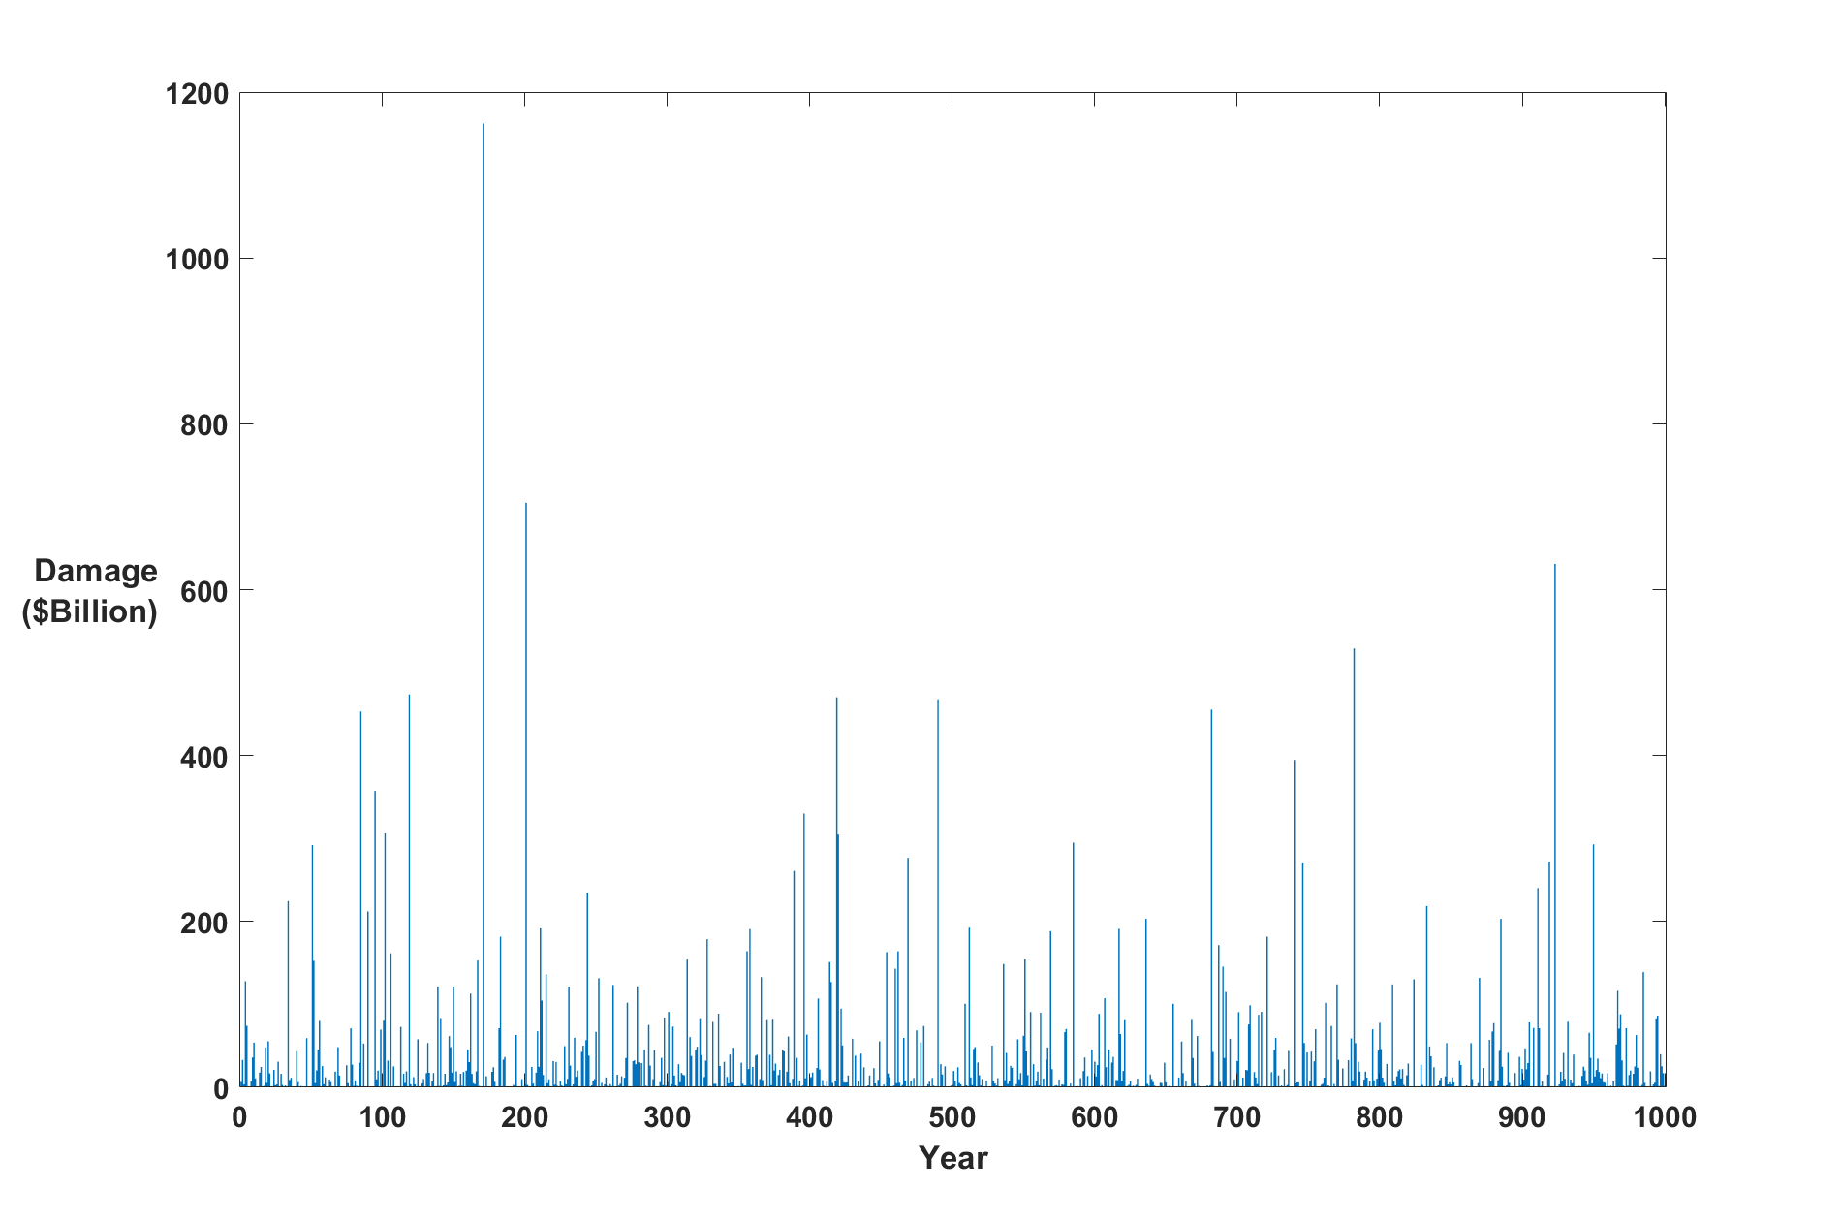
Example (one of 10,000):
Annual
Question: Can we estimate average annual loss (AAL) from 50-100 years of record?
Answer: Good luck with that!

Slide 46
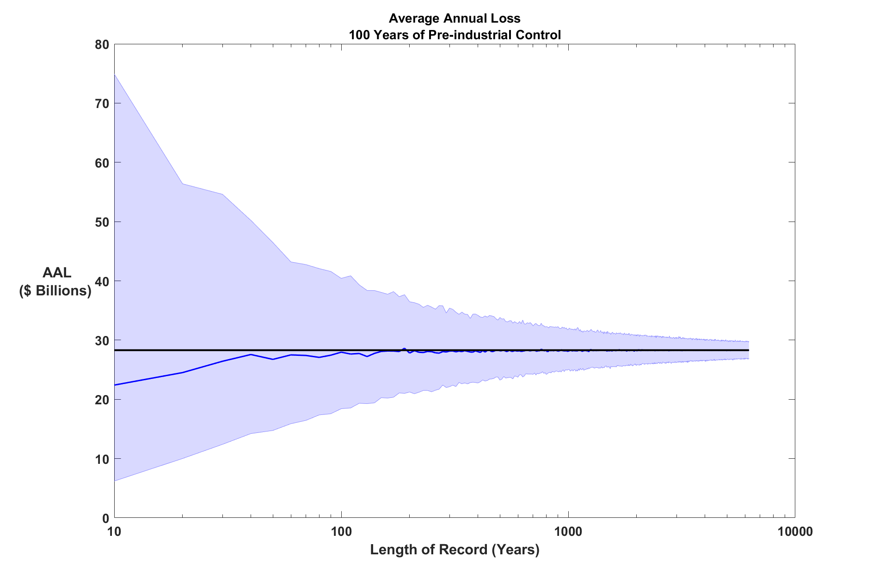
How many years of record would it take to make a robust estimate of average annual loss (AAL)?
95th percentile: $40 billion
5th percentile: $18 billion

Slide 47
Take 22-member subset of full 11,781 blocks containing major coastal cities:
Net Value: ~$ 1.8 trillion

Slide 48
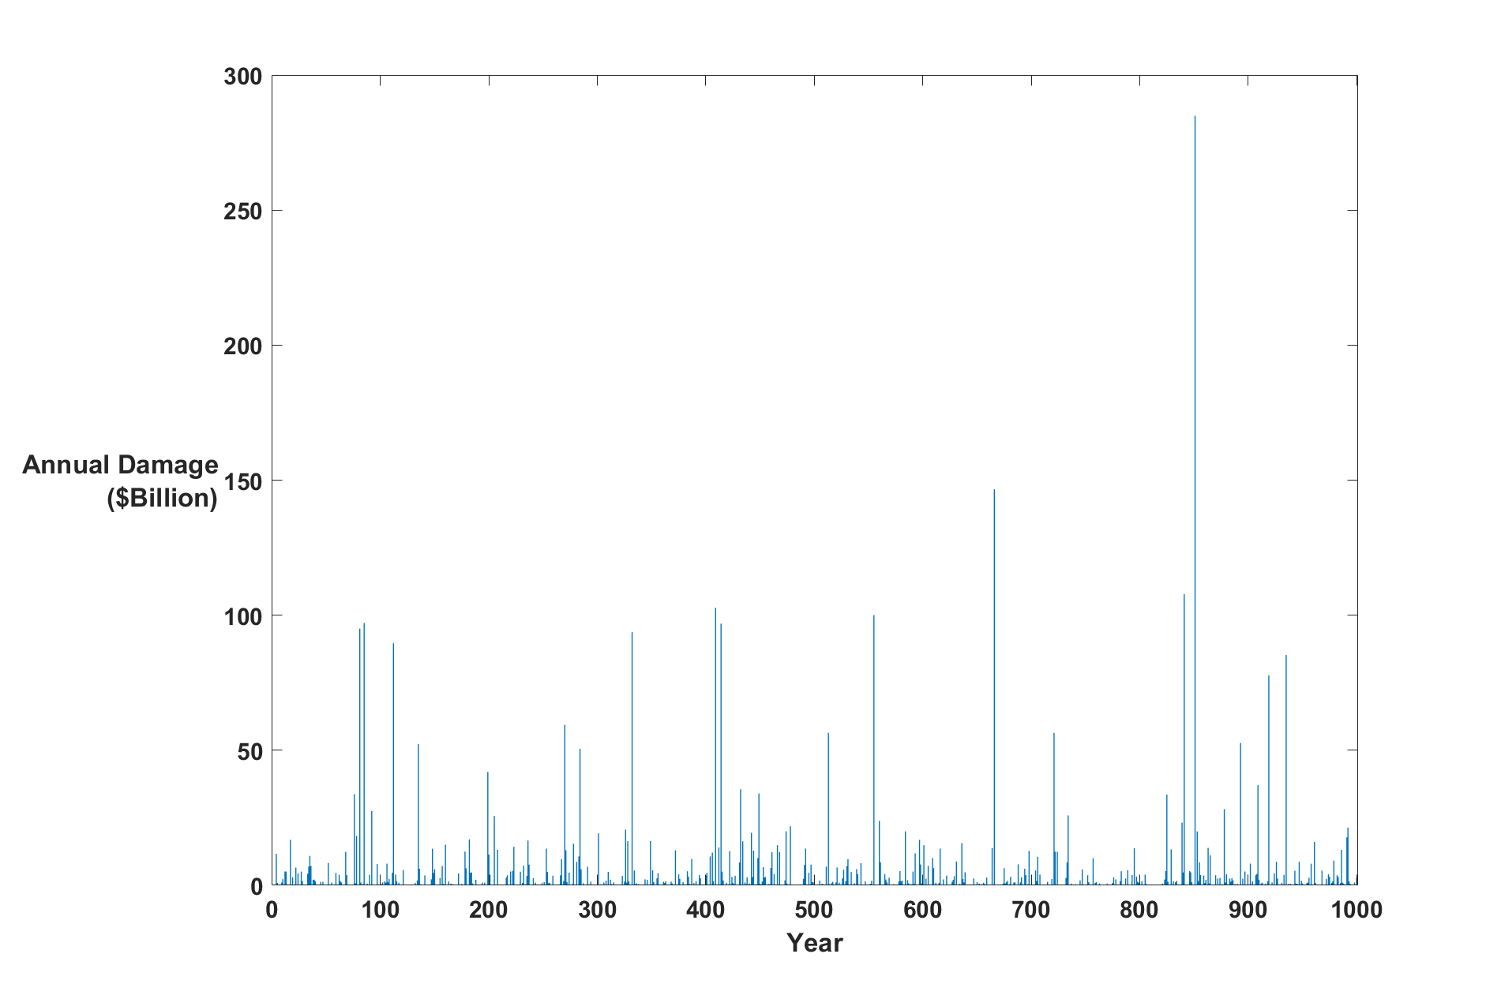
Even More Volatility

Slide 49
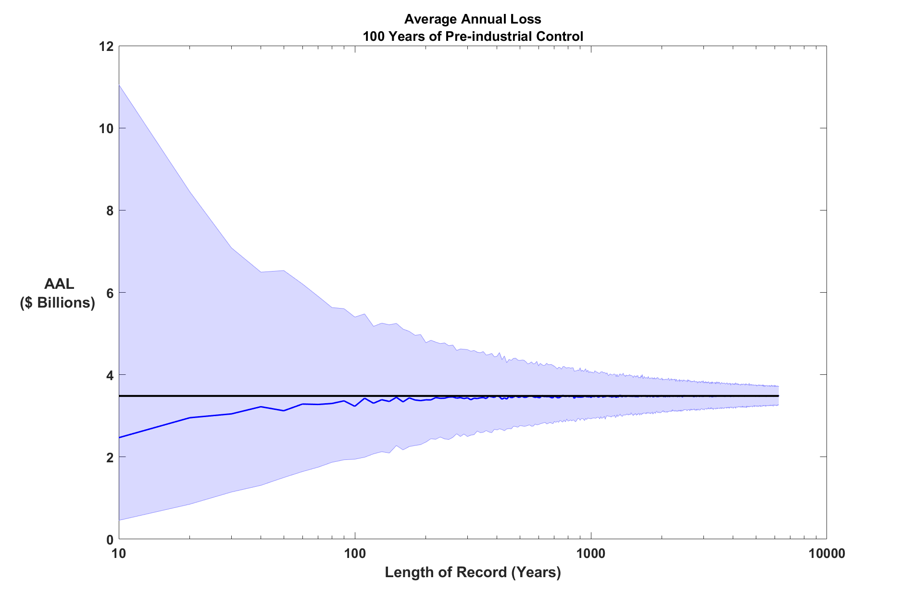
Less Robust AAL
95th percentile: $5.4 billion
5th percentile: $1.9 billion

Slide 50
Modeling Business Performance (Very Simple Case)
Company insures all property in aforementioned 22 cities
Specify a starting capital
Specify steady annual income (premiums + investment income – expenses)
No reinsurance
Use 10,000 100-year times series of loss from synthetic TC data
Calculate net capital over 100 years, 10,000 times

Slide 51
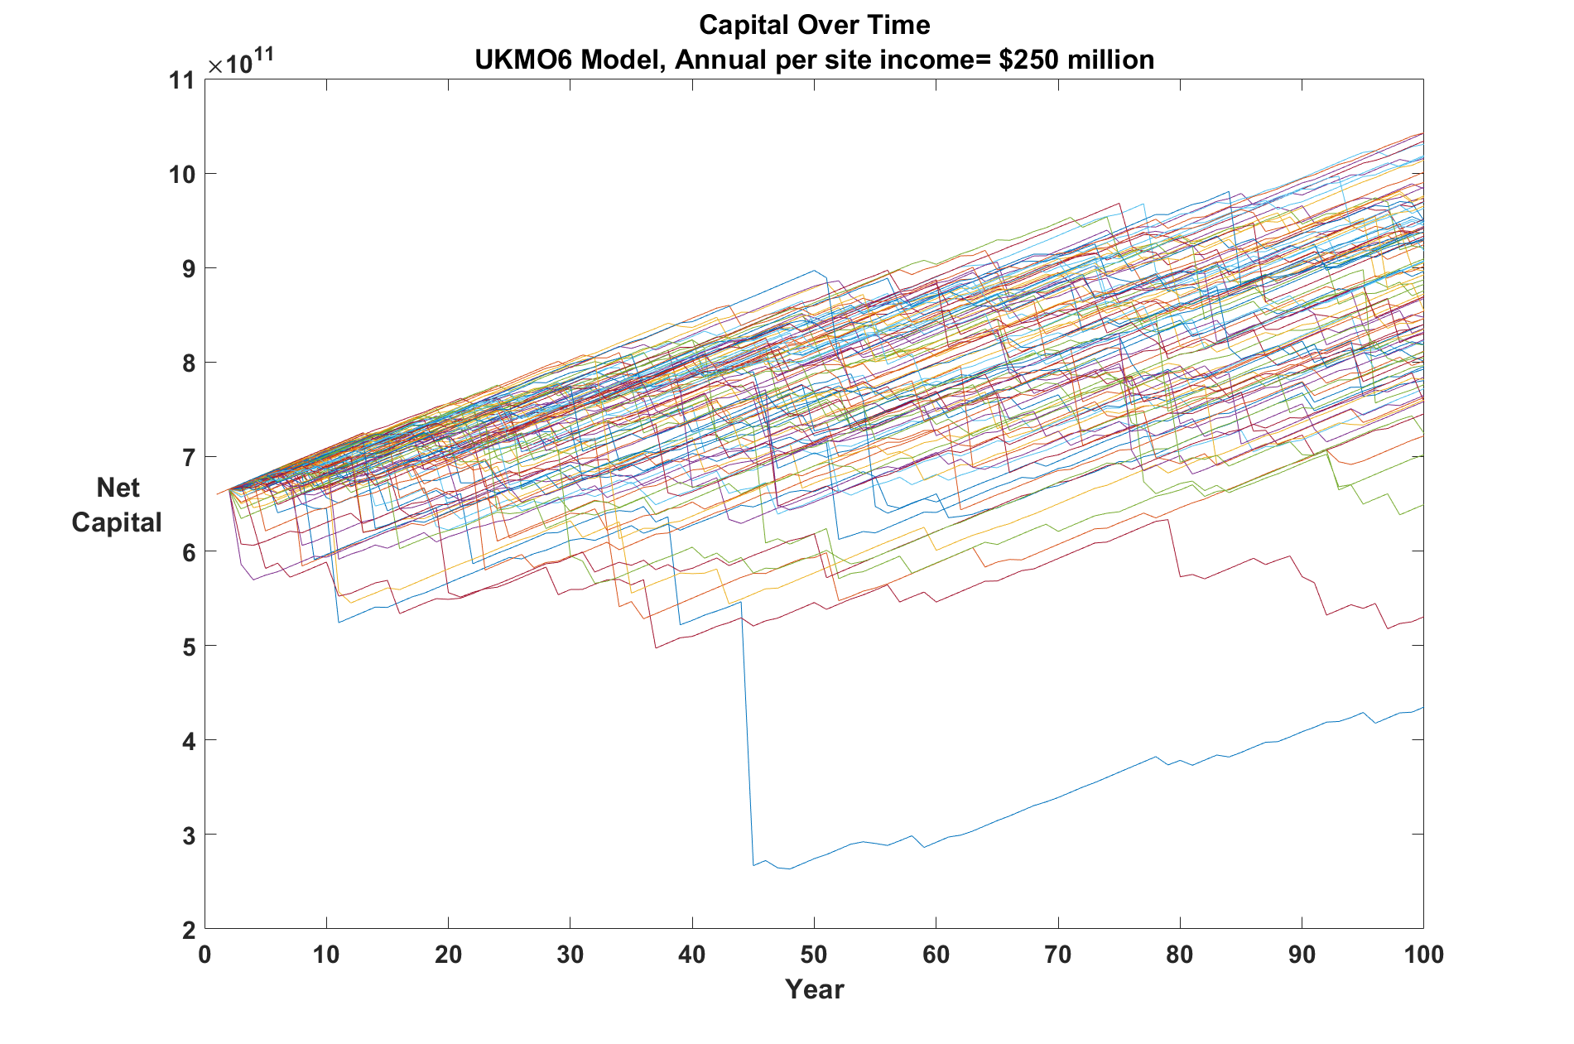
Here is 100 of 10,000 time series of the company’s capital over 100 years:
Notes:
Note that the net income of 0.018 unit is per policy.

Slide 52
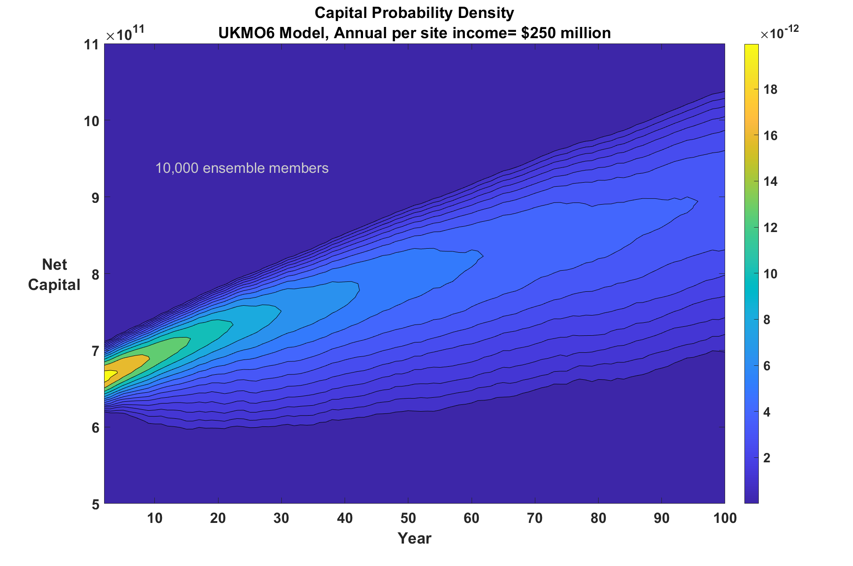
Here is the probability density of capital using all 10,000 times series:
Notes:
Note that the net income of 0.018 unit is per policy. The gray dashed line represents half the starting capital. The shape of this plots depends on the starting capital and the annual per-policy net income, as well as on the locations of the cities and the nature of the storms. Clearly, there is a small chance of business failure, but a much larger chance that we would wind up with less capital than we started with.

Slide 53
Run business again, this time letting CO₂ increase by 1% per year

Slide 54
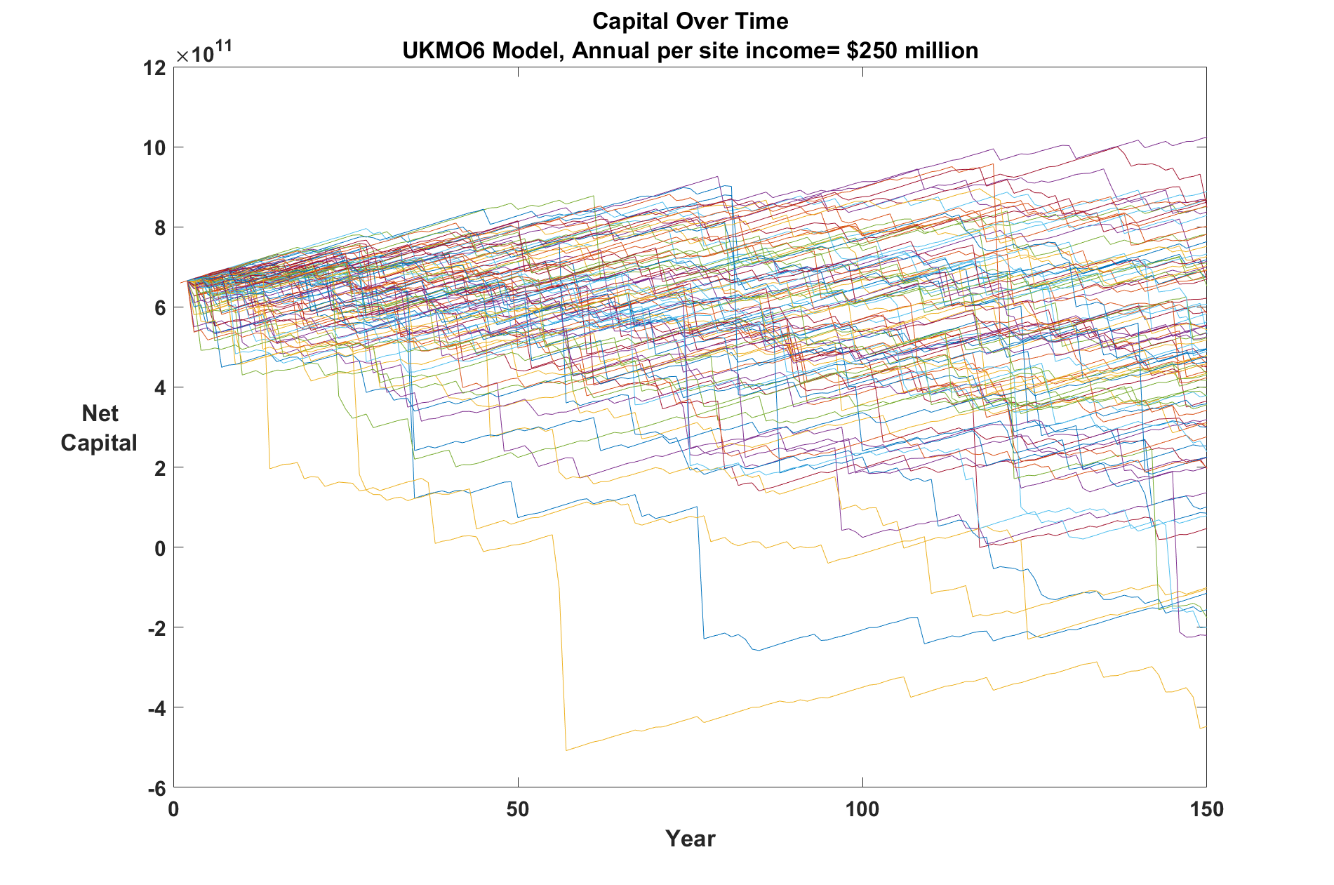
100 of 10,000 time series of the company’s capital over 150 years, increasing CO₂:

Slide 55
Probability density of capital using all 10,000 times series, increasing CO₂ :
Notes:
Note that the net income of 0.018 unit is per policy. The gray dashed line represents half the starting capital. The shape of this plots depends on the starting capital and the annual per-policy net income, as well as on the locations of the cities and the nature of the storms. Clearly, there is a small chance of business failure, but a much larger chance that we would wind up with less capital than we started with.

Slide 56
Summary
Long-term tropical cyclone risk has large contributions from events with return periods of several human generations and larger
Historical records are of insufficient length (and often quality) to make robust estimates of long-term risk, even with a stable underlying climate (aleatory uncertainty)
We need to migrate toward physically based modeling of weather hazards to create more statistically robust risk estimates and to account for climate change
Better and more robust estimates of current risk can be made using physically based hazard modeling (TCs in this case)
Volatility is a dominant factor in TC risk and should be quantified by, e.g., large ensembles of story lines

