Slide 1
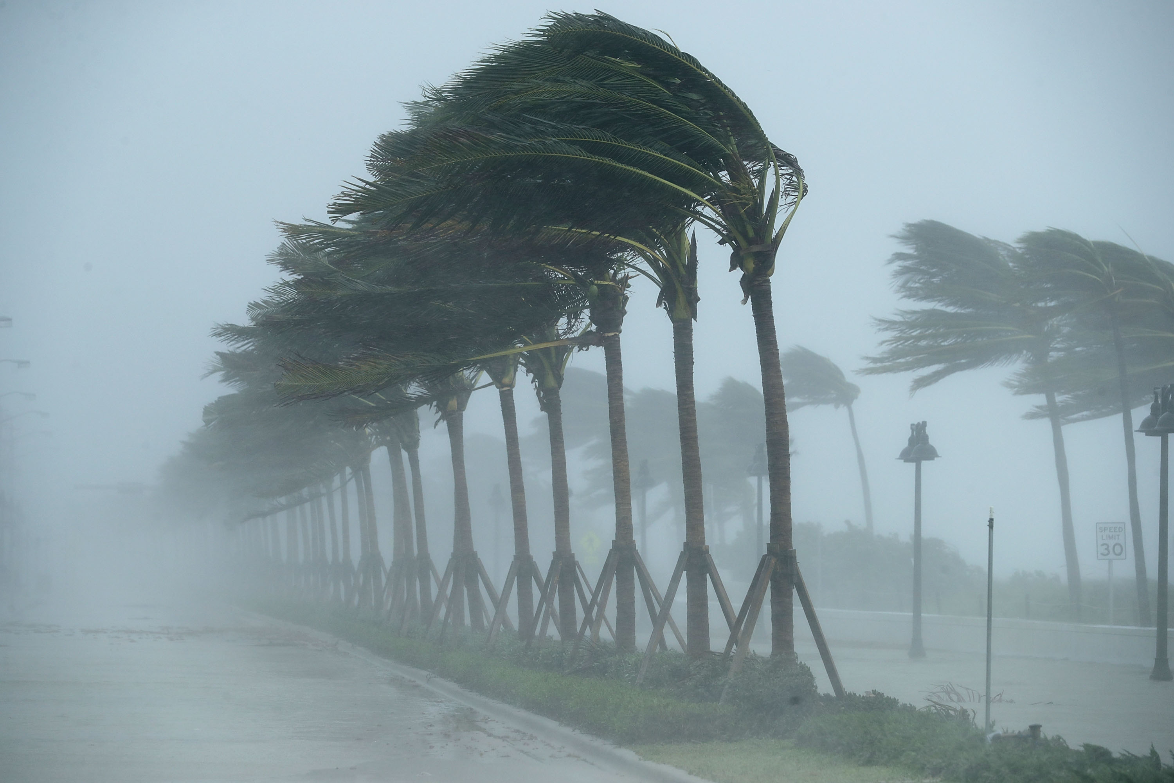
PV-Thinking and Tropical Cyclones: Wayne Schubert’s Contribution to Balanced Vortex Dynamics
Kerry Emanuel
Lorenz Center
MIT

Slide 2
Main Points
What’s wrong with comprehensive complexity?
The beauty of PV-thinking in understanding baroclinic instability
Wayne Schubert’s application of PV thinking to tropical cyclones
The analogy between surface semigeostrophy for baroclinic wave dynamics and an extension of Wayne’s transformed balanced vortex equations for tropical cyclones

Slide 3
Nonhydrostatic, Axisymmetric Equations

Slide 4
Nonhydrostatic, Axisymmetric Equations

Slide 5
Comprehensive complexity is no virtue in modelling, but rather an admission of failure
-- Ian James

Slide 6
Semi-geostrophy and PV-thinking
(after Brian Hoskins)
Geostrophic momentum approximation:
Geostrophic coordinates:
Rephrasing of geopotential:

Slide 7
Semi-geostrophic Eady Problem:
Constant potential vorticity, q_{g}, between two plates
Invertibility:
Conservation of θ on boundaries:
All the dynamics collapse to conservation of potential temperature on the two boundaries

Slide 8
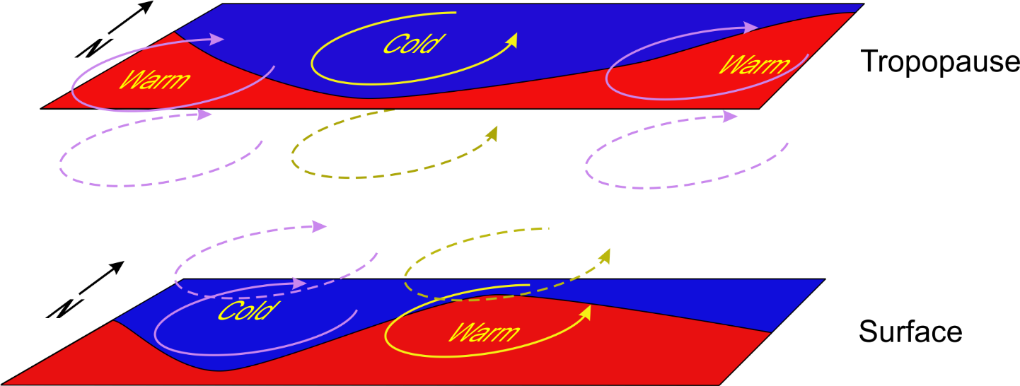
Baroclinic Instability
Image credit: Kerry Emanuel

Slide 9
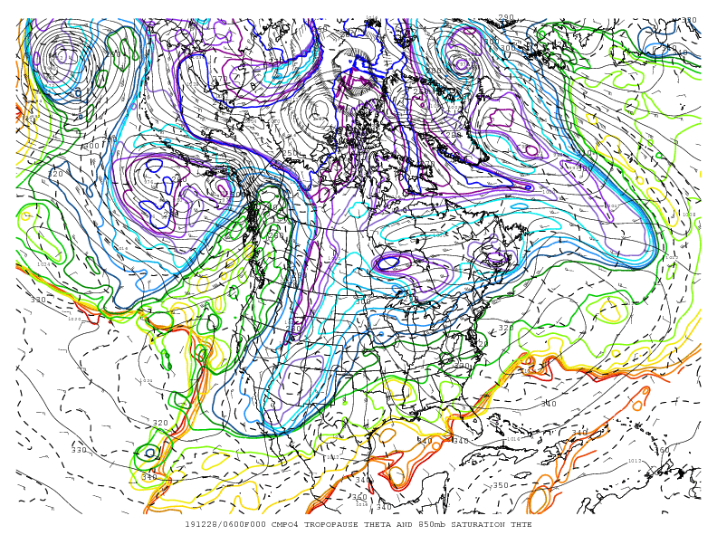

Slide 10
Wayne Schubert* extended the semigeostrophic framework to “semigradient” axisymmetric vortices
Coordinate transform:
Potential vorticity:
Invertibility:
*Schubert, W. H., and J. J. Hack, 1983: Transformed Eliassen-balanced vortex model. J. Atmos. Sci., 40, 1571-1583.

Slide 11
Eady Analogy
Except for their eyes, TCs are nearly zero “saturation PV” vortices
Neutrality to slantwise moist convection
Invertibility:
Lower boundary condition: Boundary layer
Neglects downdraft flux through PBL top
Surface drag
Surface enthalpy flux

Slide 12
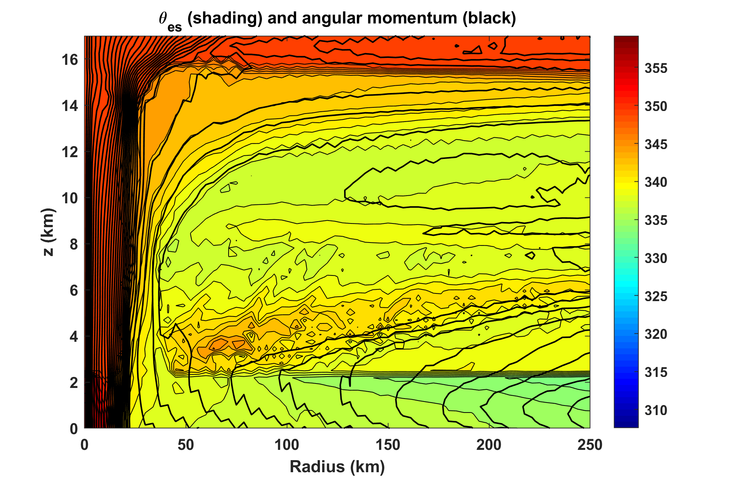
Angular momentum and θ*_{e} from nonhydrostatic, axisymmetric simulation:

Slide 13
As with Eady model, all the dynamics collapses to evolution of θ_{e} in boundary layer and at tropopause
Together with upper boundary condition that assumes that the Richardson Number equals its critical value, one may derive and approximate equation for TC intensification, assuming that the core of the storm is always saturated:

Slide 14
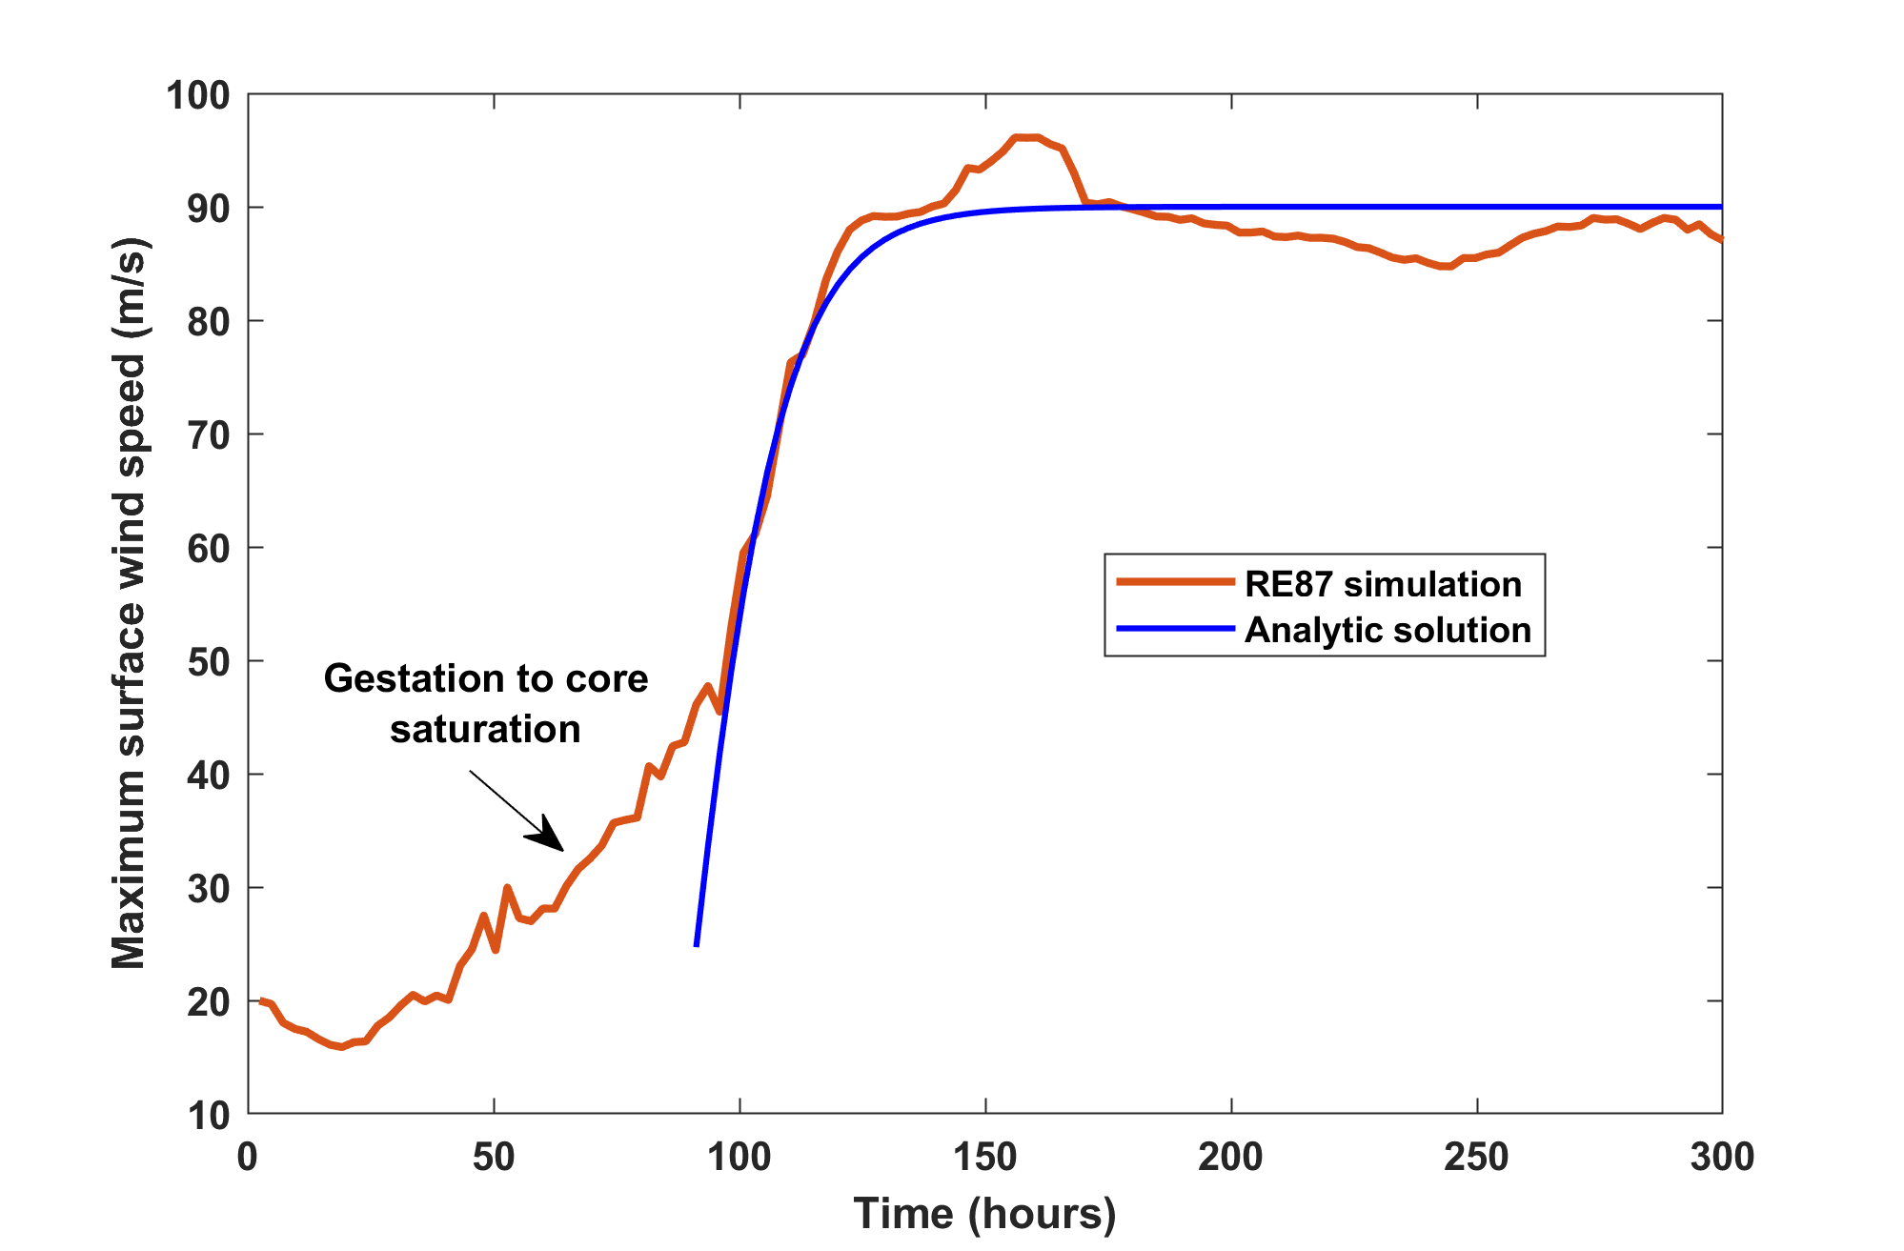
Comparison to axisymmetric, nonhydrostatic model

Slide 15
Summary
Much has been learned about tropical cyclone dynamics through Wayne Schubert’s semi-gradient equations
Like baroclinic waves, the “action” in tropical cyclone occurs in the boundary layer and at or near the tropopause, because the interior (saturation) potential vorticity is passive
Unlike in baroclinic waves, reversible boundary advection is unimportant compared to surface enthalpy fluxes and drag
Supergradient winds in the boundary layer appear to have little effect on the interior flow or on surface winds

