Slide 1
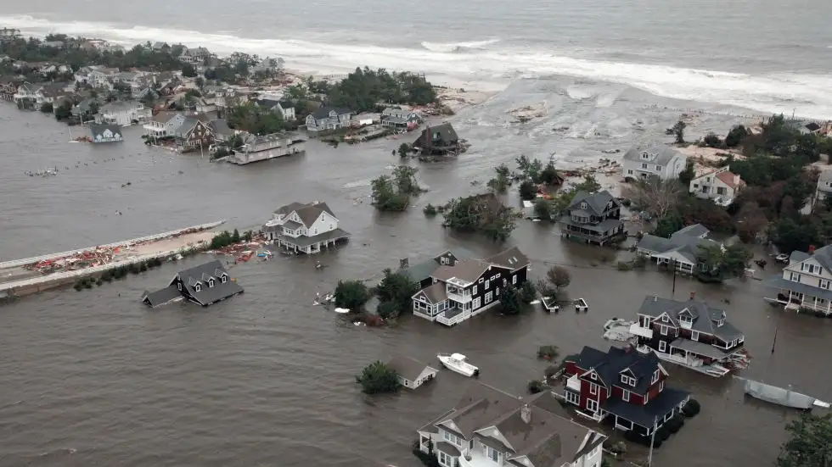
Evolving Hurricane Risk in the U.S. and Virginia Beach
Bringing physics to bear on estimating natural hazard risk
Kerry Emanuel
Lorenz Center
Massachusetts Institute of technology

Slide 2
Flawed Basis of Current Risk Modeling
Almost all current risk assessments are based on historical statistics
Historical records are flawed and short, particularly outside North America
Moreover, the past 50-150 years is a poor guide to the present owing to climate change that has already occurred
Risk modelers have been slow to migrate to a physics-based approach

Slide 3

Hurricane Flood Risk

Slide 4
The Global Hurricane Hazard
About 15,000 deaths per year since 1971
$ 1.1 trillion 2015 U.S. dollars in damages ($21 billion/yr) since 1971
Global population exposed to hurricane hazards has tripled since 1970
EM-DAT, 2020: The OFDA/CRED International Disaster Database
http://www.emdat.be/.

Slide 5
Global Tropical Cyclone Damage Normalized by Gross World Product
380% increase since 1970
Population of TC-prone regions increased by ~200%
Suggests that climate change has contributed to increasing damage
EM-DAT, 2020: The OFDA/CRED International Disaster Database
http://www.emdat.be/.

Slide 6
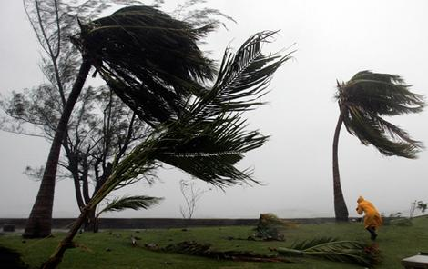
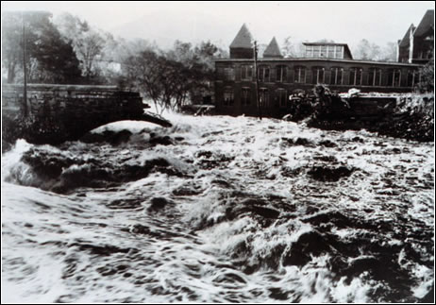
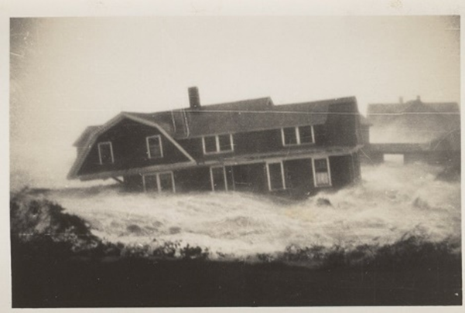

Hurricane Risks:
Wind
Rain
Storm Surge

Slide 7

Publicly
insured…
No $$$
Privately insured… $$$

Slide 8
Hurricane Risk Is Changing

Slide 9
Satellite-derived proportion of major hurricane fixes
Time series of fractional proportion of global major hurricane estimates to all hurricane estimates for the period 1979–2017. Each point, except the earliest, represents the data in a sequence of 3-y periods. The first data point is based on only 2 y (1979 and 1981) to avoid the years with no eastern hemisphere coverage. The linear Theil−Sen trend (black line) is significant at the 98% confidence level (Mann−Kendall P value = 0.02). The proportion increases by 25% in the 39-y period (about 6% per decade).
Kossin et al., PNAS, 2020

Slide 10
Hurricanes are reaching peak intensity at higher latitudes
Time series of the latitudes at which tropical cyclones reach maximum intensity.
From Kossin et al. (2014)

Slide 11
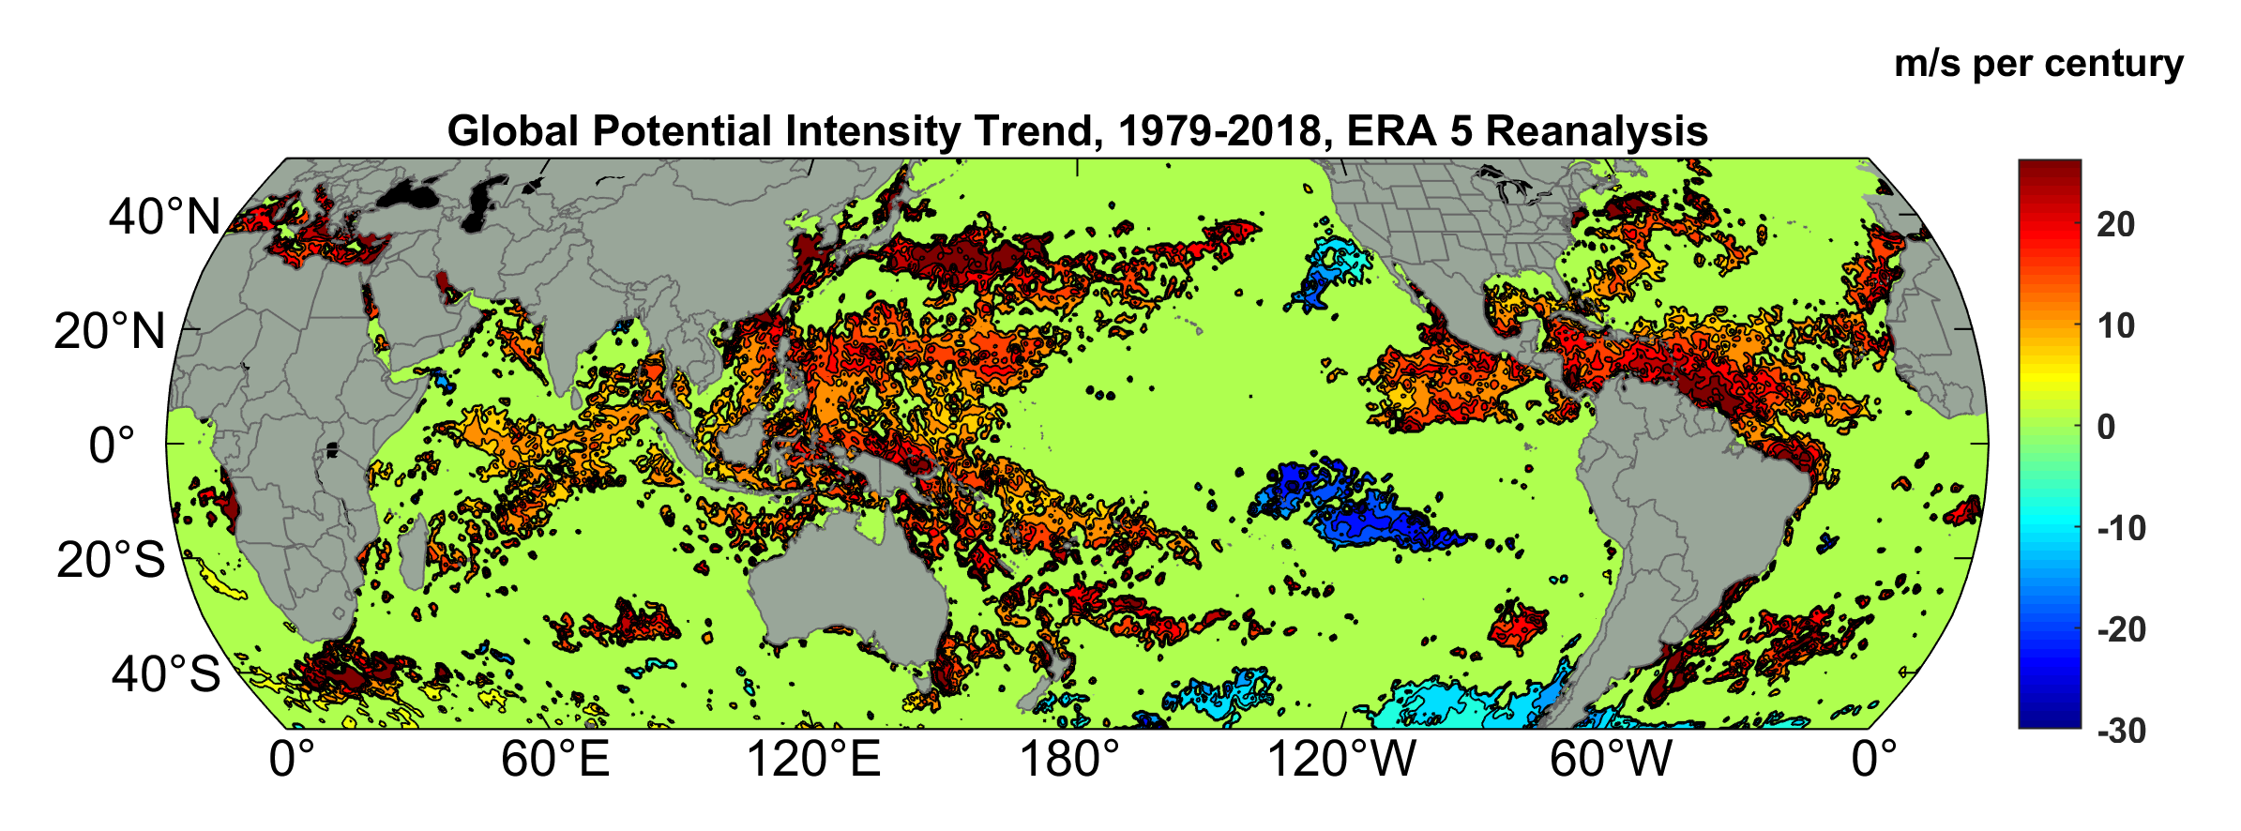
Potential Intensity Trend, 1979-2018, ERA 5 Reanalysis
(Trend shown only where p value < 0.05)

Slide 12

Inferences from Basic Theory:
Potential intensity increases with global warming
Incidence of high-intensity hurricanes should increase
Hurricanes will produce substantially more rain: Clausius-Clapeyron yields ~7% increase in water vapor per 1ºC warming
Rising sea level and increasing storm intensity indicate increasing surge risk

Slide 13
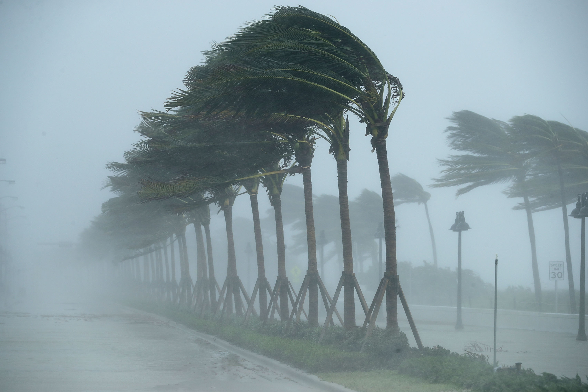
Using Physical Models to Estimate Hurricane Flood Risk
Climate change adaptation

Slide 14
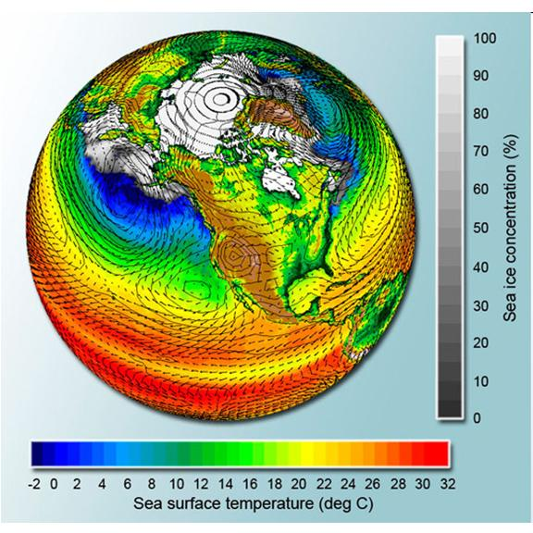
Current Global Climate Models are Too Coarse to Simulate Hurricanes Well

Slide 15
Using Physics to Assess Hurricane Risk
Reliable, global records of coarse-scale climate are robust and widely available
Cull from these datasets the key statistics known to control tropical cyclone generation, movement, and intensity evolution
Bootstrap these key statistic to create unlimited synthetic time series of the hurricane-relevant environmental variables
Use these to drive a specialized, very high resolution physical hurricane model
Extensively validate the results against historical hurricane data
Exact same method can be applied to output of climate models

Slide 16

Cumulative Distribution of Storm Lifetime Peak Wind Speed, with Sample of 1755 Synthetic Tracks
Blue bars: Actual
Red bars: Predicted
90% confidence bounds

Slide 17
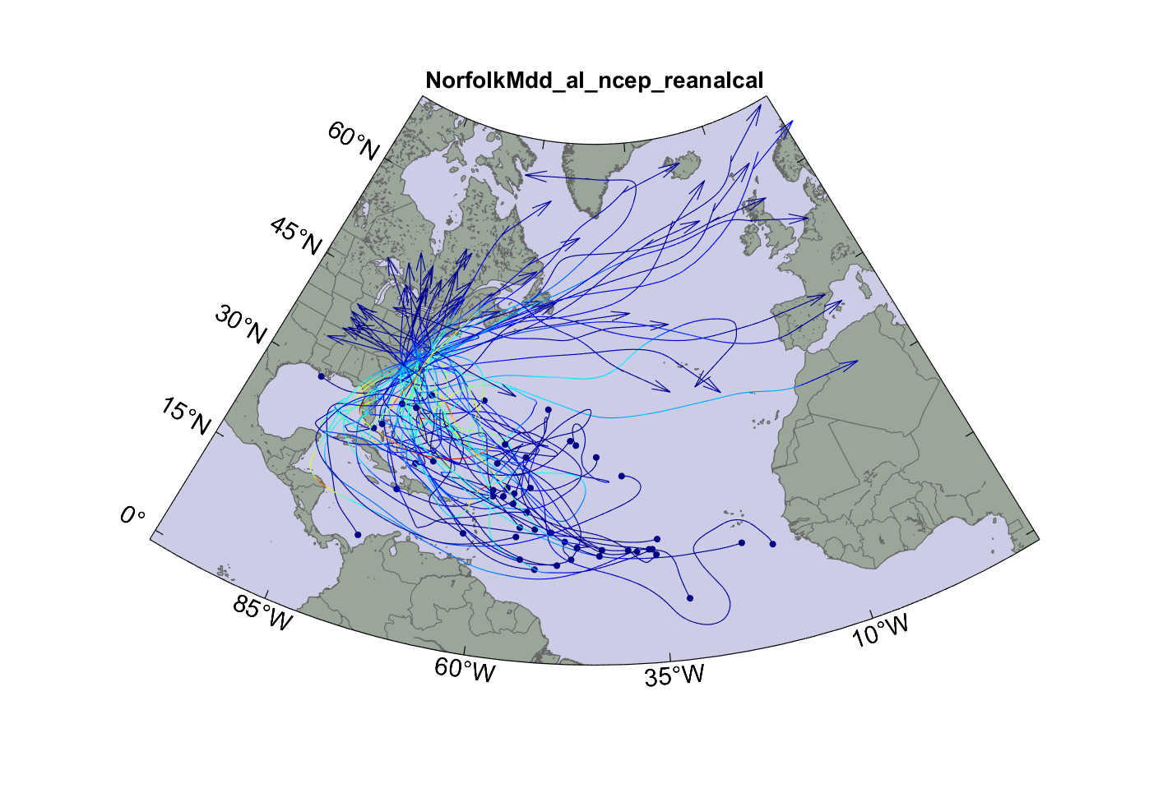
Randomly selected 50 of 4,400 tropical cyclones affecting Virginia Beach, downscaled from NCEP reanalyses

Slide 18
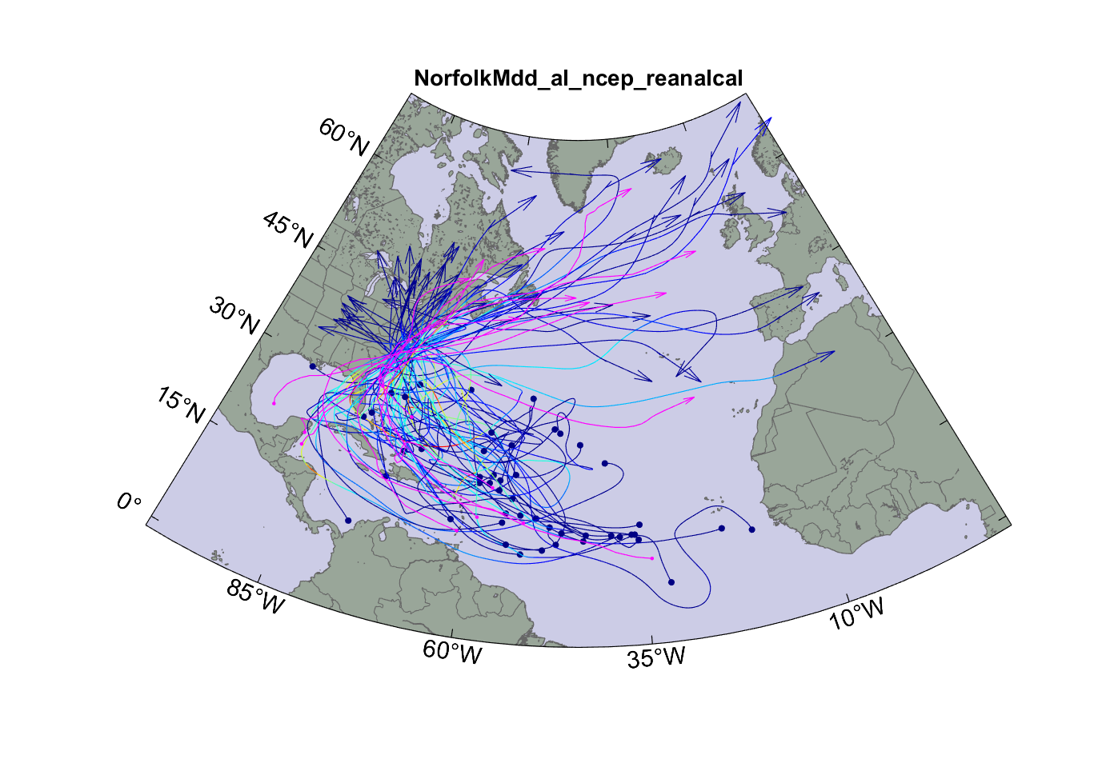
Same but with historical tropical cyclone tracks superimposed

Slide 19
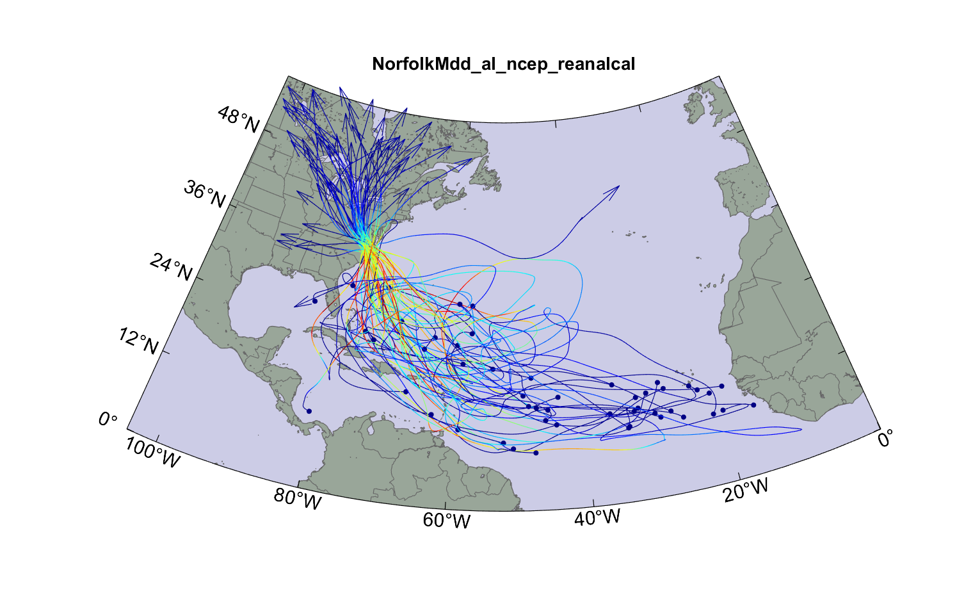
Top 50 of 4,400 tropical cyclones affecting Virginia Beach, downscaled from NCEP reanalyses
Please write me (emanuel@mit.edu) if you would like access to this data

Slide 20
Effects of Climate Change
More moisture in boundary layer
Stronger storms but more compact inner regions
Possibly larger storm diameters
Storms may be moving faster or slower

Slide 21
Apply Same Technique to Climate Models Run Over this Century:
3,000 storms from each of 4 climate models for each of 2 periods of time

Slide 22
WIND

Slide 23
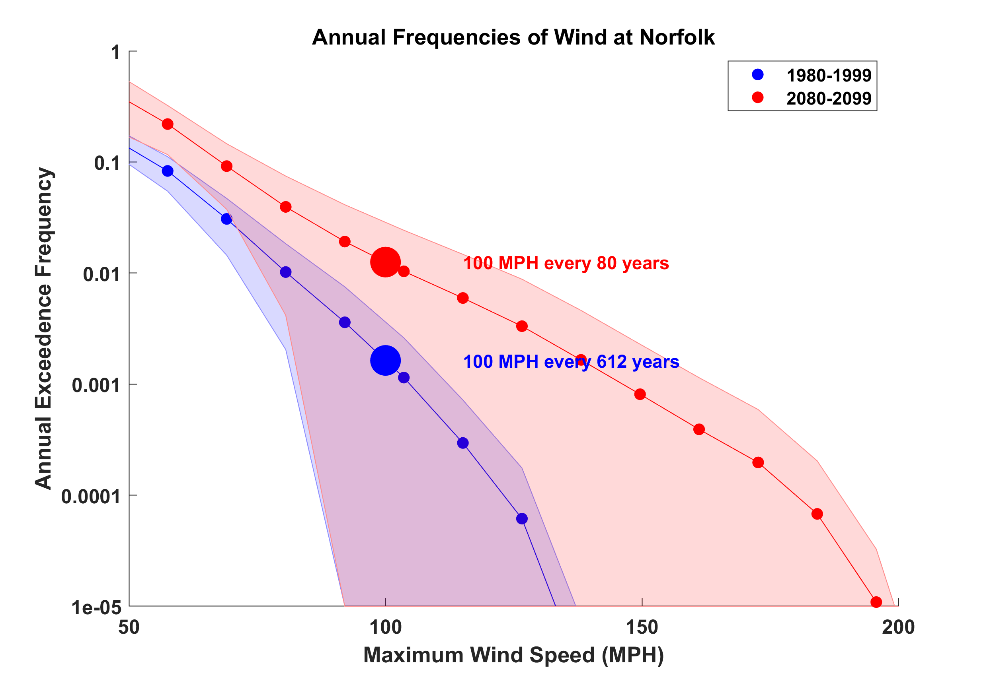

Slide 24
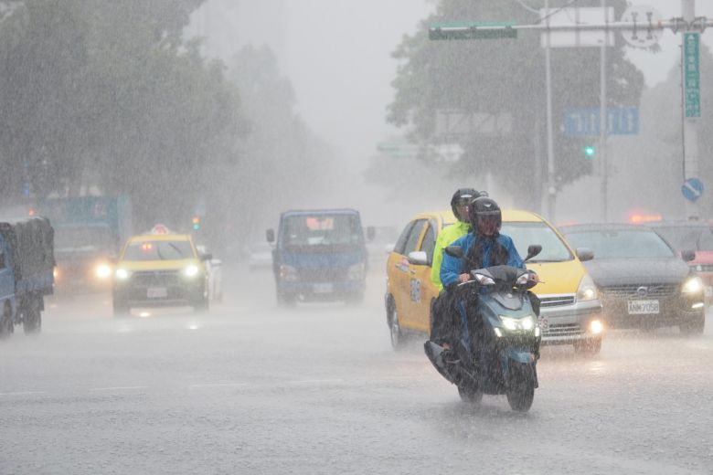
Hurricane Rain

Slide 25
An intense hurricane rain event in Virginia Beach

Slide 26
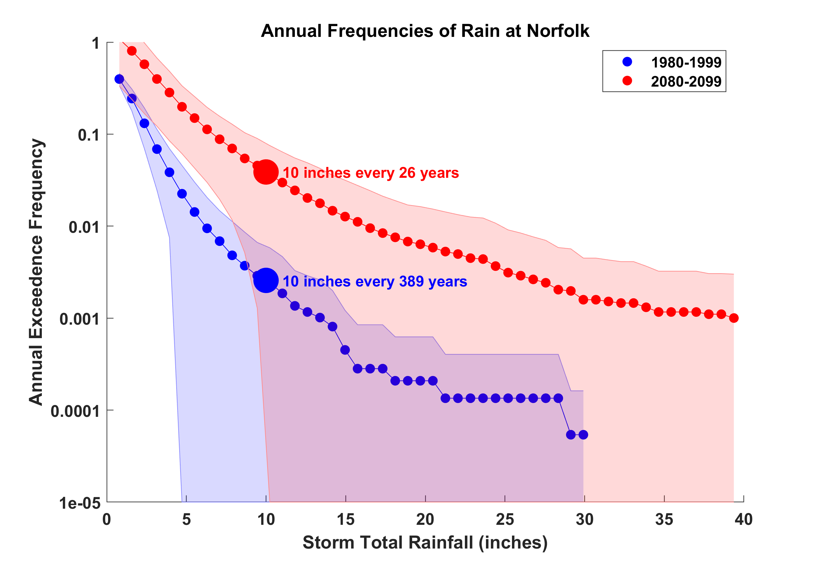

Slide 27
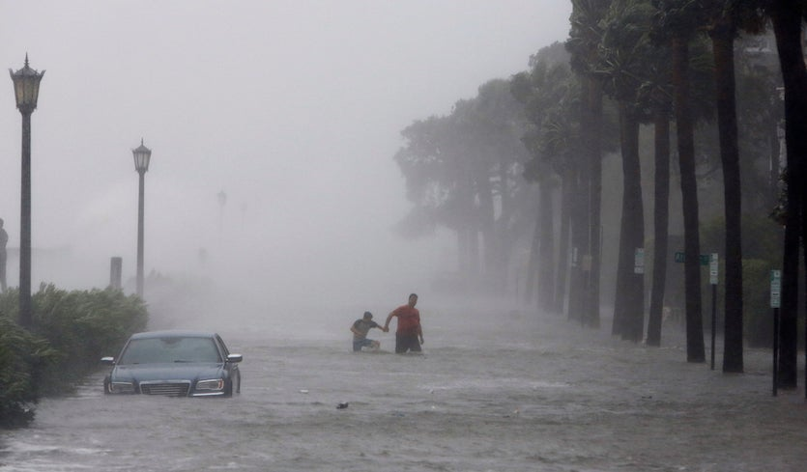
Storm Surge

Slide 28


Storm Surge Simulation
SLOSH model
(Jelesnianski et al. 1992)
SLOSH mesh
~ 10³ m
ADCIRC mesh
~ 10² m
Battery
ADCIRC model
(Luettich et al. 1992)
ADCIRC mesh
~ 10 m
(Colle et al. 2008)
Notes:
Given the storm wind and pressure fields (which is estimated from the Holland parametric pressure model) we can simulate the surge. Surge simulations with high resolution are computationally intensive, so to make it possible to simulate accurate surges for our large synthetic storm sets, we apply the two hydrodynamic models with girds of various resolutions in such a way that the main computational effort is concentrated on the storms that determine the risk. First, we apply the SLOSH model, using a mesh with resolution of about 1 km around NYC to simulate the surges for all storms and select the storms that have return periods, in terms of the surge height at the Battery, greater than 10 years. Second, we apply the ADCIRC simulation, using a grid mesh with resolution of ~100 m around NYC, to each of the selected storms. Then, we apply another ADCIRC mesh with resolution as high as ~10 m around NYC, for a set of the most extreme events, to check if the resolution of our ADCIRC grid is sufficient and if needed to make statistical correction to the results.

Slide 29

Sea Level Rising, Differentiated Locally
Mean sea level relative to 1880 (centimeters)
Norfolk
~ 4.3 mm/yr
Newport
~ 2.7 mm/yr
Global mean
~ 1.7 mm/yr
Modified from Kopp 2013
Preliminary Projections –Norfolk VA and Narragansett Bay RI
Regional Sea Level Rise Projections
29

Slide 30
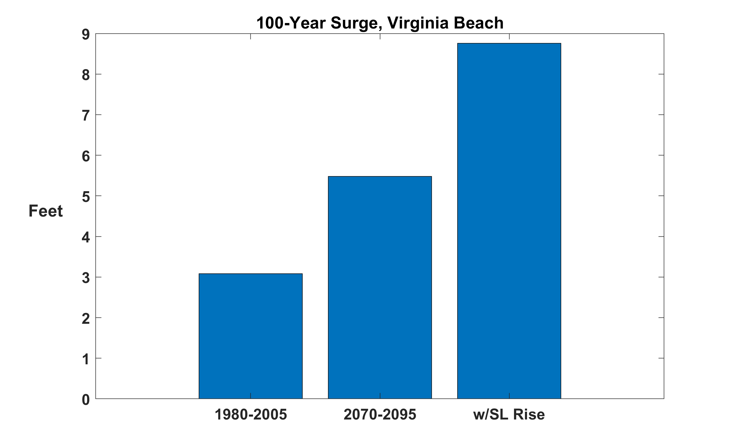

Slide 31

Making Risk Personal

Slide 32
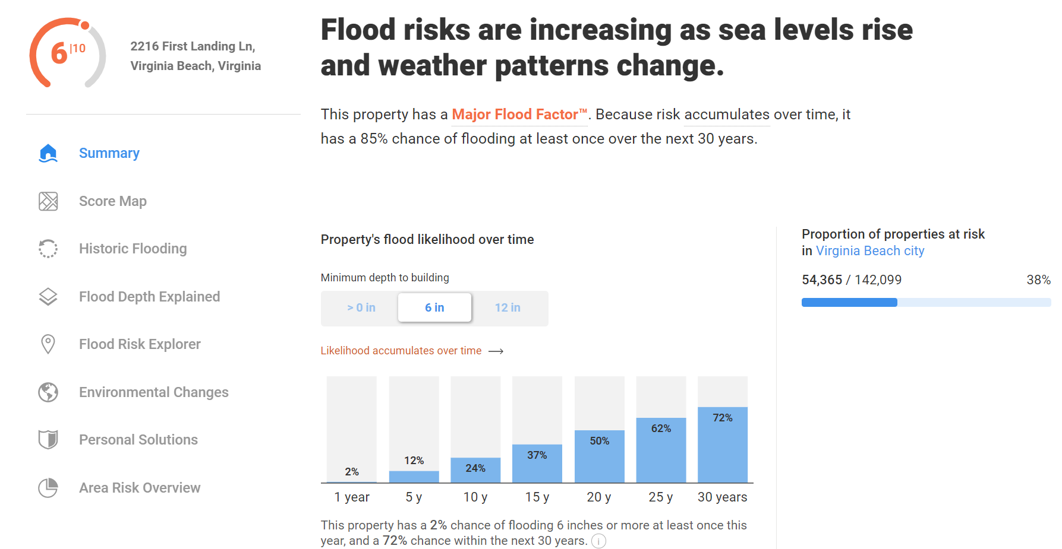

Slide 33
Take-Away Points
We can no longer regard climate change as a problem for the future; it has already tangibly affected important risks, e.g. Harvey’s rainfall was ~3 times more likely in 2017 than in 1970
Risk of hurricane winds and heavy rains is increasing in Virginia Beach and is projected to do so through this century
Sea level is rising faster in the Chesapeake region than elsewhere along the U.S. coast
100-year surge event, about 3 feet today, could be 9 feet at the end of this century

