Slide 1
Physics-Based Projection of Tropical Cyclone Risks
Why we need to bring physics to bear on estimating natural hazard risk
Kerry Emanuel
Lorenz Center
Massachusetts Institute of Technology

Slide 2
Flawed Basis of Current Risk Modeling
Almost all current risk assessments are based on historical statistics
Historical records are flawed and short, particularly outside North America
Moreover, the past 50-150 years is a poor guide to the present owing to climate change that has already occurred
Risk modelers have been slow to migrate to a physics-based approach

Slide 3
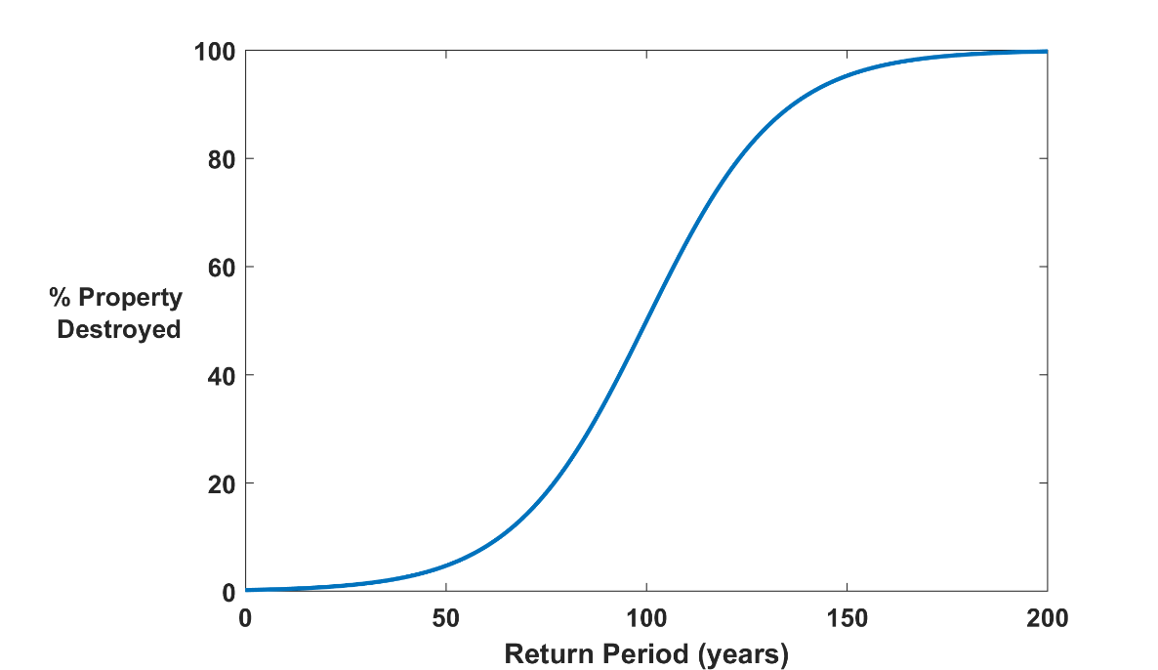

The Heart of the Natural Disaster Problem:
Societies are usually well adapted to frequent events (> 1/100 yr)
Societies are often poorly adapted to rare events
(< 1/100 yr)
Large cost increases result when > 100-yr events become < 100-yr events

Slide 4
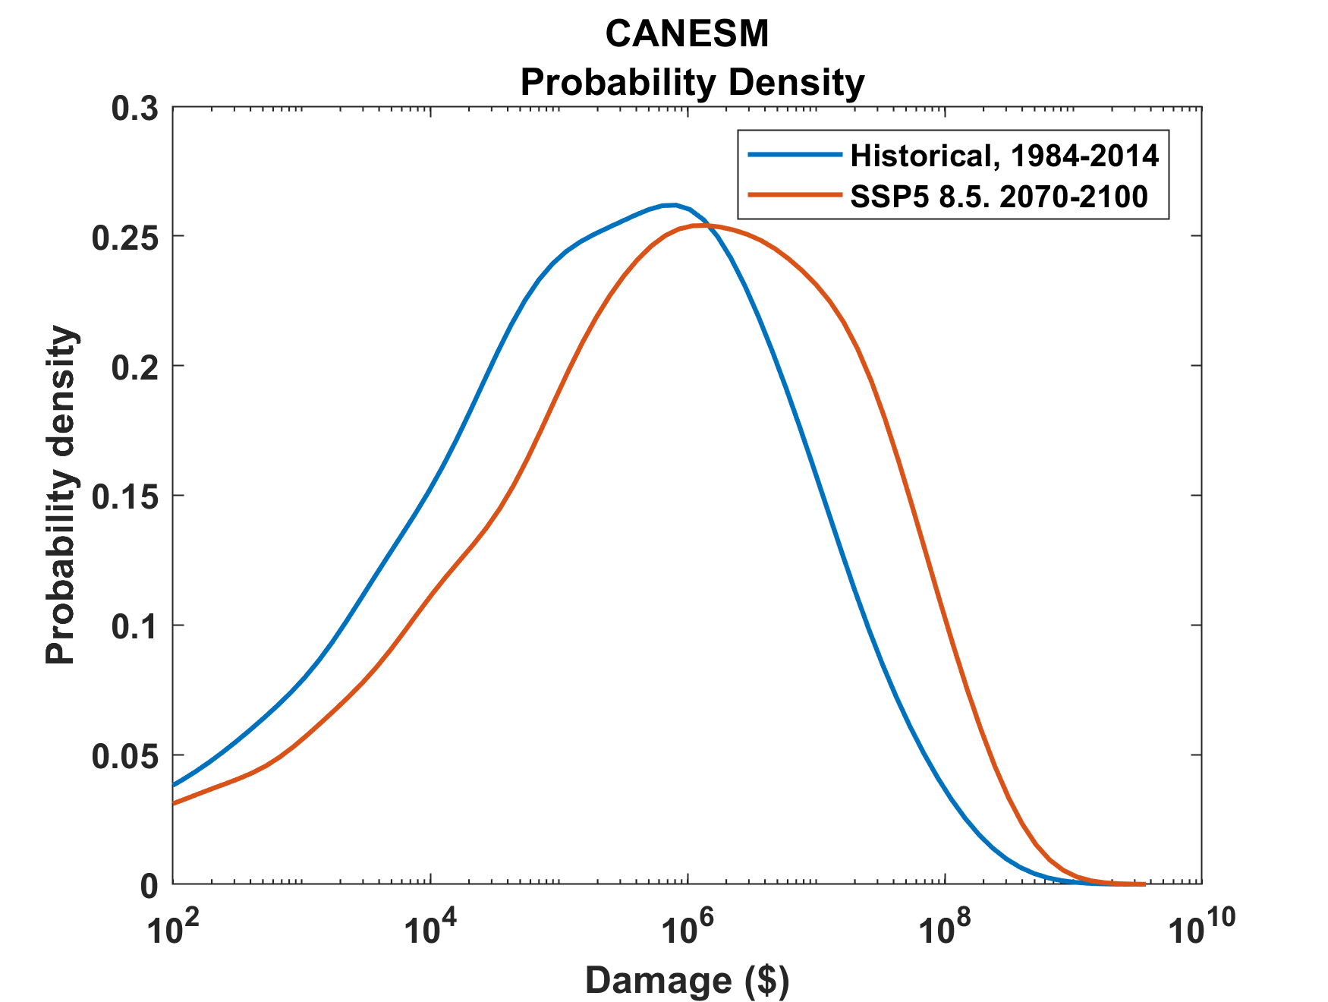
Tropical Cyclone Risk Arises Largely from High Intensity Events
1984-2014
2070-2100
Probability density of annual damage to a portfolio of insured property in the U.S.

Slide 5
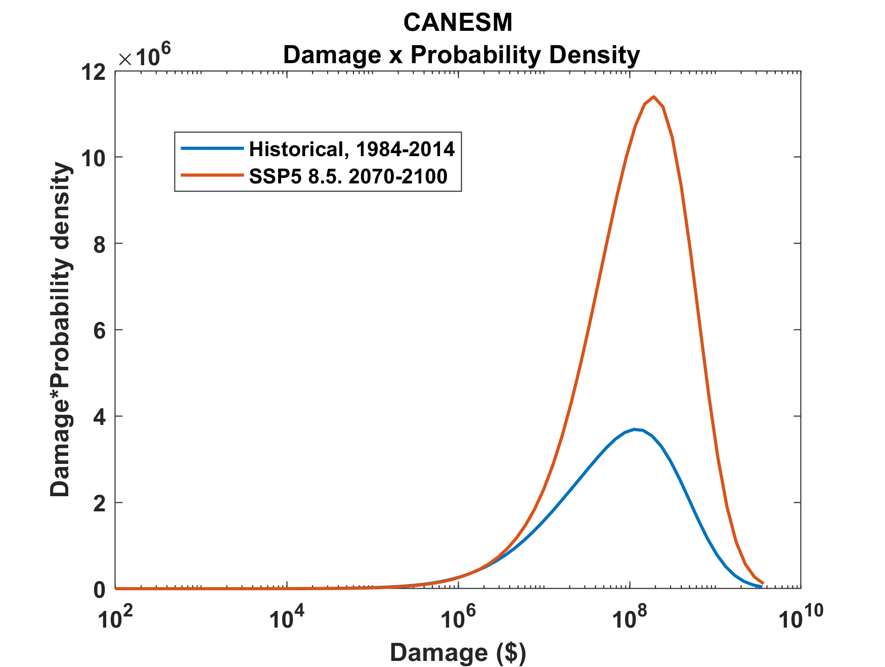
Tropical Cyclone Risk Arises Largely from High Intensity Events
2070-2100
Total expected damage proportional to area under curves
1984-2014
Damage times probability density of annual damage to a portfolio of insured property in the U.S.

Slide 6
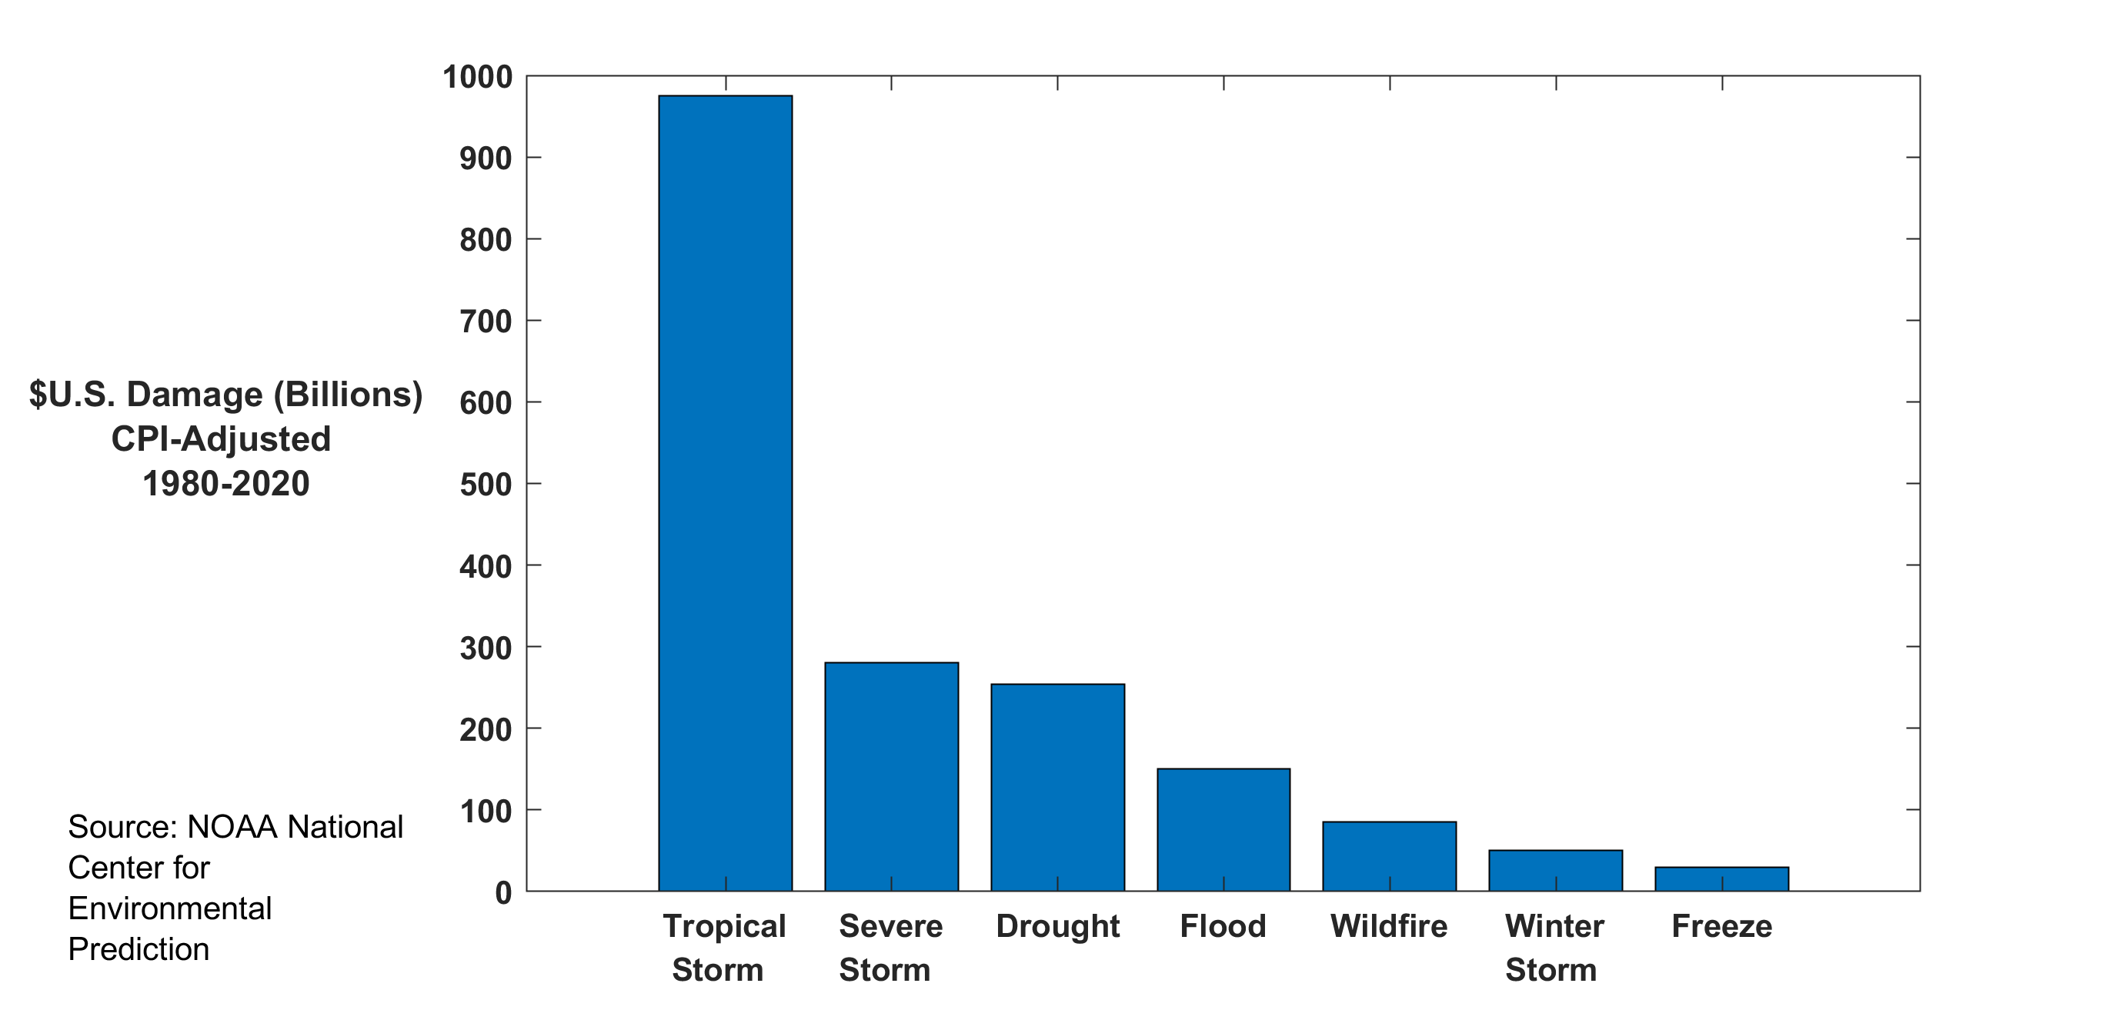
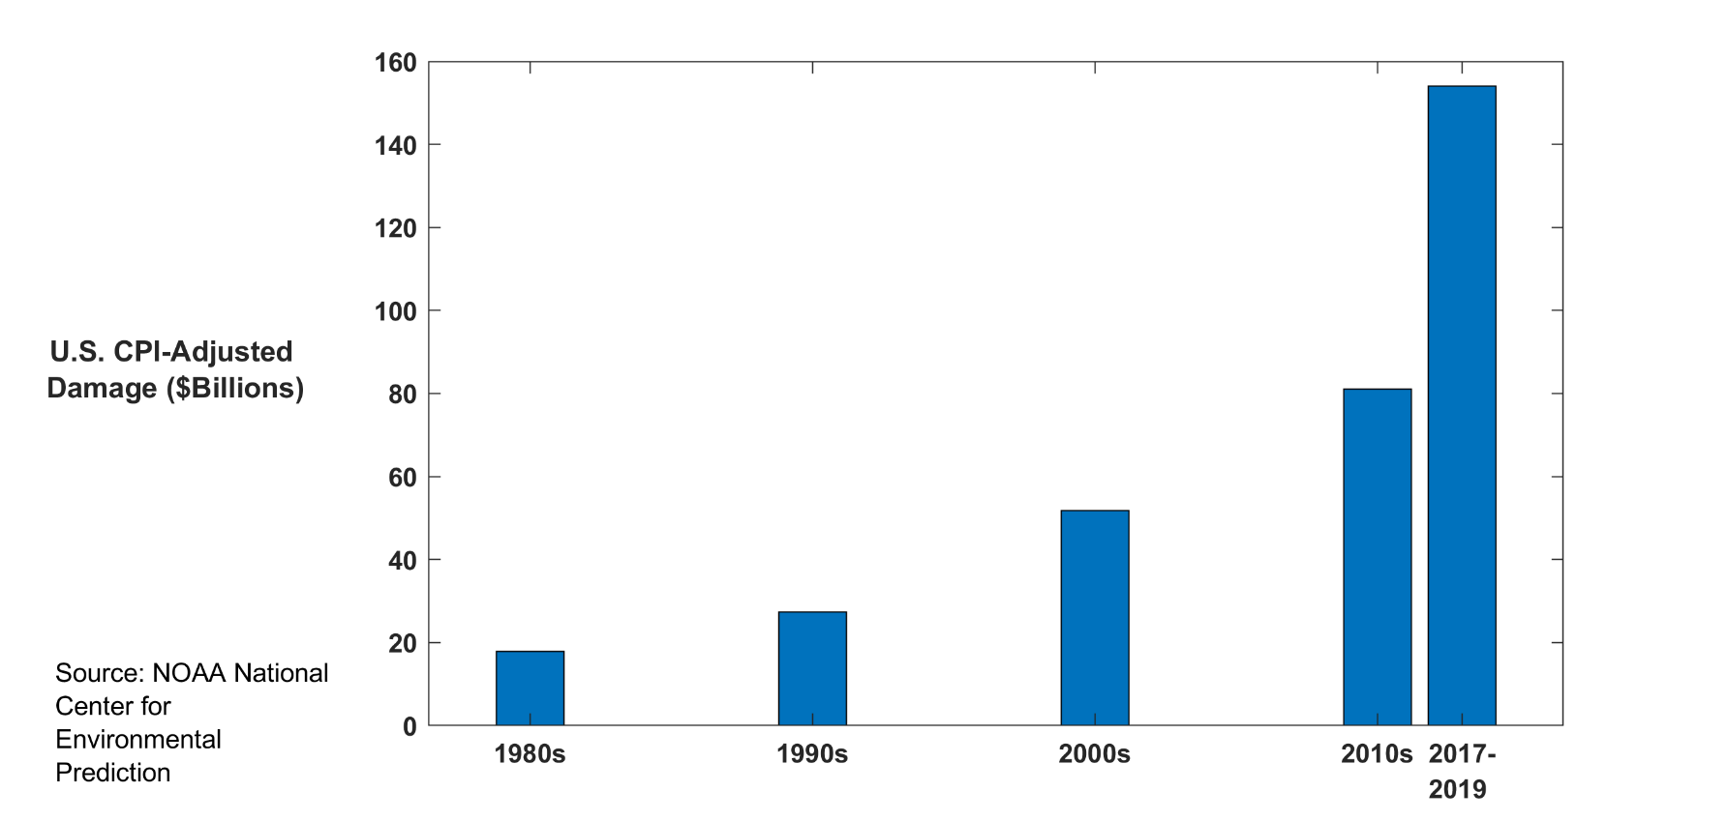

Slide 7

Case in Point: Hurricane Risk

Slide 8
The Global Hurricane Hazard
About 15,000 deaths per year since 1971
$ 1.1 trillion 2015 U.S. dollars in damages ($21 billion/yr) since 1971
Global population exposed to hurricane hazards has tripled since 1970
EM-DAT, 2020: The OFDA/CRED International Disaster Database
http://www.emdat.be/.

Slide 9
Global Tropical Cyclone Damage Normalized by Gross World Product
380% increase since 1970
Population of TC-prone regions increased by ~200%
Suggests that climate change has contributed to increasing damage
EM-DAT, 2020: The OFDA/CRED International Disaster Database
http://www.emdat.be/.

Slide 10
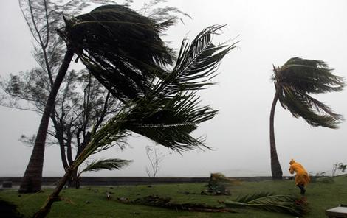
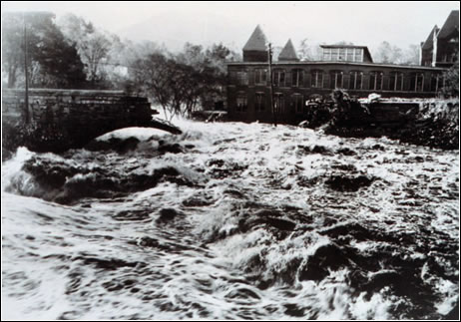
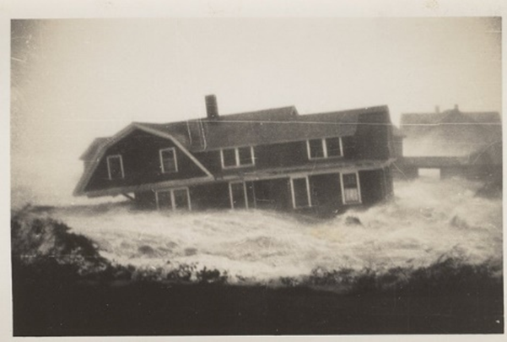

Hurricane Risks:
Wind
Rain
Storm Surge

Slide 11
What Are Historical Records Based On?
Pre-1943: Anecdotal accounts from coastal cities and ships
1943: Introduction of routine aircraft reconnaissance in Atlantic, western North Pacific
1958: Inertial navigation permits direct measurement of wind speed at flight level
1970: Complete global detection by satellites
1978: Introduction of satellite scatterometry
1987: Termination of airborne reconnaissance in western North Pacific

Slide 12
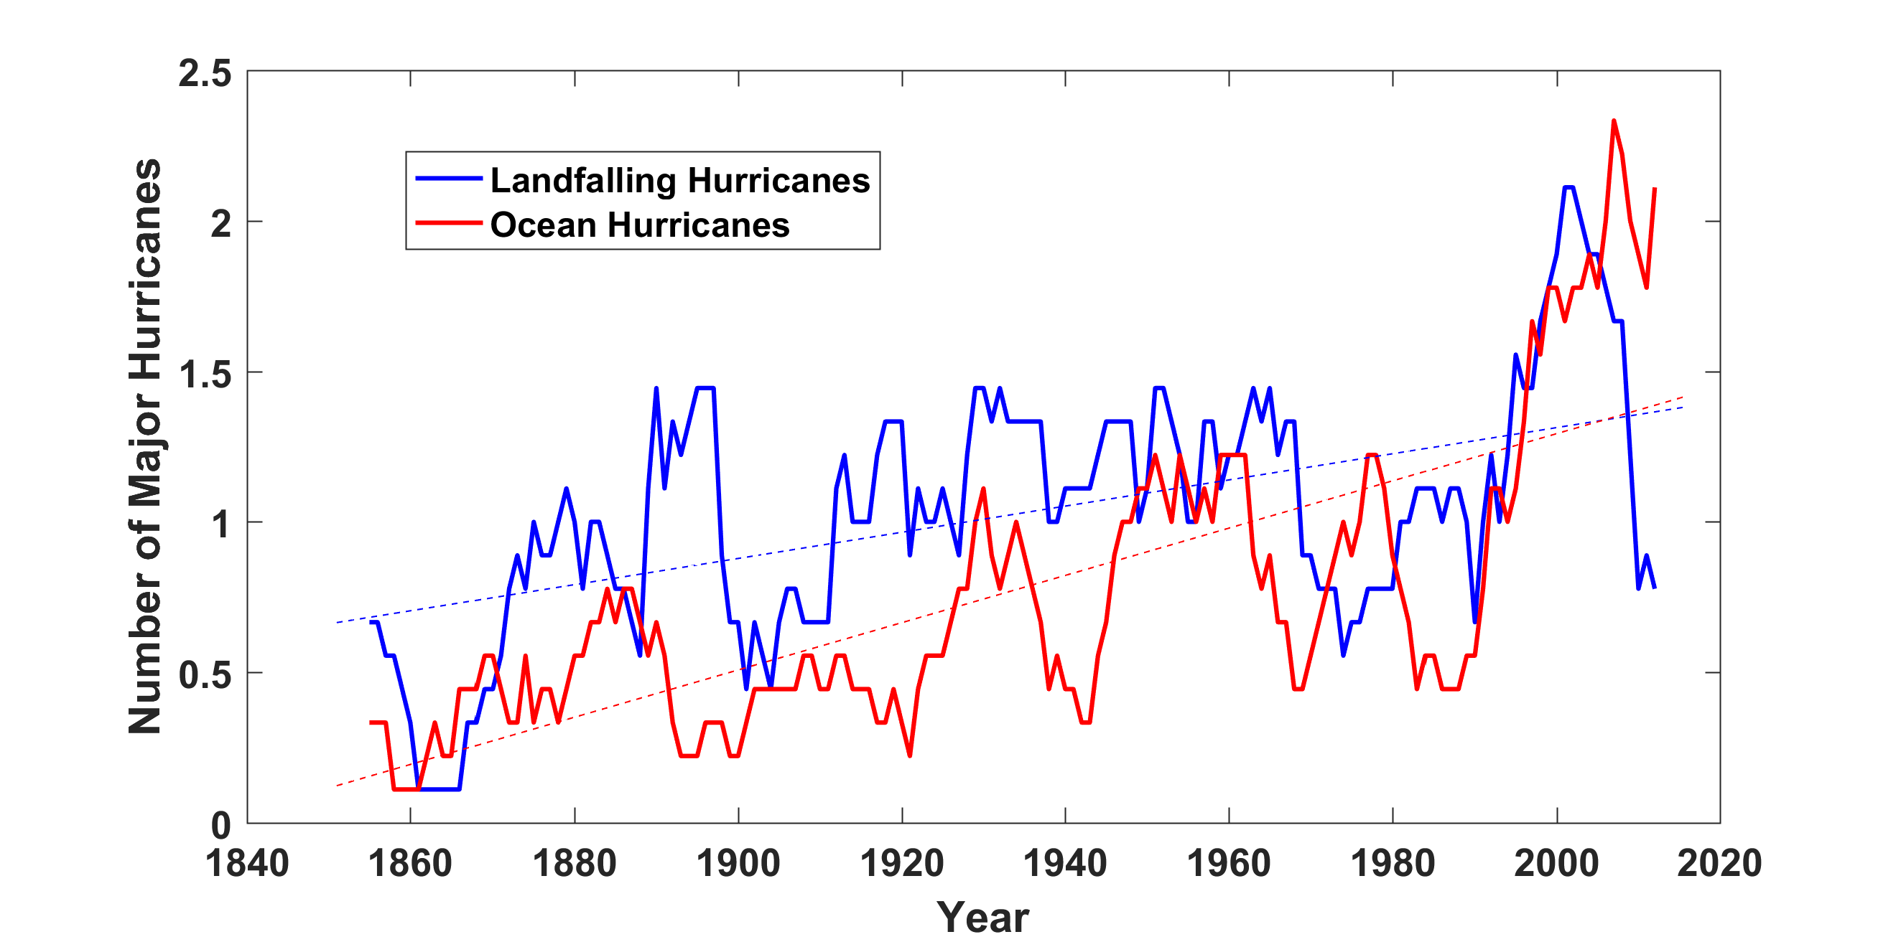
Historical Records:
Prior to 1970, Many Storms Were Missed
Major hurricanes in the North Atlantic, 1851-2016, smoothed using a 10-year running average. Shown in blue are storms that either passed through the chain of Lesser Antilles or made landfall in the continental U.S.; all other major hurricanes are shown in red. The dashed lines show the best fit trend lines for each data set.

Slide 13
Is Hurricane Risk Changing?

Slide 14
Satellite-derived proportion of major hurricane fixes
Time series of fractional proportion of global major hurricane estimates to all hurricane estimates for the period 1979–2017. Each point, except the earliest, represents the data in a sequence of 3-y periods. The first data point is based on only 2 y (1979 and 1981) to avoid the years with no eastern hemisphere coverage. The linear Theil−Sen trend (black line) is significant at the 98% confidence level (Mann−Kendall P value = 0.02). The proportion increases by 25% in the 39-y period (about 6% per decade).
Kossin et al., PNAS, 2020

Slide 15
Hurricanes are reaching peak intensity at higher latitudes
Time series of the latitudes at which tropical cyclones reach maximum intensity.
From Kossin et al. (2014)

Slide 16
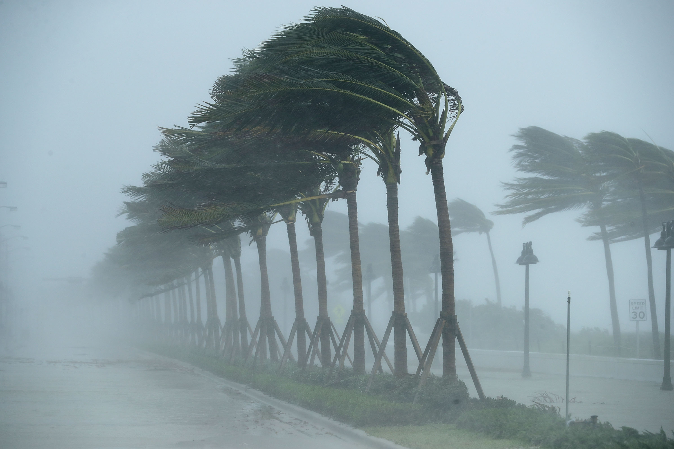
We Need to Use Physical Models to Estimate Hurricane Risk
Climate change adaptation

Slide 17
The quiet revolutions in numerical weather prediction and climate simulation
The first computational weather forecasts were made in the mid 1950s
Today, virtually every weather forecast beyond 6 hours is based wholly or heavily on numerical weather prediction models
Three-day forecasts today are as accurate as 1-day forecasts were 40 years ago
Climate models are becoming increasingly reliable in simulating such phenomena as severe winter storms, large-scale floods, droughts, and heatwaves

Slide 18
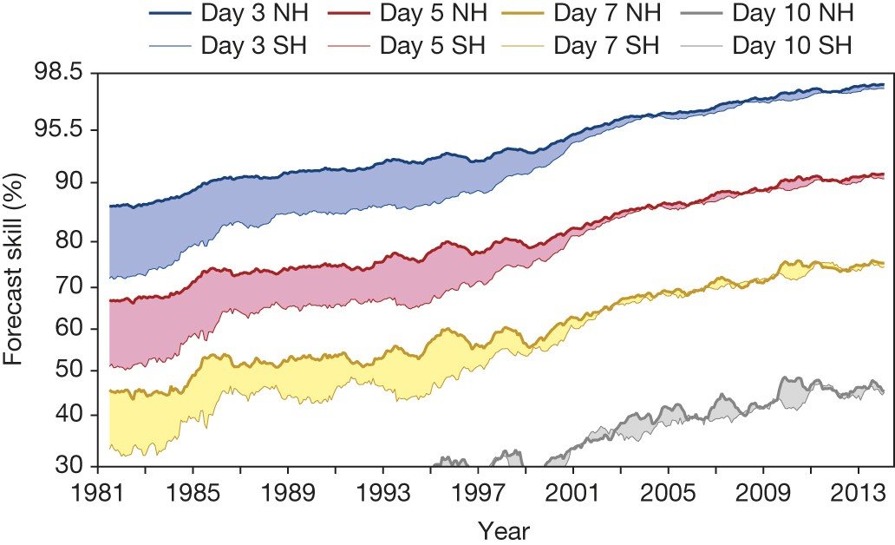
Evolution of forecast skill of a global numerical weather prediction model

Slide 19
Satellite Image
Global Model

Slide 20
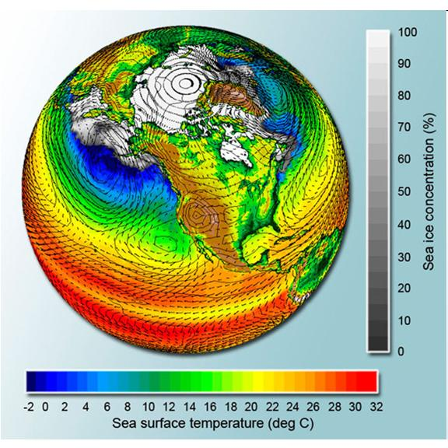
Why Not use Climate Models to Simulate Future Hurricanes?

Slide 21

Global climate models cannot yet be used to make direct estimates of hurricane risk
Histograms of Tropical Cyclone Intensity as Simulated by a Global Model with 30 mile grid point spacing. (Courtesy Isaac Held, GFDL)
Category 3
Modeled
Observed
Global models do not simulate the storms that cause destruction
Wind Speed (meters per second)

Slide 22
Using Physics to Assess Hurricane Risk
Reliable, global records of coarse-scale climate are robust and widely available
Cull from these datasets the key statistics known to control tropical cyclone generation, movement, and intensity evolution
Bootstrap these key statistic to create unlimited synthetic time series of the hurricane-relevant environmental variables
Use these to drive specialized, very high resolution physical hurricane models
Extensively validate the results against historical hurricane data
Exact same method can be applied to output of climate models

Slide 23
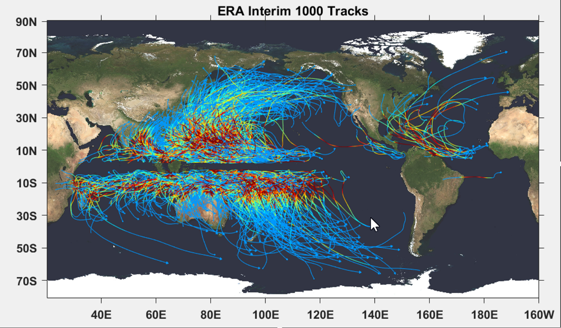

Slide 24

Cumulative Distribution of Storm Lifetime Peak Wind Speed, with Sample of 1755 Synthetic Tracks
90% confidence bounds

Slide 25
Atlantic Annual Cycle

Slide 26
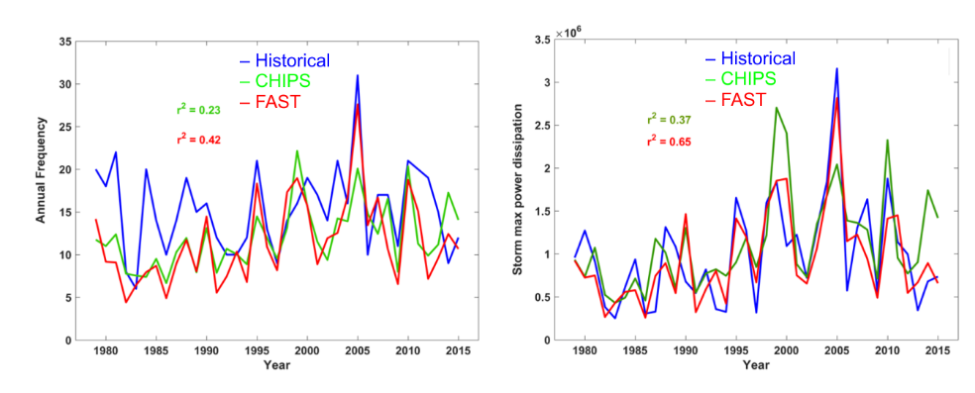
Atlantic Interannual Variability
Frequency
Power Dissipation

Slide 27

Captures effects of regional climate phenomena (e.g. ENSO, AMM)

Slide 28
Wind risk near Houston based on 4,000 tropical cyclones downscaled from ERA5 reanalysis, 1979-2018

Slide 29
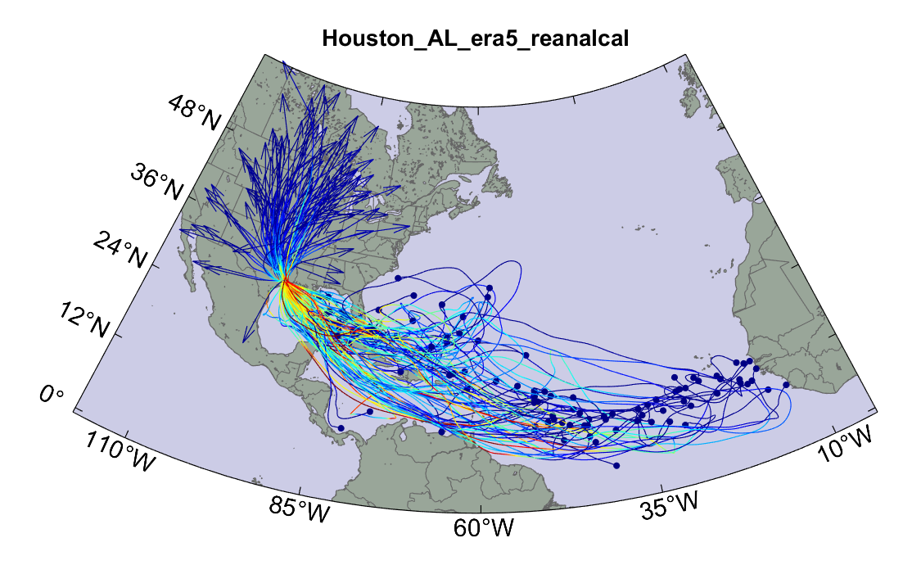
Example:
Top 100 out of 4000 TCs Affecting Houston, 1979-2018

Slide 30
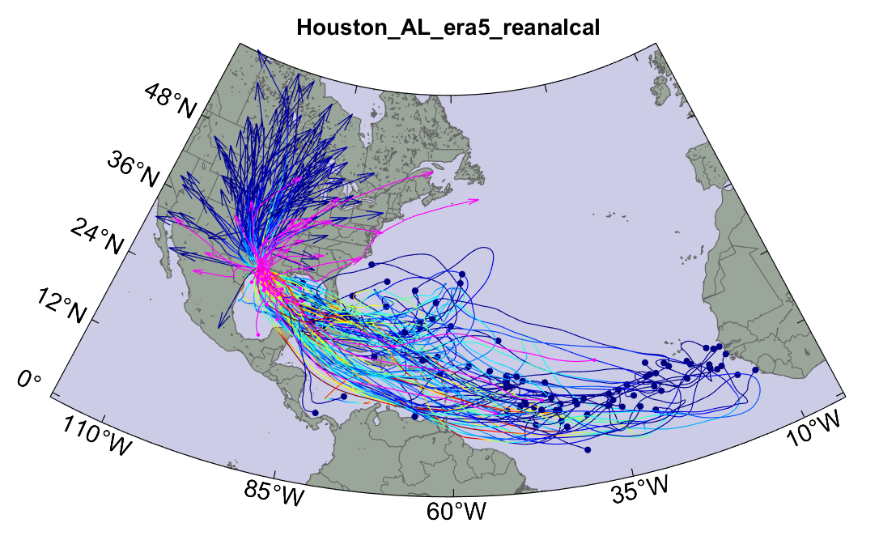
Same, but with top 20 historical tracks

Slide 31
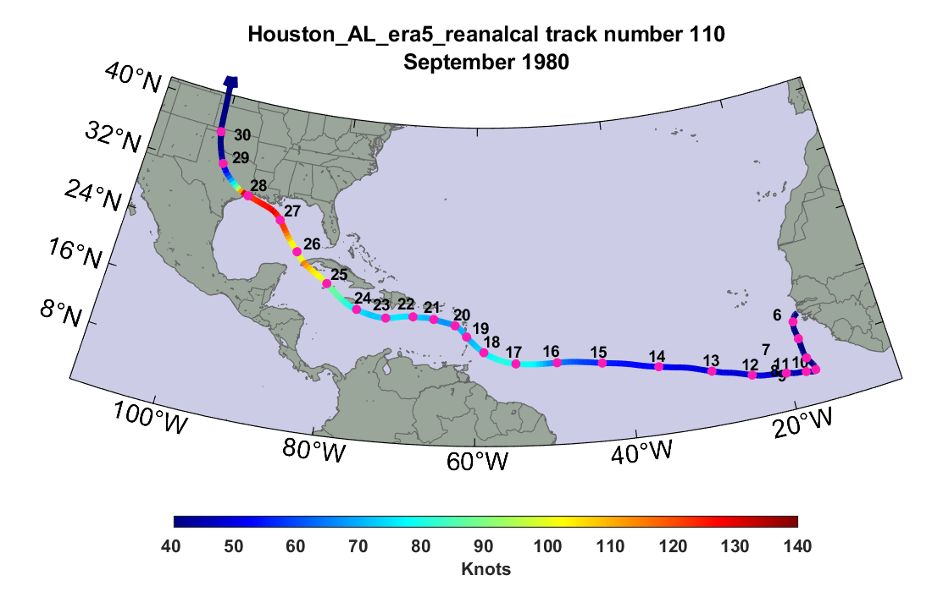
Sample Houston track

Slide 32
Peak Wind Swath

Slide 33
Model produced wind fields are used to drive hydrodynamic storm surge models to estimate surge risk
Model produced rain can be used to drive flood models to estimate flood risk

Slide 34
Storm total rainfall

Slide 35
2,000 year rain event for Houston

Slide 36
Taking Climate Change Into Account
Downscale 6 CMIP6 models for the historical period, 1981-2010, and for the period 2071-2100 under Shared Socioeconomic Pathway 5 (business as usual, heavy reliance on fossil fuels, no serious attempt at mitigation. The 6 models used were
CNRM-CM6-1
GFDL-ESM4
IPSL-CM6A-LR
MIROC6
MPI-ESM1-2-HR
UKMO UKESM1-0-LL
Three other models that produced excessively large climate responses were downscaled but discarded for the analyses presented here

Slide 37
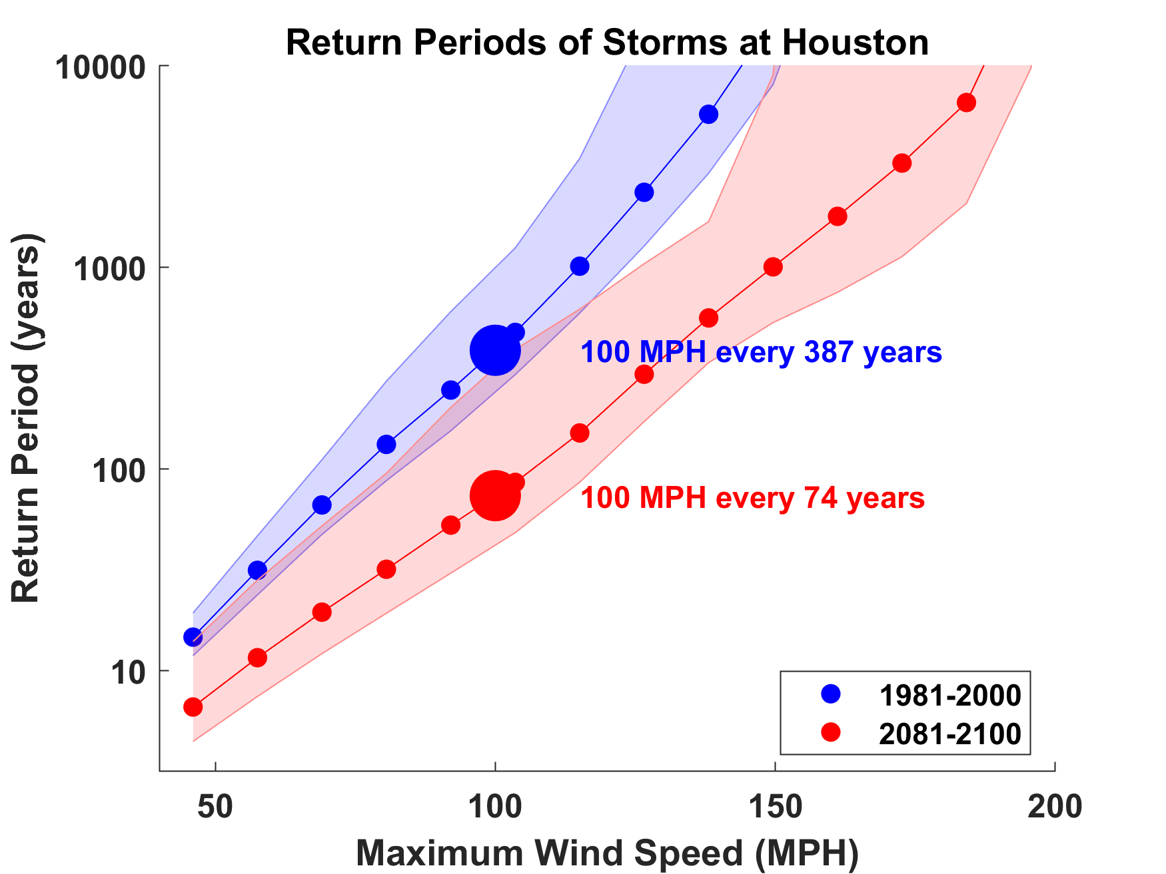

Slide 38
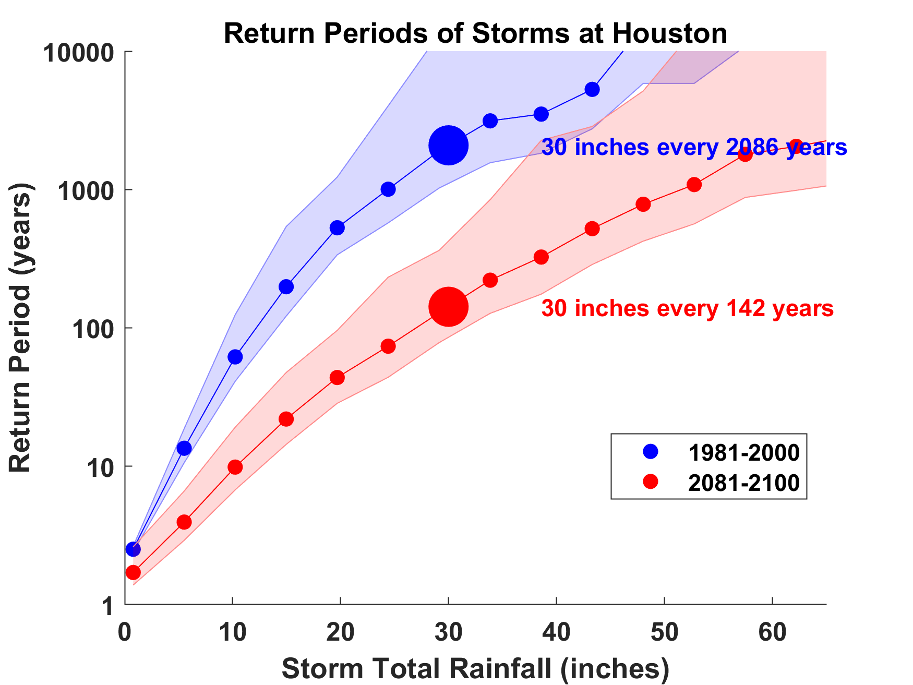
15-fold increase by century’s end
Already 3-fold by 2017!

Slide 39
A future 100-year rain event for Houston

Slide 40
Take-Away Points
We need to move away from sole dependence on flawed historical data in assessing climate- and weather-related natural hazard risk and embrace advanced modeling techniques
We can no longer regard climate change as a problem for the future; it has already tangibly affected important risks, e.g. Harvey’s rainfall was ~3 times more likely in 2017 than in 1970
Industries could help catalyze industry-relevant research in universities and government labs by creating a demand for graduates with backgrounds in physics-based risk assessment

