Slide 1
Richard Rotunno:
The First 40 Years
Kerry Emanuel
Lorenz Center
MIT

Slide 2
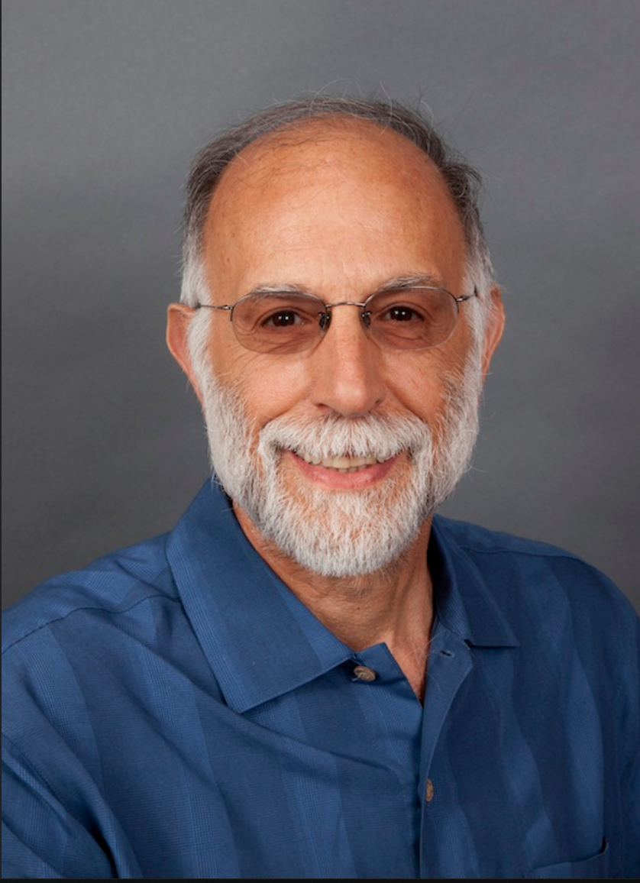
Notes:
I would like to begin by saying what a privilege and great pleasure it has been to know Rich as a colleague and a good friend. My own life would be immeasurably poorer without having known Rich and his wonderful family. I am so happy Gayle is here at this meeting, and I am most grateful to Rich’s daughter Alice for supplying some of the photos you will see.

Slide 3
Program
Brief biography
Synopsis of research achievements
Some personal reflections

Slide 4
Education
B.E. (Eng. Science), SUNY Stony Brook, 1971
M.S. (Mechanics), SUNY Stony Brook, 1972
M.A. (Geophysical Fluid Dynamics), Princeton, 1974
Ph.D. (Geophysical Fluid Dynamics), Princeton, 1976
Postdoctoral Fellow, National Center for Atmospheric Research, 1976-1977
Ph.D. Thesis: Internal gravity waves in the nocturnal planetary boundary layer

Slide 5
Some Career Milestones
Visiting Fellow, CIRES, University of Colorado, 1977-1978
Research Associate, CIRES, University of Colorado, 1978- 1979
Scientist II, National Center for Atmospheric Research, 1980- 1983
Scientist III, National Center for Atmospheric Research, 1983- 1989
Senior Scientist, National Center For Atmospheric Research, 1989-present
Director, Mesoscale and Microscale Meteorology Division, National Center for Atmospheric Research, 2010-2014
Notes:
Mention seminal role of Doug Lilly in Rich’s career

Slide 6
Some Awards and Honors
1991: Banner Miller Award
1994: Fellow of the AMS
2004: Jule G. Charney Award
2010: Banner Miller Award
2017: Carl-Gustaf Rossby Research Medal

Slide 7
Major Research Foci
Vortex dynamics
Dynamics of supercell thunderstorms
Squall line dynamics
Land-and sea-breezes, nocturnal jets, katabatic and anabatic flows (Dino Zardi)
Tropical cyclones, medicanes, and polar lows
Alpine flows and vortex shedding by hills (Andrea Buzzi, Vanda Grubišić and Manuela Lehner)
Baroclinic instability and frontal dynamics; QG and SG theory
Gravity waves, density currents, Kelvin waves and hydraulic jumps (George Bryan)
Alpine precipitation and floods (Bob Houze)
Fundamental predictability

Slide 8
Major Research Foci
Vortex dynamics
Dynamics of supercell thunderstorms
Squall line dynamics
Land-and sea-breezes, nocturnal jets, katabatic and anabatic flows (Dino Zardi)
Tropical cyclones, medicanes, and polar lows
Alpine flows and vortex shedding by hills (Andrea Buzzi, Vanda Grubišić and Manuela Lehner)
Baroclinic instability and frontal dynamics; QG and SG theory
Gravity waves, density currents, Kelvin waves and hydraulic jumps (George Bryan)
Alpine precipitation and floods (Bob Houze)
Fundamental predictability

Slide 9
Vortex Dynamics
1977: “Numerical simulation of a laboratory vortex”. First attempt to numerically simulate a laboratory vortex (that of Ward, 1972)
  Confirmed Ward’s finding that core size is mostly a function of swirl ratio
  Showed that core size becomes independent of Reynolds Number when the latter is large
  Speculated that large swirl ration would lead to multiple vortex formation owing to concentration of vorticity in a cylindrical sheet

Slide 10
Vortex Dynamics
1978: “A note on the stability of a cylindrical vortex sheet”. Rich showed that the observed azimuthal wavenumbers 1 and 2 could only be explained if there are radial shears in both vertical and azimuthal velocity.
1979: ‘A study in tornado-like vortex dynamics”: Extends 1977 work to better resolved boundary layer with no-slip condition. Finds strong swirling flow in corner region and generation of inertial waves
1984: “An investigation of a three-dimensional asymmetric vortex”. Early 3-D simulation of tornado-like vortices; confirms presence of helical modes and vortex breakdown

Slide 11
Vortex Dynamics
1986: “A theory for the maximum wind speeds in tornado-like vortices” (with Brian Fiedler): Theoretical development confirms that strongest surface winds occur in supercitical end-wall vortices
1988: “A comparative study of atmospheric and laboratory- analogue numerical tornado vortex models” (with Howells and Smith): Affirms great importance of secondary circulation produced by no-slip boundary in creating strong boundary layer inflow jet and enabling high velocities near the surface
2016: “Axisymmetric tornado simulations at high Reynolds number” (with Bryan, Nolan, and Dahl): Confirms that 2-D vortices remain laminar at high Re, suggesting that turbulence requires 3D. Maximum winds can exceed ~3 x thermodynamic limit.
2017: “Tornado vortex structure, intensity, and surface wind gusts in large-eddy simulations with fully developed turbulence” (with Nolan, Bryan and Dahl): Extends previous work to 3D. Overall vortex intensity reduced by turbulence, but surface gusts can still exceed thermodynamic limit by factor > 2

Slide 12
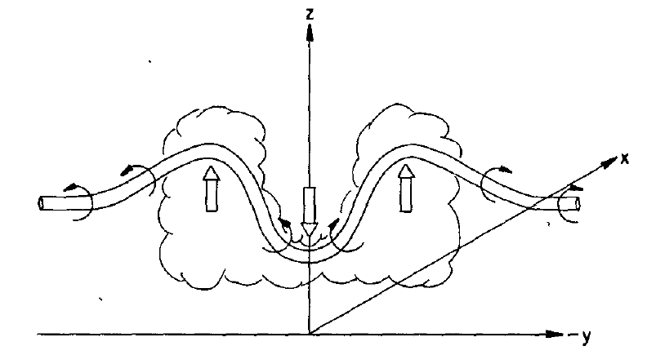
Dynamics of Supercell Thunderstorms
Rich and collaborators have provided a rigorous and highly satisfying picture of the dynamics of supercell thunderstorms, including the appearance of high vorticity at the surface
1981: “On the evolution of thunderstorm rotation”. Development of precipitation-driven downdraft splits storms and tilting of horizontal vorticity of ambient shear leads to vortex pairs

Slide 13
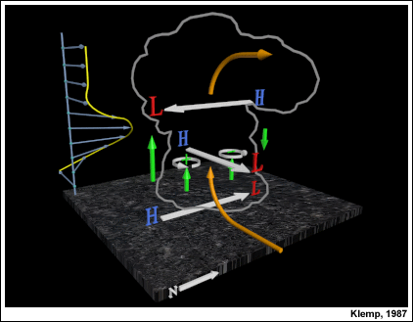
Dynamics of Supercell Thunderstorms
1982: “The influence of the shear-induced pressure gradient on thunderstorm motion” (with Klemp). Importance for storm dynamics of dynamically induced pressure gradients, as diagnosed through the nonlinear balance equations

Slide 14
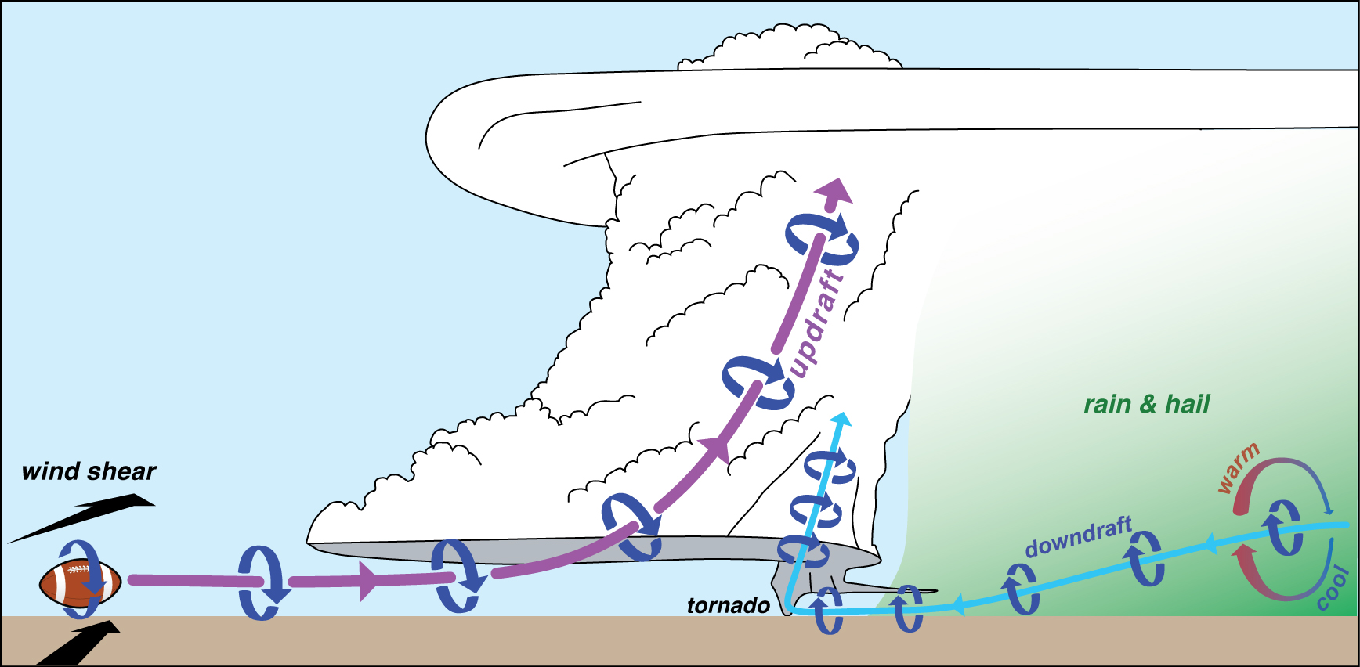
Dynamics of Supercell Thunderstorms
1983: “A study of the tornadic region within a supercell thunderstorm” (with Klemp). Identified baroclinic generation along gust fronts as an important source of low-level vorticity

Slide 15
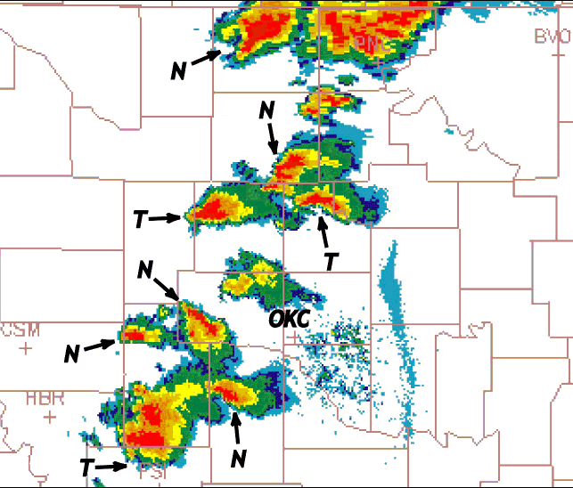
Squall Line Dynamics
1988: “A theory for strong long-lived squall lines” and “The structure and evolution of numerically simulated squall lines” (with Weisman and Klemp). Showed that optimal conditions for quasi-2D squall lines require baroclinic vorticity generation at gust fronts to cancel horizontal vorticity associated ambient low-level shear. Deep shear in certain configurations can promote lines of 3-D supercell storms.

Slide 16
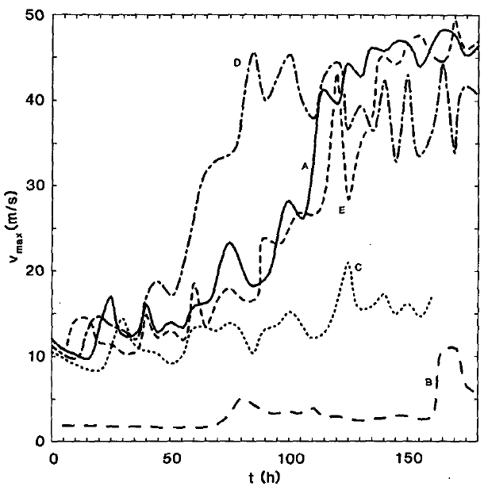
Tropical Cyclones, Medicanes and Polar Lows
1987: “An air-sea interaction theory for tropical cyclones. Part II: Evolutionary study using a nonhydrostatic axisymmetric numerical model” (with Emanuel). First demonstration that tropical cyclones can amplify in CAPE-free environments given a strong enough starting vortex

Slide 17
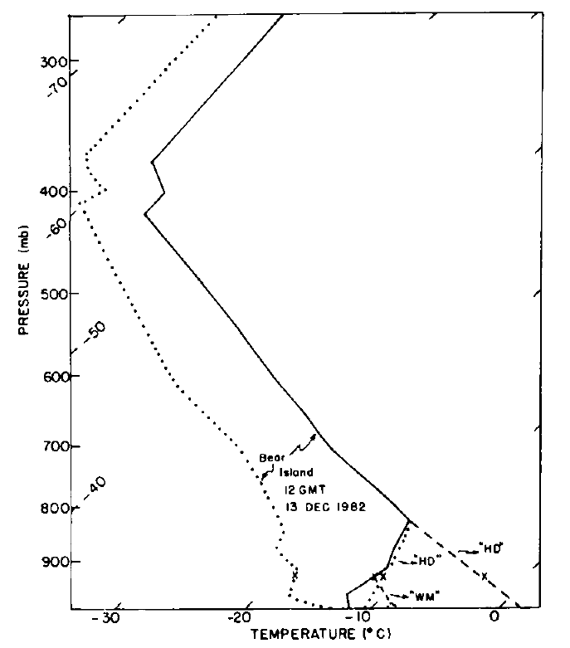
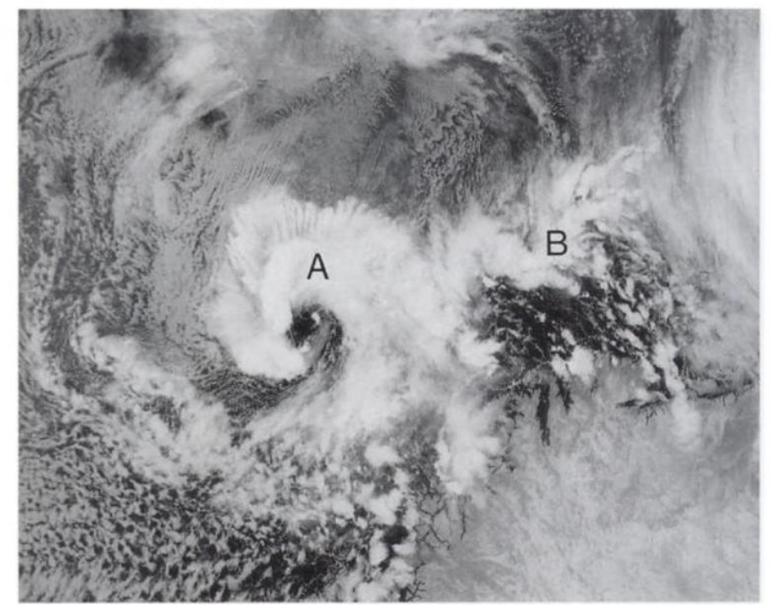
Tropical Cyclones, Medicanes and Polar Lows
1988: “Polar lows as arctic hurricanes” (with Emanuel). Showed that surface flux-driven vortices can develop in observed polar low environments, and that these ae driven mostly by sensible surface heat fluxes.
02:50 GMT 13 December 1982
12 GMT 13 December sounding at Bear Island

Slide 18
Tropical Cyclones, Medicanes and Polar Lows
2008-2009: Five papers on observations and analysis of the 26 September 2006 medicane affecting Puglia, with A. Moscatello, M. Miglietta, S. Davolio, F. Pacifico, and A. Buzzi. One of the papers is in Italian. Showed that this system originated in the lee of the Atlas Mountains and was amplified by surface heat fluxes under a cutoff cold low aloft.
Maglie radar reflectivity, 1103 GMT 9/26/2006
WRF simulation 0600 GMT 9/26/2006

Slide 19
Tropical Cyclones, Medicanes and Polar Lows
2008: “The influence of near-surface, high-entropy air in hurricane eyes on hurricane intensity” (with Bryan): Disproved a hypothesis by Persing and Montgomery that TC superintensity results from surface fluxes in the storm’s eye.
2009: “An evaluation of an analytic model for the maximum intensity of tropical cyclones” (with Bryan): Showed that super intensity is mostly owing to supergradient winds in boundary layer, while gradient wind obeys potential intensity theory. Developed a diagnostic PI that incudes supergradient wind.

Slide 20
Tropical Cyclones, Medicanes and Polar Lows
2009: “Large-eddy simulation of an idealized tropical cyclone” (with Chen, Wang, Davis, Dudhia, and Holland): Very high (~62 m) resolution 3D simulation of an idealized TC. Shows that transient, 3D wind features can greatly exceed potential intensity and uncovers a wealth of information about the mesoscale structure of TC boundary layers.
Instantaneous snapshot of the 10 m wind field produced by the
CM1 model (Δx = Δy = 31.25 m).

