Slide 1

What Sets the Climatology of CAPE?
Kerry Emanuel
Lorenz Center
MIT

Slide 2
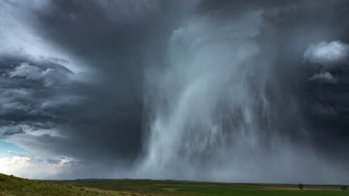
Hailstorm in Nebraska, USA

Slide 3
Why Should We Care?
Severe convective storms are a significant cause of damage and loss of crops worldwide
For example, hail losses are second only to flood losses among weather hazards in Switzerland
Comparatively little is know about how climate change affects this weather hazard
Convective Available Potential Energy (CAPE) is an important ingredient in severe convective storms
Understanding the climatology of CAPE in today’s climate is a step toward quantifying current and future severe convective storm risk

Slide 4
Some Preliminaries:
Two Broad Categories of Convection
Quasi-equilibrium convection
  Convection consumes available energy at about the rate that large- scale processes generate it
  Most tropical convection and middle-latitude summer convection is of this type
  Generally benign
  Responsible for significant fraction of global mean, annual mean rainfall
  Diurnal cycle over land produces lagged QE with some buildup of CAPE
Stored-energy convection
  Convective available energy builds up over time and is then suddenly released
  Comparatively rare
  Responsible for most convection-related problems: tornadoes, hailstorms, flash-floods, and straight-line wind storms

Slide 5

Quasi-Equilibrium Convection
A tropical meteorologists’s heart knoweth its own bitterness, but a stranger meddleth not with its joy

Slide 6
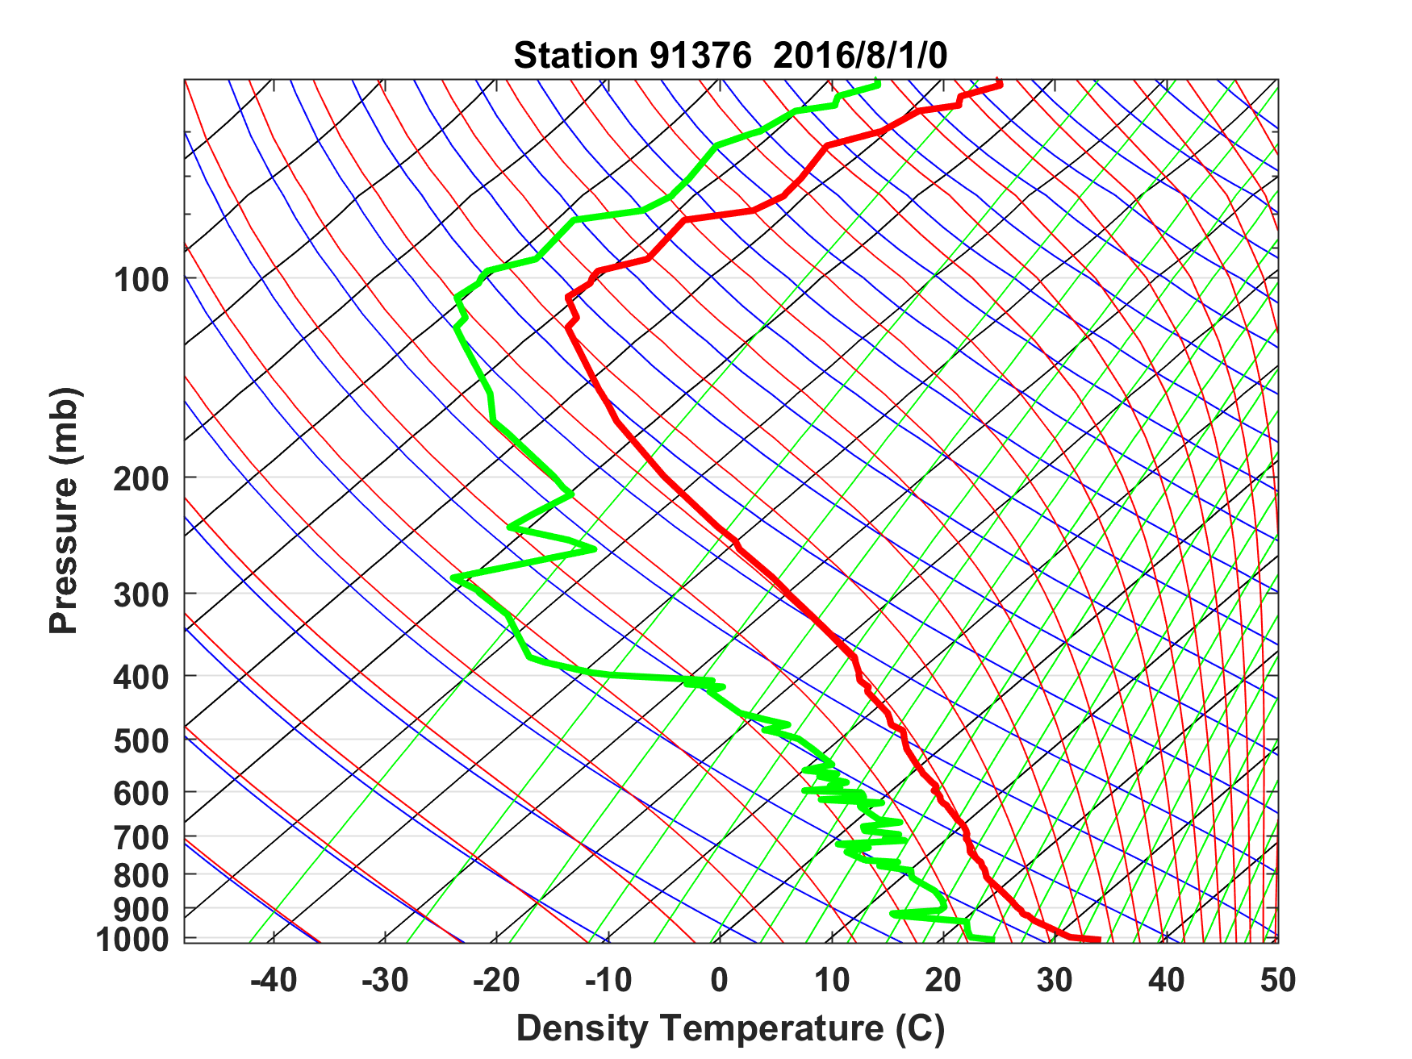
Sounding at Majuro, August 1 2016 0 GMT

Slide 7
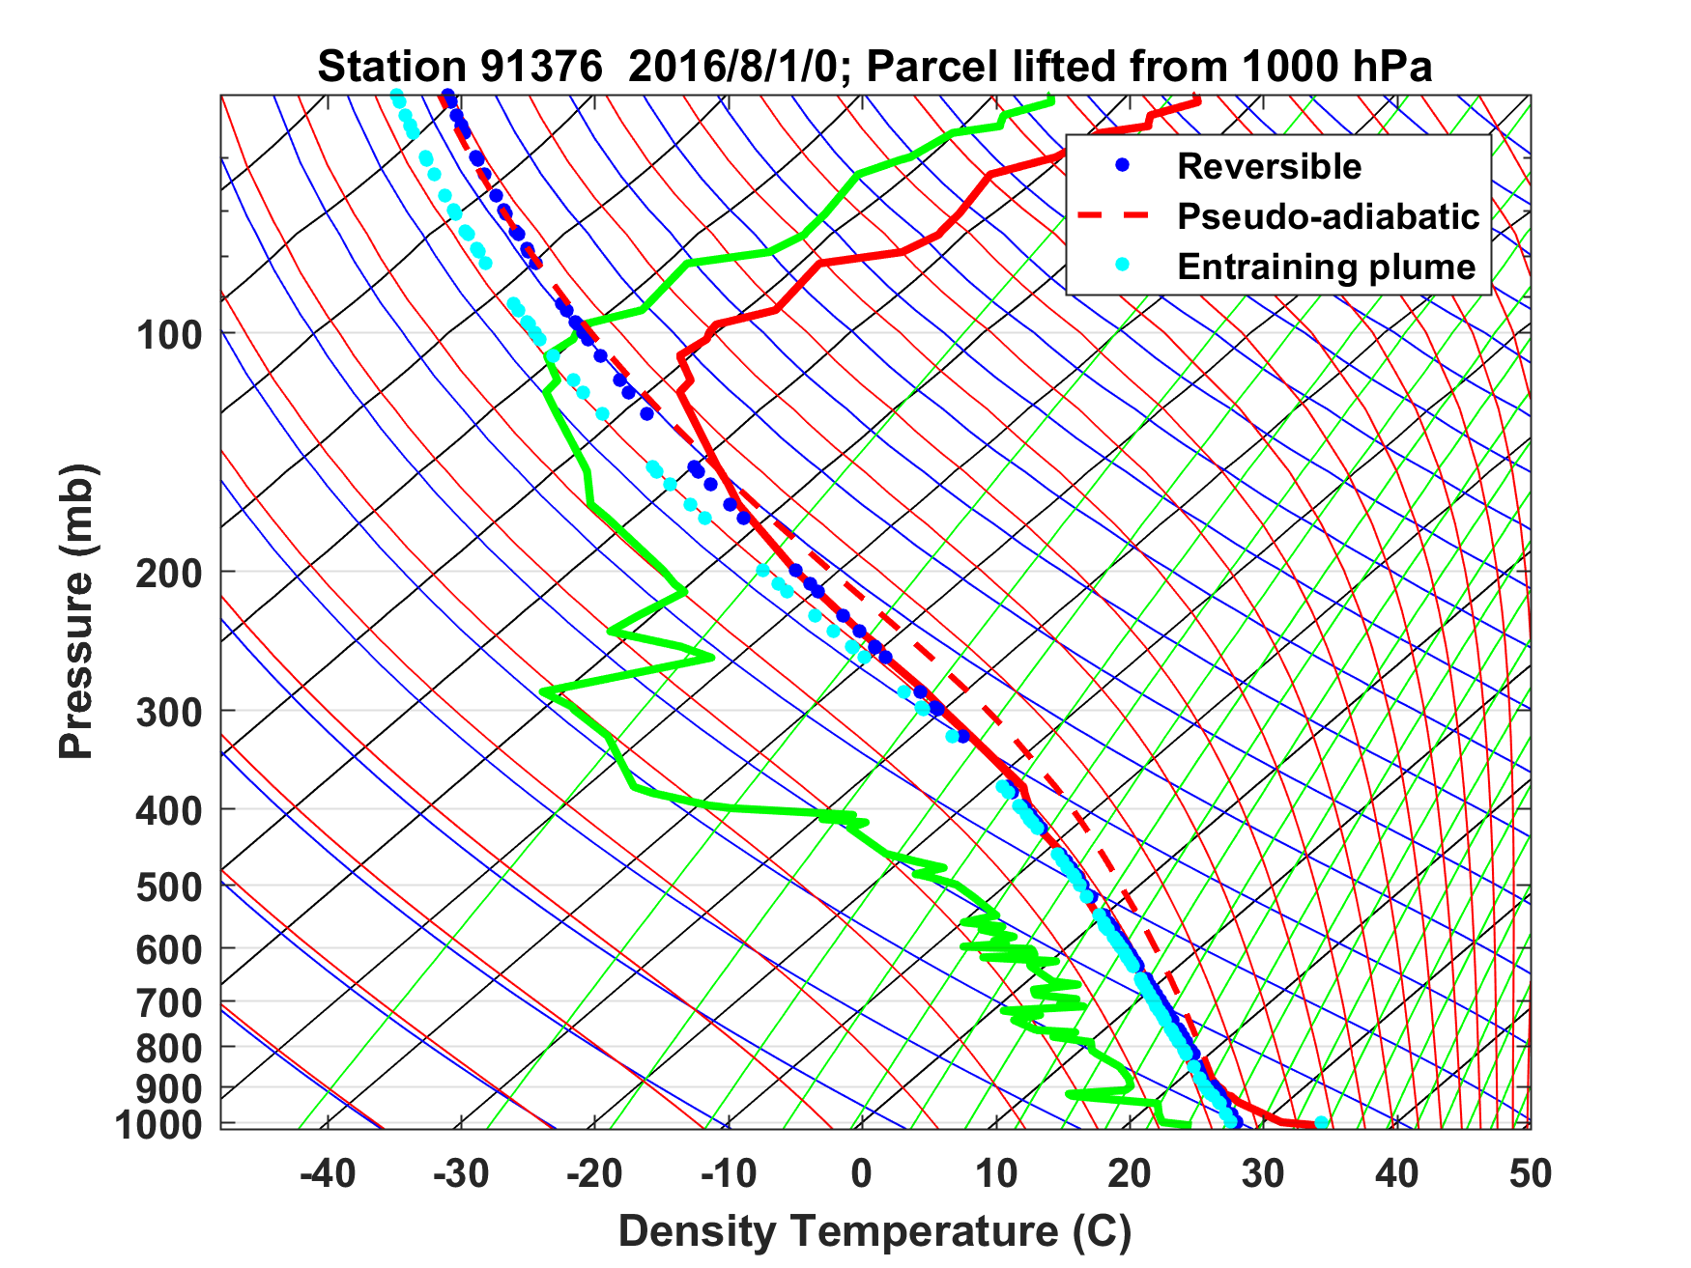
Sounding at Majuro, August 1 2016 0 GMT

Slide 8
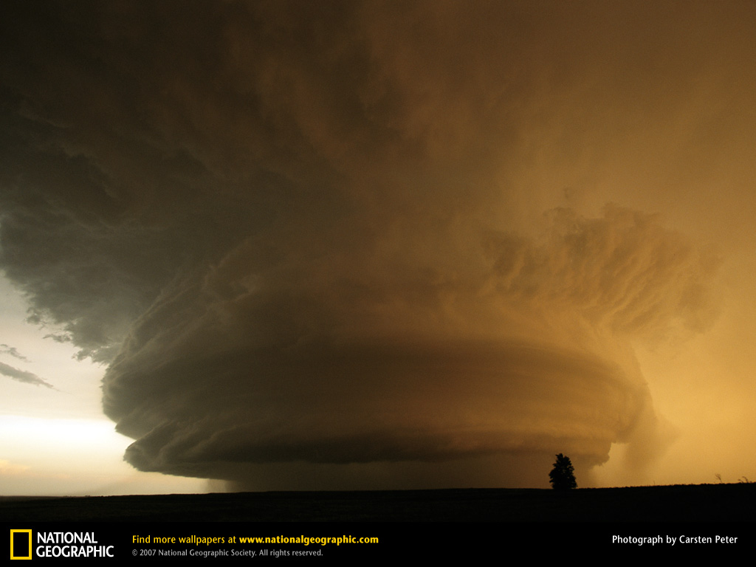
Stored-Energy Convection

Slide 9
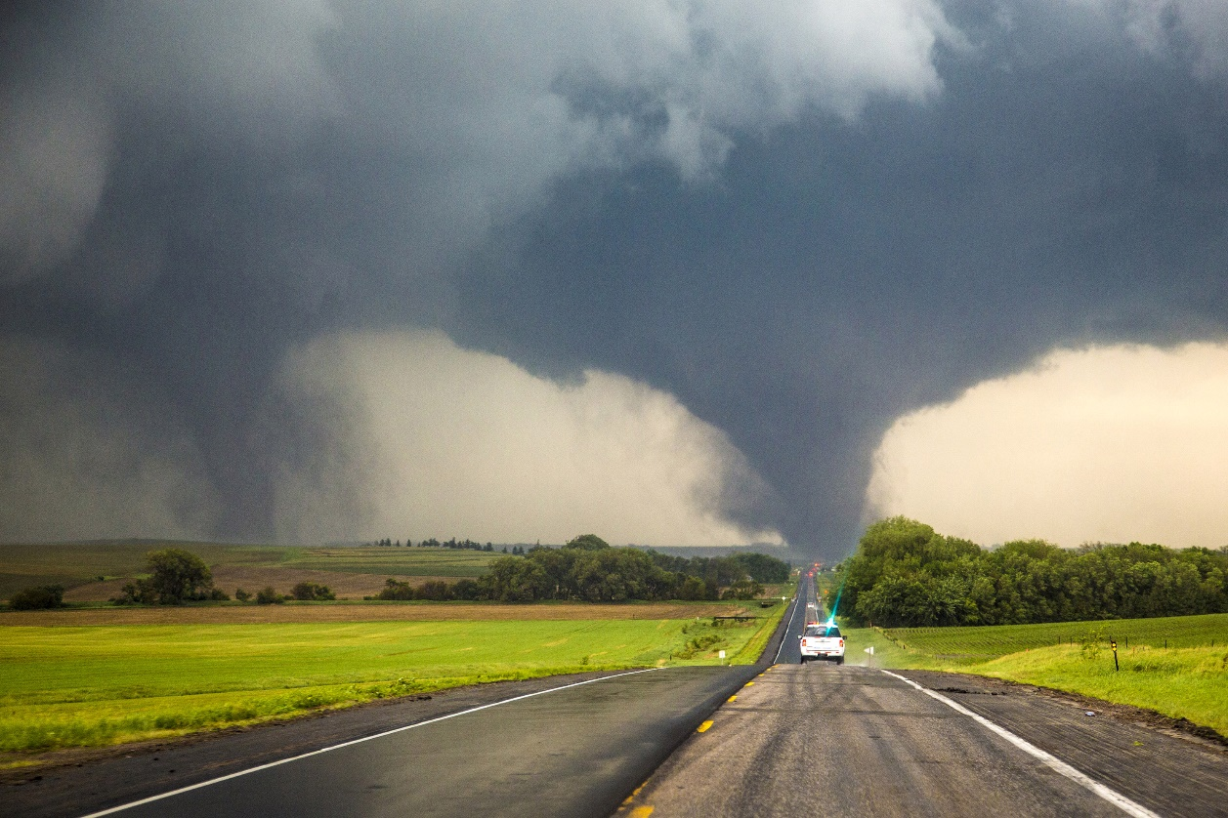
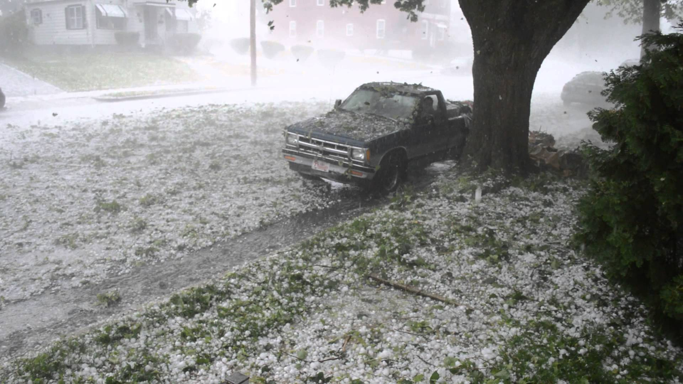
Each year in the U.S., 1,200 tornadoes on average kill 60 people, injure 1,500, and cause roughly $400 million in damages
Hail causes about $1 billion dollars in damage to crops and property each year, according to the National Oceanic Atmospheric Administration (NOAA)

Slide 10

If that were not bad enough…..

Slide 11
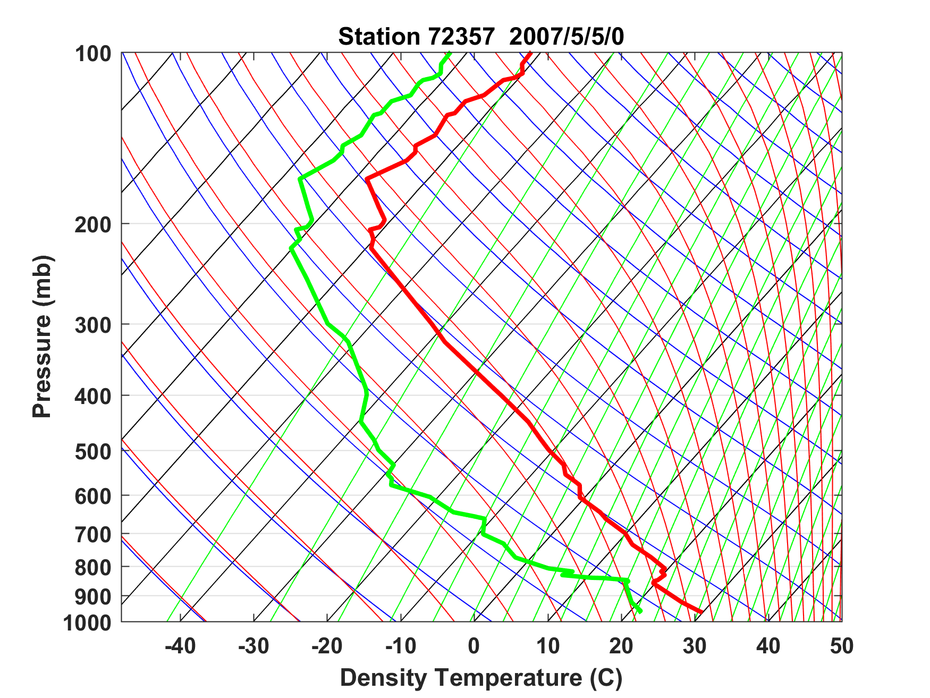
Sounding at Norman, Oklahoma, May 5th 2007
Capping inversion

Slide 12
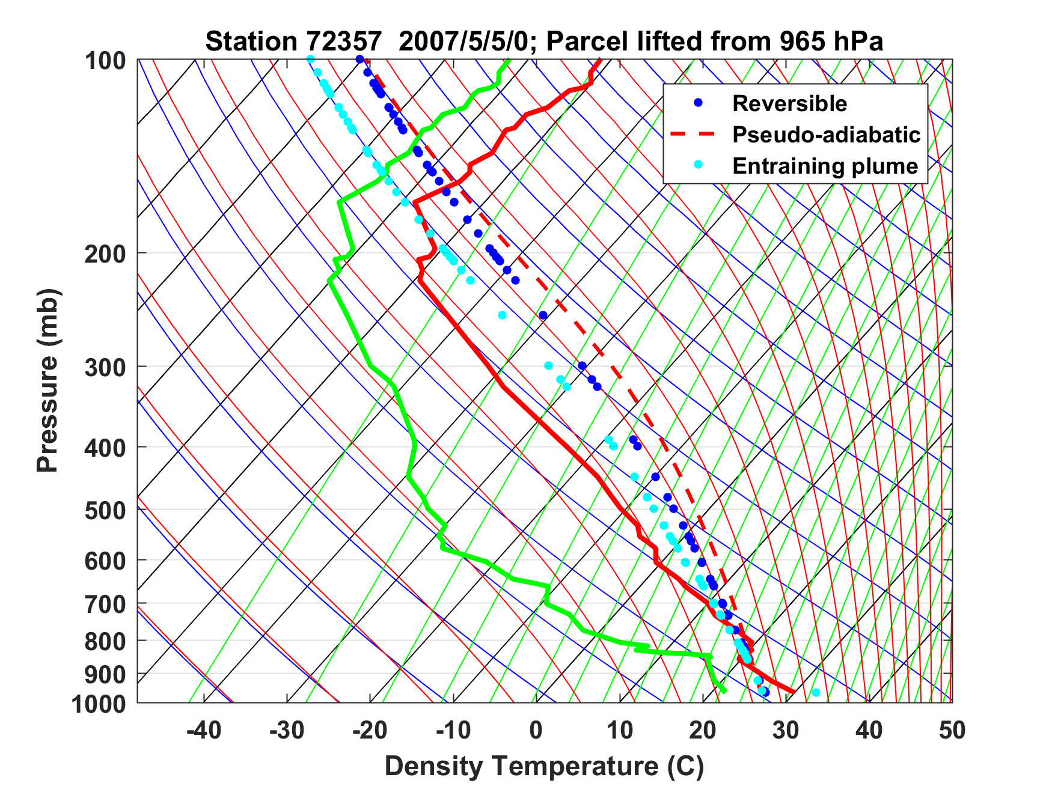
Sounding at Norman, Oklahoma, May 5th 2007

Slide 13
Sounding at Norman, Oklahoma, May 5th 2007
CAPE = 6900 J/Kg → w = 110 m/s
Capping inversion

Slide 14
How do these high CAPE soundings arise?
Clues in the climatology….

Slide 15
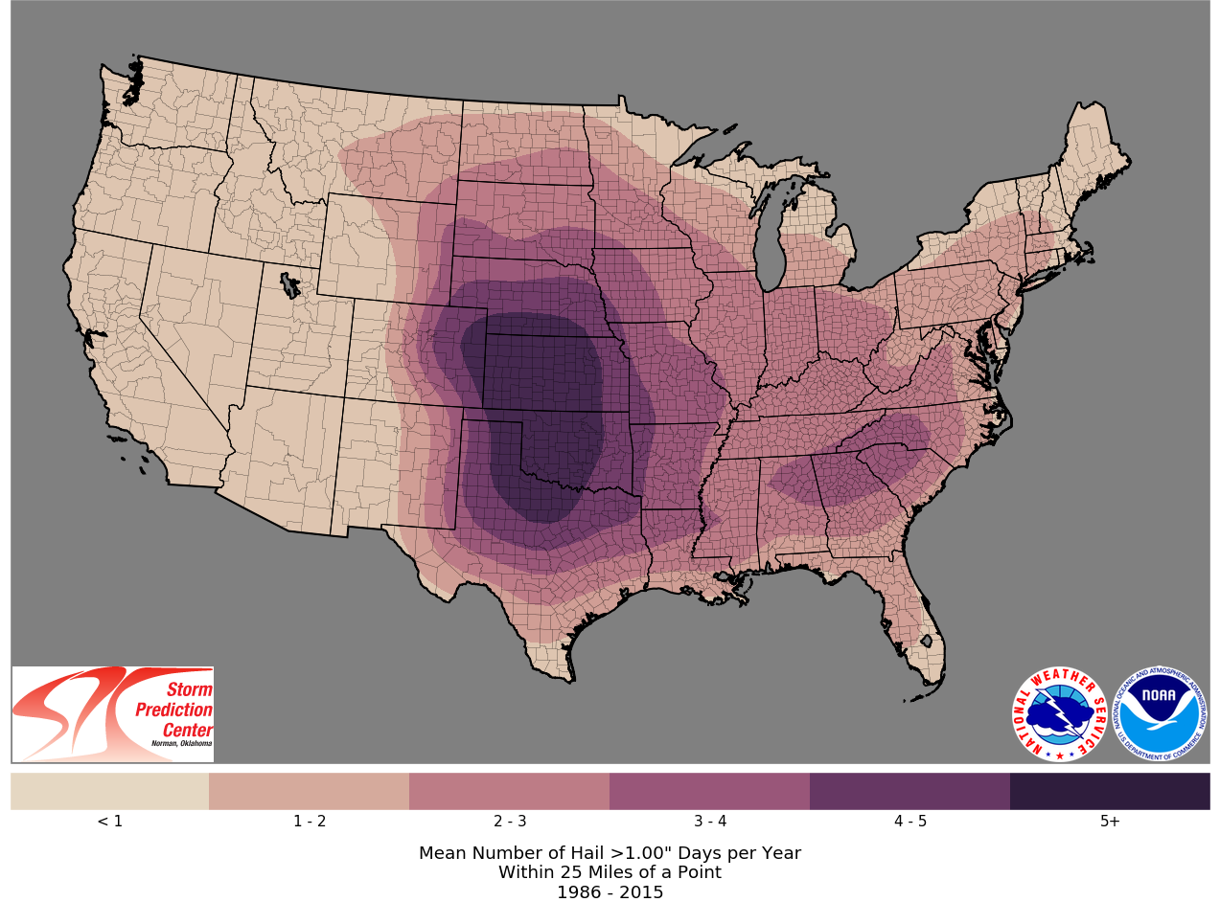

Slide 16
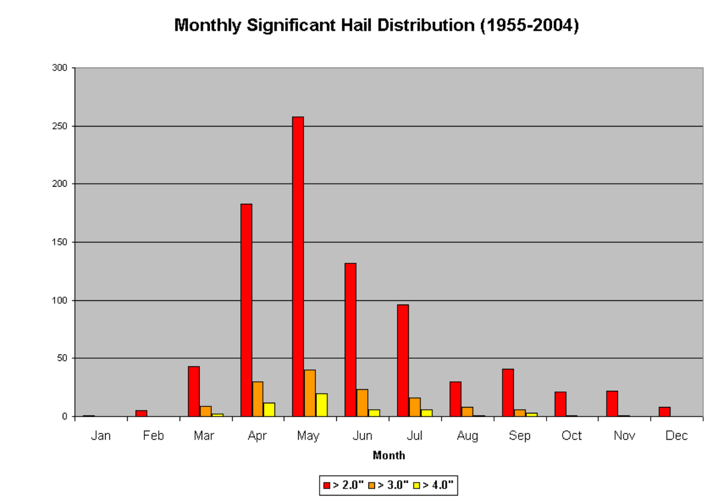
Illinois-Missouri Hail Climatology
Mark F. Britt, WFO St. Louis

Slide 17
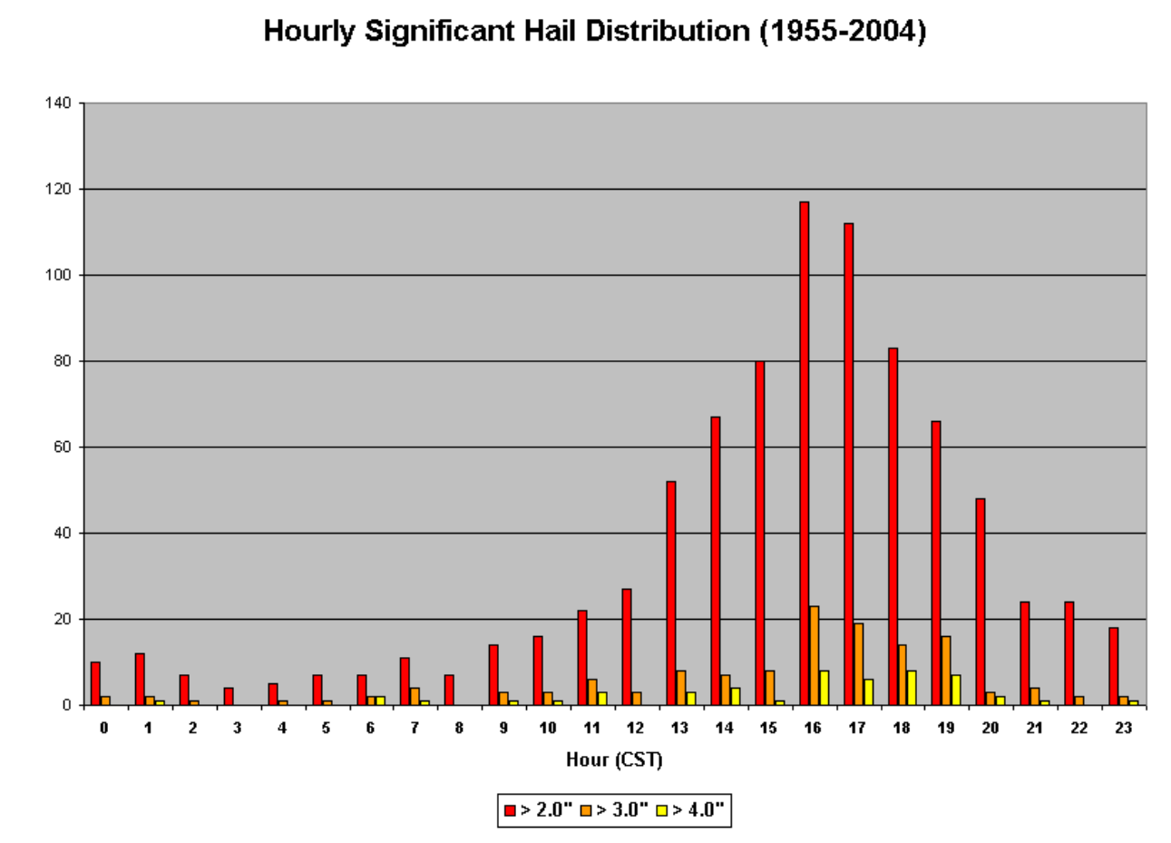
Mark F. Britt, WFO St. Louis

Slide 18
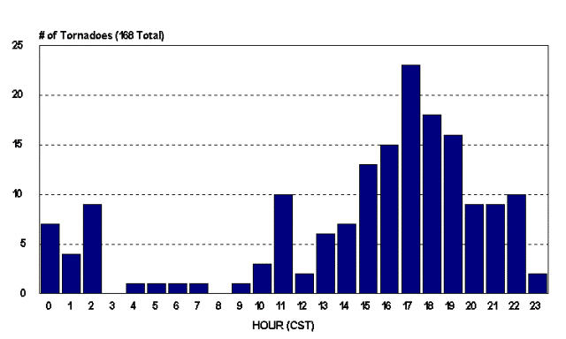
Diurnal Variation of Tornadoes

Slide 19
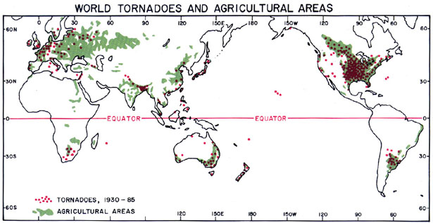
Global Distribution of Tornadoes
Ted Fujita

Slide 20

Necessary Conditions for Severe Thunderstorms:
High values of CAPE (with some interesting exceptions)
Large vertical shear of horizontal wind, particularly at low levels

Slide 21
Necessary Conditions for Severe Thunderstorms:
High values of CAPE
Large vertical shear of horizontal wind, particularly at low levels

Slide 22
Observations and global and regional climate models generally show increasing CAPE and CIN as climate warms.
Why?

Slide 23
Trends in a Measure of Favorable Environments for Hailstorms (shaded) and annual mean number of hail days (contoured)
Tang, B.H., Gensini, V.A. & Homeyer, C.R. Trends in United States large hail environments and observations. npj Clim Atmos Sci 2, 45 (2019). https://doi.org/10.1038/s41612-019-0103-7

Slide 24
Occurrence frequency of CIN and CAPE over CONUS, 20º-40º N during May and June, 2009-2013
Control
PGW - Control
WRF
CCSM4
Chen, J., A. Dai, Y. Zhang, and K. L. Rasmussen, 2020: Changes in convective available potential energy and convective inhibition under global warming. Journal of Climate, 33, 2025–2050

Slide 25
CCSM4 Control
1980-1999
CCSM4 RCP 8.5. 2081-2100, - Control
Tropics
Sub-tropics
Mid-latitudes
Chen, J., A. Dai, Y. Zhang, and K. L. Rasmussen, 2020: Changes in convective available potential energy and convective inhibition under global warming. Journal of Climate, 33, 2025–2050

Slide 26
Key Questions:
What determines geographical distribution of stored- energy storms?
Why do tornadoes and hailstorms peak in late- afternoon to early evening?
Why are peak CAPE values around 3000-6000 J/Kg?
How might these values change with climate?

Slide 27
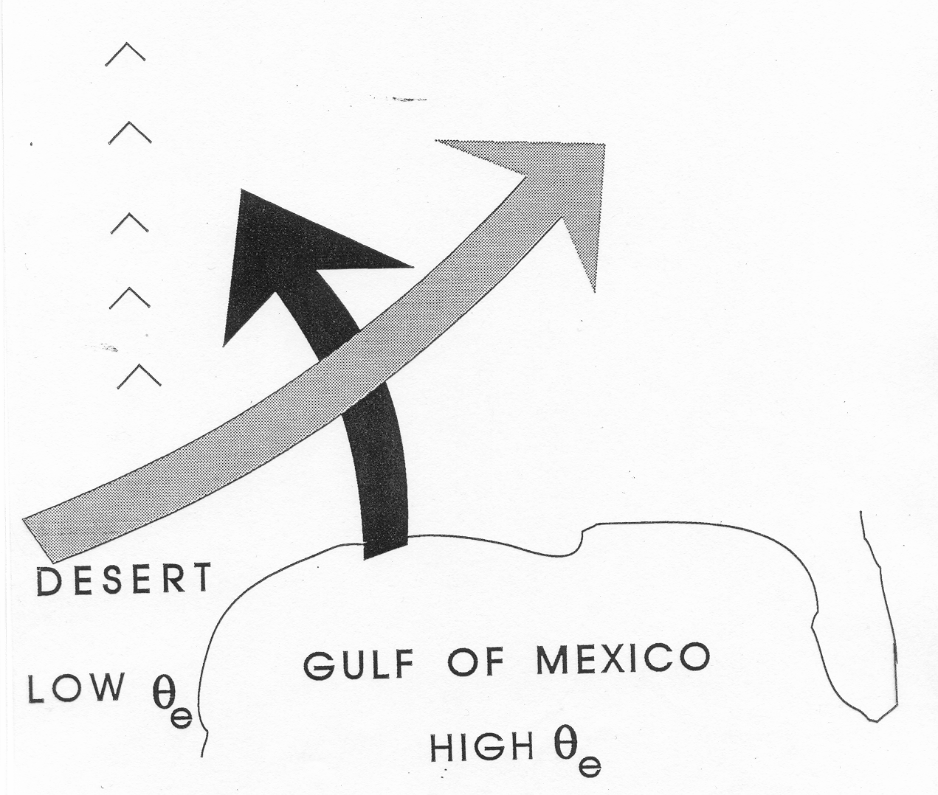
Conventional View:
Differential Advection
Emanuel, Atmospheric Convection, 1994

Slide 28
Sensitivity of the Great Plains Severe-Storm Environment to Soil-Moisture Distribution
JOHN M. LANICCI, TOBY N. CARLSON AND THOMAS T. WARNER
Department of Meteorology, The Pennsylvania State University, University Park, PA 16802
(Manuscript received 8 October 1986, in final form 24 April 1987)
[ Based on simulations using the Penn State/NCAR Regional Model ]
Results of the numerical simulations show that the dry soil conditions of northern Mexico are critical to the formation of the lid, and the variable soil conditions of the southern Great Plains are important for the processes of differential surface heating and generation of low-level instability through strong surface evaporation. The processes interact dynamically to alter the pre-storm conditions and subsequent convective rainfall patterns observed over Texas and Oklahoma in the SESAME IV case.

Slide 29
Hypothesis:
Large CAPE is produced when a deep, dry- adiabatic layer formed over dry land is advected over moist soil which is then subjected to solar heating.
(Agard and Emanuel, J. Atmos. Sci., 2017)

Slide 30
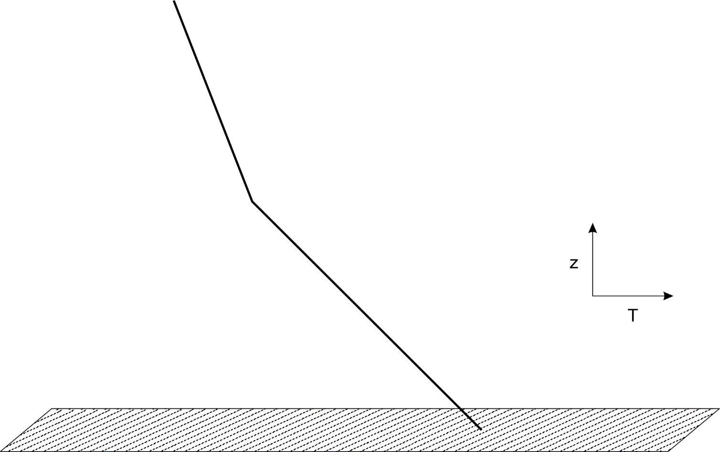
1. Start with deep dry adiabatic layer formed over dry soils

Slide 31
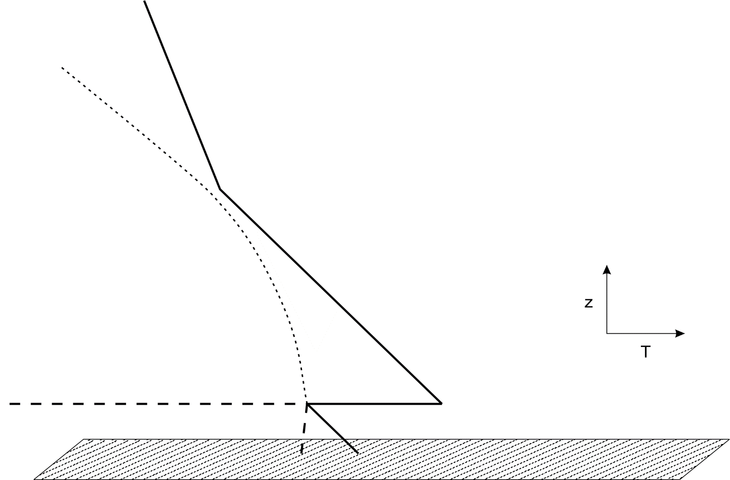
2. Move over moist soil, develop new shallow, wind-driven boundary layer, just saturated at its top, preserving moist static energy

Slide 32
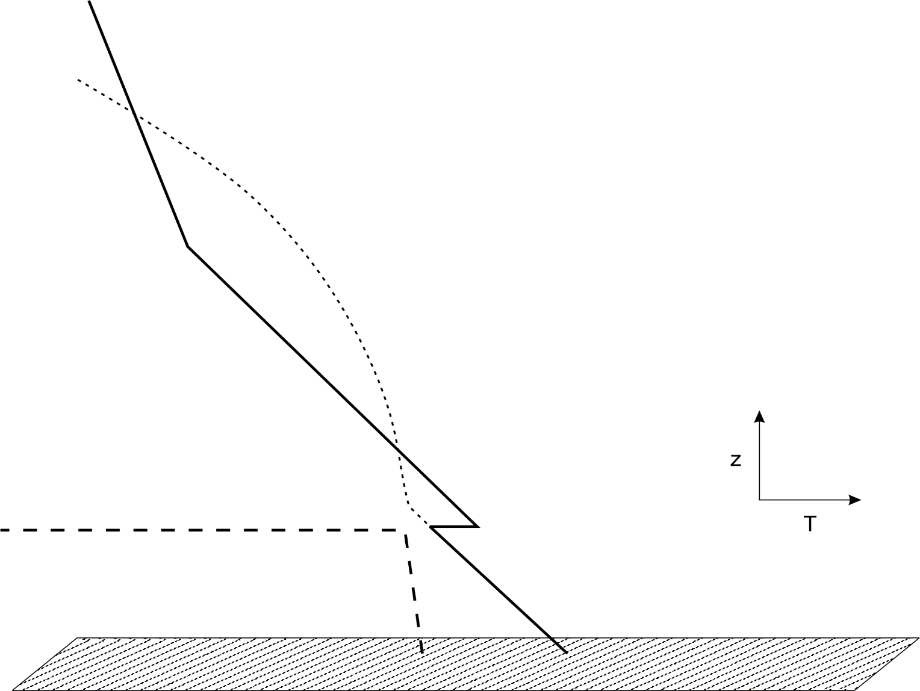
3. Sun rises and heats and moistens new boundary layer. Convective boundary layer grows and entrains low MSE air from elevated mixed layer

Slide 33
1-D PBL model
Key features:
Well mixed boundary layer
Dry adiabatic elevated mixed layer with zero moisture, giving way to stable troposphere
Surface energy balance (later replaced by soil/veg model)
Specified surface moisture (later replaced by soil/veg model)
Neutral aerodynamic surface sensible and latent fluxes
Lilly’s PBL-top entrainment formulation
Based on conservation of mass and moist and dry static energies
Assume new mixed layer has MSE=DSE of desert air and is just saturated at its top at sunrise
Entrainment of dry and moist static energy from elevated mixed layer during PBL growth
Agard and Emanuel, J. Atmos. Sci., 2017

Slide 34

Key Model Parameters
Elevated mixed layer potential temperature
Initial boundary layer temperature and humidity
Initial depth of boundary layer
Surface wind speed
Fraction of saturated surface moisture availability
Surface exchange coefficients
Magnitude and time evolution of insolation
Many more parameters added with soil/vegetation model
Tied together by assumption that initial MSE=DSE of desert air and saturated at PBL top

Slide 35
Impose a diurnal cycle of surface net radiative forcing

Slide 36
Results

Slide 37
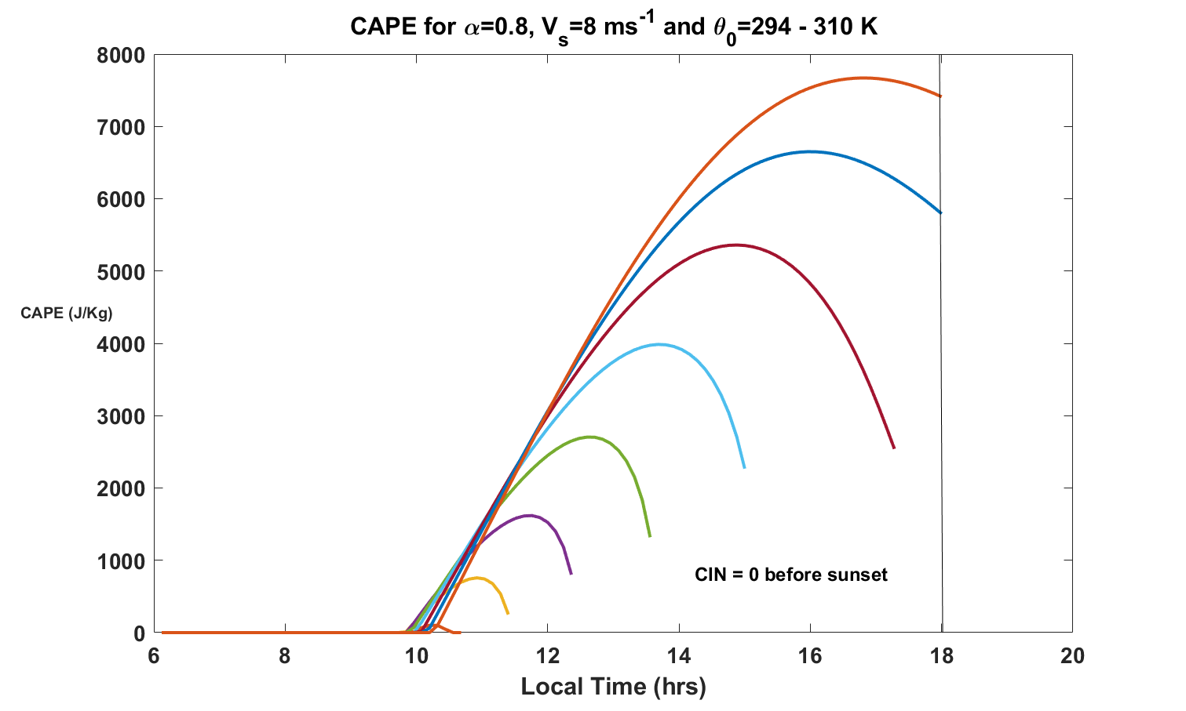
CAPE dependence on θ of desert-modified air

Slide 38
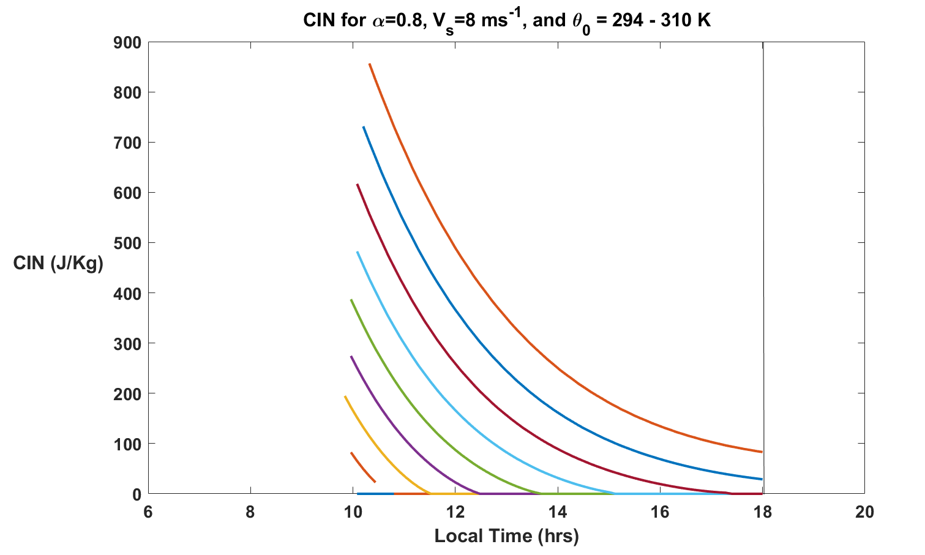
CIN dependence on θ of desert-modified air

Slide 39
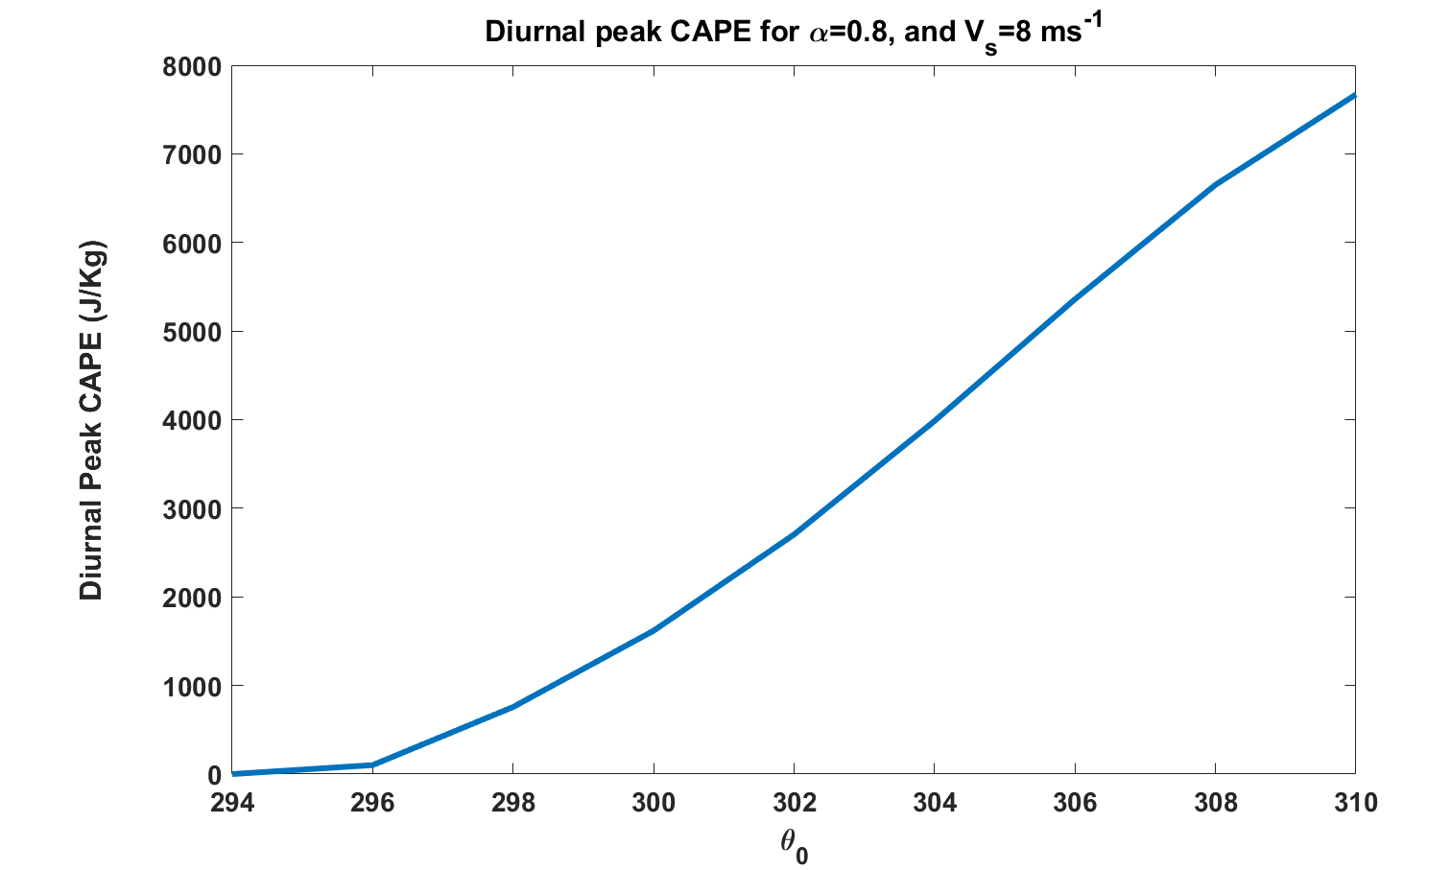
Peak CAPE dependence on θ of desert-modified air

Slide 40
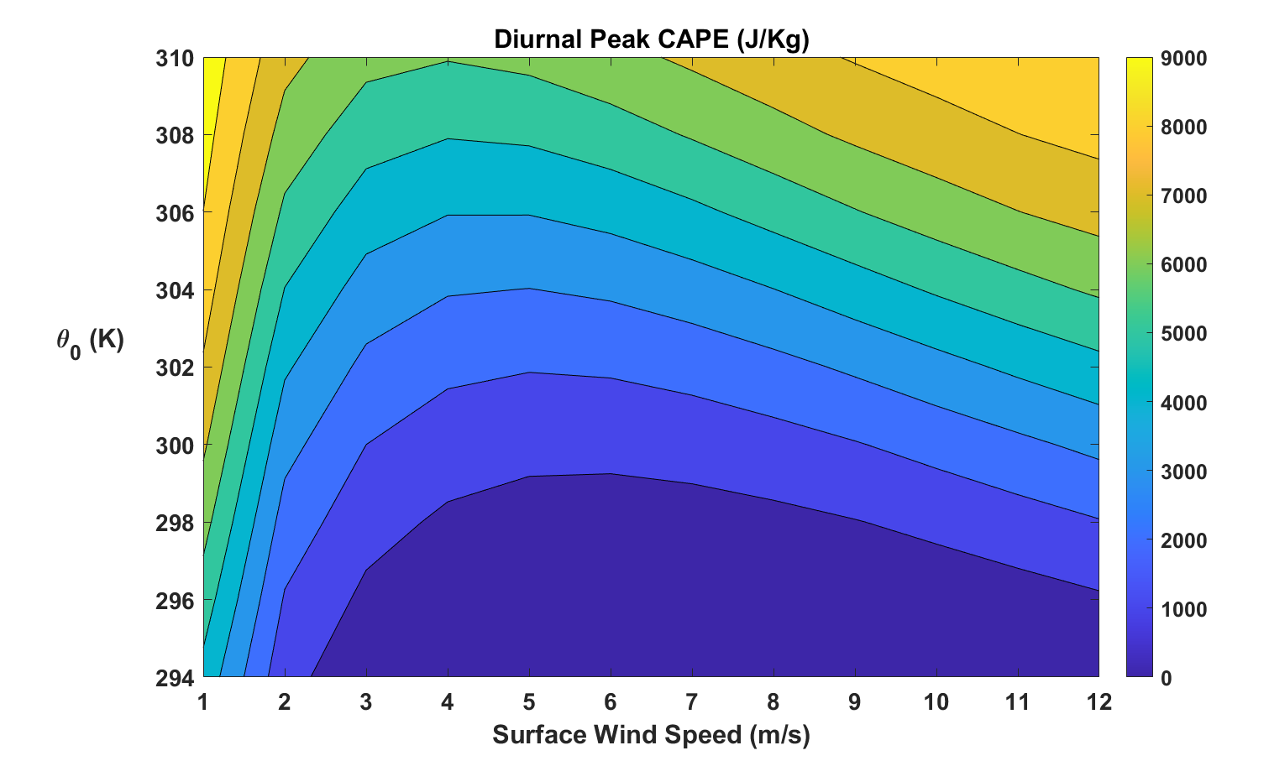
Diurnal peak CAPE as a function of surface winds and θ₀

Slide 41
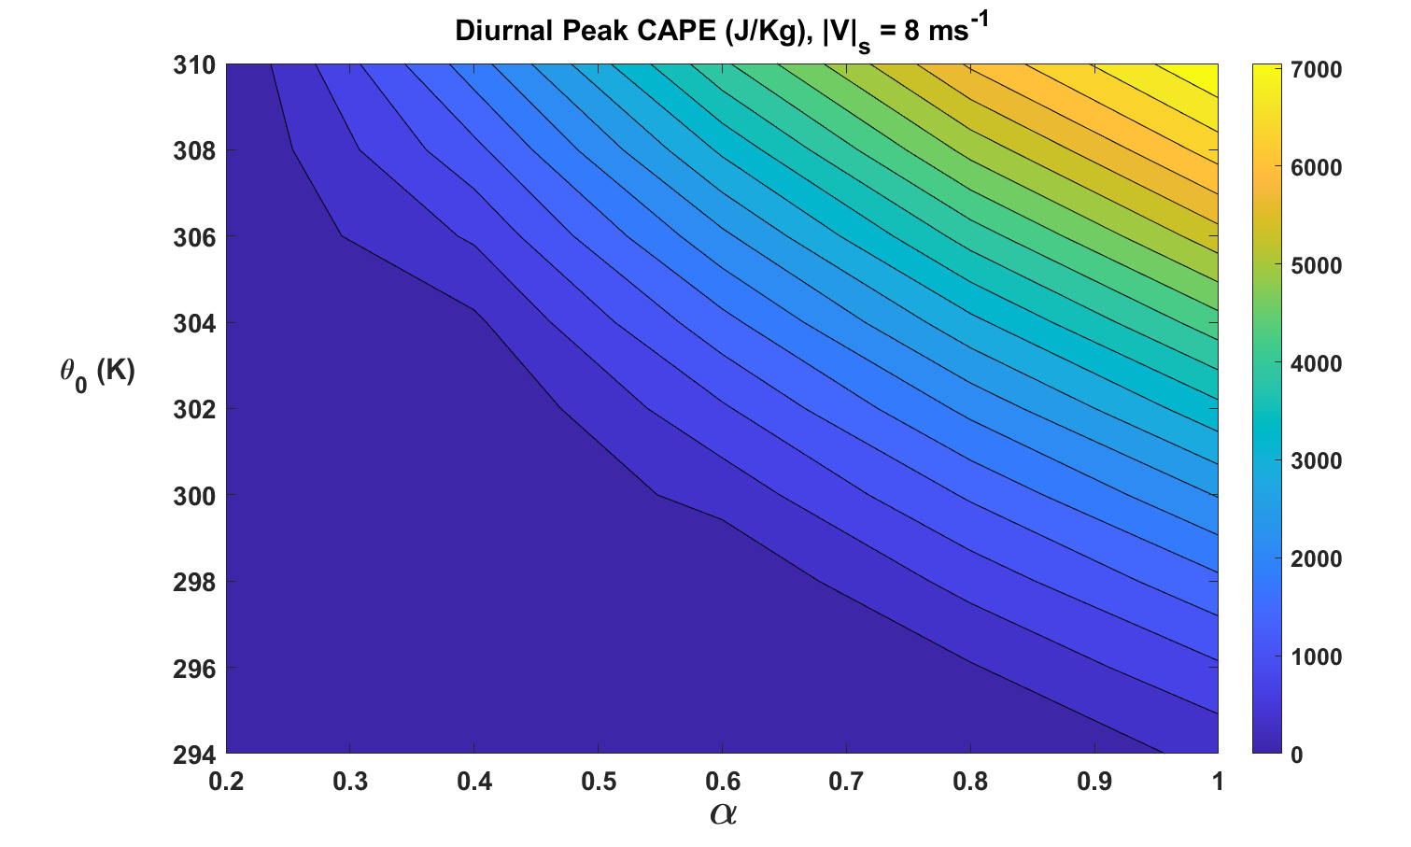
Peak CAPE dependence on desert air θ and soil moisture

Slide 42
Coupling to Soil Model
Force-restore representation of soil (Noilhan and Planton, 1989)
Surface and root zone soil variables: temperatures and volumetric moisture contents
Key soil variables include porosity, thermal conductivity and heat capacity, transmission of water through soil, vegetation cover, and variables controlling transpiration

Slide 43
Dependence of CAPE Evolution on Soil Type

Slide 44
Dependence on Vegetative Coverage

Slide 45
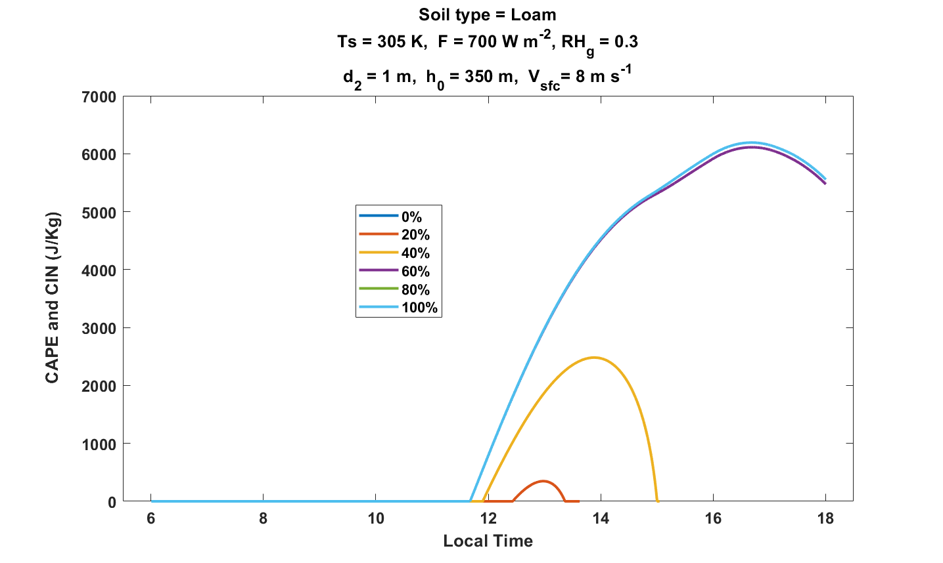
Dependence on root zone saturation level, 100% vegetative cover

Slide 46
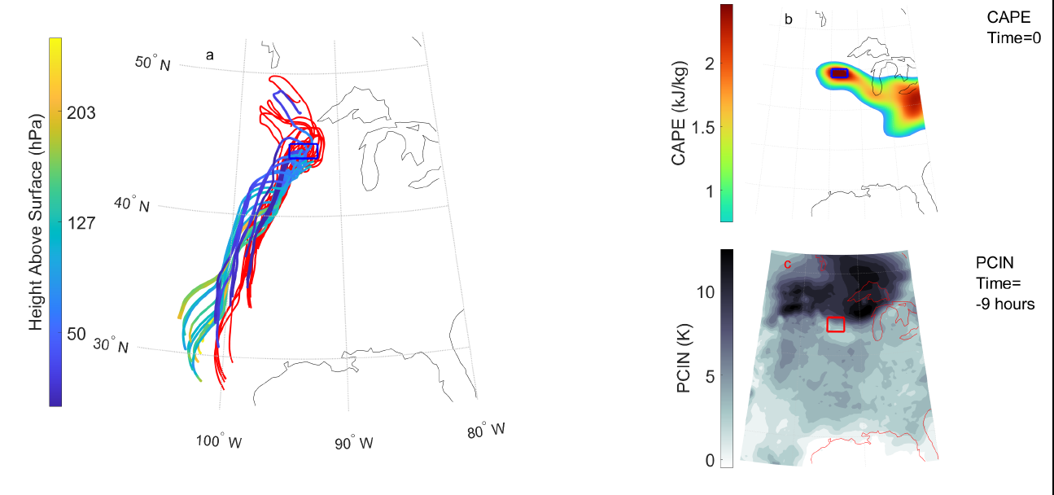
Analyze development of CAPE and CIN along trajectories
(PJ Tuckman et al., Mon. Wea. Rev., 2023)

Slide 48
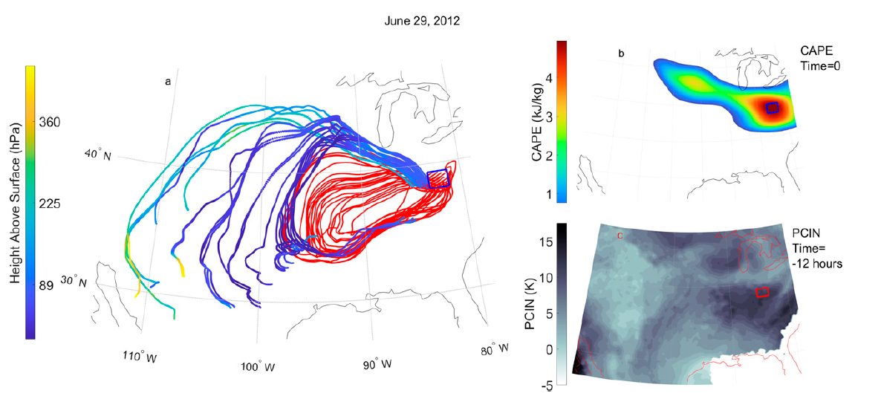
29 June 2012

Slide 49
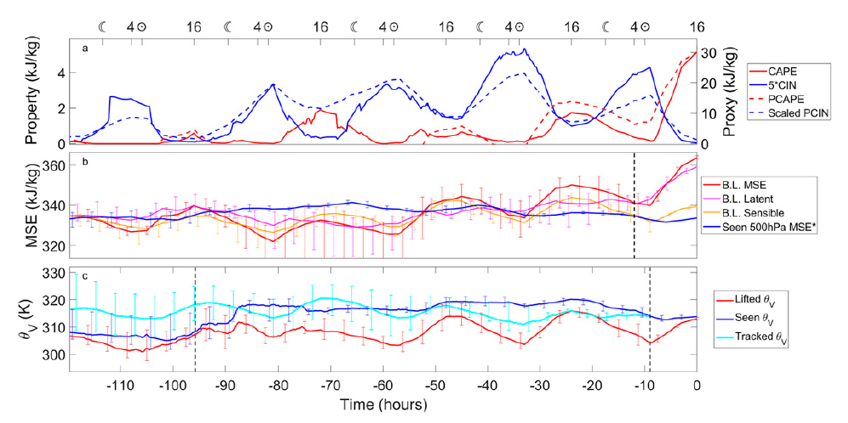
29 June 2012

Slide 50
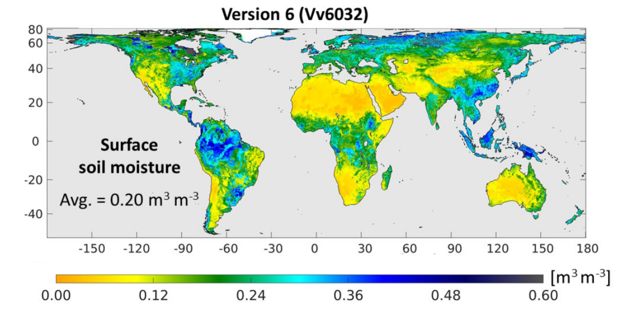
NASA Soil Moisture Active-Passive (SMAP) program
Surface Soil Moisture, April 2015-March 2021
Reichle, Rolf H., et al. Soil Moisture Active Passive (SMAP) Project Assessment Report for Version 6 of the L4_SM Data Product. Technical Report Series on Global Modeling and Data Assimilation 60 (2022).

Slide 51
Global Distribution of Tornadoes

Slide 52
Summary
Large CAPE occurs when deep dry-adiabatic layers are advected over moist and/or vegetated soils (connection to agriculture?)
Imposing a diurnal cycle limits the growth of peak CAPE with surface temperature
Diurnal peak values of CAPE increase monotonically with potential temperature of the desert-modified air
Peak CAPE also increases with surface wind speed and soil moisture, though it also large for very low wind speed
Coupling to soil thermodynamics and vegetation physics is important
Dependence on soil moisture may offer a degree of seasonal predictability of CAPE
Agricultural and other land use practices on regional scales may alter severe storm climatology

Slide 53
Summary (continued)
Global model climatology of severe convective environments likely to be sensitive to soil moisture and soil-precipitation feedbacks
Global warming increases CAPE, unless previously moist soils dry out too much or lose too much vegetation
We should develop improved severe weather proxies for application to climate models or regional models driven by climate models, for use in assessments of current and future risks from severe convective storms. AI/ML should be helpful in this endeavor, but no substitute for thoroughly understanding the physics

Slide 54
Spare Slides

Slide 55
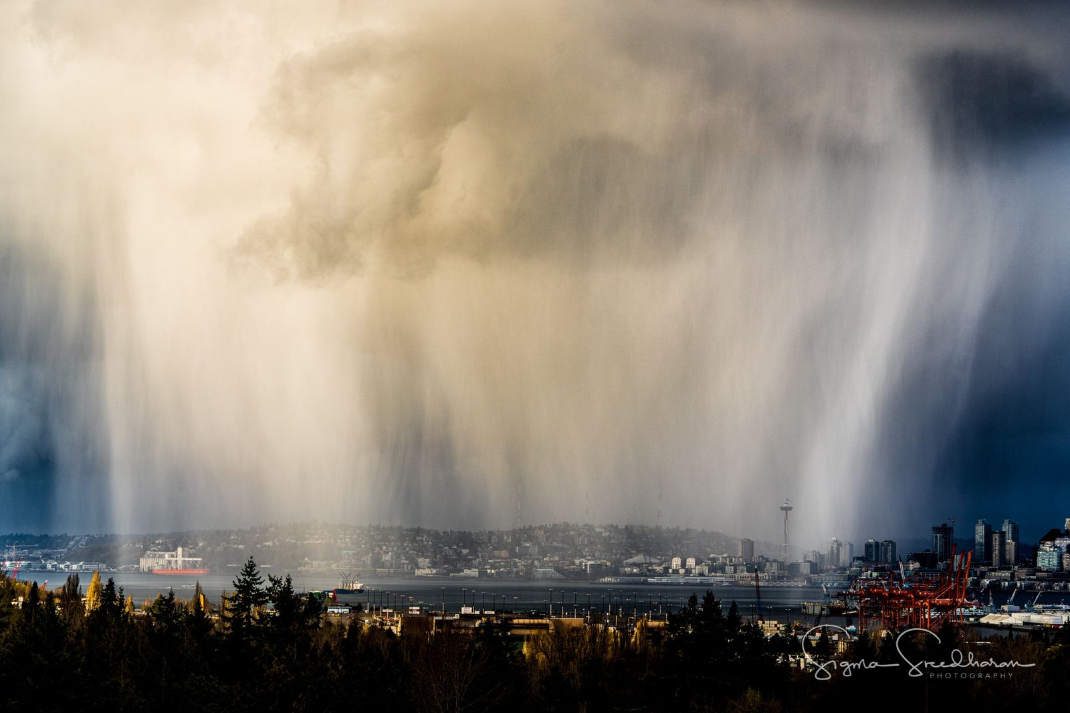

Slide 56
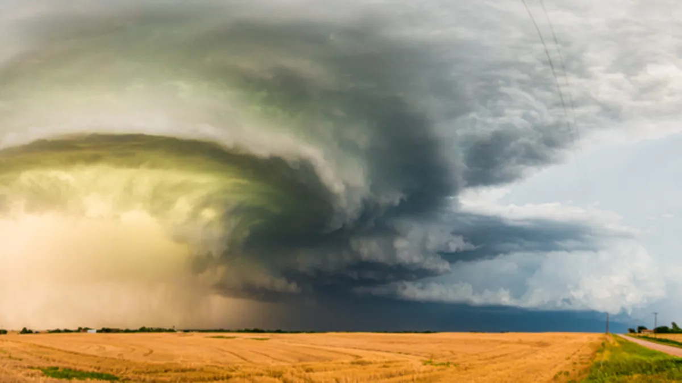

Slide 57
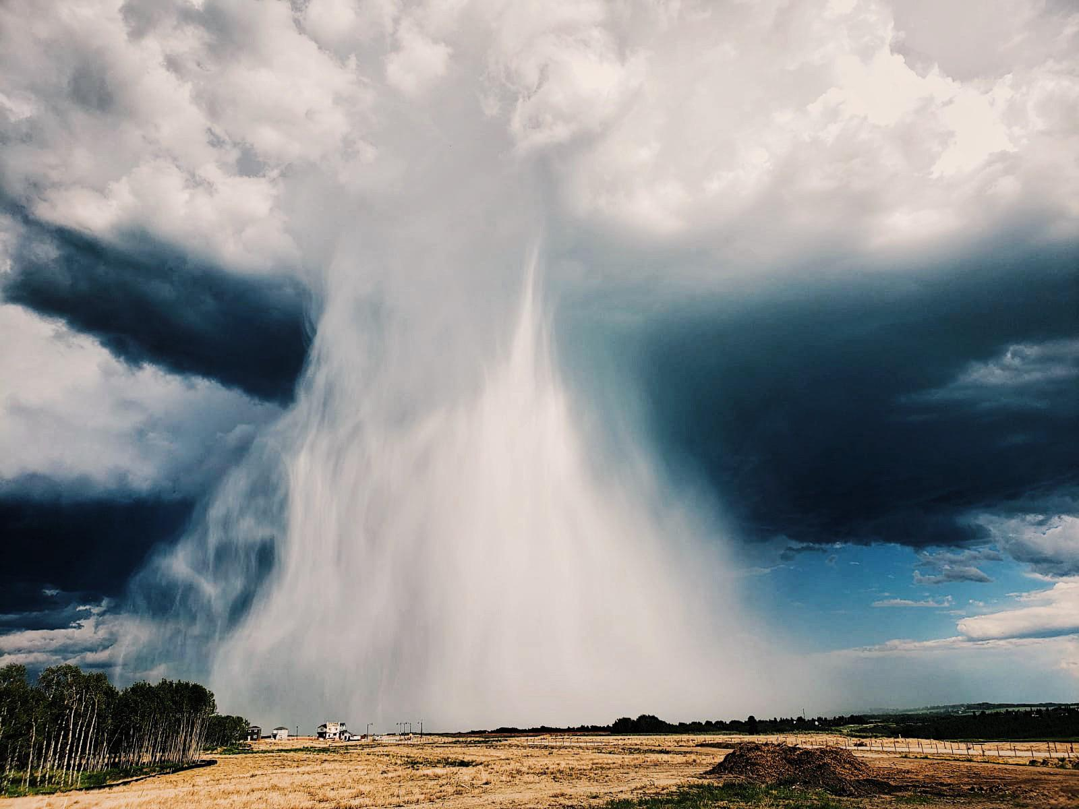

Slide 58
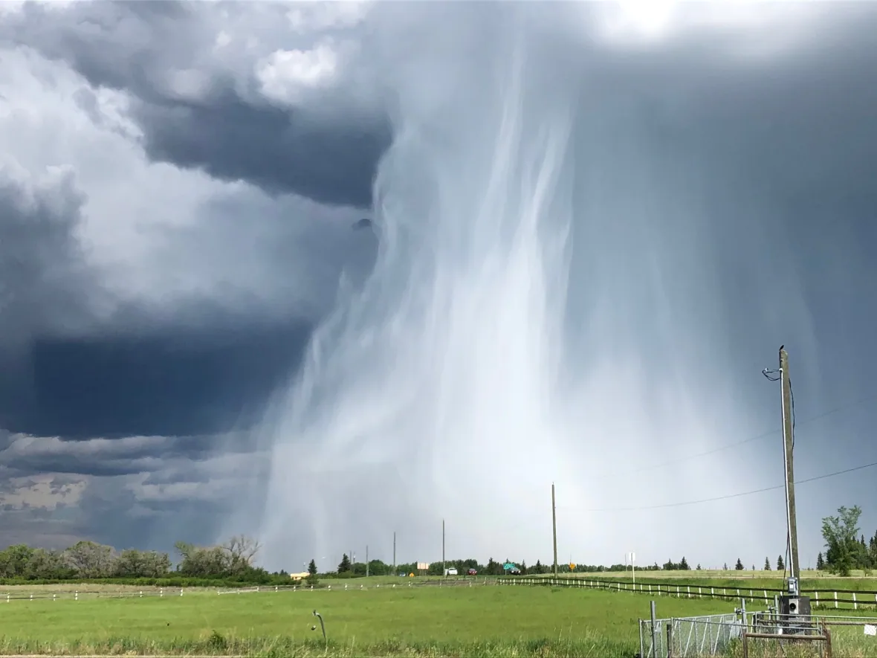

Slide 59
Formalized by very simple model whose variables are:
Dry static energy
Moist static energy
PBL depth
Entrainment velocity
Surface sensible heat flux
Surface latent heat flux
Agard and Emanuel, J. Atmos. Sci., 2017

Slide 60
Boundary Layer Equations
Dry static energy
Moist static energy
Lilly’s entrainment formulation
Surface sensible heat flux
Surface latent heat flux
Net surface flux
Boundary layer mass

Slide 61
Note: M_{s} is related to D_{s} by Clausius-Clapeyron Equation
Initial conditions:
M (t=0) = D₀
D (t=0) determined so that air is just saturated at boundary layer top
h=h₀
Initial dry static energy of free troposphere

Slide 62
Nondimensionalize:

Slide 63
Equations are normalized and recombined to arrive at
Determined so that air is initially just saturated at boundary layer top

Slide 64
Long-time Asymptotic Behavior
CAPE reaches a maximum at a particular time and then falls to zero at a later time, while the boundary layer depth goes to infinity at the later time and D, D_{s}, and M approach unity. T_{s} is the surface air temperature of the initial dry state.
CAPE still reaches a peak at a particular time and then falls off to or asymptotes to a positive long-time asymptotic value. The asymptotic limits are given by

Slide 65
Convective Available Potential Energy
(CAPE)
T_{top} determined by fixed anvil temperature hypothesis

Slide 66
Asymptotic Cape Scaling in ‘Warm’ Regime, Applicable at Time when PBL Growth Becomes Linear
CAPE rises exponentially with surface temperature
CAPE increases with increasing surface wind
CAPE increases with increasing soil moisture
For a given surface temperature, CAPE declines with absorbed solar radiation

Slide 67
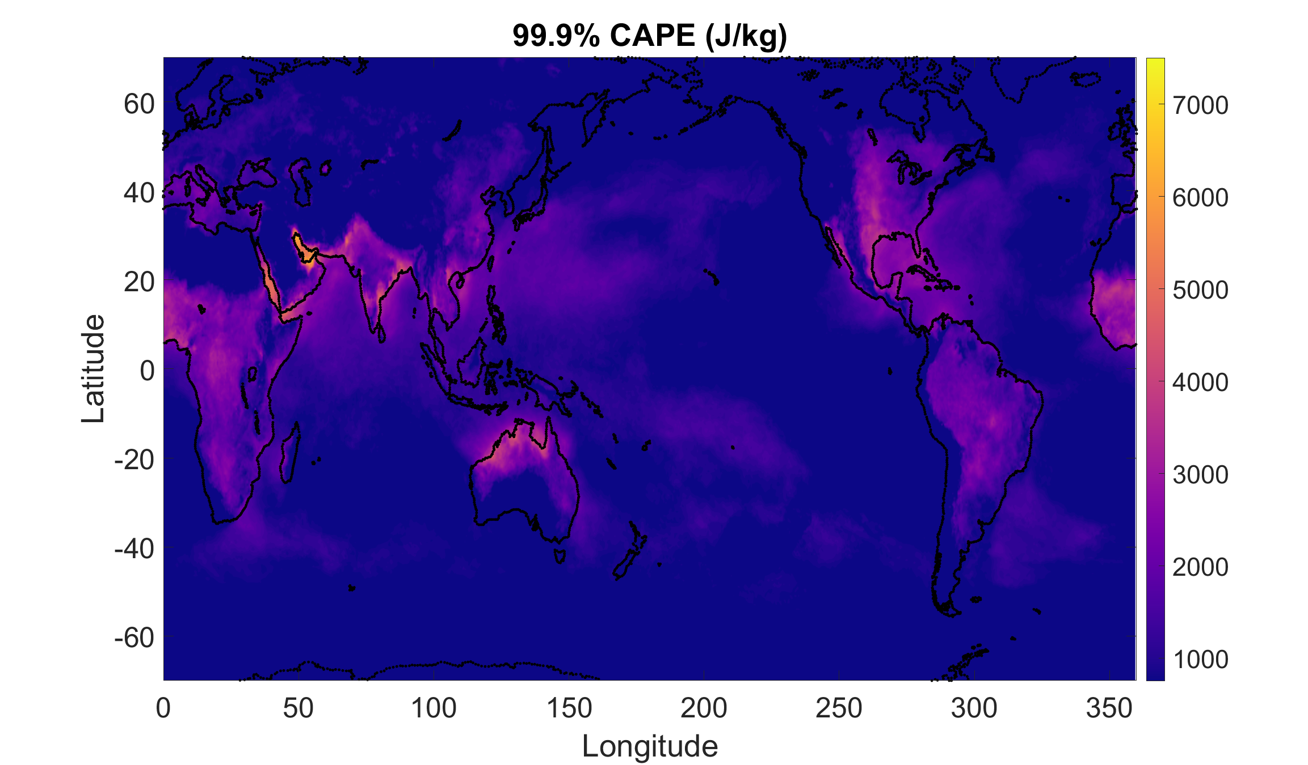
99.9% quantile of non-zero CAPE from ERA5 reanalysis hourly data over a single year. Courtesy PJ Tuckman, MIT

Slide 68
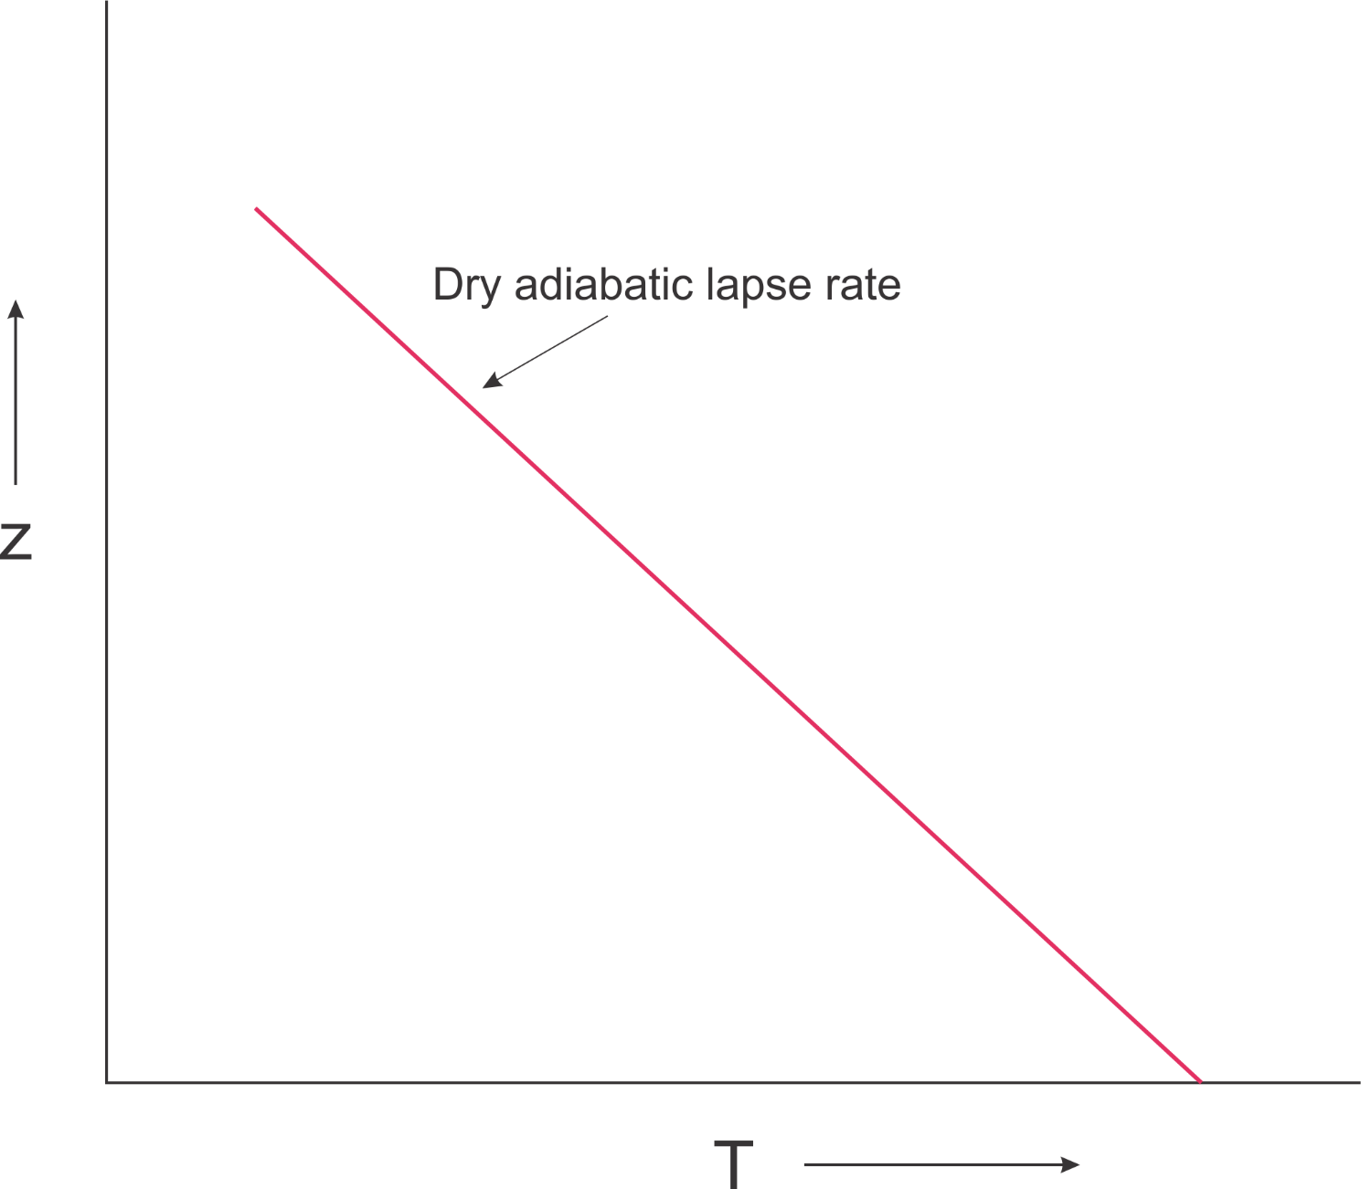

Slide 69
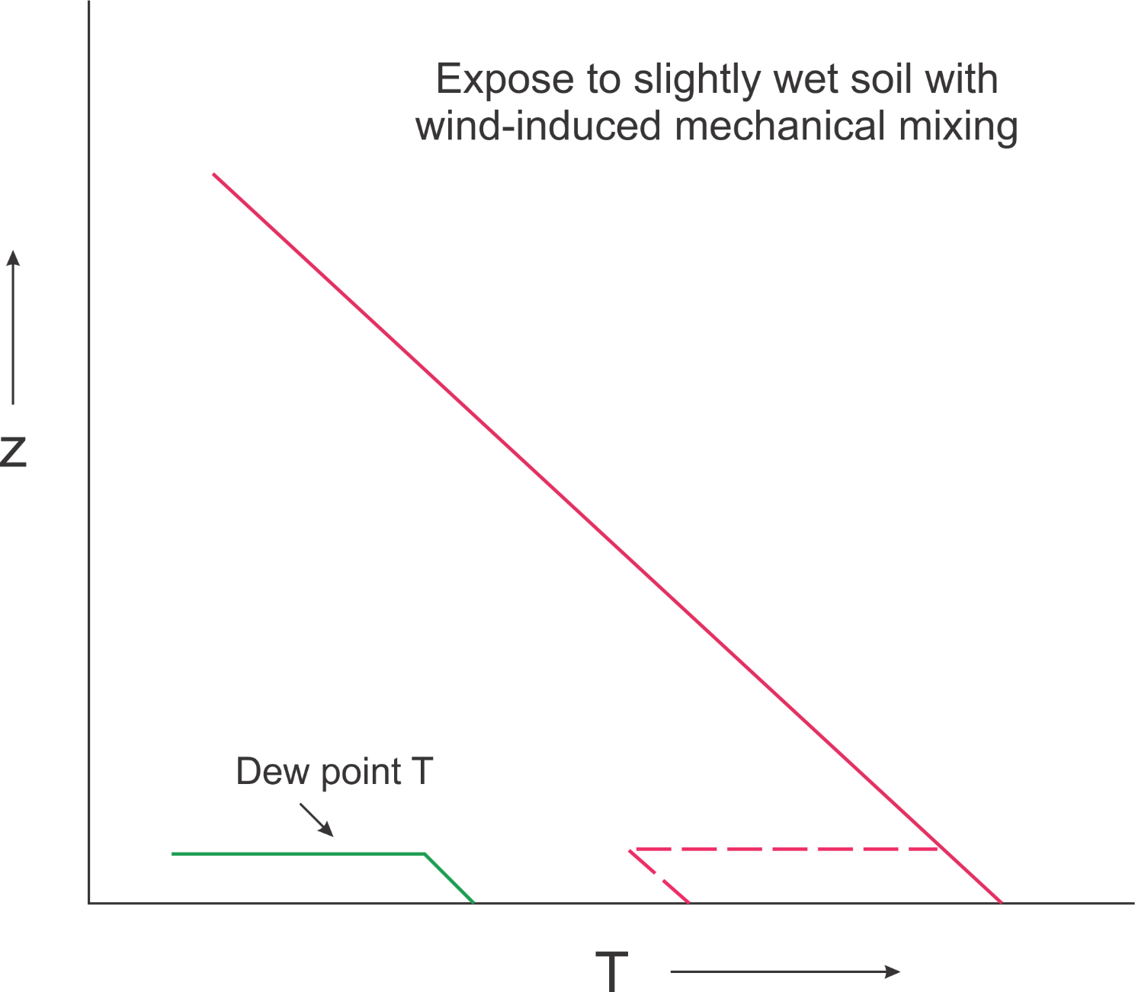

Slide 70
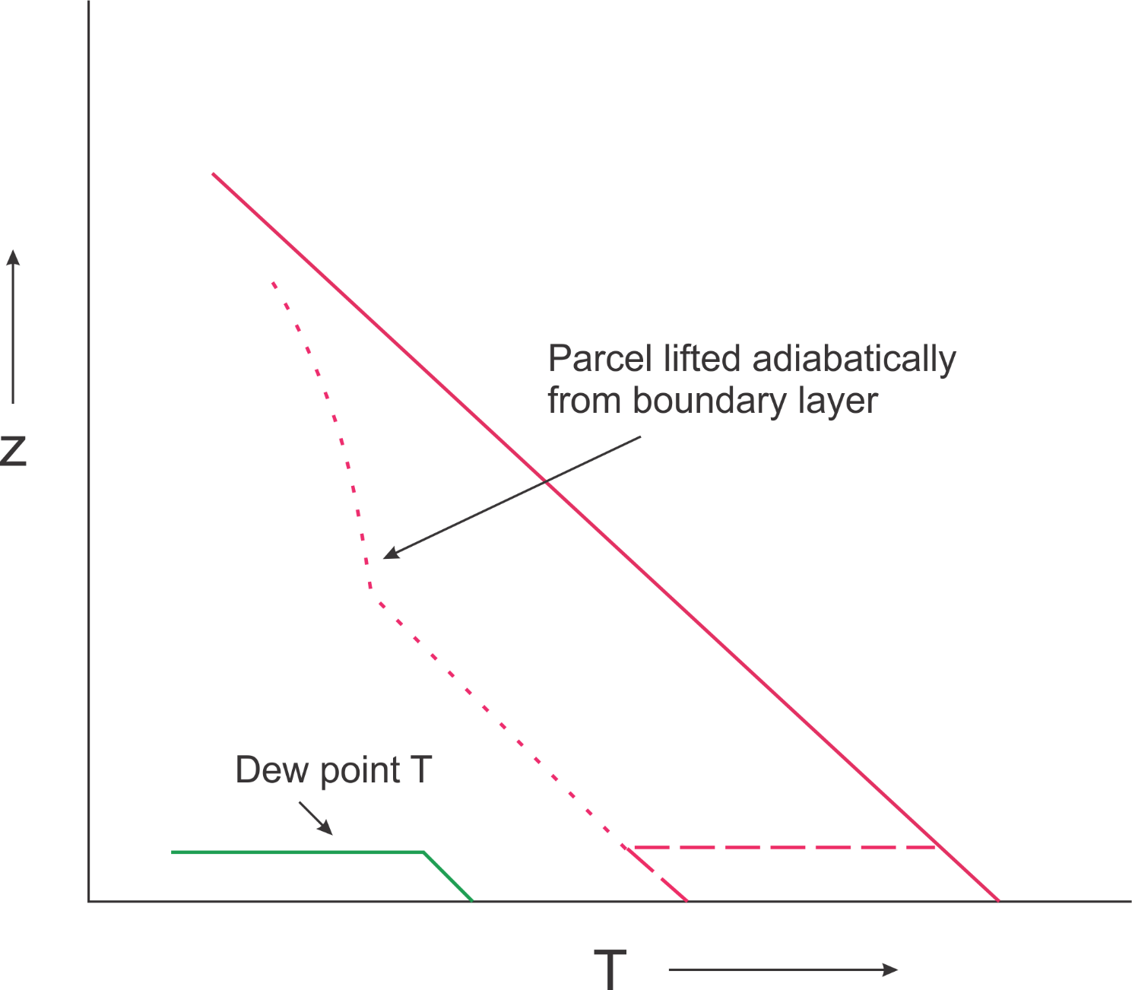

Slide 71
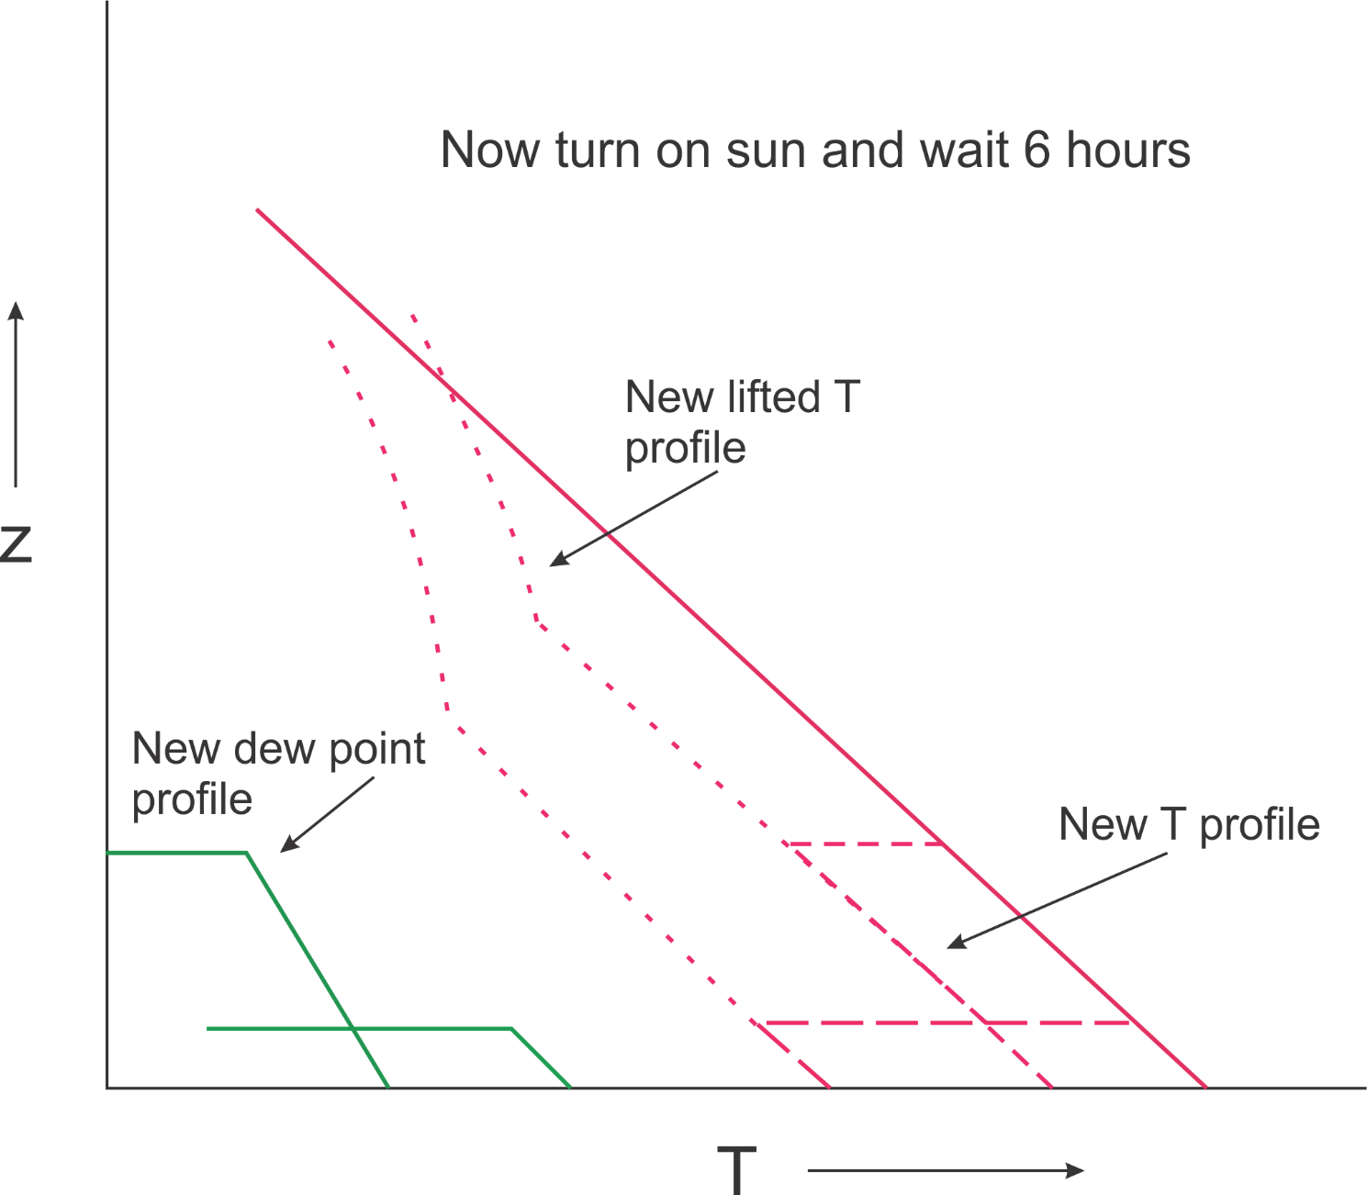

Slide 72
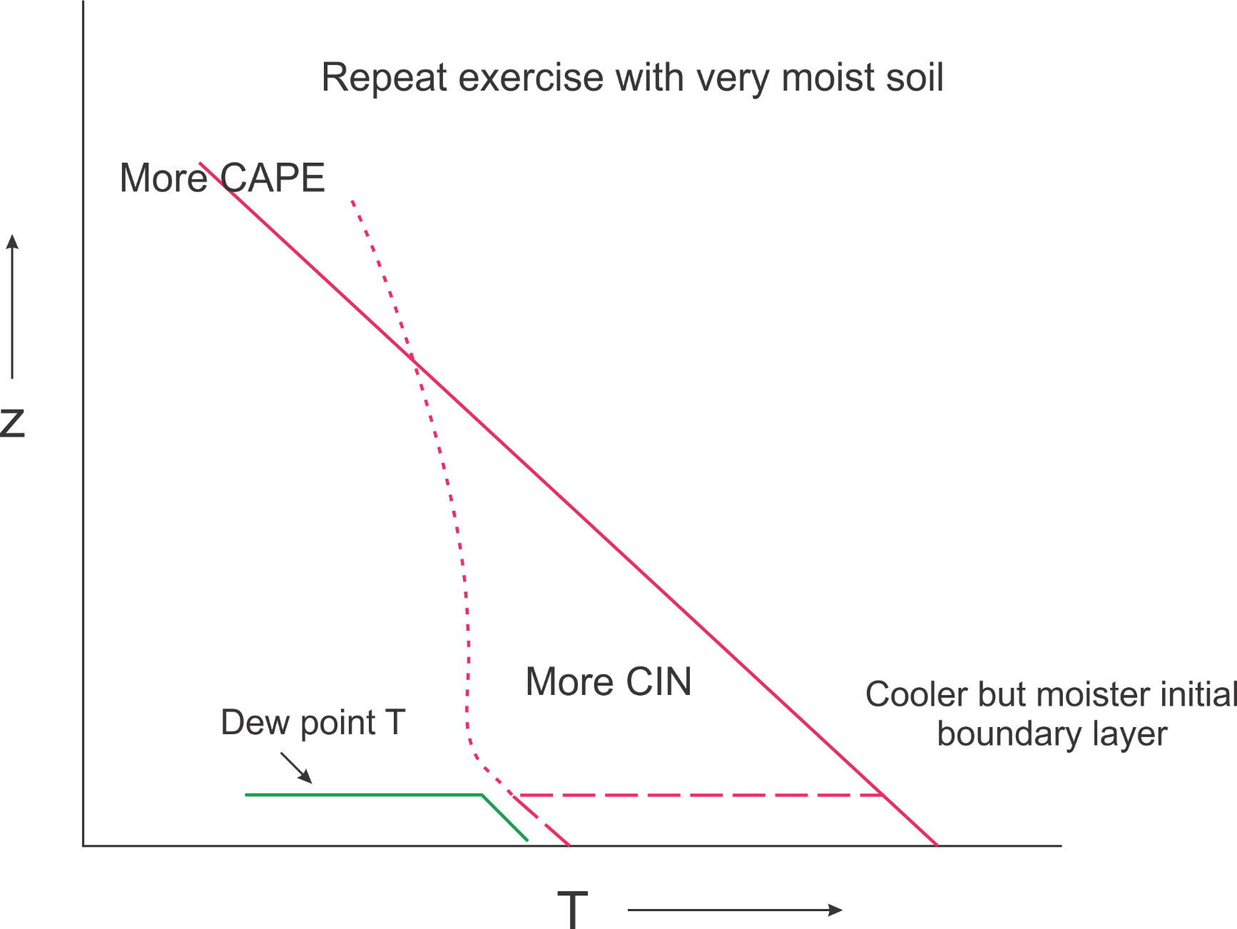

Slide 73
