Slide 1
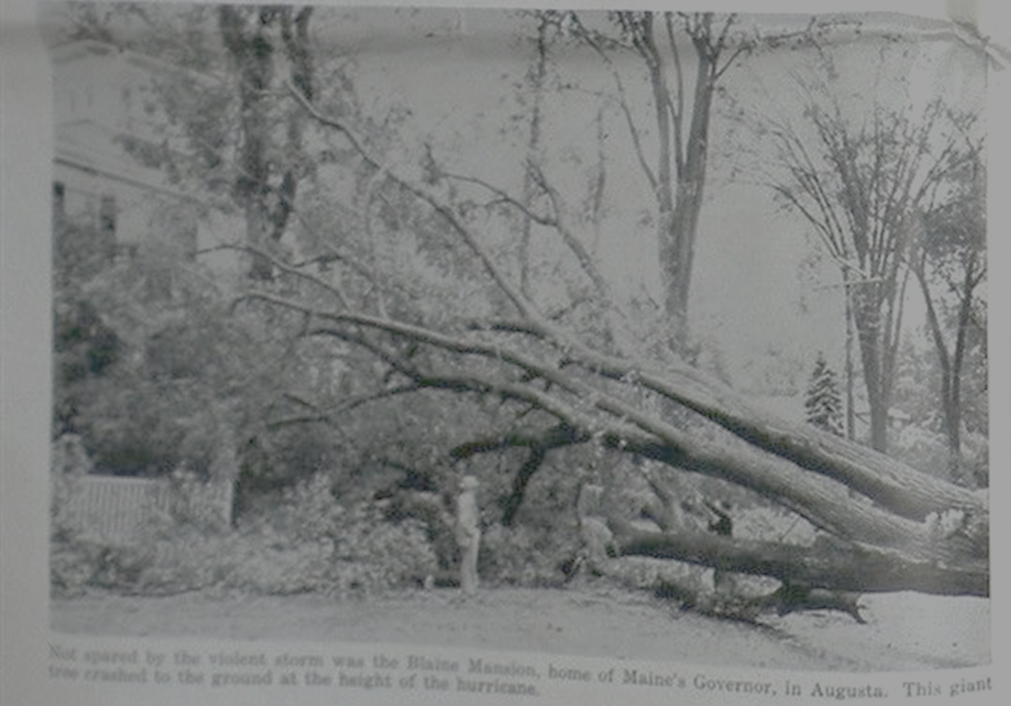
Hurricanes and Hurricane Risk in mid-coast Maine
Kerry Emanuel
Massachusetts Institute of Technology

Slide 2
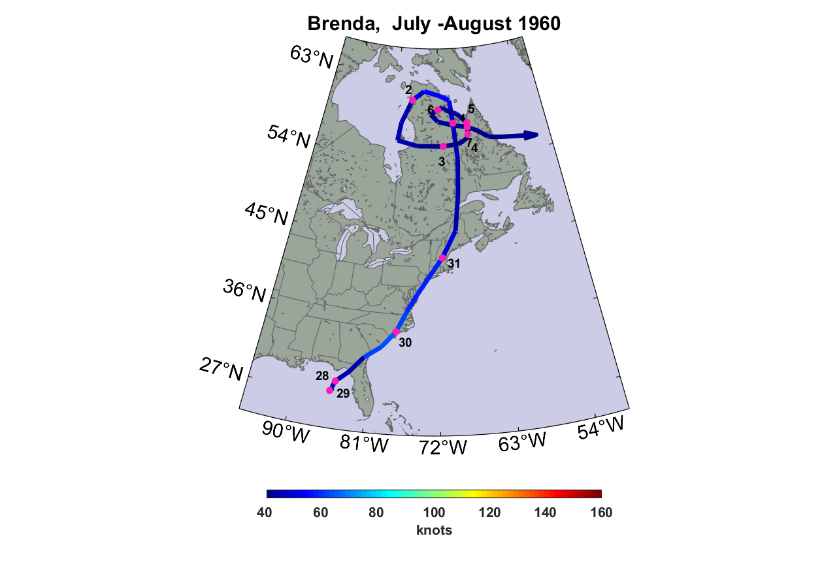

Slide 3
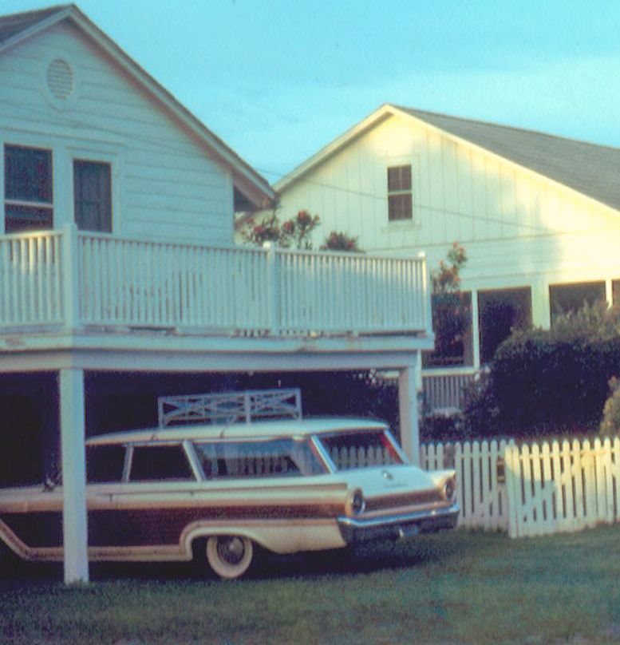
Emanuel’s station wagon in 1962

Slide 4
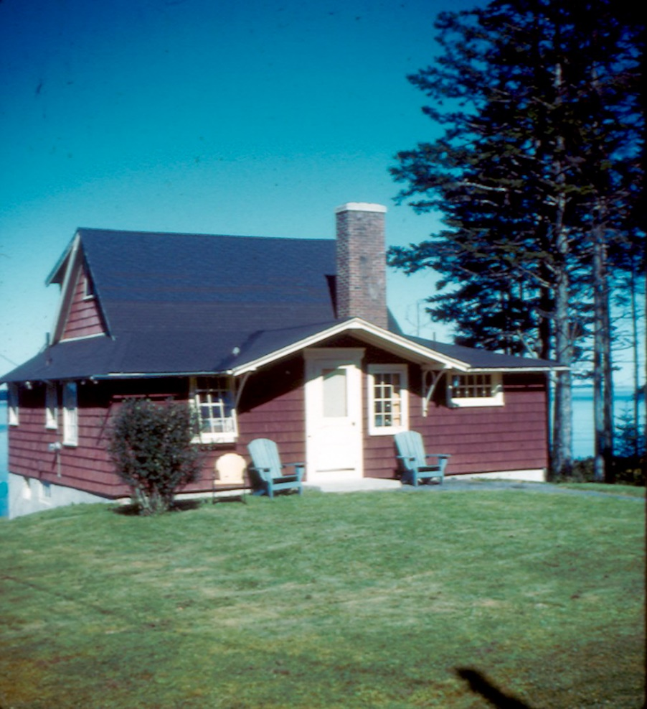

Woody, Geoff, and Kerry
Rental cottage, Crockettes Beach, Owls Head

Slide 5
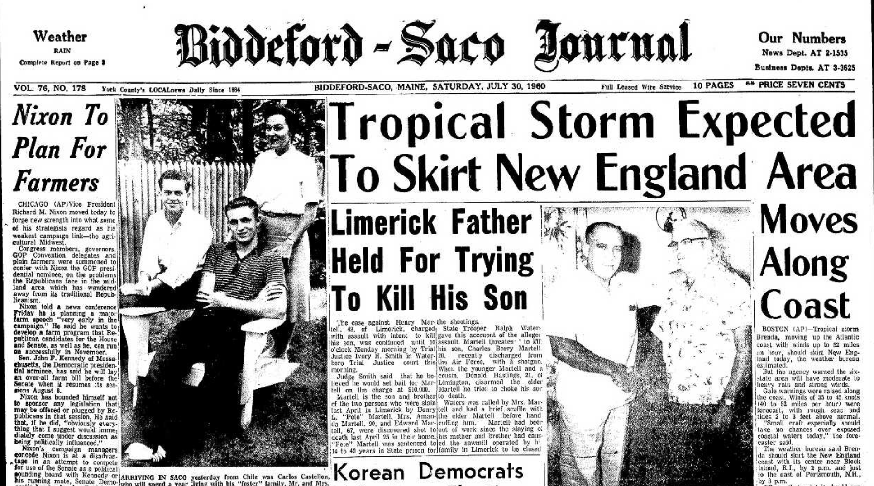
Saturday, July 30, 1960

Slide 6
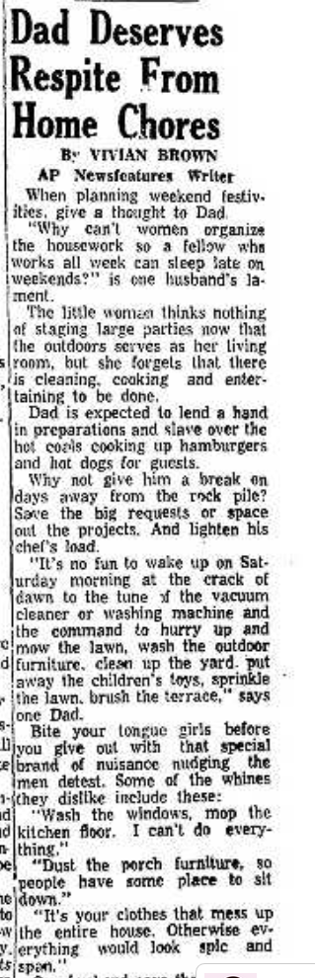

Slide 7
Some Famous Maine Hurricanes

Slide 8
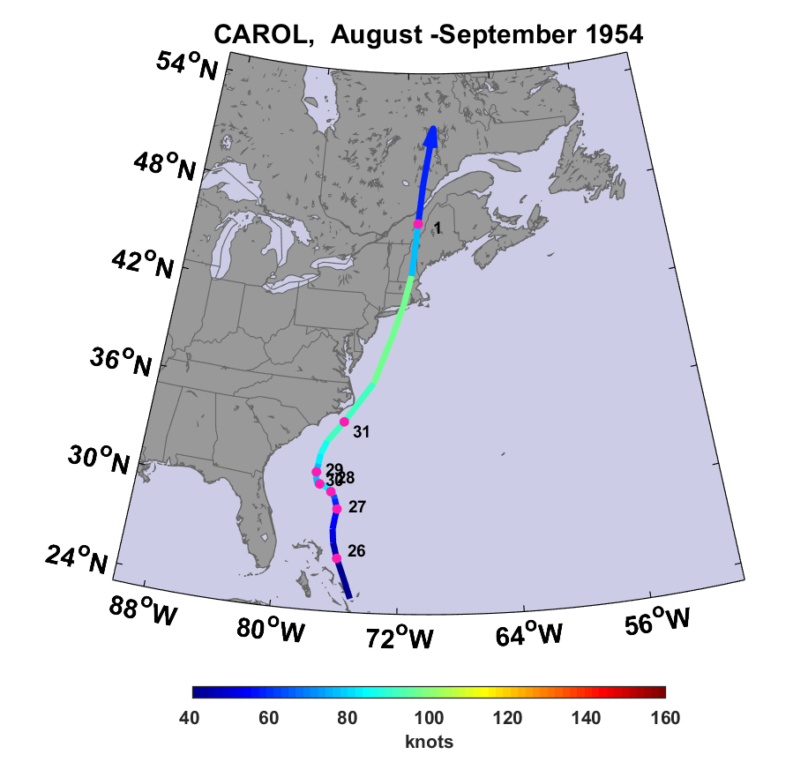

Slide 9
Hurricane Carol of 1954 in Maine
Three deaths in Maine; 65 deaths and 1,000 injuries in New England
$10 million in damages in Maine ($250 million in 2019 dollars)
$500 million in damages, New England ($12.5 billion 2019)
Peak wind gusts of 78 MPH in mid-coast Maine
2.25 inches of rain in places (not that much, but played into the Edna disaster a few weeks later)
Power lost in all of greater Portland
Most lobster fisherman reported damage
Three-quarters of the Maine apple crop destroyed

Slide 10
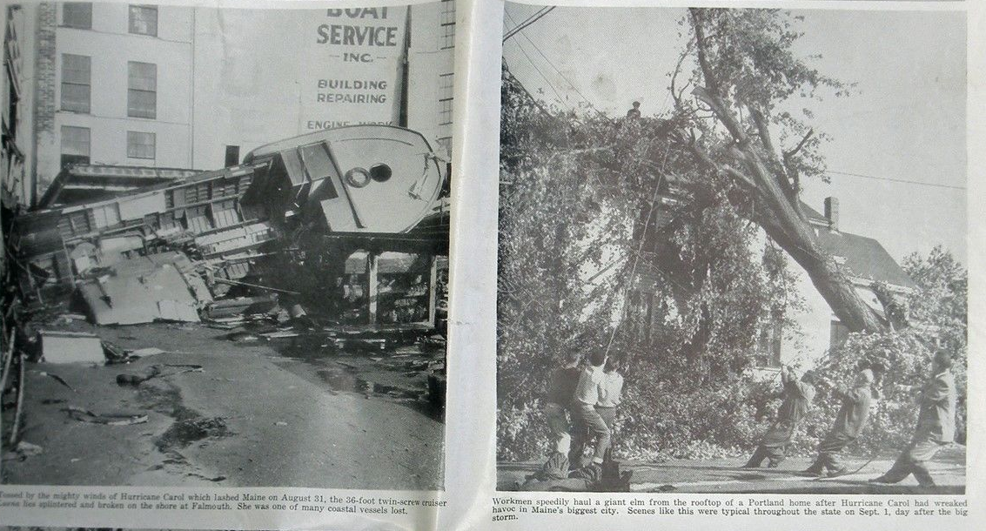
Falmouth, ME
Portland, ME

Slide 11
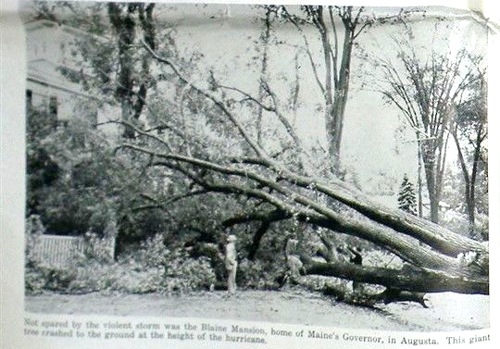
The Blaine Mansion, Augusta

Slide 12
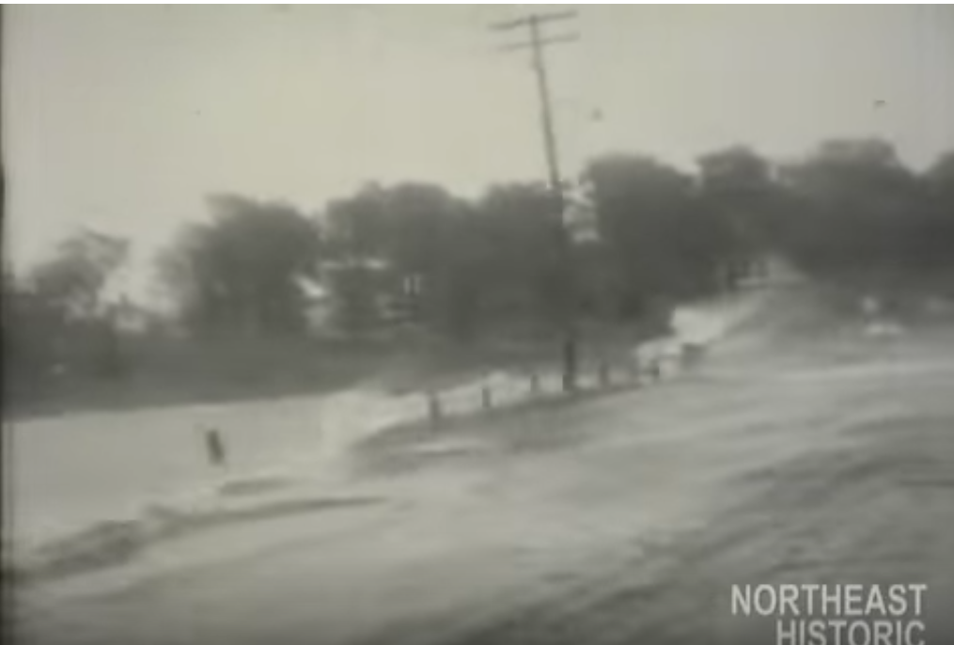
A scene in Maine during Carol

Slide 13
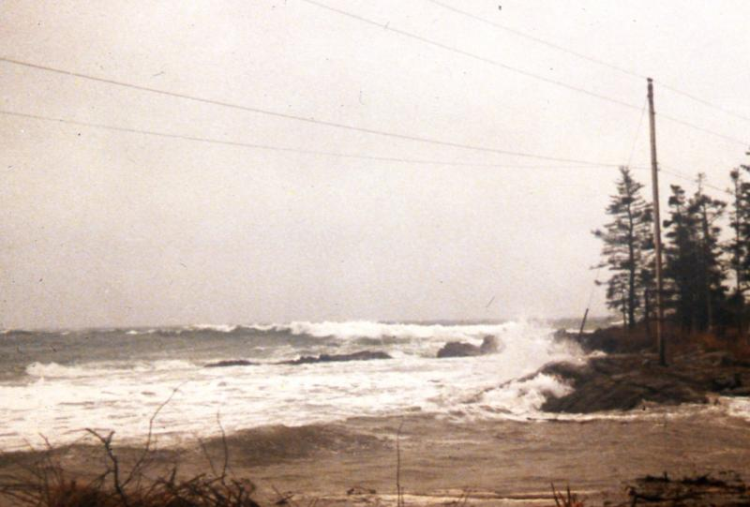
Looking SW from Ocean Point, Boothbay during Carol

Slide 14
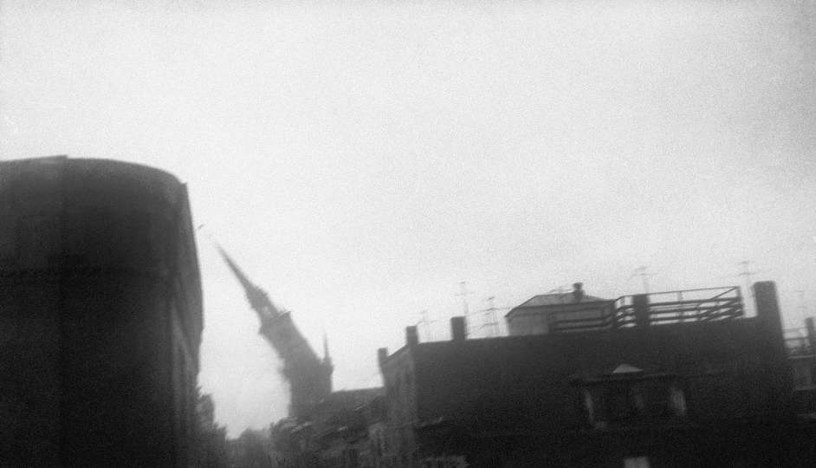
148-year-old steeple of the Old North Church in Boston falling during Hurricane Carol, 1954

Slide 15
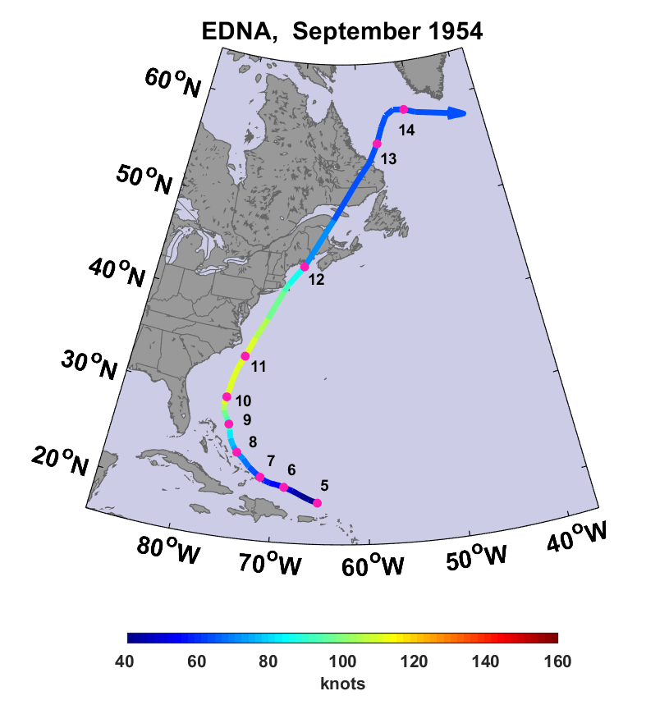

Slide 16
Hurricane Edna of 1954 in Maine
Eight deaths in Maine
$25 million damage in Maine ($240 million in 2019 dollars)
Peak wind gusts of 75 MPH in Maine
Rainfall totals as high as 7.5 inches
The Androscoggin and Kennebec rivers both reached above- normal levels, causing flooding and washing out roads
President Eisenhower declared Maine a disaster area

Slide 17
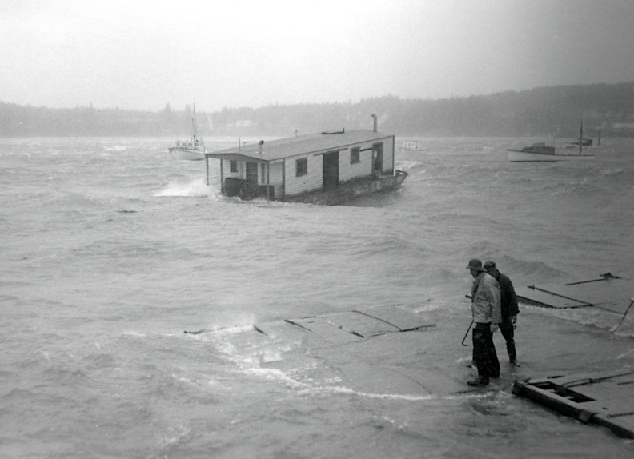
Harvard Beal's Bait Scow and Beal's Boat Yard, Southwest Harbor, during Hurricane Edna

Slide 18
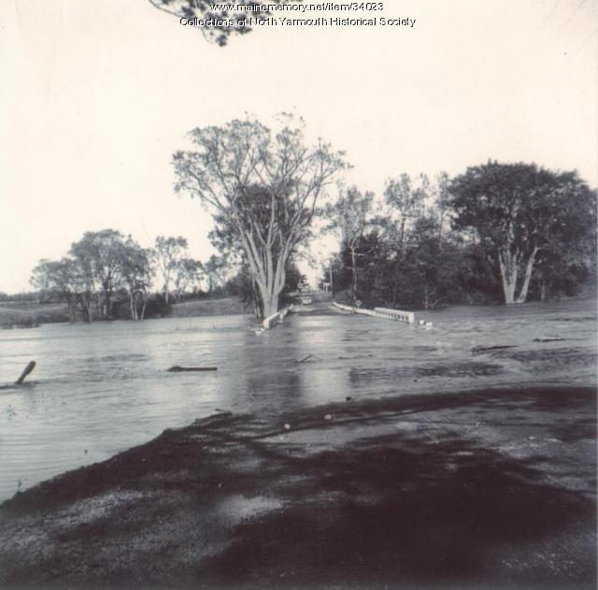
Memorial Highway near Dunn's Corner, Yarmouth

Slide 19
Damage to dam in Limestone, ME

Slide 20
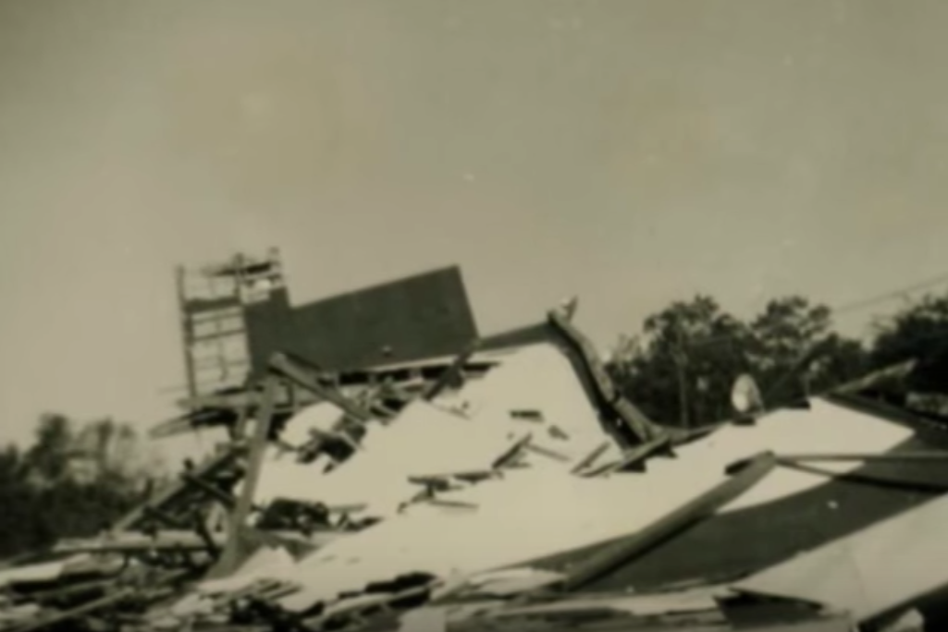
Remains of the drive-in movie theater in Rockport, ME, after Edna

Slide 21
Article by E.B. White, The New Yorker, Sept. 25th 1954
(White resided in North Brooklin, Maine)
Notes:
“At 8:44 PM the power failed, the house went dark, and it was a whole lot easier to see Edna. In almost no time the storm grew to its greatest height: the wind (NW by this time) chased black clouds across the ailing moon. The woods to the south of us bent low, as though the trees prayed for salvation. In front of the house, a large branch of the biggest balm-of Gilead tree snapped and crashed down across the driveway, closing it off. On the north side, an apple tree split clean up the middle. And for half an hour or so Edna held us in her full embrace.”

Slide 22
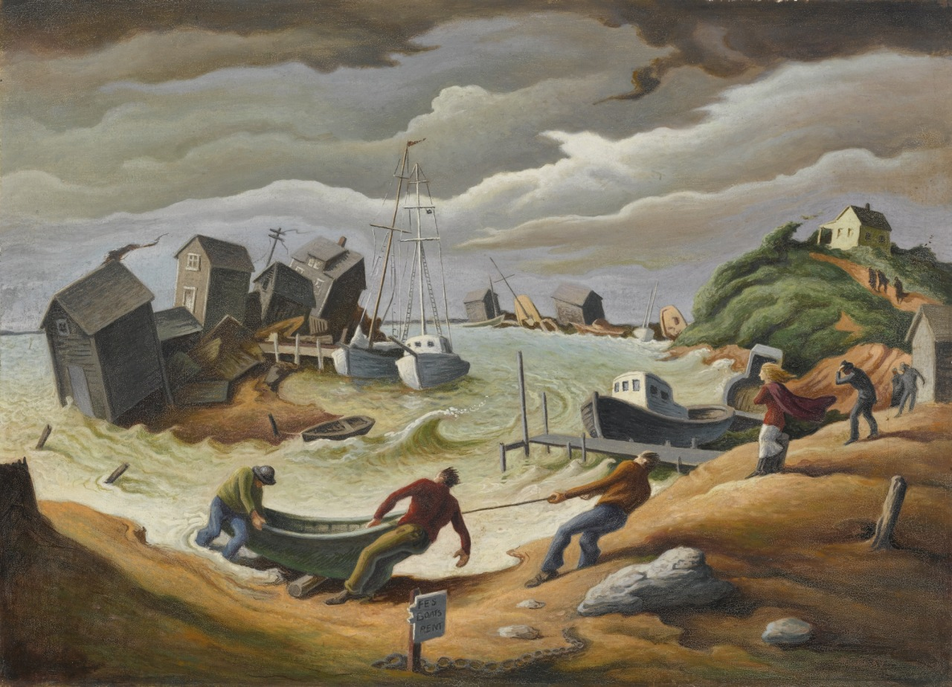
Menemsha hurricane - Thomas Hart Benton (1954). The painting depicts 1954’s Hurricane Edna which highly damaged the coast of New England. Menemsha, a small fishing village on Martha’s Vineyard, was hit especially hard.

Slide 23
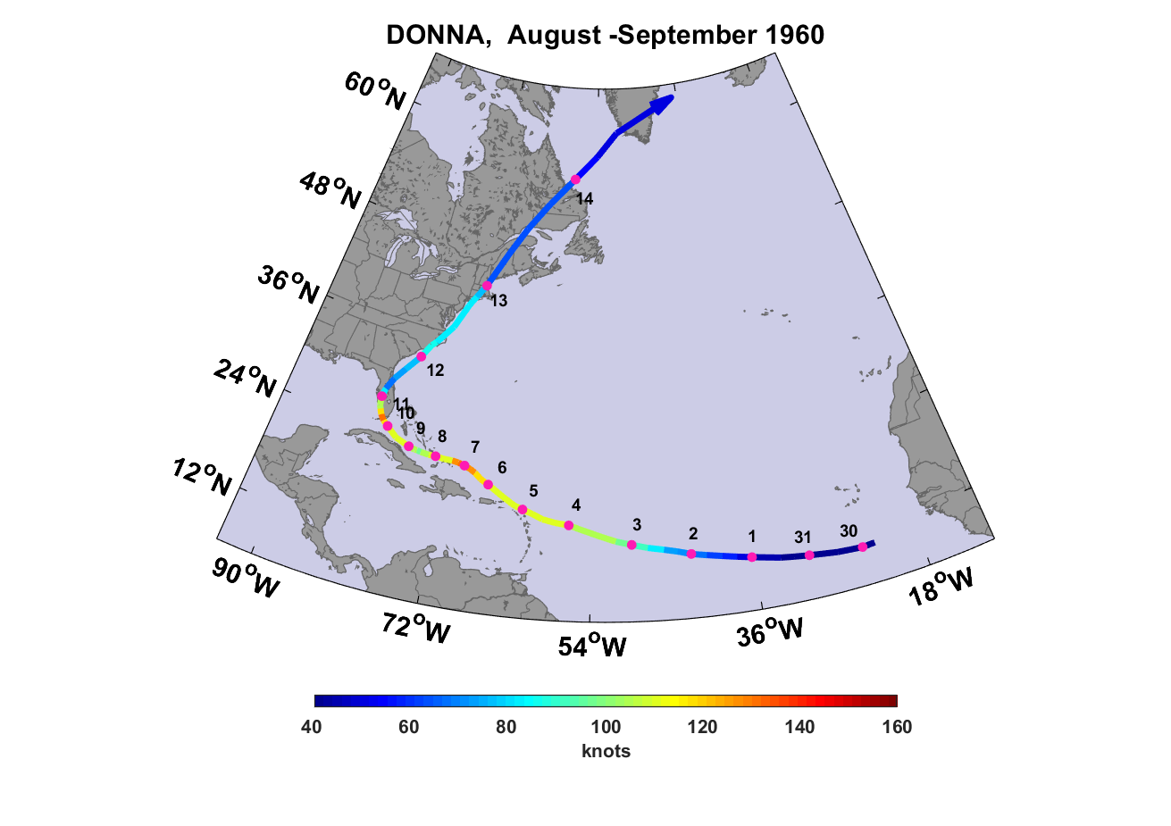
Relatively light damage in Maine, but 20-40% of apple crop destroyed

Slide 24
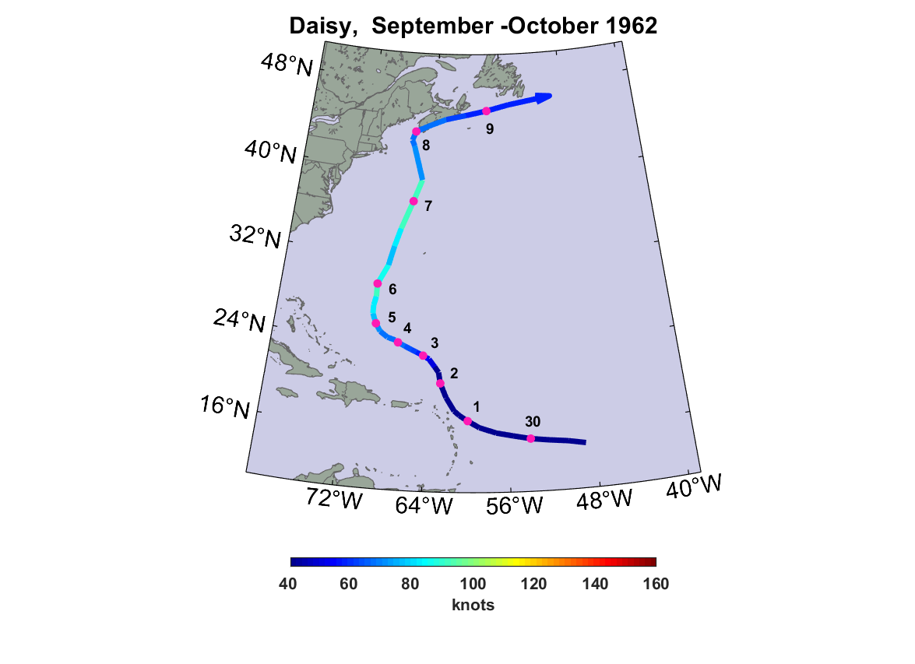

Slide 25
Hurricane Daisy in Maine
Two deaths from falling branches, in Thomaston and Rockland
9.5 inches of rain fell in Portland, an all-time record that held until Hurricane Bob of 1991
Wind gusts to 70 MPH in coastal Maine

Slide 26
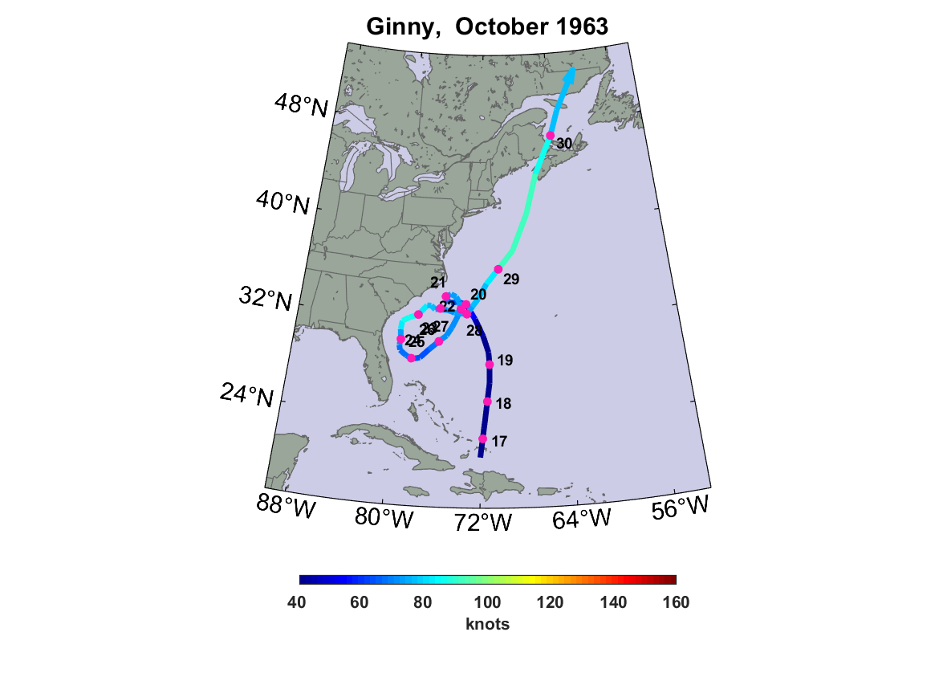
Gusts to 100 MPH at Rockland Coast Guard station. Many trees were knocked over and a barn at the Maine State Prison farm in South Warren was destroyed.

Slide 27
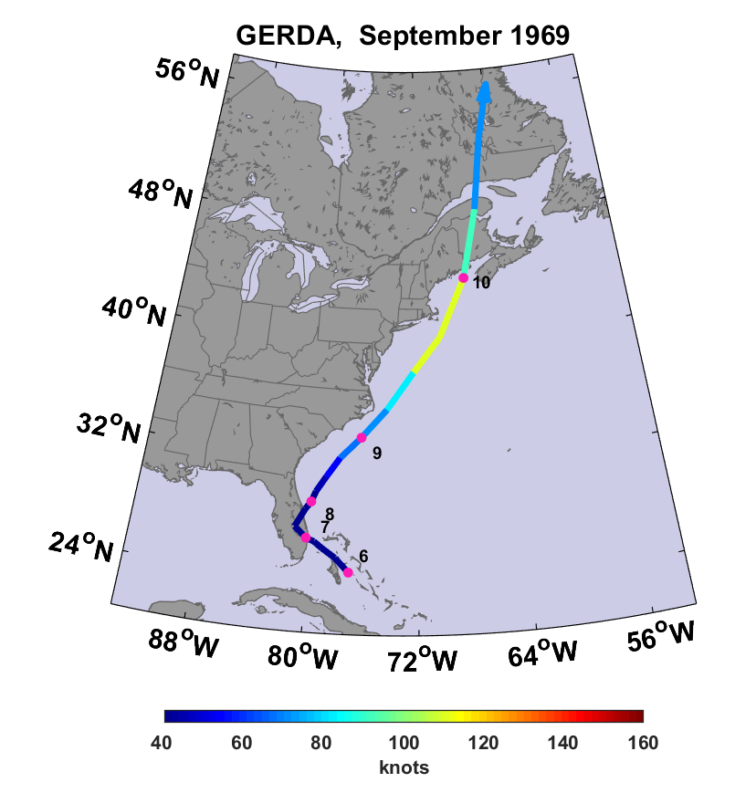
Landfall near Eastport as a Category 2 hurricane…probably strongest hurricane to strike Maine in recorded history.

Slide 28
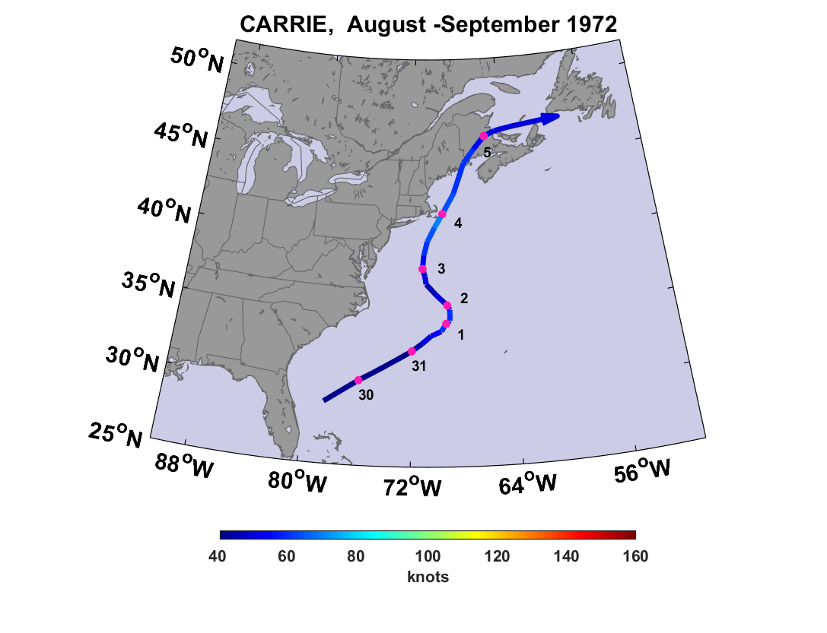
Two deaths in Maine from high surf

Slide 29
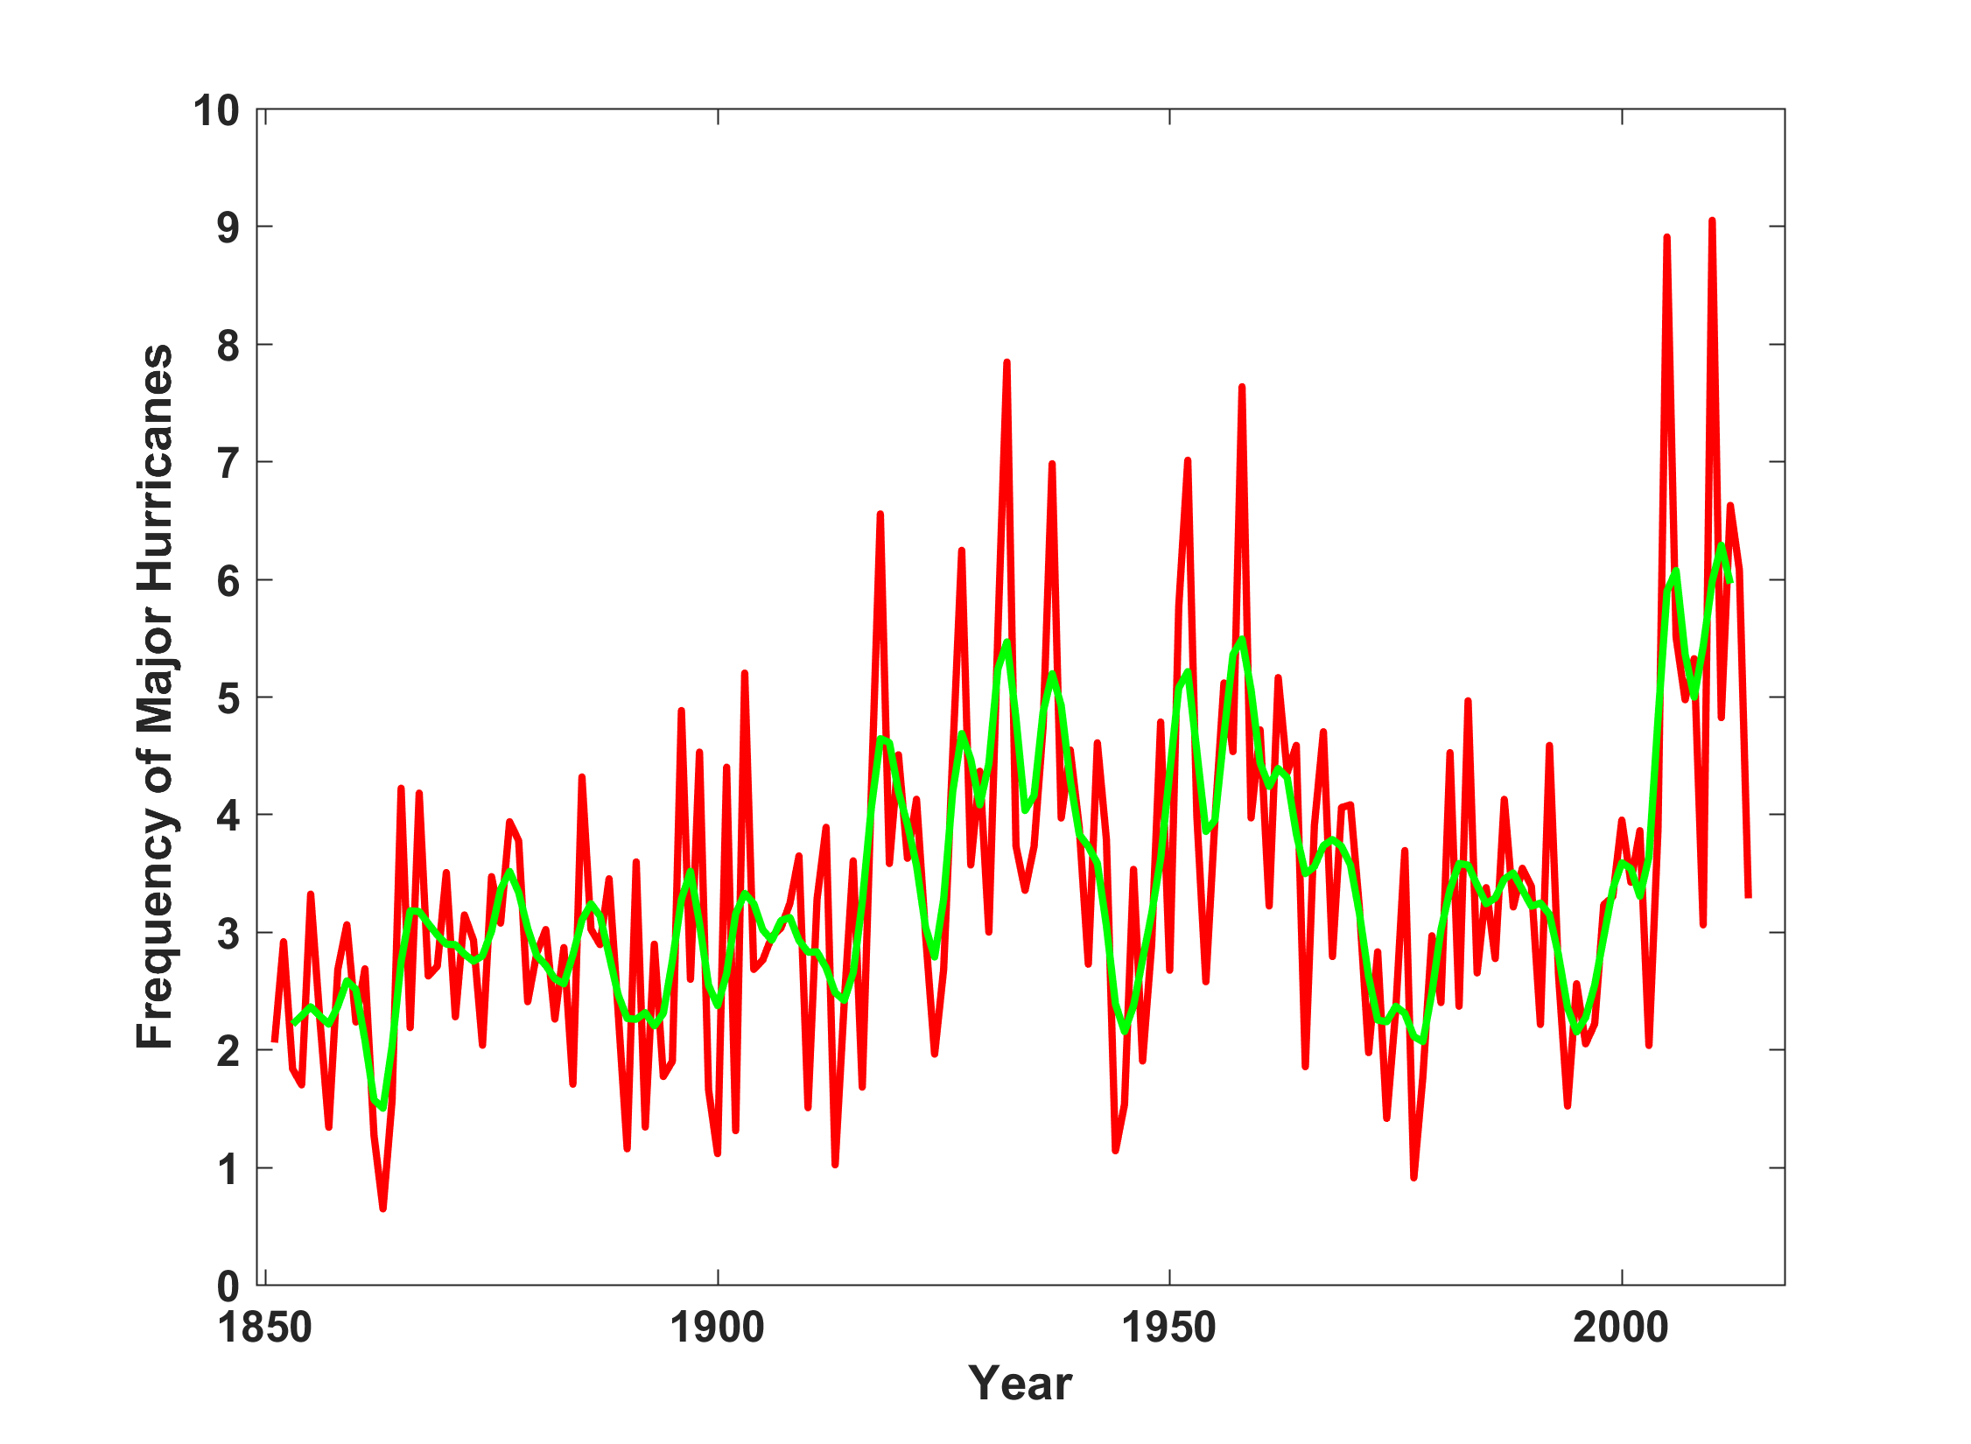
North Atlantic Major Hurricanes Downscaled from NOAA 20th Century Reanalysis
(Forced by sea surface temperature, surface pressure, and sea ice only)
Hurricane drought

Slide 30
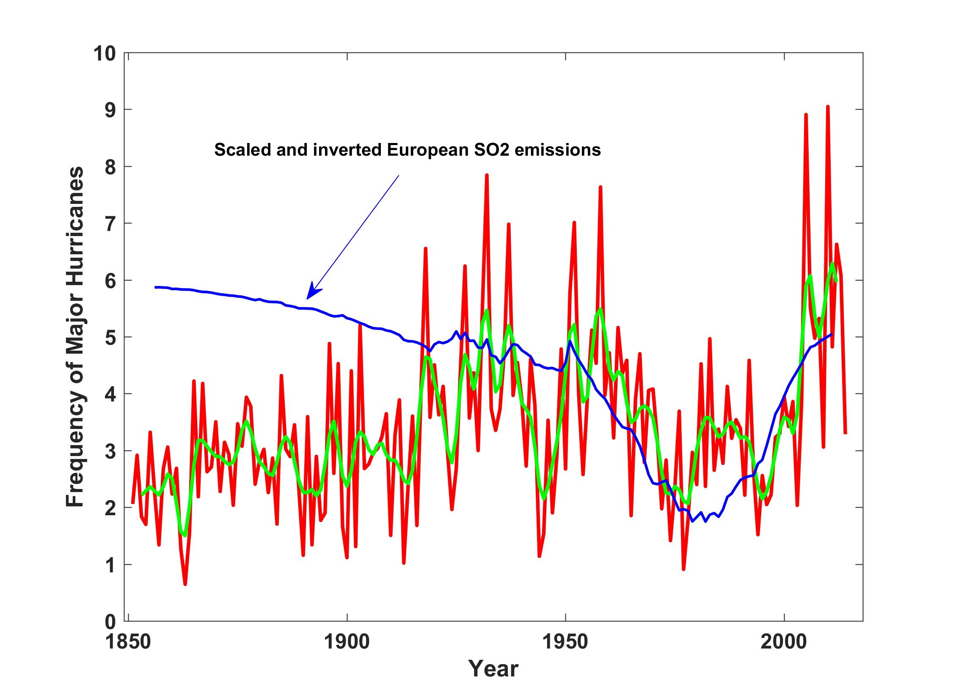
North Atlantic Major Hurricanes Downscaled from NOAA 20th Century Reanalysis
(Forced by sea surface temperature, surface pressure, and sea ice only)
Hurricane drought

Slide 31
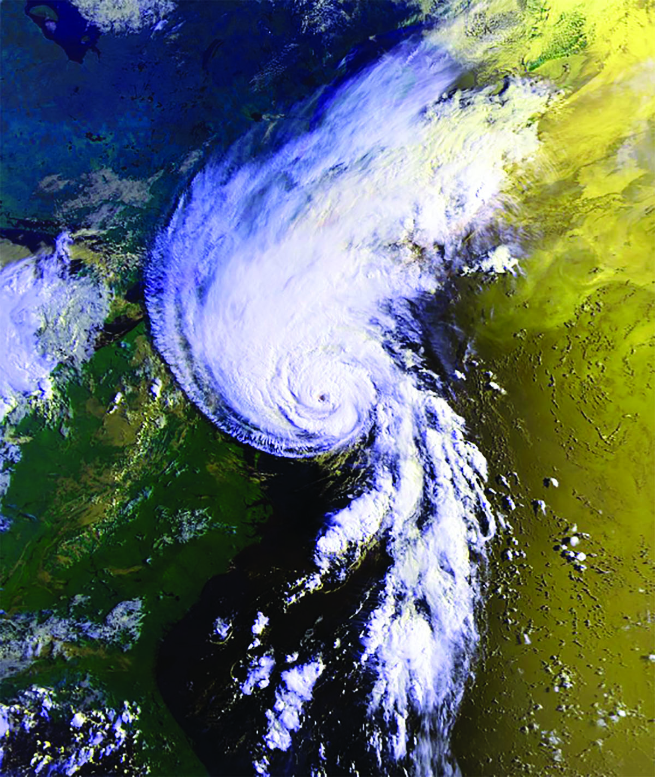
Hurricane Bob approaching Maine, August 20, 1991

Slide 32
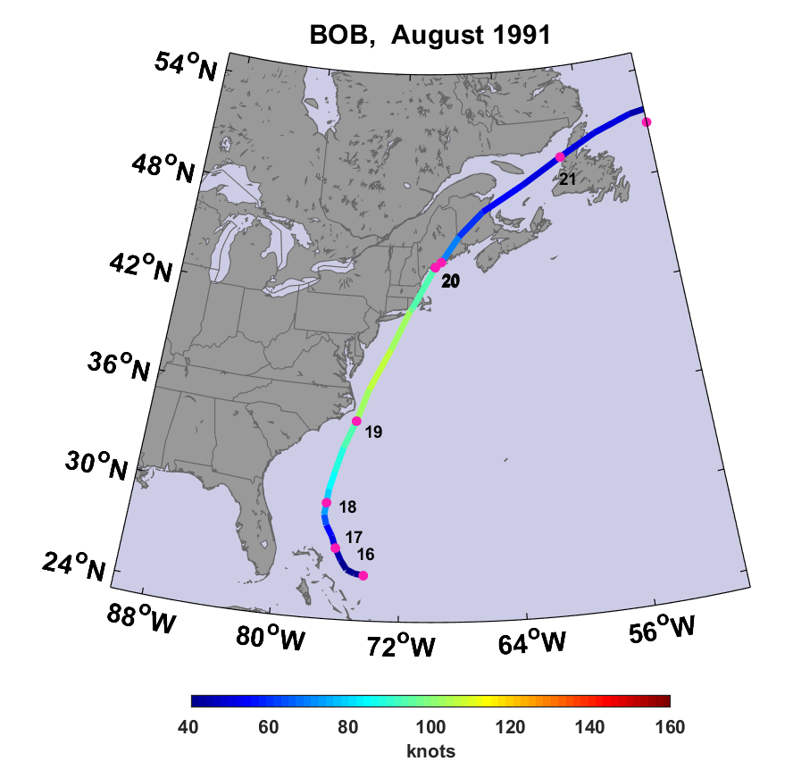

Slide 33
Hurricane Bob in Maine
Landfall near Rockland, ME
One of the costliest hurricanes ever to strike New England… $1.5 billion 1991 dollars ($2.75 billion in 2019)
3 deaths in Portland
Gusts to 70 MPH in Portland, 92 MPH in Wiscasset
8.25 inches of rain at Portland
170,000 lost power, some for more than a week
Tornado at St. Albans (unconfirmed)
2-3 ft storm surge
River flooding washed out five bridges and roads across southwestern Maine

Slide 34


Hurricane Risk Assessment: The Problem
Event Probability
Damage Probability
Current and Future Probability Density of U.S. TC Wind Damages
Current and Future Damage Probability

Slide 35

The Heart of the Problem:
Societies are usually well adapted to frequent events (> 1/100 yr)
Societies are often poorly adapted to rare events (< 1/100 yr)
Robust direct estimates of the character of ~100 yr events require ~1,000 years of data
We do not have ~1,000 years of meteorological observations

Slide 36

Our Approach: Use Physics to Estimate Hurricane Risk
Embed high-resolution, fast coupled ocean-atmosphere hurricane model in global climate model or climate reanalysis data
Coupled Hurricane Intensity prediction Model (CHIPS) has been used for 16 years to forecast real hurricanes in near-real time

Slide 37
Risk Assessment Approach:
Step 1: Seed each ocean basin with a very large number of weak, randomly located cyclones
Step 2: Cyclones are assumed to move with the large scale atmospheric flow in which they are embedded, plus a correction for the earth’s rotation and sphericity
Step 3: Run hurricane intensity model for each cyclone, and note how many achieve at least tropical storm strength
Step 4: Using the small fraction of surviving events, determine storm statistics. Can easily generate 100,000 events
Details: Emanuel et al., Bull. Amer. Meteor. Soc, 2008
Notes:
37

Slide 38
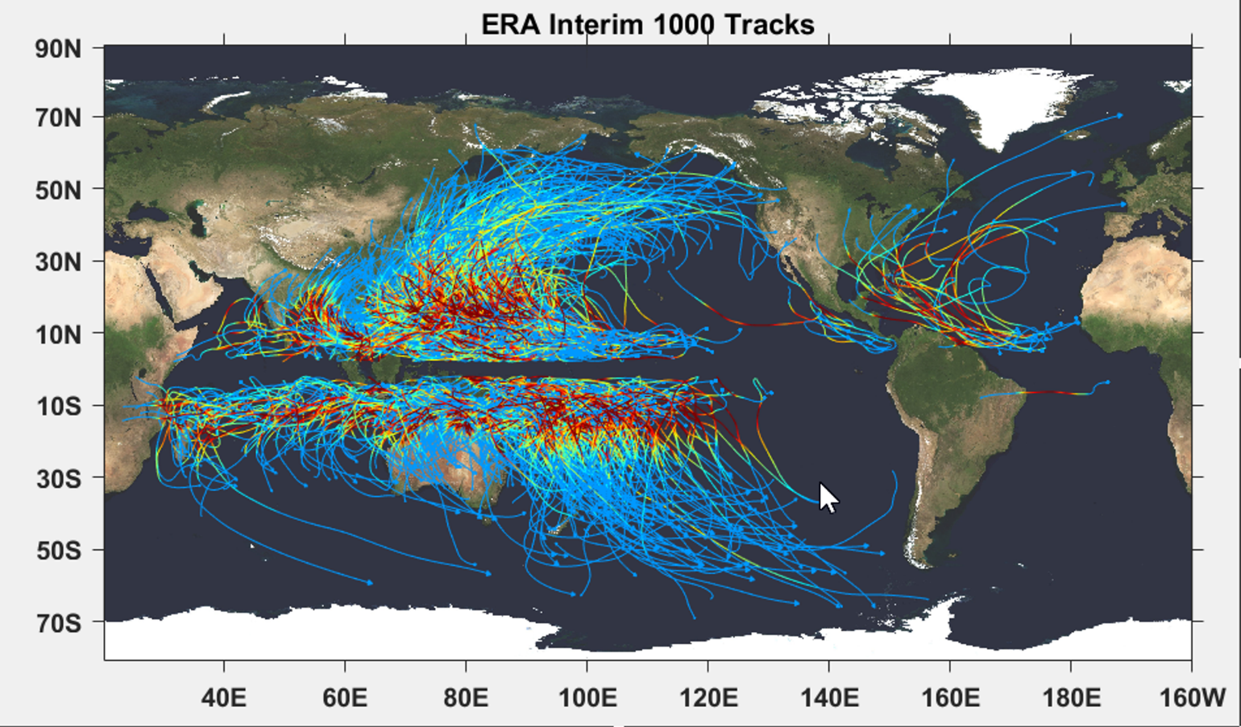

Slide 39

Cumulative Distribution of Storm Lifetime Peak Wind Speed, with Sample of 1755 Synthetic Tracks
90% confidence bounds

Slide 40
Atlantic Annual Cycle

Slide 41

Return Periods

Slide 42
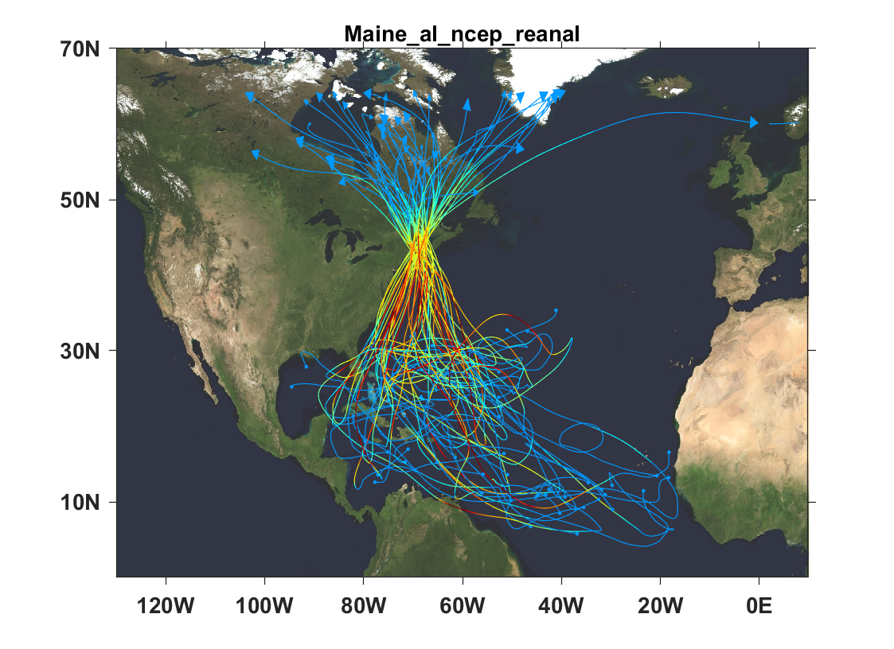
Top 50 of 1800 tropical cyclones affecting the coast of Maine

Slide 43
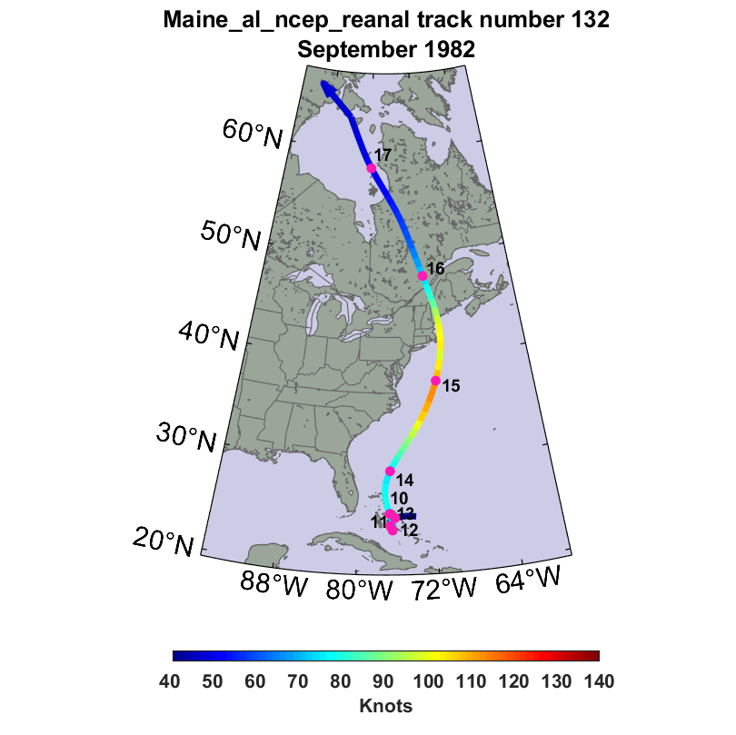
A 500-year windstorm in mid-coast Maine

Slide 44
A 500-Year Wind Storm

Slide 45
Wind Risk on the Maine Coast

Slide 46
Power dissipation, a measure of destructive potential, is largest from Penobscot Bay eastward. This chart shows power dissipation per unit length along 4 segments of the Maine coast.

Slide 47
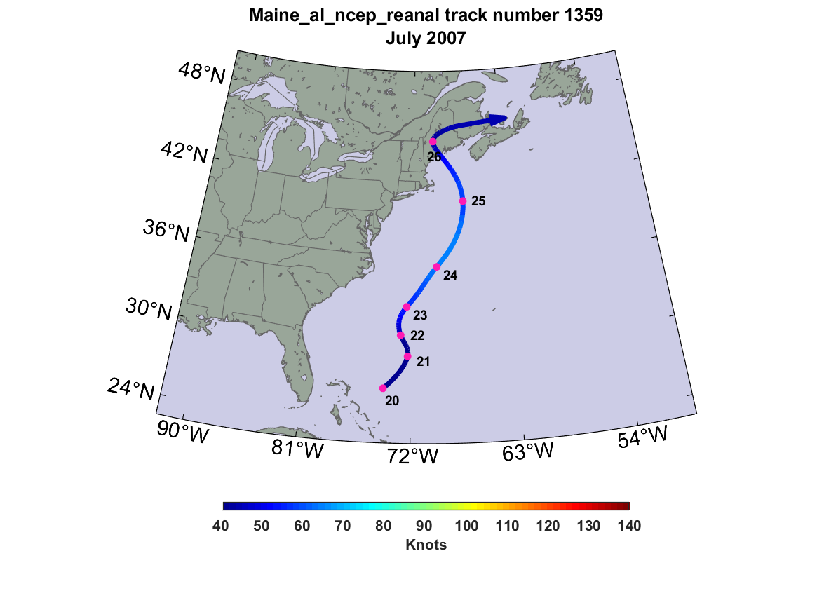
A 500-year rainstorm in mid-coast Maine

Slide 48
A 500-Year Rain Storm

Slide 49
How will Climate Change Affect Main Hurricanes?
Apply technique to 5 global climate models, running 1,000 tracks for each model for each of two time periods: 1981-2000 and 2181-2100

Slide 50
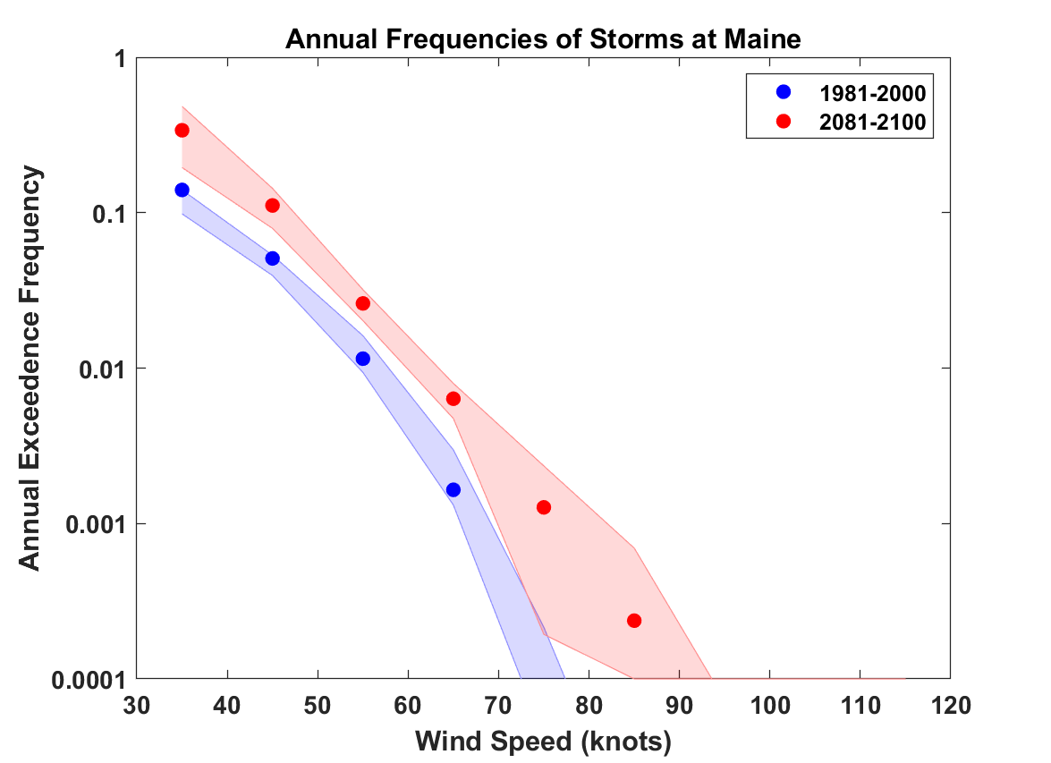
Estimates of hurricane wind risk along the Maine coast from 5 climate models
(shading shows spread among the different climate models)

Slide 51
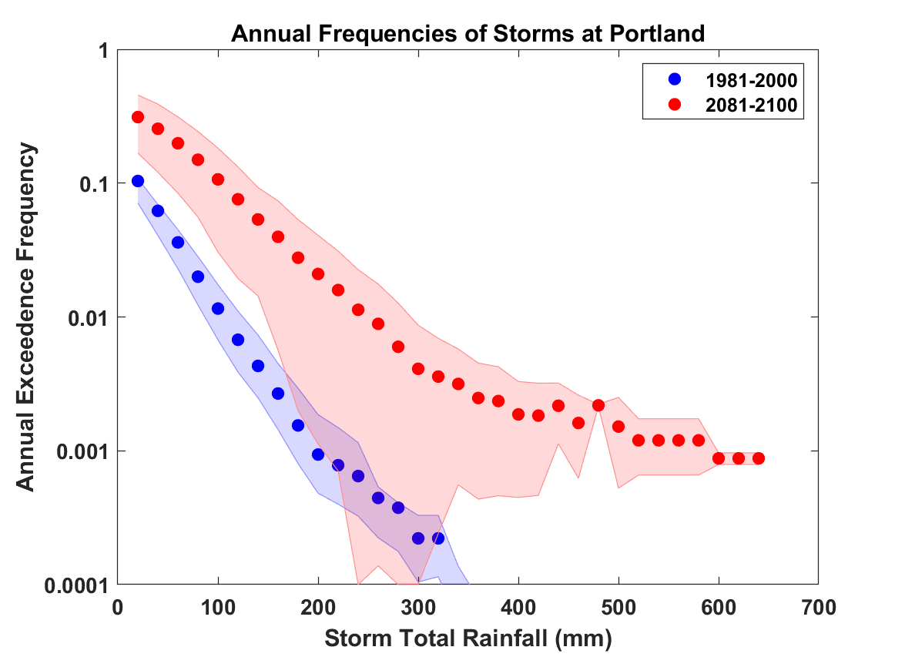
Estimates of hurricane rain risk along the Maine coast from 5 climate models

Slide 52
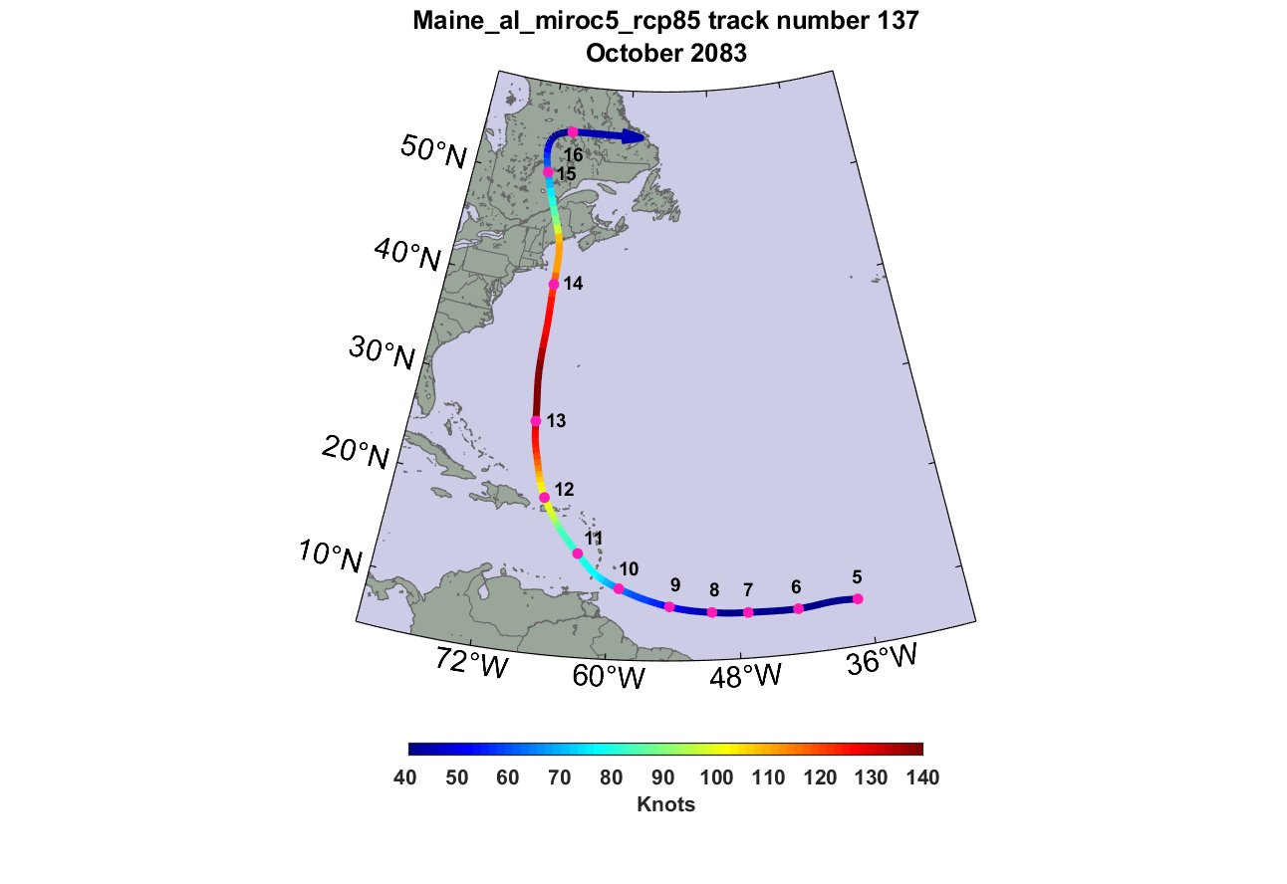
A 500-year windstorm in mid-coast Maine, in 2083

Slide 53
A 500-year wind storm at the end of the century

Slide 56
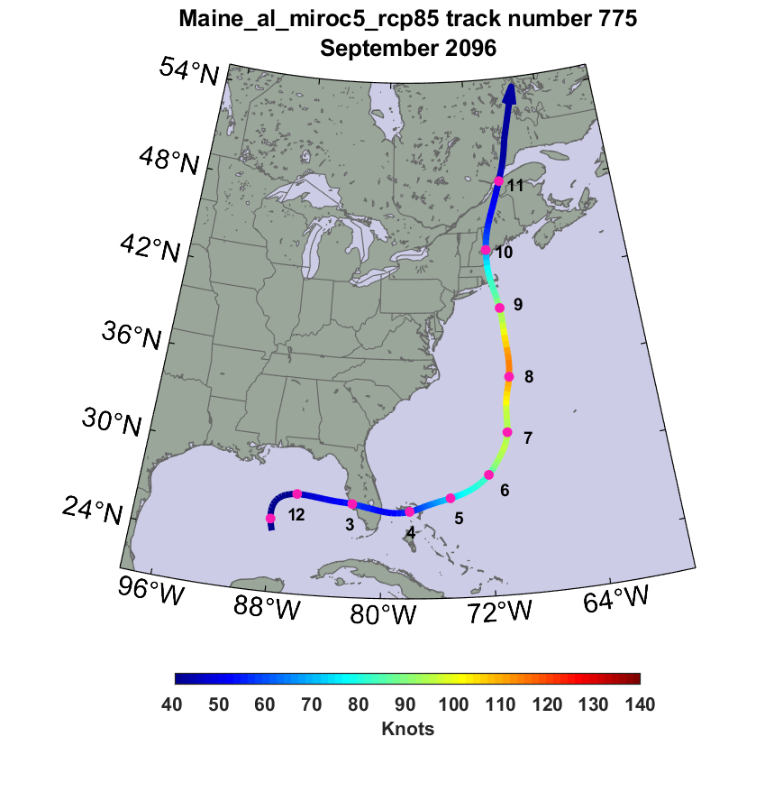
A 500-year rainstorm in mid-coast Maine, in 2096

Slide 57
A 500-year Rain Event, end of century

Slide 58
Summary
Maine is mostly protected from hurricane by cold water north of the Gulf Stream and by Cape Cod and the islands
Nonetheless, it has experienced several low category hurricanes and tropical storms which have taken lives and caused much damage through Maine’s history
Hurricane risk increases going downeast along the coast
Barring efforts to curb increases in greenhouse gases, projections suggest a modest increase in the frequency and severity of hurricanes in Maine by the end of this century
Large projected increases in hurricane rainfall are of particular concern and could lead to substantially elevated flood risk

Slide 59
Spare Slides

Slide 60
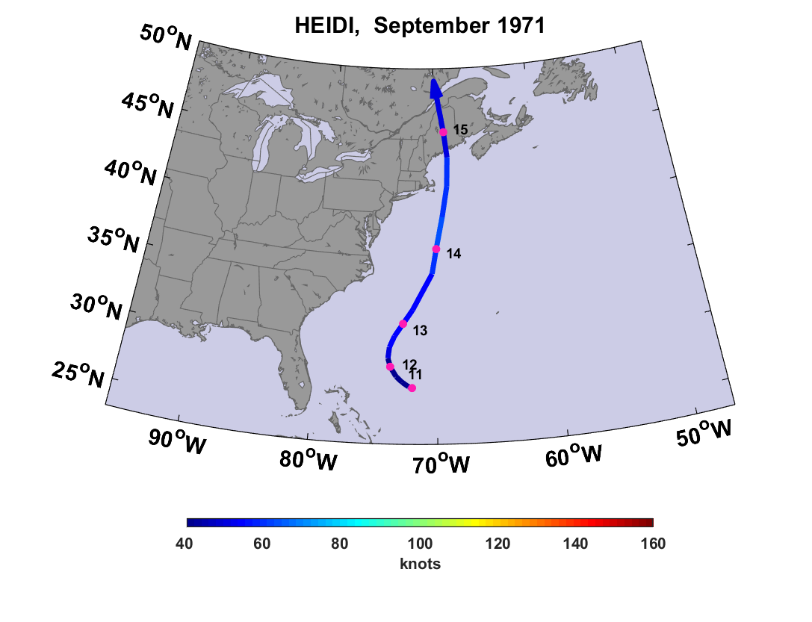

Slide 61
