Slide 1
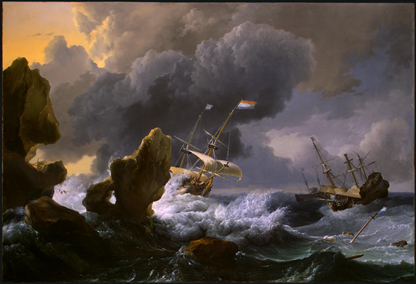
Introduction to Tropical Cyclones
Kerry Emanuel
Program in Atmospheres, Oceans, and Climate
Massachusetts Institute of Technology

Slide 2

Program
What is a hurricane?
How does it work?
What conditions favor their formation?
Historical and economic significance of hurricanes

Slide 3
What is a Hurricane?
Formal definition: A tropical cyclone with 1-min average winds at 10 m altitude in excess of 32 m/s (64 knots or 74 MPH) occurring over the North Atlantic or eastern North Pacific

Slide 4


The word Hurricane is derived from the Mayan word Huracan and the Taino and Carib word Hunraken, a terrible God of Evil, and brought to the West by Spanish explorers
Blow, winds, and crack your cheeks! rage! blow! You cataracts and hurricanoes, spout Till you have drench’d our steeples, drown’d the cocks! -- King Lear

Slide 5
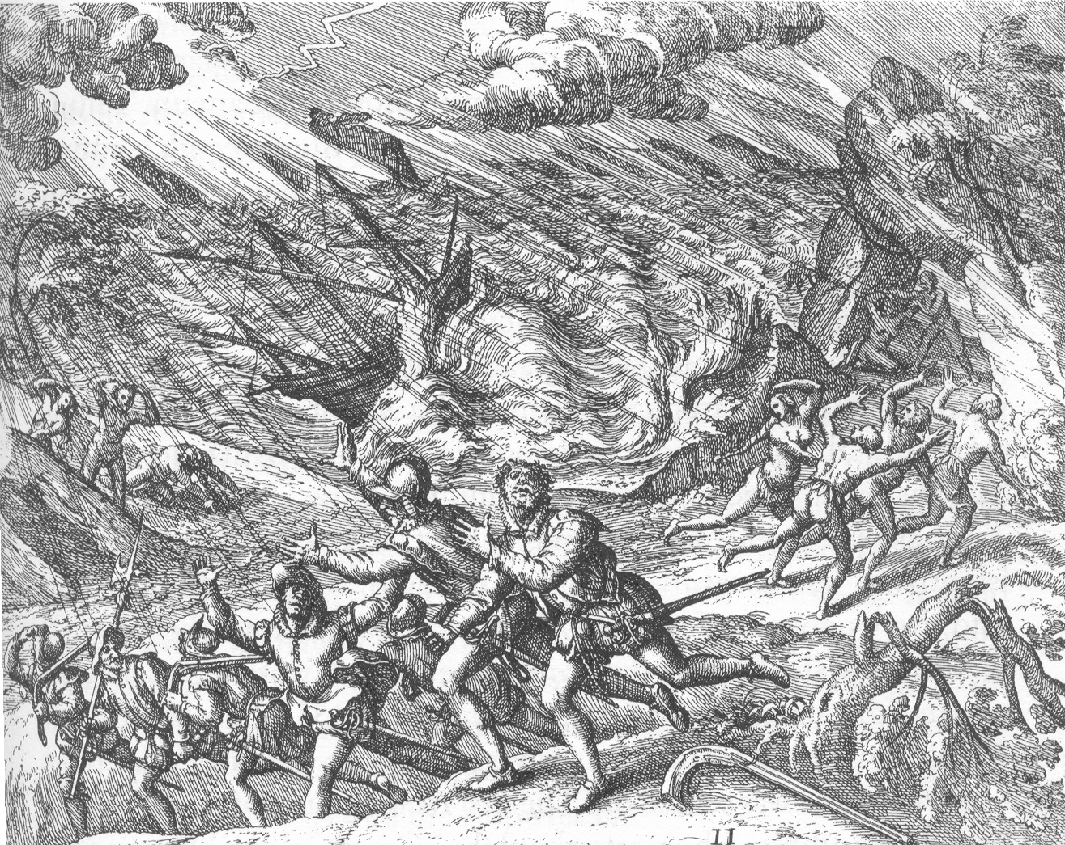
Illustration from Travels in the West Indies, Theodor DeBry

Slide 6

The View from Space
Notes:
The advent of reconnaissance aircraft and radar in the 1940s, and of satellites in the 1960s, gave scientists the means to determine the detailed structure and evolution of hurricanes. Today, almost everything we know about hurricanes is based on observations by aircraft, radar, and satellites. This satellite image shows Hurricane Floyd approaching the east coast of Florida in 1999. This image has been digitally enhanced to lend a three-dimensional perspective. The swirling mass of clouds is about 300 kilometers (180 miles) across, and Floyd’s eye is about 50 kilometers (30 miles) in diameter. Surrounding the eye is a deep ring of thick cloud called the eyewall. A thin veil of very high cloud covers most of the swirling mass of thicker clouds; this is the veil of cirrus, made up of tiny ice crystals. Underneath it, and thus invisible from above, are several spiral shaped bands of deep, thick cumulonimbus clouds, interspersed between relatively clear sky. These spiral bands produce heavy rains and gusty winds well outside the eyewall of the hurricane, where the strongest winds are found.
Image: Satellite image of Hurricane Floyd approaching the east coast of Florida in 1999. The image has been digitally enhanced to lend a three-dimensional perspective. Credit: NASA/Goddard Space Flight Center.
Description from “Divine Wind: The History and Science of Hurricanes”, Kerry Emanuel, 2005, Oxford University Press, 296 p.
Definitions
Reconnaissance is the military term for the active gathering of information about an enemy, or other conditions, by physical observation (from and for more information see http://en.wikipedia.org/wiki/Reconnaissance).
The eye is a region of mostly calm weather found at the center of strong tropical cyclones. The eye of a storm is usually circular and typically 25–40–65 kilometers (40 miles) in diameter. It is surrounded by the eyewall, where the most severe weather of a cyclone occurs (from and for more information see http://en.wikipedia.org/wiki/Eyewall).
Cirrus clouds are thin and often wispy clouds that are the most common form of high-level clouds. Typically found at heights greater than 20,000 feet (6,000 meters), cirrus clouds are composed of ice crystals that originate from the freezing of supercooled water droplets (from and for more information see http://weather.about.com/library/glossary/blglossary.htm).
Cumulonimbus clouds are large and vertically developed clouds that are fueled by vigorous convective updrafts (sometimes in excess 50 knots), the tops of cumulonimbus clouds can easily reach 39,000 feet (12,000 meters) or higher (from and for more information see http://weather.about.com/library/glossary/blglossary.htm).

Slide 7
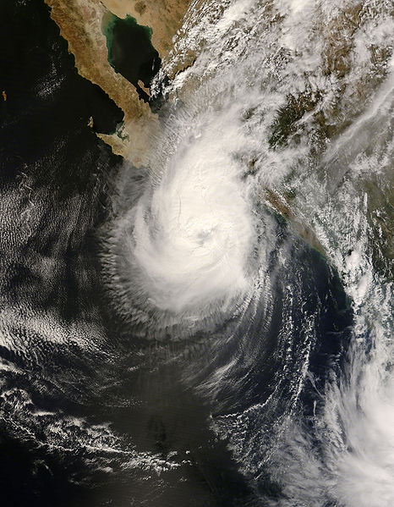
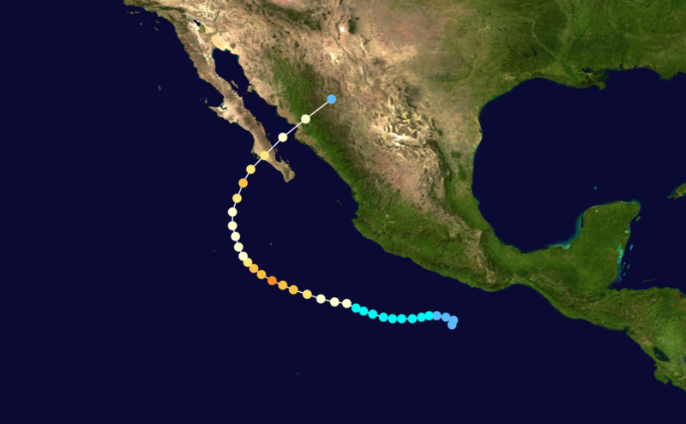
Hurricane Norbert of 2008 approaches La Paz

Slide 8
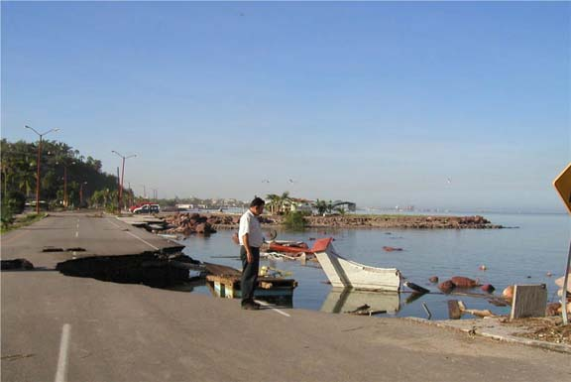
Damage to La Paz from Hurricane Marty of 2003

Slide 9
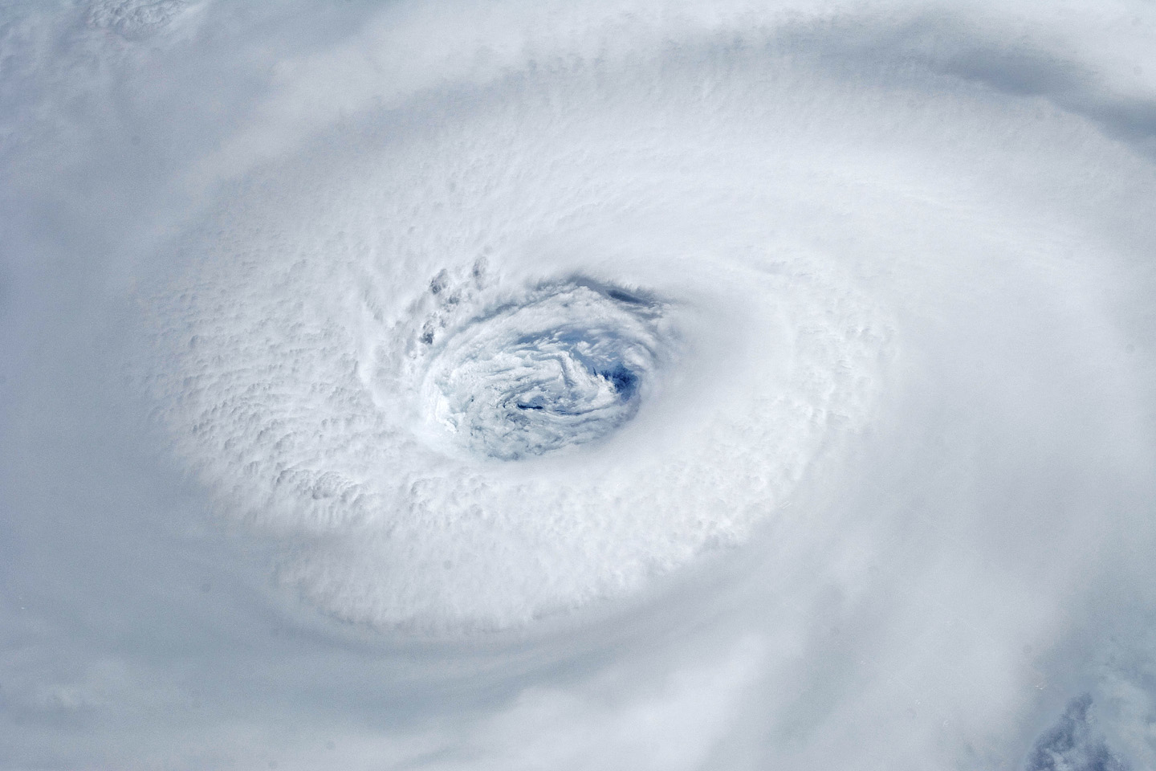
Igor, 2010
Notes:
Astronauts aboard the International Space Station took this digital photograph of the eye of Hurricane Igor at 10:56 Atlantic Daylight Time (13:56 UTC) on September 14, 2010. The storm was a category four hurricane on the Saffir-Simpson scale of intensity. At the time of the image, Igor was centered in the Atlantic Ocean near 18°N 52°W and slowly moving west-northwest at 11 kilometers (7 miles) per hour, according to the U.S. National Hurricane Center. Maximum sustained winds of 213 km (132 mi.) per hour, with gusts to 259 km (161 mi.) per hour. Credit: NASA

Slide 10
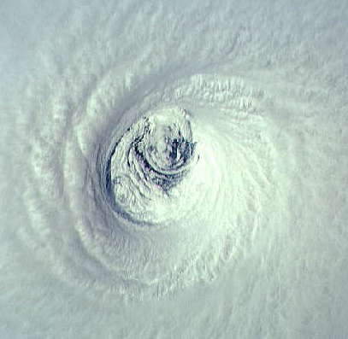
Emelia, 1994
Notes:
The eye of Hurricane Emilia over the eastern North Pacific ocean, as seen from directly above by the crew of the space shuttle Columbia on July 19th, 1994. At this time, Emilia had maximum sustained winds of 155 miles per hour. Looking at the eye from above is like staring down the middle of a bathtub whirlpool, except that the boundaries are made of cloud and the “funnel” comes to an abrupt end at the sea surface. The eyewall is visible as the stadium of thick, white cloud surrounding the eye. This is where the strongest winds and heaviest rains are found. Unlike the bathtub whirlpool, the air inside the eyewall is going up, not down, as it swirls around the eye. There are spiral striations along the inner edge of the eyewall and two big swirling eddies in the low clouds at the base of the eye. No mere photograph can do justice to the sensation of being inside the eye of a hurricane. Imagine a Roman coliseum 20 miles wide and 10 miles high, with a cascade of ice crystals falling along the coliseum’s blinding white walls.
Image: The eye of Hurricane Emilia over the eastern North Pacific on July 19, 1994, at 19:33 GMT. Credit: NASA Johnson Space Center Digital Image Collection.
Description from “Divine Wind: The History and Science of Hurricanes”, Kerry Emanuel, 2005, Oxford University Press, 296 p.
Definitions
Striations are grooves or channels in cloud formations, arranged parallel to the flow of air and therefore depicting the airflow relative to the parent cloud. Striations often reveal the presence of rotation, as in the barber pole or "corkscrew" effect often observed with the rotating updraft of an Low Precipitation (LP) storm (from http://www.srh.weather.gov/srh/jetstream/append/glossary_s.htm).
Eddies are water or air currents flowing in circular patterns (from www.terrax.org/sailing/glossary/ge.aspx).

Slide 11
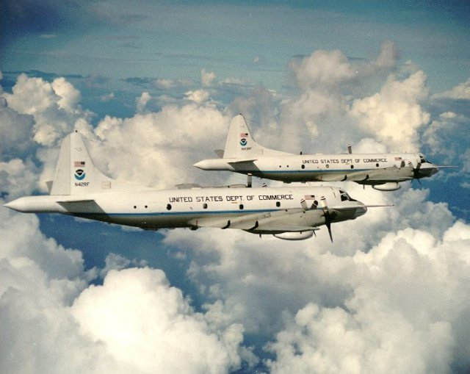

Slide 12
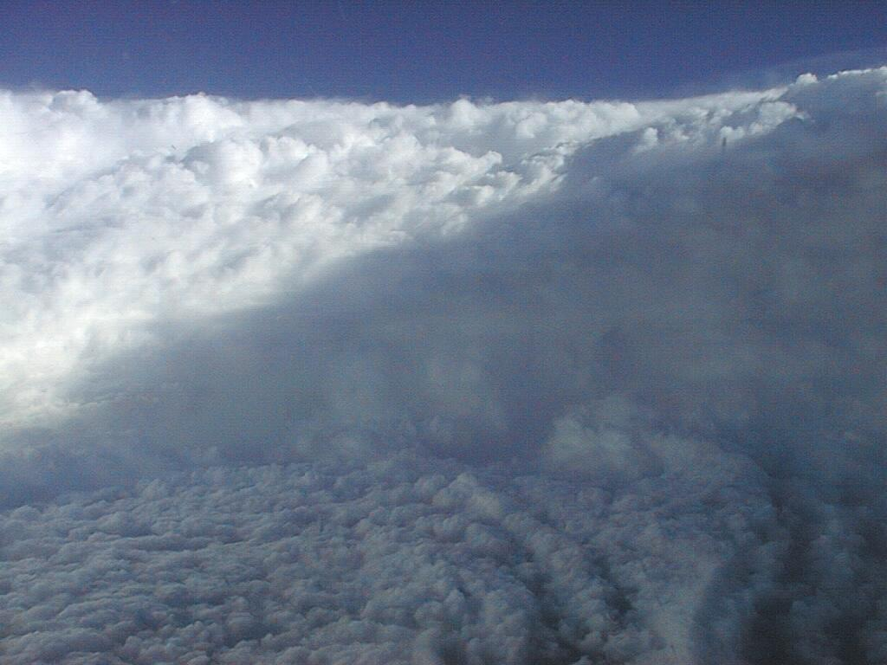
Notes:
The eye of Hurricane Georges in this photo taken from a reconnaissance aircraft gives some impression of a hurricane’s eye.
However impressive a hurricane’s visual appearance, it is the instruments aboard satellites and aircraft that reveal the essence of a hurricane’s structure and inner workings. In the early days of aircraft reconnaissance, the crew estimated wind speeds by looking down and noting how rough the sea appeared. Today, a sophisticated array of instruments automatically collects large quantities of high-quality data, which are taken back to laboratories and analyzed.
Image: The eye of Hurricane Georges in photo taken from a reconnaissance aircraft. The eyewall at right is casting a shadow across part of the eyewall ahead. Credit: Michael Black, Hurricane Research Division, NOAA-AOML, Miami, Florida.
Description from “Divine Wind: The History and Science of Hurricanes”, Kerry Emanuel, 2005, Oxford University Press, 296 p.

Slide 13
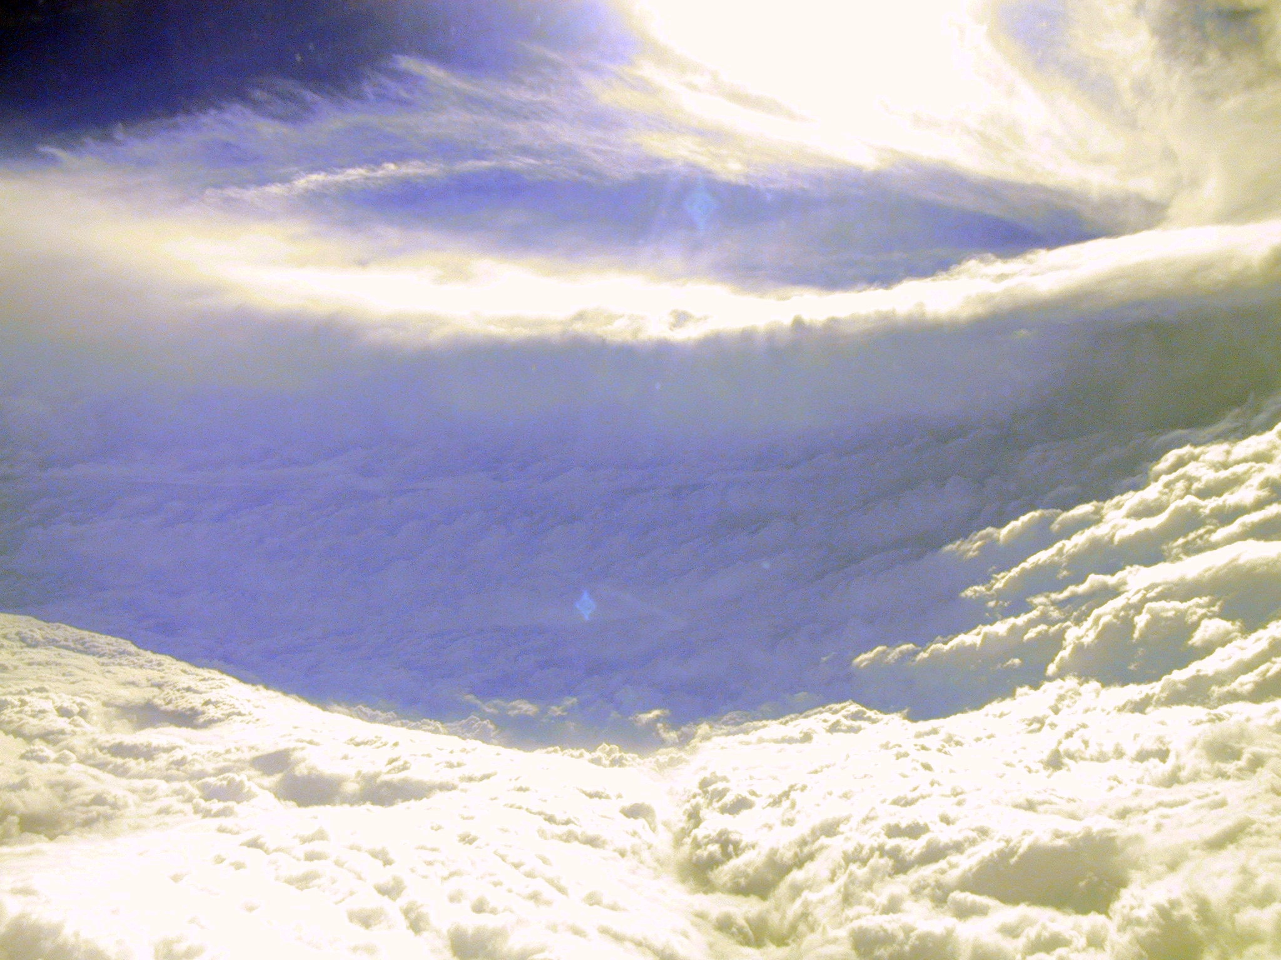

Slide 14
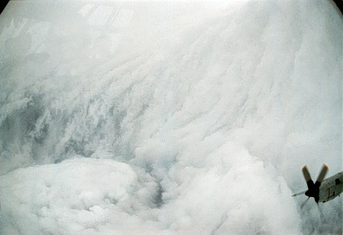

Slide 15
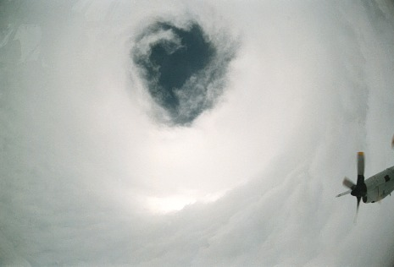

Slide 16
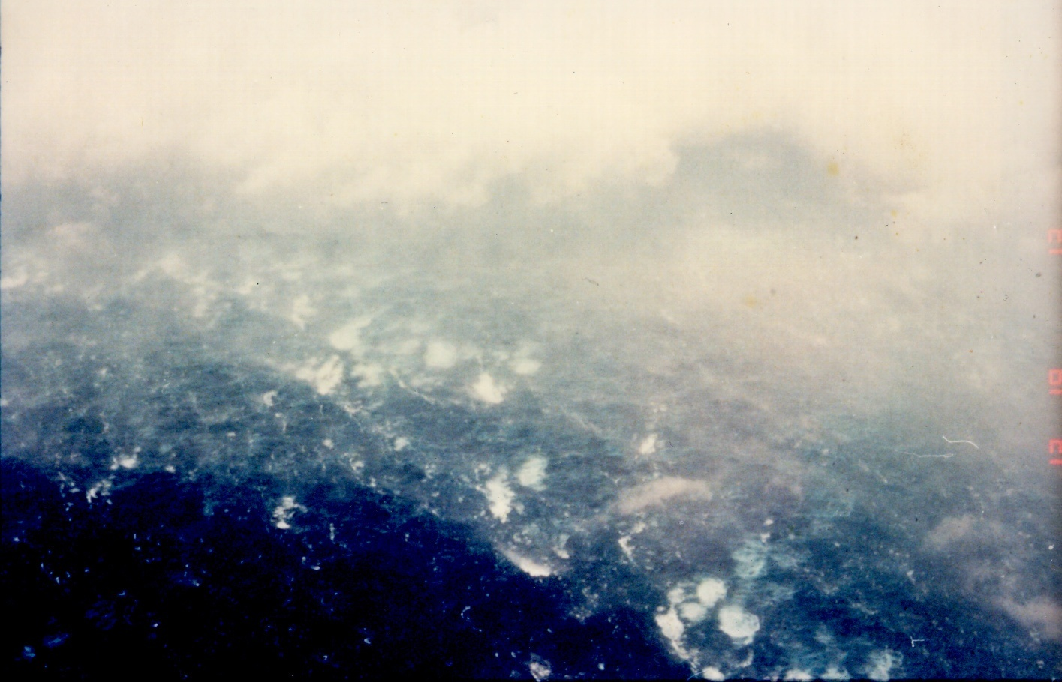

Slide 17
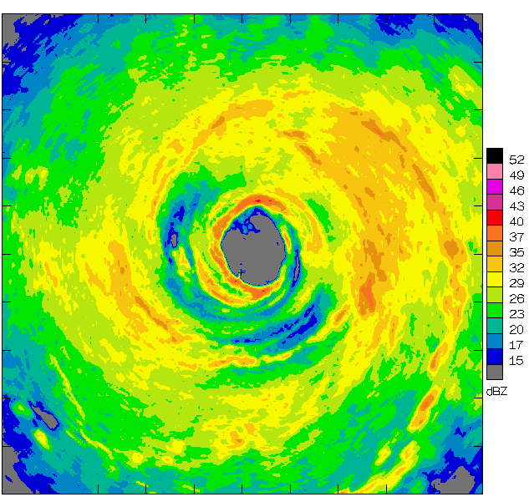
Airborne Radar: Horizontal Map
360 km
(220 mi)

Slide 18
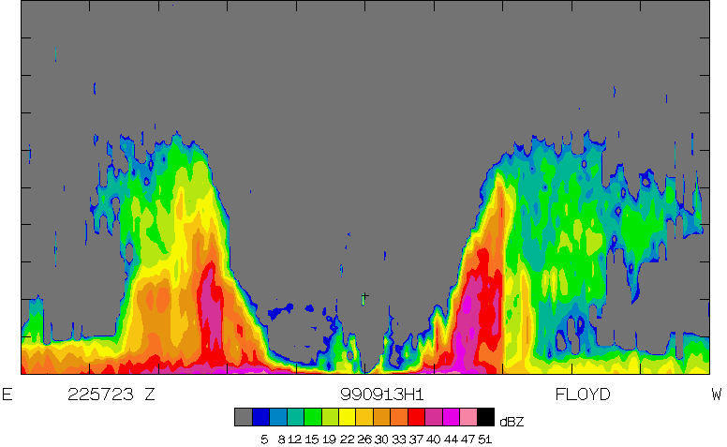
Airborne Radar: Vertical Slice
20 km
(12 mi)
120 km
(75 mi)

Slide 19
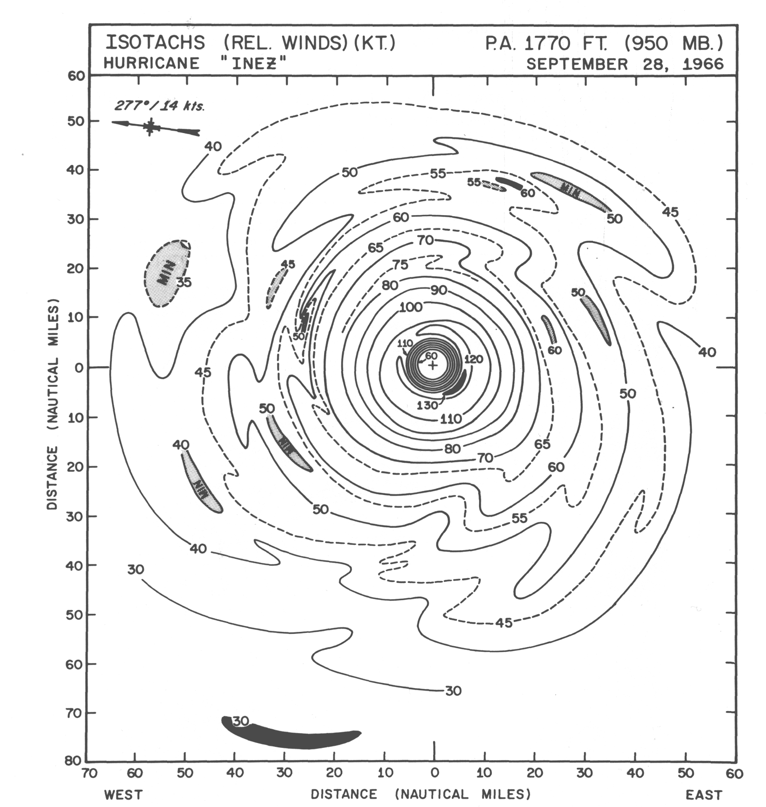

Slide 20
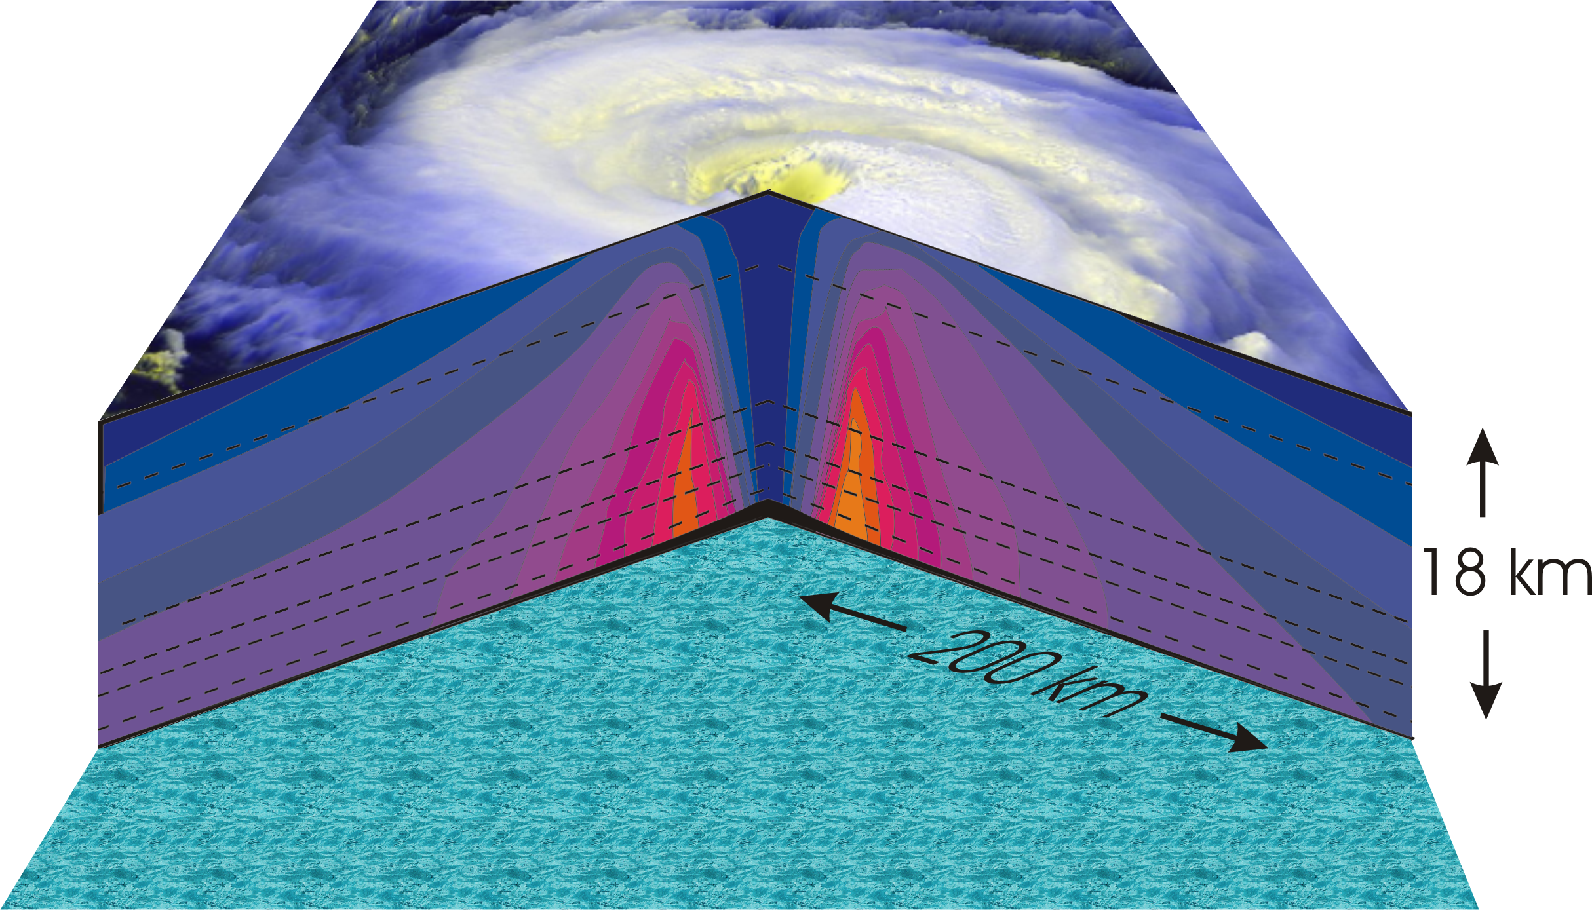
Hurricane Structure: Wind Speed
Azimuthal component of wind
< 11 mph - > 145 mph
Notes:
A composite view of the distribution of wind speed in a typical hurricane based on measurements made from research aircraft. In this image and the two that follow, the center of the hurricane is in the center of the panel and the cutaway extends outward about 200 km (125 miles) and upward to about 18 km (11 miles). A satellite image of the top of a storm has been superimposed.
This image shows the speed of the wind going counterclockwise around the center of the storm; the black dashed lines show the altitudes at which the aircraft were flying. The darkest shade of blue indicates the lightest winds, less than 5 meters/second (11 mph). Each successive color represents an increment of 5 meters/second (11 mph), with bright orange showing winds in excess of 65 meters/second (145 mph). The strongest winds occur just above the ocean in a ring around the center, slightly outside the eyewall of the storm. Winds decrease rapidly inward toward the center, which is practically calm. They also decrease outward from the ring of maximum wind , but much more slowly, so that strong winds can still be found 100 kilometers (60 miles) from the center of the storm. As we go up from the surface, the counterclockwise winds get lighter and lighter. If the highest aircraft had flown even higher, it would have actually encountered “negative” wind speed, which here means winds going the other way (clockwise) around the center.
Image is copyrighted 2005 by Oxford University Press.
Image and description from “Divine Wind: The History and Science of Hurricanes”, Kerry Emanuel, 2005, Oxford University Press, 296 p.

Slide 21
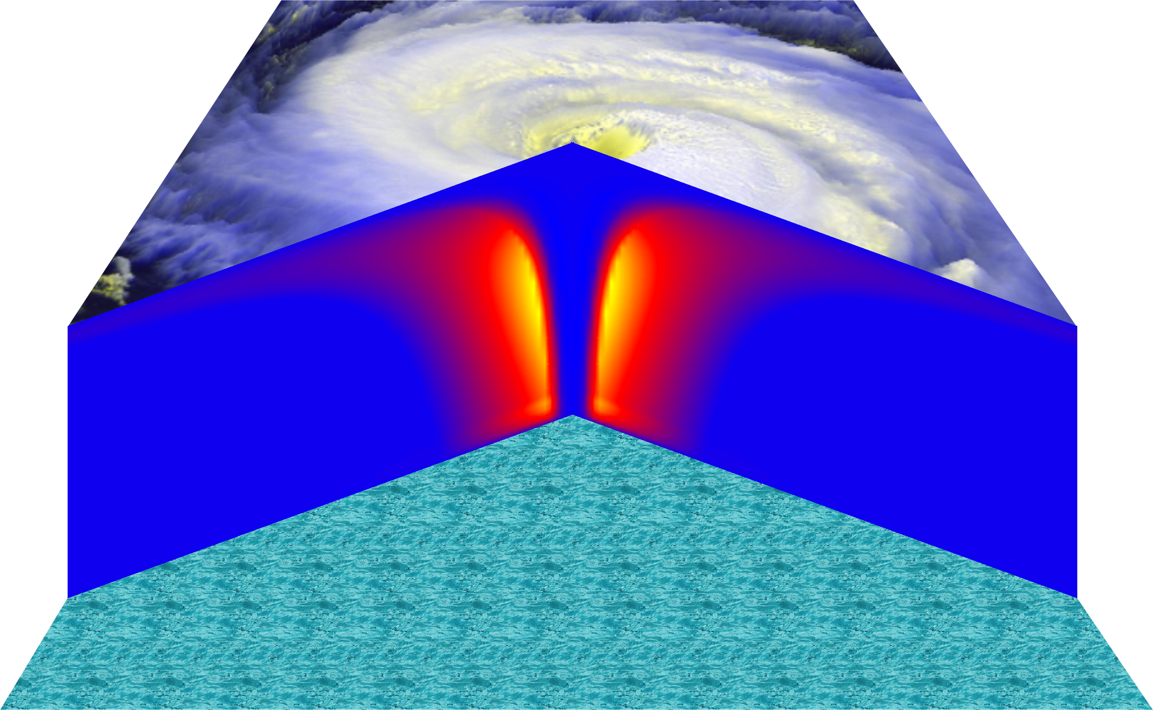
Vertical Air Motion
Updraft Speed
Strong upward motion in the eyewall
Notes:
This image shows a composite view of the distribution of updraft (vertical air motion) in a typical hurricane based on computer model calculations. The yellow and orange represent a strong upward motion in the eyewall. Although it is too weak to be seen in this figure, there is downward motion in the eye itself, strongest right next to the eyewall, and also in a broad region outside the eyewall. But since this figure is made by averaging the air motion along circles centered at the storm center, the strong updrafts associated with the spiral rain bands are missed.
Image is copyrighted 2005 by Oxford University Press.
Description from “Divine Wind: The History and Science of Hurricanes”, Kerry Emanuel, 2005, Oxford University Press, 296 p.

Slide 22
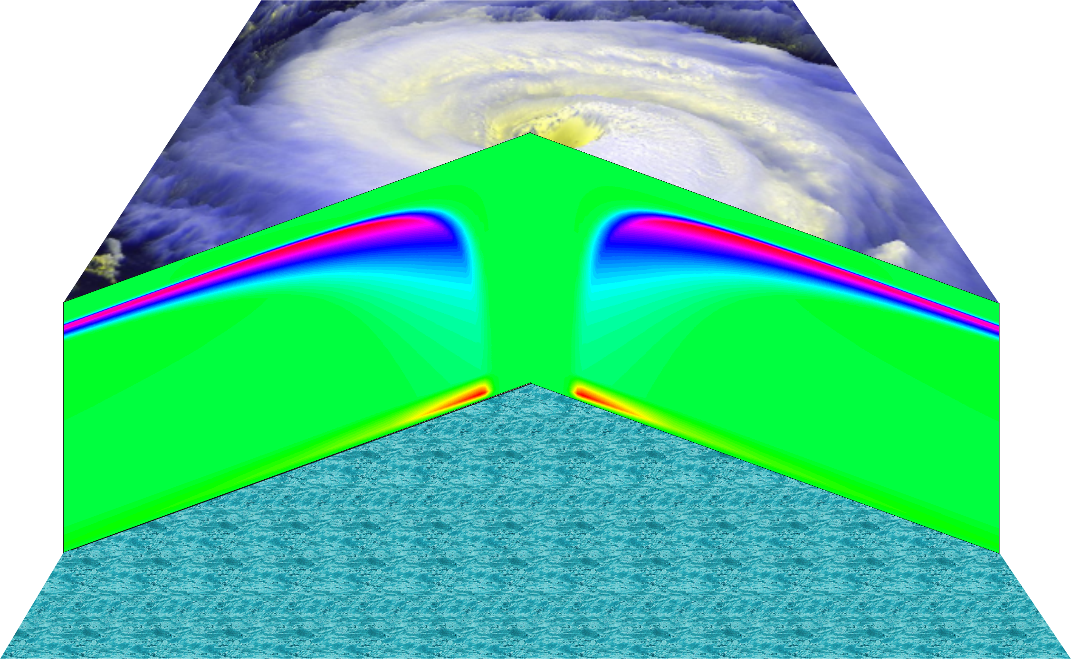
Radial wind

Slide 23
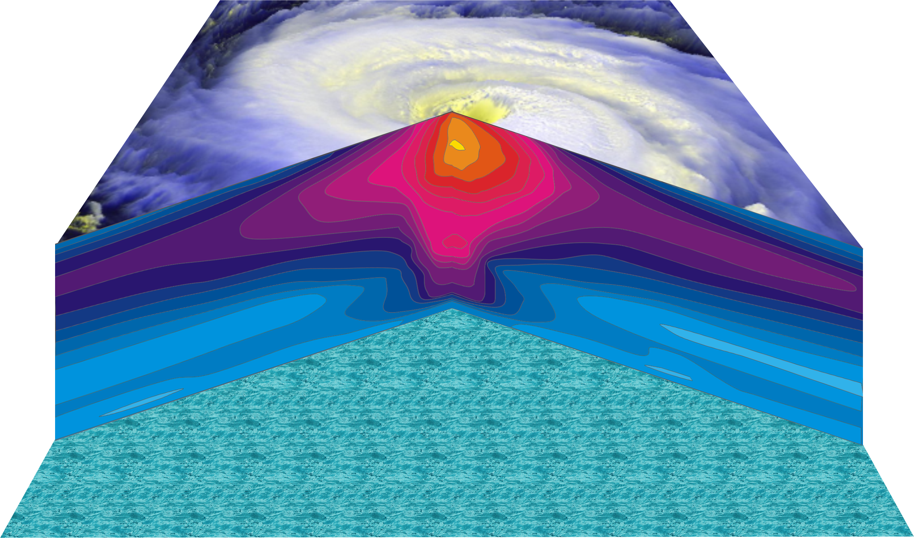
Hurricane Temperature Perturbations
No temperature difference - > 16°C (29°F) warmer
Notes:
This image shows a composite view of the distribution of temperature in a typical hurricane. This actually shows the difference between the temperature at any point and the temperature at the same altitude far away from the storm. The lightest shade of blue shows no temperature difference, while bright yellow shows air that is more than 16°C (29°F) warmer than its distant environment; each shade represents an increment of 1°C (1.8°F). Hurricanes are very hot in their centers, especially near their tops. This great warmth is one consequence of the enormous amount of heat sucked out of the ocean by the storm. On the other hand, there is very little change in temperature as you move in toward the eye along the surface of the ocean.
The distributions of temperature and wind in hurricanes are related to each other. Look carefully at the images in this slide and the slide that shows wind speed. Notice that the rate at which the wind decreases upward is proportional to the rate at which the temperature decreases outward. This relationship is fundamental to rotating fluid flows and is called the thermal wind relation.
Image is copyrighted 2005 by Oxford University Press.
Description from “Divine Wind: The History and Science of Hurricanes”, Kerry Emanuel, 2005, Oxford University Press, 296 p.
Definitions
Thermal wind is a theoretical concept that describes the wind shear between two levels in terms of the geostrophic wind at those two levels (from and for more information see http://wxman256.home.att.net/fcst/wf-pt5e.html). The basic principle of the thermal wind relationship is that in the presence of a horizontal temperature gradient, the wind speed must increase with increasing height (from and for more information see http://opwx.db.erau.edu/~mullerb/Therm_wind.html).
Wind shear is the change of wind speed or direction with distance, usually vertical (from http://ggweather.com/glossary.htm).

Slide 24
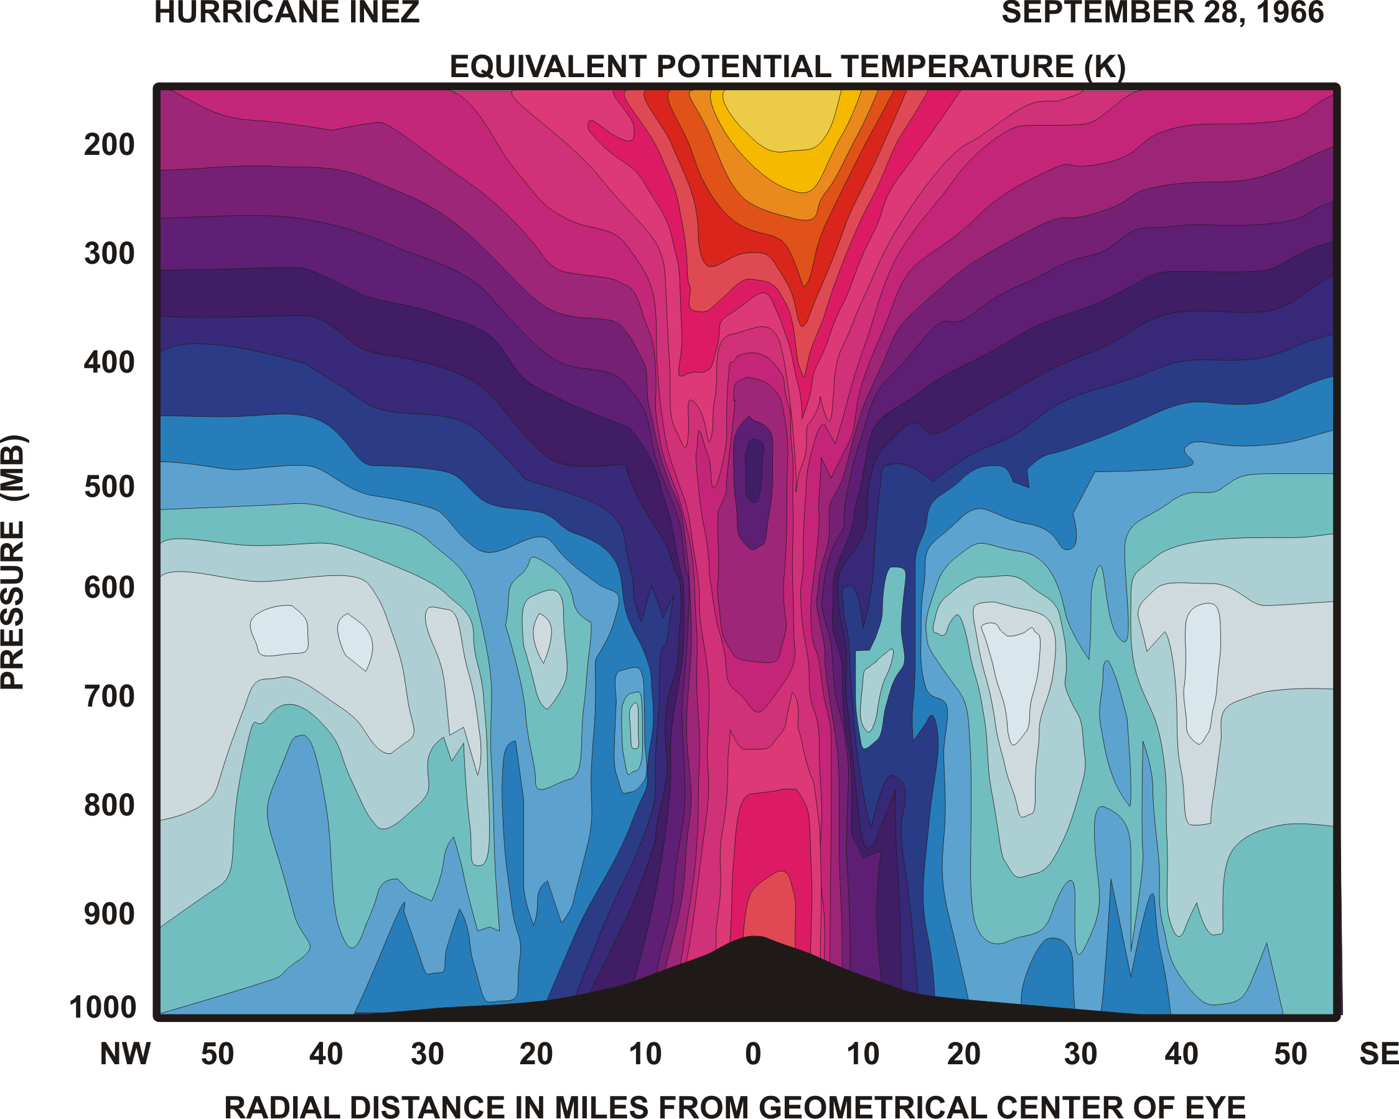

Slide 25
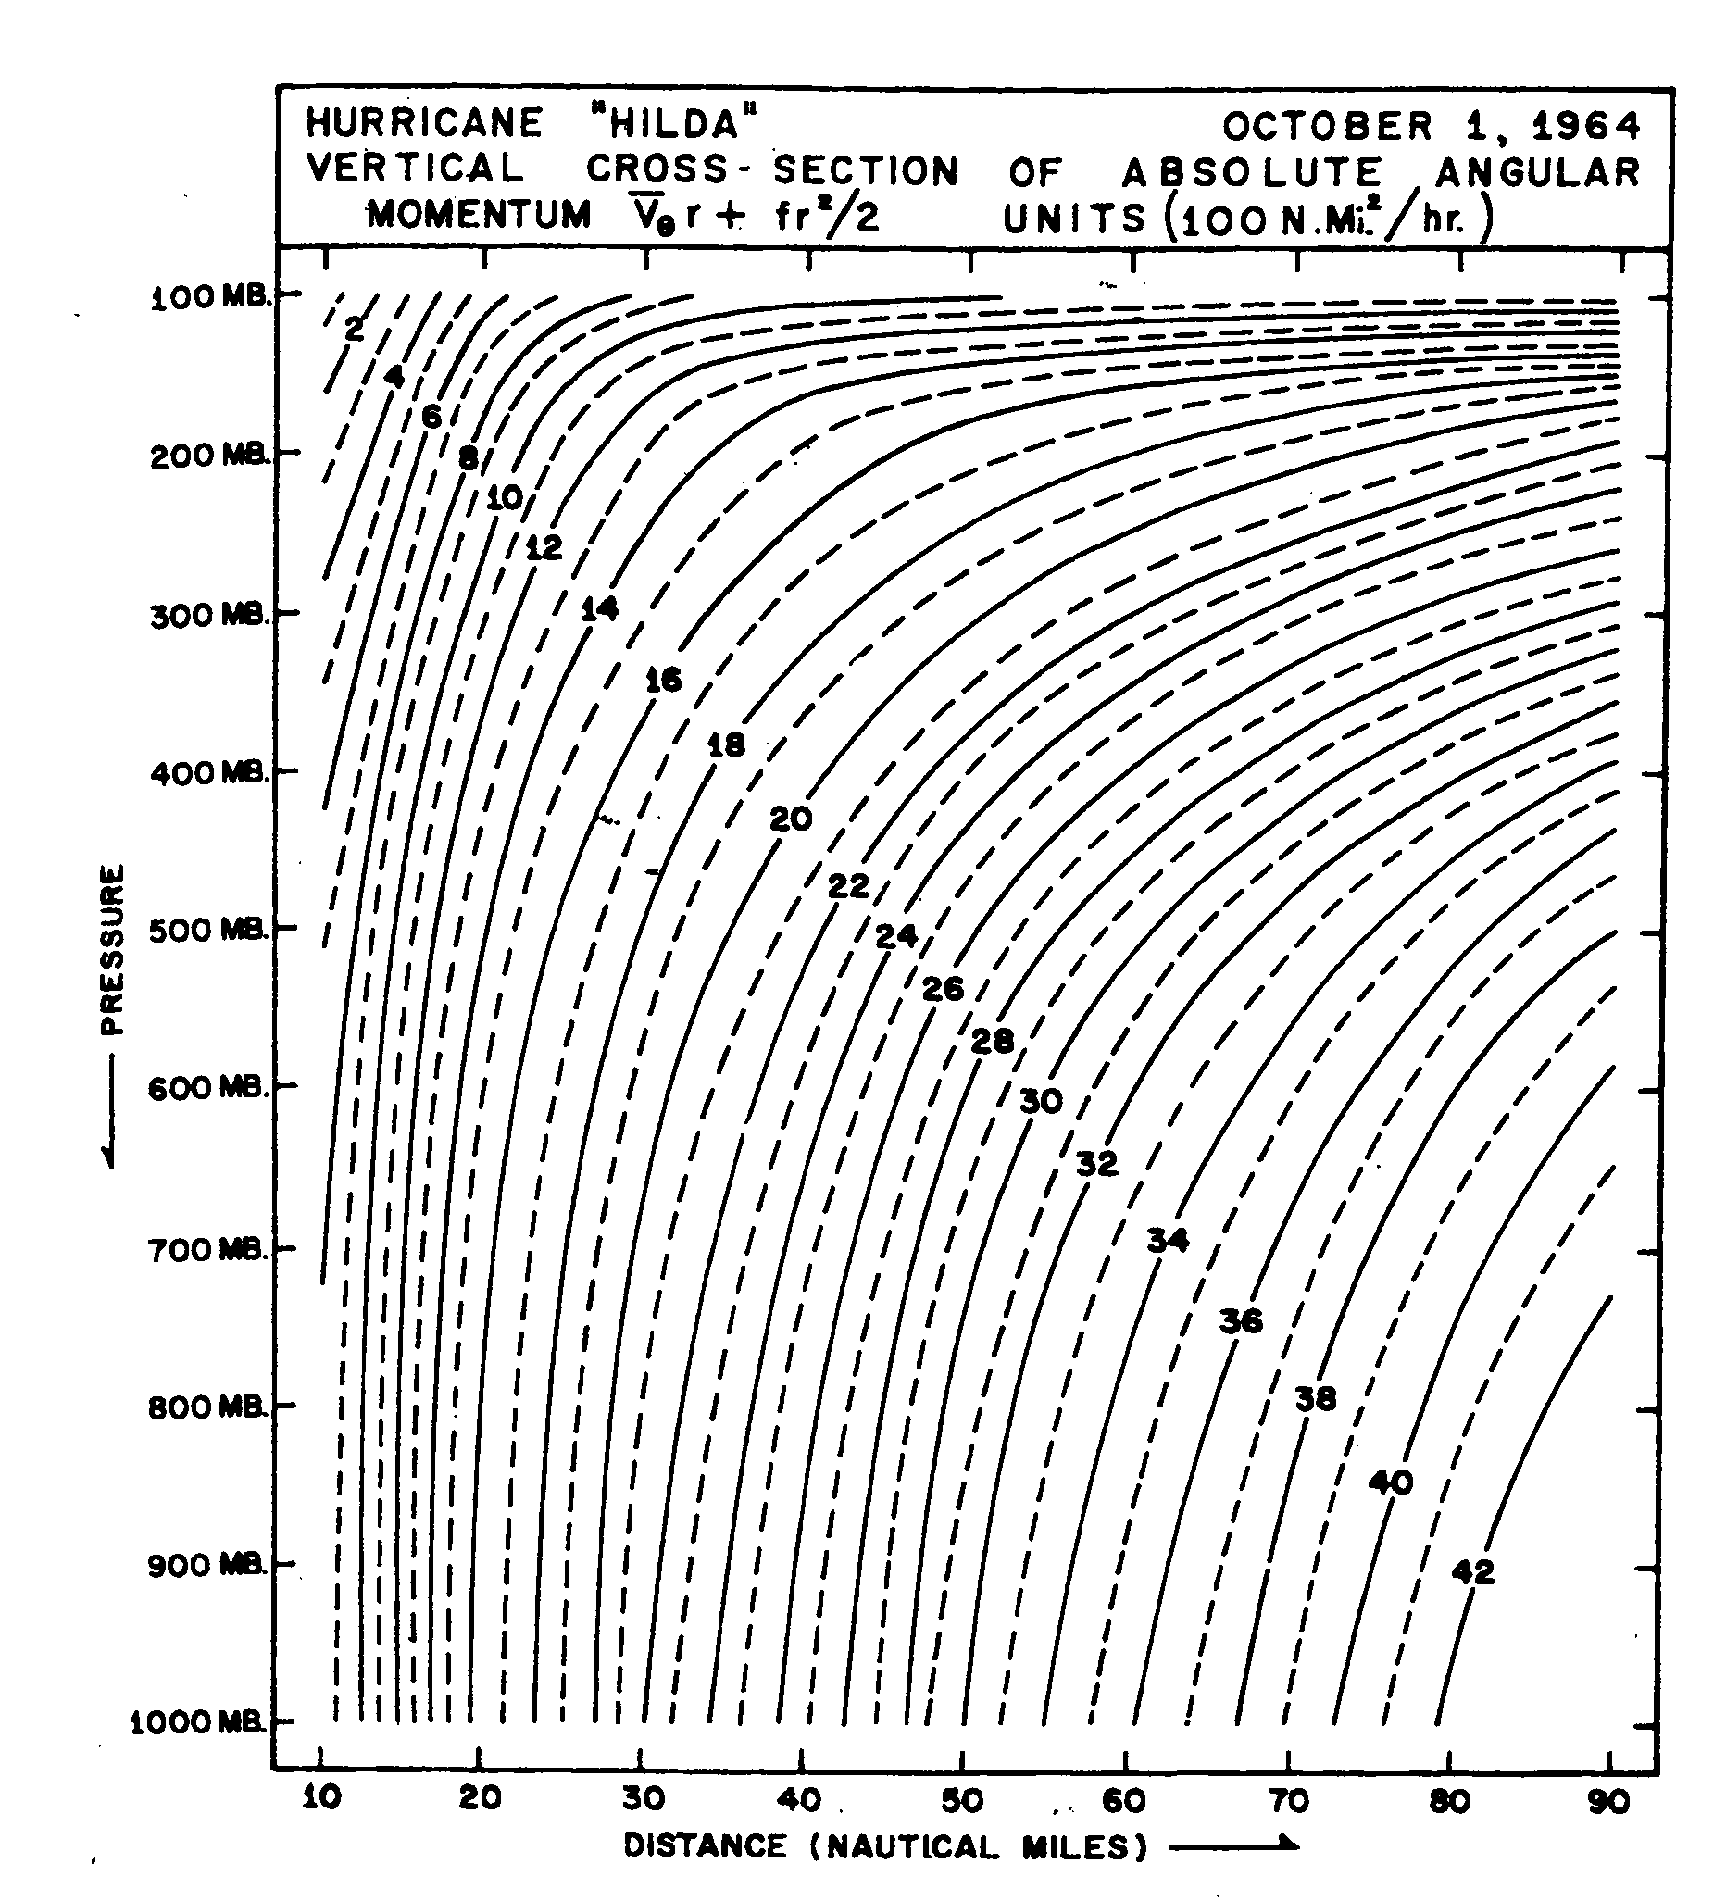
Angular momentum per unit mass

Slide 26
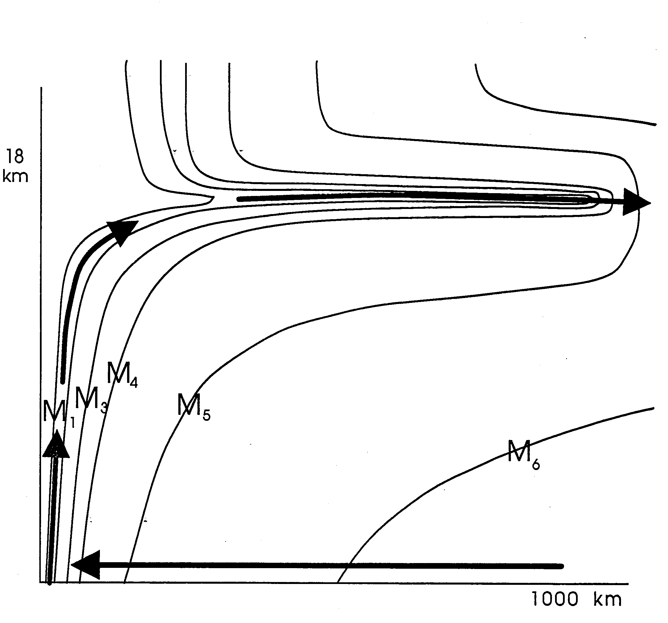

Slide 27
Tropical Cyclone Climatology

Slide 28
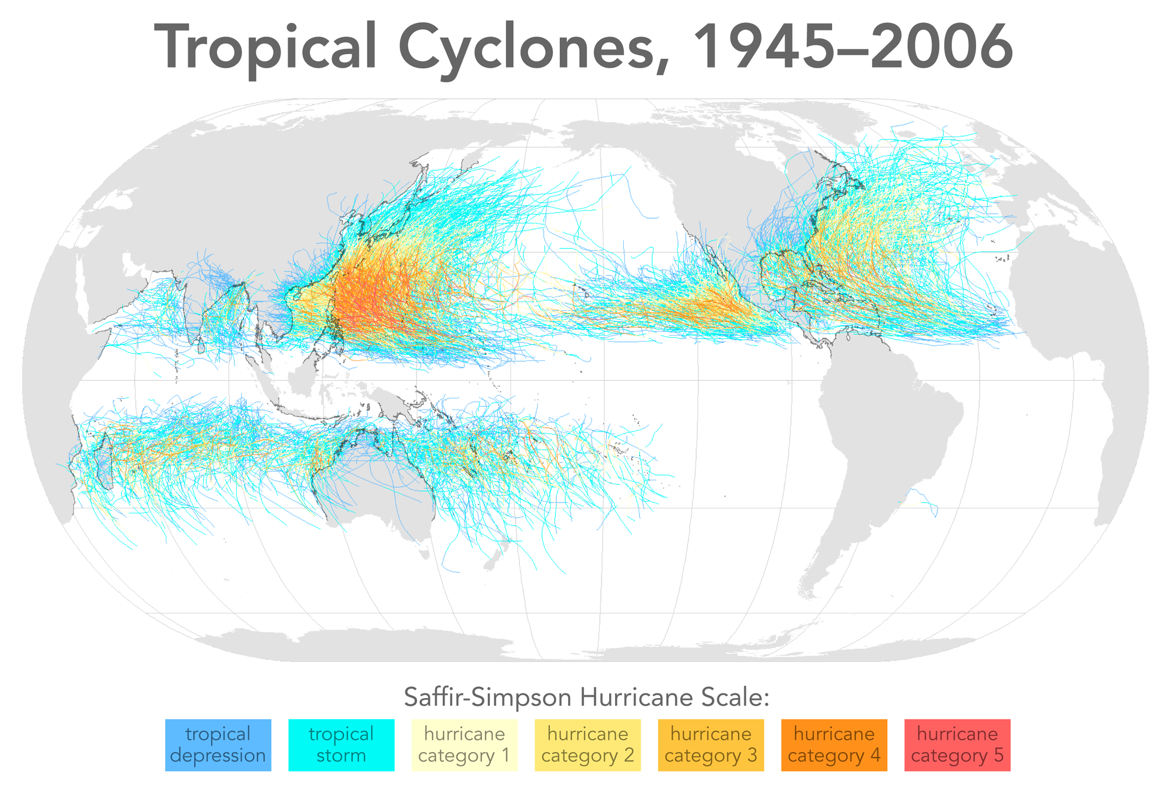

Slide 29
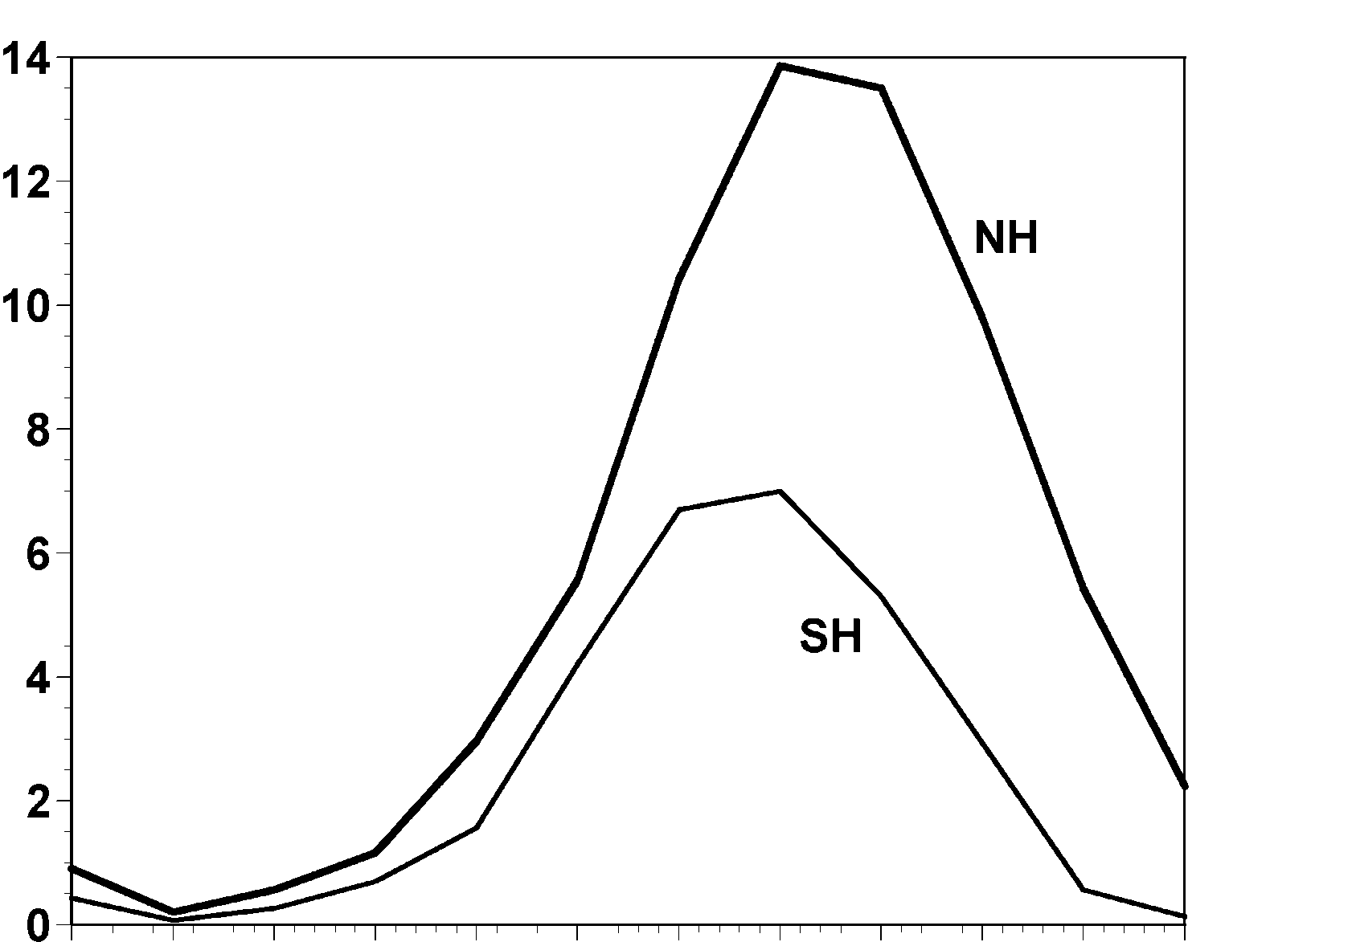
Annual Cycle of Tropical Cyclones
Number of Events per Month
a
Northern
Hemisphere
(NH)
a
Southern
Hemisphere
(SH)
Jan Feb Mar Apr May Jun Jul Aug Sep Oct Nov Dec NH
Jul Aug Sep Oct Nov Dec Jan Feb Mar Apr May Jun SH
Notes:
This graph shows the average number of tropical cyclones per month in the northern and southern hemispheres. Hurricanes tend to follow the sun, peaking in the summer and autumn and all but vanishing during the early spring. Typhoons can develop over the western North Pacific during any month of the year, but they are rare in the winter.
Image is copyrighted 2005 by Oxford University Press.
Image and description from “Divine Wind: The History and Science of Hurricanes”, Kerry Emanuel, 2005, Oxford University Press, 296 p.

Slide 30
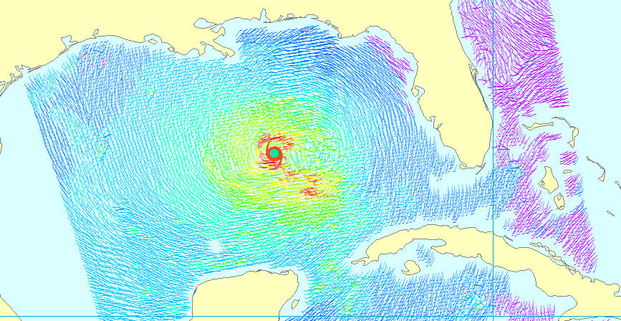
Climatology of Tropical Cyclone Size

Slide 31
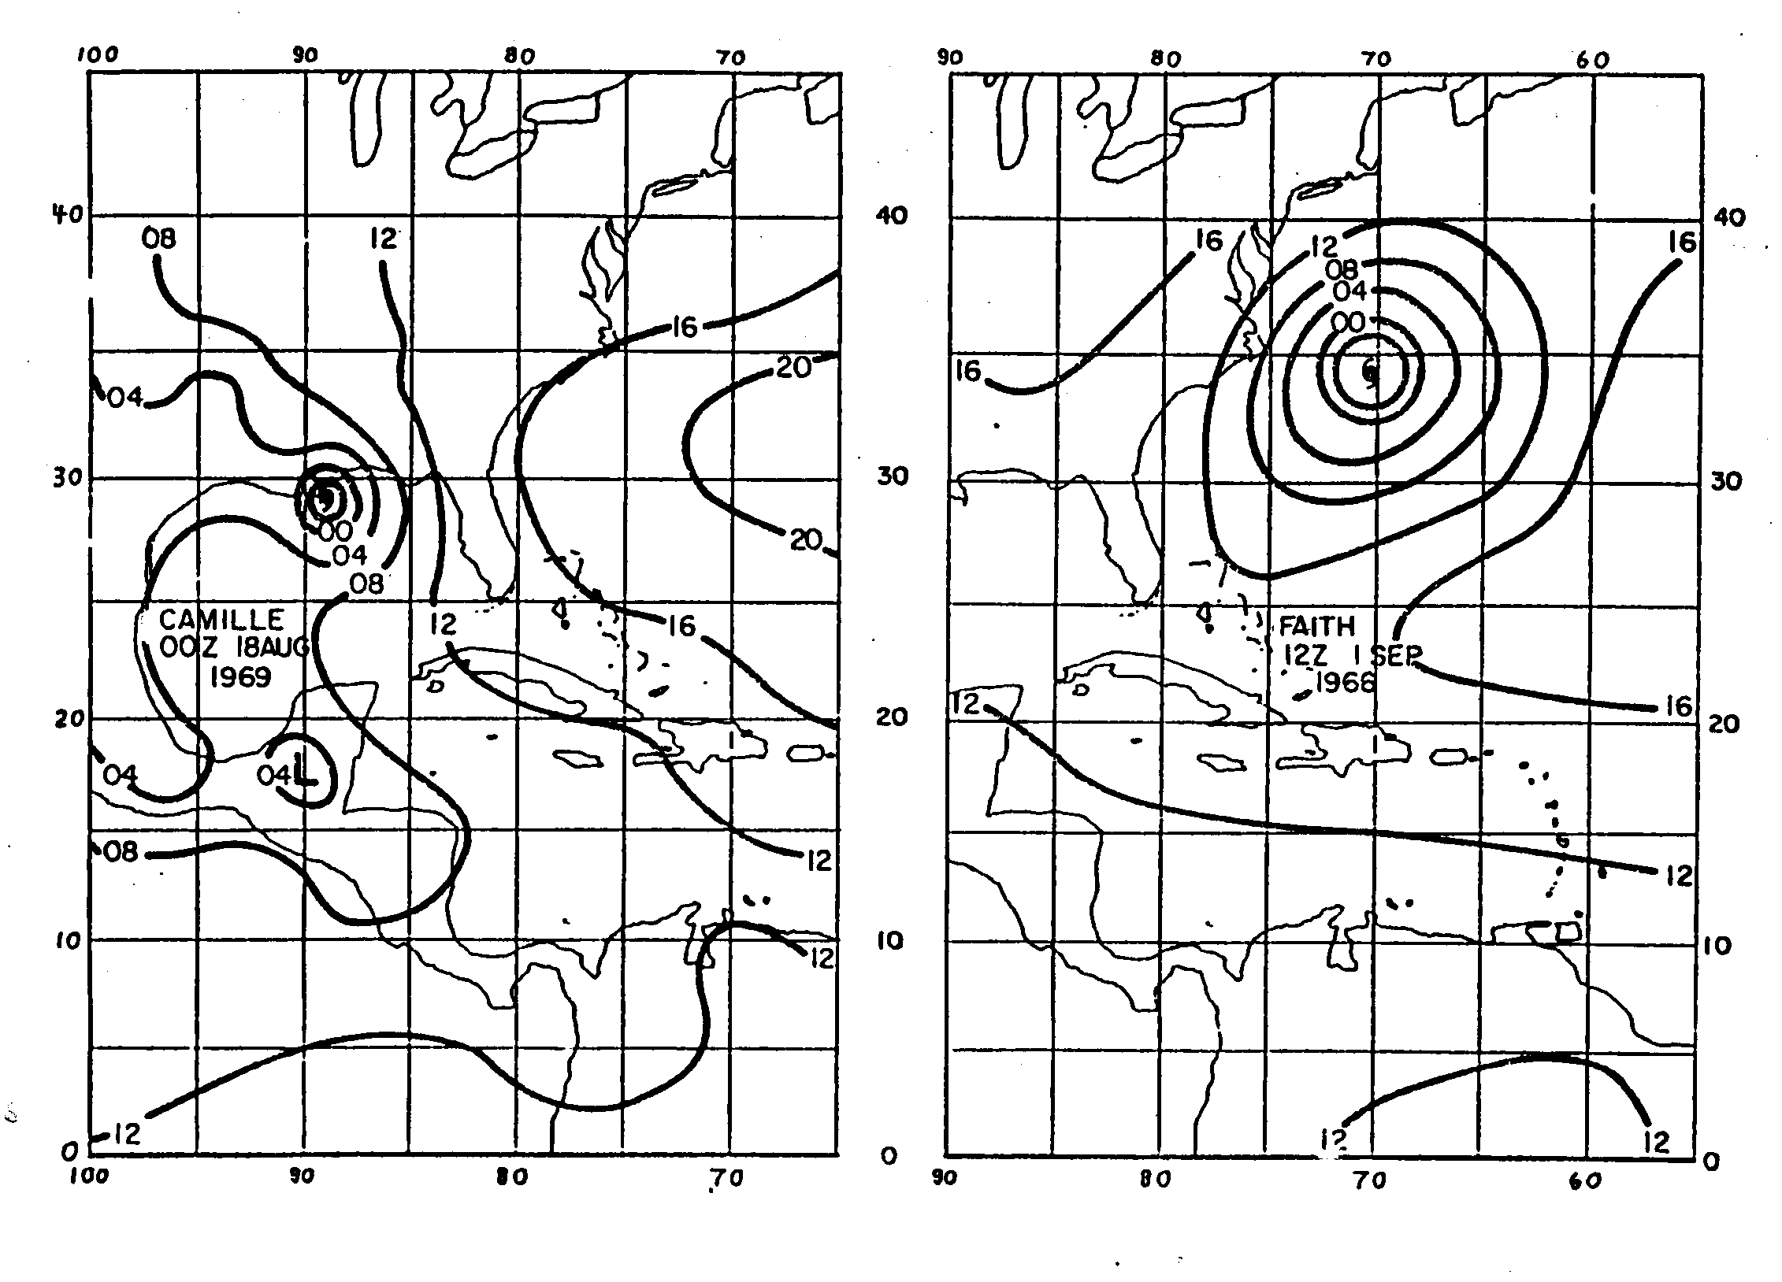

Slide 32
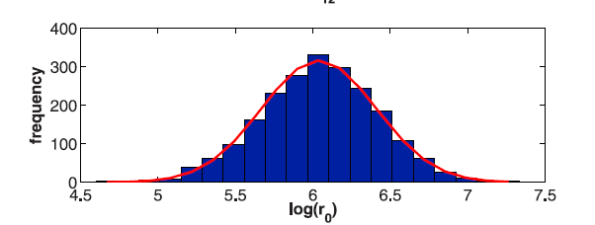
Outer radius very nearly follows a log-normal distribution with a median value of about 420 km

Slide 33
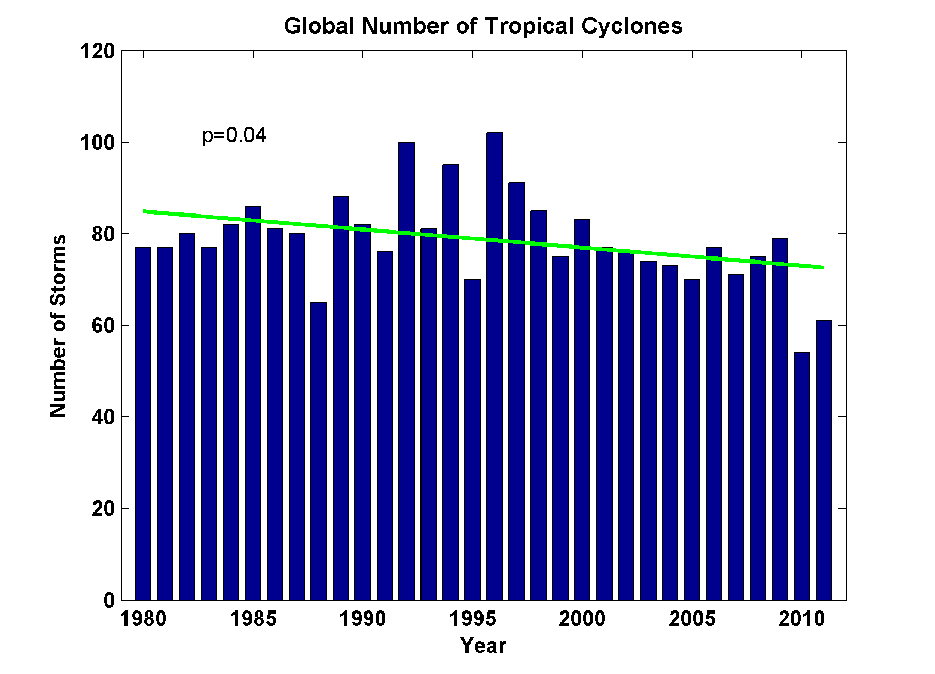
Global Tropical Cyclone Frequency, 1980-2011
2012
Data Sources: NOAA/TPC and NAVY/JTWC
Notes:
33

Slide 34
Tropical Cyclones in History

Slide 35
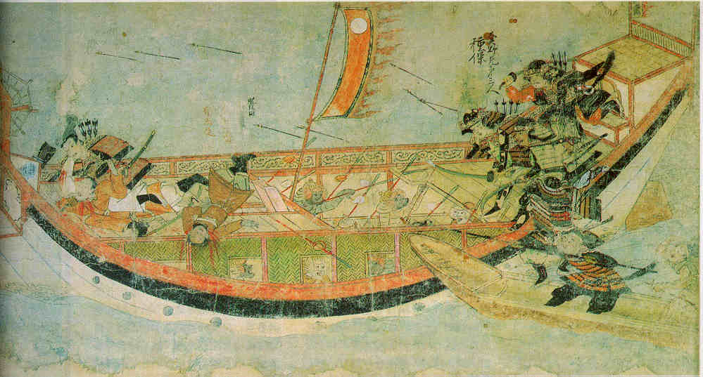
Early historical encounters: The Mongol invasions of Japan in 1274 and 1281
Scene from the 13th century Mongol invasion scrolls, based on a narrative written by the Japanese warrior Takezaki Suenaga.

Slide 36
Galveston, 1900
The opinion held by some who are unacquainted with the actual conditions of things, that Galveston will at some time be seriously damaged by some such disturbance, is simply an absurd delusion
Isaac Cline, Local Forecast Official and Section Director, U.S Weather Bureau, Galveston, Texas, in The Galveston News, 1891
Wonderful account of the event in Isaac’s Storm, by Erik Larson
Notes:
Isaac Cline, the highly educated and much respected head of the local US Weather Bureau office in Galveston, had read a scientific paper by a leading oceanographer of the day that argues that large storm surges are not possible when there is much shallow water offshore. We now know that the opposite is the case.

Slide 37
August 28th, 1900: Willis Moore, Head of the United States Weather Bureau, issues an edict banning the transmission of all West Indian storm reports from its own Havana office to its New Orleans office. It also forbade chief forecasters from issuing hurricane warnings without prior approval from Washington. Moore followed up with a message delivered through Western Union:
The United States Weather Bureau in Cuba has been greatly annoyed by independent observatories securing a few scattered reports and then attempting to make weather predictions and issue hurricane warnings to the detriment of commerce and the embarrassment of the Government service. I have reason to believe that they are copying, or contemplate doing so, data from our daily weather maps in New Orleans and cabling the same to Havana.
Notes:
The U.S. Weather Bureau had a reputation for insularity that continued until quite recently. In this case, jealousy of the very successful Cuban forecasters caused the head of the Weather Bureau to make a decision that arguably cost 8,000 lives.

Slide 38
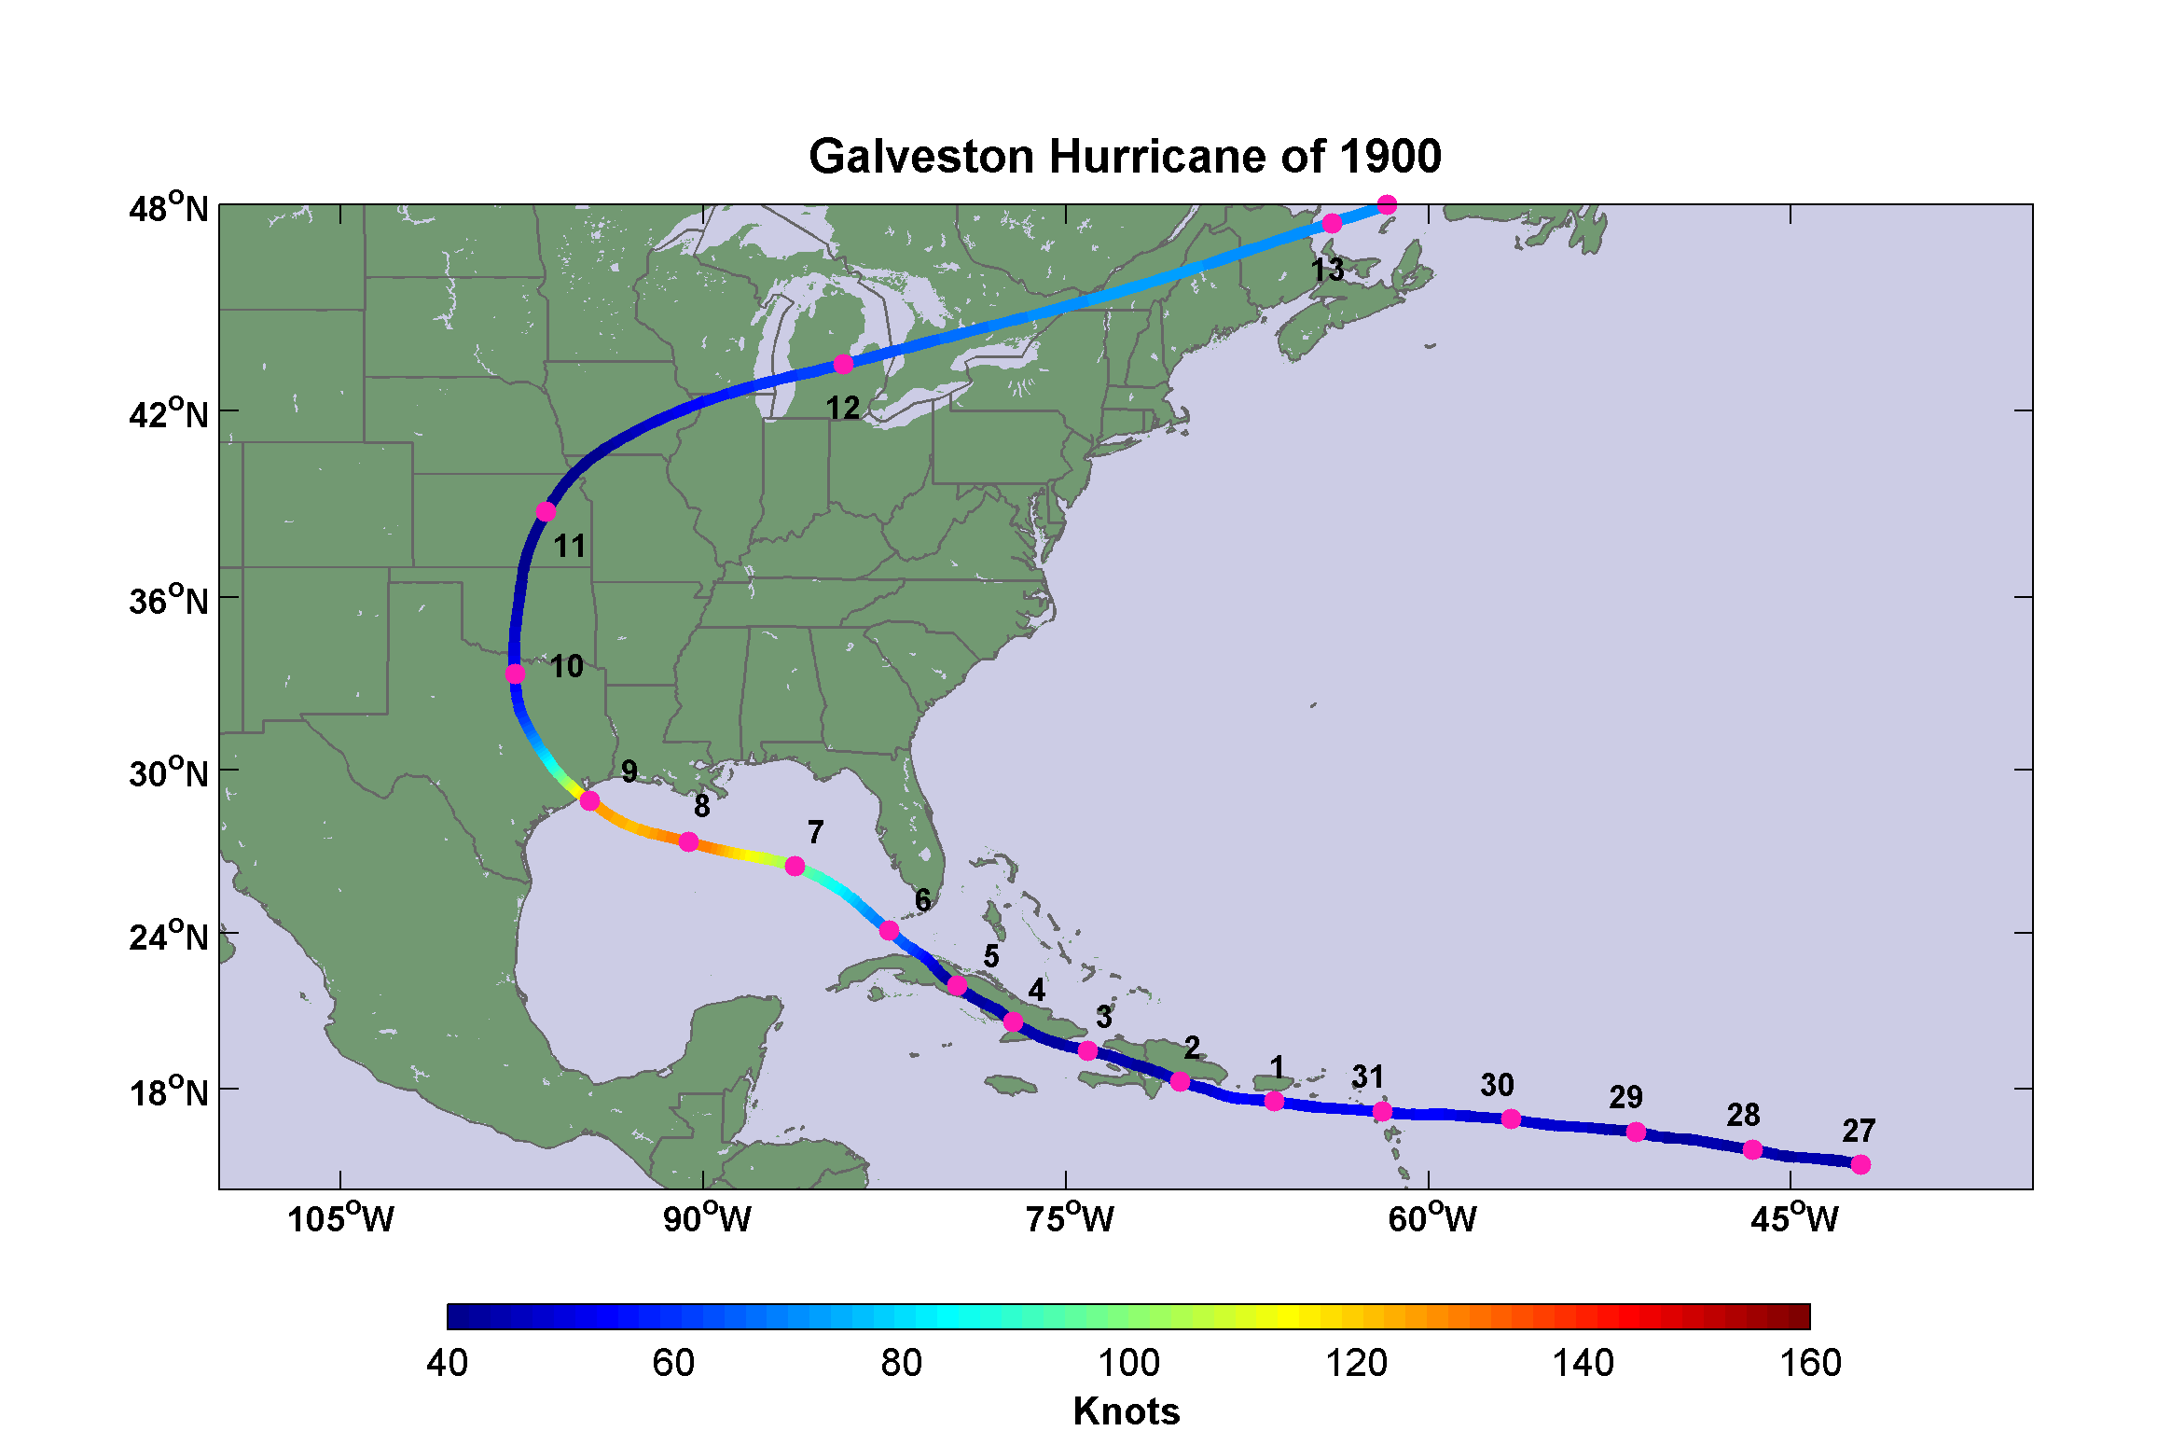
Notes:
Track of the Great Galveston Hurricane of 1900. Dates are days in August and September, and colors indicate wind speed in nautical miles per hour (knots).
Following description from “Texas Hurricane History”, David Roth, National Weather Service, Camp Springs, MD: http://www.hpc.ncep.noaa.gov/research/txhur.pdf
The question from the Racer’s Storm [of 1837] was tragically prophetic as the Great Galveston Hurricane showed on September 7-9th, 1900. It towers alone as the worst natural disaster in the United States in terms of lives lost; the most frequently used estimate of the death toll is 8,000. The potential of this disaster had been shown in the destructions of Santiago in 1844, Clarksville/Baghdad in 1867, and Indianola in 1875 and 1886. At the time, the population of Galveston was near 30,000. Most of its structures were of wood frame, built just above ground
level and supported by pilings.
A new innovation helped relay details about what the storm did in the Caribbean Islands; it was known as the wireless telegraph. Word had been received of a hurricane which had struck Trinidad and destroyed almost all the structures on that island. Word of the storm’s passing over Cuba and moving northwest into the Gulf in the direction of Texas had been relayed to the local weather office in Galveston Island. Sailors began to arrive in the port telling of nasty weather offshore.
On the 6th, a hurricane watch was posted along the Gulf Coast, westward to New Orleans. Winds began to increase as high, fish-scale shaped clouds (altocumulus) began to move inland. By the next day, the hurricane watch was extended west to include Texas. Driving rain began at 4 AM. Large waves began to pound the shores of Galveston Island. The pressure began to fall rapidly at the Weather Bureau station. This caused them to hoist a Hurricane Flag - their version of a hurricane warning. This action caused about 20,000 people to evacuate, a move that saved many lives.
Yet a number of people ignored the warning. Gentry from Houston rode out to the island via train to witness the huge waves first hand. Through the morning of the 8th, greater and greater numbers of people crowded the beaches. Isaac Cline of the Weather Bureau could not believe what was happening. He took matters into his own hands and rode with his brother down the beach in a horse-drawn buggy, warning people to go back to the mainland - in effect, making him a modern day Paul Revere. Unfortunately, few listened. The weather, however, changed their minds as a wooden pagoda along the beach and its associated boardwalk became mere driftwood before the crowd’s eyes. Then they began to disperse. For many, it turned out to be far too late. A steamer broke free of its moorings and went on a rampage, destroying all three bridges to the mainland.
Winds of 100 mph blew away the anemometer at the Weather Bureau. The pressure fell to 28.44". Winds gusting over 125 mph sent raging waters covering Galveston Island by 15 feet just before midnight, with additional waves much higher on top of the storm surge. As flood
waters rose, people fled towards the center of the island, which had slightly higher ground. This turned out to be fruitless, as it merely delayed the inevitable. The force of the wind sent boards, chairs, and tree limbs sailing through the air. Pebbles and shards of glass became deadly
missiles. When the water began rising, Harry Claiborne, keeper of the Bolivar Point Lighthouse, fled to the safety of his workplace. People soon after began pounding on the door, begging entry into the sanctuary of the lighthouse. The tower was soon crammed with 124 people, many of which were from a train stranded in the rising waters. After a while, the big door to the lighthouse was hidden under four feet of water . The lighthouse survived the storm (Roberts).
Wooden buildings floated off their pilings and smashed into one another. As houses disintegrated, unfortunate occupants were thrust into the water to drown. In all, more than 2600 houses were demolished. The picture to the right shows the devastation which occurred to Galveston, provided by the Galveston County Daily News. Twelve square blocks, 3/4 of the city, were completely wiped out. All bridges across the bay were destroyed, along with 15 miles of railroad track. All communications with the mainland were lost. Vast quantities of rain fell, with Galveston (10") and Brazoria (10") setting 24 hour rainfall records for September.
The British Freighter Kendall Castle was moored offshore. Several ships were driven against it. But is was when the Norwegian freighter Guller nudged against the Castle that it was sent on a “wild ride” over the Halfmoon Shoal lighthouse, pounding it into the sand, on its way to
Texas City (Cipra). Very little damage was seen at Sabine Pass, which shows how small the core of this storm was in areal extent.
However, fewer than 2000 of those remaining on the island survived. The weather office chief survived, but his wife drowned. Bolivar Point Lighthouse became the center of relief activities after the storm. The lighthouse over the ensuing days let people in the area know that
at least one thing still worked on the island, as it helped storm-battered ships return to shore. Martial law was declared. Looters were shot on the spot.
The old first capitol building of the Republic of Texas at West Columbia was destroyed. Mustang Island also saw many bodies littering the beach. Alvin saw 8.05" of rain fall on the 9th, setting a 24 hour rainfall record for September. Quintana was partially abandoned, after being seriously harmed by both the 1899 Flood and this hurricane. Corpus Christi had a stiff northeast breeze, but exceptional fishing. In Flour Bluff Harbor, millions of red, trout, and mullet infested the waters, in their avoidance of the hurricane. Local residents feasted on the tarpon and helped out Galveston with over $1000 for food and clothing. The storm accelerated after moving inland, racing north to the Great Lakes while still packing 70 mph winds. The low then moved across Canada, the North Atlantic, and Northern Europe before finally dying in Siberia. Thirty million dollars in damage occurred.
A massive public works project was then undertaken to raise the Galveston’s elevation and build a three mile long, 17 foot high, concrete seawall. This has, to date, prevented a tragedy of such proportions from occurring in Galveston. The city never quite regained its importance as a port, due to the construction of the Houston ship channel, similar to the fate of Indianola fourteen years before. As population swells along the coast, construction expanded into areas not protected by the seawall. Those that have not learned from history are doomed to repeat it.

Slide 39
The storm will probably continue slowly northward and its effects will be felt as far as the lower portion of the middle Atlantic coast by Friday night.
- Forecast issued by U.S. Weather Bureau, 8:00 AM Thursday, September 6, 1900
Notes:
The shear incompetence of the U.S. Weather Bureau in Washington is evident in this astoundingly bad forecast. Even an amateur would have noticed that the hurricane had passed west of Key West, Florida.

Slide 40
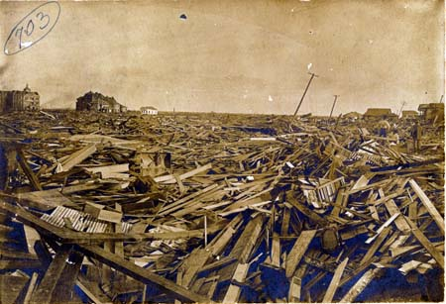
Sunday, September 9, 1900, revealed one of the most horrible sights that ever a civilized people looked upon. - Isaac Cline
Notes:
This damage could not have been avoided. But the loss of 8,000 lives can be blamed on incompetence and petty politics in Washington.

Slide 41
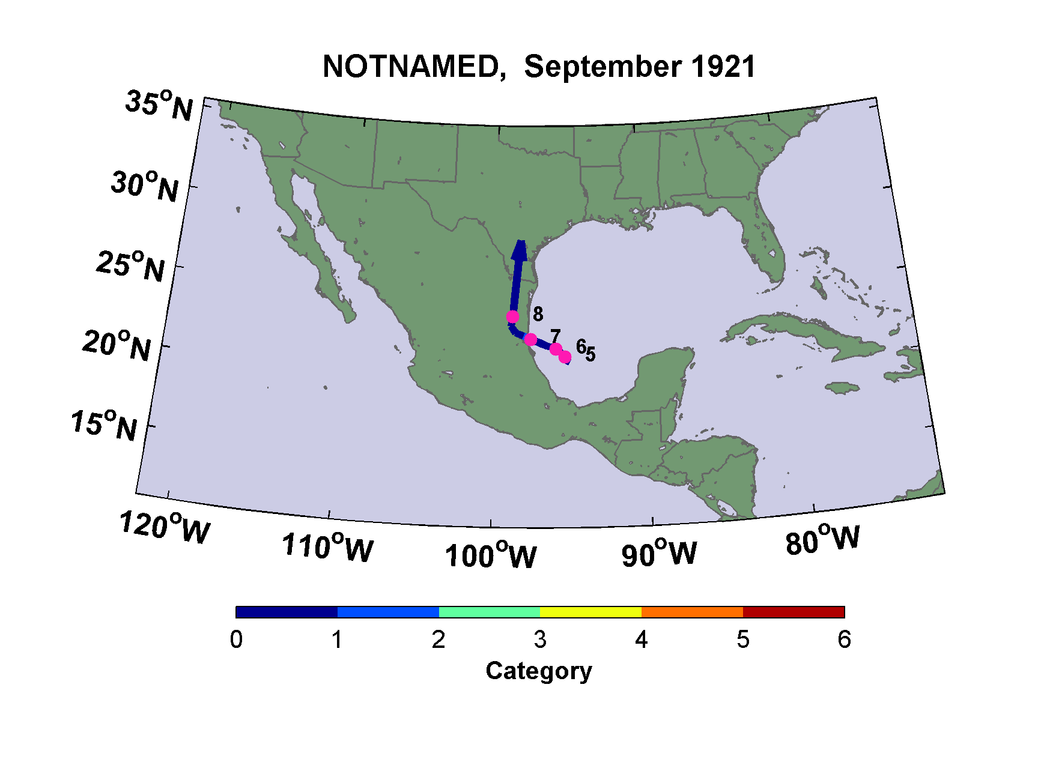
The Great San Antonio Flood of 1921
Notes:
This weak tropical storm was not even categorized as a such by the time it dropped record rainfall on San Antonio

Slide 42
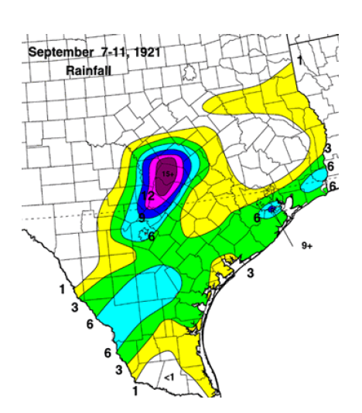
Rainfall in inches
Notes:
Figure and text from “Texas Hurricane History”, David Roth, National Weather Service, Camp Springs, MD: http://www.hpc.ncep.noaa.gov/research/txhur.pdf
September 7-11th, 1921: [In September, 1921], a tropical storm rapidly spun up in the Bay of Campeche. It progressed northwest into Mexico and crossed the Rio Grande. After passing inland into Texas on the 8th, it could barely be identified as a cyclone, except for its associated deluge that drifted northward through Texas. At Taylor, 23.11" of rain fell in 24 hours. A new 18 hour rainfall record for the United States was set in Williamson County when 36.40" fell. Thrall reported nearly 40 inches of rain in total, 38.2" in a 24 hour period. The map shows the rainfall accumulations throughout southern and central Texas related to this cyclone (after Tannehill).
Torrential rains accompanying the decaying system caused one of the most destructive floods in San Antonio’s history. The waters rose so rapidly (a flash flood) that automobiles were deserted and the occupants sought safety in high buildings. Nearly seven feet of water stood in the large hotels, theaters, and stores. In San Antonio alone, 51 lives were lost in the flooding and damage was estimated at $5 million. The largest floods occurred on the Little and San Gabriel Rivers north of Austin and south of Temple. Along the Little River, at least 159 drowned. Total damages were estimated near $19 million. In all, 215 died due to the flood in the five county area around San Antonio.

Slide 43
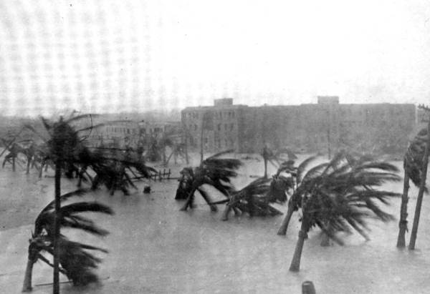
Miami, 1926

Slide 44
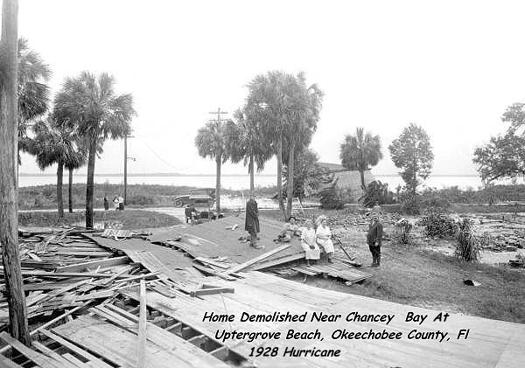
Okeechobee Hurricane of 1928

Slide 45
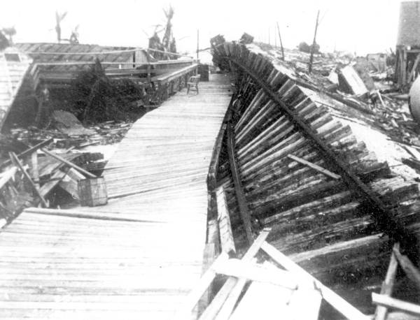
Labor Day Hurricane of 1935, Florida Keys
Indian Key absolutely swept clean, not a blade of grass, and over the high center of it were scattered live conchs that came in with the sea, craw fish, and dead morays. The whole bottom of the sea blew over it.
- Ernest Hemingway

Slide 46
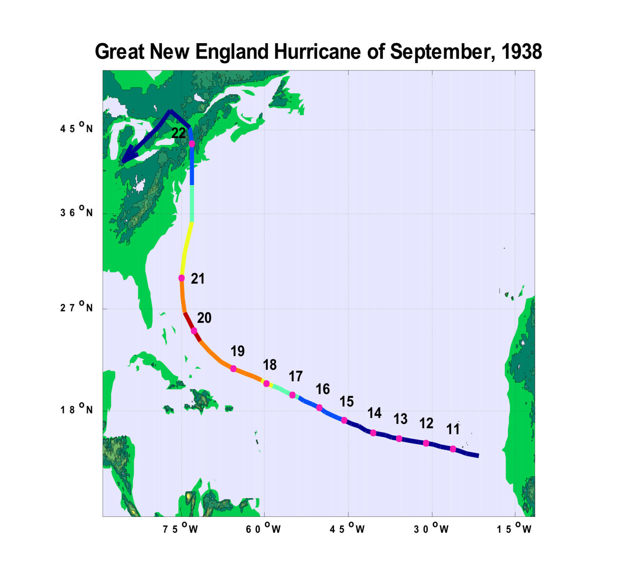

Slide 47
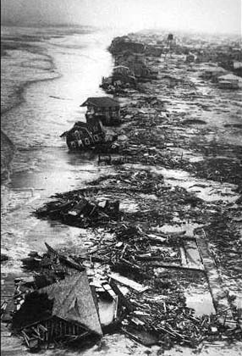
Long Island Shore after the 1938 Hurricane

Slide 48
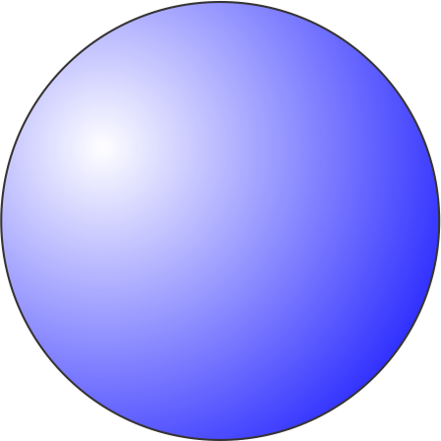
Hurricane Katrina, 2005
A major hurricane could swamp New Orleans under 20 feet of water, killing thousands. Human activities along the Mississippi River​ have dramatically increased the risk, and now only massive reengineering of southeastern Louisiana can save the city
-- Mark Fischetti, “Drowning New Orleans”, Scientific American, October, 2001
Notes:
Hurricane Katrina had, in essence, been predicted years in advance, and the city government had rehearsed for a Katrina-like event.

Slide 49
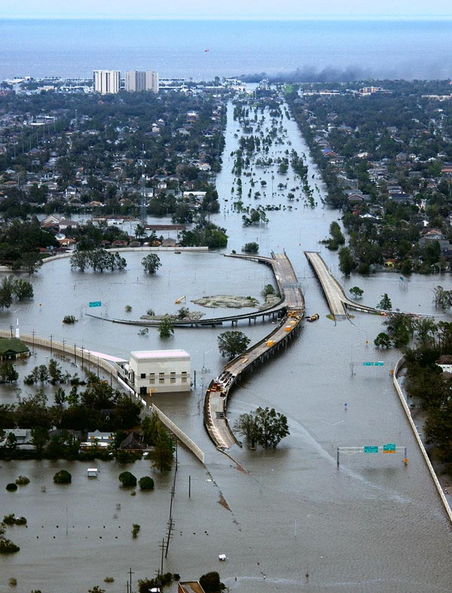

Slide 50
Hurricanes and Society

Slide 51
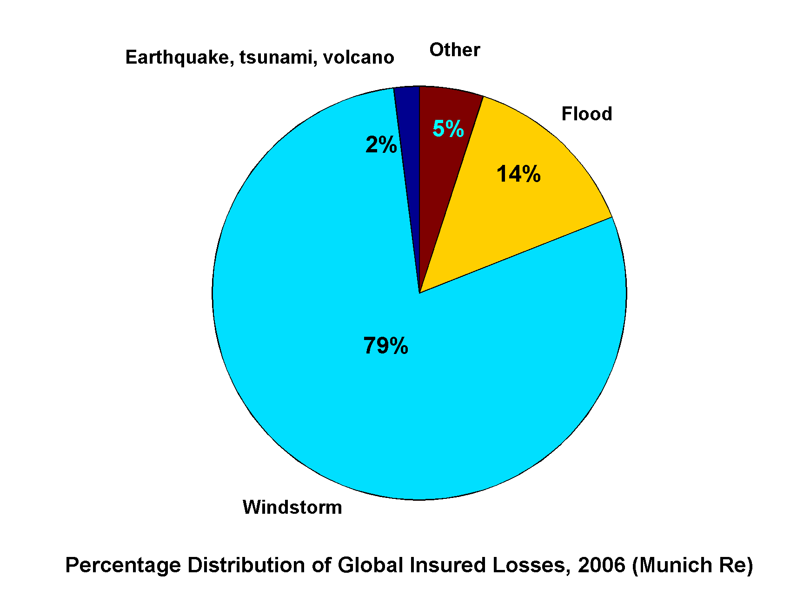
Windstorms Account for Bulk of Insured Losses Worldwide

Slide 52
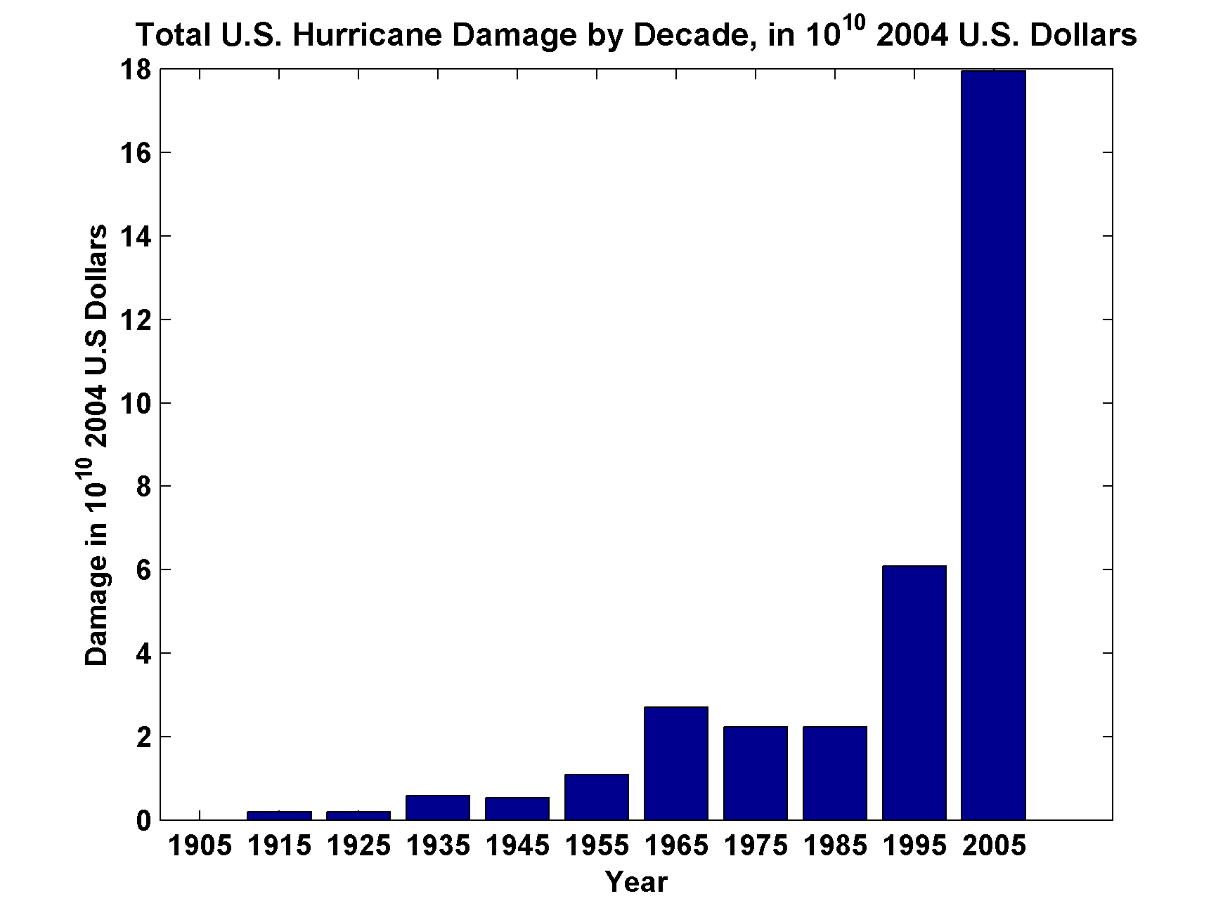
Total U.S. Hurricane Damage by Decade, in 10¹⁰ 2004 U.S. Dollars
Source: Roger Pielke, Jr.

Slide 53
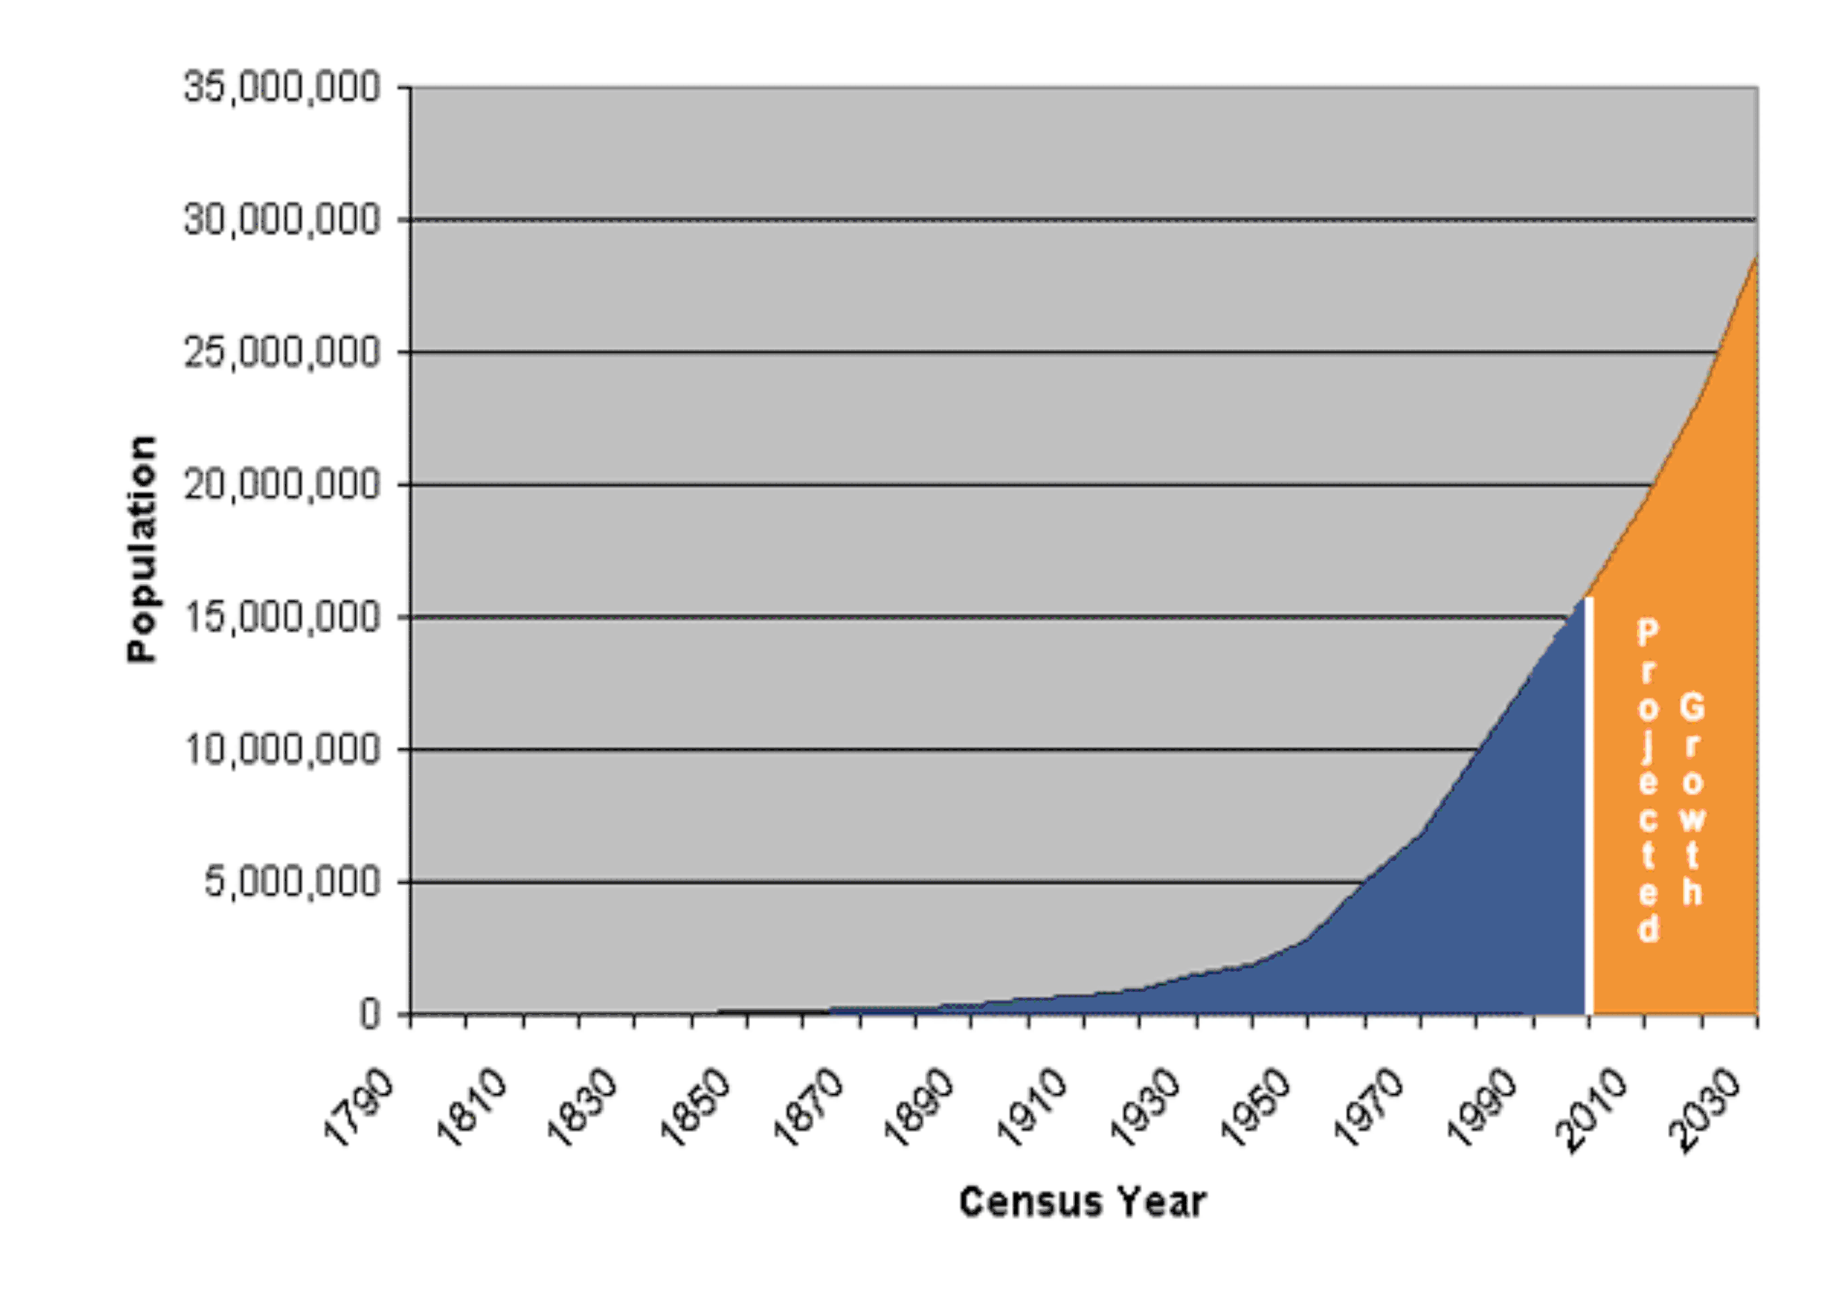
Population of Florida, 1790-2004

Slide 54
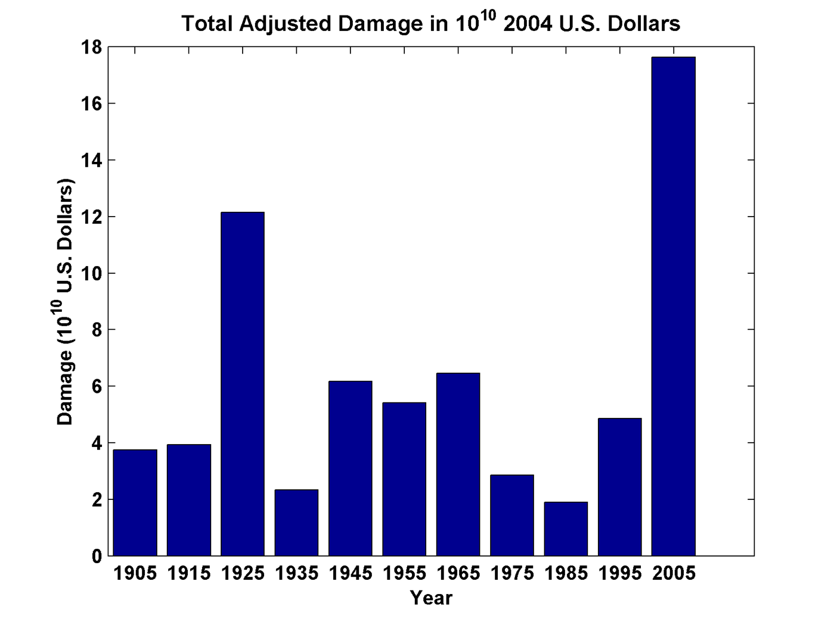
Total Adjusted Damage by Decade, in 10¹⁰ 2004 U.S. Dollars
Source: Roger Pielke, Jr.

Slide 55
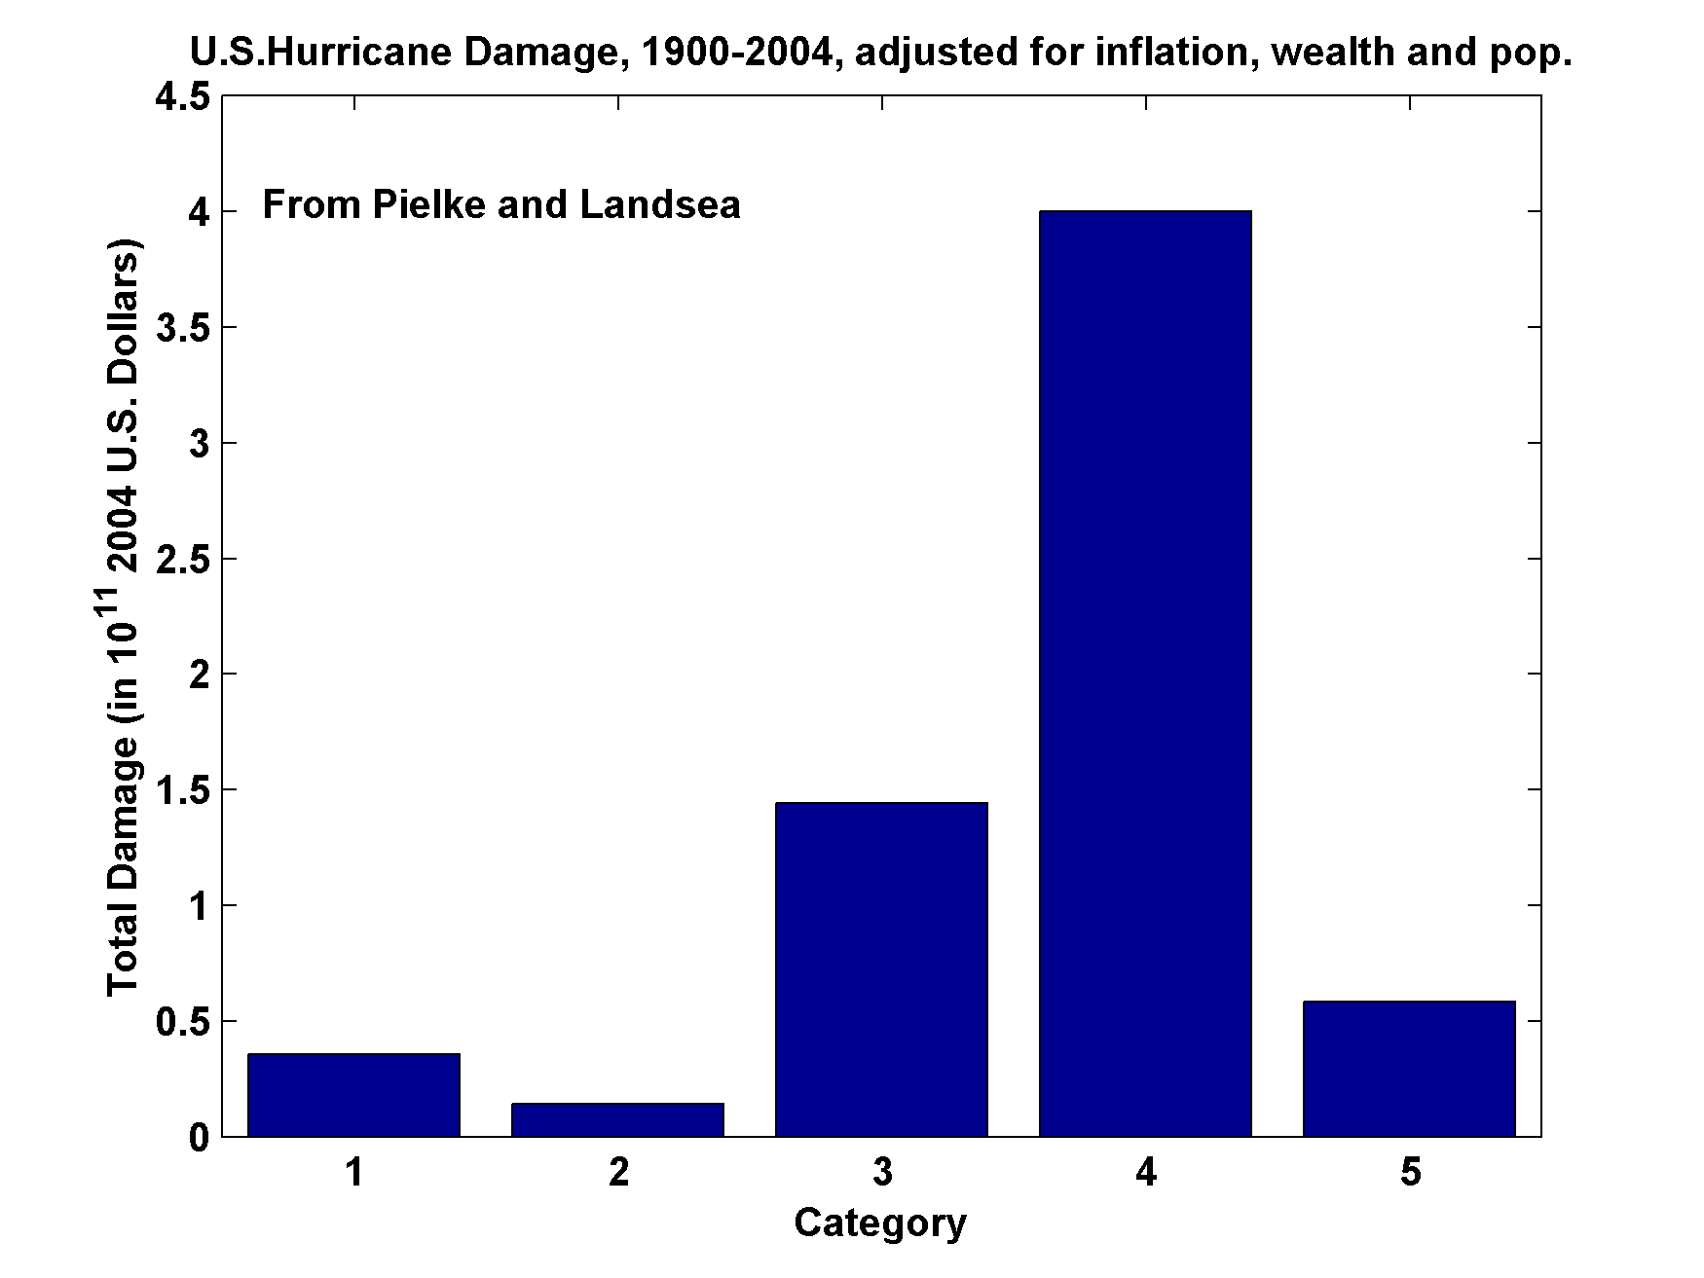
U.S. Hurricane Damage, 1900-2004,Adjusted for Inflation, Wealth, and Population

Slide 56
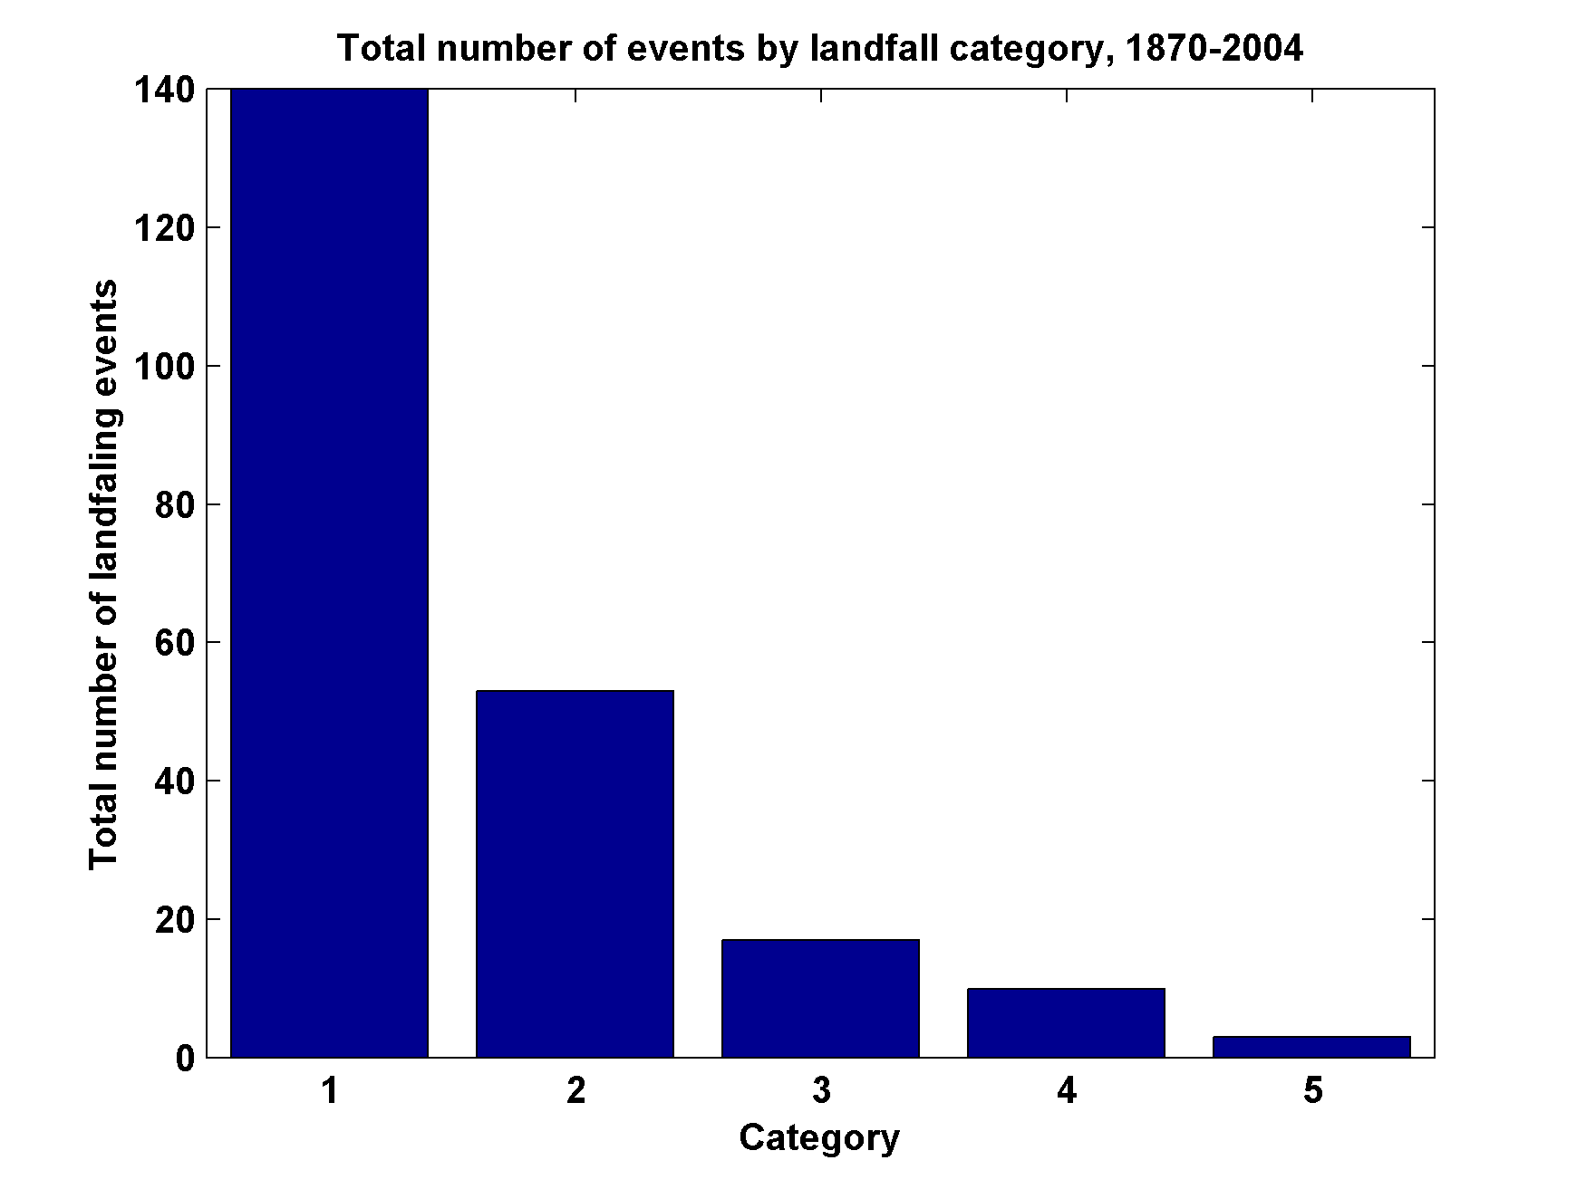
Total Number of Landfall Events, by Category, 1870-2004

Slide 57
Some Tropical Cyclone Physics

Slide 58
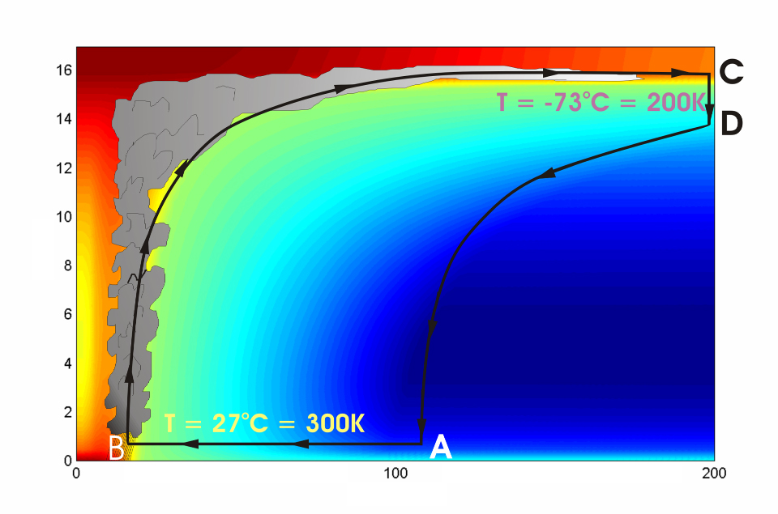





Cross-section through a Hurricane & Energy Production
eye
edge
Air loses energy
Hot air rises
Height above ocean (km)
Cooled air sinks
Low entropy (temperature)
Air spirals inward and gains energy from the ocean
Ocean surface
Radius (km)
Notes:
The energy cycle of a mature hurricane - the hurricane as a Carnot heat engine. This two-dimensional plot of the thermodynamic cycle shows a vertical cross section of the hurricane, whose storm center lies along the left edge. The colors depict the entropy distribution; cooler colors indicate lower entropy. Loosely, this means the total heat content of the air. Note that as air approaches the eyewall, its entropy increases rapidly, reflecting the large input of heat from the ocean.
Let’s follow a sample of air that begins at point A near the sea surface, a hundred kilometers or so from the storm center. The process mainly responsible for driving the storm is the evaporation of seawater, which transfers energy from sea to air. As a result of that transfer, air spirals inward close to the sea surface, between Points A and B. The storm center is an area of relatively low pressure, so the pressure on air decreases as it travels from A to B. But it is always in contact with the sea surface, which acts as an almost unlimited heat reservoir, so its temperature is approximately constant (acquiring entropy at a constant temperature). It is during this leg that enormous quantities of heat are added to the air from evaporation of seawater. Evaporation of water is a very efficient way to transfer heat from one body to another. That is why you feel cold when you are wet, especially if it is windy and/or dry: evaporation is taking heat from your body. Thus the addition of heat in leg A-B shows up mostly as an increase in humidity in the air. This form of heat is called latent heat. Evaporation of sea water into the inflowing air is by far the most important source of heat driving the hurricane, which makes leg A-B the firebox of the hurricane. When hurricanes reach land, they quickly die because they are cut off from their oceanic energy source. At point B, the air turns and flows upward through the towering cumulonimbus clouds that make up the hurricane’s eyewall. It is here that the latent heat is converted to sensible heat as water vapor condenses. But it is important to note that although there is enormous conversion between these two forms of heat, the total heat content (entropy, actually) remains approximately constant along this leg (note that the colors do not change along leg B-C). As the air flows upward, the pressure on it decreases very rapidly. What we have here is an example of adiabatic expansion. By the time the air reaches point C in the high troposphere or lower stratosphere, some 12 to 18 kilometers above the sea surface, the adiabatic expansion has lowered its temperature to a value close to that of the undisturbed upper tropical atmosphere, around -70°C or about 200 Kelvin. The air remains at approximately this temperature as it sinks down toward the tropopause (point D). Although the air is undergoing compression, it is losing heat by electromagnetic radiation to space. The depicted compression is very nearly isothermal. Finally, between D and A, the air returns to its starting point while undergoing an adiabatic compression. Voilà, the four legs of a Carnot cycle.
In a real hurricane, the energy cycle is open because hurricanes continuously exchange air with their environment.
Image is copyrighted 2005 by Oxford University Press.
Description from “Divine Wind: The History and Science of Hurricanes”, Kerry Emanuel, 2005, Oxford University Press, 296 p.
Definitions
The Carnot heat engine uses a particular thermodynamic cycle studied by Nicolas Léonard Sadi Carnot in the 1820s and expanded upon by Thomas Benoit in the 1840s and 50s. A heat engine is an engine that uses heat to produce mechanical work by carrying a working substance through a cyclic process from and for more information see http://en.wikipedia.org/wiki/Carnot_heat_engine).
Entropy is the measure of disorganization or degradation in the universe that reduces available energy, or tendency of available energy to dwindle. Chaos, opposite of order (from www.himalayasaltcrystal.com/glossary.htm).
Latent heat is the energy released or absorbed during a change of state (from www.indiaweather.in/gloss_j.asp).
Sensible heat is the heat that can be felt or sensed. The energy input which causes an increase or decrease in temperature (from www.aaronprocess.com/glossary.asp).
Adiabatic refers to changes in temperature caused by the expansion (cooling) or compression (warming) of a body of air as it rises or descends in the atmosphere, with no exchange of heat with the surrounding air (www.bbc.co.uk/weather/weatherwise/glossary/).
The troposphere is the lowest layer of the atmosphere and contains about 95 percent of the mass of air in the Earth's atmosphere. The troposphere extends from the Earth's surface up to about 10 to 15 kilometers. All weather processes take place in the troposphere. Ozone that is formed in the troposphere plays a significant role in both the greenhouse gas effect and urban smog (from ilrdss.sws.uiuc.edu/glossary/glossary_allresults.asp?glosID=T&page=5).
The Stratosphere is the layer of atmosphere that lies about 15 to 50 kilometres above the Earth's surface. In the stratosphere, the temperature rises with increasing height, which is the opposite of the situation in the lower atmosphere. Ozone occurs in minute quantities throughout the full depth of the atmosphere, but its concentration peaks within the stratosphere at an altitude of about 35 kilometres. This is referred to as the ozone layer. There is little up-and-down air movement in the stratosphere, so the ozone layer stays in position (from www.science.org.au/nova/004/004glo.htm)/
The tropopause is a boundary region in the atmosphere between the troposphere and the stratosphere (from en.wikipedia.org/wiki/Tropopause).
Electromagnetic radiation refers to energy transfer in the form of electric and magnetic waves that travel at the speed of light. Examples: light, radio waves, gamma rays, x-rays (from ie.lbl.gov/education/glossary/Glossary.htm).
Isothermal means to have equal or constant temperature with respect to either space or time (from www.4wx.com/glossary/i.php).

Slide 59
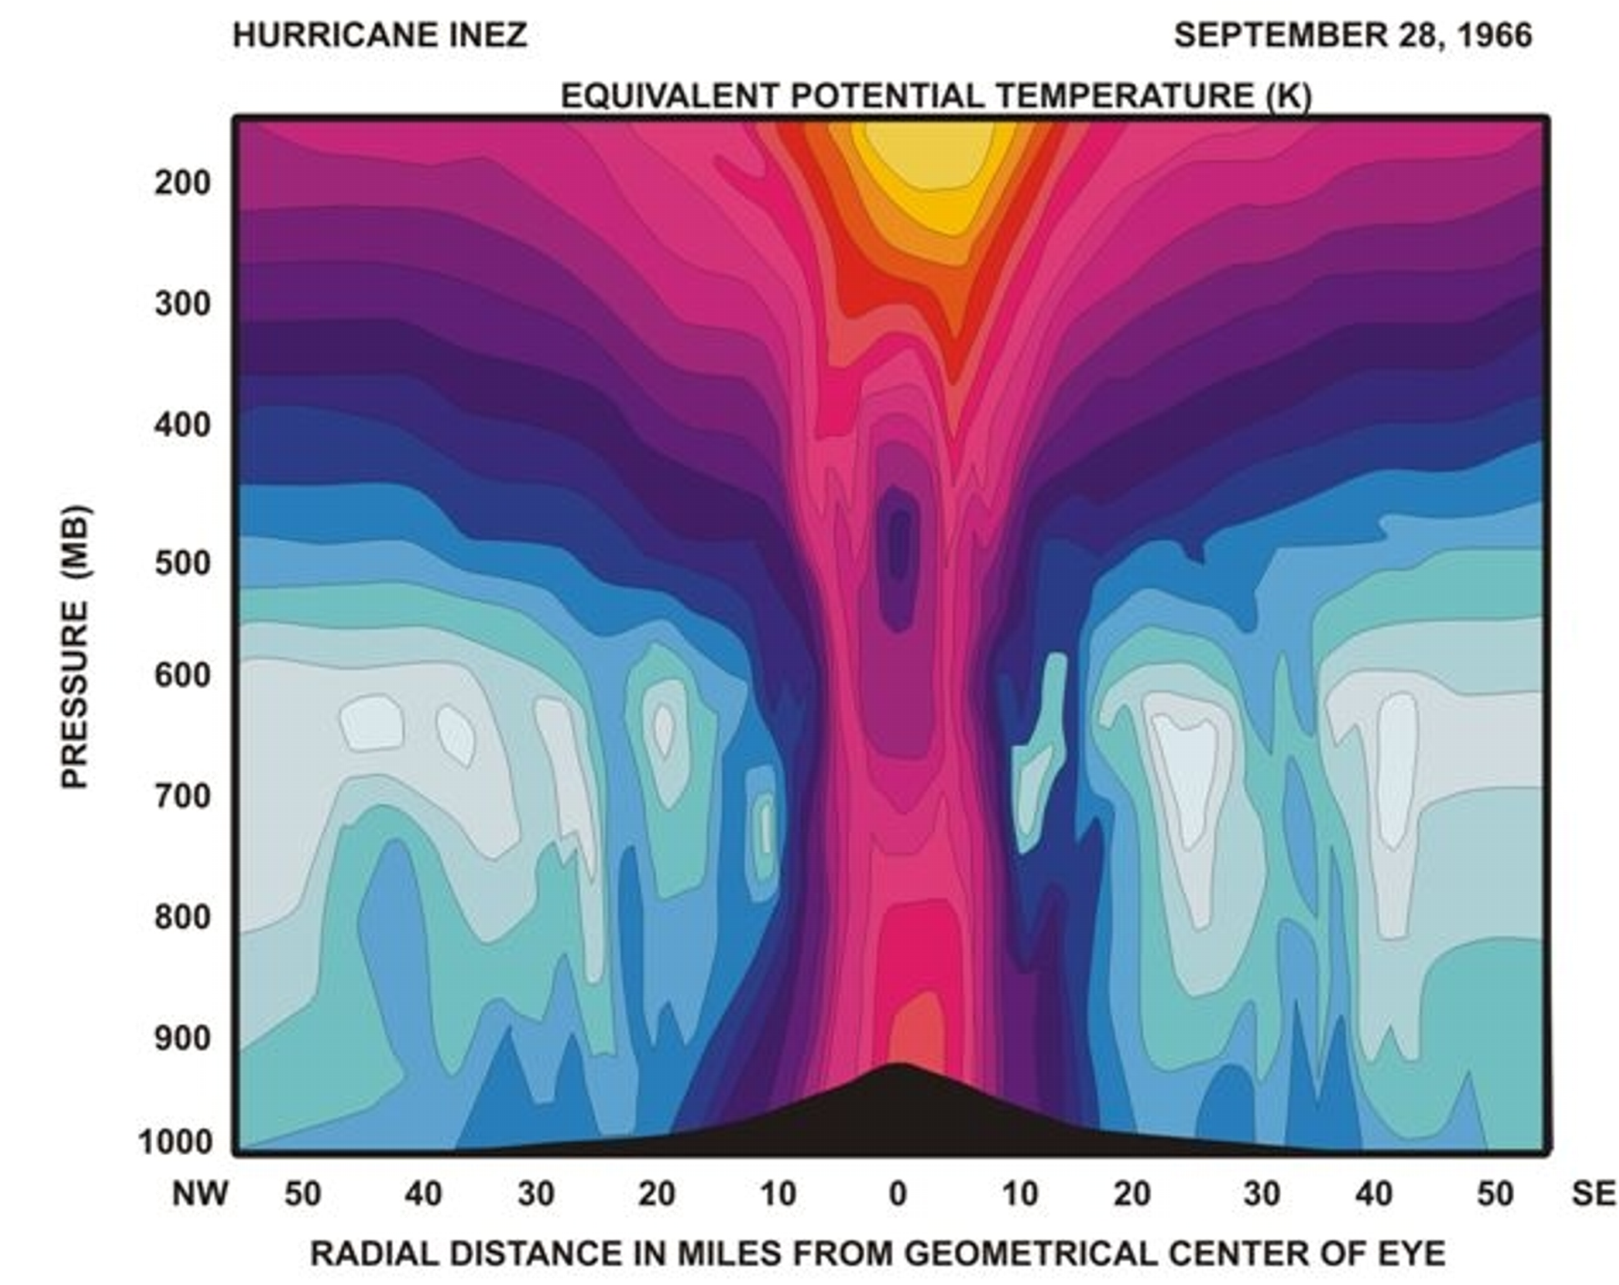
Distribution of Entropy in Hurricane Inez, 1966
Source: Hawkins and Imbembo, 1976

Slide 60
Carnot Theorem: Maximum efficiency results from a particular energy cycle:
Isothermal expansion
Adiabatic expansion
Isothermal compression
Adiabatic compression
Note: Last leg is not adiabatic in hurricane: Air cools radiatively. But since environmental temperature profile is moist adiabatic, the amount of radiative cooling is the same as if air were saturated and descending moist adiabatically.
Maximum rate of energy production:

Slide 61
Theoretical Upper Bound on Hurricane Maximum Wind Speed:
Surface temperature
Ratio of exchange coefficients of enthalpy and momentum
Outflow temperature
Air-sea enthalpy disequilibrium

Slide 62
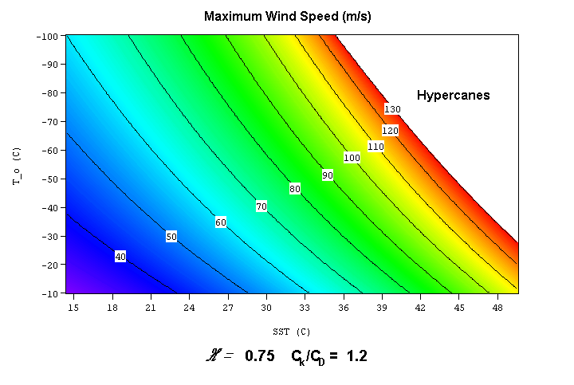

Slide 63
Annual Maximum Potential Intensity (m/s)

Slide 64
Genesis of Tropical Cyclones

Slide 65


Slide 66
Annual Maximum Potential Intensity (m/s)

Slide 67
Empirical Necessary Conditions
Potential intensity > 40 ms⁻¹
Sufficiently humid middle troposphere
Low values of vertical wind shear
Sufficient ambient vorticity

Slide 68
Genesis Potential Index:
850 hPa absolute vorticity (h)
850 – 250 hPa shear (S)
Potential intensity (PI)
Non-dimensional subsaturation of the middle troposphere:

Slide 69

Performance

Slide 70

Spatial Variability:

Slide 72

Interannual Variability
No Significant Correlations Outside the Atlantic!

Slide 73
A case study using rawinsonde and surface observations
(From Hawkins and Rubsam, Mon. Wea. Rev., 1968)

Slide 74


Slide 75


Slide 76


Slide 77


Slide 78


Slide 79


Slide 80


Slide 81


Slide 82


Slide 83


Slide 84

Tropical Experiment in Mexico (TEXMEX)
July 1 – August 10 1991

Slide 85

Flight Scheduling

Slide 86

WP-3D radars

Slide 87

Tail Doppler Scanning Strategy

Slide 88


Slide 89


Slide 90



Slide 91


Slide 92


Slide 93


Slide 94


Slide 95


Slide 96


Slide 97


Slide 98



