Slide 1

The Challenge of Estimating Long-term Tropical Cyclone Risk
Why we need to bring physics to bear on estimating natural hazard risk
Kerry Emanuel
Lorenz Center
Massachusetts Institute of technology

Slide 2
Flawed Basis of Current Risk Modeling
Almost all current risk assessments are based on historical statistics
Historical records are flawed and short
Moreover, the past 50-150 years is a poor guide to the present owing to climate change that has already occurred
Risk modelers have been slow to migrate to a physics-based approach
Risk modeling industry is being challenged by non-profits and start-ups
Government and the insurance industry should accelerate this transition
TC researchers need to get involved in physical modeling of risk

Slide 3
The Nature of the Beast
Start with total insured values (TIVs) of a particular insurance firm aggregated over zip codes
Net TIV: $ 2 trillion
12,968 zip codes

Slide 4
Procedure
Apply a set of 49,600 tropical cyclones making landfall in the continental U.S.
These have been generated using a physical model applied to the present climate (technique to be described shortly)
At each centroid, calculate the peak wind generated and apply a damage function that estimates the fraction of property value destroyed
Using insured value, calculate loss at each zip code and sum over all zip codes
From the set of 49,600 storms randomly draw 3 each year and create 1,000-year time series of damage
This is for stationary climate but the same idea can be applied to evolving climate states

Slide 5
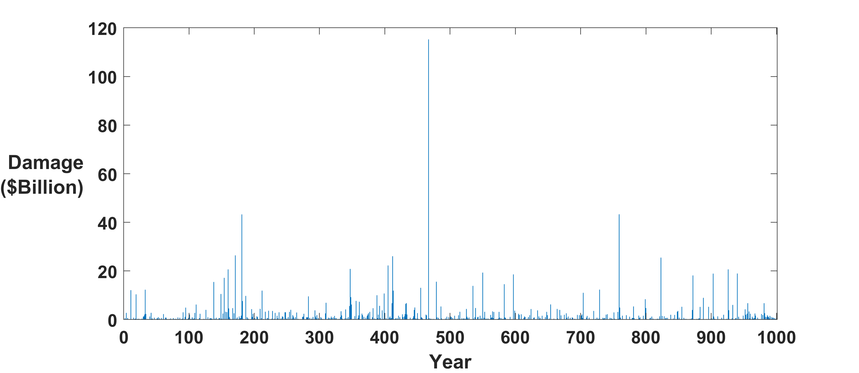
Example:
Question: Can we estimate average annual loss (AAL) from 50-100 years of record?
Answer: Good luck with that!

Slide 6
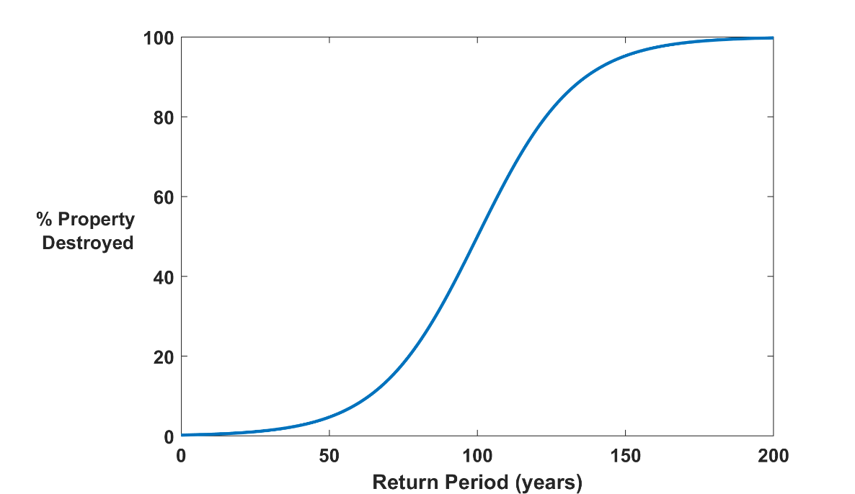

Why Climate Risk is Dominated by Extreme Events:
Societies are usually well adapted to frequent events (> 1/100 yr)
Societies are often poorly adapted to rare events (< 1/100 yr)
Large cost increases result when > 100-yr events become < 100-yr events
Largest slope

Slide 7
Historical Records
Tropical cyclones: ~< 100 years of good records (U.S.)
Even if we had 1000 years of great records, the past is no longer a good guide to the present
We need to turn to physical models to get better estimates of current (and future) weather risks

Slide 8
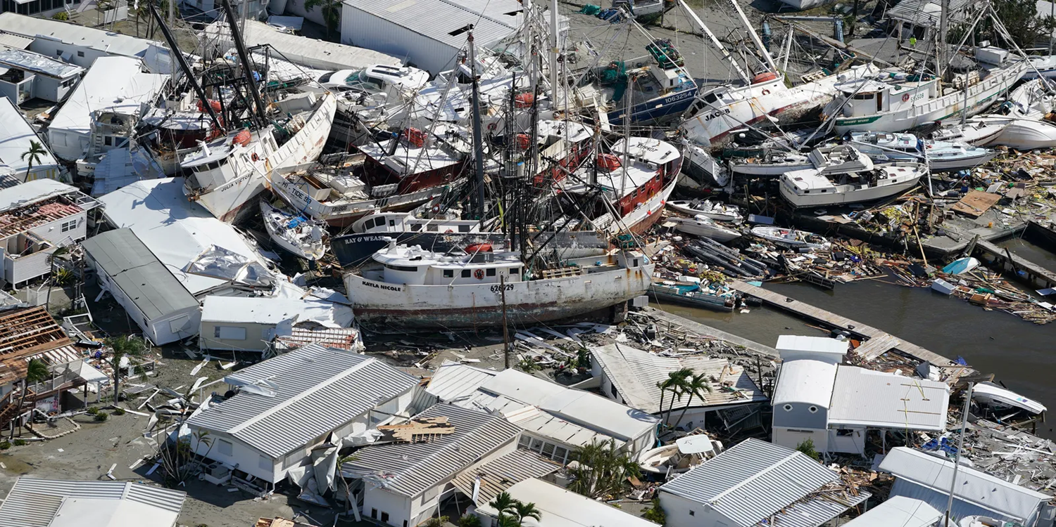
How can we bring physical modeling to bear on weather risk assessment?

Slide 9
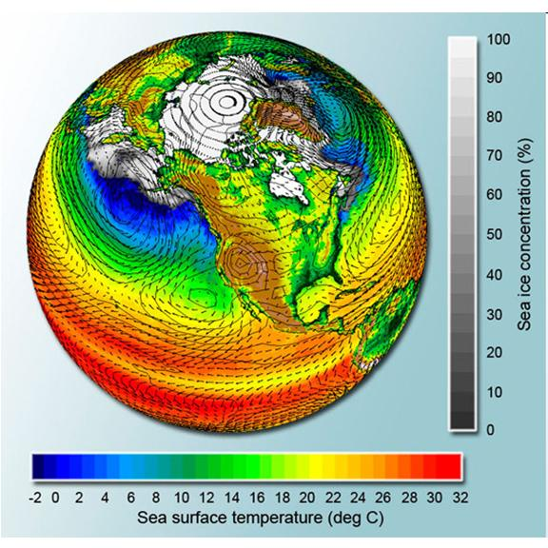
Global climate models are far too coarse for purpose

Slide 10

Problem: Today’s models are far too coarse to simulate destructive hurricanes
Histograms of Tropical Cyclone Intensity as Simulated by a Global Model with 50 km grid point spacing. (Courtesy Isaac Held, GFDL)
Category 3
Modeled
Observed
Global models do not simulate the storms that cause destruction
Wind Speed (meters per second)

Slide 11
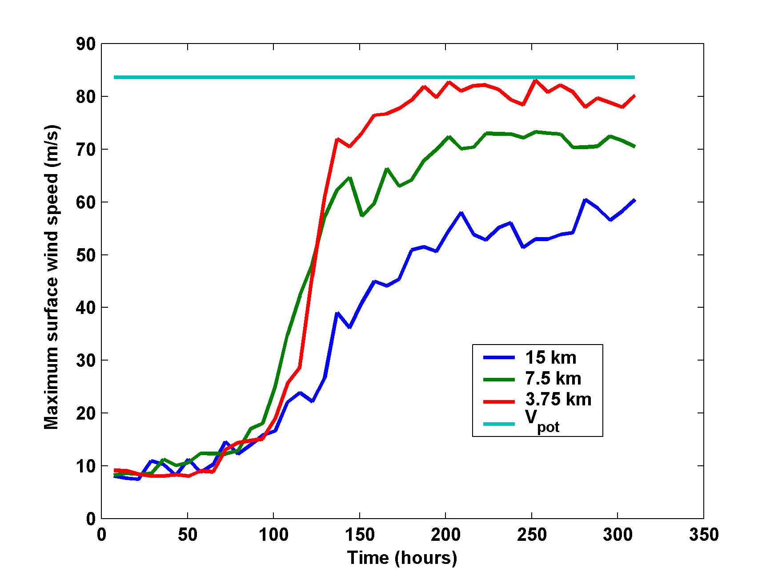
Numerical convergence in an axisymmetric, nonhydrostatic model (Rotunno and Emanuel, 1987)
HighResMip: Grid spacings of 20-200 km (NICAM has short run at 14 km)
We need high resolution AND O(1000 yr) simulations

Slide 12
Using Physics to Assess Hurricane Risk
(Downscaling)
Reliable, global records of coarse-scale climate are robust and widely available
Cull from these datasets the key statistics known to control tropical cyclone generation, movement, and intensity evolution
Bootstrap these key statistic to create unlimited synthetic time series of the hurricane-relevant environmental variables
Use these to drive specialized, very high resolution physical hurricane models
Extensively evaluate the results against historical hurricane data
Exact same method can be applied to output of climate models

Slide 13

Risk Assessment Approach:
Step 1: Seed each ocean basin with a very large number of weak, randomly located cyclones
Step 2: Cyclones are assumed to move with the large scale atmospheric flow in which they are embedded, plus a correction for the earth’s rotation and sphericity (beta-drift)
Step 3: Run the CHIPS coupled intensity model for each cyclone, and note how many achieve at least tropical storm strength (CHIPS is phrased in angular momentum coordinates. Flow-dependent resolution)
Step 4: Using the small fraction of surviving events, determine storm statistics. Can generate 100,000 events
Details: Emanuel et al., Bull. Amer. Meteor. Soc, 2008
Notes:
13

Slide 14
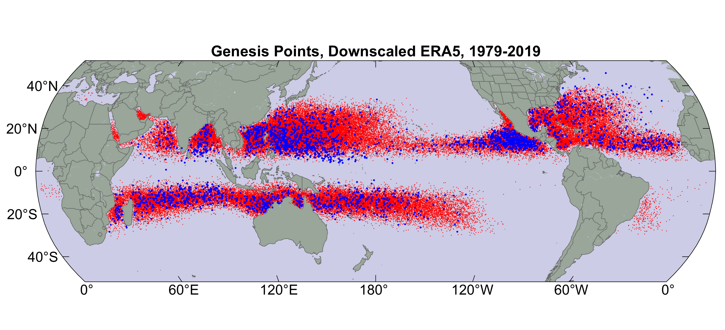
Origin points of successful seeds (red); observed genesis locations (blue)

Slide 15
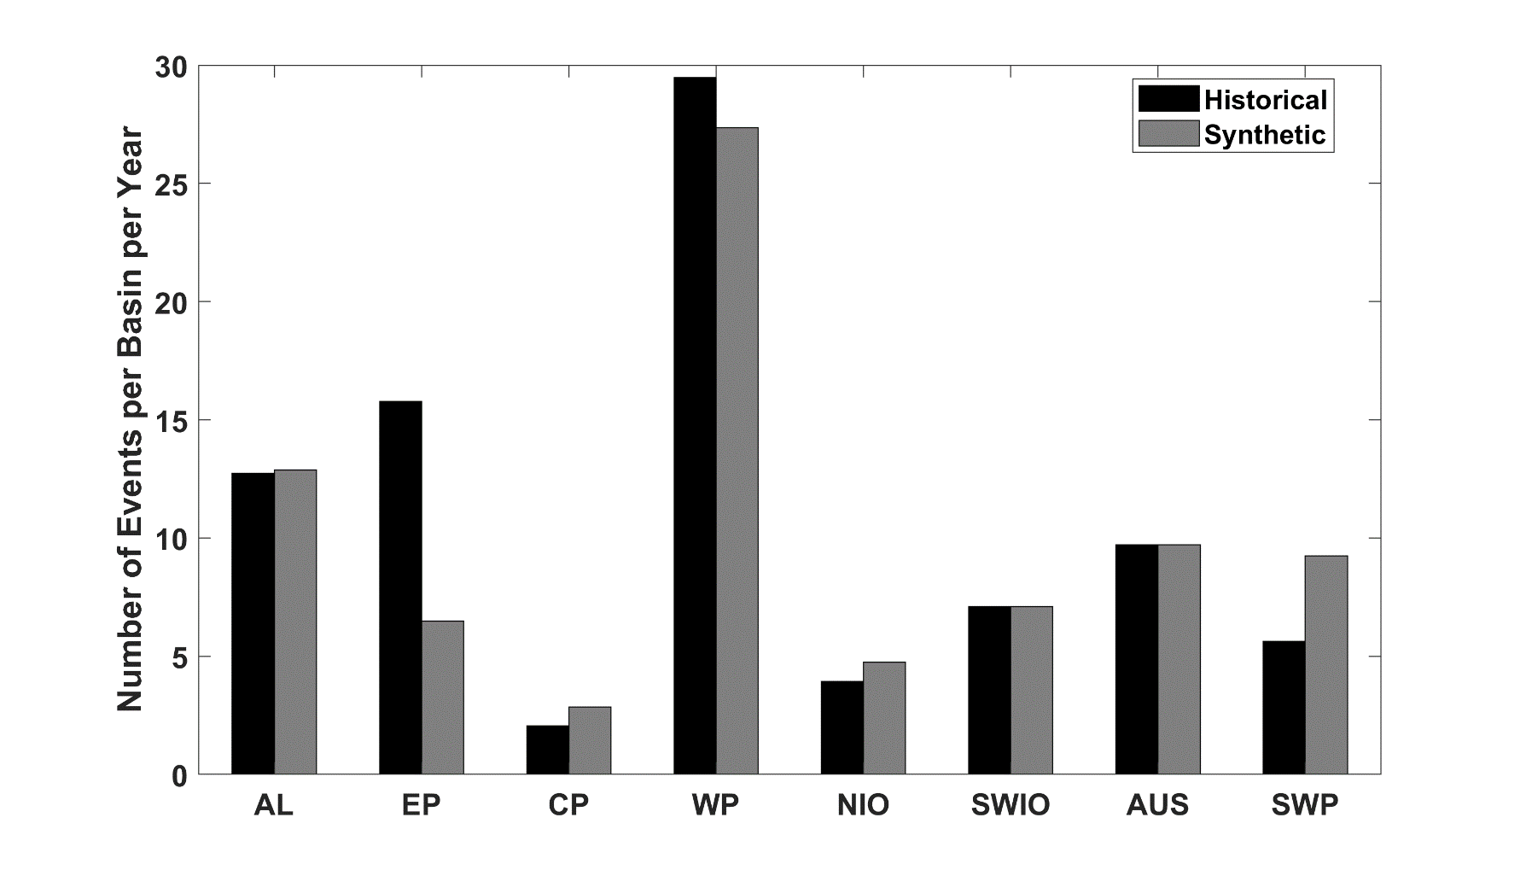
Average annual number of tropical cyclones over the period 1980-2020 in observations (IBTrACS; Knapp et al. 2010; black bars) and from random seeding of ERA-5 (gray bars)

Slide 16
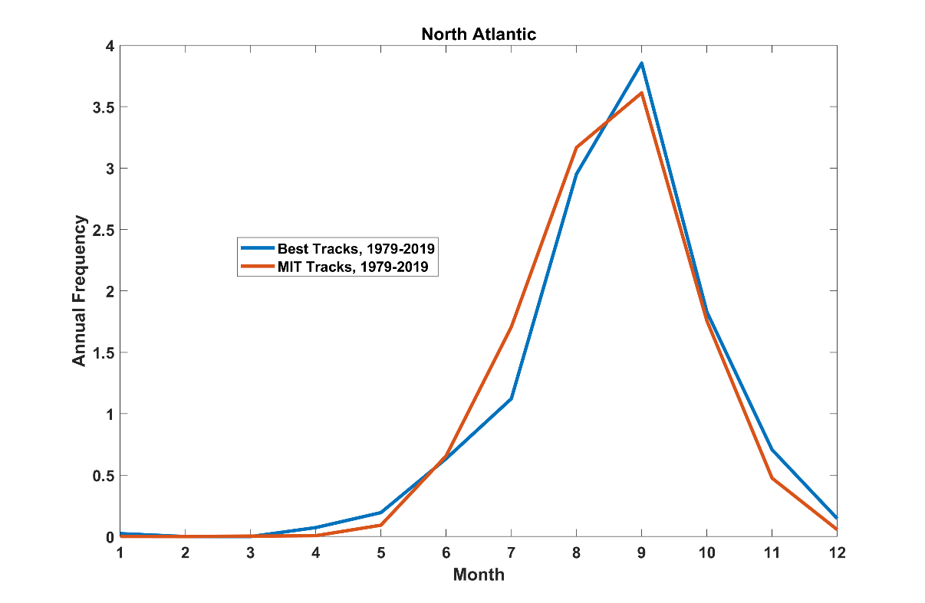
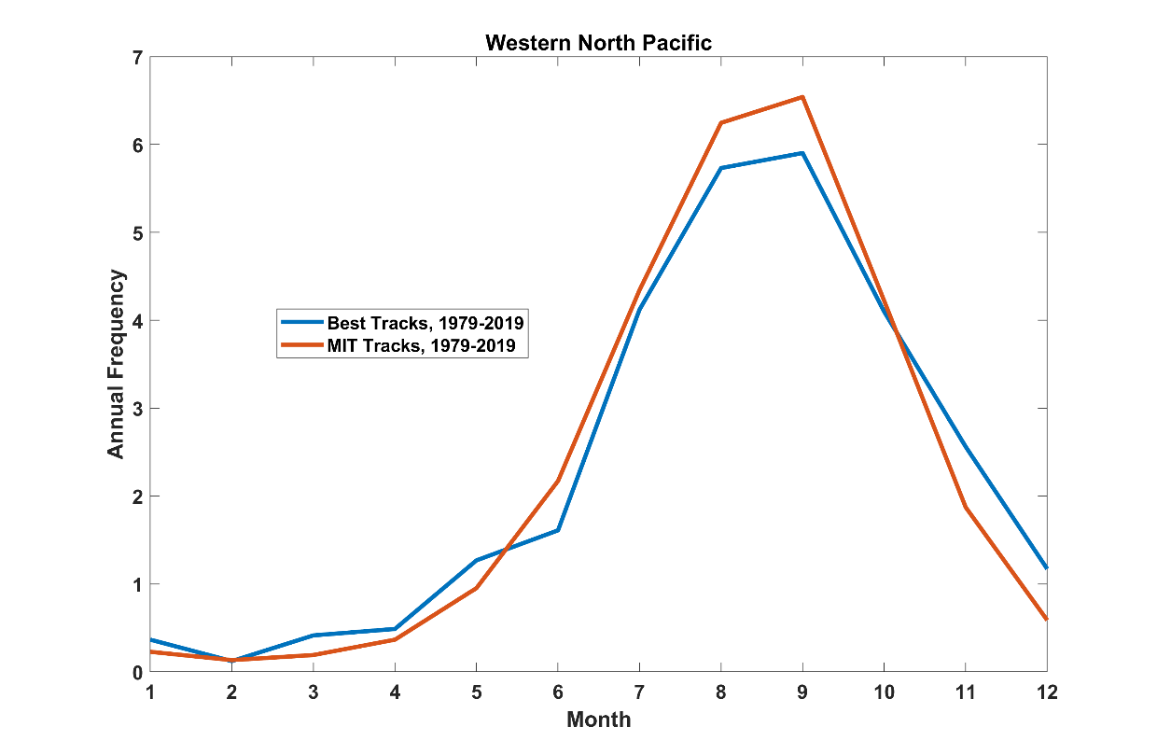
Seasonal Cycle
North Atlantic
Seasonal Cycle
Northwest Pacific

Slide 17
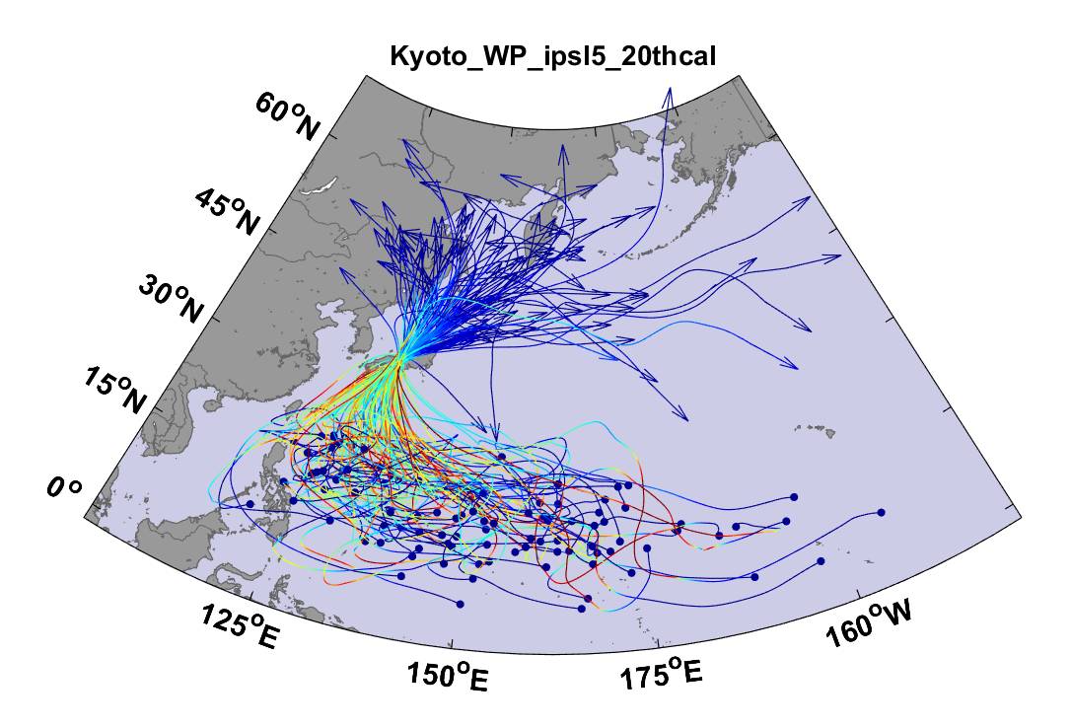
Example:
Top 100 out of 2000 TCs Affecting Kyoto, 1981-2000

Slide 18
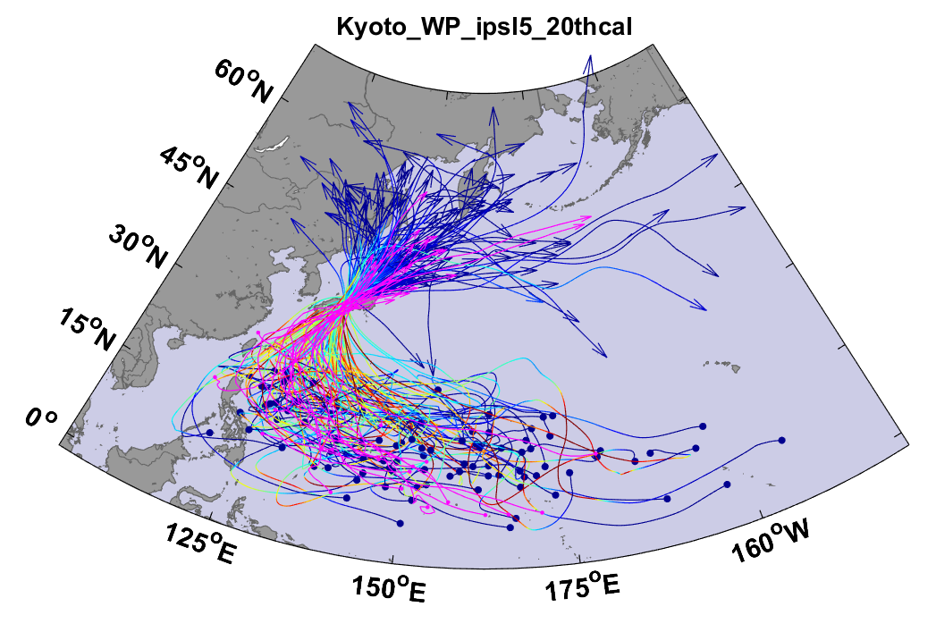
Same, but with top 20 historical tracks

Slide 19

Cumulative Distribution of Storm Lifetime Peak Wind Speed, with Sample of 1755 Synthetic Tracks
Blue bars: Actual
Red bars: Predicted
90% confidence bounds

Slide 20

Captures effects of regional climate phenomena (e.g. ENSO, AMM)
Blue bars: Actual
Red bars: Predicted

Slide 21
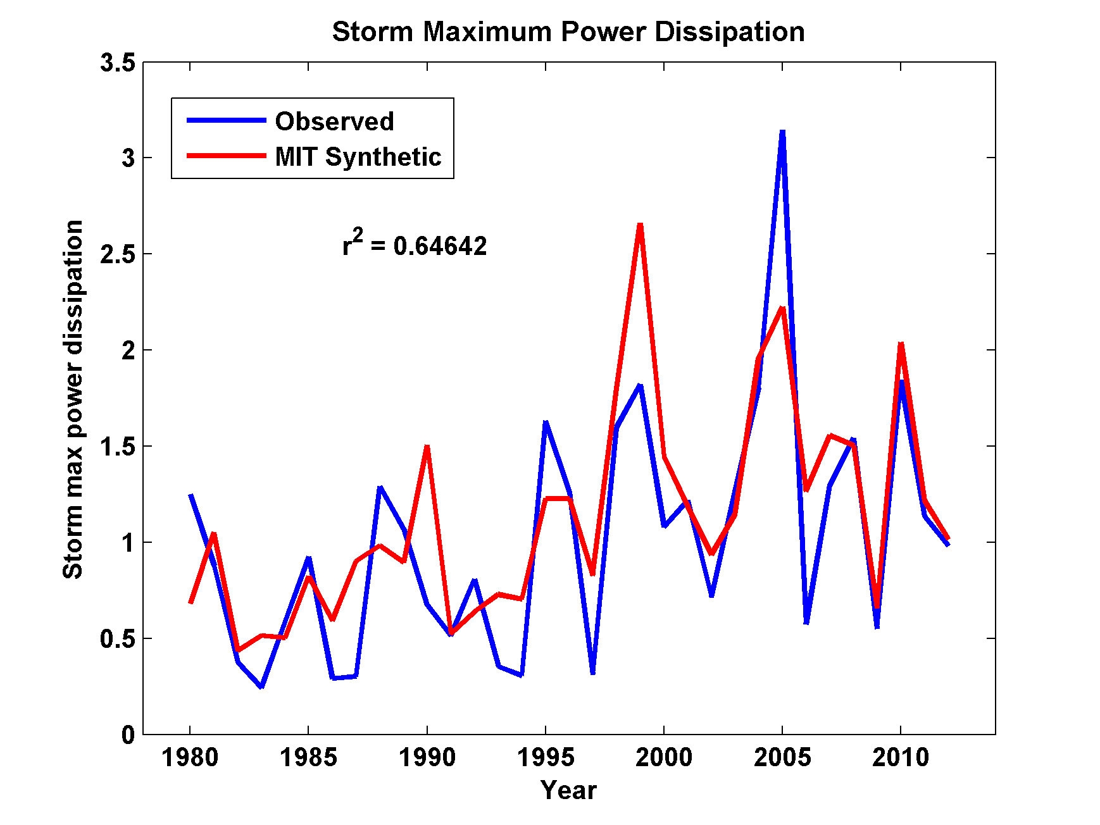
Captures Much of the Observed North Atlantic Interannual Variability
r²=0.65

Slide 22
Application to global gridded climate data:
Major Hurricanes
7-year running averages

Slide 23
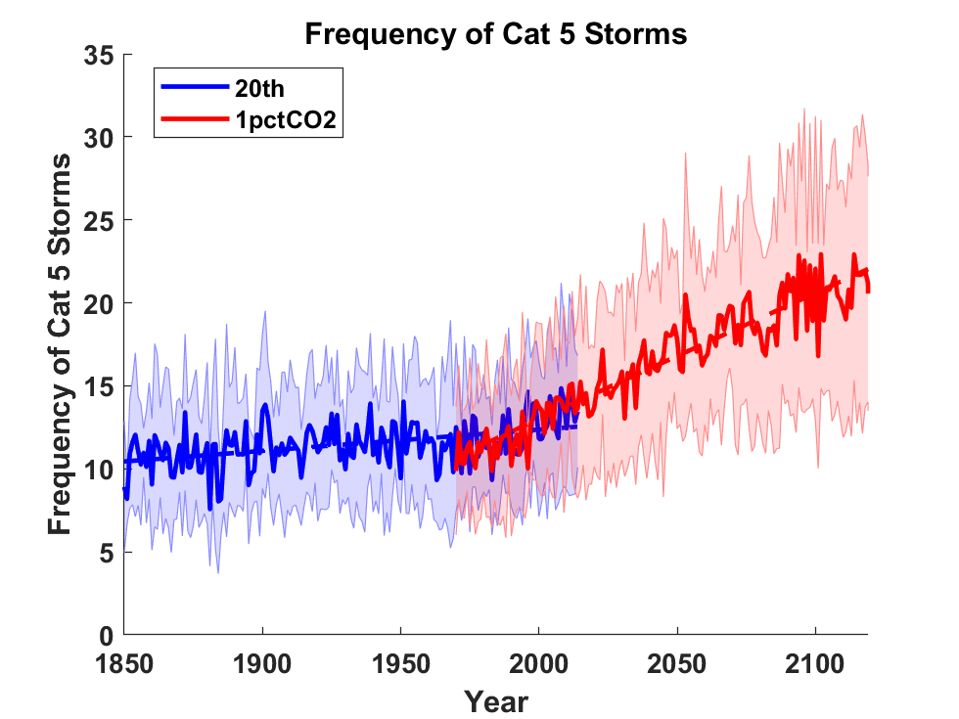
Application to Global Climate Change Simulations:
Global CAT 5 Tropical Cyclone Frequency from 9 Current Generation (CMIP6) Climate Models

Slide 24
Hurricanes are reaching peak intensity at higher latitudes
Time series of the latitudes at which tropical cyclones reach maximum intensity.
From Kossin et al. (2014)

Slide 25
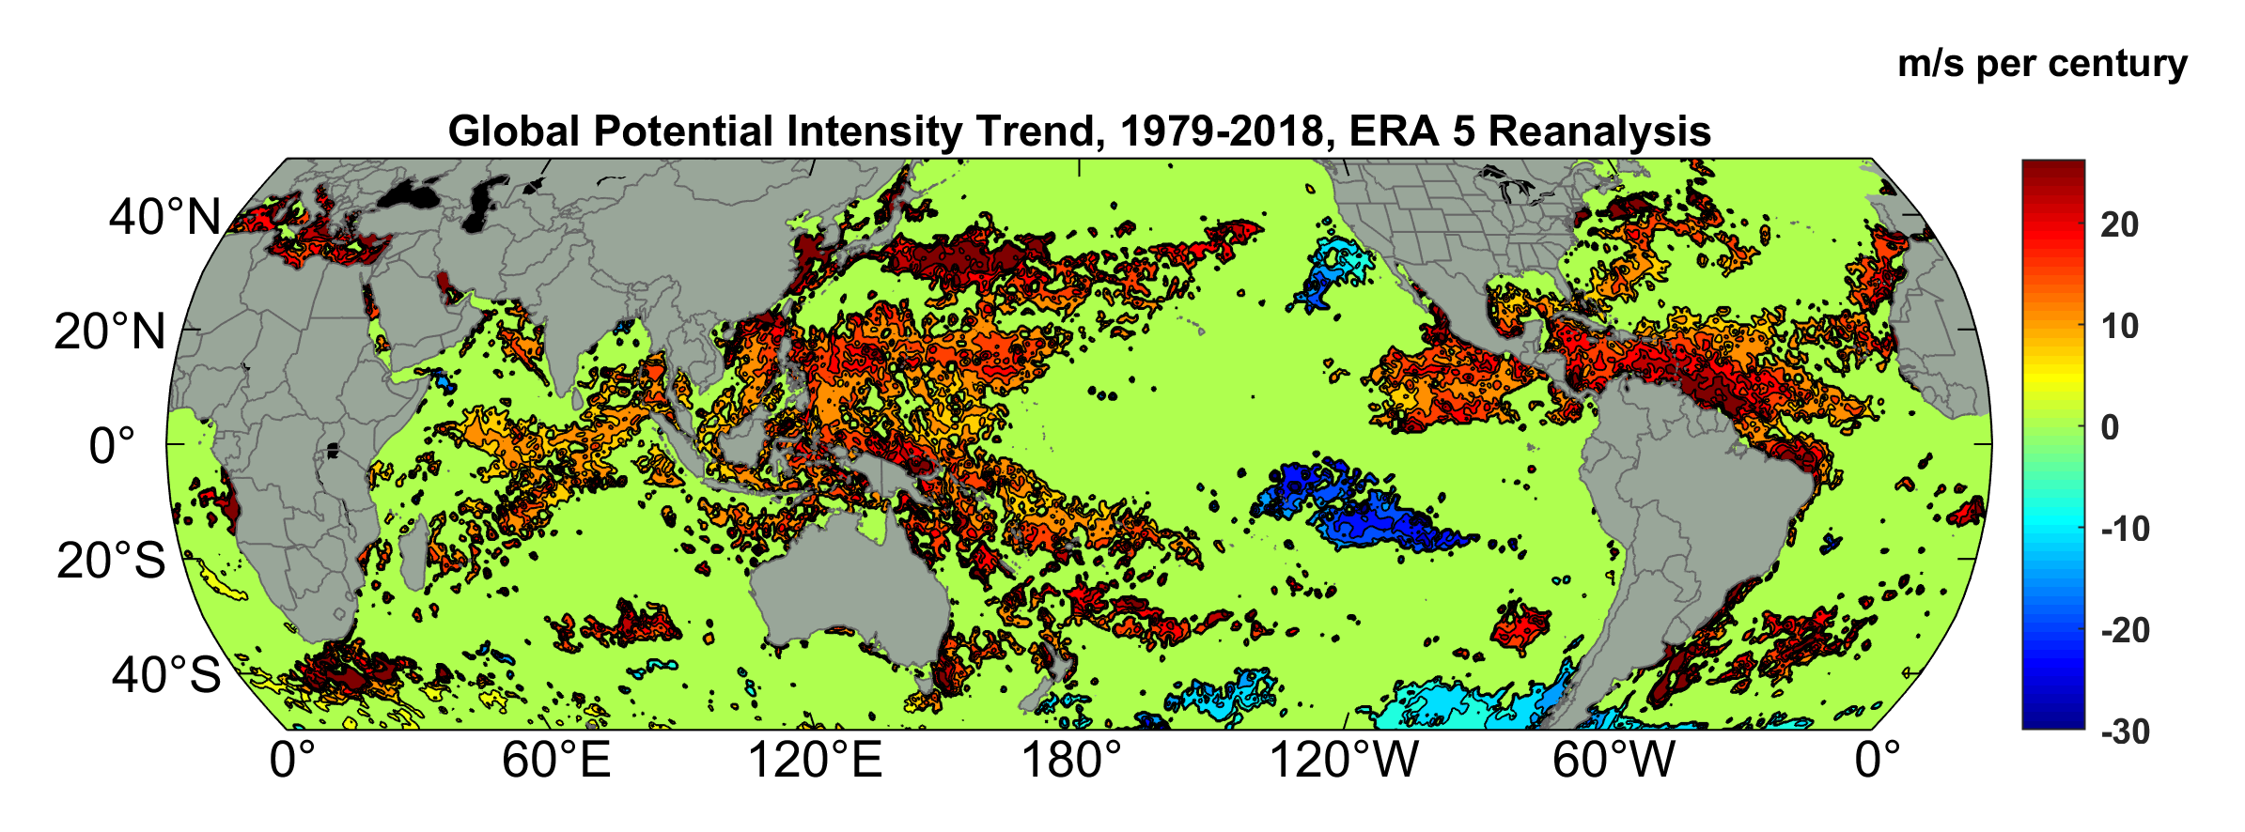
Potential Intensity Trend, 1979-2018, ERA 5 Reanalysis
(Trend shown only where p value < 0.05)

Slide 26
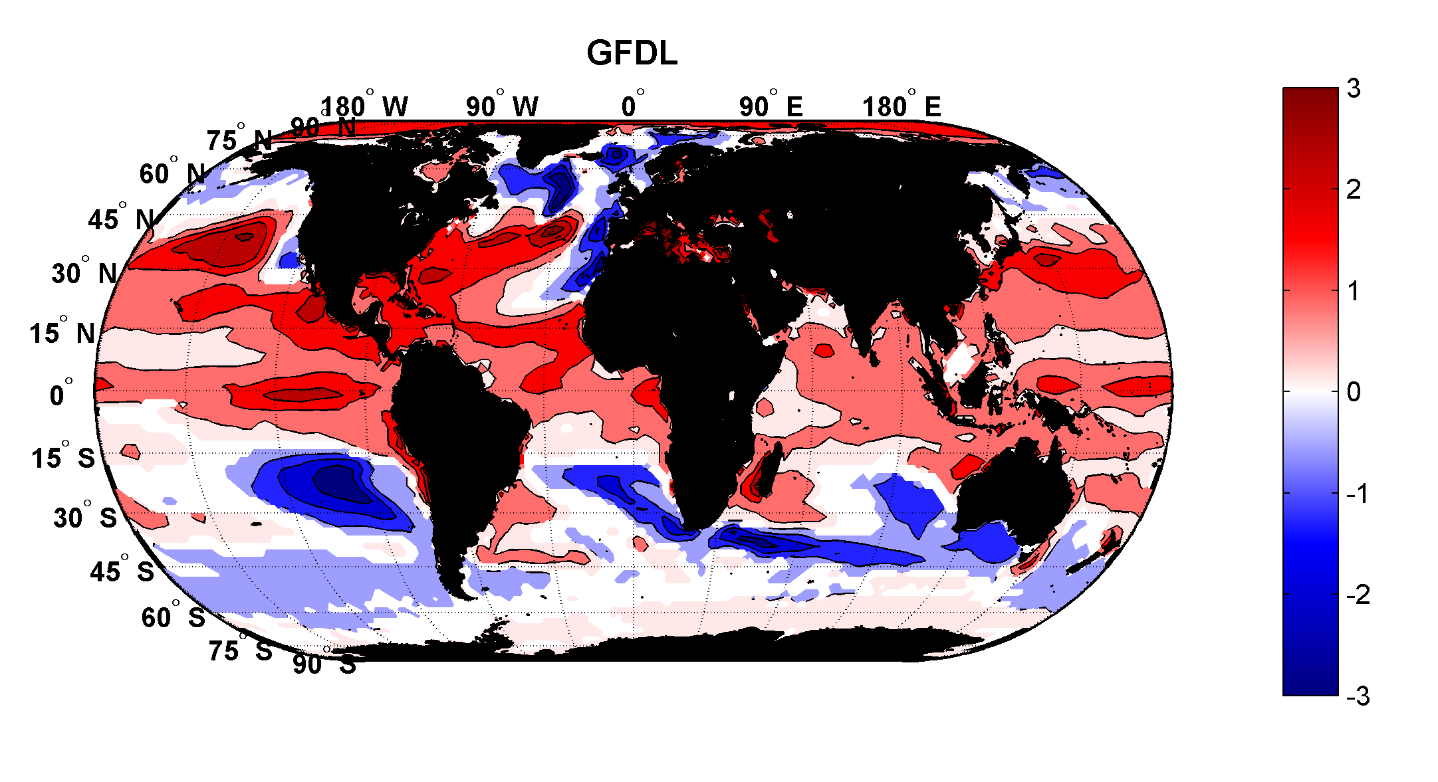
Projected Trend Over 21st Century: GFDL model under RCP 8.5
ms⁻¹decade⁻¹

Slide 27
Satellite-derived proportion of major hurricane fixes
Time series of fractional proportion of global major hurricane estimates to all hurricane estimates for the period 1979–2017. Each point, except the earliest, represents the data in a sequence of 3-y periods. The first data point is based on only 2 y (1979 and 1981) to avoid the years with no eastern hemisphere coverage. The linear Theil−Sen trend (black line) is significant at the 98% confidence level (Mann−Kendall P value = 0.02). The proportion increases by 25% in the 39-y period (about 6% per decade).
Kossin et al., PNAS, 2020

Slide 28
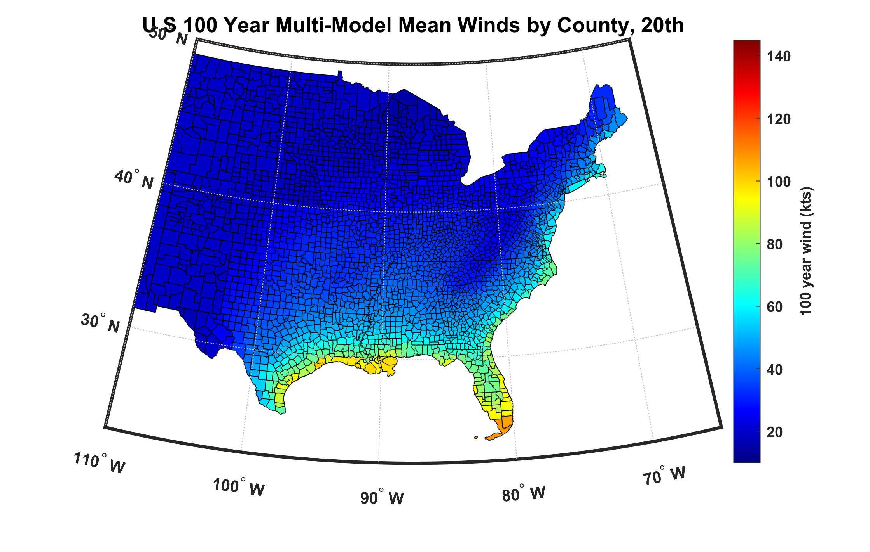
100-year hurricane peak wind based on downscaling 8 CMIP6 climate models, 1984-2014

Slide 29
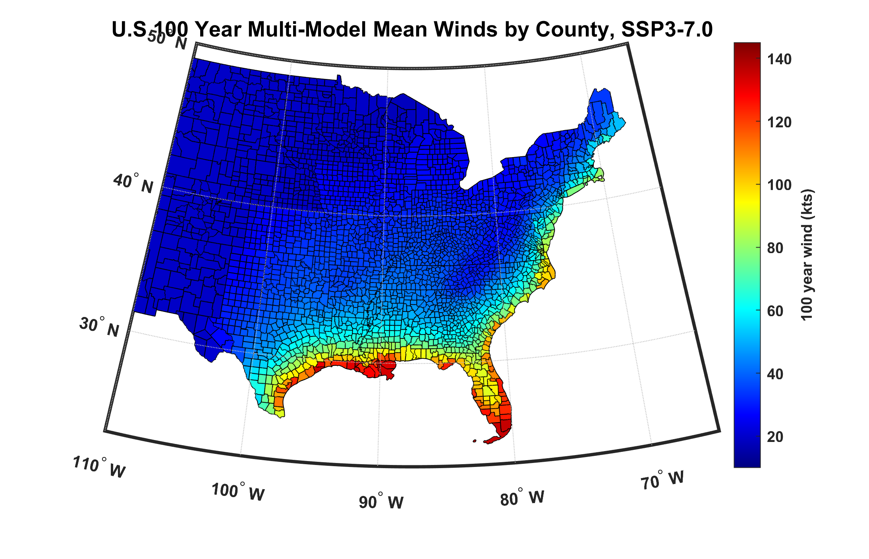
100-year hurricane peak wind based on downscaling 8 CMIP6 climate models, 2070-2100

Slide 30
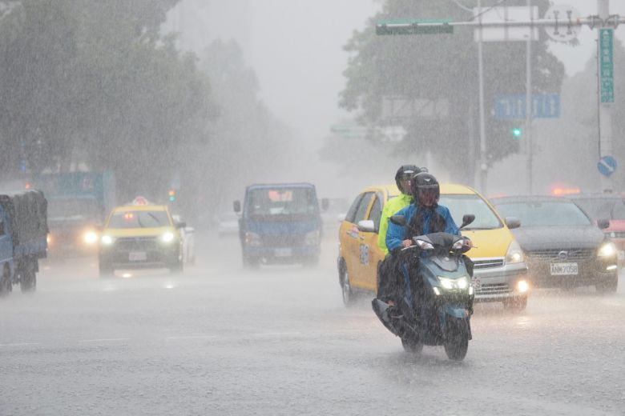
Hurricane Rain

Slide 31
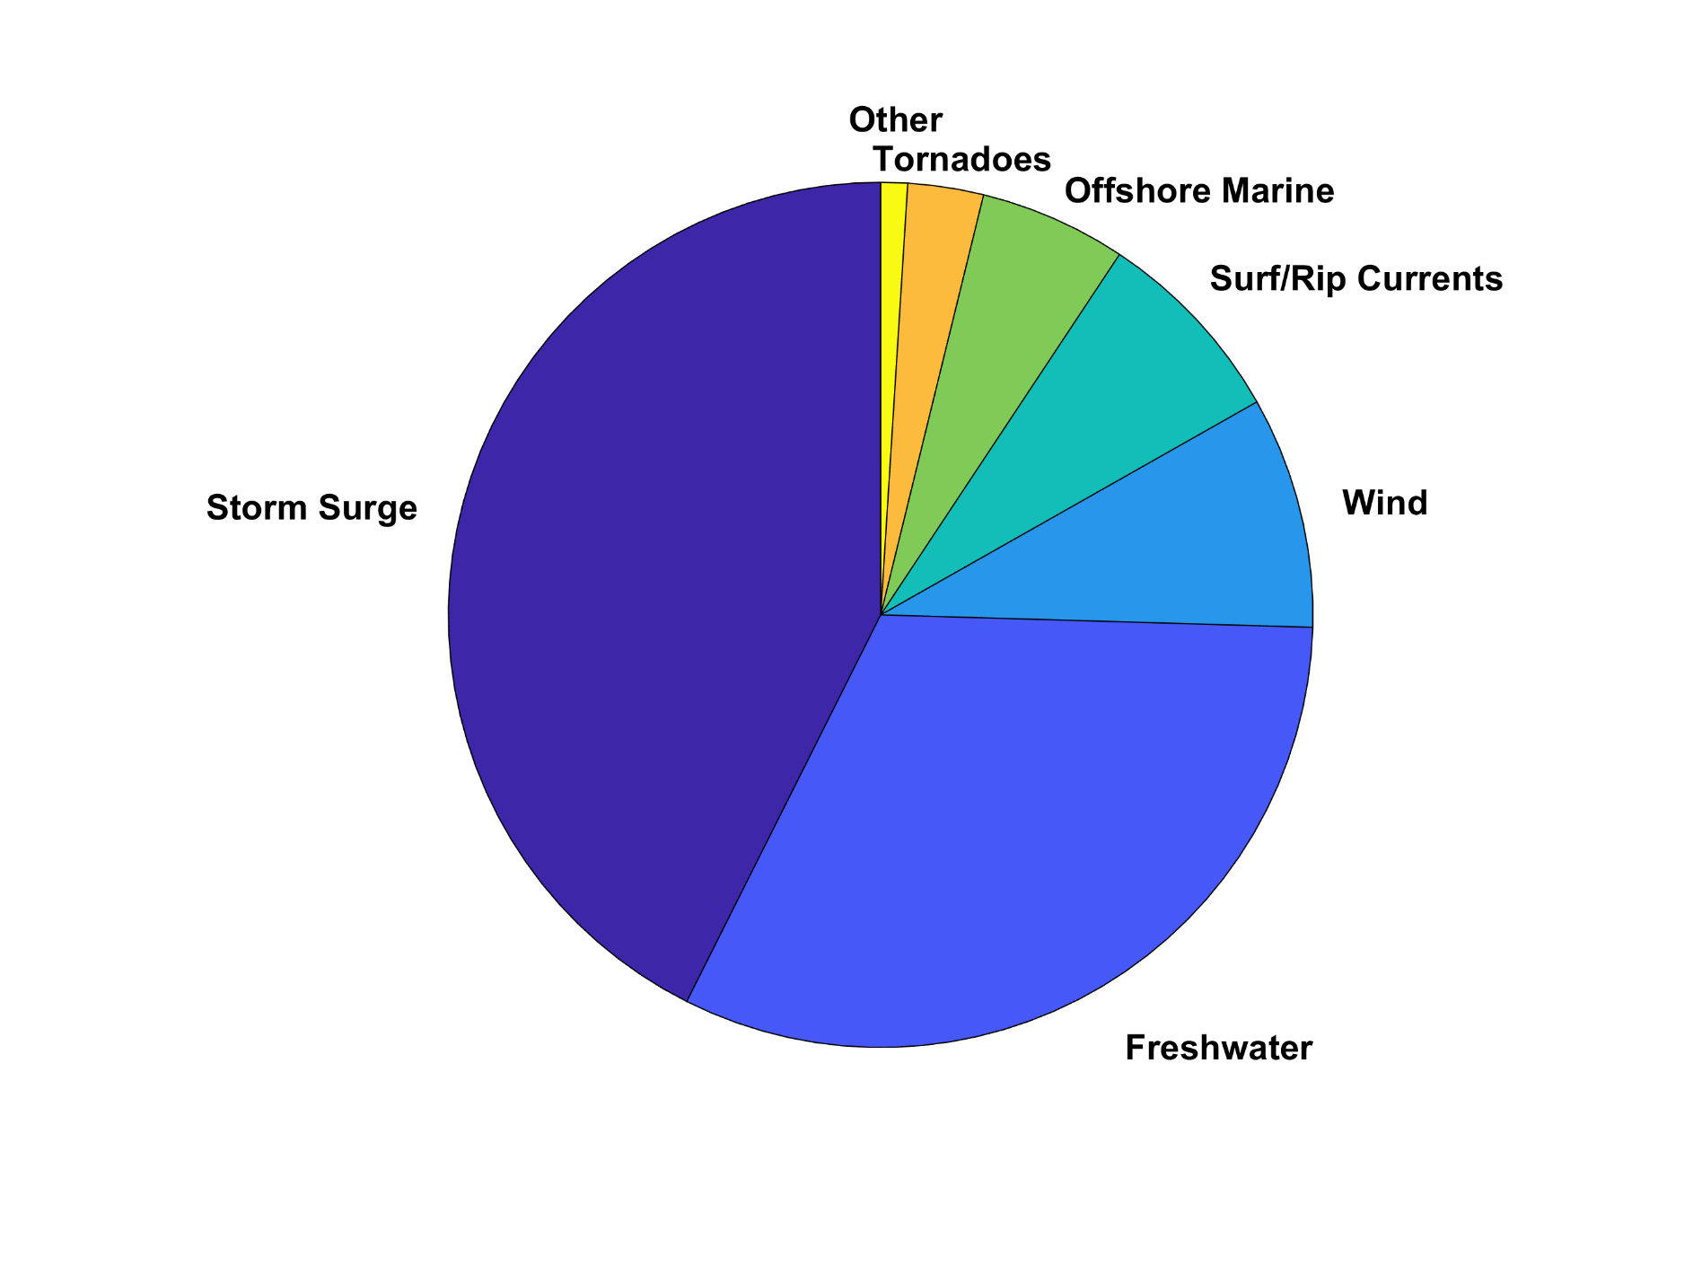
U.S. Hurricane Fatalities, 1963-2022

Slide 32
Predicting Rainfall
The CHIPS models predicts updraft and downdraft convective mass flux as a function of time and potential radius, BUT:
Storing these variables at all radii would increase overall storage requirements by a factor of ~50
(We are dealing with 10,000-100,000 individual events)

Slide 33
Basic strategy: Reconstruct time-evolving
2-D wind field by fitting a canonical radial wind profile to predicted values of V_{max} and r_{max} and adding a constant background wind. Allow resulting vortex to interact with background wind shear and thermodynamic fields.
Apply Quasi-Balanced Dynamics to Stored TC and Environmental Fields
Details: Feldmann et al, J. App. Meteor. Clim., 2019

Slide 34
Testing the Algorithm
Identify TC rainfall affecting NEXRAD sites
Choose local Daily Global Historical Climatology Network (GHCN-D) rain gauges located near NEXRAD sites
Compare statistical distributions of storm total rainfall from synthetic TCs with NEXRAD-derived rain and rain at nearby gauges
Details: Feldmann et al, J. App. Meteor. Clim., 2019

Slide 35
NEXRAD Sites

Slide 36
An Example:
Estimated gauge sampling error
Estimated radar sampling error
Feldmann et al, J. App. Meteor. Clim., 2019

Slide 37
2,000 year rain event for Houston

Slide 38
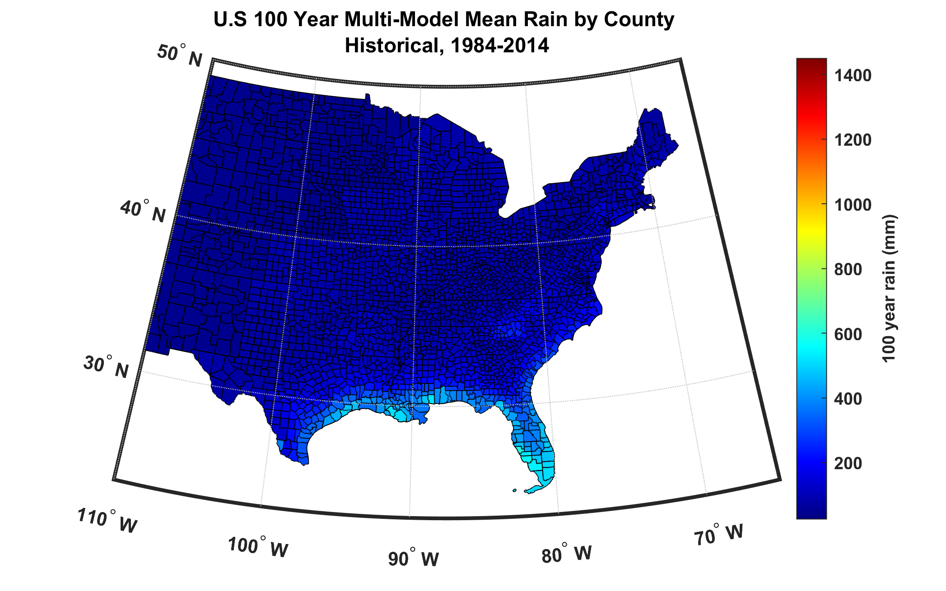
100-year hurricane storm total rain based on downscaling 8 climate models, 1984-2014

Slide 39
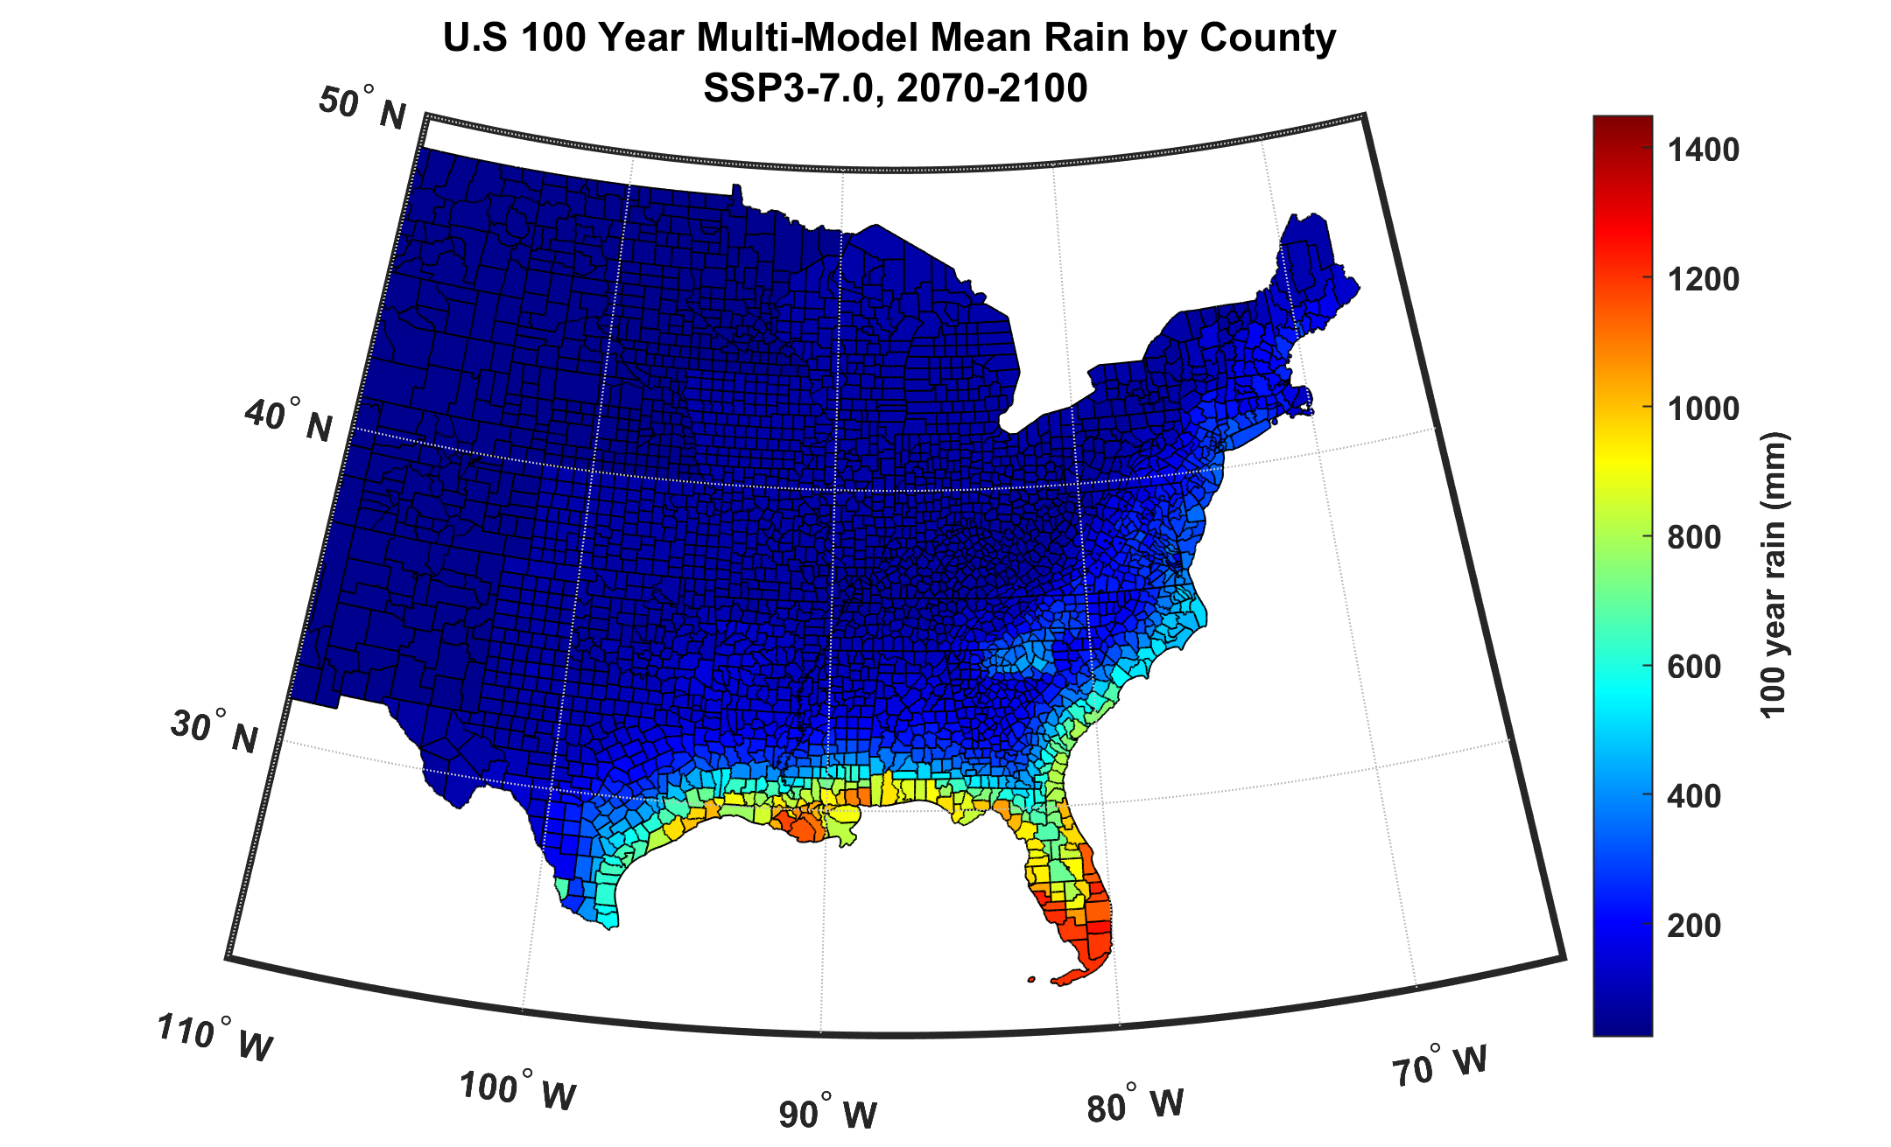
100-year hurricane storm total rain based on downscaling 8 climate models, 2070-2100

Slide 40
A version of this risk model based on the FAST intensity emulator (in place of CHIPS) is freely available at
https://github.com/linjonathan/tropical_cyclone_risk

Slide 41

Typhoon Risk in Yokohama

Slide 42
Yokohama
Downscale 3000 events from ERA-5 reanalyses, 1985-2014, passing within 150 km of Yokohama
Downscale 3000 events from historical simulations of 8 CMIP6-generation climate models, 1985-2014
Downscale 3000 events from SSP3-7.0 simulations of 8 CMIP6-generation climate models, 2071-2100
If you would like to use these tropical cyclone sets for research purposes, please write me (emanuel@mit.edu)

Slide 44
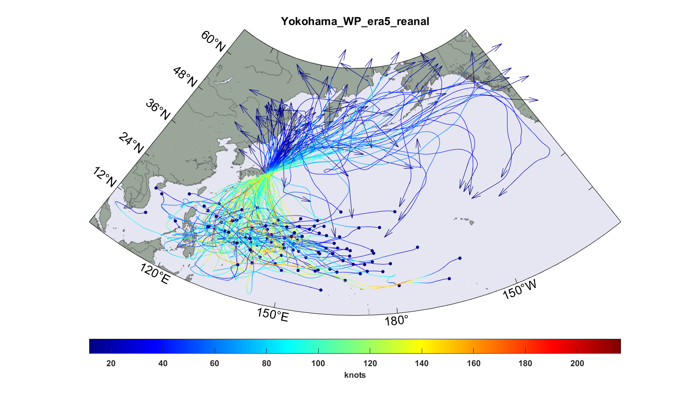
Top 100 out of 3,000 TCs passing within 150 km of Yokohama, downscaled from ERA-5 reanalyses

Slide 45
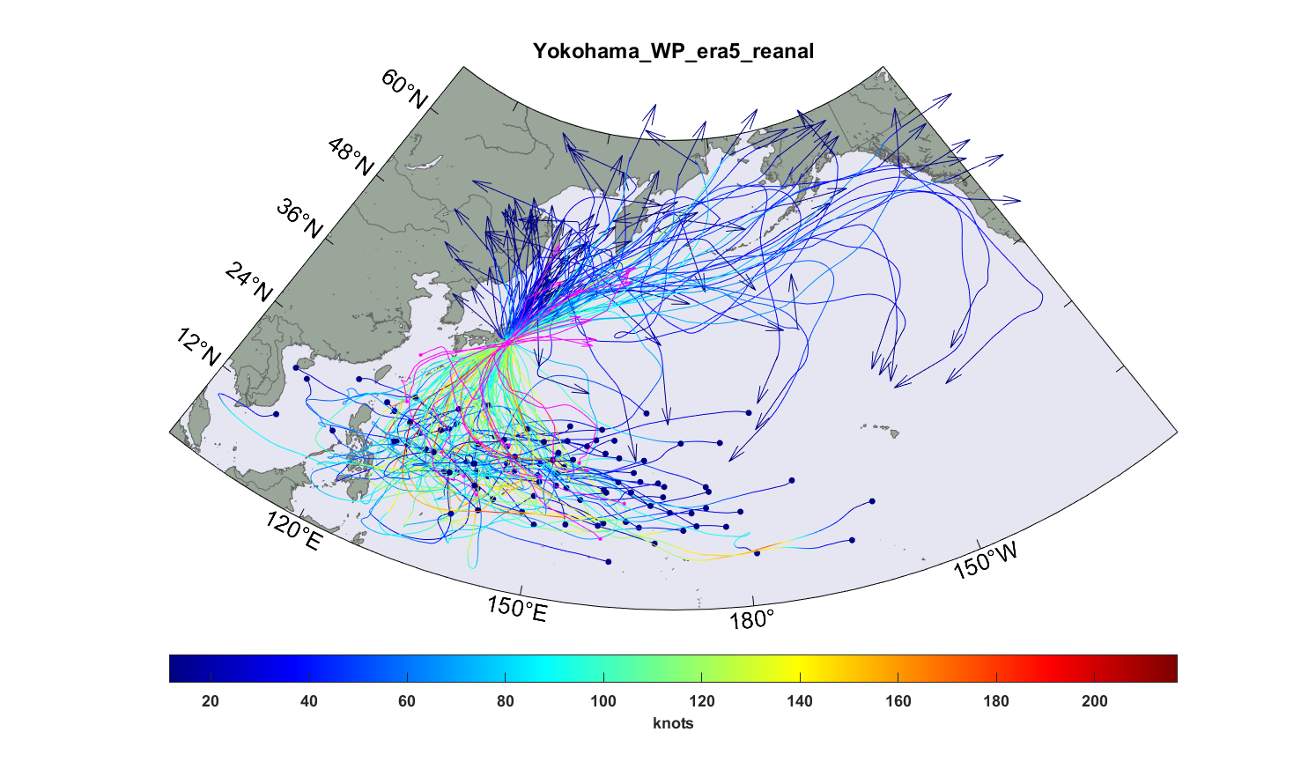
Same but with top 10 typhoons passing within 150 km of Yokohama, 1985-2014 superimposed (magenta curves)

Slide 46
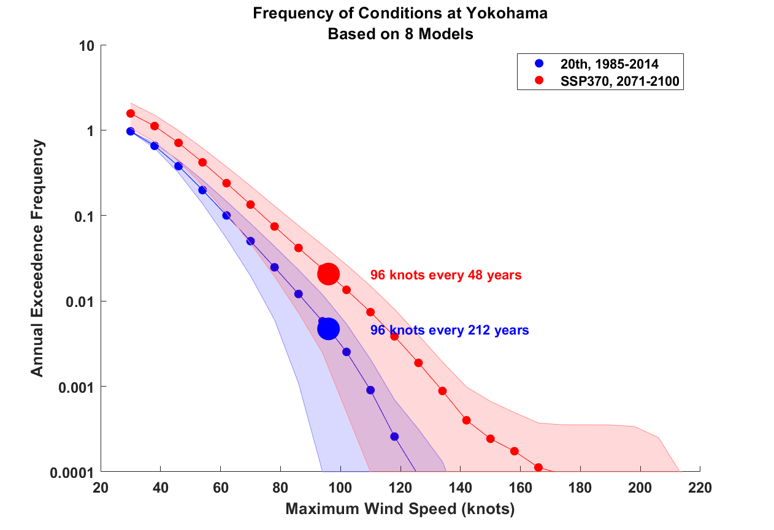

Slide 47
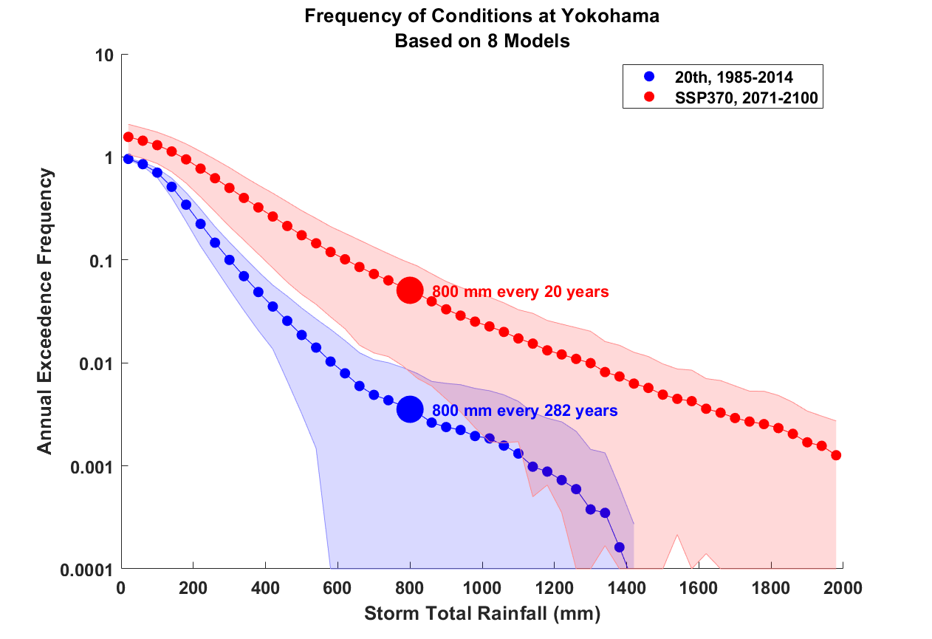

Slide 48
Use synthetic tracks to estimate current and future TC economic risk
Procedure:
Generate 6,200 synthetic hurricane events affecting eastern U.S. from each of 8 global climate models for two period of time: 1985 – 2014 and 2071 – 2100 (SSP3 7.0)
Calculate peak wind speed at each zip code centroid for each hurricane event
Use damage function to convert peak with to percentage of insured value destroyed
Apply to TIV at each of the 12,968 zip codes and sum over them to estimate total loss to insurance form

Slide 49
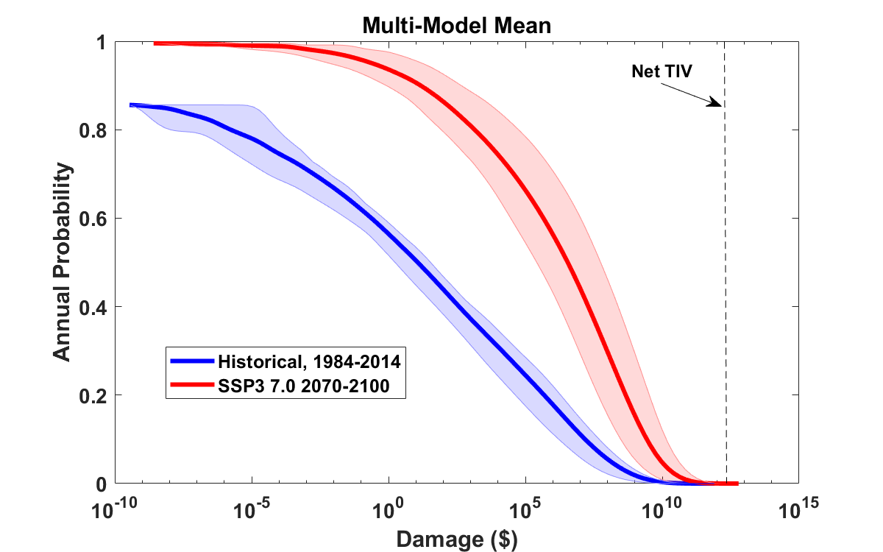
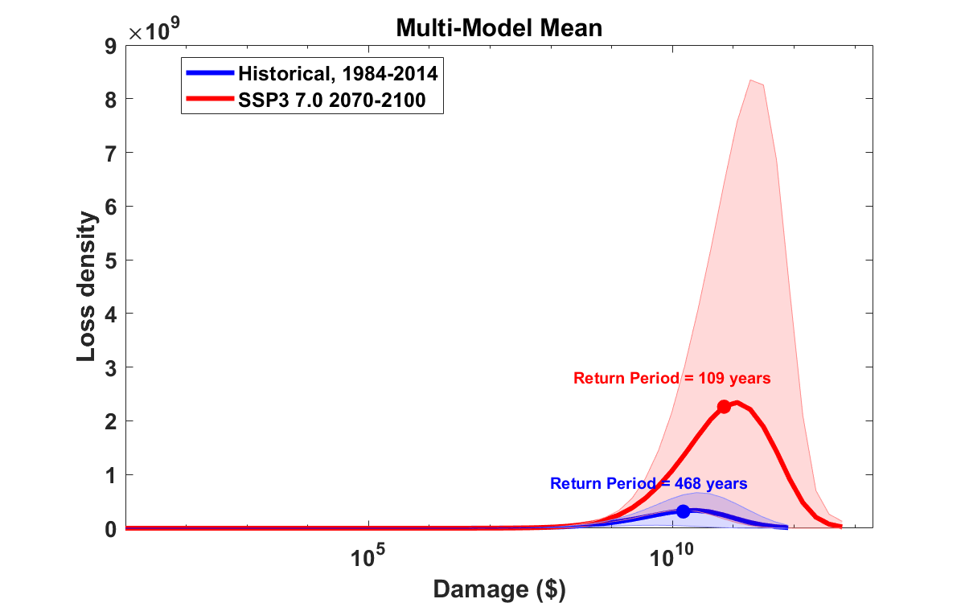
Median annual loss (2-year return period)
1984 – 2014: $ 12 ($2 – $34)
2070 – 2100: $ 3.5 million ($260 k – $56 million)
Average annual loss:
1984 – 2014: $ 536 million ($108 million – $1.25 billion)
2070 – 2100: $ 4.1 billion ($590 million – $13.7 billion)
Annual average loss strongly dominated by VERY rare events!
These will not be evident in historical records

Slide 50
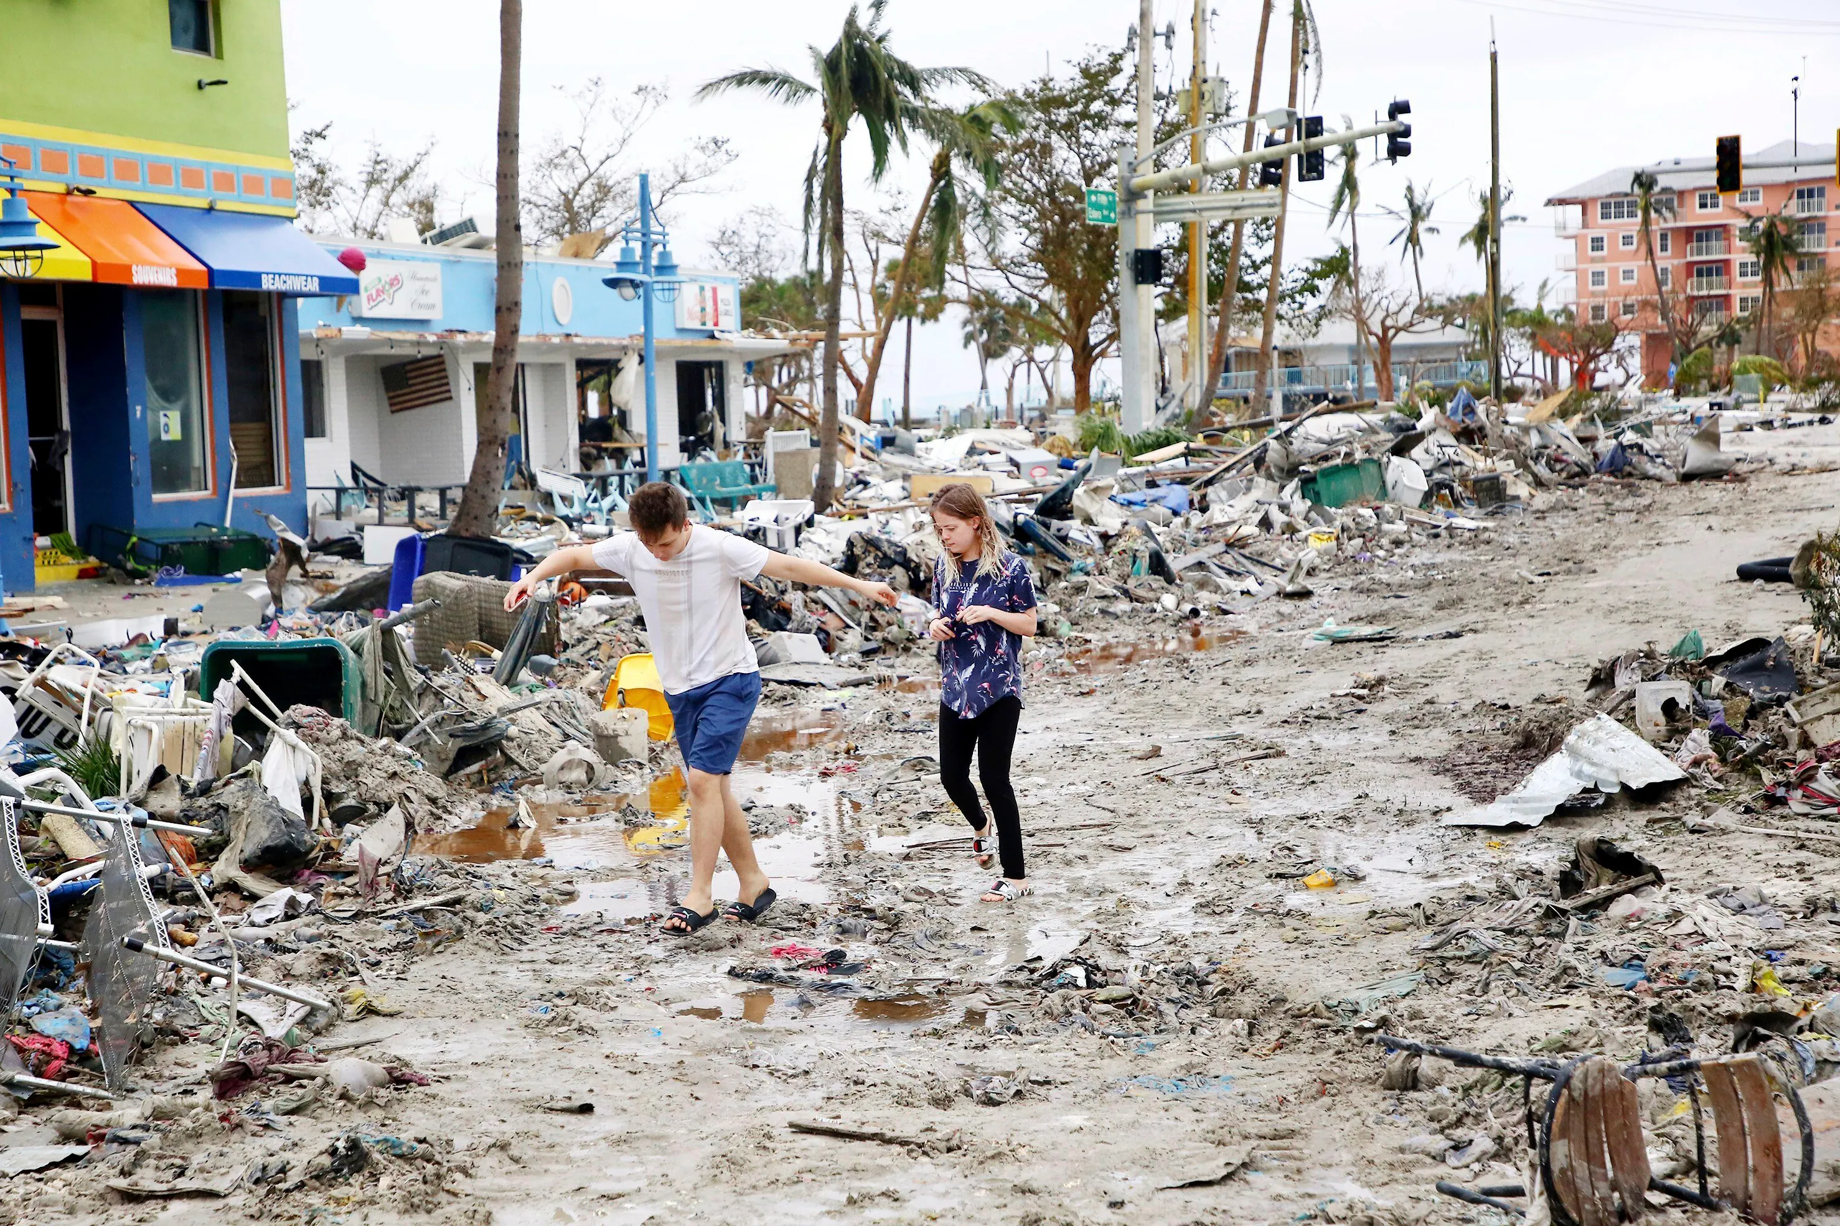
Making Risk Personal:
All Climate Change is Local!

Slide 51
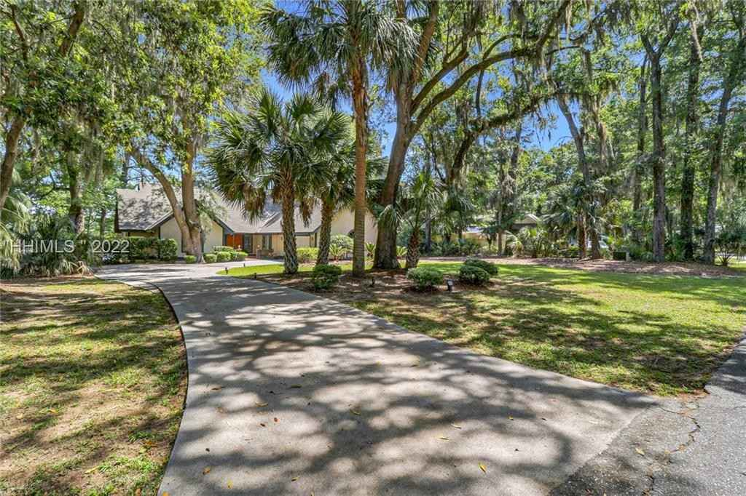
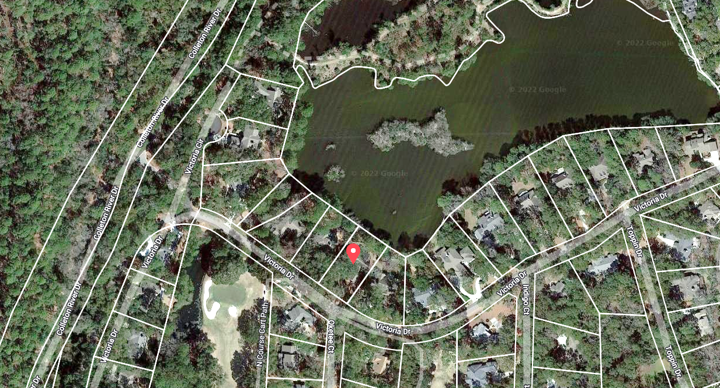
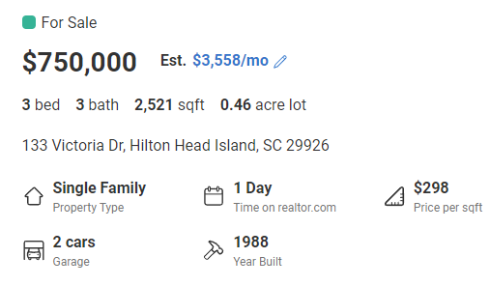


Property currently for sale in Hilton Head, SC
Realtor.com
Work of First Street Foundation

Slide 52
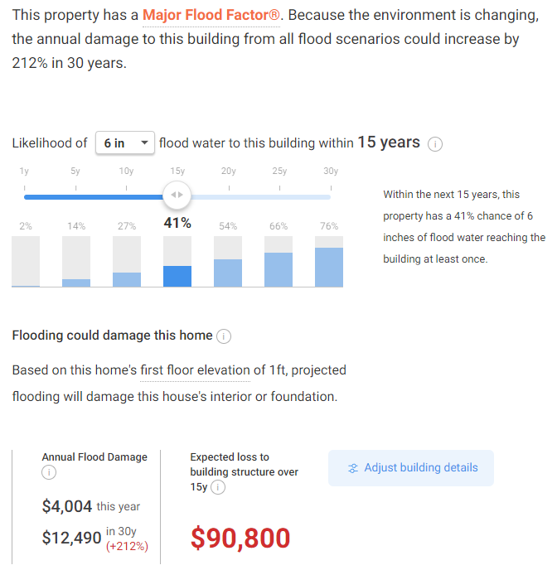

Slide 53
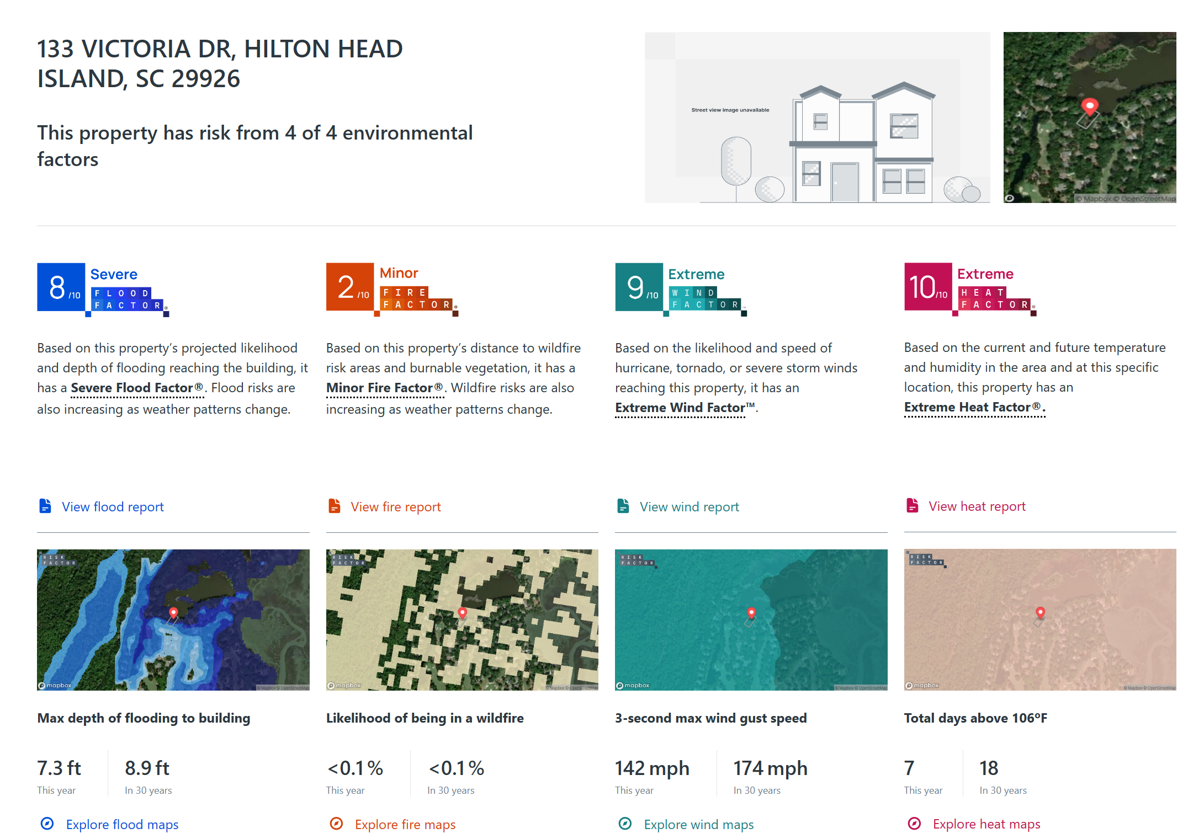
Type address into RiskFactor (https://riskfactor.com)

Slide 54
Take-Away Points
We need to move away from sole dependence on flawed historical data in assessing climate- and weather-related natural hazard risks and embrace advanced physical modeling techniques
Government, the insurance industry, research laboratories, and institutions of higher education are crucial to this effort
We can no longer regard climate change as a problem for the future; it has already tangibly affected important risks, e.g. Hurricane Harvey’s rainfall was ~3 times more likely in 2017 than in 1970
There is a large gap between current practice and what is possible and desirable. Let’s fill it.

Slide 55
Spare Slides

Slide 56
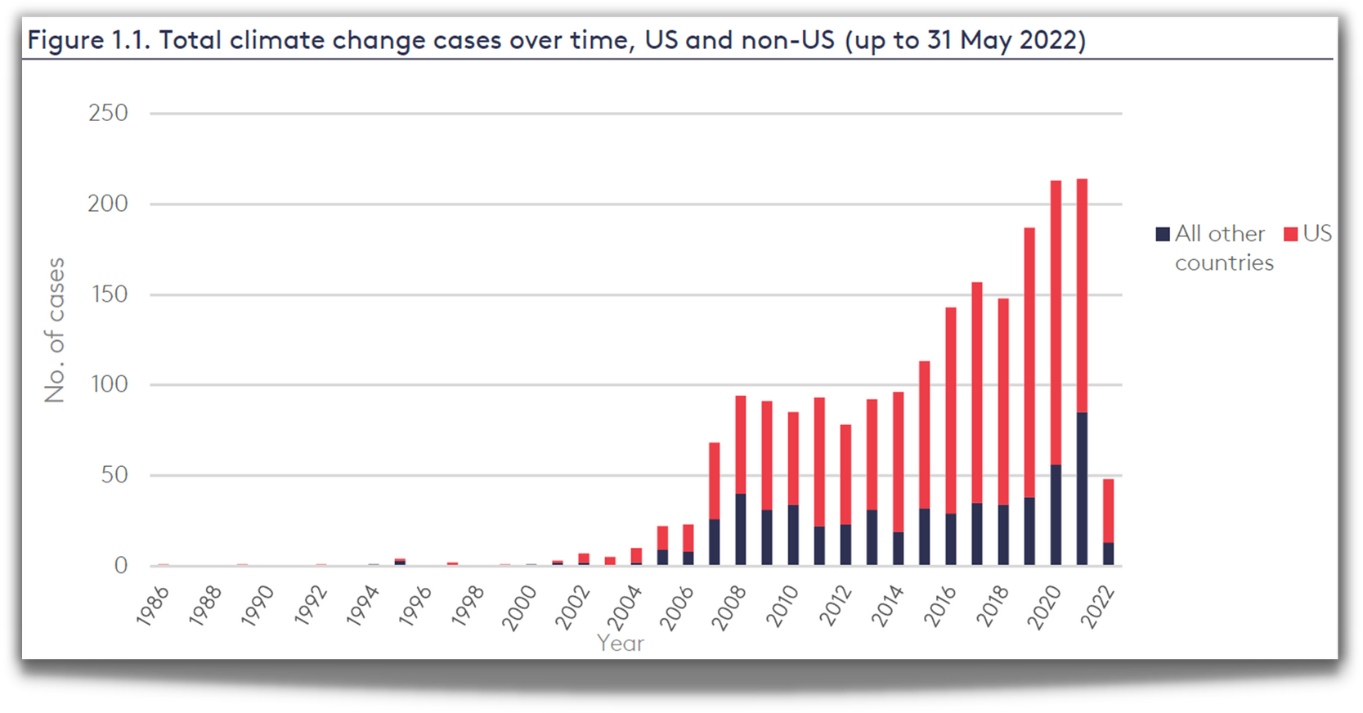

CLIMATE
LITIGATION
TRENDS
Currently 2,000+ U.S. climate cases
Source: Joana Setzer & Catherine Higham, Global Trends in Climate Change Litigation 9 (June 2022) (based on data from the Sabin Center and Climate Change Laws of the World databases)
Courtesy Sandra Thiam and Jarryd Page of the Climate Judiciary Project of the Environmental Law Institute

Slide 57
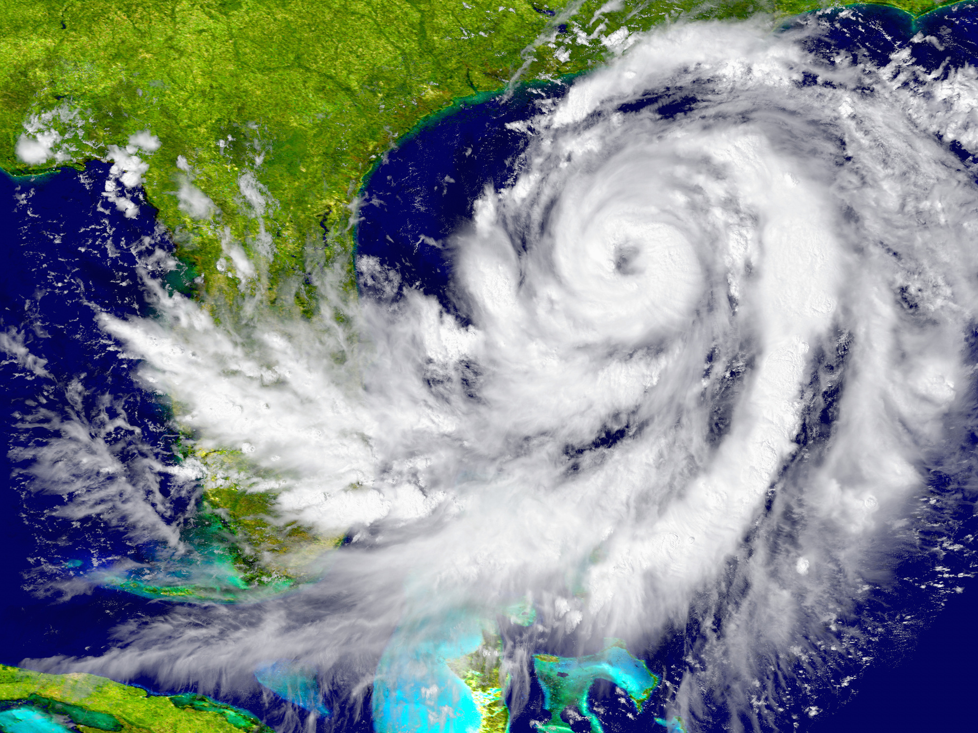
HURRICANE LITIGATION
Litigation happens before (planning and preparation) and after (impacts)
Can include:
  Torts (negligence, nuisance, trespass)
  Zoning and land use
  Impact assessments
  Insurance claims
Courtesy Sandra Thiam and Jarryd Page of the Climate Judiciary Project of the Environmental Law Institute

Slide 58
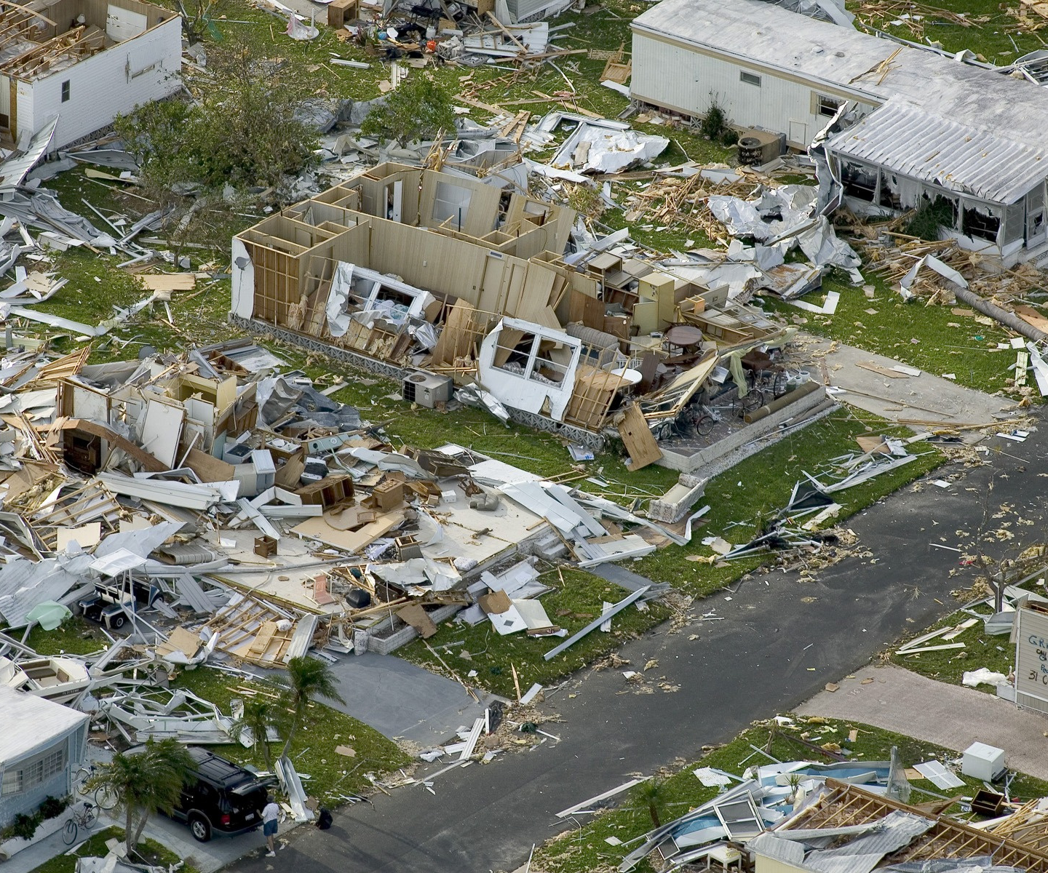
LEGAL ISSUES RELATED
TO HURRICANES:
INSURANCE
  whether homeowners' insurance settlements with insurance companies for damages sustained in a hurricane were appropriate
    (class action following Hurricane Sandy)
Courtesy Sandra Thiam and Jarryd Page of the Climate Judiciary Project of the Environmental Law Institute

