Slide 1

Trends and Variability of Tropical Cyclone Risk
Kerry Emanuel
Lorenz Center
Department of Earth, Atmospheric, and Planetary Sciences, MIT

Slide 2

Program
Brief overview of hurricanes and hurricane risk
What have hurricanes been like in the past, and how will they be affected by global warming?
How should we assess hurricane risk?

Slide 3
Tropical Cyclone Climatology

Slide 4
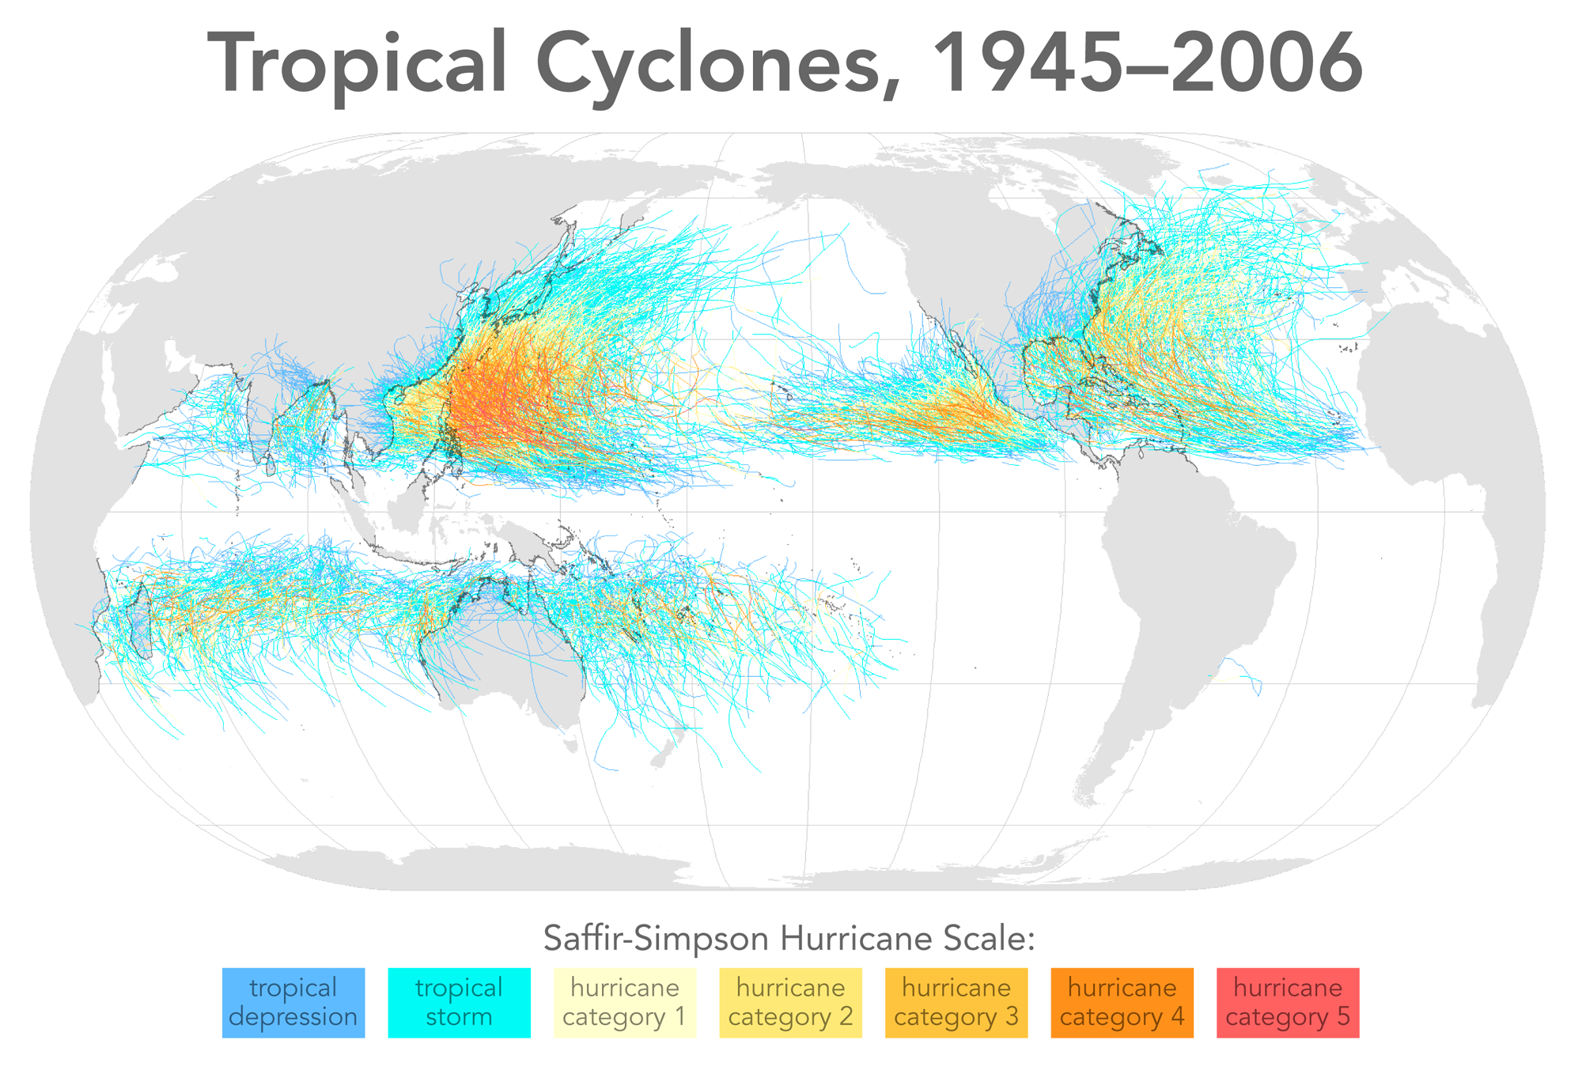

Slide 5
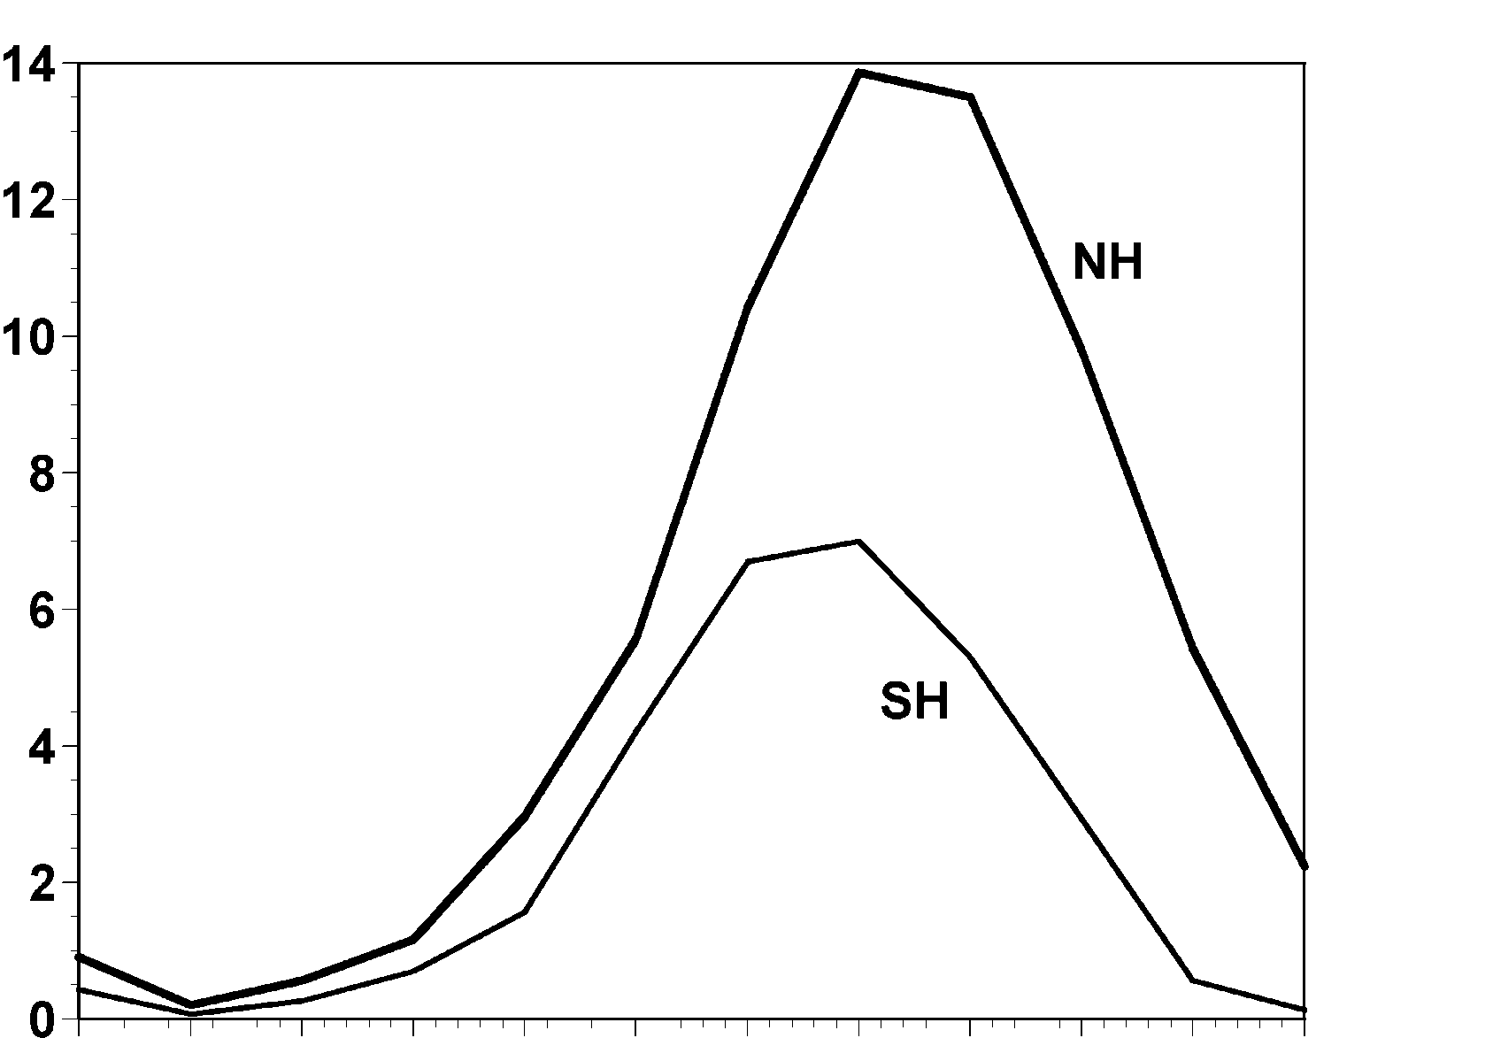
Annual Cycle of Tropical Cyclones
Number of Events per Month
a
Northern
Hemisphere
(NH)
a
Southern
Hemisphere
(SH)
Jan Feb Mar Apr May Jun Jul Aug Sep Oct Nov Dec NH
Jul Aug Sep Oct Nov Dec Jan Feb Mar Apr May Jun SH
Notes:
This graph shows the average number of tropical cyclones per month in the northern and southern hemispheres. Hurricanes tend to follow the sun, peaking in the summer and autumn and all but vanishing during the early spring. Typhoons can develop over the western North Pacific during any month of the year, but they are rare in the winter.
Image is copyrighted 2005 by Oxford University Press.
Image and description from “Divine Wind: The History and Science of Hurricanes”, Kerry Emanuel, 2005, Oxford University Press, 296 p.

Slide 6
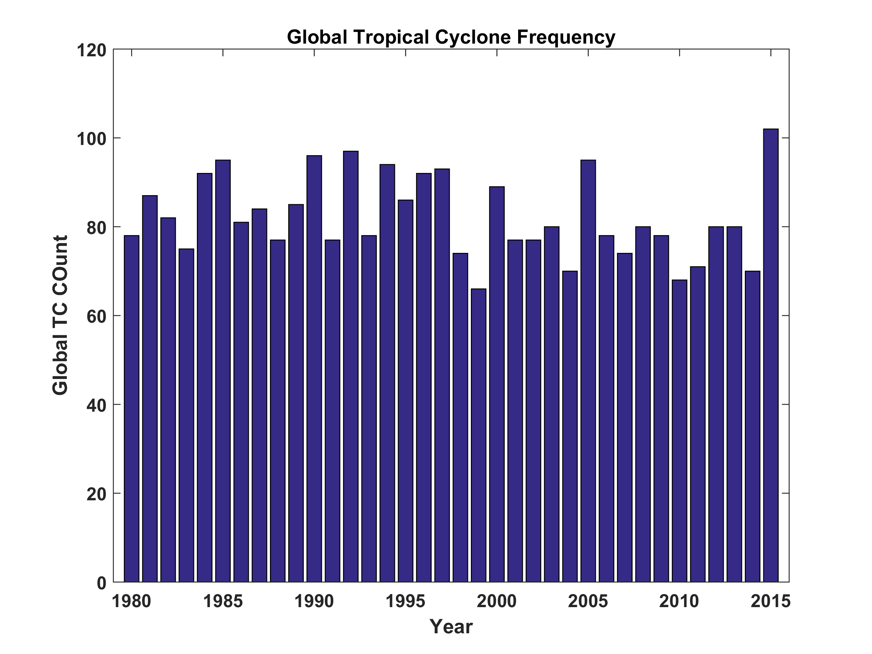

Slide 7
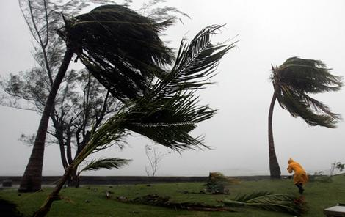
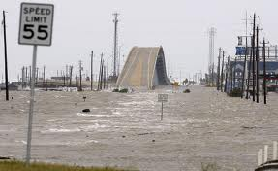
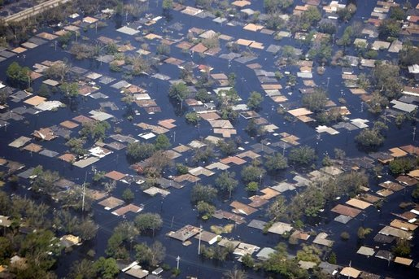
Hurricane Risks:
Wind
Storm Surge
Rain

Slide 8
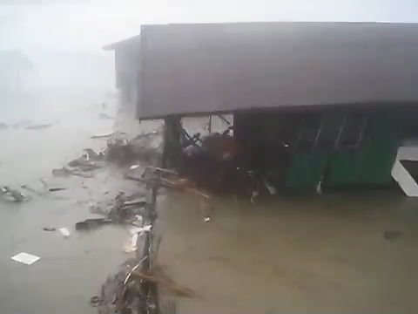

Slide 9
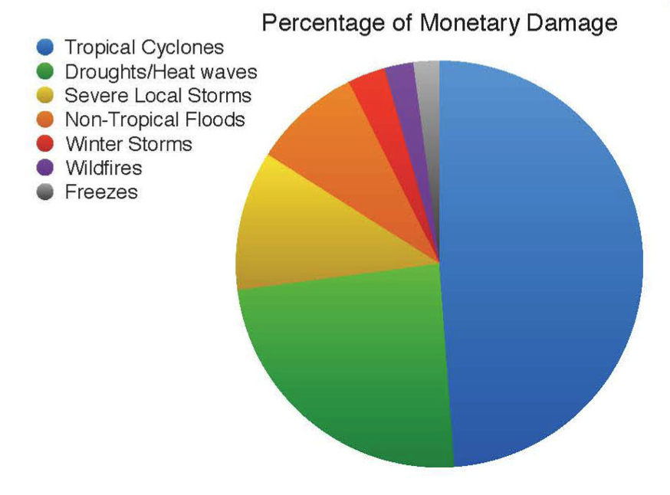
Total US Damages by Natural Hazard, 1980-2012
Source: NOAA

Slide 10
Hurricane Risk:
What Can We Learn from Historical Records?

Slide 11
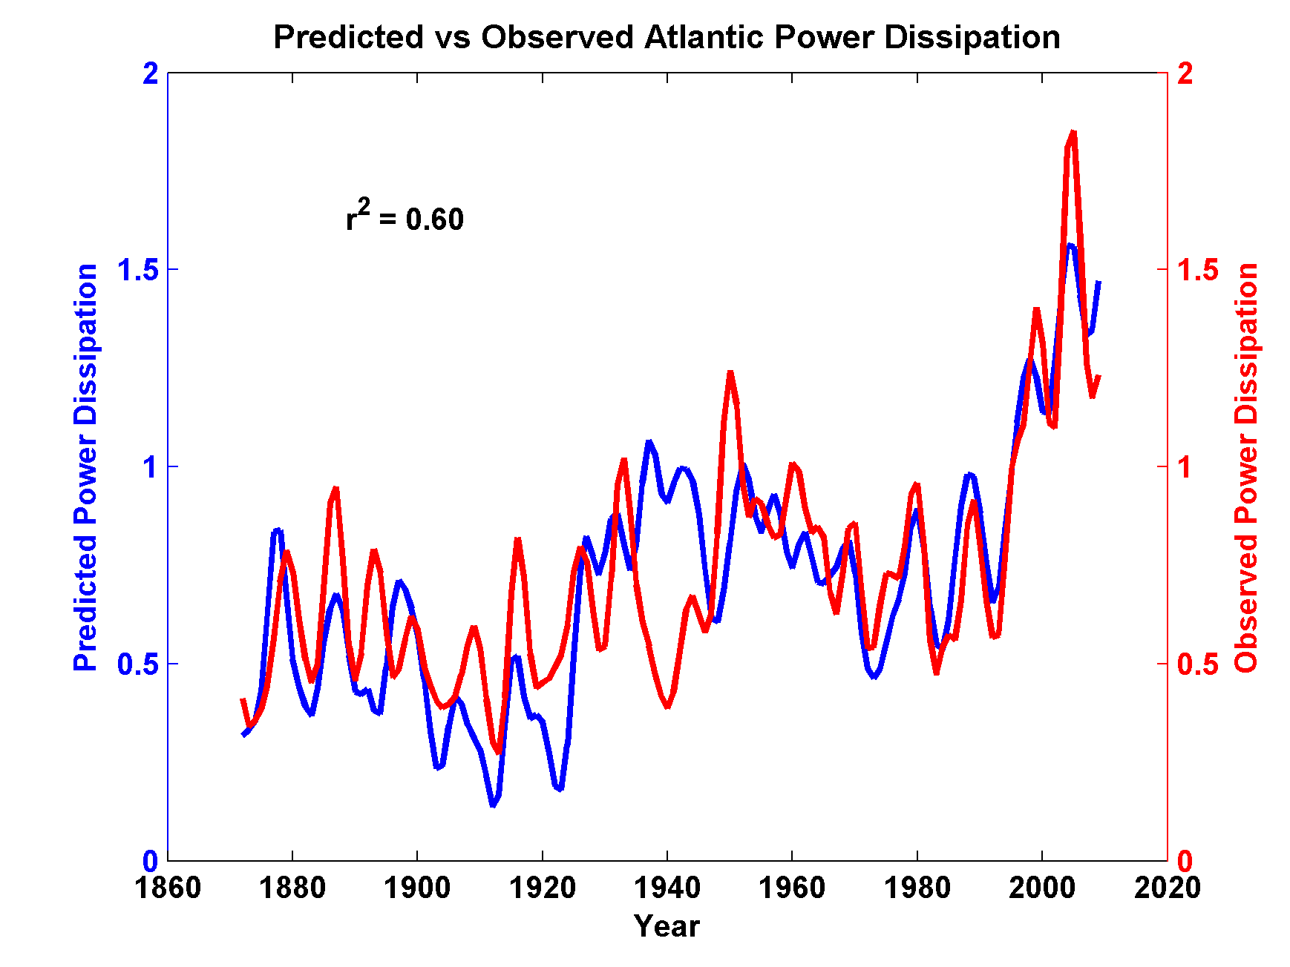
Storm Maximum Power Dissipation and SST
North Atlantic
Notes:
Same as the previous slide but also showing the hurricane power dissipation derived from (supposedly faulty) historical archives, in red.

Slide 12
Sulfate Aerosols and North Atlantic Hurricanes
During the late 20th Century, global aerosol radiative forcing is thought to be as important as CO₂ radiative forcing
Per unit radiative forcing, shortwave forcing is roughly twice as effective as longwave forcing in changing potential intensity
Much of the interannual variability of aerosol forcing over the tropical North Atlantic in summer is thought to be owing to the interaction of sulfate aerosols of European origin with African dust

Slide 13
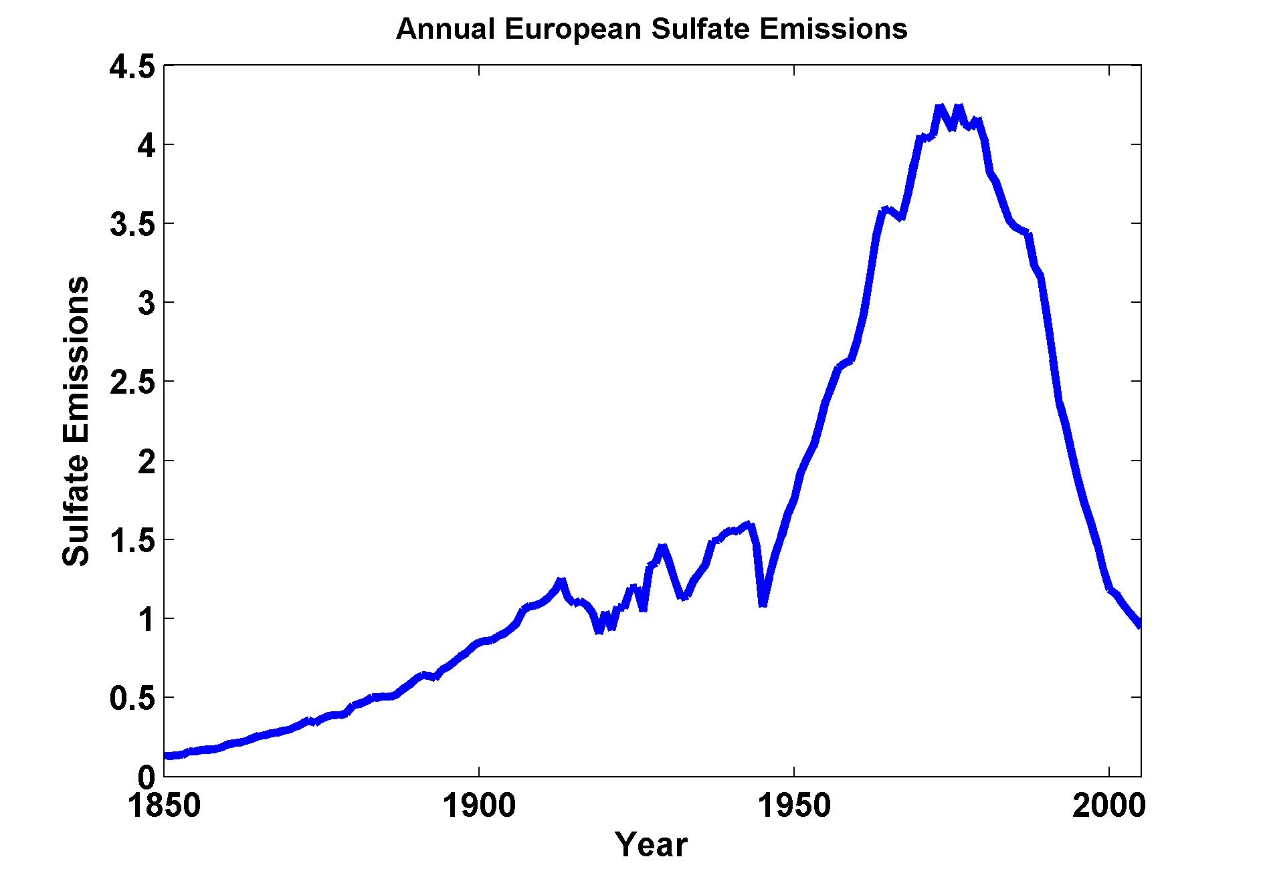

Slide 14
Storm Maximum Power Dissipation and SST
North Atlantic
Notes:
Same as the previous slide but also showing the hurricane power dissipation derived from (supposedly faulty) historical archives, in red.

Slide 15
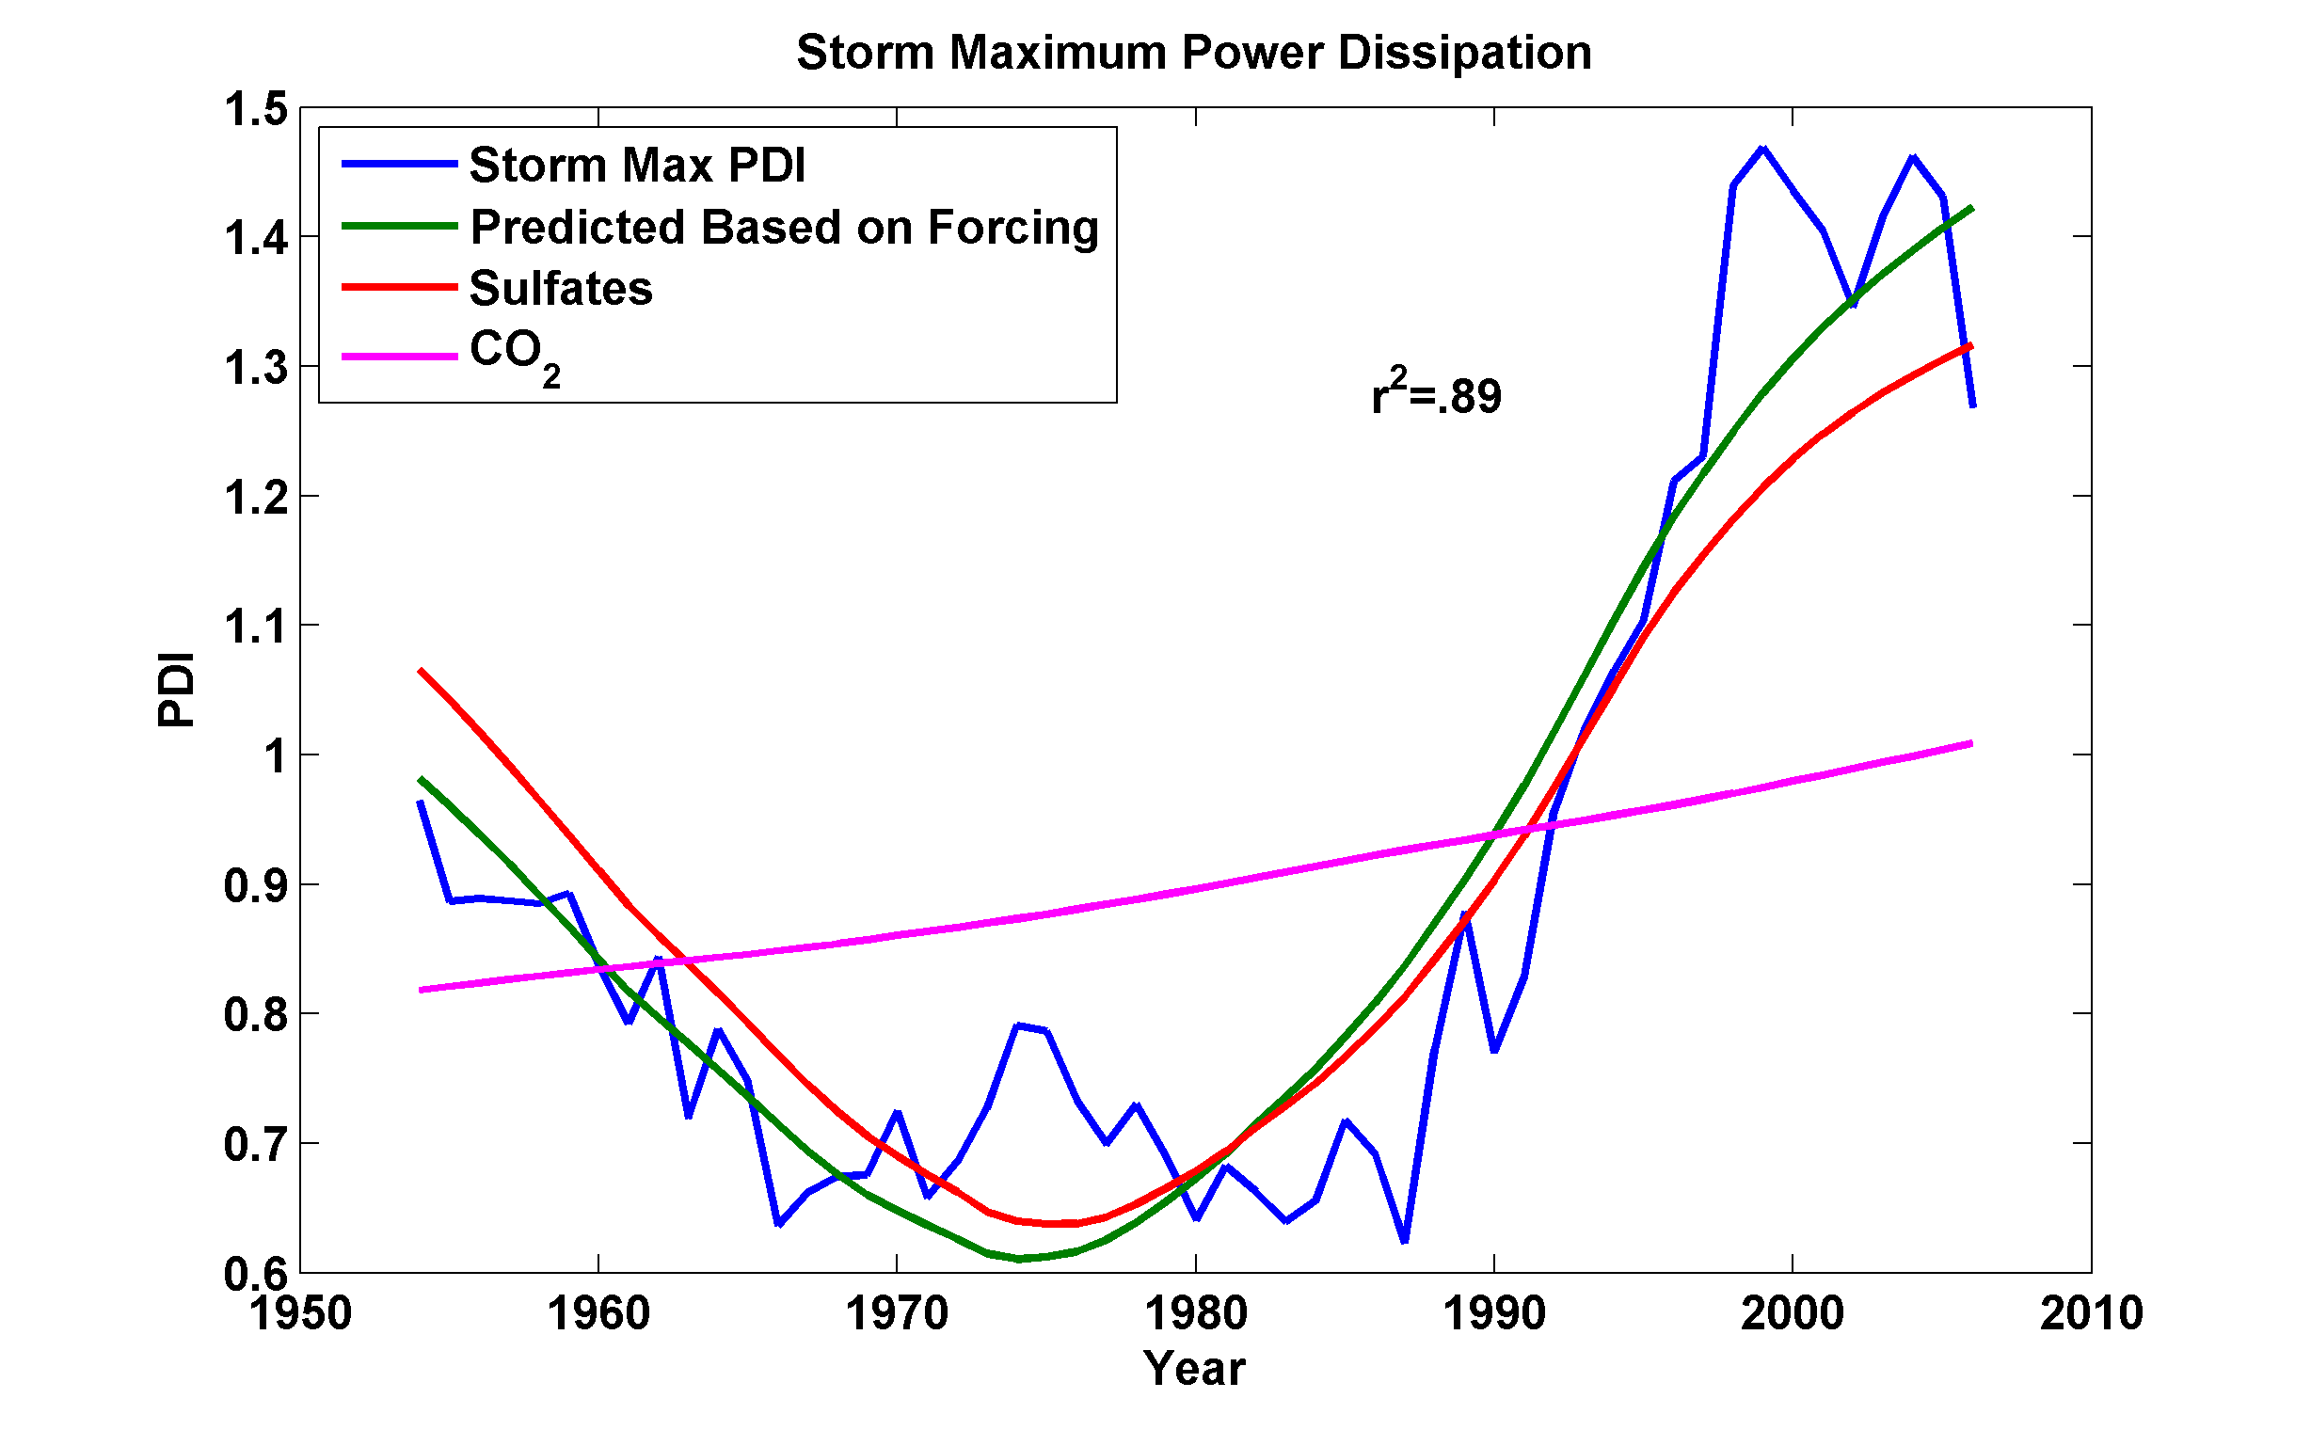

Slide 16
Hurricane Risk:
What Can We Learn from Geology?

Slide 17
Paleotempestology
barrier beach
upland
overwash fan
backbarrier marsh
a)
lagoon
barrier beach
upland
overwash fan
b)
backbarrier marsh
lagoon
terminal lobes
flood tidal delta
Source: Jeff Donnelly, WHOI
Notes:
17

Slide 18
Jeffrey P. Donnelly and Jonathan D. Woodruff, Nature, 2007

Slide 19
Near Pensacola, Florida
Lane et al., Marine Geology, 2011
Sediment record reconstruction from Mullet Pond at Bald Point for the last 4000 years. Recent historical hurricanes attributable to event beds are noted.

Slide 20
Does Global Warming Affect Hurricanes?

Slide 21

Svante Arrhenius, 1859-1927
“Any doubling of the percentage of carbon dioxide in the air would raise the temperature of the earth's surface by 4°; and if the carbon dioxide were increased fourfold, the temperature would rise by 8°.” – Världarnas utveckling (Worlds in the Making), 1906

Slide 22
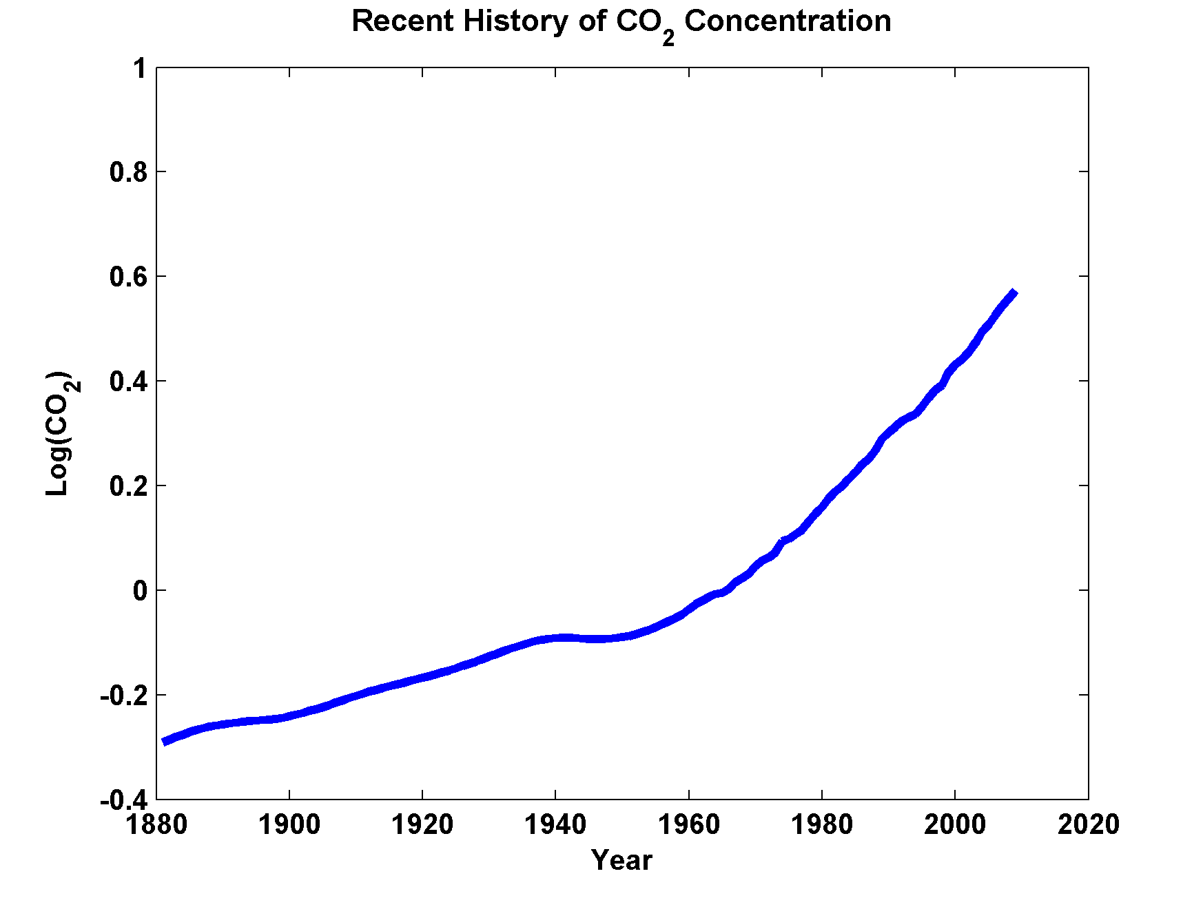

Slide 23
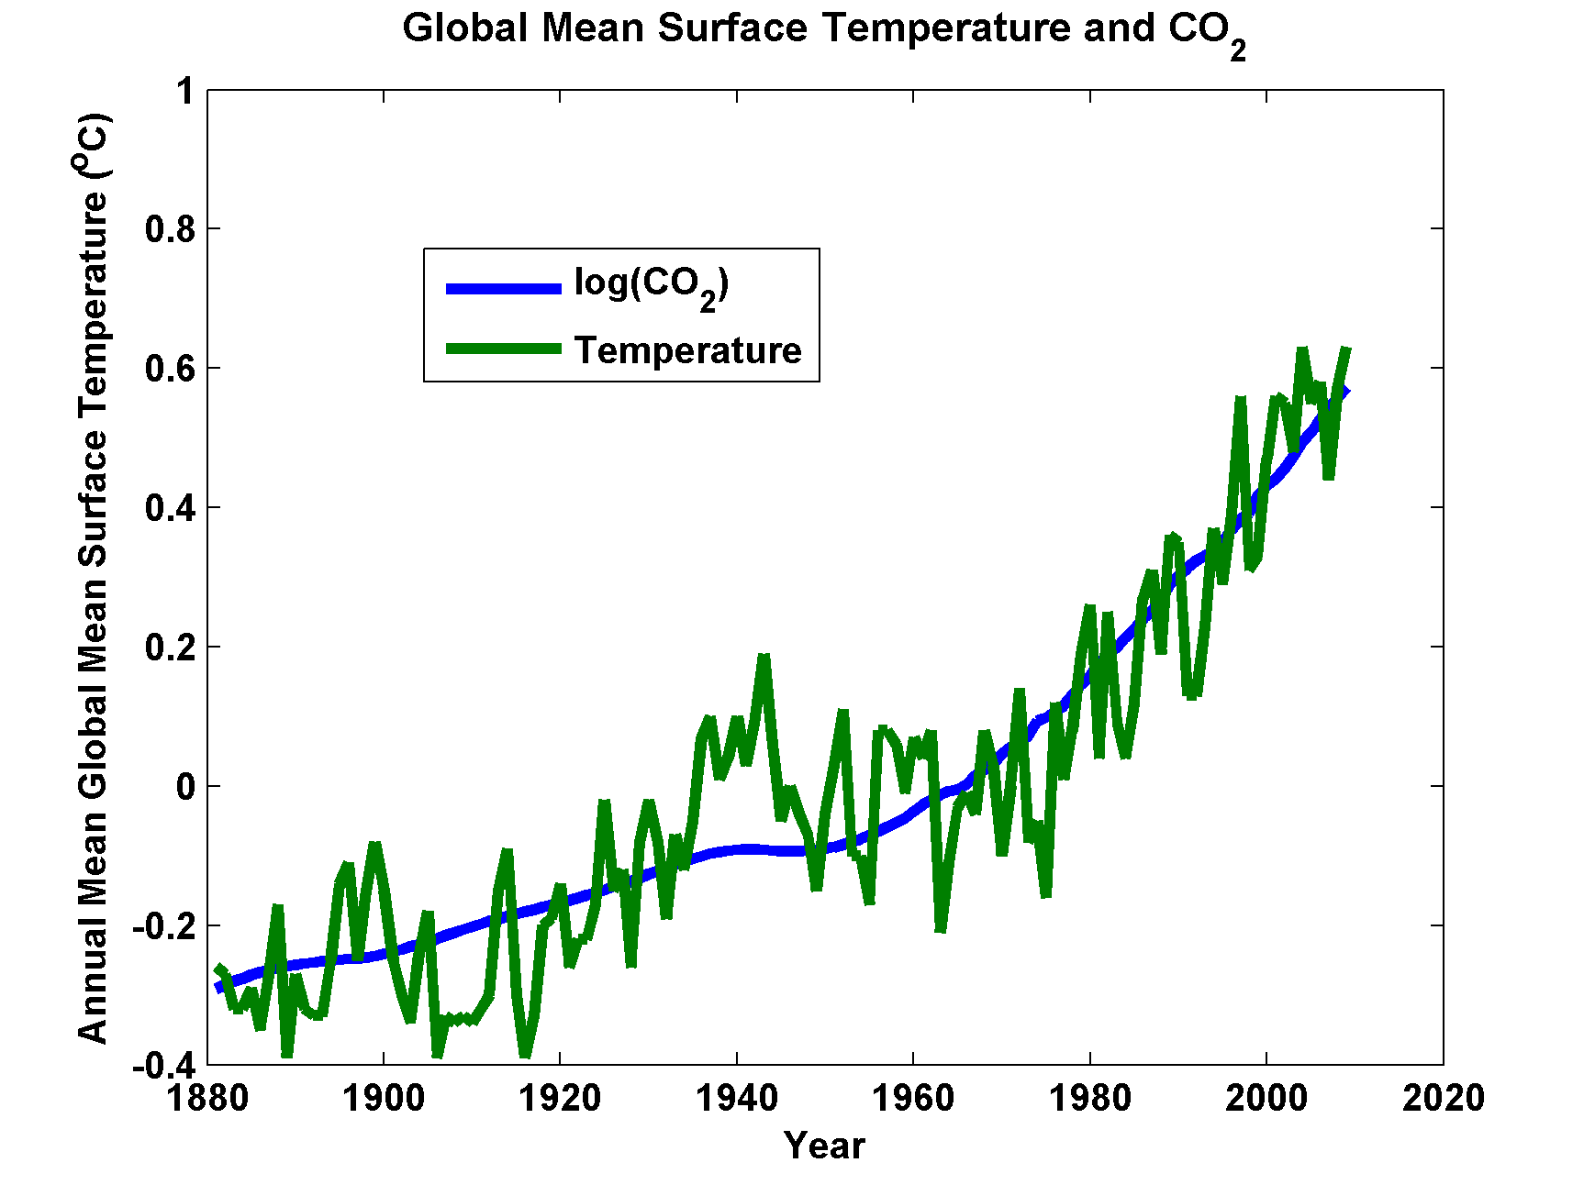

Slide 24
Hurricane Potential Intensity: What is it and How will it Change with Climate?

Slide 25
Hurricane Potential Intensity:
Maximum Sustainable Wind Speed for a given Sea Surface Temperature and Atmospheric Temperature Profile

Slide 26
Annual Maximum Potential Intensity (m/s)

Slide 27
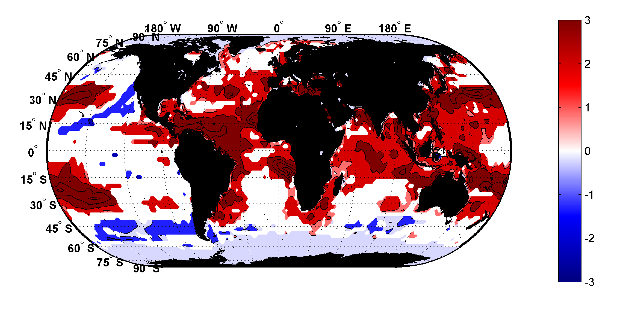
Trends in Thermodynamic Potential for Hurricanes, 1980-2010
(NCAR/NCEP Reanalysis)
ms⁻¹decade⁻¹

Slide 28
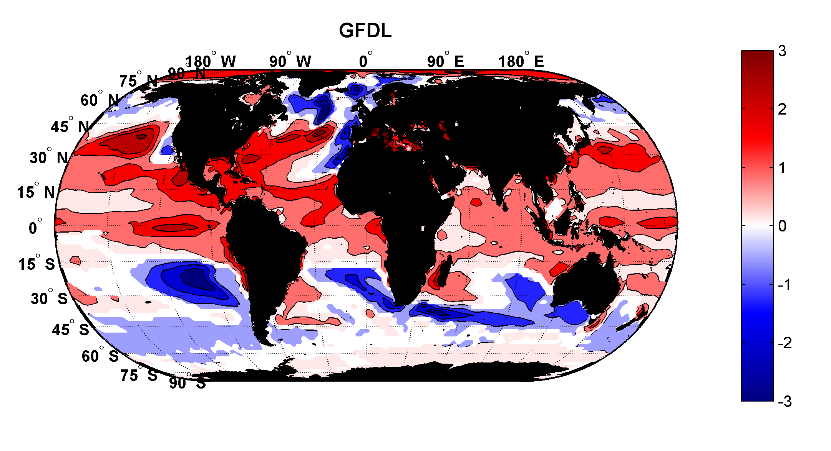
Projected Trend, 2006-2100: GFDL model
RCP 8.5
ms⁻¹decade⁻¹

Slide 29
Time series of the latitudes at which tropical cyclones reach maximum intensity.
From Kossin et al. (2014)

Slide 30
Assessments of Present and Future Hurricane Risk

Slide 31

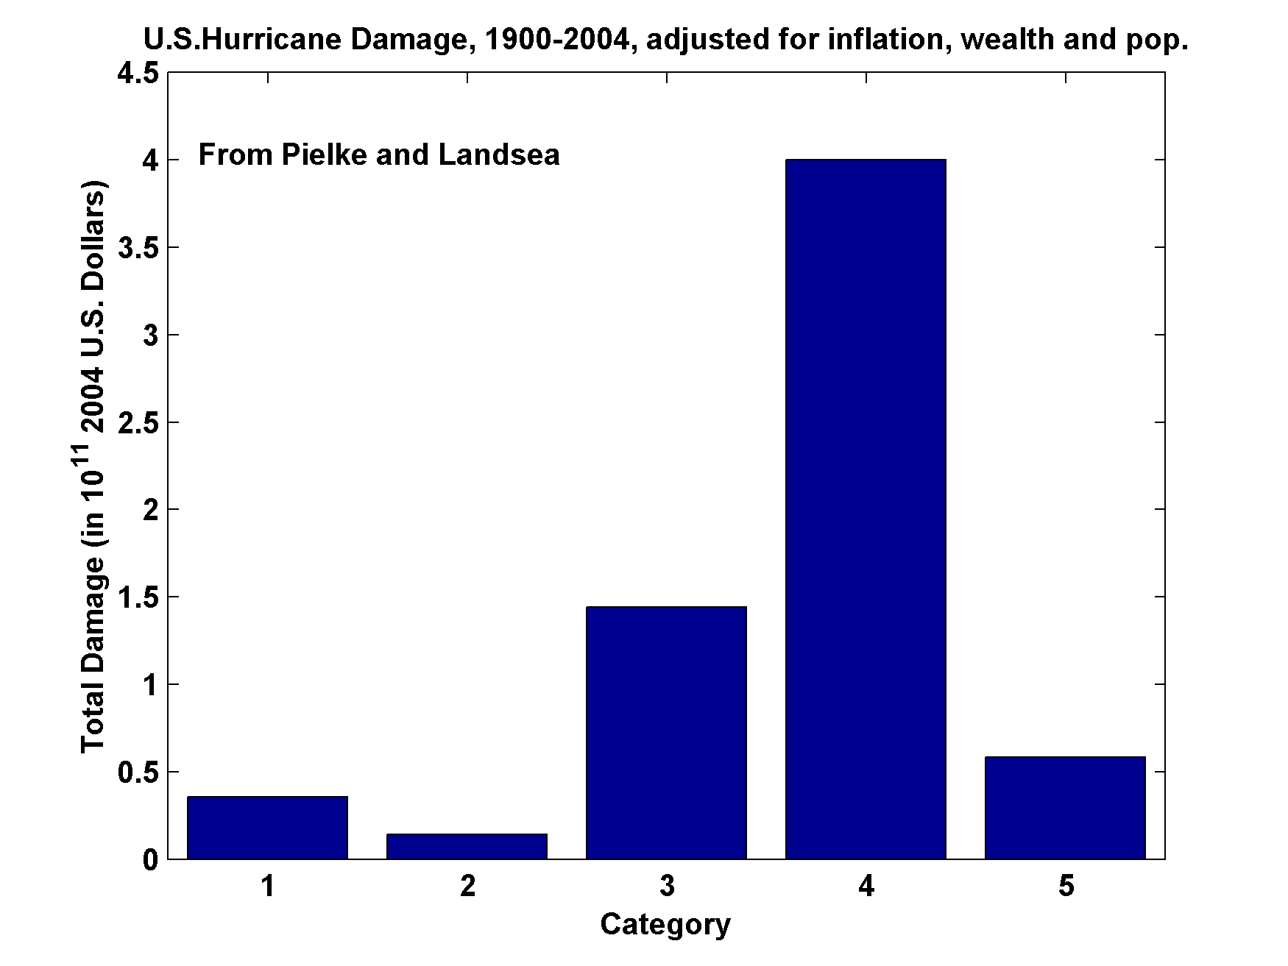
U.S. Hurricane Damage, 1900-2004, Adjusted for Inflation, Wealth, and Population

Slide 32
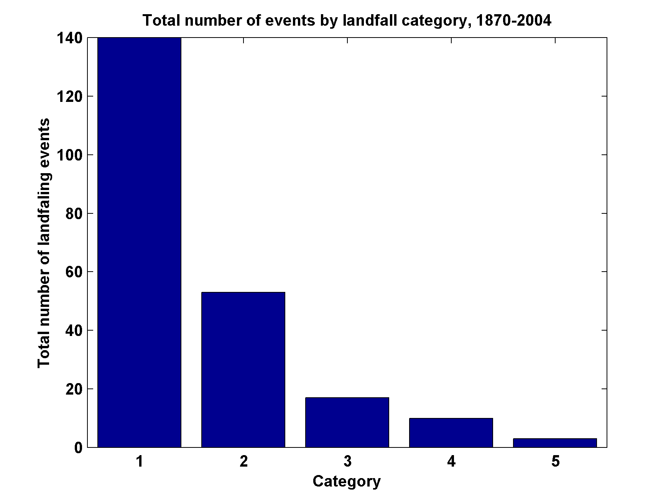
Total Number of Landfall Events, by Category, 1870-2004

Slide 33
Limitations of a strictly statistical approach to hurricane risk assessment
>50% of all normalized U.S. hurricane damage caused by top 8 events, all category 3, 4 and 5
>90% of all damage caused by storms of category 3 and greater
Category 3,4 and 5 events are only 13% of total landfalling events; only 30 since 1870
Landfalling storm statistics are inadequate for assessing hurricane risk

Slide 34
Our Approach:
Embed highly detailed computational hurricane models in large-scale conditions produced by climate analyses or climate models. Generate 1000-100,000 events
Emanuel, K., R. Sundararajan, and J. Williams, 2008: Hurricanes and global warming: Results from downscaling IPCC AR4 simulations. Bull. Amer. Meteor. Soc,, 89, 347-367

Slide 36
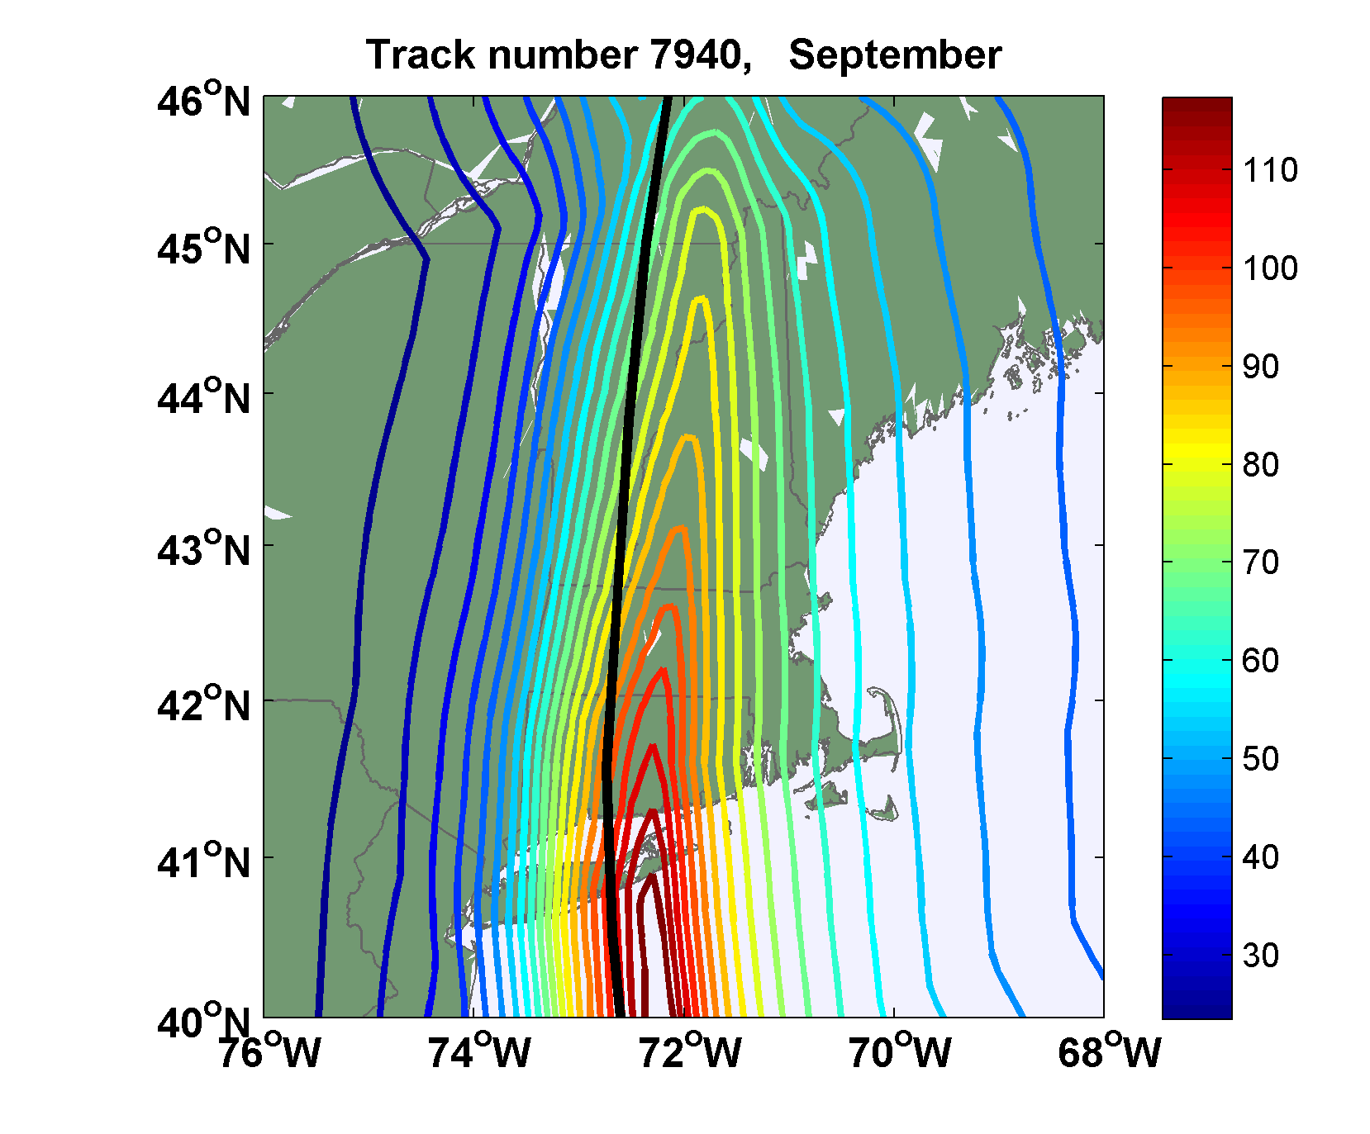
Sample Storm Wind Swath

Slide 37
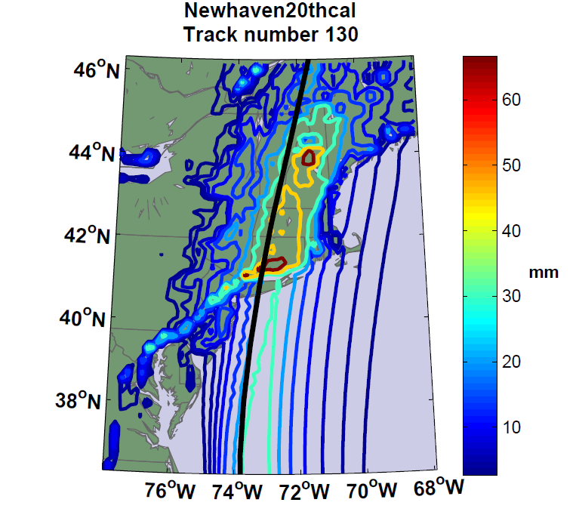
Accumulated Rainfall (mm)

Slide 38


Storm Surge Simulation (Ning Lin)
SLOSH model
(Jelesnianski et al. 1992)
SLOSH mesh
~ 10³ m
ADCIRC mesh
~ 10² m
Battery
ADCIRC model
(Luettich et al. 1992)
ADCIRC mesh
~ 10 m
(Colle et al. 2008)
Notes:
Given the storm wind and pressure fields (which is estimated from the Holland parametric pressure model) we can simulate the surge. Surge simulations with high resolution are computationally intensive, so to make it possible to simulate accurate surges for our large synthetic storm sets, we apply the two hydrodynamic models with girds of various resolutions in such a way that the main computational effort is concentrated on the storms that determine the risk. First, we apply the SLOSH model, using a mesh with resolution of about 1 km around NYC to simulate the surges for all storms and select the storms that have return periods, in terms of the surge height at the Battery, greater than 10 years. Second, we apply the ADCIRC simulation, using a grid mesh with resolution of ~100 m around NYC, to each of the selected storms. Then, we apply another ADCIRC mesh with resolution as high as ~10 m around NYC, for a set of the most extreme events, to check if the resolution of our ADCIRC grid is sufficient and if needed to make statistical correction to the results.

Slide 39
Surge Return Periods for The Battery, New York
Sandy

Slide 40
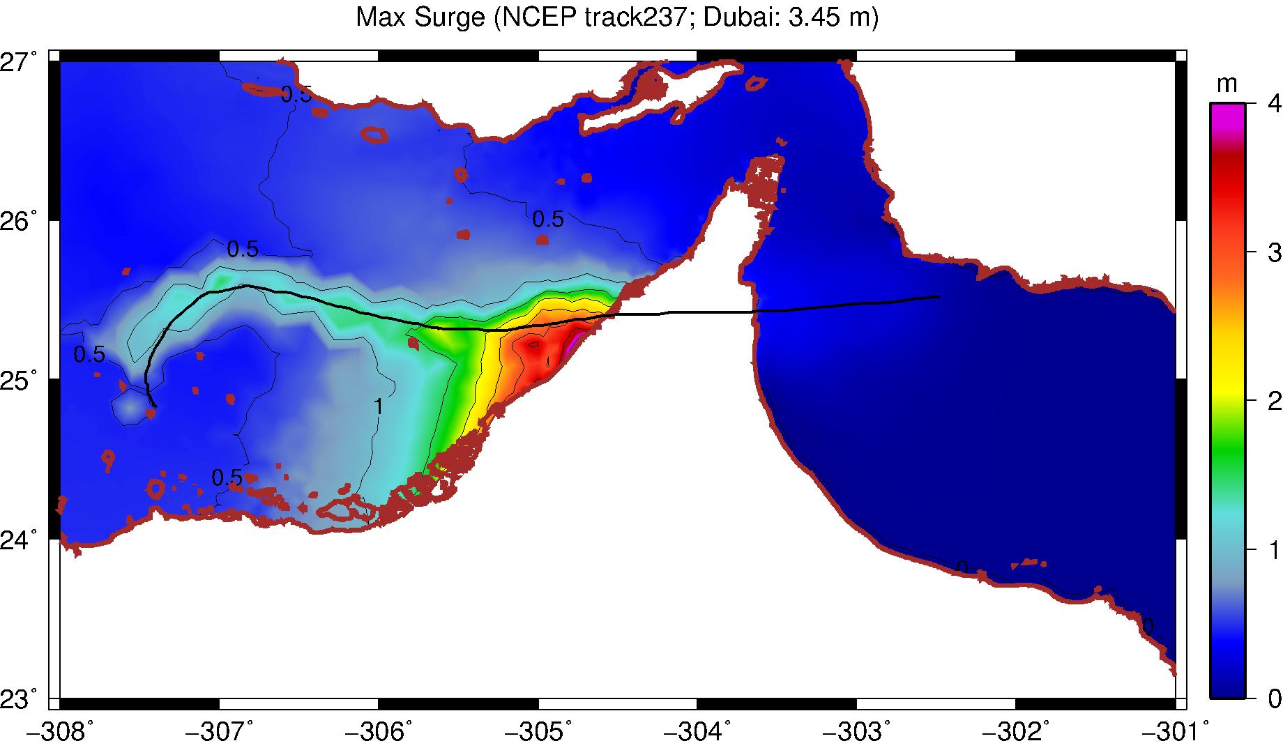
A Grey Swan: Dubai
Dubai
Lin, N. and K. Emanuel, 2015: Grey swan tropical cyclones. Nature Clim. Change, doi: 10.1038/NCLIMATE2777

Slide 41

Return Periods

Slide 42
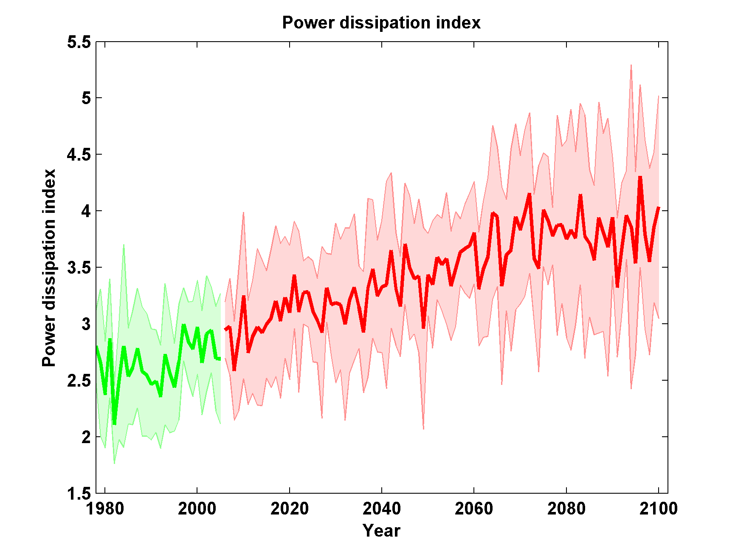
Projections of Global TC Power Dissipation using 6 CMIP5 Climate Models
Emanuel, K.A., 2013: Downscaling CMIP5 climate models shows increased tropical cyclone activity over the 21st century. Proc. Nat. Acad. Sci., 110, doi/10.1073/pnas.1301293110

Slide 43
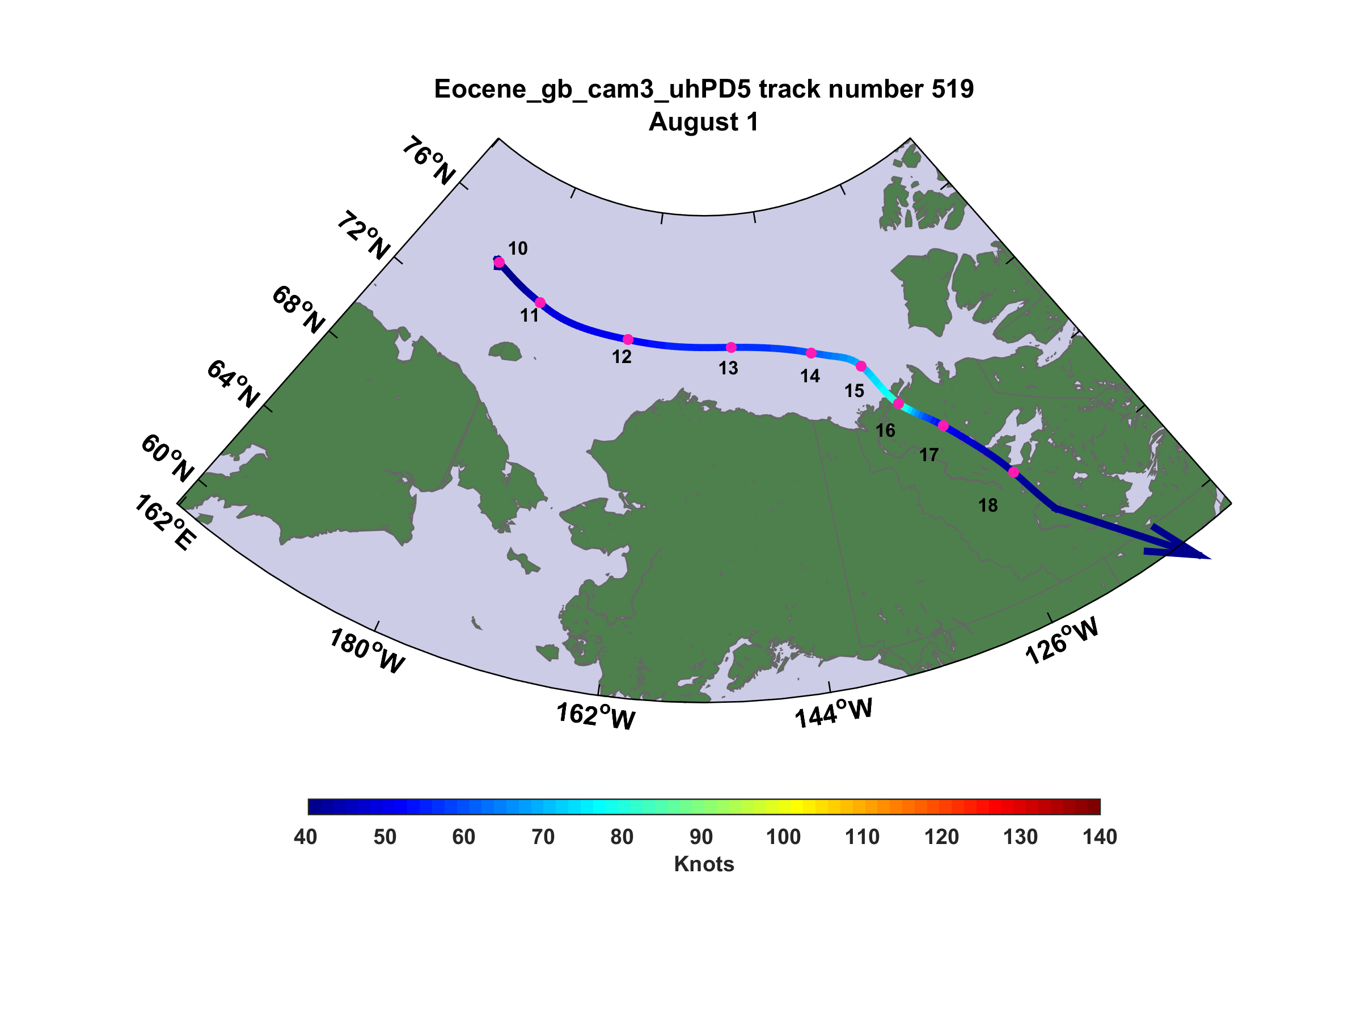
Eocene hurricane making landfall in the Yukon

Slide 44

GCM flood height return level, Battery, Manhattan
(assuming SLR of 1 m for the future climate )
Black: Current climate (1981-2000)
Blue: A1B future climate (2081-2100)
Red: A1B future climate (2081-2100) with R₀ increased by 10% and R_{m} increased by 21%
Lin, N., K. Emanuel, M. Oppenheimer, and E. Vanmarcke, 2012: Physically based assessment of hurricane surge threat under climate change. Nature Clim. Change, doi:10.1038/nclimate1389
Notes:
Then we calculate the flood height (including surge, tide, and sea level rise) return level for the four climate models, assuming a sea level rise of 1 m for the future climate, for the Battery, NYC. These results show that the combined effects of storm climatology change and sea level rise will greatly shorten the flood return periods for NYC and, by the end of the century, the current 100-year surge flooding may happen less than every 30 years, with CNRM and GFDL prediction to be less than 10 years, and the 500-year flooding may happen less than every 200 years, with the CNRM and GFDL prediction to be 20-30 years.

Slide 45
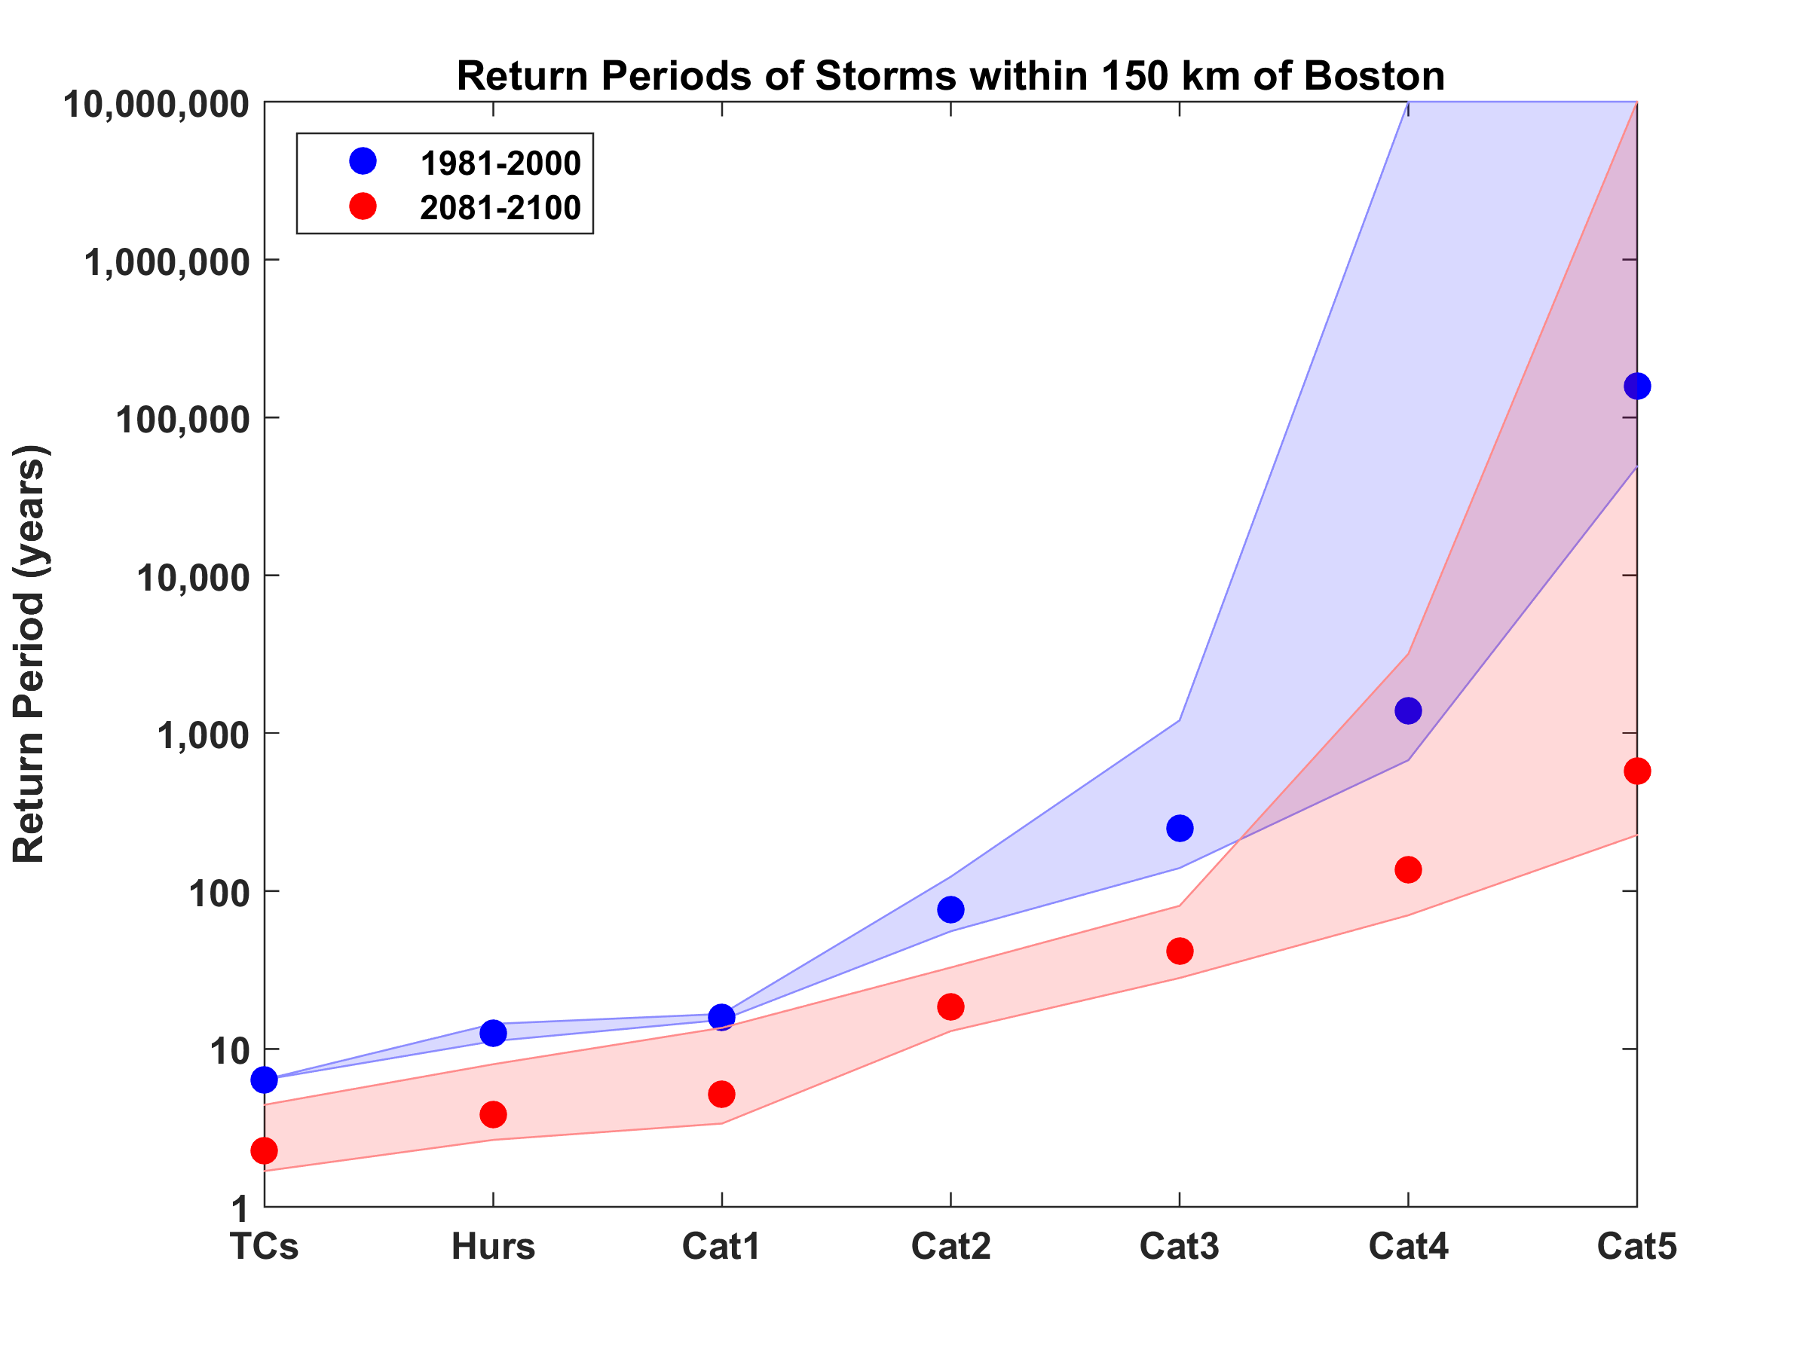
Hurricanes Passing within 150 km of Boston
Downscaled from 5 climate models

Slide 46
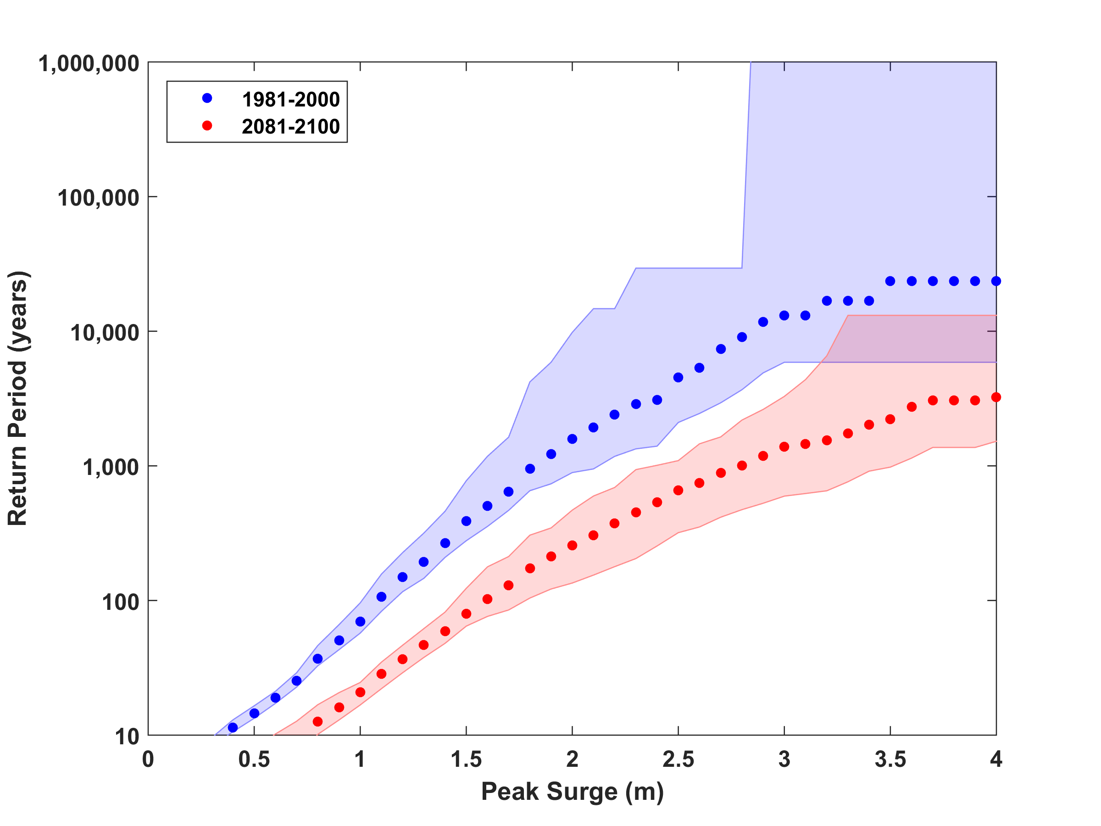
Surge Risk

Slide 47
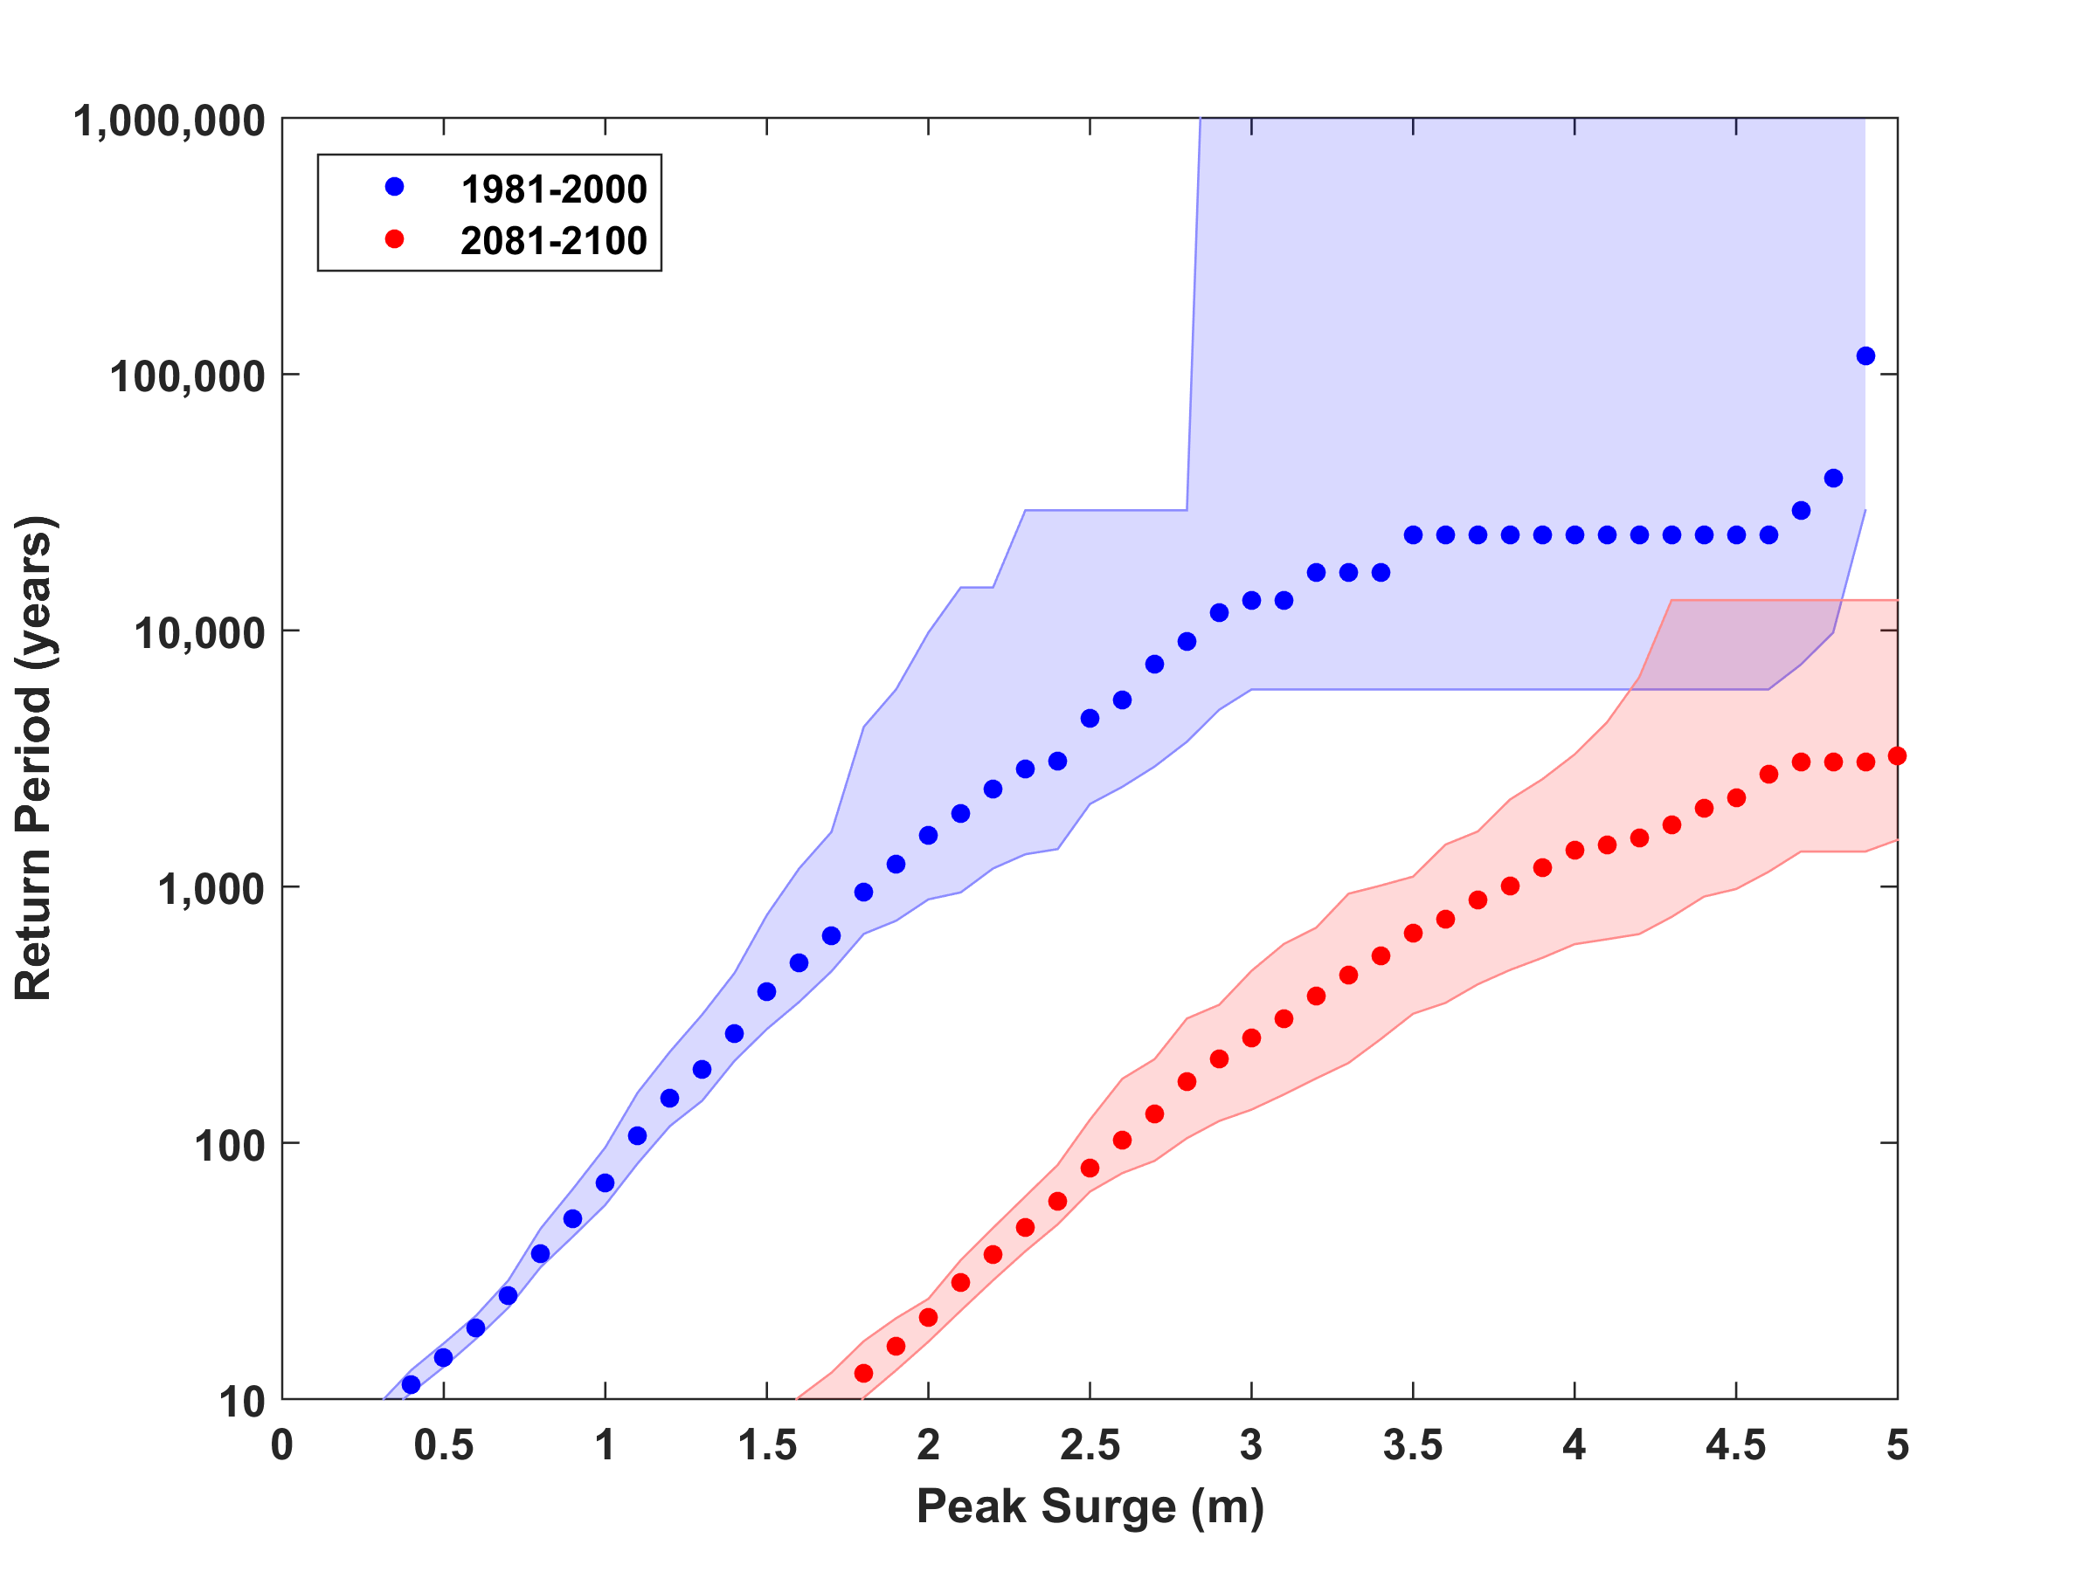
Surge Risk with 1 meter sea level rise

Slide 48
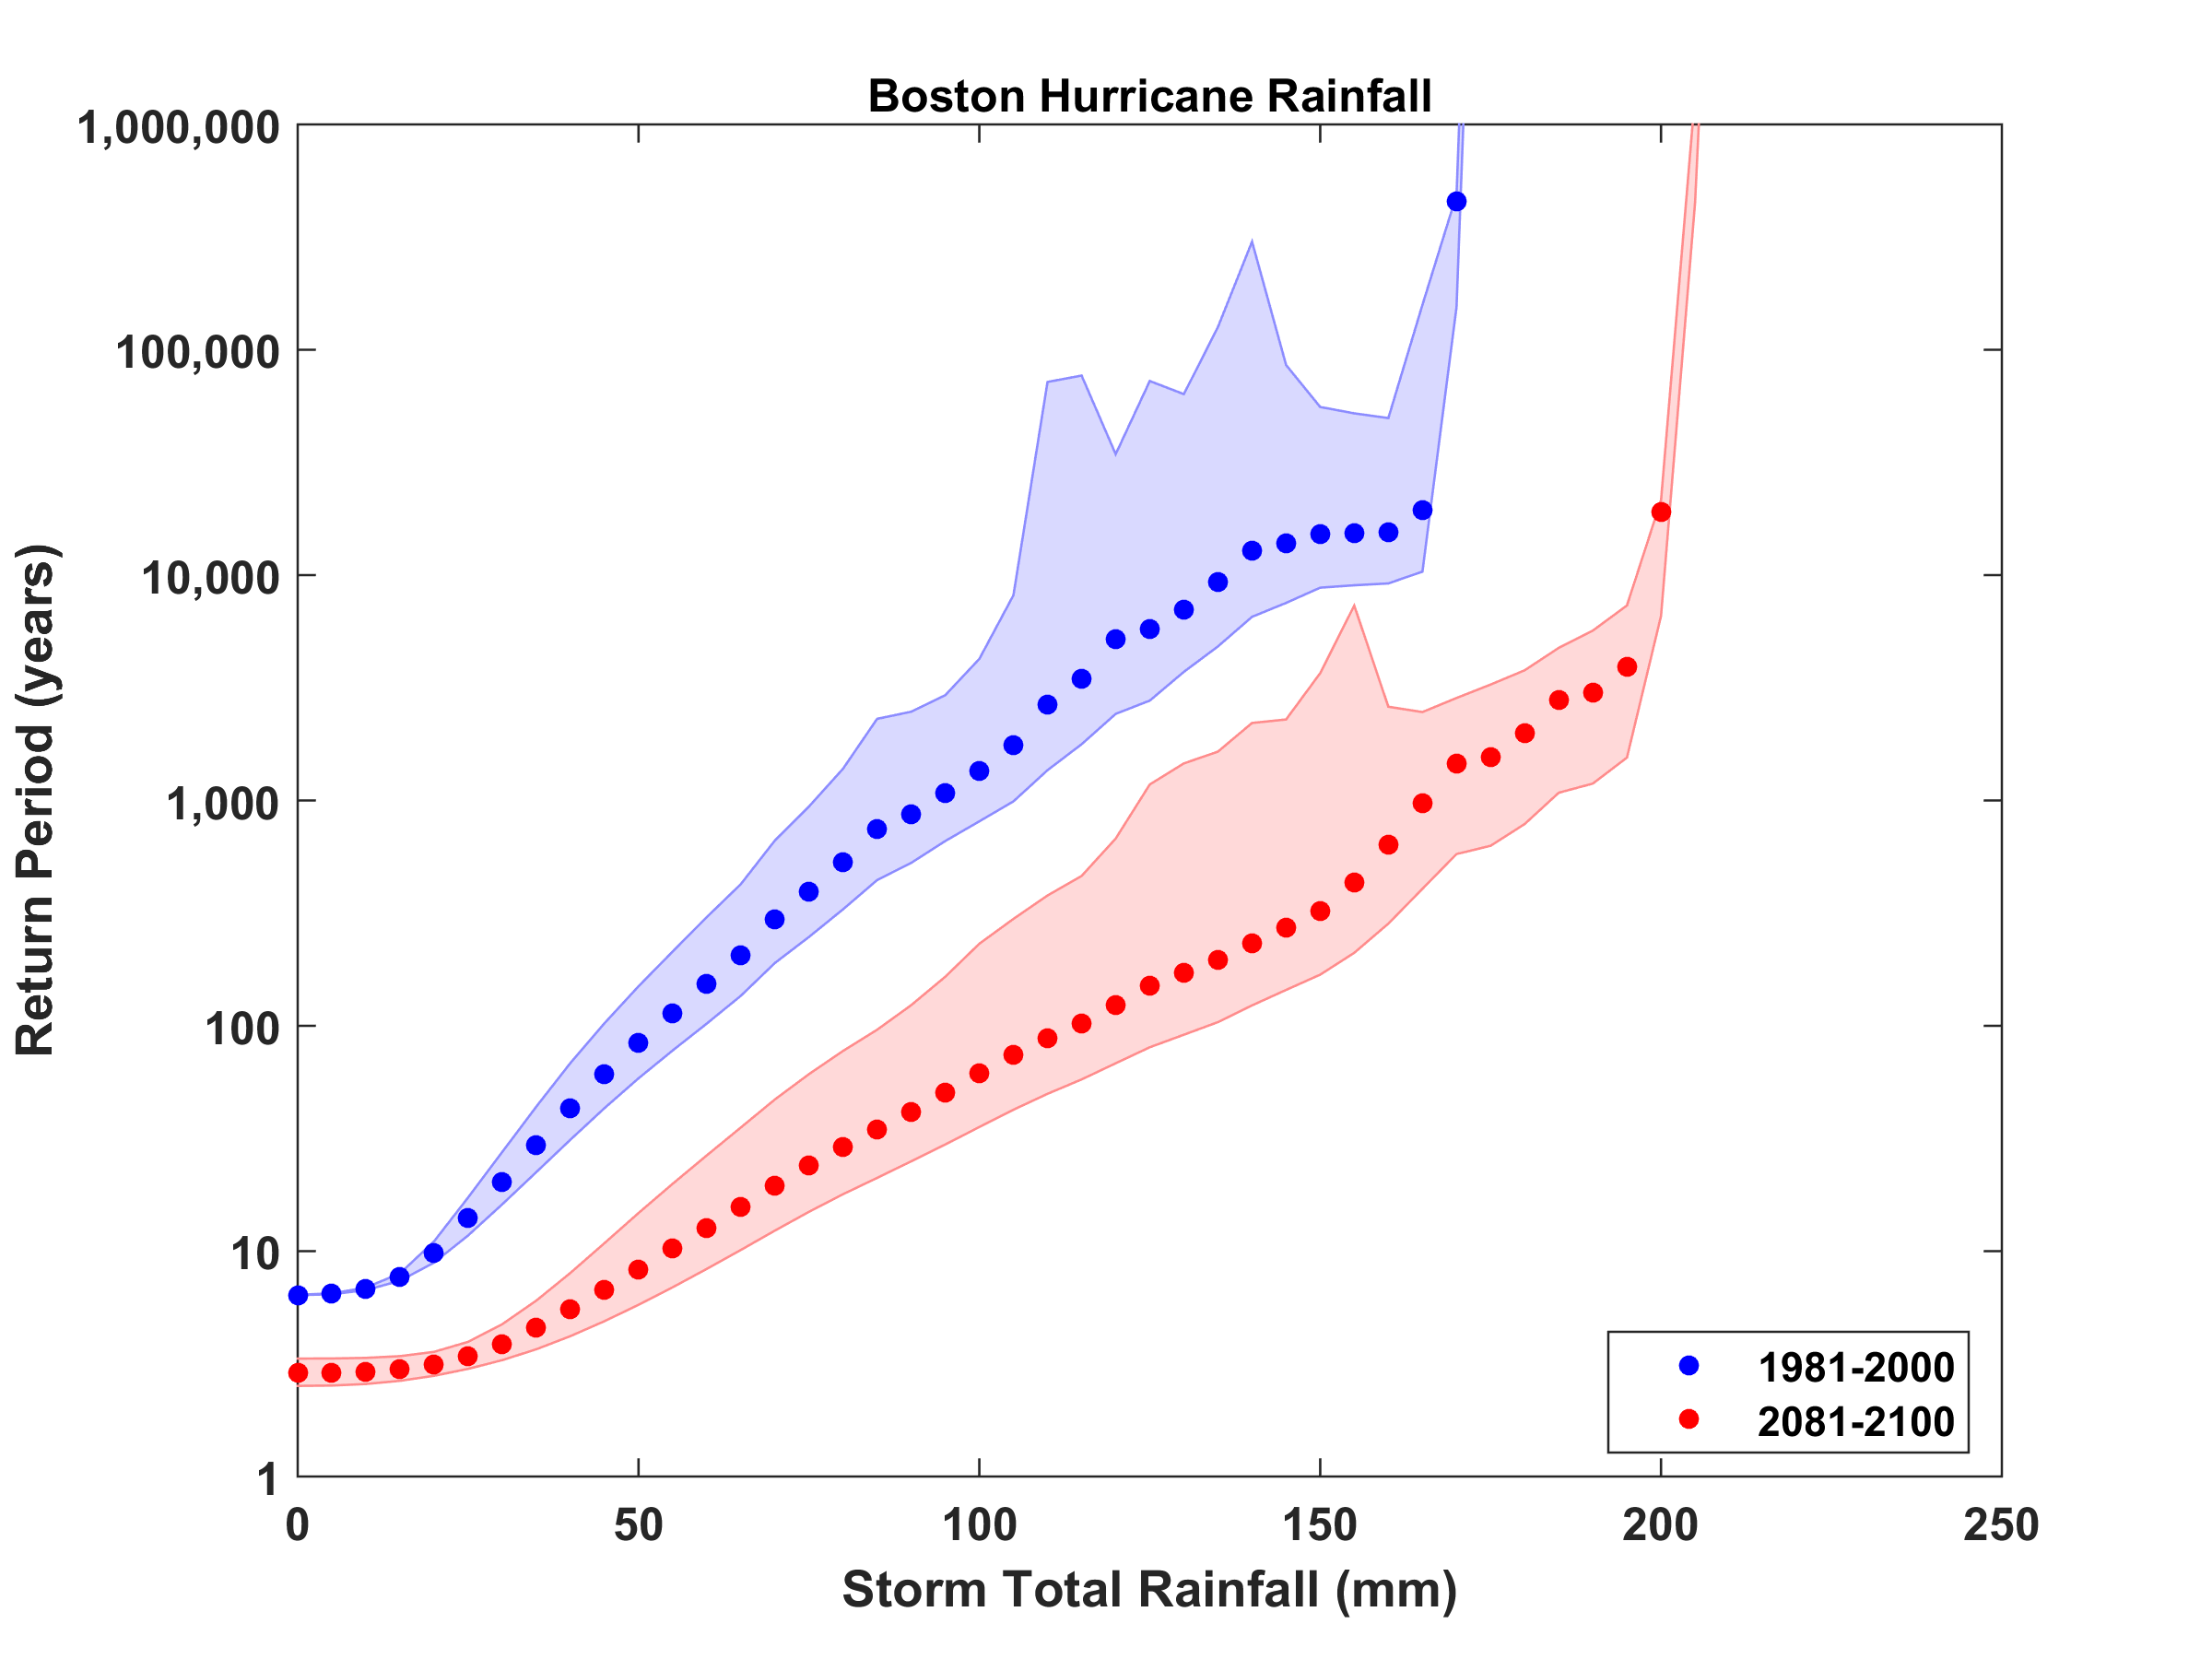
Rain Risk

Slide 49
Sea level rise + changing storms
Sea level rise alone
From: American Climate Prospectus Economic Risks in the United States

Slide 50

TC Intensity Forecast Nightmares

Slide 51
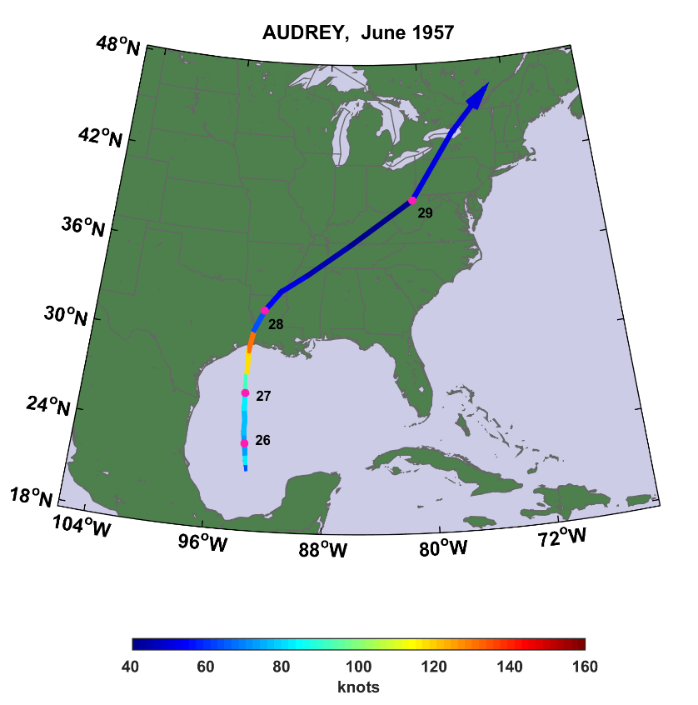
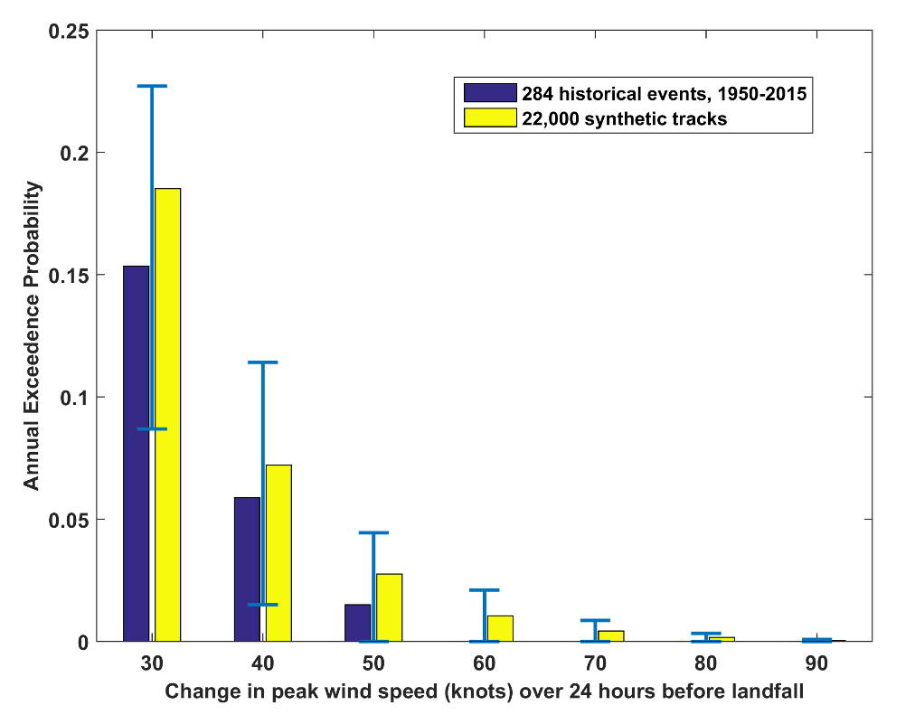
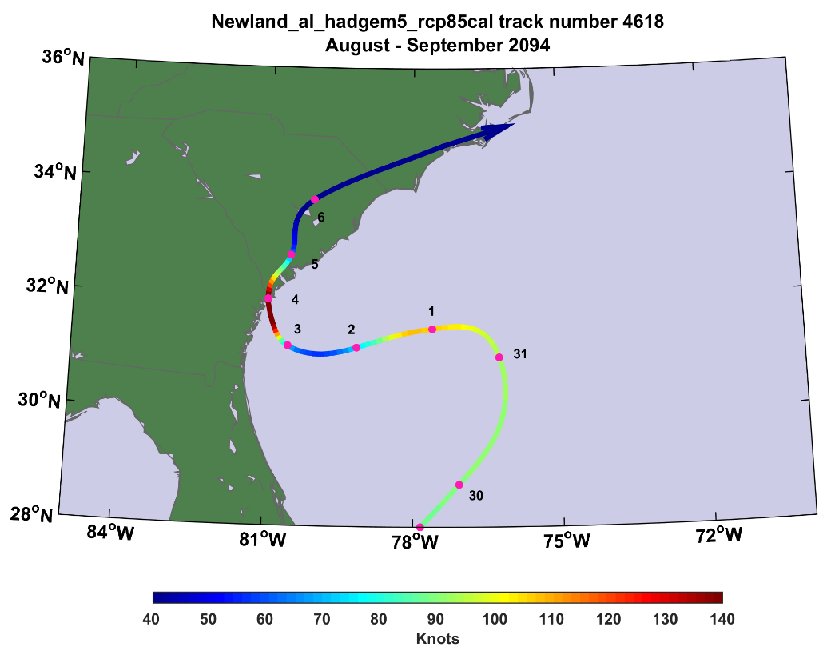
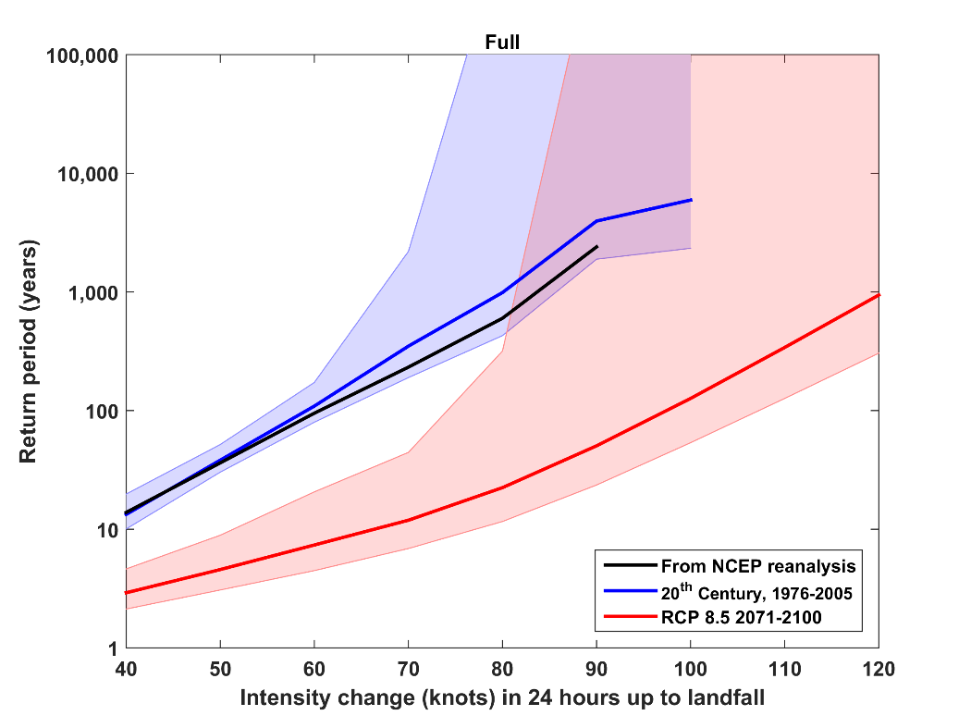
56 knots/24 hrs
120 knots/24 hrs

Slide 52

History is too short, sparse, and imperfect to estimate hurricane risk
Better estimates can be made by downscaling hurricane activity from climatological or global model output
Hurricanes clearly vary with climate and there is a decided risk that hurricane threats will increase over this century

Slide 53


Human Adaptation: Century Time Scales
Current and Future Probability Density of U.S. Damages, MIROC Model
Current and Future Damage Probability, MIROC Model

