Slide 1
The Madden-Julian Oscillation
Kerry Emanuel
Lorenz Center
Massachusetts Institute of Technology

Slide 2

The Madden-Julian Oscillation (MJO)
Discovered by Rolland Madden and Paul Julian at NCAR in 1971
Characterized by an envelope of convection ~10,000 km wide moving eastward at around 5 m/s
Most active over regions of high sea surface temperature
(> 27° C)
Can have a profound impact on the extratropical circulation
Is not always represented in general circulation models

Slide 3
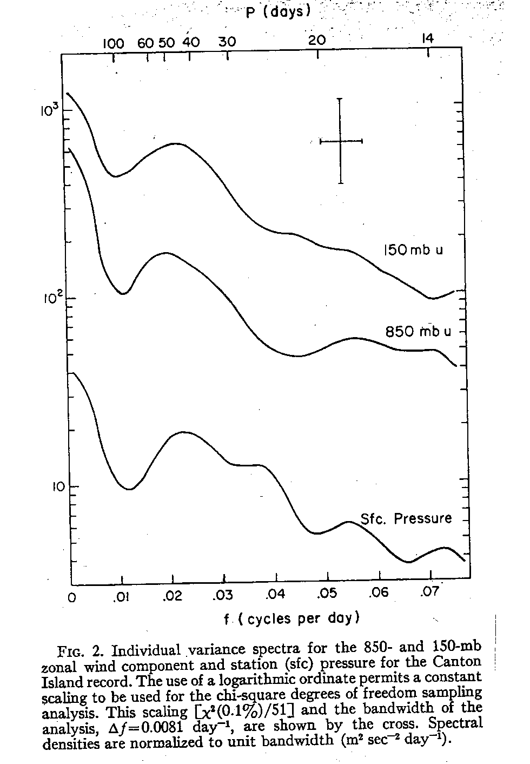
Madden and Julian, 1972

Slide 4
Recent discovery by Li et al (2018): MJO detected by Xie et al. (1963)
Original Fig. 2 from Xie et al. (1963) showing time series of 5-day running mean zonal wind (m s−1) at 700 hPa. Positive (negative) values indicate westerlies (easterlies). The abscissa represents the time from 1 Jun to 1 Sep. The station number is marked in each panel and the first column is for 1958, the second for 1959, and the third for 1960. Black dots at the bottom denote the occurrence of typhoons each year. Red arrows are added by the authors of the current study to highlight the intraseasonal periods.
“There was a quasi-periodical oscillation of strength and position of the basic zonal flow with a period longer than one month. Such an oscillation might be helpful for the extended-range forecast of initiation and development of typhoons”. From Xie et al. (1963) as translated by Li et al., BAMS, Sept. 2018
Xie, Y.-B., S.-J. Chen, I.-L. Zhang, and Y.-L. Hung, 1963: A preliminarily statistic and synoptic study about the basic currents over southeastern Asia and the initiation of typhoon (in Chinese). Acta Meteor. Sin., 33, 206–217.

Slide 5
Perturbations in surface properties and OLR/precip confined to Indian Ocean and western Pacific, but upper tropospheric wind signals are global

Slide 6
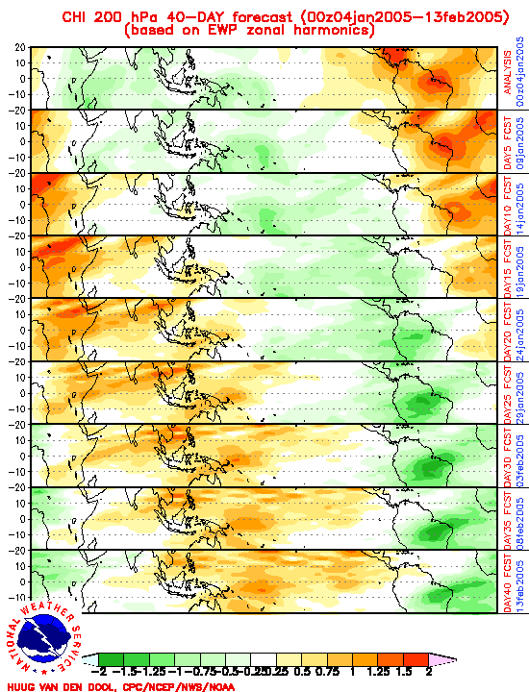
European Center forecast 200 hPa velocity potential, 4 January to 13 February, 2005

Slide 7
Observational analyses courtesy of:
George N. Kiladis
NOAA Aeronomy Laboratory, Boulder, Colorado
Katherine H. Straub
Susquehanna University
Patrick T. Haertel
University of North Dakota

Slide 8
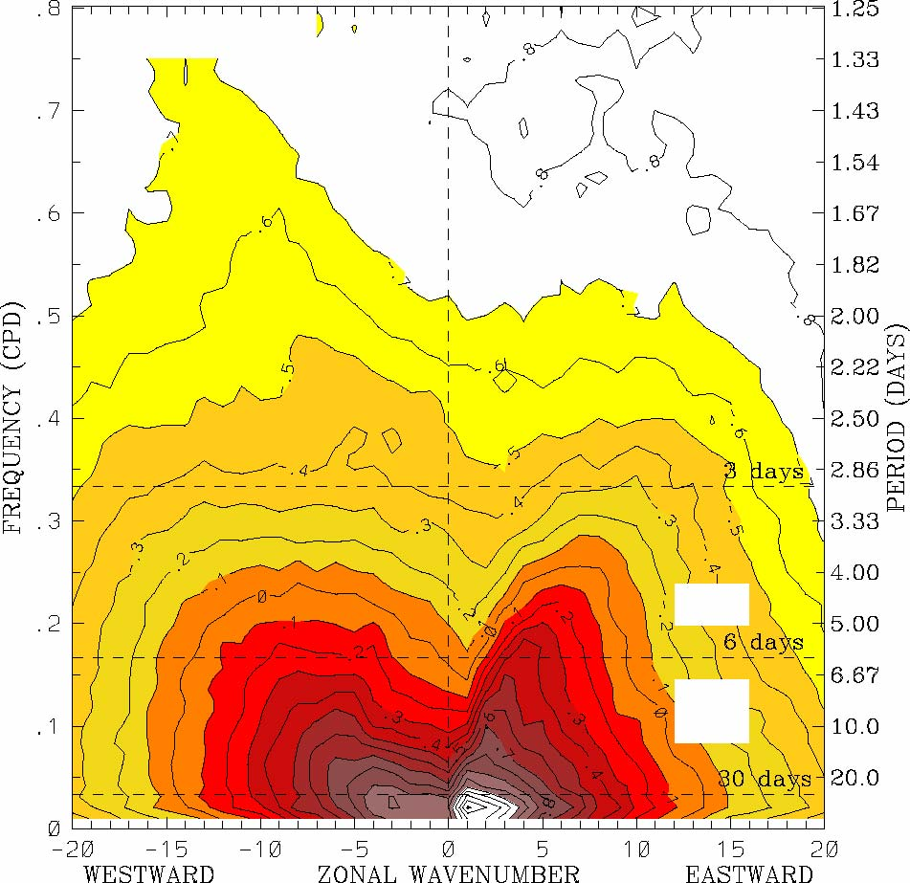
OLR power spectrum, 15ºS-15ºN, 1979–2001 (Symmetric)
from Wheeler and Kiladis, 1999

Slide 9
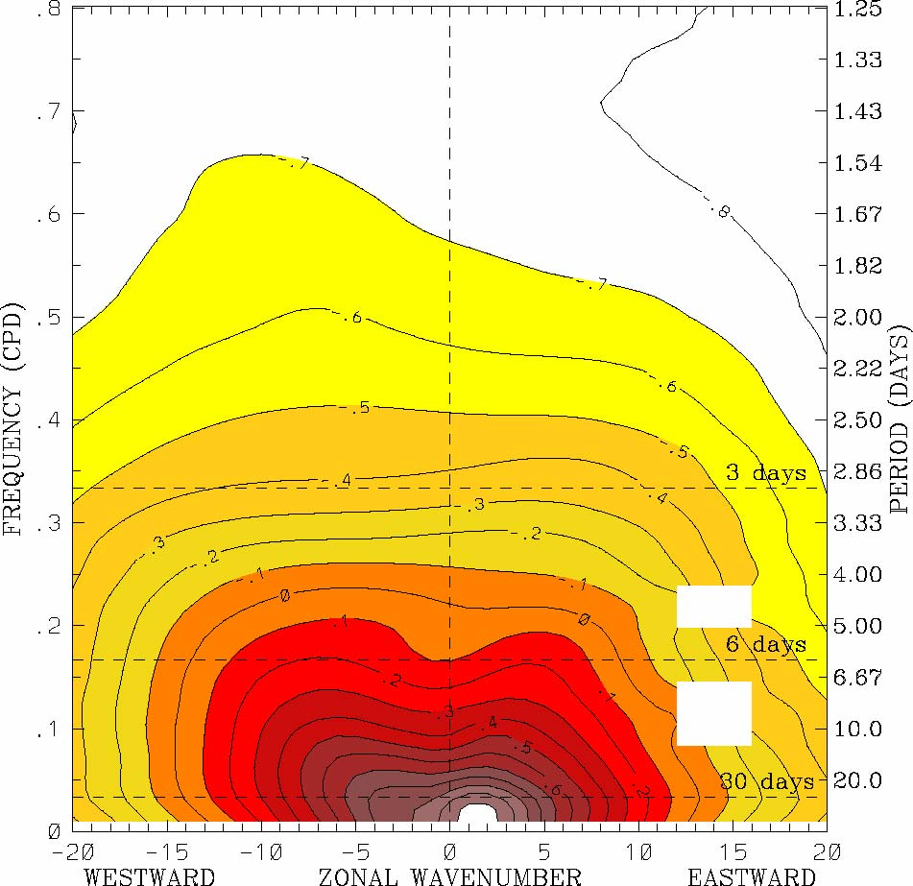
OLR background spectrum, 15ºS-15ºN, 1979–2001
from Wheeler and Kiladis, 1999

Slide 10
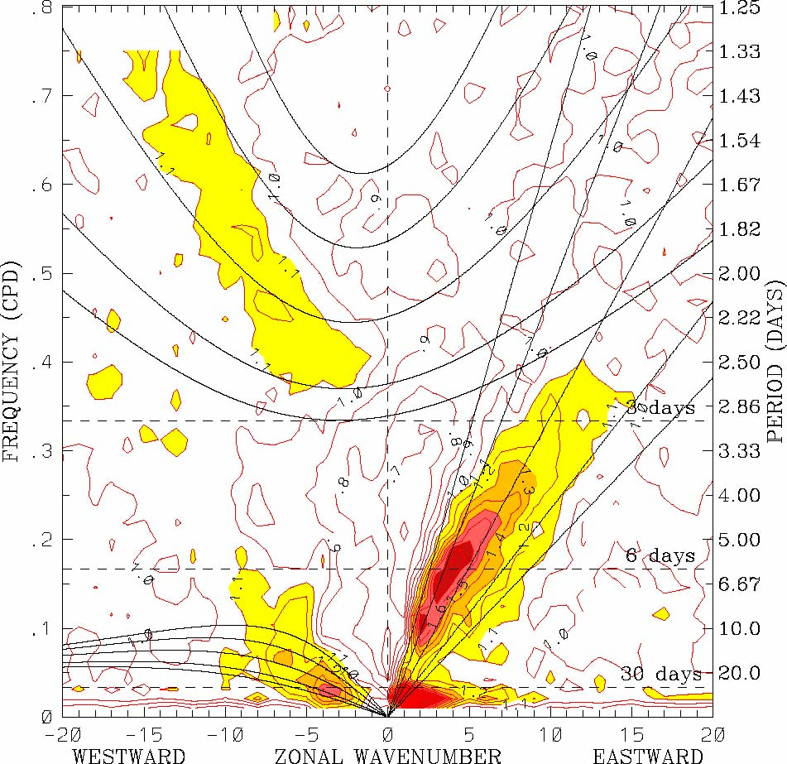
OLR power spectrum, 1979–2001 (Symmetric)
Perturbation spectra
from
Wheeler and Kiladis, 1999

Slide 11
OLR power spectrum, 1979–2001 (Symmetric)
Perturbation spectra
Kelvin
from
Wheeler and Kiladis, 1999

Slide 12
OLR power spectrum, 1979–2001 (Symmetric)
Westward Inertio-Gravity
Kelvin
from
Wheeler and Kiladis, 1999

Slide 13
OLR power spectrum, 1979–2001 (Symmetric)
Westward Inertio-Gravity
Kelvin
Equatorial Rossby
from
Wheeler and Kiladis, 1999

Slide 14
OLR power spectrum, 1979–2001 (Symmetric)
Westward Inertio-Gravity
Kelvin
Equatorial Rossby
Madden-Julian Oscillation
from
Wheeler and Kiladis, 1999

Slide 15
The MJO as a Mode of Self-Aggregation of Moist Convection

Slide 16
First published simulation of aggregating convection: Held, Hemler and Ramaswamy, 1993
In absence of imposed shear, moist convection in 2-D model tended to clump into a single spot
Air outside clump much drier than in homogeneous RCE
Aggregation happened faster at higher temperature
“Memory” of convective location ascribed to moisture anomaly

Slide 17
Convection in Radiative-Convective Equilibrium
Allison Wing, PhD thesis, 2014
Notes:
Day 1 is pretty homogeneous. By day 10 small area has become drier.

Slide 18
Self-Aggregation
Allison Wing, PhD thesis, 2014
Notes:
Day 1 is pretty homogeneous. By day 10 small area has become drier.

Slide 19
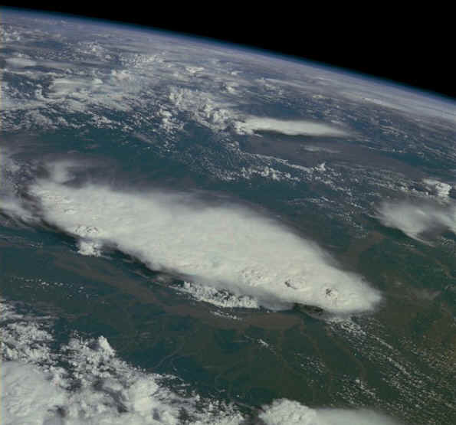
Monsoonal Thunderstorms, Bangladesh and India, July 1985

Slide 20
The MJO is quite likely owing to self-aggregation of moist convection on a rotating sphere

Slide 21
Self-Aggregation on a Sphere with Uniform SST, using SP-CAM
Arnold and Randall, JAMES, 2015

Slide 22
Self-Aggregation on a Sphere with Uniform SST, using SP-CAM
Convective entrainment rate in ordinary CAM
Arnold and Randall, JAMES, 2015

Slide 23
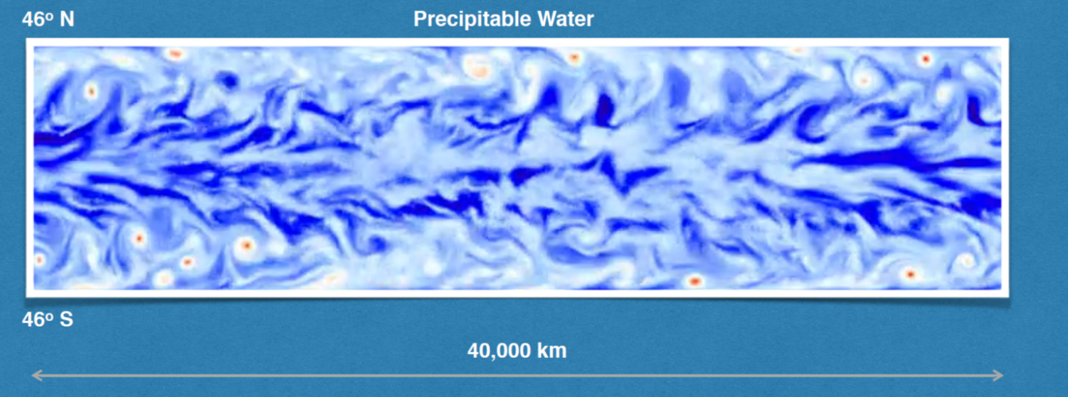
Khairoutdinov and Emanuel (2018), submitted
Model: System for Atmospheric Modeling (SAM; Khairoutdinov and Randall 2003)
Domain: 40,000 km x 10,000 km; top at 30 km
Zonally periodic; solid walls at 46ºN/S; equator at the center
Grid spacing 20 km
Aqua-planet with uniform SST=300K
Constant insolation: 650 W/m² with constant zenith angle of 52º
Realistic Coriolis parameter

Slide 24
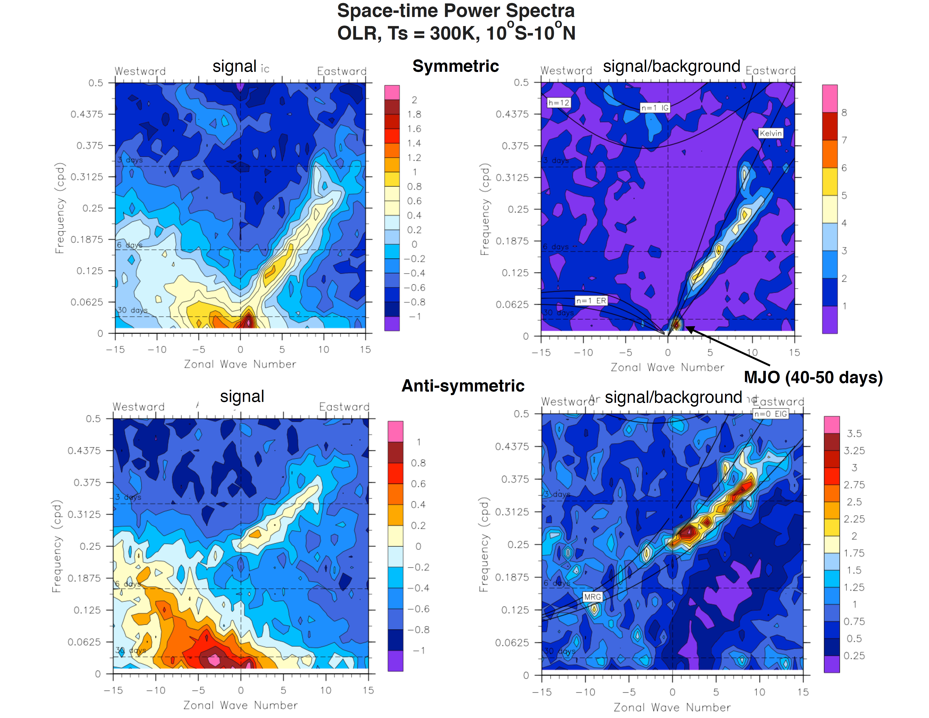
Wavenumber-Frequency Spectra
Symmetric OLR
Anti-symmetric OLR
From Khairoutdinov and Emanuel (2018)

Slide 25
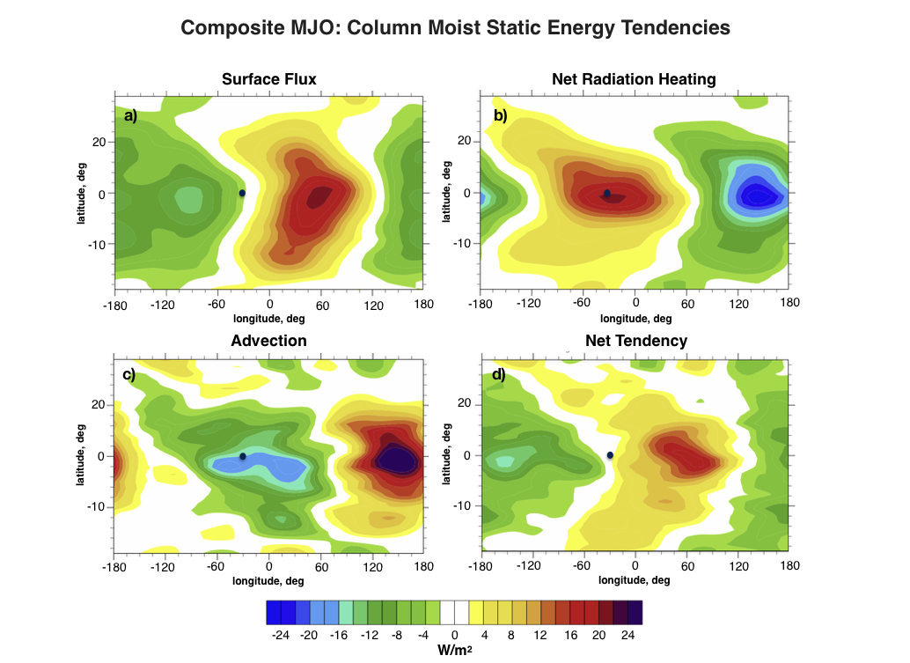
From Khairoutdinov and Emanuel (2018)

Slide 26
Mechanism-Denial Experiments:
Time-Longitude sections on Equator
From Khairoutdinov and Emanuel (2018)

Slide 27
Non-dimensional Linear Model
Zonal geostrophy
Zonal wind
Meridional wind
Free troposphere saturation entropy
Surface flux damping
Free troposphere moist entropy
Cloud-radiation feedback
WISHE
Surface flux damping
Gross moist stability
Wave radiation emulator
Moist, first-baroclinic-mode equations with convection based on PBL quasi-equilibrium
From Khairoutdinov and Emanuel (2018)

Slide 28
Cubic equation for complex growth rate:
Usually one growing and one decaying mode (third root does not satisfy boundary conditions)
Apply Weak Temperature Gradient (WTG) approximation:
Only a single mode survives:
Wave radiation emulator
Cloud-radiation feedback
WISHE
From Khairoutdinov and Emanuel (2018)

Slide 29
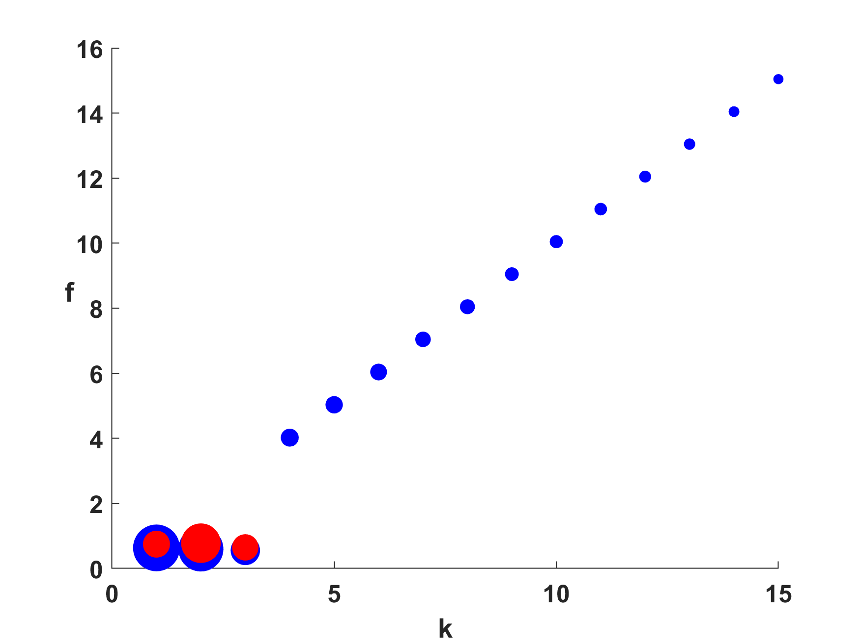
Frequency vs. wavenumber; size of circles proportional to growth rate
WISHE-driven moist Kelvin waves
WTG approximation
MJO mode
From Khairoutdinov and Emanuel (2018)

Slide 30
Summary
The Madden-Julian Oscillation (MJO) is a prominent feature of the equatorial atmosphere characterized by eastward propagation and a 30-50 day period
Purely dynamical theories fail to explain its main observed properties, even when convective coupling is considered
Recent research has shown that the MJO is quite probably an example of self-aggregation of moist convection occurring on a rotating sphere, driven by cloud-radiation and wind- induced surface enthalpy flux variations

