Slide 1
Air-Sea Interaction in Hurricanes
Kerry Emanuel
Massachusetts Institute of Technology
Notes:
Image: Satellite image of Hurricane Floyd approaching the east coast of Florida in 1999. The image has been digitally enhanced to lend a three-dimensional perspective. Credit: NASA/Goddard Space Flight Center.

Slide 2
Topics
Hurricanes are flux-driven phenomena
Hurricane intensity is sensitive to rates of transfer of enthalpy and momentum between the atmosphere and ocean
Interface tends toward an emulsion at hurricane wind speeds
Theory, modeling, lab experiments, and field experiments have led to progress in understanding air-sea interaction at very high wind speeds

Slide 3
Distribution of Entropy in Hurricane Inez, 1966
Source: Hawkins and Imbembo, 1976

Slide 4
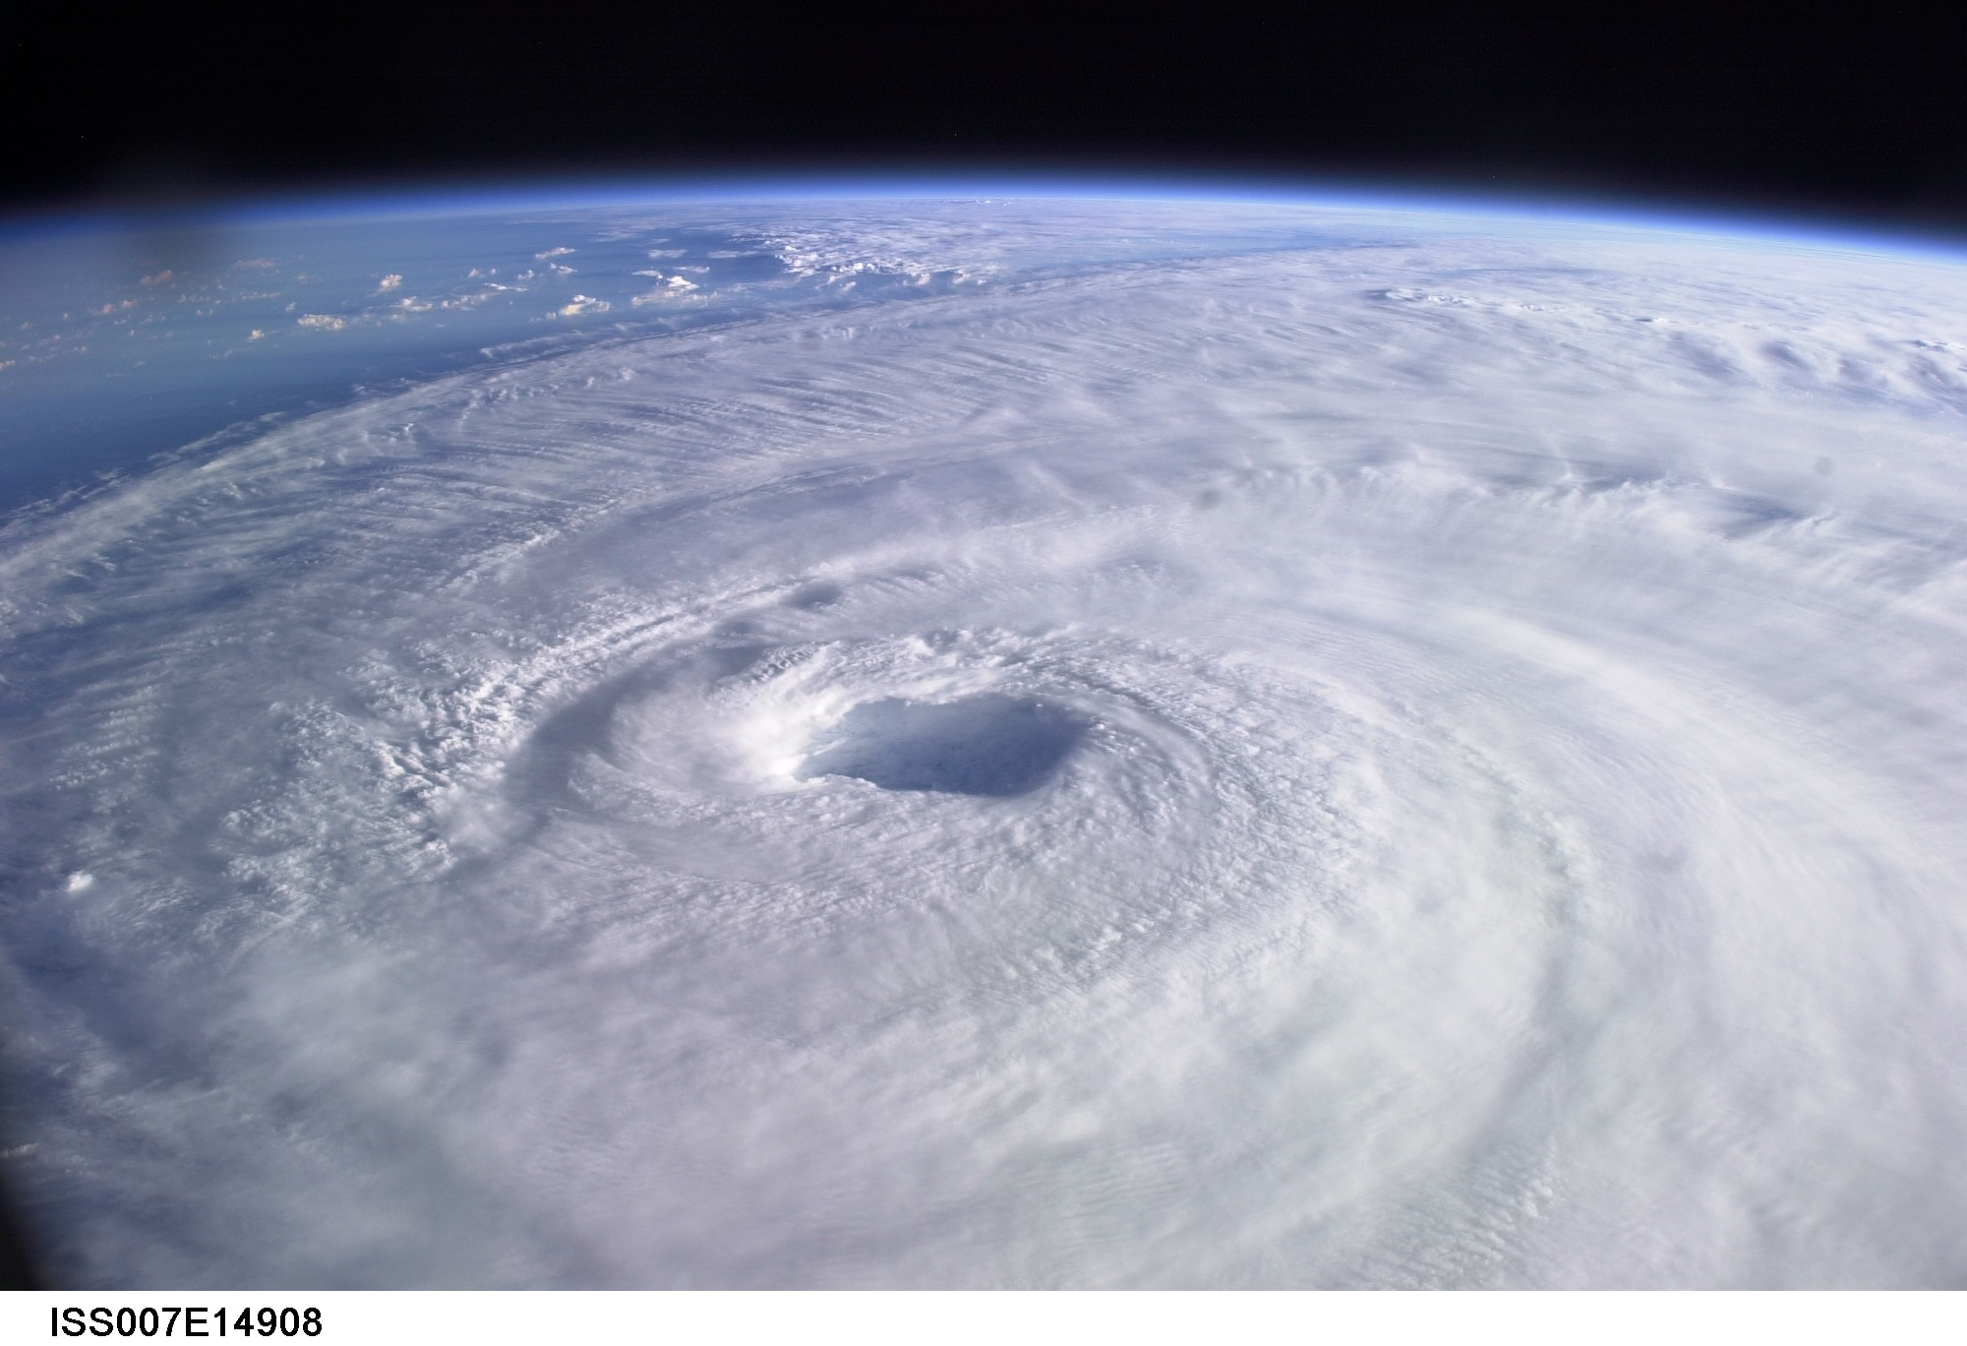
Theoretical Upper Bound on Hurricane Maximum Wind Speed:
Surface temperature
Ratio of exchange coefficients of enthalpy and momentum, pertaining to gradient wind
Outflow temperature
Air-sea enthalpy disequilibrium
Notes:
4

Slide 5
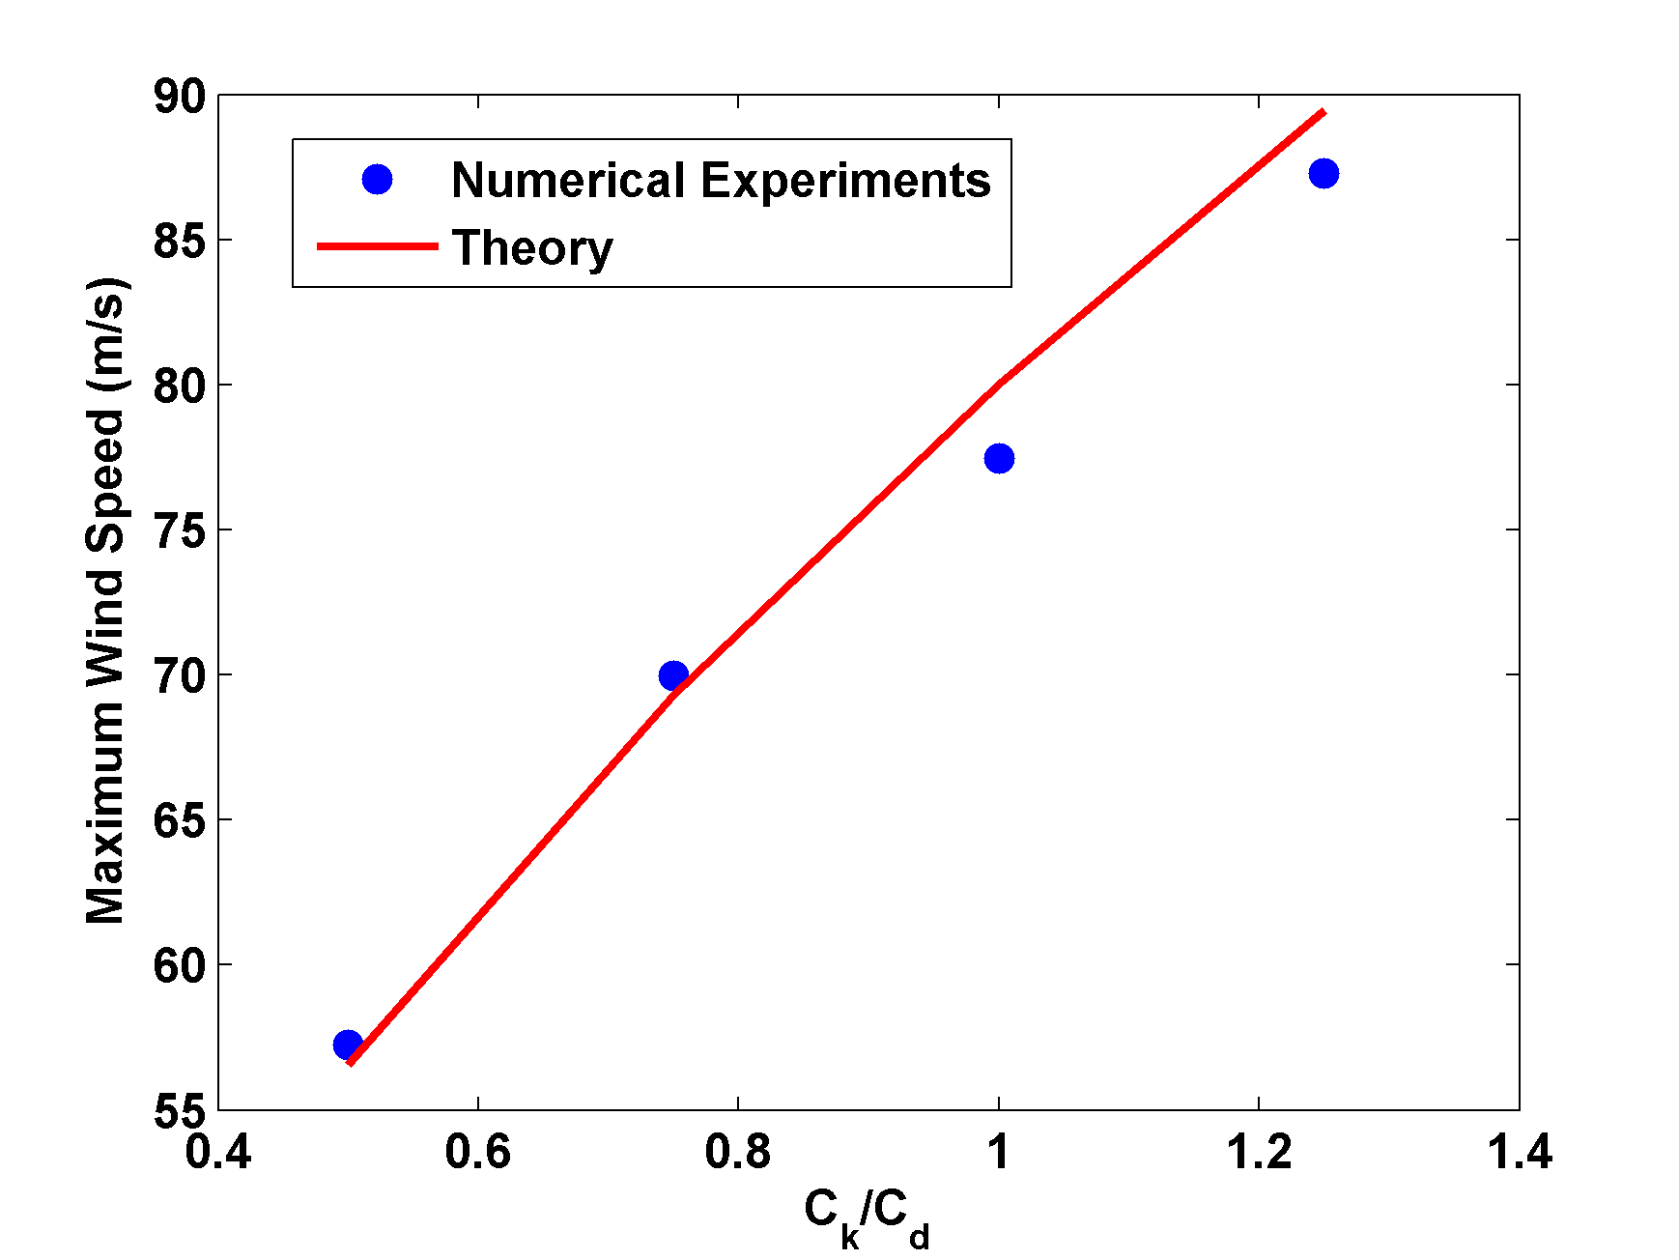
Numerical Experiments Using Reduced Model of Emanuel (1995) but with Dissipative Heating (see talk by Carl Friehe)
Note: Coefficients Pertain to Gradient Wind

Slide 6
Hindcast of Katrina Assuming C_{k}=C_{D}

Slide 7
Break in Cumulative Intensity Distribution at wind speeds near 35 m/s potentially explainable by shift in C_{k} and/or C_{D} at that wind speed
Wind speed normalized by potential intensity calculated assuming that C_{k}=C_{D}

Slide 8
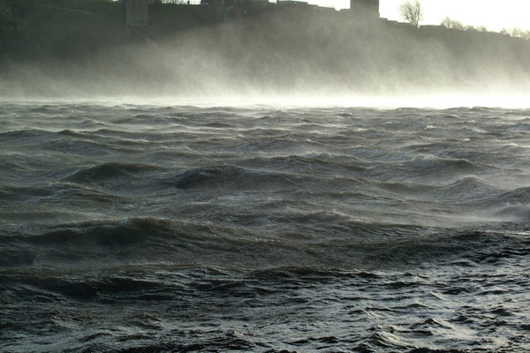
Sea Spray

Slide 9
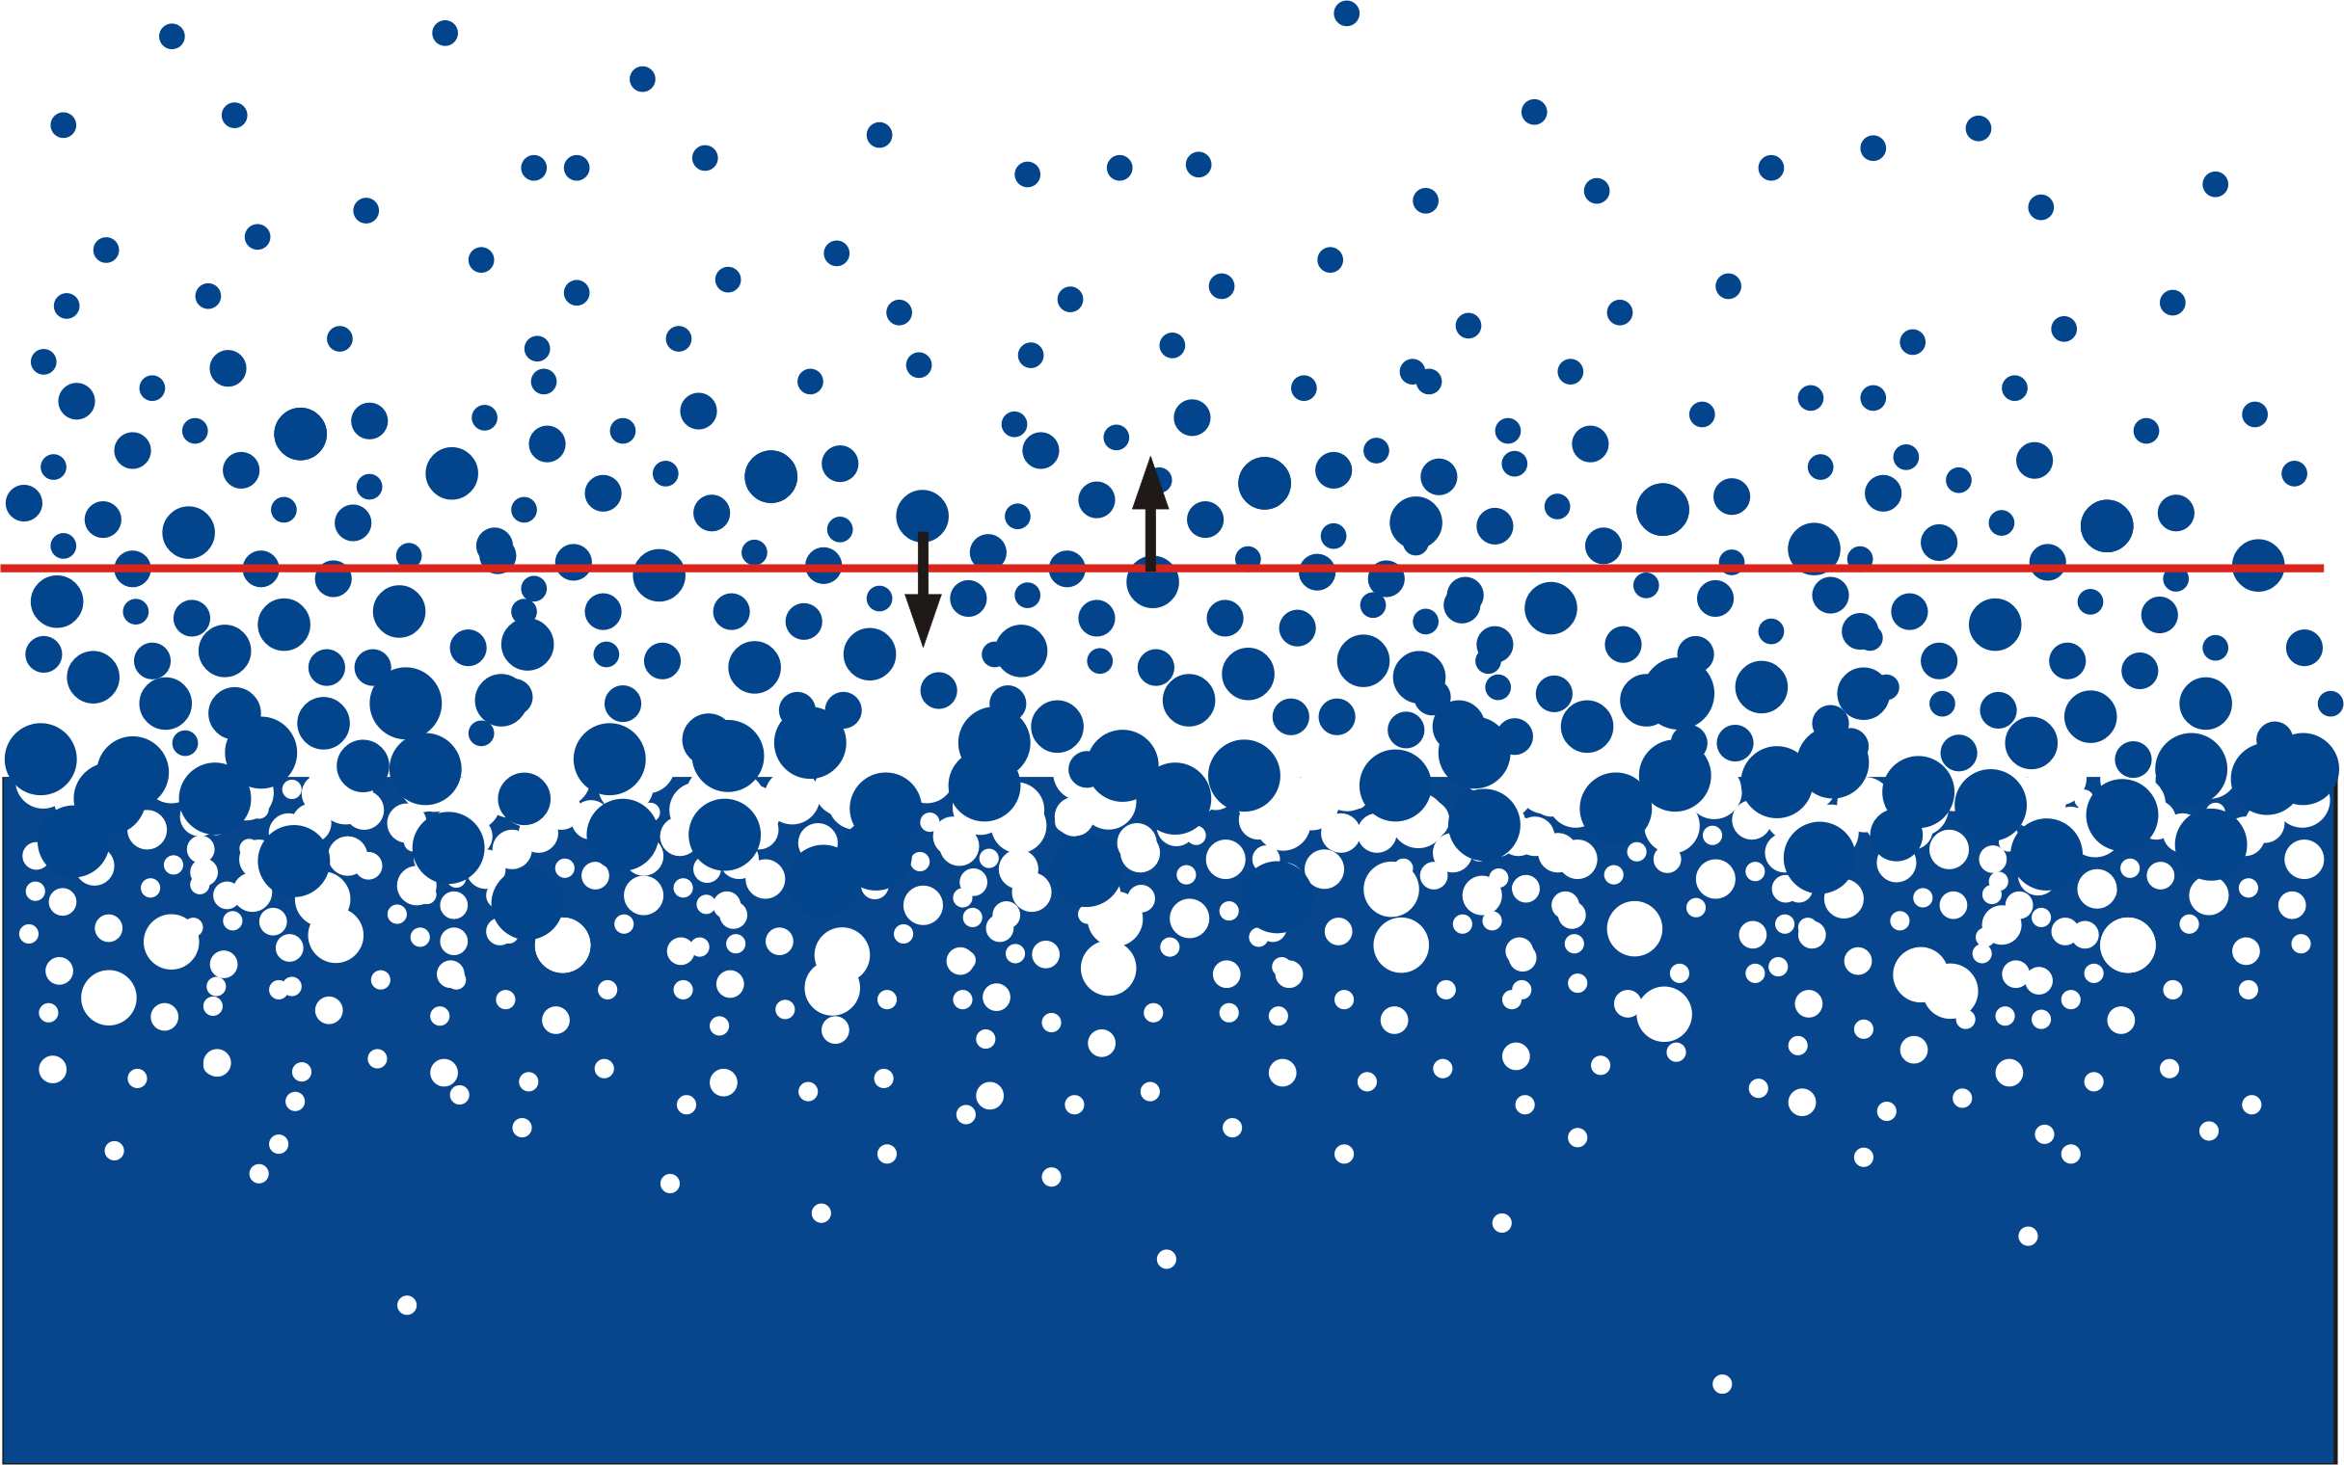

Slide 10
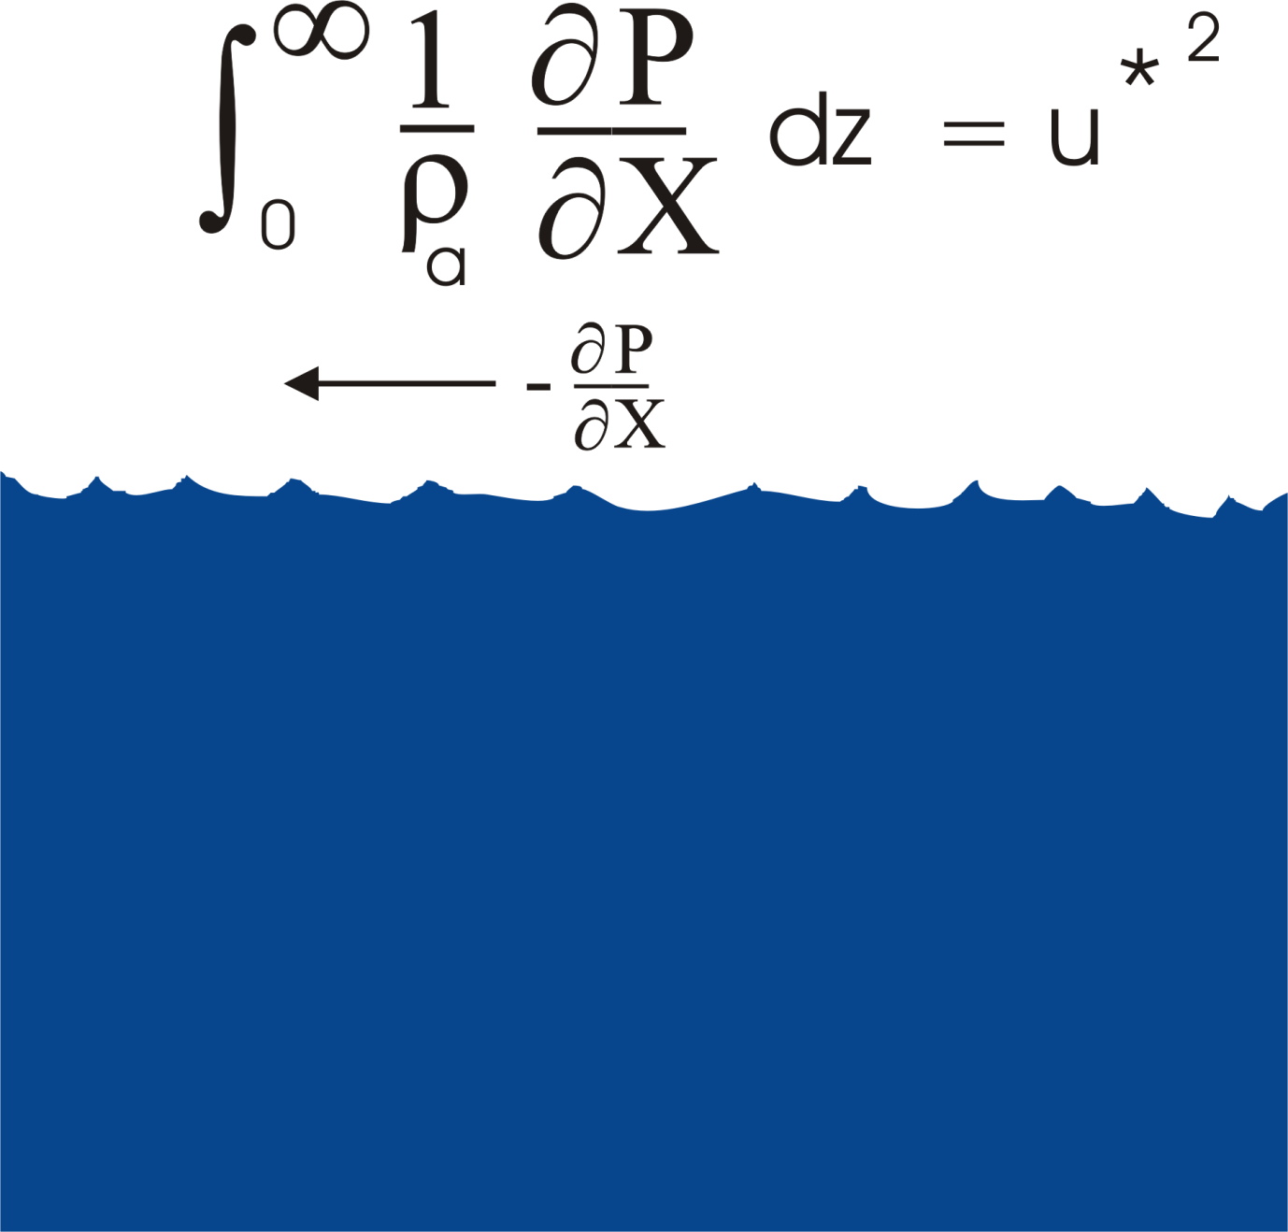

Slide 11
Nondimensional Control Parameters:

Slide 12
Similarity Hypothesis:
All quantities become independent of molecular properties in limit of large R_{u}
Sea surface becomes self-similar, with all length scales scaling as u*²/g
Nondimensional coefficients become constant

Slide 13
Mechanistic argument from Emanuel (2003):

Slide 14
Note that the previous development pertains to coefficients that operate on the gradient wind. The similarity theory predicts that the wind u at a fixed altitude z should scale as
where G is some function. Depending on the form of G, u* can be a multi-valued function of u for some range of altitude z.
See talk by Ed Andreas this afternoon!!

Slide 16
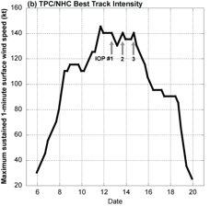
Results from 2003 CBLAST Experiment
Fabian
Isabel
Work of Michael Bell, PhD Dissertation, Naval Postgraduate School, 2010

Slide 17
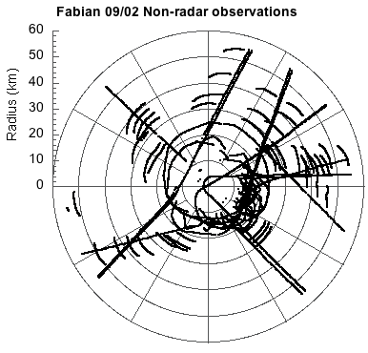
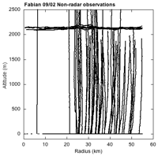
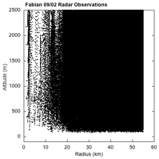

Slide 18
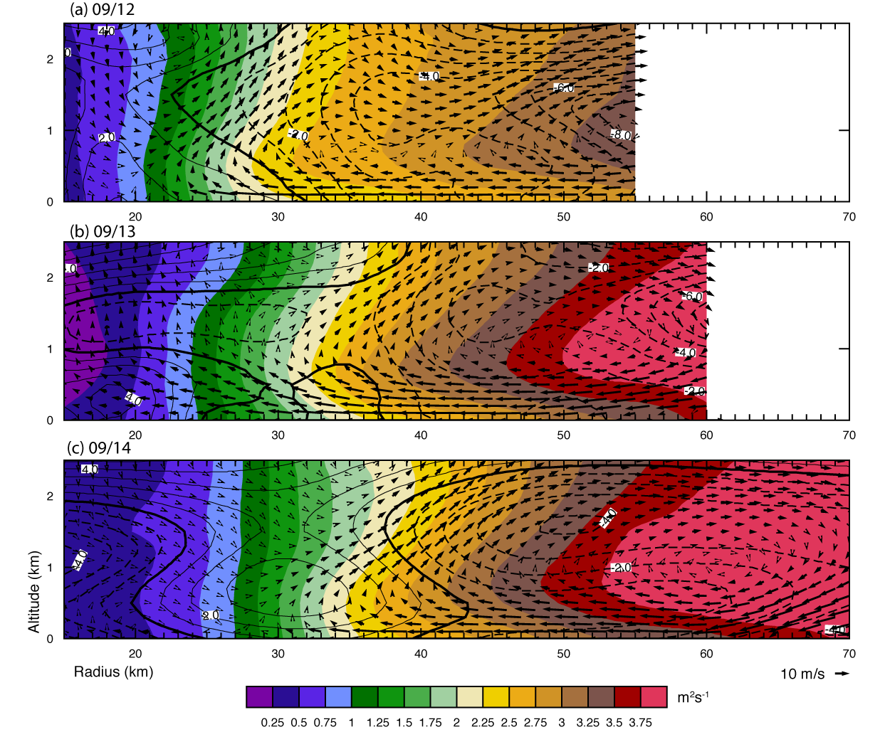
Absolute Angular Momentum and Total Energy Structure
Fabian
Isabel
(Color)
(Contour)

Slide 19
Budget Control Volumes
Bottom 0 & 100 m; Top 400 – 1000 m; Width 10 – 22 km
Aspect Ratio 20 – 30 Inner Radius 0.8 +/- 2 km
= 72 retrievals * 6 missions = 432 total samples

Slide 20
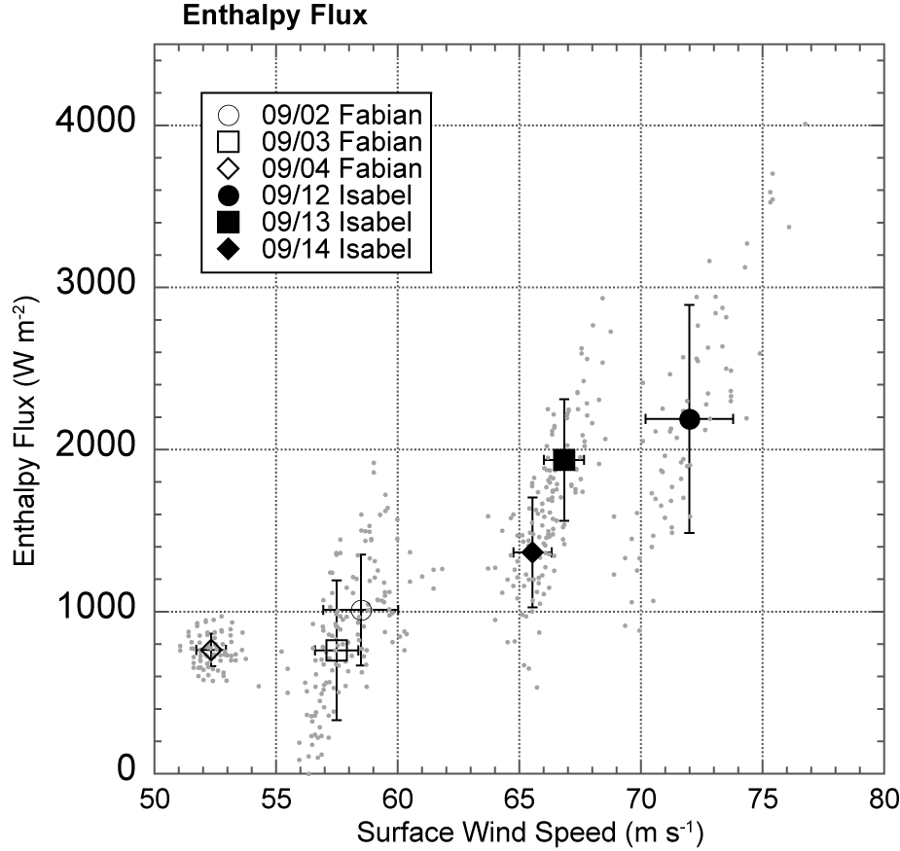
Tangential Reynolds Stress and Enthalpy Flux

Slide 21
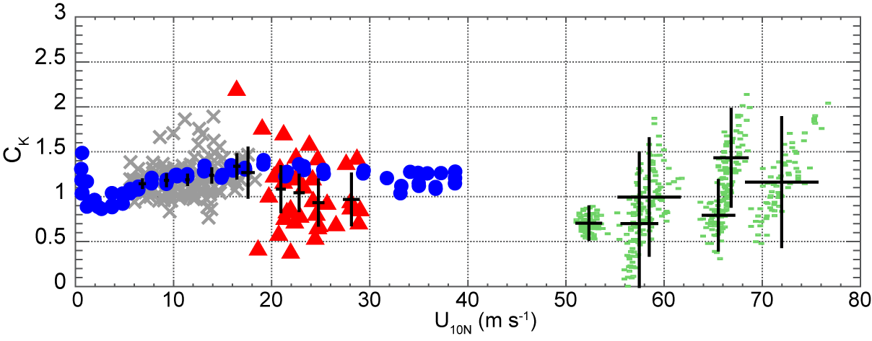
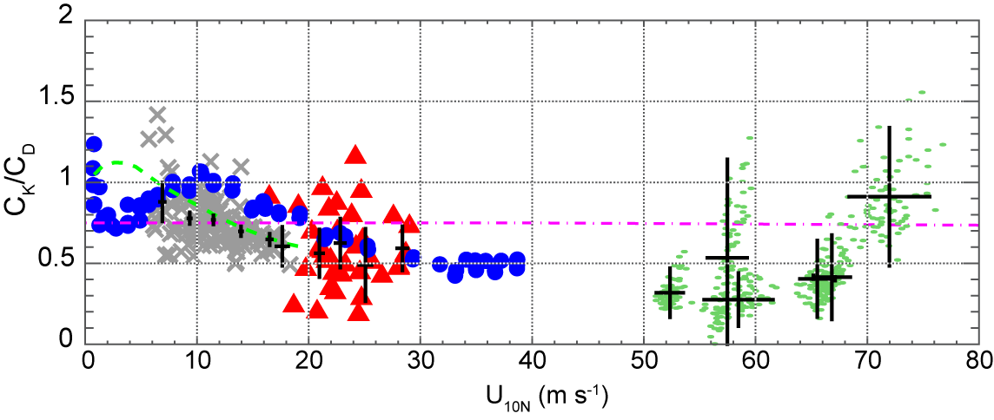
Prev Coefficients
Large and Pond 1981
Donelan et al. 2004
Black et al. 2007
French et al. 2008
Powell et al. 2003
Vickery et al. 2009
Bell 2010
C_{D}
C_{K}
Large and Pond 1982
DeCosmo et al. 1996
Black et al. 2007
Drennan et al. 2007
French et al. 2008
Zhang et al. 2008
Haus et al. 2010
Bell 2010
C_{K}
C_{D}

Slide 22
Summary
Hurricanes are driven by surface enthalpy fluxes and retarded by surface drag
Sea surface becomes emulsion-like at hurricane wind speeds
Fluxes through such an emulsion constitute a challenging problem for theory, numerical experiments, lab experiments, and field programs

Slide 23
Formulating fluxes in terms of 10-m winds may be ill-posed (see talk by Ed Andreas)
Results of field and laboratory experiments suggest little change in flux coefficients through whole range of wind speeds, but error bars still large

