Slide 1
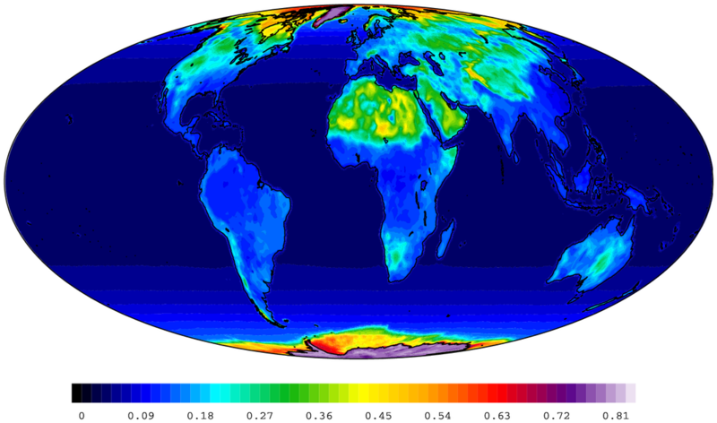
Image credit: NASA
Notes:
http://commons.wikimedia.org/wiki/File:Ceres_2004_clear_sky_albedo.png

