Slide 1

The Storm Next Time:
Hurricanes and Climate Change
Kerry Emanuel
EAPS and Lorenz Center, MIT
Notes:
1

Slide 2

Program
The global hurricane hazard
Inferences from historical and geological records
Inferences from basic physics
Using physics to estimate risk
North Carolina’s hurricane risk

Slide 3
The Global Hurricane Hazard
About 10,000 deaths per year since 1971
$700 Billion 2015 U.S. Dollars in Damages Annually since 1971
Global population exposed to hurricane hazards has tripled since 1970
EM-DAT, 2016: The OFDA/CRED International Disaster Database
http://www.emdat.be/.

Slide 4
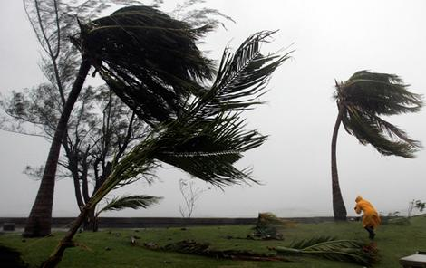
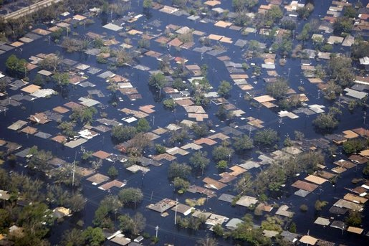
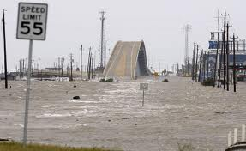

Hurricane Risks:
Wind
Rain
Storm Surge

Slide 5


Slide 6

Publicly
insured…
No $$$
Privately insured… $$$

Slide 7
Historical Records
Pre-1943: Anecdotal accounts from coastal cities and ships
1943: Introduction of routine aircraft reconnaissance in Atlantic, western North Pacific
1958: Inertial navigation permits direct measurement of wind speed at flight level
1970: Complete global detection by satellites
1978: Introduction of satellite scatterometry
1987: Termination of airborne reconnaissance in western North Pacific
2017: Introduction of CYGNSS scatterometry

Slide 8
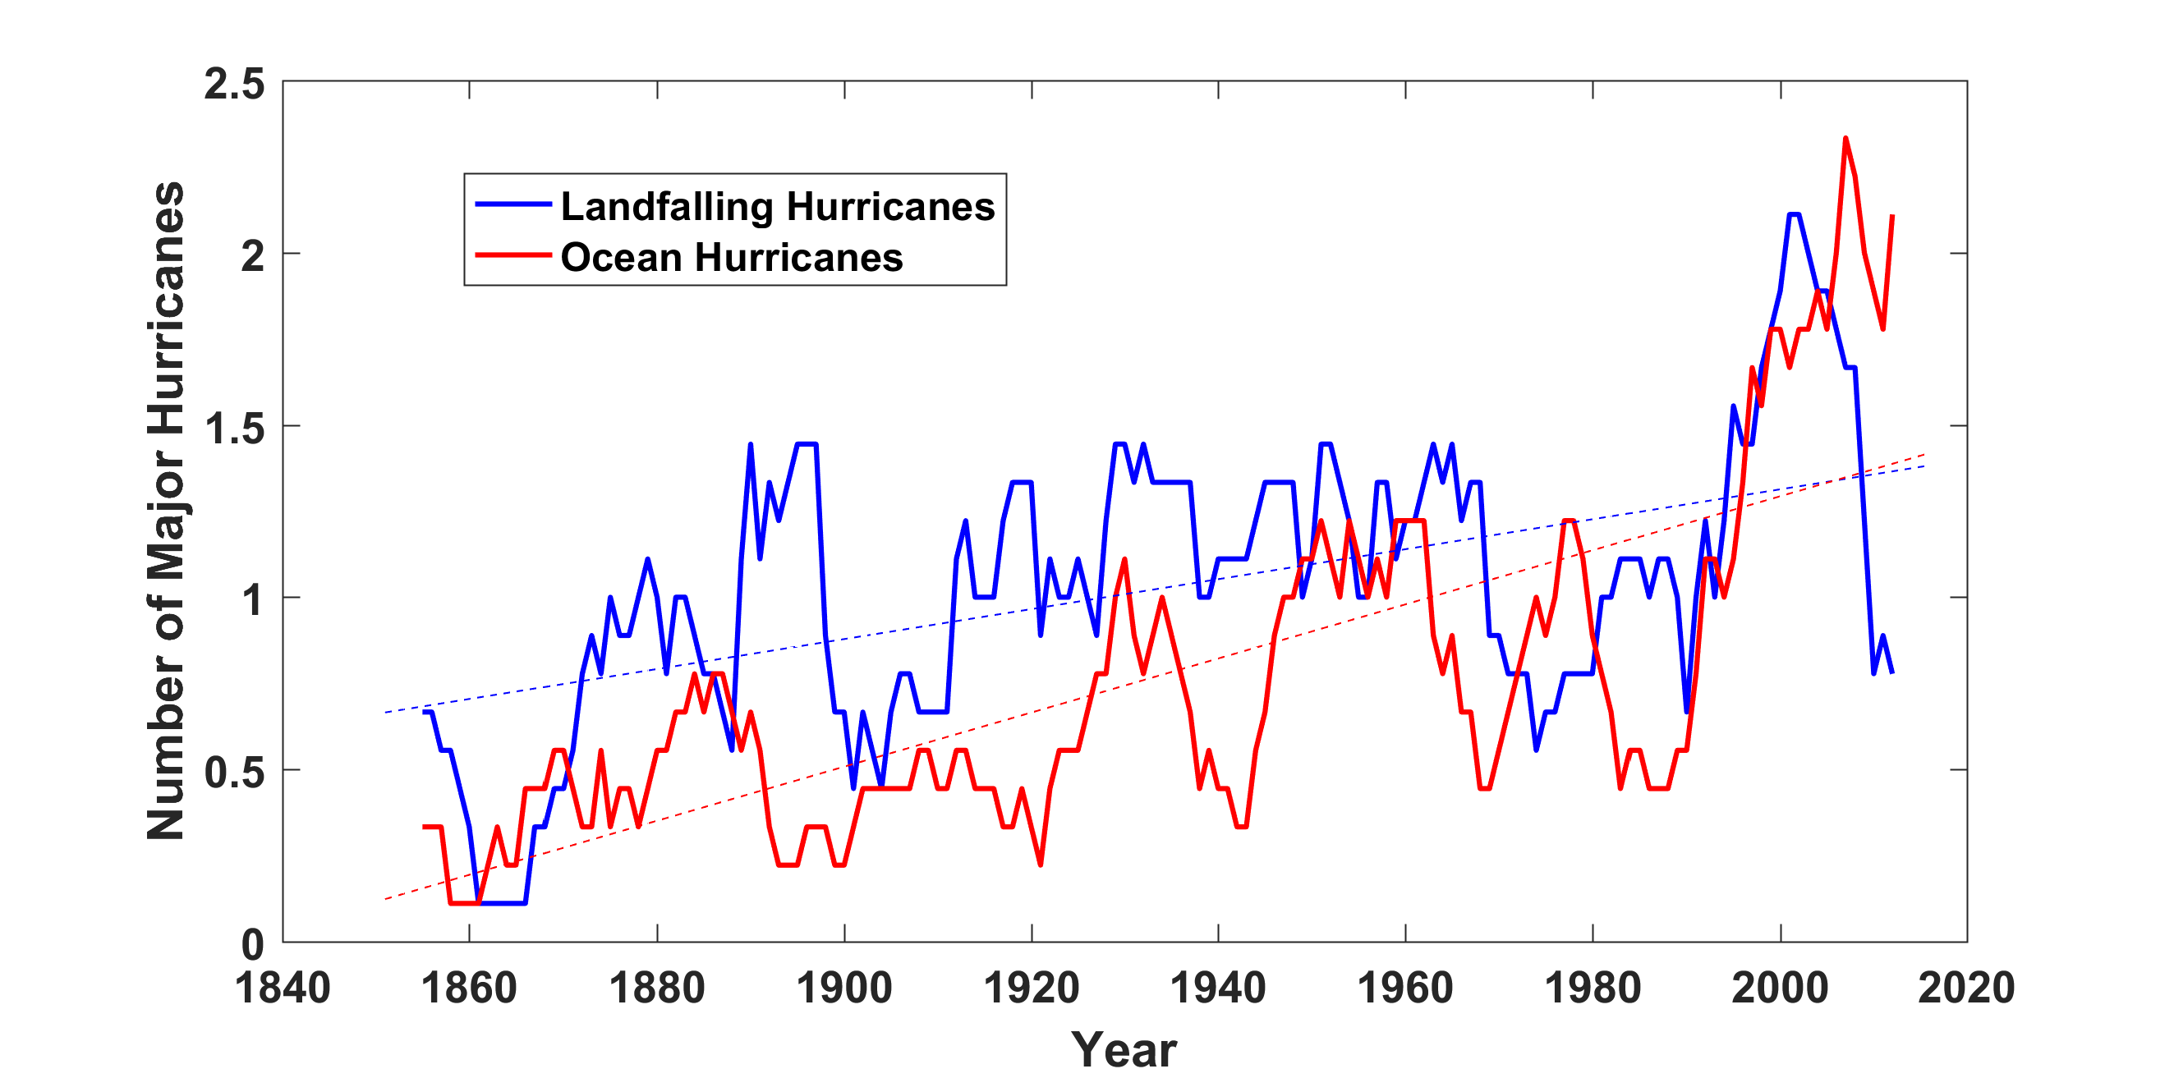
Prior to 1970, Many Storms Were Missed
Major hurricanes in the North Atlantic, 1851-2016, smoothed using a 10-year running average. Shown in blue are storms that either passed through the chain of Lesser Antilles or made landfall in the continental U.S.; all other major hurricanes are shown in red. The dashed lines show the best fit trend lines for each data set.

Slide 9
Hurricanes are reaching peak intensity at higher latitudes
Time series of the latitudes at which tropical cyclones reach maximum intensity.
From Kossin et al. (2014)

Slide 10
Note: Instrument not yet calibrated for V > 35 m/s …readings above capped at that value.
Courtesy Chris Ruf, U. Michigan

Slide 11
Paleotempestology
barrier beach
upland
overwash fan
backbarrier marsh
a)
lagoon
barrier beach
upland
overwash fan
b)
backbarrier marsh
lagoon
terminal lobes
flood tidal delta
Source: Jeff Donnelly, WHOI
Notes:
11

Slide 12
Jeffrey P. Donnelly and Jonathan D. Woodruff, Nature, 2007

Slide 13
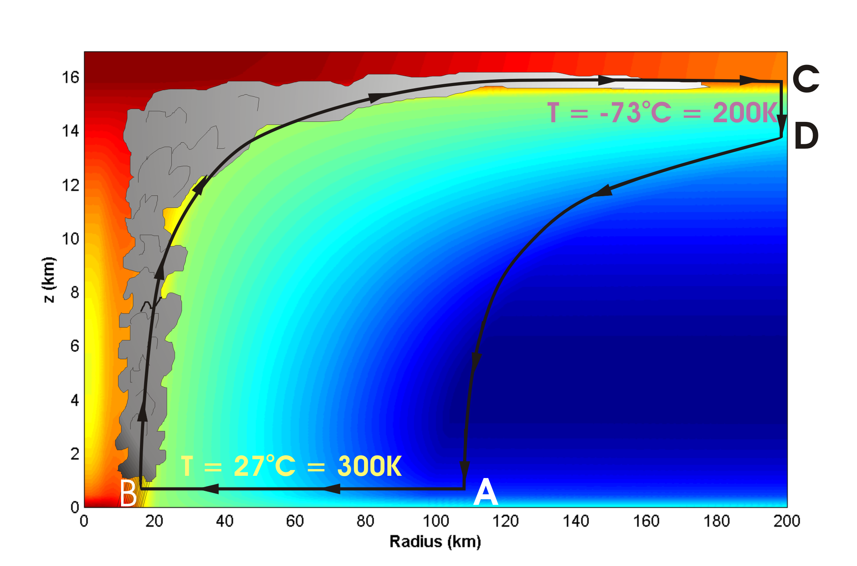
Basic Physics: Energy Production

Slide 14
Theoretical Steady-State Maximum Hurricane Wind Speed:
Surface temperature
Saturation static energy of sea surface
Saturation static energy of troposphere
Ratio of exchange coefficients of enthalpy and momentum
Outflow temperature
Air-sea enthalpy disequilibrium of moist static energy

Slide 15
Annual Maximum Potential Intensity (m/s)

Slide 16
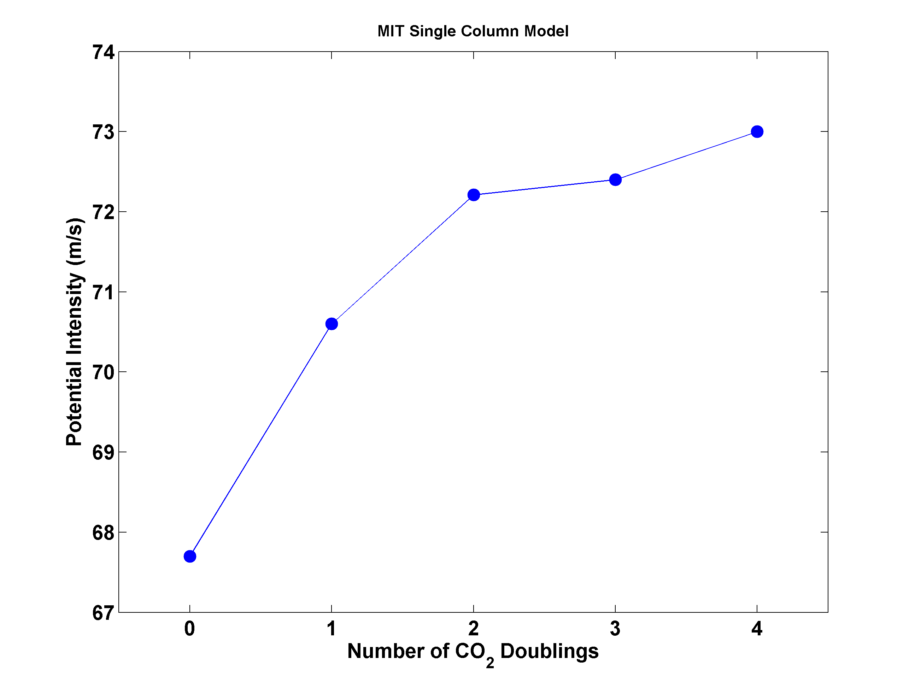
Potential Intensity and CO₂

Slide 17
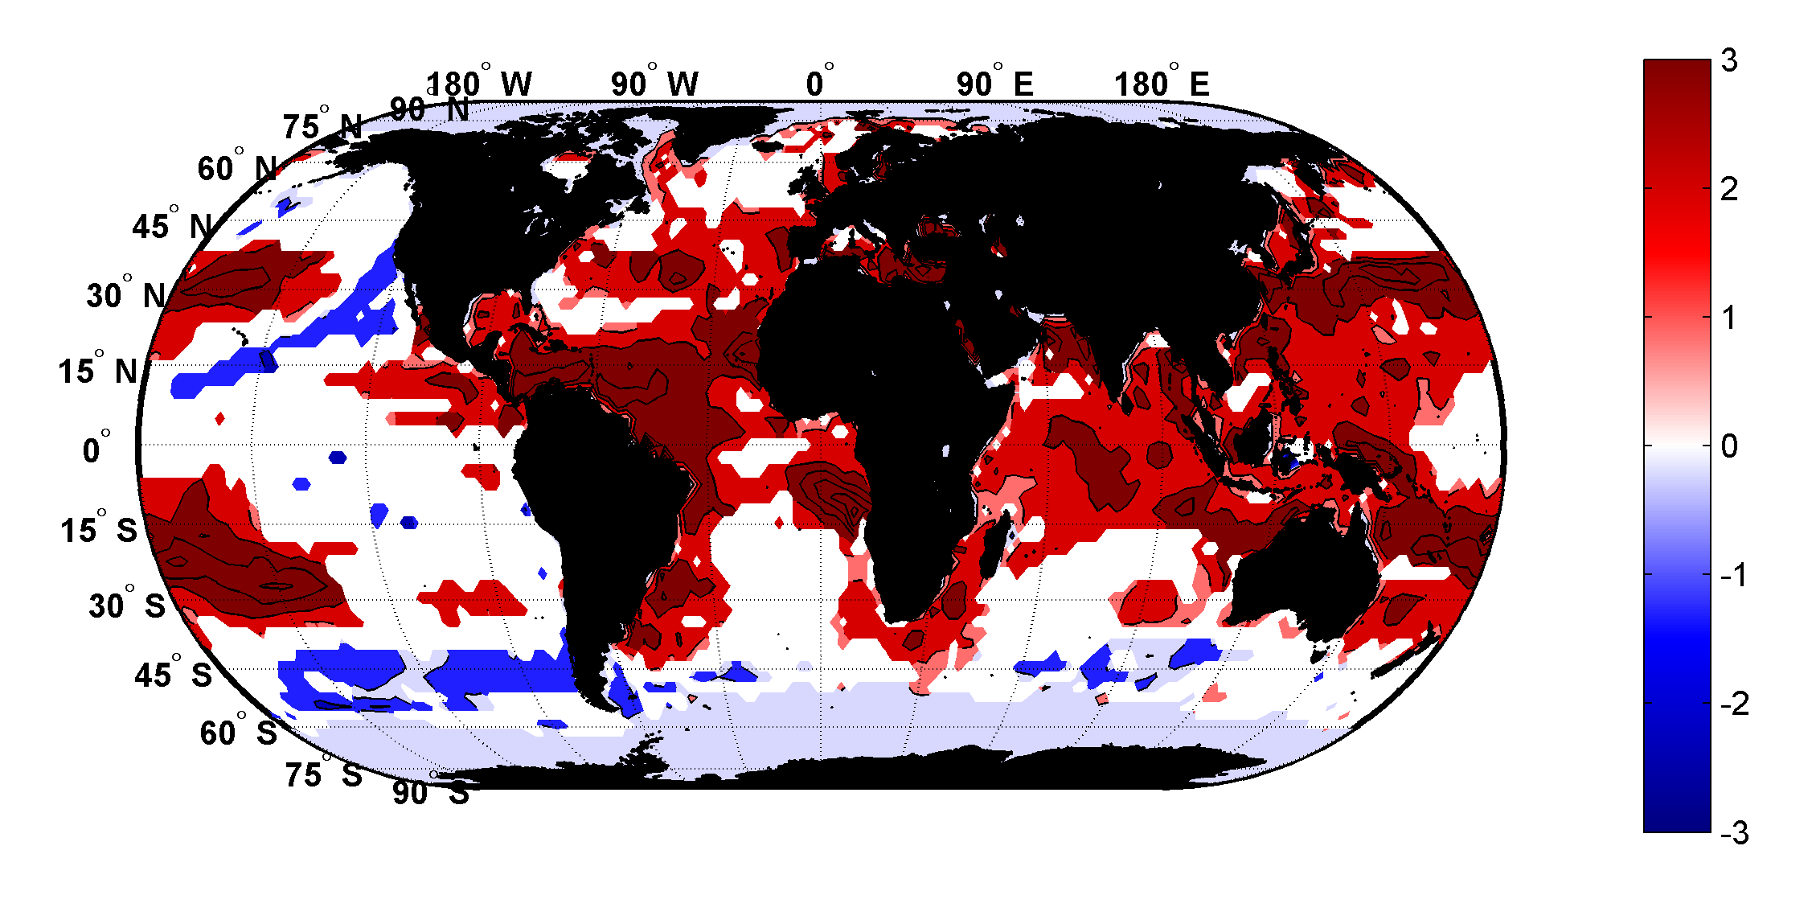
Trends in Thermodynamic Potential for Hurricanes, 1980-2010
(NCAR/NCEP Reanalysis)
ms⁻¹decade⁻¹

Slide 18
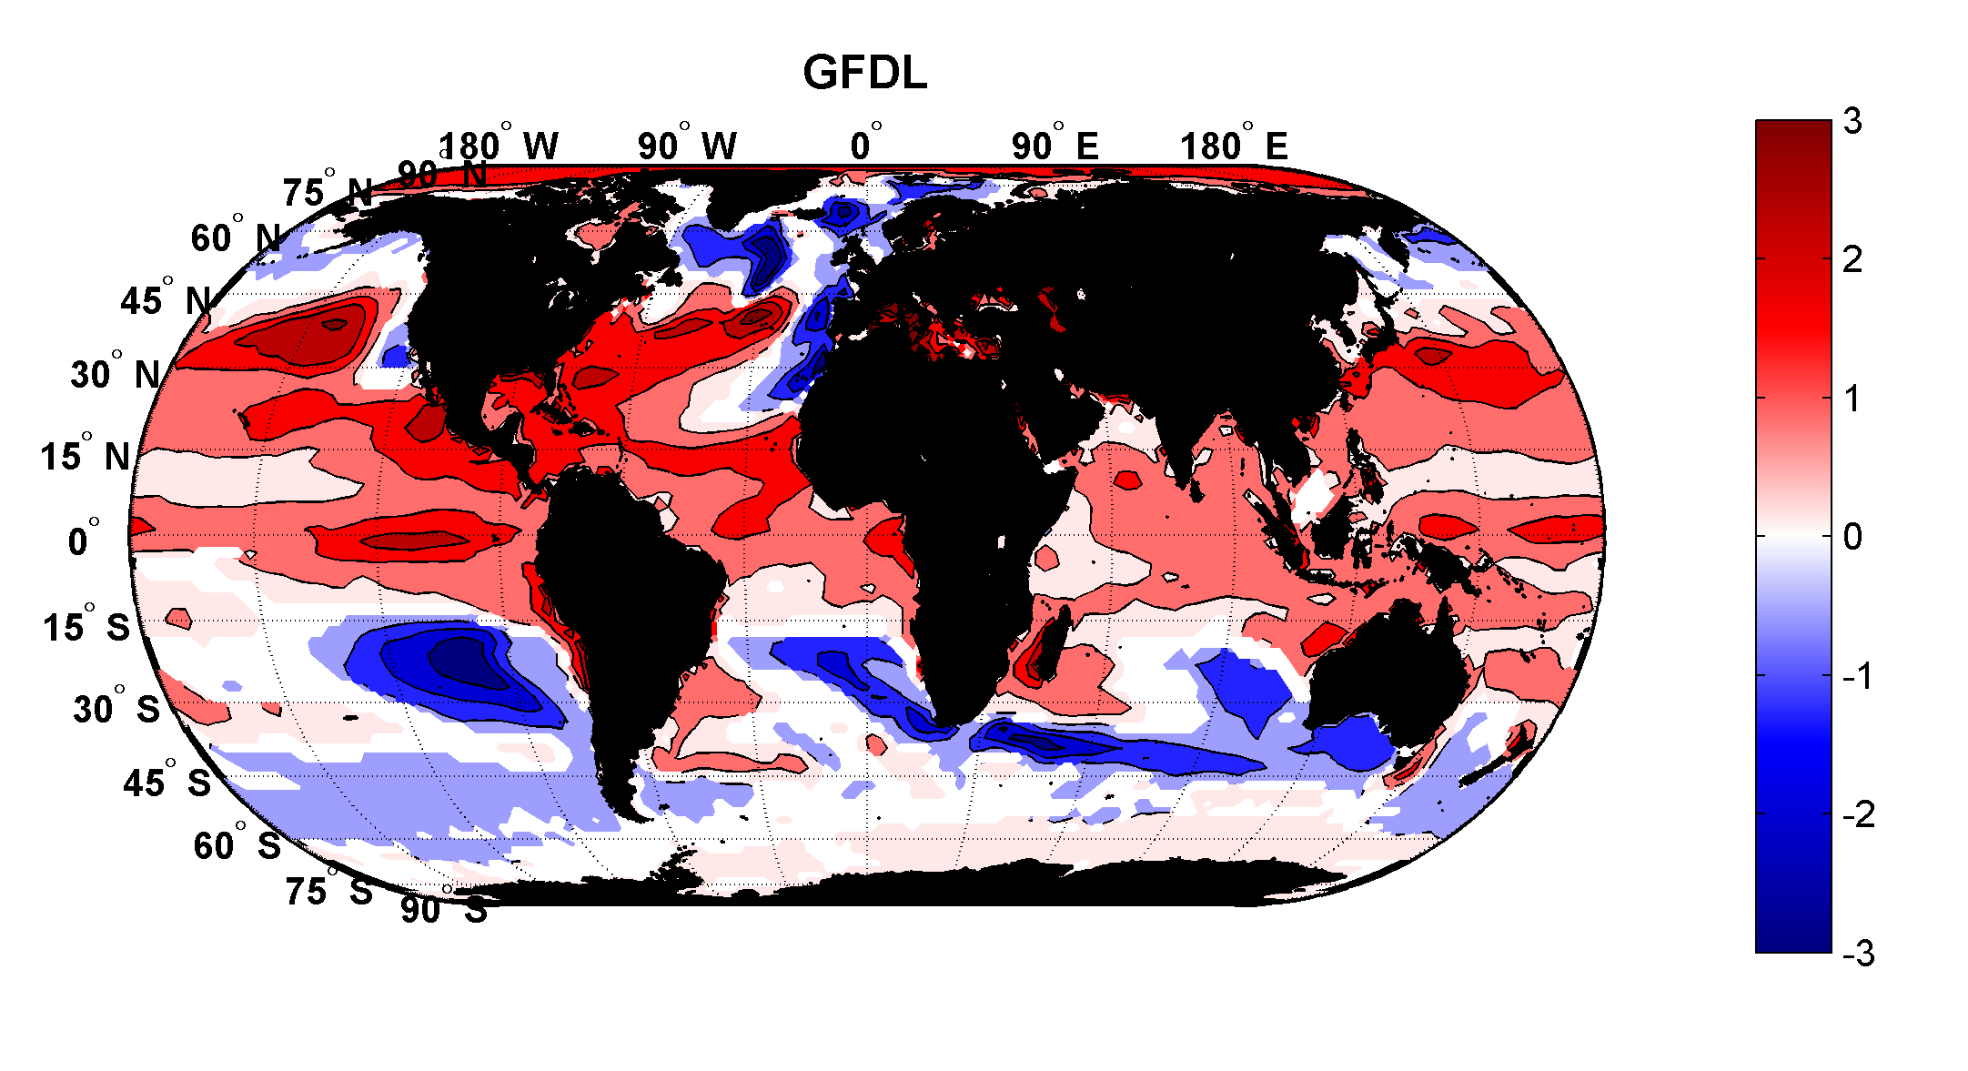
Projected Trend Over 21st Century: GFDL model under RCP 8.5
ms⁻¹decade⁻¹

Slide 19
Inferences from Basic Theory:
Potential intensity increases with global warming
Incidence of high-intensity hurricanes should increase
Increases in potential intensity should be faster in sub-tropics
Hurricanes will produce substantially more rain: Clausius-Clapeyron yields ~7% increase in water vapor per 1ºC warming

Slide 20
Using Physics to Estimate Hurricane Risk

Slide 21
Why Not Use Global Climate Models to Simulate Hurricanes?

Slide 22

Problem: Today’s models are far too coarse to simulate destructive hurricanes
Histograms of Tropical Cyclone Intensity as Simulated by a Global Model with 30 mile grid point spacing. (Courtesy Isaac Held, GFDL)
Category 3
Modeled
Observed
Global models do not simulate the storms that cause destruction
Wind Speed (meters per second)

Slide 23
How to deal with this?
Embed high-resolution, fast coupled ocean-atmosphere hurricane model in GCM or reanalysis data

Slide 24
Risk Assessment Approach:
Step 1: Seed each ocean basin with a very large number of weak, randomly located cyclones
Step 2: Cyclones are assumed to move with the large scale atmospheric flow in which they are embedded, plus a correction for the earth’s rotation and sphericity
Step 3: Run the CHIPS model for each cyclone, and note how many achieve at least tropical storm strength
Step 4: Using the small fraction of surviving events, determine storm statistics. Can easily generate 100,000 events
Details: Emanuel et al., Bull. Amer. Meteor. Soc, 2008
Notes:
24

Slide 25
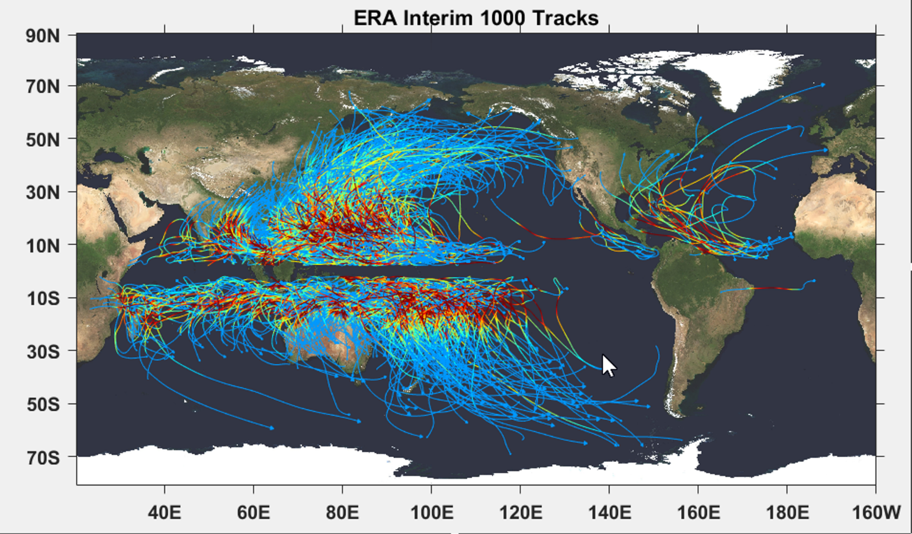

Slide 26

Cumulative Distribution of Storm Lifetime Peak Wind Speed, with Sample of 1755 Synthetic Tracks
90% confidence bounds

Slide 27
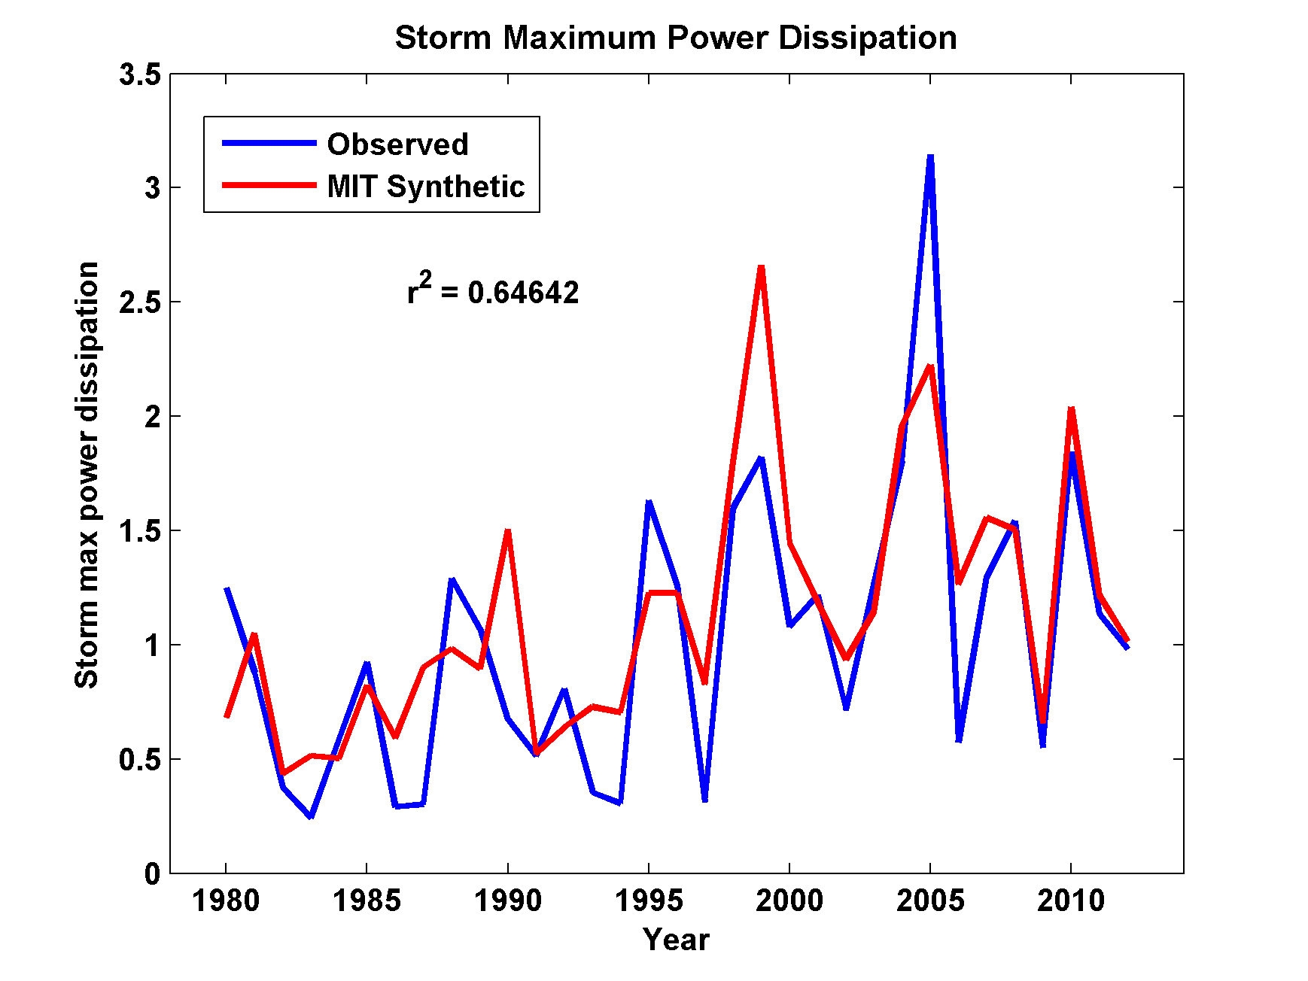
Captures Much of the Observed North Atlantic Interannual Variability
r²=0.65

Slide 28
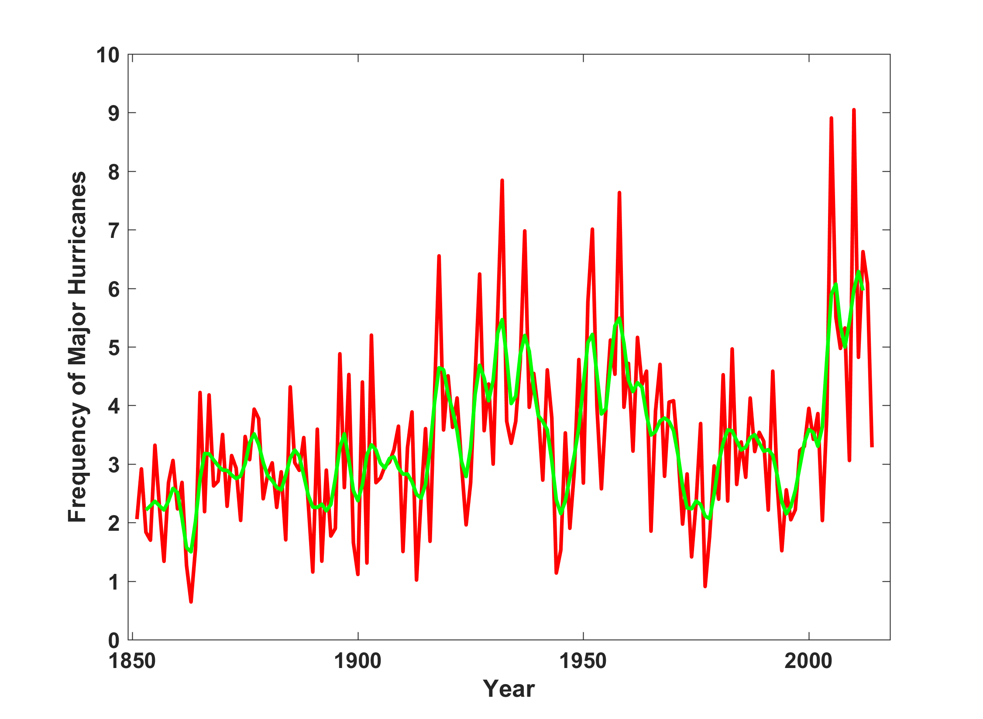
North Atlantic Major Hurricanes Downscaled from NOAA 20th Century Reanalysis
(Forced by sea surface temperature, surface pressure, and sea ice only)

Slide 29
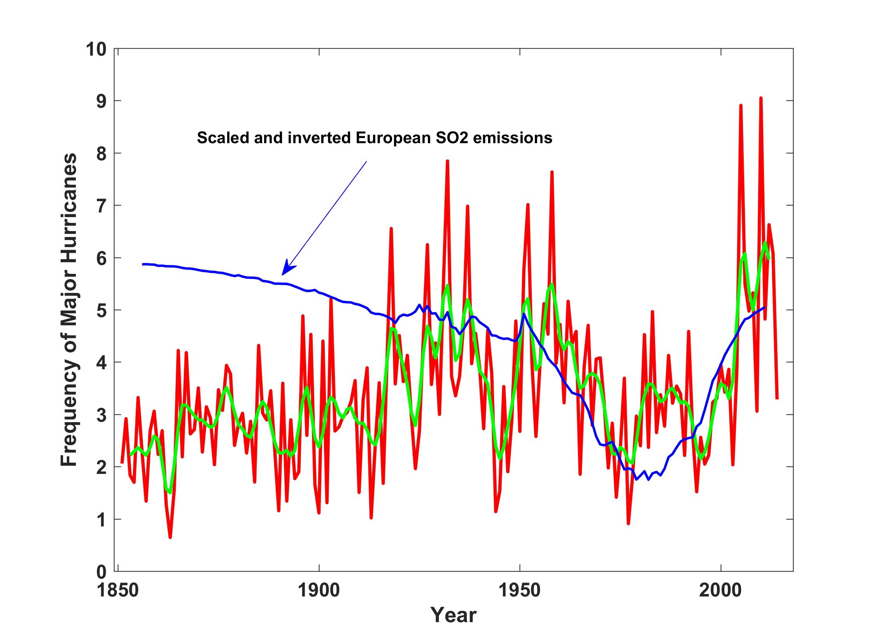
North Atlantic Major Hurricanes Downscaled from NOAA 20th Century Reanalysis
(Forced by sea surface temperature, surface pressure, and sea ice only)

Slide 30


Storm Surge Simulation (Ning Lin)
SLOSH model
(Jelesnianski et al. 1992)
SLOSH mesh
~ 10³ m
ADCIRC mesh
~ 10² m
Battery
ADCIRC model
(Luettich et al. 1992)
ADCIRC mesh
~ 10 m
(Colle et al. 2008)
Notes:
Given the storm wind and pressure fields (which is estimated from the Holland parametric pressure model) we can simulate the surge. Surge simulations with high resolution are computationally intensive, so to make it possible to simulate accurate surges for our large synthetic storm sets, we apply the two hydrodynamic models with girds of various resolutions in such a way that the main computational effort is concentrated on the storms that determine the risk. First, we apply the SLOSH model, using a mesh with resolution of about 1 km around NYC to simulate the surges for all storms and select the storms that have return periods, in terms of the surge height at the Battery, greater than 10 years. Second, we apply the ADCIRC simulation, using a grid mesh with resolution of ~100 m around NYC, to each of the selected storms. Then, we apply another ADCIRC mesh with resolution as high as ~10 m around NYC, for a set of the most extreme events, to check if the resolution of our ADCIRC grid is sufficient and if needed to make statistical correction to the results.

Slide 31
Surge Return Periods for The Battery, New York
Sandy

Slide 32
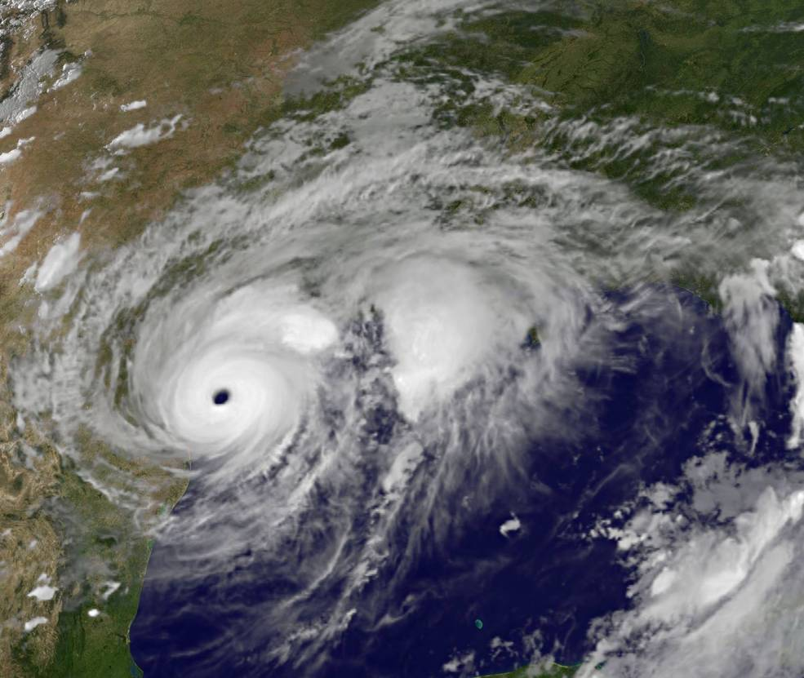
Application to Hurricane Harvey

Slide 33
Risk Assessment for Houston and Texas:
Run 100 events for each year from 1980 to 2016 (3700 events total) passing within 300 km of Houston, downscaled from three climate reanalyses
Run 100 events each year from 1979-2015 passing over the Texas coastline, downscaled from NCAR/NCEP reanalyses. Calculate storm total rainfall for each event at each of 78 points constituting a grid extending from 26º N to 31º N and from 99º W to 94º W, at increments of 0.5º, but excluding points over the Gulf
Run 100 events each year during two periods: 1981-2000 and 2081-2100, passing within 300 km of Houston, downscaled from six climate models
Notes:
33

Slide 34
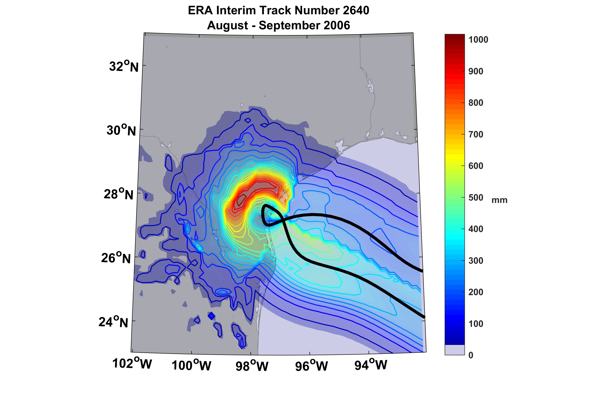
Example of Accumulated Rainfall from a Harvey-like Event Downscaled from ERA Interim Reanalysis

Slide 35
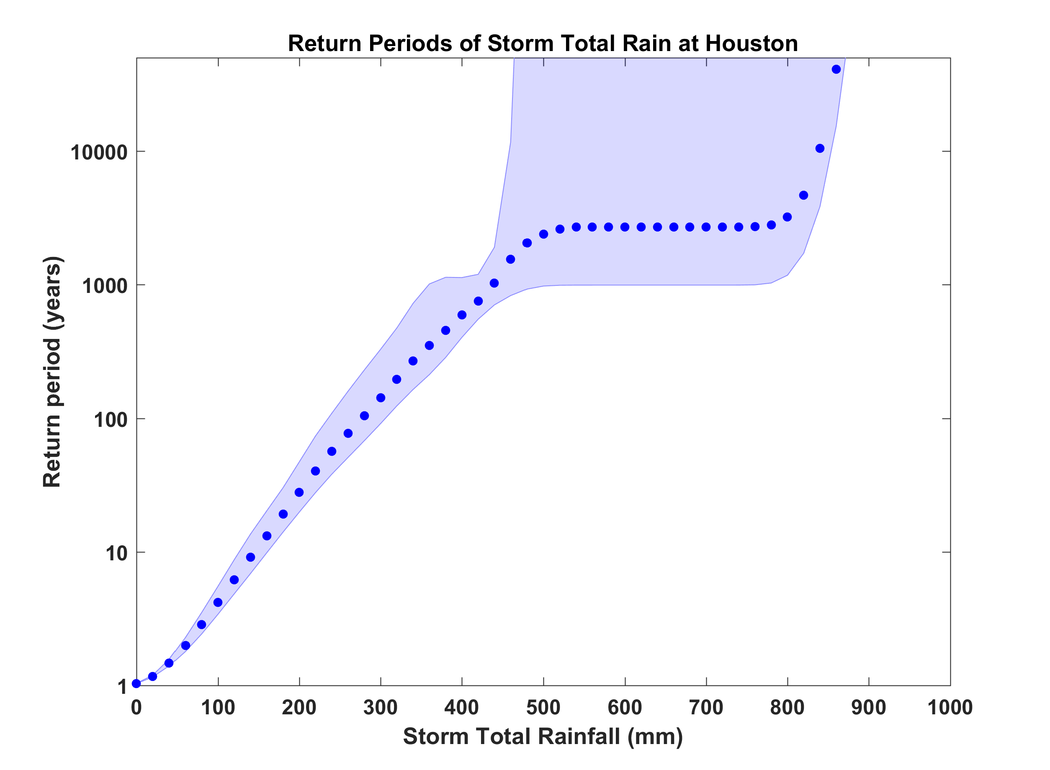
Probability of Storm Accumulated Rainfall at Houston, from 3 Climate Reanalyses, 1980-2016 Based on 3700 Events Each. Shading shows spread among the reanalyses.
Harvey

Slide 36
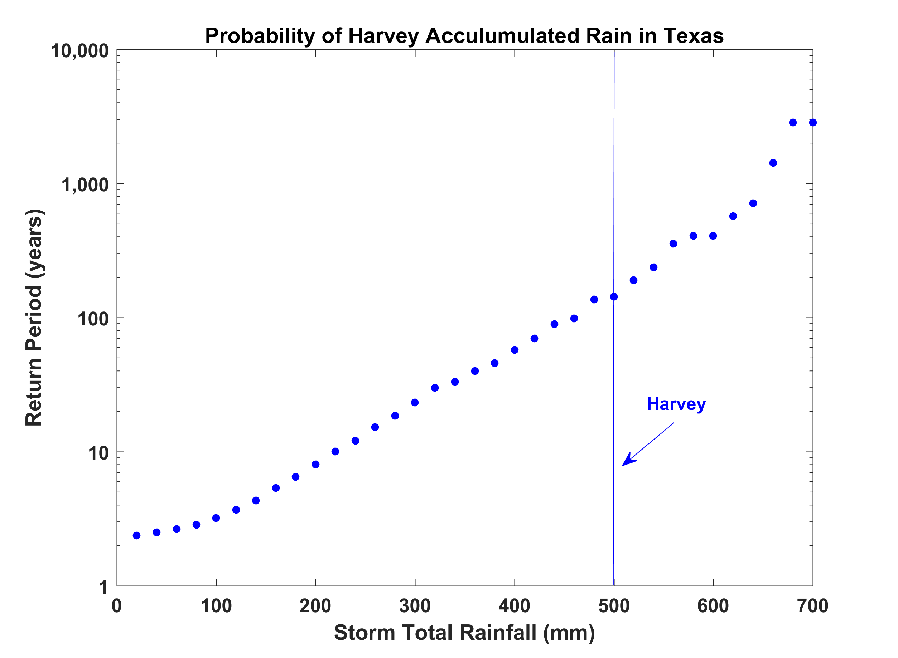
Probability of a Accumulated Hurricane Rain Anywhere in Texas, based on 3700 Events Downscaled from NCAR/NCEP Reanalysis with Rainfall Analyzed at 78 Points

Slide 37
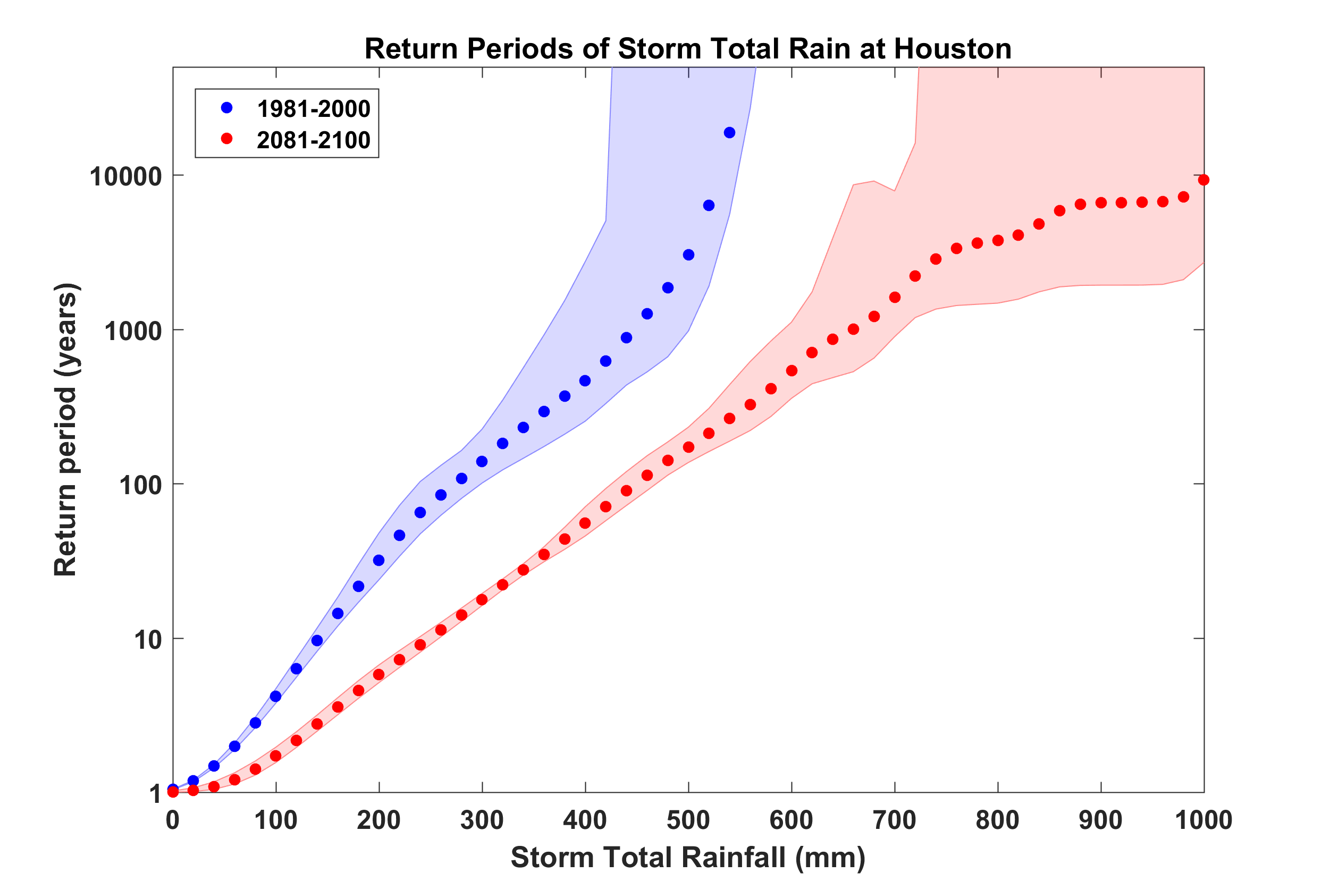
Probability of Storm Accumulated Rainfall at Houston, from 6 Climate models, 1981-2000 and 2081-2100, Based on 2000 Events Each. Shading shows spread among the models.
Harvey

Slide 38
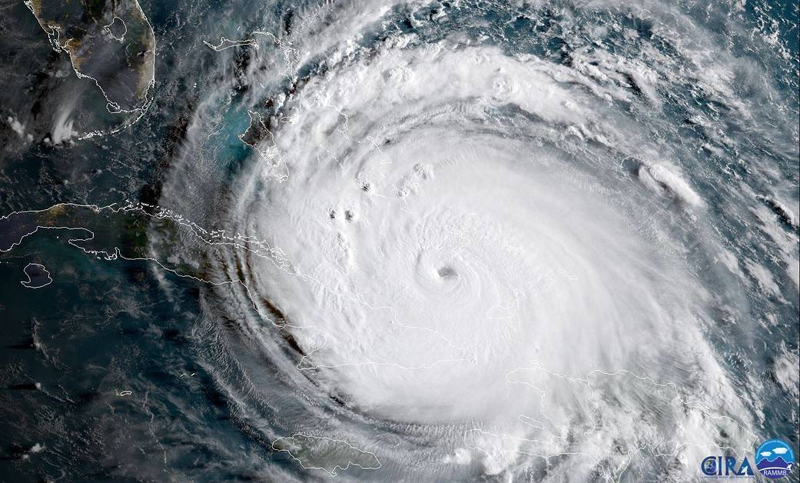
Hurricane Irma

Slide 39
Irma
Run 100 events each year during two periods: 1981-2000 and 2081-2100, passing within 300 km of Barbuda, downscaled from six climate models

Slide 40
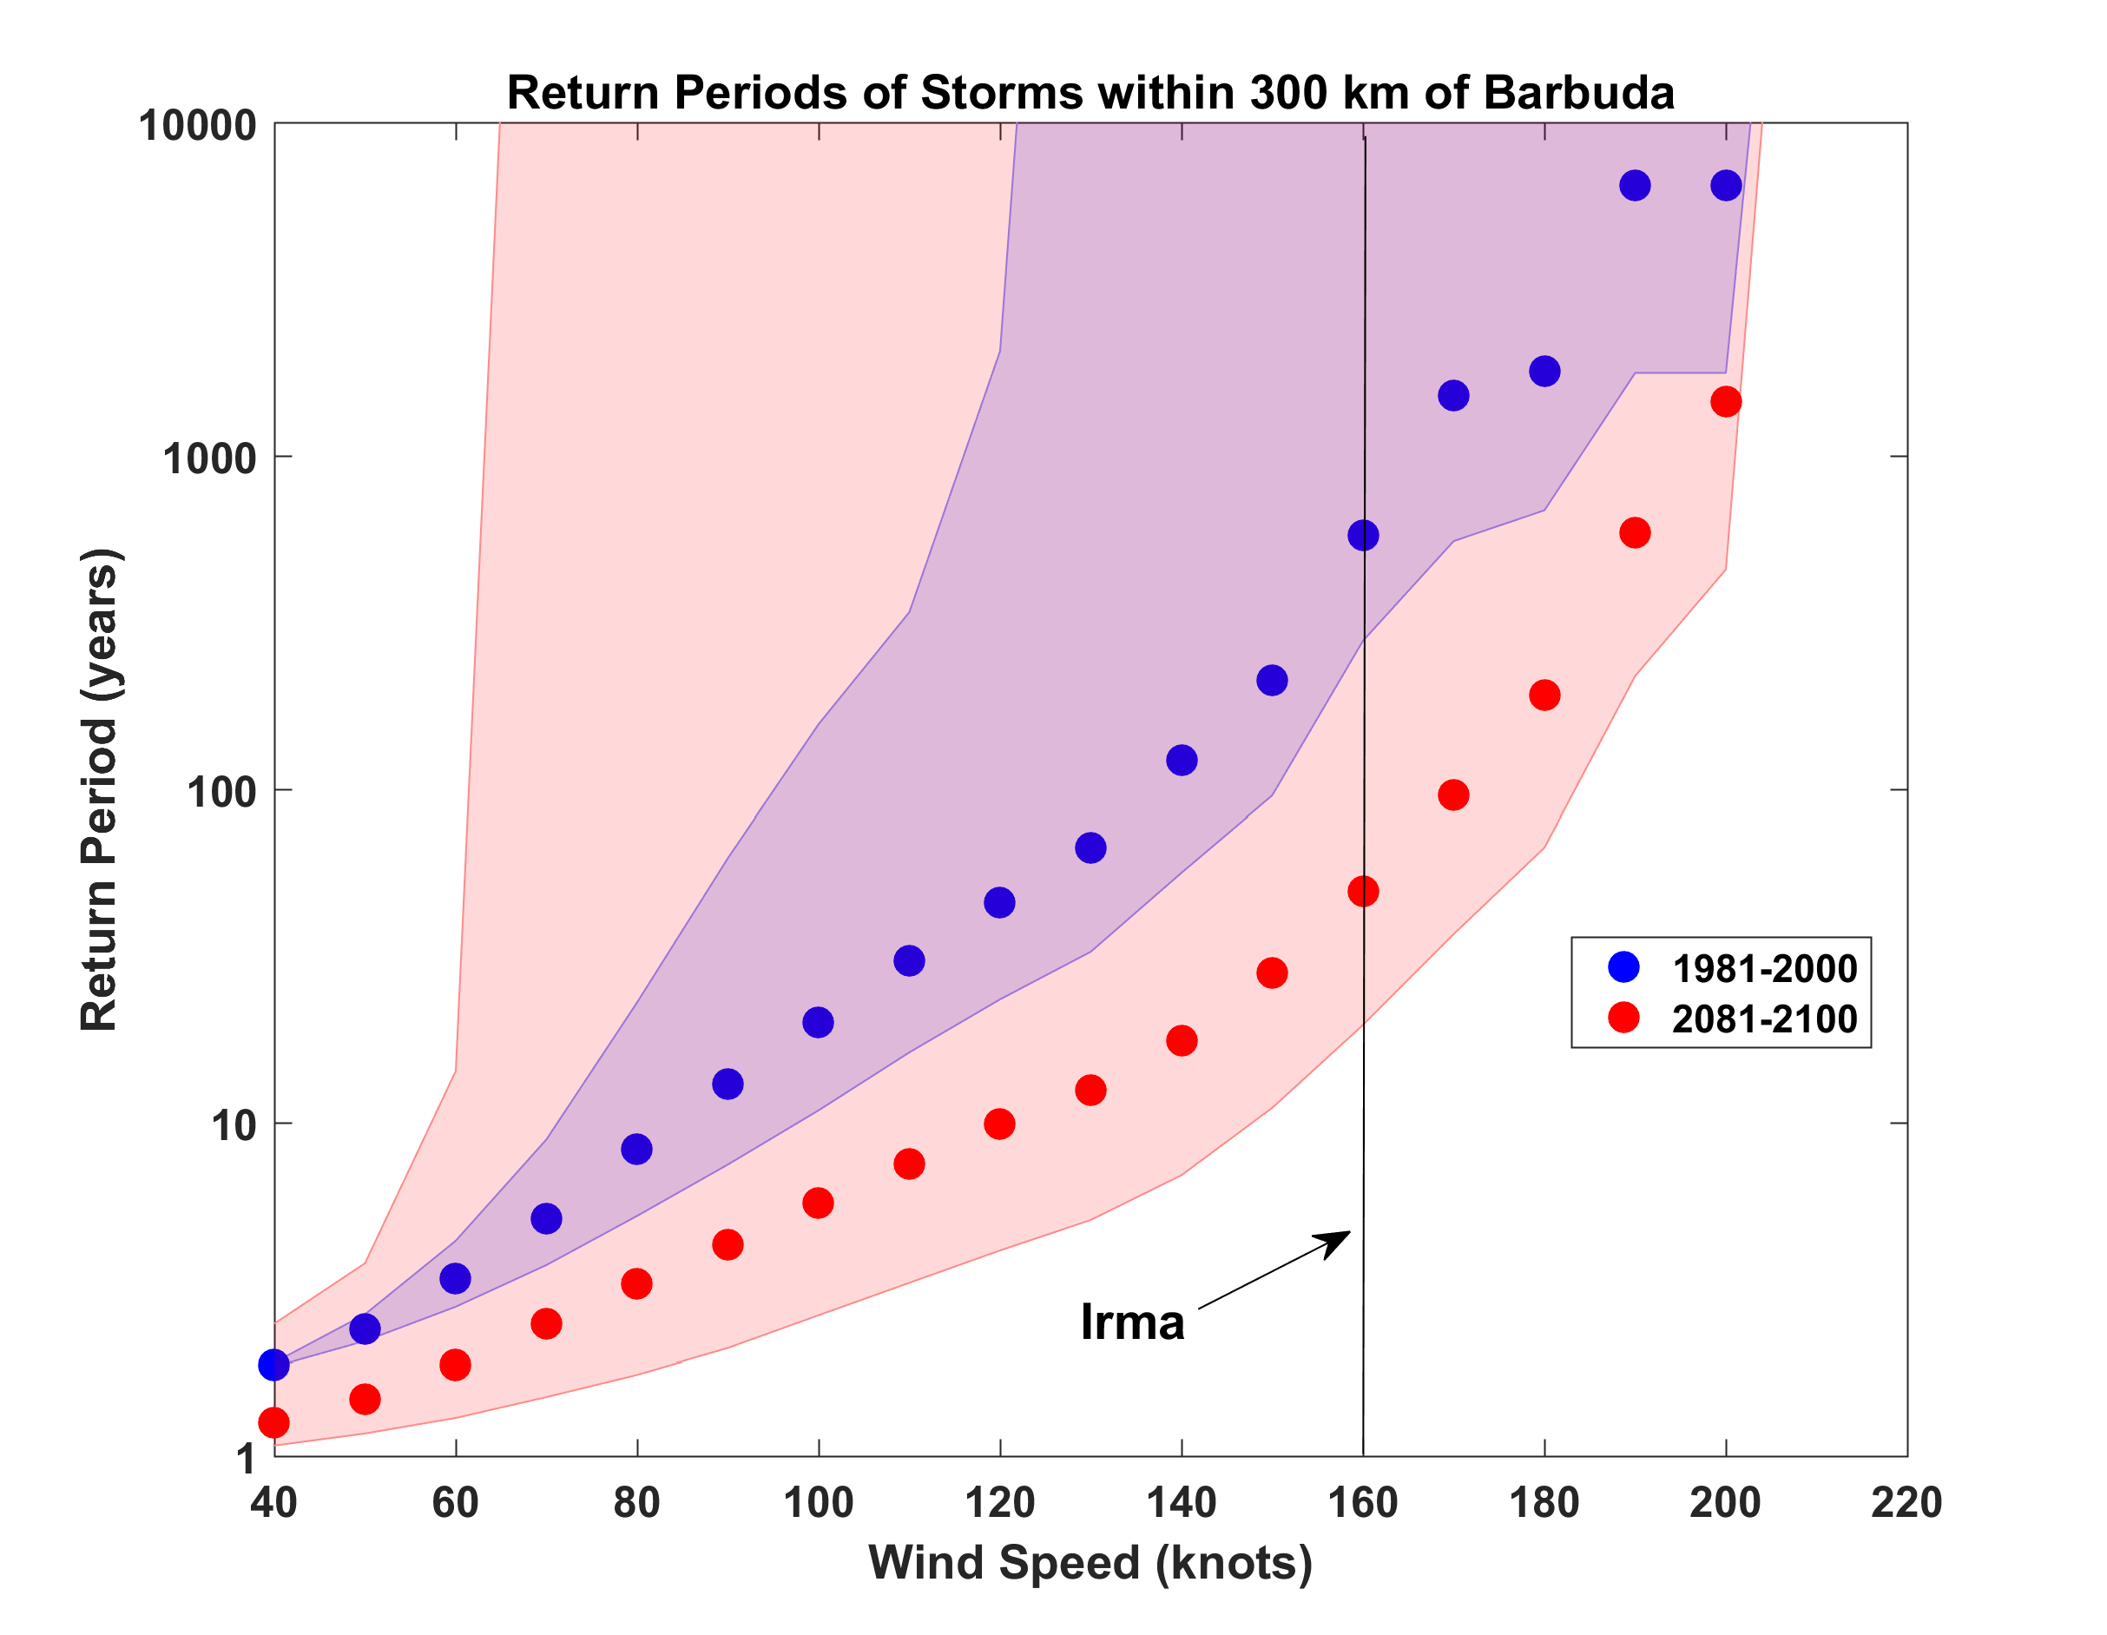
Probabilities of Storms of Irma’s Intensity within 300 km of Barbuda, from 6 Climate models, 1981-2000 and 2081-2100, Based on 2000 Events Each. Shading shows spread among the models.

Slide 41
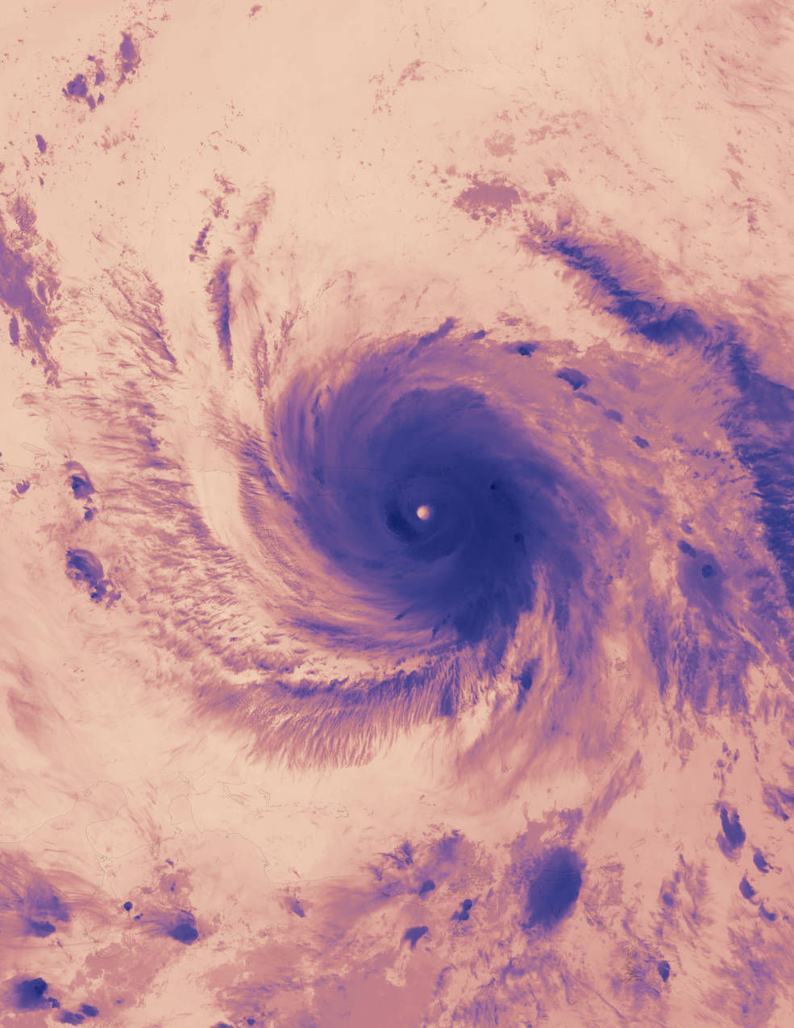
Hurricane Maria

Slide 42
Maria
Run 100 events each year during two periods: 1981-2000 and 2081-2100, passing within 150 km of 17ºN, 64ºW, downscaled from four climate models

Slide 43
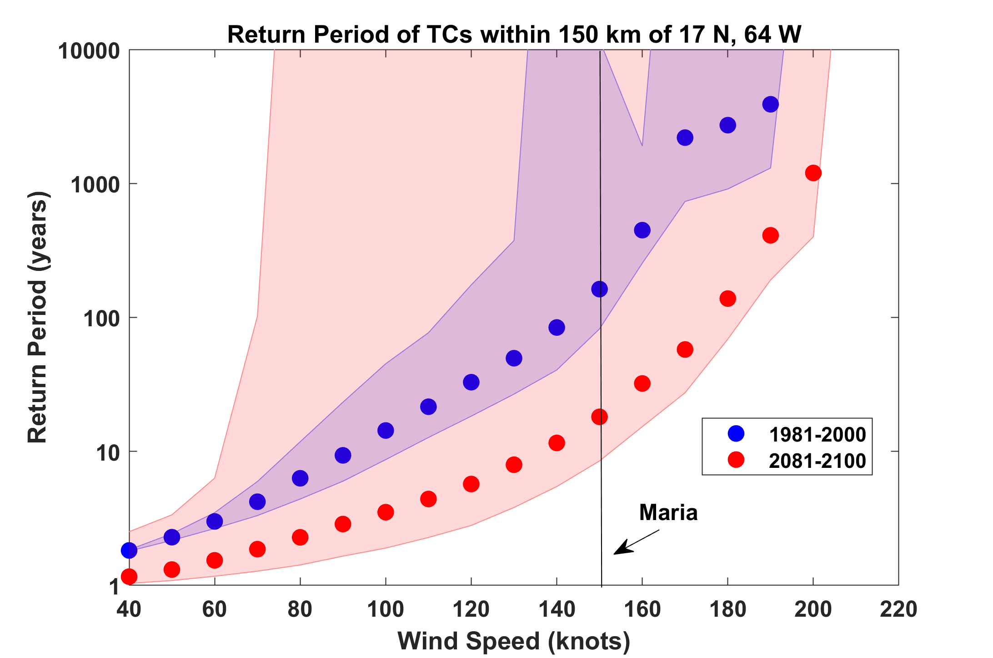

Slide 44
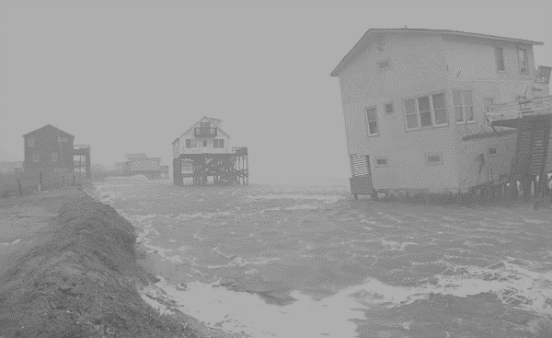
North Carolina Hurricanes
Over its history, North Carolina has experienced over 400 tropical cyclones that passed over or near the state
NC ranks 4th among all states in number of hurricanes
Collectively, hurricanes have killed more than 1,000 residents and caused more than $11 billion (2008) in losses
Notes:
44

Slide 46
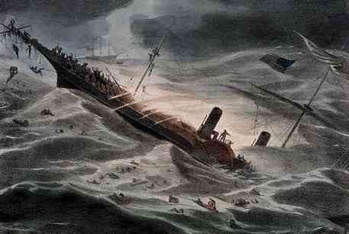
SS Central America
Loss of 424 people, 30,000 lbs gold

Slide 47
Longest lived Atlantic hurricane on record (August 3 – September 4)
Maybe strongest hurricane to affect North Carolina (120 MPH, though instruments destroyed)
All of Cape Hatteras submerged
All piers and bridges destroyed

Slide 49
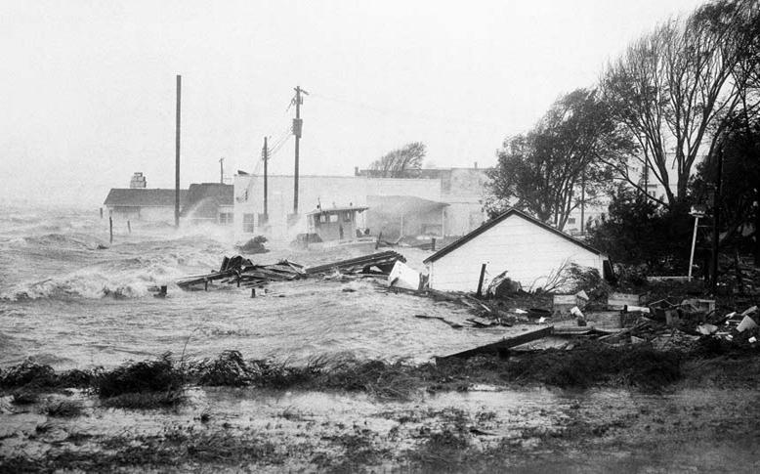
Hurricane Hazel, 1954
18 ft storm surge + 115 knot (130 MPH) winds, probably strongest on record
NWS, Raleigh: “All traces of civilization on the immediate waterfront between the state line and Cape Fear were practically annihilated”
“Every pier in a distance of 170 miles of coastline was demolished".
Still a Cat 1 hurricane at Toronto, doing much damage there

Slide 50
Hurricane Floyd, 1999
Notes:
The advent of reconnaissance aircraft and radar in the 1940s, and of satellites in the 1960s, gave scientists the means to determine the detailed structure and evolution of hurricanes. Today, almost everything we know about hurricanes is based on observations by aircraft, radar, and satellites. This satellite image shows Hurricane Floyd approaching the east coast of Florida in 1999. This image has been digitally enhanced to lend a three-dimensional perspective. The swirling mass of clouds is about 300 kilometers (180 miles) across, and Floyd’s eye is about 50 kilometers (30 miles) in diameter. Surrounding the eye is a deep ring of thick cloud called the eyewall. A thin veil of very high cloud covers most of the swirling mass of thicker clouds; this is the veil of cirrus, made up of tiny ice crystals. Underneath it, and thus invisible from above, are several spiral shaped bands of deep, thick cumulonimbus clouds, interspersed between relatively clear sky. These spiral bands produce heavy rains and gusty winds well outside the eyewall of the hurricane, where the strongest winds are found.
Image: Satellite image of Hurricane Floyd approaching the east coast of Florida in 1999. The image has been digitally enhanced to lend a three-dimensional perspective. Credit: NASA/Goddard Space Flight Center.
Description from “Divine Wind: The History and Science of Hurricanes”, Kerry Emanuel, 2005, Oxford University Press, 296 p.
Definitions
Reconnaissance is the military term for the active gathering of information about an enemy, or other conditions, by physical observation (from and for more information see http://en.wikipedia.org/wiki/Reconnaissance).
The eye is a region of mostly calm weather found at the center of strong tropical cyclones. The eye of a storm is usually circular and typically 25–40–65 kilometers (40 miles) in diameter. It is surrounded by the eyewall, where the most severe weather of a cyclone occurs (from and for more information see http://en.wikipedia.org/wiki/Eyewall).
Cirrus clouds are thin and often wispy clouds that are the most common form of high-level clouds. Typically found at heights greater than 20,000 feet (6,000 meters), cirrus clouds are composed of ice crystals that originate from the freezing of supercooled water droplets (from and for more information see http://weather.about.com/library/glossary/blglossary.htm).
Cumulonimbus clouds are large and vertically developed clouds that are fueled by vigorous convective updrafts (sometimes in excess 50 knots), the tops of cumulonimbus clouds can easily reach 39,000 feet (12,000 meters) or higher (from and for more information see http://weather.about.com/library/glossary/blglossary.htm).

Slide 51
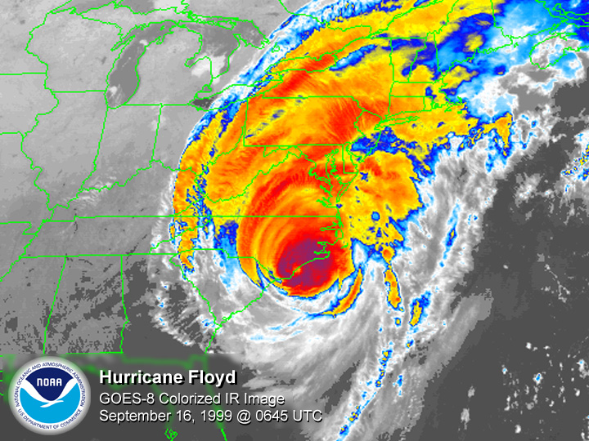
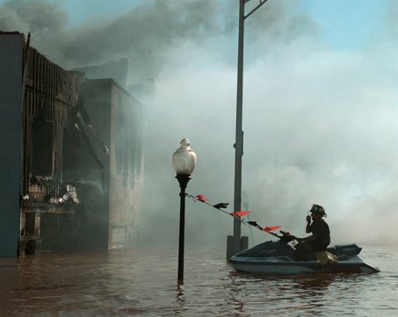

Slide 52
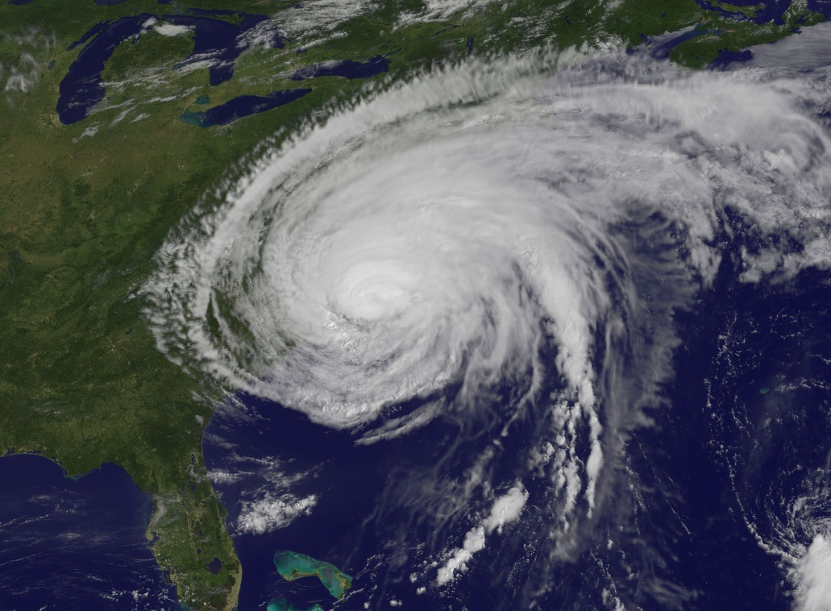
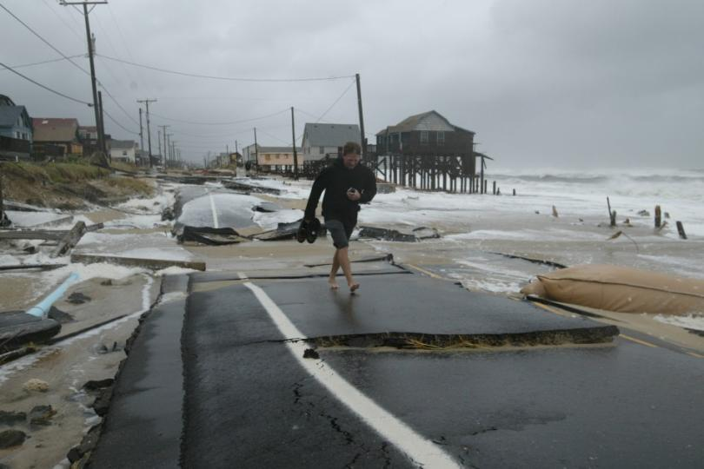
Hurricane Irene, 2011

Slide 53
The Future of North Carolina Hurricanes
Notes:
53

Slide 54
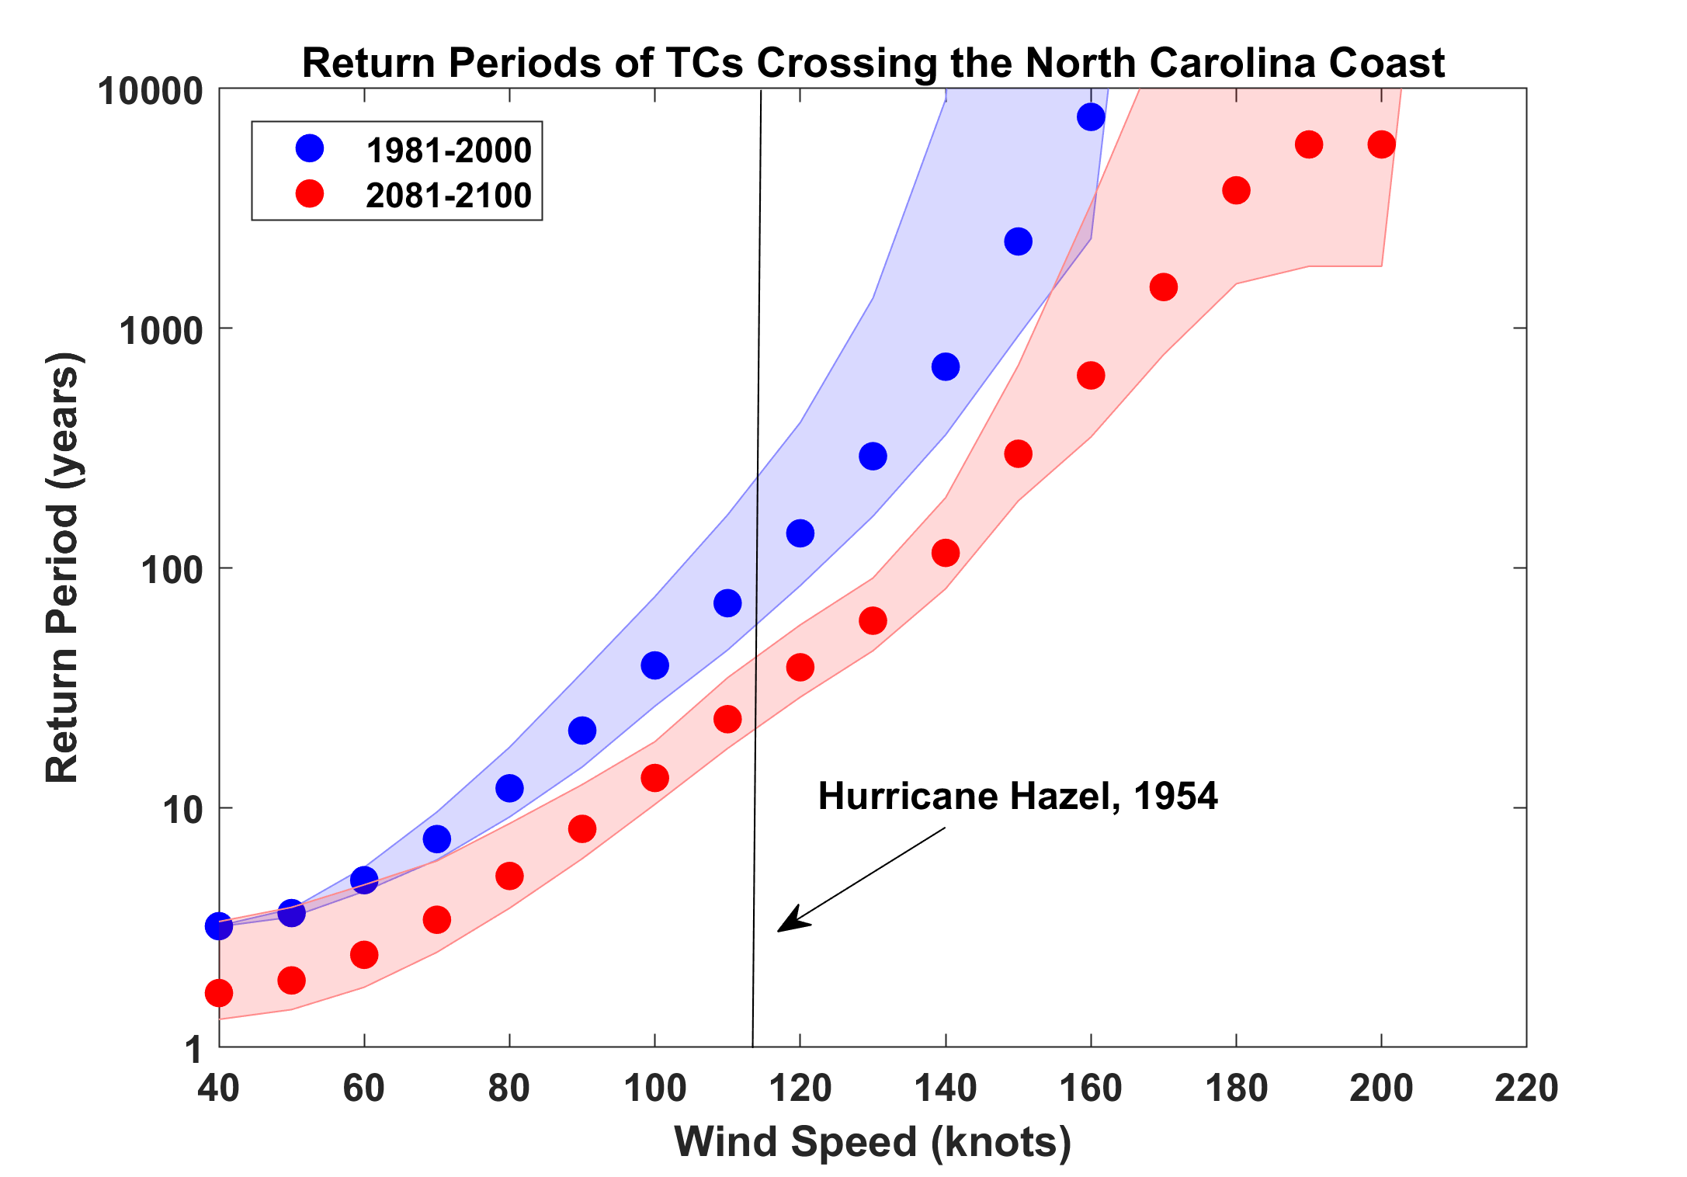

Slide 55
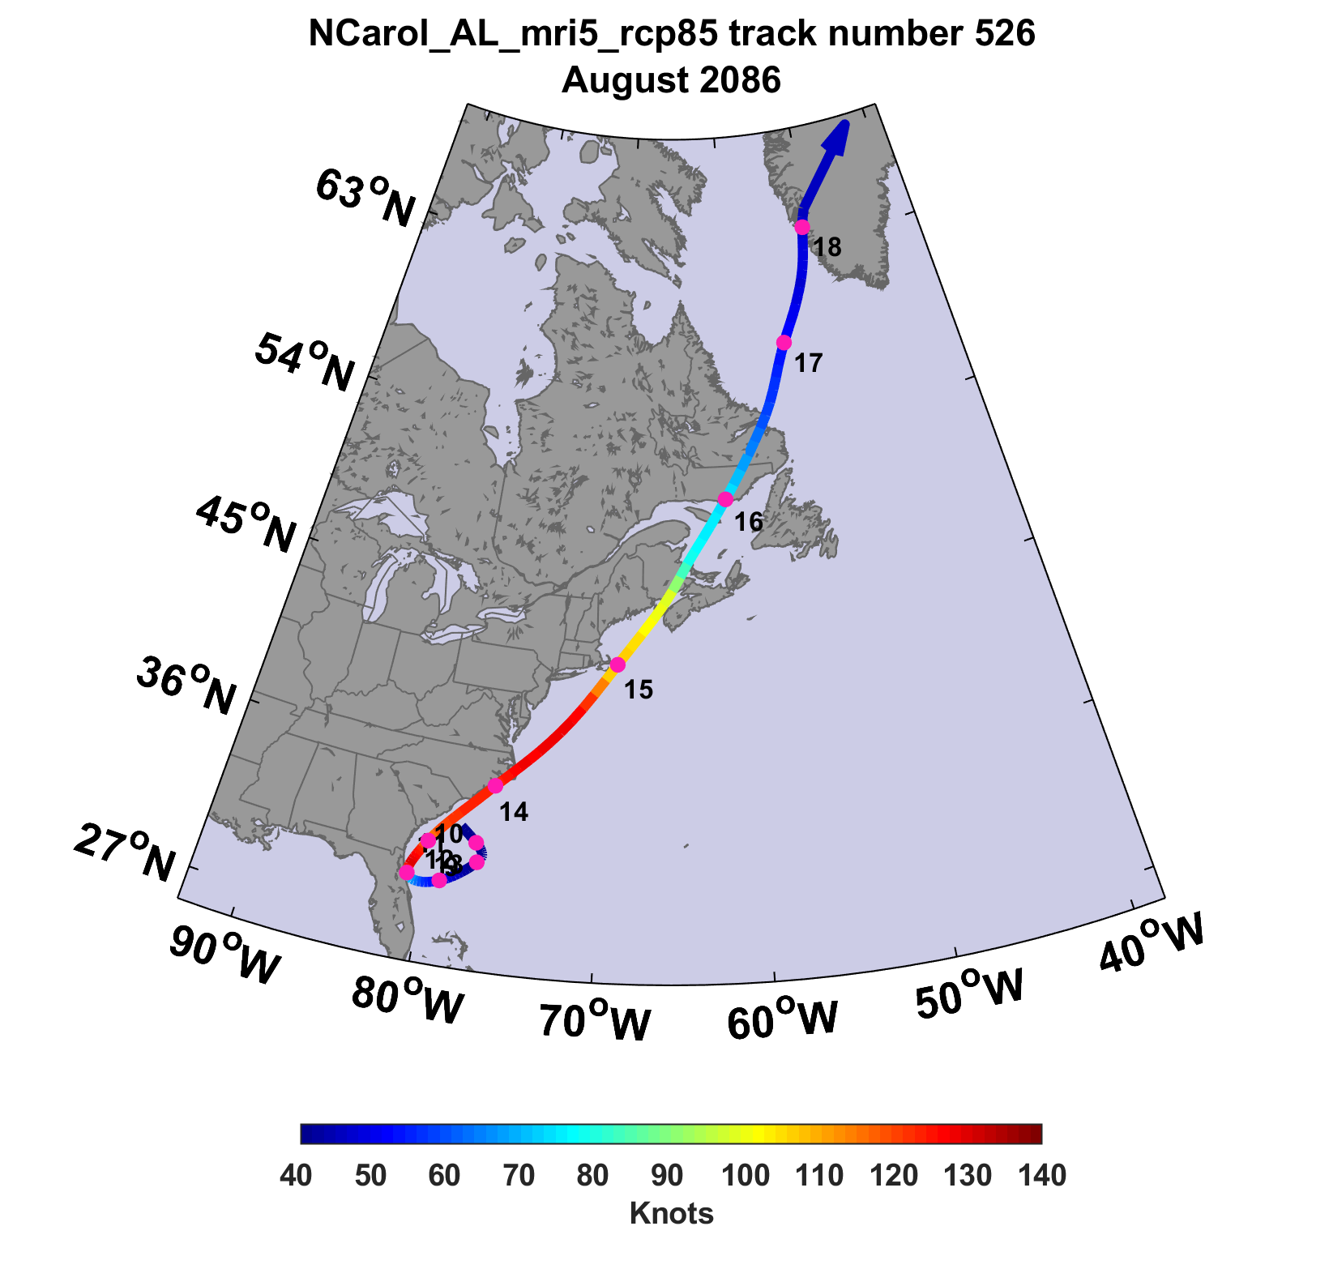
The 100-year event in 2086: 140 knots at NC landfall

Slide 56
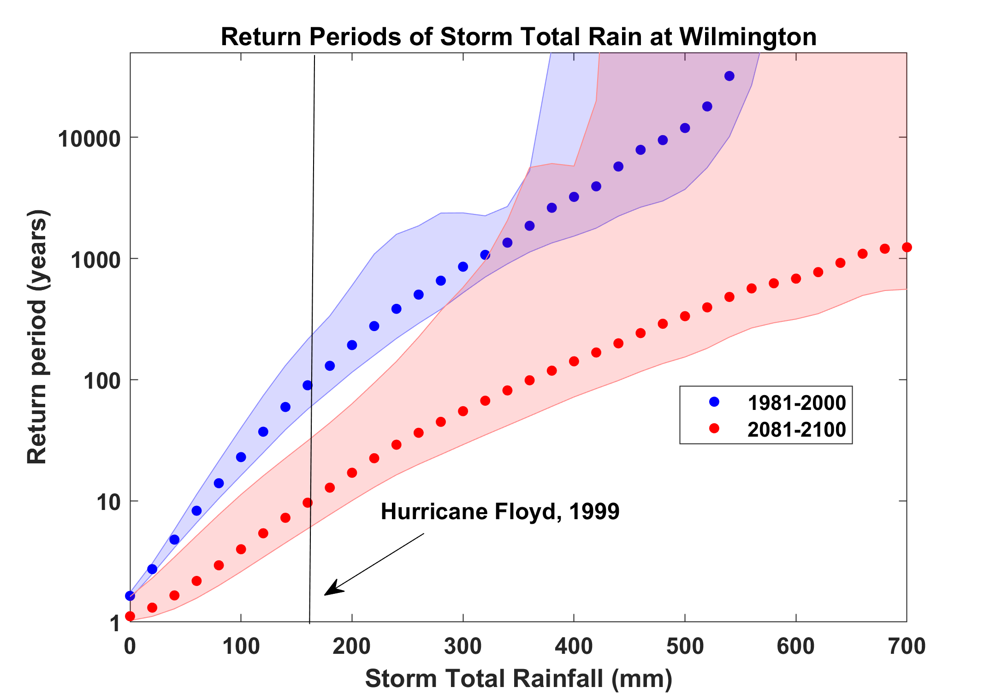

Slide 57
Summary
The observational record of hurricanes is too short and noisy, and of a quality too low to make robust inferences of climate signals
Satellite data do show a migration of peak intensity toward higher latitudes and some indication of a greater fraction of intense storms
Recovery of hurricane proxies from the geological record is beginning to show some climate signals

Slide 58
Summary (continued)
Potential intensity theory demonstrates that the thermodynamic limit on hurricane intensity rises with temperature
Observations show that this limit is indeed increasing
Physics can be used to model hurricane risk in current and future climates

Slide 59
Summary (continued)
Rain of Harvey’s magnitude in Texas was a ~ 1% annual probability event in 1990 and is projected to increase to 18% by 2090. A linear increase in frequency yields a 6% probability in 2017.
Irma’s peak winds of 185 MPH within 300 km of Barbuda are estimated to have had an annual probability of 0.13% in 1990, increasing to 1.3% in 2090
North Carolina’s hurricane wind and flood risks are projected to increase substantially over this century

Slide 60
Spare Slides

Slide 61
Flood inundation signal. Courtesy Chris Ruf

Slide 62
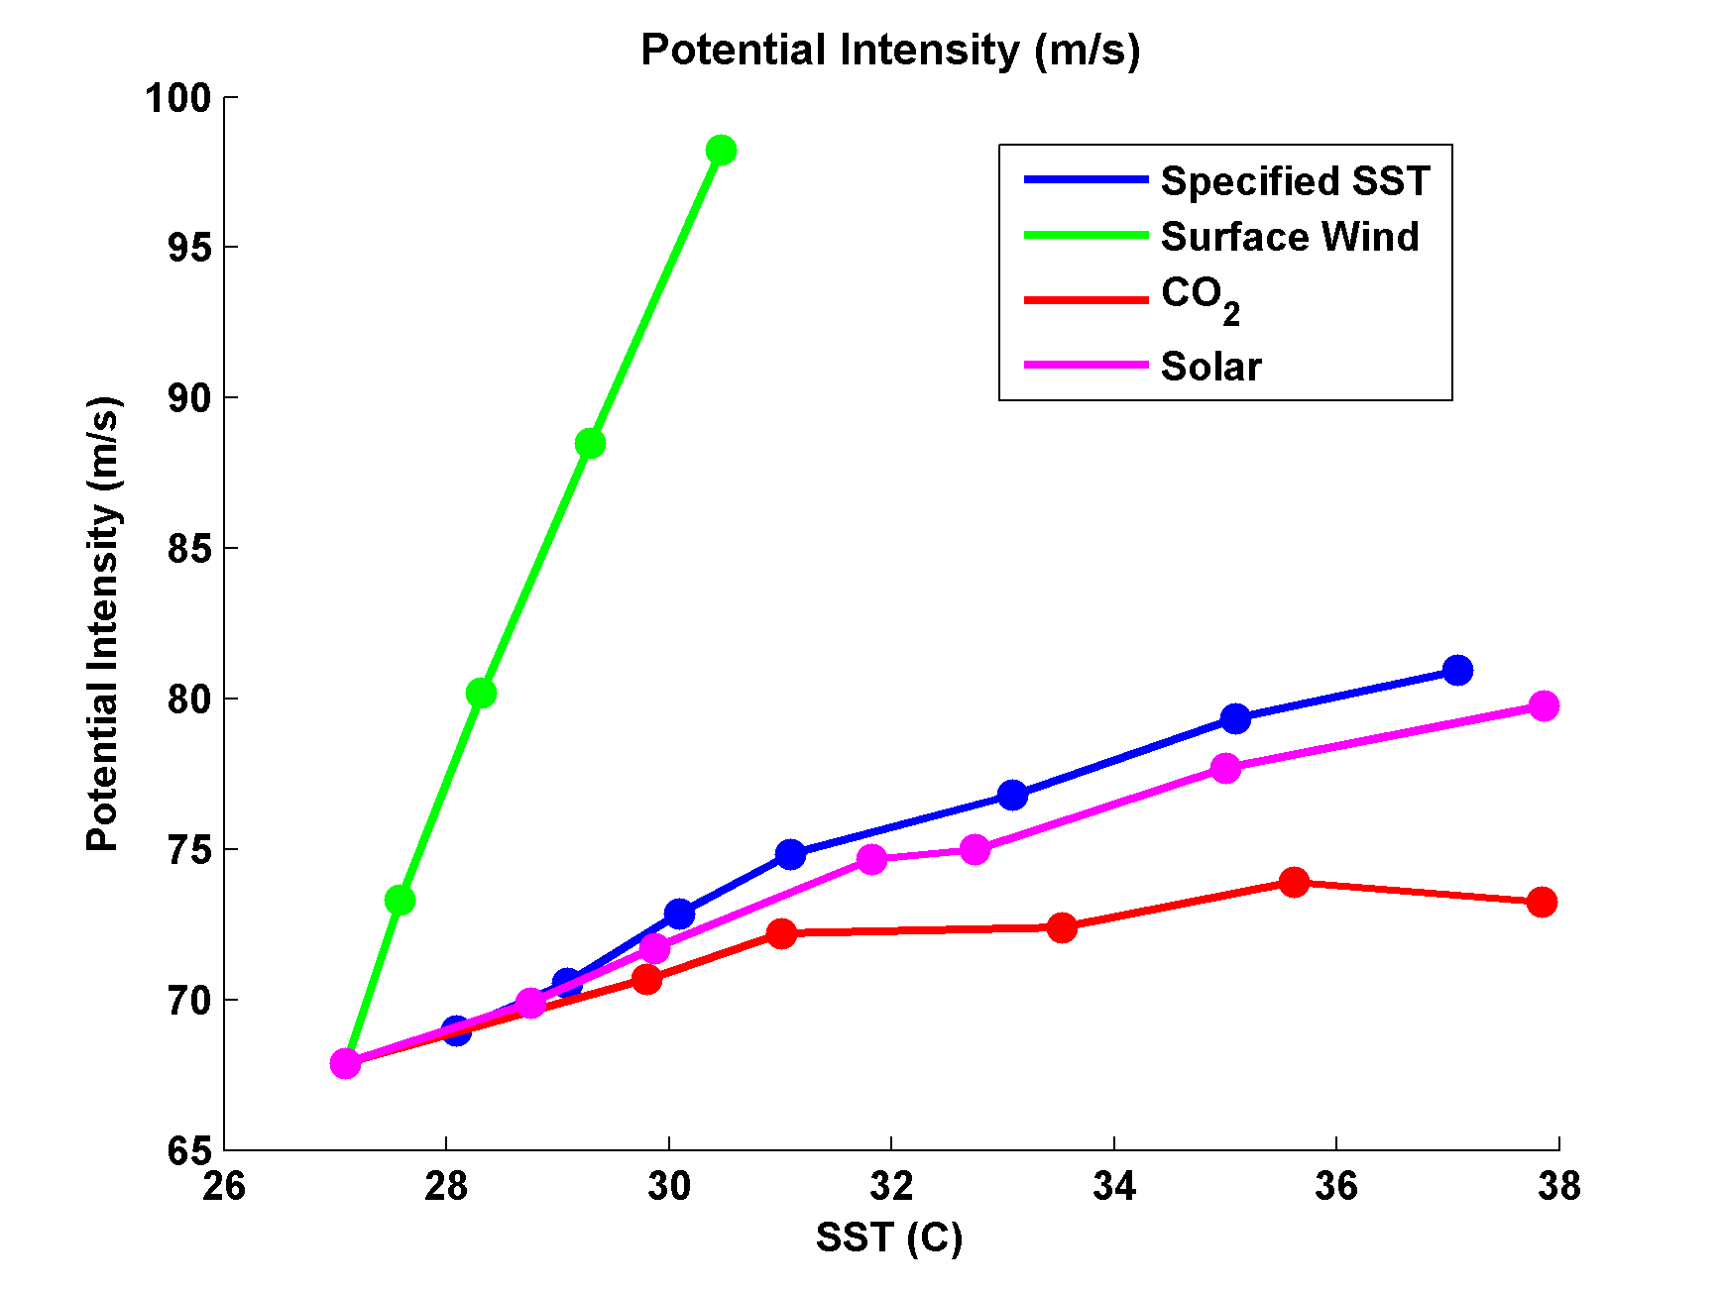
Variation of Potential Intensity with Ocean Heat Flux, Surface Wind Speed, CO₂, and Solar Forcing
Emanuel, K., and A. Sobel, 2013: Response of tropical sea surface temperature, precipitation, and tropical cyclone-related variables to changes in global and local forcing. J. Adv. Model. Earth Sys., 5, doi:10.1002/jame.20032

Slide 63
Tracks of North Atlantic hurricanes that reaches at least Category 4 intensity in the climate of the late 20th century (top) and late 21st century (bottom). These storms were simulated by a high resolution regional model driven by the global climate state representing an average of 18 global climate models. The regional model was developed at NOAA’s Geophysical Fluid Dynamics Laboratory in Princeton, NJ. From Bender and co-authors, Science, 2010.

Slide 64
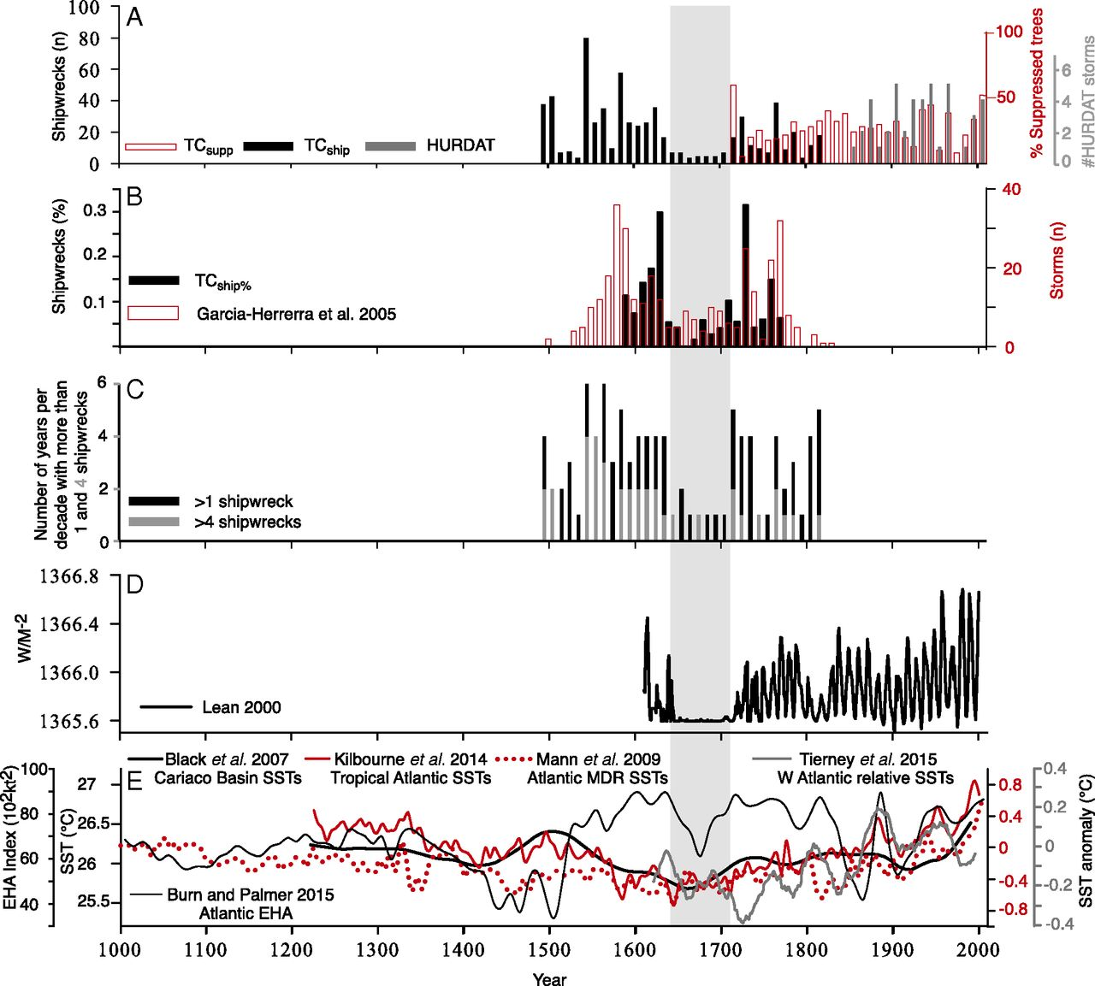
Inferences from Spanish Shipwrecks
Trouet at al., PNAS. 2016

Slide 65
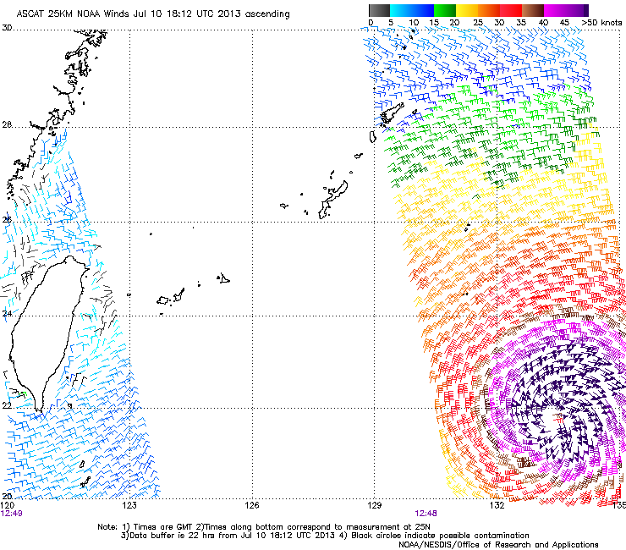
Sea Surface Scatterometry

Slide 66
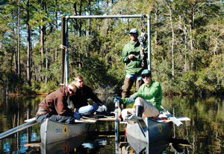
Woods Hole research assistants Dana McDonald, Skye Moret, Sam Zipper and Phil Lane on a makeshift catamaran used in paleotempestology research. (Photo by Jim Morrison)

Slide 67
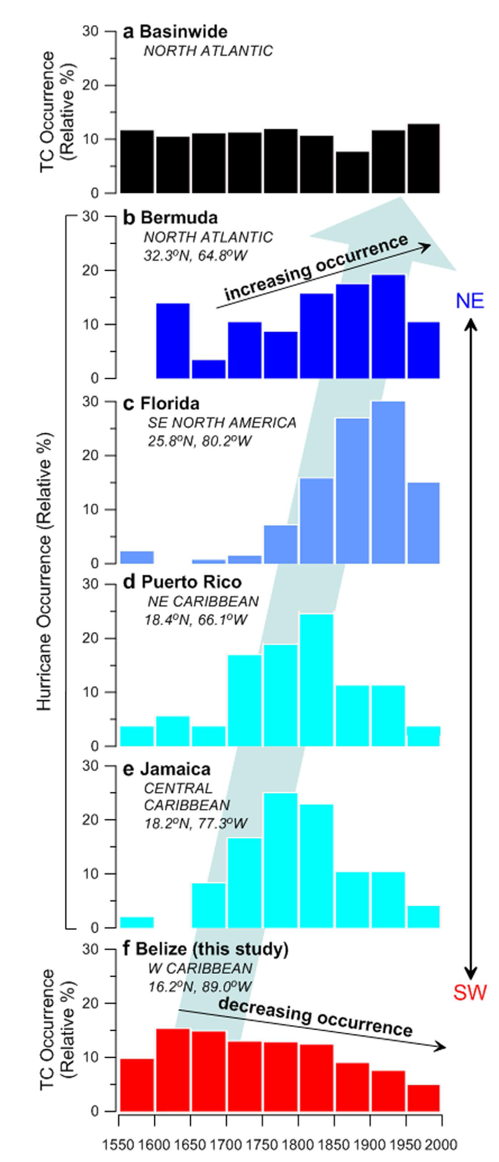
The YOK-GTC reconstruction compared to documentary records of hurricane landfall in the Caribbean and North Atlantic Basins. Frequency distributions (relative %) of hurricanes affecting (a) the entire North Atlantic Basin and locations along the western margin of the North Atlantic (b) Bermuda, (c)
Florida, (d) Puerto Rico, and (e) Jamaica, calculated from previously published documentary data. From Baldini et al., Nature Scientific Reports, 2016, DOI: 10.1038/srep37522
Belize data based on stable isotope analysis of stalagmites at Yoks Balum cave in southern Belize

Slide 68
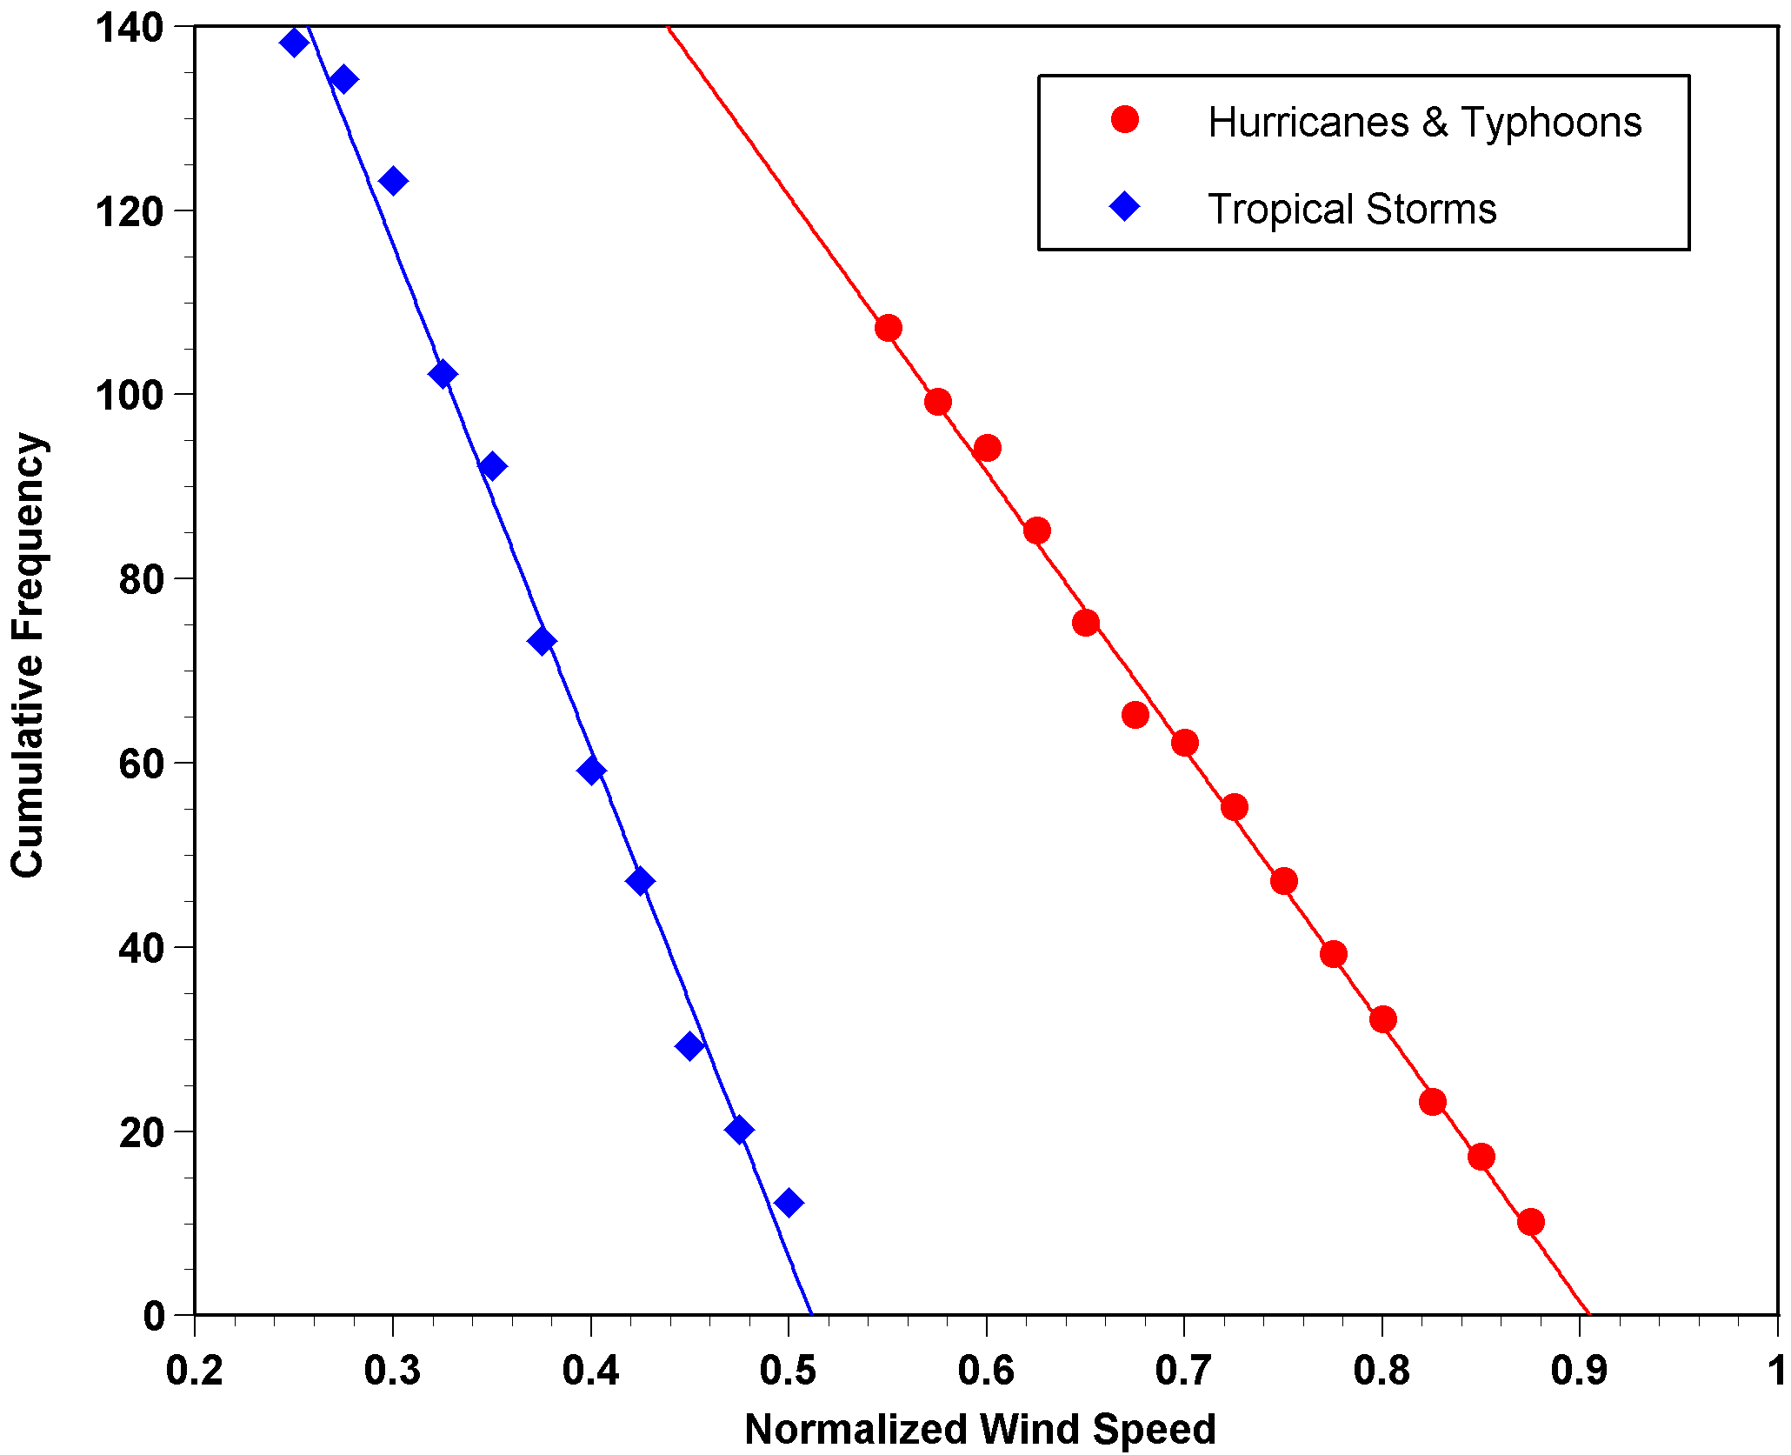
Cumulative Frequency of Storm Lifetime Maximum Intensity Normalized by Potential Intensity

Slide 69
Time-dependent, axisymmetric model phrased in R space
Hydrostatic and gradient balance above PBL
Moist adiabatic lapse rates on M surfaces above PBL
Boundary layer quasi-equilibrium convection
Deformation-based radial diffusion
Coupled to simple 1-D ocean model
Environmental wind shear effects parameterized

Slide 70
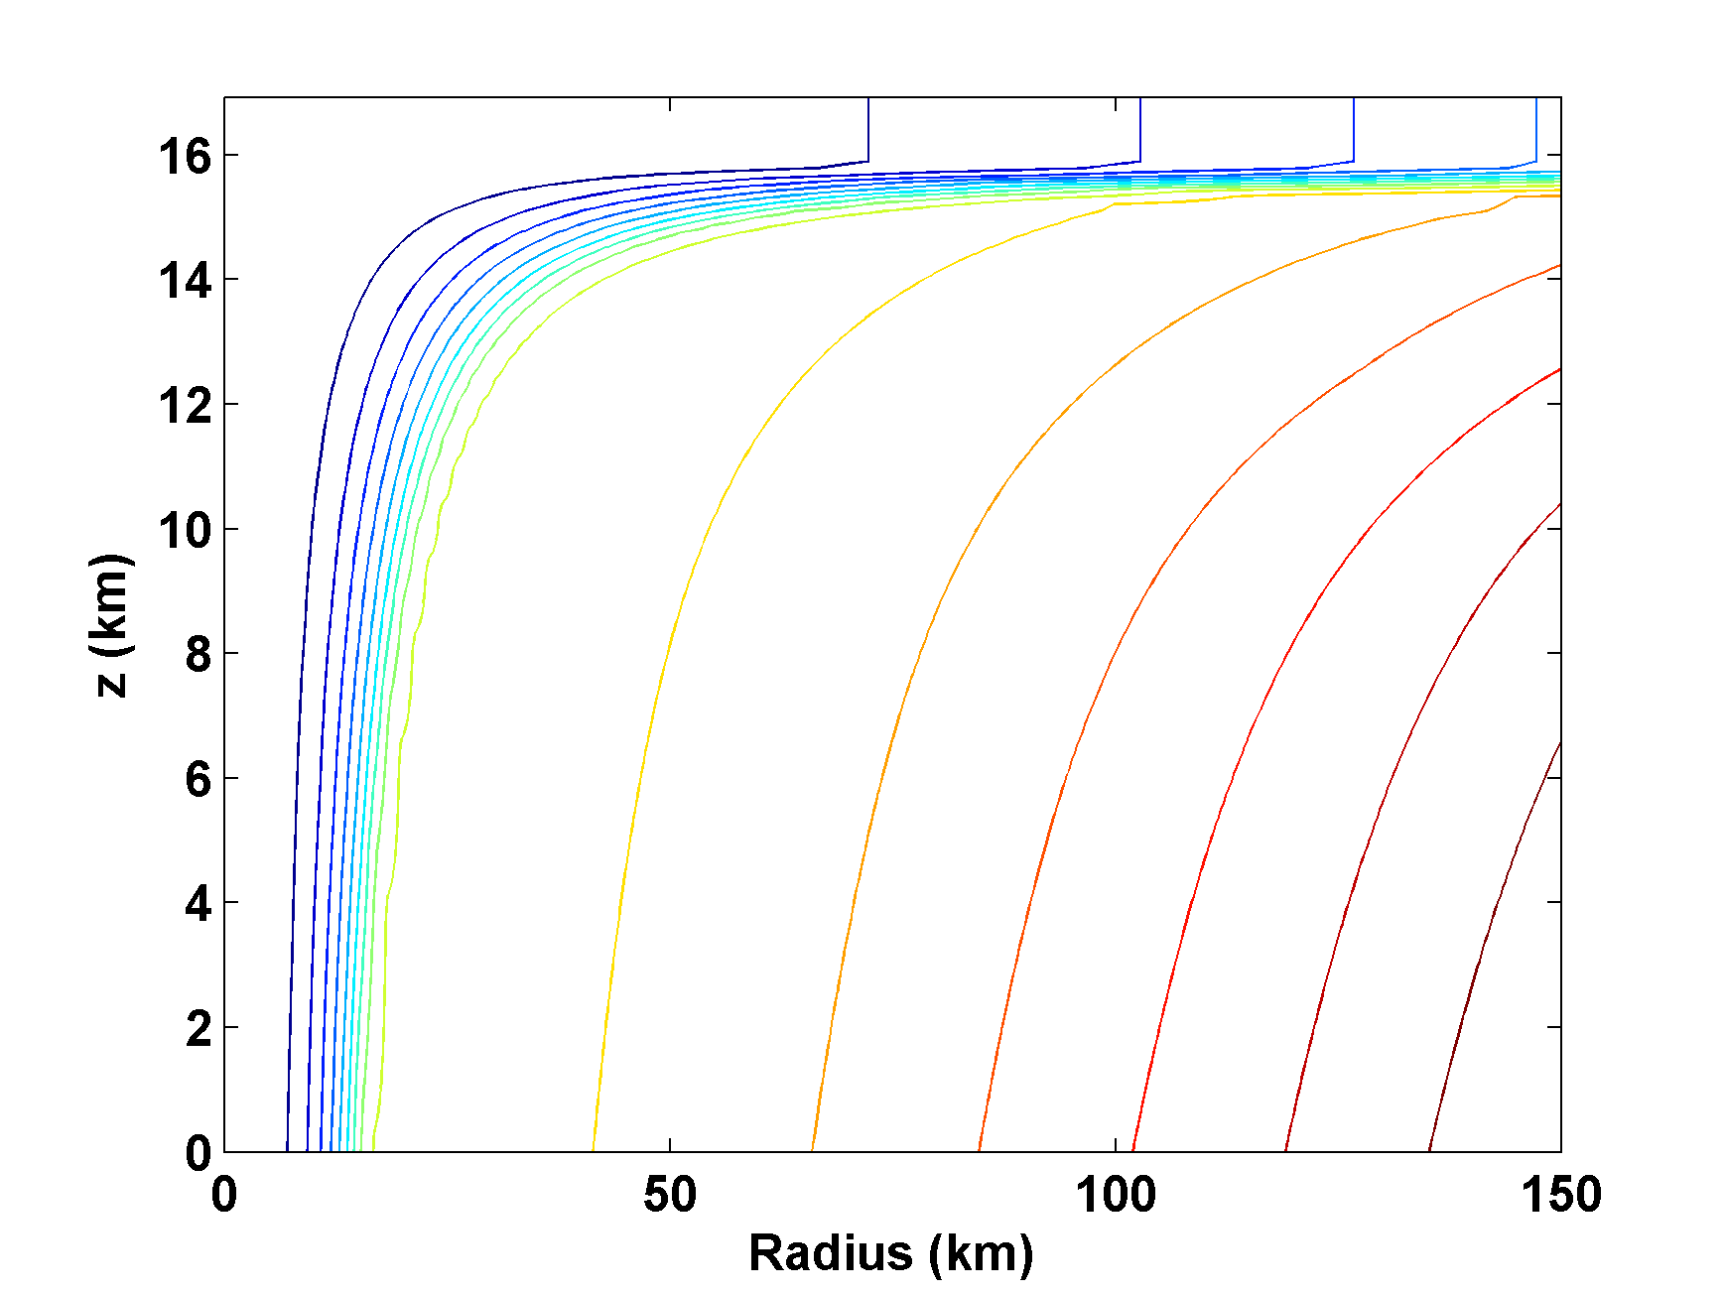
Angular Momentum Distribution
Altitude (km)
Storm Center

Slide 71
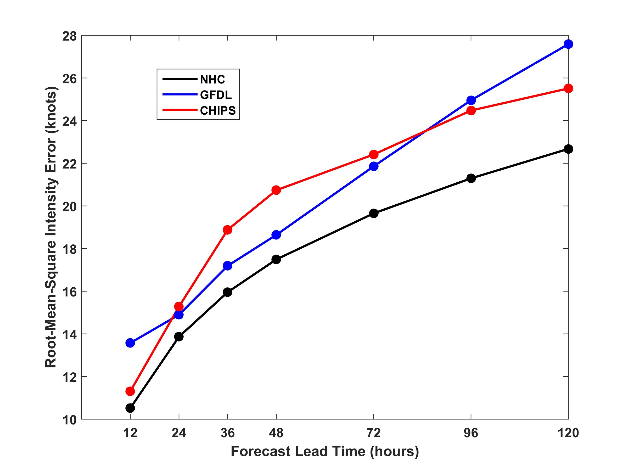
RMS Intensity Error, 2009-2015
North Atlantic

Slide 72
How Can We Use This Model to Help Assess Hurricane Risk in Current and Future Climates?

Slide 73
Hurricane Floyd
10 ft storm surge, numerous tornadoes, extreme freshwater flooding
35 fatalities, $4 billion (1999 dollars) damage
7,000 homes destroyed, 17,000 uninhabitable, 56,000 damaged
500,000 households lost electricity
Some streams experienced 500 year floods
NC Secretary of Health and Human Services: “Nothing since the Civil War has been as destructive to families here”.

