Slide 1
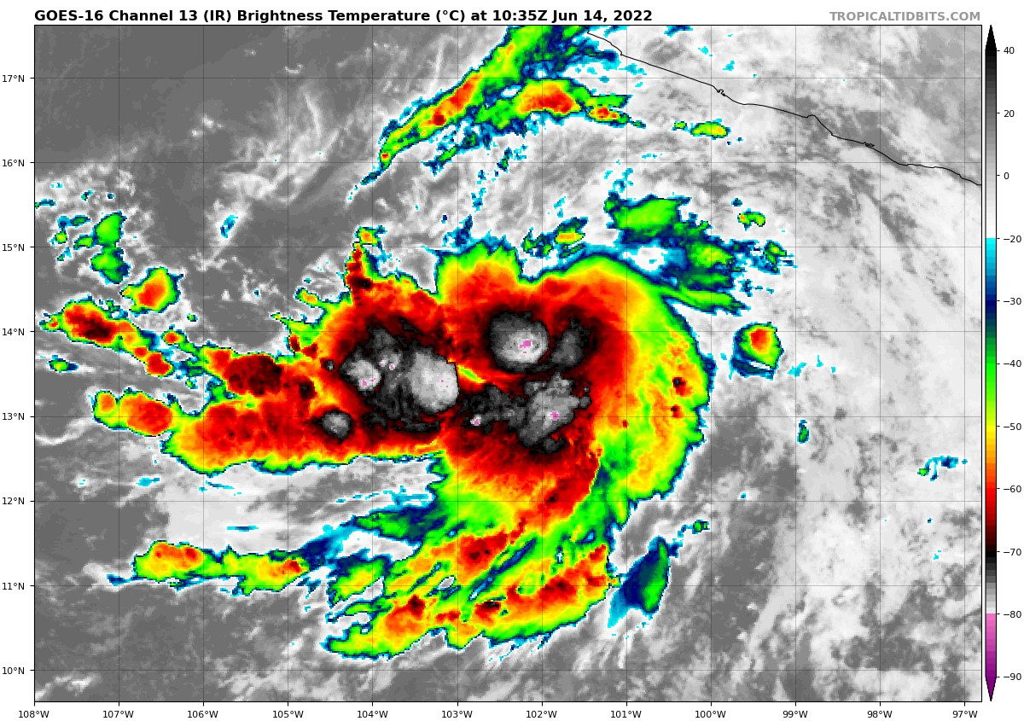
The Enduring Enigma of Tropical Cyclones and Climate
Kerry Emanuel
Lorenz Center
MIT

Slide 2
Program
What distinguishes tropical cyclones from other forms of convection
What we know about tropical cyclone intensity and rainfall
History of genesis research
The genesis enigma
Summary

Slide 3
Program
What distinguishes tropical cyclones from other forms of convection

Slide 4

Back to Basics:
Parallel-Plate Convection
Three types of boundary conditions:
  Constant temperature (Rayleigh, 1916)
  Constant heat flux
  Aerodynamic (rough boundaries)

Slide 5
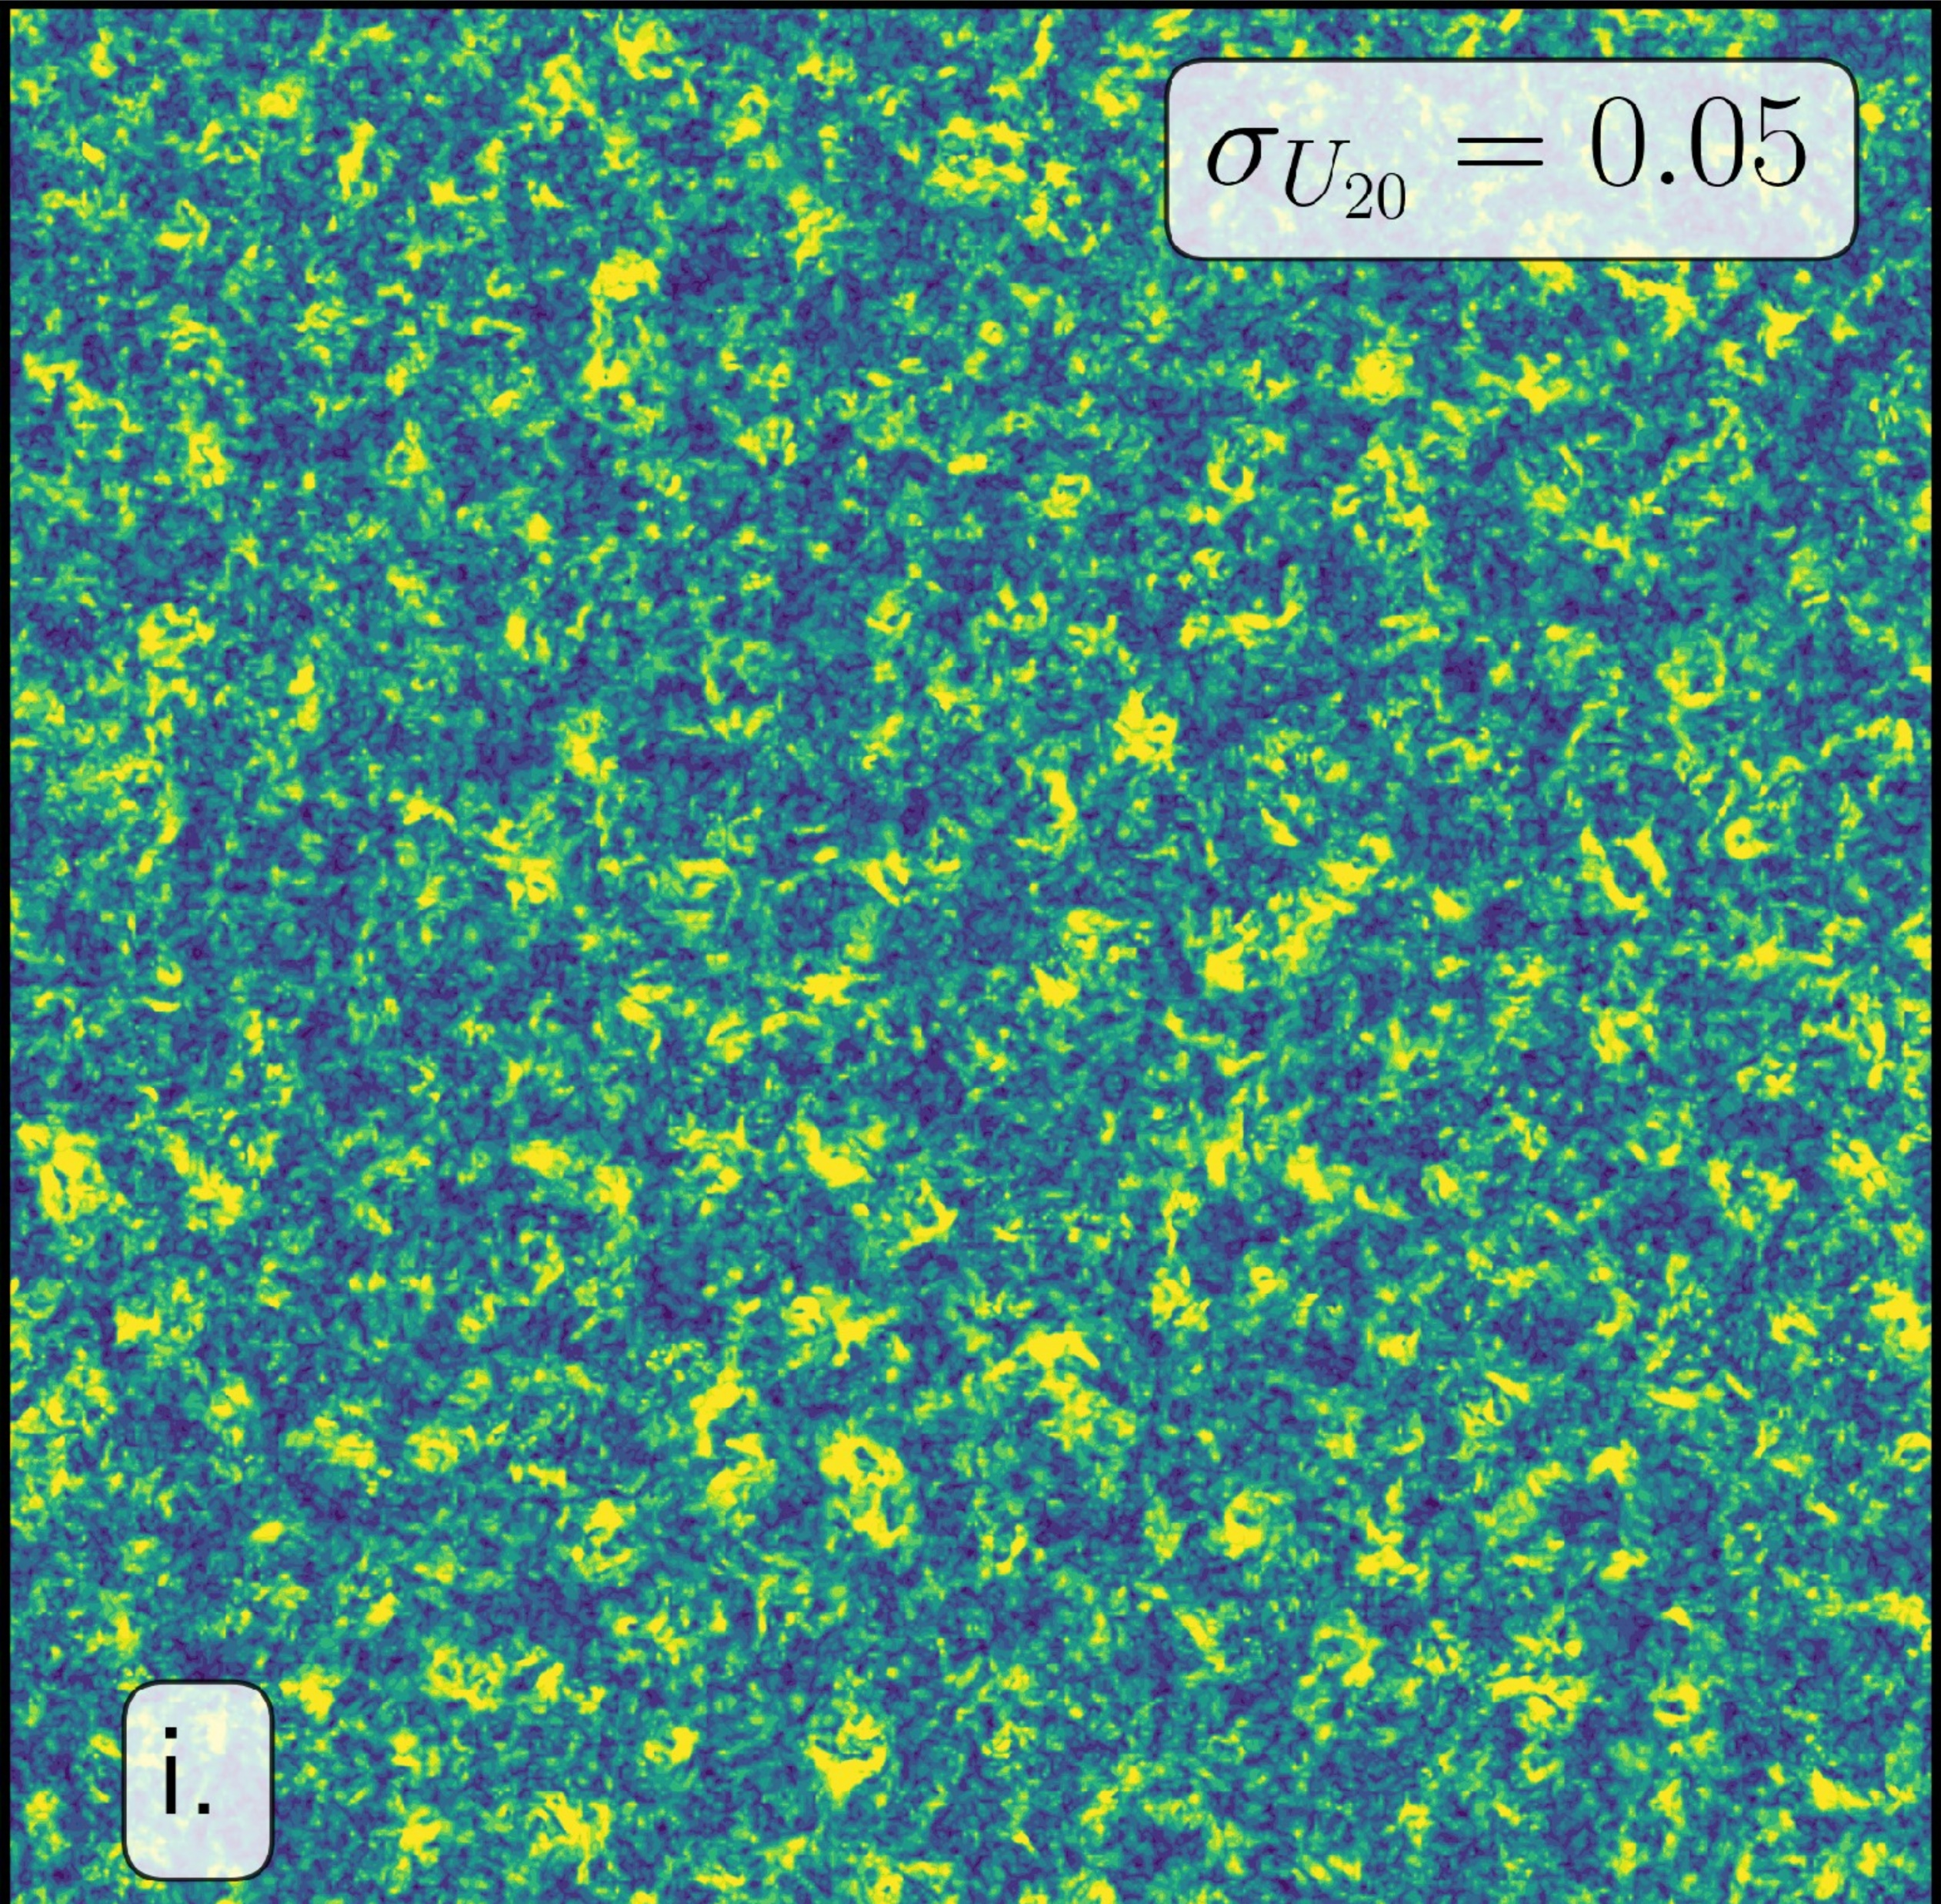
Classical case with rotation (f)
Horizontal wind speed at 20% of domain height

Slide 6
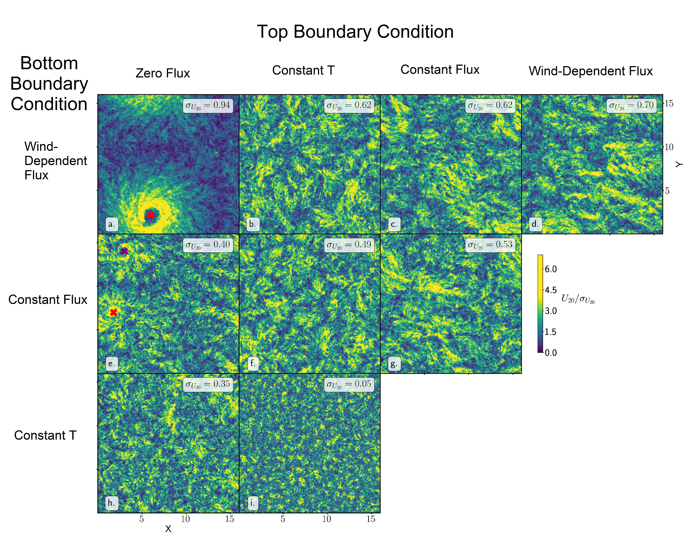
Velez-Pardo, M., and T. W. Cronin, 2023: Large-scale circulations and dry tropical cyclones in direct numerical simulations of rotating Rayleigh-Bénard convection. Journal of the Atmospheric Sciences, https://doi.org/10.1175/JAS-D-23-0018.1.

Slide 7
Tropical cyclones are driven by wind-dependent lower boundary heat fluxes. They are NOT driven by latent heat release in clouds.

Slide 8
Program
What distinguishes tropical cyclones from other forms of convection
What we know about tropical cyclone intensity and rainfall

Slide 9
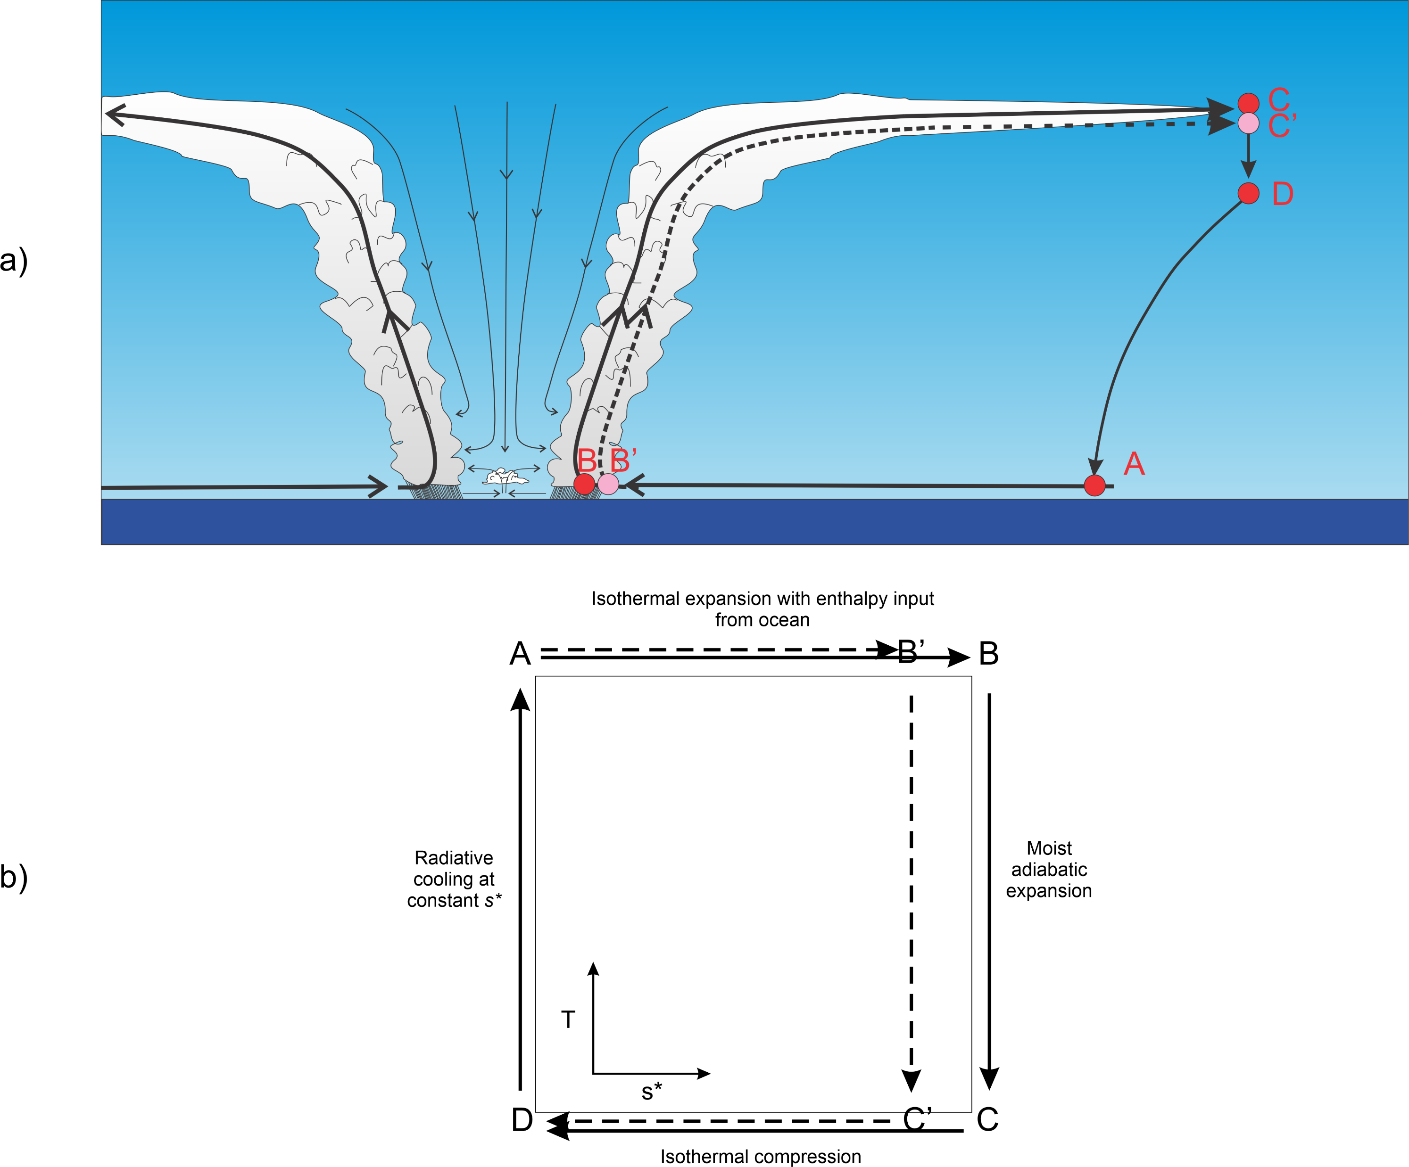

Slide 10
Potential Intensity
Rousseau-Rizzi, R., and K. Emanuel, 2019: An evaluation of hurricane superintensity in axisymmetric numerical models. Journal of the Atmospheric Sciences, 76, 1697–1708, https://doi.org/10.1175/jas-d-18-0238.1.

Slide 11
Rainfall
Responsible for large mortality and damage in tropical cyclones
Increases at least as fast as Clausius- Clapeyron (6% K⁻¹)

Slide 12
Program
What distinguishes tropical cyclones from other forms of convection
What we know about tropical cyclone intensity and rainfall
History of genesis research

Slide 13
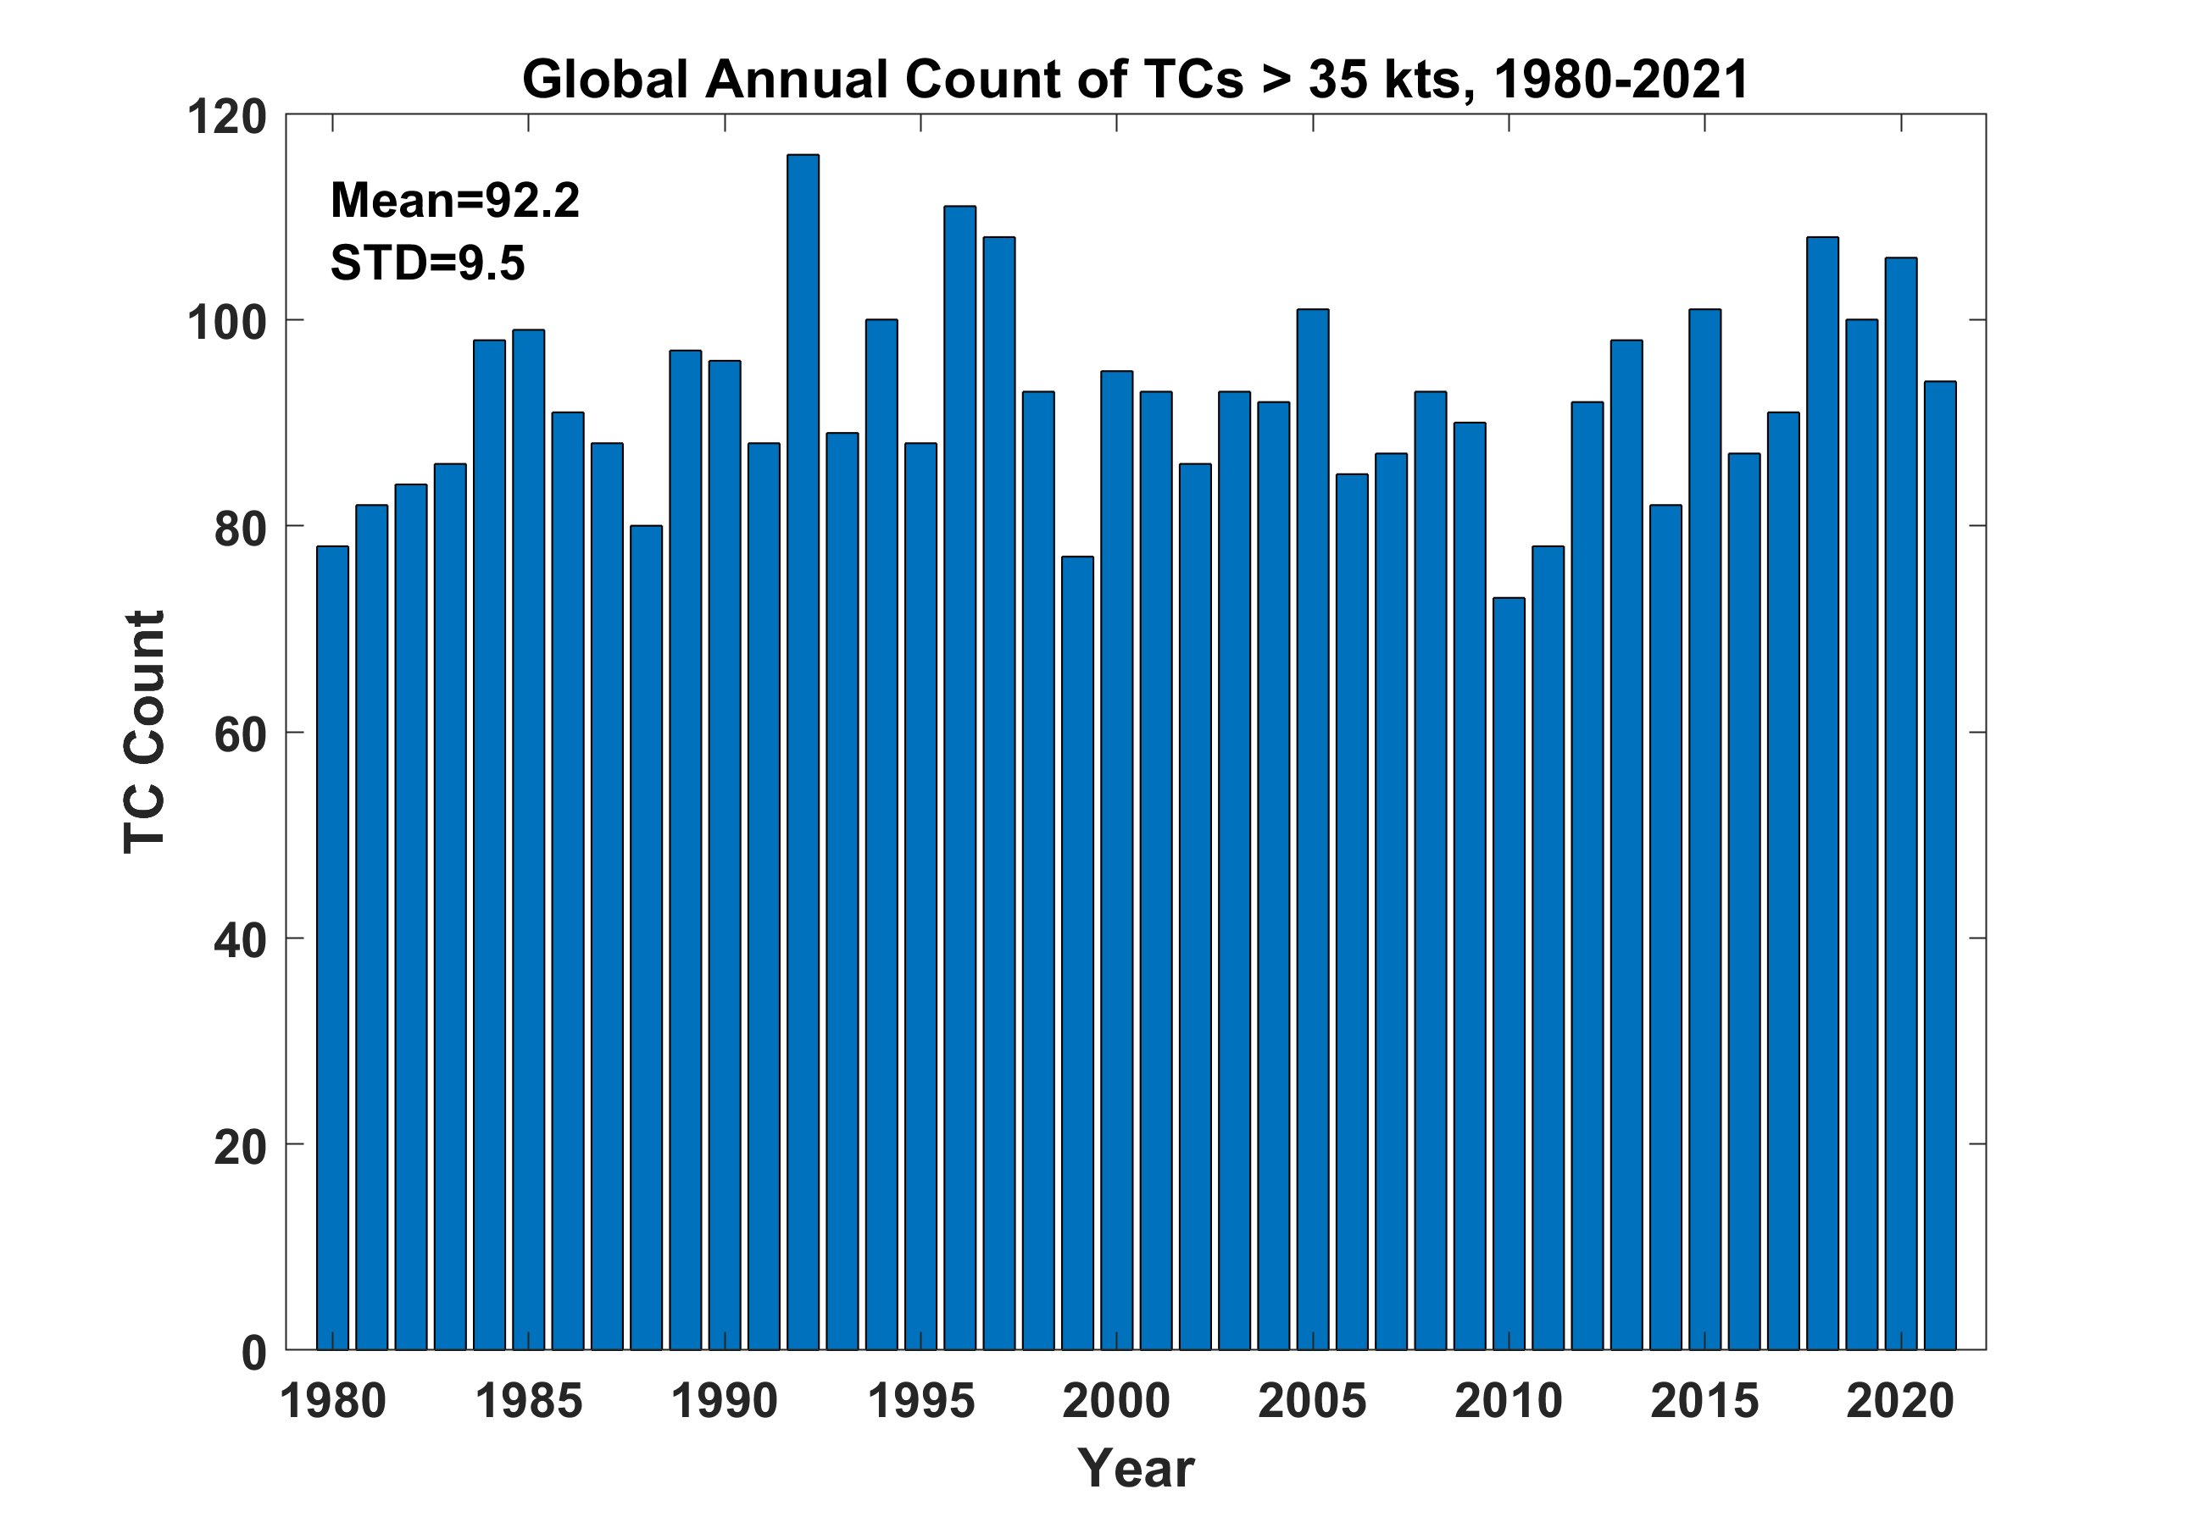

Slide 14
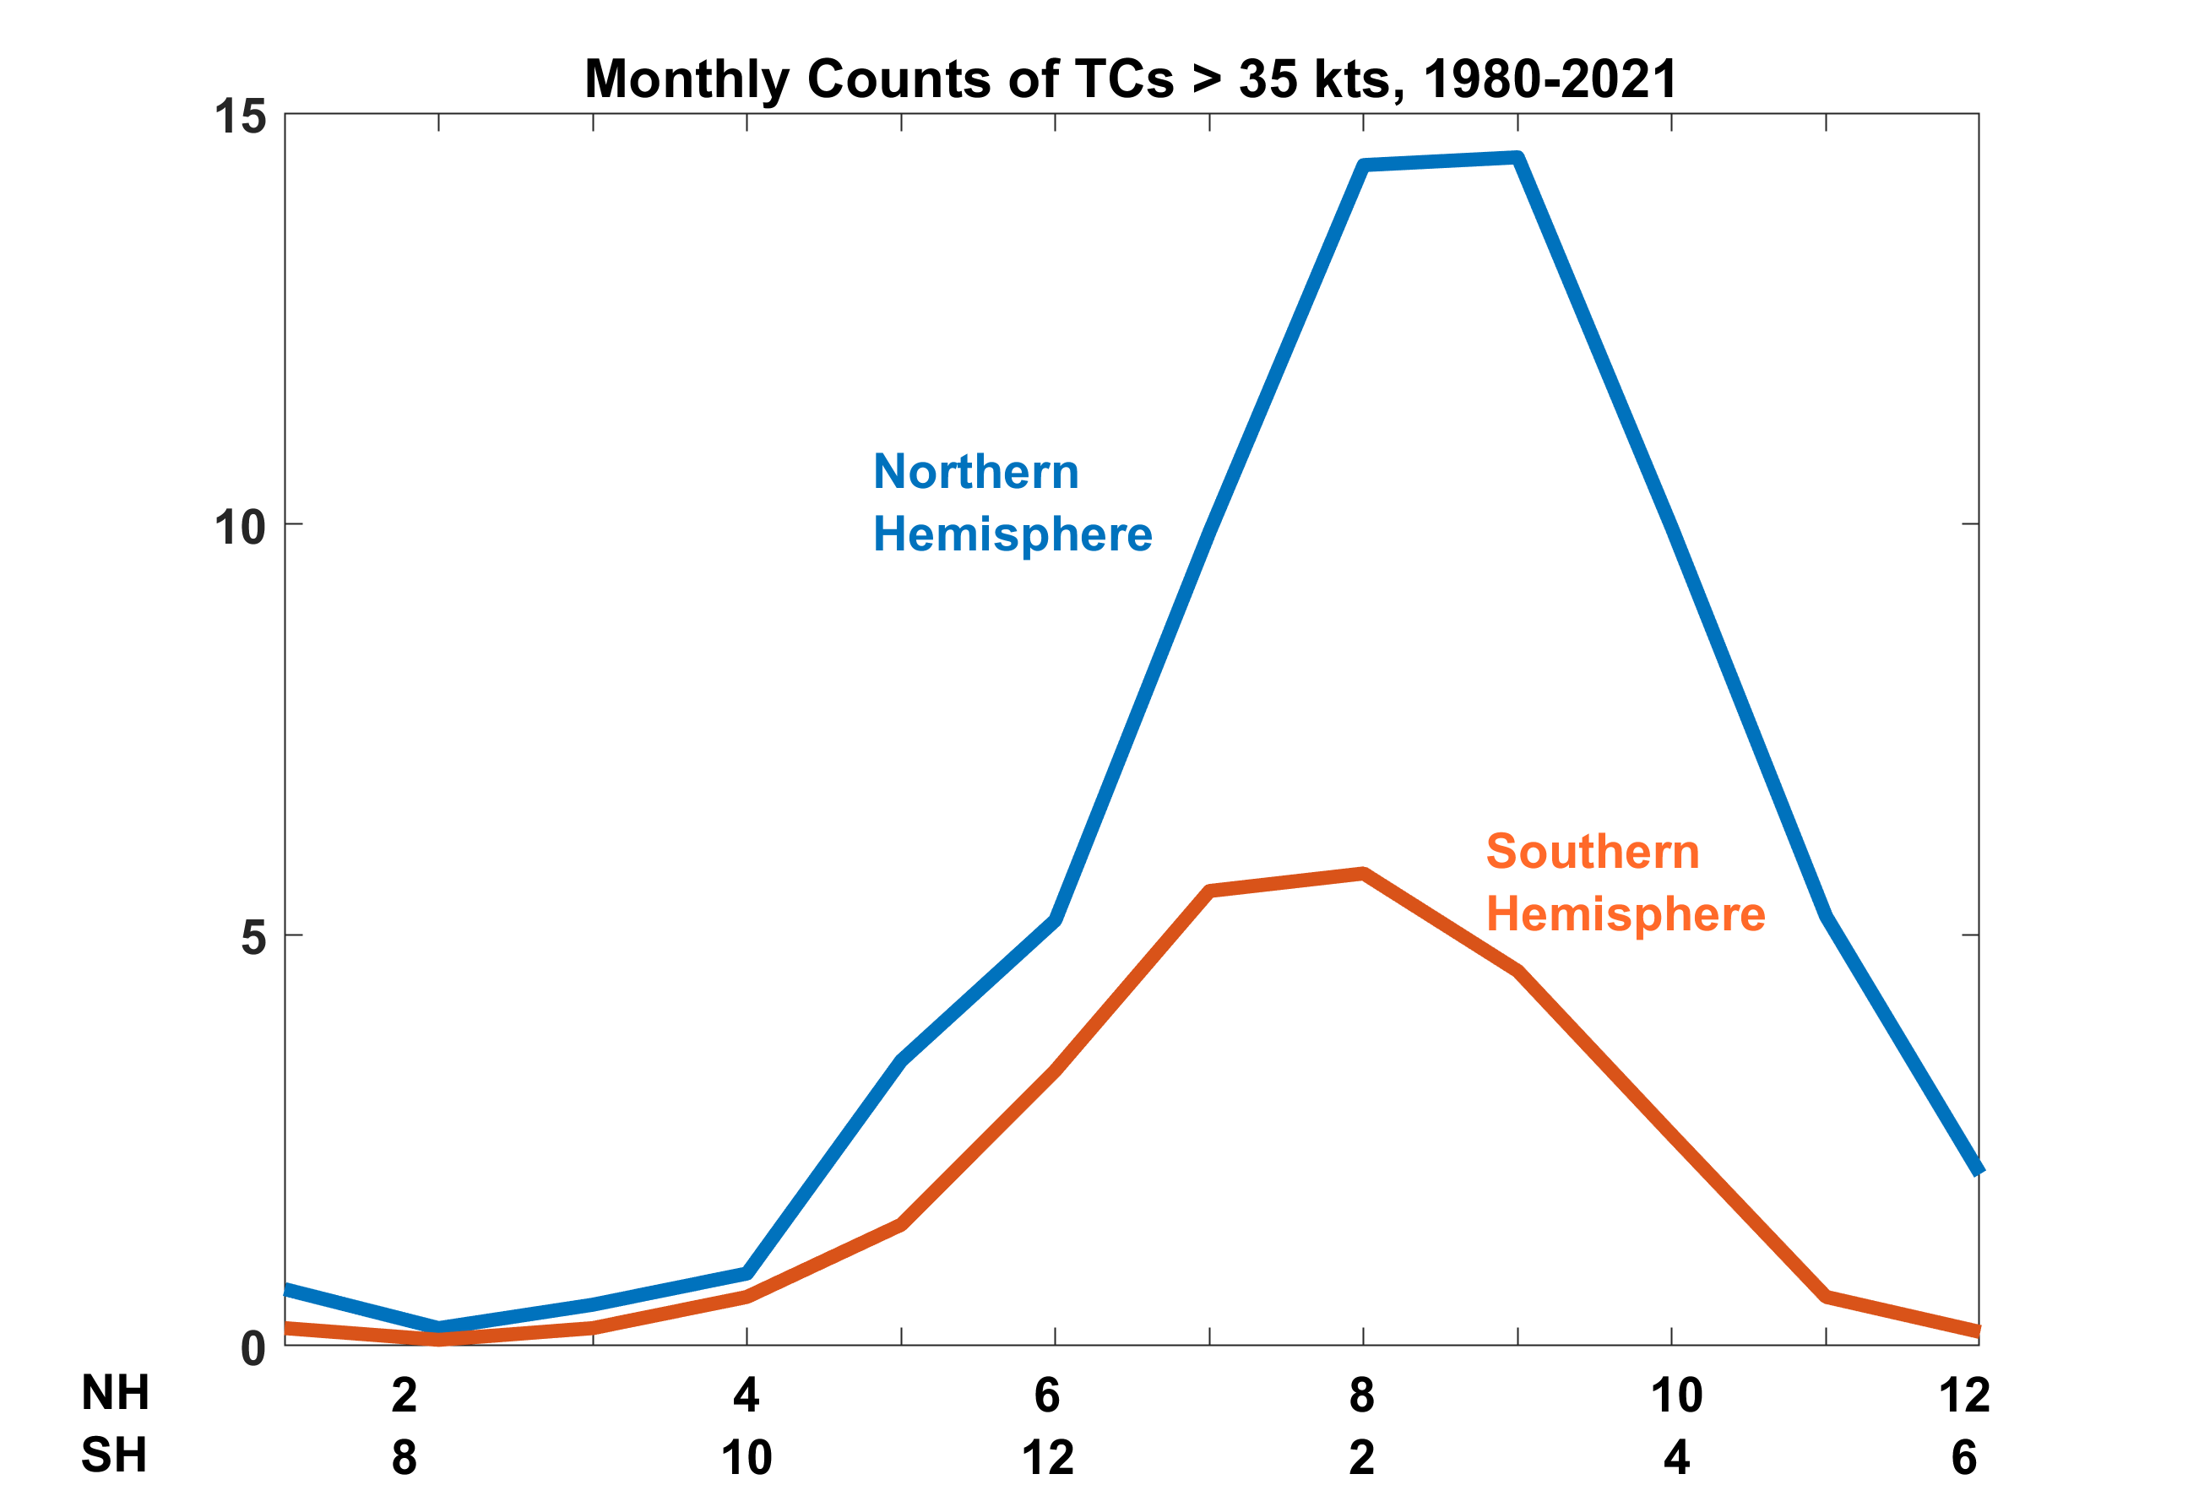

Slide 15
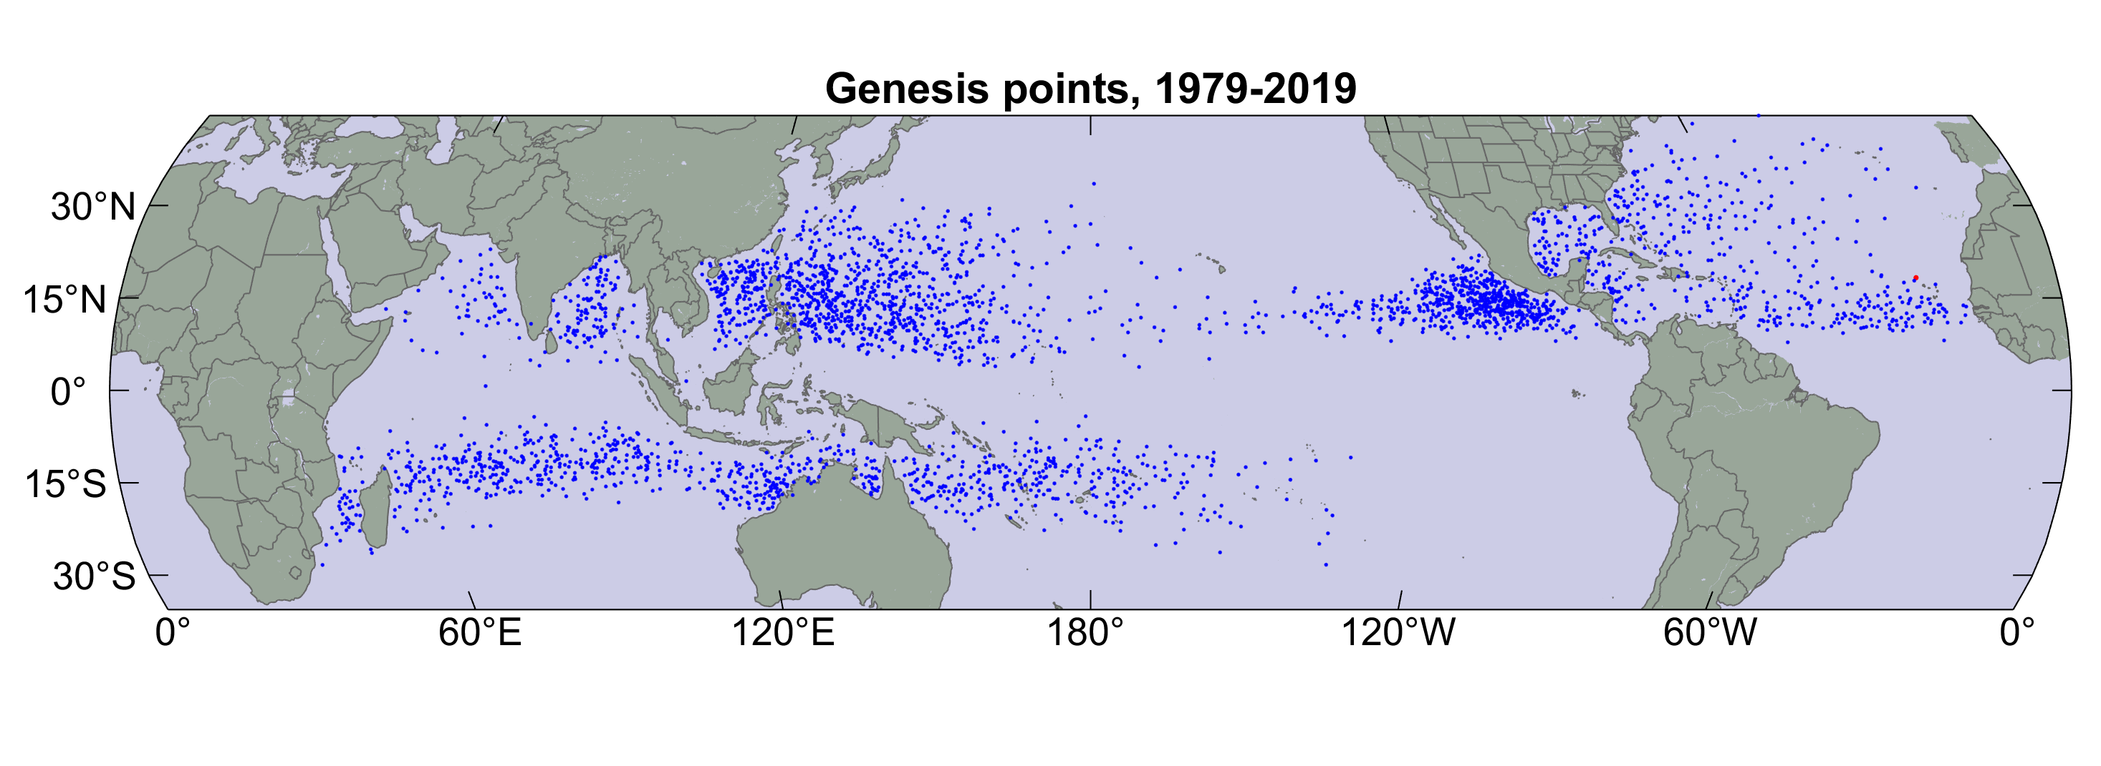

Slide 16
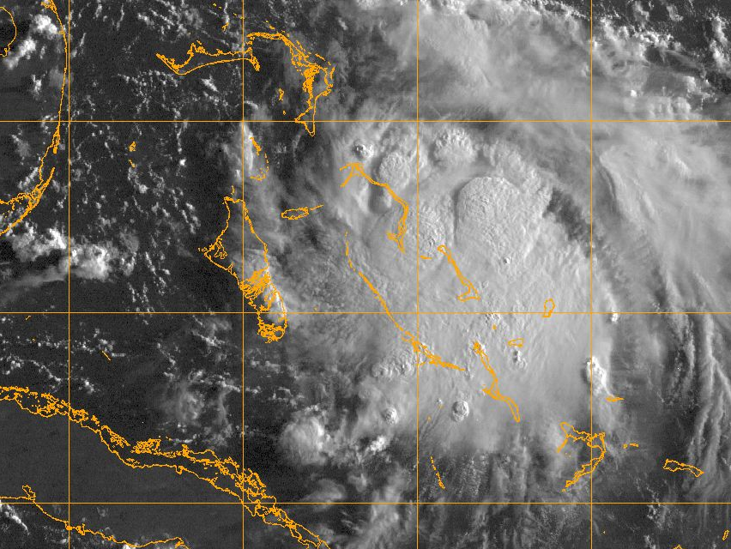
Two Distinct Threads of Genesis and Maintenance Theories

Slide 17
TC formation as a mode of release of conditional instability
  Espy (1841), The Philosophy of Storms
  Palmén (1948), On the formation and structure of tropical hurricanes
  Charney and Eliassen (1964): On the growth of the hurricane depression
  Yamasaki (1968): Numerical simulation of tropical cyclone development with the use of primitive equations
Example:
Numerous cumulonimbus clouds warm and gradually moisten their environment. This warming…produces a pressure fall at the surface, because warm air weighs less than cool air. The slowly converging horizontal winds near the surface respond to this slight drop of pressure by accelerating inward. But the increased inflow produces increased lifting, so that the thunderstorms become more numerous and intense. The feedback loop is now established.
-- from a textbook published in the late 1970s

Slide 18
Already in 1901 Julius von Hann voiced an objection:
“Since a thundercloud does not give any appreciable pressure fall [at the surface] but even a pressure rise, it would be unreasonable to assume that a magnifying of this process would cause the strongest pressure falls known”
-- As paraphrased by Bergeron, QJRMS, 1954

Slide 19
Diagram from Bergeron, QJRMS, 1954
z
x
y
x

Slide 20
TC formation as a surface flux-driven phenomenon
  Riehl (1950): A model for hurricane formation
  Kleinschmidt (1951): Principles of the theory of tropical cyclones (in German)
  Ooyama (1969): Numerical simulation of the life cycle of tropical cyclones (Note: A foot in both camps)
  Rosenthal (1971): The response of a tropical cyclone model to variations in boundary layer parameters, initial conditions, lateral boundary conditions, and domain size
  Gray (1975): Tropical Cyclone Genesis. (First to note role of cloud-radiation interactions)
Example:
The heat removed from the sea by the storm is the basic energy
source of typhoon. In comparison to it, the latent heat of the water vapor, which the air carries with it from the outside, plays no more than a secondary role.
- Ernst Kleinschmidt, 1951

Slide 21
Program
What distinguishes tropical cyclones from other forms of convection
What we know about tropical cyclone intensity and rainfall
History of genesis research
The genesis enigma

Slide 22
The Local View

Slide 23
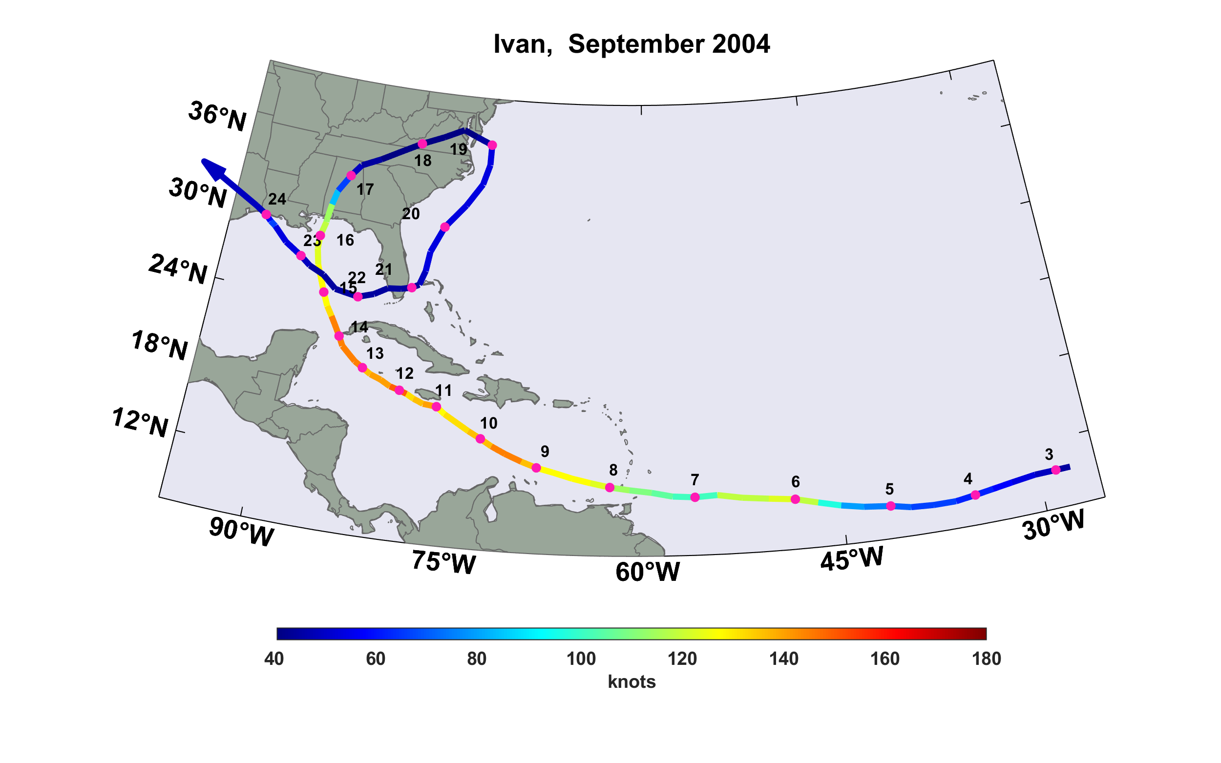
Case Study: Hurricane Ivan, 2004

Slide 24
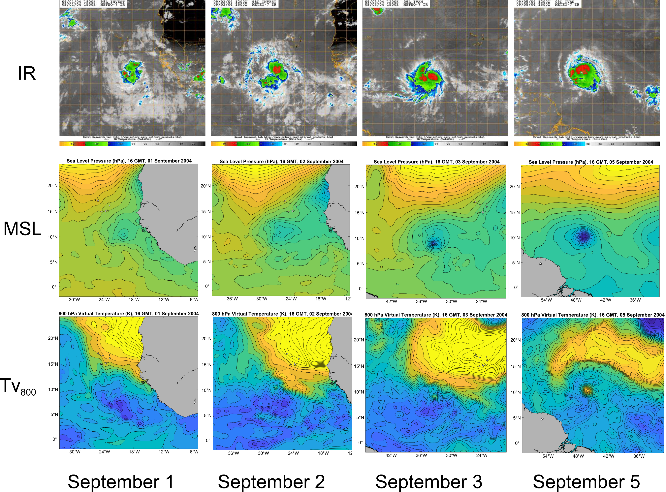

Slide 25
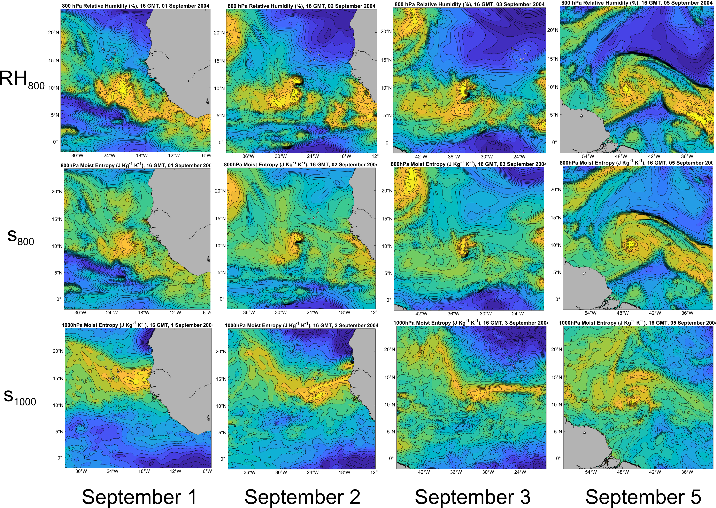

Slide 26
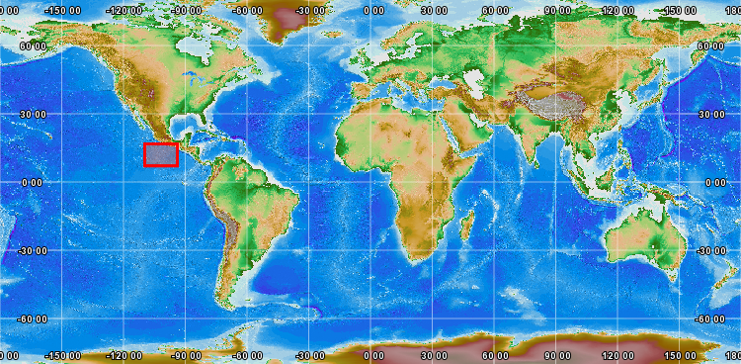
Tropical Experiment in Mexico (TEXMEX)
Summer of 1991

Slide 27
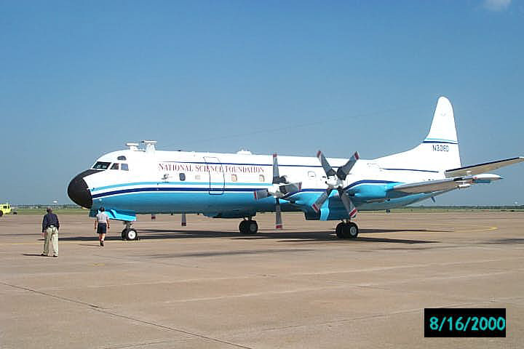

NSF/NCAR Lockheed Electra
NOAA Lockheed P3 Orion

Slide 28
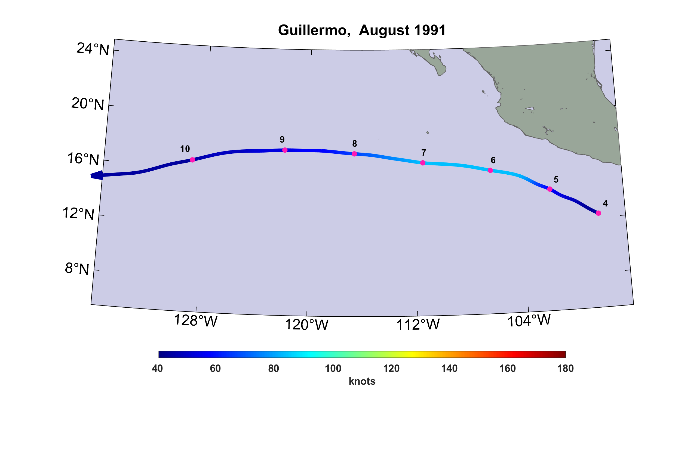
Genesis of Eastern North Pacific Hurricane Guillermo, August, 1991
Acapulco

Slide 29
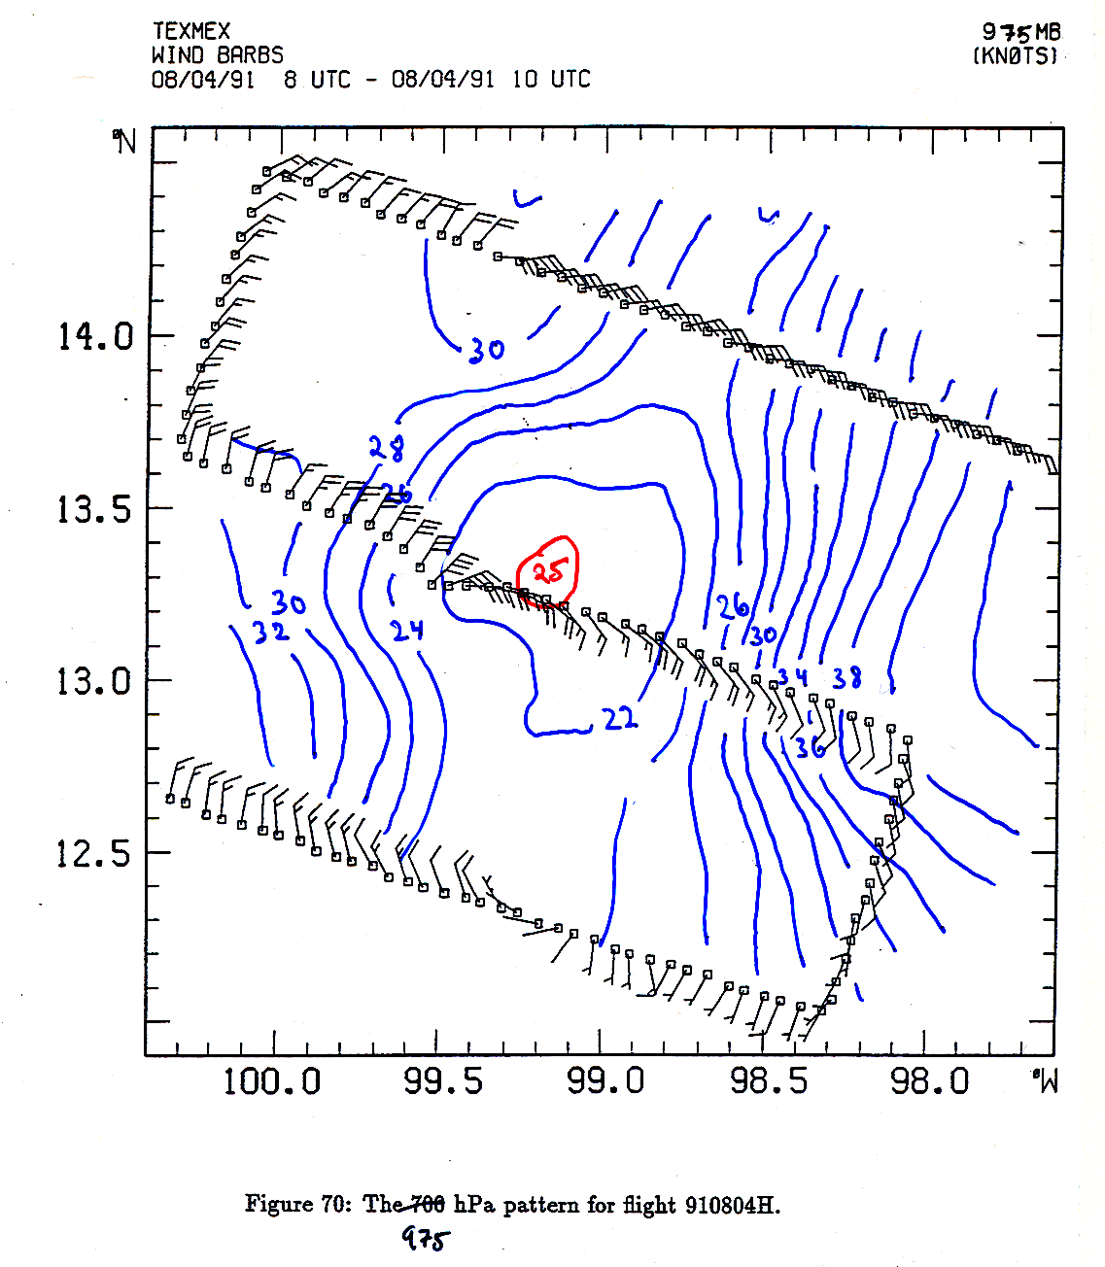
Flight level winds at 975 hPa and temperature
(blue in tenths + 20)
August 4 1991
08-10 UTC
Analysis by Marja Bister
And K. Emanuel

Slide 30
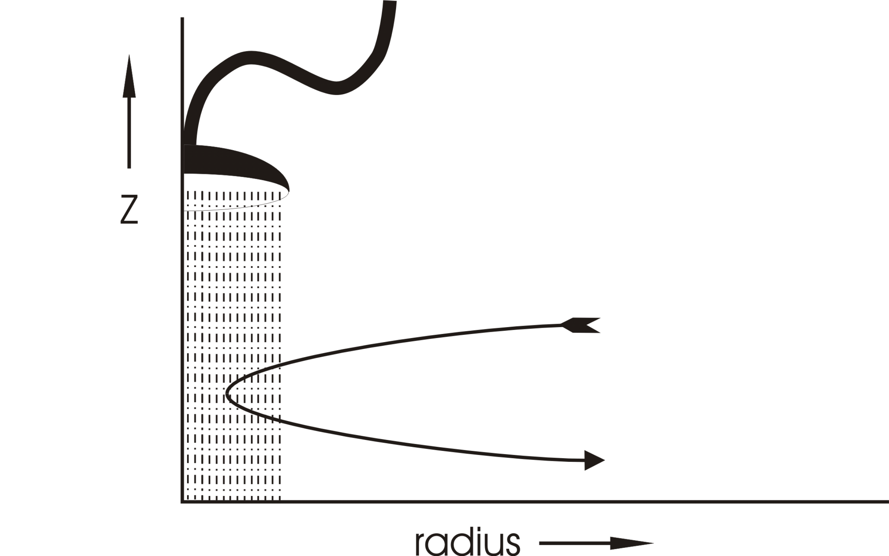
Configuration of a “showerhead” inserted into the center of the nonhydrostatic, axisymmetric model of Rotunno and Emanuel (1987)

Slide 31
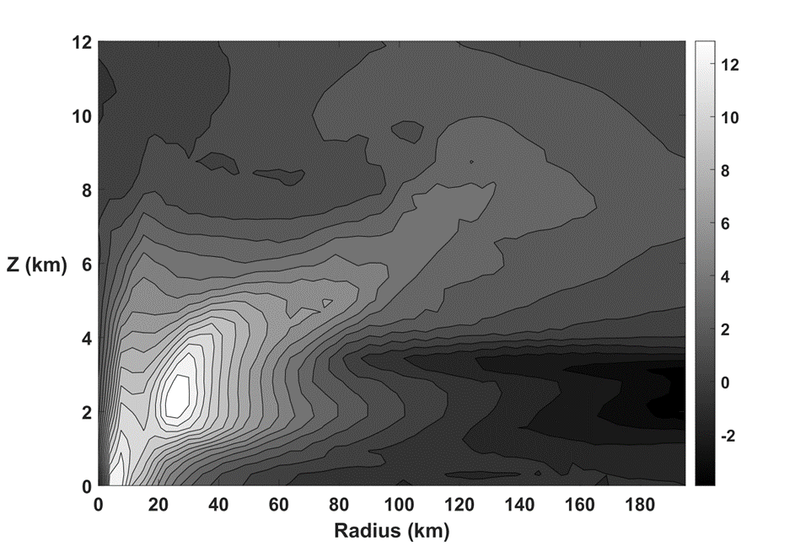
Cross-section of azimuthal wind speed (m s⁻¹) at about the time that a warm core vortex appears within the broader cold-core mesocyclone in a simulation using the non-hydrostatic, axisymmetric model of Rotunno and Emanuel (1987).

Slide 32
The Thermodynamic Inhibition to Genesis

Slide 33
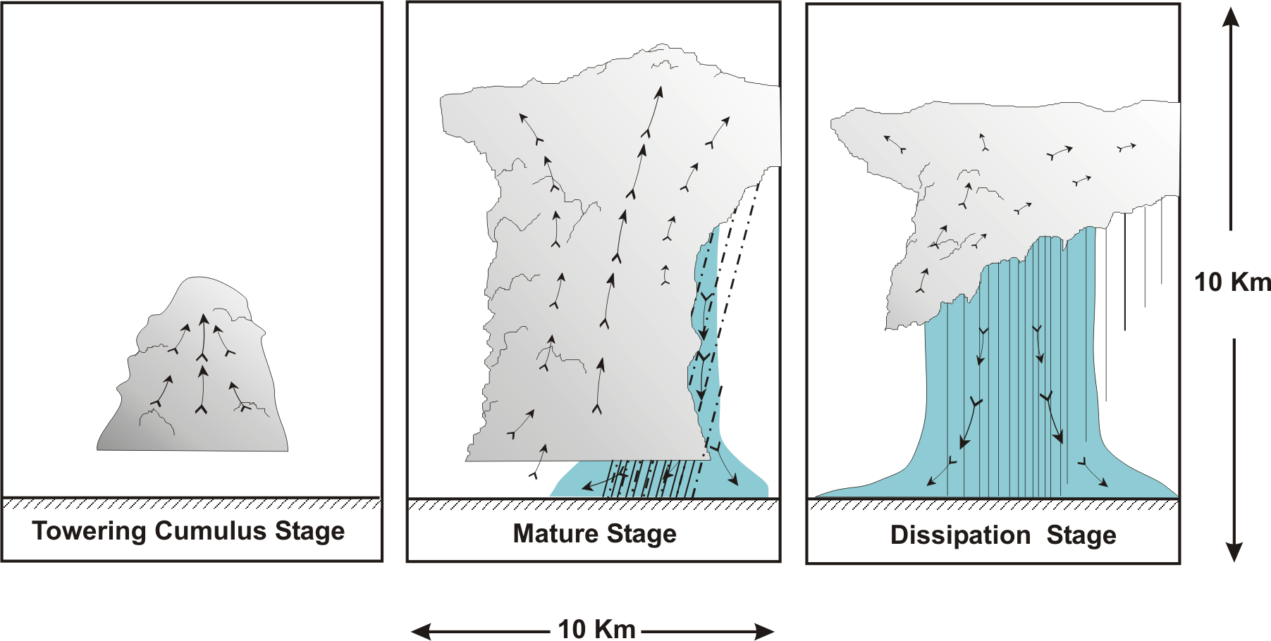
“Air-Mass” Showers:
After Byers and Braham, 1948

Slide 34
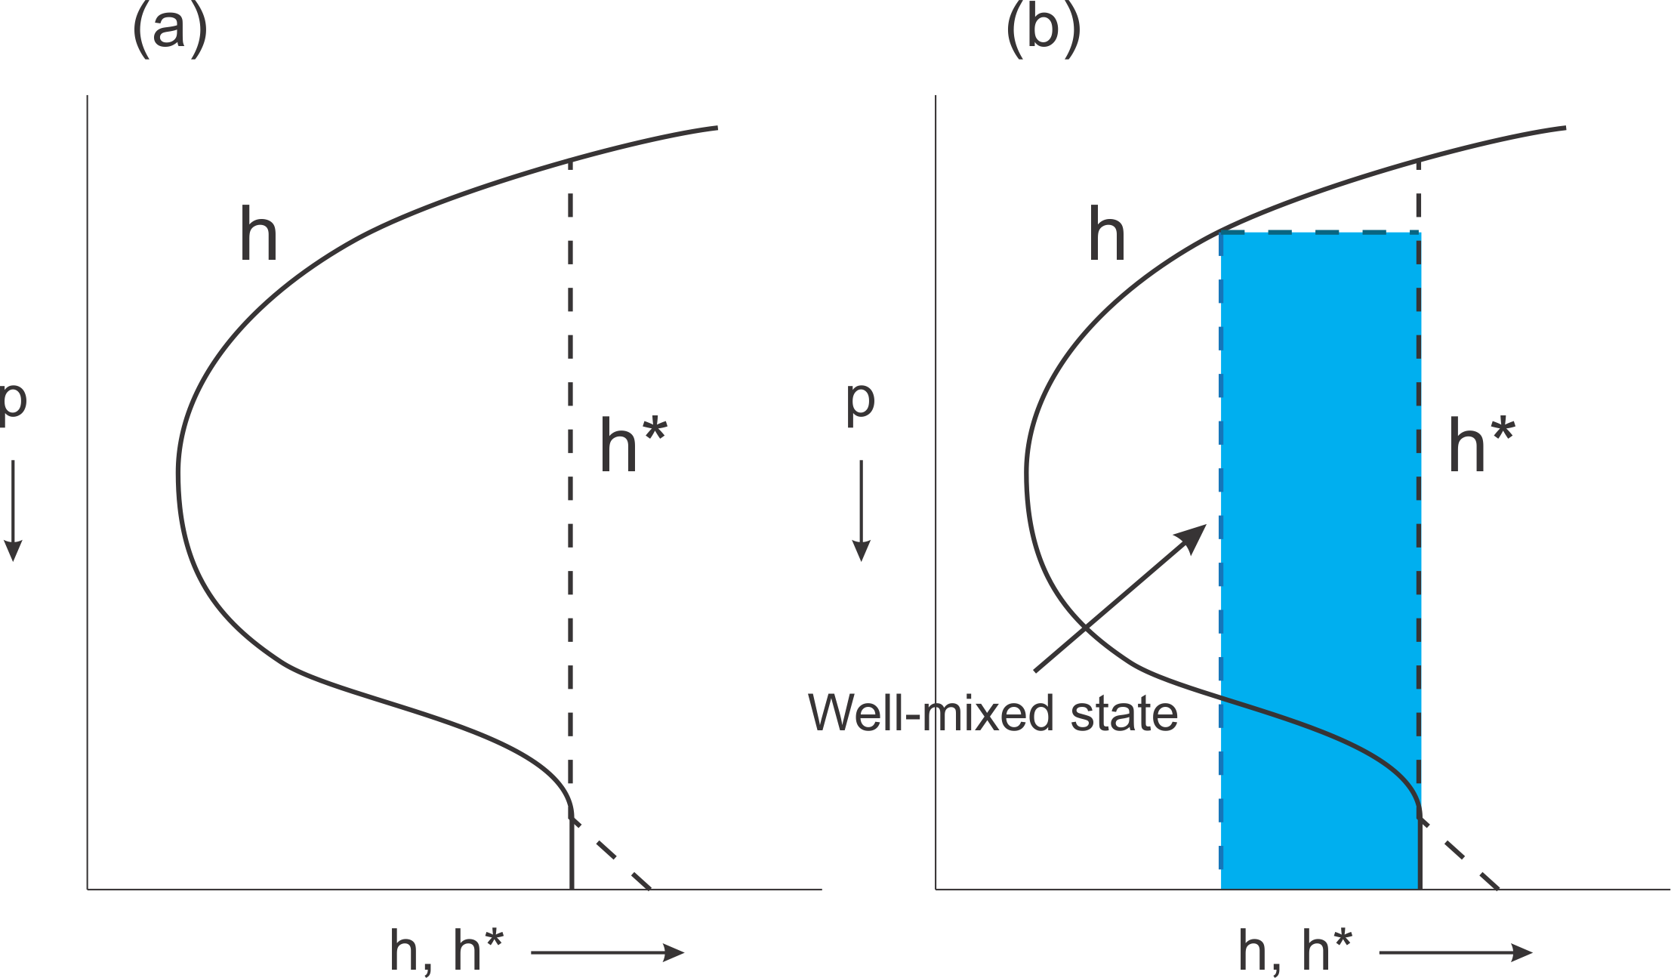
To overcome thermodynamic inhibition, mesoscale column must come close to saturation. How does that happen?
Saturation at SST

Slide 35
The Global View

Slide 36
Genesis Indices
Pioneered by Bill Gray (1975)

Slide 37
A Genesis Potential Index:
850 hPa absolute vorticity (h)
850 – 250 hPa shear (S)
Potential intensity (PI)
Non-dimensional subsaturation of the middle troposphere:

Slide 38
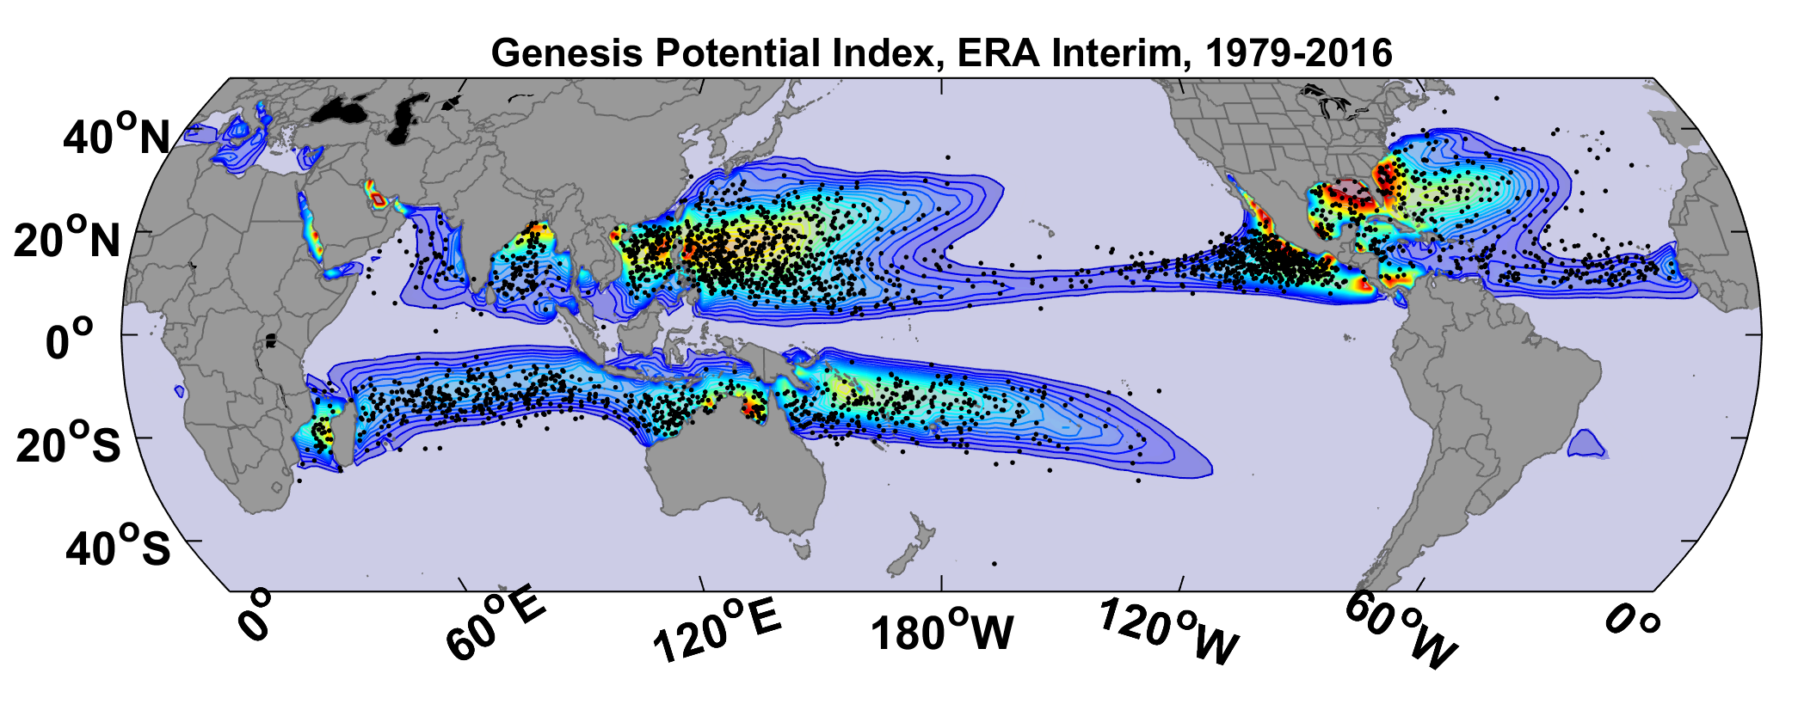
GPI from ERA-Interim Data, 1979-2016, with Observed Genesis Points

Slide 39
Seasonal Cycle
Genesis Potential Index from ERA5 reanalysis, 1979-2018 vs. Observed TCs, 1980-2018

Slide 40
Random Seeding and Natural Selection
Seed time-evolving, global state with very weak tropical cyclone seeds
Random in space and time
Seeds move with prevailing large-scale winds plus a correction for earth’s rotation
Coupled ocean-atmosphere, very high resolution model used to calculate disturbance intensity
Throw out seeds that fail to develop

Slide 41
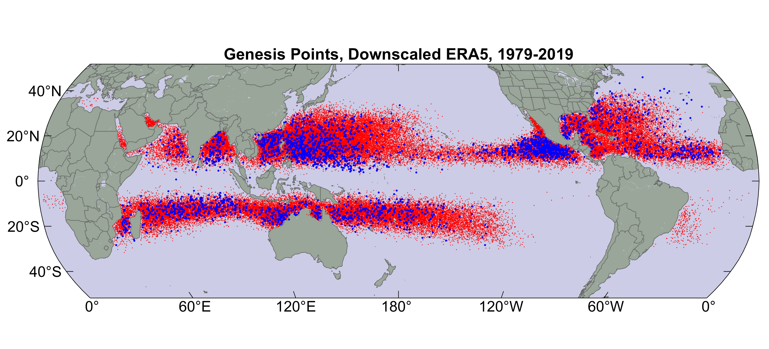
Origin points of successful seeds (red); observed genesis locations (blue)

Slide 42
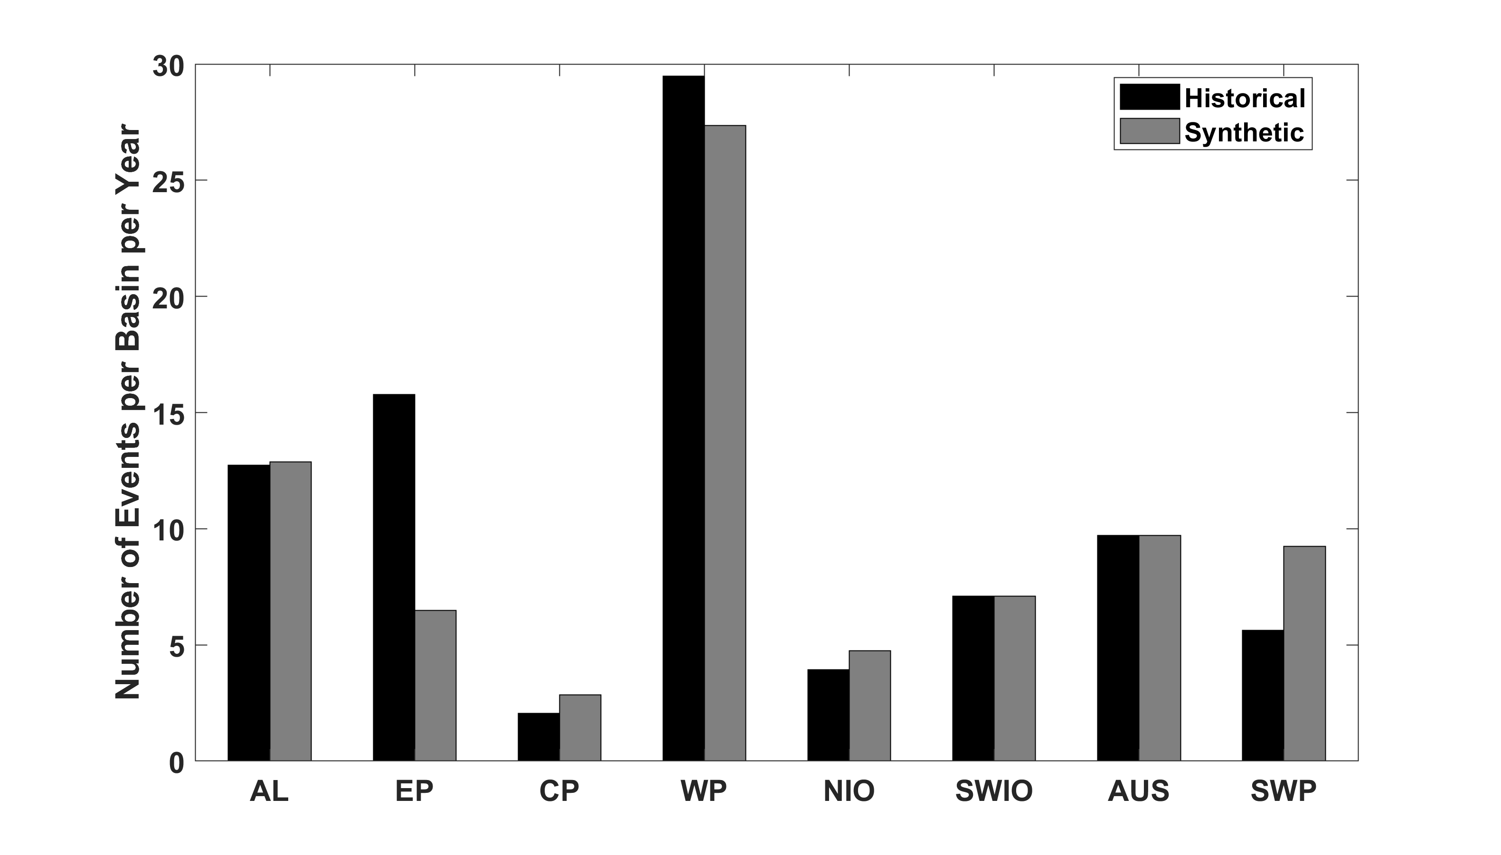
Average annual number of tropical cyclones over the period 1980-2020 in observations (IBTrACS; Knapp et al. 2010; black bars) and from random seeding of ERA-5 (gray bars)

Slide 43
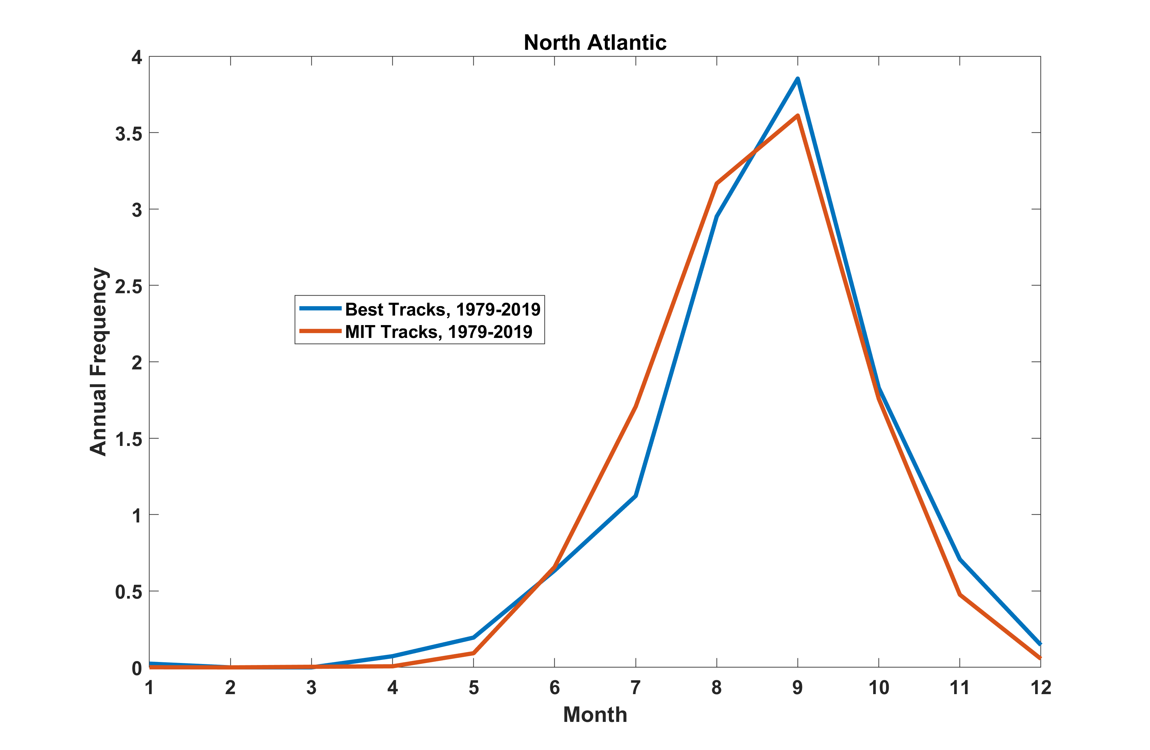
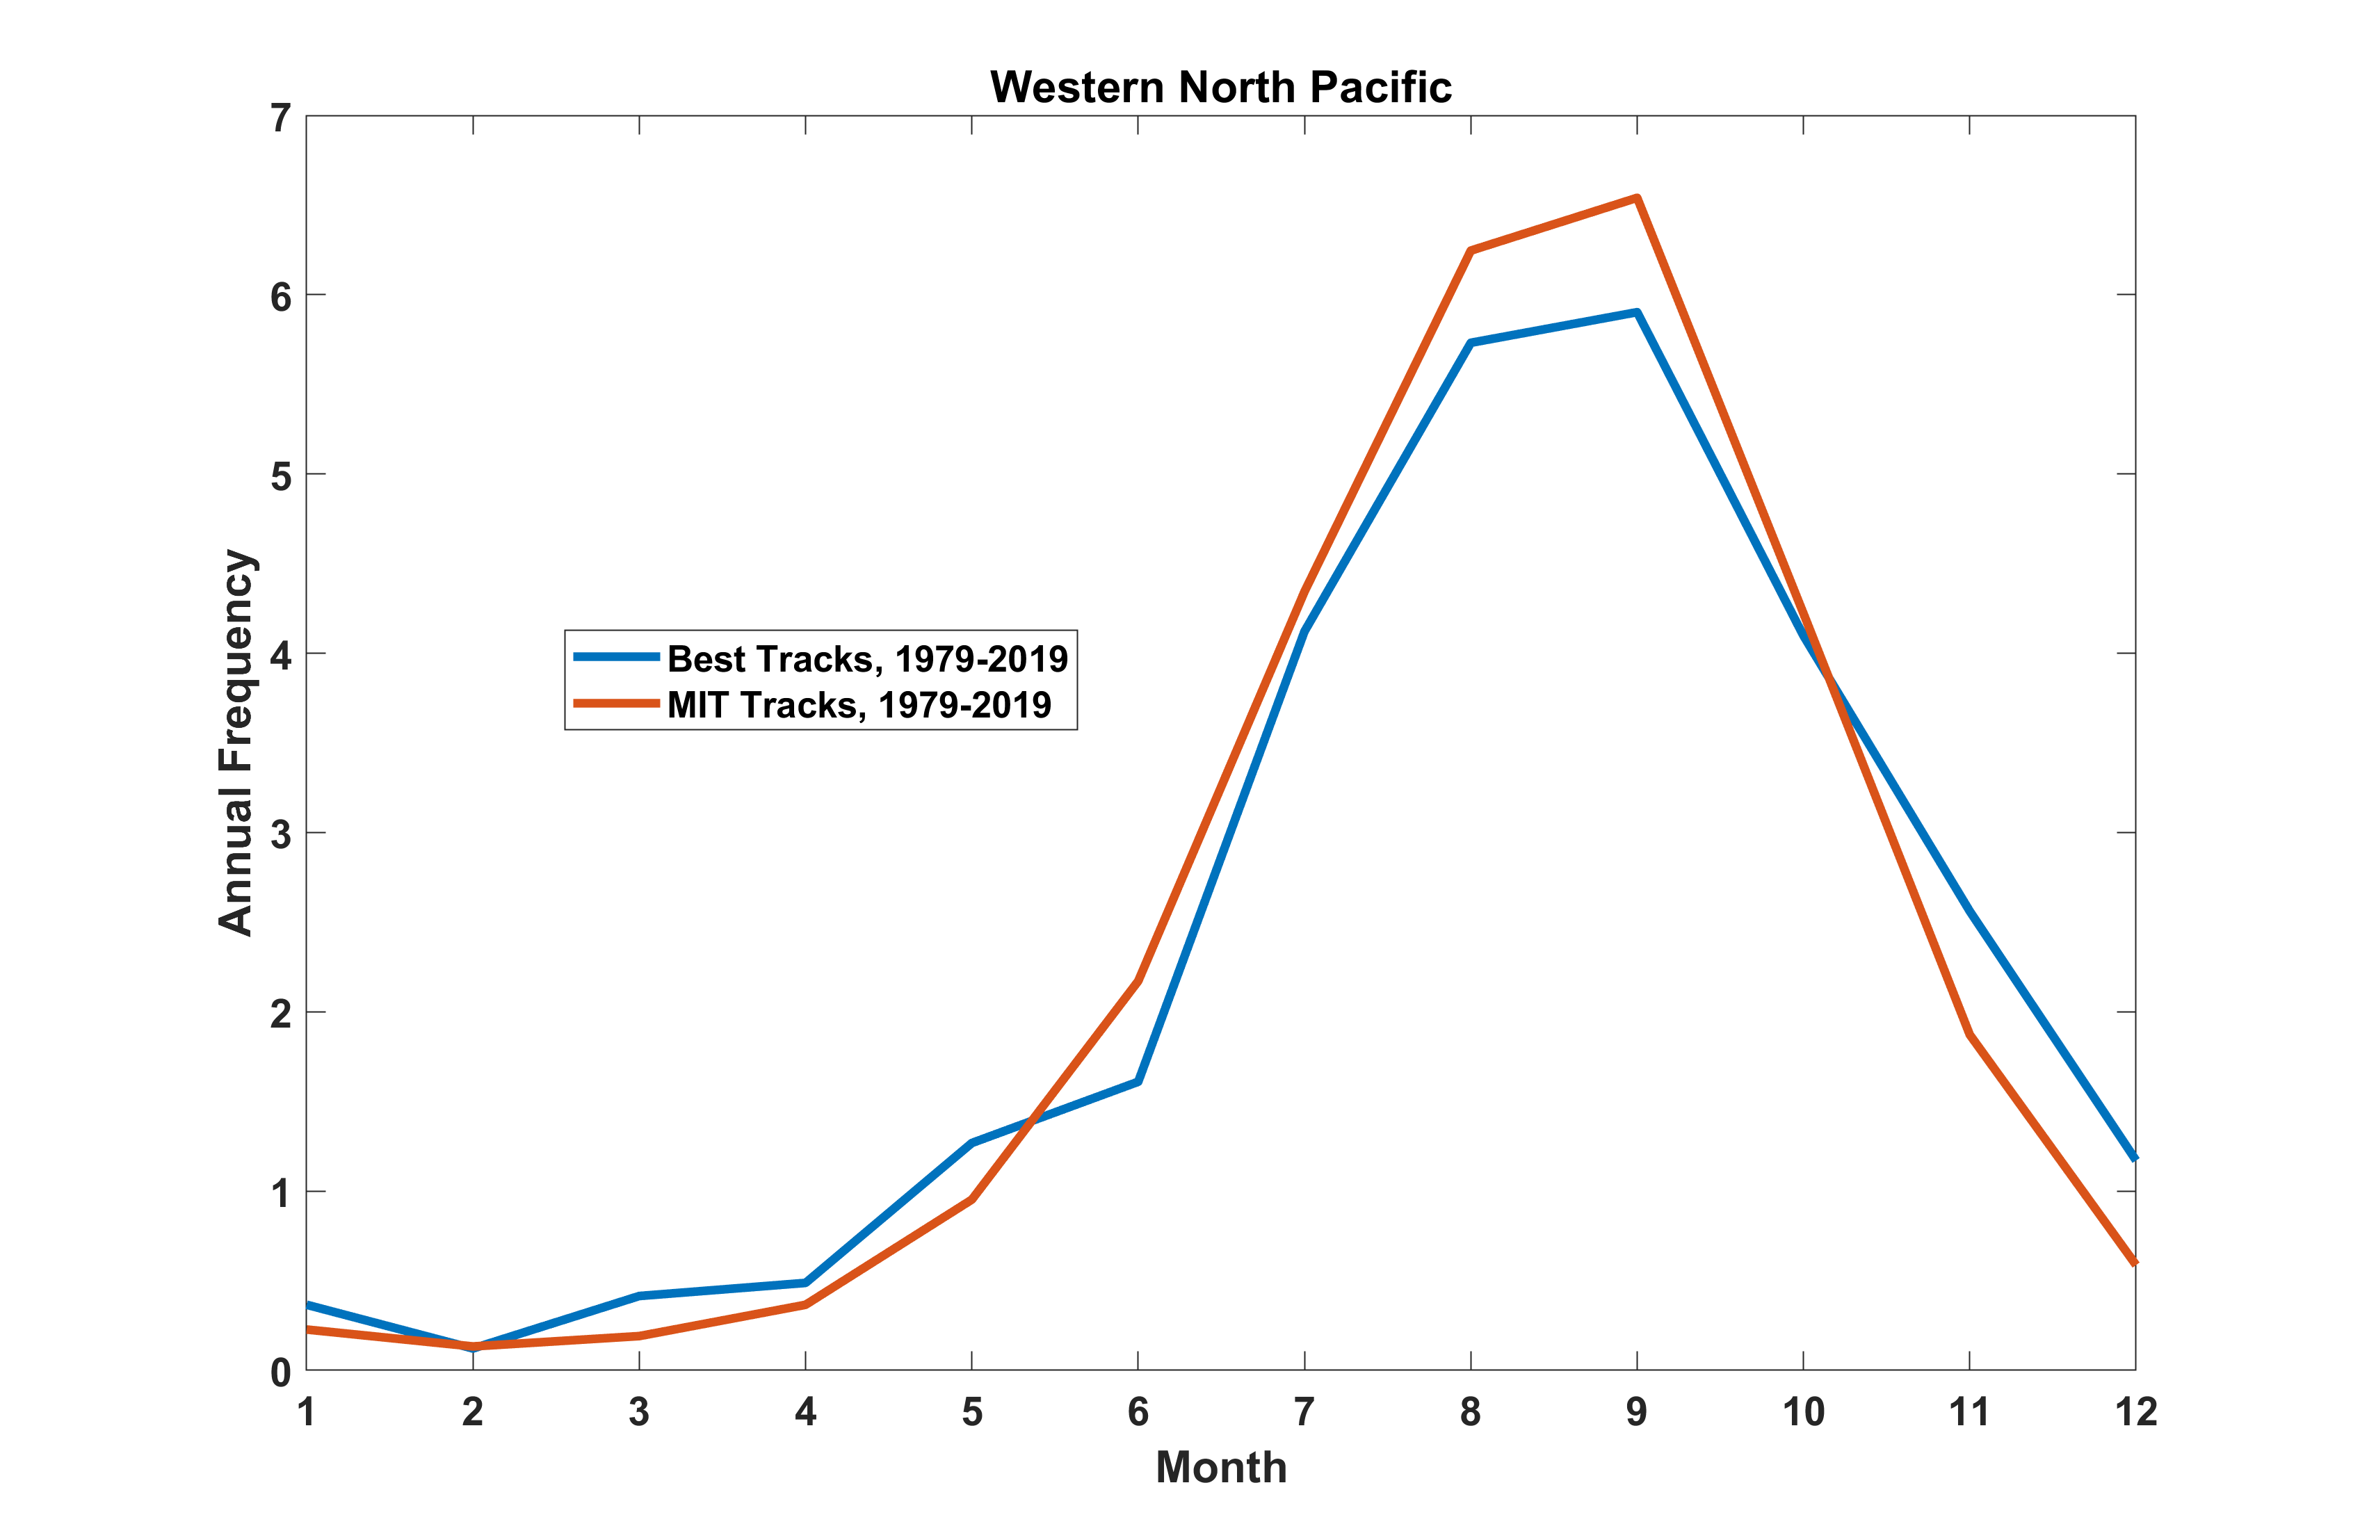
Seasonal Cycle
North Atlantic
Seasonal Cycle
Northwest Pacific

Slide 44
Three Views on Genesis Rates
1) Genesis requires favorable large-scale environment and suitable initiating disturbances; rates affected by both
2) TC numbers reflect how many storms can be packed into a region of favorable large-scale environment, independent of triggering disturbances
3) Global TC numbers determined by a self- organized critical process involving feedbacks of TCs on climate

Slide 45
Early researchers recognized that genesis must depend on a combination of environmental favorability and the presence of initiating disturbances
“The origin of tropical disturbances cannot be explained solely from the local structure of the air masses in which the vortex motion develops. A suitable combination of external forces and local conditions is necessary” – Riehl and Burgner (1950)
This is the prevailing view today

Slide 46
Contemporary support for this view:
Sugi et al. (2020): Examined TCs in high-resolution global models; showed that TC rates largely determined by frequency of seeds, defined as disturbances with max winds of 20-35 kts
Hsieh et al. (2020) used a 50-km resolution AGCM and showed that the frequency of simulated TCs can be well described by n_{tc} = n_{c} x P₁ x P₂, where
  n_{c} = frequency of non-rotating clusters
  P₁ = probability of transition to seeds
  P₂ = probability of transition from seeds to TCs
They formulated n_{c}, P₁ and P₂ as functions of large-scale model variables, so that net rate could be regarded as a genesis index. But innovation here is that different physics may operate at different stages of TC evolution.

Slide 47
BUT………

Slide 48
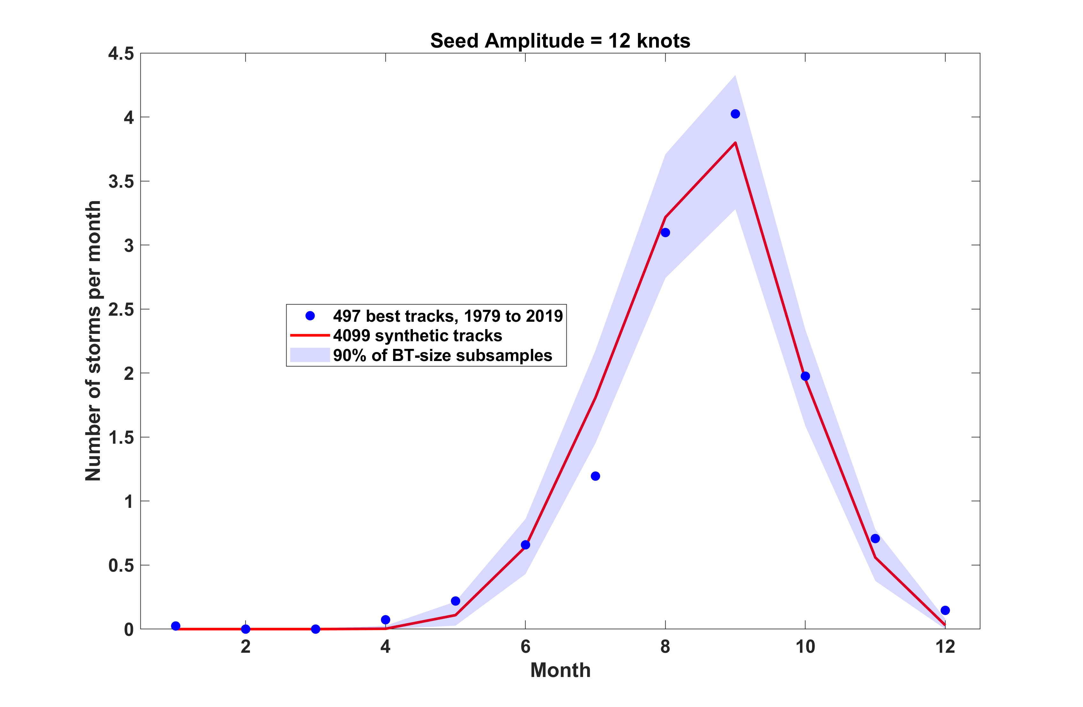
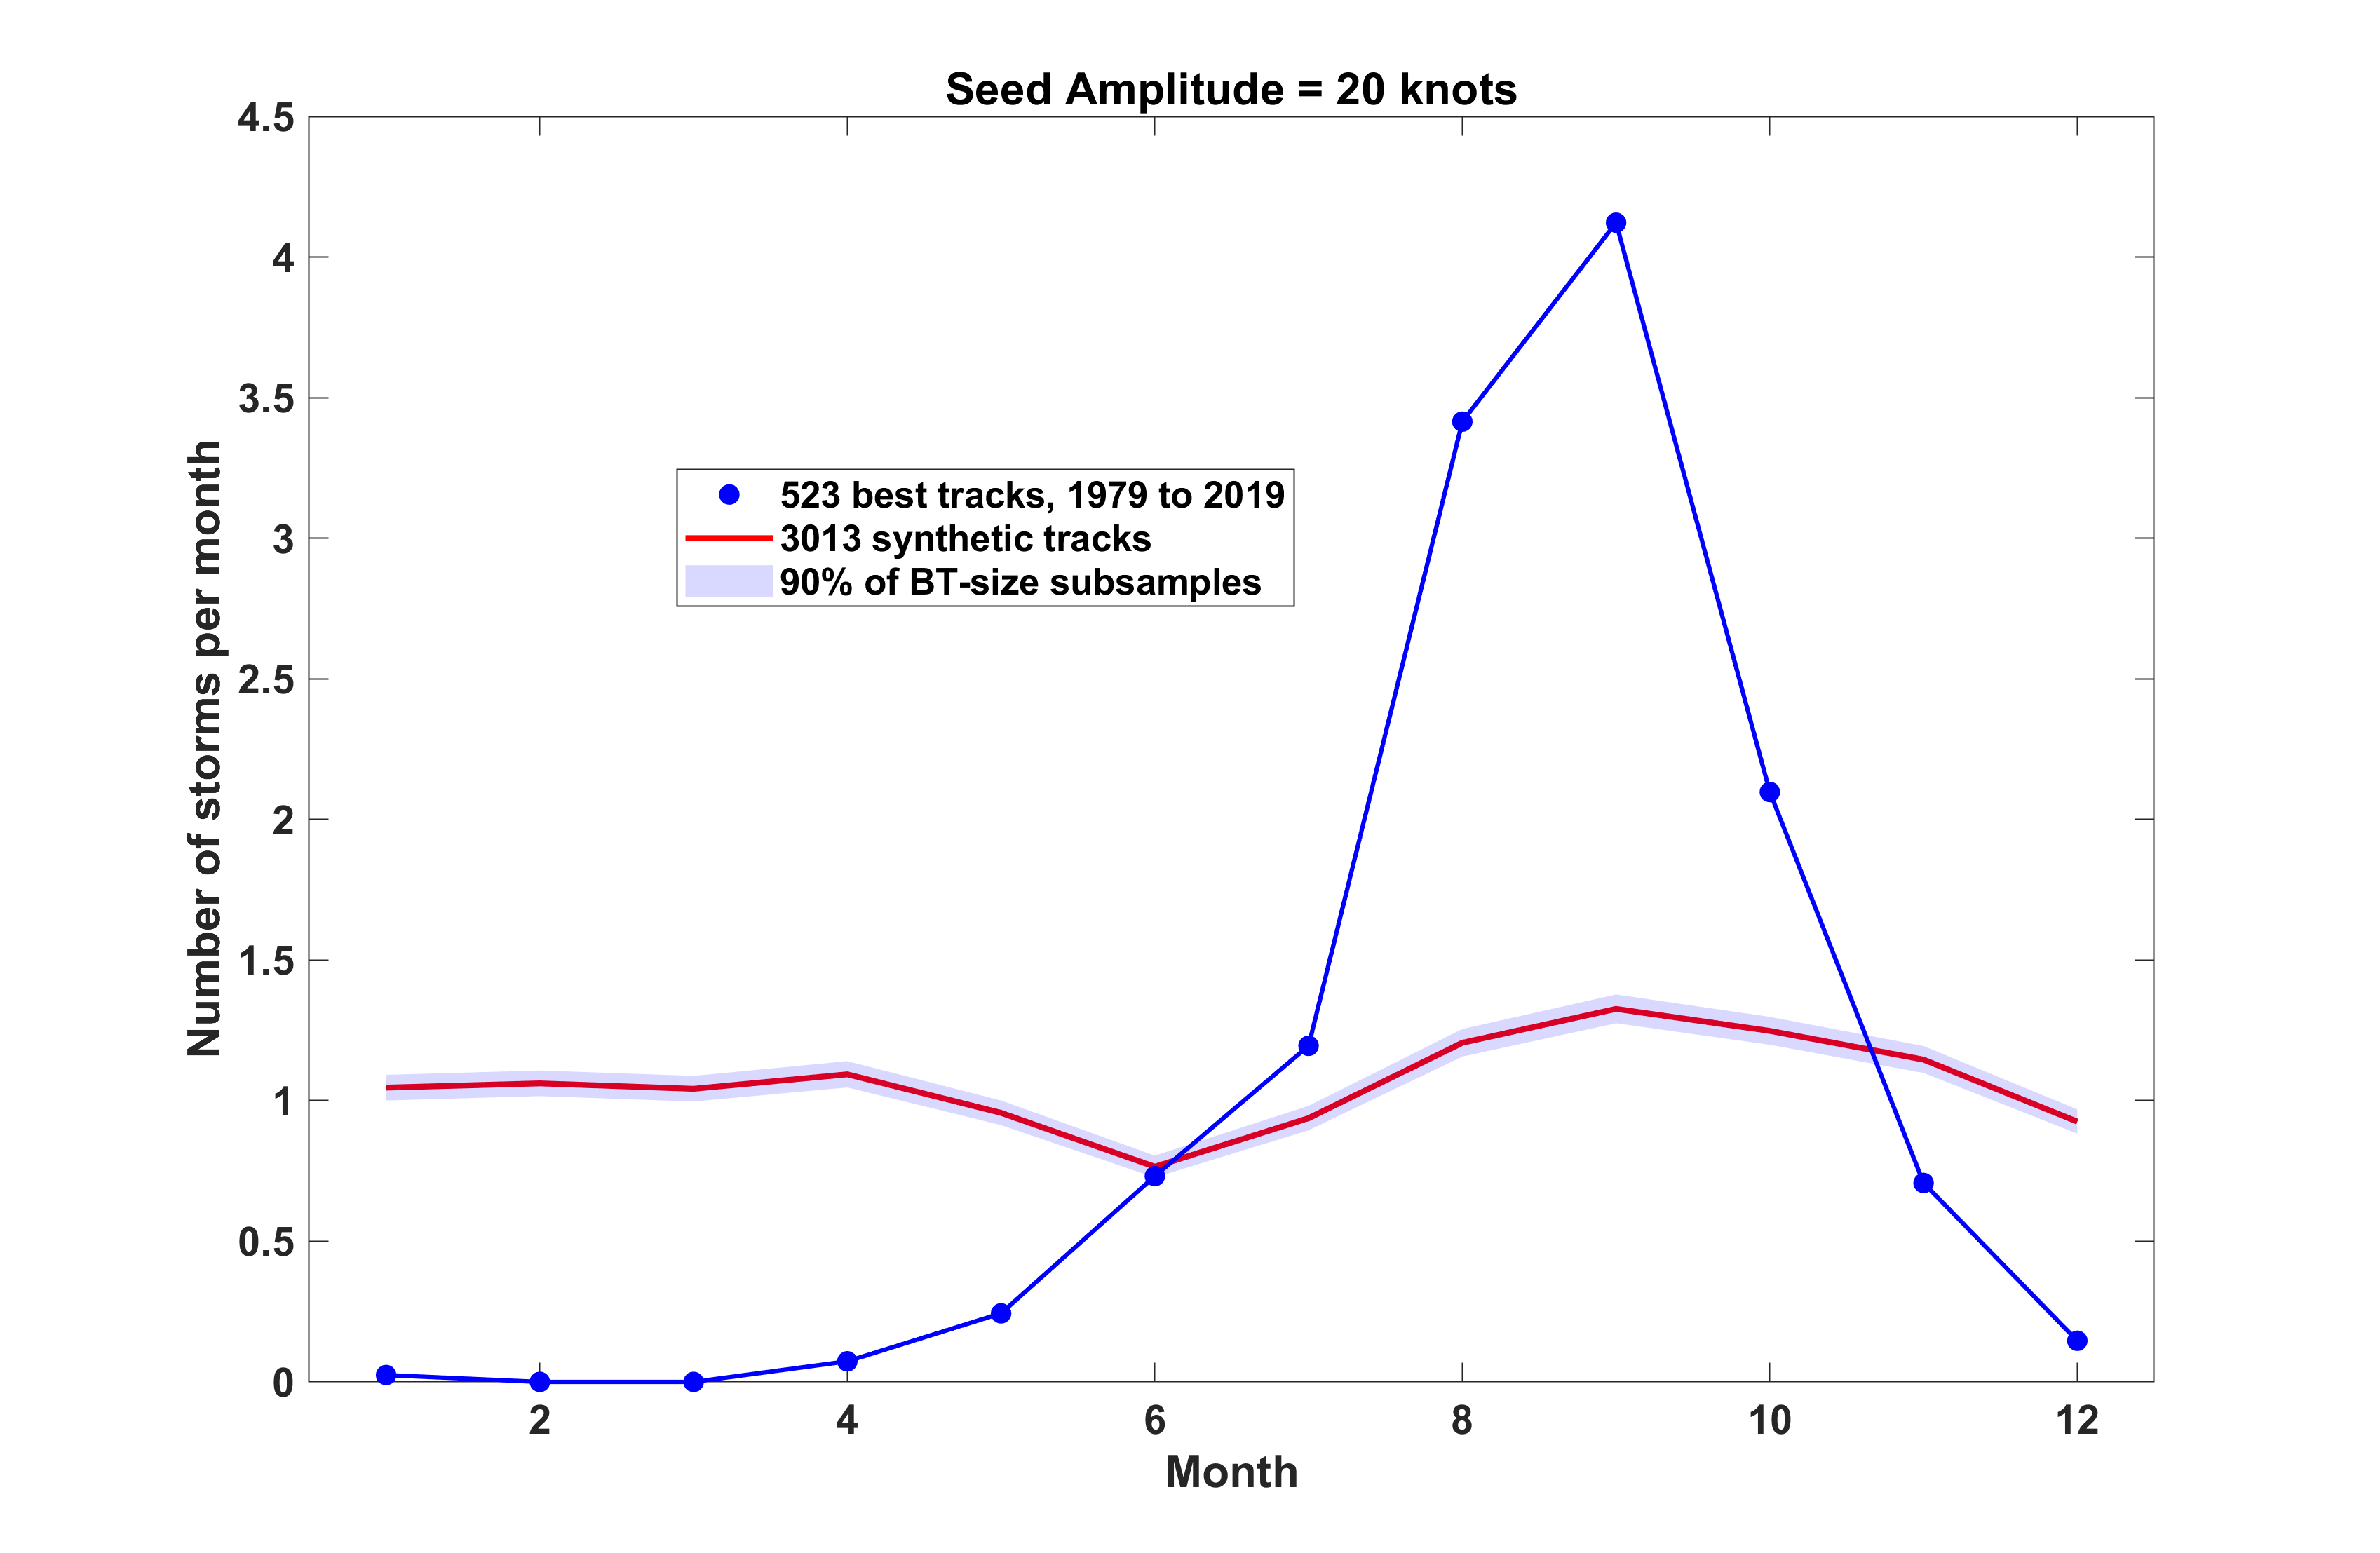
In random seeding, selection does not work if seeds too strong
Seed amplitude = 12 knots
Seed amplitude = 20 knots

Slide 49
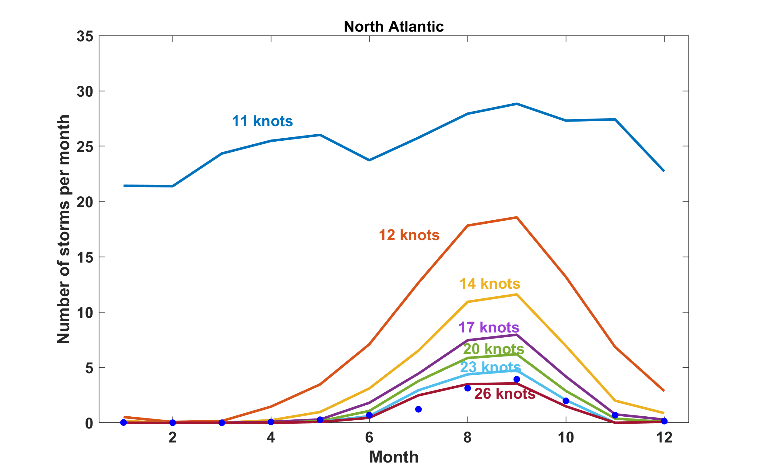
Selection in Action
The annual average monthly frequency of simulated storms whose lifetime maximum circular wind speed exceeds the values labeled on the curves, from the weak seed simulation. Blue dots are from historical observations.
Emanuel (2022)

Slide 50
Do African Easterly Waves Control Atlantic TC Frequency?
Experiments with a regional model forced by reanalysis boundary conditions
(a) The regional climate model domain. The blue rectangle denotes the latitude over which a 2–10 day Lanczos filter was applied to the eastern LBC in the AEW suppressed experiment. (b) The time series of 6-hourly meridional wind (m/s)
at 15°N, 15°W (denoted by star in Figure 1a) and 700 hPa prescribed in the eastern LBC for the (black) control simulation and (blue) AEW suppressed experiment.
Patricola et al., 2017, Geophysical Research Letters, 45, 471–479

Slide 51
Results with 10-member ensembles
Note: With African easterly waves, location and timing of genesis highly correlated among the ten ensemble members.
Without AEWs, location and timing uncorrelated among the ensemble members
Patricola et al., 2017, Geophysical Research Letters, 45, 471–479

Slide 52
If global TC rate is not controlled by “seed” frequency, then what does control it?

Slide 53
Hypothesis advanced by Hoogewind, Chavas, Schenkel, and O’Neill, 2020:
Actual global TC count is a packing problem conditioned on places and times that large-scale environment is favorable
Still overestimates the observed global tropical cyclone frequency by an order of magnitude

Slide 54
Third Possibility:
TC-Climate Feedback
TCs depend on high potential intensity, low shear, humid troposphere
Aggregated convection dries out troposphere in models (Bretherton and Khairoutdinov, 2005), opening IR window, lowering both potential intensity and increasing genesis inhibition
Aggregation is observed to dry out troposphere (Tobin et al., 2012, 2013; Holloway et al. (2017); Stein et al.,2017; Bony et al., 2020)
Vu et al. (2021) used a tropical channel version of WRF to show that episodes of high TC activity are preceded by high GPI and followed by lower GPI, with much of the effect on GPI through mid-tropospheric water vapor
In addition, strong TCs mix cold water to the surface, leading to an export of ocean heat energy to colder regions
These are negative feedbacks on TCs themselves, possibly leading to self-regulation of both TCs and climate (Khairoutdinov and Emanuel, 2010, Mauritsen and Stevens, 2015)

Slide 55
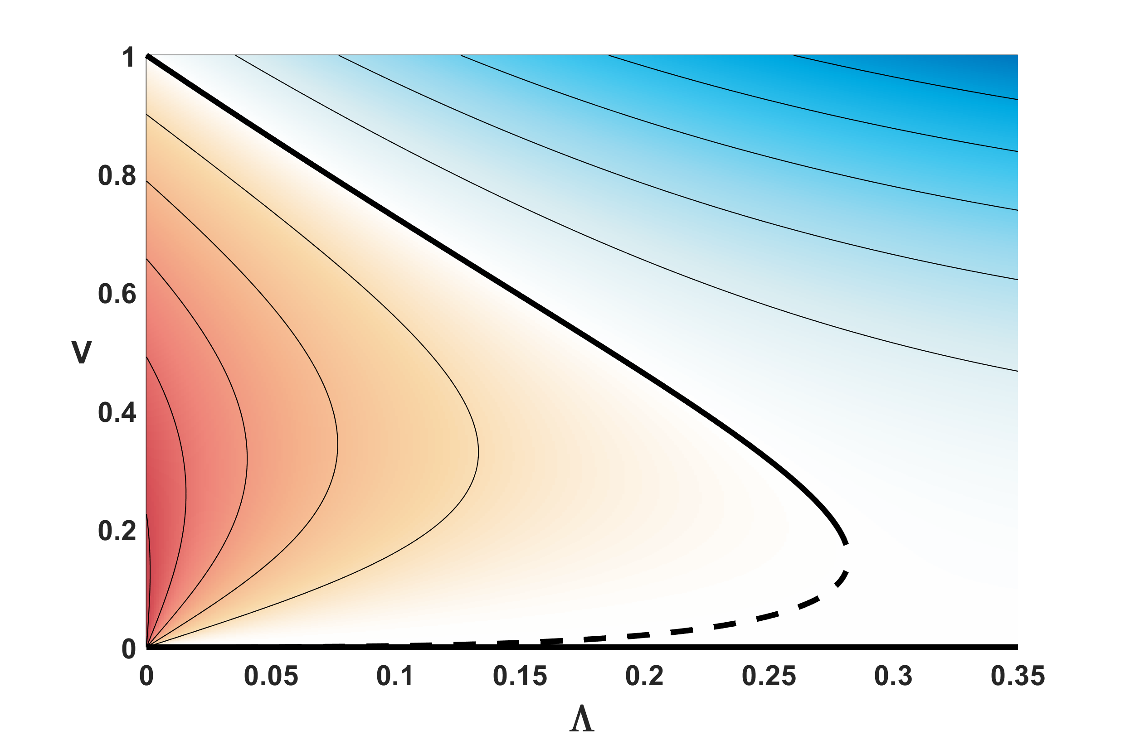
Manifold of the FAST nonlinear hurricane intensity model
Warm colors indicate intensification; cold colors denote decaying solutions
Growth rates are for nullcline of core moisture variable
Non-dimensional
Surface wind speed
Non-dimensional ventilation parameter (shear)
Emanuel, K., 2017: A fast intensity simulator for tropical cyclone risk analysis. Nat. Hazards, https://doi.org/10.1007/s11069-017-2890-7.

Slide 56
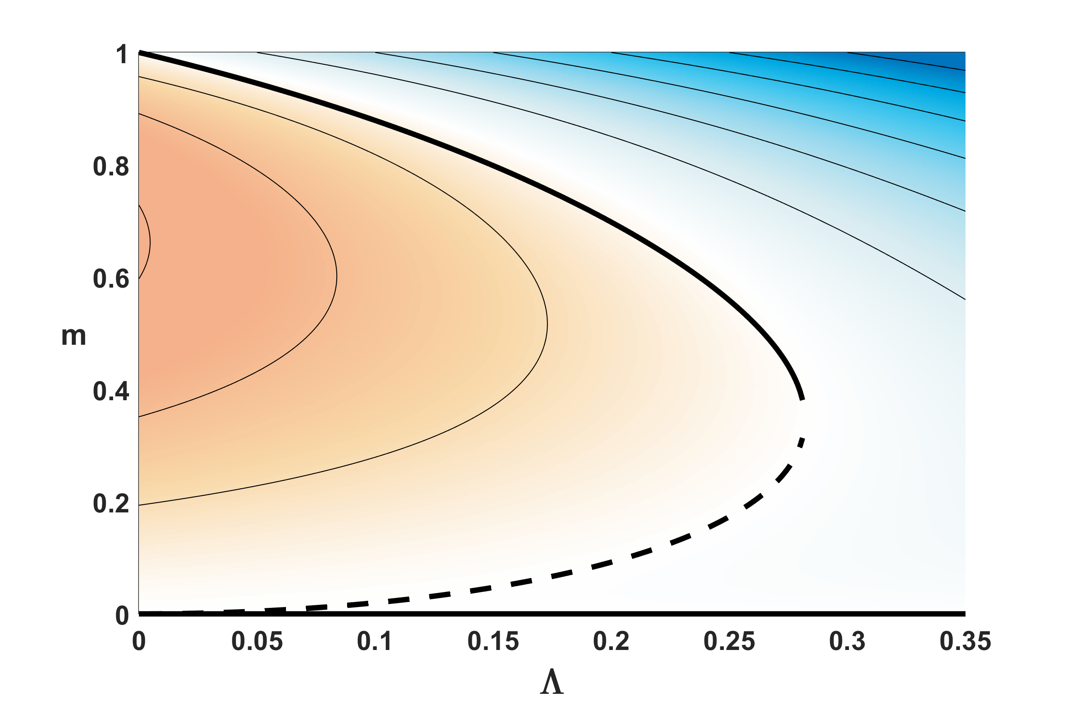
Warm colors indicate intensification; cold colors denote decaying solutions
Growth rates are for nullcline of surface wind speed variable
Non-dimensional core moisture
Non-dimensional ventilation parameter (shear)

Slide 57
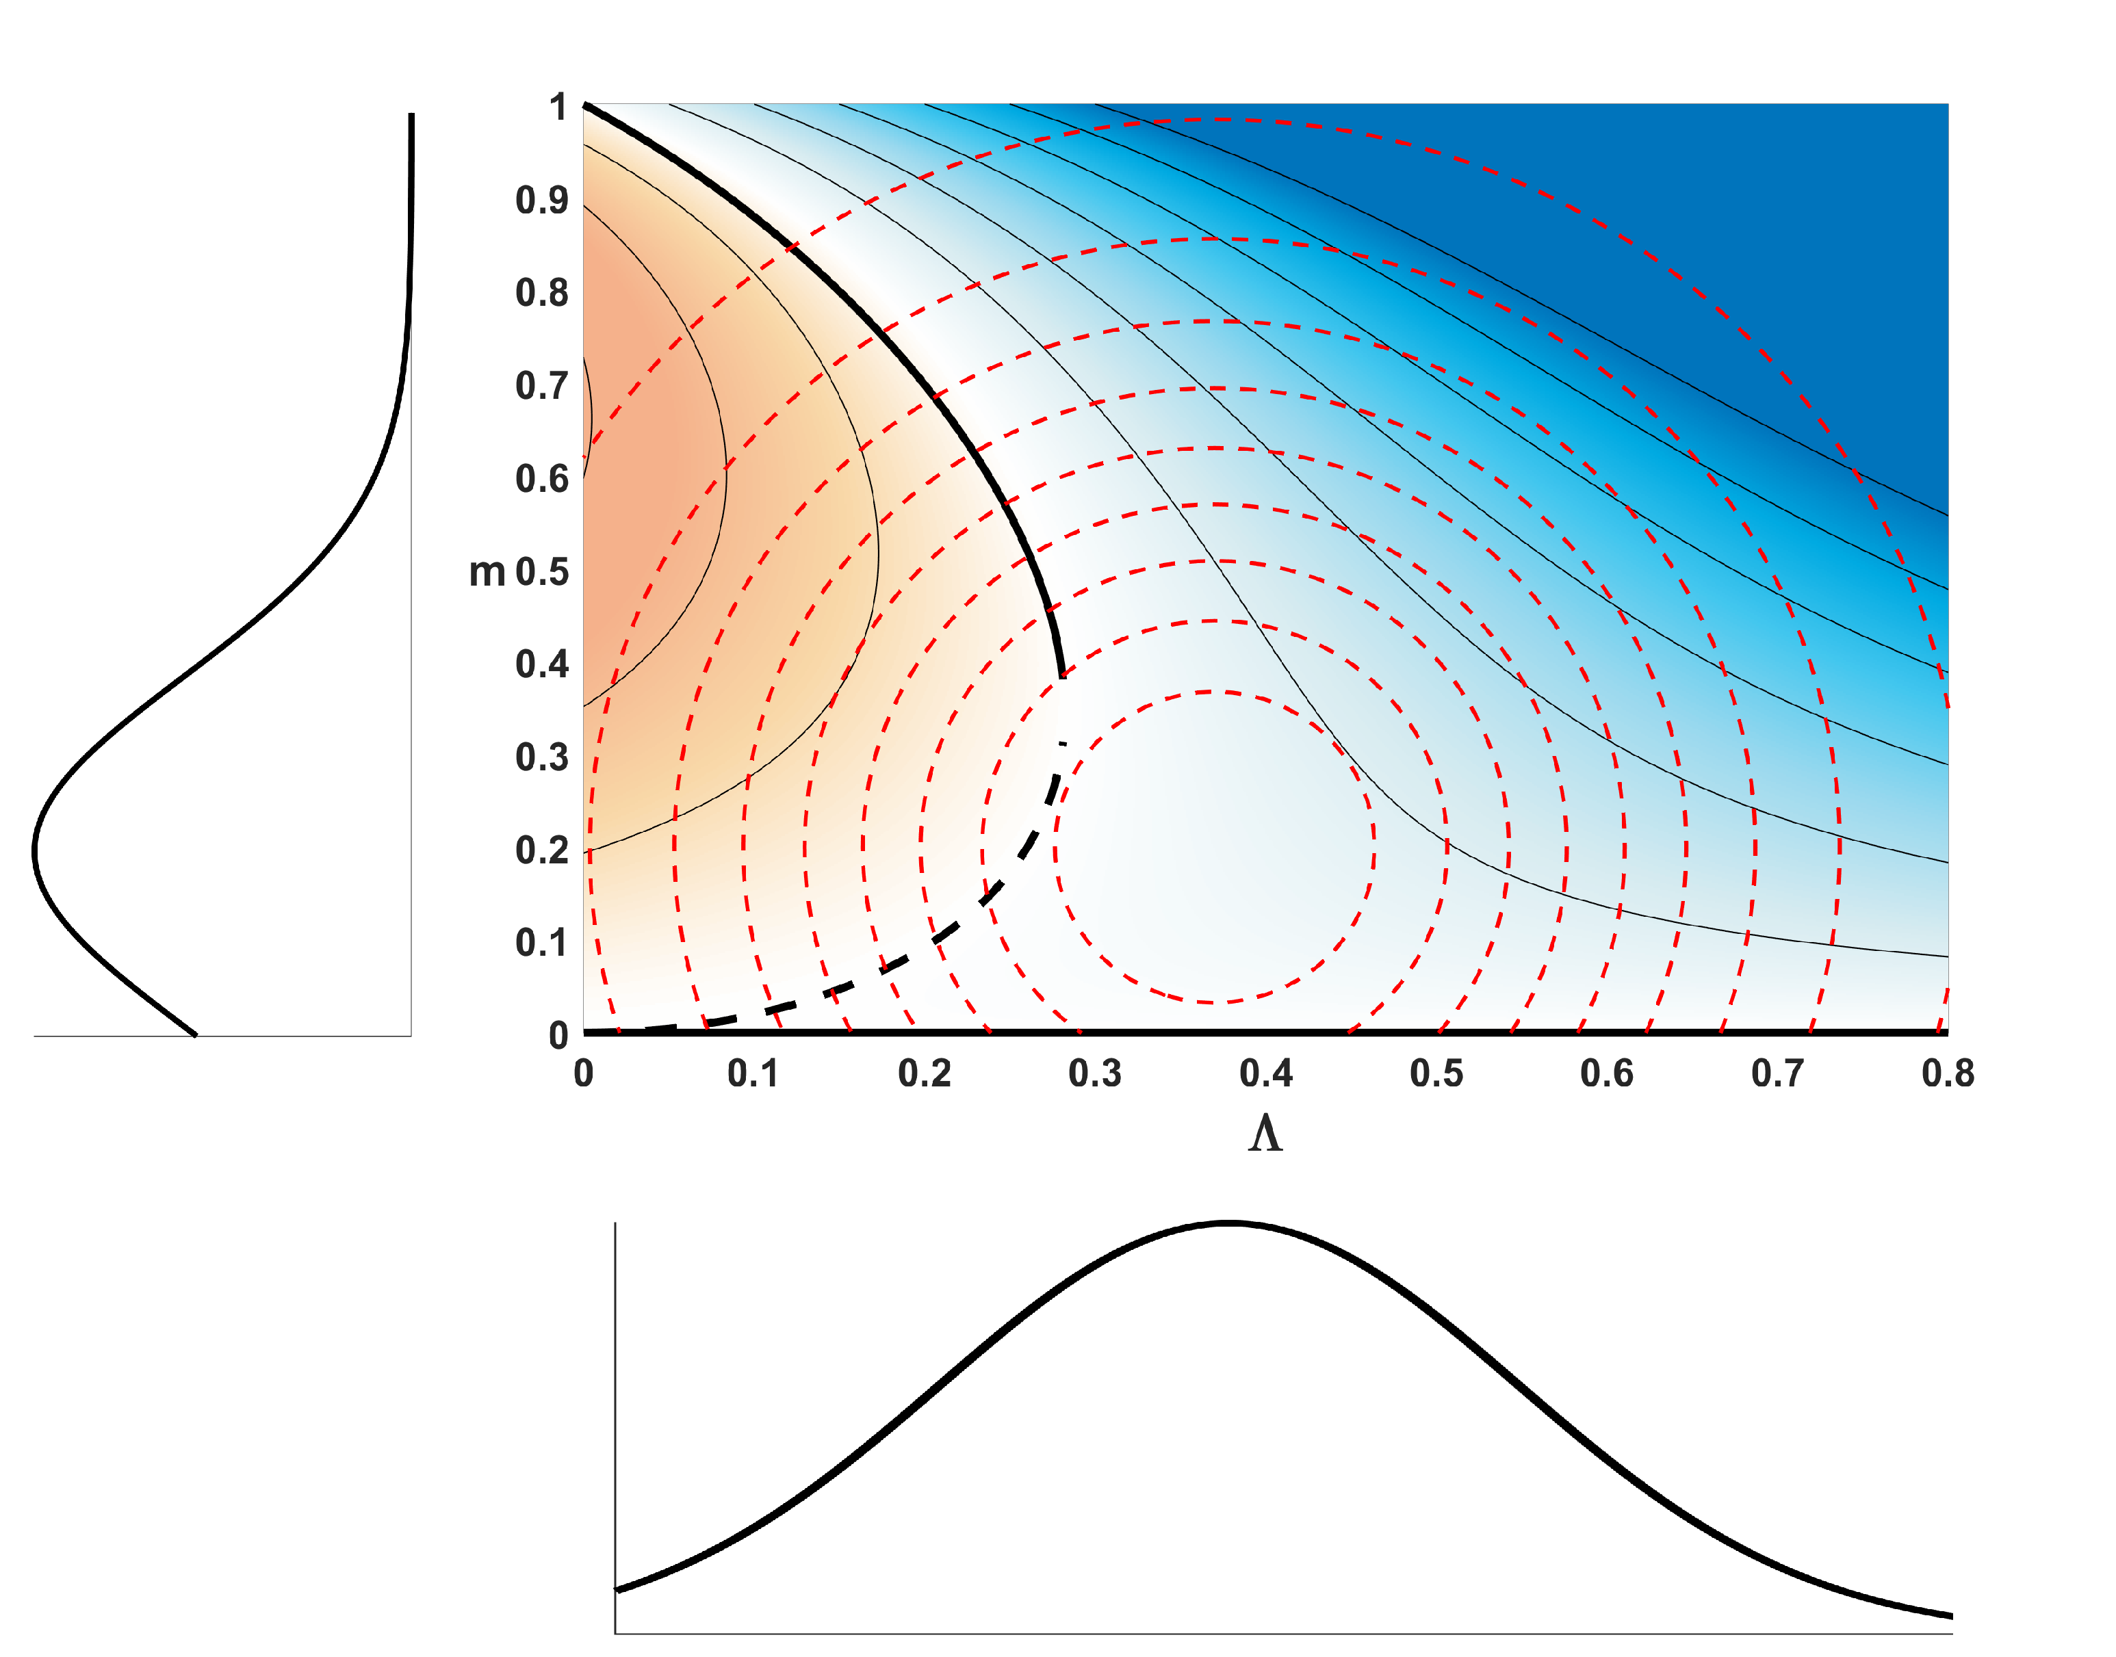
Red dashed curves denote joint probability distribution of weather noise in mid-level moisture and ventilation
Weather noise in mid-level moisture
Weather noise in ventilation

Slide 58
Summary
Theory and observations strongly suggest that TC intensity and rainfall both increase in a warming climate
Appreciable advances have been made in understanding both the detailed physics behind individual cases of genesis and the control of genesis statistics by the large-scale environment
In spite of these advances, we still lack a generally accepted theory for the observed global rate of genesis
Understanding genesis in the context of climate, including feedbacks of TCs on climate and the possibility of self-regulation of climate and TCs, may prove essential

Slide 59
Spare Slides

Slide 60
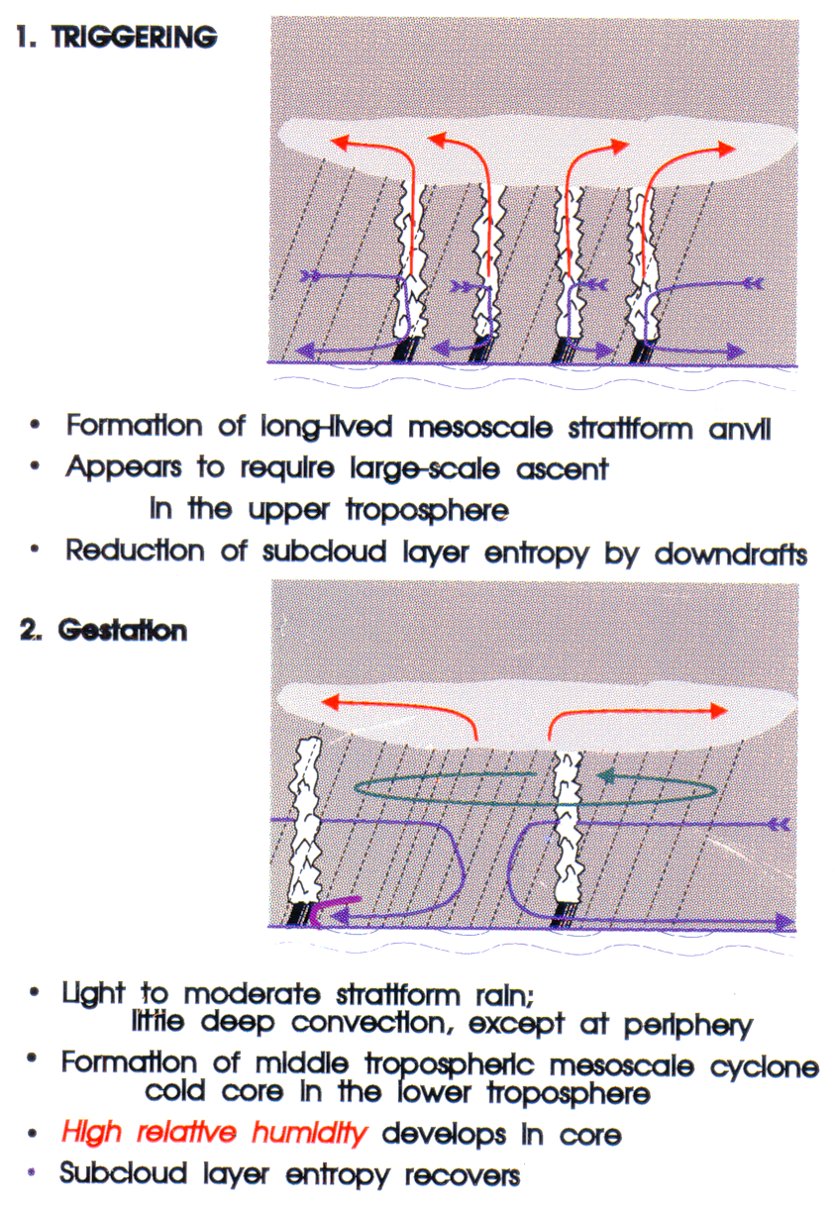
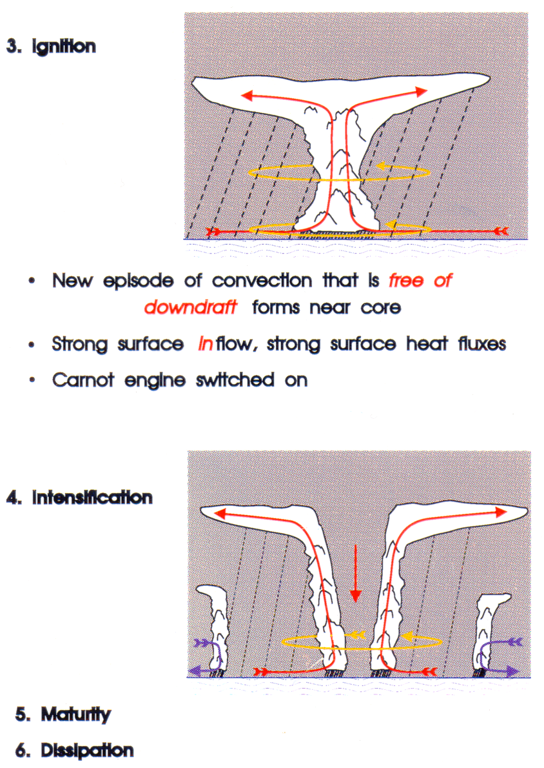

Slide 61
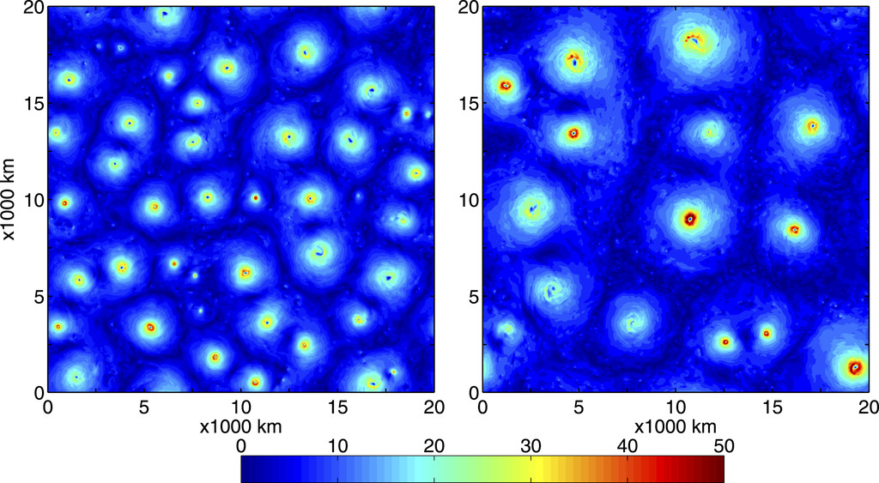
TC Worlds: f-plane Experiments in doubly-periodic boxes
Bretherton and Khairoutdinov (2005), Nolan et al. (2007), and many others
SST=24ºC
SST=32ºC
From Zhou, Held and Garner, 2014

Slide 62
Budget of variance of column moist static energy
(Lines: ensemble mean; Shading: Std. deviation)
Radiation and surface fluxes comparable
Surface fluxes dominant
Note: Genesis does occur with homogeneous radiation
Wing et al., J. Atmos. Sci., 2016

Slide 63

Hurricane-World Scaling
Radius of maximum winds:
Distance between storm centers:
Number density:
Note: I was able to show (2022) that the D scale above is consistent with the matched inner-outer radial profile developed by Dan Chavas and me, if it is assumed that the inner core radius scales as V_{pot}/f
Khairoutdinov and Emanuel, 2013

Slide 64
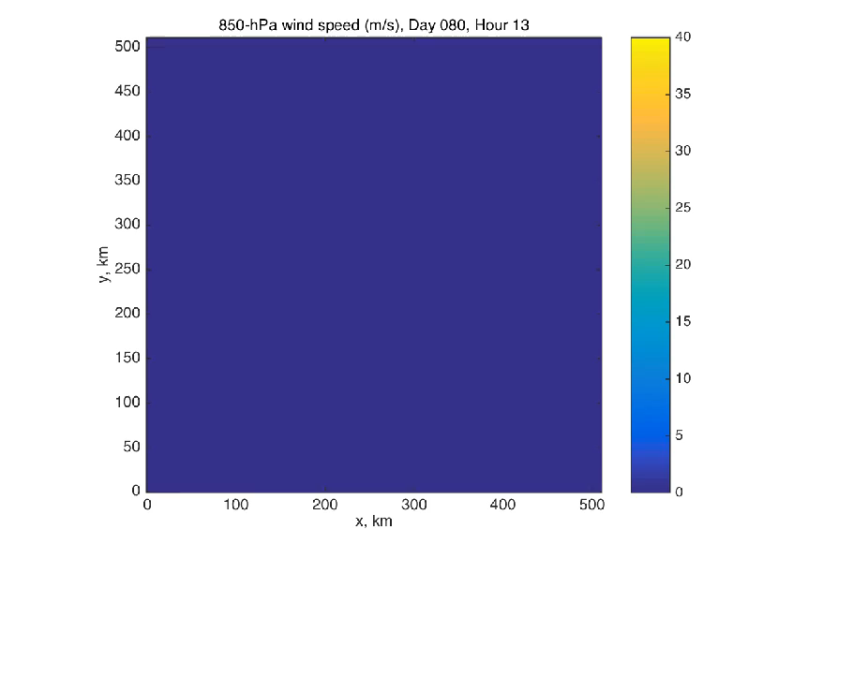
Dry Hurricanes in Dry RCE State
Cronin and Chavas, 2019
(Courtesy Tim Cronin)

Slide 65
The idea that ‘triggers” are needed has a long history
“In all cases of hurricane formation noted in the course of this study, deepening began, without exception, in pre-existing tropical disturbances” – Gordan Dunn (1951)
“Storms never develop spontaneously in the undisturbed tropical currents but always in a preexisting disturbance – Herbert Riehl (1951)

Slide 66
Early researchers focused some attention on the nature of pre-existing disturbances:
“Tropical cyclones originate in easterly waves, in the intertropical convergence zone, and occasionally in the trailing southerly portions of old polar troughs….[but] there is as yet no generally accepted definition of exactly what synoptic situation is responsible for the formation of a tropical cyclone” – Dunn (1951)

