Slide 1

What We Know About Climate Change
Kerry Emanuel
Lorenz Center
Department of Earth, Atmospheric, and Planetary Sciences, MIT

Slide 2
This Evening’s Program
Overview of climate and climate change
Solutions

Slide 3

Important Points about Climate and Climate Science
Earth’s climate is not terribly stable
Climate science has a long and illustrious history
Human activities can and do have a strong effect on climate
The idea that we are altering climate is based on much more than complex global models
Anthropogenic climate change is not controversial among climate scientists

Slide 4
Important Points about Climate and Climate Science
Earth’s climate is not terribly stable
Climate science has a long and illustrious history
Human activities can and do have a strong effect on climate
The idea that we are altering climate is based on much more than complex global models
Anthropogenic climate change is not controversial among climate scientists

Slide 5
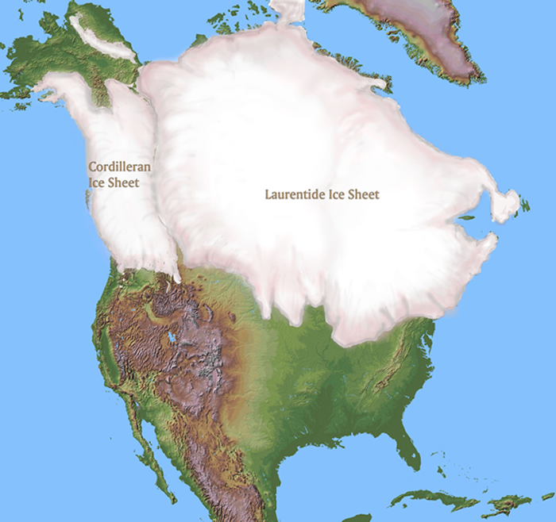
~ 20,000 years before present

Slide 6

Polar radiative forcing: 10 W/m² (4 W/m² for 2 x CO₂)
Global mean temperature fluctuation: ~5 C

Slide 7
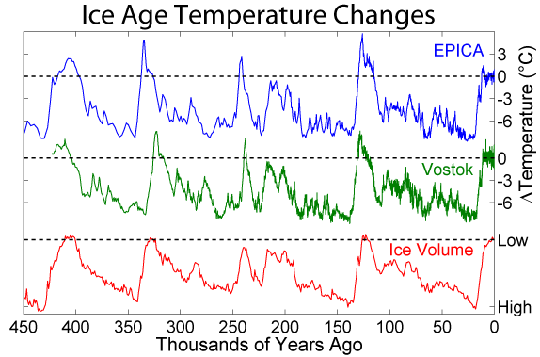
Last 450 Thousand Years

Slide 8
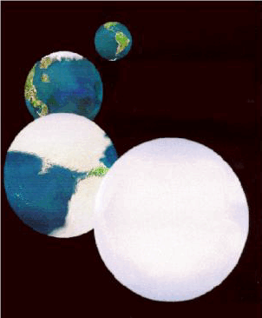
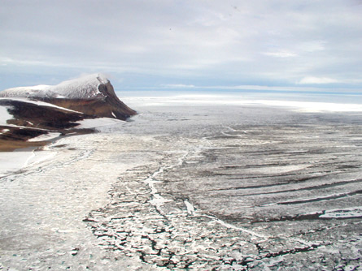

The Snowball Earth, 650-750 mya

Slide 9
Important Points about Climate and Climate Science
Earth’s climate is not terribly stable
Climate science has a long and illustrious history
Human activities can and do have a strong effect on climate
The idea that we are altering climate is based on much more than complex global models
Anthropogenic climate change is not controversial among climate scientists

Slide 10
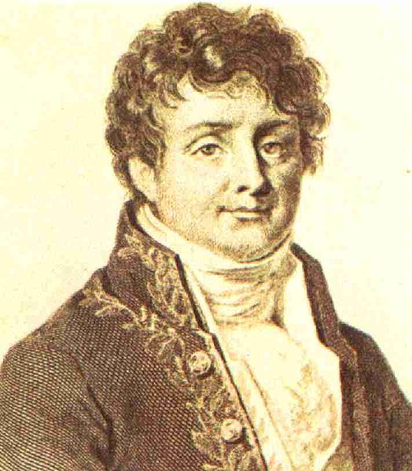


Jean Baptiste Joseph Fourier
(1768-1830)
John Tyndall (1820-1893)

Slide 11

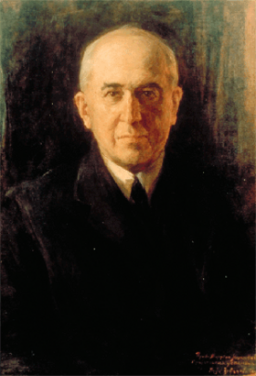
Climate Forcing by Orbital Variations (1912)
Milutin Milanković, 1879-1958

Slide 12
Last 450 Thousand Years

Slide 13
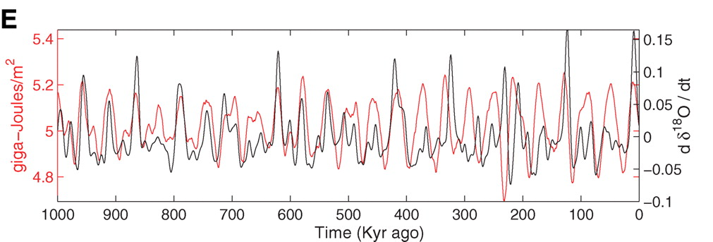
Strong Correlation between High Latitude Summer Insolation and Ice Volume
Black: Time rate of change of ice volume
Red: Summer high latitude sunlight
P. Huybers, Science, 2006

Slide 14

Svante Arrhenius, 1859-1927

Slide 15
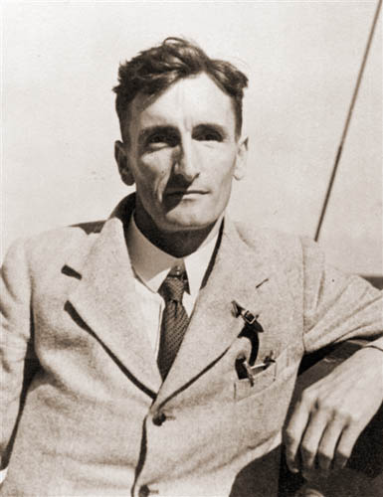
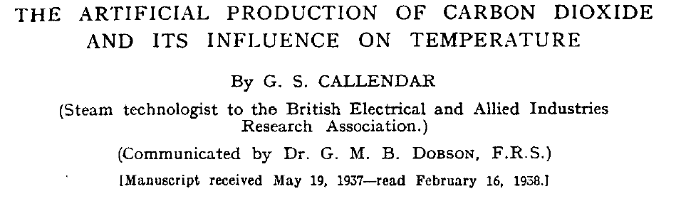
Guy Stewart Callendar (1898 - 1964)

Slide 16
Carbon Dioxide and Climate:
A Scientific Assessment
Report to the National Academy of Sciences
Jule G. Charney and co-authors
1979
When it is assumed that the CO2 content of the atmosphere is doubled and statistical thermal equilibrium is achieved, the more realistic of the modeling efforts predict a global surface warming of between 2°C and 3.5 °C, with greater increases at high latitudes.

Slide 17
Important Points about Climate and Climate Science
Earth’s climate is not terribly stable
Climate science has a long and illustrious history
Human activities can and do have a strong effect on climate
The idea that we are altering climate is based on much more than complex global models
Anthropogenic climate change is not controversial among climate scientists

Slide 18
John Tyndall (1820-1893)

Slide 19
Tyndall’s Essential Results:
Oxygen (O₂ ), nitrogen (N₂), and argon (Ar), though they make up ~99% of the atmosphere, are almost entirely transparent to solar and terrestrial radiation
Water vapor (H₂O), carbon dioxide (CO₂), nitrous oxide (N₂O), and a handful of other trace gases make the lower atmosphere nearly opaque to infrared radiation, though still largely transparent to solar radiation (but clouds have strong effects on radiation at all wavelengths). Together they increase the Earth’s surface temperature from about 0ºF to around 60ºF.

Slide 20
Atmospheric Composition
The orange sliver (can you see it?) makes the difference between a mean surface temperature of 0ºF and of 60ºF.

Slide 21
Water Vapor (H₂O), about 0.25% of the mass of the atmosphere, is the most important greenhouse gas, but responds to atmospheric temperature change on a time scale of about 2 weeks
Climate is therefore strongly influenced by long-lived greenhouse gases (e.g. CO₂, CH₄, N₂O) that together comprise about 0.04% of the mass of the atmosphere. Concentration of CO₂ has increased by 43% since the dawn of the industrial revolution

Slide 22
Svante Arrhenius, 1859-1927
“Any doubling of the percentage of carbon dioxide in the air would raise the temperature of the earth's surface by 4°; and if the carbon dioxide were increased fourfold, the temperature would rise by 8°.” – Världarnas utveckling (Worlds in the Making), 1906

Slide 23
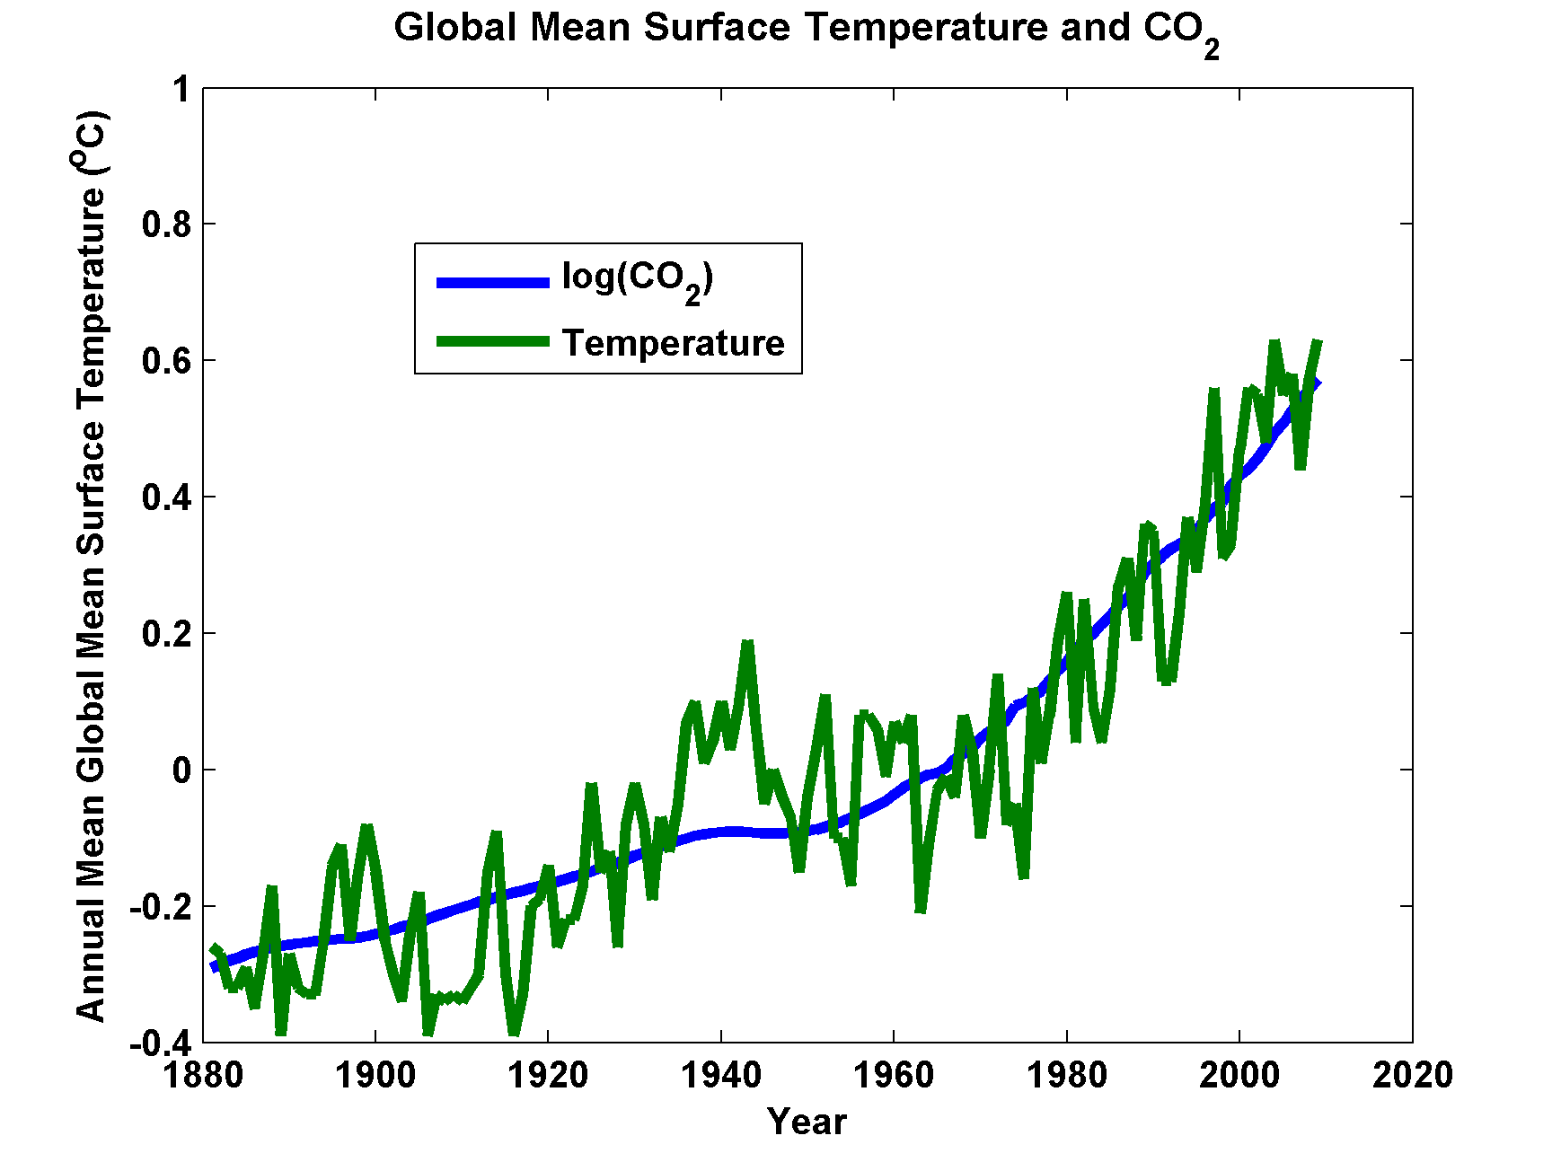

Slide 24
Important Points about Climate and Climate Science
Earth’s climate is not terribly stable
Climate science has a long and illustrious history
Human activities can and do have a strong effect on climate
The idea that we are altering climate is based on much more than complex global models
Anthropogenic climate change is not controversial among climate scientists

Slide 25
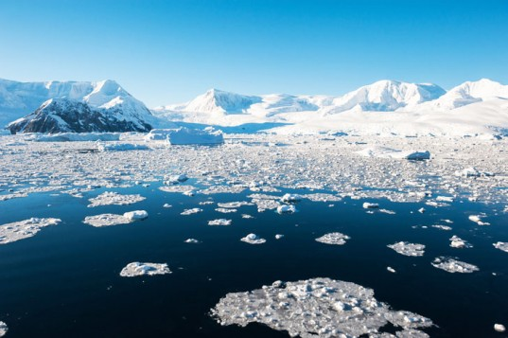
Paleoclimate

Slide 26
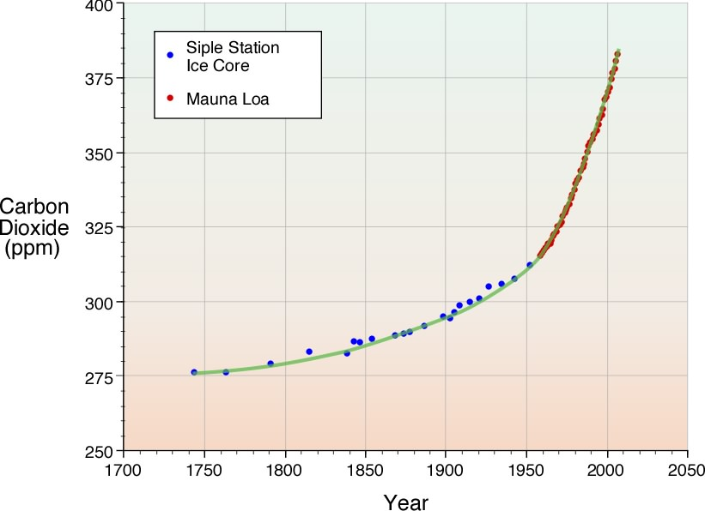
Carbon Dioxide from Ice Cores and Direct Measurements

Slide 27
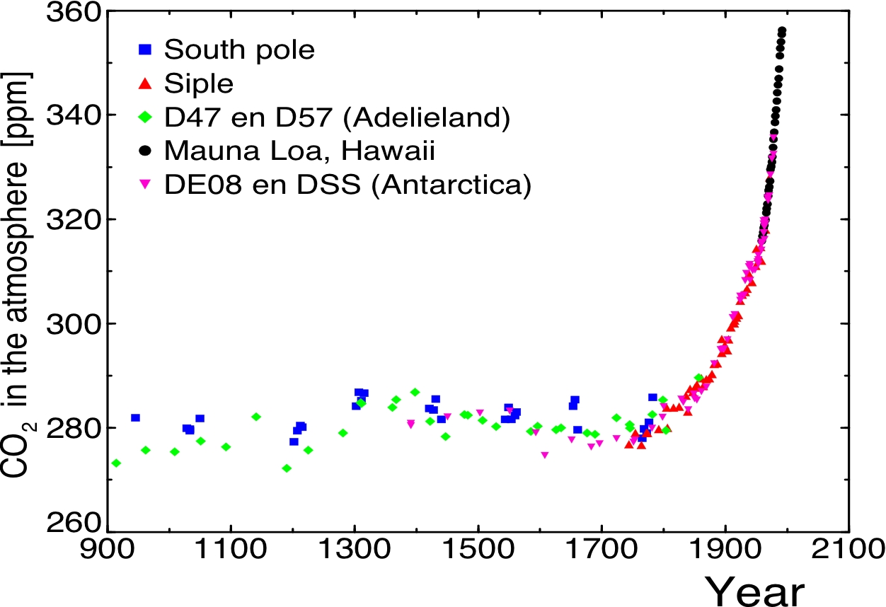

Slide 28
Variation in carbon dioxide and methane over the past 20,000 years, based on ice core and other records

Slide 29

Paleo reconstructions of temperature change over the last 2000 years
“Hockey Stick”
Instrumental Record
Year
Notes:
29

Slide 30
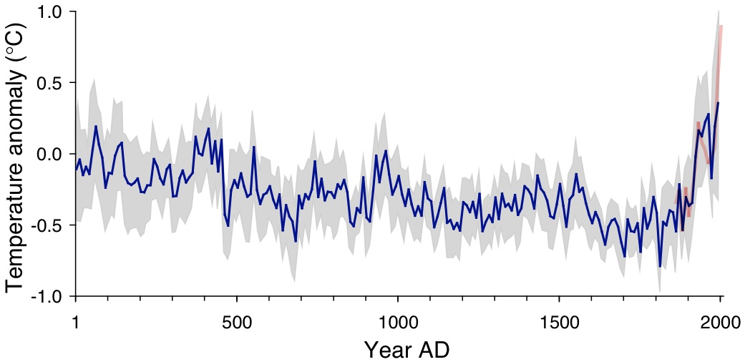
Arctic air temperature change reconstructed (blue), observed (red)
The long-term cooling trend in the Arctic was reversed during recent decades. The blue line shows the estimated Arctic average summer temperature over the last 2000 years, based on proxy records from lake sediments, ice cores, and tree rings. The shaded area represents variability among the 23 sites use for the reconstruction. The red line shows the recent warming based on instrumental temperatures. From Kaufman et al. (2009).

Slide 31
Instrumental Record

Slide 32
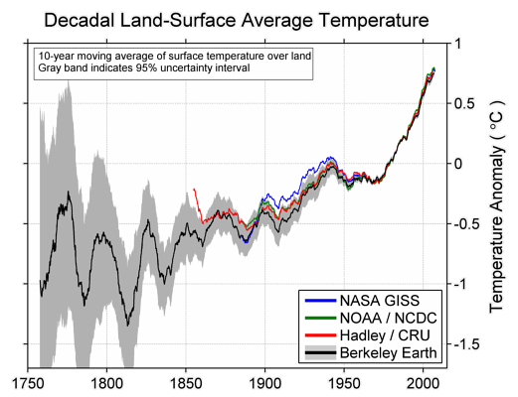

Slide 33
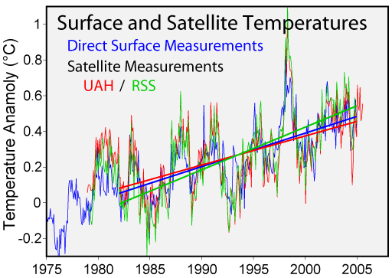

Slide 34
Distribution of temperature change, 1901-2005

Slide 35
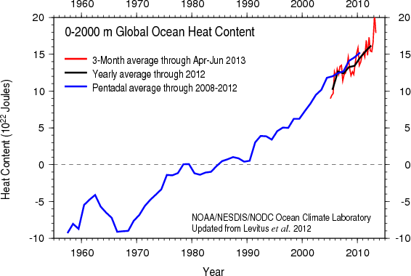
Based on bathythermograph and ARGO (post-2004) data
Image credit: NOAA

Slide 36
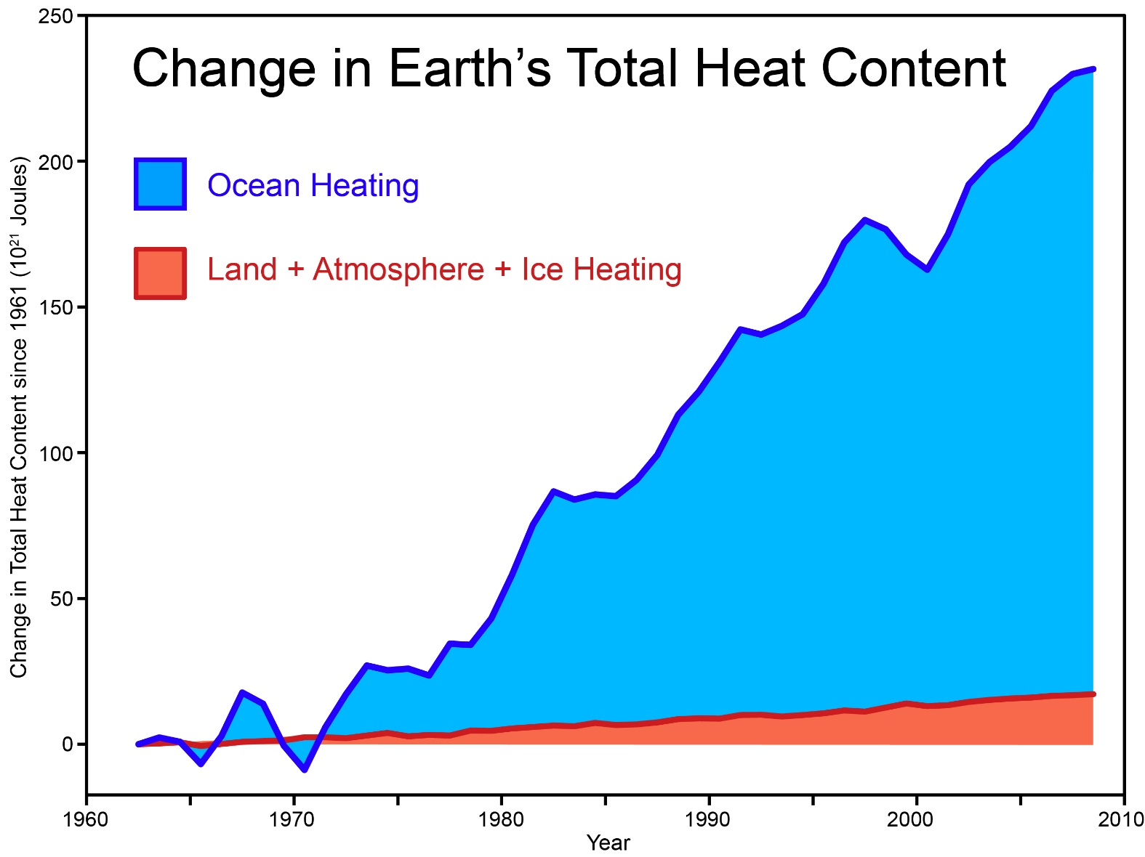
Total amount of heat from global warming that has accumulated in Earth's climate system since 1961, from Church et al. (2011) (many thanks to Neil White from the CSIRO for sharing their data).
Notes:
http://www.skepticalscience.com/graphics.php?g=46

Slide 37
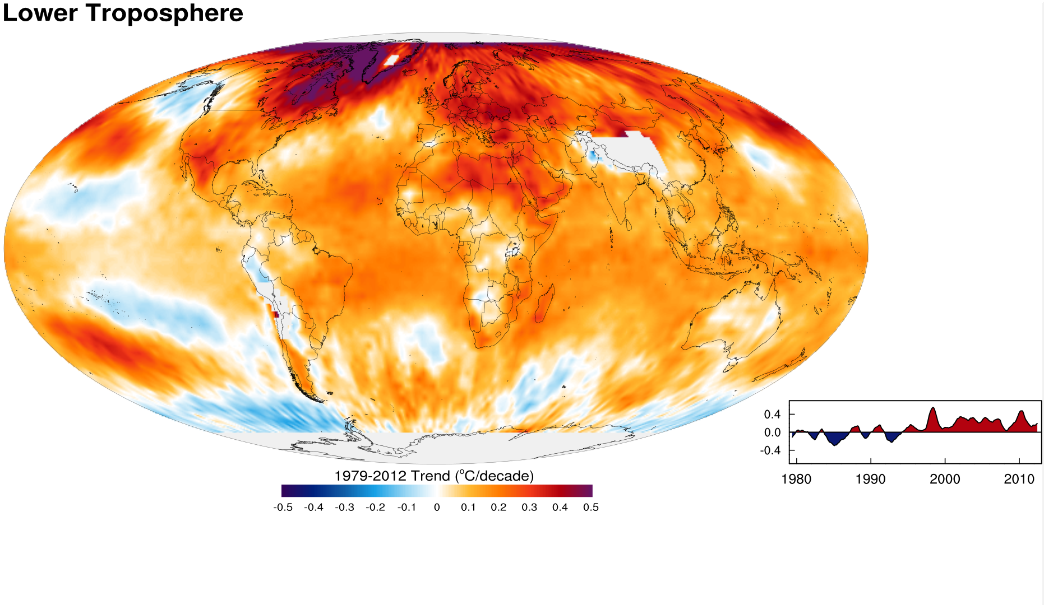
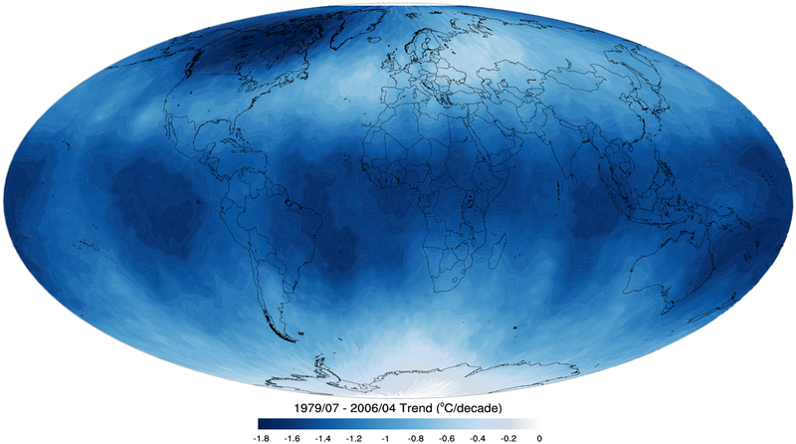
Tropospheric temperature trend from 1979-2012 based on satellite measurements (RSS)
Top of the stratosphere (TTS) 1979-2006 temperature trend.

Slide 38
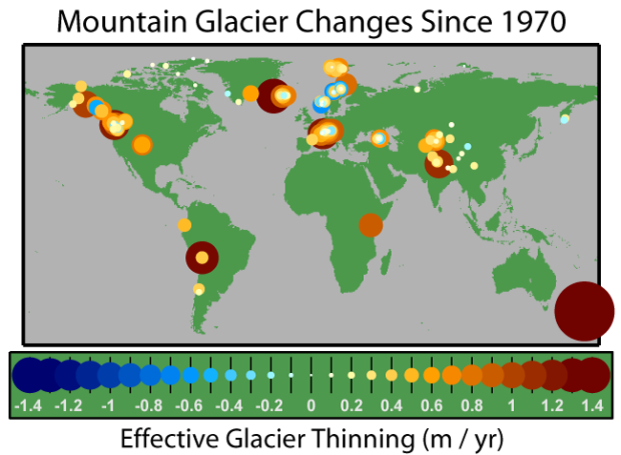

Slide 39
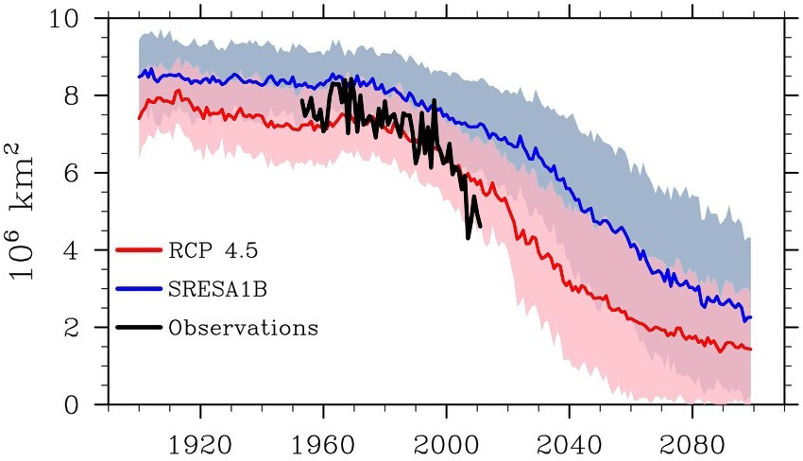
September Arctic Sea Ice Extent
.
2012
Credit: National Snow and Ice Data Center courtesy Stroeve et al. 2012

Slide 40
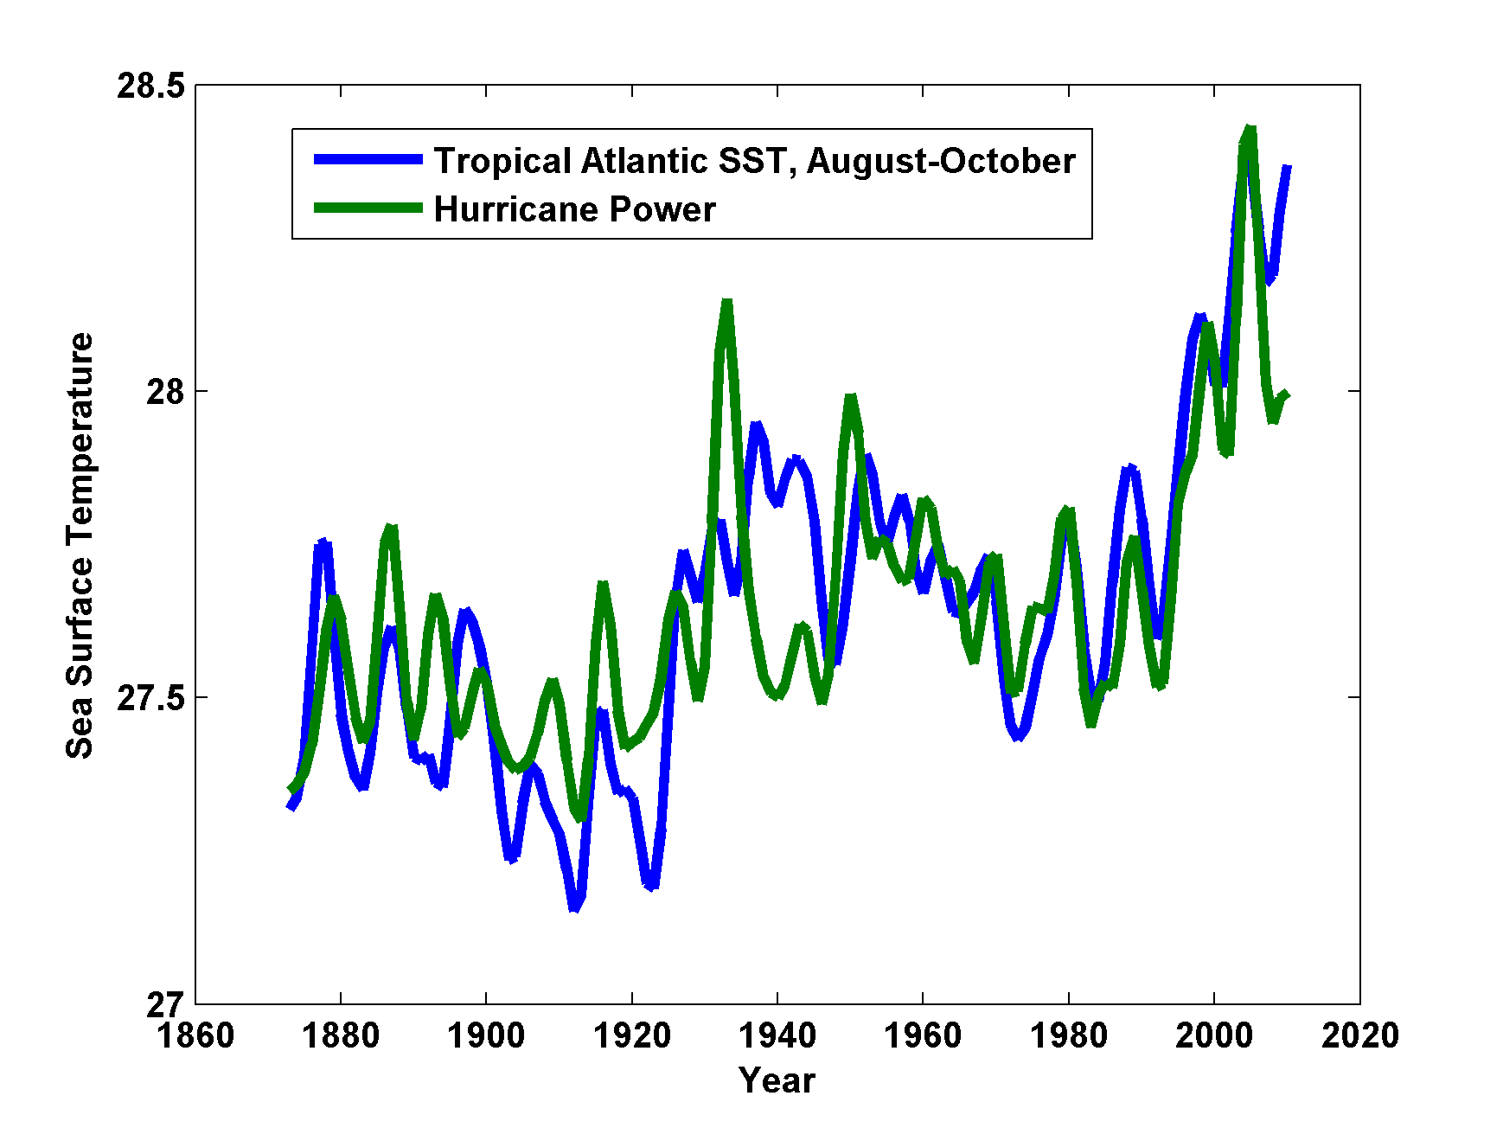

Slide 41
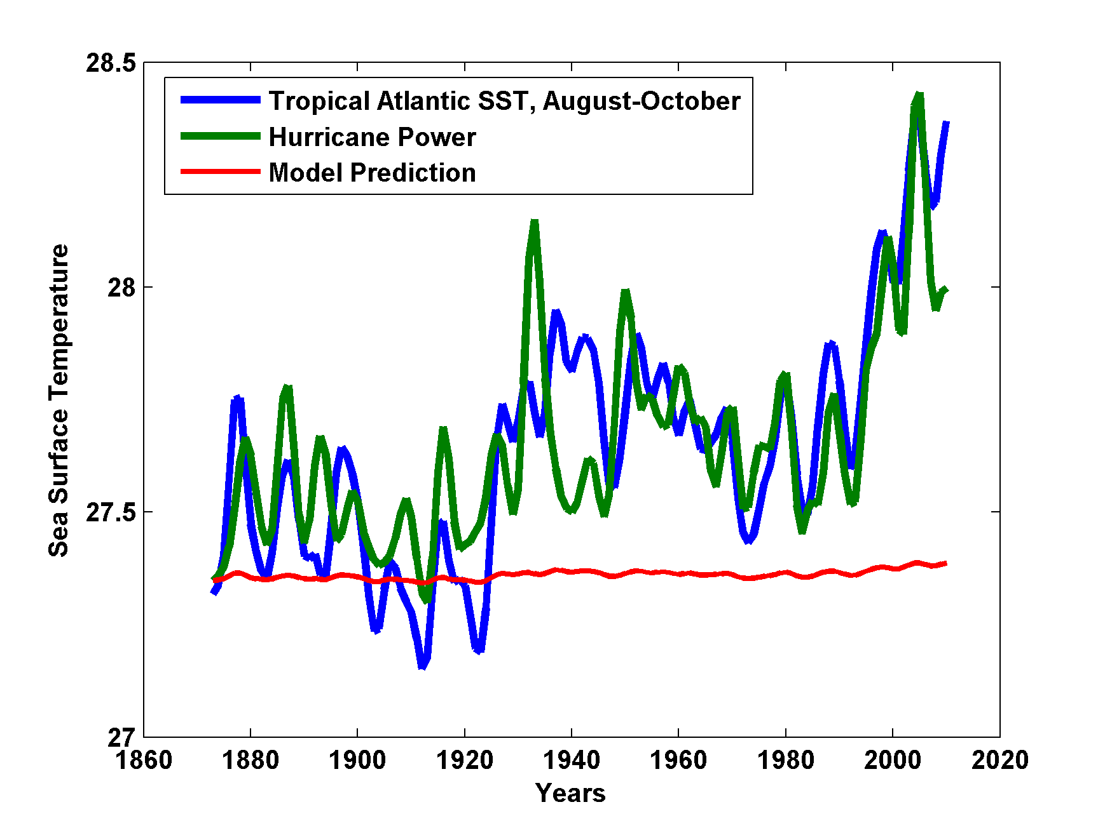

Slide 42

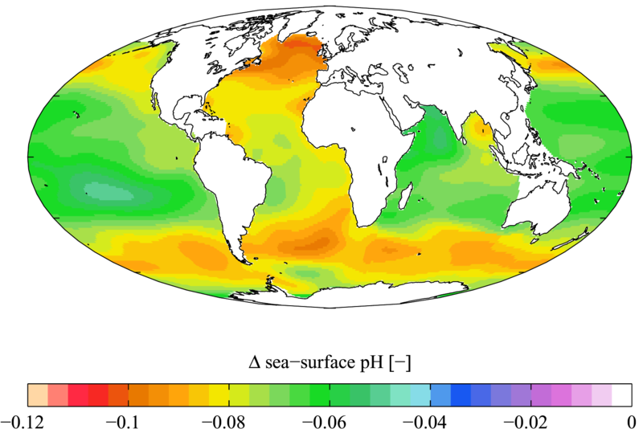

Slide 43

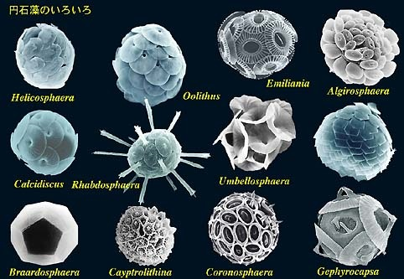

Acidification through CO₂ threatens marine life
Plankton
Coral Reefs
Notes:
Abbildung 4.3-1
Aragonitsättigung und
gegenwärtige Riffstandorte
von Warmwasserkorallen
(blaue Punkte). (a)
vorindustrielle Werte
(ca. 1870, atmosphärische
CO2-Konzentration
280 ppm), (b) Gegenwart
(ca. 2005, 375 ppm CO2), (c)
Zukunft (ca. 2065, 517 ppm
CO2). Der Grad der
Aragonitsättigung (Ù)
bezeichnet das relative
Verhältnis zwischen dem
Produkt der Konzentrationen
von Kalzium- und
Karbonationen und dem
Löslichkeitsprodukt für
Aragonit. Standorte mit
einer Aragonitsättigung
unterhalb von 3,5 sind nur
noch bedingt für riffbildende
Warmwasserkorallen
geeignet (marginal),
unterhalb von 3 sind sie
ungeeignet.
Quelle: Steffen et al., 2004

Slide 44
Simple Models

Slide 45
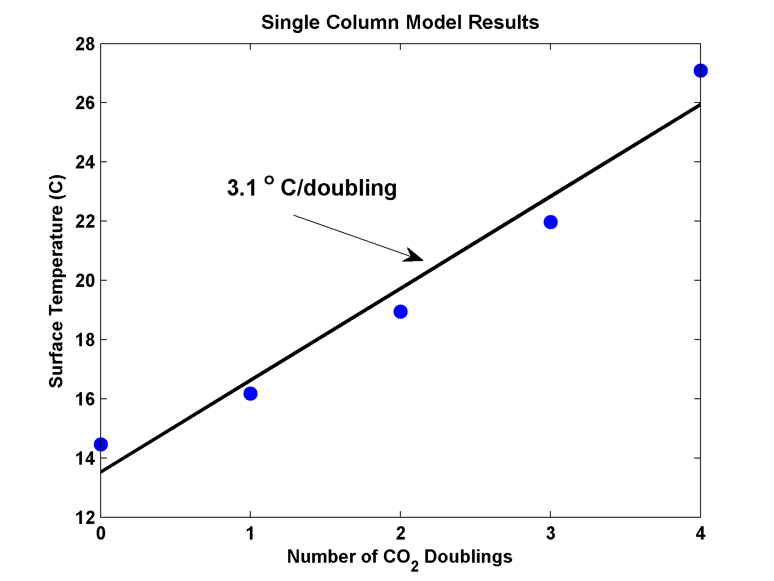
MIT Single Column Model
IPCC Estimate:
2-4.5 ºC

Slide 46
Important Points about Climate and Climate Science
Earth’s climate is not terribly stable
Climate science has a long and illustrious history
Human activities can and do have a strong effect on climate
The idea that we are altering climate is based on much more than complex global models
Anthropogenic climate change is not controversial among climate scientists

Slide 47
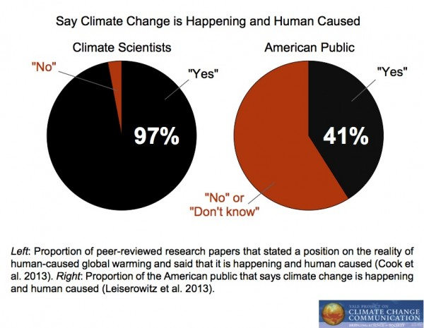

Slide 48
Known Risks
Increasing sea level
Increasing hydrological events… droughts and floods
Increasing incidence of high category hurricanes and associated storm surges and freshwater flooding
More heat stress

Slide 49
“Climate change could have significant geopolitical impacts around the world, contributing to poverty, environmental degradation, and the further weakening of fragile governments. Climate change will contribute to food and water scarcity, will increase the spread of disease, and may spur or exacerbate mass migration.”
    -- Quadrennial Defense Review, U.S. Department of Defense, February, 2010

Slide 50
The Future

Slide 51


Estimate of how much global climate will warm as a result of doubling CO₂: a probability distribution
Source: 100000 PAGE09 runs
Chris Hope, U. Cambridge
courtesy Tim Palmer
Notes:
Describe pdf. Reflects post-IPCC knowledge as well as IPCC AR4.

Slide 52

CO₂ Will Go Well Beyond Doubling
Double Pre-Industrial

Slide 53

IPCC 2007: Doubling CO₂ will lead to an increase in mean global surface temperature of 2 to 4.5 ºC.
Atmospheric CO₂ assuming that emissions stop altogether after peak concentrations
Global mean surface temperature corresponding to atmospheric CO₂ above
Courtesy Susan Solomon

Slide 54
Realistic Solutions
Carbon Capture and Sequestration
  Currently would add ~$200/ton to energy costs
  Reasonable prospects for reducing this to ~$100/ton
  Currently little incentive to develop this
Nuclear Energy

Slide 55
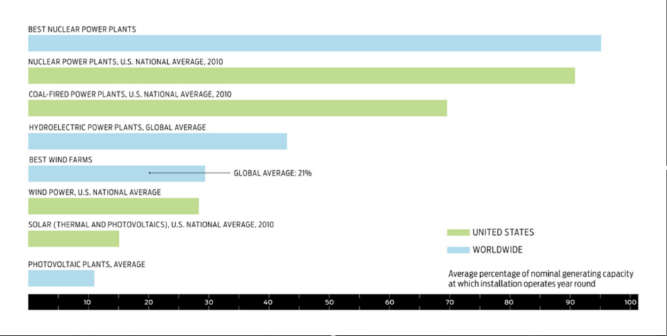
Renewables Require Baseload

Slide 56
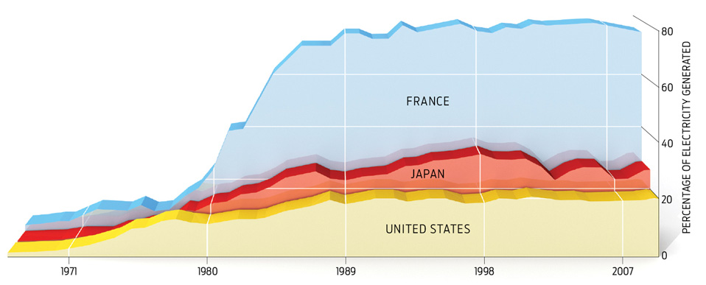
Can be deployed on 15-25 year time scale

Slide 57
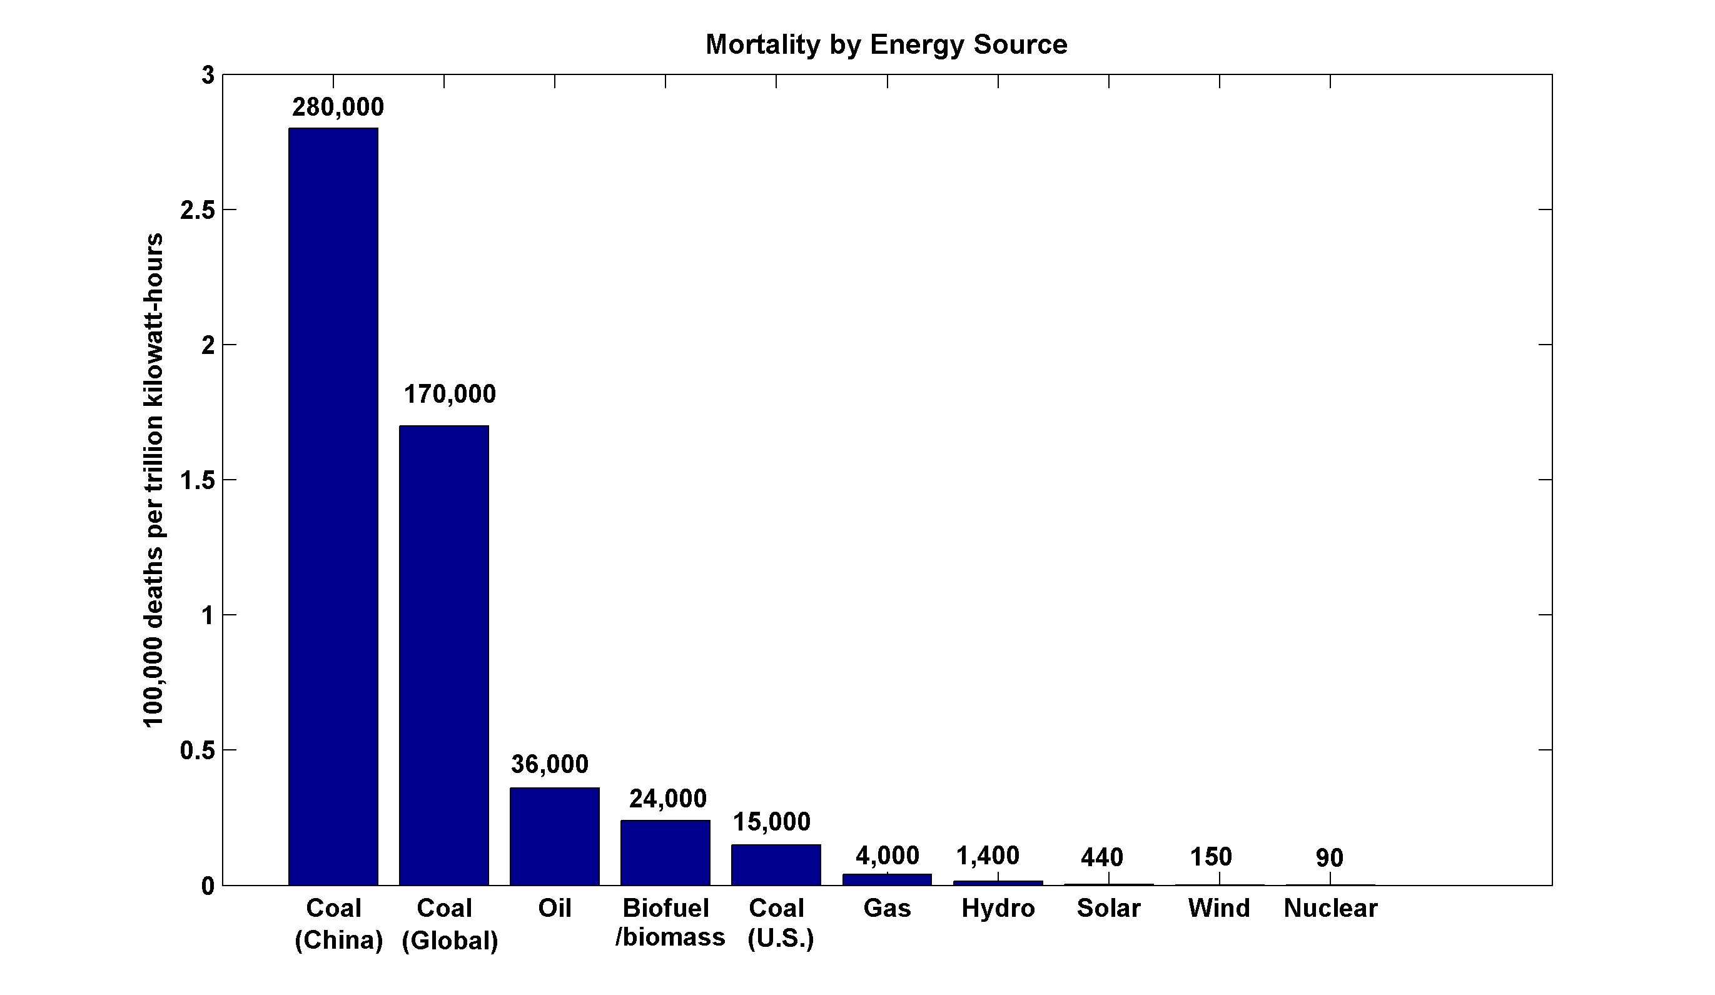
(includes Chernobyl, Fukushima)

Slide 58
Summary of Main Points
Several aspects of climate science are well established
Projections entail uncertainty, particularly at the regional scale
Ill effects felt mostly through sea level rise, weather extremes and through indirect fallout, such as global armed conflict

Slide 59
Summary of Main Points
Highly asymmetric risk function
Rational response to risk impeded by well-funded and highly effective marketing campaign by fossil fuel interests
Rational measures possible when many begin to notice tangible climate change

Slide 60
Spare Slides

Slide 61
Energy Source Mortality Rate (deaths/trillionkWhr)
Coal – global average 170,000 (50% global electricity)
Coal – China 280,000 (75% China’s electricity)
Coal – U.S. 15,000 (44% U.S. electricity)
Oil (electricity) 36,000 (36% of energy, 8% of Natural Gas 4,000 (20% global electricity)
Biofuel/Biomass 24,000 (21% global energy)
Solar (rooftop) 440 (< 1% global electricity)
Wind 150 (~ 1% global electricity)
Hydro – global average 1,400 (15% global electricity)
Nuclear – global average 90 (17% global electricity w/Chern&Fukush)

Slide 62
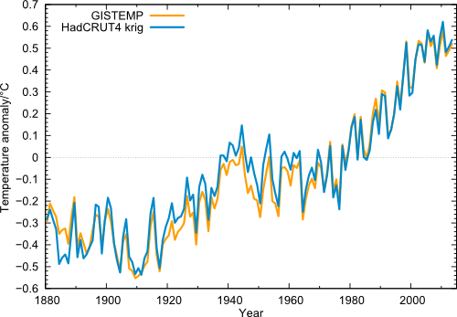
Global temperature (annual values) in the data from NASA GISS (orange) and from Cowtan & Way (blue), i.e. HadCRUT4 with interpolated data gaps.

Slide 63
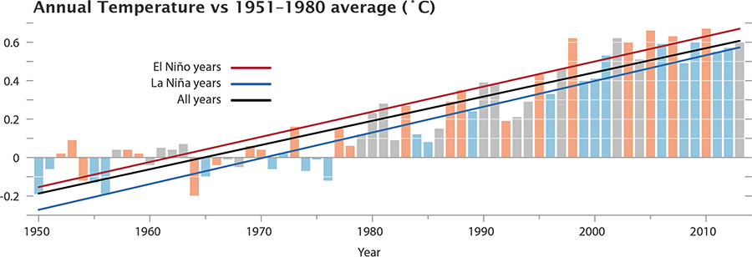
The GISS data, with El Niño and La Niña conditions highlighted. Neutral years like 2013 are gray.

Slide 64
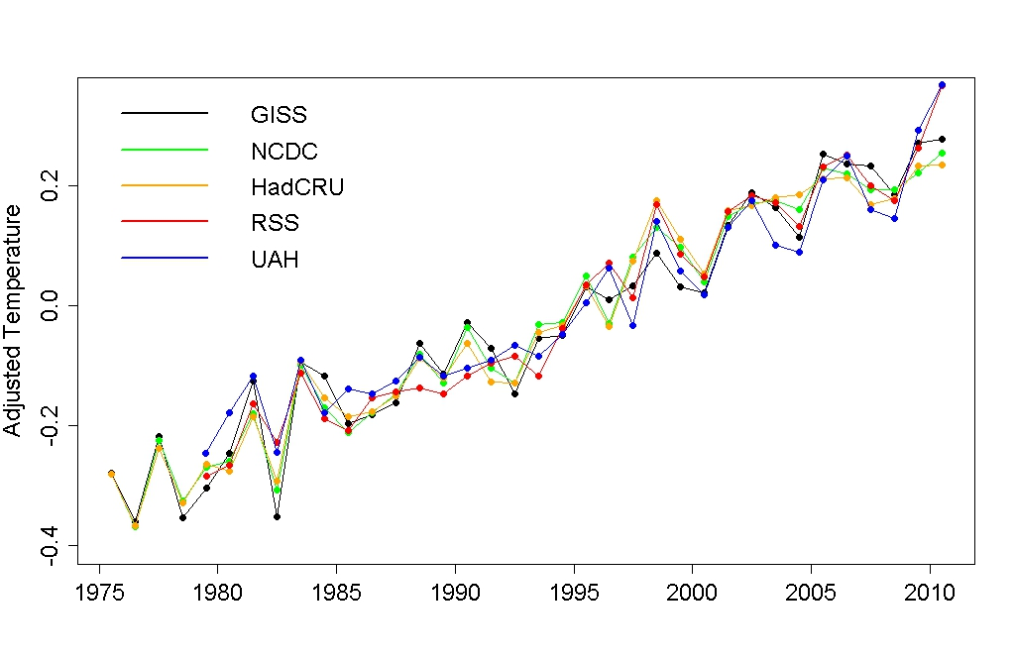
Adjusted annual average temperature data with the estimated impact of El Niño, volcanic eruptions, solar variation, and the residual annual cycle removed.
Notes:
http://tamino.wordpress.com/2011/01/20/how-fast-is-earth-warming/

Slide 65
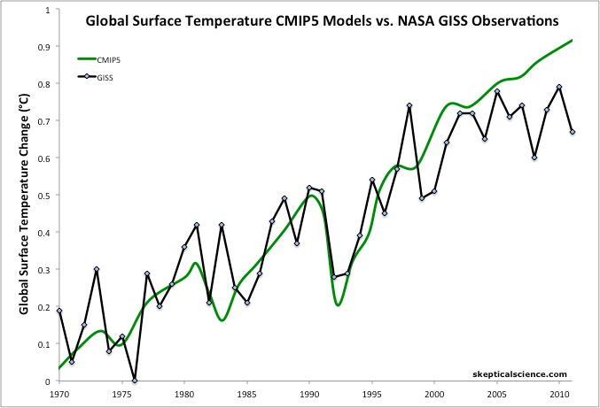
Figure 1: Average global temperature surface anomaly multi-model mean from CMIP5 (green) and as measured by the NASA Goddard Institute for Space Studies (GISS black). Most of this figure is a hindcast of models fitting past temperature data.
Notes:
http://www.skepticalscience.com/christy-exaggerates-model-data-discrepancy.html

Slide 66
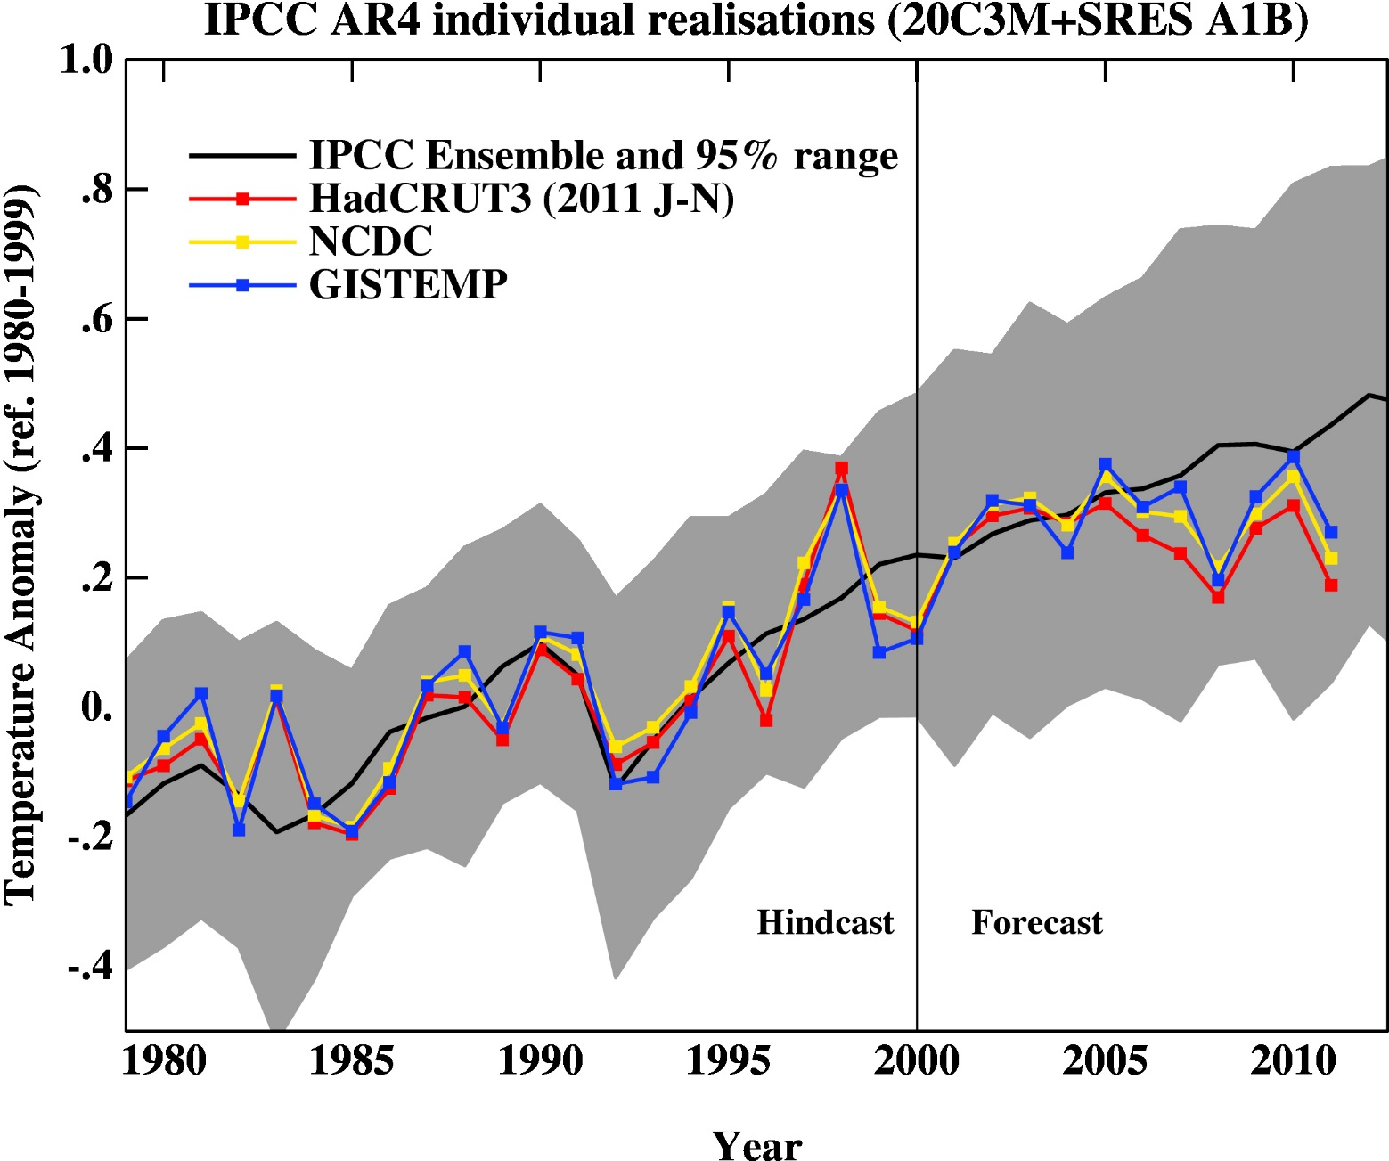
Figure 2: 2007 IPCC report model ensemble mean (black) and 95% individual model run envelope (grey) vs. surface temperature anomaly from GISS (blue), NOAA (yellow), and HadCRUT3 (red).
Notes:
http://www.skepticalscience.com/christy-exaggerates-model-data-discrepancy.html

Slide 67
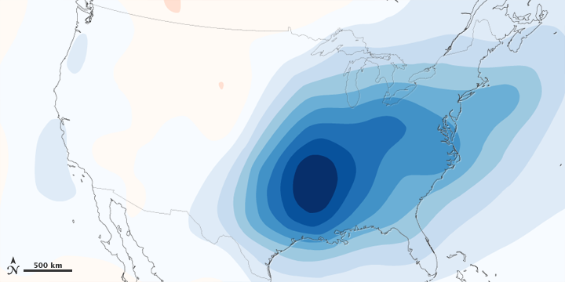
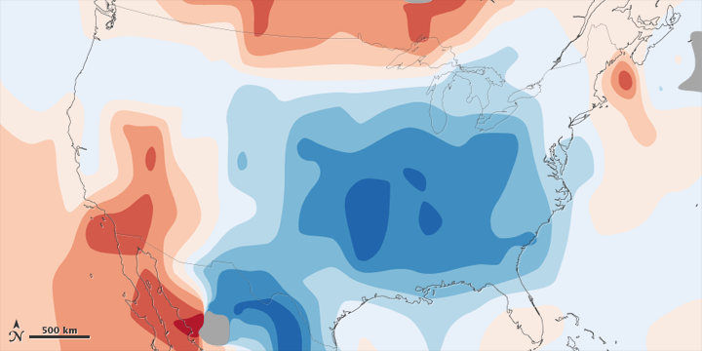
Figure 5: 1970-1990 aerosol loading of the atmosphere over the lower 48 United States and estimated associated surface air temperature change.
Figure 6: Observed total surface temperature change over the lower 48 United States from 1930 to 1990.
Notes:
http://www.skepticalscience.com/christy-exaggerates-model-data-discrepancy.html

Slide 68
Past and Projected Sea Level vs. Temperature
(Source: WBGU after David Archer 2006)
Notes:
This graph shows how temperature and sea level were closely related in Earth’s history. During the last Ice Age, temperatures were about 6 ºC colder than now, while sea level was 120 meters lower. During the Pliocene, when it was last significantly warmer than now (by about 2 ºC), sea level was 20-30 meters higher. During the Eocene there was almost no ice on the planet, and sea level was about 70 meters higher.
The history of climate thus sends a strong warning: past climate changes by just a few degrees in global temperature have come with very large sea level changes, by tens of meters. In the long run, this is likely to happen again. The sea level rise by the year 2100 (likely below one meter) is only the small beginning of a much larger rise that will unfold over coming centuries and perhaps millennia, caused by our carbon emissions in this century.

