Slide 1
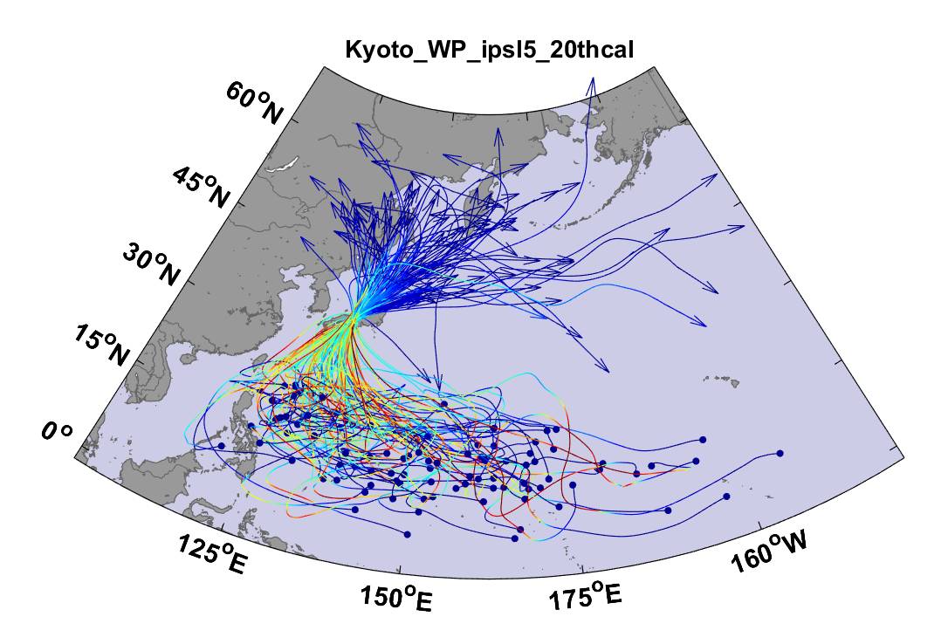
Example:
Top 100 out of 2000 TCs Affecting Kyoto, 1981-2000

Slide 2
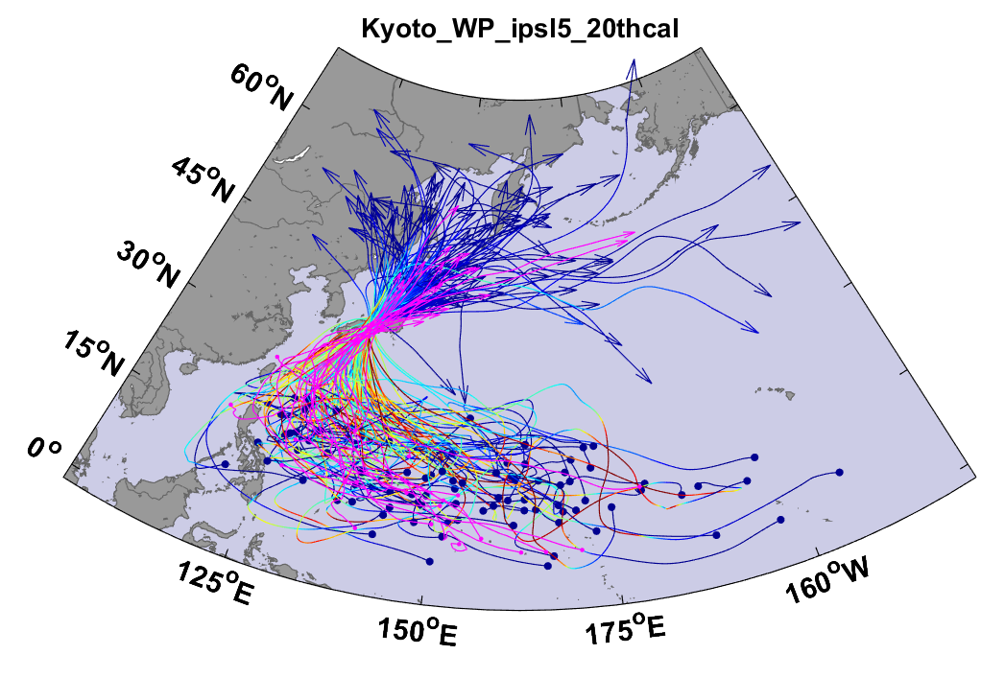
Same, but with top 20 historical tracks

Slide 3
Atlantic Annual Cycle

Slide 4

Cumulative Distribution of Storm Lifetime Peak Wind Speed, with Sample of 1755 Synthetic Tracks
Blue bars: Actual
Red bars: Predicted
90% confidence bounds

Slide 5
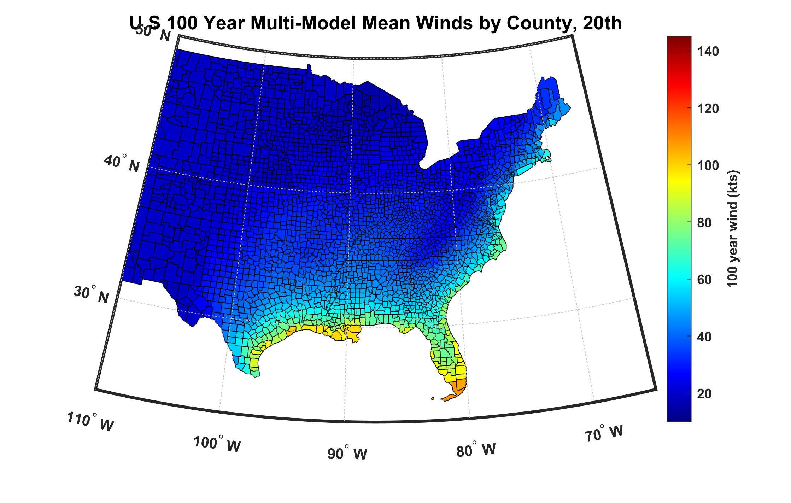
100-year hurricane peak wind based on downscaling 8 CMIP6 climate models, 1984-2014

Slide 6
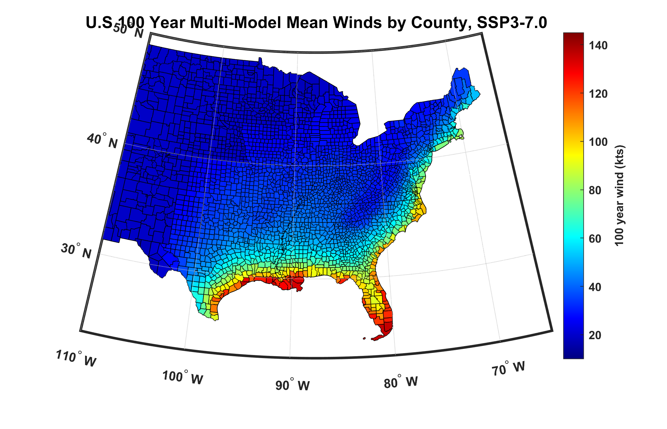
100-year hurricane peak wind based on downscaling 8 CMIP6 climate models, 2070-2100

Slide 7
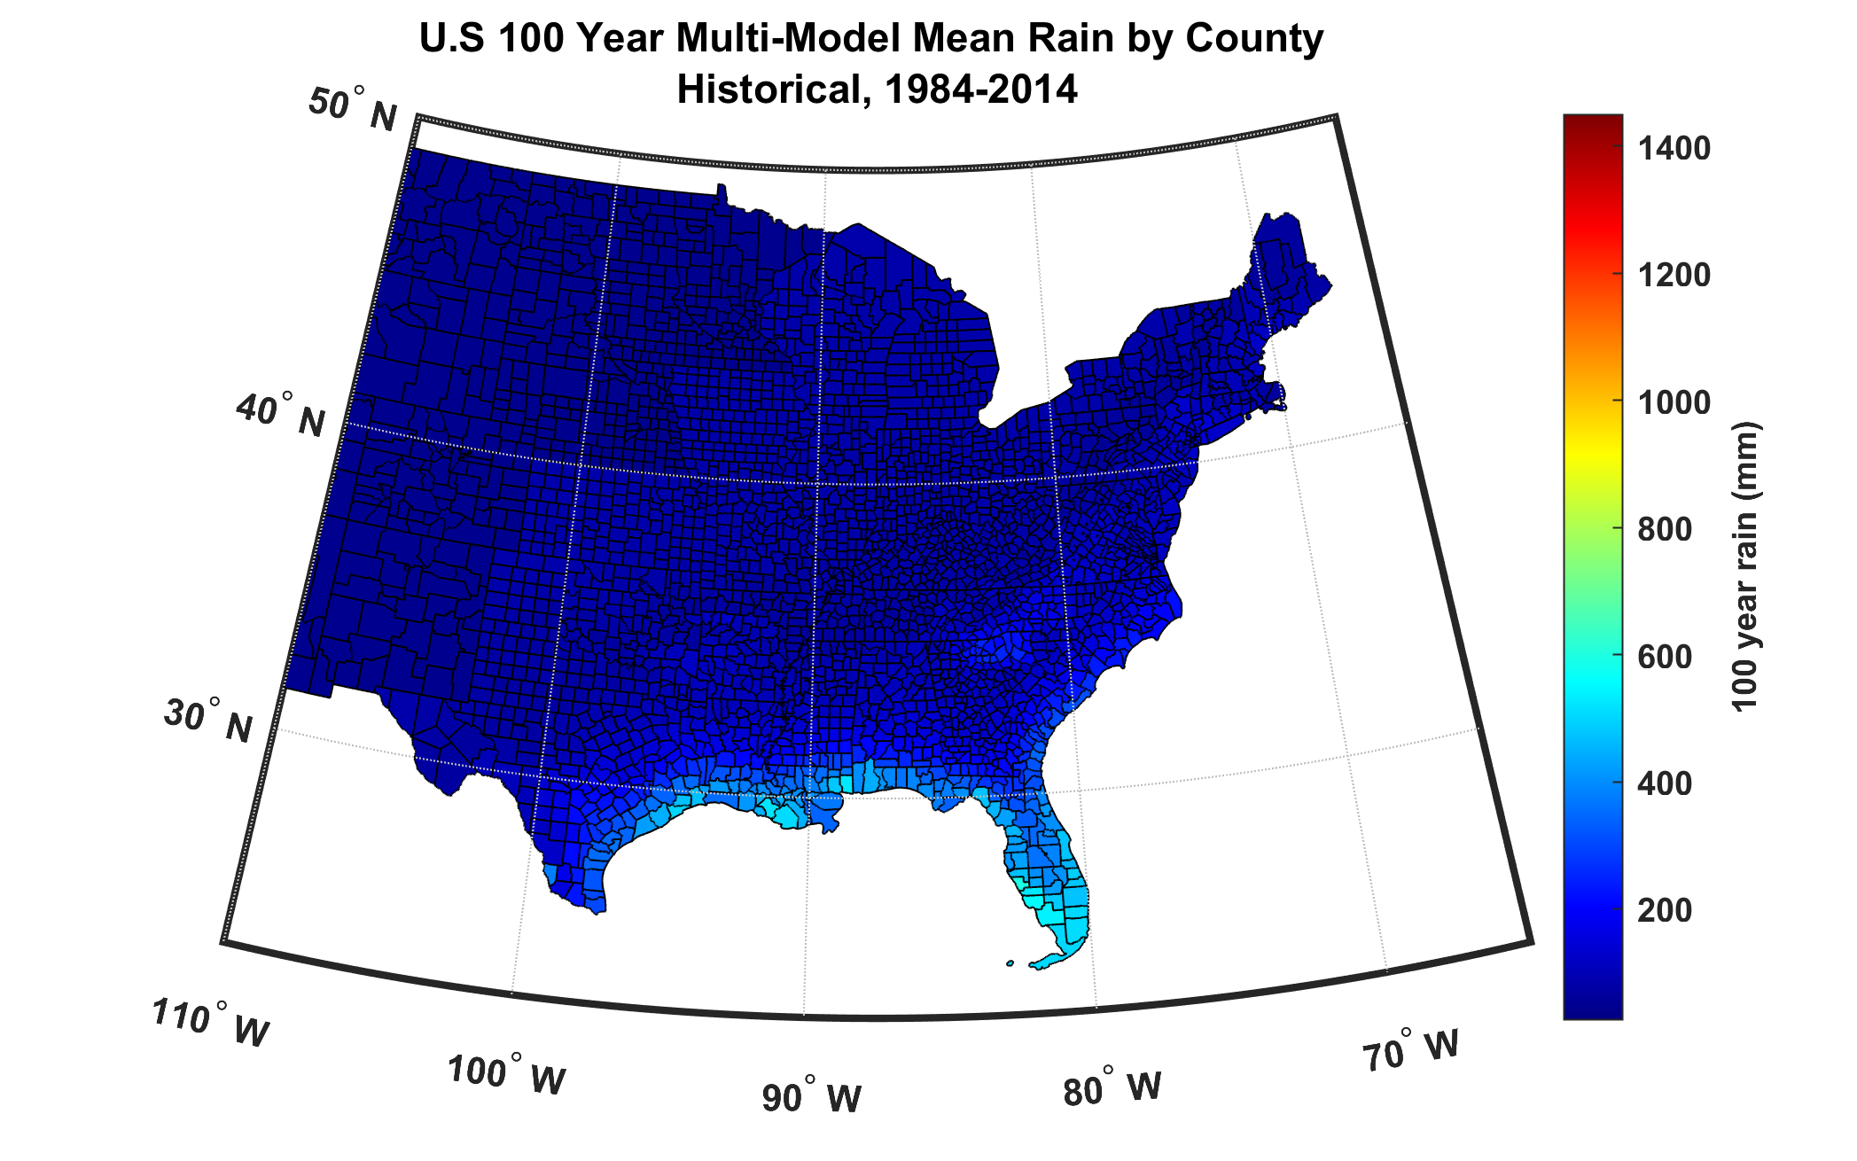
100-year hurricane storm total rain based on downscaling 8 climate models, 1984-2014

Slide 8
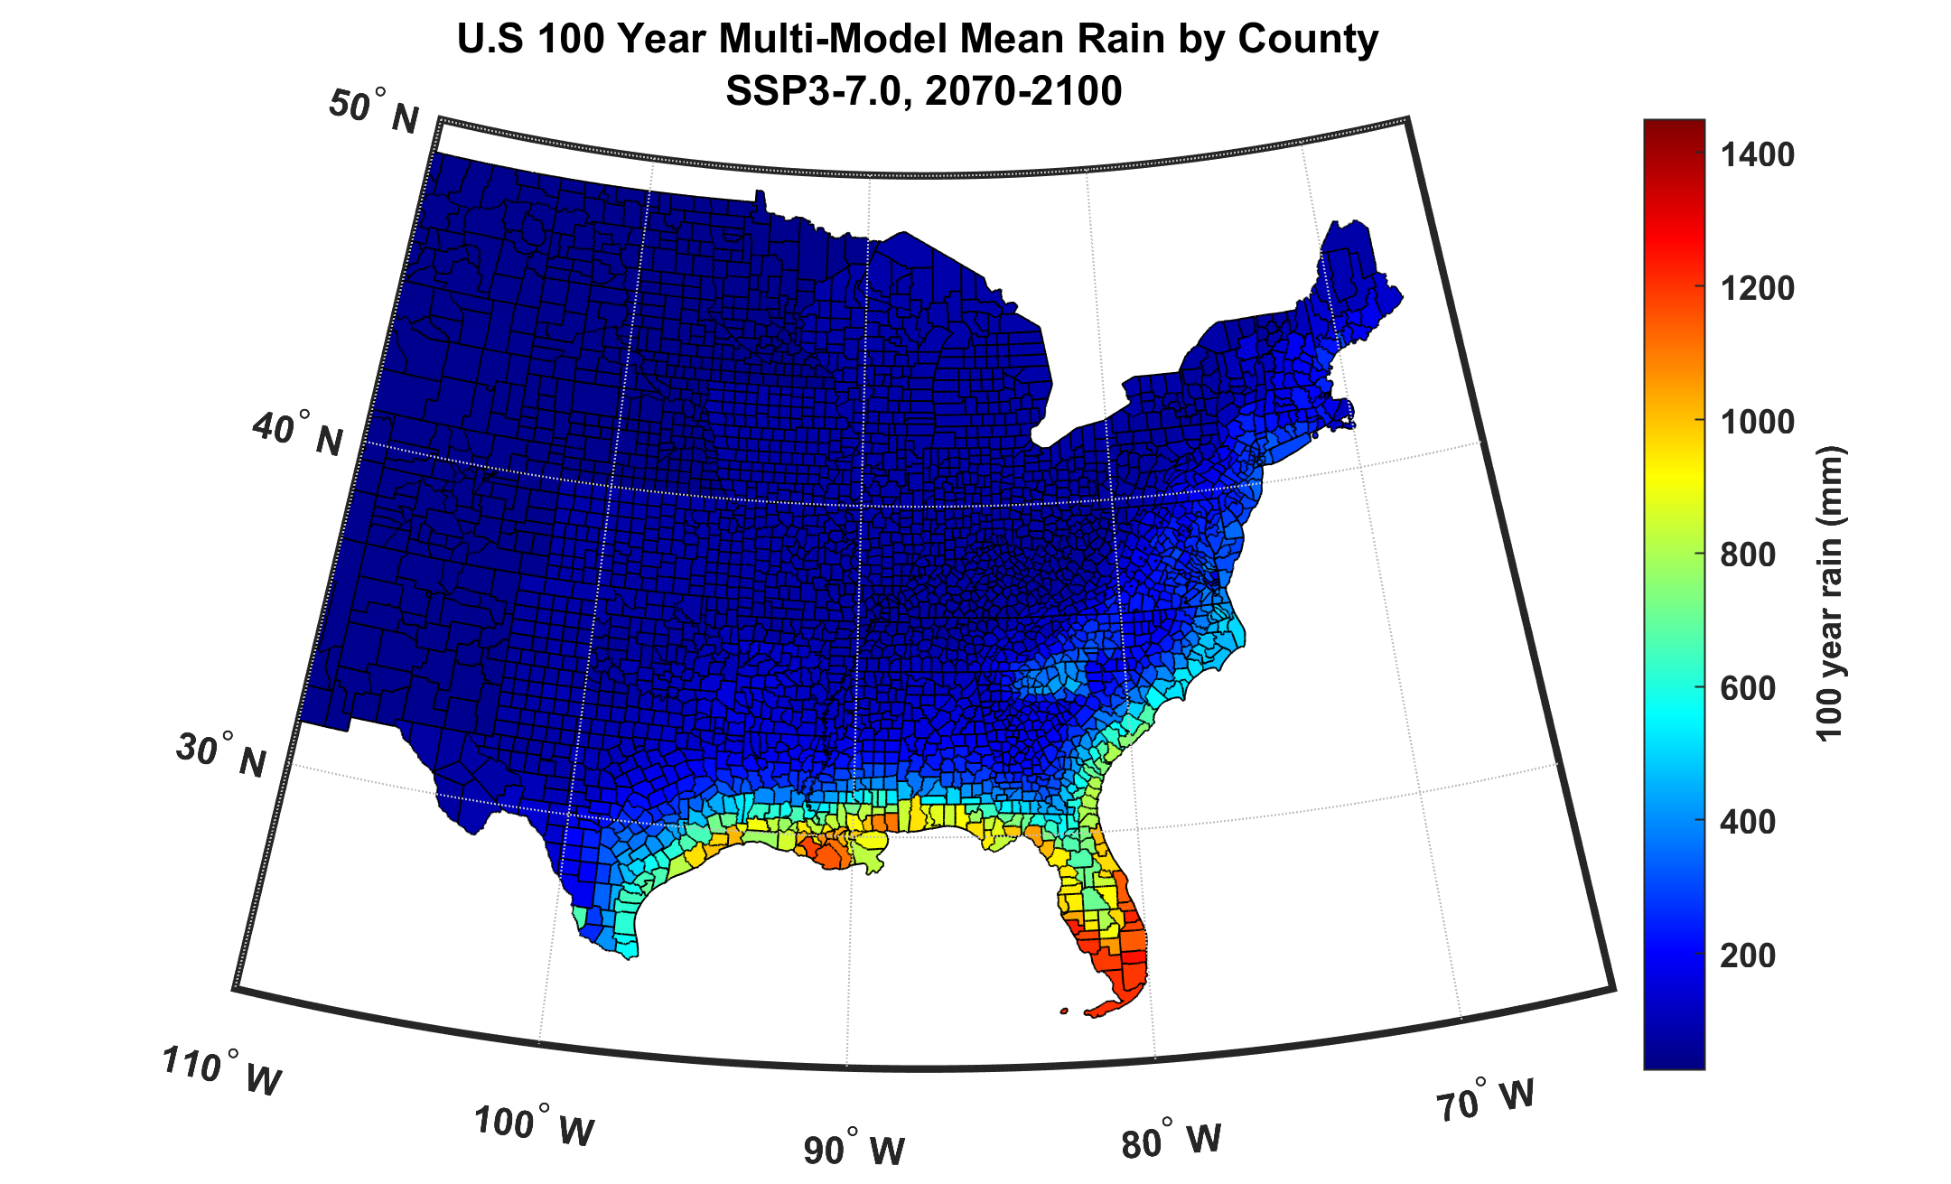
100-year hurricane storm total rain based on downscaling 8 climate models, 2070-2100

Slide 9
The nature of financial risks from weather hazards:
Hurricanes as an example
Total insured values (TIVs) of particular insurance firm aggregated over zip codes
Net TIV: $ 2 trillion
12,968 zip codes

Slide 10
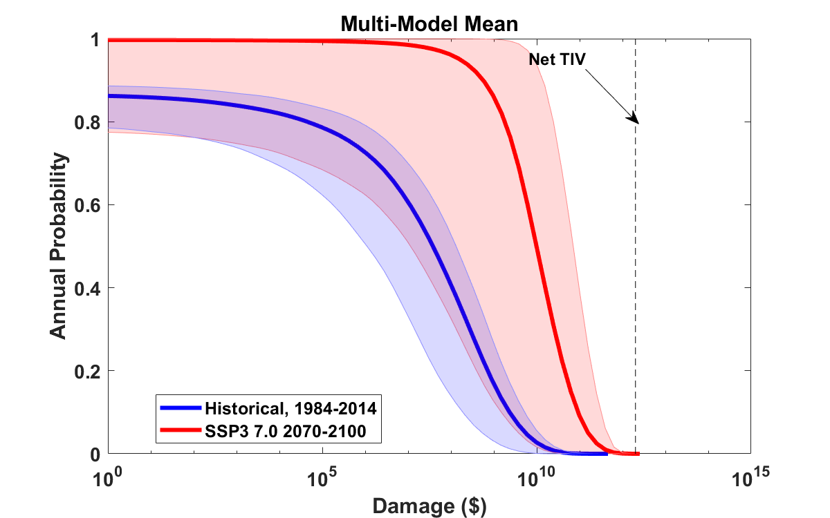
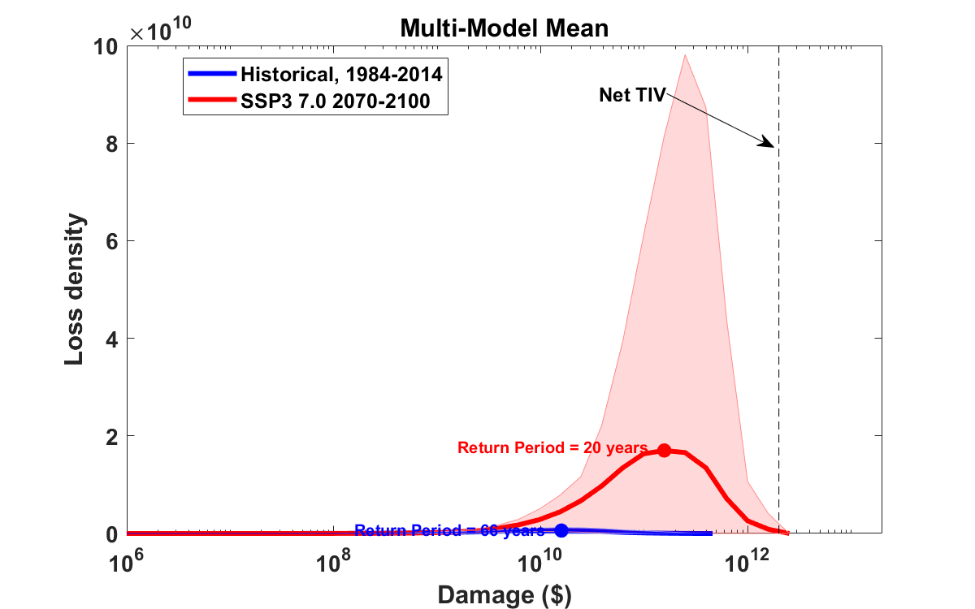
Median annual loss (2-year return period)
1984 – 2014: $ 37 million ($ 1 million – $ 132 million)
2070 – 2100: $ 9.8 billion ($ 11 million – $ 70 billion)
Average annual loss:
1984 – 2014: $ 940 million ($675 million – $11 billion)
2070 – 2100: $ 20 billion ($11 billion – $93 billion)
Annual average loss strongly dominated by rare events
These may not be evident in historical records

Slide 11
2,000 year rain event for Houston

Slide 12
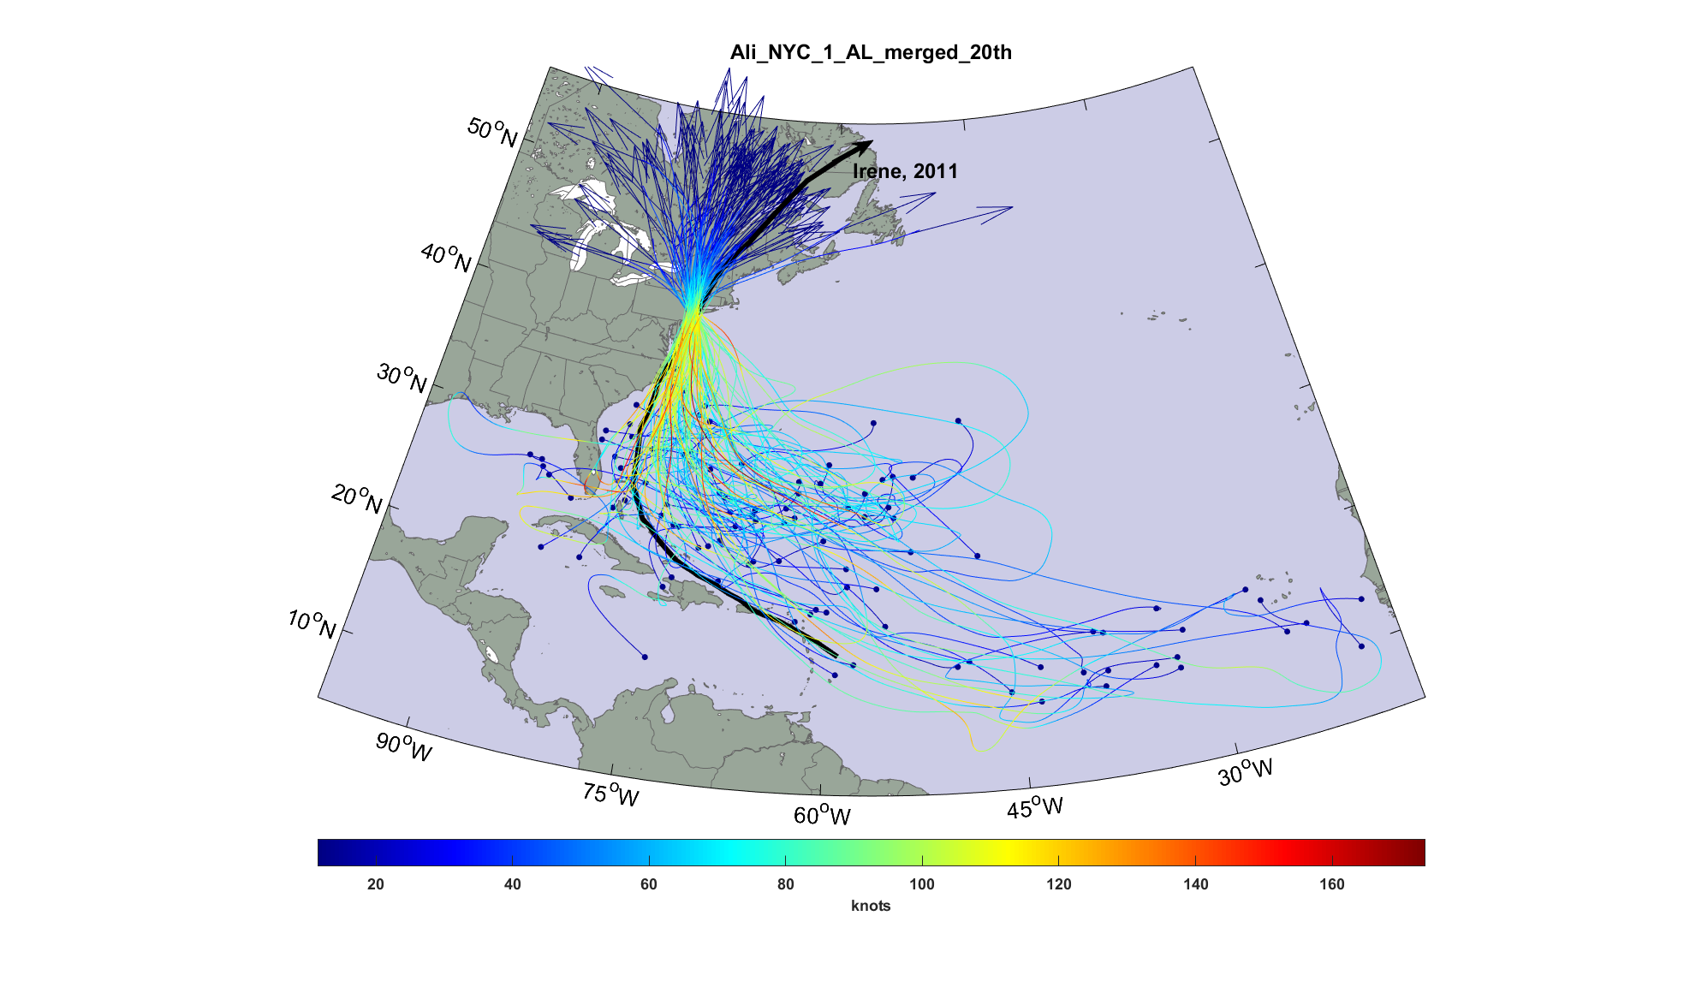
Top 100 of 11,700 tropical cyclones affecting New York City

Slide 13
Sandy: surge driven Flooding – ERA5 #1299

Slide 14
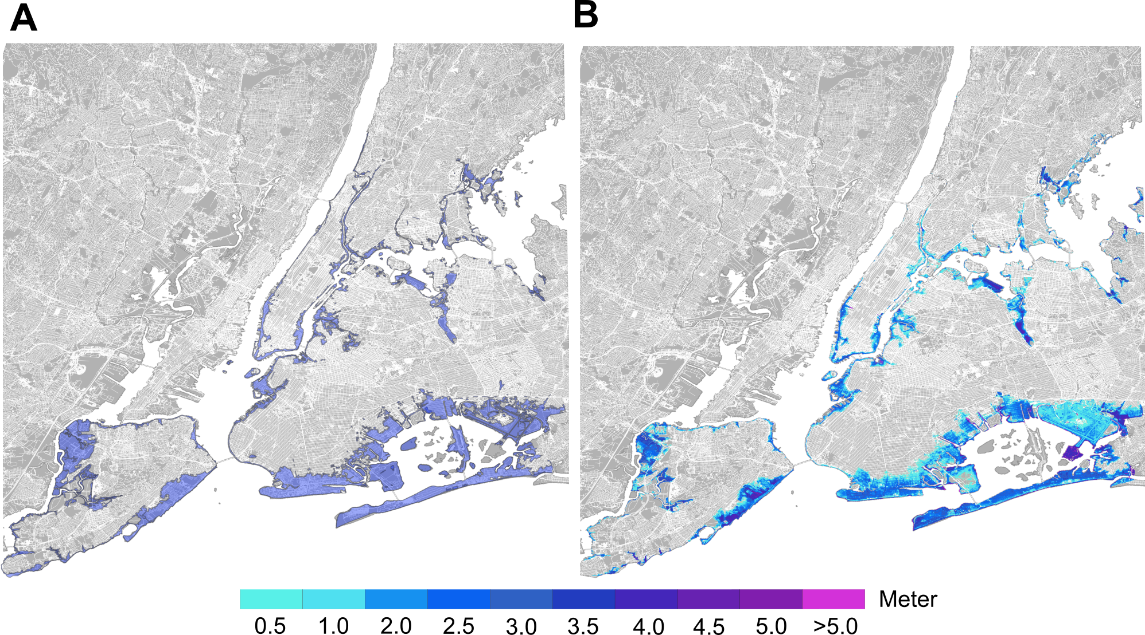
Sandy: surge driven Flooding – evaluation
FEMA surge driven flooding extent (Observed)
Surge driven flooding (Simulated)
Notes:
Performance evaluation of the LISFLOOD hydraulic model in simulating Sandy's surge driven flooding occurred in October 2012 in NYC. (A) Simulated surge driven flooding map from the Sandy-like event (synthetic track \#1299 downscaled from ERA-Interim reanalysis) restricted to NYC. (B) Sandy's surge driven flooding extent map recorded from FEMA in NYC. Note that the FEMA map does not show flood levels but only areas inundated.

Slide 15
Sandy: rainfall driven Flooding – ERA5 #1299

Slide 16
Sandy: Compound Flooding – ERA5 #1299

Slide 17
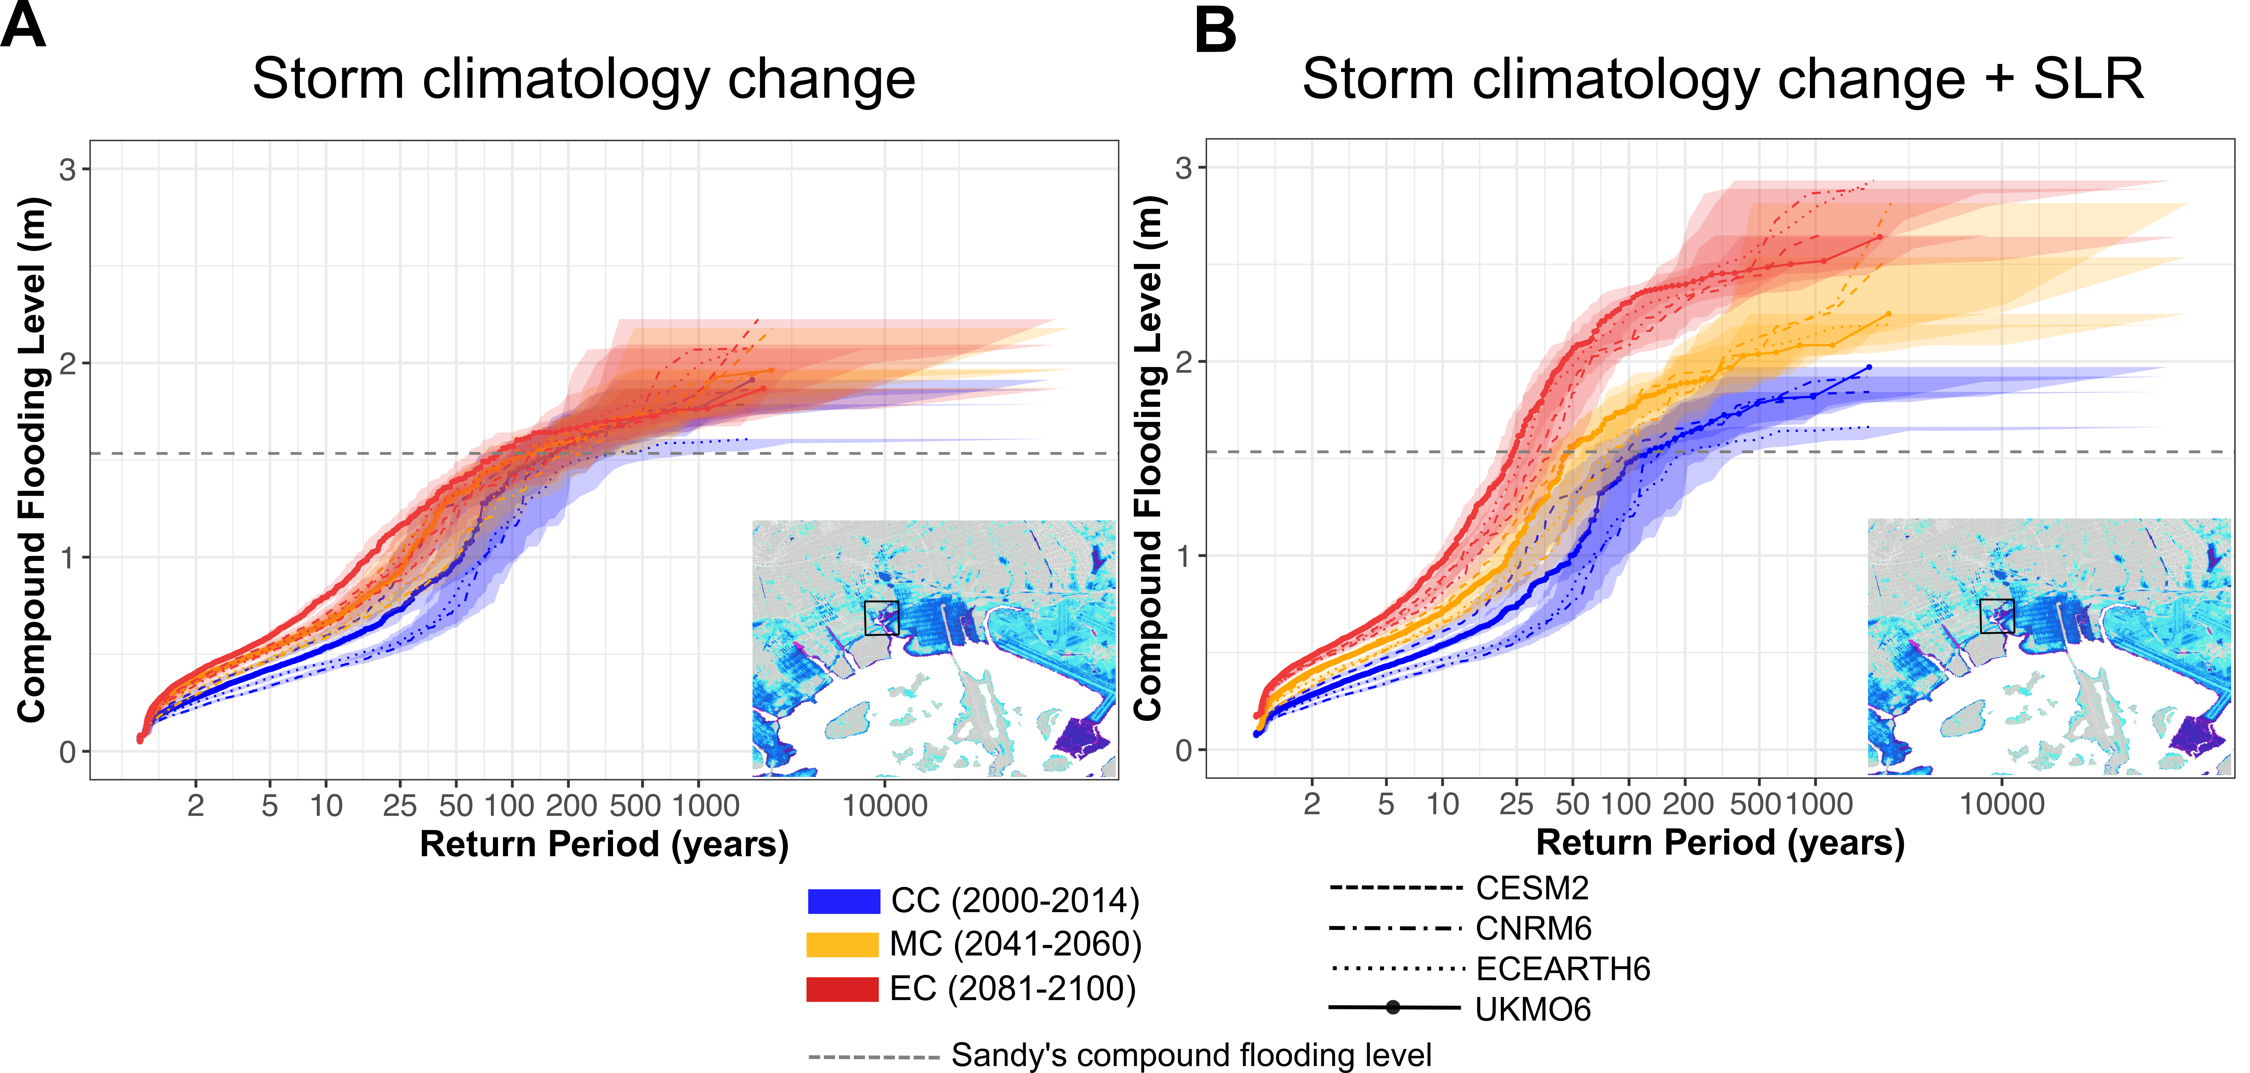
Impact of drivers on future compound flooding (TC)
Notes:
Impact of future TC climatology change and SLR on the risk of compound flooding in NYC. (A) Contribution of TC climatology change alone, and (B) contribution of both TC climatology change and SLR to the future risk of compound flooding. The results are based on the mean of compound flooding level (calculated for the depicted coastal area) in the current and future climates. Each line shows the results from synthetic TCs downscaled from each climate model in the current and future climates. The blue color represents the results for the current climate, orange color represents the middle of the century, and red color represents the end of the century. The gray dashed line shows the magnitude of compound flooding from Sandy (calculated from the Sandy-like event (\#1299) for the depicted area.

