Slide 1

Severe Thunderstorms and Climate
Kerry Emanuel
Lorenz Center
MIT

Slide 2
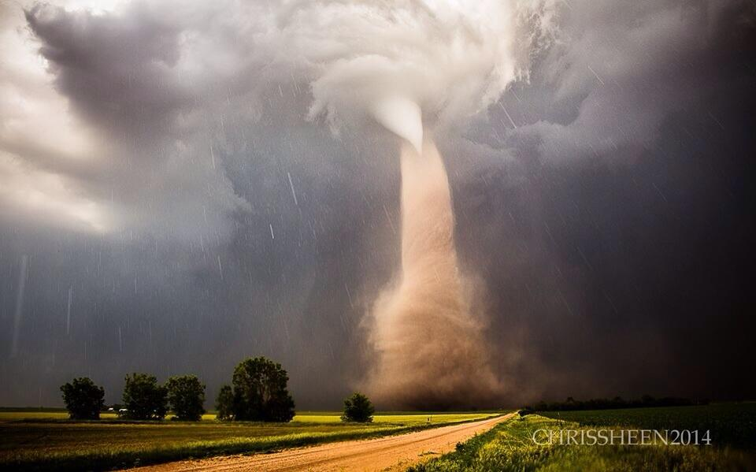

Slide 3
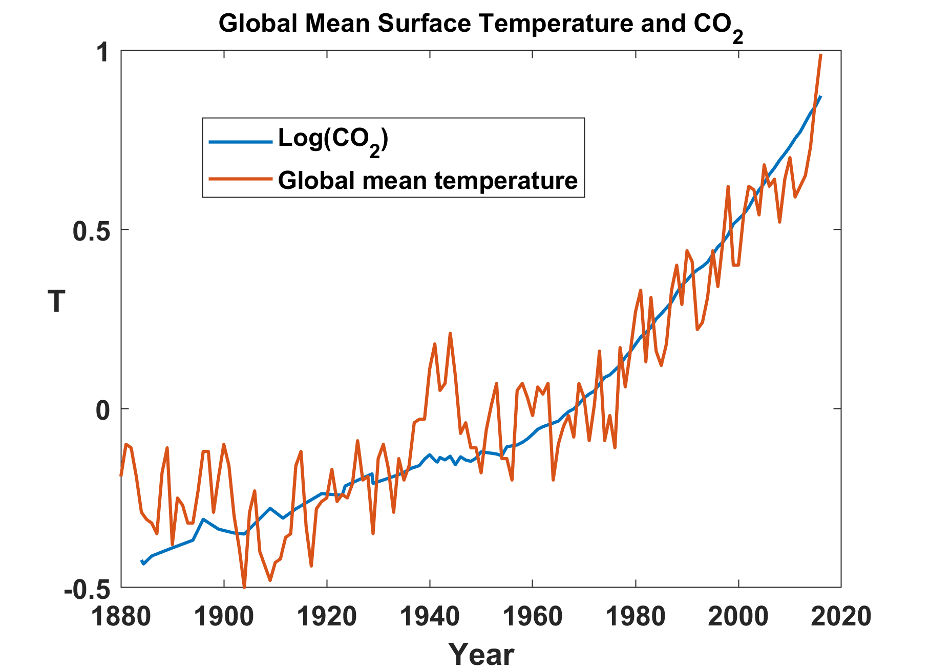

Slide 4
Some Preliminaries:
Two Broad Categories of Convection
Quasi-equilibrium convection
  Convection consumes available energy at about the rate that large- scale processes generate it
  Most tropical convection and middle-latitude summer convection is of this type
  Generally benign
  Responsible for significant fraction of global mean, annual mean rainfall
Stored-energy convection
  Convective available energy builds up over time and is then suddenly released
  Comparatively rare
  Responsible for most convection-related problems: tornadoes, hailstorms, flash-floods, and straight-line wind storms

Slide 5
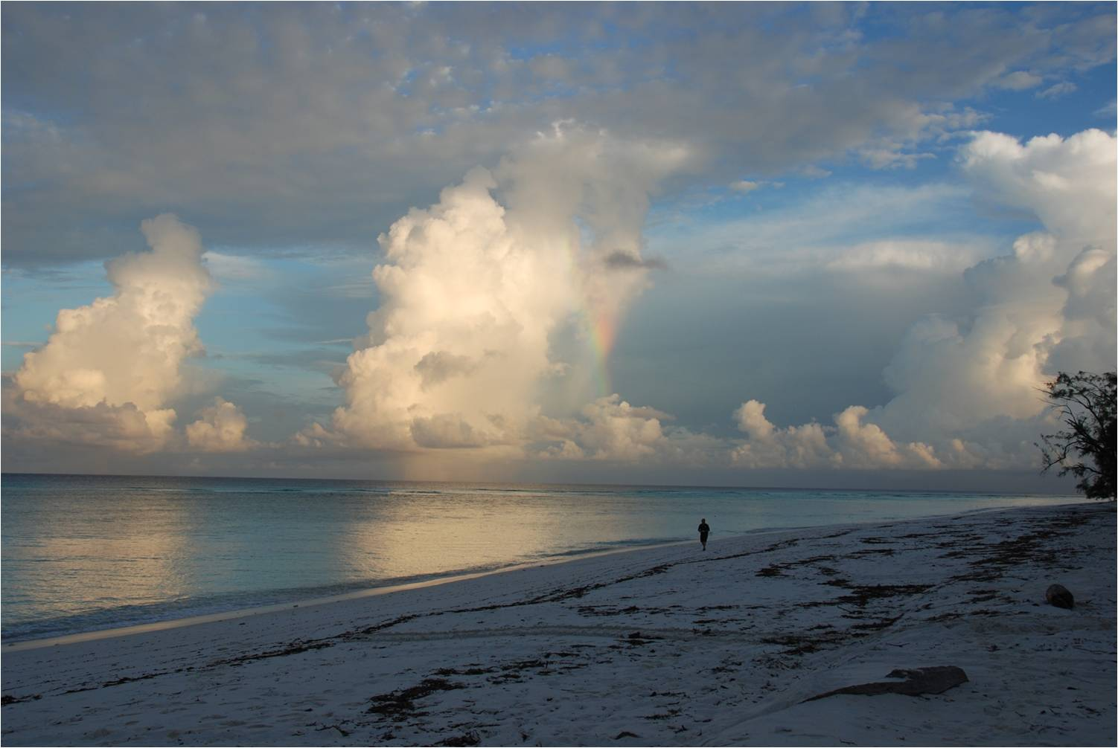
Quasi-Equilibrium Convection

Slide 6
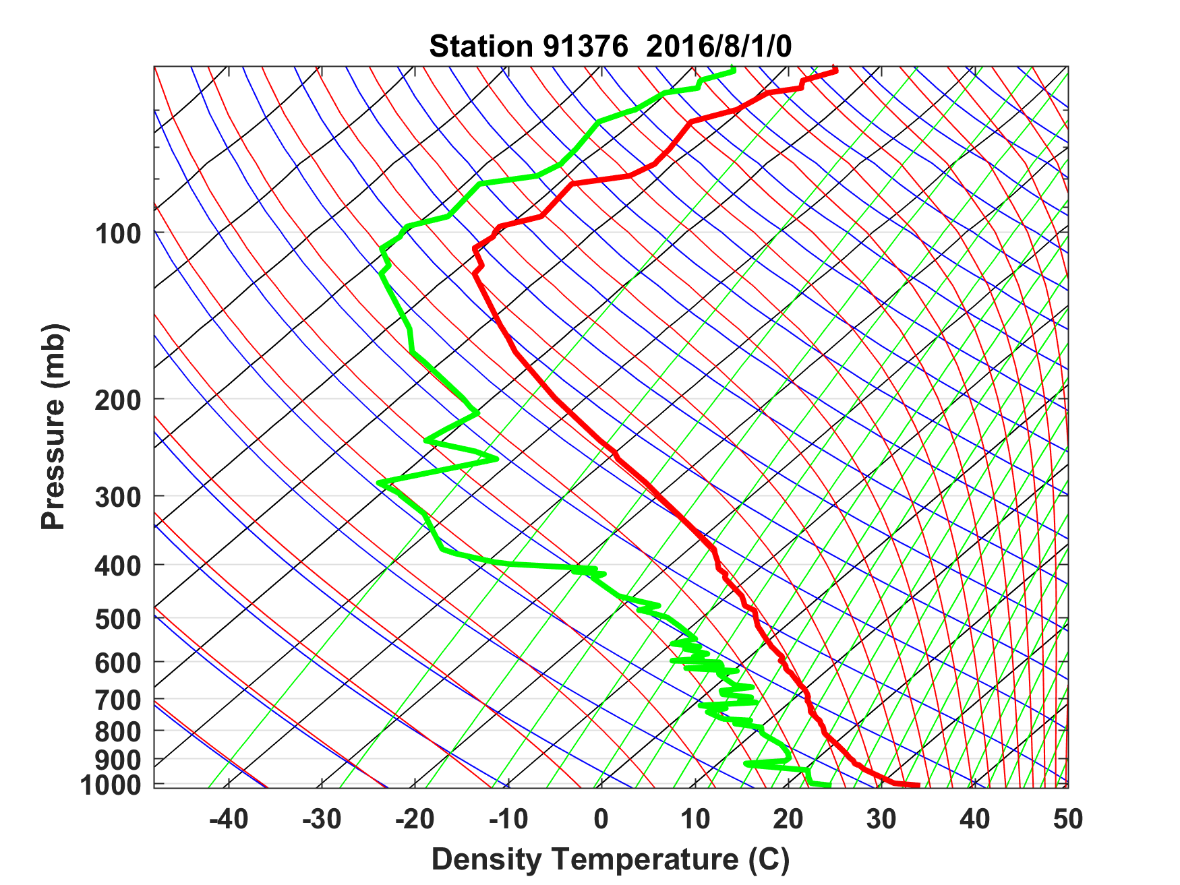
Sounding at Majuro, August 1 2016 0 GMT

Slide 7
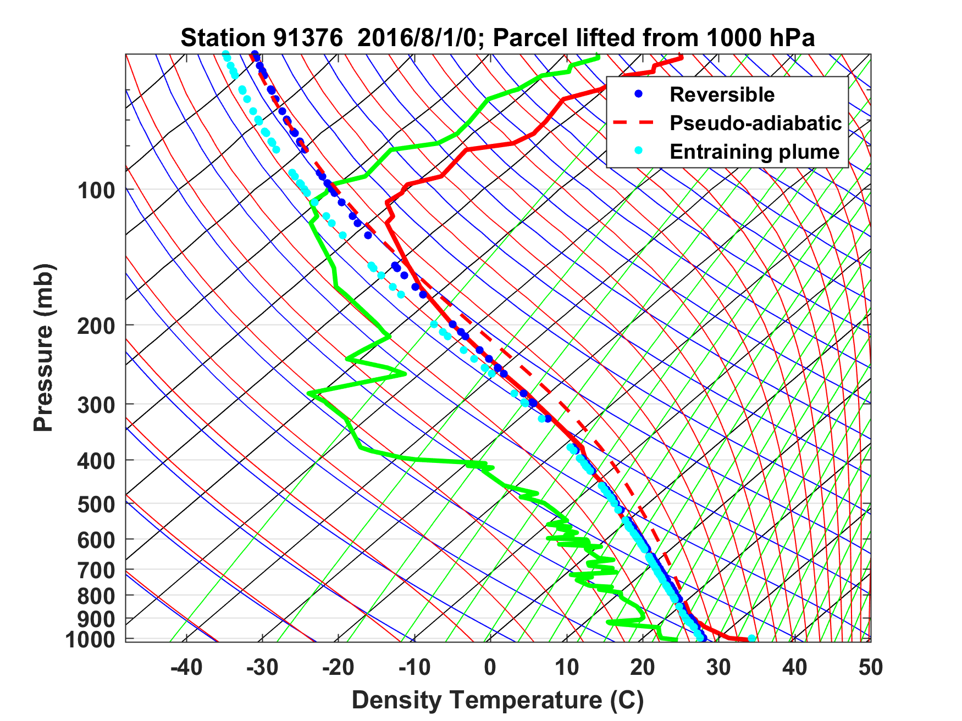
Sounding at Majuro, August 1 2016 0 GMT

Slide 8
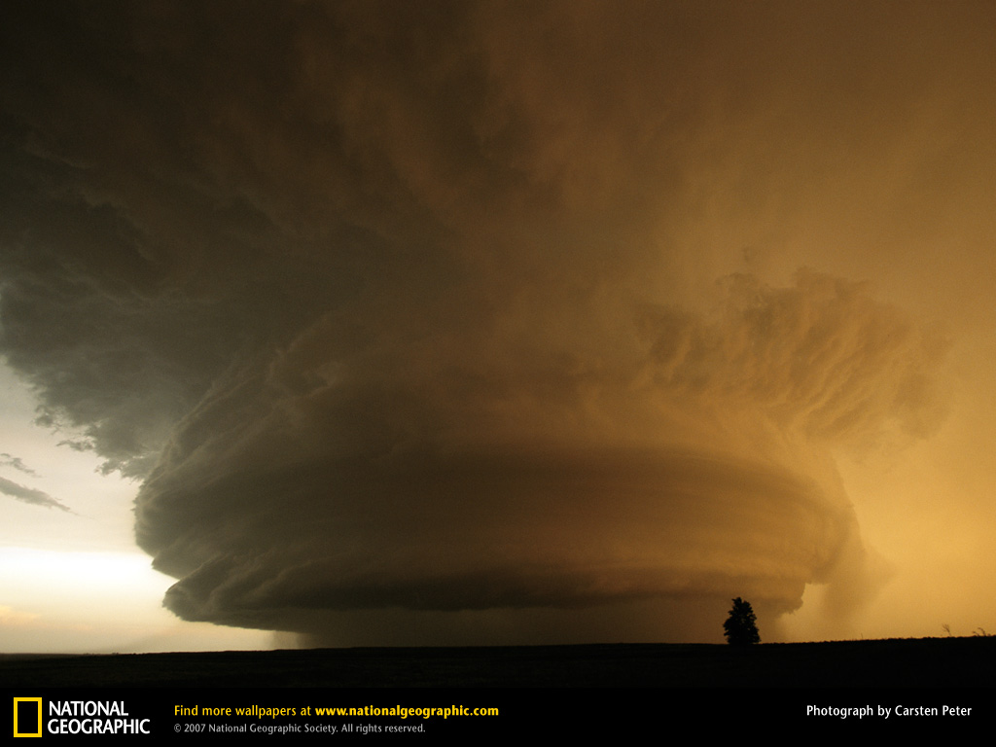
Stored-Energy Convection

Slide 9
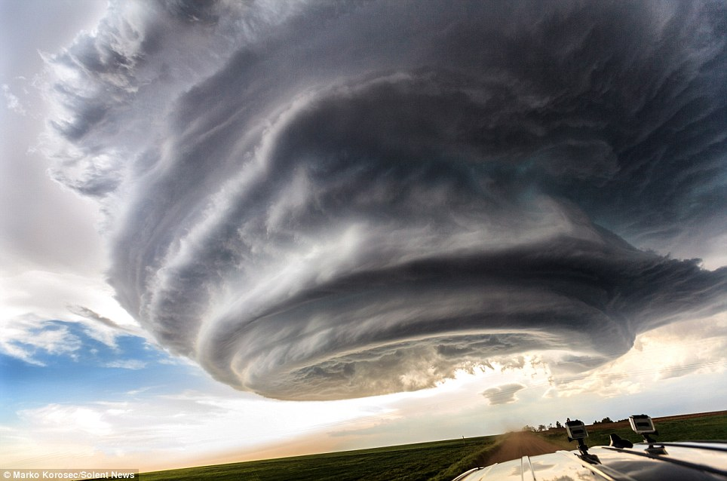

Slide 10
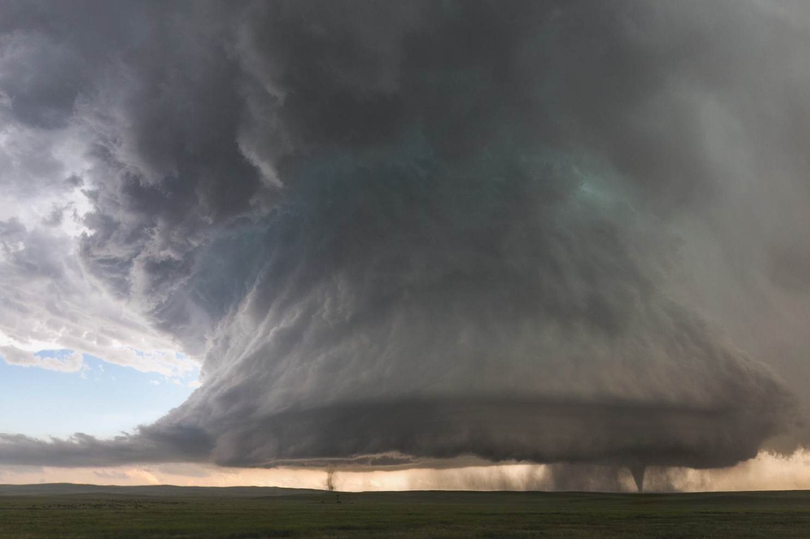

Slide 11
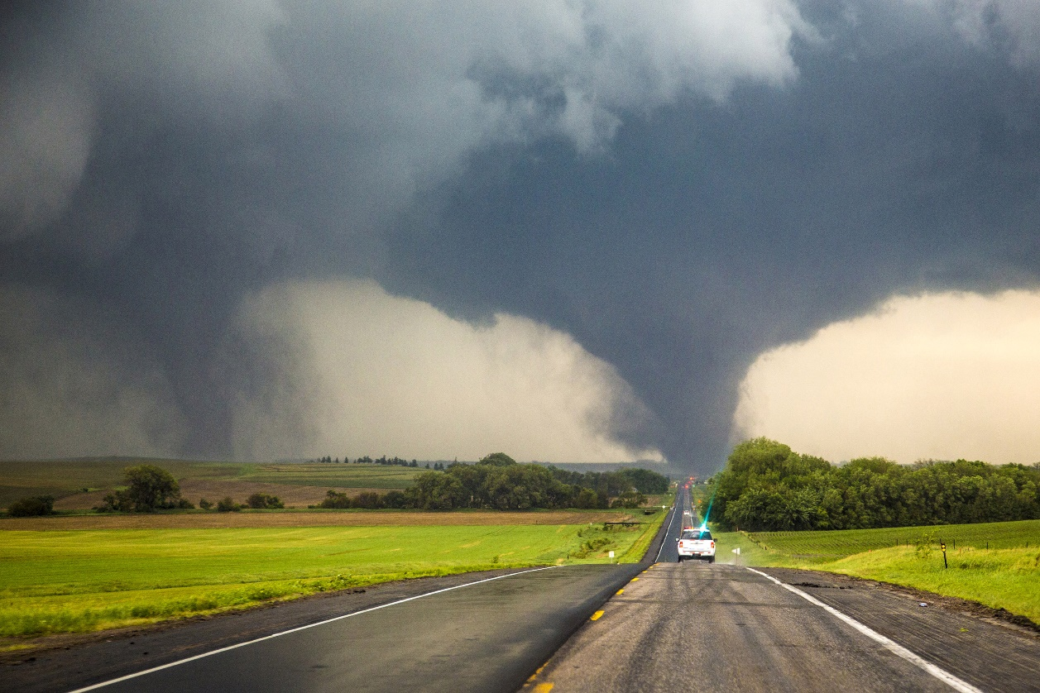
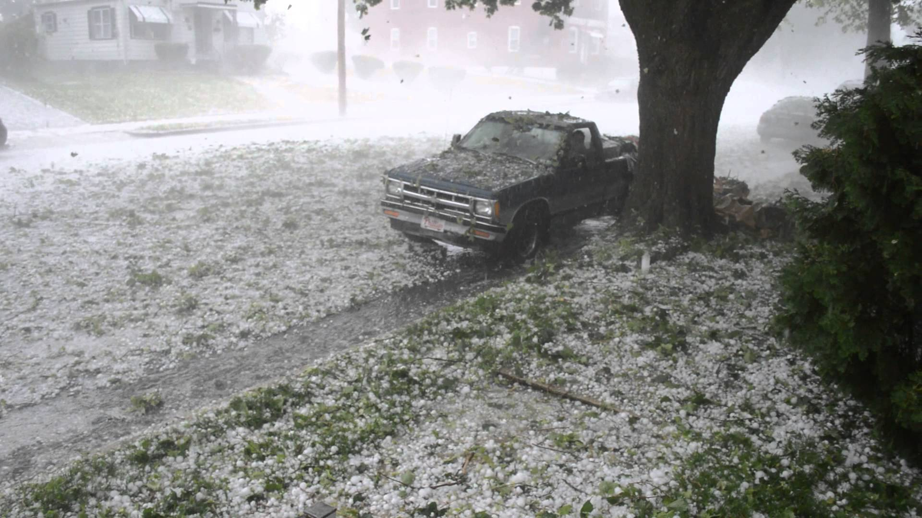
Each year in the U.S., 1,200 tornadoes on average kill 60 people, injure 1,500, and cause roughly $400 million in damages
Hail causes about $1 billion dollars in damage to crops and property each year, according to the National Oceanic Atmospheric Administration (NOAA)

Slide 12
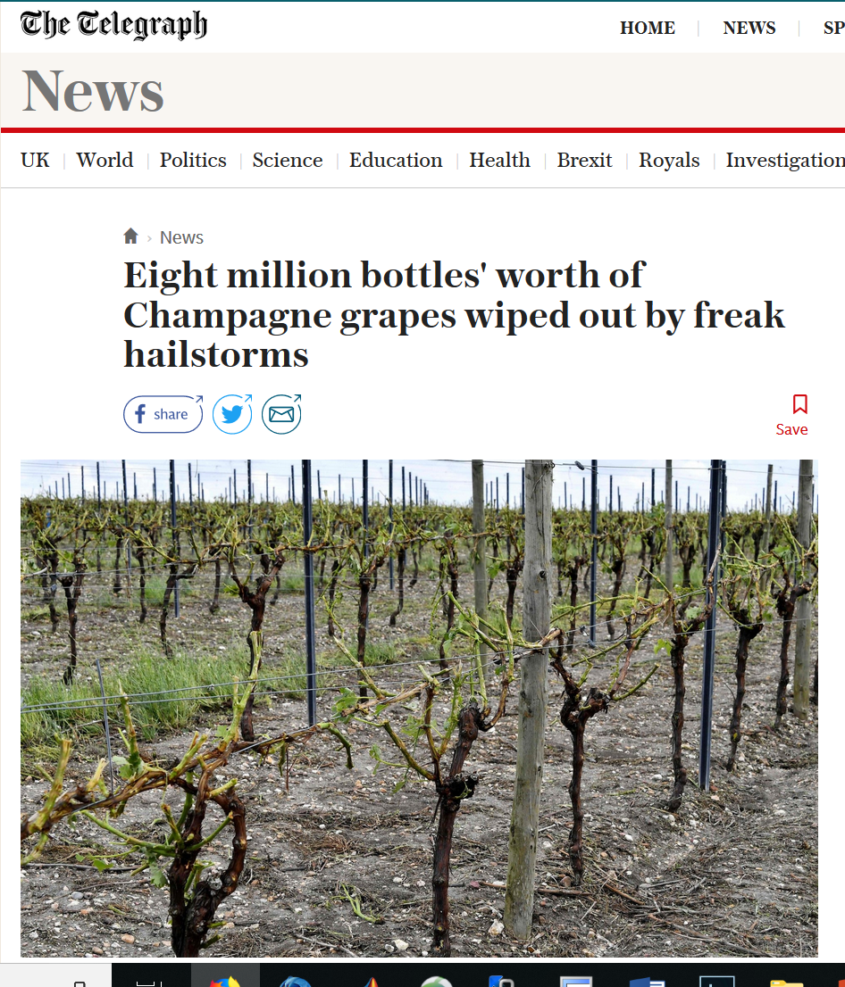
Even worse…..

Slide 13
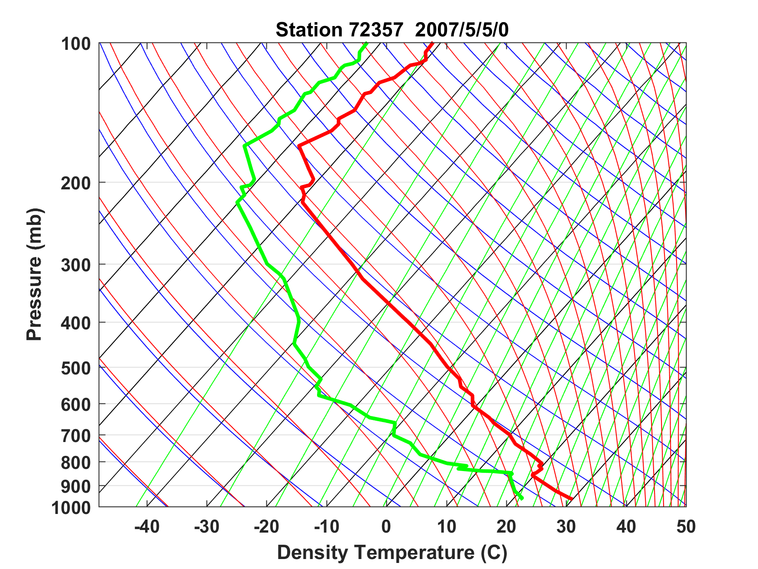
Sounding at Norman, Oklahoma, May 5th 2007
Capping inversion

Slide 14
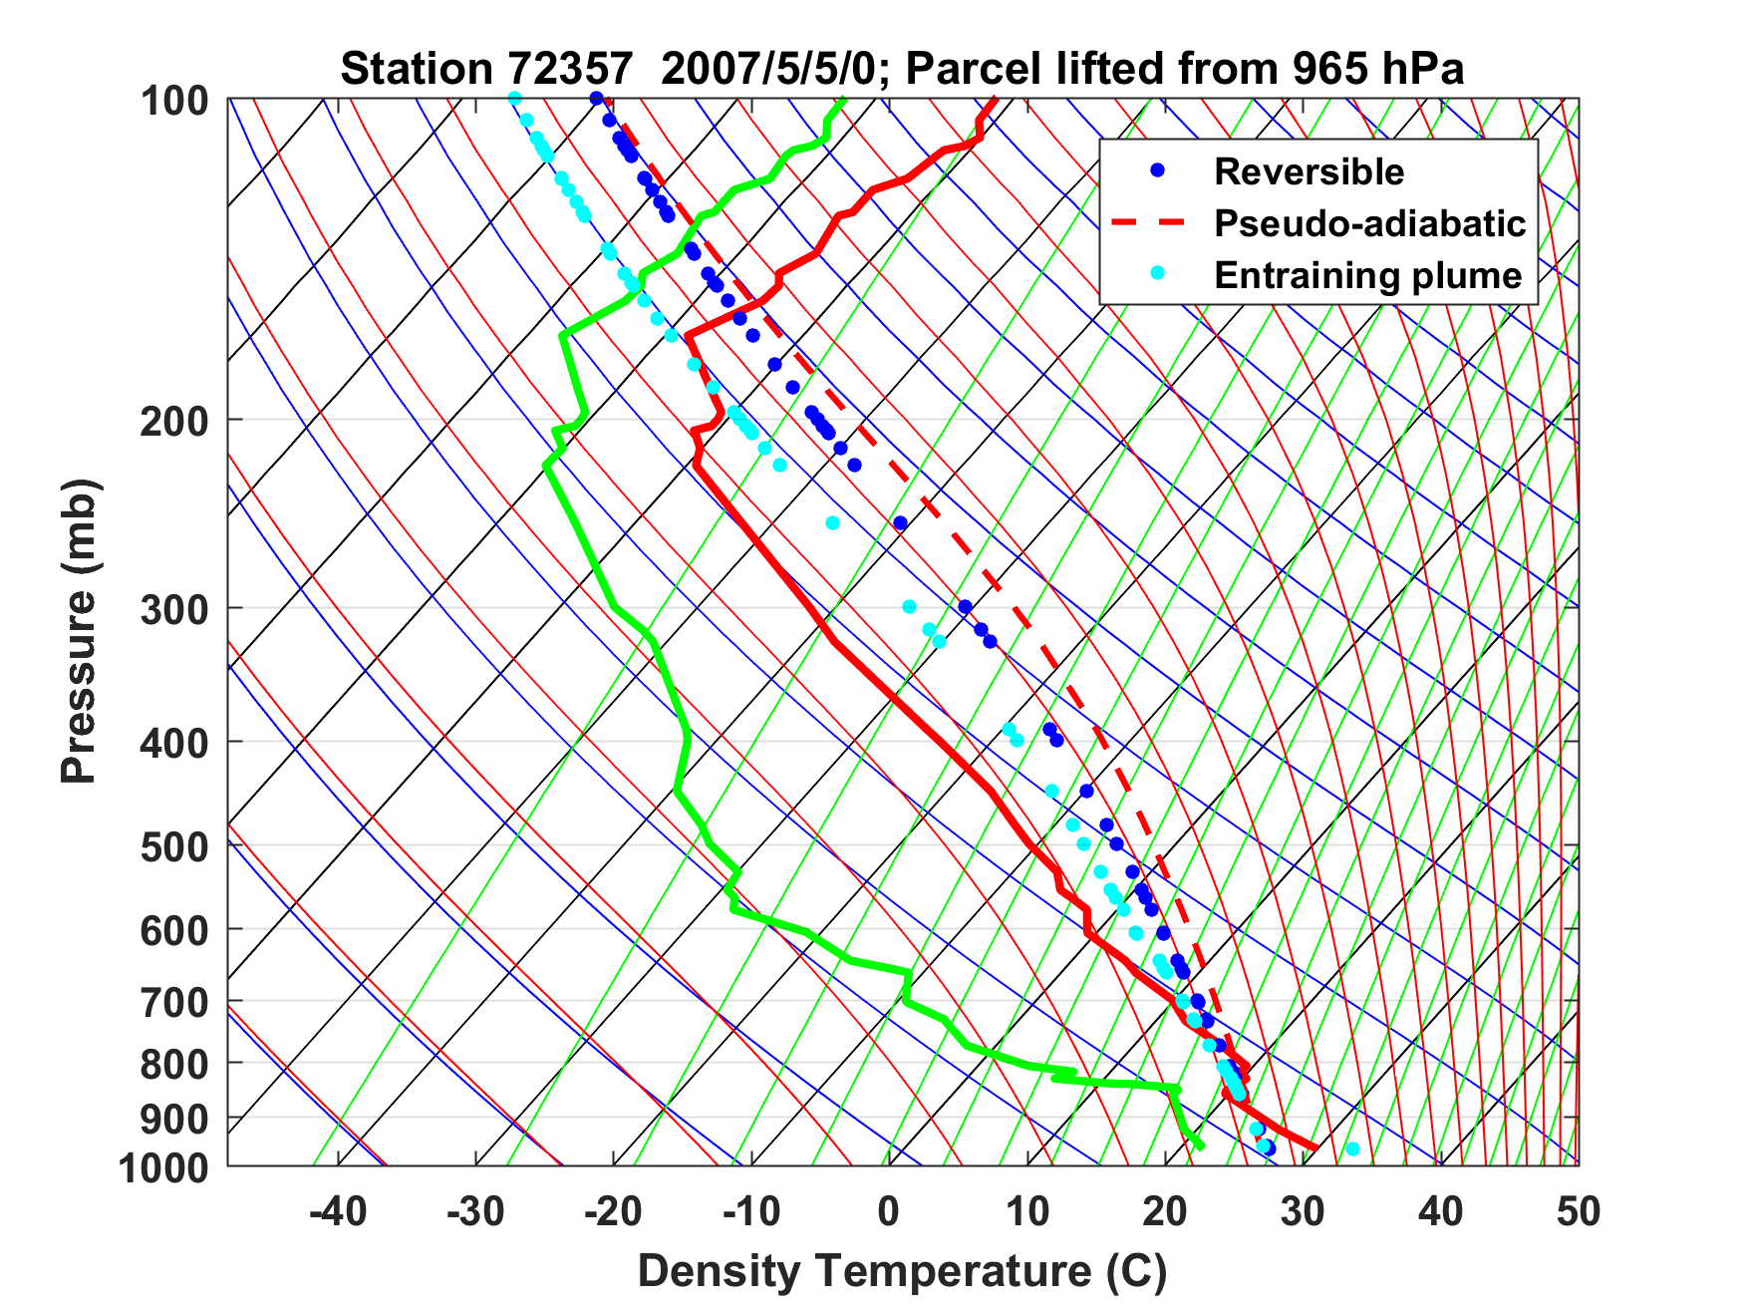
Sounding at Norman, Oklahoma, May 5th 2007

Slide 15
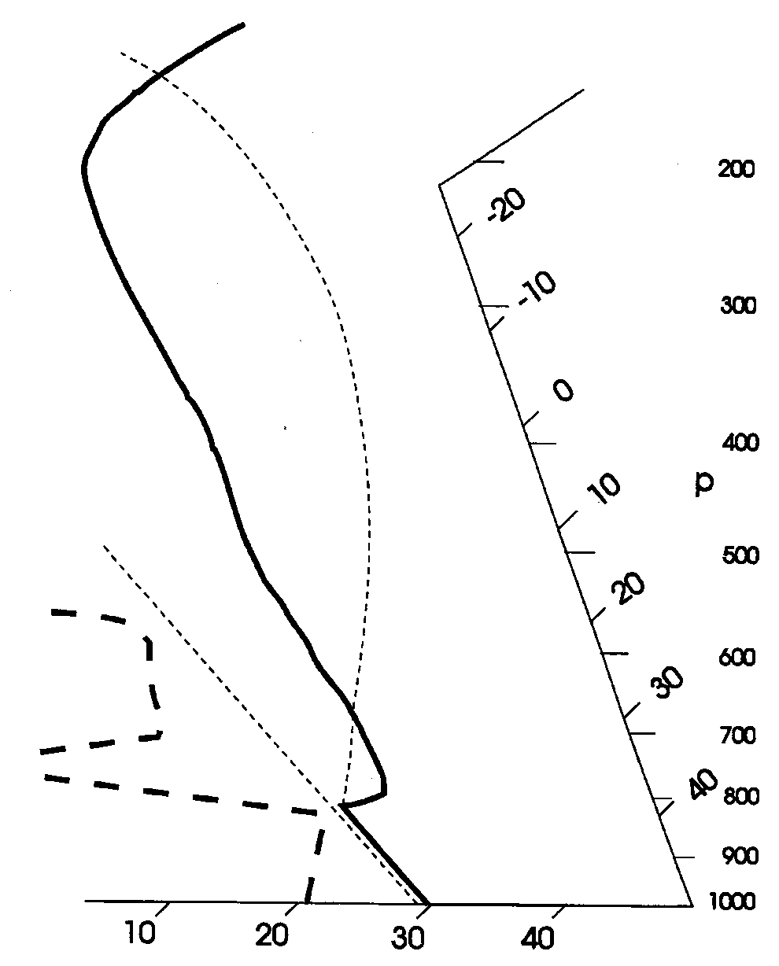
Stability Assessment using Tephigrams:
Convective Available Potential Energy
(CAPE):

Slide 16
Sounding at Norman, Oklahoma, May 5th 2007
CAPE = 6900 J/Kg → w = 110 m/s
Capping inversion

Slide 17
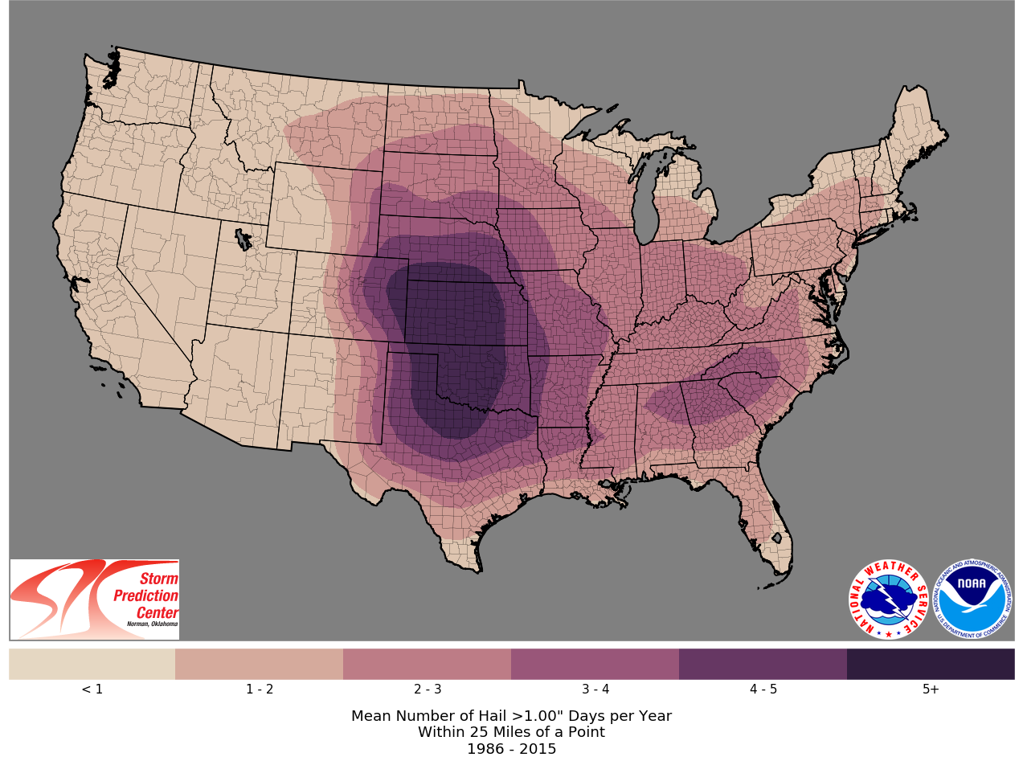

Slide 18
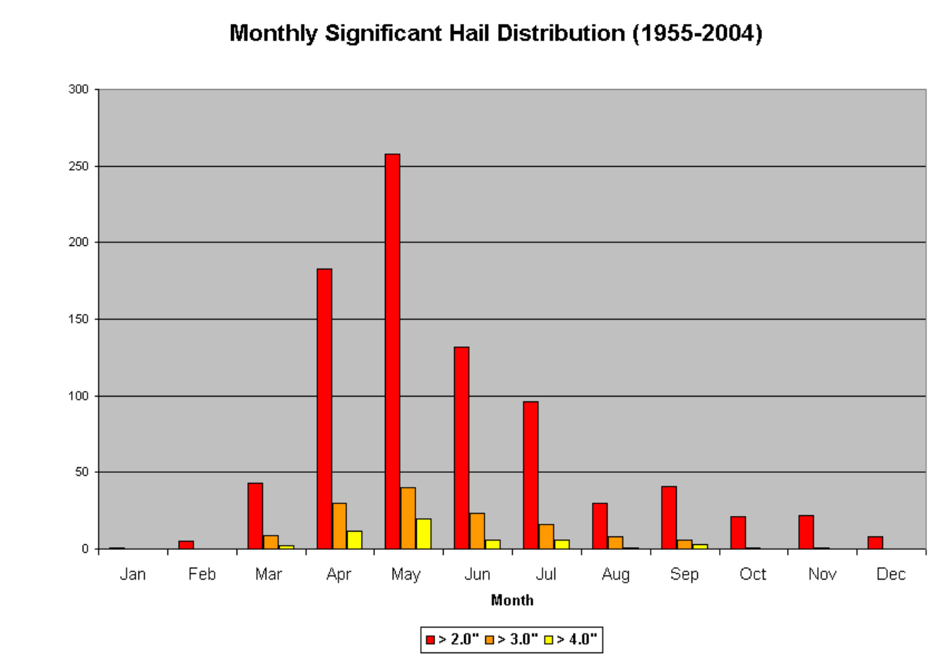
Illinois-Missouri Hail Climatology
Mark F. Britt, WFO St. Louis

Slide 19
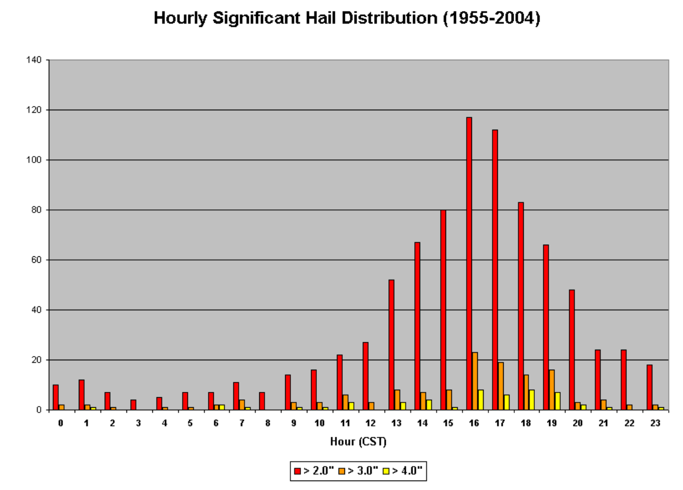
Mark F. Britt, WFO St. Louis

Slide 20
Trends in a Measure of Favorable Environments for Hailstorms (shaded) and annual mean number of hail days (contoured)
Tang, B.H., Gensini, V.A. & Homeyer, C.R. Trends in United States large hail environments and observations. npj Clim Atmos Sci 2, 45 (2019). https://doi.org/10.1038/s41612-019-0103-7

Slide 21
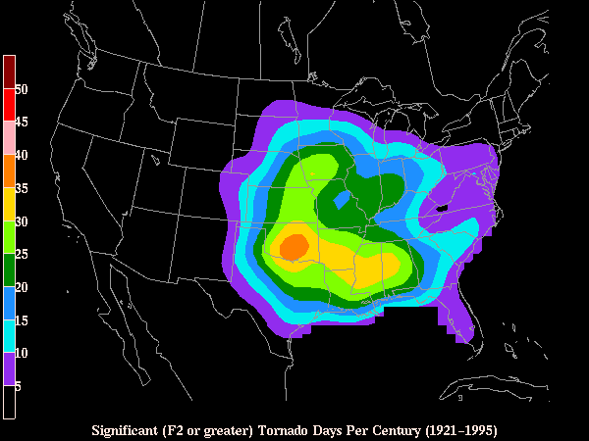
Number of Significant (>= F2) Tornadoes per Century

Slide 22

Necessary Conditions for Severe Thunderstorms:
High values of CAPE
Large vertical shear of horizontal wind, particularly at low levels

Slide 23
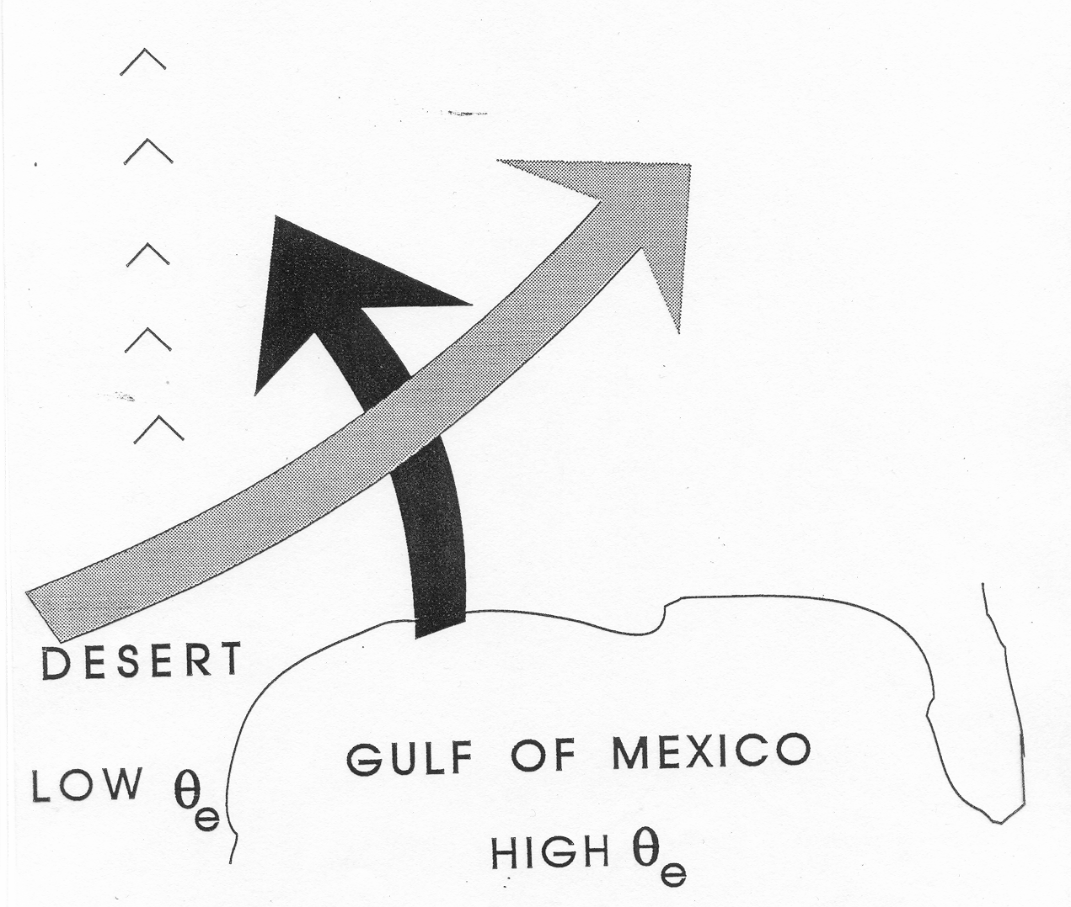
Conventional View:
Differential Advection
Emanuel, Atmospheric Convection, 1994

Slide 24
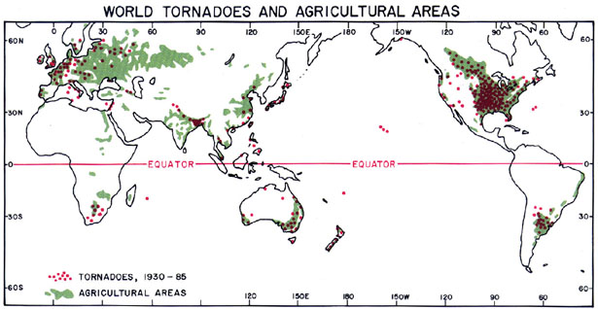
Global Distribution of Tornadoes
Ted Fujita

Slide 25
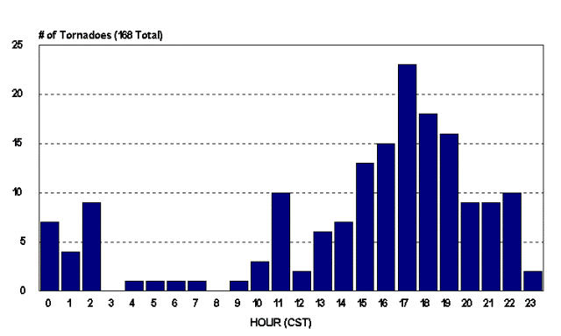
Diurnal Variation of Tornadoes

Slide 26
Mark F. Britt, WFO St. Louis

Slide 27
Key Questions:
What determines geographical distribution of stored- energy storms?
Why do tornadoes and hailstorms peak in late- afternoon to early evening?
Why are peak CAPE values around 3000-6000 J/Kg?
How might these values change with climate?

Slide 28
Hypothesis:
Large CAPE is produced when a deep, dry- adiabatic layer is advected over moist soil which is then subjected to solar heating.
Agard and Emanuel, J. Atmos. Sci., 2017

Slide 29
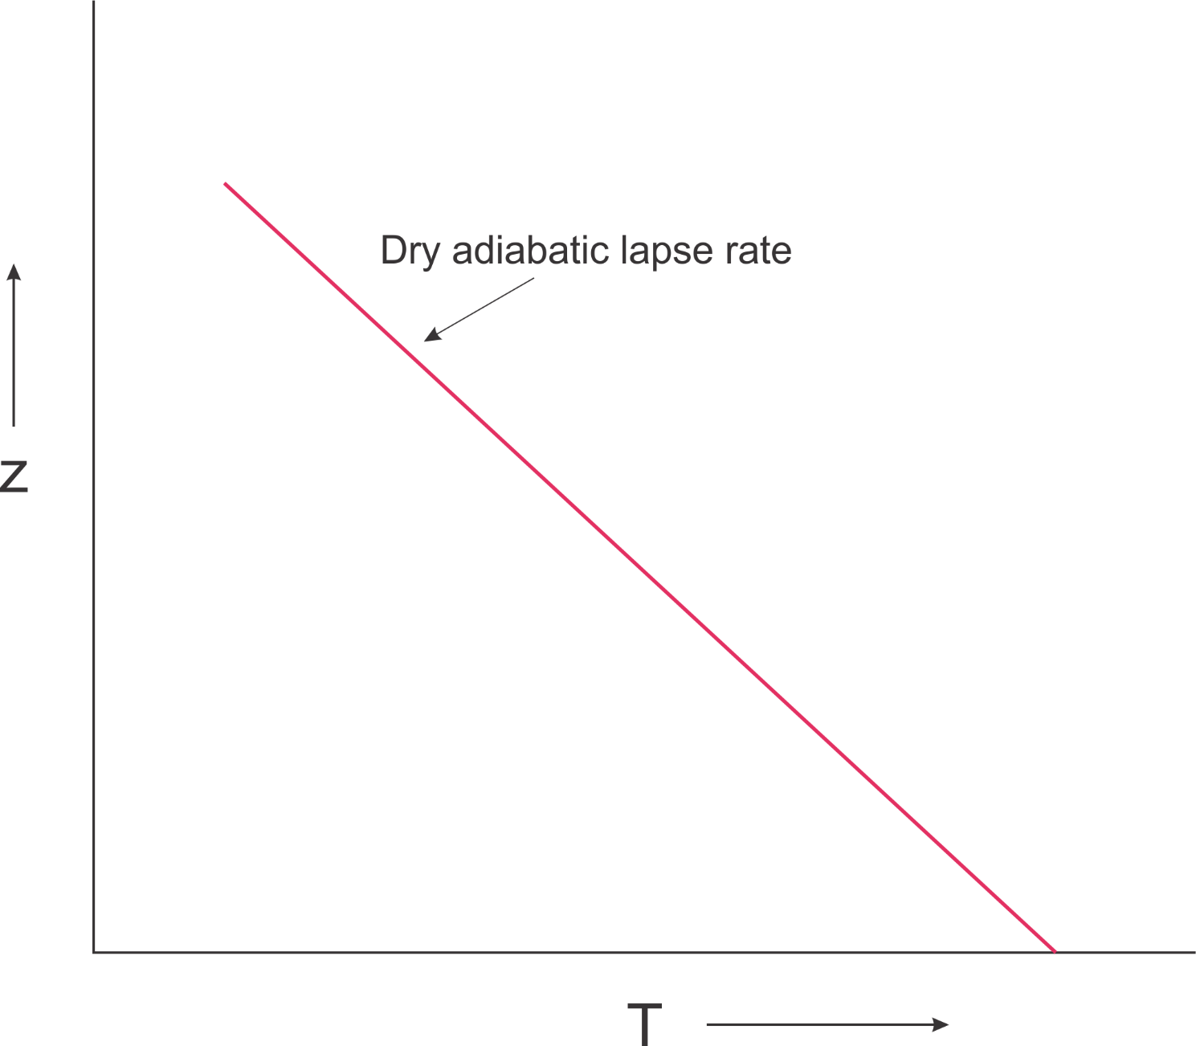

Slide 30
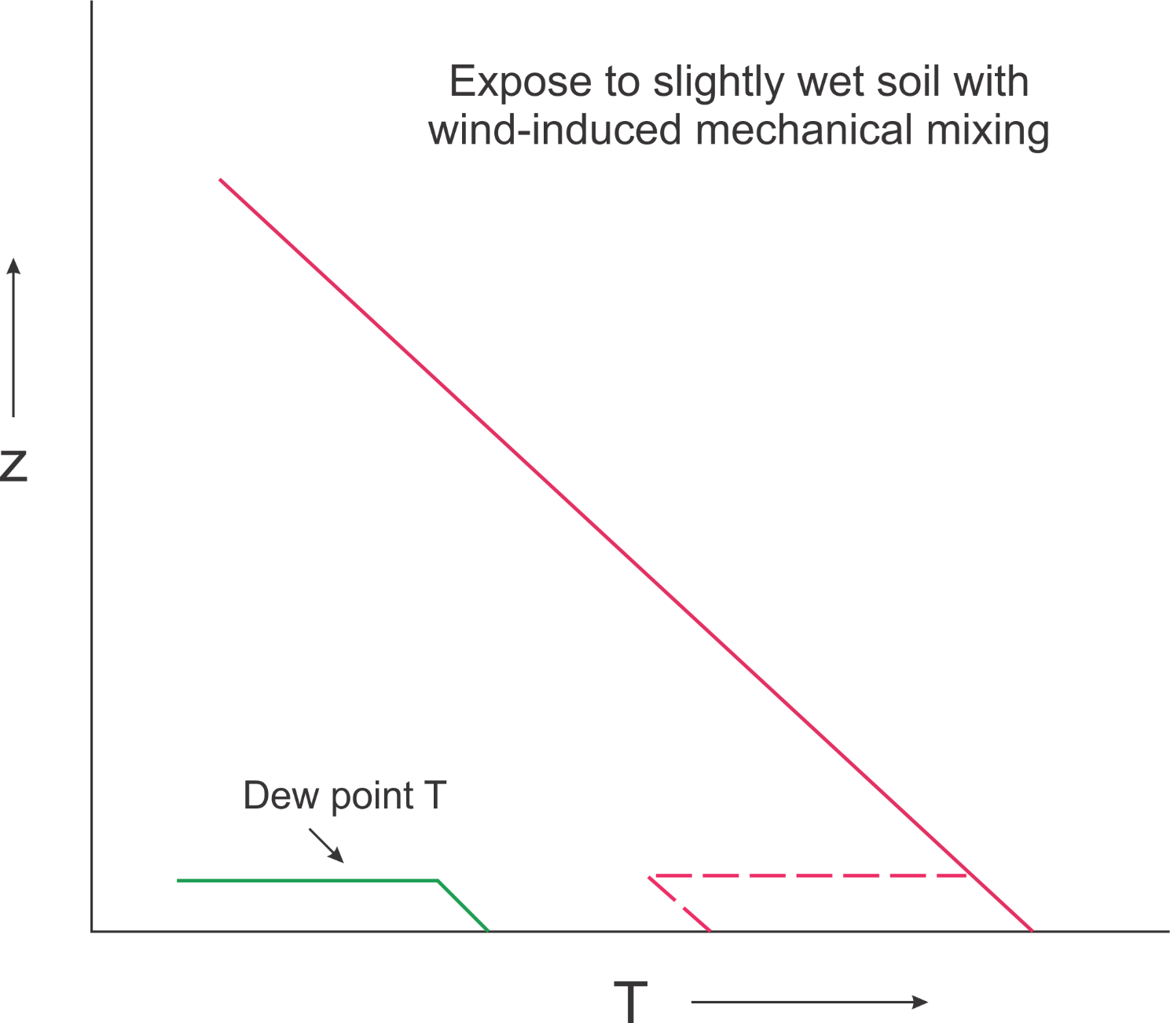

Slide 31
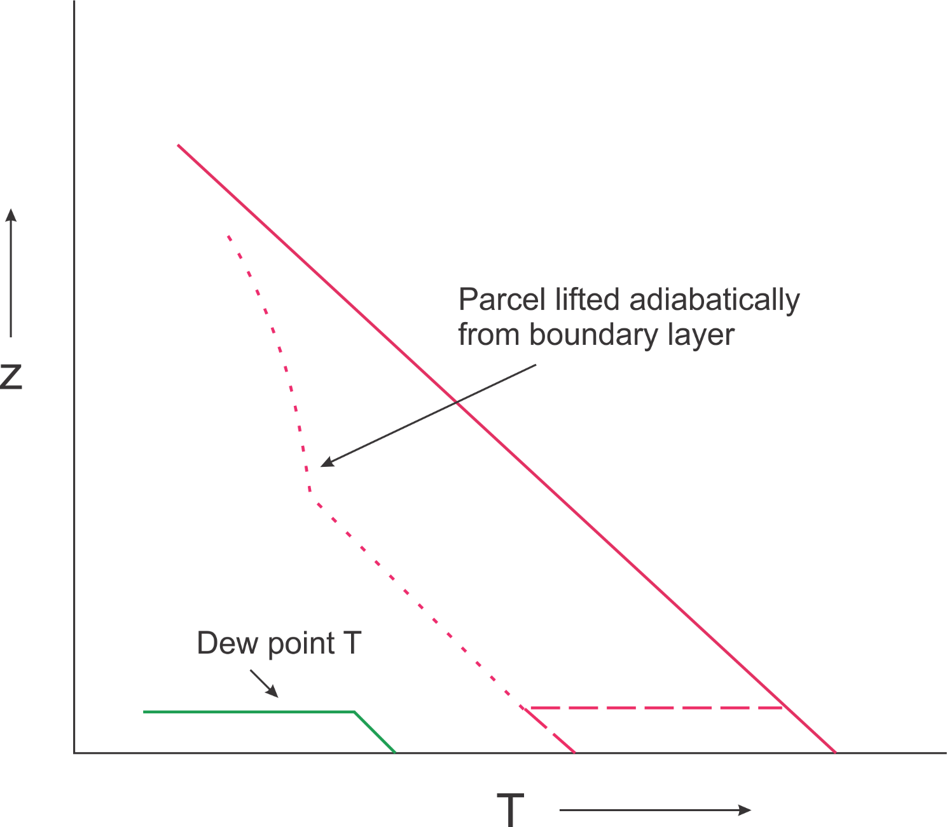

Slide 32
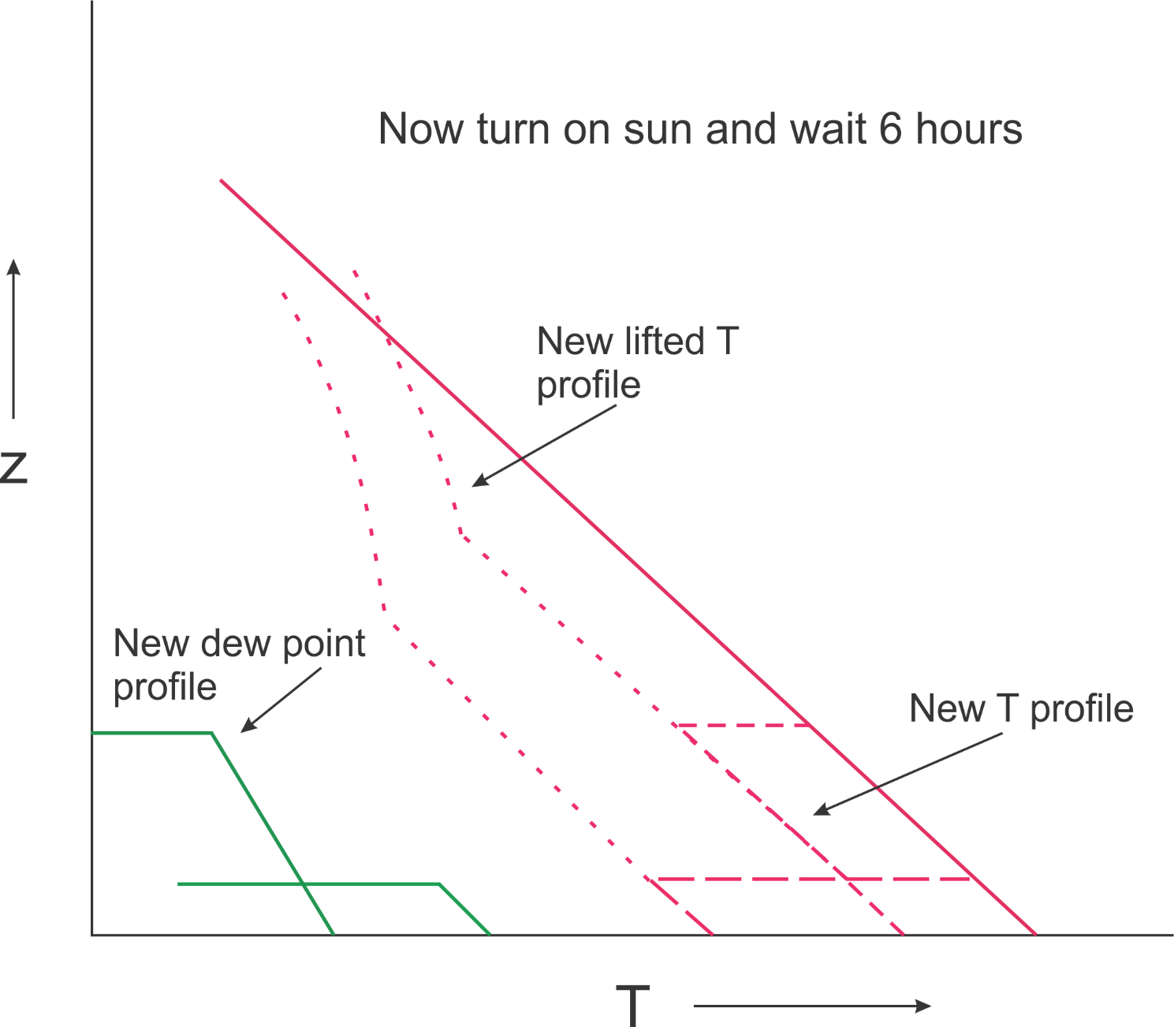

Slide 33
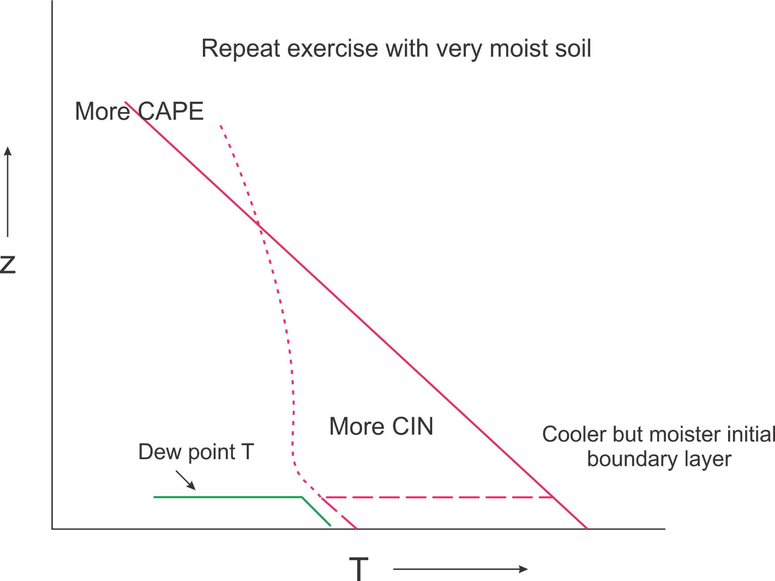

Slide 34
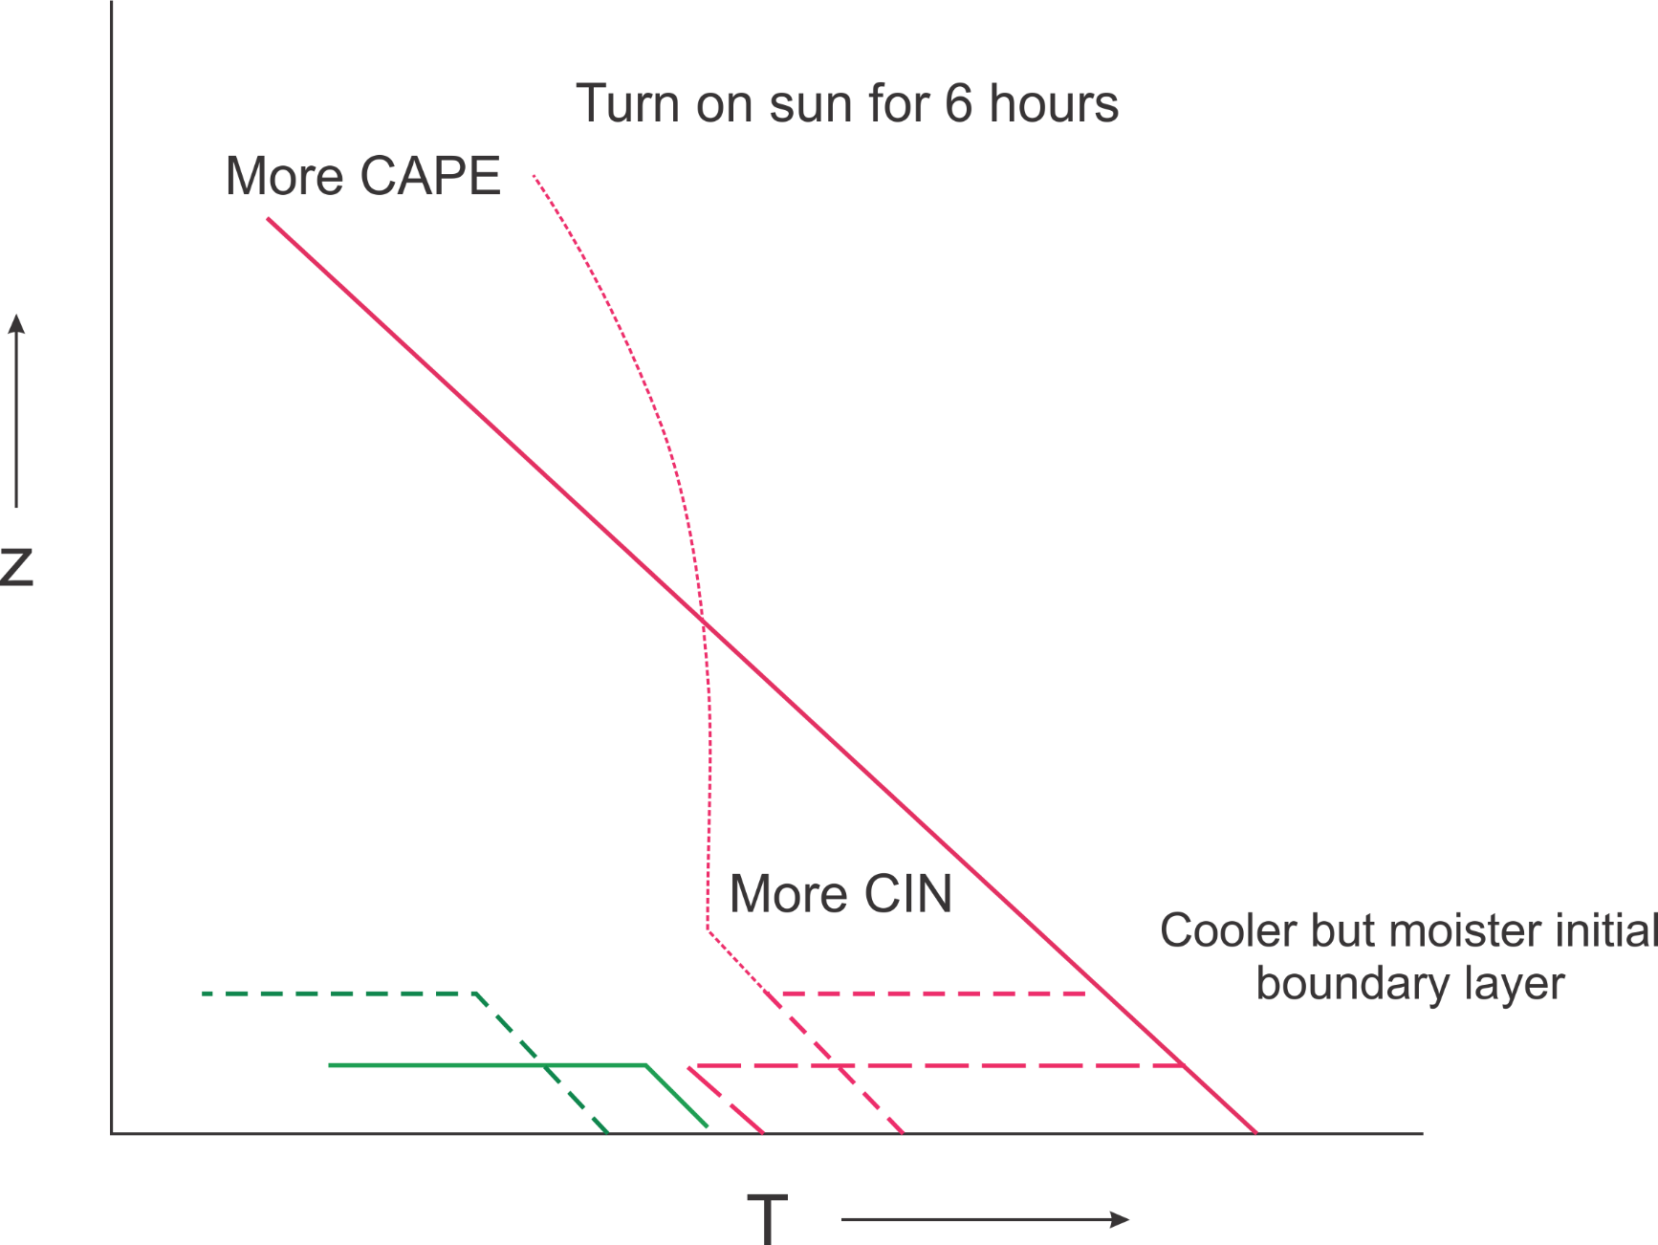

Slide 35
Formalized by very simple model whose variables are:
Dry static energy
Moist static energy
PBL depth
Entrainment velocity
Surface sensible heat flux
Surface latent heat flux
Agard and Emanuel, J. Atmos. Sci., 2017

Slide 36
Boundary Layer Equations
Dry static energy
Moist static energy
Lilly’s entrainment formulation
Surface sensible heat flux
Surface latent heat flux
Net surface flux
Boundary layer mass

Slide 37
Note: M_{s} is related to D_{s} by Clausius-Clapeyron Equation
Initial conditions:
M (t=0) = D₀
D (t=0) determined so that air is just saturated at boundary layer top
h=h₀
Initial dry static energy of free troposphere

Slide 38
Nondimensionalize:

Slide 39
Equations are normalized and recombined to arrive at
Determined so that air is initially just saturated at boundary layer top

Slide 40
Long-time Asymptotic Behavior
CAPE reaches a maximum at a particular time and then falls to zero at a later time, while the boundary layer depth goes to infinity at the later time and D, D_{s}, and M approach unity. T_{s} is the surface air temperature of the initial dry state.
CAPE still reaches a peak at a particular time and then falls off to or asymptotes to a positive long-time asymptotic value. The asymptotic limits are given by

Slide 41
Convective Available Potential Energy
(CAPE)
T_{top} determined by fixed anvil temperature hypothesis

Slide 42
Asymptotic Cape Scaling in ‘Warm’ Regime, Applicable at Time when PBL Growth Becomes Linear
CAPE rises exponentially with surface temperature
CAPE increases with increasing surface wind
CAPE increases with increasing soil moisture
For a given surface temperature, CAPE declines with absorbed solar radiation

Slide 43
Impose a diurnal cycle of forcing

Slide 44
Results

Slide 45
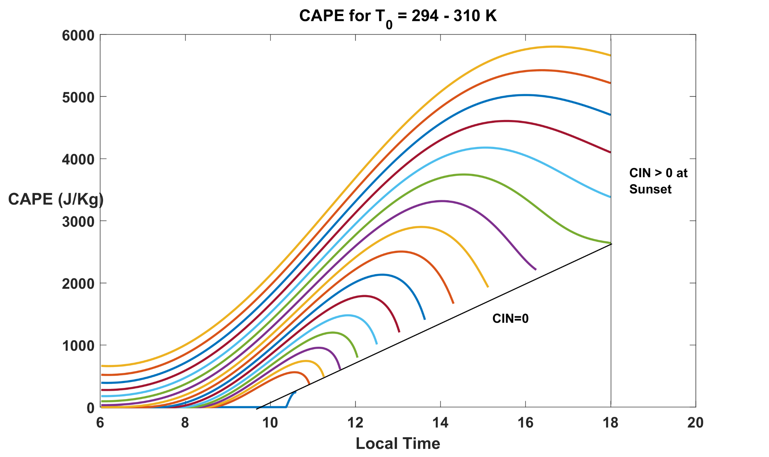

Slide 46
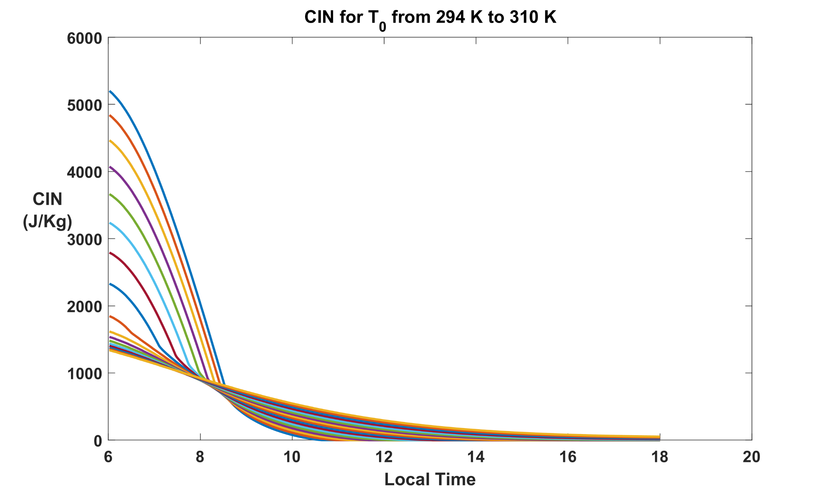

Slide 47
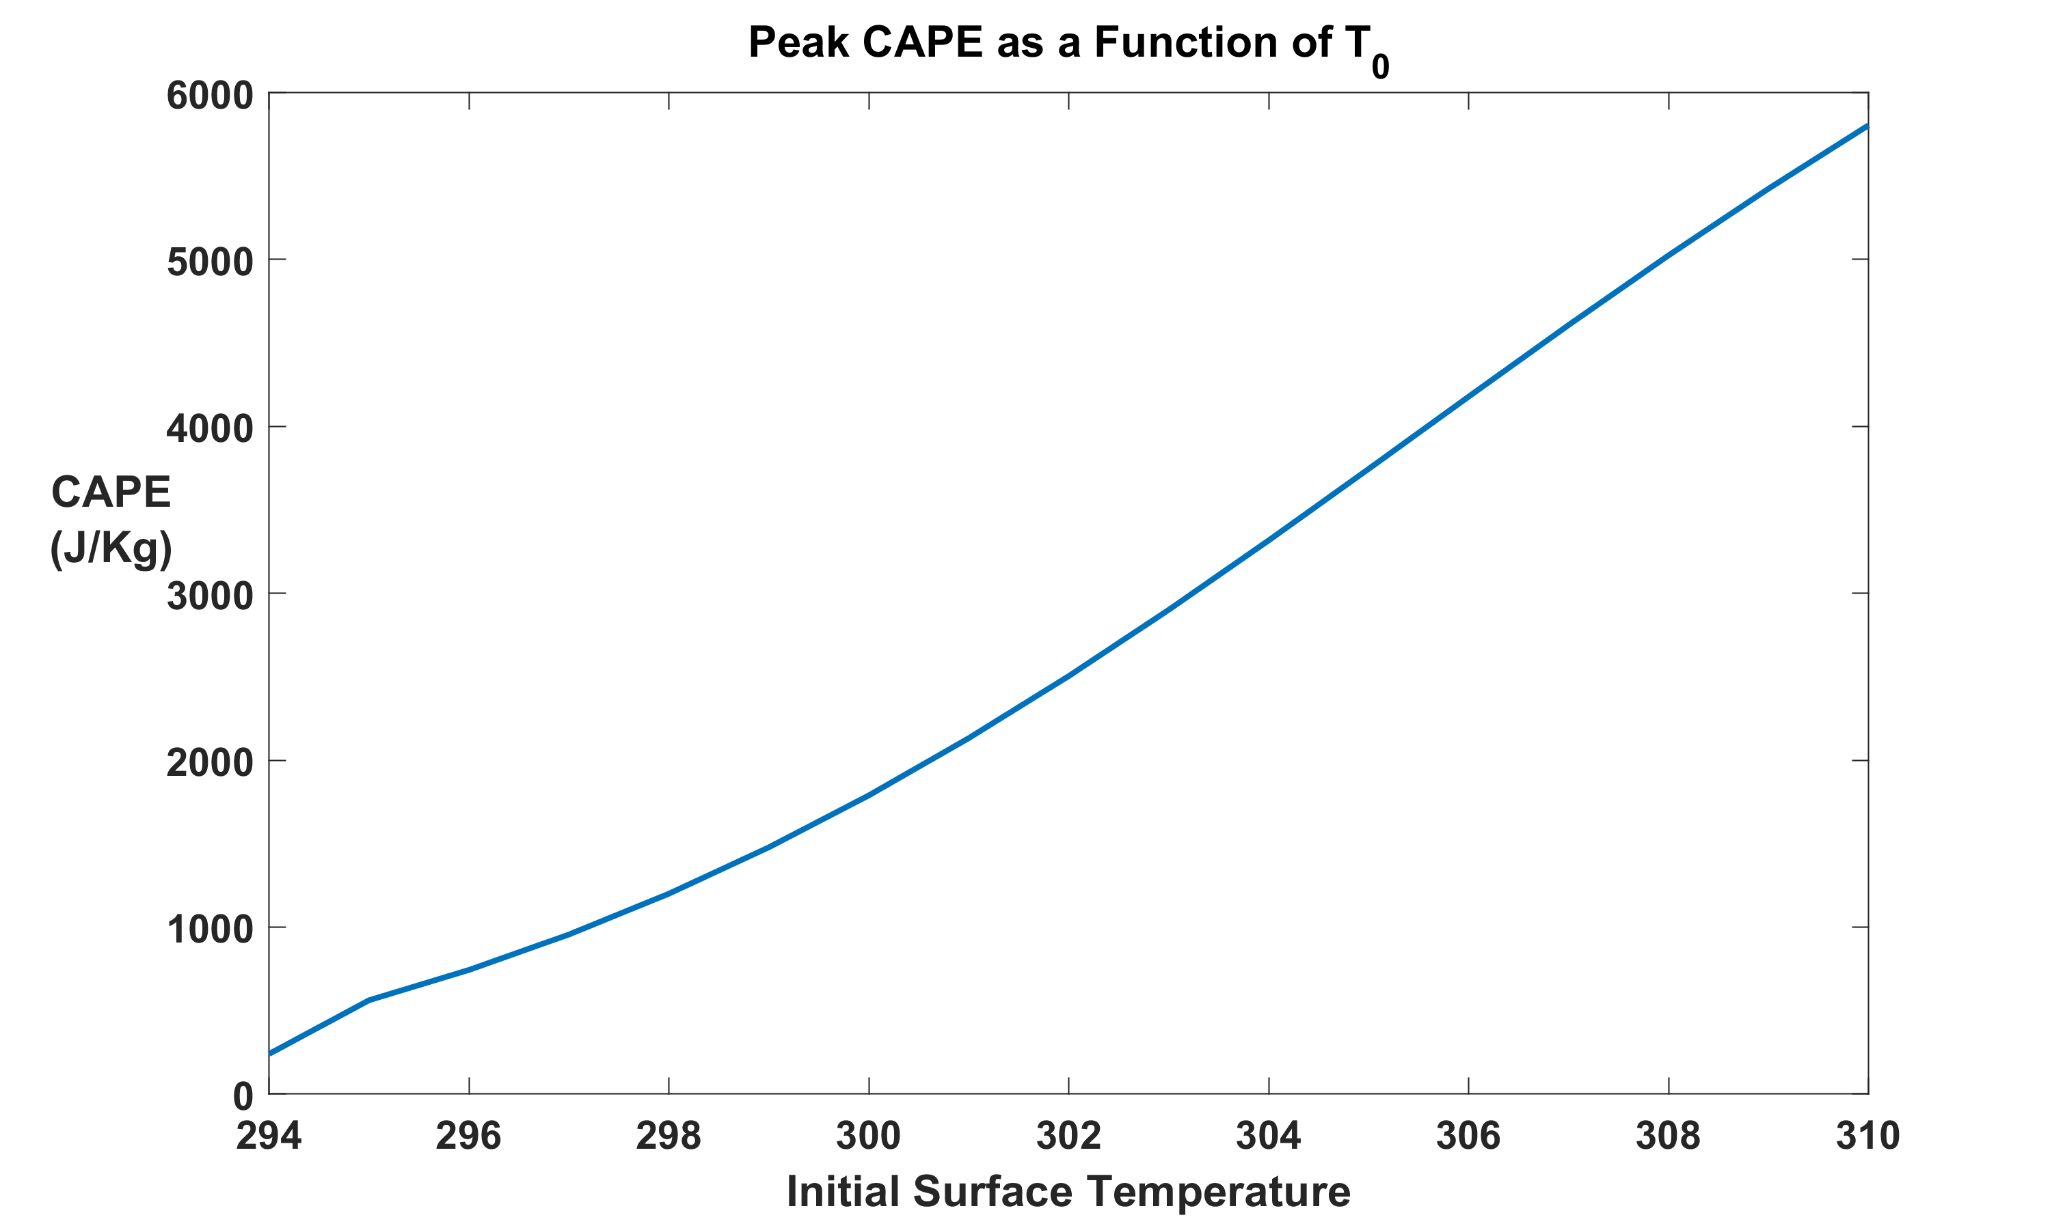

Slide 48
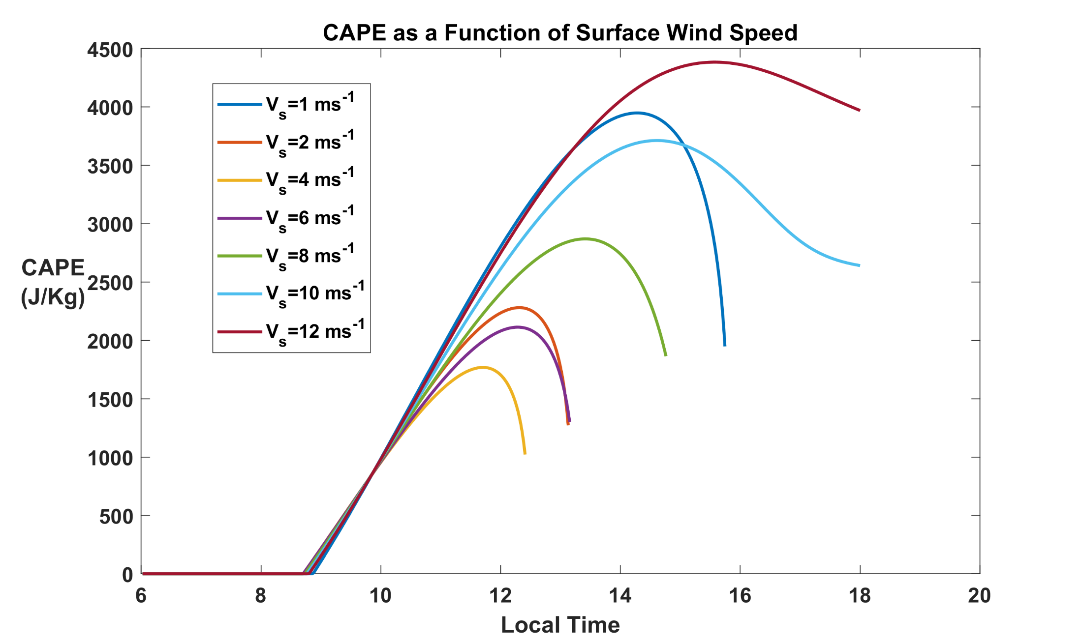

Slide 49
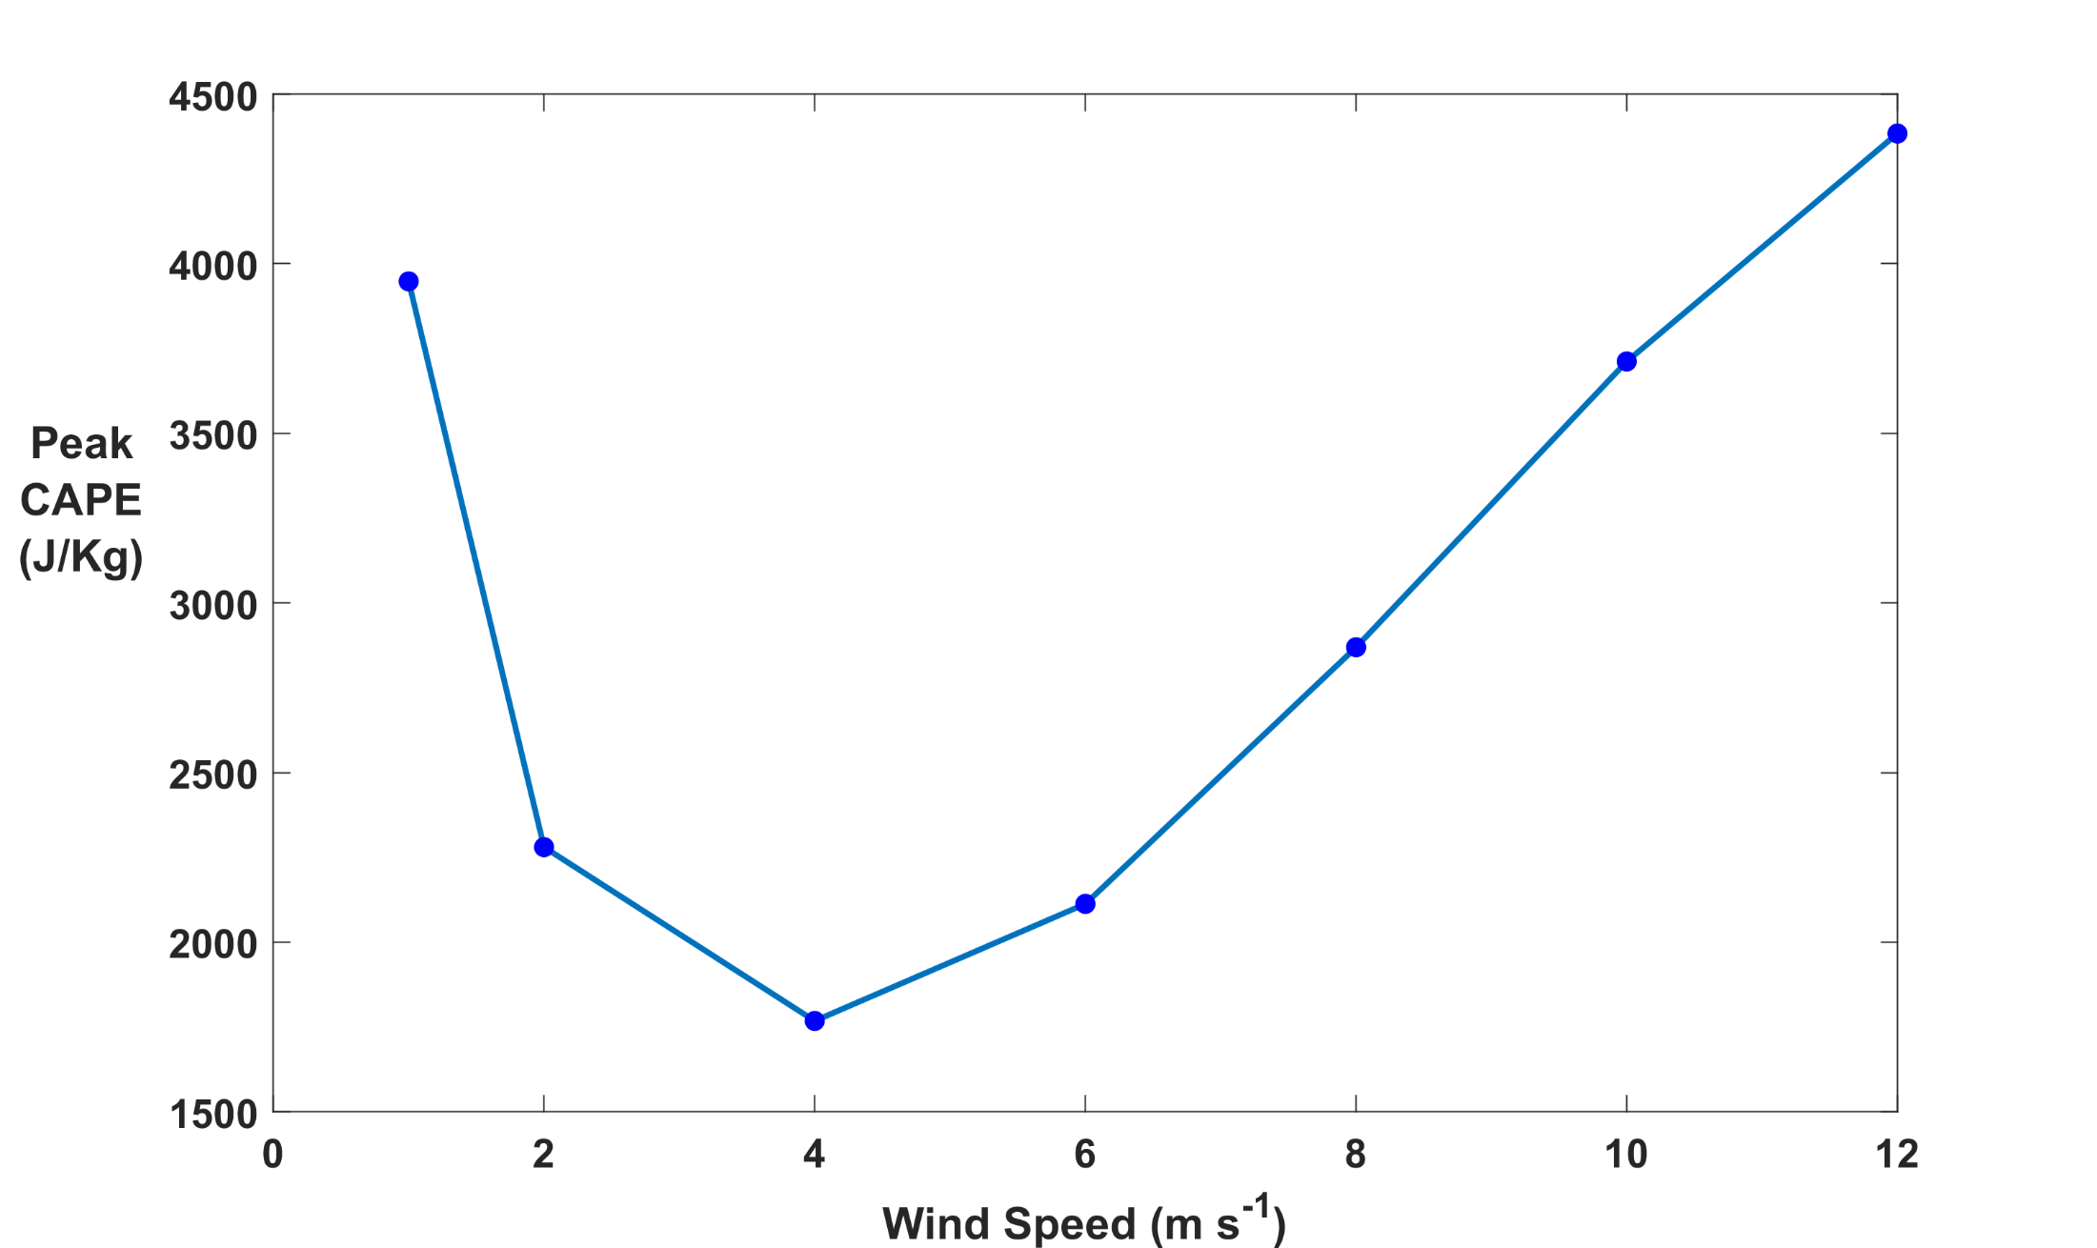

Slide 51
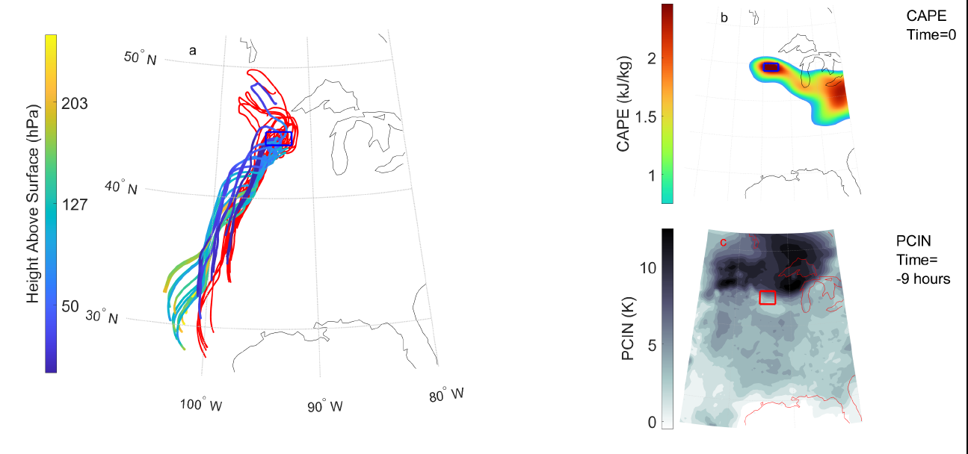
Analyze development of CAPE and CIN along trajectories
(PJ Tuckman and K. Emanuel, Mon. Wea. Rev., submitted)

Slide 53
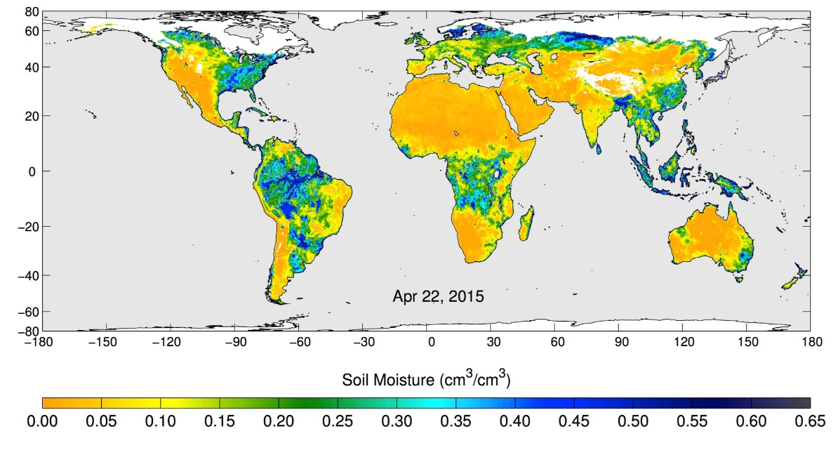
Volumetric water content in the top 5 centimeters of soil, from NASA's Soil Moisture Active Passive (SMAP) observatory, 22 April 2015
Notes:
These maps of global soil moisture were created using data from the radiometer instrument on NASA's Soil Moisture Active Passive (SMAP) observatory. Each image is a composite of three days of SMAP radiometer data, centered on April 15, 18 and 22, 2015. The images show the volumetric water content in the top 2 inches (5 centimeters) of soil. Wetter areas are blue and drier areas are yellow. White areas indicate snow, ice or frozen ground.

Slide 54
Global Distribution of Tornadoes

Slide 55
Summary
Large CAPE occurs when deep dry-adiabatic layers are advected over moist soils (connection to agriculture?)
Diurnal peak values of CAPE increase nearly linearly with surface temperature of the dry land
Imposing a diurnal cycle limits the growth of peak CAPE with surface temperature
Peak CAPE also increases with surface wind speed and soil moisture, though it also large for very low wind speed
Dependence on soil moisture may offer a degree of seasonal predictability of CAPE
Dependence on soil moisture may also yield multiple equilibria

Slide 56
Spare Slides

Slide 57
We can model these circumstances with an idealized initial value problem
z=H
Dry Static Energy:
D = c_{p}T + gz
Moist Static Energy:
M = c_{p}T + L_{v}q + gz
Dry adiabatic
free troposphere
Start with a dry-adiabatic column over a heated, dry surface
D = D₀
M = D₀
q = 0
Q_{rad}
Q_{S}
T=T₀
T = T_{sfc0}; q = 0
dry surface
Agard and Emanuel, J. Atmos. Sci., 2017
Notes:
So now we can think about this problem in terms of the dry and moist static energies in the different parts of the column. Initially, before the BL forms, the entire column is just a solid block with constant dry static energy (dry adiabatic), and since there’s no moisture anywhere, its moist static energy is just equal to its dry static energy. That all remains true in the free troposphere even after the BL forms. However, in the BL, we make that requirement that moist static energy be conserved upon contact with the moist surface. That means that the dry static energy must decrease when this happens, so D<D0 in the BL, and we have a deficit of DSE between the BL and the FT. On the other hand, we start off with M in the BL equal to D0, and it’s going to increase as heat and moisture get fluxed in. Therefore, we have a *surplus* of MSE in the BL wrt the FT. Since CAPE can be expressed as the vertical integral of the MSE difference between a lifted parcel and its environment, we can interpret the MSE surplus as an indicator of CAPE, and likewise, the DSE deficit is an indicator of CIN (convective inhibition).

Slide 58
Replace lower boundary by a moist soil surface and create an initially thin, moist boundary layer. Then heat surface with solar radiation and allow new boundary layer to develop.
z=H
D = c_{p}T + gz
M = c_{p}T + L_{v}q + gz
Dry adiabatic
free troposphere
D = D₀
M = D₀
q = 0
z=h
Q_{e}
D < D₀
M > D₀
q > 0
Q_{rad}
Moist
boundary layer
Q_{S}
T=T_{BL}
Q_{L}
T = T_{sfc}; q = q*(T_{sfc})
moist surface
Agard and Emanuel, J. Atmos. Sci., 2017
Notes:
So now we can think about this problem in terms of the dry and moist static energies in the different parts of the column. Initially, before the BL forms, the entire column is just a solid block with constant dry static energy (dry adiabatic), and since there’s no moisture anywhere, its moist static energy is just equal to its dry static energy. That all remains true in the free troposphere even after the BL forms. However, in the BL, we make that requirement that moist static energy be conserved upon contact with the moist surface. That means that the dry static energy must decrease when this happens, so D<D0 in the BL, and we have a deficit of DSE between the BL and the FT. On the other hand, we start off with M in the BL equal to D0, and it’s going to increase as heat and moisture get fluxed in. Therefore, we have a *surplus* of MSE in the BL wrt the FT. Since CAPE can be expressed as the vertical integral of the MSE difference between a lifted parcel and its environment, we can interpret the MSE surplus as an indicator of CAPE, and likewise, the DSE deficit is an indicator of CIN (convective inhibition).

