Slide 1
Building Hurricane-Resilient Smart Grids:
Optimal Resource Allocation and Microgrid Operation
by
Kerry Emanuel
Cecil and Ida Green Professor of Atmospheric Science, Dept. of EAPS
and
Saurabh Amin
Associate Professor, Dept. of CEE and LIDS
(joint work with Derek Chang and Devendra Shelar)
MITEI Seed Fund program – Annual Research Conference
November 17, 2021

Slide 2
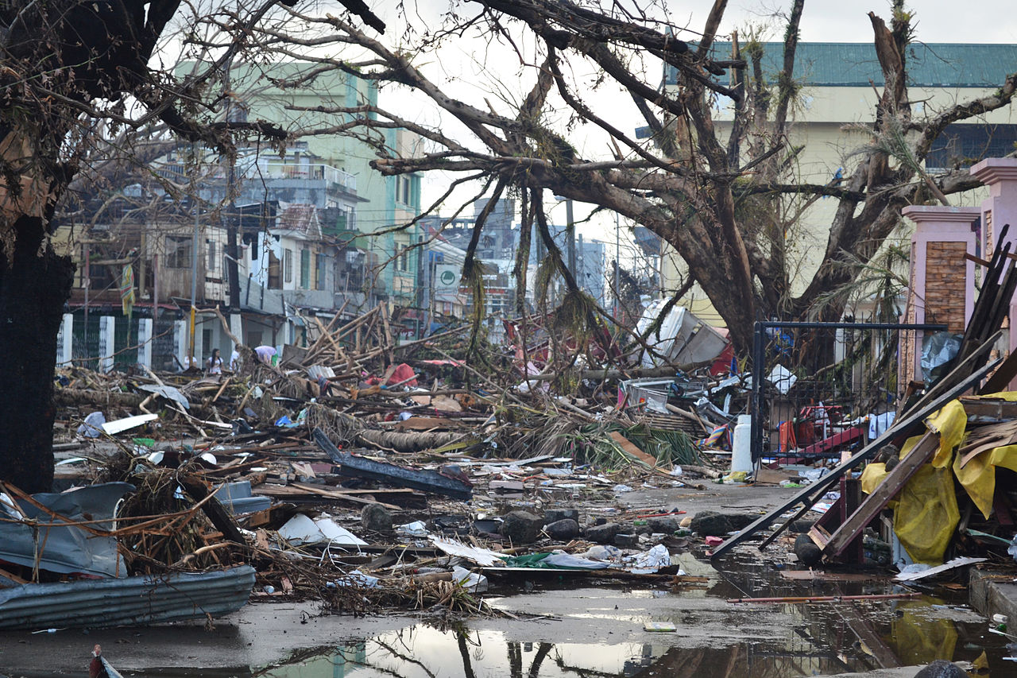
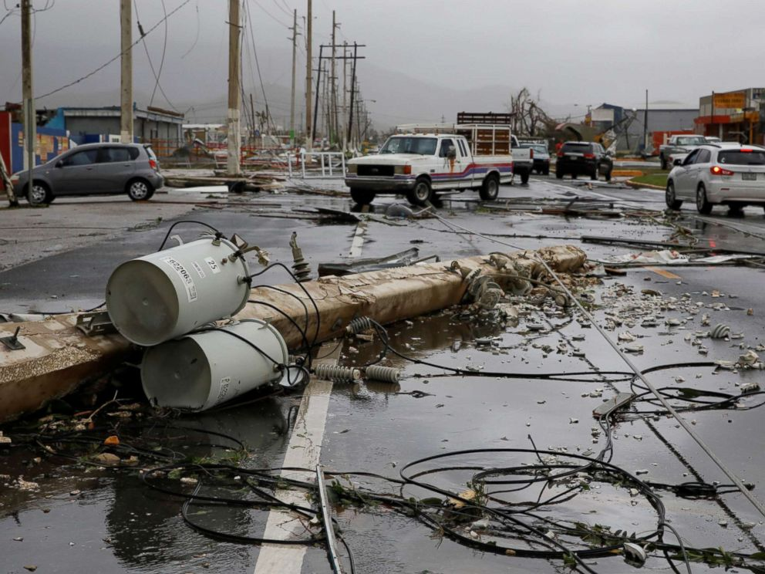
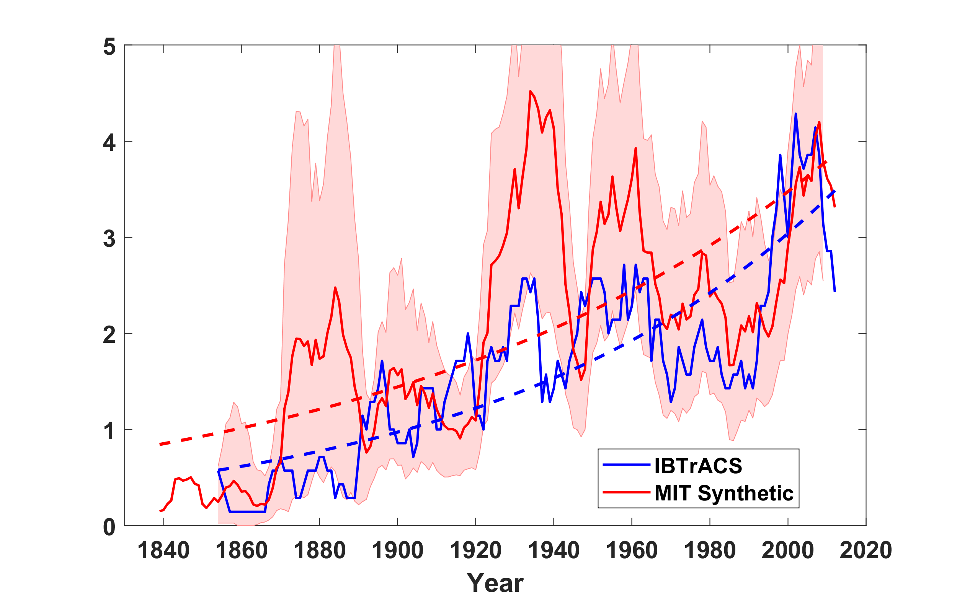
Motivation
Super Typhoon Haiyan (November 2013)
Hurricane Maria
(September 2017)
Texas power crisis
(February 2021)
Weather-induced disruptions cause ~44% of outages in the U.S.¹
Rising frequency of severe weather episodes due to climate change²
Major Hurricanes
1. Campbell, 2013
2. Third National Climate Assessment
Notes:
Haiyan: 7,500 deaths in Philippines
Maria: full restoration of power took 11 months, delays especially severe for people in more remote regions
Texas power crisis: By Feb 17, around the third day of outages, over 2 million Texans were without power. There were also issues with the water infrastructure system
Power dissipation index: a measure of cumulative hurricane intensity within an annual hurricane season

Slide 3
Power Sector Risks
Cyber-physical disruptions $⟹$ Huge societal losses
2021 Texas power crisis: disrupted natural gas pipelines, power plants
Hurricane Maria (2017): damaged transmission lines, utility poles
Question: How can we make power distribution systems more resilient, in order to satisfy demand in the face of hurricane-induced damage or disruptions in bulk power infrastructure?
Notes:
Electric power infrastructure plays a major role in ensuring the functionality of our daily life, and the US power grid is very large. The US power grid supplies over 4 terawatt hours of energy per year.
A power system consists of 5 major subsystems.
Our focus is on distribution systems, although we note that resilience of other subsystems is also important.
About 90% of outages are due to disruptions to the local distribution systems

Slide 4
Challenges
Utilities continue to struggle to respond to severe weather events:
Inadequate decisions about proactive operational strategies: despite the progress in distributed energy resources and smart grid analytics
Prolonged delay in restoration of infrastructural loss-of-service
Need physically-based risk assessment framework
Hurricane risk assessment
(using models of wind field,
and probabilistic forecasts)
Strategic and operational decision-making
(using analytics and stochastic optimization)
Notes:
One potentially impactful solution to distribution system resilience is that we can readily place distributed energy resources or DERs, such as small diesel generators, truck-mounted generators, wind turbines, and solar panels, to produce locally power on a smaller scale.
These DERs can be integrated in a smart grid with controllers and energy storage devices, to provide alternative energy sources when bulk power supplies are unavailable.
In summary, Distributed energy resources (DERs) and smart grids can increase post-disruption network resilience
Whereas smart grid technologies are being integrated into today’s electric power infrastructure, restoration of service following weather-induced disruptions has still been problematic for a few potential reasons:

Slide 5
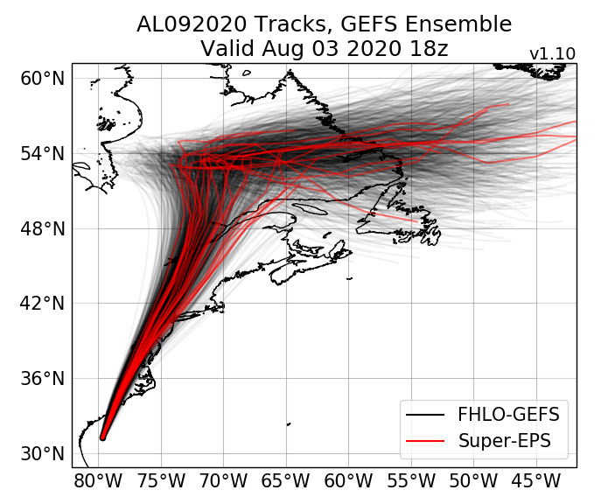
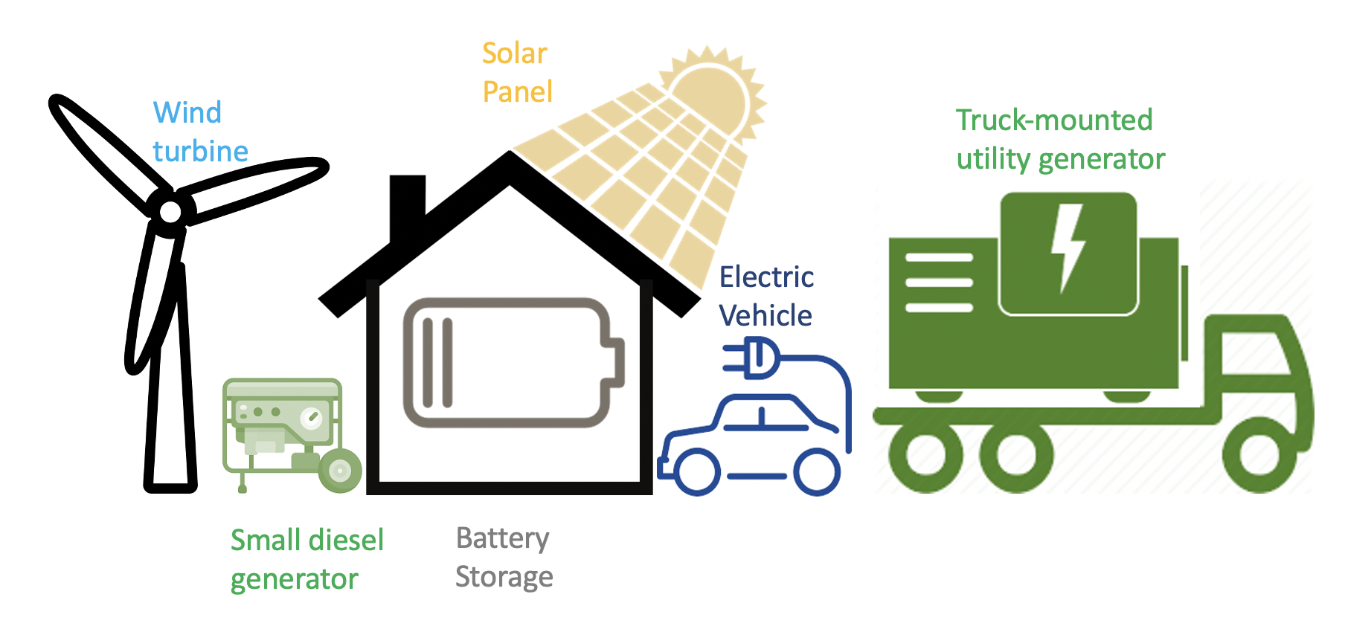
Risk-based Framework
Hurricane Risk Assessment
Resilient Operations
Stage I (Pre-storm)
Stage II (Post-storm)
Hurricane wind field forecast
Infrastructure damage model
Resource allocation
Network restoration
Microgrid operation
Surface wind field velocities (m/s)
Average failure rate of assets (#/hr/km)
Outages per 100 households
Allocation of
Distributed Energy
Resources to enable functional microgrids

Slide 6
Including Forecast Uncertainty
Forecasts of Hurricanes using Large-Ensemble Outputs (FHLO):¹
‘Ensemble’ consists of ~1,000 randomly-generated forecast `members’ for an incoming hurricane, initialized at a given time and location.
Each ensemble member forecast includes:
Track forecast: stochastic track locations as function of time
Wind field: 2-D surface wind field (velocities as a fn. of space & time)
Track ensemble generated using FHLO¹
Ensemble-averaged failure rate²
Lin, Emanuel, and Vigh, Weather and Forecasting (WAF), 2020
Chang, Emanuel, and Amin, Risk Analysis (submitted)
Notes:
0. So far, we have formulated a model for estimating failure distributions given wind field inputs. Now, we want to discuss how we obtain such wind field inputs in a way that accounts for uncertainties in hurricane forecasts
To do so, we use Forecasts of Hurricanes using Large-Ensemble Outputs (FHLO)
Model framework to generate probabilistic forecasts of hurricane wind field that has been developed by Kerry and his student, Jonathan Lin
The forecast consists of around 1,000 ensemble members or synthetic hurricanes, and accounts for uncertainties in the track, initial conditions, thermodynamic conditions and dynamic conditions
Here is an example of a track ensemble generated using FHLO, which indicates a set of around 1,000 tracks
The broad question that we wish to answer in this section is, How do uncertainties represented by FHLO ensemble members affect:
Estimates of failure rates
Estimates of probability distributions over number of failures
FR-2, is the ensemble-averaged failure rate, taken by calculating the failure rate under each ensemble member’s wind field and then computing the average of these. This estimate more properly and fully accounts for the uncertainties represented by the ensemble members,
Critical zone is about 5x larger under FR-2 than under FR-1 (in considered geographical region plotted here). The discrepancy is largely due to the fact that for Hurricane Hermine, the ensemble-averaged wind field has few exceedances of critical velocity.
The overall takeaway here? If we do not properly account for uncertainties from the ensemble members, as is illustrated in FR-1, we obtain underestimated failure rates.

Slide 7
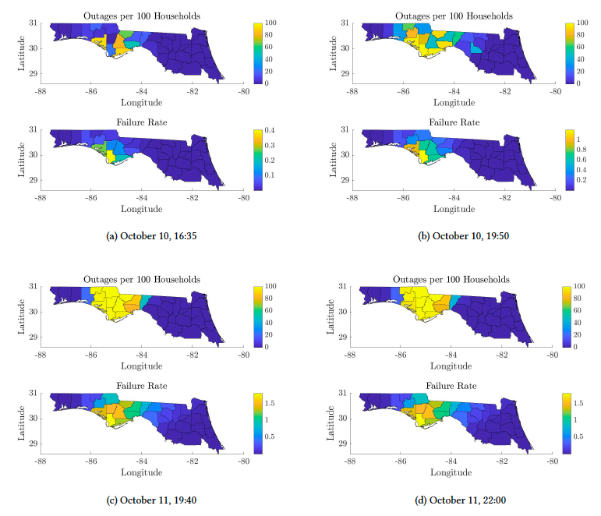
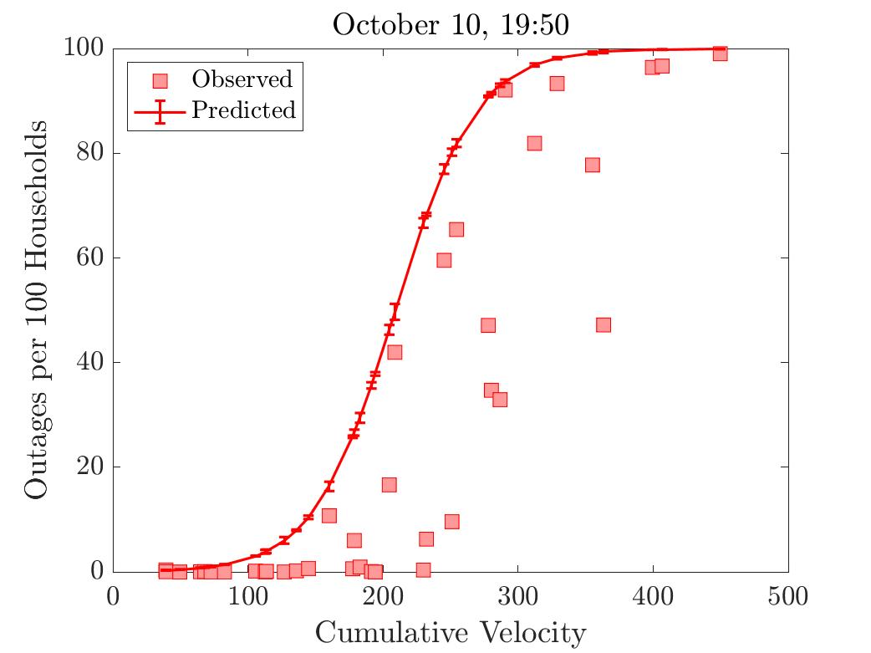
Predicting Outages from Damage Forecasts
Application to Hurricane Michael ‘18
Left: Comparative visualization of outages and failures for Michael (2018) in Northern Florida.
Bottom: Outages vs. cumulative velocity for counties in Northern Florida (Oct. 10, 7:50pm)
“S-shaped” curve:
Negligible outages below cumulative velocity threshold
Rapid increase in outages above threshold
Saturation of outage rate at 100%
Chang, Emanuel, and Amin.
Risk Analysis, submitted.
Notes:
Outage plots:
Note that counties with high number of outages occur mostly within the critical zone (as demonstrated by the failure rate plots)
By October 11, 19:40 (Figure c), many counties have ‘saturated’ in terms of number of households w/ outages – denoted by bright yellow
Scatterplot:
S-shaped curve in outages vs. cumulative velocity
Below a certain threshold (~200 in cumulative velocity), outages are minimal
Outages then rise rapidly then peak when approaching 100%

Slide 8
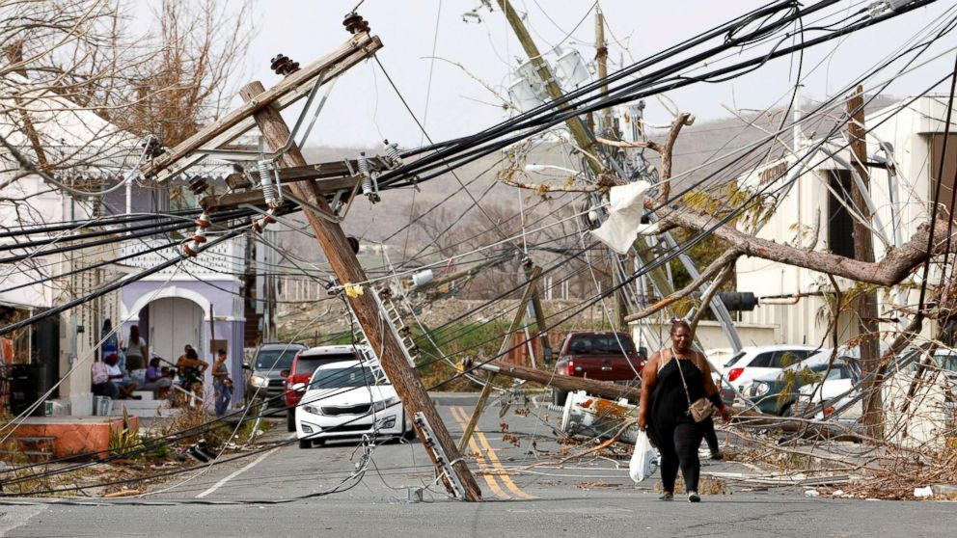
Planning for Storm Events
For given
set of sub-networks at risk
repair times of lines
inventory of portable DERs with varying capabilities
Question: What is the optimal deployment of DERs before the hurricane and optimal repair scheduling after the event to minimize the operator’s loss?
SN2
SN4
SN1
SN3
DER = Distributed Energy Resource

Slide 9
System Resilience $⟹$ Smaller Impact + Faster Recovery
Nominal performance
Nominal performance
Disturbance
Restoration
Window of opportunity
$$100$$
$$ℒ_{wr}$$
$$ℒ_{nr}$$
$$ℛ_{wr}$$
System Performance (in %)
$$ℒ_{max}$$
Response
$$ℛ_{nr}$$
Traditional Secondary/ Tertiary control
No response - cascade
$$0$$
$$t$$
System Resilience $ℛ=100\left(1−\frac{ℒ}{ℒ_{max}}\right) \%$
Maximize $ℛ$ in electric power infrastructure in face of disruptions
$ℒ=$expected cost $\sum_{s∈S}{\text{Pr}\left(s\right)\text{Cost}(s)}$ for damage outcome $s$

Slide 10
Summary
Hurricane risk assessment (probabilistic damage assessment)
Captures effect of wind field spatial variability (incl. asymmetry) on damage to infrastructure assets
Accounts for the uncertainties in hurricane track forecasts
Can be calibrated for asset failures, outages, and network costs
Resource allocation and response strategies
Modeling and decisions approach (2-stage stochastic optimization)
Network model to capture network state during disruptions
Scalable solution approaches based on Benders Decomposition
Resiliency curves can help estimate value of resource allocation (DERs, repair crew positions) and dispatch/repair decisions under variable microgrid configurations

Slide 11
Thank you
Contacts:
Kerry Emanuel emanuel@mit.edu
Saurabh Amin amins@mit.edu

