Slide 1

Tropical cyclones, Medicanes, and Polar Lows in a Warming World
Kerry Emanuel
Lorenz Center
Massachusetts Institute of Technology

Slide 2
Program
Observations and theory
Why climate models cannot simulate TCs, polar lows, etc.
Using physics to downscale TC activity
Medicanes and polar lows
Summary

Slide 3

Are Hurricanes Changing?

Slide 4
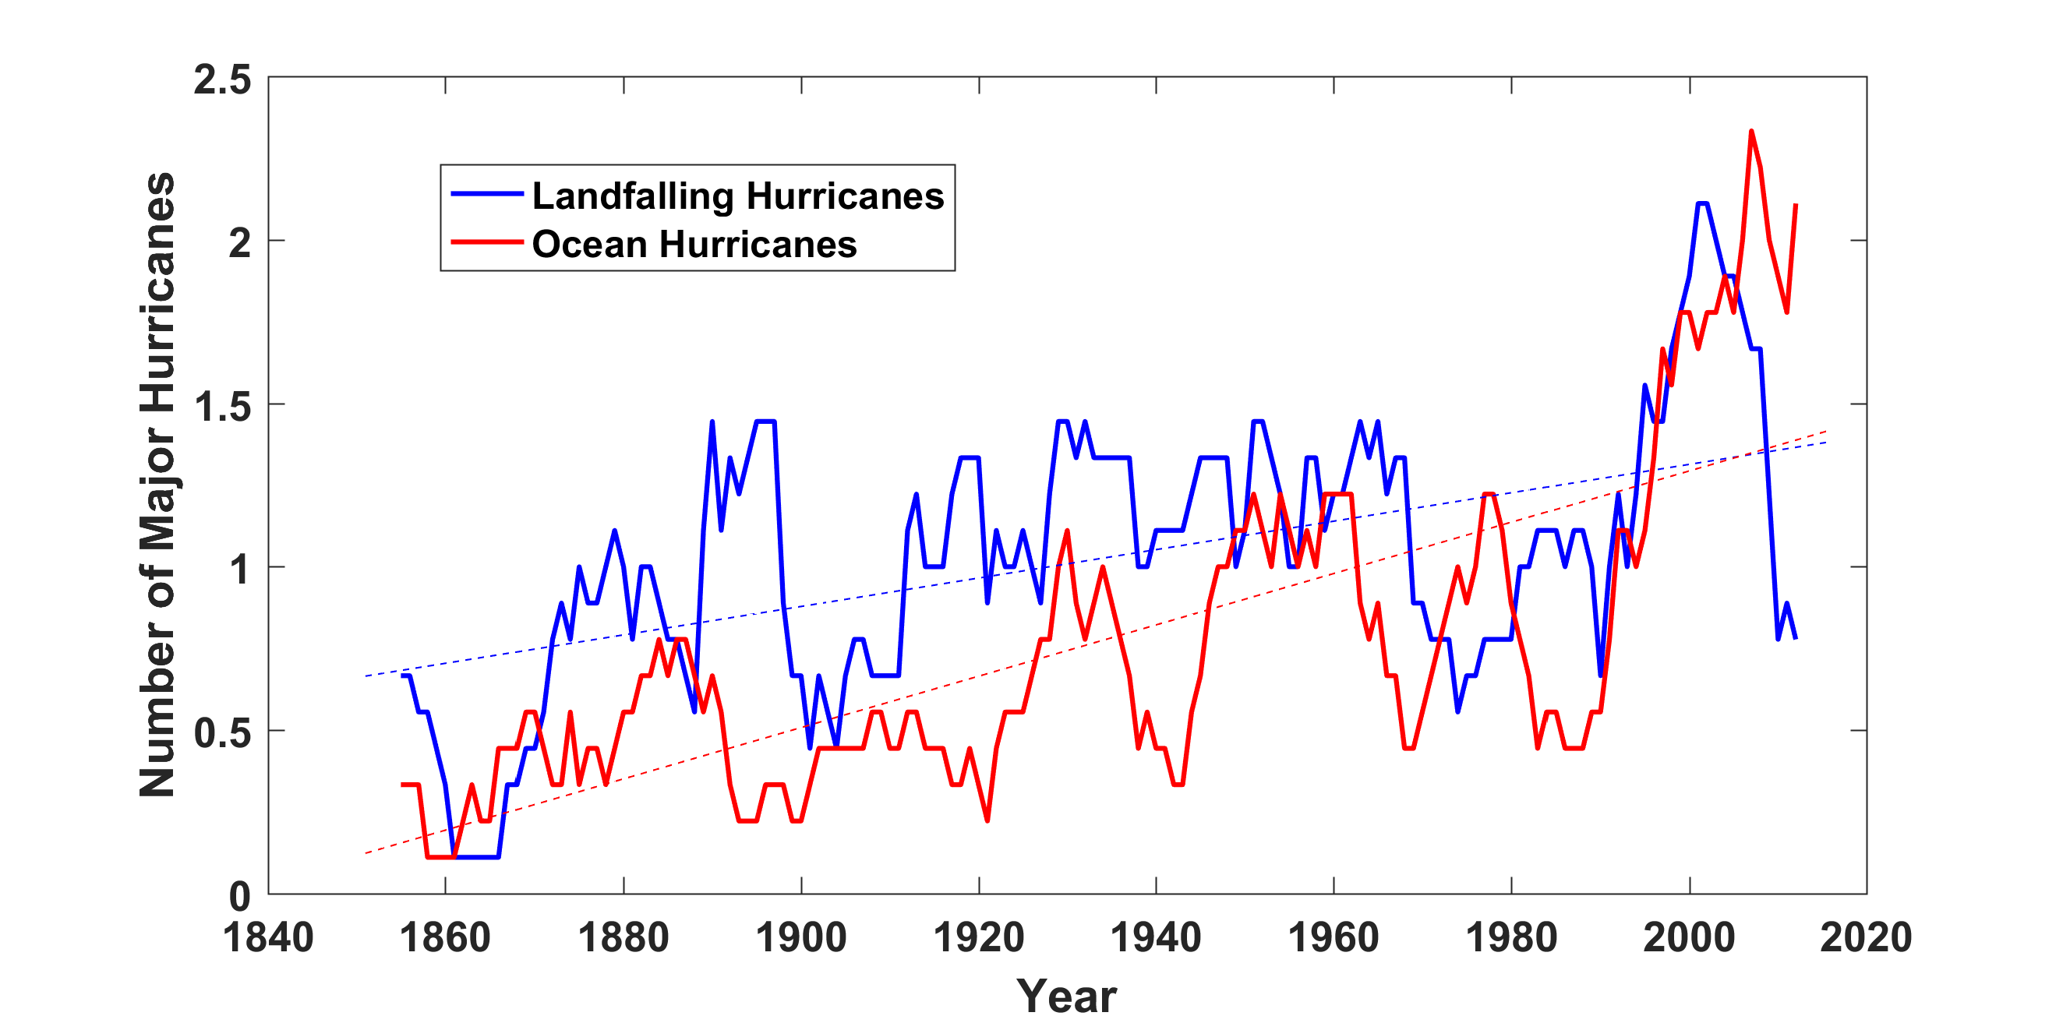
Historical Records:
Prior to 1970, Many Storms Were Missed
Major hurricanes in the North Atlantic, 1851-2016, smoothed using a 10-year running average. Shown in blue are storms that either passed through the chain of Lesser Antilles or made landfall in the continental U.S.; all other major hurricanes are shown in red. The dashed lines show the best fit trend lines for each data set.

Slide 5
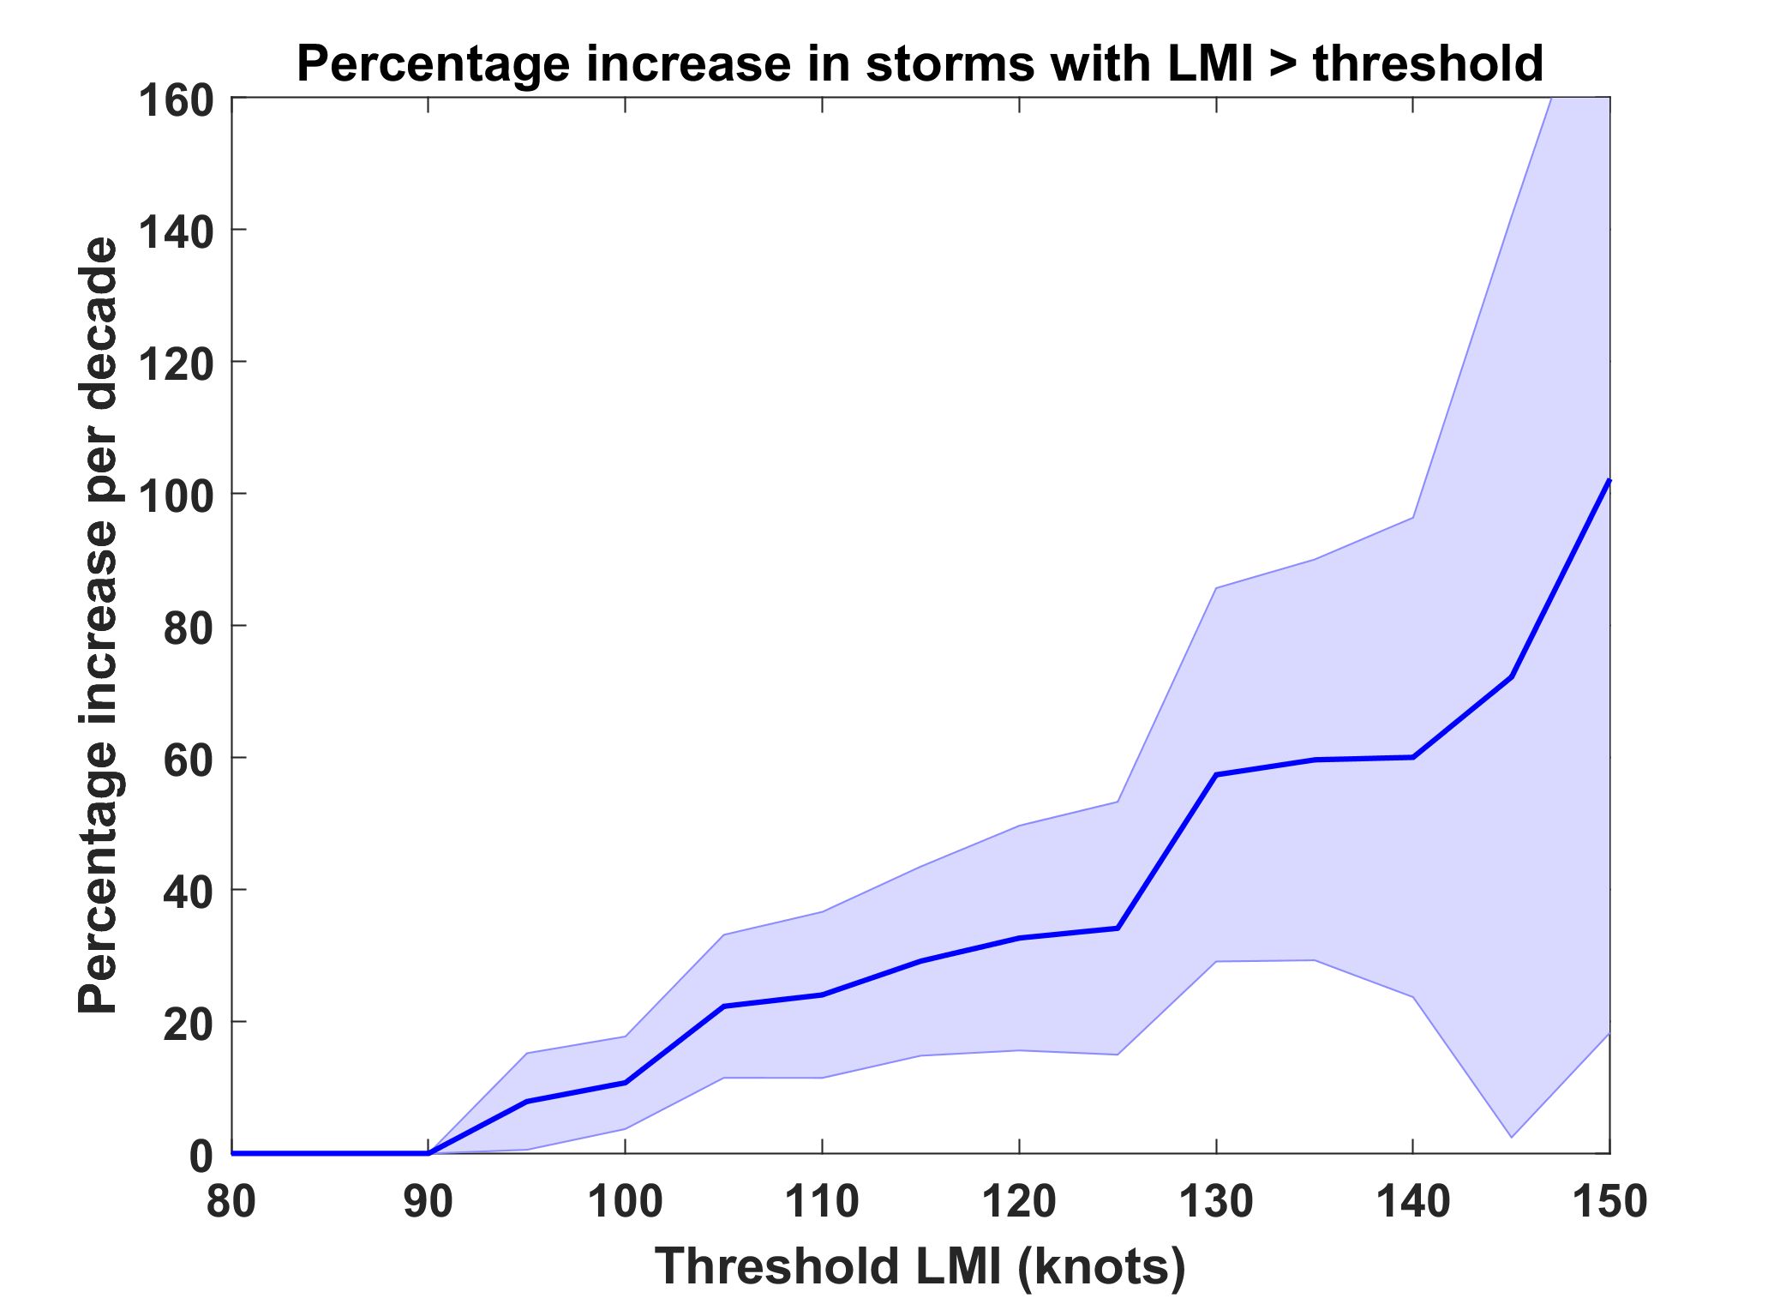
Trends in Global TC Frequency Over Threshold Intensities, from Historical TC Data, 1980-2016. Trends Shown Only When p < 0.05.
Category

Slide 6
A Little Theory

Slide 7
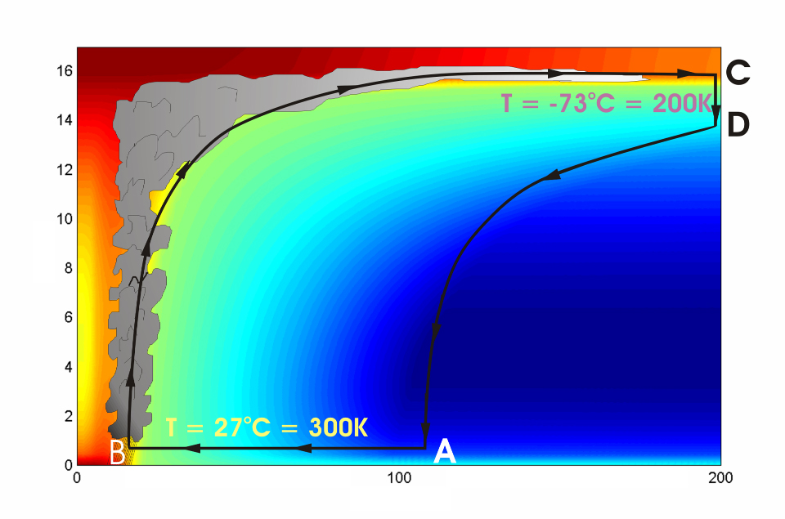




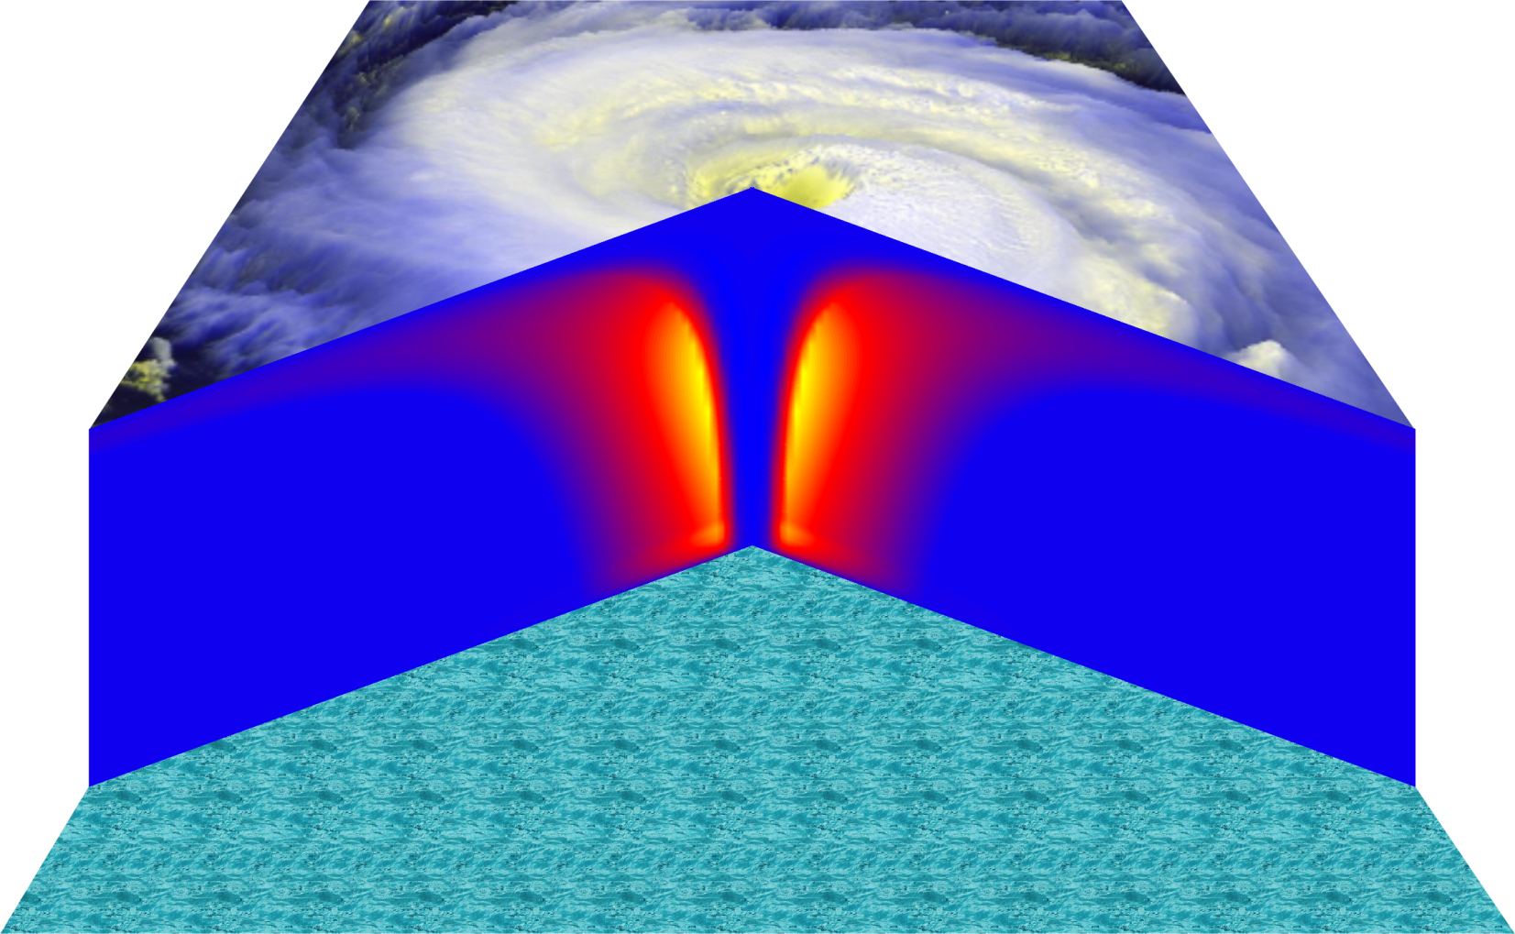
Cross-section through a Hurricane & Energy Production
eye
edge
Isothermal compression
Adiabatic expansion
Adiabatic compression
Height above ocean
Nearly isothermal expansion
Low entropy
Ocean surface
Radius (km)
Notes:
NOTE: We have animated the path of air for this slide and included labels to help our audience understand what you will be describing. Many of them will have never even heard of a Carnot heat engine and do not have a strong understanding of entropy. We would like to do whatever we can in to make this information accessible to our audience. Please let us know if you approve of these changes, and feel free to replace the labels as needed. The simpler you can keep your description of this, the better. You do an excellent job of describing the process in your book.
***
The energy cycle of a mature hurricane - the hurricane as a Carnot heat engine. This two-dimensional plot of the thermodynamic cycle shows a vertical cross section of the hurricane, whose storm center lies along the left edge. The colors depict the entropy distribution; cooler colors indicate lower entropy. Loosely, this means the total heat content of the air. Note that as air approaches the eyewall, its entropy increases rapidly, reflecting the large input of heat from the ocean.
Let’s follow a sample of air that begins at point A near the sea surface, a hundred kilometers or so from the storm center. The process mainly responsible for driving the storm is the evaporation of seawater, which transfers energy from sea to air. As a result of that transfer, air spirals inward close to the sea surface, between Points A and B. The storm center is an area of relatively low pressure, so the pressure on air decreases as it travels from A to B. But it is always in contact with the sea surface, which acts as an almost unlimited heat reservoir, so its temperature is approximately constant (acquiring entropy at a constant temperature). It is during this leg that enormous quantities of heat are added to the air from evaporation of seawater. Evaporation of water is a very efficient way to transfer heat from one body to another. That is why you feel cold when you are wet, especially if it is windy and/or dry: evaporation is taking heat from your body. Thus the addition of heat in leg A-B shows up mostly as an increase in humidity in the air. This form of heat is called latent heat. Evaporation of sea water into the inflowing air is by far the most important source of heat driving the hurricane, which makes leg A-B the firebox of the hurricane. When hurricanes reach land, they quickly die because they are cut off from their oceanic energy source. At point B, the air turns and flows upward through the towering cumulonimbus clouds that make up the hurricane’s eyewall. It is here that the latent heat is converted to sensible heat as water vapor condenses. But it is important to note that although there is enormous conversion between these two forms of heat, the total heat content (entropy, actually) remains approximately constant along this leg (note that the colors do not change along leg B-C). As the air flows upward, the pressure on it decreases very rapidly. What we have here is an example of adiabatic expansion. By the time the air reaches point C in the high troposphere or lower stratosphere, some 12 to 18 kilometers above the sea surface, the adiabatic expansion has lowered its temperature to a value close to that of the undisturbed upper tropical atmosphere, around -70°C or about 200 Kelvin. The air remains at approximately this temperature as it sinks down toward the tropopause (point D). Although the air is undergoing compression, it is losing heat by electromagnetic radiation to space. The depicted compression is very nearly isothermal. Finally, between D and A, the air returns to its starting point while undergoing an adiabatic compression. Voilà, the four legs of a Carnot cycle.
In a real hurricane, the energy cycle is open because hurricanes continuously exchange air with their environment.
Image is copyrighted 2005 by Oxford University Press.
Description from “Divine Wind: The History and Science of Hurricanes”, Kerry Emanuel, 2005, Oxford University Press, 296 p.

Slide 8
Annual Maximum Potential Intensity (m/s)
Derived from Carnot Theorem

Slide 9
We use a simple Carnot cycle model to estimate the maximum intensity of tropical cyclones under the somewhat warmer conditions expected to result from increased atmospheric CO₂ content. Estimates based on August mean conditions over the tropical oceans predicted by a general circulation model with twice the present CO₂ content yield a 40-50% increase in the destructive potential of hurricanes. [12-15% increase in wind speed]
-- Emanuel (Nature, 1987)

Slide 10
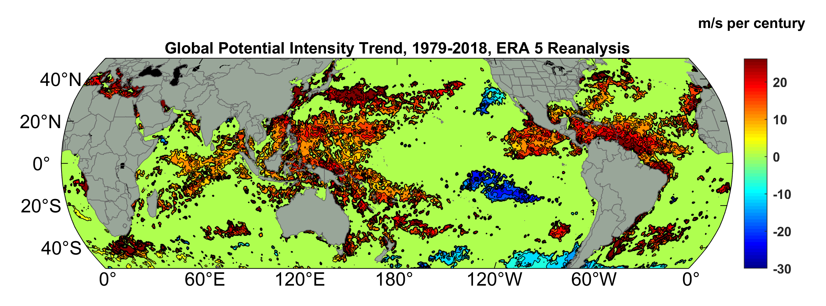
Potential Intensity Trend, 1979-2018, ERA 5 Reanalysis
(Trend shown only where p value < 0.05)

Slide 11
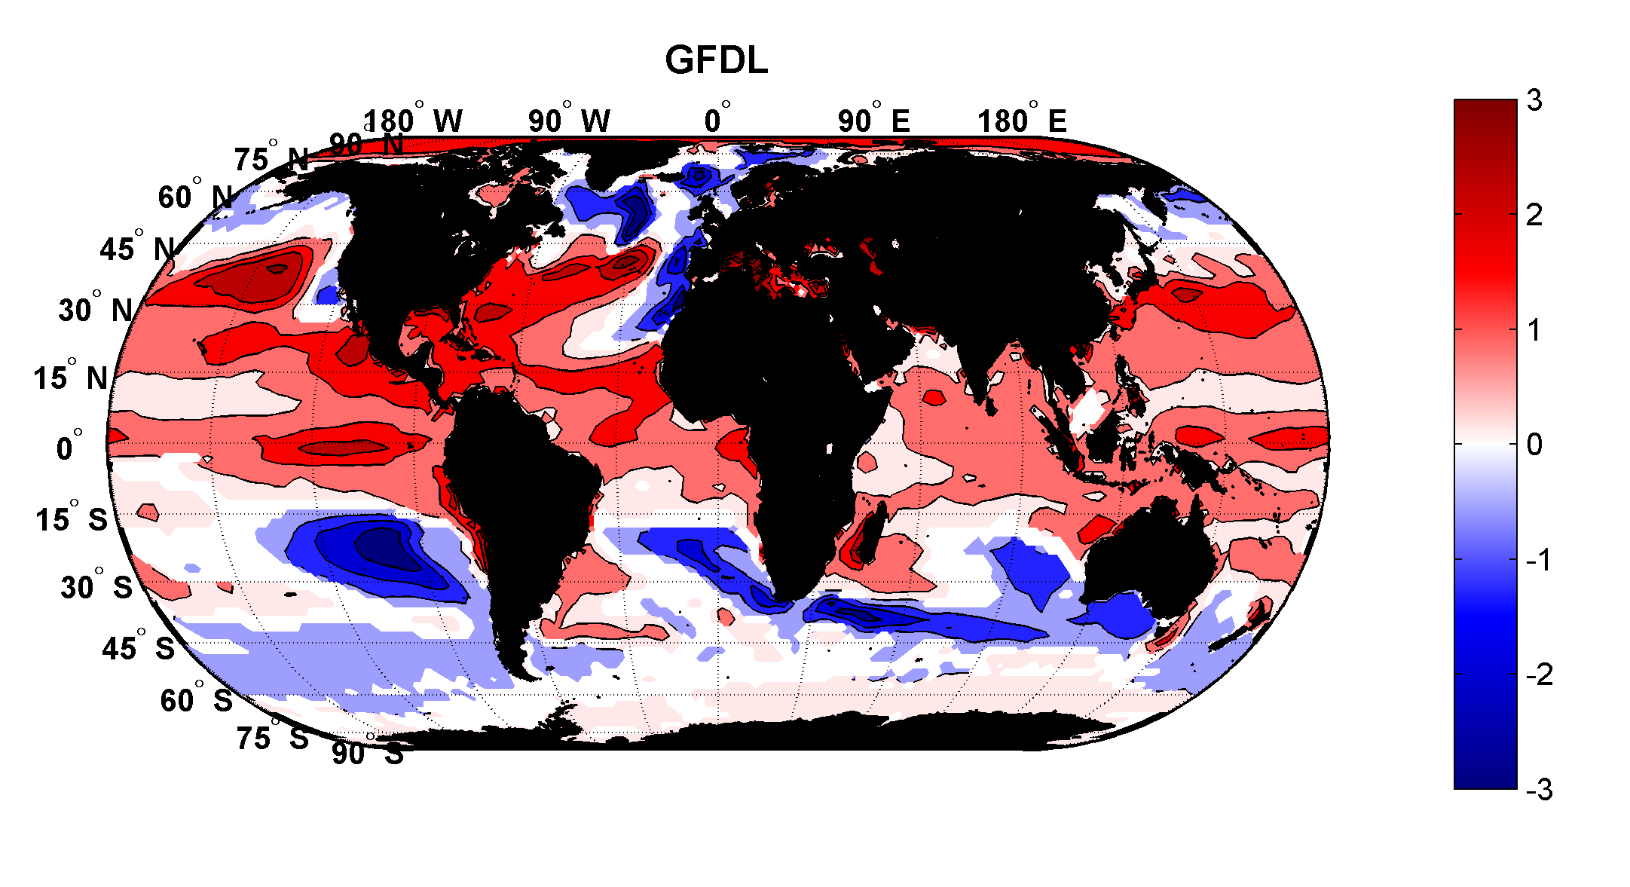
Projected Trend Over 21st Century: GFDL model under RCP 8.5
ms⁻¹decade⁻¹

Slide 12

Inferences from Basic Theory:
Potential intensity increases with global warming
Incidence of high-intensity hurricanes should increase
Increases in potential intensity should be faster in sub-tropics
Hurricanes will produce substantially more rain: Fundamental physics yields a ~7% increase in water vapor per 1ºC warming

Slide 13

The Nature of Hurricane Risk
Notes:
13

Slide 14


Risk Assessment in a Changing Climate: The Problem
Event Probability
Damage Probability
Current and Future Probability Density of U.S. TC Wind Damages
Current and Future Damage Probability

Slide 15
Why Not Use Global Climate Models to Simulate Hurricanes in a Changing Climate?

Slide 16

Problem: Today’s models are far too coarse to simulate destructive hurricanes
Histograms of Tropical Cyclone Intensity as Simulated by a Global Model with 30 mile grid point spacing. (Courtesy Isaac Held, GFDL)
Category 3
Modeled
Observed
Global models do not simulate the storms that cause destruction
Wind Speed (meters per second)

Slide 17
Using Physics to Estimate Hurricane Risk

Slide 18

Embed high-resolution, fast coupled ocean- atmosphere hurricane model in global climate model or climate reanalysis data
Coupled Hurricane Intensity prediction Model (CHIPS) has been used for 18 years to forecast real hurricanes in near- real time
Can easily generate > 100,000 storms

Slide 19
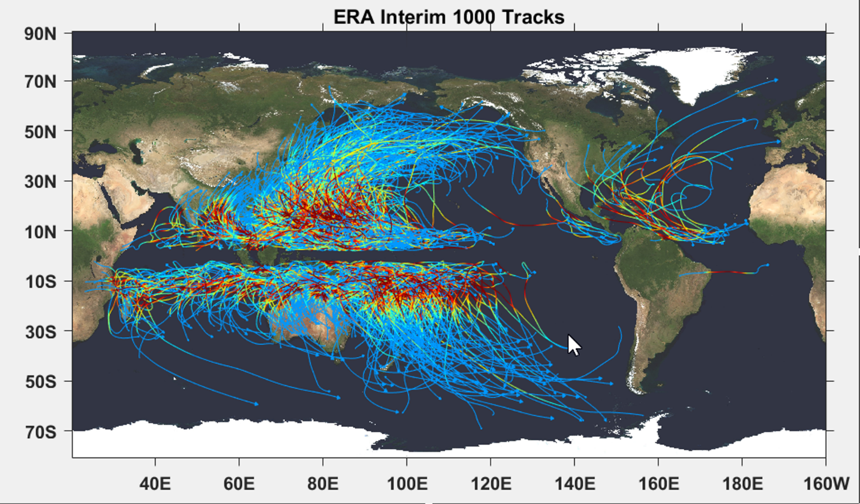

Slide 20
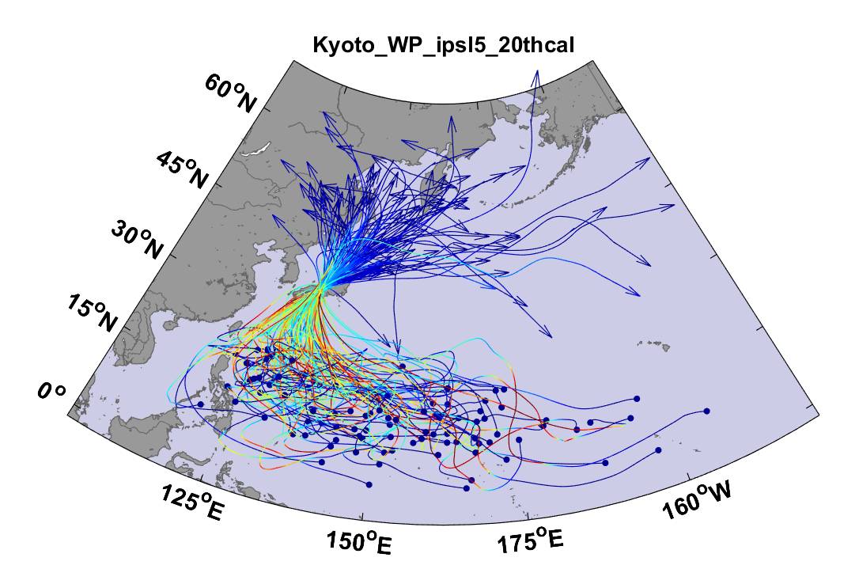
Top 100 out of 2000 TCs Affecting Kyoto, 1981-2000

Slide 21
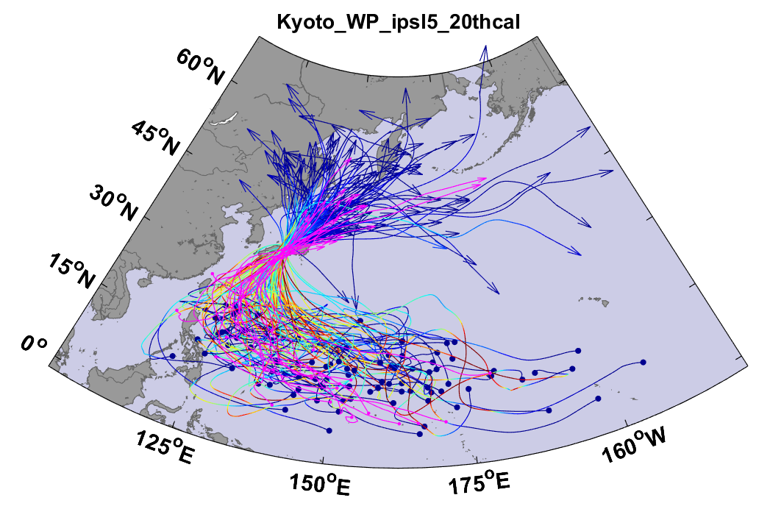
Same, but with top 20 historical tracks

Slide 22

Cumulative Distribution of Storm Lifetime Peak Wind Speed, with Sample of 1755 Synthetic Tracks
90% confidence bounds

Slide 23
Atlantic Annual Cycle

Slide 24
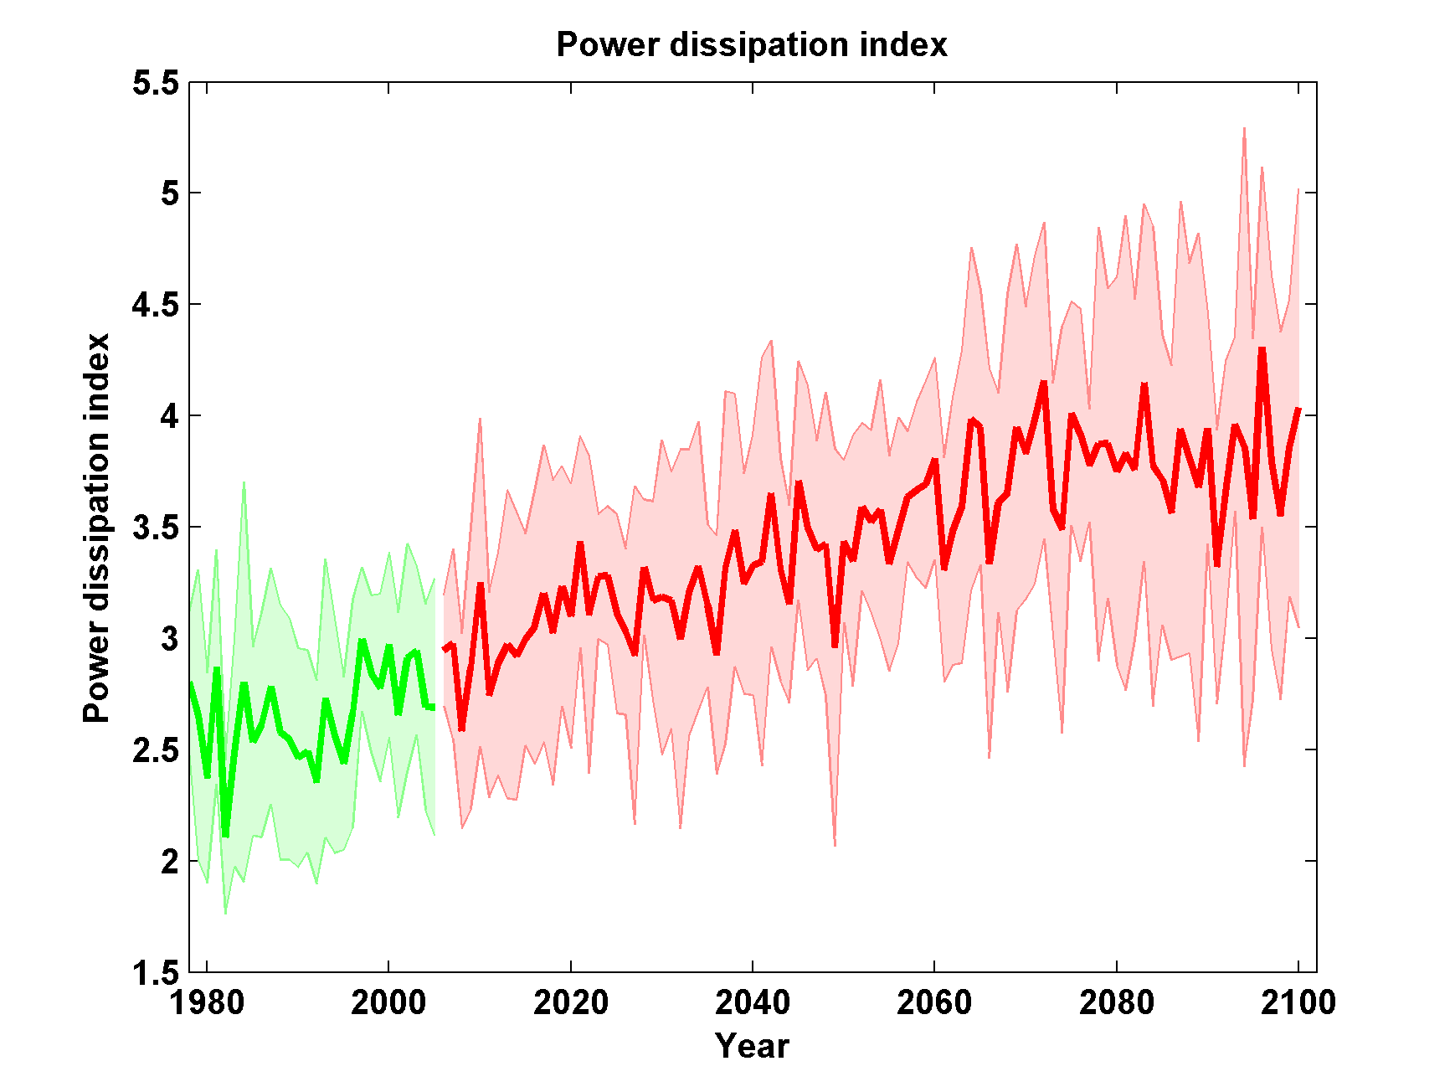
Global Hurricane Power under RCP 8.5
Six CMIP5 Models

Slide 25
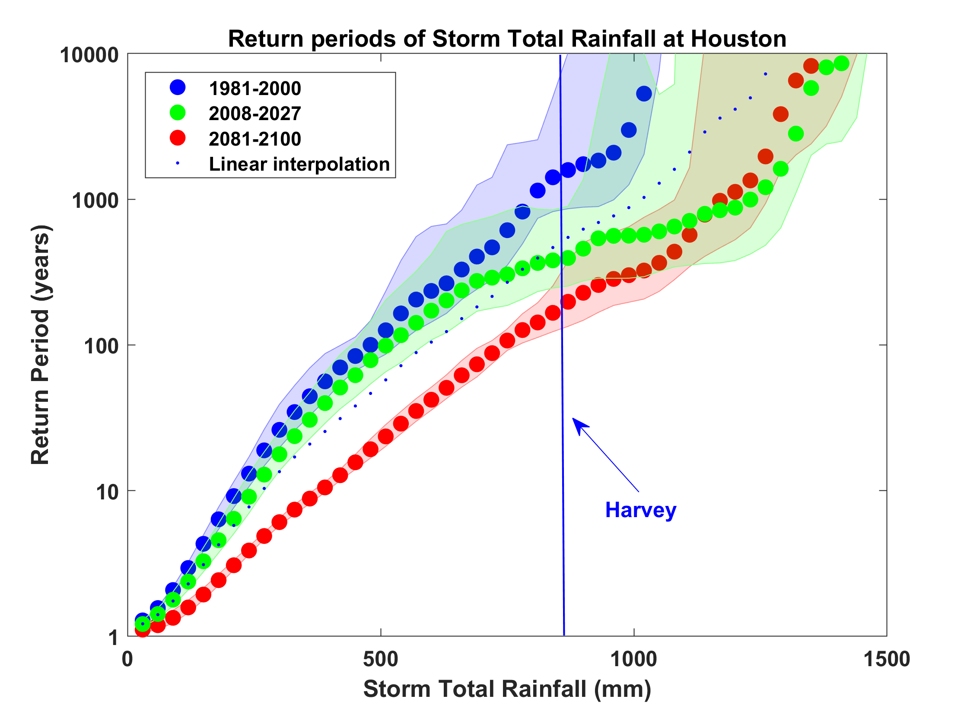
Probability of Storm Accumulated Rainfall in Harris County, from 6 Climate models, 1981-2000, 2008-2027, and 2081-2100, Based on 2000 Events Each, and Using RCP 8.5. Shading Shows Spread Among the Models.

Slide 26
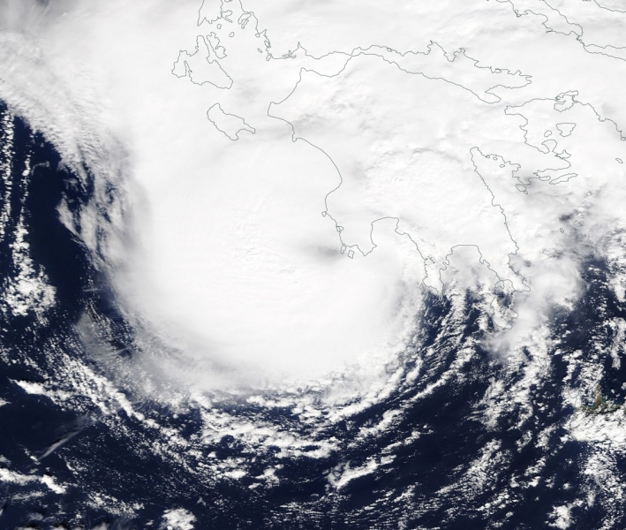
Mediterranean Hurricanes (“Medicanes”)
Medicane “Zorba” making landfall in southwest Peloponnese, September 29th 2018

Slide 27
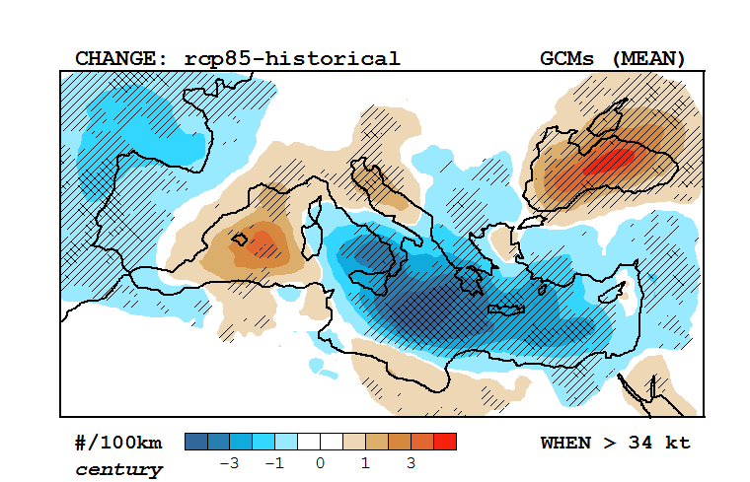
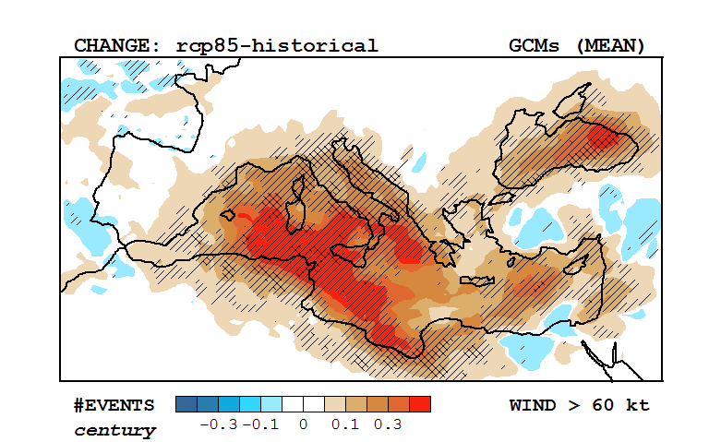
Response of Medicanes to a Changing Climate
Change in multi-model mean track density, RCP 8.5 –historical (2090-1995)
Based on downscaling of 30 CMIP5 models
(light and dark hatching; > 66% and 80% consensus)
Change in multi-model mean frequency of winds > 60 knots, RCP 8.5 –historical (2090-1995)
Romero and Emanuel, J. Clim., 2017

Slide 28
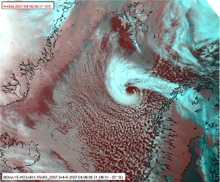
Polar Lows

Slide 29
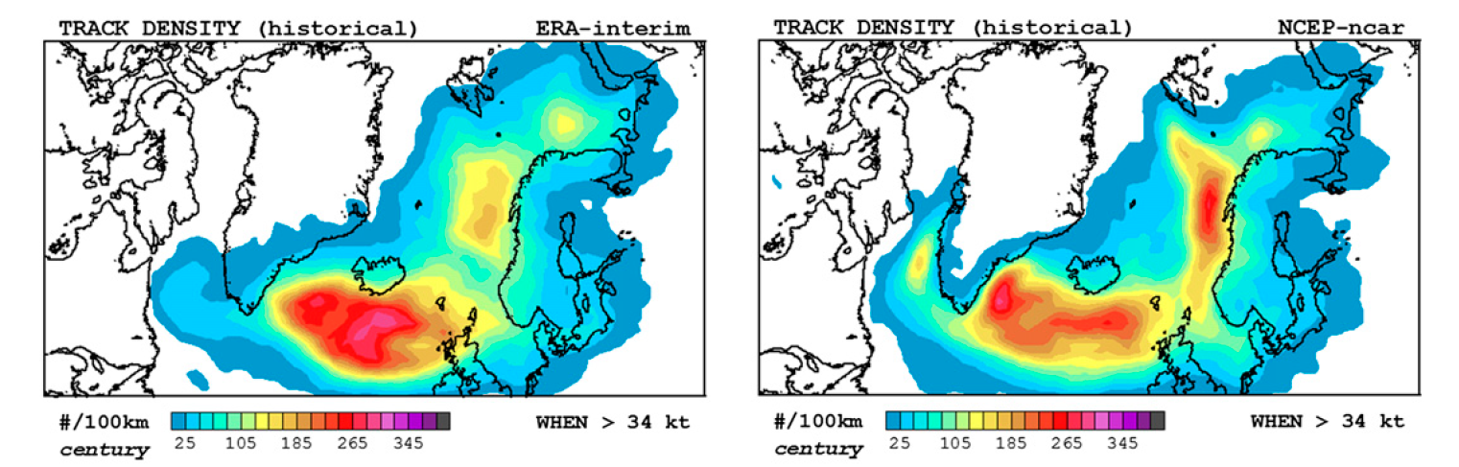
Response of Polar Lows to a Changing Climate
Change in multi-model mean track density, RCP 8.5 –historical (2090-1995)
Romero and Emanuel, J. Clim., 2017

Slide 30
Summary
There is compelling evidence that we are changing the climate in significant and risky ways
Among the many risks of climate change, extreme events are both early harbingers of change and among its worst consequences
Tropical cyclones are among the most damaging and lethal of extreme weather phenomena

Slide 31
Summary (continued)
Potential intensity theory demonstrates that the thermodynamic limit on hurricane intensity rises with temperature
Observations show that this limit is indeed increasing
Physics can be used to model hurricane, medicane and polar low risk in current and future climates
Global warming is not merely a problem for the future; current risk estimates are already out of date

Slide 32
Spare Slides

Slide 33
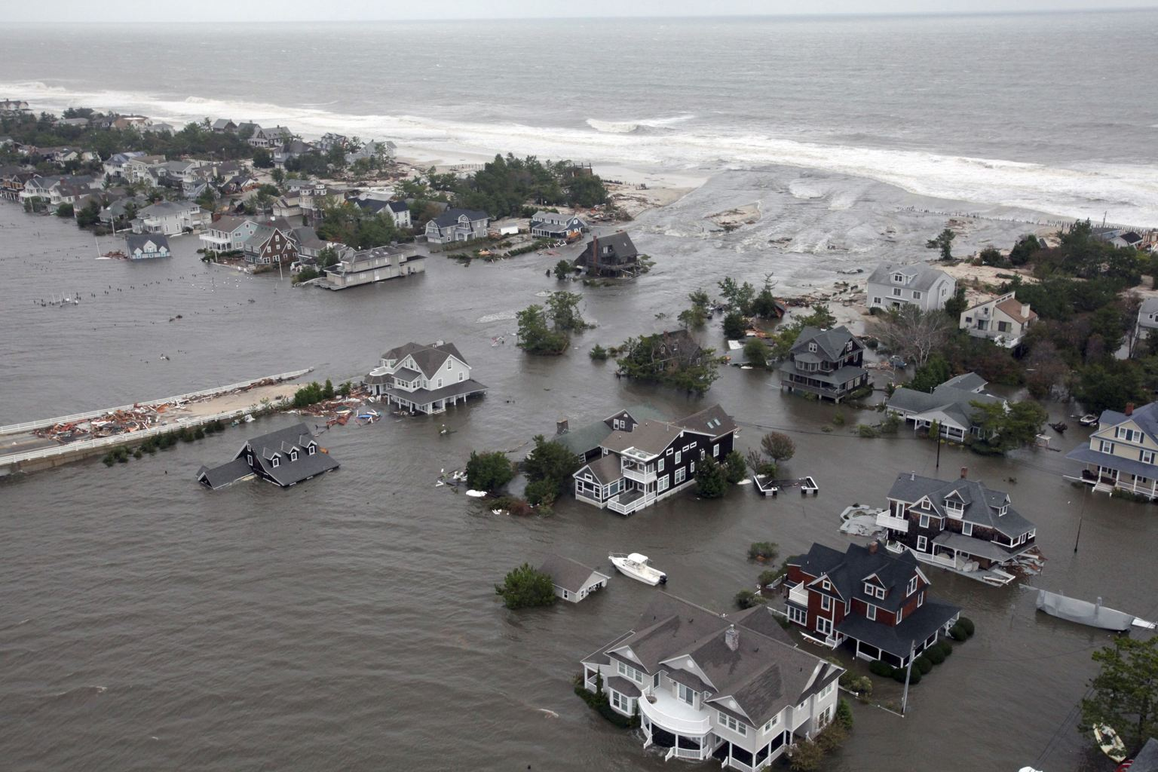
Storm Surges

Slide 34


Storm Surge Simulation (Ning Lin)
SLOSH model
(Jelesnianski et al. 1992)
SLOSH mesh
~ 10³ m
ADCIRC mesh
~ 10² m
Battery
ADCIRC model
(Luettich et al. 1992)
ADCIRC mesh
~ 10 m
(Colle et al. 2008)
Notes:
Given the storm wind and pressure fields (which is estimated from the Holland parametric pressure model) we can simulate the surge. Surge simulations with high resolution are computationally intensive, so to make it possible to simulate accurate surges for our large synthetic storm sets, we apply the two hydrodynamic models with girds of various resolutions in such a way that the main computational effort is concentrated on the storms that determine the risk. First, we apply the SLOSH model, using a mesh with resolution of about 1 km around NYC to simulate the surges for all storms and select the storms that have return periods, in terms of the surge height at the Battery, greater than 10 years. Second, we apply the ADCIRC simulation, using a grid mesh with resolution of ~100 m around NYC, to each of the selected storms. Then, we apply another ADCIRC mesh with resolution as high as ~10 m around NYC, for a set of the most extreme events, to check if the resolution of our ADCIRC grid is sufficient and if needed to make statistical correction to the results.

Slide 35
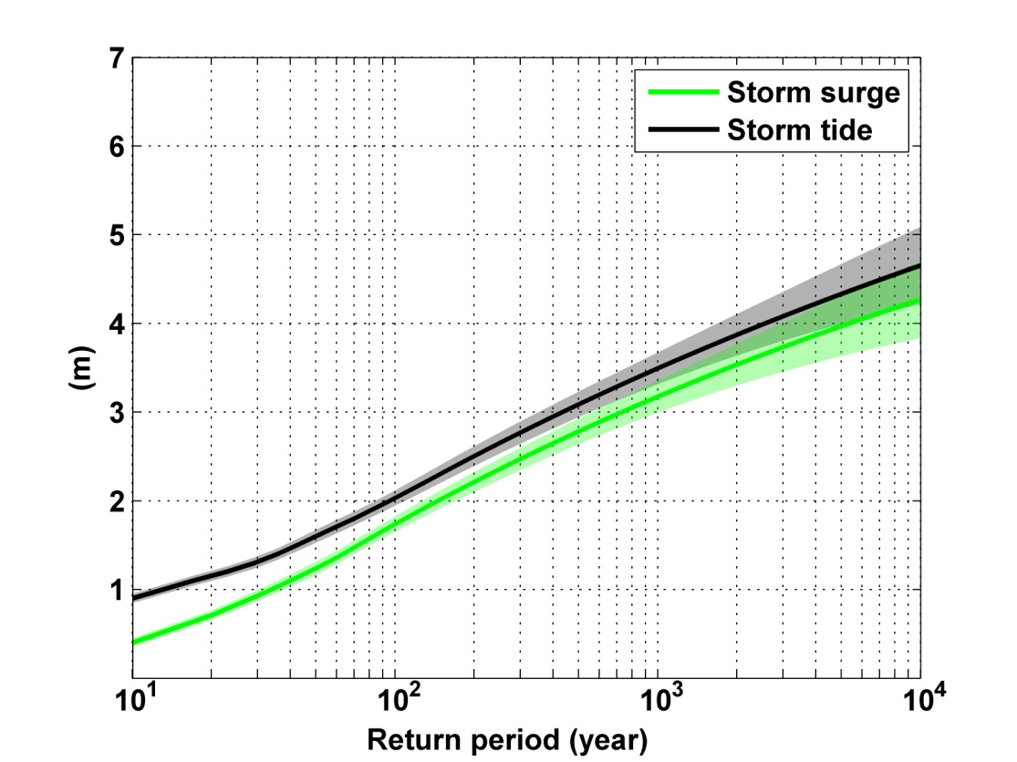
Sandy, 2012
Sandy: ~ 400 years
Notes:
Storm surge and storm tide (surge and tide) return level curves for the Battery, NYC, for the 1981-2000 NCAR/NCEP climate conditions (5000 synthetic storms). Astronomical tide and nonlinear interaction between surge and tide are accounted for statistically.

Slide 36
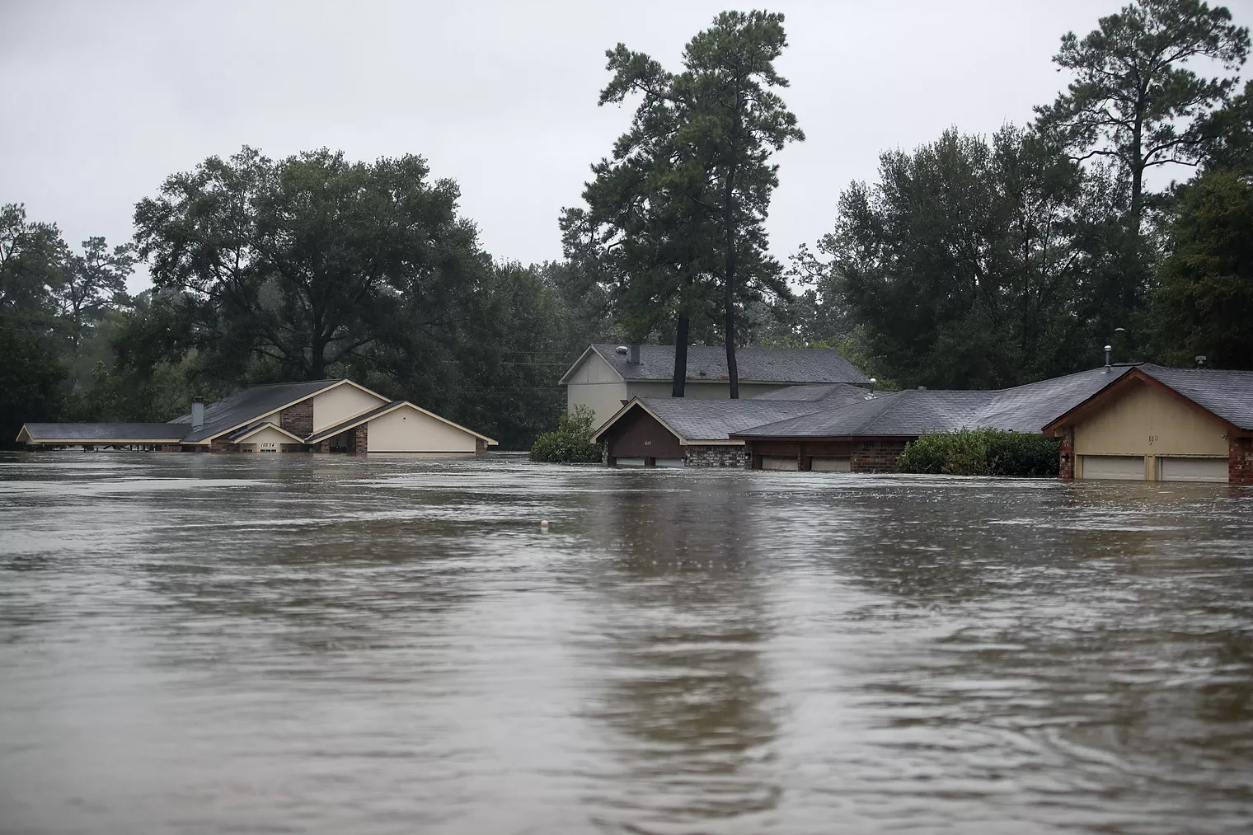
Rain

Slide 37
An Example:
Estimated gauge sampling error
Estimated radar sampling error

Slide 38
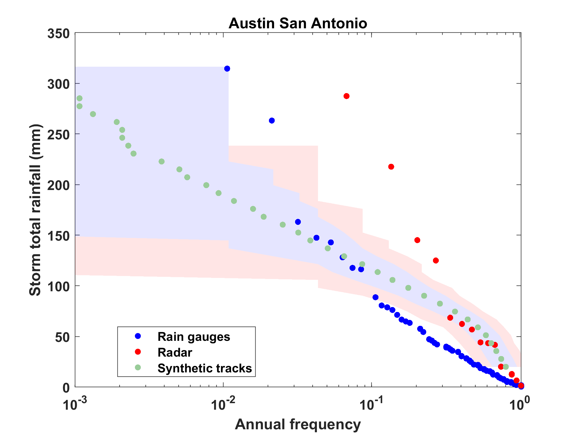

Slide 39
Effects of Climate Change
More moisture in boundary layer
Stronger storms but more compact inner regions
Possibly larger storm diameters
Storms may be moving faster or slower

Slide 40
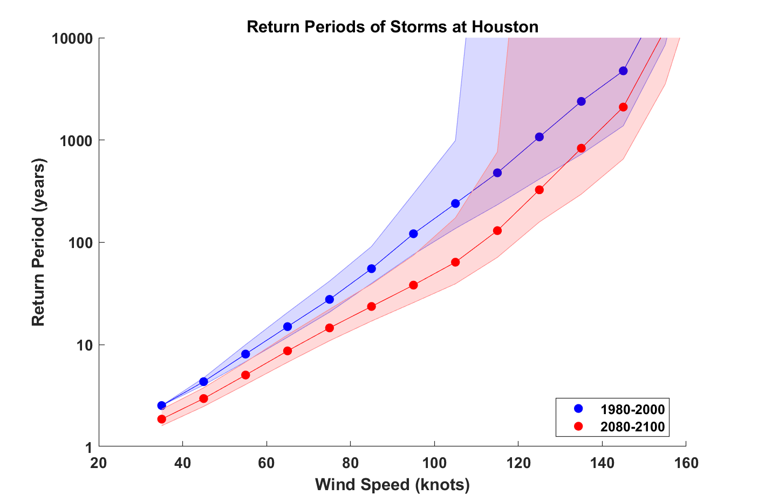

Slide 41

GCM flood height return level, Battery, Manhattan
(assuming SLR of 1 m for the future climate )
Black: Current climate (1981-2000)
Blue: A1B future climate (2081-2100)
Red: A1B future climate (2081-2100) with R₀ increased by 10% and R_{m} increased by 21%
Lin et al. (2012)
Notes:
Then we calculate the flood height (including surge, tide, and sea level rise) return level for the four climate models, assuming a sea level rise of 1 m for the future climate, for the Battery, NYC. These results show that the combined effects of storm climatology change and sea level rise will greatly shorten the flood return periods for NYC and, by the end of the century, the current 100-year surge flooding may happen less than every 30 years, with CNRM and GFDL prediction to be less than 10 years, and the 500-year flooding may happen less than every 200 years, with the CNRM and GFDL prediction to be 20-30 years.

