Slide 1
Climate Models and Climate Modeling

Slide 2
Global Climate Modeling
General philosophy and history:
  Simulate large-scale motions of atmosphere, oceans, ice
  Solve approximations to full radiative transfer equations
  Parameterize processes too small to resolve
  Some models also try to simulate biogeochemical processes
  First GCMs developed in 1960s

Slide 3
Model Partial Differential Equations
Conservation of momentum
Conservation of mass
Conservation of water
Conservation of certain chemical species
First law of Thermodynamics
Equation of state
Radiative transfer equations

Slide 4
The Governing Equations

Slide 5
Additional equations for radiative transfer, conservation of water (atmosphere) and salinity (ocean), etc.

Slide 6
Numerical solution of PDEs
Finite difference method, e.g.
Spectral methods

Slide 7
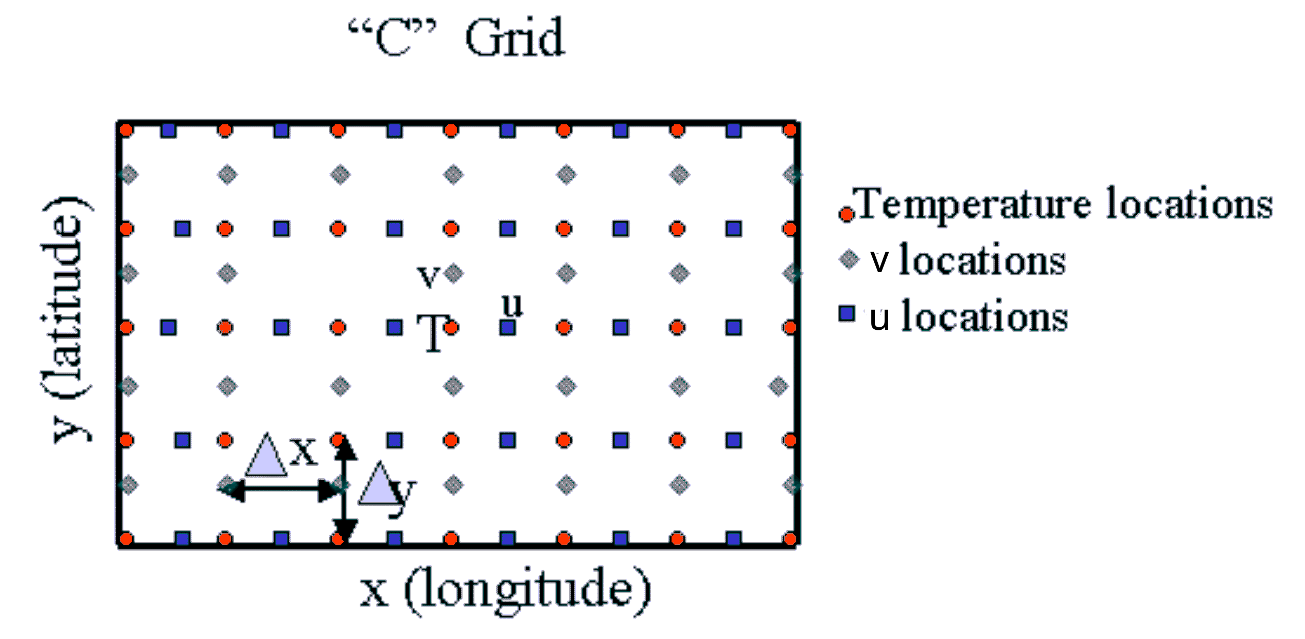
Image credit: U.S. Navy Postgraduate School
Notes:
http://www.oc.nps.edu/nom/modeling/grids.html

Slide 8
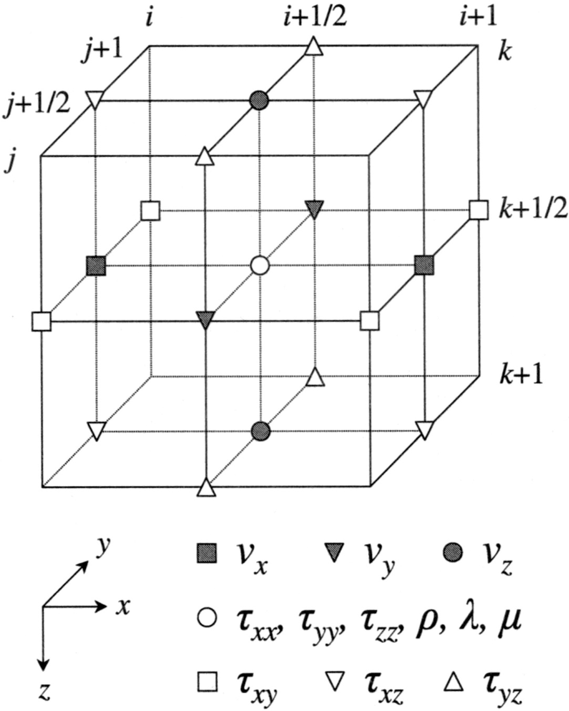
Image credit: Tae-Seob Kang and Chang-Eob Baag, Bulletin of the Seismological Society of America October 2004 vol. 94 no. 5 1690-1705

Slide 9
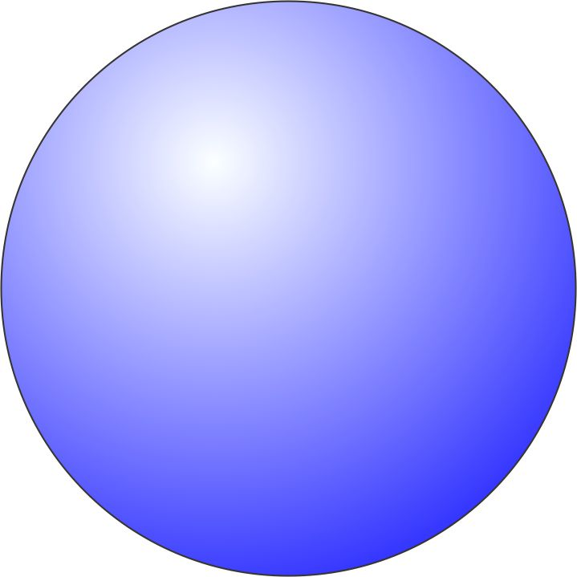
Vertical Layers
Climate models usually have fewer vertical slices than typical weather forecast models
Not equally spaced
  More levels closer to ground and near the tropopause (things change quickly near these levels)
Sigma Coordinate is typically used as the vertical coordinate
Actual pressure
Surface pressure

Slide 10
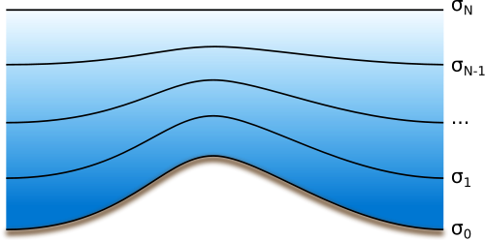
Sigma Coordinates
Image credit: Roger A. Pielke, Wikipedia
Notes:
http://en.wikipedia.org/wiki/File:Sigma-z-coordinates.svg

Slide 11
Sigma Coordinate
Advantages
  Conforms to natural terrain (mountains are represented in models)
  Will never intersect the ground like a height coordinate
  Simplifies mathematical equations in model
Limitations
  Complicates certain computations (pressure gradient force in sloped regions
  Sometimes land points extend into oceans due to smoothing near mountainous terrain

Slide 12
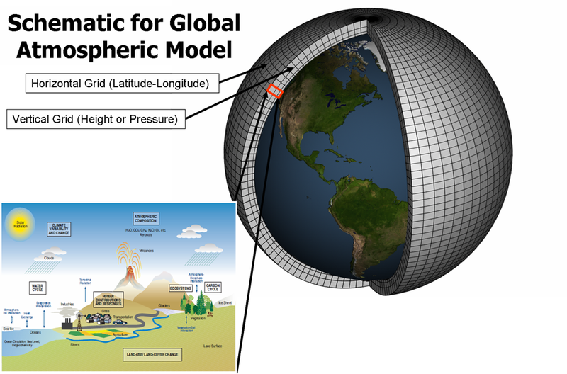
PDE’s written as finite difference equations, or phrased in finite elements, or spectrally decomposed
Image credit: NOAA, Wikipedia
Notes:
http://en.wikipedia.org/wiki/File:Global_Climate_Model.png

Slide 13
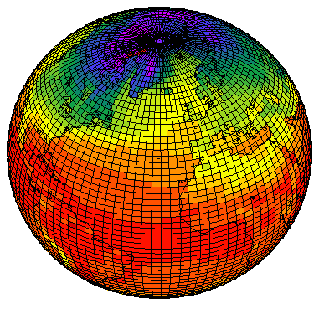
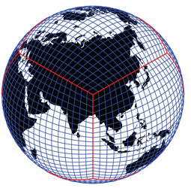
Alternative Grids:
Classical spherical coordinates
Conformal mapping of cube onto sphere
Image credit: United Kingdom Meteorological Office
Image credit: University Corporation for Atmospheric Research

Slide 14
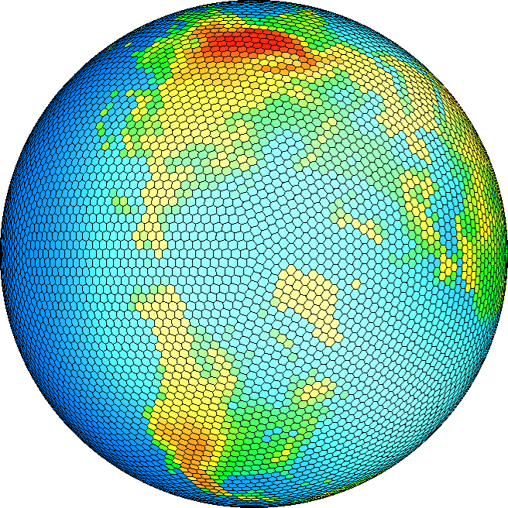
Geodesic Grids
Image credit: Colorado State University

Slide 15

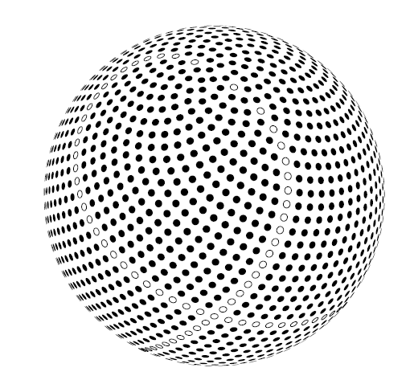
A spherical grid based on the Fibonacci sequence. The grid is highly uniform and isotropic.
Image credit: Swinbank, R., and R. J.. Purser,2006: Fibonacci grids: A novel approach to global modelling. Quart. J. Roy. Meteor. Soc., 132, 1769-1793.

Slide 16
Spectral methods:
Must use spherical harmonics for equations on a sphere

Slide 17
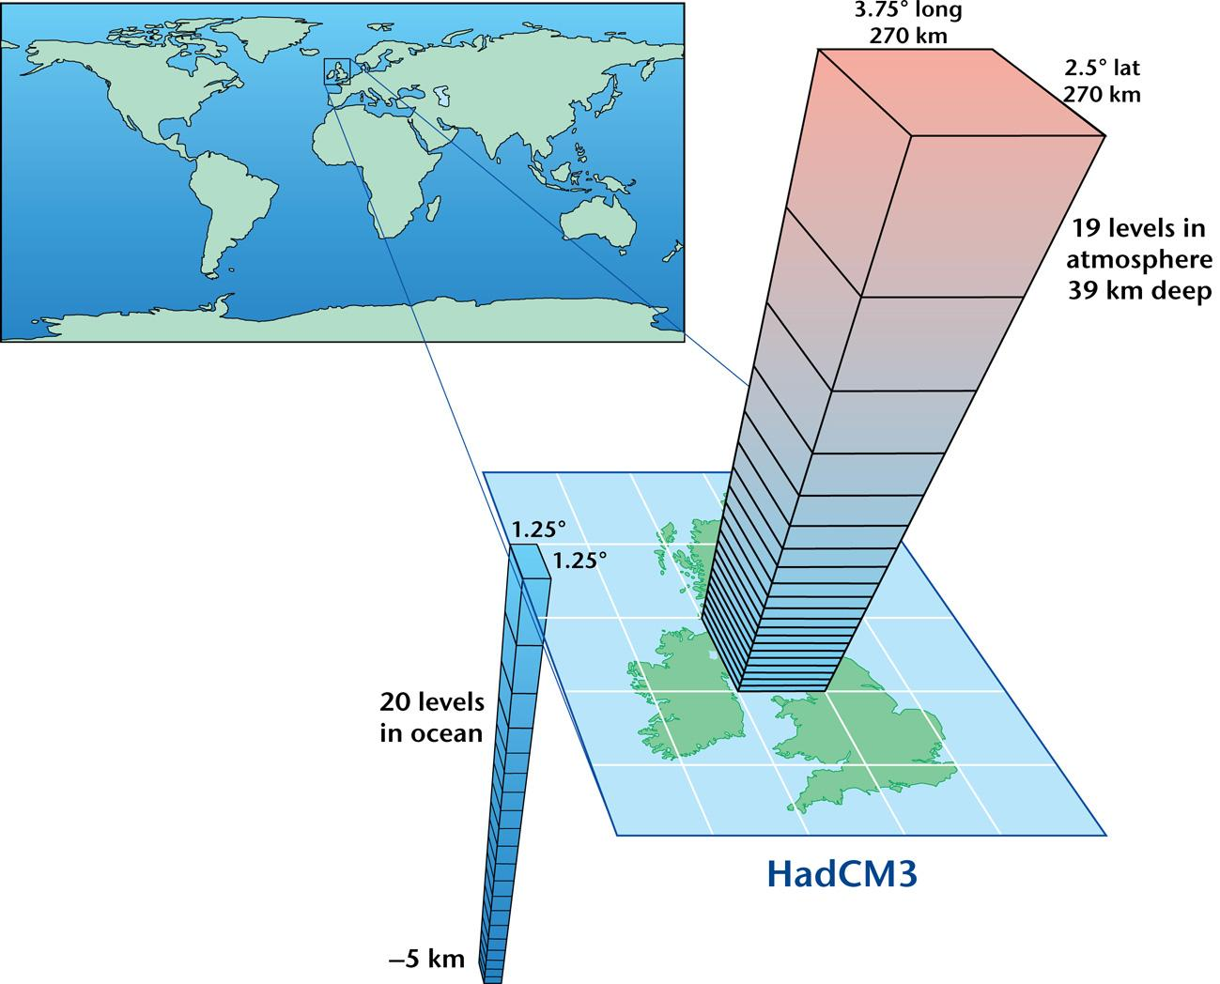
Note: Spectral method not used for vertical differences
Image credit: United Kingdom Meteorological Office

Slide 18
Some Fundamental Numerical Constraints
Courant-Friedrichs-Lewy (CFL) condition:
where c is the phase speed of the fastest wave in the system, Δt is the time step used by the model, and Δx is a characteristic spacing between grid points.
Typical size of model: 20 levels, grid points spaced ~120 km apart, 10-15 variables to defines state of atmosphere or ocean at each grid point: ~1,000,000-5,000,000 variables. Typical time step: 20 minutes. Thus 70,000,000 -350,000,000 variables calculated per simulated day.

Slide 19
History of Climate Modeling

Slide 20
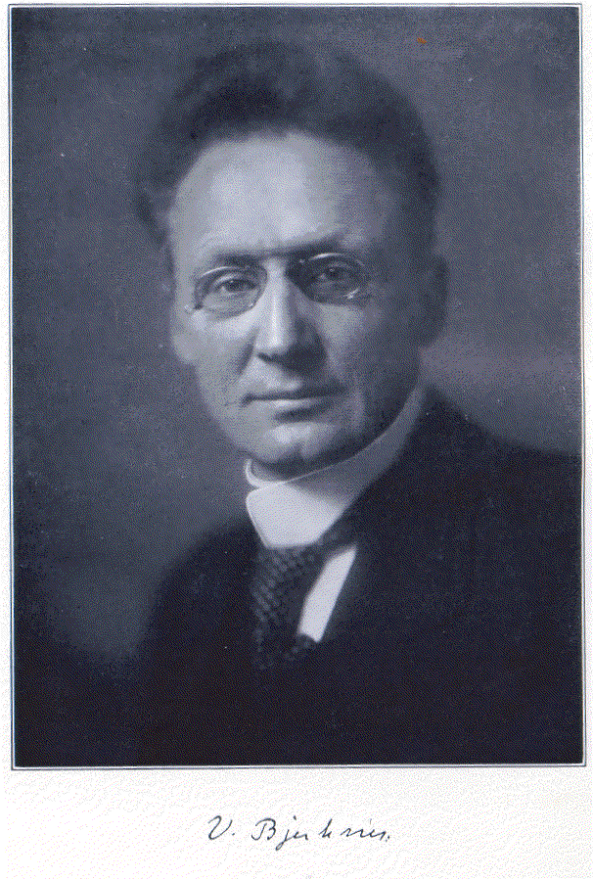
Norwegian physicist and meteorologist Vilhelm Bjerknes (1862-1951)
“Father of modern meteorology”
Image Credit: University of Leipzig

Slide 21
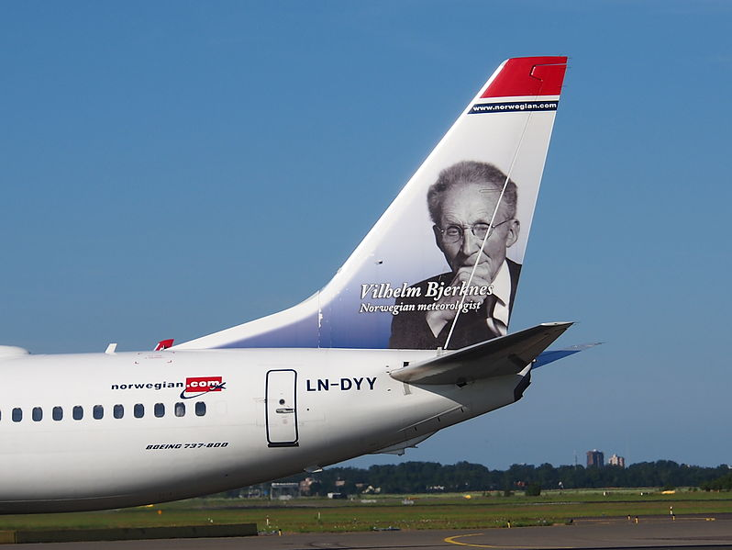
Image source: Alf van Beem (Wikipedia commons)
Notes:
http://commons.wikimedia.org/wiki/File:LN-DYY_Norwegian_Air_Shuttle_Boeing_737-8JP%28WL%29_%28Vilhelm_Bjerknes_livery%29-_cn_39012_taxiing_19july2013_pic5.JPG

Slide 22
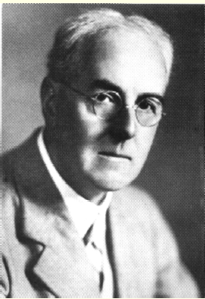
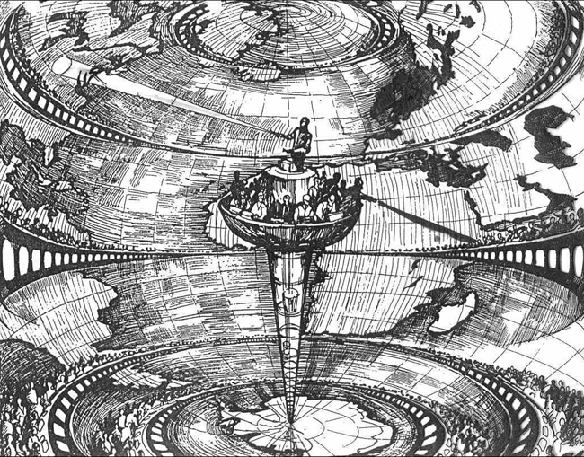
Numerical Weather Prediction: Lewis Fry Richardson, 1922
Richardson’s “Forecast Factory”
“Perhaps some day in the dim future it will be possible to advance the computations faster than the weather advances and at a cost less than the saving to mankind due to the information gained. But that is a dream.”
Image Credit: NOAA
Image Credit: NOAA

Slide 23
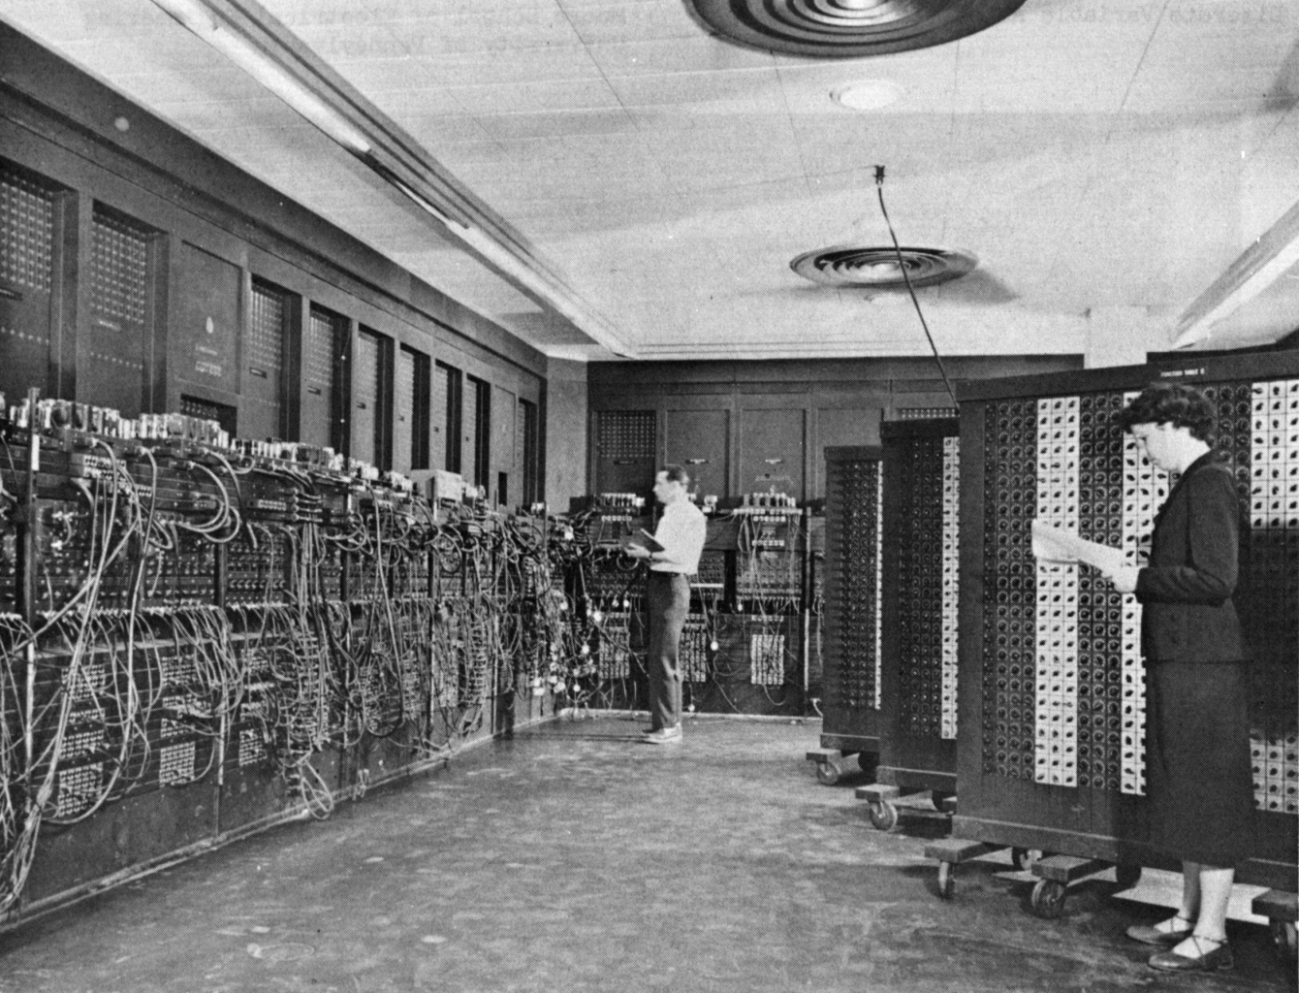
The ENIAC: Electronic Numerical Integrator And Computer (1946)
17,468 vacuum tubes, 7,200 crystal diodes, 1,500 relays, 70,000 resistors, 10,000 capacitors and around 5 million hand-soldered joints. Weight: 30 short tons. 350 floating point operations per second (flops). (Modern PC: 21 Gigaflops!)
Image Credit: U.S. Army

Slide 24
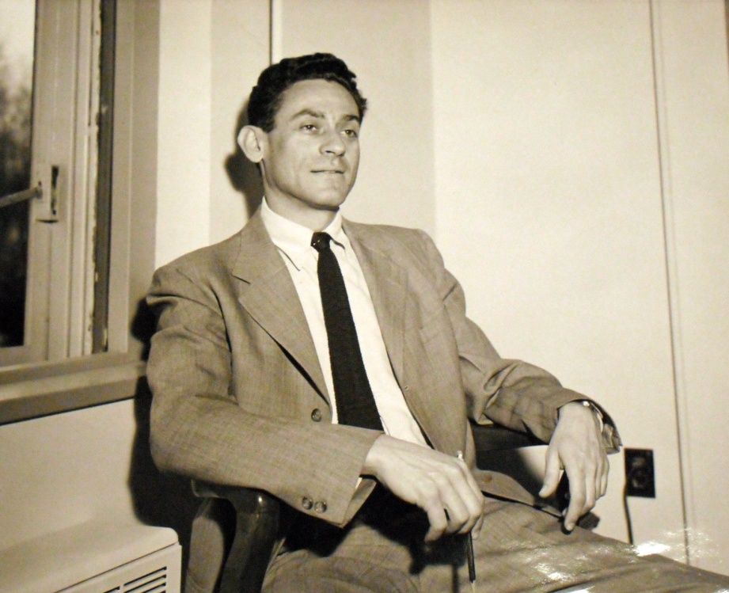
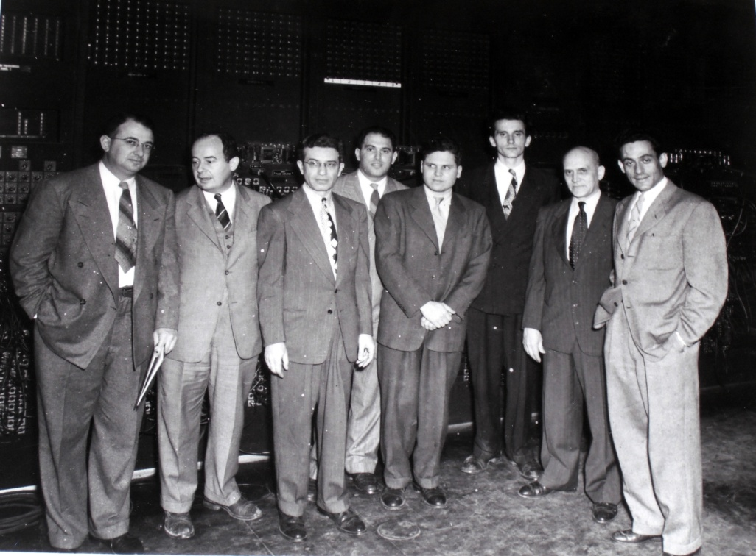
First Successful Numerical Weather Forecast in April, 1950:
Jule Gregory Charney, (1917-1981)
Image Credit: M.I.T. Archives
Image Credit: M.I.T. Museum

Slide 25
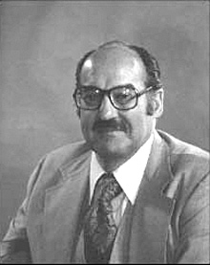
Mid-late 1950s
  First routine numerical weather forecasts by U.S. Joint Numerical Weather Prediction Unit
  First efforts to regularly collect weather data at surface and upper atmosphere
  Major general circulation modeling effort evolved into the Geophysical Fluid Dynamics Laboratory at Princeton University
Joseph Smagorinsky, Former
Director of the NOAA Geophysical
Fluid Dynamics Laboratory
Image Credit: NOAA

Slide 26
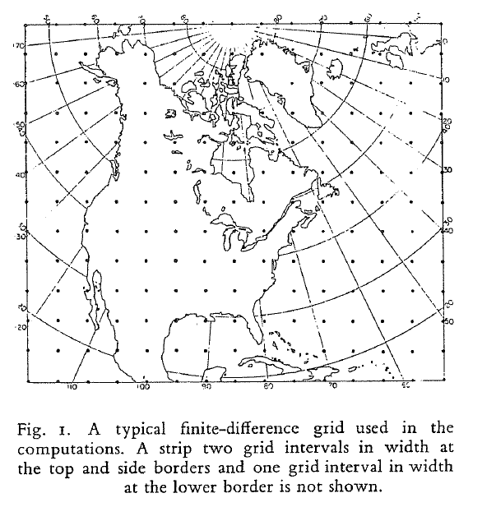
Image Credit: Charney, J. G., R. Fjortoft and J. von Neumann, 1950: Numerical integration of the
barotropic vorticity equation. Tellus, 2, 237-254

Slide 27
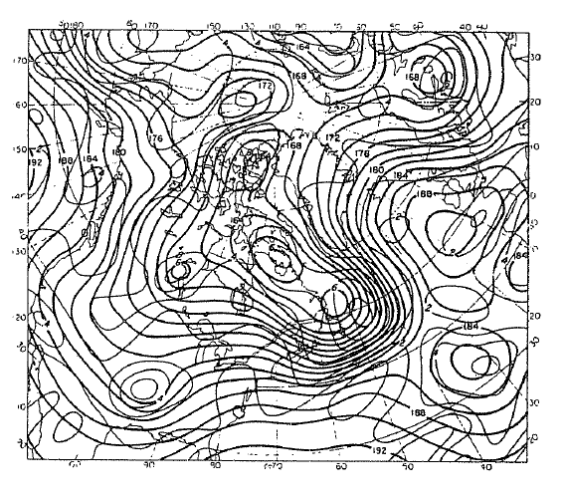
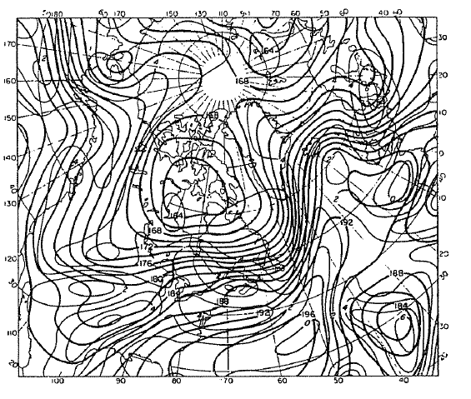
Observed (left) and 24-hour forecast (right) of 500 hPa geopotential heights (thick) and vorticity (thin) for 0300 GMT 31 January 1949
Image Credit: Charney, J. G., R. Fjortoft and J. von Neumann, 1950: Numerical integration of the
barotropic vorticity equation. Tellus, 2, 237-254

Slide 28
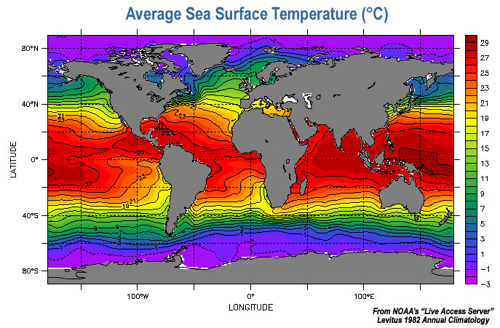
Early to mid 1960s
  Ocean models developed
  Roles of sea ice, snow, land processes, and biosphere begin to be incorporated into general circulation models (GCMs)
Image Credit: NOAA

Slide 29
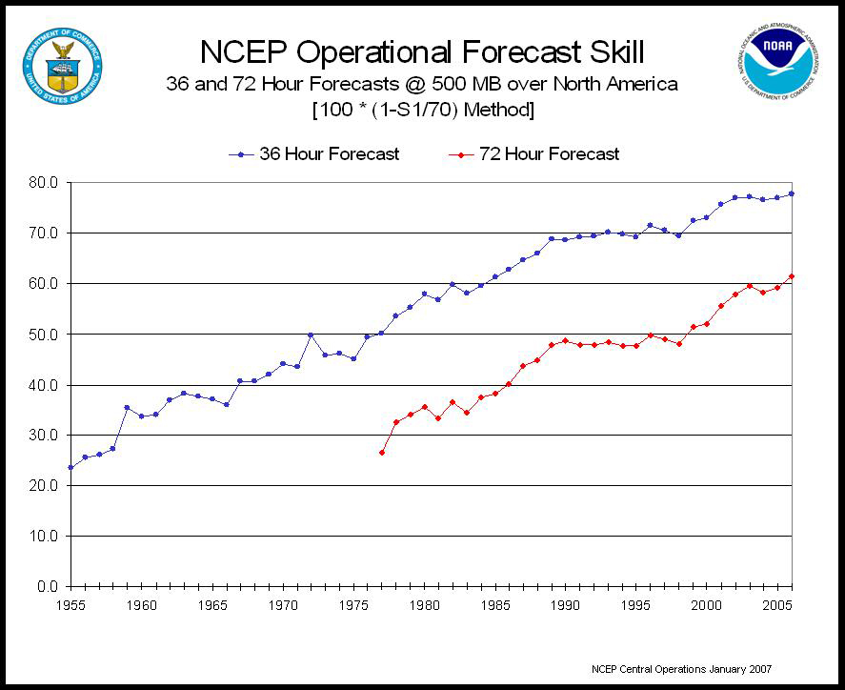
Image Credit: NOAA

Slide 30
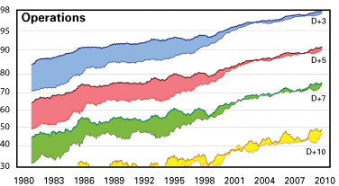
500 hPa anomaly correlations
(Forecast model of the European Centre for Medium Range Weather Forecasts)
Upper curves: Northern Hemisphere; Lower curves: Southern Hemisphere
Image Credit: World Meteorological Organization
Notes:
http://www.wmo.int/pages/publications/bulletin_en/archive/60_2_en/60_2_simmons_en.html

Slide 31
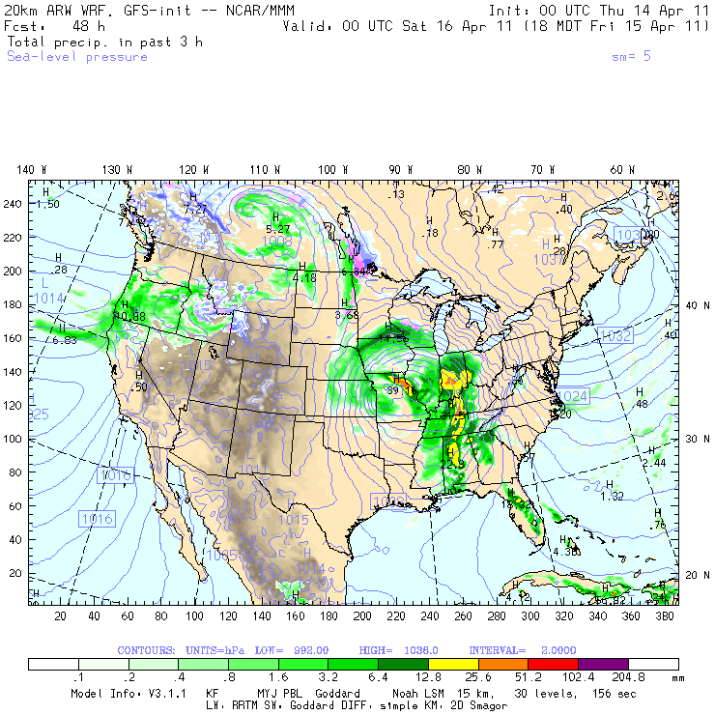
Image Credit: National Center for Atmospheric Research, National Science Foundation

Slide 32
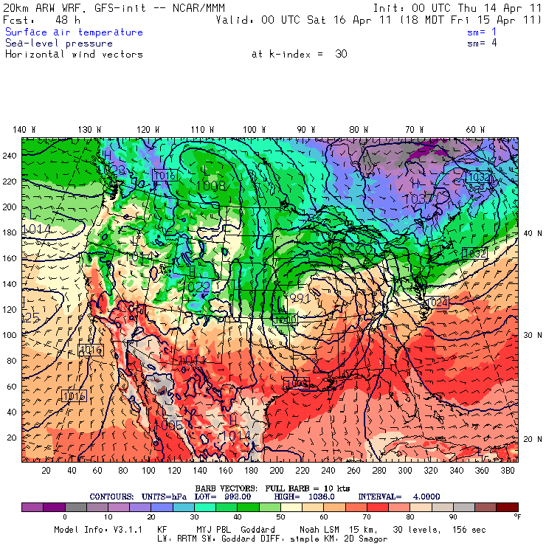
Image Credit: National Center for Atmospheric Research, National Science Foundation

Slide 33
Weather versus Climate

Slide 34
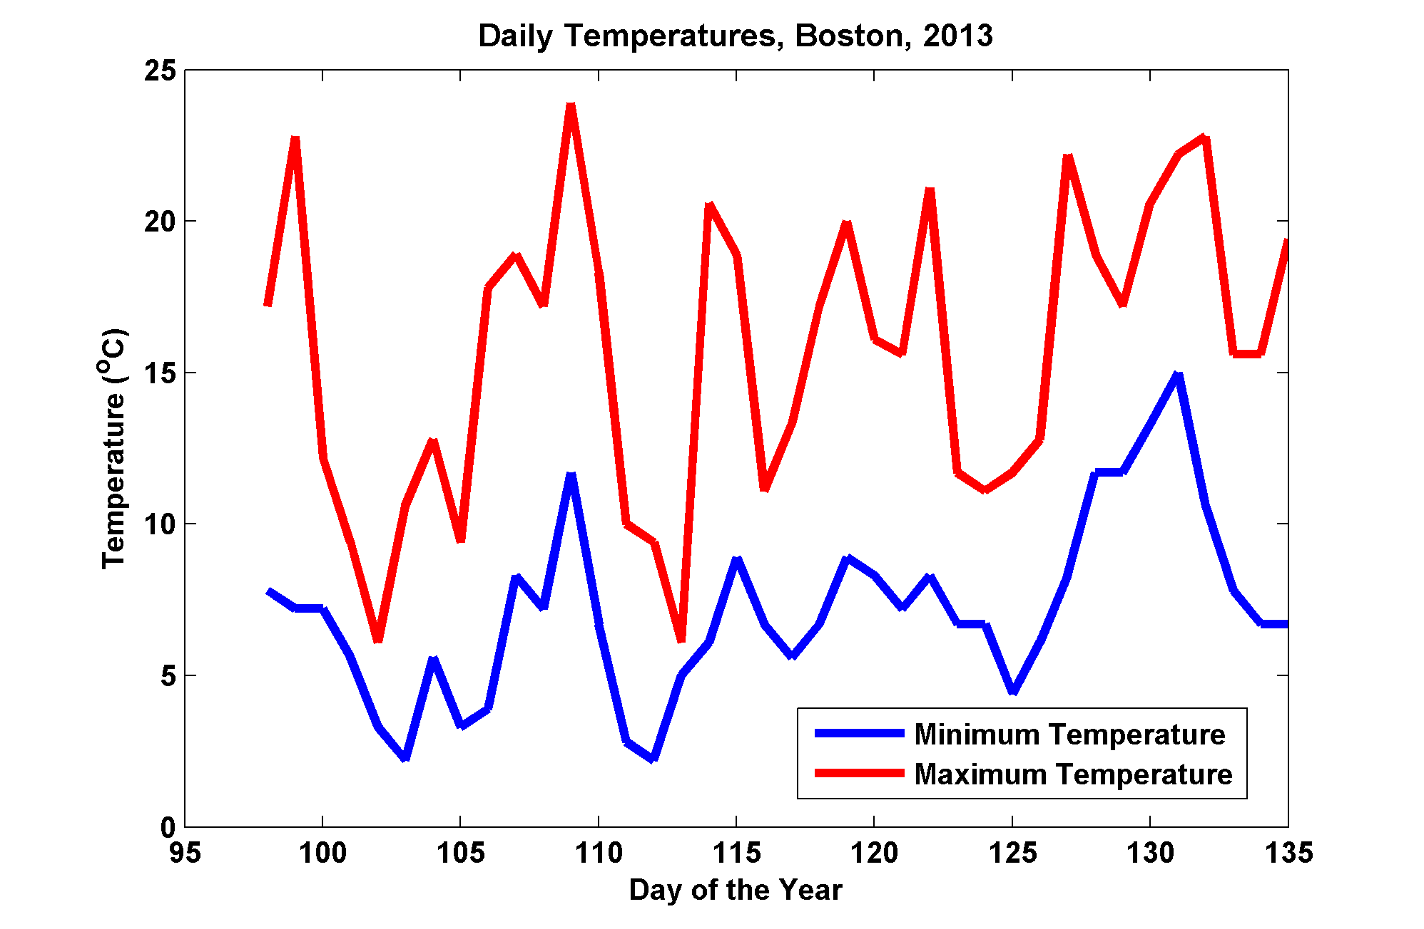
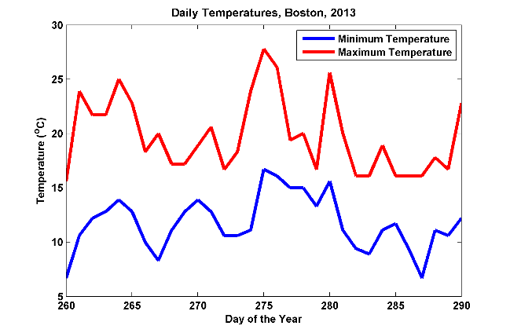
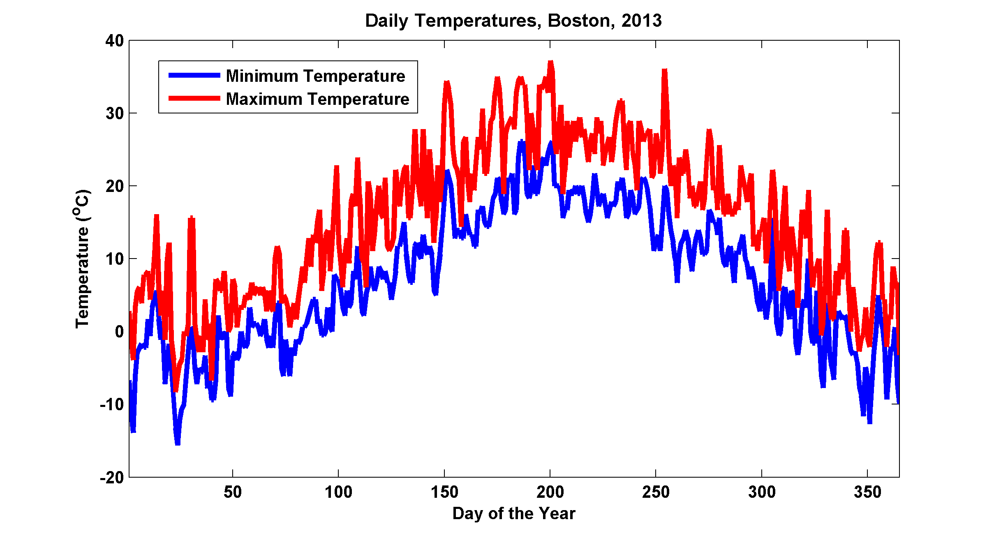
Image Credit: K. Emanuel

Slide 35
What is in a climate model?
Atmospheric general circulation model
  Dynamics
  Sub-grid scale parameterized physics processes
    Turbulence, solar/infrared radiation transport, clouds.
Oceanic general circulation model
  Dynamics (mostly)
Sea ice model
  Viscous elastic plastic dynamics
  Thermodynamics
Land Model
  Energy and moisture budgets
  Biology
Chemistry
  Tracer advection, possibly stiff rate equations.

Slide 36
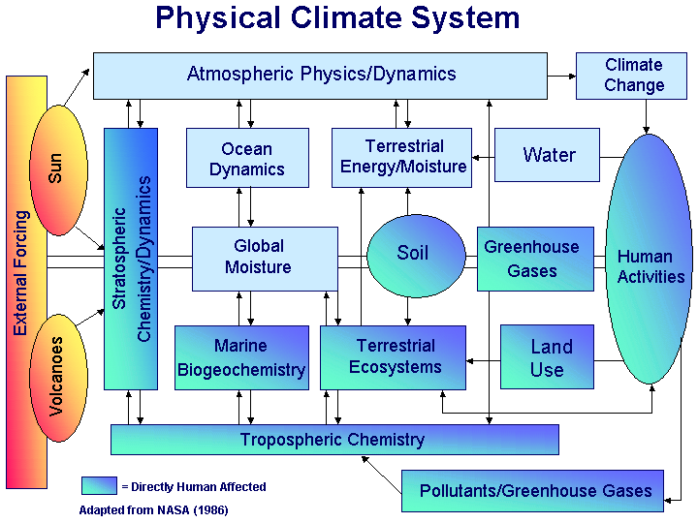
Image Credit: NASA

Slide 37
Modern climate models
Forcing: solar irradiance, natural and anthropogenic aerosols, greenhouse gases
Variables: Temperature, pressure, wind, water vapor, clouds, soil moisture, ocean currents, salinity, sea ice, and more
Spatial resolution:
  <1 deg lat/long effective grid spacing
  ~50 atmosphere layers, ~30 ocean layers, ~10 soil layers
  ==> 6.5 million grid boxes
Time steps: Several minutes
Ensemble runs (multiple experiments)
Model experiments (e.g. 1800-2100) take weeks to months on supercomputers
Image credit: NOAA, Wikipedia

Slide 38
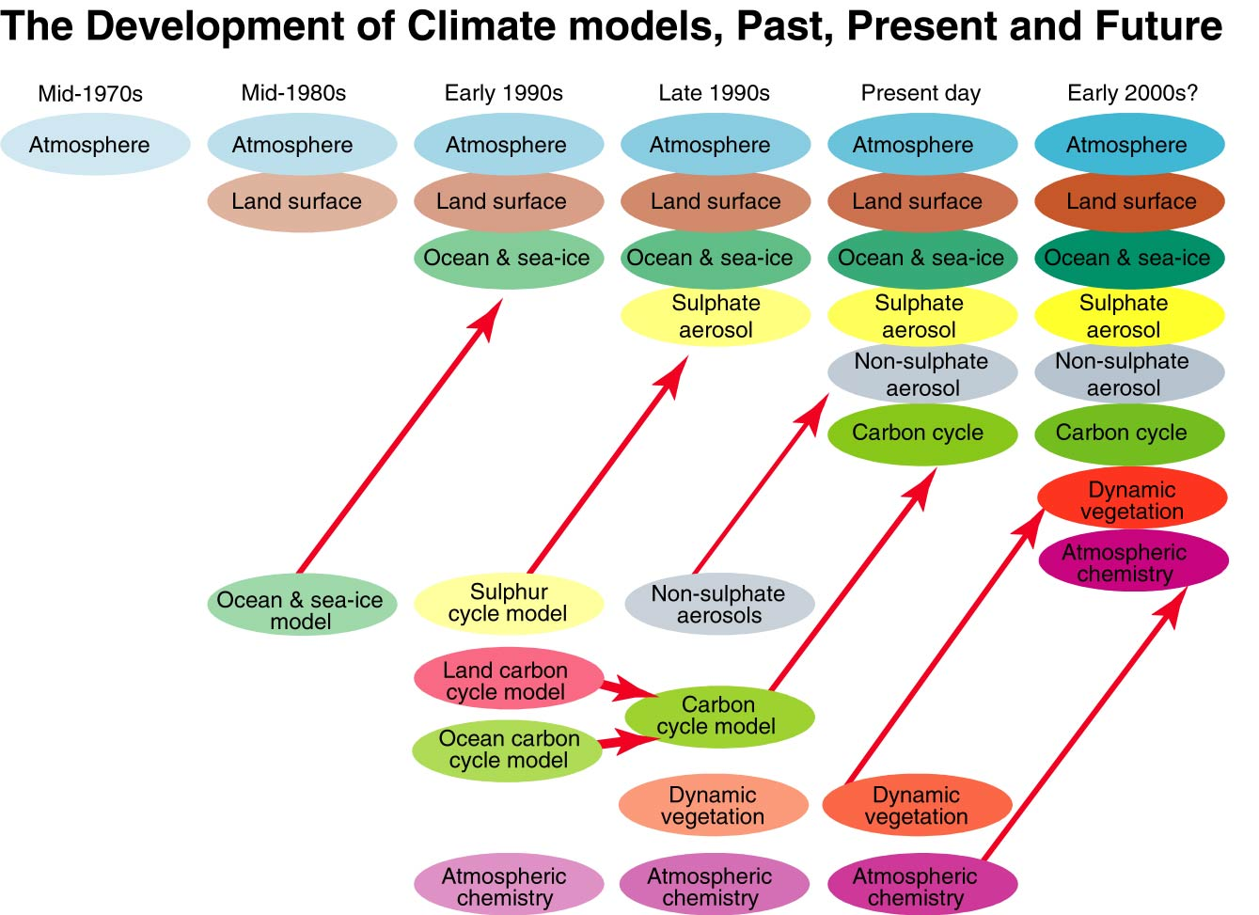
Image credit: IPCC Third Assessment Report
Notes:
http://www.ipcc.ch/ipccreports/tar/vol4/index.php?idp=91

Slide 39
Progress in Climate Modeling
IPCC Terminology:
FAR=First Assessment Report
SAR=Second “ “
TAR=Third “ “
AR4=Assessment Report 4
Image credit: IPCC Fourth Assessment Report

Slide 40
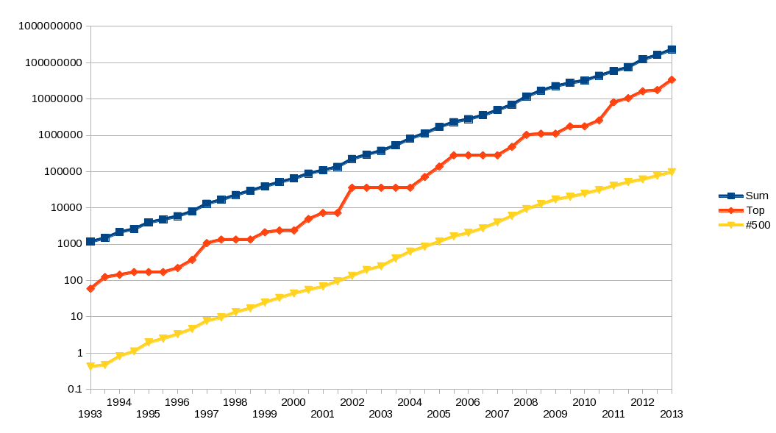
Earth Simulator
Geometric growth of supercomputers performance, based on data from top500.org site. Y Axis shows performance in GFLOPS. Red line denotes fastest supercomputer in the world at the time. Yellow line denotes supercomputer no. 500 on TOP500 list. Dark blue line denotes total combined performance of supercomputers on TOP500 list.
Image credit: Wikipedia
Notes:
http://en.wikipedia.org/wiki/File:Supercomputers.png

Slide 41
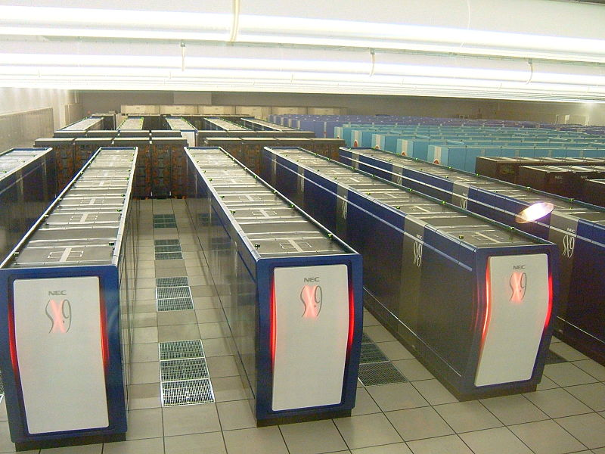
Earth Simulator
Earth simulator at JAMSTEC Yokohama Institute for Earth Sciences
Image credit: GenGen, Wikipedia
Notes:
http://en.wikipedia.org/wiki/File:Earth_simulator_ES2.jpg

Slide 42
Atmosphere Component of GCM
Similar to weather forecast model, except:
  Lower spatial resolution
  More attention paid to radiation, clouds (insofar as they affect radiation), aerosols, and other processes that operate on time scales longer than weather predictability horizons

Slide 43
Ocean Component of GCM
Similar governing equations as atmosphere except:
  Oceans are liquid
  Salinity is carried as an important variable
  Ocean basin geometry is more complex
Many important features in the ocean are too small to be resolved in most of today’s climate models
  Gulf Stream, Kuroshio currents less than 1° wide

Slide 44
Land Component of GCM
Must contain heat and moisture balance equations and a snow cover model
Vegetation, as it effects albedo and evapotranspiration, must be modeled
GCMs have been shown to be very sensitive to surface albedo and moisture characteristics

Slide 45
Sea Ice Models
Sea ice:
  Increases surface albedo
  Inhibits exchanges of heat, moisture, and momentum between ocean and atmosphere
  Alters local salinity
Assume ice forms if sea surface temperature falls below threshold
Also should predict movement of ice

Slide 46
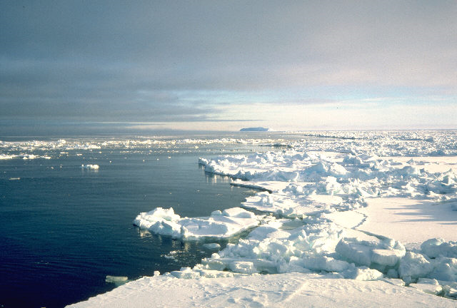
Image credit: Lamont Doherty Earth Observatory, Columbia University

Slide 47
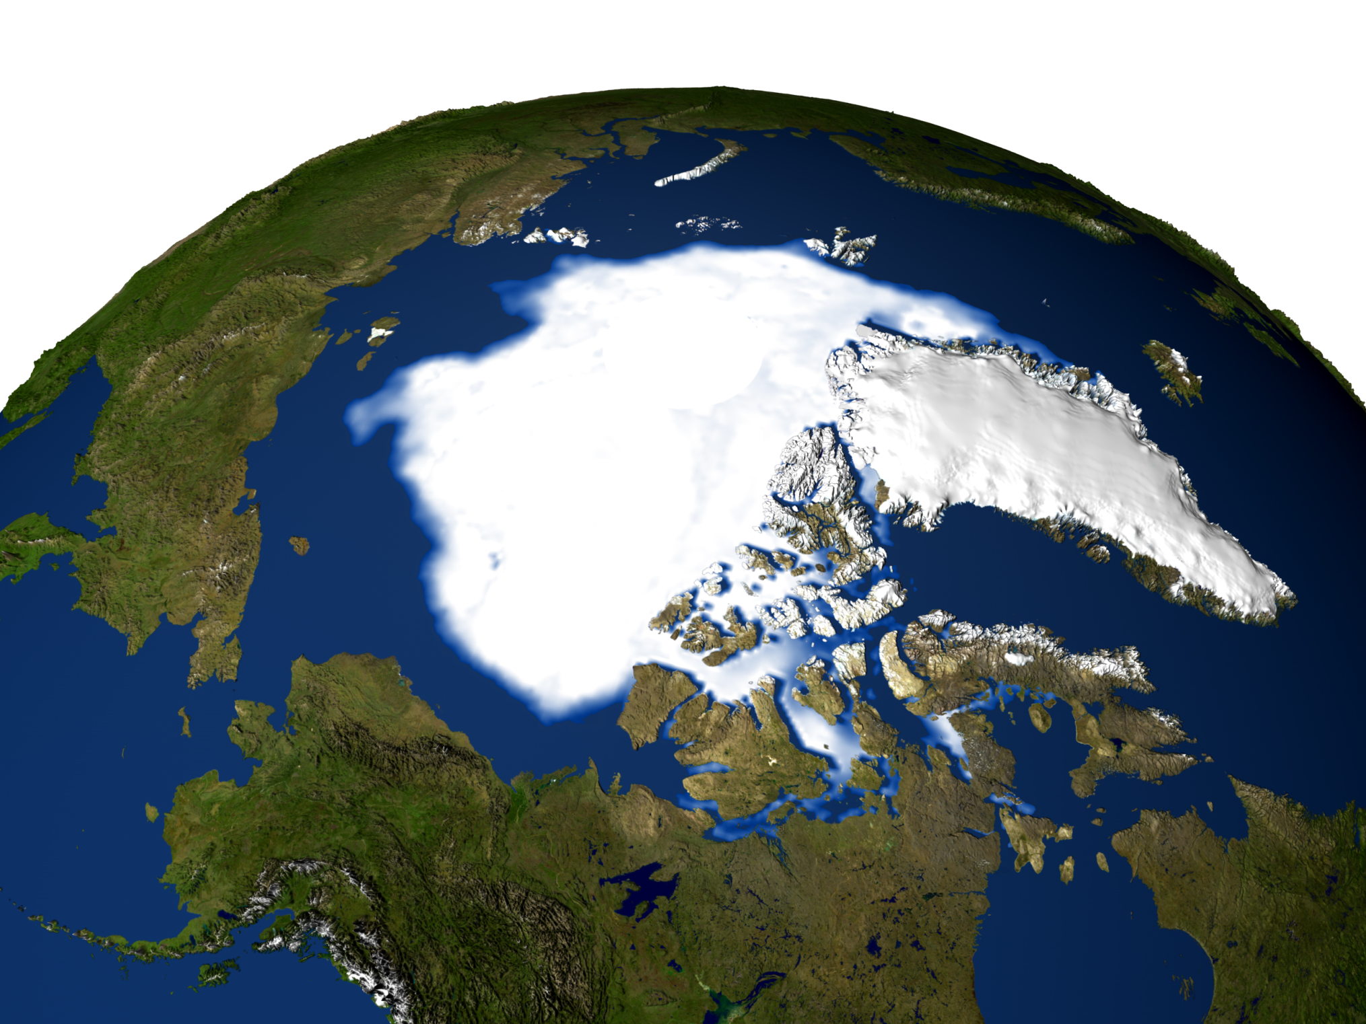
Image credit: NASA

Slide 48
Unresolved physical processes must be handled parametrically
Convection
Thin and/or broken clouds
Cloud microphysics
Aerosols and chemistry (e.g. photochemical processes, ozone)
Turbulence, including surface fluxes
Sea ice
Land ice
Land surface processes

Slide 49
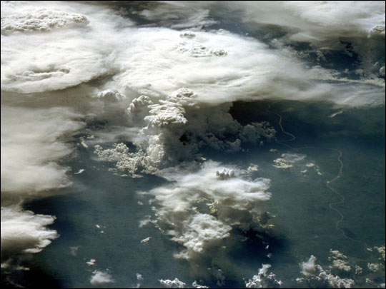
Convection
Boundary layer
Clouds
  stratiform
  convective
Cloud microphysics
Image credit: NASA

Slide 50
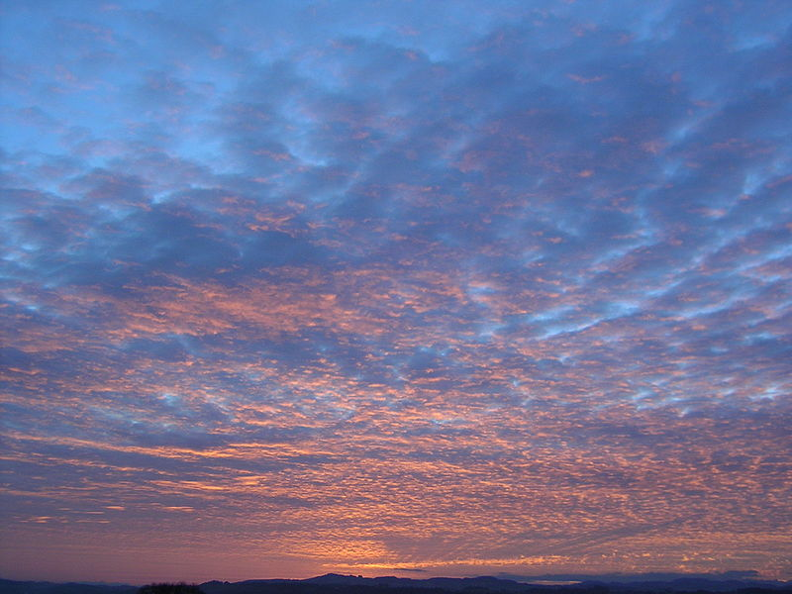
Thin and broken clouds
Altocumulus
Image credit: Simon Eugster, Wikipedia
Notes:
http://en.wikipedia.org/wiki/File:Partially_illuminated_Ac_with_shadows.JPG

Slide 51
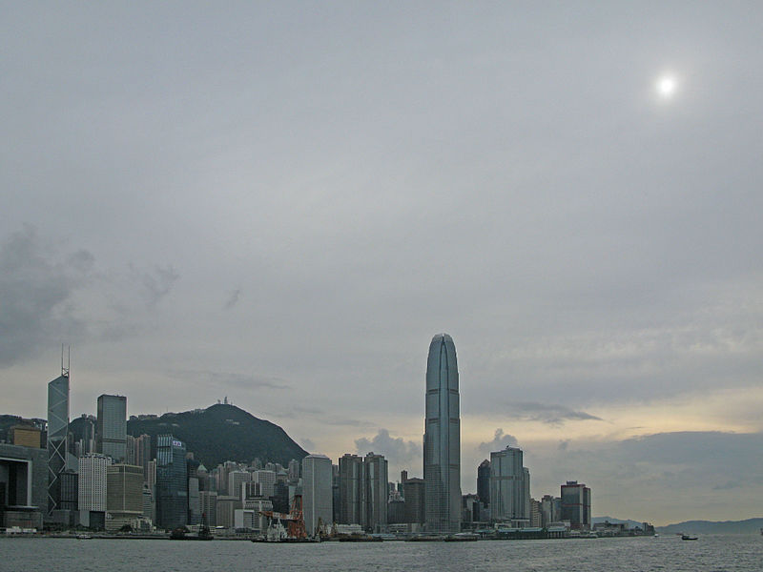
Altostratus
Image credit: Wikipedia
Notes:
http://en.wikipedia.org/wiki/File:Altostratus_clouds_over_Hong_Kong.JPG

Slide 52
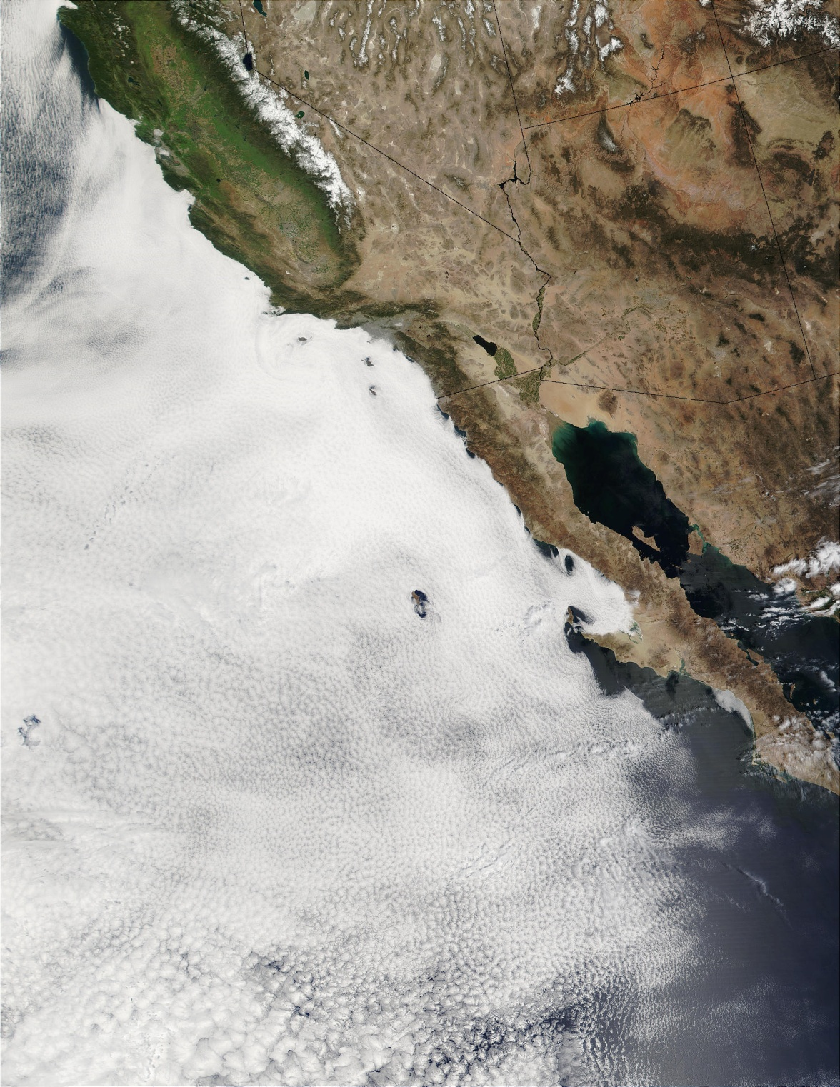
Stratocumulus
Image credit: NASA
Notes:
http://visibleearth.nasa.gov/view.php?id=58014

Slide 53
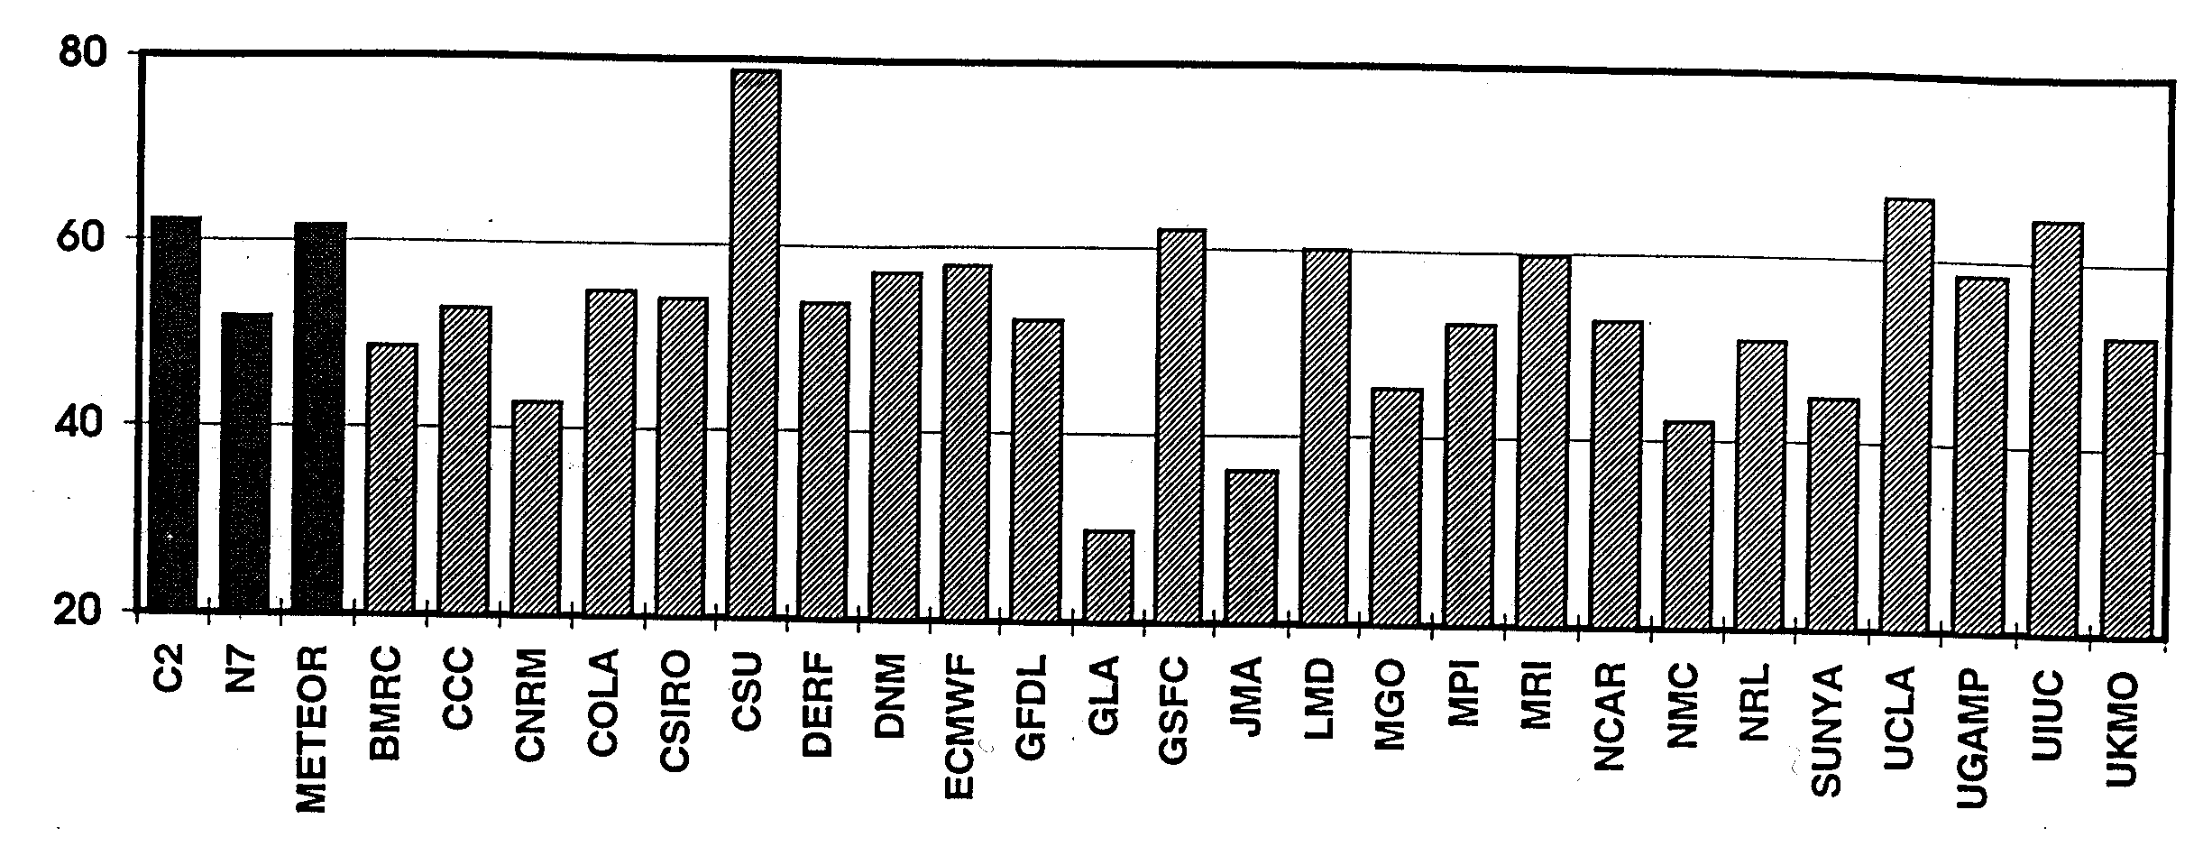
Parameterization of Clouds
Cloud amount (fraction) as simulated by 25 atmospheric GCMs
Image credit: Weare, Bryan C., Igor I. Mokhov, 1995: Evaluation of Total Cloudiness and Its Variability in the Atmospheric Model Intercomparison Project. J. Climate, 8, 2224–2238.

Slide 54
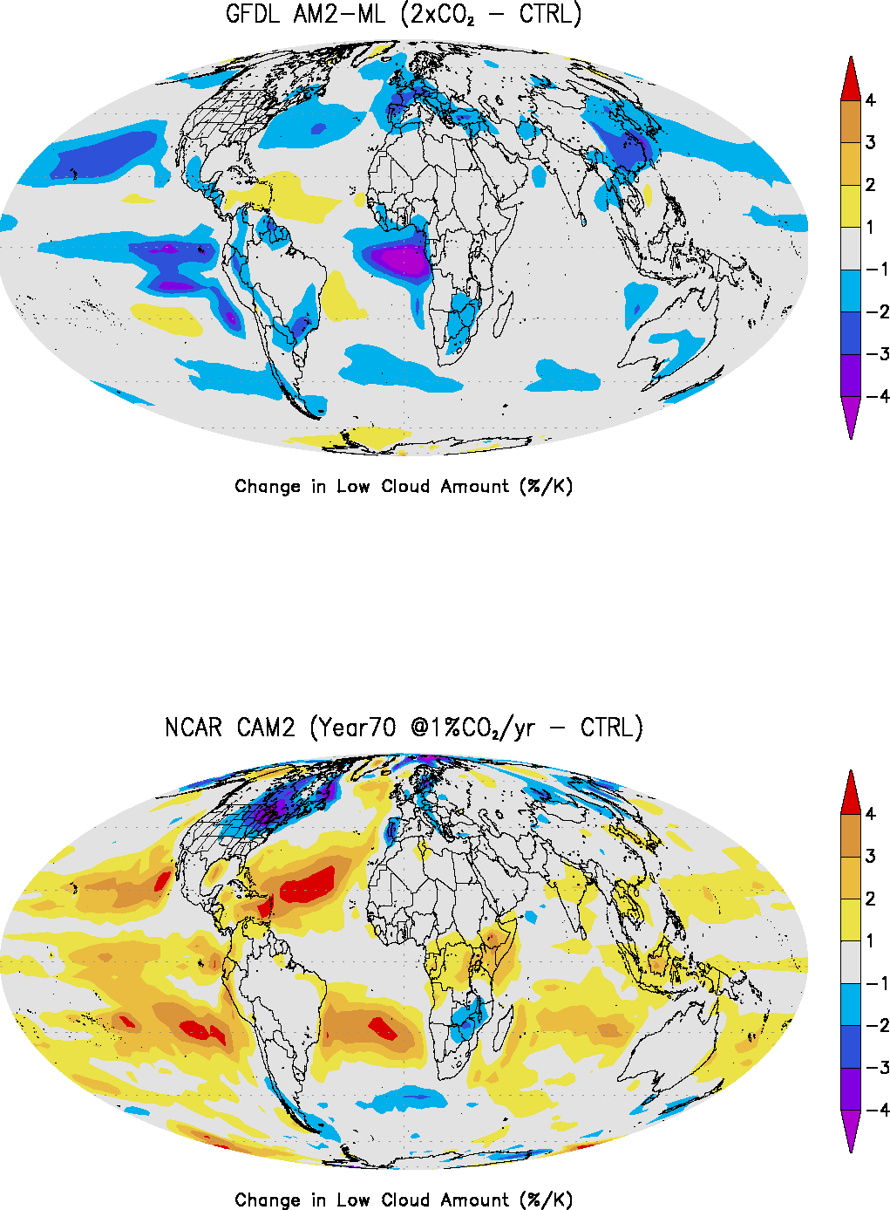
Low Clouds in Climate Models
Change in low cloud
with 2xCO2
2 Models: Changes
are OPPOSITE
Image credit: Stephens, G. L., 2005: J. Climate, 18, 237-273.
Notes:
http://journals.ametsoc.org/doi/pdf/10.1175/JCLI-3243.1

Slide 55
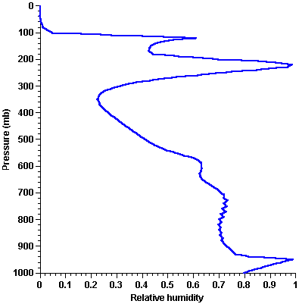
Sensitivity to cloud microphysics
Image credit: K. Emanuel

Slide 56
Sensitivity of relative humidity to assumptions about cloud microphysical processes
Image credit: K. Emanuel

Slide 57
Evaluation of Climate Models

Slide 58
How Do We Know If We Have It Right?
Very few tests of model as whole: annual and diurnal cycles, weather forecasts, 20th century climate, response to orbital variations
Tuning may be ill-posed: More free parameters than tests against independent degrees of freedom
Alternative: Rigorous, off-line tests of model subcomponents. Arduous, unpopular: Necessary but not sufficient for model robustness: Model as whole may not work even though subcomponents are robust

Slide 59
Global mean temperature (black) and simulations using many different global models (colors) including all forcings
Models are more alike in hindcasts than in projections
Same as above, but models run with only natural forcings
Image credit: IPCC Fourth Assessment Report
Notes:
59

Slide 60
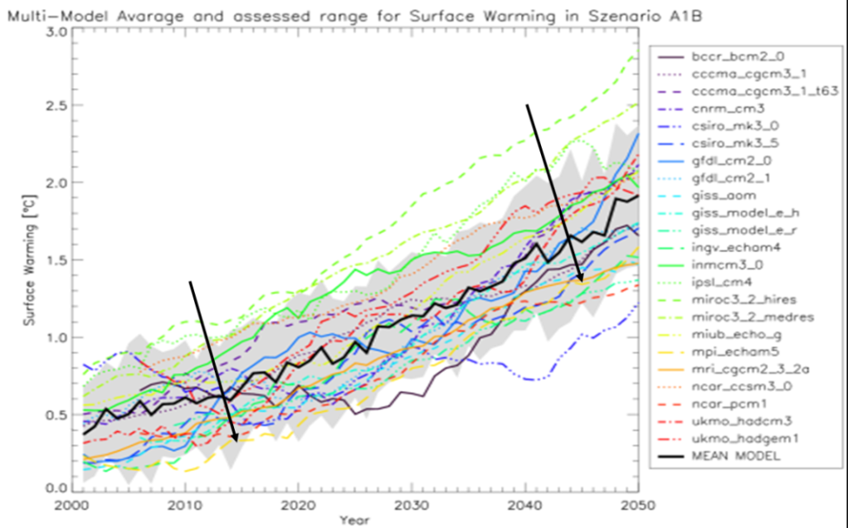
Ensemble of climate models, Scenario A1b
Image Credit: Ernst Gebetsroither, Johann Züger and Wolfgang Loibl (2013). Drought in Alpine Areas Under Changing Climate Conditions, Management Strategies to Adapt Alpine Space Forests to Climate Change Risks, Dr. Gillian Cerbu (Ed.), ISBN: 978-953-51-1194-8, InTech, DOI: 10.5772/56277.
Notes:
http://www.intechopen.com/books/management-strategies-to-adapt-alpine-space-forests-to-climate-change-risks/drought-in-alpine-areas-under-changing-climate-conditions

Slide 61
Annual-mean surface (2 m) air temperature (°C) for the period 1980–2005. (a) Multi-model (ensemble) mean (b) Multi-model-mean bias as the difference between the CMIP5 multi-model mean and the climatology from ECMWF reanalysis (c) Mean absolute model error with respect to the climatology from ERA-Interim. (d) Mean inconsistency among reanalyses
Image credit: IPCC Fifth Assessment Report

Slide 62
Seasonality (December–January–February minus June–July–August ) of the difference between the multi-model mean and the ECMWF reanalysis of the global atmosphere and surface conditions (ERA)-Interim seasonality.
Image credit: IPCC Fifth Assessment Report

Slide 63
Annual-mean precipitation rate (mm day–1) for the period 1980–2005. (a) Multi-model-mean constructed with one realization of all available AOGCMs used in the CMIP5 historical experiment. (b) Difference between multi-model mean and precipitation analyses from the Global Precipitation Climatology Project
Image credit: IPCC Fifth Assessment Report

Slide 64
Annual-mean cloud radiative effects of the CMIP5 models compared against the Clouds and the Earth’s Radiant Energy System Energy Balanced and Filled data set (in W m–2; top row: shortwave effect; middle row: longwave effect; bottom row: net effect). On the left are the global distributions of the multi-model-mean biases, and on the right are the zonal averages of the cloud radiative effects from observations (solid black: CERES EBAF 2.6; dashed black: CERES ES-4), individual models (thin grey lines), and the multi-model mean (thick red line). Model results are for the period 1985–2005, while the available CERES data are for 2001–2011.
Image credit: IPCC Fifth Assessment Report

Slide 65
(a) Potential temperature (oC) and (b) salinity (PSS-78); shown in color are the time-mean differences between the CMIP5 ensemble mean and observations, zonally averaged for the global ocean (excluding marginal and regional seas). The observed climatological values are shown as labelled black contours. White contours show regions in (a) where potential temperature differences exceed positive or negative 1, 2 or 3°C, and in (b) where salinity differences exceed positive or negative 0.25, 0.5, 0.75 or 1 (PSS-78). The simulated annual mean climatologies are obtained for 1975 to 2005 from available historical simulations, whereas WOA09 synthesizes observed data from 1874 to 2008 in calculations of the annual mean; A total of 43 available CMIP5 models have contributed to the temperature panel (a) and 41 models to the salinity panel (b).
Image credit: IPCC Fifth Assessment Report

Slide 66
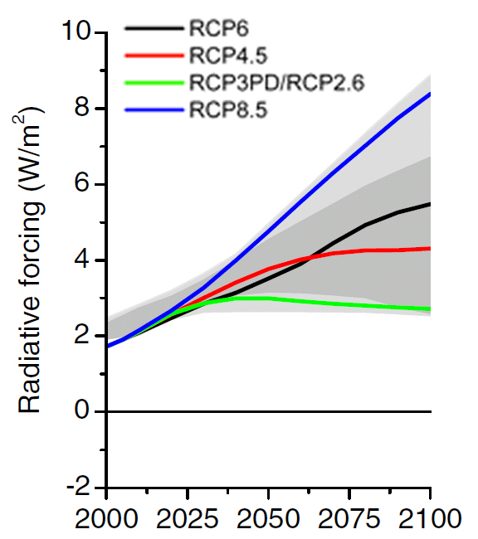
Projections
Radiative Forcing of the Representative Concentration Pathways (RCPs). The light grey area captures 98% of the range in previous IAM scenarios, and dark grey represents 90% of the range.
Image credit: IPCC Fifth Assessment Report

Slide 67
Image credit: IPCC Fifth Assessment Report

Slide 68
Simulations and projections of annual mean GMST 1986–2050 (anomalies relative to 1986–2005). Projections under all RCPs from CMIP5 models (grey and coloured lines, one ensemble member per model), with four observational estimates for the period 1986–2012 (black lines).
Image credit: IPCC Fifth Assessment Report

Slide 69
CMIP5 multi-model ensemble mean of projected changes in December, January and February and June, July and August surface air temperature for the period 2016–2035 relative to 1986–2005 under RCP4.5 scenario (left panels).
Image credit: IPCC Fifth Assessment Report
Notes:
The right panels show an estimate of the model-estimated internal variability (standard deviation of 20-year means). Hatching in left-hand panels indicates areas where projected changes are small compared to the internal variability (i.e., smaller than one standard deviation of estimated internal variability), and stippling indicates regions where the multi-model mean projections deviate significantly from the simulated 1986–2005 period (by at least two standard deviations of internal variability) and where at least 90% of the models agree on the sign of change.

Slide 70
CMIP5 multi-model ensemble mean of projected changes (%) in precipitation for 2016–2035 relative to 1986–2005 under RCP4.5 for the four seasons. The number of CMIP5 models used is indicated in the upper right corner.
Image credit: IPCC Fifth Assessment Report

