Slide 1

Inferences from Simple Models of Tropical Convection
Kerry Emanuel
Lorenz Center
MIT

Slide 2
Objective: Most Basic Theory for Observed Behavior of Tropical Atmosphere
Basic temperature and humidity profiles
Relationship between rainfall and column water vapor
Walker Circulation
Self-Aggregation

Slide 3
Application of Three Principles:
Quasi-Equilibrium of subcloud layer energy
Quasi-equilibrium of free tropospheric energy
Weak Temperature Gradient approximation

Slide 4
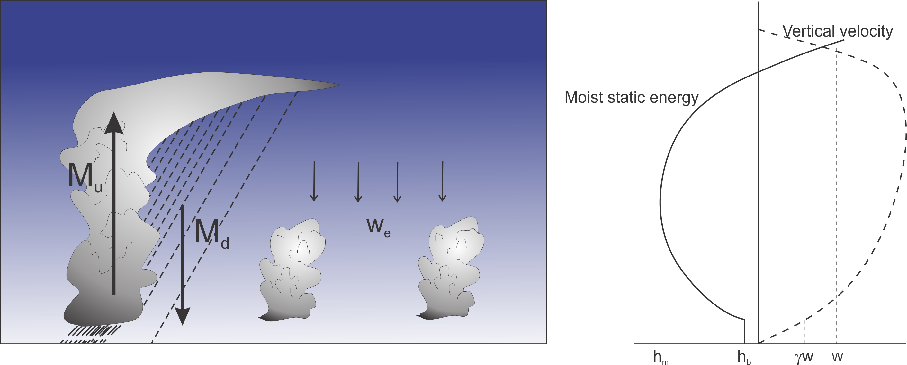
Boundary Layer Quasi-Equilibrium

Slide 5
Boundary Layer Quasi-Equilibrium

Slide 6
Free Troposphere Dry Static Energy

Slide 7
Free Troposphere Moisture:

Slide 8
Eliminate M_{d} and w_{e}:
+

Slide 9
Radiative-Convective Equilibrium:

Slide 10
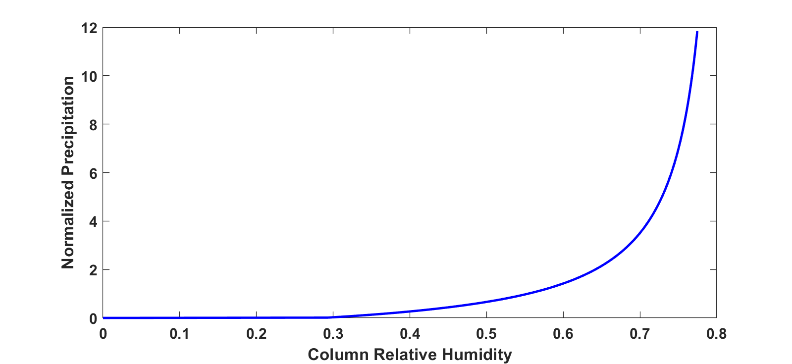
Precipitation vs. Column Water
Find steady solutions varying F_{h} while holding G and Q constant
From Bretherton, Peters, and Back, 2014
Column relative humidity

Slide 11
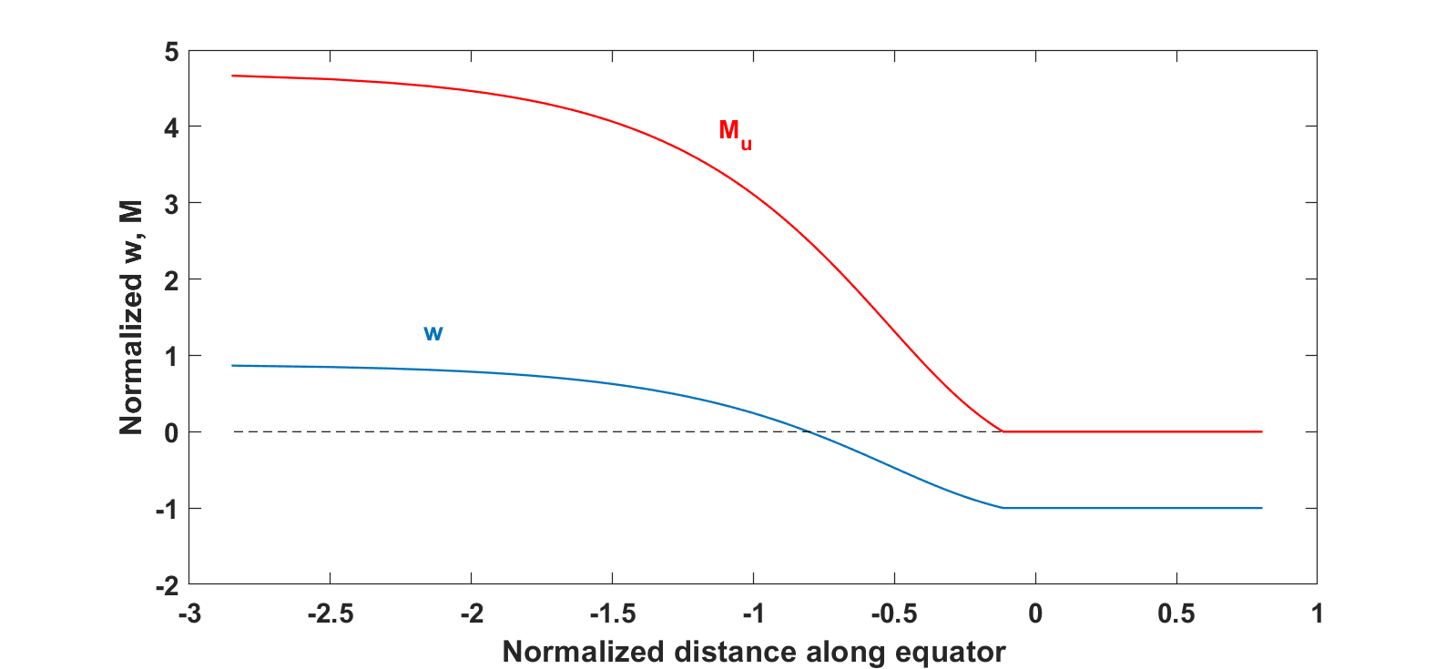
Walker Circulation
Again look for steady solutions

Slide 12
Self-Aggregation of Convection
(less cooling in moister columns)
Can solve nonlinear, time-dependent problem starting from small perturbation to RCE state.

Slide 13
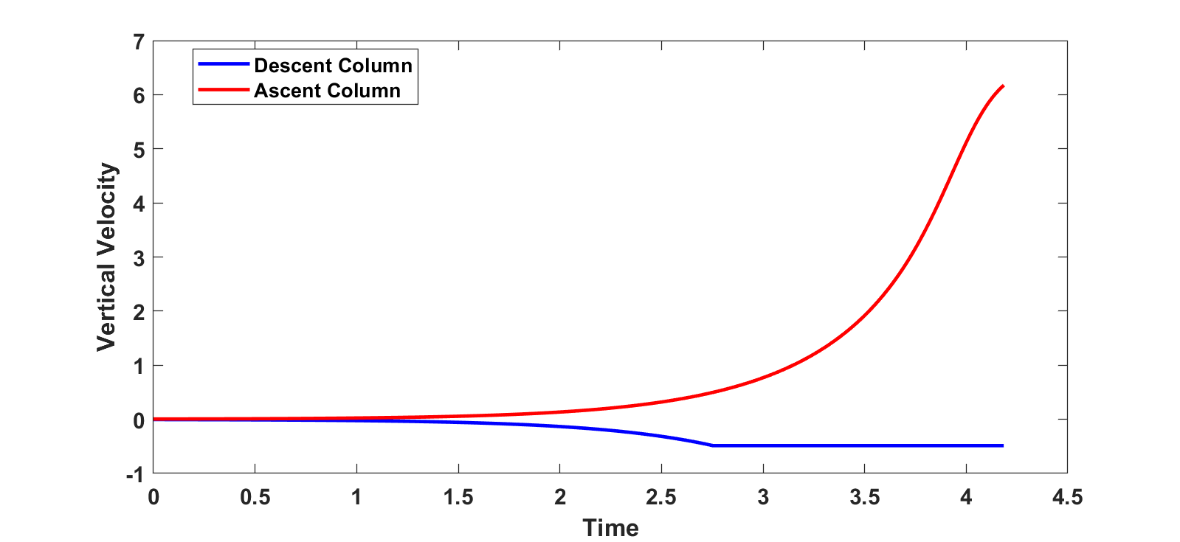
Full Nonlinear Analytic Solution:

Slide 14
Summary
Quasi-equilibrium of subcloud layer and free tropospheric energy are powerful constraints on tropical convective systems
Time-dependence of “slow” systems like the Walker Circulation and self-aggregation enters through tropospheric moisture (or moist static energy) equation
Basic properties of the tropical atmosphere, such as dependence of equilibrium moisture on cloud physics, relationship between column moisture and rainfall, Walker- type circulations, and self-aggregation, can be understood without resort to exotic formulations of entrainment or cloud physics
While this is pedagogically useful, quantitative modeling of the tropical atmosphere does require detailed understanding of moist convection, including, e.g., entrainment.

